Slide 1


Diabetes Pathophysiology
Beverly Dyck Thomassian, RN, MPH, BC-ADM, CDE
President, Diabetes Education Services
www.DiabetesEd.net

Slide 2
Lecture Objectives
Discuss the current epidemiologic impact of diabetes.
Describe the pathway of pathophysiological defects associated with the development of diabetes
Describe and differentiate between the different types: prediabetes, Type 1, Type 2, LADA and GDM
Describe the laboratory tests used for the diagnosis of Diabetes Mellitus including FBG, OGTT, A1C, antibodies
List the characteristics of Insulin Resistance.
Differentiate between hypoglycemia, hyperglycemic crisis and the macrovascular complications of DM.

Slide 3

Quick Question
What best describes the prevalence of diabetes in the U.S.?
  30% of people above the age of 20 have type 2 diabetes.
  The prevalence of type 1 and type 2 diabetes are almost equal.
  1 out 3 persons has type 2 diabetes.
  About 10% of Americans have diabetes.

Slide 4
CDC Announces
35% of Americans will have Diabetes by 2050
Boyle, Thompson, Barker, Williamson
2010, Oct 22:8(1)29
www.pophealthmetrics.com

Slide 5
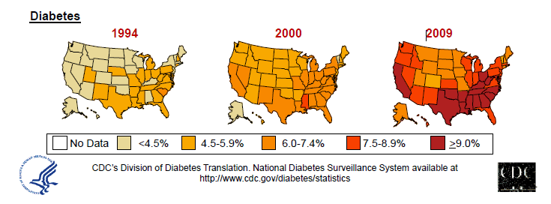
Diabetes in America 2016
29 million or > 9.3%
27% don’t know they have it
37% of US adults have pre diabetes (86 mil)

Slide 6
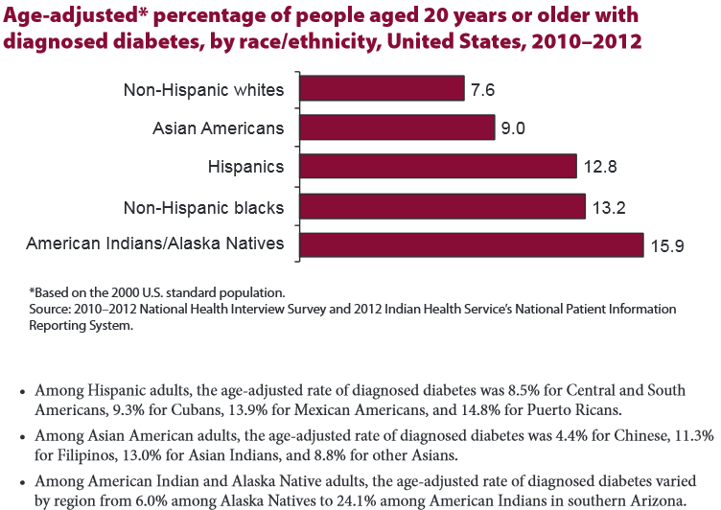

Age-adjusted Diabetes Prevalence
20 yrs or older, by race/ethnicity— U.S. 20014

Slide 7
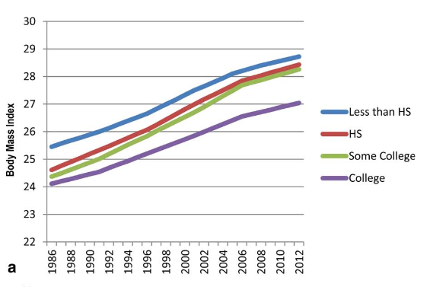
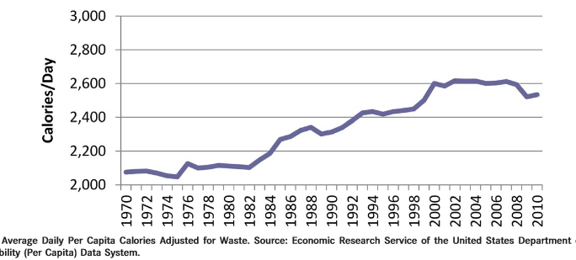
Obesity and Economics in America
68% overweight or obese
  34% BMI 30 +, 34% BMI 25-29
1/3 of all overwt people don’t get diabetes
We burn 100 cals less a day at work
Overall, food costs ~ 10-15% of income
Calorie Intake is on the rise

Slide 8
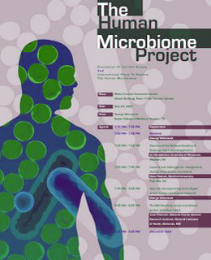

Bacterial Cells Outnumber Human Cells 10 to 1
10 trillion human cells
Host 100 trillion bacterial and fungal cells

Slide 9

Quick Question
How much does your gut bacteria weigh?
  A. 24 ounces
  B. 3 pounds
  C. Less than 1 pound
  D. 1.5 pounds
  E . Not sure

Slide 10
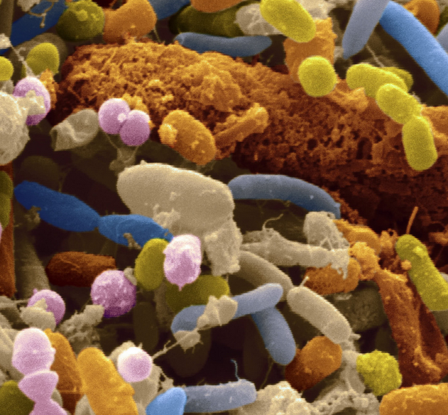
3 lbs of Microbes in our Gut
Community of bacteria extra 'organ' "microbiome".
Evolved together with our microbiome over millions of years.
Ratios of these communities has changed over the past 30 years
Mirrors global spikes in obesity, diabetes, allergic and inflammatory diseases
What are we doing to change these bacteria?

Slide 11

Gut Microbiome
Part of endocrine axis
Stabilized by 3 years of age
Influenced by:
  Birth method
  Breast fed
  Early Antibiotic use
  Environment
  Travel
Help us
  utilize energy
  fight off invaders
30% C-Section
CA- 60% and 40%
70% of < 2yrs, more Rx = increased obesity risk

Slide 12
Human Intestine Friends
The majority belong 2 major phyla:
Firmicutes
  includes Clostridium, Enterococcus, Lactobacillus and Ruminococcus
Bacteroidetes
  includes Bacteroides and Prevotella
in proportions determined in part by birth, breastfeeding, diet

Slide 13
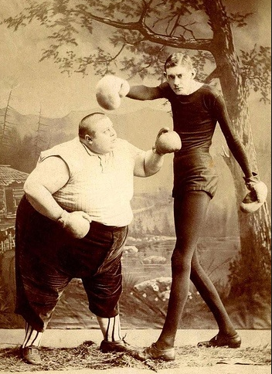
Weight and Gut Bacteria
New and Early Research
Leaner people appear to have more bacterial diversity and a higher proportion of bacteroidetes
Obese people appear to have higher levels of firmicutes
Bacteria tend to run in families

Slide 14
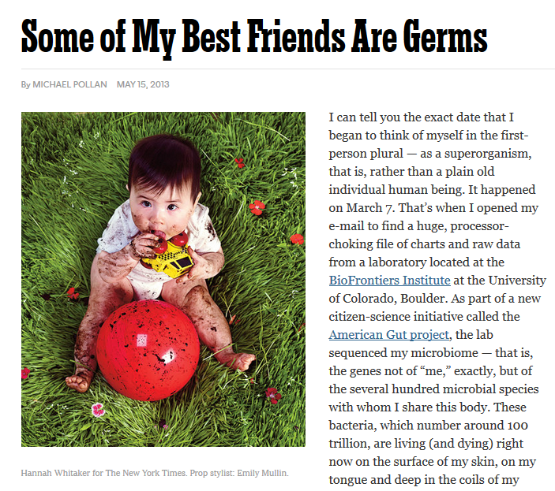
By Age 3, Gut Guests are Settled In
NPR Story Oct 1, 15
Kids who:
  Born vaginally
  Are breastfed
  Limited antibiotic exposure
Have less allergy and asthma
And a different microbiome

Slide 15

Follow Your Gut – Dr. Rob Knight
Check out Dr. Knight’s:
TED Talk
Website –AmericanFoodProject.org
Articles in Nature and all over

Slide 16


Now, let’s get to the Nitty Gritty

Slide 17



Slide 18
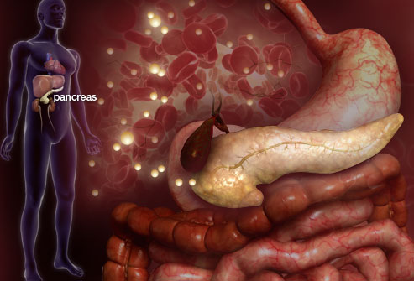

Slide 19
Hormones Effect on Glucose
Hormone
Glucagon (pancreas)
Stress hormones (kidney)
Epinephrine (kidney)
Insulin (pancreas)
Amylin (pancreas)
Gut hormones - incretins (GLP-1) released by L cells of intestinal mucosa, beta cell has receptors)
Effect



⇒
⇒
⇒

Slide 20
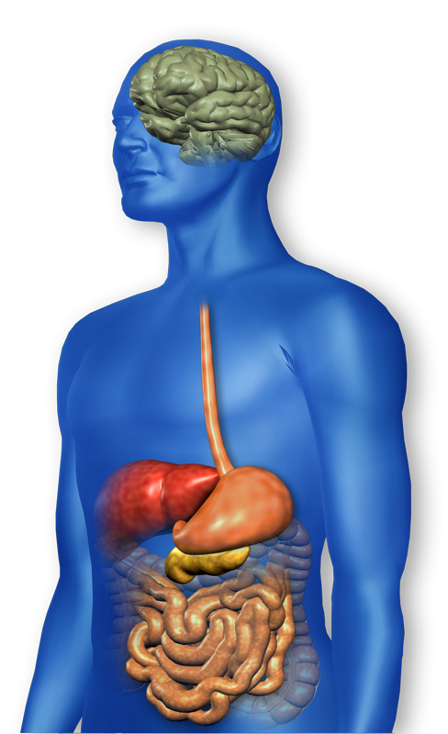
GLP-1 Effects in Humans
Understanding the Natural Role of Incretins
GLP-1 secreted upon the ingestion of food
Promotes satiety and
reduces appetite
Alpha cells:
↓ Postprandial
glucagon secretion
↑ Beta-cell
response
Liver:
↓ Glucagon reduces hepatic glucose output
Beta cells:
Enhances glucose-dependent insulin secretion
Stomach:
Helps regulate gastric emptying
Adapted from Flint A, et al. J Clin Invest. 1998;101:515-520
Adapted from Larsson H, et al. Acta Physiol Scand. 1997;160:413-422
Adapted from Nauck MA, et al. Diabetologia. 1996;39:1546-1553
Adapted from Drucker DJ. Diabetes. 1998;47:159-169
GLP-1 degraded by
DPP-4 w/in minutes
Notes:
20
20
Required
DISCUSSION POINTS:
--Upon food ingestion, GLP-1 is secreted into the circulation from L cells of small intestine.
--GLP-1 increases beta-cell response by enhancing glucose-dependent insulin secretion.
--GLP-1 decreases beta-cell workload and hence the demand for insulin secretion by:
--Regulating the rate of gastric emptying such that meal nutrients are delivered to the small intestine and, in turn, absorbed into the circulation more smoothly, reducing peak nutrient absorption and insulin demand (beta-cell workload)
--Decreasing postprandial glucagon secretion from pancreatic alpha cells, which helps to maintain the counterregulatory balance between insulin and glucagon
--Reducing postprandial glucagon secretion, GLP-1 has an indirect benefit on beta-cell workload, since decreased glucagon secretion will produce decreased postprandial hepatic glucose output
--Having effects on the central nervous system, resulting in increased satiety (sensation of satisfaction with food intake) and a reduction of food intake
--By decreasing beta-cell workload and improving beta-cell response, GLP-1 is an important regulator of glucose homeostasis.
SLIDE BACKGROUND:
--Effect on Beta-cell: Drucker DJ. Diabetes. 1998; 47:159-169
--Effect on Alpha cell: Larsson H, et al. Acta Physiol Scand. 1997; 160:413-422
--Effects on Liver: Larsson H, et al. Acta Physiol Scand. 1997; 160:413-422
--Effects on Stomach: Nauck MA, et al. Diabetologia. 1996; 39:1546-1553
--Effects on CNS: Flint A, et al. J Clin Invest. 1998; 101:515-520

Slide 21







Slide 22

Signs of Diabetes
Polyuria
Polydipsia
Polyphasia
Weight loss
Fatigue
Skin and other infections
Blurry vision
Glycosuria, H₂O losses
Dehydration
Fuel Depletion
Loss of body tissue, H₂O
Poor energy utilization
Hyperglycemia increases incidence of infection
Osmotic changes

Slide 23

Quick Question
Which of the following level is considered pre-diabetes range:
  a. A1c of 6.2 %
  b. Fasting BG of 62
  c. A1c of 7.1 %
  d. After meal BG of 127

Slide 24
Natural History of Diabetes
Normal
FBG <100
Random <140
A1c <5.7%
Prediabetes
FBG 100-125
Random 140 - 199
A1c ~ 5.7- 6.4%
50% working pancreas
Diabetes
FBG 126 +
Random 200 +
A1c 6.5% or +
20% working pancreas
Yes!
NO
Development of type 2 diabetes happens over years or decades

Slide 25
6. A1c Test
Measures glycation of RBC’s over 2-3 months
Weighted mean (50% preceding month)
Each 1% ~ 29mg/dl
Accuracy: affected by some anemias, hemoglobinopathies
A measurement of glucose in fasting and postprandial states
African Americans may have false lows

Slide 26


Slide 27

6. A1c and Estimated Avg Glucose (eAG)
A1c (%) eAG
5 97
6 126
7 154
8 183
9 212
10 240
11 269
12 298
eAG = 28.7 x A1c-46.7 ~ 29 pts per 1%
Translating the A1c Assay Into Estimated Average Glucose Values – ADAG Study
Diabetes Care: 31, #8, August 2008
Order teaching tool kit free at diabetes.org

Slide 28
Diagnostic Criteria
All test should be repeated in the absence of unequivocal hyperglycemia
If test abnormal, repeat same test to confirm diagnosis on a different day
If one test normal, the other abnormal, repeat the abnormal test to determine status
Medicare still using fasting as criteria for reimbursement for education

Slide 29
Quick Question
What factors would make you suspect type 1 diabetes?
  a. Pt has a history of celiac disease
  b. Pt presents with low HDL cholesterol
  c. Friend tells you she has been eating "tons of sweets“
  d. Pt is slightly overweight

Slide 30

What Kind of Diabetes?
AJ, a 12 year old female admitted to the ICU with a blood glucose of 476 mg/dl and a pH of 7.1.
What further questions and or testing is needed to determine if patient has type 1 or type 2 diabetes?

Slide 31

Type 1 Diabetes

Slide 32
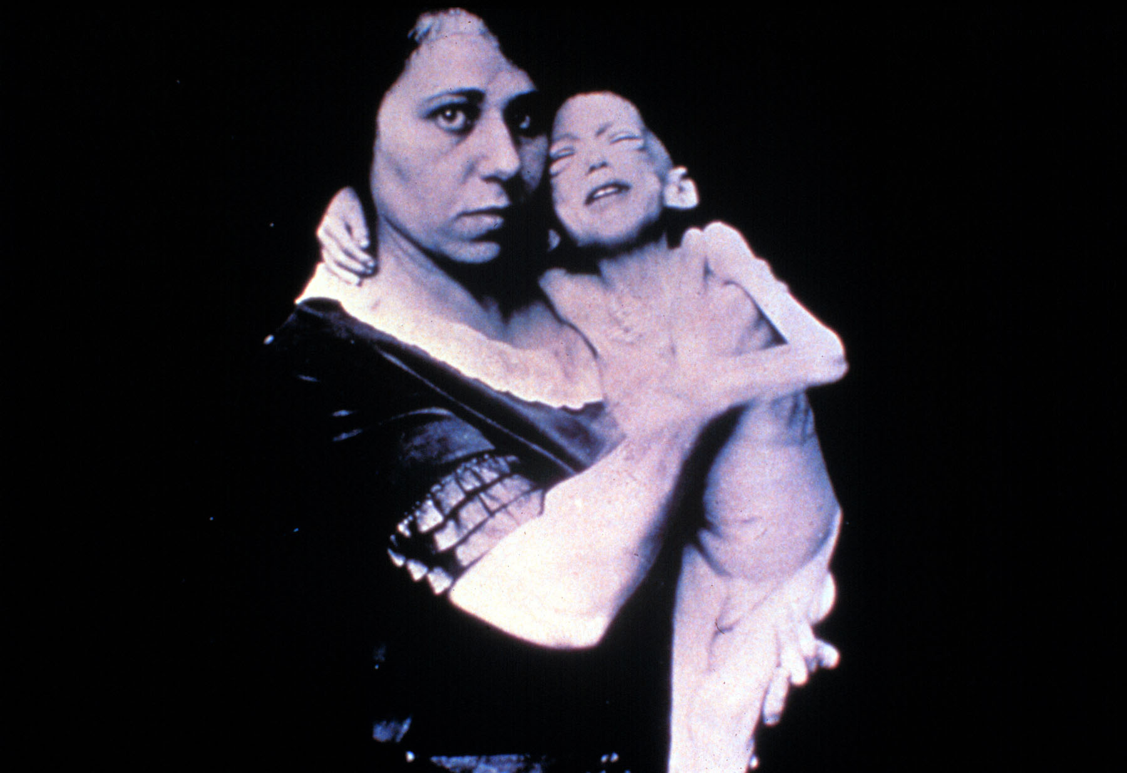

Slide 33


Slide 34
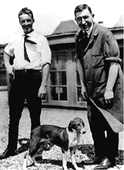
Dr. Banting and Best with Marjorie at University of Toronto

Slide 35
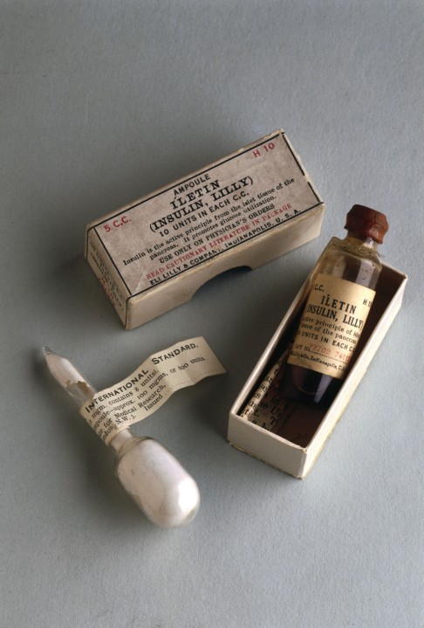
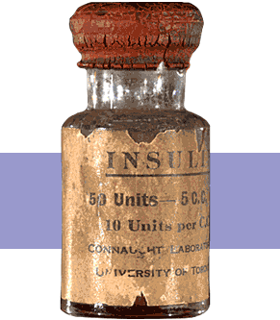
Insulin Finally Available - 1922

Slide 36
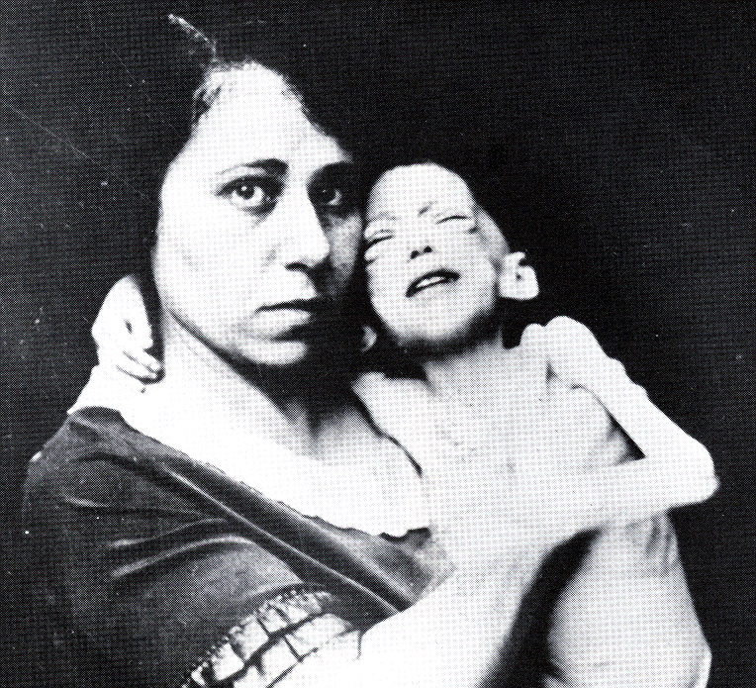

Miracle of Insulin
The Miracle of Insulin
Patient J.L., December 15, 1922
February 15, 1923

Slide 37




What Does Type 1 Look Like?
Mary Tyler Moore
Justice Sonia Sotomayor
Bret Michaels
Nick Jonas

Slide 38

Type 1 Rates Increasing Globally
23% rise in type 1 diabetes incidence from 2001-2009
Why?
  Autoimmune disease rates increasing over all
  Changes in environmental exposure and gut bacteria?
  Hygiene hypothesis
  Obesity?

Slide 39

Incidence of Type 1 in Youth
General Pop 0.3%
Sibling 4%
Mother 2-3%
Father 6-8%
Rate doubling every 20 yrs
Many trials underway to detect and prevent (Trial Net)

Slide 40
Type 1 – 10% of all Diabetes
Genetics and Risk Factors
  Auto-immune pancreatic beta cells destruction
  Most commonly expressed at age 10-14
  Insulin sensitive (require 0.5 - 1.0 units/kg/day)
  Combo of genes and environment:
    Autoimmunity tends to run in families
    Higher rates in non breastfed infants
    Viral triggers: congenital rubella, coxsackie virus B, cytomegalovirus, adenovirus and mumps.

Slide 41

How do we know someone has Type 1 vs Type 2?
Type 1
  Positive antibodies
    GAD
    ICA
    IAA and others
Younger people develop quickly
Older people take longer to develop
Body wt and presentation

Slide 42
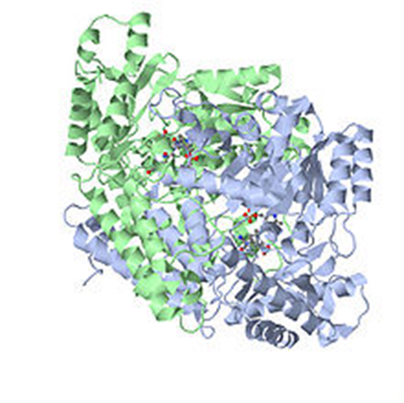
Autoantibodies Assoc w/ Type 1
Panel of autoantibodies –
  GAD65 - Glutamic acid decarboxylase –
  ICA - Islet Cell Cytoplasmic Autoantibodies
  IAA - Insulin Autoantibodies

Slide 43
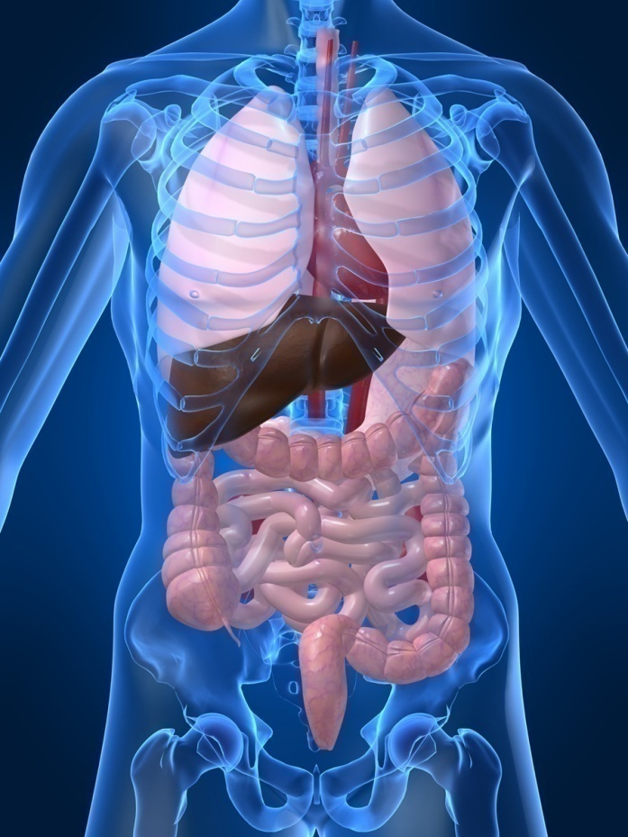
Type 1 Diabetes Associated with other immune conditions
Celiac disease (gluten intolerance)
Thyroid disease
Addison’s Disease
Rheumatoid arthritis
Other

Slide 44

Type 1 back in hospital
14 yr old admitted for 3rd time this month for DKA
Admission BG 648.
She is 5’6 inches and weighs 100-110 lbs
They ask you to provide diabetes education.
What top 3 things are you going to assess for?
If no action taken, what could this lead to?

Slide 45

Disordered Eating
“DiaBulimia”
People with type 1 diabetes give themselves less insulin than needed to lose weight
Tends to start in adolescence, more likely to occur in women than men.
Signs: unexplainable spikes, A1c, weight loss, lack of marks from fingerpricks, lack of prescription refills for diabetes meds, records that don’t match A1c.
Treatment – Mental health specialist and team

Slide 46

Diabetes KetoAcidosis
135,000 Hospitalizations a year
$2.4 billion U.S. dollars spent on treatment
Often a cry for help
ADA article on Hyperglycemic Crises

Slide 47
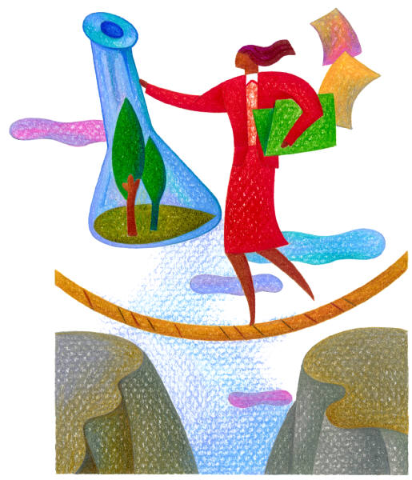
DKA Precipitating Factors
25 -30% of time, illness and infection
  increases stress hormone release
50% inadequate insulin dosage
initial manifestation of type 1
emotional stress - especially with teens, neglect or
mismanagement

Slide 48
Extreme Hyperglycemia –
Diabetes KetoAcidosis (DKA)
DKA - profound insulin deficiency
Excess stress hormones such as glucagon, epinephrine, and cortisol render insulin less effective
Excess glucose production by liver
Lipolysis leads to FFA’s and ketones
Osmotic diuresis, dehydration, lyte imbalances, acidosis

Slide 49
DKA Signs and Symptoms
hyperglycemia- leads to weakness, lethargy, malaise, headache
GI symptoms - N/V, abd pain
Kussmaul’s deep, rapid breathing
hypothermia, acetone breath
hyperpnea - to rid acidosis
changes in mentation, hyporeflexia/tonia
dehydration, ortho hypo

Slide 50
Extreme Hyperglycemia –
Hyperosmolar Hyperglycemic State (HHS)
occurs in elderly pt’s w/ type 2 - esp if not closely monitored
often precipitated by illness or stress
symptoms may go unrecognized for wks
massive fluid loss from osmotic diuresis
  burns, hyperglycemia, diarrhea, hemodialysis, diuretics, steroids
MI, infections, hypertonic feedings

Slide 51
DKA vs HHS
Usually < 40 yrs old
< 2 days symptoms
Glucose >250
Serum Ketones: +++
pH low (<7.3)
Anion Gap > 12
Usually Type 1
3 – 10% mortality
Usually >60 yrs old
> 5 days symptoms
Glucose >600
Ketones: none to +
pH normal (>7.3)
Usually Type 2
10 - 20% mortality

Slide 52
DKA - HHS Presentation and Action
Action
  maintain insulin drip until ketone neg, glucose <200
  maintain hydration
  check BG q1 hour
  assess lytes (esp K+)
  give sub-Q insulin before d/c IV insulin
  teach, teach, teach
Labs
  NA - low to high
  K+ - moves into vascular space
  Hct and Hgb ⬆ dehydration
  BUN / Creatinine ⬆
  WBC ⬆ (no infect)
  pH low to normal

Slide 53
DKA and HHS
5 most important interventions
  Fluids (NS, →0.45 NS, →D51/2 NS once glucose 300mg/dl)
  Insulin (.05 - 0.1unit/kg per hour)
  Potassium / lyte replacement
    (K^{+,} Mg, Ca, Phos)
  Determine, treat precipitating cause
  Education to prevent future episodes

Slide 54

Type 1 Summary
Autoimmune pancreatic destruction
Need insulin replacement therapy
Often first present in DKA
At risk for other autoimmune diseases
Eval coping strategies

Slide 55
What kind of Diabetes?
Pt is 58, states she has had type 1 diabetes for 18 years. Quit smoking a year ago and gained about 20 lbs. BMI 25.
Meds
  Humalog 18-23 units before each meal
  Lantus 28 units at bedtime
  Metformin 500mg TID
What tests would you recommend?
25% of patients with Type 1 also have type 2 diabetes.
ADA Post Grad, 2010

Slide 56


Slide 57

What type of Diabetes?
72 Years old
A1c 3 months prior 6.2%
A1c now 13.9%
BMI 24.5
Lost about 10 pounds over last month

Slide 58

Latent AutoImmunity Diabetes in Adults (LADA)
Antibody positive to 1-2 of below
  GAD-65 autoantibodies
  Insulin Autoantibodies
  Islet Cell antigen-2
Adult Age at onset
Usually need insulin w/in first 6 months of diagnosis
Early insulin therapy may preserve beta cell function
Diabetes Care 26:536-538, 2003
Jerry P. Palmer, MD and Irl B. Hirsch, MD

Slide 59
LADA Clinical Features Compared to Type 2
Feature LADA Type 2
Age <50 63% 19%
Acute hyperglycemia 66 24
BMI < 25 33 13
Hx of autoimmune dx 27 12
Family hx autoimmune 46 35
Practical Diabetology March 08, Unger MD

Slide 60


Patti Labelle
"divabetic”
“I have diabetes, it doesn’t have me”

Slide 61

Path to Type 2 Diabetes

Slide 62
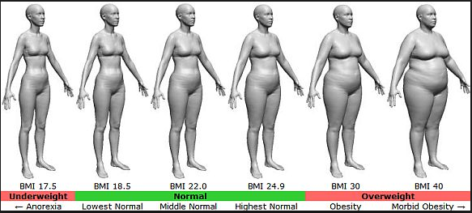
BMI – Visual Image

Slide 63




Slide 64

Insulin Resistance is the Seed

Slide 65
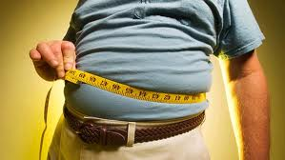
Factors Associated with Insulin Resistance
Abdominal obesity
Sedentary lifestyle
Genetics / Ethnicity
Gestational Diabetes
Polycystic ovary syndrome
Acanthosis Nigricans
Obstructive Sleep Apnea
Cancer
American College of Endocrinology, 2001

Slide 66
Quick Question
Which of the following BEST describes insulin resistance?
  Lack of sufficient insulin receptors on fat and muscle cells.
  Visceral adipose tissue.
  A physiological condition where insulin becomes less effective at lowering blood glucose levels.
  Excessive triglyceride levels

Slide 67

2. Classification and DM Diagnosis
Pre Diabetes & Type 2- Screening Guidelines
Start screening at age 45 or for anyone who is overweight (BMI ≥ 25, Asians BMI ≥ 23 ) with one or > additional risk factor:
  First-degree relative w/ diabetes
  Member of a high-risk ethnic population
  Habitual physical inactivity
  PreDiabetes
  History of heart disease

Slide 68

Diabetes 2 - Who is at Risk?
(ADA Clinical Practice Guidelines)
Risk factors cont’d
  HTN - BP > 140/90
  HDL < 35 or triglycerides > 250
  baby >9 lb or history of Gestational Diabetes Mellitus (GDM
  Polycystic ovary syndrome (PCOS)
  Other conditions assoc w/ insulin resistance:
    Severe obesity, acanthosis nigricans (AN)

Slide 69
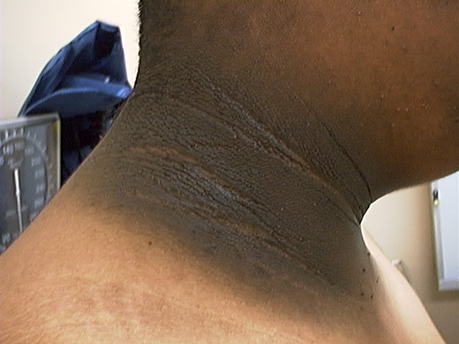
Acanthosis Nigricans

Slide 70
Acanthosis Nigricans (AN)
Signals high insulin levels in bloodstream
Patches of darkened skin over parts of body that bend or rub against each other
  Neck, underarm, waistline, groin, knuckles, elbows, toes
  Skin tags on neck and darkened areas around eyes, nose and cheeks.
No cure, lesions regress with treatment of insulin resistance

Slide 71

What is Type 2 Diabetes?
Complex metabolic disorder ….
  (Insulin resistance and deficiency)
with social, behavioral and environmental risk factors unmasking the effects of genetic susceptibility.
New Diagnosis?
Call 800 – DIABETES to request “Getting Started Kit”
www.Diabetes.org

Slide 72
Natural Progression of Type 2 Diabetes
Plasma
Glucose
Postprandial glucose
Fasting glucose
126 mg/dL
Relative
β-Cell
Function
Insulin resistance
Insulin secretion
-20
-10
0
10
20
30
Years of Diabetes
Prior to diagnosis
After diagnosis
Adapted from Bergenstal et al. 2000; International Diabetes Center.
Notes:
These graphs show the typical progressive nature of type 2 diabetes in terms of 2 key indices: increasing plasma glucose level (top panel) and decline in relative β-cell function as reflected by the drop in endogenous insulin and rise in insulin resistance (lower panel).
In the natural history of type 2 diabetes, insulin resistance rises, insulin secretion falls, and glucose levels begin to rise before diabetes is diagnosed.
Based on the natural history, type 2 diabetes is a disease of progressive insulin failure as shown in the graphic model developed by researchers at the International Diabetes Center.¹
Before the onset of diabetes, glucose levels start to rise, with a slightly sharper increase in the postprandial value than in fasting glucose. Both postprandial and fasting plasma glucose levels continue to rise if diabetes is left untreated.²
Prior to the diagnosis of diabetes, resistance of cell receptor sites to insulin starts to increase, while insulin secretion by β-cells decreases. Insulin resistance reaches a peak and remains constant. Endogenous insulin secretion continues to decline over the course of diabetes.²
References:
1. Kendall DM. Postprandial blood glucose in the management of type 2 diabetes: the emerging role of incretin mimetics. Available at: http://www.medscape.com/viewarticle/515693.
Accessed April 21, 2006.
2. Ramlo-Halsted BA, Edelman SV. The natural history of type 2 diabetes: implications for clinical practice. Prim Care. 1999;26:771-789.

Slide 73
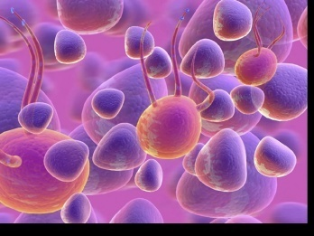
Ominous Octet
Decreased
satiation neuro-
transmission
Decreased
amylin, β-cell secretion
80% loss at dx
Increased renal glucose reabsorption
Decreased
Gut hormones
Increased glucagon secretion
G
I
G
I
G
G
I
I
G
G
Increased lipolysis
G
I
I
G
G
I
Increase glucose
production
I
G
G
Decreased glucose
uptake
Notes:
73
73

Slide 74

Life Study – Mrs. Jones
Mrs. Jones is 62 years old, overweight and complaining of feeling tired and urinating several times a night. She is admitted with a urinary tract Infection. Her WBC is 12.3, glucose 237. She is hypertensive with a history of gestational diabetes. No ketones in urine.
What are her risk factors, signs of diabetes
What type of diabetes does she have?
Does she have insulin resistance?

Slide 75
What Do You Say?
Mrs. Jones asks you
What is type 2 diabetes?
Will this go away?
Will I get complications?
Will I need to take diabetes medication for the rest of my life?
How come I got diabetes?
Do I have to check my blood sugars?

Slide 76

Quick Question
What is the preferred approach when providing diabetes education with patients?
  Provide patient centered self-management support
  Instruct all patients to meet national standards
  Highlight risk of complications when goals aren’t met
  Remind them that insulin treatment can be beneficial.

Slide 77
Comparison of
Type 1,Type 2, LADA
Type 1
Type 2 LADA
Obesity
x
xxx x
Insulin dependence
xxx
30% 6mos
Respond to oral agents
0
xxx x
Ketosis
xxx
x x
Antibodies present
xxx
0 xx
Typical Age of onset
teens
adult adult
Insulin Resistance
0
xxx
x

Slide 78

Diabetes is also associated with
Fatty liver disease
Obstructive sleep apnea
Cancer; pancreas, liver, breast
Alzheimer’s
Depression

Slide 79


Other Types of Diabetes
Gestational
Other specific types of diabetes

Slide 80

Gestational DM ~ 7% of all Pregnancies
GDM prevalence increased by
  ∼10–100% during the past 20 yrs
Native Americans, Asians, Hispanics, African-American women at highest risk
Immediately after pregnancy, 5% to 10% of GDM diagnosed with type 2 diabetes
Within 5 years, 50% chance of developing DM in next 5 years.

Slide 81

Increasing Prevalence –
A public health perspective
Body weight before and during pregnancy influences risk of GDM and future diabetes
Children born to women with GDM at greater risk of diabetes
Focus on prevention

Slide 82
Quick Question
What best describes gestational diabetes?
Diabetes discovered within the first 12 weeks of pregnancy.
Diabetes discovered in the 24-28 week of pregnancy.
Risk of getting diabetes before pregnancy.
Diabetes discovered at any point during pregnancy.

Slide 83

Screen Pregnant Women
Before 13 weeks
Screen for undiagnosed Type 2 at the first prenatal visit using standard risk factors.
Women found to have diabetes at their initial prenatal visit treated as “Diabetes in Pregnancy”
If normal, recheck at 24-28 weeks

Slide 84

Postpartum after GDM
50% risk of getting diabetes in 5 years
Screen at 6-12 wks post partum
Repeat at 3 yr intervals or signs of DM
  Encourage Breast Feeding
  Encourage weight control
  Encourage exercise
  Make sure connected with health care
  Lipid profile/ follow BP
  Preconception counseling

Slide 85
The Link Between Hyperglycemia, Insulin Resistance and Cardiovascular Disease

Slide 86
Heart Disease & DM = 3-5xs Risk
CHF
  7.9 % w/ diabetes vs.
  1.1 % no diabetes
Heart attack
  9.8 % w/ diabetes vs.
  1.8 % no diabetes
Coronary heart disease
  9.1 % w/ diabetes vs.
  2.1 % no diabetes
Stroke
  6.6 % w/ diabetes vs.
  1.8 % no diabetes
  2007 AACE

Slide 87

Cardio Metabolic Risk -
5 Hypers -
Hyperinsulinemia (resistance)
Hyperglycemia
Hyperlipidemia
Hypertension
Hyper”waistline”emia (35” women, 40” men)
Manifestations of Insulin Resistance

Slide 88
Vascular Disease & Diabetes “atheroscleropathy”
  Normal endothelial cells are protective
  Abnormal glucose = Endothelial cell dysfunction
    Lower Nitric Oxide levels = Poor vasodilation
    Release of inflammatory mediators
    Higher aldosterone levels
    Adipokines = > angiotensin = HTN
    = Increased risk of acute thrombotic event
  Increased arterial stiffness
      Due to chronic hyperglycemia, endothelial inflammation

Slide 89
Quick Question
MJ has been admitted with a heart attack and wants to know what he can do to get healthier. Which of the following are considered modifiable cardiovascular risk factors?
  Family history, obesity
  Smoking, obesity
  Hypertension, ethnicity
  BMI and age

Slide 90
CardioVascular Risk Factors
Cardio
Metabolic
Risk
Insulin
Resistance
Syndrome
Smoking
Physical
Inactivity
Age, Race
Gender,
Family hx
Inflammation
Hyper-
coagulation
Hypertension
Abnormal
Lipid
Metabolism
BMI >25
Waist
35” women
40” men
The more risk
factors = greater
risk of heart
disease and
diabetes
ADA 2007

Slide 91
Bottom Line
Cardiovascular disease is the leading cause of death for people with diabetes
65% of people with diabetes die from heart disease (36% in general population)
Prevention and aggressive treatment of diabetes is critical

Slide 92
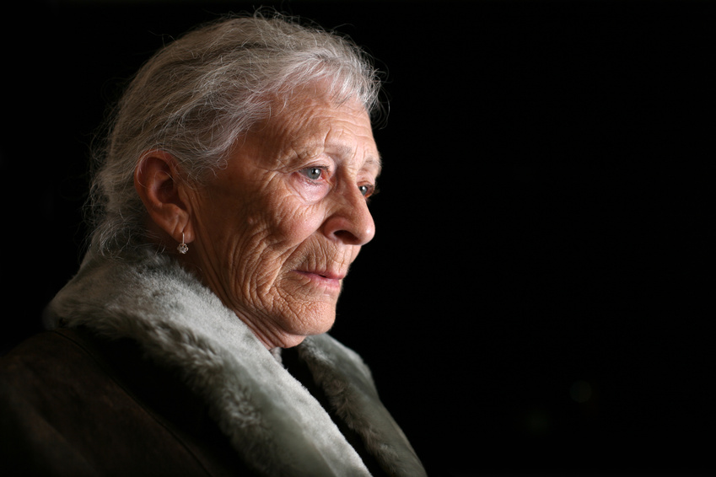
Hypoglycemia prevention
72 yr old, thin, lives alone, A1c 7.3%. History of MI, stroke. DM for 12 yrs, takes glyburide 10mg BID. Limited income. Creat 1.4.
What strategies to
Prevent hypo?

Slide 93
Glycemic Threshold Values
John White, PharmD, Diabetes Spectrum, 2007
Classification BG Physical Response
Lower euglycemia 80-90’s Endogenous insulin
Hypoglycemia 70’s Glucagon, adrenaline
Symptoms 60s Growth hormone, cortisol
50’s Cognitive deterioration
Neuroglycopenia 40’s
30’s
Severe 20’s Coma, seizures
neuroglycopenia 10
(shortage of glucose in the brain
affects function of the neurons)

Slide 94

Hypoglycemia Awareness
autonomic symptoms adrenergically based
after 2-5 yrs of type 1 dm,
  glucagon secretion impaired
  epinephrine secretion becomes primary mechanism to restore BG levels
over time, epi response diminished or delayed
decreases awareness of hypo and hormonal response

Slide 95

Hypoglycemia Symptoms
Autonomic
  Anxiety
  Palpitations
  Sweating
  Tingling
  Trembling
  Hypoglycemic Unawareness
Neuroglycopenia
  Irritability
  Drowsiness
  Dizziness
  Blurred Vision
  Difficulty with speech
  Confusion
  Feeling faint

Slide 96
Treatment of Hypoglycemia
If blood glucose 70mg/dl or below:
  10-15 gms of carb to raise BG 30 - 45mg/dl
Retest in 15 minutes, if still low, treat again, even without symptoms
Follow with usual meal or snack
If BG less than 40, allow recovery time
Severe hypo may require glucagon

Slide 97

80 /20 Rule – Perfect Not Required

Slide 98

Key points
At the center of diabetes is someone living with it everyday.
Focus on their successes
Coach and support

Slide 99

Thank You
www.DiabetesEd.net

