Slide 1


Welcome to
Diabetes in 21st Century
Beverly Dyck Thomassian, RN, MPH, BC-ADM, CDE
President, Diabetes Education Services
www.DiabetesEd.net

Slide 2
Diabetes in the 21st Century:
A Clinical and Educational Update
Describe impact of diabetes
Discuss prevention, management strategies
Discuss different types of diabetes
Describe insulin therapy
Review glucose patterns and determine how to adjust therapy to improve glucose.
Gain understanding of Type 2 Meds.
Discuss how the gut influences health
Demonstrate successful teaching strategies

Slide 3

Foundations of Care
Education
Nutrition
Monitoring
Physical Activity
Psychosocial Care
Medications
Getting to Best Possible Health

Slide 4

Strategies for Improving Care
Start with patient centered communication.
  Incorporate pt preferences, literacy, life experiences
Treatment decisions timely, based on evidence and tailored to individual pt.
Align care with Chronic Care Model to ensure proactive practice and informed, activated patient.
Support team-based care, community involvement, decision support tools.

Slide 5
CDC Announces
35% of Americans will have Diabetes by 2050
Boyle, Thompson, Barker, Williamson
2010, Oct 22:8(1)29
www.pophealthmetrics.com

Slide 6
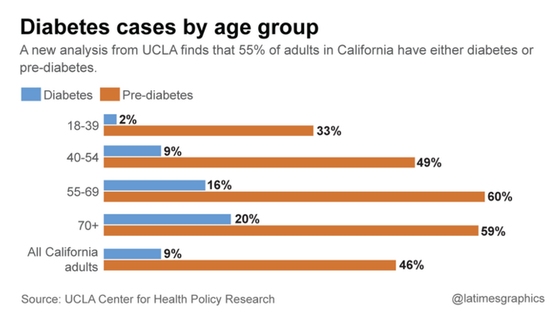
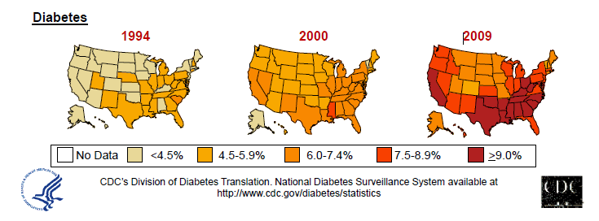
Diabetes in America 2016
29 million or > 9.3%
27% don’t know they have it
37% of US adults have pre diabetes (86 mil)

Slide 7
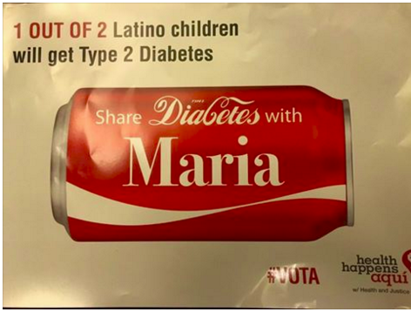
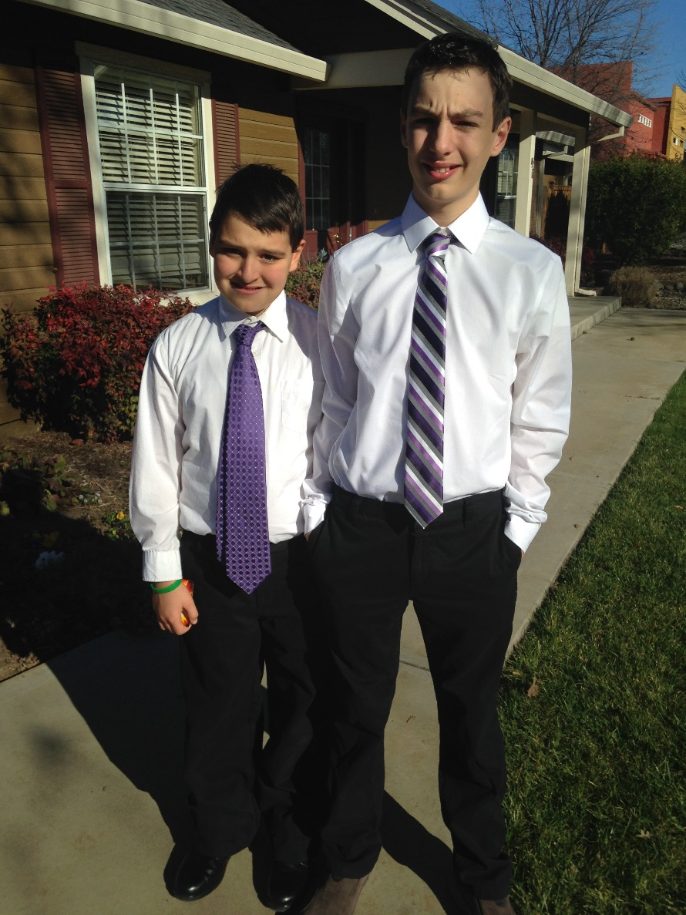
My Boys –Robert and Jackson
By the time they are 50, 1/3 will have diabetes

Slide 8


Type 2 in Kids
7 fold increase since 1990
1 in 6 overwt kids (age 12- 19) have prediabetes.
~2,500 to 3,700 new cases in U.S. annually.
Highest risk: very obese, minority, female, low socioeconomic status, limited education
In age range 12-19, less than 1% have Type 2 – NHANES
Environmental changes urgently needed

Slide 9

Global Epidemic
Every 10 seconds
  1 person dies with diabetes
  2 people develop diabetes
Every year
  3 million deaths
  6 million new cases
World Diabetes Day is November 14
March is ADA Sound the Alert Day “find people w/ undetected diabetes”

Slide 10


World diabetes day – November 14
DIABETES: PROTECT OUR FUTURE

Slide 11
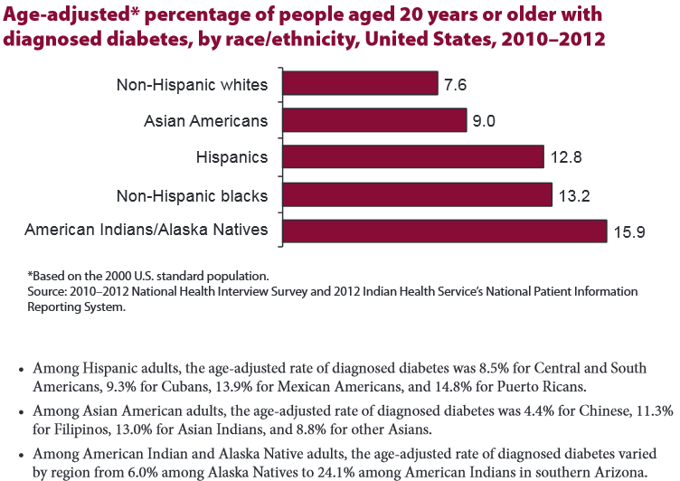

Age-adjusted Diabetes Prevalence
20 yrs or older, by race/ethnicity— U.S. 2014
1 out of 2 black men, Hispanic men and Hispanic women will develop Type 2 Diabetes during their lifetime. NDEP 2016

Slide 12

Why Should Zip Code Determine Life Expectancy?
Measureofamerica.org

Slide 13

Free Live Webinars and Live Seminars at DiabetesEd.net
Free Webinars
  Preparing to take CDE
  New Frontiers
  BC-ADM
Free Newsletter
  Sign up today

Slide 14


Slide 15
Role of the Pancreas
Endocrine Functions
Beta Cells - Insulin
  Anabolic hormone - helps store glucose as glycogen in muscle, liver
  secreted in response to elevated glucose
  halts breakdown of glycogen in liver
  increases protein synthesis, fat storage
  powerful hypoglycemic
Beta Cells - Amylin
  secreted in 1:1 ratio with insulin
  Causes satiety
  Lowers post-prandial glucagon response
  Slows gastric emptying
  Type 1 make none
  Type 2 make less than normal amounts

Slide 16
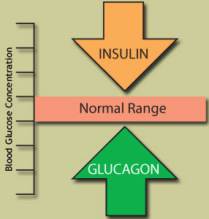
Role of the Pancreas
Endocrine Functions
Alpha cells - Glucagon
  Opposes action of insulin at the liver
  stimulated in response to low glucose levels
  stimulates liver to convert glycogen to glucose
  inhibits liver from glucose uptake
  causes hyperglycemia

Slide 17
Hormones Effect on Glucose
Hormone
Glucagon (pancreas)
Stress hormones (kidney)
Epinephrine (kidney)
Insulin (pancreas)
Amylin (pancreas)
Gut hormones - incretins (GLP-1) released by L cells of intestinal mucosa, beta cell has receptors)
Effect



⇒
⇒
⇒

Slide 18
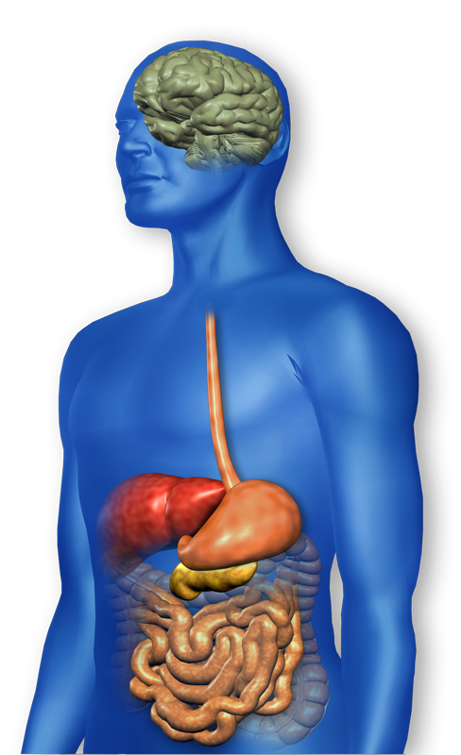
GLP-1 Effects in Humans
Understanding the Natural Role of Incretins
GLP-1 secreted upon the ingestion of food
Promotes satiety and
reduces appetite
Alpha cells:
↓ Postprandial
glucagon secretion
↑ Beta-cell
response
Liver:
↓ Glucagon reduces hepatic glucose output
Beta cells:
Enhances glucose-dependent insulin secretion
Stomach:
Helps regulate gastric emptying
Adapted from Flint A, et al. J Clin Invest. 1998;101:515-520
Adapted from Larsson H, et al. Acta Physiol Scand. 1997;160:413-422
Adapted from Nauck MA, et al. Diabetologia. 1996;39:1546-1553
Adapted from Drucker DJ. Diabetes. 1998;47:159-169
GLP-1 degraded by
DPP-4 w/in minutes
Notes:
18
18
Required
DISCUSSION POINTS:
--Upon food ingestion, GLP-1 is secreted into the circulation from L cells of small intestine.
--GLP-1 increases beta-cell response by enhancing glucose-dependent insulin secretion.
--GLP-1 decreases beta-cell workload and hence the demand for insulin secretion by:
--Regulating the rate of gastric emptying such that meal nutrients are delivered to the small intestine and, in turn, absorbed into the circulation more smoothly, reducing peak nutrient absorption and insulin demand (beta-cell workload)
--Decreasing postprandial glucagon secretion from pancreatic alpha cells, which helps to maintain the counterregulatory balance between insulin and glucagon
--Reducing postprandial glucagon secretion, GLP-1 has an indirect benefit on beta-cell workload, since decreased glucagon secretion will produce decreased postprandial hepatic glucose output
--Having effects on the central nervous system, resulting in increased satiety (sensation of satisfaction with food intake) and a reduction of food intake
--By decreasing beta-cell workload and improving beta-cell response, GLP-1 is an important regulator of glucose homeostasis.
SLIDE BACKGROUND:
--Effect on Beta-cell: Drucker DJ. Diabetes. 1998; 47:159-169
--Effect on Alpha cell: Larsson H, et al. Acta Physiol Scand. 1997; 160:413-422
--Effects on Liver: Larsson H, et al. Acta Physiol Scand. 1997; 160:413-422
--Effects on Stomach: Nauck MA, et al. Diabetologia. 1996; 39:1546-1553
--Effects on CNS: Flint A, et al. J Clin Invest. 1998; 101:515-520

Slide 19
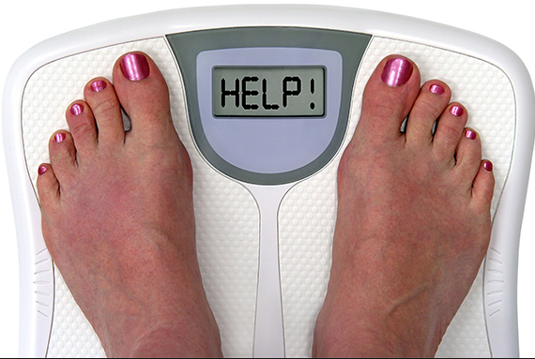
Incretin Mimetics
Byetta, Bydureon, Trulicity, Tanzeum
Action (synthetic gut hormone)
  Insulin release in response to meal
  Slows gastric emptying
  Causes Satiety – promotes wt loss
  Preserves Beta Cells
Details:
    Daily and long acting version - 1x week injection
    Efficacy: Decreases A1c by 0.5 – 1.6%, wt by 3lbs +
Benefits/Issues – wt loss, no hyp. Expensive, N/V
        Pancreatitis Warning – report signs immediately
Notes:
19
19

Slide 20





CDE® Coach App – Download Success

Slide 21
Bariatric Surgery
Consider on diabetes pts w/ BMI >35, esp with comorbidities
Remission (BG normalized)
  rates range from 40 – 95%
  Better results with newer diabetes (more beta cell mass)
  Due to increase incretins (gut hormones)
Still researching long term benefits, cost effectiveness and risk

Slide 22
Natural History of Diabetes
Normal
FBG <100
Random <140
A1c <5.7%
Prediabetes
FBG 100-125
Random 140 - 199
A1c ~ 5.7- 6.4%
50% working pancreas
Diabetes
FBG 126 +
Random 200 +
A1c 6.5% or +
20% working pancreas
Yes!
NO
Development of type 2 diabetes happens over years or decades

Slide 23
Signs of Diabetes
Polyuria
Polydipsia
Polyphasia
Weight loss
Fatigue
Skin and other
infections
Blurry vision
Glycosuria, H₂O losses
Dehydration
Fuel Depletion
Loss of body tissue, H₂O
Poor energy utilization
Hyperglycemia increases incidence of infection
Osmotic changes

Slide 24

Diabetes Classifications
Type 1
Type 2
Gestational
Secondary
Notes:
Type 1-absent insulin
Type 2-too much insulin early, then resistence and less secretion
GDm-simliar to Type 2, found during pregnancy

Slide 25
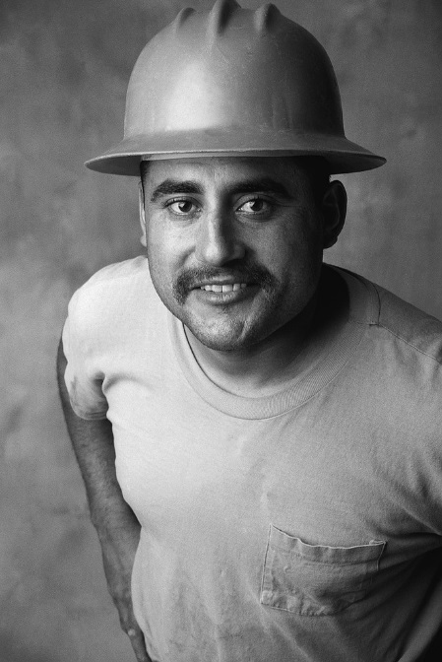

Case Study
1. Pt profile: 5’8”, 192 lb male
Diabetes 12 years, on insulin 3 yrs
What type of DM and how do you know?
2. 5’6”, 108 lb female
On insulin 3u Regular before meals, 10u NPH at bedtime
What type of DM and how do you know?

Slide 26


Slide 27
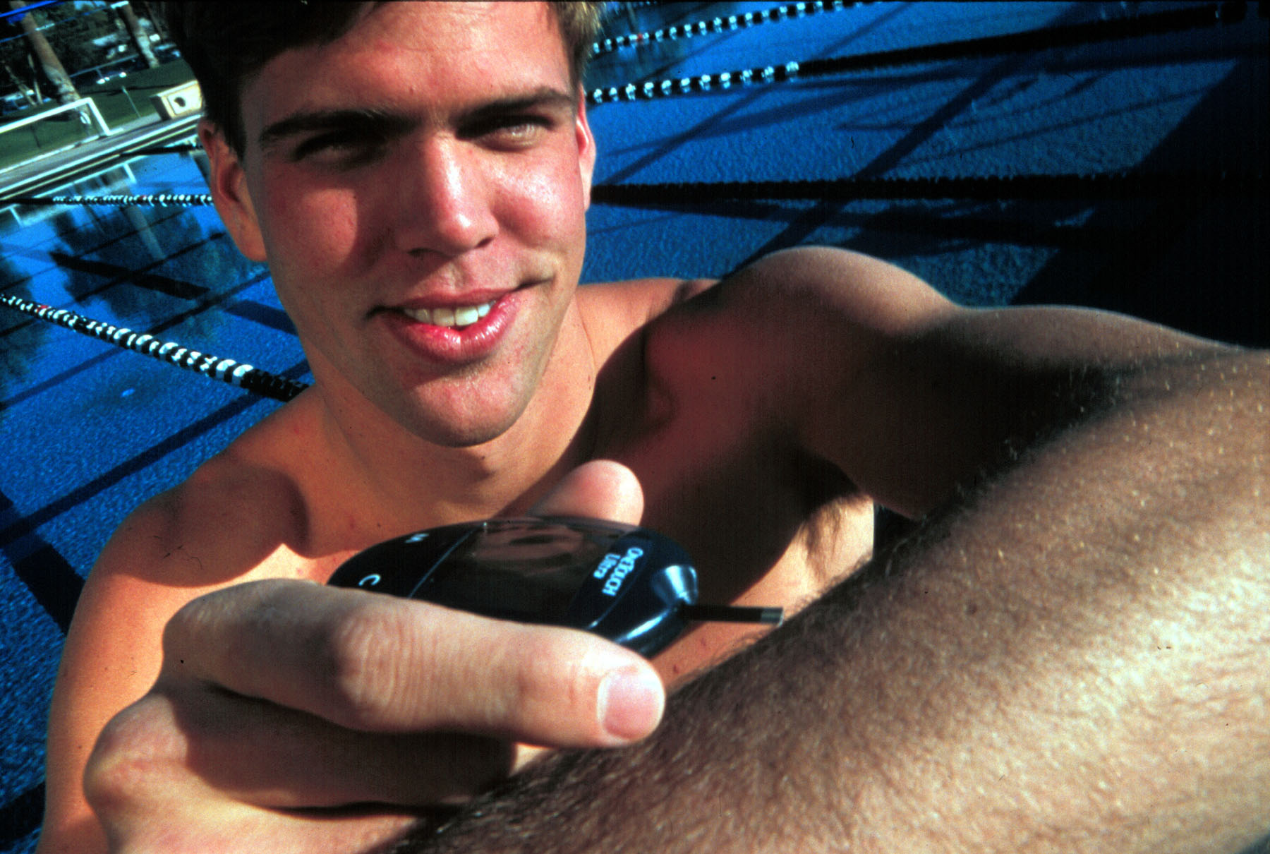

Slide 28
Type 1 Diabetes – Genetics and Risk Factors
  1- 400 to 1-1000 = Risk of type 1 in gen pop
  1-20 to 1-50 in offspring of diabetes parents
  Combo of genes and disease susceptibility
  Risk Factors:
    Autoimmunity tends to run in families
    Higher rates in non breastfed infants
    Viral triggers: congenital rubella, coxsackie virus B, cytomegalovirus, adenovirus and mumps.

Slide 29
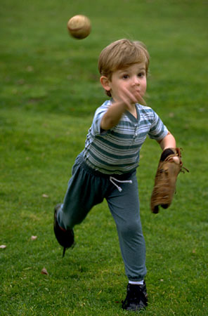
Incidence of Type 1 in Youth
General Pop 0.3%
Sibling 4%
Mother 2-3%
Father 6-8%
Rate doubling every 20 yrs
Many trials underway to detect and prevent (Trial Net)

Slide 30

Type 1 – 10% of all Diabetes
Genetics and Risk Factors
  Auto-immune pancreatic beta cells destruction
  Most commonly expressed at age 10-14
  Insulin sensitive (require 0.5 - 1.0 units/kg/day)
  Combo of genes and environment:
    Autoimmunity tends to run in families
    Higher rates in non breastfed infants
    Viral triggers: congenital rubella, coxsackie virus B, cytomegalovirus, adenovirus and mumps.

Slide 31
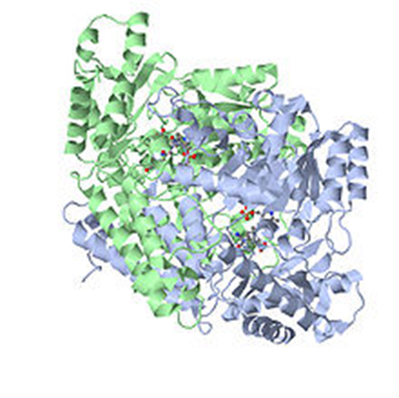
Autoantibodies Assoc w/ Type 1
Panel of autoantibodies –
  GAD65 - Glutamic acid decarboxylase –
  ICA - Islet Cell Cytoplasmic Autoantibodies
  IAA - Insulin Autoantibodies

Slide 32



Ms. Idaho and Ms America – Pumpin’ It

Slide 33





What Does Type 1 Look Like?
Bret Michaels
Sharon Stone
Halle Berry
Mary Tyler Moore
From Debbie Nagata’s slide collection
Adam Morrison
Nick Jonas
Justice Sonia Sotomayor

Slide 34
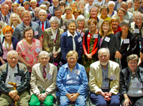
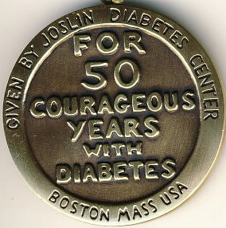
Medalist Study – Harvard
Joslin Diabetes Center
After 50 years with diabetes
  Many still produced some insulin
  Many had no eye disease

Slide 35
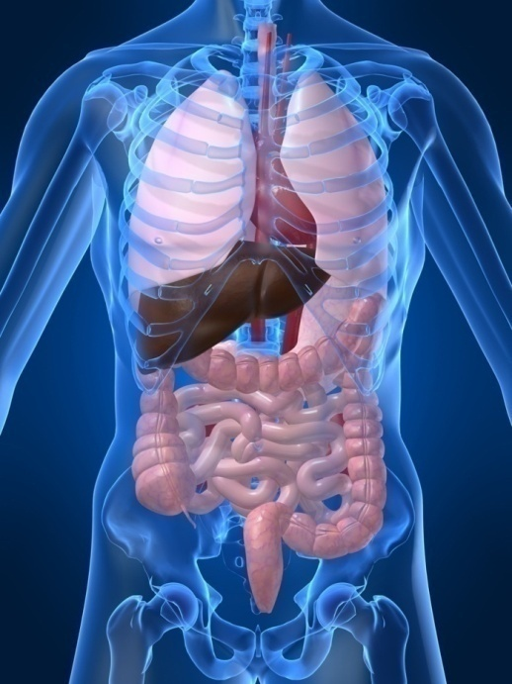
Type 1 Diabetes Associated with other immune conditions
Celiac disease (gluten intolerance)
Thyroid disease
Addison’s Disease
Rheumatoid arthritis
Other

Slide 36

Type 1 Summary
Autoimmune pancreatic destruction
Need insulin replacement therapy
Often first present in DKA
At risk for other autoimmune diseases
Eval coping strategies

Slide 37

Type 1 in Hospital
43 yr old admitted to evaluate angina.
Morning blood sugar is 92.
Based on Regular insulin sliding scale, no insulin required.
Breakfast tray shows up and patient says, I need my insulin shot before I eat.
What do you say?

Slide 38
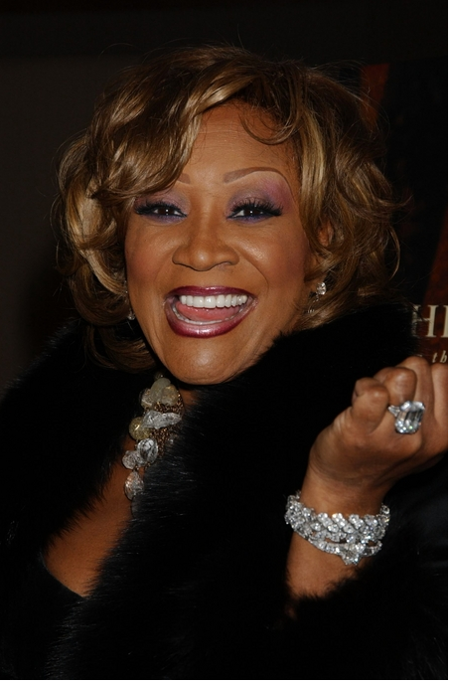
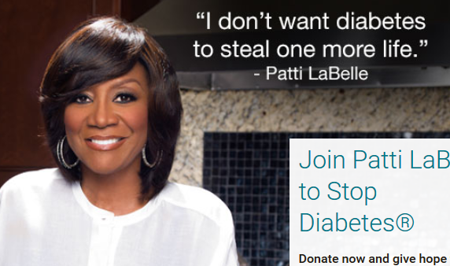
Patti Labelle
"divabetic”
“I have diabetes, it doesn’t have me”

Slide 39
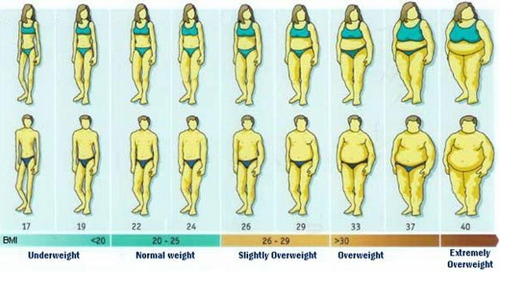
BMI Categories

Slide 40

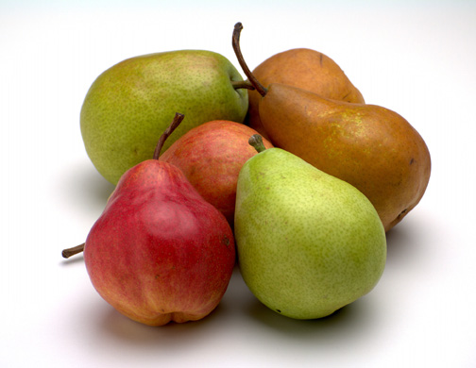


Slide 41
Natural Progression of Type 2 Diabetes
Plasma
Glucose
Postprandial glucose
Fasting glucose
126 mg/dL
Relative
β-Cell
Function
Insulin resistance
Insulin secretion
-20
-10
0
10
20
30
Years of Diabetes
Prior to diagnosis
After diagnosis
Adapted from Bergenstal et al. 2000; International Diabetes Center.

Slide 42

Cardio Metabolic Risk -
5 Hypers -
Hyperinsulinemia (resistance)
Hyperglycemia
Hyperlipidemia
Hypertension
Hyper”waistline”emia (35” women, 40” men)
Manifestations of Insulin Resistance

Slide 43

Pre Diabetes & Type 2- Screening Guidelines (ADA Clinical Practice Guidelines)
Start screening at age 45 or for anyone who is overweight (BMI ≥ 25, Asians BMI ≥ 23 ) with one or > additional risk factor:
  First-degree relative w/ diabetes
  Member of a high-risk ethnic population
  Habitual physical inactivity
  PreDiabetes
  History of heart disease

Slide 44

Diabetes 2 - Who is at Risk?
(ADA Clinical Practice Guidelines)
Risk factors cont’d
  HTN - BP > 140/90
  HDL < 35 or triglycerides > 250
  baby >9 lb or history of Gestational Diabetes Mellitus
  Polycystic ovary syndrome (PCOS)
  Other conditions assoc w/ insulin resistance:
    Severe obesity, acanthosis nigricans (AN)

Slide 45
Acanthosis Nigricans (AN)
Signals high insulin levels in bloodstream
Patches of darkened skin over parts of body that bend or rub against each other
  Neck, underarm, waistline, groin, knuckles, elbows, toes
  Skin tags on neck and darkened areas around eyes, nose and cheeks.
No cure, lesions regress with treatment of insulin resistance

Slide 46
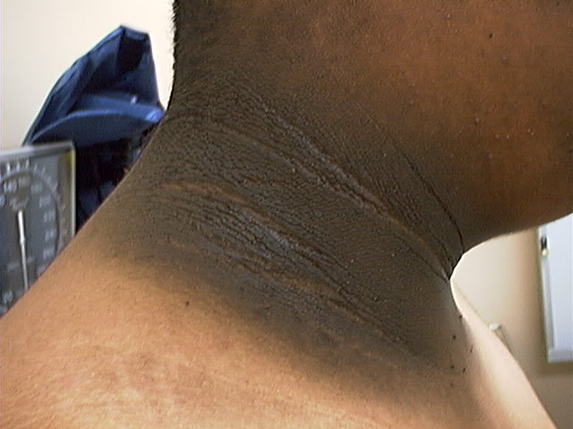
Acanthosis Nigricans

Slide 47
Diabetes Detectives Needed
On average – takes 6.5 years to diagnose diabetes
1/4 of all people with diabetes don’t know they have it

Slide 48
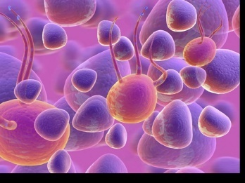
Ominous Octet
Decreased
satiation neuro-
transmission
Decreased
amylin, β-cell secretion
80% loss at dx
Increased renal glucose reabsorption
Decreased
Gut hormones
Increased glucagon secretion
G
I
G
I
G
G
I
I
G
G
Increased lipolysis
G
I
I
G
G
I
Increase glucose
production
I
G
G
Decreased glucose
uptake
© Copyright 1999-2013, Diabetes Educational Services, All Rights Reserved.
Notes:
48
48

Slide 49

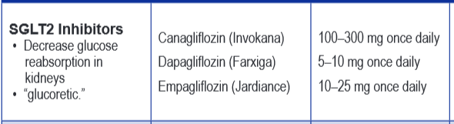
SGLT2 Inhibitors- “Glucoretics”
Action: “Glucoretic” decreases renal reabsorption in the proximal tubule of the kidneys (reset renal threshold and increase glycosuria)
Benefits: Lowers A1c 0.7 – 1.5%, lowers wt 1-3 lbs, no hypo
Issues: Can initially lower GFR, monitor kidney function and lytes. Watch for hypotension/ GU infections. Expensive
Decreases Glucose
Reabsorption
Notes:
49
49
Thiazolidinediones (TZDs) enhance insulin sensitivity in muscle and adipose tissue by binding to cell receptors,which leads to an increase in glucose transporter expression. TZDs encourage beta cells to respond more efficiently by lowering the amount of glucose and free fatty acids in the bloodstream, both of which are known to be detrimental to insulin secretion. Finally, these drugs reduce glucose production in the liver.
Clinical trials indicate that pioglitazone and rosiglitazone are slightly more effective at reducing A1C (1.5-1.6% reduction) than troglitazone (1.1% reduction).
Some of the beneficial side effects of thiazolidinediones include an increase in HDL cholesterol and reduction of triglyceride concentrations. This class of drugs has also been shown to lower blood pressure and decrease vascular inflammation in vitro. There are clinical studies underway to further examine the cardiovascular benefit to TZDs.
Some adverse effects of TZDs include weight gain, a potential increase in LDL cholesterol levels, and a possible increase in alanine aminotransferase levels (ALT). Because of the risk of weight gain, edema, and increased LDL cholesterol, thiazolidinediones are contraindicated in patients with advanced forms of congestive heart failure. Due to reported cases of liver failure and liver toxicity caused by the increase in ALT levels, TZDs are contraindicated in patients with abnormal liver function.
TZDs are the most expensive of the oral antidiabetic agents.

Slide 50

EMPA-REG OUTCOME®: Summary
Empagliflozin, as used in this trial, for 3 years in 1,000 patients with type 2 diabetes at high CV risk:
Empagliflozin reduced hospitalisation for heart failure by 35%
¤ 14 fewer hospitalisations for heart failure (42 vs 28)
Empagliflozin reduced CV death by 38%
¤ 25 lives saved (82 vs 57 deaths)
    22 fewer CV deaths (59 vs 37)
Empagliflozin improved survival by reducing all-cause mortality by 32%
¤ 53 additional genital infections (22 vs 75)

Slide 51
Comparison of
Type 1 and Type 2
Type 1
Type 2
Obesity
x
xxx
Insulin dependence
xxx
30%
Respond to oral agents
0
xxx
Ketosis
xxx
x
Antibodies present
xxx
0
Typical Age of onset
teens
adult
Insulin Resistance
0
xxx

Slide 52

Gestational DM ~ 7% of all Pregnancies
GDM prevalence increased by
  ∼10–100% during the past 20 yrs
Native Americans, Asians, Hispanics, African-American women at highest risk
Immediately after pregnancy, 5% to 10% of GDM diagnosed with type 2 diabetes
Within 5 years, 50% chance of developing DM in next 5 years.

Slide 53
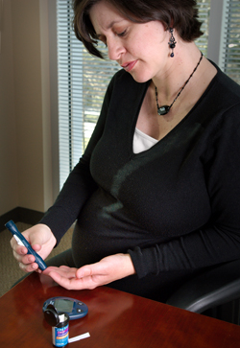
Diabetes in pregnant mothers associated with …
Offspring
  Fetal Complications
  Obesity and diabetes later in life
Mother
  More complicated pregnancy and delivery
  Diabetes later in life
Intrauterine environment is important

Slide 54
Postnatal Health:
Maternal Behavior
Encourage breastfeeding for one year
  (25% of women achieving this goal)
Screening 6-12 weeks post partum using non-pregnant OGTT criteria (50%)
Repeat at 3 yr intervals or signs of DM
Encourage weight control and exercise
Make sure connected with health care
Preconception counseling

Slide 55

Start Metformin therapy
For women with PreDiabetes and History of GDM

Slide 56
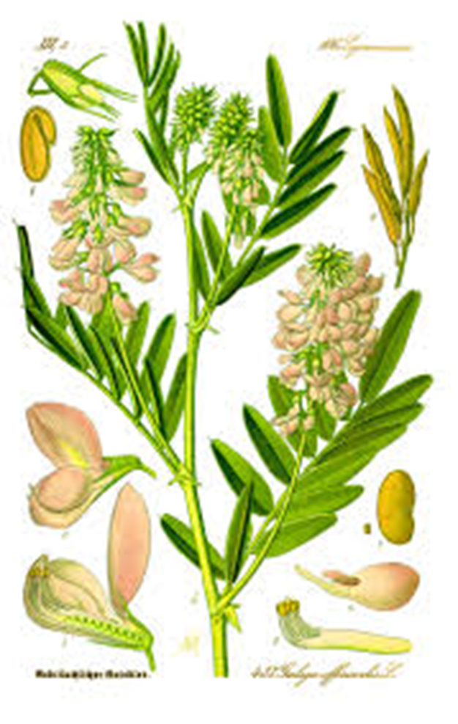
Biguanides – Metformin (Glucophage)
Action: decrease hepatic glucose (glycogen)
Names:
  Metformin (Glucophage)
    Starting dose: 500 BID, max 2500mg daily
  Metformin extended release (3 different versions)
    Starting dose 500mg at dinner, max dose 2000 to 2500 mg daily
  Efficacy:
    Decrease fasting plasma glucose 60-70 mg/dl
    Reduce A1C 1.0-2.0%
Notes:
56
56
The mechanism of action of metformin is not entirely understood, but it's predominant effect is to suppress hepatic glucose production and to enhance insulin sensitivity in peripheral tissues (primarily muscle). It is unclear if insulin sensitivity occurs by metformin binding to cell receptors,which leads to an increase in glucose transporter expression, or whether insulin sensitivity is simply a secondary effect of the suppressed glucose production.
Metformin's ability to lower A1C and decrease fasting plasma glucose is similar to that of sulfonylurea drugs. However, the UKPDS showed that those who received metformin had less hypoglycemia and weight gain than those who received sulfonylureas.
Metformin must be avoided in patients with renal impairments, as those patients are at higher risk of experiencing lactic acidosis. However, metformin is an effective monotherapy and may be an ideal drug for overweight patients since it does not cause weight gain and has been seen to cause modest amounts of weight loss when first administered. Diarrhea and abdominal discomfort can be alleviated by changes in diet and slow increases in metformin dosage.

Slide 57
Biguanides - Metformin
Benefits
  Decrease LDL cholesterol and triglycerides
  No weight gain, possible modest weight loss
  Cancer protective?
Concerns
  Diarrhea and abdominal discomfort – Use XR (may see pill shell in stool – okay)
  Lactic acidosis if improperly prescribed
  Watch for B12 deficiency
  Hold before and 48 hours after IV contrast dye studies. Resume when kidney function adequate.
Notes:
57
57
The mechanism of action of metformin is not entirely understood, but it's predominant effect is to suppress hepatic glucose production and to enhance insulin sensitivity in peripheral tissues (primarily muscle). It is unclear if insulin sensitivity occurs by metformin binding to cell receptors,which leads to an increase in glucose transporter expression, or whether insulin sensitivity is simply a secondary effect of the suppressed glucose production.
Metformin's ability to lower A1C and decrease fasting plasma glucose is similar to that of sulfonylurea drugs. However, the UKPDS showed that those who received metformin had less hypoglycemia and weight gain than those who received sulfonylureas.
Metformin must be avoided in patients with renal impairments, as those patients are at higher risk of experiencing lactic acidosis. However, metformin is an effective monotherapy and may be an ideal drug for overweight patients since it does not cause weight gain and has been seen to cause modest amounts of weight loss when first administered. Diarrhea and abdominal discomfort can be alleviated by changes in diet and slow increases in metformin dosage.

Slide 58

Considerations
Biguanide - Metformin (Glucophage®)
Contraindications due to risk of lactic acidosis:
  creatinine >1.4 females, >1.5 males
  liver disease
  alcohol abuse
  over 80 years old
  risk of acidosis
  during IV dye study
  CHF requiring meds
FDA 2016 suggests GFR more appropriate measure. If GFR <45 – don’t start new pts and eval benefit vs risk. If GFR <30, stop metformin.
Notes:
58
58

Slide 59
Other Causes of Hyperglycemia
  Steroids
  Agent Orange
  Tube feedings / TPN
  Transplant medications
  Cystic Fibrosis
  Regardless of cause, requires treatment
    Insulin always works
    Sign of pancreatic malfunction

Slide 60

Diabetes is also associated with
Fatty liver disease
Obstructive sleep apnea
Cancer; pancreas, liver, breast
Alzheimer’s
Depression

Slide 61
Diabetes Bingo
“DiaBingo” Shout out Right Answer

Slide 62
DiaBingo
B Frequent skin and yeast infections
B A BMI of ____ or greater is considered overweight
B To reduce complications, control A1c, Blood pressure, Cholesterol
B PreDiabetes – fasting glucose level of ___ to ____
B Erectile dysfunction indicates greater risk for ____
B Diabetes – fasting glucose level____ or greater
B Type 1 diabetes is best described as an ______ disease
B People with diabetes are ______ times more likely to die of heart dx
B Elevated triglycerides, < HDL, smaller dense LDL
B Each percentage point of A1c = _____ mg/dl glucose
B At dx of type 2, about __% of the beta cell function is lost
B Diabetes – random glucose ____ or greater

Slide 63

Life Study – Mrs. Jones
Mrs. Jones is 62 years old, overweight and complaining of feeling tired and urinating several times a night. She is admitted with a urinary tract Infection. Her WBC is 12.3, glucose 237. She is hypertensive with a history of gestational diabetes. No ketones in urine.
What are her risk factors, signs of diabetes
What type of diabetes does she have?
Does she have insulin resistance?

Slide 64

Strategies – One Step at a Time, Focus on Survival Skills
Look for
“teaching moment” opportunities

Slide 65
What Do You Say?
Mrs. Jones asks you
What is type 2 diabetes?
Will this go away?
Will I get complications?
Will I need to take diabetes medication for the rest of my life?
How come I got diabetes?
Do I have to check my blood sugars?

Slide 66
I don’t want to!

Slide 67
No one is Unmotivated
…. to lead and long and healthy life
These are the 3 usual Critical Barriers
  Perceived worthlessness
  Too many personal obstacles
  Absence of support and resources
  Bill Polonsky, PhD, CDE

Slide 68
Overcoming barriers
Confront the key misbelief. Ask the question, does dm cause complications?
Offer pts evidence based hope message –
Frequent contact
Paired glucose testing
Ask pt, “Tell me 1 thing that is driving you crazy about your diabetes”
Discuss medication beliefs
To improve outcomes, see pts more often
  Bill Polonsky, PhD, CDE

Slide 69
How will blood glucose testing help me?
See if your treatment plan is working
Make decisions regarding food and/or med adjustment when exercising
Find out how that pizza affected your BG
Avoid unwanted weight gain
Enhanced athletic performance
Find patterns
Manage illness

Slide 70
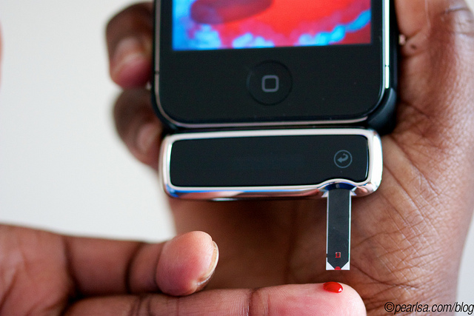
How Often Should I Check?
Be realistic!!
Type 2 on orals – Medicare covers 100 strips for 3 months
Based on individual - Consider:
  Types and timing of meds
  Goals
  Ability (physical and emotional)
  Finances / Insurance

Slide 71

Spiritual Care

Slide 72

“The highest form of wisdom is kindness.”
The Talmud
How many times has a person arrived disheartened?
This moment of discouragement and despair provides us an opportunity.
By modeling kindness and understanding, we can encourage them to be a kinder self-coach from this day forward.

Slide 73

Give the gift of Non-Judgment

Slide 74
Complications - Why?
Degree of hyperglycemia “glucose toxicity”
Duration of hyperglycemia
Genes
Multiple risk factors: smoking, vascular disease, dyslipidemia, hypertension, other

Slide 75
Diabetes Complications
Heart disease leading cause of death.
CAD death rates are about 2 -4x’s as high as adults without diabetes (it’s not getting better)
Risk of stroke is 2 - 4 times higher
60% - 65% of people with DM have HTN.
DM accounts for 40% of new cases of ESRD
60 - 70% have mild - severe forms of neuropathy
Diabetes is the leading cause of blindness
Accounts for 50% of lower limb amputations

Slide 76
Control Matters
Prevention
Trials
Practice Recommendations

Slide 77

Financial Advisor
Mid 30s, friendly, he smiles to greet you and you notice his gums are inflamed. You’d guess a BMI of 26 or so, with most of the extra weight in the waist area.
If you could give him some health related suggestions, what would they be?

Slide 78

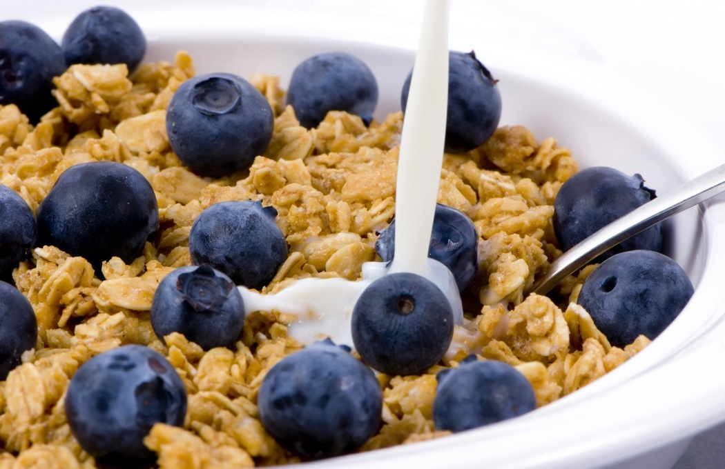


Preventing Pre Diabetes

Slide 79
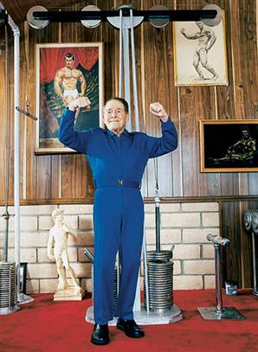
Can Type 2 be Prevented in Older Adults?
Overall, 9 of 10 new cases of diabetes attributable to these 5 lifestyle factors.
89% risk reduction when all at goal.
35% rel risk reduction for each additional
Physical activity (30 mins a day)
Dietary score (higher fiber intake, low saturated fat and trans-fat, lower mean glycemic index)
Not Smoking
Alcohol use (up to 2 drinks a day);
BMI <25 and waist circumference
Dariush Mozaffarian, MD,
Arch Intern Med. 2009;169(8):798-807.

Slide 80
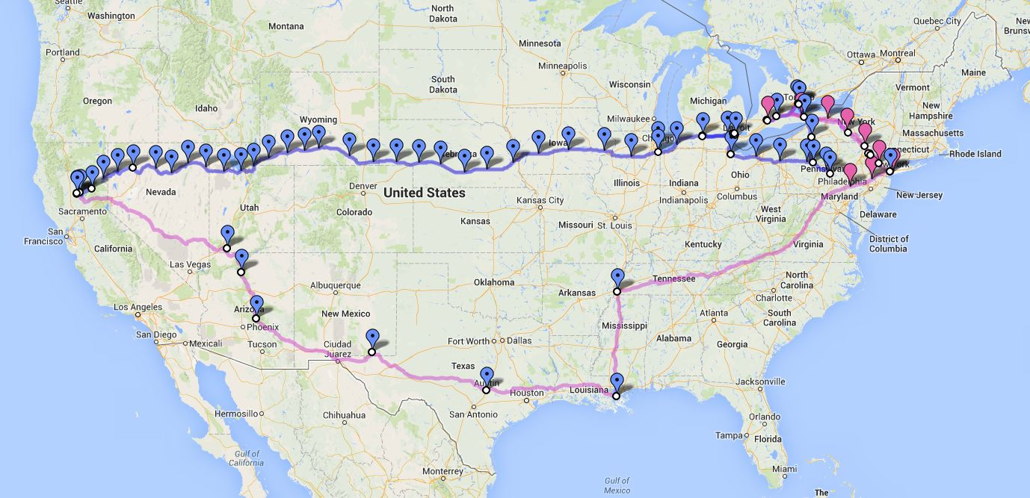
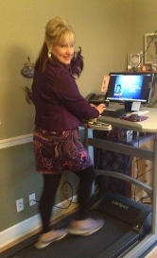
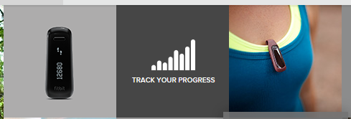
We Made It – 3129 miles- Now Walking Back
Track miles with fitbit
Fitbit.com
Lifespan Treadmill Desk - Amazon

Slide 81

Can we stop pre diabetes from progressing?
3, 234 people w/ Pre-Diabetes randomized:
  Placebo
  Diet/Exercise or
  Metformin
over a three year period
Diabetes Prevention Program (DPP) 2001

Slide 82

Diabetes Prevention Program
Standard Group - 29% developed DM
Lifestyle Results - 14% developed DM
  58% (71% for 60yrs +) Risk reduction
    30 mins daily activity
    5-7% of body wt loss
Metformin 850 BID - 22% developed DM
  31% risk reduction (less effective with elderly and thinner pt’s)

Slide 83

Weight loss and Prevention
For every 2.2 pounds of weight loss, risk of type 2 diabetes was reduced by 13%.

Slide 84
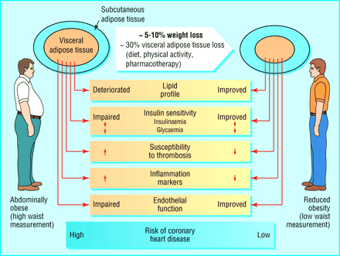

Slide 85

Use Technology to Prevent Diabetes
Recent studies support content delivery through virtual small groups, internet social networks, cell phones and mobile devices.
  Validated studies that these approaches can:
    Support wt loss
    Reduce A1c (prediabetes)
  The CDC Diabetes Prevention Program is incorporating these tools into their program content

Slide 86

Goals of Care

Slide 87

ABCs of Diabetes –
A1c less than 7% (avg 3 month BG)
  Pre-meal BG 80-130
  Post meal BG <180
Blood Pressure < 140/90
Cholesterol
  DM and 40 yrs, start statin
  HDL >40
  Triglyceride < 150
E xercise, Education
H ealthy Eating

Slide 88

1% decrease in A₁c reduces microvascular complications by 35%
1% decrease in A₁c reduces diabetes related deaths by 25%
B/P control (144/82) reduced risk of:
  Heart failure (56%)
  Stroke (44%)
  Death from diabetes (32%)
Lancet 352: 837-865, 1998

Slide 89
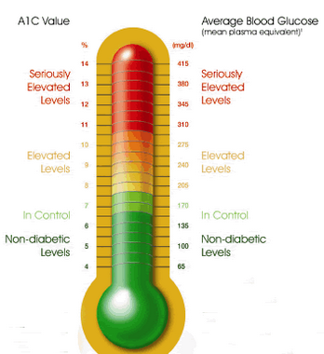
6. Glycemic Targets
Adult non pregnant A1c goals
  A1c < 7% - a reasonable goal for adults.
  A1c < 6.5% - may be appropriate for those without significant risk of hypoglycemia or other adverse effects of treatment.
  A1c < 8% - may be appropriate for patients with history of hypoglycemia, limited life expectancy, or those with longstanding diabetes and vascular complications.

Slide 90

When does old age start?

Slide 91

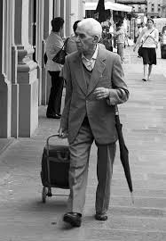
Healthy & Good Functional Status
Set more intensive goals if:
  Good cognitive and physical function
  Expected to live long enough to reap benefits of intensive management,
Ongoing follow-up to eval safety
Goals:
  Reasonable A1c goal <7.5%,
  Fasting BG 90 – 130
  Blood Pressure < 140/90
  Statin unless contraindicated or not tolerated

Slide 92

Patients with Complications and Reduced Functionality - Less Intense Goals
Adjusted based on shared -decision making and safety.
Keep it realistic
Consider DE-Intesification
Goals:
  Reasonable A1c goal <8.0%
  Fasting BG 90 – 150
  Blood Pressure < 140/90
  Statin unless contraindicated or not tolerated

Slide 93

A1c and Estimated Avg Glucose (eAG) 2008
A1c (%) eAG
5 97
6 126
7 154
8 183
9 212
10 240
11 269
12 298
eAG = 28.7 x A1c-46.7 ~ 29 pts per 1%
Translating the A1c Assay Into Estimated Average Glucose Values – ADAG Study
Diabetes Care: 31, #8, August 2008
Order teaching tool kit free at diabetes.org

Slide 94


Slide 95

“Legacy Effect”
For participants of DCCT and UKPDS
  long lasting benefit of early intensive BG control prevents
    microvascular complications
    Macrovascular complications (15-55% decrease)
  Even though their BG levels increased over time
  Message – Catch early and
  Treat aggressively

Slide 96
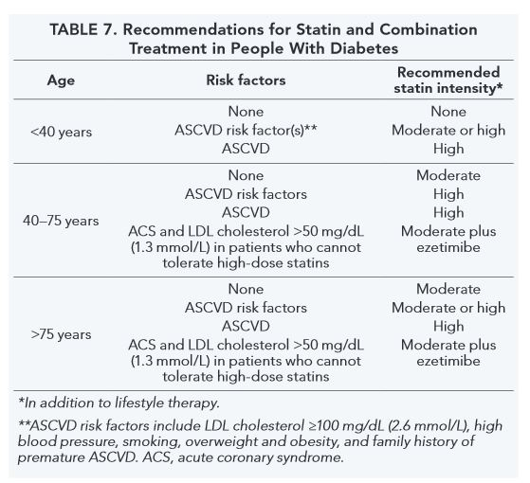
Updated Recommendations
Statin – lowers cholesterol production in liver
Ezetimibe (Zetia) – blocks absorption of cholesterol in intestine

Slide 97
Vaccinations- Immunizations
Flu vaccine
  every year starting 6 months
Pneumococcal starting at 2 years.
  One time Revaccination for those over 64 and had first vaccine >5 years prior
Hepatitis B Vaccine (ADA Stds 2013, pg s28)
  For diabetes pts age 19 – 59 (not previously vaccinated)
  Double risk of Hep B due to lancing devices/ glucose meter exposure

Slide 98

Education
People with diabetes and pre diabetes should receive DSME
  Monitor for effective self-management and quality of life
  Address psychosocial issues and emotional well being
  Results in cost savings and improved outcomes, should be reimbursed by third party payers.

Slide 99
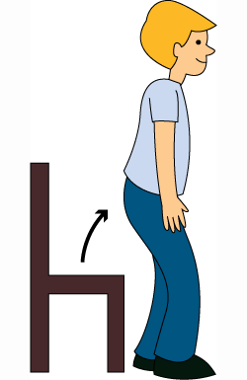
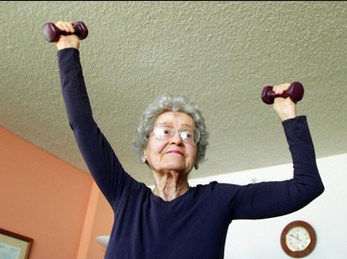
Exercise Recommendations
Activity update –Don’t sit more than 90 minutes
Evidence supports that everyone, including with diabetes should be encouraged to reduce sedentary time, by not sitting for more than 90 minutes at a time.
It is recommended that people with pre diabetes and diabetes engage in 150 minutes of activity a week and at least 2 weekly sessions of resistance exercise.

Slide 100
Good Exercise Info / Quotes
20 % of people walk 30 mins a day
Exercise decrease A1c 0.7%
No change in body wt, but 48% loss in visceral fat
ADA PostGrad 2010
“If you don’t have time for exercise, you better make time for disease.”
“I don’t have time to exercise, I MAKE time.”
Mike Huckabee

Slide 101
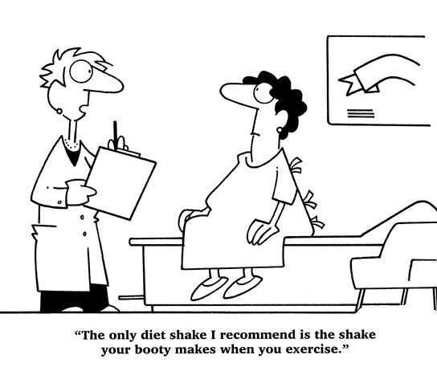
Best Shake For People with Diabetes
From Debbie Nagata’s slide collection

Slide 102
Vaccinations- Immunizations
Flu vaccine
  every year starting 6 months
Pneumococcal starting at 2 years.
  One time Revaccination for those over 64 and had first vaccine >5 years prior
Hepatitis B Vaccine
  For diabetes pts age 19 – 59 (not previously vaccinated)
  Double risk of Hep B due to lancing devices/ glucose meter exposure

Slide 103
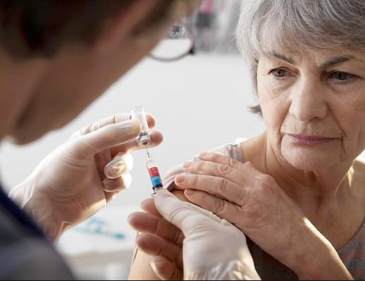
Pneumonia Vaccination Update
Pneumonia polysaccharide PPSV23 vaccine to all patients starting at age 2
Adults ≥ 65 years of age, if not previously vaccinated, should receive pneumococcal conjugate vaccine 13 (PCV13), followed by PPSV23 6-12 months after initial vaccination.
Adults ≥ 65 years of age, if previously vaccinated with PPSV23 should receive a follow-up ≥ 12 months with PCV13.

Slide 104
Diabetes Bingo
“DiaBingo” Shout out Right Answer

Slide 105
DiaBingo- G
G ADA goal for A1c is less than ____%
G People with DM need to see their provider at least every month
G Blood pressure goal is less than
G People with DM should see eye doctor (ophthalmologist) at least
G The goal for triglyceride level is less than
G Goal for my HDL cholesterol is more than
G The goal for blood sugars 1-2 hours after a meal is less than:
G People with DM should get this shot every year
G People with DM need to get urine tested yearly for ___________
G Periodontal disease indicates increased risk for heart disease
G The goal for blood sugar levels before meals is:
G The activity goal is to do ___ minutes on most days

Slide 106
Diabetes Care Guidelines- ADA
Test / Exam Frequency
A1c At least twice a year
B/P Each diabetes visit
Cholesterol (LDL, HDL, Tri) Yearly (less if normal)
Weight each diabetes visit
Microalbumin/GFR/Creat Yearly
Eye exam Yearly
Dental Care At least twice a year
Comprehensive Foot Exam Yearly (more if high risk)
Physical Activity Plan As needed to meet goals
Preconception counseling As needed

Slide 107
Mr. Jones - What are Your Recommendations?
Self-Care Skills
Walks dog around block 3 x’s a week
Bowls every Friday
3 beers daily
What meds?
What referrals?
My foot hurts
Patient Profile
64 yr old with type 2 for 11 yrs. Hx of CVD.
Labs:
  A1c 9.3%
  HDL 37 mg/dl
  Triglyceride 260mg/dl
  Proteinuria - neg
  B/P 152/94

Slide 108
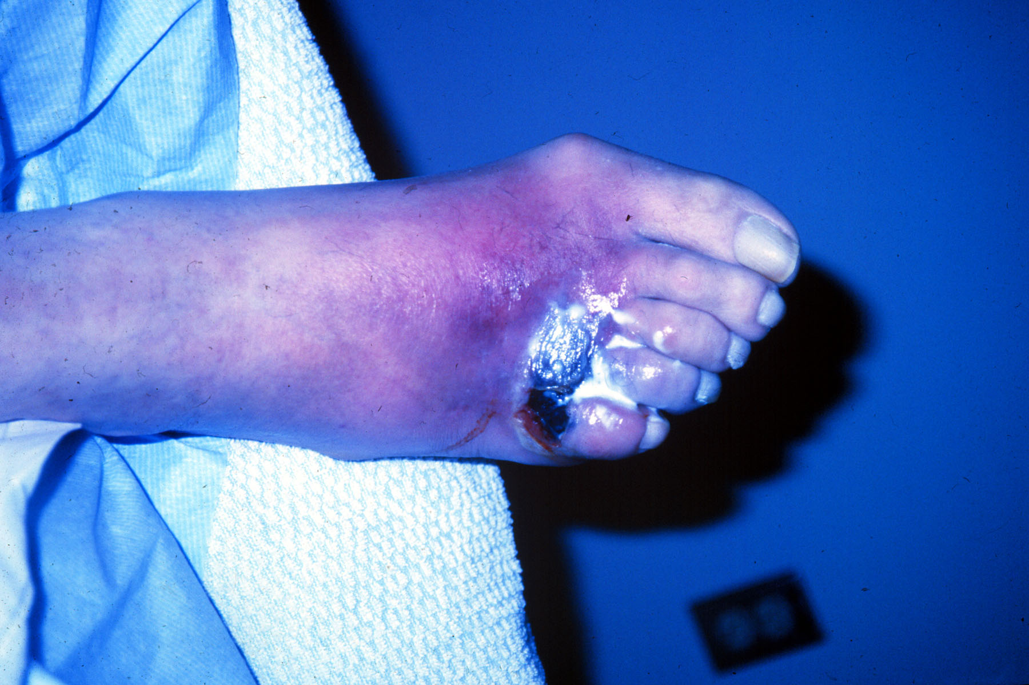

Slide 109

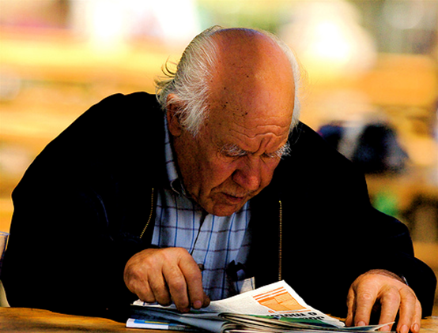
Glucose Management and Hospitalized Patients
In hospitalized patients with critical illness, hyperglycemia is a signal that warrants our attention.

Slide 110

Hospitals and Hyperglycemia –
What’s the Big Deal?
Hyperglycemia is associated with increased morbidity and mortality in hospital settings.
  Acute Myocardial Infarction
  Stroke
  Cardiac Surgery
  Infection
  Longer lengths of stay

Slide 111

WHAT SHOULD WE AIM FOR?
Critically Ill pts
  BG > 180- Start insulin
  BG goal 140-180
Non Critically Ill patients BG Goals
  Premeal <140
  Post meal <180
Insulin therapy preferred treatment
Consensus: Inpt Hyperglycemia, Endocr Pract. 2009;15 (No.4)

Slide 112

Management of Hyperglycemia and Diabetes
Stop oral agents (ie) metformin & sulfonylurea on admission
“The sole use of Sliding Scale insulin is discouraged” – ADA 2014
For discharge, oral meds can be resumed
  Start Basal/bolus therapy
    NPH and Regular insulin
    Long-acting and rapid-acting insulin
    Premixed insulin

Slide 113
Now What?
Nurse administered insulin and pt only ate a few bites of turkey and drank non sugar tea?
Nurse had an emergency and pt already ate lunch?
You just gave 3 units of Regular and patient needs to go to OR NOW!

Slide 114
Foot Care
Lift the sheets and look at the Feets!

Slide 115
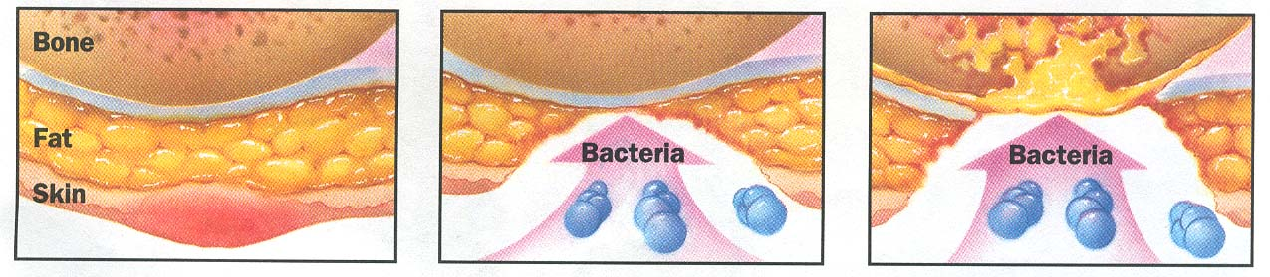
Foot Wounds
Blisters Ulcers Bone infection
Calluses

Slide 116
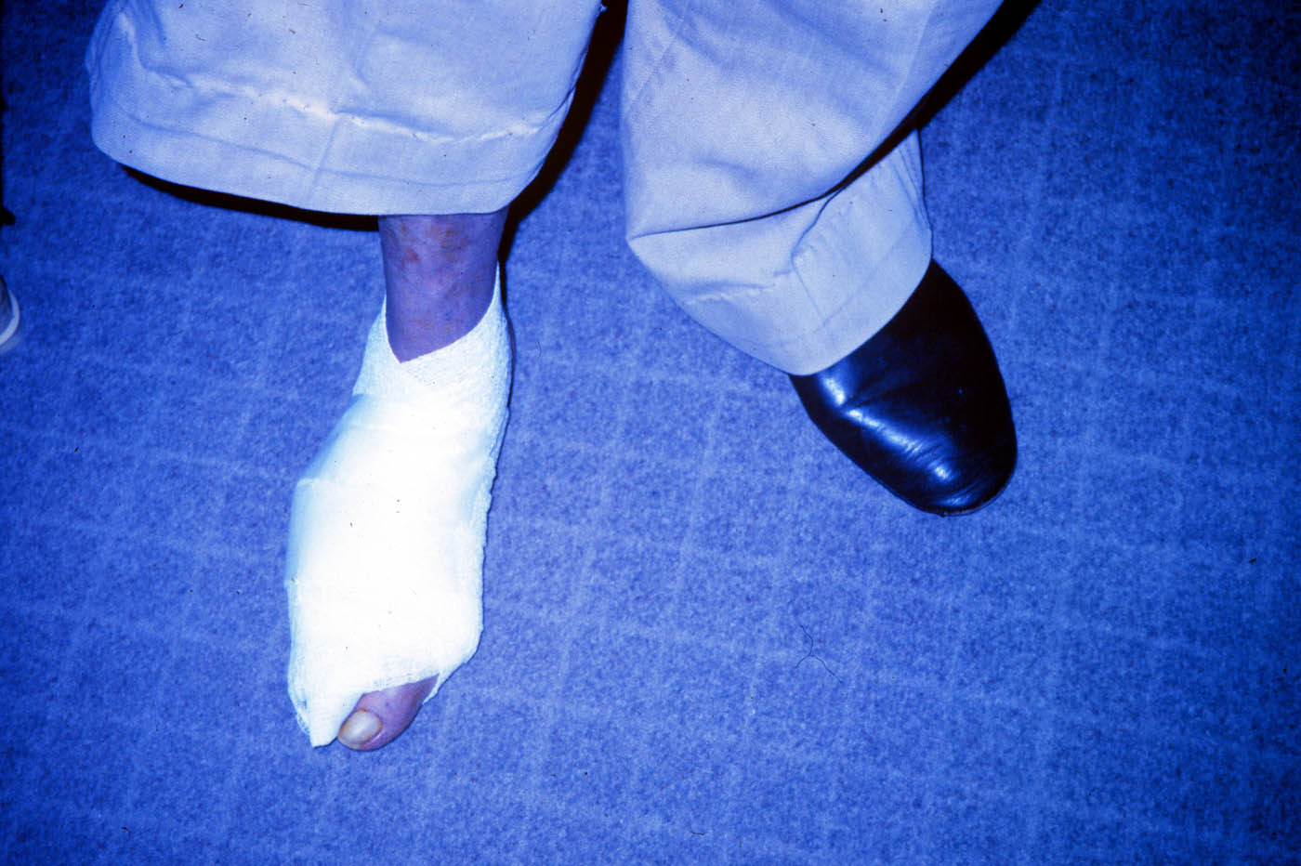

Slide 117
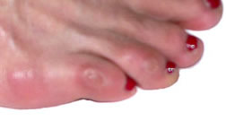
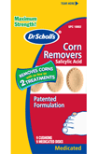

No Bathroom Surgery

Slide 118
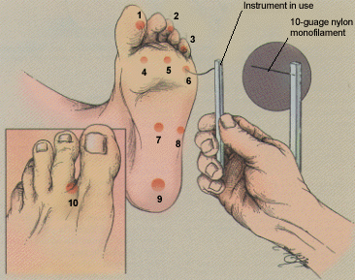
5.07 monofilament = 10gms linear pressure
Free Monofilaments
http://www.hrsa.gov/leap/

Slide 119

Mr. Jones - What are Your Recommendations?
Patient Profile
64 yr old with type 2 for 11 yrs. Hx of CVD.
Current Status:
  A1c 9.3%
  On Metformin 500mg BID
  Partial foot amputation
  Lives alone
  What resources, teaching?

Slide 120
Three Most Important
Foot Care Tips
Inspect and apply lotion to your feet every night before you go to bed.
Do NOT go barefoot, even in your house. Always wear shoes!
Every time you see your doctor, take off your shoes and show your feet.

Slide 121

Bottom Line
30-40% of hospitalized patients have diabetes
  10% aren’t officially diagnosed
Cardiovascular disease is the leading cause of hospitalization for people with diabetes
Look for patients with hyperglycemia and cardiometabolic risk factors: smokers, HTN,
central obesity, abnormal lipids, Acanthosis.
Provide education and promote self-advocacy

Slide 122

“Getting diabetes saved my life.”
~ Sherri Sheperd
Sherri Shepard decided to embrace diabetes and use it as a motivator to improve her health.

Slide 123
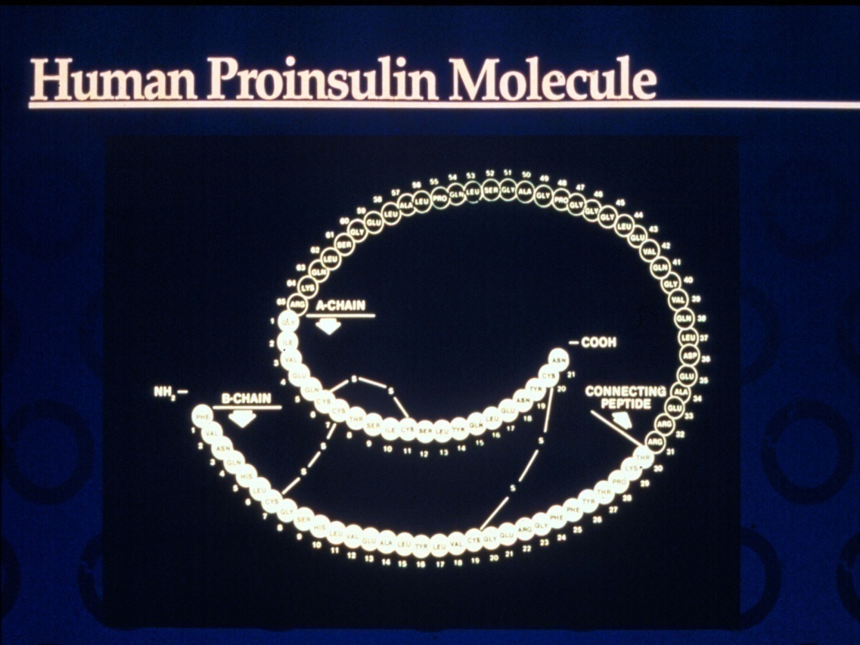
Insulin – the Ultimate Hormone Replacement Therapy
  Objectives:
  Discuss the actions of different insulins
  Describe using pattern management as an insulin adjustment tool.

Slide 124

Insulin Therapy
From Ants to Analogs:

Slide 125
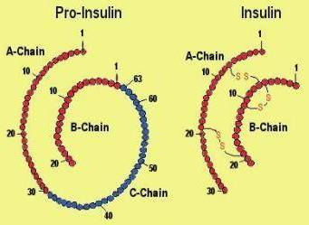
Insulin – the Ultimate Hormone Replacement Therapy
  Objectives:
  Discuss the actions of different insulins
  Describe using pattern management as an insulin adjustment tool.

Slide 126
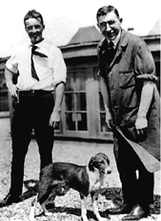

Slide 128
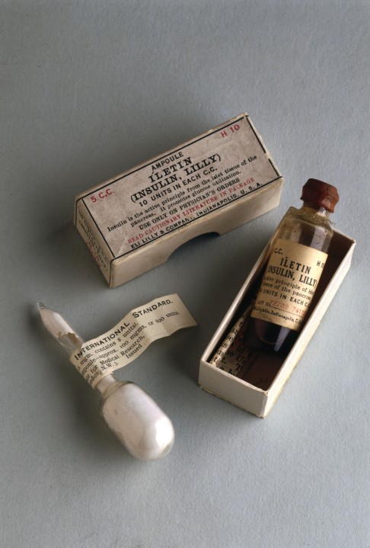
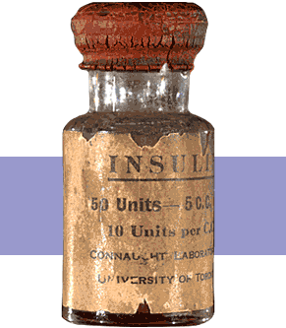
Insulin Finally Available - 1922

Slide 129


The Miracle of Insulin
Patient J.L., December 15, 1922
February 15, 1923

Slide 130

Psychological Insulin Resistance (PIR)
50% of providers in study threatened pts “with the needle”.
Less than 50% of providers realized insulins’ positive effect on type 2 dm
Most pts don’t believe that insulin would “better help them manage their diabetes”.
Solutions: Find the root of PIR and address
Diabetes Attitudes, Wishes, Needs Study - Rubin

Slide 131

Needle Size often a Barrier
Size Does Matter
Use more short needles – 4 mm
Effective for pts with BMI of 24- 49
Keeps it subq
If pt thin, inject at angle
To avoid leakage, count to 10 before withdrawing needle
½ the patients who could benefit from insulin are not using it due to needle phobias

Slide 132
Physiologic Insulin Secretion:
24-Hour Profile
50
Insulin
(µU/mL)
Bolus Insulin
25
0
Basal Insulin
Breakfast Lunch Dinner
150
Glucose
(mg/dL)
100
Mealtime Glucose
50
Basal Glucose
0
7
8
9
10
11
12
1
2
3
4
5
6
7
8
9
A.M.
P.M.
Time of Day

Slide 133
Insulin Action Teams
Bolus: lowers after meal glucose levels
  Rapid Acting
    Aspart, Lispro, Glulisine, Afrezza
  Short Acting
    Regular
Basal: controls glucose between meals, hs
  Intermediate
    NPH
  Long Acting
    Detemir (Levemir)
    Glargine (Lantus, Basaglar)
    Degludec (Tresiba)

Slide 134

Case Study
70 yr old, weighs 100kg
History of CABG, tobacco
A1c – 11.3%, BG 400-500 for past weeks
Insulin – 100+ units Lantus at hs (solostar)
Oral Meds: Metformin, Invokana
What is a better insulin dosing strategy?
Pt can’t afford insulin pen – what other option
Diabetes Meds on a Budget - 2014 - provides practical and affordable strategies to manage hyperglycemia

Slide 135

Cost Per Vial in Northern CA

Slide 136


Slide 137
Bolus Insulins
(½ of total daily dose ÷ meals)
Name Onset Peak Action
Lispro (Humalog) 15-30 min 1-1.5 hrs
Aspart (NovoLog)
Glulisine (Apidra)
Afrezza (Inhaled)
Regular 30 mins 2-4 hrs

Slide 138
Bolus Insulin Summary
Regular, Novolog, Humalog, Apidra,
Starts working fast (15-30 mins)
Gets out fast (3-6 hours)
Post meal BG reflects effectiveness
Should comprise about ½ total daily dose
Covers food or hyperglycemia.
1 unit
  Covers ≈ 10 -15 gms of carb
  Lowers BG ≈ 30 – 50 points

Slide 139
Bolus Insulin Timing
How is the effectiveness of bolus insulin determined?
  2 hour post meal (if you can get it)
  Before next meal blood glucose
Glucose goals (ADA) – may be modified by provider/pt
  1-2 hours post meal <180
  Before next meal – 70 - 130

Slide 140


Pattern Management –AKA
How to think
like a pancreas

Slide 141
Pattern Management
Safety 1st!! - Evaluate 3 day patterns
Hypo: eval 1st and fix:
  If possible, decrease medication dose
  Timing of meals, exercise, medications
Hyperglycemia: evaluate 2nd
  Identify patterns
  Before increase insulin, make sure not missing something (carbs, exercise, omission)

Slide 142
Type 2 – BMI 32. New diagnosis, No meds.
What Patterns? Recommendations? Meds?

Slide 143
Bolus – Insulin Sliding Scale
Starts at 150, 2 units for every 50 mg/dl >150

Slide 144
Basal Insulins
(½ of total daily dose)
Intermediate Acting Peak Action Duration
NPH 4-12 hrs 12-24
Long Acting Peak Action Duration
Detemir (Levemir) No Peak 20 hrs
Glargine (Lantus) 24 hrs
Glargine (Basaglar) 24 hrs
Degludec (Tresiba) 42 hrs
Fasting BG reflects efficacy of basal

Slide 145


Degludec
Degludec (Tresiba)
  An ultra long acting insulin - lasts
  up to 42 hours
  Takes 3-4 days to reach steady state
  Available in u-100 and u-200 pens
  Seems to cause less hypo
  Adjust dose every 3-4 days
  Wait at least 8 hours between doses
  Good at room temp for 8 wks
Ryzodeg 70/30
  mixture of insulin degludec and aspart

Slide 146
Basal Insulin Summary
NPH, Levemir, Lantus, Degludec
Covers in between meals, through night
Starts working slow (4 hours)
Stays in long (12-24 hours)
  NPH 12 hrs
  Levemir, Lantus 20-24 hrs
  Degludec – 42 hours
Fasting blood glucose reflects effectiveness

Slide 147

Basal + Metformin
Type 2, 80kg – A1c 8.7%

Slide 148
Notes:
Basal insulin alone is usually the optimal initial regimen, beginning at 0.1-0.2 U/kg body weight, depending on the degree of hyperglycemia. It is usually prescribed in conjunction with 1-2 non-insulin agents, although insulin secretagogues (sulfonylureas, meglitinides) are typically stopped once more complex regimens beyond basal insulin are utilized.
In patients still not at target after basal insulin has been adequately titrated, and the patient is willing to take >1 injections, there are several options. First, consider GLP-1 receptor agonists (see Fig. 2). The combination of basal insulin + GLP-1RA is becoming well established after several studies confirmed its efficacy on par with more complex multi-dose insulin regimens, but with less hypoglycemia and with weight loss instead of weight gain. If such an approach is not possible or has been tried and proven unsuccessful, there are 3 possible advanced insulin regimens:
Adding 1 injection of a rapid acting insulin analogue before the largest meal,
Adding 2-3 injections of a rapid acting insulin analogue before 2-3 meals, or
Using premixed insulin BID
Each approach has its advantages and disadvantages. The figure describes the number of injections required at each stage, together with the relative complexity and flexibility.
Once a strategy is initiated, titration of the insulin dose is important, with dose adjustments made based on the prevailing BG levels as reported by the patient.
Comprehensive education regarding self-monitoring of BG, diet, exercise, and the avoidance of, and response to, hypoglycemia are critical in any patient on insulin therapy.

Slide 149

When is it Too much basal insulin?

Slide 150
Next Steps
At max basal dose
  80 x 0.5 = 40 units
Start bolus insulin at largest meal
Or switch to 70/30 Insulin

Slide 151
Combo Sub-Q Insulin

Slide 152
Next Steps – Switch from 40 units basal to 70/30 Insulin
Switch to 70/30 Insulin
Take current dose and give 2/3 in am and 1/3 in pm.
  2/3 of basal in am
    40 units x 0.6 = 24 units 70/30
  1/3 of basal in *pm
    40 units x 0.4 = 16 units 70/30
  *pm = before dinner

Slide 153
24u 70/30 am, 16 u 70/30 pm
Patterns? Changes needed?

Slide 154
Type 2 – Glyburide 20mg AM, 10u NPH pm

Slide 155
What Medications Cause Hypoglycemia?
Insulin
Sulfonylureas
Meglitinides
Or any combo medication that includes these

Slide 156
Sulfonylureas - Squirts
Action: Increase endogenous insulin secretion throughout day
Efficacy:
  Decrease FPG 60-70 mg/dl
  Reduce A1C by 1.0-2.0%
Side Effects:
  Weight gain, hypoglycemia
Benefits:
  Cheap, effective
Notes:
156
156
Sulfonylureas (SUs) increase insulin secretion by binding to receptors on the surface of pancreatic beta cells, triggering a series of reactions which leads to insulin secretion.
Because SUs cause circulating insulin levels to increase, there is a risk of hypoglycemia. There is also some concern that increased insulin levels are associated with cardiovascular disease, however the UKPDS did not show a relationship between increased mortality and SU administration. Finally, there is concern that SUs will exhaust beta cell function by increasing insulin secretion. However, the decline in beta cell function is more likely caused by the disease itself, and not the use of SUs.
First generation sulfonylureas are just as efficacious as the second generation drugs, however the second generation may be more potent and safer than first. When diet and exercise fail, SUs are an effective monotherapy.

Slide 157
Hypoglycemia = “Limiting Factor”
Defined as glucose of 70mg/dl or below
50% of episodes occur during the night
Higher mortality rate with severe hypoglycemia secondary to sulfonylureas
  Especially (glyburide) Micronase®, Diabeta®
Blood glucose levels don’t describe severity, response is individual

Slide 158

Hypoglycemic Symptoms
Autonomic
  Anxiety
  Palpitations
  Sweating
  Tingling
  Trembling
  Hypoglycemic Unawareness
Neuroglycopenia
  Irritability
  Drowsiness
  Dizziness
  Blurred Vision
  Difficulty with speech
  Confusion
  Feeling faint

Slide 159
Treatment of Hypoglycemia
If blood glucose 70mg/dl or below:
  10-15 gms of carb to raise BG 30 - 45mg/dl
Retest in 15 minutes, if still low, treat again, even without symptoms
Follow with usual meal or snack
If BG less than 40, allow recovery time

Slide 160
15 - 20 Gms Carb Sources
3 - 4 Glucose Tablets
8 - 10 Lifesavers candy
8 - 10 Hard candies
2 Tablespoons Raisins
4 - 6 oz’s Nondiet soda
4 - 6 oz’s Fruit Juice
8 oz Milk (non fat)

Slide 161



Treating Hypo

Slide 162
Basal Bolus – What Adjustments?
Pt weighs 80kg

Slide 163
Intensive Diabetes Therapy
Insulin Dosing Strategy
50/50 Rule
0.5-1.0 units/kg day
Basal = 50% of total
  Glargine QD
  NPH or Detemir BID
Bolus = 50% of total
  usually divided into 3 meals
Example
Wt 50kg x 0.5 = 25 units of insulin/day
Basal dose: 13 units
  Glargine 13 units QD
  NPH/Detemir 6u BID
Bolus dose: 12 units
  4 units NovoLog, Apidra Humalog, Regular each meal

Slide 164
Intensive Diabetes Therapy
Insulin Dosing Strategy
50/50 Rule
0.5-1.0 units/kg day
Basal = 50% of total
  Glargine QD
  NPH or Detemir BID
Bolus = 50% of total
  usually divided into 3 meals
Example – You Try
Wt 60 kg x 0.5 = ___ units of insulin/day
Basal dose: ____ units
  Glargine ____ QD
  NPH/Detemir __ BID
Bolus dose: ____ units
___units NovoLog, Apidra Humalog, Reg each meal

Slide 165
Intensive Diabetes Therapy
Insulin Dosing Strategy
50/50 Rule
0.5-1.0 units/kg day
Basal = 50% of total
  Glargine QD
  NPH or Detemir BID
Bolus = 50% of total
  usually divided into 3 meals
Example – You Try
Wt 60kg x 0.5 = 30 units of insulin/day
Basal dose: 15 units
  Glargine 15 QD or
  NPH/Detemir 7u BID
Bolus dose: 15 units
  5 NovoLog, Apidra, Humalog, Reg each meal

Slide 166
Basal Bolus – Using 50/50 Rule - Pt weighs 80kg

Slide 167
Insulin Teaching Keys
Bolus insulin with meals
Basal 1-2xs daily
Abdomen preferred injection site
Stay 1” away from previous site
Don’t re-use ultra fine syringes
Keep unopened insulin in refrigerator
Toss opened insulin vial after 28 days
Proper disposal
Review patients ability to withdraw and inject.
Side effects include hypoglycemia/wt gain
Insulin pens –
    Prime needle to assure accurate insulin dose given
    Hold needle in for 5 seconds after injection
    Roll 70/30 pens

Slide 168


Sharps Disposal: Product and Info
Look in the Government section white pages for a household hazardous waste listing for your city or county.
Call 1-800-CLEANUP (1-800-253-2687)
Search for collection centers on the California Integrated Waste Management Board (CIWMB) Web site: http://www.ciwmb.ca.gov/HHW/HealthCare/Collection/

Slide 169

Diabetes Vacations

Slide 170
Diabetes Bingo
“DiaBingo” Shout out Right Answer

Slide 171
DiaBingo - I
I Injected hormone that is an analog of amylin
I Glargine, Detemir, NPH are types of
I Breakdown of glycogen into glucose
I Anabolic hormone
I Insulin is released when glucose levels are low
I Once opened, insulin vials are good for one _____
I Elevated post-prandial glucose indicate need for pre-meaI
I Epinephrine increases insulin resistance
I Creation of glucose from amino acids and lactate
I Decreasing renal function for people on insulin can cause
I Bolus insulins
I A hormone that increases blood glucose levels

Slide 172


Slide 173



U.S. Weight - 68% overweight or obese
34% BMI 25-29
34% BMI 30 +
1/3 of all overwt people don’t get diabetes
We burn 100 cals less a day at work
Overall, food costs ~ 10-15% of income
Calorie Intake is on the rise

Slide 174

Bigger Meals, Bigger Kids

Slide 175


Average American Consumes
25 teaspoons of sugar a day (400 cals)
Warning label on sodas proposed
One soda has 12 teaspoons sugar
On avg, 1 person consumes 40 gallons of soda each year
ADA guidelines “limit sodas and beverages with sugar, High Fructose Corn Syrup, (HFCS)

Slide 176



Bacterial Cells Outnumber Human Cells 10 to 1
10 trillion human cells
Host 100 trillion bacterial and fungal cells

Slide 177

Poll Question 1
How much does your gut bacteria weigh?
  A. 24 ounces
  B. 3 pounds
  C. Less than 1 pound
  D. 1.5 pounds
  E . Not sure

Slide 178

3 lbs of Microbes in our Gut
This community of bacteria can be thought of as an extra 'organ' "microbiome".
We have evolved together with our microbiome over millions of years.
Ratios of these communities has changed over the past 30 years
Mirrors global spikes in obesity, diabetes, allergic and inflammatory diseases
What are we doing to change these bacteria?

Slide 179

Gut Microbiome
Part of endocrine axis
Stabilized by 3 years of age
Influenced by:
  Birth method
  Breast fed
  Early Antibiotic use
  Environment
  Travel
Help us
  utilize energy
  fight off invaders
30% C-Section
CA- 60% and 40%
70% of < 2yrs, more Rx = increased obesity risk

Slide 180
Human Intestine Friends
The majority belong 2 major phyla:
Firmicutes
  includes Clostridium, Enterococcus, Lactobacillus and Ruminococcus
Bacteroidetes
  includes Bacteroides and Prevotella
in proportions determined in part by birth, breastfeeding, diet

Slide 181

Weight and Gut Bacteria
New and Early Research
Leaner people appear to have more bacterial diversity and a higher proportion of bacteroidetes
Obese people appear to have higher levels of firmicutes
Bacteria tend to run in families

Slide 182

Follow Your Gut – Dr. Rob Knight
Check out Dr. Knight’s:
TED Talk
Website –AmericanFoodProject.org
Articles in Nature and all over

Slide 183
Medical Nutrition Therapy – ADA
Focus on the Individual
Maintain pleasure of eating
Provide positive messages about food
Limit food choices only when backed by science
Provide practical tools
Refer to a RD and Diabetes Education – Lowers A1c by 1-2%

Slide 184
Approach Depends on Patient
New Type 2
  Portion Control
  Plate Method
  Record Keeping
  Education
On Insulin?
  Carb counting
  Post prandial checks

Slide 185

What are next steps?
72 yr old, thin, lives alone, A1c 7.3%. History of MI, stroke. DM for 12 yrs, “diet controlled”. Limited income. Creat 1.4.

Slide 186
DPP-4 Inhibitors – “Incretin Enhancers”
Januvia (sitagliptin) – Tradjenta (linagliptin)
Onglyza (saxagliptin) Nesina (alogliptin)
Action:
  Increase insulin release w/ meals
  Suppress glucagon
Dosing: Januvia – 100mg a day
        Onglyza – up to 5mg a day
        Tradjenta – 5mg a day
        Nesina – up to 25 mg a day
Efficacy: Decreases A1c by 0.6 -0.8%
Benefits/ Issues: weight neutral, no hypo, few side effects. Expensive
Notes:
186
186

Slide 187

Januvia, Onglyza eliminated via kidney, lower dose needed
Do not cause wt gain or hypoglycemia
Side effects – headache, runny nose, sore throat - watch for pancreatitis
Saxagliptin and alogliptin can increase risk of heart failure. Notify MD for shortness of breath, edema, weakness, etc.
Cost $100 - $150 mo
Notes:
187
187

Slide 188
Losing 2-8kg Early in diagnosis Type 2 Helpful
ADA 2014
Weight Loss –
  The optimal macronutrient intake to lose weight not known
  The literature does not support one particular nutrition therapy to reduce weight, but rather a spectrum of eating patterns that result in reduced energy intake.
  To lose one pound – avoid 3,500 cals
    Decrease intake 250-500 cals daily + exercise

Slide 189

Successful weight loss strategies include
Weekly self-weighing
Eat breakfast
Reduce fast food intake.
Decrease portion size
Increase physical activity
Use meal replacements
Eat healthy foods
Drink lots of water

Slide 190

Diabetes Prevention Program
Focus on fat = wt loss success
http://www.cdc.gov/diabetes/prevention/recognition/curriculum.htm

Slide 191
How nutrients affect blood sugar

Slide 192






Move toward the Tomato

Slide 193

Choose Healthy Carbs
Carbs have fiber, vitamins, minerals and phytonutrients
25 gms of fiber a day
Power Carbs include:
  Beans
  Veggies
  Fruits
  Whole grain foods

Slide 194
10 Superfoods
Beans
Dark Green Leafy Vegs
Citrus Fruit
Sweet Potatoes
Berries
Tomatoes
Fish High in Omega-3 Fatty Acids
Whole Grains
Nuts
Fat-Free Milk and Yogurt

Slide 195

USDA Plate Method www.myplate.gov
Balancing Calories
Enjoy your food, but eat less.
Avoid oversized portions.
Foods to Increase
Make half your plate fruits and vegetables.
Make at least half your grains whole grains.
Switch to fat-free or low-fat (1%) milk.
Foods to Reduce
Compare sodium in foods like soup, bread, and frozen meals ― and choose the foods with lower numbers.
Drink water instead of sugary drinks.

Slide 196

Another plate example

Slide 197

Mindful Eating

Slide 198

Carbohydrate Needs for
Most Adults
Grams Servings
Each Meal 45-60 gm 3 - 4
Snacks 15-30 gm 1- 2
Carbs affect Post Meal Blood Glucose

Slide 199
Using Alcohol Safely
Women- 1 or fewer alcoholic drinks a day
Men 2 or fewer alcoholic drinks a day
  1 alcoholic drink equals
    12 oz beer, 5 oz glass of wine, or 1.5 oz distilled spirits (vodka, gin etc)
If drink, limit amount and drink w/ food.
Ask HCP if safe for you to drink. Tell them your usual quantity and frequency.
Can cause hypo and worsen neuropathy

Slide 200
Ms. Gonzales’ Daily Meal plan

Slide 201

Unconditional Positive regard
Unconditional Positive Regard –
involves showing complete support and acceptance of a person no matter what that person says or does.
Help with
Unconditional
Guidance and Support
  Anne Peters, MD, CDE
  ADA Post Grad
Term coined by humanist, Carl Rogers

Slide 202










Carb Counting - Starch
Each Food has:
80 Calories
15 grams carb
1 small ear of corn or 1/2 cup corn
1/3 cup cooked pasta
1/2 cup
cooked beans
3/4 cup cold cereal
1 slice bread
1/3 cup cooked rice
1 small potato
1/2 English muffin
1 small tortilla
5-6 small crackers

Slide 203









Carb counting- fruit
Each Food has:
60 Calories
15 grams carb
½ cup fruit juice
½ banana
1 small fresh fruit
½ cup unsweetened apple sauce
1 slice bread
17 small grapes
1 cup melon
¼ cup dried fruit
2 tbsp raisins
1 1/4 cup strawberries

Slide 204







Carb Counting - Milk
Each Food has:
90-150 calories
12-15 grams carb
8 oz buttermilk
1 packet diet hot cocoa
1 slice bread
6 oz plain yogurt
8 oz milk
6 oz light fruit yogurt
8 oz soy milk

Slide 205









Carb Counting - Sweets
Each Food has:
Calories vary
15 grams carb
2 inch square cake or brownie, unfrosted
½ cup regular jello
2 tbsp light syrup
½ cup diet pudding
1 slice bread
1 tbsp syrup, jam, jelly, table sugar, honey
2 small cookies
¼ cup sorbet
½ cup ice cream or frozen yogurt
½ cup sherbet

Slide 206
DiaBingo - N
N DPP demonstrated that exercise and diet reduced risk of DM by ___%
N An _______a day can help prevent heart attack and stroke
N Rebound hyperglycemia
N Scare tactics are effective at motivating patients to change behavior
N Losing ___ % of body weight, can improve blood glucose, BP, lipids
N Drugs that can cause hyperglycemia
N 2/3 cups of rice equals ______ serving carbohydrate
N A1c of 7% equals glucose of
N One % drop in A1c reduces risk of complications by ___ %
N 1 gm of fat equal _____kilo/calories
N Metabolic syndrome = hyperglycemia, hyperlipidemia, hypertension
N Average American consumes 25 teaspoons of sugar a day.

Slide 207

Thank You
Questions?
Email bev@diabetesed.net
Web www.diabetesed.net

