Slide 1


Exploring Diabetes – a Curiosity Based Approach
Beverly Thomassian, RN, MPH, BC-ADM, CDE
President, Diabetes Education Services
© Copyright 1999-2016, Diabetes Education Services, All Rights Reserved.

Slide 2

Schedule of Topics
Where we are at with diabetes
Patient Centered Approach
Head to Toe

Slide 3

Spiritual Care

Slide 4
CDC Announces
35% of Americans will have Diabetes by 2050
Boyle, Thompson, Barker, Williamson
2010, Oct 22:8(1)29
www.pophealthmetrics.com

Slide 5
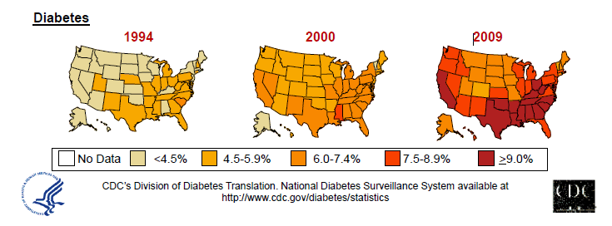
Diabetes in America 2016
29 million or > 9.3%
27% don’t know they have it
37% of US adults have pre diabetes (86 mil)

Slide 6
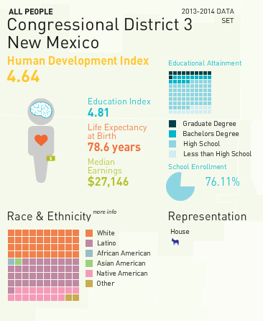

Why Should Zip Code Determine Life Expectancy?
California Endowment – look up your zip code at www.measureofamerica.org

Slide 7
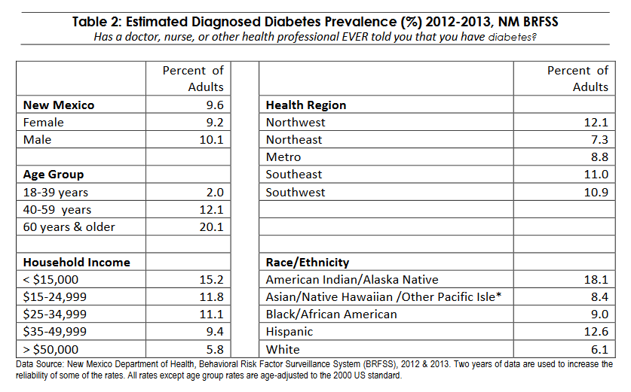
Diabetes

Slide 8
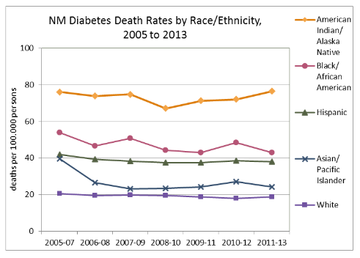
Diabetes

Slide 9


Type 2 in Kids
7 fold increase 1990
1 in 6 overwt kids (age 12- 19) have prediabetes.
~2,500 to 3,700 new cases in U.S. annually.
Highest risk: very obese, minority, female, low socioeconomic status, limited education
In age range 12-19, less than 1% have Type 2 – NHANES
Environmental changes to urgently needed

Slide 10

Global Epidemic
Every 10 seconds
1 person dies with diabetes
2 people develop diabetes
Every year
3 million deaths
6 million new cases
World Diabetes Day is November 14
March is ADA Sound the Alert Day “find people w/ undetected diabetes”

Slide 11


World Diabetes Day November 14

Slide 12

“The highest form of wisdom is kindness.” The Talmud

Slide 13

Path to Type 2 Diabetes

Slide 14
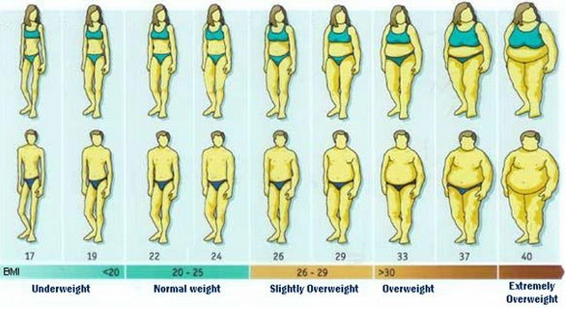
BMI Categories

Slide 15
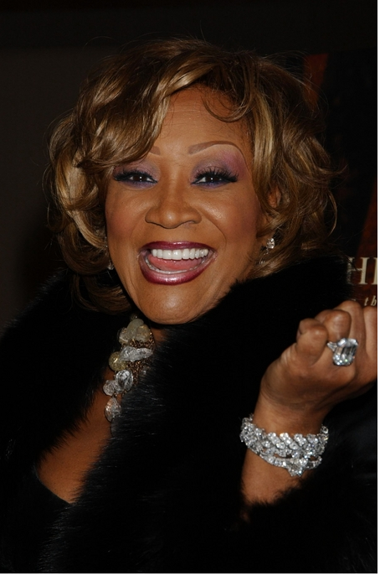
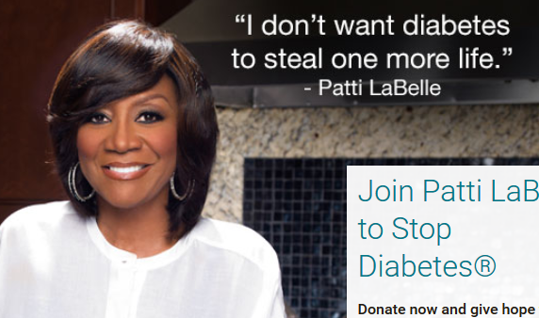
Patti Labelle
"divabetic”
“I have diabetes, it doesn’t have me”

Slide 16




Slide 17

2. Classification and DM Diagnosis
Pre Diabetes & Type 2- Screening Guidelines
Start screening at age 45 or for anyone who is overweight (BMI ≥ 25, Asians BMI ≥ 23 ) with one or > additional risk factor:
First-degree relative w/ diabetes
Member of a high-risk ethnic population
Habitual physical inactivity
PreDiabetes
History of heart disease

Slide 18

Diabetes 2 - Who is at Risk? (ADA Clinical Practice Guidelines)
Risk factors cont’d
HTN - BP > 140/90
HDL < 35 or triglycerides > 250
baby >9 lb or history of Gestational Diabetes Mellitus
Polycystic ovary syndrome (PCOS)
Other conditions assoc w/ insulin resistance:
Severe obesity, acanthosis nigricans (AN)

Slide 19
Acanthosis Nigricans (AN)
Signals high insulin levels in bloodstream
Patches of darkened skin over parts of body that bend or rub against each other
Neck, underarm, waistline, groin, knuckles, elbows, toes
Skin tags on neck and darkened areas around eyes, nose and cheeks.
No cure, lesions regress with treatment of insulin resistance

Slide 20
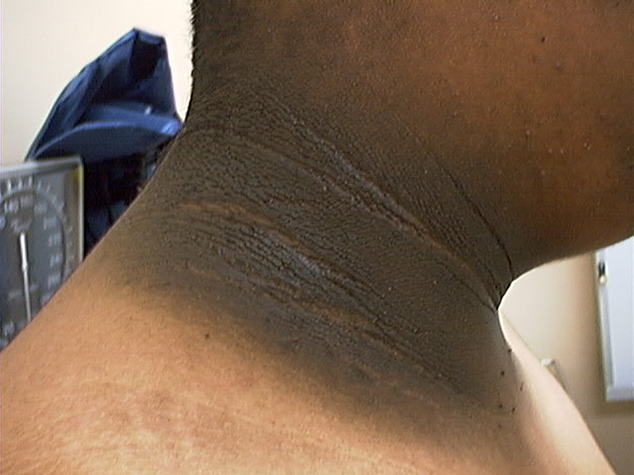
Acanthosis Nigricans

Slide 21
Diabetes Detectives Needed
On average – takes 6.5 years to diagnose diabetes
1/4 of all people with diabetes don’t know they have it

Slide 22
Natural Progression of Type 2 Diabetes
Plasma
Glucose
Postprandial glucose
Fasting glucose
126 mg/dL
Relative β-Cell Function
Insulin resistance
Insulin secretion
-20
-10
0
10
20
30
Years of Diabetes
Prior to diagnosis
After diagnosis
Adapted from Bergenstal et al. 2000; International Diabetes Center.
Notes:
These graphs show the typical progressive nature of type 2 diabetes in terms of 2 key indices: increasing plasma glucose level (top panel) and decline in relative β-cell function as reflected by the drop in endogenous insulin and rise in insulin resistance (lower panel).
In the natural history of type 2 diabetes, insulin resistance rises, insulin secretion falls, and glucose levels begin to rise before diabetes is diagnosed.
Based on the natural history, type 2 diabetes is a disease of progressive insulin failure as shown in the graphic model developed by researchers at the International Diabetes Center.¹
Before the onset of diabetes, glucose levels start to rise, with a slightly sharper increase in the postprandial value than in fasting glucose. Both postprandial and fasting plasma glucose levels continue to rise if diabetes is left untreated.²
Prior to the diagnosis of diabetes, resistance of cell receptor sites to insulin starts to increase, while insulin secretion by β-cells decreases. Insulin resistance reaches a peak and remains constant. Endogenous insulin secretion continues to decline over the course of diabetes.²
References:
1. Kendall DM. Postprandial blood glucose in the management of type 2 diabetes: the emerging role of incretin mimetics. Available at: http://www.medscape.com/viewarticle/515693. Accessed April 21, 2006.
2. Ramlo-Halsted BA, Edelman SV. The natural history of type 2 diabetes: implications for clinical practice. Prim Care. 1999;26:771-789.

Slide 23
Natural History of Diabetes
Normal
FBG <100
Random <140
A1c <5.7%
Prediabetes
FBG 100-125
Random 140 - 199
A1c ~ 5.7- 6.4%
50% working pancreas
Diabetes
FBG 126 +
Random 200 +
A1c 6.5% or +
20% working pancreas
Yes!
NO
Development of type 2 diabetes happens over years or decades

Slide 24
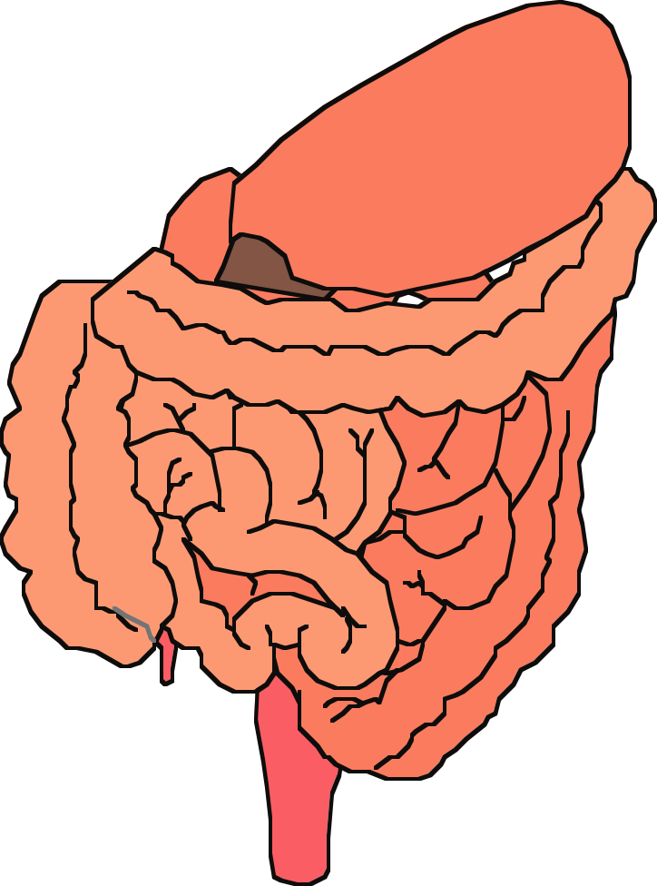



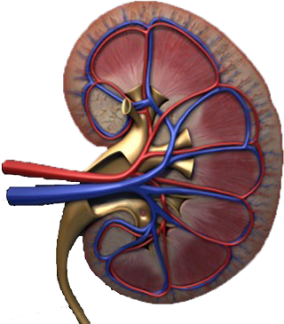
Multiple, Complex Pathophysiological Abnormalities in T2DM
Adapted from: Inzucchi SE, Sherwin RS in: Cecil Medicine 2011
pancreatic
insulin
secretion
incretin
effect
pancreatic
glucagon
secretion
_
?
gut
carbohydrate
delivery &
absorption
HYPERGLYCEMIA
_
+
hepatic
glucose
production
peripheral
glucose
uptake
renal glucose excretion
Notes:
This slide provides a broad overview of the main pathophysiological defects in type 2 diabetes. Insulin resistance is demonstrated in peripheral tissues, such as skeletal muscle and adipocytes. The pancreas develops relative insulin secretory failure and is no longer provide the amount of insulin required for normal glucose. The pancreas also demonstrates a failure of the normal suppression of glucagon after meals. This may be mediated through abnormalities in the incretin axis. Hepatic glucose production is also increased. Renal glucose output is set at a higer threshold than normal. Many of these defects may be influenced by abnormal central control of metabolism.

Slide 25
Diabetes Bingo “DiaBingo” Shout out Right Answer

Slide 26
DiaBingo
B Frequent skin and yeast infections
B A BMI of ____ or greater is considered overweight
B To reduce complications, control A1c, Blood pressure, Cholesterol
B PreDiabetes – fasting glucose level of ___ to ____
B Erectile dysfunction indicates greater risk for ____
B Diabetes – fasting glucose level____ or greater
B Type 1 diabetes is best described as an ______ disease
B People with diabetes are ______ times more likely to die of heart dx
B Elevated triglycerides, < HDL, smaller dense LDL
B Each percentage point of A1c = _____ mg/dl glucose
B At dx of type 2, about __% of the beta cell function is lost
B Diabetes – random glucose ____ or greater

Slide 27

Life Study – Mrs. Jones
Mrs. Jones is 62 years old, overweight and complaining of feeling tired and urinating several times a night. She is admitted with a urinary tract Infection. Her WBC is 12.3, glucose 237. She is hypertensive with a history of gestational diabetes. No ketones in urine.
What are her risk factors, signs of diabetes
What type of diabetes does she have?
Does she have insulin resistance?

Slide 28
What Do You Say? Mrs. Jones asks you
What is type 2 diabetes?
Will this go away?
Will I get complications?
Will I need to take diabetes medication for the rest of my life?
How come I got diabetes?
Do I have to check my blood sugars?

Slide 29

Strategies – One Baby Step at a Time
Pause

Slide 30
I don’t want to!

Slide 31
No one is Unmotivated
…. to lead and long and healthy life
These are the 3 usual Critical Barriers
Perceived worthlessness
Too many personal obstacles
Absence of support and resources
Bill Polonsky, PhD, CDE

Slide 32
Overcoming barriers
Confront the key misbelief. Ask the question, does dm cause complications?
Offer pts evidence based hope message –
Frequent contact
Paired glucose testing
Ask pt, “Tell me 1 thing that is driving you crazy about your diabetes”
Discuss medication beliefs
To improve outcomes, see pts more often
Bill Polonsky, PhD, CDE

Slide 33
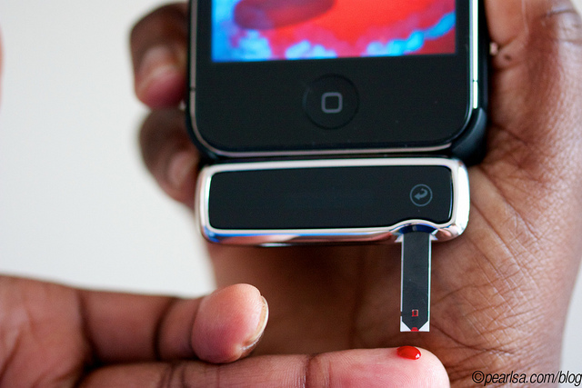
How Often Should I Check?
Be realistic!!
Type 2 on orals – Medicare covers 100 strips for 3 months
Based on individual - Consider:
Types and timing of meds
Goals
Ability (physical and emotional)
Finances / Insurance

Slide 34

Give the gift of Non-Judgment

Slide 35
Complications - Why?
Degree of hyperglycemia “glucose toxicity”
Duration of hyperglycemia
Genes
Multiple risk factors: smoking, vascular disease, dyslipidemia, hypertension, other

Slide 36
Control Matters
Prevention
Trials
Practice Recommendations

Slide 37

Financial Advisor
Mid 30s, friendly, he smiles to greet you and you notice his gums are inflamed. You’d guess a BMI of 26 or so, with most of the extra weight in the waist area.
If you could give him some health related suggestions, what would they be?

Slide 38

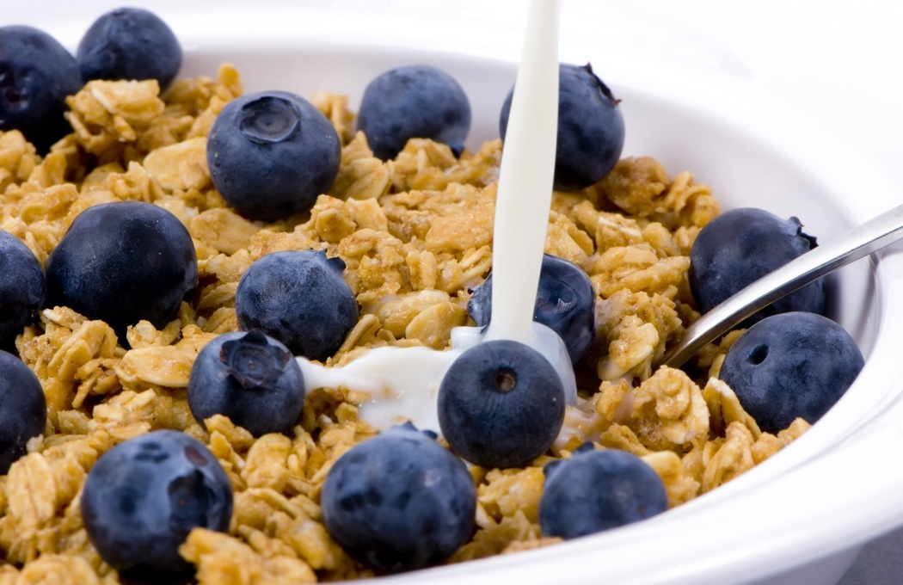


Preventing Pre Diabetes

Slide 39
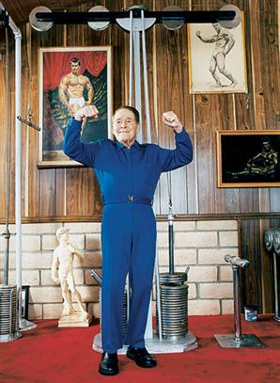
Can Type 2 be Prevented in Older Adults?
Overall, 9 of 10 new cases of diabetes attributable to these 5 lifestyle factors.
89% risk reduction when all at goal.
35% rel risk reduction for each additional
Physical activity (30 mins a day)
Dietary score (higher fiber intake, low saturated fat and trans-fat, lower mean glycemic index)
Not Smoking
Alcohol use (up to 2 drinks a day);
BMI <25 and waist circumference
Dariush Mozaffarian, MD,
Arch Intern Med. 2009;169(8):798-807.

Slide 40

Exercise – Getting Active
“Physical activity is the closest thing we have to a wonder drug,”
“Being active is one of the most important things people of all ages, sizes, and shapes can do to improve their health.”
Dr. Thomas Frieden, Director of CDC

Slide 41
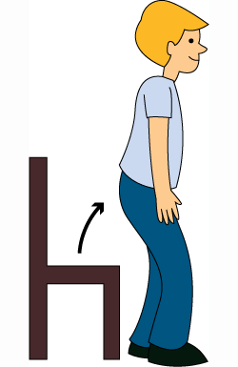

Exercise Recommendations
Activity update –Don’t sit more than 90 minutes
Evidence supports that everyone, including with diabetes should be encouraged to reduce sedentary time, by not sitting for more than 90 minutes at a time.
It is recommended that people with pre diabetes and diabetes engage in 150 minutes of activity a week and at least 2 weekly sessions of resistance exercise.

Slide 42
Good Exercise Info / Quotes
20 % of people walk 30 mins a day
Exercise decrease A1c 0.7%
No change in body wt, but 48% loss in visceral fat
ADA PostGrad 2010
“If you don’t have time for exercise, you better make time for disease.”
“I don’t have time to exercise, I MAKE time.”
Mike Huckabee

Slide 43
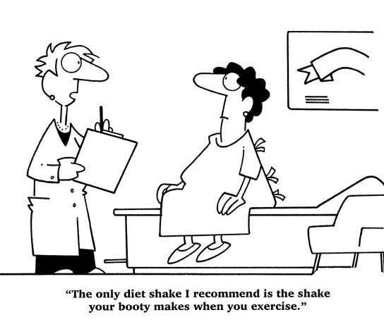
Best Shake For People with Diabetes
From Debbie Nagata’s slide collection

Slide 44

Can we stop pre diabetes from progressing?
3, 234 people w/ Pre-Diabetes randomized:
Placebo
Diet/Exercise or
Metformin
over a three year period
Diabetes Prevention Program (DPP) 2001

Slide 45

Diabetes Prevention Program
Standard Group - 29% developed DM
Lifestyle Results - 14% developed DM
58% (71% for 60yrs +) Risk reduction
30 mins daily activity
5-7% of body wt loss
Metformin 850 BID - 22% developed DM
31% risk reduction (less effective with elderly and thinner pt’s)

Slide 46

Weight loss and Prevention
For every 2.2 pounds of weight loss, risk of type 2 diabetes was reduced by 13%.

Slide 47
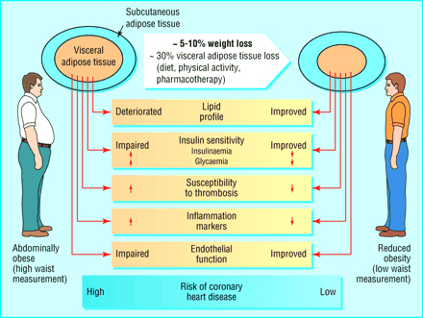

Slide 48

Goals of Care

Slide 49

ABCs of Diabetes –
A1c less than 7% (avg 3 month BG)
Pre-meal BG 80-130
Post meal BG <180
Blood Pressure < 140/90
Cholesterol
DM and 40 yrs, start statin
HDL >40
Triglyceride < 150
E xercise, Education
H ealthy Eating

Slide 50
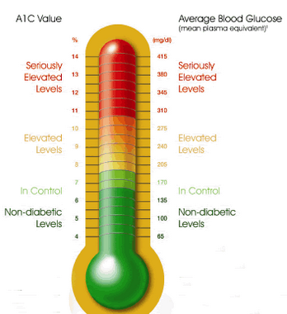
Glycemic Targets - ADA
Adult non pregnant A1c goals
A1c < 7% - a reasonable goal for adults.
A1c < 6.5% - may be appropriate for those without significant risk of hypoglycemia or other adverse effects of treatment.
A1c < 8% - may be appropriate for patients with history of hypoglycemia, limited life expectancy, or those with longstanding diabetes and vascular complications.

Slide 51

A1c and Estimated Avg Glucose (eAG) 2008
A1c (%) eAG
5 97
6 126
7 154
8 183
9 212
10 240
11 269
12 298
eAG = 28.7 x A1c-46.7 ~ 29 pts per 1%
Translating the A1c Assay Into Estimated Average Glucose Values – ADAG Study
Diabetes Care: 31, #8, August 2008
Order teaching tool kit free at diabetes.org

Slide 52


Slide 53
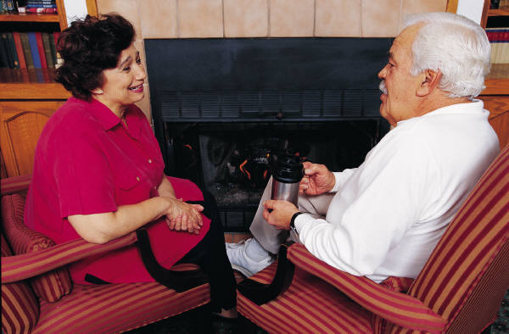
Older Adults - Considerations
Reduced life expectancy
Higher CVD burden
Reduced GFR
At risk for adverse events from polypharmacy
More likely to be compromised from hypoglycemia
Less ambitious targets
A1c <7.5–8.0%
Focus on drug safety
Diabetes Care 2012;35:1364–1379
Diabetologia 2012;55:1577–1596

Slide 54

Diabetes and the Cairn

Slide 55
Diabetes Bingo “DiaBingo” Shout out Right Answer

Slide 56
DiaBingo- G
G ADA goal for A1c is less than ____%
G People with DM need to see their provider at least every month
G Blood pressure goal is less than
G People with DM should see eye doctor (ophthalmologist) at least
G The goal for triglyceride level is less than
G Goal for my HDL cholesterol is more than
G The goal for blood sugars 1-2 hours after a meal is less than:
G People with DM should get this shot every year
G People with DM need to get urine tested yearly for ___________
G Periodontal disease indicates increased risk for heart disease
G The goal for blood sugar levels before meals is:
G The activity goal is to do ___ minutes on most days

Slide 57



Antihyperglycemic Therapy – 1st Step
Lifestyle Changes
Weight control
Healthy eating
Activity
Diabetes Care 2012;35:1364–1379
Diabetologia 2012;55:1577–1596
ADA-EASD Position Statement: Management of Hyperglycemia in T2DM

Slide 58
Patient Centered Approach
“...providing care that is respectful of and responsive to individual patient preferences, needs, and values - ensuring that patient values guide all clinical decisions.”
Gauge patient’s preferred level of involvement.
Explore, where possible, therapeutic choices.
Utilize decision aids.
Shared decision making – final decisions re: lifestyle choices ultimately lie with the patient.
Diabetes Care 2012;35:1364–1379
Diabetologia 2012;55:1577–1596
ADA-EASD Position Statement: Management of Hyperglycemia in T2DM

Slide 59
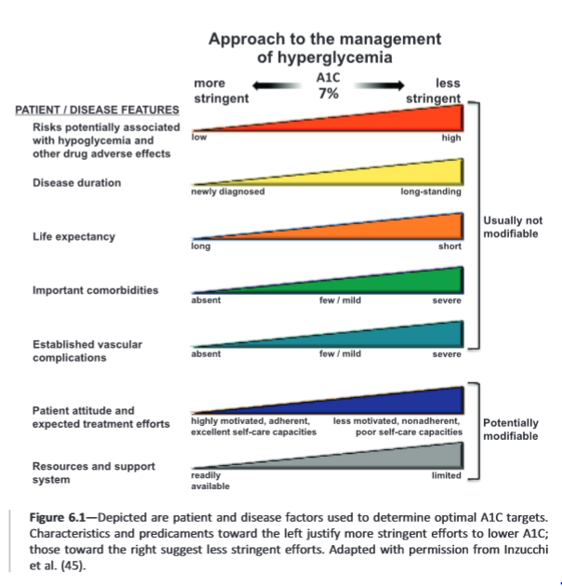
ADA Standards of Care 2015

Slide 60

Treating Hyperglycemia with Meds
For all of the following case studies, we assume we are providing ongoing education on lifestyle – including referral to the Diabetes Ed Team and other resources.
In describing what meds match the patient best, we act as patient advocates and consultants to providers.

Slide 61

Life Study
61 year old overweight woman with type 2 diabetes 3 months. Has been trying to control diabetes with diet and exercise. GFR in 90s. Worried about weight gain.
Most recent A1c 6.9%
ADA
AACE
Cash pay or
Good insurance

Slide 62
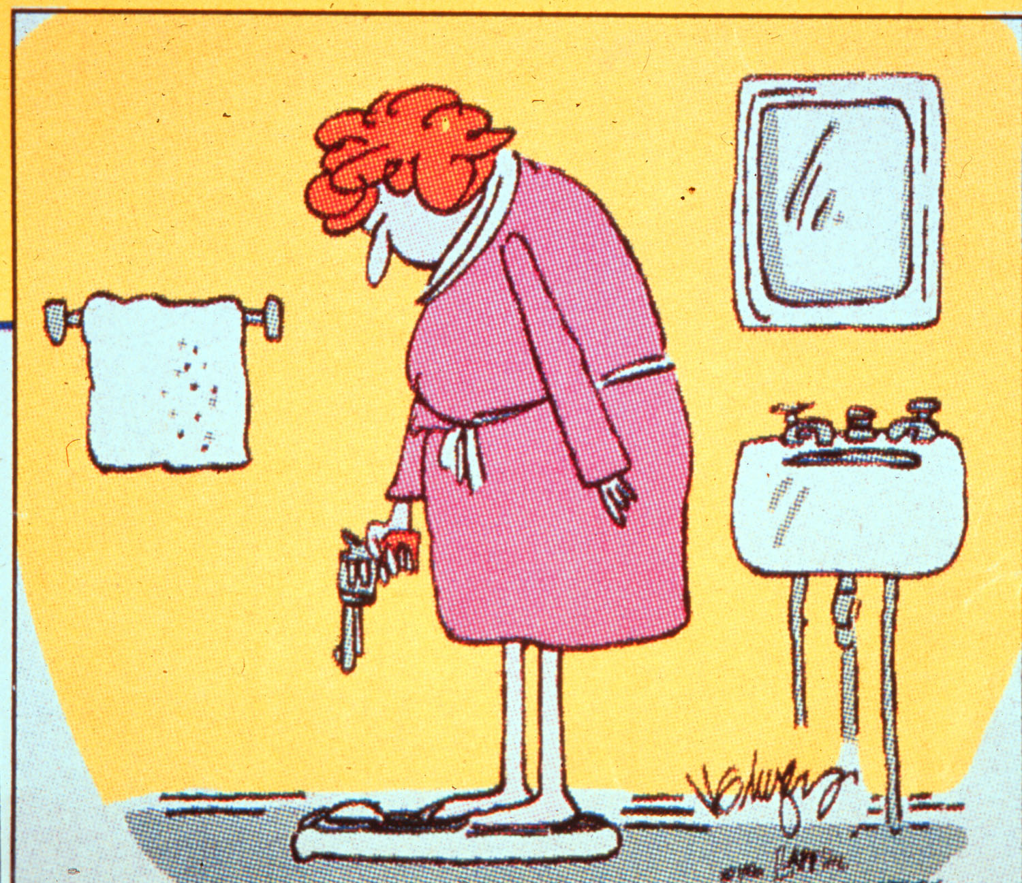

Slide 63
ADA Step Wise Approach to Hyperglycemia 2015
Start with lifestyle coaching
When lifestyle alone is not achieving A1c goal – Metformin should be added at, or soon after diagnosis (unless contraindicated).
Metformin has a long standing evidence base for efficacy and safety, is cheap and may reduce CV risk.

Slide 64
Other Considerations
Cost
Hypoglycemia
Age
Weight
Comorbidities
Kidney disease
Heart disease – CHF, CAD
Liver dysfunction
ADA-EASD Position Statement: Management of Hyperglycemia in T2DM
Diabetes Care 2012;35:1364–1379
Diabetologia 2012;55:1577–1596

Slide 65
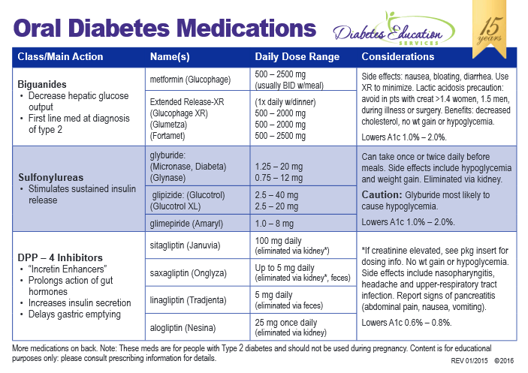

Slide 66
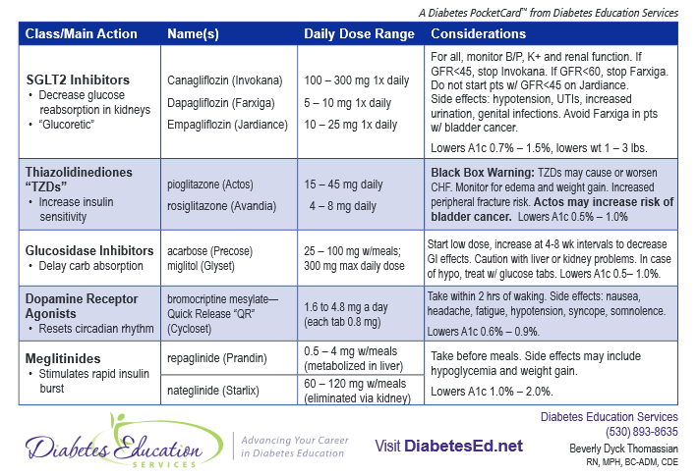

Slide 67
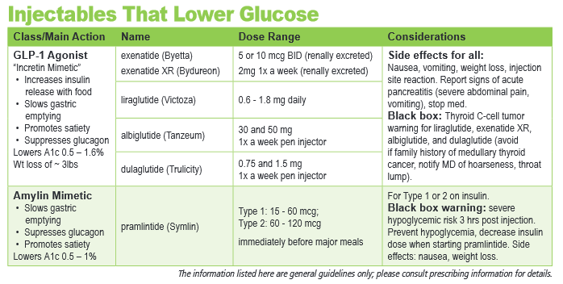

Slide 68





CDE® Coach App – Download Success

Slide 69
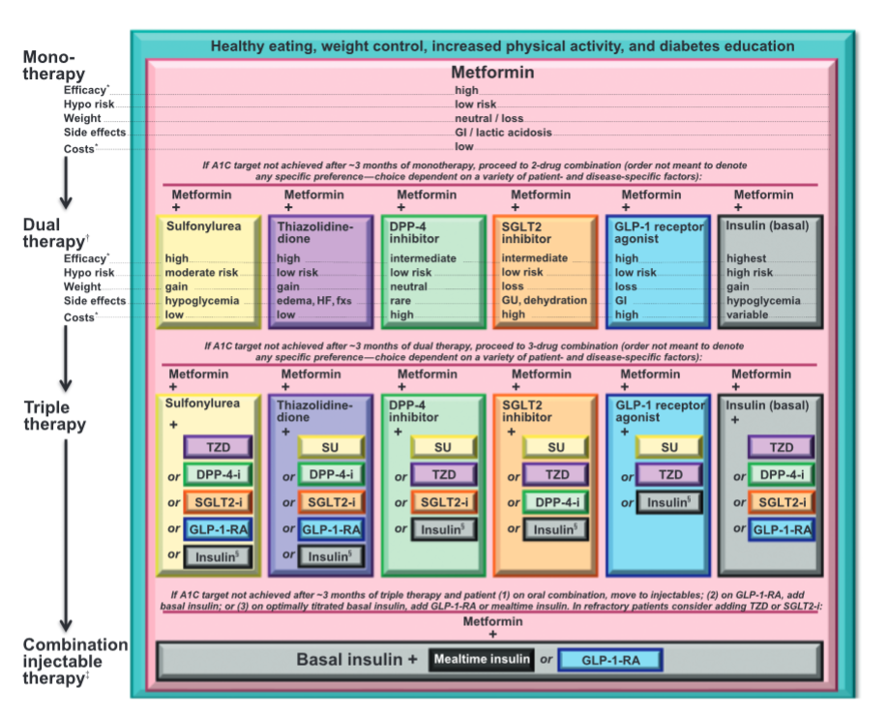
ADA Standards of Care 2015

Slide 70
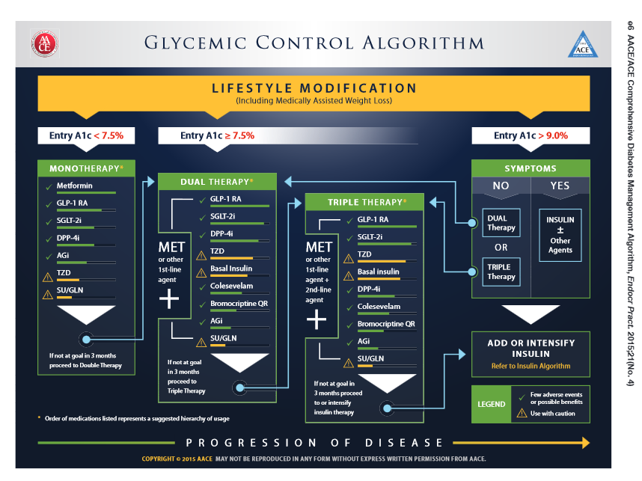

Slide 71
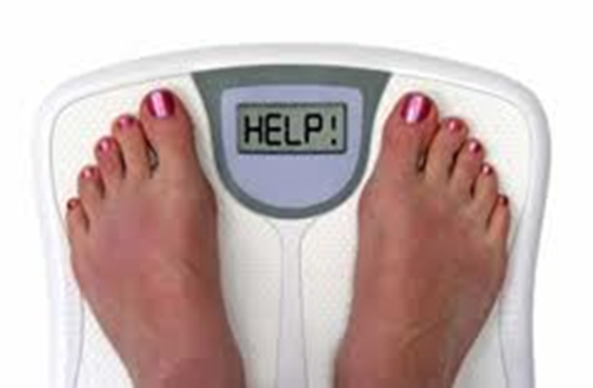
When goal is to avoid weight gain
These meds are weight neutral
Metformin
DPP-IV Inhibitors: Januvia, Onglyza, Tradjenta, Nesina
Acarbose
These meds associated with wt loss
GLP-1 agonists (Byetta, Bydureon, Victoza, Tanzeum, Trulicity)
SGLT-2 Inhibitors (Canagliflozin, Dapagliflozin, Empagliflozin)
Symlin (Pramlintide)

Slide 72
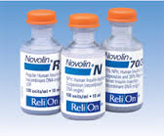
When goal is to minimize cost
Go generic.
Oral Meds -Metformin and Sulfonylureas
Walmart offers 3 mo supply of following meds for ~ $10
Metformin and Metformin XR
Glipizide, Glyburide, Glimepiride
Insulins – Oldies but Goodies
NPH, Regular, 70/30 mix
$25 a vial at Walmart – ReliOn
Vials and needles cheaper

Slide 73
Life Study
61 year old overweight woman with type 2 diabetes 3 months. Has been trying to control diabetes with diet and exercise. GFR in 90s. Worried about weight gain.
Most recent A1c 6.9%
ADA
AACE
Cash pay
Good insurance
Solutions?

Slide 74
Life Study
61 year old overweight woman with type 2 diabetes 3 months. Has been trying to control diabetes with diet and exercise. GFR in 90s. Worried about weight gain.
Most recent A1c 6.9%
ADA
AACE
Cash pay
Good insurance
Solutions?
Consider no meds, monitor or start Metformin (ADA - Cash)
Start Metformin 500 mg 1-2 x a day (AACE)
If can’t tolerate metformin, good insurance, consider?

Slide 75

Life Study
54 year old smoker, has CVD disease, creatinine 1.2, BMI 27. Not checking BG, even though he has glucose meter. On Metformin 500mg BID for past 4 months. Had bad experience with hypoglycemia on glyburide.
Most recent A1c 7.9%
ADA
AACE
Cash pay
Good insurance

Slide 76

When goal is to avoid Hypoglycemia
Avoid sulfonylureas
Careful insulin dosing
May need to up adjust glucose goals
Monitor kidney function
Reinforce for patients on insulin to “TIE”
Test
Inject
Eat

Slide 77
ADA Standards of Care 2015

Slide 79

Life Study
54 year old smoker, has CVD disease, creatinine 1.2, BMI 27. Not checking BG, even though he has glucose meter. On Metformin 500mg BID for past 4 months. Had bad experience with hypoglycemia on glyburide.
Most recent A1c 7.9%
Solution:
Change to Metformin XR and double dose
Good insurance? Add GLP-1 or SGLT-2
If cash pay, increase Metformin, if needed add insulin or glipizide

Slide 80

Diabetes Vacations

Slide 81
Other Meds Needed?
54 year old smoker, has CVD disease, creatinine 1.2, BMI 27. Not checking BG, even though he has glucose meter. On Metformin 500mg BID for past 4 months..
Most recent A1c 7.9%
Other Meds to protect against CVD?
In addition to LifeStyle Coaching

Slide 82

8. Coronary Heart Disease
In pts with known CVD, use:
Aspirin
Statin
B/P Med
Consider ACE Inhibitor to reduce risk of CV event
In pts with prior MI, Beta Blockers should be continued at least 2 years after the event
Don’t use Actos or Avandia in pts with CHF
In pts with stable CHF, Metformin can be used in renal function normal and stable

Slide 83


Life Study
71 year old woman with type 2 diabetes for past year. BMI 24. Has been trying to control diabetes by limiting carbs and exercise. Creat 1.6. Good social support.
Most recent A1c 8.6%
She has great insurance or
She is cash pay or
She hates needles

Slide 84
ADA Standards of Care 2015

Slide 85

Life Study
71 year old woman type 2 diabetes. BMI 24. Has been trying to control diabetes by limiting carbs and exercise. Creat 1.6. GFR low 30s. Good social support.
Most recent A1c 8.6%
Solutions
Great insurance – GLP1, DPP-IV Inhibitor, Analog insulin
She is cash pay – Sulfonylurea or NPH or 70/30
She hates needles – Sulfonylurea, DPP-IV Inhibitor - if doesn’t work, see if she will reconsider insulin, GLP1

Slide 86
Pattern Management
Safety 1st!! - Evaluate 3 day patterns
Hypo: eval 1st and fix:
If possible, decrease medication dose
Timing of meals, exercise, medications
Hyperglycemia: evaluate 2nd
Identify patterns
Before increase insulin, make sure not missing something (carbs, exercise, omission)

Slide 87
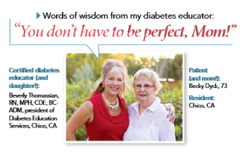
80 /20 Rule – Perfect Not Required

Slide 88
Diabetes Bingo “DiaBingo” Shout out Right Answer

Slide 89
DiaBingo - N
N DPP demonstrated that exercise and diet reduced risk of DM by ___%
N An _______a day can help prevent heart attack and stroke
N Rebound hyperglycemia
N Scare tactics are effective at motivating patients to change behavior
N Losing ___ % of body weight, can improve blood glucose, BP, lipids
N Drugs that can cause hyperglycemia
N 2/3 cups of rice equals ______ serving carbohydrate
N A1c of 7% equals glucose of
N One % drop in A1c reduces risk of complications by ___ %
N 1 gm of fat equal _____kilo/calories
N Metabolic syndrome = hyperglycemia, hyperlipidemia, hypertension
N Average American consumes 25 teaspoons of sugar a day.

Slide 90

Case Study
68 yr old, avid walker
BMI 24, Weighs 90kg
A1c – 8.6%, BG 270s during day for past wks
On glyburide 10mg BID
Doesn’t have a glucose meter
Tells you, “my foot hurts”

Slide 91

Diabetes and Lower Extremity Ulcers
Up to 15% of DM patients have ulcers in their lifetime
Mortality with foot ulcers is twice usual

Slide 92
Lower Extremity Amputations Dropping over past 10yrs
60% of amputations in 7% of pop
Higher in men, elderly, minorities, Chronic Kidney Disease (CKD)
Lower extremity complications represent 20% of hospitalizations for elderly
Amputations cost $40,000
Amputation associated w/ earlier death compared to revascularization
10 yr survival after LEA

Slide 93
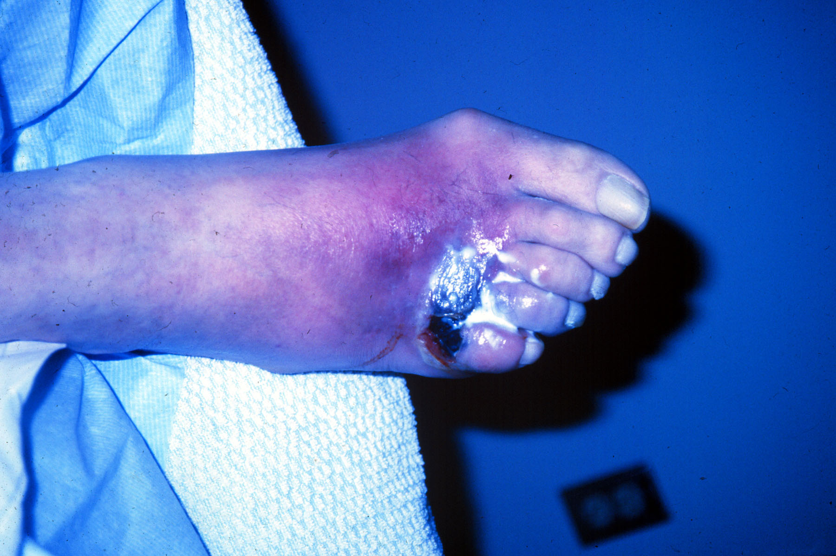

Slide 94

Risk factors for Foot Ulcers/ Amputation
Previous amputation
Past foot ulcer history
Peripheral neuropathy
Foot deformity
Peripheral vascular disease
Visual impairment
Diabetic nephropathy (especially patients on dialysis)
Poor glycemic control
Cigarette smoking
ADA Task Force - 2008

Slide 95
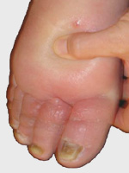
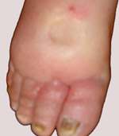
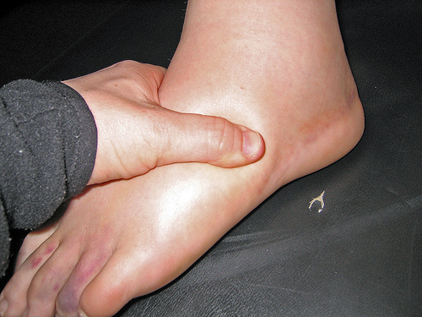
Pitting Edema

Slide 96
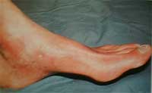
Peripheral Arterial Disease Assessment

Slide 97
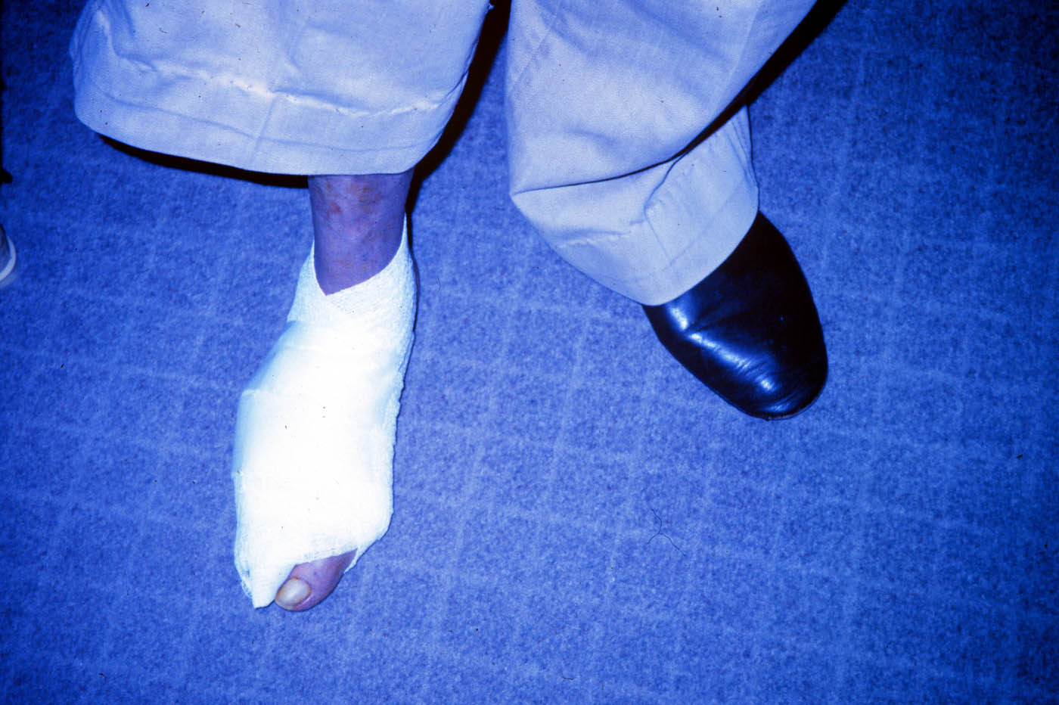

Slide 98
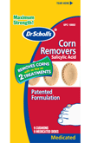
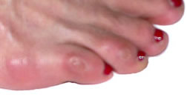

No Bathroom Surgery

Slide 99

You Can Make A Difference
Assess
Nail condition, nail care, in between the toes
Who trims your nails
Have you ever cut your self?
Shoes – type and how often
Socks
Skin/skin care and vascular health
Ability to inspect
Loss of protective sensation

Slide 100

Three Most Important Foot Care Tips
Inspect and apply lotion to your feet every night before you go to bed.
Do NOT go barefoot, even in your house. Always wear shoes!
Every time you see your doctor, take off your shoes and show your feet. Report any foot problems right away!

Slide 101

“Getting diabetes saved my life.” ~ Sherri Sheperd
Sherri Shepard decided to embrace diabetes and use it as a motivator to improve her health.

Slide 102


Patient Perspective Matters!
“I am no where.”
“I am now here!”

Slide 103


Thank You
www.DiabetesEd.net

