Slide 1

10 Steps to Prevent Diabetes
Beverly Thomassian, RN, MPH, BC-ADM, CDE
LiveWell Diabetes Program Manager

Slide 2

How do we get to our best health?

Slide 3
CDC Announces
35% of Americans will have Diabetes by 2050
Boyle, Thompson, Barker, Williamson
2010, Oct 22:8(1)29
www.pophealthmetrics.com

Slide 4

Diabetes in America 2018
30 million or > 9.3%
27% don’t know they have it
37% of US adults have pre diabetes (86 mil)
Increasing rates 3 key factors
We are getting older
Increasing size of higher-risk minority populations
People with diabetes are living longer

Slide 5

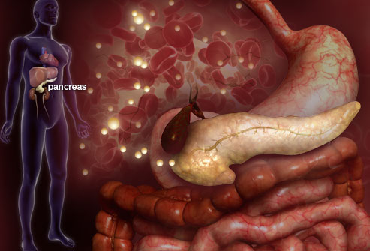

Slide 6

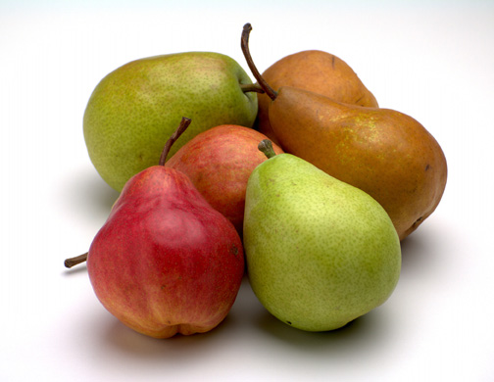


Slide 7

Screening for PreDiabetes & Diabetes
Start screening at age 45 or for anyone who is overweight (BMI ≥ 25, Asians BMI ≥ 23 ) with one or > additional risk factor:
First-degree relative w/ diabetes
Member of a high-risk ethnic population
Habitual physical inactivity
PreDiabetes
History of heart disease

Slide 8
Natural History of Diabetes
Happy Pancreas
Fasting <100
Random <140
A1c <5.7%
Prediabetes
Fasting100-125
Random 140 - 199
A1c ~ 5.7- 6.4%
50% working pancreas
Diabetes
Fasting 126 +
Random 200 +
A1c 6.5% or +
20% working pancreas
Yes!
NO
Development of type 2 diabetes happens over years or decades

Slide 9

Financial Advisor
Mid 30s, friendly, he smiles to greet you and you notice his gums are inflamed. You’d guess a BMI of 26 or so, with most of the extra weight in the waist area.
If you could give him some health related suggestions, what would they be?

Slide 10

Your teeth need extra special attention
Goal: Brush teeth at least twice daily and floss at least once daily

Slide 11

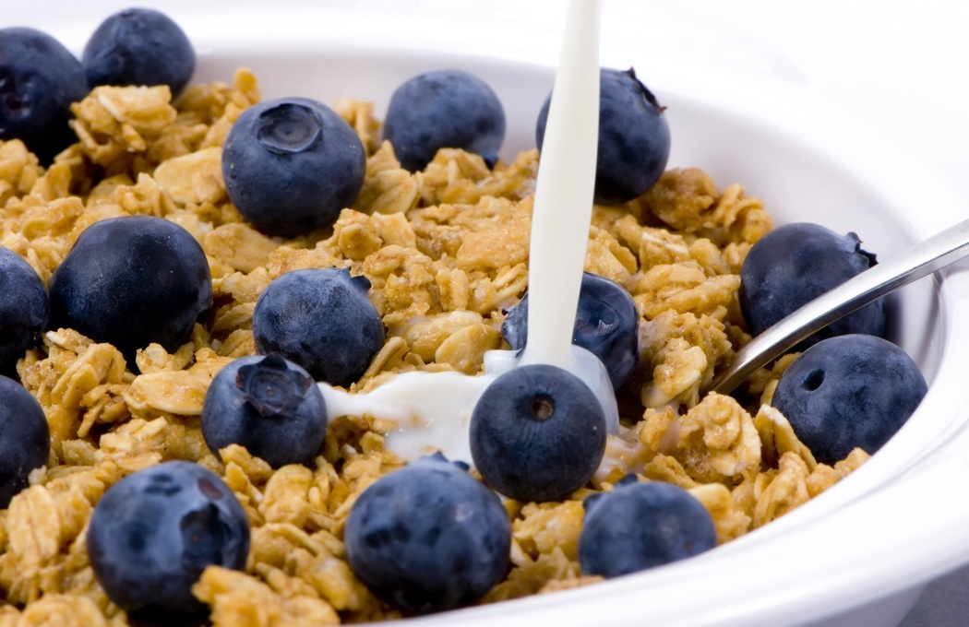


Preventing Pre Diabetes and Diabetes

Slide 12

Ditch the Nicotine Stick
Goal: Quit Smoking and Don’t Start

Slide 13

Be a Sleep Warrior
Make time for sleep
Restorative
Decreases hunger
Lowers Blood Sugar
Improves ability to cope
Goal: Get at least 7 hours of sleep a night.
You deserve it.

Slide 14

Keep Active
Goal: Work toward 30 minutes of activity a day plus strengthening exercises twice a week

Slide 15

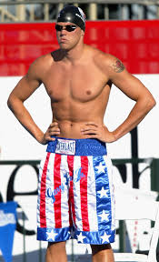
Where are you on this continuum?

Slide 16
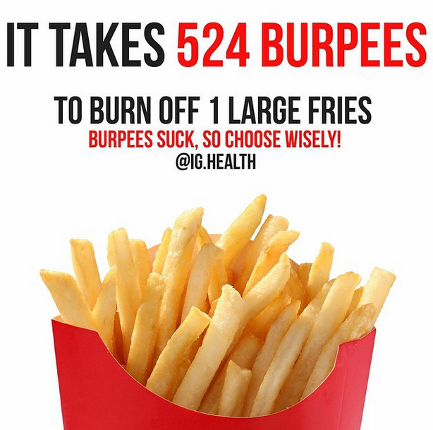
A hard truth
Exercise alone doesn’t cause weight loss
But….
It helps keep weight off
Decreases visceral fat
Decreases CV Risk
To combat obesity, we need to change the food environment
“You cannot outrun a bad diet”.

Slide 17

Exercise decreases:
Sleep apnea
Diabetes kidney disease, retinopathy
Depression
Sexual dysfunction
Urinary incontinence
Knee pain
Need for medications
Health care costs

Slide 18
Good Exercise Info / Quotes
“Passagiata” – take an after meal stroll
Exercise decreases A1c 0.7%
No change in body wt, but 48% loss in visceral fat
ADA PostGrad 2010
“Every minute of activity lowers blood sugar one point.”
“I don’t have time to exercise, I MAKE time.” Mike Huckabee

Slide 19

Each minute of activity lowers BG by 1 point
Each minute of exercise lowers BG 1 point
15 minutes of walking drops BG 15 points
30 minutes of biking drops BG 30 points
40 minutes of housework drops BG 40 points
50 minutes of walking and window shopping lowers BG 50 points

Slide 20
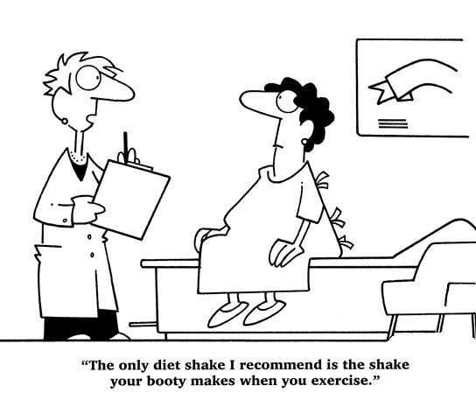
Best Shake For People with Diabetes
From Debbie Nagata’s slide collection

Slide 21
Nourishing our Bodies

Slide 22

Whole Foods - Don’t Forget the Fiber
Goal: Enjoy 25-30 gms of fiber rich foods daily

Slide 23
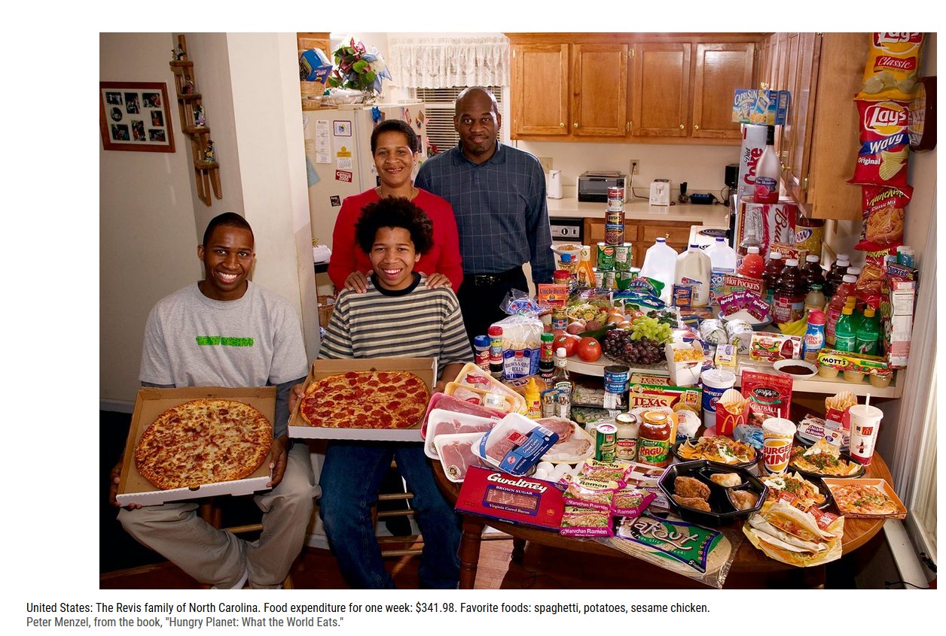
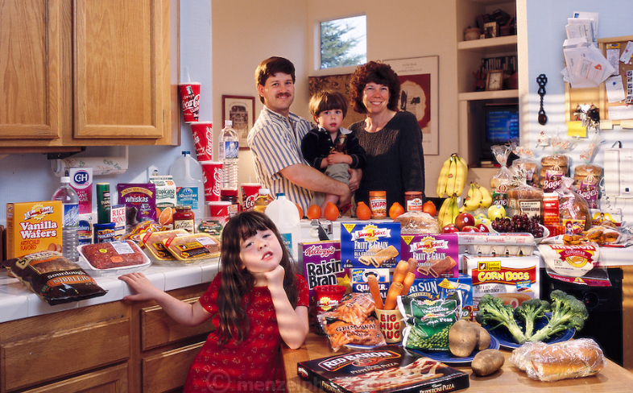

Slide 24


Slide 25


Super Foods
Found in the pigments, chemicals, and fiber of plants
Sources include:
Greens: Kale, spinach, bok choy
Deep orange fruit and veggies: carrots, winter squash, apricots, sweet potatoes
Red and purple fruits and veggies: berries, beets, plums, red grapes and red peppers
Nuts, onions, citrus, cruciferous vegetables, dark chocolate!

Slide 26
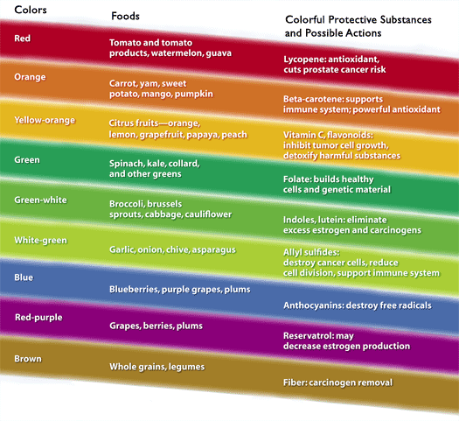
Notes:
PCRM = Physicians Committee for Responsible Medicine. Beneficial phytochemicals naturally found in plant foods. Synergistic effect in the whole state, vs. when isolated and supplemented.

Slide 27

Your health can only get better

Slide 28

You are Already Sweet Enough
Goal: Limit sugar to 6 teaspoons a day

Slide 29
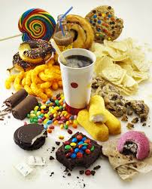
Average American Consumes 25 teaspoons of sugar a day (400 cals)
Warning label on sodas proposed
One soda has 12 teaspoons sugar
ADA guidelines “limit sodas and beverages with sugar, High Fructose Corn Syrup, (HFCS)
Goal- 6 teaspoons a day

Slide 30
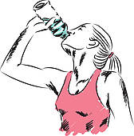
Enjoy the Ultimate Beverage – H20
Goal: Keep hydrated by enjoying plenty of water

Slide 31

Keep Connected to friends and family who love you just the way you are!
Goal: Self-care is important

Slide 32


Take moment to enjoy nature and find enchantment
Goal: Step into nature daily

Slide 33

Take inventory of things that you are grateful for
Goal: Take note of special moments

Slide 34
Attend a Diabetes Program
PreDiabetes? - Consider joining the LiveWell Diabetes Prevention Program
Diabetes? Consider joining our Diabetes Education Program
Diabetes Support Group meet first Tuesday of month at 4pm (snacks provided)
Strides for Diabetes Oct 28at at 9:30

Slide 35


Slide 36



Slide 37

Thank You
Questions?
Email careyc1@ah.org
876-7297

