Slide 1


Welcome to
Diabetes in 21st Century
Beverly Dyck Thomassian, RN, MPH, BC-ADM, CDE
President, Diabetes Education Services
www.DiabetesEd.net

Slide 2
Diabetes in the 21st Century:
A Clinical and Educational Update
Describe impact of diabetes
Discuss prevention, management strategies
Discuss different types of diabetes
Describe insulin therapy
Review glucose patterns and determine how to adjust therapy to improve glucose.
Gain understanding of Type 2 Meds.
Discuss how the gut influences health
Demonstrate successful teaching strategies

Slide 3
CDC Announces
35% of Americans will have Diabetes by 2050
Boyle, Thompson, Barker, Williamson
2010, Oct 22:8(1)29
www.pophealthmetrics.com

Slide 4
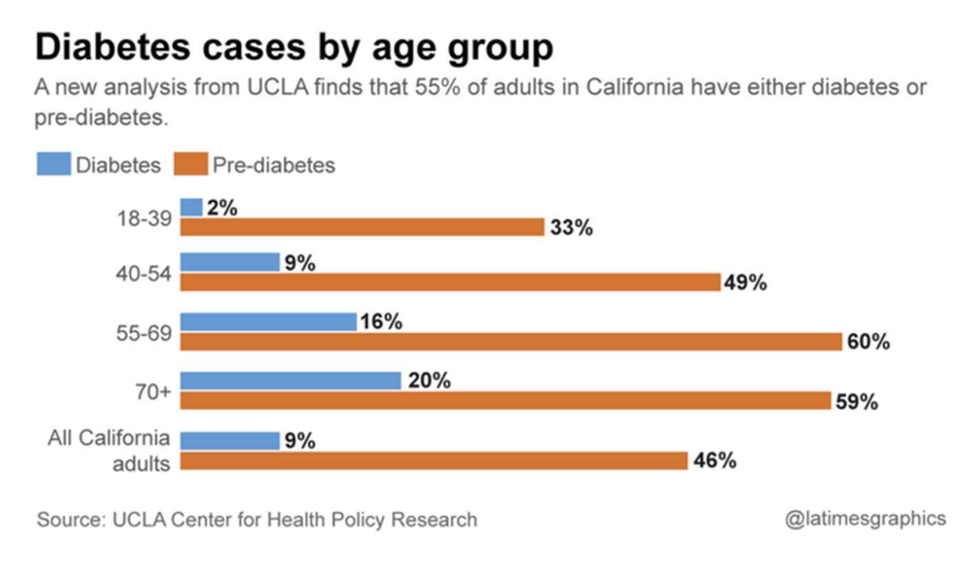

Diabetes in America 2018
30.3 million or > 9.4%
24% don’t know they have it
34 % of US adults have pre diabetes (84 mil
Increasing rates 3 key factors
  Aging of U.S. Population
  Increasing size of higher-risk minority populations
  Declining mortality among those with diabetes

Slide 5
Age-Adjusted Prevalence of Obesity and
Diagnosed Diabetes Among US Adults
1994
Notes:
5
Methodology
The percent of U.S. adults who are obese or who have diagnosed diabetes was determined by using data from the Behavioral Risk Factor Surveillance System (BRFSS, available at http://www.cdc.gov/brfss). An ongoing, yearly, state-based telephone survey of the non-institutionalized adult population in each state, the BRFSS provides state-specific information on behavioral risk factors for disease and on preventive health practices. Respondents who reported that a physician told them they had diabetes (other than during pregnancy) were considered to have diagnosed diabetes. Self reported weight and height were used to calculate body mass index (BMI): weight in kilograms divided by the square of height in meters. A BMI greater than or equal to 30 was considered to be obese. Rates were age-adjusted using the 2000 U.S. Standard Population.

Slide 6
Age-Adjusted Prevalence of Obesity and
Diagnosed Diabetes Among US Adults
2004
Notes:
Methodology
The percent of U.S. adults who are obese or who have diagnosed diabetes was determined by using data from the Behavioral Risk Factor Surveillance System (BRFSS, available at http://www.cdc.gov/brfss). An ongoing, yearly, state-based telephone survey of the non-institutionalized adult population in each state, the BRFSS provides state-specific information on behavioral risk factors for disease and on preventive health practices. Respondents who reported that a physician told them they had diabetes (other than during pregnancy) were considered to have diagnosed diabetes. Self reported weight and height were used to calculate body mass index (BMI): weight in kilograms divided by the square of height in meters. A BMI greater than or equal to 30 was considered to be obese. Rates were age-adjusted using the 2000 U.S. Standard Population.
6

Slide 7
Age-Adjusted Prevalence of Obesity and
Diagnosed Diabetes Among US Adults
2013
Notes:
Methodology
The percent of U.S. adults who are obese or who have diagnosed diabetes was determined by using data from the Behavioral Risk Factor Surveillance System (BRFSS, available at http://www.cdc.gov/brfss). An ongoing, yearly, state-based telephone survey of the non-institutionalized adult population in each state, the BRFSS provides state-specific information on behavioral risk factors for disease and on preventive health practices. Respondents who reported that a physician told them they had diabetes (other than during pregnancy) were considered to have diagnosed diabetes. Self reported weight and height were used to calculate body mass index (BMI): weight in kilograms divided by the square of height in meters. A BMI greater than or equal to 30 was considered to be obese. Rates were age-adjusted using the 2000 U.S. Standard Population.
7

Slide 8
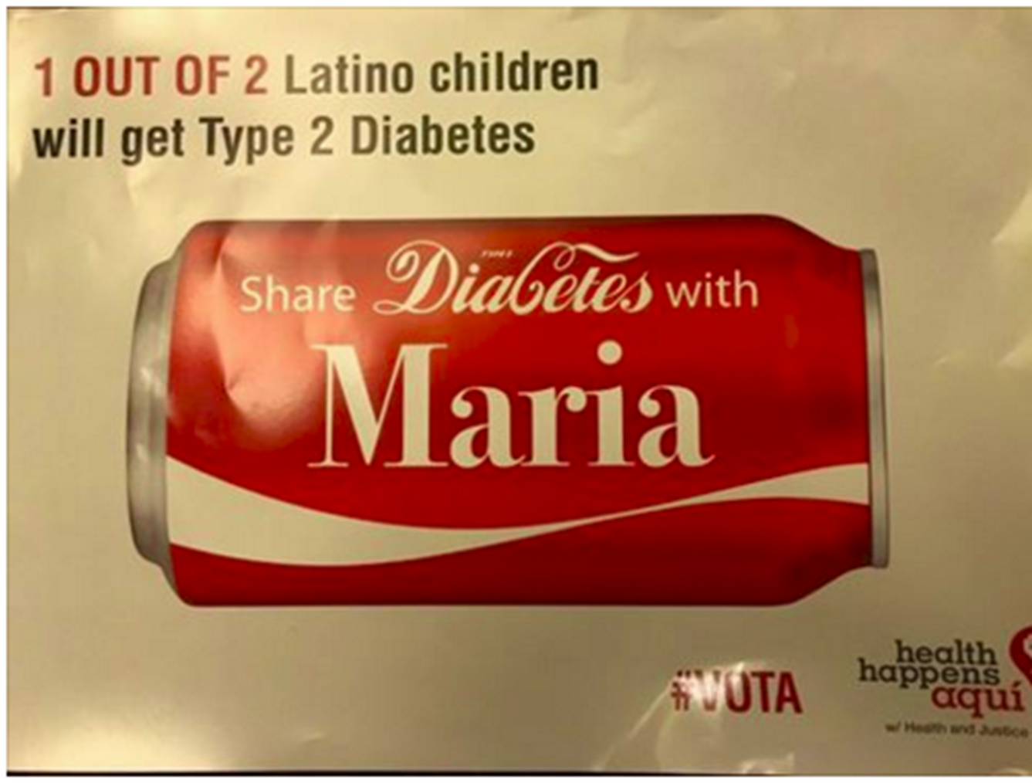


Type 2 in Kids
7 fold increase since 1990
1 in 6 overwt kids (age 12- 19) have prediabetes.
~2,500 to 3,700 new cases in U.S. annually.
Highest risk: very obese, minority, female, low socioeconomic status, limited education
In age range 12-19, less than 1% have Type 2 – NHANES
Environmental changes urgently needed

Slide 9
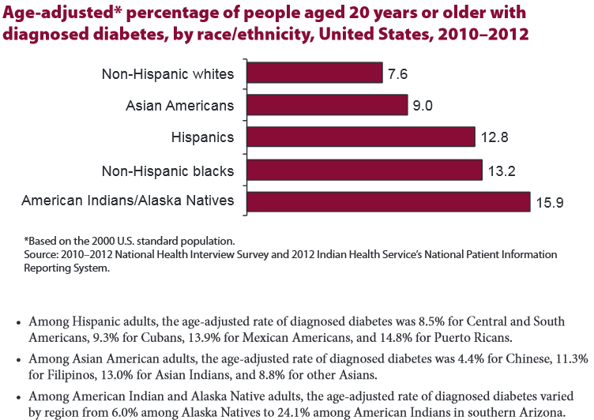

Age-adjusted Diabetes Prevalence
20 yrs or older, by race/ethnicity— U.S. 2014
1 out of 2 black men, Hispanic men and Hispanic women will develop Type 2 Diabetes during their lifetime. NDEP 2016

Slide 10

Why Should Zip Code Determine Life Expectancy?
Measureofamerica.org

Slide 11

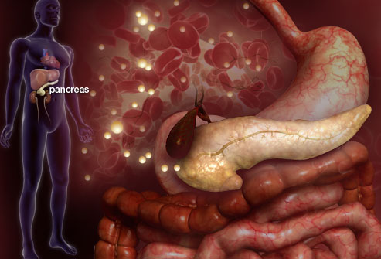

Slide 13
Role of the Pancreas
Endocrine Functions
Beta Cells - Insulin
  Anabolic hormone - helps store glucose as glycogen in muscle, liver
  secreted in response to elevated glucose
  halts breakdown of glycogen in liver
  increases protein synthesis, fat storage
  powerful hypoglycemic
Beta Cells - Amylin
  secreted in 1:1 ratio with insulin
  Causes satiety
  Lowers post-prandial glucagon response
  Slows gastric emptying
  Type 1 make none
  Type 2 make less than normal amounts

Slide 14
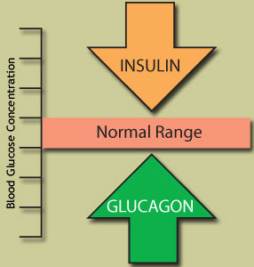
Role of the Pancreas
Endocrine Functions
Alpha cells - Glucagon
  Opposes action of insulin at the liver
  stimulated in response to low glucose levels
  stimulates liver to convert glycogen to glucose
  inhibits liver from glucose uptake
  causes hyperglycemia

Slide 15
Hormones Effect on Glucose
Effect



⇒
⇒
⇒
Hormone
Glucagon (pancreas)
Stress hormones (kidney)
Epinephrine (kidney)
Insulin (pancreas)
Amylin (pancreas)
Gut hormones - incretins (GLP-1) released by L cells of intestinal mucosa, beta cell has receptors)

Slide 16
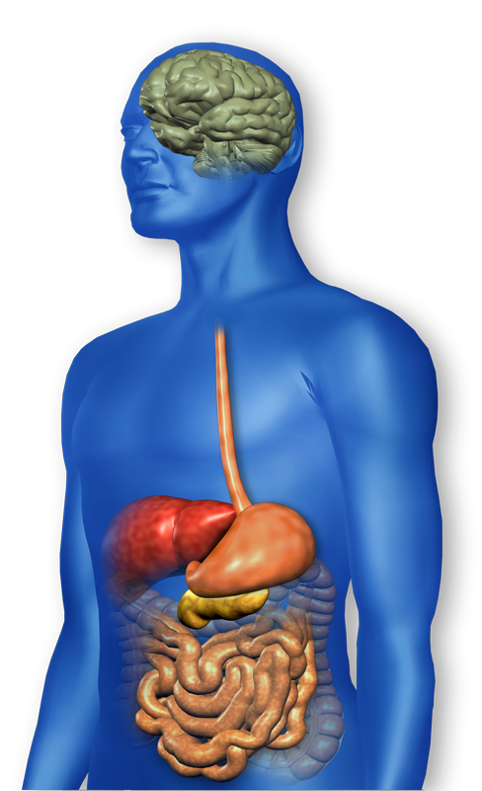
GLP-1 Effects in Humans
Understanding the Natural Role of Incretins
GLP-1 secreted upon the ingestion of food
Promotes satiety and
reduces appetite
Alpha cells:
↓ Postprandial
glucagon secretion
↑ Beta-cell
response
Liver:
↓ Glucagon reduces hepatic glucose output
Beta cells:
Enhances glucose-dependent insulin secretion
Stomach:
Helps regulate gastric emptying
Adapted from Flint A, et al. J Clin Invest. 1998;101:515-520
Adapted from Larsson H, et al. Acta Physiol Scand. 1997;160:413-422
Adapted from Nauck MA, et al. Diabetologia. 1996;39:1546-1553
Adapted from Drucker DJ. Diabetes. 1998;47:159-169
GLP-1 degraded by
DPP-4 w/in minutes
Notes:
16
16
Required
DISCUSSION POINTS:
--Upon food ingestion, GLP-1 is secreted into the circulation from L cells of small intestine.
--GLP-1 increases beta-cell response by enhancing glucose-dependent insulin secretion.
--GLP-1 decreases beta-cell workload and hence the demand for insulin secretion by:
--Regulating the rate of gastric emptying such that meal nutrients are delivered to the small intestine and, in turn, absorbed into the circulation more smoothly, reducing peak nutrient absorption and insulin demand (beta-cell workload)
--Decreasing postprandial glucagon secretion from pancreatic alpha cells, which helps to maintain the counterregulatory balance between insulin and glucagon
--Reducing postprandial glucagon secretion, GLP-1 has an indirect benefit on beta-cell workload, since decreased glucagon secretion will produce decreased postprandial hepatic glucose output
--Having effects on the central nervous system, resulting in increased satiety (sensation of satisfaction with food intake) and a reduction of food intake
--By decreasing beta-cell workload and improving beta-cell response, GLP-1 is an important regulator of glucose homeostasis.
SLIDE BACKGROUND:
--Effect on Beta-cell: Drucker DJ. Diabetes. 1998; 47:159-169
--Effect on Alpha cell: Larsson H, et al. Acta Physiol Scand. 1997; 160:413-422
--Effects on Liver: Larsson H, et al. Acta Physiol Scand. 1997; 160:413-422
--Effects on Stomach: Nauck MA, et al. Diabetologia. 1996; 39:1546-1553
--Effects on CNS: Flint A, et al. J Clin Invest. 1998; 101:515-520

Slide 17
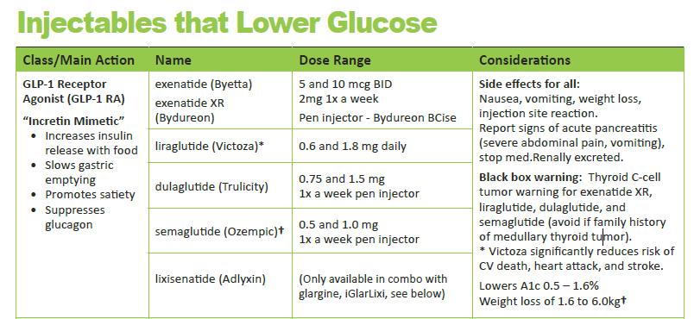
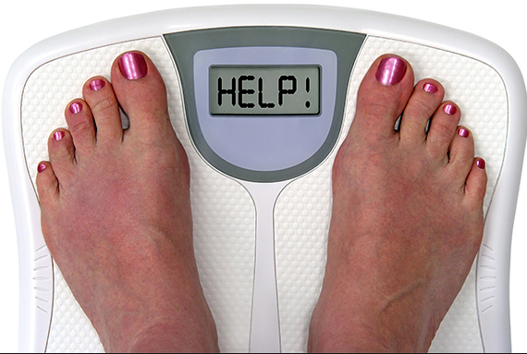
Incretin Mimetics
Byetta, Bydureon, Trulicity, Ozempic, Victoza
Notes:
17
17

Slide 18
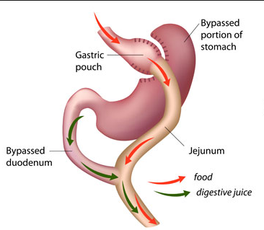
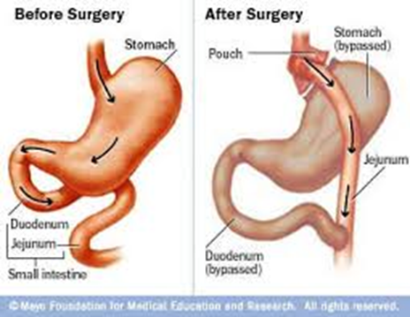
Metabolic Surgery Benefits
Increases gut hormone availability
More likely to cause remission* with recently diagnosed diabetes (more beta cell mass)
  30 - 63% remission over 1-5 years
  35 – 50% redeveloped diabetes
    Avg remission time 8.3 years
  Most pts who undergo surgery maintain substantial improvement of BG control from baseline for ~5 yrs
Trials demonstrate metabolic surgery achieves superior BG control and reduction of CV risk factors in obese pts with type 2 compared to lifestyle/medical intervention
Improvements in micro and macro disease and cancer have been observed.
Procedure may reduce long term mortality
  *remission = BG levels normal without meds

Slide 19
Natural History of Diabetes
Normal
FBG <100
Random <140
A1c <5.7%
Prediabetes
FBG 100-125
Random 140 - 199
A1c ~ 5.7- 6.4%
50% working pancreas
Diabetes
FBG 126 +
Random 200 +
A1c 6.5% or +
20% working pancreas
Yes!
NO
Development of type 2 diabetes happens over years or decades

Slide 20

Signs of Diabetes
Polyuria
Polydipsia
Polyphasia
Weight loss
Fatigue
Skin and other
infections
Blurry vision
Glycosuria, H₂O losses
Dehydration
Fuel Depletion
Loss of body tissue, H₂O
Poor energy utilization
Hyperglycemia increases incidence of infection
Osmotic changes

Slide 21

Diabetes Classifications
Type 1
Type 2
Gestational
Secondary
Notes:
Type 1-absent insulin
Type 2-too much insulin early, then resistence and less secretion
GDm-simliar to Type 2, found during pregnancy

Slide 22
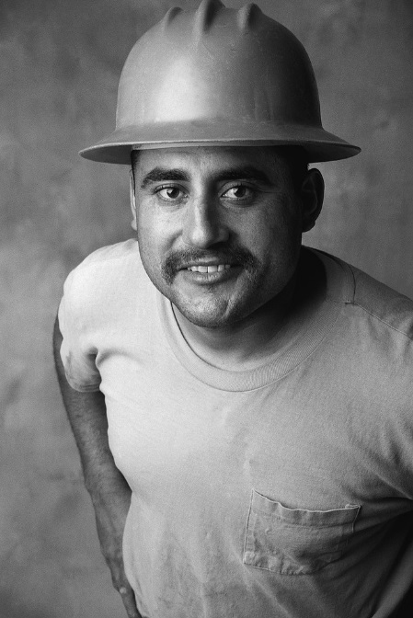

Case Study
1. Pt profile: 5’8”, 192 lb male
Diabetes 12 years, on insulin 3 yrs
What type of DM and how do you know?
2. 5’6”, 108 lb female
On insulin 3u Regular before meals, 10u NPH at bedtime
What type of DM and how do you know?

Slide 23
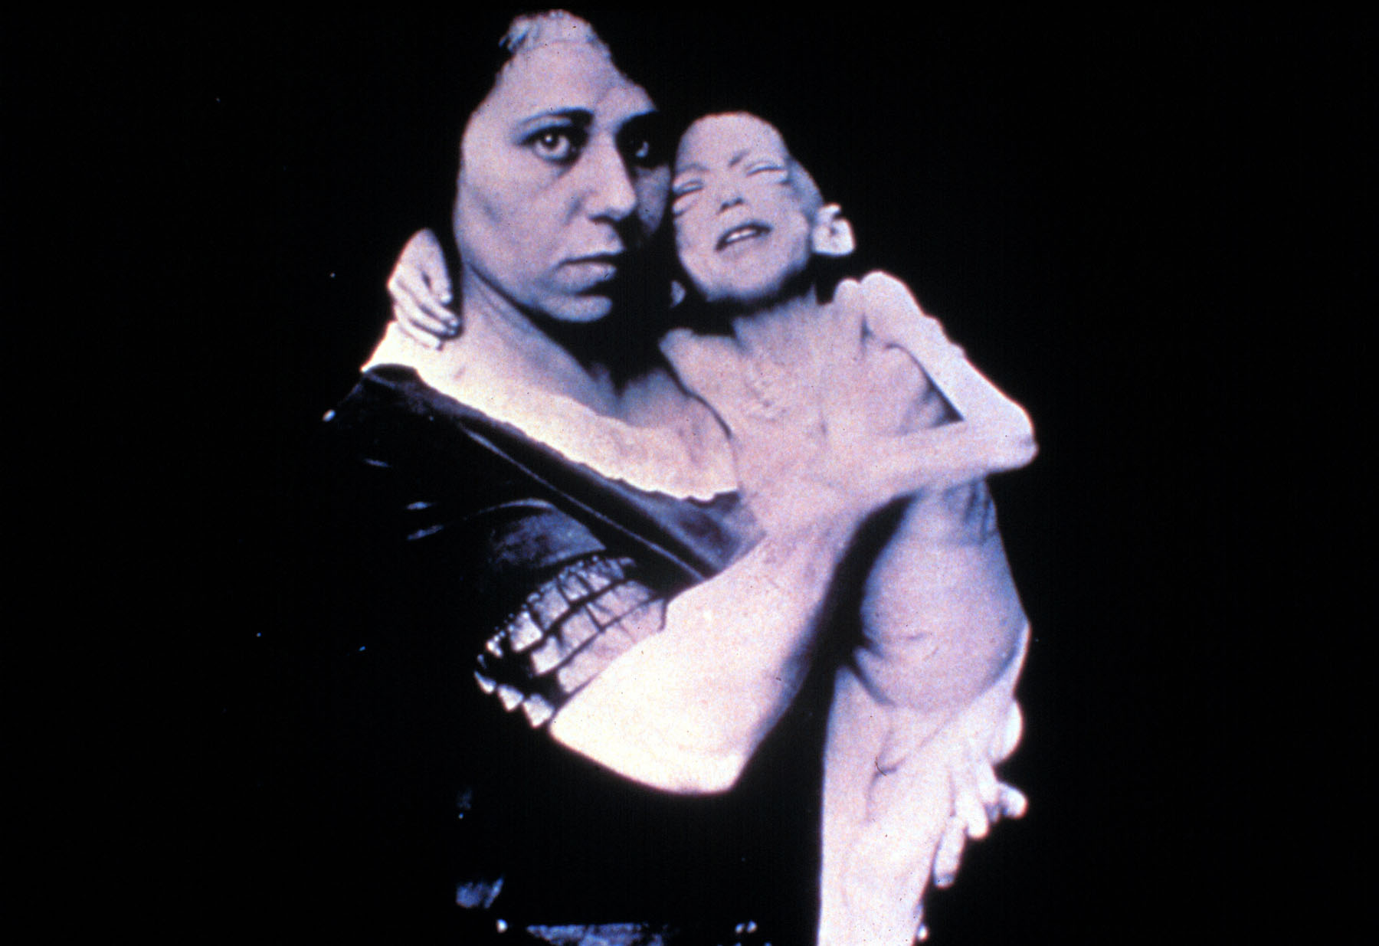

Slide 24
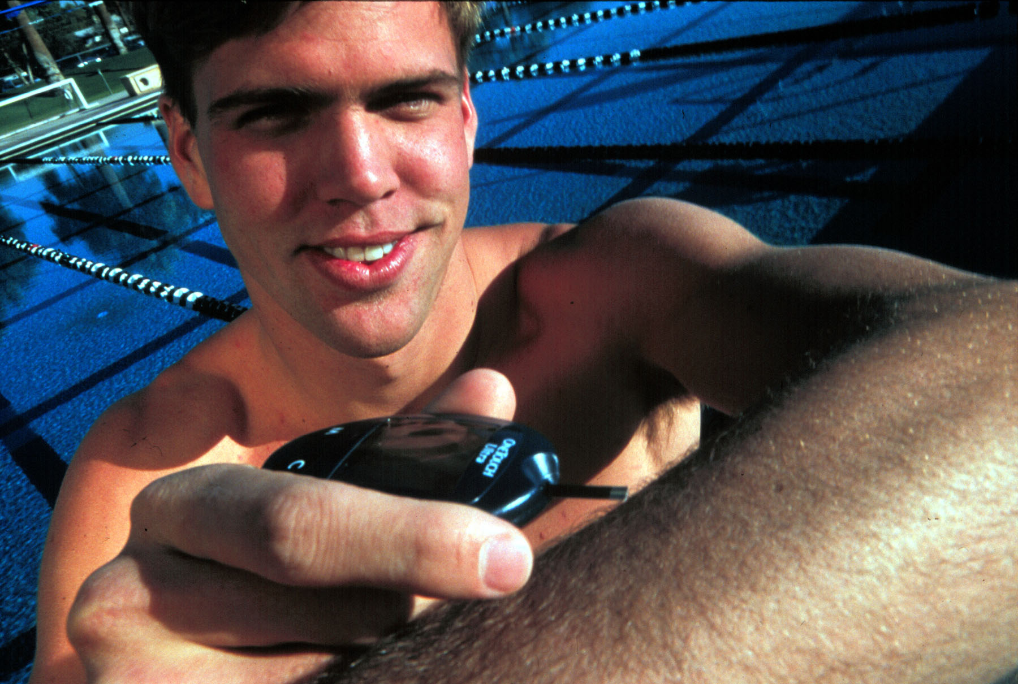

Slide 25
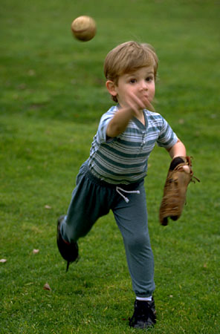
Incidence of Type 1 in Youth
General Pop 0.3%
Sibling 4%
Mother 2-3%
Father 6-8%
Rate doubling every 20 yrs
Many trials underway to detect and prevent (Trial Net)

Slide 26

Type 1 – 10% of all Diabetes
Genetics and Risk Factors
  Auto-immune pancreatic beta cells destruction
  Most commonly expressed at age 10-14
  Insulin sensitive (require 0.5 - 1.0 units/kg/day)
  Combo of genes and environment:
    Autoimmunity tends to run in families
    Higher rates in non breastfed infants
    Viral triggers: congenital rubella, coxsackie virus B, cytomegalovirus, adenovirus and mumps.

Slide 27
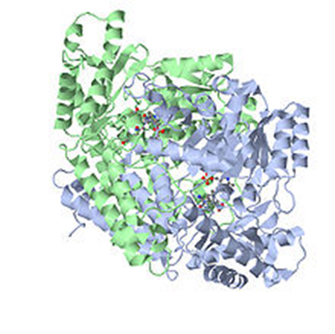
Autoantibodies Assoc w/ Type 1
Panel of autoantibodies –
  GAD65 - Glutamic acid decarboxylase –
  ICA - Islet Cell Cytoplasmic Autoantibodies
  IAA - Insulin Autoantibodies

Slide 28



Ms. Idaho and Ms America – Pumpin’ It

Slide 29




What Does Type 1 Look Like?
Mary Tyler Moore
Justice Sonia Sotomayor
Bret Michaels
Nick Jonas
From Debbie Nagata’s slide collection

Slide 30
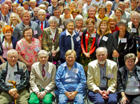
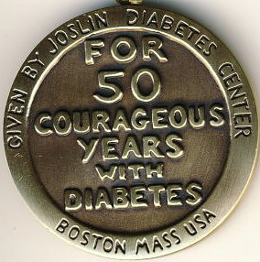
Medalist Study – Harvard
Joslin Diabetes Center
After 50 years with diabetes
  Many still produced some insulin
  Many had no eye disease

Slide 31
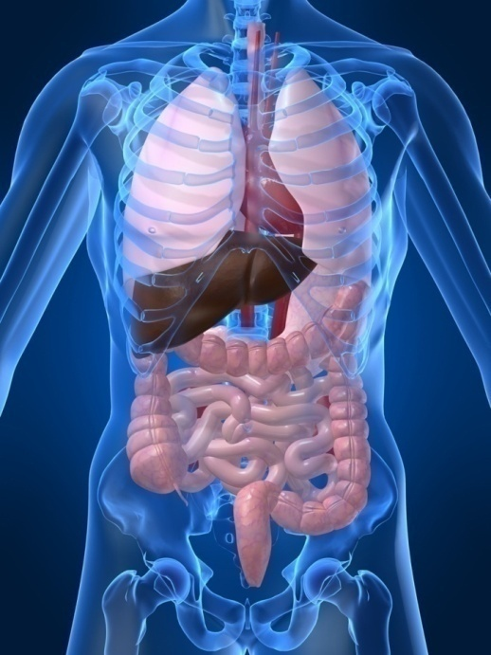
Type 1 Diabetes Associated with other immune conditions
Celiac disease (gluten intolerance)
Thyroid disease
Addison’s Disease
Rheumatoid arthritis
Other

Slide 32

Type 1 Summary
Autoimmune pancreatic destruction
Need insulin replacement therapy
Often first present in DKA
At risk for other autoimmune diseases
Eval coping strategies

Slide 33

Type 1 in Hospital
43 yr old admitted to evaluate angina.
Morning blood sugar is 92.
Based on Regular insulin sliding scale, no insulin required.
Breakfast tray shows up and patient says, I need my insulin shot before I eat.
What do you say?

Slide 34
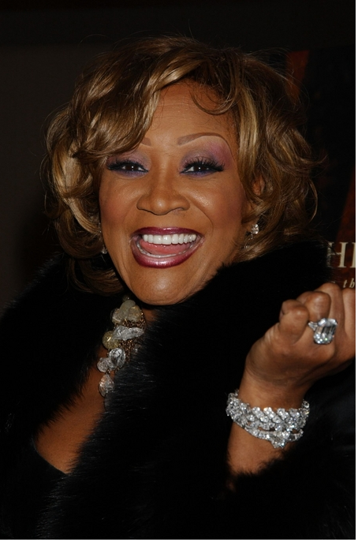
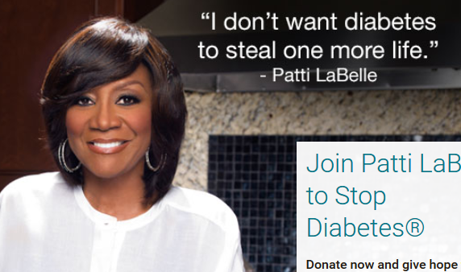
Patti Labelle
"divabetic”
“I have diabetes, it doesn’t have me”

Slide 35
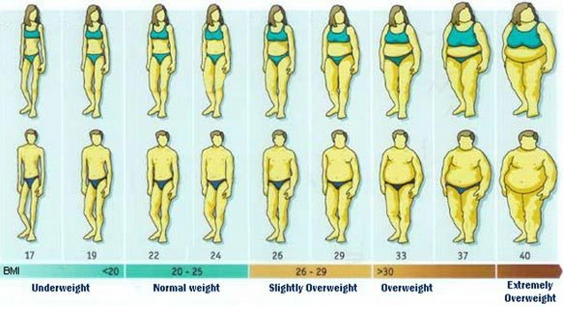
BMI Categories

Slide 36

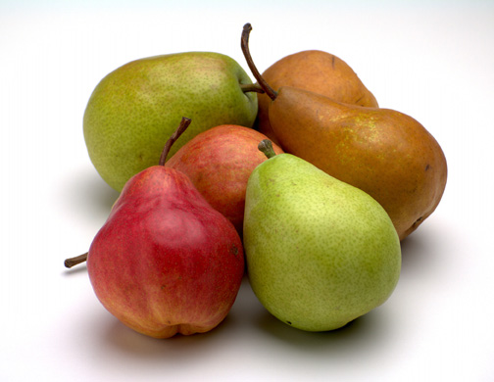


Slide 37
Natural Progression of Type 2 Diabetes
Plasma
Glucose
Postprandial glucose
Fasting glucose
126 mg/dL
Relative
β-Cell
Function
Insulin resistance
Insulin secretion
-20
-10
0
10
20
30
Years of Diabetes
Prior to diagnosis
After diagnosis
Adapted from Bergenstal et al. 2000; International Diabetes Center.

Slide 38
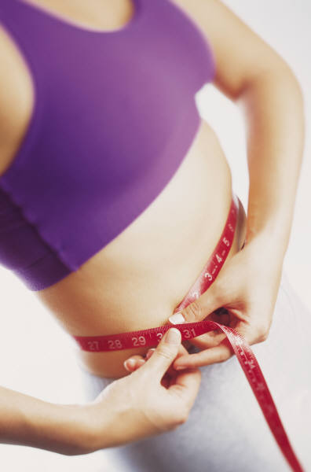
Cardio Metabolic Risk -
5 Hypers -
Hyperinsulinemia (resistance)
Hyperglycemia
Hyperlipidemia
Hypertension
Hyper”waistline”emia (35” women, 40” men)
Manifestations of Insulin Resistance

Slide 39

Pre Diabetes & Type 2- Screening Guidelines (ADA Clinical Practice Guidelines)
Start screening at age 45 or for anyone who is overweight (BMI ≥ 25, Asians BMI ≥ 23 ) with one or > additional risk factor:
  First-degree relative w/ diabetes
  Member of a high-risk ethnic population
  Habitual physical inactivity
  PreDiabetes
  History of heart disease

Slide 40

Diabetes 2 - Who is at Risk?
(ADA Clinical Practice Guidelines)
Risk factors cont’d
  HTN - BP > 140/90
  HDL < 35 or triglycerides > 250
  history of Gestational Diabetes Mellitus
  Polycystic ovary syndrome (PCOS)
  Other conditions assoc w/ insulin resistance:
    Severe obesity, acanthosis nigricans (AN)

Slide 41
Acanthosis Nigricans (AN)
Signals high insulin levels in bloodstream
Patches of darkened skin over parts of body that bend or rub against each other
  Neck, underarm, waistline, groin, knuckles, elbows, toes
  Skin tags on neck and darkened areas around eyes, nose and cheeks.
No cure, lesions regress with treatment of insulin resistance

Slide 42
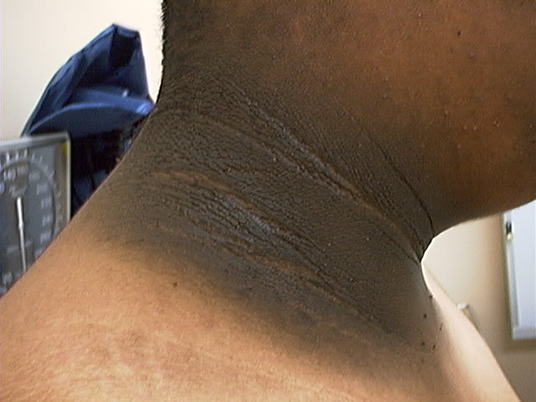
Acanthosis Nigricans

Slide 43
Diabetes Detectives Needed
On average – takes 6.5 years to diagnose diabetes
1/4 of all people with diabetes don’t know they have it

Slide 44
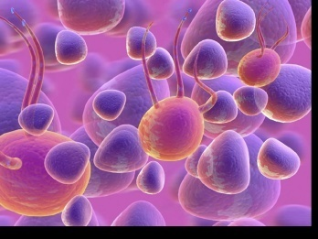
Ominous Octet
Decreased
satiation neuro-
transmission
Decreased
amylin, β-cell secretion
80% loss at dx
Increased renal glucose reabsorption
Decreased
Gut hormones
Increased glucagon secretion
G
I
G
I
G
G
I
I
G
G
Increased lipolysis
G
I
I
G
G
I
Increase glucose
production
I
G
G
Decreased glucose
uptake
© Copyright 1999-2013, Diabetes Educational Services, All Rights Reserved.
Notes:
44
44

Slide 45

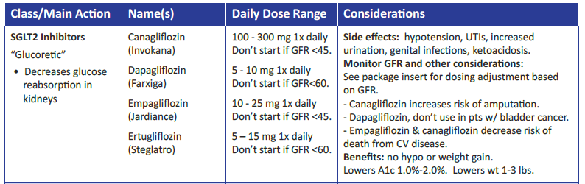
SGLT2 Inhibitors- “Glucoretics”
Action: “Glucoretic” decreases renal glucose reabsorption (resets renal threshold and increases glucosuria)
Expensive
Notes:
45
45
Thiazolidinediones (TZDs) enhance insulin sensitivity in muscle and adipose tissue by binding to cell receptors,which leads to an increase in glucose transporter expression. TZDs encourage beta cells to respond more efficiently by lowering the amount of glucose and free fatty acids in the bloodstream, both of which are known to be detrimental to insulin secretion. Finally, these drugs reduce glucose production in the liver.
Clinical trials indicate that pioglitazone and rosiglitazone are slightly more effective at reducing A1C (1.5-1.6% reduction) than troglitazone (1.1% reduction).
Some of the beneficial side effects of thiazolidinediones include an increase in HDL cholesterol and reduction of triglyceride concentrations. This class of drugs has also been shown to lower blood pressure and decrease vascular inflammation in vitro. There are clinical studies underway to further examine the cardiovascular benefit to TZDs.
Some adverse effects of TZDs include weight gain, a potential increase in LDL cholesterol levels, and a possible increase in alanine aminotransferase levels (ALT). Because of the risk of weight gain, edema, and increased LDL cholesterol, thiazolidinediones are contraindicated in patients with advanced forms of congestive heart failure. Due to reported cases of liver failure and liver toxicity caused by the increase in ALT levels, TZDs are contraindicated in patients with abnormal liver function.
TZDs are the most expensive of the oral antidiabetic agents.

Slide 46
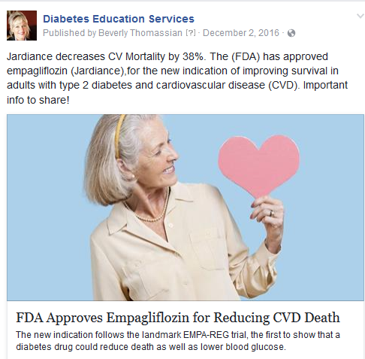
Jardiance gets special FDA CV approval

Slide 47
Comparison of
Type 1 and Type 2
Type 1
Type 2
Obesity
x
xxx
Insulin dependence
xxx
30%
Respond to oral agents
0
xxx
Ketosis
xxx
x
Antibodies present
xxx
0
Typical Age of onset
teens
adult
Insulin Resistance
0
xxx

Slide 48

Gestational DM ~ 7% of all Pregnancies
GDM prevalence increased by
  ∼10–100% during the past 20 yrs
Native Americans, Asians, Hispanics, African-American women at highest risk
Immediately after pregnancy, 5% to 10% of GDM diagnosed with type 2 diabetes
Within 5 years, 50% chance of developing DM in next 5 years.

Slide 49
Postnatal Health:
Maternal Behavior
Encourage breastfeeding for one year
  (25% of women achieving this goal)
Screening 6-12 weeks post partum using non-pregnant OGTT criteria (50%)
Repeat at 3 yr intervals or signs of DM
Encourage weight control and exercise
Make sure connected with health care
Preconception counseling

Slide 50
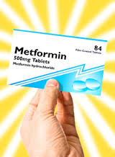
Start Metformin therapy
For women with PreDiabetes and History of GDM
Patient has PreDiabetes and is obese

Slide 51
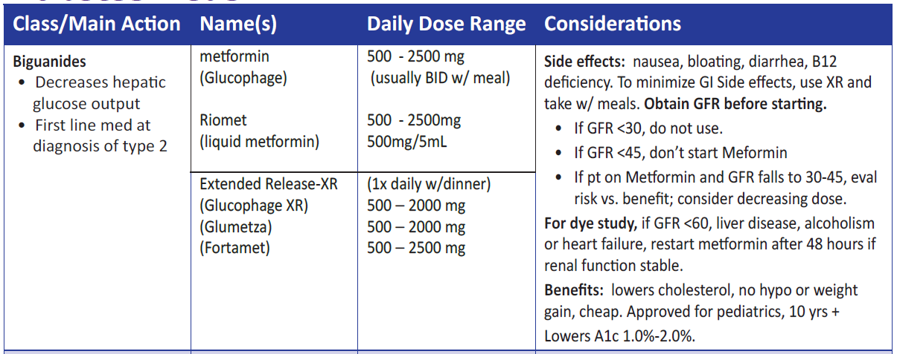
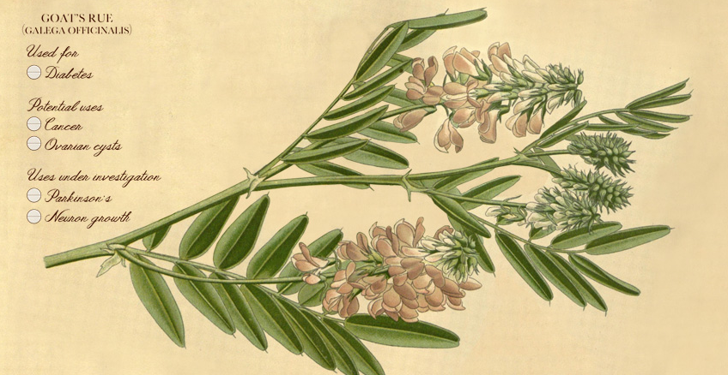
Metformin – New GFR Guidelines
Biguanide derived from:
Goat’s Rue Galega officinalis,
French Lilac

Slide 52
Biguanides – Metformin (Glucophage)
Action: decrease hepatic glucose (glycogen)
Names:
  Metformin (Glucophage)
    Starting dose: 500 BID, max 2500mg daily
  Metformin extended release (3 different versions)
    Starting dose 500mg at dinner, max dose 2000 to 2500 mg daily
  Efficacy:
    Decrease fasting plasma glucose 60-70 mg/dl
    Reduce A1C 1.0-2.0%
Notes:
52
52
The mechanism of action of metformin is not entirely understood, but it's predominant effect is to suppress hepatic glucose production and to enhance insulin sensitivity in peripheral tissues (primarily muscle). It is unclear if insulin sensitivity occurs by metformin binding to cell receptors,which leads to an increase in glucose transporter expression, or whether insulin sensitivity is simply a secondary effect of the suppressed glucose production.
Metformin's ability to lower A1C and decrease fasting plasma glucose is similar to that of sulfonylurea drugs. However, the UKPDS showed that those who received metformin had less hypoglycemia and weight gain than those who received sulfonylureas.
Metformin must be avoided in patients with renal impairments, as those patients are at higher risk of experiencing lactic acidosis. However, metformin is an effective monotherapy and may be an ideal drug for overweight patients since it does not cause weight gain and has been seen to cause modest amounts of weight loss when first administered. Diarrhea and abdominal discomfort can be alleviated by changes in diet and slow increases in metformin dosage.

Slide 53
Other Causes of Hyperglycemia
  Steroids
  Agent Orange
  Tube feedings / TPN
  Transplant medications
  Cystic Fibrosis
  Regardless of cause, requires treatment
    Insulin always works
    Sign of pancreatic malfunction

Slide 54

Diabetes is also associated with
Fatty liver disease
Obstructive sleep apnea
Cancer; pancreas, liver, breast
Alzheimer’s
Depression

Slide 55
Diabetes Bingo
“DiaBingo” Shout out Right Answer

Slide 56
DiaBingo
B Frequent skin and yeast infections
B A BMI of ____ or greater is considered overweight
B To reduce complications, control A1c, Blood pressure, Cholesterol
B PreDiabetes – fasting glucose level of ___ to ____
B Erectile dysfunction indicates greater risk for ____
B Diabetes – fasting glucose level____ or greater
B Type 1 diabetes is best described as an ______ disease
B People with diabetes are ______ times more likely to die of heart dx
B Elevated triglycerides, < HDL, smaller dense LDL
B Each percentage point of A1c = _____ mg/dl glucose
B At dx of type 2, about __% of the beta cell function is lost
B Diabetes – random glucose ____ or greater

Slide 57

Life Study – Mrs. Jones
Mrs. Jones is 62 years old, overweight and complaining of feeling tired and urinating several times a night. She is admitted with a urinary tract Infection. Her WBC is 12.3, glucose 237. She is hypertensive with a history of gestational diabetes. No ketones in urine.
What are her risk factors, signs of diabetes
What type of diabetes does she have?
Does she have insulin resistance?

Slide 58

Strategies – One Step at a Time, Focus on Survival Skills
Look for
“teaching moment” opportunities

Slide 59
What Do You Say?
Mrs. Jones asks you
What is type 2 diabetes?
Will this go away?
Will I get complications?
Will I need to take diabetes medication for the rest of my life?
How come I got diabetes?
Do I have to check my blood sugars?

Slide 60
I don’t want to!

Slide 61
No one is Unmotivated
…. to lead and long and healthy life
These are the 3 usual Critical Barriers
  Perceived worthlessness
  Too many personal obstacles
  Absence of support and resources
  Bill Polonsky, PhD, CDE

Slide 62
Overcoming barriers
Confront the key misbelief. Ask the question, does dm cause complications?
Offer pts evidence based hope message –
Frequent contact
Paired glucose testing
Ask pt, “Tell me 1 thing that is driving you crazy about your diabetes”
Discuss medication beliefs
To improve outcomes, see pts more often
  Bill Polonsky, PhD, CDE

Slide 63
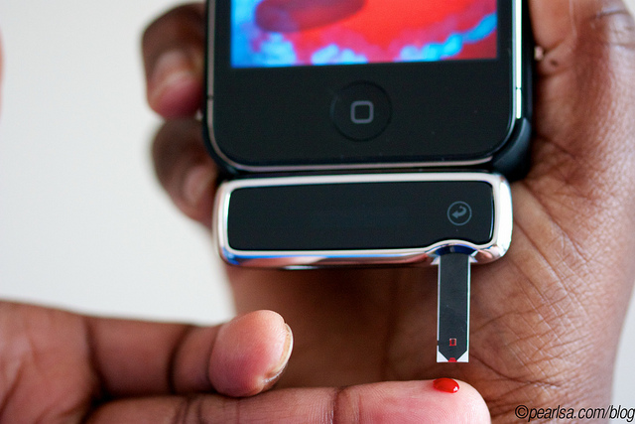
How Often Should I Check?
Be realistic!!
Type 2 on orals – Medicare covers 100 strips for 3 months
Based on individual - Consider:
  Types and timing of meds
  Goals
  Ability (physical and emotional)
  Finances / Insurance

Slide 64

“The highest form of wisdom is kindness.”
The Talmud
How many times has a person arrived disheartened?
This moment of discouragement and despair provides us an opportunity.
By modeling kindness and understanding, we can encourage them to be a kinder self-coach from this day forward.

Slide 65
Complications - Why?
Degree of hyperglycemia “glucose toxicity”
Duration of hyperglycemia
Genes
Multiple risk factors: smoking, vascular disease, dyslipidemia, hypertension, other

Slide 66
Diabetes Complications
Heart disease leading cause of death.
CAD death rates are about 2 -4x’s as high as adults without diabetes (it’s not getting better)
Risk of stroke is 2 - 4 times higher
60% - 65% of people with DM have HTN.
DM accounts for 40% of new cases of ESRD
60 - 70% have mild - severe forms of neuropathy
Diabetes is the leading cause of blindness
Accounts for 50% of lower limb amputations

Slide 67
Control Matters
Prevention
Trials
Practice Recommendations

Slide 68

Financial Advisor
Mid 30s, friendly, he smiles to greet you and you notice his gums are inflamed. You’d guess a BMI of 26 or so, with most of the extra weight in the waist area.
If you could give him some health related suggestions, what would they be?

Slide 69

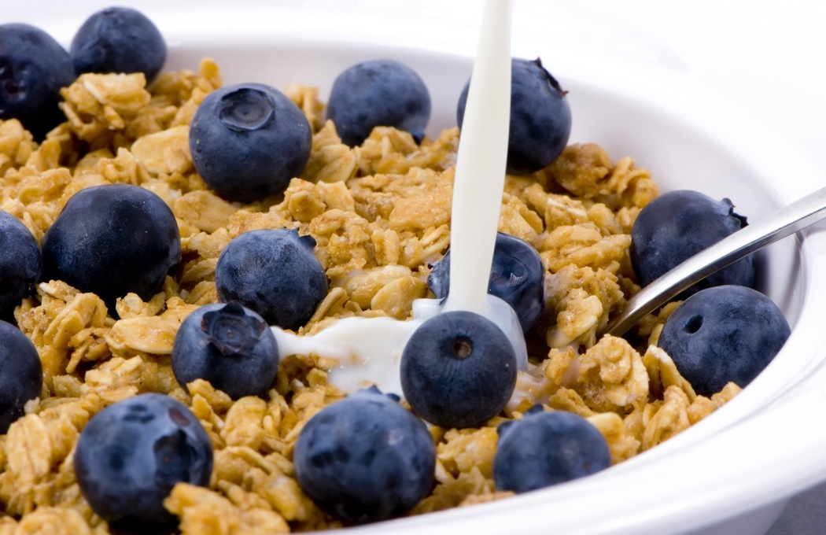


Preventing Pre Diabetes

Slide 70
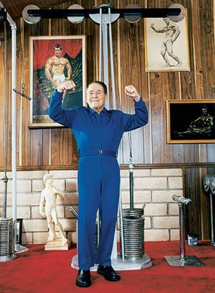
Can Type 2 be Prevented in Older Adults?
Overall, 9 of 10 new cases of diabetes attributable to these 5 lifestyle factors.
89% risk reduction when all at goal.
35% rel risk reduction for each additional
Physical activity (30 mins a day)
Dietary score (higher fiber intake, low saturated fat and trans-fat, lower mean glycemic index)
Not Smoking
Alcohol use (up to 2 drinks a day);
BMI <25 and waist circumference
Dariush Mozaffarian, MD,
Arch Intern Med. 2009;169(8):798-807.

Slide 71

Can we stop pre diabetes from progressing?
3, 234 people w/ Pre-Diabetes randomized:
  Placebo
  Diet/Exercise or
  Metformin
over a three year period
Diabetes Prevention Program (DPP) 2001

Slide 72

Diabetes Prevention Program
Standard Group - 29% developed DM
Lifestyle Results - 14% developed DM
  58% (71% for 60yrs +) Risk reduction
    30 mins daily activity
    5-7% of body wt loss
Metformin 850 BID - 22% developed DM
  31% risk reduction (less effective with elderly and thinner pt’s)

Slide 73

Weight loss and Prevention
For every 2.2 pounds of weight loss, risk of type 2 diabetes was reduced by 13%.

Slide 74
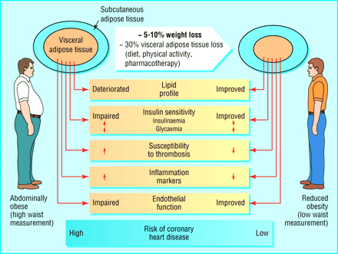

Slide 75

Goals of Care

Slide 76

ABCs of Diabetes – ADA Goals
A1c less than 7% (avg 3 month BG)
  Pre-meal BG 80-130
  Post meal BG <180
Blood Pressure < 140/90
Cholesterol
  DM and 40 yrs, start statin
  HDL >40
  Triglyceride < 150
E xercise, Education
H ealthy Eating

Slide 77

1% decrease in A₁c reduces microvascular complications by 35%
1% decrease in A₁c reduces diabetes related deaths by 25%
B/P control (144/82) reduced risk of:
  Heart failure (56%)
  Stroke (44%)
  Death from diabetes (32%)
Lancet 352: 837-865, 1998

Slide 78
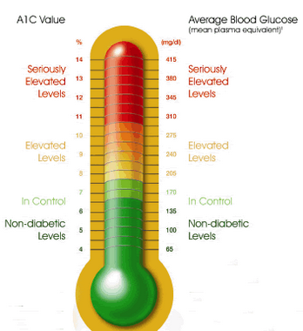
6. Glycemic Targets
Adult non pregnant A1c goals
  A1c < 7% - a reasonable goal for adults.
  A1c < 6.5% - may be appropriate for those without significant risk of hypoglycemia or other adverse effects of treatment.
  A1c < 8% - may be appropriate for patients with history of hypoglycemia, limited life expectancy, or those with longstanding diabetes and vascular complications.

Slide 79

What are next steps?
72 yr old, thin, lives alone, A1c 7.3%. History of MI, stroke. DM for 12 yrs, “diet controlled”. Good Insurance. Creat 1.4.

Slide 80
DPP-4 Inhibitors – “Incretin Enhancers”
Januvia (sitagliptin) – Tradjenta (linagliptin)
Onglyza (saxagliptin) Nesina (alogliptin)
Action:
  Increase insulin release w/ meals
  Suppress glucagon
Dosing: Januvia – 100mg a day
        Onglyza* – up to 5mg a day
        Tradjenta – 5mg a day
        Nesina* – up to 25 mg a day
Efficacy: Decreases A1c by 0.6 -0.8%
Benefits/ Issues: weight neutral, no hypo, few side effects. Expensive
Notes:
80
80

Slide 81
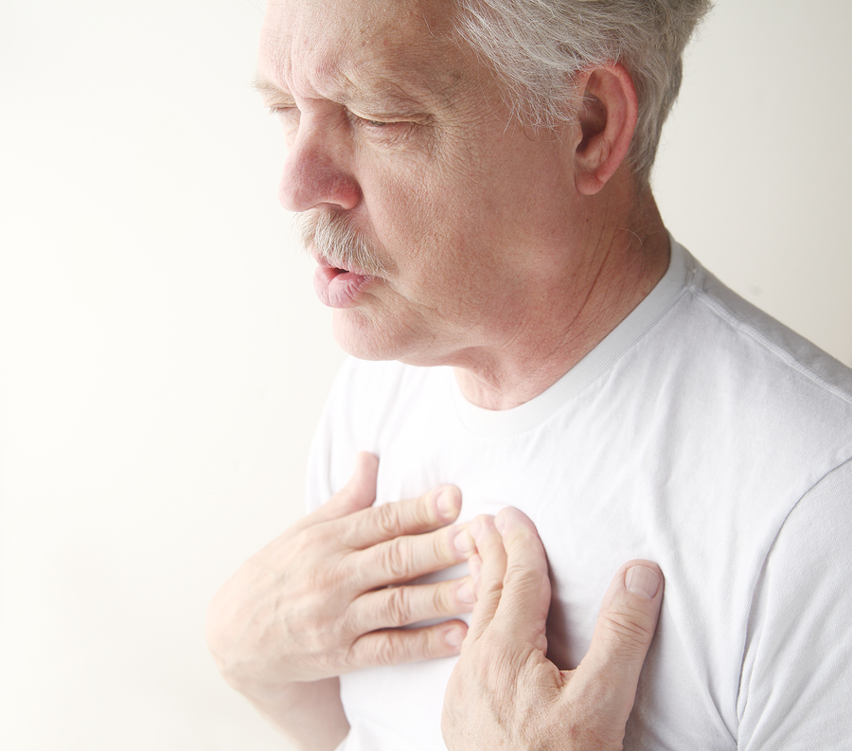
DPP-IV Inhibitor Updates
Can cause severe, disabling join pain.
  Contact Provider, Stop Medication
Saxagliptin (Onglyza) and Alogliptin (Nesina) can increase risk of heart failure.
  Notify provider for shortness of breath, edema, weakness, etc.
Side effects: headache and flu-like symptoms
Report signs of pancreatitis
No wt gain or hypoglycemia
Lowers A1c 0.6% - 0.8%

Slide 82
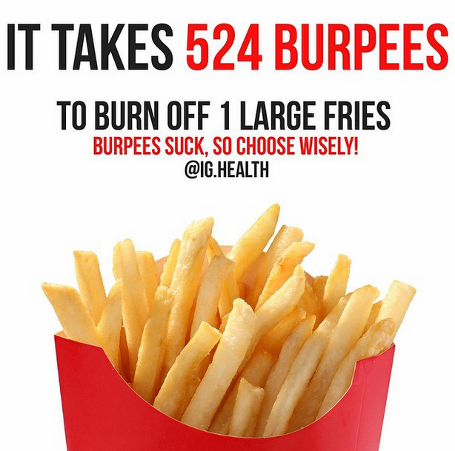
A hard truth
Exercise alone doesn’t cause weight loss
But….
  It helps keep weight off
  Decreases visceral fat
  Decreases CV Risk
To combat obesity, we need to change the food environment
“You cannot outrun a bad diet”.

Slide 83
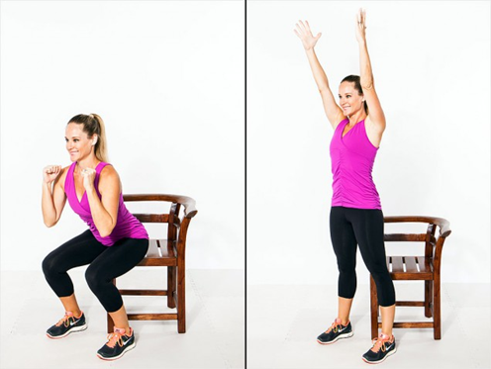
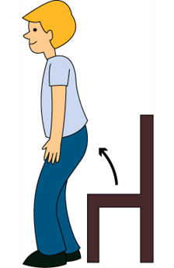
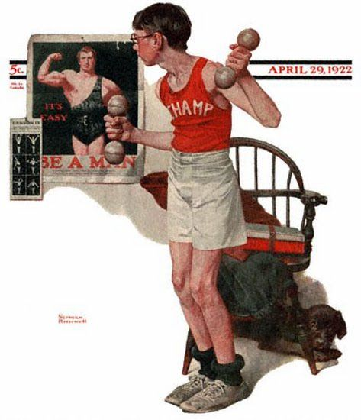
Exercise Standards
Adults – 150 min/wk moderate intensity
  over 3 days a week.
  Don’t miss > 2 consecutive days w/out exercise
  Get up every 30 mins - Reduce sedentary time
  Flexibility and balance training 2-3 xs a week (Yoga and Tai Chi)
  T1 and T2 – resistance training 2 -3 xs a week

Slide 84


Where are your patients on this continuum?

Slide 85
Good Exercise Info / Quotes
“Passagiata” – take an after meal stroll
Exercise decreases A1c 0.7%
No change in body wt, but 48% loss in visceral fat
ADA PostGrad 2010
“Every minute of activity lowers blood sugar one point.”
“I don’t have time to exercise, I MAKE time.” Mike Huckabee

Slide 86

Each minute of activity lowers
BG by 1 point
Each minute of exercise lowers BG 1 point
  15 minutes of walking drops BG 15 points
  30 minutes of biking drops BG 30 points
  40 minutes of housework drops BG 40 points
  50 minutes of walking and window shopping lowers BG 50 points

Slide 87
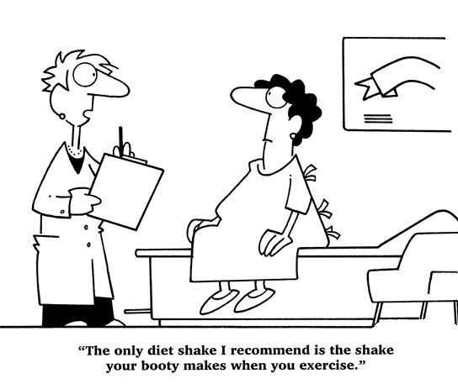
Best Shake For People with Diabetes
From Debbie Nagata’s slide collection

Slide 88
Diabetes Bingo
“DiaBingo” Shout out Right Answer

Slide 89
DiaBingo- G
G ADA goal for A1c is less than ____%
G People with DM need to see their provider at least every month
G Blood pressure goal is less than
G People with DM should see eye doctor (ophthalmologist) at least
G The goal for triglyceride level is less than
G Goal for my HDL cholesterol is more than
G The goal for blood sugars 1-2 hours after a meal is less than:
G People with DM should get this shot every year
G People with DM need to get urine tested yearly for ___________
G Periodontal disease indicates increased risk for heart disease
G The goal for blood sugar levels before meals is:
G The activity goal is to do ___ minutes on most days

Slide 90
Diabetes Care Guidelines- ADA
Test / Exam Frequency
A1c At least twice a year
B/P Each diabetes visit
Cholesterol (LDL, HDL, Tri) Yearly (less if normal)
Weight each diabetes visit
Microalbumin/GFR/Creat Yearly
Eye exam Yearly
Dental Care At least twice a year
Comprehensive Foot Exam Yearly (more if high risk)
Physical Activity Plan As needed to meet goals
Preconception counseling As needed

Slide 91
Mr. Jones - What are Your Recommendations?
Self-Care Skills
Walks dog around block 3 x’s a week
Bowls every Friday
3 beers daily
What meds?
What referrals?
My foot hurts
Patient Profile
64 yr old with type 2 for 11 yrs. Hx of CVD.
Labs:
  A1c 9.3%
  HDL 37 mg/dl
  Triglyceride 260mg/dl
  Proteinuria - neg
  B/P 152/94

Slide 92
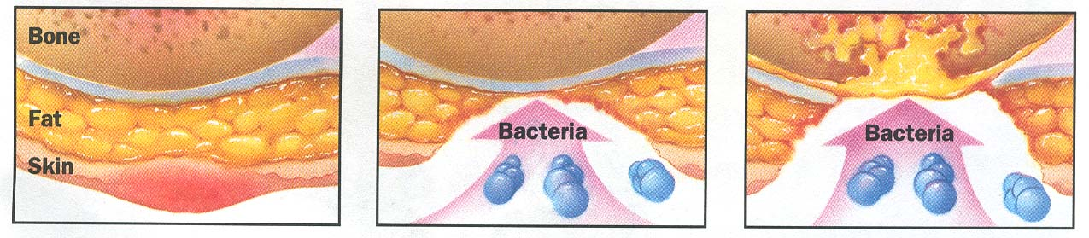
Foot Wounds
Blisters Ulcers Bone infection
Calluses

Slide 93
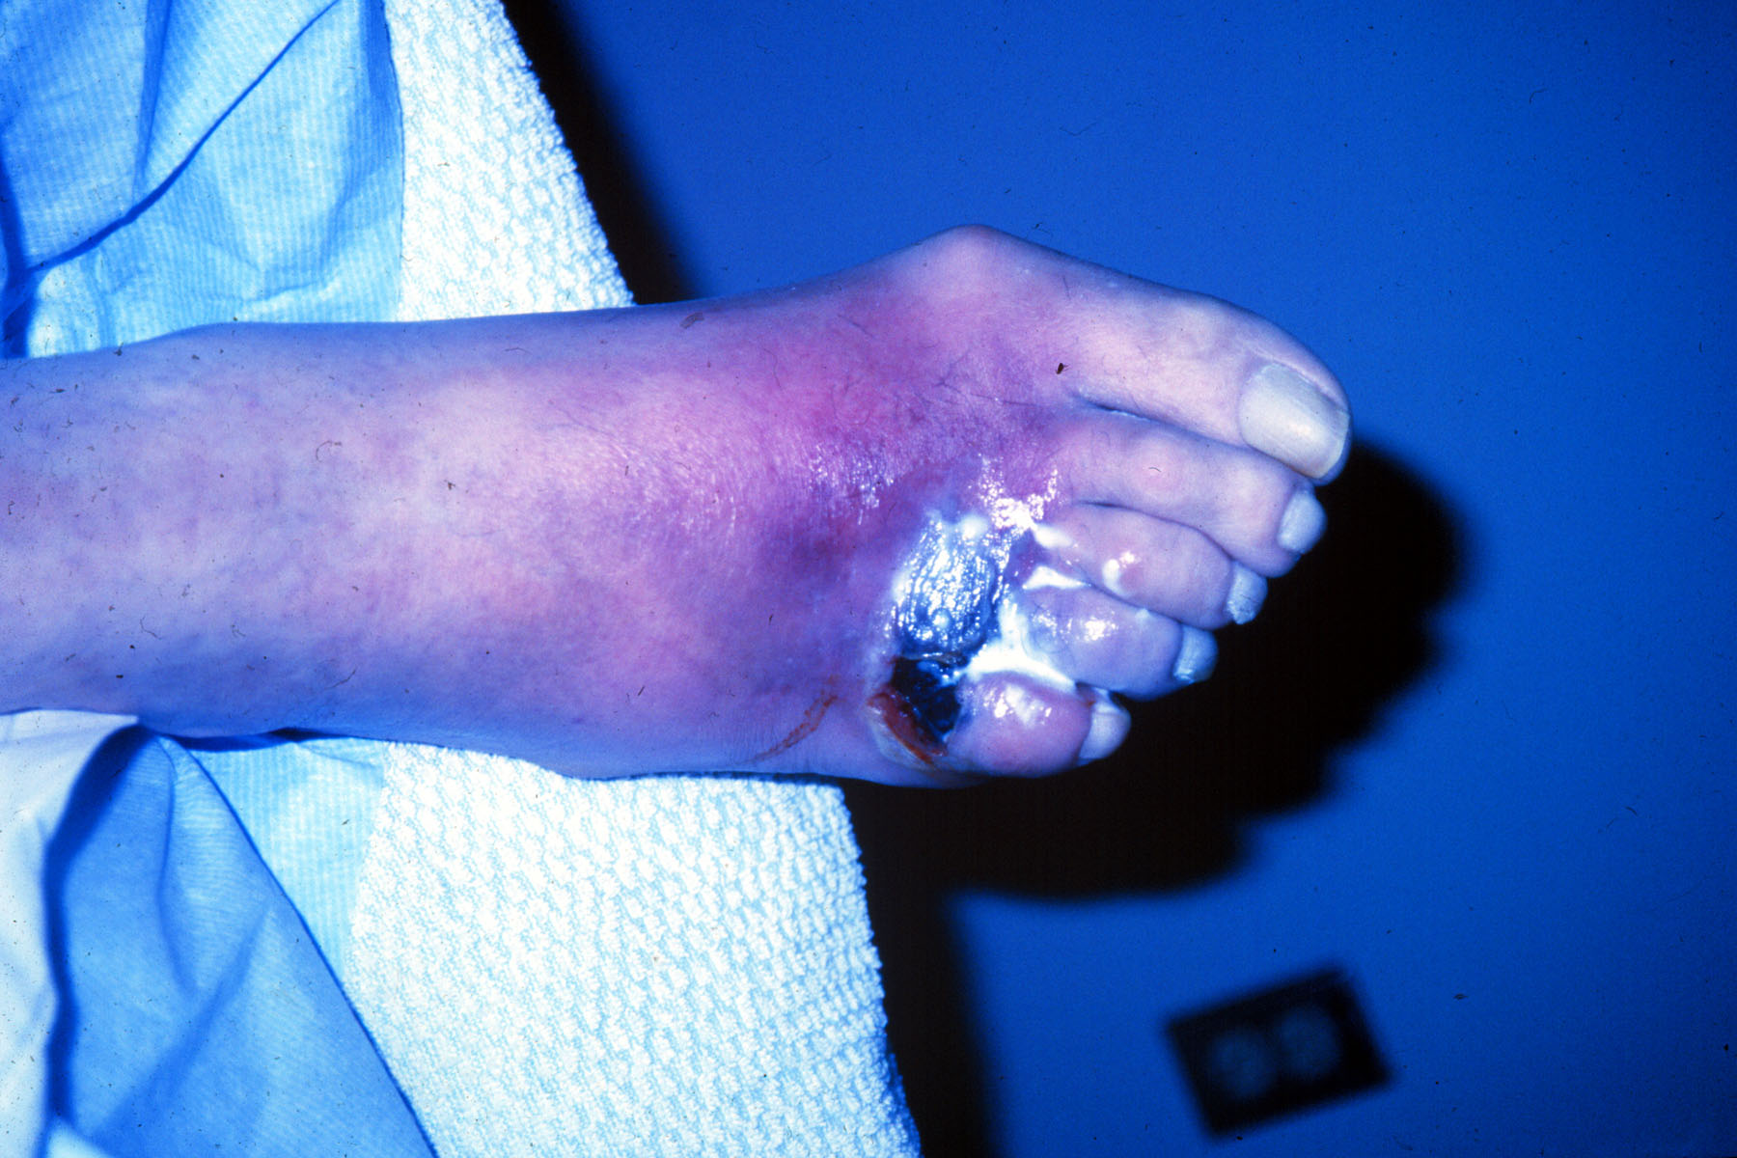

Slide 94
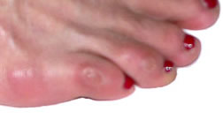
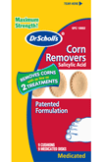

No Bathroom Surgery

Slide 95
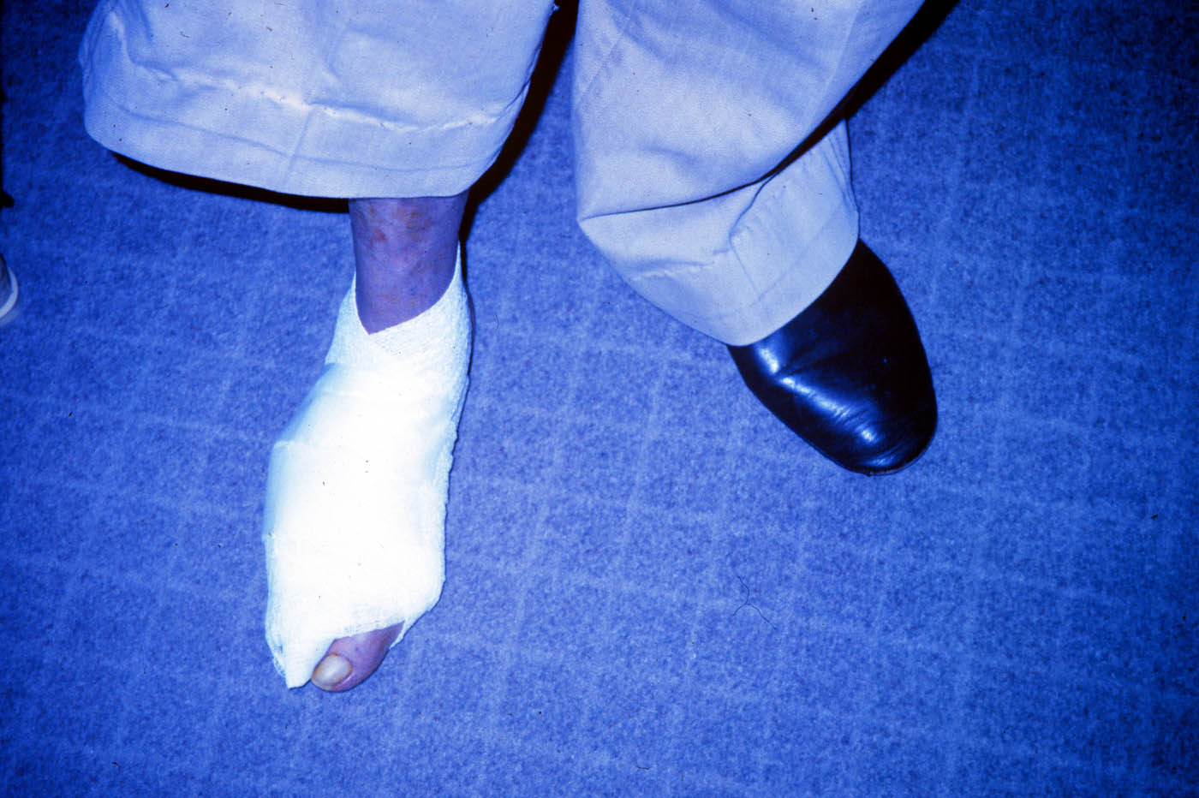

Slide 96
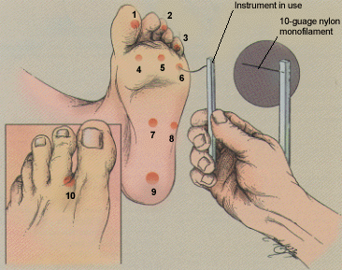
5.07 monofilament = 10gms linear pressure
Free Monofilaments
http://www.hrsa.gov/leap/

Slide 97
Three Most Important
Foot Care Tips
Inspect and apply lotion to your feet every night before you go to bed.
Do NOT go barefoot, even in your house. Always wear shoes!
Every time you see your doctor, take off your shoes and show your feet.

Slide 98

“Getting diabetes saved my life.”
~ Sherri Sheperd
Sherri Shepard decided to embrace diabetes and use it as a motivator to improve her health.

Slide 99
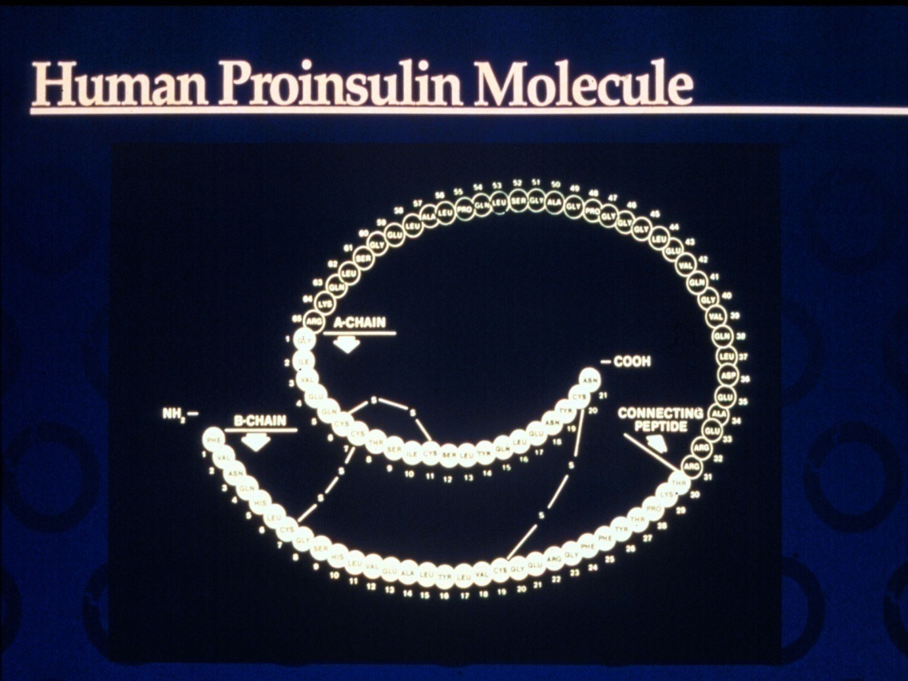
Insulin – the Ultimate Hormone Replacement Therapy
  Objectives:
  Discuss the actions of different insulins
  Describe using pattern management as an insulin adjustment tool.

Slide 100

Insulin Therapy
From Ants to Analogs:

Slide 101
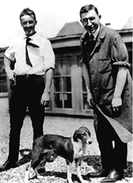

Slide 103
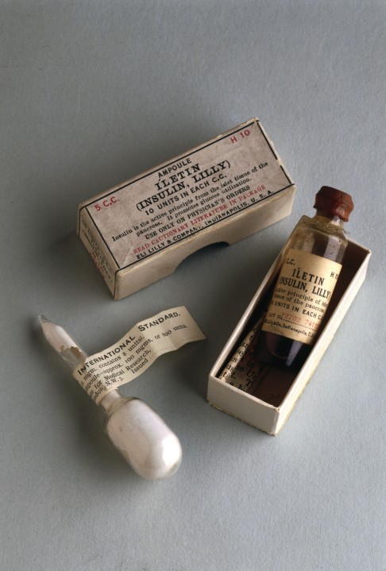

Insulin Finally Available - 1922

Slide 104


The Miracle of Insulin
Patient J.L., December 15, 1922
February 15, 1923

Slide 105

Psychological Insulin Resistance (PIR)
50% of providers in study threatened pts “with the needle”.
Less than 50% of providers realized insulins’ positive effect on type 2 dm
Most pts don’t believe that insulin would “better help them manage their diabetes”.
Solutions: Find the root of PIR and address
Diabetes Attitudes, Wishes, Needs Study - Rubin

Slide 106

Needle Size often a Barrier
Size Does Matter
Use more short needles – 4 mm
Effective for pts with BMI of 24- 49
Keeps it subq
If pt thin, inject at angle
To avoid leakage, count to 10 before withdrawing needle
½ the patients who could benefit from insulin are not using it due to needle phobias

Slide 107
Physiologic Insulin Secretion:
24-Hour Profile
50
Insulin
(µU/mL)
Bolus Insulin
25
0
Basal Insulin
Breakfast Lunch Dinner
150
Glucose
(mg/dL)
100
Mealtime Glucose
50
Basal Glucose
0
7
8
9
10
11
12
1
2
3
4
5
6
7
8
9
A.M.
P.M.
Time of Day

Slide 108
Insulin Action Teams
Bolus: lowers after meal glucose levels
  Very Rapid Acting – Aspart (Fiasp)
  Rapid Acting
    Aspart, Lispro, Admelog, Glulisine, Afrezza
  Short Acting - Regular
Basal: controls glucose between meals, hs
  Intermediate
    NPH
  Long Acting
    Detemir (Levemir)
    Glargine (Lantus, Basaglar)
    Degludec (Tresiba)

Slide 109

Case Study
70 yr old, weighs 100kg
History of CABG, tobacco
A1c – 11.3%, BG 400-500 for past weeks
Insulin – 100+ units Lantus at hs (solostar)
Oral Meds: Metformin, Invokana
What is a better insulin dosing strategy?
Pt can’t afford insulin pen – what other option
Diabetes Meds on a Budget - 2014 - provides practical and affordable strategies to manage hyperglycemia

Slide 110

Cost Per Vial in Northern CA

Slide 111


Slide 112
Bolus Insulins
(½ of total daily dose ÷ meals)
Name Onset Peak Action
Aspart (Fiasp) 2.5 min 1 hour
Aspart (NovoLog) 15-30 min 1-1.5 hrs
Lispro
(Humalog, Admelog)
Glulisine (Apidra)
Afrezza (Inhaled)
Regular 30 mins 2-4 hrs

Slide 113


Aspart (Fiasp)
New Aspart formulation, which includes the addition of niacinamide (vitamin B3) to increase absorption speed
Appears in blood in ~ 2.5 mins.
Faster onset and offset.
Starts working within minutes
Can be taken as long as 20 minutes after starting a meal.
Fiasp available in Flex Touch Pens and 10mL vials.

Slide 114




BioSimilars - Lispro (Admelog) - bolus
Glargine (Basaglar) – basal
Can’t use the term generics for large molecule biologicals because they are manufactured in living organisms (bacteria and yeast)
Each batch may be slightly different
Correct term is “biosimilar”
Currently - Pharmacist to contact Provider before switching to biosimilar
  Future – may be same as generics
Insulin – Large Molecule
Aspirin – Small Molecule

Slide 115



More than 200 units a day?

Slide 116


Slide 117



Consider U-500 High Potency Insulin
5 x’s the concentration of u100
500 units per mL vs 100 units per mL
  20 mL a vial. 500 units per mL= 10,000 units/vial
  Costs ~ $400 $1,200 per vial
  Less volume

Slide 118
Bolus Insulin Summary
Regular, aspart, lispro, glulisine,
Starts working fast (15-30 mins)
Gets out fast (3-6 hours)
Post meal BG reflects effectiveness
Should comprise about ½ total daily dose
Covers food or hyperglycemia.
1 unit
  Covers ≈ 10 -15 gms of carb
  Lowers BG ≈ 30 – 50 points

Slide 119
Bolus Insulin Timing
How is the effectiveness of bolus insulin determined?
  2 hour post meal (if you can get it)
  Before next meal blood glucose
Glucose goals (ADA) – may be modified by provider/pt
  1-2 hours post meal <180
  Before next meal – 80 - 130

Slide 120


Pattern Management –AKA
How to think
like a pancreas

Slide 121
Pattern Management
Safety 1st!! - Evaluate 3 day patterns
Hypo: eval 1st and fix:
  If possible, decrease medication dose
  Timing of meals, exercise, medications
Hyperglycemia: evaluate 2nd
  Identify patterns
  Before increase insulin, make sure not missing something (carbs, exercise, omission)

Slide 122
Bolus – Insulin Sliding Scale
Starts at 150, 2 units for every 50 mg/dl >150

Slide 123
Basal Insulins
(½ of total daily dose)
Intermediate Acting Peak Action Duration
NPH 4-12 hrs 12-24
Long Acting Peak Action Duration
Detemir (Levemir) No Peak 20 hrs
Glargine (Lantus) 24 hrs
Glargine (Basaglar) 24 hrs
Degludec (Tresiba) 42 hrs
Fasting BG reflects efficacy of basal

Slide 124
Basal Insulin Summary
NPH, Levemir, Lantus, Degludec
Covers in between meals, through night
Starts working slow (4 hours)
Stays in long (12-24 hours)
  NPH 12 hrs
  Levemir, Lantus 20-24 hrs
  Degludec – 42 hours
Fasting blood glucose reflects effectiveness

Slide 125

Basal + Metformin
Type 2, 80kg – A1c 8.7%

Slide 126
Next Steps
When is it too much basal insulin?
  If basal insulin is >0.5 units/kg day, advance to combination injectable therapy
    Add bolus, switch premixed 70/30 or to Basal + GLP-RA
Pt is at max basal dose
  80 x 0.5 = 40 units

Slide 127


Slide 128
Combo Sub-Q Insulin

Slide 129
Next Steps – Switch from 40 units basal to 70/30 Insulin
Switch to 70/30 Insulin
Take current dose and give 2/3 in am and 1/3 in pm.
  2/3 of basal in am
    40 units x 0.6 = 24 units 70/30
  1/3 of basal in *pm
    40 units x 0.4 = 16 units 70/30
  *pm = before dinner

Slide 130
24u 70/30 am, 16 u 70/30 pm
Patterns? Changes needed?

Slide 131
What Medications Cause Hypoglycemia?
Insulin
Sulfonylureas
Meglitinides
Or any combo medication that includes these

Slide 132
Sulfonylureas - Squirts
Action: Increase endogenous insulin secretion throughout day
Efficacy:
  Decrease FPG 60-70 mg/dl
  Reduce A1C by 1.0-2.0%
Side Effects:
  Weight gain, hypoglycemia
Benefits:
  Cheap, effective
Notes:
132
132
Sulfonylureas (SUs) increase insulin secretion by binding to receptors on the surface of pancreatic beta cells, triggering a series of reactions which leads to insulin secretion.
Because SUs cause circulating insulin levels to increase, there is a risk of hypoglycemia. There is also some concern that increased insulin levels are associated with cardiovascular disease, however the UKPDS did not show a relationship between increased mortality and SU administration. Finally, there is concern that SUs will exhaust beta cell function by increasing insulin secretion. However, the decline in beta cell function is more likely caused by the disease itself, and not the use of SUs.
First generation sulfonylureas are just as efficacious as the second generation drugs, however the second generation may be more potent and safer than first. When diet and exercise fail, SUs are an effective monotherapy.

Slide 133
Hypoglycemia = “Limiting Factor”
Defined as glucose of 70mg/dl or below
50% of episodes occur during the night
Higher mortality rate with severe hypoglycemia secondary to sulfonylureas
  Especially (glyburide) Micronase®, Diabeta®
Blood glucose levels don’t describe severity, response is individual

Slide 134

Hypoglycemic Symptoms
Autonomic
  Anxiety
  Palpitations
  Sweating
  Tingling
  Trembling
  Hypoglycemic Unawareness
Neuroglycopenia
  Irritability
  Drowsiness
  Dizziness
  Blurred Vision
  Difficulty with speech
  Confusion
  Feeling faint

Slide 135
Treatment of Hypoglycemia
If blood glucose 70mg/dl or below:
  10-15 gms of carb to raise BG 30 - 45mg/dl
Retest in 15 minutes, if still low, treat again, even without symptoms
Follow with usual meal or snack
If non responsive, give D50 IV or glucagon Emergency Kit
Figure out how to prevent in future

Slide 136
15 - 20 Gms Carb Sources
4 ounces apple juice
3 - 4 Glucose Tablets
8 - 10 Lifesavers candy
8 - 10 Hard candies
2 Tablespoons Raisins
4 - 6 oz’s Nondiet soda
4 - 6 oz’s Fruit Juice
8 oz Milk (non fat)

Slide 137





Slide 138
Basal Bolus – What Adjustments?
Pt weighs 80kg

Slide 139
Intensive Diabetes Therapy
Insulin Dosing Strategy
50/50 Rule
0.5-1.0 units/kg day
Basal = 50% of total
  Glargine QD
  NPH or Detemir BID
Bolus = 50% of total
  usually divided into 3 meals
Example
Wt 50kg x 0.5 = 25 units of insulin/day
Basal dose: 13 units
  Glargine 13 units QD
  NPH/Detemir 6u BID
Bolus dose: 12 units
  4 units NovoLog, Apidra Humalog, Regular each meal

Slide 140
Intensive Diabetes Therapy
Insulin Dosing Strategy
50/50 Rule
0.5-1.0 units/kg day
Basal = 50% of total
  Glargine QD
  NPH or Detemir BID
Bolus = 50% of total
  usually divided into 3 meals
Example – You Try
Wt 60 kg x 0.5 = ___ units of insulin/day
Basal dose: ____ units
  Glargine ____ QD
  NPH/Detemir __ BID
Bolus dose: ____ units
___units NovoLog, Apidra Humalog, Reg each meal

Slide 141
Intensive Diabetes Therapy
Insulin Dosing Strategy
50/50 Rule
0.5-1.0 units/kg day
Basal = 50% of total
  Glargine QD
  NPH or Detemir BID
Bolus = 50% of total
  usually divided into 3 meals
Example – You Try
Wt 60kg x 0.5 = 30 units of insulin/day
Basal dose: 15 units
  Glargine 15 QD or
  NPH/Detemir 7u BID
Bolus dose: 15 units
  5 NovoLog, Apidra, Humalog, Reg each meal

Slide 142
Basal Bolus – Using 50/50 Rule - Pt weighs 80kg

Slide 143
Insulin Teaching Keys
Bolus insulin with meals
Basal 1-2xs daily
Abdomen preferred injection site
Stay 1” away from previous site
Don’t re-use ultra fine syringes
Keep unopened insulin in refrigerator
Toss opened insulin vial after 28 days
Proper disposal
Review patients ability to withdraw and inject.
Side effects include hypoglycemia/wt gain
Insulin pens –
    Prime needle to assure accurate insulin dose given
    Hold needle in for 5 seconds after injection
    Roll 70/30 pens

Slide 144


Sharps Disposal: Product and Info
Look in the Government section white pages for a household hazardous waste listing for your city or county.
Call 1-800-CLEANUP (1-800-253-2687)
Search for collection centers on the California Integrated Waste Management Board (CIWMB) Web site: http://www.ciwmb.ca.gov/HHW/HealthCare/Collection/

Slide 145

Diabetes Vacations

Slide 146
Diabetes Bingo
“DiaBingo” Shout out Right Answer

Slide 147
DiaBingo - N
N DPP demonstrated that exercise and diet reduced risk of DM by__%
N Average A1c of 7% = Avg BG of ____
N An _____a day can help prevent heart attack and stroke
N Rebound hyperglycemia
N Scare tactics are effective at motivating patients to change behavio
N Losing ___ % of body weight, can improve blood glucose, BP, lipids
N Drugs that can cause hyperglycemia
N 2/3 cups of rice equals ______ serving carbohydrate
N One % drop in A1c reduces risk of complications by ___ %
N 1 gm of fat equal _____kilo/calories
N Metabolic syndrome = hyperinsulinemia, hyperlipidemia, hypertension
N Average American consumes 15 teaspoons of sugar a day.
N Medication that was derived from the saliva of the Gila Monster

Slide 148


Slide 149



U.S. Weight - 68% overweight or obese
34% BMI 25-29
34% BMI 30 +
1/3 of all overwt people don’t get diabetes
We burn 100 cals less a day at work
Overall, food costs ~ 10-15% of income
Calorie Intake is on the rise

Slide 150

Bigger Meals, Bigger Kids

Slide 151

Average American Consumes
22 teaspoons of added sugar a day
WHO and AHA – Goal 6 teaspoons a Day
1 tsp = 4 gms sugar (15 cals)
15cals x 22 teaspoons a day =
  330 cals a day just from added sugars
One soda has 12 tsps sugar
New labels will list added sugar

Slide 152


Reduce refined Carbs, Added Sugars - ADA
To control wt, reduce risk of CVD and fatty liver disease
ADA strongly discourages consumption of:
  Sugar sweetened beverages
  Processed “low-fat” or “non-fat” foods with high amounts of refined grains & added sugar
Sugary and processed foods can displace healthier, more nutrient dense food choices

Slide 153

Your health can only get better

Slide 154


In the Beginning
Earth
Human
Spirit

Slide 155



Bacterial Cells Outnumber Human Cells 10 to 1
10 trillion human cells
Host 100 trillion bacterial and fungal cells

Slide 156

Poll Question
How much does your gut bacteria weigh?
  A. 24 ounces
  B. 3 pounds
  C. Less than 1 pound
  D. 1.5 pounds
  E . Not sure

Slide 157

3 lbs of Microbes in our Gut
This community of bacteria can be thought of as an extra 'organ' "microbiome".
We have evolved together with our microbiome over millions of years.
Ratios of these communities has changed over the past 30 years
Mirrors global spikes in obesity, diabetes, allergic and inflammatory diseases
What are we doing to change these bacteria?

Slide 158

Weight and Gut Bacteria
New and Early Research
Leaner people appear to have more bacterial diversity and a higher proportion of bacteroidetes
  Gut bacteria less efficient at converting food to calories
Obese people appear to have higher levels of firmicutes
  Gut bacteria very efficient at calorie extraction
Bacteria tend to run in families

Slide 159
Getting to Better Gut Bacterial Health
Eat more PREbiotics
PRObiotics
Foods with indigestible fibers that nourish the good bacteria:
  High fiber foods like, whole grains, fruits, veggies, nuts
  High in prebiotic fibers include: Jerusalem artichokes, onions, kale, Brussels sprouts, bananas, dandelion greens & more
These foods contain healthy bacteria like Bifidobacterium and lactobacillus.
  Yogurt, Kefir – look for “live or active cultures”
  Fermented foods like: Sauerkraut, Kimchi, Miso soup, kombucha

Slide 160

Follow Your Gut – Dr. Rob Knight
Check out Dr. Knight’s:
TED Talk
Website –AmericanFoodProject.org
Articles in Nature and all over

Slide 161

Take Home Message
Get Dirty
Limit Unnecessary C-Sections
Breastfeed if possible
Limit early antibiotics
Eat a wide variety of fiber foods

Slide 162
Medical Nutrition Therapy – ADA
Focus on the Individual
Maintain pleasure of eating
Provide positive messages about food
Limit food choices only when backed by science
Provide practical tools
Refer to a RD and Diabetes Education – Lowers A1c by 1-2%

Slide 163


Slide 164


Slide 165
Approach Depends on Patient
New Type 2
  Portion Control
  Plate Method
  Record Keeping
  Education
On Insulin?
  Carb counting
  Post prandial checks

Slide 166

Successful weight loss strategies include
Weekly self-weighing
Eat breakfast
Reduce fast food intake.
Decrease portion size
Increase physical activity
Use meal replacements
Eat healthy foods
Drink Water
Sleep

Slide 167

Healthy Eating Patterns
Mediterranean Diet
DASH Diet
Plant based eating
Diabetes Plate Method
Weight Watchers or other groups

Slide 168

Mediterranean Diet Pyramid

Slide 169
10 SuperFoods
Beans
Dark Green Leafy Vegs
Citrus Fruit
Sweet Potatoes
Berries
Tomatoes
Fish High in Omega-3 Fatty Acids
Whole Grains
Nuts
Fat-Free Milk and Yogurt
As posted on diabetes.org website

Slide 170

Another plate example

Slide 171

Carbohydrate Needs for
Most Adults
Grams Servings
Each Meal 45-60 gm 3 - 4
Snacks 15-30 gm 1- 2
Carbs affect Post Meal Blood Glucose

Slide 172
Ms. Gonzales’ Daily Meal plan

Slide 173
Using Alcohol Safely
Women- 1 or fewer alcoholic drinks a day
Men 2 or fewer alcoholic drinks a day
  1 alcoholic drink equals
    12 oz beer, 5 oz glass of wine, or 1.5 oz distilled spirits (vodka, gin etc)
If drink, limit amount and drink w/ food.
Ask HCP if safe for you to drink. Tell them your usual quantity and frequency.
Can cause hypo and worsen neuropathy

Slide 174










Carb Counting - Starch
Each Food has:
80 Calories
15 grams carb
1 small ear of corn or 1/2 cup corn
1/3 cup cooked pasta
1/2 cup
cooked beans
3/4 cup cold cereal
1 slice bread
1/3 cup cooked rice
1 small potato
1/2 English muffin
1 small tortilla
5-6 small crackers

Slide 175









Carb counting- fruit
Each Food has:
60 Calories
15 grams carb
½ cup fruit juice
½ banana
1 small fresh fruit
½ cup unsweetened apple sauce
1 slice bread
17 small grapes
1 cup melon
¼ cup dried fruit
2 tbsp raisins
1 1/4 cup strawberries

Slide 176







Carb Counting - Milk
Each Food has:
90-150 calories
12-15 grams carb
8 oz buttermilk
1 packet diet hot cocoa
1 slice bread
6 oz plain yogurt
8 oz milk
6 oz light fruit yogurt
8 oz soy milk

Slide 177









Carb Counting - Sweets
Each Food has:
Calories vary
15 grams carb
2 inch square cake or brownie, unfrosted
½ cup regular jello
2 tbsp light syrup
½ cup diet pudding
1 slice bread
1 tbsp syrup, jam, jelly, table sugar, honey
2 small cookies
¼ cup sorbet
½ cup ice cream or frozen yogurt
½ cup sherbet

Slide 178

Give the gift of Non-Judgment

Slide 179

100 Trillion Friends to Call Your Own
From the way back when, to current time
man and bacteria have been intertwined.
Start with your head, it's a happening place,
there's staphylococcus all over your face.
Next up is gums, teeth and mouth,
You'll find streptococcus inside and out!
Now to your stomach, to keep the pH,
H. pylori is on the case!
Inside the intestines, 30 feet of tube,
3 pounds of bacteria digesting your food.
From Bacteroidetes to keep you lean,
to Firmicutes, a junk food digesting machine!
Prevotella another bug on the scene,
breaks down fiber, veggies and beans!
Lactobacillus is a newborn's friend,
lining birth canal from tip to end.
Down to your feet, in-between the toes,
that's where lots of pseudomonas grows!
Short chain fatty acids, you wanna keep them around
Protects gut mucous lining from breakin’ down
So here’s my message, always nourish your gut
With fresh fruit, grains, veggies, beans and nuts
More kefir, miso, sauerkraut, kimchi
Less sugar and fast foods to keep away disease
Breast feed, get dirty, limit antibiotic use
Let newborns come out through the natural shoot
Be reassured that you're never alone
You've got 100 trillion friends to call your own!
Copyright Diabetes Education Services© May not be used without written permission. www.DiabetesEd.net
100 Trillion Friends to Call Your Own by Beverly Thomassian, RN, MPH, CDE, BC-ADM to the tune “Yeah” in the style of Usher.

Slide 180

Thank You
Questions?
Email bev@diabetesed.net
Web www.diabetesed.net

