Slide 1


ADA/EASD Meds Update, Solving Glucose Mysteries, 3 Steps to DeFEET Amputations
Beverly Dyck Thomassian, RN, MPH, BC-ADM, CDCES
President, Diabetes Education Services
www.DiabetesEd.net

Slide 2

Coach Bev has no Conflict of Interest
She’s not on any speaker's bureau
Does not invest or have any financial relationships with diabetes related companies.
Gathers information from reading package inserts, research and articles
The ADA Standards of Medical Care is main resource for course content

Slide 3

Diabetes Overview and Glycemic Goals
Objectives:
1. Discuss current state of diabetes in the U.S.
2. Describe goals of care.
3. Summarize the new ADA/ EASD Management Guidelines.
4. Apply new guidelines to individual case studies.

Slide 4
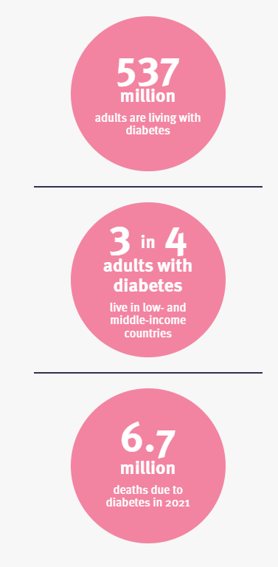
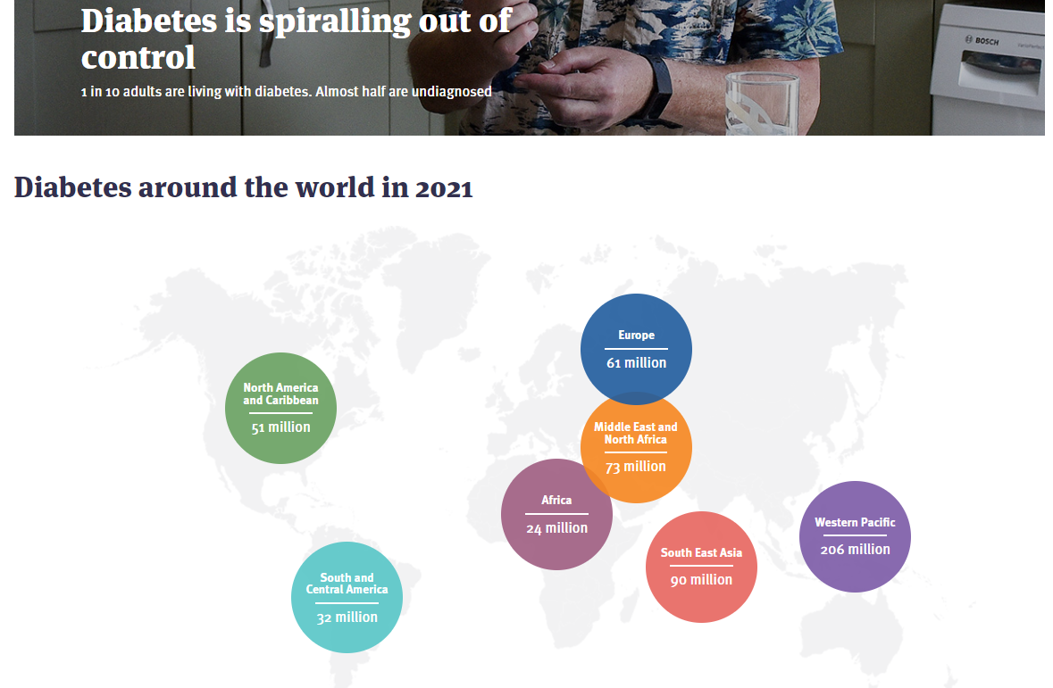


Global Epidemic
www. DiabetesAtlas.org
World Diabetes Day is November 14

Slide 5
CDC Announces
35% of Americans will have Diabetes by 2050
Boyle, Thompson, Barker, Williamson
2010, Oct 22:8(1)29
www.pophealthmetrics.com

Slide 6
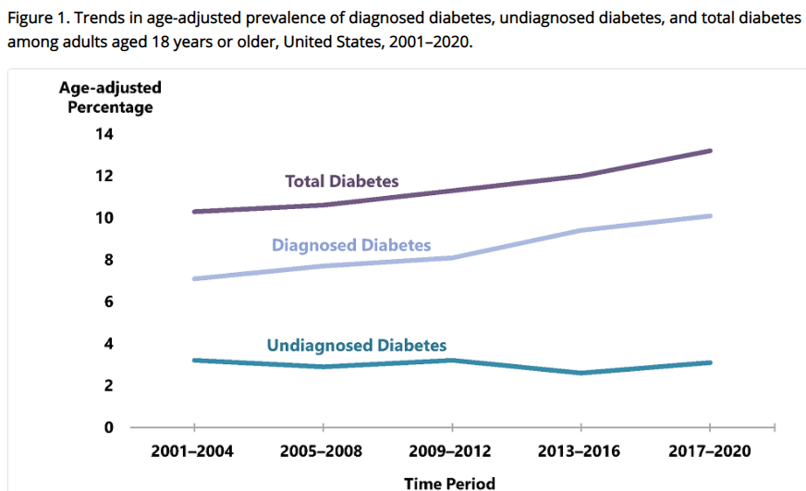
Diabetes in America 2022 - CDC
11% of adults have diabetes (37.3 mil)
23% of those don’t know they have diabetes
38% of adults have prediabetes (96 mil)
19% reported being told they have prediabetes.
CDC 2022 Report https://www.cdc.gov/diabetes/data/statistics-report/diagnosed-diabetes.html
www.DiabetesEd.net

Slide 7
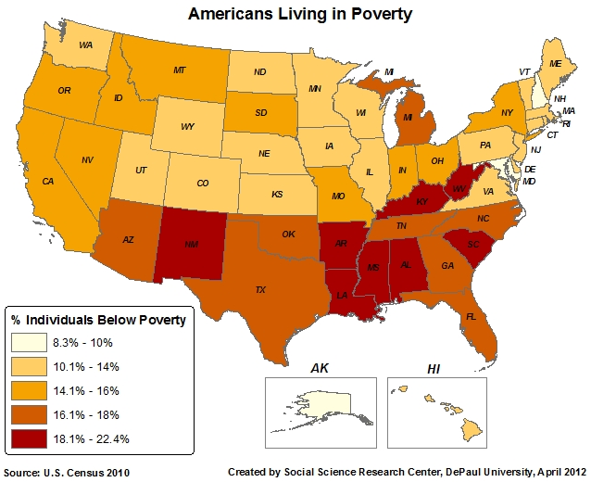
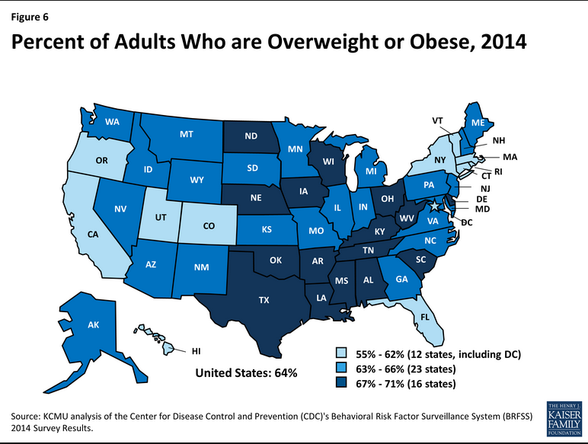
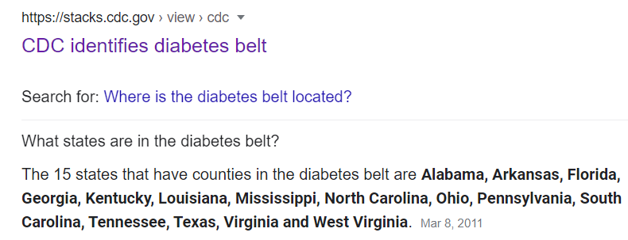
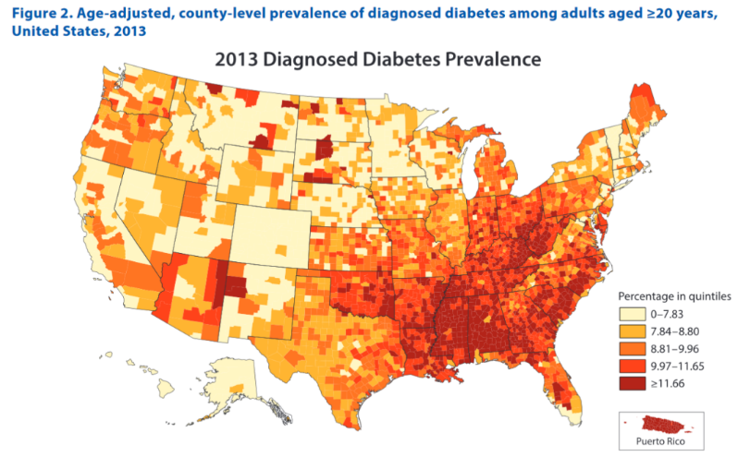
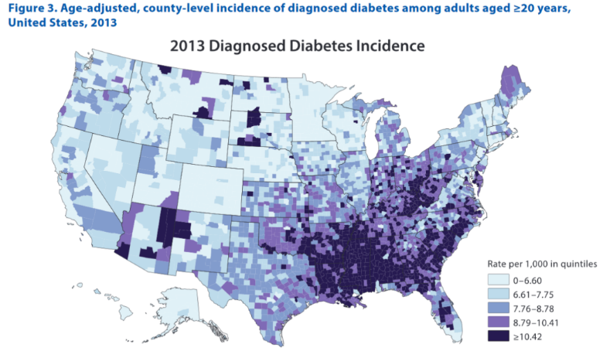
Geography of Diabetes, Poverty, Weight – Diabetes Belt

Slide 8
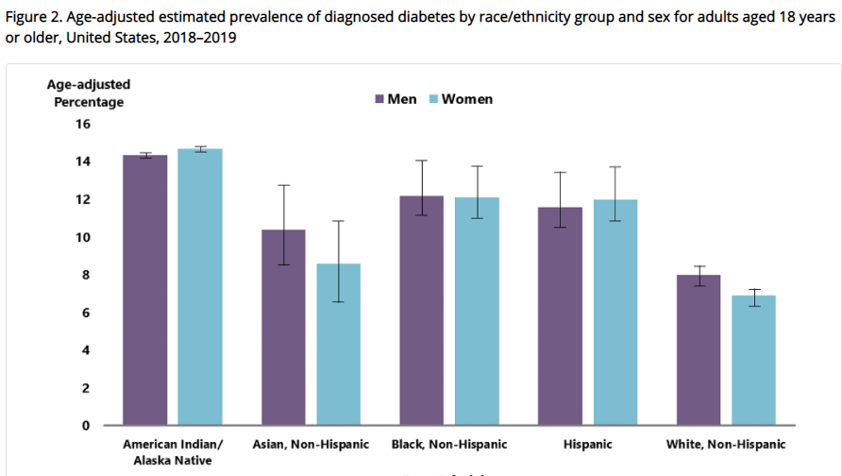
Diagnosed Diabetes by Ethnic Group
Highest prevalence among
Indigenous people
Mexican and Puerto Ricans
Asian Indians and Filipinos
https://www.cdc.gov/diabetes/data/statistics-report/diagnosed-diabetes.html

Slide 9

Socioeconomics – Diabetes Diagnosis
Prevalence varied significantly by education level, an indicator of SES status
13.4% - Less than high school education
9.2% - High school education
7.1% - More than high school education
CDC 2022

Slide 10

1. Improving Care and Promoting Health in Populations
Population Health includes:
Outcomes (mortality, morbidity)
Disease burden (incidence and prevalence)
Behavioral and metabolic factors (A1c, MNT, exercise
Diabetes annual cost 2017 - $327 bil
Targets
64% of ind’s met A1c targets
70% achieved BP targets
57% met LDL target
In total, 23% met all targets

Slide 11


Now, let’s get to the Nitty Gritty

Slide 12



Slide 13
Hormones Effect on Glucose
Effect



⇒
⇒
⇒
Hormone
Glucagon (pancreas)
Stress hormones (kidney)
Epinephrine (kidney)
Insulin (pancreas)
Amylin (pancreas)
Gut hormones - incretins (GLP-1) released by L cells of intestinal mucosa, beta cell has receptors)

Slide 14
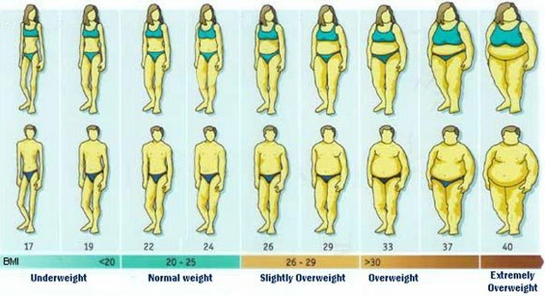
Updated BMI Categories
Experiencing Underwt Healthy weight Experiencing overwt Experiencing obesity

Slide 15




Slide 16

What is Type 2 Diabetes?
Complex metabolic disorder ….
(Insulin resistance and deficiency)
with social, behavioral and environmental risk factors unmasking the effects of genetic susceptibility.
New Diagnosis? Call 800 – DIABETES to request “Getting Started Kit”
www.Diabetes.org

Slide 17

Ominous Octet
Decreased satiation neuro-
transmission
Decreased amylin, β-cell secretion
80% loss at dx
Increased renal glucose reabsorption
Decreased Gut hormones
Increased glucagon secretion
G
I
G
I
G
G
I
I
G
Increased lipolysis
G
G
I
I
G
G
I
Increase glucose
production
I
G
G
Decreased glucose
uptake
Notes:
17
17

Slide 18

ABCs of Diabetes
A1c less than 7% (avg 3 month BG)
Pre-meal BG 80-130
Post meal BG <180
Blood Pressure < 140/90
BP target <130/80
With CVD or if 10 year CVD Risk > 15%
Cholesterol
Statin therapy

Slide 19


A1c and Estimated Avg Glucose (eAG)
A1c (%) eAG__
5 97 (76-120)
6 126 (100-152)
7 154 (123-185)
8 183 (147-217)
9 212 (170 -249)
10 240 (193-282)
11 269 (217-314)
12 298 (240-347)
eAG = 28.7 x A1c-46.7 ~ 29 pts per 1%
Translating the A1c Assay Into eAG – ADAG Study

Slide 20


Slide 21
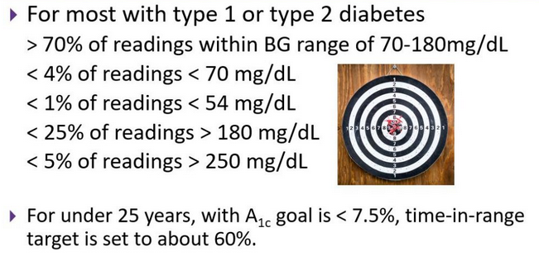
Ambulatory Glucose Profile
Standardized report with visual cues for those on CGM devices
Evaluate Time in Range (TIR)
Target 70-180 mg/dL

Slide 22
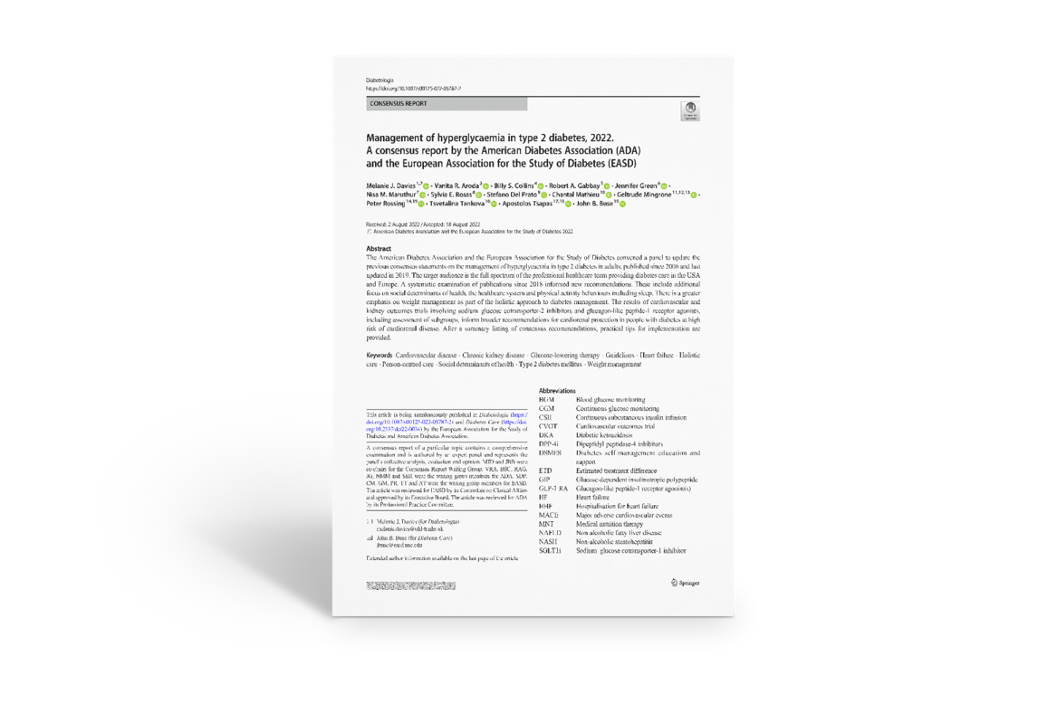
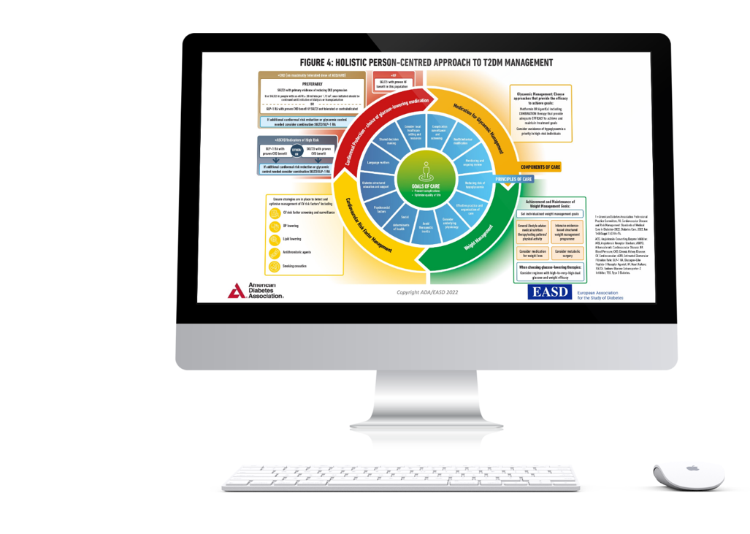
NEW! ADA & European Association for the Study of Diabetes (EASD) Consensus Management of Hyperglycemia in Type 2
Sept 23, 2022
Davies MJ, Aroda VR, Collins BS, Gabbay RA, Green J, Maruthur NM, Rosas SE, Del Prato S, Mathieu C, Mingrone G, Rossing P, Tankova T, Tsapas A, Buse JB Diabetes Care 2022; https://doi.org/10.2337/dci22-0034. Diabetologia 2022; https://doi.org/10.1007/s00125-022-05787-2.

Slide 23
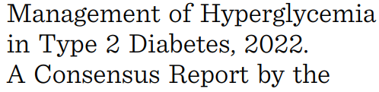
ADA & European Association for the Study of Diabetes (EASD) Consensus Management of Hyperglycemia Type 2
Davies MJ, Aroda VR, Collins BS, Gabbay RA, Green J, Maruthur NM, Rosas SE, Del Prato S, Mathieu C, Mingrone G, Rossing P, Tankova T, Tsapas A, Buse JB Diabetes Care 2022; https://doi.org/10.2337/dci22-0034. Diabetologia 2022; https://doi.org/10.1007/s00125-022-05787-2.

Slide 24
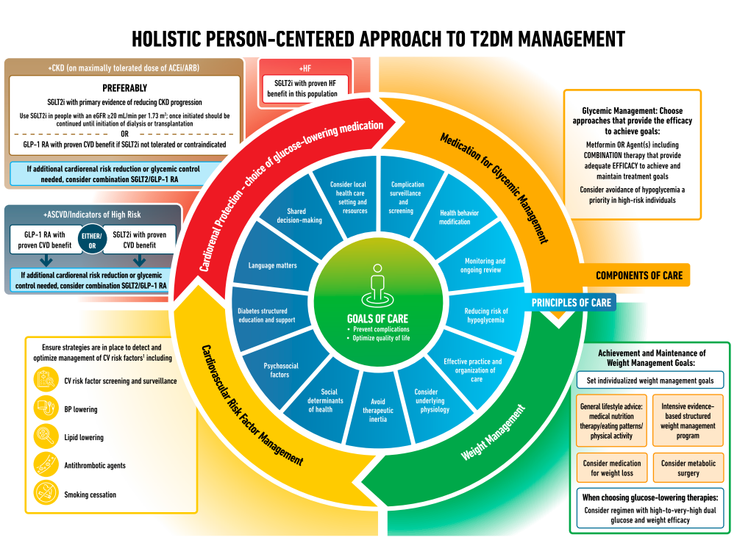
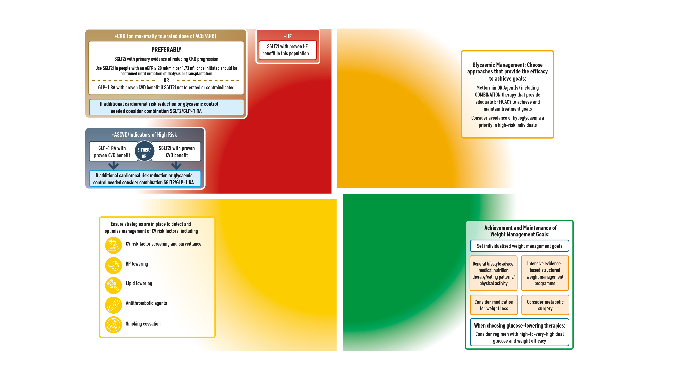
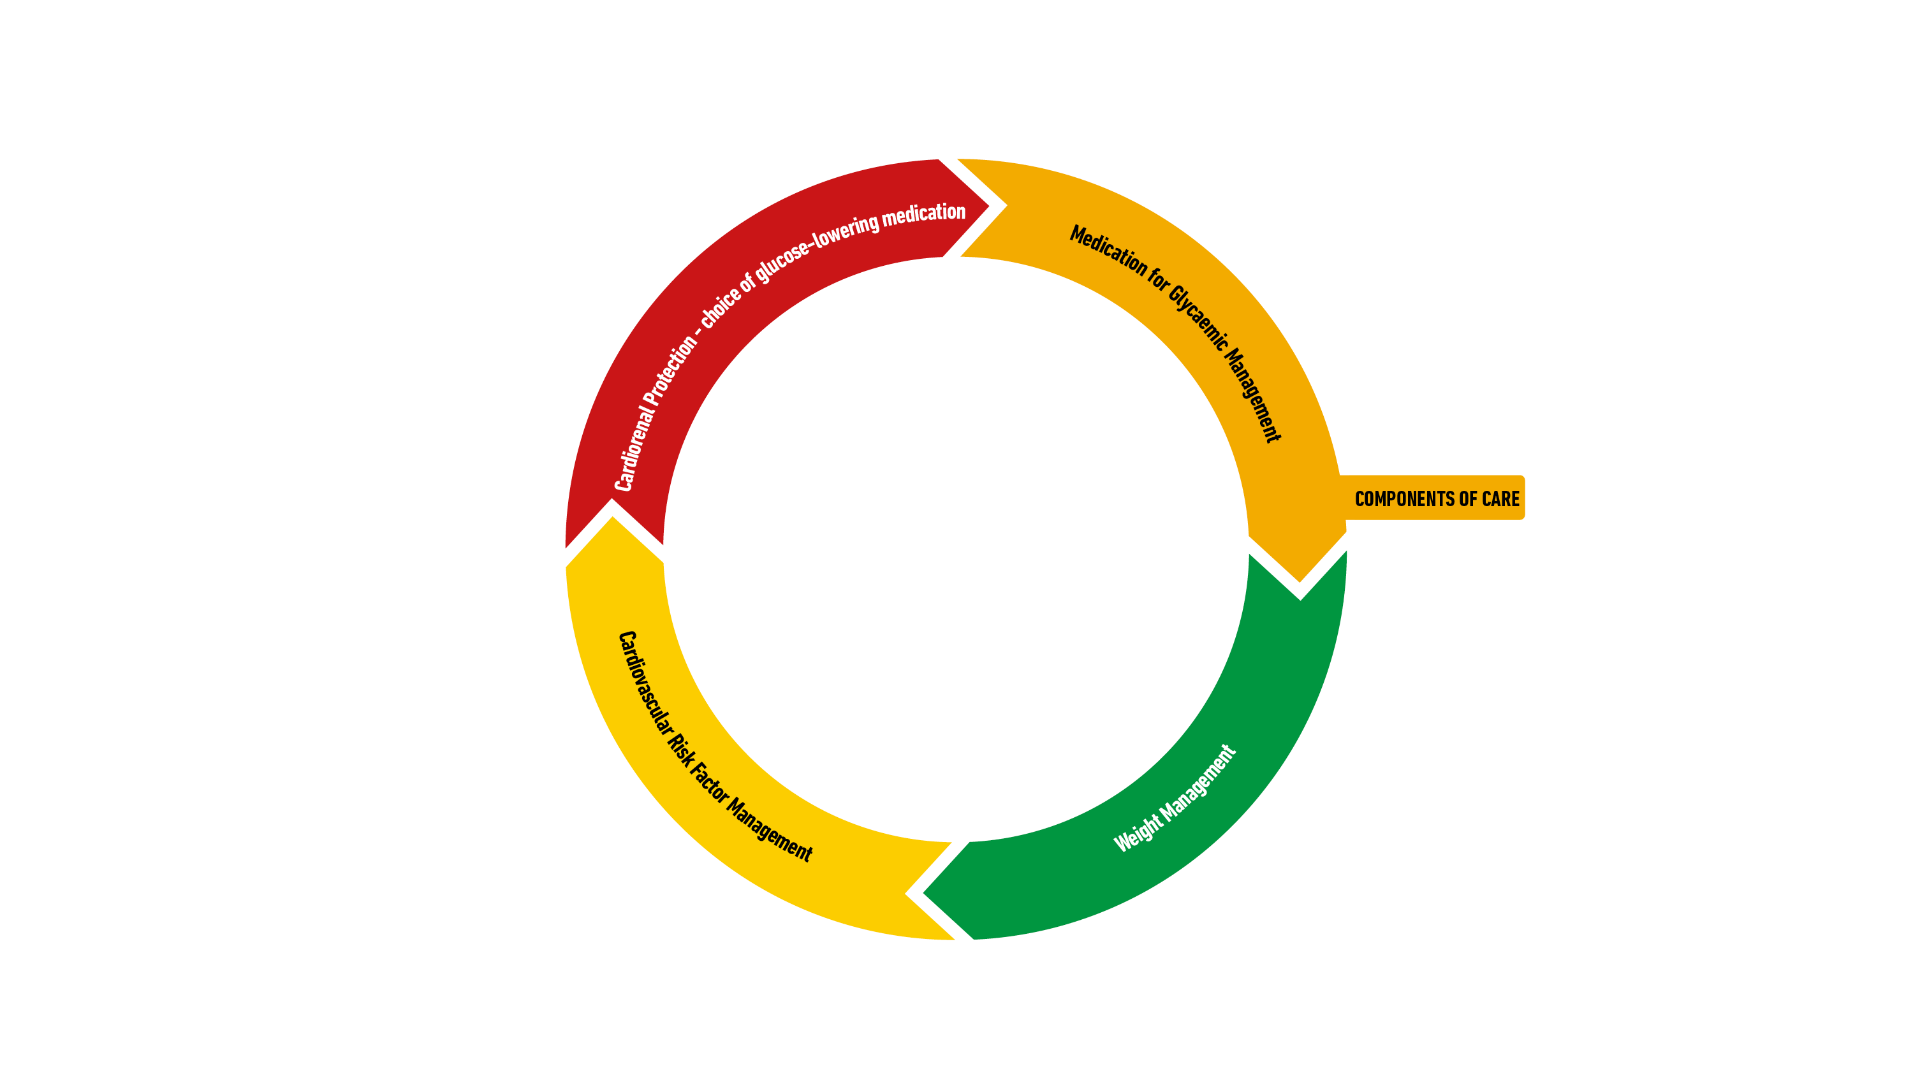
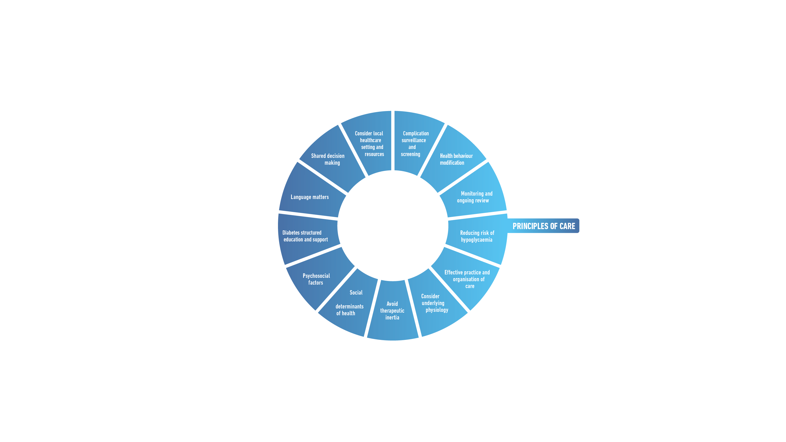

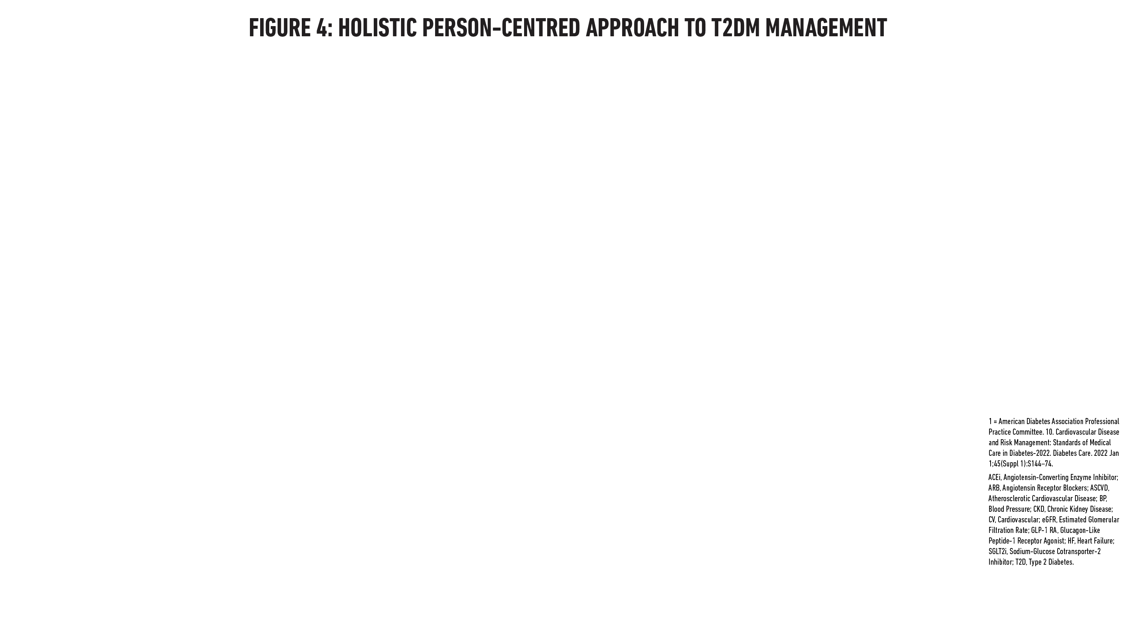
Davies MJ, Aroda VR, Collins BS, Gabbay RA, Green J, Maruthur NM, Rosas SE, Del Prato S, Mathieu C, Mingrone G, Rossing P, Tankova T, Tsapas A, Buse JB Diabetes Care 2022; https://doi.org/10.2337/dci22-0034. Diabetologia 2022; https://doi.org/10.1007/s00125-022-05787-2.

Slide 25
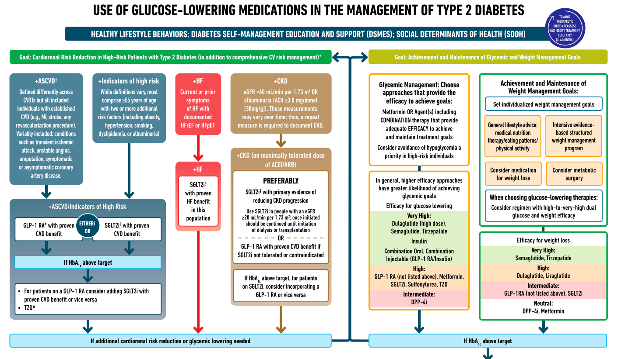
Let’s Break it Down / ADA & EASD

Slide 26
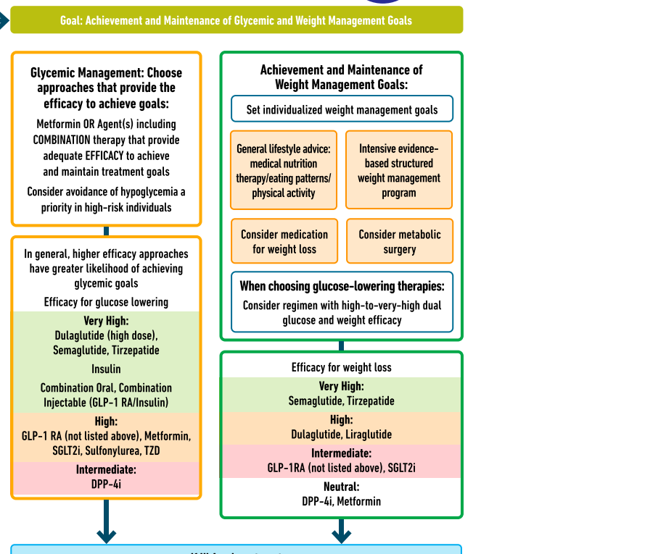
Effective- ness Ranking of Diabetes Meds

Slide 27

Choice of Glucose Lowering Meds
Person centered
Co-conditions
Values and needs
Reduce risk
CV and renal
Affordable
Weight impact

Slide 28


Metformin, Sulfonylureas & DPP-IV Inhibitors

Slide 29

Quick Question 1
KR had GDM, now has prediabetes. Started on Metformin 500mg BID. Which of the following is true?
Metformin can cause kidney problems.
If you forget to take metformin before the meal, hold the dose
Metformin may cause loose stools
Stop metformin if GFR is less than 60.
Notes:
Correction answer: C

Slide 30
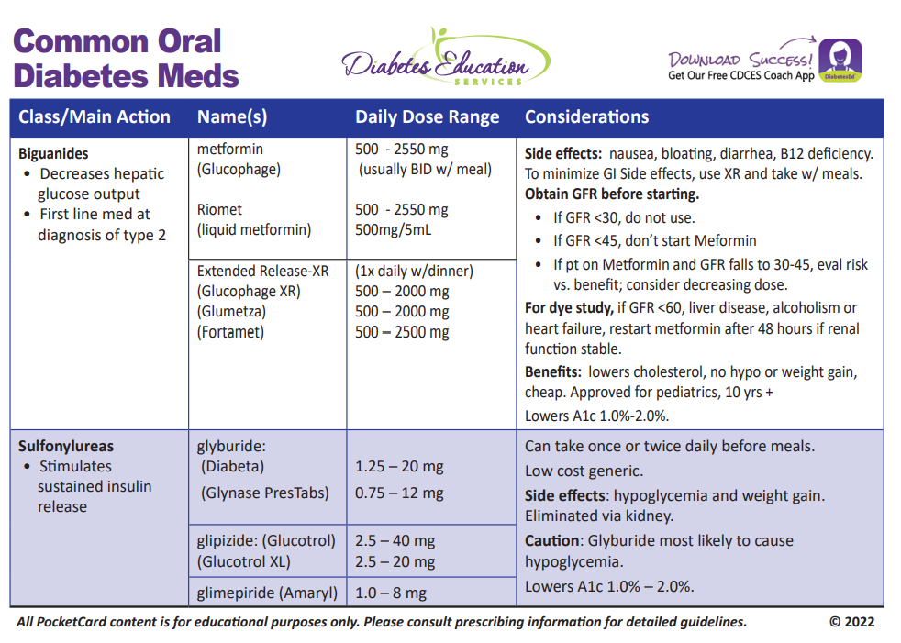

Biguanide derived from:
Goat’s Rue Galega officinalis,
French Lilac
Does NOT harm kidneys
$10 for 3-month supply from Walmart & other pharmacies

Slide 31
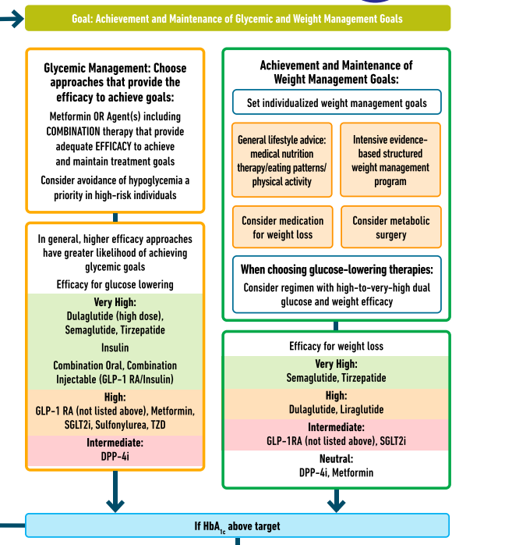
Metformin is “Usually” 1st Line for Type 2 Diabetes
Why metformin?
Longstanding evidence
High efficacy and safety
Inexpensive - 3 months for $12
Weight neutral
If ASCVD, HF or CKD or high ASCVD risk, use SGLT2i or GLP-1 RA +/- metformin

Slide 32

Cost Related Non-Adherence (CRN)
Among people with chronic illnesses, 2/3 of those who reported not taking medications as prescribed due to CRN never shared this with their physician.
*CRN = Cost related non-adherence.
Especially associated with diabetes medications and insulin.

Slide 33

Medication Taking Behaviors
Adequate medication taking is defined as 80%
23% of time, if A1c, B/P, lipids above target - due to med taking behavior
Assess for barriers
If taking meds 80% of time and goals not met, consider medication intensification
Barriers include:
Forgetting to fill Rx, forgetting to take, fear, depression, health beliefs, med complexity, cost, knowledge gap, system factors, etc.
Work on targeted approach for specific barrier

Slide 34
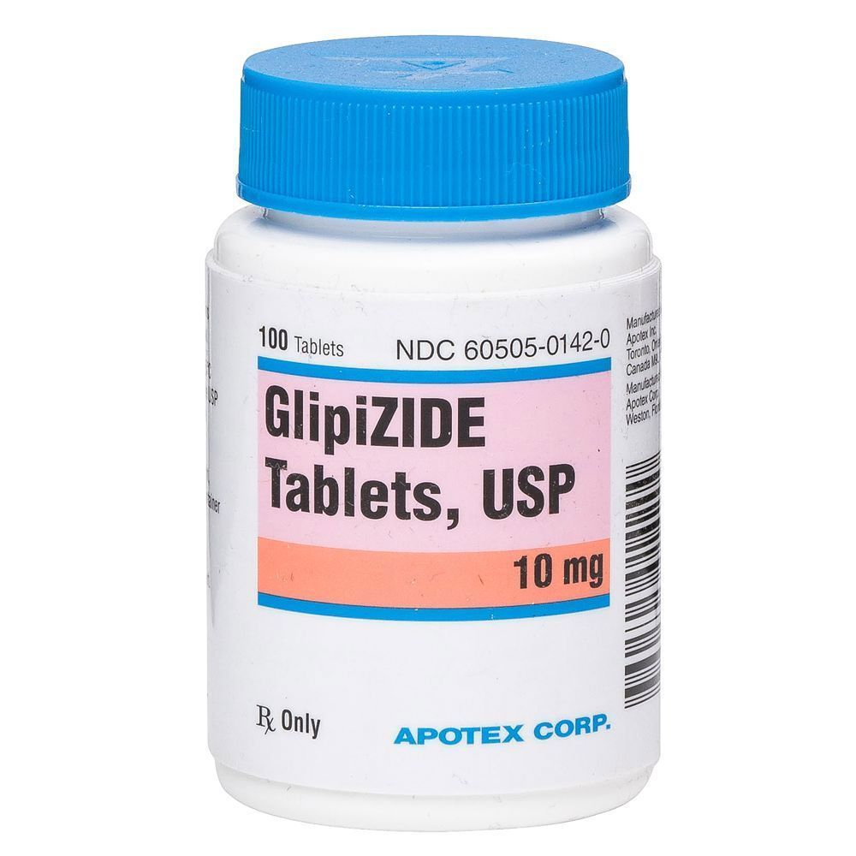
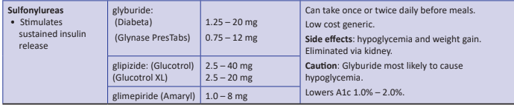
Sulfonylureas
Mechanism: Stimulate beta cells to release insulin
Dosed 1-2x daily before meals
Adverse effects
Hypoglycemia, Weight gain, watch renal function
Low cost, $12 for 3 months supply
Can help with glucose toxicity, lowers A1C 1-2%
Notes:
CAROLINA tral (linagliptin vs glimepiride)
Meta-analysis: In type 2 diabetes, the use of sulfonylureas is associated with increased mortality and a higher risk of stroke

Slide 35

Case Study KR – Poll 2
KR is a 47yoM with type 2 diabetes x 5 years. Complains of dizziness/shakiness 3x/week, especially after surfing. Last A1C=6.7%. Which of their medications is most likely causing hypoglycemia?
A. Metformin
B. Sitagliptin (Januvia)
C. Glimepiride (Amaryl)
D. Pioglitazone (Actos)
Notes:
Answer. C

Slide 36
Preventing Hypoglycemia
Nocturnal Lows
If bedtime glucose <110, reduce meds
If increased daytime activity, may need extra hs snack
Eval pre-dinner insulin/meds
Other
Monitor kidney function / wt loss
Monitor BG trends
Too much meds?
Skipped /delayed meals?
Plan ahead
Alcohol precautions
Exercise planning

Slide 37
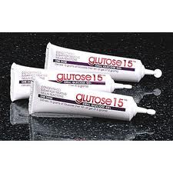
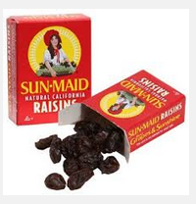
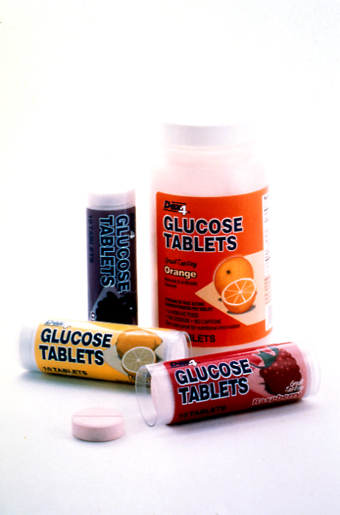


Slide 38
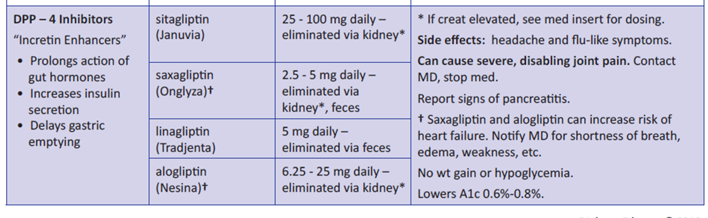
DPP-4 Inhibitors – “Incretin Enhancers” Januvia (sitagliptin) Tradjenta (linagliptin) Onglyza (saxagliptin) Nesina (alogliptin)
Notes:
38
38

Slide 39
Hypoglycemia & Next Steps
Do NOT Cause Hypoglycemia
Can Cause Hypoglycemia
DPP-4 Inhibitor
GLP-1 RA
SGLT-2 Inhibitor
TZD
Sulfonylurea
Meglitinides
Insulin
Diabetes Care 2022;45(Suppl. 1):S125-S143.

Slide 40
Next Step for KR
KR is a 47yoM with type 2 diabetes x 5 years. Complains of dizziness/shakiness 3x/week, especially after surfing. Last A1C=6.7%.
Stopped KR’s glimepiride due to hypoglycemia and wt gain.
Referred to DSME Program and RD/RDN
Had a recent “small stroke”
Goal is to reduce Major Adverse Cardiovascular Events (MACE)
Notes:
Answer. C

Slide 41
Let’s Break it Down / ADA & EASD

Slide 42
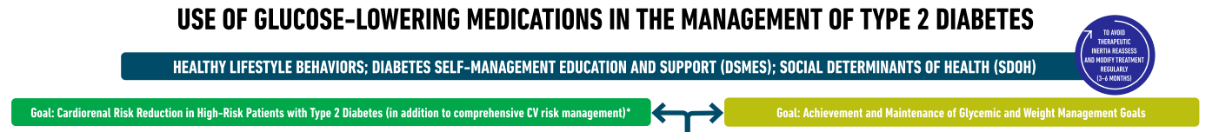
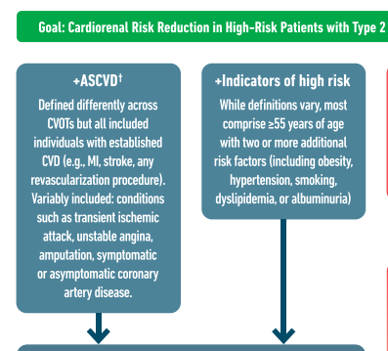
Atherosclerotic Cardiovascular Risk Reduction – High Importance

Slide 43
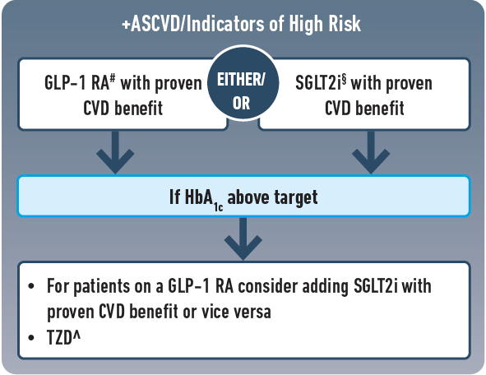
Choosing glucose-lowering medication in people with CVD
Most effective meds based on Cardiovascular Outcomes Trial (CVOT)
GLP-1 RA’s Preferred semaglutide (Ozempic), liraglutide (Victoza), dulaglutide (Trulicity)
~ Or~
SGLT2i Empagliflozin (Jardiance), canagliflozin (Invokana), dapagliflozin (Farxiga)
ASCVD = atherosclerotic cardiovascular disease
Notes:
For people with established atherosclerotic cardiovascular disease or indicators of high risk our recommendation is to choose a GLP-1 receptor agonist or an SGLT-2 inhibitor with proven cardiovascular benefit. In case HbA1c remains above target one should add an agent from the other category or pioglitazone as deemed necessary. Our recommendation is based on the favourable results of cardiovascular outcomes trials that established the favourable effect of GLP-1 receptor agonists and SGLT-2 inhibitors on a series of hard clinical outcomes including major adverse cardiovascular events and all-cause mortality.

Slide 44

GLP & GIP Receptor Agonists
Reduce Major Adverse Cardiovascular Events (MACE)

Slide 45
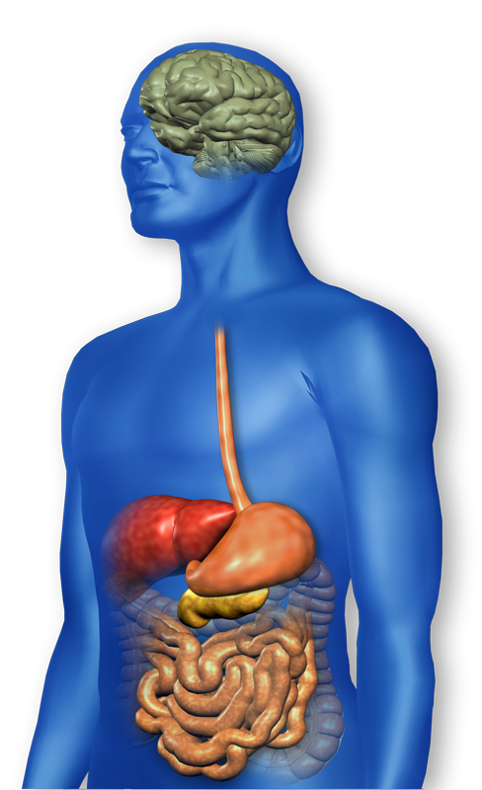
GLP-1 Effects in Humans Understanding the Natural Role of Incretins
GLP-1 secreted upon the ingestion of food
Promotes satiety and reduces appetite
Alpha cells:
↓ Postprandial glucagon secretion
↑ Beta-cell
response
Liver: ↓ Glucagon reduces hepatic glucose output
Beta cells: Enhances glucose-dependent insulin secretion
Stomach: Helps regulate gastric emptying
Adapted from Flint A, et al. J Clin Invest. 1998;101:515-520 Adapted from Larsson H, et al. Acta Physiol Scand. 1997;160:413-422 Adapted from Nauck MA, et al. Diabetologia. 1996;39:1546-1553 Adapted from Drucker DJ. Diabetes. 1998;47:159-169
GLP-1 degraded by
DPP-4 w/in minutes
Notes:
45
45
Required
DISCUSSION POINTS:
--Upon food ingestion, GLP-1 is secreted into the circulation from L cells of small intestine.
--GLP-1 increases beta-cell response by enhancing glucose-dependent insulin secretion.
--GLP-1 decreases beta-cell workload and hence the demand for insulin secretion by:
--Regulating the rate of gastric emptying such that meal nutrients are delivered to the small intestine and, in turn, absorbed into the circulation more smoothly, reducing peak nutrient absorption and insulin demand (beta-cell workload)
--Decreasing postprandial glucagon secretion from pancreatic alpha cells, which helps to maintain the counterregulatory balance between insulin and glucagon
--Reducing postprandial glucagon secretion, GLP-1 has an indirect benefit on beta-cell workload, since decreased glucagon secretion will produce decreased postprandial hepatic glucose output
--Having effects on the central nervous system, resulting in increased satiety (sensation of satisfaction with food intake) and a reduction of food intake
--By decreasing beta-cell workload and improving beta-cell response, GLP-1 is an important regulator of glucose homeostasis.
SLIDE BACKGROUND:
--Effect on Beta-cell: Drucker DJ. Diabetes. 1998; 47:159-169
--Effect on Alpha cell: Larsson H, et al. Acta Physiol Scand. 1997; 160:413-422
--Effects on Liver: Larsson H, et al. Acta Physiol Scand. 1997; 160:413-422
--Effects on Stomach: Nauck MA, et al. Diabetologia. 1996; 39:1546-1553
--Effects on CNS: Flint A, et al. J Clin Invest. 1998; 101:515-520

Slide 46
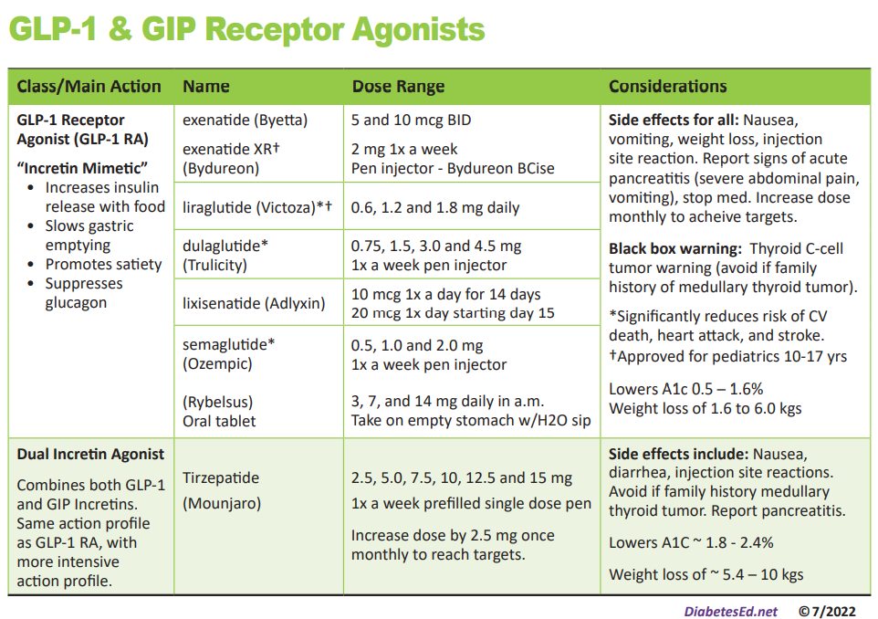
Pocket Card: GLP-1 & GIP RA
Notes:
Update with exenatide indication in pediatrics.

Slide 47
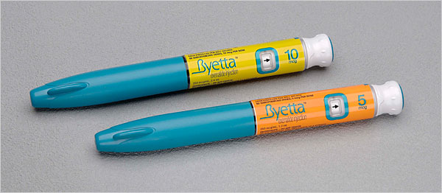
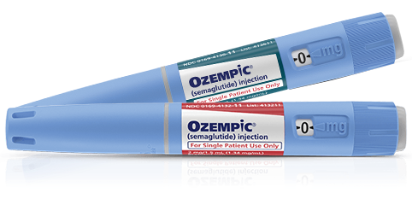
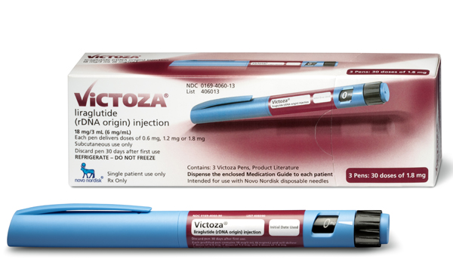
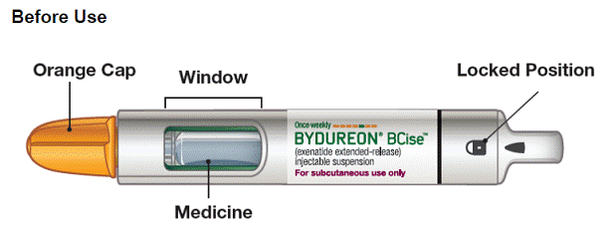
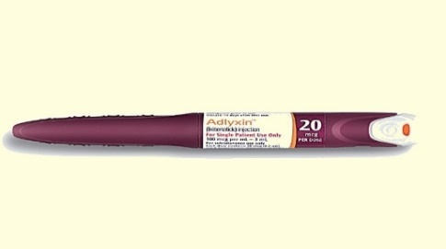
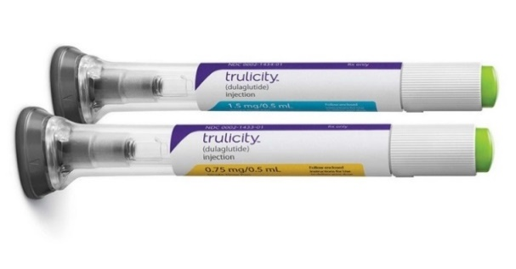
GLP-1 Receptor Agonist Devices
Byetta
Ozempic
Victoza
1.2mg, 2 pens/mo - (15 doses per pen)
1.8mg, 3 pens/month
- (10 doses per pen)
Requires Rx for needles
5mcg or 10mcg pen
1 pen/month
Requires Rx for needles
3 pen options: 0.5, 1, 2mg 1 pen/month
Comes with needles
Adlyxin
Bydureon
Trulicity
Contains 14 doses (20mcg)
2 pens/month
Requires Rx for needles
2mg pen
4 pens/month
Shake 15 seconds
Never see needle
0.75, 1.5, 3, 4.5mg pens
4 pens/month
Never see needle

Slide 48
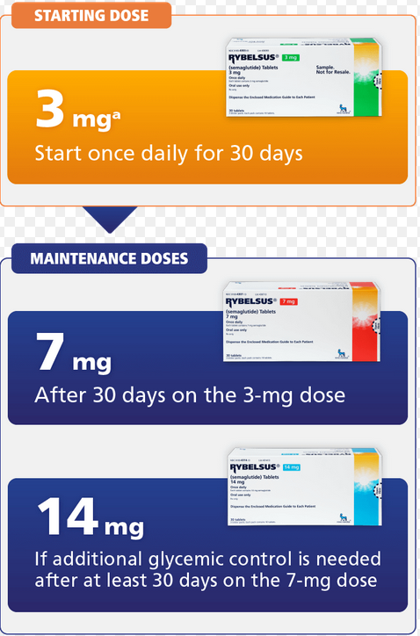
Oral Semaglutide (Rybelsus)
Dose: 3, 7 and 14 mg daily
Take daily at least 30 mins before first food, beverage, or other oral meds
Take with no more than 4 ounces of plain water
Swallow tablets whole (don't cut or crush)
Dosing:
Start with 3 mg once daily for 30 days
Then increase to 7mg once daily for 30 days
If A1c at target, maintain at 7mg daily
If A1c not at target, increase to 14 mg once daily

Slide 49
GLP-1 Receptor Agonist Indications
Drug | Lower BG | Reduce CV Risk? | Wt loss approved?
Exenatide IR (Byetta) Lixisenatide (Adlyxin) Semaglutide (Rybelsus) | Yes
Exenatide ER (Bydureon) | Yes for 10 yrs and older
Dulaglutide (Trulicity) | Yes | Yes
Semaglutide (Ozempic) | Yes | Yes | Yes Wegovy 2.4mg
Liraglutide (Victoza) | Yes for 10 yrs and older | Yes | Yes Saxenda 3mg
Package inserts, dailymed.nlm.nih.gov

Slide 50

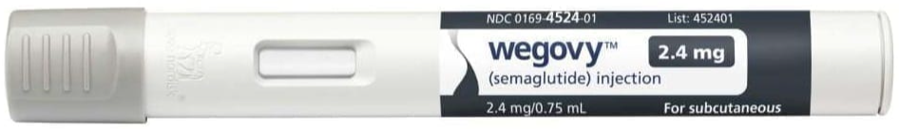
GLP-1 RA Approved for Weight Loss
Saxenda and Victoza same active ingredient (liraglutide) at different doses
Saxenda 3 mg (Victoza 1.8 mg)
6% wt loss, $1619 a month
Wegovy and Ozempic same active ingredient (semaglutide) at different doses
Wegovy 2.4mg (Ozempic 2mg)
6% wt loss, $1619 a month
Both are FDA approved as a treatment option for chronic weight management in addition to a reduced calorie diet and physical activity.
Approved for use in adults with a
BMI of ≥ 30 or
BMI of ≥ 27 or greater who have hypertension, type 2 diabetes, or dyslipidemia.

Slide 51
Notes:
Update with exenatide indication in pediatrics.

Slide 52

GIP/GLP-1 Receptor Agonist
Tirzepatide (Mounjaro) is a GIP/GLP-1 Receptor Agonist
GIP: glucose-dependent insulinotropic polypeptide
GLP-1: glucagon like peptide-1
Studied in the SURPASS clinical program (T2DM)
Studied in the SURMOUNT clinical program (Obesity)
Once weekly injectable disposable pen: abdomen, legs, arms
FDA approved for T2DM: May, 2022

Slide 53
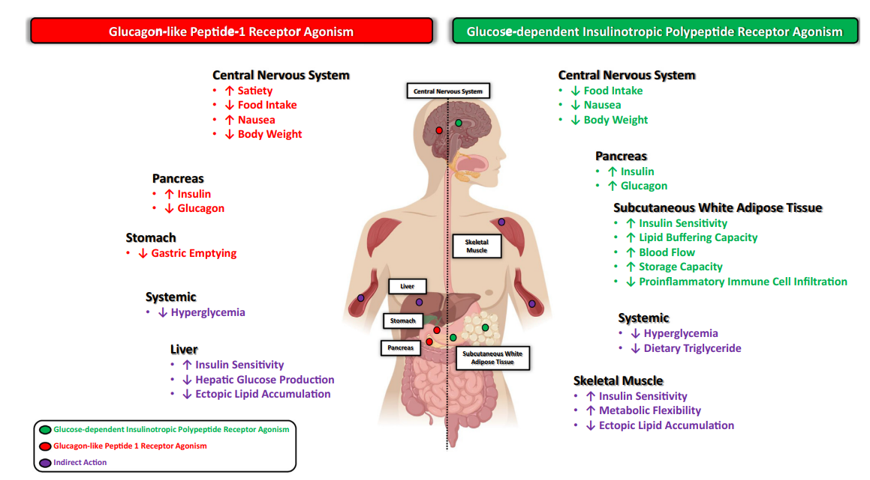
GLP and GIP Mechanism of Action
Samms RJ, Coghlan MP, Sloop KW. How May GIP Enhance the Therapeutic Efficacy of GLP-1? Trends Endocrinol Metab. 2020 Jun;31(6):410-421.

Slide 54
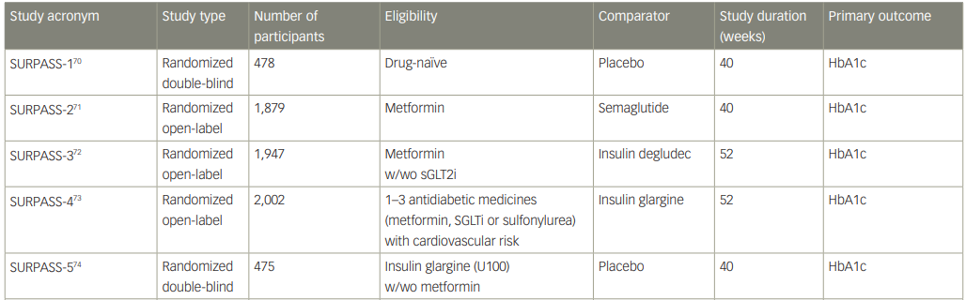
SURPASS Clinical Program
Evaluated A1C & Weight reductions with Tirzepatide
Rosenstock J, et al. Lancet. 2021;398:143–55. Frias JP, et al. N Engl J Med. 2021;358:503–15.82. Ludvik B, et al. Lancet. 2021;398:583–98. 83. Del Prato S et al. Lancet. 2021;398:1811–24. 84. Dahl Det al. Diabetologia. 2021:64(Suppl. 1):S13. Abstr 20. Kaneko S.. touchREV Endocrinol. 2022 Jun;18(1):10-19.

Slide 55
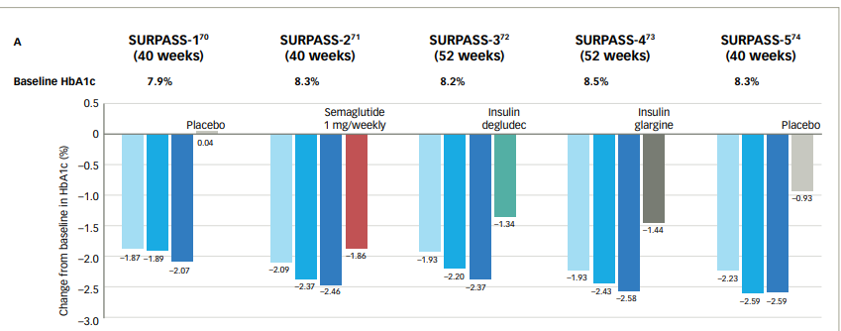

SURPASS: A1C Change w/ Tirzepatide
Rosenstock J, et al. Lancet. 2021;398:143–55. Frias JP, et al. N Engl J Med. 2021;358:503–15. 82. Ludvik B, et al. Lancet. 2021;398:583–98. 83. Del Prato S et al. Lancet. 2021;398:1811–24. 84. Dahl Det al. Diabetologia. 2021:64(Suppl. 1):S13. Abstr 20. Kaneko S.. touchREV Endocrinol. 2022 Jun;18(1):10-19.

Slide 56
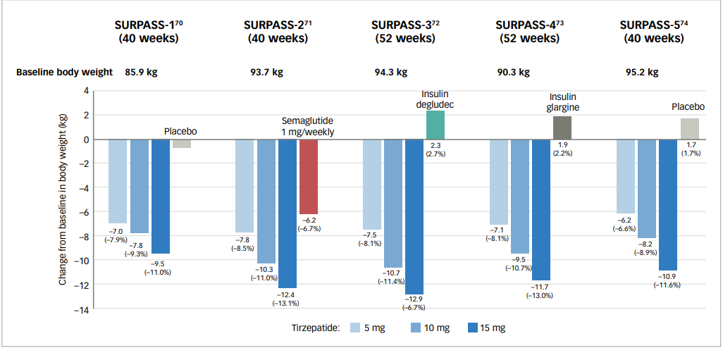
SURPASS: Change in Body Wt - Tirzepatide
Rosenstock J, et al. Lancet. 2021;398:143–55. Frias JP, et al. N Engl J Med. 2021;358:503–15. 82. Ludvik B, et al. Lancet. 2021;398:583–98. 83. Del Prato S et al. Lancet. 2021;398:1811–24. 84. Dahl Det al. Diabetologia. 2021:64(Suppl. 1):S13. Abstr 20. Kaneko S.. touchREV Endocrinol. 2022 Jun;18(1):10-19.

Slide 57
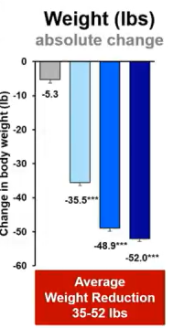
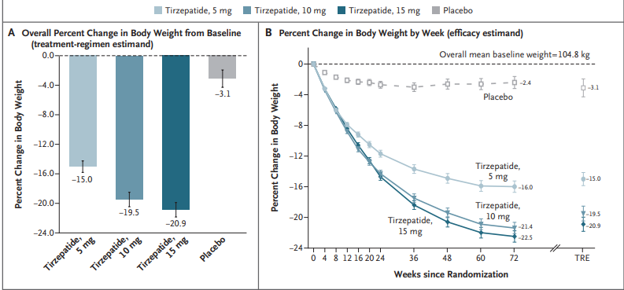
Surmount-1 Study - Weight loss Results (Tirzepatide) without diabetes
20.9% wt loss with 15mg dose or 35-52lbs lost!
Mean BMI 38 at baseline
Jastreboff AM, et al., on behalf of the SURMOUNT-1 Investigators. Tirzepatide Once Weekly for the Treatment of Obesity. N Engl J Med 2022;387:205-16.
Notes:
At baseline, the mean body weight was 104.8 kg, the mean BMI was 38.0, and 94.5% of participants had a BMI of 30 or higher. The mean percentage change in weight at week 72 was −15.0% (95% confidence interval [CI], −15.9 to −14.2) with 5-mg weekly doses of tirzepatide, −19.5% (95% CI, −20.4 to −18.5) with 10-mg doses, and −20.9% (95% CI, −21.8 to −19.9) with 15-mg doses and −3.1% (95% CI, −4.3 to −1.9) with placebo (P
In this phase 3 double-blind, randomized, controlled trial, we assigned 2539 adults with a body-mass index (BMI; the weight in kilograms divided by the square of the height in meters) of 30 or more, or 27 or more and at least one weight-related complication, excluding diabetes, in a 1:1:1:1 ratio to receive once-weekly, subcutaneous tirzepatide (5 mg, 10 mg, or 15 mg) or placebo for 72 weeks, including a 20-week dose-escalation period. Coprimary end points were the percentage change in weight from baseline and a weight reduction of 5% or more. The treatment-regimen estimand assessed effects regardless of treatment discontinuation in the intention-to-treat population.

Slide 58
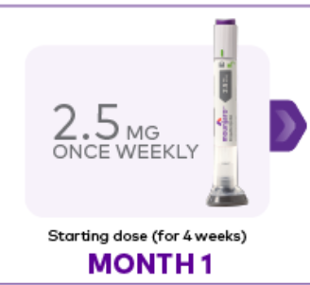
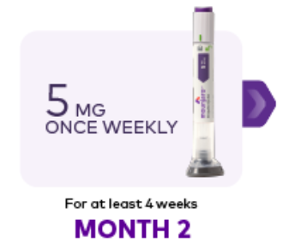

Tirzepatide (Mounjaro) Clinical Use

Slide 59

Tirzepatide (Mounjaro) Safety Profile
GI side effects
Nausea, appetite loss, diarrhea, constipation, dyspepsia, abdominal pain
Pancreatitis
Hypoglycemia with concomitant use of insulin or secretagogues
Hypersensitivity reactions
Acute kidney injury
Thyroid C-Cell tumors
Acute gallbladder disease
Mounjaro package insert.
Notes:
Pancreatitis: Acute pancreatitis, including fatal and nonfatal hemorrhagic or necrotizing pancreatitis, has been observed in patients treated with GLP-1 receptor agonists. Pancreatitis has been reported in Mounjaro clinical trials. Mounjaro has not been studied in patients with a prior history of pancreatitis. It is unknown if patients with a history of pancreatitis are at higher risk for development of pancreatitis on Mounjaro. Observe patients for signs and symptoms including persistent severe abdominal pain sometimes radiating to the back, which may or may not be accompanied by vomiting. If pancreatitis is suspected, discontinue Mounjaro and initiate appropriate management.
In both male and female rats, tirzepatide causes dose-dependent and treatment-duration-dependent thyroid C-cell tumors at clinically relevant exposures. It is unknown whether Mounjaro causes thyroid C-cell tumors, including medullary thyroid carcinoma (MTC), in humans as human relevance of tirzepatide-induced rodent thyroid C-cell tumors has not been determined.
Mounjaro is contraindicated in patients with a personal or family history of MTC or in patients with Multiple Endocrine Neoplasia syndrome type 2 (MEN 2). Counsel patients regarding the potential risk for MTC with the use of Mounjaro and inform them of symptoms of thyroid tumors (e.g., a mass in the neck, dysphagia, dyspnea, persistent hoarseness). Routine monitoring of serum calcitonin or using thyroid ultrasound is of uncertain value for early detection of MTC in patients treated with Mounjaro.
Mounjaro has been associated with gastrointestinal adverse reactions, which include nausea, vomiting, and diarrhea. These events may lead to dehydration, which if severe could cause acute kidney injury. In patients treated with GLP-1 receptor agonists, there have been postmarketing reports of acute kidney injury and worsening of chronic renal failure, sometimes requiring hemodialysis. Some of these events have been reported in patients without known underlying renal disease. A majority of reported events occurred in patients who had experienced nausea, vomiting, diarrhea, or dehydration. Monitor renal function when initiating or escalating doses of Mounjaro in patients with renal impairment reporting severe adverse gastrointestinal reactions.
In clinical trials, acute gallbladder disease was reported by 0.6% of Mounjaro-treated patients and 0% of placebo-treated patients. If cholelithiasis is suspected, gallbladder diagnostic studies and appropriate clinical follow-up are indicated.

Slide 60

Counseling Points: GLP-1 RA & GLP-1/GIP
Avoid if personal or family history of medullary thyroid cancer
Start at lower dose and titrate
Eat smaller meals to reduce nausea
Avoid high fat meals
Rotate sites
Store extra pens in fridge
Avoid in combo with DPP-4 inhibitors
Caution with pancreatitis
Ask about recent eye exam
Potential increase in diabetes retinopathy
Notes:
Inject at room temperature, let alcohol fully dry

Slide 61
Case Study Question 3
KZ is on max dose of metformin and is started on tirzepatide to help with BMI of 39 and decrease CV risk. What outcomes can KR expect at highest dose?
A1C drop of 3-4%, Wt loss of 3-5kg
Increased risk of UTI, A1C drop of 1-2%
Potential for ~10% body wt loss
Doubles risk of pancreatic cancer

Slide 62

BREAK TIME

Slide 63
Let’s Break it Down / ADA & EASD

Slide 64

Choosing glucose-lowering medication in people with heart failure
In people with heart failure, use SGLT2i because they improve heart failure and kidney outcomes.
Proven benefit:
Empagliflozin, ertugliflozin, canagliflozin, dapagliflozin
Notes:
For individuals with heart failure our recommendation is that SGLT2i with proven benefit should be used because they improve heart failure and kidney outcomes.

Slide 65

Choosing glucose-lowering medication in people with chronic kidney disease
In people with renal failure, use SGLT-2 in people with GFR ≥ 20 and continue until initiation of dialysis or transplantation
Or
GLP with proven CVD benefit if SGLT2 not tolerated or contraindicated

Slide 66

Diabetes + CKD – Increases CVD Risk
Chronic kidney disease (CKD) is a frequent complication in diabetes
Type 1 diabetes ~30%
Type 2 diabetes ~40%
In several studies, participants on SGLT2i with GFRs of 30-60 (stage 3) reduced ASCVD risk and improved renal function
Slowed kidney disease or death
Reduced albuminuria
National Kidney Foundation. https://www.kidney.org/atoz/content/diabetes

Slide 67

Evaluating Kidney Function - Albumin
Urinary Albumin Creatinine Ratio (UACR)
UACR can be assessed with a urinary spot collection.
Evaluates ratio of urine albumin /creatinine in mg/g
Target range < 30mg/g
If elevated, repeat test to verify
Check at diagnosis in T2D and within 5 years in T1D
2.9 / 91 = 0.0318 mg/mg or 31.8 (32) in mg/g
Albuminuria Categories | Urinary Albumin Creatine Ratio (UACR)
Normal to mildly increased – A1 | < 30 mg/g
Moderately increased – A2 | 30 – 299 mg/g
Severely increased – A3 | 300 mg/g +

Slide 68
Evaluating Kidney Function - GFR
Glomerular Filtration Rate (GFR)– target is 60 or greater
Stage 3 indicates progressive renal failure
GFR 30 to 59
Stage 4 and 5 indicates severe loss and failure
GFR 29 or less
Kidney Disease Stage | GFR
Stage 1 – Normal | 90+
Stage 2 – Mild loss | 89 - 60
Stage 3a – Mild to Mod | 59 - 45
Stage 3b – Mod to Severe | 44 - 30
Stage 4 – Severe loss | 29 -15
Stage 5 – Kidney failure | 14 - 0
www.DiabetesEd.net

Slide 69


From: 11. Chronic Kidney Disease and Risk Management: Standards of Medical Care in Diabetes—2022
Diabetes Care. 2021;45(Supplement_1):S175-S184. doi:10.2337/dc22-S011
Date of Download: 10/11/2022
Copyright © 2022 American Diabetes Association. All rights reserved.

Slide 70

SGLT-2 Inhibitors

Slide 71

SGLT-2 Inhibitors Comparison

Slide 72
Benefits of SGLT-2 Inhibitors
A1C lowering
Weight loss
Cardiovascular benefits
Renal benefits
Heart failure benefits
Blood pressure lowering

Slide 73
Side Effects of SGLT-2 Inhibitors
Genitourinary infections
Volume depletion
Increased urination
Hypotension
Hyperkalemia
Diabetes ketoacidosis (DKA)
Notes:
Cana: bone mineral density decline: hip ≤1%; lumbar spine, femoral neck, and distal forearm <1%
UTI: 6%Genito infection: 11-12%
Increased serum K+: 9-27%
Amputation risk
Emgag: UTI: females 18%, males 4%
Genito infection: 5%
Dapag: UTI: 6%, genito infection: 3%

Slide 74
SGLT-2i Indications
Drug | Lower BG | Reduce CV Risk? | Use to treat Heart Failure? | Slow renal disease?
Ertugliflozin (Steglatro) | Yes |  |  | Yes
Canagliflozin (Invokana) | Yes | Yes | Yes w/ Diabetes | Yes
Dapagliflozin (Farxiga) | Yes | Yes | Yes +/- Diabetes | Yes
Empagliflozin (Jardiance) | Yes | Yes | Yes +/- Diabetes | Yes
Package inserts, dailymed.nlm.nih.gov

Slide 75

SGLT2i: Managing Adverse Effects
Maintain good hygiene to reduce risk of genital mycotic infections
Higher risk with higher glucose
DKA risk
Use caution with reducing insulin dose
Monitor BP
May need to reduce antihypertensive meds
UTI risk greater with hyperglycemia
Amputations observed with canagliflozin
Good foot care, check feet daily
Monitor renal function/potassium

Slide 76

Case Study LS
LS is 69 with type 2 diabetes for over a decade. Takes metformin 1000mg twice daily and dulaglutide 3mg weekly.
A1C=7.3%.
UACR 212mg/gm
eGFR=56 B/P 146/82
Weight: 205lbs, 5”7, BMI=32kg/m²
Lost 10lbs in the last year
Notes:
Answer: D Metformin

Slide 77
LS continued Poll 4
What is the best drug to add to LS regimen?
Glipizide
Dapagliflozin (Farxiga)
Pioglitazone (Actos)
Linagliptin (Tradjenta)
More than 1 correct answer
What teaching would you include? Could we increase the dulaglutide dose?
How would we manage other risk factors:
Use of ACE-inhibitor,/ARB, BP management
Statin for CV risk
Notes:
What dose to start? Limit to 100mg daily
Answer: B

Slide 78


What the Rx?
Now on to other diabetes medications we haven’t yet covered

Slide 79
How Many Drug Options for Diabetes?
Biguanide
Sulfonylureas
Meglitinides
Thiazolidinediones (TZD’s)
Dipeptidylpeptidase-4 (DPP-4) inhibitors
Glucagon-like-peptide-1 (GLP-1) receptor agonists
GLP/GIP receptor agonists
Sodium glucose cotransporter-2 (SGLT-2) inhibitors
Bile acid sequestrant
Dopamine-2-agonist
Amylin mimetic
Alpha-glucosidase inhibitors
Insulin
Glucagon

Slide 80


Slide 81

Drug Targets in Diabetes
DeFronzo et al. Diabetes Spectrum Volume 27, Number 2, 2014

Slide 82
We Did IT – Now let’s apply IT

Slide 83

Case Study - PR
PR is a 46yoM newly diagnosed with type 2 diabetes. A1C=8.2%.
UACR 13 mg/gm GFR >60
Has hypertension, takes HCTZ 25mg daily.
Weight: 220lbs, BMI=34kg/m²
Social history
Works full time as an accountant
Skips breakfast, eats a small lunch, eats a large dinner, snacks in evening
No Exercise
Loves beer (drinks a 6 pk on most nights)
Notes:
Answer: D Metformin

Slide 84
Poll 5. These are meds covered by PR’s formulary. Which is the best medication to Start PR on?
A. Glipizide (sulfonylurea)
B. Linagliptin (DPP-4 inhibitor)
C. Empagliflozin (SGLT-2 inhibitor)
D. Metformin (Biguanide)
Notes:
Answer: D

Slide 85
Poll Question 6
A potential side effect of SGLT-2 Inhibitors is:
ketoacidosis
Hypertension
Kidney tenderness
Increased uric acid

Slide 86

PR wants to lose more weight
After 3 months, PR’s A1C has decreased to 7.1%. After meeting with diabetes care and education specialist, has increased physical activity to 3 days/week of walking. Lost 6lbs and would like to lose more.
Current DM Meds: empagliflozin(Jardiance) 25mg daily.
BMI=34kg/m²
What drug would be best to start next?

Slide 87


When Goal is to Avoid Weight Gain
These meds associated with wt loss
GLP-1 and GIP agonists
SGLT-2 Inhibitors
These meds are weight neutral
Metformin
DPP-4 Inhibitor
ADA /EASD

Slide 88

7. Best medication to lose weight?
Lost 6lbs and would like to lose more. Current DM Meds: empagliflozin (Jardiance) 25mg daily. BMI=34.
What drug would be best to start next?
Tirzepatide
Metformin
Semaglutide
Degludec
A or C
Of course, lifestyle coaching and RD referral included in plan!

Slide 89

Poll 8 - Check Your Knowledge
Which of the following medications is least affordable?
Pioglitazone (Actos)
Metformin (Glucophage)
Glimepiride (Amaryl)
Sitagliptin (Januvia)

Slide 90

How much do they cost?
Which of the following groups of meds for a month supply are cheapest? (multiple)
a. Actos and Avandia
b. Glipizide, Glyburide, Glimepiride
c. Metformin and Metformin XR
d. Januvia and Onglyza
e. Exenatide and Semaglutide
f. Empagliflozin and SGLT-2s
g. Tirzepatide (Mounjaro)
$5 & $324
$10 for 3 mo’s
$10 for 3 mo’s
$596 & $549
$909, $1022
$658
$974
See Table 9.3 in ADA Standards on Median Monthly Average Wholesale Price (AWP) 2022

Slide 91
Wait, what about insulin?

Slide 92

Start with GLP-1. If not at target add
Basal insulin -10 units or
- 0.1 to 0.2 units a day
- Get fasting to goal
Then add bolus as needed for daytime hyperglycemia

Slide 93

Quick Question 14
JZ is excited about his A1c of 5.4%. He takes bolus insulin 4-6 times a day using a pen to keep his BG to target. Plus, adjusts glargine as needed if his pm BG is elevated. What is your biggest concern?
A. Does he change his needle each time?
B. Why is he adjusting glargine?
C. Is he adjusting insulin for exercise?
D. How many hypoglycemic events per week?

Slide 94

Hypoglycemia (Glucose) Alert Values
BG <70mg/dl – Level 1
Follow 15/15 rule and contact provider to make needed changes
BG < 54mg/dl – Level 2
Indicates serious hypo. Contact provider for med change. Glucagon Emergency Kit
Severe Hypoglycemia – Level 3
Requires external assistance – no threshold

Slide 95



Slide 96


Slide 97



Glucagon Emergency Kit
Store 68-77 degrees prior to reconstitution, single use only

Slide 98


Nasal Glucagon - Baqsimi
Approved for ages 4 +
Absorbed nasally
No reconstitution or refrigeration needed
Kept in temps up to 86
Raises BG 67-73 mg/dl
Don’t use in those with
Pheochromocytoma
Insulinoma
See package insert

Slide 99


Gvoke HypoPen – Single dose injector For children ages 2+. Peds dose up to 45kg

Slide 100




Dasiglucagon (Zegalogue)

Slide 101

EV Arrives and Requests Help
58 yr old complains of 4 lb wt gain for past month. BMI 31, wt 90 kg. B/P 142/96. A1C 8.3%
Meds include:
Sitagliptin, Metformin
Actos 15mg ac breakfast
Basaglar 58 units
Semaglutide 0.5mg weekly
Levothyroxine (ran out)
Lisinopril 10mg
Gabapentin 100 mg TID
What story do these meds tell?
Any med(s) missing?
Any med needs to be stopped?

Slide 102
EV Arrives and Requests Help
58 yr old complains of 4 lb wt gain for past month. BMI 31, wt 90 kg. B/P 142/96. Checks BG in morning; 150ish. A1C 8.3%
Meds include:
Sitagliptin (DPP-IV), Metformin
Basaglar 58 units (Basal)
Semaglutide 0.5mg wk (GLP-1)
Levothyroxine (ran out)
Lisinopril 10mg (ACE)
Lovastatin 20mg (Statin)
Gabapentin 100 mg TID (leg pain)
What does this tell us about EV?
Struggling with weight
B/P & A1C above target
Overbasalized (max dose 0.5 units/kg a day
Why not taking thyroid med?
Lower extremity pain contributing to distress?
Elevated CV risk?

Slide 103

EV is Gaining Weight and is Tired
58 yr old complains of 4 lb wt gain for past month. BMI 31, wt 90 kg. B/P 142/96. Checks BG in morning; 150ish. A1C 8.3%
Meds include:
Sitagliptin, Metformin
Actos 15mg ac breakfast
Basaglar 58 units
Semaglutide 0.5mg weekly
Levothyroxine – ran out
Lisinopril 10mg
Gabapentin 100 mg TID
Labs
A1C – 8.3%
UACR 26 GFR >60
TSH 10.6
LDL 98 mg/dl, Trig 158
ALT 85 IU/L, AST 90 IU/L
(normal range 25-50)
Life situation
Takes care of dad with dementia
Gums inflamed
No eye doctor for year
Both feet hurt at night

Slide 104

ABCs of Diabetes
A1c less than 7%
Pre-meal BG 80-130
Post meal BG <180
Blood Pressure < 140/90
BP target <130/80
If CVD or 10-year CVD Risk > 15%
Cholesterol
Statin therapy indicated if 40+

Slide 105

Advocating for Best Health for people with Diabetes
Modifiable
Sleep
Activity
Smoking
Dietary Habits
Glucose
Blood Pressure
Lipids
Oral Care
Immunizations
Psychosocial care
Make small, achievable goals. We are in this for the long run.

Slide 106

Diabetes is a long path
Get at least 7 hours of sleep a night – Check for sleep apnea

Slide 107

Obstructive Sleep Apnea - OSA
OSA affects ~25% of people with type 2
Up to 60% of those with type 2 have disordered sleep
Associated with increased CVD risk
4-10 increased risk if BMI 30+ with visceral adiposity
Treatment:
Lifestyle modification
Continuous positive oral airway pressure and devices
Surgery

Slide 108


Where are we on this continuum?
Only about 50% of us are meeting activity goals

Slide 109
Good Exercise Info / Quotes
“Passagiata” – take an after meal stroll
Exercise decreases A1c 0.7%
No change in body wt, but 48% loss in visceral fat
“Every minute of activity lowers blood sugar one point.”
“I don’t have time to exercise, I MAKE time.” Mike Huckabee

Slide 110

Best Shake For People with Diabetes
From Debbie Nagata’s slide collection

Slide 111

Smoking and Diabetes
Smoking and Diabetes
Smoking increases risk of diabetes 30%
Ask at every visit
Assess
Advise
Assist with stop smoking
Arrange for referrals
Organize your clinic

Slide 112

USDA www.myplate.gov
Balancing Calories
Enjoy your food, but eat less.
Avoid oversized portions.
Foods to Increase
Make half your plate fruits and vegetables.
Make at least half your grains whole grains.
Switch to fat-free or low-fat (1%) milk.
Foods to Reduce
Compare sodium in foods like soup, bread, and frozen meals ― and choose the foods with lower numbers.
Drink water instead of sugary drinks.

Slide 113





Plate example

Slide 114
Diabetes Toolkit
Meter
Strips that aren’t expired?
List of Meds
Plan for Lows
Emergency Plan
Power back-up
BG Checks and logging results
Diabetes ID
Phone, medic alert, on person
Carbohydrate source
Granola bar, glucose tabs, GU, gummy bears
Rescue Meds

Slide 115

Collaborative Action Plan
Increase semaglutide to 1.0mg
Decrease basaglar by 10 units
Stop sitagliptin, pioglitazone (Actos)
Walk after lunch during work week
Restart levothyroxine, Re-Check TSH - Re-evaluate in 4 weeks.
Eat one serving of veggie a day and decrease meat intake to 4 nights a week.
Meet with RD/RDN
Check BG a few times a week before bed (in addition to am)
What about alcohol intake?
Are these goals realistic?

Slide 116



Exercise Standards
Adults – 150 min/wk moderate intensity
over 3 days a week.
Don’t miss > 2 consecutive days w/out exercise
Get up every 30 mins - Reduce sedentary time
Flexibility and balance training 2-3 xs a week (Yoga and Tai Chi)
T1 and T2 – resistance training 2 -3 xs a week
ADA Standards 2022

Slide 117



Slide 118

24 hour Physical Behavior Impact

Slide 119

EV has the beginning of NAFLD
NAFLD is defined as hepatic steatosis in >5% of hepatocytes based histological analysis or when fat reaches 5% to 10% of the liver's weight

Slide 120
Stages of liver failure
NAFLD – non alcoholic fatty liver disease
NAFL – simple fatty liver, doesn’t usually progress to cause liver damage
NASH – non alcoholic steatohepatitis
Liver inflammation and cell damage.
Can cause fibrosis, scarring
About 35% of NASH cases progress to liver fibrosis
Cirrhosis – degeneration of cells, inflammation, fibrous thickening
End-stage liver disease & Liver Cancer
https://liverfoundation.org/for-patients/about-the-liver/the-progression-of-liver-disease/#fibrosis-scarring

Slide 121


Natural History of NAFLD to NASH
NASH – Non-Alcoholic Steatohepatitis
https://liverfoundation.org/wp-content/uploads/2020/11/StagesFibrosis.jpg

Slide 122


Fatty liver disease and diabetes
Associated with :
Increased BMI (30+)
Larger waist circumference,
Elevated triglycerides
Lower HDL cholesterol levels. ADA 2022
First indicators may include elevated alanine transaminase (ALT) and aspartate transaminase (AST).
The growing epidemic of NAFLD in western societies: - 20 to 30% of overall population - 45 to 75% of ind’s with type 2 diabetes
https://clindiabetesendo.biomedcentral.com/articles/10.1186/s40842-020-00097-1

Slide 123
Symptoms of Fatty Liver
If symptoms do appear, they may include:
A feeling of fullness in the middle or upper right side of the abdomen
Abdominal pain, nausea
Loss of appetite or weight loss
Weakness
Jaundice
Swelling of the abdomen and legs
Mental confusion
Extreme fatigue or tiredness
Signs of advanced disease include:
Portal hypertension, spider angiomas, reddening of palms, declining platelet counts
Mayo Clinic

Slide 124
Finding Liver Disease
Imaging procedures used to diagnose NAFLD include:
Abdominal ultrasound, which is often the initial test when liver disease is suspected.
Transient elastography, an enhanced form of ultrasound that measures the stiffness of liver. Liver stiffness indicates fibrosis or scarring.
Magnetic resonance elastography, works by combining MRI imaging with sound waves to create a visual map (elastogram) showing the stiffness of body tissues
Biopsy by liver specialist confirms definitive diagnosis
Mayo Clinic

Slide 125

Treatment for NAFLD and NASH
Interventions that improve metabolic abnormalities include:
weight loss, glycemic improvement and meds that treat hyperglycemia, dyslipidemia
For biopsy proven NAFLD – these treatments improve liver histology but need long term studies (ADA 2022):
Pioglitazone (Actos) Vitamin E GLP-1 Receptor Agonists

Slide 126

Collaborative Action Plan and F/U
Make appointment with dentist and eye doctor.
Brush twice daily and floss daily.
Need some relief from nerve pain.
Feet calluses

Slide 127

Meds for Neuropathy – Cheat Sheet

Slide 128


Meds for Neuropathy – Cheat Sheet

Slide 129

Other strategies to help ease the pain
Music
Podcasts
Movies
Pet’s
Massage
Touch
Topical creams
Lidocaine patches
Mineral salts baths
Neurostimulators
Tylenol / Ibuprofen
Earthing
Sleep
Hobbies
Aromatherapy
Time with special people
Work / volunteering

Slide 130

EV is feeling Empowered
Her A1c has dropped, she feels better about herself with healthier eating and increased activity.
She is back on her thyroid medication and has more energy.
Appointment with Podiatrist
The pain in her feet is better and she is more hopeful overall!

Slide 131








Davies MJ, Aroda VR, Collins BS, Gabbay RA, Green J, Maruthur NM, Rosas SE, Del Prato S, Mathieu C, Mingrone G, Rossing P, Tankova T, Tsapas A, Buse JB Diabetes Care 2022; https://doi.org/10.2337/dci22-0034. Diabetologia 2022; https://doi.org/10.1007/s00125-022-05787-2.
.

Slide 132

No DE-FEET

Slide 133


Preventing Agony of “DeFeet”
Describe risk factors for lower extremity complications.
Discuss prevention strategies.
Demonstrate steps involved in lower extremity assessment.

Slide 134



Notes from Beverly
All HCP can help save feet!
Some of these images may be difficult to view.

Slide 135

Lower Extremity Complications
Combination of vascular, neurological, and musculoskeletal dysfunction
Foot ulcers and amputations (from neuropathy and peripheral arterial disease) are associated with higher morbidity and mortality rates.
Early recognition and treatment makes a difference

Slide 136


Diabetes and Amputations
Rate declined 43% - 2000 – 2009
Increased 50% from 2009-2015
2.1 per 1000 then up to 4.2 per 1000
Driven by a 62% increase in minor amputations (toes)
Highest rates in young and middle age adults (18- 64 years).
130,000 adults annually with diabetes have lower extremity amputations NIDDK /NIH
This number equates to five out of every 1,000 people with diabetes.
Diabetes Care 2018

Slide 137

Health Disparities and Lower Extremity Amputations
African Americans and people of color have 3-4 times the rate of amputation, compared to White Americans
60% of amputations in 7% of population
Amputations cost $30,000 – 60,000
Associated w/ earlier death compared to revascularization

Slide 138


The Black American Amputation Epidemic
https://features.propublica.org/diabetes-amputations/black-american-amputation-epidemic/

Slide 139

Foot Ulcer usually doesn’t lead to amputation – but it can.
Foot ulcers occur in 4–10% of people with diabetes.
Outcomes include:
60–80 percent of foot ulcers will heal
10–15 percent will remain active
5–24 percent will eventually lead to limb amputation within 6–18 months of the initial evaluation
https://www.ncbi.nlm.nih.gov/pmc/articles/PMC3508111/

Slide 140

Poll Question 1
Which of the following factor(s) increase risk for amputation in diabetes?
Socioeconomic status
Cigarette smoking
Previous amputation
Age and ethnicity
All of the above

Slide 141

Racial Disparities and Amputations
Risk for amputation? Consider these factors:
region. People who live in the southern United States have the highest rates of amputation. They also have the lowest rates of revascularization.
race. Most people receiving amputations are minorities: Black Americans, Hispanics/Latinos, and American Indians.
age. Many people who receive amputations are older. PAD may be missed in older adults because the symptoms are attributed to arthritis or gout. Also, primary care doctors may not know about PAD and may not screen patients for PAD early. Patients undergo an amputation when they are older because PAD was missed.
socioeconomic status. Poorer patients and those living in poorer regions of the country have less access to quality health care and have the highest amputation rates. Unfortunately, many of these patients are minorities with low incomes.
hospital volume of vascular procedures. Hospitals are better at preventing amputation if they can assemble a team of specialists proficient in aggressive limb salvage, wound care, nutritional care, and diabetes management and treatment. Rural areas, such as those in the southern United States, don’t have a significant number of these specialists.
https://www.niddk.nih.gov/health-information/professionals/diabetes-discoveries-practice/reducing-disparities-in-diabetic-amputations?utm_source=diabetes%20discoveries%20%26%20practice%20blog&utm_medium=e-mail

Slide 142
Poll Question 2
Which of the following is true about diabetes and lower extremities?
Over 30% of people with diabetes experience amputation.
Over 50% of amputations could have been avoided.
Most amputations happen before the age of 70
The rate of amputations continues to decrease.

Slide 143

Foot Care Standards - ADA
Perform a comprehensive foot evaluation at least annually to identify risk factors for ulcers and amputations.
Provide general preventive foot self-care education to all people living with diabetes.
Sensory loss or prior ulceration or amputation?
inspect feet at every visit.
High-risk may need specialized therapeutic footwear:
If severe neuropathy, foot deformities, ulcers, callous formation, poor peripheral circulation, or history of amputation.

Slide 144

High Risk of Ulcers Amputation
Poor glycemic control
Peripheral neuropathy with LOPS
Cigarette smoking
Foot deformities
Preulcerative callus or corn
Peripheral Arterial Disease
History of foot ulcer
Amputation
Visual impairment
Chronic kidney disease (especially if on dialysis)

Slide 145

ADA Stds – Exam components
Inspection of the skin
Assessment of foot deformities
Neurological assessment (10-g monofilament testing with at least one other assessment: pinprick, temperature, vibration), and
Vascular assessment including pulses in the legs and feet.

Slide 146



Lower Extremities
Lift the Sheets and Look at the Feet
By Alton Johnson Jr., DPM, CWSP https://www.woundsource.com/blog/amputation-crisis-african-american-patients

Slide 147

12 Steps to Evaluate Lower Extremity Risk
Lift the Sheets and Look at the Feets

Slide 148


Question 1 and 2
Question 1: Is there a history of foot ulcers?
Question 2: Is there a foot ulcer now?
History of a foot ulcer increases the risk of developing another foot ulcer and increases the potential of future amputation.
A person with a past or present foot ulcer is considered permanently in Risk Category 3.

Slide 149


Question 3 – Deformity?
Question 3: Is there toe deformity?
Question 4: Is there an abnormal shape of the foot?
Look for prominent bony areas,
Partial or complete amputations of the foot or toes
Clawed or hammer toes
Bunions, or "Charcot Foot".

Slide 150


Question 3 and 4 – Charcot Foot
Question 3: Is there toe deformity?
Question 4: Is there an abnormal shape of the foot?
A Charcot Foot is a neuropathic foot that may present with:
swelling,
increased temperature,
and little or no pain.
Advanced cases show progressive signs of deformity into what is referred to as a "rocker bottom" or "boat-shaped" foot.
A person with a Charcot Foot is permanently in Risk Category 3.

Slide 151


Q5 - Toenails
Question 5: Are the toenails thick or ingrown?
Identify Mycotic, significantly hypertrophic, or ingrown nails.
Ask how they are cutting their nails and identify problem areas.
Consider Podiatry Referral and Treatment

Slide 152


Q6: Callus Buildup
Question 6: Is there callus buildup?
Identify focal and/or heavy callous.
Determine cause and provide coaching.
Assess if the person is self-treating calluses (with a razor or other tools) and encourage them to see a foot specialist to prevent complications.

Slide 153

Poll Question 3
JR has dry skin cracks in the back of their heel. What is the best action?
Gently scrape the dead skin with a razor
Apply petroleum jelly or other lotion nightly to affected area.
Walk barefoot to promote healing
Wear white cotton socks

Slide 154



Q7: Assess for Swelling
Question 7: Is there swelling? Swelling may stem from a variety of causes such as a Charcot fracture, infection, or “venous stasis”.
Assess for potential causes and encourage the person to elevate extremities and receive treatment.

Slide 155

8- Check for Elevated Skin Temp
Question 8: Is there elevated skin temperature?
Elevated, localized skin temperature can indicate
excessive mechanical stress,
bone fracture
or infection and requires further evaluation.
A temperature elevation of greater than 2 degrees centigrade or a noticeable difference by touch when compared with the contralateral foot is considered clinically significant and requires follow-up.

Slide 156


Q9 – Muscle Weakness
Question 9: Is there muscle weakness?
A manual muscle test of foot and great toe dorsi and plantar flexion. Weakness or inflexibility is associated with diabetes neuropathy and increases the risk of injury.
Prayer Sign

Slide 157


Q10 - See Bottom of Feet?
Question 10: Can the person see the bottom of his/her feet?
Extra weight and/or lack of flexibility can make it difficult for people to visually assess their feet.
Self-inspection and foot care are also difficult.

Slide 158

Q11 & 12 – How do the Shoes Fit?
Question 11: Are they wearing improperly fitted shoes?
Can create foot pressures that lead to further complications.
Sensory loss often results in wearing shoes that are too short and/or narrow resulting in ischemic ulcers on the medial or lateral metatarsal heads or the toes of a foot with claw toe deformity.
Properly sized added depth shoes with soft custom molded insoles are usually indicated for those with loss of sensation and deformity to prevent ulceration.
Question 12: Is the footwear appropriate for their category?

Slide 159
Poll question #4
What is the most common cause of ulcers?
Dr. Scholl’s corn pads
Minor trauma
Trimming calluses
Burns from hot water

Slide 160

Common Causes of Ulcers
Tight shoe and minor trauma
Neuropathy and peripheral vascular disease
Autonomic: blood pooling, swelling
Motor: atrophic musculature, deformity, joint stiffness
Resulting increased plantar pressure, trauma

Slide 161

Foot Wounds
Blisters Ulcers Bone infection
Calluses

Slide 162


Risk Factors for Peripheral Arterial Disease
Risk factors include:
diabetes
over the age of 60
hypertension,
hyperlipidemia,
who smoke, are at higher risk for PAD.
African Americans have 3-4 times increased risk of PAD
careful screening and appropriate intervention for these higher risk groups is imperative.

Slide 163

Symptoms of Peripheral Arterial Disease
What are symptoms of PAD?
The classic symptom of PAD is pain in the legs with physical activity, such as walking, that gets better after rest.
However, up to 4 in 10 people with PAD have no leg pain.
Symptoms of pain, aches, or cramps with walking (claudication) can happen in the buttock, hip, thigh, or calf.
American College of Cardiology

Slide 164

Signs of Peripheral Arterial Disease
Physical signs
include leg muscle atrophy (weakness);
hair loss; smooth, shiny skin;
skin that is cool to the touch, especially if accompanied by pain while walking (that is relieved by stopping walking);
decreased or absent pulses in the feet;
sores or ulcers in the legs or feet that don’t heal; and cold or numb toes.

Slide 165

Peripheral Arterial Disease Intermittent Claudication
Physical Exam – Skin
Pale or blue, purple
Dependent rubor, blanching when elevated
Cool to touch, loss of hair, nonhealing wounds, gangrenous
Diminished pulses
Treatment = Protect feet
Avoid constriction, increase walking, stop smoking, get ABI, medications and/or surgery

Slide 166

Vascular Status Assessment
Posterior tibial pulse
Dorsalis pedis pulse
Temperature
Appearance

Slide 167

Dorsalis Pedis Pulse

Slide 168

Taking the Dorsalis Pedis Pulse

Slide 169

Posterior Tibial Pulse

Slide 170

Taking the Posterior Tibial Pulse

Slide 171
Refer. Include Multi-Disciplinary Team
If claudication or decreased/absent pedal pulses
refer for ankle-brachial index and for further vascular assessment
Foot ulcers and high-risk feet
Refer to multidisciplinary team(e.g., dialysis, Charcot foot, prior ulcers or amputation
Foot care specialists recommended:
those who smoke
histories of prior lower-extremity complications
loss of protective sensation
structural abnormalities
peripheral arterial disease
Ongoing preventive care lifelong surveillance.

Slide 172

ADA Stds – Poor Circulation / High risk
If have symptoms of claudication or decreased or absent pedal pulses:
refer for ankle-brachial index and for further vascular assessment as appropriate
A multidisciplinary approach is recommended for individuals with foot ulcers and high-risk feet
Use of specialized foot wear recommended

Slide 173

Using the ABI: An Example
Right ABI
80/160=0.50
Left ABI
120/160=0.75
ABI
(Normal >0.99)
Brachial SBP
150 mm Hg
Brachial SBP
160 mm Hg
Highest brachial Systolic BP
PT SBP 40 mm Hg
PT SBP 120 mm Hg
Highest of PT or DP Systolic BP
DP SBP 80 mm Hg
DP SBP 80 mm Hg
ABI=ankle-brachial index; DP=dorsalis pedis; PT=posterior tibial; SBP=systolic blood pressure.

Slide 174
Interpreting the Ankle-Brachial Index
ABI |  | Interpretation
1.00–1.29 |  | Normal
0.91–0.99 |  | Borderline
0.41–0.90 |  | Mild-to-moderate disease
≤0.40 |  | Severe disease
≥1.30 |  | Noncompressible
Adapted from Hirsch AT, et al. J Am Coll Cardiol. 2006;47:e1-e192. Figure 6.

Slide 175


Loss of Protective Sensation (LOPS)
“I didn’t notice”
Needle in foot
Pebble in shoe
Stepped on a nail
Cut too deep
Shoes were rubbing
Others?

Slide 176

Loss of Protective Sensation
Monofilament Testing
5.07 touched to plantar
surface and top of foot
C shape delivers 10 gms pressure
Test four sites
Plantar surfaces of
Each great toe
1st, 3rd and 5th metatarsal head

Slide 177



5.07 monofilament delivers 10gms linear pressure

Slide 178


Slide 179

Determine Risk Category
Step 3: Report Risk Category and Needed Follow-Up
The higher the Risk Category, the higher the risk there is of recurrent foot ulceration, progressive deformity, and ultimately, amputation of the foot.
Risk Category Description - Categories for the Foot
0 - Diabetes, but no loss of protective sensation in feet or peripheral arterial disease.
1 - Diabetes, loss of protective sensation in feet (doesn’t feel 5.07 monofilament in one or more locations) plus deformity
2 - Diabetes, loss of protective sensation in feet with high pressure (callous/deformity), or poor circulation (PAD)
3 - Diabetes, history of plantar ulceration, amputation or neuropathic fracture.

Slide 180
Action Based On Risk
0 – Provide Education emphasizing disease control, and proper shoe fit/design. Follow-up yearly for foot screen. Follow as needed for skin/callus/nail care or orthotics
1 - Education emphasizing diabetes management, proper shoe fit/design, daily self-inspection, skin/nail care, and early reporting of foot injuries. Proper fitting/design footwear with soft inserts/soles. Routine follow-up 3 – 6 months for foot/shoe examination & nail care
2 - Education emphasizing diabetes management, proper shoe fit/design, self-inspection, skin/nail/callus care, and early reporting of foot injuries. Depth-inlay footwear, molded/modified orthotics; modified shoes as needed. Routine follow-up 1 – 3 months for foot/activity/footwear evaluation and callus/nail care.
3 - Education emphasizing diabetes management, proper fitting footwear, self-inspection, skin/nail/callus care, and early reporting of foot injuries. Depth-inlay footwear, molded/modified orthoses; modified/custom footwear, ankle-foot orthoses as needed. Routine follow-up 1 – 12 weeks for foot/activity/footwear evaluation and callus/nail care. Diabetic Foot Clinic visit frequency may vary based on individual needs.

Slide 181
No DE-FEET

Slide 182

Check Feet Daily
Check and wash your feet daily. If you have trouble bending, use a mirror to see the bottom of your feet. Make sure to dry well and check in between toes.
Let your provider know right away if you discover any sores, red areas, calluses, drainage, or unusual foot odor.
Prevent dry skin and cracks by applying lotion or petroleum jelly to the top and bottom of your feet a few times a week.

Slide 183


Lotions – Apply to Top and Bottom

Slide 184

Education Points – Wear Shoes
Avoid going barefoot, even inside, to avoid accidental injury.
Buy new shoes at the end of the day when feet are most swollen.
Break in new shoes gradually by wearing them for a few hours each day (1 hour the first day, 2 hours the second day, etc.).
Inspect shoes for rough spots, torn linings, or other objects which could injure your feet. Make sure there is enough room to wiggle your toes.

Slide 185


ADA Standards - Shoes
Broad and square toe box
Laces with 3-4 eyes per side or Velcro straps
Padded tongue
Quality lightweight materials
Sufficient depth to accommodate a cushioned insole
Custom shoes as needed
Medicare approves 1 pair of custom shoes and 3 inserts yearly.
Dr. Comfort 6 Wide

Slide 186

Make Sure There is Enough Room

Slide 187

Feet Deserve Special Care
Daily inspection
With order from MD and Loss of Protective Sensation (LOPS), Medicare Covers:
Annual custom shoes
3 pairs of orthotic inserts

Slide 188

Foot Care Tips – Check Temp
Avoid heating pads, Jacuzzis and hot water bottles. Use sunscreen to avoid sunburn.
Since feet may not sense temperatures that are too hot or cold, you need to protect them. Wear warm socks or lined shoes if feet become cold.
Use diabetes socks that are free of seams and not too tight around the calf.
No bathroom surgery (this includes trimming calluses with a razor or liquid corn and callus removers). This can lead to injury.

Slide 189

Diabetes Socks
Seamless
Not too tight at calf
Good cushion
Cotton/poly blend
Affordable

Slide 190



No Bathroom Surgery

Slide 191

Get Help and Prevent Injury
Have a foot doctor trim your toenails if you cannot see or feel your feet, you cannot reach your feet, your toenails are thick or yellowed or your nails curve and grow into the skin.

Slide 192




Cutting Thick Toenails
https://www.wikihow.com/Trim-Toenails-with-Fungus

Slide 193

Tinea Pedis / Toenail Fungus
Fungus that infects the areas between toes and skin of feet is called athlete's foot (tinea pedis).
Onychomycosis, also called tinea unguium, is a fungal infection that affects either the fingernails or toenails.
Often subungual
For skin fungus, try an antifungal cream
For toenail fungus,
topical or oral antifungals

Slide 194


ADA Stds – Education is Critical
Based on risk assessment, review:
Foot care, including nail and skin care
Daily foot monitoring
If have LOPS, how to evaluate feet status
Footwear and home behaviors
Identify resources if have trouble with cognition or physical constraints

Slide 195

Lower Extremities
“If there is ANY foot problems, take off your shoes and socks and show your feet!"
Complete foot exam annually
More frequent checks on those at high risk
Keep close eye if loss of protective sensation, foot deformities, or a history of foot ulcers

Slide 196

You Can Make A Difference
Assess
Nail condition, nail care, in between the toes
Who trims your nails
Have you ever cut your self?
Shoes – type and how often
Socks
Skin/skin care and vascular health
Ability to inspect
Loss of protective sensation

Slide 197

FREE NO DeFEET Webinar – Invite your Friends and Colleagues
www.DiabetesEd.net

Slide 198

Thank You
Questions?
info@diabetesed.net
www.DiabetesEd.net
530/ 893-8635

