Slide 1


Your Voice Matters – A Strength Based Approach to Improving Diabetes Care
For North Valley Indian Health, Inc
Beverly Thomassian, RN, MPH, CDCES, BC-ADM
Diabetes Nurse, Mom, Community Member, Wife, Advocate
March 25, 2023

Slide 2


Beverly has no conflicts of interest
Not on any speaker's bureau
Does not invest in pharmaceutical or device companies
Gathers information from reading package inserts, research and standards
Majority of Content from ADA Standards www.Diabetes.org

Slide 3
Topics for Your Voice Matters
From Prediabetes to Diabetes – What are the Goals of Care?
New diabetes medications that do more than just lower blood sugars.
Your voice matters- strategies to collaborate with your health care team.
Understanding the impact of adverse childhood experiences on our health – a Message of Hope

Slide 4

How do we get to our best health?

Slide 5


Slide 6

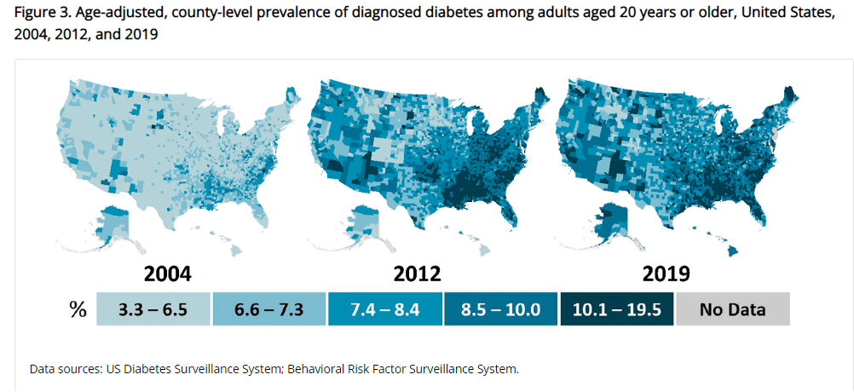
Type 2 Diabetes in America 2023
11.3% with Diabetes
37 million adults
23% don’t know they have it
38% with Prediabetes – 96 mil
Centers for Disease Control and Prevention. National Diabetes Stats Report https://www.cdc.gov/diabetes/data/statistics-report/index.html. Accessed 1/23

Slide 7
CDC Announces
35% of Americans will have Diabetes by 2050
Boyle, Thompson, Barker, Williamson
2010, Oct 22:8(1)29
www.pophealthmetrics.com

Slide 8
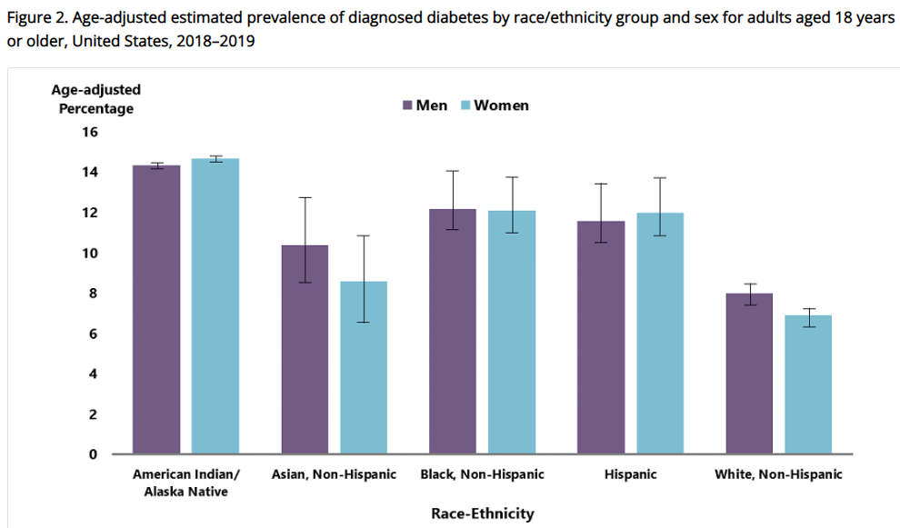
Diabetes Prevalence by Ethnic Group
For adults, diabetes prevalence highest among:
American Indians and Alaska Natives (14.5%),
Non-Hispanic Blacks (12.1%),
People of Hispanic origin (11.8%),
Non-Hispanic Asians (9.5%)
www.cdc.gov/diabetes/data/statistics-report/diagnosed-diabetes.html

Slide 9

Social Determinants of Health
The conditions in which people:
Play
Live
Work
Learn
Pray
Directly affects their health risks and outcome
AADE Population Health & Diabetes Educators Evolving Role 2019

Slide 10

Socioeconomics – Diabetes Prevalence
Prevalence of diabetes varied significantly by education level
7.1% - More than high school education
9.2% - High school education
13.4% - Less than high school education
13.7 – 14.4% of men and women with income below federal poverty level have highest prevalence of diabetes.
CDC 2023
https://www.cdc.gov/diabetes/data/statistics-report/diagnosed-diabetes.html

Slide 11

Tailoring Treatment for Social Context
“Social determinants of health (SDOH)—often out of direct control of the individual and potentially representing lifelong risk—contribute to health care and psychosocial outcomes and must be addressed to improve all health outcomes”
The ADA recognizes this relationship and is taking action.

Slide 12
In Your Community
Barriers to Healthy Living
Opportunities for Healthy Living

Slide 13

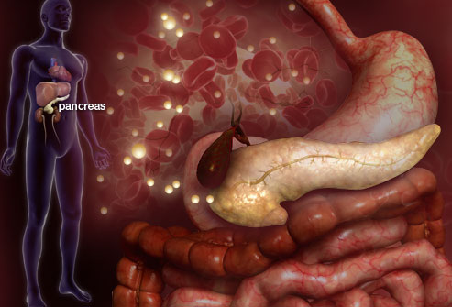

Slide 14
Natural History of Diabetes
Happy Pancreas
Fasting <100
Random <140
A1c <5.7%
Prediabetes
Fasting100-125
Random 140 - 199
A1c ~ 5.7- 6.4%
50% working pancreas
Diabetes
Fasting 126 +
Random 200 +
A1c 6.5% or +
20% working pancreas
Yes!
NO
Development of type 2 diabetes happens over years or decades

Slide 15




Slide 16

Pre Diabetes & Type 2- Screening Guidelines (ADA 2023 Clinical Practice Guidelines)
Start screening all people at age 35.
Screen at any age if BMI ≥ 25 (Asians BMI ≥ 23) plus one or > additional risk factor:
First-degree relative w/ diabetes
Member of a high-risk ethnic population
Habitual physical inactivity
PreDiabetes*
HIV on antiretroviral meds*
History of heart disease

Slide 17
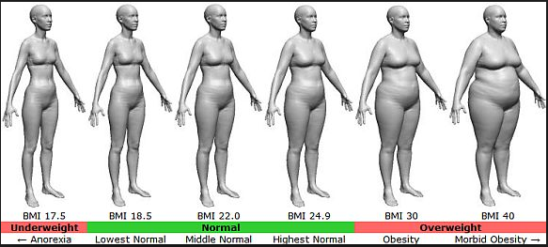
BMI – Visual Image

Slide 18

Diabetes 2 - Who is at Risk? (ADA Clinical Practice Guidelines)
Risk factors cont’d
BP > 140/90
HDL < 35 or triglycerides > 250
History of Gestational Diabetes Mellitus
Polycystic ovary syndrome (PCOS)
Other conditions assoc w/ insulin resistance:
Elevated BMI, acanthosis nigricans (AN)
Screen using A1c, Fasting Blood Glucose or OGTT.
If negative, repeat screening at least every 3 years.
*If prediabetes, on antiretroviral meds, recheck yearly

Slide 19
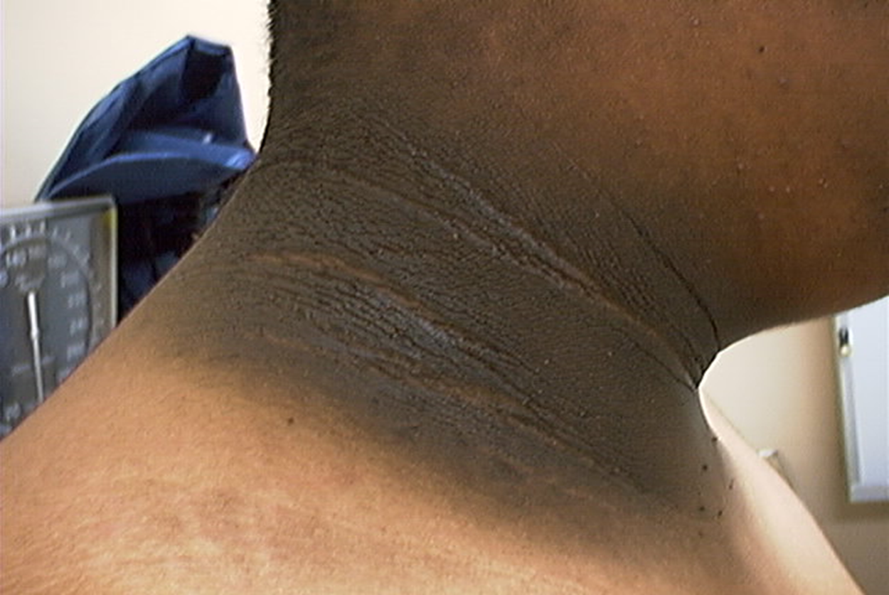
Acanthosis Nigricans (AN)
Signals high insulin levels in bloodstream
Patches of darkened skin over parts of body that bend or rub against each other
Neck, underarm, waistline, groin, knuckles, elbows, toes
Skin tags on neck and darkened areas around eyes, nose and cheeks.
No cure, lesions regress with treatment of insulin resistance

Slide 20

Signs of Diabetes
Going to Bathroom
Super thirsty
Super hungry
Weight loss without trying
Fatigue – so tired
Skin and other infections
Blurry vision

Slide 21

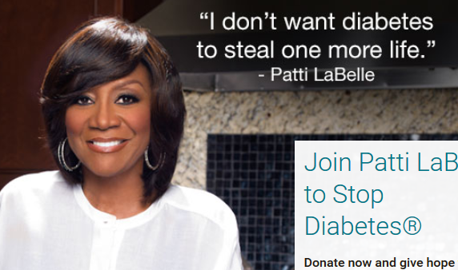
Patti Labelle
"divabetic”
“I have diabetes, it doesn’t have me”

Slide 22

What is Type 2 Diabetes?
Complex metabolic problem
(Insulin resistance and deficiency)
with social, behavioral and environmental factors unmasking genetic risk.
It’s no one's fault they have diabetes.
New Diagnosis? Call 800 – DIABETES to request “Getting Started Kit”
www.Diabetes.org

Slide 23

8 things Amiss - Type 2 Diabetes
Decreased satiation neuro-
transmission
Decreased amylin, β-cell secretion
80% loss at dx
Increased renal glucose reabsorption
Decreased Gut hormones
Increased glucagon secretion
G
I
G
I
G
G
I
I
G
Increased lipolysis
G
G
I
I
G
G
I
Increase glucose
production
I
G
G
Decreased glucose
uptake
Notes:
23
23

Slide 24

Motivation comes from within.
Rediscover the Spark

Slide 25


Diabetes is Complex

Slide 26

ABC’s of Diabetes
A1C less than 7% (individualize)
Pre-meal blood sugar 80-130
Post meal blood sugar <180
AGP - Time in Range (70-180) 70% of time
Blood Pressure < 130/80
Cholesterol – Age 40+, cholesterol medication recommended (statin)
LDL <70 (lousy cholesterol) if at higher risk
LDL <55 if had heart attack or stroke

Slide 27

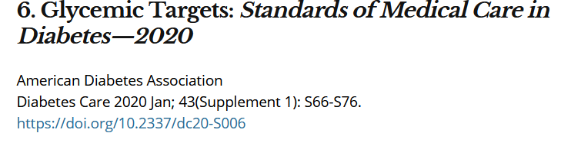
A1c and Estimated Avg Glucose (eAG)
A1c (%) eAG__
5 97 (76-120)
6 126 (100-152)
7 154 (123-185)
8 183 (147-217)
9 212 (170 -249)
10 240 (193-282)
11 269 (217-314)
12 298 (240-347)
eAG = 28.7 x A1c-46.7 ~ 29 pts per 1%
Translating the A1c Assay Into eAG – ADAG Study

Slide 28


Slide 29
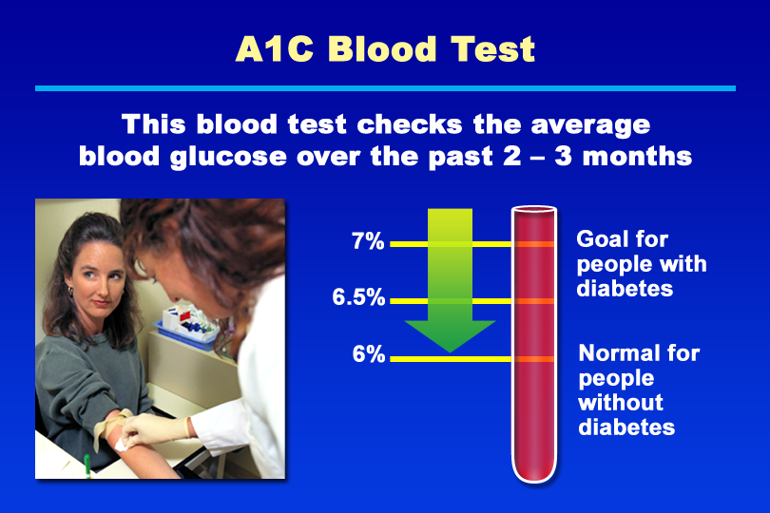
A1C Blood Test
Notes:
KEY MESSAGE: The A1C test measures a person’s average blood glucose over the previous 2 to 3 months.
Supporting Points
The A1C test is used to monitor blood glucose control. The test measures the level of glycosylated hemoglobin, which forms when glucose binds to hemoglobin in red blood cells. Because the lifespan of red blood cells is approximately 120 days, the glycosylated hemoglobin level is a good measure of average blood glucose over the past 2 to 3 months.
The American Diabetes Association recommends an A1C goal of less than 7% for people with diabetes. In people without diabetes, the normal A1C level is below 6%. For most people with diabetes, the A1C test is recommended at least twice yearly. Some people are advised to have more frequent (quarterly) A1C testing. An A1C value of 8% or higher almost always necessitates a change in the person’s treatment plan.
The American College of Endocrinology (ACE) and American Association of Clinical Endocrinology (AACE) recommend an A1C goal of 6.5% or less. An ACE consensus panel recommended this lower A1C goal to further reduce the risk of complications in people with diabetes. The American Association of Diabetes Educators has stated its support of this lower A1C goal.* The ADA recommends considering more stringent A1C goals (normal A1C; less than 6%) in individual patients.
Keeping the A1C level within the goal range can prevent or delay long-term complications of diabetes. Improved glycemic control is associated with reduced risk of cardiovascular events and microvascular complications, such as retinopathy, neuropathy, and nephropathy. The United Kingdom Prospective Diabetes Study found that lowering blood glucose in type 2 diabetes with intensive therapy (median A1C of 7%) reduced overall microvascular complications by 25%. The Diabetes Control and Complications Trial found that for every 1% reduction in A1C, the risk of microvascular complications was reduced by 40% on average.
* Berkowitz KJ. AADE supports new guidelines for diabetes management. Diabetes Educator. 2002;28(1):26,29.

Slide 30
Why bother? Blood sugars matter!
Every 1 point drop in A1c causes a 35% decrease in diabetes problems.
By getting active and eating healthy.
Medications like insulin, injections and pills help too.
Keep your pancreas happy.
It’s worth it!

Slide 31
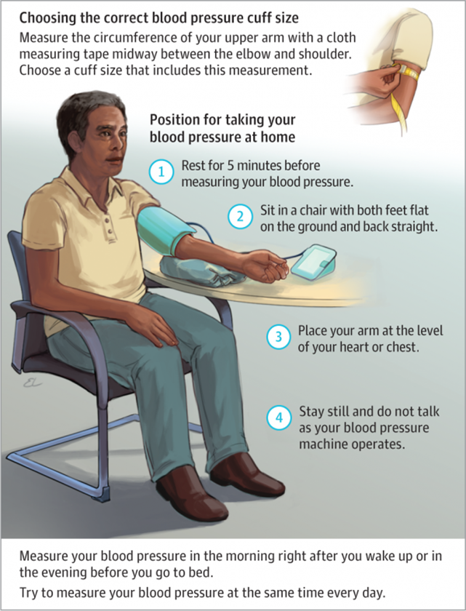

Blood Pressure is really important.
Goal is 130/80 or less (if safe for you).

Slide 32

Cholesterol Goals
Cholesterol – If over 40 years, cholesterol medication (statin) + diet and exercise recommended.
Goals
LDL (lousy) - LDL (lousy) cholesterol target less than 70 if at high risk - LDL cholesterol target less than 55 if had heart attack or stroke
Triglycerides less than 150
HDL (happy) more than 40

Slide 33
Statin Dosing
High Intensity:
Lowers LDL ≥50%
Moderate Intensity:
Lower LDL 30-<50%
Lipitor (atorvastatin)
40-80mg
Crestor (rosuvastatin)
20-40mg
Lipitor (atorvastatin)
10-20mg
Crestor (rosuvastatin)
5-10mg
Zocor (Simvastatin)
20-40mg
Pravachol (pravastatin)
40 – 80mg
Mevacor (lovastatin) 40 mg
Lescol (fluvastatin) XL 80mg
Livalo (pitavastatin) 2-4mg
***If can’t tolerate intended statin dose, use maximally tolerated dose

Slide 34
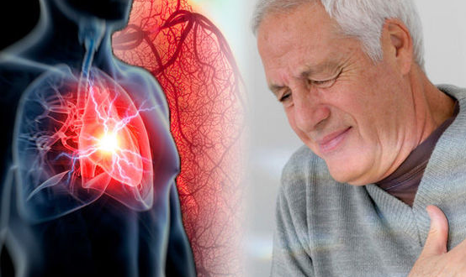
Cardiovascular Disease is the Leading Cause of Death in Diabetes

Slide 35
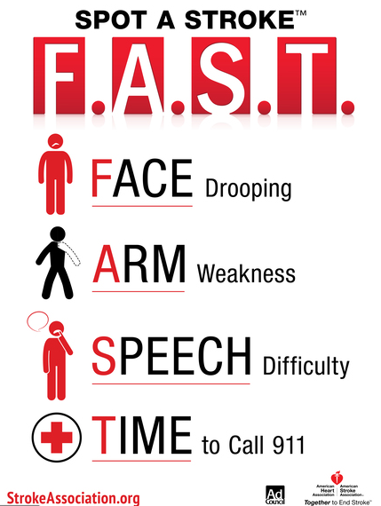
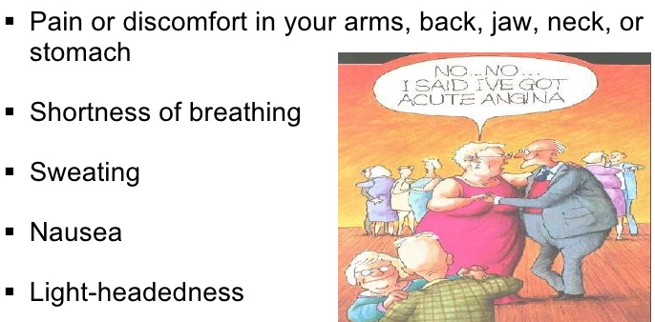
Stroke and Heart Attack
Make sure people with diabetes know the signs and seek immediate help.
People with diabetes may not experience intense chest or jaw pain during heart attack due to neuropathy.

Slide 36
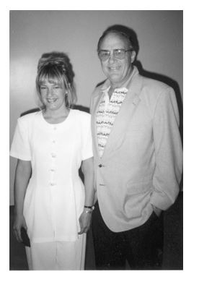

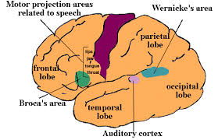
Stroke of Luck

Slide 37

Living with PreDiabetes or Diabetes?
How do we move from Dis-Ease to Well-Being?

Slide 38

Let’s Be Health Warriors
Every day actions make a big difference
Protect against health issues and improve outcomes if you do have an event.
Keep strong.

Slide 39

Financial Advisor
Mid 30s, friendly, he smiles to greet you and you notice his gums are inflamed. He tells you he has prediabetes and is worried that he might have diabetes soon,
If you could give him some health-related suggestions, what would they be?

Slide 40

Your teeth need extra special attention
Goal: Brush teeth at least twice daily and floss at least once daily.
See dentist at least yearly.
Teeth cleaning twice a year.

Slide 41


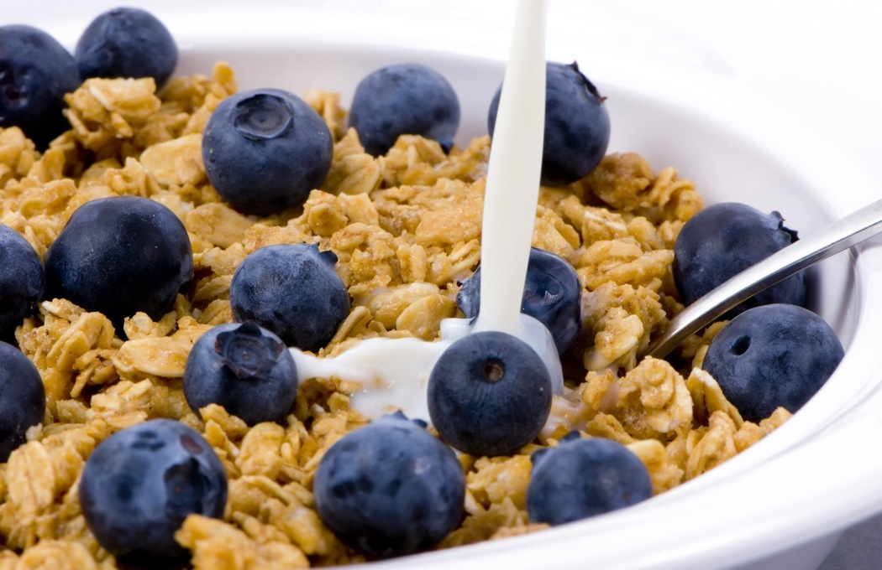

Preventing Pre Diabetes and Diabetes

Slide 42

Ditch the Nicotine Stick
Goal: Quit Smoking (vaping) and Don’t Start

Slide 43

Be a Sleep Warrior
Make time for sleep
Restorative
Decreases hunger
Lowers Blood Sugar
Improves ability to cope
Goal: Get at least 7 hours of sleep a night.
You deserve it.

Slide 44
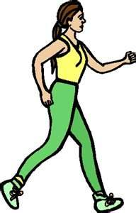
Keep Active
Goal: Work toward 30 minutes of activity a day plus strengthening exercises twice a week

Slide 45


Where are you on this continuum?

Slide 46
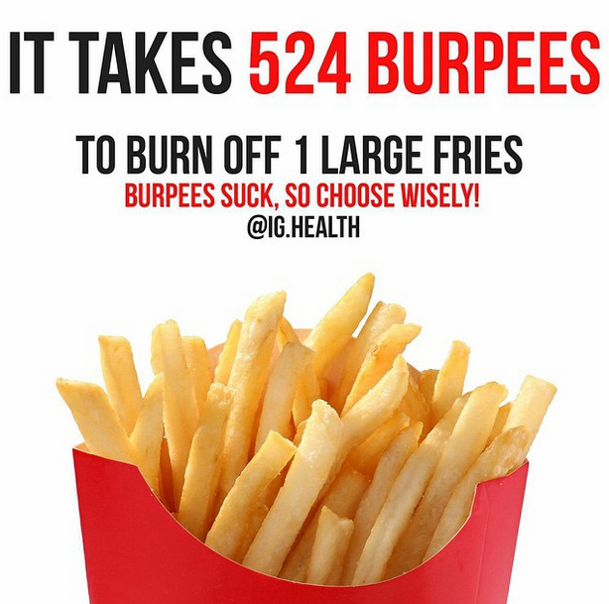
A hard truth
Exercise alone doesn’t cause weight loss
But….
It helps keep weight off
Decreases visceral fat
Decreases CV Risk
To combat obesity, we need to change the food environment
“You cannot outrun a bad diet”.

Slide 47

Exercise benefits
Sleep better.
Less diabetes kidney disease, retinopathy
Improved mood and vitality
Improved sexual health
Less urinary incontinence
Better Knee health
Less need for medications
Decreased health care costs

Slide 48
Good Exercise Info
“Passagiata” – take an after meal stroll
Exercise decreases A1c 0.7%
No change in body wt, but 48% loss in visceral fat
ADA PostGrad 2010
“Every minute of activity lowers blood sugar one point.”
“I don’t have time to exercise, I MAKE time.” Mike Huckabee

Slide 49
DiaBingo- G
G ADA goal for A1c is less than ____%
G Blood pressure goal is less than
G People with DM should see eye doctor (ophthalmologist) at least
G The goal for blood sugars 1-2 hours after a meal is less than:
G People with DM should get this shot every year
G People with DM need to get these kidney tests yearly
G Periodontal disease indicates increased risk for heart disease
G The goal for blood sugar levels before meals is:
G The activity goal is to do ___ minutes on most days
G Name 3 healthy foods to include in daily meal plan

Slide 50

Half Way Stretch Break

Slide 51
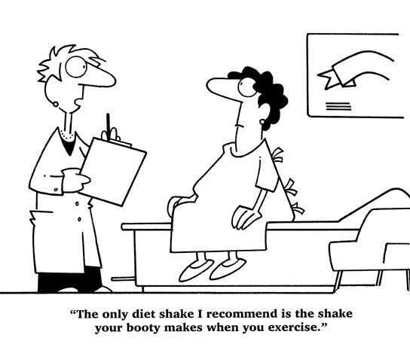
Best Shake For People with Diabetes
From Debbie Nagata’s slide collection

Slide 52
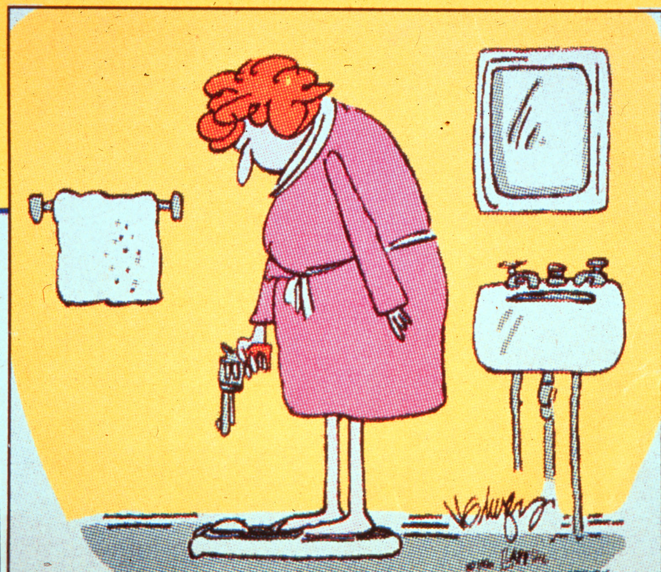

Slide 53
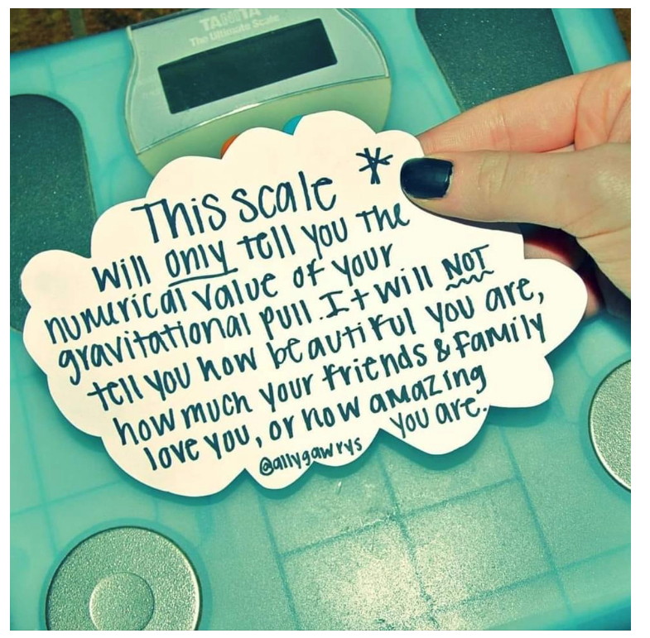
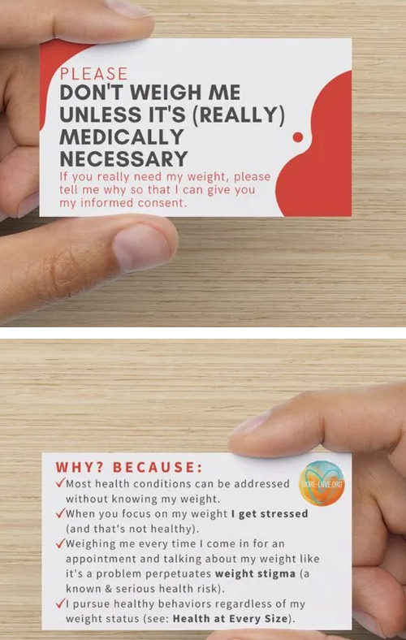

Weight is a Heavy Issue

Slide 54
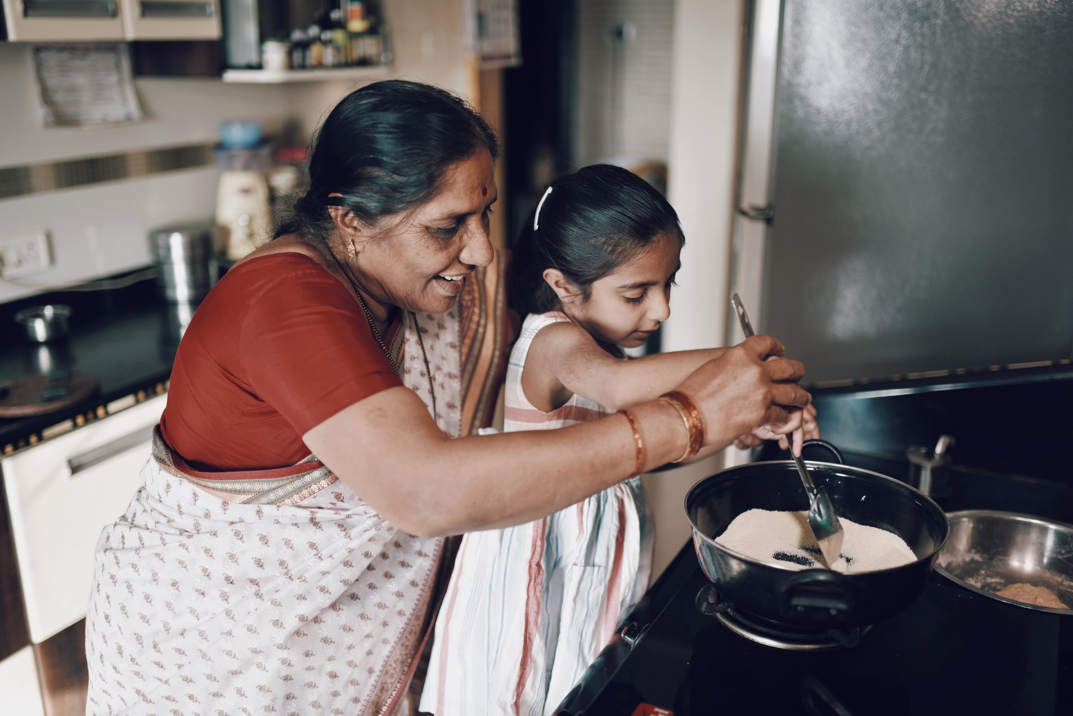
Nourishing our Bodies

Slide 55
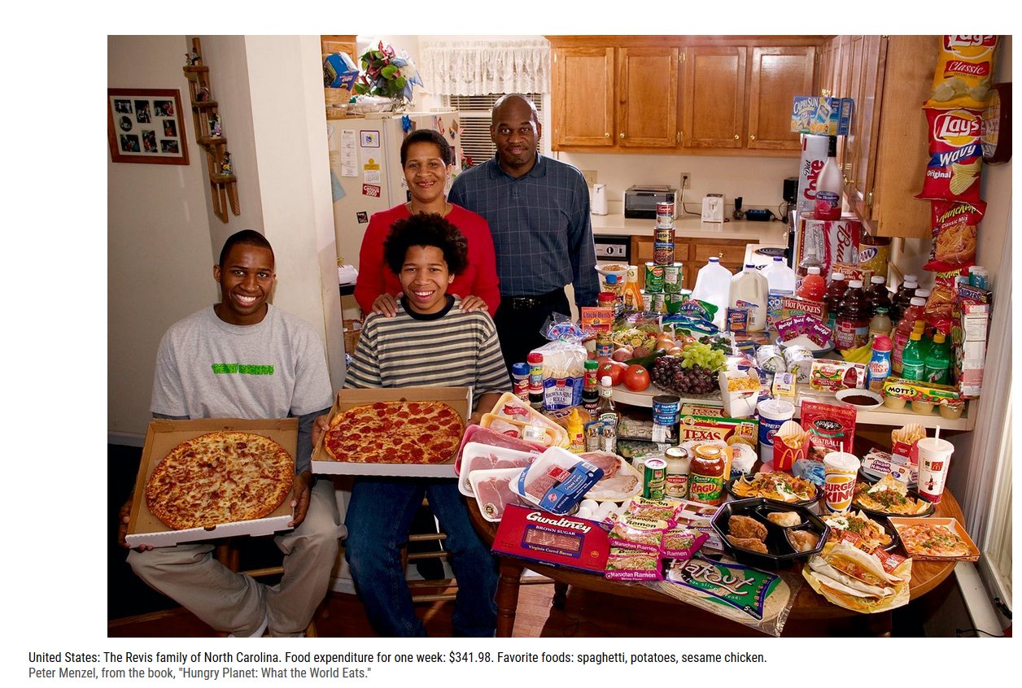
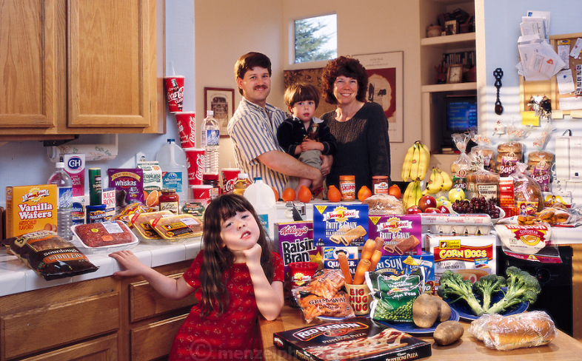

Slide 56


Slide 57






Move toward the Tomato

Slide 58

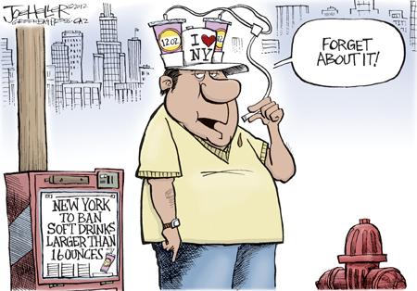
Immediately Improve Your Health Eat Less Junk Food & Sugary Drinks –
Less Processed Foods
Less Sugary Beverages
increase visceral adiposity
With sugar or
High fructose corn syrup

Slide 59

Average American Consumes 25 teaspoons of sugar a day (400 cals)
One soda has 12 teaspoons sugar
ADA guidelines “limit sodas and beverages with sugar, High Fructose Corn Syrup, (HFCS)
Goal- 6 teaspoons of sugar a day

Slide 60

Your health can only get better

Slide 61

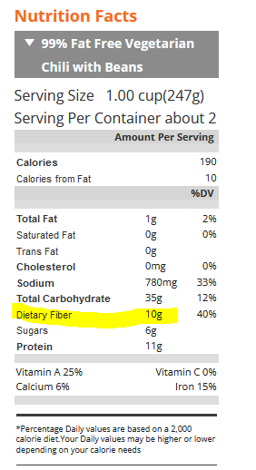
Fiber – the New “F” Word
Goal:
14 gms / 1000 calories ~ 30 gms a day
How?
Whole, intact grains, beans, fruits, veggies, nuts, avocados
Why?
Associated with lower mortality for people with type 2.
Fiber intake inversely associated with type 2 diabetes
Avoid highly processed foods
If label says 0-2gms of fiber per serving, low fiber food.

Slide 62

Limit refined carbs and added sugars Instead eat more HIGH Fiber foods:
High fiber carbs loaded with vitamins, minerals and phytonutrients
25+ gms of fiber a day
Power Carbs include:
Beans
Veggies
Fruits
Whole grain foods
Associated with decrease in all cause mortality
Improves microbial diversity

Slide 63

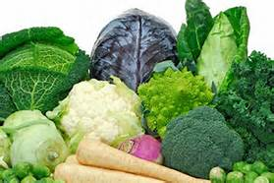
Super Foods
Found in the pigments, chemicals, and fiber of plants
Sources include:
Greens: Kale, spinach, bok choy
Deep orange fruit and veggies: carrots, winter squash, apricots, sweet potatoes
Red and purple fruits and veggies: berries, beets, plums, red grapes and red peppers
Nuts, onions, citrus, cruciferous vegetables, dark chocolate!

Slide 64
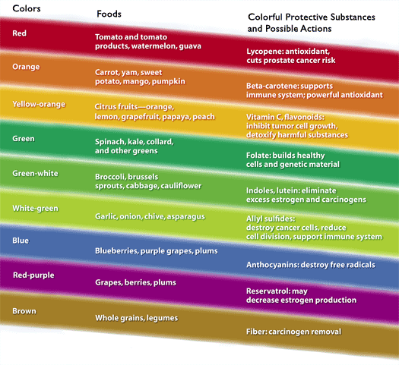
Notes:
PCRM = Physicians Committee for Responsible Medicine. Beneficial phytochemicals naturally found in plant foods. Synergistic effect in the whole state, vs. when isolated and supplemented.

Slide 65
10 Super Foods
Beans
Dark Green Leafy Vegs
Citrus Fruit
Sweet Potatoes
Berries
Tomatoes
Fish High in Omega-3 Fatty Acids
Whole Grains
Nuts
Fat-Free Milk and Yogurt

Slide 66

USDA Food Pyramid www.myplate.gov
Balancing Calories
Enjoy your food, but eat less.
Avoid oversized portions.
Foods to Increase
Make half your plate fruits and vegetables.
Make at least half your grains whole grains.
Switch to fat-free or low-fat (1%) milk.
Foods to Reduce
Compare sodium in foods like soup, bread, and frozen meals ― and choose the foods with lower numbers.
Drink water instead of sugary drinks.

Slide 67
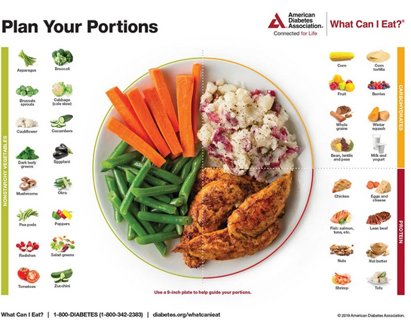
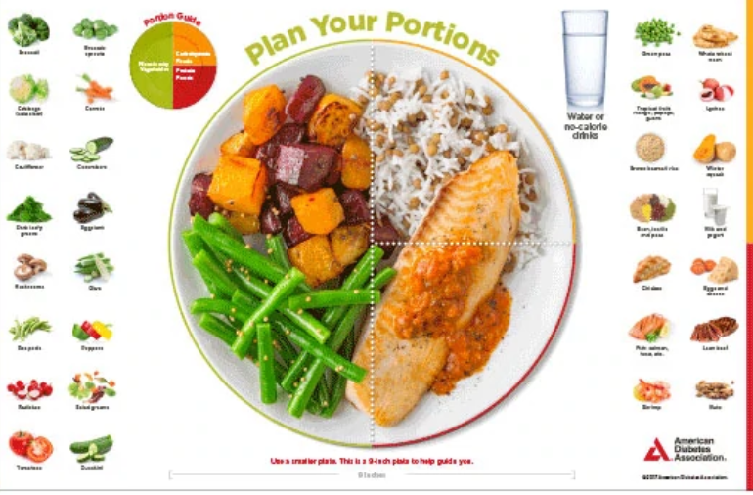



Plate example

Slide 68
Handy Meal Plan
Per Meal Serving
Each finger = 15 gms carb (can have 3-4 servings/meal)
Palm of hand = 3 oz’s protein
Thumbnail = 1 tsp fat serving

Slide 69
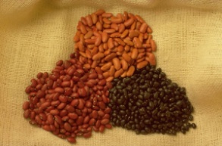


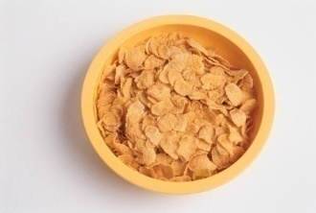
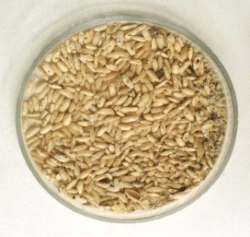
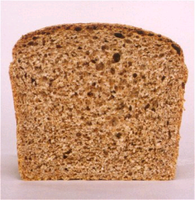

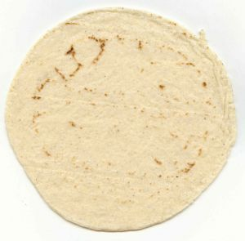

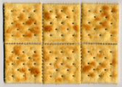
Carb counting- starch
Each Food has:
80 Calories
15 grams carb
1 small ear of corn or 1/2 cup corn
1/3 cup cooked pasta
1/2 cup
cooked beans
3/4 cup cold cereal
1 slice bread
1/3 cup cooked rice
1 small potato
1 small tortilla
1/2 English muffin
5-6 small crackers

Slide 70









Carb counting- fruit
Each Food has:
60 Calories
15 grams carb
½ cup fruit juice
1 small fresh fruit
½ banana
½ cup unsweetened apple sauce
1 slice bread
17 small grapes
1 cup melon
¼ cup dried fruit
1 1/4 cup strawberries
2 tbsp raisins

Slide 71


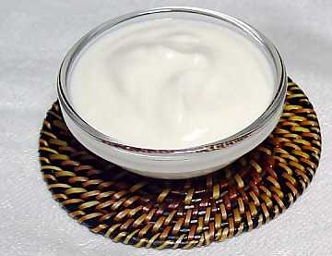
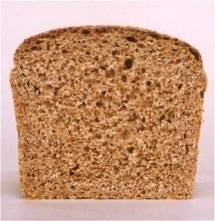



Carb counting- milk
Each Food has:
90-150 calories
12-15 grams carb
8 oz buttermilk
1 packet diet hot cocoa
1 slice bread
6 oz plain yogurt
8 oz milk
6 oz light fruit yogurt
8 oz soy milk

Slide 72


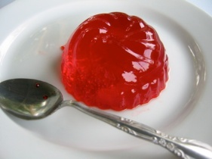

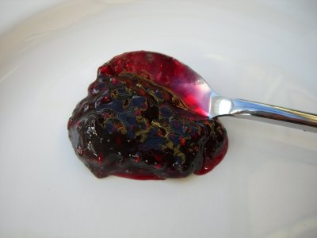
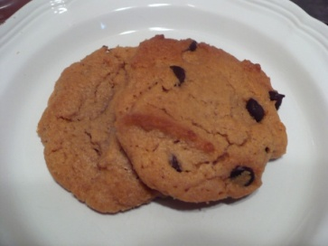



Each Food has:
Calories vary
15 grams carb
Carb counting - sweets
½ cup regular jello
2 tbsp light syrup
½ cup diet pudding
2 inch square cake or brownie, unfrosted
1 slice bread
1 tbsp syrup, jam, jelly, table sugar, honey
2 small cookies
½ cup ice cream or frozen yogurt
¼ cup sorbet
½ cup sherbet

Slide 73
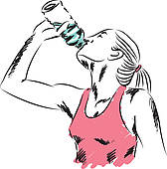
Enjoy the Ultimate Beverage – H20
Goal: Keep hydrated by enjoying plenty of water

Slide 74
Goals to Work On
Make a Plan – You are Worth It
My activity Goal for this week ___________________________________________________________________
___________________________________________________________________
My Nutrition Goal for this week ____________________________________________________________
___________________________________________________________________

Slide 75
Goals for Diabetes
Drugs – Know the medications you are taking, keep updated list on phone or paper and
Eyes – Get checked yearly, report any vision changes
Feet – Check them daily, and if you notice and sores or infection, let your provider know
Food - Healthy eating, more fiber, vegetables, beans, whole grains, fruits. Meet with dietitian.
Kidneys – Check for kidney health annually by knowing your: - GFR (goal is more than 60) and - UACR (urine test) with goal of less than 30 mg/gm.
A1C – less than 7% - Premeal sugar target is 80-130 - 1-2 hours after a meal, less than 180
Blood Pressure – less than 130/80
Cholesterol – If over 40, cholesterol medication + diet and exercise recommended - LDL (lousy) cholesterol target less than 70 if at high risk - LDL cholesterol target less than 55 if had heart attack or stroke

Slide 76
Meds for Type 2 – Sulfonylureas and Metformin
Sulfonylureas
Glipizide
Glyburide
Glimepiride (Amaryl)
Lower A1C 1-2%
Cheap ($4 month)
Cause low blood sugar/ weight gain
Metformin
Lowers A1C 1-2% points
Cheap ($4 a month)
Lowers LDL cholesterol
Take with meals
Use extended release to prevent nausea
Does not harm kidneys
Don’t take if GFR less than 30

Slide 77
Meds – DPP-IV’s and Actos
DPP-IV’s: Januvia, Onglyza, Tradjenta, Nesina
Lower A1C 0.6% -1.5
Expensive $600 /mo
No low blood sugar or weight gain.
Can cause joint pain (rare)
TZD - Actos
Actos cost $35 a month
Lower A1C by ~1.0%
Can cause fluid weight gain
Not for people with heart failure
Actos is recommended post-stroke and for those with fatty liver

Slide 78
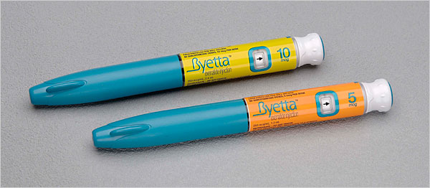
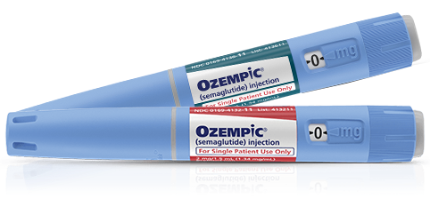
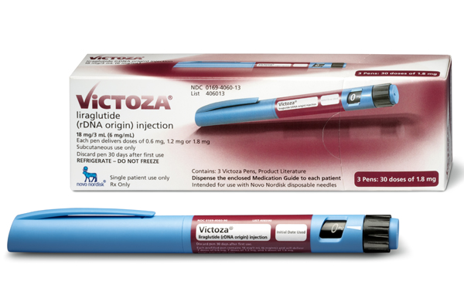
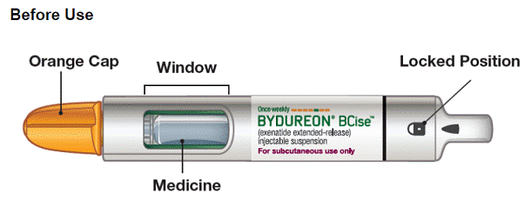
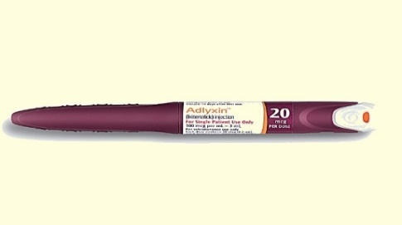
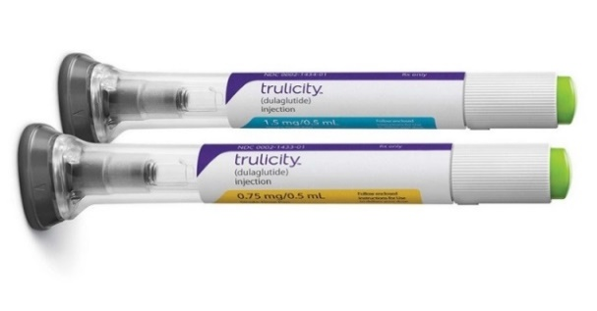
GLP-1 Receptor Agonist Devices
Byetta
Ozempic
Victoza
1.2mg, 2 pens/mo - (15 doses per pen)
1.8mg, 3 pens/month
- (10 doses per pen)
Requires Rx for needles
5mcg or 10mcg pen
1 pen/month
Requires Rx for needles
3 pen options: 0.5, 1, 2mg 1 pen/month
Comes with needles
Adlyxin
Bydureon
Trulicity
Contains 14 doses (20mcg)
2 pens/month
Requires Rx for needles
2mg pen
4 pens/month
Shake 15 seconds
Never see needle
0.75, 1.5, 3, 4.5mg pens
4 pens/month
Never see needle

Slide 79
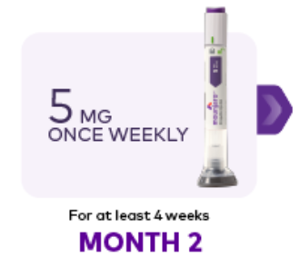
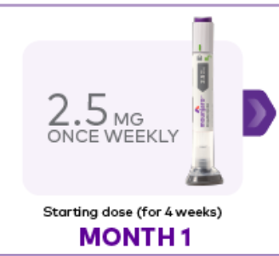

Tirzepatide Clinical Use

Slide 80
Benefits of GLP-1 & GIP Meds
“Gut Hormone Imitators”
A1C lowering
1-3%
Weight loss
4-13%
Cardiovascular
Less Appetite
Help with fatty liver?
Once a week Injection

Slide 81

Counseling Points: GLP-1 RA & GLP-1/GIP
Avoid if personal or family history of medullary thyroid cancer
Start at lower dose and gradually increase
Eat smaller nourishing meals to reduce nausea
Avoid high fat meals
Reconsider nausea as feeling full
Store extra pens in fridge
Report any sudden abdominal pain or pancreatitis symptoms

Slide 82
SGLT-2i Indications Summary
Drug | Lower BG | Reduce CV Risk? | Use to treat Heart Failure? | Slow renal disease?
Dapagliflozin (Farxiga) | Yes | Yes | Yes +/- Diabetes | Yes
Empagliflozin (Jardiance) | Yes | Yes | Yes +/- Diabetes | Yes
Canagliflozin (Invokana) | Yes | Yes | Yes w/ Diabetes | Yes
Ertugliflozin (Steglatro) | Yes | No | Yes w/ Diabetes | Yes
Bexagliflozin (Brenzavvy) | Yes | NA | NA | NA
Package inserts, dailymed.nlm.nih.gov

Slide 83
Benefits of SGLT-2 Inhibitors
“Glucoretics” – Urinate out Sugar
A1C lowering
0.6-1.5%
Weight loss 3-5 pounds
Cardiovascular
Protects Kidneys (GFR & UACR)
Helps with Heart failure
Blood pressure lowering

Slide 84
Side Effects of SGLT-2 Inhibitors
“Glucoretics” – Urinate out Sugar
Genital infections
Volume depletion
Increased urination
Hypotension
Urinary Tract Infection
Diabetes ketoacidosis (DKA)
Notes:
Cana: bone mineral density decline: hip ≤1%; lumbar spine, femoral neck, and distal forearm <1%
UTI: 6%Genito infection: 11-12%
Increased serum K+: 9-27%
Amputation risk
Emgag: UTI: females 18%, males 4%
Genito infection: 5%
Dapag: UTI: 6%, genito infection: 3%

Slide 85
Meds GLP/GIPs & SGLT-2s
GLP-1 & GIP (Gut hormone imitators)
Lowers by A1C 1-3%
Expensive $900 /mo
Weight loss (4-13%)
Protects against heart disease.
Can cause nausea/loss of appetite
Report any stomach pain
SGLT-2s (Glucoretic)
Lower A1C by ~1.0 – 1.5%
Expensive ~ $600 /mo
Protects kidneys, recommended in those with kidney failure
Recommended for those with CHF or heart disease
Weight loss
Genital infections, low blood pressure

Slide 86

Preparing for Provider Visit
Preparing for Provider Visit:
Bring list of medications currently taking or take a picture of the meds you are taking.
If you are keeping track of your blood sugars, bring in your log book.
Consider ahead of time the top 1-2 things you want to address during your visit and write them down.
If you have a hard time remembering what is said, bring someone with you and write down main points after the visit.
Ask for a copy of your lab results so you can keep your own personal record

Slide 87

Collaborate with Health Care Team
Learn about diabetes
Be familiar with your health /labs
Ask what action you can take to improve your health
Referrals as needed
Your interest increases engagement
Keep an eye on the ABC’s of your diabetes.

Slide 88
Goals to Work On
Make a Plan – You are Worth It
My activity Goal for this week ___________________________________________________________________
_______________________________________________________________________________
My Nutrition Goal for this week ___________________________________________________________________
_______________________________________________________________________________
When I meet with my provider, I am going to ask about:
___________________________________________________________________
_______________________________________________________________________________

Slide 89

Look Beyond – What impacts DSM
Improving diabetes treatment outcomes requires looking at multiple factors:
Living situation
Adequacy of medical management
Duration of diabetes
Weight gain / weight loss
Other health related problems
Social structural factors
Childhood trauma – Adverse Childhood Experiences

Slide 90

Question - What is ACE?
ACE =
Adverse
Childhood
Experiences
(before 18 yrs)
What is the relationship between childhood trauma, diabetes and health?
www.AcesAware.org

Slide 91

10 Assessment Areas for ACE – Use 10 Question Screening Tool to Assess
https://www.npr.org/sections/health-shots/2015/03/02/387007941/take-the-ace-quiz-and-learn-what-it-does-and-doesnt-mean

Slide 92
ACE increases risk for 9 out of 10 leading causes of death in US
Odds Ratio with ≥ 4 ACEs
Leading Cause of Death
Heart Disease
Stroke
Diabetes
Kidney Disease
Cancer
Alzheimer’s
Suicide(attempts)
2.1
2.0
1.4
1.7
2.3
4.2
37.5
https://www.cdc.gov/vitalsigns/aces/index.html

Slide 94

The Act of Recognition is Healing

Slide 95
Actions To Buffer Toxic Stress Response
Person Centered Care
Balanced Nutrition
Regular Exercise
Mindfulness Meditation
Quality Sleep
Supportive Relationships
Behavioral Health

Slide 96


Helping with Healing

Slide 97

Quotes from “What Happened to You?”
The lesson is that no matter what has happened, you get a chance to rewrite the script.
(You are not your number.)
I wouldn't be who I am without my trauma, so I own it.
I use my trauma in service to others - empathy, compassion and forgiveness.

Slide 98
Quotes from “What Happened to You?”
Trauma and adversity, in a way, are gifts.
All of us who have been broken and scarred by trauma have the chance to turn those experiences into post-traumatic wisdom.
Forgive yourself, forgive them. Step out of your history and into the path of your future.

Slide 99

Remember by Joy Harjo – Poet Laureate
Remember the earth whose skin you are: red earth, black earth, yellow earth, white earth, brown earth, we are earth.
Remember the plants, trees, animal life who all have their tribes, their families, their histories, too. Talk to them, listen to them. They are alive poems.
Remember the wind. Remember her voice. She knows the origin of this universe.
Remember you are all people and all people are you. Remember you are this universe and this universe is you. Remember all is in motion, is growing, is you. Remember language comes from this. Remember the dance language is, that life is. Remember.
We are all connected

Slide 100

Keep Connected with friends and family who love you just the way you are!
Goal: Self-care is important

Slide 101


Take moment to enjoy nature and find enchantment
Goal: Step into nature daily. Moments of Awe

Slide 102

Take inventory of things that you are grateful for
Goal: Take note of special moments

Slide 103



Actionforhappiness.org

Slide 104

Thank You – We DID IT
Questions? Please email info@diabetesed.net
Website www.DiabetesEd.net

