Slide 1
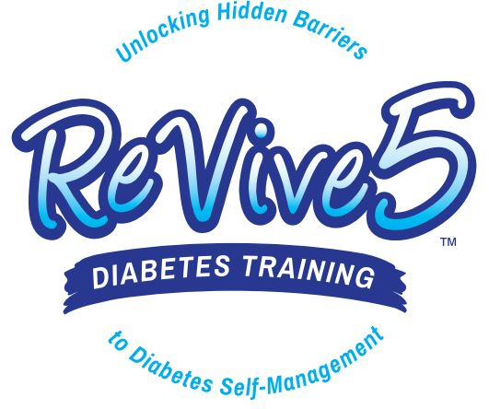

ReVive 5 Diabetes Training Program Session 1
Welcome!
Get Ready to Optimize self-management based on personal choices and values—”find the expert within.”

Slide 2



so please download your certificates into a file on your computer.
Welcome to our DiabetesEd Online University
Our goal is to provide an exceptional user experience and build a sense of community.
Notes:
Welcome to our new and Improved Diabetes Education Services Online University, where you can earn CE's, prepare for certification, and increase your confidence.
Our goal is to offer you exceptional and personalized service and build a sense of community.

Slide 3

Bryanna is here to Help!
If you have questions, you can chat with Bryanna at www.DiabetesEd.net or call 530 / 893-8635 or email at info@diabetesed.net
Bryanna Sabourin
Director of Operations
Certification Pathway Coach &
Customer Happiness Expert

Slide 4
ReVive 5 Training Program
Session 1:
What is Diabetes Distress, and what do we know about it?
How does diabetes distress affect self-care?
How is diabetes distress different from depression?
How can diabetes distress be assessed practically in clinical care?
Using the ReVive 5-step approach to address distress and support behavior change
Specific tools to enhance effective communication strategies to address diabetes distress.
Four practical steps to address diabetes distress as a barrier to self-care.
Session 2:
Finding the Expert Within – four steps to help individuals discover their expertise to improve glucose and feelings of self-efficacy
Reviewing the diabetes knowledge
Establishing a diabetes toolkit
How to determine if basal insulin is right
Discover the impact of diet, exercise, stress, insulin, etc. on glucose levels.
How to evaluate insulin-to-carb ratios and correction factors without fancy formulas.
Using ReVive 5-Step Approach to Integrate the Whole Person Intensive Case Study
Explore glucose patterns and identify problems
Use an integrated log sheet as a tool to identify what needs fixing: pattern recognition.
Case reviews that exemplify common glucose problems and enhance problem-solving skills.
Utilizes the person’s distress profile to better anticipate and respond to barriers and setbacks.

Slide 5
ReVive 5 Diabetes Training Program Resources
The ReVive 5 Training Program Includes:
14.0 CEs - Includes the 2 Session ReVive 5 Training Program, Certificate and 5 FREE bonus courses to supplement content
Quarterly 1 hour follow-up sessions with ReVive Team – July 31st, October 30th
A comprehensive set of assessment tools, educational materials, log sheets and resources
Access to the recorded courses, podcasts and resources for one full year.
To Earn CE’s, log onto Diabetes Ed Online University and complete survey, critical thinking tool and test for CE certificate.

Slide 6

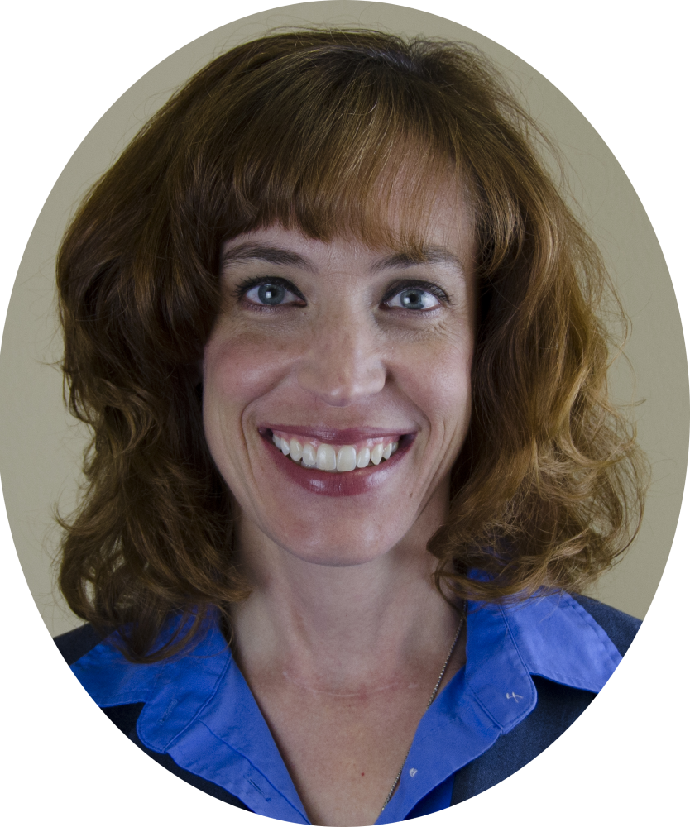
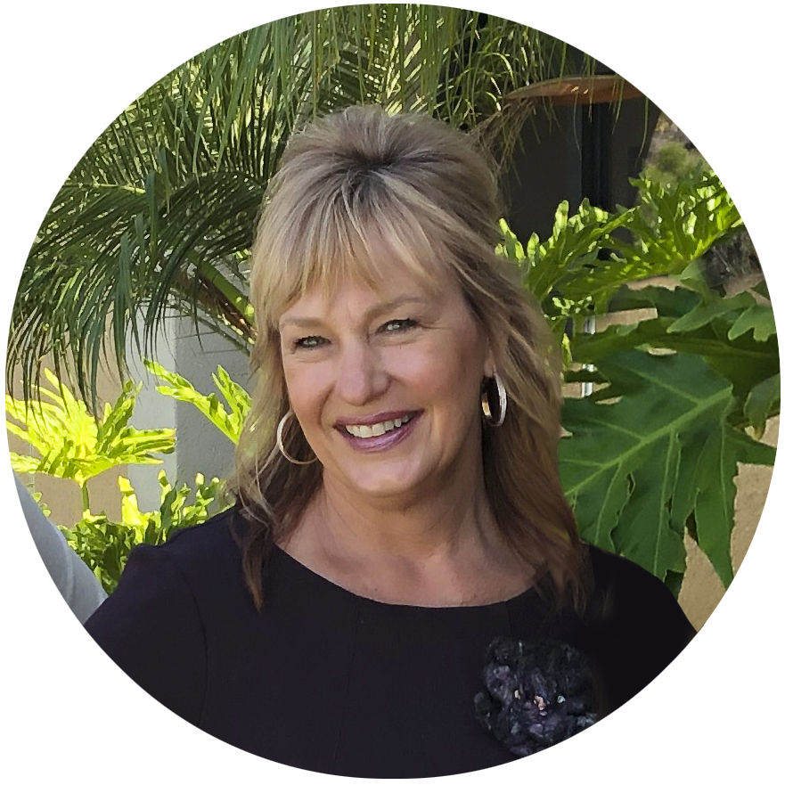
Introducing the ReVive Team
ReVive 5 is taught by a team of 3 Interdisciplinary Experts:
Lawrence Fisher, Ph.D., ABPP, Professor Emeritus, UCSF
Susan Guzman, PhD
Beverly Thomassian, RN, MPH, CDCES, BC-ADM
The speakers have no conflict of interest to report.

Slide 7

ReVive 5 – Finding the Expert Within
Is a program that helps people diabetes:
Make choices about living with and managing their diabetes that are more effective
Provides a better fit with their life goals and values.
Enhance glucose problem solving skills
The goal is provide coaching to help the person with diabetes to “find their expert within”.

Slide 8


Managing Type 1 Diabetes Is Tough
A huge amount to manage and balance
No vacation – constant & unrelenting
Efforts never good enough
Frightening: hypers, hypos, complications, costs
Most others don’t see the amount of work involved
For many this takes an emotional toll

Slide 9

Diabetes Distress (DD)
DD refers to the expected worries, concerns, fears, and threats that are associated with a demanding chronic disease (e.g., management struggles, threats of complications, loss of functioning, access to care).

Slide 10
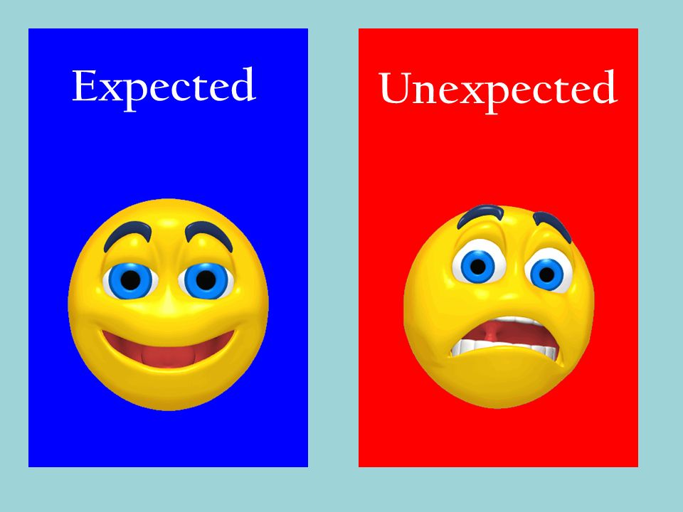
DD Is To Be Expected
Distress is an expected response to living with any chronic health condition and is not psychopathology or a co-morbid condition.
DD is simply the emotional side of living with diabetes
Notes:
h

Slide 11
DD can show itself in many forms
Most common:
May not show itself outwardly.
Feelings of frustration, powerlessness, hopelessness.
Pronounced fear of hypos or complications.
Avoidance of tough feelings “Who me?” “Everything is fine.”
Burnout because of all of the management tasks, frustrating results, dealing with insurance.
Anger/frustration with providers: distrust, no-shows.
Hyper attention to CGM screens and excessive BG checking.

Slide 12
DD can show itself in many forms
How it is expressed can vary by how it is expressed and its intensity over time.
Can increase with diabetes-related events (change in medications or dosage or change in new technologies).
Occurs across the A1C spectrum (perhaps for different reasons/different sources): don’t assume that DD is low if A1C is below 7.0%.

Slide 13
Poll Question 1
Which of the following is NOT a component of Diabetes Distress?
A. Feeling powerless with diabetes
B. Challenges with healthcare professionals
C. Concerns about hypoglycemia
D. General life stress

Slide 14
Poll Question 2
Which of the following is true?
A. DD is a form of psychopathology.
B. DD refers to the emotional side of diabetes.
C. DD is expressed in the same way over time.
D. DD occurs only among individuals with a high HbA1C.

Slide 15

Why is DD Important?
DD is significantly linked cross-sectionally and over time with:
- A1C: high DD associated with high A1C (but impactful throughout the entire A1C range)
- Reduced medication/insulin taking
- Missed healthcare visits
- Less physical activity, weight and diet
- Lower quality of life
DD has a highly significant clinical impact!
Fisher et al., 2015, 2016, 2018; Hessler, et al., 2017

Slide 16
DD Prevalence
High prevalence among T1D adults- 42%, 9-12 month incidence = 54%.
DD does not disappear on its own (easily becomes chronic without intervention): of those T1D adults with high DD at baseline, 74% screened positive 9 months later.
Prevalence of elevated DD on at least one of seven primary sources of DD = 83%.
Fisher, et al., 2016

Slide 17
Poll Question 3
Which of the following is false?
A. DD is episodic.
B. DD is highly prevalent.
C. DD is linked to diabetes management.
D. DD has a significant clinical impact.

Slide 18
What About Depression and Distress?
DD is distinct from clinical depression or Major Depressive Disorder (MDD).
‘Depression’ is measured in studies in different ways: depressed affect, symptoms of depression, or a clinical diagnosis of MDD.
Most people with diabetes who display symptoms of “depression” do not meet criteria for MDD.
Among those with diabetes, much of what we might think of as ‘depression’ is really elevated DD.

Slide 19
Depression vs. Diabetes Distress?
Depressive Disorder
Diabetes Distress
Hopelessness about life in general.
Pervasive and persistent mood problems (most of the day, more days than not).
Interferes with functioning across domains (relationships, work, health).
“I’m a failure. Everything is hopeless.”
Sadness and tough feelings about diabetes.
Persistent stressors related to diabetes.
May or may not affect diabetes management or functioning in other areas.
“I’m failing at diabetes. My efforts at diabetes are hopeless.”

Slide 20
Depression, DD, and Diabetes
Depression screeners (e.g., PHQ9) yield high rates of false positive diagnoses when compared with standard MDD diagnostic methods: 54% (ACCORD TRIAL) and 72% (REDEEM TRIAL).
Correlations between depression screening scales and DD scales are very high (0.60), suggesting that much of what depression screening scales measure is really the tough feelings of DD.
Fisher, et al, 2016; Sullivan, et al., 2012

Slide 21
Prevalence Of Depressive Disorders
For those with diabetes
New data

Slide 22
Poll Question 4
What percent of adults with T1D who meet criteria for elevated DD?
A. About 40%
B. About 30%
C. About 20%
D. Less that 10%

Slide 23
Conclusions About Depression & DD
DD and ‘depression’ may look similar (especially on screeners), but they are very different.
ADA guidelines suggest that DD be assessed and managed within diabetes care – no need to refer.
This means that you are the front-line, DD interventionists – and you can do it!
NOTE: MDD does occur in the diabetes population. When detected and diagnosed adequately, it needs to be treated.

Slide 24
Summary Of What We Know About DD
It is alarmingly prevalent and is an expected part of living with diabetes.
It highly clinically significant at any level.
Best not to assess DD with summary scores or brief screeners – use comprehensive measures.
Much of what we might think of as depression is really elevated DD.
You are the front-line DD interventionists.

Slide 25
Poll Question 5
Which of the following are true (check all that apply)?
A. Much of what is measured by depression screening scales is really elevated DD.
B. Depression screening scales often yield a high rate of false positives.
C. Depressive disorder reflects feelings of hopelessness about life in general.
All of the above.

Slide 26

How does DD impact diabetes management?
DD serves as a barrier to improved management. People who are distressed display:
Less energy and motivation.
Reduced engagement in management.
Less ability and willingness to make helpful management choices, which leads to further DD.
Fisher, et al., 2018; Hessler, et al., 2021

Slide 27
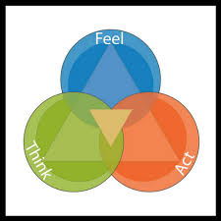
Why Does DD Lead To Problematic Management Choices?
How you feel and what you think can direct the choices you make!
Feelings and beliefs drive behavior!!

Slide 28
Why Does DD Lead To Problematic Management Choices?
Examples:
If you feel that you are powerless to keep BG in range, why try?
If you think that you will never be safe from a low, why take the right amount of insulin?
If you feel your efforts are never good enough, why bother trying something new?

Slide 29
DD Is A Barrier To Change
DD reduces responsiveness to education & other interventions.
It is hard for diabetes education and management interventions to overcome problematic DD feelings & thoughts, unless DD is addressed directly.
To maximize outcomes, best to address DD before education or at the same time.
Fisher, et al., 2018; Hessler, et al., 2021

Slide 30
Poll Question 6
Which of the following is false?
A. Distress often motivates people to make better management choices.
B. High DD is associated with greater engagement.
C. DD interventions should taker place after diabetes education.
D. All of the above.

Slide 31


Reducing DD: The Good News!!
DD is highly malleable:
Highly responsive to intervention.
Dramatic reductions can occur quickly.
Interventions do not have to be time-consuming or require extensive mental health training.
Similar findings for T1D and T2D adults.

Slide 32

Addressing DD in clinical care requires a different kind of conversation!
Let’s review some important assessment and intervention tools to help make this happen.

Slide 33
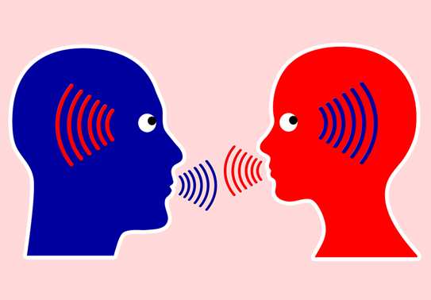
Conversational Tools You Can Use To Address DD In Your Practice
The idea is to use these tools to help build a relationship with the PWD that will effectively address the emotional side of diabetes.
You may already be familiar with these tools – our goal here is to target them specifically and apply them to DD.

Slide 34
Conversational Tools You Can Use To Address DD In Your Practice
The goal is to help the PWD label, verbalize, share, consider, and evaluate these frequently unaddressed and often hidden feelings and thoughts about diabetes.
Building the relationship with conversational skills is the intervention!

Slide 35

Relationship Building │ Three Tools To Make It Happen
Relationship Building
1. Open-Ended Questions
2. Active Listening
3. Clinician Engagement Skills
This Photo by Unknown Author is licensed under CC BY-SA

Slide 36
Tools │ #1. Open-Ended Questions
What are closed-ended questions?
Answers have to do with short, fixed responses (that then require a clinician to then ask the next question).
Examples of closed-ended questions:
- What kind of exercise do you like to do? “Walk!”
- How often do you walk? “3-times a week.”
- How often do you check your BG?
“Five times a day.”
Closed-ended questions do not help address DD.

Slide 37
Tools │ #1. Open-Ended Questions
What are open-ended questions?
Questions that ask “how, what, why.”
They require a more detailed response.
Examples:
“How do you respond when you go low?”
“What worries you the most about your diabetes?”
“What sense do you make of these BG numbers?”
“Why do you think that you are having trouble lowering your BG levels? What might be going on?”
Open-ended questions sometimes make clinicians nervous(never know what the response might be) –but they open the door to a more effective clinical conversation.

Slide 38
Tools │#2. Active Listening
What is “active listening?”
Listen attentively – talk much less (< 50%).
Alter tone and pace of speech (tolerate silences).
Attend to the position of HCP and PWD in the room.
Maintain eye contact (engage physically).
Prevent computer, charts, papers, from distracting.
Create an atmosphere of engaged, empathetic, and attentive listening.

Slide 39
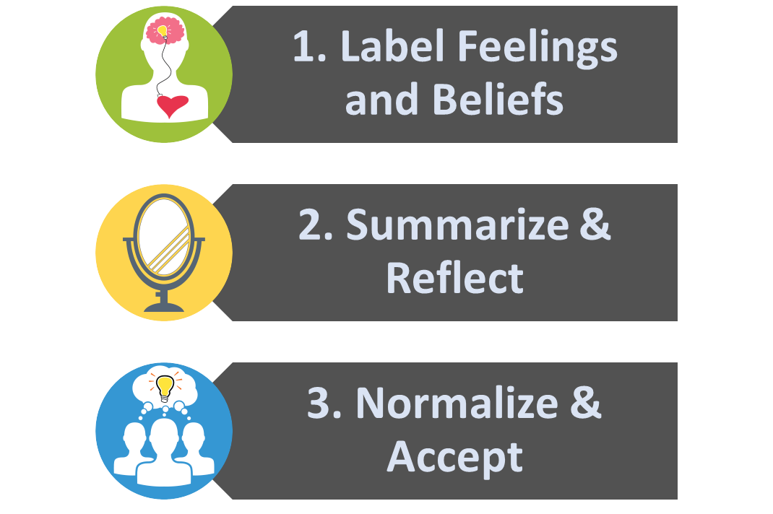
Tools │#3. Clinical Engagement Skills
Based on MI, empowerment, autonomy support:

Slide 40
Clinical Engagement Tools: Label & Address Feelings
Many people are unaware of what they feel.
Many feel many things at the same time – hard to separate and label each (anger and self-blame).
Many are ashamed or embarrassed about what they feel – “I shouldn’t feel this way.”

Slide 41
Clinical Engagement Tools: Label & Address Feelings
TOOL: Sprinkle feeling words throughout the conversation.
Use the conversation to focus on feelings – label them explicitly.
Practice using these words – pick ones that fit your style.
Expect some people to be surprised at your use of feeling words (no one ever talked to them this way).
Don’t worry about saying the wrong feeling word – they will correct you.
Common feeling words: sad, frustrated, disappointed, angry, hopeless, defeated, ashamed, embarrassed, burned out.
“Sounds like you were really frustrated about …”
“You must have ended up feeling disappointed …”
“Perhaps you were feeling it was your fault anyway, yet you seem to be angry at them at the same time.”

Slide 42
Clinical Engagement Tools: Label & Address Feelings
Common feeling words:
Sad
Frustrated
Scared/fearful
Disappointed
Angry
Hopeless
Defeated
Ashamed/embarrassed
Burned out

Slide 43
Clinical Engagement Tools: Summarize & Reflect
It helps the PWD know that you are listening carefully and are interested.
It helps them know that you understand & accept without judgement.
It helps them to evaluate and consider their own experience – it becomes more objective, since the repetition comes from you (from outside of their own head).
It helps them consolidate/integrate their experience, feelings and reactions (puts the entire picture together).

Slide 44
Clinical Engagement Tools: Summarize & Reflect
TOOL: Periodically summarize and repeat back without judgement.
Do not fix or correct anything, even if it might be factually incorrect.
Add feeling words, even if they were not used originally.
Emphasize that this is a way to make sure that you understand and have it right.
“So you are saying that … Do I have that right?”
“Let me see if I understand (this happened, that happened, you reacted, etc.; that must have left you feeling...”

Slide 45
Clinical Engagement Tools: Normalize & Accept
TOOL: Comment often that how they feel makes sense, that their feelings and experiences are very common among PWDs, and that it is OK that they feel this way – it is just being human and having tough feelings about a tough disease.
“Anyone going through this would feel the same way”
“Many of the people I see with diabetes feel exactly the way you do.”
“If I were in your shoes, I’d probably feel the same way.”
“It makes sense that you would feel that way, given what is happening.”

Slide 46
Poll Question 7
Which of the following can be used as a conversational tool?
A. Use closed-ended questions to speed up the interaction.
B. Keep your clinical reports and records in front of you to use for reference.
C. Don’t use too many feeling words because you might embarrass the PWD.
D. Accept the PWD’s experience without judgement.

Slide 47

Poll Question 8
Which is NOT a good example of a conversational tool?
A. Speak frequently to gather information and save time.
B. Correct inaccuracies or misperceptions when they arise.
C. Point out when they are overreacting.
D. All of the above.

Slide 48

Question Check In

Slide 49
Now let’s take these Clinical Engagement Tools and use them as part of a practical 5-step plan to reduce DD and enhance management.

Slide 50

ReVive5: A Five Step Plan
ReVive 5: A 5-Step Plan
Assess DD regularly and systematically using the T1-Diabetes Distress Scale (T1-DDS).
2. Begin a conversation to foster a new or different perspective.
3. Consider different management choice(s) that are not driven by tough thoughts and feelings.
4. Optimize management based on personal choice and values – find the expert within
5. Make changes and plan for next steps

Slide 51
A Warning Before We Begin
You may feel that you don’t have the time to do this.
Can’t I just refer this person to someone else (who?)?
A focus on feelings may make you uncomfortable. Not in your job description or what you were trained to do.
DON’T PANIC:
This is a normal reaction.
Building new skills takes time/practice/patience.
Give it a try, we are here to help.
Suspend judgement for now and go with the flow!

Slide 52
ReVive5: A Five Step Plan
ReVive 5: A 5-Step Plan
Assess DD regularly and systematically using the T1-Diabetes Distress Scale (T1-DDS).
2. Begin a conversation to foster a new or different perspective.
3. Consider different management choice(s) that are not driven by tough thoughts and feelings.
4. Optimize management based on personal choice and values – find the expert within
5. Make changes and plan for next steps

Slide 53
1. Assess DD Regularly, Systematically & Comprehensively With Everyone
WHY?
Makes no sense providing education/intervention when DD will limit responsiveness.
Regular assessment makes it part of your clinical routine – harder to forget or skip.
Assessment is comprehensive – leaves no important gaps.
The results can be used to start an intervention through a clinical conversation.
Change can be assessed over time.

Slide 54

Measuring Diabetes Distress
Major tools to measure DD:
T2-DDAS (Type 2 Diabetes Distress Assessment System): developed 2022
8 item core scale, 21 items with 7 subscales.
PAID (Problem Areas in Diabetes Scale): developed in the 1990’s.
20 items, 5-point Likert scale, one total score with no subscales.
T1-DDS (T1-Diabetes Distress Scale): developed in 2012.
28 items, 5-point Likert scale, seven subscales.
T1-DDAS (T1-Diabetes Distress Assessment Scale). 2023
If these tools are not available (as a last resort):
“Can you tell me something about what it’s been like for you living with diabetes recently?”
“Can you tell me what bothers you most about life with diabetes?”
“On a scale from 1 to 5 can you tell me how stressed you feel by the demands of living with diabetes?”

Slide 55
The Diabetes Distress Scale
We
28-item scale: total DD score plus 7 common Source Scales:
Powerlessness
Management Distress
Hypo Distress
Negative Social Perceptions
Eating Distress
Physician Distress
Friend/Family Distress
Each has a cut-point (>2.0) that defines elevated DD for that source (a copy in your packet).
Notes:
for each sourceA

Slide 56
The T1-Diabetes Distress Scale
How To Administer?
Smart phone prior to appointment (Print/Save PDF)
Tablet or computer kiosk in the waiting room (most common)
Tablet or computer in your office
Hard copy form in office or waiting room
The T1-DDS results can be integrated into your EHR

Slide 57
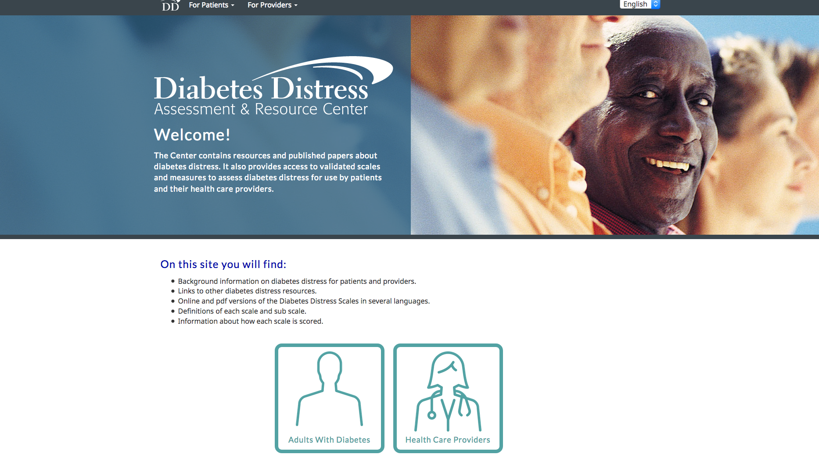

Diabetesdistress.org
T1-DDS in English & Spanish for download

Slide 58


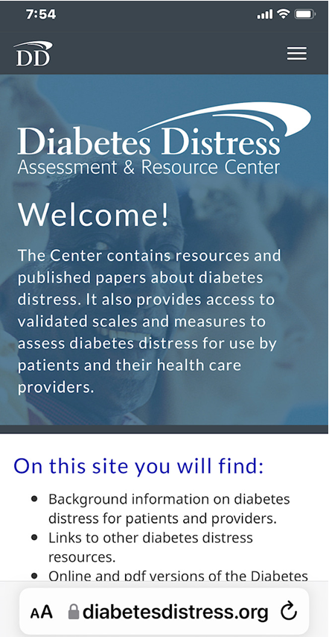
T1-Diabetes Distress Scale
Obtain the T1-DDS at:
www.diabetesdistress.org
Download PDF of the questionnaire in English or Spanish, with scoring instructions.
Administer the T1-DDS online using a smartphone, tablet or computer: the site will automatically score it for you.
The site will automatically prepare a report with scored subscales and items for review online or for download as a pdf.
Notes:
for each sourceA

Slide 59
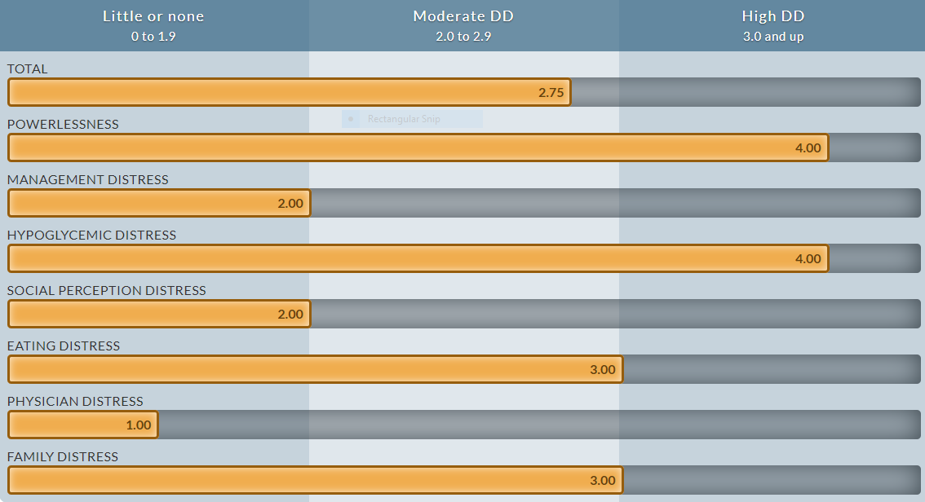

T1-DDS Total and Subscales
T1-DDS Total And 7 Sub Scals

Slide 60
Total Distress Score
The total score reflects an overall assessment of how distressed the person is about T1D

Slide 61
Powerlessness
Broadly discouraged about T1D (“no matter how hard I try, it will never be good enough”)

Slide 62
Management Distress
Disappointed with self-care efforts (“I don’t give T1D as much attention as I probably should”)

Slide 63
Hypoglycemia Distress
Concerns about severe hypos
(“I can’t ever be safe from the possibility of a serious hypo event”)

Slide 64
Social Perception Distress
Concerns about the judgments of others (“I have to hide my diabetes from other people”)

Slide 65
Eating Distress
Concerns that your eating is out of control (“thoughts about food control my life”).

Slide 66
Physician Distress
Disappointed with current HCPs (“I don’t get the help I really need from my diabetes doctor “)

Slide 67
Family Distress
Too much focus on T1D among loved ones (“my family and friends make a bigger deal out of T1D than they should”)

Slide 68
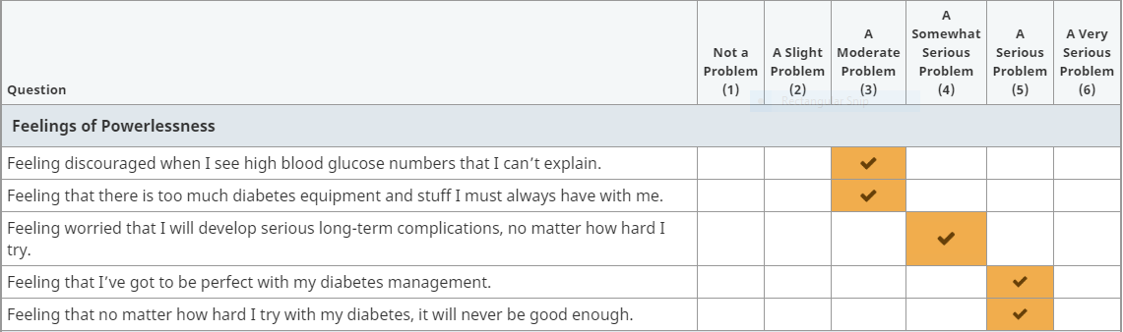
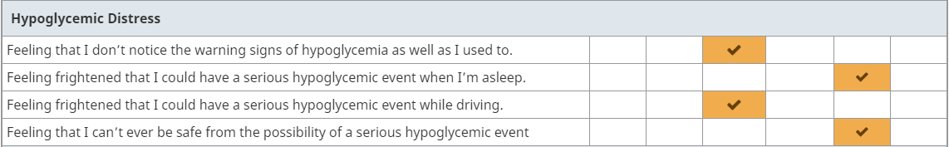

T1-DDS Item Report
T1-DDS Item Report

Slide 69
T1-DDS Source Scales & Items
T1-DDS Item Scores
The Source Scales describe different aspects (sources) of DD for that person – where the DD may be coming from (hypos, eating/food, family/friend, etc.).
But not all people with a high score on a specific Source Scale are distressed about the same thing. So it is important to examine highly scored items within that scale as well.
It is helpful for you to become very familiar with the items, to fully grasp their meaning for individuals.

Slide 70
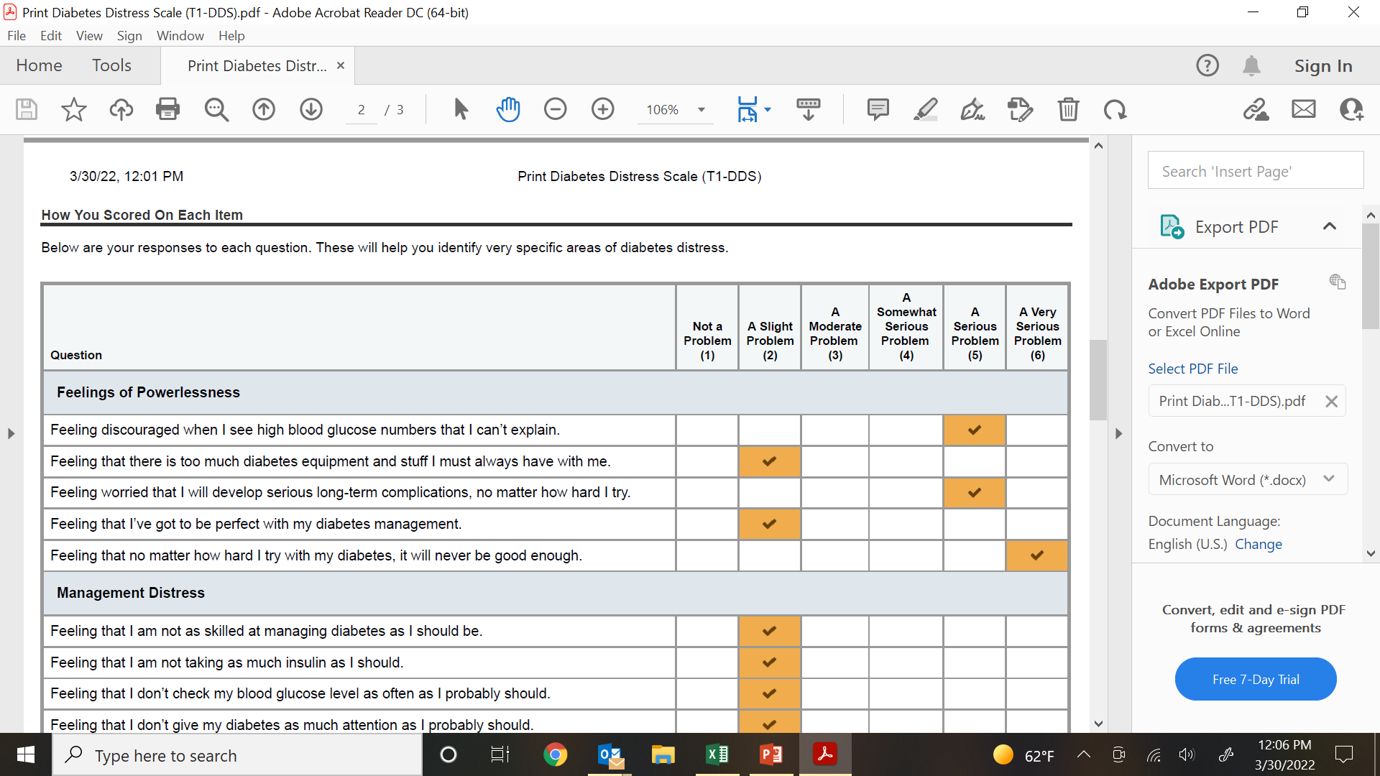
Subscale – 2 Different Results
Other Source Scales may be highly scored.
So it is crucial to review all elevated items in the T1-DDS.

Slide 71
How to Use the T1-DDS
Getting started:
“Living with diabetes can be tough and we are interested in learning about how you are feeling about your diabetes and how it affects your management (or referring problem). We would like you to complete this brief scale and we will review the results together.”

Slide 72
How to Use the T1-DDS
- Once the T1-DDS has been completed and printed, it is time to have a very different kind of conversation.
- This requires you to make a big shift in style, timing and tone.
- In this conversation, you are not talking and problem solving, you are listening and helping the PWD tell their DD Story.
- Use the relationship building tools we reviewed to make this happen.

Slide 73
Poll Question 9
It is always best to assess DD when:
A. You suspect high DD.
B. You have a new PWD in your practice.
C. With each PWD regularly and systematically.
D. Only if you have time.

Slide 74
Poll Question 10
It is always best to:
A. Focus on the T1-DDS total score.
B. Focus only on the high T1-DDS sub scale scores.
C. Focus on the highest 2 items.
D. None of the above.

Slide 75
SUMMARY SO FAR
We have reviewed the Clinical Conversational Tools.
We have outlined the ReVive5 plan to reduce DD and enhance management
We have reviewed Step-1 of the plan – assessing DD systematically using the T1-DDS.
In the next section we will review the remaining 4 steps

Slide 76

Let’s Take a Break

Slide 77
ReVive5: A Five Step Plan
ReVive 5: A 5-Step Plan
Assess DD regularly and systematically using the T1-Diabetes Distress Scale (T1-DDS).
2. Begin a conversation to foster a new or different perspective.
3. Consider different management choice(s) that are not driven by tough thoughts and feelings.
4. Optimize management based on personal choice and values – find the expert within
5. Make changes and plan for next steps

Slide 78
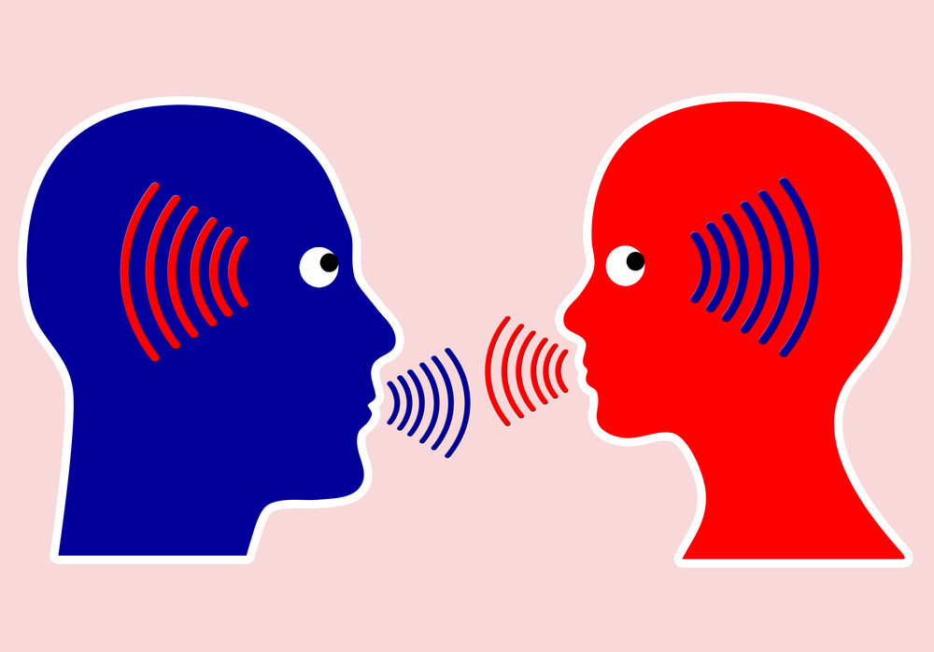

Step #2: A Different Kind Of Conversation
Your Task:
Help them tell their Diabetes Story about these highly scored items using the Conversational Tools

Slide 79

Step #2: A Different Kind Of Conversation
What is a DD story? Using the high T1-DDS scores, a recent example of:
What they are distressed about (e.g., lows, cannot ‘control’ their BG or eating)?
Their feelings and thoughts about it – what it means to them
How they choose to manage their diabetes in reaction to their DD?
What they would have liked to have done but didn’t?
The story tells you the “good reason” why a person is making their current choices. (If terrified you cannot be safe, you stay high.)

Slide 80
Getting The Conversation Started
“To prepare for this visit, you completed a questionnaire that looks at Diabetes Distress. This questionnaire reflects how stressed you are about diabetes right now and what you might be stressed about.
Can we take a look at your results together?”

Slide 81

Getting the Conversation Started
Start by identifying high Source scores:
“What strikes you about these scores? You scored ‘feeling powerless’ quite high. Can tell me more about why you are feeling this way?”
Then identify all highly scored items:
“I notice that you scored high on the item: ‘Feeling that my eating is out of control.’ Can you tell me what might be going on?”

Slide 82
Having A Different Kind Of Conversation
Use the T1-DDS printout and worksheet to gently structure the conversation:
First: Ask for a specific recent experience (example) that captures the issue reflected in the highly scored item(s).
Generate discussion about these 5 points to make the Story clear. (Use the Worksheet to help keep the conversation focused.)
- What happened during the experience?
- What were your thoughts/feelings?
- What did you actually do (specifically)?
- How did it turn out?
- Ideally, what would you have liked to have happened?
This Is Their Diabetes Story

Slide 83
Having A Different Kind Of Conversation
Establish a “judgement-free” environment.
Most have never been asked how they feel or think about their diabetes and can elicit painful feelings and thoughts.
We may not be used to hearing & tolerating this (painful and uncomfortable for us too)
May want to jump in and make them feel better
May feel that you don’t have the time for this or that it is not part of your professional role
Remember: you do not have to “fix” them (no need to rescue them, solve it, or make them feel better – just elicit the story)

Slide 84
Diabetes Distress Stories
Common events you will hear about:
Scary or embarrassing lows
Surprising highs
Difficulty managing BG
Eating challenges
Managing all of the tech
Situations with friends, family, colleagues
Managing health care (feeling judged and misunderstood), insurance, etc.

Slide 85
Diabetes Distress Stories
“Can you tell me about a recent example of this DD item?”
“I had a low right before I was to drive to a big family wedding.”
“I could not get my sugars down – nothing I did seemed to work.”
“At a family dinner everyone kept looking at me when I reached for dessert.”

Slide 86
Having the Conversation
Listen for major common themes: (Referenced in handout)
Hopelessness/powerlessness: “No matter what I do, I can’t control my diabetes”
Negative self- judgement: “It is all my fault – I am a bad diabetic. I should be able to do it by now.”
Shame: “I don’t tell people I have diabetes.” “I keep my challenges to myself.”
Burden: “I am a burden on my family, friends and the healthcare system.”
“I am broken” (damaged goods): “I am not as attractive to others because of diabetes”
Doom/Fatalism: “I am destined for terrible complications”

Slide 87
Having the Conversation
Use The Conversational Tools:
Reflect often with empathy and use “feeling” words: “That must have really frustrated you.” “You must have been so angry.”
Common “feeling” words: anger, fear, frustration, exhaustion, sad, embarrassed, guilty, overwhelmed, etc. They will correct you if you are wrong.
Listen for how they are self-critical and beat themselves up (I’m a bad diabetic.” “I should know this by now.”).

Slide 88
Having the Conversation
Review and summarize the story you hear:
“Do I have this right?”
“Is there anything missing?”
Then ask:
“How does all of this strike you?”
“Does any of this surprise you?”

Slide 89
Poll Question 1
Which of the following is NOT part of Having A Different Kind Of Conversation?
A. Ask for a specific experience or example
B. Tell them about new devices that could help
C. Establish a judgement free zone
D. Use the conversational tools

Slide 90
Having the Conversation
An Illustration of ReVive Steps 1 and 2:
You will now hear conversation that illustrates the use of the tools and how to get the conversation started. See if you can notice each of the conversational tools. Refer to your packet where each of the tools is highlighted in the conversation:
Open-ended questions (O)
Reflecting feelings words (R)
Summarizing (S)
Normalizing (N)
Active listening with empathy (E)

Slide 91


Meet Sally
45 years old, T1D for 30 years, lives with husband, two teens
On CSII, but no CGM (disappointed after trying one many years earlier)
Recent A1C results: 7.4%, (9 months later) 8.8% (and 8 lb weight gain)
Referred to Diabetes Education for “medical nutrition counselling”

Slide 92

Let’s Ask Sally
“Before we get started, I wanted to ask you to complete a brief questionnaire that looks at how you are feeling about your diabetes right now. We know that tough thoughts and feelings are really common for people with T1D and can make diabetes even harder to live with and manage.” (N)

Slide 93

Sally’s T1-DDS Results
Notes:
Describe the scale on top: mild, moderate high. Even moderate DD is important.
Ask group to describe Sally’s DD profile. Have them analyze this – what do we see here?

Slide 94
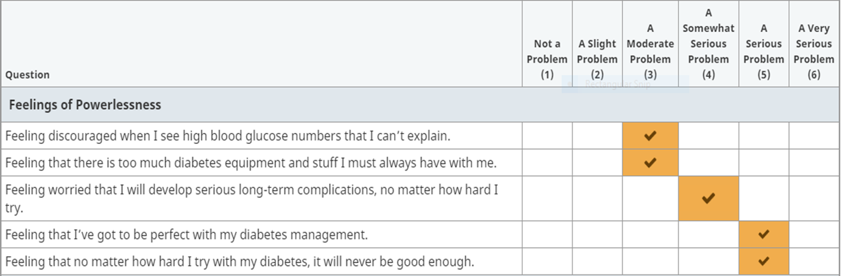

Sally’s Elevated Subscale Items
Notes:
Describe the scale on top: mild, moderate high. Even moderate DD is important.
Ask group to describe Sally’s DD profile. Have them analyze this – what do we see here?

Slide 95
Let’s Ask Sally
“Looking at your T1-DDS results, it seems like T1D is really getting you down, especially when it comes to hypoglycemia and feeling powerless with your diabetes.(R) Can you tell me more? (O) Can you give me an example so that I can understand more about how you are feeling?”(O)

Slide 96
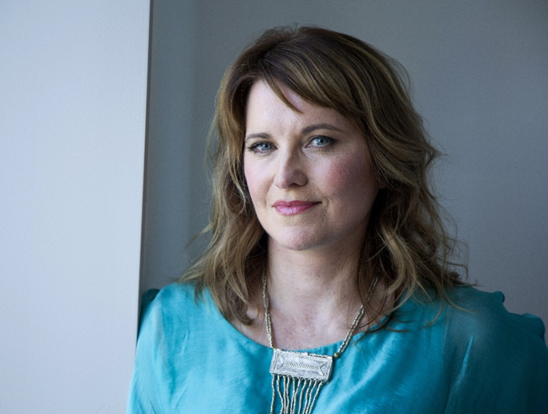
And Sally Responds…
“I had a bad low two months ago – got down to 40 mg/dL at night and woke up only because my dog was barking. I’m worried I can’t feel my lows anymore.”

Slide 97

“That sounds really frightening.(E,R) How has that affected how you feel and impacted your diabetes management?” (O)

Slide 98
“It was terrifying. And to be honest, I have been scared ever since this happened. Since that bad low, I have had trouble sleeping for fear of another low that I don’t wake up from. I now drink a milkshake before bed just to try and stay safe.

Slide 99
“Many people with T1D intentionally stay high after having a scary low. (N) It is a logical response to not feeling safe. (R) Unfortunately, then the person often feels bad about themselves and has lots of highs and weight gain. (N) Does that fit your experience?” (O)

Slide 100

“Yes. I feel like an idiot. I have had diabetes for 30 years. If I can’t get this right or perfect by now, I don’t think I will ever will.”

Slide 101
“No wonder you are feeling so down about your diabetes.(E, R) Since you had that really terrifying experience of a low at night you woke up from only because your dog barked, you have been trying to feel safe by having a milkshake before bed. Now you are having highs and weight gain and feeling pretty hopeless about your diabetes management. (R, S) Did I get that right?” (O)

Slide 102
“Yes. It really is a tough spot.”

Slide 103
“In your ideal scenario, what would you have liked to have happened after that scary low, instead of what has happened since then?” (O)

Slide 104
“I would have just realized that lows occasionally happen and moved on, like I have at other times. I would tolerate going to bed with a lower BG and certainly wouldn’t be drinking a milkshake before bed!”

Slide 105
Summary So Far
1)You have assessed DD and reviewed the results
2) You have used the conversational tools to help the PWD tell their diabetes story of a recent event that illustrated the DD item.
Did you notice when the HCP:
Asked open-ended questions
Used feeling words
Summarized statements
Normalized tough experiences
Used active listening with empathy
(See packet for how the conversational tools were used by the HCP in this example.)

Slide 106
Summary So Far
You have heard Sally’s “Diabetes Distress Story”. She told us of a recent event that illustrated the DD item:
What happened during the experience
What her thoughts/feelings were
What she actually did (specifically)
How it turned out
What she would have liked to have happened that didn’t
How this has impacted her management choices
This DD story opens the door to foster a new perspective…

Slide 107
Having the Conversation – Part 2
Foster A New Perspective
Key points:
People have tough thoughts and feelings about diabetes (“I can never be safe from hypos”)
Many react to these thoughts/feelings with certain actions (“I drink a milkshake before bed”)
These DD-driven choices do not really get them closer to their goals (what they want). (“I would’ve liked to have moved on after that low and tolerated a lower BG before bed”)

Slide 108
Foster A New Perspective
Key points (cont’d):
Telling the DD story out loud helps the person see how DD keeps them stuck.
Adopting another perspective allows them to consider other choices/actions that can take them closer to their goals

Slide 109
Let’s Ask Sally
“How do you think your fear of having another severe low and believing that you will never get this right or perfect keeps you stuck and prevents you from doing things differently?”

Slide 110

“I don’t feel like I can even try.”

Slide 111
Three Approaches to Help Foster A New Perspective
Distinguish between thoughts/feelings and actions, so that other choices can be made.
Address inaccurate diabetes beliefs.
Help establish more realistic expectations.
Decide which to use (or in combination), depending on the presenting problem and content of the Diabetes Distress Story.

Slide 112
Three Approaches to Help Foster A New Perspective
Distinguish between thoughts/feelings and actions, so that other choices can be made.
Address inaccurate diabetes beliefs.
Help establish more realistic expectations.

Slide 113
Help Foster A New Perspective
Approach 1 : Separating Thoughts/Feelings From Actions
People can feel/think one way and act another!
People can make other choices, even though
they have tough feelings.
Your job is to help them set their feelings/thoughts aside (tolerate them) so that they can make different choices.
These new choices are to move them closer to what they really want to happen.
Notes:
e

Slide 114


Approach 1: Separating Thoughts/Feelings from Actions
What to do:
First, demonstrate how their distress is currently driving an action they really don’t want to happen.

Slide 115
Approach 1: Separating Thoughts/Feelings from Actions
Example:
“I know that you have had a few bad lows at night in the past. But this time it was different: it really scared you. And then you started going to bed high, taking less insulin at night. It seems that it is not the low itself, but your fear of another low that is driving you to do things that are not helpful. Do I have this right?”
This separates the feelings that drive the behavior from the behavior itself.

Slide 116
“Sometimes the tough thoughts and feelings that you have been describing make it hard to make changes. The thoughts and feelings keep you stuck. When this happens, managing your diabetes is obsessed by the tough thoughts and feelings, not by what you really want to happen.”

Slide 117
“For example, when that scary low happened, you felt fearful that you could never be safe from a severe low while sleeping again. Then you responded by keeping your BG high at night. But, if you could have set these thoughts/feelings aside, you would have preferred to recognize lows occasionally happen and would go to bed with a lower BG. Does this make sense?”

Slide 118

“Yes, that completely makes sense.”

Slide 119
Question Check In

Slide 120

Approach 1: Separating Thoughts/Feelings from Actions
After the connection is made, ask if they are willing to consider another choice (based on what they really want to happen).
“Can you set these tough feelings aside and choose to do something different?”
“Can you decide that these tough feelings are not going direct what is best for you?”
“Can you be afraid and take a different action to get you closer to your goals?”

Slide 121
“Anybody that went through such a scary experience, might feel the same way. Do you think that you can tolerate your fear of lows in order to make a different choice that takes you closer to your goals?”

Slide 122
Three Approaches to Help Foster A New Perspective
Distinguish between thoughts/feelings and actions, so that other choices can be made.
Address inaccurate diabetes beliefs.
Help establish more realistic expectations.

Slide 123
Approach 2: Address Inaccurate Diabetes Beliefs
What to do:
Reflect back the “inaccurate belief” as closely as you can using their words. “It sounds like you believe that…”
Ask if you can offer a different perspective with fact-based data that instills hope. “Many people with diabetes believe…Is it Ok to share with you some new data you may have not heard?”

Slide 124
Approach 2: Address Inaccurate Diabetes Beliefs
Examples of inaccurate beliefs:
“You seem to be saying that the only way to have ‘good control’ is an A1C of < 6%.”
“I hear you saying that you ‘should’ be able to keep your BG in range 100% of the time – otherwise you are a bad diabetic. Is that even achievable?”
“You believe that you are doomed to have complications because you haven’t been perfect. Can I show you the real facts?

Slide 125
Approach 2: Address Inaccurate Beliefs
“It seems that you are saying that you will likely go blind because of your diabetes. I can understand why you might feel that way.
Would you like to hear the real facts about the likelihood of this happening?”

Slide 126
Approach 2: Address Inaccurate Beliefs
The following 3 slides (see packet) are examples of fact-based data that address common inaccurate beliefs about:
Frequency of complications among T1D
A1C expectations
A1C is only part of the risk of complications

Slide 127
Frequency of Complications After 30+ Years: A big change
Notes:
Note: Vertical axis - % of patients with DM in the study. Also, the graphics will change such that the green bars will fly in to dramatize the effect.
This graph represents 2 studies on people who had type 1 diabetes for 30 or more years. The first study, in blue bars, was completed in 1978. You can see that in those times, the news regarding complications for people with type 1 diabetes was disheartening. Now shift your attention to the green bars. This new information is based on people who participated in the DCCT, now 30 years later. After the active phase of the DDCT study, the different arms of the study ended up with an average A1C of about an 8%. Look at how the story has changed. The outcomes for these people was surprisingly good. The message about complications with diabetes needs to be updated.
With good care, not perfect management, odds are good that you can live a long and healthy life with diabetes.
_____________________________________________________________________
Here is another myth that can be debunked.

Slide 128
A1C Expectations: Percentage of People with T1D Achieving ADA A1C Target
% reaching ADA target
Pettus et al, 2019

Slide 129
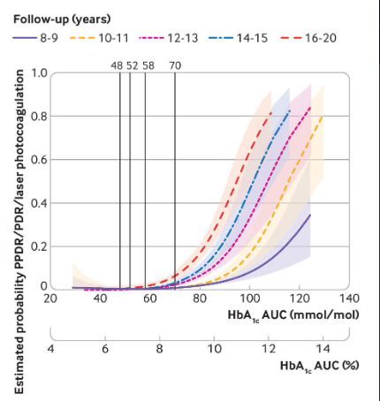
A1C and Risk of Retinopathy
Lind et al, 2019

Slide 130
A1C is Only Part of the Risk Story
A1C only accounts for between 15-50% of the complications risk story.
Other factors associated with risk of complications independent of A1C are:
BG variability (above and below target range: 70 to 180)
Physiological factors: body composition, BP, LDL
Genetic factors
Important message: You can only do the best you can with what is possible to change! (You can’t pick your parents!)
Notes:
NOTE DIFFERENCE BETWEEN MICRO (15%) AND MACRO (50%

Slide 131
Three Approaches to Help Foster A New Perspective
Distinguish between thoughts/feelings and actions, so that other choices can be made.
Address inaccurate diabetes beliefs.
Help establish more realistic expectations.

Slide 132
Examples of More Realistic Expectations
Perfect isn’t possible and you don’t need to be (healthy good enough) “Do you have to be perfect to be healthy?”
Having a tough time with a tough disease is normal. “Most people with DM find it tough going – this is not you, it is diabetes.”
You are not alone if you struggle with diabetes and/or have challenges with the emotional side of diabetes
These more realistic expectations are about keeping diabetes in perspective

Slide 133
Approach 3: Help Establish Realistic Expectations
What to do:
Acknowledge the common DD Story (“Many people with T1D struggle with trying to be perfect.”)
Connect their story to the unrealistic expectation that keeps them stuck (“Trying to be perfect often leads to frustration and burnout and makes people stop trying.”)
Discuss an alternative expectation for consideration (“An alternative to perfectionism is shooting for a goal that is ambitious but realistic.”)

Slide 134
Unrealistic Expectations are part of DD Stories (See Handout) and Lead to Unhelpful Conclusions
DD Stories and Unhelpful Conclusions
I’m a bad diabetic (Am powerless to change)
I can’t do this right or perfect. (So why bother trying?)
I’m an idiot/can’t do this/failure. (Am powerless)
I’m a burden. (Need to keep to self)
I’m broken/defective. (May be rejected)
I’m doomed (No point in trying/Am powerless)

Slide 135
Example of A More Realistic Expectation: From Perfectionism to “Healthy Good Enough”
Perfectionistic thinking: has 2 speeds, perfect or failure, not achievable for very long, exhausting, contributes to burnout
Healthy Good Enough
Personalized
Ambitious and realistic
Allows for normal fluctuations, mistakes and experiments
Sees small steps as valuable
Focus is on efforts made, not numbers
Forward looking: What now?

Slide 136
Help Establish Realistic Expectations
“You said that you think that you will never get this right or perfect and this makes you feel like you can’t even try. And, this has kept you stuck. Is this right?”

Slide 137

“Yes. If I can’t do it right, why even bother trying?”

Slide 138
“Feeling the need to be perfect is a common experience for people with T1D. Unfortunately, perfect is impossible and efforts to achieve perfect outcomes often lead people to feel exhausted, discouraged and diabetes burnout. Does that make sense?”

Slide 139
“I certainly can relate to that. I’m pretty exhausted by it all.”

Slide 140
“An alternative to trying to be perfect is to consider a “healthy good enough” goal. This is ambitious, yet realistic. It is personalized to reflect your daily best effort and considers how diabetes fits into your life. It allows for normal BG excursions that go with life with diabetes. How does that sound to you?”

Slide 141
“A healthy good enough – what a concept! I could use that idea in a lot of places in my life. It sounds good.”

Slide 142
Poll Question 2
Which of the following does not effectively foster a new perspective?
A. Address inaccurate diabetes beliefs.
B. Distinguish between thoughts/feelings and actions so that other choices can be made.
C. Review plans to increase monitoring of BG.
D. Help establish more realistic expectations.

Slide 143
Poll Question 3
Which of the following can be helpful in fostering a new perspective?
A. Provide accurate information to counter inaccurate beliefs and perceptions.
B. Consider making a referral.
C. Suggest that they should not be feeling this way.
D. Suggest that they could overcome the problem if they only tried harder.

Slide 144
ReVive5: A Five Step Plan
ReVive 5: A 5-Step Plan
Assess DD regularly and systematically using the T1-Diabetes Distress Scale (T1-DDS).
2. Begin a conversation to foster a new or different perspective.
3. Consider different management choice(s) that are not driven by tough thoughts and feelings.
4. Optimize management based on personal choice and values – find the expert within
5. Make changes and plan for next steps

Slide 145
Step 3: Consider A Different Choice Not Driven By DD
Ask how comfortable they are with a new perspective and if they are willing to consider moving forward:
“Given what you have been saying, what do you think that you can do to address this?”
“If you are the boss moving forward, instead of your fear making the choices for you, what would you be willing to try?”
“Your feeling doomed seems to be holding you back from action. If you can consider that are not doomed, what is one thing that you might do differently?”

Slide 146
Step 3: Consider A Different Choice
Remember that THEY are the fixer, not you!
Have them come up with suggestions for a ‘small’ change that is important to them.
Make sure that the change is simple and achievable.
Only a trial – an experiment for a brief period.
Recognize and warn them that they will at times slide back – it’s OK, it’s understandable.
The tough feelings will continue –but don’t have to dictate what they choose to do – they can feel one way and act another! They are the boss not the DD!

Slide 147
Step #3: Consider A Different Choice
Use the person’s ideas and let them define what change and how much – even though you may not agree that it will lead to a significant clinical change.
All change is worth doing!
It is OK for you to offer ideas and structure to help them implement their change they select (they may need your help).
Steps 4 and 5 are about trouble shooting BG challenges and helping the PWD identify sensible changes.

Slide 148
Step 3: Consider a Different Choice
“Given what you have been saying, what do you think that you would be willing to do to address this? Are you willing to tolerate some fear to try something new?”

Slide 149
And Sally Responds…
“I would be willing to try the CGM again. I understand they have come a long way since I last used one. And, I could try going to bed with a lower blood sugar.”

Slide 150
“That sounds like a very important step! What BG number would you be willing to going to bed with to start and what exactly are you going to do differently? It will help if you have a good plan that you feel confident in.”

Slide 151
“I have been making sure I am over 250 mg/dl before bed. I am thinking I could start with going to bed at 200 mg/dl. Maybe I could cut the amount of milkshake I drink in half. Would that be enough?

Slide 152
“Trying out a BG of 200 mg/dl is an important choice. How can you know if half of a milk shake is the right amount for this goal?”

Slide 153
“I can check! This will be easier once I get my new CGM.”

Slide 154
“Yes, you may need to experiment a little to get it to the right amount for your goal. When do you plan to start this change?”

Slide 155
“I can start tonight with the half of a milkshake and target for 200 mg/dl before bed. And, I will move forward with the process of getting the CGM today.”

Slide 156
“Let me summarize your plan and let me know if I have it all correct. In an effort to face the fear of lows at night and have a BG level that is closer to where you want to be, you are going to start tonight by drinking half a milkshake and go to bed with a BG of 200 mg/dl. You will also move forward with the process of getting a CGM today. Do I have that right?

Slide 157
“Yes. You have that correct. This feels like a weight has been lifted. I’ve been really stuck and this feels like a plan that I can really do. Thank you.”

Slide 158
“I’m really glad. Expect that you will be fearful when you try this out tonight. It is scary to move forward after having a bad low. You have a good plan to begin to regain your confidence. And, thank you for your willingness to share your diabetes story with me. Let’s plan to talk by phone next week to discuss how it is going.

Slide 159
Step #3: Consider A Different Choice
Arrange for some kind of follow-up:
Phone call
Live or video appointment
Text
Follow-Up Tasks:
Trouble shoot problem areas
Remind them of the key messages
Build on progress
Help them decide on next steps (may involve Steps 4 and 5)

Slide 160
Step #3: Consider A Different Choice
Help them decide on next steps (may involve Steps 4 and 5)
Steps 4 and 5 are not necessary for everyone.
At the end of Step 3, some PWD may sensibly choose to:
Change to inulin pump or hybrid closed loop system
Use CGM
See a dietician, personal trainer, or mental health professional
Steps 4 and 5 are most useful when more glucose data are required to identify effective solutions (“My numbers are wacky and are unpredictable!”)

Slide 161
ReVive5: A Five Step Plan
ReVive 5: A 5-Step Plan
Assess DD regularly and systematically using the T1-Diabetes Distress Scale (T1-DDS).
2. Begin a conversation to foster a new or different perspective.
3. Consider different management choice(s) that are not driven by tough thoughts and feelings.
4. Optimize management based on personal choice and values – find the expert within
5. Make changes and plan for next steps

Slide 162
You Can Do This!
We know that:
It seems like a lot to do with a lot of steps and might take too much time.
You may feel unprepared or uncertain (happens whenever develop a new skill set)
You don’t have to be a mental health professional to do this! Although, you may see things that do need to be referred (MDD, eating disorders, etc.)
Incorporating the emotional side into your program will be more personally rewarding, appreciated by PWDs and lead to better outcomes!

Slide 163

Thank you & Resource Page
Packet Resources
PDF of slides with conversational tools illustrated
ReVive 5 Worksheet
Common DD Stories
Current Fact-based Info Handout
PDF of T1-DDS with scoring instructions
Additional Resources
5 Steps Cheat Sheet
Diabetes Distress Info
Log sheets
Articles on carb counting, insulin replacement therapy, exercise and more
Resources for people living with type 1 diabetes.

Slide 164
Question Check In

Slide 165

Next Session will focus on ReVive Steps 4 and 5
Questions?
Email us at info@diabetesed.net
Chat with Bryanna @DiabetesEd.net
Call us at 530-893-8635

