Slide 1

Welcome to ReVive 5 Training Program – Session 2

Slide 2




so please download your certificates into a file on your computer.
Welcome to our DiabetesEd Online University
Our goal is to provide an exceptional user experience and build a sense of community.
Notes:
Welcome to our new and Improved Diabetes Education Services Online University, where you can earn CE's, prepare for certification, and increase your confidence.
Our goal is to offer you exceptional and personalized service and build a sense of community.

Slide 3

Bryanna is here to Help!
If you have questions, you can chat with Bryanna at www.DiabetesEd.net or call 530 / 893-8635 or email at info@diabetesed.net
Bryanna Sabourin
Director of Operations
Certification Pathway Coach &
Customer Happiness Expert

Slide 4
What Have We Covered? Session 1
Defined Diabetes Distress (DD)
Reviewed how it presents itself
Described its prevalence
Indicated its clinical impact
Differentiated it from ”depression”
Described how it works as a barrier
Provided tools for a new kind of clinical conversation
Eliciting a diabetes story
Listening for the major DD themes
Three approaches to fostering a new perspective
Distinguish between thoughts/feelings & actions
Address inaccurate beliefs
Establish more realistic expectations
Considering different management choices

Slide 5

ReVive 5 – Welcome to Session 2
Session 2| Finding the Expert Within – Helping individuals discover their expertise to improve glucose and feelings of self-efficacy
Reviewing the diabetes knowledge and toolkit
How to evaluate insulin and glucose balance
Discovering the impact of diet, exercise, stress, insulin, on glucose levels.
Session 2 | Using ReVive 5 Step approach to integrate the Whole Person Intensive Case Study |
Explore glucose patterns and identifying issues.
Using an integrated log sheet as a powerful tool to identify what needs fixing: pattern recognition.
Case reviews that exemplify common glucose problems and enhance problem solving skills.
Session 1 | What is Diabetes Distress, and what do we know about it? | Recorded
How does diabetes distress affect self-care?
How is diabetes distress different from depression?
How can diabetes distress be assessed practically in clinical care?
Session 1 | Using the ReVive 5 step approach to address distress and support behavior change | Recorded
Specific tools to enhance effective communication strategies to address diabetes distress.
Four practical steps to address diabetes distress as a barrier to self-care.

Slide 6

Land Acknowledgment
We acknowledge and are mindful that Diabetes Education Services stands on lands that were originally occupied by the first people of this area, the Mechoopda, and we recognize their distinctive spiritual relationship with this land, the flora, the fauna, and the waters that run through this area.

Slide 7
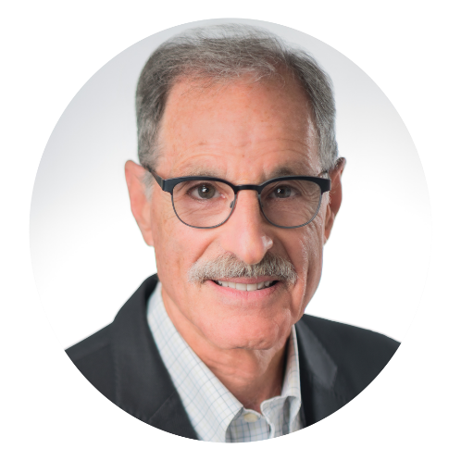
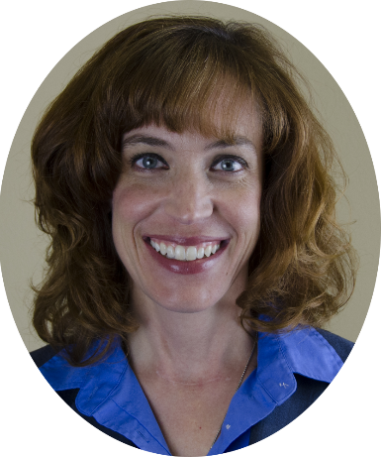
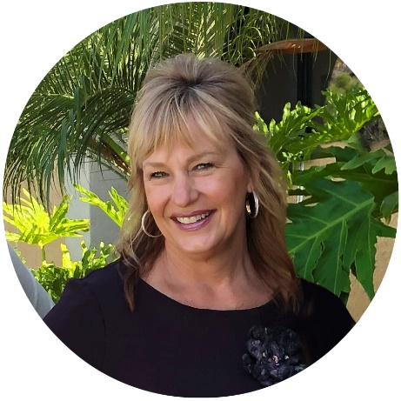
ReVive Teaching Team
ReVive 5 team of Experts:
Lawrence Fisher, Ph.D., ABPP, Professor Emeritus, UCSF
Susan Guzman, PhD
Beverly Thomassian, RN, MPH, CDCES, BC-ADM

Slide 8
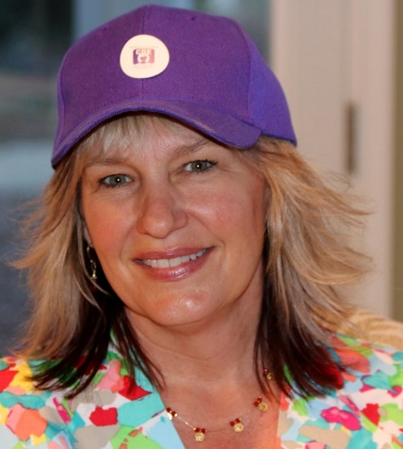
Coach Beverly - Speaker for Session 2
Beverly Thomassian is president and CEO of Diabetes Education Services. She served as a lead coach in the Embark Study and provided hundreds of calls to people living with type 1 as part of the study.
She transformed her approach and increased her confidence during this one -year study, and now incorporates the strategies learned in her clinical practice.
Beverly Thomassian (She/her) RN, MPH, CDCES, BC-ADM
Beverly has no conflict of interest to disclose.

Slide 9



Goals of the ReVive 5 Approach
Work with individuals to identify their values and goals.
Utilize ReVive 5 problem solving strategies to help individuals reach their goals.
Apply problem-solving skills learned in ReVive 5 to diabetes-related problems that individuals will encounter in the future.
Focus on problem solving strategies to find the expert within and enhance diabetes management for a lifetime.

Slide 10
ReVive 5 Steps
5 Steps to Address Distress Diabetes and Enhance Management
Assess diabetes distress
Begin a conversation to foster a new perspective
Consider different management choices that are not driven by tough thoughts and feelings
Optimize self-management based on personal choice and values—”find the expert within.”
Make changes and plan for next steps.

Slide 11
ReVive Step 4
Problem solve and enhance glucose management
Step 4: Optimize self-management based on personal choice and values—”find the expert within.”
This step has several elements.
- Organize diabetes tool kit
- Collect data and identify most pressing problem
- Explore problem and identify patterns

Slide 12

You don’t have to be Diabetes Tech Expert to use the ReVive 5 Step Approach
We are going to lean into the expertise of the person living with diabetes.
People use a variety of strategies to manage diabetes including injections, pumps, CGM, meters, online chat groups, life coaches, low carb eating, exercise and changing combinations.
We are going to explore tough thoughts and feelings in a conversational approach.

Slide 13
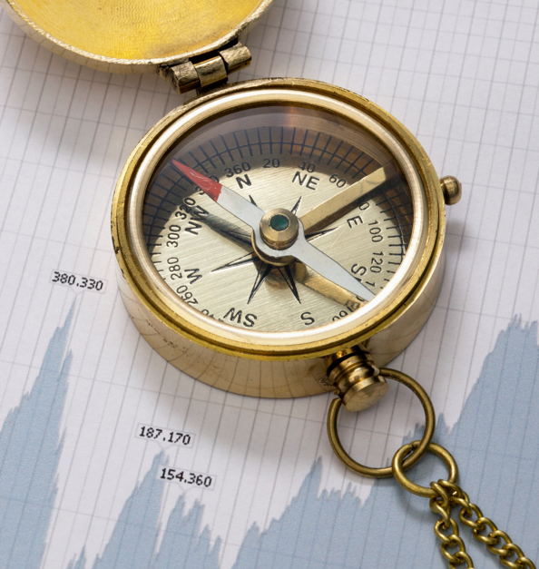
Discover Knowledge Gaps
People with diabetes have gained lots of self-expertise from living with diabetes 24/7/365.
Even though people with diabetes have lived with it for many years, they often have knowledge gaps in some or many areas of diabetes self-management.
We suggest a quick review of the basics to evaluate baseline knowledge in preparation for glucose problem solving.

Slide 14
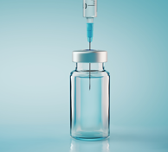
Quick Review: What is Type 1 Diabetes?
Simply stated:
Type 1 is an autoimmune condition.
Due to a combination of genes and unknown triggers, the pancreas no longer makes insulin.
Since there is not enough insulin, blood sugars elevate.
A person with type 1 imitates the work of a very complex organ, while preventing blood sugars from going too high or too low 24 hours a day, 365 days a year.
There are no vacation days.
Diabetes isn’t your fault.

Slide 15

~30% of People with Type 2 use Insulin
Insulin Resistance Coupled with Insulin Deficiency

Slide 16

Poll question 1
What best describes the role of bolus insulins?
a. cover carbs at meals and hyperglycemia
b. helps to lower fasting blood glucose
c. keeps overnight blood sugars under control
d. best used during hypoglycemic episodes

Slide 17
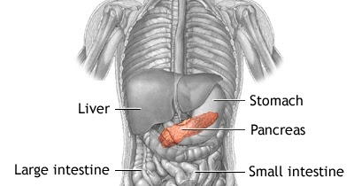

“How to Think Like a Pancreas”
We are going to try and imitate the work of your pancreas.
Your pancreas releases little doses of insulin through out the day and night.
This is called basal insulin
Your pancreas also releases a squirt of insulin with meals or if your blood sugars are running above target
This is called bolus insulin

Slide 18
Physiologic Insulin Secretion: 24-Hour Profile
50
Insulin
(µU/mL)
Bolus Insulin
25
0
Basal Insulin
Breakfast Lunch Dinner
150
100
Mealtime Glucose
Glucose
(mg/dL)
50
Basal Glucose
0
7
8
9
10
11
12
1
2
3
4
5
6
7
8
9
A.M.
P.M.
Time of Day

Slide 19
Blood Sugars with Diabetes
Notes:
This is the CGM data for someone with type 1 diabetes – it does include several months but the point is the range of fluctuation - <40 on the low end and >400 on the high end.

Slide 20
Insulin Release: Individuals without diabetes
Insulin bolus occurs in the first 10 minutes after eating
Insulin
Blood glucose
Basal insulin
Basal insulin is released every 12 minutes
Meal
Meal
Meal
Blood glucose– goes up after eating

Slide 21
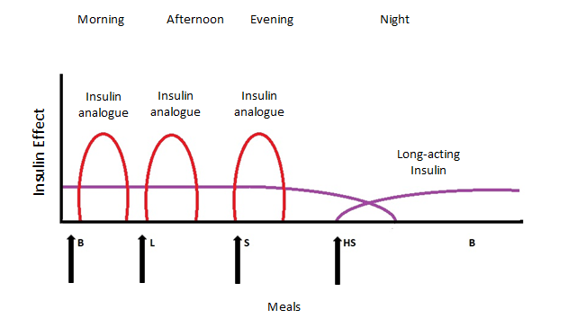
Long-acting Insulin with Insulin analog
Long-acting serves as basal
insulin analog serves as bolus
Dipiro JT et al, eds. Pharmacotherapy: a pathophysiologic approach. 11th ed. 2020.
Notes:
Drawn by Jill Haug

Slide 22
ReVive Step 4
Problem solve and enhance glucose management
Step 4: Optimize self-management based on personal choice and values—”find the expert within.”
This step has several elements.
- Organize diabetes tool kit
- Collect data and identify most pressing problem
- Explore problem and identify patterns

Slide 23
Start Here - Organize Tool Kit
Organizing the Toolkit is the MOST frequently omitted step, yet it may be the MOST important one!
Gather all insulin devices and medications in one place.
Check everything systematically to make sure that everything is working the way it should.
Make sure supplies and insulin are not out of date.
Evaluate injection sites.
Then move onto checking insulin dosing
Notes:
Now we are at Step 1.

Slide 24
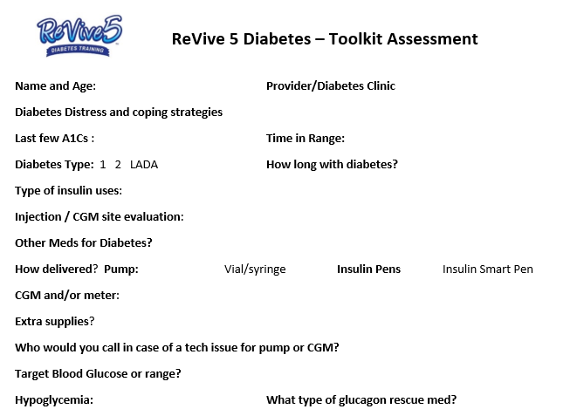
ReVive 5 Tool Kit Assessment Sheet

Slide 25
Diabetes Toolkit
CGM / Meter Supplies
Strips that aren’t expired?
Pump & Supplies
Site Evaluation
Low Glucose Plan
Meds & Disaster Plan
Can access glucose reports?
Diabetes ID
Phone, medic alert, on person
Carbohydrate source
Granola bar, glucose tabs, GU, gummy bears
Glucagon Rescue Meds

Slide 26
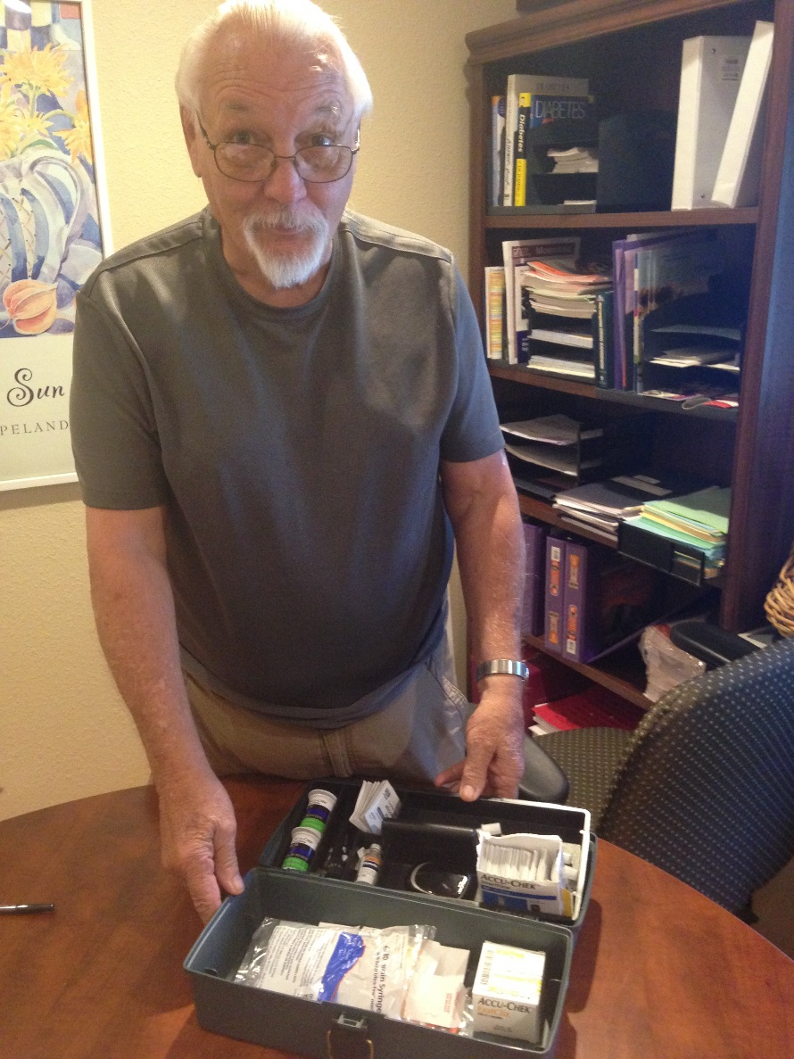
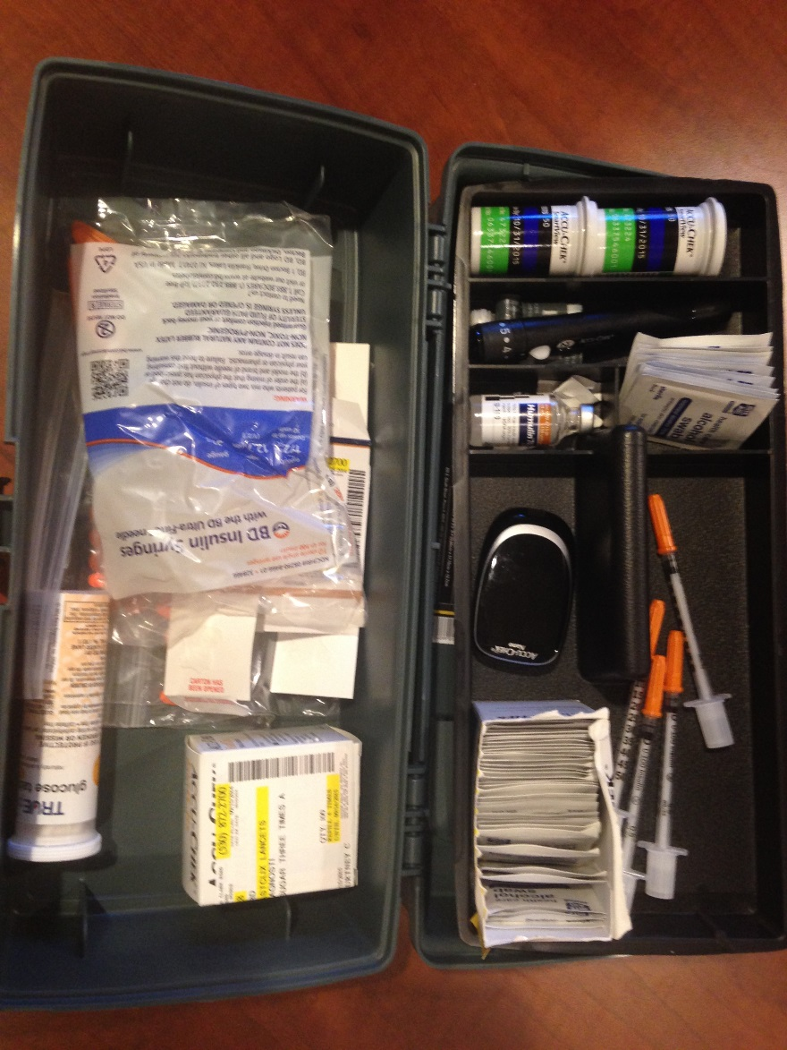
$4.99 Tackle box - Wow

Slide 27
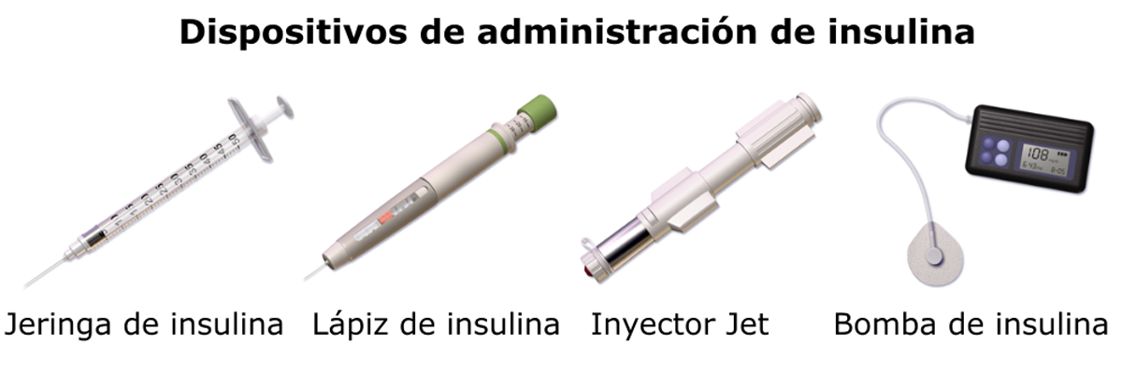
Devices to Inject insulin
Syringe Pen Injector Pump
This Photo by Unknown Author is licensed under CC BY-SA
Choice of device is person centered and based on:
Preference
Cost
Convenience

Slide 28
Poll Question 2
RT says they keep using the same site for their insulin pump, since it doesn’t hurt as much. When you evaluate their abdomen, you notice a large lump at the site. Why are you worried about this practice?
A. Magnified risk of hypoglycemia
B. Acanthosis nigricans
C. Development of a lipoma
D. Decreased insulin absorption

Slide 29
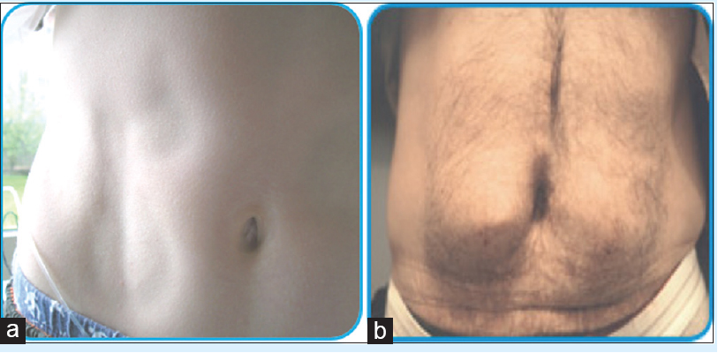
Evaluate Insulin & Injection Sites
Keep unopened insulin in refrigerator
Look for:
Lipodystrophy (a)
Lipohypertrophy (b)
Make sure insulin isn’t expired
Proper disposal
Review person’s ability to in insert and rotate sites for CGM, Pumps, injections

Slide 30
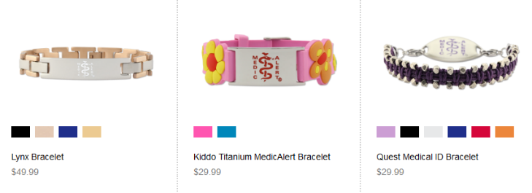

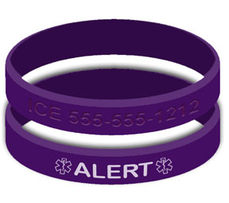
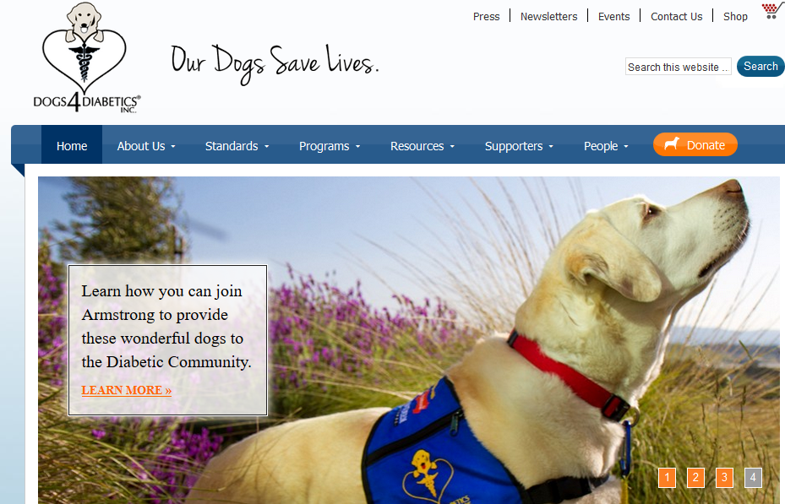
Medic Alert – Just in Case
LaurensHope.Com
MedicAlert.org
Elegant Medical Alert

Slide 31
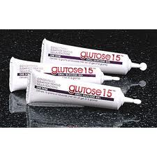
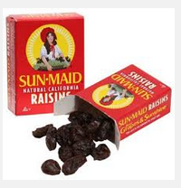
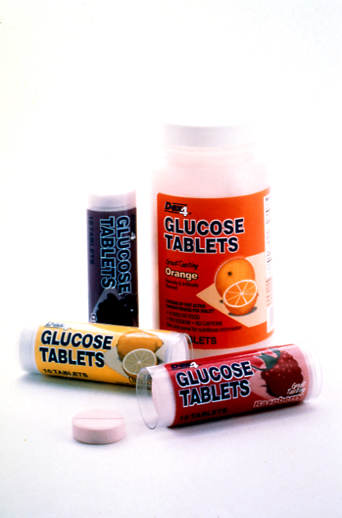

Treatment for Low Blood Sugars

Slide 32

RT not sure what to tell partner
RK has lived with type 1 diabetes for over 20 years. After a divorce, RT started surfing and dating.
RK has told their partner they have diabetes but has not told them what to do in case of a low blood sugar emergency.
RT asks about treatment options.
How might you respond?

Slide 33
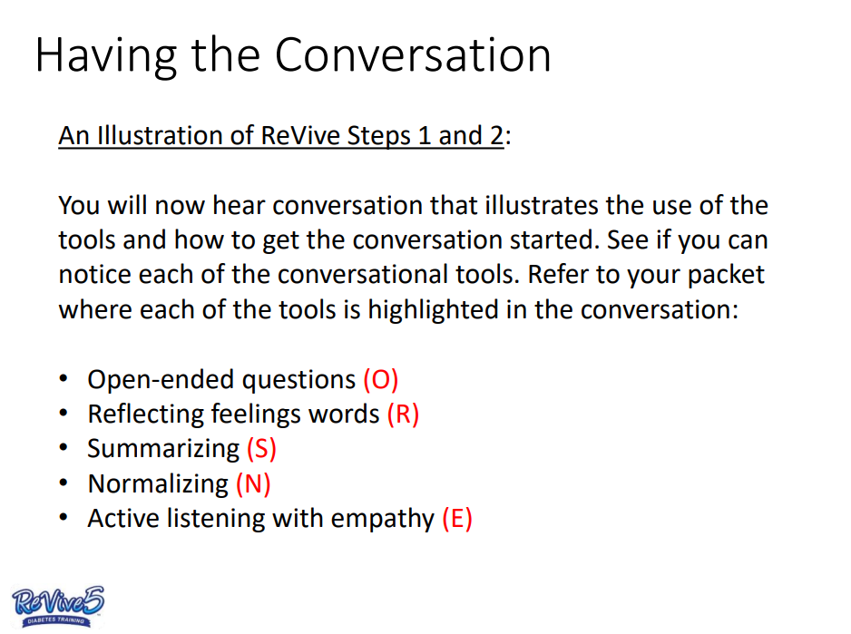
Having the Conversation

Slide 34

Hypoglycemia Conversation
What is the story you are telling yourself?
It sounds like you are afraid that if you tell your boyfriend about your risk of low blood sugar, he might feel uncomfortable? Did I get that right? (R, S)
That makes sense to me. (N)
Would you be interests in exploring some newer treatment options for low blood sugar?
What do you think would be the next best step? (O)

Slide 35
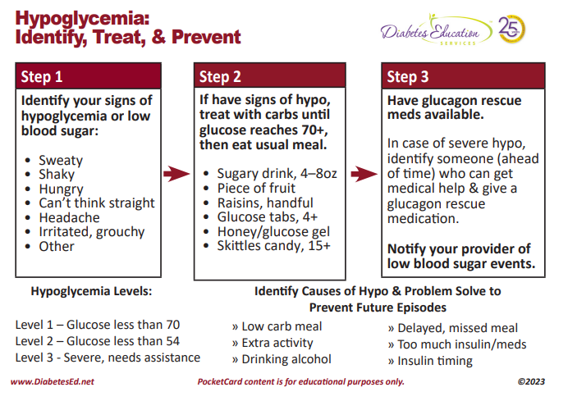

Slide 36
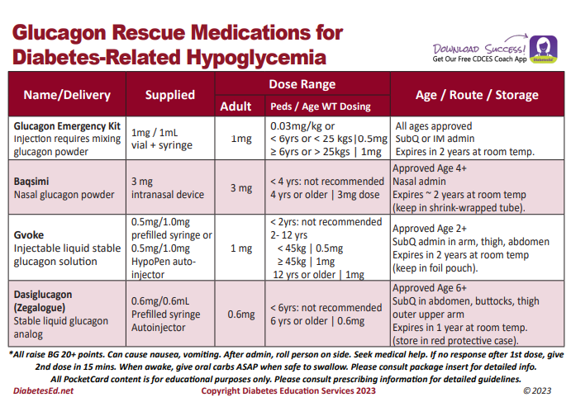

Slide 37
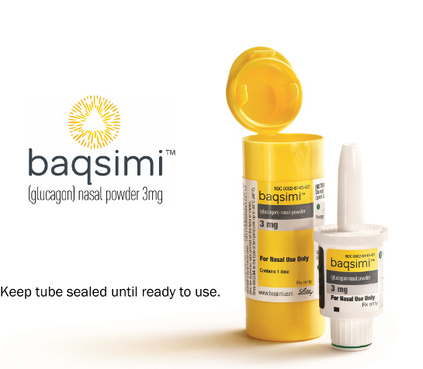
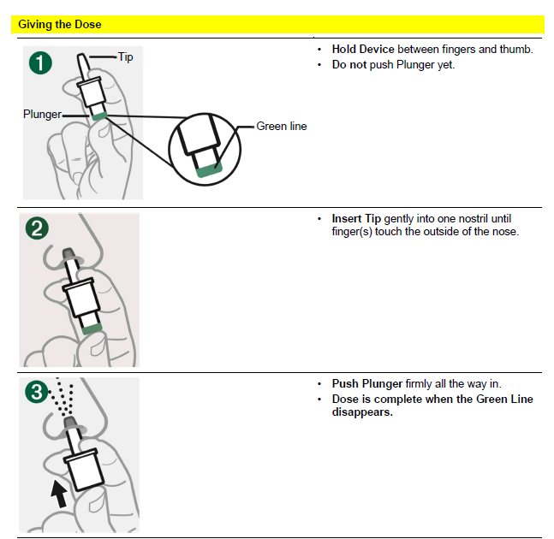
Nasal Glucagon - Baqsimi
Approved for ages 4 +
Absorbed nasally
No reconstitution or refrigeration needed
Kept in temps up to 86
Raises BG 67-73 mg/dl
Don’t use in those with
Pheochromocytoma
Insulinoma
See package insert

Slide 38
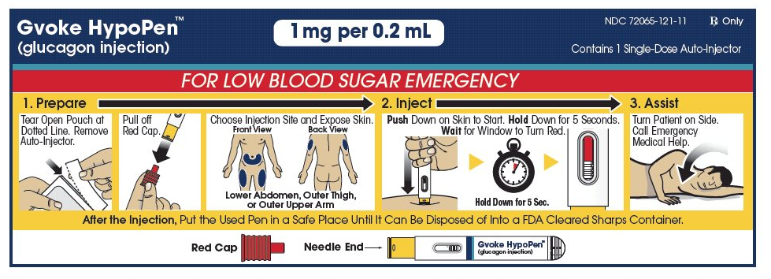
Gvoke HypoPen – Single dose injector

Slide 39

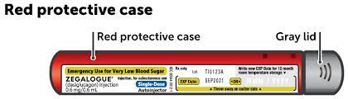
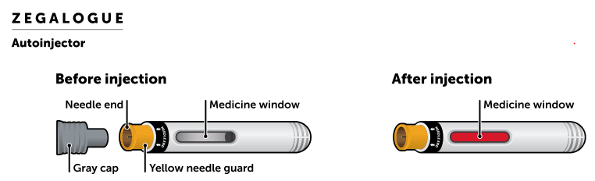
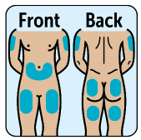
Dasiglucagon (Zegalogue)

Slide 40
Toolkit Detail Summary
Device/Med | Tips
Meter | Ensure that strips are stored properly and are not expired. Ensure sample is not contaminated – fruit juice, lotion, etc. Use to double check CGM or if CGM is not in use
Insulin | Check storage temperature and expiration date. Start new vial/pen at least once each month.
Insulin Pump | Check tubing for air. Change set site every 3 days. Consider insulin flow interruption – crimped set.
Injection Site | Rotate sites Avoid overused areas
CGM | Calibrate if needed – best to do when BG is stable.
Notes:
This is SO important. This will make your data more accurate and improve success of your experiment. These are variables that are easy to eliminate.

Slide 41
Getting to Glucose Target
ADA Glucose guidelines:
Pre-meal → 80 to 130 mg/dl
Post-meal peak → 130 to 180 mg/dl
Time in range:
70% time in target range and less than 5% below target
Modify to fit individual values and preferences – goals are a combination of what the person and the team feel are right!

Slide 42
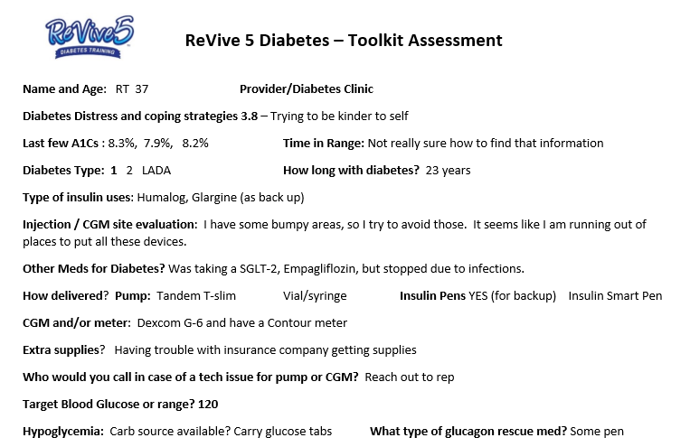
ReVive 5 Tool Kit Assessment Safety Focus First

Slide 43

Stretch and Question Break Next: Checking Basal and Bolus Insulin

Slide 44
ReVive Step 4
Problem solve and enhance glucose management
Step 4: Optimize self-management based on personal choice and values—”find the expert within.”
This step has several elements.
- Organize diabetes tool kit
- Collect data and identify most pressing problem
- Explore problem and identify patterns

Slide 45
Basal and Bolus Keep BG in Range
There are two basic strategies that help keep BG levels in range:
Basal insulin dose and timing.
Bolus insulin dose and timing.
Bolus insulin involves:
Determining amount of carbs eaten
Using carb/insulin ratios
Using insulin correction factors
More information on each of these can be found in the resource page provided.

Slide 46
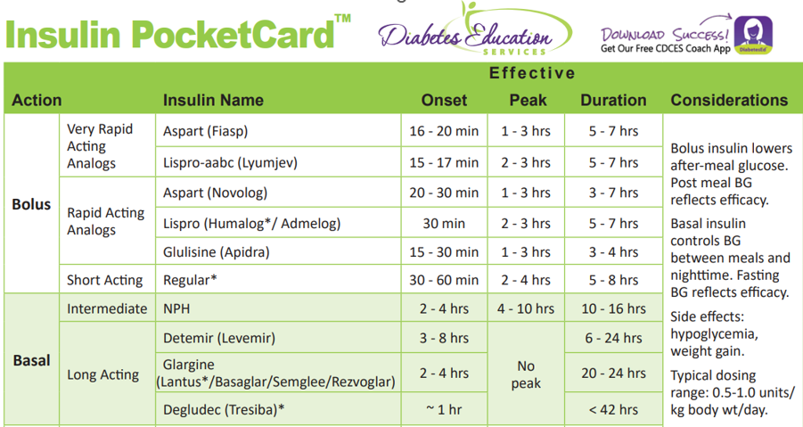
Basal Insulin
Another name is background insulin
For those on an insulin pump, rapid acting insulin is infused through the pump 24 hours a day and referred to as the basal insulin.
For those on injections they may use NPH, detemir, glargine, degludec.
A person with a working pancreas, releases about 0.5 units of insulin an hour.

Slide 47

Think Basal Insulin First
Basal insulin provides the foundation of glucose management.
Basal insulin is the platform from which everything else works – including how effective bolus insulin works.
For those on insulin pumps, ask them for their current basal rates.
If they don’t know, ask them to scroll through their pump to discover the time segments and basal rates.
Have them write or type this info, take a photo, and save for future reference.

Slide 48

Basal Insulin Dosing Options
Basal insulin injections: Basal insulin can be delivered once a day; sometimes it work best if taken twice a day.
Insulin Pump Therapy: provides continuous subcutaneous insulin using rapid-acting insulin.
Since it is infused all day/night, the rapid insulin acts as a basal insulin.
People may be using hybrid closed loop technology that auto adjusts their basal insulin dose based on CGM data.

Slide 49

Basal Insulin Dose Evaluation
If basal dose is too high, glucose levels drift down. The person will find themselves needing to eat snacks to avoid going too low. Often called “feeding the insulin”.
If basal dose is too low, glucose levels will tend to drift up.
A person will find themselves taking corrective doses of rapid acting insulin to lower glucose levels.
Notes:
SIMPLE ON THE SURFACE, BUT THINGS CAN GET COMPLEX QUICKLY.

Slide 50
Basal Insulin Dose Evaluation
1. Start with overnight first:
Eat dinner early (by 7:00 P.M.); no evening snacks; check at bedtime.
If bedtime glucose is reasonable ~ 120 to 150 mg/dL – don’t do anything;
Recheck: 2am and morning
If minimal drift (less than ~30 points), overnight basal is set correctly.
If glucose above or below target, consider dose adjustment.
Repeat next day to confirm.

Slide 51

Basal Insulin Evaluation
2. Check basal in the morning:
3. Use the same procedure at lunch, dinner and evening.
If morning glucose is on target – delay breakfast for one to two hours.
There will be minimal drift in the morning if basal is set correctly.
Do this more than once to confirm.
If not on target, explore solutions and implement.
Recheck.
If on target, move to next meal
Always repeat to confirm.
If basal dose and timing are correct, then there should be minimal drift during these non-eating segments.

Slide 52

Making insulin changes
ReVive 5 is designed to encourage the person with diabetes to “find their expert within”.
We want them to feel confident and comfortable talking to their medical team about insulin adjustments.
As the diabetes coach, you are helping them discover what insulin changes might be helpful.
The person with diabetes is responsible for sharing these changes with their health care team.

Slide 53
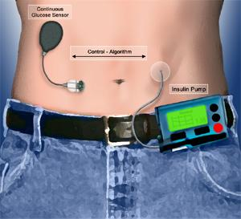
Let’s Move to Bolus Insulin
These rapid acting insulins are used to cover the carbs in a meal or correct a high blood sugar.
People with diabetes imitate the bolus release of insulin by injecting insulin or taking a bolus using a pump.

Slide 54
Bolus Insulin – Getting to the Right Dose
Getting to the right bolus dose requires 3 things:
1. Accurate carb counting
2. Accurate bolus ratio
3. Accurate correction bolus
Let’s review each.
Ask person with diabetes to discover:
Their insulin to carb ratios.
This includes for meals, snacks and different times of day.
Correction scales
This may vary by time of day
Make a record of this info and add to assessment sheet

Slide 55

Bolus Insulin and Carb Counting
The insulin bolus covers the carbs consumed as evidenced by post meal glucose levels on target.
The goal is to make sure that carb count is accurate, or else the person either
ends up taking too much or too little insulin
and glucose levels are above or below target.
During the Embark Trial, many people were struggling with carb counting.

Slide 56
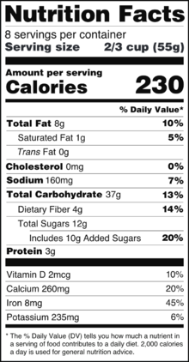
Tips on Accurate Carb Counting
Here are some strategies people can use to count carbs accurately (or come up with a really good estimate).
Most people use a “best guess,” but for checking the accuracy of carb ratios, the count needs to be very accurate.
Here are some helpful tools:
Food labels
Phone apps (Calorie King, My Fitness Pal)
Websites
Carb counting books
Cookbooks
Fast food and chain restaurant brochures
Refer to resource page for tips on carb counting.
Notes:
Has anyone found good websites or phone apps that you use? Would you mind sharing with the group. Let’s take a look at the label. Note serving size vs number of servings in the package. Also note total carbohydrate – sugar is included, ok to subtract fiber.

Slide 57
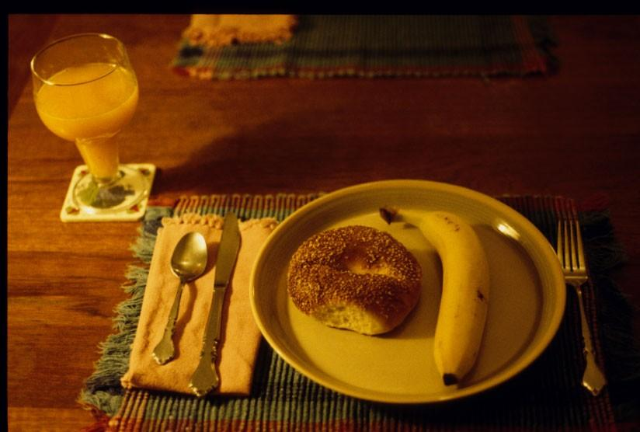

Bolus Dosing for Carbs – How Much?
Coffee – 0 gms
Toast - 15 gms
Eggs – 0gms
Sausage- 0 gms?
Total= 15 gms
1 unit for every 15 gms carb = 1 unit?
You might want to ask the person you are working with, how much insulin would they give for each example.
Juice – 30 gms
Bagel - 60 gms
Banana – 30 gms
Total = 120 gms
But what if bagel is only 45 gms
Total = 105 gms
Example: If carb ratio is 1 unit for each 15g CHO
Poll 3: How many grams of carb in this breakfast?
Poll 4: How many units of insulin for this breakfast?
Notes:
2 different breakfasts that require very different amounts of insulin but use the same ratio.

Slide 58
Determining best insulin/carb ratios
What is the right insulin/CHO ratio?
Generally, these guideline ratios vary by time of day and by a person’s age.
Age: | Ratio:
Early 20’s | 1:10
Late 20’s/early 30’s | Breakfast and dinner 1:10; Lunch 1:12
Late 30’s | Breakfast and dinner 1:12
40’s and older | 1:15 all meals
These guidelines vary from individual to individual and within individuals over time.
Notes:
These are very general guidelines and may give you an idea about what we might expect your ratio to be. Do you use ratio’s that are close to these or are they quite different?

Slide 59
Poll Question 5
JT tells you, if I have a steak and salad for dinner, I will give myself 2-3 units of bolus insulin. What is the best response?
A. That could be dangerous.
B. How many times has your glucose dropped using that approach?
C. I am curious to know how that has affected your post meal glucose.
D. Giving the insulin after the meal would be a better idea.

Slide 60
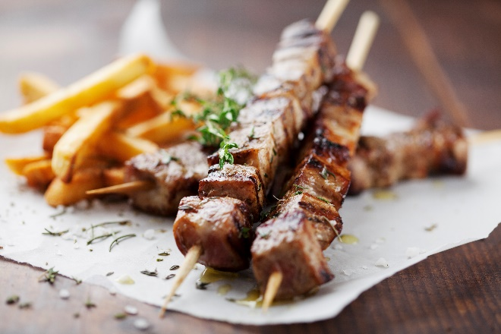
Bolus Coverage for Protein and Fat
What about Protein and Fat?
Foods high in protein and fat can cause delayed post meal spikes.
There is no consensus on how much insulin is needed to cover for protein and fat
Some people might add extra insulin to prevent post meal spikes
Other might split the bolus dose and take some before the meal and the rest a few hours after the meal
Notes:
Also important to look at the meal content – for example a quickly digested breakfast will digest much more quickly than a high fat breakfast – ie Cheerios with milk vs breakfast burrito with cheese and sausage.

Slide 61

Testing Insulin to Carb Ratio
A simple way to test the carb ratio
When pre-meal glucose is at goal (around 100), eat a meal with carbs.
Know the exact carb content (use label, app etc.)
Give the bolus insulin based on current ratio.
Wait 1 1/2 to 2 hours and re-check glucose.
If carb ratio is correct, post meal glucose will be within target
(ADA guideline 130 to 180 mg/dl).
Important note:
Repeat experiment
Remember, the numbers are approximate.
Individualize targets based on person’s goals .
Notes:
Also important to look at the meal content – for example a quickly digested breakfast will digest much more quickly than a high fat breakfast – ie Cheerios with milk vs breakfast burrito with cheese and sausage.

Slide 62

Bolus Timing Makes a Difference
Timing: Insulin boluses can be taken:
Right before the meal.
During the meal.
Right after the meal.
30 minutes after finishing the meal.
Boluses can be taken at different times.
Timing is based on what works best for the individual
Notes:
Right before – prob most of the time
During – bg was on the low side , forgot to take before
Right after – didn’t know how much I was going to eat, slow gastric emptying
30 minutes or more after – high fat meal

Slide 63

Alcohol and Diabetes
Alcohol intake can lead to hypoglycemia and sometimes hyperglycemia.
Help individual consider how alcohol impacts their glucose.
Assess and provide coaching with safety in mind.

Slide 64

Bolus Timing and Dose
Despite best efforts, glucose levels sometimes go over target.
Miscounted carb
High protein or fat meal
Wrong insulin/carb ratio
Stress
Rebound from a low
Overused sites
Pump problems
Expired insulin
Other reasons

Slide 65
At least 42 factors affect glucose!
Food
Meds
Activity
Biological
Environ-mental
Behavioral and decision making
↑↑ Carbo-hydrate quantity
→↑Carbo-hydrate type
→↑ Fat
→↑ Protein
→↑ Caffeine
↓↑Alcohol
↓↑ Meal timing
↑Dehydration
? Personal microbiome
→↓Dose
↓↑ Timing
↓↑ Inter-actions
↑↑ Steroid administration
↑ Niacin (vitamin B3)
→↓ Light exercise
↓↑ High/ moderate exercise
→↓ Level of fitness/training
↓↑ Time of day
↓↑ Food and insulin timing
↑ Insufficient sleep
↑ Stress and illness
↓ Recent hypoglycemia
→↑ During-sleep blood sugars
↑ Dawn phenomenon
↑ Infusion set issues
↑ Scar tissue and lipodystrophy
↓↓ Intramuscular insulin delivery
↑ Allergies
↑ A higher glucose level
↓↑ Menstruation
↑↑ Puberty
↓ Celiac disease
↑ Smoking
↑ Expired insulin
↑ Inaccurate BG reading
↓↑ Outside temperature
↑ Sunburn
? Altitude
↓ Frequency of glucose checks
↓↑ Default options and choices
↓↑ Decision-making biases
↓↑ Family relationships and social pressures
Adapted from Brown A. DiaTribe Learn: Making sense of diabetes... diatribe.org/42factors

Slide 66

Determining Bolus Ratios
Carb ratio: determines how many carbs one unit of rapid insulin will cover.
The ratio is different for each person and can vary at different times of the day for the same person.
Variation is based on insulin sensitivity.
Insulin sensitivity is how much effect 1 unit of insulin has on an individual’s BG level.
Several factors play a role in determining which ratio is best for a person:
example, age, weight, genetics, physical activity.

Slide 67

Correction bolus insulin dosing
Why is a correction insulin dose needed?
A bolus correction is added to insulin bolus based on glucose level before eating.
If above range before a meal, more insulin is needed during the meal to achieve post meal target
If glucose in range, a correction isn’t needed.
If below range, treat the low with carbs and/or take less bolus insulin for the meal.

Slide 68

Correction Insulin
Different people have different targets and different insulin sensitivities.
EXAMPLE
Let’s say a correction formula is 1 unit of extra insulin per 50 points over 120 mg/dl.
This means that 1 unit of rapid insulin lowers glucose about 50 points to reach glucose target of 120 mg/dl

Slide 69
Bolus – Correction Ratio Calculations
The correction ratio can be guesstimated based on their insulin to carb ratio.
For example: if one unit of insulin covers 15 grams of carbs, then one unit of insulin will lower blood sugar about 50 points.
CHO ratio | Correction ratio (over target of 100 or 120 or 150 – depending on person)
1 /15 g CHO | 1/50
1/12 g CHO | 1/40
1/10 g CHO | 1/33 – can round to 1/30
1/8 g CHO | 1/27 – can round to 1/25 or 1/30
(More info in resource page)
Notes:
These again are general guidelines but your carb bolus ratio must be correct to correlate to the correction ratio
THIS SLIDE IS IN YOUR PACKET

Slide 70
Bolus Correction Dose May need adjustment
If basal insulin and insulin to carb ratio seem right and blood glucose is still above or below target.
Correction insulin may need to be adjusted.
Explore how they feel most comfortable sharing or suggesting these dose adjustments with their provider.

Slide 71

Insulin Duration and Stacking
TIPS:
Some people may bolus in between meals if they see their glucose rising
Duration of rapid insulin action is about 4 hours.
Important to wait for the correction dose to work.
Taking more insulin during that time, is called “stacking” the insulin and can lead to hypoglycemia.
“After eating, when I see my blood sugar rising, I keep blousing to bring it down. Then I crash and I have to eat a ton of carbs to bring it up again.”

Slide 72
Having the Conversation

Slide 73
Stacking Conversation
What is the story you are telling yourself?
It sounds like you may be worried you will get complications if your blood sugars go too high and so you are giving extra bolus insulin? (R)
You’re not alone, I have talked to lots of people who do the same thing. (N)
It sounds like you want to work on avoiding low blood sugars due to stacking? (S)
Next time you see your arrows pointing up and you want to give an extra bolus of insulin before the four hours, what could be an alternate plan? (O)
Stacking is sometimes referred to as “rage blousing”

Slide 74

Calculating Bolus Insulin Summary
Three topics to discuss and clarify:
1. Accurate carb counting
2. Accurate bolus ratio
3. Accurate correction bolus
Each part depends on the accuracy of the previous part(s).

Slide 75

Toolkit & Basal Bolus Insulin Summary
Clarify and Review:
1. Check Toolkit
2. Basal and bolus insulin dosing and timing.
Determine best timing, ratio and dose:
accurate carb counting
correct insulin/carb ratios
correct insulin correction factors

Slide 76

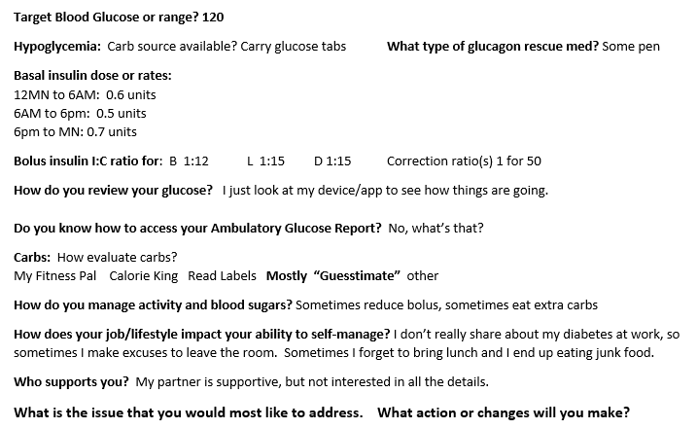

Slide 77
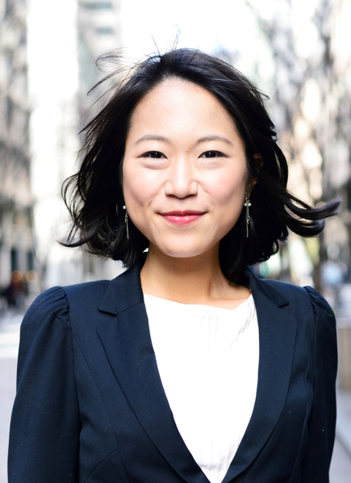
Summary and Tips
Encourage individual to go through these steps on an ongoing basis, to make sure that the toolkit is current and insulin dosing and ratios are on target.
Expect that over time, ratios and corrections need to be adjusted.

Slide 78

ReVive 5 Program – Fresh Perspective
The purpose of ReVive 5 Program:
To help look at things differently.
To gain a new perspective.
To get out of a blood glucose rut.
With new perspective, we partner with the person with diabetes
Who is the expert in their lives
To figure out what to do about it.

Slide 79

Let’s Take a 15 minute Break

Slide 80
Glycemic Management and Discovering the Expert Within – So Far…
Type 1 diabetes review
Organize and optimize diabetes tool kit
The basics of basal and bolus insulin
Practical tips for accurate carb counting
Carb ratios and corrections
Optimize management based on personal goals (not ours)

Slide 81
ReVive 5 Steps
5 Steps to Address Distress Diabetes and Enhance Management
Assess diabetes distress
Begin a conversation to foster a new perspective
Consider different management choices that are not driven by tough thoughts and feelings
Optimize self-care based on personal choice and values—”find the expert within.”
Make changes and plan for next steps.

Slide 82

ReVive 5 approach works
We are going to use a few common situations as a way of demonstrating the 5-step approach, -- but the same process can be applied to a variety of problems or issues, whether they occur frequently or only occasionally.

Slide 83
Integrating the DD Story
Anticipate the DD Story will come up during the conversation.
Normalize emotional responses (fear, frustration, hopelessness).
Refer back to their DD Story often.
Encourage them to stand with the DD to help make a different choice.

Slide 84

Next: Narrow Down the Problem
Everyone has a different BG issue – some are very specific (“morning highs”) and some are less specific (“BG is out of control”).
Our job is to be curious, ask questions and help the person determine their most pressing issue.

Slide 85
Common Blood Glucose Comments
“My BG values are all over the place.”
“I am having problems with exercise; unexplained highs, lows.”
“I can’t seem to control my BG.”
“When should I bolus? How does type of meal affect bolus timing?”
“Are my meal bolus doses correct?”
“I get tired of being hooked up to so much stuff.”

Slide 86
ReVive Step 4
Problem solve and enhance glucose management
Step 4: Optimize self-management based on personal choice and values—”find the expert within.”
Identify most pressing problem & collect data
Go through each step
Help practice using log sheets and collecting data
Help individual Identify their most pressing BG problem.
Then help the individual to figure out a way to resolve it.

Slide 87

Choosing the Right Problem
No matter what problem, make sure that:
It is important to the individual
It occurs frequently (not a random event)
They are willing to tolerate some distress in order in order to take new action
Otherwise, individuals will probably not complete the problem-solving tasks.

Slide 88
A Circle of Self-Discovery
Collect Information “data”
Identify the Problem
Helping Individuals Identify their “expert within”

Slide 89
Identify Management Issues and Collect Info
Once the issue has been Identified it is time to collect information.
Collect accurate information so the Individual can clearly recognize what is happening.
Yes, medical teams may want to see the information, but since the individual lives with diabetes every day, it is mostly for the INDIVIDUALS USE.
Empower the individual to be the primary diabetes problem solver!

Slide 90
Collecting Info to benefit the Individual Needs
What information to collect?
Comprehensive – adequate information to see what is going on.
Collected over several days to see how things change.
Valuable and easy enough to collect and record so individual does not feel overburdened and give up.
This takes some effort;
Make sure that it is worth it to the individual before starting.

Slide 91


Gathering Data to Determine Issue and Make Changes
Keep 3 days of glucose/ food/insulin logs
Identify problem areas
Remind them that their story and tough thoughts and feelings might emerge, and that is okay.
Focus on recognition of issues and progress
Help them decide on next steps for making changes

Slide 92
Log Sheets | What info to collect
BG information from finger stick (7 per day) or CGM/flash monitor.
Basal insulin units taken and timing.
Bolus insulin units taken and timing.
Number of carbs consumed – when and what food?
Insulin to Carb Ratios and Correction Ratios
Exercise and Other events (stress, alcohol).
Collect for 3 days

Slide 93
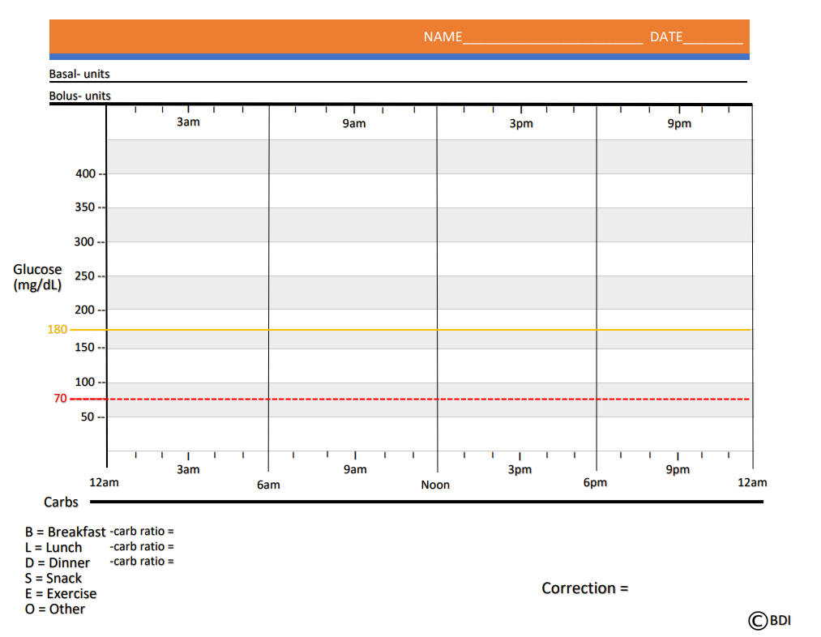
ReVive 5 Log Sheet Overview

Slide 94
RT

Slide 95
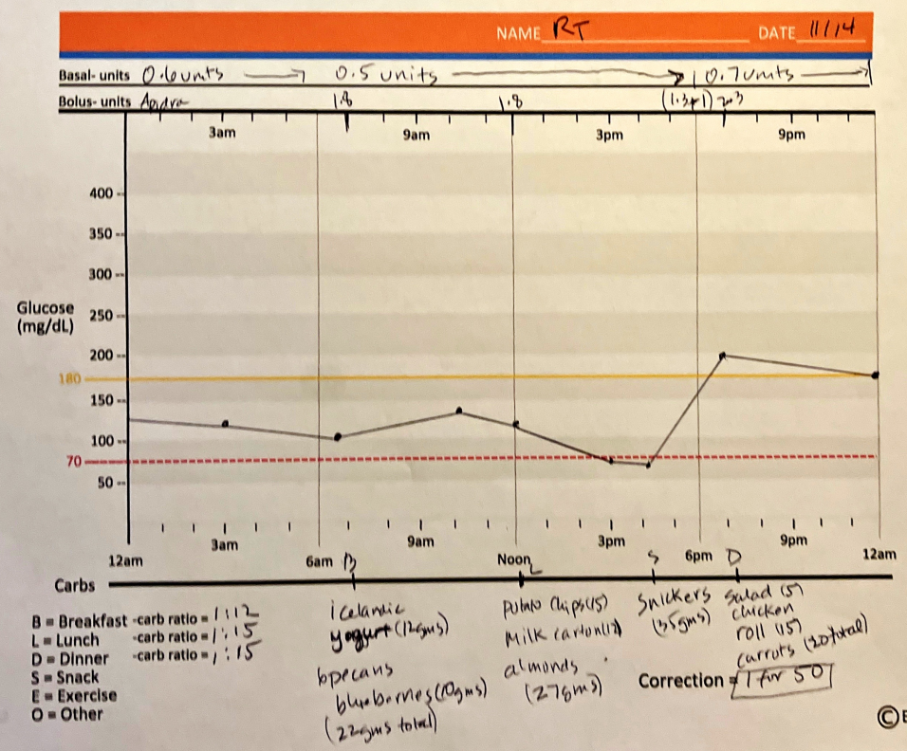

Slide 96

How To Use Log Sheets
The Individual as Detective- Four Tasks:
Scan at the BG line for the first day and night and look for above and below target results.
Check basal and bolus insulin dose and timing.
Check food and carbs.
Put it all together.

Slide 97
Log Sheets: Looking at BG
Scan at the BG line for the first day and night:
Start with basal- blood glucose drifting up or down?
Look at the ups and downs during the day- when is it below target or above target?
Look across days to see how the glucose levels change during the same time period.
What does the individual think is the main problem and when does it occur? (there may be more than one)

Slide 99

Diabetes Detective – Basal Insulin
Assess basal insulin injected or delivered
Confirm timing and units of basal insulin taken.
Evaluate morning glucose and in-between meal drifts.
Considerations:
Using hybrid closed loop system that adjusts basal insulin based on CGM results?
Using pump without closed loop system?
Injecting basal insulin?
Sites and insulin type
Check DiabetesToolkit

Slide 100
Log Sheet – What is the Issue?
Not enough basal insulin
Notes:
Example 7: NOT ENOUGH BASAL INSULIN.

Slide 101
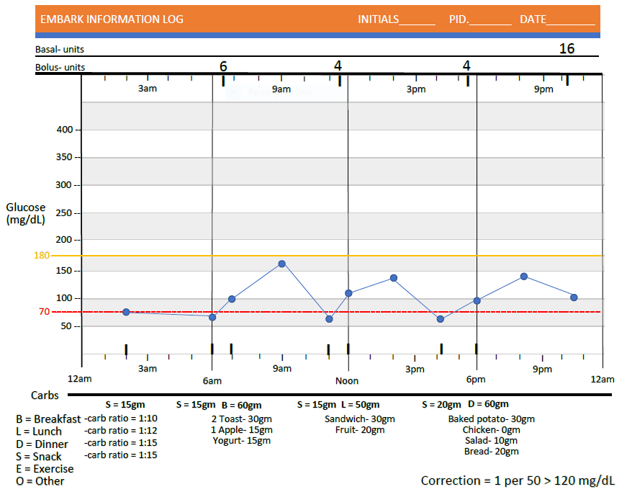
Log Sheet – What is Issue?
Too much basal insulin
Notes:
Example 6: TOO MUCH BASAL INSULIN.

Slide 102
Diabetes Detective – Bolus Insulin
Bolus insulin assessment
Is the amount of bolus insulin taken enough to cover the carbs eaten?
Carbs count accurate?
What carb ratio used?
Bolus insulin timing?
Too little/too much bolus insulin taken, given the carbs eaten?
Correction needed? Was it taken?
Check out carb counting apps

Slide 104
List of typical “Problem Causers.”
Knowing the DD Story helps you anticipate the causes of BG problems
Basal insulin dose or rates may need adjusting.
Carb count accurate?
Right meal carb ratio?
Right correction bolus insulin?
Timing of insulin dosing may need adjustment- insulin taken early or late.
Type of food consumed affected glucose response (fats, protein, fiber).
Effects of exercise and physical activity.
‘Stacking’ insulin boluses.
Response to concerns about hypoglycemia.
Stress: family, work, financial, etc.
Notes:
YOU HAVE A COPY OF THESE “TYPICAL” PROBLEM CAUSERS IN YOUR PACKET. AS WE WORK THROUGH SOME EXAMPLES, IT CAN BE HELPFUL TO GAVE THE LIST CLOSE BY TO HELP IDENTIFY WHAT MIGHT BE GOING ON.

Slide 105

Be a Detective – What is the Issue?
Put it all together: What do THEY think might be going on based on the DD Story?
Get as specific as possible.
This is a best guess – it might not be a correct guess, but it is a place to start.
Usually, the first guess may be correct in perhaps 50% of the cases, so be prepared to use this only as a place to start.
Notes:
REMEMBER – THERE IS NO “RIGHT” OR “WRONG” ANSWER. THIS IS A PROCESS.

Slide 106
ReVive 5 – Explore Problem & Identify Patterns
Problem solve and enhance glucose management
Step 4: Optimize self-management based on personal choice and values—”find the expert within.”
This step has several elements.
- Organize diabetes tool kit
- Collect data and identify most pressing problem
- Explore problem and identify patterns
Step 5: Make changes and plan for next steps.

Slide 107
JR keeps getting low when bike riding
JR rides their bike for 1.5 hours twice weekly.
Limits carb intake to 30 gms daily to avoid weight gain.
Uses a pump and tries to manage glucose with basal insulin only.
Is reluctant to treat lows with carbs.
Over the past month, JR’s blood sugar has dropped below 70 while bike riding at least 3 times.
What questions would help you support problem solving?

Slide 108
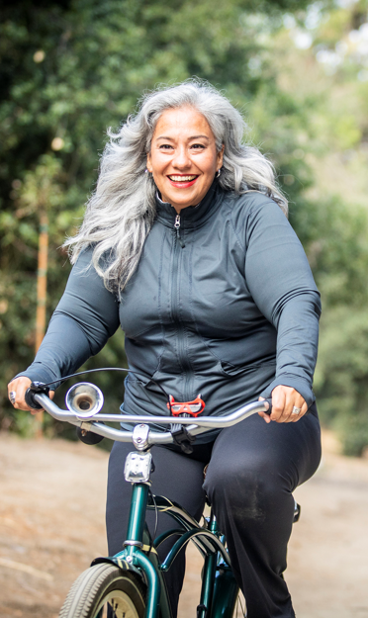
Adjustments for Activity
People may decide to:
Adjust their basal insulin or bolus insulin
Adjust food intake in anticipation of activity
Set higher blood glucose goal before activity
Assess and provide coaching to explore what approach works best for them.
Consider spontaneous and planned activity.
Options include:
Reducing bolus coverage for previous meal
Creating a temporary basal rate
Eating additional carbs before or during activity
Other?

Slide 109
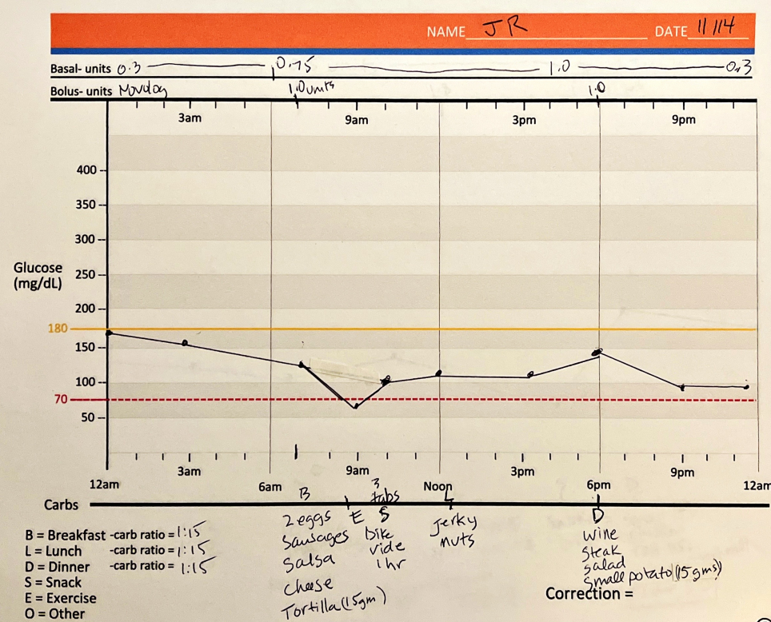
Drops with Exercise – JR Log

Slide 110
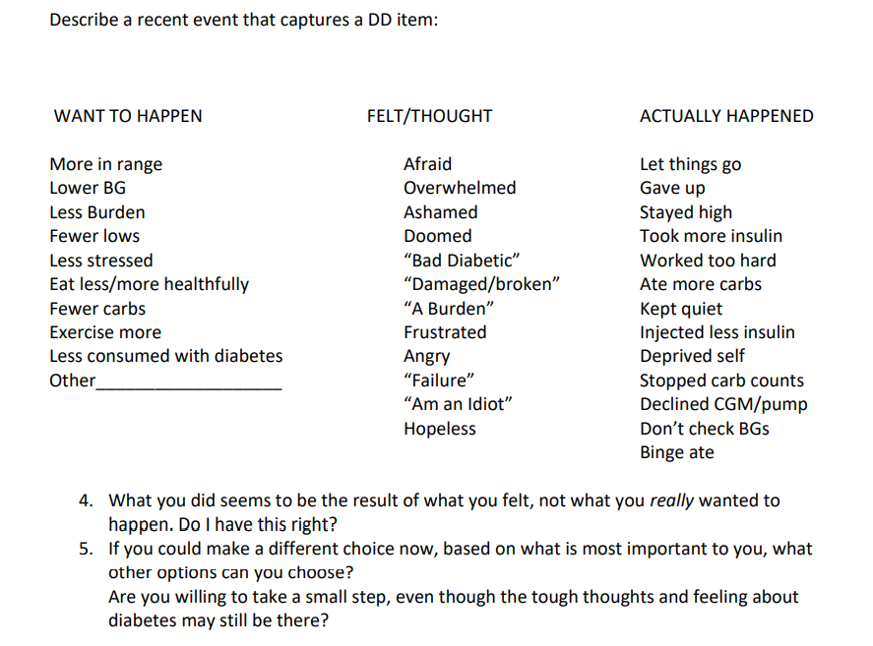

Diabetes Distress – Putting it together
Trying to eat fewer carbs and exercise more to prevent complications but having lows while exercising that sabotage efforts.

Slide 111
Exercise Hypo – JR’s Situation
JR Tells You
You Explore
Story – limiting my carbs will keep my blood sugars on target.
I am worried about complications, so I try to avoid carbs, even with exercise.
Would you be willing to be present with that fear to try and keep blood sugars in a safe range during bike riding?
Are there any other strategies that might work to keep glucose in a safe range during your bike ride?

Slide 112
ReVive 5 – Explore Problem & Identify Patterns
Problem solve and enhance glucose management
Now that you have collected the data.
Now that you have identified patterns.
Now that you have identified how DD drives the problem.
Now you are ready to try an experiment.
Help the person decide what change(s) they can make
to address the problem

Slide 113
JR Decides and Makes a Plan
Make sure that the change they make is VERY specific.
The clearer and more specific the change, the more easily evaluated.
I will decrease my basal insulin 1 hour before and during my bike ride or
I will eat an extra 15gms of carb at meal before my bike ride days.
I will eat 15 gms of carb if my glucose drops less than 70 during my bike ride.

Slide 114

Helping People Succeed
The change has to be achievable – something they actually can do.
Remind them that feelings and action are not the same thing.
The first change may not fix the problem, but it helps people discover what to do next.
The first change may point them in the right direction, but it still might not be enough change.
This is a step-wise process.

Slide 115
Checking in with JR 2 weeks later
JR Responds
You Say / Ask
Yes, I noticed my worry as I prepared for my ride.
I put my pump on exercise mode when I started my ride. I got a little low at first, had some glucose tabs, and then things stabilized.
Next time, I will start with a higher BG plus put my pump on exercise mode.
Thank you for keeping logs on your exercise days.
Did you notice your DD story showed up?
Were you able to try any of the experiments?
Did you discover anything new?

Slide 116
Setting Up Experiment/ Taking Action
Change experiments need to be time limited (not forever) – this is only an experiment – try it out for 3 days and see what happens.
They could realize that it actually isn’t an issue or maybe it is something different.
Based on JR results:
Make a small change (exercise mode > higher BG)
Realize, that the story and tough feelings can be major barrier to change. (It is scary, but I can feel worried and still try these new strategies)
Discover an unexpected issue (maybe basal rate is too much).

Slide 117
What is happening here?

Slide 118
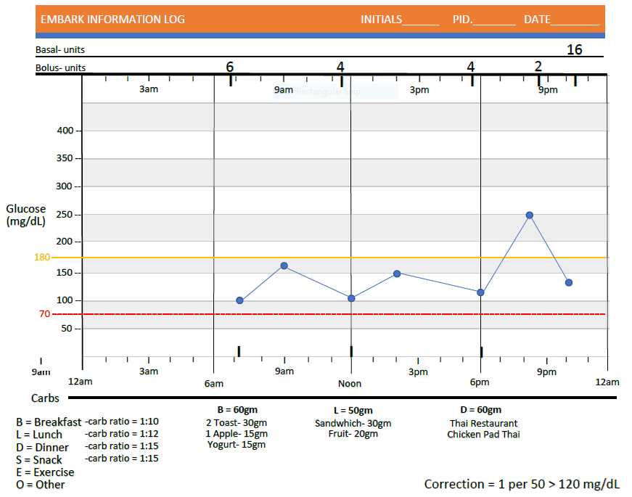
Diabetes Detectives

Slide 119
RT Loves Eating Out
RT loves to eat dinner out with their friends 2-3 times a week.
However, blood sugars always seem to go above target on those evenings.
Want to have improved time in range to feel better, worry less and enjoy time with friends.
Story- I am such a failure, my blood sugars are always going too high. Makes me not even want to try.
Action: I will tolerate these feelings and I will look up carb content of food to try and figure out how much insulin I actually need.

Slide 120
RT Sets up Experiment/ Takes Action
Steps
RT Changes
Make a small change
Realize, that the story and tough feelings can be major barrier to change.
Discover an unexpected issue
Look up carbs on app/website.
Ask her friends for support
Asking for help is hard, but I think it will help.
See how drinking wine with dinner affects BG

Slide 121
Checking in with RT 2 weeks later
RT Responds
You Say / Ask
We went to the same restaurant 2 times in the same week. My friends helped me figure out the carbs in my favorite dish, but the first night, it still went high. I noticed the DD story of feeling like a failure.
A few nights later, I tolerated my DD, ordered the same dish, and increased my bolus by 2 units. My blood sugar was right on track!
Thank you for keeping logs on your eating out days.
Did your DD Story show up?
Were you able to try any of the experiments?
Did you discover anything new?

Slide 122
Checking in with RT 2 weeks later
RT Responds
You Say / Ask
I didn’t have a chance to check that out yet. But next time, I am going to eat the same dish, take the same amount of insulin and add have a glass of wine to see what happens.
I see that I need to keep challenging myself to not give in to feeling like a failure and keep making new choices.
I know you also mentioned you wanted to see how wine affected your blood sugars.
Did you discover anything new?

Slide 123
Some people might also want to use their downloaded Ambulatory Glucose Profile
These Log Sheets may seem like a lot of work, but people love them and want to keep using after the study concluded.
There are blank log sheets in your Resource Center.
That is okay – but ask them to use the logs for at least 3 days first
Once they learn the concepts behind the log sheets, they can apply these concepts to the downloaded reports.
They may even become more curious about how to access their Ambulatory Glucose Reports.
Encourage their curiosity.

Slide 124
Collaborate: How can they access their data
System: | Associated Mobile Apps | Data Sources
Glooko | Glooko | Insulin pumps (Omnipod, T:slim X2), G6, Eversense, many glucose meters, InPen
Clarity | Dexcom G6, Clarity, Dexcom Follow, Undermyfork, Sugarmate | G6, InPen
LibreView | LibreLink, LibreLinkUp, Libre 14 day, Libre 2, Libre 3 | Libre 14 day, Libre 2, Libre 3
Carelink | Guardian Connect, Carelink | 770G, Guardian CGM
Tidepool | Tidepool Mobile | Insulin pumps (770G, T:Slim X2, Tandem, Omnipod), G6, Guardian, Libre, many glucose meters, InPen
T:Connect | T:Connect Mobile | T:Slim X2, G6
Eversense Data Management System | Eversense | Eversense
InPen Insights Report | InPen | InPen, G6, Guardian Connect
Bigfoot Unity | Bigfoot Unity | Bigfoot Unity pen cap, Libre 2

Slide 125

Putting it all together

Slide 126
ReVive 5 Steps
5 Steps to Address Distress Diabetes and Enhance Management
Assess diabetes distress
Begin a conversation to foster a new perspective
Consider different management choices that are not driven by tough thoughts and feelings
Optimize self-care based on personal choice and values—”find the expert within.”
Make changes and plan for next steps.

Slide 127

Step 5- Collect new data to see what happened
The best way to know is to collect a new batch of information
Then compare the original information with the new information to discover if change occurred.
It is VERY common to find that something has changed, but more is required.
Let’s go back to Sally. She was drinking a full milkshake to prevent nighttime lows, but cut it back to a half milkshake, even though she was still afraid.
Notes:
We are now on Step 5.

Slide 128

“In an effort to face the fear of lows at night and have a BG level that is closer to where you want to be, you are going to start tonight by drinking half a milkshake and go to bed with a BG of 200 mg/dl. You will also move forward with the process of getting a CGM today. Do I have that right?

Slide 129
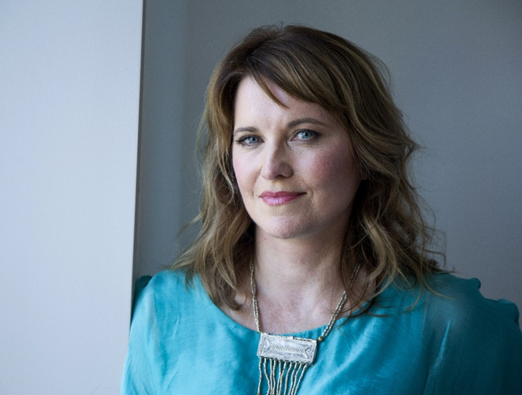
“Yes. You have that correct. This feels like a weight has been lifted. I’ve been really stuck and this feels like a plan that I can really do. Thank you.”

Slide 130
“I’m really glad. Expect that you will be fearful when you try this out tonight. It is scary to move forward after having a bad low. You have a good plan to begin to regain your confidence. And, thank you for your willingness to share your diabetes story with me. Let’s plan to look at your logs next visit to review how it is going.

Slide 131
“I finally got my CGM and have been wearing it for the past few weeks. Thank goodness for the alarm feature. On the first night I drank only a half a milkshake, I had a low blood sugar of 61 around 3am. I drank some juice and went back to bed. However, when I looked at my log sheets, I think I might have discovered the issue ”

Slide 132
“Thank you for sharing all of this. First, I want to recognize that you got your CGM, moved forward with the experiment and kept log sheets. I am sorry that you experienced a low blood sugar. I am sure this event brought up a lot of emotions for you.
I am curious to know more about this and what else you think you discovered.”

Slide 133
“It was really scary, but I took a step back and looked at the logs to see if I could figure out what was happening.
For 3 nights in a row, my blood sugar dropped around 3am. I noticed that my basal insulin was set at 0.5 units an hour from 7pm to 2am. But at 2am the basal rate increased to 0.8 units until 7am.
I think my basal rate is too high at night.

Slide 134
“This is really great detective work. By looking at your data and log sheets, you realized that you are on too much basal insulin and that is what’s causing the low blood sugars.
What do you think would be the next step?”

Slide 135
“Actually, I already contacted my provider and shared the data with them. I asked if we could reduce the basal rate to 0.5 an hour through the night.
My provider was so pleased that I discovered that and supported the insulin rate change.
I am just disappointed that my diabetes team didn’t figure this out earlier.”

Slide 136
“Yes, I can imagine that feels disappointing.
That’s why we are sharing this approach with people living with diabetes. By getting really familiar with the details of your diabetes management plan, you can start steering the boat and identify issues and take action right away.
This approach recognizes that people living with diabetes are experts in themselves. How does that seem to you?”

Slide 137
“It feels a little overwhelming and kind of reassuring at the same time.
I realize now how much I didn’t know about my diabetes plan and how my DD story was impacting my management. By being more aware of all these details, I have more say in my own outcomes.”

Slide 138
“What you are saying makes complete sense.
The good news is that you are not alone on this journey of discovery. We will keep checking in on a regular basis and you can always make an appointment if you feel stuck.
Diabetes changes over time and we will keep needing to adjust the approach to match you.

Slide 139
ReVive 5 Program – Fresh Perspective
To help look at things differently.
To gain a new perspective.
To get out of a blood glucose rut.
With this new perspective, we partner with the person with diabetes, who is the expert in their lives, to figure out next steps.

Slide 140
ReVive 5 Steps
5 Steps to Address Distress Diabetes and Enhance Management
Assess diabetes distress
Begin a conversation to foster a new perspective
Consider different management choices that are not driven by tough thoughts and feelings
Optimize self-care based on personal choice and values—”find the expert within.”
Make changes and plan for next steps.

Slide 141
ReVive 5 Connect 2023
You are invited to join us 4 times a year for a one hour meeting.
Our team will provide a case study for discussion.
Plus participants are invited to share difficult situations or successes with all of us for feedback and support.
Dates:
February 27th
April 24th
July 31st
October 30th
Time:
11:30 to 1:00pm PST
No CE’s are provided, but this is a great opportunity to connect. Keep an eye on your inbox for your invitation.

Slide 142

Questions?

Slide 143
Last piece: Putting It All Together
Identifying glucose profiles through specialized Log Sheets
Discovering patterns and issues
Integrating how feelings drive glucose as seen on the log sheets
Being present with uncomfortable feelings to help make different management choices
Seeing the results of new choices using log sheets.
Case Studies that incorporate the ReVive 5 Process.
ReVive 5 Connect – We will meet 4 times in 2023 & 2024 to check in and provide support.

Slide 144

ReVive 5 Resource Page

Slide 145

Please go to DiabetesEd Online University to take the post test, complete survey and earn your CE’s.
You have access to the recorded webinars, podcasts, and resources for one year.
We look forward to seeing you at our ReVive5 Connect
July 31 and October 30th
11:30 to 12:30 am
Bring your stories for ongoing support.

Slide 146

Thank you!
Thank you for joining us!
Please let us know if we can answer any questions.
We are here to help!
www.DiabetesEd.net | info@diabetesed.net | 530-893-8635

