Slide 1

Diabetes Fundamentals Series 2024 Class 2 – Nutrition & Exercise
Beverly Dyck Thomassian, RN, MPH, BC-ADM, CDCES
President, Diabetes Education Services
www.DiabetesEd.net

Slide 2



so please download your certificates into a file on your computer.
Welcome to our DiabetesEd Online University
Our goal is to provide an exceptional user experience and build a sense of community.
Notes:
Welcome to our new and Improved Diabetes Education Services Online University, where you can earn CE's, prepare for certification, and increase your confidence.
Our goal is to offer you exceptional and personalized service and build a sense of community.

Slide 3



DiabetesEd.net Website Orientation
PocketCards
CDCES Coach App
Beverly Thomassian, RN, MPH, CDCES, BC-ADM
CEO, coach, instructor, cheerleader, mentor
www.DiabetesEd.net | info@diabetesed.net | 530-893-8635

Slide 4

Bryanna is here to Help!
If you have questions, you can chat with Bryanna at www.DiabetesEd.net or call 530 / 893-8635 or email at info@diabetesed.net
Bryanna Sabourin
Director of Operations
Certification Pathway Coach &
Customer Happiness Expert

Slide 5

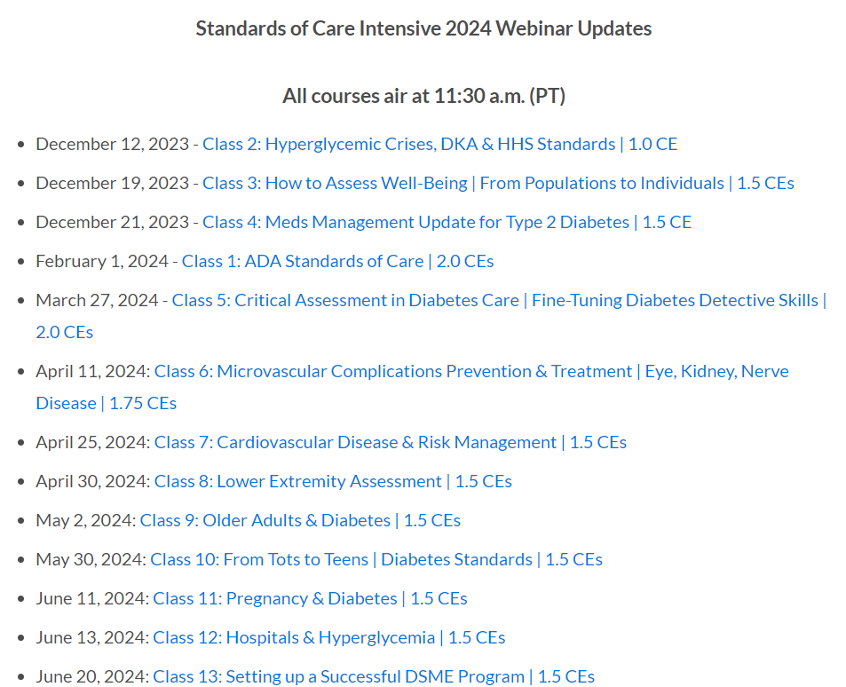

Level 2 – ADA Standards of Care Explained 2024

Slide 6


Coach Bev has no Conflict of Interest
She’s not on any speaker's bureau
Does not invest or have any financial relationships with diabetes related companies.
Gathers information from reading package inserts, research and articles
The ADA Standards of Medical Care is main resource for course content

Slide 7
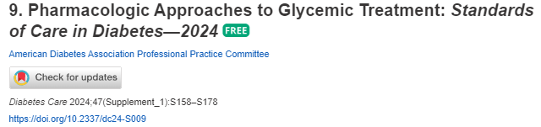
Meds Management Update for Type 2 Diabetes

Slide 8

Land Acknowledgment
We acknowledge and are mindful that Diabetes Education Services stands on lands that were originally occupied by the first people of this area, the Mechoopda, and we recognize their distinctive spiritual relationship with this land, the flora, the fauna, and the waters that run through this area.

Slide 9
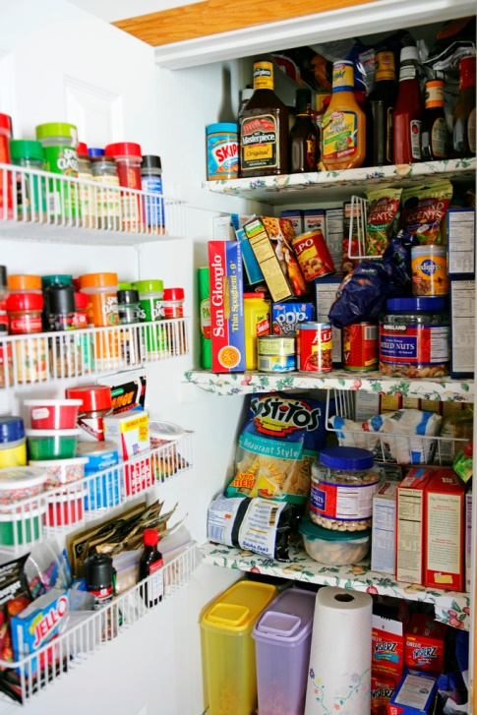
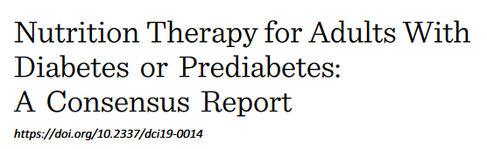

Class 2 – Nutrition and Activity
List Self-Management Benefits
Nutrition guidelines
Describe current MNT recommendations
List 3 teaching strategies for success
Exercise Guidelines
Discuss goals and safety precautions
4/2019

Slide 10

More Nutrition Info?
Ashley LaBrier, MS, RD, CDCES provides 4-hour presentation on the latest in nutrition care and management.

Slide 11

ADA Standards 2023 – Section 5
Benefits of Diabetes Self-Management Education and Support
Medical Nutrition Therapy
Activity

Slide 12

Objectives of Diabetes Self Management Education and Support (DSMES)
Facilitates knowledge and decision making
Promotes skill mastery needed for optimal self care.
Consider treatment burden.
Incorporates needs, goals, and life experiences of the individual
Supports informed decision making, self-care behavior, problem solving and active collaboration.

Slide 13

Diabetes Self Management Ed Benefits
Improved knowledge
Lower weight
Improved quality of life
Reduced mortality
Positive coping
Reduced cost
Only 5-7% of Medicare/insured receive DSME)
Increased primary care, preventive services
Less frequent us of acute care and inpt admissions
More likely to follow best practice recommendations (esp those with Medicare)

Slide 14
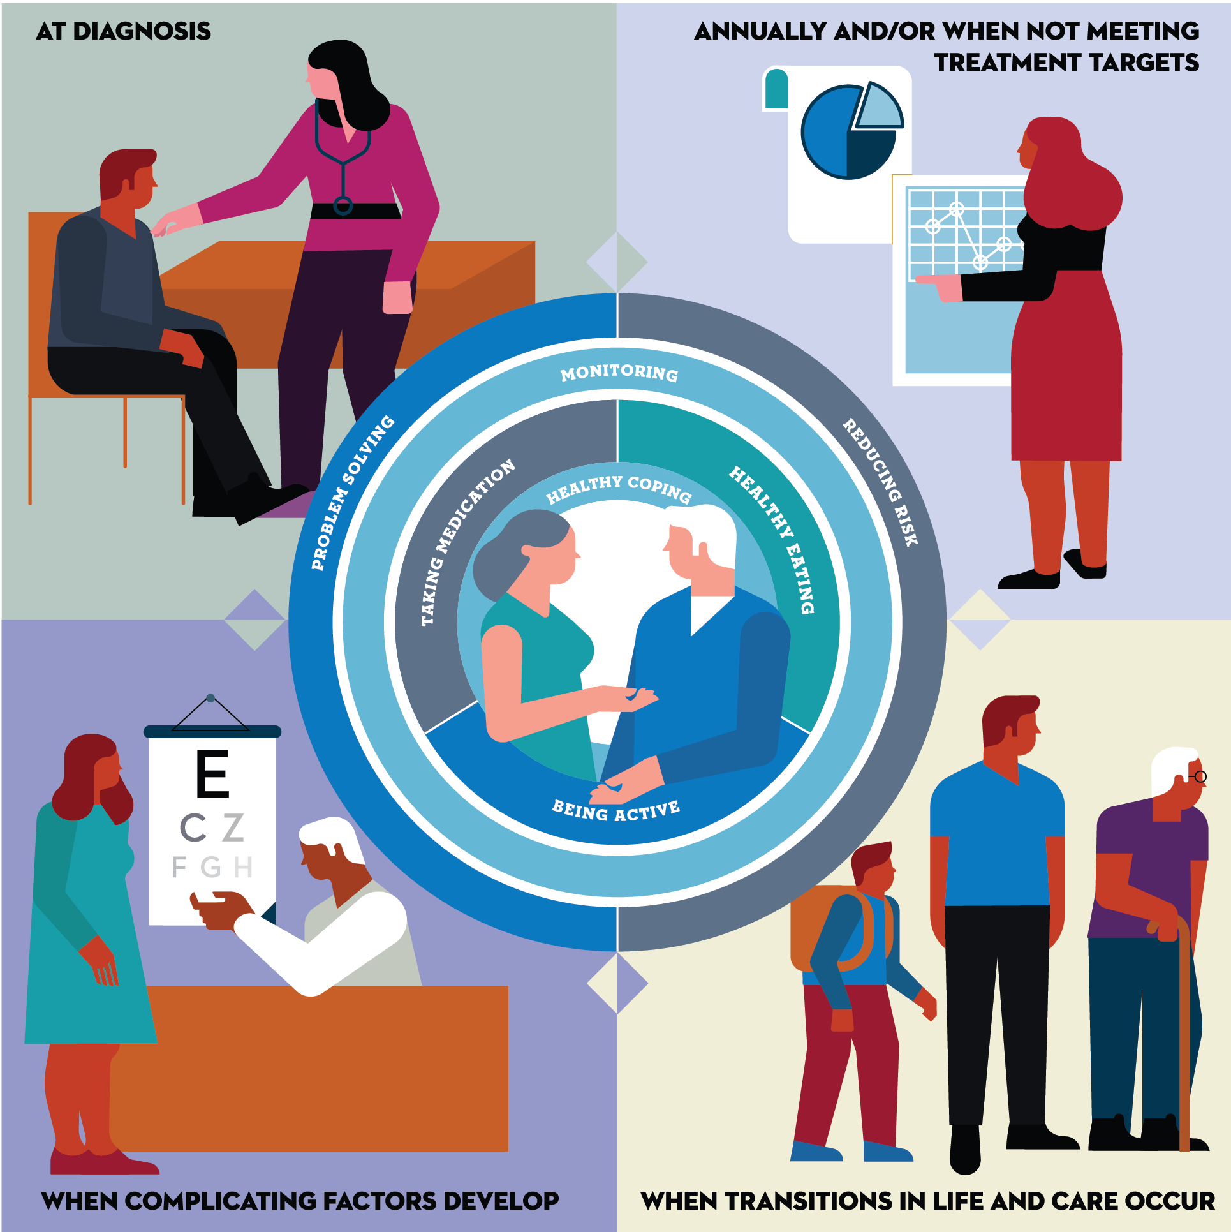
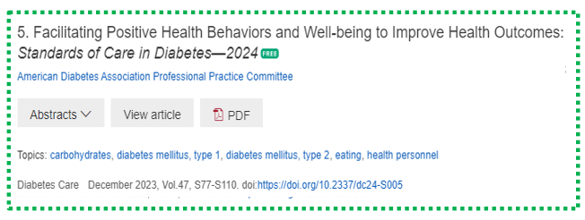
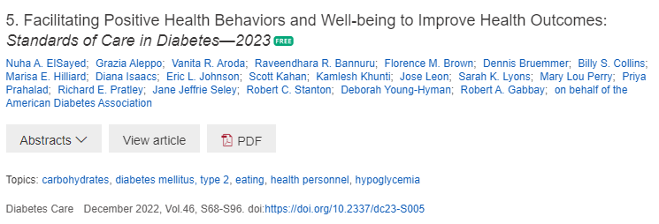
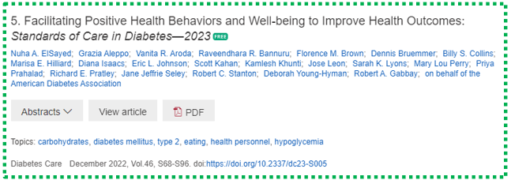
FIVE critical times to provide and modify DSMES
At diagnosis.
When not meeting treatment goals.
Annually
When complicating factors develop (medical, physical, psychosocial).
When transitions in life and care occur.
Powers MA, Bardsley JK, et al. DSMES Consensus Report, The Diabetes Educator, 2020
ADCES. AADE7 Self-Care Behaviors, The Diabetes Educator, 2020
(cdc.gov/diabetes/professional-info/training.html)

Slide 15

Address Barriers to Self Management
Design and delivery of DSME with ultimate goal of health equity across all populations.
Barriers exist within health system, payer, health care professional & individual.
Address barriers through innovation, including community health workers, telehealth, other digital health solutions.
Consider social determinants of health in the target population when designing care.

Slide 16

Social Determinants of Health
The conditions in which people:
Play
Live
Work
Learn
Pray
Directly affects their health risks and outcome AADE Population Health & Diabetes Educators Evolving Role 2019

Slide 17

Assess for Food Insecurity
Any member of the health care team can screen for food insecurity using The Hunger Vital Sign.
Households are considered at risk if they answer either or both of the following statements as “often true” or “sometimes true”
“Within the past 12 months, we worried whether our food would run out before we got money to buy more.”
“Within the past 12 months, the food we bought just didn’t last, and we didn’t have money to get more.”

Slide 18

ADA Standards 2023 – Section 5
“For many individuals with diabetes, the most challenging part of the treatment plan is determining what to eat”.

Slide 19
Assess Knowledge, Self Management Skills
Refer all people with diabetes for individualized MNT by a Registered Dietitian.
Individualized MNT Plan
Eating Patterns
Preferences, portion sizes, timing on meals and snacks, eating environment, disordered eating

Slide 20

Medical Nutrition Therapy for Diabetes – What Medicare Covers
Must be ADA/ADCES Recognized
3 hours initial benefit in first calendar year
2 hours follow-up annually
Only 10% of people with diabetes are referred
MNT provided by RD reduces A1c up to 2% points

Slide 21
Goals of Medical Nutrition Therapy – ADA Promote and support Individualized healthful eating patterns
Support healthful eating patterns
Emphasize eating a variety of nutrient dense foods in appropriate portions to:
Attain individualized B/P, BG and lipid goals
Attain and maintain body wt goals
Delay and/or prevent complications
Maintain pleasure of eating. Provide positive, nonjudgmental messages about food
Limit food choices only when backed by science
Provide practical tools for day-to-day healthy meal planning

Slide 22

Medical Nutrition Therapy – ADA
No ideal percentage of calories from protein, carbohydrate and fat for people with diabetes.
Consider personal preferences
tradition, culture, religion, health beliefs and goals, economics
as well as metabolic goals when working with individuals to determine the best eating pattern for them
Macronutrient distribution based on individualized assessment
Each team member should be knowledgeable about nutrition therapy principles.

Slide 23
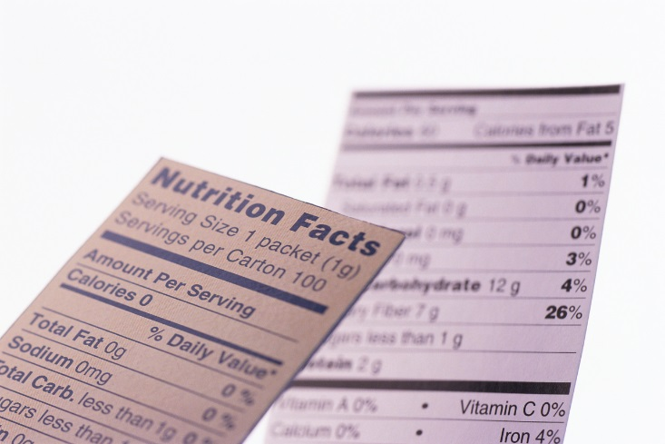
Sodium, Vitamins and Fat
Sodium – Try and keep less than 2,300 mg a day (one tsp a day)
Vitamin and mineral supplements not recommended -lack of evidence.
Consider B12 replacement therapy for those on metformin if level is low
Fat - same as recommended for general population
Less than 10% saturated fat,
Limit trans fats
Less than 300 mg cholesterol daily
Mediterranean Diet looks like good option
The type of fats consumed is more important than total amount of fat

Slide 24

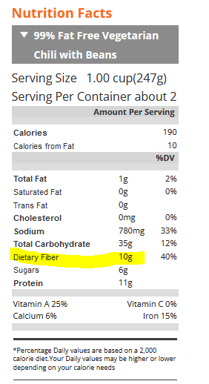
Fiber – the New “F” Word
Goal:
14 gms / 1000 calories ~ 30 gms a day
How?
Whole, intact grains, beans, fruits, veggies, nuts, avocados
Why?
Associated with lower mortality for people with type 2.
Fiber intake inversely associated with type 2 diabetes
Avoid highly processed foods
If label says 0-2gms of fiber per serving, low fiber food.

Slide 25
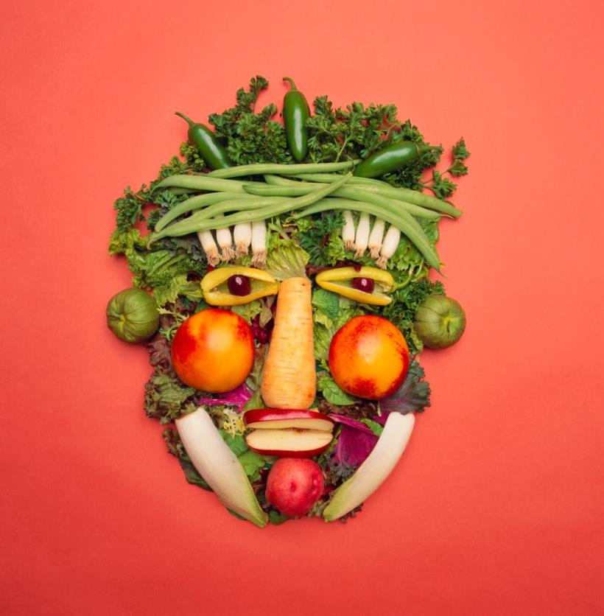
Limit refined carbs and added sugars Instead eat more HIGH Fiber foods:
High fiber carbs loaded with vitamins, minerals and phytonutrients
25+ gms of fiber a day
Power Carbs include:
Beans
Veggies
Fruits
Whole grain foods
Associated with decrease in all cause mortality
Improves microbial diversity

Slide 26

ADA MNT Standards 2023
Until there is more evidence:
Emphasize non starchy vegetables
Minimize added sugars, sugary beverages and refined grains
Choose whole foods
Individualized eating pattern that considers
health status, food and numeracy skills, resources, food preferences, health goals, and food access.

Slide 27

Healthy Eating Patterns
Low-Carbohydrate
Carb Counting
Diabetes Plate Method
Mediterranean Diet
Plant based eating
DASH (Dietary approaches to address hypertension)

Slide 28
Poll Question 1
AR has type 2 diabetes, is on metformin 1000mg BID, has a BMI of 29.3 and GFR of 62. Most recent A1C 8.3%. AR wants to lose weight and tells you they are on a low-carb diet. What is the best response?
A. That approach can harm kidneys
B. How is it working for you?
C. We recommend 50% of your intake comes from carbs.
D. This meal plan approach is not recommended

Slide 29

Carbs and Lowering Glucose
Reducing overall carb intake has demonstrated most evidence for improved glycemia
Low carb = 25% or less of cals from carbs
Most people consume 44-46% of cals from carb
Emphasize nonstarchy vegetables, fruits, and whole grains, as well as dairy products, with minimal added sugars
A systematic review found:
- Each 10% decrease in carb intake reduced A1C, fasting plasma glucose levels, weight, lipids, BP at 6 months.
But favorable effects diminished and were not maintained at follow-up or at greater than 12 months.
ADA Standards

Slide 30

Low Carb Meal Plan Not Recommended for:
Women who are pregnant or lactating or children
People with or at risk for disordered eating
People who have renal disease
Use with caution if taking SGLT-2 Inhibitor due to potential risk of ketoacidosis

Slide 31

Poll Question 2
For people with an elevated BMI and new type 2 diabetes, which best reflects ADA Standard recommendations?
A. Avoid all desserts and processed foods
B. Goal is to lose 5-15% of current body weight
C. Eat less than 7% saturated fat
D. Consume about 30-45 gms of carb at each meal.

Slide 32
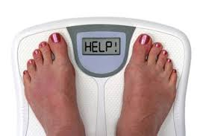
Weight Loss is Helpful
Prediabetes weight loss goal is 7-10% for preventing diabetes progression.
Diabetes: Strong evidence that a 5-15% body wt loss:
Improves glycemic control
Improve triglycerides
Reduces need for medications
Optimal goal is healthy weight maintenance
Consider use of Incretin Mimetic therapy

Slide 33
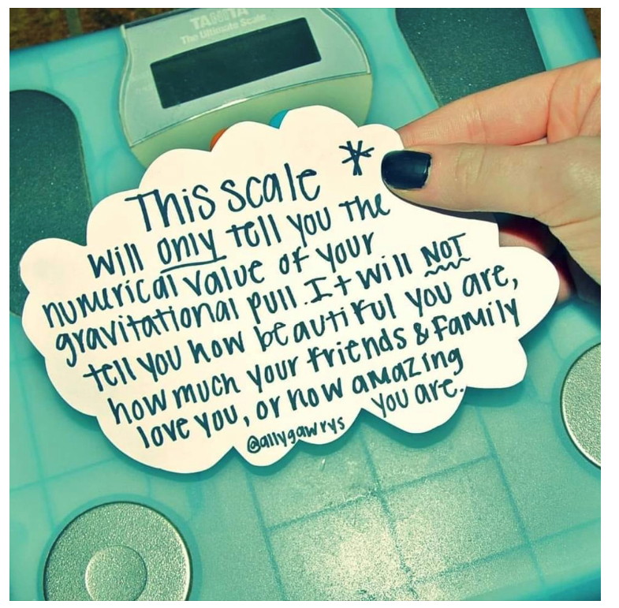
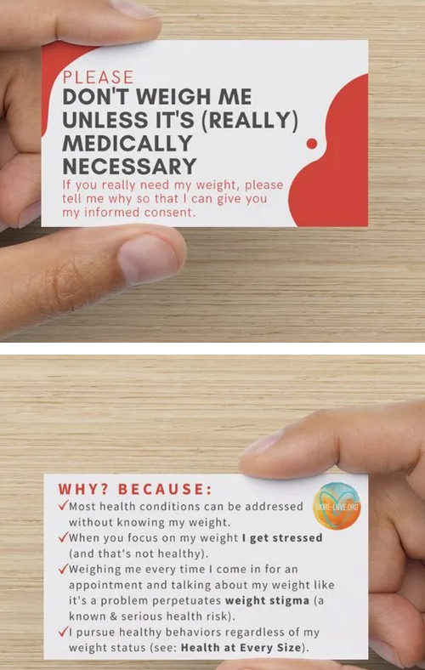

Weight is a Heavy Issue

Slide 34

New Consult for Diabetes Ed
JR, 63 yrs, BMI 32, A1c 9.3%, Type 2 diabetes 10+ years. On Metformin 2000mg daily + Glipizide 20mg. Low income and doesn’t like to drive much due to poor vision. Interested in losing weight.
Nutrition
Breakfast – doesn’t really eat. Has cup of coffee
Lunch around 11am – Jimmy Dean
Dinner – Sandwich or burger
Evening – Snacks, crackers, boiled egg
Beverages – Diet sodas, tea, water

Slide 35

How to Achieve Weight Loss?
Energy deficit + enhanced activity
Modest persistent weight loss can delay, prevent and help manage diabetes
Goal: 500 -700 kcal/day energy deficit (3,500 kcals = 1 pound)
What is 500 kcals?
10 slices bacon, a Big Mac, bagel w/ cream cheese, 4 oz’s tortilla chips, 3 sodas, 9 Oreo cookies, blueberry muffin
5 apples, 5 bananas, 5 eggs, 2 cups of beans, 1 cup almonds

Slide 36

Successful weight loss strategies include
Weekly self-weighing
Eat breakfast
Reduce fast food intake.
Decrease portion size
Increase physical activity
Use meal replacements
Eat healthy foods
Drink Water
Get Sleep
GLP and GIP/GLP Meds
Prediabetes wt loss goal is 7-10%. If at healthy wt, focus on aerobic & resistant exercises.
Diabetes wt loss goal is 5-15%

Slide 37
Intermittent Fasting
3 overall approaches
Alternate-day fasting
500–600 calories on alternating days.
5:2 diet
500–600 calories on two days with usual intake the other five
Time-restricted eating
Daily calorie restriction based on 8-15 hour window of time
Results
Each produces mild to moderate weight loss of 3–8% loss from baseline over short durations (8–12 weeks)
No significant differences in weight loss when compared with continuous calorie restriction.
Longer term studies needed

Slide 38

Keep it Person Centered
An individualized eating pattern considers health status, skills, literacy, resources and environment.
Address individual nutrition needs based on:
personal and cultural preferences, access to food, willingness and barriers

Slide 39
New Consult for Diabetes Ed
JR, 63 yrs, BMI 32, A1c 9.3%, Type 2 diabetes 10+ years. On Metformin 2000mg daily + Glipizide 20mg. Low income and doesn’t like to drive much due to poor vision.
Nutrition
Breakfast – doesn’t really eat. Has cup of coffee
Lunch around 11am – Jimmy Dean
Dinner – Sandwich or burger
Evening – Snacks, crackers, boiled egg
Beverages – Diet sodas, tea, water

Slide 40
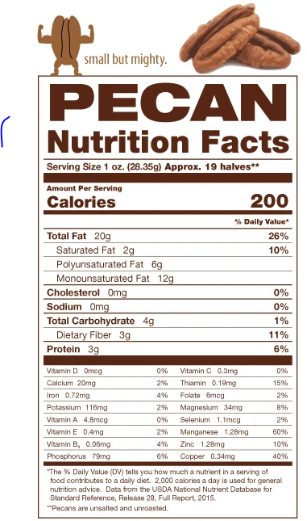
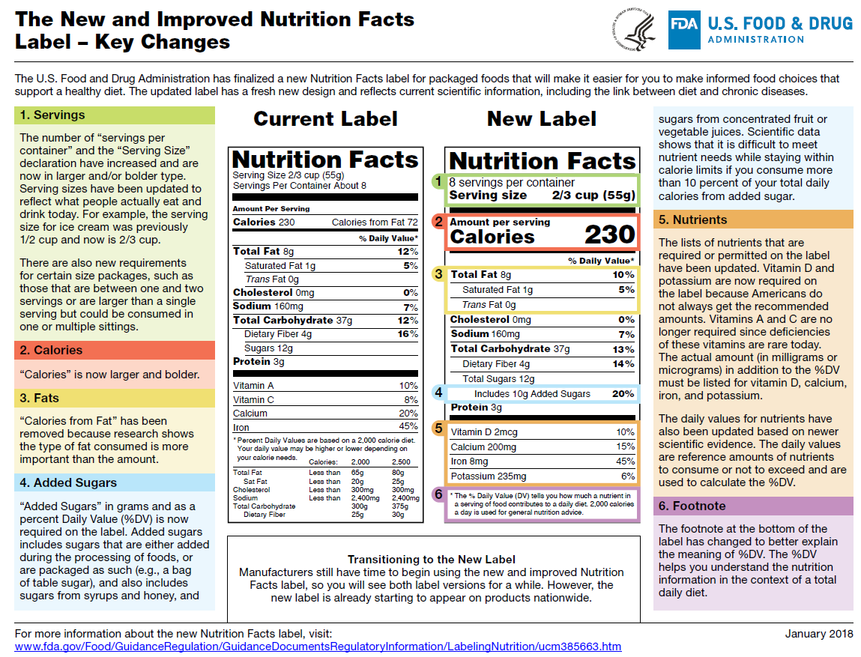
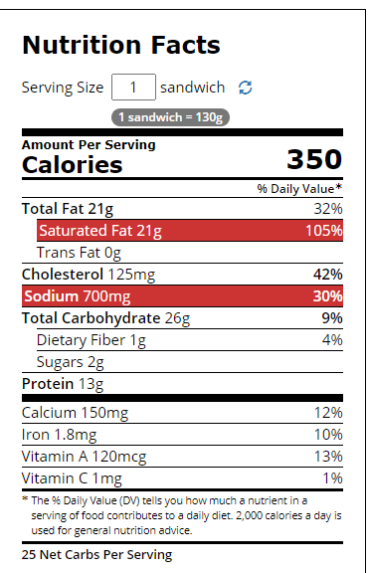

Nutrition Facts
Serving Size 1/2 cup (114 g)
Servings Per Container 4
Amount Per Serving
Calories 90 Calories from Fat 30
Fooducate App – gives grade and nutrition info.
% Daily Value*
Total Fat 3g 5%
Saturated Fat 0g 0%
Cholesterol 0g 0%
Sodium 300mg 13%
Total Carbohydrate 13g 4%
Dietary Fiber 3g 12%
1 tsp sugar =4 gms
Sugars 3g
Protein 3g
Vitamin A 80% * Vitamin C 60%
Calcium 4% * Iron 4%
* Percent Daily Values are based on a 2,000 calorie diet. Your daily values may be higher or lower depending on your calorie needs:
Calories _ 2000 2500
Total Fat Less than 65g 80g
Sat Fat Less than 20g 25g
Cholesterol Less than 300mg 300mg
Sodium Less than 2400mg 2400mg
Total Carbohydrate 300g 375g
Fiber 25g 30g
Calories per gram: Fat 9 Carbohydrates 4 Protein 4

Slide 41

Stretch and Digest Break

Slide 42
How nutrients affect blood sugar
If type 1, may need some insulin coverage for high fat / protein meals

Slide 43

Carbs affect Post meal Blood Glucose
Starch
Fruit
Milk
Desserts

Slide 44
Poll Question 3
Which of the following servings equals ~ 15 gms of carbohydrate? (multiple)
A. ½ Bagel
B. 1 ¼ cup strawberries
C. Cup of milk
D. ½ cup of rice
E. ½ cup of jello

Slide 45
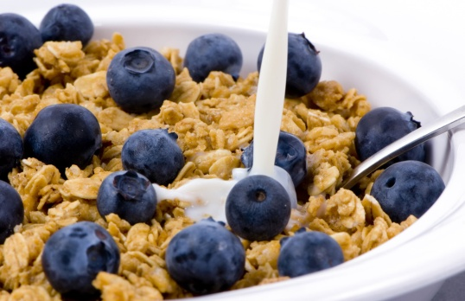
Carbohydrate Needs Estimate for Most Adults (not ADA Std)
Grams Servings
Each Meal 45-60 gm 3 - 4
Snacks 15-30 gm 1- 2
Carbs affect Post Meal Blood Glucose
RDA – at least 130 gms of Carb a day
PWD get about 45% of cals from carbs

Slide 46
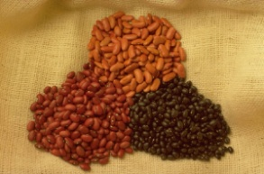


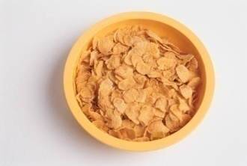
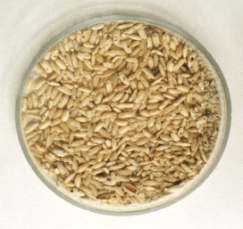
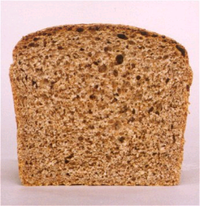

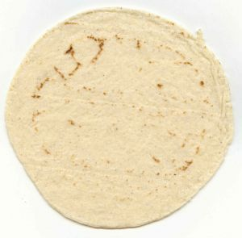
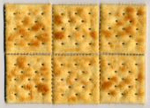

Carb Counting - Starch
Each Food has:
80 Calories
15 grams carb
1 small ear of corn or 1/2 cup corn
1/3 cup cooked pasta
1/2 cup
cooked beans
3/4 cup cold cereal
1 slice bread
1/3 cup cooked rice
1 small potato
1/2 English muffin
1 small tortilla
5-6 small crackers

Slide 47









Carb counting- fruit
Each Food has:
60 Calories
15 grams carb
½ cup fruit juice
½ banana
1 small fresh fruit
½ cup unsweetened apple sauce
1 slice bread
17 small grapes
1 cup melon
¼ cup dried fruit
2 tbsp raisins
1 1/4 cup strawberries

Slide 48


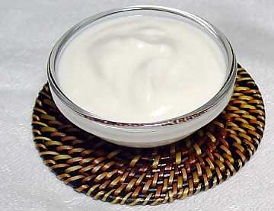
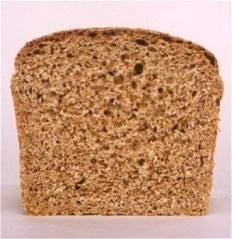



Carb Counting - Milk
Each Food has:
90-150 calories
12-15 grams carb
8 oz buttermilk
1 packet diet hot cocoa
1 slice bread
6 oz plain yogurt
8 oz milk
6 oz light fruit yogurt
8 oz soy milk

Slide 49




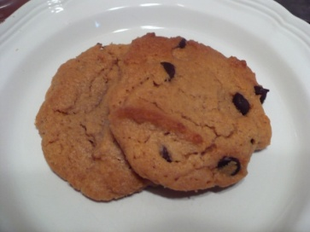
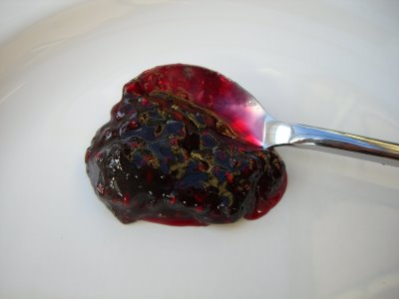



Carb Counting - Sweets
Each Food has:
Calories vary
15 grams carb
2 inch square cake or brownie, unfrosted
½ cup regular jello
2 tbsp light syrup
½ cup diet pudding
1 slice bread
1 tbsp syrup, jam, jelly, table sugar, honey
2 small cookies
¼ cup sorbet
½ cup ice cream or frozen yogurt
½ cup sherbet

Slide 50

Average American Consumes 22 teaspoons of added sugar a day
WHO and AHA – Goal 6 teaspoons a Day
1 tsp = 4 gms sugar (15 cals)
15cals x 22 teaspoons a day =
330 cals a day just from added sugars
One soda has 12 tsps sugar
New labels list added sugar

Slide 51
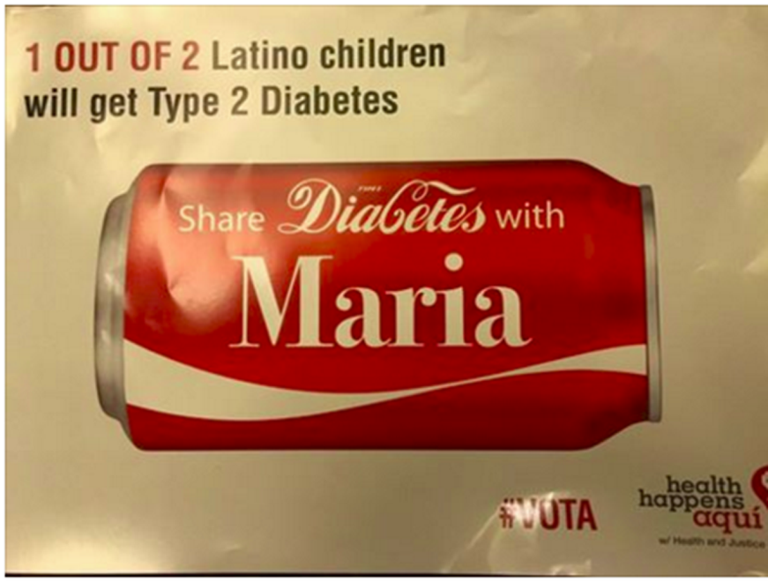
Reduce refined Carbs, Added Sugars - ADA
To control wt, reduce risk of CVD and fatty liver disease
ADA strongly discourages consumption of:
Sugar sweetened beverages
Processed “low-fat” or “non-fat” foods with high amounts of refined grains & added sugar
Sugary and processed foods can displace healthier, more nutrient dense food choices
Water is best

Slide 52

Non-Nutritive Sweeteners
Use can reduce overall calorie intake if substituting for sugary beverages
But overall, people are encouraged to decrease both sweetened and non-sweetened beverages.
Emphasize water intake.

Slide 53
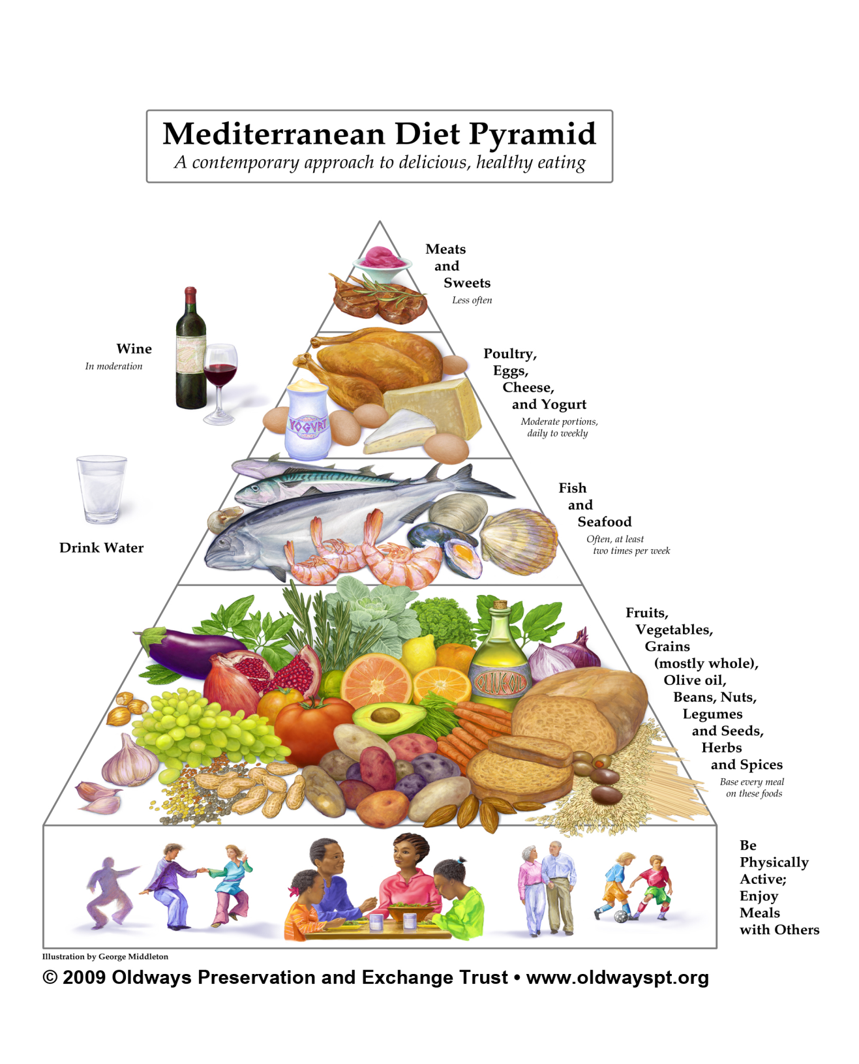
Mediterranean Diet Pyramid

Slide 54
USDA www.myplate.gov
Balancing Calories
Enjoy your food, but eat less.
Avoid oversized portions.
Foods to Increase
Make half your plate fruits and vegetables.
Make at least half your grains whole grains.
Switch to fat-free or low-fat (1%) milk.
Foods to Reduce
Compare sodium in foods like soup, bread, and frozen meals ― and choose the foods with lower numbers.
Drink water instead of sugary drinks.

Slide 55
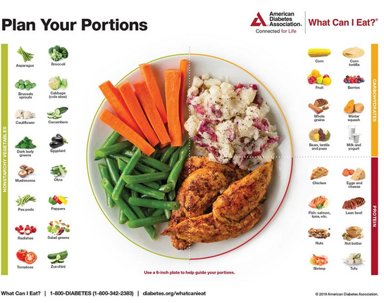
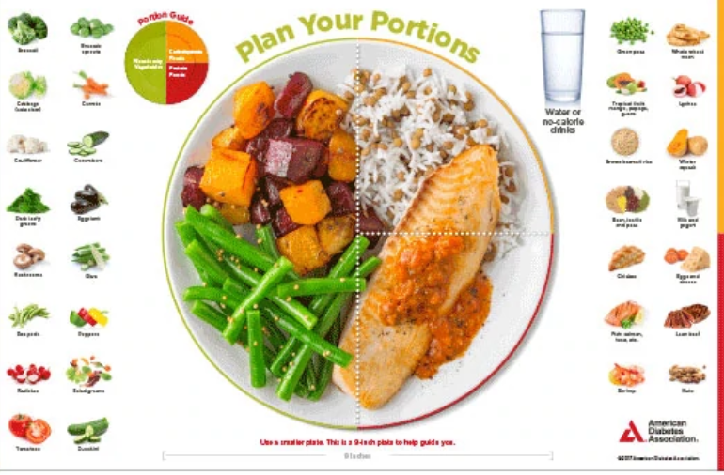
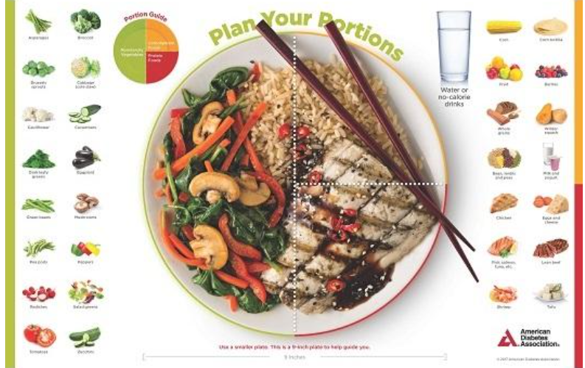

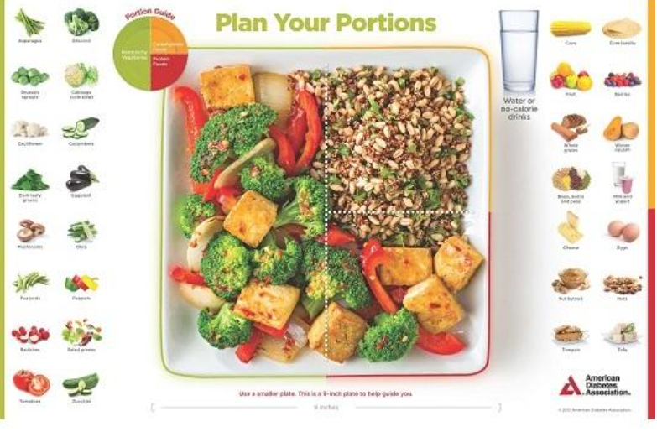
Plate example

Slide 56
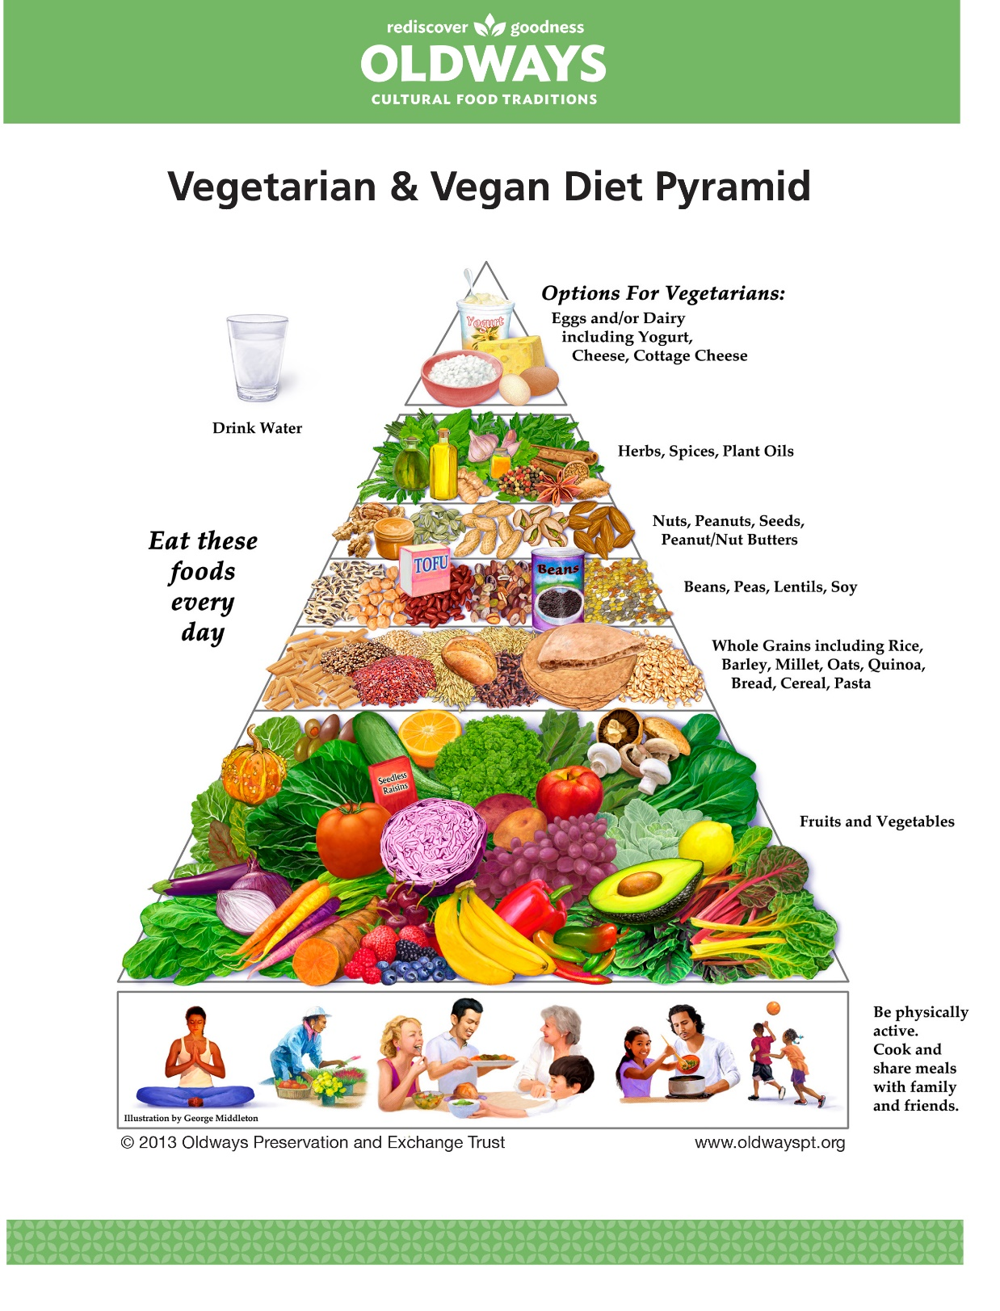
OLDWAYS
https://oldwayspt.org/traditional-diets/vegetarian-vegan-diet

Slide 57
New Consult for Diabetes Ed
JR, 63 yrs, BMI 32, A1c 9.3%, Type 2 diabetes 10+ years. On Metformin 2000mg daily + Glipizide 20mg. Low income and doesn’t like to drive much due to poor vision.
Nutrition
Breakfast – doesn’t really eat. Has cup of coffee
Lunch around 11am – Jimmy Dean
Dinner – Sandwich or burger
Evening – Snacks, crackers, boiled egg
Beverages – Diet sodas, tea, water
Strategies?
What is JR doing right?
Plate method?
Increase fruit / veggie intake – canned or frozen
Add in beans, chili, soups (lower sodium)
Include, Yogurt, Nuts, oatmeal, wheat toast
Refer to RD / RDN

Slide 58
Poll Question 5
If someone with diabetes is underweight, what are some possible causes?
A. Taking less insulin than needed
B. Disordered eating
C. Finances
D. Poor dentition
E. All of the above

Slide 59

Disordered Eating
For people with type 1
insulin omission causing glycosuria in order to lose weight is the most reported disordered eating behavior
Have high rates of diabetes distress and fear of hypoglycemia.
For people with type 2
bingeing excessive food intake with an accompanying sense of loss of control most reported.
If treated with insulin, intentional omission is also frequently reported.
People with diabetes and diagnosable eating disorders have high rates of other psychiatric disorders

Slide 60
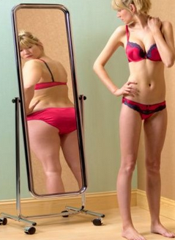
Screen for Disordered Eating
“DiaBulimia”
People with diabetes give themselves less insulin than needed to lose weight
Tends to start in adolescence, more likely to occur in women than men.
Signs: unexplainable spikes, A1c, weight loss, lack of marks from fingerpricks, lack of prescription refills for diabetes meds, records that don’t match A1c.
Treatment – Mental health specialist and team

Slide 61
Poll Question 7
Which of the following is true about alcohol and diabetes based on ADA Standards?
A. Only white wine decreases blood sugars
B. Men can have up to 2 drinks and women can have one drink a day
C. Alcohol increases risk of hyperglycemia
D. 6 ounces of wine is considered one serving.

Slide 62
Using Alcohol Safely
Women- 1 or fewer alcoholic drinks a day
Men 2 or fewer alcoholic drinks a day
1 alcoholic drink equals
12 oz beer, 5 oz glass of wine, or 1.5 oz distilled spirits (vodka, gin etc)
If drink, limit amount and drink w/ food.
Can cause hypo and worsen neuropathy

Slide 63

Physical Activity – Key areas
ADA Physical Activity Position Statement
Benefits, barriers precautions
Exercise and activity plan (aerobic, resistance training, etc)
Adjustment and monitoring of food and/or meds

Slide 64


Where are we on this continuum?
Only about 50% of us are meeting activity goals

Slide 65
Poll Question 8
Which of the following is an accurate exercise recommendations for people with diabetes?
a. Exercise must be done daily for 30 mins to be effective
b. Must get stress test before starting an exercise program
c. Try not to miss more than 2 consecutive days of exercise
d. Incorporate resistance training 2 days a week
E. C and D

Slide 66

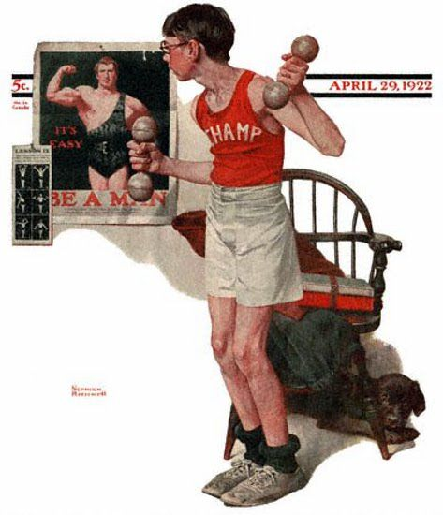
Exercise Standards
Adults – 150 min/wk moderate intensity
over 3 days a week.
Don’t miss > 2 consecutive days w/out exercise
Get up every 30 mins - Reduce sedentary time
T1 and T2 – resistance training 2 -3 xs a week
Flexibility and balance training 2-3 xs a week (Yoga and Tai Chi)

Slide 67

Physical Activity - Kids
Children should be encouraged to engage in at least 60 minutes of moderate/vigorous physical activity a day.
Plus bone/muscle strengthening 3 times a week

Slide 68
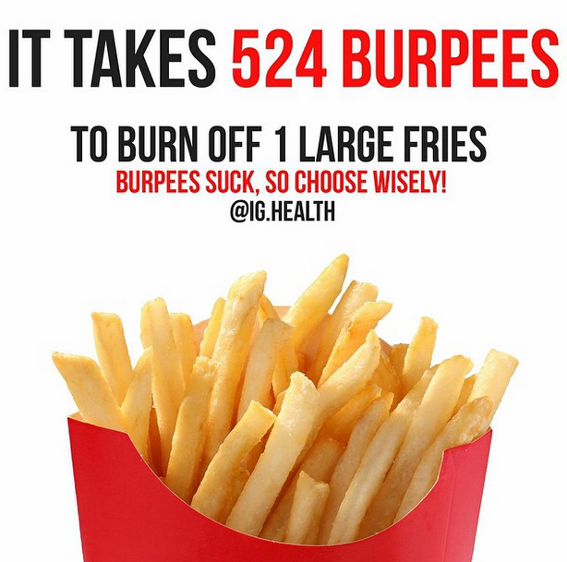
A hard truth
Exercise alone doesn’t cause weight loss
But….
It helps keep weight off
Decreases visceral fat
Decreases CV Risk
To keep healthy, we need to change the food environment

Slide 69


How many hours do you sit a day?
People with type 2 who achieved 150 a week.
White 44%
African American 42%
Hispanic 65%
Get up every 30 minutes and move it!

Slide 70
Benefits of Exercise and Diabetes
Increase muscle glucose uptake 5-fold
Glucose uptake remains elevated for 24 - 48 hours (depending on exercise duration)
Increases insulin sensitivity in muscle, fat, liver.
Reduce CV Risk factors (BP, cholesterol, A1c)
Maintain wt loss
Contribute to well being
Muscle strength
Better physical mobility

Slide 71

Exercise decreases:
Sleep apnea
Diabetic kidney disease, retinopathy
Depression
Sexual dysfunction
Urinary incontinence
Knee pain
Need for medications
Health care costs

Slide 72
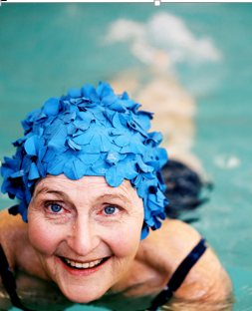
Importance of Exercise with Diabetes
Vital component of prevention as well of the management of type 1 and type 2 diabetes
Decreases mortality and CV Risk
Type 1 – emphasis on adjusting insulin to allow for safe participation in all forms of activity.

Slide 73

After dinner stroll “Passeggiata”
Walk 10-15 minutes after dinner (and other meals if possible)
Maximize the walking benefit
Get the most BG lowering effect
Especially after high carb meals
Diabetologia, Oct 2016.

Slide 74

Each minute of activity lowers BG by 1 point
Each minute of exercise lowers BG 1 point
15 minutes of walking drops BG 15 points
30 minutes of biking drops BG 30 points
40 minutes of housework drops BG 40 points
50 minutes of walking and window shopping lowers BG 50 points

Slide 75
Good Exercise Info / Quotes
“Passagiata” – take an after meal stroll
Exercise decreases A1c 0.7%
No change in body wt, but 48% loss in visceral fat
ADA PostGrad 2010
“Every minute of activity lowers blood sugar one point.”
“I don’t have time to exercise, I MAKE time.” Mike Huckabee

Slide 76
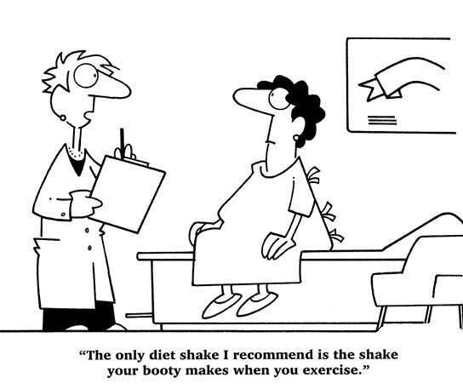
Best Shake For People with Diabetes
From Debbie Nagata’s slide collection

Slide 77
Poll Question 9 - Bonus
What are some exercise precautions for people with diabetes on insulin?
a. Carry some form of ID on you at all times
b. Have a snack if BG less than 90
c. Look for signs of hypo for up to 24 hrs after exercise
d. Carry a snack with you during exercise.
e. All of the above.

Slide 78
Discuss these symptoms with provider before starting exercise or during
Chest pain and/or shortness of breath
Leg cramps that go away with rest
Head, shoulder, neck and or back aches.
Any unexplained pain above the belt line should be considered cardiac in origin until proven otherwise.

Slide 79
Hypoglycemia Prevention Strategies for Insulin/Secretagogues
Adjust carbohydrate prior to planned activity:
If using insulin and /or secretagogues
BG < 90, consume 15 -30 gms
Carry carb snack/ glucagon ER Kit
Extra Carb in post exercise period
Caution with alcohol post exercise

Slide 80
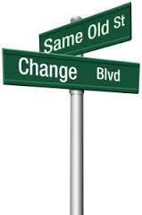

Behavior Change Strategies
Five key techniques for success:
1. Prompt focus on past success
2. Barrier identification/problem-solving
3. Use of follow-up prompts
4. Provision of information on where & when to perform the behavior
5. Prompt review of behavioral goals.

Slide 81

Help Prepare for Setbacks

Slide 82


Thank You
Questions?
Info@DiabetsEd.net
530-893-8635
Bryanna is here to help.

