Slide 1


Welcome to Boot Camp 6 – Medical Nutrition Therapy 2023
Beverly Dyck Thomassian, RN, MPH, BC-ADM, CDCES
President, Diabetes Education Services

Slide 2


Level 3 | DiabetesEd Specialist 2023 Boot Camp | 12+ CEs
Class 1 - Diabetes - Not Just Hyperglycemia 1.75 CEs - Ready
Class 2 – Standards of Care & Cardiovascular Goals 1.8 CEs - Ready
Class 3 - Meds for Type 2 - Ready
Class 4 - Insulin Therapy - From Basal/Bolus to Patterns - Ready
Class 5 - Insulin Intensive - Monitoring, Sick Days, LE - Ready
February 23, 2023 - Class 6 - Medical Nutrition Therapy
February 28, 2023 - Class 7 - Screening, Prevention, and Treatment of Microvascular Complications & Exercise
March 2, 2023 - Class 8 - Coping and Behavior Change
March 9, 2023 - Class 9 - Test-Taking Coach Session (48 Questions) No CE

Slide 3

Bryanna is here to Help!
If you have questions, you can chat with Bryanna at www.DiabetesEd.net or call 530 / 893-8635 or email at info@diabetesed.net
Bryanna Sabourin
Director of Operations
Certification Pathway Coach &
Customer Happiness Expert

Slide 4

Coach Bev has no conflicts of interest
Not on any speaker's bureau
Does not invest in pharmaceutical or device companies
Gathers information from reading package inserts, research and standards

Slide 5
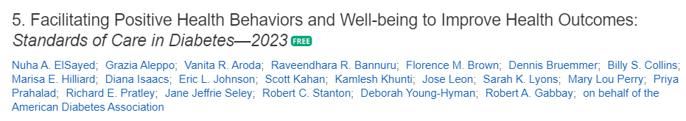
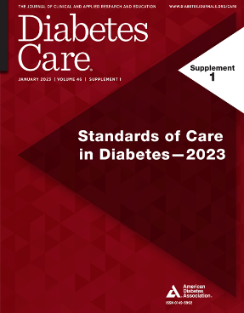
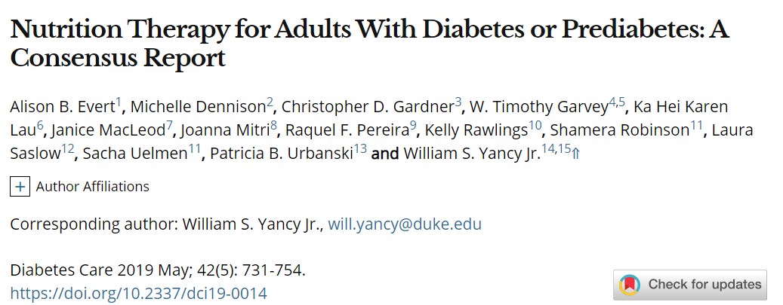
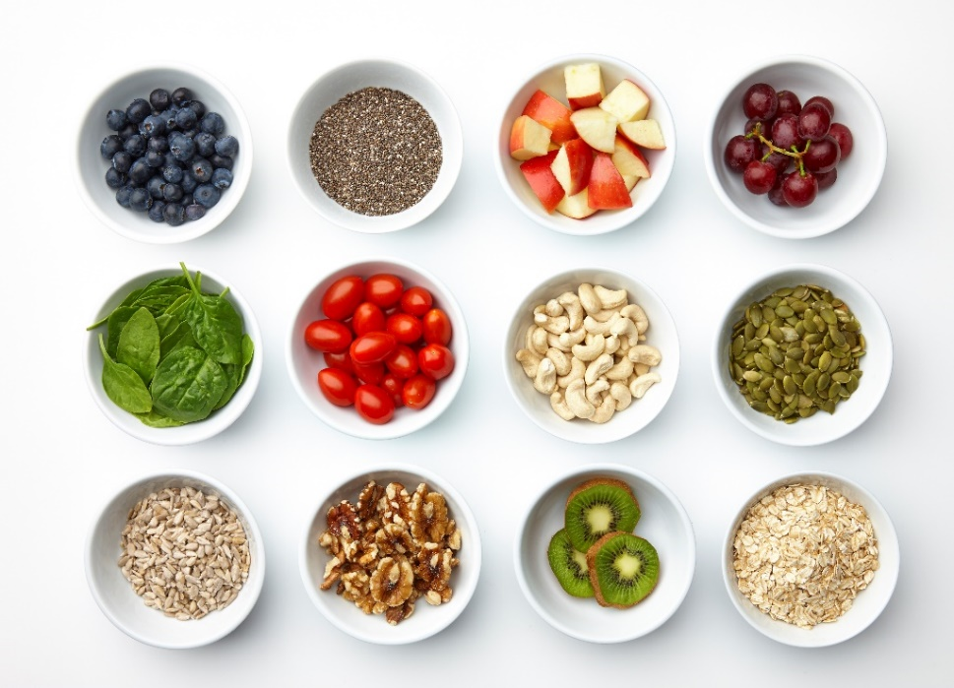
References
https://care.diabetesjournals.org/content/42/5/731.full-text.pdf
Diabetes Exchange List » a brief summary of serving size and carbohydrate counts for common foods. Excellent study tool for the exam.

Slide 6


Training Programs – 4 Hours of MNT
Virtual DiabetesEd Training Course 2023

Slide 7
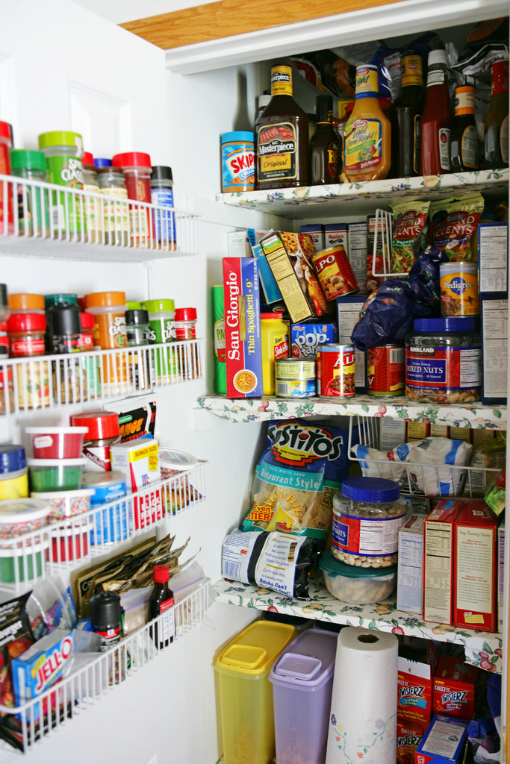
Boot Camp Class 6:
Medical Nutrition Therapy
Objectives:
Discuss national guidelines for Medical Nutrition Therapy
State different meal planning approaches
Describe gastrointestinal issues associated with diabetes
Discuss approaches to discussing and supporting weight loss

Slide 8

ADA Standards 2023 – Section 5
For many individuals with diabetes, the most challenging part of the treatment plan is determining what to eat.
5. Facilitating Behavior Change and Well-being to Improve Health Outcomes

Slide 9


Medical Nutrition Therapy – ADA
No ideal percentage of calories from protein, carbohydrate and fat for people with diabetes.
Consider personal preferences
tradition, culture, religion, health beliefs and goals, economics
as well as metabolic goals when working with individuals to determine the best eating pattern for them
Macronutrient distribution based on individualized assessment
Each team member should be knowledgeable about nutrition therapy principles.

Slide 10
Goals of Medical Nutrition Therapy – ADA Promote and support Individualized healthful eating patterns
Support healthful eating patterns
Emphasize eating a variety of nutrient dense foods in appropriate portions to:
Attain individualized B/P, BG and lipid goals
Attain and maintain body wt goals
Delay and/or prevent complications
Address individual nutrition needs based on
personal and cultural preferences, access to food, willingness and barriers
Maintain pleasure of eating by providing positive messages about food
Limit food choices only when backed by science
Provide practical tools for day-to-day planning

Slide 11

Poll Question 1
Based on the 2023 ADA Standards of care on nutrition therapy, which statement is most accurate?
MNT provided by a RD/RDN is associated with an A1c decrease of 0.3 to 2.0%.
A low carbohydrate, high protein diet is associated with increased risk of renal failure.
With new type 2 diabetes, try to achieve A1c targets with MNT for 3 months advancing to medication therapy.
People with diabetes and hypertension have improved outcomes when they decrease sodium intake to less than 1,500 mg a day.

Slide 12
ADA or ADCES Recognized Program DSME & Medical Nutrition Therapy – What Medicare Covers
MNT
3 hours initial benefit in first calendar year
2 hours follow-up annually
DSME
1 hour individual assess
9 hours group (once in a lifetime)
2 hours follow-up annually (starts on Month 13 after first DSME Bill)
Billing Codes
G0108- 1:1
GO109 – Group (2-20 people)
Meeting with a RD can result in a 0.3-2% drop in A1C

Slide 13

Keep it Person Centered
An individualized eating pattern considers the individual's health status, skills, resources, food preferences, and health goals.
Address individual nutrition needs based on:
personal and cultural preferences, access to food, willingness and barriers

Slide 14
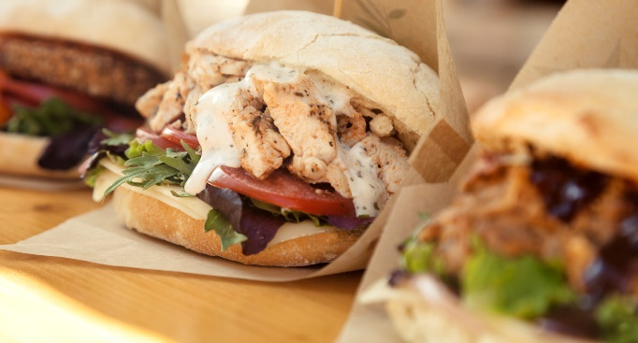
Person Centered – Bonus Question
MR eats fast foods for lunch and notices that they have been feeling worse as a result. What response would support sustained behavior change?
A. Do you think you could bring a packed lunch a few days a week?
B. What about asking for burgers without the bun?
C. Could you eliminate sodas?
D. What change do you think you could start with?

Slide 15
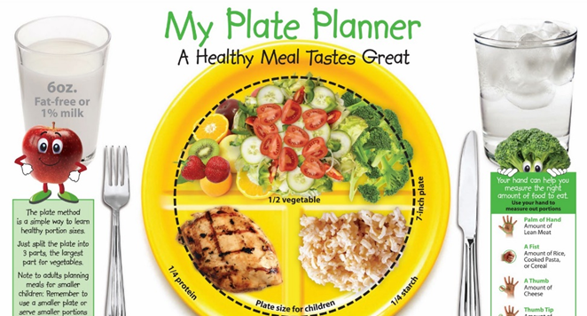
ADA MNT Standards 2023
Until there is more evidence:
Emphasize non starchy vegetables
Minimize added sugars, sugary beverages and refined grains
Choose whole foods
Individualized eating pattern that considers
health status, food and numeracy skills, resources, food preferences, health goals, and food access.
Referral to RD/RDN Lowers A1c 0.3-2%

Slide 16
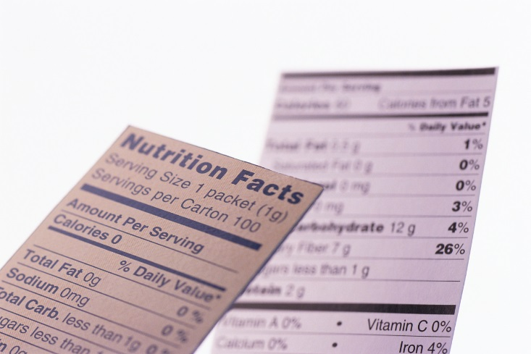
Sodium, Fat and Fiber
Sodium – Try and keep less than 2,300 mg a day
Vitamin and mineral supplements not recommended -lack of evidence.
Fat - same as recommended for general population
Less saturated fat, more polys and monounsaturated fats
Limit trans fats
Mediterranean Diet looks like good option

Slide 17
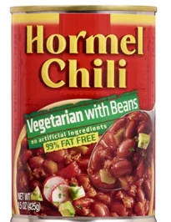
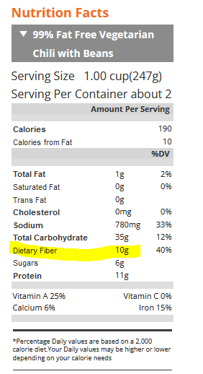
Fiber – the New “F” Word
Goal:
14 gms / 1000 calories ~ 30 gms a day
How?
Whole, intact grains, beans, fruits, veggies, nuts, avocados
Why?
Associated with lower mortality for people with type 2.
Fiber intake inversely associated with type 2 diabetes
Avoid highly processed foods
If label says 0-2gms of fiber per serving, low fiber food.

Slide 18
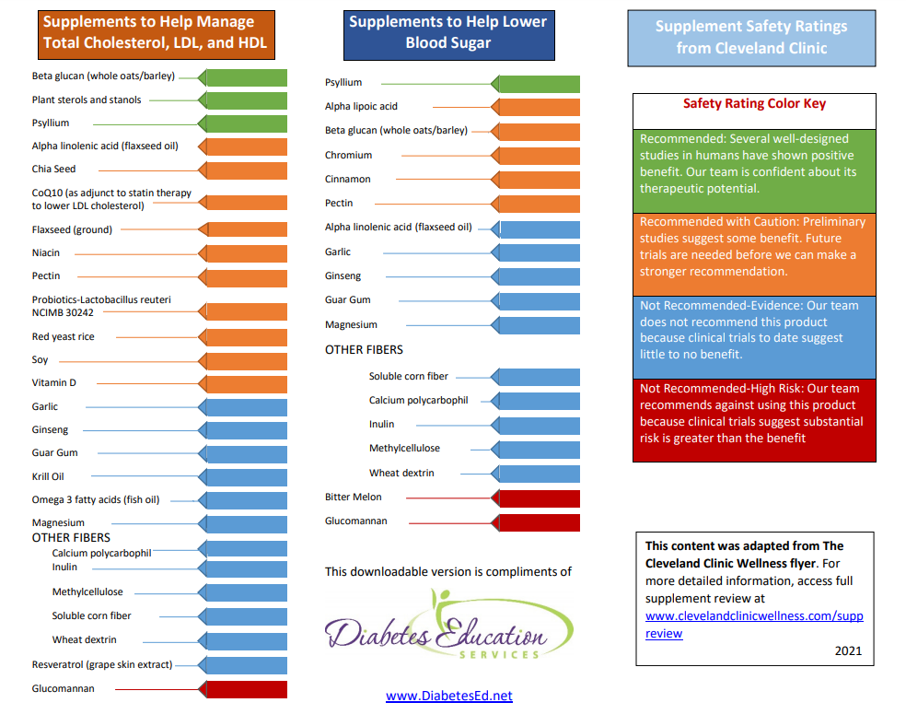
Supplements CHEAT Sheet

Slide 19

Poll Question 2
Mary has newly diagnosed type 2 diabetes. Her BMI is 31 and her A1c is 7.3%. She wants to learn how to adjust her eating habits to help lower her BG. Where would you start?
Focus on the importance of counting carbs.
Gently encourage her to avoid junk food and sugary drinks.
Provide information an ADA diabetic diet
Ask her about her usual eating habits

Slide 20

Health at Every Size (HAES)
"Health at Every Size is about taking care of your body without worrying about whether you're ‘too’ big or small,"
"People might think they can tell who's fit and who's not by looking at them, but in fact, it's trickier than that.
Lots of people are fat and fit—many avid dancers, runners, lifters, and sports team members are big to start with and stay that way. They tend to be far healthier than thin people who don't move around much or eat a nutritious mix of foods.
Health at Every Size: The Surprising Truth About Your Weight. Bacon holds a Ph.D. in physiology with a focus on nutrition and weight regulation.

Slide 21
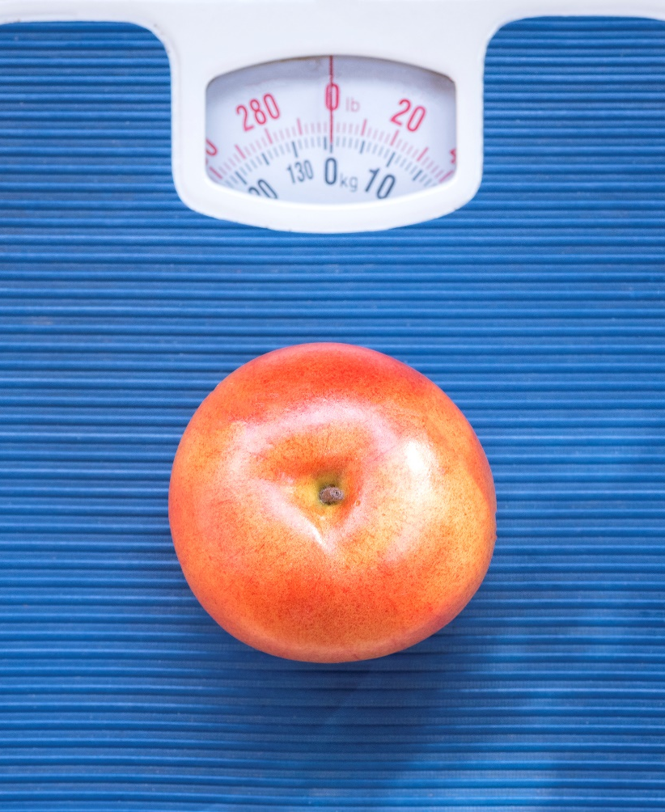
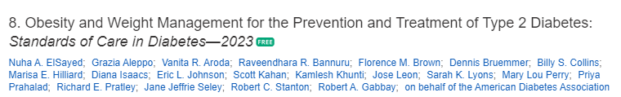
8. Obesity and Weight Management for Prevention & Treatment of Type 2 Diabetes
Provides cost information for pharmacologic treatment of obesity
Once a year, calculate BMI and assess weight trajectory to inform approach
Be sensitive and allow for privacy when weighing
Use person centered language

Slide 22
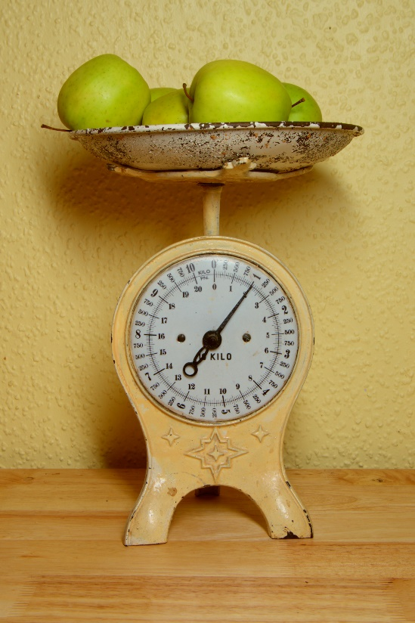
Weighing and Respect
If weighing is questioned or refused,
Be mindful of possible prior stigmatizing experiences
Consider the value of weight monitoring
Is it needed to inform treatment decisions?
Situate scales in a private area or room.
Measure and report weight nonjudgmentally.
Take care to regard weight and BMI as sensitive health information.

Slide 23
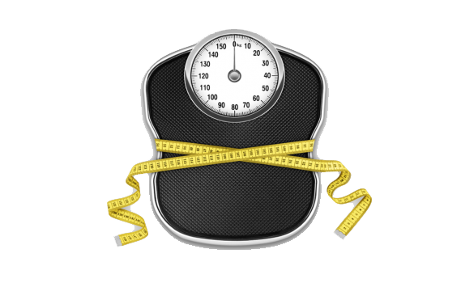
Interested in Weight Loss?
Assess readiness to engage in changes for weight loss
Jointly determine behavioral and weight-loss goals and person-centered appropriate intervention strategies
Strategies may include dietary changes, physical activity, behavioral therapy, pharmacologic therapy, medical devices, and metabolic surgery

Slide 24
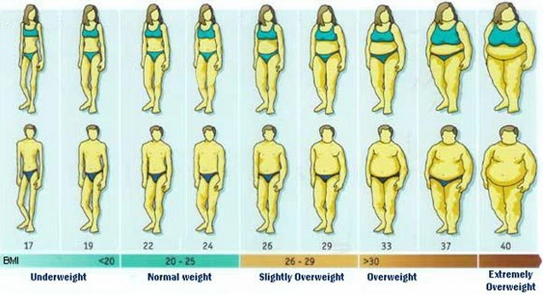
BMI Categories
Experiencing Healthy weight Experiencing overwt Experiencing obesity
Underweight

Slide 25
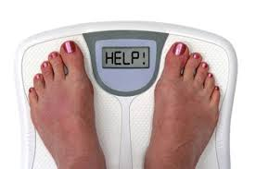
Weight Loss is Helpful
Prediabetes weight loss goal is 7-10% for preventing diabetes progression.
Diabetes: Strong evidence that a 5-15% body wt loss:
Improves glycemic control
Improve triglycerides
Reduces need for medications
Optimal goal is healthy weight maintenance
Consider Incretin Mimetic therapy to reach goals

Slide 26

How to Achieve Weight Loss?
Energy deficit + enhanced activity
Modest persistent weight loss can delay, prevent and help manage diabetes
Goal: 500 -700 kcal/day energy deficit (3,500 kcals = 1 pound)
What is 500 kcals?
10 slices bacon, a Big Mac, bagel w/ cream cheese, 4 oz’s tortilla chips, 3 sodas, 9 Oreo cookies, blueberry muffin
5 apples, 5 bananas, 5 eggs, 2 cups of beans, 1 cup almonds

Slide 27

Successful weight loss strategies include
Weekly self-weighing
Eat breakfast
Reduce fast food intake.
Decrease portion size
Increase physical activity
Use meal replacements
Eat healthy foods
Drink Water
Get Sleep
Medications?
Prediabetes wt loss goal 7-10% to prevent diabetes
If at healthy wt, focus on aerobic & resistant exercises

Slide 28

Poll question 3 – Get your calculator
JJ eats 2 snickers bars a day. Each snickers bar is 215 calories. JJ is committed to losing weight. If JJ stopped eating all snickers bars for two weeks, how much weight would JJ lose?
1.7 pounds
.86 pounds
2.4 pounds
1.7 kgs
2 x 215 cals = 430 cals a day
430 x 14 days = 6020 cals
6020 / 3,500* = 1.7 pounds
*3,500 cals per pound

Slide 29
Intermittent Fasting
3 overall approaches
Alternate-day fasting
500–600 calories on alternating days.
5:2 diet
500–600 calories on two days with usual intake the other five
Time-restricted eating
Daily calorie restriction based on 8-15 hour window of time
Results
Each produces mild to moderate weight loss of 3–8% loss from baseline over short durations (8–12 weeks)
No significant differences in weight loss when compared with continuous calorie restriction.
Longer term studies needed

Slide 30

Metabolic (Bariatric) Surgery
Consider for adults with;
BMI 30-34.9 (27.5 -32.4 for Asian Americans) if hyperglycemia is inadequately controlled despite optimal medical control by either oral or injectable medications.
BMI 35 – 39.9 (32.5 -37.4 Asian Americans) when hyperglycemia is inadequately controlled despite lifestyle and optimal therapy
BMI 40 + (37.5 for Asian Americans) regardless of BG control
Perform metabolic surgery at high volume center with an experienced team
Need life long support and monitoring
Provide comprehensive mental health assessment prior to surgery and ongoing mental health support

Slide 31
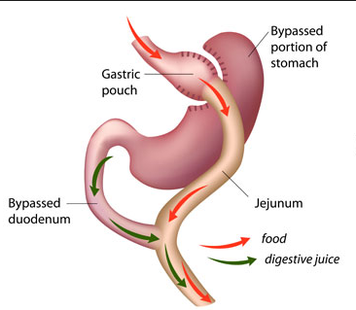
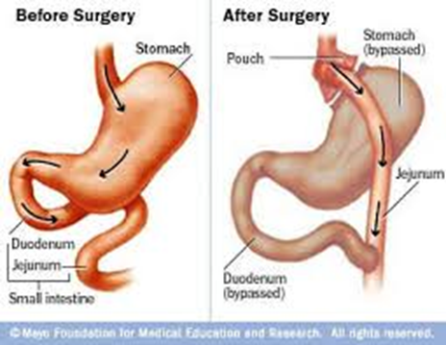
Metabolic Surgery Benefits
Increases gut hormone availability
More likely to cause remission* with recently diagnosed diabetes (more beta cell mass)
30 - 63% remission over 1-5 years
35 – 50% redeveloped diabetes
Avg remission time 8.3 years
Most pts who undergo surgery maintain substantial improvement of BG control from baseline for ~5 yrs
Trials demonstrate metabolic surgery achieves superior BG control CV reductions in type 2 obese pts compared to lifestyle/medical intervention
Improvements in micro and macro disease and cancer have been observed.
Procedure may reduce long term mortality
*remission = BG levels normal without meds

Slide 32
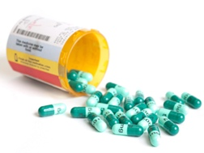
Pharmacotherapy & Diabetes
Avoid diabetes meds that cause wt gain (sulfonylureas, insulin, TZDs)
Whenever possible, avoid meds for co-morbidities that cause weight gain
(ie steroids, atypical antipsychotics)
BMI 27+ -Weight loss meds may be effective as add on to lifestyle
Assess benefit vs risk
If wt loss <5% at 3 months, consider alternate treatment

Slide 33


GLP-1 RAs Approved for Weight Loss
Liraglutide packaged as Victoza and Saxenda
Same active ingredient:
Victoza 1.8 mg (diabetes)
Saxenda 3 mg (wt loss)
6% wt loss, $1619 a month
Semaglutide packaged as Ozempic and Wegovy
Ozempic 2mg (diabetes)
Wegovy 2.4mg (wt loss)
6% wt loss, $1619 a month
Both FDA approved as treatment option for chronic wt management in addition to reduced calorie diet and physical activity.
Approved for use in adults with a
BMI of ≥ 30 or
BMI of ≥ 27 or greater who have hypertension, type 2 diabetes, or dyslipidemia.

Slide 34

Treatment options for BMI 25+
Consider using diabetes medications that contribute to weight loss, including GLP-1 RAs and SGLT-2 inhibitors.

Slide 35
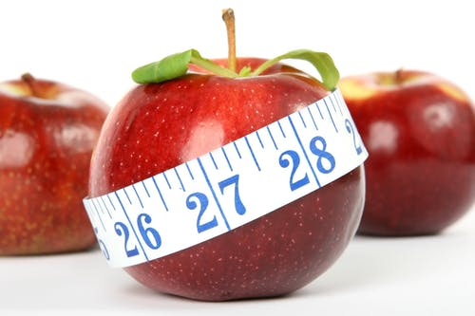
Very low calorie diets - <800 cals/day
Small studies have demonstrated with type 2 and obesity, extreme dietary restriction
Can lead to diabetes remission
A1c <6.5% and FPG <126
Without medications
These improvements are more likely early in the natural history of type 2
Must be provided by trained practitioners in medical care settings with close monitoring
Weight regain more likely than with lifestyle
Low Carbohydrate and Very Low Carbohydrate Eating Patterns in Adults with Diabetes: A Guide for Health Care Providers
Author(s): Kelly Siverhus MS, RD, CD

Slide 36

Poll question 4
Joan has type 1 diabetes, teaches aerobics with a BMI of 17. Fasting BG 312-380s. Which is most important intervention to improve her diabetes management?
Eat a 15 gm carb snack before teaching class.
Acknowledge this hyperglycemia signifies end of honeymoon period
Increase basal insulin dose
Consider referral to mental health professional

Slide 37

Disordered Eating
For people with type 1
insulin omission causing glycosuria in order to lose weight is the most reported disordered eating behavior
Have high rates of diabetes distress and fear of hypoglycemia.
For people with type 2
bingeing excessive food intake with an accompanying sense of loss of control most reported.
If treated with insulin, intentional omission is also frequently reported.
People with diabetes and diagnosable eating disorders have high rates of other psychiatric disorders

Slide 38
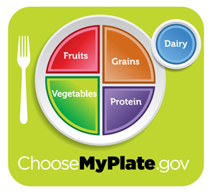
Healthy Eating Patterns
Low-Carbohydrate
Carb Counting
Diabetes Plate Method
Mediterranean Diet
Plant based eating
DASH (Dietary approaches to address hypertension)

Slide 39
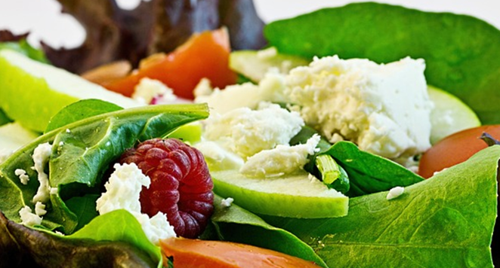
Carbs and Lowering Glucose
Reducing overall carb intake has demonstrated most evidence for improved glycemia
Low carb = 25% or less of cals from carbs
Most people consume 44-46% of cals from carb
Emphasize nonstarchy vegetables, fruits, and whole grains, as well as dairy products, with minimal added sugars
A systematic review found:
- Each 10% decrease in carb intake reduced A1C, fasting plasma glucose levels, weight, lipids, BP at 6 months.
But favorable effects diminished and were not maintained at follow-up or at greater than 12 months.

Slide 40

Low Carb Meal Plan Not Recommended for:
Women who are pregnant or lactating or children
People with or at risk for disordered eating
People who have renal disease
Use with caution if taking SGLT-2 Inhibitor due to potential risk of ketoacidosis

Slide 41

Stretch and Digest Break

Slide 42
Poll Question 5
AJ is a 9-year-old with type 1 diabetes, A1c of 7.2%, uses an insulin pump and CGM. They ask you how to best work in a piece of birthday cake for an upcoming birthday celebration. What is the best advice?
A. Take additional bolus insulin to cover the extra carbs.
B. Accept the cake but don't actually eat it.
C. Increase their daytime basal insulin to prevent hyperglycemia.
D. Skip the previous meal to allow for the extra cake carbs.

Slide 43

DASH Diet – Dietary Approaches to Stop Hypertension
The DASH diet emphasizes vegetables, fruits and low-fat dairy foods — and moderate amounts of whole grains, fish, poultry and nuts.
Pt recommendations
Eat lots of whole grains, fruits, vegetables and low-fat dairy products.
Also includes some fish, poultry and legumes, and encourages a small amount of nuts and seeds a few times a week.
Red meat, sweets and fats in small amounts.
Focus on low saturated fat, cholesterol and total fat.

Slide 44
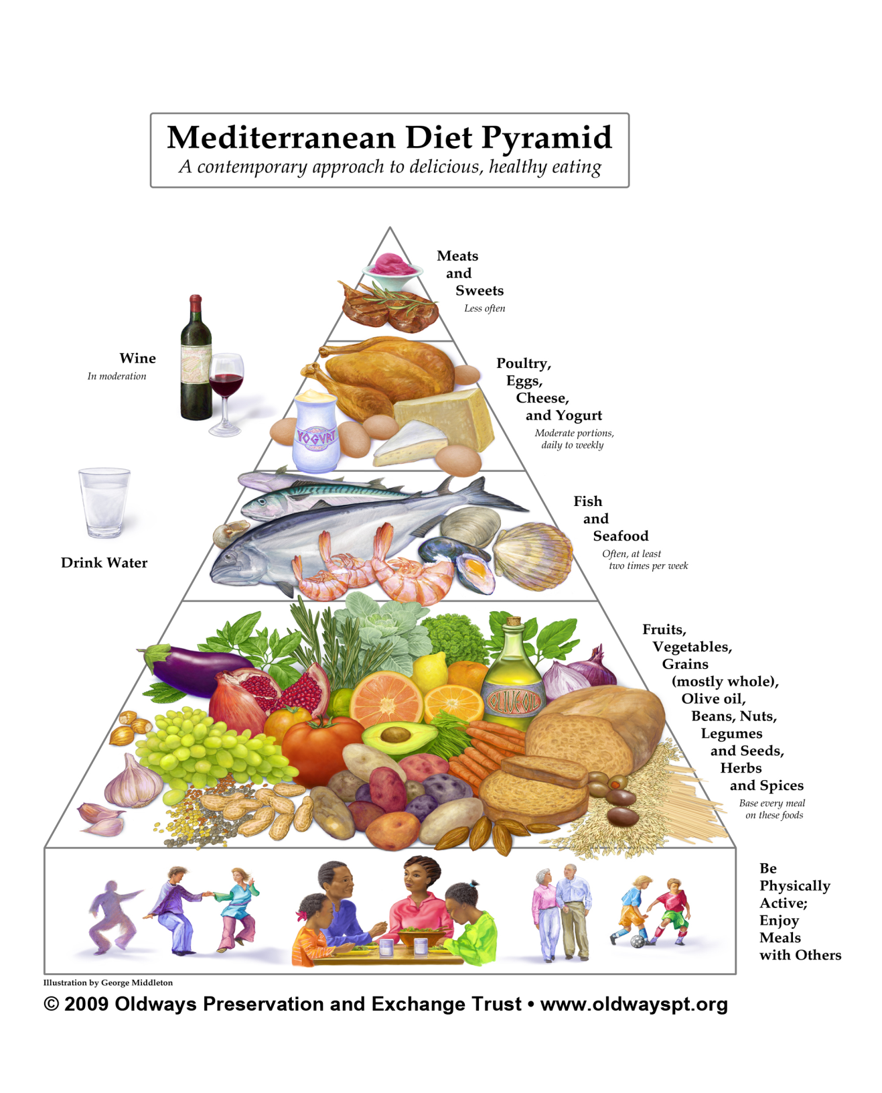
Mediterranean Diet Pyramid

Slide 45
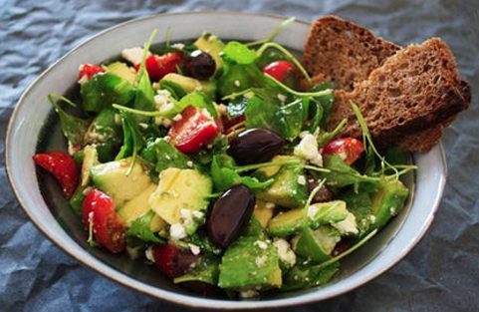
The Mediterranean diet emphasizes:
Eating primarily plant-based foods, such as fruits and vegetables, whole grains, legumes and nuts
Replacing butter with healthy fats such as olive oil and canola oil
Using herbs and spices instead of salt to flavor foods
Limiting red meat to no more than a few times a month
Eating fish and poultry at least twice a week
Enjoying meals with family and friends
Drinking red wine in moderation (optional)
Getting plenty of exercise

Slide 46
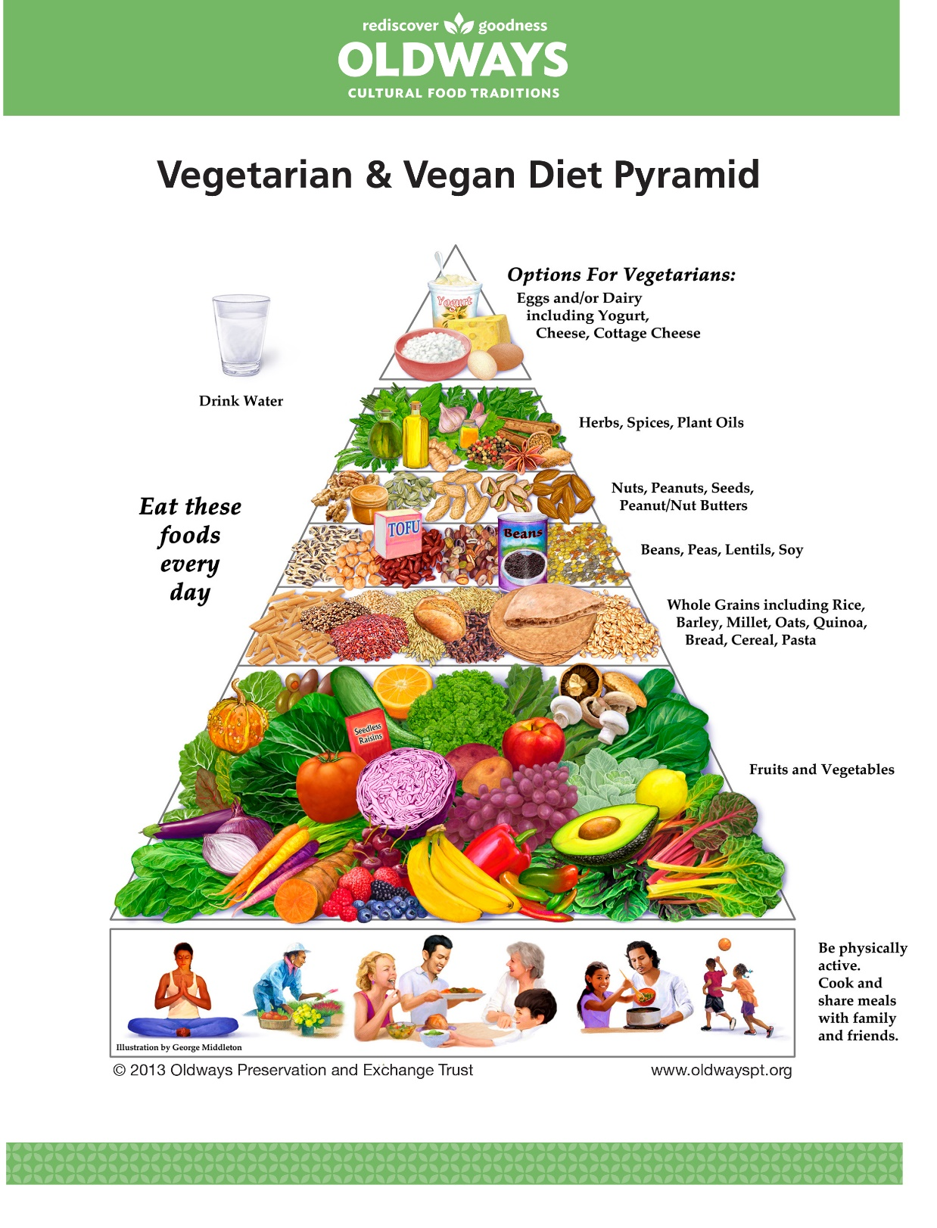
OLDWAYS
https://oldwayspt.org/traditional-diets/vegetarian-vegan-diet

Slide 47
USDA www.myplate.gov
Balancing Calories
Enjoy your food, but eat less.
Avoid oversized portions.
Foods to Increase
Make half your plate fruits and vegetables.
Make at least half your grains whole grains.
Switch to fat-free or low-fat (1%) milk.
Foods to Reduce
Compare sodium in foods like soup, bread, and frozen meals ― and choose the foods with lower numbers.
Drink water instead of sugary drinks.

Slide 48
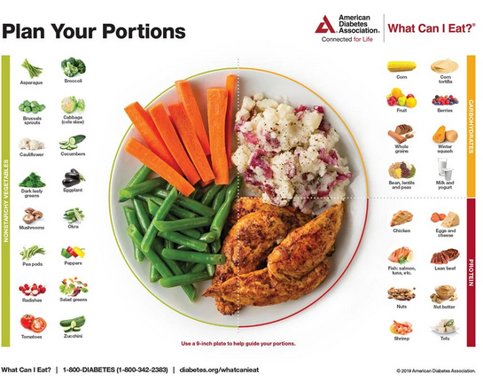
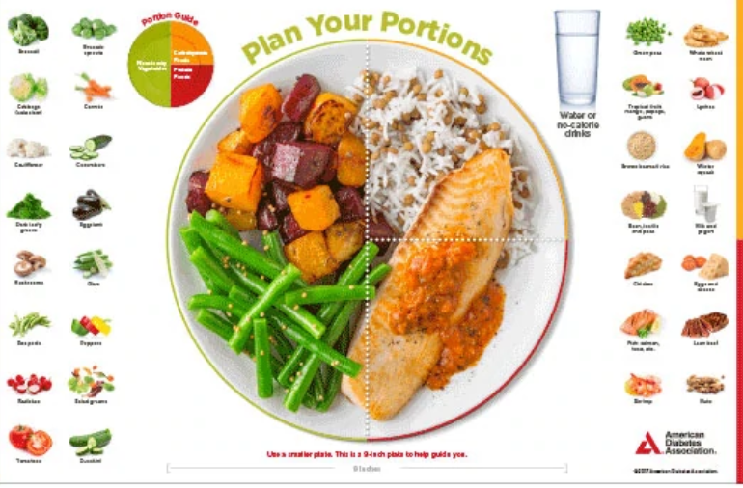
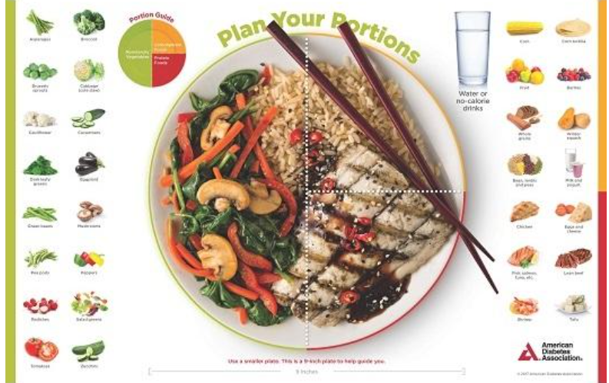
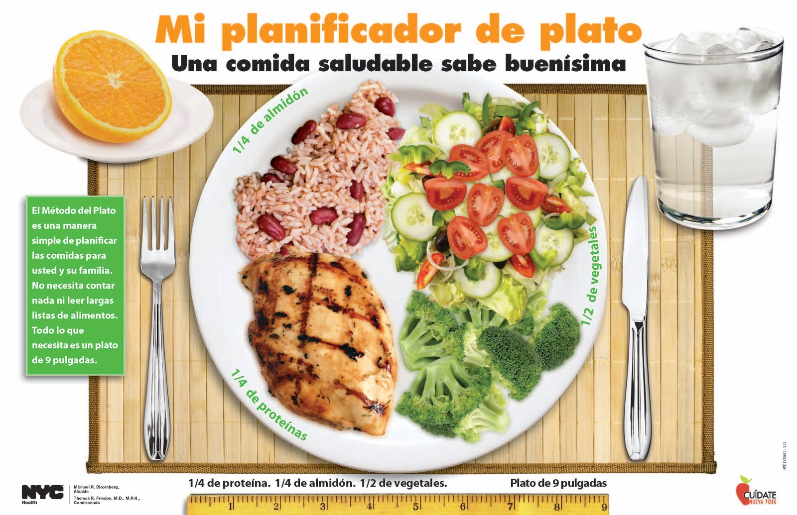
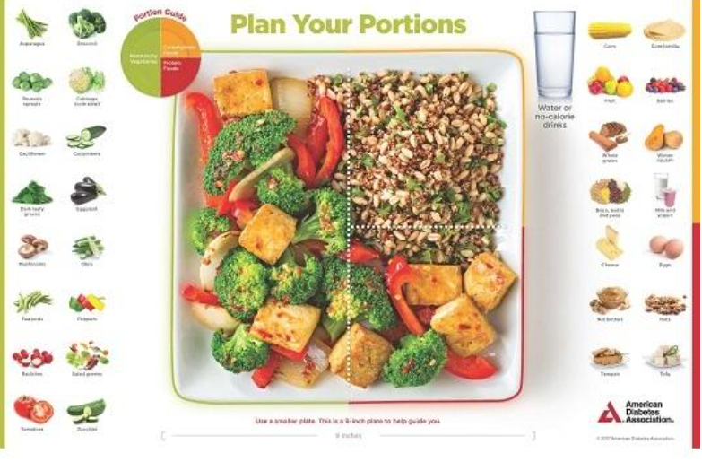
Plate example

Slide 49
Another plate example

Slide 50

Assess for Food Insecurity
Any member of the health care team can screen for food insecurity using The Hunger Vital Sign.
Households are considered at risk if they answer either or both of the following statements as “often true” or “sometimes true”
“Within the past 12 months, we worried whether our food would run out before we got money to buy more.”
“Within the past 12 months, the food we bought just didn’t last, and we didn’t have money to get more.”

Slide 51


Healthy Lower Cost Foods
Beans
Lentils
Frozen vegetable and fruits
Canned veggies and fruit
Milk
Yogurt tubs
Oatmeal
Corn tortillas
Salsa
Fruits & Veggies in season
Brown rice
Pasta/ sauce
Peanut butter
Canned tuna
Soups – homemade or canned
Chili
www.DiabetesEd.net

Slide 52
How nutrients affect blood sugar
If type 1, may need some insulin coverage for high fat / protein meals

Slide 53
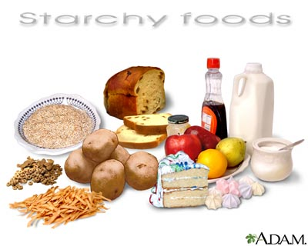
Carbs affect Post meal Blood Glucose
No ideal amount of daily carb intake
However, monitoring carb intake and available insulin are key strategies for post meal blood glucose.

Slide 54
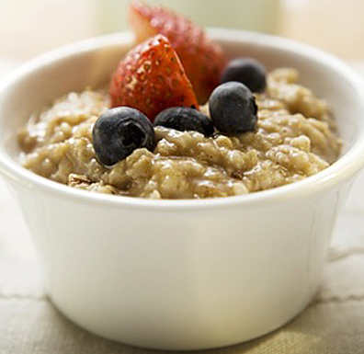
Poll Question 6
Mary can’t figure out why her BG always spikes after breakfast. How many grams of carb is in the following breakfast? I cup of plain oatmeal, ½ cup of milk, 2 Tbsp raisins, and 2 eggs with salsa?
57 gms
36 gms
51 gms
37 gms
30gms, 6gms, 15 gms = 51 gms

Slide 55
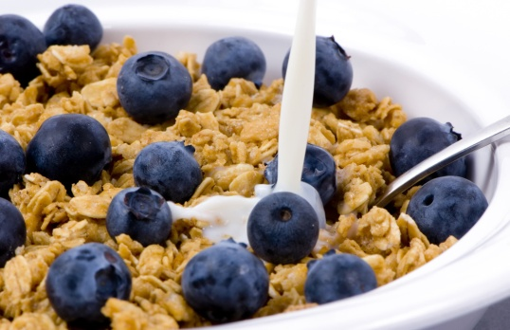
Carbohydrate Needs for Most Adults
Grams Servings
Each Meal 45-60 gm 3 - 4
Snacks 15-30 gm 1- 2
Carbs affect Post Meal Blood Glucose
Not for exam, just a framework
RDA – at least 130 gms of Carb a day

Slide 56
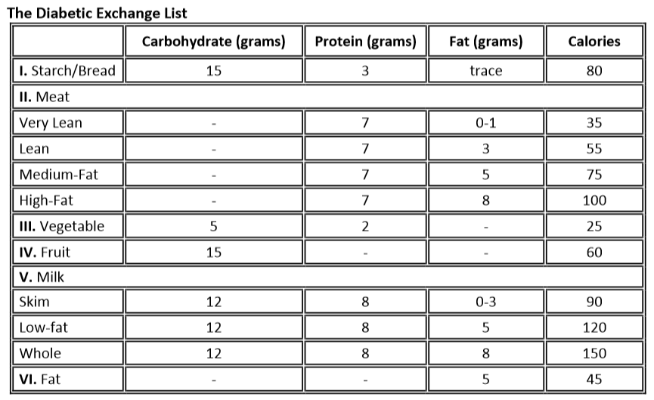
Diabetes Exchange List

Slide 57
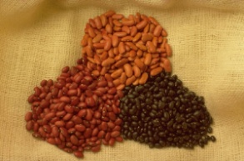


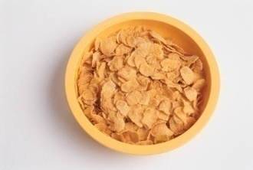
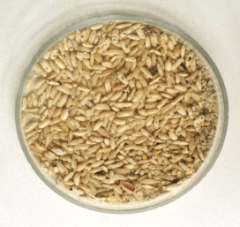
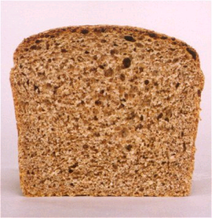

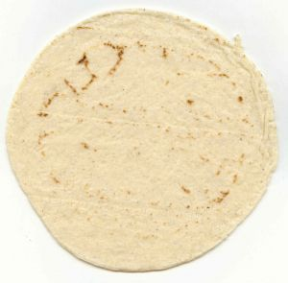
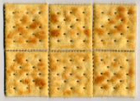

Carb Counting - Starch
Each Food has:
80 Calories
15 grams carb
1 small ear of corn or 1/2 cup corn
1/3 cup cooked pasta
1/3 cup
cooked beans
3/4 cup cold cereal
1 slice bread
1/3 cup cooked rice
1 small potato
1/2 English muffin
1 small tortilla
5-6 small crackers

Slide 58



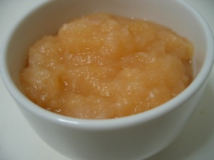





Carb counting- fruit
Each Food has:
60 Calories
15 grams carb
½ cup fruit juice
½ banana
1 small fresh fruit
½ cup unsweetened apple sauce
1 slice bread
17 small grapes
1 cup melon
¼ cup dried fruit
2 tbsp raisins
1 1/4 cup strawberries

Slide 59
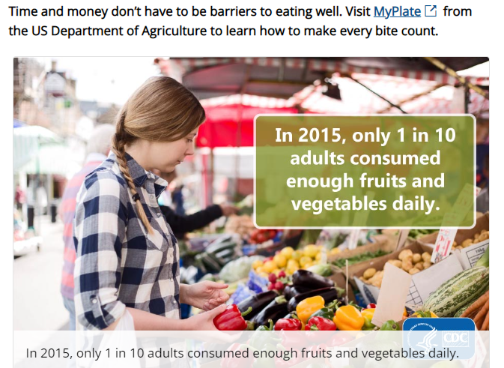
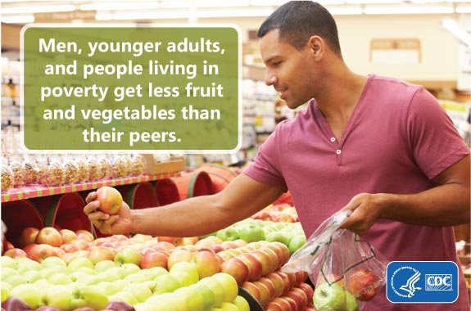
Only 1 in 10 eating enough Fruits and Vegetables
https://www.cdc.gov/nccdphp/dnpao/division-information/media-tools/adults-fruits-vegetables.html

Slide 60


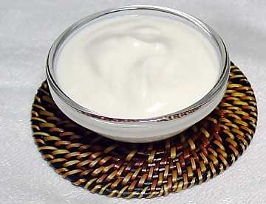
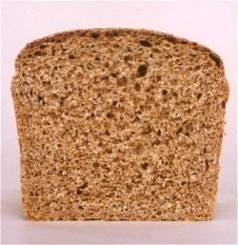

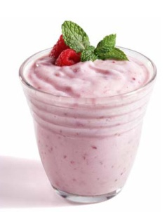

Carb Counting - Milk
Each Food has:
90-150 calories
12-15 grams carb
8 oz buttermilk
1 packet diet hot cocoa
1 slice bread
6 oz plain yogurt
8 oz milk
6 oz light fruit yogurt
8 oz soy milk

Slide 61
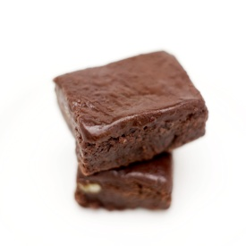
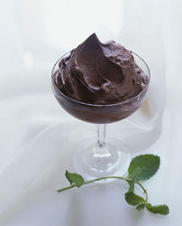
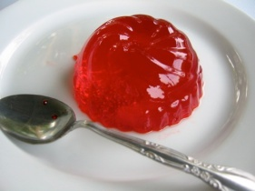






Carb Counting - Sweets
Each Food has:
Calories vary
15 grams carb
2 inch square cake or brownie, unfrosted
½ cup regular jello
2 tbsp light syrup
½ cup diet pudding
1 slice bread
1 tbsp syrup, jam, jelly, table sugar, honey
2 small cookies
¼ cup sorbet
½ cup ice cream or frozen yogurt
½ cup sherbet

Slide 62

Eating behavior is strongly linked to emotions

Slide 63

Reduce refined Carbs, Added Sugars - ADA
To control wt, reduce risk of CVD and fatty liver disease
ADA strongly discourages consumption of:
Sugar sweetened beverages
Processed “low-fat” or “non-fat” foods with high amounts of refined grains & added sugar
Sugary and processed foods can displace healthier, more nutrient dense food choices

Slide 64
Poll Question 7
JR has type 2 diabetes and is trying to lose weight by eating less and moving more. JR asks your advice about drinking diet sodas. Based on the recommendations in the ADA Standards of Care, what is the best the response?
Sodas that contain non-nutritive sweeteners help with weight loss and increase sugar cravings.
Try to decrease intake of beverages with non-nutritive sweeteners and increase water intake.
Drinking beverages with non-nutritive sweeteners is better than drinking sugary beverages.
Research has found that drinking beverages with nonnutritive sweeteners decreases diabetes risk.

Slide 65

Non-Nutritive Sweeteners
Use can reduce overall calorie intake if substituting for sugary beverages
But overall, people are encouraged to decrease both sweetened and non-sweetened beverages.
Increase Water intake.

Slide 66

Caloric Sweeteners
Nutritive sweeteners (sucrose and fructose)
Sucrose does not increase glucose more than isocaloric amounts of starch
Okay to include in meal plan but avoid excess sucrose intake
Fructose as sweetener not recommended since may adversely affect lipids. Naturally occurring fructose okay.
Reduced calorie sweeteners (sugar alcohols)
Not completely absorbed, so less calories
Unpleasant side effects, diarrhea, bloating and gas
Sorbitol, maltilol, erythritol, isomalt, xylitol, lactitol, mannitol, tagtose

Slide 67


Fooducate App – gives grade and nutrition info.
Sugar Rush gives info on how much added sugar
1 tsp sugar =4 gms

Slide 68


Label – How many Teaspoons of added sugar in the Buns and BBQ sauce?
BBQ Sauce
1.5 teaspoons
2.5 teaspoons

Slide 69

Top Diabetes Apps CHEAT Sheet

Slide 70

Poll Question 8
You are teaching label reading. If they ate 4 servings of this Macaroni and Cheese, how much saturated fat would they be eating?
32 gms
40%
2 2/3 cup
4 gms

Slide 71
Poll Question 9
You are teaching about counting fat. If they ate 2 servings of this Macaroni and Cheese, how many calories would come from total fat?
a. 16 gms
b. 144 kcals
c. 460 kcals
d. 20%
8 gms of fat per serving
2 servings = 16 gms fat
1gm of fat – 9 kcals
16x9 = 144 kcals

Slide 72

Fats- 9 calories per gram
Monounsaturated - healthy
Olive & canola oils, Nuts, Avocado
Lowers total cholesterol and LDL
Raise HDL, high in omega 3 fatty acids
Polyunsaturated - healthy
corn, walnut, safflower, soybean
Lowers total cholesterol and LDL
Saturated fats (unhealthy)
Animal products – meat, chicken, pork, fish, skin, cheese butter, dairy
Plant products include; palm, coconut, palm kernel oil
Solid at room temp
Serving sizes
1 tsp butter, margarine, oil, mayonnaise
1 Tbsp salad dressing, cream cheese, seeds
2 Tbsp avocado, cream, sour cream
1 slice bacon

Slide 73
Fat – From ADA Standards
Evidence is inconclusive for ideal amount of total fat intake for people with diabetes;
goals should be individualized;
fat quality appears to be far more important than quantity.
The amount of dietary saturated fat, cholesterol, and trans fat recommended the same as recommended for general population

Slide 74

Protein and Kidney Disease
Maintain dietary protein at 0.8g/kg/day
Reducing below this not recommended – does not improve BG, CVD or slow kidney disease progression
Do not use protein foods to treat hypoglycemia for type 2 (can enhance carb related insulin release)

Slide 75


Protein – 4 cals per gram
Choose lean protein
Poultry, fish, egg, lean beef
Plant sources- beans, lentils, nuts
Low fat cheese- cottage cheese, mozzarella cheese
Limit high fat protein
Bacon & sausage
High fat cuts of beef
Whole milk cheese
Serving size
1 oz = ¼ cup
3 oz = deck of cards
Protein needs ~ 0.8 g per kg of body weight. For example, a person weighs 75 kg (165 pounds) needs ~ 60 g of protein/day

Slide 76

Poll Question 10
MJ is on a insulin pump and takes 1 unit of insulin for every 15 gms of carb. For this meal with 5 ounces of steak, MJ bolused 3 units of insulin to cover carbs. What might MJ expect to happen 3 hours later?
Glucose spike
Hypoglycemia
BG on target
Need for more carbs.
Avg person needs about 60gms a day
5 ounces steak is ~35gms

Slide 77
Poll Question 11
JL is 19 and has type 1 diabetes, drinks a “few beers” on the weekends with their college friends. JL uses an insulin pump, but mostly relies of fingerstick checks to monitor blood sugars. According to their log, JL has had a few low blood glucose levels over the past weekend of 62, 49 and 51. What is the most important recommendation?
A. Check BG at least 4 times a day when drinking.
B. Get glucagon rescue medication.
C. Make sure to eat carbs when drinking to avoid low blood glucose levels.
D. Decrease or stop alcohol intake.

Slide 78
Using Alcohol Safely
Women- 1 or fewer alcoholic drinks a day
Men 2 or fewer alcoholic drinks a day
1 alcoholic drink equals
12 oz beer
5 oz glass of wine
1.5 oz distilled spirits (vodka, gin etc.)
If drink, limit amount and drink w/ food.
Can cause hypo and worsen neuropathy

Slide 79

Celiac Disease
Type 1 – Affects ~10 %
Immune reaction to gluten - affects function of villi in intestine, decreasing nutrient absorption
S/S: bloating, malabsorption, wt loss, fatty stools, diarrhea, muscle tenderness, failure to thrive
Diagnosis: measure either anti-endomysial antibodies (EMA) titers or tissue transglutaminase.
If positive, refer to GI specialist for endoscopy and biopsy of small intestine to confirm diagnosis.

Slide 80

Treatment – Gluten Free for Life
Avoid
Barley
Rye
Oats
Wheat (einkorn, durum, faro, graham, kamut, semolina, spelt),
Refer to a RD/RDN
ASSOCIATED AUTOIMMUNE DISORDERS
Insulin-dependent Type 1 Diabetes Mellitus, Liver diseases, Thyroid Disease-Hashimoto’s Thyroiditis, Lupus (SLE), Addison’s Disease, Chronic Active Hepatitis, Rheumatoid Arthritis
“BROW”

Slide 81

Poll question 12
John has gastroparesis and is struggling with bloating and nausea after meals. What is the best recommendation?
Eat low fiber, small meals
Eat raw vegetables and limit fruit
Always take insulin after meals
Avoid foods containing wheat

Slide 82

Gastroparesis
Gastroparesis: affects 20 – 30% of pt’s w/ longstanding dm
Delayed emptying of stomach contents due to nerve damage
S/S include early satiety, fullness, postprandial hypo, vomiting
Diagnosis: gastric emptying studies, post-prandial hypoglycemia
Tx: improve BG, small, low fat & fiber meals meds: reglan, erythromycin

Slide 83
Last Note - Know these Facts
Fat - 9 cals per gm
Carb – 4 cals per gm
Protein – 4 cal per gm
Alcohol - 7cals per gm
Common food carb count
Milk is 12 gms of carb
1 lb = 3,500 cals
7,500 to 10,000 steps recommended a day
2000 steps – 1 mile
Alcohol serving sizes

Slide 84


Thank You
Questions?
Info@DiabetsEd.net
530-893-8635
Bryanna is here to help.

