Slide 1
[Section Title] [Year]
[Program Title]
Diabetes Education Services Presents:
[Instructor Name and Credentials]
Pronouns: [instructor pronouns]
[Instructor Title]

Slide 2
[Program Orientation]
Added by DES team

Slide 3
Diabetes Ed Online Courses Feature:
Accreditation:
Diabetes Education Services
is an approved provider.
Commission on Dietetic Registration (CDR), Provider DI002
California Board of Registered Nursing, Provider 12640
Online Courses Include:
Access for one full year and extensions are available too.
Live webinar, podcast, handouts & resources
A sense of community
Can’t make it live? No worries, all programs are recorded.
Our CEs count toward the CDCES & BC-ADM exams and certification renewals.

Slide 4
[Program Schedule]
Added by DES team

Slide 5

Land Acknowledgment
We acknowledge and are mindful that Diabetes Education Services stands on lands that were originally occupied by the first people of this area, the Mechoopda, and we recognize their distinctive spiritual relationship with this land, the flora, the fauna, and the waters that run through this area.

Slide 6

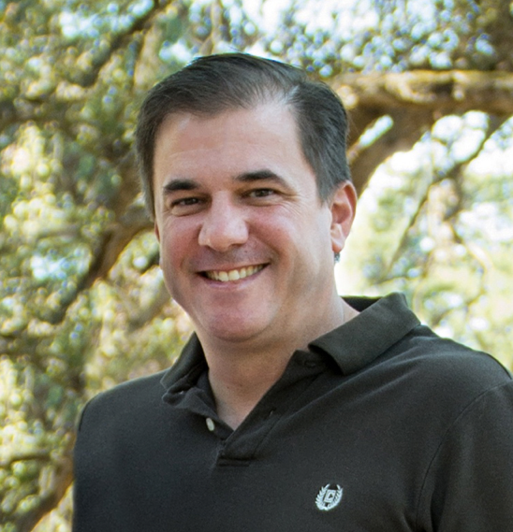
We are Here to Help!
Bryanna Sabourin
Director of Operations
Certification Pathway Coach &
Customer Happiness Expert
Brent McMenomey Customer Advocate and Brand Ambassador
If you have questions, you can chat with us at www.DiabetesEd.net or call 530 / 893-8635 or email at info@diabetesed.net

Slide 7

Diabetes Education Services Inclusion Statement
Based on the IDEA Initiative inspired by CDR
Inclusion
Diversity
Equity
Access
We are committed to promoting diversity and inclusion in our educational offerings.
We recognize, respect, and include differences in ability, age, culture, ethnicity, gender, gender identity, sexual orientation, size, and socioeconomic characteristics.
Our goal is to promote equity and access, acknowledging historical and institutional inequities.
We are committed to practicing cultural humility and cultivating our cultural competence.
We wish to create a safe space within our community where one's beliefs, experiences, identity, and differences in ability, age, size, socio-cultural/socioeconomic characteristics, and political affiliations are considered and respected.

Slide 8
[Section Objectives & Learning Outcomes]
Outline the objectives/learning outcomes for program/course section. See more information in notes below.
Notes:
Here is a handy chart to outline objectives vs. learning outcomes: https://www.uclahealth.org/sites/default/files/documents/ce-LearningOutcome-v-LearningObjective-052016.pdf

Slide 9
[Instructor Conflict of Interest]
Outline any conflict of interests you have. See slide notes below for definitions and disclosure form.
Notes:
The Commission of Dietetic Registration Accreditation Manual describes conflicts of interest as:
8.0 Relevant Financial Relationships and Conflicts of Interest
Conflicts of interest (COI) in CPE arise when individual financial relationships relevant to the CPE content compromise or have the potential to compromise professional judgment and / or impart bias into the CPE content. Relevant financial relationships shall be disclosed. A financial relationship is relevant if the CPE content that an individual influences, controls, contributes to, or presents relates to business lines, products, services, or commodities that may contribute to that individual’s financial or professional gain.
8.1 Collection of Disclosure Information
Individuals must disclose all financial relationships occurring within the prior 24 months, regardless of the amount. Disclosure information must include:
• The name of the company or organization with which the individual has a financial relationship
• The nature of the financial relationship
• Declaration of conflicts of interest or lack thereof
Examples of financial relationships include employee, researcher, consultant, advisor, speaker, independent contractor (including contracted researcher), royalties or patent beneficiary, executive, person with ownership interest, and recipient of in-kind products. Individual stocks and stock options should be disclosed; diversified mutual funds do not need to be disclosed. Research funding should be disclosed by the principal or named investigator even if that individual’s institution receives the research grant and manages the funds.

Slide 10
[Section Content]
See notes below for content guidelines.
Notes:
Each instructor will be evaluated based on the following criteria established by our accreditor the Commission of Dietetic Registration (CDR): https://diabetesed.net/wp-content/uploads/2024/01/Course-Eval-2024.pdf
Marketing Guidelines:
Case Studies
How can a Continuing Professional Education (CPE) Provider meet the Commission on Dietetic Registration's policies regarding marketing and CPE?
https://www.cdrnet.org/vault/2459/web/Case%20Scenarios%20-%20Marketing[78].pdf
When is it acceptable to include logos in or peripheral to CDR Prior Approved Continuing Professional Education?
https://www.cdrnet.org/vault/2459/web/Case%20Scenarios%20-%20Logo%20Use%5B6%5D.pdf
From the CDR Accreditation Manual:
7.0 Marketing and Commercial Bias in CPE
CPE is not a vehicle for product or service marketing. All attempts to favor, recommend, purchase, use, or promote particular products, product groups, commodity organizations, equipment, devices, services, branded treatment options, diagnostic screening tools, or tests are prohibited. This includes efforts made by Providers, commercial supporters, or funders, as well as individuals involved in planning, development, review, marketing, implementation, presentation, hosting, learner feedback and assessment, and evaluation. The Accountable Contact is responsible for ensuring that the physical space or virtual location of the CPE is free of marketing However, marketing may occur before and after CPE as detailed below.
7.1 Content Containing Products or Services
Verbal, printed, or visual depictions of products or services in CPE content shall be generic, unbranded, and / or de-identified. Education materials that are part of CPE content such as slides, abstracts, handouts, evaluation mechanisms, or disclosure information must not contain any marketing including logos, trade names, or product group messages or images. Provider logo display in CPE content is prohibited for any type of Provider including but not limited to colleges, universities, health systems, foundations, nonprofits, and corporations. Copyright statements on Provider-owned materials are allowed.
“Education materials that are part of CPE content such as slides, abstracts, handouts, evaluation mechanisms, or disclosure information must not contain any marketing including logos, trade names, or product group messages or images
Inclusion, Diversity, Equity, and Access (IDEA) by CDR:
From the CDR CPE Provider Manual – Section 11.0 – Inclusion, Diversity, Equity, and Access (IDEA) in CPE Planning, Development, and Presentation
Providers shall utilize resources and incorporate processes that enable those who influence, control, contribute to, present, or participate in CPE content to examine explicit (conscious) and implicit (unconscious) biases, assumptions, privileges, and language. Established models, theories, and frameworks shall be utilized in the planning, development, and presentation of CPE to effectively promote inclusion, diversity, equity, and access.
IDEA in CPE applies to:
• Planners, reviewers, faculty, authors
• Content
• RD/DTR learners
• Patients, clients, customers
CPE that promotes diversity and inclusion is developed and presented to recognize, respect, and include differences in ability, age, creed, culture, ethnicity, gender, gender identity, political affiliation, race, religion, sexual orientation, size, and socioeconomic characteristics. CPE that promotes equity and access acknowledges historical and institutional inequities. CPE is a safe space when approached with cultural humility and an openness to the cultivation of cultural competence. Beliefs, experiences, identities, and differences in abilities, age, size, socio-cultural / socioeconomic characteristics, and political affiliations are considered and respected.

Slide 11



Keep Up to Date
Facebook: https://www.facebook.com/DiabetesEducationalServices
Twitter: https://twitter.com/CDCESCoach
Instagram: https://www.instagram.com/cdcescoach/
Linked In: https://www.linkedin.com/in/beverlythomassian/
Monthly Newsletter:
https://diabetesed.net/monthly-newsletter-past-issues/
Sign up for Blog Bytes – Question of Week: https://diabetesed.net/diabetes-blog-bytes-sign-up/

Slide 12

You Got This
Take Practice Tests
Review Articles
Keep studying what you don’t know
Keep moving
Make sleep a priority
Nourish your body
See you next class
www.DiabetesEdUniversity.net

Slide 13

Thank You
Thank you!
Please email or call us with any questions.
We are here to help
info@diabetesed.net
www.diabetesed.net
530-893-8635

