Slide 1

Virtual DiabetesEd Specialist Training Conference – Day 1
Beverly Thomassian, RN, MPH, BC-ADM, CDCES
President, Diabetes Education Services
Notes:
Am I slides 205-207?

Slide 2
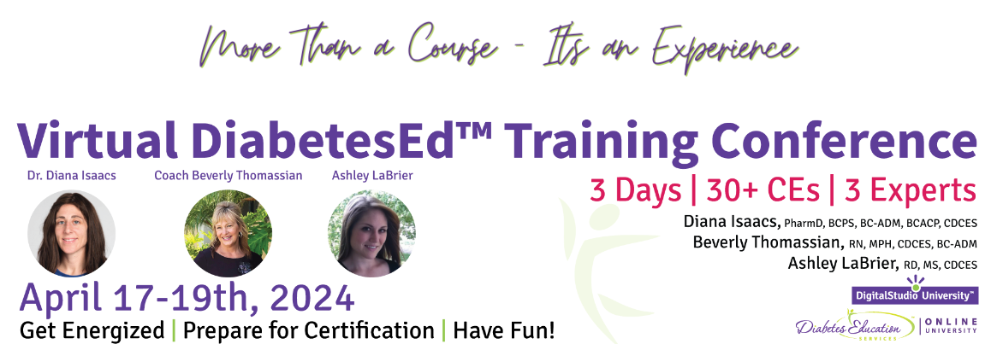
Welcome Everyone
Good Morning and Welcome.
Grab your coffee, tea or other beverage, a healthy snack and get comfy.
We will start promptly at 8:00 AM Pacific Time.
If you are having any technical difficulty, please chat with Bryanna at www.DiabetesEd.net or call 530 / 893-8635 or email at info@diabetesed.net

Slide 3

Land Acknowledgment
We acknowledge and are mindful that Diabetes Education Services stands on lands that were originally occupied by the first people of this area, the Mechoopda, and we recognize their distinctive spiritual relationship with this land, the flora, the fauna, and the waters that run through this area.

Slide 4
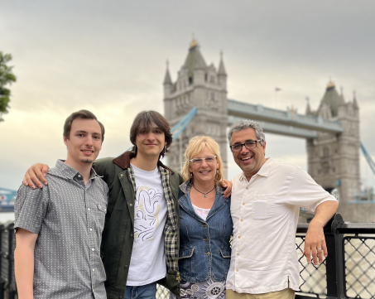

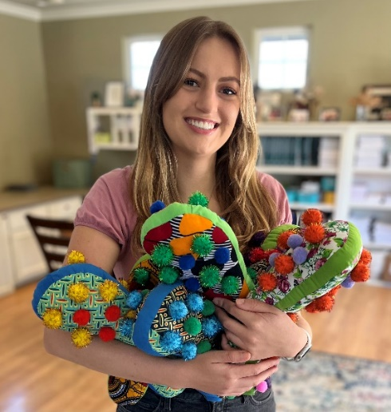
Thank You
The Amazing Bryanna
My Family
Robert 20 years
Jackson 17 years
Kris, my husband for 24 yrs
Pancreas Pro Amanda

Slide 5


We are Here to Help!
Bryanna Sabourin
Director of Operations
Certification Pathway Coach &
Customer Happiness Expert
Brent McMenomey Customer Advocate and Brand Ambassador
If you have questions, you can chat with us at www.DiabetesEd.net or call 530 / 893-8635 or email at info@diabetesed.net

Slide 6

Diabetes Education Services Inclusion Statement
Based on the IDEA Initiative inspired by CDR
Inclusion
Diversity
Equity
Access
We are committed to promoting diversity and inclusion in our educational offerings.
We recognize, respect, and include differences in ability, age, culture, ethnicity, gender, gender identity, sexual orientation, size, and socioeconomic characteristics.
Our goal is to promote equity and access, acknowledging historical and institutional inequities.
We are committed to practicing cultural humility and cultivating our cultural competence.
We wish to create a safe space within our community where one's beliefs, experiences, identity, and differences in ability, age, size, socio-cultural/socioeconomic characteristics, and political affiliations are considered and respected.

Slide 7
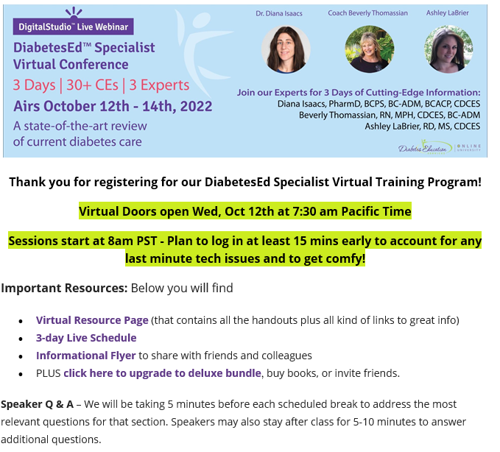

Look in your Inbox
For this email with lots of helpful links and info!
The GOTo Webinar Link is the same for all 3 days.

Slide 8
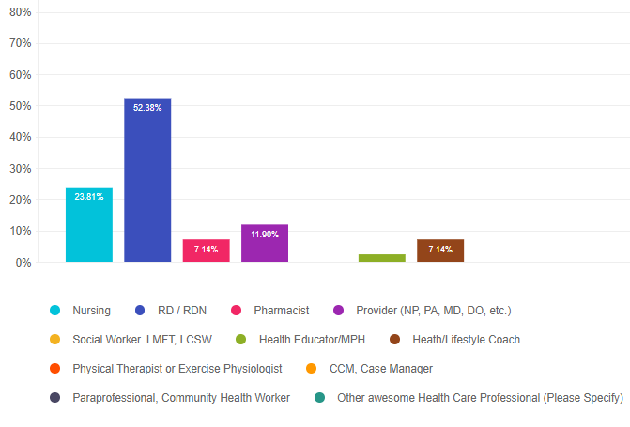
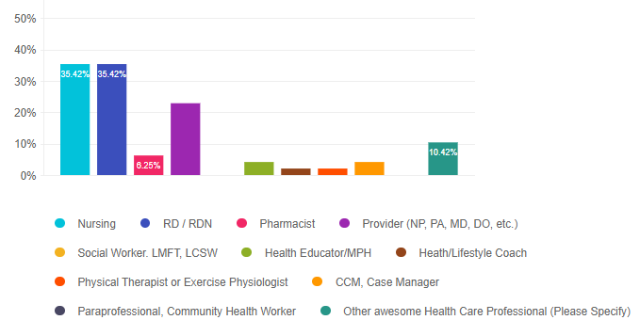
Who is attending this conference?
Other
Nutritionist (2)
Diabetes Educator (2)
Community Health Educator (1)

Slide 9
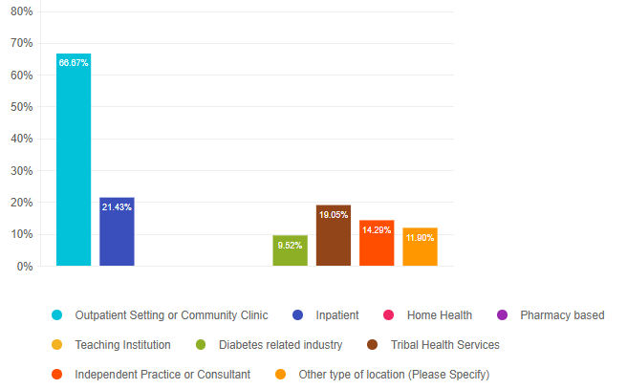
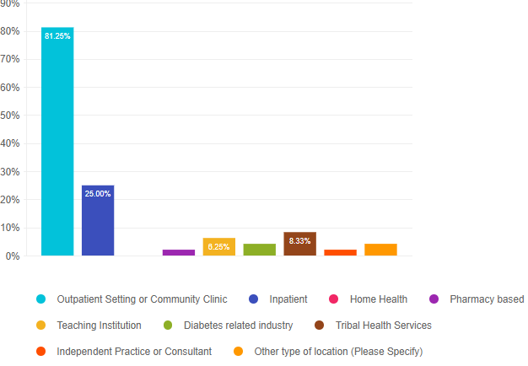
What is your job setting?
Other
- Community health dept of acute care hospital system
- Pediatrics
- Remote insurance Company
- Non-Profit, public health

Slide 10
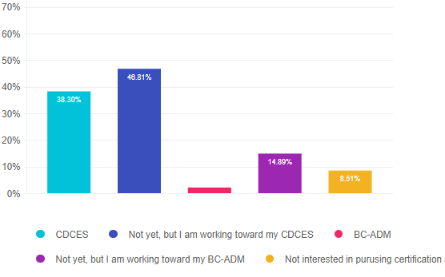
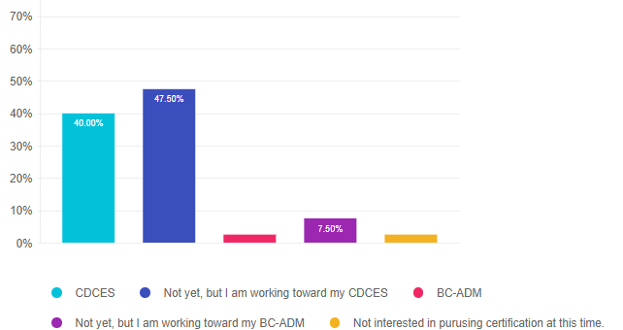
Certifications?

Slide 11
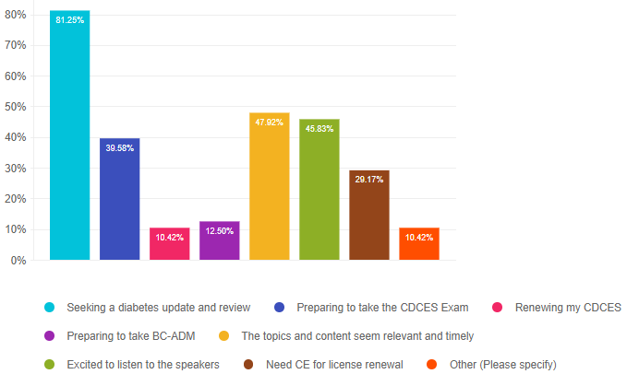
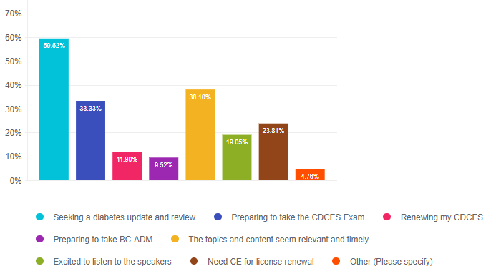
What motivated you to attend?

Slide 12


Thank you for Being a Part of This Awesome Community

Slide 13
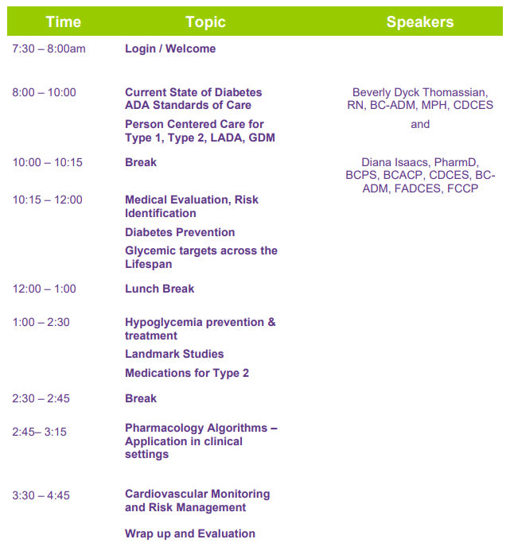
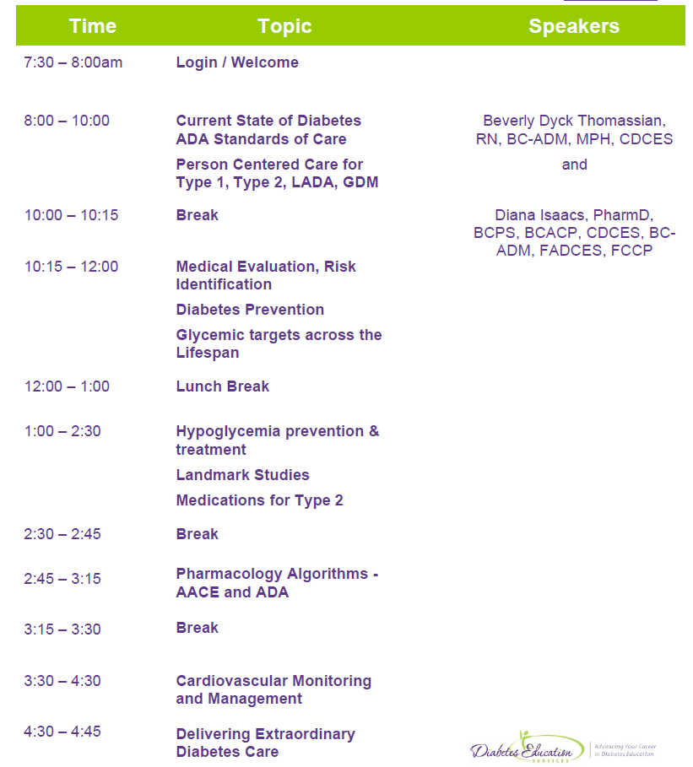
Virtual Course Schedule – Day 1
April 17

Slide 14

Speaker Question and Answer
Before each break, we will provide a 5-minute Q&A session.
We will choose questions that will most benefit participants.
If you have a burning question that is not answered, you can re-ask after class.

Slide 15
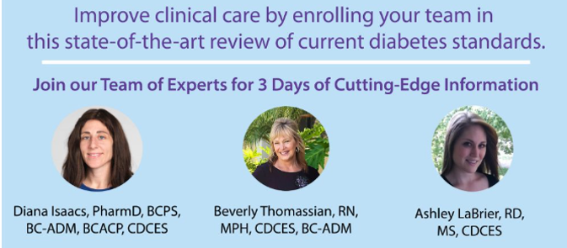
Thank you to our Speakers

Slide 16

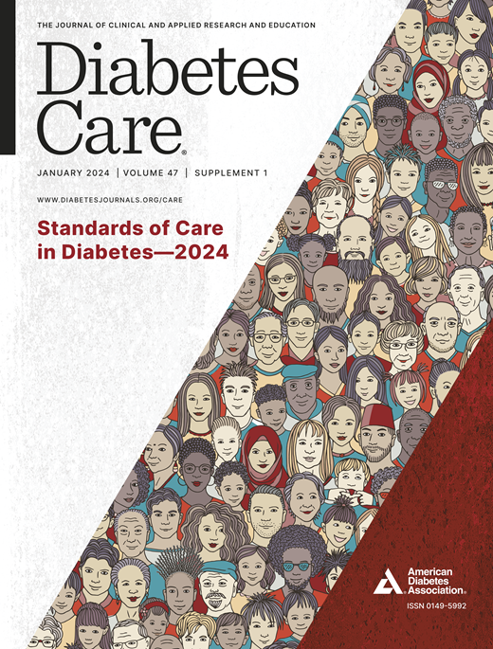
Coach Bev has no Conflict of Interest
She’s not on any speaker's bureau
Does not invest or have any financial relationships with diabetes related companies.
Gathers information from reading package inserts, research and articles
The ADA Standards of Medical Care is main resource for course content

Slide 17

Diana Isaacs, PharmD, BCPS, BCACP,
BC-ADM, CDCES, FADCES, FCCP
Provides diabetes care to all regardless of insurance
Provides care to specialized populations especially transplant, pregnancy and other high-risk individuals.
Usually sees about 10 clients a day
Author & contributor
Endocrine Clinical Pharmacy Specialist
CGM Program Coordinator
Co-Director Center of Excellence for Endocrine Disorders in Pregnancy
Cleveland Clinic Endocrinology and Metabolism Institute
ADCES Educator of the Year in 2020

Slide 18
Disclosures for Dr. Isaacs
Diana Isaacs, PharmD, BCPS, BCACP, CDCES, BC-ADM, FADCES, FCCP declares the following disclosures:
Speaker: Abbott, Dexcom, Novo Nordisk, Insulet, Medtronic, Lilly, Cequr
Consultant: Sanofi, Undermyfork
CBDCES Credentialing Committee
ADA Professional Practice Committee
ADCES Board Member

Slide 19

Diabetes Overview and Glycemic Goals
Objectives:
Discuss current Diabetes ADA Standards
Describe person-centered care for Type 1, Type 2, LADA, GDM
List steps for Medical Evaluation, Risk Identification and Prevention
State glycemic targets across the lifespan
Discuss hypoglycemia prevention & treatment
Describe significance of Landmark Diabetes Studies
List medications considerations for Type 2
Describe the pharmacology Algorithms
Discuss most recent cardiovascular risk mitigation strategies and goals.

Slide 20

17. Diabetes Advocacy
People living with diabetes deserve to be free from the burden of discrimination.
We need to all be a part of advocating to ensure a healthy and productive life for people living with diabetes.
Decrease barriers to diabetes self-management.
Diabetes Care needs to meet outlined standards in all settings.
- In school setting
Young children in childcare
For occupational drivers
In work settings
In Correctional Institutions

Slide 21
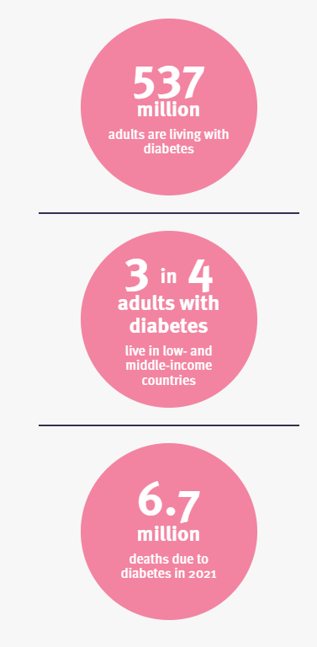
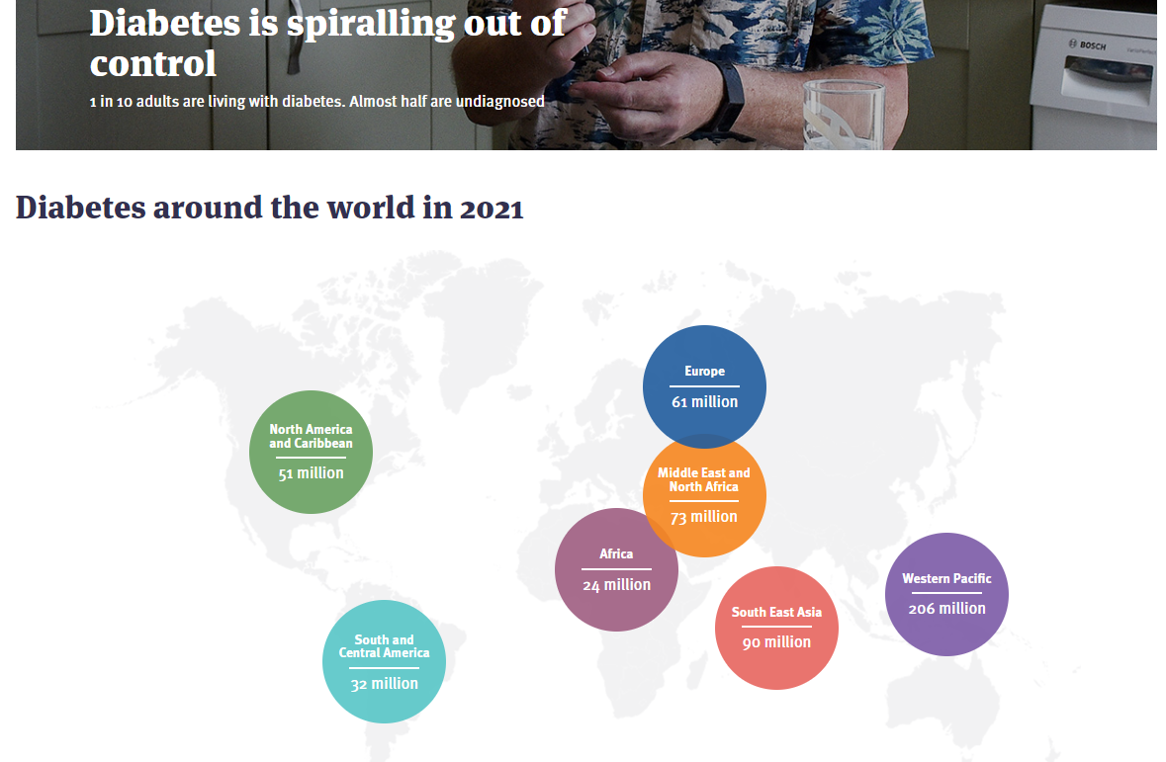


Global Epidemic
www. DiabetesAtlas.org
World Diabetes Day is November 14

Slide 22

Poll Question 1
According to the CDC, what best describes the current prevalence of prediabetes and diabetes in the U.S.?
  30% of people above the age of 20 have type 2 diabetes.
  The rate of type 1 and type 2 diabetes have tripled since 2010.
  A total of 50% of people have prediabetes or diabetes.
  1 out of 2 persons above age 20 have prediabetes.

Slide 23

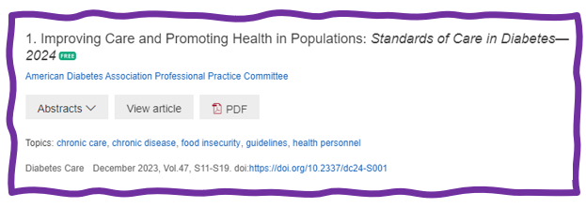
1. Improving Care and Promoting Health in Populations
“Health outcomes of a group of individuals -
  including the distribution of health outcomes within the group”
These outcomes can be measured in terms of health:
  mortality, morbidity, health, and functional status
  disease burden
    (incidence and prevalence)
  behavioral and metabolic factors
    (exercise, diet, A1C, etc.)
ADA Standards 2024

Slide 24
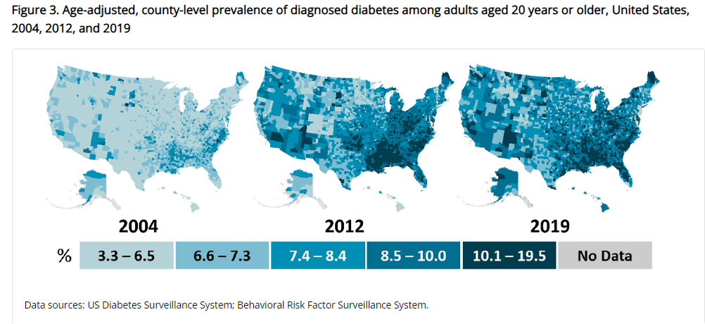
Type 2 Diabetes in America 2024
11.3% with Diabetes - 37 million adults
  23% don’t know they have it
38% with Prediabetes – 96 million adults
Centers for Disease Control and Prevention. National Diabetes Stats Report https://www.cdc.gov/diabetes/data/statistics-report/index.html. Accessed 1/23

Slide 25
CDC Announces
35% of Americans will have Diabetes by 2050
Boyle, Thompson, Barker, Williamson
2010, Oct 22:8(1)29
www.pophealthmetrics.com

Slide 26
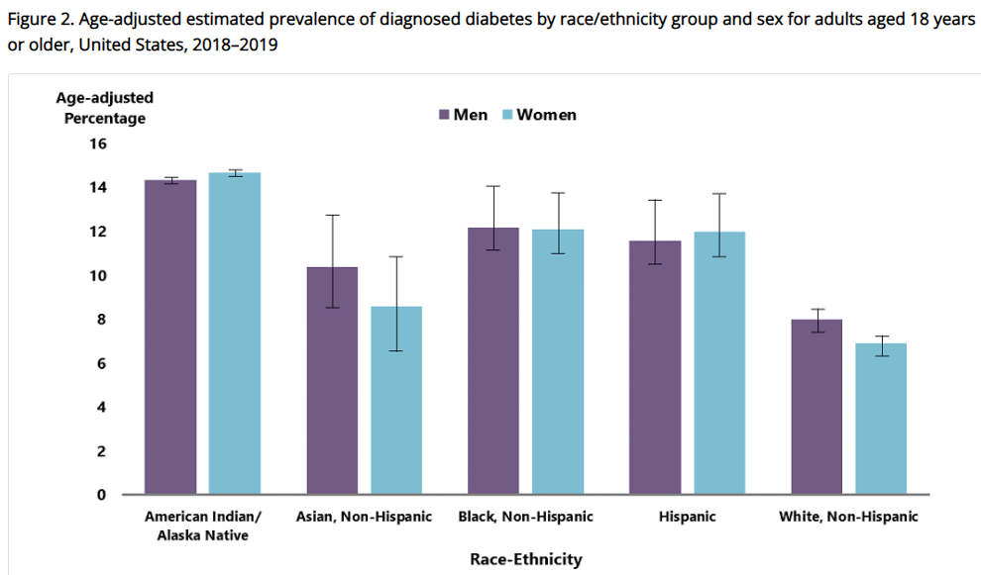
Diabetes Prevalence by Ethnic Group
For adults, diabetes prevalence highest among:
  American Indians and Alaska Natives (14.5%),
  Non-Hispanic Blacks (12.1%),
  People of Hispanic origin (11.8%),
  Non-Hispanic Asians (9.5%)
www.cdc.gov/diabetes/data/statistics-report/diagnosed-diabetes.html

Slide 27
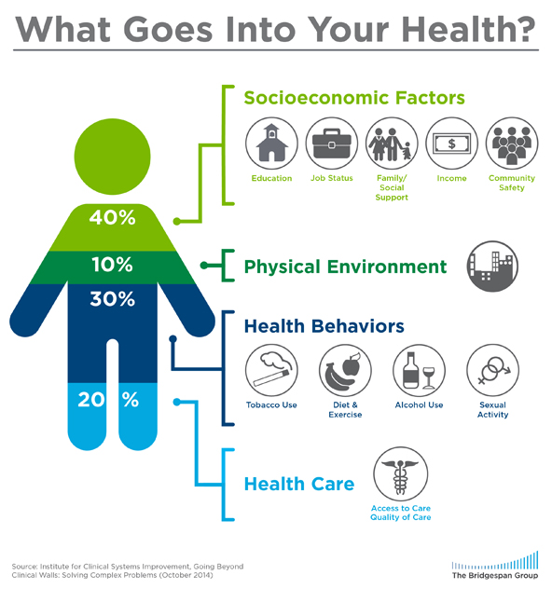

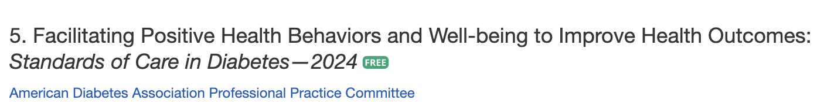
Address Barriers to Self Management
Design and deliver DSMES with ultimate goal of health equity across all populations.
Barriers exist within health system, payer, health care professional & individual.
Address barriers through innovation, including community health workers, telehealth, other digital health solutions.
Consider social determinants of health in the target population when designing care.
This Photo by Unknown Author is licensed under CC
BY
Notes:
Access and health equity is the ultimate goal when designing and delivering DSMES.
Creating culturally appropriate and varied modalities of settings has been shown to improve outcomes.
We know barriers to care exist at every level from the health system to individual.
However we can address these barriers by working to educate participants and health care providers on the critical times when DSMES is needed.
We can work with health systems and clinics to develop population health screening and clinical outreach,
create protocols to reduce time for referral and
collaborate health and community systems to address social needs.
We can include other health partners including community health workers to support delivery of diabetes peer support.
Barriers can be also be addressed by developing a diversity of delivery models.
From traditional inperson classrooms to community-based strategies and technology enabled solutions including telehealth or virtual environments varying modes can serve different needs.

Slide 28

Social Determinants of Health
The conditions in which people:
  Play
  Live
  Work
  Learn
  Pray
Directly affects their health risks and outcome
AADE Population Health & Diabetes Educators Evolving Role 2019

Slide 29

Socioeconomics – Diabetes Prevalence
Prevalence of diabetes varied significantly by education level, an indicator of SES status
  7.1% - More than high school education
  9.2% - High school education
  13.4% - Less than high school education
  13.7 – 14.4% of men and women with income below federal poverty level have highest prevalence of diabetes.
CDC 2023
https://www.cdc.gov/diabetes/data/statistics-report/diagnosed-diabetes.html

Slide 30

Status of Diabetes Care
In 2015–2018, U.S. community-dwelling adults with diabetes achieved:
  A1C <7% by 50.5%
    75.4% achieved A1C <8%.
  BP target of <130/80 achieved by 47.7%
    70.4% achieved blood pressure <140/90 mmHg.
  Lipid control (non-HDL cholesterol) <130 mg/dL, achieved by 55.7%
22.2% met targets for all three risk factors
Many not receiving adequate lifestyle or pharmacotherapy.

Slide 31


Now, let’s get to the Nitty Gritty

Slide 32



Slide 33
Hormones Effect on Glucose
Effect



⇒
⇒
⇒
Hormone
Glucagon (pancreas)
Stress hormones (kidney)
Epinephrine (kidney)
Insulin (pancreas)
Amylin (pancreas)
Gut hormones - incretins (GLP-1) released by L cells of intestinal mucosa, beta cell has receptors)

Slide 34

Incretins:
GLP-1 & GLP-1/GIP Receptor Agonists

Slide 35
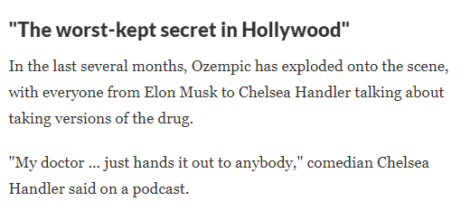


New Drugs Take Hollywood by Storm
Notes:
References
https://www.npr.org/2023/04/01/1166781510/ozempic-weight-loss-drug-big-business

Slide 36
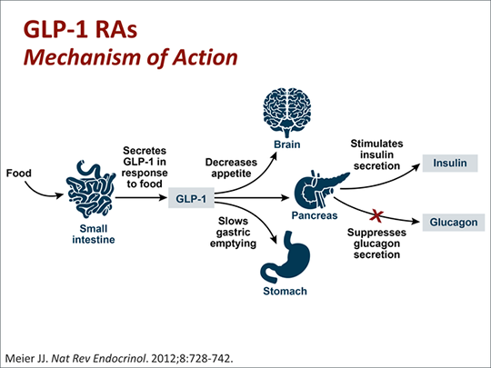
GLP-1 Receptor Agonist Mechanism

Slide 37
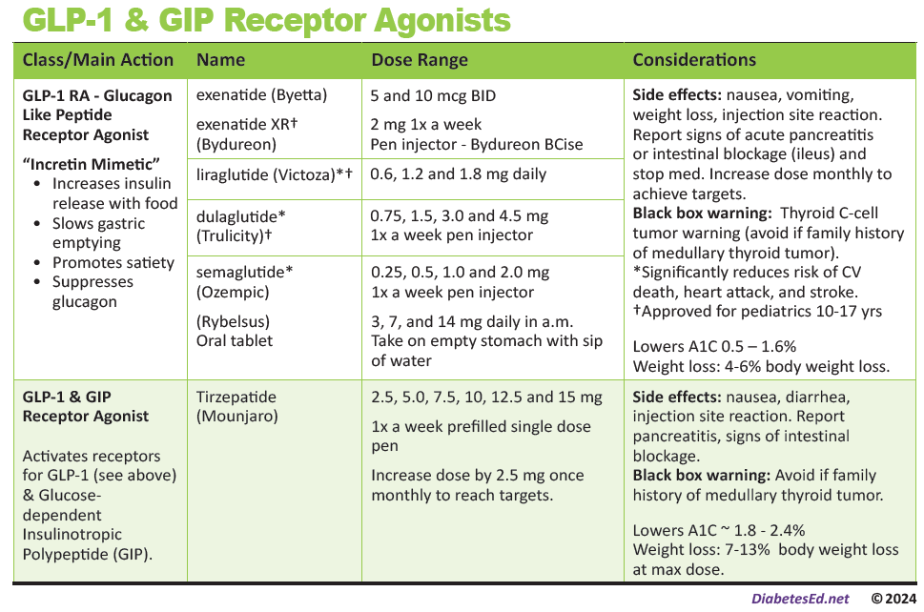
Pocket Card: GLP-1 & GIP RA
Notes:
Update with exenatide indication in pediatrics.

Slide 38
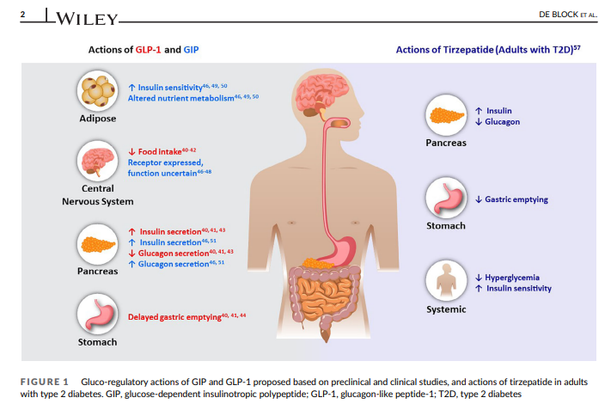
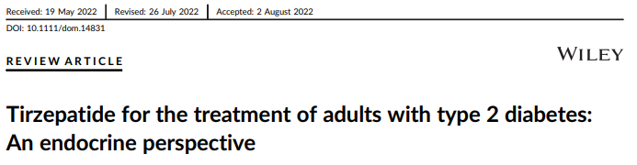
Actions of GLP-1 and GIP

Slide 39
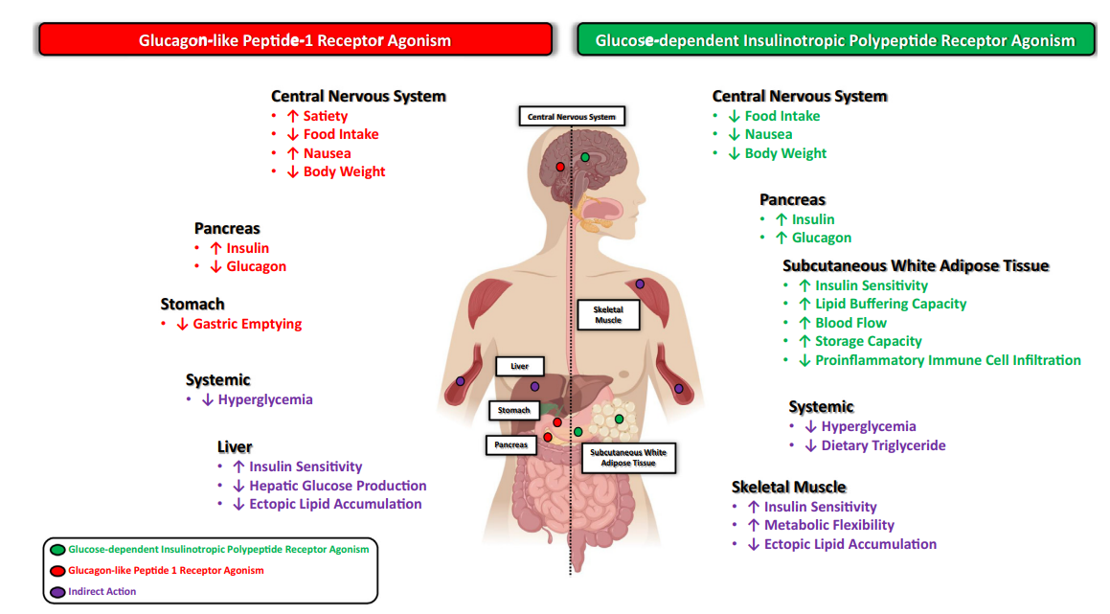
GLP-1 & GIP
Samms RJ, Coghlan MP, Sloop KW. How May GIP Enhance the Therapeutic Efficacy of GLP-1? Trends Endocrinol Metab. 2020 Jun;31(6):410-421.
Notes:
GIP: Glucose-dependent Insulinotropic Polypeptide
GLP: glucagon-like peptide

Slide 40

GIP/GLP-1 Receptor Agonist
Tirzepatide (Mounjaro) is a GIP/GLP-1 Receptor Agonist
  GIP: glucose-dependent insulinotropic polypeptide
  GLP-1: glucagon like peptide-1
Studied in the SURPASS clinical program (T2DM)
Studied in the SURMOUNT clinical program (Obesity)
Once weekly injectable disposable pen: abdomen, legs, arms
AWP - $974 a month

Slide 41
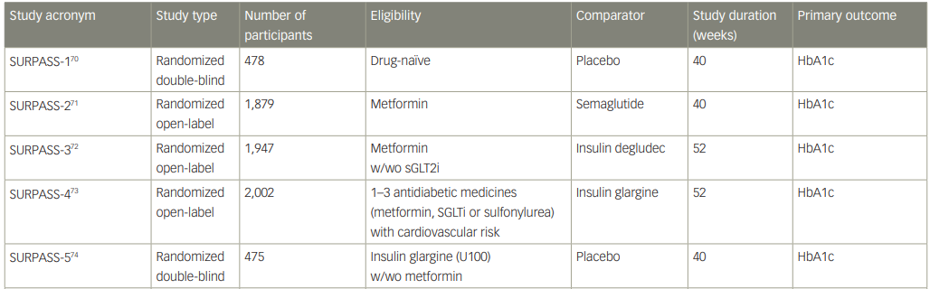
SURPASS Clinical Program
Rosenstock J, et al. Lancet. 2021;398:143–55. Frias JP, et al. N Engl J Med. 2021;358:503–15.82. Ludvik B, et al. Lancet. 2021;398:583–98. 83. Del Prato S et al. Lancet. 2021;398:1811–24. 84. Dahl Det al. Diabetologia. 2021:64(Suppl. 1):S13. Abstr 20. Kaneko S.. touchREV Endocrinol. 2022 Jun;18(1):10-19.

Slide 42
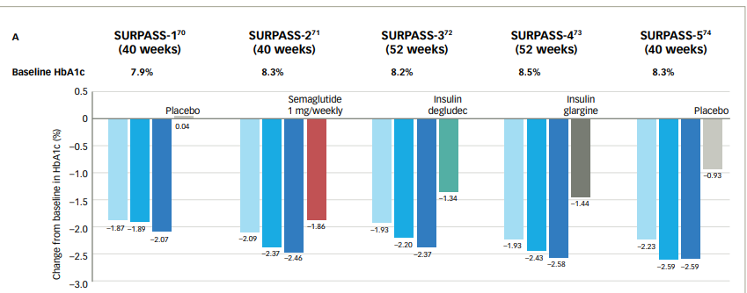

SURPASS: A1C Change
Rosenstock J, et al. Lancet. 2021;398:143–55. Frias JP, et al. N Engl J Med. 2021;358:503–15. 82. Ludvik B, et al. Lancet. 2021;398:583–98. 83. Del Prato S et al. Lancet. 2021;398:1811–24. 84. Dahl Det al. Diabetologia. 2021:64(Suppl. 1):S13. Abstr 20. Kaneko S.. touchREV Endocrinol. 2022 Jun;18(1):10-19.

Slide 43
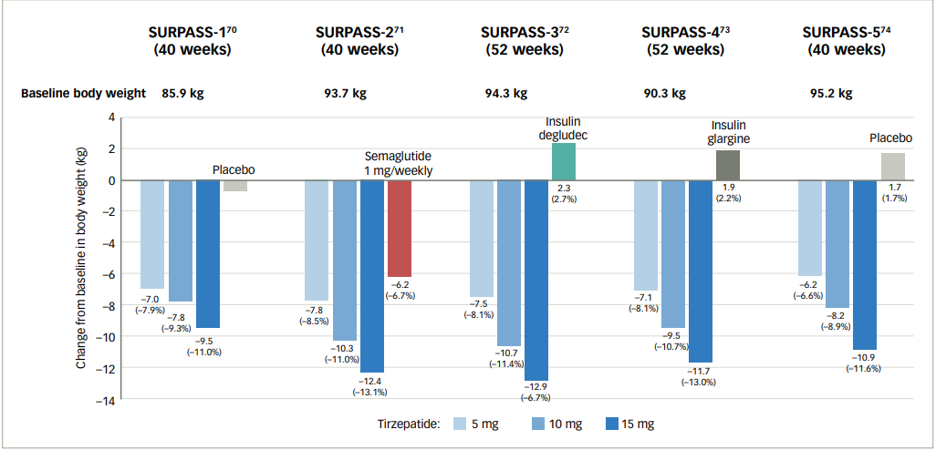
SURPASS: Change in Body Weight
Rosenstock J, et al. Lancet. 2021;398:143–55. Frias JP, et al. N Engl J Med. 2021;358:503–15. 82. Ludvik B, et al. Lancet. 2021;398:583–98. 83. Del Prato S et al. Lancet. 2021;398:1811–24. 84. Dahl Det al. Diabetologia. 2021:64(Suppl. 1):S13. Abstr 20. Kaneko S.. touchREV Endocrinol. 2022 Jun;18(1):10-19.

Slide 44

Tirzepatide Wt loss and A1C impact
A1C drop in Surpass Trials of
1.9% to 2.6%
Weight loss in Surpass Trials of
7.8% to 12.9% or
13.6 to 28.4 pounds
Approved as wt loss medication in 11/23. “Zepbound”

Slide 45

Notes:
Update with exenatide indication in pediatrics.

Slide 46
Tirzepatide & GLP-1 RA Safety Profile
GI side effects
  Nausea, appetite loss, diarrhea, constipation, dyspepsia, abdominal pain
Pancreatitis
Hypoglycemia with concomitant use of insulin or secretagogues
Hypersensitivity reactions
Acute kidney injury
Thyroid C-Cell tumors
Acute gallbladder disease
Worsening retinopathy
Package inserts.
Notes:
Pancreatitis: Acute pancreatitis, including fatal and nonfatal hemorrhagic or necrotizing pancreatitis, has been observed in patients treated with GLP-1 receptor agonists. Pancreatitis has been reported in Mounjaro clinical trials. Mounjaro has not been studied in patients with a prior history of pancreatitis. It is unknown if patients with a history of pancreatitis are at higher risk for development of pancreatitis on Mounjaro. Observe patients for signs and symptoms including persistent severe abdominal pain sometimes radiating to the back, which may or may not be accompanied by vomiting. If pancreatitis is suspected, discontinue Mounjaro and initiate appropriate management.
In both male and female rats, tirzepatide causes dose-dependent and treatment-duration-dependent thyroid C-cell tumors at clinically relevant exposures. It is unknown whether Mounjaro causes thyroid C-cell tumors, including medullary thyroid carcinoma (MTC), in humans as human relevance of tirzepatide-induced rodent thyroid C-cell tumors has not been determined.
Mounjaro is contraindicated in patients with a personal or family history of MTC or in patients with Multiple Endocrine Neoplasia syndrome type 2 (MEN 2). Counsel patients regarding the potential risk for MTC with the use of Mounjaro and inform them of symptoms of thyroid tumors (e.g., a mass in the neck, dysphagia, dyspnea, persistent hoarseness). Routine monitoring of serum calcitonin or using thyroid ultrasound is of uncertain value for early detection of MTC in patients treated with Mounjaro.
Mounjaro has been associated with gastrointestinal adverse reactions, which include nausea, vomiting, and diarrhea. These events may lead to dehydration, which if severe could cause acute kidney injury. In patients treated with GLP-1 receptor agonists, there have been postmarketing reports of acute kidney injury and worsening of chronic renal failure, sometimes requiring hemodialysis. Some of these events have been reported in patients without known underlying renal disease. A majority of reported events occurred in patients who had experienced nausea, vomiting, diarrhea, or dehydration. Monitor renal function when initiating or escalating doses of Mounjaro in patients with renal impairment reporting severe adverse gastrointestinal reactions.
In clinical trials, acute gallbladder disease was reported by 0.6% of Mounjaro-treated patients and 0% of placebo-treated patients. If cholelithiasis is suspected, gallbladder diagnostic studies and appropriate clinical follow-up are indicated.

Slide 47
GLP-1/GIP Receptor Agonist Indications
Drug | Lower BG | Reduce CV Risk? | Wt loss approved?
Exenatide IR (Byetta) Lixisenatide (Adlyxin) Semaglutide (Rybelsus) | Yes
Exenatide ER (Bydureon) | Yes for 10 yrs and older
Dulaglutide (Trulicity) | Yes for 10 yrs and older | Yes
Semaglutide (Ozempic) | Yes | Yes | Yes Wegovy 2.4mg
Liraglutide (Victoza) | Yes for 10 yrs and older | Yes | Yes Saxenda 3mg
Tirzepatide (Mounjaro) | Yes | ? | Yes, Zepbound up to 15 mg
Package inserts, dailymed.nlm.nih.gov

Slide 48

Poll Question 7
AR is 36 years old with type 2 diabetes and a BMI of 41. Current diabetes medications include: metformin, sitagliptin (Januvia) and empagliflozin (Jardiance) at maximum doses. AR is prescribed tirzepatide (Mounjaro). Based on this information, what action do you recommend to the provider?
Verify kidney function first.
Stop the sitagliptin when initiating tirzepatide.
Decrease the dose of metformin to prevent hypoglycemia.
Evaluate thyroid function before starting tirzepatide.

Slide 49

Counseling Points: GLP-1 RA & GLP-1/GIP
Avoid if personal or family history of medullary thyroid cancer
Start at lower dose and titrate
Eat smaller nourishing meals to reduce nausea
Avoid high fat meals -
Reconsider nausea as feeling full
Store extra pens in fridge
Avoid in combo with DPP-4 inhibitors
Report any sudden abdominal pain or pancreatitis symptoms
Ask about recent eye exam
  Potential increase in diabetes retinopathy
Notes:
Inject at room temperature, let alcohol fully dry

Slide 50

Poll Question 2
Alice injects tirzepatide once a week. Which of the following is true?
May experience nausea
May cause hypoglycemia
Muscle aches are common
Doubles risk of pancreatic cancer

Slide 51
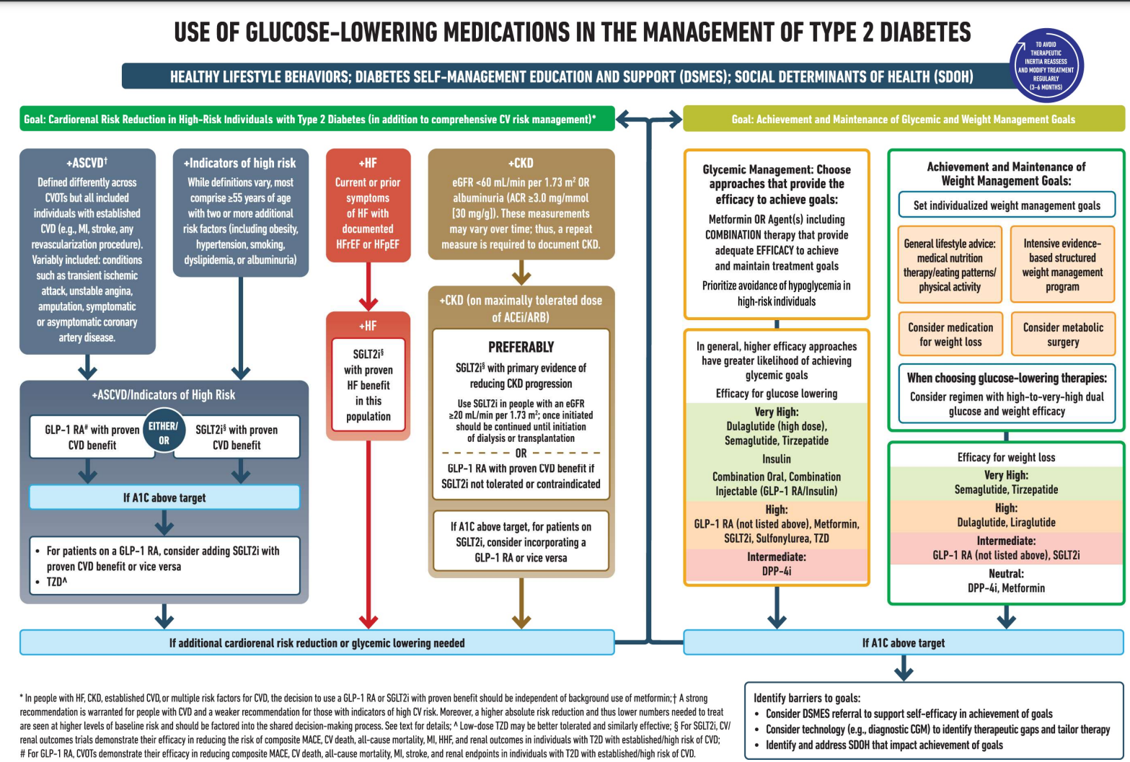

ADA Algorithm: Where do GLP-1 Fit?

Slide 52
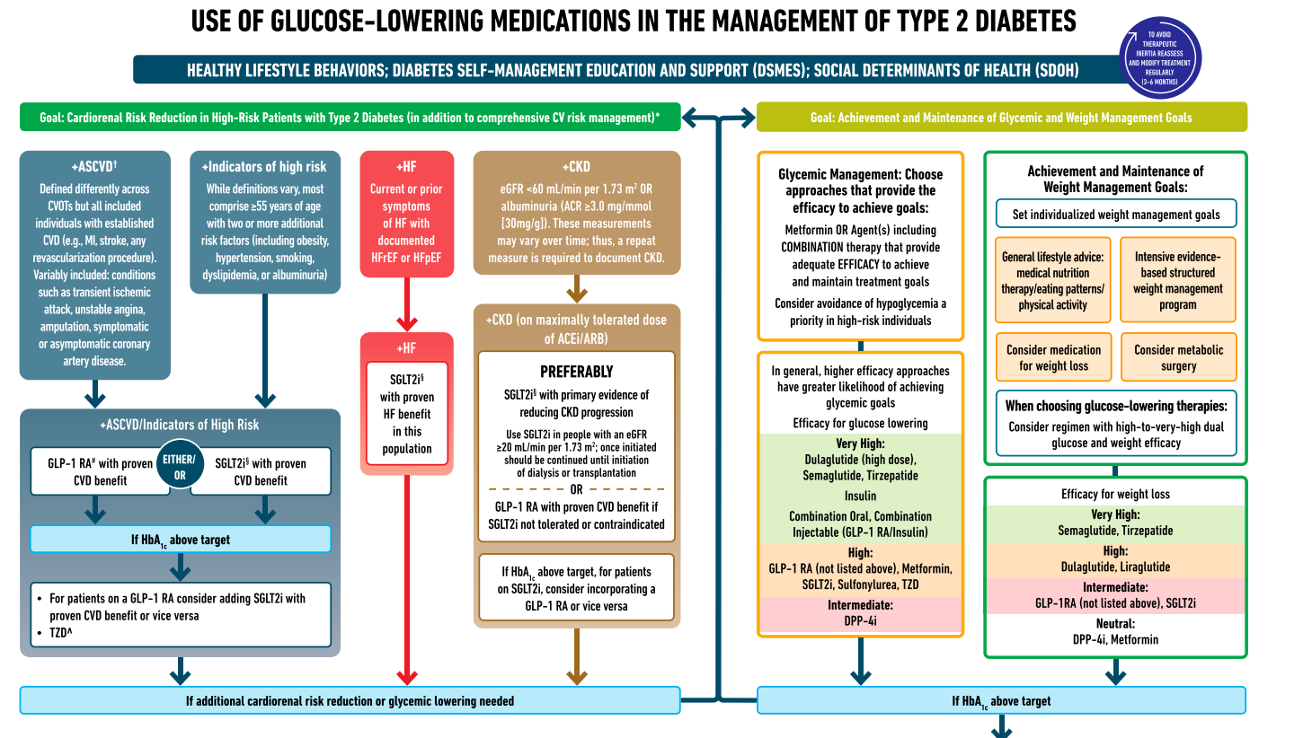

ADA Meds Algorithm

Slide 53
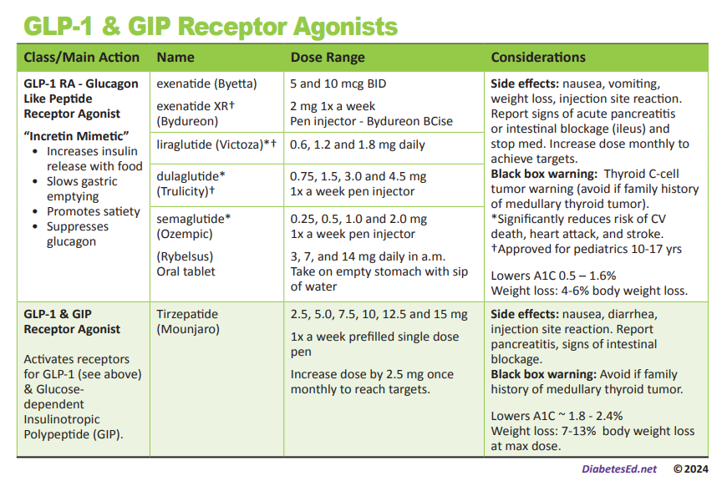

Slide 54
GLP-1 /GIPs Approved for Weight Loss
Liraglutide:
  Victoza 1.8 mg (diabetes)
  Saxenda 3 mg (wt loss)
  6% wt loss, $1349 a mo
Semaglutide:
  Ozempic 2mg (diabetes)
    Wegovy 2.4mg (wt loss)
  6% wt loss, $1349 a mo
Tirzepatide
  Mounjaro 15mg (diabetes)
  Zepbound (wt loss)
  13% wt loss - $1056 a mo
All 3 Approved for use in adults with a:
  BMI of ≥ 30 or
  BMI of ≥ 27 or greater who have hypertension, type 2 diabetes, or dyslipidemia.

Slide 55
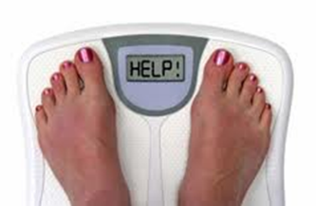
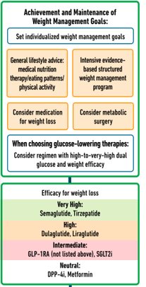
Weight Management
These meds associated with wt loss
  GLP-1 agonists
  SGLT-2 Inhibitors
These meds are weight neutral
  Metformin
  DPP-4 Inhibitors

Slide 56
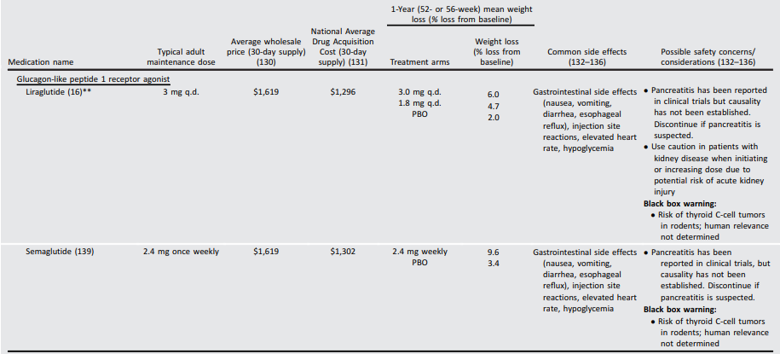
Saxenda & Wegovy Weight Loss
Diabetes Care 2023;46(Supplement_1):S113–S124

Slide 57
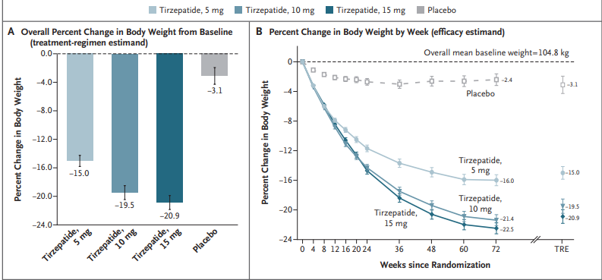
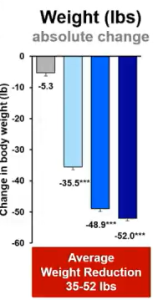
Tirzepatide for Weight Loss: SURMOUNT-1
20.9% weight loss with 15mg dose and 35-52lbs lost!
Jastreboff AM, et al., on behalf of the SURMOUNT-1 Investigators. Tirzepatide Once Weekly for the Treatment of Obesity. N Engl J Med 2022;387:205-16.
Notes:
At baseline, the mean body weight was 104.8 kg, the mean BMI was 38.0, and 94.5% of participants had a BMI of 30 or higher. The mean percentage change in weight at week 72 was −15.0% (95% confidence interval [CI], −15.9 to −14.2) with 5-mg weekly doses of tirzepatide, −19.5% (95% CI, −20.4 to −18.5) with 10-mg doses, and −20.9% (95% CI, −21.8 to −19.9) with 15-mg doses and −3.1% (95% CI, −4.3 to −1.9) with placebo (P
In this phase 3 double-blind, randomized, controlled trial, we assigned 2539 adults with a body-mass index (BMI; the weight in kilograms divided by the square of the height in meters) of 30 or more, or 27 or more and at least one weight-related complication, excluding diabetes, in a 1:1:1:1 ratio to receive once-weekly, subcutaneous tirzepatide (5 mg, 10 mg, or 15 mg) or placebo for 72 weeks, including a 20-week dose-escalation period. Coprimary end points were the percentage change in weight from baseline and a weight reduction of 5% or more. The treatment-regimen estimand assessed effects regardless of treatment discontinuation in the intention-to-treat population.

Slide 58
Incretin Mimetics – How Do They Rate?
Question Answer
Cause hypoglycemia?
Cause weight gain?
Affordable?
Lowers CV risk?
Can most tolerate /use?
No
No
No, $1000/month
Liraglutide / Semaglutide/Dulaglutide
Yes/No (GI)
4.5

Slide 59
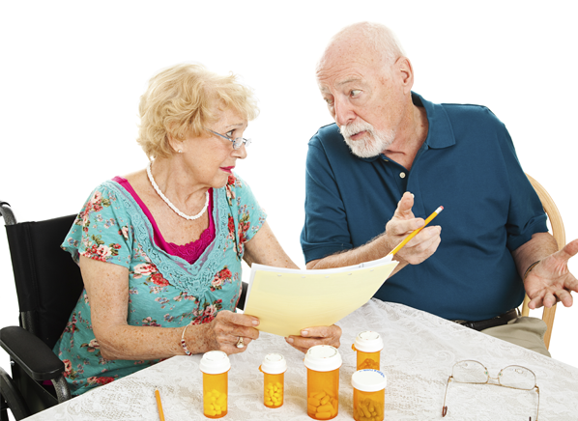
Medication Taking Behaviors
Adequate medication taking is defined as 80%
23% of time, if A1c, B/P, lipids above target - due to med taking behavior
Assess for barriers
If taking meds 80% of time and goals not met, consider medication intensification
Barriers include:
Forgetting to fill Rx, forgetting to take, fear, depression, health beliefs, med complexity, cost, knowledge gap, system factors, etc.
Work on targeted approach for specific barrier

Slide 60


Pre Diabetes & Type 2- Screening Guidelines (ADA 2024 Clinical Practice Guidelines)
Start screening all people at age 35.
Screen at any age if BMI ≥ 25 (Asians BMI ≥ 23) plus one or > additional risk factor:
  First-degree relative w/ diabetes
  Member of a high-risk ethnic population
  Habitual physical inactivity
  *PreDiabetes
  History of heart disease
  *Taking high risk meds; antiretrovirals, 2nd generation antipsychotics or steroids
  History of pancreatitis

Slide 61
Second-Generation Antipsychotic Meds and Diabetes Risk
People taking these meds require frequent monitoring due to increased risk of hyperglycemia and other metabolic effects.
There is a range of effects across second-generation antipsychotic medications;
  Olanzapine, haloperidol, clozapine, quetiapine, and risperidone tend to have more metabolic effects.
  Aripiprazole and ziprasidone tend to have fewer metabolic effects.
  It taking these agents, screen for prediabetes or diabetes at baseline, rescreen at 12–16 weeks after medication initiation, and screen annually thereafter ADA 2024

Slide 62

Diabetes 2 - Who is at Risk?
(ADA 2024 Clinical Practice Guidelines)
Risk factors cont’d
  HTN - BP > 130/80
  HDL < 35 or triglycerides > 250
  History of Gestational Diabetes Mellitus
  Polycystic ovary syndrome (PCOS)
  Other conditions associated w/ insulin resistance:
    Elevated BMI, acanthosis nigricans (AN)
Screen using A1C, Fasting Blood Glucose or OGTT.
Repeat screening at least every 3 years if negative.
*If prediabetes or on high risk meds, recheck yearly

Slide 63
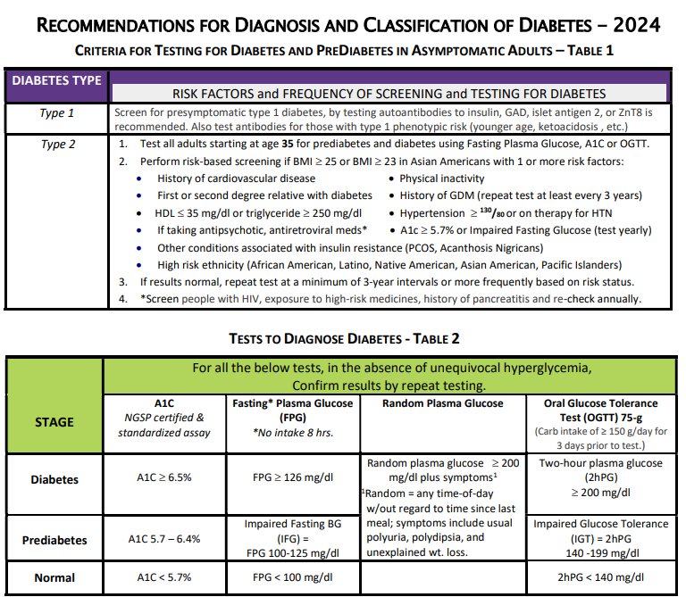
DiabetesEd.net Cheat Sheets

Slide 64

Poll Question 3
Which of the following level is considered pre-diabetes range?
  a. Fasting BG of 62
  b. A1c of 5.9 %
  c. After meal BG of 137
  d. A1c of 7.1 %

Slide 65
Natural History of Diabetes
Healthy
FBG <100
Random <140
A1c <5.7%
Prediabetes
FBG 100-125
Random 140 - 199
A1c ~ 5.7- 6.4%
~ 50% working pancreas
Diabetes
FBG 126 +
Random 200 +
A1c 6.5% or +
~ 20% working pancreas
Yes!
NO
Development of type 2 diabetes happens over years or decades

Slide 66

PreDiabetes is FREAKING ME OUT
96 million people in US
80% don’t know they have it
In 3-5 years, about 30% of predm will get diabetes
Associated with higher rates of heart attack, stroke, neuropathy and vessel disease
Why isn’t is called stage 1 diabetes?

Slide 67

Poll Question 4
What best describes prediabetes in the U.S.?
  Prediabetes affects 18-20% of people above the age of 20.
  The prevalence of prediabetes and diabetes are almost equal.
  Most people with BMI of 30 or greater have prediabetes.
  Prediabetes is associated with increased risk of CV disease

Slide 68


3. Detecting PreDiabetes Matters
Given the cost-effectiveness of lifestyle behavior modification programs for diabetes prevention:
  Offer diabetes prevention programs to adults at high risk of type 2 diabetes
  Should be covered by third-party payers,
  Address inconsistencies in access
Screening guidelines for people with Type 1

Slide 69


3. Prevent or Delay Diabetes for those with Prediabetes
Prediabetes defined as:
  A1c 5.7 – 6.4% or fasting BG 100 -125mg/dl
Action:
  Screen yearly for diabetes
  For adults with BMI 23/25
    Refer to DPP approved programs
    Includes intensive behavioral lifestyle interventions with 7% wt reduction goal + 150 min exercise week
    Provide in person or certified assisted programs

Slide 70
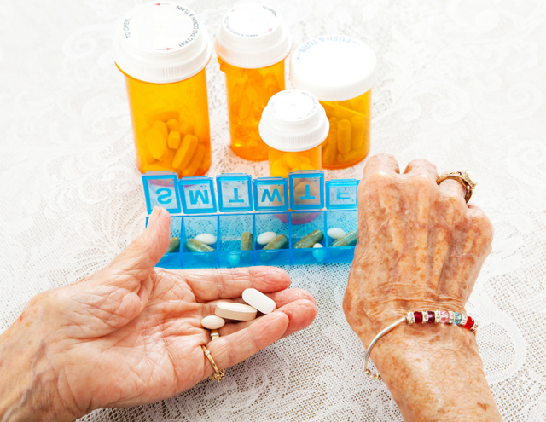
3. Prediabetes Pharmacologic Intervention
No FDA approved med for prevention (off label)
Consider Metformin Therapy for Prediabetes
Especially for ages 25-59
  BMI of 35+
  If A1c is ~6.0 or FPG is 110mg/dL
  Women with history of GDM
Monitor B12 level (esp with neuropathy or anemia)
CV Risk Mitigation important.
Statin can increase BG, stop if notice elevation
Consider low dose pioglitazone (Actos) if history of stroke.

Slide 71

Diabetes is Complex
Goal – achieve well being and negotiated outcomes
Psychological factors:
  Environmental
  Social
  Behavioral
  Emotional
Keep it person centered while integrating care into daily life
  Consider the individual

Slide 72

Tailoring Treatment for Social Context
“Social determinants of health (SDOH)—often out of direct control of the individual and potentially representing lifelong risk—contribute to health care and psychosocial outcomes and must be addressed to improve all health outcomes”
The ADA recognizes this relationship and is taking action.

Slide 73

Remember by Joy Harjo – Poet Laureate
Remember the earth whose skin you are:
red earth, black earth, yellow earth, white earth, brown earth, we are earth.
Remember the plants, trees, animal life who all have their tribes, their families, their histories, too. Talk to them,
listen to them. They are alive poems.
Remember the wind. Remember her voice. She knows the origin of this universe.
Remember you are all people and all people
are you.
Remember you are this universe and this
universe is you.
Remember all is in motion, is growing, is you.
Remember language comes from this.
Remember the dance language is, that life is.
Remember.
We are all connected

Slide 74

Person Centered Care
Emphasize that a collaboratively developed plan improves well-being and outcomes.
Provides care that is respectful and responsive to the individuals preferences, needs and values.
Ensuring that the person’s values guide all clinical decisions
Recognizes the expert within.
Goal is to improve outcomes and encourage self-management for the long run.

Slide 75
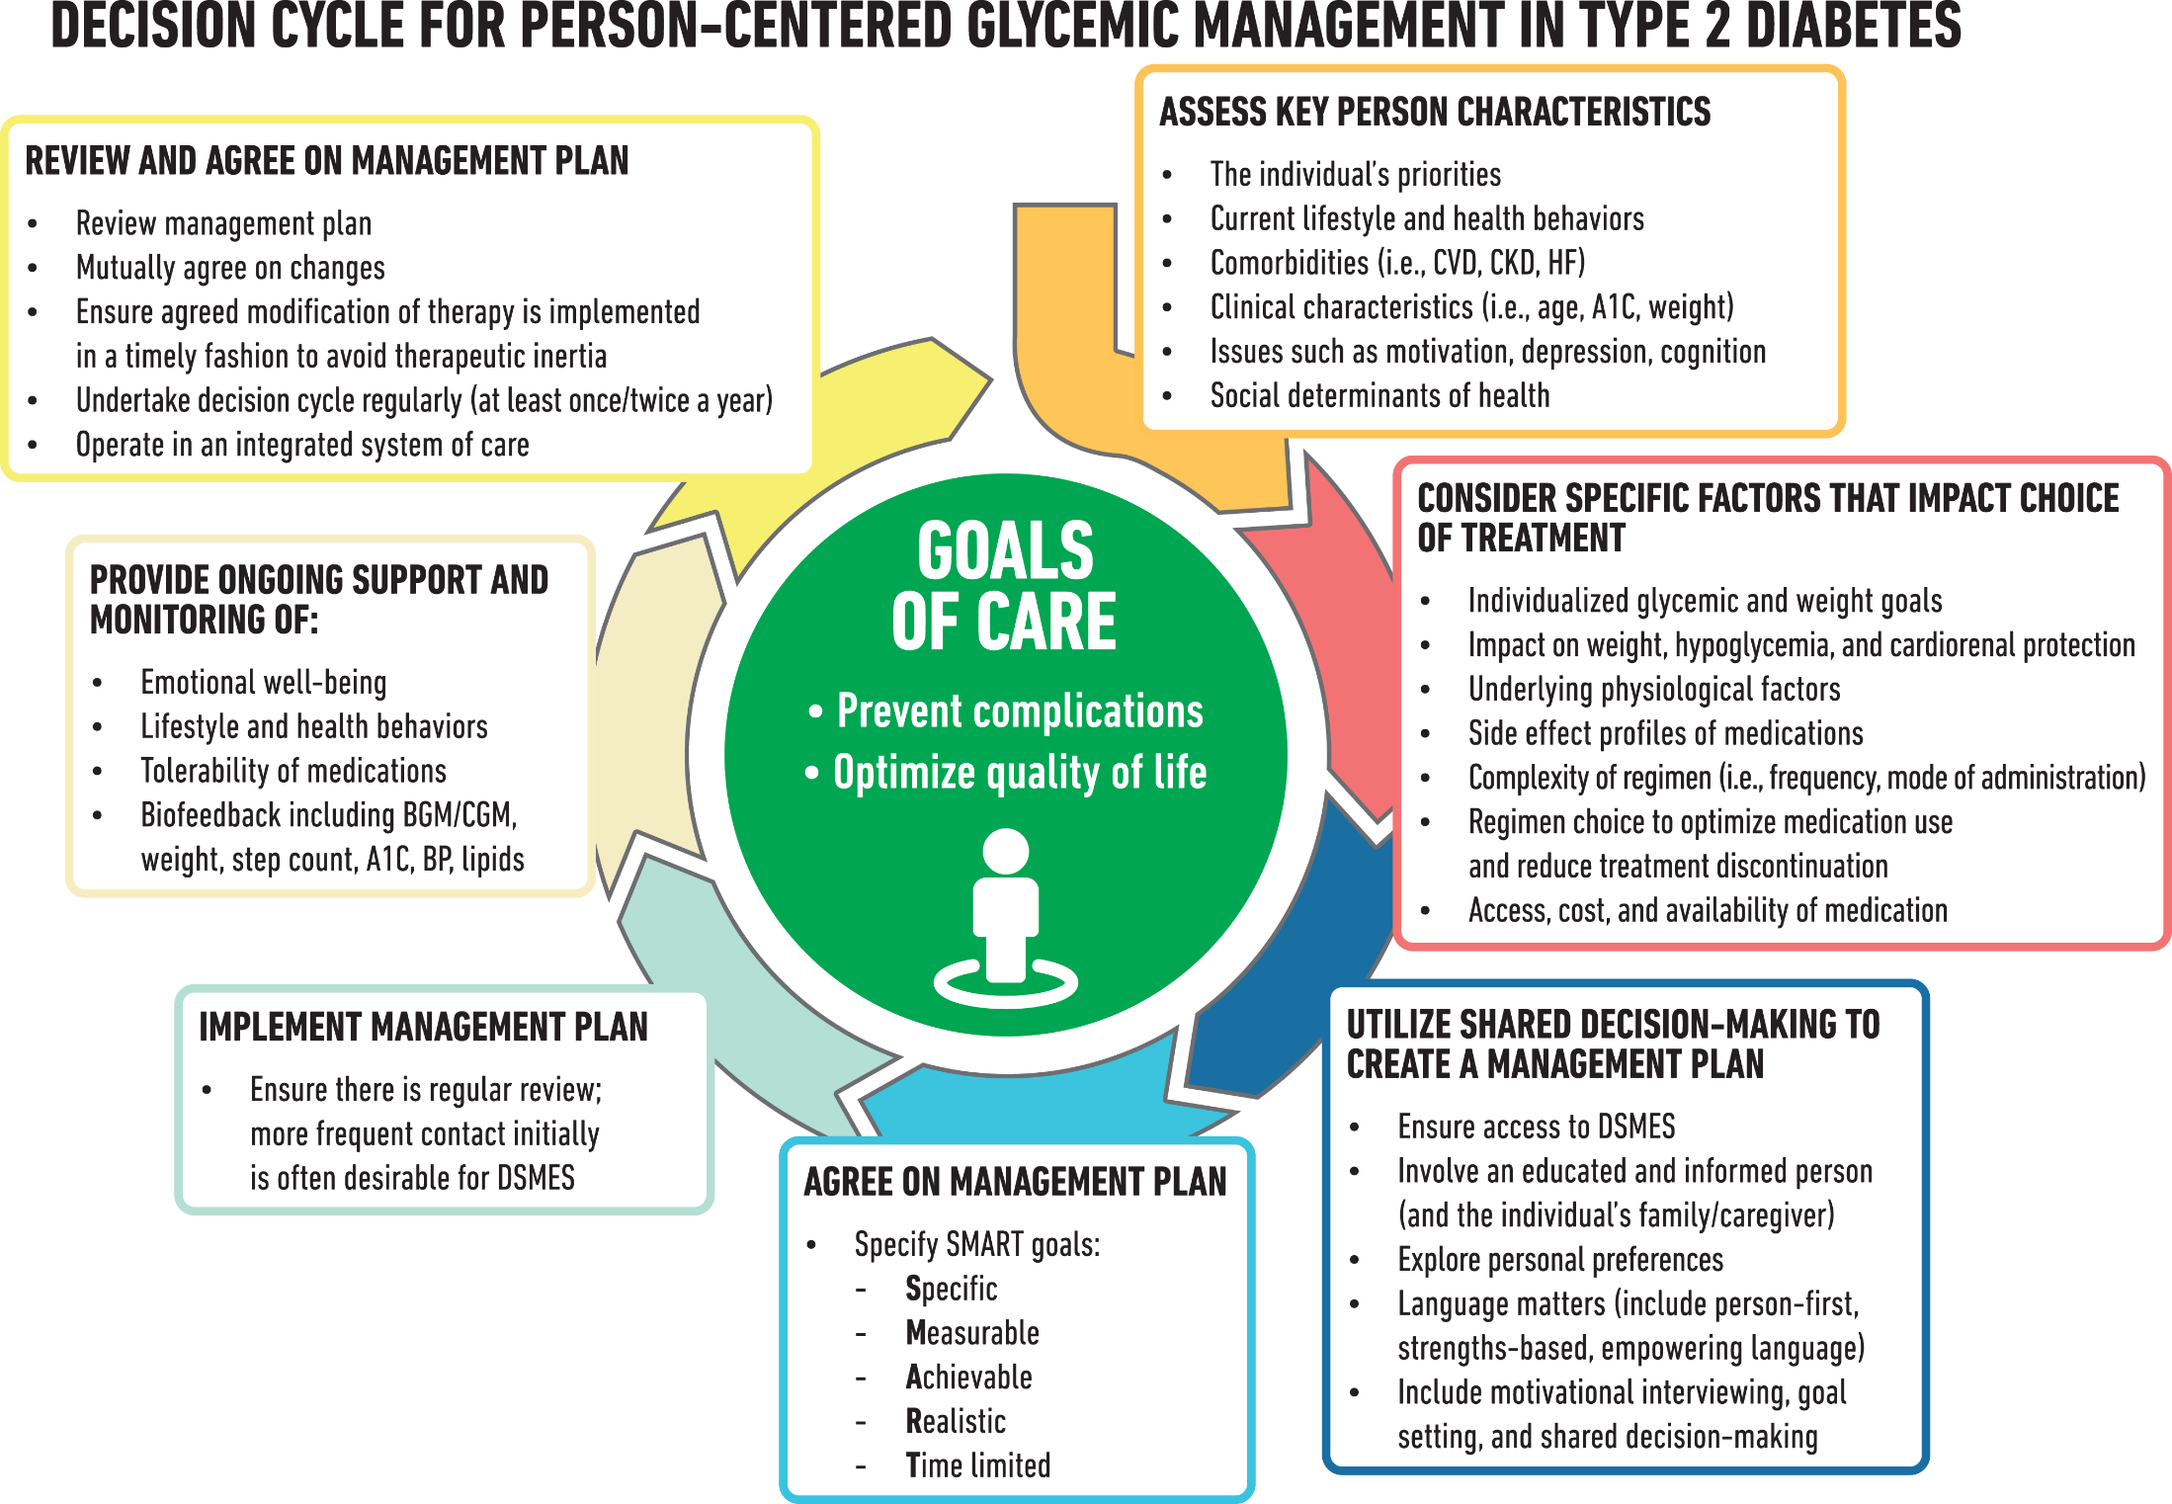
American Diabetes Association
ADA Standard 4 2023

Slide 76

Let’s meet people where they are at.

Slide 77

Type 1 ~ Immune Mediated Diabetes

Slide 78


Slide 79



“Diabetes is my biggest competitor” Gary Hall Jr

Slide 80

Poll Question 3
JR’s mom has type 1 diabetes and JR’s dad has type 2 diabetes. JR is 28 years old and in the emergency room with a glucose of 482 mg/dl. Besides checking glucose, ketones and A1C levels, which of the following lab test can be used to determine if someone has autoimmune diabetes?
Endogenous insulin titer
Glutamic Acid Decarboxylase
Beta cells auto antibodies
Langerhan’s antibody

Slide 81

How do we know someone has Type 1 vs Type 2?
Type 1 - Positive antibodies
  GAD - glutamic acid decarboxylase (primary)
  IA2 - islet antigen 2, or
  ZnT8 - zinc transporter 8
Can also check C-peptide levels to determine endogenous insulin production
Younger people develop quickly
Older people take longer to develop
“misdiagnosis is common and can occur in ∼40% of adults with new type 1 diabetes”

Slide 82

Determine if Type 1 - Use AABBCC Approach
Age
  e.g., for individuals <35 years old, consider type 1 diabetes
Autoimmunity
  e.g., personal or family history of autoimmune disease or polyglandular autoimmune syndromes
Body habitus
  e.g., BMI <25 kg/m2
Background
  e.g., family history of type 1 diabetes
Control
  e.g., level of glucose control on noninsulin therapies
Comorbidities
  e.g., treatment with immune checkpoint inhibitors for cancer can cause acute autoimmune type 1 diabetes or presence of other autoimmune conditions

Slide 83


Type 1 Diabetes Features?
For JR, a 28 admitted to the ICU with a blood glucose of 476 mg/dl, pH of 7.1, anion gap of 15. Recently lost 13 pounds.
Type 1 Most Discriminative Features
Younger than 35 years at diagnosis
Lower BMI (<25 kg/m²)
Unintentional weight loss
Ketoacidosis
Glucose 360 mg/dl or greater.

Slide 84
Type 1 Diabetes Progression
 | Stage 1 | Stage 2 | Stage 3
Characteristics | • Autoimmunity | • Autoimmunity | • Autoimmunity
 | • Normoglycemia | • Dysglycemia | • Overt hyperglycemia
 | • Presymptomatic | • Presymptomatic | • Symptomatic
Diagnostic criteria | • Multiple islet autoantibodies GAD, glutamic acid decarboxylase (primary) islet antigen 2, or Zinc transporter 8 (ZnT8) | • Islet autoantibodies Dysglycemia: Elevated IFG and/or IGT • FPG 100–125 mg/dL • 2-h PG 140–199 mg/dL • A1C 5.7–6.4% or ≥10% increase in A1C | • Autoantibodies may disappear over time (5-10% may not express antibodies) • Diabetes diagnosed by standard criteria
www.DiabetesEd.net

Slide 85
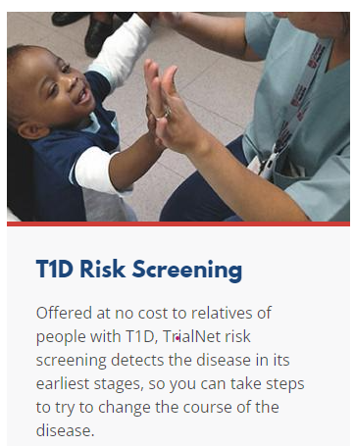
3. Prevention or Delay of Diabetes and Associated Comorbidities (for Preclinical Type 1 Diabetes)
Positive Antibodies with Prediabetes:
  A1c 5.7 – 6.4% or fasting BG 100 -125mg/dl
Action:
  Screen A1C every 6 months
  75- OGTT every year
  Modify screening based on antibodies and glycemic metrics.
  May benefit from CGM to monitor progression
Trialnet.org

Slide 86
Type 1 & Lifestyle Prevention
Observational studies in those with antibodies, shed light on factors that increase β-cell demand:
  Less physical activity
  Consuming higher glycemic index foods
  Sugar intake.
Factors that reduced risk of progression from TEDDY study:
Daily minutes spent doing vigorous physical exercise.
More info needed

Slide 87

Pharmacologic Intervention to Delay Symptomatic Type 1 (in Stage 2)
Teplizumab-Tzield (CD3-monoclonal antibody)
14-day infusion can delay the onset of symptomatic type 1 diabetes (stage 3)
An option in selected individuals aged ≥8 years with stage 2 type 1 diabetes.
In a single trial, 44 individuals received 14-day course of teplizumab vs 32 placebo.
The median time to stage 3 diagnosis of type 1
  48.4 months in tep group
  24.4 months placebo

Slide 88
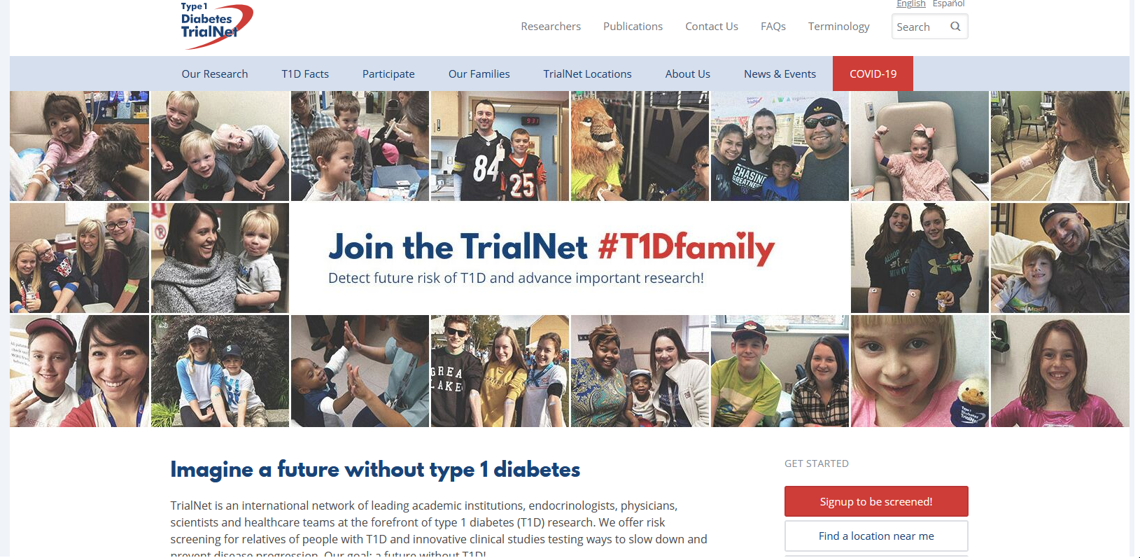
  Type 1 (stage 2) Delayed with Teplizumab by 2 years www.DiabetesTrialNet.org
How to get families linked to screening?

Slide 89
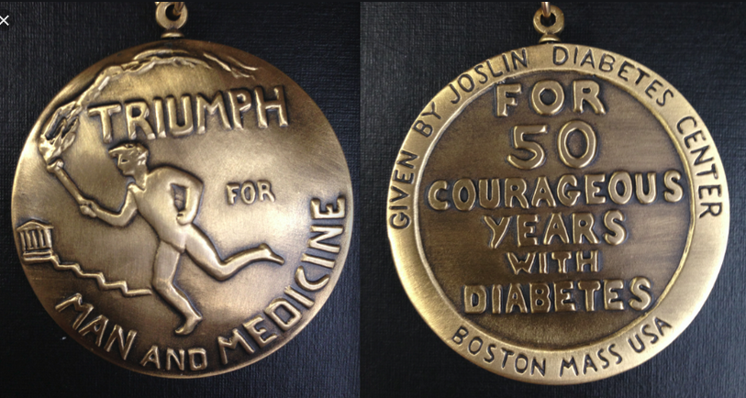

Medalist Study – Harvard Joslin Diabetes Center
After 50 years with diabetes
  Many still produced some insulin
  Many had no eye disease

Slide 90
Quick Question
Question: LT has just been diagnosed with stage 2, type 1 diabetes. They have 2 positive antibodies and their blood sugars are slightly elevated. They ask you if they are a candidate for “that therapy” that can protect their beta cells and slow progression of type 1 diabetes. What is the most accurate response?
  Unfortunately, you are not a candidate, since you already have 2 positive antibodies.
  Let’s talk to your provider about the possibility of starting Teplizumab therapy.
  With your blood sugar elevation, the best early intervention is insulin therapy.
  Since you are already in stage 2, the monoclonal antibody therapy won’t be effective.

Slide 91

What kind of Diabetes?
58 yr old, states she has had type 1 diabetes for 18 years. Quit smoking a year ago and gained about 20 lbs. BMI 25.
Meds
  Humalog 18-23 units before each meal
  Glargine 28 units at bedtime
  Metformin 500mg TID
What tests would you recommend?
25% of ind’s with Type 1 also have type 2 diabetes.
ADA Post Grad, 2010

Slide 92
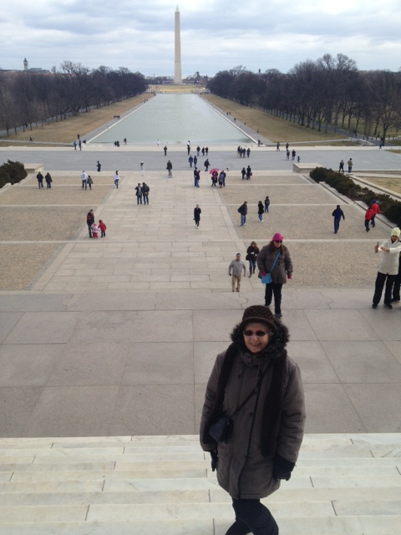
What type of Diabetes?
72 Years old
A1c 3 months prior 6.2%
A1c now 13.9%
BMI 24.5
Lost about 10 pounds over last month

Slide 93

Latent AutoImmunity Diabetes in Adults (LADA)
Antibody positive to 1-2 of below
  GAD-65 autoantibodies
  Insulin Autoantibodies
  Islet Cell antigen-2
Adult Age at onset
Usually need insulin w/in first 6 months of diagnosis
Early insulin therapy may preserve beta cell function
Diabetes Care 26:536-538, 2003
Jerry P. Palmer, MD and Irl B. Hirsch, MD

Slide 94
LADA Clinical Features Compared to Type 2
Feature LADA Type 2
Age <50 63% 19%
Acute hyperglycemia 66 24
BMI < 25 33 13
Hx of autoimmune dx 27 12
Family hx autoimmune 46 35
Practical Diabetology March 08, Unger MD

Slide 95
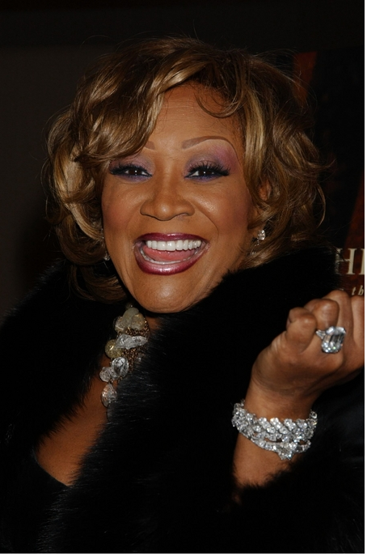
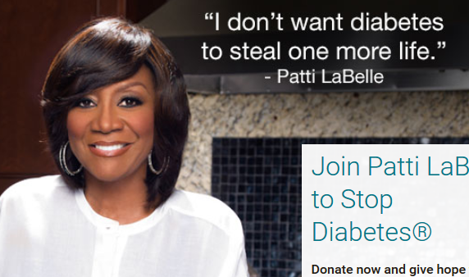
Patti Labelle
"divabetic”
“I have diabetes, it doesn’t have me”

Slide 96

BMI – Visual Image

Slide 97
Signs of Diabetes
Polyuria
Polydipsia
Polyphasia
Weight loss
Fatigue
Skin and other infections
Blurry vision
Glycosuria, H₂O losses
Dehydration
Fuel Depletion
Loss of body tissue, H₂O
Poor energy utilization
Hyperglycemia increases incidence of infection
Osmotic changes

Slide 98




Slide 99

What is Type 2 Diabetes?
Complex metabolic disorder ….
  (Insulin resistance and deficiency)
with social, behavioral and environmental risk factors unmasking the effects of genetic susceptibility.
New Diagnosis?
Call 800 – DIABETES to request “Getting Started Kit”
www.Diabetes.org

Slide 100

Ominous Octet
Decreased
satiation neuro-
transmission
Decreased
amylin, β-cell secretion
80% loss at dx
Increased renal glucose reabsorption
Decreased
Gut hormones
Increased glucagon secretion
G
I
G
I
G
G
I
I
G
Increased lipolysis
G
G
I
I
G
G
I
Increase glucose
production
I
G
G
Decreased glucose
uptake
Notes:
100
100

Slide 101

SGLT-2 Inhibitors

Slide 102

SGLT and the Kidney

Slide 103
Poll Question 7
A potential side effect of SGLT-2 Inhibitors is:
Urinary tract infections
Hypertension
Kidney tenderness
Increased uric acid

Slide 104





SGLT2 Inhibitors- “Glucoretics”
Action: decreases renal reabsorption of glucose proximal tubule of kidneys (reset renal threshold)
Preferred diabetes treatment for people with heart and kidney failure. Decreases BG & CV Risk.
AWP: ~$650 a month
% ‘f
Notes:
104
104
Thiazolidinediones (TZDs) enhance insulin sensitivity in muscle and adipose tissue by binding to cell receptors,which leads to an increase in glucose transporter expression. TZDs encourage beta cells to respond more efficiently by lowering the amount of glucose and free fatty acids in the bloodstream, both of which are known to be detrimental to insulin secretion. Finally, these drugs reduce glucose production in the liver.
Clinical trials indicate that pioglitazone and rosiglitazone are slightly more effective at reducing A1C (1.5-1.6% reduction) than troglitazone (1.1% reduction).
Some of the beneficial side effects of thiazolidinediones include an increase in HDL cholesterol and reduction of triglyceride concentrations. This class of drugs has also been shown to lower blood pressure and decrease vascular inflammation in vitro. There are clinical studies underway to further examine the cardiovascular benefit to TZDs.
Some adverse effects of TZDs include weight gain, a potential increase in LDL cholesterol levels, and a possible increase in alanine aminotransferase levels (ALT). Because of the risk of weight gain, edema, and increased LDL cholesterol, thiazolidinediones are contraindicated in patients with advanced forms of congestive heart failure. Due to reported cases of liver failure and liver toxicity caused by the increase in ALT levels, TZDs are contraindicated in patients with abnormal liver function.
TZDs are the most expensive of the oral antidiabetic agents.

Slide 105
SGLT-2i Indications Summary
Drug | Lower BG | Reduce CV Risk? | Use to treat Heart Failure? | Slow renal disease?
Dapagliflozin (Farxiga) | Yes | Yes | Yes +/- Diabetes | Yes
Empagliflozin (Jardiance) | Yes | Yes | Yes +/- Diabetes | Yes
Canagliflozin (Invokana) | Yes | Yes | Yes w/ Diabetes | Yes
Ertugliflozin (Steglatro) | Yes | No | Yes w/ Diabetes | Yes
Bexagliflozin (Brenzavvy) | Yes | NA | NA | NA
Package inserts, dailymed.nlm.nih.gov

Slide 106
Benefits of SGLT-2 Inhibitors
A1C lowering
Weight loss
Cardiovascular
Renal
Heart failure
Blood pressure lowering

Slide 107
Side Effects of SGLT-2 Inhibitors
Genitourinary infections
Volume depletion
Increased urination
Hypotension
UTI
Diabetes ketoacidosis (DKA)
Amputation risk? Fournier’s gangrene?
Notes:
Cana: bone mineral density decline: hip ≤1%; lumbar spine, femoral neck, and distal forearm <1%
UTI: 6%Genito infection: 11-12%
Increased serum K+: 9-27%
Amputation risk
Emgag: UTI: females 18%, males 4%
Genito infection: 5%
Dapag: UTI: 6%, genito infection: 3%

Slide 108
SGLT2i: Managing Adverse Effects
Maintain good hygiene to reduce risk of genital mycotic infections
  Higher risk with higher glucose
DKA risk
  Use caution with reducing insulin dose
Monitor BP
  May need to reduce antihypertensive meds
UTI risk greater with hyperglycemia
Amputations observed with canagliflozin
  Good foot care, check feet daily
Monitor renal function/potassium

Slide 109

Case Study: Rick
Rick is a 51yoM diagnosed with type 2 diabetes 5 years ago.
He takes metformin 1000mg twice daily and semaglutide 2mg weekly. His A1C=7.3%.
In the last 3 months, he was diagnosed with kidney disease. He has albuminuria and eGFR=50.
Weight: 205lbs, 5”7, BMI=32kg/m²
He lost 20lbs in the last year
Notes:
Answer: D Metformin

Slide 110
Case Study: Rick (continued) Poll 8
What is the best drug to add to Rick’s regimen?
Glipizide
Dapagliflozin (Farxiga)
Pioglitazone (Actos)
Linagliptin (Tradjenta)
More than 1 correct answer
Notes:
Don’t forget managing other risk factors:
Use of ACE-inhibitor,/ARB, BP management, +/- finerenone
Statin for CV risk

Slide 111
SGLT2 Inhibitors- How do they rate?
Question Answer
Cause hypoglycemia?
Cause weight gain?
Affordable?
Lowers Cardiorenal risk?
Can most tolerate /use?
No
No
No
Yes
Yes

Slide 112

“Getting diabetes saved my life.”
~ Sherri Sheperd
Sherri Shepard decided to embrace diabetes and use it as a motivator to improve her health.

Slide 113
Comparison of Type 1,Type 2, LADA
Type 1
Type 2 LADA
Excess weight
x
xxx x
Insulin dependence
xxx
30% 6mos
Respond to oral agents
0
xxx x
Ketosis
xxx
x x
Antibodies present
xxx
0 xx
Typical Age of onset
teens
adult adult
Insulin Resistance
0
xxx
x

Slide 114


Other Types of Diabetes
Gestational
Other specific types of diabetes

Slide 115

Screening in early Pregnancy
Check glucose before 15 weeks of gestation:
  Can find undetected diabetes or hyperglycemia
  Prevent fetal exposure to hyperglycemia
  Allows providers and pregnant people to take action to prevent complications
Use standard diabetes diagnostic criteria.
  If positive, diagnosis “Diabetes in Pregnancy”
If fasting BG 110+ or A1C 5.9%+
  At higher risk of adverse outcomes and more likely to experience GDM and need insulin.
  If BG in normal range, recheck at 24-28 weeks for Gestational Diabetes

Slide 116

Poll question 9
What best describes gestational diabetes?
Diabetes discovered within the first 12 weeks of pregnancy.
Diabetes discovered in the 24-28 weeks of pregnancy.
Risk of getting diabetes before pregnancy.
Diabetes discovered at any point during pregnancy.

Slide 117

Gestational DM ~ 9% of all Pregnancies
Detected at 24-28 weeks of pregnancy (most insulin resistant phase)
50% chance of getting diabetes post delivery
Offspring at greater risk of insulin resistance and diabetes

Slide 118

Rates of Gestational Diabetes (GDM) and Diabetes in Pregnancy increasing
1% to 2% have type 1 or type 2 during pregnancy
6% to 9% develop GDM.
From 2000 to 2010
  GDM rates increased 56%
  Type 1 or type 2 before pregnancy increased 37%.
Asian and Hispanic women have higher rates of GDM
Black and Hispanic women have higher rates of type 1 or type 2 diabetes during pregnancy.
CDC https://www.cdc.gov/reproductivehealth/maternalinfanthealth/diabetes-during-pregnancy.htm

Slide 119


See Diabetes and Pregnancy Level 2
Screening and Diagnosis of Diabetes Cheat Sheet

Slide 120

Gestational Diabetes and Pregnancy
Test for GDM at 24-28 weeks
Test GDM women for post partum diabetes at 4-12 weeks, using OGTT
Women with GDM need lifelong screening for prediabetes/diabetes at least every 3 yrs
Women with hx of GDM, found to have prediabetes need intensive lifestyle interventions or metformin to prevent diabetes.

Slide 121

Other Specific Types of DM
Medications such as: steroids, protease inhibitors and Prograf®
Secondary to Agent Orange
Liver failure
TPN or tube feedings
Pancreatic cancers or removal
Cystic fibrosis, pancreatitis
Other

Slide 122

Regardless of the cause, hyperglycemia needs to be treated.

Slide 123

6. Glycemic Targets
  A1C
  Blood Pressure
  Cardiovascular risk reduction

Slide 124

ABC’s of Diabetes
A1c less than 7% (individualize)
  Pre-meal BG 80-130
  Post meal BG <180
  AGP - Time in Range (70-180) 70% of time
Blood Pressure < 130/80
Cholesterol
  Statin therapy based on age & risk status
  If 40+ with ASCVD Risk, decrease 50%, LDL <70
  If 40+ with ASCVD, decrease 50%, LDL <55

Slide 125

6. Glycemic Targets for Non-Pregnant Adults
  A1c < 7% - a reasonable goal for adults.
  A1c < 6.5% - for those without significant risk of hypoglycemia
  A1c < 8% - for those with history of hypoglycemia, limited life expectancy, or those with longstanding diabetes and vascular complications.
  A1c Check Frequency:
    If meeting goal - At least 2 times a year
    If not meeting goal – Quarterly
  Also review Ambulatory Glucose Profile

Slide 126
6. Glycemic Targets
Individualize Targets – ADA
  Pre-Prandial BG 80- 130
  1-2 hr post prandial < than 180
    *for nonpregnant adults
  Time in Range: 70%
    BG of 70-180 mg/dL

Slide 127


A1c and Estimated Avg Glucose (eAG)
A1c (%) eAG__
5 97 (76-120)
6 126 (100-152)
7 154 (123-185)
8 183 (147-217)
9 212 (170 -249)
10 240 (193-282)
11 269 (217-314)
12 298 (240-347)
eAG = 28.7 x A1c-46.7 ~ 29 pts per 1%
Translating the A1c Assay Into eAG – ADAG Study

Slide 128


Slide 129

BGM vs CGM
= glucometer readings
Undetected hyperglycemia
Undetected hypoglycemia
Image created and permission to use granted by John Moorman, PharmD.
SMBG, self-monitoring of blood glucose.

Slide 130

A1C Alone is Just Not Enough
https://diatribe.org/time-range.

Slide 131

Time in Range
Evaluate Time in Range (TIR)
  Target 70-180 mg/dl
  Target time below goal
    Less than 70
    Less than 54
  Target time above goal
    Above 180
    Above 250
Battelino T, et al. Diabetes Care. 2019;42(8):1593-1603.

Slide 132
Estimation of A1c for a Given TIR
TIR⁷⁰⁻¹⁸⁰ (%) | Estimated HbA1c (%) | 95% CI for the predicted value
20 | 9.4 | (8.0, 10.7)
30 | 8.9 | (7.7, 10.2)
40 | 8.4 | (7.1, 9.7)
50 | 7.9 | (6.6, 9.2)
60 | 7.4 | (6.1, 8.8)
70 | 7.0 | (5.6, 8.3)
80 | 6.5 | (5.2, 7.8)
90 | 6.0 | (4.7, 7.3)
10% ΔTIR ≈ 0.5% ΔHbA1c
Beck RW, et al. J Diabetes Sci Technol. 2019;13:614-626.
Notes:
Beck RW, Bergenstal RM, Cheng P, Kollman C, Carlson AL, Johnson ML, Rodbard D. The Relationships Between Time in Range, Hyperglycemia Metrics, and HbA1c. J Diabetes Sci Technol. 2019 Jul;13(4):614-626. doi: 10.1177/1932296818822496. Epub 2019 Jan 13. PMID: 30636519; PMCID: PMC6610606.

Slide 133

Ambulatory Glucose Profile Report
CGM key metrics
AGP
Daily tracings

Slide 134

15. ADA Pregnancy Targets –
For those with type 1, type 2 and GDM
A1c < 6-6.5% (closer to 6 in 2nd/3rd tri)
Fasting and Post Meal BG Goals
  Fasting glucose 70–95 mg/dL and either
  One-hour postprandial glucose 110–140 mg/dL or
  Two-hour postprandial glucose 100–120 mg/dL
Time in range: 63-140 mg/dL
Battelino T, et al. Diabetes Care. 2019;42(8):1593-1603.

Slide 135

Lunch Break 12:00 to 12:55 PDT
Question and Answer Session from
12:55 to 1pm

Slide 136

Pharmacologic Treatment during Pregnancy
Insulin is preferred therapy for GDM, type 1 and 2
  Does not cross placenta
  Can overcome insulin resistance assoc w/ type 2
Sulfonylureas pass through placenta / associated with neonatal hypo (glyburide)
Metformin – lower risk of hypo and maternal wt gain but may increase prematurity rate
  Passes through placenta
  If using for PCOS, stop by end of first trimester
Refer to specialized center
ADA SOC 2024

Slide 137

Pregnancy and Hypertension
If pregnant with diabetes and chronic hypertension
  Blood pressure target of 110–135/85 mmHg
    Reduces risk for accelerated maternal hypertension
    Minimizes impaired fetal growth
  Stop potentially harmful medications in prep for pregnancy
    Avoid ACE inhibitors, angiotensin receptor blockers (ARBs), statins in sexually active women of childbearing age if not using reliable contraception
    Stop these meds at conception
    Preferred meds: labetolol, nifedipine
ADA SOC 2023

Slide 138

Case Study - Ricki
Ricki is a 36yoF with a history of GDM and newly diagnosed with type 2 diabetes. A1C=7.4%. Normal kidney function. Past medical history includes hypertension for which she takes HCTZ 25mg daily.
Weight: 220lbs, BMI=34kg/m²
Social history
  Works full time as an accountant
  Skips breakfast, eats a small lunch, eats a large dinner, snacks in evening
  No Exercise
  Loves Starbucks Frappuccino's
Notes:
Answer: D Metformin

Slide 139
Poll. What Treatment Should Ricki Be Started On?
  A. Glipizide (sulfonylurea)
  B. Linagliptin (DPP-4 inhibitor)
  C. Empagliflozin (SGLT-2 inhibitor)
  D. Metformin (Biguanide)
  E. Lifestyle modifications only
Notes:
Answer: D

Slide 140
ADA Meds Management

Slide 141

Metformin is “Usually” 1st Line
Why metformin?
  Longstanding evidence
  High efficacy and safety
  Inexpensive - 3 months for $12
  Weight neutral
If ASCVD, HF or CKD or high ASCVD risk, use SGLT2i or GLP-1 RA +/- metformin
If A1C ≥ 8.5%, consider combo therapy.

Slide 142

AACE 2023 Diabetes Guideline

Slide 143
Quick Question 10
Ricki is started on Metformin 500mg BID. Which of the following is true?
Hold metformin if your blood glucose is below 80 mg/dl
If you forget to take metformin before the meal, hold the dose
Metformin may cause loose stools
Avoid Metformin if GFR is less than 60
Notes:
Correction answer: C

Slide 144


Biguanide derived from:
Goat’s Rue Galega officinalis,
French Lilac
Does NOT harm kidneys
$10 for 3-month supply from Walmart & other pharmacies

Slide 145
Metformin Dosing and Mechanism
Mechanism: decreases hepatic glucose production
Data suggest metformin may be safely continued with eGFR of 30-45 mL/min/1.73m² with dose reductions
Do not initiate when eGFR < 45
Max effective dose: 2000mg/day
Monitor vitamin B12 levels and renal function
GI issues: nausea, vomiting, diarrhea
  Consider long-acting formulation, dose reduction

Slide 146
Metformin – How Does it Rate?
Question Answer
Cause hypoglycemia?
Cause weight gain?
Affordable?
Lowers CV risk?
Can most tolerate /use?
(GI, creat)
No
No
Yes
Yes
Yes/No

Slide 147

Risk-Based Screening for PreDiabetes or Type 2 in Children and Youth
Test youth with excess weight (BMI >85% percentile)
Plus any ONE of following risk factors:
    Maternal diabetes or GDM during child’s gestation
    Family history type 2 in 1st or 2nd degree relative
    Native American, African American, Latin, Asian, Pacific Islander
    Signs of insulin resistance (acanthosis nigricans, HTN, dyslipidemia, Polycystic Ovary Syndrome – PCOS or small for gestational age birth weight
Test at 10 yrs or puberty (whichever is first) and at least every 3 yrs or more frequently if indicated. Consider earlier screening if multiple risk factors.

Slide 148

14. Type 2 and Kids Goals
A1c goal of 7% if on oral meds alone
A1c goal of 7.5% if at risk for hypoglycemia
Some children benefit from A1c of 6.5% or less
Initiate pharmacologic therapy, in addition to lifestyle therapy, at diagnosis
Confirm diagnosis with antibody testing
Treat glucose, B/P and lipids
Engage in lifestyle coaching
Please see Kids and Diabetes Level 2 Course

Slide 149

14. Pediatric Glycemic Targets
A1c goal 6.5 – 8.0% for Type 1
  Generally, goal is <7.0%
  Individualization is encouraged.
  A goal <6.5% may be considered for those at low risk of excessive hypoglycemia
  A goal of <8.0 may be needed
  CGM / Insulin pump important tools.

Slide 150

When Does Old Age Start?

Slide 151

Quick Question 11
What percent of the population over the age of 65 has type 2 diabetes?
  9.3%
  18%
  26%
  34%

Slide 152

13. Older Adults Goals – Whole Picture
Consider the assessment of medical, psychological and self-care domains to provide context to determine targets and therapeutic approaches for management.
Screen for geriatric issues
  polypharmacy,
  cognitive impairment, depression
  urinary incontinence, falls, and persistent pain
  that can affect diabetes self-management and diminish quality of life
See Level 2 Course, Older Adults and Diabetes

Slide 153

Treatment Goals Based On:
  Length of time living with diabetes (new onset, undiagnosed for many years or longer history)
  Presence or absence of complications
  Comorbidities
  Degree of frailty
  Cognitive function
  Life expectancy (often longer than expected)
  Functional status

Slide 154

Poll Question 12
RT, is a healthy 74-year-old who is on metformin 1000mg BID. He has had diabetes for 11 years. His latest A1c was 7.3% What is best response?
  A. Good job, let’s get the A1c less than 7%
  B. Have you been snacking more than usual?
  C. What do you think about your A1c level?
  D. Let’s add on another medication to get your A1c to target.

Slide 155


Healthy & Good Functional Status
Set more intensive goals if:
  Good cognitive and physical function
  Expected to live long enough to reap benefits of intensive management,
Ongoing follow-up to eval safety and hypoglycemia frequency
Goals:
  Reasonable A1c goal <7.0 - 7.5%
  Fasting BG 80 – 130
  Bedtime Glucose 80-180
  Blood Pressure < 130/80
  Statin unless contraindicated or not tolerated

Slide 156
Poll 13 – Review Question
HR is a 78-year-old with a stroke and limited cognition. She has had diabetes for 8 years and is on intensive insulin therapy: Bolus coverage at meals and basal at night. Her A1c is 6.2%. She has a part time care taker. What do you suggest?
A. Evaluate food intake
B. Discuss de-intensifying insulin regimen
C. Move Lantus to morning
D. Stop insulin and start on oral medications

Slide 157

Older Adults with Complications and Reduced Functionality - Less Intense Goals
Intermediate remaining life expectancy, high treatment burden, hypo and fall risk.
Consider DE-Intensification
Goals:
  Reasonable A1c goal <8.0%
  Fasting BG 90 – 150
  Bedtime BG 100-180
  Blood Pressure < 130/80
  Statin unless contraindicated or not tolerated

Slide 158

Older Adults (≥65 years) with diabetes
Annual screening for early detection of mild cognitive impairment or dementia
High priority population for depression screening and treatment
Avoid hypoglycemia in this high risk group
  Prevent hypo by adjusting glycemic targets and adjusting pharmacologic interventions

Slide 159

Older Adults and Medications
In older adults at increased risk of hypoglycemia, meds with low risk of hypoglycemia are preferred.
Overtreatment of diabetes is common in older adults and should be avoided.
Deintensification (or simplification) of complex regimens is recommended to reduce the risk of hypoglycemia, if it can be achieved within the individualized A1C target.

Slide 160

4. ADA – Complete Medical Evaluation
At initial visit :
  Whole person care and psychosocial evaluation
  Explore diabetes self-management and health status
  Evaluate if changes in diabetes treatment would improve well being.
Engagement in formulation of a care management plan
Develop a plan for continuing care

Slide 161
ADA Assess and Treatment Plan
Assess risk of diabetes complications
  ASCVD risk factors and heart failure history
  Stage chronic kidney disease
  Hypoglycemia risk
  Assess for neuropathy, retinopathy
Goal setting
  Set A1C/blood glucose targets & Time in Range
  Address hypertension and lipids
  Diabetes self-management goals
Therapeutic treatment plans
  Lifestyle management – referral to RD, DSME and specialists
  Pharmacologic therapy: glucose lowering
  Pharmacologic therapy: cardiorenal risk factors
  Use of glucose monitoring and insulin delivery devices
  Referral for DSME and RDN

Slide 162

Physical Exam
Height, weight, BMI, pubertal development
Blood pressure
Fundoscopic exam
Skin exam – insulin insertion sites, acanthosis, fungus, sores
Comprehensive foot exam
  Visual eval
  Screen for Peripheral Arterial Disease
  Monofilament and vibration assessment

Slide 163
Quick Question
Why is the evaluation of glomerular filtration rate (GFR) and Urinary Albumin Creatinine Ratio (UACR) of critical importance for people with diabetes?
Answer Choices:
Evaluate if peritoneal or hemodialysis is necessary for the individual.
Determine best anti-hypertensive and glucose pharmacotherapy.
Protect against immune mediated renal complications.
Slow the progression of chronic kidney disease development.

Slide 164

Lab Eval
A1c (each 3-6 mo’s)
Each year
  Lipids
  Liver function
  Spot urinary albumin-to-creat ratio (UACR))
  Serum creat and GFR
  TSH (type 1)
  B12 check (on metformin if needed)
Serum K
  If on ACE, ARBs or diuretics

Slide 165

Referrals for Initial Care Mgmt
Family planning
RDN for Med Nutrition therapy
DSMES - Diabetes Self-Management Education and support
Dentist for comprehensive dental and periodontal examination
Eye Care and Evaluation
Mental health professional
Audiology if indicated
Social Services & Community Resources

Slide 166
ADA – Follow-up Visit to include:
Interval medical history
  Psychosocial Status
  Assess med taking behavior
Physical exam
  Skin appearance
  Ambulation and gate
  Lower extremities, feet
  Activity levels strengthening and cardiovascular workout
Health
  Dental health
  Eye check
  Mammogram
  Vaccinations
  RDN, CDCES, Diabetes Ed Program
Nutritional status and relationship with food
  GI health (constipation, diarrhea, gastroparesis, fatty liver)
  GU health – continence, creat, GFR, creat /alb ratio
  Menstruation and contraception
  Thyroid – Symptoms + TSH
  Heart – blood pressure, chest pain, heart rate, cholesterol

Slide 167
Immunization Schedule for Diabetes 2024
Vaccine | Who by Age | Series and Frequency
Hepatitis B Vaccine | Less than 60 years* | 2-3 dose series
RSV | Adults ≥ 60 years | Single dose
Influenza (avoid live attenuated vaccine) | All | Annually
Tetanus, diphtheria, pertussis (TDAP) | All adults; extra dose during pregnancy | Booster every 10 years.
Zoster | 50+ | 2 dose Shingrix
COVID-19 | Starting at age 6 mo’s | Initial vaccination and boosters
Pneumonia (PPSV23) Pneumovax | Adults19-64* | See Standards for schedule and details and for those 65 or older.
*Pneumococcal Conjugate Vaccine (PCV15, PCV20) | 19-64 with underlying risk factors or no previous vaccination*. | May need PPSV23 follow-up vaccine ≥1 year.* If 65+, discuss with provider.
2024 ADA Standards, Vol.47, S52-S76.
*See ADA Standards, Table 4.4 for detailed info/considerations.
For educational purposes only. www.DiabetesEd.net

Slide 168

Pneumococcal Vaccine for US Adults

Slide 169



Slide 170

Social History and Med Taking
Eating Patterns & weight history
Sleep behaviors – goal 7 hrs
Tobacco, alcohol, substance use
Social supports and coping skills
Medication taking behaviors
  How many times a day/week are you taking this medication?
  Complimentary meds
  Evaluate for hyper and hypo glycemia

Slide 171

QuickHitCard.pdf (clevelandclinicwellness.com)
Notes:
QuickHitCard.pdf (clevelandclinicwellness.com)

Slide 172
Diabetes Bingo
“DiaBingo” Shout out Right Answer

Slide 173
DiaBingo
B Frequent skin and yeast infections
B A BMI of ____ or greater indicates increased pre/diabetes risk?
B To reduce complications, control A1c, Blood pressure, Cholesterol
B PreDiabetes – fasting glucose level of ___ to ____
B Erectile dysfunction indicates greater risk for ____
B Diabetes – fasting glucose level____ or greater
B Type 1 diabetes is best described as an ______ disease
B People with diabetes are ______ times more likely to die of heart dx
B Elevated triglycerides, < HDL, smaller dense LDL
B Each percentage point of A1C = _____ mg/dl glucose
B At dx of type 2, about __% of the beta cell function is lost
B Diabetes – random glucose ____ or greater

Slide 174
Diabetes Toolkit - Individualize
Meter
Strips that aren’t expired?
List of Meds
Plan for Lows
Emergency Plan
Power back-up
BG Checks and logging results
Diabetes ID
  Phone, medic alert, on person
Carbohydrate source
  Granola bar, glucose tabs, GU, gummy bears
Rescue Meds

Slide 175

Hypoglycemia (Glucose) Alert Values
BG <70mg/dl – Level 1
Follow 15/15 rule and contact provider to make needed changes. At increased hypo risk.
BG < 54mg/dl – Level 2
Indicates serious hypo. Reassess BG Goals. Consider med decrease. Predictive of Level 3 Hypo. Needs Glucagon Emergency Kit
Severe Hypoglycemia – Level 3
Altered mental, physical functioning.
Requires external assistance – no threshold

Slide 176

Hypoglycemia: Clinical Risk Factors

Slide 177
Components of hypoglycemia prevention for high-risk individuals at initial, follow-up, and annual visits
Hypoglycemia prevention action | Initial visit | Follow-up visit | Annual visit
Hypoglycemia history assessment | ✓ | ✓ | ✓
Hypoglycemia awareness assessment | ✓ |  | ✓
Cognitive function and other hypoglycemia risk factor assessment | ✓ |  | ✓
Structured education for hypoglycemia prevention and treatment | ✓ | ✓* | ✓*
Consideration of continuous glucose monitoring needs | ✓ | ✓ | ✓
Reevaluation of diabetes treatment plan with deintensification, simplification, or agent modification as appropriate | ✓ | ✓† | ✓†
Glucagon prescription and training for close contacts for insulin-treated individuals or those at high hypoglycemic risk | ✓ |  | ✓
Training to reestablish awareness of hypoglycemia | ✓ |  | ✓

Slide 178

Tx of Level 2 & 3 Hypoglycemia
If can swallow w/out risk of aspiration, try gel, honey, etc. inside cheek
If unable to swallow, D50 IV or Glucagon
Glucagon injection (need Rx)
  Inform and instruct caregivers, school personnel, family, coworkers of hypo signs and appropriate action
  Dosing: Adults 1mg, Children <20kg 0.5mg
  Glycemic effect 20 - 30mg, short lived
  Must intake carb as soon as able
If on Insulin or level 2 or 3 hypo, (<54), get Glucagon ER Kit. Re-evaluate diabetes med treatment plan.

Slide 179



Slide 180
Poll Question 7
JL is 78 and drinks a “few cocktails” every night. Lives with partner and takes basal insulin at night and bolus insulin as needed. Checks BG a few times a week. Most recent A1c was 5.9%. What is the BG target for JL?
A. A1c less than 6.5%
B. Fasting BG 100 +
C. Ask JL to determine their A1c target.
D. A1c less than 7% based on the Legacy Trial results.

Slide 181




Medic Alert for those on Insulin
LaurensHope.Com
MedicAlert.org
Elegant Medical Alert

Slide 182

If on insulin or sulfonylurea – special precautions required
Carb source on person, car, by bed at all times
Identification
  Phone (ICE)
  Wallet Card
  Bracelet
If pattern of lows, med adjustment required
Pre-meal target
  100-130?
Post meal
  Less than 180
Bedtime
  110 - 180

Slide 183


Sulfonylureas - Secretagogues or “Squirters”
Mechanism: Stimulate beta cells to release insulin
Dosed 1-2x daily before meals
Adverse effects
  Hypoglycemia, Weight gain, watch renal function
Low cost, $12 for 3 months supply
Can help with glucose toxicity, lowers A1C 1-2%
Notes:
CAROLINA tral (linagliptin vs glimepiride)
Meta-analysis: In type 2 diabetes, the use of sulfonylureas is associated with increased mortality and a higher risk of stroke

Slide 184
Meglitinides - Squirts
Action: stimulate insulin secretion (rapid and short duration) when glucose present
Names:
  repaglinide (Prandin)
    Dosing: 0.5 to 4 mg a.c. Max dose 16mg
    Metabolized by liver and mostly excreted in feces (some renally).
  nateglinide (Starlix)
    Dosing: 120 mg tid with meals
    Metabolized by liver, excreted by kidney
Efficacy:
  Decreases peak postprandial glucose
  Decreases plasma glucose 60-70 mg/dl
  Reduce A1C 1.0-2.0%
Notes:
184
184
The mechanism of action of repaglinide is similar to that of the sulfonylurea drugs: binding to beta cell receptors to stimulate insulin secretion. The major difference between the two drug classes is that meglitinides are shorter-acting, and are most effective when taken after meals in the presence of glucose.
Adverse effects include weight gain and hypoglycemia. An additional drawback to this drug is the dosing schedule since it must be taken with meals.

Slide 185

Case Study Ken – Poll
Ken is a 67yoM with type 2 diabetes x 5 years. He complains of dizziness/shakiness 3x/week. Last A1C=6.7%. Which of his medications is most likely causing hypoglycemia?
  A. Metformin
  B. Sitagliptin (Januvia)
  C. Glimepiride (Amaryl)
  D. Pioglitazone (Actos)
Notes:
Answer. C

Slide 186

Reducing Hypoglycemia
Which are the only diabetes meds that directly cause hypoglycemia?
Insulin
Secretagogues (sulfonylureas, glitinides)
Diabetes Care 2023;46(Suppl. 1):S125-S143.

Slide 187


Slide 188

Quick Question
JZ is excited about his A1c of 5.4%. He takes rapid acting insulin 4-6 times a day using a pen to keep his BG to target. Plus, adjusts glargine as needed if his pm BG is elevated. What is your biggest concern?
A. Does he change his needle each time?
B. Why is he adjusting glargine?
C. Is he adjusting insulin for exercise?
D. How many hypoglycemic events per week?

Slide 189
Preventing Hypoglycemia
Nocturnal Lows
If bedtime glucose <110, reduce meds
If increased daytime activity, may need extra snack
Eval pre-dinner insulin/meds
Other
Monitor kidney function / wt loss
Monitor BG trends
Too much meds?
Skipped /delayed meals?
Plan ahead
Alcohol precautions
Exercise planning
CGM

Slide 190

“The highest form of wisdom is kindness.”
The Talmud

Slide 191

Landmark Trials

Slide 192

Quick Question
Which study demonstrated that keeping A1c less than 7% reduces complications for Type 1?
Diabetes Prevention Trial
Diabetes Control and Complications Trial
United Kingdom Prospective Diabetes Study
YOUTH Trial

Slide 193

Diabetes Control and Complications Trial (DCCT)
Type 1 – Does getting A1c <7% matter?
The largest, most comprehensive diabetes study ever conducted.
10 year study involved more than 1400 subjects with Type 1 DM.
Compared the effects of two treatment regimens:
  standard therapy and
  intensive control-on the complications of diabetes.

Slide 194

DCCT Conclusions
By maintaining A1C < 7%:
Eye disease - 76% reduced risk
Kidney disease - 50% reduced risk
Nerve disease - 60% reduced risk
Management elements included:
  SMBG 4 or more times a day
  4 daily insulin injections or insulin pump
  Greater risk of hypoglycemia
  More associated weight gain

Slide 195
UKPDS Results
United kingdom Prospective Diabetes Study
Conducted over 20 years involving over 5,100 patients with Type 2 diabetes
1% decrease in A₁c reduces microvascular complications by 35%
1% decrease in A₁c reduces diabetes related deaths by 25%
B/P control (144/82) reduced risk of:
  Heart failure (56%)
  Stroke (44%)
  Death from diabetes (32%)
Lancet 352: 837-865, 1998

Slide 196

“Legacy Effect”
For participants of DCCT and UKPDS
  long lasting benefit of early intensive BG control prevents
    Microvascular complications
    Macrovascular complications (15-55% decrease)
  Even though their BG levels increased over time
  Message – Catch early and
  Treat aggressively

Slide 197

Question and Break Time – 3:05
Energizing Ideas
  Dance
  Walk outside
  Enjoy a snack
  Hydrate with spa water
  Stretch and Breathe

Slide 198

Section 9- Pharmacologic Approaches to Glycemic Treatment for Type 2 Diabetes
Person centered with focus on addressing:
  Atherosclerotic CV Disease (ASCVD)
  Heart failure (HF) and
  Chronic Kidney Disease (CKD),
  Weight loss
when choosing diabetes medication.
Updated chart on cost and attributes of different meds.

Slide 199


What the Rx?
Now on to other diabetes medications we haven’t yet covered

Slide 200
How Many Drug Options for Diabetes?
Biguanide
Sulfonylureas
Meglitinides
Thiazolidinediones (TZD’s)
Dipeptidylpeptidase-4 (DPP-4) inhibitors
Glucagon-like-peptide-1 (GLP-1) receptor agonists
GLP/GIP receptor agonist
Sodium glucose cotransporter-2 (SGLT-2) inhibitors
Bile acid sequestrant
Dopamine-2-agonist
Amylin mimetic
Alpha-glucosidase inhibitors
Insulin

Slide 201

Drug Targets in Diabetes
DeFronzo et al. Diabetes Spectrum Volume 27, Number 2, 2014

Slide 202
ADA Meds Management for Type 2

Slide 203

AACE 2023 Diabetes Guideline

Slide 204


Indications for Insulin Sensitizers
Rosiglitazone (Avandia), Pioglitazone (Actos)
Action: decrease insulin resistance by making muscle and adipose cells more sensitive to insulin. Decrease free fatty acids
Names:
  pioglitazone (Actos) – bladder cancer warning
    Dosing: 15-45 mg daily
    Consider adding low dose if history of stroke or have steatosis
  rosiglitazone (Avandia)
    Dosing: 4-8 mg daily
Efficacy/ Considerations
  Reduce A1C ~0.5-1.0%
  6 weeks for maximum effect
  Actos $5 a month, Avandia $300 a month
  Can cause fluid retention, not indicated w/ CHF
Notes:
204
204
Thiazolidinediones (TZDs) enhance insulin sensitivity in muscle and adipose tissue by binding to cell receptors,which leads to an increase in glucose transporter expression. TZDs encourage beta cells to respond more efficiently by lowering the amount of glucose and free fatty acids in the bloodstream, both of which are known to be detrimental to insulin secretion. Finally, these drugs reduce glucose production in the liver.
Clinical trials indicate that pioglitazone and rosiglitazone are slightly more effective at reducing A1C (1.5-1.6% reduction) than troglitazone (1.1% reduction).
Some of the beneficial side effects of thiazolidinediones include an increase in HDL cholesterol and reduction of triglyceride concentrations. This class of drugs has also been shown to lower blood pressure and decrease vascular inflammation in vitro. There are clinical studies underway to further examine the cardiovascular benefit to TZDs.
Some adverse effects of TZDs include weight gain, a potential increase in LDL cholesterol levels, and a possible increase in alanine aminotransferase levels (ALT). Because of the risk of weight gain, edema, and increased LDL cholesterol, thiazolidinediones are contraindicated in patients with advanced forms of congestive heart failure. Due to reported cases of liver failure and liver toxicity caused by the increase in ALT levels, TZDs are contraindicated in patients with abnormal liver function.
TZDs are the most expensive of the oral antidiabetic agents.

Slide 205
TZDs – How Do They Rate?
Question Answer
Cause hypoglycemia?
Cause weight gain?
Affordable?
Lowers CV risk?
Can most tolerate /use?
No
Yes
Generic
??
Watch HF

Slide 206

Alpha-glucosidase Inhibitors
Action: blocks enzymes that digest starches in the small intestine
Name: acarbose (Precose) or miglitol (Glyset)
  Dosing: 25-100mg TID, max 300mg/day
Efficacy
  Decrease postprandial glucose 40-50 mg/dl
  Decrease A1C 0.5-1.0%
Other Effects
  Flatulence or abdominal discomfort
  Contraindicated in patients with inflammatory bowel disease or cirrhosis
Special Consideration
  In case of hypoglycemia, treat with glucose tabs or milk
  (other starches are blocked by medication))
Notes:
206
206
Alpha-glucosidase inhibitors (AGIs) work by blocking the enzyme in the small intestine that breaks down complex carbohydrates, alpha-glucosidase. By blocking this enzyme these drugs prevent starches from being absorbed into the bloodstream and in doing so lower blood glucose levels. AGIs are the only drug class used to treat type 2 diabetes that does not specifically target the pathology of the disease.
Because AGIs work in the digestive tract, they are more effective at lowering postprandial glucose levels than fasting plasma glucose levels. On average, AGIs are less effective at lowering A1c levels than biguanides or sulfonylureas.
What makes this class of drug attractive to patients and physicians is it's disassociation with weight gain and hypoglycemia. However, it is known to cause abdominal discomfort and diarrhea. AGIs are also rarely used as monotherapy because of their low efficacy.

Slide 207

Check Your Knowledge
Which of the following medications is least affordable?
Pioglitazone (Actos)
Metformin (Glucophage)
Glimepiride (Amaryl)
Ozempic (semaglutide)

Slide 208
Medication Cost Considerations
Lowest cost medications - AWP for a month
  Metformin - $3
  Sulfonylureas $3
  TZD – Pioglitazone $3
  Lower cost insulin
  Brenzavvy-$48, costplus
  Insulin-$35
Highest cost medications – AWP for a month
  GLP-1 RA - $1000+
  GLP-1/GIP RA - 1000+
  SGLT2i - $650
  DPP-IV’s - $550-600

Slide 209

Cost Related Barriers
Among people with chronic illnesses, 2/3 of those who reported not taking medications as prescribed due to CRB never shared this with their physician.
Especially associated with diabetes medications and insulin.

Slide 210


Slide 211

Standard 11 - Chronic Kidney Disease and Risk Management
  Optimize glucose and B/P to protect kidneys
  Screen Urine Albumin Create ratio, GFR
    Type 2 at dx then yearly
    Type 1 with diabetes for 5 years, then yearly
    If established CKD, screen 1-4 times a year to guide therapy.
  Treat hypertension with ACE or ARB and for elevated albumin-to-creatinine ratio of 30 -299.
  Monitor serum creat and K+
    if on ACE, ARB or diuretics or MRAs

Slide 212


ADA 2024 Standard 11 - Chronic Kidney Disease and Risk Management
  Optimize glucose and BP to protect kidneys
  Screen Urine Albumin Creatinine ratio (UACR) & GFR
    Type 2 at dx then yearly
    Type 1 with diabetes for 5 years, then yearly
    If urinary albumin ≥300 and GFR 30–60 monitor 1-4 times a year to guide therapy.
  Treat hypertension with ACEI or ARB and for elevated albumin-to-creatinine ratio of 30 -299.
  Monitor serum creat and K+
    if on ACE, ARB or diuretics

Slide 213

Poll Question 15
Evaluating kidney function is important to determine most beneficial treatment interventions. Which of the following measurements would indicate that JR has healthy kidney function?
Urinary albumin creatinine ratio of 30-299 mg/g with GFR of 45.
GFR of 60 or greater and urinary albumin creatinine ratio of 12 mg/g.
Urinary albumin creatinine ratio less than 30 mg/g and GFR of 30-45.
Creatinine of 1.5 and urinary albumin creatinine ratio of 300 mg/g or greater.

Slide 214


Slide 215
Diabetes + CKD – Increases CVD Risk
Chronic kidney disease (CKD) is a frequent complication in diabetes
  Type 1 diabetes ~30%
  Type 2 diabetes ~40%
In several studies, participants on SGLT2i with GFRs of 30-60 (stage 3) reduced ASCVD risk and improved renal function
  Slowed kidney disease or death
  Reduced albuminuria
National Kidney Foundation. https://www.kidney.org/atoz/content/diabetes

Slide 216

Standard 11 – Protect Kidneys
Diabetes with a
- GFR ≥20 and
- UACR ≥200 mg/g
Start SGLT2 to reduce chronic kidney disease progression and cardiovascular events.
If type 2 diabetes and established Chronic Kidney Disease (CKD)
  Start nonsteroidal mineralocorticoid receptor antagonist (finerenone) and/or GLP-1 RA recommended for cardiovascular risk reduction.

Slide 217

Finerenone
See Diabetes Cheat Sheets – Medications Cheat Sheets

Slide 218



Choosing glucose-lowering medication in people with Chronic Kidney Disease
In people with renal failure, use SGLT-2 in people with GFR ≥ 20 and continue until initiation of dialysis or transplantation
Or
GLP with proven CVD benefit if SGLT2 not tolerated or contraindicated
Semaglutide (Ozempic), liraglutide (Victoza), dulaglutide (Trulicity)

Slide 219
SGLT2 Inhibitor CKD Evidence Summary
Trial Name | SGLT2 Inhibitor vs placebo | Outcomes (Primary Bolded)
CREDENCE | Canagliflozin | N=4401, Median follow-up 2.6 years, Prior CVD 50.4% ESRD, doubling of create or death from renal or CV cause (primary): 0.70 (0.59-0.82), 3 point MACE 0.80 (0.67-0.95)
DAPA-CKD | Dapagliflozin | N=4304, 2906 with diabetes, Median follow-up 2.4 years, Prior CVD 37.4% >50% decline in eGFR, ESKD or renal/CV death (primary): 0.61 (0.51-0.72)
EMPA-Kidney | Empagliflozin | N=6609, Median follow-up 2.0 years, Prior CVD 27%, 46% with DM ESRD, >40% decline in eGFR, ESKD, or renal/CV death (primary): 0.72 (0.64-0.82), stopped early due to positive benefit
Perkovic V, Jardine MJ, Neal B, et al. Canagliflozin and renal outcomes in type 2 diabetes and nephropathy. N Engl J Med. 2019;380:2295–2306.
Heerspink HJL, Stefansson BV, Correa-Rotter R, et al. Dapagliflozin in patients with chronic kidney disease. N Engl J Med. 2020;383:1436–1446.
EMPA-KIDNEY Collaborative Group, Herrington WG, Staplin N, Wanner C, et al. Empagliflozin in Patients with Chronic Kidney Disease. N Engl J Med. 2022 Nov 4. doi: 10.1056/NEJMoa2204233. Epub ahead of print. PMID: 36331190.

Slide 220
SGLT-2 Inhibitor Dosing & Indication
Once an SGLT2i is initiated, it is reasonable to continue an SGLT2i even if the eGFR falls below 20 ml/min/1.73 m2 , unless it is not tolerated or kidney replacement therapy is initiated.
Drug | Dose | Renal Adjustment | FDA Approved Indications
Ertugliflozin (Steglatro) | 5-15 mg daily | Not recommended for eGFR < 45 | As an adjunct to diet and exercise to improve glycemic control in adults with T2DM (All)
Dapagliflozin (Farxiga) | 5-10 mg daily | Not recommended for eGFR <45 (glycemic control) or <25: avoid initiation, may continue for CV, CKD benefits | To reduce the risk of hospitalization for HF in adults with T2DM and established CVD or multiple CV risk factors. To reduce the risk of CV death and hospitalization for HF in adults with NYHA class II-IV with reduced ejection fraction. To reduce the risk of sustained eGFR decline, ESKD, CV death, and hospitalization for HF in adults with CKD at risk of progression.
Empagliflozin (Jardiance) | 10-25 mg daily | Not recommended for eGFR<30mL/min (glycemic control) or <20 :avoid initiation, may continue for CV, CKD benefits | To reduce the risk of CV death in adults with T2DM and established CVD. To reduce the risk of CV death and hospitalization for HF in adults with HF
Canagliflozin (Invokana) | 100-300mg daily | eGFR 30 to <60:: 100 mg once daily eGFR < 30: avoid initiation, may continue 100mg daily until ESRD | To reduce MACE in adults with T2DM and established CVD. To reduce the risk of ESKD, doubling of serum creatinine, CV death, and hospitalization for HF in adults with T2DM and diabetic nephropathy with albuminuria >300 mg/day.
Bexagliflozin | 20mg daily | Not recommended for eGFR < 30 | As an adjunct to diet and exercise to improve glycemic control in adults with T2DM
Package inserts, dailymed.nlm.nih.gov

Slide 221

Kidney Protective Med: Finerenone

Slide 222

Finereone’s Place in Therapy
In people with CKD and albuminuria who are at increased risk for CV events or CKD progression
  a nonsteroidal mineralocorticoid receptor antagonist (finerenone) is recommended to reduce CKD progression and CV events.
First optimize ACEI or ARB
ADA SOC 2023.

Slide 223
Kidney Goals and MNT
In people with chronic kidney disease with UACR ≥300 mg/g
Goal is a reduction of 30% or greater in mg/g urinary albumin to slow chronic kidney disease progression
Nutrition Recommendations
For people with non–dialysis-dependent stage 3 or higher chronic kidney disease
  dietary protein intake aimed to a target level of 0.8 g/kg body weight per day.
For those on dialysis,
  consider higher levels of dietary protein intake since protein energy wasting can be of concern

Slide 224
Diabetes Bingo
“DiaBingo” Shout out Right Answer

Slide 225
DiaBingo - O
SGLT-2 Inhibitors main action
Januvia(sitagliptin) belongs to which class?
These classes of diabetes pills increase insulin release
Which treatments help lower elevated fasting BG
On Acarbose (Precose) should treat hypo with ___
On Metformin (Glucophage) stop med if GFR ___
On which med should ind’s know about hypoglycemia SE’s
Possible side effects of TZD’s include
Metformin can damage kidney function
What warning for DPP- IV and GLP-1 RA
GLP-1 Receptor agonists cause increased satiety
Side effects of Canagliflozin (Invokana) include
If GI side effects on Metformin try ____

Slide 226

Activity Break with Iris
Iris McDuffie
Activity Volunteer
Scholarship Recipient
Tomorrow
Stephany Gholston

Slide 227

Cardiovascular Disease is the Leading Cause of Death in Diabetes

Slide 228

Please see ADA standards, Table 10.1 for second half

Slide 229


Stroke and Heart Attack
Make sure people with diabetes know the signs and seek immediate help.
People with diabetes may not experience intense chest or jaw pain during heart attack due to neuropathy.

Slide 230



Stroke of Luck

Slide 231

10. Cardiovascular Disease and Risk Management
Atherosclerotic cardiovascular disease (ASCVD) and Heart Failure are leadings causes of morbidity and mortality in diabetes.
ASCVD includes:
  coronary heart disease (CHD),
  cerebrovascular disease, or
  peripheral arterial disease
$39.4 billion in cardiovascular-related spending per year
Large benefits are seen when multiple CV risk factors are addressed simultaneously
With more aggressive goals, rates of CVD have decreased over past decade

Slide 232


Atherosclerotic Cardiovascular Disease
ASCVD risk
  Established CV disease
  High CV Risk
    55+ with 2 or more risk factors
    Risk factors include obesity, HTN, dyslipidemia, albuminuria, smoking
  Most effective meds based on Cardiovascular Outcomes Trials (CVOT)
    SGLT2i - Empagliflozin (Jardiance) & canagliflozin (Invokana)
    GLP-1 RAs - Semaglutide (Ozempic), liraglutide (Victoza), dulaglutide (Trulicity)
Diabetes Care 2023;46(Suppl. 1):S125-S143.

Slide 233

Heart Failure
If HF or reduced Ejection Fraction (rEF) and Left Ventricular Ejection Fraction (LVEF) <45%
Empagliflozin FDA approved for preserved EF
SGLT-2 inhibitor if eGFR is adequate (>20 to start, may continue until ESRD)
Avoid TZD
If using a DPP4 inhibitor, avoid saxagliptin and alogliptin
Which SGLT2i have proven benefit in this population?
Proven benefit: All
Diabetes Care 2023;46(Suppl. 1):S125-S143.
Notes:
All of them

Slide 234
SGLT2 Inhibitor HF/ASCVD Evidence Summary
Trial Name | SGLT2 Inhibitor vs. placebo | Outcomes (Primary Bolded)
EMPA-REG Outcome | Empagliflozin | N=7020, Median follow-up 3.1 years, Prior CVD 99% 3 Point MACE (primary): 0.86 (0.74-0.99), CV death: 0.62 (0.49-0.77)
EMPEROR Reduced | Empagliflozin | N=3730, 1856 with diabetes, Median follow-up 1.3 years, 100% HF with reduced EF CV death or HF hospitalization (primary) 0.75 (0.65-0.86)
EMPEROR Preserved | Empagliflozin | N=5988, 2938 with diabetes, Median follow-up 2.2 years, 100% HF with EF > 40% CV death or HF hospitalization (primary) 0.79 (0.69-0.90)
CANVAS Program | Canagliflozin | N=10142, Median follow-up 3.6 years, Prior CVD 65.6% 3 point MACE (primary): 0.86 (0.75-0.97), Worsening nephropathy 0.60 (0.47-0.77)
DECLARE-TIMI 58 | Dapagliflozin | N=17160, Median follow-up 4.2 years, Prior CVD 40% 3 point MACE (primary): 0.93 (0.84-1.03) CV death or HF hospitalization: 0.83 (0.73-0.95),
DAPA-HF | Dapagliflozin | N=4744 (1983 with diabetes), Median follow-up 1.5 years, 100% HF Worsening Hf or CV death (primary) 0.74 (0.65-0.85)
DELIVER | Dapagliflozin | N=6263, 2807 with diabetes, Median follow-up 2.3 years, 100% with HF with EF > 40% Worsening HF or CV death (primary) 0.82 (0.73-0.92)
VERTIS-CV | Ertugliflozin | N=8246, Median follow-up 3.5 years, Prior CVD 99.9% 3 point MACE (primary) 0.97 (0.85-1.11), HF hospitalization 0.70 (0.51-0.90)
American Diabetes Association. 10. Cardiovascular disease and risk management: Standards of Care in Diabetes—2023. Diabetes Care 2023;46(Suppl. 1):S158–S190

Slide 235
GLP-1 Analog CVOT Data Summary
Trial Name | GLP-1 Agent/ Comparator | Outcomes (Primary Bolded) | FDA Indication
LEADER | Liraglutide/placebo | 81% Prior CVD, 3 point MACE 0.87 (0.58-0.95) N=9340, Median follow-up 3.8 years Worsening nephropathy 0.78 (0.67-0.92) | As an adjunct to diet and exercise to improve glycemic control in patients 10 years and older with type 2 DM To reduce the risk of major adverse CV events in adults with type 2 DM and established CVD
ELIXA | Lixesenatide/placebo | 100% Prior CVD, 4 point MACE 1.02 (0.89-1.17) N=6068, Median follow-up 2.1 years | As an adjunct to diet and exercise to improve glycemic control in adults with type 2 DM
SUSTAIN-6 | Semaglutide inj/ placebo | 60% Prior CVD, 3 point MACE 0.74 (0.58-0.95) N=3297, Median follow-up 2.1 years Worsening nephropathy 0.64 (0.46-0.88) | As an adjunct to diet and exercise to improve glycemic control in adults with type 2 DM To reduce the risk of major adverse CV events in adults with type 2 DM and established CVD
PIONEER-6 | Semaglutide oral/ placebo | 84.7% Prior CVD, 3 point MACE 0.79 (0.57-1.11) N=3183, Median follow-up 1.3 years | As an adjunct to diet and exercise to improve glycemic control in adults with type 2 DM
EXSCEL | Exenatide –(weekly)/ placebo | 73.1% Prior CVD, 3 point MACE 0.91 (0.83-1.00) N=14752, Median follow-up 3.2 years | As an adjunct to diet and exercise to improve glycemic control in patients 10 years and older with type 2 DM
REWIND | Dulaglutide/placebo | 32% Prior CVD, 3 point MACE 0.88 (0.79-0.99) N=9901, Median follow up 5. 4 years Worsening nephropathy 0.85 (0.77-0.93) | As an adjunct to diet and exercise to improve glycemic control in adults with type 2 DM To reduce the risk of major adverse CV events in adults with type 2 DM and established CVD or multiple CVD risk factors
American Diabetes Association. 10. Cardiovascular disease and risk management: Standards of Care in Diabetes—2023. Diabetes Care 2023;46(Suppl. 1):S158–S190
Notes:
MACE: CV death, non-fatal myocardial infarction, or non-fatal stroke)

Slide 236
GLP-1 RA Outcomes: CV, HF, Renal
Drug/ Size | Trial | Major Adverse Cardiovascular Events (MACE-stroke, nonfatal MI, CV death) | MACE Benefit | Hospitalization for Heart Failure (HHF) | HHF Benefit | Renal Outcomes | Renal Benefit
Lixisenatide N=6,068 | ELIXA | 1.02 (0.89-1.17)*^ | N | 0.96 (0.75-1.23) | N | NA | NA
Liraglutide N=9,340 | LEADER | 0.87 (0.78-0.97)* | Y | 0.87 (0.73-1.05) | N | 0.78 (0.67-0.92) | Y
Semaglutide N=3,297 | SUSTAIN-6 | 0.76 (0.78-0.97)* | Y | 0.82 (0.47-1.44) | N | 0.64 (0.46-0.88) | Y
Semaglutide oral N=3,183 | PIONEER-6 | 0.78 (0.57-1.11)* | N | 0.86 (0.48-1.55) | N | NA | NA
Exenatide N=14,752 | EXSCEL | 0.91 (0.83-1.0)* | N | 1.05 (0.74-1.50) | N | NA | NA
Dulaglutide N=9,901 | REWIND | 0.88 (0.79-0.99)* | Y | 0.93 (0.77-1.12) | N | 0.85 (0.77-0.93) | Y
MACE refers to 3-point MACE (stroke, nonfatal MI, CV death) except lixisenatide (4-point MACE included hospitalization for unstable angina).
*: primary outcome, renal outcomes refer to worsening nephropathy; Y-yes, N-no. HHF: hospitalizations for heart failure
Confidence interval <1 means that the drug was beneficial compared to placebo
Notes:
4-point MACE

Slide 237
Meet Alice
Alice is a 56yo AAF presenting for follow-up for type 2 diabetes. Alice reports that her blood pressure has been higher lately. Denies s/sx of hypoglycemia.
PMH
  Type 2 diabetes x5 years
  HTN x 5 years
  Depression
Meds
  Metformin1000mg PO bid
  Glipizide 10mg PO qam
  Chlorthalidone 25mg PO daily
  Escitalopram 10mg PO daily
PE
  Ht: 5’3” Wt: 185lbs , BMI:32.8kg/m²
  BP: 140/88mmHg
  A1c=6.9%, K: 4.5mEq/L, Scr:0.8mg/dL, ACR 202 mg/g
  Tchol=204mg/dL, HDL=34mg/dL, LDL=120mg/dL, TG=250mg/dL
Social history
  (+)Alcohol: 1-2 drinks/week
  (+) Tobacco use: 1/2ppd
  Exercise: walks 15 min twice/week
  Occ: receptionist
Home monitoring
  FBG and pre-meal: 110-130 mg/dL
  BP: 140-150/80-90mmHg

Slide 238

Questions to Think About
What are Alice’s blood pressure, cholesterol and glucose targets?
What lifestyle changes should be advised to reduce cardiovascular risk?
What changes should be made to optimize Alice’s medication regimen?

Slide 239

Hypertension Management in People with Diabetes

Slide 240
Classifying Hypertension
BP Category | SBP |  | DBP
Normal | <120 mmHg | And | <80mmHg
Elevated | 120-129mmHg | And | <80mmHg
Hypertension
Stage 1 | 130-139 mmHg | Or | 80-89mmHg
Stage 2 | ≥140mmHg | Or | ≥90mmHg
Individuals with SBP and DBP in 2 categories should be designated to the higher BP category
Whelton et al. 2017 High Blood Pressure Clinical Practice Guideline

Slide 241


Taking an accurate Blood Pressure

Slide 242

BP and Diabetes Targets 2024
BP target <130/80
(if it can be safely attained)
Confirm systolic BP ≥ 130 or diastolic BP ≥ 80 using multiple readings, including measurements on a separate day, to diagnose hypertension.
If BP ≥ 180/110, can be diagnosed at single visit
BP target based on ind assessment, shared decision making and potential adverse effects
Monitor BP at home and at each visit
During pregnancy, with previous history of HTN
  B/P Target of 110 -135/85

Slide 243

BP Treatment in addition to Lifestyle
First Line B/P Drugs if 130/80 +
  With albuminuria* or ASCVD
    Start either ACE or ARB
  No albuminuria - Any of the 4 classes of BP meds can be used:
    *ACE Inhibitors, *ARBs, *thiazide-like diuretics or calcium channel blockers.
    *Monitor K+ 7-14 days after start/annually
  Avoid ACE and ARB at same time
  Multiple Drug Therapy often required
If B/P ≥ 150 /90 start 2 drug combo
*Albuminuria = Urinary albumin creatinine ratio of 30+

Slide 244


Slide 245

Cost vs Benefit of Treating HTN
Consider potential adverse effects of BP medications
  Hypotension, syncope, falls, acute kidney injury, and electrolyte abnormalities
  Older people, those with chronic kidney disease, and frailty have been shown to be at higher risk
  People with orthostatic hypotension, substantial comorbidity, functional limitations, or polypharmacy higher risk and may prefer relaxed B/P targets to enhance quality of life.

Slide 246

HTN Lifestyle Treatment Strategies
If BP > 120/80, start with lifestyle
DASH Diet
Weight loss if indicated
Sodium intake <2,300mg/day
Eat more fruits & veggies (8-10 a day)
Low fat dairy products (2-3 servings/day)
Limit alcohol 1-2 drinks a day
Increase activity level

Slide 247

Back to Alice
Alice is a 56yo AAF presenting for follow-up for type 2 diabetes. Alice reports that her blood pressure has been higher lately. Denies s/sx of hypoglycemia.
PMH
  Type 2 diabetes x5 years
  HTN x 5 years
  Depression
Meds
  Metformin1000mg PO bid
  Glipizide 10mg PO qam
  Chlorthalidone 25mg PO daily
  Escitalopram 10mg PO daily
PE
  Ht: 5’3” Wt: 185lbs , BMI:32.8kg/m²
  BP: 140/88mmHg
  A1c=6.9%, K: 4.5mEq/L, Scr:0.8mg/dL, ACR 202 mg/g
  Tchol=204mg/dL, HDL=34mg/dL, LDL=120mg/dL, TG=250mg/dL
Social history
  (+)Alcohol: 1-2 drinks/week
  (+) Tobacco use: 1/2ppd
  Exercise: walks 15 min twice/week
  Occ: receptionist
Home monitoring
  FBG and pre-meal: 110-130 mg/dL
  BP: 140-150/80-90mmHg

Slide 248

Calculating ASCVD Risk
http://tools.acc.org/ASCVD-Risk-Estimator-Plus/#!/calculate/estimate/

Slide 249


What Is Alice’s ASCVD risk?
42% risk of a cardiovascular event in the next 10 years
This puts Alice at HIGH risk

Slide 250


Poll 7 - What is the blood pressure goal for Alice?
A. BP<120/80 mmHg
B. BP<130/80 mmHg
C. BP<140/80 mmHg
D. BP<140/90 mmHg
Notes:
Answer B

Slide 251
Does Alice have albuminuria?
Albumin to Creatinine ratio (ACR)= 202 mg/g
YES

Slide 252


Slide 253

ACE Inhibitors
Initial dose adjustment may be needed for renal dysfunction or elderly

Slide 254

Angiotensin Receptor blockers (ARB’s)
Initial dose adjustment may be needed for renal dysfunction or elderly

Slide 255

ACEI/ARB Adverse Effects
Adverse effects
  Dry cough with ACEI
    Caused by inhibition of bradykinin breakdown
  Hyperkalemia
  Angioedema (< 1%)
    Occurs 2-4x more frequently in African Americans
  Bump in SCr
    Up to 30% is acceptable
  Orthostatic hypotension (initial dose)
  Skin rash (captopril)
Contraindications
  Pregnancy
  Bilateral renal artery stenosis
Notes:
Hyperkalemia, especially in patients receiving potassium sparing diuretic, adlosterone antagonist, ARB or direct renin inhibitor,

Slide 256

Thiazide diuretics

Slide 257

Calcium Channel Blockers

Slide 258

Resistant hypertension
Not meeting BP targets on 3 classes of antihypertensive meds (including a diuretic) at optimal doses
Consider mineralocorticoid receptor antagonist
  Spironolactone (Aldactone®) 25-100mg daily
  Eplerenone (Inspira®) 50-100mg daily
Monitor serum creatinine, potassium
Avoid use with finerenone

Slide 259

Beta Blockers
Use in recurrent MI, heart failure
Side effects: depression, sexual dysfunction, exercise intolerance, sedation, dizziness
Monitor BP, lipids, heart rate, glucose
When stopping, taper dose gradually
Can elevate glucose and mask adrenergic symptoms of hypoglycemia (ex. tachycardia)
  Sweating will still occur (cholinergic mediated)

Slide 260


Slide 261

Other Hypertension Meds
Direct renin inhibitors (Alsikiren-Tekturna®)
  Similar side effects to ACEI/ARB, rarely used in clinical practice
Combined alpha and beta blockers (ex. Carvedilol)
  Similar precautions as beta blockers, additional MOA
Loop diuretics (Furosemide, Torsemide, Bumetanide)
  Use when eGFR<30 or if greater diuresis is needed, monitor electrolytes
Potassium sparing diuretics (ex. Amiloride, Triamterene)
  Use in combination with thiazide to retain potassium, minimal effect on BP

Slide 262

Other hypertension meds (cont)
Alpha 1 blockers (Doxazosin, Prazosin, Terazosin)
  Vasodilator, risk of orthostatic hypotension
  Often used for people with DM + benign prostatic hypertrophy (BPH)
Alpha 2 agonists (Clonidine, Methyldopa)
  Centrally acting
  Administer with a diuretic
  Side effects: sedation, dry mouth, orthostatic hypotension, impotence
  Avoid abrupt discontinuation

Slide 263
Poll - What Changes are Best to Make to Alice’s Hypertension Regimen?
Add lisinopril
Replace chlorthalidone with lisinopril
Add amlodipine
Replace chlorthalidone with amlodipine
Assume all choices include lifestyle modifications
Notes:
Answer: A

Slide 264
Cholesterol Management in People with Diabetes
1 minute stretch and Questions?

Slide 265

Poll Question 14
RZ is 47 years old with type 2 diabetes and hypertension. RZ takes metformin 1000 mg BID, plus lisinopril 20mg daily. RZs LDL is 130 mg/dL. Based on the most recent ADA Standards, what is the LDL Cholesterol target for RZ?
LDL less than 100 mg/dL.
Lower LDL by 30%.
LDL target of 65 mg/dL or less.
Determine LDL target based on ASCVD risk.

Slide 266

Lipid Goals – Primary Prevention
For people with diabetes aged 40–75 at higher cardiovascular risk*
  (*HTN, Smoke, CKD, BMI 30+ albuminuria, family hx ACSVD)
  High-intensity statin therapy is recommended
  Reduce LDL cholesterol by at least 50% of baseline AND
  Target LDL cholesterol <70 mg/dL.
If LDL cholesterol 70 +
  it may be reasonable to add ezetimibe or a PCSK9 inhibitor to maximum tolerated statin therapy.

Slide 267

Lipid Goals for People with ASCVD
For people of all ages with diabetes and atherosclerotic cardiovascular disease:
  Add high-intensity statin to lifestyle therapy.
  Reduce LDL cholesterol by 50% or greater from baseline with LDL cholesterol goal of <55.
  Addition of ezetimibe or a PCSK9 inhibitor with proven benefit in recommended if goal is not achieved on maximum tolerated statin therapy.

Slide 268
Lipid Therapy in Diabetes by Age
All ages 20+ with ASCVD, add high-intensity statin
20–39 and additional ASCVD risk factors
  may be reasonable to initiate statin therapy
  40-75 without ASCVD and low CV risk
    Moderate intensity statin
  40-75 without ASCVD with 1 or more CV risk factor, reduce LDL by 50%, use high-intensity statin, LDL goal <70
75 years or older and already on statin
  it is reasonable to continue statin treatment.
75 years or older
  it may be reasonable to initiate moderate-intensity statin therapy after discussion of potential benefits and risks.

Slide 269
Statin Dosing
High Intensity:
Lowers LDL ≥50%
Moderate Intensity:
Lower LDL 30-<50%
  Lipitor (atorvastatin)
    40-80mg
  Crestor (rosuvastatin)
    20-40mg
  Lipitor (atorvastatin)
    10-20mg
  Crestor (rosuvastatin)
    5-10mg
  Zocor (Simvastatin)
    20-40mg
  Pravachol (pravastatin)
    40 – 80mg
  Mevacor (lovastatin) 40 mg
  Lescol (fluvastatin) XL 80mg
  Livalo (pitavastatin) 2-4mg
***If person can’t tolerate intended statin dose, use maximally tolerated dose

Slide 270

From Meds Cheat Sheet Page – Diabetesed.net

Slide 271
Lipid Monitoring and Lifestyle Treatment Strategies
Lipid Goals
  HDL >40
  Triglycerides <150
  LDL target based on risk
Weight loss if indicated
Mediterranean or DASH Diet
Reduction of saturated fat intake
Increase of omega-3 fatty acids, viscous fibers and plant stanols/sterols
Increase activity level
BG lowering helps lower triglycerides and increase HDL
Monitoring:
If not taking statins and unde rage of 40.
- check at time of diagnosis and every 5 yrs.
On statin
Monitor lipids at diagnosis and yearly.
Monitor lipids 4-12 weeks after statin dose adjustment.

Slide 272
Statin: Then What?
Consider fibrates or fish oil when TG>500mg/dL and definitely when TG>1000mg/dL
  High TG puts people at increased pancreatitis risk
  Rule out secondary causes
In People with ASCVD on a statin with controlled LDL but elevated TG (135-499mg/dL), adding icosapent ethyl can be considered to reduce CV risk (REDUCE-IT trial)
Additional agents to lower LDL
  Bempedoic acid (Nexltetol), lowers LDL by ~23% when added to statin
  Iclisiran (Leqvio), lowers LDL by ~50% when added to statin

Slide 273

Clinical Trials Showing CVD Risk Reduction

Slide 274

Diabetes Meds Lower CV Risk
If diabetes plus ASCVD risk factors
  SGLT-2s* and GLP-1s* reduce risk of major adverse CV events
  Plus ACE or ARB
  Post MI, continue beta blockers for 3 years.
If type 2 diabetes and heart failure
  SGLT-2s reduce risk of heart failure and hospitalization.
  Also consider beta blocker

Slide 275

Back to Alice
Alice’s lipid panel is as follows:
  Total cholesterol: 204mg/dL
  LDL: 120mg/dL
  HDL: 34mg/dL
  Triglycerides: 250mg/dL
Which ASCVD risk factors does Alice have?
  Low HDL, smokes, obesity, HTN, albuminuria
10 year ASCVD risk=42%

Slide 276
Poll 9 - What is the best Lipid Recommendation for Alice?
Optimize lifestyle modifications only
Lifestyle + initiate a moderate intensity statin
Lifestyle + initiate a high intensity statin
Lifestyle + initiate high intensity statin + icosapent ethyl
Lifestyle + initiate high intensity statin + bempedoic acid
Notes:
Answer: C
Technically ezetimibe + high intensity statin could be considered since she’s such high risk.

Slide 277
ADA 2024 Summary
A1c less than 7% (individualize)
Pre-meal BG 80-130
Post meal BG <180
Time in Range (70-180) 70% of time
Blood Pressure
<130/80
Cholesterol
Statin therapy based on age & risk status
If 40+ with ASCVD Risk, decrease LDL by 50%, LDL <70
If 40+ with ASCVD, decrease LDL by 50%, LDL <55

Slide 278
Antiplatelet Agents

Slide 279

10 - ADA Antiplatelet Agents
Use aspirin therapy (75–162 mg/day) as a secondary prevention strategy in those with diabetes and a history of atherosclerotic cardiovascular disease.
    Aspirin therapy dose (75–162 mg/day)
    Increased bleeding risk
    Dual antiplatelet therapy with a P2Y12 inhibitor for 1 year after acute coronary syndrome and may have benefits beyond
Aspirin may be considered as a primary prevention strategy in diabetes (usually over age 50) with increased CV risk.
  Requires comprehensive discussion w/ person on benefits versus increased risk of bleeding.
Aspirin allergy, consider different agent

Slide 280

Should Alice start aspirin?
Yes
No
Individualized discussed with shared decision making
Notes:
Do not make this a polling question.

Slide 281
Would you change Alice’s Diabetes Regimen?
Current meds
  Metformin1000mg PO bid
  Glipizide 10mg PO qam
  Chlorthalidone 25mg PO daily
  Escitalopram 10mg PO daily
Home monitoring
  FBG and pre-meal: 110-130mg/dL
  Denies s/sx hypoglycemia.
A1C=6.9%

Slide 282
Which of the Following Changes Would you Make to Alice’s regimen? Poll 11
No changes since A1C is at target
Add empagliflozin (Jardiance)
Add dulaglutide (Trulicity)
Add linagliptin (Tradjenta)
If you add an agent, would you stop or decrease any of the others?
Notes:
Answer: b since albuminurea
And yes, would stop or decrease sulfonylurea.

Slide 283



Lifestyle Modifications to Reduce CV risk

Slide 284
Lifestyle modifications
Category | Recommendations
Nutrition | Maintain optimal weight Calorie restriction Plant based diet-high in polyunsaturated and monounsaturated fats Avoid trans fats, limit saturated fats Consider DASH/Mediterranean meal plans Increase omega-3 fatty acids, viscous fiber, plant stanols/sterols (lipids)
Physical Activity | 150 minutes/week moderate exertion Strength training
Sleep | 6-8 hours per night
Alcohol | 2 drinks/day for men 1 drink/day for women
Tobacco Cessation | Avoid tobacco products
Salt Intake | <2300mg/day
Diabetes Care 2020;43(Suppl. 1):S111-134
ENDOCRINE PRACTICE Vol 26 No. 1 January 2020

Slide 285
Poll - What Lifestyle Modifications are Recommended for Alice?
Tobacco cessation
Weight loss
Increase physical activity
Reduce alcohol intake
Reduce salt intake
Social history
  (+)Alcohol: 1-2 drinks/week
  (+) Tobacco use: 1/2ppd
  Exercise: walks 15 min twice/week
  Occ: receptionist
BMI:32.8kg/m²
Select all that apply

Slide 286

Thank You – We DID IT
Go To Webinar Pop Up Survey – if you want to share something that we can pass along to our team.
We will resume the Virtual Conference at 8:00am Pacific Time on Thursday with Coach Beverly and Diana Isaacs.

Slide 287
Thank You – Questions?
Thanks for joining us!
Questions?
Info@diabetesed.net
Call Bryanna at 530-893-8635
www.DiabetesEdUniversity.net

Slide 288
Diabetes Bingo “DiaBingo”
Shout out Right Answer

Slide 289
DiaBingo - I
I Inhaled insulin
I Glargine, Detemir, NPH are types of
I Breakdown of glycogen into glucose
I Anabolic hormone made by pancreatic beta cells
I Insulin is released when glucose levels are low
I In which injection site is insulin most rapidly absorbed?
I Elevated post-prandial glucose indicate need for pre-meaI
I Epinephrine increases insulin resistance
I Creation of glucose from amino acids and lactate
I Decreasing renal function for people on insulin can cause
I Bolus insulins
I A hormone that increases blood glucose levels

Slide 290
DiaBingo - N
N DPP demonstrated that exercise and diet reduced risk of DM by__%
N Average A1c of 7% = Avg BG of ____
N The goal is to eat 14 gms per 1000 cals of this nutrient a day
N Rebound hyperglycemia
N Scare tactics are effective at motivating behavior change
N Get LDL less than ____for most people with diabetes 40 years+
N Drugs that can cause hyperglycemia
N 2/3 cups of rice equals ______ serving carbohydrate
N 1% A1c = how many points of blood sugar _____
N One % drop in A1c reduces risk of complications by ___ %
N 1 gm of fat equal _____kilo/calories
N Metabolic syndrome = hyperinsulinemia, hyperlipidemia, hypertension
N Average American consumes 15 teaspoons of sugar a day.
N Medication derived from the saliva of the Gila Monster

Slide 291
DiaBingo- G
G ADA goal for A1c is less than ____%
G People with DM need to see their provider at least every month
G Blood pressure goal is less than
G People with DM should see eye doctor (ophthalmologist) at least
G The goal for triglyceride level is less than
G Goal for my HDL cholesterol is more than
G The goal for blood sugars 1-2 hours after a meal is less than:
G People with DM should get this shot every year
G People with DM need to get urine tested yearly for ___________
G Periodontal disease indicates increased risk for heart disease
G The goal for blood sugar levels before meals is:
G The activity goal is to do ___ minutes on most days

Slide 292
DiaBingo - O
SGLT-2 Inhibitors main action
Januvia(sitagliptin) belongs to which class?
These classes of diabetes pills increase insulin release
People with high am fasting glucose may benefit from pm
On Acarbose (Precose) should treat hypo with ___
On Metformin (Glucophage) stop med if GFR ___
On which med should ind’s know about hypoglycemia SE’s
Possible side effects of TZD’s include
Metformin can damage kidney function
What warning for DPP- IV and GLP-1 RA
GLP-1 Receptor agonists cause increased satiety
Side effects of Canagliflozin (Invokana) include
If GI side effects on Metformin try ____

Slide 293
Break Time & 5 minute Q&A
Energizing Ideas
  Dance
  Walk outside
  Get a nourishing snack
  Drink some spa water
  Do some jumping jacks
  Stretch and Breathe

Slide 294


Lipid and HTN Meds Cheat Sheets
Website: https://diabetesed.net/coach-bevs-diabetes-cheat-sheets/
On CDCES Coach App too
For exam, know major classes, when used, side effects and considerations.

Slide 295
ADA 2024 Summary for Exams
A1c less than 7% (individualize)
Pre-meal BG 80-130
Post meal BG <180
Time in Range (70-180) 70% of time
Blood Pressure
<130/80
Cholesterol
Statin therapy based on age & risk status
If 40+ with ASCVD Risk, decrease LDL by 50%, LDL <70
If 40+ with ASCVD, decrease LDL by 50%, LDL <55

