Slide 1

Standards of Care Updates 2024
Thank You
ADCES NorCal Chapter Christine Z., Christine C., Dawn, Micayla
Plus, our Partners & Helpers
Thank you to Pat Macias & monca

Slide 2
Standards of Care Updates 2024
Sponsored by ADCES NorCal Chapter
Beverly Dyck Thomassian, RN, MPH, BC-ADM, CDCES
Pronouns: She, her, hers
President, Diabetes Education Services

Slide 3

Land Acknowledgment
We acknowledge and are mindful that Diabetes Education Services stands on lands that were originally occupied by the first people of this area, the Mechoopda, and we recognize their distinctive spiritual relationship with this land, the flora, the fauna, and the waters that run through this area.

Slide 4


Coach Bev has no Conflict of Interest
She’s not on any speaker's bureau
Does not invest or have any financial relationships with diabetes related companies.
Gathers information from reading package inserts, research and articles
The ADA Standards of Medical Care is main resource for course content

Slide 5

Outcomes and Objectives
Learning Outcome:
Participants will identify updates and articulate recommendations from the 2024 ADA Standards of Care that can be applied to their practice.
Objectives:
State the changes and updates to the annual ADA Standards of Medical Care in Diabetes.
Identify key elements of the position statement.
Discuss how health care professionals can apply this information in their clinical setting

Slide 6
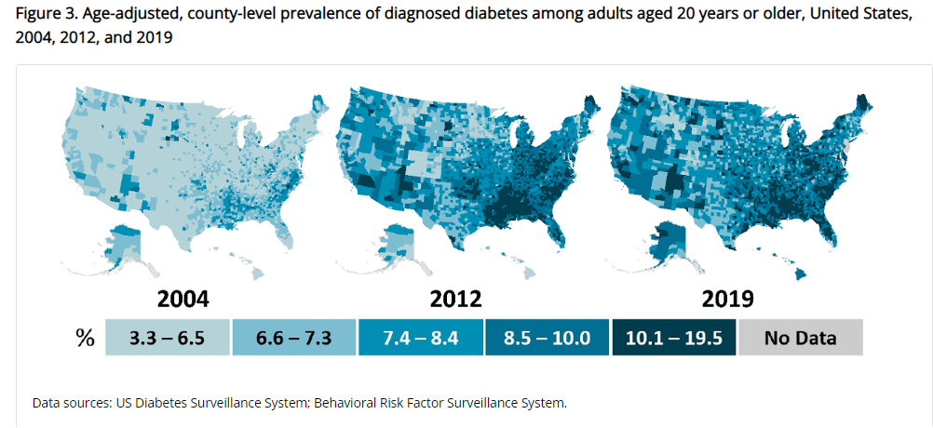
Type 2 Diabetes in America 2024
11.3% with Diabetes - 37 million adults
23% don’t know they have it
38% with Prediabetes – 96 million adults
Centers for Disease Control and Prevention. National Diabetes Stats Report https://www.cdc.gov/diabetes/data/statistics-report/index.html. Accessed 1/23

Slide 7
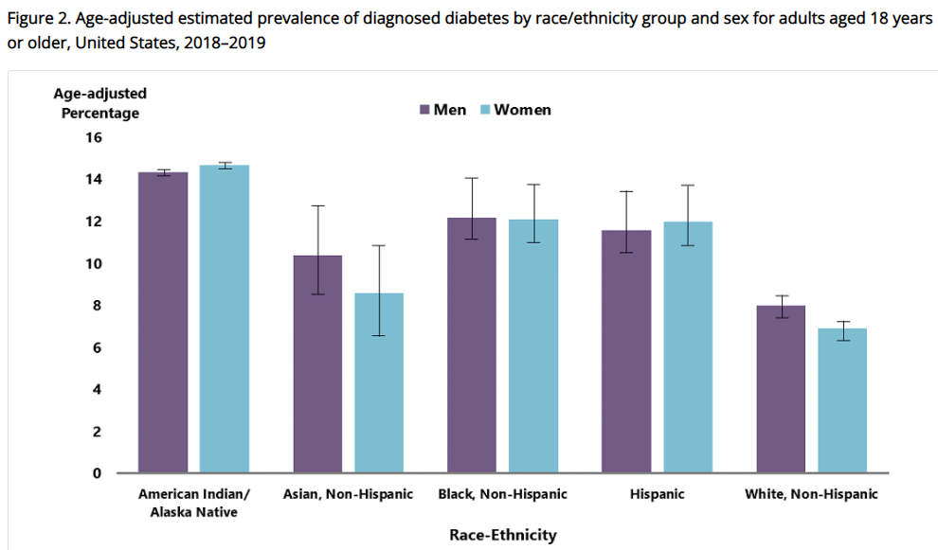
Diabetes Prevalence by Ethnic Group
For adults, diabetes prevalence highest among:
American Indians and Alaska Natives (14.5%),
Non-Hispanic Blacks (12.1%),
People of Hispanic origin (11.8%),
Non-Hispanic Asians (9.5%)
www.cdc.gov/diabetes/data/statistics-report/diagnosed-diabetes.html

Slide 8

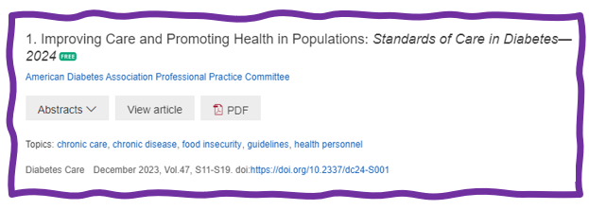
Status of Diabetes Care
In 2015–2018, U.S. community-dwelling adults with diabetes achieved:
A1C <7% by 50.5%
75.4% achieved A1C <8%.
BP target of <130/80 achieved by 47.7%
70.4% achieved blood pressure <140/90 mmHg.
Lipid control (non-HDL cholesterol) <130 mg/dL, achieved by 55.7%
22.2% met targets for all three risk factors
Many not receiving adequate lifestyle or pharmacotherapy.

Slide 9
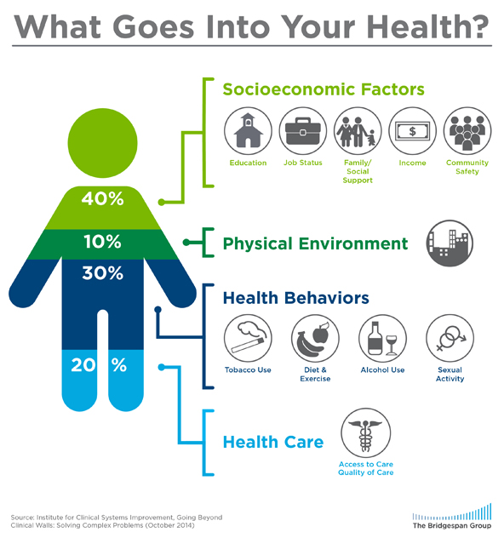
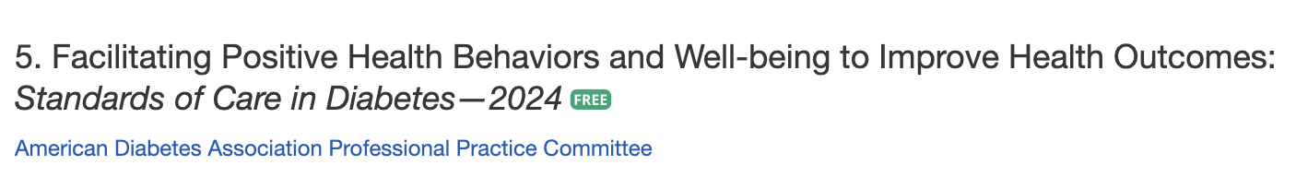
Address Barriers to Self Management
Barriers exist within health system, payer, health care professional & individual.
Address barriers through innovation, including community health workers, telehealth, other digital health solutions.
Consider social determinants of health in the target population when designing care.
https://coveragetoolkit.org/health-equity/defining-health-equity/
Notes:
Access and health equity is the ultimate goal when designing and delivering DSMES.
Creating culturally appropriate and varied modalities of settings has been shown to improve outcomes.
We know barriers to care exist at every level from the health system to individual.
However we can address these barriers by working to educate participants and health care providers on the critical times when DSMES is needed.
We can work with health systems and clinics to develop population health screening and clinical outreach,
create protocols to reduce time for referral and
collaborate health and community systems to address social needs.
We can include other health partners including community health workers to support delivery of diabetes peer support.
Barriers can be also be addressed by developing a diversity of delivery models.
From traditional inperson classrooms to community-based strategies and technology enabled solutions including telehealth or virtual environments varying modes can serve different needs.

Slide 10
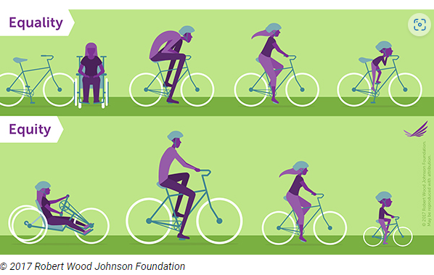
Equality vs Equity
Design and deliver diabetes care with goal of health equity across all populations.
https://coveragetoolkit.org/health-equity/defining-health-equity/

Slide 11

What is Type 2 Diabetes?
Complex metabolic disorder ….
(Insulin resistance and deficiency)
with social, behavioral and environmental risk factors unmasking the effects of genetic susceptibility.
New Diagnosis? Call 800 – DIABETES to request “Getting Started Kit”
www.Diabetes.org
American Diabetes Association

Slide 12
2. Diagnosis and Classification and of Diabetes Natural History of Diabetes
No diabetes
FBG <100
Random <140
A1c <5.7%
Prediabetes
FBG 100-125
Random 140 - 199
A1c ~ 5.7- 6.4%
50% working pancreas
Diabetes
FBG 126 +
Random 200 +
A1c 6.5% or +
20% working pancreas
Yes!
NO
Development of type 2 diabetes happens over years or decades

Slide 13


Pre Diabetes & Type 2- Screening Guidelines (ADA 2024 Clinical Practice Guidelines)
Start screening all people at age 35.
Screen at any age if BMI ≥ 25 (Asians BMI ≥ 23) plus one or > additional risk factor:
First-degree relative w/ diabetes
Member of a high-risk ethnic population
Habitual physical inactivity
*PreDiabetes
History of heart disease
*Taking high risk meds; antiretrovirals, 2nd generation antipsychotics or steroids
History of pancreatitis

Slide 14
Second-Generation Antipsychotic Meds and Diabetes Risk
People taking these meds require frequent monitoring due to increased risk of hyperglycemia and other metabolic effects.
There is a range of effects across second-generation antipsychotic medications;
Olanzapine, haloperidol, clozapine, quetiapine, and risperidone tend to have more metabolic effects.
Aripiprazole and ziprasidone tend to have fewer metabolic effects.
It taking these agents, screen for prediabetes or diabetes at baseline, rescreen at 12–16 weeks after medication initiation, and screen annually thereafter ADA 2024

Slide 15

Diabetes 2 - Who is at Risk? (ADA 2024 Clinical Practice Guidelines)
Risk factors cont’d
HTN - BP > 130/80
HDL < 35 or triglycerides > 250
History of Gestational Diabetes Mellitus
Polycystic ovary syndrome (PCOS)
Other conditions associated w/ insulin resistance:
Elevated BMI, acanthosis nigricans (AN)
Screen using A1C, Fasting Blood Glucose or OGTT.
Repeat screening at least every 3 years if negative.
*If prediabetes or on high risk meds, recheck yearly

Slide 16

Poll Question
JR’s mom has type 1 diabetes and JR’s dad has type 2 diabetes. JR is 28 years old and in the emergency room with a glucose of 482 mg/dl. Besides checking glucose, ketones and A1C levels, which of the following lab test can be used to determine if someone has autoimmune diabetes?
Endogenous insulin titer
Glutamic Acid Decarboxylase
Beta cells auto antibodies
Langerhan’s antibody

Slide 17

How do we know someone has Type 1 vs Type 2?
Type 1 - Positive antibodies
GAD - glutamic acid decarboxylase (primary)
IA2 - islet antigen 2, or
ZnT8 - zinc transporter 8
Can also check C-peptide levels to determine endogenous insulin production
Younger people develop quickly
Older people take longer to develop
“misdiagnosis is common and can occur in ∼40% of adults with new type 1 diabetes”

Slide 18

Determine if Type 1 - Use AABBCC Approach
Age
e.g., for individuals <35 years old, consider type 1 diabetes
Autoimmunity
e.g., personal or family history of autoimmune disease or polyglandular autoimmune syndromes
Body habitus
e.g., BMI <25 kg/m2
Background
e.g., family history of type 1 diabetes
Control
e.g., level of glucose control on noninsulin therapies
Comorbidities
e.g., treatment with immune checkpoint inhibitors for cancer can cause acute autoimmune type 1 diabetes or presence of other autoimmune conditions

Slide 19



Type 1 Diabetes Features?
For JR, a 28 admitted to the ICU with a blood glucose of 476 mg/dl, pH of 7.1, anion gap of 15. Recently lost 13 pounds.
Type 1 Most Discriminative Features
Younger than 35 years at diagnosis
Lower BMI (<25 kg/m²)
Unintentional weight loss
Ketoacidosis
Glucose 360 mg/dl or greater.

Slide 20
Type 1 Diabetes Progression
 | Stage 1 | Stage 2 | Stage 3
Characteristics | • Autoimmunity | • Autoimmunity | • Autoimmunity
 | • Normoglycemia | • Dysglycemia | • Overt hyperglycemia
 | • Presymptomatic | • Presymptomatic | • Symptomatic
Diagnostic criteria | • Multiple islet autoantibodies GAD, glutamic acid decarboxylase (primary) islet antigen 2, or Zinc transporter 8 (ZnT8) | • Islet autoantibodies Dysglycemia: Elevated IFG and/or IGT • FPG 100–125 mg/dL • 2-h PG 140–199 mg/dL • A1C 5.7–6.4% or ≥10% increase in A1C | • Autoantibodies may disappear over time (5-10% may not express antibodies) • Diabetes diagnosed by standard criteria
www.DiabetesEd.net

Slide 21
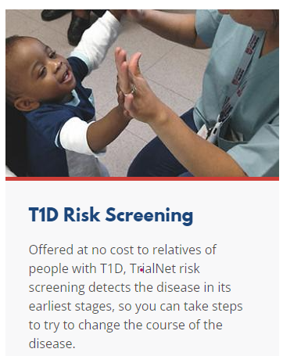

3. Prevention or Delay of Diabetes and Associated Comorbidities (for Preclinical Type 1 Diabetes)
Positive Antibodies with Prediabetes:
A1c 5.7 – 6.4% or fasting BG 100 -125mg/dl
Action:
Screen A1C every 6 months
75- OGTT every year
Modify screening based on antibodies and glycemic metrics.
May benefit from CGM to monitor progression
Trialnet.org

Slide 22
Type 1 & Lifestyle Prevention
Observational studies in those with antibodies, shed light on factors that increase β-cell demand:
Less physical activity
Consuming higher glycemic index foods
Sugar intake.
Factors that reduced risk of progression from TEDDY study:
Daily minutes spent doing vigorous physical exercise.
More info needed

Slide 23

Pharmacologic Intervention to Delay Symptomatic Type 1 (in Stage 2)
Teplizumab-Tzield (CD3-monoclonal antibody)
14-day infusion can delay the onset of symptomatic type 1 diabetes (stage 3)
An option in selected individuals aged ≥8 years with stage 2 type 1 diabetes.
In a single trial, 44 individuals received 14-day course of teplizumab vs 32 placebo.
The median time to stage 3 diagnosis of type 1
48.4 months in tep group
24.4 months placebo

Slide 24

3. Detecting PreDiabetes Matters
Given the cost-effectiveness of lifestyle behavior modification programs for diabetes prevention:
Offer Diabetes Prevention Programs to adults at high risk of type 2 diabetes
Should be covered by third-party payers,
Address inconsistencies in access
Screening guidelines for people with Type 1

Slide 25
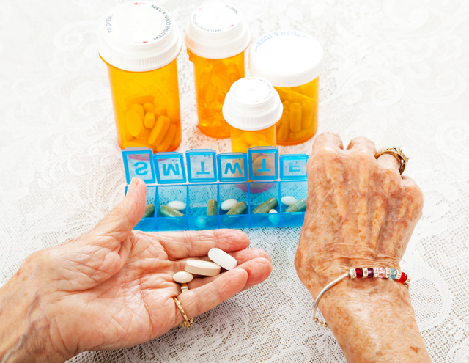
3. Prediabetes Pharmacologic Intervention
No FDA approved med for prevention (off label)
Consider Metformin Therapy for Prediabetes
Especially for ages 25-59
BMI of 35+
If A1c is ~6.0 or FPG is 110mg/dL
Women with history of GDM
Monitor B12 level (esp with neuropathy or anemia)
CV Risk Mitigation important.
Statin can increase BG, stop if notice elevation
Consider low dose pioglitazone (Actos) if history of stroke.

Slide 26
Diabetes Bingo “DiaBingo” Shout out Right Answer

Slide 27
DiaBingo
B Frequent skin and yeast infections
B A BMI of ____ or greater indicates increased pre/diabetes risk?
B To reduce complications, control A1c, Blood pressure, Cholesterol
B PreDiabetes – fasting glucose level of ___ to ____
B Erectile dysfunction indicates greater risk for ____
B Diabetes – fasting glucose level____ or greater
B Type 1 diabetes is best described as an ______ disease
B People with diabetes are ______ times more likely to die of heart dx
B Elevated triglycerides, < HDL, smaller dense LDL
B Each percentage point of A1C = _____ mg/dl glucose
B At dx of type 2, about __% of the beta cell function is lost
B Diabetes – random glucose ____ or greater

Slide 28

Mr. J - What are Your Recommendations?
Mr. J Profile
67 yr old with newly type 2. History of stroke.
Meds: Metoprolol, metformin, lovastatin 20mg.
Labs:
A1C 9.3%
LDL 136 mg/dl
Triglycerides 260mg/dl
GFR 58, UACR 32
B/P 142/79
Liver enzymes in normal range
Self-Care Skills
Goes to gym 2-3 times a week
Plays golf on occasion.
Eats out 2 times a week.
Has appt with RD
Feeling overwhelmed.
What are the Goals?

Slide 29

ABCs of Diabetes – ADA 2024
A1c less than 7% (individualize)
Pre-meal BG 80-130
Post meal BG <180
Time in Range (70-180) 70% of time
Blood Pressure < 130/80
Cholesterol
Statin therapy based on age & risk status
If 40+ with ASCVD Risk, decrease 50%, LDL <70
If 40+ with ASCVD, decrease 50%, LDL <55

Slide 30
Mr. J - What are Your Recommendations?
Mr. J Profile
67 yr old with newly type 2. History of stroke.
Meds: Metoprolol, metformin, lovastatin 20mg.
Labs:
A1C 9.3% (goal 7%)
LDL 136 mg/dl (goal <55)
Triglycerides 260mg/dl (<150)
GFR 58, UACR 32 (>50, <30)
B/P 142/79 (130/80)
Liver enzymes in normal range
Self-Care Skills
Goes to gym 2-3 times a week
Plays golf on occasion.
Eats out 2 times a week.
Has appt with RD
Feeling overwhelmed.
Next Steps?

Slide 31
Immunization Schedule for Diabetes 2024
Vaccine | Who by Age | Series and Frequency
Hepatitis B Vaccine | Less than 60 years* | 2-3 dose series
RSV | Adults ≥ 60 years | Single dose
Influenza (avoid live attenuated vaccine) | All | Annually
Tetanus, diphtheria, pertussis (TDAP) | All adults; extra dose during pregnancy | Booster every 10 years.
Zoster | 50+ | 2 dose Shingrix
COVID-19 | Starting at age 6 mo’s | Initial vaccination and boosters
Pneumonia (PPSV23) Pneumovax | Adults19-64* | See Standards for schedule and details and for those 65 or older.
*Pneumococcal Conjugate Vaccine (PCV15, PCV20) | 19-64 with underlying risk factors or no previous vaccination*. | May need PPSV23 follow-up vaccine ≥1 year.* If 65+, discuss with provider.
2024 ADA Standards, Vol.47, S52-S76.
*See ADA Standards, Table 4.4 for detailed info/considerations. For educational purposes only. www.DiabetesEd.net

Slide 32

NEW Bone Health Recommendations
Diabetes associated with increased fractures
Take preventive action:
For high-risk older adults (aged >65 years) and younger individuals with multiple risk factors.
Monitor bone mineral density using dual-energy X-ray absorptiometry every 2–3 years.
Avoid medications that increase fractures in high risk
Problem solve to prevent falls
Adequate calcium and vita D intake
Consider antiresorptive meds, osteoanabolic agents for those with low bone mineral density score.

Slide 33
Risk Factors for Fracture
General risk factors
Prior osteoporosis fracture
Age > 65 years
Low BMI
Sex
Malabsorption
Recurrent falls
Glucocorticoid use
Family history
Alcohol /tobacco abuse
Rheumatoid arthritis
Diabetes Specific Risk Factors
Lumbar spine or hip T-score ≤ -2.0
Frequent hypoglycemia
Diabetes >10 years
Diabetes meds: TZDs or sulfonylureas, insulin
A1C > 8%
Peripheral autonomic neuropathy
Retinopathy and nephropathy
www. DiabetesEd.net

Slide 34

Nonalcoholic Fatty Liver Disease or Metabolic Steatotic Liver Disease
Recent studies estimate that MASLD is prevalent in >70% of adults with type 2 diabetes.
Higher risk in those with type 2 diabetes or prediabetes with cardiometabolic risk factors
Screen for liver fibrosis using FIB 4 Index
Uses liver enzymes (ALT & AST), platelet count plus age
If positive, follow-up with imaging or ultrasound

Slide 35
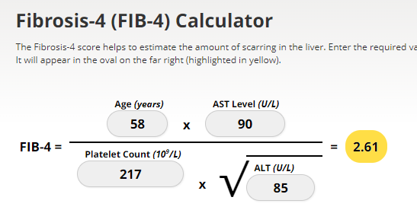
Screening for NASH – FIB-4
FIB-4 estimates risk of hepatic cirrhosis (age 35+):
Calculated by imputing:
Age
plasma aminotransferases (AST and ALT)
and platelet count
FIB-4 Risk Levels
Lower risk is <1.3
Intermediate 1.3 to 2.67
High risk >2.67
considered as having a high probability of advanced fibrosis (F3–F4).
The American College of Gastroenterology considers Upper limit of normal ALT levels:
29–33 units/L for males
19–25 units/L for female individuals
(mdcalc.com/calc/2200/fibrosis-4-fib-4-index-liver-fibrosis).
www.DiabetesEd.net

Slide 36
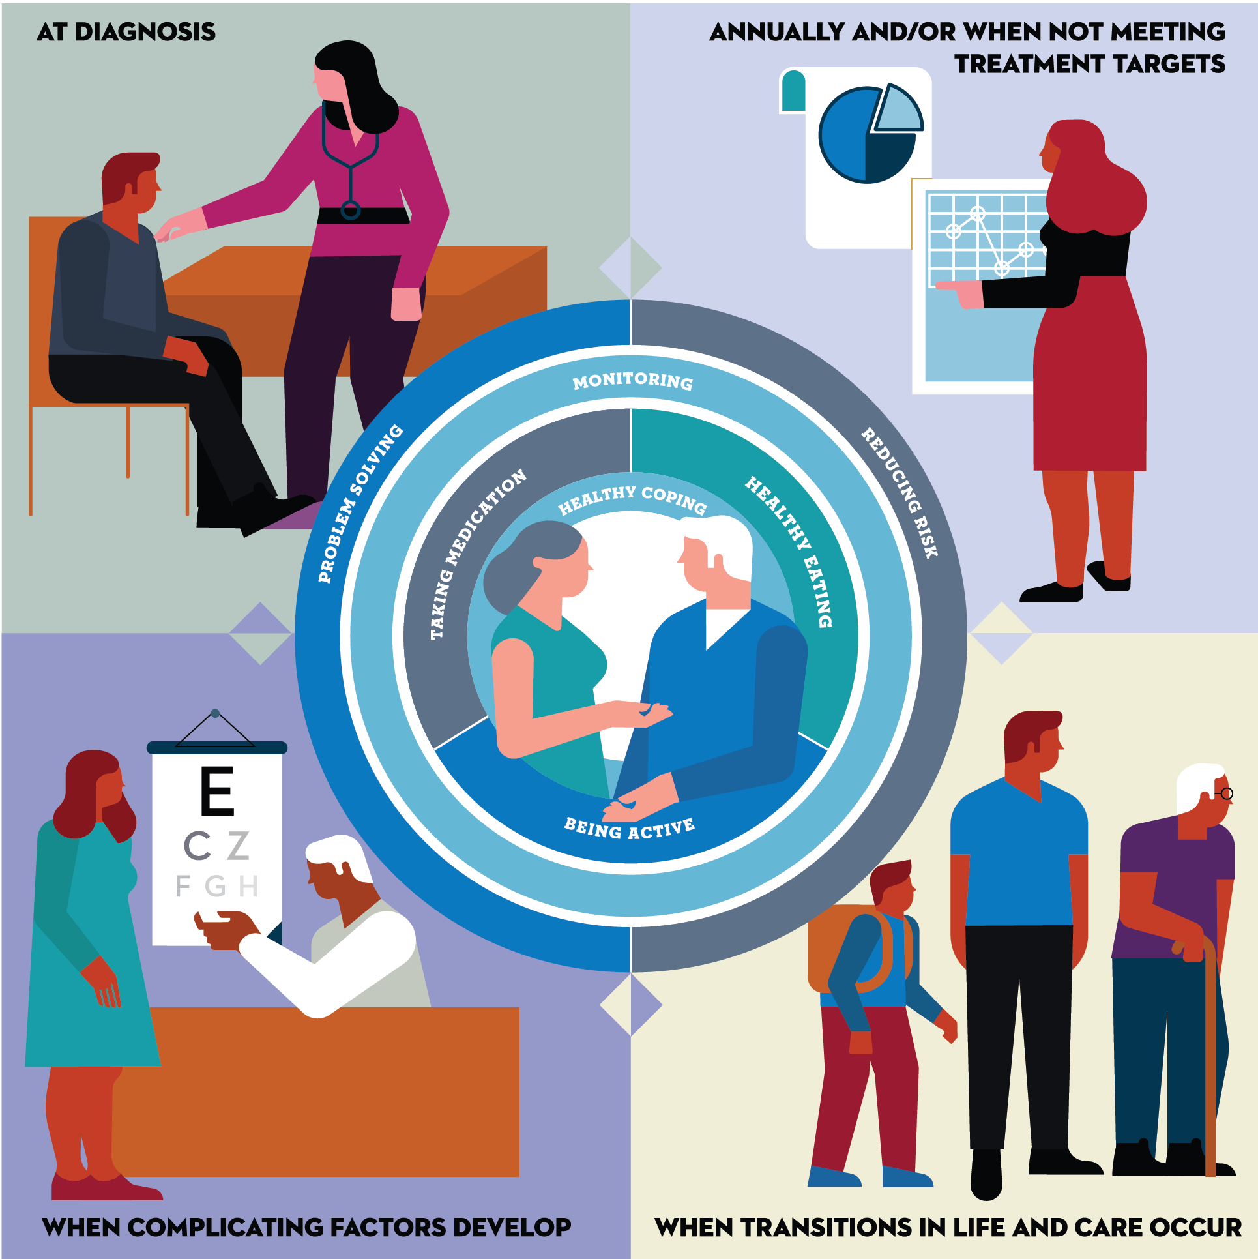
FIVE critical times to provide and modify DSMES
At diagnosis.
When not meeting treatment goals.
Annually
When complicating factors develop (medical, physical, psychosocial).
When transitions in life and care occur.
Powers MA, Bardsley JK, et al. DSMES Consensus Report, The Diabetes Educator, 2020
ADCES. AADE7 Self-Care Behaviors, The Diabetes Educator, 2020
(cdc.gov/diabetes/professional-info/training.html)
Notes:
Change this year- increase to 5! Vs. 4 but splitting the

Slide 37

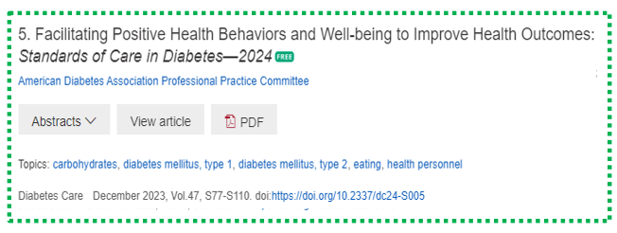
DSMES is underutilized
Despite the benefit of DSMES, data from the 2017 and 2018 Behavioral Risk Factor Surveillance System of 61,424 adults with self-reported diabetes indicate that
53% of individuals eligible for DSMES through their health insurance receive it.
Scan for NorCal Resource Directory

Slide 38
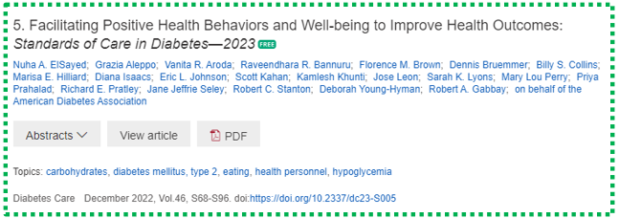
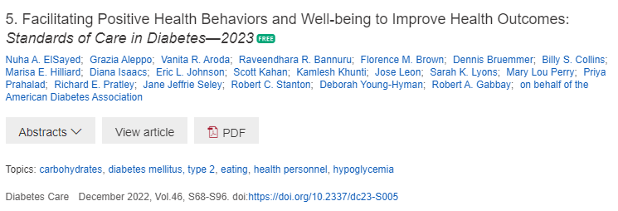
DSMES is for Everyone
All people with diabetes benefit from diabetes self-management education and support to facilitate the knowledge, decision-making, and skills mastery for diabetes self-care.
Assess clinical outcomes, health status, well being and support.
Person centered
Digital coaching
Identify barriers
Eval SDOH
Consider barriers

Slide 39

Psychosocial Assessment – Screen for:
Integrate psychosocial care using a collaborative, person centered approach for all people with diabetes, to optimize health outcomes and health-related quality of life
Assess for:
Diabetes Distress annually
Depression
Anxiety
Disordered eating
Cognitive capacities
Use validated tools
Initial visit & periodically
If over 65, screen for depression & cognitive impairment
Refer to behavioral health specialist if warranted

Slide 40
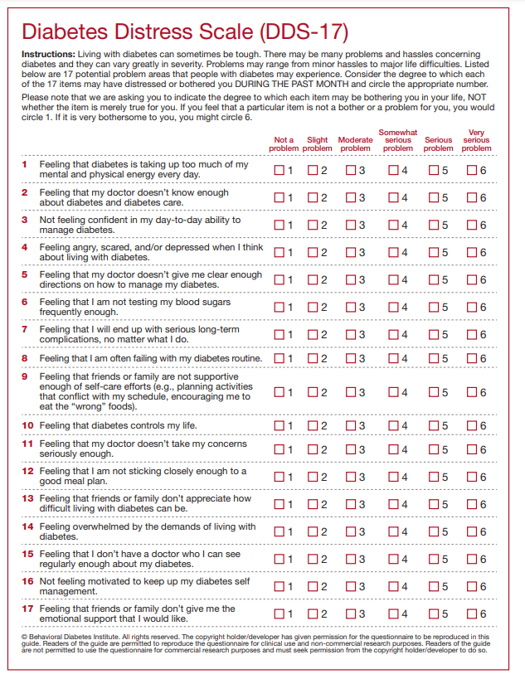
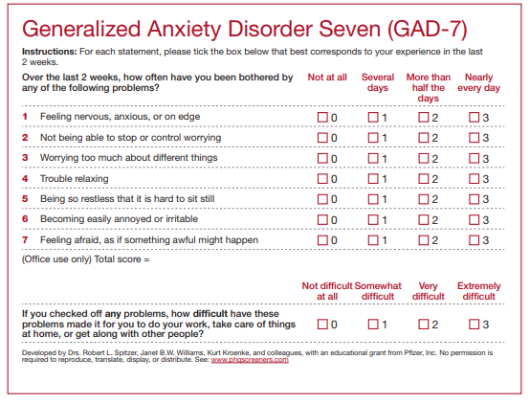
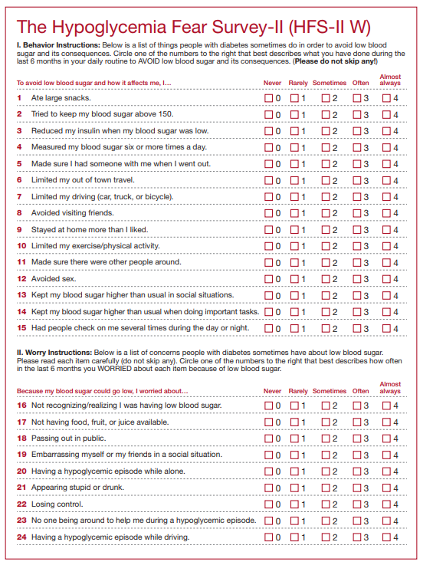
Diabetes Distress & Screening Tools
Screen people with diabetes, caregivers, and family members for diabetes distress at least annually.
Consider more frequent monitoring when treatment targets are not met, at transitional times, and/or in the presence of diabetes complications.
Health care professionals can address diabetes distress
May consider referral to a qualified behavioral health professional, ideally one with experience in diabetes, for further assessment and treatment if indicated.
The ADA provides access to tools for screening specific psychosocial topics, such as diabetes distress, fear of hypoglycemia, and other relevant psychological symptoms
professional.diabetes.org/sites/default/files/media/ada_mental_health_toolkit_questionnaires.pdf

Slide 41

Medical Nutrition Therapy – ADA Macronutrient Distribution
No ideal percentage of calories from protein, carbohydrate and fat for people with diabetes.
Consider personal preferences
tradition, culture, religion, health beliefs and goals, economics
as well as metabolic goals when working with individuals to determine the best eating pattern for them
Macronutrient distribution based on individualized assessment
Healthcare team members complement MNT, providing guidance on healthy food choices for the individual
Notes:
Evidence suggests
On average people with diabetes consume about 45% of calories from carbohydrate and 1-1.5% (15-20% of kcals from protein).
Medical Nutrition Therapy is only provided by a Dietitian (or in some states CN with masters degrees) but everyone working in diabetes care at some point will discuss food.
To quote the ADA standards of Care-

Slide 42

Eating Patterns ADA Standards 2024
Until there is more evidence:
Emphasize non-starchy vegetables
Choose whole foods, including ”power carbs”, nuts/seeds
Minimize meat, added sugars, sugary beverages, refined grains and ultra-processed foods
Any approach should consider:
Individualize based on “health status, personal and cultural preferences, ability to sustain recommendations and ultimately food access and nutrition security”
Meeting with a RD can result in a 0.3-2% drop in A1C
Notes:
No one eating pattern is better than another and we find many similarities among eating patterns. The ADA Standards of Care recommend until concise evidence presents we should emphasize

Slide 43
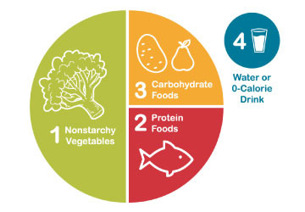
Healthy Eating Patterns/Approaches
Eating Patterns:
Carb-Restricted
Mediterranean Diet
Plant based eating
DASH (Dietary Approaches to Stop Hypertension)
Structured low-calorie
Approaches:
Diabetes Plate Method
Carbohydrate Counting
Intermittent fasting/time restricted
Meal replacements
Notes:
The updated 2024 standards of care is the call out of the definitions of eating pattern, meal plan or dietary approach.
Simplified we can consider these calls outs to define What we eat, How much and How
Eating pattern is the foods we consume
Meal plan is developed by a dietitian as a specific individualized guideline
Dietary approach are the tools/ that support implementation of healthy eating patterns.
There is no one pattern that is better than another so we work with the individual with diabetes to determine an effective eating pattern and approach.
When considering approaches take into account religious fasting. (Add content)
New concept- chrononutrition

Slide 44
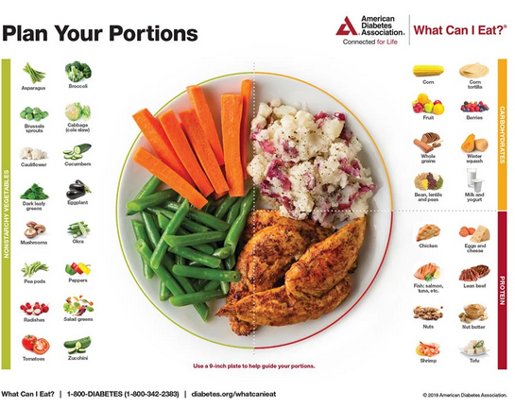
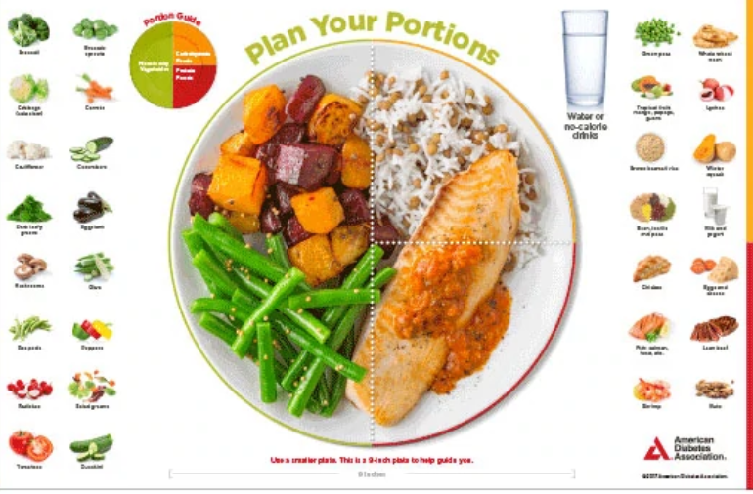



Plate example

Slide 45

Carbs and Lowering Glucose
Reducing overall carb intake has demonstrated most evidence for improved glycemia
Low carb = Definition Varies
25% or less, Cals from carbs
Most people consume 44-46% of Cals from carb
Emphasize non-starchy vegetables, fruits, and whole grains, as well as dairy products, with minimal added sugars
A systematic review found:
- Each 10% decrease in carb intake reduced A1C, fasting plasma glucose levels, weight, lipids, BP at 6 months.
But favorable effects diminished and were not maintained at follow-up or at greater than 12 months.
Notes:
Reducing carbohydrate intake has shown most evidence for helping improve glycemia but where you start and where you end up is individualized.
One study published in the SOC found a low carb diet defined here as < 26% of carbs reduced A1c at 6 months but less differences were seen at 12 months. This was also seen in a systemic reduce which found lowering carbs 10% should outcomes at 6 months but limited these outcomes at 12 months or forward.

Slide 46

Low Carb Meal Plan Not Recommended for:
Women who are pregnant or lactating or children
People with or at risk for disordered eating
People who have renal disease
Use with caution if taking SGLT-2 Inhibitor due to potential risk of ketoacidosis

Slide 47
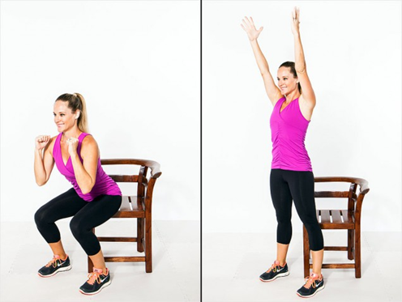

Exercise Standards
Adults – 150 min/wk moderate intensity
over 3 days a week.
Don’t miss > 2 consecutive days w/out exercise
Get up every 30 mins - Reduce sedentary time
T1 and T2 – resistance training 2 -3 xs a week
Flexibility and balance training 2-3 xs a week (Yoga and Tai Chi)

Slide 48

Half way there

Slide 49
Mr. J - What are Your Recommendations?
Mr. J Profile
67 yr old with newly type 2. History of stroke.
Meds: Metoprolol, metformin, lovastatin 20mg.
Labs:
A1C 9.3% (goal 7%)
LDL 136 mg/dl (goal <55)
Triglycerides 260mg/dl (<150)
GFR 58, UACR 32 (>50, <30)
B/P 142/79 (130/80)
Liver enzymes in normal range
Self-Care Skills
Goes to gym 2-3 times a week
Plays golf on occasion.
Eats out 2 times a week.
Next Steps
Nutrition coaching
Has appt with RD
Vaccines
DSME

Slide 50
ABCs of Diabetes – ADA 2024
A1c less than 7%
Pre-meal BG 80-130
Post meal BG <180
Time in Range (70-180) 70% of time
Time below range | Low, less than 70mg/dL <4% of time &
Very low, less than 54 mg/dL <1% of time
Blood Pressure < 130/80
Cholesterol
Statin therapy based on age & risk status
If 40+ with ASCVD Risk, decrease 50%, LDL <70
If 40+ with ASCVD, decrease 50%, LDL <55
Glycemic targets need to be woven into the overall person-centered strategy.

Slide 51
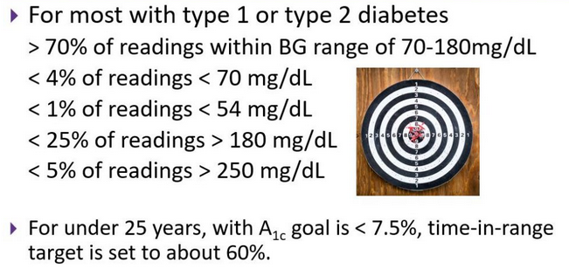
Ambulatory Glucose Profile
Standardized report with visual cues for those on CGM devices
Evaluate Time in Range (TIR)
Target 70-180 mg/dl (70% of time)
Eval % time below goal
< 70 (less than 4% of time)
<54 (less than 1% of time)
Eval % time above > 180 (less than 25% of time)
Eval % time above > 250 (less than 5% of time)
For those with frailty or at high risk of hypoglycemia recommend:
- Target of 50% time in range
- Less than1% time below range

Slide 52

Assess for Hypoglycemia (Glucose)
BG <70mg/dl – Level 1
Follow 15/15 rule and contact provider to make needed changes. At increased hypo risk.
BG < 54mg/dl – Level 2
Indicates serious hypo. Reassess BG Goals. Consider med decrease. Predictive of Level 3 Hypo. Needs Glucagon Emergency Kit
Severe Hypoglycemia – Level 3
Altered mental, physical functioning.
Requires external assistance – no threshold

Slide 53

Tx of Level 2 & 3 Hypoglycemia
If can swallow w/out risk of aspiration, try gel, honey, etc. inside cheek
If unable to swallow, D50 IV or Glucagon
Glucagon injection (need Rx)
Inform and instruct caregivers, school personnel, family, coworkers of hypo signs and appropriate action
Dosing: Adults 1mg, Children <20kg 0.5mg
Glycemic effect 20 - 30mg, short lived
Must intake carb as soon as able
If on Insulin or level 2 or 3 hypo, (<54), get Glucagon ER Kit. Re-evaluate diabetes med treatment plan. Glucose sensor recommended.

Slide 54

Poll Question
JL is 78 and drinks a “few cocktails” every night. Lives with partner and takes basal insulin at night and bolus insulin as needed. Has had a few low blood glucose levels in past week of 62, 49 and 51. What is the most important recommendation?
A. Decrease alcohol intake
B. Check BG at least 4 times a day.
C. Double check injection sites.
D. Get glucagon rescue medication.

Slide 55
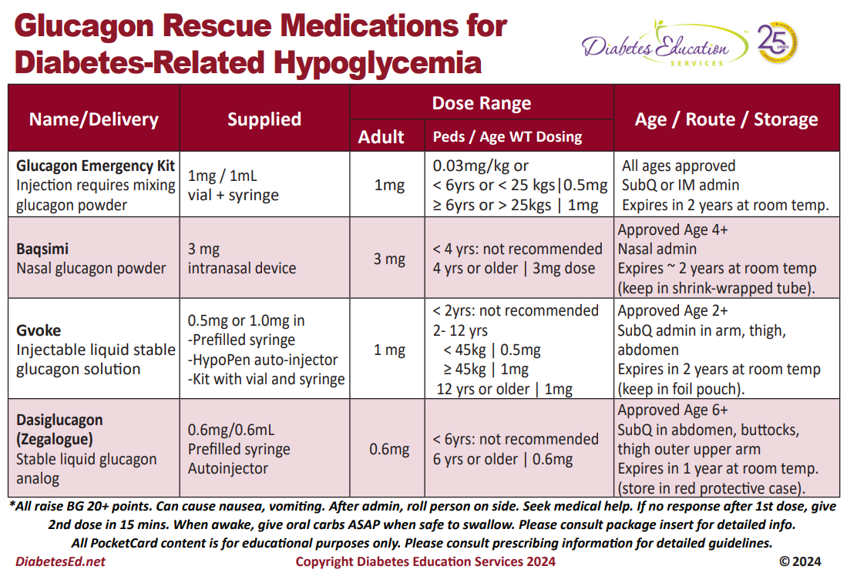

Slide 56
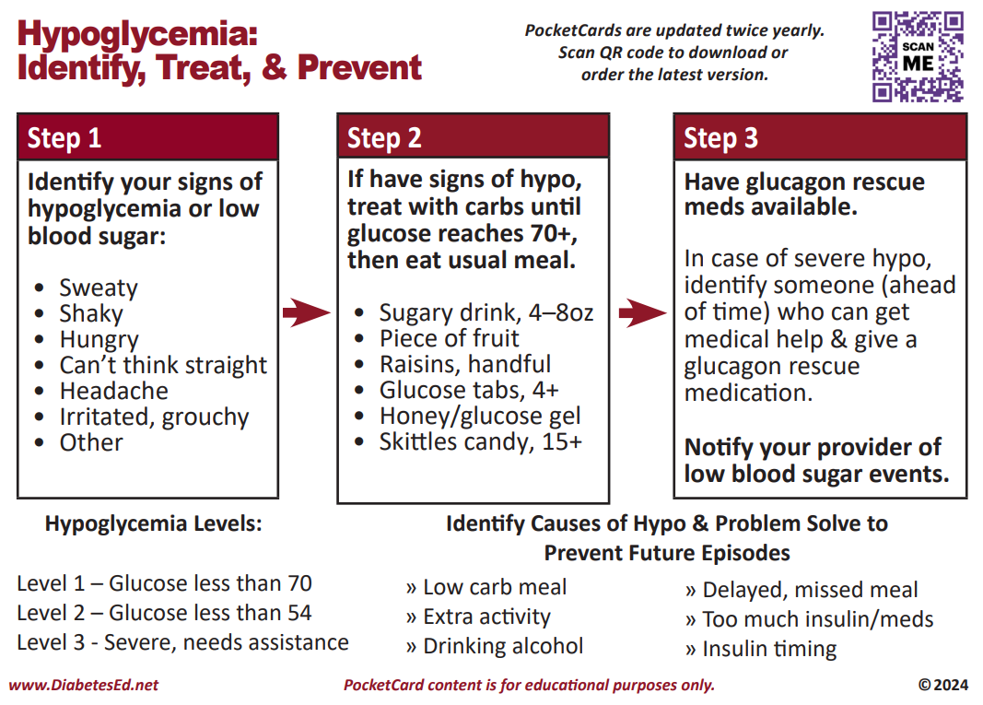
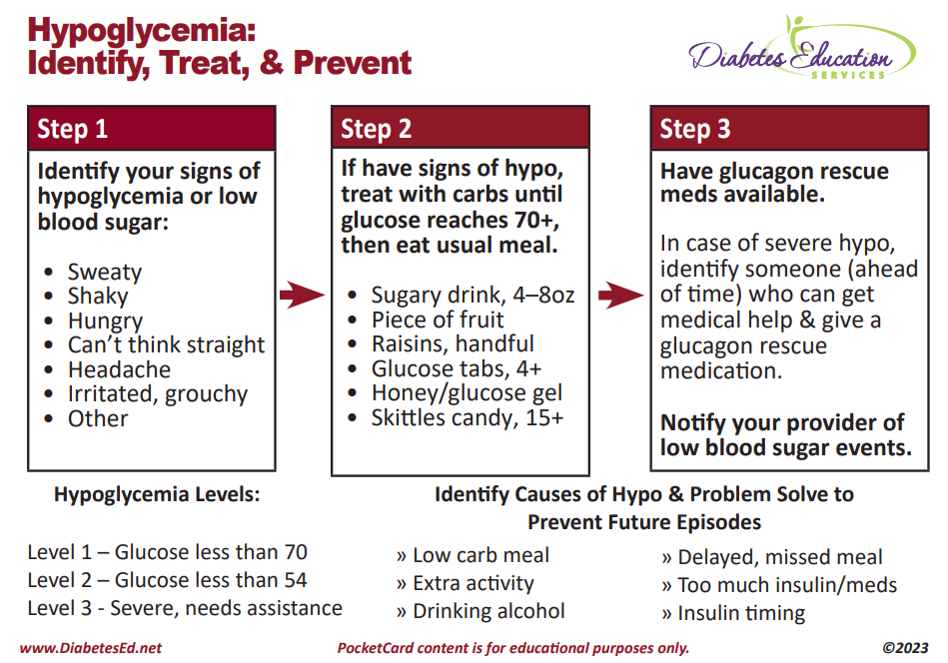

Slide 57


8. Obesity and Weight Management for Prevention & Treatment of Type 2 Diabetes
Once a year, calculate BMI and assess weight trajectory to inform approach
Be sensitive and allow for privacy when weighing
Use person centered language based on indivdual preference
Person with higher weight or person in larger body

Slide 58
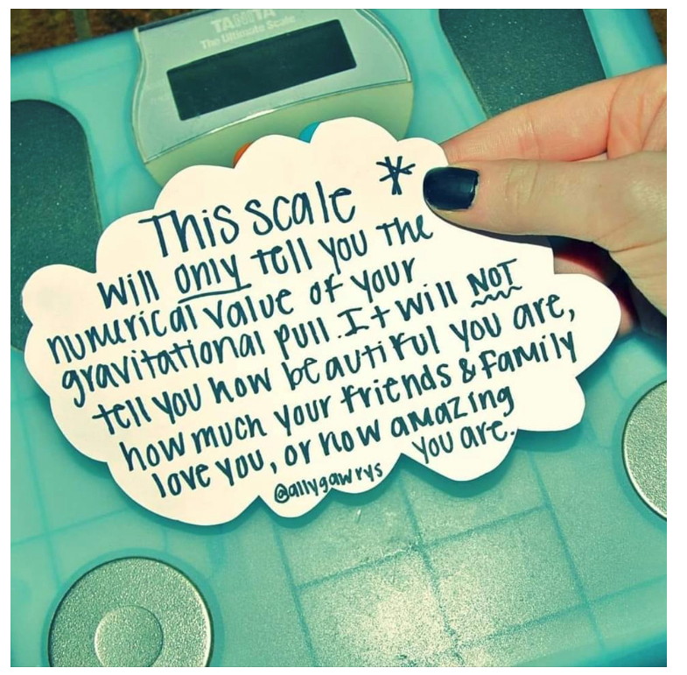
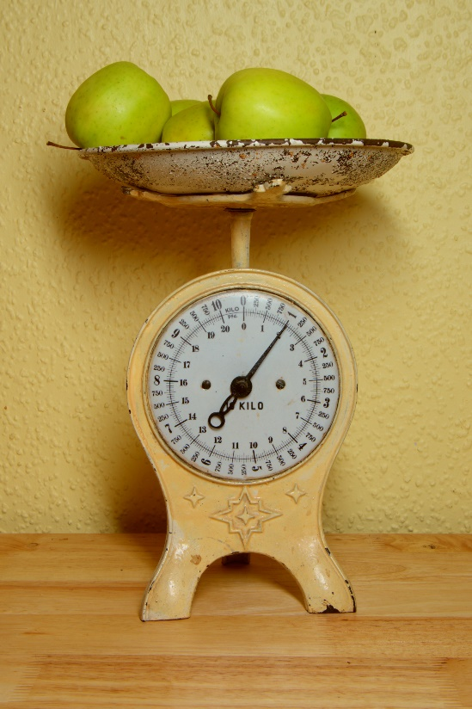
Weight is a Heavy Issue

Slide 59

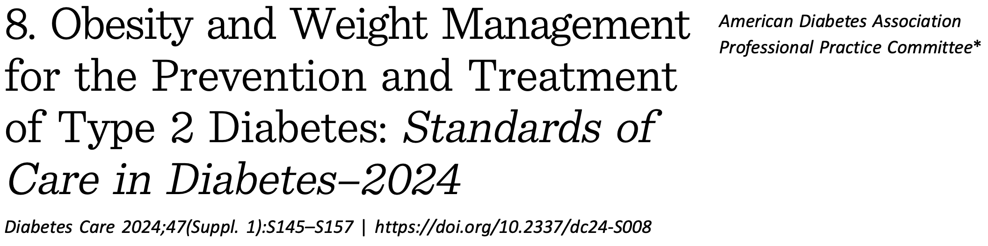
Use of BMI
BMI poor indicator for ”excessive fat” and health risk
WHO defines Obesity as: abnormal or excessive fat accumulation that presents a risk to health
Dx obesity using :
BMI + distribution measures like waist circumference, waist:hip or waist:height ratio and associated health consequences
Notes:
Language throughout Section 8 of the SOC was amended to be person centered and to emphasize the importance of weight management within the overall context of the treatment of people with diabetes.

Slide 60

9: Step Wise Approach to Hyperglycemia 2024
Usually, start one medication at a time
However, evidence supports initial combo therapy if A1C 8.5% or more, to quickly reach goals and slow decline of glucose control.
Where to start?
Individual values
CVD, Heart failure or Kidney Disease
Minimize Hypoglycemia
Minimize wt gain or promote wt loss
Consider Cost

Slide 61
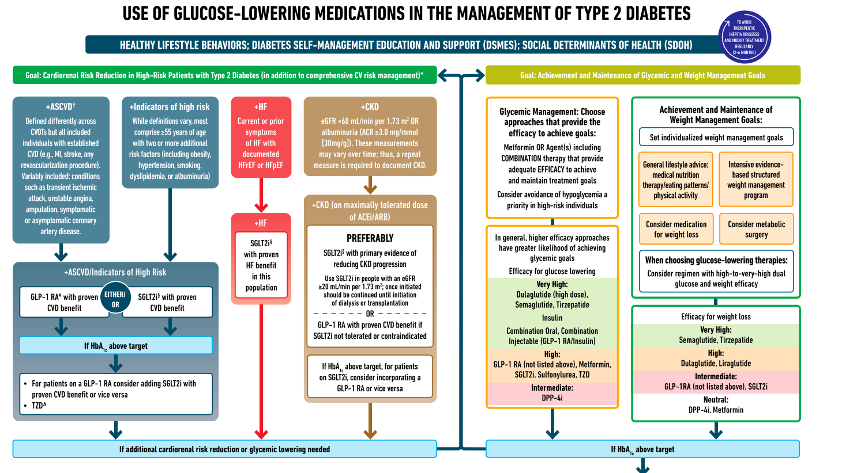

ADA Meds Algorithm

Slide 62
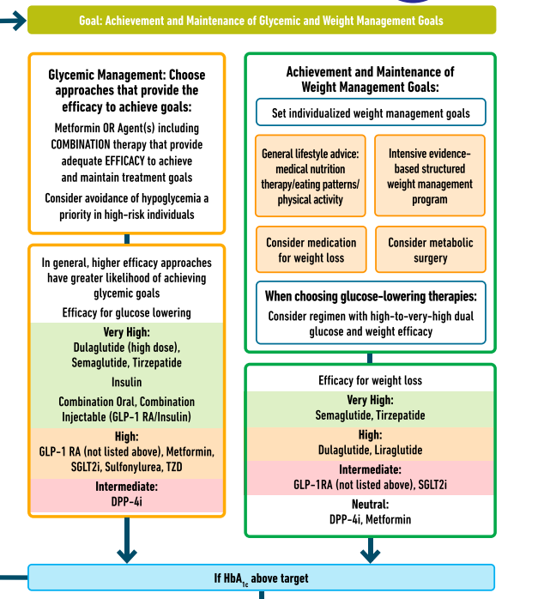
Metformin is “Usually” 1st Line
Why metformin?
Longstanding evidence
High efficacy and safety
Inexpensive - 3 months for $12
Weight neutral
If ASCVD, HF or CKD or high ASCVD risk, use SGLT2i or GLP-1 RA +/- metformin
If A1C ≥ 8.5%, consider combo therapy.

Slide 63
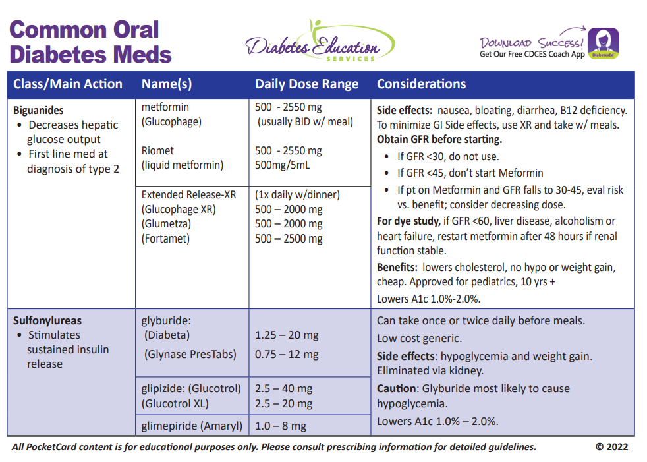

Biguanide derived from:
Goat’s Rue Galega officinalis,
French Lilac
Does NOT harm kidneys
$10 for 3-month supply from Walmart & other pharmacies

Slide 64

ADA Meds Algorithm

Slide 65
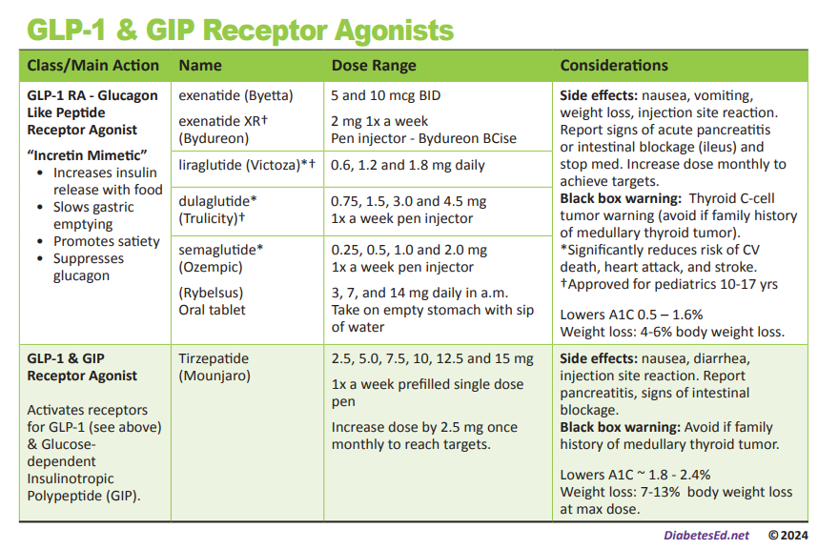

Slide 66
GLP-1/GIP Receptor Agonist Indications
Drug | Lower BG | Reduce CV Risk? | Wt loss approved?
Exenatide IR (Byetta) Lixisenatide (Adlyxin) Semaglutide (Rybelsus) | Yes
Exenatide ER (Bydureon) | Yes for 10 yrs and older
Dulaglutide (Trulicity) | Yes for 10 yrs and older | Yes
Semaglutide (Ozempic) | Yes | Yes | Yes Wegovy 2.4mg
Liraglutide (Victoza) | Yes for 10 yrs and older | Yes | Yes Saxenda 3mg
Tirzepatide (Mounjaro) | Yes | ? | Yes, Zepbound up to 15 mg
Package inserts, dailymed.nlm.nih.gov

Slide 67
ADA Meds Algorithm

Slide 68

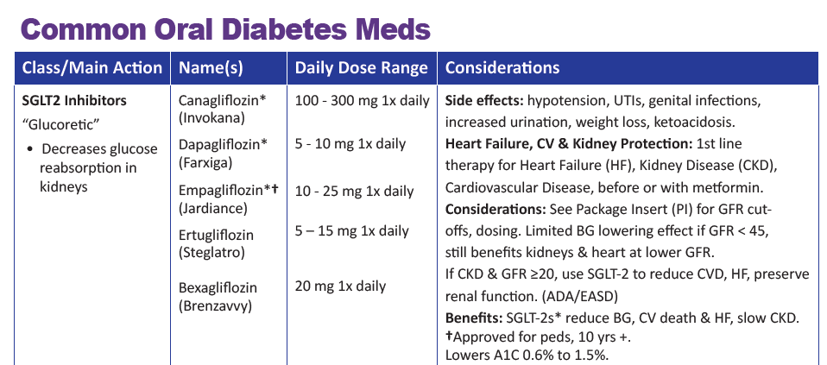

SGLT2 Inhibitors- “Glucoretics”
Action: “Glucoretic” decreases renal reabsorption in the proximal tubule of the kidneys (reset renal threshold and increase glucosuria). Risk of ketoacidosis, Fournier's gangrene
Indicated as first line therapy for those with Congestive Heart Failure and diminishing kidney function.
% ‘f
Notes:
68
68
Thiazolidinediones (TZDs) enhance insulin sensitivity in muscle and adipose tissue by binding to cell receptors,which leads to an increase in glucose transporter expression. TZDs encourage beta cells to respond more efficiently by lowering the amount of glucose and free fatty acids in the bloodstream, both of which are known to be detrimental to insulin secretion. Finally, these drugs reduce glucose production in the liver.
Clinical trials indicate that pioglitazone and rosiglitazone are slightly more effective at reducing A1C (1.5-1.6% reduction) than troglitazone (1.1% reduction).
Some of the beneficial side effects of thiazolidinediones include an increase in HDL cholesterol and reduction of triglyceride concentrations. This class of drugs has also been shown to lower blood pressure and decrease vascular inflammation in vitro. There are clinical studies underway to further examine the cardiovascular benefit to TZDs.
Some adverse effects of TZDs include weight gain, a potential increase in LDL cholesterol levels, and a possible increase in alanine aminotransferase levels (ALT). Because of the risk of weight gain, edema, and increased LDL cholesterol, thiazolidinediones are contraindicated in patients with advanced forms of congestive heart failure. Due to reported cases of liver failure and liver toxicity caused by the increase in ALT levels, TZDs are contraindicated in patients with abnormal liver function.
TZDs are the most expensive of the oral antidiabetic agents.

Slide 69
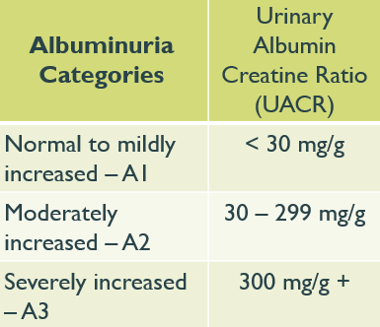
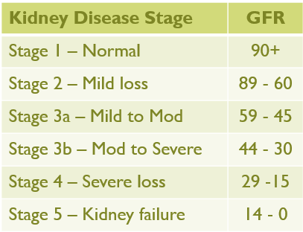
2024 Standard 11 - Chronic Kidney Disease and Risk Management
Optimize glucose and B/P Control to protect kidneys
Screen Urine Albumin Create ratio (UACR) & GFR
Type 2 at dx then yearly
Type 1 with diabetes for 5 years, then yearly
If urinary albumin ≥300 and GFR 30–60 monitor 1-4 times a year to guide therapy.
Treat hypertension with ACE or ARB and for elevated albumin-to-creatinine ratio of 30 -299.
Monitor serum creat and K+
if on ACE, ARB or diuretics

Slide 70
SGLT-2i Indications Summary
Drug | Lower BG | Reduce CV Risk? | Use to treat Heart Failure? | Slow renal disease?
Dapagliflozin (Farxiga) | Yes | Yes | Yes +/- Diabetes | Yes
Empagliflozin (Jardiance) | Yes | Yes | Yes +/- Diabetes | Yes
Canagliflozin (Invokana) | Yes | Yes | Yes w/ Diabetes | Yes
Ertugliflozin (Steglatro) | Yes |  | Yes w/ Diabetes | Yes
Bexagliflozin (Brenzavvy) | Yes |  | Yes w/Diabetes | Yes
Package inserts, dailymed.nlm.nih.gov

Slide 71

Diabetes Meds Lower CV Risk
If diabetes plus ASCVD risk factors
SGLT-2s* and GLP-1s* reduce risk of major adverse CV events
Plus ACE or ARB if HTN
Post MI, continue beta blockers for 3 years.
If type 2 diabetes and heart failure
SGLT-2s reduce risk of heart failure and hospitalization.
Also consider beta blocker

Slide 72

How much do they cost?
TZD’s - Actos and Avandia
“Squirters” - Glipizide, Glyburide, Glimepiride
Metformin and Metformin XR
“Incretin enhancers” or DPP-IVi Januvia, Tradjenta
“Incretin Injection” - (GLP-1 RA’s)
Exenatide and Semaglutide
“Glucoretic”- SGLT-2s Empagliflozin
“Twincretin” (GLP-1 + GIP) Tirzepatide (Mounjaro)
$5 & $348
$10 for 3 mo’s
$657 & $630
$964, $1123
$408- $718
See Table 9.3 in ADA Standards on Median Monthly Average Wholesale Price (AWP) 2024
$982

Slide 73
Mr. J - What are Your Recommendations?
Mr. J Profile
67 yr old with newly type 2. History of stroke.
Meds: Metoprolol, metformin, lovastatin 20mg.
ADD SGLT-2 or GLP-1
Labs:
A1C 9.3% (goal 7%)
LDL 136 mg/dl (goal <55)
Triglycerides 260mg/dl (<150)
GFR 58, UACR 32 (>50, <30)
B/P 142/79 (130/80)
Liver enzymes in normal range
Self-Care Skills
Goes to gym 2-3 times a week
Plays golf on occasion.
Eats out 2 times a week.
Next Steps
Continue healthy eating, activity
Add SGLT-2 or GLP
Make sure on max metformin dose

Slide 74
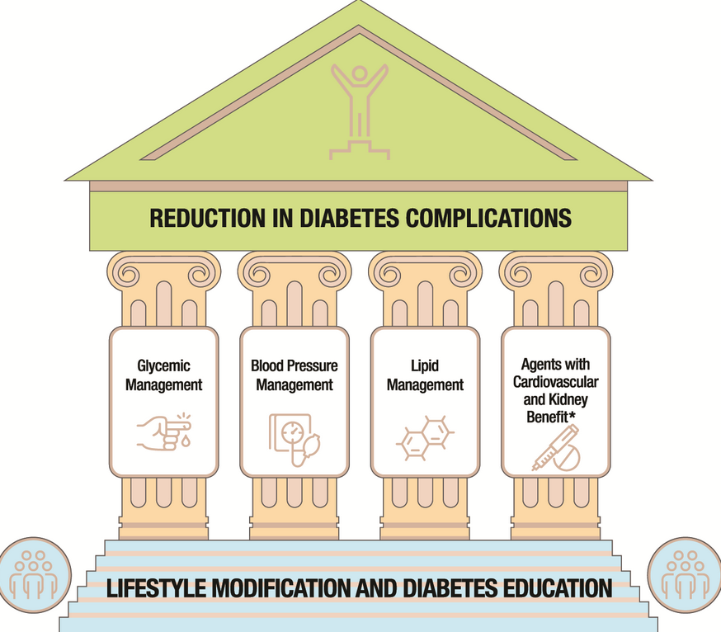
Large benefits are seen when multiple CV risk factors are addressed simultaneously
With more aggressive goals, rates of CVD have decreased over past decade
Please see ADA standards, Table 10.1 for second half

Slide 75

BP Treatment in addition to Lifestyle
BP target <130/80 (if it can be safely attained)
With albuminuria* or ASCVD
Start either ACE or ARB
No albuminuria - Any of the 4 classes of BP meds can be used:
*ACE Inhibitors, *ARBs, *thiazide-like diuretics or calcium channel blockers.
*Monitor K+ 7-14 days after start/annually
Avoid ACE and ARB at same time
Multiple Drug Therapy often required
If B/P ≥ 150 /90 start 2 drug combo
*Albuminuria = Urinary albumin creatinine ratio of 30+

Slide 76
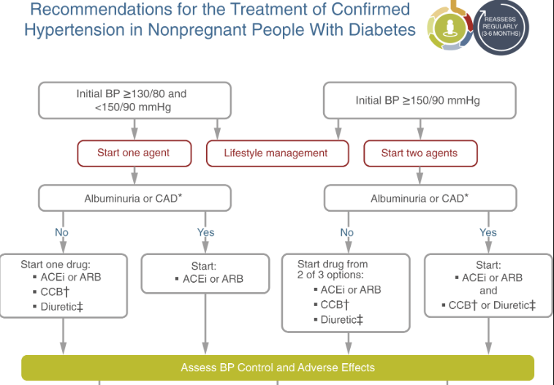

Slide 77

Poll Question
RZ is 47 years old with type 2 diabetes and hypertension. RZ takes metformin 1000 mg BID, plus lisinopril 20mg daily. RZs LDL is 130 mg/dL. Based on the most recent ADA Standards, what is the LDL Cholesterol target for RZ?
LDL less than 100 mg/dL.
Lower LDL by 30%.
LDL target of 65 mg/dL or less.
Determine LDL target based on ASCVD risk.

Slide 78
ADA 2024 Summary
A1c less than 7% (individualize)
Pre-meal BG 80-130
Post meal BG <180
Time in Range (70-180) 70% of time
Blood Pressure
<130/80
Cholesterol
Statin therapy based on age & risk status
If 40+ with ASCVD Risk, decrease LDL by 50%, LDL <70
If 40+ with ASCVD, decrease LDL by 50%, LDL <55

Slide 79
Lipid Monitoring and Lifestyle Treatment Strategies
Lipid Goals
LDL < 70 or 55 based on risk
HDL >40
Triglycerides <150
Weight loss if indicated
Mediterranean or DASH Diet
Reduction of saturated fat intake
Increase of omega-3 fatty acids, viscous fibers and plant stanols/sterols
Increase activity level
BG lowering helps lower triglycerides and increase HDL
Monitoring:
If not taking statins and underage of 40.
- check at time of diagnosis and every 5 yrs.
On statin
Monitor lipids at diagnosis and yearly.
Monitor lipids 4-12 weeks after statin dose adjustment.

Slide 80

Statin Therapy
Moderate intensity (lowers LDL 30-50%)
atorvastatin (Lipitor) 10-20mg
rosuvastatin (Crestor) 5-10mg
simvastatin (Zocor) 20-40mg
pravastatin (Pravachol) 40 – 80mg
lovastatin (Mevacor) 40 mg
fluvastatin (Lescol) XL 80mg
pitavastatin (Livalo) 1-4mg
High intensity statins (lowers LDL 50%):
atorvastatin (Lipitor) 40-80mg
rosuvastatin (Crestor) 20-40mg

Slide 81
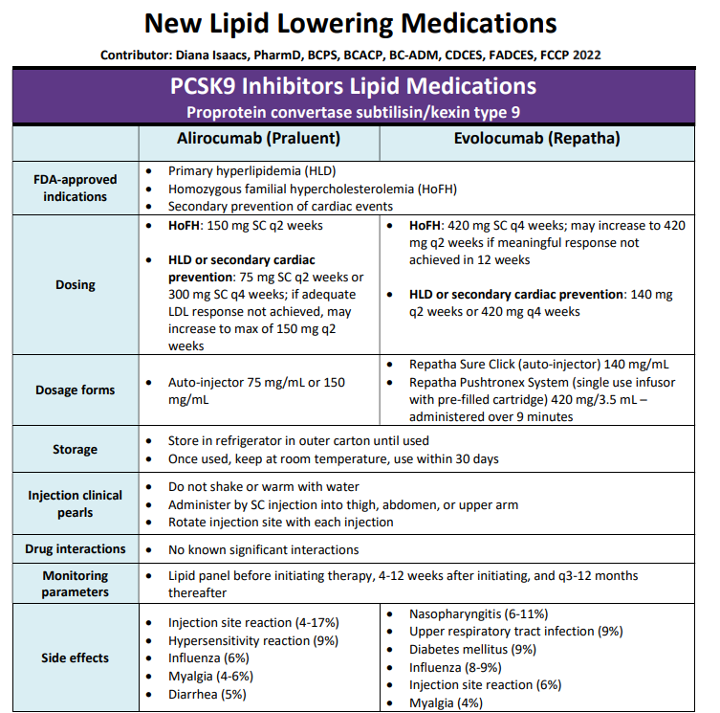
From Meds Cheat Sheet Page

Slide 82

Coronary Vessel Disease Meds
In those with CVD or at higher risk:
Get blood glucose to goal
Statin therapy with addition of ezetimibe or a PCSK9 inhibitor recommended if goals not achieved on maximum tolerated statin therapy.
B/P Med (ACE or ARB)
Beta blocker after MI or CHF
Aspirin (or another agent)
Diabetes Meds that significantly decrease CV events:
*SGLT-2i’s
Empagliflozin (Jardiance), canagliflozin (Invokana), dapagliflozin (Farxiga)
*GLP-1 RA’s
Semaglutide (Ozempic), liraglutide (Victoza), dulaglutide (Trulicity)

Slide 83
Mr. J - What are Your Recommendations?
Mr. J Profile
67 yr old with newly type 2. History of stroke.
Meds: Metoprolol, metformin, lovastatin 20mg.
ADD SGLT-2 or GLP-1
Increase lovastatin
Add ACE or ARB
Labs:
A1C 7.3% (goal 7%)
LDL 118 mg/dl (goal <55)
Triglycerides 210mg/dl (<150)
GFR 58, UACR 32 (>50, <30)
B/P 138/79 (130/80)
Liver enzymes in normal range
Self-Care Skills
Goes to gym 2-3 times a week
Plays golf on occasion.
Eats out 2 times a week.
Next Steps
Continue healthy eating, activity
Get B/P machine for home
Make sure has meter
Check UACR/GFR in next few months
Gets admitted to hospital

Slide 84


16. Diabetes Care in the Hospital - What’s the Big Deal?
Hyperglycemia is associated with increased morbidity and mortality in hospital settings.
Acute Myocardial Infarction
Stroke
Cardiac Surgery
Infection
Longer lengths of stay

Slide 85

ADA Goals and Treatments Hospitalized Patients
Critical Care
Individualize based on pt status
Once insulin therapy initiated, blood glucose goal is 140-180
More stringent goals of 110 -140 may be appropriate in ICU, with careful consideration of preventing hypo.
Basal bolus or Insulin drip
Med Surg Goals
100 -180
Poor oral intake – use basal insulin + correction
Healthy intake – basal bolus

Slide 86

SGLT-2’s in Hospital Setting?
Recommended if type 2 diabetes and heart failure.
Initiate use of a SGLT-2 or continue during hospitalization and upon discharge, if no contraindications and after recovery from the acute illness.
Avoid SGLT2 inhibitors in cases of severe illness, in people with ketonemia or ketonuria, and during prolonged fasting and surgical procedures
Hold SGLT-2’s 3 days (4 days for Ertugliflozin) before surgery

Slide 87
Diabetes Bingo “DiaBingo” Shout out Right Answer

Slide 88
DiaBingo- G
G ADA goal for A1c is less than ____%
G People with DM need to see their provider at least every month
G Blood pressure goal is less than
G People with DM should see eye doctor (ophthalmologist) at least
G The goal for triglyceride level is less than
G Goal for my HDL cholesterol is more than
G The goal for blood sugars 1-2 hours after a meal is less than:
G People with DM should get this shot every year
G People with DM need to get urine tested yearly for ___________
G Periodontal disease indicates increased risk for heart disease
G The goal for blood sugar levels before meals is:
G The activity goal is to do ___ minutes on most days

Slide 89

Congratulations – We made it!

Slide 90

Survey – Just Click and Complete

