Slide 1
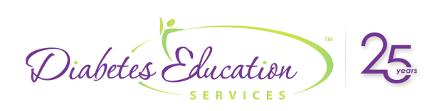

Exploring the GI System or
“Gut to the Butt”
Beverly Dyck Thomassian, RN, MPH, BC-ADM, CDCES
Pronouns: She, Her, Hers
President, Diabetes Education Services

Slide 2


Coach Bev has no Conflict of Interest
She’s not on any speaker's bureau
Does not invest or have any financial relationships with diabetes related companies.
Gathers information from reading package inserts, research and articles
The ADA Standards of Medical Care is main resource for course content

Slide 3


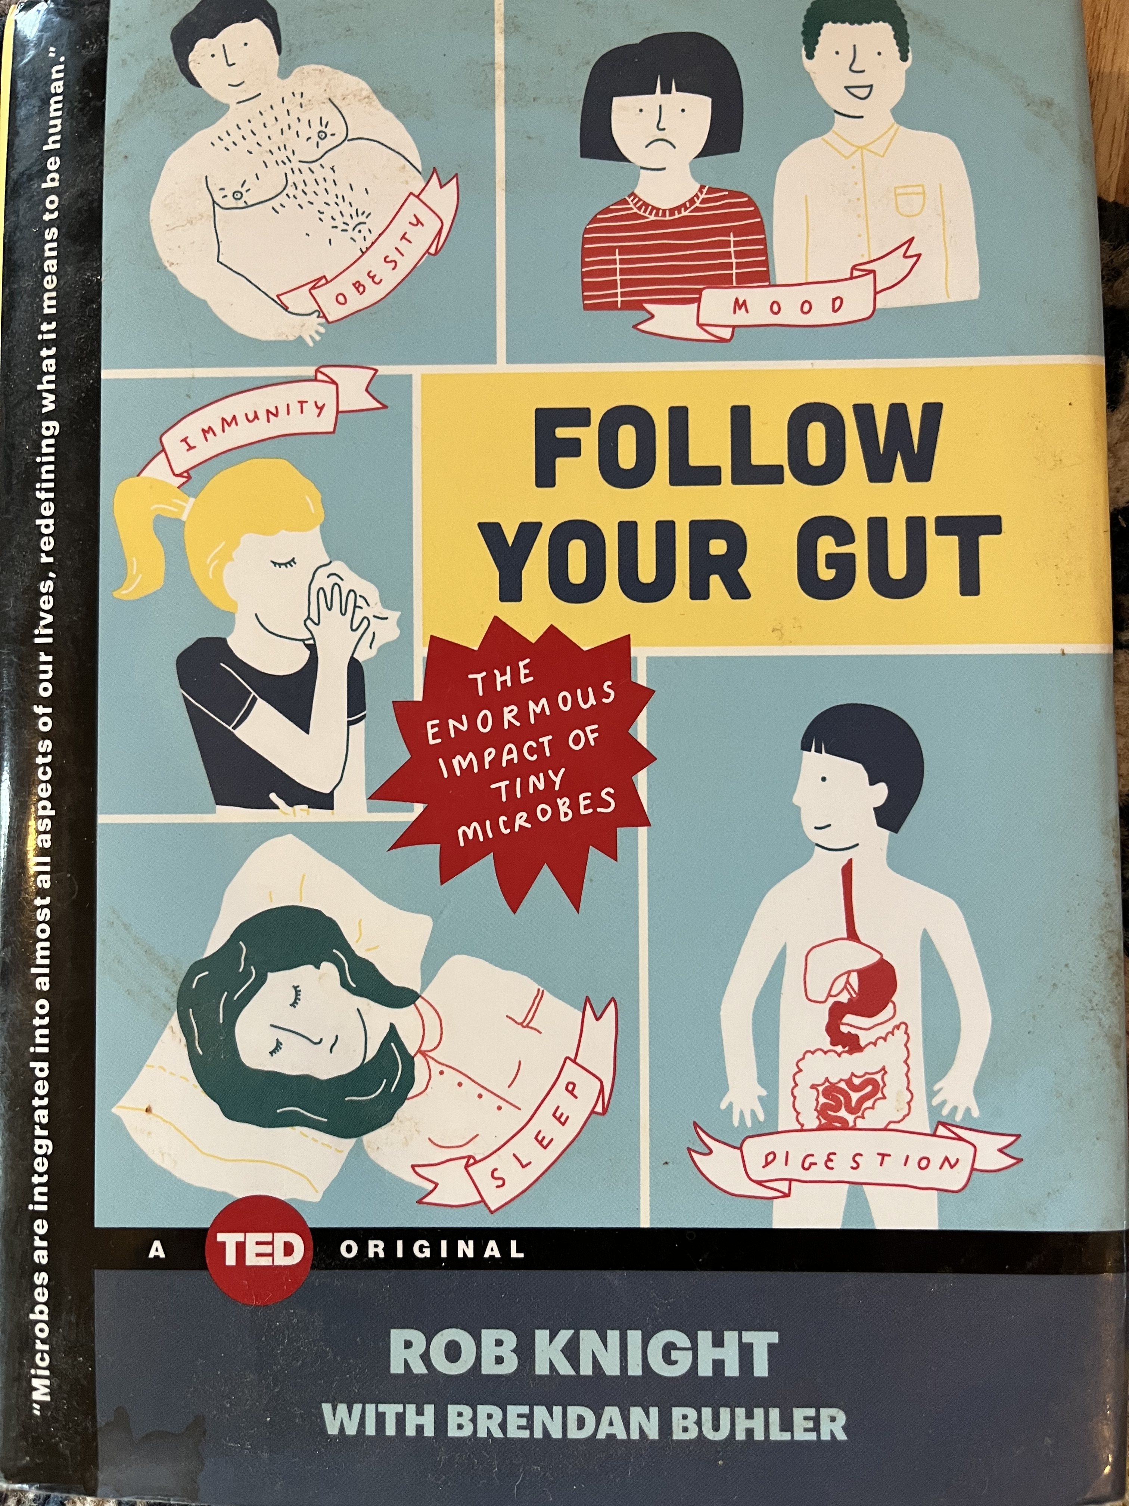
Books

Slide 4
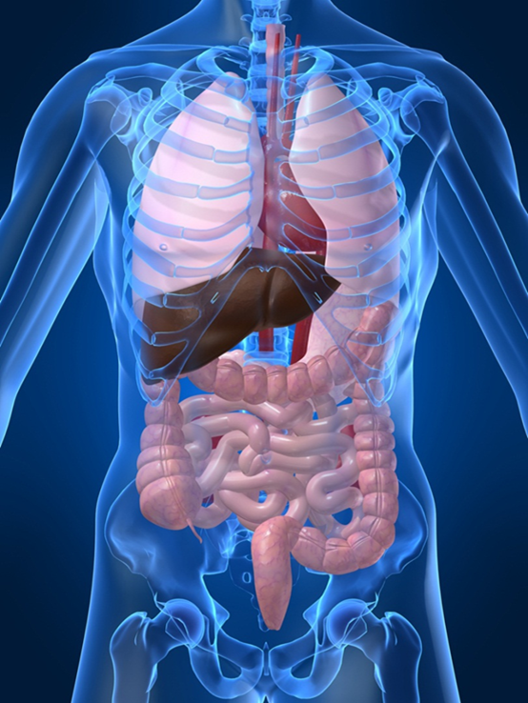
Learning Objectives Exploring the GI Tract
Explain the links between diabetes and oral disease.
Explore the co-relationship between hyperglycemia and the gastrointestinal system.
Describe the pancreatic exocrine dysfunction in diabetes.
List new nomenclature and screening guidelines for liver disease.
Discuss the endocrine function of the intestine and the importance of a healthy microbiome.
Enjoy a state of WONDER.

Slide 5
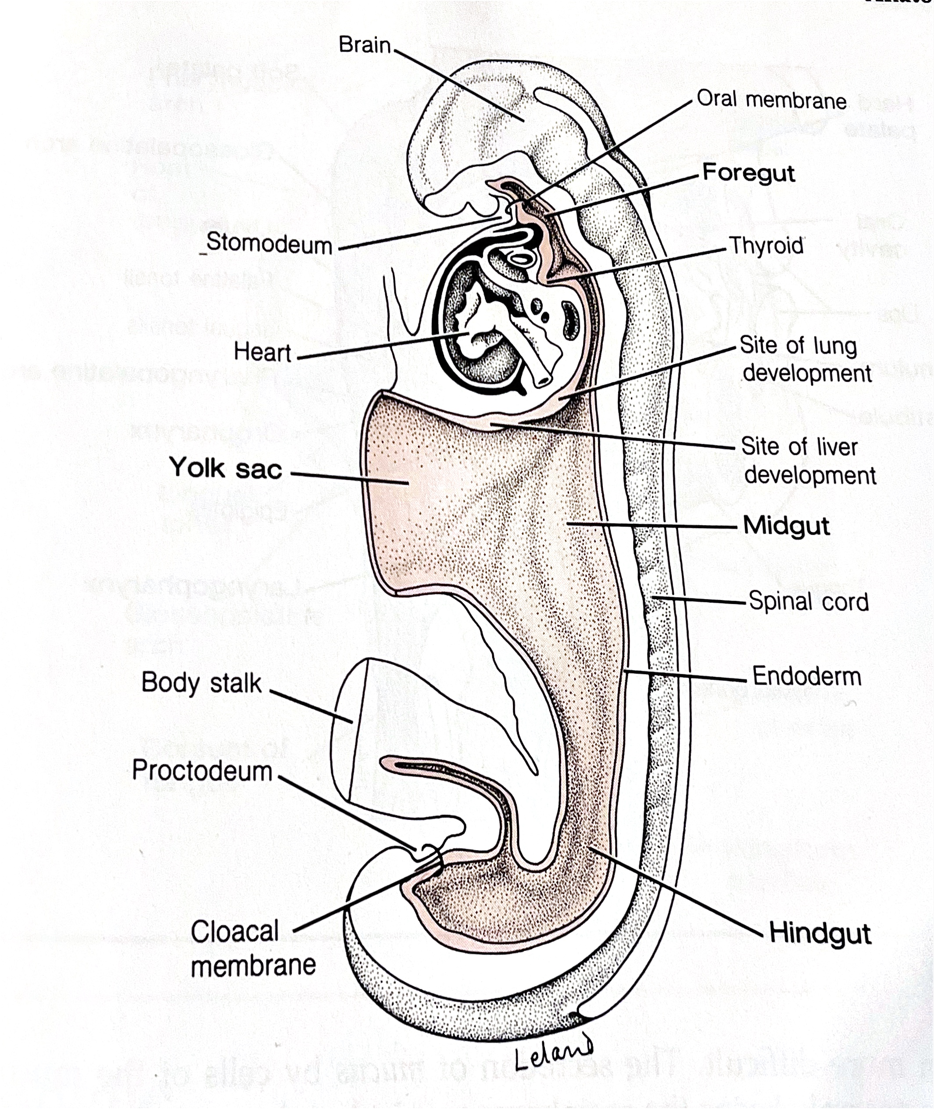






Gut Tube -Embryonic Starting Point
Embryonic endoderm develops into the interior linings of two tubes in the body, respiratory and
Digestive Tube
  Salivary glands
  Esophagus
  Stomach
  Small and Large Intestine
  Liver
  Gallbladder
  Pancreas
Thyroid gland
Parathyroid glands
    Lose connection with gut before birth to become endocrine organs
Basic Human Anatomy, A. Pense, 1982

Slide 6

Eating Starts with the Eyes

Slide 7
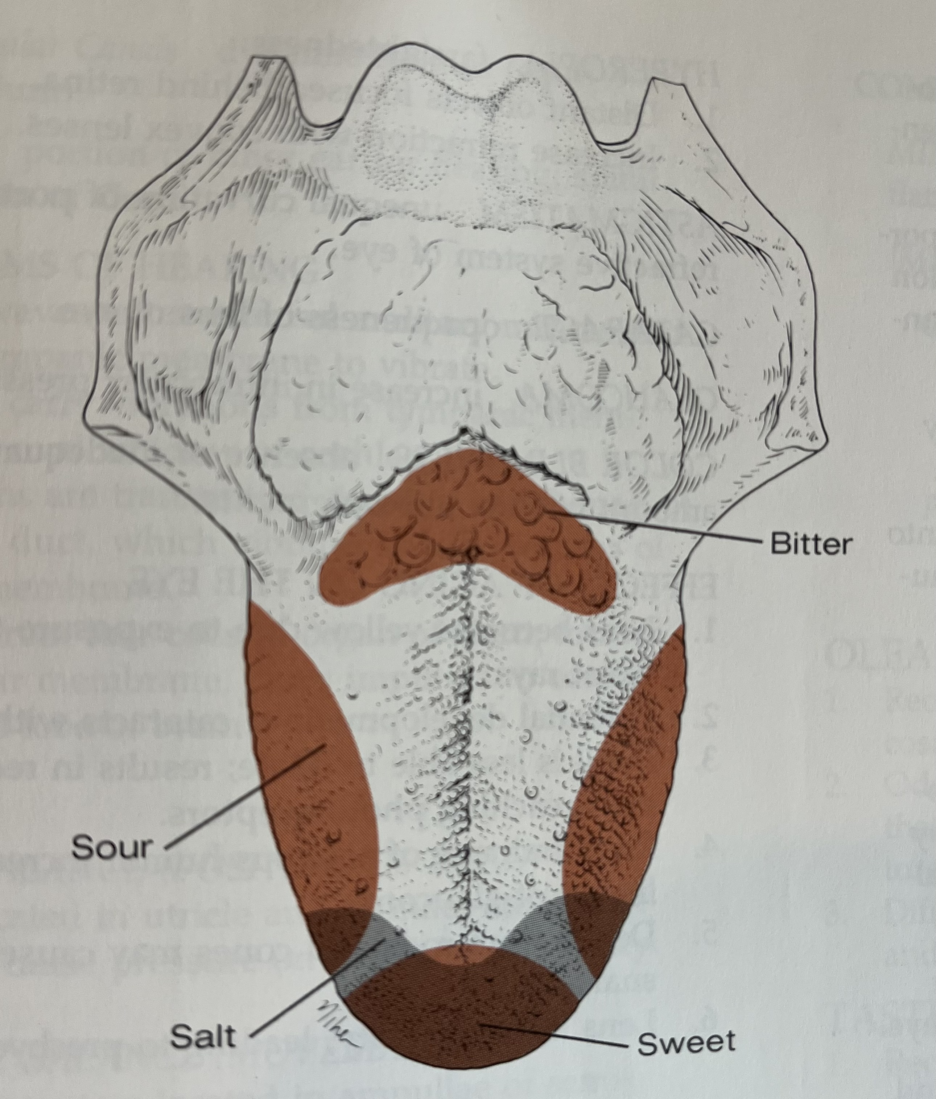
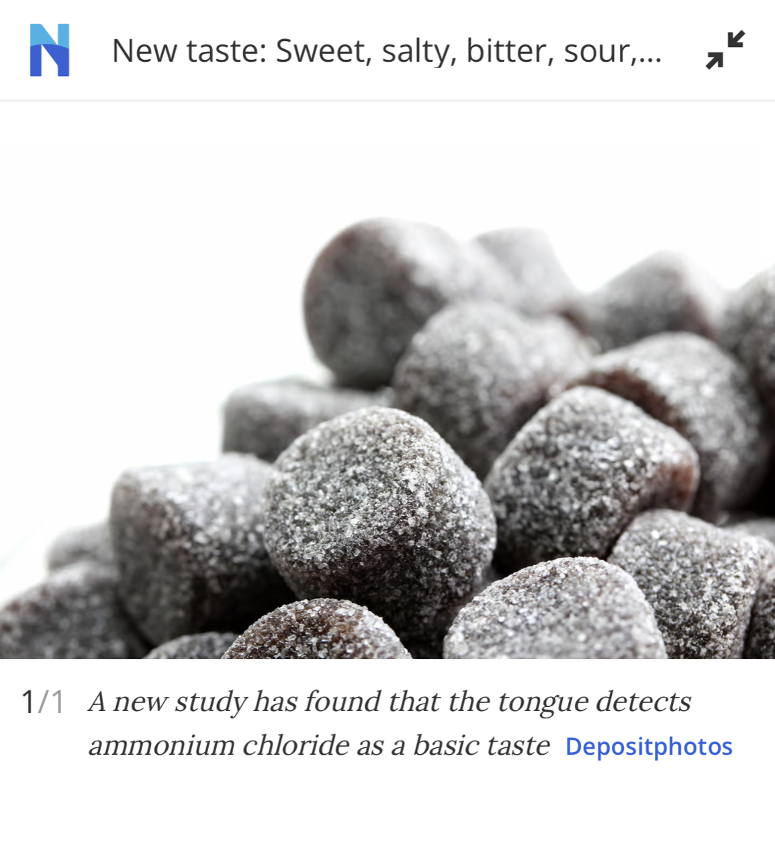
5 or 6 types of Flavor Detection
JR thinks that their ability to taste food has diminished recently. They ask you, what are the five confirmed basic tastes of the tongue? Which of the following lists describes the best answer?
What are the 5 flavors?
Sweet
Sour
Bitter
Salty
Umami (savory)
Tongue might also detect ammonium chloride (USC recent discovery) to avoid harmful substances?
Umami

Slide 8

Digestion Gets Started
Eyes see food and make an appraisal of how to best prepare for incoming load.
Glands secrete saliva to prepare for chewing.
Salivary enzymes (amylase) help with initial digestion
Creates bolus.
Upper pharynx and esophagus under conscious control, the rest involuntary.
Esophagus smooth muscle, controlled by brain.
Lower esophageal sphincter gateway from esophagus to stomach.
  Prevents reflux of gastric contents

Slide 9
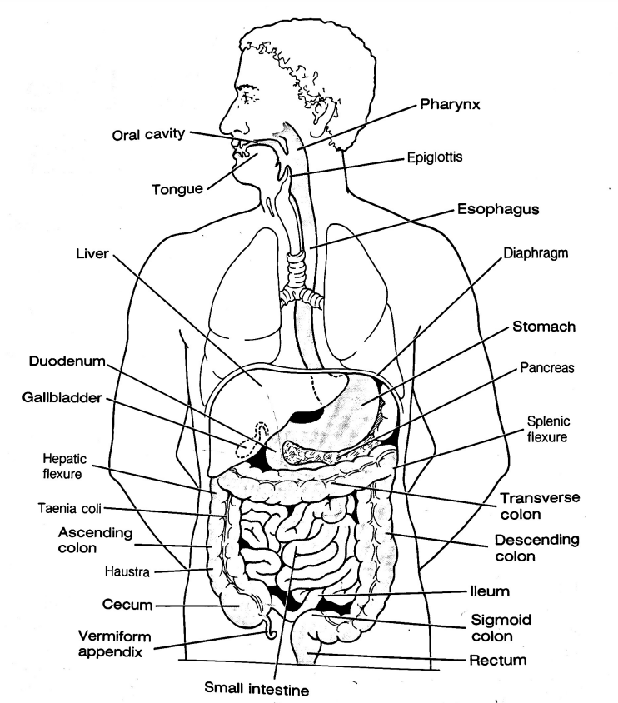








Alimentary Canal
Buckle up!

Slide 10

Quick Question 1
Diabetes is associated with an increased risk of oral disease. Which of the following statements is true?
People with diabetes benefit from vinegar gargles to decrease bacterial load
People with diabetes are at greater risk for tongue cancer.
1 in 5 cases of tooth loss is linked to diabetes
Diabetes is associated with increased tonsillitis.

Slide 11
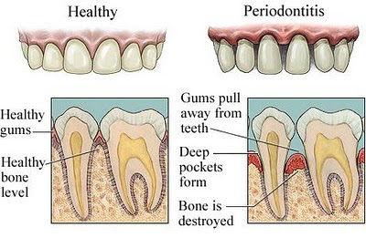
Periodontal Disease
More severe and prevalent with diabetes and elevated A1c levels.
  periodontal treatment associated with better glycemic control
  (A1C 8.3% vs. 7.8%)
  Benefits lasted for 12 mo’s
People with periodontal disease have higher rates of diabetes.
Bidirectional
Oral Care Matters
See dentist at least yearly
Dental hygienist twice yearly
Brush twice daily
Floss daily

Slide 12

Salivary Dysfunction and Xerostomia (dry mouth) in DM
Less saliva uptake and excretion = less protection against bacteria
Hyperglycemia increases glucose levels in saliva, providing medium for bacterial growth- also promotes dry mouth
Dry mouth increases risk of infection and can alter nutritional intake (due to chewing, swallowing difficulties)

Slide 13
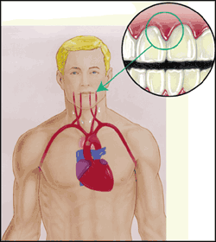
Periodontal disease and Heart Disease
Heart disease link:
  oral bacteria enter the blood stream, attach to fatty plaques in coronary arteries increasing clot formation
  inflammation increases plaque build up, which may contribute to arterial inflammation
Hyperglycemia = Gingivitis = Heart Disease

Slide 14
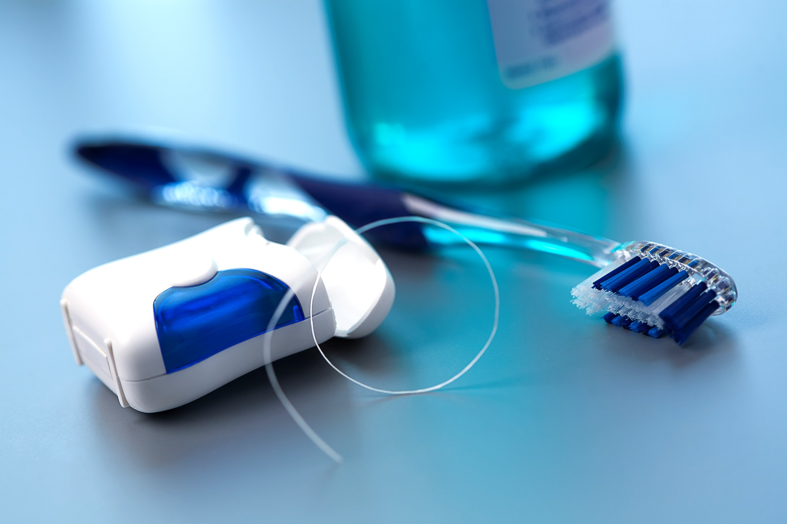
Best $10 You Will Ever Spend

Slide 15

Stomach & Beyond

Slide 16
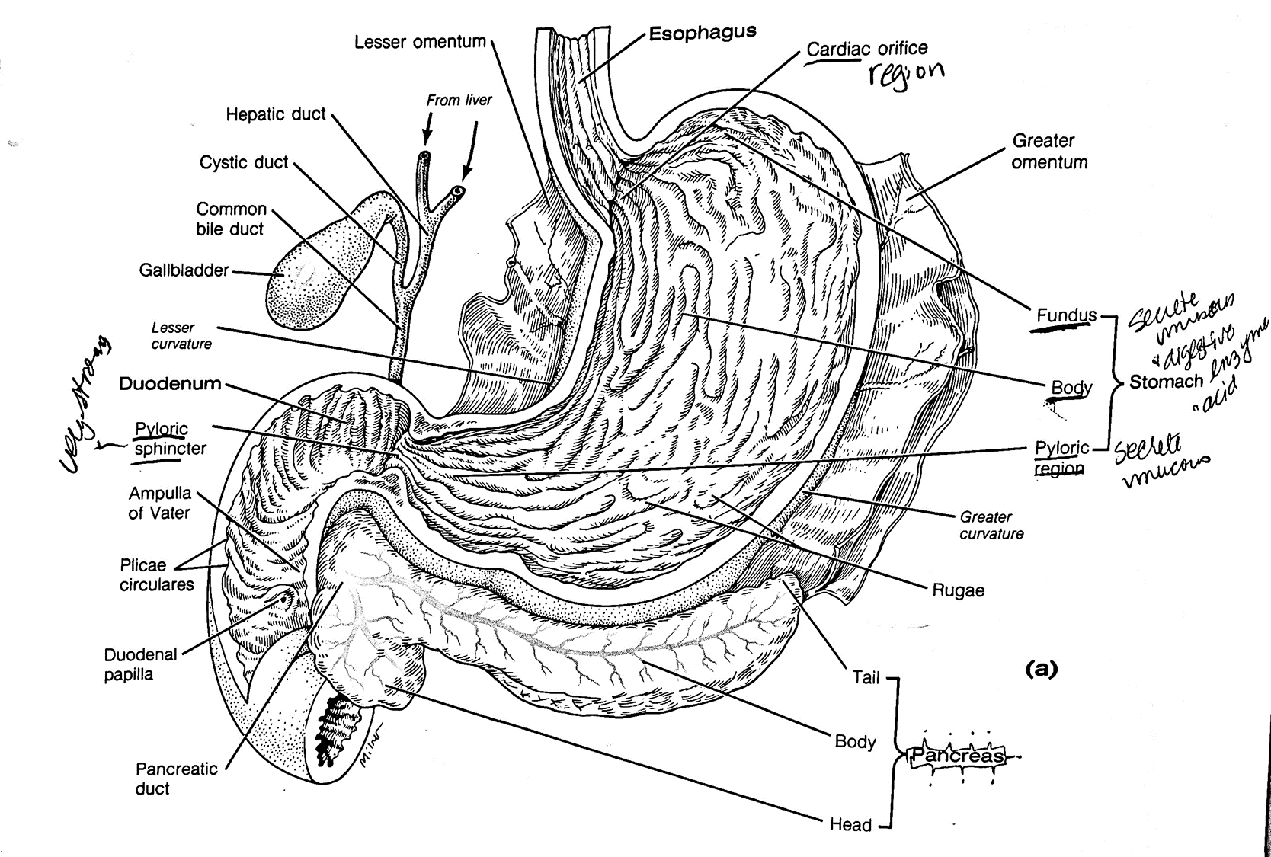











Stomach

Slide 17
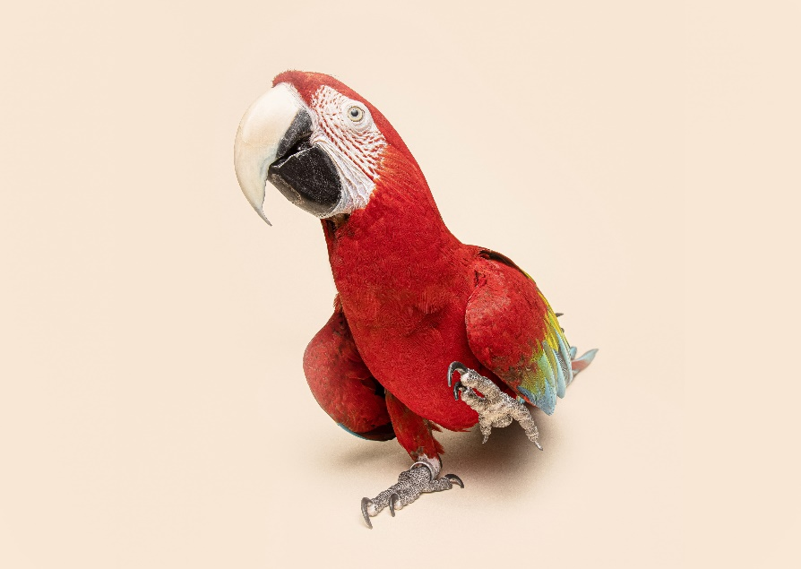
Bonus Question 2
Best definition for borborygmi is:
A tropical fruit used for nausea
Stomach rumbling
Gastric reflux
Treatment for constipation

Slide 18
What Happens in Stomach?
Food in fundus – serves as a holding and mixing area
Gastric juice start breaking down larger particles.
Bolus moved to lower regions and broken into smaller particles through stomach acid and motility.
Gurgling and stomach rumbling is audible reflection of movement.
Usual meal takes about 4 hours to pass through or 1-4 kcals per minute.
Carbs take a few hours to pass through.
Protein/fatty meals can take up to 6 hours.

Slide 19

Digestion Time based on Calories
400 cals
4 cals a minute
100 minutes or
1 hour 40 minutes to digest
1000 cals
4 cals a minute
250 minutes or
4 hours and 10 minutes

Slide 20

Stomach Issues
H. Pylori infection
Gastroparesis
  G-POEM
Metabolic surgery

Slide 21
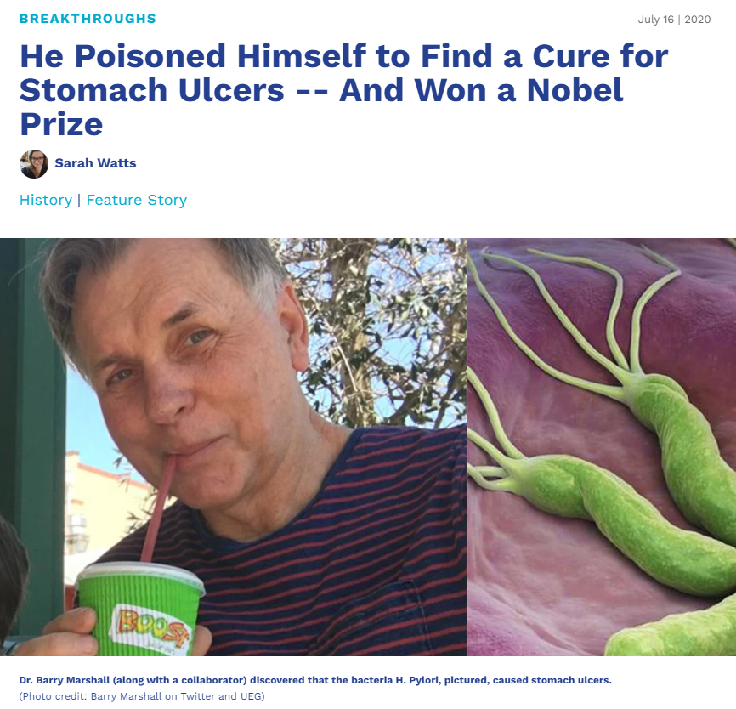

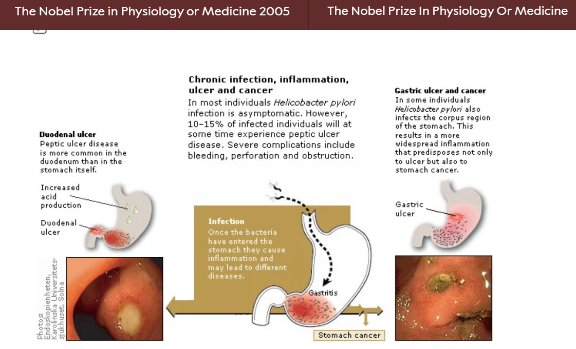
Nobel Prize for Link Between H. Pylori and Gastric Ulcers (Took 20 Years)

Slide 22
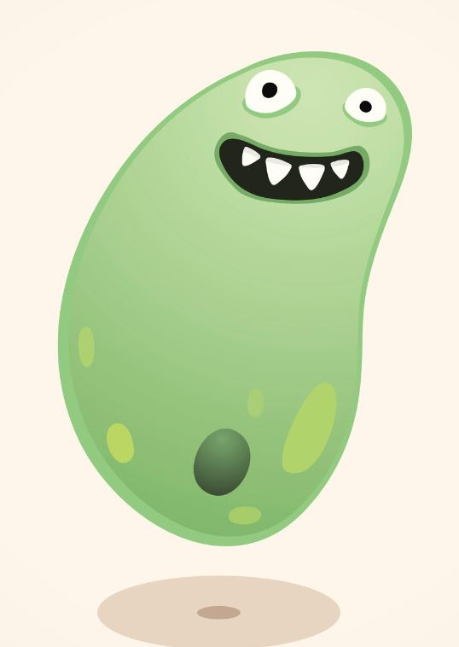
H. Pylori Infection Symptoms
50% of world’s population co-exist with H. Pylori
  Causes inflammation in a small percentage of people
Main Symptom - An aching or burning pain in abdomen which may be worse with an empty stomach.
H. pylori infection symptoms include:
  Feeling of fullness or bloating with fluid and solid food
  Hunger and empty feeling in the stomach, often 1 to 3 hours after meal
  Mild nausea that may go away with vomiting
  Loss of appetite
  Weight loss without trying
  Burping
  Bloody or dark, tarry stools or bloody vomit
About 10% to 15% of people infected with H pylori develop peptic ulcer disease.
About 1-3% develop stomach cancer
People with diabetes at risk for H. pylori and vice versa.

Slide 23

Quick Question: Bloating & Post Meal Hypo
JR has lived with type 1 diabetes for over 30 years and has been complaining that they feel full and bloated after eating and experiencing more post-meal hypoglycemia.
Based on this information, what is the most appropriate recommendation for JR?
Evaluate transglutaminase levels.
Encourage small, frequent, low fiber meals.
Suggest a consult for a gastric pacemaker.
Recommend they try avoiding foods with gluten for a few weeks to see if they feel better.

Slide 24
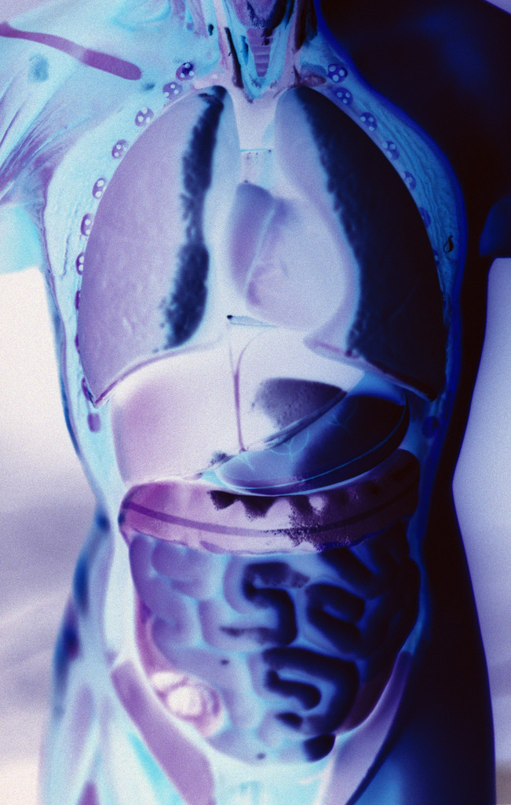
Gastroparesis
Gastroparesis: affects 20 – 30% of individuals with longstanding diabetes
Delayed emptying of stomach contents due to nerve damage
S/S include early satiety, fullness, postprandial hypo, vomiting
Diagnosis: gastric emptying studies, post-prandial hypoglycemia
Tx: improve BG, small, low fat & fiber meals & meds

Slide 25
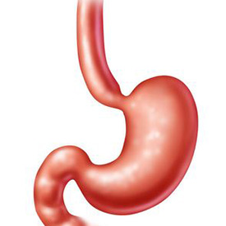
Nutrition for Gastroparesis
Dietary changes are a high priority in treatment
Consider the following dietary modifications:
  Decrease fiber (may lead to bezoar formation)
  Evaluate fat intake
    Fat is a good/high source of calories so limit only after other measures are exhausted
    Liquid fats may be tolerated better
Notes:
Most nutrition therapy recommendations for gastroparesis are based on the knowledge of the pathophysiology and clinical judgement due to limited research- there are almost no clinical trial results to determine the success of any nutritional intervention for gastroparesis.
The advice focuses on selecting foods that are easy to digest or modifying foods so that they digest easier and faster. This minimizes symptoms.
Lowering fiber intake can be helpful. We need to consider fat intake more closely because it is a good source of calories and some people with gastroparesis struggle with intake. Liquid fat may be more tolerable
____________________________________
_____________________________________
Big book 165 / 2022 Standards 190

Slide 26

Nutrition for Gastroparesis
Consider dietary modifications:
  Multi supplement if intake is insufficient
  Small and frequent meals
  Liquid/pureed calories
    May need to try liquid calories later in the day
  Chew foods well
  Sit up for 1-2 hours after eating
Notes:
Those with gastroparesis may need supplementation if their intake is low. Small frequent meals can help, as can having liquid or pureed calories. You can puree just about anything – we have a gentleman with gastroparesis that, every year, purees thanksgiving dinner and loves it!
Stabilizing glucose levels is particularly important because gastroparesis is exacerbated with wide swings in blood sugars, particularly with BG readings above 240 mg/dl which impairs emptying

Slide 27
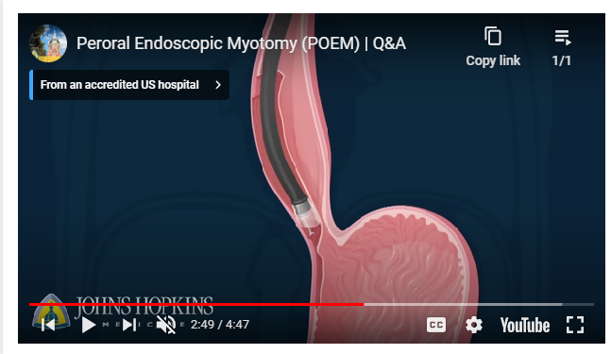
Gastric peroral endoscopic myotomy or G-POEM
The gateway from the small intestine to the duodenum is the pylorus.
Food knocks of the pyloric sphincter for admission to duodenum
Doors usually easily open, with limited resistance.
With gastroparesis, pyloric sphincter is stiff and closed shut.
This endoscopic G-POEM procedure cuts the muscles near the pyloric sphincter (a myotomy).
Helps to permanently relax the sphincter, so food can empty freely.
https://www.hopkinsmedicine.org/health/treatment-tests-and-therapies/peroral-endoscopic-myotomy

Slide 28

Stretch Break

Slide 29

Gut Hormones
Gut hormones secreted by the L-cell of the intestine. Some in the small intestine, but more the larger intestine.
People with type 2 make about 50% less of gut hormones, but new study shows that people with type 1 may benefit from GLP-1 therapy early in diagnosis.
Can slow peristalsis down too much, and lead to an intestinal blockage – Ozempic warning.

Slide 30
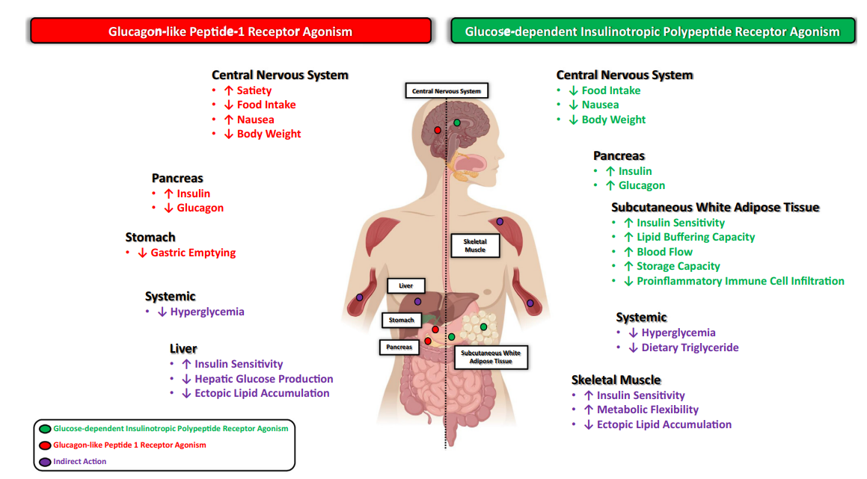
GLP-1 & GIP Hormones
Samms RJ, Coghlan MP, Sloop KW. How May GIP Enhance the Therapeutic Efficacy of GLP-1? Trends Endocrinol Metab. 2020 Jun;31(6):410-421.
Notes:
GIP: Glucose-dependent Insulinotropic Polypeptide
GLP: glucagon-like peptide

Slide 31
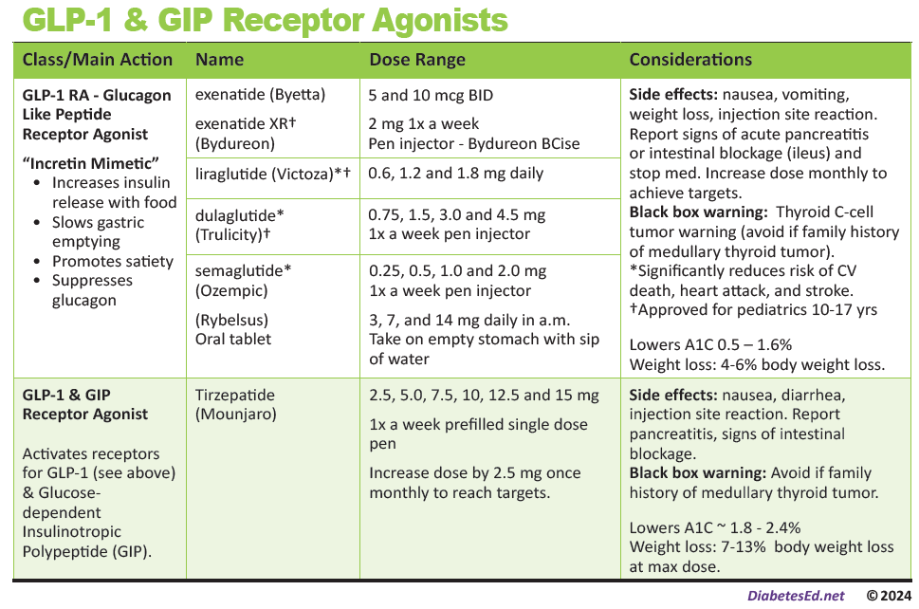
Pocket Card: GLP-1 & GIP RA
Notes:
Update with exenatide indication in pediatrics.

Slide 32

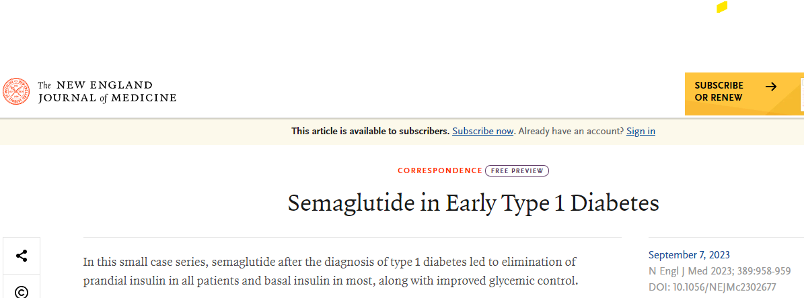
GLP-1 RA’s as Adjunctive Therapy for Newly Diagnosed Type 1
NEJM study looked at the effects of semaglutide on new-onset type 1 diabetes.
Study evaluated blood glucose of 10 adults, ages 21-39, who had started taking semaglutide within three months of diagnosis.
At diagnosis, all the participants were taking basal and mealtime insulin.
Participants started with 0.125 mg semaglutide per week, with a maximum of 0.5 mg semaglutide per week, while mealtime insulin dose was lowered.
Basal insulin dose was reduced based on CGM readings.
https://www.nejm.org/doi/full/10.1056/NEJMc2302677

Slide 33
GLP-1 RA’s as Adjunctive Therapy for Newly Diagnosed Type 1
What were the key findings?
Within 3 months, participants no longer needed mealtime insulin.
At six months, 7 out of 10 no longer needed basal insulin.
Most of the people in the study were able to stop taking any insulin after six months of treatment with semaglutide.
A1C levels fell from an average of 11.7% at diagnosis to 5.9% at six months and 5.7% at one year,
Participants also achieved time in range (70-180) of 89%.
Side effects:
  Some participants experienced mild hypo while the semaglutide dose was increased. Once the semaglutide dose stabilized, there were no problems with hypoglycemia.
  There were no reports of diabetic ketoacidosis or other serious side effects.

Slide 34
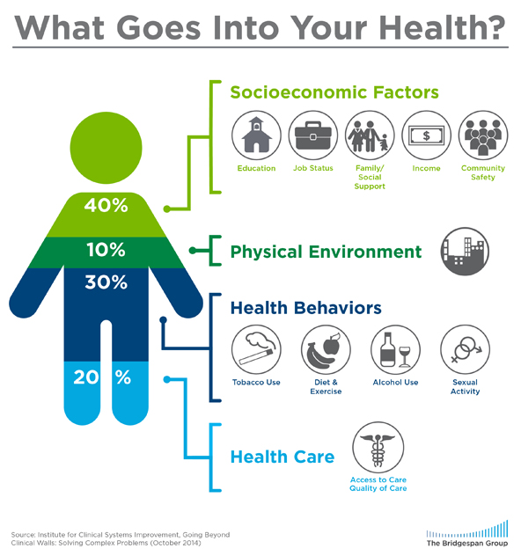
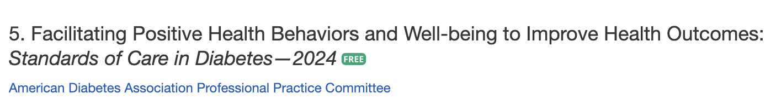
Address Barriers to Self Management
Barriers exist within health system, payer, health care professional & individual.
Address barriers through innovation, including community health workers, telehealth, other digital health solutions.
Consider social determinants of health in the target population when designing care.
https://coveragetoolkit.org/health-equity/defining-health-equity/
Notes:
Access and health equity is the ultimate goal when designing and delivering DSMES.
Creating culturally appropriate and varied modalities of settings has been shown to improve outcomes.
We know barriers to care exist at every level from the health system to individual.
However we can address these barriers by working to educate participants and health care providers on the critical times when DSMES is needed.
We can work with health systems and clinics to develop population health screening and clinical outreach,
create protocols to reduce time for referral and
collaborate health and community systems to address social needs.
We can include other health partners including community health workers to support delivery of diabetes peer support.
Barriers can be also be addressed by developing a diversity of delivery models.
From traditional inperson classrooms to community-based strategies and technology enabled solutions including telehealth or virtual environments varying modes can serve different needs.

Slide 35

GLPs & Intestinal Blockage
More than a dozen reports of intestinal blockage or ileus among people using semaglutide (Ozempic).
New warning to report any signs of intestinal blockage including:
  Bloating, abdominal cramps, constipation, nausea, vomiting, and constipation that doesn’t subside within a few days.
Encourage individuals to report these signs and consult with a healthcare provider.

Slide 36
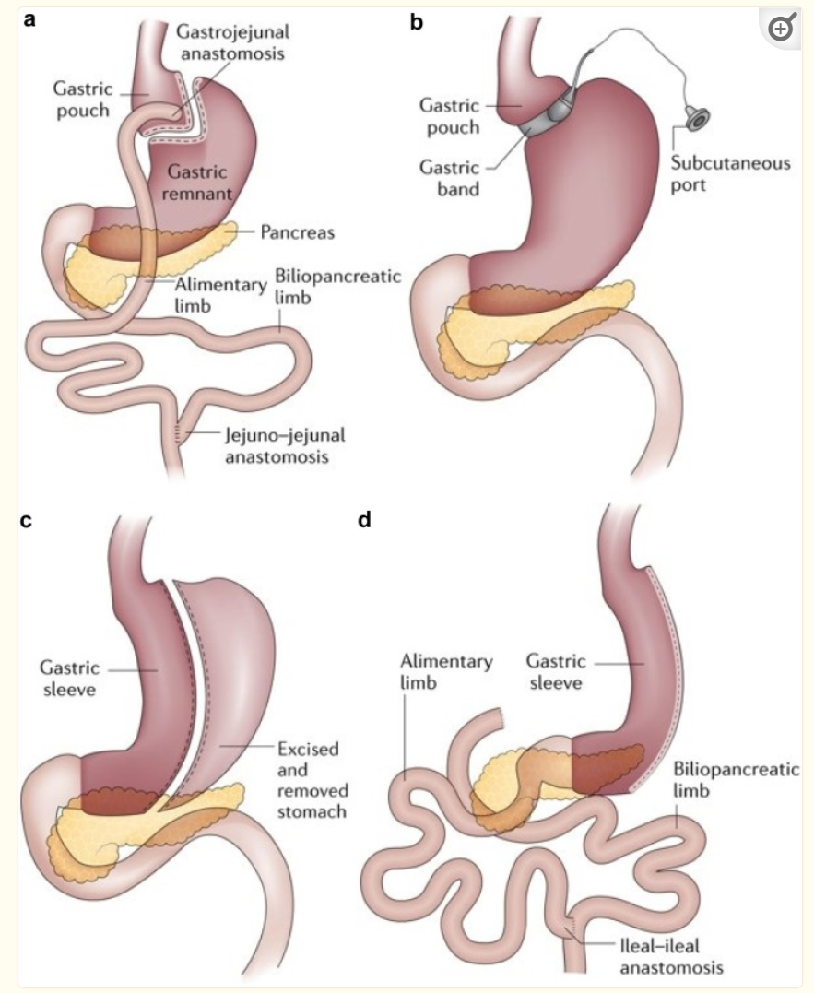
Metabolic Surgery for Weight Loss
Considered as an option to treat T2DM for screened surgical candidates with:
  BMI 30 – 34.9 kg/m² for those who don’t achieve wt. loss w/ nonsurgical methods
Recommended as an option to treat T2DM for screened surgical candidates with:
  BMI ≥ 40 kg/m²
  BMI 35 - 39.9 kg/m² for those who don’t achieve wt. loss w/ nonsurgical methods
*Reduce BMI by 2.5 kg/m2 for Asian Americans
https://www.ncbi.nlm.nih.gov/pmc/articles/PMC6343052/#:~:text=Malabsorption%20status%20after%20bariatric%20surgery,is%20achieved%20after%20bariatric%20surgery.
Notes:
Another option for weight loss is metabolic surgery. It is recommended as an option to treat T2DM for screened surgical candidates with higher BMIs
____________________
____________________
*All BMI thresholds need to be reduced by 2.5 kg/m² for Asian Americans
P 464 big book and s119

Slide 37
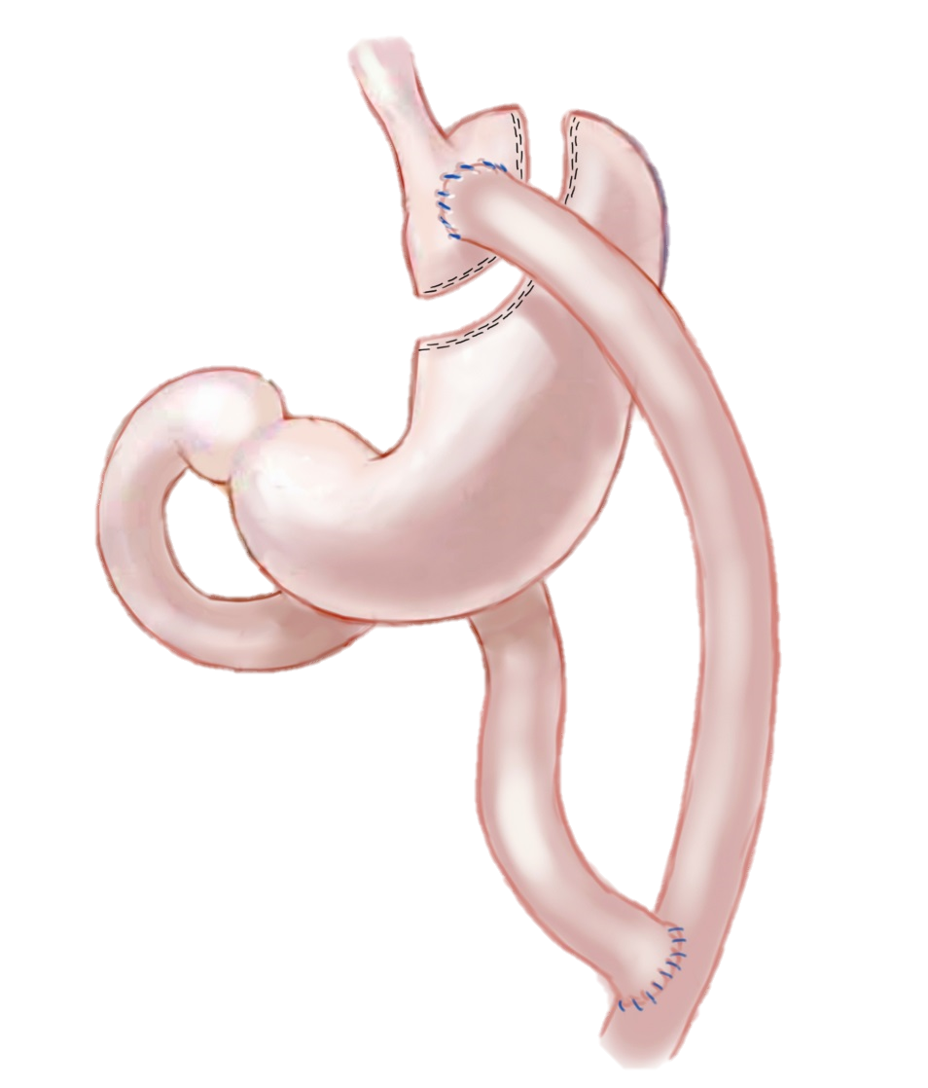
Metabolic Surgery for Weight Loss
Disadvantages
Advantages in T2DM
Diabetes remission in 30-63% of those with RYGB.
  35-50% of those who go into remission experience recurrence, but median disease-free period is 8.3 years.
Many with diabetes will sustain glycemic improvement for 5-15 years.
Additional health benefits
Costly (but likely cost effective)
Long-term concerns: dumping syndrome, anemia, osteoporosis, severe hypoglycemia, nutrient deficiency.
Increased risk of substance use, new-onset depression/anxiety
Notes:
As for some of the advantages of Metabolic Surgery
Randomized controlled trials have documented Diabetes remission in up to 63% of individuals who undergo metabolic surgery for weight loss.
While many of the patients who go into remission experience recurrence, the median disease-free period is 8.3 years. There are some pre-surgical predictors of success for longer remission. These include having the surgery at a younger age or having a had shorter duration of diabetes (<8 years) prior to surgery. Individuals who don’t require insulin and those who maintain their weight loss are also more likely to have a longer remission.
That said, with or without remission, the majority of people with diabetes sustain improvement in their glucose levels for 5-15 years after surgery. Other benefits include: substantial reduction in cardiovascular disease risk, reductions in the incidence of microvascular disease, and enhancements in quality of life.
S120
S 106

Slide 38

Weight is a Heavy Issue
Notes:
Now that we’ve spent that time discussing diabetes and weight with a focus on weight loss, I want to take a minute to talk about weight from another angle.
We want to realize that weight is not the only indicator of health and not every person with diabetes will need or want to lose weight.
And so, providing weight-inclusive care focuses on establishing self-care behaviors rather than promoting restriction or endorsing unsustainable eating or exercise patterns as a way to “get healthy.” As many of you know there is significant stigma and blame around weight, particularly in the diabetes world. This can be a significant emotional and mental burden for the person with diabetes.
As diabetes experts, our job is to advocate and support the person with diabetes in a way that feels right for that individual… and mental wellbeing is a big piece of this. With such, weight loss may not be a goal for every individual who lives with diabetes.

Slide 39

Now to the Duodenum

Slide 40
Duodenum, gallbladder, pancreas

Slide 41
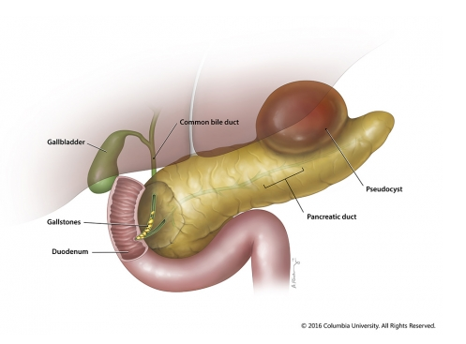
Pancreatitis
Pancreatitis caused by digestion of the organ from pancreatic enzymes normally carried to the SI through pancreatic duct.
Detected through elevated Amylase levels & pain
Causes:
  HIV meds and other meds
  Alcohol ingestion
  Gallstones blocking pancreatic enzyme flow to small intestine
  Elevated triglycerides
  Cancer, injury and other

Slide 42
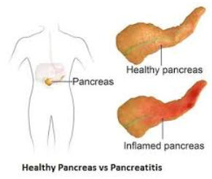
Pancreatitis
People with diabetes 2xs risk of acute pancreatitis
After episode of pancreatitis, one third of people will get prediabetes or diabetes
Pancreatitis is an exocrine dysfunction:
  Disrupts global architecture or physiology of pancreas
  Results in both exocrine and endocrine dysfunction

Slide 43

Exocrine Pancreatic Insufficiency
Fatty stools
Abdominal pain especially after high fat meals
Can happen with both type 1 & 2 diabetes
May need to take fat soluble vitamins, enzymes
Avoid smoking, excess alcohol to protect pancreas.
Cystic fibrosis

Slide 44
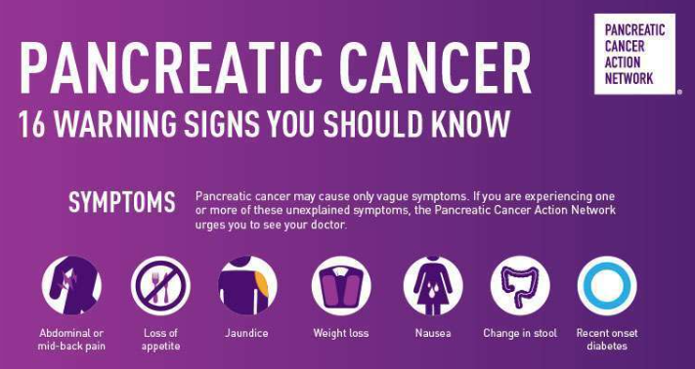
Pancreas Cancer
The American Cancer Society’s estimates for pancreatic cancer in U.S. for 2023 are:
About 64,050 people will be diagnosed with pancreatic cancer.
About 50,550 people will die of pancreatic cancer.
Pancreatic cancer accounts for about 3% of all cancers in the US and about 7% of all cancer deaths.
https://pancan.org/

Slide 45
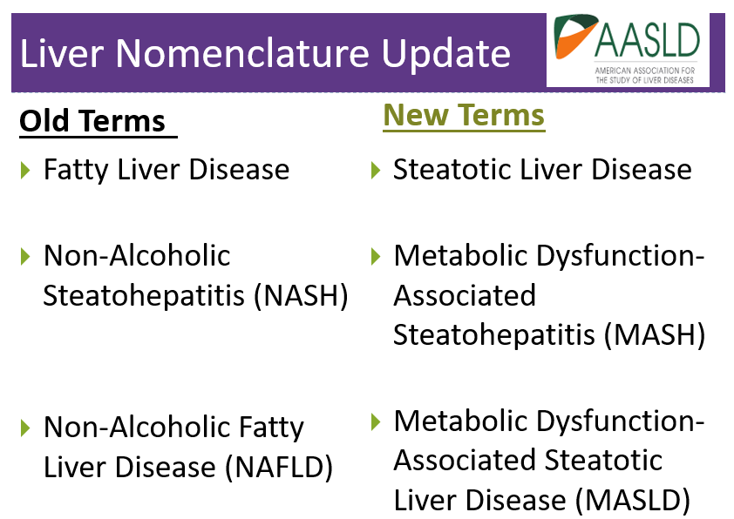

Slide 46

Steatotic Liver Disease (SLD)
MASLD* is when fat reaches 5% to 10% of the liver's weight
  Adults with type 2 diabetes.
  MASLD is prevalent in >70%
    Of those 50% have NASH*
  12-20% have fibrosis
Need evaluation for nonalcoholic steatohepatitis and liver fibrosis for those:
  At high risk: type 2 or prediabetes with cardiometabolic risk factors
  Elevated liver enzymes (ALT) or
  Fatty liver on imaging or ultrasound
Associated with :
Increased BMI (30+)
Cardiometabolic risk factors
Over 50 yrs
ALT & AST 30 units/L +
*Now called MASH - Metabolic Dysfunction-Associated Steatohepatitis.

Slide 47
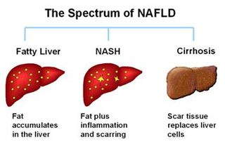
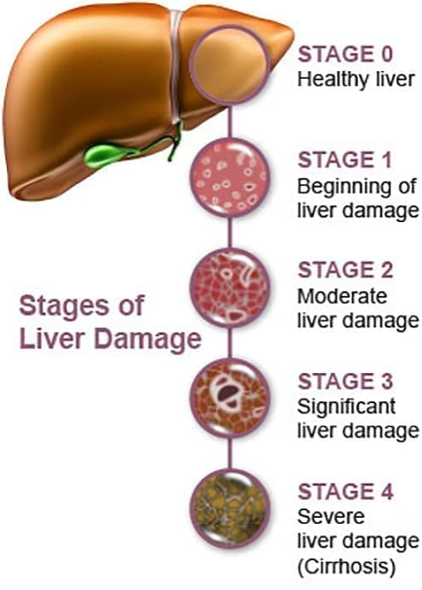
Natural History of MASLD* to MASH**
*Metabolic Dysfunction-Associated Steatotic Liver Disease
**Metabolic Dysfunction-Associated Steatohepatitis.
https://liverfoundation.org/wp-content/uploads/2020/11/StagesFibrosis.jpg

Slide 48
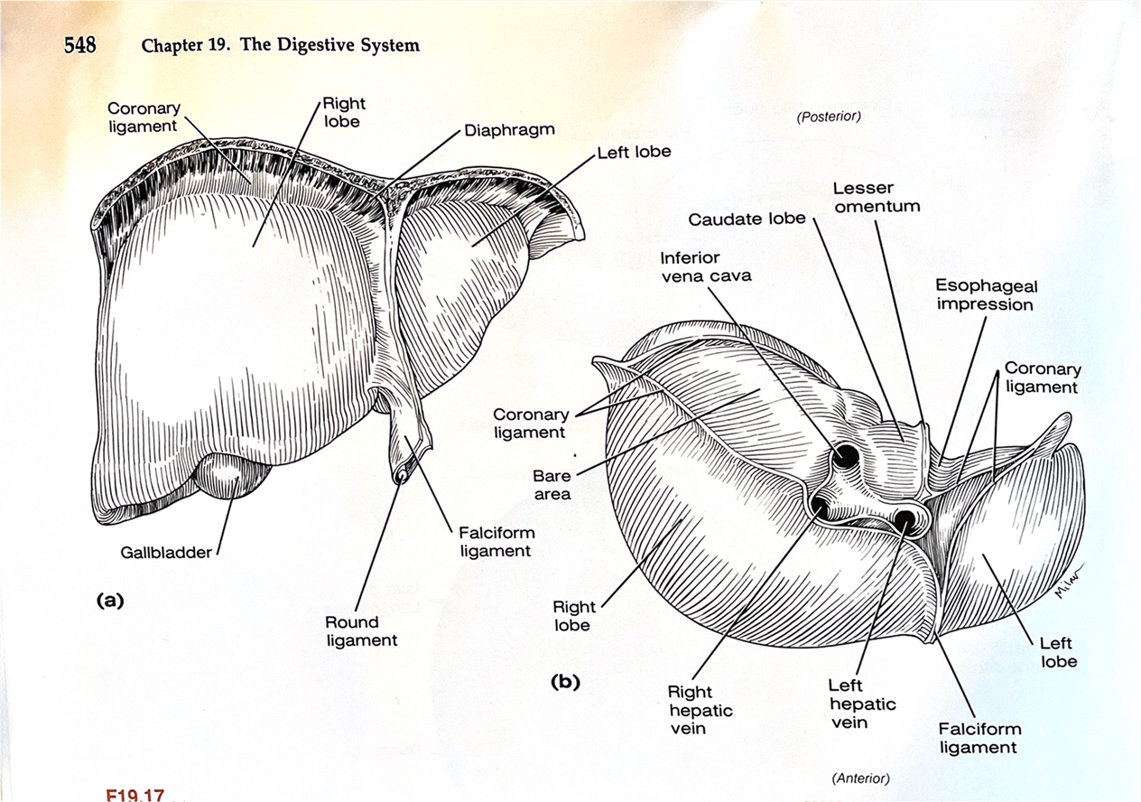
Quick Question: Detecting Steatosis
EV is 58 years old with type 2 diabetes and a BMI of 33. In addition, EV has hypertension and hyperlipidemia, with elevated liver enzymes (ALT and AST). To determine if EV is at risk for liver fibrosis and cirrhosis, which of the following would provide a risk calculation?
UACR
FIB-4
GAD or ICA
Weight in (kg) divided by the square of height in meters (m2)

Slide 49
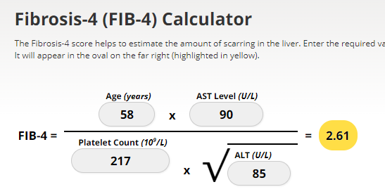
Screening for NASH – FIB-4
FIB-4 estimates risk of hepatic cirrhosis (age 35+):
Calculated by imputing:
  Age
  plasma aminotransferases (AST and ALT)
  and platelet count
FIB-4 Risk Levels
  Lower risk is <1.3
  Intermediate 1.3 to 2.67
  High risk >2.67
    considered as having a high probability of advanced fibrosis (F3–F4).
The American College of Gastroenterology considers Upper limit of normal ALT levels:
29–33 units/L for males
19–25 units/L for female individuals
(mdcalc.com/calc/2200/fibrosis-4-fib-4-index-liver-fibrosis).
www.DiabetesEd.net

Slide 50
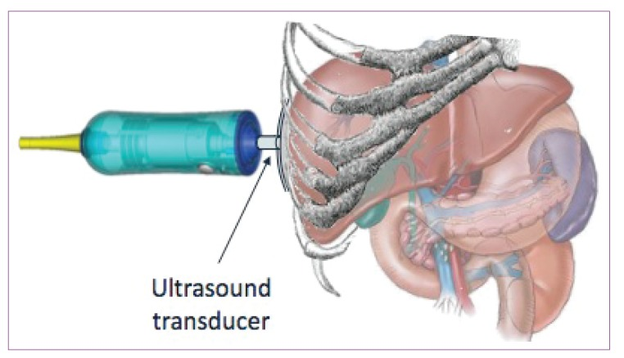
Liver Elastography or FibroScan
https://www.ncbi.nlm.nih.gov/pmc/articles/PMC3594956/

Slide 51

Actions To Decrease Fatty Liver
Increase activity
  Strength training
  Yoga or Thai Chi
  Walking & aerobics
Thoughtful eating
  More fiber
  Less processed foods & less added sugar (especially sugary beverages)
  Less alcohol
  See RDN
Treatment
  Actos
  GLP-1
  Statins
Prevention
  Cancer Screenings
  Decrease inflammation

Slide 52
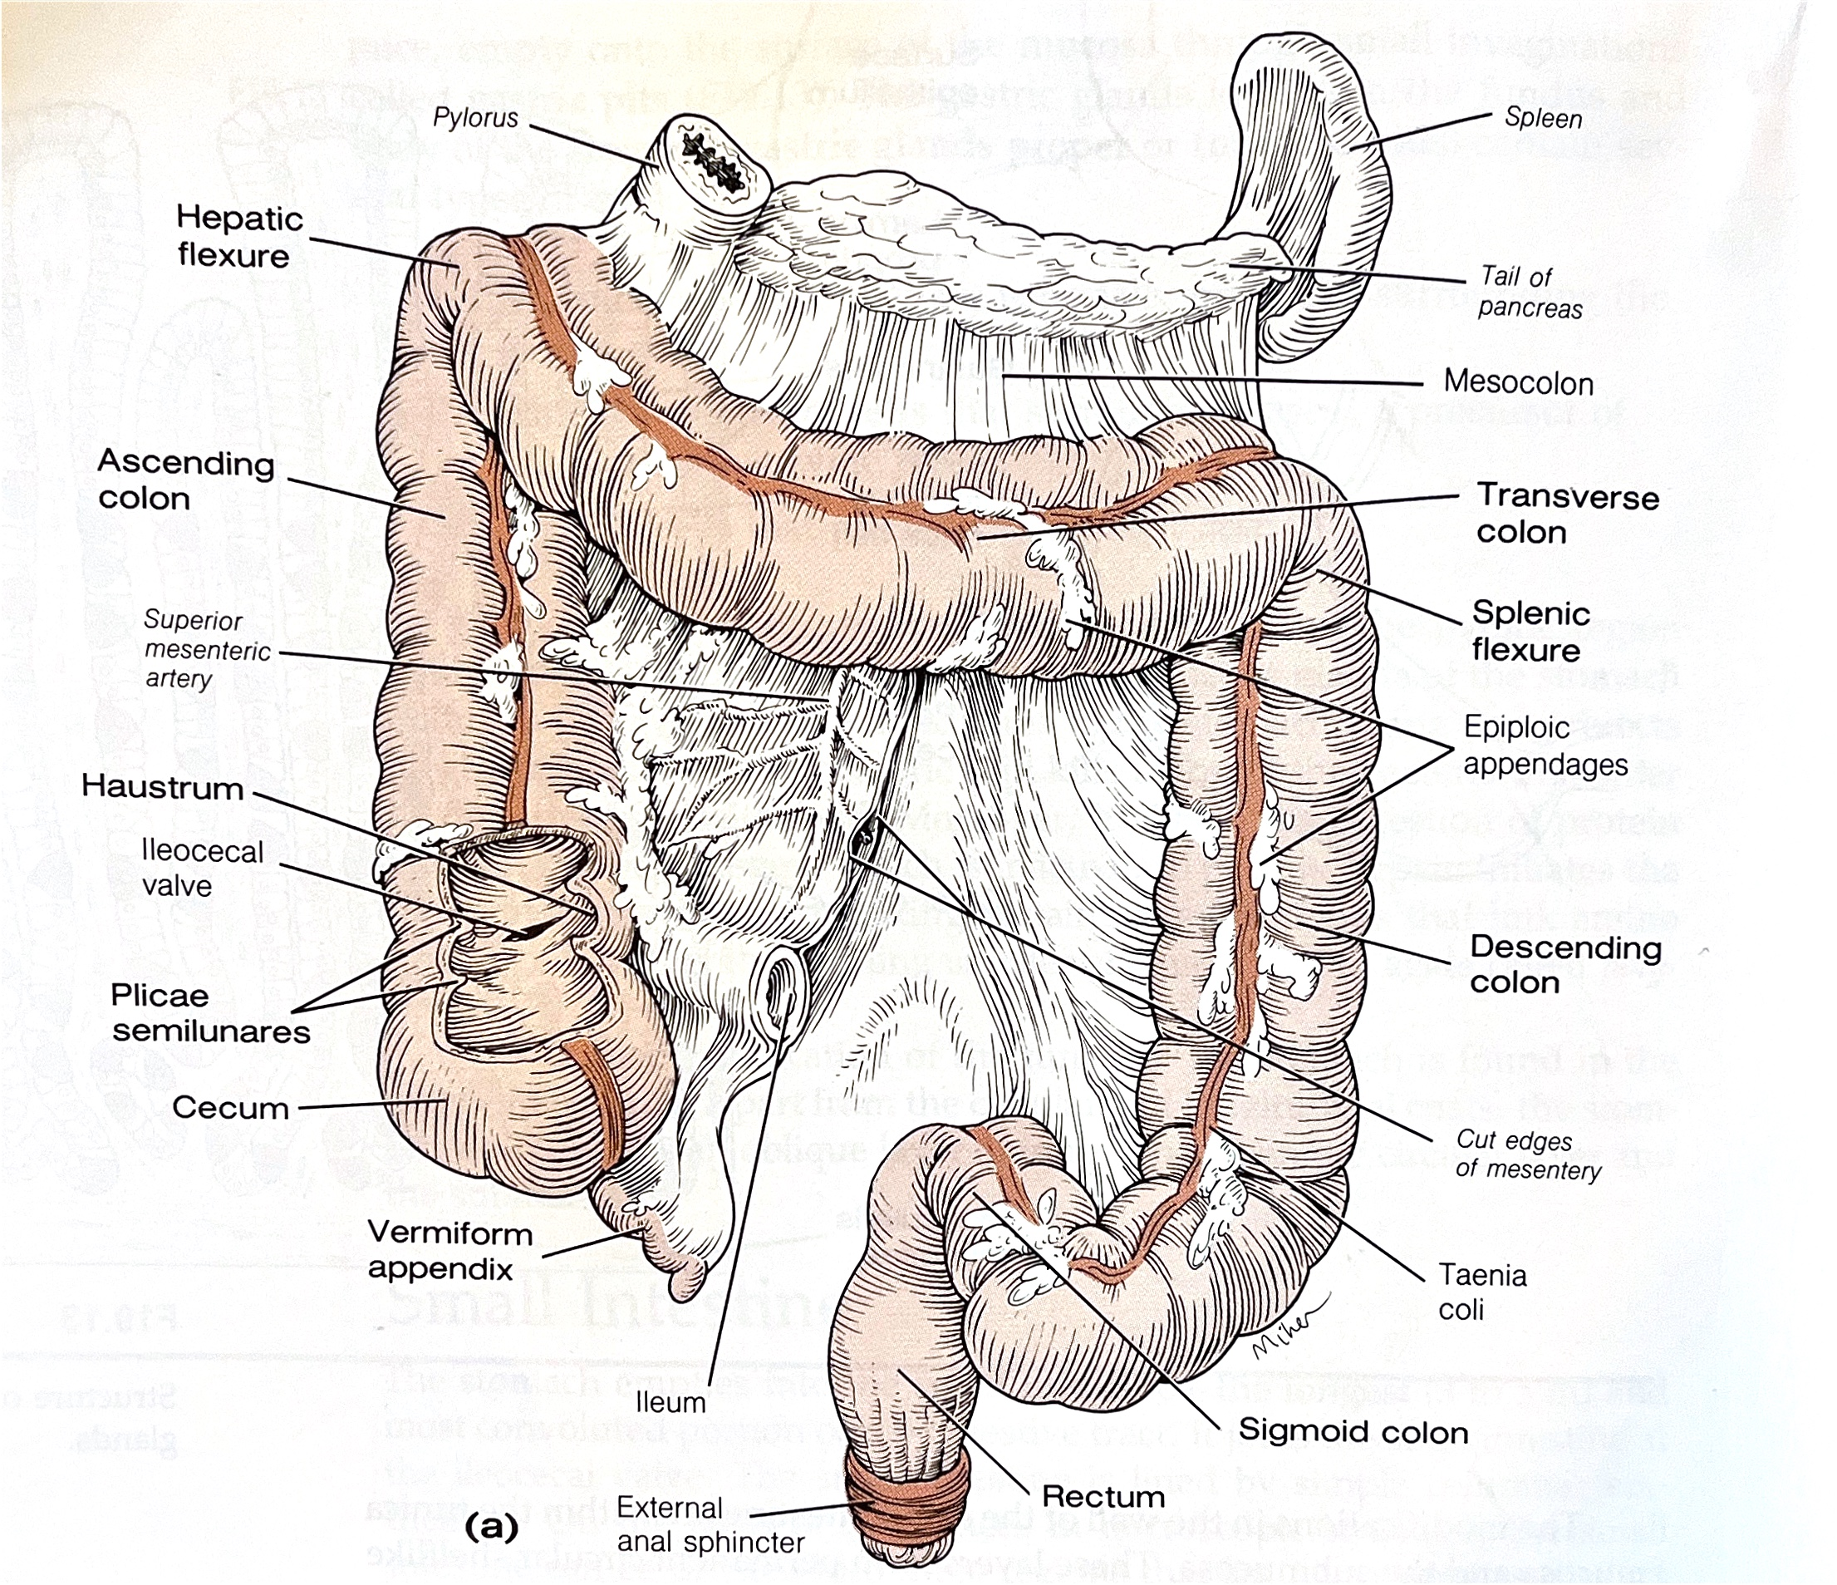

Almost There – Ileum to Anus

Slide 53
Ileum to Anus
Ileum last 2 meters of intestine. To move from the ileum to the cecum (first part of large intestine), food passes through the ileocecal valve.
The appendix hangs out near this juncture. It traps harmful bacteria and contains lymphoid cells similar to tonsils. If appendix gets blocked with bacteria and white blood cells, can lead to appendicitis
Large intestine – The bacterial party center of your GI Tract
  Ascending
  Transverse
  Descending
  Sigmoid colon makes and Sideway S as it enters the iliac fossa
  Then the rectum
  Anus – 2 sphincters internal and external
  External sphincter anal skeletal muscle under voluntary control and internal anal muscle not

Slide 54
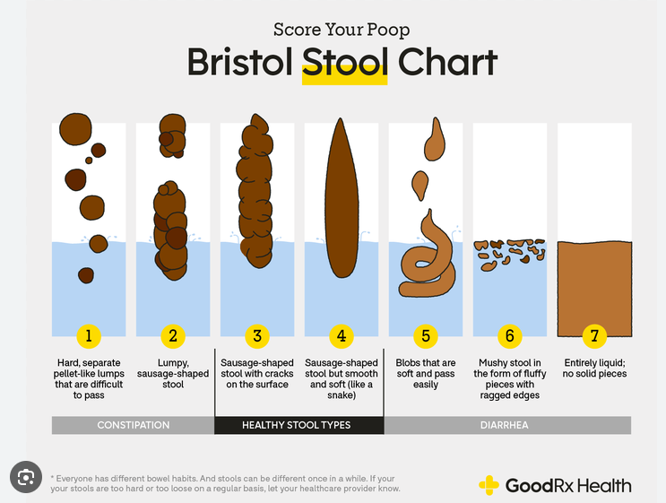
Look at your Poop – Stool Chart

Slide 55
How many words for Stool?
Bowel movement
Poop
Poo
Ca Ca
Excrement
Code Brown
Snake
Rocks
Squirt
Defecation
Turtle head
Turd
Potty
Skid
Squirt
Feces
Dump
Pile
#2
Cowpie

Slide 56
Bowel Issues - Diarrhea
Defined and Treatment
Possible Causes
  Elevated glucose
  Autonomic neuropathy
  Metformin
  GLP-1 RA’s
  Celiac disease
  Bacterial /yeast infection
  Exocrine pancreatic insufficiency
  Irritable bowel syndrome
  Sugar free foods
  Other
3 or more bowel movements a day
Treat & Determine Cause
Improve glucose levels
Eat whole foods — including whole grains and fiber.
Drink plenty of water.
Get regular exercise.
Quit smoking and using tobacco products.
Limit alcohol.
Take medications as necessary.

Slide 57

Bowel Issues - Constipation
Defined as less than 3 bowel movements a week.
More common in diabetes
GLP-1 RA can contribute
Treatment
  Get glucose to target
  Increase fiber, activity, H2O
  Bulking agents (psyllium)
  Laxatives or other agents
  Bathroom habits review

Slide 58

Promoting Colon Health
Nourish gut bacteria
Get enough sleep
Keep active
Drinking enough fluids
Consider alcohol intake
Quit smoking
Go outside
Thoughtful antibiotic use
Meditation may enhance helpful gut bacteria

Slide 59

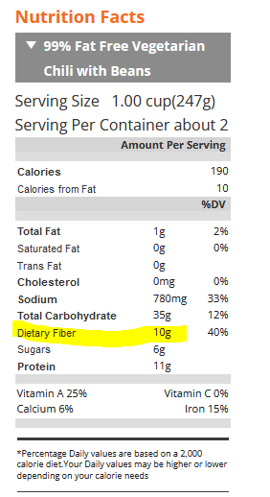
Fiber – the New “F” Word
Goal:
  14 gms / 1000 calories ~ 30 gms a day
How?
  Whole, intact grains, beans, fruits, veggies, nuts, avocados
Why?
  Associated with lower mortality for people with type 2.
  Fiber intake inversely associated with type 2 diabetes
Avoid highly processed foods
  If label says 0-2gms of fiber per serving, low fiber food.

Slide 60
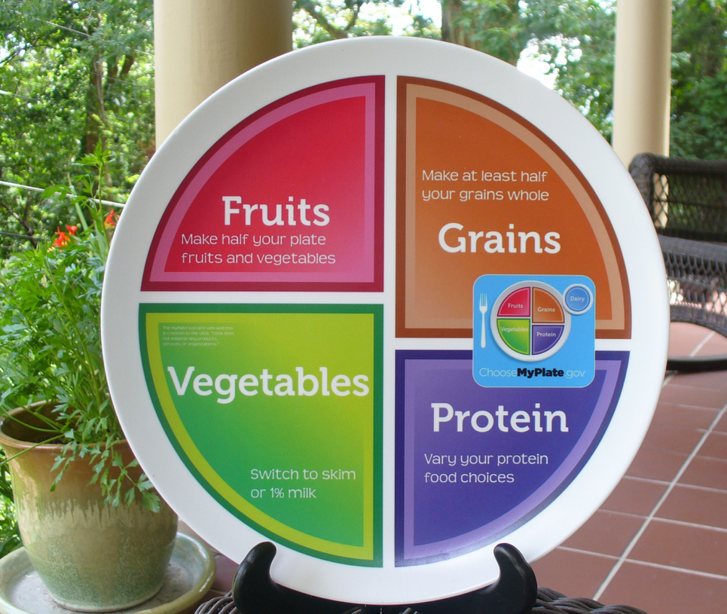
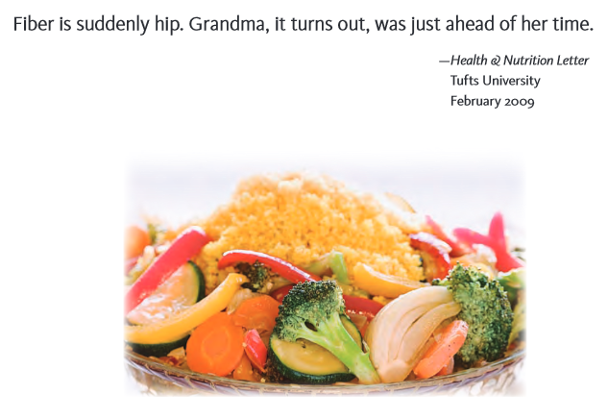
GET Lots of Diverse Fiber Foods
Goal is 25 – 30 gms day
American Food Project
Full Plate Diet
Helps increase fiber in usual meals

Slide 61
Getting to Better Gut Bacterial Health
Eat more PREbiotics
PRObiotics
Foods with indigestible fibers that nourish the good bacteria:
  High fiber foods like, whole grains, fruits, veggies, nuts
  High in prebiotic fibers include: Jerusalem artichokes, onions, kale, Brussels sprouts, bananas, dandelion greens & more
These foods contain healthy bacteria like Bifidobacterium and lactobacillus.
  Yogurt, Kefir – look for “live or active cultures”
  Fermented foods like: Sauerkraut, Kimchi, Miso soup, kombucha

Slide 62

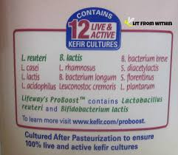
Kefir – Fermented Milk
From the Turkish word keyif, which means “feeling good” after eating

Slide 63

100 Trillion Friends to Call Your Own
From way back when, to current time
man and bacteria have been intertwined.
Start with your head, it's a happening place,
there's staphylococcus all over your face.
Next up is gums, teeth and mouth,
You'll find streptococcus inside and out!
Now to your stomach, to keep the pH,
H. pylori is on the case!
Inside the intestines, 30 feet of tube,
3 pounds of bacteria digesting your food.
From Bacteroidetes to keep you lean,
to Firmicutes, a junk food digesting machine!
Prevotella another bug on the scene,
breaks down fiber, veggies and beans!
Lactobacillus is a newborn's friend,
lining birth canal from tip to end.
Down to your feet, in-between the toes,
that's where lots of pseudomonas grows!
Short chain fatty acids, you wanna keep them around
Protects gut mucous lining from breakin’ down
So here’s my message, always nourish your gut
With fresh fruit, grains, veggies, beans and nuts
More kefir, miso, sauerkraut, kimchi
Less sugar and fast foods to keep away disease
Breast feed, get dirty, limit antibiotic use
Let newborns come out through the natural shoot
Be reassured that you're never alone
You've got 100 trillion friends to call your own!
Copyright Diabetes Education Services© May not be used without written permission. www.DiabetesEd.net
100 Trillion Friends to Call Your Own by Beverly Thomassian, RN, MPH, CDE, BC-ADM to the tune “Yeah” in the style of Usher.

Slide 64

Thank You
Questions?
Email info@diabetesed.net
Web www.DiabetesEd.net
Phone 530-893-8635

