Slide 1

Welcome Everyone
Quick request:
- Please share your biggest takeaway(s) from yesterday's program in the chat.
Good Morning and Welcome.
Grab your coffee, tea or other beverage, a healthy snack and get comfy.
We will start promptly at 8:00 AM Pacific Time.
If you are having any technical difficulty, please chat with Bryanna or Brent at www.DiabetesEd.net or call 530 / 893-8635 or email at info@diabetesed.net

Slide 2
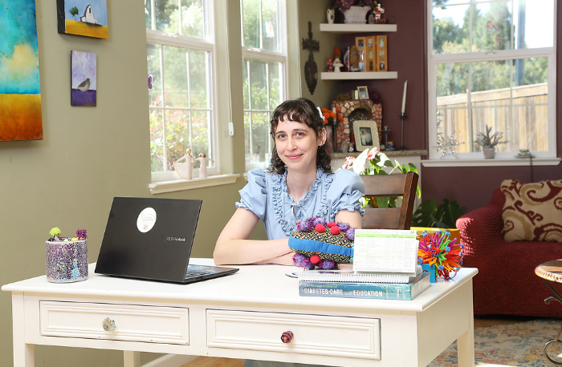
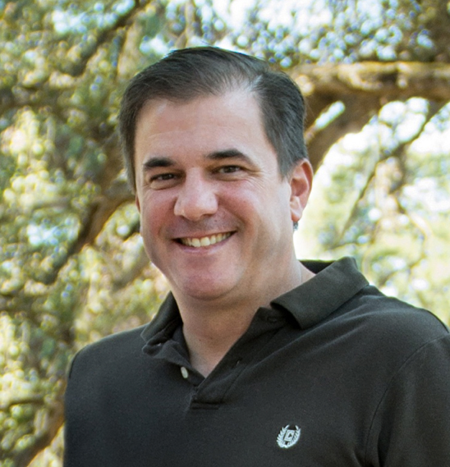
We are Here to Help!
Bryanna Sabourin
Director of Operations
Certification Pathway Coach &
Customer Happiness Expert
Brent McMenomey Customer Advocate and Brand Ambassador
If you have questions, you can chat with us at www.DiabetesEd.net or call 530 / 893-8635 or email at info@diabetesed.net

Slide 3
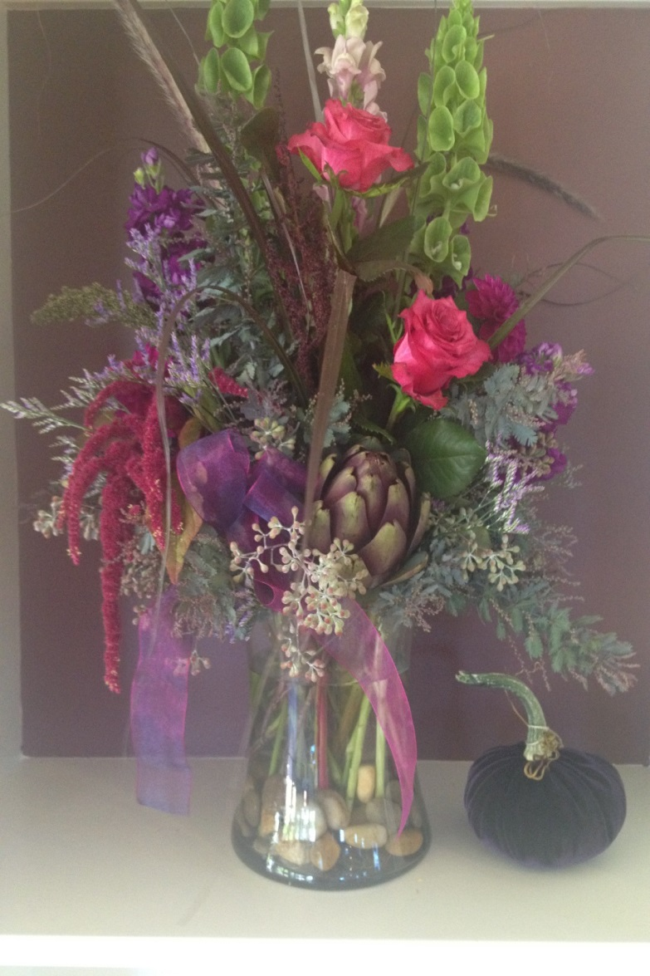
Thank You – Questions?
Thanks for joining us!
Questions?
Info@diabetesed.net
Call us at 530-893-8635
www.DiabetesEdUniversity.net

