Slide 1

Virtual DiabetesEd Specialist Training Conference – Day 2
Diabetes Education Services and Team
Notes:
Am I slides 205-207?

Slide 2
Welcome Everyone
Quick request:
- Please share your biggest takeaway(s) from yesterday's program in the chat.
Good Morning and Welcome.
Grab your coffee, tea or other beverage, a healthy snack and get comfy.
We will start promptly at 8:00 AM Pacific Time.
If you are having any technical difficulty, please chat with Bryanna or Brent at www.DiabetesEd.net or call 530 / 893-8635 or email at info@diabetesed.net

Slide 3
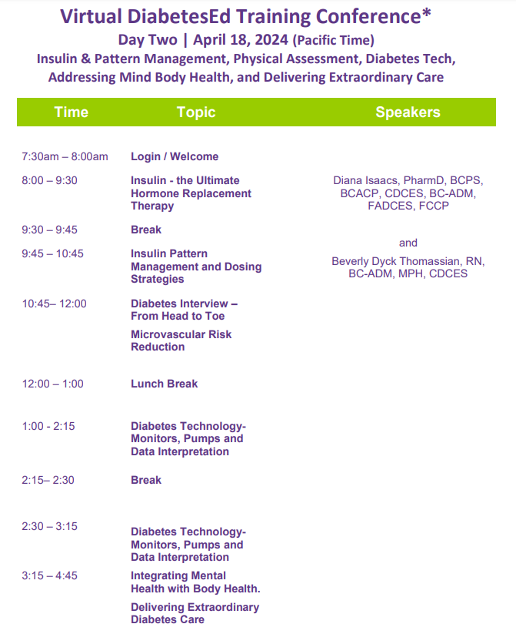
Virtual Course Schedule – Day 2 April 18
Schedule Update:
- Coach Bev will be kicking off the morning with Diabetes Interview.
- Please share your biggest takeaway(s) from yesterdays program in the chat.
- Please send any questions to info@diabetesed.net.

Slide 4


We are Here to Help!
Bryanna Sabourin
Director of Operations
Certification Pathway Coach &
Customer Happiness Expert
Brent McMenomey Customer Advocate and Brand Ambassador
If you have questions, you can chat with us at www.DiabetesEd.net or call 530 / 893-8635 or email at info@diabetesed.net

Slide 5
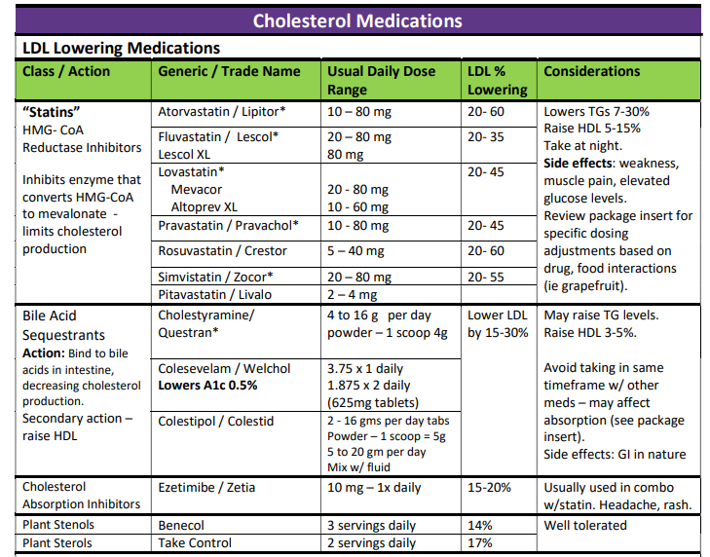

For exam, be familiar with content on Cheat Sheets
For CDCES – be familiar with the action, side effects and monitoring for the main BP meds and lipid meds.
For BC-ADM, be familiar with list above, plus dosing parameters and be comfortable looking at research results.

Slide 6

Diabetes Interview – From Head to Toe & Microvascular Risk
During interviews, outline strategies to identify previously undiscovered diabetes co-conditions, identify clinical inertia and move to best health.
www.DiabetesEd.net
Beverly Thomassian, RN, MPH, BC-ADM, CDCES
President, Diabetes Education Services

Slide 7

Objectives
Identify common yet often under diagnosed co-conditions associated with type 1 and type 2 diabetes.
Describe the interrelationship between glucose, inflammation and diabetes complications.
List the elements of a head-to-toe assessment including lower extremity assessment.
Discuss barriers to sexual health and communication strategies.

Slide 8

4. Comprehensive Medical Evaluation and Assessment of Comorbidities
Person centered communication, strength-based language, active listening, literacy, quality of life
It is necessary to take into account all aspects of a person’s life circumstance
It is important to integrate medical eval, engagement and lifestyle changes.
Interdisciplinary teams provide best care

Slide 9

EV Arrives and Requests Help
58 yr old complains of 4 lb wt gain for past month. BMI 31, wt 90 kg. B/P 142/96. A1C 8.3%
Meds include:
Sitagliptin, Metformin
Actos 15mg ac breakfast
Basaglar 58 units
Semaglutide 0.5mg weekly
Levothyroxine (ran out)
Lisinopril 10mg
Gabapentin 100 mg TID
What story do these meds tell?
Any med(s) missing?
Any med needs to be stopped?

Slide 10
EV Arrives and Requests Help
58 yr old complains of 4 lb wt gain for past month. BMI 31, wt 90 kg. B/P 142/96. Checks BG in morning; 150ish. A1C 8.3%
Meds include:
Sitagliptin (DPP-IV), Metformin
Basaglar 58 units (Basal)
Actos 15mg (TZD)
Semaglutide 0.5mg wk (GLP-1)
Levothyroxine (ran out)
Lisinopril 10mg (ACE)
Lovastatin 20mg (Statin)
Gabapentin 100 mg TID (leg pain)
What does this tell us about EV?
Struggling with weight
B/P & A1C above target
Overbasalized (max dose 0.5 units/kg a day
Why not taking thyroid med?
Lower extremity pain contributing to distress?
Elevated CV risk?

Slide 11

EV is Gaining Weight and is Tired
58 yr old complains of 4 lb wt gain for past month. BMI 31, wt 90 kg. B/P 142/96. Checks BG in morning; 150ish. A1C 8.3%
Meds include:
Sitagliptin, Metformin
Actos 15mg ac breakfast
Basaglar 58 units
Semaglutide 0.5mg weekly
Levothyroxine – ran out
Lisinopril 10mg
Gabapentin 100 mg TID
Labs
A1C – 8.3%
UACR 26 GFR >60
TSH 10.6
LDL 98 mg/dl, Trig 158
ALT 85 IU/L, AST 90 IU/L
Life situation
Takes care of dad with dementia
Gums inflamed
No eye doctor for year
Both feet hurt at night

Slide 12

ABC’s of Diabetes
A1c less than 7% (individualize)
Pre-meal BG 80-130
Post meal BG <180
AGP - Time in Range (70-180) 70% of time
Blood Pressure < 130/80
Cholesterol
Statin therapy based on age & risk status
If 40+ with ASCVD Risk, decrease 50%, LDL <70
If 40+ with ASCVD, decrease 50%, LDL <55

Slide 13
Assessment and Treatment Plan
Assessing risk of diabetes complications
• ASCVD and heart failure history
• ASCVD risk factors and 10-year ASCVD risk assessment
• Staging of chronic kidney disease
• Hypoglycemia risk
• Assessment for retinopathy
• Assessment for neuropathy
• Assessment for NAFLD/NASH
Goal setting
• Set A1C/blood glucose/time in range
• If hypertension is present, establish blood pressure goal
• Weight management and physical activity goals
• Diabetes self-management goals
Therapeutic treatment plans
• Lifestyle management
• Pharmacologic therapy: glucose lowering
• Pharmacologic therapy: cardiovascular and kidney disease risk factors
• Weight management with pharmacotherapy or metabolic surgery, as appropriate
• Use of glucose monitoring and insulin delivery devices
• Referral to diabetes education, behavioral health, and medical specialists

Slide 14

Advocating for Best Health for people with Diabetes
Modifiable
Sleep
Activity
Smoking
Dietary Habits
Glucose
Blood Pressure
Lipids
Oral Care
Immunizations
Psychosocial care
Make small, achievable goals. We are in this for the long run.

Slide 15

Diabetes is a long path
Get at least 7 hours of sleep a night – Check for sleep apnea

Slide 16

Obstructive Sleep Apnea - OSA
OSA affects ~25% of people with type 2
Up to 60% of those with type 2 have disordered sleep
Associated with increased CVD risk
Signs include excessive daytime sleepiness, snoring and witnessed apnea
Treatment:
Lifestyle modification
Continuous positive oral airway pressure and devices
Surgery

Slide 17


Where are we on this continuum?
Only about 50% of us are meeting activity goals

Slide 18
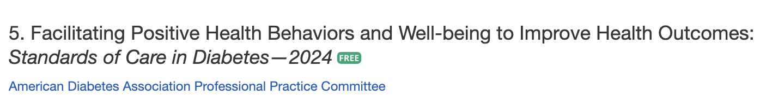
Benefits of Exercise and Diabetes
Increase muscle glucose uptake 5-fold
Glucose uptake remains elevated for 24 - 48 hours (depending on exercise duration)
Increases insulin sensitivity in muscle, fat, liver.
Reduce CV Risk factors (BP, cholesterol, A1c)
Maintain wt loss
Contribute to well being
Muscle strength
Better physical mobility

Slide 19

Exercise decreases:
Sleep apnea
Diabetic kidney disease, retinopathy
Depression
Sexual dysfunction
Urinary incontinence
Knee pain
Need for medications
Health care costs

Slide 20
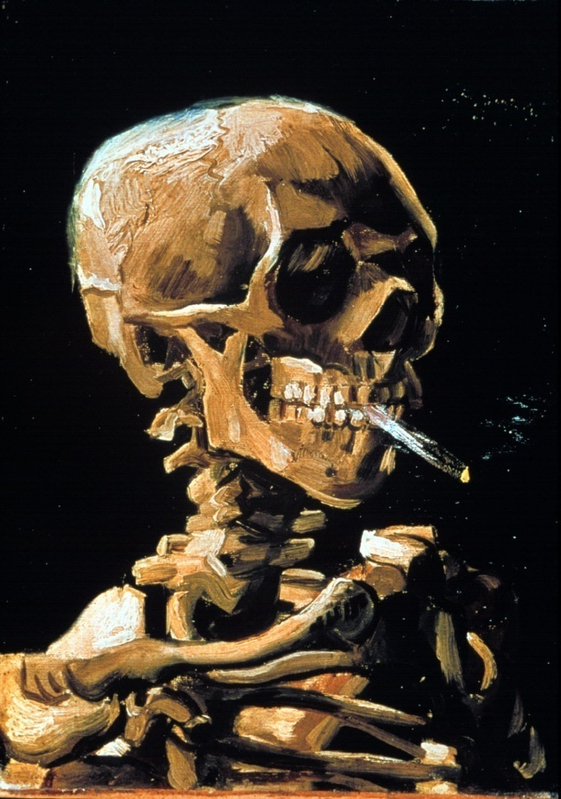
Smoking and Diabetes
Smoking and Diabetes
Smoking increases risk of diabetes 30%
Ask at every visit
Assess
Advise
Assist with stop smoking
Arrange for referrals
Organize your clinic

Slide 21
Goals of Medical Nutrition Therapy – ADA Promote and support Individualized healthful eating patterns
1. Support healthful eating patterns Emphasize eating a variety of nutrient dense foods in appropriate portions to: Attain individualized BP, glycemic and lipid goals Attain and maintain body wt goals Delay and/or prevent complications | 2. Individualize nutrition care based on: Personal and cultural preferences Health literacy and numeracy Access to healthful foods Willingness and ability to make behavioral changes Barriers to Change
3. Maintain pleasure of eating. Provide positive, nonjudgmental messages about food Limit food choices only when backed by science | 4. Provide practical tools for day-to-day healthy meal planning
Notes:
The ADA Standards of Care along with the Academy of Nutrition and Dietetics nutrition practice guidelines focus on 4 goals of MNT in Diabetes Care.
We highlight in purple maintaining the pleasure of eating……

Slide 22
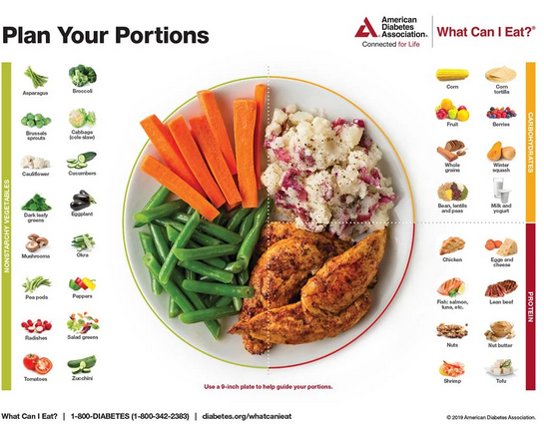
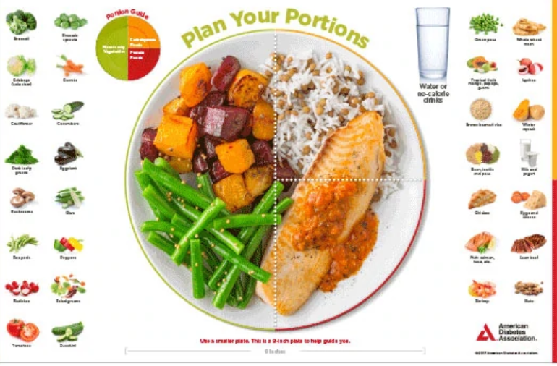
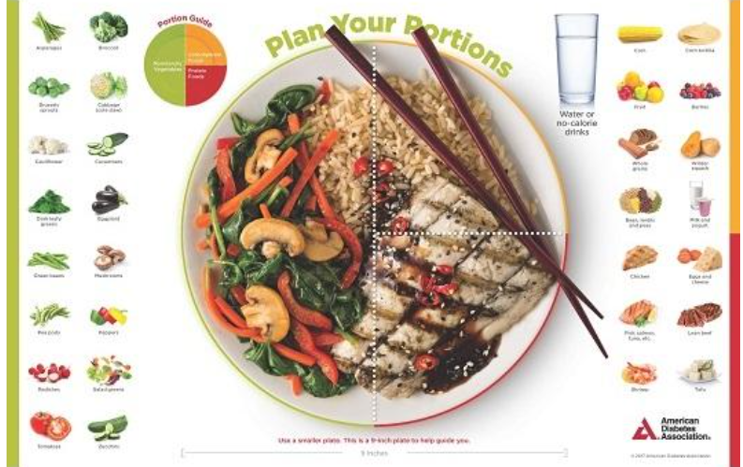

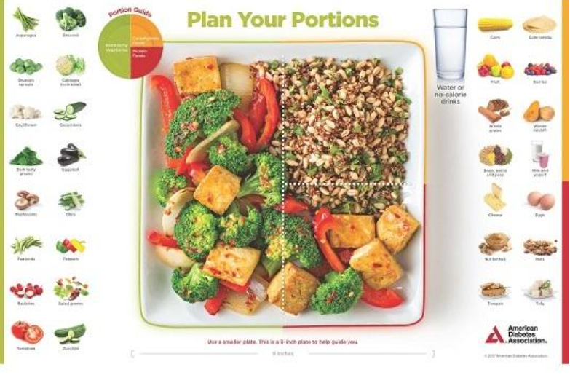
Plate example

Slide 23
EV asks why the weight gain?
Fluid retention - diabetes doubles risk for Congestive Heart Failure (CHF). Check lower extremities.
Inaccurate nutrition knowledge
Actos and Avandia, (TZD’s) associated with edema
Blood sugars improving
Thyroid disease under treated
Novel Antipsychotics
Depression / Increased intake

Slide 24

Poll question 13
Which of the following is a true statement?
Atypical antipsychotics are contraindicated for people with diabetes and thyroid disease.
Hypothyroidism is more common than hyperthyroidism.
Hyperthyroidism can be associated with weight gain or weight loss.
Hypothyroidism causes LDLs to decrease.

Slide 25
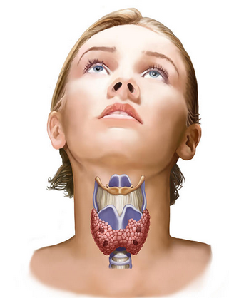
Thyroid Disease and Diabetes
15 to 30% of people w/ diabetes & their siblings or parents are likely to develop thyroid disease
Up to 60 percent of those with thyroid disease are unaware of their condition.
Women are 5-8x’s more likely than men to have thyroid problems.
Check TSH on Type 1 & 2 annually or if indicated.
Hashimoto’s thyroiditis – autoimmune thyroid
most common cause of hypothyroidism w/ dm
Associated with:
Elevated cholesterol levels
Increased risk of CV disease
Weight gain
AACE Website

Slide 26

Thyroid & TSH* Levels
*Thyroid Stimulating Hormone - secreted by pituitary gland
controls thyroid hormone thyroxine production
first and best test
TSH Norm = up to 4.5 mIU/mL
Treatment based on TSH plus symptoms.
4.5 – 10 based on risk, s/s
10 or more = treat
Lower = hyperthyroidism
Higher = hypothyroidism–
AACE Guidelines

Slide 27
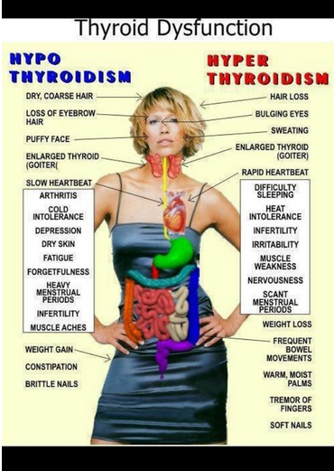
A TSH above 10 mIU/L,
in combination with
a subnormal free T4 characterizes overt hypothyroidism.
If TSH in range, but person is symptomatic,
Check for thyroid peroxidase atb or TPO antibodies
A low TSH indicates hyperthyroidism (0.1 ish)

Slide 28

Collaborative Action Plan
Increase semaglutide to 1.0mg
Decrease basaglar by 10 units
Stop sitagliptin
Continue pioglitazone (Actos)
Walk after lunch during work week
Restart levothyroxine, Re-Check TSH - Re-evaluate in 4 weeks.
Eat one serving of veggie a day and decrease meat intake to 4 nights a week.
Meet with RD/RDN
Check BG a few times a week before bed (in addition to am)
Labs
A1C – 8.3%
UACR 26 GFR >60
TSH 10.6
LDL 98 mg/dl, Trig 158
ALT 85 IU/L, AST 90 IU/L

Slide 29

Non-Alcoholic Steatosis Disease
NAFLD is when fat reaches 5% of the liver's weight
Without consumption of significant amounts of alcohol defined as:
Ingestion of less than 21 standard drinks per week in men and
Less than 14 standard drinks per week in women
over a 2-year period preceding evaluation) or the presence of other secondary causes of Steatosis disease.
Non-Alcoholic Fatty Liver Disease (NAFLD)
Metabolic dysfunction–associated steatotic liver disease (MAFLD)

Slide 30
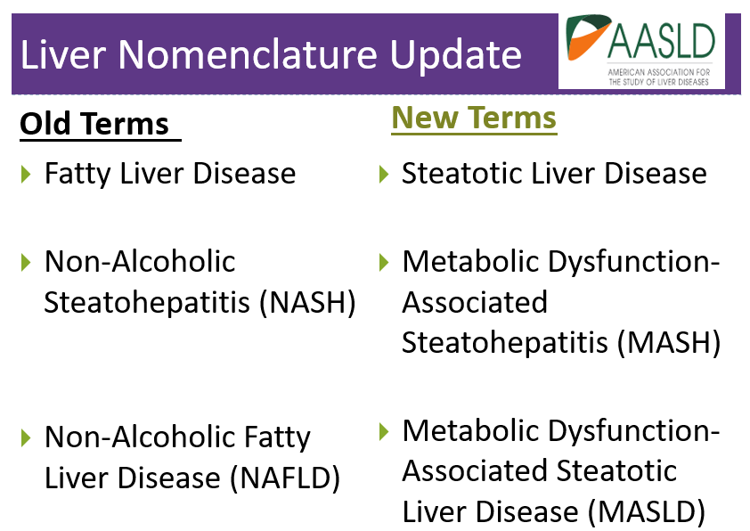

Slide 31

Fatty Liver Disease & Steatohepatitis
Adults with type 2 diabetes.
NAFLD is prevalent in >70%
Of those 50% have NASH*
12-20% have fibrosis
Associated with :
Increased BMI (30+)
Cardiometabolic risk factors
Over 50 yrs
*ALT & AST 30 units/L +
*
*Non-Alcoholic Steatohepatitis (NASH)
*ALT & AST (Eval if more if 30+ for 6 mo’s - ADA) Gastroenterologist norm
ALT 29-33 men
ALT 19-25 women

Slide 32
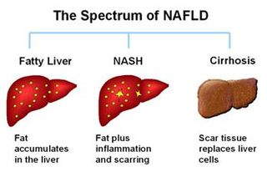
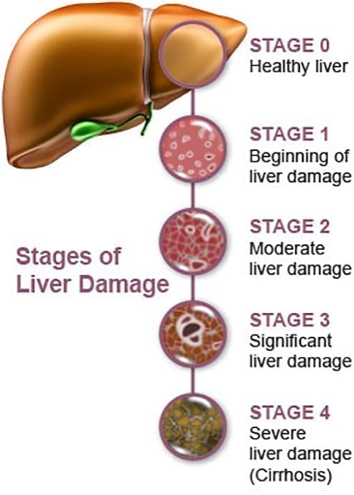
Natural History of NAFLD to NASH
NASH – Non-Alcoholic Steatohepatitis
MASH – Metabolic Assoc Steatohepatitis
https://liverfoundation.org/wp-content/uploads/2020/11/StagesFibrosis.jpg

Slide 33
Stages of Liver Failure
NAFLD – nonalcoholic fatty liver disease
NAFL – simple fatty liver, doesn’t usually progress to cause liver damage
NASH or MASH nonalcoholic / metabolic steatohepatitis
Liver inflammation and cell damage.
Can cause fibrosis, scarring
Leading cause of hepatocellular carcinoma and liver transplants (ADA)
Cirrhosis – degeneration of cells, inflammation, fibrous thickening
End-stage liver disease & Liver Cancer
https://liverfoundation.org/for-patients/about-the-liver/the-progression-of-liver-disease/#fibrosis-scarring

Slide 34
Nonalcoholic Fatty Liver Disease and Nonalcoholic Steatohepatitis Screening
Screen adults with type 2 diabetes or prediabetes
particularly those with BMI 30 +
cardiometabolic risk factors or established CV disease
even if normal liver enzymes.
Screen and provide risk stratification for clinically significant liver fibrosis using
Calculated fibrosis-4 index (FIB-4) (derived from age, ALT, AST, and platelets

Slide 35
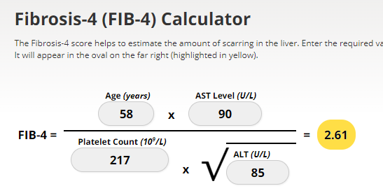
Screening for NASH – FIB-4
FIB-4 estimates risk of hepatic cirrhosis (age 35+):
Calculated by imputing:
Age
plasma aminotransferases (AST and ALT)
and platelet count
FIB-4 Risk Levels
Lower risk is <1.3
Intermediate 1.3 to 2.67
High risk >2.67
considered as having a high probability of advanced fibrosis (F3–F4).
The American College of Gastroenterology considers Upper limit of normal ALT levels:
29–33 units/L for males
19–25 units/L for female individuals
(mdcalc.com/calc/2200/fibrosis-4-fib-4-index-liver-fibrosis).
www.DiabetesEd.net

Slide 36
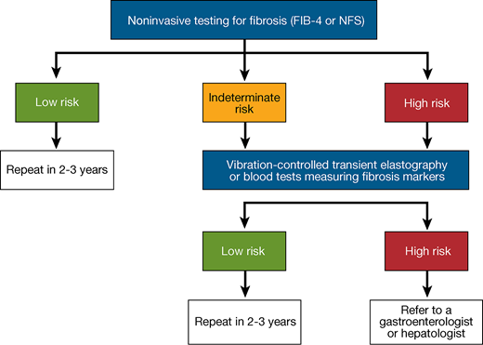
Screening for Fibrosis Risk
Goal of screening is to identify if on a disease path to cirrhosis.

Slide 37
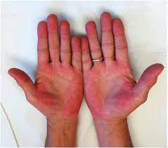
Symptoms of Steatosis
If symptoms do appear, they may include:
A feeling of fullness in the middle or upper right side of the abdomen
Abdominal pain, nausea
Loss of appetite or weight loss
Weakness
Jaundice
Swelling of the abdomen and legs
Mental confusion
Extreme fatigue or tiredness
Signs of advanced disease include:
Portal hypertension, spider angiomas, reddening of palms, declining platelet counts
Mayo Clinic
https://dermcollective.com/palmar-erythema/

Slide 38

Question: What does a Liver Elastography reveal?
The provider is sending JR for a Liver Elastography or FibroScan test since JR has elevated ALT and AST levels along with an elevated Fib-4 score. Which of the following are measured during this liver ultrasound procedure?
Liver diameter and density.
Liver scarring and ductal health.
Hepatocyte density and distribution.
Liver stiffness and fat density.

Slide 39
Finding Liver Disease
Imaging procedures used to diagnose NAFLD include:
Abdominal ultrasound, which is often the initial test when liver disease is suspected.
Transient elastography, an enhanced form of ultrasound that measures the stiffness of liver. Liver stiffness indicates fibrosis or scarring.
Magnetic resonance elastography, works by combining MRI imaging with sound waves to create a visual map (elastogram) showing the stiffness of body tissues
Biopsy by liver specialist confirms definitive diagnosis
Referral to Hepatologist or GI specialist
Mayo Clinic

Slide 40
Steatosis Interventions
Nutrition
Weight loss goal of 5-10% or more
Mediterranean Diet
Avoid alcohol
Decrease processed foods, meats and sugary foods.
Increase vegetables and other high fiber foods.
Move more – including aerobic activity and strength training.
Close follow-up and ongoing monitoring
Can be associated with worsening renal function

Slide 41

Other Treatments for NAFLD and NASH
Meds that lower glucose, cholesterol and weight
Bariatric surgery
Pioglitazone (Actos)
Improves lipid and glucose metabolism
Reverses steatohepatitis in prediabetes/diabetes
Causes 1-2% wt gain at 15 mg
3-5% wt gain at 45 mg
GLP-1 Receptor Agonists
Support lifestyle changes

Slide 42
Actions To Decrease Steatosis
Increase activity
Strength training
Yoga or Thai Chi
Walking & aerobics
Thoughtful eating
More fiber
Less processed foods & less added sugar
Avoid alcohol
Treatment
Actos
GLP-1
Statin
Prevention
Cancer Screenings
Decrease inflammation

Slide 43

NEW Bone Health Recommendations
Diabetes associated with increased fractures
Take preventive action:
For high-risk older adults (aged >65 years) and younger individuals with multiple risk factors.
Monitor bone mineral density using dual-energy X-ray absorptiometry every 2–3 years.
Avoid medications that increase fractures in high risk
Problem solve to prevent falls
Adequate calcium and vita D intake
Consider antiresorptive meds, osteoanabolic agents for those with low bone mineral density score.

Slide 44
Risk Factors for Fracture
General risk factors
Prior osteoporosis fracture
Age > 65 years
Low BMI
Sex
Malabsorption
Recurrent falls
Glucocorticoid use
Family history
Alcohol /tobacco abuse
Rheumatoid arthritis
Diabetes Specific Risk Factors
Lumbar spine or hip T-score ≤ -2.0
Frequent hypoglycemia
Diabetes >10 years
Diabetes meds: TZDs or sulfonylureas, insulin
A1C > 8%
Peripheral autonomic neuropathy
Retinopathy and nephropathy
www. DiabetesEd.net

Slide 45

Movement Break – Before Microdisease

Slide 46

EV Dental, Eye, Kidney and Nerve Care

Slide 47
Poll Question 14
Diabetes is associated with an increased risk of oral disease. Which of the following statements is true?
Diabetes is associated with decreased saliva production.
People with diabetes benefit from vinegar gargles to decrease bacterial load
People with diabetes are at greater risk for tongue cancer.
Diabetes is associated with increased tonsillitis.

Slide 48
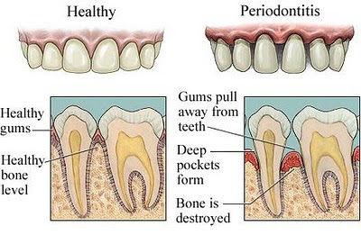
Periodontal Disease
More severe and prevalent with diabetes and elevated A1c levels.
periodontal treatment associated with better glycemic control
(A1C 8.3% vs. 7.8%)
Benefits lasted for 12 mo’s
People with periodontal disease have higher rates of diabetes.
Bidirectional

Slide 49
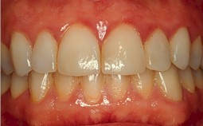
Gingivitis

Slide 50
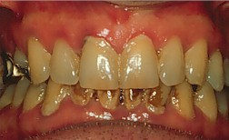
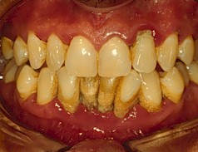
Mild to Severe Periodontitis

Slide 51
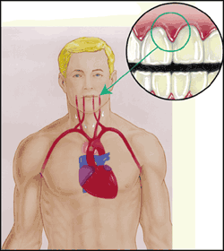
Periodontal disease and Heart Disease
Heart disease link:
oral bacteria enter the blood stream, attach to fatty plaques in coronary arteries increasing clot formation
inflammation increases plaque build up, which may contribute to arterial inflammation
Hyperglycemia = Gingivitis = Heart Disease

Slide 52
Salivary Dysfunction and Xerostomia (dry mouth) in DM
Less saliva uptake and excretion = less protection against bacteria
Hyperglycemia increases glucose levels in saliva, providing medium for bacterial growth- also promotes dry mouth
Dry mouth increases risk of infection and can alter nutritional intake (due to chewing, swallowing difficulties)

Slide 53
Keeping Oral Healthy
Oral disease linked with heart disease
Dental exams (every 6 mo’s)
Metabolic control critical
Quit smoking
Brush twice daily and floss daily.
Help access affordable dental care.
Treat infections with ATB’x, can lower A1c by 1-2%. Lowering BG shortens infection.

Slide 54


Retinopathy Changes How We See
View of boys by person with normal vision
View of boys by person with diabetic retinopathy.

Slide 55
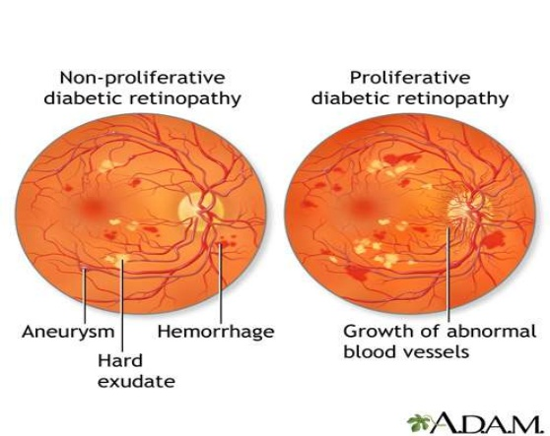
Non - Proliferative to Proliferative Diabetic Retinopathy

Slide 56

Quick Question 15
Which of the following is correct regarding eye screening for people with diabetes?
A. All people with diabetes must get a complete eye exam every year
B. All people diagnosed with type 1 and 2 need an immediate eye exam.
C. All people diagnosed with type 2 need an immediate eye exam.
D. People with diabetes over age of 60 need an eye exam every 6 months.

Slide 57
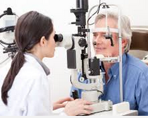
12. Microvascular Complications - Eyes
Optimize BG and B/P Control to protect eyes
Screen with initial dilated and comprehensive eye exam by ophthalmologist or optometrist:
Type 2 at diagnosis, then every year*
Type 1 within 5 years of dx, then every year*
Type 1 or type 2 diabetes need eye exam before pregnancy and 1st trimester. Monitor every trimester and for 1 year postpartum as indicated by the degree of retinopathy.
*If no evidence of retinopathy and glycemic indicators within goal range, then screening every 1–2 years may be considered.
Appropriate to use retinal photography with remote reading or U.S. FDA of approved artificial intelligence algorithms to improve access to diabetes retinopathy screening.
Promptly refer people with macular edema, severe non-proliferative disease to trained specialist.

Slide 58

Retinopathy Prevention
To reduce the risk or slow the progression of retinopathy
Optimize glycemia
Optimize blood pressure
Optimize lipids
retinopathy progression may be slowed by the addition of fenofibrate

Slide 59
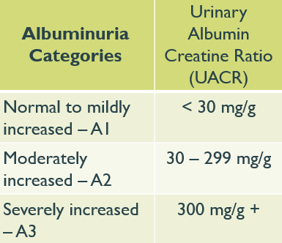
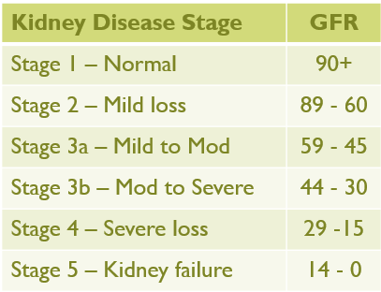

Standard 11 - Chronic Kidney Disease and Risk Management
Optimize glucose and B/P Control to protect kidneys
Screen Urine Albumin Create ratio (UACR) & GFR
Type 2 at dx then yearly
Type 1 with diabetes for 5 years, then yearly
If urinary albumin ≥300 and GFR 30–60 monitor 1-4 times a year to guide therapy.

Slide 60
Definitions of Abnormalities in Albumin Excretion
Urine albumin – creatinine ratio (UACR)
Category UACR mg/g
Normal <30
Moderately increased urinary albumin 30-299
Severely increased urinary albumin >300
2 of 3 tests w/in 3-6 mo abnormal to confirm*
*Exercise within 24 h, infection, fever, congestive heart failure, marked hyperglycemia, menstruation, and marked hypertension may elevate UACR independently of kidney damage.

Slide 61
Optimizing Health - Kidney Disease
Optimize glucose and B/P to protect kidneys
If UACR > 30 mg/g treat hypertension with ACE or ARB, monitor K+
For people with type 2 diabetes and CKD eGFR ≥20 and urinary albumin ≥200 mg/g.
For cardiovascular risk reduction:
Use SGLT2 inhibitor (if eGFR is ≥20)
Use a glucagon-like peptide 1 agonist,
or a nonsteroidal mineralocorticoid receptor antagonist (if eGFR is ≥25).
Potassium levels should be monitored.
Refer to nephrologist if GFR <30
At higher risk of Hypoglycemia

Slide 62

Collaborative Action Plan and F/U
Make appointment with dentist and eye doctor.
Brush twice daily and floss daily.
Need some relief from nerve pain.
Experiencing vaginal dryness.

Slide 63

Moving on to the Lower Half

Slide 64
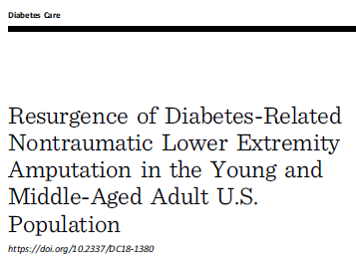

Diabetes and Amputations
Rate declined 43% - 2000 – 2009
Increased 50% from 2009-2015
2.1 per 1000 then up to 4.2 per 1000
Driven by a 62% increase in minor amputations
Highest rates in young and middle age adults (18- 64 years).
50% of amputations can be avoided through self-care skill education and early intervention
Diabetes Care 2018

Slide 65

Poll Question 16
Which of the following is true about diabetes and lower extremities?
Excess hair on the toes indicates compromised circulation.
People with diabetes need to inspect lower extremities weekly.
People over 65, with high-risk feet, qualify for a pair of custom shoes annually
Once a person with diabetes has an amputation, they are not likely to have another.

Slide 66
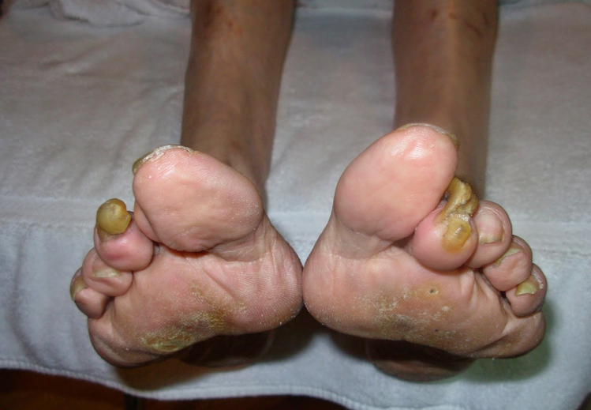

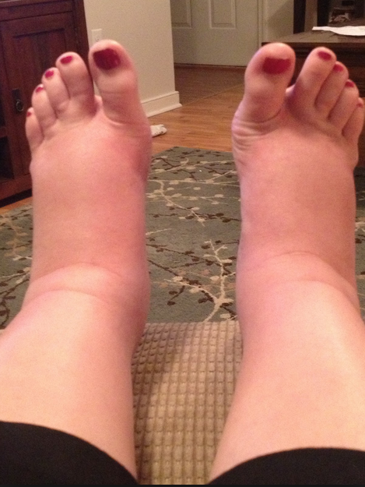
Lower Extremities
Lift the Sheets and Look at the Feet
No DeFEET

Slide 67

Feet Deserve Special Care
Daily inspection
With order from MD and Loss of Protective Sensation (LOPS), Medicare Covers:
Annual custom shoes
3 pairs of orthotic inserts

Slide 68
Medicare and Custom Shoes
The doctor who treats diabetes must certify need for therapeutic shoes or inserts and be a medicare provider.
A podiatrist or other qualified doctor must prescribe the shoes or inserts, and ind must get the shoes or inserts from one of these:
A podiatrist A prosthetist
A pedorthist An orthotist
Another qualified individual

Slide 69
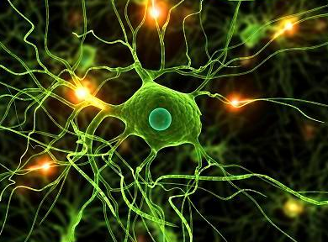
Nerve disease Screening
Screen all people with diabetes for nerve disease using simple tests, such as pinprick, vibration & monofilament sensation.
Type 2 at diagnosis, then annually
Type 1 diabetes at 5 years, then annually
Glycemic management is the main strategy to prevent or delay the development and progression of neuropathy.
Assess and treat to reduce pain and symptoms to improve quality of life.

Slide 70

Testing for Small and Large Nerve Fiber Loss
Test for nerve fiber function and loss of protective sensation:
Small-fiber function: pinprick and temperature sensation.
Large-fiber function: vibration perception and 10-g monofilament.
Protective sensation: 10-g monofilament.
Up to 50% of diabetes peripheral neuropathy may be asymptomatic.

Slide 71

Consider Other Causes of Neuropathy
toxins (e.g., alcohol)
neurotoxic medications (e.g., chemotherapy)
vitamin B12 deficiency
hypothyroidism
renal disease
malignancies (e.g., multiple myeloma, bronchogenic carcinoma)
infections (e.g., HIV)
chronic inflammatory demyelinating neuropathy
inherited neuropathies, and vasculitis

Slide 72
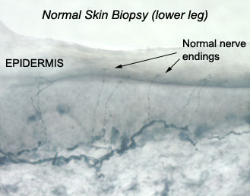
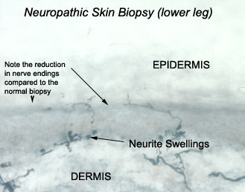
Skin Biopsy to Assess Neuropathy

Slide 73
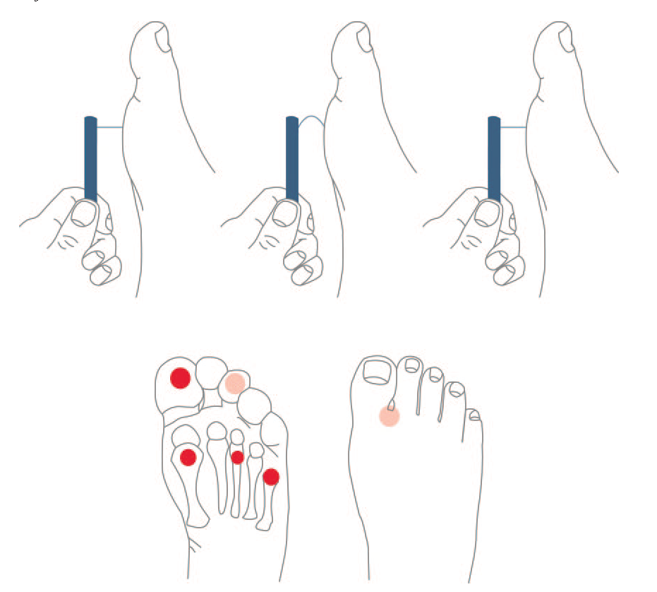
5.07 monofilament delivers 10gms linear pressure
10 Free Monofilaments
www.hrsa.gov/hansensdisease/leap/

Slide 74
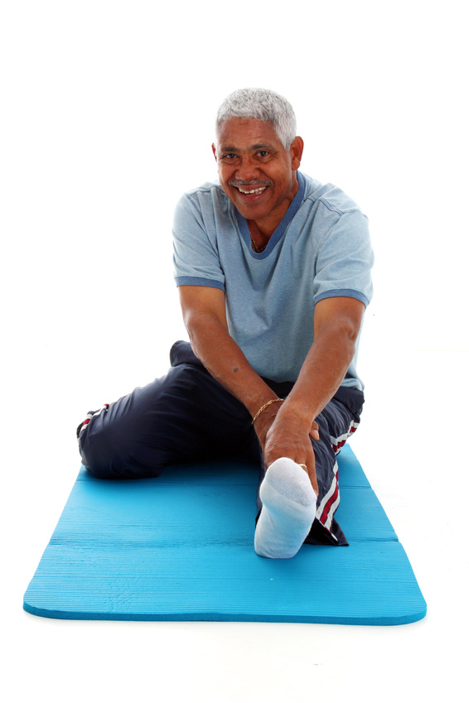
Treating Neuropathy
Improve glycemic control
Control pain
Relief from depression from chronic pain
Massage, stretching,
Pain control clinic,
Transcutaneous Electrical Nerve Stimulation (TENS)
Avoid alcohol
Relaxation exercises....

Slide 75
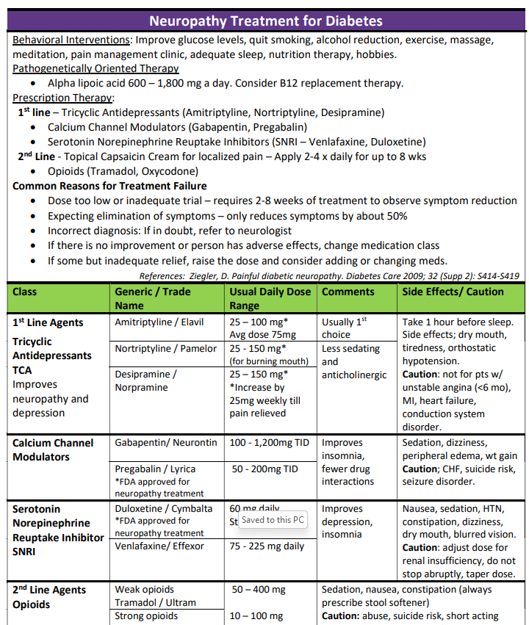
Meds for Neuropathy – Cheat Sheet
Also consider Capsaicin cream 8% patch or
Lidocaine 5% patch

Slide 76

Other strategies to help ease the pain
Music
Podcasts
Movies
Pet’s
Massage
Touch
Topical creams
Lidocaine patches
Mineral salts baths
Neurostimulators
Tylenol / Ibuprofen
Earthing
Sleep
Hobbies
Aromatherapy
Time with special people
Work / volunteering

Slide 77

We Can Make A Difference
Assess
Nail condition, nail care, in between the toes
Who trims your nails
Have you ever cut your self?
Shoes – type and how often
Socks
Skin/skin care and vascular health
Ability to inspect
Loss of protective sensation
Nerve pain treatment

Slide 78
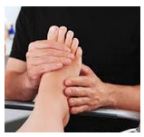
Lower Extremities
"Every time you see your provider, take off your shoes and socks and show your feet!"
For those at high risk for foot complications
with loss of protective sensation, foot deformities, or a history of foot ulcers
Everyone else needs a thorough, annual inspection

Slide 79

“DAN” Diabetic Autonomic Neuropathy
50% of ind’s with peripheral neuropathy also have DAN
DAN associated with higher M/M Rates
hypoglycemia unawareness
resting tachycardia, orthostatic hypotension
gastroparesis, constipation, diarrhea, fecal incontinence
neurogenic bladder
sudomotor dysfunction with either increased or decreased sweating
erectile dysfunction
Who is DAN?

Slide 80

Sexual Functions as We Age
20-30 years trice daily
30-40 years tri weekly
40-50 years try weekly
50-60 years try weakly
60-70 years try oysters
70-80 years try anything
80-90 years try to remember
A touch of humor from AADE-New Perspectives on Erectile Dysfunction, 1999

Slide 81

Asking about sexual health
“ I’m going to ask you a few questions about your sexual health. Since sexual health is very important to overall health, I ask each person these same questions.
Before I begin, do you have any questions or sexual concerns you’d like to discuss? ”
Have you noticed any changes in your sex life over the past year?
Trouble with erection, lowered libido, decreased sensation, painful intercourse or something else?

Slide 82

Improving Sex Life
Treatment
Lower blood glucose / blood pressure
Treat vaginal infections and UTI’s
Water based lubricants for vaginal dryness
Hormone replacement therapy
Eat to prevent lows during intimacy
Allow time, touching and romance
People with diabetes get more vaginal and bladder infections
Difficulty achieving orgasm due to neuropathy
Painful intercourse due to lack of vaginal lubrication
Many people with diabetes have issues with sexual desire, arousal, or orgasm. How about you?”

Slide 83

Erectile Dysfunction
Affects about 50% of men with diabetes
Loss of erections sufficient for intercourse
Due to combo of vascular and nerve damage
Tests: penile tumescence to eval if organic or psychogenic
Treatment:
Sildenafil (Viagra), Vardenafil (Levitra), Tadalfil (Cialis)
Use caution if taking nitrate drugs. Check w/ MD first
Other meds, vacuum devices, prosthetics
HRT- testosterone gel, patches, injections, pills

Slide 84
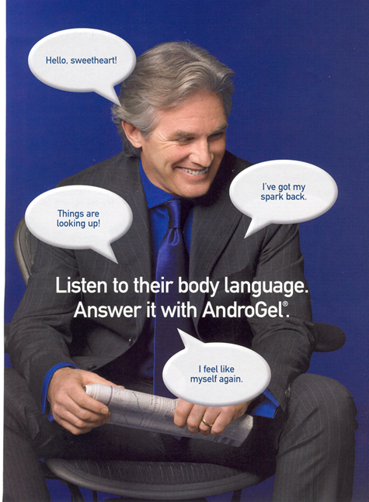
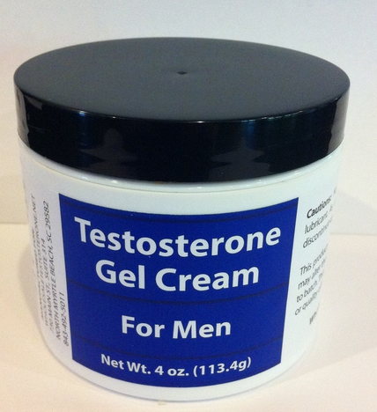
Low Testosterone
Hypogonadism: loss of sex drive or activity
Screening: morning serum levels
Mean testosterone levels lower in men with diabetes – also associated with elevated BMI
Testosterone replacement therapy can improve:
Sexual function, strength, bone density, mood
Repeat am testosterone level after treatment to eval response

Slide 85

EV is feeling Empowered
Her A1c has dropped, she feels better about herself with healthier eating and increased activity.
She is back on her thyroid medication and has more energy.
The pain in her feet is better and she is more hopeful overall!

Slide 86

The ABC’s of Diabetes Management
A - A1c less than 7%, TIR 70%
B - Blood pressure < 130/80
C - Cholesterol
LDL< 70, HDL > 40, Triglycerides < 150
D - Drugs- Keep list on phone
E - Exercise and Eyes
F - Food and Feet
G – Glucose checks and goals
H- Healthy Coping - Hoorah for your hard work!
K – Kidneys – Check UACR & GFR

Slide 87

Break and Question Time
Energizing Ideas
Dance
Walk outside
Get a nourishing snack
Drink some spa water
Do some jumping jacks
Stretch and Breathe

Slide 88

Insulin – Ultimate Hormone Replacement Therapy
Diana Isaacs, PharmD, BCPS, BCACP, CDCES, BC-ADM, FADCES, FCCP
Endocrine Clinical Pharmacy Specialist
Co-Director Endocrine Disorders in Pregnancy
Cleveland Clinic Diabetes Center
Notes:
2.5 hours.
Ideal is 150 slides.

Slide 89
Disclosures for Dr. Isaacs
Diana Isaacs, PharmD, BCPS, BCACP, CDCES, BC-ADM, FADCES, FCCP declares the following disclosures:
Speaker: Abbott, Dexcom, Novo Nordisk, Insulet, Medtronic, Lilly, Cequr, Sanofi
Consultant: Undermyfork, Sequel
ADCES Board Member

Slide 90
Objectives – Insulin –The Ultimate Hormone Replacement Therapy
Objectives:
Discuss the actions of different insulins
Describe how to use the ADA algorithm for insulin management
Counsel a person with diabetes on safe and effective insulin use
Discuss strategies to determine and fine-tune basal and bolus insulin settings based on glucose pattern management
Describe how insulin settings are used to program insulin pumps and connected insulin pens
Notes:
o Latest update on available insulins
o How to use ADA algorithm for insulin management
o Teaching pointers for safe and effective insulin use

Slide 91
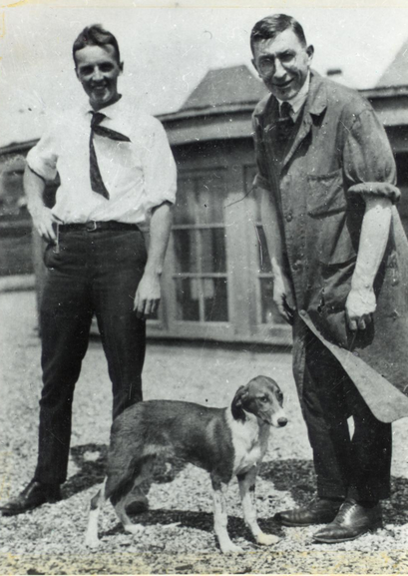
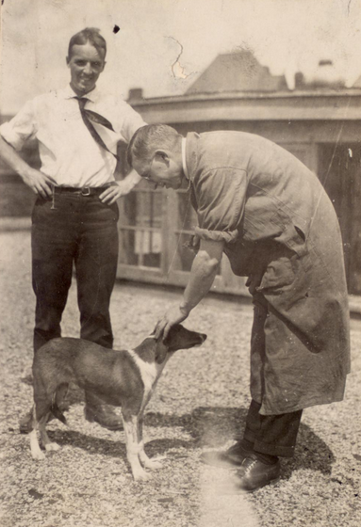
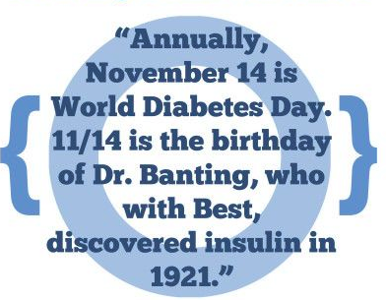
Best and Banting – U of Toronto 1921

Slide 92
History of insulin
Insulin is produced by beta cells in the pancreas
Discovered in 1921 by Frederick Banting and his assistant Charles Best from a dog’s pancreas
First used in a dog with diabetes and kept him alive for 70 days until they ran out of extract
With the help of JB Collip and John Macleod, insulin was derived from the pancreas of cattle and in January 1922, given to a 14-year-old dying from diabetes in a Toronto hospital
In 1923, Banting and Macleod received the Nobel Price in Medicine which they shared with Best and Collip
Soon after, Eli Lilly started large-scale production of insulin
ADA. The history of a wonderful thing we call insulin (accessed 2020 Aug 29).

Slide 93
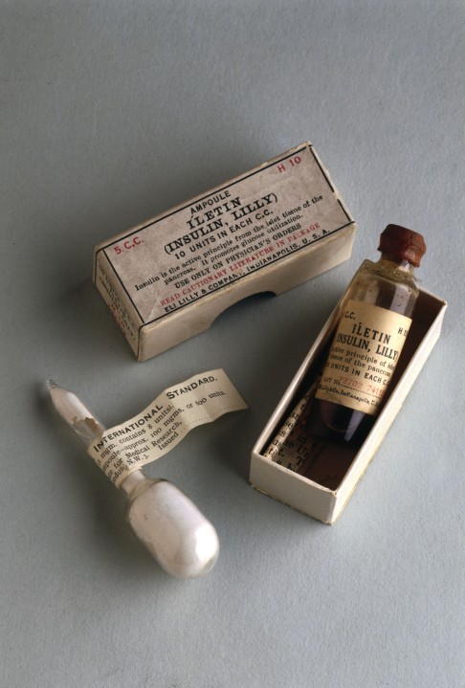
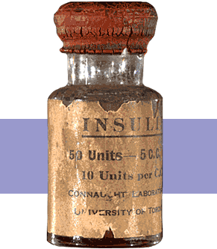
1st Insulin Available - 1922

Slide 94


Miracle of Insulin
The Miracle of Insulin
February 15, 1923
Patient J.L., December 15, 1922

Slide 95
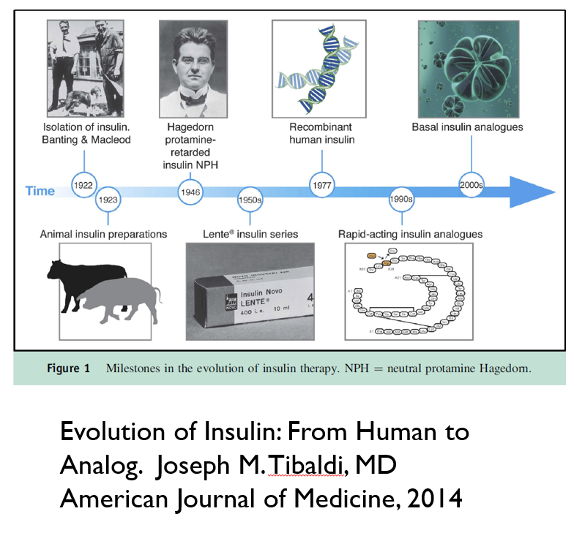
Notes:
Earlier insulins derived from bovine and porcine pancreas
All human insulin now made from recombinant DNA technology
Modification of human insulin molecules
Overcame problems with human insulin
Onset of action
Duration of action
Absorption

Slide 96
Physiologic Insulin Release: Individuals without diabetes
Insulin
Blood glucose
Basal insulin
Meal
Meal
Meal
Blood glucose– goes up after eating

Slide 97
Physiologic Insulin at Meals
1st phase: peak 1-2 minutes, duration 10 minutes, suppresses hepatic glucose production
2nd phase: duration 1-2 hours
The perfect insulin would be fast enough to match the absorption of carbohydrates
Freeman JS. J Am Osteopath Assoc. 2009;109:26-36.
Notes:
Freeman. The Journal of the American Osteopathic Association, January 2009, Vol. 109, 26-36.
http://jaoa.org/article.aspx?articleid=2093701#72978607
Within seconds of food ingestion, there is an initial release of insulin, which peaks in 1 to 2 minutes and lasts about 10 minutes.^{21,22} This first phase is responsible for suppressing hepatic glucose output, limiting PPG elevations, and stimulating phase 2 insulin release of newly manufactured insulin. This second phase lasts 1 to 2 hours until normoglycemia is restored.^{20,21} However, in patients with type 2 diabetes mellitus, phase 1 insulin secretion is markedly decreased or absent. As the disease progresses, phase 2 insulin release is also reduced, often by more than 50%

Slide 98
Insulin Overview
None of the commercially available insulins are as fast as true physiologic insulin
Almost all insulin is injected (SC or IV) with 1 inhaled option
All people with T1D require basal + bolus insulin or insulin pump therapy
Many people with T2D require insulin due to the progressive nature of the condition

Slide 99
Basal aka “Background” Insulin
The liver plays a major role in maintaining glucose levels by regulating the process of gluconeogenesis and glycogenolysis
Excessive hepatic glucose release leads to hyperglycemia
In a person without diabetes, there is a low level of insulin to keep glucose homeostasis from glucose produced by the liver (basal insulin)
People with type 1 diabetes lack the ability to produce insulin to counteract the liver’s effects
In people with type 2 diabetes, there may not be enough insulin due to insulin resistance
Long-acting insulins or intermediate-acting insulins serve as a basal or “background insulin”
In an insulin pump, a regular or rapid-acting insulin can be given continuously to serve as the basal
Everyone with T1D need basal insulin and many with T2D may need it
Sharabi K et al. Mol Aspects Med. 2015; 46:21-22.

Slide 100
Bolus Insulin
Glucose rises in response to carbohydrates
A regular or rapid-acting insulin is given as a bolus to prevent the glucose from rising too much
A regular or rapid-acting insulin can also be given to “correct” or bring down a high glucose
Everyone with T1D needs bolus insulin, some people with T2D may need it to achieve glycemic targets

Slide 101
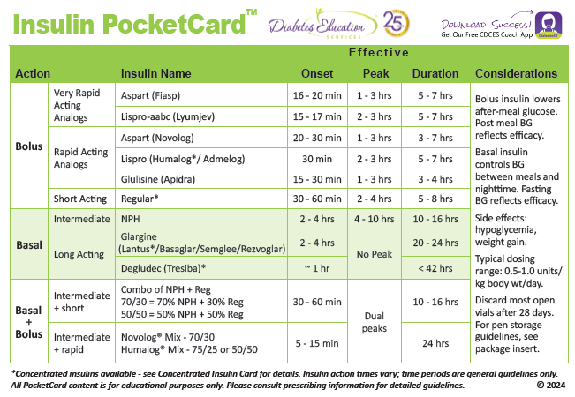

Slide 102
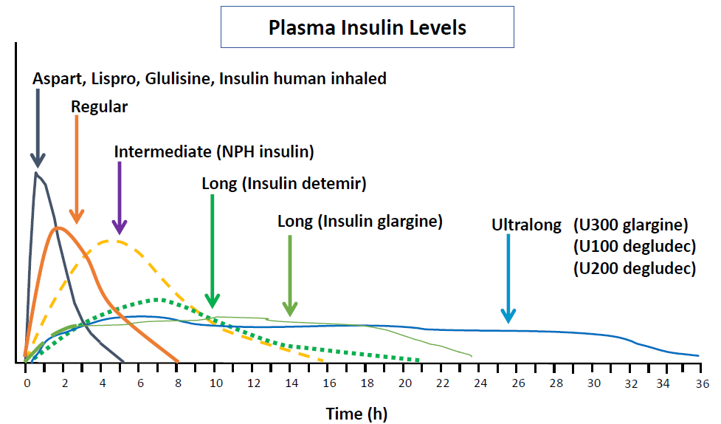
Insulin Profiles
Hirsch IB. NEJM 2005;352:174-183.
Lexicomp Online, Lexi-Drugs Online, Hudson, Ohio: UpToDate, Inc; 2020; August 21, 2020.

Slide 103
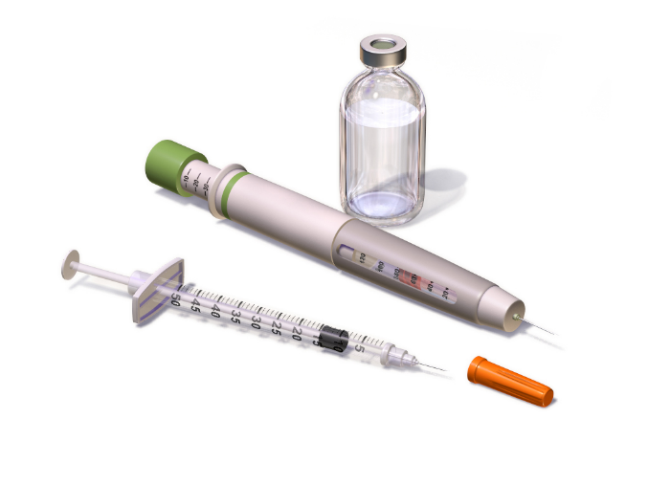
Insulin Concentration
Most insulin is U100: 100 units/mL
There is also concentrated insulin
U500 insulin, 500 units/mL, U300, 300 units/mL, and U200, 200 units/mL
Insulin is available in a vial, pen, or cartridge
U100 insulin:
1 vial =10mL = 1000 units
1 pen =3 mL = 300 units
1 cartridge = 3 mL = 300 units
1 box of pens = 5 pens = 1500 units
Inhaled insulin
4, 8, 12 units cartridges
Afrezza, Novolog, Humalog, Lantus, Levmir (package inserts) 2022
Image: :Blausen.com staff (2014). Medical gallery of Blausen Medical 2014. WikiJournal of Medicine 1 (2).

Slide 104
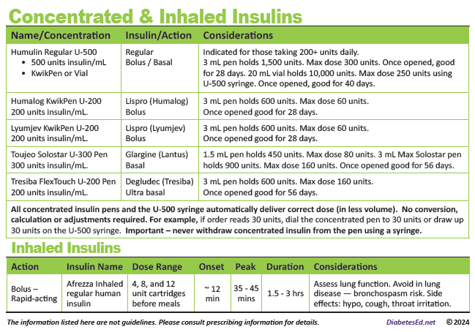
Concentrated and Inhaled Insulin

Slide 105
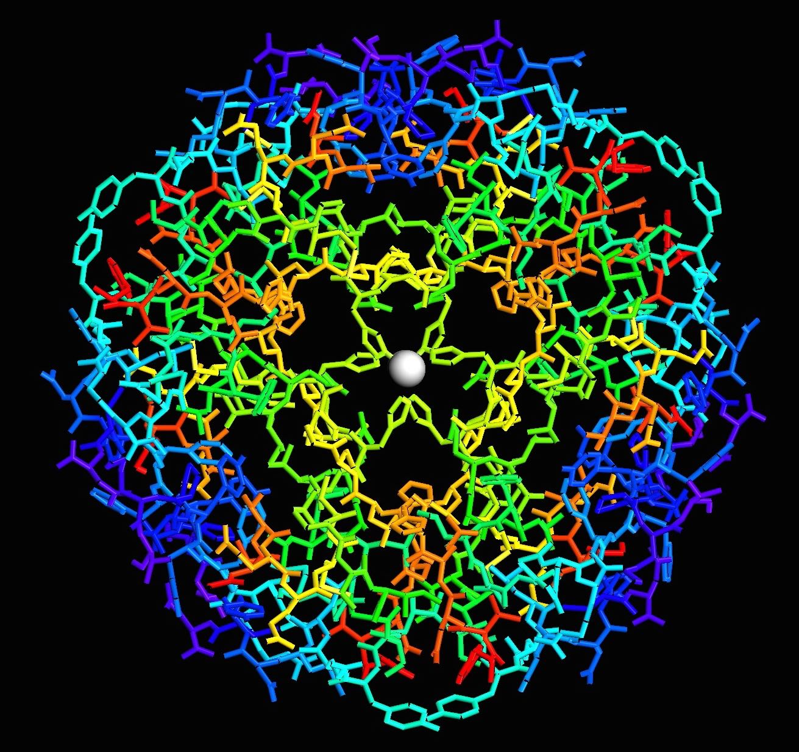
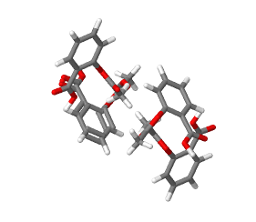
Follow-On Insulin
Follow-on insulin products requires a separate prescription (not directly interchangeable)
Examples:
Insulin glargine (Lantus), follow-on product (Basaglar)
Insulin lispro (Humalog), follow-on product (Ademlog)
Semglee and Rezvoglar can be interchangeable with Lantus (insulin glargine)
Insulin – Large Molecule
Aspirin – Small Molecule

Slide 106
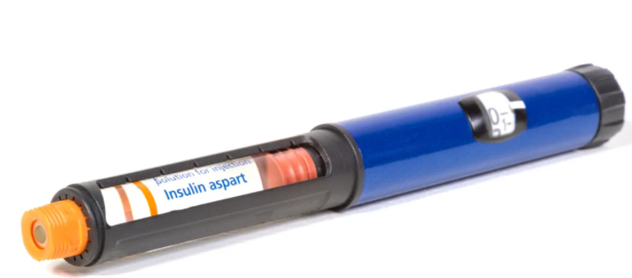
Generic Insulins
Insulin aspart
Insulin lispro
Insulin glargine
About half the cost of the brand name
Exact same formulation, produced by same manufacturer, interchangeable at pharmacy

Slide 107
Which Insulin is Interchangeable with Lantus (Insulin glargine U100)?
Toujeo (Insulin glargine U300)
Basaglar (Insulin glargine U100)
Semglee (Insulin glargine U100)
Insulin degludec U100
All of the above
Notes:
Answer: C

Slide 108

Insulin Injection Sites
Sites should be rotated
Notes:
https://www.bing.com/images/search?view=detailV2&ccid=J0qrzUzi&id=605DACD019791DB4D176BBBA06E2B08398849C0D&thid=OIP.J0qrzUzi0LJ2oJpx5HAGjQHaEy&mediaurl=https%3a%2f%2fwww.cornerstones4care.com%2fcontent%2fcornerstones4care%2fen%2fmedicine%2fwhat-to-do%2fusing-and-taking-care-of-your-medicine%2f_jcr_content%2fpar_left%2fheroimage.img.full.high.jpeg%2f1530054324694.jpeg&exph=300&expw=464&q=insulin+injection+sites&simid=607999160964812015&ck=30C0E430CA937537627C1715925BC74C&selectedIndex=9&qft=+filterui%3alicense-L2_L3_L5_L6&ajaxhist=0
Imagine free to use

Slide 109

Insulin Key Counseling Points
Do not shake insulin
Cloudy insulin (NPH or pre-mixed) should be rolled before use so suspension is uniform
Skin thickness is usually 2mm regardless of person’s size, so shortest needles (4mm) work well for most
Take outer and inner covering off for pen needles
Leave the needle/syringe in the body for 5-10 seconds
Change needle or syringe with each injection
Dispose of needles/syringes in a sharps container or per local regulations
Dang DK. Taking medication. In: Cornell S et al, eds. The art and science of diabetes self-management education desk reference. 5th ed.

Slide 110

Priming insulin
Pens should be primed before every use to get air bubbles out
Hold vertically with needle at the top
Turn dial to 2 units
Push plunger
Repeat until insulin comes out of the top
May have to do multiple times for a new pen
This will ensure all air is out and that pen needle works
Do this every time an insulin pen injection is given
Notes:
Image obtained from Diana Isaacs.

Slide 111


Storage Options
Notes:
Storage options include frio bag and vivicap, logos covered.

Slide 112

Insulin Storage and Expiration Cheat Sheet Available

Slide 113

Side Effects of Insulin
Weight Gain
Lipodystrophy/
Lipohypertrophy
Hypoglycemia
Dang DK. Taking medication. In: Cornell S et al, eds. The art and science of diabetes self-management education desk reference. 4th ed.
Notes:
Weight gain is predominantly from increased truncal fat, and tends to be related to daily dose and plasma insulin levels present. Weight gain is undesirable in most type 2 DM patients, but can be seen as beneficial in underweight patients with type 1 DM. Weight gain appears to be related to intensive insulin therapy, and can be somewhat minimized by physiologic replacement of insulin.
Two forms of lipodystrophy, although much less common today in people with diabetes, still occur. Lipohypertrophy is caused by many injections into the same injection site. Because of insulin's anabolic actions, a raised fat mass is present at the injection site with resultant variable insulin absorption. Lipoatrophy, in contrast, is thought to be caused by insulin antibodies, with destruction of fat at the site of injection. Injection away from the site with more purified insulin is recommended, although several reports of lipoatrophy with lispro have been reported.

Slide 114



Sharps Disposal: Product and Info
Search for household hazardous waste listing for your city or county.
Call 1-800-CLEANUP (1-800-253-2687)

Slide 115
Polling Question 1
After how many days should an open vial of insulin degludec be discarded?
28 days
30 days
42 days
56 days
Notes:
Answer: D

Slide 116

Question Time
Break for Questions

Slide 117
How to Dose Insulin

Slide 118
Type 1 Diabetes (T1D)
Absolute deficiency in endogenous insulin
Exogenous insulin is required
The regimen should include:
Basal
Insulin
Bolus Insulin
+

Slide 119
How to Dose Insulin? T1D
Newly diagnosed T1D
Total insulin dose: 0.5-1.0 units/kg/day
50% basal
50% bolus
Bolus can initially start with set doses or calculations can be used to determine initial carbohydrate ratio and correction factor
Pamagluapatai LG et al. In: Cornell S et al., Pharmacolotherapy for Glucose Management. The art and science of diabetes self-management education desk reference. 5th ed.

Slide 120

Choice of Basal Insulin
NPH
Detemir
Glargine U-300
Delgudec U-100
Glargine
Degludec U-200
1.
Lowest Cost
2.
3.
1. Shortest duration, 2. Medium duration, 3. Longest duration

Slide 121
Weekly Insulin
Awiqli® (once-weekly basal insulin icodec) approved for use in the EU
Anticipated US approval in the near future
Half-life: 196 hours ~8 days
U700 insulin, 3mL pen = 2100 units/pen
70 units icodec weekly = 10 units glargine daily
Rosenstock J, et al. Weekly Icodec versus Daily Glargine U100 in Type 2 Diabetes without Previous Insulin. N Engl J Med. 2023 Jul 27;389(4):297-308.
Notes:
The day of weekly administration can be changed if necessary, by up to 3 days. A minimum of 4 days between injections should always be ensured.

Slide 122

Glargine vs. Icodec in T2D
492 pts in each group
Primary outcome: change in A1C
Conclusion: glycemic control better with icodec
Rosenstock J, et al. Weekly Icodec versus Daily Glargine U100 in Type 2 Diabetes without Previous Insulin. N Engl J Med. 2023 Jul 27;389(4):297-308.
Notes:
Insulin naieve people with T2D
Background: Insulin icodec is an investigational once-weekly basal insulin analogue for diabetes management.
Methods: We conducted a 78-week randomized, open-label, treat-to-target phase 3a trial (including a 52-week main phase and a 26-week extension phase, plus a 5-week follow-up period) involving adults with type 2 diabetes (glycated hemoglobin level, 7 to 11%) who had not previously received insulin. Participants were randomly assigned in a 1:1 ratio to receive once-weekly insulin icodec or once-daily insulin glargine U100. The primary end point was the change in the glycated hemoglobin level from baseline to week 52; the confirmatory secondary end point was the percentage of time spent in the glycemic range of 70 to 180 mg per deciliter (3.9 to 10.0 mmol per liter) in weeks 48 to 52. Hypoglycemic episodes (from baseline to weeks 52 and 83) were recorded.
Results: Each group included 492 participants. Baseline characteristics were similar in the two groups. The mean reduction in the glycated hemoglobin level at 52 weeks was greater with icodec than with glargine U100 (from 8.50% to 6.93% with icodec [mean change, -1.55 percentage points] and from 8.44% to 7.12% with glargine U100 [mean change, -1.35 percentage points]); the estimated between-group difference (-0.19 percentage points; 95% confidence interval [CI], -0.36 to -0.03) confirmed the noninferiority (P<0.001) and superiority (P = 0.02) of icodec. The percentage of time spent in the glycemic range of 70 to 180 mg per deciliter was significantly higher with icodec than with glargine U100 (71.9% vs. 66.9%; estimated between-group difference, 4.27 percentage points [95% CI, 1.92 to 6.62]; P<0.001), which confirmed superiority. Rates of combined clinically significant or severe hypoglycemia were 0.30 events per person-year of exposure with icodec and 0.16 events per person-year of exposure with glargine U100 at week 52 (estimated rate ratio, 1.64; 95% CI, 0.98 to 2.75) and 0.30 and 0.16 events per person-year of exposure, respectively, at week 83 (estimated rate ratio, 1.63; 95% CI, 1.02 to 2.61). No new safety signals were identified, and incidences of adverse events were similar in the two groups.
Conclusions: Glycemic control was significantly better with once-weekly insulin icodec than with once-daily insulin glargine U100. (Funded by Novo Nordisk; ONWARDS 1 ClinicalTrials.gov number, NCT04460885.).

Slide 123
Choice of Bolus Insulin
Regular
Lispro (Humalog®, Admelog®)
Glulisine (Apidra®)
Aspart (Fiasp®)
Aspart (Novolog®)
Lispro (Lyumjev®)
Inhaled (Afrezza®)
Lowest Cost
1.
2.
3.
1. Slowest, 2. Medium, 3. Quickest

Slide 124
T1D: Insulin Dosing Regimens
Time of Insulin Administration | Before breakfast | Before lunch | Before dinner | Bedtime
Method 1 | Intermediate: Regular (2/3 TDD) 2:1 ratio |  | Intermediate: Regular (1/3 TDD) 2:1 ratio
Method 2 | Regular/ analog (1/2 TDD ÷ by 3) | Regular/ analog (1/2 TDD ÷ by 3) | Regular/ analog (1/2 TDD ÷ by 3) | Long-acting (1/2 TDD)
***These are starting regimens and are adjusted based on ability to carbohydrate count and glycemic management as determined by A1C, BGM and/or CGM

Slide 125

Intermediate-acting Insulin + Regular Insulin or Insulin Analog
Intermediate insulin serves as basal while
regular or insulin analog serves as bolus
Regular insulin: Novolin R, Humulin R
Intermediate insulin: Novolin N, Humulin N
Insulin analogue: aspart, lispro, glulisine
Dipiro JT et al, eds. Pharmacotherapy: a pathophysiologic approach. 11th ed. 2020.
Notes:
Drawn by Jill Haug

Slide 126

Long-acting Insulin with Insulin analog
Long-acting serves as basal
insulin analog serves as bolus
Dipiro JT et al, eds. Pharmacotherapy: a pathophysiologic approach. 11th ed. 2020.
Notes:
Drawn by Jill Haug

Slide 127
Carbohydrate Ratio
Insulin to carbohydrate ratio (ICR)
1 unit of insulin is expected to cover X grams of carbohydrates
Rule of 450 or 500 can be used
500/TDD = estimated carbohydrate ratio
Trujillo J et al. Diabetes mellitus. In: Dipiro JT et al., eds. Pharmacotherapy: a pathophysiologic approach. 11th ed.

Slide 128
Correction Factor
Insulin correction factor (ICF)
Often returned to as insulin sensitivity
1 unit of insulin is expected to lower glucose by Y points
Rule of 1700 or 1800 can be used
1700/TDD = estimated ICF
For regular insulin, the rule of 1500 is typically used
Trujillo J et al. Diabetes mellitus. In: Dipiro JT et al., eds. Pharmacotherapy: a pathophysiologic approach. 11th ed.

Slide 129
An Example: Meet Austin
Austin is a 12-year-old newly diagnosed with T1D, he weighs 40kg
He is started on 0.5 units/kg/day of total insulin
40*0.5=20 units
50% basal=10 units
50% bolus=10 units
Austin is prescribed 10 units of long-acting insulin and 3 units of rapid-acting insulin at meals
The insulin doses will be adjusted based on glucose data

Slide 130

Austin Calculation cont’d
Austin is ready for carbohydrate counting
Based on the rule of 500 and rule of 1700, what should his ICR and ICF be?

Slide 131
Poll Question 2
Based on the rule of 500 and rule of 1700, what should Austin’s ICR and ICF be? (TDD=20 units/day)
ICR=25, ISF=85
ICR=20, ISF=60
ICR=15, ISF=50
ICR=30, ISF=75
I am not sure

Slide 132
Answer and Explanation
ICR=500/20=25
This means that 1 unit of insulin covers 25 grams of carbohydrate
If Austin eats 50 grams of carbohydrate, he should inject 2 units
ISF=1700/20=85
This means that 1 unit of insulin is expected to lower glucose by 85 mg/dL
Austin’s glucose target is 100
If his current glucose is 185, he should take 1 extra unit of insulin

Slide 133
Correction Scale 1 Rapid/Fast Acting Insulin (1 unit:50 mg/dl>150)
Less than 70 | Subtract 1 unit
70-150 mg/dl | 0 units
151-200 mg/dl | 1 unit
201-250 mg/dl | 2 units
251-300 mg/dl | 3 units
301-350 mg/dl | 4 units
351-400 mg/dl | 5 units

Slide 134
Correction Scale 2 Rapid/Fast Acting Insulin (2 units:50 mg/dl>150)
Less than 70 | Subtract 1 unit
70-150 mg/dl | 0 units
151-200 mg/dl | 2 unit
201-250 mg/dl | 4 units
251-300 mg/dl | 6 units
301-350 mg/dl | 8 units
351-400 mg/dl | 10 units

Slide 135

Poll Question 3
How much insulin does a person with type 1 diabetes need a day?
1 to 2 units/kg per day
No more than 0.5 units/kg per day
5 to 10 units/kg per day
0.5 to 1 units/kg per day

Slide 136


Inhaled Insulin
Injected Meal Time Dose | Inhaled Insulin Dose
Up to 4 units | 4 units
5-8 units | 8 units
9-12 units | 12 units
12-16 units | 16 units
17-20 units | 20 units
21-24 units | 24 units
FDA approved for adults over 18yo
Not indicated for pregnancy, while breastfeeding

Slide 137



Inhaled Insulin

Slide 138
Inhaled Insulin Storage
Opened inhaler: use in 15 days
Sealed foil packages: refrigerate until expiration date on package
Sealed blister card strips: room temp-use within 10 days, fridge-30 days
Opened strips: room temperature, use within 3 days
Before using, inhaler and strips should be at room temperature for at least 10 minutes
https://afrezza.com/wp-content/uploads/2020/01/Afrezza-Storage-and-Handling-Guide.pdf

Slide 139
Inhaled Insulin Dosing and Counseling
Bolus insulin – inhaled before meals
Dosing: 4, 8 and 12 unit cartridges
Lung function test before start (FEV1)
Not for pts w/ chronic lung issues
Asthma, COPD, history of lung cancer, smoking within past 6 months
Can cause acute bronchospasm – Black box warning
Side effects:
Sore throat, cough
Less hypoglycemia than injected insulin

Slide 140

Bolus Insulin Timing
How is the effectiveness of bolus insulin determined?
1-2 hours post meal
Before next meal blood glucose
Glucose goals may be modified by HCP/pt
1-2 hours peak post meal <180 (ADA)
2 hour post meal <140 (AACE)
Before next meal 80 - 130

Slide 141

Poll Question 5
Mary takes 4 units of insulin lispro (Humalog) before breakfast. Which BG result reflects that the dose was the right dose?
Before breakfast BG of 97
1 hour post lunch BG of 160
Before lunch BG of 87
2 hour post breakfast BG of 185

Slide 142

Stretch Break and Questions: -)

Slide 143
U500 Insulin

Slide 144
More than 200 units a day?
Drug Name | Availability | Pen Units | Expiration | Onset | Peak Effect | Duration of Action | Clinical Pearls
Insulin human regular (humulin R U500) | Pen, Vial | 5 unit | Vial: 40 days Pen: 28 days | 0.25-0.5 hours | 4-8 hr | 13-24 hr | This insulin is 5 time as concentrated. If using a vial, use the special U500 syringe.
DailyMed: https://dailymed.nlm.nih.gov/dailymed/index.cfm
Stahnke AM et al. ADCES in Practice. March, 2020. https://doi.org/10.1177/2633559X20896414

Slide 145
Switching to u500 insulin
Typically reserved for people requiring insulin >200 units/day
U500 acts like an intermediate acting insulin but replaces both the basal and bolus doses
If A1C< 8%, recommend to reduce TDD by 10-20%
If A1C≥ 8%, consider 1:1 conversion
Typically dosed 2-3 times daily
It should be taken 30 minutes prior to meals
Often initiated as a 60/40 or 40/30/30 split
Reid TS, et al. Postgrad Med. 2017;129(5):554-562.
Notes:
New Reference: Reid TS, Schafer F, Brusko C. Higher concentration insulins: an overview of clinical considerations. Postgrad Med. 2017;129(5):554-562. doi:10.1080/00325481.2017.1325311

Slide 146

U500 example
A woman with obesity, T2D, and insulin resistance takes insulin glargine 120 units BID and insulin aspart 60 units TID a.c. Her most recent A1C=9%. How would she switch to U500?
1:1 conversion since A1C > 8%
TDD=180+240=420 units split as 40/30/30
New Dose:
U500 165 units QAM, 125 units at lunch, 125 units at dinner
Must round to nearest 5 unit increment
Inject 30 minutes before each meal
Use U500 syringe or U500 pen
Do not use U100 syringes!
Reid TS, et al. Postgrad Med. 2017;129(5):554-562.

Slide 147
Barriers to Insulin Use

Slide 148

Poll Question 6
AJ tells you she doesn't want to start on insulin. What is your best response?
a. The needles are so small, you won’t even feel it.
b. Lots of people are afraid of insulin.
c. It sounds like you are refusing to take insulin?
d. I’m sorry, but there is a doctors' order to start insulin.
e. What concerns do you have about taking insulin?

Slide 149

Psychological Insulin Resistance (PIR)
50% of providers in study threatened pts “with the needle”.
Less than 50% of providers realized insulins’ positive effect on type 2 DM
Most pts don’t believe that insulin would “better help them manage their diabetes”.
Solutions: Find the root of PIR and address it
Diabetes Attitudes, Wishes, Needs Study - Rubin

Slide 150

Needle Size often a Barrier: Size Matters
Use shortest needles – 4 mm
Effective for almost ALL patients
Keeps it subq
If thin, inject at angle
To avoid leakage, count to 10 before withdrawing needle
For needle phobias, consider insulin pumps, patches, iport, and inhaled insulin

Slide 151
How To’s of Adding Insulin in Type 2 DM

Slide 152

Injectable Therapy for Type 2 Diabetes
Use GLP-1 RA as first injectable when possible
Start basal insulin 10 units or 0.1 to 0.2 units/kg day
Titrate up 2 units every 3-4 days, until FBG at goal
If hypo, decrease insulin 20% or 4 units
If basal insulin is >0.5 unit/kg day, add bolus insulin (avoid overbasalization)
Adding bolus
Start with 4 units bolus at largest meal or
Start 1-2 injections with 10% of basal or
Switch to 70/30 twice or three times daily.

Slide 153

Intensifying Injectable Footnotes 9.2
Consider insulin as the first injectable if evidence of ongoing catabolism A1C levels (>10%) or BG levels ≥300mg/dL or a diagnosis of type 1 diabetes is a possibility.
For those on GLP-1RA and basal insulin combination, consider using a fixed-ratio combination product (iDegLira or iGlarLixi).
Consider switching from evening NPH to a basal analog if there is hypoglycemia and/or the individual frequently forgets to administer NPH in the evening. In this case, an AM dose of a long-acting basal insulin could be a better choice.
If adding prandial insulin to NPH, consider initiation of a self-mixed or premixed insulin regimen to decrease number of injections.

Slide 154


Slide 155


Intensifying to injectable therapies.
Notes:
Basal insulin alone is usually the optimal initial regimen, beginning at 0.1-0.2 U/kg body weight, depending on the degree of hyperglycemia. It is usually prescribed in conjunction with 1-2 non-insulin agents, although insulin secretagogues (sulfonylureas, meglitinides) are typically stopped once more complex regimens beyond basal insulin are utilized.
In patients still not at target after basal insulin has been adequately titrated, and the patient is willing to take >1 injections, there are several options. First, consider GLP-1 receptor agonists (see Fig. 2). The combination of basal insulin + GLP-1RA is becoming well established after several studies confirmed its efficacy on par with more complex multi-dose insulin regimens, but with less hypoglycemia and with weight loss instead of weight gain. If such an approach is not possible or has been tried and proven unsuccessful, there are 3 possible advanced insulin regimens:
Adding 1 injection of a rapid acting insulin analogue before the largest meal,
Adding 2-3 injections of a rapid acting insulin analogue before 2-3 meals, or
Using premixed insulin BID
Each approach has its advantages and disadvantages. The figure describes the number of injections required at each stage, together with the relative complexity and flexibility.
Once a strategy is initiated, titration of the insulin dose is important, with dose adjustments made based on the prevailing BG levels as reported by the patient.
Comprehensive education regarding self-monitoring of BG, diet, exercise, and the avoidance of, and response to, hypoglycemia are critical in any patient on insulin therapy.

Slide 156



Slide 157


Slide 158
Case Study: Jenny
Jenny is a 50-year-old woman that takes insulin glargine 100 units daily, glipizide 10mg BID, metformin 1000mg BID, and linagliptin 5mg daily. A1C is 9.3%. She weighs 110kg. She checks glucose in the AM only and reports it’s 90-130mg/dL. Her eGFR is 70. She previously had UTI’s with empagliflozin.
What is the best recommendation to adjust this regimen?

Slide 159

Thinking about the choices
Continue glargine?
Continue glipizide?
Continue linagliptin?
Add GLP-1 agonist?
Switch to combination GLP1 receptor agonist /insulin injectable?
Add prandial insulin?
Add SGLT-2 inhibitor?

Slide 160
Piecing it Together
New Regimen:
Insulin glargine 80 units once daily (20% reduction)
Semaglutide 0.25mg weekly, titrated up to 2mg weekly
Stop linagliptin
Continue glipizide (for now)
Next step could be to retry SGLT2i with counseling on how to avoid UTIs
Or replacing glipizide with prandial insulin with largest meal
CGM!

Slide 161
Switching Insulin

Slide 162
How to Switch Basal Insulin
When going from twice daily basal insulin to once daily, reduce dose by 20%
Examples:
Insulin NPH BID to insulin glargine daily
Insulin detemir BID to insulin degludec daily
When switching between once daily, a unit per unit conversion is okay
Long-acting to glargine U300 often requires higher doses (10 to 18%) but start with a unit to unit conversion
When switching from glargine U300 to another long-acting insulin, reduce dose by 20%
Need to use clinical judgement
For example, if A1C, FBG, and pre-meal BG are all above target, then may not be necessary to reduce basal insulin dose
Clinical Resource. Pharmacist’s Letter/Prescriber’s Letter. August 2019.

Slide 163

Poll 7 - Making the switch: Meet Joan
Joan is taking insulin glargine 30 units twice daily. Her insurance formulary wants her to switch to insulin degludec. Her current A1C is 6.9%. What is the best dose recommendation?
Insulin degludec 30 units twice daily
Insulin degludec 60 units once daily
Do not switch since her A1C is well-controlled and get a prior authorization to continue with insulin glargine
Insulin degludec 48 units once daily
Notes:
The correct answer is D. a 20% reduction when going from twice daily to once daily.

Slide 164
Switching Meal time Insulin
This is a 1:1 conversion when switching between regular insulin, aspart, lispro, and glulisine including Fiasp® and Lyumjev™.
The exception is when switching to Afrezza
Injected Meal Time Dose | Inhaled Insulin Dose
Up to 4 units | 4 units
5-8 units | 8 units
9-12 units | 12 units
12-16 units | 16 units
17-20 units | 20 units
21-24 units | 24 units
Clinical Resource. Pharmacist’s Letter/Prescriber’s Letter. August 2019.
Afrezza (package insert) 2019.

Slide 165
Poll 8. Patient Case: Lumy
Lumy’s insurance formulary changed from insulin lispro to insulin aspart.
She was following an insulin to carbohydrate ratio of 1:12 and a correction factor of 1:50.
How should she dose insulin aspart when she switches?
Reduce all doses by 10%
Increase all doses by 10%
Same dosing
Submit prior authorization so she doesn’t change insulin

Slide 166
Insulin Pattern Management

Slide 167


Pattern Management –AKA
How to think like a pancreas

Slide 168


What do the numbers mean?
It’s like a BIG puzzle!
Notes:
Images Labeled for resuse
https://www.google.com/search?q=diabetes+puzzle&tbm=isch&ved=2ahUKEwim6amp8OvqAhUIG6wKHVFgBjAQ2-cCegQIABAA&oq=diabetes+puzzle&gs_lcp=CgNpbWcQAzIECAAQGDIECAAQGDoECCMQJzoECAAQQzoFCAAQsQM6AggAOgcIABCxAxBDOggIABCxAxCDAVC6iAJYsZUCYPeVAmgAcAB4AIABU4gBywiSAQIxNZgBAKABAaoBC2d3cy13aXotaW1nwAEB&sclient=img&ei=uPcdX6atHIi2sAXRwJmAAw&bih=869&biw=1902#imgrc=BxqsnbW3m9mE6M
https://www.researchgate.net/figure/Unlocking-the-puzzle-of-caring-for-the-patient-with-diabetes-mellitus-cardiometabolic_fig3_327175579

Slide 169
At Least 42 Factors Affect Glucose!
Food
Medication
Activity
Biological
Environmental
Behavioral and decision making
↑↑ Carbo-hydrate quantity
→↑Carbo-hydrate type
→↑ Fat
→↑ Protein
→↑ Caffeine
↓↑Alcohol
↓↑ Meal timing
↑Dehydration
? Personal microbiome
→↓Dose
↓↑ Timing
↓↑ Inter-actions
↑↑ Steroid administration
↑ Niacin (vitamin B3)
→↓ Light exercise
↓↑ High/ moderate exercise
→↓ Level of fitness/training
↓↑ Time of day
↓↑ Food and insulin timing
↑ Insufficient sleep
↑ Stress and illness
↓ Recent hypoglycemia
→↑ During-sleep blood sugars
↑ Dawn phenomenon
↑ Infusion set issues
↑ Scar tissue and lipodystrophy
↓↓ Intramuscular insulin delivery
↑ Allergies
↑ A higher glucose level
↓↑ Menstruation
↑↑ Puberty
↓ Celiac disease
↑ Smoking
↑ Expired insulin
↑ Inaccurate BG reading
↓↑ Outside temperature
↑ Sunburn
? Altitude
↓ Frequency of glucose checks
↓↑ Default options and choices
↓↑ Decision-making biases
↓↑ Family relationships and social pressures
Adapted from Brown A. DiaTribe Learn: Making sense of diabetes... diatribe.org/42factors

Slide 170

Poll Question 9
When looking at glucose patterns, which problem do you fix first?
a. Hyperglycemia
b. Hypoglycemia
c. Non-compliance
d. Legible writing

Slide 171
Pattern Management
Safety 1st!! - Evaluate 3 day patterns
Hypo: eval 1st and fix:
If possible, decrease medication dose
Timing of meals, exercise, medications
Hyperglycemia: evaluate 2nd
Identify patterns
Before increase insulin, make sure not missing something (carbs, exercise, omission)

Slide 172
General Rules with Basal Bolus
Optimize basal dose
Stay within 30mg/dL when not eating
Stay within 50mg/dL after a meal
Insulin Management
Fix hypoglycemia
Check basal/bolus ratio
Fine tune bolus settings
Optimize basal insulin

Slide 173
Adjusting Insulin doses in a Basal/Bolus regimen (T1DM & T2DM)
Out of Range Glucose | Insulin to Adjust
Fasting | Long acting insulin or evening NPH
Post-breakfast/pre-lunch | Pre-breakfast rapid/regular insulin
Post lunch/pre-dinner | Pre-lunch rapid/regular insulin or morning NPH
Post-dinner/before bedtime | Pre-dinner rapid/regular insulin

Slide 174
Tips for Data Interpretation
Start by asking the person what they’ve experienced and noticed with their glucose patterns
Avoid judgment
Learn from 1 time episodes, but make changes based on patterns
Fix lows first but some amount is expected (<1-4%) and if you remove all lows, you may end up with too many highs
If it’s not making sense, dig deeper (ex. missed doses, rationing, injection technique, food insecurity, etc)
Eating Patterns
Behaviors
Medications

Slide 175

Meal Time Data Review
Glucose data before and after breakfast, lunch and dinner
Ideally, 2 hour post-meal should not rise above 180mg/dL or 50mg/dL from the pre-meal start
By 4-5 hours, glucose should return to pre-meal level
Notes:
Image from cleveland clinic companion medical patient report

Slide 176
Bolus Pattern Management
Does glucose go low after a correction dose?
May need a higher sensitivity
Ex. 1:60 instead of 1:50
Does glucose remain high after a correction dose?
May need a lower sensitivity
Ex. 1:40 instead of 1:50
Often people are more sensitive overnight (less insulin needed)
Does the person spike high after eating?
Is the person bolusing BEFORE the meal
Counting carbs correctly?
May need a more intensive carb ratio
Ex. 1:6 instead of 1:8
Does the person go low after eating?
Counting carbs correctly?
May need a less intensive carb ratio
Ex. 1:10 instead of 1:8
Adjustments typically made 10-20% at a time

Slide 177


Checking the Sensitivity
TDD=49 units
Rule of 1700
1700/49=35
Current sensitivity is 40
The calculation is slightly different from the current sensitivity. Look at the glucose data to determine if the sensitivity should be decreased.

Slide 178
Checking the Carb Ratio
TDD=49 units
Rule of 450
450/49=12.9
Current carb ratio is 15
The calculation is different from the current carb ratio. Look at the glucose data to determine if the carb ratio should be decreased.

Slide 179


Basal Insulin Review

Slide 180
Case Study: Larry Poll Question 12
Larry takes metformin 1000mg BID, insulin glargine 50 units once daily, empagliflozin 10mg daily. His A1C is 7.8%. He weighs 90kg. FBG averages 100mg/dL. 2 hr PP breakfast=190mg/dL, 2 hr PP lunch=210mg/dL, and 2 hr PP dinner is 240mg/dL. What is the best recommendation for an agent to add to the regimen to achieve A1C target?
Initiate insulin aspart 5 units at dinner, decrease insulin glargine to 45 units daily
Initiate insulin aspart 5 units with all meals, decrease insulin glargine to 35 units daily
Initiate insulin aspart 5 units at dinner, continue insulin glargine 50 units daily
Initiate tirzepatide 2.5mg weekly, decrease insulin glargine to 45 units daily

Slide 181
Summary
Many different types of insulin
Basal + bolus needed for T1DM
Weight based dosing and rules of 1700/1800 and 500/450 can be used to calculate correction factor and carb ratio
GLP1 agonist preferred 1st injectable in T2DM
Avoid overbasalization, if taking more than 0.5unit/kg/day, think about GLP1 agonist +/- prandial insulin
Counsel patients on injection site technique, administration and storage
Fine tune insulin settings based on BGM and CGM data

Slide 182

Q & A

Slide 183

Questions and Lunch
Class starts again at 1:00 pm
Thank you

