Slide 1
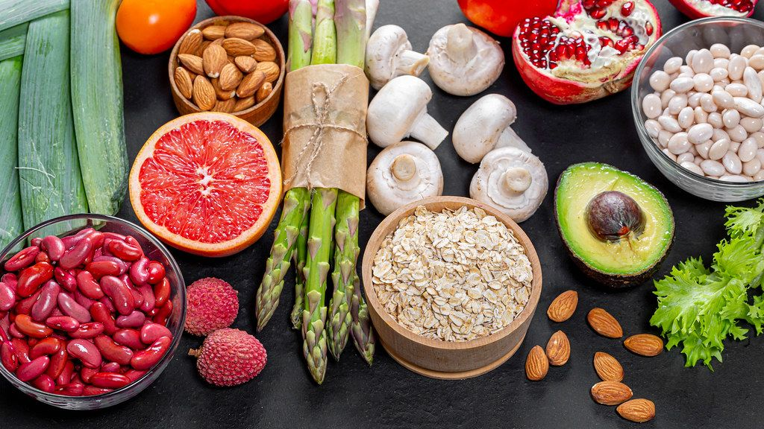
MEDICAL NUTRITION THERAPY
Jessica Jones, MS, RDN, CDCES
Co-Founder and CEO of Diabetes Digital

Slide 2
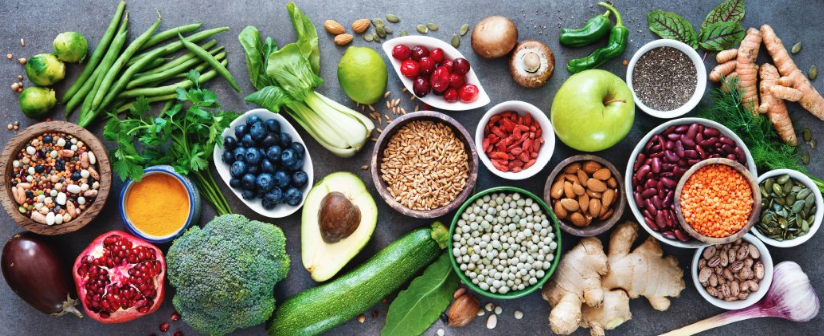
Allow Me to Introduce Myself
I am a Registered Dietitian, CDCES & Co-Founder and CEO of Diabetes Digital–insurance-based group practice providing 1:1 nutrition counseling for people with DM & PreDM
Worked in many institutions from NYC Dept of Health to University of California San Francisco to Private Practice
Values: Culturally Humble, Accessibility, Weight Inclusivity, Promoting a XXXX Relationship with Food
Notes:
I want to start off by acknowledging that nutrition and healthy eating can be complicated.
Our food choices are heavily influenced by many variables including:
Emotions, Traditions, Family and cultural eating patterns, Health beliefs, Food preferences, availability, and affordability
So if you’ve ever been overwhelmed in trying to eat more healthfully yourself or struggled to teach someone else about healthy eating then you’re not alone.
Many clinicians consider healthy eating to be the most challenging of the Self-Care Behaviors to implement successfully.
My hope today is to provide more clarity on current nutrition recommendations to both prepare you for the exam, if that’s something you’re planning to take, and also increase your confidence in teaching others about healthy eating.

Slide 3
Healthy Eating
Healthy Eating involves behaviors and decisions on what, when, and how much to eat
Influences on healthy eating are complex and numerous
Many clinicians consider healthy eating to be the most challenging of the AADE7 Self-Care Behaviors to implement successfully
Notes:
I want to start off by acknowledging that nutrition and healthy eating can be complicated.
Our food choices are heavily influenced by many variables including:
Emotions, Traditions, Family and cultural eating patterns, Health beliefs, Food preferences, availability, and affordability
So if you’ve ever been overwhelmed in trying to eat more healthfully yourself or struggled to teach someone else about healthy eating then you’re not alone.
Many clinicians consider healthy eating to be the most challenging of the Self-Care Behaviors to implement successfully.
My hope today is to provide more clarity on current nutrition recommendations to both prepare you for the exam, if that’s something you’re planning to take, and also increase your confidence in teaching others about healthy eating.

Slide 4
Healthy Eating
Medical Nutrition Therapy (MNT)
Evidence-based treatment of a condition through the modification of nutrient or whole-food intake
Often provided by a RD/RDN or similarly qualified professional
All diabetes care and education specialists must be ready and able to apply the principles of MNT!
Notes:
So today is all about Medical nutrition therapy.
Medical Nutrition Therapy (MNT) is nutrition based treatment for a condition. It should be evidence based. While MNT is typically provided by and can be billed for when provided by a dietitian, all diabetes care and education specialists must be ready to apply the principles of MNT when working with those who live with diabetes.

Slide 5
Goals of MNT for All Persons With Diabetes (PWD)
Decrease the risk of diabetes and cardiovascular disease with intensive lifestyle modification
Refer those at risk for diabetes to an intensive lifestyle program
Ex: Diabetes Prevention Program and/or individualized MNT
Notes:
Lets jump in by reviewing the goals of MNT - first, for people with PREDIABETES
The primary goal of MNT for those living with prediabetes is to reduce the risk of developing diabetes and cardiovascular disease. This is done by providing education and supporting individuals in implementing lifestyle change.
The standards recommended that a person with prediabetes gets referred into a program to provide support in making these lifestyle adjustments. That could be a diabetes prevention program or an individualized medical nutrition therapy program.

Slide 6
The Power of Prevention
Diabetes Prevention Program (DPP) shows lifestyle changes may reduce risk of incident T2DM by 58% over 3 years
Benefit of lifestyle change is more significant in those over the age of 60 – may decrease risk of T2DM by 71%
Lifestyle intervention was effective in both sexes, across all racial and ethnic groups, and in people predisposed to diabetes
The Diabetes Prevention Program Research Group. (2002). Reduction in the incidence of type 2 diabetes with lifestyle intervention or metformin. New England Journal of Medicine, 346(6), 393–403. https://doi.org/10.1056/nejmoa012512
Notes:
Diabetes prevention programs are based on strong research that shows that lifestyle changes are effective in delaying and potentially preventing type 2 diabetes.
The diabetes prevention program research group randomly assigned approximately 3200 participants with prediabetes who were living with overweight or obesity into one of three groups:
lifestyle intervention aimed at modest weight loss through diet and exercise
treatment with generic metformin or
a placebo control group
The findings were published in the Lancet in 2002. They showed that over 3 years, when compared to placebo, that:
lifestyle intervention reduced the conversion rate to diabetes by 58% and
metformin reduced the rate of conversion to diabetes by 31%
A follow up study at 10 years continued to show significant benefit of making lifestyle changes.
Not only did lifestyle intervention lead to substantial health benefits, it also resulted in savings in health care costs. The net 10-year cost of the program was thought to be quite modest.
________________________________________________________________________________________
ORIGINAL PARAGRAPH
The DPP was a comparative effectiveness trial involving 3234 overweight or obese adults with impaired glucose tolerance (prediabetes). Forty-five percent of the participants belonged to racial or ethnic minority groups that have an increased risk of type 2 diabetes. Participants were assigned to receive one of three interventions: lifestyle intervention aimed at modest weight loss through diet and exercise, treatment with generic metformin, or a placebo control. DPP findings published in 2002 indicated that, relative to placebo, lifestyle intervention and metformin reduced the rate of conversion to diabetes by 58% and 31%, respectively, over 3 years.1 Subgroup analyses showed that lifestyle intervention was effective in both sexes, across all racial and ethnic groups, and in people with a genetic predisposition to diabetes. Lifestyle intervention worked best in participants 60 years of age or older, a group in which metformin did not provide a significant benefit. Metformin worked well among younger participants and was particularly effective in women with a history of gestational diabetes. Most DPP participants (88%) enrolled in the DPPOS, in which continued follow-up demonstrated that the 10-year risk reduction for type 2 diabetes was 31% for lifestyle intervention and 18% for metformin.
Beyond reducing diabetes risk, lifestyle intervention led to substantial health benefits and health care cost savings. Even though these interventions were initially delivered by highly trained professionals who conducted individual sessions, the net 10-year cost was quite modest; although metformin conferred fewer benefits and prevented fewer cases of diabetes, thanks to its lower cost it yielded net savings.

Slide 7
The Power of Prevention
Lifestyle intervention/goals in DPP included:
Increase physical activity: goal of 150 minutes of physical activity per week
Decrease fat and calorie intake*
Decrease weight: sustained loss of 7% of initial body weight
*DPP initially encouraged a lower fat/calorie eating plan but current data suggests there is no ideal percentage of calories from carbs, protein, and fat to prevent diabetes. A variety of eating patterns may be appropriate.
Diabetes Prevention Program (DPP) Research Group. (2002). The Diabetes Prevention Program (DPP): Description of lifestyle intervention. Diabetes Care, 25(12), 2165-2171. doi:10.2337/diacare.25.12.2165
Notes:
The focus of Lifestyle intervention in the Diabetes Prevention Program was to increase physical activity and decrease calorie intake, with weight loss in mind. Specifically, participants in the lifestyle group were asked to
Increase physical activity to 150 minutes per week. The intensity of the activity was equivalent to brisk walking.
Including resistance training is also thought to be beneficial, as is reducing long periods of sedentary time.
Dietary changes
The DPP used fat and calorie restriction - Calorie goals were calculated by estimating daily calories needed to maintain initial weight and then subtracting 500-1000 calories with the aim of losing 1-2 lbs per week.
While the program initially used fat and calorie restriction, I want to mention that the current evidence shows there are a variety of eating patterns that may be appropriate for people with prediabetes; what's more important is calorie reduction and overall quality of diet. Reducing a specific macronutrient is thought to be less important.
3. The trial also focused on sustained weight loss of 7% of initial body weight. 7% was selected as a target in the study because it was thought to be feasible to achieve and maintain. Longer term data revealed greater prevention of diabetes at about 7-10% of weight loss relative to starting body weight.
- Weight loss was the most significant factor in reducing risk of developing diabetes but the exercise behavioral goal was also impactful. Adding 150 minutes a week independently reduced the risk of converting to diabetes by 44%.

Slide 8
Having Said That!
10-year follow-up of DPP study, many participants regained most of the weight they initially lost
Despite weight regain, participants in the lifestyle intervention group continued to experience a reduced risk of developing type 2 diabetes
Suggests that the benefits observed in the study—such as reduced diabetes risk—were not solely dependent on weight loss
Recap of DPP lifestyle Changes
Increased Physical Activity
Increased Fiber
Increased Fruit
Increased Vegetable Intake
10-year follow-up of diabetes incidence and weight loss in the Diabetes Prevention Program Outcomes Study. (2009b). The Lancet, 374(9702), 1677–1686. https://doi.org/10.1016/s0140-6736(09)61457-4
Notes:
In the original Diabetes Prevention Program (DPP) study, researchers found that people at high risk for diabetes were able to lower their chances of getting the disease by 58% if they followed an intensive lifestyle program, and by 31% if they took the medication metformin, compared to those who didn’t receive any special treatment. To see if these benefits lasted over time, researchers followed up with participants for about 10 years. Nearly 90% of the original participants continued to be monitored. During this time, all the groups—those who were originally in the lifestyle program, the metformin group, and the placebo group—were offered lifestyle support, and those on metformin continued taking the medication.
Over the 10 years, people in the lifestyle group initially lost an average of about 7% of their body weight but gained some of it back, maintaining an average weight loss of around 2%. Despite this partial weight regain, the lifestyle group still had the lowest overall rate of developing diabetes, with a 34% lower risk compared to the placebo group. The metformin group also had a reduced risk, by 18%, though it wasn’t as strong as the lifestyle group. What’s particularly interesting is that even though the differences in diabetes rates among the groups began to even out over time, the lifestyle group continued to show the greatest long-term benefit in preventing or delaying diabetes. This suggests that making sustainable lifestyle changes can have lasting effects on your health, even years down the road, regardless of whether all the initial weight loss is maintained.
https://www.ncbi.nlm.nih.gov/pmc/articles/PMC3135022/

Slide 9
There is No “Prediabetes Diet”
Many eating patterns may be appropriate
Overall quality of food is associated with lower risk of type 2 diabetes
Diabetes Prevention Program (DPP) Research Group. (2002). The Diabetes Prevention Program (DPP): Description of lifestyle intervention. Diabetes Care, 25(12), 2165-2171. doi:10.2337/diacare.25.12.2165
Notes:
Based on other trials, a variety of eating patterns may be appropriate for individuals with prediabetes including the mediterranean, low carb, DASH, vegetarian, plant-based.
Overall quality of food (as measured by Healthy eating index or the alternative healthy eating index or DASH score) with an emphasis on whole grains, legumes, nuts, fruits, and vegetables with minimal refined and processed foods is also associated with a lower risk of type 2 diabetes.

Slide 10
The Power of Prevention
Find a DPP in your community:
CDC-recognized DPP Lifestyle Change programs:
https://www.cdc.gov/diabetes-prevention/lifestyle-change-program/find-a-program.html
Medicare-enrolled CDC-recognized programs:
https://innovation.cms.gov/innovation-models/medicare-diabetes-prevention-program/mdpp-map
Notes:
There are DPP programs all over the united states. To find a program near you, I’ve included these web-links.
________________________
Eligibility criteria:
Regular programs: Eligibility: BMI ≥ 25, at risk for diabetes based on laboratory testing, previous dx of GDM, or a positive risk test
Medicare: Eligibility: BMI greater than 25 (or >= 23 for Asians) and laboratory testing consistent with prediabetes in the last 1 year
To participate, you must meet ALL 4 of these requirements:
Be 18 years or older.
Have a body mass index (BMI) of 25 or higher (23 or higher if you're an Asian American person).
Not be previously diagnosed with type 1 or type 2 diabetes.
Not be pregnant.
You'll also need to meet 1 of these requirements:
1. Had a blood test result in the prediabetes range within the past year (includes any of these tests and results):
Hemoglobin A1C: 5.7%–6.4%
Fasting plasma glucose: 100–125 mg/dL
2-hour plasma glucose (after a 75g glucose load): 140–199 mg/dL.
2. Be previously diagnosed with gestational diabetes (diabetes during pregnancy).
3. Received a high-risk result (score of 5 or higher) on the Prediabetes Risk Test.
If you're enrolling in the Medicare Diabetes Prevention Program, different criteria apply. Find them here.
https://www.cdc.gov/diabetes-prevention/about-prediabetes-type-2/index.html

Slide 11
Goals of MNT for All Persons With Diabetes
Promote/support healthful eating patterns, emphasizing a variety of nutrient dense foods in appropriate portion sizes, to improve overall health and:
Achieve individualized glycemic, blood pressure, and lipid goals, achieve/maintain body weight goals, delay/prevent complications of diabetes
Notes:
Alright, now lets review the goals of MNT for those living with diabetes
The first goal for MNT for people with diabetes is to promote healthy eating patterns to improve health, ultimately, with the goal of delaying or preventing complications from diabetes
Standards pg: S64

Slide 12
Goals of MNT for All Persons With Diabetes
2. Address individual nutritional needs based on:
Personal and cultural food preferences
Health literacy and numeracy
Access to healthful food choices
Willingness and ability to make changes
Barriers to change
Notes:
So we want to supporting healthful eating patterns, but we want to be considerate of the needs of the individual.
As a dietitian I often get requests for a list of yes and no foods – someone comes in and says, you know, “just give me a list of foods I can eat and foods I can’t eat”
I must say, this is one of my least favorite requests. I try to avoid giving out a one-sized fits all list like this – rather, it’s important to work with each individual to understand food preferences, health goals, and more – prior to providing recommendations.
Remember that on day one, one of Bev’s diabingo questions asked us to enter 3 healthy foods, and while there was overlap almost no answer was exactly the same. That is because we each come to the table with our own opinions, experiences, and biases. It’s important to try to leave those at the door when you’re counseling on nutrition and focus on the individual’s needs.
S64

Slide 13
Goals of MNT for All Persons With Diabetes
Maintain the pleasure of eating by:
Providing positive/nonjudgmental messages about food choices
Limiting food choices only when evidence-based
Provide practical tools for day-to-day meal planning and healthful eating patterns (rather than focusing on individual macros, micros, or single foods)
Notes:
Another goal is to support individuals in maintaining the pleasure of eating.
This is SO HARD – I’m sure we all know this - there is so much judgement, shame, and guilt around food. This is especially true in the world of diabetes. As educators we have tremendous potential improve upon this by trying to be thoughtful with our language. A simple example is trying to avoid labeling foods as “good” or “bad” - rather, try using verbiage like “more nutritious” or that food “has less vitamins and minerals.” Avoid use of words like “cheat day” – the word cheat automatically has a negative connotation and people with diabetes are going to have days where their eating pattern is more nourishing and days where it is less, just like every other person.
Further, we are encouraged avoid making recommendations that limit food choices unless the scientific evidence to do so is clear.
One thing I have found helpful is to focus on incorporating more fiber and vitamin and mineral rich foods, rather than pushing individuals to limit foods. Often, as people fill up on nutritious food and feel more satisfied, then eating smaller amounts of foods that are less nutrient dense becomes much easier.
And then lastly, always remember to provide practical advice.
An easy way to do this is to always ask yourself, “would I be willing to do this or make this change” if the answer is no, it’s likely that the recommendation you’re making is not practical.
S64

Slide 14
Benefit of MNT for Those With Diabetes
Refer people with diabetes to RDN at dx and as needed
Sustained A1C improvement with ongoing support from RD/RDN
MNT is cost-effective
Decrease in A1C After 3-6 Months of Receiving MNT
Type 1 Diabetes | 1.0% - 1.9%
Type 2 Diabetes | 0.3% - 2.0%
Franz, M. J., MacLeod, J., Evert, A., Brown, C., Gradwell, E., Handu, D., Reppert, A., & Robinson, M. (2017). Academy of Nutrition and Dietetics Nutrition practice guideline for type 1 and type 2 diabetes in adults: Systematic review of evidence for medical nutrition therapy effectiveness and recommendations for integration into the Nutrition Care Process. Journal of the Academy of Nutrition and Dietetics, 117(10), 1659–1679. https://doi.org/10.1016/j.jand.2017.03.022
Notes:
There is strong evidence showing the value of MNT. In fact, research shows that MNT provided by a dietitian can assist those with diabetes in improving A1C.
And, ongoing nutrition education can assist with maintenance of that A1C improvement.
These A1C improvements can translate to a reduction in diabetes comorbidities, which improves quality of life, and may decrease need for medications and healthcare costs. So in addition to improved quality of life for people with diabetes, MNT may also lead to a reduction in the use of health services and costs.
Because of this, current recommendations state that “All providers should refer people with diabetes for individualized MNT… at diagnosis and as needed throughout the lifespan.
S64
_______________________________________________
_______________________________________________
The evidence in support of this is:
In people with type 1 diabetes, several studies have reported that MNT contributed to signiﬁcantly decreased A1c levels. At 6 months, individualized MNT using carbohydrate counting
to determine premeal insulin doses assisted in decreasing baseline mean A1C levels by 1.0% and 1.9%. An initial series of RDN encounters (4 to 6;total encounter time of 4 to 6 hours) with regular continued RDN encounters were reported. Ongoing MNT support provided by RDNs resulted in maintenance of the reduced HbA1c levels at 1 year, and in the large Diabetes Control and Complications Trial (DCCT) assisted in maintaining the mean HbA1C level at 6.9% in the intensive treatment arm throughout the 6.5 years of the trial.
Studies in persons with type 2 diabetes who received MNT for 3 months, show an absolute decrease in A1C that is up to 2.0%. Longer-term studies show that the A1C improvement is maintained with ongoing support from the dietitian; at one year out, decreases in A1C ranged from 0.6% to 1.8%.
I’d also like to note that although MNT interventions were effective throughout the disease process, the decrease in HbA1c was the largest in studies in which participants were newly diagnosed with type 2 diabetes.

Slide 15

Let’s Talk About Weight
In Those at Risk for Diabetes and Those Living with Diabetes
Notes:
Next we will talk about nutrition therapy for weight management in those at risk for developing diabetes and in those who live with diabetes

Slide 16

Rethinking Weight and Health
Notes:
Now that we’ve spent that time discussing diabetes and weight with a focus on weight loss, I want to take a minute to talk about weight from another angle.
We want to realize that weight is not the only indicator of health and not every person with diabetes will need or want to lose weight.
And so, providing weight-inclusive care focuses on establishing self-care behaviors rather than promoting restriction or endorsing unsustainable eating or exercise patterns as a way to “get healthy.” As many of you know there is significant stigma and blame around weight, particularly in the diabetes world. This can be a significant emotional and mental burden for the person with diabetes.
As diabetes experts, our job is to advocate and support the person with diabetes in a way that feels right for that individual… and mental wellbeing is a big piece of this. With such, weight loss may not be a goal for every individual who lives with diabetes.

Slide 17
Introduction to Health at Every Size (HAES®)
HAES® Overview
Developed in the late 1990s, rooted in the civil rights movements of the 1960s.
Focuses on providing equitable healthcare without centering on weight loss.
Aims to challenge weight-based oppression and promote compassionate care for all body sizes.
Healthcare as a Human Right: Everyone, regardless of size, deserves access to comprehensive and compassionate healthcare.
Rejecting weight-based discrimination and ensuring care for all body sizes.

Slide 18
How HAES® Affects Health
Sustainability of Healthy Behaviors
Intentional weight loss is often unsustainable, with most dieters regaining more weight than they lose, leading to weight cycling. Repeated dieting can lower resting metabolic rate, making weight regain more likely. Weight cycling is linked to higher risks of hypertension, insulin resistance, and hyperlipidemia.
Health Beyond Weight
Health can improve through behaviors like balanced eating, regular physical activity, and stress management, regardless of weight changes.
Reducing Health Risks
Adopting HAES®-aligned practices can reduce risks associated with chronic diseases, independent of weight loss. Reference?
Notes:
Talking Points:
Highlight the historical context, emphasizing that HAES® was born out of the civil rights movement.
Discuss the evolution of HAES® as a response to weight-based oppression in healthcare.
Mention that HAES® principles guide a non-weight-centric approach to healthcare, ensuring all bodies receive compassionate care.

Slide 19
Restrictive Eating Cycle
The restrict-binge cycle starts in an attempt to control weight or “improve your health” by restricting food intake.
Desire to
lose weight
Restrictive
dieting
Feelings of shame, guilt, anxiety
Feelings of hunger and cravings
Binge eating

Slide 20
How Does this Compare to the 2024 ADA Standards of Care?
 | HAES | ADA
Focus on Weight | Emphasizes that health can be achieved at any size, discouraging intentional weight loss as a primary goal. It promotes body diversity and challenges the societal focus on thinness. | While the ADA does not solely focus on weight loss, it acknowledges weight management as an important factor in diabetes care. The 2024 Standards recommend weight loss for “overweight” or “obese” individuals as a means to improve glycemic control, blood pressure, and lipid levels.
Health Goals | Prioritizes overall well-being, mental health, and sustainable behaviors, such as intuitive eating and enjoyable physical activity, over weight loss. HAES® argues that these behaviors can lead to improved health outcomes regardless of changes in weight. | The ADA Standards focus on managing diabetes and preventing complications. While it does promote lifestyle changes, such as diet and exercise, these recommendations are often tied to achieving and maintaining weight loss to improve metabolic health.
Approach to Treatment | Advocates for a person-centered approach that respects individual autonomy and informed consent, without emphasizing weight loss. It calls for compassionate care free from weight bias and discrimination. | The ADA Standards provide evidence-based guidelines for managing diabetes, including the use of medications, monitoring blood glucose, and lifestyle interventions. Weight management is recommended as part of a comprehensive treatment plan for people with diabetes or at risk for diabetes.
Notes:
It has been shown, and I think we are all familiar, that an increase in BMI is generally associated with an increase in the prevalence of insulin resistance and type 2 diabetes, as well as other chronic health conditions.
here is a table with a refresher for BMI classifications.

Slide 21
How Does this Compare to the 2024 ADA Standards of Care?
 | HAES | ADA
Social Justice and Equity | Strongly rooted in social justice, HAES® addresses the broader social determinants of health, such as access to healthcare, food security, and environmental factors. It seeks to dismantle systemic biases, including anti-fat bias and racism, that affect health outcomes. | The ADA acknowledges disparities in diabetes care and outcomes, particularly among racial and ethnic minorities, and emphasizes the need for culturally competent care. However, it does not specifically address weight bias or promote a framework that explicitly challenges systemic oppression as HAES® does.
Research and Evidence | Questions the validity of much of the research linking weight and health, arguing that many studies are biased due to weight-centric assumptions. HAES® advocates for a broader interpretation of health data that includes social and psychological factors. | Bases its recommendations on a large body of clinical research, which often includes studies showing that weight loss can improve various health markers. The ADA uses this evidence to support its guidelines for diabetes management, including weight management as a key component.
Notes:
It has been shown, and I think we are all familiar, that an increase in BMI is generally associated with an increase in the prevalence of insulin resistance and type 2 diabetes, as well as other chronic health conditions.
here is a table with a refresher for BMI classifications.

Slide 22
ADA Weight Recommendations & Guidelines
Leans on studies that suggest an increasing BMI is associated with an increasing prevalence of insulin resistance/DM, hypertension, and dyslipidemia. These studies suggest that a 7-10% reduction in body weight can improve these markers.
*Please note that these classification terms can be stigmatizing to people in larger bodies. Preferred terms: “higher weight” and “larger body”
Classification* | Body Mass Index (BMI), kg/m²
“Underweight” | <18.5
“Healthy Weight” | 18.5 – 24.9
“Overweight” | 25 – 29.9
“Obesity” | > 30
Notes:
It has been shown, and I think we are all familiar, that an increase in BMI is generally associated with an increase in the prevalence of insulin resistance and type 2 diabetes, as well as other chronic health conditions.
here is a table with a refresher for BMI classifications.

Slide 23
Overview of 2024 ADA Standards Weight Recommendations
Nutrition, physical activity, and behavioral therapy to achieve and maintain a ≥5% weight loss are recommended for people with diabetes and overweight or obesity.
Frequent counseling (≥16 sessions in 6 months) focusing on nutrition, exercise, and behavior strategies to achieve a 500-750 kcal/day energy deficit is beneficial and recommended if available.
Long-term support (≥1 year) is advised for those meeting weight loss goals, offering monthly support, body weight monitoring, self-monitoring strategies, and regular physical activity (200-300 minutes/week).
Notes:
It has been shown, and I think we are all familiar, that an increase in BMI is generally associated with an increase in the prevalence of insulin resistance and type 2 diabetes, as well as other chronic health conditions.
here is a table with a refresher for BMI classifications.

Slide 24
Do We Need to Weigh Clients?
ADA Standards:
Calculate BMI and document in medical record at medical annual visit
If weighing is questioned or refused:
Be mindful of possible prior stigmatizing experiences
Consider the value of weight monitoring
Situate scales in a private area or room
Measure and report weight non-judgmentally
Take care to regard weight and BMI as sensitive health information
Use non-judgmental language
Notes:
So, a few things to consider:
When it comes to taking weight, work to be respectful of your client’s wishes.
Weighing may be declined by someone, and that’s ok. We will review the ADA standards on taking weight on the next slide, but until we do that, ask yourself: if you didn’t weigh a person, how much would it really influence your appointments and care plan?
I work with several individuals who do not want to be weighed. We have a note in their chart so our staff is aware. The reality is, this doesn’t influence our care plan. We have very similar conversations to any other visit – I encourage selection of nutrient dense foods to fuel the body. We might discuss movement for benefits like stress management, improved glycose levels, and improved energy.
I also want to encourage you to situate scales in private areas. Weight is it’s own bit of protected health information and needs to be treated as such.
And always, measure weight in a non-judgmental way using appropriate neutral language

Slide 25
How Can We Help Our Clients?
Don’t assume weight loss is a goal. If weight loss is a goal, ask “what benefits do you hope weight loss will bring?”
Ask about their goals: “If weight weren’t a concern, what would healthy eating look like for you?”
Be compassionate and listen to lived experience
Also note that patient has autonomy over their life
Notes:
Never assume that weight loss is a goal for a client. Always ask, as not all individuals will desire weight loss. There are a variety of ways to ask this question. In our clinic, we ask “are you comfortable with your current weight?” to help understand this.
In general, I also believe that it is a good practice is to avoid commenting on how someone looks, particularly as it relates to weight – for instance, avoid saying “oh wow, you look good today! Did you lose weight?” – first, we don’t know the full story behind weight loss. I’ve got a client right now who has a history of disordered eating patterns, and stress in her life has triggered some of those challenges to reemerge. She has lost weight, but it’s unintentional and she is concerned. I’ve got another individual who lost weight prior to receiving a diagnosis of cancer. Neither of these individuals want to be congratulated for weight loss. Also, I'm always aware that commenting on someone’s weight sets a precedent that it’s something I’m noticing; that is not the impression I want to give. I want my clients to know that their wellbeing is my priority, regardless of the numbers on the scale.
So, instead, consider more weight neutral messages that celebrate things that are unrelated to weight. Even if a client has decreased their weight and you notice, perhaps, greet them by saying something like “I’m so happy you made it in to see me today. I’m really looking forward to hearing about how you’re doing.” OR “I know you’re busy and appreciate that you prioritized our appointment today. It’s so good to see you.” – both of these message suggests that you value them as a person, regardless of weight.
If someone does say they’ve lost weight and they’re glad, try shifting the conversation to focus on behaviors that are supporting weight loss rather than the number on the scale. Try asking what strategies the person has been using to achieve weight loss and reinforce healthful behaviors.
An example of that may be it is consistent use of their weight loss medication OR maybe it is regular activity OR focusing on smaller portions and more nutrient dense foods.

Slide 26
HAES®-Aligned Approach To Helping Our Clients
Nourish, Don’t Restrict
Encourage a variety of nourishing foods without targeting specific calorie deficits.
Use the My Plate method as a place to start
Focus on balanced nutrition, regular physical activity, and stress management rather than a number on the scale as a goal.
Emphasize health-promoting habits through regular, behavior-focused counseling rather than weight as a primary outcome.

Slide 27
Setting Goals with a Weight-Inclusive Approach
I will continue to care for my body by doing [x].
x = walking 10 minutes after lunch each day
x = having a vegetable with dinner every night
x = honoring my hunger and eating consistently
x = keeping all my appointments with my therapist
x = getting 7-8 hours of sleep each night
x = checking my blood sugar every morning
Notes:
So when setting goals with a client, remember that goals don’t always need to be weight oriented. Weight is not the only indicator of health or success. There are many others, like:
How someone is feeling or
more objective things like the number of times a week someone is incorporating movement, or the frequency that they're swapping fruit for a bag of chips as a snack
Here you can see some examples of goals that are weight neutral.

Slide 28

Notes:
Lets do a quick knowledge check.

Slide 29
Review Question
Joe is 5’9” and weighs 202 lbs. (BMI 29.8). He was just diagnosed with prediabetes with an A1C at 6.3%. He does not want to start medication. What is his best option?
Lose 14-20 lbs - A is best answer, cuz needs to lose 7-10%
Focus on a nutrient rich eating pattern, increased physical activity, and reduced stress
Decrease his fat intake by 5-10%
Reconsider medications and try Metformin
Notes:
Joe is 5’9” and weighs 202 lbs. (BMI 29.8). He was just diagnosed with prediabetes with an A1C at 6.3%. He does not want to start medication. What is his best option?
Lose 10-15 lbs.
Lose 14-20 lbs.
Decrease his fat intake by 5-10%
Reconsider medications and try Metformin
D – No, remember that care should be patient-centered; Joe doesn’t want to start medication so D should be out. Further, results from the DPP show us that lifestyle adjustments is nearly twice as effective as medications in preventing diabetes.
C – Yes dietary improvements are helpful, but remember a variety of eating patterns may be appropriate.
A and B – The key for prevention of diabetes is thought to be weight loss of 7-10%; do the math you end up with answer B.

Slide 30
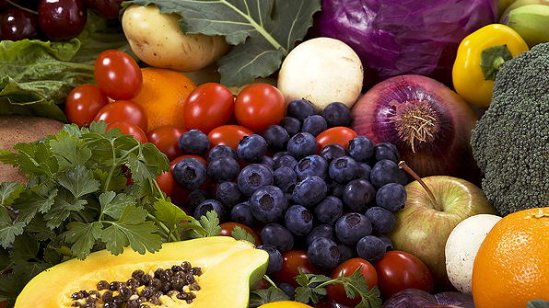
Healthy Eating Patterns & Macronutrients
Carbohydrates, Protein, & Fat
Notes:
Next we are going to transition to talk about healthy eating patterns and macronutrients

Slide 31

Common Eating Pattern
Breakfast: Skipped or just coffee
Lunch: Salad, low or no carbs, diet soda
Afternoon snack: fruit, veggies and hummus, yogurt, granola, candy
Dinner: Pizza, burger and fries, takeout
Evening snack: Cookies, ice cream, chips, cereal, sweets, crackers
Notes:
what do we movie about this? majority of food is consumed later in the day! 65-70% of energy intake past late afternoon Research about circadian rhythm and glycemic control. https://www.ncbi.nlm.nih.gov/pmc/articles/PMC9919634/

Slide 32

Why This Common Eating Pattern Can Be Physiologically Challenging
By 3pm, blood glucose levels dropping
Feel hangry (hungry + angry)
Brain seeks quick energy from high carb/calorie foods
Eat to the point of being over full
Blood glucose levels rise
Elevated postprandial and fasting glucose levels

Slide 33
Instead of this approach …
Sharp drops in blood glucose from under-eating early in the day can cause intense hunger and eating past point of fullness and inconsistent blood glucose levels above target

Slide 34
We want this…
Slight dips in blood glucose gently signal it’s time to eat
Eat adequate and consistently, including all? food groups at each meal
B
D
L

Slide 35
Healthy Eating Patterns
Consensus Recommendation: There is no ideal percentage of calories from carb, protein, and fat for people with diabetes.
A healthy eating pattern includes:
↑ non-starchy vegetables, whole fruit and grains, legumes, nuts, seeds, low-fat diary
↓meat, SSBs, sweets, refined grains, ultra processed foods
This eating approach limits saturated and trans fats, added sugar, and sodium.
Notes:
The current consensus report from ADA on Nutrition Therapy for Adults states that there is not an ideal percentage of calories from carbohydrate, protein, and fat for people with diabetes or those at risk for diabetes. Therefore, macronutrient distribution should be based on an individualized assessment of someone’s current eating patterns, preferences, and metabolic goals.
ADA's statement concludes that a variety of eating patterns are acceptable for the management of diabetes. It’s not a one size fits all approach. A variety of nutrition therapy interventions are reported to be effective.
In general, a healthful eating pattern consists of a variety of vegetables, fruits, grains, low fat dairy, and a variety of proteins. In doing this we limit processed foods that contain trans/saturated fat, added sugars, and sodium.

Slide 36
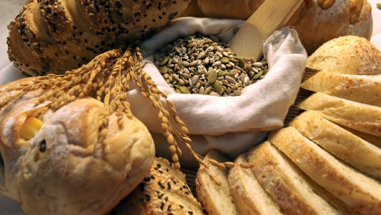
Carbohydrates & Sweeteners
Sugars, High Intensity Sweeteners, Sugar Alcohols, Starch, & Fiber
Notes:
The first macronutrient we will talk about is carbohydrates.

Slide 37
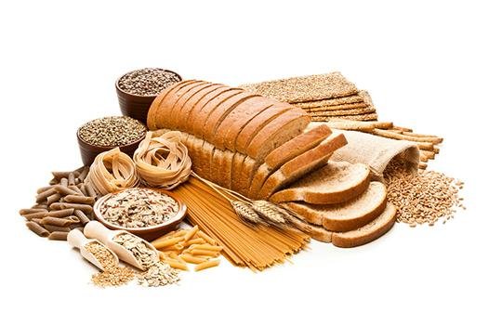
Carbohydrates
Inconclusive evidence for ideal amount of carbohydrate per day
RDA is 130 g/day in people w/o diabetes. This can be fulfilled via intake or by body’s metabolic processes
Amount of carb eaten is main dietary influence on postprandial BG
Type/quality of carb makes a difference
Notes:
Current evidence is inconclusive on the ideal amount of carbohydrate intake per day
Recommended dietary allowance is 130 g/day in people without diabetes. This value is based on the amount of sugar and starch that is required to provide the brain with an adequate supply of glucose.
This can be fulfilled via diet but it doesn’t have to be. That glucose can be made through the body’s metabolic processes like gluconeogenesis.
That said, when it comes to blood sugar regulation, the amount of carb eaten at a meal is one of the primary dietary influences on postprandial blood glucose levels. Generally, the more carbs someone eats the higher the blood sugar will go. Less carbs means a lesser degree of rise in the blood sugar. However, the type of carb, how its prepared, the other nutrients it’s consumed with, will also have an impact.
_____________
_____________
ADA consensus statement p 733

Slide 38

Carbohydrates
Reducing overall carbohydrate intake for individuals with diabetes shows evidence for improving glycemia
Low and very low carb diets lower A1C in short-term only; difficult to sustain macronutrient distribution changes long-term
Most PWD report moderate carb intake (44-46% of total calories)
Notes:
Because of this, reducing overall carbohydrate intake for individuals with diabetes has demonstrated the most evidence for improving glycemia, particularly in improving the post prandial glucose response.
However, efforts to modify habitual eating patterns are often unsuccessful in the long-term. People generally go back to their usual macronutrient distribution. Thus, while reducing overall carbohydrate intake may improve glycemia, it is recommended to individualize meal plans with a macronutrient distribution that is more consistent with personal preference and usual intake. This can increase the likelihood for long-term maintenance
(stds of care p s65

Slide 39


Carbohydrates
Focus on the “quality of carbohydrate foods selected”
Nutrient dense carbs with dietary fiber, vitamins, and minerals
Low in added sugars, fats, and sodium
Minimally processed
Notes:
Encourage individuals to focus on selecting nutrient dense carbs with fiber, vitamins, and minerals to maximize health.
For example, if someone really loves bread – can you get them to transition from white bread to whole wheat.
S65

Slide 40
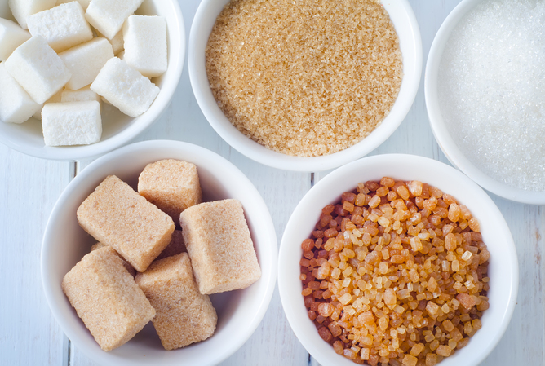
Sugars
Types: glucose, fructose, sucrose (glucose + fructose), and others
Glucose: If eaten alone, has highest glycemic peak relative to other sugars
Fructose: metabolized mostly in the liver; goes to replenish liver glycogen & triglyceride synthesis so it has less acute impact on BG
Sucrose: Broken into 50% glucose and 50% fructose
Notes:
Lets talk about carbohydrates a little further. We are going to break carbs into 3 groups: sugars, starch, and fiber.
Sugars, as many of you know, are a subgroup of carbohydrates. There are several types of sugars. For example:
Glucose. When eaten alone, glucose has the highest glycemic peak compared to other sugars. This is in part because glucose is the type of sugar that circulates in our blood, so digestion time is minimal. It can move through the digestive process and absorb into the blood rapidly.
Fructose – a type of sugar that is metabolized mostly in the liver and then it goes to replenish liver glycogen & for triglyceride synthesis. This means it will have a lesser acute impact on blood glucose when compared to other sugars.
Sucrose – a single sucrose is composed of a glucose and a fructose bound together. When digested it breaks into glucose and fructose, and then these are metabolized individually. While the glucose will go directly into the blood, the fructose is metabolized by the liver into glucose, glycogen, and triglycerides. Again, a lesser amount of fructose will enter into general circulation.

Slide 41
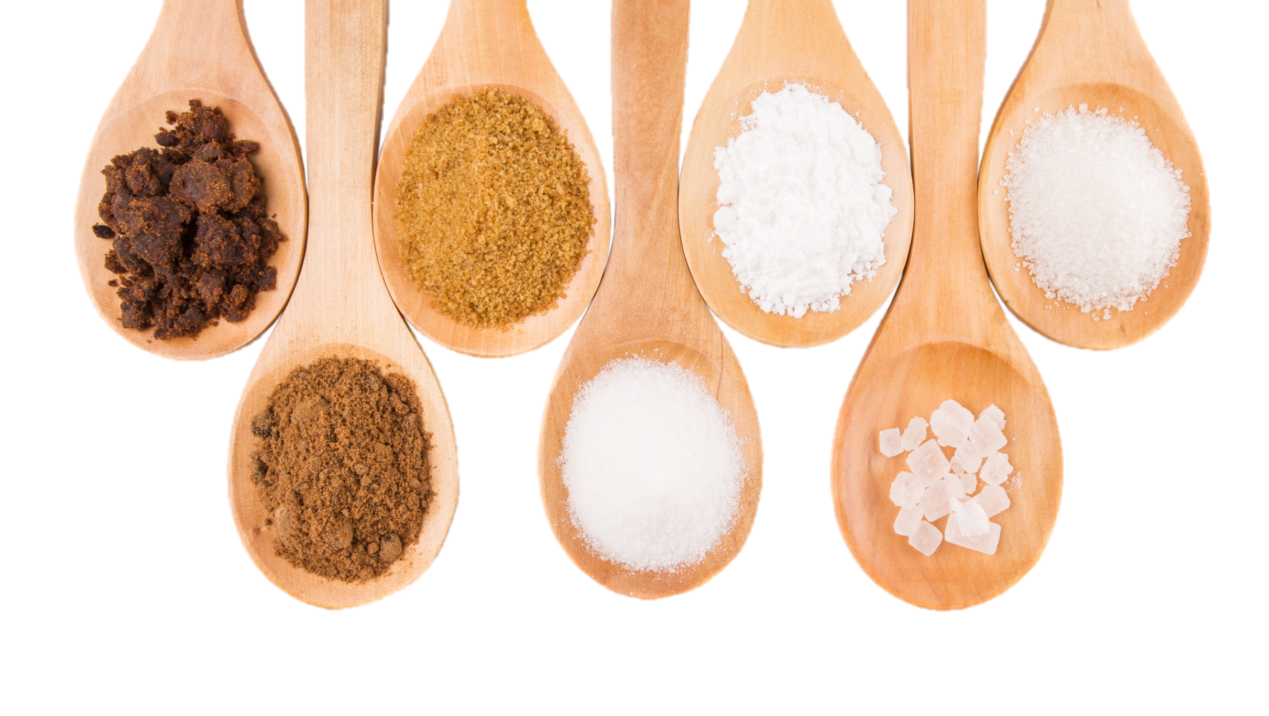
Fructose as a Sweetener
Lower postprandial response compared to other sweeteners
Not recommended as a sweetening agent because it may adversely affect lipids
Franz, M. J., MacLeod, J., Evert, A., Brown, C., Gradwell, E., Handu, D., Reppert, A., & Robinson, M. (2017). Academy of Nutrition and Dietetics Nutrition practice guideline for type 1 and type 2 diabetes in adults: Systematic review of evidence for medical nutrition therapy effectiveness and recommendations for integration into the Nutrition Care Process. Journal of the Academy of Nutrition and Dietetics, 117(10), 1659–1679. https://doi.org/10.1016/j.jand.2017.03.022
Notes:
Although fructose may not raise blood sugar as much as other sugars, excessive consumption is not recommended. This is because high amounts of it can negatively impact lipid levels and may increase the risk of non-alcoholic fatty liver disease
The sugars in agave syrup comprise around 80% fructose and 20% glucose. Due to its high fructose concentration, it may have less of an impact on blood glucose levels plus fructose is sweeter than sucrose so people may not use as much, but because of the potential impact on lipids it is not recommended.
P 456

Slide 42

Fructose in Fruit
No reason to avoid naturally occurring fructose in fruits and vegetables
“Free fructose” in fruit may result in better glycemic control compared with isocaloric intake of sucrose or starch and is not likely to have detrimental effects on triglycerides
Notes:
When it comes to fructose in fruit, two review studies conducted in persons with diabetes showed that naturally existing “free fructose” like that found in fruit, may result in more optimal glycemic control compared to isocaloric intake of sucrose or starch, and its not likely to have detrimental effects on triglycerides. This is assuming it is not consumed in excessive amounts, which was defined as >12% of energy intake. For most people, fructose intake typically accounts for about 3-4% energy intake.
As a dietitian, I do encouraged people with diabetes to eat fruit. Fruit is a nutrition powerhouse, filled with vitamins, minerals, fiber, and other good things our bodies need. Encouraging fruit is a great way to help displace other more processed foods like cookies or chips that may contain more saturated fat and sodium and less fiber and micronutrients.
I always educate that it will cause blood glucose levels to rise. But again, so would many other snacks and fruits overall nutrition profile is excellent. I encourage a few pieces of fruit per day. I recommend that they are spread out through the day rather than eating them all at once. That the fruit be whole, rather than blended or dried, to maximize satiety and assist with glucose response. You can also try to have fruit with a protein or a heart healthy fat, like low-fat/low sugar Greek yogurt, cottage cheese, or nut butter , which as we will discuss later can help slow digestion/absorption so it doesn’t raise blood sugar as quickly.
________
________
P 456
(if it’s not consumed in excessive amounts)
Excessive amounts = >12% of energy intake; in most people it typically accounts for 3-4% of energy intake

Slide 43
A Unique Sugar: Allulose
A type of sugar that is GRAS by the FDA
Small amounts naturally in wheat and some fruits; can be manufactured
~70% as sweet as table sugar
Contributes few calories, produces negligible increases in blood glucose and insulin levels, does not promote dental decay
Labeling for allulose:
Not included in “Total Sugars” or ”Added Sugars”
Included in Total Carbohydrates
Calories calculated with 0.4 kcals/gram
Must be in ingredient list

Slide 44
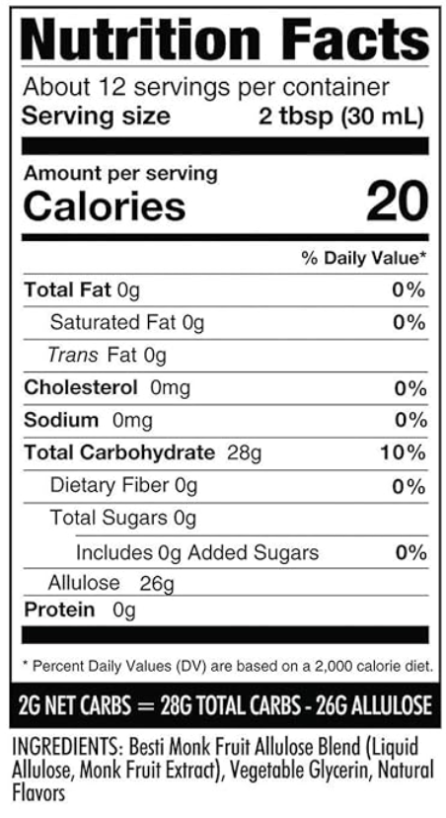
A Unique Sugar: Allulose

Slide 45

Sugar Sweetened Beverages (SSBs)
General population: SSBs should be avoided to ↓risk of type 2 diabetes, heart disease, weight gain, non-alcoholic liver disease, and tooth decay.
In people with and without diabetes: replace SSBs with water as often as possible.
Helps ↓ calorie intake.
Notes:
Lets now turn our attention to sugar sweetened beverages. Interestingly, about 25% of sugar in the American pattern comes from regular soft drinks. I don’t think this will be a surprise to anyone but both people with and without diabetes should be encouraged to replace SSBs with water as often as possible.
Meta analysis studies have shown that individuals with prediabetes who consume at least 1 serving of SSB per day had a 26% greater risk of developing diabetes. Another meta-analysis showed consumption of regular soda increased risk of developing type 2 diabetes by 13%.
Conversely, replacing SSBs with an equal amount water has shown to reduce the risk of type 2 diabetes and other chronic health conditions.
ADA consensus statement

Slide 46

Hypoglycemia Treatment
Treat hypoglycemia with 15g fast-acting carbs if glucose level reaches <70 mg/dl
Best option: pure glucose
Other options: glucose-containing carbs
Do NOT select foods with fat or protein
Recheck 15 minutes later; retreat if still low
If on AID system, consider less treatment (5-10g)
Notes:
While we are discussing sugar, I want to take a minute to discuss hypoglycemia treatment.
ADA recommends treatment of low blood sugar less than 70 by using 15-20 grams of sucrose or glucose in the form of glucose tablets, liquid, or gel. This is recommended OVER fruit snacks or juice. That’s not to say that a person having a low blood sugar couldn’t use juice if that’s what was available, but glucose products are preferred. Remember, glucose is the type of sugar that circulates in the blood, so its digestion and absorption is quick.
As for protein and fat, we will discuss them a little further in a bit, but protein and fat can delay the absorption of carbohydrate based foods, so using a treatment with protein and fat may delay the blood sugar increase that we are trying to achieve. This means avoiding foods like peanut butter sandwich, milk, chocolate, or ice cream during a low.
I encourage everyone to prioritize education on hypoglycemia treatment, when it is appropriate. If a person with diabetes is using a medication that may lead to hypoglycemia, then discussion of this topic is critical. I find in my practice, that it’s not uncommon for persons to be started on insulin, or oral agents that can cause hypo, without receiving education on low blood sugar treatment. Also teach individuals to carry appropriate treatment at all times….
S90

Slide 47
Non-Nutritive Sweeteners
Also known as High Intensity Sweeteners & Artificial Sweetners
Ingredients used to sweeten and enhance the flavor of foods
FDA approved for consumption by the general public and PWD
Safety is a source of concern and confusion for the public
Very sweet, so smaller amounts are needed to achieve the same sweetness as sugar in food
Notes:
High-intensity sweeteners are considered food additives. They are ingredients used to sweeten and enhance the flavor of foods.
People may choose to use high-intensity sweeteners in place of sugar for a number of reasons. A popular one is that these do not contribute calories or at least provide a very limited number of calories to the diet. Another is that high-intensity sweeteners generally will not raise blood sugar levels.
_______________
FDAs website

Slide 48

Notes:
International Agency for Research on Cancer and a WHO Expert committee on food additives labeled aspartame as possibly carcinogenic to humans
FDA replied, stating that there were shortcomings in the research used to make this statement.
FDA states no safety concerns for aspartame when used in approved conditions. The accpetable daily intake (ADI) = 50 mg/kg/body weight per day. For 150 lb person, that’s about 17 diet sodas a day.

Slide 49
Non-Nutritive Sweeteners
Six are approved by the FDA as food additives
Advantame
Neotame
Saccharin
Sucralose
Aspartame
Acesulfame potassium
Plant and fruit-based GRAS Sweeteners
Thaumatin
Stevia
Luo Han Guo (Monk Fruit)
Notes:
There are 6 high intensity sweeteners approved by the FDA. There are three that are generally recognized as safe or “grass” – that is stevia and monk fruit.
FDAs website

Slide 50
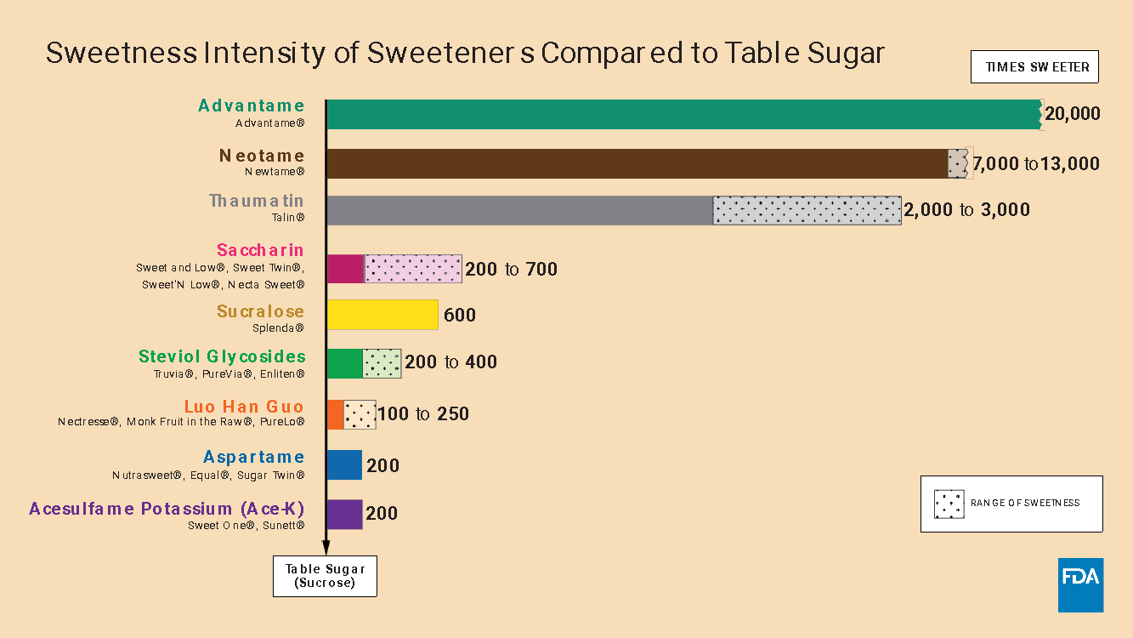

Slide 51
Non-Nutritive Sweeteners
Non-Nutritive Sweeteners contribute no/few calories to the diet and do not raise blood glucose levels
Could reduce overall calorie/carb intake, as long as there is no compensatory energy increase elsewhere
No reduction to weight without energy restriction
Notes:
The thought is that replacing added sugars with sugar substitutes could decrease daily intake of carbohydrates and calories, which could possibly lead to a beneficial affect on glucose levels, weight, and cardiometabolic health.
However, an advisory committee from the American Heart Association that was supported by ADA concluded that there is not enough evidence to determine whether sugar substitutes definitely lead to these benefits.

Slide 52
Sugar Alcohols
Another category of sweeteners approved for consumption for general public and PWD
Calorie contribution is often similar to sugar
Associated with bloating, flatulence, and diarrhea
Examples: Sorbitol, maltitol, erythritol, isomalt, xylitol, lactitol
Notes:
Sugar alcohols represent another category of sweeteners used in sugar-free foods. They aren’t completely digested by the body so they provider fewer calories and a lesser rise in blood sugar compared to the same amount of sugar.
Different sugar alcohols contribute different amounts of calories, but all have fewer calories than sugar. On average, they contain half the calories of sugar. However, some have as few as 0.2 calories per gram while others are as high as 3 calories per gram. That said, they are not as sweet as sugar so a larger amount of them may be required to match the degree of sweetness of sugar. This may bring the calorie content of a food with sugar alcohols to a level that is similar to a food sweetened with sugar.
I want to highlight Erythritol – a sugar alcohol that contributes close to 0 calories per gram and has essentially no impact on blood glucose. Although Erythritol and other sugar alcohols are generally thought to be safe, an NIH funded research group recently found an association between higher blood levels of erythritol and an increased risk of heart attack and stroke. The results highlight the need for further study of erythritol’s long-term risks for cardiovascular health.
The other notable concern with sugar alcohols is their potential to cause gastrointestinal effects in sensitive individuals. Because they’re not fully absorbed, some people note bloating and diarrhea.
___________
So, they exposed human platelets, which control blood clotting, to erythritol. Doing so increased the platelets’ sensitivity to blood clotting signals. Increasing blood erythritol levels also sped up blood clot formation and artery blockage in mice.

Slide 53
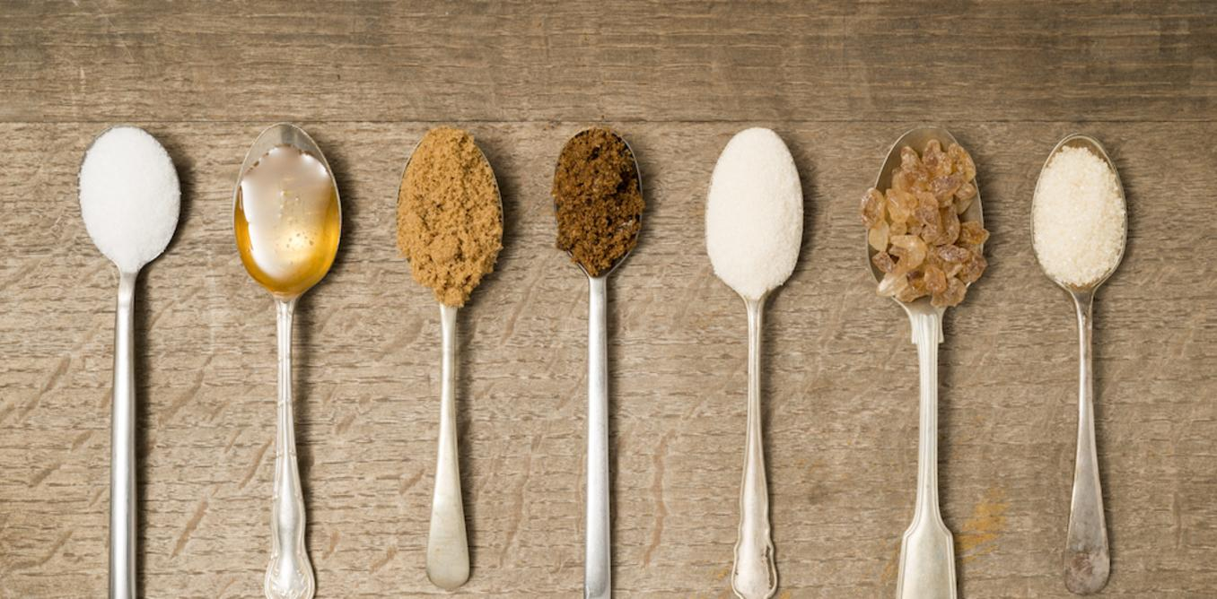
Sugar Alcohols
Little evidence on benefit for people with diabetes
Consumption produces a small rise in blood glucose
Postprandial response is lower than with fructose, glucose, or sucrose
To carb count: consider subtracting ½ of sugar alcohol from total carb grams
Notes:
Currently, there is little research on the potential benefits of sugar alcohols for people with diabetes and little evidence that they improve long-term blood sugar levels or weight.
We will talk about carb counting more later, but for now I want to mention that a good rule of thumb is that if you’re teaching someone to carb count, consider subtract ½ the grams of of sugar alcohol from the grams of total carb

Slide 54
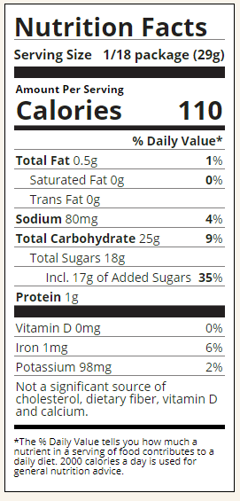
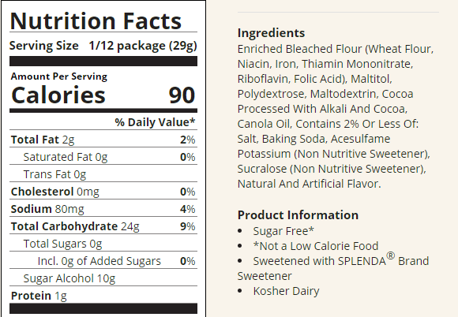
Sugar Alcohols
Notes:
Here is a label for you to check out – notice that the serving size is the same in both the regular and sugar free brown mix.
The calorie content is very similar
The total carbohydrates is also similar

Slide 55
Nonnutritive Sweeteners
For both high-intensity sweeteners and sugar alcohols recommend:
Reductions in sugar intake and calories with or without use of nonnutritive sweeteners
Moderation

Slide 56
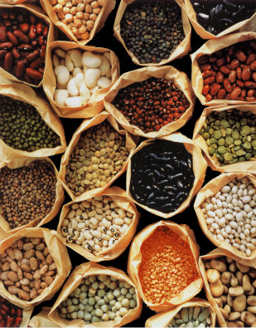
Starch
The digestive tract is efficient in breaking starches into glucose
Glycemic effect of a particular starch is determined by:
Type/structure of starch
Types of processing and cooking used
Other macronutrients consumed with the starch
Focus on starches with fiber, rather than refined/processed grains
Notes:
Next we will talk about starch, another type of carbohydrate.
The digestive tract is efficient in breaking starch into glucose. How quickly that happens can depend on many variables like the type or structure of the starch, how it’s processed or cooked, and other macronutrients that are consumed around the same time.
I don’t teach people to avoid starch. Rather, I focus on incorporating high fiber starch, consideration of portion size, and how to balance the starch with other nutrients to improve after meal glucose levels

Slide 57


Impact of Starch on BG
Structure/type of the starch
Amylose vs. amylopectin
AMYLOSE
More “resistant starch”
Lesser impact on glucose levels
Example: Long grain rice, beans, lentils
AMYLOPECTIN
Greater impact on glucose levels
Example: Short grain rice, potatoes
Notes:
Starch is a long strand of glucose units bound together. There are two types: amylose and amylopectin.
Because of amylose's chemical structure, it is harder to digest and it contains more resistent starch which is a type of fiber. Resistant starch is a portion of starch that cannot be digested by amylases in the small intestine and passes to the colon to be fermented by gut bacteria.
Studies have suggested that resistant starch can help with weight loss and benefit heart health. It may also improve blood sugar levels, insulin sensitivity, and digestive health. This means that starches with more amylose and less amylopectin will have a lesser impact on blood glucose levels. Examples of starches with more: long-grain rice, beans, lentils vs. short-grain rice, potato
There are different types of resistant starch. Another type is retrograded starch, where the cooking then cooling process actually allows more resistant starch to form.
To make that practical, you can recommend cooking starches like rice, potatoes, beans, and pasta a day in advance and cooling them in the refrigerator overnight. It’s ok to reheat the starch before eating. Reheating doesn’t destroy the resistant starch that’s created

Slide 58

Impact of Starch on BG
Structure/type of the starch
Ripeness
Example: As a banana ripens, resistant starch converts into sugars
Notes:
An example of how the structure of a starch can impact the glycemic effect of the starch is with ripeness in fruit – a good example we could use is a banana. As a banana ripens, the resistant starch converts to sugar. This gives the ripe banana more sweet taste, and may influence the speed of the post-prandial blood sugar rise. For this reason, I’ve worked with clients who have said that they’ve been told to has eat green bananas. Remember that Medical Nutrition Therapy needs to be practical and person-centered. Whenever someone says this to me, I always ask whether they like green bananas. If the answer is no, then we’ve found our answer on whether bananas are best green or should be eaten yellow.

Slide 59

Impact of Starch on BG
Types of processing and cooking used
Cooking method and time
Amount of heat and moisture
Example: The longer pasta cooks, the more water-logged its molecules become, making it easier for the body to break it down to glucose
Notes:
Al dente pasta may also impact blood sugar more slowly compared to pasta that’s been cooked longer. The more water-logged its molecules become, making it easier for the body to break it down to glucose

Slide 60
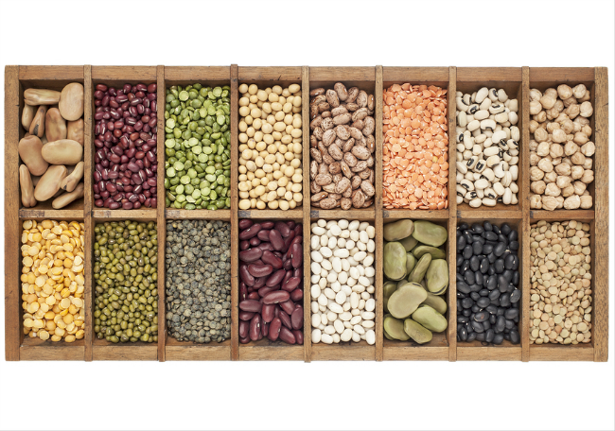
Fiber
A type of carbohydrate that passes through the body largely undigested, thus contributes minimal glucose to the postprandial rise
Intake is inversely associated with risk of T2DM
Sufficient intake is associated with lower all-cause mortality in people with diabetes
Notes:
Now lets talk about fiber.
fiber is a type of carbohydrate that passes through the body largely undigested, thus it contributes less glucose to the postprandial rise relative to the other types of carbohydrates
The benefits of fiber are vast:
Help with weight management
Reduce cholesterol and improve heart health
Support a healthy intestinal tract and prevent constipation
Consumption may help with blood sugar management
Regular intake of fiber is associated with lower all cause mortality in people with diabetes

Slide 61
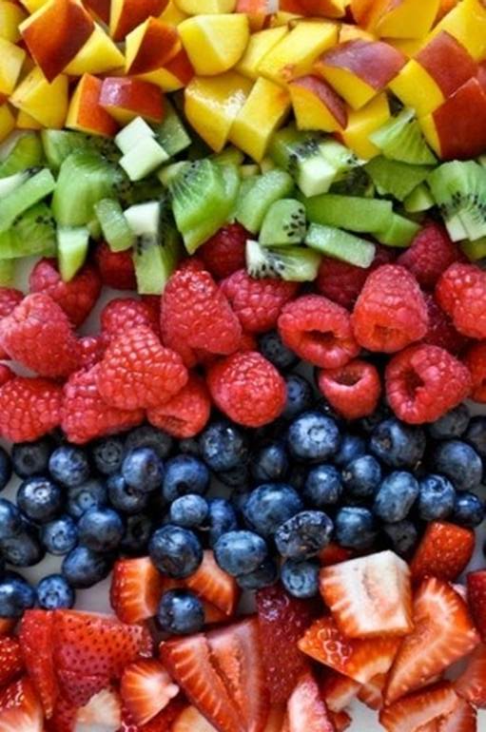
Fiber
Sources of fiber:
Whole fruits, starchy and non-starchy vegetables, beans, peas, lentils, nuts, seeds, and whole grains
Goal: 14 grams of fiber/1000 kcal
Typical American gets ~15 grams/day
Improved glycemia with ~44-50 grams/day; may be difficult due to palatability and GI side effects
50% of grain consumption from whole intact grains
Notes:
Intrinsic fibers are found in fruits, vegetables, nuts, seeds, whole grains. These foods are often colorful. For example, sources are fruits, vegetables, legumes, whole grains, nuts and seeds, and more. Notice that fiber is found in foods that are also rich with vitamins and minerals.
There are also isolated and synthetic fibers that are approved by the FDA to be added to foods. These foods may not have the nutrient density that the intrinsic fibers have.
The goal for intake of fiber is 14grams per every 1000 calories. Unfortunately, the typical American gets only about 15grams per day total.
Studies show improved glycemia with ~44-50 grams/day however this may be difficult due to palatability and GI side effects
S66

Slide 62
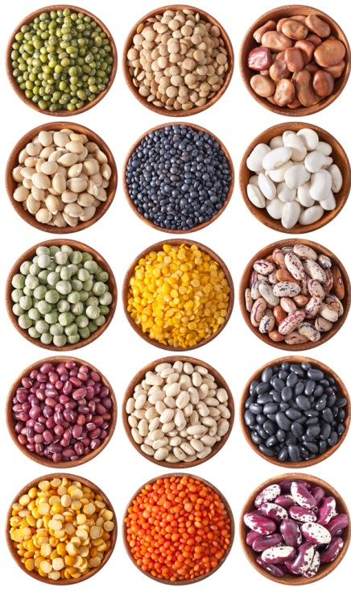
Tips to Increase Fiber
Real-world tips to increase fiber:
Eat whole fruit instead of drinking juice
Replace white flour products/rice with brown rice and whole grains
Snack on nuts, seeds, fruit, or vegetables more often
Substitute beans/lentils for meat in a salad, chili, or soup
Notes:
Here are a few tips to support a person in increasing their fiber intake.
READ THE EXAMPLES

Slide 63

Fiber & Carbohydrate Counting
Since fiber is a type of carbohydrate that the body can’t digest, it does not affect blood sugar levels like other carbs.
On Nutrition Facts food labels, the grams of dietary fiber are already included in the total carbohydrate.
In those who are intensively managed with insulin and carb counting, consider subtracting the grams of fiber from the total carbohydrate.
Notes:
Since fiber is a type of carbohydrate that the body can’t digest, it does not affect blood sugar levels like other carbs.
On Nutrition Facts food labels, the grams of dietary fiber are already included in the total carbohydrate.
Consider subtracting the grams of fiber from the total carbohydrate.
I don’t teach everyone this: I consider numeracy level and fiber intake. Especially knowing that the average American eats an average of less than 15 grams per day, in many people that are carb counting, the amount of fiber consumed may be negligible. However, I may in individuals who eat a more plant-forward diet or those who eat a lot of beans and lentils.

Slide 65
Knowledge Check
Which of the following is true about sucrose digestion?
Sucrose is broken down into glucose & fructose, and the fructose is metabolized almost completely in the liver
Sucrose is broken down into glucose & maltose, and the glucose is metabolized almost completely in the liver
Sucrose is broken down into glucose & fructose, and the glucose is metabolized almost completely in the liver
Sucrose is broken down into glucose & maltose, and the maltose is metabolized almost completely in the liver

Slide 66
Knowledge Check
Taylor, who has type 1 diabetes, begins experiencing symptoms of hypoglycemia after a long-day of swimming. When she checks, her blood sugar is 63 mg/dl. What should she do?
Drink 8 oz of soda and recheck her glucose level in 15 minutes
Eat 4 glucose tablets and recheck her glucose level in 15 minutes
Drink 15g of liquid glucose and recheck her glucose level in 30 minutes
Eat a piece of fruit and recheck her glucose level in 30 minutes
Notes:
Correct answer: B
Remember, for the use of carbs in treating lows, ADA recommends 15-20g of sucrose or glucose in the form of tablets, liquid, or gel, rather than fruit snacks or juice.
The blood glucose level should be rechecked in 15 minutes; if still low, retreat until reaching >70 mg/dl

Slide 67

Stand up & Stretch!

Slide 68

Protein

Slide 69

Protein Sources
Meat: beef, pork, lamb, veal, etc.
Plant-based meats
Poultry: chicken, turkey, duck, emu, goose, bush birds, etc.
Fish and seafood: fish, prawns, crab, lobster, scallops, etc.
Eggs
Dairy products: milk, yogurt, cheese, cottage cheese
Soy milk
Nuts, seeds, nut butters
Tofu, tempeh, edamame
Beans, lentils, peas, hummus
Grains: quinoa, wheat berry, millet, couscous, buckwheat, oatmeal, high protein cereal
Notes:
Here is a list of protein sources.
Just take a second to notice how many foods have protein.
Protein has many roles in the human body, from helping to repair and build body tissue to assisting with fluid balance. It’s also a nutrient that helps us feel satisfied when eating.

Slide 70

Protein
Recommended vs. Actual Intake
RDA: 0.8 g/kg body weight/day
Most Americans eat 1-1.5 g/kg body weight/day or 15-20% of total calories from protein
No evidence that adjusting actual intake towards the recommended intake will improve health
This Photo by Unknown Author is licensed under CC BY
This Photo by Unknown Author is licensed under CC BY
This Photo by Unknown Author is licensed under CC BY
Notes:
Because protein is found in so many foods, most Americans get more than the Recommended Dietary Allowance.
Where the RDA is 0.8 grams of protein per kilogram of body weight per day, actual intake in the US is more like 1-1.5 grams per kg of body weight per day. Currently there is no evidence that adjusting the actual intake closer to the RDA will improve health.
__________________________________________________
Standards of care p s66

Slide 71
Protein
Dietary protein in diabetes management:
Inconclusive research regarding the ideal amount of dietary protein to optimize glycemic management or CVD risk
Individualize protein goals based on current eating patterns
This Photo by Unknown Author is licensed under CC BY
Notes:
Similar to carbs, research to determine an ideal amount of protein to optimize glucose control is inconclusive.
However, there is some research that shows higher protein eating plans have allowed for successful glucose management in type 2 diabetes and can help people to feel more satisfied when eating (20-30% of kcal from protein).
This may have to do with the fact that protein intake has been linked with release of GLP-1 hormone in the gut. GLP-1 = enhanced satiety and reduced energy intake, also helps to stimulate insulin secretion (i.e., to act as an incretin hormone) and to inhibit glucagon secretion
Overall though, protein goals should be individualized based on current eating patterns.
s66

Slide 72
Protein & CKD
Dietary protein in diabetes management for persons with nondialysis-dependent CKD
Intake goal is 0.8g protein/kg body weight/day
Less doesn’t provide benefit and may increase malnutrition risk
More is associated with accelerated decline in kidney function
This Photo by Unknown Author is licensed under CC BY
Notes:
Historically, low-protein eating plans were recommended for those with diabetic kidney disease, where there was with albuminurea or a reduction in GFR
However, at this time, current recommendation is to keep intake around the current RDA of 0.8 grams of protein per kg body weight for people with CKD stage 3 or 4
Higher levels of dietary protein intake (>1.3g of protein per kg body weight per day) are associated with increased albuminuria and a more rapid rate of decline in kidney function.
Evidence suggests that lowering intake beyond this level may not improve glucose levels, reduce CV risk, or alter the course of GFR decline BUT, it could increase the chance of malnutrition.
S179

Slide 73
Protein & CKD
For persons with diabetes on dialysis
Malnutrition is common
Consider intake higher than 0.8g protein/kg body weight/day to reduce risk of under nourishment
This Photo by Unknown Author is licensed under CC BY
Notes:
For persons with diabetes on dialysis, malnutrition is common, so consider intake higher than 0.8g protein/kg body weight/day to reduce risk of malnutrition
S176

Slide 74
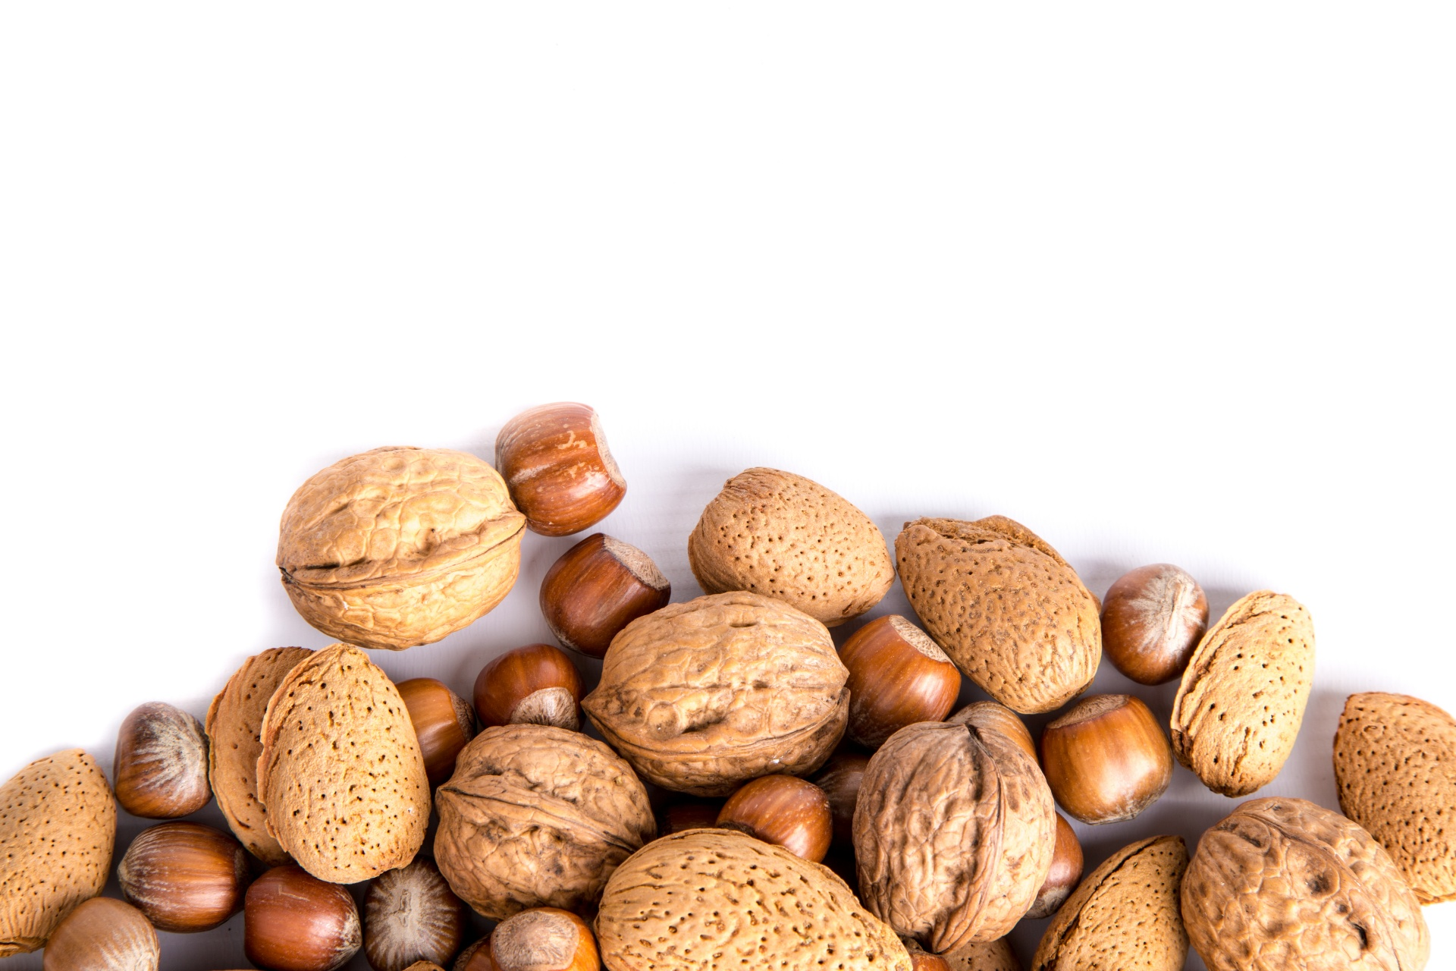


Protein
In someone living with T2DM, protein intake may stimulate the release of insulin
Therefore, use of carb sources high in protein to treat/prevent hypoglycemia should be avoided
Examples of foods to avoid are milk, nuts, peanut butter
This Photo by Unknown Author is licensed under CC BY-NC
Notes:
Fun fact on protein:
Protein intake can enhance or increase insulin response to dietary carbohydrates in Type 2 diabetes. Therefore, the use of carbohydrate sources high in protein to treat/prevent hypoglycemia should be avoided due to the potential concurrent rise in endogenous insulin
Examples of foods to be avoided include: milk, nuts, and peanut butter
Remember that this is not as relevant for those with type 1 diabetes who don’t have endogenous insulin production. Although protein may still delay digestion, so generally more pure carbohydrate choices are recommended.

Slide 75

Protein
In someone living with T2DM, consuming non-starchy vegetables and protein 5-15 minutes prior to eating carbohydrate foods has been shown to lower postprandial glucose and insulin excursions
Notes:
Another interesting piece on protein:
Multiple randomized cross over studies have shown that when eating a meal, the order that macronutrients are consumed can impact post-prandial glucose response. Eating protein and non starchy vegetables first, then carbohydrates last may significantly lower postprandial glucose and insulin levels in people with type 2 diabetes. This was in comparison to eating carbohydrates first or together with non-starchy vegetables and protein (eg a sandwich) at the same time.
The thought is that eating the protein or vegetable first may increase GLP-1 secretion and delay gastric emptying which leads to a reduction in blood sugar excursions. Research has suggested that the benefit may be quite significant.
I like to provide patients with this tip; although it may not always be practical particularly with mixed meals

Slide 76

Fats
Saturated, Trans, and Unsaturated Fats

Slide 77

Fats
Sources: a variety of foods including meat, poultry, fish/seafood, eggs, dairy products, nuts and seeds, avocado, butter/oil, processed and fried foods
Dietary fat is needed for absorption of fat-soluble vitamins (A, D, E, and K), function of nerves and brain, and healthy skin and body cells.
Notes:
Dietary fat is needed for absorption of fat-soluble vitamins, function of nerves and brain, and healthy skin and body cells.

Slide 78
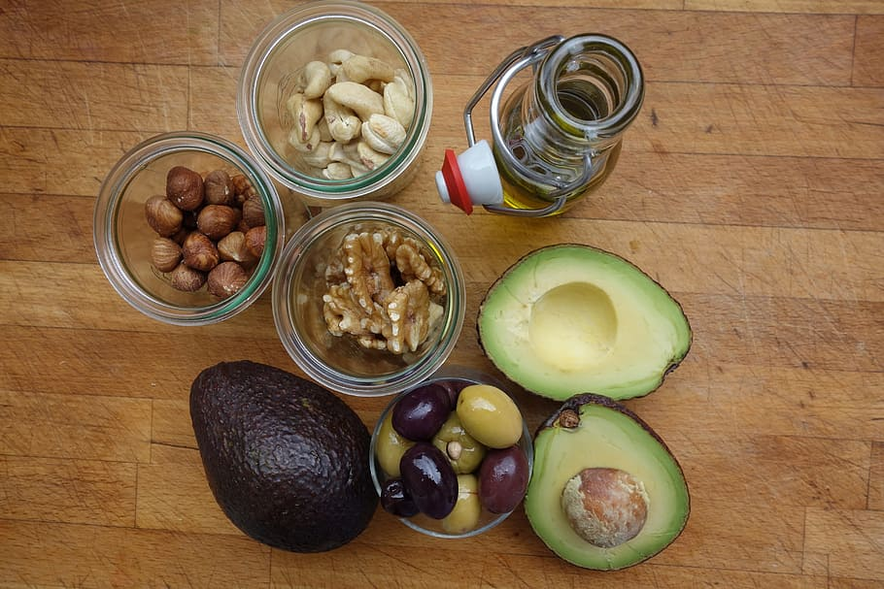
Fats
There is not an ideal percentage of calories from fat for people at risk for or living with diabetes
Type of fat consumed is more important than total fat
Limit intake of saturated fat
Avoid trans fat
Keep cholesterol as “low as possible” w/o compromising diet
Notes:
Again, similar to protein and carbs, evidence suggests there is not an ideal percentage of calories from fat for people at risk for or living with diabetes.
The type of fat consumed is more important than total fat when looking at metabolic goals and CVD risk
_____________________
_____________________
S66-67

Slide 79
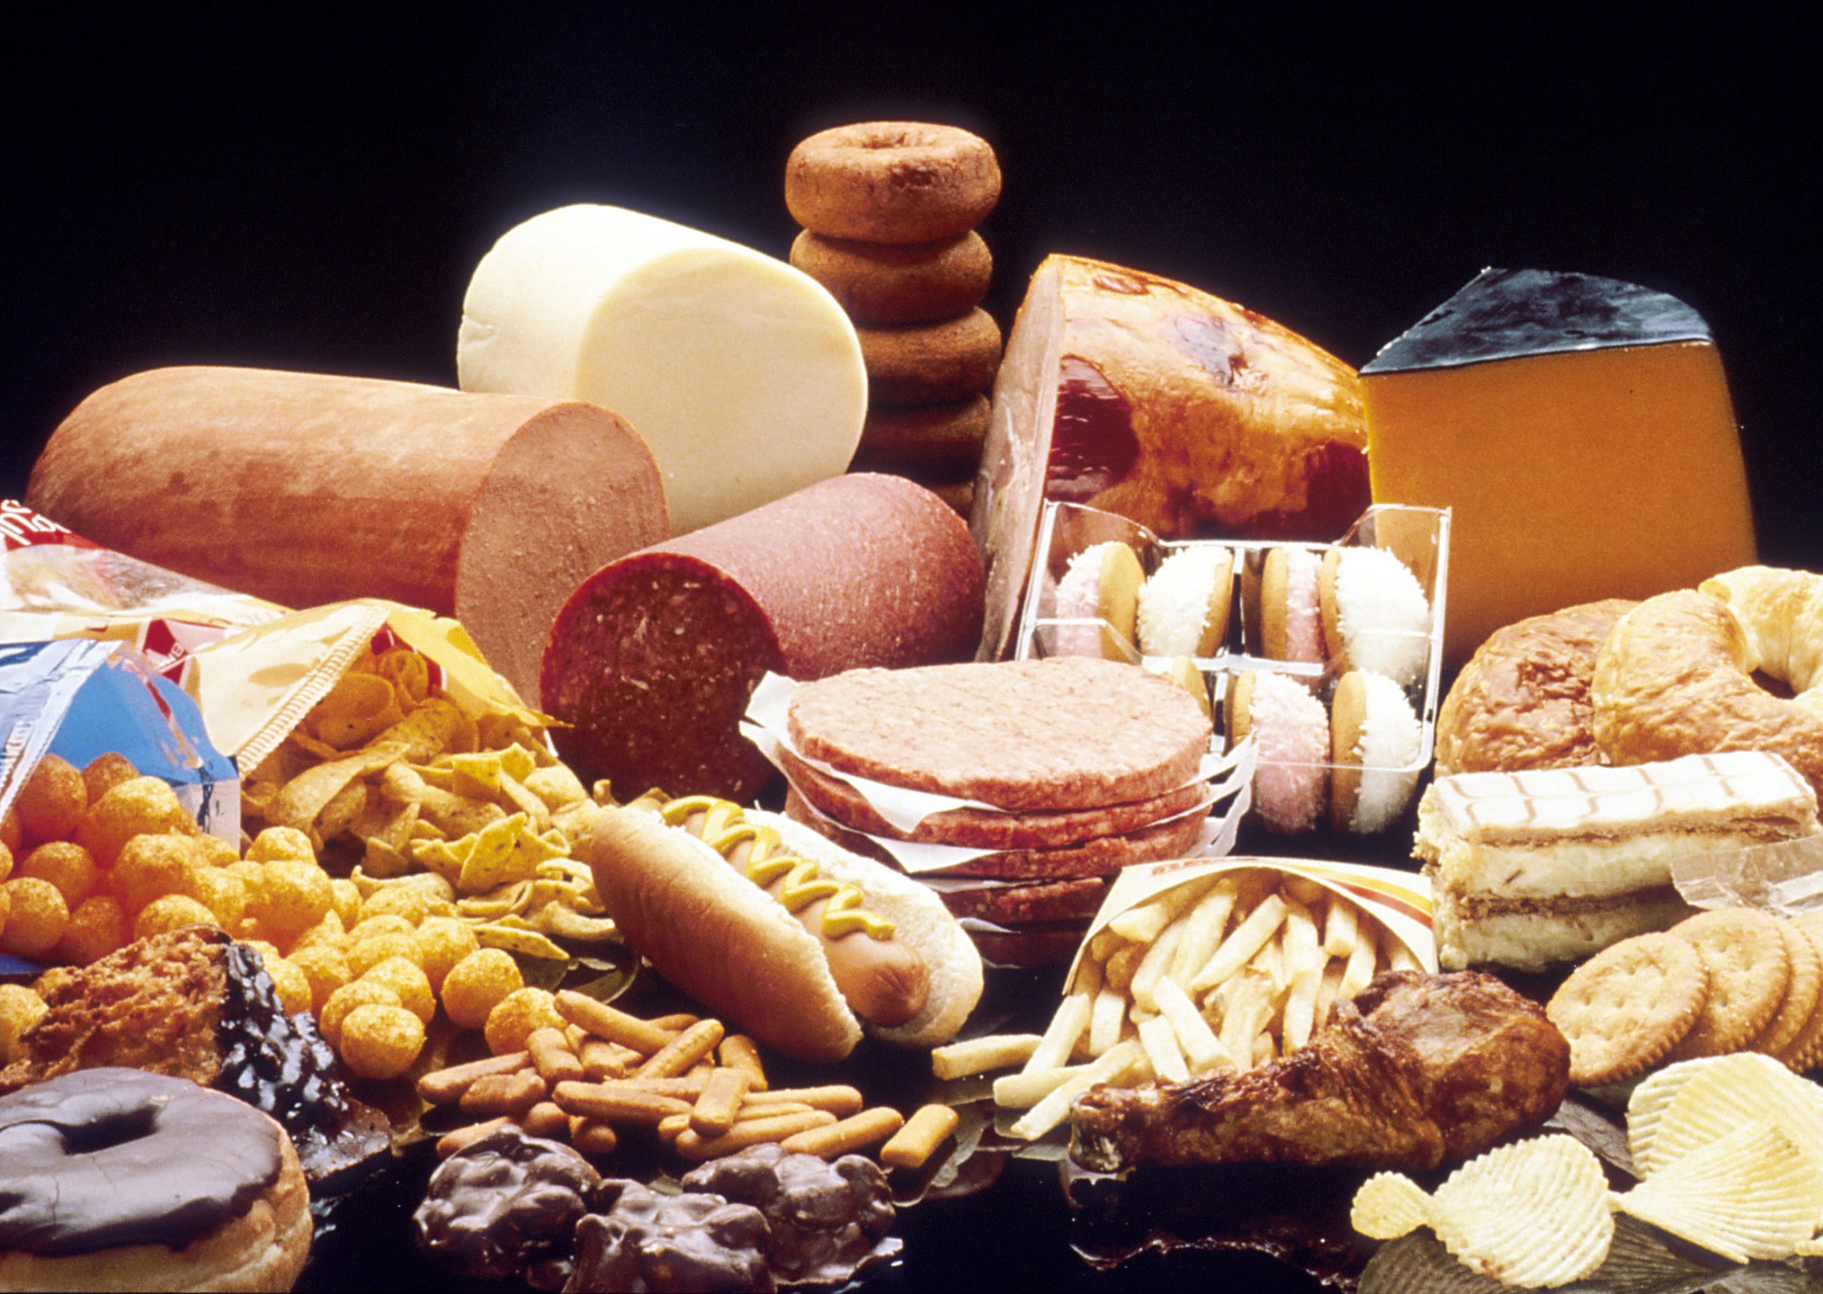
Saturated Fat
Sometimes Fat (Less Healthy)
Primary sources of saturated fats include:
Red meat (beef, lamb, pork)
Chicken skin
Whole fat dairy products (milk, cream, and cheese), butter, and ice cream
Lard
Tropical oils like coconut and palm oil
Processed foods
Notes:
So lets talk about the different types of fats. Saturated fat is first.
Sources of it are red meat, chicken skin and there is some in the flesh as well, whole fat dairy, lard, and some tropical oils. Processed foods may contain them, as well.

Slide 80

Saturated Fat
Limit calories from saturated fat
Quality of fat is more important that quantity of fat
Replace saturated with unsaturated fat to reduce total and LDL cholesterol
Replace saturated with unsaturated fat; not refined carb
This would also reduce total and LDL cholesterol, but may increase triglycerides and reduce HDL
Notes:
The consensus from ADA is to limit calories from saturated fat by substituting for other types of more healthful fats.
Doing so can improve total and LDL cholesterol without negatively influencing triglycerides and HDL cholesterol.
Interestingly, epidemiological data and clinical trials have suggested that chronic intake of higher levels of total dietary fat, particularly saturated fat, may be associated with insulin resistance. Studies showing reduction in saturated fat have indicated that it may improve insulin sensitivity, even without energy restriction.
____________________________
______________________________
ADA consensus statement – section on preventing complications

Slide 81

Trans Fat
Avoid, considered “unhealthy fat”
Historical sources: processed foods like baked goods, microwave popcorn, frozen pizza, refrigerated dough like biscuits and rolls, fried foods, nondairy coffee creamer
Trans fat should be avoided; associated with all-cause mortality, total CHD, and CHD mortality.
Notes:
Trans fat, as you know, is also considered an unhealthy fat.
Recommendations are to avoid trans fat due to its association with all cause mortality and coronary heart disease
_____________
_____________
CHD = coronary heart disease

Slide 82

Trans Fat
Most trans fat in food is formulated through partial hydrogenation
Manufacturers added hydrogen to vegetable oil, turning the liquid into a solid fat (like shortening or hard margarine)
Process increases the shelf life and flavor stability of foods
Notes:
Trans fat is a type of fat that is formulated from a process called hydrogenation or partial hydrogenation where manufacturers add hydrogen to vegetable oil to turn the liquid fat into a sold
The process increases shelf life and flavor stability of food

Slide 83
Trans Fat
The FDA’s Ban of Partially Hydrogenated Oils (PHOs)
In 2015 the FDA determined that PHOs are not GRAS*
Food manufacturers were allowed time to reformulate foods and move foods already produced through distribution
Compliance date to move these food through distribution was January 1, 2021.
*GRAS: “generally recognized as safe”
Notes:
The FDA has taken steps to remove artificial trans fats from processed foods.
In 2015 the FDA determined that partially hydrogenated oils are not generally recognized as safe.
Food manufacturers were allowed time to reformulate foods and move foods already produced through distribution
The compliance date to move these foods through distribution was January 1, 2021 for food manufacturers who had petitioned for an extension.
For the most part, trans fats is now minimized in our diet. Although, trans fat occurs naturally in small amounts in meat and dairy products and is present at very low levels in oils.
_____
While often used interchangeably, PHOs are a type of trans fat and are created by heating oil in the presence of hydrogen. PHOs are the largest source of trans fats in most people’s diet.

Slide 84
Mono and Polyunsaturated Fats
Always, as these fats have health promoting properties
Eating patterns rich in these can improve glycemic control and blood lipids (Ex: Mediterranean diet)
Type of Fat | Sources
Monounsaturated | Foods: avocado, edamame, olives, nuts Oils: avocado, olive, peanut, canola
Polyunsaturated | Foods: Walnuts, sesame, flax, and sunflower seeds, fish (salmon, albacore tuna) Oils: corn, soybean, safflower, sesame
Notes:
Next up we have the fats that are described as being healthy - eating patterns rich in these can improve glycemic control and lipid levels.
Monounsaturated fats are found in
Foods like avocado, edamame, olives, nuts and
Oils like avocado, olive, peanut, canola
Polyunsaturated fats are found in
Foods like Walnuts, seeds, and fish and
Oils: corn, soybean, safflower, sesame

Slide 85
Polyunsaturated Fats
Increasing foods with the long-chain omega-3 fatty acids (EPA and DHA) is recommended for prevention of cardiovascular disease
Have two servings of fatty fish per week
Wild salmon, mackerel, herring, anchovies
NOT commercially fried fish filets
Plant sources for vegetarian/vegan eating patterns (ALA)
Ground flaxseed/flax meal, chia seeds, walnuts, soybeans, mung beans, green leafy vegetables, whole grains, and beans
Notes:
As is recommended for the general public, an increase in foods containing the long-chain, omega-3 fatty acids EPA and DHA, like what is found in fatty fish, is recommended for individuals with diabetes. Consumption is beneficial for prevention of heart disease.
For people following a vegetarian or vegan eating pattern, where they may not be eating fatty fish, the body can get plant-derived omega-3s from alpha-linolenic acid (ALA). The body can then convert ALA into DHA and EPA.
ALA is found in plant foods such as flax, walnuts, and soy.
______________
______________
Omega 3s:
DHA = docosahexaenoic acid (DHA) which is important for brain health—
EPA = eicosapentaenoic acid
ALA = α-linoleic acid (ALA)
Recommended by the ADA consensus

Slide 86

Polyunsaturated Fats
Evidence does not conclusively support recommending omega-3 (EPA and DHA) supplements for all people with diabetes for the prevention or treatment of cardiovascular events
Notes:
When it comes to supplementation, evidence is not conclusive on recommending EPA and DHA supplements for people with diabetes in the prevention or treatment of cardiovascular events.
However, these supplements may have utility in people who require triglyceride reduction.
Encourage people to find these in foods rather than supplementation.
_____________________________________
ADA Consensus
In the most recent ASCEND trial, supplementation of omega-3 fatty acids compared to placebo did not lead to cardiovascular benefit in people with diabetes without evidence of CVD
(A Study of Cardiovascular Events iN Diabetes)

Slide 88
Knowledge Check
Which of the following food items has the highest percentage of saturated fat per ounce?
Chicken
Olives
Peanuts
Soybean oil

Slide 89
Knowledge Check: Answered

Slide 90
Knowledge Check
Olive oil and canola oil are good sources of:
Monounsaturated fats
Polyunsaturated fats
Saturated fats
Trans fats
Notes:
A.

Slide 91

Micronutrients & Supplements

Slide 92
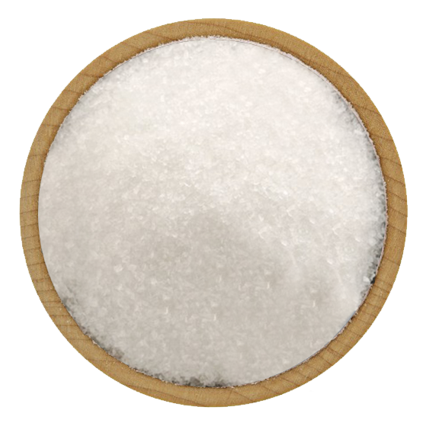
Sodium
Limit sodium intake to less than 2300 mg/day
Limit of <1500 mg/day is not recommended
Sodium recommendations should consider palatability, availability, affordability, and the difficulty of achieving low-sodium recommendations in a nutritionally adequate diet.
Notes:
For sodium, most agree that intake in the US, which is typically >3,500 mg per day, should be reduced. Reducing it to the general recommendation of <2,300 mg/day demonstrates beneficial effects on blood pressure. Further reduction warrants caution.
Sodium intake goals that are significantly lower than 2,300 mg/day should only be considered only on an individual basis.
__________________________________________________________________
Some studies measuring urine sodium excretion in people with type 1 (313) and type 2 (314) diabetes have shown increased mortality associated with the lowest sodium intakes. A secondary analysis of data from the Ongoing Telmisartan Alone and in Combination With Ramipril Global Endpoint Trial (ONTARGET) suggests sodium excretions <3 g/day and >7 g/day were both associated with increased mortality in people with type 2 diabetes (315), leading to continued controversy over the potential benefits versus harms of lowering sodium intake below the general recommendation. In the absence of clear scientific evidence for benefit in people with combined diabetes and hypertension (313,314), sodium intake goals that are significantly lower than 2,300 mg/day should be considered only on an individual basis. When individualizing sodium intake recommendations, careful consideration must be given to issues such as food preference, palatability, availability, and additional cost of fresh or specialty low-sodium products (316).

Slide 93
Calcium & Vitamin D
Fracture risk is higher in people with diabetes
Advise those with diabetes on dietary or supplemental intake of intake of Calcium and Vitamin D
Calcium – meet age specific recommendations for intake
Vitamin D – aim for serum levels ≥20 or >30 ng/mL
Notes:
In both men and women with t1d or t2d, age specific fracture risk is greater by 34% compared to those without diabetes.
Intake of calcium should reflect age-specific recommendations, same as those in the general population, and it can be obtained through the diet or with supplementation.
The optimal level of vitamin D is controversial, although serum levels of >20 ng/mL is thought to be sufficient. However, because is a risk factor for fractures some guidelines suggest that >30 ng/mL.

Slide 94
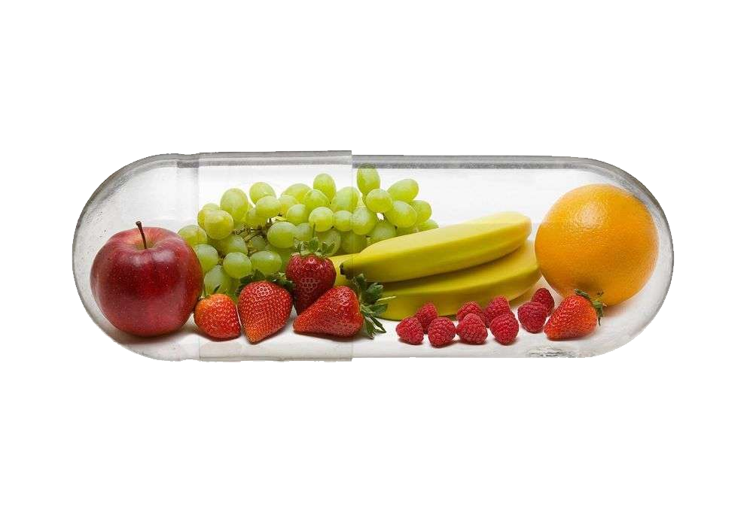
Micronutrients & Supplements
Nutrition therapy should include education on how to acquire adequate amounts of vitamins and minerals from food
Typically, unless deficient, use of herbal, vitamin, or mineral supplementation in those with diabetes is not supported
Notes:
Teach those with diabetes to eat their vitamins and minerals in their foods.
Unless there is a specific deficiency noted, Scientific evidence does not support the use of vitamins or minerals supplements in people with diabetes or prediabetes.
_________________
________________
Current Consensus Statement

Slide 95

Micronutrients & Supplements
Select groups with may need a multivitamin supplement
Elderly
Women planning pregnancy, currently pregnant, lactating
Strict vegetarians/vegans
People with celiac disease
Those on calorie or carb-restricted diets
Notes:
That said, there are certain groups that you can see here that may need a multivitamin supplement

Slide 96
Micronutrients & Supplements
Long-term metformin use may be associated with vitamin B12 deficiency
Consider periodic testing of of B12 status if taking Metformin chronically, especially for those with anemia or peripheral neuropathy
Notes:
Long term metformin use may be associated with vitamin B12 deficiency. B12 deficiency can lead to anemia and peripheral neuropathy
The cause of deficiency in people taking metformin is unknown. Some research may suggest malabsorption caused by metformin.
If deficient, B12 injections or high-dose oral supplementation may be effective treatment. More research is needed in this area.
________________________
(((( B12 deficiency can lead to anemia and peripheral neuropathy)))))
S42

Slide 97

Micronutrients & Supplements
Ask PWD about supplement use
Routine supplementation with antioxidants such as vitamins E, C, and carotene is not advised
Insufficient evidence to support the routine use of most herbal supplements and micronutrients
See Bev’s handout for more information
Notes:
As for antioxidant supplements: Antioxidant supplementation is not recommended due to long-term safety concerns.
And routine use of herbal supplements is generally not recommended either
This is because, as already mentioned, nutritional supplements and herbal products are not standardized or regulated (255,256).
As health care providers, we are encouraged to ask about the use of supplements and herbal products, and discuss the potential benefit of these products weighed against the cost and possible adverse effects and drug interactions.

Slide 98
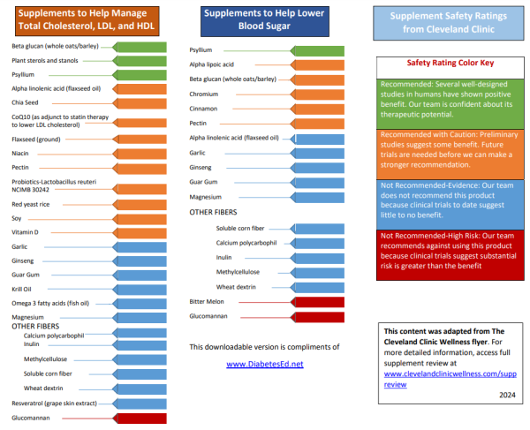
Micronutrients & Supplements
Notes:
Bev has a great handout to help you learn more about these supplements and where current literature stands.
Here it is – you can find it on your website, it was adapted from the Cleveland clinic.
_________________
The consensus from ADA is to consider that nutritional supplements and herbal products are not standardized or regulated (255,256).
As health care providers, we are encouraged to ask about the use of supplements and herbal products, and discuss the potential benefit of these products weighed against the cost and possible adverse effects and drug interactions. The variability of herbal and micronutrient supplements makes research in this area challenging and makes it difficult to conclude effectiveness. To date, there is limited evidence supporting the addition of herbal supplements to manage glycemia.

Slide 99

Alcohol & Glycemia

Slide 100


Alcohol & Glycemia
Moderate consumption has minimal acute or long-term effect on glucose and insulin concentrations
Limit intake to:
1 drink or less per day for women
2 drinks or less per day for men
Notes:
For the majority of people who choose to drink alcohol in moderation, it does not need to be discouraged.
Moderate alcohol consumption has no significant acute effect on glucose and insulin concentrations.
The recommendation is to limit intake to:
1 drink or less per day for women
2 drinks or less per day for men
Obviously, some individuals should abstain from alcohol consumption including
Individuals with a history of alcohol abuse
Women during pregnancy
Individuals with certain medical problems ((like liver disease pancreatitis, advanced neuropathy, severe hypertriglyceridemia (>500))
__________________________________________
Big book p 460

Slide 101

Alcohol & Glycemia
What is a drink?
5 ounces of wine
12 ounces of beer
1½ ounces of a hard alcohol
1 drink has approximately ~15 grams of alcohol
1 gram of alcohol = 7 calories
Consider when discussing wt. management
Notes:
A drink is defined as
5 ounces of wine
12 ounces of beer
1½ ounces of a hard alcohol
1 drink has approximately ~15 grams of alcohol
1 gram of alcohol provides 7 calories
So if someone is interested in weight loss, alcohol intake may be something to look at more closely

Slide 102



Alcohol & Glycemia
Risk of hyperglycemia:
Consistently having 3+ drinks/day can contribute to hyperglycemia
Carb consumed with alcohol (e.g. mixed drink, beer, wine) may acutely raise BG
Notes:
Where alcohol can contribute to hyperglycemia is:
Drinks that also contain carbohydrate
Consistently having 3+ drinks/day can contribute to hyperglycemia

Slide 103

Alcohol & Glycemia
Risk of hypoglycemia:
Individuals using insulin or insulin secretagogues are at risk for hypoglycemia following consumption
Evening drinking may increase the risk of nocturnal/fasting hypo
Individuals may consume food with alcohol to reduce the risk
Notes:
In individuals using insulin or insulin secretagogues, there may also be a risk of hypoglycemia. This is because as alcohol is cleaned up by the liver, there is less glucose being released by the liver into the blood.
A possible way to reduce the risk is to have an individuals consume a carbohydrate containing snack with alcohol.

Slide 104
Knowledge Check – Bev updated
Chris has had T1D for 30 years. They use Multiple Daily Injections and wear a CGM. They are out celebrating and have 4 rum and cokes and appetizers. They take insulin for carbs. When they get home, the CGM shows a glucose at 162 mg/dl. What advice would you give?
The ADA recommends limiting alcohol to no more than 2 drinks a day.
Have you ever wondered if you are drinking too much alcohol?
Make sure they have glucagon rescue medication by their bed.
Investigate how they would usually handle this situation,

Slide 106
Macronutrients: Final Thoughts
“People eat foods, not nutrients, and nutrient recommendations need to be applied to what people eat.”
Macros vary in quality, not all within the group are interchangeable
E.g. Carbs include legumes, whole grains, and fruits – this is the same category as candy and refined grains, yet the health impact of these is not the same

Slide 107

Nutrition Interventions for Special Populations
Youth, Pregnancy, Celiac Disease, and Eating Disorders

Slide 108

Youth with Diabetes
Key concepts for youth with all types of diabetes
Meet energy requirements for growth and activity
Use food plan or meal plan not diet
Engage the child or adolescent in planning, shopping, and preparing healthy foods for the entire family
Notes:
☺

Slide 109


Youth with T1D
Balance carb intake and insulin
Educate on impact of high-fat/protein
Integrate insulin regimen into lifestyle
Avoid withholding food to prevent hyperglycemia or having a child eat without an appetite to avoid hypoglycemia
Notes:
In youth with T1D specifically, we aim to avoid food restriction or forcing the child to eat to regulate blood sugars.
The focus is often on mastering the use of insulin to achieve blood sugar targets.
Personally, when I’m working with kids with type 1 diabetes, I aim to normalize their eating experience as much as possible while simultaneously encouraging healthful food choices.

Slide 110

Youth with T1D
For those on fixed insulin program, focus on consistent carb intake considering timing and amount
For those on flexible insulin program, provide education on carb estimating/counting
Notes:
Again for T1D…
For those on fixed insulin program, focus on consistent carb intake to keep blood sugars safely balanced.
For those on flexible insulin program, we educate on carb counting and matching insulin to intake. If it is possible and appropriate for the child and family, I consider this to be the gold standard. This really supports normalcy with eating because it allows the family to navigate proper dosing of insulin in any food situation.

Slide 111

T1D & Flexible Insulin Therapy
In a mixed meal (carb + high in fat/protein), insulin need is not based on carb alone
Consider the glycemic impact of fat and protein, too
Relative to a lower fat/protein meal, high-fat and high-protein meals may require:
More insulin
A different approach to insulin timing
More research is needed to determine optimal insulin dose and delivery strategy
Notes:
I want to talk a little more about flexible insulin therapy and type 1 diabetes…
Historically, the focus in type 1 diabetes has been to count carbs and match insulin to carb intake only, without considering the other macronutrients. However, since the 2022 Standards it has been recommend that those on flexible insulin therapy receive education on how carbohydrates, fat, and protein impact blood sugar. The standards acknowledge that high fat and/or high protein meals may impact the post prandial glucose response in a significant way and require more insulin.
I want to briefly review some of the thoughts behind how fat and protein impact blood sugar and then talk about strategies to deal with it when counseling individuals with type 1 diabetes.
Lets talk about fat, first:
Fat is very slow to digest relative to carbohydrate alone. When mixed with carb, it may delay the digestion and absorption of the carb to glucose. Also, free-fatty acids may induce insulin resistance, ultimately leading the person with diabetes to need more insulin. There might also be more gluconeogenesis later (and if you’re not remembering from biochemistry, I’ll remind you that gluconeogenesis is when the liver makes glucose from other sources)
Because of these factors, when research looks at the blood sugar levels in someone with diabetes following a meal higher fat meal, it was noted that:
Blood sugars are reduced in the first 2–3 h
Then this is often followed by: Hyperglycemia, which occurs later in the post-prandial period and can last for several hours, some research shows as long as 5-8 hours afterwards.
The impact appears to be dose dependent; so more dietary fat = more hyperglycemia later.
Lets now talk about protein:
After protein is digested and absorbed into the body, the amino acids can be converted into glucose. This takes some time to occur, so we may see a rise in glucose levels later in the post-prandial period. In fact, the research looking at this shows that blood glucose levels may rise between 100 minutes and 4 hours after the meal.
The extent to which this occurs appears to depend on the amount of protein consumed. More protein means more of a rise later-on. The effect also changes depending on how much carb is consumed with the protein.
So that’s some of the science behind fat and protein metabolism. While the research providing us with this information is strong, and the standards recommend that we educate on this topic, they also note that more research is needed. There is no consensus on optimal dosing strategies to address this.
If you do some reading online, there are a multitude of strategies that you may see, but none have been formally endorsed by ADA.
At our clinic, we do our best to address this issue despite the lack of formal advice. In counseling people with type 1 diabetes:
I always start by learning about how the person with diabetes eats. This helps to steer the conversation. Our discussion varies depending on whether the person follows a diet that is more balanced with carb/fat/protein vs if someone follows a lower carb diet.
For the person who follows a more balanced diet, my strategy is to:
Educate and focus on carbohydrate counting, using a ICR, and dosing accordingly. This will work for the majority of meals.
After that… then we talk fat and protein.
I acknowledge that fat and protein do impact blood sugar
I then go through examples of high fat and high protein meals that might cause this. Examples might include foods like pizza, fried chicken or steak with mashed potatoes and gravy, or a burger with fries and a milk shake, etc.
At this point we go through practical advice about how to approach these meals.
3) The person with diabetes can split doses for meals like this; basically, count the carbs and determine the dose for the carbs. Then, administer the insulin with special consideration to timing.
MDI: half at start of meal, half 1 hour later
Pump: extended doses with ~50/50 split over 1-2.5 hours
4) Encourage monitoring glucose levels in the hours after the meal; administer a correction dose of insulin if needed.
We use this particular strategy of correcting after the fact because much of the available research on other strategies, where additional insulin is taken earlier, shows more hypoglycemia. Plus, the calculations can also be complicated.
For individuals following low carb diets, other strategies may be necessary.
I’ve found more of these individuals’ dose their insulin from “experience” rather than using a strategy that involves carb counting or use of an ICR. They also may benefit from dosing later – like at the start of the meal or a little after.

Slide 112
Youth with T2D
Youth and family must prioritize lifestyle modifications
Dietary recommendations:
Focus on nutrient dense, high quality foods / decrease calorie-dense, nutrient-poor foods (particularly SSBs)
Increase exercise
Aim for sustainable 7-10% decrease in excess weight for youth with overweight/obesity
Notes:
For kids with T2D, youth and family must prioritize lifestyle modifications. Other recommendations are to focus on nutrient dense, high-quality foods, decrease calorie-dense, nutrient-poor foods - particularly sugar sweetened beverages.
As we discussed with weight before, it’s important to be considerate and compassionate. When discussing weight with kids who are in their formative years, this is especially true.
We generally use behavioral strategies rather than talking weight loss directly.
Examples of these include:
- portion management by eating to appetite rather than cleaning plates
- avoid distractions while eating (like tv, phone, computer) to support kiddos in paying attention to appetite
Standards p S219

Slide 113
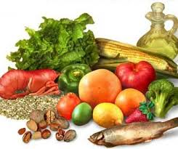
Youth with T2D
With dyslipidemia, use MNT to support:
Limit calories from fat: 25-30%
Limit calories from saturated fat: <7%
Limit cholesterol: <200 mg/day
Avoid trans fat
Aim for ~10% of calories from monounsaturated fat
For elevated triglycerides: ↓ simple sugar, ↑ omega-3s
Notes:
If lipids are abnormal in kids with diabetes, initial therapy should consist of medical nutrition therapy to swap saturated to more healthful fat sources, and lower simple sugars. These recommendations can support healthy growth and development

Slide 114
Youth with T2D
Assess for steatosis / MASLD*
With overweight/obesity: aim for 7-10% weight loss
With nephropathy: protein intake at the RDA of 0.85-1.2 g/kg/day (based on age)
*metabolic associated Steatotic liver disease
Notes:
If lipids are abnormal in kids with diabetes, initial therapy should consist of medical nutrition therapy to swap saturated to more healthful fat sources, and lower simple sugars. These recommendations can support healthy growth and development

Slide 115

Pregnancy
With pre-existing diabetes planning pregnancy, refer to RDN
Prenatal vitamins:
At least 400 µg folic acid
150 mg potassium iodide
Notes:
For women with diabetes in pregnancy or GDM, the focus is to incorporate enough calories for appropriate weight gain, minimize blood glucose excursions, and ensure safe nutrition.
______________________________
Diabetes in pregnancy = Women with preexisting diabetes (type 1 or type 2)
Gestational diabetes mellitus is diabetes diagnosed in the second or third trimester of pregnancy (hyperglycemia noted in the first trimester is NOT GDM)
Sate nutrition:
Nonnutritive sweeteners in moderation
No alcohol
No mercury-contaminated fish (shark, swordfish, king mackerel, others)
Avoid deli meat/hot dogs, soft cheese, meat spreads, smoked seafood, raw or unpasteurized milk (risk of Listeriosis)
Avoid raw or undercooked eggs, poultry, meat, and unpasteurized milk or juice (risk of Salmonella)
Stds S204

Slide 116
Pregnancy
For women with diabetes in pregnancy or GDM, focus on:
Adequate calories for appropriate weight gain (weight loss not recommended)
Minimize blood glucose excursions
Ensure nutrient-dense, safe nutrition
Notes:
For women with diabetes in pregnancy or GDM, the focus is to incorporate enough calories for appropriate weight gain, minimize blood glucose excursions, and ensure safe nutrition.
______________________________
Diabetes in pregnancy = Women with preexisting diabetes (type 1 or type 2)
Gestational diabetes mellitus is diabetes diagnosed in the second or third trimester of pregnancy (hyperglycemia noted in the first trimester is NOT GDM)
Sate nutrition:
Nonnutritive sweeteners in moderation
No alcohol
No mercury-contaminated fish (shark, swordfish, king mackerel, others)
Avoid deli meat/hot dogs, soft cheese, meat spreads, smoked seafood, raw or unpasteurized milk (risk of Listeriosis)
Avoid raw or undercooked eggs, poultry, meat, and unpasteurized milk or juice (risk of Salmonella)
Stds S204

Slide 117
Pre-pregnancy BMI and Weight Gain
Weight-for-Height Category | Recommended Total Weight Gain (Singleton Gestation)
With Underweight (BMI ≤18.5) | 28-40 lbs
Healthy Weight (BMI 18.6 – 24.9) | 25-35 lbs
With Overweight (BMI 25.0 – 29.9) | 15-25 lbs
With Obesity (BMI ≥ 30) | 11-20 lbs
Moore Simas, T. A., Waring, M. E., Sullivan, G. M., Liao, X., Rosal, M. C., Hardy, J. R., & Berry Jr, R. E. (2013). Institute of Medicine 2009 gestational weight gain guideline knowledge: Survey of obstetrics/gynecology and family medicine residents of the United States. Birth, 40(4), 237–246. https://doi.org/10.1111/birt.12061
Notes:
This table shows the recommended weight gain for women in pregnancy. Remember that weight loss is not recommended in pregnancy for women of any starting BMI. There is very little data on weight recommendations for women with BMI >35.
____________________
S2
P 749 of the big book

Slide 118

DRIs and Pregnancy
For pregnant women, dietary reference intake recommend a minimum of:
175 grams/day of carbohydrates
71 grams/day of protein
28 grams/day of fiber
Amount/type of carb will impact postprandial glucose levels
Emphasize mono- and polyunsaturated fats
Notes:
Dietary reference intakes recommend the following for women in pregnancy:
Carbohydrates: 175g per day to support mom’s brain and fetal growth. Glucose is transported across the placenta and is the preferred fuel sources over amino acids and free fatty acids.
- Low and very low carb diets are not recommended for pregnant women
Protein: Recommendation for protein is at 1.1 grams per kilogram per day (about 25 grams extra per day for singleton gestation) in a pregnant woman
Fiber: Aim for 28 grams of fiber per day
Other Keys:
- Simple carbohydrates will result in higher post meal excursions so minimize.
- Emphasize those heart healthy fats and decrease the saturated and trans fats
- Ultimately, trying to get enough calories and carbs to promote appropriate weight gain and avoid maternal starvation ketosis.
_______________________________
P 749 big book / stds 237

Slide 119
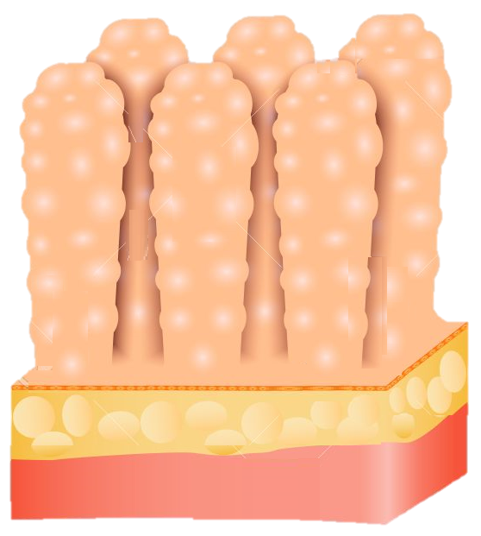
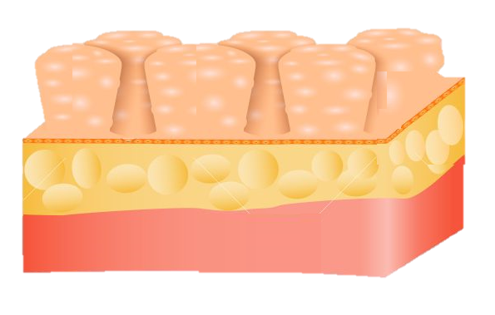
Celiac Disease
Immune-mediated disorder where destruction of the small intestine villi occurs following exposure to gluten
Occurs more often in people with T1D
1%-16% of individuals compared to 0.3%-1% in general population
Notes:
Celiac is a disorder where the immune system causes destruction of the vili in the small intestines after exposure to gluten.
It is more common in people who live with type 1 diabetes
________
Big book 164 / 2022 Stds s215

Slide 120
Celiac Disease
When to Screen for Celiac Disease
Pediatrics with T1D | Adults with T1D
Within 2 years of diagnosis Again 5 years after diagnosis or sooner if symptoms present | With suggestive GI symptoms (diarrhea, malabsorption, abdominal pain) Signs (Osteoporosis, vitamin deficiency, iron deficiency anemia)
Notes:
When to screen:
In pediatrics within 2 years of type 1 diagnosis and again about 5 years after diagnosis, or sooner if symptoms present.
In adults with type 1 diabetes if signs of symptoms present.
While some people with celiac can be asymptomatic, symptoms include abdominal pain, diarrhea, and malabsorption. It is also associated with osteoporosis, and iron deficiency.
________
Big book 164 / 2022 Stds s215

Slide 121
Celiac Disease
Diagnosis via blood tests and a small intestine biopsy
Screen for celiac by testing IgA if person with T1D has suggestive symptoms or signs:
If normal serum IgA, measure IgA-tTG antibodies
If IgA deficient, measure IgG tTg and IgG DGA
IgA: immunoglobulin A
IgG: immunoglobulin G
tTG: tissue transglutaminase
DGA: deaminated gliadin antibodies
Notes:
Diagnosis of celiac is done via blood tests looking for antibodies and a biopsy of the small intestine.
screen by measuring IgA tissue transglutaminase antibodies
About 3% of people are deficient in IgA so if that’s the case, we can measure IgG tissue transglutaminase antibodies or IgG deaminated gladin peptide antibodies.
.
_____
2022 Stds S215

Slide 122

Celiac Disease
Treatment for celiac disease is a lifetime gluten-free diet
Eliminate all wheat (including durum, semolina, spelt, and farro) and the related grains of rye, barley, and triticale.
Caution with oats – may be contaminated with wheat
Remember “BROW” – Barley, Rye, (some) Oats, Wheat
Refer to a dietitian for help with food selection/label reading
Notes:
Someone who is positive for celiac should be referred to a dietitian for food selection and label reading, as treatment for celiac disease is a lifetime gluten-free diet.
That means eliminate all wheat and the related grains of rye, barley and triticale (tri·tuh·kay·lee), which is a hybrid of wheat and rye.
We want to be cautious with oats – which are naturally gluten free but may be contaminated
A tip is to remember “BROW” – Barley, Rye, (some) Oats, Wheat
2022 - S215

Slide 123
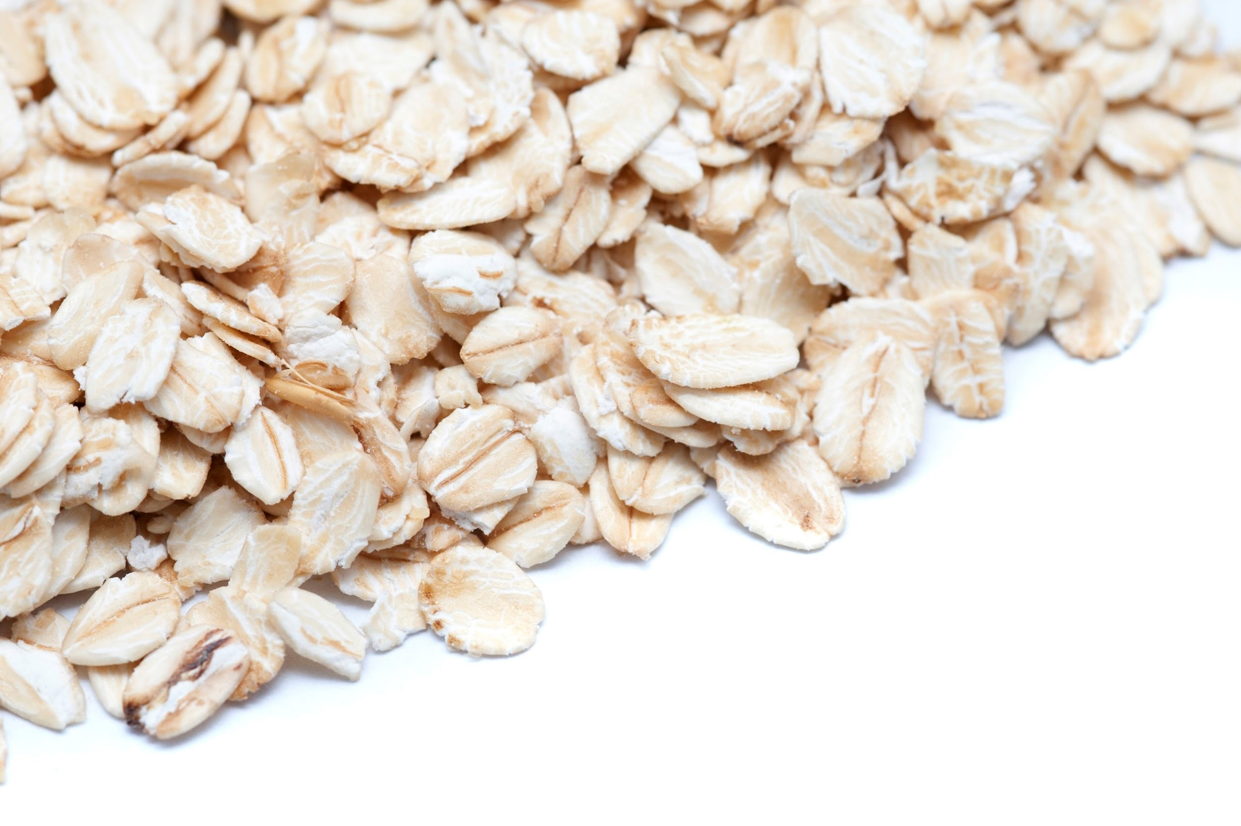
Nutrition Interventions: Celiac Disease
Gluten Free Whole Grains & Starches include:
Millet
Rice
Wild rice
Buckwheat
Job’s Tears (Hato Mugi)
Montina (Indian rice grass)
Sorghum
Teff
Quinoa
Potatoes
Beans & Peas
Cassava
Corn
Oats*
Flax
Amaranth
*Oats are inherently gluten-free may be contaminated with wheat during growing or processing.
Notes:
Here is a list of gluten free grains and starches for you to reference.

Slide 124
Disordered Eating Patterns
Estimated prevalence of disordered eating behavior and eating disorders varies in people with diabetes
Most reported disordered eating behaviors:
T1D: insulin omission causing loss of glucose/calories via the urine
T2D: bingeing (excessive intake with sense of loss of control)
Notes:
Prevalence of disordered eating patterns is estimated to be between 18-40% in people with diabetes.
The most commonly reported disordered eating behaviors are different depending on the type of diabetes:
T1D: Insulin omission causing loss of glucose/calories via the urine.
T2D: Binging (excessive intake with sense of loss of control). In those treated with insulin, omission is also common
2022 Standards S73

Slide 125
Disordered Eating Patterns – Case Study Added by Bev
MR is a 59 year old living with diabetes who shares that their provider keeps telling them to lose weight. MR is trying to eat less and decrease portions, but then they get “so hungry, they end up bingeing on ice cream or other treats. Then, their blood glucose levels go up and they feel really bad about themselves”.
What is your first reaction when you hear MR’s story?
How would you approach this honest sharing by MR in a way that helps move MR toward healing?
What you want to consider any referrals?
Notes:
Prevalence of disordered eating patterns is estimated to be between 18-40% in people with diabetes.
The most commonly reported disordered eating behaviors are different depending on the type of diabetes:
T1D: Insulin omission causing loss of glucose/calories via the urine.
T2D: Binging (excessive intake with sense of loss of control). In those treated with insulin, omission is also common
2022 Standards S73

Slide 126

Disordered Eating Patterns
Screen for it along with regular medical care
Especially if patterns when hyperglycemia and weight loss are unexplained
Multidisciplinary team approach to treatment is a standard of care
Early referral to mental health professional
Notes:
There are a variety of tools to screen for disordered eating patterns in diabetes; they include “Diabetes Eating Problem Survey” the Eating Disorder Inventory 3, which has been modified for use in people with type 1 diabetes. There is also another that I like called SEEDS that stands for screen for early eating disorder signs.
Multidisciplinary team approach to treatment is a standard of care

Slide 127
Disordered Eating Patterns
Anorexia nervosa: restricted energy intake relative to need
Marked by low body weight, fear of weight gain, and disturbance in the way in which one’s body weight or shape is experienced
Bulimia nervosa: recurring binge eating and compensatory behavior
Binging characterized by a sense of a lack in control.
Compensatory behaviors vary
Diabulimia (unofficial diagnostic term): reduction/omission of insulin doses
This causes hyperglycemia and loss of glucose calories through the urine.
Notes:
Here are some definitions of disordered eating patterns.
Note that diabulimia is not recognized by the DSM. You may have heard of it though, and can be quite dangerous. This is where a person with diabetes omits insulin, which causes elevated glucose levels, and the spilling of glucose and calories into the urine. This leads to an increased risk hospitalization from DKA and chronic complications.

Slide 129
Knowledge Check
Sara has just been diagnosed with gestational diabetes. Her current weight is 176 lbs. and her pre-pregnancy BMI was 28. What is the total recommended weight gain for Sara’s pregnancy?
15 pounds
15-25 pounds
25-35 pounds
28-40 pounds
Notes:
Answer B

Slide 130
Knowledge Check
What are the nutrient goals for pregnant women?
130 grams of carbohydrate/day, 71 grams of protein/day, 14 grams of fiber/day
130 grams of carbohydrate/day, 90 grams of protein/day, 28 grams of fiber/day
175 grams of carbohydrate/day, 90 grams of protein/day, 14 grams of fiber/day
175 grams of carbohydrate/day, 71 grams of protein/day, 28 grams of fiber/day
Notes:
Answer D

Slide 131
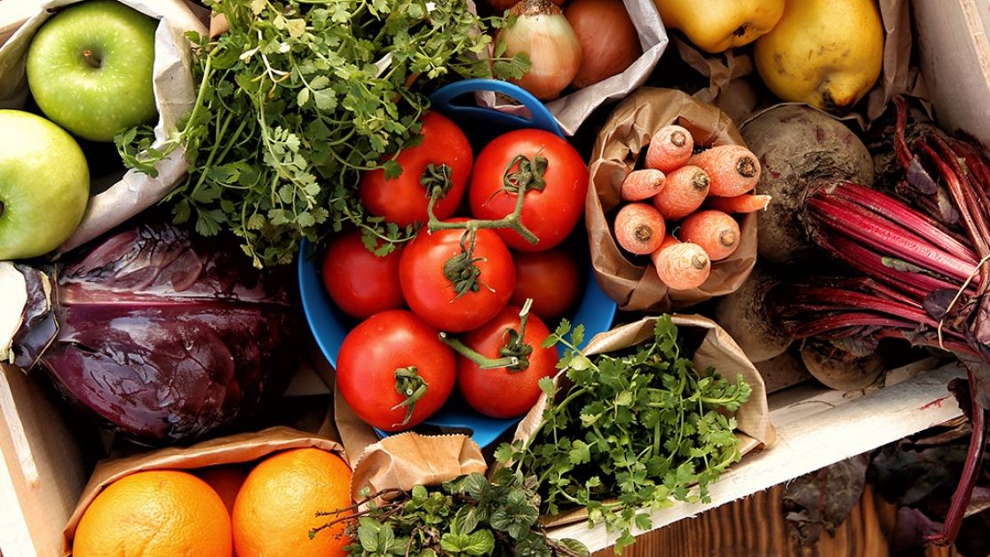
Nutrition to Support the Management of Diabetes Complications & Comorbidities

Slide 132
Mediterranean Eating Pattern
Description & Notes | Encourages plant-based foods, fish and shellfish, some dairy. Olive oil is primary fat source. Limitations: Moderate number of eggs, minimal red meat, wine in low to moderate amount, rare use of concentrated sugars or honey.
Current Literature | Improves CVD risk factors Energy restricted version of these meal plans can improve weight and glycemia
Notes:
Based on traditional eating in countries boarding the Mediterranean Sea
Mediterranean
Encouraged foods:
Plant-based foods, fish and shellfish, olive oil as main sources of culinary fat, some dairy (mainly cheese and yogurt)
Limitations: <4 eggs per week, minimal red meat, wine in low to moderate amounts, rare use of concentrated sugars or honey
Current literature shows this eating plan Improves CVD risk factors
Energy restricted version of this meal plan can improve weight and glycemia

Slide 133
DASH Eating Pattern
Description & Notes | Dietary Approaches to Stop Hypertension Encouraged foods: Fruits & Veg (8-10 servings/day), whole grains (6-8 servings/day), low-fat dairy (2-3 servings/day), poultry & fish (6 servings/week), nuts & seeds (4-5 servings/week) Limitations: Red meat, sweets, sugar-containing, processed food, excessive alcohol consumption
Current Literature | Improves BP and reduces risk for CVD in people w/o diabetes Limited evidence exists for people with diabetes but ”one would expect similar results”
Notes:
Dietary Approaches to Stop Hypertension
Encouraged foods: Fruits and veg (8-10 servings/day), whole grains (6-8 servings/day), low-fat dairy (2-3 servings/day), poultry and fish (6 servings/week), nuts and seeds (4-5 servings/week)
Limitations: Red meat, sweets and sugar-containing beverages, processed foods, excessive alcohol consumption
Current Literature shows this eating plan Improves BP and reduces risk for CVD in people w/o diabetes
Limited evidence exists for people with diabetes but “one would expect similar results”

Slide 134
Plant-Based Eating Pattern
Description & Notes | Limited/no flesh foods; may allow egg and/or dairy Associated with lower intake of saturated fat and cholesterol
Current Literature | Energy restricted version of these meal plans can improve CVD risk factors, weight, and glycemia

Slide 135
Intermittent Fasting & Time Restricted Eating
Description & Notes | Alternate-day fasting 5:2 diet Time-restricted eating
Current Literature | Results in mild to moderate weight loss over short durations No difference vs. continuous calorie restriction Time restricted eating may be easier to follow due to ease, no need to count calories, sustainability
Notes:
Alternate-day fasting (restrict ~500 kcals on alternating days with usual intake the other days)
5:2 diet (restriction of ~500 kcals 2x per week with usual intake the other days)
Time-restricted eating (daily restriction during window of time – typically 8-15 hours)
Shown to support mild to moderate weight loss of 3-8% overbaseline during short periods of time
No difference in weight loss when compared to continuous calorie restriction.
From standards of care: People with diabetes who are on insulin and/or secretagogues should be medically monitored during the fasting period (163).

Slide 136
Other Eating Patterns/Plans
Partial/Total Meal Replacements | Bars, shakes, soups with set macros/micros Shown to improve nutrient quality and glucose control Effective short-term strategy for weight loss
Chrononutrition | Growing specialty Aims to understand how timing of nutrition impacts metabolic health Early studies indicate benefit of eating earlier
Notes:
Chrononutrition is a growing and emerging specialty in the field of nutrition and biology that tries to understand how the timing of food ingestion affects metabolic health (168). Glucose metabolism follows a circadian rhythm through diurnal variation of glucose tolerance, peaking during daylight hours when food is consumed. Some preliminary studies show cardiometabolic benefits when food is consumed earlier (169). Similarly, circadian disruptions found in shift workers increase risk of type 2 diabetes (170). Although more research needs to be done, this evolving area of research may show promise to improve glucose regulation.

Slide 137

Nutrition for Lipid Management
Per ADA: Consider a calorie-restriction for weight loss in people with BMI of 25 or more
Mediterranean-style or DASH eating pattern
Reduce saturated and trans fat, increase omega-3 fatty acids
Increase fiber
Increase plant stanols/sterols
Add physical activity
Notes:
Lipid management
The Mediterranean diet or DASH diet are thought to be beneficial because they reduce saturated/trans fat, increase fiber. These eating plans increase fruits, vegetables, whole grains, nuts, seeds, fish while lowering red and processed meats and processed foods.
Among people with type 2 diabetes and overweight or obesity who have inadequate glycemic, blood pressure, and lipid management and/or other obesityrelated metabolic complications, modest and sustained weight loss (3–7% of body weight) improves glycemia, blood pressure, and lipids and may reduce the need for disease-specific medications (7–9,40). In people at risk, 3–7% weight loss reduces progression to diabetes (2,7,8,41,42). Greater weight loss may produce additional benefits (20,21). Mounting data have shown that >10% body weight loss usually confers greater benefits on glycemia and possibly diabetes remission and improves other metabolic comorbidities, including cardiovascular outcomes, nonalcoholic steatohepatitis, nonalcoholic fatty liver disease, adipose tissue inflammation, and sleep apnea, as well as physical comorbidities and quality of life (6,20, 21,30,41,43–52). - Jess from ADA S146
______________
______________
2022 Standards S151

Slide 138

Nutrition for Hypertension
Managing HTN reduces rate of micro/macrovascular complications
For individuals with BP >120/80 mmHg, focus on:
ADA: Weight loss
Increase physical activity
Try DASH diet for healthy eating
Sodium restriction (~2300 mg/day)
Avoid excessive alcohol consumption
Notes:
Hypertension
Weight loss has the most significant impact. Adding exercise, then restricting salt, and alcohol moderation are also beneficial.
________
DASH
8-10 servings of fruits and vegetables
Low fat dairy (2-3 servings per day)
2022 Standard S148

Slide 139
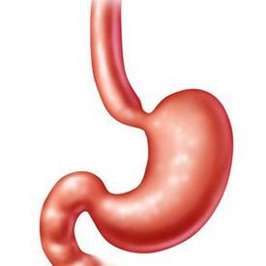
Nutrition for Gastroparesis
Gastroparesis: a form of autonomic neuropathy that delays emptying of the stomach
Symptoms: nausea, vomiting, fullness with little food, bloating, and low appetite.
Unpredictable movement of food thru GI can cause erratic BGs
Timing of insulin delivery is important; hypo can result if insulin is given and gastric emptying is delayed
This Photo by Unknown Author is licensed under CC BY-NC-ND
Notes:
Gastroparesis: a form of autonomic neuropathy that delays emptying of the stomach.
Symptoms include nausea, vomiting, fullness with little food, bloating, and low appetite.
Unpredictable movement of food thru GI can cause erratic BGs
Timing of insulin delivery is important; hypo can result if insulin is given and gastric emptying is delayed

Slide 140
Nutrition for Gastroparesis
Dietary changes are a high priority in treatment
Consider the following dietary modifications:
Decrease fiber (may lead to bezoar formation)
Evaluate fat intake
Fat is a good/high source of calories so limit only after other measures are exhausted
Liquid fats may be tolerated better
This Photo by Unknown Author is licensed under CC BY-NC-ND
Notes:
Most nutrition therapy recommendations for gastroparesis are based on the knowledge of the pathophysiology and clinical judgement due to limited research- there are almost no clinical trial results to determine the success of any nutritional intervention for gastroparesis.
The advice focuses on selecting foods that are easy to digest or modifying foods so that they digest easier and faster. This minimizes symptoms.
Lowering fiber intake can be helpful. We need to consider fat intake more closely because it is a good source of calories and some people with gastroparesis struggle with intake. Liquid fat may be more tolerable
____________________________________
_____________________________________
Big book 165 / 2022 Standards 190

Slide 141
Nutrition for Gastroparesis
Consider dietary modifications:
Multi supplement if intake is insufficient
Small and frequent meals
Liquid/pureed calories
May need to try liquid calories later in the day
Chew foods well
Sit up for 1-2 hours after eating
This Photo by Unknown Author is licensed under CC BY-NC-ND
Notes:
Those with gastroparesis may need supplementation if their intake is low. Small frequent meals can help, as can having liquid or pureed calories. You can puree just about anything – we have a gentleman with gastroparesis that, every year, purees thanksgiving dinner and loves it!
Stabilizing glucose levels is particularly important because gastroparesis is exacerbated with wide swings in blood sugars, particularly with BG readings above 240 mg/dl which impairs emptying

Slide 142
Nutrition for NAFLD
Nonalcoholic fatty liver disease includes a range of liver conditions
Studies estimate it is prevalent in >70% of people with T2DM
Nutrition-Related Management
Reduce calories and add exercise for weight loss of ≥5%, preferably ≥10% to improve liver histology
Limit saturated fat, sugar, starch, and sugar
Mediterranean diet has best evidence
This Photo by Unknown Author is licensed under CC BY-NC-ND
Notes:
Nonalcoholic fatty liver disease includes a range of liver conditions
Studies estimate it is prevalent in >70% of people with T2DM
Nutrition-Related Management
Weight loss of ≥5%, preferably ≥10% to improve liver histology, although more weight loss is needed to impact fibrosis

Slide 144
Knowledge Check
Jane has type 1 diabetes and was recently diagnosed with gastroparesis. She is a runner and has not been able to exercise recently due to nausea, vomiting, bloating, and intestinal pain. She experiences lows about 3 times a week. What hypoglycemia treatment should she use?
Juice
Fruit
Glucose tablets or gels
Peanut butter crackers
Notes:
glucose can be absorbed directly through oral tissue

Slide 145

Dietary Approaches for Diabetes Management
This Photo by Unknown Author is licensed under CC BY

Slide 146

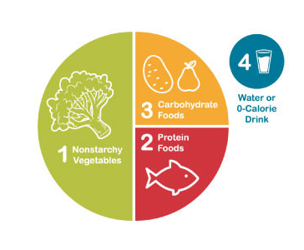
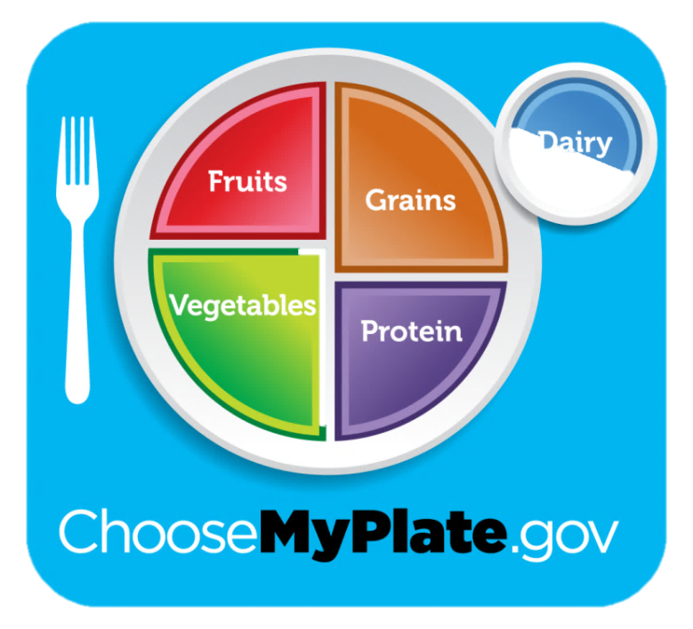
Dietary Approaches
Practical tool(s) to develop healthy eating patterns
Plate Method
Carbohydrate exchanges
Carbohydrate Counting

Slide 147
Dietary Approaches
Therapy | Dietary Approach
Nutrition therapy only or on meds excluding insulin or insulin secretagogues | Consider reducing overall carb intake, portion sizes, plate method, or food exchange lists
Fixed insulin doses or insulin secretagogues | Educate on carbohydrate consistency with respect to time and amount. Consider tools like carbohydrate counting or choices, plate method, simplified meal plan, or food exchange lists
Flexible insulin therapy | Educate on carbohydrate counting and using an insulin-to-carb ratio
Notes:
When working on meal planning, strategies for carbohydrate management may vary depending on the medication therapy being used. When selecting a strategy, it’s important to consider numeracy and food literacy level.
For example, if someone is not using medications to manage glucose levels then the plate method may be a very effective education tool.
This, compared to someone who is using multiple daily injections of insulin and his or her meal time doses are flexible. In this case, carbohydrate counting and using an ICR may be an excellent strategy. With new AID systems, precise counting may be less important.
We are going to first focus on strategies that are likely more effective for those on oral medications, secretagogues, or fixed doses of insulin.
S66

Slide 148
Plate Method
MyPlate introduces simple nutrition
Emphasizes portion control and healthy food choices
Using a small plate and filling ½ plate with fruits and veg helps with calorie management
Consider using with:
Individuals with T2D not on insulin
Those with limited health literacy or numeracy
Older adults prone to hypoglycemia
Notes:
I love, love, love using my plate. It is so beautifully simple and there is so much that can be drawn from it. It’s very visual for individuals with limited literacy.
Myplate starts by emphasizing portion sizes – like filling half the plate with fruits and vegetables. The majority of folks aren’t getting enough – I am a firm believer that that simple change can improve health.

Slide 149

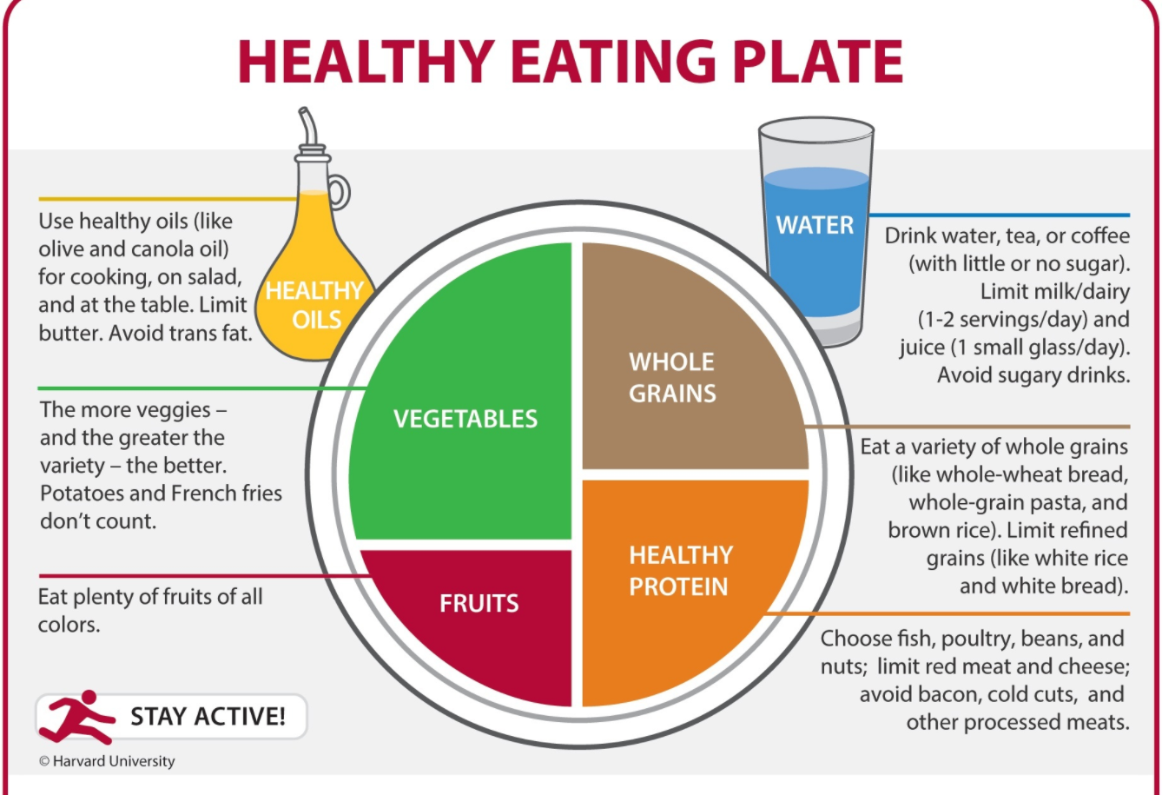
Plate Method Alternatives
Harvard School of Public Health alternative =“Healthy Eating Plate”
Visit www.hsph.harvard.edu/nutritionsource
ADA alternative = “Diabetes Plate Method”
Visit diabetesfoodhub.org
Notes:
There are a couple different alternatives to my plate
The Harvard School of Public Health provides an alternative version of MyPlate called the “Healthy Eating Plate”
The Healthy Eating Plate has key differences:
- Replaces milk with water, coffee, or tea
- Emphasizes healthy oils, a variety of fruits and vegetables, whole and intact grains rather than refined options
- protein sources other than red or processed meats which helps lower saturated fat
Provides examples of foods within each category
Another version that's may be a better fit is ADA's Diabetes plate method. Again, it swaps milk for water or other drinks without added sugar.
A great resources is ADA's cooking and nutrition site called food hub - I've included the link for you - it has visuals of healthy plates and lots of recipes.

Slide 150
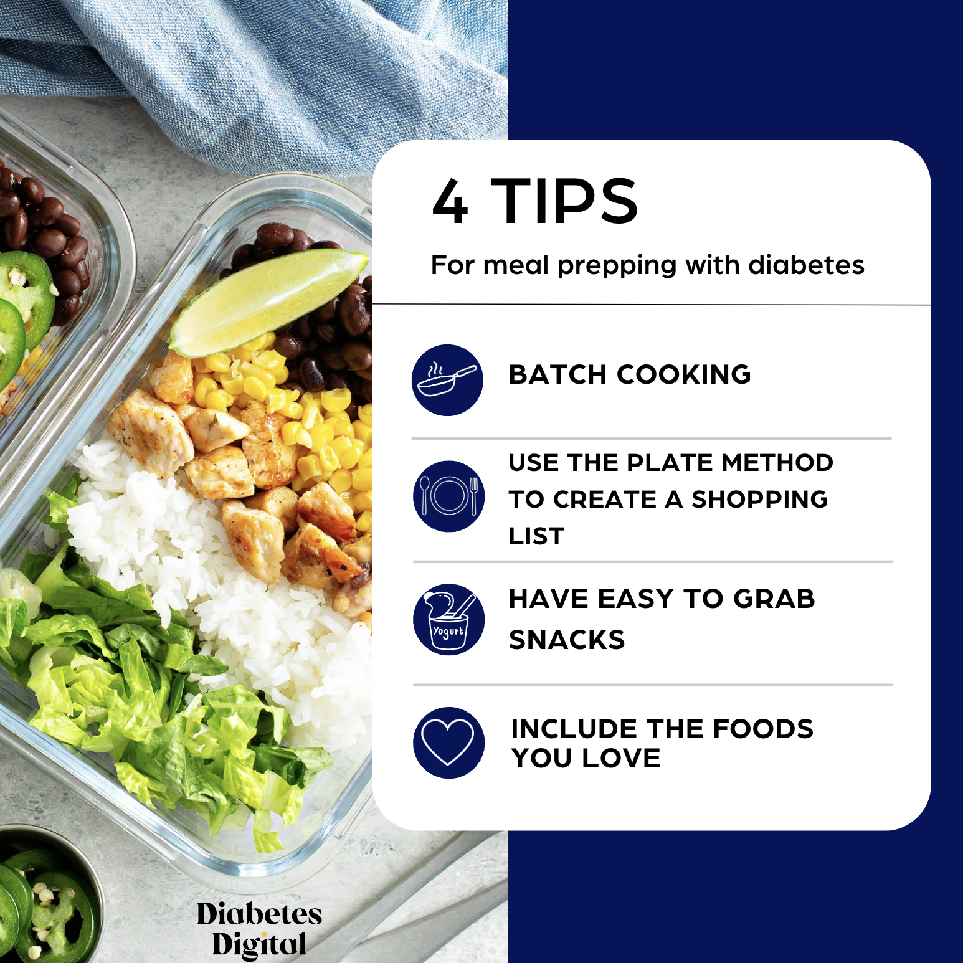
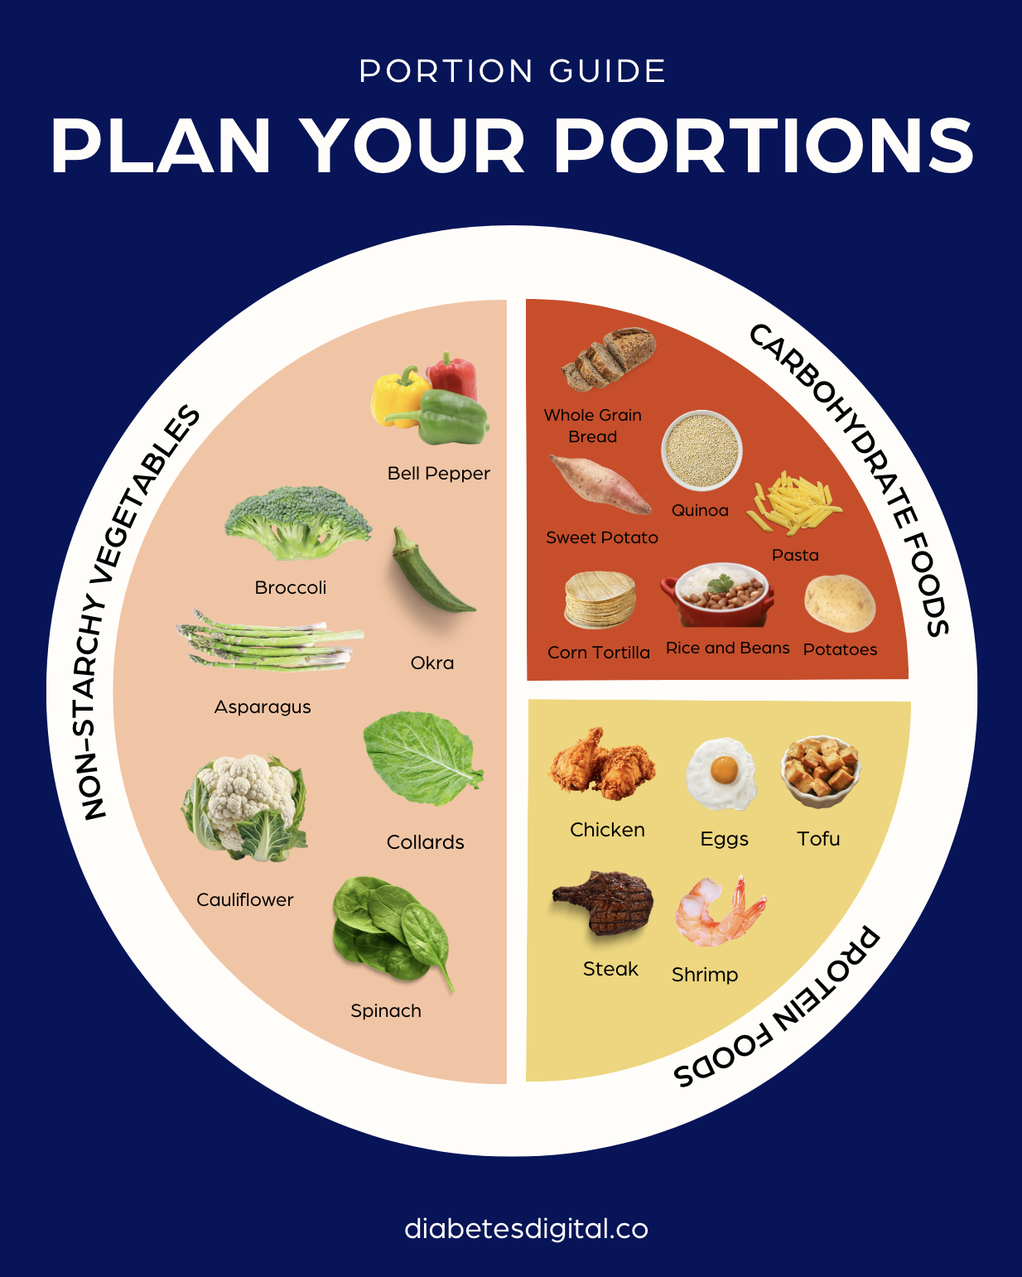
Notes:
There are a couple different alternatives to my plate
The Harvard School of Public Health provides an alternative version of MyPlate called the “Healthy Eating Plate”
The Healthy Eating Plate has key differences:
- Replaces milk with water, coffee, or tea
- Emphasizes healthy oils, a variety of fruits and vegetables, whole and intact grains rather than refined options
- protein sources other than red or processed meats which helps lower saturated fat
Provides examples of foods within each category
Another version that's may be a better fit is ADA's Diabetes plate method. Again, it swaps milk for water or other drinks without added sugar.
A great resources is ADA's cooking and nutrition site called food hub - I've included the link for you - it has visuals of healthy plates and lots of recipes.

Slide 151
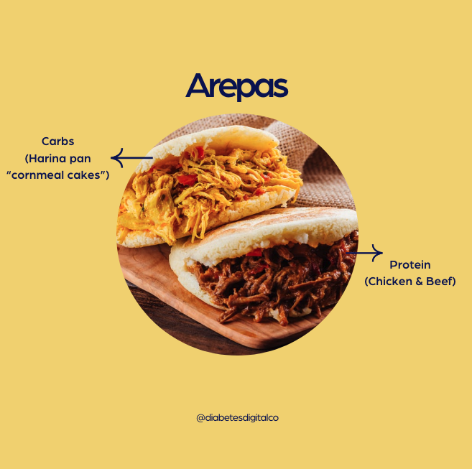
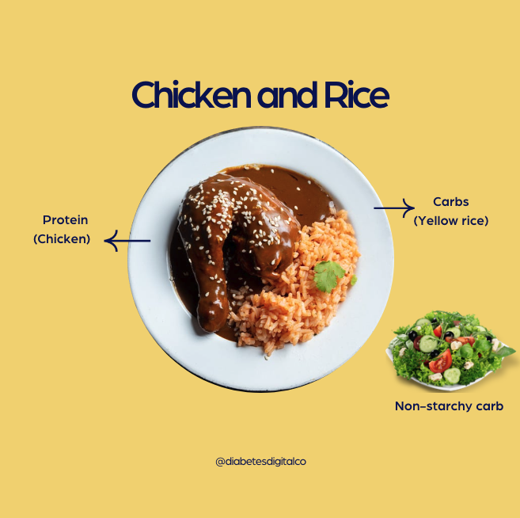
Notes:
There are a couple different alternatives to my plate
The Harvard School of Public Health provides an alternative version of MyPlate called the “Healthy Eating Plate”
The Healthy Eating Plate has key differences:
- Replaces milk with water, coffee, or tea
- Emphasizes healthy oils, a variety of fruits and vegetables, whole and intact grains rather than refined options
- protein sources other than red or processed meats which helps lower saturated fat
Provides examples of foods within each category
Another version that's may be a better fit is ADA's Diabetes plate method. Again, it swaps milk for water or other drinks without added sugar.
A great resources is ADA's cooking and nutrition site called food hub - I've included the link for you - it has visuals of healthy plates and lots of recipes.

Slide 152
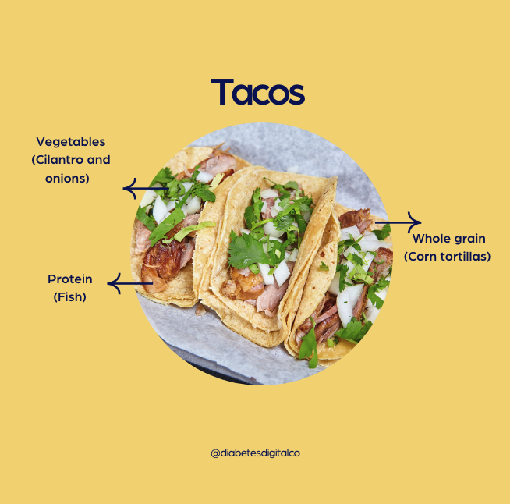
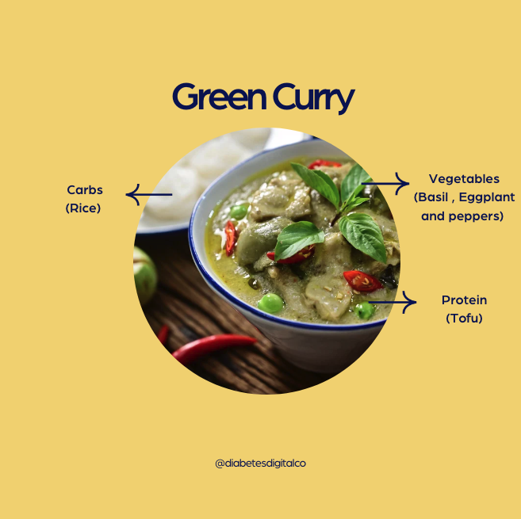
Notes:
There are a couple different alternatives to my plate
The Harvard School of Public Health provides an alternative version of MyPlate called the “Healthy Eating Plate”
The Healthy Eating Plate has key differences:
- Replaces milk with water, coffee, or tea
- Emphasizes healthy oils, a variety of fruits and vegetables, whole and intact grains rather than refined options
- protein sources other than red or processed meats which helps lower saturated fat
Provides examples of foods within each category
Another version that's may be a better fit is ADA's Diabetes plate method. Again, it swaps milk for water or other drinks without added sugar.
A great resources is ADA's cooking and nutrition site called food hub - I've included the link for you - it has visuals of healthy plates and lots of recipes.

Slide 153
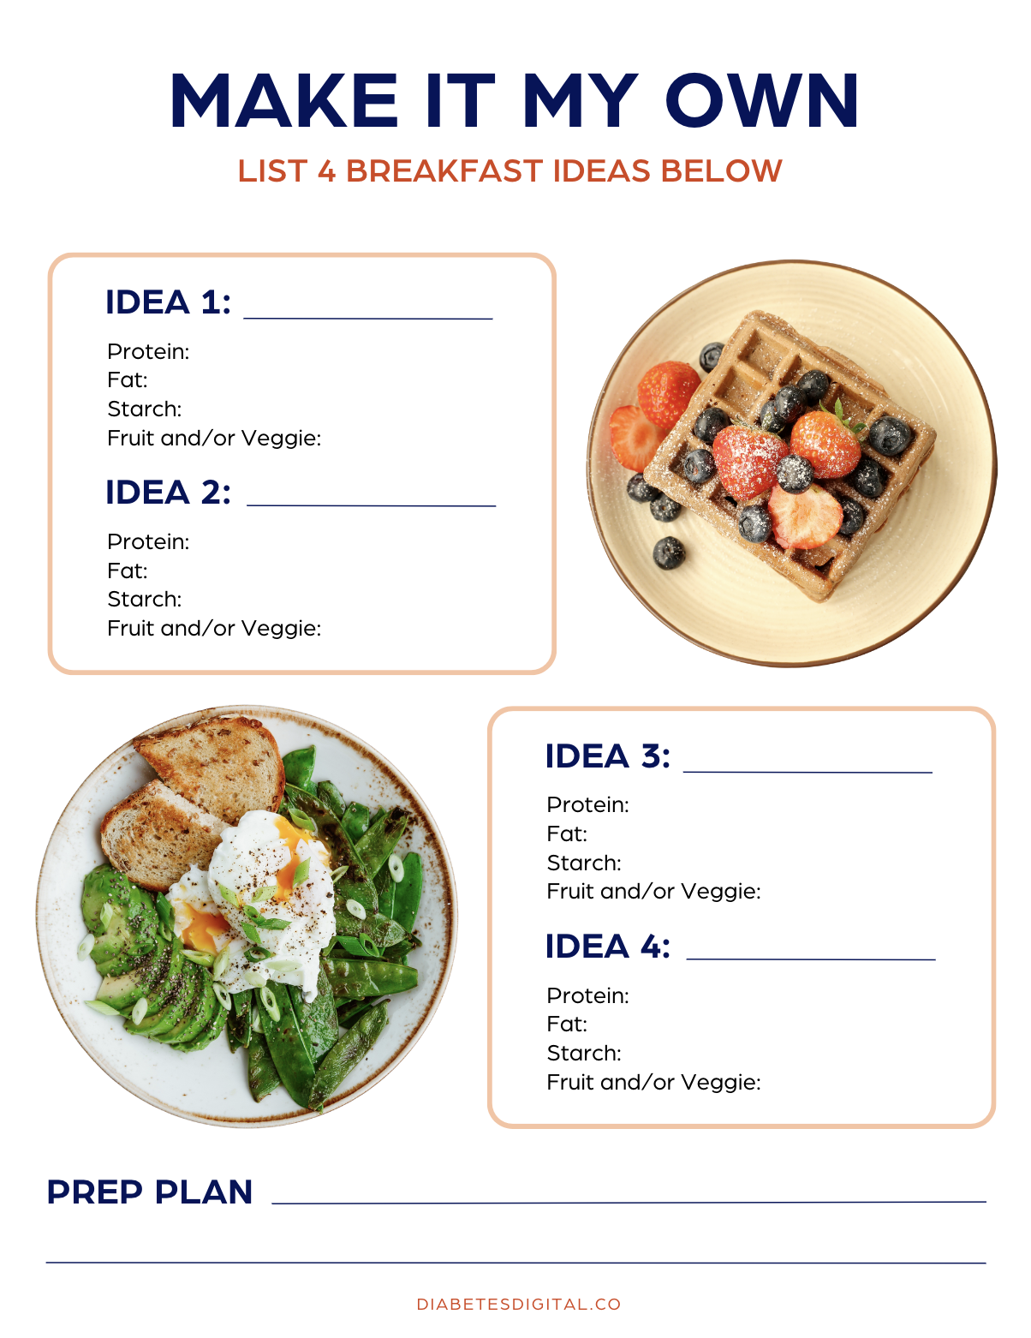

Helping Patients Meal Planning
Notes:
There are a couple different alternatives to my plate
The Harvard School of Public Health provides an alternative version of MyPlate called the “Healthy Eating Plate”
The Healthy Eating Plate has key differences:
- Replaces milk with water, coffee, or tea
- Emphasizes healthy oils, a variety of fruits and vegetables, whole and intact grains rather than refined options
- protein sources other than red or processed meats which helps lower saturated fat
Provides examples of foods within each category
Another version that's may be a better fit is ADA's Diabetes plate method. Again, it swaps milk for water or other drinks without added sugar.
A great resources is ADA's cooking and nutrition site called food hub - I've included the link for you - it has visuals of healthy plates and lots of recipes.

Slide 154
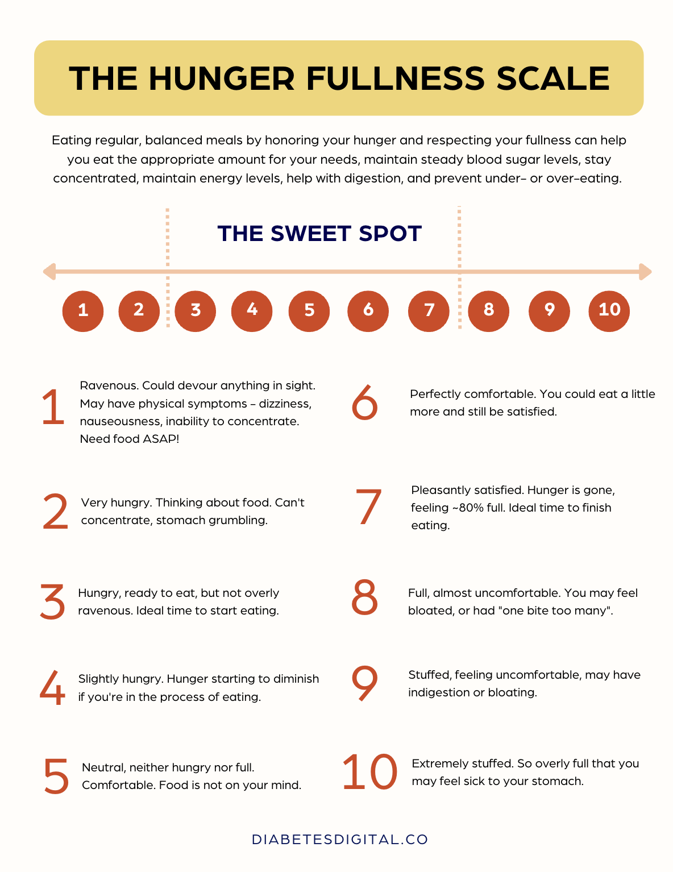
Tool: The Hunger-Fullness Scale
Notes:
There are a couple different alternatives to my plate
The Harvard School of Public Health provides an alternative version of MyPlate called the “Healthy Eating Plate”
The Healthy Eating Plate has key differences:
- Replaces milk with water, coffee, or tea
- Emphasizes healthy oils, a variety of fruits and vegetables, whole and intact grains rather than refined options
- protein sources other than red or processed meats which helps lower saturated fat
Provides examples of foods within each category
Another version that's may be a better fit is ADA's Diabetes plate method. Again, it swaps milk for water or other drinks without added sugar.
A great resources is ADA's cooking and nutrition site called food hub - I've included the link for you - it has visuals of healthy plates and lots of recipes.

Slide 155


Exchanges
The exchange system groups like foods that have similar nutritional value (specifically macronutrient and caloric value) into exchanges that can be swapped for another
Example: the “starch” category has food items in predetermined servings that are ~80 kcals, ~15g of carb, and ~3g protein
An individual may count the number of food exchanges in each category at each meal/thru the day
Notes:
Exchange lists were developed years ago to help standardize meals for people with diabetes. In the original exchange-list system the diet is divided into six major categories, but it has since been expanded upon. Today there are multiple versions of the exchange list available.
The system groups like foods with similar energy and macronutrient content. Each food serving is known as an exchange and can be swapped or “exchanged” for another food within the same group.
An individual may count the number of food exchanges in each category at each meal. It can help with carbohydrate counting

Slide 156
Exchanges
Advantages
Disadvantages
Allows for flexibility and personalization
Encourages consistency in the timing and amounts at meals and snacks
Requires learning how to fit unlisted foods into the plan (especially today with so many food choices)
Less attention given to micronutrient content
Notes:
There are some advantages and disadvantages.

Slide 157








Exchanges
Categories within the exchange system
Starch
Fruit
Dairy / Milk
Sweets/ Dessert
Vegetable
Meat / Protein
Fats
“Free”
Notes:
The Exchange groups may include:
Starch (may be referred to as bread/cereal)
Fruit
Milk or dairy
Sweets / desserts
Veggies
Meat / meat substitutes, may be referred to as protein
Fat (sometimes called fats/oils)
Free foods – in the portion sizes described they are generally omitted from calculations since they don’t include significant amounts of macronutrients and usually have <15-20 kcals per serving. However, individuals may be cautioned to limit their intake to no more than 3 servings through the day because they can add up both from a calorie perspective and for their impact on blood glucose

Slide 158
 | Exchange | Carb | Prot | Fat | Cals | Examples
 | Starch | 15 | 3 | 0-1 | 80 | ⅓ cup beans, lentils, peas, rice, ½ cup cooked cereal, corn, potato, pasta 1 oz. bread (1 slice) or bagel (½), ½ english muffin
 | Fruit | 15 | 0 | 0 | 60 | 1 small apple or kiwi, ½ large banana, 1¼ cup whole strawberries, 1 cup raspberries, ¾ cup blackberries, ½ (most) to ⅓ (grape, cran) cup juice
 | Dairy / Milk | 12 | 8 | 0-8 | 90-120 | 1 cup milk, 8 oz. plain yogurt (any fat content)
 | Sweets/ Desserts | 15 | Varies | Varies | Varies | ¼ cup granola, 1 small granola bar, ½ cup frozen fruit yogurt, ½ cup ice cream (any flavor)
Notes:
<<Review how to read the table>>
- Notice that each exchange group here has 15g of carb per serving, with the exception of milk which has 12g
On the exam, exchanges may come up. So aim to understand how many carbs are in each exchange.
Someone is eating 2/3 cup of rice, 1.25 cups strawberrys, and 3 oz of fish. How many carbs are in the meal.
__________________
_________________
Sweets / desserts = combination food
Granola 1 starch, 1 fat
1 small granola bar 1 starch 1 fat
Frozen yogurt 1 starch
Ice c cream 1 starch, 2 fats

Slide 159
 | Exchange | Carb | Prot | Fat | Cals | Examples
 | Veggies | 5 | 2 | 0 | 25 | 1 cup raw vegetables, ½ cup cooked vegetables of vegetable juice
 | Meat / Protein | 0 | 7 | 1-8 | 35-100 | 1 oz. fish, chicken, beef, pork or cheese, ½ cup tofu, 1 egg
 | Fat | 0 | 0 | 5 | 45 | 1 tsp. oil, butter, or mayo, 6 almonds, 2 whole walnuts
 | Free | 0-5 | 0 | 0 | 0-25 | Sugar free gelatin, 1 tbsp catsup 2 tsp sugar free jam, 1-2 tbsp sugar free syrup, coffee, tea, spices
Notes:
And here are the vegetables, protein groups, fat, and the free group. I also want to mention that not all free foods are actually free. It depends on the serving size consumed.

Slide 160

General Rules for Serving Sizes
 | Exchange | Category | Measure
 | Starch | Beans/Lentils/Peas/Rice | ⅓ cup
 |  | Cooked Cereals/Pasta/Potato | ½ cup
 |  | Bread Products | 1 ounce
 | Fruit | Fresh | 1 small piece
 |  | Dried | ¼ cup
 |  | Juice/Canned/Applesauce | ½ cup
 |  | Cubed Melon | 1 cup
Notes:
The next couple of slides provide general guidance on serving sizes within each exchange group. For instance, with fresh fruit, 1 small piece is generally 1 carbohydrate exchange.
I encourage you to spend some time on starches, fruit, dairy, and the sweets (the carb foods) to be aware of the general measures for each of these categories. There are a few benefits of doing so:
- that if you’re preparing for the exam, test you’ll able to do the carb counts in any questions
- Good to have a baseline knowledge about carb containing foods and their amounts to help you teach this to a person with diabetes or assess someone’s ability to carb count.

Slide 161
General Rules for Serving Sizes
 | Exchange | Category | Measure
 | Dairy / Milk | Skim, 1%, 2%, Whole | 1 cup
 |  | Ice Cream | ½ cup
 |  | Yogurt | 1 cup
 | Sweets / Desserts | Cookies | 1 small (1¾”)
 |  | Granola | ¼ cup
 |  | Cake | 1½” square

Slide 162
General Rules for Serving Sizes
 | Exchange | Category | Measure
 | Vegetables | Raw | 1 cup
 |  | Cooked | ½ cup
 |  | Juice | ½ cup
 | Protein | Meats/Chicken/Fish | 1 ounce
 |  | Cheese | 1 ounce
 |  | Egg | 1

Slide 163

General Rules for Serving Sizes
 | Exchange | Category | Measure
 | Fat | Avocado | 1/8 whole
 |  | Butter/Margarine/Oil/Mayo | 1 tsp
 |  | Nuts/Seeds | 1 tbsp
 | Free | Coffee, tea | Unlimited
 |  | SF Syrup | 1-2 tbsp
 |  | SF Jam/Jelly | 2 tsp

Slide 164
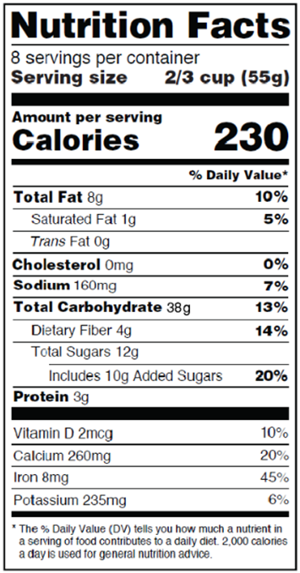
Carbohydrate Counting
Reading nutrition facts to carb count
Look at the serving size
Look at “Total Carbohydrates”
Consider subtracting ½ of sugar alcohols and fiber content
Adjust the count depending on the number of servings that will be eaten
Total the carbs for all items in the snack/meal
Notes:
Next, we are going to review carb counting…
Carb counting may be something to do with some clients. Remember that carbohydrates do have the most significant impact on blood glucose levels, so being aware of carb counts may benefit some persons with diabetes.
Here are the steps to carb count…
Look at the serving size
Look at “Total Carbohydrates”
Consider subtracting ½ of sugar alcohols and fiber content
Adjust the count depending on the number of servings that will be eaten
Total the carbs for all items in the snack/meal

Slide 165
Carbohydrate Counting
Things to consider:
Will simpler portion guidelines suffice?
Does the PWD have measuring tools?
Does the PWD feel comfortable doing the math?
Is the PWD motivated to learn carb counting?

Slide 166
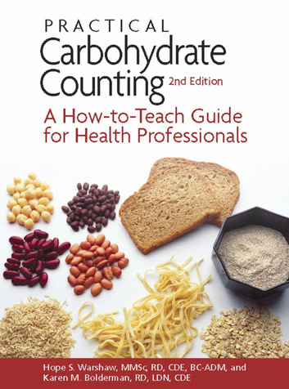

Tips for Carb Counting
Understanding and teaching carb counting:
Practice carb counting your own meals!
Keep foods in your office for practice
Encourage the PWD to bring in familiar foods into the office to practice with you
Encourage a “cheat sheet” with counts for regularly consumed foods

Slide 167


Tips for Carb Counting
Understanding and teaching carb counting:
Buy measuring cups/spoons at the dollar store
Watch/share online tutorials on fractions
Encourage a calculator for math
Encourage the PWD practice/record using food logs; review logs prior to moving on to more complicated topics like using an ICR
Encourage books, phone apps, and carb counting sheets for assistance

Slide 168
Tools for Carbohydrate Counting
Resources for carbohydrate counting:
Calorie King (book, website, smartphone app for iOS and Android – available in English & Spanish)
Diabetes Tracker (app $)
MyFitnessPal (smartphone application for iOS and Android)
UnderMyFork (app) Take photo of food to get nutrition info
Nutrition.gov (website)
Smart food scales

Slide 169
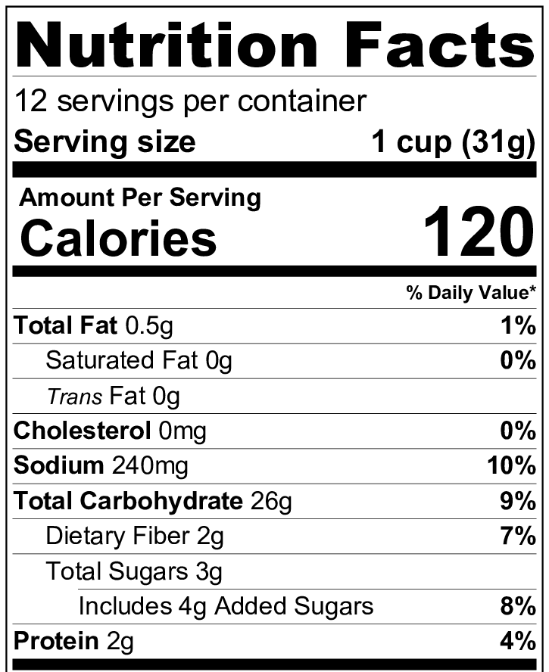
NOTE: The 1 cup measure as the serving size is for convenience only! All information provided by the Nutrition Facts label is based on the weight (the information in parentheses) of the food serving.
Notes:
Lets talk a minute about foods scales - food scales can be a great tool for someone with diabetes who carb counts.
For this label... (ADVANCE)
We have 26 grams carb (ADVANCE) in 1 cup of cereal.
The 1 cup measure at the top of the label is for convenience only.
The nutrition facts for a food are based on the weight of 1 serving of the food, which is found in parentheses next to that 1 cup measurement (in this case its 31g).
This can get tricky…think about when you first open the box of cereal when the pieces are whole vs at the very end, when the pieces are crumbled. You can fit a lot more of those crumbles into a measuring cup, and thus get a lot more carb in your 1 cup.
If a PWD is calculating an insulin dose based on that incorrect carb count, the dose is likely to be incorrect.
Another tricky point is counting the carbs in fruit or other foods without labels. How does one really count the carbs in those items, aside from memorizing a list of estimates? there can be a big difference between a small banana and a large banana.

Slide 170


Tools for Carbohydrate Counting
Smart food scales can be purchased to do the math
Kitrics Nutritional Scale
Perfect Portions Scale
Notes:
So without further ado, I want to introduce smart food scales.
These are so cool! ((Describe))
Available on Amazon and bed bath and beyond

Slide 171
Case Study: Patient L.J.
L.J. is a 43 year old female dx with T2DM 8 days ago
At dx, her PCP started her on the following medications:
Metformin: 1000 mg BID
Crestor: 10 mg per day
Amlodipine: 5 mg per day
Lab Work / Vitals at Dx
BMI | 29.6 kg/m²
A1C | 6.9%
Total Cholesterol | 198 mg/dL
LDL | 127 mg/dL
HDL | 36 mg/dL
Triglycerides | 207 mg/dL
BP | 148/90 mm Hg
Notes:
So that is some of the information on the various diets and techniques you can use to teach people with diabetes about healthy eating.

Slide 172
Case Study: Patient L.J.
Other important considerations:
Eager to making dietary changes; would really like guidance on what types of foods to eat more/less of
Has a family hx of CVD
Has a strong family support system
Enjoys a variety of foods, cooking with her family, and her husband’s favorite dishes are chicken mole and pollo verde
Would like to increase the nutritious foods in her children’s diet, as well.

Slide 173
DASH Eating Pattern
Addresses elevated blood pressure and other CV risk factors
Incorporates chicken, where plant-based eating would minimize fleshy foods

Slide 174
Case Study: Patient C.S.
C.S. is a 68 year old male dx with with T2DM 13 years ago
Current medications:
30u Lantus QHS
10u Novolog TID before B, L, D
1000 mg Metformin XR BID
Lipitor 20 mg/day
Lisinopril 10 mg/day
Other important considerations:
Low health numeracy
Has hypoglycemia unawareness
Lives alone
Most Recent Lab Work / Vitals
BMI | 35.2 kg/m²
A1C | 7.9%
Total Cholesterol | 176 mg/dL
LDL | 103 mg/dL
HDL | 49 mg/dL
Triglycerides | 122 mg/dL
BP | 128/82 mm Hg

Slide 175
C.S.’s Dietary Recall
Fasting BG | Breakfast Meal | 2 Hrs PP
102 | 2 eggs scrambled with ½ cup beans and fajita vegetables, ½ large banana, 1 cup milk | 172
- | 2 eggs, 4 pieces turkey bacon, 2 slices bacon, water | 58
117 | 1 cup cooked oatmeal, 1 large banana 1 cup milk, 1 hardboiled egg | 199
108 | Large Carmel Macchiato and breakfast sandwich | 257
130 | 1 cup granola, 1.5 cups milk | 223
- | 4 corn tortillas, 2 scrambled eggs w/ potatos, peppers, and onions | 200
140 | 1 large banana with peanut butter, water | 165

Slide 176
ADA’s Plate Method
Encourages consistent carbohydrate intake to help balance fixed insulin dosages
Balance carbohydrates with protein/veg
Simple and avoids complicated math

Slide 177
Cultural Humility
Cultural humility is a lifelong process of self-reflection and self-critique, whereby individuals continuously learn about and respect different cultures, recognizing and challenging their own biases, assumptions, and power imbalances. It involves approaching every cultural encounter with openness, humility, and a commitment to understanding the unique experiences and perspectives of others. Unlike cultural competence, which implies a mastery of knowledge about other cultures, cultural humility emphasizes the ongoing process of learning and the importance of building respectful, equitable relationships.
Notes:
The concept of cultural humility was developed by Dr. Melanie Tervalon and Dr. Jann Murray-García in 1998. They introduced it in their influential paper titled "Cultural Humility Versus Cultural Competence: A Critical Distinction in Defining Physician Training Outcomes in Multicultural Education." Their work emphasized the importance of a lifelong commitment to self-evaluation and self-critique, recognizing and addressing power imbalances, and developing mutually beneficial partnerships with communities. This concept has since been widely adopted in various fields, including healthcare, education, and social work, as a more dynamic and relational approach to cultural awareness and sensitivity.

Slide 178
Cultural Humility
“...eliminates the need for a complete mastery of every group’s health beliefs... because the patient, in the ideal scenario, is encouraged to communicate how little or how much culture has to do with that particular clinical encounter.”
Tervalon, M., & Murray-García, J. (1998). Cultural humility versus cultural competence: a critical distinction in defining physician training outcomes in multicultural education. Journal of Health Care for the Poor and Underserved, 9(2), 117–125.
Notes:
So today is all about Medical nutrition therapy.
Medical Nutrition Therapy (MNT) is nutrition based treatment for a condition. It should be evidence based. While MNT is typically provided by and can be billed for when provided by a dietitian, all diabetes care and education specialists must be ready to apply the principles of MNT when working with those who live with diabetes.

Slide 179
Cultural Humility in Practice
Your patient is the expert of themselves and their cultural identities
Prioritize listening, connecting, and learning
Respect your patient as an individual
Incorporate preferences, culture and boundaries
Always involved patient in decision making
Educate yourself on historical realities and injustices that shape today
Notes:
So today is all about Medical nutrition therapy.
Medical Nutrition Therapy (MNT) is nutrition based treatment for a condition. It should be evidence based. While MNT is typically provided by and can be billed for when provided by a dietitian, all diabetes care and education specialists must be ready to apply the principles of MNT when working with those who live with diabetes.

Slide 180
Resources for Professional Development
Diversify Dietetics - https://www.diversifydietetics.org/ddwebinars
EatWell Exchange
Culinary Nutrition Collaborative- Global Cuisine Series
BIPOC Eating Disorder Conference
Academy of Nutrition and Dietetics Member Interest Groups
National Organization of Blacks in Nutrition and Dietetics (NOBIDAN)
Latino and Hispanics in Nutrition and Dietetics (LAHIDAN)
Asian Americans and Pacific Islanders (AAPI)
Cultures of Gender and Age (COGA)
Disabilities MIG
Notes:
So today is all about Medical nutrition therapy.
Medical Nutrition Therapy (MNT) is nutrition based treatment for a condition. It should be evidence based. While MNT is typically provided by and can be billed for when provided by a dietitian, all diabetes care and education specialists must be ready to apply the principles of MNT when working with those who live with diabetes.

Slide 181
Social Determinants of Health (SDOH)
Understanding SDOH: Social determinants of health are the conditions in which people are born, grow, live, work, and age, which can significantly influence health outcomes.
Impact on Diabetes Management:
Food Access: Economic stability and neighborhood environments impact the availability and affordability of healthy food options.
Healthcare Access and Quality: Disparities in healthcare access and quality can lead to delayed diagnosis, inadequate treatment, and poor management of diabetes.
Education and Health Literacy: Patients with higher levels of education and health literacy are better equipped to manage their diabetes effectively.
Social Support Networks: Strong social connections can enhance self-care behaviors and provide emotional support for diabetes management.
Economic Stability: Financial resources affect a patient’s ability to afford medications, regular healthcare visits, and healthy foods, all of which are crucial for managing diabetes.
Notes:
Connecting SDOH to Patient Outcomes: Emphasize how SDOH directly affect patients' ability to follow MNT recommendations, adhere to medication, and access ongoing diabetes care.
Role of RDs and RNs: Discuss the importance of RDs and RNs recognizing and addressing SDOH when creating personalized MNT plans. Highlight the need to consider factors like food insecurity, transportation, and financial barriers when counseling patients.
Practical Strategies: Share strategies for incorporating SDOH into diabetes care, such as connecting patients with community resources, advocating for policy changes, and using culturally sensitive communication to better meet the needs of diverse populations.
Holistic Approach: Encourage viewing the patient as a whole, considering how their environment and social context influence their health behaviors and outcomes.

Slide 182

Food Insecurity

Slide 183

Food Insecurity: Defined
Unreliable availability of nutritious food and inability to consistently obtain nutritious food
Lack of consistent access to enough food for an active, healthy life
Notes:
Summary 1 in the the standards of care is about improving care and promoting health in populations. One of the areas they look at is food insecurity – they reference that between 2005-2014, over 18% of Americans reported food insecurity and that the rate is slightly higher in people with diabetes.
That’s a lot- it’s 1 in 5. So for many of us, we are going to be working with those that are food insecure.
Also of note, food insecurity is associated with lower engagement in the self-care behaviors and med use, depression, diabetes distress, and worse glycemic control relative to those who have food security. People are more at risk for both uncontrolled hyperglycemia (consumption of inexpensive carb desne foods, financial contraints with obtaining medication) and severe hypoglycemia (in those on insulin or sulfonyureas where carb intake is inconsistent)
You can assess the risk for food insecurity with this two item screening tool – ask the following questions….

Slide 184
Food Insecurity: Screening
Assess food insecurity with two questions:
“Within the past 12 months, we worried whether our food would run out before we got money to buy more.”
Within the past 12 months the food we bought just didn’t last, and we didn’t have the money to get more.”
Answers and their corresponding risk:
Never true: not at risk
Sometimes true: at risk
Often true: at risk
Notes:
Summary 1 in the the standards of care is about improving care and promoting health in populations. One of the areas they look at is food insecurity – they reference that between 2005-2014, over 18% of Americans reported food insecurity and that the rate is slightly higher in people with diabetes.
That’s a lot- it’s 1 in 5. So for many of us, we are going to be working with those that are food insecure.
Also of note, food insecurity is associated with lower engagement in the self-care behaviors and med use, depression, diabetes distress, and worse glycemic control relative to those who have food security. People are more at risk for both uncontrolled hyperglycemia (consumption of inexpensive carb desne foods, financial contraints with obtaining medication) and severe hypoglycemia (in those on insulin or sulfonyureas where carb intake is inconsistent)
You can assess the risk for food insecurity with this two item screening tool – ask the following questions….

Slide 185
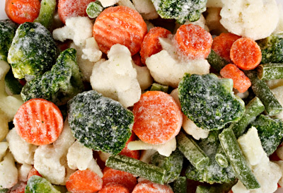
Food Insecurity: Providing Support
Refer to food programs when possible
Educate on:
Planning meals
Shopping with in season produce, frozen or canned fruits and vegetables, low-cost proteins (beans, peas, lentils, canned tuna, eggs), grains like brown rice and oatmeal are often more affordable
Remember: eating out is often more expensive than nutrient dense home prepped options!
This Photo by Unknown Author is licensed under CC BY-SA-NC
This Photo by Unknown Author is licensed under CC BY-NC-ND
Notes:
Remember that healthy eating doesn’t need to be expensive, and it is often cheaper when done at home compared to eating out:
Frozen or canned fruits and vegetables – on canned items you can teach people to look for those with less added sugar/sodium and also teach them to rinse
Low-cost proteins include beans, peas, lentils, canned tuna, eggs
Grains like brown rice and oatmeal are often more affordable

Slide 186
Healthy Eating on a Budget
Breakfast at Home
Bottle of water (16 oz) $0.21
2 eggs $0.45
½ banana $0.13
½ cup dry oatmeal $0.18
Total $0.97
Fast Food Breakfast
Sausage Egg Sandwich $5.15
Hash brown $3.01
Orange Juice $2.75
Total $10.91

Slide 187
Healthy Eating on a Budget – How would you approach this?
A 21-year-old Latino/Latinx college student is newly diagnosed with type 2 diabetes. Mom had GDM. Since leaving home and living in an apartment with roommates, they have been eating more fast foods and processed foods because they are “cheaper”.
Their A1C is 9.3%, BMI 29.3 and LDL is 119 mg/dL. BP is 118/76.
What questions would you ask regarding nutrition and health?
What would be the end goal of this visit?

Slide 188
Stand up & Stretch!

Slide 189

Activity, Movement, & Exercise

Slide 190

Types & Benefits of Exercise
Aerobic, Resistance Training, and Flexibility

Slide 191
Types of Exercise: Aerobic Activity
Aerobic, also called “Cardio”
Repeated/continuous movement of the same large muscle groups
Typically have the greatest acute impact on BG
Examples: walking, biking, dancing, swimming
Studies show benefit of walking 10,000 steps a day
2,000 steps = 1 mile
Notes:
Aerobic or cardio is continuous, dynamic exercise that uses large muscle groups and requires aerobic metabolic pathway to get energy.
Typically these types of activity have the greatest acute impact on BG.
It is the more traditionally prescribed activity for people with diabetes.
Examples: walking, biking, dancing, swimming
The recommended type of aerobic activity should be largely based on preference, and safety should also be considered

Slide 192

Impact of Aerobic Activity on DM
BG improves for 2-72 hours after aerobic activity; thus need to do it regularly to maintain improved BGs
Postprandial exercise can prevent/reduce the rise in BG levels that occurs after eating
Notes:
BG improves for 2-72 hours after aerobic activity; thus need to do it regularly to maintain improved BGs
Cardiovascular exercise after eating can lower the rise in BG levels that occurs after eating
For those on insulin:
Aerobic exercise will decrease insulin requirements, and so balancing insulin/food may become difficult. The risk for hypo may increase.

Slide 193

Types of Exercise: Resistance Training
Use of muscular strength to move a weight or work against a resistive load
Increases strength, endurance, and overall calories burned in a day
Example: weightlifting, sprinting
Notes:
Resistance training is also important - It increases strength, endurance, and burns calories.
It can also hep to maintain independence in performing the daily activities of living and reduce the possibility of injury.

Slide 194

Impact of Resistance Training on DM
Resistance training may improve glycemic levels more than aerobic activity in T2D
Best results come from mix of resistance and aerobic
Results are less clear for individuals with T1D
Notes:
Resistance training may improve glycemic levels more than aerobic activity in T2D
Best results come from mix of resistance and aerobic training.
Before starting resistance training, it is advised that individuals receive instruction on proper technique to ensure exercise is done safely.

Slide 195
Impact of Resistance Training on DM
Resistance exercise may weaken the exercise related decrease in BGs during and after exercise
In T1D: complete resistance training 1st, aerobic training 2nd to ↑ glycemic stability ↓ post exercise hypo
Key for older adults for maintaining independence
Improved strength/balance reduces fall risk
Increases mobility
Notes:
Other benefits of resistance training:
Are that it is key for older adults for maintaining independence
Improved strength/balance reduces fall risk
Increases mobility
Resistance training may weaken the exercise related decrease in BGs during and after exercise
So, thinking about our special populations:
In T1D or those on insulin try complete resistance training 1st, aerobic training 2nd to improve glycemic stability and decrease post exercise hypo

Slide 196

Types of Exercise: Flexibility
Flexibility (stretching / postural):
The ability to move a joint through complete range of motion
Examples: Yoga, tai chi, or other with balance, agility, coordination
Notes:
And then we have flexibility training, which helps to support movement through a more complete range of motion

Slide 197

Impact of Flexibility Training on DM
Benefits less established than other exercise types
Yoga and tai chi may improve glucose and lipid levels, body comp, neuropathic symptoms, and quality of life
May help prevent falls
Minimal precautions needed with this type of activity
Notes:
The benefits of flexibility training are less established than other exercise types
The good news is that minimal precautions needed with this type of activity – so these can be used by individuals of all skill levels and ages.
Flexibility programs may provide introduction to a more physically active life for those who are deconditioned

Slide 198

Sedentary Time: The benefit of Reducing It
Long-periods of sedentary activity (regardless of physical activity) may be associated with the onset of T2D.
Encourage breaks in sedentary activity every 30 minutes
Small increases in activity may reduce mortality from all causes and improve insulin resistance/BG, BP, and BMI
Notes:
Long-periods of sedentary activity (regardless of physical activity) may be associated with the onset of T2D.
When working with clients, try to encourage breaks in sedentary activity every 30 minutes - it may ↓ postprandial glucose and insulin levels
I think this is so powerful….. Break up TV at commercial breaks, I have been trying to do a pushup between every client that I see, etc.
Small increases in activity may reduce mortality from all causes and improve insulin resistance/BG, BP, and BMI

Slide 199

Exercise Goals for Various Populations
Children, Adults, and Older Adults
Notes:
So now that we reviewed the types of exercise, lets touch on the goals for activity for various populations

Slide 200

Exercise: All Children
Exercise Goals:
Aerobic: 60 minutes of moderate to vigorous-intensity activity daily
Resistance training: at least 3 days/week
Other considerations if using insulin
Due to risk of hypo, advise frequent glucose monitoring before, during, and after. Use CGM when possible
Educate on targets, management of blood sugars including hypo
Notes:
For kiddos,
The goal is to reach 60 minutes of moderate or higher intensity activity each day
And resistance training several times per week.

Slide 201
Exercise: Children with T1DM
If using insulin, educate on strategies to prevent hypo before, during, and after exercise. Consider:
Lowering meal or snack time insulin before exercise
Reducing basal insulin
Increasing carb intake
Eating a bedtime snack
Some of these recommendations may be helpful for kids with T2DM on insulin, as well.
Notes:
If you have a client using insulin, educate on strategies to prevent hypo before, during, and after exercise. Consider:
- Lowering meal or snack time insulin before exercise
- Reducing other insulin doses – because of how long the impact of exercise can last.
- Increasing carb intake
- Eating a bedtime snack

Slide 202
Exercise: Adults with Prediabetes
Exercise Goals:
Increase moderate-intensity physical activity to at least 150 minutes/week
Example: brisk walking
May include resistance training
Break-up sedentary time
Achieving the behavioral goal of 150 minutes of physical activity per week reduces the incidence of type 2 diabetes by 44% (even w/o weight loss!)
Notes:
Exercise Goals for adults with prediabetes.
- Increase moderate-intensity physical activity to at least 150 minutes/week
Example: brisk walking
May include resistance training
Break-up sedentary time – this is associated with moderately lower postprandial glucose levels
Although weight loss is the most important factor to reduce the risk of incident diabetes, in the DPP we saw that achieving the behavioral goal of 150 minutes of physical activity per week reduced the incidence of type 2 diabetes dramatically, even without weight loss.

Slide 203
Exercise: Adults with T1 or T2 Diabetes
Exercise Goals:
Aerobic: ≥150 minutes/week of moderate to vigorous-intensity activity
Tips: spread over 3 or more days/week with no more than 2 consecutive days w/o activity
For those who achieve weight loss goals, long-term maintenance is supported by 200-300 minutes/week
Resistance exercise: 2-3 sessions/week on nonconsecutive days
Notes:
Recommendations For Adults with diabetes
A minimum of 150-300 min/wk. at moderate intensity
Federal guidelines state that it’s ok to get all the recommended aerobic exercise in one day (“weekend warrior”). This is for the general population.
For the person with diabetes, more benefit is obtained if exercise is spaced throughout the week. For people with diabetes, recommendation is to not go more than 2 consecutive days without aerobic activity because of the transient nature of improvements in insulin sensitivity that occur with aerobic exercise…
___________________
2022 standard
S67
S198

Slide 204
Exercise: Adults with T1 or T2 Diabetes
Exercise Goals:
Sedentary Time: All adults, particularly those with T2DM, should reduce sedentary time
Interrupt sitting every 30 minutes
Flexibility and balance training: recommended 2-3x per week for older adults
Notes:
Also in adults with diabetes…
Remember to aim to reduce sedentary time by interrupting sitting
Flexibility training is also recommended for older adults.

Slide 205

Thank You – Questions?
Thanks for joining us!
Questions?
Info@diabetesed.net
Call us at 530-893-8635
www.DiabetesEd.net

