Slide 1

All Voices Matter – Providing Collaborative Diabetes Care
Beverly Thomassian, RN, MPH, BC-ADM, CDCES
Founder - www.DiabetesEd.net

Slide 2


Coach Bev has no Conflict of Interest
She’s not on any speaker's bureau
Does not invest or have any financial relationships with diabetes related companies.
Gathers information from reading package inserts, research and articles
The ADA Standards of Medical Care is main resource for course content

Slide 3

All Voices Matter – Providing Collaborative Care
Topics include:
Latest ADA Goals of Diabetes Care,
Identifying barriers to diabetes self-management
Incorporating communication approaches that work
Taking a strength-based approach.

Slide 4

CDC Announces
35% of Americans will have Diabetes by 2050
Boyle, Thompson, Barker, Williamson
2010, Oct 22:8(1)29
www.pophealthmetrics.com

Slide 5

Poll Question 1
According to the CDC, what best describes the current prevalence of prediabetes and diabetes in the U.S.?
30% of people above the age of 20 have type 2 diabetes.
The rate of type 1 and type 2 diabetes have tripled since 2010.
A total of 50% of people have prediabetes or diabetes.
1 out of 2 persons above age 20 have prediabetes.

Slide 6
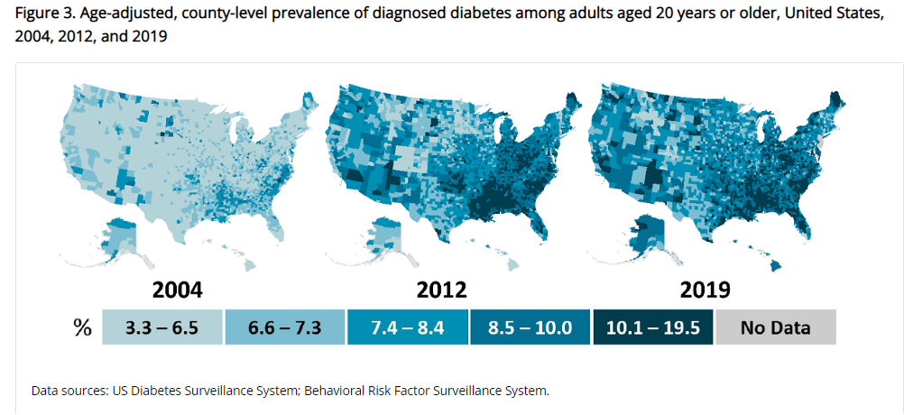
Type 2 Diabetes in America 2024
11.3% with Diabetes - 37 million adults
23% don’t know they have it
38% with Prediabetes – 96 million adults
Centers for Disease Control and Prevention. National Diabetes Stats Report https://www.cdc.gov/diabetes/data/statistics-report/index.html. Accessed 1/23

Slide 7
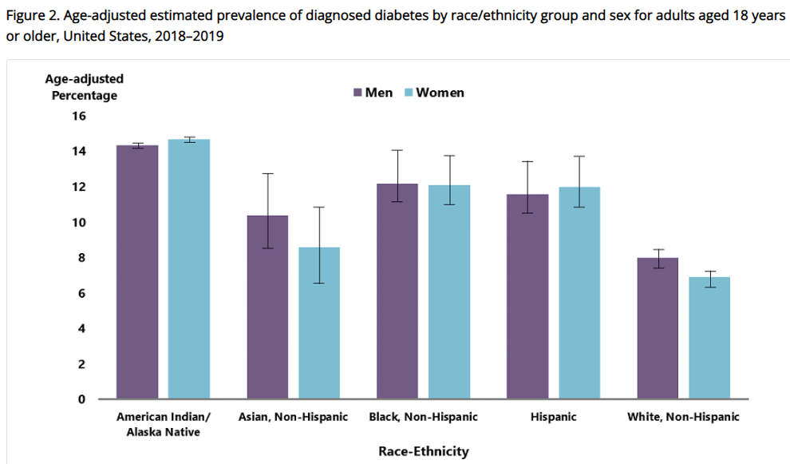
Diabetes Prevalence by Ethnic Group
For adults, diabetes prevalence highest among:
American Indians and Alaska Natives (14.5%),
Non-Hispanic Blacks (12.1%),
People of Hispanic origin (11.8%),
Non-Hispanic Asians (9.5%)
www.cdc.gov/diabetes/data/statistics-report/diagnosed-diabetes.html

Slide 8

Social Determinants of Health
The conditions in which people:
Play
Live
Work
Learn
Pray
Directly affects their health risks and outcome AADE Population Health & Diabetes Educators Evolving Role 2019

Slide 9


Now, let’s get to the Nitty Gritty

Slide 10


Notes:
Measurement of C-peptide is preferable to the measurement of insulin as it has a longer half-life, not subjected to the first-pass hepatic metabolism, and a steady-state clearance from the circulation. Insulin undergoes first-pass hepatic metabolism, has variable clearance, a much shorter half-life, and exogenously administered insulin can confound results.

Slide 11
Hormones Effect on Glucose
Effect



⇒
⇒
⇒
Hormone
Glucagon (pancreas)
Stress hormones (kidney)
Epinephrine (kidney)
Insulin (pancreas)
Amylin (pancreas)
Gut hormones - incretins (GLP-1) released by L cells of intestinal mucosa, beta cell has receptors)

Slide 12


Pre Diabetes & Type 2- Screening Guidelines (ADA 2024 Clinical Practice Guidelines)
Start screening all people at age 35.
Screen at any age if BMI ≥ 25 (Asians BMI ≥ 23) plus one or > additional risk factor:
First-degree relative w/ diabetes
Member of a high-risk ethnic population
Habitual physical inactivity
*PreDiabetes
History of heart disease
*Taking high risk meds; antiretrovirals, 2nd generation antipsychotics or steroids
History of pancreatitis

Slide 13

Diabetes 2 - Who is at Risk? (ADA 2024 Clinical Practice Guidelines)
Risk factors cont’d
HTN - BP > 130/80
HDL < 35 or triglycerides > 250
History of Gestational Diabetes Mellitus
Polycystic ovary syndrome (PCOS)
Other conditions associated w/ insulin resistance:
Elevated BMI, acanthosis nigricans (AN)
Screen using A1C, Fasting Blood Glucose or OGTT.
Repeat screening at least every 3 years if negative.
*If prediabetes or on high risk meds, recheck yearly

Slide 14

Poll Question 2
Which of the following level is considered pre-diabetes range?
a. Fasting BG of 62
b. A1c of 5.9 %
c. After meal BG of 137
d. A1c of 7.1 %

Slide 15
Natural History of Diabetes
Healthy
FBG <100
Random <140
A1c <5.7%
Prediabetes
FBG 100-125
Random 140 - 199
A1c ~ 5.7- 6.4%
~ 50% working pancreas
Diabetes
FBG 126 +
Random 200 +
A1c 6.5% or +
~ 20% working pancreas
Yes!
NO
Development of type 2 diabetes happens over years or decades

Slide 16


PreDiabetes is FREAKING ME OUT
96 million people in US
80% don’t know they have it
In 3-5 years, about 30% of predm will get diabetes
Associated with higher rates of heart attack, stroke, neuropathy and vessel disease

Slide 17

Financial Advisor
Mid 30s, friendly, he smiles to greet you and you notice his gums are inflamed. You’d guess a BMI of 26 or so, with most of the extra weight in the waist area.
If you could give him some health related suggestions, what would they be?

Slide 18


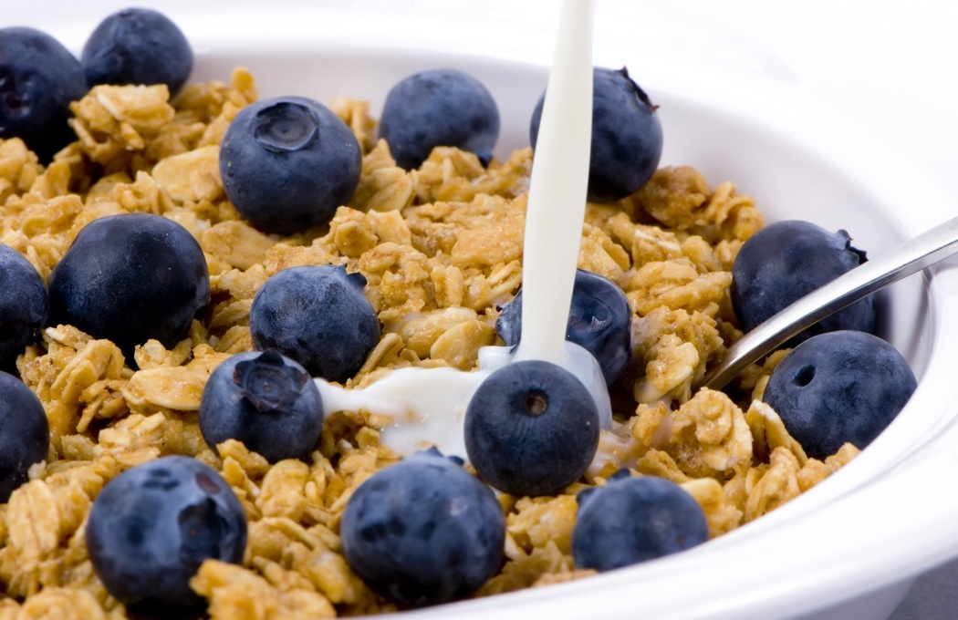


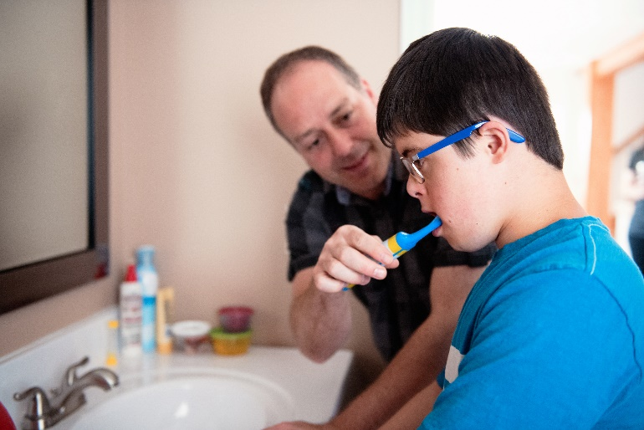
Preventing Pre Diabetes and Diabetes

Slide 19

Ominous Octet
Decreased satiation neuro-
transmission
Decreased amylin, β-cell secretion
80% loss at dx
Increased renal glucose reabsorption
Decreased Gut hormones
Increased glucagon secretion
G
I
G
I
G
G
I
I
G
G
Increased lipolysis
G
I
I
G
G
I
Increase glucose
production
I
G
G
Decreased glucose
uptake
Notes:
19
19

Slide 20

What is Type 2 Diabetes?
Complex metabolic disorder ….
(Insulin resistance and deficiency)
with social, behavioral and environmental risk factors unmasking the effects of genetic susceptibility.
New Diagnosis? Call 800 – DIABETES to request “Getting Started Kit”
www.Diabetes.org

Slide 21

ABC’s of Diabetes
A1c less than 7% (individualize)
Pre-meal BG 80-130
Post meal BG <180
AGP - Time in Range (70-180) 70% of time
Blood Pressure < 130/80
Cholesterol
Statin therapy based on age & risk status
If 40+ with ASCVD Risk, decrease 50%, LDL <70
If 40+ with ASCVD, decrease 50%, LDL <55

Slide 22
6. Glycemic Targets Individualize Targets – ADA
Pre-Prandial BG 80- 130
1-2 hr post prandial < than 180
*for nonpregnant adults
Time in Range: 70%
BG of 70-180 mg/dL

Slide 23

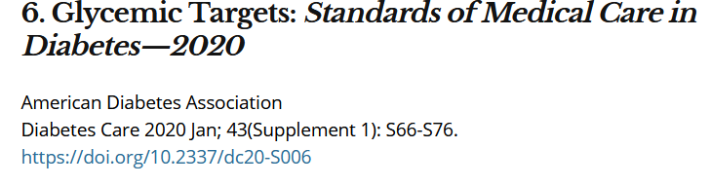
A1c and Estimated Avg Glucose (eAG)
A1c (%) eAG__
5 97 (76-120)
6 126 (100-152)
7 154 (123-185)
8 183 (147-217)
9 212 (170 -249)
10 240 (193-282)
11 269 (217-314)
12 298 (240-347)
eAG = 28.7 x A1c-46.7 ~ 29 pts per 1%
Translating the A1c Assay Into eAG – ADAG Study

Slide 24


Slide 25
Diabetes Bingo “DiaBingo” Shout out Right Answer

Slide 26
DiaBingo- G
G ADA goal for A1c is less than ____%
G People with DM need to see their provider at least every month
G Blood pressure goal is less than
G People with DM should see eye doctor (ophthalmologist) at least
G The goal for triglyceride level is less than
G Goal for LDL cholesterol for people with diabetes is less than ___
G The goal for blood sugars 1-2 hours after a meal is less than:
G People with DM should get this shot every year
G People with DM need to get urine tested yearly for ___________
G Periodontal disease indicates increased risk for heart disease
G The goal for blood sugar levels before meals is:
G The activity goal is to do ___ minutes on most days

Slide 27

Diabetes is Complex
Goal – achieve well being and negotiated outcomes
Psychological factors:
Environmental
Social
Behavioral
Emotional
Keep it person centered while integrating care into daily life
Consider the individual

Slide 28

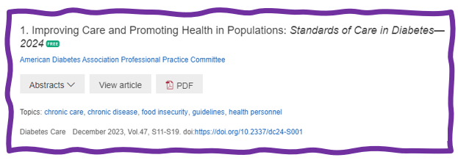
Status of Diabetes Care
In 2015–2018, U.S. community-dwelling adults with diabetes achieved:
A1C <7% by 50.5%
75.4% achieved A1C <8%.
BP target of <130/80 achieved by 47.7%
70.4% achieved blood pressure <140/90 mmHg.
Lipid control (non-HDL cholesterol) <130 mg/dL, achieved by 55.7%
22.2% met targets for all three risk factors
Many not receiving adequate lifestyle or pharmacotherapy.

Slide 29
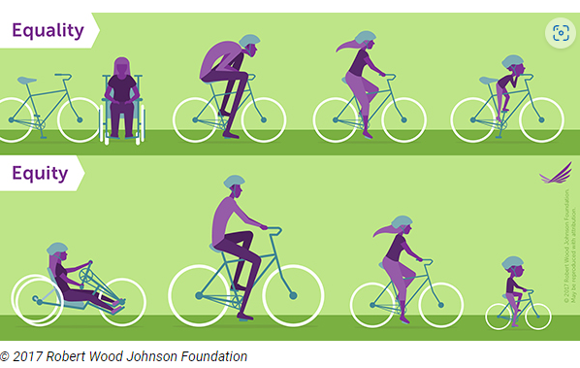
Equality vs Equity
Design and deliver diabetes care with goal of health equity across all populations.
https://coveragetoolkit.org/health-equity/defining-health-equity/

Slide 30
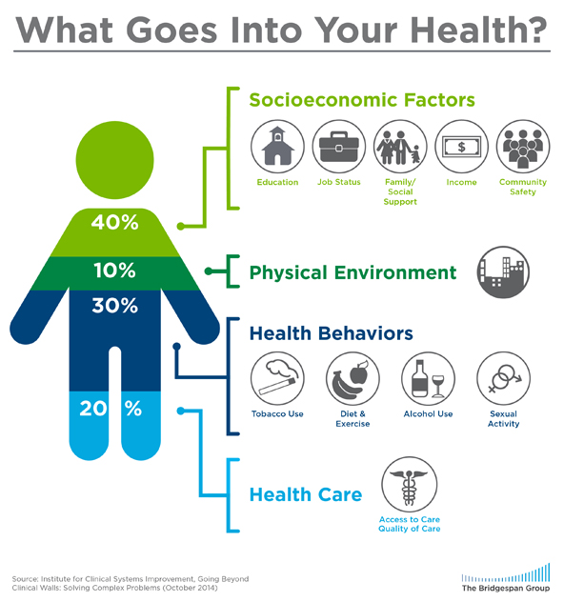

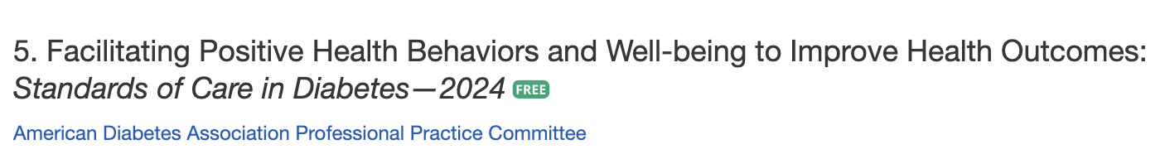
Address Barriers to Self Management
Design and deliver DSMES with ultimate goal of health equity across all populations.
Barriers exist within health system, payer, health care professional & individual.
Address barriers through innovation, including community health workers, telehealth, other digital health solutions.
Consider social determinants of health in the target population when designing care.
This Photo by Unknown Author is licensed under CC
BY
Notes:
Access and health equity is the ultimate goal when designing and delivering DSMES.
Creating culturally appropriate and varied modalities of settings has been shown to improve outcomes.
We know barriers to care exist at every level from the health system to individual.
However we can address these barriers by working to educate participants and health care providers on the critical times when DSMES is needed.
We can work with health systems and clinics to develop population health screening and clinical outreach,
create protocols to reduce time for referral and
collaborate health and community systems to address social needs.
We can include other health partners including community health workers to support delivery of diabetes peer support.
Barriers can be also be addressed by developing a diversity of delivery models.
From traditional inperson classrooms to community-based strategies and technology enabled solutions including telehealth or virtual environments varying modes can serve different needs.

Slide 31

Tailoring Treatment for Social Context
“Social determinants of health (SDOH)—often out of direct control of the individual and potentially representing lifelong risk—contribute to health care and psychosocial outcomes and must be addressed to improve all health outcomes”
The ADA recognizes this relationship and is taking action.

Slide 32
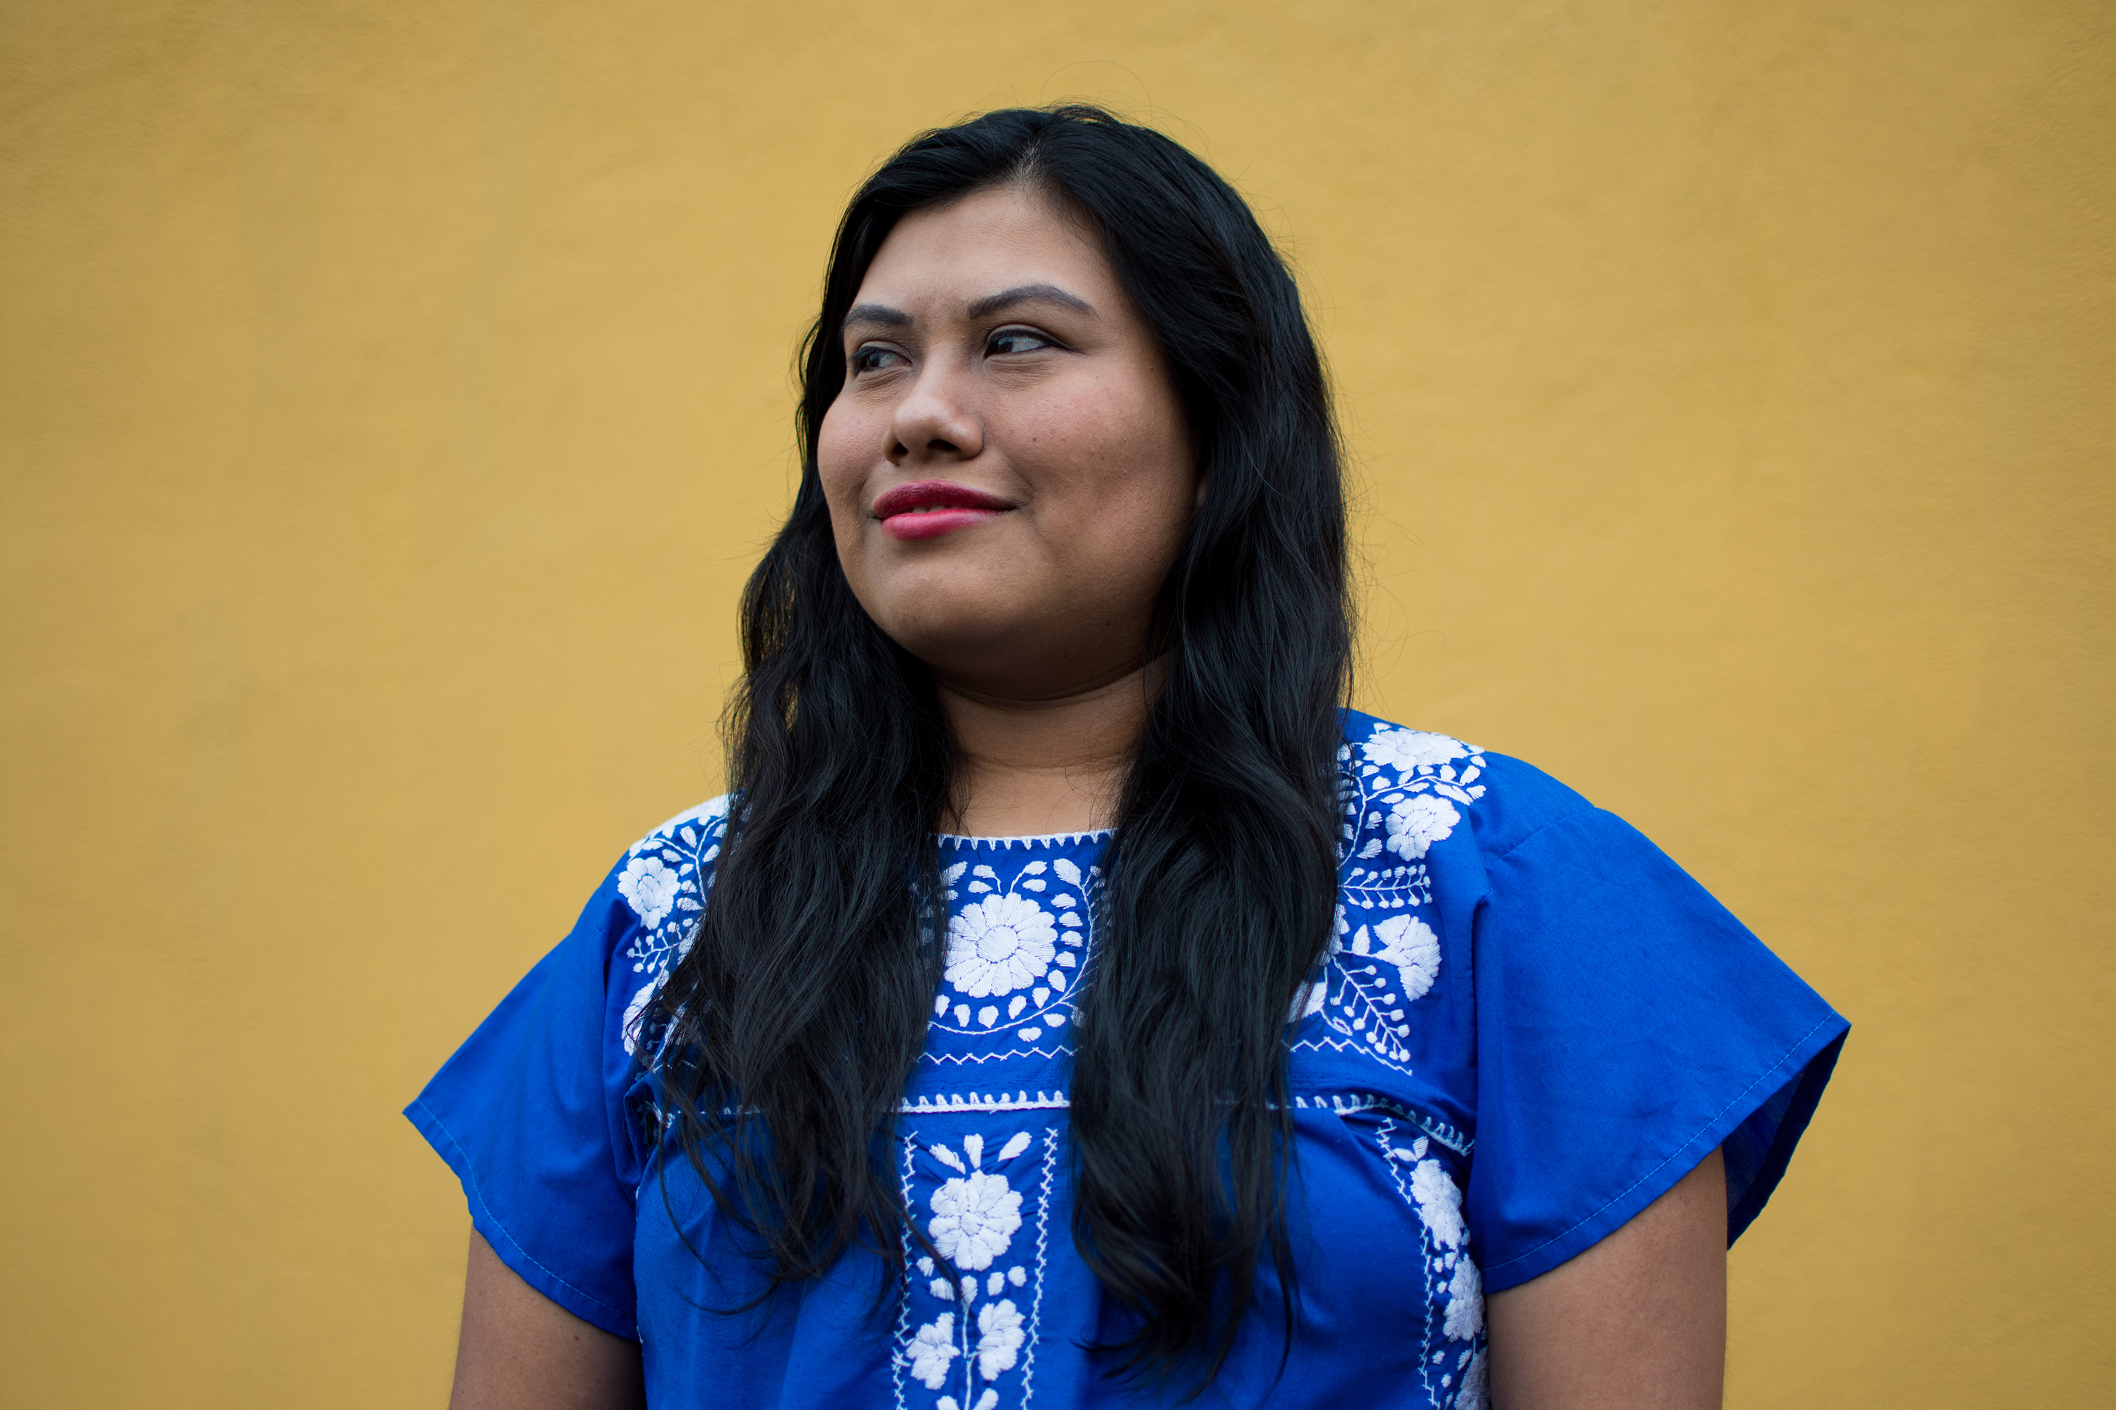
Person Centered Care
Emphasize that a collaboratively developed plan improves well-being and outcomes.
Provides care that is respectful and responsive to the individuals preferences, needs and values.
Ensuring that the person’s values guide all clinical decisions
Recognizes the expert within.
Goal is to improve outcomes and encourage self-management for the long run.

Slide 33
What does a collaborative practice look like?
Ind
CDCES, BC-ADM
RDN
Nurse
Pharm D
MD, PA, NP
MA, NA, CHW
Starts with the simple act of LISTENING.

Slide 34


Look Beyond Diabetes
ACE – Adverse Childhood Experiences
Diabetes Distress
Cultural traditions, family system.
Social, religious and employment influences
Personal factors: attitudes, cognitive factors, literacy, learning styles, health beliefs
Depression, anxiety
Mental illness
Addiction issues

Slide 35
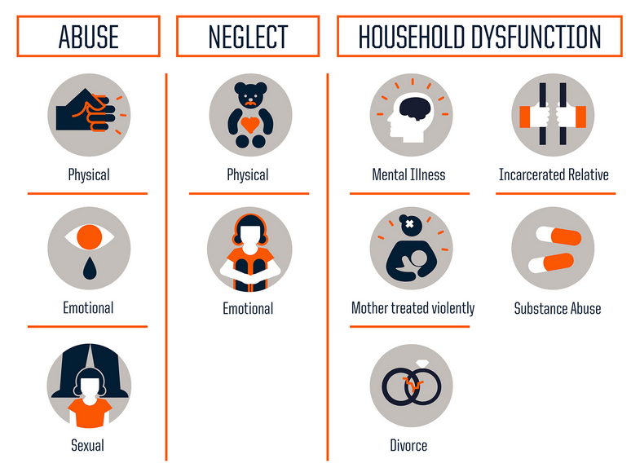
10 Assessment Areas for ACE – Use 10 Question Screening Tool to Assess
https://www.npr.org/sections/health-shots/2015/03/02/387007941/take-the-ace-quiz-and-learn-what-it-does-and-doesnt-mean

Slide 36
ACE increases risk for 9 out of 10 leading causes of death in US
Odds Ratio with ≥ 4 ACEs
Leading Cause of Death
Heart Disease
Stroke
Diabetes
Kidney Disease
Cancer
Alzheimer’s
Suicide(attempts)
2.1
2.0
1.4
1.7
2.3
4.2
37.5
https://www.cdc.gov/vitalsigns/aces/index.html

Slide 37
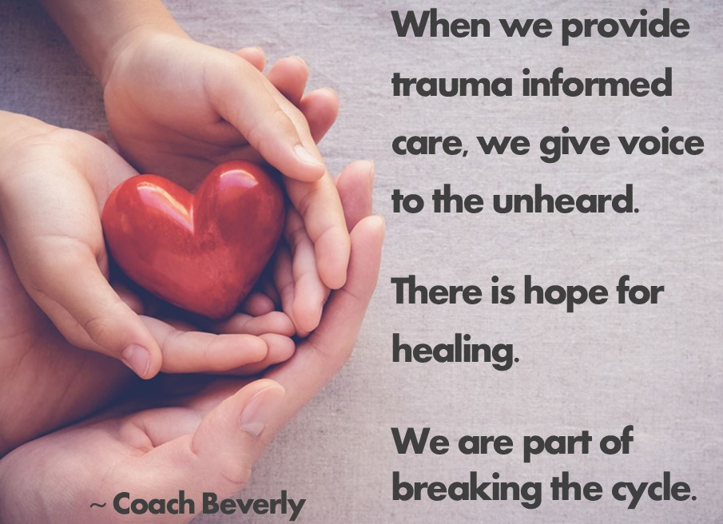
The Act of Recognition is Healing

Slide 38

Address and Assess for Diabetes Distress
Diabetes distress (also known as “diabetes-specific distress” or “diabetes-related distress”) is the emotional response to living with diabetes, the burden of relentless, daily self-management, and (the prospect of) its long- term complications.
The ADA created a wonderful resource, the ADA Behavioral Health Toolkit, which houses diabetes distress and other screening tools for easy reference.

Slide 39
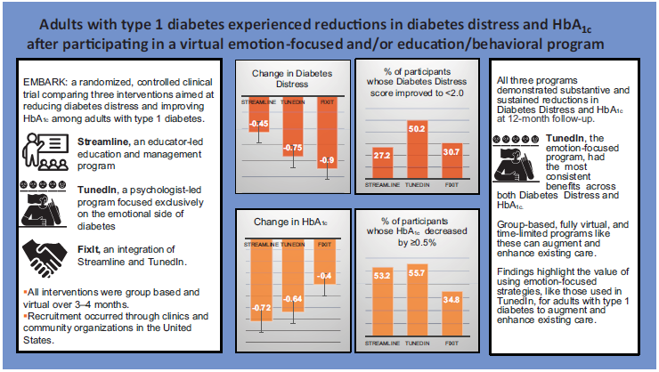
Embark Trial
EMBARK: A Randomized, Controlled Trial Comparing Three Approaches to Reducing Diabetes Distress and Improving HbA_{1c} in Adults With Type 1 Diabetes. Diabetes Care 2024; dc232452. https://doi.org/10.2337/dc23-2452

Slide 40

Impact of Embark Trial
The year I spent coaching study participants in the Embark Trial significantly changed my approach to diabetes self-management coaching.
~ Coach Beverly

Slide 41

Embark Trial Takeaways
Currently, diabetes education and management focuses on fostering self-management change.
This strategy assumes that people will become less distressed as they engage more effectively with their management.
Need a Shift - Make emotional considerations our priority.
The key to improving glycemic outcomes is to directly address the feelings, beliefs, and expectations that underlie diabetes distress and serve as barriers to management change.

Slide 42

Releasing the Brake
This strategy recognizes that diabetes distress acts as a brake on the application of existing diabetes knowledge and skills.
By releasing the diabetes distress brake through emotion-focused intervention, the negative cycle can be efficiently ended.

Slide 43

Embark Trial Takeaways
Better outcomes when using an integrated approach that combines an education and management with a diabetes distress emotion-centered approach.
Creating a Judgment Free Zone

Slide 44

Let’s meet people where they are at.

Slide 45
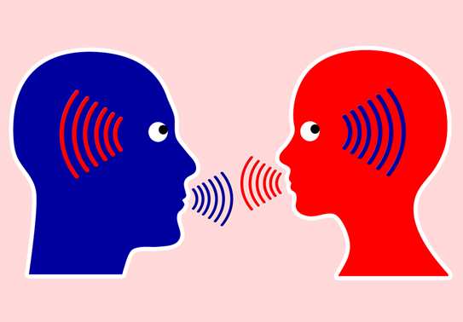
Conversational Tools You Can Use To Address DD In Your Practice
The goal is to help the PWD label, verbalize, share, consider, and evaluate these frequently unaddressed and often hidden feelings and thoughts about diabetes.
Building the relationship with conversational skills is the intervention!
Used with permission from ReVive 5 Program; Larry Fisher, PhD & Susan Guzman, PhD

Slide 46

Relationship Building │ Three Tools To Make It Happen
Relationship Building
1. Open-Ended Questions
2. Active Listening
3. Clinician Engagement Skills
Used with permission from ReVive 5 Program; Larry Fisher, PhD & Susan Guzman, PhD

Slide 47
Tools │ #1. Open-Ended Questions
What are closed-ended questions?
Answers have to do with short, fixed responses (that then require a clinician to then ask the next question).
Examples of closed-ended questions:
- What kind of exercise do you like to do? “Walk!”
- How often do you walk? “3-times a week.”
- How often do you check your BG?
“Five times a day.”
Closed-ended questions do not help address DD.
Used with permission from ReVive 5 Program; Larry Fisher, PhD & Susan Guzman, PhD

Slide 48
Tools │ #1. Open-Ended Questions
What are open-ended questions?
Questions that ask “how, what, why.”
They require a more detailed response.
Examples:
“How do you respond when you go low?”
“What worries you the most about your diabetes?”
“What sense do you make of these BG numbers?”
“Why do you think that you are having trouble lowering your BG levels? What might be going on?”
Open-ended questions sometimes make clinicians nervous(never know what the response might be) –but they open the door to a more effective clinical conversation.
Used with permission from ReVive 5 Program; Larry Fisher, PhD & Susan Guzman, PhD

Slide 49
Tools │#2. Active Listening
What is “active listening?”
Listen attentively – talk much less (< 50%).
Alter tone and pace of speech (tolerate silences).
Attend to the position of HCP and PWD in the room.
Maintain eye contact (engage physically).
Prevent computer, charts, papers, from distracting.
Create an atmosphere of engaged, empathetic, and attentive listening.
Used with permission from ReVive 5 Program; Larry Fisher, PhD & Susan Guzman, PhD

Slide 50
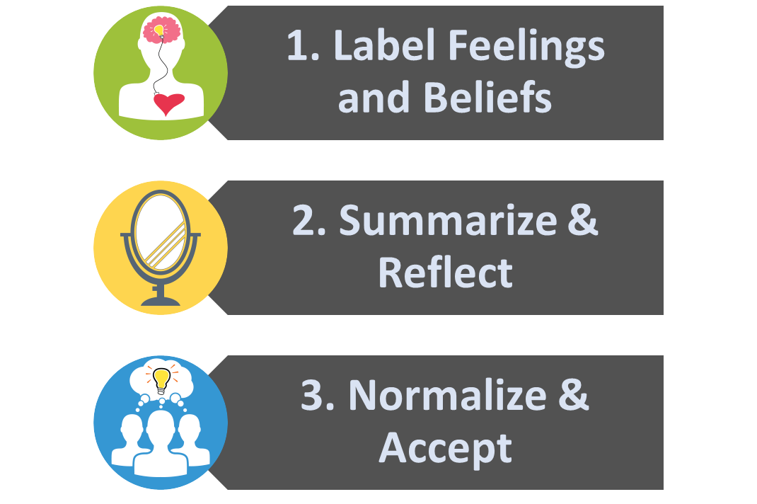
Tools │#3. Clinical Engagement Skills
Based on MI, empowerment, autonomy support:
Used with permission from ReVive 5 Program; Larry Fisher, PhD & Susan Guzman, PhD

Slide 51
Clinical Engagement Tools: Label & Address Feelings
Many people are unaware of what they feel.
Many feel many things at the same time – hard to separate and label each (anger and self-blame).
Many are ashamed or embarrassed about what they feel – “I shouldn’t feel this way.”
Listen carefully for underlying feelings throughout the conversation.
Used with permission from ReVive 5 Program; Larry Fisher, PhD & Susan Guzman, PhD

Slide 52

Clinical Engagement Tools: Label & Address Feelings
Common feeling words:
Sad
Frustrated
Scared/fearful
Disappointed
Angry
Hopeless
Defeated
Ashamed/embarrassed
Burned out
Used with permission from ReVive 5 Program; Larry Fisher, PhD & Susan Guzman, PhD

Slide 53

Embark Trial – Emotions as Priority
I have finally given myself permission to make addressing the emotional aspects of diabetes a priority.
~Coach Beverly

Slide 54
Create a Judgement Free Zone – Roll out the Carpet of Acceptance
There are no bad or good blood glucose numbers.
There is no cheating.
You are not failing at your diabetes.
It is not your fault you have diabetes.
Thank you for showing up today.
Notes:
Judgement Free Zone
Creating a judgment-free zone during diabetes coaching and education sessions lays the groundwork to make meaningful connections. This “safety zone” provides individuals with a place to share their truth and have someone acknowledge and recognize what they are going through. It also helps to identify areas of distress and collaborate on problem-solving. Setting a judgment-free zone also opens the door to more fruitful conversation when gathering groups together in person or virtually. To create this environment, the facilitators need to establish the ground rules. For example, the facilitator might say, “There are no good or bad blood sugars or good or bad foods. If a person is stressed out and eats a donut, they are not cheating; they are choosing to have a donut. If people have blood glucose levels out of range, they are not failing; they need support and help with problem-solving based on their lived experiences.” If someone uses judgmental terms during the session, the educator gently reminds them that this is a judgment-free zone and encourages them to rephrase it.

Slide 55
JR and Donut Fridays
You are reviewing JR’s ambulatory glucose profile and it is over 70% time in range. JR usually takes bolus insulin before each meal and basal insulin at night. However, you notice that once a week on Fridays, JR’s blood glucose levels are above target between 2-5pm.
When you bring this Friday glucose elevation to JR’s attention, they tell you it’s because the boss always brings in donuts after lunch on Fridays to celebrate everyone’s hard work. JR asks you about strategies to address this time above target. What is the wise approach?
Have you considered eating a piece of fruit instead?
w that you appreciate the gesture, but your diabetes doesn’t allow for this treat.
Would you consider giving a little extra bolus insulin and enjoying the donut?
Would you be willing to bring in a special low carb treat for everyone to enjoy?

Slide 56

Informed vs Wise Decisions
Informed:
I know that tomatoes are a fruit.
Wise
I know not to put tomatoes in my fruit salad.

Slide 57
WISE For Life
Wise choices consider and recognize the individual’s values, preferences, needs, and wants.
For example, if a person tells you, “I am going to cut out carbs to get my blood sugars under target,” we would acknowledge that this might be an informed choice.
“Yes, cutting out carbs will likely lower your blood sugars, but is it a “WISE” choice?”
Does it match their values, preferences, needs, and wants? Or would cutting out carbs significantly decrease their life’s pleasure and joy?
Notes:
Of course, the ultimate decision is up to the individual, but it is worth helping them explore and consider their choices out loud. After all, diabetes lasts a lifetime, and we want to support daily quality of life while reducing the risk of complications.

Slide 58

Take a Strength Based Approach
Individuals asked to take active role in directing the day-to-day planning, monitoring, evaluation and problem-solving.
Need to eval perceptions about their own ability and self-efficacy to manage diabetes
Explore past situations where they have had past success
Use strength-based language

Slide 59

Thank You – Questions?
Thanks for joining us!
Questions?
Info@diabetesed.net
Contact us at 530-893-8635
www.DiabetesEd.net

