Slide 1


2024 ADA Standards of Care Update - Back to the Basics and Beyond 2024
QR Code for Handouts PDF & Resources
Beverly Thomassian, RN, MPH, BC-ADM, CDCES
Founder - www.DiabetesEd.net

Slide 2

Hawaii ADCES Coordinating Body
Hawaii Chapter President Naomi Fukuda, APRN, BC-ADM, CDCES
Camlyn Masuda, PharmD, CDCES, BCACP

Slide 3
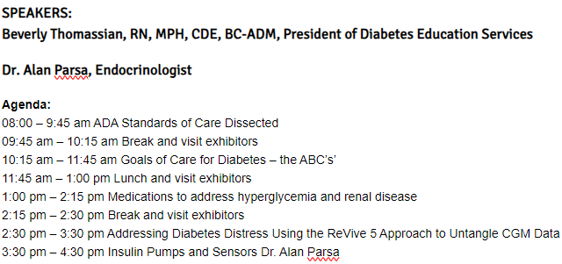
Speakers & Agenda

Slide 4
Coach Bev has no Conflict of Interest
She’s not on any speaker's bureau
Does not invest or have any financial relationships with diabetes related companies.
Gathers information from reading package inserts, research and articles
The ADA Standards of Medical Care is main resource for course content

Slide 5

Standards of Care Update - Back to the Basics and Beyond
Objectives:
Review the changes & updates to the annual ADA Standards of Medical Care in Diabetes.
Identify the key elements of the standards that improve clinical care for people with diabetes.
Review and discuss appropriate use of the latest medications that address hyperglycemia and cardiorenal health.
Describe how diabetes distress affects self-management.
Share practical approaches to assess and address diabetes distress in clinical care.
Describe how to assess CGM reports and provide collaborative care.
Discuss the latest in insulin pump and CGM technology.

Slide 6

17. Diabetes Advocacy
People living with diabetes deserve to be free from the burden of discrimination.
We need to all be a part of advocating to ensure a healthy and productive life for people living with diabetes.
Decrease barriers to diabetes self-management.
Diabetes Care needs to meet outlined standards in all settings.
- In school setting
Young children in childcare
For occupational drivers
In work settings
In Correctional Institutions

Slide 7
CDC Announces
35% of Americans will have Diabetes by 2050
Boyle, Thompson, Barker, Williamson
2010, Oct 22:8(1)29
www.pophealthmetrics.com

Slide 8

Poll Question 1
According to the CDC, what best describes the current prevalence of prediabetes and diabetes in the U.S.?
30% of people above the age of 20 have type 2 diabetes.
The rate of type 1 and type 2 diabetes have tripled since 2010.
A total of 50% of people have prediabetes or diabetes.
1 out of 2 persons above age 20 have prediabetes.

Slide 9

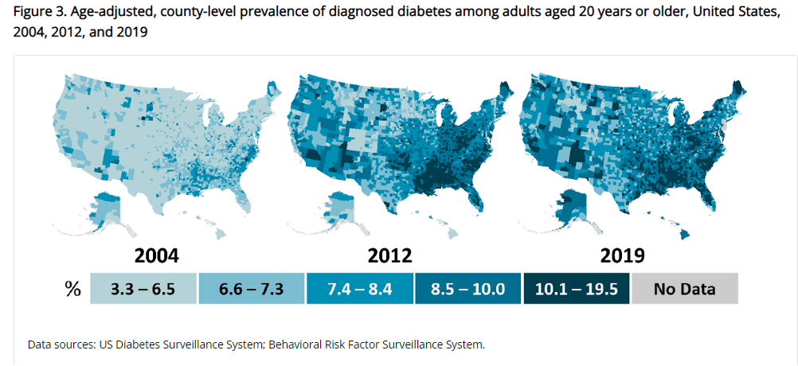
Type 2 Diabetes in America 2024
11.3% with Diabetes - 37 million adults
23% don’t know they have it
38% with Prediabetes – 96 million adults
Centers for Disease Control and Prevention. National Diabetes Stats Report https://www.cdc.gov/diabetes/data/statistics-report/index.html. Accessed 1/23

Slide 10
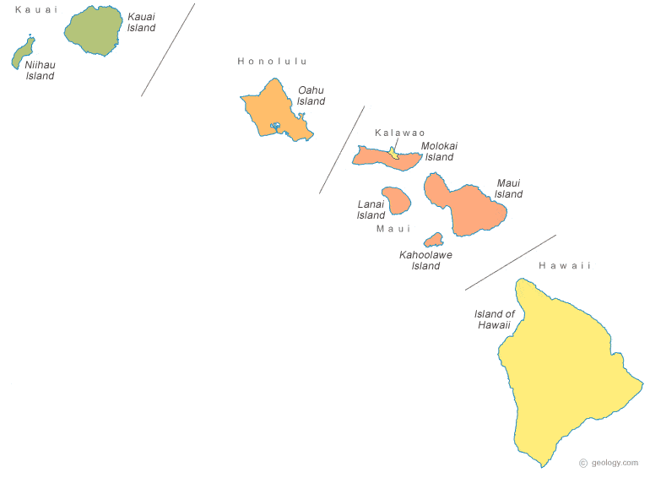
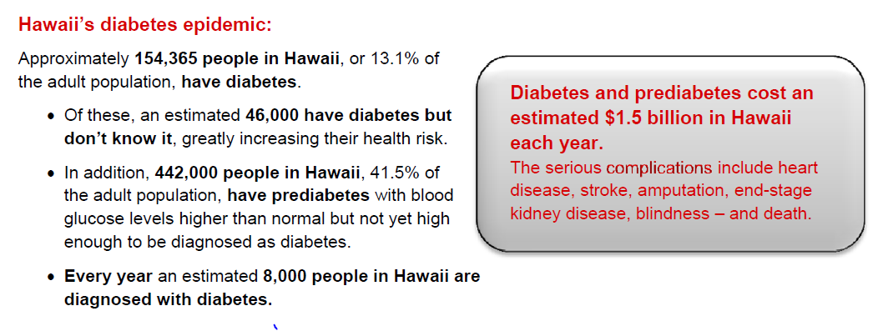
Diabetes in Hawaii
13% with diabetes
About 1/3 of people don’t know they have it
41% with Prediabetes
Costs Hawaii $1.5 billion a year

Slide 11


Slide 12
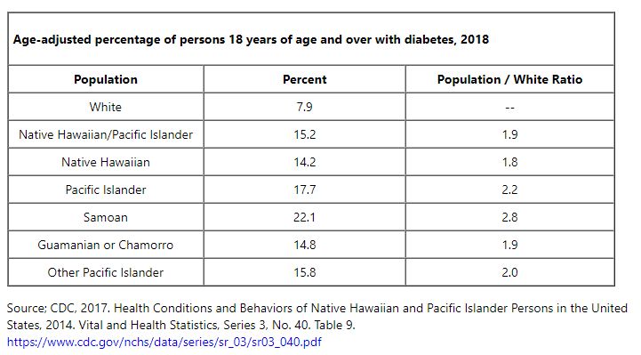

Native Hawaiian & Pacific Islander Adults with Diabetes

Slide 13
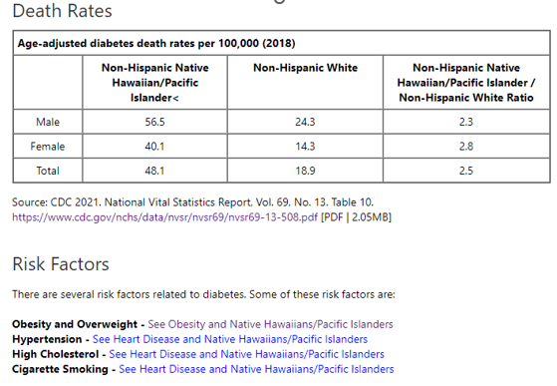

Death Rates from Diabetes In Hawaii

Slide 14
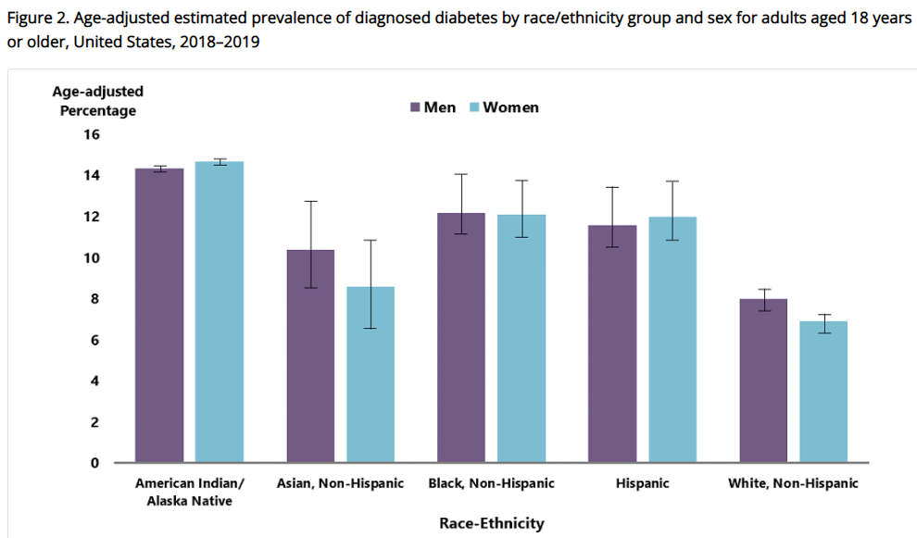
Diabetes Prevalence by Ethnic Group
For adults, diabetes prevalence highest among:
American Indians and Alaska Natives (14.5%),
Non-Hispanic Blacks (12.1%),
People of Hispanic origin (11.8%),
Non-Hispanic Asians (9.5%)
www.cdc.gov/diabetes/data/statistics-report/diagnosed-diabetes.html

Slide 15

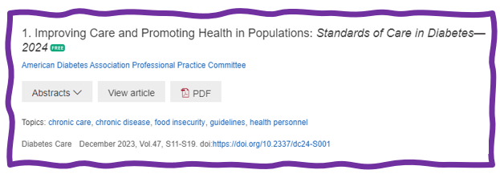
1. Improving Care and Promoting Health in Populations
“Health outcomes of a group of individuals -
including the distribution of health outcomes within the group”
These outcomes can be measured in terms of health:
mortality, morbidity, health, and functional status
disease burden
(incidence and prevalence)
behavioral and metabolic factors
(exercise, diet, A1C, etc.)
ADA Standards 2024

Slide 16
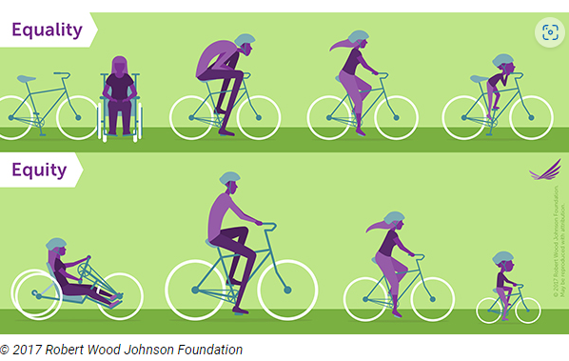
Equality vs Equity
Design and deliver diabetes care with goal of health equity across all populations.
https://coveragetoolkit.org/health-equity/defining-health-equity/

Slide 17
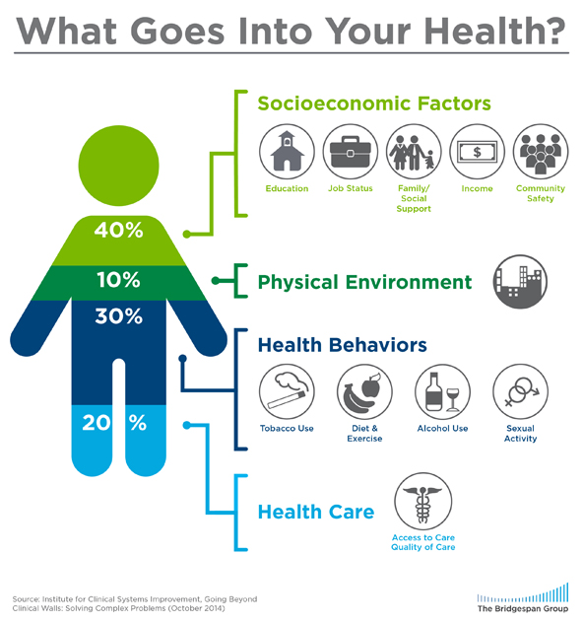
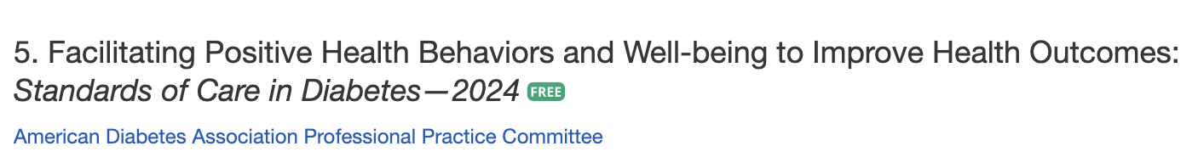
Address Barriers to Self Management
Barriers exist within health system, payer, health care professional & individual.
Address barriers through innovation, including community health workers, telehealth, other digital health solutions.
Consider social determinants of health in the target population when designing care.
https://coveragetoolkit.org/health-equity/defining-health-equity/
Notes:
Access and health equity is the ultimate goal when designing and delivering DSMES.
Creating culturally appropriate and varied modalities of settings has been shown to improve outcomes.
We know barriers to care exist at every level from the health system to individual.
However we can address these barriers by working to educate participants and health care providers on the critical times when DSMES is needed.
We can work with health systems and clinics to develop population health screening and clinical outreach,
create protocols to reduce time for referral and
collaborate health and community systems to address social needs.
We can include other health partners including community health workers to support delivery of diabetes peer support.
Barriers can be also be addressed by developing a diversity of delivery models.
From traditional inperson classrooms to community-based strategies and technology enabled solutions including telehealth or virtual environments varying modes can serve different needs.

Slide 18

Social Determinants of Health
The conditions in which people:
Play
Live
Work
Learn
Pray
Directly affects their health risks and outcome AADE Population Health & Diabetes Educators Evolving Role 2019

Slide 19

Tailoring Treatment for Social Context
“Social determinants of health (SDOH)—often out of direct control of the individual and potentially representing lifelong risk—contribute to health care and psychosocial outcomes and must be addressed to improve all health outcomes”
The ADA recognizes this relationship and is taking action.

Slide 20

Status of Diabetes Care
In 2015–2018, U.S. community-dwelling adults with diabetes achieved:
A1C <7% by 50.5%
75.4% achieved A1C <8%.
BP target of <130/80 achieved by 47.7%
70.4% achieved blood pressure <140/90 mmHg.
Lipid control (non-HDL cholesterol) <130 mg/dL, achieved by 55.7%
22.2% met targets for all three risk factors
Many not receiving adequate lifestyle or pharmacotherapy.

Slide 21


Notes:
Measurement of C-peptide is preferable to the measurement of insulin as it has a longer half-life, not subjected to the first-pass hepatic metabolism, and a steady-state clearance from the circulation. Insulin undergoes first-pass hepatic metabolism, has variable clearance, a much shorter half-life, and exogenously administered insulin can confound results.

Slide 22
Hormones Effect on Glucose
Effect



⇒
⇒
⇒
Hormone
Glucagon (pancreas)
Stress hormones (kidney)
Epinephrine (kidney)
Insulin (pancreas)
Amylin (pancreas)
Gut hormones - incretins (GLP-1) released by L cells of intestinal mucosa, beta cell has receptors)

Slide 23


Pre Diabetes & Type 2- Screening Guidelines (ADA 2024 Clinical Practice Guidelines)
Start screening all people at age 35.
Screen at any age if BMI ≥ 25 (Asians BMI ≥ 23) plus one or > additional risk factor:
First-degree relative w/ diabetes
Member of a high-risk ethnic population
Habitual physical inactivity
*PreDiabetes
History of heart disease
*Taking high risk meds; antiretrovirals, 2nd generation antipsychotics or steroids
History of pancreatitis

Slide 24
Second-Generation Antipsychotic Meds and Diabetes Risk
People taking these meds require frequent monitoring due to increased risk of hyperglycemia and other metabolic effects.
There is a range of effects across second-generation antipsychotic medications;
Olanzapine, haloperidol, clozapine, quetiapine, and risperidone tend to have more metabolic effects.
Aripiprazole and ziprasidone tend to have fewer metabolic effects.
It taking these agents, screen for prediabetes or diabetes at baseline, rescreen at 12–16 weeks after medication initiation, and screen annually thereafter ADA 2024

Slide 25

Diabetes 2 - Who is at Risk? (ADA 2024 Clinical Practice Guidelines)
Risk factors cont’d
HTN - BP > 130/80
HDL < 35 or triglycerides > 250
History of Gestational Diabetes Mellitus
Polycystic ovary syndrome (PCOS)
Other conditions associated w/ insulin resistance:
Elevated BMI, acanthosis nigricans (AN)
Screen using A1C, Fasting Blood Glucose or OGTT.
Repeat screening at least every 3 years if negative.
*If prediabetes or on high risk meds, recheck yearly

Slide 26
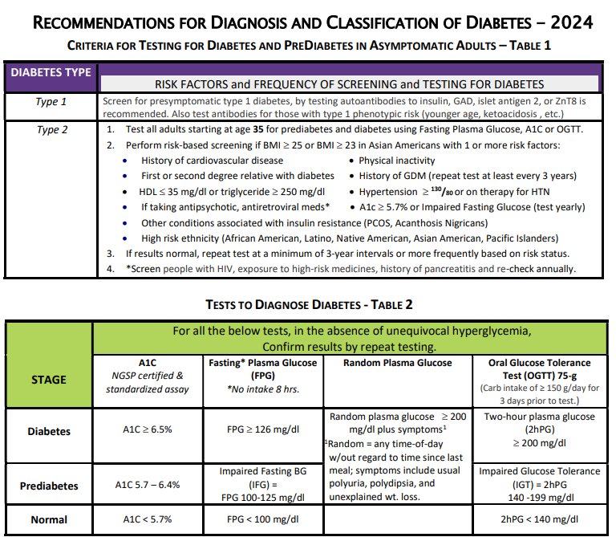
DiabetesEd.net Cheat Sheets – See appendix in back of syllabus

Slide 27

Poll Question 2
Which of the following level is considered pre-diabetes range?
a. Fasting BG of 62
b. A1c of 5.9 %
c. After meal BG of 137
d. A1c of 7.1 %

Slide 28
Natural History of Diabetes
Healthy
FBG <100
Random <140
A1c <5.7%
Prediabetes
FBG 100-125
Random 140 - 199
A1c ~ 5.7- 6.4%
~ 50% working pancreas
Diabetes
FBG 126 +
Random 200 +
A1c 6.5% or +
~ 20% working pancreas
Yes!
NO
Development of type 2 diabetes happens over years or decades

Slide 29


PreDiabetes is FREAKING ME OUT
96 million people in US
80% don’t know they have it
In 3-5 years, about 30% of predm will get diabetes
Associated with higher rates of heart attack, stroke, neuropathy and vessel disease

Slide 30

Poll Question 3
What best describes prediabetes in the U.S.?
Prediabetes affects 18-20% of people above the age of 20.
The prevalence of prediabetes and diabetes are almost equal.
Most people with BMI of 30 or greater have prediabetes.
Prediabetes is associated with increased risk of CV disease

Slide 31

3. Detecting PreDiabetes Matters
Given the cost-effectiveness of lifestyle behavior modification programs for diabetes prevention:
Offer diabetes prevention programs to adults at high risk of type 2 diabetes
Should be covered by third-party payers,
Address inconsistencies in access
Screening guidelines for people with Type 1

Slide 32


3. Prevent or Delay Diabetes for those with Prediabetes
Prediabetes defined as:
A1c 5.7 – 6.4% or fasting BG 100 -125mg/dl
Action:
Screen yearly for diabetes
For adults with BMI 23/25
Refer to DPP approved programs
Includes intensive behavioral lifestyle interventions with 7% wt reduction goal + 150 min exercise week
Provide in person or certified assisted programs

Slide 33
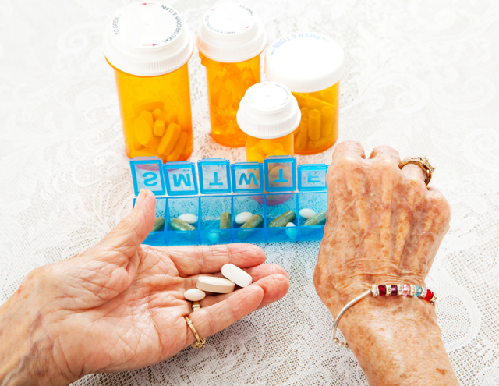
3. Prediabetes Pharmacologic Intervention
No FDA approved med for prevention (off label)
Consider Metformin Therapy for Prediabetes
Especially for ages 25-59
BMI of 35+
If A1c is ~6.0 or FPG is 110mg/dL
Women with history of GDM
Monitor B12 level (esp with neuropathy or anemia)
CV Risk Mitigation important.
Statin can increase BG, stop if notice elevation
Consider low dose pioglitazone (Actos) if history of stroke.

Slide 34
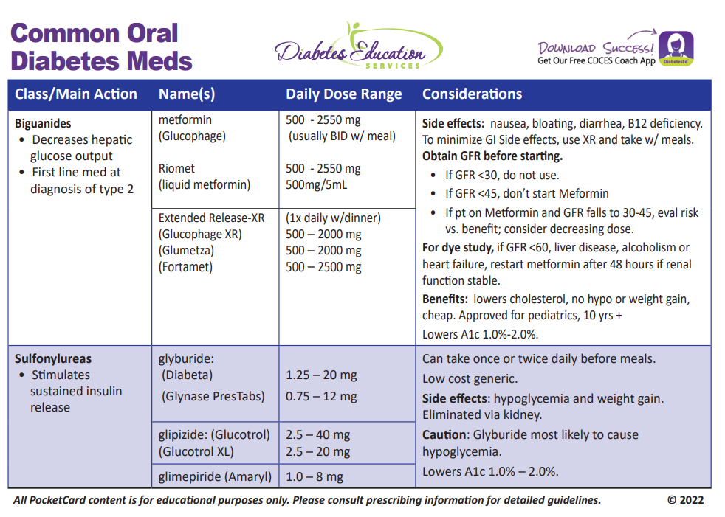
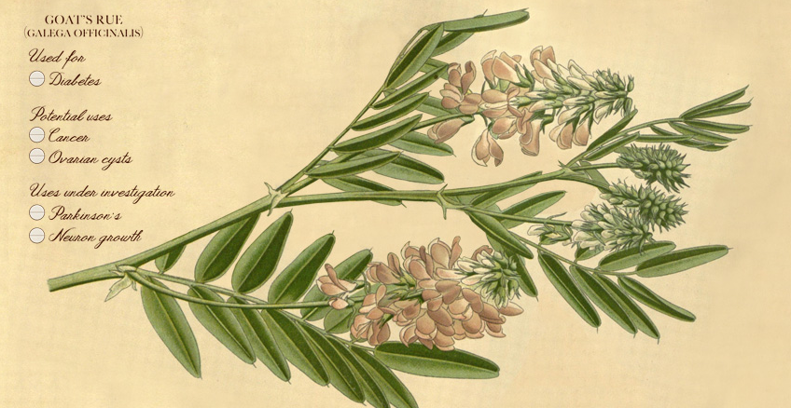
Biguanide derived from:
Goat’s Rue Galega officinalis,
French Lilac
Does NOT harm kidneys
$10 for 3-month supply from Walmart & other pharmacies

Slide 35

Quick Question 4
Ricki is started on Metformin 500mg BID. Which of the following is true?
Hold metformin if your blood glucose is below 80 mg/dl
If you forget to take metformin before the meal, hold the dose
Metformin can harm kidneys
Avoid Metformin if eGFR is less than 30
Notes:
Correction answer: C

Slide 36
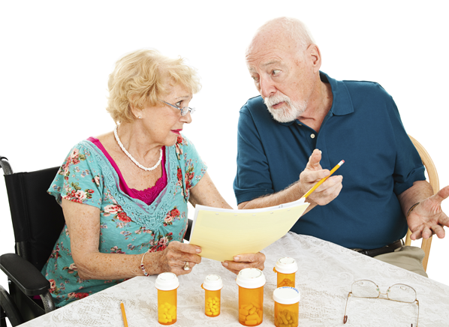
Medication Taking Behaviors
Adequate medication taking is defined as 80%
23% of time, if A1c, B/P, lipids above target - due to med taking behavior
Assess for barriers
If taking meds 80% of time and goals not met, consider medication intensification
Barriers include:
Forgetting to fill Rx, forgetting to take, fear, depression, health beliefs, med complexity, cost, knowledge gap, system factors, etc.
Work on targeted approach for specific barrier

Slide 37


Indications for Insulin Sensitizers Rosiglitazone (Avandia), Pioglitazone (Actos)
Action: decrease insulin resistance by making muscle and adipose cells more sensitive to insulin. Decrease free fatty acids
Names:
pioglitazone (Actos) – bladder cancer warning
Dosing: 15-45 mg daily
Consider adding low dose if history of stroke or have steatosis
rosiglitazone (Avandia)
Dosing: 4-8 mg daily
Efficacy/ Considerations
Reduce A1C ~0.5-1.0%
6 weeks for maximum effect
Actos $5 a month, Avandia $300 a month
Can cause fluid retention, not indicated w/ CHF
Notes:
37
37
Thiazolidinediones (TZDs) enhance insulin sensitivity in muscle and adipose tissue by binding to cell receptors,which leads to an increase in glucose transporter expression. TZDs encourage beta cells to respond more efficiently by lowering the amount of glucose and free fatty acids in the bloodstream, both of which are known to be detrimental to insulin secretion. Finally, these drugs reduce glucose production in the liver.
Clinical trials indicate that pioglitazone and rosiglitazone are slightly more effective at reducing A1C (1.5-1.6% reduction) than troglitazone (1.1% reduction).
Some of the beneficial side effects of thiazolidinediones include an increase in HDL cholesterol and reduction of triglyceride concentrations. This class of drugs has also been shown to lower blood pressure and decrease vascular inflammation in vitro. There are clinical studies underway to further examine the cardiovascular benefit to TZDs.
Some adverse effects of TZDs include weight gain, a potential increase in LDL cholesterol levels, and a possible increase in alanine aminotransferase levels (ALT). Because of the risk of weight gain, edema, and increased LDL cholesterol, thiazolidinediones are contraindicated in patients with advanced forms of congestive heart failure. Due to reported cases of liver failure and liver toxicity caused by the increase in ALT levels, TZDs are contraindicated in patients with abnormal liver function.
TZDs are the most expensive of the oral antidiabetic agents.

Slide 38

Diabetes is Complex
Goal – achieve well being and negotiated outcomes
Psychological factors:
Environmental
Social
Behavioral
Emotional
Keep it person centered while integrating care into daily life
Consider the individual

Slide 39

Remember by Joy Harjo – Poet Laureate
Remember the earth whose skin you are: red earth, black earth, yellow earth, white earth, brown earth, we are earth.
Remember the plants, trees, animal life who all have their tribes, their families, their histories, too. Talk to them, listen to them. They are alive poems.
Remember the wind. Remember her voice. She knows the origin of this universe.
Remember you are all people and all people are you. Remember you are this universe and this universe is you. Remember all is in motion, is growing, is you. Remember language comes from this. Remember the dance language is, that life is. Remember.
We are all connected

Slide 40

Person Centered Care
Emphasize that a collaboratively developed plan improves well-being and outcomes.
Provides care that is respectful and responsive to the individuals preferences, needs and values.
Ensuring that the person’s values guide all clinical decisions
Recognizes the expert within.
Goal is to improve outcomes and encourage self-management for the long run.

Slide 41

Let’s meet people where they are at.

Slide 42

Type 1 ~ Immune Mediated 5-10% of Diabetes
1.5 Million people have type 1 in U.S.
Prevalence increasing:
2001 – 1.48 per 1000 youths diagnosed with diabetes
2017 - 2.15 per 1000 youths diagnosed with diabetes
Incidence & Prevalence increasing
Highest incidence in Finland or Northern Europe.
ADCES In Practice - March 2024 Recent Advances in Type 1 Diabetes: Teplizumab (Tzeild®)
Karen S. Fiano, PHARMD, BCACP, Devada Singh-Franco, PHARMD, CDCES, Young M. Kwon, BS, PHD

Slide 43

Poll Question 5
JR’s mom has type 1 diabetes and JR’s dad has type 2 diabetes. JR is 28 years old and in the emergency room with a glucose of 482 mg/dl. Besides checking glucose, ketones and A1C levels, which of the following lab test can be used to determine if someone has autoimmune diabetes?
Endogenous insulin titer
Glutamic Acid Decarboxylase
Beta cells auto antibodies
Langerhan’s antibody

Slide 44

How do we know someone has Type 1 vs Type 2?
Type 1 - Positive antibodies
GAD - glutamic acid decarboxylase (primary)
IA2 - islet antigen 2, or
ZnT8 - zinc transporter 8
Can also check C-peptide levels to determine endogenous insulin production
Younger people develop quickly
Older people take longer to develop
“misdiagnosis is common and can occur in ∼40% of adults with new type 1 diabetes”

Slide 45

Determine if Type 1 - Use AABBCC Approach
Age
e.g., for individuals <35 years old, consider type 1 diabetes
Autoimmunity
e.g., personal or family history of autoimmune disease or polyglandular autoimmune syndromes
Body habitus
e.g., BMI <25 kg/m2
Background
e.g., family history of type 1 diabetes
Control
e.g., level of glucose control on noninsulin therapies
Comorbidities
e.g., treatment with immune checkpoint inhibitors for cancer can cause acute autoimmune type 1 diabetes or presence of other autoimmune conditions
Diabetes Care, June 2023

Slide 46

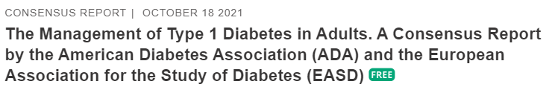
Type 1 Diabetes Features?
For JR, a 28 admitted to the ICU with a blood glucose of 476 mg/dl, pH of 7.1, anion gap of 15. Recently lost 13 pounds.
Type 1 Most Discriminative Features
Younger than 35 years at diagnosis
Lower BMI (<25 kg/m²)
Unintentional weight loss
Ketoacidosis
Glucose 360 mg/dl or greater.

Slide 47
Type 1 Diabetes Progression
 | Stage 1 | Stage 2 | Stage 3
Characteristics | • Autoimmunity | • Autoimmunity | • Autoimmunity
 | • Normoglycemia | • Dysglycemia | • Overt hyperglycemia
 | • Presymptomatic | • Presymptomatic | • Symptomatic
Diagnostic criteria | • Multiple islet autoantibodies GAD, glutamic acid decarboxylase (primary) islet antigen 2, or Zinc transporter 8 (ZnT8) | • Islet autoantibodies Dysglycemia: Elevated IFG and/or IGT • FPG 100–125 mg/dL • 2-h PG 140–199 mg/dL • A1C 5.7–6.4% or ≥10% increase in A1C | • Autoantibodies may disappear over time (5-10% may not express antibodies) • Diabetes diagnosed by standard criteria
www.DiabetesEd.net

Slide 48
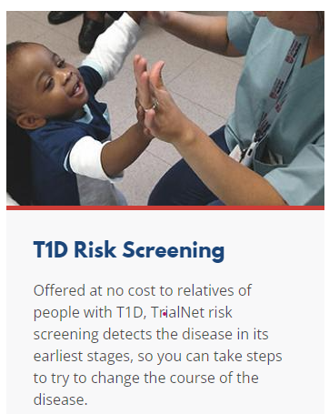
3. Prevention or Delay of Diabetes and Associated Comorbidities (for Preclinical Type 1 Diabetes)
Positive Antibodies with Prediabetes:
A1c 5.7 – 6.4% or fasting BG 100 -125mg/dl
Action:
Screen A1C every 6 months
75- OGTT every year
Modify screening based on antibodies and glycemic metrics.
May benefit from CGM to monitor progression
Trialnet.org

Slide 49
Type 1 & Lifestyle Prevention
Observational studies in those with antibodies, shed light on factors that increase β-cell demand:
Less physical activity
Consuming higher glycemic index foods
Sugar intake.
Factors that reduced risk of progression from TEDDY study:
Daily minutes spent doing vigorous physical exercise.
More info needed

Slide 50

Pharmacologic Intervention to Delay Symptomatic Type 1 (in Stage 2)
Teplizumab-Tzield (CD3-monoclonal antibody)
14-day infusion can delay the onset of symptomatic type 1 diabetes (stage 3)
An option in selected individuals aged ≥8 years with stage 2 type 1 diabetes.
In a single trial, 44 individuals received 14-day course of teplizumab vs 32 placebo.
The median time to stage 3 diagnosis of type 1
48.4 months in tep group
24.4 months placebo
Cost: $193,000
Provention Bio has financial assist programs.

Slide 51
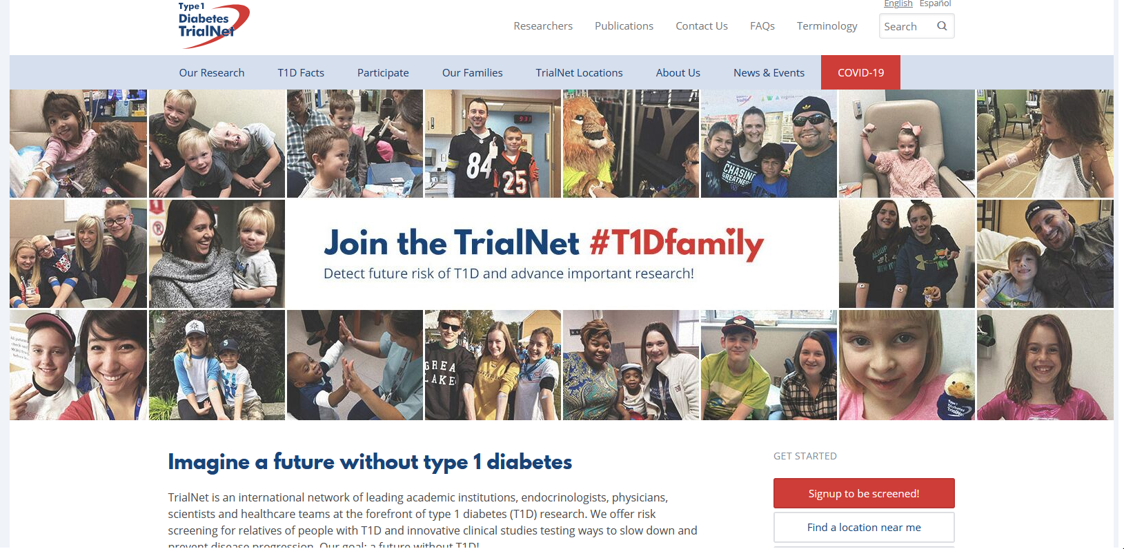
Type 1 (stage 2) Delayed with Teplizumab by 2 years www.DiabetesTrialNet.org
How to get families linked to screening?

Slide 52
Quick Question 6
Question: LT has just been diagnosed with stage 2, type 1 diabetes. They have 2 positive antibodies and their blood sugars are slightly elevated. They ask you if they are a candidate for “that therapy” that can protect their beta cells and slow progression of type 1 diabetes. What is the most accurate response?
Unfortunately, you are not a candidate, since you already have 2 positive antibodies.
Let’s talk to your provider about the possibility of starting Teplizumab therapy.
With your blood sugar elevation, the best early intervention is insulin therapy.
Since you are already in stage 2, the monoclonal antibody therapy won’t be effective.

Slide 53
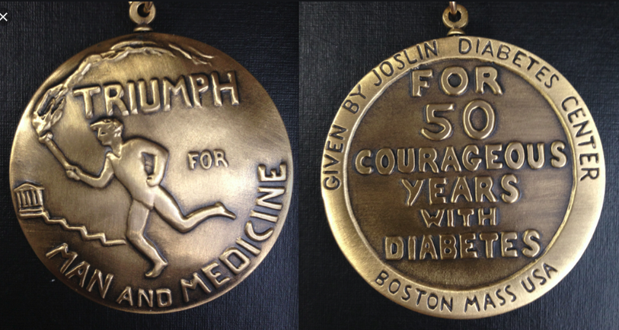

Medalist Study – Harvard Joslin Diabetes Center
After 50 years with diabetes
Many still produced some insulin
Many had no eye disease

Slide 54

What kind of Diabetes?
58 yr old, states she has had type 1 diabetes for 18 years. Quit smoking a year ago and gained about 20 lbs. BMI 25.
Meds
Humalog 18-23 units before each meal
Glargine 28 units at bedtime
Metformin 500mg TID
What tests would you recommend?
25% of ind’s with Type 1 also have type 2 diabetes.
ADA Post Grad, 2010

Slide 55
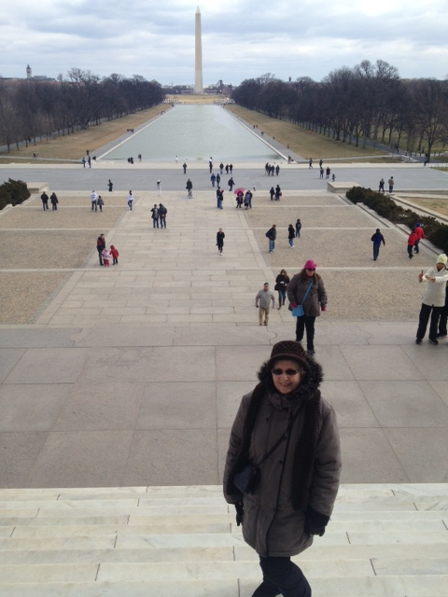
What type of Diabetes?
72 Years old
A1c 3 months prior 6.2%
A1c now 13.9%
BMI 24.5
Lost about 10 pounds over last month

Slide 56

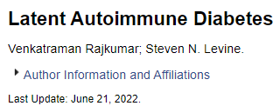
Latent AutoImmunity Diabetes in Adults (LADA)
Antibody positive to 1-2 of below
GAD-65 autoantibodies
Insulin Autoantibodies
Islet Cell antigen-2
ZnT8
Adult Age at onset
Usually benefit from insulin w/in first 6 months of diagnosis
Early insulin therapy may preserve beta cell function
Diabetes Care 26:536-538, 2003 Jerry P. Palmer, MD and Irl B. Hirsch, MD

Slide 57
LADA Clinical Features Compared to Type 2
Feature LADA Type 2
Age <50 63% 19%
Acute hyperglycemia 66 24
BMI < 25 33 13
Hx of autoimmune dx 27 12
Family hx autoimmune 46 35
Practical Diabetology March 08, Unger MD

Slide 58
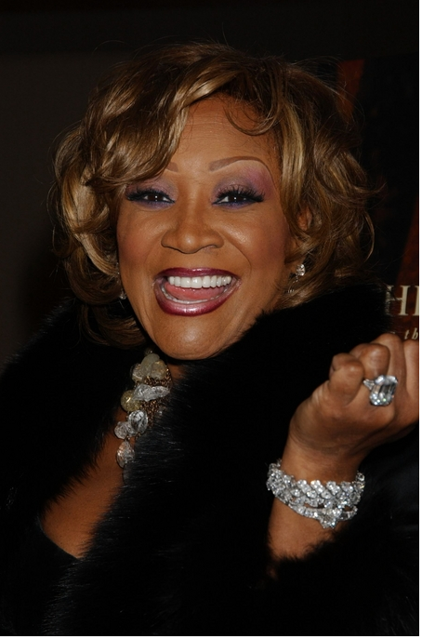
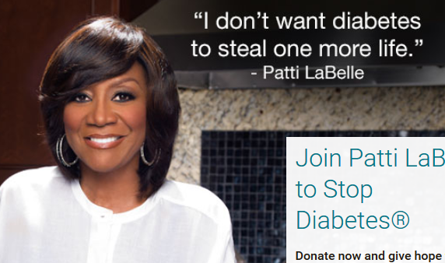
Patti Labelle
"divabetic”
“I have diabetes, it doesn’t have me”

Slide 59
Signs of Diabetes
Polyuria
Polydipsia
Polyphasia
Weight loss
Fatigue
Skin and other infections
Blurry vision
Glycosuria, H₂O losses
Dehydration
Fuel Depletion
Loss of body tissue, H₂O
Poor energy utilization
Hyperglycemia increases incidence of infection
Osmotic changes

Slide 60




Slide 61

What is Type 2 Diabetes?
Complex metabolic disorder ….
(Insulin resistance and deficiency)
with social, behavioral and environmental risk factors unmasking the effects of genetic susceptibility.
New Diagnosis? Call 800 – DIABETES to request “Getting Started Kit”
www.Diabetes.org

Slide 62

Ominous Octet
Decreased satiation neuro-
transmission
Decreased amylin, β-cell secretion
80% loss at dx
Increased renal glucose reabsorption
Decreased Gut hormones
Increased glucagon secretion
G
I
G
I
G
G
I
I
G
Increased lipolysis
G
G
I
I
G
G
I
Increase glucose
production
I
G
G
Decreased glucose
uptake
Notes:
62
62

Slide 63
Poll Question 7
A potential side effect of SGLT-2 Inhibitors is:
Euglycemic DKA
Hypertension
Kidney tenderness
Increased uric acid

Slide 64

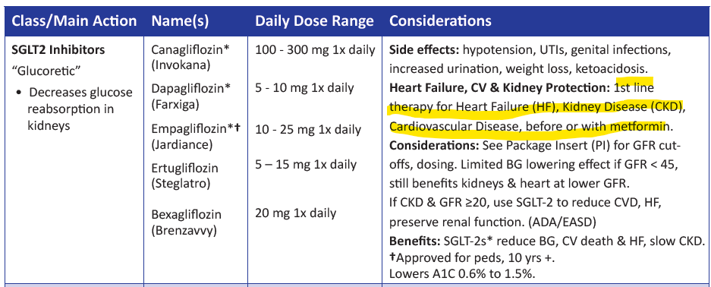



SGLT2 Inhibitors- “Glucoretics”
Action: decreases renal reabsorption of glucose proximal tubule of kidneys (reset renal threshold)
Preferred diabetes treatment for people with heart and kidney failure. Decreases BG & CV Risk.
AWP: ~$650 a month
% ‘f
Notes:
64
64

Slide 65
Benefits of SGLT-2 Inhibitors
A1C lowering
Weight loss
Cardiovascular
Renal
Heart failure
Blood pressure lowering

Slide 66
Side Effects of SGLT-2 Inhibitors
Genitourinary infections
Volume depletion
Increased urination
Hypotension
UTI
Diabetes ketoacidosis (DKA)
Amputation risk? Fournier’s gangrene?
Notes:
Cana: bone mineral density decline: hip ≤1%; lumbar spine, femoral neck, and distal forearm <1%
UTI: 6%Genito infection: 11-12%
Increased serum K+: 9-27%
Amputation risk
Emgag: UTI: females 18%, males 4%
Genito infection: 5%
Dapag: UTI: 6%, genito infection: 3%

Slide 67
SGLT-2i Indications Summary
Drug | Lower BG | Reduce CV Risk? | Use to treat Heart Failure? | Slow renal disease?
Dapagliflozin (Farxiga) | Yes | Yes | Yes +/- Diabetes | Yes
Empagliflozin (Jardiance) | Yes | Yes | Yes +/- Diabetes | Yes
Canagliflozin (Invokana) | Yes | Yes | Yes w/ Diabetes | Yes
Ertugliflozin (Steglatro) | Yes | No | Yes w/ Diabetes | Yes
Bexagliflozin (Brenzavvy) | Yes | NA | NA | NA
Package inserts, dailymed.nlm.nih.gov

Slide 68
Comparison of Type 1,Type 2, LADA
Type 1
Type 2 LADA
Excess weight
x
xxx x
Insulin dependence
xxx
30% 6mos
Respond to oral agents
0
xxx x
Ketosis
xxx
x x
Antibodies present
xxx
0 xx
Typical Age of onset
teens
adult adult
Insulin Resistance
0
xxx
x

Slide 69

“Getting diabetes saved my life.” ~ Sherri Sheperd
Sherri Shepard decided to embrace diabetes and use it as a motivator to improve her health.

Slide 70

Other Types of Diabetes
Gestational
Other specific types of diabetes

Slide 71

Other Specific Types of DM
Medications such as: steroids, protease inhibitors and Prograf®
Secondary to Agent Orange
Liver failure
TPN or tube feedings
Diabetes Type 3c
Cystic fibrosis, pancreatitis
Pancreatic cancers or removal
Hemochromatosis

Slide 72


Screening in early Pregnancy
Checking glucose levels before 15 weeks of gestation:
Can find undetected diabetes or hyperglycemia
Prevent fetal exposure to hyperglycemia
Allows providers and pregnant people to take action to prevent complications
Use standard diabetes diagnostic criteria.
If positive, diagnosis “Diabetes complicating pregnancy”
If fasting BG 110+ or A1C 5.9%+
At higher risk of adverse outcomes and more likely to experience GDM and need insulin.

Slide 73

Gestational Diabetes and Pregnancy
Test for GDM at 24-28 weeks
Test GDM women for post partum diabetes at 4-12 weeks, using OGTT
Women with GDM need lifelong screening for prediabetes/diabetes at least every 3 yrs
Women with hx of GDM, found to have prediabetes need intensive lifestyle interventions or metformin to prevent diabetes.

Slide 74
DiaBingo
B Frequent skin and yeast infections
B A BMI of ____ or greater indicates increased pre/diabetes risk?
B To reduce complications, control A1c, Blood pressure, Cholesterol
B PreDiabetes – fasting glucose level of ___ to ____
B Erectile dysfunction indicates greater risk for ____
B Diabetes – fasting glucose level____ or greater
B Type 1 diabetes is best described as an ______ disease
B People with diabetes are ______ times more likely to die of heart dx
B Elevated triglycerides, < HDL, smaller dense LDL
B Each percentage point of A1C = _____ mg/dl glucose
B At dx of type 2, about __% of the beta cell function is lost
B Diabetes – random glucose ____ or greater

Slide 75
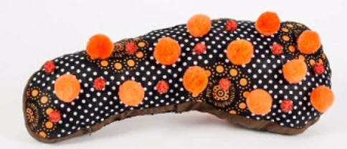
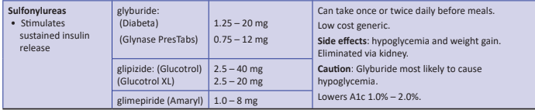
Sulfonylureas - Secretagogues or “Squirters”
Mechanism: Stimulate beta cells to release insulin
Dosed 1-2x daily before meals
Adverse effects
Hypoglycemia, Weight gain, watch renal function
Low cost, $12 for 3 months supply
Can help with glucose toxicity, lowers A1C 1-2%
Notes:
CAROLINA tral (linagliptin vs glimepiride)
Meta-analysis: In type 2 diabetes, the use of sulfonylureas is associated with increased mortality and a higher risk of stroke

Slide 76

Reducing Hypoglycemia
Which are the only diabetes meds that directly cause hypoglycemia?
Insulin
Secretagogues (sulfonylureas, glitinides)
ADA SOC 2024.

Slide 77

Hypoglycemia (Glucose) Alert Values
BG <70mg/dl – Level 1
Follow 15/15 rule and contact provider to make needed changes. At increased hypo risk.
BG < 54mg/dl – Level 2
Indicates serious hypo. Reassess BG Goals. Consider med decrease. Predictive of Level 3 Hypo. Needs Glucagon Emergency Kit
Severe Hypoglycemia – Level 3
Altered mental, physical functioning.
Requires external assistance – no threshold

Slide 78
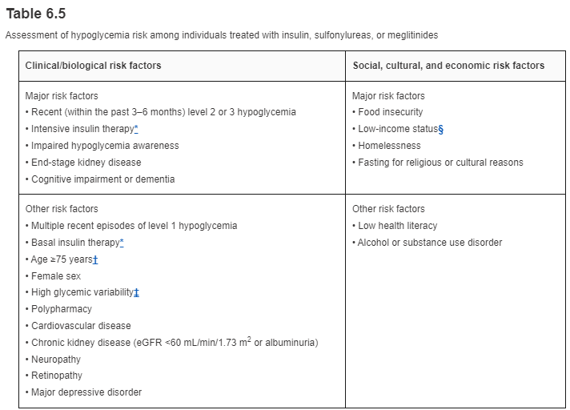
Hypoglycemia: Clinical Risk Factors

Slide 79
Components of hypoglycemia prevention for high-risk individuals at initial, follow-up, and annual visits
Hypoglycemia prevention action | Initial visit | Follow-up visit | Annual visit
Hypoglycemia history assessment | ✓ | ✓ | ✓
Hypoglycemia awareness assessment | ✓ |  | ✓
Cognitive function and other hypoglycemia risk factor assessment | ✓ |  | ✓
Structured education for hypoglycemia prevention and treatment | ✓ | ✓* | ✓*
Consideration of continuous glucose monitoring needs | ✓ | ✓ | ✓
Reevaluation of diabetes treatment plan with deintensification, simplification, or agent modification as appropriate | ✓ | ✓† | ✓†
Glucagon prescription and training for close contacts for insulin-treated individuals or those at high hypoglycemic risk | ✓ |  | ✓
Training to reestablish awareness of hypoglycemia | ✓ |  | ✓

Slide 80

Tx of Level 2 & 3 Hypoglycemia
If can swallow w/out risk of aspiration, try gel, honey, etc. inside cheek
If unable to swallow, D50 IV or Glucagon
Glucagon injection (need Rx)
Inform and instruct caregivers, school personnel, family, coworkers of hypo signs and appropriate action
Dosing: Adults 1mg, Children <20kg 0.5mg
Glycemic effect 20 - 30mg, short lived
Must intake carb as soon as able
If on Insulin or level 2 or 3 hypo, (<54), get Glucagon ER Kit. Re-evaluate diabetes med treatment plan.

Slide 81
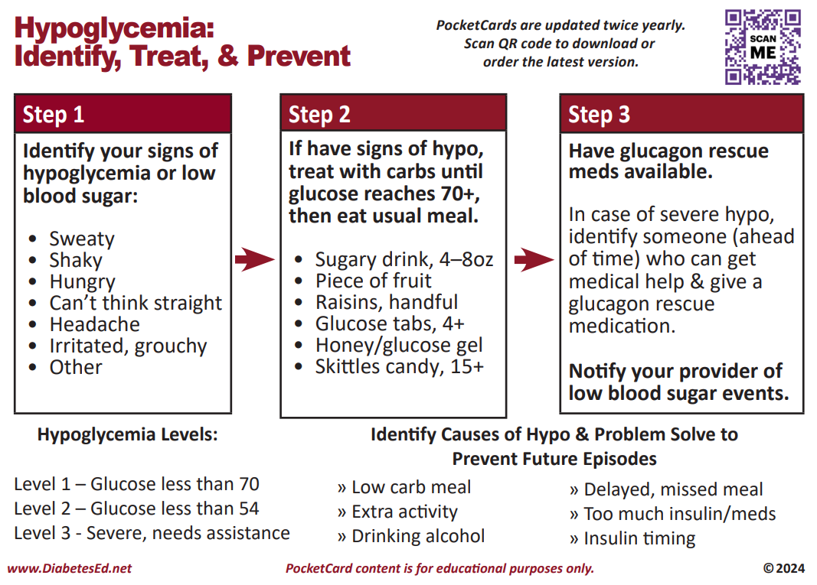
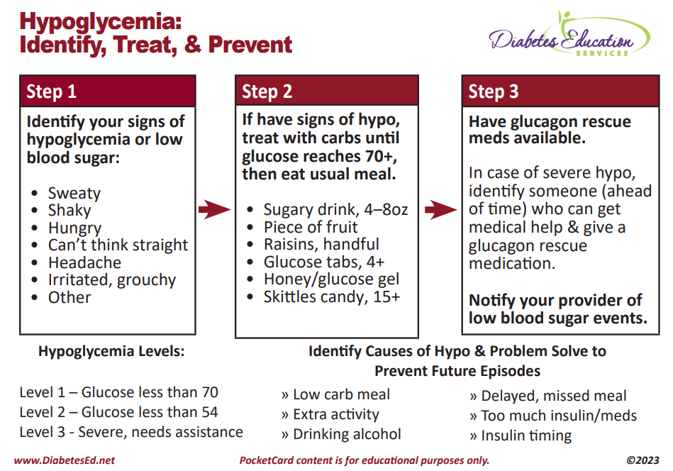

Slide 82

Poll Question 8
JL is 78 and drinks a “few cocktails” every night. Lives with partner and takes basal insulin at night and bolus insulin as needed. Checks BG a few times a week. Most recent A1c was 5.9%. What is the BG target for JL?
A. A1c less than 6.5%
B. Fasting BG 100 +
C. Ask JL to determine their A1c target.
D. A1c less than 7% based on the Legacy Trial results.

Slide 83

If on insulin or sulfonylurea – special precautions required
Carb source on person, car, by bed at all times
Identification
Phone (ICE)
Wallet Card
Bracelet
If pattern of lows, med adjustment required
Pre-meal target
100-130?
Post meal
Less than 180
Bedtime
110 - 180

Slide 84
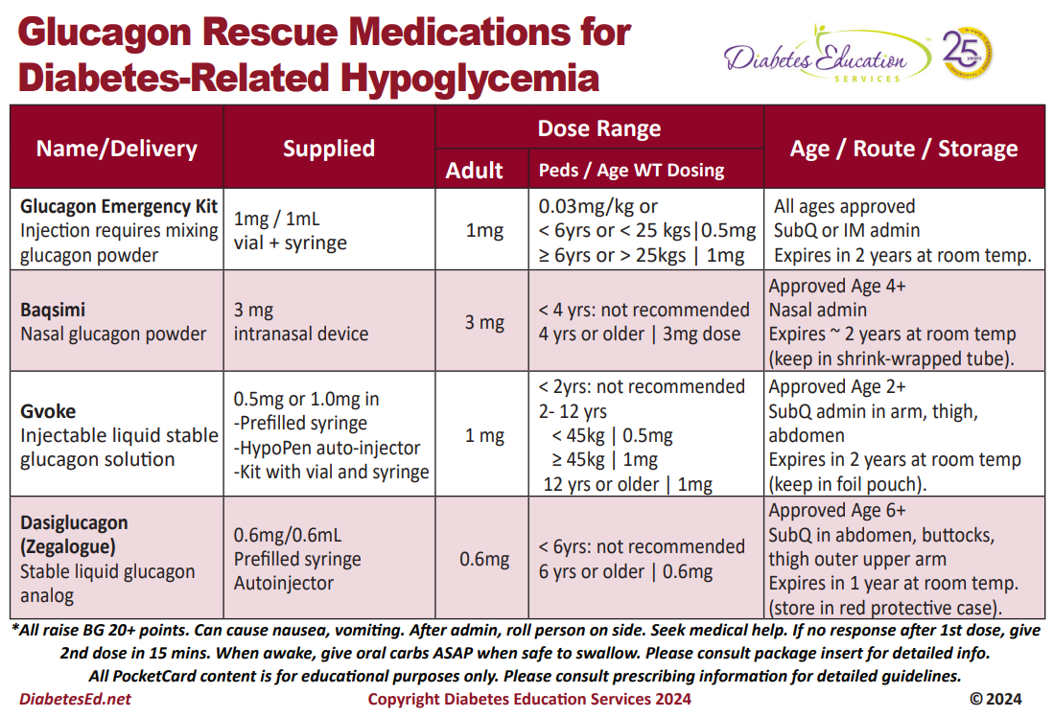

Slide 85

Quick Question 9
JZ is excited about his A1c of 5.4%. He takes rapid acting insulin 4-6 times a day using a pen to keep his BG to target. Plus, adjusts glargine as needed if his pm BG is elevated. What is your biggest concern?
A. Does he change his needle each time?
B. Why is he adjusting glargine?
C. Is he adjusting insulin for exercise?
D. How many hypoglycemic events per week?

Slide 86


8. Obesity and Weight Management for Prevention & Treatment of Type 2 Diabetes
Provides cost information for pharmacologic treatment of obesity
Once a year, calculate BMI and assess weight trajectory to inform approach
Be sensitive and allow for privacy when weighing
Use person centered language

Slide 87
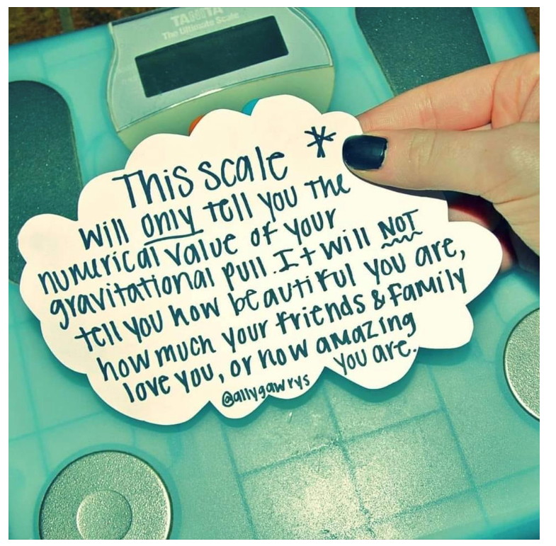
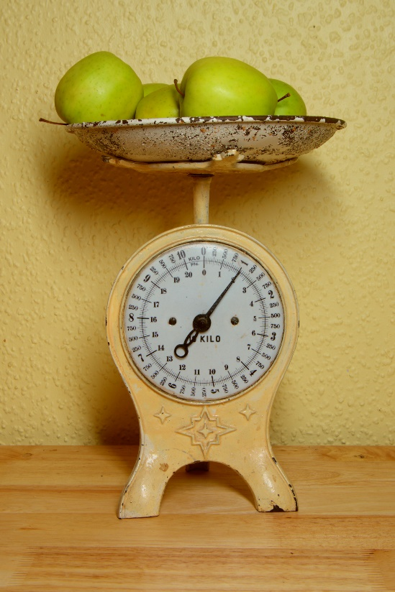
Weight is a Heavy Issue

Slide 88

Person-centered communication
Use inclusive and nonjudgmental language and active listening
Elicit individual preferences and beliefs and assesses potential barriers to optimize health outcomes and health-related quality of life.
Use person-first language (e.g., “person with extra weight” rather than “obese person”) to avoid defining people by their condition.

Slide 89

Use of BMI and Other Assessments
Overall - assess individual’s
- adipose tissue mass
- distribution (using waist circumference, waist-to-hip ratio, or waist-to-height ratio),
- function and
- presence of associated health or well-being consequences: metabolic, physical, or psychological well-being
WHO defines Obesity as: abnormal or excessive fat accumulation that presents a risk to health
BMI poor indicator for ”excessive fat” and health risk
Notes:
Health at Every Size
Language throughout the section was amended to be person centered and to emphasize the importance of weight management within the overall context of the treatment of people with diabetes.

Slide 90
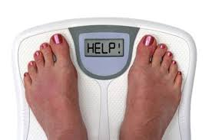
Weight Loss is Helpful
Prediabetes weight loss goal is > 7% for preventing diabetes progression.
Diabetes: Strong evidence that
Weight loss of 3–7% improves glycemia & intermediate CVD risk
>10% loss, may lead to remission of type 2 diabetes, CVD, & reduced mortality
Reduces need for medications
Optimal goal is healthy weight maintenance
“People with diabetes and overweight or obesity may benefit from any magnitude of weight loss.”
“Nutrition, physical activity, and behavioral therapy to achieve and maintain ≥5% weight loss are recommended for people with type 2 diabetes and overweight or obesity”
Notes:
Any degree of weight reduction is helpful.
3-7%
>10% shows greater benefits and can reduce fatty liver which is a growing concern within diabetes population.
the justification for a weight-based approach to diabetes treatment has been expanded. The recommendations and text pertaining to weight management treatment have been expanded to acknowledge the expected range of benefits across the spectrum of weight loss.
In people at risk, 3–7% weight loss reduces progression to diabetes (2,7,8,41,42). Greater weight loss may produce additional benefits (20,21). Mounting data have shown that >10% body weight loss usually confers greater benefits on glycemia and possibly diabetes remission and improves other metabolic comorbidities, including cardiovascular outcomes, nonalcoholic steatohepatitis, nonalcoholic fatty liver disease, adipose tissue inflammation, and sleep apnea, as well as physical comorbidities and quality of life

Slide 91
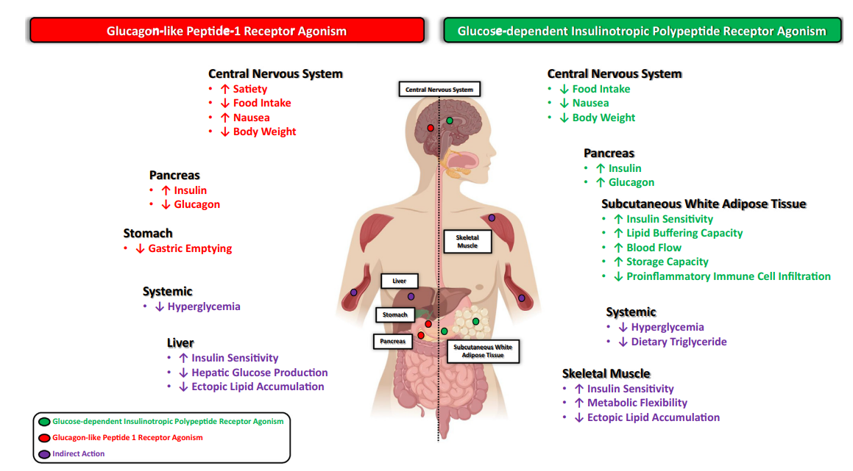
Action of GLP-1 and GIP
Samms RJ, Coghlan MP, Sloop KW. How May GIP Enhance the Therapeutic Efficacy of GLP-1? Trends Endocrinol Metab. 2020 Jun;31(6):410-421.
Notes:
GIP: Glucose-dependent Insulinotropic Polypeptide
GLP: glucagon-like peptide

Slide 92
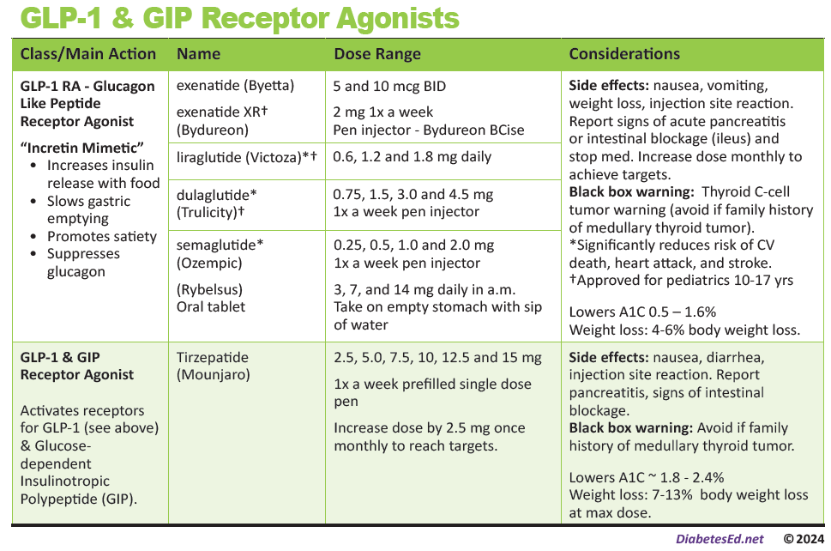
Pocket Card: GLP-1 & GIP RA
Notes:
Update with exenatide indication in pediatrics.

Slide 93
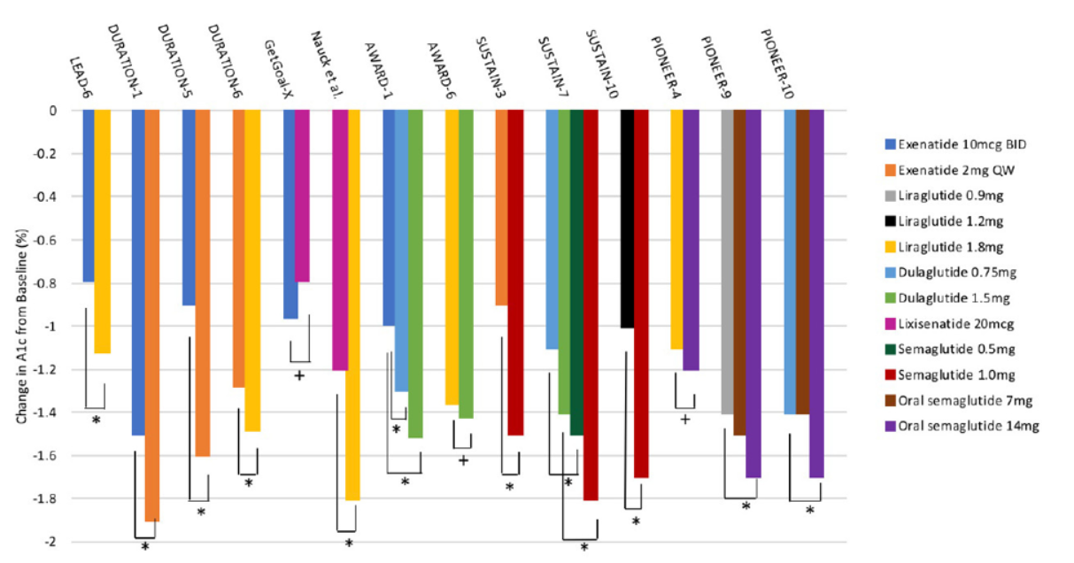
A1C Lowering with GLP-1 RA
Trujillo JM, Nuffer W, Smith BA. GLP-1 receptor agonists: an updated review of head-to-head clinical studies. Ther Adv Endocrinol Metab. 2021.

Slide 94
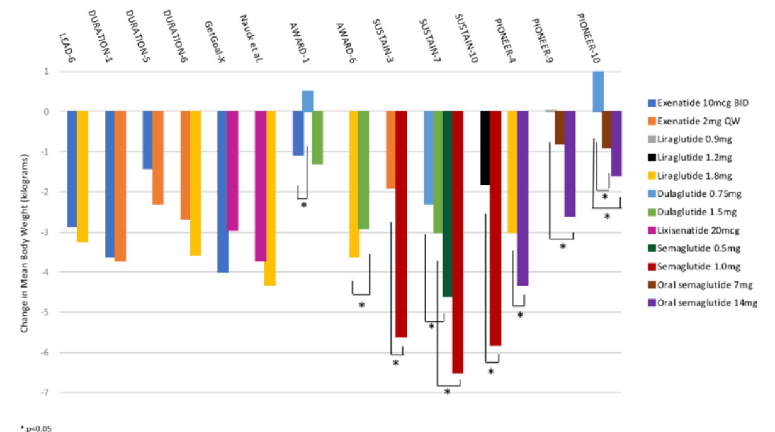
Weight Loss with GLP-1 RA

Slide 95

Counseling Points: GLP-1 RA & GLP-1/GIP
Avoid if personal or family history of medullary thyroid cancer
Start at lower dose and titrate
Eat smaller nourishing meals to reduce nausea
Avoid high fat meals
Reconsider nausea as feeling full
Store extra pens in fridge
Avoid in combo with DPP-4 inhibitors
Report any sudden abdominal pain or pancreatitis symptoms
Ask about recent eye exam
Potential increase in diabetes retinopathy
Notes:
Inject at room temperature, let alcohol fully dry

Slide 96
Poll Question 10
AR is 36 years old with type 2 diabetes and a BMI of 41kg/m². Current diabetes medications include: metformin, sitagliptin (Januvia) and empagliflozin (Jardiance) at maximum doses. AR is prescribed tirzepatide (Mounjaro). Based on this information, what action do you recommend to the provider?
Verify kidney function first.
Stop the sitagliptin when initiating tirzepatide.
Decrease the dose of metformin to prevent hypoglycemia.
Evaluate thyroid function before starting tirzepatide.
Notes:
Answer is B.

Slide 97
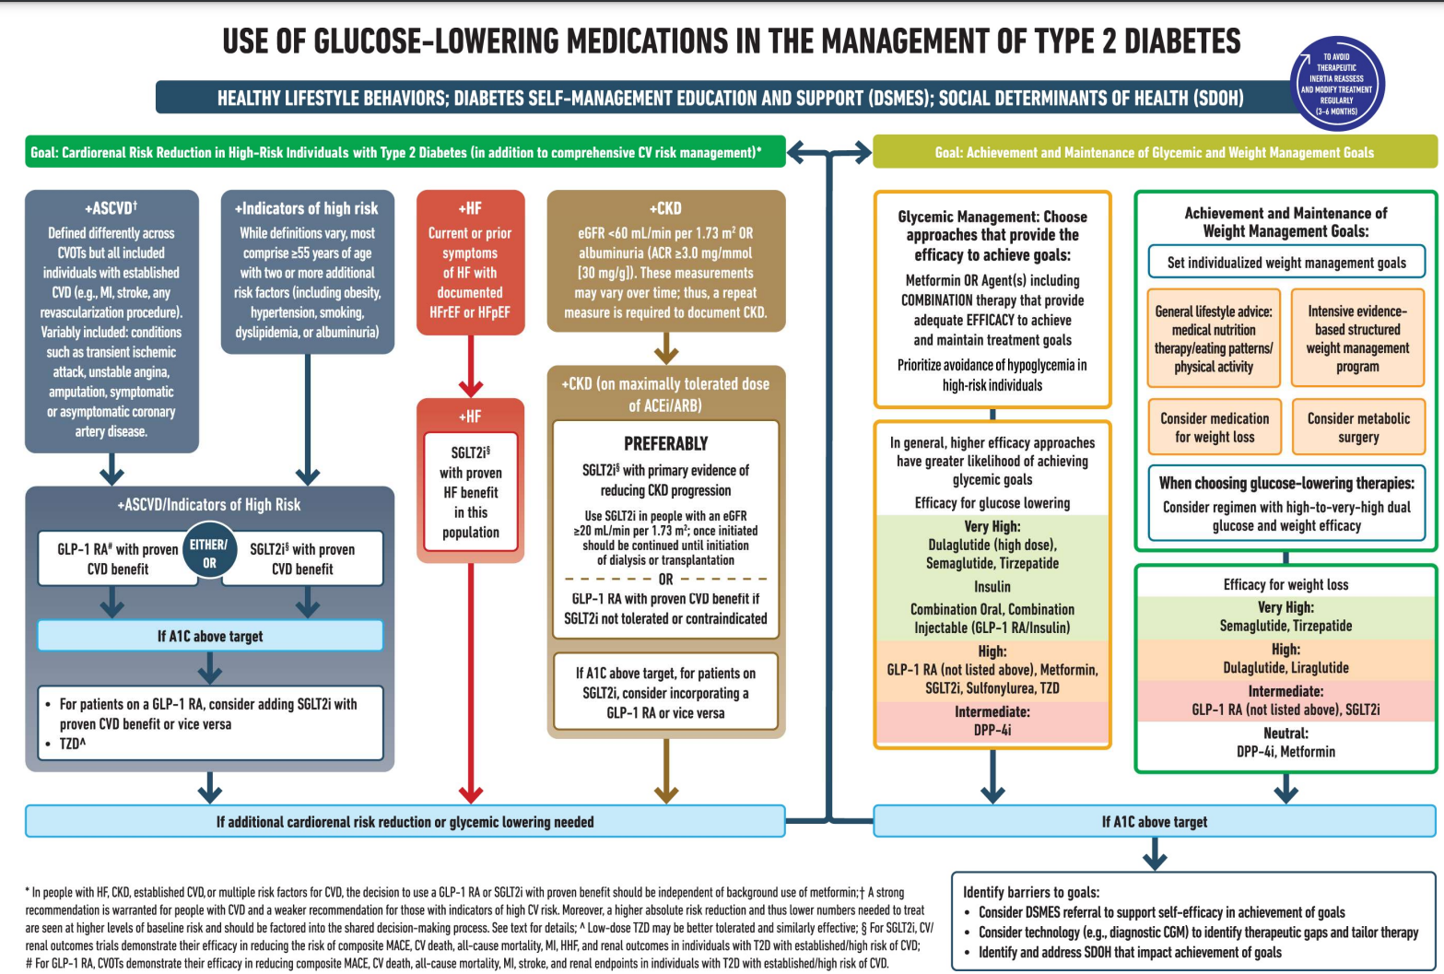

ADA Algorithm: Where do GLP-1 Fit?
See appendix in back of syllabus

Slide 98
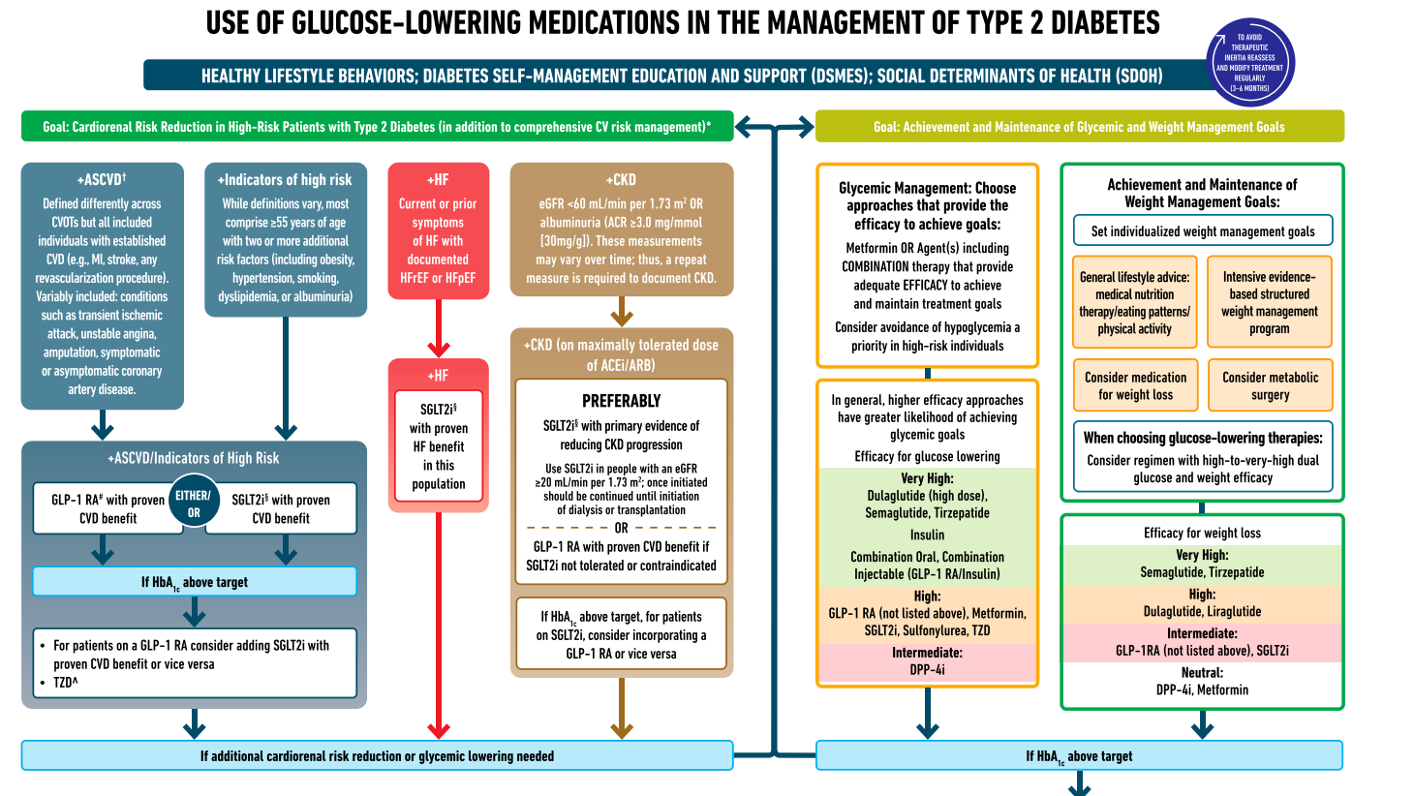

ADA Meds Algorithm

Slide 99
GLP-1/GIP Receptor Agonist Indications
Drug | Lower BG | Reduce CV Risk? | Wt loss approved?
Exenatide IR (Byetta) Lixisenatide (Adlyxin) Semaglutide (Rybelsus) | Yes
Exenatide ER (Bydureon) | Yes for 10 yrs and older
Dulaglutide (Trulicity) | Yes for 10 yrs and older | Yes
Semaglutide (Ozempic) | Yes | Yes | Yes Wegovy 2.4mg
Liraglutide (Victoza) | Yes for 10 yrs and older | Yes | Yes Saxenda 3mg
Tirzepatide (Mounjaro) | Yes | ? | Yes, Zepbound up to 15 mg
Package inserts, dailymed.nlm.nih.gov

Slide 100
GLP-1 /GIPs Approved for Weight Loss
Liraglutide:
Victoza 1.8 mg (diabetes)
Saxenda 3 mg (wt loss)
6% wt loss, $1349 a mo
Semaglutide:
Ozempic 2mg (diabetes)
Wegovy 2.4mg (wt loss)
6% wt loss, $1349 a mo
Tirzepatide
Mounjaro 15mg (diabetes)
Zepbound (wt loss)
13% wt loss - $1056 a mo
All 3 Approved for use in adults with a:
BMI of ≥ 30 or
BMI of ≥ 27 or greater who have hypertension, type 2 diabetes, or dyslipidemia.

Slide 101
Metabolic Surgery Stats
Surgical Treatment and Medications Potentially Eradicate Diabetes Efficiently (STAMPEDE) trial, randomized 150 participants with diabetes to receive either metabolic surgery or medical treatment.
A1C of 6.0% or lower after 5 years - 29% of those treated with RYGB and 23% treated with vertical sleeve gastrectomy (vs 5% med mgmt)
Avg wt loss 25 -30% plus decreased CV mortality & improved QoL
Erosion of diabetes remission over time
at least 35–50% of individuals who initially have remission eventually experience recurrence.
Median disease-free period among such individuals following RYGB is 8.3 years
Majority of those who undergo surgery maintain substantial improvement of glycemia from baseline for at least 5–15 yrs

Slide 102

Treatment options for BMI 25+
Consider using diabetes medications that contribute to weight loss, including GLP-1 RAs and SGLT-2 inhibitors.

Slide 103

6. Glycemic Goals & Hypo
A1C
Blood Pressure
Cardiovascular risk reduction

Slide 104

ABC’s of Diabetes
A1c less than 7% (individualize)
Pre-meal BG 80-130
Post meal BG <180
AGP - Time in Range (70-180) 70% of time
Blood Pressure < 130/80
Cholesterol
Statin therapy based on age & risk status
If 40+ with ASCVD Risk, decrease 50%, LDL <70
If 40+ with ASCVD, decrease 50%, LDL <55

Slide 105

6. Glycemic Targets for Non-Pregnant Adults
A1c < 7% - a reasonable goal for adults.
A1c < 6.5% - for those without significant risk of hypoglycemia
A1c < 8% - for those with history of hypoglycemia, limited life expectancy, or those with longstanding diabetes and vascular complications.
A1c Check Frequency:
If meeting goal - At least 2 times a year
If not meeting goal – Quarterly
Also review Ambulatory Glucose Profile

Slide 106
6. Glycemic Targets Individualize Targets – ADA
Pre-Prandial BG 80- 130
1-2 hr post prandial < than 180
*for nonpregnant adults
Time in Range: 70%
BG of 70-180 mg/dL

Slide 107

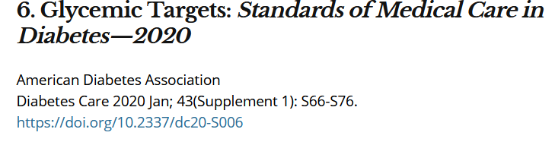
A1c and Estimated Avg Glucose (eAG)
A1c (%) eAG__
5 97 (76-120)
6 126 (100-152)
7 154 (123-185)
8 183 (147-217)
9 212 (170 -249)
10 240 (193-282)
11 269 (217-314)
12 298 (240-347)
eAG = 28.7 x A1c-46.7 ~ 29 pts per 1%
Translating the A1c Assay Into eAG – ADAG Study

Slide 109
Diabetes Bingo “DiaBingo” Shout out Right Answer

Slide 110


Slide 111
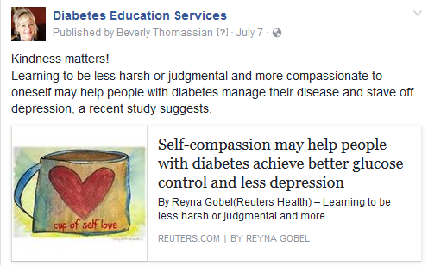
“The highest form of wisdom is kindness.” The Talmud

Slide 112
ADA 2024 Summary for Exams
A1c less than 7% (individualize)
Pre-meal BG 80-130
Post meal BG <180
Time in Range (70-180) 70% of time
Blood Pressure
<130/80
Cholesterol
Statin therapy based on age & risk status
If 40+ with ASCVD Risk, decrease LDL by 50%, LDL <70
If 40+ with ASCVD, decrease LDL by 50%, LDL <55

Slide 113
DiaBingo- G
G ADA goal for A1c is less than ____%
G People with DM need to see their provider at least every month
G Blood pressure goal is less than
G People with DM should see eye doctor (ophthalmologist) at least
G The goal for triglyceride level is less than
G Goal for LDL cholesterol for people 40+ with diabetes is _________
G The goal for blood sugars 1-2 hours after a meal is less than:
G People with DM should get this shot every year
G People with DM need to get urine tested yearly for ___________
G Periodontal disease indicates increased risk for heart disease
G The goal for blood sugar levels before meals is:
G The activity goal is to do ___ minutes on most days

Slide 114
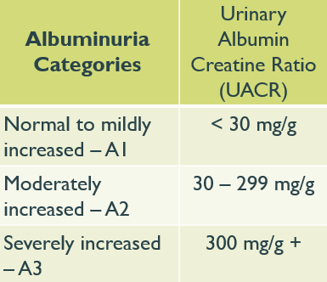
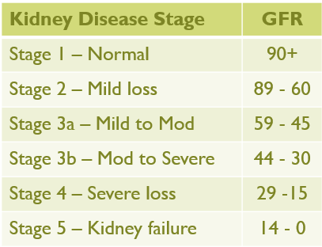
ADA 2024 Standard 11 - Chronic Kidney Disease and Risk Management
Optimize glucose and BP to protect kidneys
Screen Urine Albumin Creatinine ratio (UACR) & GFR
Type 2 at dx then yearly
Type 1 with diabetes for 5 years, then yearly
If urinary albumin ≥300 and GFR 30–60 monitor 1-4 times a year to guide therapy.
Treat hypertension with ACEI or ARB and for elevated albumin-to-creatinine ratio of 30 -299.
Monitor serum creat and K+
if on ACE, ARB or diuretics

Slide 115

Poll Question 5
Evaluating kidney function is important to determine most beneficial treatment interventions. Which of the following measurements would indicate that JR has healthy kidney function?
Urinary albumin creatinine ratio of 30-299 mg/g with GFR of 45.
GFR of 60 or greater and urinary albumin creatinine ratio of 12 mg/g.
Urinary albumin creatinine ratio less than 30 mg/g and GFR of 30-45.
Creatinine of 1.5 and urinary albumin creatinine ratio of 300 mg/g or greater.

Slide 116
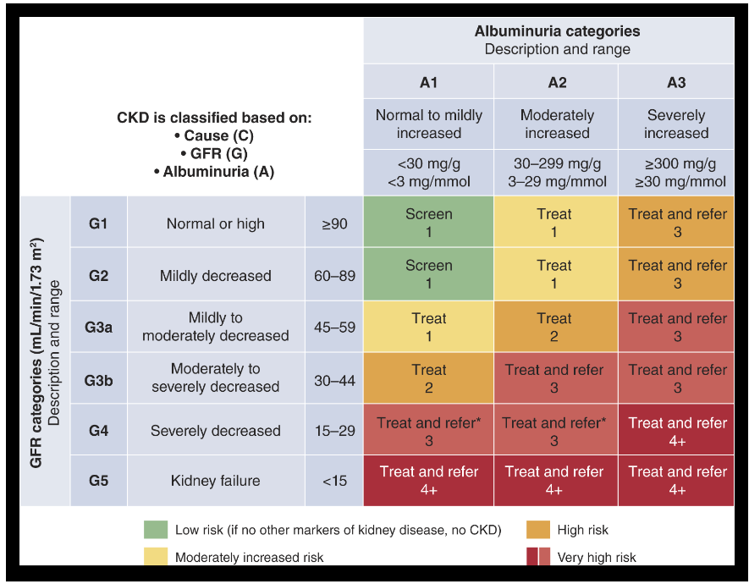

Slide 117
Diabetes + CKD – Increases CVD Risk
Chronic kidney disease (CKD) is a frequent complication in diabetes
Type 1 diabetes ~30%
Type 2 diabetes ~40%
In several studies, participants on SGLT2i with GFRs of 30-60 (stage 3) reduced ASCVD risk and improved renal function
Slowed kidney disease or death
Reduced albuminuria
National Kidney Foundation. https://www.kidney.org/atoz/content/diabetes

Slide 118
ADA Meds Management

Slide 119
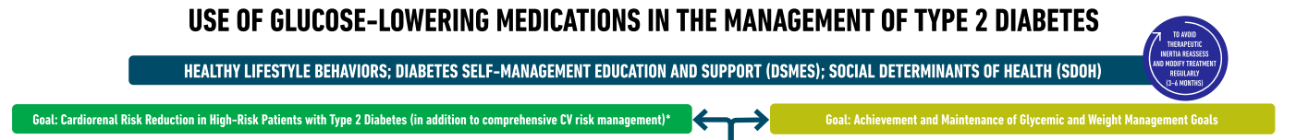
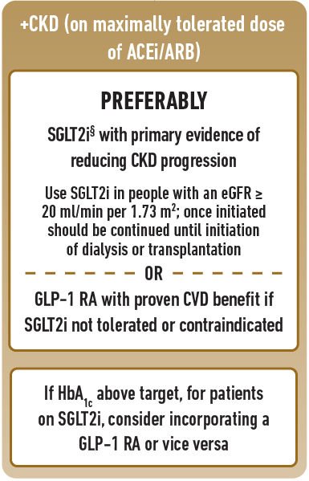
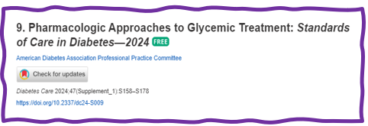
Choosing glucose-lowering medication in people with Chronic Kidney Disease
In people with renal failure, use SGLT-2 in people with GFR ≥ 20 and continue until initiation of dialysis or transplantation
Or
GLP with proven CVD benefit if SGLT2 not tolerated or contraindicated
Semaglutide (Ozempic), liraglutide (Victoza), dulaglutide (Trulicity)

Slide 120
SGLT2 Inhibitor CKD Evidence Summary
Trial Name | SGLT2 Inhibitor vs placebo | Outcomes (Primary Bolded)
CREDENCE | Canagliflozin | N=4401, Median follow-up 2.6 years, Prior CVD 50.4% ESRD, doubling of create or death from renal or CV cause (primary): 0.70 (0.59-0.82), 3 point MACE 0.80 (0.67-0.95)
DAPA-CKD | Dapagliflozin | N=4304, 2906 with diabetes, Median follow-up 2.4 years, Prior CVD 37.4% >50% decline in eGFR, ESKD or renal/CV death (primary): 0.61 (0.51-0.72)
EMPA-Kidney | Empagliflozin | N=6609, Median follow-up 2.0 years, Prior CVD 27%, 46% with DM ESRD, >40% decline in eGFR, ESKD, or renal/CV death (primary): 0.72 (0.64-0.82), stopped early due to positive benefit
Perkovic V, Jardine MJ, Neal B, et al. Canagliflozin and renal outcomes in type 2 diabetes and nephropathy. N Engl J Med. 2019;380:2295–2306.
Heerspink HJL, Stefansson BV, Correa-Rotter R, et al. Dapagliflozin in patients with chronic kidney disease. N Engl J Med. 2020;383:1436–1446.
EMPA-KIDNEY Collaborative Group, Herrington WG, Staplin N, Wanner C, et al. Empagliflozin in Patients with Chronic Kidney Disease. N Engl J Med. 2022 Nov 4. doi: 10.1056/NEJMoa2204233. Epub ahead of print. PMID: 36331190.

Slide 121
SGLT-2 Inhibitor Dosing & Indication
Once an SGLT2i is initiated, it is reasonable to continue an SGLT2i even if the eGFR falls below 20 ml/min/1.73 m2 , unless it is not tolerated or kidney replacement therapy is initiated.
Drug | Dose | FDA Approved Indications
Ertugliflozin (Steglatro) | 5-15 mg daily | As an adjunct to diet and exercise to improve glycemic control in adults with T2DM (All)
Dapagliflozin (Farxiga) | 5-10 mg daily | To reduce the risk of hospitalization for HF in adults with T2DM and established CVD or multiple CV risk factors. To reduce the risk of CV death and hospitalization for HF, and urgent HF visit in adults with HF. To reduce the risk of sustained eGFR decline, ESKD, CV death, and hospitalization for HF in adults with CKD at risk of progression.
Empagliflozin (Jardiance) | 10-25 mg daily | To reduce the risk of CV death in adults with T2DM and established CVD. To reduce the risk of CV death and hospitalization for HF in adults with HF To reduce the risk of sustained decline in eGFR, ESKD, CV death, and hospitalization in adults with CKD at risk of progression.
Canagliflozin (Invokana) | 100-300mg daily | To reduce MACE in adults with T2DM and established CVD. To reduce the risk of ESKD, doubling of serum creatinine, CV death, and hospitalization for HF in adults with T2DM and diabetic nephropathy with albuminuria >300 mg/day.
Bexagliflozin | 20mg daily | As an adjunct to diet and exercise to improve glycemic control in adults with T2DM
Package inserts, dailymed.nlm.nih.gov

Slide 122
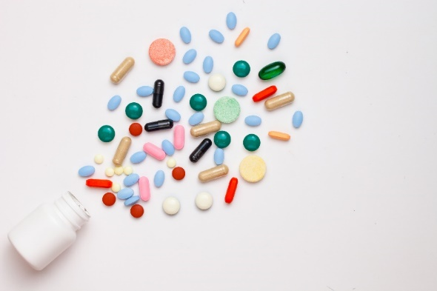
Standard 11 – Protect Kidneys
Diabetes with a - GFR ≥20 and - UACR ≥200 mg/g
Start SGLT2 to reduce chronic kidney disease progression and cardiovascular events.
If type 2 diabetes and established Chronic Kidney Disease (CKD)
Start nonsteroidal mineralocorticoid receptor antagonist (finerenone) and/or GLP-1 RA recommended for cardiovascular risk reduction.

Slide 123

Finereone’s Place in Therapy
In people with CKD and albuminuria who are at increased risk for CV events or CKD progression
a nonsteroidal mineralocorticoid receptor antagonist (finerenone) is recommended to reduce CKD progression and CV events.
First optimize ACEI or ARB
ADA SOC 2024

Slide 124
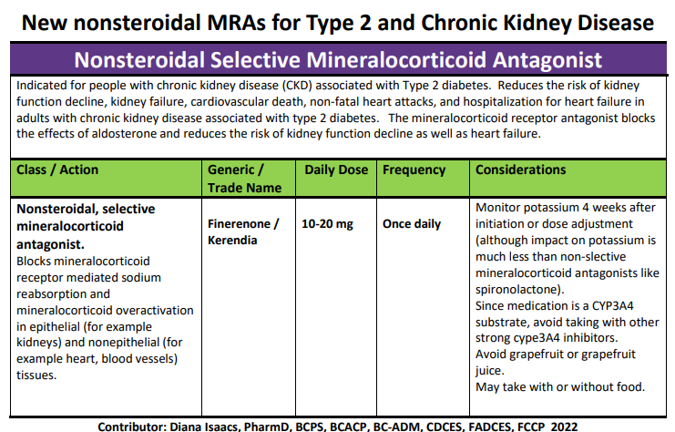
Finerenone Resource

Slide 125
Kidney Goals and MNT
In people with chronic kidney disease with UACR ≥300 mg/g
Goal is a reduction of 30% or greater in mg/g urinary albumin to slow chronic kidney disease progression
Nutrition Recommendations
For people with non–dialysis-dependent stage 3 or higher chronic kidney disease
dietary protein intake aimed to a target level of 0.8 g/kg body weight per day.
For those on dialysis,
consider higher levels of dietary protein intake since protein energy wasting can be of concern

Slide 126

Diabetes Meds Lower CardioRenal Risk
If diabetes plus ASCVD risk factors
SGLT-2s* and GLP-1s* reduce risk of major adverse CV events
Plus ACE or ARB
Post MI, continue beta blockers for 3 years.
If type 2 diabetes and heart failure
SGLT-2s reduce risk of heart failure and hospitalization.
Also consider beta blocker

Slide 127

10. Cardiovascular Disease and Risk Management
Atherosclerotic cardiovascular disease (ASCVD) and Heart Failure are leadings causes of morbidity and mortality in diabetes.
ASCVD includes:
coronary heart disease (CHD),
cerebrovascular disease, or
peripheral arterial disease
$39.4 billion in cardiovascular-related spending per year
Large benefits are seen when multiple CV risk factors are addressed simultaneously
With more aggressive goals, rates of CVD have decreased over past decade

Slide 128

Please see ADA standards, Table 10.1 for second half

Slide 129

Assess ASCVD and Heart Failure Risk Yearly
Duration of diabetes
BMI
Hypertension
Dyslipidemia
Smoking
Family history of premature coronary disease
Chronic kidney disease – presence of albuminuria
Treat modifiable risk factors as described in ADA guidelines.

Slide 130

Poll Question 13
RJ is a healthy 52 yr old with diabetes. RJ takes an ACE Inhibitor, insulin and a statin. According to ADA Standards of Care 2024, what is the blood pressure target for RJ?
A. Less than 120/70
B. Less than 130/80
C. Less than 140/90
D. Less than 135 /85

Slide 131

BP and Diabetes Targets
BP target <130/80 (if it can be safely attained)
Confirm systolic BP ≥ 130 or diastolic BP ≥ 80 using multiple readings, including measurements on a separate day, to diagnose hypertension.
If BP ≥ 180/110, can be diagnosed at single visit
BP target based on ind assessment, shared decision making and potential adverse effects
Monitor BP at home and at each visit
During pregnancy, with previous history of HTN
B/P Target of 110 -135/85

Slide 132


Lipid and HTN Meds Cheat Sheets
Website: https://diabetesed.net/coach-bevs-diabetes-cheat-sheets/
On CDCES Coach App too
For exam, know major classes, when used, side effects and considerations.

Slide 133

BP Treatment in addition to Lifestyle
First Line B/P Drugs if 130/80 +
With albuminuria* or ASCVD
Start either ACE or ARB
No albuminuria - Any of the 4 classes of BP meds can be used:
*ACE Inhibitors, *ARBs, *thiazide-like diuretics or calcium channel blockers.
*Monitor K+ 7-14 days after start/annually
Avoid ACE and ARB at same time
Multiple Drug Therapy often required
If B/P ≥ 150 /90 start 2 drug combo
*Albuminuria = Urinary albumin creatinine ratio of 30+

Slide 134


Slide 135

Poll Question 14
RZ is 47 years old with type 2 diabetes and hypertension. RZ takes metformin 1000 mg BID, plus lisinopril 20mg daily. RZs LDL is 130 mg/dL. Based on the most recent ADA Standards, what is the LDL Cholesterol target for RZ?
LDL less than 100 mg/dL.
Lower LDL by 30%.
LDL target of 65 mg/dL or less.
Determine LDL target based on ASCVD risk.

Slide 136
Lipid Monitoring and Lifestyle Treatment Strategies
Lipid Goals
LDL < 70 or 55 based on risk
HDL >40
Triglycerides <150
Weight loss if indicated
Mediterranean or DASH Diet
Reduction of saturated fat intake
Increase of omega-3 fatty acids, viscous fibers and plant stanols/sterols
Increase activity level
BG lowering helps lower triglycerides and increase HDL
Monitoring:
If not taking statins and underage of 40.
- check at time of diagnosis and every 5 yrs.
On statin
Monitor lipids at diagnosis and yearly.
Monitor lipids 4-12 weeks after statin dose adjustment.

Slide 137

Statin Therapy
Moderate intensity (lowers LDL 30-50%)
atorvastatin (Lipitor) 10-20mg
rosuvastatin (Crestor) 5-10mg
simvastatin (Zocor) 20-40mg
pravastatin (Pravachol) 40 – 80mg
lovastatin (Mevacor) 40 mg
fluvastatin (Lescol) XL 80mg
pitavastatin (Livalo) 1-4mg
High intensity statins (lowers LDL 50%):
atorvastatin (Lipitor) 40-80mg
rosuvastatin (Crestor) 20-40mg

Slide 138

From Meds Cheat Sheet Page

Slide 139
Lipid Therapy in Diabetes by Age
All ages 20+ with ASCVD, add high-intensity statin to lifestyle
20–39 and additional ASCVD risk factors
may be reasonable to initiate statin therapy in addition to lifestyle.
40-75 years
Moderate to high intensity statin based on risk (see previous slides)
75 years or older and already on statin
it is reasonable to continue statin treatment.
75 years or older
it may be reasonable to initiate moderate-intensity statin therapy after discussion of potential benefits and risks.

Slide 140

Coronary Vessel Disease Meds
In those with CVD or at higher risk:
Get blood glucose to goal
Statin therapy with addition of ezetimibe or a PCSK9 inhibitor recommended if goals not achieved on maximum tolerated statin therapy.
B/P Med (ACE or ARB)
Beta blocker after MI or CHF
Aspirin (or another agent)
Diabetes Meds that significantly decrease CV events:
*SGLT-2i’s
Empagliflozin (Jardiance), canagliflozin (Invokana), dapagliflozin (Farxiga)
*GLP-1 RA’s
Semaglutide (Ozempic), liraglutide (Victoza), dulaglutide (Trulicity)

Slide 141
A 67 yr old man, smokes ppd
A1C 8.9% (down from 10.4%)
B/P 139/76 AM BG 100, 2 hr pp 190
Chol – TG 54, HDL 46, LDL 98
GFR 47, UACR 34 mg/g
Meds:
Insulin – 28 units basaglar insulin
Losartan 25mg – ARB for blood pressure
Metoprolol 50mg – Beta blocker
Glyburide 5mg BID - Sulfonylurea
Any special instructions?
Any meds missing?
Stop any meds?

Slide 142
A 67 yr old man, smokes ppd
A1c 8.9% (down from 10.4%)
B/P 139/76 AM BG 100, 2 hr pp 190
Chol – TG 54, HDL 46, LDL 98
GFR 47, UACR 34 mg/g
Meds:
Insulin – 28 units basaglar insulin
Losartan 25mg – ARB for blood pressure
Metoprolol 50mg – Beta blocker
Glyburide 5mg BID - Sulfonylurea
Any special instructions?
Any meds missing?
- Statin
- SGLT 2
- Aspirin
Stop any meds?
Special instruction – sweating may indicate hypoglycemia

Slide 143
ReVive 5 Steps
5 Steps to Address Distress Diabetes and Enhance Management (from EMBARK)
Assess diabetes distress
Begin a conversation to foster a new perspective
Consider different management choices that are not driven by tough thoughts and feelings
Optimize self-care based on personal choice and values—”find the expert within.”
Make changes and plan for next steps.

Slide 144

Embark Trial
EMBARK: A Randomized, Controlled Trial Comparing Three Approaches to Reducing Diabetes Distress and Improving HbA_{1c} in Adults With Type 1 Diabetes. Diabetes Care 2024; dc232452. https://doi.org/10.2337/dc23-2452

Slide 145

Impact of Embark Trial
The year I spent coaching study participants in the Embark Trial significantly changed my approach to diabetes self-management coaching.
~ Coach Beverly

Slide 146

Embark Trial Takeaways
Currently, diabetes education and management focuses on fostering self-management change.
This strategy assumes that people will become less distressed as they engage more effectively with their management.
Need a Shift - Make emotional considerations our priority.
The key to improving glycemic outcomes is to directly address the feelings, beliefs, and expectations that underlie diabetes distress and serve as barriers to management change.

Slide 147

Releasing the Brake
This strategy recognizes that diabetes distress acts as a brake on the application of existing diabetes knowledge and skills.
By releasing the diabetes distress brake through emotion-focused intervention, the negative cycle can be efficiently ended.

Slide 148

Embark Trial Takeaways
Better outcomes when using an integrated approach that combines an education and management with a diabetes distress emotion-centered approach.
This capitalizes on the strengths of each, leading to a more effective and efficient strategy for reducing diabetes distress and improving glycemic management.

Slide 149
Embark Trial – Emotions as Priority
I have finally given myself permission to make addressing the emotional aspects of diabetes a priority. ~Coach Beverly

Slide 150

Trusting our Intuition
As healthcare professionals, we tend to focus on problem-solving around lifestyle, medications, and glucose levels.
The results of the Embark study confirm our intuition to prioritize addressing emotions to support individuals living with diabetes.
Let’s reprioritize our checklist by assessing and addressing distress and move into the heart of providing effective diabetes care.

Slide 151

Emotion Based Approach and DD
This emotion-based approach aligns with the 2024 American Diabetes Standards, which recommend annually assessing Diabetes Distress.
These important study results remind and prompt us to assess and address Diabetes Distress to improve diabetes care outcomes.
The ADA created a wonderful resource, the ADA Behavioral Health Toolkit, which houses diabetes distress and other screening tools for easy reference.

Slide 152

Conversational Tools You Can Use To Address DD In Your Practice
The goal is to help the PWD label, verbalize, share, consider, and evaluate these frequently unaddressed and often hidden feelings and thoughts about diabetes.
Building the relationship with conversational skills is the intervention!
Used with permission from ReVive 5 Program; Larry Fisher, PhD & Susan Guzman, PhD

Slide 153

Relationship Building │ Three Tools To Make It Happen
Relationship Building
1. Open-Ended Questions
2. Active Listening
3. Clinician Engagement Skills
Used with permission from ReVive 5 Program; Larry Fisher, PhD & Susan Guzman, PhD

Slide 154
Tools │ #1. Open-Ended Questions
What are closed-ended questions?
Answers have to do with short, fixed responses (that then require a clinician to then ask the next question).
Examples of closed-ended questions:
- What kind of exercise do you like to do? “Walk!”
- How often do you walk? “3-times a week.”
- How often do you check your BG?
“Five times a day.”
Closed-ended questions do not help address DD.
Used with permission from ReVive 5 Program; Larry Fisher, PhD & Susan Guzman, PhD

Slide 155
Tools │ #1. Open-Ended Questions
What are open-ended questions?
Questions that ask “how, what, why.”
They require a more detailed response.
Examples:
“How do you respond when you go low?”
“What worries you the most about your diabetes?”
“What sense do you make of these BG numbers?”
“Why do you think that you are having trouble lowering your BG levels? What might be going on?”
Open-ended questions sometimes make clinicians nervous(never know what the response might be) –but they open the door to a more effective clinical conversation.
Used with permission from ReVive 5 Program; Larry Fisher, PhD & Susan Guzman, PhD

Slide 156
Tools │#2. Active Listening
What is “active listening?”
Listen attentively – talk much less (< 50%).
Alter tone and pace of speech (tolerate silences).
Attend to the position of HCP and PWD in the room.
Maintain eye contact (engage physically).
Prevent computer, charts, papers, from distracting.
Create an atmosphere of engaged, empathetic, and attentive listening.
Used with permission from ReVive 5 Program; Larry Fisher, PhD & Susan Guzman, PhD

Slide 157

Tools │#3. Clinical Engagement Skills
Based on MI, empowerment, autonomy support:
Used with permission from ReVive 5 Program; Larry Fisher, PhD & Susan Guzman, PhD

Slide 158
Clinical Engagement Tools: Label & Address Feelings
Many people are unaware of what they feel.
Many feel many things at the same time – hard to separate and label each (anger and self-blame).
Many are ashamed or embarrassed about what they feel – “I shouldn’t feel this way.”
Listen carefully for underlying feelings throughout the conversation.
Used with permission from ReVive 5 Program; Larry Fisher, PhD & Susan Guzman, PhD

Slide 159
Clinical Engagement Tools: Label & Address Feelings
TOOL: Sprinkle feeling words throughout the conversation.
Use the conversation to focus on feelings – label them explicitly.
Practice using these words – pick ones that fit your style.
Expect some people to be surprised at your use of feeling words (no one ever talked to them this way).
Don’t worry about saying the wrong feeling word – they will correct you.
Examples:
“Sounds like you were really frustrated about …”
“You must have ended up feeling disappointed …”
“Perhaps you were feeling it was your fault anyway, yet
you seem to be angry at them at the same time.”
Used with permission from ReVive 5 Program; Larry Fisher, PhD & Susan Guzman, PhD

Slide 160

Clinical Engagement Tools: Label & Address Feelings
Common feeling words:
Sad
Frustrated
Scared/fearful
Disappointed
Angry
Hopeless
Defeated
Ashamed/embarrassed
Burned out
Used with permission from ReVive 5 Program; Larry Fisher, PhD & Susan Guzman, PhD

Slide 161

Clinical Engagement Tools: Summarize & Reflect
It helps the PWD know that you are listening carefully and are interested.
It helps them know that you understand & accept without judgement.
It helps them to evaluate and consider their own experience – it becomes more objective, since the repetition comes from you (from outside of their own head).
It helps them consolidate/integrate their experience, feelings and reactions (puts the entire picture together).
Used with permission from ReVive 5 Program; Larry Fisher, PhD & Susan Guzman, PhD

Slide 162
Clinical Engagement Tools: Summarize & Reflect
TOOL: Periodically summarize and repeat back without judgement.
Do not fix or correct anything, even if it might be factually incorrect.
Add feeling words, even if they were not used originally.
Emphasize that this is a way to make sure that you understand and have it right.
“So you are saying that … Do I have that right?”
“Let me see if I understand (this happened, that happened, you reacted, etc.; that must have left you feeling...”
Used with permission from ReVive 5 Program; Larry Fisher, PhD & Susan Guzman, PhD

Slide 163
Clinical Engagement Tools: Normalize & Accept
TOOL: Comment often that how they feel makes sense, that their feelings and experiences are very common among PWDs, and that it is OK that they feel this way – it is just being human and having tough feelings about a tough disease.
“Anyone going through this would feel the same way”
“Many of the people I see with diabetes feel exactly the way you do.”
“If I were in your shoes, I’d probably feel the same way.”
“It makes sense that you would feel that way, given what is happening.”
Used with permission from ReVive 5 Program; Larry Fisher, PhD & Susan Guzman, PhD

Slide 164
Having the Conversation
Review and summarize the story you hear:
“Do I have this right?”
“Is there anything missing?”
Then ask:
“How does all of this strike you?”
“Does any of this surprise you?”
Used with permission from ReVive 5 Program; Larry Fisher, PhD & Susan Guzman, PhD

Slide 165

Case Study with MR
MR is 69 years old, lives alone, works in an office but is currently out of work and very stressed. Diabetes distress score is elevated in the areas of .
Looking at her ambulatory glucose profile, the TIR is around 46-50% and she has no episodes of hypo.
Insulin includes 30units glargine at bedtime and 10-15 of apidra with meals based only on what she is going to eat.

Slide 166
Case Scenario with MR
MR wears a CGM, but only checks the app results a few times a day. They tell you,
“I don’t want to look at the device because the numbers are always bad”.
What do you say?

Slide 167
MR says
The numbers always go up after I eat meals.
What do you say now?

Slide 168
We ask MR
Have you noticed if certain foods tend to increase your elevating your blood glucose?
MR says “when I eat shrimp”.
What do you say then?

Slide 169

Blood Sugars with Diabetes
Notes:
This is the CGM data for someone with type 1 diabetes – it does include several months but the point is the range of fluctuation - <40 on the low end and >400 on the high end.

Slide 170
At least 42 factors affect glucose!
Food
Meds
Activity
Biological
Environ-mental
Behavioral and decision making
↑↑ Carbo-hydrate quantity
→↑Carbo-hydrate type
→↑ Fat
→↑ Protein
→↑ Caffeine
↓↑Alcohol
↓↑ Meal timing
↑Dehydration
? Personal microbiome
→↓Dose
↓↑ Timing
↓↑ Inter-actions
↑↑ Steroid administration
↑ Niacin (vitamin B3)
→↓ Light exercise
↓↑ High/ moderate exercise
→↓ Level of fitness/training
↓↑ Time of day
↓↑ Food and insulin timing
↑ Insufficient sleep
↑ Stress and illness
↓ Recent hypoglycemia
→↑ During-sleep blood sugars
↑ Dawn phenomenon
↑ Infusion set issues
↑ Scar tissue and lipodystrophy
↓↓ Intramuscular insulin delivery
↑ Allergies
↑ A higher glucose level
↓↑ Menstruation
↑↑ Puberty
↓ Celiac disease
↑ Smoking
↑ Expired insulin
↑ Inaccurate BG reading
↓↑ Outside temperature
↑ Sunburn
? Altitude
↓ Frequency of glucose checks
↓↑ Default options and choices
↓↑ Decision-making biases
↓↑ Family relationships and social pressures
Adapted from Brown A. DiaTribe Learn: Making sense of diabetes... diatribe.org/42factors

Slide 171
Physiologic Insulin Secretion: 24-Hour Profile
50
Insulin
(µU/mL)
Bolus Insulin
25
0
Basal Insulin
Breakfast Lunch Dinner
150
100
Mealtime Glucose
Glucose
(mg/dL)
50
Basal Glucose
0
7
8
9
10
11
12
1
2
3
4
5
6
7
8
9
A.M.
P.M.
Time of Day

Slide 172

BGM vs CGM
= glucometer readings
Undetected hyperglycemia
Undetected hypoglycemia
Image created and permission to use granted by John Moorman, PharmD.
SMBG, self-monitoring of blood glucose.

Slide 173

Ambulatory Glucose Profile Report
CGM key metrics
AGP
Daily tracings

Slide 174

Time in Range
Evaluate Time in Range (TIR)
Target 70-180 mg/dl
Target time below goal
Less than 70
Less than 54
Target time above goal
Above 180
Above 250
Battelino T, et al. Diabetes Care. 2019;42(8):1593-1603.

Slide 175
Examples of More Helpful Expectations
Perfect isn’t possible and you don’t need to be (healthy good enough) “Do you have to be perfect to be healthy?”
Having a tough time with a tough disease is normal. “Most people with DM find it tough going – this is not you, it is diabetes.”
You are not alone if you struggle with diabetes and/or have challenges with the emotional side of diabetes
These more helpful expectations are about keeping diabetes in perspective
Used with permission from ReVive 5 Program; Larry Fisher, PhD & Susan Guzman, PhD

Slide 176
Help Establish Helpful Expectations
What to do:
Acknowledge the common DD Story (“Many people with diabetes struggle with trying to be perfect.”)
Connect their story to the unhelpful expectations that keeps them stuck (“Trying to be perfect often leads to frustration and burnout and makes people stop trying.”)
Discuss an alternative expectation for consideration (“An alternative to perfectionism is shooting for a goal that is ambitious but realistic.”)
Used with permission from ReVive 5 Program; Larry Fisher, PhD & Susan Guzman, PhD

Slide 177
Unhelpful Expectations are Part of DD Stories (See Handout) and Lead to Unhelpful Conclusions
DD Stories and Unhelpful Conclusions
I’m a bad diabetic (Am powerless to change)
I can’t do this right or perfect. (So why bother trying?)
I’m an idiot/can’t do this/failure. (Am powerless)
I’m a burden. (Need to keep to self)
I’m broken/defective. (May be rejected)
I’m doomed (No point in trying/Am powerless)
Used with permission from ReVive 5 Program; Larry Fisher, PhD & Susan Guzman, PhD

Slide 178
Example of A More Helpful Expectation: From Perfectionism to “Healthy Good Enough”
Perfectionistic thinking: has 2 speeds, perfect or failure, not achievable for very long, exhausting, contributes to burnout
Healthy Good Enough
Personalized
Ambitious and realistic
Allows for normal fluctuations, mistakes and experiments
Sees small steps as valuable
Focus is on efforts made, not numbers
Forward looking: What now?
Used with permission from ReVive 5 Program; Larry Fisher, PhD & Susan Guzman, PhD

Slide 179
Having A Different Kind Of Conversation
Establish a “judgement-free” environment.
Most have never been asked how they feel or think about their diabetes and can elicit painful feelings and thoughts.
We may not be used to hearing & tolerating this (painful and uncomfortable for us too)
May want to jump in and make them feel better
May feel that you don’t have the time for this or that it is not part of your professional role
Remember: you do not have to “fix” them (no need to rescue them, solve it, or make them feel better – just elicit the story)
Used with permission from ReVive 5 Program; Larry Fisher, PhD & Susan Guzman, PhD

Slide 180
Diabetes Distress Stories
Common events you will hear about:
Scary or embarrassing lows
Surprising highs
Difficulty managing BG
Eating challenges
Managing all of the tech
Situations with friends, family, colleagues
Managing health care (feeling judged and misunderstood), insurance, etc.
Used with permission from ReVive 5 Program; Larry Fisher, PhD & Susan Guzman, PhD

Slide 181
Having the Conversation
Listen for major common themes:
Hopelessness/powerlessness: “No matter what I do, I can’t control my diabetes”
Negative self- judgement: “It is all my fault – I am a bad diabetic. I should be able to do it by now.”
Shame: “I don’t tell people I have diabetes.” “I keep my challenges to myself.”
Burden: “I am a burden on my family, friends and the healthcare system.”
“I am broken” (damaged goods): “I am not as attractive to others because of diabetes”
Doom/Fatalism: “I am destined for terrible complications”
Used with permission from ReVive 5 Program; Larry Fisher, PhD & Susan Guzman, PhD

Slide 182
Having the Conversation
Use The Conversational Tools:
Reflect often with empathy and use “feeling” words: “That must have really frustrated you.” “You must have been so angry.”
Common “feeling” words: anger, fear, frustration, exhaustion, sad, embarrassed, guilty, overwhelmed, etc. They will correct you if you are wrong.
Listen for how they are self-critical and beat themselves up (I’m a bad diabetic.” “I should know this by now.”).
Used with permission from ReVive 5 Program; Larry Fisher, PhD & Susan Guzman, PhD

Slide 183

RT not sure what to tell partner
RK has lived with type 1 diabetes for over 20 years. After a divorce, RT started surfing and dating.
RK has told their partner they have diabetes but has not told them what to do in case of a low blood sugar emergency.
RT asks about treatment options.
How might you respond?

Slide 184

Having the Conversation
Eliciting a diabetes story
Listening for the major DD themes
Three approaches to fostering a new perspective
Distinguish between thoughts/feelings & actions
Address inaccurate beliefs
Establish more realistic expectations
Considering different management choices

Slide 185

Hypoglycemia Conversation
What is the story you are telling yourself?
It sounds like you are afraid that if you tell your boyfriend about your risk of low blood sugar, he might feel uncomfortable? Did I get that right? (R, S)
That makes sense to me. (N)
Would you be interested in exploring some newer treatment options for low blood sugar?
What do you think would be the next best step? (O)

Slide 186

Create a Judgement Free Zone – Roll out the Carpet of Acceptance
There are no bad or good blood glucose numbers.
There is no cheating.
You are not failing at your diabetes.
It is not your fault you have diabetes.
Thank you for showing up today.
Notes:
Judgement Free Zone
Creating a judgment-free zone during diabetes coaching and education sessions lays the groundwork to make meaningful connections. This “safety zone” provides individuals with a place to share their truth and have someone acknowledge and recognize what they are going through. It also helps to identify areas of distress and collaborate on problem-solving. Setting a judgment-free zone also opens the door to more fruitful conversation when gathering groups together in person or virtually. To create this environment, the facilitators need to establish the ground rules. For example, the facilitator might say, “There are no good or bad blood sugars or good or bad foods. If a person is stressed out and eats a donut, they are not cheating; they are choosing to have a donut. If people have blood glucose levels out of range, they are not failing; they need support and help with problem-solving based on their lived experiences.” If someone uses judgmental terms during the session, the educator gently reminds them that this is a judgment-free zone and encourages them to rephrase it.

Slide 187
List of typical “Problem Causers.”
Knowing the DD Story helps you anticipate the causes of BG problems
Basal insulin dose or rates may need adjusting.
Carb count accurate?
Right meal carb ratio?
Right correction bolus insulin?
Timing of insulin dosing may need adjustment- insulin taken early or late.
Type of food consumed affected glucose response (fats, protein, fiber).
Effects of exercise and physical activity.
‘Stacking’ insulin boluses.
Response to concerns about hypoglycemia.
Stress: family, work, financial, etc.
Notes:
YOU HAVE A COPY OF THESE “TYPICAL” PROBLEM CAUSERS IN YOUR PACKET. AS WE WORK THROUGH SOME EXAMPLES, IT CAN BE HELPFUL TO GAVE THE LIST CLOSE BY TO HELP IDENTIFY WHAT MIGHT BE GOING ON.

Slide 188


Slide 189
The 5 M’s
The 5 M’s for Diabetes Self-Management Include:
Mood – including emotions, diabetes distress, and physical stress
Medicines – type and dose
Movement – physical activity
Meals – food, beverages, and portions
Minutes – the timing of medicine, meals, movement, and monitoring
Initially, facilitators explore the meaning of each of the 5 M’s and continue to use them as a discussion framework in each session.
The repetition of returning to the 5 M’s each meeting provides participants with a way to organize and integrate diabetes information into their own lives.

Slide 190

Informed vs Wise Decisions
Informed:
I know that tomatoes are a fruit.
Wise
I know not to put tomatoes in my fruit salad.

Slide 191
Making the Wise Choice
Wise choices consider and recognize the individual’s values, preferences, needs, and wants.
For example, if a person tells you, “I am going to cut out carbs to get my blood sugars under target,” we would acknowledge that this might be an informed choice.
“Yes, cutting out carbs will likely lower your blood sugars, but is it a “WISE” choice?”
Does it match their values, preferences, needs, and wants? Or would cutting out carbs significantly decrease their life’s pleasure and joy?
Notes:
Of course, the ultimate decision is up to the individual, but it is worth helping them explore and consider their choices out loud. After all, diabetes lasts a lifetime, and we want to support daily quality of life while reducing the risk of complications.

Slide 192

Insulin Duration and Stacking
Some people may bolus in between meals if they see their glucose rising
Duration of rapid insulin action is about 4 hours.
Important to wait for the correction dose to work.
Taking more insulin during that time, is called “stacking” the insulin and can lead to hypoglycemia.
“After eating, when I see my blood sugar rising, I keep bolusing to bring it down. Then I crash and I have to eat a ton of carbs to bring it up again.”

Slide 193

Having the Conversation

Slide 194
Stacking Conversation
What is the story you are telling yourself?
It sounds like you may be worried you will get complications if your blood sugars go too high and so you are giving extra bolus insulin? (R)
You’re not alone, I have talked to lots of people who do the same thing. (N)
It sounds like you want to work on avoiding low blood sugars due to stacking? (S) Is that right?
I am curious. Next time you see your arrows pointing up and you want to give an extra bolus of insulin before 4 hours, what could be an alternate plan? (O)
Stacking is sometimes referred to as “rage blousing”

Slide 195

Be a Detective – What is the Issue?
Put it all together: What do THEY think might be going on based on the DD Story?
Get as specific as possible.
This is a best guess – it might not be a correct guess, but it is a place to start.
Usually, the first guess may be correct in perhaps 50% of the cases, so be prepared to use this only as a place to start.
Notes:
REMEMBER – THERE IS NO “RIGHT” OR “WRONG” ANSWER. THIS IS A PROCESS.

Slide 196
JR keeps getting low when bike riding
JR rides their bike for 1.5 hours twice weekly.
Limits carb intake to 30 gms daily to avoid weight gain.
Uses a pump and tries to manage glucose with basal insulin only.
Is reluctant to treat lows with carbs.
Over the past month, JR’s blood sugar has dropped below 70 while bike riding at least 3 times.
What questions would help you support problem solving?

Slide 197

Adjustments for Activity
People may decide to:
Adjust their basal insulin or bolus insulin
Adjust food intake in anticipation of activity
Set higher blood glucose goal before activity
Assess and provide coaching to explore what approach works best for them.
Consider spontaneous and planned activity.
Options include:
Reducing bolus coverage for previous meal
Creating a temporary basal rate
Eating additional carbs before or during activity
Other?

Slide 198

Drops with Exercise – JR Log

Slide 199
Exercise Hypo – JR’s Situation
JR Tells You
You Explore
Story – limiting my carbs will keep my blood sugars on target.
I am worried about complications, so I try to avoid carbs, even with exercise.
Would you be willing to be present with that fear to try and keep blood sugars in a safe range during bike riding?
Are there any other strategies that might work to keep glucose in a safe range during your bike ride?

Slide 200
ReVive 5 – Explore Problem & Identify Patterns
Problem solve and enhance glucose management
Now that you have collected the data.
Now that you have identified patterns.
Now that you have identified how DD drives the problem.
Now you are ready to try an experiment.
Help the person decide what change(s) they can make
to address the problem

Slide 201
JR Decides and Makes a Plan
Make sure that the change they make is VERY specific.
The clearer and more specific the change, the more easily evaluated.
I will decrease my basal insulin 1 hour before and during my bike ride or
I will eat an extra 15gms of carb at meal before my bike ride days.
I will eat 15 gms of carb if my glucose drops less than 70 during my bike ride.

Slide 202

Helping People Succeed
The change has to be achievable – something they actually can do.
Remind them that feelings and action are not the same thing.
The first change may not fix the problem, but it helps people discover what to do next.
The first change may point them in the right direction, but it still might not be enough change.
This is a step-wise process.

Slide 203
Checking in with JR 2 weeks later
JR Responds
You Say / Ask
Yes, I noticed my worry as I prepared for my ride.
I put my pump on exercise mode when I started my ride. I got a little low at first, had some glucose tabs, and then things stabilized.
Next time, I will start with a higher BG plus put my pump on exercise mode.
Thank you for keeping logs on your exercise days.
Did you notice your DD story showed up?
Were you able to try any of the experiments?
Did you discover anything new?

Slide 204
Setting Up Experiment/ Taking Action
Change experiments need to be time limited (not forever) – this is only an experiment – try it out for 3 days and see what happens.
They could realize that it actually isn’t an issue or maybe it is something different.
Based on JR results:
Make a small change (exercise mode > higher BG)
Realize, that the story and tough feelings can be major barrier to change. (It is scary, but I can feel worried and still try these new strategies)
Discover an unexpected issue (maybe basal rate is too much).

Slide 205
What is happening here?

Slide 206

Diabetes Detectives

Slide 207
RT Loves Eating Out
RT loves to eat dinner out with their friends 2-3 times a week.
However, blood sugars always seem to go above target on those evenings.
Want to have improved time in range to feel better, worry less and enjoy time with friends.
Story- I am such a failure, my blood sugars are always going too high. Makes me not even want to try.
Action: I will tolerate these feelings and I will look up carb content of food to try and figure out how much insulin I actually need.

Slide 208
RT Sets up Experiment/ Takes Action
Steps
RT Changes
Make a small change
Realize, that the story and tough feelings can be major barrier to change.
Discover an unexpected issue
Look up carbs on app/website.
Ask her friends for support
Asking for help is hard, but I think it will help.
See how drinking wine with dinner affects BG

Slide 209
Checking in with RT 2 weeks later
RT Responds
You Say / Ask
We went to the same restaurant 2 times in the same week. My friends helped me figure out the carbs in my favorite dish, but the first night, it still went high. I noticed the DD story of feeling like a failure.
A few nights later, I tolerated my DD, ordered the same dish, and increased my bolus by 2 units. My blood sugar was right on track!
Thank you for keeping logs on your eating out days.
Did your DD Story show up?
Were you able to try any of the experiments?
Did you discover anything new?

Slide 210
Checking in with RT 2 weeks later
RT Responds
You Say / Ask
I didn’t have a chance to check that out yet. But next time, I am going to eat the same dish, take the same amount of insulin and add have a glass of wine to see what happens.
I see that I need to keep challenging myself to not give in to feeling like a failure and keep making new choices.
I know you also mentioned you wanted to see how wine affected your blood sugars.
Did you discover anything new?

Slide 211

Avoid and Lean Into
AVOID: Pressure, fix, or control.
We are careful to avoid forced solutions or controlling language. Our job is to help the person with diabetes find their own answers and solutions.
Let's stop "Shoulding" on people.
It's time to let go of terms like "You must, you should, you have to, it's better, it's important, do it for me" since they fall under the category of "controlling motivation"—which can be hurtful and lead to the individual becoming defensive or shutting down.
Ditch the scare tactics too!
Lean into - A person-centered approach energizes individuals to take the lead in managing their condition, in step with their providers and supporters.

Slide 212

ReVive 5 Program – Fresh Perspective
To help look at things differently.
To gain a new perspective.
To get out of a blood glucose rut.
With this new perspective, we partner with the person with diabetes, who is the expert in their lives, to figure out next steps.

Slide 213
ReVive 5 Steps
5 Steps to Address Distress Diabetes and Enhance Management
Assess diabetes distress
Begin a conversation to foster a new perspective
Consider different management choices that are not driven by tough thoughts and feelings
Optimize self-care based on personal choice and values—”find the expert within.”
Make changes and plan for next steps.

Slide 214
DiaBingo - N
N DPP demonstrated that exercise and diet reduced risk of DM by__%
N Average A1c of 7% = Avg BG of ____
N The goal is to eat 14 gms per 1000 cals of this nutrient a day
N Rebound hyperglycemia
N Scare tactics are effective at motivating behavior change
N Get LDL less than ____for most people with diabetes 40 years+
N Drugs that can cause hyperglycemia
N 2/3 cups of rice equals ______ serving carbohydrate
N 1% A1c = how many points of blood sugar _____
N One % drop in A1c reduces risk of complications by ___ %
N 1 gm of fat equal _____kilo/calories
N Metabolic syndrome = hyperinsulinemia, hyperlipidemia, hypertension
N Average American consumes 15 teaspoons of sugar a day.
N Medication derived from the saliva of the Gila Monster

Slide 215

Thank You – Questions?
Thanks for joining us!
Questions?
Info@diabetesed.net
Call us at 530-893-8635
www.DiabetesEd.net

