Slide 1

Older Adults and Diabetes
ADA Standards 2024
Beverly Thomassian, RN, MPH, BC-ADM, CDCES
Diabetes Nurse Specialist
www.DiabetesEd.net
Notes:
Add comparative effectiveness of slgt2 inhibitors
Add sotagliflozin slide.
add pocket card: bromocriptine/colsevelam-slide 212
Am I slides 205-207?

Slide 2

Land Acknowledgment
We acknowledge and are mindful that Diabetes Education Services stands on lands that were originally occupied by the first people of this area, the Mechoopda, and we recognize their distinctive spiritual relationship with this land, the flora, the fauna, and the waters that run through this area.

Slide 3


Thanks to Bryanna and Brent!
Bryanna Sabourin
Director of Operations
Certification Pathway Coach &
Customer Happiness Expert
Brent McMenomey Customer Advocate and Brand Ambassador
If you have questions, you can chat with us at www.DiabetesEd.net or call 530 / 893-8635 or email at info@diabetesed.net

Slide 4

Diabetes Education Services Inclusion Statement
Based on the IDEA Initiative inspired by CDR
Inclusion
Diversity
Equity
Access
We are committed to promoting diversity and inclusion in our educational offerings.
We recognize, respect, and include differences in ability, age, culture, ethnicity, gender, gender identity, sexual orientation, size, and socioeconomic characteristics.
Our goal is to promote equity and access, acknowledging historical and institutional inequities.
We are committed to practicing cultural humility and cultivating our cultural competence.
We wish to create a safe space within our community where one's beliefs, experiences, identity, and differences in ability, age, size, socio-cultural/socioeconomic characteristics, and political affiliations are considered and respected.

Slide 5

Conflict of Interest?
Nope. Coach Beverly has no conflict to disclose.

Slide 6

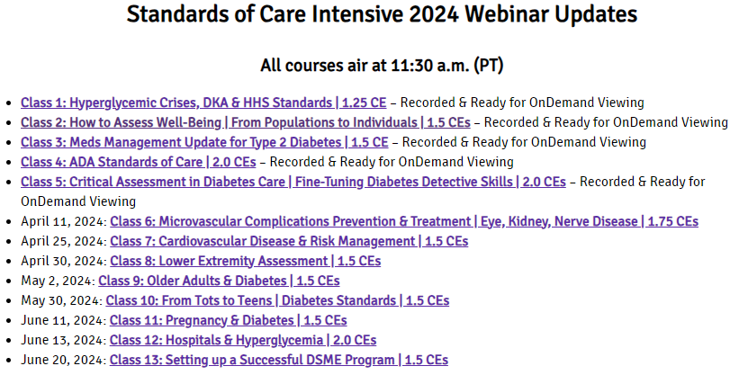
Standards & Resources
This course is a part of our LEVEL 2 Series.

Slide 7


References
Challenges and Strategies for Diabetes Management in Community‐Living Older Adults
Alan J. Sinclair¹,² and
Ahmed H. Abdelhafiz³
+ Author Affiliations
Diabetes Spectrum 2020 Aug; 33(3): 217-227. https://doi.org/10.2337/ds20-0013

Slide 8

Older Adults
Objectives:
Self-management considerations for older individuals
Strategies to prevent complications and maintain optimal quality of life
Determine targets and therapeutic approaches
Approaches to providing individualized care
Discuss the role of the Diabetes Educator as advocate

Slide 9

When Does Old Age Start?
"The aging process is a biological reality which has its own dynamic, largely beyond human control.
Age is also subject to the constructs of each society. (WHO)
In the developed world, 60 or 65, is said to be the beginning of old age (retirement)
In developing world, old age is seen to begin at the point when active contribution is no longer possible." (Gorman, 2000).

Slide 10
What is the best term for 65+?
Super Ager
Older
Elderly
Aged
Senior
Seasoned Citizen
Elder
Retiree
Geriatric

Slide 11

Aging: 3 Aspects
Biological age
  “present position of the individual relative to their life span” (ie telomeres)
  Biological age closely related to chronological age, but the two are not identical
Psychological age
  Adaptive capacities and subjective reactions relative to their group in society
https://www.encyclopedia.com/medicine/anatomy-and-physiology/anatomy-and-physiology/aging

Slide 12

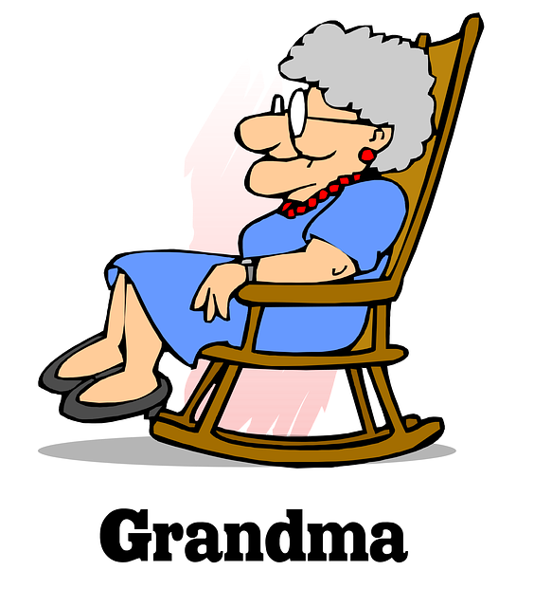
Aging: 3 Aspects
Social Age
  Social habits and roles of the individual
  Societies hold age-status systems that lead to expectations of how an individual should behave in relation to others

Slide 13
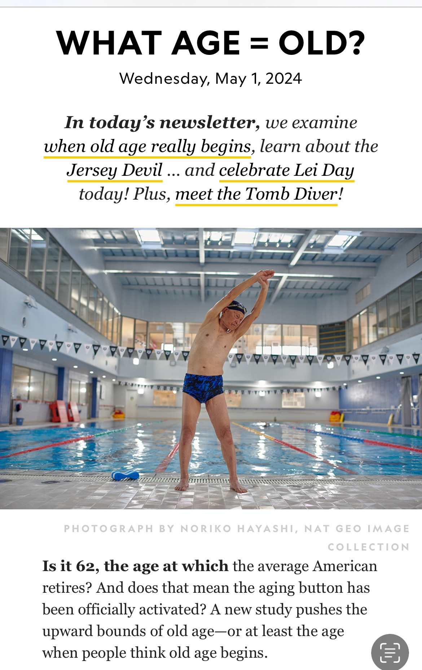

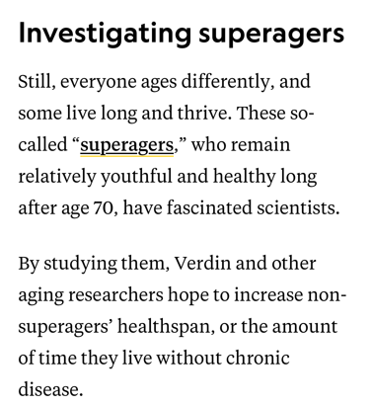
When does old age start?
Martha Stewart on Becoming Sports Illustrated’s Oldest Swimsuit Cover Model at 81 years.
“I don’t want to talk about aging, that is boring” NPR

Slide 14

SuperAger Secrets
SuperAgers lose brain volume more slowly than their peers, they may be better protected from dementia.
Secrets?
  Active Lifestyle
  Challenge themselves
  Social Butterflies
  Indulge
https://www.nm.org/healthbeat/healthy-tips/4-habits-super-agers

Slide 15



Hsu Sho-er, 84, and her husband Chang Wan-ji, 83, have been operating a laundry in the Houli district of Taiwan for the past 70 years.

Slide 16

What does the future hold?
Each person undertakes their own unique path

Slide 17

Poll Question 1
What percent of the population over the age of 65 has type 2 diabetes?
  26%
  9.3%
  18%
  34%

Slide 18

Older People and Diabetes Stats
26% of Americans age 65 or older have diabetes (11.8 million seniors)
50% of people with diabetes, 65 yrs plus
50% of older adults have prediabetes
Rate of older population with diabetes growing rapidly due to increasing life expectancy.
Diabetes prevalence to double in next 20 years, in part due to the aging population
Need regular assessment of medical, psychological, functional, and social domains

Slide 19

Fried Frailty Index – “Compromised energetics”
Frailty
Pre-Frail Stage
Meeting 3 out of 5 phenotypic criteria
low grip strength,
low energy,
slowed waking speed,
low physical activity, and/or
unintentional weight loss
1 or 2 criteria are present
Identifies a subset at high risk of progressing to frailty

Slide 20
3 Categories of Diabetes Complications in Older Adults – Reciprocal & Synergistic Relationships
Mental Dysfunction
Dementia
Depression
Behavioral & anxiety disorders
Physical & Neuropathic Complications
Sarcopenia
Frailty
Proximal motor neuropathy
Vascular Disease
Microvascular - Macrovascular
Retinopathy - Cardiovascular
Nephropathy - Cerebrovascular
Sensory neuropathy - Peripheral vascular
Lower extremity complications
Challenges and Strategies for Diabetes Management in Community‐Living Older Adults Diabetes Spectrum 2020 Aug; 33(3): 217-227.
Disability
Visual loss - Immobility - Falls
12 months of daily mental health symptoms

Slide 21
What can we do?
Early assessment plus
Timely intervention
May delay adverse outcomes.

Slide 22

RT, 72 & living with Type 2
Lives by self
Recently lost his twin brother
Had his phone turned off because forgot to pay bill
Kids want to him to move to “old folks' home”
Diabetes Management includes:
Metformin 1000 mg BID
70/30 insulin 30 units BID

Slide 23
Individualize Goals of Care
Preserve autonomy
Preserve independence
Preserve quality of life at the heart of care plans
A1c individualized
6.5 - 8%
Glucose goals
Before meals 100-130
After meals < 180

Slide 24
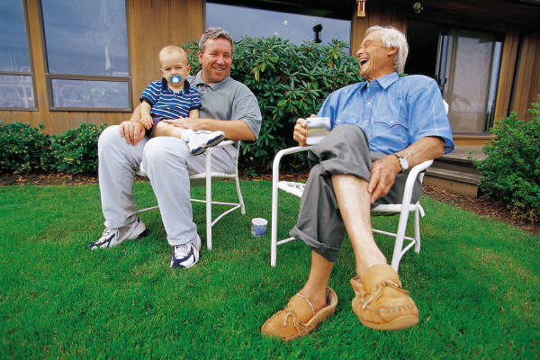

Older Adults – Psychological Assessment
Social support
  Who do they live with?
  Anyone helping with self-care?
Feelings
Finances
  Housing, food, transportation
Activity, Nutrition

Slide 25
RT, 72 & living with Type 2
Lives by self
No one outside of diabetes team helps with diabetes care
Attends support group
Admits to feeling depressed and angry
House paid off but has limited income for food and medicine
Can still drive and shop, but often forgets appointments
Likes to have a few drinks in the evening to relax
Diabetes Medications
Metformin 1000 mg BID
70/30 insulin 30 units BID

Slide 26

Psychosocial Issues “Integrity vs. Despair”
15-20% of older adults with diabetes live with depression
Assess other factors that may impact QOL
  lack of income
  isolation
  loss of partner, family, friends
  limited mobility
  alcohol or substance use

Slide 27

Older adults Substance Use Disorder (SUD)
1 million adults, 65+ live with SUD
Admission for SUD increased from 3.4% to 7.0% from 2001 to 2012
Alcohol is most used drug for 65+
  65% report high risk drinking (exceeding guidelines at least weekly).
  10% report binge drinking (4-5 drinks at one time)
https://www.drugabuse.gov/publications/substance-use-in-older-adults-drugfacts 2020

Slide 28

Alcohol Use Disorder Accounts for most admission to treatment centers for older adults
One study documented a 107% increase from 2001 to 2013.
Alcohol increases risk of:
  pancreatitis (hyperglycemia)
  high blood pressure, triglycerides
  hypoglycemia, malnutrition
  liver and bone problems
  neuropathic pain
  memory issues and mood disorders.
https://www.drugabuse.gov/publications/substance-use-in-older-adults-drugfacts 2020

Slide 29

Older Adults Substance Use Disorder (SUD)
Cannabis use is on the rise
Opioid and heroin use on the rise
About 8-10% of adults smoke cigarettes
https://www.drugabuse.gov/publications/substance-use-in-older-adults-drugfacts 2020

Slide 30
Poll question 2
Which of the following is true about diabetes and depression in older adults?
  A. Most older adults with diabetes are depressed.
  B. Older adults with diabetes are at low risk for depression.
  C. Older adults need regular evaluation for depression
  D. Alcoholism is the most common symptom of depression in older adults

Slide 31

ADA Recommendations - Depression
Older Adults (65 years of age) with diabetes should be considered a high-priority population for depression screening and treatment.

Slide 32

Depression Assessment
Depression:
  Over the last 2 weeks, have you felt down, depressed or hopeless?
  Over the last 2 weeks, have you felt little pleasure in doing things?
If they say yes to either of these, action is required.

Slide 33
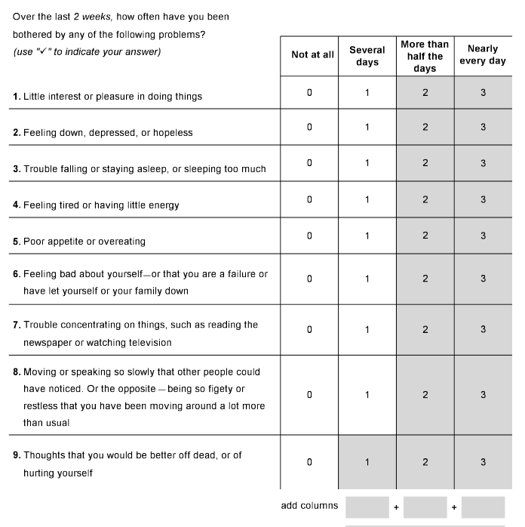
If say yes to screening question
Patient Health Questionnaire – Depression Screen
Quick Depression Assessment
  If there are at least four 3s in the shaded section (including Questions #1 and #2), consider a depressive disorder. Add score to determine severity.
  Consider Major Depressive Disorder - if there are at least five 3s in the shaded section (one of which corresponds to Question #1 or #2)
  Consider Other Depressive Disorder - if there are two to four 3s in the shaded section (one of which corresponds to Question #1 or #2)
PHQ-9

Slide 34
RT, 76 & living with Type 2
PHQ-9 – had 3 checks in shaded area
Scored 2 on the Mini-Cog
Ran out of insulin a week ago
Forgot to check blood glucose levels
Blood sugar “high”
Diabetes Medications
Metformin 1000 mg BID
70/30 insulin 30 units BID

Slide 35

NeuroCognitive Function
Perform annual cognition screen for 65+
Hyperglycemia is associated with cognitive function decline
Longer duration of diabetes worsens cognitive function
  Vascular Dementia
  Alzheimer’s
Treatment:
  Refer to specialist for assessment
  Achieve optimal BG control
  Pharmacist to evaluate drug safety and potential drug interactions
  Keep physically active

Slide 36
Cognitive Issues
Persistent hypo and hyperglycemia can double risk of cognitive dysfunction and dementia
Diabetes increases risk of incident depression by 27%
Diabetes + Dementia + Depression a pathway to mental disability
Self care gets compromised
Less able to detect and treat hypoglycemia
Dementia decreases communication ability
Safety becomes an issue
Challenges and Strategies for Diabetes Management in Community‐Living Older Adults Diabetes Spectrum 2020 Aug; 33(3): 217-227. https://doi.org/10.2337/ds20-0013

Slide 37

Cognitive Screening - Mini-Cog
“I am going to say three words that I want you to remember now and later.
The words are banana, sunrise, chair.
Please say them now.” Give the person three tries to repeat the words.
You may repeat the words to them for each try.
If they are unable to repeat the words back to you after three tries, go directly to the clock drawing.
Next, ask them to draw a clock
https://mini-cog.com/mini-cog-instrument/standardized-mini-cog-instrument/

Slide 38
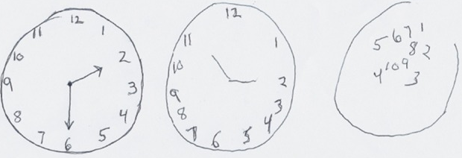
Cognitive Screening – Mini-Cog
Tasks - “Please draw a clock in the circle.”
“Put all the numbers in the circle”
“Now set the hand to show ten past eleven.”
Recall the 3 items
banana, sunrise, chair.
Score 1 for each task performed and for each item
A score less 3 of the 5 items defines cognitive impairment
Example of the same person drawing a clock over time with increasing dementia

Slide 39

Action Needed for RT
Let provider know about PHQ and Mini-Cog Test
  Referral to Gerontologist
Not taking insulin
  Found free service where volunteers would call every day to remind to check glucose and take insulin
  RT to check in with Diabetes Educator weekly
  Bought extra 70/30 insulin from Walmart, $25 a vial

Slide 40

Older Adults (≥65 years) with diabetes
Annual screening for early detection of mild cognitive impairment or dementia
High priority population for depression screening and treatment
Avoid hypoglycemia in this high risk group
  Prevent hypo by adjusting glycemic targets and adjusting pharmacologic interventions

Slide 41

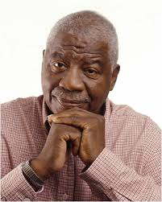
Consider the Individual
Start with a thorough assessment During the initial interview, ask questions to reveal medical, functional, mental and social domains.
This will help to provide a framework to determine realistic targets and best treatment approaches.
Cognition protected when blood glucose and B/P levels are closer to target.

Slide 42

Consider the Individual
Eval ability to afford diabetes medication, food and shelter.
Well phrased questions can provide opportunities for sharing and collaborative problem solving

Slide 43

Breath and Beauty

Slide 44
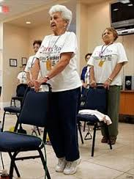

Functional Considerations – Older Adults with Diabetes
Peripheral Neuropathy in 50-70%
  Postural instability which limits physical activity
Falls and Fractures –higher risk w/ diabetes
  Women at risk for hip and humeral fractures
  Consider physical therapy, balance practice
Polypharmacy – 6 or more drugs daily
  Affordability, interactions, increased risk of falling
Visual impairment in 20%
Hearing impairment twice as common

Slide 45

Treatment Goals based on:
  Length of time living with diabetes (new onset, undiagnosed for many years or longer history)
  Presence or absence of complications
  Comorbidities
  Degree of frailty
  Cognitive function
  Life expectancy (often longer than expected)
  Functional status

Slide 46

Poll Question 4
RT, is a healthy 74-year-old who is on metformin 1000mg BID. Has had diabetes for 11 years. Latest A1c was 7.3% What is your response?
  A. Good job, let’s get the A1c less than 7%
  B. Have you been snacking more than usual?
  C. What do you think about your A1c level?
  D. Let’s add on another medication to get your A1c to target.

Slide 47


Healthy & Intact Functional Status
Set more intensive goals if:
  Intact cognitive and physical function
  Expected to live long enough to reap benefits of intensive management,
Ongoing follow-up to eval safety, CV risk reduction and hypoglycemia frequency
Goals:
  Reasonable A1c goal <7.0 - 7.5%,
  Fasting BG 80 – 130
  Bedtime Glucose 80-180
  Blood Pressure < 130/80
  Statin unless contraindicated or not tolerated

Slide 48
Poll Question 5
HR is a 78-year-old with a stroke and limited cognition. Has had diabetes for 8 years and is on intensive insulin therapy: Humalog coverage at meals and Lantus at night. A1c is 6.2%. Has a part time care taker. What do you suggest?
A. Evaluate food intake
B. Discuss de-intensifying insulin regimen
C. Move Lantus to morning
D. Stop insulin and start on oral medications

Slide 49
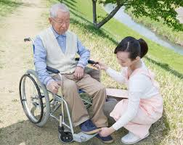
Patients with Complications and Reduced Functionality - Less Intense Goals
For older adults with
  advanced diabetes complications,
  life-limiting illnesses
  substantial cognitive, functional impairment.
Less likely to benefit from reduced risk of microvascular complications
At higher risk of hypoglycemia, hypotension and adverse effects from polypharmacy

Slide 50

Older Adults with Complications and Reduced Functionality - Less Intense Goals
Intermediate remaining life expectancy, high treatment burden, hypo and fall risk.
Consider DE-Intensification
Goals:
  Reasonable A1c goal <8.0%
  Fasting BG 90 – 150
  Bedtime BG 100-180
  Blood Pressure < 130/80
  Statin unless contraindicated or not tolerated

Slide 51
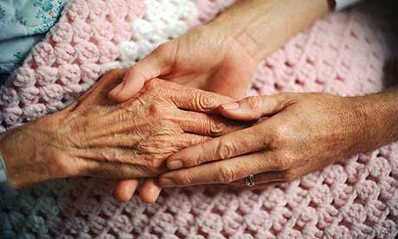
Very Complex Inds with Poor Health
For people with:
  limited life expectancy and end stage chronic illnesses, benefit uncertain
Focus on quality of life and avoidance of hypo & hyperglycemic crisis.
Goals:
  No A1C target, avoid hypo and
  hyperglycemia for comfort
  Fasting BG 100 – 180
  Bedtime BG 110-200
  Blood Pressure < 140/90
  Consider likely benefit of
  statin unless contraindicated or not tolerated

Slide 52

ADA Recommendations – End of Life
Overall comfort, prevention of distressing symptoms, and preservation of quality of life and dignity are primary goals for diabetes management at the end of life.

Slide 53

ADA Recommendations – Long Term Care Facilities
Provide diabetes education to staff (including for devices)
People with diabetes residing in long-term care facilities need:
  careful assessment to establish glycemic goals
  make appropriate choices of glucose-lowering agents based on their clinical and functional status.
  Evaluation of frequency of BGM

Slide 54
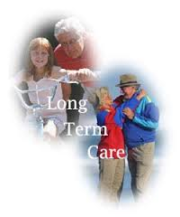
Long Term Care Consideration
Staff training - to increase knowledge of diabetes and promote individualized care
Nutrition – at high risk for under-nutrition.
  Tailor diet to culture, preferences and personal goals, swallowing issues
Hypoglycemia – more vulnerable to hypo
  Due to multiple comorbidities
Ongoing eval
  Federal guidelines – MD must assess pt every 30 days for 1st 90 days, then once every 60 days
  Monitor if resident may be experiencing hypo/hyper and encourage treatment change

Slide 55
Poll Question 6
When should the long-term care staff contact the provider about medication change assessment?
A. If blood sugars are above 180 twice a week.
B. If morning blood sugars are consistently 100-130.
C. If blood sugars go below 70 one time.
D. If post meal sugar goes above 300 once

Slide 56

When to Contact Provider – Long term Care Hypo/Hyper Guidelines:
Hypoglycemia indicates TOO MUCH Diabetes Medication
Call provider immediately for low blood glucose levels <70 mg/dL
Call as soon as possible when
  glucose values are 70–100 mg/dL (regimen may need to be adjusted),
  glucose values are consistently >250 within a 24-h period
  glucose values are consistently >300 over 2 consecutive days
  any reading is too high for glucose monitoring device, or
  the resident is sick, with vomiting, symptomatic hyperglycemia, or poor oral intake.
Consider use of CGM for those at higher risk of hypo/hyper

Slide 57

Shared Decision Making
For all these situations, a patient-centered approach and shared decision making can help establish goals and treatment strategies that are reasonable for the patient, family and provider.

Slide 58

CV Risk Reduction – Older Adults
When treating Cardiovascular risk factors consider time frame of benefit and the individual patient.
Hypertension treatment is indicated in virtually all older adults
Lipid-lowering and aspirin therapy may benefit those with longer life expectancy

Slide 59

Goals – Keeping it in Perspective
Greater reductions in death and complications may result from CV risk factor reduction than tight BG control alone
Strong evidence to treat HTN
Less evidence for lipid lowering and aspirin therapies
Research ongoing

Slide 60

Older Adults and Medications
In older adults at increased risk of hypoglycemia, meds with low risk of hypoglycemia are preferred.
Overtreatment of diabetes is common in older adults and should be avoided.
Deintensification (or simplification) of complex regimens is recommended
Consider cost of care and insurance coverage

Slide 61

Individualize regimen for older people
Match regimen complexity to the self-management ability of the individuals and their available social and medical support.
Intensive glycemic control with insulin and sulfonylureas in those with complex medical conditions are considered
  overtreatment
  found to be very common in clinical practice

Slide 62

Older People with diabetes
Are often
  Under Treated and
  Over Treated

Slide 63
Poll Question 7
A daughter of an 83-year-old with diabetes asks you about what particular issues to watch for with her mother? Which of the following is most important to monitor for her older mother with diabetes?
  A. Hypoglycemia
  B. Ability to send an urgent text
  C. Keeping morning BG 80-130
  D. Making sure she has a 30gm snack at night

Slide 64

Avoid Hypoglycemia in Older Adults
Associated with
  Cognitive decline
  Falls
  Arrythmias.
Screen for hypo on regular basis
Prevent and determine cause
Make needed med /food adjustment
For those on insulin therapy, encourage use of CGM
For those with type 1, consider Automated insulin delivery

Slide 65

Hypoglycemia & Older Adults
Evaluate for Hypoglycemia awareness and action
  Assess food access and timing
  Skipping meals?
  Repeating insulin doses?
  Forgetting insulin, meds?
  Ongoing monitoring and problem solving
  Kidney function, esp if GFR <60
  Alcohol intake

Slide 66
RT, 76 & living with Type 2
Updated info
  A1C 8.9%
  GFR 49, UACR 221
  No hypoglycemia
  Checks BG a few times a week.
  Very sedentary
Is this the right medication regimen for RT?
Diabetes Medications
Metformin 1000 mg BID
70/30 insulin 30 units BID

Slide 67

Medications – Biguanides
Metformin – one of 1st line agent in older adults
  Use caution in those with impaired renal or hepatic function or CHF on diuretics.
  Temporarily hold during acute illness, procedures which may compromise renal and liver function.
  Use long-acting version to decrease N/V
For those on long term metformin therapy, consider monitoring B12 levels.

Slide 68
Poll Question 8
JT has an A1c of 7.4, GFR 42, UACR is 219 mg/g. Tried to get blood glucose down through exercise and diet. What med is ADA recommended to get A1c to target and protect renal function?
A. sitagliptin (Januvia)
B. canagliflozin (Invokana)
C. glyburide (Diabeta)
D. metformin (Glucophage)

Slide 69
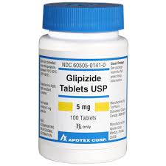
Older Adults - Secretagogues
Sulfonylureas
  Glipizide or glimepiride preferred
  Cause hypo, use cautiously
  Review signs of hypo, treatment and follow-up
  Associated with 5-7 lb wt gain
  Glyburide contraindicated (hypo)
BG monitoring helpful
If experiencing hypo, contact provider to decrease dose

Slide 70

Caution with TZDs
Use thiazolidinediones very cautiously for those on
  insulin therapy or at risk for
  heart failure, osteoporosis, falls or fractures, and/or macular edema.
Lower dose pioglitazone (Actos) may be beneficial for:
  Those with history of stroke
  Those with fatty liver disease

Slide 71
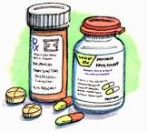
Older Adults – SGLT-2 Inhibitors
Benefits of these “Glucoretics”
  Can lower weight / BP. No hypoglycemia
  Reduces risk of CVD, Heart failure and preserves long term kidney function
    Consider empagliflozin, dapagliflozin, canagliflozin
Considerations
  Cost may be a barrier
  Monitor GFR, weight loss
  Hypotension, dehydration, electrolyte imbalances
  Increased risk of genital infections, dehydration
  Can be used to reduce cardiorenal risk only (even if BG on target.

Slide 72
Older Adults: DPP-IVs
DPP-IV Inhibitors
  Few side effects, no hypo
  Cost may be barrier
  A1c drop about 0.6%
  Increased risk of heart failure risk with saxagliptin and alogliptin

Slide 73
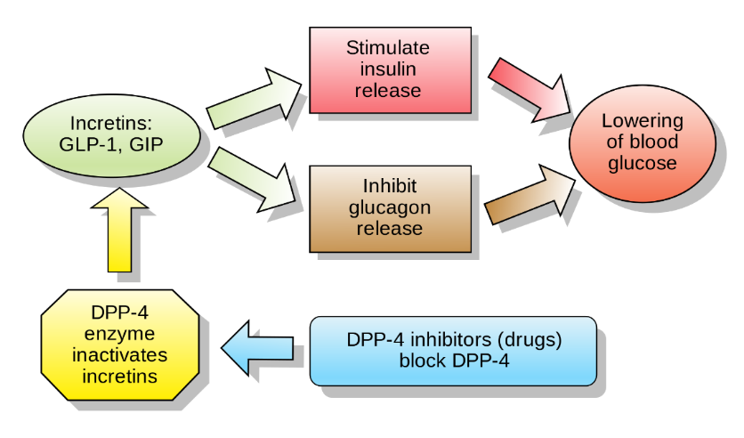
Older Adult Consideration: GLP-1s
GLP-1 Receptor Agonists
reduce major adverse cardiovascular events,
  cardiovascular deaths
  stroke, and myocardial infarction for people over age 65 (and younger too)
  Injections may require more visual, cognitive and motor coordination.
  Can cause N/V and lead to weight loss
  Can be costly
  Can be used to reduce cardiorenal risk only (even if BG on target.

Slide 74

Insulin Therapy
Evaluate ability to safely use, inject and afford.
May need to simplify.
Eval if oral meds can be increased and insulin decreased.
If type 1, able to self-manage or is support needed?
Hypoglycemia awareness and knowledge how to treat?

Slide 75
Poll Question 9
For older adults with diabetes on insulin, which of the following is the most accurate statement?
Older adults are at greater risk of hypoglycemia than younger adults.
Due to cognitive decline, continuous glucose monitoring is not recommended.
Divide basal insulin into two separate doses to enhance absorption.
Give insulin after meals to prevent hypoglycemia

Slide 76
RT, 76 & living with Type 2
Updated info
  A1C 8.9%
  GFR 49, UACR 221
  No hypoglycemia
  Checks BG a few times a week.
  Very sedentary
Is this the right medication regimen for RT?
Diabetes Medications
Metformin 1000 mg BID
70/30 insulin 30 units BID
Add SGLT-2 for renal protection and BG improvement.
Then consider adding GLP-1 RA with decrease of insulin.

Slide 77
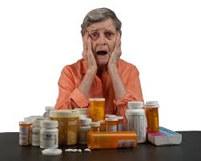
Medication Factors to Consider
Construct a tailored care plan – focus on safety
Social difficulties and living situation
Assess affordability
Get meds from one pharmacy
  Consult with pharmacist
  Medication reconciliation
Keep list of meds on hands

Slide 78

Physical Activity Benefits for
Older Adults
Lower overall mortality.
Lower risk of
  coronary heart disease.
  colon cancer.
  diabetes.
  high blood pressure
  obesity.
  falls and injury
  Alzheimer's
Improves
  Mood, relieves depression
  Improved QOL / function
  Function in persons with arthritis
  Mental clarity
National Institute on Aging

Slide 79


Google Go4Life
Exercise ideas
Videos
Resources

Slide 80
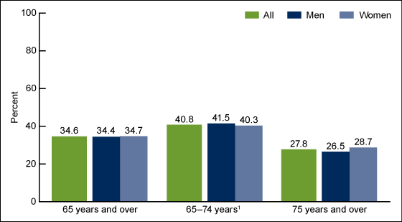
Weight and Older Adults
Refer to RD
Elevated BMI prevalent
Increases decline in physical function
Increases frailty
Encourage strategies that combine physical activity, nutrition therapy to promote wt loss
Prevalence of BMI 30+ among adults aged 65 and over, by sex: U.S., 2007–2010. CDC

Slide 81

Nutrition Considerations for Older Adults
Asses for underweight & extra weight
Smaller more frequent meals
Fortify usual foods
Adding liquid nutrition supplement
Identifying community resources (meals on wheels, Senior Centers, etc.)
Encourage fluid intake
Snacks as needed
Cultural preferences and palatability

Slide 82

Older Adults at Risk for Malnutrition
Due to:
  Altered taste and smell
  Swallowing difficulties
  Oral/dental issues
  Functional difficulties shopping for/preparing food
  Anorexia
  Overly restrictive eating patterns - carb deprivation
    Self-imposed or provider/partner directed

Slide 83

Sleep
Poor sleep associated with higher glucose levels.
People with dementia may sleep more or have disrupted sleeping patterns.
How much sleep are you getting a night?
Do you wake up well rested?
Have you had a sleep study?

Slide 84

Oral Hygiene
Oral health affects blood glucose and vascular inflammation.
  Gums swollen?
  Brushing frequency
  Flossing frequency
  Dental visits
  Tooth abscess?
  Dentures fitting?

Slide 85
Social Connectedness
Is key to healthy aging.
Studies have shown that older people who have close connections and relationships not only live longer, but also cope better with health conditions and experience less depression.
Weekly groups
Volunteering
Social Media Connections
Family nearby
Places of worship
Pets
https://www.healthinaging.org/blog/social-connectedness-a-key-to-healthy-aging/

Slide 86
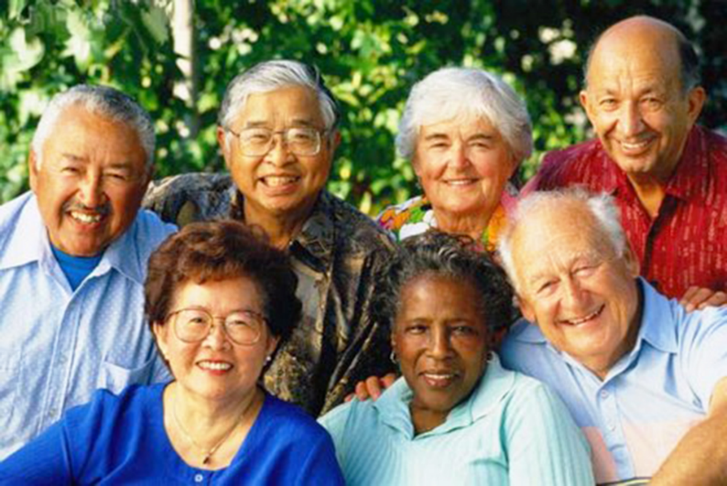
INDIVIDUALIZE – The Best Strategy for All Ages
Consider the individual
Identify polypharmacy/ financial problems
Promote diabetes self-management training
Recognize emotional distress
Emotional support – Support Groups
Realistic goal setting
Follow-up and resources

Slide 87

Hope: Our Best Gift

Slide 88

Thank You
Questions:
We are here to help.
info@diabetesed.net
www.DiabetesEd.net
530-893-8635
www.DiabetesEd.net

