Slide 1
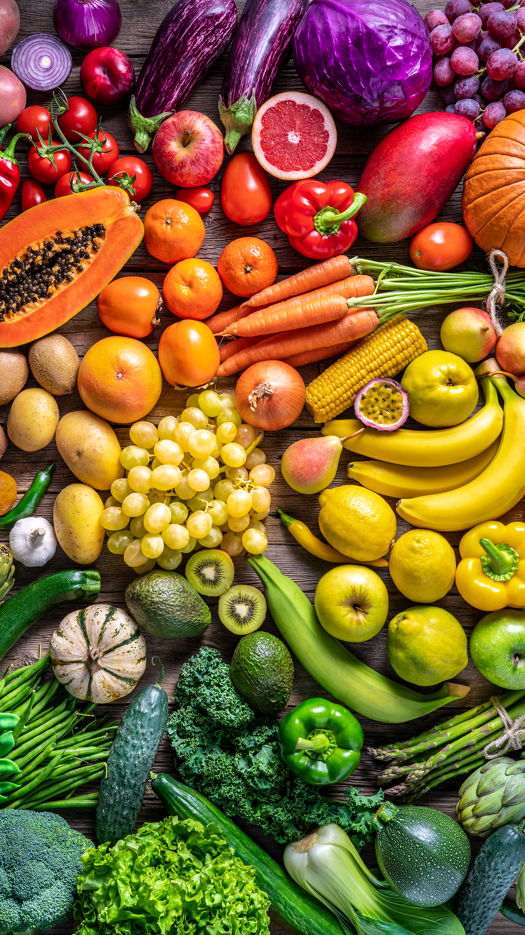
Keeping Healthy with Prediabetes & Diabetes

Slide 2


Goals
To know risk factors for type 2 diabetes.
To understand diabetes management strategies.
To learn the ABCs of Diabetes management.
To set one SMART goal for the Holidays.

Slide 3
Type 2 Diabetes Risk Factors
Inactivity
Carrying extra weight, especially around the abdomen
Age, especially >45 years old
Family history
Minority ethnicity
Poor diet
Stress
Insufficient sleep
Socioeconomic status
High blood pressure
High cholesterol
History of prediabetes or gestational diabetes
Having non-alcoholic fatty liver disease

Slide 4
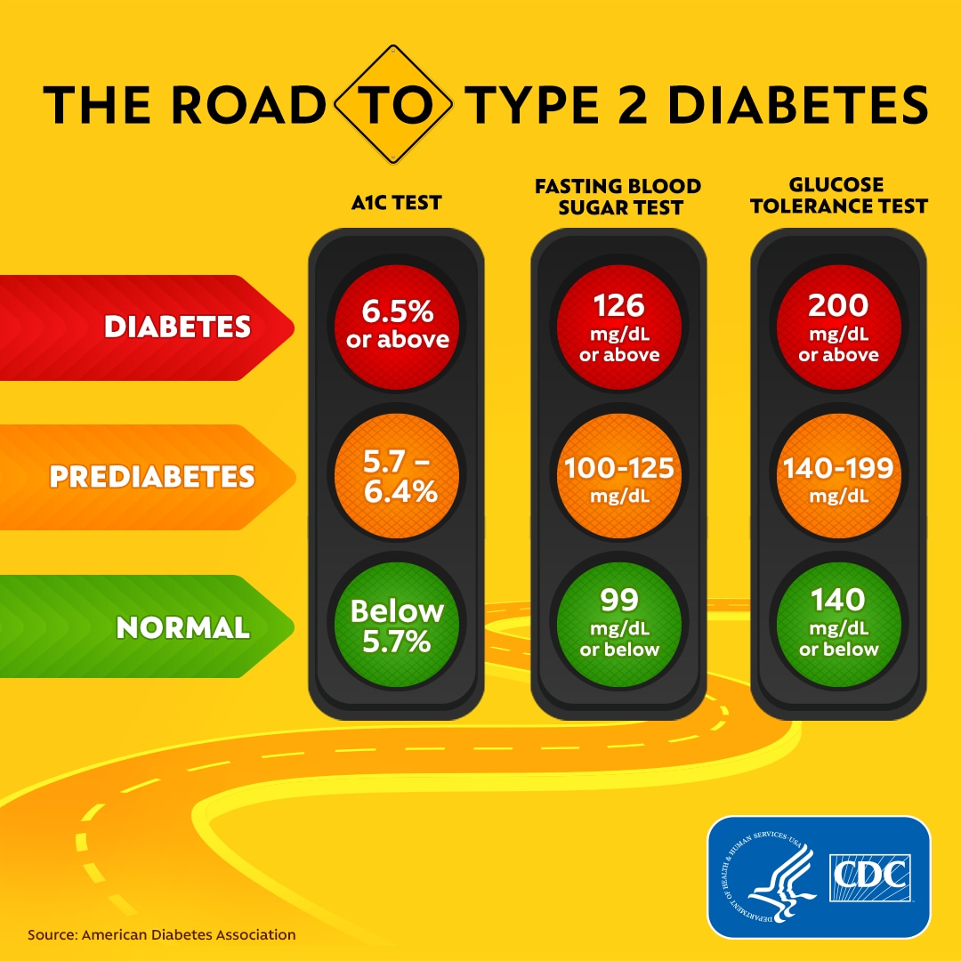

This Photo by Unknown Author is licensed under CC BY
https://www.cdc.gov/diabetes/images/basics/CDC_Diabetes_Social_Ad_Concept_A2_Facebook.png

Slide 5
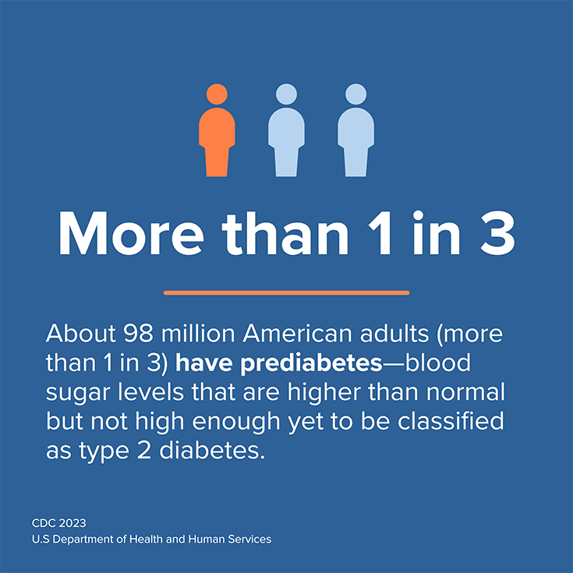
The Stats:
Diabetes Total: 11.6% of the U.S. population
Undiagnosed: 22.8% of adults with diabetes are undiagnosed
Prediabetes Total: 38.0% of the adult U.S. population
Among U.S. adults aged 18 + with diabetes:
  89.8% were overweight or had obesity (BMI > 24)
  80.6% had a systolic blood pressure of 130 mmHg or higher or diastolic blood pressure of 80 mmHg or higher or were on prescription medication for their high blood pressure
  39.5% had a non-HDL level of 130 mg/dL or higher
New cases: 1.2 million Americans are diagnosed with diabetes every year.

Slide 6
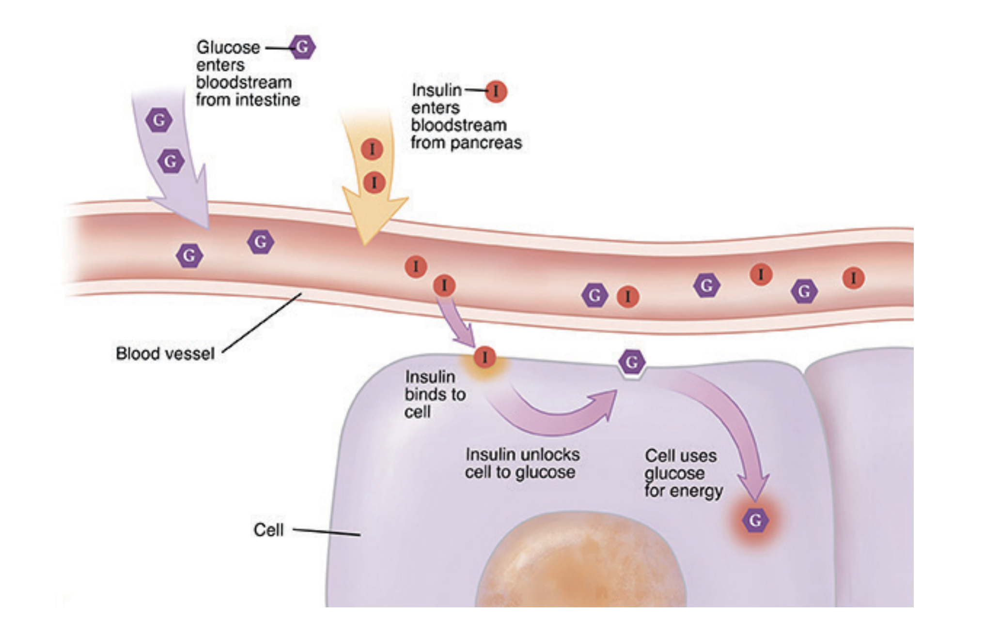
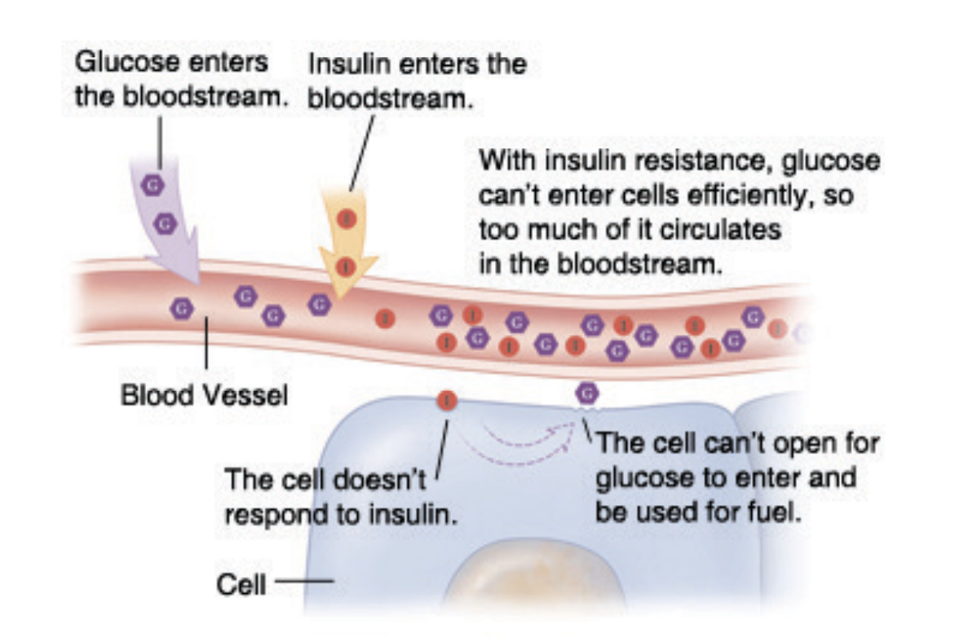
Glucose uptake with and without Type 2 Diabetes:
Note that in type 1 diabetes, an autoimmune disease, results in lack of insulin production.
Images: 2000-2023 The StayWell Company, LLC. & https://www.uclahealth.org/medical-services/endocrinology/diabetes/type-2-diabetes

Slide 7
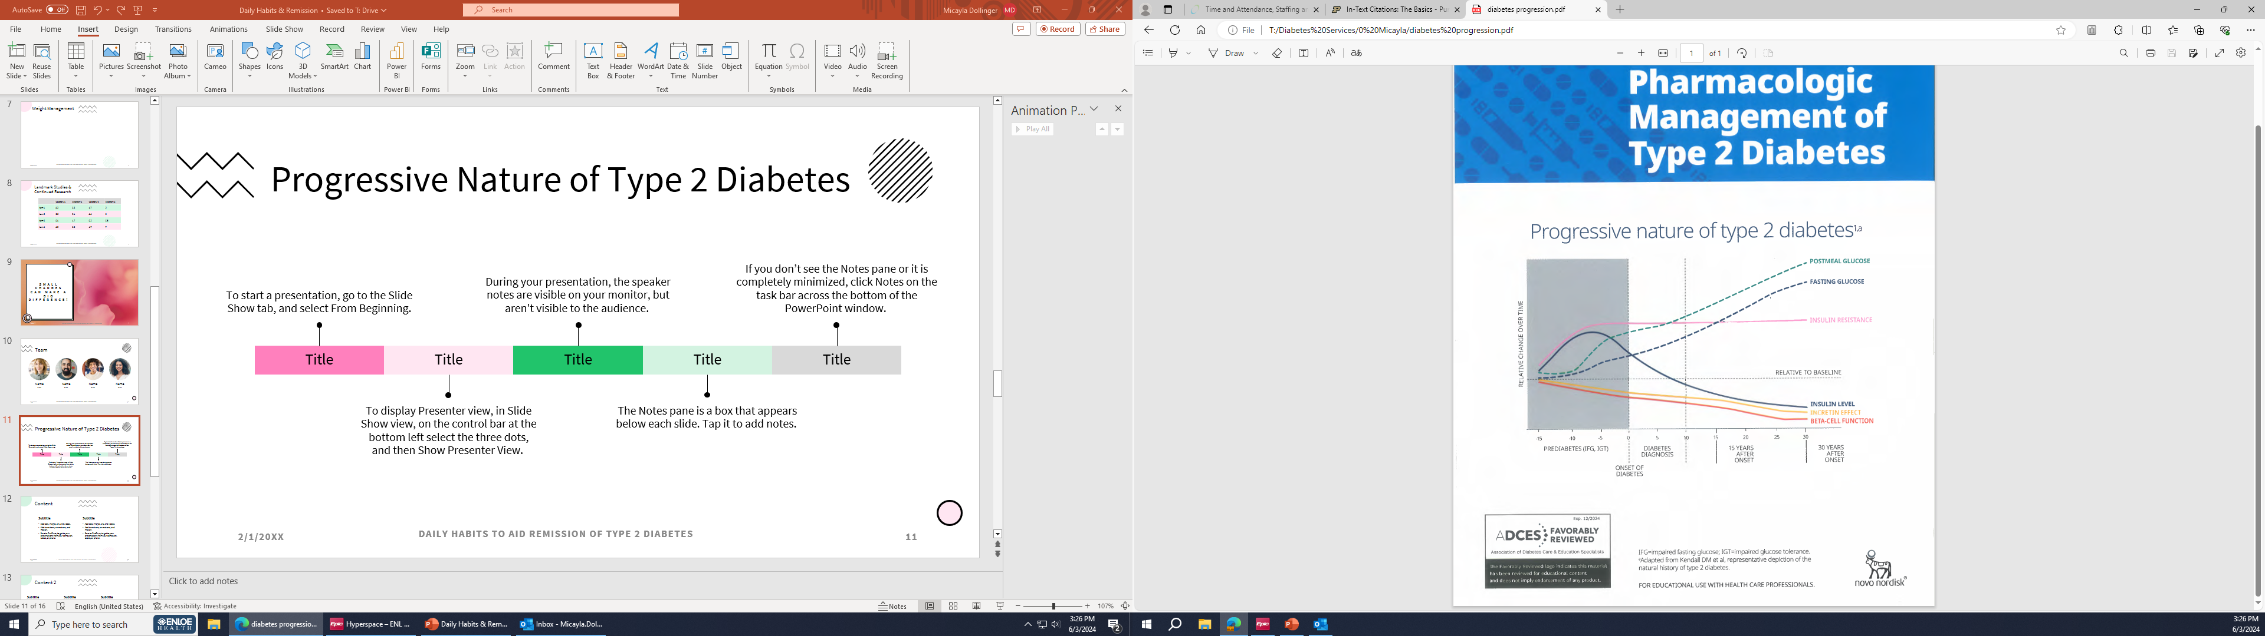
Progressive Nature of Type 2 Diabetes

Slide 8

How do we get to our best health?

Slide 9



Six pillars of active lifestyle intervention:
Nutrition —evidence supports whole food, plant-predominant eating plan
Physical activity — movement combats the negative effects of sedentary behavior and builds mental health
Stress management — excess stress can lead to anxiety, depression, obesity and immune dysfunction
Sleep — inadequate or disordered sleep depresses mood, lowers daytime caloric burn, increases hunger and causes insulin resistance;
Social connectedness — positive relationships enhance mental, physical and emotional health
Avoiding risky substances — avoidance reduces risk for chronic diseases and death. -Person, et al

Slide 10

Nourishing our Bodies
Processed Foods
Whole
Foods
Plant
foods
Food choices make a difference in how we feel everyday.
Healthy approaches could include:
  Plant based
  Intermittent Fasting
  Calorie Restriction
  Mediterranean
  DASH Diet
  Other?

Slide 11



Activity Recommendations
Strive for 30 minutes of exercise 5 days per week
Consider taking a walk post meal
Building muscle helps with fat loss and improves glucose use--incorporate strength training

Slide 12

Exercise benefits
Sleep better.
Less diabetes kidney disease, retinopathy
Improved mood and vitality
Improved sexual health
Less urinary incontinence
Better knee health
Less need for medications
Decreased health care costs
Other?

Slide 13
ABC’s of Diabetes Care

Slide 14

Use a ‘SMART’ goal structure
“The first three key action statements of the guideline call for advocating for lifestyle management as first-line treatment, assessing a person’s baseline lifestyle habits with regard to the six pillars of lifestyle medicine, and establishing priorities for lifestyle change that also incorporate the six pillars. Rosenfeld said health care professionals should use a SMART goal structure — which stands for Specific, Measurable, Action-oriented, Realistic, Time-sensitive goals — to support positive lifestyle change.”
-Person, et al.
American College of Lifestyle Medicine are working on new guidelines that focus on lifestyle treatments for people with type 2 diabetes and prediabetes.

Slide 15
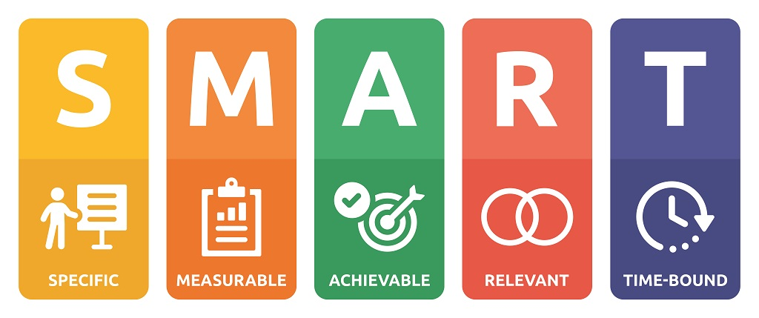
I encourage each person here, including myself and other presenters, to write down a SMART goal to work on for the remainder of November.
Remember to evaluate your progress at the end of the month and set new goals for December!

Slide 16

Small Changes can make a BIG difference!

Slide 17


Resources:
American Diabetes Association; Implications of the United Kingdom Prospective Diabetes Study. Diabetes Care 1 January 2002; 25 (suppl_1): s28–s32. https://doi.org/10.2337/diacare.25.2007.S28
American Diabetes Association Professional Practice Committee; 3. Prevention or Delay of Diabetes and Associated Comorbidities: Standards of Care in Diabetes—2024. Diabetes Care 1 January 2024; 47 (Supplement_1): S43–S51. https://doi.org/10.2337/dc24-S003
American Diabetes Association Professional Practice Committee; 8. Obesity and Weight Management for the Prevention and Treatment of Type 2 Diabetes: Standards of Care in Diabetes–2024. Diabetes Care 1 January 2024; 47 (Supplement_1): S145–S157. https://doi.org/10.2337/dc24-S008
Centers for Disease Control and Prevention. National Diabetes Statistics Report website. https://www.cdc.gov/diabetes/php/data-research/index.html Accessed [date].
Coelho M, Oliveira T, Fernandes R. Biochemistry of adipose tissue: an endocrine organ. Arch Med Sci. 2013 Apr 20;9(2):191-200. doi: 10.5114/aoms.2013.33181. Epub 2013 Feb 10. PMID: 23671428; PMCID: PMC3648822.
Matthew C. Riddle, William T. Cefalu, Philip H. Evans, Hertzel C. Gerstein, Michael A. Nauck, William K. Oh, Amy E. Rothberg, Carel W. le Roux, Francesco Rubino, Philip Schauer, Roy Taylor, Douglas Twenefour; Consensus Report: Definition and Interpretation of Remission in Type 2 Diabetes. Diabetes Care 1 October 2021; 44 (10): 2438–2444. https://doi.org/10.2337/dci21-0034
Person, Schaffer, R., & Schaffer is a medical journalist and editor. She received her BA in English and Journalism from Rowan University. &nbsp; Schaffer has been in medical publishing since 2015. She is currently Executive Editor for Healio Women’s Health &amp; OB/GYN. She has, including cardiology. (2024, October 29). “this is the Foundation”: New guideline emphasizes lifestyle-first approach to diabetes. Healio. https://www.healio.com/news/endocrinology/20241029/this-is-the-foundation-new-guideline-emphasizes-lifestylefirst-approach-to-diabetes?utm_source=selligent&utm_medium=email&utm_campaign=news
Rosenfeld RM, Kelly JH, Agarwal M, et al. Dietary Interventions to Treat Type 2 Diabetes in Adults with a Goal of Remission: An Expert Consensus Statement from the American College of Lifestyle Medicine. American Journal of Lifestyle Medicine. 2022;16(3):342-362. doi:10.1177/15598276221087624
Shahrad Taheri; Type 2 Diabetes Remission: A New Mission in Diabetes Care. Diabetes Care 2 January 2024; 47 (1): 47–49. https://doi.org/10.2337/dci23-0062
Theresa V. Rohm, Daniel T. Meier, Jerrold M. Olefsky, Marc Y. Donath, Inflammation in obesity, diabetes, and related disorders, Immunity, Volume 55, Issue 1, 2022, Pages 31-55, ISSN 1074-7613, https://doi.org/10.1016/j.immuni.2021.12.013. (https://www.sciencedirect.com/science/article/pii/S1074761321005495)
Type 2 diabetes. UCLA Health. (n.d.). https://www.uclahealth.org/medical-services/endocrinology/diabetes/type-2-diabetes

