Slide 1

Diabetes Fundamentals Series 2025 Class 2 – Nutrition & Exercise
Christine Craig, MS RDN CDCES
Dietitian- Diabetes Educator
Founder: Nutrition for Daily Living

Slide 2
Land Acknowledgment
We acknowledge and are mindful that Diabetes Education Services stands on lands that were originally occupied by the first people of this area, the Mechoopda, and we recognize their distinctive spiritual relationship with this land, the flora, the fauna, and the waters that run through this area.

Slide 3


We are Here to Help!
Bryanna Sabourin
Director of Operations
Certification Pathway Coach &
Customer Happiness Expert
Tiffany Bergeron
Customer Advocate &
Customer Happiness Expert
If you have questions, you can chat with us at www.DiabetesEd.net or call 530 / 893-8635 or email at info@diabetesed.net

Slide 4

Diabetes Education Services Inclusion Statement
Based on the IDEA Initiative inspired by CDR
Inclusion
Diversity
Equity
Access
We are committed to promoting diversity and inclusion in our educational offerings.
We recognize, respect, and include differences in ability, age, culture, ethnicity, gender, gender identity, sexual orientation, size, and socioeconomic characteristics.
Our goal is to promote equity and access, acknowledging historical and institutional inequities.
We are committed to practicing cultural humility and cultivating our cultural competence.
We wish to create a safe space within our community where one's beliefs, experiences, identity, and differences in ability, age, size, socio-cultural/socioeconomic characteristics, and political affiliations are considered and respected.

Slide 5
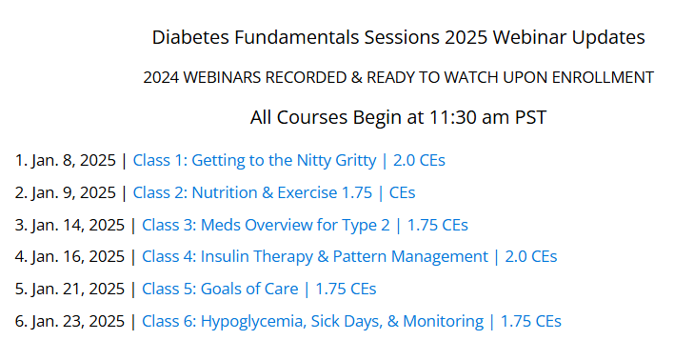

Welcome to our DiabetesEd Online University
Our goal is to provide an exceptional user experience and build a sense of community.
Level 1 - Diabetes Fundamentals

Slide 6
Christine Craig, MS, RDN, CDCES has No Relevant Conflicts of Interest
Information is based on:
The ADA Standards of Care in Diabetes
Christine is a Registered Dietitian, a Certified Diabetes Care and Education Specialist, and a consultant dietitian. She has worked across health systems; providing diabetes care within Primary, Telemedicine and Endocrinology clinics. Currently, she is the Founder of Nutrition for Daily Living, where it is her mission to increase access to compassionate and evidenced-based nutrition and diabetes care.

Slide 7
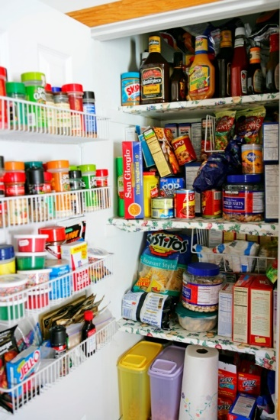


Class 2 – Nutrition and Activity
Outcome goal: Articulate the medical nutrition therapy and activity fundamentals and discuss the impact of weight stigma on individuals with diabetes.
Objectives:
Discuss self-management strategies.
List Nutrition Guidelines for people with diabetes.
Describe current MNT recommendations.
List 3 teaching strategies for success.
State ADA Exercise Guidelines highlights.
Discuss goals and safety precautions for diabetes and exercise.

Slide 8


ADA Standards 2025 – Section 5
Facilitating Positive Health Behaviors and Wellbeing to Improve Health Outcomes
Benefits of Diabetes Self-Management Education and Support
Medical Nutrition Therapy
Activity
Notes:
Lets great ready by taking 3 deep breaths. We are going to breath in for a count of 4, hold for a count of four and breath out for a count of four. Ready go.
Deep breath exercises helps activate our parasympathetic system. Daily deep breathing can help lower resting blood pressure, reduce stress and anxiety AND make us more present in our work and learning.
Today we are going to review the Standards of Care updates for 2025 with a focus on Diabetes Self-management education and support, nutrition therapy and activity.

Slide 9

Objectives of Diabetes Self Management Education and Support (DSMES)
Support informed decision making
Promote skill mastery needed for optimal self care
Consider treatment burden
Routinely assess outcomes, health status, well being and screen behavioral health
Incorporates needs, goals, and life experiences of the individual
Supports informed decision making, self-care behavior, problem solving and active collaboration.
Notes:
In Diabetes Self-Management Education and Support or DSMES we are the facilitators. We support engaging individuals with diabetes in making informed decisions,
learning how to self-manage and care for their conditions and
promote learning skills to optimize this self-care.
We use non-judgmental language and take the individual into account, considering treatment burden, confidence and the individuals own needs, goals, and experiences.
We consider burden of treatment, self-efficacy (an individual's belief in their actions), and available support.
“Clinical outcomes, health status and well-being are key goals and should be accessed as part of routine care.“
Screening for behavioral health at same critical times as DSMES may supported increased engagement.

Slide 10
DSMES Benefits
Improved knowledge
Lower A1c and weight
Improved quality of life
Reduced mortality
Positive coping
Reduced cost
Only 5-7% of Medicare/insured receive DSMES)
Increased primary care, preventive services
Less frequent use of acute care and inpt admissions
More likely to follow best practice recommendations (esp. those with Medicare)
Notes:
With engagement and tailoring of DSMES interventions we see greater outcomes and benefits.
DSMES has been shown to…..
Lower A1c by about 0.55% (https://www.cdc.gov/diabetes-toolkit/php/business-case/overall-value-roi.html#:~:text=A%20systematic%20review%20of%20DSMES,in%20hemoglobin%20A1C%20of%200.55%25.)
Reduced cost: In 2022 cost was 413 billion dollars annually (about 20000 per person) with $307 billon dollars in direct health care costs and the remainder in reduced productivity.
Less than 5% of Medicare beneficiaries and 6.8% of people with private insurance use these services in their first year of diagnosis. And only 53% of individuals eligible receive it.
https://www.cdc.gov/diabetes/health-equity/increase-diabetes-education.html

Slide 11
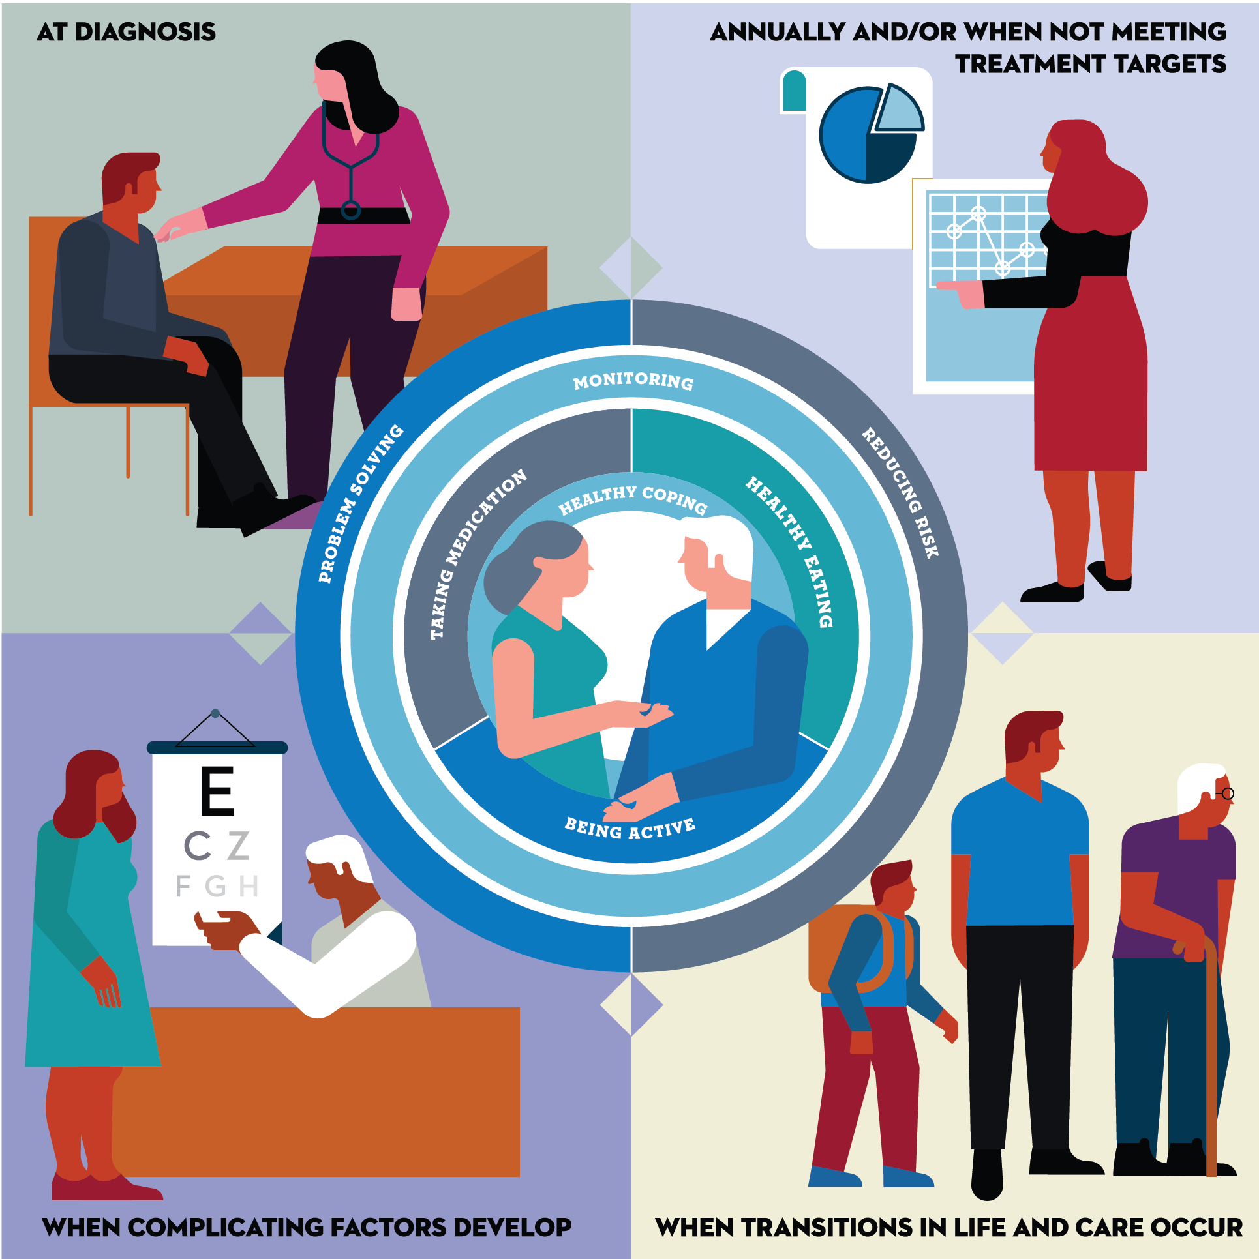
Critical times to provide and modify DSMES
At diagnosis.
Annually and/or when not meeting treatment goals.
When complicating factors develop (medical, functional, psychosocial).
When transitions in life and care occur.
Powers MA, Bardsley JK, et al. DSMES Consensus Report, The Diabetes Educator, 2020
ADCES. AADE7 Self-Care Behaviors, The Diabetes Educator, 2020
Referring to DSMES: https://www.cdc.gov/diabetes/hcp/dsmes/index.html
Notes:
ADA has listed the critical times to refer to DSMES.

Slide 12

Critical times to provide and modify DSMES
- Annually and/or when not meeting treatment goals
- When complicating factors develop (medical, physical, psychosocial) develop
- When transitions in life and care occur.
Powers MA, Bardsley JK, et al. DSMES Consensus Report, The Diabetes Educator, 2020
ADCES. AADE7 Self-Care Behaviors, The Diabetes Educator, 2020

Slide 13


Address Barriers to Self Management
Design and deliver DSMES with ultimate goal of health equity across all populations.
Barriers exist within health system, payer, clinic, health care professional & individual.
Address barriers through innovation - including community health workers, telehealth, other digital health solutions aligned with individual needs.
Consider social determinants of health of specific population when designing care delivery.
Notes:
Despite the beneficial outcomes only 50% of individuals who quality, access DSMES- and barriers exist.
Access and health equity is the ultimate goal when designing and delivering DSMES.
We know barriers to care exist at every level from the health system to individual.
However we can address these barriers by working to educate participants and health care providers on the critical times when DSMES is needed.
We can work with health systems and clinics to develop population health screening and clinical outreach,
create protocols to reduce time for referral and
collaborate health and community systems to address social needs and include SDOH screening and social needs support.
We can include other health partners including community health workers to support delivery of diabetes peer support.
Barriers can be also be addressed by developing a diversity of delivery models.
From traditional inperson classrooms to community-based strategies and technology enabled solutions including telehealth or virtual environments varying modes can serve different needs.
Creating culturally appropriate and varied modalities of settings has been shown to more effectively improve outcomes depending upon population needs.

Slide 14
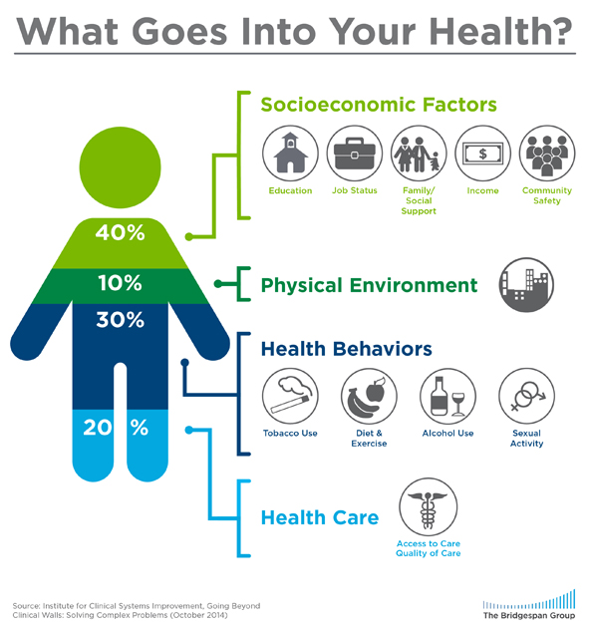
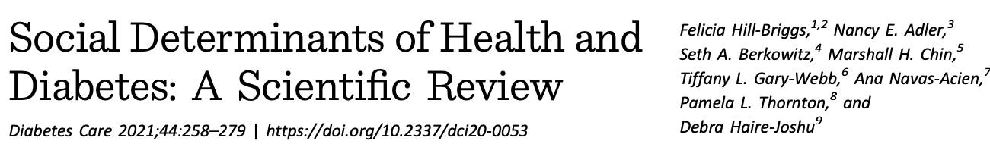
Social Determinants of Health
The conditions in which people:
Born
Play
Live
Work
Learn
Pray
Directly affects health risks and outcomes
Notes:
Health behaviors are only as small percentage of what goes into health.
Socioeconomic factors, our environment, and access to care all contribute to health outcomes.
Social Determinants of health are the conditions in which people are…….
Impacted by education, occupation, income, living and food environment, and health care access.
They are mostly responsible for health inequities.
Creating interventions that address specific populations health needs while also considering the individual may have the best outcomes.

Slide 15

Assess for Food Insecurity
Screen at all levels within the healthcare system. Any member of the health care team can screen for food insecurity using The Hunger Vital Sign.
Households are considered at risk if they answer either or both of the following statements as “often true” or “sometimes true”
“Within the past 12 months, we worried whether our food would run out before we got money to buy more.”
“Within the past 12 months, the food we bought just didn’t last, and we didn’t have money to get more.”
https://childrenshealthwatch.org/public-policy/hunger-vital-sign/
Notes:
As we are discussing nutrition and activity access to NUTRIOUS FOODS and physical activity is one determent of health.
The ADA Standards of Care recommends we assess for social determinants of health which includes food insecurity
In 2022, food insecurity affected 16% of adults with diabetes compared to 9% without diabetes.
Individuals facing food insecurity, have lower engagement in self-care behaviors and medication use, have higher rates of depression and diabetes distress, and have worse glycemic management compared with individuals who are food secure.
Lack of consistent access to food and/or types of foods has a direct relationship on diabetes risk.
A validated screening tool is the Hunger Vital Sign.
Household considered at risk if they answer either or both of the following statements as “often true” or “sometimes true”.
In the link provided includes access to this tool in multiple languages.

Slide 16
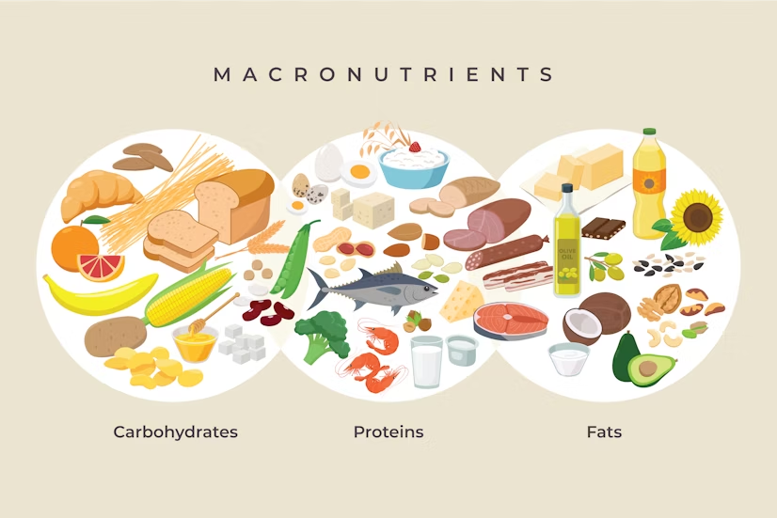
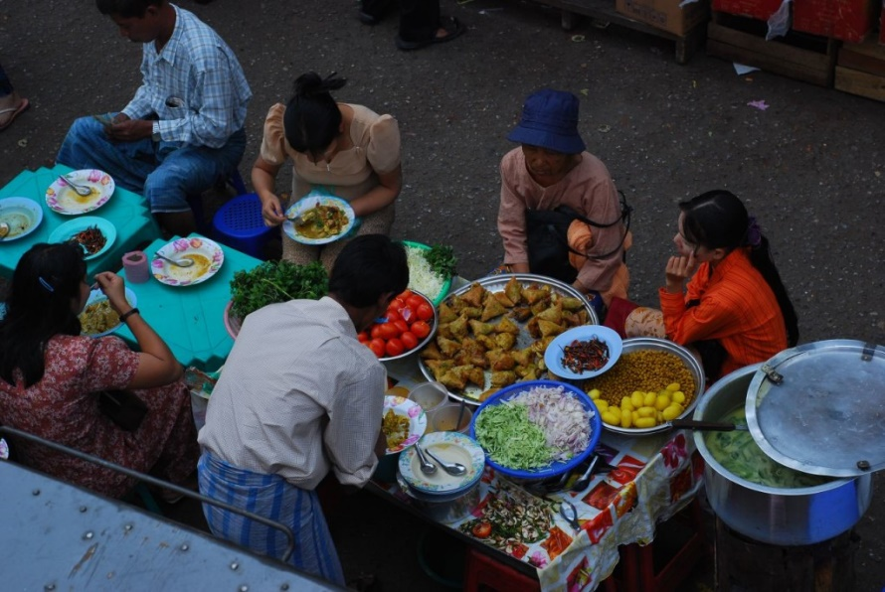
ADA Standards 2025 – Section 5
“People eat food, not nutrients, nutrient recommendations need to be applied to WHAT people eat”
https://innerbody.com/nutrition/macronutrients
Notes:
The focus on the dietary guidelines is moving away from specific macronutrient recommendations and more towards diet patterns and dietary approaches. In the 2025 Standards Update the focus on HOW the individual will making nutrition behavior changes is emphasized.
Simply, people eat food, not nutrients, nutrient recommendations need to be applied to WHAT people eat. For example carbohydrates can come from legumes and whole grains or can come from added sugars.
As we will discuss in future slides, many of recommendations are specific to the individual and not the diabetes population.

Slide 17
Assess Knowledge, Self Management Skills
Refer all people with diabetes for individualized MNT by a Registered Dietitian Nutritionist (RDN)
Individualized MNT Plan
Nutrition Care Process
Indepth Care Plan
Assess Eating Patterns
Preferences, portion sizes, timing on meals and snacks, eating environment, disordered eating
Notes:
As Health care professional working with people with diabetes we all at some point will be talking about food.
But only a registered dietitian can deliver Medical Nutrition Therapy OR MNT
Medical nutrition therapy uses the nutrition care process to provide a comprehensive nutrition care plan and uses shared decision making to determine how to implement the care plan.
Similar to DSMES we refer all persons with diabetes at diagnosis, annually or when changes in condition or life transitions occur.
An RDN will assess knowledge, self-management skills, eating patterns and help plan when, what and how much to eat daily, taking into consideration other comorbidities.

Slide 18

Medical Nutrition Therapy for Diabetes – What Medicare Covers
Initial Benefit: 3 hours first calendar year
Annually: 2 hours follow-up
Additional hours per provider recommendation
Only 10% of people with diabetes are referred
MNT provided by RDN reduces A1c:
1-1.9% in individuals with Type 1 Diabetes
0.3-2% in individuals with Type 2 Diabetes
Also provides cost savings and improved cardiometabolic
Notes:
The number of hours can be increased if the treating physician determines there is a change in medical condition, diagnosis and/or treatment plan.
MNT by an RD has been shown to reduce A1c by 0.3-2% in type 2 and 1-1.9% in type 1 diabetes.

Slide 19
Goals of Medical Nutrition Therapy – ADA Promote and support Individualized healthful eating patterns
1. Support healthful eating patterns Emphasize eating a variety of nutrient dense foods in appropriate portions to: Attain individualized BP, glycemic and lipid goals Attain and maintain body wt goals Delay and/or prevent complications | 2. Individualize nutrition care based on: Personal and cultural preferences Health literacy and numeracy Access to healthful foods Willingness and ability to make behavioral changes Barriers to Change
3. Maintain pleasure of eating. Provide positive, nonjudgmental messages about food Limit food choices only when backed by science | 4. Provide practical tools for developing healthful eating patterns

Slide 20

Medical Nutrition Therapy – ADA Macronutrient Distribution
No one-sized-fits-all eating pattern for individuals with diabetes
no ideal percent of calories from protein, carbohydrate and fat.
Macronutrient distribution based on individualized assessment
Consider personal preferences
tradition, culture, religion, health beliefs and goals, economics
metabolic goals and comorbidities
Healthcare team members should complement MNT, providing guidance on healthy food choices for the individual and behavioral support
Notes:
Evidence suggests there is no one sized fits all approach for individuals with diabetes.
On average people with diabetes consume about 45% of calories from carbohydrate and 1-1.5% (15-20% of kcals from protein).

Slide 21
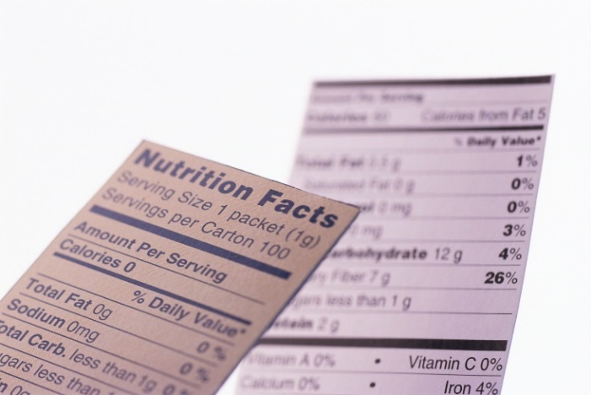
Sodium, Vitamins and Fat
Sodium – Limit to less than 2,300 mg a day (one tsp a day)
Vitamin and mineral supplements not recommended -lack of evidence.
B12: Consider screening on metformin, provide supplementation if level is low
Fat - same as recommended for general population (DGA)
HOW: limit red meat, full-fat dairy, butter and coconut oil.
Mediterranean Diet, outcomes reduced CVD events – basic principles can be applied across patterns.
The type of fats consumed is more important than total amount of fat
Notes:
The ADA recommends individuals limit sodium to less than 2300 mg per day based on clinical evidence and they suggest this is best achieved by limiting processed food consumption and using herbs, onions, garlic and other spices for instead to enhance flavors.
Almost 60% of people with diabetes take vitamin supplements but ADA do not promote the use of micronutrient, herbal or other supplements due to lack of evidence and potential safety concerns with certain supplements such as B-carotene. It is important to recognize supplementation is supported when evidence prevents. For example- 6-30% of people on metformin can show B12 deficiency.
DGA: Less than 10% saturated fat, Avoid trans fats, Less than 300 mg cholesterol daily

Slide 22
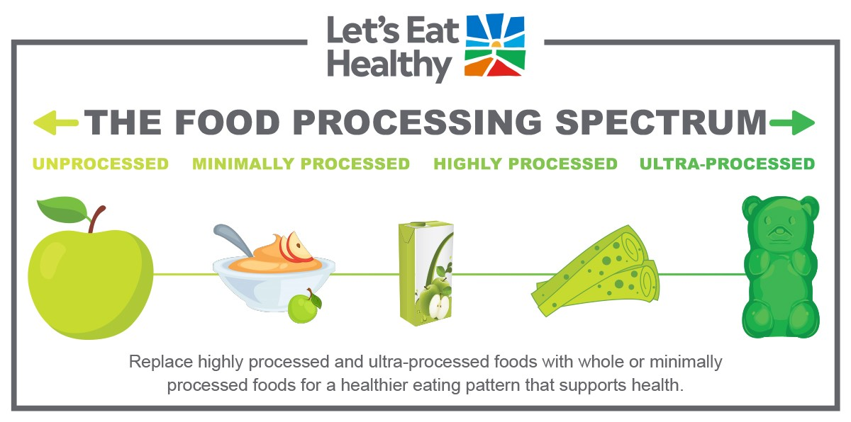
Limit Highly Processed Carbs and Added Sugars Eat more HIGH Fiber foods:
Choose High fiber carbs loaded with vitamins, minerals and phytonutrients
“Power Carbs” include:
Beans/Lentils
Veggies
Whole Fruits
Low-fat, low sugar milk/yogurt
Whole Grain foods
as culturally appropriate
Notes:
There is not ideal amount of carbohydrate for each individual with diabetes focus on quality, choosing unprocessed/minimally processed, nutrient-dense sources. Choosing high in fiber foods should be the focus.
Encourage whole grain foods as culturally appropriate. Otherwise focus on portion and increased fiber from other food sources.

Slide 23
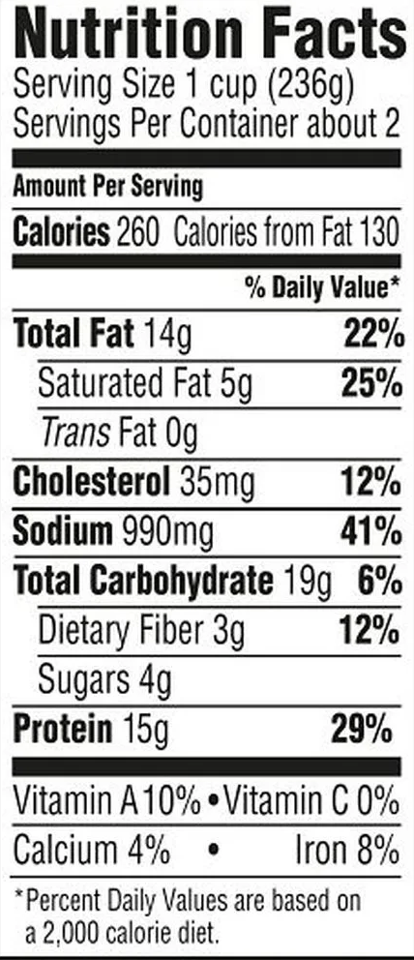
Fiber – the New “F” Word
Goal: minimum
14 gms / 1000 calories, ~ 30 gms a day
How?
Avoid highly processed foods
Choose > 3 gm fiber per serving
Foods: Whole intact grains, legumes, fruits, veggies, nuts/seeds, avocados
Why?
Lower all cause mortality and reduced risk of type 2 diabetes
Increased microbiome diversity
Notes:
Processed foods are ones that have undergone changes to their natural state.
Highly or ultra processed foods go beyond general chopping, blending, cooking etc and have multiple additives and ingredients.
These foods are often low in fiber. Low fiber is defined by < 3 grams of fiber and we consider a high fiber foods those with more than 5 grams of fiber.

Slide 24
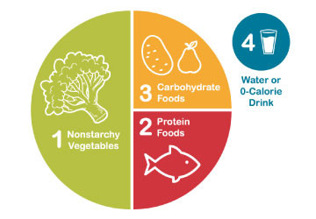
Healthy Eating Patterns/Approaches
Eating Patterns:
Total Foods Consumed
Mediterranean Diet
Plant based eating
DASH (Dietary Approaches to Stop Hypertension)
Low Carbohydrate
Eating Approach:
Tools for developing an eating pattern.
Diabetes Plate Method
Carbohydrate Counting
Individualized behavioral approaches
Notes:
The standards of care call out the importance of understanding different terms in nutrition including eating patterns, meal plan or dietary approach.
Eating pattern the totality of the foods we consume over a time period. Examples include……
A Meal Plan is an individualized and created by an RDN and is
Dietary or Eating approach is the strategy or tool used to support implementation of healthy eating patterns.
There is no one pattern that is better than another so we work with the individual with diabetes to determine an effective eating pattern and approach.
The 2025 Standards of Care have added much detail about considering approaches that take into account religious fasting or other new concepts of intermittent fasting or chrononutrition

Slide 25

Eating Patterns: Key Nutrition Principles
Until there is more evidence:
Emphasize non-starchy vegetables in a rainbow of colors
“Power carbs”: fruit, legumes, whole grains, nuts and seeds, lean proteins, low-fat dairy
Minimize red meat, added sugars, sugary beverages, refined grains and ultra-processed foods
Any approach should consider:
Individualize based on “health status, personal and cultural preferences, ability to sustain recommendations and ultimately food access and nutrition security”
Notes:
No one eating pattern is better than another and we find many similarities among eating patterns. \
Until there is more evidence the ADA Standards of Care recommend we emphasize

Slide 26
Poll Question 1
AR has type 2 diabetes, is on metformin 1000mg BID, has a BMI of 29.3, and GFR of 62. Most recent A1C 8.3%. AR wants to lose weight and tells you they are on a low-carb diet. What is the best response?
A. That approach can harm kidneys
B. How is it working for you?
C. We recommend 50% of your intake comes from carbs.
D. This meal plan approach is not recommended

Slide 27

Carbs and Lowering Glucose
Reducing carb intake has significant evidence for improved glycemia
Low Carb Definitions
Very Low = < 26% of kcals
Ketogenic: 20-50 gm carb, also high fat.
Most people consume 44-46% of Cals from carb
HOW: Focus on key nutrition principles, food quality, and choose minimally processed foods and high fiber foods.
Systematic reviews and RCT found:
Very low carbohydrate diet effectively reduced A1c at 6 months, less difference beyond 1 year.
Ketogenic Diet increased LDL and no sig. difference in A1c compared with low-carb Mediterranean diet.
Notes:
Reducing carbohydrate intake has shown most evidence for helping improve glycemia but where you start and where you end up is individualized. We can also apply this concept to a variety of eating patterns and nutrient quality is also taken into account.
One study published in the SOC found a low carb diet defined here as < 26% of carbs reduced A1c at 6 months but less differences were seen at 12 months. This was also seen in a systemic reduce which found lowering carbs 10% should outcomes at 6 months but limited these outcomes at 12 months or forward.

Slide 28

Very Low Carb Meal Plan Not Recommended for:
Women who are pregnant or lactating or children
People with or at risk for disordered eating
People who have kidney disease
Avoid ketogenic diets if taking SGLT-2 Inhibitor due to high risk of ketoacidosis
Educate on prevention, signs of DKA, how to measure ketones.
Notes:
Very low carb or less than 26% of kcals from carbohydrates is not recommended for the following individuals. We also should take caution in those that are using an SGLT2 due to risk of euglycemic ketoacidosis.
The 2025 ADA standards of care added emphasis in this recommendation with focus on T1 and T1 on SGLT-2 inhibitors should avoid ketogenic eating patterns and be educated on the signs and symptoms of ketoacidosis. It is important to

Slide 29

Poll Question 2
For people newly diagnosed with type 2 diabetes with an elevated BMI AND waist circumference, which best reflects ADA Standard of Care recommendations?
A. Avoid all desserts and processed foods
B. > 3-5% weight loss from current body
weight may be beneficial
C. Eat less than 7% saturated fat
D. Consume about 30-45 gms of carb at each meal

Slide 30
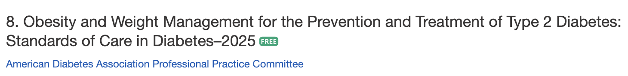
Use of BMI
WHO defines Obesity as: abnormal or excessive fat accumulation that presents a risk to health
BMI poor indicator for ”excessive fat” and health risk
Assess using:
BMI, distribution measures like waist circumference and associated health and well-being consequences
Notes:
Health at Every Size
Language throughout the section was amended to be person centered and to emphasize the importance of weight management within the overall context of the treatment of people with diabetes.

Slide 31
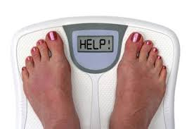
Weight Loss is Helpful
Prediabetes weight loss: 3-7%, higher to prevent diabetes progression.
Diabetes: Strong evidence that
Weight loss of 3–7% improves glycemia & intermediate CVD risk
>10% loss, may lead to remission of type 2 diabetes, CVD, & reduced mortality
Reduces need for medications
Optimal goal is weight maintenance
“People with diabetes and overweight or obesity may benefit from any magnitude of weight loss.”
Notes:
Any degree of weight reduction is helpful.
3-7%
>10% shows greater benefits and can reduce fatty liver metabolic dysfunction- associated steatohepatitis (MASH) which is a growing concern within diabetes population.
the justification for a weight-based approach to diabetes treatment has been expanded. The recommendations and text pertaining to weight management treatment have been expanded to acknowledge the expected range of benefits across the spectrum of weight loss.
In people at risk, 3–7% weight loss reduces progression to diabetes (2,7,8,41,42). Greater weight loss may produce additional benefits (20,21). Mounting data have shown that >10% body weight loss usually confers greater benefits on glycemia and possibly diabetes remission and improves other metabolic comorbidities, including cardiovascular outcomes, metabolic associated nonalcoholic steatohepatitis, adipose tissue inflammation, and sleep apnea, as well as physical comorbidities and quality of life
Nutrition, physical activity, and behavioral therapy to achieve and maintain 3-5% weight loss are recommended for people with type 2 diabetes and overweight or obesity

Slide 32
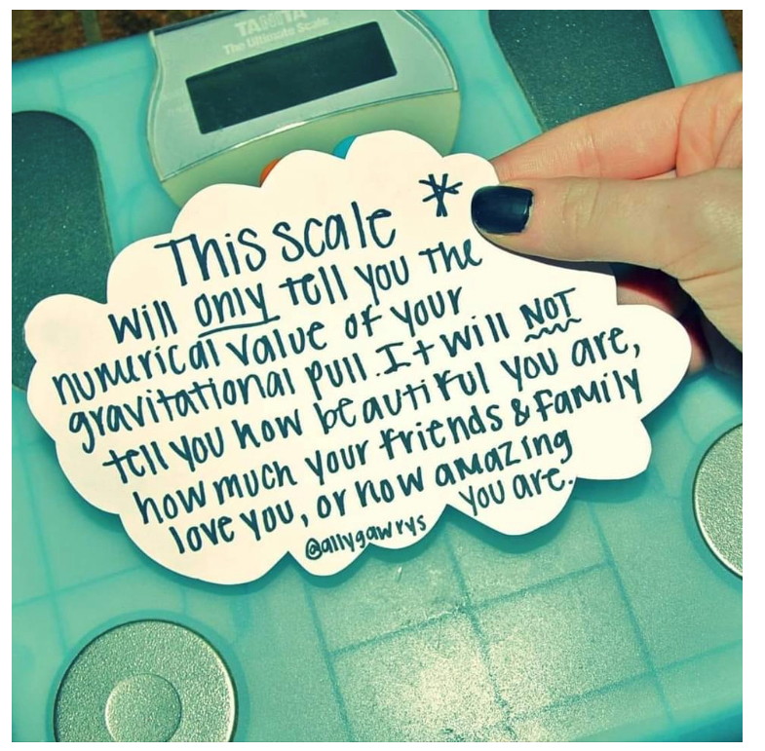
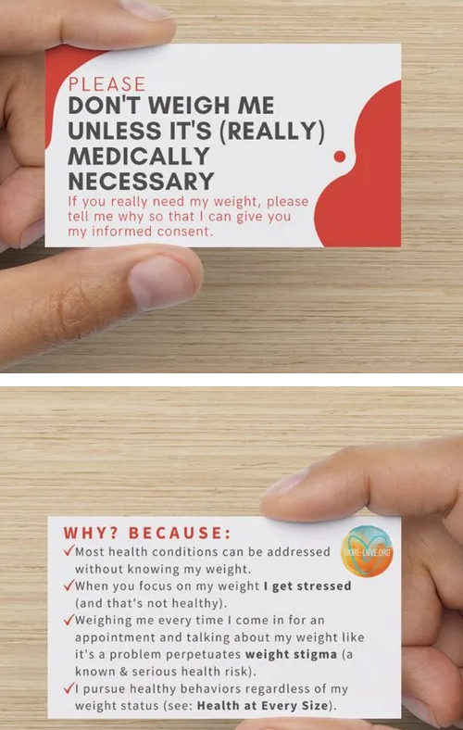

Weight Stigma in Healthcare
Notes:
People with diabetes are vulnerable to not only medical stigma but weight stigma.
Adverse health consequences can include psychological distress and disordered eating behaviors.
The language we use and how we approach discussing weight is an important factor in reducing stigma.
Never assuming an individual wants to discuss weight, we can ask permission to discuss, ensure weight is taken privately and focus on shared decision making and importance of weight loss goals for the individual. There are so many things we can discussed related to diabetes care and we take take a behavioral health approach vs. solely focusing on weight loss as the goal.

Slide 33

New Consult for Diabetes Ed
JR, 63 y/o M, BMI 32, Waist circumference: 43”, A1c 9.3%, Type 2 diabetes 10+ years. On Metformin 2000mg daily + Glipizide 20mg. Low income and doesn’t like to drive much due to poor vision. Interested in losing weight.
Nutrition, typical day
Breakfast – doesn’t really eat. Has cup of coffee
Lunch around 11am – packaged breakfast sandwich
Dinner – Sandwich or burger
Evening – Snacks, nuts, crackers, boiled egg
Beverages – Diet sodas, tea, water

Slide 34

How to Achieve Weight Loss?
Individualized plan
Energy deficit + enhanced activity + behavior therapy
Goal: 500 -750 kcal/day energy deficit (3,500 kcals = 1 pound)
What is 500 kcals?
1 Large Fry, 1 Double Cheeseburger, 1 King Size Snickers, 1 bagel w/ cream cheese, 4 oz tortilla chips, ~ 3 cans sodas
5 apples, 2 sweet potatoes, 5 eggs, 2 cups of beans, 1 cup almonds
Notes:
Clinical benefits of weight loss can be seen with as little as 3% weight change, but benefits are progressive.

Slide 35
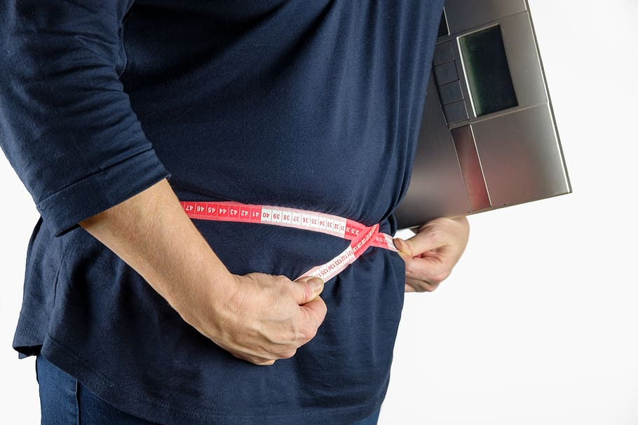
Weight Loss/Maintenance Strategies
Weekly self-weighing/tracking
Structured programs
Increase physical activity
200-300 minutes/week
Alter macronutrients
Use meal replacements
Eat “healthy” foods
Drink Water
Get Sleep, Consider Chrononutrition
Consider Incretin or metabolic surgery
Notes:
Eat Healthy- reduce ultra processed foods and replace with less processed foods isocalorically showed modest weight loss benefits.
Greater weight loss benefits seen in semaglutide or tirzepatide
It is important to note that the ADA calls out that in some populations, such as South Asian, traditional interventions have not been as effective in preventing or remission of type 2 diabetes so this group may need additional tailored approaches.

Slide 36
Intermittent Fasting
Results
Each produces mild to moderate weight loss of 3–8% loss from baseline over short durations (8–12 weeks)
No significant differences in weight loss, waist cir. when compared with continuous calorie restriction.
Longer term studies needed
3 overall approaches
Alternate-day fasting
500–600 calories on alternating days
5:2 diet
500–600 calories on two days with usual intake the other five
Time-restricted eating
Daily calorie restriction based on 8-15 hour window of time
Notes:
Consider medication regimen.
The ADA has added a significant recommendations and risk assessment related to religious fasting not addressed in this basic course.

Slide 37
Assessing Malnutrition
At Risks Groups:
Individuals on GLP-1 or GIP RA or s/p metabolic surgery
Individuals with multiple chronic conditions
Older age groups
Food insecurity and poverty
Screen:
For malnutrition and sarcopenia
Recommend:
Whole- food-based eating pattern
Adequate protein
Resistance training
Notes:
New this year the ADA calls out the importance of screening for malnutrition.
We frequently screen for malnutrition in individuals who are underweight or in hospital settings but starting BMI and desire for weight loss does to prevent malnutrition risk.
Individuals on incretin therapies or have had metabolic surgery and have experienced significant weight loss of > 20% or more than 4 kg (or about 9 pounds) should be screened for malnutrition. (Simplified Nutritional appetite Questionaries and Malnutrition Universal Screening tool).

Slide 38

Keep it Person Centered
An individualized eating pattern considers health status, skills, literacy, resources, and environment
Develop interventions based on: Medical history, life circumstances, access to food, personal/cultural preferences, readiness and motivation, shared-decision making
Long-term support needed from diabetes care team
Notes:
Keep it person centered
Long-term support from the diabetes care team.

Slide 39
New Consult for Diabetes Ed
JR, 64 y/o cis-male. BMI 32, Waist circumference: 43”, A1c 9.3%. Type 2 diabetes 10+ years. Takes Metformin 2000mg daily + Glipizide 20mg. Low income and doesn’t like to drive much due to poor vision.
Nutrition, typical day
Breakfast – doesn’t really eat. Has cup of coffee
Lunch around 11am – packaged breakfast sandwich
Dinner – Sandwich or burger
Evening – Snacks, nuts, crackers, boiled egg
Beverages – Diet sodas, tea, water
Notes:
Based on what we have learned so far how can we support JR in implementing nutrition interventions and consider additional medication management, including a incretin therapy or potentially metabolic surgery (given BMI > 30) to support additional A1c reduction along with weight loss.
BMI is indicative of stage I obesity and waist circumference greater than 40 “ in men is consider elevated which suggests increased central adiposity.
We will continue the discussion about JR below.

Slide 40
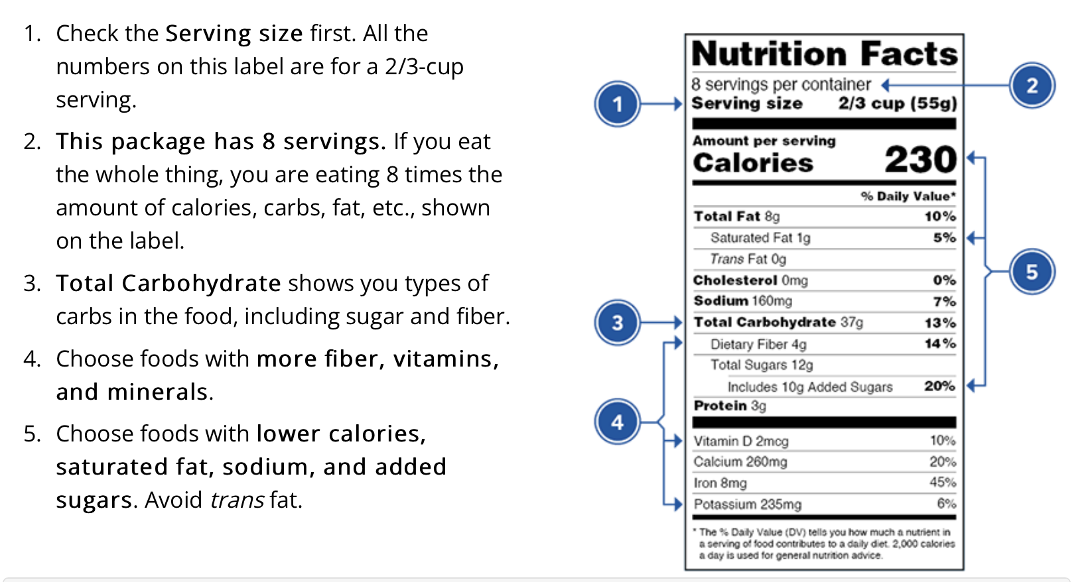
Reading the Food Label
1 tsp sugar =4 gms
https://www.fda.gov/food/food-labeling-nutrition/changes-nutrition-facts-label

Slide 41
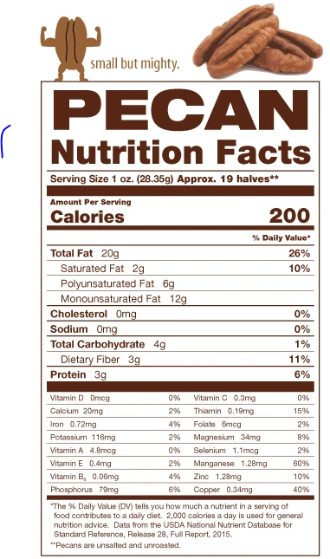
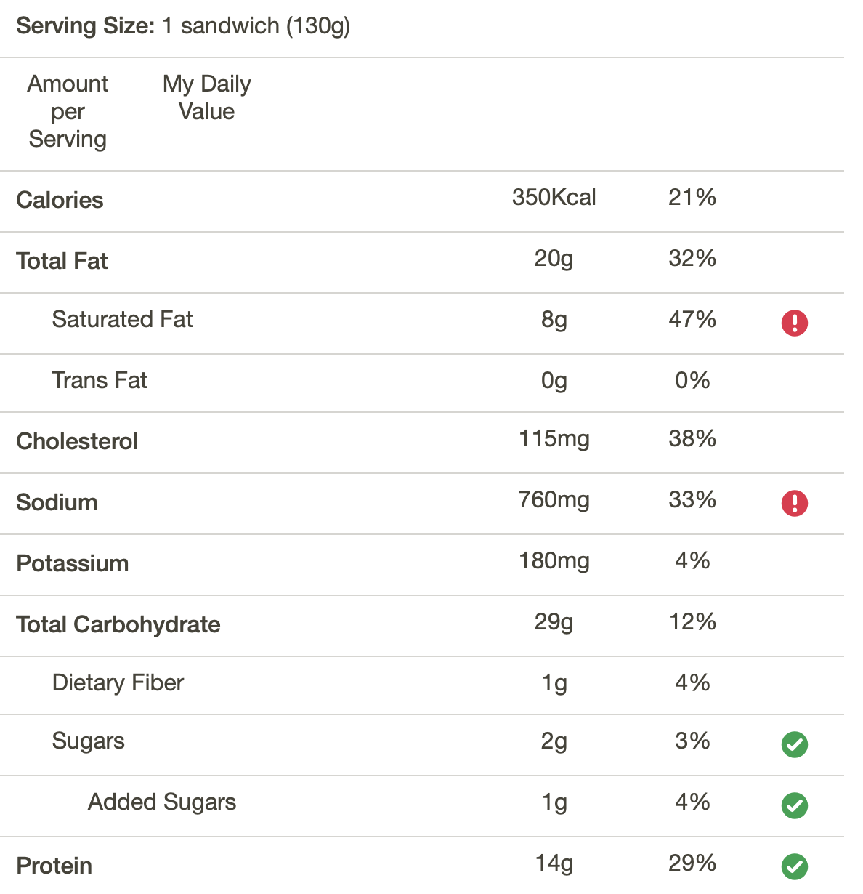
Packaged Breakfast Sandwich
Fooducate App – Gives grade and nutrition info.
Ideas for alternatives
Notes:
Or we can read the food label on the package. JR consumes pecans recently for his snack of nuts.

Slide 42

Digest, Stretch and Stand Break
Notes:
Lets talk a quick moment and break.
If you have just finished eating I want you to stand and toe touch from side to side. Moving to help digestion and moving glucose into those cells.
If you have been bending and moving all day, I want you to stand up and move those hips in a circular motion.
If you have been sitting at a desk or car, I want you to stand and roll your shoulders.
Lets continue the discuss of how would could potentially support JR and what are the options for diet interventions.

Slide 43
How Nutrients Affect Blood Sugar
If type 1/MDI, may need additional insulin or change in dosing strategy for high fat/ protein meals
Notes:
The ADA recommendations providing education on the impact of carbohydrate, fat and protein and tailor indidivuals needs, insulin plan and preferences to optimal meal time dosing.
Understanding nutrients and the affect on blood sugar can be important for managing diabetes.
For people on insulin at mealtime understanding of the relationship between carbohydrate intake and insulin is important.
Consumption of fat and protein can affect early and delayed post-prandial hyperglycemia.
meals containing >40 g fat and 25 g protein, people should increase the insulin dose calculated based on their ICR by 25–30% using a combination (dual-wave) bolus, initially administering 30–50% of the dose and then extending the remainder over 2–2.5 hours.
35 g of dietary fat to 30 g of carbohydrate significantly increased postprandial BGL from 3 h onward. Studies investigating insulin dosing for high-fat, high-protein meals (+40 to 50 g fat) report ∼40–65% more insulin is needed despite identical carbohydrate content
Kirstine J. Bell, Chantelle Z. Fio, Stephen Twigg, Sally-Anne Duke, Gregory Fulcher, Kylie Alexander, Margaret McGill, Jencia Wong, Jennie Brand-Miller, Garry M. Steil; Amount and Type of Dietary Fat, Postprandial Glycemia, and Insulin Requirements in Type 1 Diabetes: A Randomized Within-Subject Trial. Diabetes Care 1 January 2020; 43 (1): 59–66.

Slide 44

Carbs affect Post-Meal Glucose
Starch
Fruit
Milk
Desserts
Notes:
For individuals with type 1 diabetes or type 2 diabetes taking mealtime insulin.
Comprehensive education on nutrition content and need to pair insulin with carbohydrate intake.
For individuals with variable meal schedule, understanding the relationship between carb intake and insulin needs is important.
Education on using insulin to carbohydrate ratios can provide the most flexibility.
How do we determine the amount of carbohydrates in foods. We can read food labels like we already reviewed, we can use food databases or apps (even just ask siri), or we can estimate carbohydrates and portion size.
Working with individuals it is helpful for us to have general knowledge of portions and amounts.

Slide 45
Poll Question 3
Based on the Food list for Diabetes: which of the following food choices equals ~ 15 gms of carbohydrate? (multiple)
A. ½ bagel, 4 oz
B. 1 ¼ cup strawberries
C. 1 cup of milk
D. ½ cup of cooked rice
E. 1 oz trail mix with fruit

Slide 46
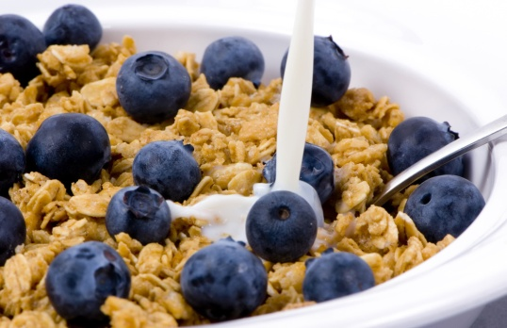
Estimating Carbohydrate for Meals Example (Not ADA Standard)
Grams Servings
Each Meal 45-60 gm 3 - 4
Snacks 15-30 gm 1- 2
Carbs affect Post-Meal Glucose
RDA – at least 130 grams of Carb a day
PWD get about 45% of Cals from carbs
Calories | 20% | 30% | 40% | 50%
1500 | 75 g | 113 g | 150 g | 188 g
2000 | 100 g | 150 g | 200 g | 250 g
Notes:
Carbohydrate counting is a more advanced tool and literacy and numeracy must be taken into account.
When on fixed insulin doses individuals can be educated about following a fixed carbohydrate meal plan. We can work the the individual to determine what they are currently consuming and recommend specific foods to help meet those needs.
When helping create or support a meal plan as dietitians we help determine about how many grams of carbohydrate are appropriate for each individual.
We know most individuals with diabetes consume about 45% of kcals from carbs. We can determine this to be about 225 grams of carbohydrate for a 2000 calorie diet. We can then divide and develop a general meal if we don’t have a great starting point. We can also modify this goal depending upon the individualized eating pattern and meal pattern plan.
We no longer just provide the gram per meal goal but then help translate this into what to do.
Consideration of consistent meal size and carbohydrate content may be appropriate for individuals with type 1 and type 2 diabetes on a fixed insulin regimen. As health care providers understanding amounts of carbohydrates and contribution of fat and protein to rising glucose levels.
(Ps93)

Slide 47
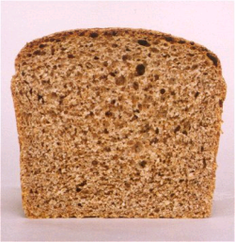


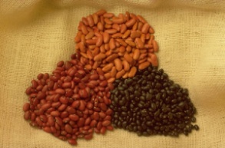

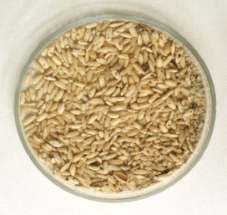

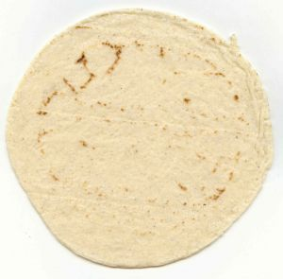
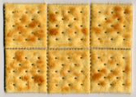


Carb Counting - Starch
1 small ear of corn or 1/2 cup corn
1 slice bread
1/3 cup cooked pasta
1/2 cup
cooked beans
3/4 cup cold cereal
Each Food has:
80 Calories
15 grams carb
1/3 cup cooked rice
1 small potato
1/2 English muffin
5-6 small crackers
6” tortilla
6” roti

Slide 48









Carb Counting- Fruit
½ cup fruit juice
½ banana, 4”
1 small fresh fruit
½ cup unsweetened apple sauce
Each Food has:
60 Calories
15 grams carb
17 small grapes
1 cup melon
¼ cup dried fruit
2 tbsp raisins
1 1/4 cup strawberries

Slide 49






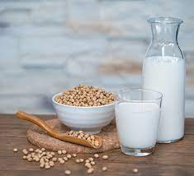
Carb Counting - Milk
1 packet sugar-free
hot cocoa
8 oz buttermilk
6 oz low-fat plain yogurt
Each Food has:
100-160 calories
12 grams carb
8 oz milk
6 oz light, no added sugar
fruit yogurt
8 oz rice milk, plain
8 oz soy milk, plain

Slide 50









Carb Counting - Sweets
2-inch square cake or brownie, unfrosted
½ cup regular jello
2 tbsp light syrup
½ cup sugar-free pudding
Each Food has:
Calories vary
15 grams carb
1 tbsp syrup, jam, jelly, table sugar, honey
2 small cookies
¼ cup sorbet
½ cup ice cream or frozen yogurt
1 oz trail mix with fruit

Slide 51


Average American Consumes 17 teaspoons added sugar per day
WHO/DGA and AHA – Goals
< ~ 5 - 10 teaspoons/day
1 tsp = 4 gms sugar (15 Cals)
15 cals x 19 teaspoons a day =
285 cals a day just from added sugars
12oz. soda = 39 gm carb/10 tsps added sugar
https://www.cdc.gov/nutrition/php/data-research/added-sugars.html
Notes:
Good news is American sugar consumption is reducing but 3 in 5 Americans continue to consume added sugar in excess of diet recommendations.
The ADA does not have specific sugar goals but we can look to the WHO, DGA and AHA.
AHA goals is < 6% of kcals from added sugar and WHO/DGA is <10% kcals from added sugars. This is equal to about 5-10 teaspoons of sugar per day if considering a 2000 calories diet. Or 30 – 50 grams of added sugar per day.
In American diets, 24% of added sugar comes from sugar sweetened beverages.
285 kcals is 14% of 2000 Cal diet.

Slide 52
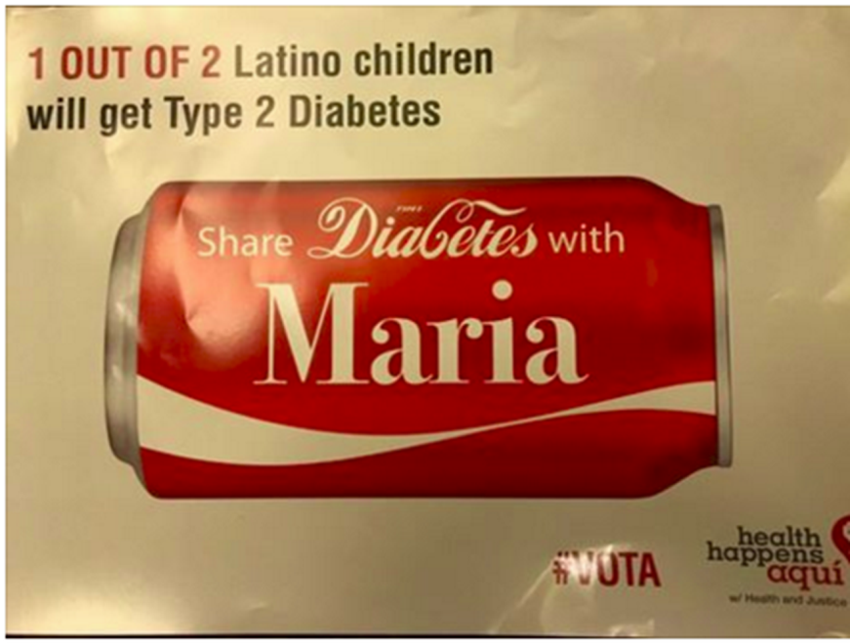
Reduce Refined Carbs, Added Sugars - ADA
To manage wt, reduce CVD risk and fatty liver disease
ADA strongly discourages consumption of:
Sugar sweetened beverages
Processed “low-fat” or “non-fat” foods with high amounts of refined grains & added sugar
Sugary and processed foods can displace healthier, more nutrient dense food choices
Water is recommended
Notes:
46.1% of PWD are Hispanic
C

Slide 53

Non-Nutritive Sweeteners
Use in moderation and short term to reduce overall calorie/carbohydrate.
Encourage decrease in both sweetened and non-nutritive sweetened beverages.
Emphasize water intake.
How: add lemon, lime, or cucumber slices to water, choose no calorie waters
https://www.fda.gov/food/food-additives-petitions/aspartame-and-other-sweeteners-food
Notes:
Last year the WHO – even called out does not apply to the population with diabetes and Cleveland clinics exposed concerns regarding use of non-nutritive sweeteners.

Slide 54


Mediterranean Diet
Emphasizes vegetables, fruits, whole grains, beans/ legumes
Includes low-fat/non-fat dairy, fish, poultry, oils, nuts
Limits highly processed foods/refined carbohydrates, added sugars, sugar-sweetened beverages, sodium, saturated fats, high fat/process meats
Find Recipes:
American Diabetes Association
Meal Planning Tips:
https://www.diabetesfoodhub.org/articles/meal-planning-for-a-mediterranean-style-eating-pattern.html
This Photo by Unknown Author is licensed under CC BY-NC-ND
Notes:
Another great resources is oldways which has lots of resources on Mediterranean diet.
The Mediterranean Diet is just one dietary pattern frequently discussed as it is associated with reduced risk of diabetes, A1c reduction, lower TG and reduced risk of major CVD events but other dietary patterns exist and modifications to the Mediterranean diet, such as low carb mediterranean is reviewed throughout the ADA guidelines report.
And visiting the 2019 Nutrition Consen reviews eating patterns from the DASH, Mediterranean to

Slide 55
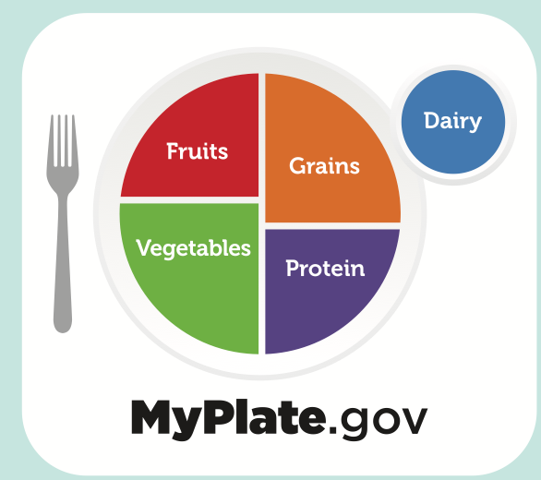
USDA MyPlate.gov
Make Every Bit Count
Eat a variety of fruits, vegetables, grains,
protein foods, dairy/fortified soy alternatives
Foods to Increase
Make half your plate fruits and vegetables.
Make at least half your grains whole grains.
Move to low-fat or fat-free dairy milk or yogurt (or lactose-free dairy or fortified soy versions)
Vary your protein
Foods to Reduce
Added sugars, saturated fat, and sodium
Check packaged foods that have less or no added sugar
Choose plain water/sparkling water with a squeeze of fruit
Tools: Myplate-Kitchen, Shop Simple with MyPlate
Notes:
Discussion of what to put on your plate supports implementation of change. Again, this pattern generally encourages increasing whole food based options.
MyPlate Kitchen provides recipes and resources to support building healthy and budget-friendly meals.
Shop simple with myplate – app that helps you find healthy choices within budget

Slide 56
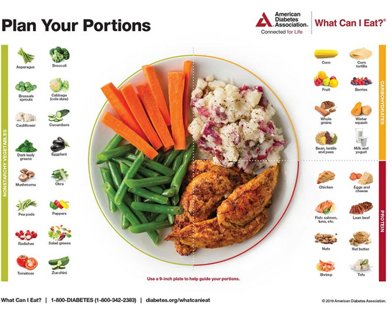


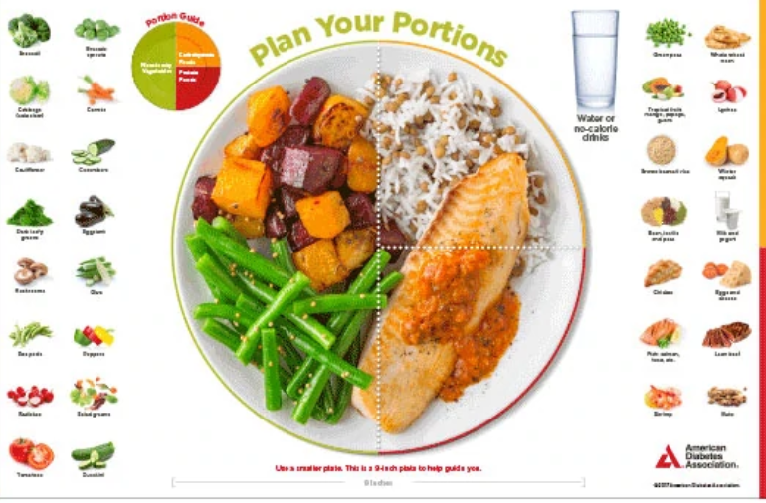
Plate example
American Diabetes Association

Slide 57

Plant-based, Vegetarian or Vegan Diet Patterns
https://oldwayspt.org/traditional-diets/vegetarian-vegan-diet
Notes:
Newest guidelines recommend PWD and at risk incorporate more plant-based proteins sources (nuts, seeds, legumes) as part of an overall dietary pattern to reduce risk of CVD.

Slide 58
New Consult for Diabetes Ed
JR, 64 y/o cis-male. BMI 32, Waist circumference: 43”, A1c 9.3%. Type 2 diabetes 10+ years. Takes Metformin 2000mg daily + Glipizide 20mg. Low income and doesn’t like to drive much due to poor vision.
Nutrition, typical day
Breakfast – doesn’t really eat. Has cup of coffee
Lunch around 11am – packaged breakfast sandwich
Dinner – Sandwich or burger
Evening – Snacks, nuts, crackers, boiled egg
Beverages – Diet sodas, tea, water
Strategies?
What is JR doing right?
Plate method?
Increase fruit / veggie intake – canned or frozen
Add in beans, chili, soups (lower sodium)
Include, Yogurt, Nuts, oatmeal, wheat toast
Refer to RD / RDN
Notes:
We can suggest modifications the types of foods, portions (which we need to learn more about), increasing fiber but we must also consider JRs motivations and desires.
JR has limited knowledge about foods so we can start by discussing his current intake and learning about current choices.

Slide 59
Poll Question 5
A person with diabetes presents with unexplained weight loss, what are some possible causes?
A. Taking less insulin than needed
B. Disordered eating
C. Finances
D. Poor dentition
E. All the above

Slide 60

Disordered Eating
For people with type 1
insulin omission causing glycosuria to lose weight is the most reported disordered eating behavior.
Have high rates of diabetes distress and fear of hypoglycemia.
For people with type 2
bingeing episodes with an accompanying sense of loss of control most reported.
If treated with insulin, intentional omission is also frequently reported.
People with diabetes and diagnosable eating disorders have high rates of other psychiatric disorders
Notes:
The standards of care recognizes people entering DSMES or MNT should be screened for past dieting behaviors and disordered eating patterns.
Insulin omission is 10% more common in women then men with T1D.

Slide 61

Screen for Disordered Eating
“DiaBulimia”
Anyone with insulin dependent diabetes who omits/restricts insulin as means of weight loss
Tends to start in adolescence, more likely to occur in women than men.
Signs: unexplainable hyperglycemia/ elevate A1c, weight loss, lack of marks from fingerpricks, lack of prescription refills for diabetes meds, records that don’t match A1c. May have other classic symptoms of eating disorders
Treatment – Mental health specialist and team
Notes:
Classic symptoms of eating disorders— excessive exercise, fatigue, weakness, lethargy, being overly critical of appearance, amenorrhea
In your resources we have given you links to screening tools such as the mSCOFF and DEPS-R which screen disordered eating behaviors and are most tested in type 1 diabetes.
These screening tools can then support referral to providers specialized in treatment of eating disorders.

Slide 62
Poll Question 6
Which of the following is true about alcohol and diabetes based on ADA Standards?
A. Only white wine decreases blood sugars
B. Men can have up to 2 drinks and women can have one drink a day
C. Alcohol increases risk of hyperglycemia
D. 6 ounces of wine is considered one serving.

Slide 63
Consuming Alcohol Safely
No benefit for those who do not drink
To reduce risk of harm: consume in moderation & with food
Women: < 1 drink per day
Men: < 2 drinks a day
Risks:
hypoglycemia, weight gain, hyperglycemia, may worsen neuropathy
1 drink equals:
12 oz beer, 5 oz glass of wine, or 1.5 oz distilled spirits (vodka, gin etc)
Notes:
In 2022, the WHO declared there is no safe amount of alcohol intake.
The ADA states risks and to reduce those risk those that drink should not start at those that choose to drink moderation is recommended.

Slide 64


Physical Activity – Key Areas
ADA Physical Activity Position Statement
Planning Activity: Exercise and Movement
Benefits, barriers, precautions
Adjustment and monitoring of food and/or meds

Slide 65



Where are we on this continuum?
Only about 50% of us are meeting activity goals
Notes:
Difference between Physical Activity vs. Exercise and Definitions.
For the general population about 46.9% meet aerobic activity guidelines and only 24% meet muscle-strength training guidelines.
38% of individuals with diabetes report being active < 10 minutes per week.
For all persons with diabetes evaluate time spent in activity vs. sedentary behaviors.
Pictured is Gary Hall former Olympic swimmer with T1D. Dx in 1999.
Noah Grey- Current Kanas City Chiefs tight-end with t1D

Slide 66
Poll Question 7
Which of the following are accurate exercise recommendations for people with diabetes?
a. Exercise must be done daily for 30 mins at a time to be effective
b. Must get stress test before starting an exercise program
c. Try not to miss more than 2 consecutive days of exercise
d. Incorporate resistance training 2 days a week
E. C and D

Slide 67
Physical Behaviors: The 5 ”S”
Stepping
Sitting
Sweating
Strengthening
Sleep
Notes:
The ADA Standards of Care reviews the importance of Physical Behaviors in Type 2 Diabetes. Noting increasing walking/steps, limiting sitting time and ensuring adequate sleep all support reduced risk of type 2 diabetes.
For both type 1 and type 2 diabetes focus on Exercise standards is important to support improving metabolic management.

Slide 68


Sweat: Exercise Standards
Adults: 150 min/wk of moderate to vigorous intensity
Over at least 3 days a week
Don’t miss > 2 consecutive days w/out exercise
Resistance training 2 -3 xs a week
Older Adults: Flexibility and balance training
2-3 times a week (Yoga and Tai Chi)
For all:
Increase activity above baseline
Notes:
Aerobic and Resistance training combined optional for glycemic and health outcomes.
As little as 30 minutes per week may have metabolic benefits.
Flexibility and balance training in addition to resistance training may help to reduce falls by 30%.

Slide 69

Physical Activity - Youth
Encourage at least 60 minutes/day of moderate to vigorous activity
Include bone/muscle strengthening 3 times a week.
Limit recreational screen time/sedentary time
Notes:
Limit screen time to less than 2 hours per day.

Slide 70


How many hours do you Sit a day?
People with type 2 who achieved 150 a week:
White 44%
African American 43%
Hispanic 65%
Get up every 30 minutes and move it!
Notes:
Evidence supports reduced sitting behaviors.
Break up sitting every 30 minutes by briefly standing, walking or performing other light physical activities
Reducing sitting time may help prevent type 2 diabetes- higher frequency of of regular leisure-time activity was more effective for reducing A1c.

Slide 71

Steps
Add 500 steps per day
Add 5-6 min brisk intensity
“Passeggiata”- after dinner stroll
Walk 10-15 minutes after dinner (and other meals if possible)
Maximize the walking benefit
Get the most BG lowering effect
Especially after high carb meals
Diabetologia, Oct 2016.
Notes:
Paseggiata was highlighted at the Nov 2024 World Diabetes Day in Tuscany Italy. In Italy taking a stroll after dinner and inclusive walking is encouraged for both young and old for a healthy lifestyle.
Based on the recent research results, three 15-minute periods after meals may have the highest benefit even compared to one 45-minute morning walk.

Slide 72
Exercise: The Good News
Increase muscle glucose uptake 5-fold
Glucose uptake remains elevated for 24 - 48 hours (depending on exercise duration)
Increases insulin sensitivity in muscle, fat, liver.
Reduce CV Risk factors (BP, cholesterol, A1c)
Maintain wt loss
Muscle strength
Maintain LBM if on wt mgmt. meds
Better physical mobility
Contribute to well being
Notes:
For both type 1 and type 2 diabetes and those at risk exercise has many benefits:
How exercise works- Glut 4. Improved insulin sensitivity.
Lowers A1c regardless of wt loss
8 week structured programed lowered a1c by 0.66% in PWT2.

Slide 73

Exercise decreases:
Sleep apnea
Diabetic kidney disease, retinopathy
Depression
Sexual dysfunction
Urinary incontinence
Knee pain
Need for medications
Health care costs
Notes:
Look Ahead trial – largest randomized lifestyle intervention trial in older adults with type 2 diabetes spanned 8 years.
No improvement in CVD events but many other benefits were found from aiming for least 175 minutes/week.

Slide 74

Glucose during or after activity is highly individual
Type, intensity, duration of activity affects glucose
Monitor glucose before/after activity
After-meal activity:
30 minutes of walking, decreased glucose ~30 points
Diabetes Care. 2013 Oct; 36(10): e177.
Notes:
A 2013 article published in diabetes care reviewed CGM patterns post activity in PW t1. The study looked at differences in type, frequency and duration and found an average of about 30 mg/dl decline after 30 minutes of moderate activity which as mostly reported as walking.
If taking insulin or secretagogues it is important to monitor due to increased risk of hypoglycemia and potentially greater decline in glucose but available insulin and time since last meal are both factors.
Adding 3-15 minutes of activity per day is effective to reduce post-meal glucose.
HITT exercise has been shown to increase glucose values.

Slide 75

Importance of Exercise with Diabetes
Vital component of diabetes prevention and management of type 1 and type 2 diabetes
Decreases mortality and CV Risk
Type 1/ Type 2 insulin users – emphasize monitoring, adjusting insulin and carbs to allow for safe participation in all forms of activity.

Slide 76

Good Exercise Quotes
Small steps, big impact: Every bit of activity counts when managing diabetes
Passeggiata- Take an after- meal stroll
“Exercise decreases A1c 0.7%”
This Photo by Unknown Author is licensed under CC BY-SA-
"Diabetes taught me strength I didn’t know I had, and exercise reminded me that my body is capable of incredible things.”
Person with Diabetes
“I don’t have time to exercise, I MAKE time.” Mike Huckabee

Slide 77
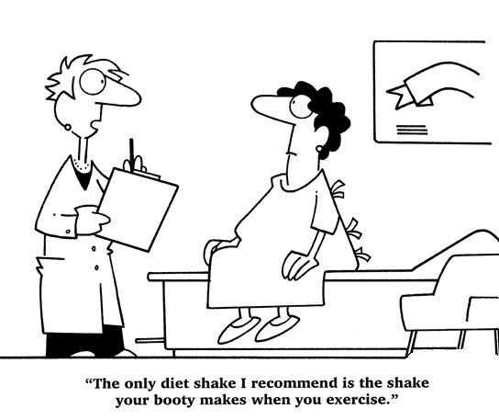
Best Shake For People with Diabetes
From Debbie Nagata’s slide collection

Slide 78
Poll Question 8 - Bonus
What are some exercise precautions for people with diabetes on insulin?
a. Carry some form of ID on you at all times
b. Have a snack if BG less than 90
c. Look for signs of hypo for up to 24 hrs after exercise
d. Carry a snack with you during exercise.
e. All of the above.

Slide 79
Discuss these symptoms with provider before starting exercise or during
Chest pain and/or shortness of breath, reduced exercise tolerance
Leg cramps that go away with rest
Head, shoulder, neck and or back aches.
Any unexplained pain above the belt line should be considered cardiac in origin until proven otherwise.
Notes:
Dx that prompt screening: uncontrolled Hypertension, untreated proliferative retinopathy, autonomic neuropathy, peripheral neuropathy, balance impairment, foot ulcers/Charcot foot.

Slide 80
Hypoglycemia Prevention Strategies for Insulin/Secretagogues
Check glucose before activity
Adjust carbohydrate/insulin prior to planned activity:
If using insulin and /or secretagogues
BG < 90, consume carb (15-30 gm)
Carry carb snack/ glucagon ER Kit
Extra Carb in during/post exercise
Caution with alcohol post exercise
Notes:
With newer AID amt of carb needed may vary in guidance.
Prolonged activity may need 0.5-1.0 gm/kg per hour of exercise.

Slide 81
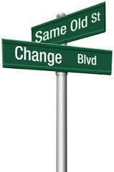

Behavior Change Strategies
Adapt strategies to the individual & population
Use motivational interviewing
Implement activation strategies
Guide goal setting and action planning
Support barrier identification and teach problem-solving skills
Encourage tracking or self-monitoring of health behaviors
Facilitate opportunities for social support
Notes:
Adapt strategies to the individual & population
Use motivational interviewing
explore and strengthen individuals' motivation for change
Implement activation strategies
encourage individuals to take an active role in their care
Guide goal setting and action planning
creating achievable, personalized objectives
Teach problem-solving skills
address barriers to self-management
Encourage tracking or self-monitoring of health behaviors
increase accountability and awareness
Facilitate opportunities for social support
build a network of encouragement from family, caregivers, or peers
Barrier Identification and Problem Solving

Slide 82

Help Prepare for Setbacks
Notes:
Preparing for setbacks I like to talk about change in terms of a experiment or imperfect actions with my clients.
We can try, we can see if it worked we can try again and again.

Slide 83

Thank You
Questions?
Info@DiabetsEd.net
530-893-8635
www.DiabetesEd.net
We are here to help!

