Slide 1


An Introduction to
Diabetes Education Services
Narrated by Founder & President
Beverly Thomassian, RN, MPH, BC-ADM, CDCES
Pronouns: She, her, hers
www.DiabetesEd.net | info@diabetesed.net | 530-893-8635
Notes:
Welcome. My name is Beverly Thomassian and I'm the Founder & President of Diabetes Education Services. I am also an Instructor, Mentor, Coach, and Cheerleader.
I'm thrilled you're joining us for this brief video, summarizing the Services and Online Courses we provide.

Slide 2

Intro to www.DiabetesEd.net
Notes:
We are committed to offering you the resources you need for certification and your clinical practice. On the top right corner, you can download our CDCES Coach App and wildly popular PocketCards and subscribe to our newsletter. Click on the FREE dropdown to access free webinar, cheats sheets and lots of other helpful info. Press the green Get Started button to figure out your next steps. Now, we are going to click on the online university tab learn about our course offerings.

Slide 3



Notes:
At our Diabetes Education Services Online University, you can earn CE's, prepare for certification, and increase your Diabetes Care & Education knowledge. Our goal is to offer you exceptional and personalized service and build a sense of community.
Each course includes a video presentation of the webinar with handouts, a podcast version, additional helpful resources, and your CE Certificate once the post test and evaluation is completed. Our company holds accreditation by the CA BRN and our courses have received Prior Approval from the national CDR.

Slide 4
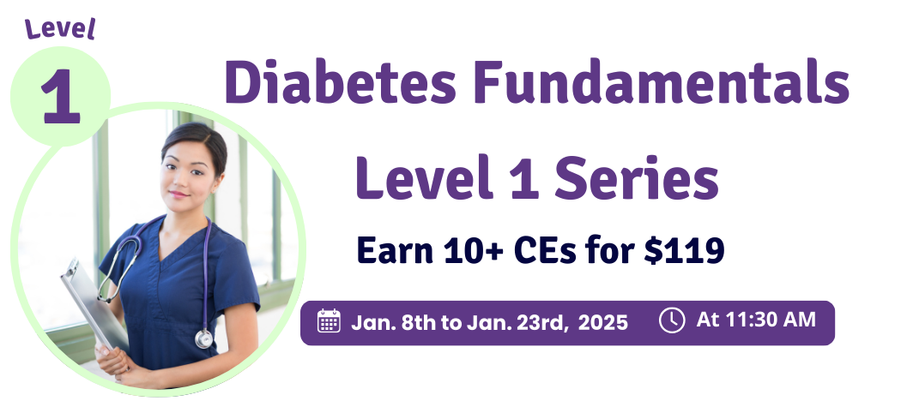
Can’t make it to the Live Session? No worries, our courses are recorded for online viewing. Registrants have access for one full year.
1. Getting to the Nitty Gritty
2. Nutrition & Exercise
3. Meds Overview for Type 2
4. Insulin Therapy & Pattern Management
5. Goals of Care
6. Hypoglycemia, Sick Days, Monitoring
Notes:
We divide our courses into progressive levels, starting with Level One, Diabetes Fundamentals. Level 1 is a great place to get started, whether you're just expanding your diabetes knowledge or working toward certification. Don’t worry if you can’t attend the live session. All of our Courses are recorded for online viewing and registrants have access for one full year from date of purchase.

Slide 5

1. Hyperglycemic Crises, DKA, Euglycemic DKA and HHS
2. How to Assess Well-Being | From Populations to Individuals
3. Meds Mgmt. for Type 2
4. ADA Standards of Care
5. Critical Assessment in Diabetes Care
6. Microvascular Complications Prevention & Treatment
7. Cardiovascular Disease & Risk Management
8. Lower Extremity Assessment
9. Older Adults & Diabetes
10. From Tots to Teens
11. Pregnancy & Diabetes
12. Hospitals & Hyperglycemia
13. Setting up a Successful DSME Program
Notes:
In our Level 2 series, we take a deep dive into the American Diabetes Association Standards of Care. We carefully highlight the content that is most important for your clinical practice and exam success.

Slide 6


1. Diabetes | Not Just Hyperglycemia
2. Standards of Care & Cardiovascular Goals
3. Meds for Type 2 | What you need to know
4. Insulin Therapy | From Basal/Bolus to Pattern Management
5. Insulin Intensive & Risk Reduction | Monitoring, Sick Days, Lower Extremities
6. Medical Nutrition Therapy
7. Microvascular Complications & Exercise | Screen, Prevent, Treat
8. Coping & Behavior Change
9. Test-Taking Coach Session (75+ Practice Questions)
Notes:
Level 3 is our Diabetes Mastery & Cert Readiness Level designed for those who are getting ready to take their certification exams in the near future. It is an intense series, but a lot of fun. In these 9 information packed sessions, we drill down to the content you'll need to succeed at the CDCES or BC-ADM exam. Plus, we provide dozens of poll questions and test questions to get your test-taking muscle into great shape.

Slide 7

Clinical Practice & Assessment
1. Behavior Change Theories Made Easy
2. CardioRenal Risk Reduction Toolkit with Dr. Diana Isaacs
3. What We Say Matters: Language that Respects the Individual and Imparts Hope
4. Type 2 Diabetes Intensive
5. Three Steps to DeFeet Amputation; Assess, Screen, & Report
6. Navigating the Unexpected: Disaster Preparedness and Travel Tips
Insulin Calculations & Pattern Management
7. Insulin Calculation Workshop | From Pumps & Beyond
8. Solving Glucose Mysteries for Type 1
9. Solving Glucose Mysteries for Type 2
10. Basal Bolus Insulin Therapy in Hospital
Notes:
Level four is our advance level, where we delve into more complex topics and delve into cutting-edge information.
These classes are also specifically designed as preparation for the BC ADM certification.

Slide 8

Level 5 – Coming Summer 2025!
Notes:
This summer, we are thrilled to introduce our brand-new Level 5 series, featuring healthcare experts from diverse fields who will share their specialized knowledge and passion for a range of specialty diabetes topics.

Slide 9



Certification Boot Camps
For cost savings and convenience, we package our levels into study bundles to help you reach your goals.
Dual Cert.
Boot Camp
CDCES
Boot Camp
BC-ADM
Boot Camp
Notes:
If you are looking for a clear study path that provides cost saving, we offer our levels in bundles. Our most popular bundles include the CDCES, BC-ADM, and Dual Cert. Boot Camps.
Each bundle combines the necessary Levels, courses, and materials to help you achieve your certification goals.

Slide 10


Training Programs with
Expert Speakers
DiabetesEd Training Conference
ReVive 5 Training Program
Notes:
We invite you to join our specialized training programs with invited guest speakers.
These virtual programs include our very popular 3 Day DiabetesEd Virtual Program, and the ReVive 5 Diabetes Training, where our team of experts unlock the hidden barriers to diabetes care.
These courses will inform and inspire your approach to diabetes self-management education.

Slide 11

Certification Renewal Bundle
Notes:
If you are already certified and need CE hours for renewal, our Certification Renewal Bundle gives you access to every course and program we offer, so you can earn the most CEs for your renewal.

Slide 12


Toolkits
Tech Data Toolkit
Test Taking Toolkit
Notes:
We offer online toolkits such as or Technology Toolkit featuring our world-renowned technology and diabetes expert, Dr. Diana Isaac's. Our test taking toolkit has 220 sample test questions

Slide 13

Check out our FREE Webinars
We understand you have limited time & you want the best value.
You are invited to view FREE videos on our home page & get a feel for our quality and content
Notes:
If you are wondering if our Online University is the right choice for you, we invite to view our FREE webinars to evaluate the quality and content of our information, including our Prep for CDCES and BC ADM and many others. Just go to the FREE Dropdown menu on our website to get started.

Slide 14


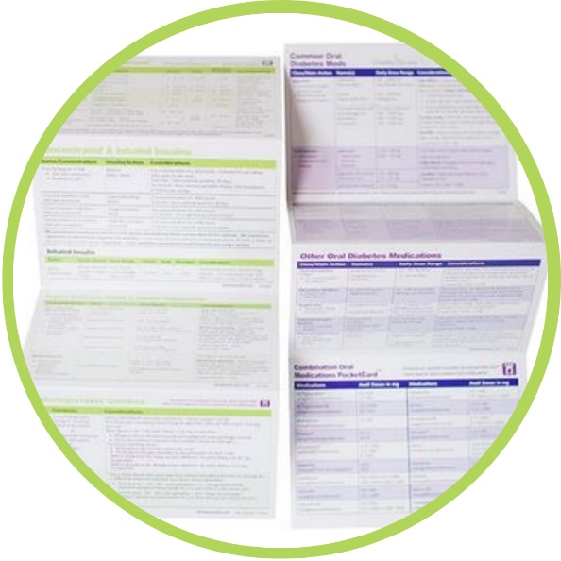
Study & Teaching Tools
Pancreas Partner & DiaCell Teaching Tools
Medication PocketCards
Online Store
DiabetesEdStore.net
Notes:
To register for our Courses and Training Programs, you are invited to our online store, where we also offer ebooks, our Pancreas Partner & DiaCell Teaching Tools, Medication Pocketcards & more. Visit our Online Store at DiabetesEdStore.net to make your own discoveries.

Slide 15


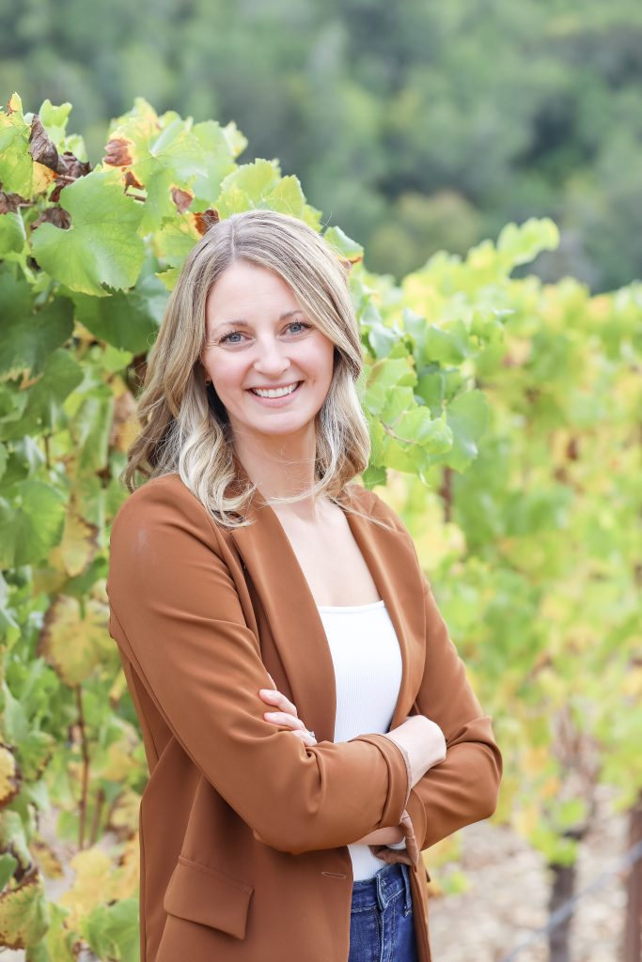
Graduate Success Stories
Johanna Ruiz, RDN, LDN
Marie-Renee D. Lucien-Jean
Brenna Howsepian, RDN, CDCES
Notes:
If you want to get inspired, I invite you to visit our CDCES and BC-ADM Graduates Success Stories page. I’ve highlighted three of our course graduates here. The stories of their journey to certification are heartfelt and motivating.

Slide 16

Bridge Program
Building a Bridge to Welcome New Diabetes Care and Education Specialists
Notes:
The Bridge program is about welcoming and mentoring the next generation of diabetes care and education specialist. It’s about making connections, fostering growth and building a community of passionate diabetes care professionals. We are outreaching to health care professionals and mentors to provide scholarships and support! By working together, we can achieve meaningful change.

Slide 17
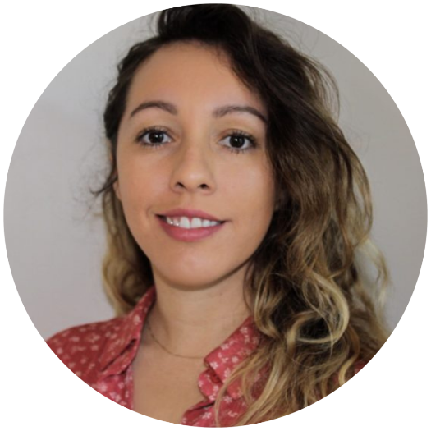

Diabetes Education Services’ Programs
Bryanna Sabourin
Director of Operations &
Customer Happiness
Tiffany Bergeron Customer Advocate Admin
If you have questions, you can chat with us at www.DiabetesEd.net or call 530 / 893-8635 or email at info@diabetesed.net
Notes:
We are here to help! Our top-notch customer success team can help guide you on your certification journey, based on your individual goals and dreams.
You can reach us by phone or by e-mail.

Slide 18

Connect with other Educators
Our Facebook Certification Study Group is a great way to connect with other aspiring Diabetes Educators!
Join by searching “Diabetes Education Specialist Study Group” on Facebook
Notes:
Our Facebook Certification Study Group is a great way to connect with other aspiring Diabetes Educators! Search us on Facebook to join the conversation and connect with colleagues who are working toward certification.

Slide 19


Thank You
Questions? We are here to help!
  Email info@diabetesed.net
  Call 530/ 893-8635
  www.DiabetesEd.net
Notes:
Let’s keep in touch. Our goal is to share cutting-edge information on diabetes care that is filled with compassion and evidence base content that will help you in your daily clinical practice and beyond.
Thank you very much for joining us. This is Beverly Thomassian signing off.

