Slide 1
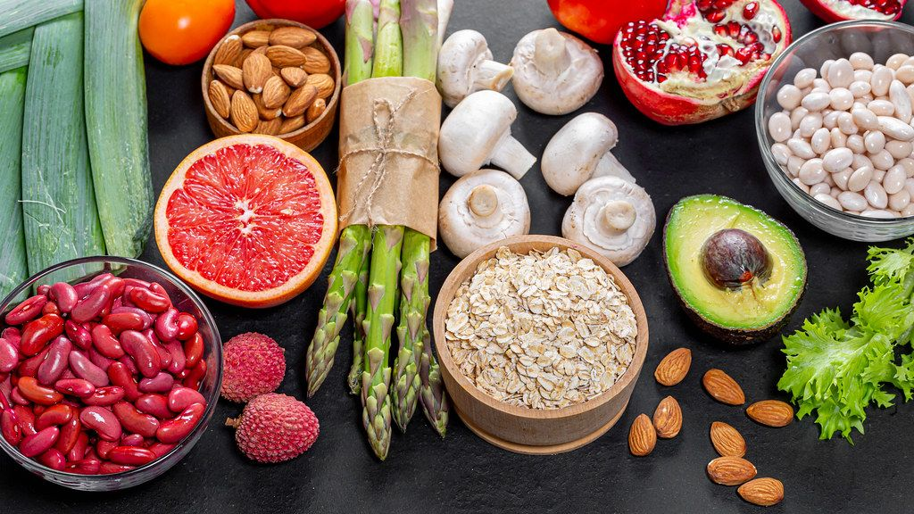
MEDICAL NUTRITION THERAPY

Slide 2
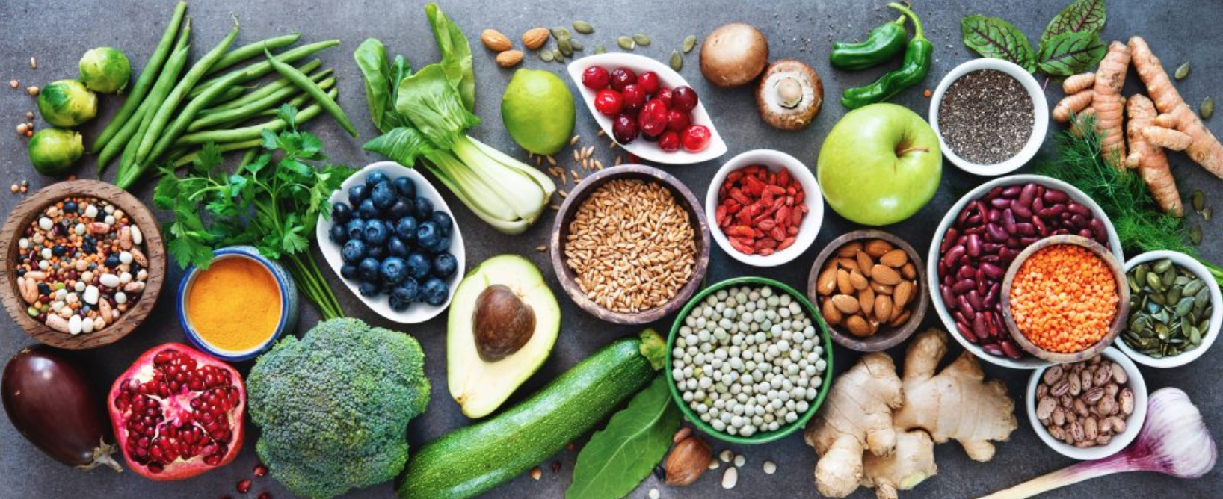
Healthy Eating
Healthy Eating involves behaviors and decisions on what, when, and how much to eat
Influences on healthy eating are complex and numerous
Many clinicians consider healthy eating to be the most challenging of the AADE7 Self-Care Behaviors to implement successfully
Notes:
I want to start off by acknowledging that nutrition and healthy eating can be complicated.
Our food choices are heavily influenced by many variables including:
Emotions, Traditions, Family and cultural eating patterns, Health beliefs, Food preferences, availability, and affordability
So if you’ve ever been overwhelmed in trying to eat more healthfully yourself or struggled to teach someone else about healthy eating then you’re not alone.
Many clinicians consider healthy eating to be the most challenging of the Self-Care Behaviors to implement successfully.
My hope today is to provide more clarity on current nutrition recommendations to both prepare you for the exam, if that’s something you’re planning to take, and also increase your confidence in teaching others about healthy eating.

Slide 3
Healthy Eating
Medical Nutrition Therapy (MNT)
  Evidence-based treatment of a condition through the modification of nutrient or whole-food intake
  Often provided by a RD/RDN or similarly qualified professional
  All diabetes care and education specialists must be ready and able to apply the principles of MNT!
Notes:
So today is all about Medical nutrition therapy.
Medical Nutrition Therapy (MNT) is nutrition based treatment for a condition. It should be evidence based. While MNT is typically provided by and can be billed for when provided by a dietitian, all diabetes care and education specialists must be ready to apply the principles of MNT when working with those who live with diabetes.

Slide 4
Goals of MNT for All Persons with Prediabetes
Decrease the risk of diabetes and cardiovascular disease with intensive lifestyle modification
  Refer those at risk for diabetes to an intensive lifestyle program
    Ex: Diabetes Prevention Program and/or individualized MNT
Notes:
Lets jump in by reviewing the goals of MNT - first, for people with PREDIABETES
The primary goal of MNT for those living with prediabetes is to reduce the risk of developing diabetes and cardiovascular disease. This is done by providing education and supporting individuals in implementing lifestyle change.
The standards recommended that a person with prediabetes gets referred into a program to provide support in making these lifestyle adjustments. That could be a diabetes prevention program or an individualized medical nutrition therapy program.

Slide 5
The Power of Prevention
Diabetes Prevention Program (DPP) shows lifestyle changes may reduce risk of incident T2DM by 58% over 3 years
  Benefit of lifestyle change is more significant in those over the age of 60 – may decrease risk of T2DM by 71%
  Lifestyle intervention was effective in both sexes, across all racial and ethnic groups, and in people predisposed to diabetes
The Diabetes Prevention Program Research Group. (2002). Reduction in the incidence of type 2 diabetes with lifestyle intervention or metformin. New England Journal of Medicine, 346(6), 393–403. https://doi.org/10.1056/nejmoa012512
Notes:
Diabetes prevention programs are based on strong research that shows that lifestyle changes are effective in delaying and potentially preventing type 2 diabetes.
The diabetes prevention program research group randomly assigned approximately 3200 participants with prediabetes who were living with overweight or obesity into one of three groups:
lifestyle intervention aimed at modest weight loss through diet and exercise
treatment with generic metformin or
a placebo control group
The findings were published in the Lancet in 2002. They showed that over 3 years, when compared to placebo, that:
lifestyle intervention reduced the conversion rate to diabetes by 58% and
metformin reduced the rate of conversion to diabetes by 31%
A follow up study at 10 years continued to show significant benefit of making lifestyle changes.
Not only did lifestyle intervention lead to substantial health benefits, it also resulted in savings in health care costs. The net 10-year cost of the program was thought to be quite modest.
________________________________________________________________________________________
ORIGINAL PARAGRAPH
The DPP was a comparative effectiveness trial involving 3234 overweight or obese adults with impaired glucose tolerance (prediabetes). Forty-five percent of the participants belonged to racial or ethnic minority groups that have an increased risk of type 2 diabetes. Participants were assigned to receive one of three interventions: lifestyle intervention aimed at modest weight loss through diet and exercise, treatment with generic metformin, or a placebo control. DPP findings published in 2002 indicated that, relative to placebo, lifestyle intervention and metformin reduced the rate of conversion to diabetes by 58% and 31%, respectively, over 3 years.1 Subgroup analyses showed that lifestyle intervention was effective in both sexes, across all racial and ethnic groups, and in people with a genetic predisposition to diabetes. Lifestyle intervention worked best in participants 60 years of age or older, a group in which metformin did not provide a significant benefit. Metformin worked well among younger participants and was particularly effective in women with a history of gestational diabetes. Most DPP participants (88%) enrolled in the DPPOS, in which continued follow-up demonstrated that the 10-year risk reduction for type 2 diabetes was 31% for lifestyle intervention and 18% for metformin.
Beyond reducing diabetes risk, lifestyle intervention led to substantial health benefits and health care cost savings. Even though these interventions were initially delivered by highly trained professionals who conducted individual sessions, the net 10-year cost was quite modest; although metformin conferred fewer benefits and prevented fewer cases of diabetes, thanks to its lower cost it yielded net savings.

Slide 6
The Power of Prevention
Lifestyle intervention/goals in DPP included:
  Increase physical activity: goal of 150 minutes of physical activity per week
  Decrease fat and calorie intake*
  Decrease weight: sustained loss of 7% of initial body weight
*DPP initially encouraged a lower fat/calorie eating plan but current data suggests there is no ideal percentage of calories from carbs, protein, and fat to prevent diabetes. A variety of eating patterns may be appropriate.
Diabetes Prevention Program (DPP) Research Group. (2002). The Diabetes Prevention Program (DPP): Description of lifestyle intervention. Diabetes Care, 25(12), 2165-2171. doi:10.2337/diacare.25.12.2165
Notes:
The focus of Lifestyle intervention in the Diabetes Prevention Program was to increase physical activity and decrease calorie intake, with weight loss in mind. Specifically, participants in the lifestyle group were asked to
Increase physical activity to 150 minutes per week. The intensity of the activity was equivalent to brisk walking.
Including resistance training is also thought to be beneficial, as is reducing long periods of sedentary time.
Dietary changes
The DPP used fat and calorie restriction - Calorie goals were calculated by estimating daily calories needed to maintain initial weight and then subtracting 500-1000 calories with the aim of losing 1-2 lbs per week.
While the program initially used fat and calorie restriction, I want to mention that the current evidence shows there are a variety of eating patterns that may be appropriate for people with prediabetes; what's more important is calorie reduction and overall quality of diet. Reducing a specific macronutrient is thought to be less important.
3. The trial also focused on sustained weight loss of 7% of initial body weight. 7% was selected as a target in the study because it was thought to be feasible to achieve and maintain. Longer term data revealed greater prevention of diabetes at about 7-10% of weight loss relative to starting body weight.
- Weight loss was the most significant factor in reducing risk of developing diabetes but the exercise behavioral goal was also impactful. Adding 150 minutes a week independently reduced the risk of converting to diabetes by 44%.

Slide 7
The Power of Prevention
Other eating patterns may be appropriate, too.
Overall quality of food is associated with lower risk of type 2 diabetes
Diabetes Prevention Program (DPP) Research Group. (2002). The Diabetes Prevention Program (DPP): Description of lifestyle intervention. Diabetes Care, 25(12), 2165-2171. doi:10.2337/diacare.25.12.2165
Notes:
Based on other trials, a variety of eating patterns may be appropriate for individuals with prediabetes including the mediterreanean, low carb, DASH, vegetarian, plant-based.
Overall quality of food (as measured by Healthy eating index or the alternative healthy eating index or DASH score) with an emphasis on whole grains, legumes, nuts, fruits, and vegetables with minimal refined and processed foods is also associated with a lower risk of type 2 diabetes.

Slide 8
The Power of Prevention
Find a DPP in your community:
  CDC-recognized DPP Lifestyle Change programs:
    www.cdc.gov/diabetes/prevention/find-a-program.html
  Medicare-enrolled CDC-recognized programs:
    https://innovation.cms.gov/innovation-models/medicare-diabetes-prevention-program/mdpp-map
Notes:
There are DPP programs all over the united states. To find a program near you, I’ve included these web-links.
________________________
Eligibility criteria:
Regular programs: Eligibility: BMI ≥ 25, at risk for diabetes based on laboratory testing, previous dx of GDM, or a positive risk test
Medicare: Eligibility: BMI greater than 25 (or >= 23 for Asians) and laboratory testing consistent with prediabetes in the last 1 year

Slide 9
Goals of MNT for All Persons With Diabetes
Promote/support healthful eating patterns, emphasizing a variety of nutrient dense foods in appropriate portion sizes, to improve overall health and:
    Achieve individualized glycemic, blood pressure, and lipid goals, achieve/maintain body weight goals, delay/prevent complications of diabetes
Notes:
Alright, now lets review the goals of MNT for those living with diabetes
The first goal for MNT for people with diabetes is to promote healthy eating patterns to improve health, ultimately, with the goal of delaying or preventing complications from diabetes
Standards pg: S64

Slide 10
Goals of MNT for All Persons With Diabetes
2. Address individual nutritional needs based on:
    Personal and cultural food preferences
    Health literacy and numeracy
    Access to healthful food choices
    Willingness and ability to make changes
    Barriers to change
Notes:
So we want to supporting healthful eating patterns, but we want to be considerate of the needs of the individual.
As a dietitian I often get requests for a list of yes and no foods – someone comes in and says, you know, “just give me a list of foods I can eat and foods I can’t eat”
I must say, this is one of my least favorite requests. I try to avoid giving out a one-sized fits all list like this – rather, it’s important to work with each individual to understand food preferences, health goals, and more – prior to providing recommendations.
Remember that on day one, one of Bev’s diabingo questions asked us to enter 3 healthy foods, and while there was overlap almost no answer was exactly the same. That is because we each come to the table with our own opinions, experiences, and biases. It’s important to try to leave those at the door when you’re counseling on nutrition and focus on the individual’s needs.
S64

Slide 11
Goals of MNT for All Persons With Diabetes
Maintain the pleasure of eating by:
    Providing positive/nonjudgmental messages about food choices
    Limiting food choices only when evidence-based
Provide practical tools for day-to-day meal planning and healthful eating patterns (rather than focusing on individual macros, micros, or single foods)
Notes:
Another goal is to support individuals in maintaining the pleasure of eating.
This is SO HARD – I’m sure we all know this - there is so much judgement, shame, and guilt around food. This is especially true in the world of diabetes. As educators we have tremendous potential improve upon this by trying to be thoughtful with our language. A simple example is trying to avoid labeling foods as “good” or “bad” - rather, try using verbiage like “more nutritious” or that food “has less vitamins and minerals.” Avoid use of words like “cheat day” – the word cheat automatically has a negative connotation and people with diabetes are going to have days where their eating pattern is more nourishing and days where it is less, just like every other person.
Further, we are encouraged avoid making recommendations that limit food choices unless the scientific evidence to do so is clear.
One thing I have found helpful is to focus on incorporating more fiber and vitamin and mineral rich foods, rather than pushing individuals to limit foods. Often, as people fill up on nutritious food and feel more satisfied, then eating smaller amounts of foods that are less nutrient dense becomes much easier.
And then lastly, always remember to provide practical advice.
An easy way to do this is to always ask yourself, “would I be willing to do this or make this change” if the answer is no, it’s likely that the recommendation you’re making is not practical.
S64

Slide 12
Benefit of MNT for Those With Diabetes
Refer people with diabetes to RDN at dx and as needed
  Sustained A1C improvement with ongoing support from RD/RDN
  MNT is cost-effective
Decrease in A1C After 3-6 Months of Receiving MNT
Type 1 Diabetes | 1.0% - 1.9%
Type 2 Diabetes | 0.3% - 2.0%
Franz, M. J., MacLeod, J., Evert, A., Brown, C., Gradwell, E., Handu, D., Reppert, A., & Robinson, M. (2017). Academy of Nutrition and Dietetics Nutrition practice guideline for type 1 and type 2 diabetes in adults: Systematic review of evidence for medical nutrition therapy effectiveness and recommendations for integration into the Nutrition Care Process. Journal of the Academy of Nutrition and Dietetics, 117(10), 1659–1679. https://doi.org/10.1016/j.jand.2017.03.022
Notes:
There is strong evidence showing the value of MNT. In fact, research shows that MNT provided by a dietitian can assist those with diabetes in improving A1C.
And, ongoing nutrition education can assist with maintenance of that A1C improvement.
These A1C improvements can translate to a reduction in diabetes comorbidities, which improves quality of life, and may decrease need for medications and healthcare costs. So in addition to improved quality of life for people with diabetes, MNT may also lead to a reduction in the use of health services and costs.
Because of this, current recommendations state that “All providers should refer people with diabetes for individualized MNT… at diagnosis and as needed throughout the lifespan.
S64
_______________________________________________
_______________________________________________
The evidence in support of this is:
In people with type 1 diabetes, several studies have reported that MNT contributed to signiﬁcantly decreased A1c levels. At 6 months, individualized MNT using carbohydrate counting
to determine premeal insulin doses assisted in decreasing baseline mean A1C levels by 1.0% and 1.9%. An initial series of RDN encounters (4 to 6;total encounter time of 4 to 6 hours) with regular continued RDN encounters were reported. Ongoing MNT support provided by RDNs resulted in maintenance of the reduced HbA1c levels at 1 year, and in the large Diabetes Control and Complications Trial (DCCT) assisted in maintaining the mean HbA1C level at 6.9% in the intensive treatment arm throughout the 6.5 years of the trial.
Studies in persons with type 2 diabetes who received MNT for 3 months, show an absolute decrease in A1C that is up to 2.0%. Longer-term studies show that the A1C improvement is maintained with ongoing support from the dietitian; at one year out, decreases in A1C ranged from 0.6% to 1.8%.
I’d also like to note that although MNT interventions were effective throughout the disease process, the decrease in HbA1c was the largest in studies in which participants were newly diagnosed with type 2 diabetes.

Slide 13

Nutrition Therapy for Weight Management
In Those at Risk for Diabetes and Those Living with Diabetes
Notes:
Next we will talk about nutrition therapy for weight management in those at risk for developing diabetes and in those who live with diabetes

Slide 14
BMI and Diabetes Risk
Increasing BMI is associated with an increasing prevalence of insulin resistance/DM, hypertension, and dyslipidemia
Additional measures: waist circumference, waist/hip and waist/ht ratio
Classification | Body Mass Index (BMI), kg/m²
With Underweight | <18.5
Healthy Weight | 18.5 – 24.9
With Overweight | 25 – 29.9
With Obesity | > 30
Notes:
It has been shown, and I think we are all familiar, that an increase in BMI is generally associated with an increase in the prevalence of insulin resistance and type 2 diabetes, as well as other chronic health conditions.
here is a table with a refresher for BMI classifications.

Slide 15
Effectiveness of Weight Loss in T2D
Percent Weight Loss from Initial Weight | Results
3-7% | Benefit on glycemic control, lipids, and blood pressure Recommended for most people w/ T2D and BMI ≥25
≥10% *When feasible and safe | Optimal, especially in those who are newly diagnosed.
Clinical benefit of weight loss is progressive; more intensive loss maximizes benefit
Franz, M. J., MacLeod, J., Evert, A., Brown, C., Gradwell, E., Handu, D., Reppert, A., & Robinson, M. (2017). Academy of Nutrition and Dietetics Nutrition practice guideline for type 1 and type 2 diabetes in adults: Systematic review of evidence for medical nutrition therapy effectiveness and recommendations for integration into the Nutrition Care Process. Journal of the Academy of Nutrition and Dietetics, 117(10), 1659–1679. https://doi.org/10.1016/j.jand.2017.03.022
Lean, Michael E, et al. “Durability of a Primary Care-Led Weight-Management Intervention for Remission of Type 2 Diabetes: 2-Year Results of the Direct Open-Label, Cluster-Randomised Trial.” The Lancet Diabetes & Endocrinology, vol. 7, no. 5, 1 May 2019, pp. 344–355., https://doi.org/10.1016/s2213-8587(19)30068-3.
Notes:
For those diagnosed with diabetes, weight loss can lead to various health improvements.
At 5% loss there are beneficial outcomes in glucose levels, lipids, and blood pressure. The standards recommend this amount of weight loss for most people with T2D who also live with overweight or obesity.
Clinical benefits of weight loss is shown to be progressive, and more intensive weight loss of 15% may maximize benefits.
That said, we also know it is incredibly difficult to lose weight. In general, weight loss intervention studies in people without diabetes show that, on average, individuals may lose 5-10% of their starting weight by 6 months, at which time the weight loss reaches a plateau. Adaptive mechanisms with the reduced energy intake then occur in the body. Examples of that would be hormonal changes, or mechanisms that cause a decline in basal energy requirements. If this is occurring then maintaining the weight loss becomes more realistic than continued loss.
New weight loss medications may support maintenance of weight loss long-term.
_______________
________________
S115
As diabetes progresses and an individual becomes more insulin deficient, weight loss may not significantly improve glycemia so it is appropriate for focus to shift away from weight loss and more towards maintenance
Big book p462

Slide 16
Nutrition for Weight Management
Weight loss is primarily associated with energy-reduction NOT macronutrient composition or type of eating pattern
  For weight loss, aim for 500-750 kcals/day energy deficit
  High frequency of counseling can be beneficial
  Very low-calorie eating (800-1,000 kcals/day) should only be prescribed to selected individuals by trained practitioners
  Nutrition supplements not shown to be effective; not recommended
Notes:
If you are counseling someone regarding weight loss, keep in mind that it is primarily associated with energy-reduction NOT macronutrient composition or type of eating pattern.
For weight loss, aim for an energy deficit of 500-750 kcals/day. This is thought to translate to weight loss of 1-2 lbs per week. Interventions with high frequency of sessions (more than 16 in 6 months), that focus on nutrition, exercise, and behavioral strategies to achieve the deficit of 500-750 kcals per day have been shown to be beneficial for weight loss and should be considered when available.
S114

Slide 17

Notes:
Lets do a quick knowledge check.

Slide 18
Knowledge Check
Joe is 5’9” and weighs 202 lbs. (BMI 29.8). He was just diagnosed with prediabetes with an A1C at 6.3%. He does not want to start medication. What is his best option?
    Lose 10-15 lbs.
    Lose 14-20 lbs.
    Decrease his fat intake by 5-10%
    Reconsider medications and try Metformin
Notes:
Joe is 5’9” and weighs 202 lbs. (BMI 29.8). He was just diagnosed with prediabetes with an A1C at 6.3%. He does not want to start medication. What is his best option?
Lose 10-15 lbs.
Lose 14-20 lbs.
Decrease his fat intake by 5-10%
Reconsider medications and try Metformin
D – No, remember that care should be patient-centered; Joe doesn’t want to start medication so D should be out. Further, results from the DPP show us that lifestyle adjustments is nearly twice as effective as medications in preventing diabetes.
C – Yes dietary improvements are helpful, but remember a variety of eating patterns may be appropriate.
A and B – The key for prevention of diabetes is thought to be weight loss of 7-10%; do the math you end up with answer B.

Slide 19

Weight is a Heavy Issue
Notes:
Now that we’ve spent that time discussing diabetes and weight with a focus on weight loss, I want to take a minute to talk about weight from another angle.
We want to realize that weight is not the only indicator of health and not every person with diabetes will need or want to lose weight.
And so, providing weight-inclusive care focuses on establishing self-care behaviors rather than promoting restriction or endorsing unsustainable eating or exercise patterns as a way to “get healthy.” As many of you know there is significant stigma and blame around weight, particularly in the diabetes world. This can be a significant emotional and mental burden for the person with diabetes.
As diabetes experts, our job is to advocate and support the person with diabetes in a way that feels right for that individual… and mental wellbeing is a big piece of this. With such, weight loss may not be a goal for every individual who lives with diabetes.

Slide 20
Weight & Respect
Use non-judgmental and person-first language
If weighing is questioned or refused:
  Be mindful of possible prior stigmatizing experiences
  Consider the value of weight monitoring
Situate scales in a private area or room
Measure and report weight non-judgmentally
Take care to regard weight and BMI as sensitive health information
Notes:
So, a few things to consider:
When it comes to taking weight, work to be respectful of your client’s wishes.
Weighing may be declined by someone, and that’s ok. We will review the ADA standards on taking weight on the next slide, but until we do that, ask yourself: if you didn’t weigh a person, how much would it really influence your appointments and care plan?
I work with several individuals who do not want to be weighed. We have a note in their chart so our staff is aware. The reality is, this doesn’t influence our care plan. We have very similar conversations to any other visit – I encourage selection of nutrient dense foods to fuel the body. We might discuss movement for benefits like stress management, improved glycose levels, and improved energy.
I also want to encourage you to situate scales in private areas. Weight is it’s own bit of protected health information and needs to be treated as such.
And always, measure weight in a non-judgmental way using appropriate neutral language

Slide 21
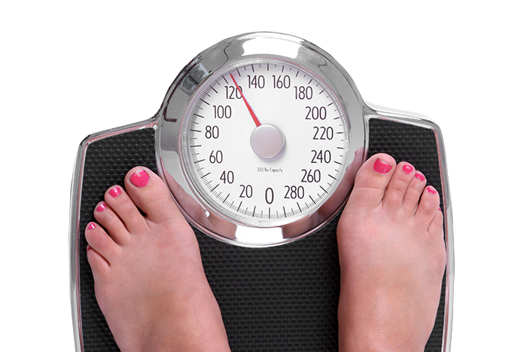
Weight & Respect
ADA Standards:
  Calculate BMI and document in medical record at annual visit
  Be sensitive and allow for privacy when weighing
  Use person-centered, nonjudgmental language
Notes:
The ADA standard is to take the weight once per year and to make accommodations so that there is privacy when someone is being weighed. Remember, we don’t necessarily need a weight at every visit.
S113

Slide 22

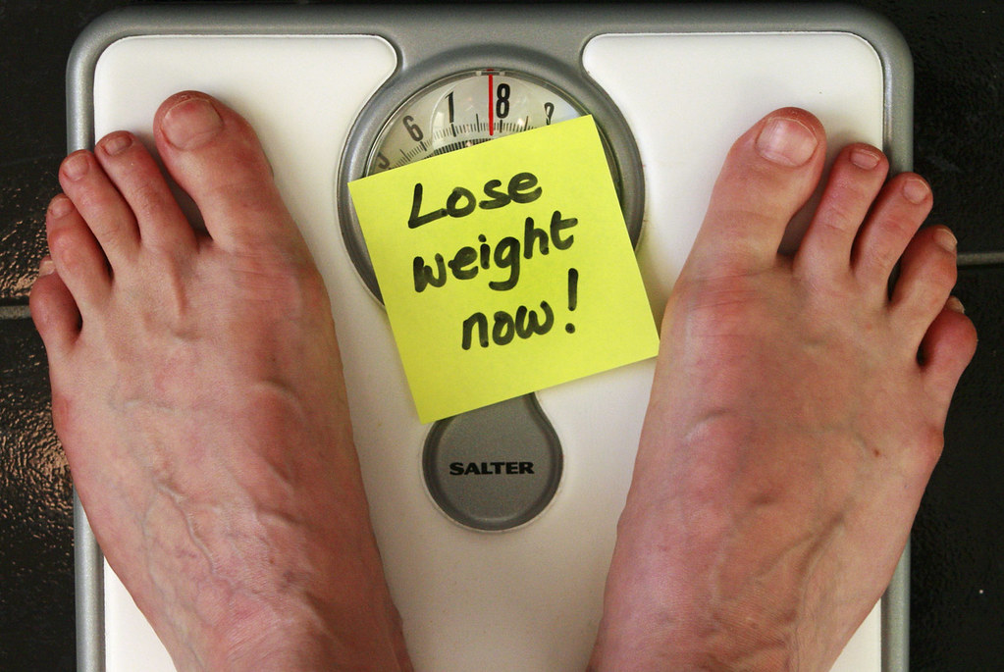
Using a Weight Neutral Approach
Ask whether weight loss is a goal before assuming
Remember: there are many indicators of success!
                or
Notes:
Never assume that weight loss is a goal for a client. Always ask, as not all individuals will desire weight loss. There are a variety of ways to ask this question. In our clinic, we ask “are you comfortable with your current weight?” to help understand this.
In general, I also believe that it is a good practice is to avoid commenting on how someone looks, particularly as it relates to weight – for instance, avoid saying “oh wow, you look good today! Did you lose weight?” – first, we don’t know the full story behind weight loss. I’ve got a client right now who has a history of disordered eating patterns, and stress in her life has triggered some of those challenges to reemerge. She has lost weight, but it’s unintentional and she is concerned. I’ve got another individual who lost weight prior to receiving a diagnosis of cancer. Neither of these individuals want to be congratulated for weight loss. Also, I'm always aware that commenting on someone’s weight sets a precedent that it’s something I’m noticing; that is not the impression I want to give. I want my clients to know that their wellbeing is my priority, regardless of the numbers on the scale.
So, instead, consider more weight neutral messages that celebrate things that are unrelated to weight. Even if a client has decreased their weight and you notice, perhaps, greet them by saying something like “I’m so happy you made it in to see me today. I’m really looking forward to hearing about how you’re doing.” OR “I know you’re busy and appreciate that you prioritized our appointment today. It’s so good to see you.” – both of these message suggests that you value them as a person, regardless of weight.
If someone does say they’ve lost weight and they’re glad, try shifting the conversation to focus on behaviors that are supporting weight loss rather than the number on the scale. Try asking what strategies the person has been using to achieve weight loss and reinforce healthful behaviors.
An example of that may be it is consistent use of their weight loss medication OR maybe it is regular activity OR focusing on smaller portions and more nutrient dense foods.

Slide 23
Setting Goals with a Weight Neutral Approach
I will continue to care for my body by doing [x].
  x = walking 10 minutes after lunch each day
  x = having a vegetable with dinner every night
  x = keeping all my appointments with my therapist
  x = getting 7-8 hours of sleep each night
  x = checking my blood sugar every morning
Notes:
So when setting goals with a client, remember that goals don’t always need to be weight oriented. Weight is not the only indicator of health or success. There are many others, like:
How someone is feeling or
more objective things like the number of times a week someone is incorporating movement, or the frequency that they're swapping fruit for a bag of chips as a snack
Here you can see some examples of goals that are weight neutral.

Slide 24
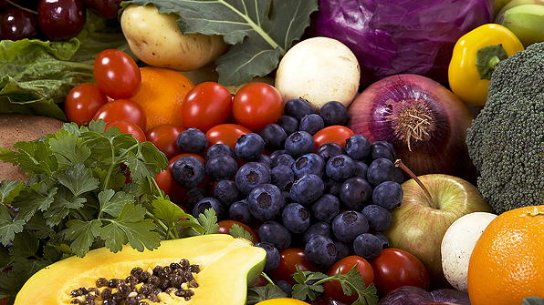
Healthy Eating Patterns & Macronutrients
Carbohydrates, Protein, & Fat
Notes:
Next we are going to transition to talk about healthy eating patterns and macronutrients

Slide 25
Healthy Eating Patterns
Consensus Recommendation: There is no ideal percentage of calories from carb, protein, and fat for people with diabetes.
A healthy eating pattern should:
  ↑ non-starchy vegetables, whole fruit and grains, legumes, nuts, seeds, low-fat diary
  ↓meat, SSBs, sweets, refined grains, ultraprocessed foods
This limits saturated and trans fats, added sugar, and sodium.
Notes:
The current consensus report from ADA on Nutrition Therapy for Adults states that there is not an ideal percentage of calories from carbohydrate, protein, and fat for people with diabetes or those at risk for diabetes. Therefore, macronutrient distribution should be based on an individualized assessment of someone’s current eating patterns, preferences, and metabolic goals.
ADA's statement concludes that a variety of eating patterns are acceptable for the management of diabetes. It’s not a one size fits all approach. A variety of nutrition therapy interventions are reported to be effective.
In general, a healthful eating pattern consists of a variety of vegetables, fruits, grains, low fat dairy, and a variety of proteins. In doing this we limit processed foods that contain trans/saturated fat, added sugars, and sodium.

Slide 26
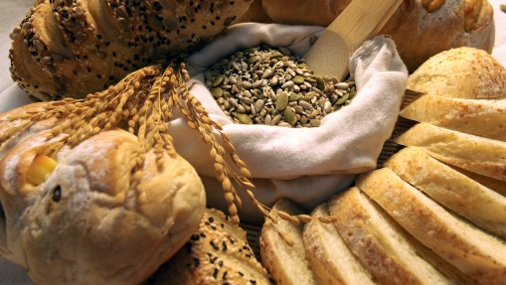
Carbohydrates & Sweeteners
Sugars, High Intensity Sweeteners, Sugar Alcohols, Starch, & Fiber
Notes:
The first macronutrient we will talk about is carbohydrates.

Slide 27
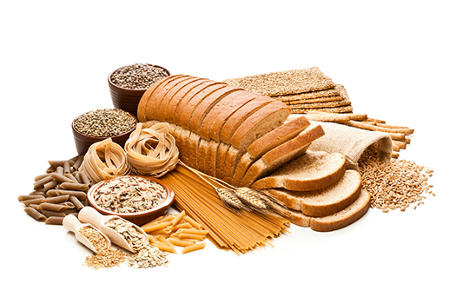
Carbohydrates
Inconclusive evidence for ideal amount of carbohydrate per day
  RDA is 130 g/day in people w/o diabetes. This can be fulfilled via intake or by body’s metabolic processes
Amount of carb eaten is main dietary influence on postprandial BG
  Type/quality of carb makes a difference
Notes:
Current evidence is inconclusive on the ideal amount of carbohydrate intake per day
Recommended dietary allowance is 130 g/day in people without diabetes. This value is based on the amount of sugar and starch that is required to provide the brain with an adequate supply of glucose.
This can be fulfilled via diet but it doesn’t have to be. That glucose can be made through the body’s metabolic processes like gluconeogenesis.
That said, when it comes to blood sugar regulation, the amount of carb eaten at a meal is one of the primary dietary influences on postprandial blood glucose levels. Generally, the more carbs someone eats the higher the blood sugar will go. Less carbs means a lesser degree of rise in the blood sugar. However, the type of carb, how its prepared, the other nutrients it’s consumed with, will also have an impact.
_____________
_____________
ADA consensus statement p 733

Slide 28

Carbohydrates
Reducing overall carbohydrate intake for individuals with diabetes shows evidence for improving glycemia
  Low and very low carb diets lower A1C in short-term only; difficult to sustain macronutrient distribution changes long-term
  Most PWD report moderate carb intake (44-46% of total calories)
Notes:
Because of this, reducing overall carbohydrate intake for individuals with diabetes has demonstrated the most evidence for improving glycemia, particularly in improving the post prandial glucose response.
However, efforts to modify habitual eating patterns are often unsuccessful in the long-term. People generally go back to their usual macronutrient distribution. Thus, while reducing overall carbohydrate intake may improve glycemia, it is recommended to individualize meal plans with a macronutrient distribution that is more consistent with personal preference and usual intake. This can increase the likelihood for long-term maintenance
(stds of care p s65

Slide 29


Carbohydrates
Focus on the “quality of carbohydrate foods selected”
  Nutrient dense carbs with dietary fiber, vitamins, and minerals
  Low in added sugars, fats, and sodium
  Minimally processed
Notes:
Encourage individuals to focus on selecting nutrient dense carbs with fiber, vitamins, and minerals to maximize health.
For example, if someone really loves bread – can you get them to transition from white bread to whole wheat.
S65

Slide 30
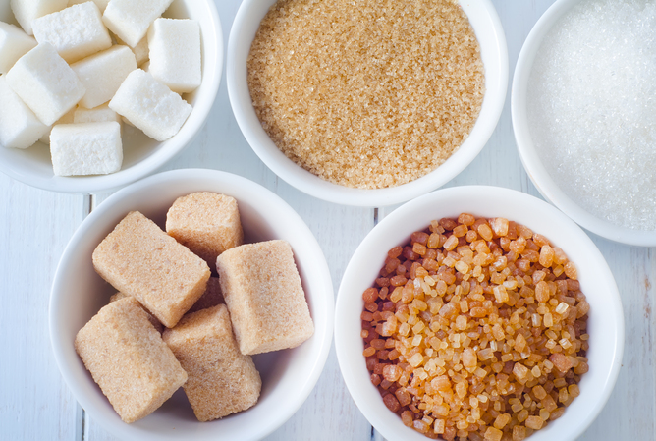
Sugars
Types: glucose, fructose, sucrose (glucose + fructose), and others
  Glucose: If eaten alone, has highest glycemic peak relative to other sugars
  Fructose: metabolized mostly in the liver; goes to replenish liver glycogen & triglyceride synthesis so it has less acute impact on BG
  Sucrose: Broken into 50% glucose and 50% fructose
Notes:
Lets talk about carbohydrates a little further. We are going to break carbs into 3 groups: sugars, starch, and fiber.
Sugars, as many of you know, are a subgroup of carbohydrates. There are several types of sugars. For example:
Glucose. When eaten alone, glucose has the highest glycemic peak compared to other sugars. This is in part because glucose is the type of sugar that circulates in our blood, so digestion time is minimal. It can move through the digestive process and absorb into the blood rapidly.
Fructose – a type of sugar that is metabolized mostly in the liver and then it goes to replenish liver glycogen & for triglyceride synthesis. This means it will have a lesser acute impact on blood glucose when compared to other sugars.
Sucrose – a single sucrose is composed of a glucose and a fructose bound together. When digested it breaks into glucose and fructose, and then these are metabolized individually. While the glucose will go directly into the blood, the fructose is metabolized by the liver into glucose, glycogen, and triglycerides. Again, a lesser amount of fructose will enter into general circulation.

Slide 31
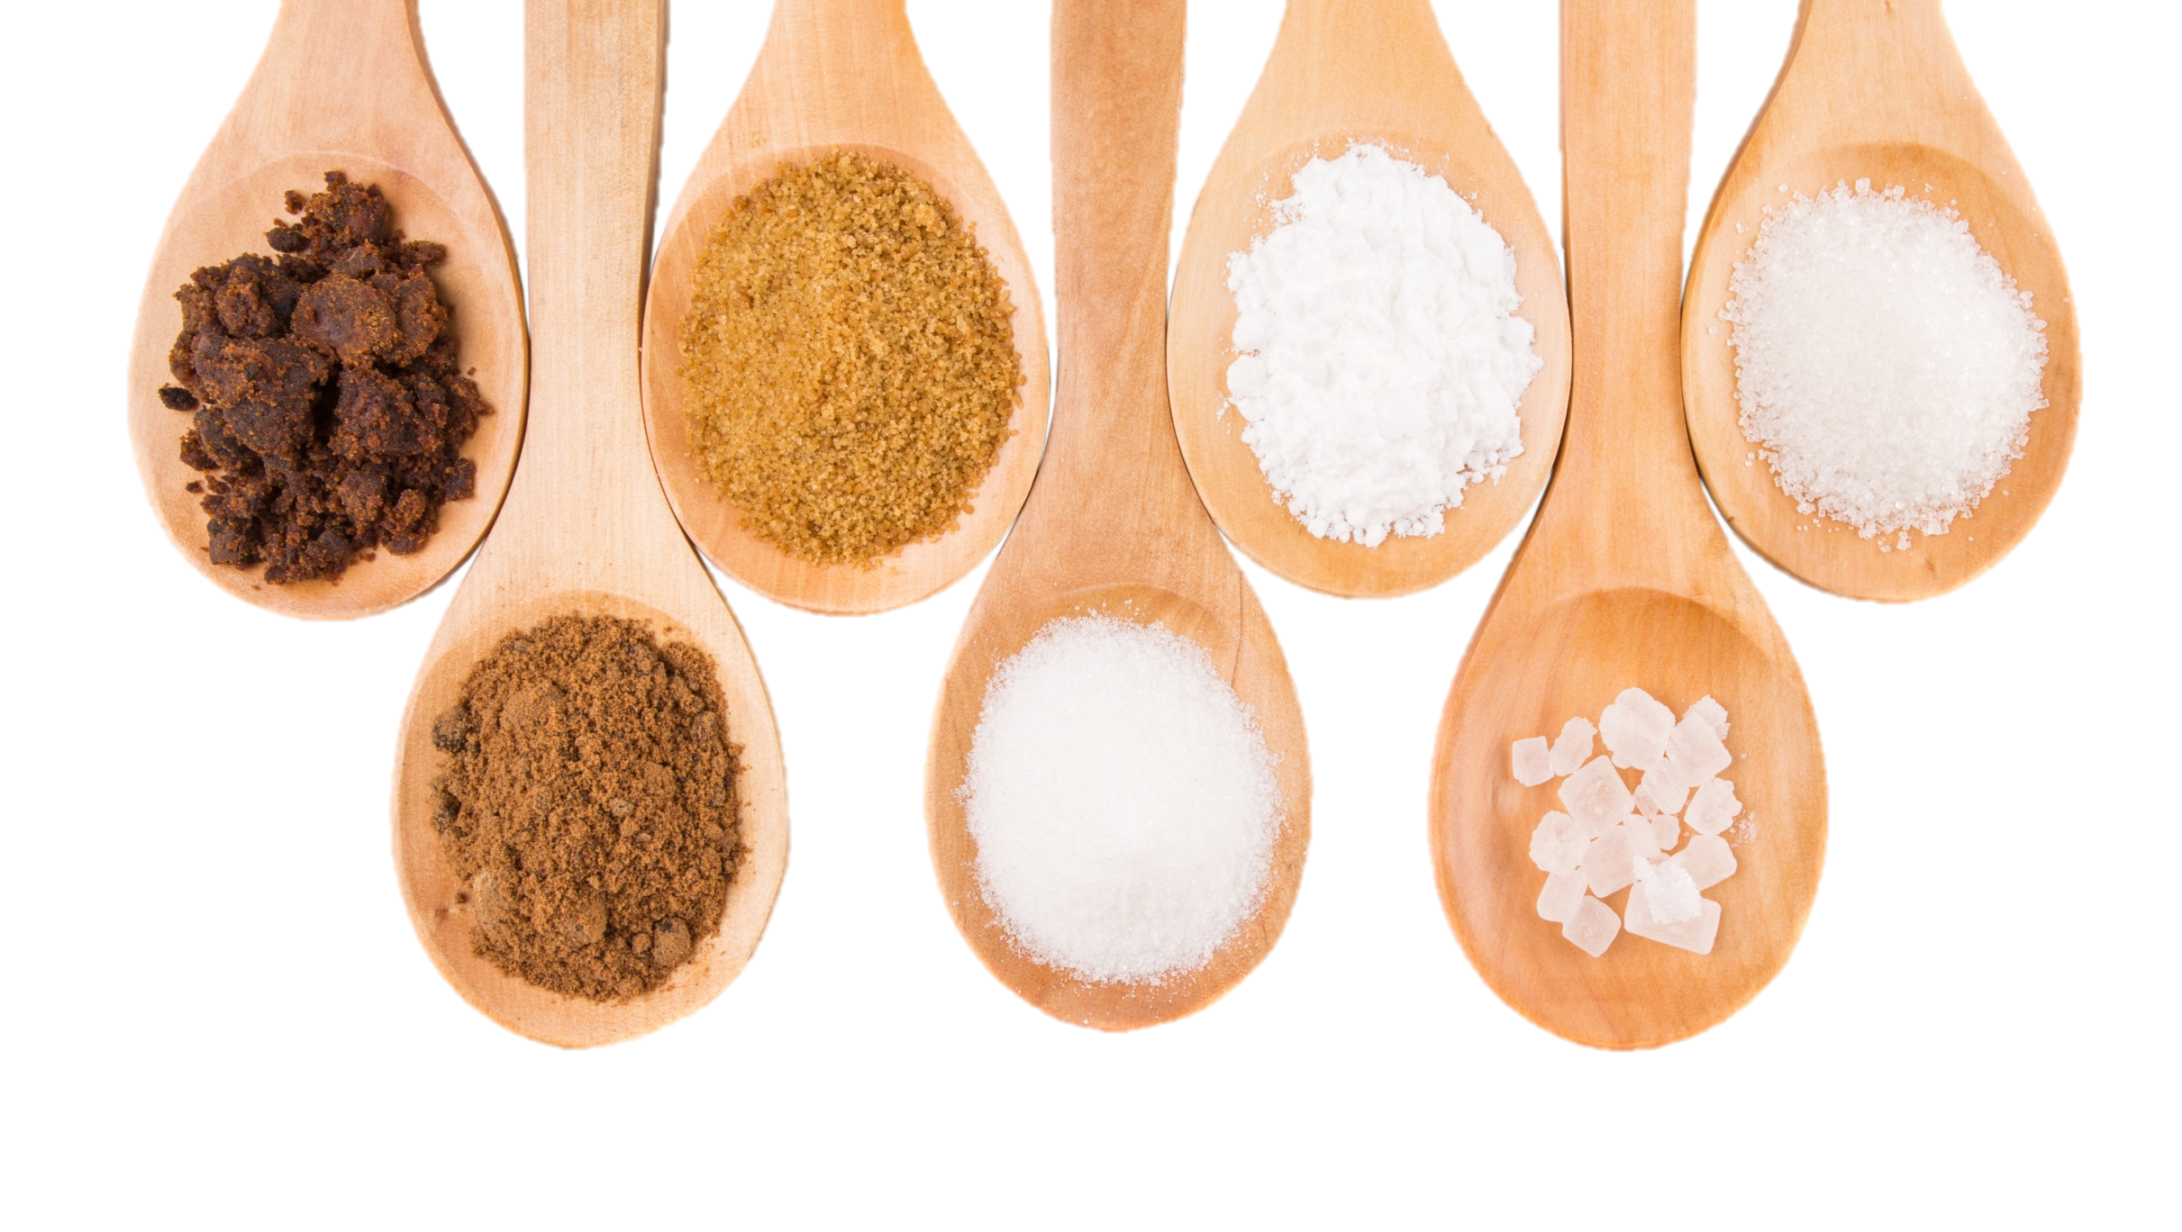
Fructose as a Sweetener
Lower postprandial response compared to other sweeteners
Not recommended as a sweetening agent because it may adversely effect lipids
Franz, M. J., MacLeod, J., Evert, A., Brown, C., Gradwell, E., Handu, D., Reppert, A., & Robinson, M. (2017). Academy of Nutrition and Dietetics Nutrition practice guideline for type 1 and type 2 diabetes in adults: Systematic review of evidence for medical nutrition therapy effectiveness and recommendations for integration into the Nutrition Care Process. Journal of the Academy of Nutrition and Dietetics, 117(10), 1659–1679. https://doi.org/10.1016/j.jand.2017.03.022
Notes:
Although fructose may not raise blood sugar as much as other sugars, excessive consumption is not recommended. This is because high amounts of it can negatively impact lipid levels and may increase the risk of non-alcoholic fatty liver disease
The sugars in agave syrup comprise around 80% fructose and 20% glucose. Due to its high fructose concentration, it may have less of an impact on blood glucose levels plus fructose is sweeter than sucrose so people may not use as much, but because of the potential impact on lipids it is not recommended.
P 456

Slide 32

Fructose in Fruit
No reason to avoid naturally occurring fructose in fruits and vegetables
  “Free fructose” in fruit may result in better glycemic control compared with isocaloric intake of sucrose or starch and is not likely to have detrimental effects on triglycerides
Notes:
When it comes to fructose in fruit, two review studies conducted in persons with diabetes showed that naturally existing “free fructose” like that found in fruit, may result in more optimal glycemic control compared to isocaloric intake of sucrose or starch, and its not likely to have detrimental effects on triglycerides. This is assuming it is not consumed in excessive amounts, which was defined as >12% of energy intake. For most people, fructose intake typically accounts for about 3-4% energy intake.
As a dietitian, I do encouraged people with diabetes to eat fruit. Fruit is a nutrition powerhouse, filled with vitamins, minerals, fiber, and other good things our bodies need. Encouraging fruit is a great way to help displace other more processed foods like cookies or chips that may contain more saturated fat and sodium and less fiber and micronutrients.
I always educate that it will cause blood glucose levels to rise. But again, so would many other snacks and fruits overall nutrition profile is excellent. I encourage a few pieces of fruit per day. I recommend that they are spread out through the day rather than eating them all at once. That the fruit be whole, rather than blended or dried, to maximize satiety and assist with glucose response. You can also try to have fruit with a protein or a heart healthy fat, like low-fat/low sugar Greek yogurt, cottage cheese, or nut butter , which as we will discuss later can help slow digestion/absorption so it doesn’t raise blood sugar as quickly.
________
________
P 456
(if it’s not consumed in excessive amounts)
Excessive amounts = >12% of energy intake; in most people it typically accounts for 3-4% of energy intake

Slide 33

A Unique Sugar: Allulose
A type of sugar that is GRAS by the FDA
  Small amounts naturally in wheat and some fruits; can be manufactured
  ~70% as sweet as table sugar
  Contributes few calories, produces negligible increases in blood glucose and insulin levels, does not promote dental decay
Labeling for allulose:
  Not included in “Total Sugars” or ”Added Sugars”
  Included in Total Carbohydrates
  Calories calculated with 0.4 kcals/gram
  Must be in ingredient list

Slide 34
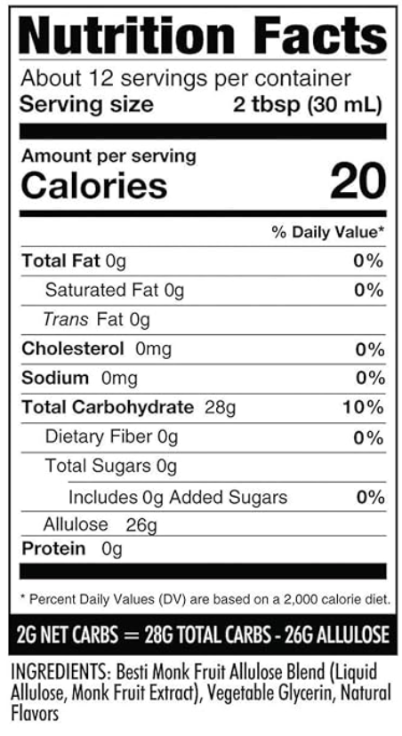

A Unique Sugar: Allulose

Slide 35

Sugar Sweetened Beverages (SSBs)
General population: SSBs should be avoided to ↓risk of type 2 diabetes, heart disease, weight gain, non-alcoholic liver disease, and tooth decay.
In people with and without diabetes: replace SSBs with water as often as possible.
  Helps ↓ calorie intake.
Notes:
Lets now turn our attention to sugar sweetened beverages. Interestingly, about 25% of sugar in the American pattern comes from regular soft drinks. I don’t think this will be a surprise to anyone but both people with and without diabetes should be encouraged to replace SSBs with water as often as possible.
Meta analysis studies have shown that individuals with prediabetes who consume at least 1 serving of SSB per day had a 26% greater risk of developing diabetes. Another meta-analysis showed consumption of regular soda increased risk of developing type 2 diabetes by 13%.
Conversely, replacing SSBs with an equal amount water has shown to reduce the risk of type 2 diabetes and other chronic health conditions.
ADA consensus statement

Slide 36

Hypoglycemia Treatment
Treat hypoglycemia with 15g fast-acting carbs if glucose level reaches <70 mg/dl
  Best option: pure glucose
  Other options: glucose-containing carbs
  Do NOT select foods with fat or protein
Recheck 15 minutes later; retreat if still low
If on AID system, consider less treatment (5-10g)
Notes:
While we are discussing sugar, I want to take a minute to discuss hypoglycemia treatment.
ADA recommends treatment of low blood sugar less than 70 by using 15-20 grams of sucrose or glucose in the form of glucose tablets, liquid, or gel. This is recommended OVER fruit snacks or juice. That’s not to say that a person having a low blood sugar couldn’t use juice if that’s what was available, but glucose products are preferred. Remember, glucose is the type of sugar that circulates in the blood, so its digestion and absorption is quick.
As for protein and fat, we will discuss them a little further in a bit, but protein and fat can delay the absorption of carbohydrate based foods, so using a treatment with protein and fat may delay the blood sugar increase that we are trying to achieve. This means avoiding foods like peanut butter sandwich, milk, chocolate, or ice cream during a low.
I encourage everyone to prioritize education on hypoglycemia treatment, when it is appropriate. If a person with diabetes is using a medication that may lead to hypoglycemia, then discussion of this topic is critical. I find in my practice, that it’s not uncommon for persons to be started on insulin, or oral agents that can cause hypo, without receiving education on low blood sugar treatment. Also teach individuals to carry appropriate treatment at all times….
S90

Slide 37
High Intensity Sweeteners
Ingredients used to sweeten and enhance the flavor of foods
FDA approved for consumption by the general public and PWD
Safety is a source of concern and confusion for the public
Very sweet, so smaller amounts are needed to achieve the same sweetness as sugar in food
Notes:
High-intensity sweeteners are considered food additives. They are ingredients used to sweeten and enhance the flavor of foods.
People may choose to use high-intensity sweeteners in place of sugar for a number of reasons. A popular one is that these do not contribute calories or at least provide a very limited number of calories to the diet. Another is that high-intensity sweeteners generally will not raise blood sugar levels.
_______________
FDAs website

Slide 38

Notes:
International Agency for Research on Cancer and a WHO Expert committee on food additives labeled aspartame as possibly carcinogenic to humans
FDA replied, stating that there were shortcomings in the research used to make this statement.
FDA states no safety concerns for aspartame when used in approved conditions. The accpetable daily intake (ADI) = 50 mg/kg/body weight per day. For 150 lb person, that’s about 17 diet sodas a day.

Slide 39

High Intensity Sweeteners
Six are approved by the FDA as food additives
  Advantame
  Neotame
  Saccharin
  Sucralose
  Aspartame
  Acesulfame potassium
Plant and fruit-based GRAS Sweeteners
  Thaumatin
  Stevia
  Luo Han Guo (Monk Fruit)
Notes:
There are 6 high intensity sweeteners approved by the FDA. There are three that are generally recognized as safe or “grass” – that is stevia and monk fruit.
FDAs website

Slide 41
High Intensity Sweeteners
High Intensity Sweeteners contribute no/few calories to the diet and do not raise blood sugar levels
    Could reduce overall calorie/carb intake, as long is there is no compensatory energy increase elsewhere
    No benefit to weight without energy restriction
Notes:
The thought is that replacing added sugars with sugar substitutes could decrease daily intake of carbohydrates and calories, which could possibly lead to a beneficial affect on glucose levels, weight, and cardiometabolic health.
However, an advisory committee from the American Heart Association that was supported by ADA concluded that there is not enough evidence to determine whether sugar substitutes definitely lead to these benefits.

Slide 42
Sugar Alcohols
Another category of sweeteners approved for consumption for general public and PWD
  Calorie contribution is often similar to sugar
  Associated with bloating, flatulence, and diarrhea
Examples: Sorbitol, maltitol, erythritol, isomalt, xylitol, lactitol
Notes:
Sugar alcohols represent another category of sweeteners used in sugar-free foods. They aren’t completely digested by the body so they provider fewer calories and a lesser rise in blood sugar compared to the same amount of sugar.
Different sugar alcohols contribute different amounts of calories, but all have fewer calories than sugar. On average, they contain half the calories of sugar. However, some have as few as 0.2 calories per gram while others are as high as 3 calories per gram. That said, they are not as sweet as sugar so a larger amount of them may be required to match the degree of sweetness of sugar. This may bring the calorie content of a food with sugar alcohols to a level that is similar to a food sweetened with sugar.
I want to highlight Erythritol – a sugar alcohol that contributes close to 0 calories per gram and has essentially no impact on blood glucose. Although Erythritol and other sugar alcohols are generally thought to be safe, an NIH funded research group recently found an association between higher blood levels of erythritol and an increased risk of heart attack and stroke. The results highlight the need for further study of erythritol’s long-term risks for cardiovascular health.
The other notable concern with sugar alcohols is their potential to cause gastrointestinal effects in sensitive individuals. Because they’re not fully absorbed, some people note bloating and diarrhea.
___________
So, they exposed human platelets, which control blood clotting, to erythritol. Doing so increased the platelets’ sensitivity to blood clotting signals. Increasing blood erythritol levels also sped up blood clot formation and artery blockage in mice.

Slide 43

Sugar Alcohols
Little evidence on benefit for people with diabetes
Consumption produces a small rise in blood glucose
  Postprandial response is lower than with fructose, glucose, or sucrose
  To carb count: consider subtracting ½ of sugar alcohol from total carb grams
Notes:
Currently, there is little research on the potential benefits of sugar alcohols for people with diabetes and little evidence that they improve long-term blood sugar levels or weight.
We will talk about carb counting more later, but for now I want to mention that a good rule of thumb is that if you’re teaching someone to carb count, consider subtract ½ the grams of of sugar alcohol from the grams of total carb

Slide 44

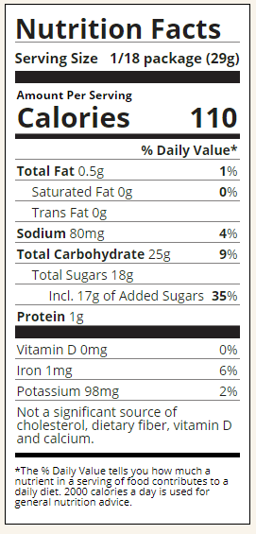
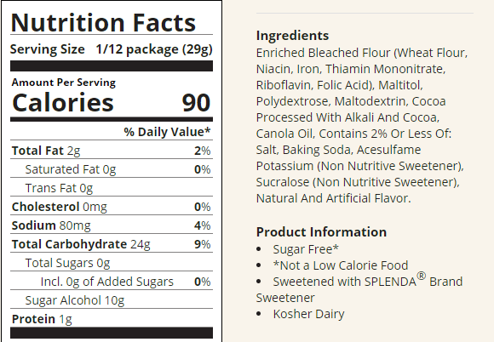

Sugar Alcohols
Notes:
Here is a label for you to check out – notice that the serving size is the same in both the regular and sugar free brown mix.
The calorie content is very similar
The total carbohydrates is also similar

Slide 45
Nonnutritive Sweeteners
For both high-intensity sweeteners and sugar alcohols recommend:
  Reductions in sugar intake and calories with or without use of nonnutritive sweeteners
  Moderation

Slide 46
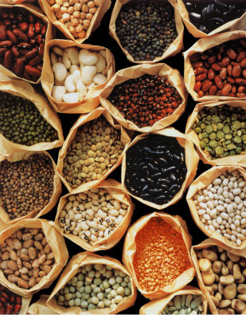
Starch
The digestive tract is efficient in breaking starches into glucose
Glycemic effect of a particular starch is determined by:
  Type/structure of starch
  Types of processing and cooking used
  Other macronutrients consumed with the starch
Focus on starches with fiber, rather than refined/processed grains
Notes:
Next we will talk about starch, another type of carbohydrate.
The digestive tract is efficient in breaking starch into glucose. How quickly that happens can depend on many variables like the type or structure of the starch, how it’s processed or cooked, and other macronutrients that are consumed around the same time.
I don’t teach people to avoid starch. Rather, I focus on incorporating high fiber starch, consideration of portion size, and how to balance the starch with other nutrients to improve after meal glucose levels

Slide 47


Impact of Starch on BG
Structure/type of the starch
  Amylose vs. amylopectin
AMYLOSE
More “resistant starch”
Lesser impact on glucose levels
Example: Long grain rice, beans, lentils
AMYLOPECTIN
Greater impact on glucose levels
Example: Short grain rice, potatoes
Notes:
Starch is a long strand of glucose units bound together. There are two types: amylose and amylopectin.
Because of amylose's chemical structure, it is harder to digest and it contains more resistent starch which is a type of fiber. Resistant starch is a portion of starch that cannot be digested by amylases in the small intestine and passes to the colon to be fermented by gut bacteria.
Studies have suggested that resistant starch can help with weight loss and benefit heart health. It may also improve blood sugar levels, insulin sensitivity, and digestive health. This means that starches with more amylose and less amylopectin will have a lesser impact on blood glucose levels. Examples of starches with more: long-grain rice, beans, lentils vs. short-grain rice, potato
There are different types of resistant starch. Another type is retrograded starch, where the cooking then cooling process actually allows more resistant starch to form.
To make that practical, you can recommend cooking starches like rice, potatoes, beans, and pasta a day in advance and cooling them in the refrigerator overnight. It’s ok to reheat the starch before eating. Reheating doesn’t destroy the resistant starch that’s created

Slide 48

Impact of Starch on BG
Structure/type of the starch
  Ripeness
    Example: As a banana ripens, resistant starch converts into sugars
Notes:
An example of how the structure of a starch can impact the glycemic effect of the starch is with ripeness in fruit – a good example we could use is a banana. As a banana ripens, the resistant starch converts to sugar. This gives the ripe banana more sweet taste, and may influence the speed of the post-prandial blood sugar rise. For this reason, I’ve worked with clients who have said that they’ve been told to has eat green bananas. Remember that Medical Nutrition Therapy needs to be practical and person-centered. Whenever someone says this to me, I always ask whether they like green bananas. If the answer is no, then we’ve found our answer on whether bananas are best green or should be eaten yellow.

Slide 49

Impact of Starch on BG
Types of processing and cooking used
  Cooking method and time
  Amount of heat and moisture
    Example: The longer pasta cooks, the more water-logged its molecules become, making it easier for the body to break it down to glucose
Notes:
Al dente pasta may also impact blood sugar more slowly compared to pasta that’s been cooked longer. The more water-logged its molecules become, making it easier for the body to break it down to glucose

Slide 50
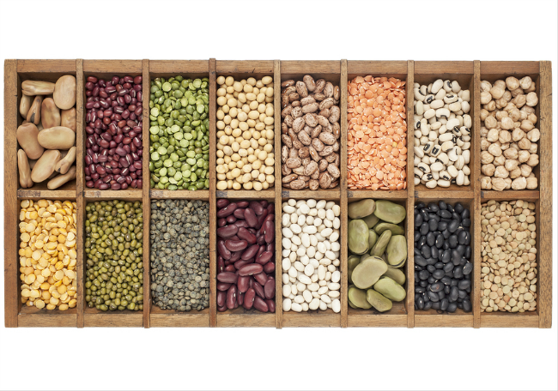
Fiber
A type of carbohydrate that passes through the body largely undigested, thus contributes minimal glucose to the postprandial rise
Intake is inversely associated with risk of T2DM
Sufficient intake is associated with lower all-cause mortality in people with diabetes
Notes:
Now lets talk about fiber.
fiber is a type of carbohydrate that passes through the body largely undigested, thus it contributes less glucose to the postprandial rise relative to the other types of carbohydrates
The benefits of fiber are vast:
Help with weight management
Reduce cholesterol and improve heart health
Support a healthy intestinal tract and prevent constipation
Consumption may help with blood sugar management
Regular intake of fiber is associated with lower all cause mortality in people with diabetes

Slide 51

Fiber
Sources of fiber:
  Whole fruits, starchy and non-starchy vegetables, beans, peas, lentils, nuts, seeds, and whole grains
Goal: 14 grams of fiber/1000 kcal
  Typical American gets ~15 grams/day
  Improved glycemia with ~44-50 grams/day; may be difficult due to palatability and GI side effects
50% of grain consumption from whole intact grains
Notes:
Intrinsic fibers are found in fruits, vegetables, nuts, seeds, whole grains. These foods are often colorful. For example, sources are fruits, vegetables, legumes, whole grains, nuts and seeds, and more. Notice that fiber is found in foods that are also rich with vitamins and minerals.
There are also isolated and synthetic fibers that are approved by the FDA to be added to foods. These foods may not have the nutrient density that the intrinsic fibers have.
The goal for intake of fiber is 14grams per every 1000 calories. Unfortunately, the typical American gets only about 15grams per day total.
Studies show improved glycemia with ~44-50 grams/day however this may be difficult due to palatability and GI side effects
S66

Slide 52
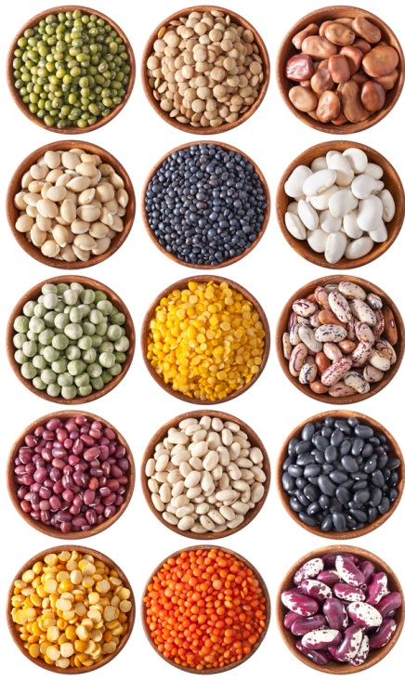
Tips to Increase Fiber
Real-world tips to increase fiber:
  Eat whole fruit instead of drinking juice
  Replace white flour products/rice with brown rice and whole grains
  Snack on nuts, seeds, fruit, or vegetables more often
  Substitute beans/lentils for meat in a salad, chili, or soup
Notes:
Here are a few tips to support a person in increasing their fiber intake.
READ THE EXAMPLES

Slide 53

Fiber & Carbohydrate Counting
Since fiber is a type of carbohydrate that the body can’t digest, it does not affect blood sugar levels like other carbs.
On Nutrition Facts food labels, the grams of dietary fiber are already included in the total carbohydrate.
In those who are intensively managed with insulin and carb counting, consider subtracting the grams of fiber from the total carbohydrate.
Notes:
Since fiber is a type of carbohydrate that the body can’t digest, it does not affect blood sugar levels like other carbs.
On Nutrition Facts food labels, the grams of dietary fiber are already included in the total carbohydrate.
Consider subtracting the grams of fiber from the total carbohydrate.
I don’t teach everyone this: I consider numeracy level and fiber intake. Especially knowing that the average American eats an average of less than 15 grams per day, in many people that are carb counting, the amount of fiber consumed may be negligible. However, I may in individuals who eat a more plant-forward diet or those who eat a lot of beans and lentils.

Slide 55
Knowledge Check
Which of the following is true about sucrose digestion?
Sucrose is broken down into glucose & fructose, and the fructose is metabolized almost completely in the liver
Sucrose is broken down into glucose & maltose, and the glucose is metabolized almost completely in the liver
Sucrose is broken down into glucose & fructose, and the glucose is metabolized almost completely in the liver
Sucrose is broken down into glucose & maltose, and the maltose is metabolized almost completely in the liver

Slide 56
Knowledge Check
Taylor, who has type 1 diabetes, begins experiencing symptoms of hypoglycemia after a long-day of swimming. When she checks, her blood sugar is 63 mg/dl. What should she do?
  Drink 8 oz of soda and recheck her glucose level in 15 minutes
  Eat 4 glucose tablets and recheck her glucose level in 15 minutes
  Drink 15g of liquid glucose and recheck her glucose level in 30 minutes
  Eat a piece of fruit and recheck her glucose level in 30 minutes
Notes:
Correct answer: B
Remember, for the use of carbs in treating lows, ADA recommends 15-20g of sucrose or glucose in the form of tablets, liquid, or gel, rather than fruit snacks or juice.
The blood glucose level should be rechecked in 15 minutes; if still low, retreat until reaching >70 mg/dl

Slide 57

Stand up & Stretch!

Slide 58

Protein

Slide 59
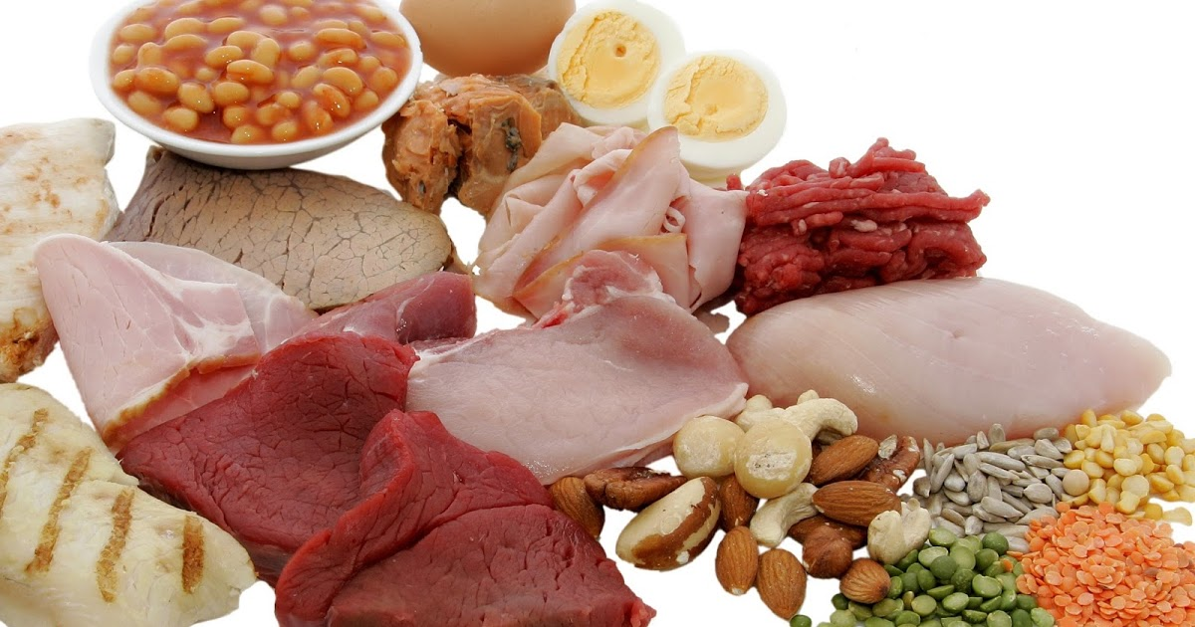
Protein Sources
Meat: beef, pork, lamb, veal, etc.
Plant-based meats
Poultry: chicken, turkey, duck, emu, goose, bush birds, etc.
Fish and seafood: fish, prawns, crab, lobster, scallops, etc.
Eggs
Dairy products: milk, yogurt, cheese, cottage cheese
Soy milk
Nuts, seeds, nut butters
Tofu, tempeh, edamame
Beans, lentils, peas, hummus
Grains: quinoa, wheat berry, millet, couscous, buckwheat, oatmeal, high protein cereal
Notes:
Here is a list of protein sources.
Just take a second to notice how many foods have protein.
Protein has many roles in the human body, from helping to repair and build body tissue to assisting with fluid balance. It’s also a nutrient that helps us feel satisfied when eating.

Slide 60
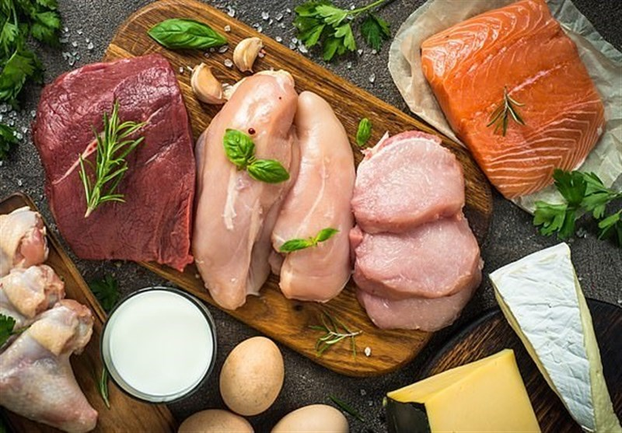
Protein
Recommended vs. Actual Intake
  RDA: 0.8 g/kg body weight/day
  Most Americans eat 1-1.5 g/kg body weight/day or 15-20% of total calories from protein
No evidence that adjusting actual intake towards the recommended intake will improve health
This Photo by Unknown Author is licensed under CC BY
This Photo by Unknown Author is licensed under CC BY
This Photo by Unknown Author is licensed under CC BY
Notes:
Because protein is found in so many foods, most Americans get more than the Recommended Dietary Allowance.
Where the RDA is 0.8 grams of protein per kilogram of body weight per day, actual intake in the US is more like 1-1.5 grams per kg of body weight per day. Currently there is no evidence that adjusting the actual intake closer to the RDA will improve health.
__________________________________________________
Standards of care p s66

Slide 61
Protein
Dietary protein in diabetes management:
  Inconclusive research regarding the ideal amount of dietary protein to optimize glycemic management or CVD risk
  Individualize protein goals based on current eating patterns
This Photo by Unknown Author is licensed under CC BY
Notes:
Similar to carbs, research to determine an ideal amount of protein to optimize glucose control is inconclusive.
However, there is some research that shows higher protein eating plans have allowed for successful glucose management in type 2 diabetes and can help people to feel more satisfied when eating (20-30% of kcal from protein).
This may have to do with the fact that protein intake has been linked with release of GLP-1 hormone in the gut. GLP-1 = enhanced satiety and reduced energy intake, also helps to stimulate insulin secretion (i.e., to act as an incretin hormone) and to inhibit glucagon secretion
Overall though, protein goals should be individualized based on current eating patterns.
s66

Slide 62
Protein & CKD
Dietary protein in diabetes management for persons with nondialysis-dependent CKD
  Intake should be 0.8g protein/kg body weight/day
    Less doesn’t provide benefit and may increase malnutrition risk
    More is associated with accelerated decline in kidney function
This Photo by Unknown Author is licensed under CC BY
Notes:
Historically, low-protein eating plans were recommended for those with diabetic kidney disease, where there was with albuminurea or a reduction in GFR
However, at this time, current recommendation is to keep intake around the current RDA of 0.8 grams of protein per kg body weight for people with CKD stage 3 or 4
Higher levels of dietary protein intake (>1.3g of protein per kg body weight per day) are associated with increased albuminuria and a more rapid rate of decline in kidney function.
Evidence suggests that lowering intake beyond this level may not improve glucose levels, reduce CV risk, or alter the course of GFR decline BUT, it could increase the chance of malnutrition.
S179

Slide 63
Protein & CKD
For persons with diabetes on dialysis
  Malnutrition is common
  Intake higher than 0.8g protein/kg body weight/day should be considered to reduce risk
This Photo by Unknown Author is licensed under CC BY
Notes:
For persons with diabetes on dialysis, malnutrition is common, so consider intake higher than 0.8g protein/kg body weight/day to reduce risk of malnutrition
S176

Slide 64
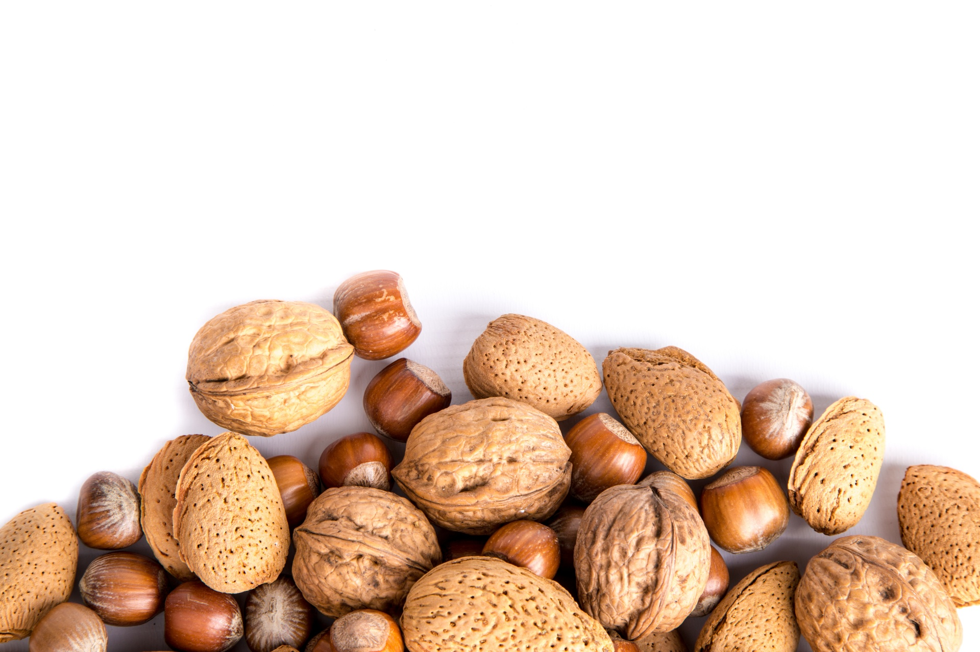


Protein
In someone living with T2DM, protein intake may stimulate the release of insulin
  Therefore, use of carb sources high in protein to treat/prevent hypoglycemia should be avoided
  Examples of foods to avoid are milk, nuts, peanut butter
This Photo by Unknown Author is licensed under CC BY-NC
Notes:
Fun fact on protein:
Protein intake can enhance or increase insulin response to dietary carbohydrates in Type 2 diabetes. Therefore, the use of carbohydrate sources high in protein to treat/prevent hypoglycemia should be avoided due to the potential concurrent rise in endogenous insulin
Examples of foods to be avoided include: milk, nuts, and peanut butter
Remember that this is not as relevant for those with type 1 diabetes who don’t have endogenous insulin production. Although protein may still delay digestion, so generally more pure carbohydrate choices are recommended.

Slide 65

Protein
In someone living with T2DM, consuming non-starchy vegetables and protein 5-15 minutes prior to eating carbohydrate foods has been shown to lower postprandial glucose and insulin excursions
Notes:
Another interesting piece on protein:
Multiple randomized cross over studies have shown that when eating a meal, the order that macronutrients are consumed can impact post-prandial glucose response. Eating protein and non starchy vegetables first, then carbohydrates last may significantly lower postprandial glucose and insulin levels in people with type 2 diabetes. This was in comparison to eating carbohydrates first or together with non-starchy vegetables and protein (eg a sandwich) at the same time.
The thought is that eating the protein or vegetable first may increase GLP-1 secretion and delay gastric emptying which leads to a reduction in blood sugar excursions. Research has suggested that the benefit may be quite significant.
I like to provide patients with this tip; although it may not always be practical particularly with mixed meals

Slide 66

Fats
Saturated, Trans, and Unsaturated Fats

Slide 67

Fats
Sources: a variety of foods including meat, poultry, fish/seafood, eggs, dairy products, nuts and seeds, avocado, butter/oil, processed and fried foods
Dietary fat is needed for absorption of fat-soluble vitamins (A, D, E, and K), function of nerves and brain, and healthy skin and body cells.
Notes:
Dietary fat is needed for absorption of fat-soluble vitamins, function of nerves and brain, and healthy skin and body cells.

Slide 68
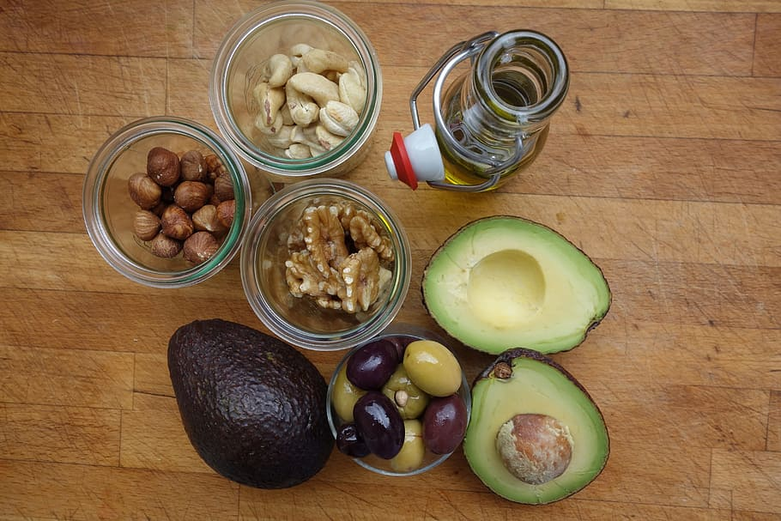
Fats
There is not an ideal percentage of calories from fat for people at risk for or living with diabetes
Type of fat consumed is more important than total fat
  Limit intake of saturated fat
  Avoid trans fat
  Keep cholesterol as “low as possible” w/o compromising diet
Notes:
Again, similar to protein and carbs, evidence suggests there is not an ideal percentage of calories from fat for people at risk for or living with diabetes.
The type of fat consumed is more important than total fat when looking at metabolic goals and CVD risk
_____________________
_____________________
S66-67

Slide 69
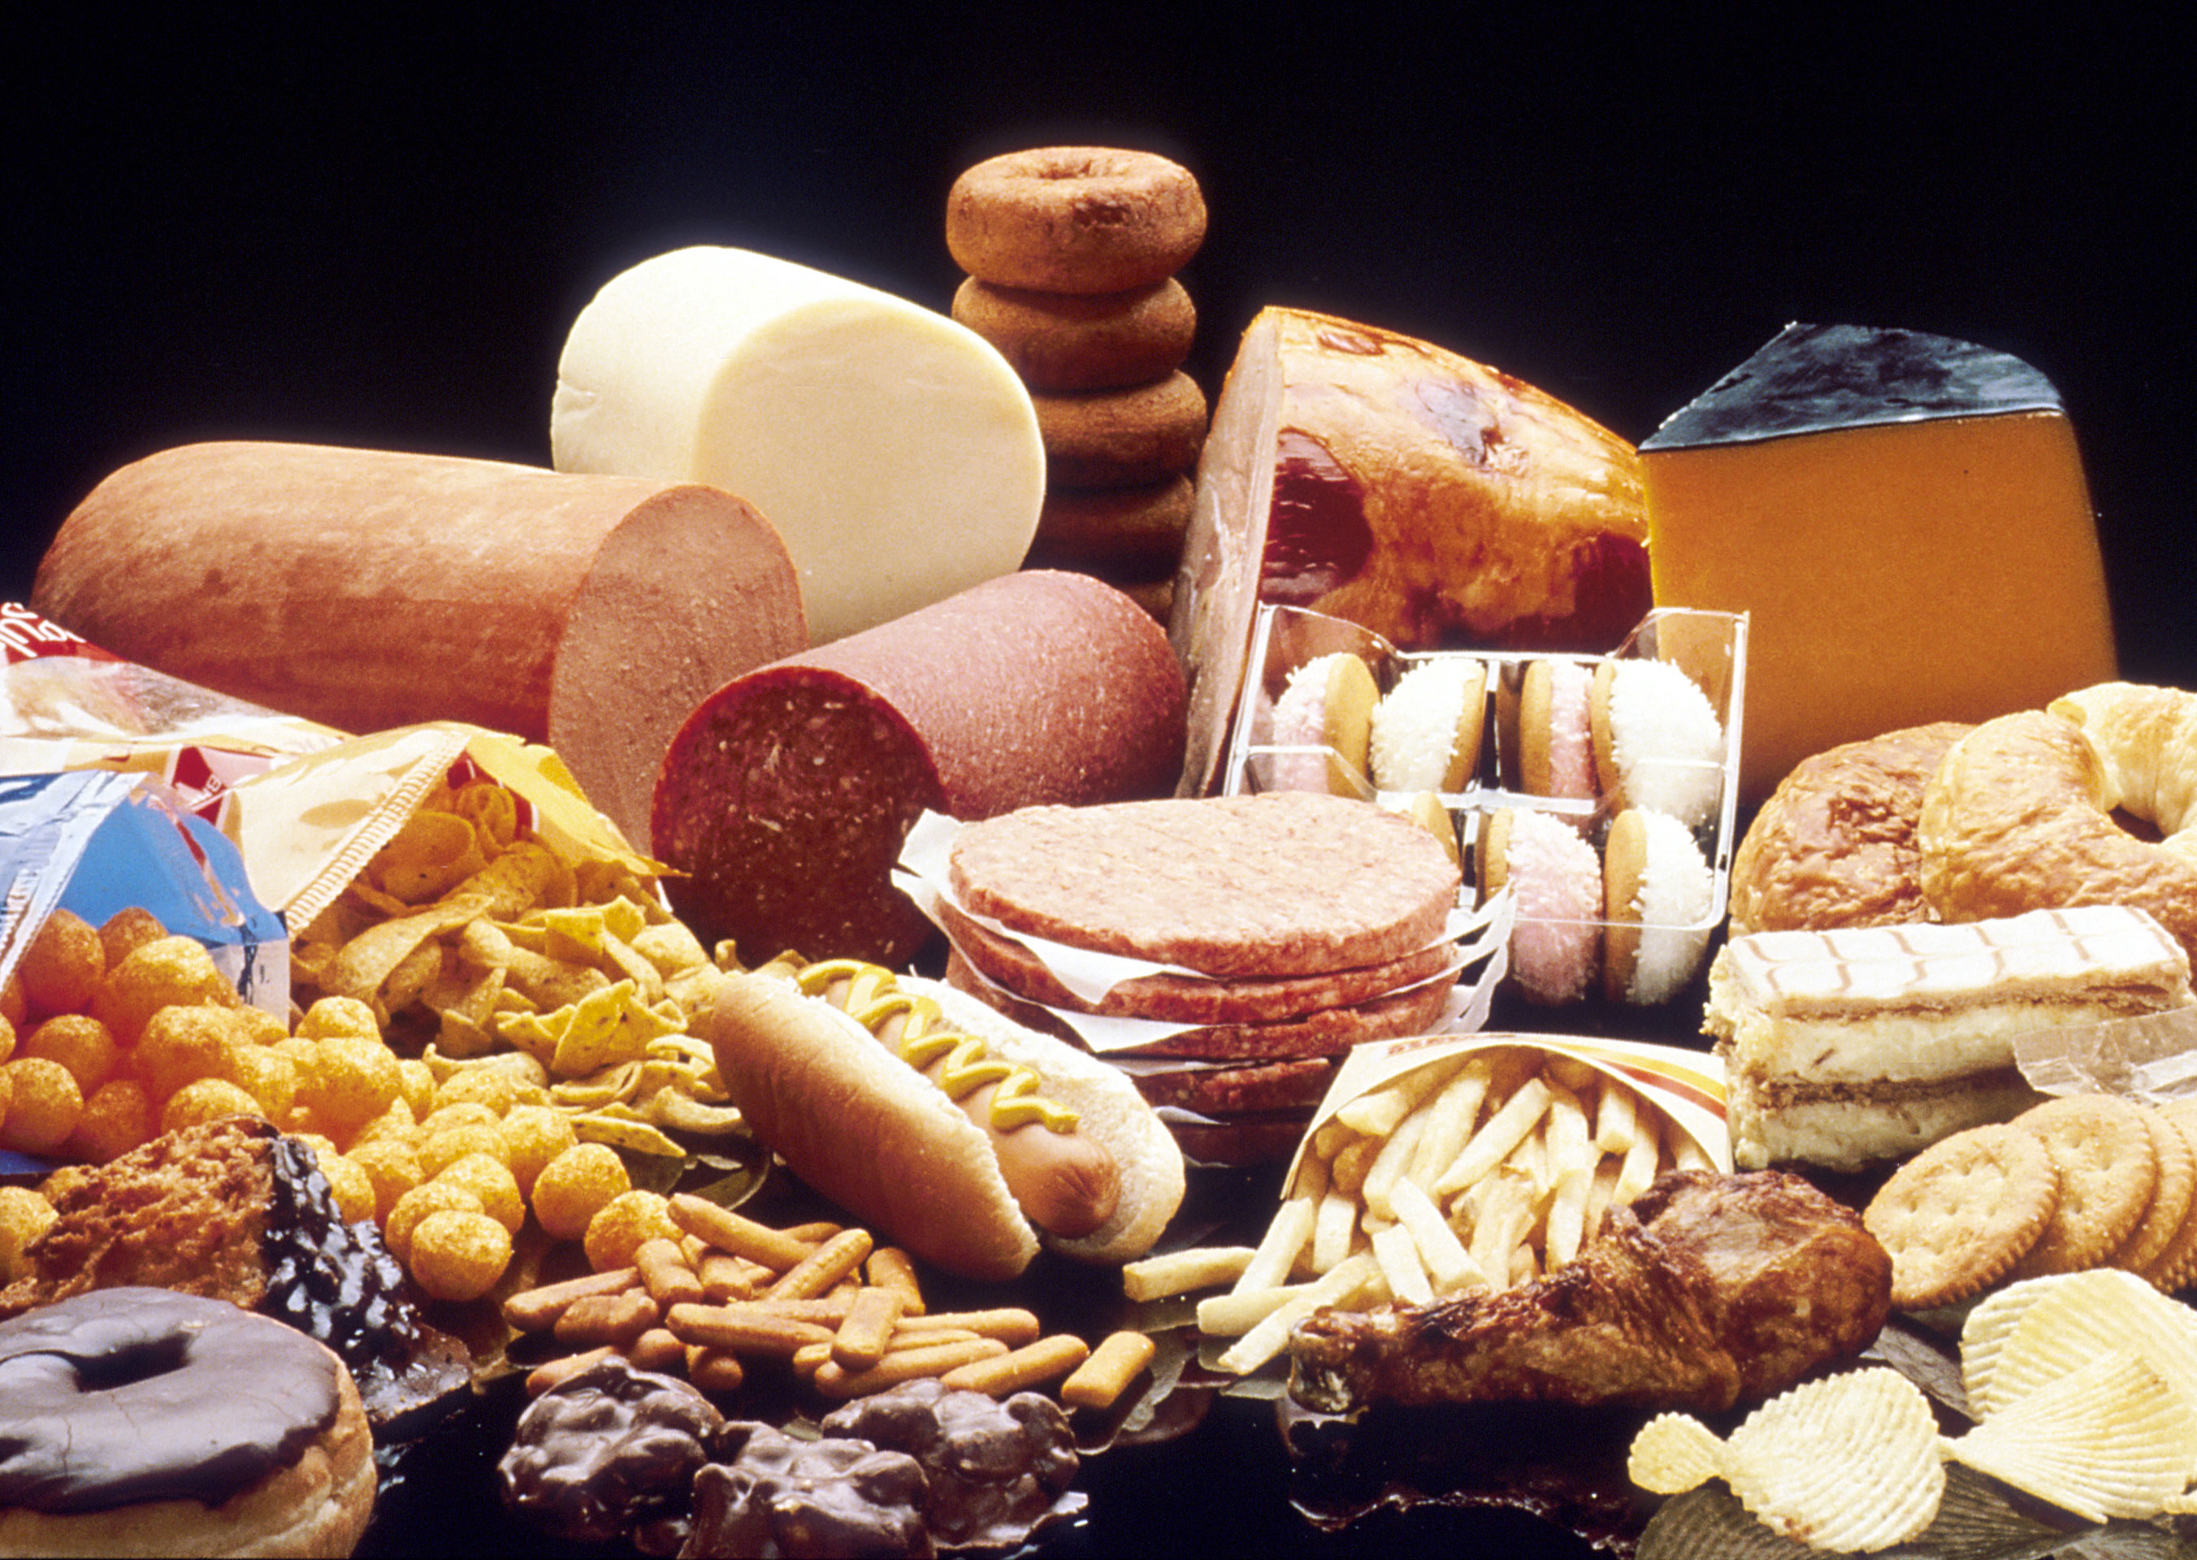
Saturated Fat
“Unhealthy Fat”
Primary sources of saturated fats include:
  Red meat (beef, lamb, pork)
  Chicken skin
  Whole fat dairy products (milk, cream, and cheese), butter, and ice cream
  Lard
  Tropical oils like coconut and palm oil
  Processed foods
Notes:
So lets talk about the different types of fats. Saturated fat is first.
Sources of it are red meat, chicken skin and there is some in the flesh as well, whole fat dairy, lard, and some tropical oils. Processed foods may contain them, as well.

Slide 70

Saturated Fat
Limit calories from saturated fat
  Quality of fat is more important that quantity of fat
  Replace saturated with unsaturated fat to reduce total and LDL cholesterol
  Replace saturated with unsaturated fat; not refined carb
    This would also reduce total and LDL cholesterol, but may increase triglycerides and reduce HDL
Notes:
The consensus from ADA is to limit calories from saturated fat by substituting for other types of more healthful fats.
Doing so can improve total and LDL cholesterol without negatively influencing triglycerides and HDL cholesterol.
Interestingly, epidemiological data and clinical trials have suggested that chronic intake of higher levels of total dietary fat, particularly saturated fat, may be associated with insulin resistance. Studies showing reduction in saturated fat have indicated that it may improve insulin sensitivity, even without energy restriction.
____________________________
______________________________
ADA consensus statement – section on preventing complications

Slide 71

Trans Fat
“Unhealthy Fat”
Historical sources: processed foods like baked goods, microwave popcorn, frozen pizza, refrigerated dough like biscuits and rolls, fried foods, nondairy coffee creamer
Trans fat should be avoided; associated with all-cause mortality, total CHD, and CHD mortality.
Notes:
Trans fat, as you know, is also considered an unhealthy fat.
Recommendations are to avoid trans fat due to its association with all cause mortality and coronary heart disease
_____________
_____________
CHD = coronary heart disease

Slide 72

Trans Fat
Most trans fat in food is formulated through partial hydrogenation
  Manufacturers added hydrogen to vegetable oil, turning the liquid into a solid fat (like shortening or hard margarine)
  Process increases the shelf life and flavor stability of foods
Notes:
Trans fat is a type of fat that is formulated from a process called hydrogenation or partial hydrogenation where manufacturers add hydrogen to vegetable oil to turn the liquid fat into a sold
The process increases shelf life and flavor stability of food

Slide 73
Trans Fat
The FDA’s Ban of Partially Hydrogenated Oils (PHOs)
  In 2015 the FDA determined that PHOs are not GRAS*
  Food manufacturers were allowed time to reformulate foods and move foods already produced through distribution
  Compliance date to move these food through distribution was January 1, 2021.
  *GRAS: “generally recognized as safe”
Notes:
The FDA has taken steps to remove artificial trans fats from processed foods.
In 2015 the FDA determined that partially hydrogenated oils are not generally recognized as safe.
Food manufacturers were allowed time to reformulate foods and move foods already produced through distribution
The compliance date to move these foods through distribution was January 1, 2021 for food manufacturers who had petitioned for an extension.
For the most part, trans fats is now minimized in our diet. Although, trans fat occurs naturally in small amounts in meat and dairy products and is present at very low levels in oils.
_____
While often used interchangeably, PHOs are a type of trans fat and are created by heating oil in the presence of hydrogen. PHOs are the largest source of trans fats in most people’s diet.

Slide 74
Mono and Polyunsaturated Fats
“Healthy Fats”: eating patterns rich in these can improve glycemic control and blood lipids (Ex: Mediterranean diet)
Type of Fat | Sources
Monounsaturated | Foods: avocado, edamame, olives, nuts Oils: avocado, olive, peanut, canola
Polyunsaturated | Foods: Walnuts, sesame, flax, and sunflower seeds, fish (salmon, albacore tuna) Oils: corn, soybean, safflower, sesame
Notes:
Next up we have the fats that are described as being healthy - eating patterns rich in these can improve glycemic control and lipid levels.
Monounsaturated fats are found in
Foods like avocado, edamame, olives, nuts and
Oils like avocado, olive, peanut, canola
Polyunsaturated fats are found in
Foods like Walnuts, seeds, and fish and
Oils: corn, soybean, safflower, sesame

Slide 75
Polyunsaturated Fats
Increasing foods with the long-chain omega-3 fatty acids (EPA and DHA) is recommended for prevention of cardiovascular disease
  Have two servings of fatty fish per week
    Wild salmon, mackerel, herring, anchovies
    NOT commercially fried fish filets
  Plant sources for vegetarian/vegan eating patterns (ALA)
    Ground flaxseed/flax meal, chia seeds, walnuts, soybeans, mung beans, green leafy vegetables, whole grains, and beans
Notes:
As is recommended for the general public, an increase in foods containing the long-chain, omega-3 fatty acids EPA and DHA, like what is found in fatty fish, is recommended for individuals with diabetes. Consumption is beneficial for prevention of heart disease.
For people following a vegetarian or vegan eating pattern, where they may not be eating fatty fish, the body can get plant-derived omega-3s from alpha-linolenic acid (ALA). The body can then convert ALA into DHA and EPA.
ALA is found in plant foods such as flax, walnuts, and soy.
______________
______________
Omega 3s:
DHA = docosahexaenoic acid (DHA) which is important for brain health—
EPA = eicosapentaenoic acid
ALA = α-linoleic acid (ALA)
Recommended by the ADA consensus

Slide 76

Polyunsaturated Fats
Evidence does not conclusively support recommending omega-3 (EPA and DHA) supplements for all people with diabetes for the prevention or treatment of cardiovascular events
Notes:
When it comes to supplementation, evidence is not conclusive on recommending EPA and DHA supplements for people with diabetes in the prevention or treatment of cardiovascular events.
However, these supplements may have utility in people who require triglyceride reduction.
Encourage people to find these in foods rather than supplementation.
_____________________________________
ADA Consensus
In the most recent ASCEND trial, supplementation of omega-3 fatty acids compared to placebo did not lead to cardiovascular benefit in people with diabetes without evidence of CVD
(A Study of Cardiovascular Events iN Diabetes)

Slide 78
Knowledge Check
Which of the following food items has the highest percentage of saturated fat per ounce?
  Chicken
  Olives
  Peanuts
  Soybean oil

Slide 79
Knowledge Check: Answered

Slide 80
Knowledge Check
Olive oil and canola oil are good sources of:
Monounsaturated fats
Polyunsaturated fats
Saturated fats
Trans fats
Notes:
A.

Slide 81

Micronutrients & Supplements

Slide 82
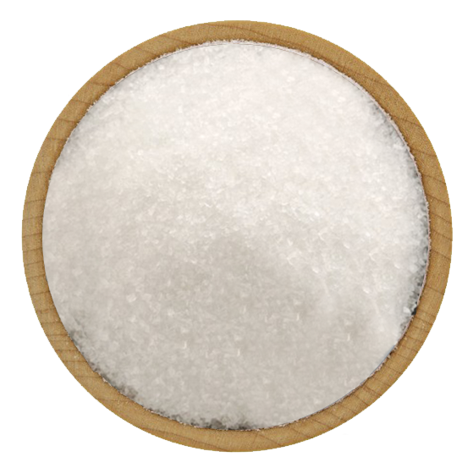
Sodium
Limit sodium intake to less than 2300 mg/day
  Limit of <1500 mg/day is not recommended
Sodium recommendations should consider palatability, availability, affordability, and the difficulty of achieving low-sodium recommendations in a nutritionally adequate diet.
Notes:
For sodium, most agree that intake in the US, which is typically >3,500 mg per day, should be reduced. Reducing it to the general recommendation of <2,300 mg/day demonstrates beneficial effects on blood pressure. Further reduction warrants caution.
Sodium intake goals that are significantly lower than 2,300 mg/day should only be considered only on an individual basis.
__________________________________________________________________
Some studies measuring urine sodium excretion in people with type 1 (313) and type 2 (314) diabetes have shown increased mortality associated with the lowest sodium intakes. A secondary analysis of data from the Ongoing Telmisartan Alone and in Combination With Ramipril Global Endpoint Trial (ONTARGET) suggests sodium excretions <3 g/day and >7 g/day were both associated with increased mortality in people with type 2 diabetes (315), leading to continued controversy over the potential benefits versus harms of lowering sodium intake below the general recommendation. In the absence of clear scientific evidence for benefit in people with combined diabetes and hypertension (313,314), sodium intake goals that are significantly lower than 2,300 mg/day should be considered only on an individual basis. When individualizing sodium intake recommendations, careful consideration must be given to issues such as food preference, palatability, availability, and additional cost of fresh or specialty low-sodium products (316).

Slide 83
Calcium & Vitamin D
Fracture risk is higher in people with diabetes
Advise those with diabetes on dietary or supplemental intake of intake of Calcium and Vitamin D
  Calcium – meet age specific recommendations for intake
  Vitamin D – aim for serum levels ≥20 or >30 ng/mL
Notes:
In both men and women with t1d or t2d, age specific fracture risk is greater by 34% compared to those without diabetes.
Intake of calcium should reflect age-specific recommendations, same as those in the general population, and it can be obtained through the diet or with supplementation.
The optimal level of vitamin D is controversial, although serum levels of >20 ng/mL is thought to be sufficient. However, because is a risk factor for fractures some guidelines suggest that >30 ng/mL.

Slide 84
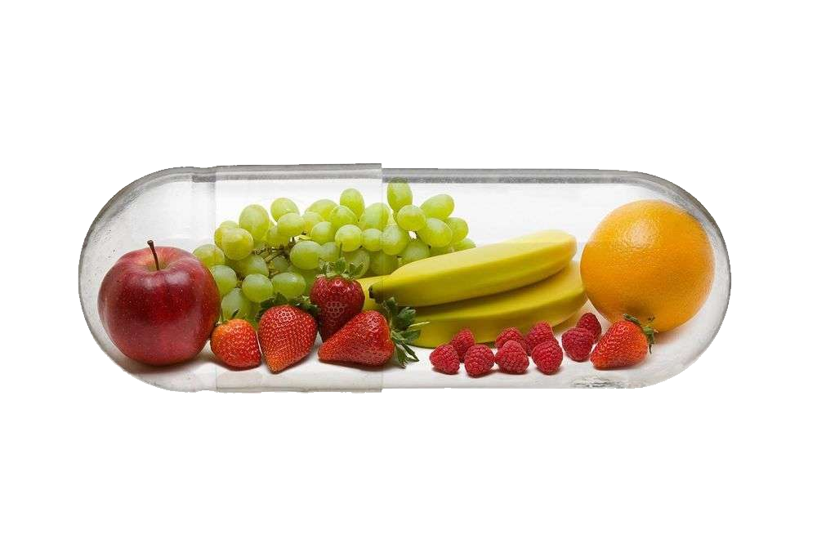
Micronutrients & Supplements
Nutrition therapy should include education on how to acquire adequate amounts of vitamins and minerals from food
Typically, unless deficient, use of herbal, vitamin, or mineral supplementation in those with diabetes is not supported
Notes:
Teach those with diabetes to eat their vitamins and minerals in their foods.
Unless there is a specific deficiency noted, Scientific evidence does not support the use of vitamins or minerals supplements in people with diabetes or prediabetes.
_________________
________________
Current Consensus Statement

Slide 85
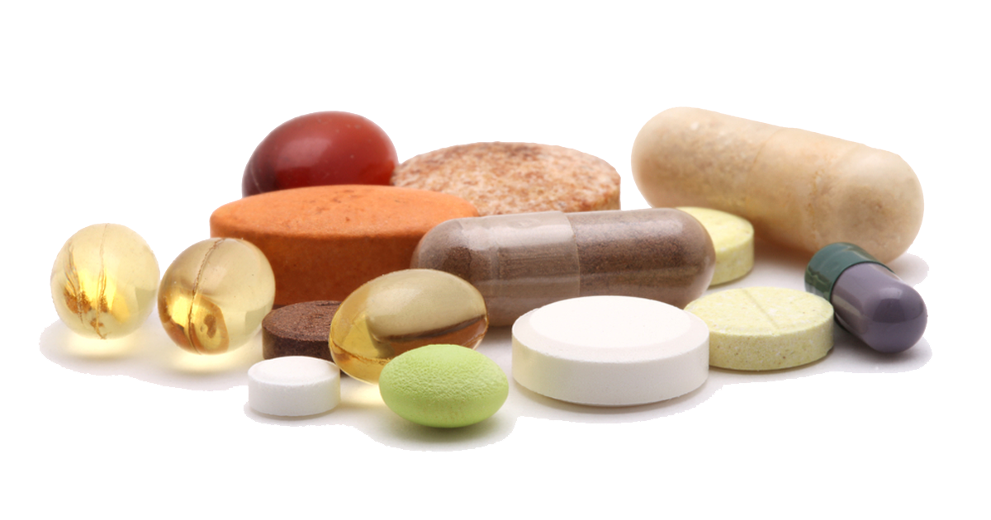
Micronutrients & Supplements
Select groups with may need a multivitamin supplement
  Elderly
  Women planning pregnancy, currently pregnant, lactating
  Strict vegetarians/vegans
  People with celiac disease
  Those on calorie or carb-restricted diets
Notes:
That said, there are certain groups that you can see here that may need a multivitamin supplement

Slide 86
Micronutrients & Supplements
Long-term metformin use may be associated with vitamin B12 deficiency
  Consider periodic testing of of B12 status if taking Metformin chronically, especially for those with anemia or peripheral neuropathy
Notes:
Long term metformin use may be associated with vitamin B12 deficiency. B12 deficiency can lead to anemia and peripheral neuropathy
The cause of deficiency in people taking metformin is unknown. Some research may suggest malabsorption caused by metformin.
If deficient, B12 injections or high-dose oral supplementation may be effective treatment. More research is needed in this area.
________________________
(((( B12 deficiency can lead to anemia and peripheral neuropathy)))))
S42

Slide 87

Micronutrients & Supplements
Ask PWD about supplement use
Routine supplementation with antioxidants such as vitamins E, C, and carotene is not advised
Insufficient evidence to support the routine use of most herbal supplements and micronutrients
  See Bev’s handout for more information
Notes:
As for antioxidant supplements: Antioxidant supplementation is not recommended due to long-term safety concerns.
And routine use of herbal supplements is generally not recommended either
This is because, as already mentioned, nutritional supplements and herbal products are not standardized or regulated (255,256).
As health care providers, we are encouraged to ask about the use of supplements and herbal products, and discuss the potential benefit of these products weighed against the cost and possible adverse effects and drug interactions.

Slide 88
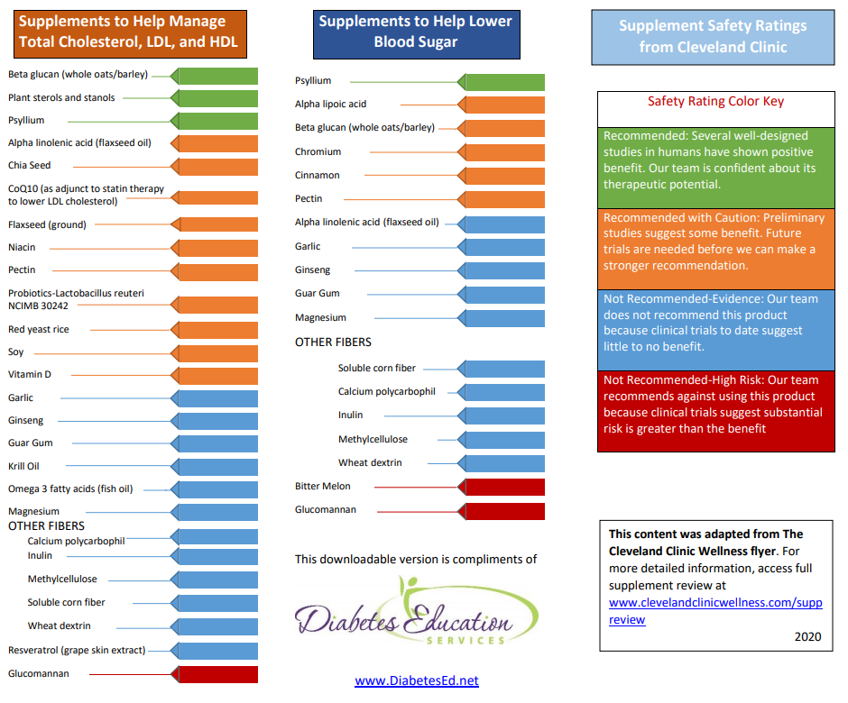
Micronutrients & Supplements
Notes:
Bev has a great handout to help you learn more about these supplements and where current literature stands.
Here it is – you can find it on your website, it was adapted from the Cleveland clinic.
_________________
The consensus from ADA is to consider that nutritional supplements and herbal products are not standardized or regulated (255,256).
As health care providers, we are encouraged to ask about the use of supplements and herbal products, and discuss the potential benefit of these products weighed against the cost and possible adverse effects and drug interactions. The variability of herbal and micronutrient supplements makes research in this area challenging and makes it difficult to conclude effectiveness. To date, there is limited evidence supporting the addition of herbal supplements to manage glycemia.

Slide 89

Alcohol & Glycemia

Slide 90


Alcohol & Glycemia
Moderate consumption has minimal acute or long-term effect on glucose and insulin concentrations
Limit intake to:
  1 drink or less per day for women
  2 drinks or less per day for men
Notes:
For the majority of people who choose to drink alcohol in moderation, it does not need to be discouraged.
Moderate alcohol consumption has no significant acute effect on glucose and insulin concentrations.
The recommendation is to limit intake to:
1 drink or less per day for women
2 drinks or less per day for men
Obviously, some individuals should abstain from alcohol consumption including
Individuals with a history of alcohol abuse
Women during pregnancy
Individuals with certain medical problems ((like liver disease pancreatitis, advanced neuropathy, severe hypertriglyceridemia (>500))
__________________________________________
Big book p 460

Slide 91

Alcohol & Glycemia
What is a drink?
  5 ounces of wine
  12 ounces of beer
  1½ ounces of a hard alcohol
1 drink has approximately ~15 grams of alcohol
1 gram of alcohol = 7 calories
  Consider when discussing wt. management
Notes:
A drink is defined as
5 ounces of wine
12 ounces of beer
1½ ounces of a hard alcohol
1 drink has approximately ~15 grams of alcohol
1 gram of alcohol provides 7 calories
So if someone is interested in weight loss, alcohol intake may be something to look at more closely

Slide 92



Alcohol & Glycemia
Risk of hyperglycemia:
  Consistently having 3+ drinks/day can contribute to hyperglycemia
  Carb consumed with alcohol (e.g. mixed drink, beer, wine) may acutely raise BG
Notes:
Where alcohol can contribute to hyperglycemia is:
Drinks that also contain carbohydrate
Consistently having 3+ drinks/day can contribute to hyperglycemia

Slide 93

Alcohol & Glycemia
Risk of hypoglycemia:
  Individuals using insulin or insulin secretagogues are at risk for hypoglycemia following consumption
    Evening drinking may increase the risk of nocturnal/fasting hypo
  Individuals may consume food with alcohol to reduce the risk
Notes:
In individuals using insulin or insulin secretagogues, there may also be a risk of hypoglycemia. This is because as alcohol is cleaned up by the liver, there is less glucose being released by the liver into the blood.
A possible way to reduce the risk is to have an individuals consume a carbohydrate containing snack with alcohol.

Slide 95
Knowledge Check
Chris has had T1D for 30 years. He uses MDI and wears a CGM. He is out celebrating and has 4 rum and cokes and appetizers. He takes insulin for his carbs. When he gets home, his Dexcom shows his glucose at 162 mg/dl. Drinking alcohol put Chris at risk for:
  Hyperglycemia through the night due to gluconeogenesis
  Hyperglycemia through the next day
  DKA due to ketone production associated with excessive alcohol consumption
  Hypoglycemia due to inhibition of gluconeogenesis in the liver

Slide 96
Macronutrients: Final Thoughts
“People eat foods, not nutrients, and nutrient recommendations need to be applied to what people eat.”
Macros vary in quality, not all within the group are interchangeable
  E.g. Carbs include legumes, whole grains, and fruits – this is the same category as candy and refined grains, yet the health impact of these is not the same

Slide 97

Nutrition Interventions for Special Populations
Youth, Pregnancy, Celiac Disease, and Eating Disorders

Slide 98

Youth with Diabetes
Key concepts for youth with all types of diabetes
  Meet energy requirements for growth and activity
  Use food plan or meal plan not diet
  Engage the child or adolescent in planning, shopping, and preparing healthy foods for the entire family
Notes:
☺

Slide 99


Youth with T1D
Balance carb intake and insulin
  Educate on impact of high-fat/protein
Integrate insulin regimen into lifestyle
Avoid withholding food to prevent hyperglycemia or having a child eat without an appetite to avoid hypoglycemia
Notes:
In youth with T1D specifically, we aim to avoid food restriction or forcing the child to eat to regulate blood sugars.
The focus is often on mastering the use of insulin to achieve blood sugar targets.
Personally, when I’m working with kids with type 1 diabetes, I aim to normalize their eating experience as much as possible while simultaneously encouraging healthful food choices.

Slide 100

Youth with T1D
For those on fixed insulin program, focus on consistent carb intake considering timing and amount
For those on flexible insulin program, provide education on carb estimating/counting
Notes:
Again for T1D…
For those on fixed insulin program, focus on consistent carb intake to keep blood sugars safely balanced.
For those on flexible insulin program, we educate on carb counting and matching insulin to intake. If it is possible and appropriate for the child and family, I consider this to be the gold standard. This really supports normalcy with eating because it allows the family to navigate proper dosing of insulin in any food situation.

Slide 101

T1D & Flexible Insulin Therapy
In a mixed meal (carb + high in fat/protein), insulin need is not based on carb alone
  Consider the glycemic impact of fat and protein, too
Relative to a lower fat/protein meal, high-fat and high-protein meals may require:
  More insulin
  A different approach to insulin timing
More research is needed to determine optimal insulin dose and delivery strategy
Notes:
I want to talk a little more about flexible insulin therapy and type 1 diabetes…
Historically, the focus in type 1 diabetes has been to count carbs and match insulin to carb intake only, without considering the other macronutrients. However, since the 2022 Standards it has been recommend that those on flexible insulin therapy receive education on how carbohydrates, fat, and protein impact blood sugar. The standards acknowledge that high fat and/or high protein meals may impact the post prandial glucose response in a significant way and require more insulin.
I want to briefly review some of the thoughts behind how fat and protein impact blood sugar and then talk about strategies to deal with it when counseling individuals with type 1 diabetes.
Lets talk about fat, first:
Fat is very slow to digest relative to carbohydrate alone. When mixed with carb, it may delay the digestion and absorption of the carb to glucose. Also, free-fatty acids may induce insulin resistance, ultimately leading the person with diabetes to need more insulin. There might also be more gluconeogenesis later (and if you’re not remembering from biochemistry, I’ll remind you that gluconeogenesis is when the liver makes glucose from other sources)
Because of these factors, when research looks at the blood sugar levels in someone with diabetes following a meal higher fat meal, it was noted that:
Blood sugars are reduced in the first 2–3 h
Then this is often followed by: Hyperglycemia, which occurs later in the post-prandial period and can last for several hours, some research shows as long as 5-8 hours afterwards.
The impact appears to be dose dependent; so more dietary fat = more hyperglycemia later.
Lets now talk about protein:
After protein is digested and absorbed into the body, the amino acids can be converted into glucose. This takes some time to occur, so we may see a rise in glucose levels later in the post-prandial period. In fact, the research looking at this shows that blood glucose levels may rise between 100 minutes and 4 hours after the meal.
The extent to which this occurs appears to depend on the amount of protein consumed. More protein means more of a rise later-on. The effect also changes depending on how much carb is consumed with the protein.
So that’s some of the science behind fat and protein metabolism. While the research providing us with this information is strong, and the standards recommend that we educate on this topic, they also note that more research is needed. There is no consensus on optimal dosing strategies to address this.
If you do some reading online, there are a multitude of strategies that you may see, but none have been formally endorsed by ADA.
At our clinic, we do our best to address this issue despite the lack of formal advice. In counseling people with type 1 diabetes:
I always start by learning about how the person with diabetes eats. This helps to steer the conversation. Our discussion varies depending on whether the person follows a diet that is more balanced with carb/fat/protein vs if someone follows a lower carb diet.
For the person who follows a more balanced diet, my strategy is to:
Educate and focus on carbohydrate counting, using a ICR, and dosing accordingly. This will work for the majority of meals.
After that… then we talk fat and protein.
I acknowledge that fat and protein do impact blood sugar
I then go through examples of high fat and high protein meals that might cause this. Examples might include foods like pizza, fried chicken or steak with mashed potatoes and gravy, or a burger with fries and a milk shake, etc.
At this point we go through practical advice about how to approach these meals.
3) The person with diabetes can split doses for meals like this; basically, count the carbs and determine the dose for the carbs. Then, administer the insulin with special consideration to timing.
MDI: half at start of meal, half 1 hour later
Pump: extended doses with ~50/50 split over 1-2.5 hours
4) Encourage monitoring glucose levels in the hours after the meal; administer a correction dose of insulin if needed.
We use this particular strategy of correcting after the fact because much of the available research on other strategies, where additional insulin is taken earlier, shows more hypoglycemia. Plus, the calculations can also be complicated.
For individuals following low carb diets, other strategies may be necessary.
I’ve found more of these individuals’ dose their insulin from “experience” rather than using a strategy that involves carb counting or use of an ICR. They also may benefit from dosing later – like at the start of the meal or a little after.

Slide 102
Youth with T2D
Youth and family must prioritize lifestyle modifications
  Dietary recommendations:
    Focus on nutrient dense, high quality foods / decrease calorie-dense, nutrient-poor foods (particularly SSBs)
  Increase exercise
  Aim for sustainable 7-10% decrease in excess weight for youth with overweight/obesity
Notes:
For kids with T2D, youth and family must prioritize lifestyle modifications. Other recommendations are to focus on nutrient dense, high-quality foods, decrease calorie-dense, nutrient-poor foods - particularly sugar sweetened beverages.
As we discussed with weight before, it’s important to be considerate and compassionate. When discussing weight with kids who are in their formative years, this is especially true.
We generally use behavioral strategies rather than talking weight loss directly.
Examples of these include:
- portion management by eating to appetite rather than cleaning plates
- avoid distractions while eating (like tv, phone, computer) to support kiddos in paying attention to appetite
Standards p S219

Slide 103
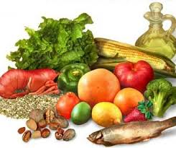
Youth with T2D
With dyslipidemia, use MNT to support:
  Limit calories from fat: 25-30%
  Limit calories from saturated fat: <7%
  Limit cholesterol: <200 mg/day
  Avoid trans fat
  Aim for ~10% of calories from monounsaturated fat
  For elevated triglycerides: ↓ simple sugar, ↑ omega-3s
Notes:
If lipids are abnormal in kids with diabetes, initial therapy should consist of medical nutrition therapy to swap saturated to more healthful fat sources, and lower simple sugars. These recommendations can support healthy growth and development

Slide 104
Youth with T2D
Assess for NAFLD
With overweight/obesity: aim for 7-10% weight loss
With nephropathy: protein intake at the RDA of 0.85-1.2 g/kg/day (based on age)
Notes:
If lipids are abnormal in kids with diabetes, initial therapy should consist of medical nutrition therapy to swap saturated to more healthful fat sources, and lower simple sugars. These recommendations can support healthy growth and development

Slide 105

Pregnancy
With pre-existing diabetes planning pregnancy, refer to RDN
Prenatal vitamins:
  At least 400 µg folic acid
  150 mg potassium iodide
Notes:
For women with diabetes in pregnancy or GDM, the focus is to incorporate enough calories for appropriate weight gain, minimize blood glucose excursions, and ensure safe nutrition.
______________________________
Diabetes in pregnancy = Women with preexisting diabetes (type 1 or type 2)
Gestational diabetes mellitus is diabetes diagnosed in the second or third trimester of pregnancy (hyperglycemia noted in the first trimester is NOT GDM)
Sate nutrition:
Nonnutritive sweeteners in moderation
No alcohol
No mercury-contaminated fish (shark, swordfish, king mackerel, others)
Avoid deli meat/hot dogs, soft cheese, meat spreads, smoked seafood, raw or unpasteurized milk (risk of Listeriosis)
Avoid raw or undercooked eggs, poultry, meat, and unpasteurized milk or juice (risk of Salmonella)
Stds S204

Slide 106
Pregnancy
For women with diabetes in pregnancy or GDM, focus on:
  Adequate calories for appropriate weight gain (weight loss not recommended)
  Minimize blood glucose excursions
  Ensure nutrient-dense, safe nutrition
Notes:
For women with diabetes in pregnancy or GDM, the focus is to incorporate enough calories for appropriate weight gain, minimize blood glucose excursions, and ensure safe nutrition.
______________________________
Diabetes in pregnancy = Women with preexisting diabetes (type 1 or type 2)
Gestational diabetes mellitus is diabetes diagnosed in the second or third trimester of pregnancy (hyperglycemia noted in the first trimester is NOT GDM)
Sate nutrition:
Nonnutritive sweeteners in moderation
No alcohol
No mercury-contaminated fish (shark, swordfish, king mackerel, others)
Avoid deli meat/hot dogs, soft cheese, meat spreads, smoked seafood, raw or unpasteurized milk (risk of Listeriosis)
Avoid raw or undercooked eggs, poultry, meat, and unpasteurized milk or juice (risk of Salmonella)
Stds S204

Slide 107
Pre-pregnancy BMI and Weight Gain
Weight-for-Height Category | Recommended Total Weight Gain (Singleton Gestation)
With Underweight (BMI ≤18.5) | 28-40 lbs
Healthy Weight (BMI 18.6 – 24.9) | 25-35 lbs
With Overweight (BMI 25.0 – 29.9) | 15-25 lbs
With Obesity (BMI ≥ 30) | 11-20 lbs
Moore Simas, T. A., Waring, M. E., Sullivan, G. M., Liao, X., Rosal, M. C., Hardy, J. R., & Berry Jr, R. E. (2013). Institute of Medicine 2009 gestational weight gain guideline knowledge: Survey of obstetrics/gynecology and family medicine residents of the United States. Birth, 40(4), 237–246. https://doi.org/10.1111/birt.12061
Notes:
This table shows the recommended weight gain for women in pregnancy. Remember that weight loss is not recommended in pregnancy for women of any starting BMI. There is very little data on weight recommendations for women with BMI >35.
____________________
S2
P 749 of the big book

Slide 108

DRIs and Pregnancy
For pregnant women, dietary reference intake recommend a minimum of:
  175 grams/day of carbohydrates
  71 grams/day of protein
  28 grams/day of fiber
Amount/type of carb will impact postprandial glucose levels
Emphasize mono- and polyunsaturated fats
Notes:
Dietary reference intakes recommend the following for women in pregnancy:
Carbohydrates: 175g per day to support mom’s brain and fetal growth. Glucose is transported across the placenta and is the preferred fuel sources over amino acids and free fatty acids.
- Low and very low carb diets are not recommended for pregnant women
Protein: Recommendation for protein is at 1.1 grams per kilogram per day (about 25 grams extra per day for singleton gestation) in a pregnant woman
Fiber: Aim for 28 grams of fiber per day
Other Keys:
- Simple carbohydrates will result in higher post meal excursions so minimize.
- Emphasize those heart healthy fats and decrease the saturated and trans fats
- Ultimately, trying to get enough calories and carbs to promote appropriate weight gain and avoid maternal starvation ketosis.
_______________________________
P 749 big book / stds 237

Slide 109
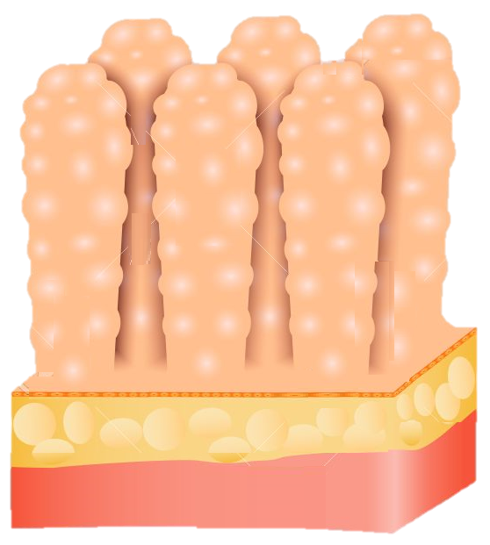
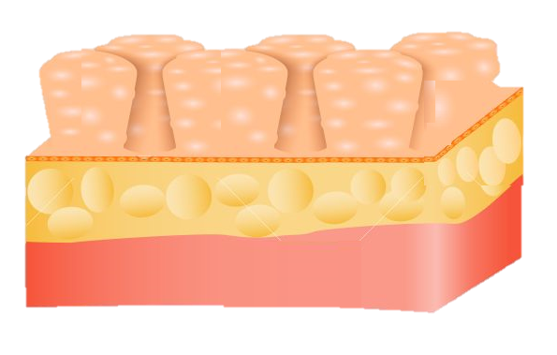
Celiac Disease
Immune-mediated disorder where destruction of the small intestine villi occurs following exposure to gluten
Occurs more often in people with T1D
  1%-16% of individuals compared to 0.3%-1% in general population
Notes:
Celiac is a disorder where the immune system causes destruction of the vili in the small intestines after exposure to gluten.
It is more common in people who live with type 1 diabetes
________
Big book 164 / 2022 Stds s215

Slide 110
Celiac Disease
When to Screen for Celiac Disease
Pediatrics with T1D | Adults with T1D
Within 2 years of diagnosis Again 5 years after diagnosis or sooner if symptoms present | With suggestive GI symptoms (diarrhea, malabsorption, abdominal pain) Signs (Osteoporosis, vitamin deficiency, iron deficiency anemia)
Notes:
When to screen:
In pediatrics within 2 years of type 1 diagnosis and again about 5 years after diagnosis, or sooner if symptoms present.
In adults with type 1 diabetes if signs of symptoms present.
While some people with celiac can be asymptomatic, symptoms include abdominal pain, diarrhea, and malabsorption. It is also associated with osteoporosis, and iron deficiency.
________
Big book 164 / 2022 Stds s215

Slide 111
Celiac Disease
Diagnosis via blood tests and a small intestine biopsy
  Screen for celiac by testing IgA if person with T1D has suggestive symptoms or signs:
    If normal serum IgA, measure IgA-tTG antibodies
    If IgA deficient, measure IgG tTg and IgG DGA
IgA: immunoglobulin A
IgG: immunoglobulin G
tTG: tissue transglutaminase
DGA: deaminated gliadin antibodies
Notes:
Diagnosis of celiac is done via blood tests looking for antibodies and a biopsy of the small intestine.
screen by measuring IgA tissue transglutaminase antibodies
About 3% of people are deficient in IgA so if that’s the case, we can measure IgG tissue transglutaminase antibodies or IgG deaminated gladin peptide antibodies.
.
_____
2022 Stds S215

Slide 112

Celiac Disease
Treatment for celiac disease is a lifetime gluten-free diet
  Eliminate all wheat (including durum, semolina, spelt, and farro) and the related grains of rye, barley, and triticale.
  Caution with oats – may be contaminated with wheat
  Remember “BROW” – Barley, Rye, (some) Oats, Wheat
Refer to a dietitian for help with food selection/label reading
Notes:
Someone who is positive for celiac should be referred to a dietitian for food selection and label reading, as treatment for celiac disease is a lifetime gluten-free diet.
That means eliminate all wheat and the related grains of rye, barley and triticale (tri·tuh·kay·lee), which is a hybrid of wheat and rye.
We want to be cautious with oats – which are naturally gluten free but may be contaminated
A tip is to remember “BROW” – Barley, Rye, (some) Oats, Wheat
2022 - S215

Slide 113
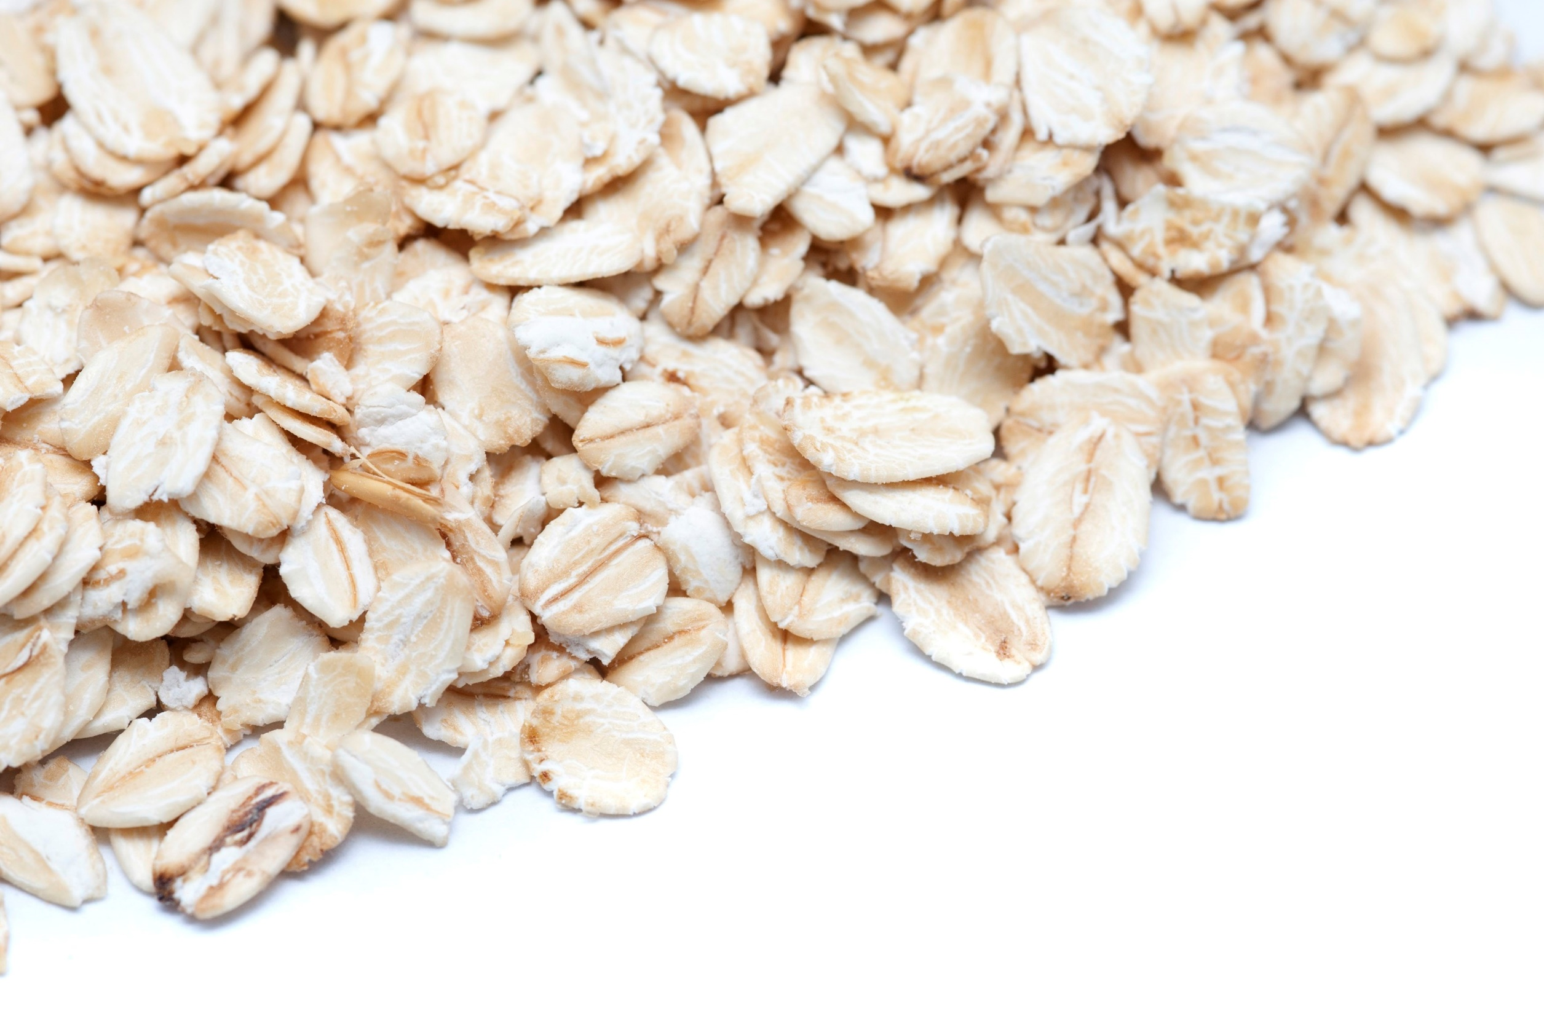
Nutrition Interventions: Celiac Disease
Gluten Free Whole Grains & Starches include:
  Millet
  Rice
  Wild rice
  Buckwheat
  Job’s Tears (Hato Mugi)
  Montina (Indian rice grass)
  Sorghum
  Teff
  Quinoa
  Potatoes
  Beans & Peas
  Cassava
  Corn
  Oats*
  Flax
  Amaranth
  *Oats are inherently gluten-free may be contaminated with wheat during growing or processing.
Notes:
Here is a list of gluten free grains and starches for you to reference.

Slide 114
Disordered Eating Patterns
Estimated prevalence of disordered eating behavior and eating disorders varies in people with diabetes
Most reported disordered eating behaviors:
  T1D: insulin omission causing loss of glucose/calories via the urine
  T2D: bingeing (excessive intake with sense of loss of control)
Notes:
Prevalence of disordered eating patterns is estimated to be between 18-40% in people with diabetes.
The most commonly reported disordered eating behaviors are different depending on the type of diabetes:
T1D: Insulin omission causing loss of glucose/calories via the urine.
T2D: Binging (excessive intake with sense of loss of control). In those treated with insulin, omission is also common
2022 Standards S73

Slide 115

Disordered Eating Patterns
Screen for it along with regular medical care
  Especially if patterns when hyperglycemia and weight loss are unexplained
Multidisciplinary team approach to treatment is a standard of care
  Early referral to mental health professional
Notes:
There are a variety of tools to screen for disordered eating patterns in diabetes; they include “Diabetes Eating Problem Survey” the Eating Disorder Inventory 3, which has been modified for use in people with type 1 diabetes. There is also another that I like called SEEDS that stands for screen for early eating disorder signs.
Multidisciplinary team approach to treatment is a standard of care

Slide 116
Disordered Eating Patterns
Anorexia nervosa: restricted energy intake relative to need
  Marked by low body weight, fear of weight gain, and disturbance in the way in which one’s body weight or shape is experienced
Bulimia nervosa: recurring binge eating and compensatory behavior
  Binging characterized by a sense of a lack in control.
  Compensatory behaviors vary
Diabulimia (unofficial diagnostic term): reduction/omission of insulin doses
  This causes hyperglycemia and loss of glucose calories through the urine.
Notes:
Here are some definitions of disordered eating patterns.
Note that diabulimia is not recognized by the DSM. You may have heard of it though, and can be quite dangerous. This is where a person with diabetes omits insulin, which causes elevated glucose levels, and the spilling of glucose and calories into the urine. This leads to an increased risk hospitalization from DKA and chronic complications.

Slide 118
Knowledge Check
Sara has just been diagnosed with gestational diabetes. Her current weight is 176 lbs. and her pre-pregnancy BMI was 28. What is the total recommended weight gain for Sara’s pregnancy?
  15 pounds
  15-25 pounds
  25-35 pounds
  28-40 pounds
Notes:
Answer B

Slide 119
Knowledge Check
What are the nutrient goals for pregnant women?
  130 grams of carbohydrate/day, 71 grams of protein/day, 14 grams of fiber/day
  130 grams of carbohydrate/day, 90 grams of protein/day, 28 grams of fiber/day
  175 grams of carbohydrate/day, 90 grams of protein/day, 14 grams of fiber/day
  175 grams of carbohydrate/day, 71 grams of protein/day, 28 grams of fiber/day
Notes:
Answer D

Slide 120
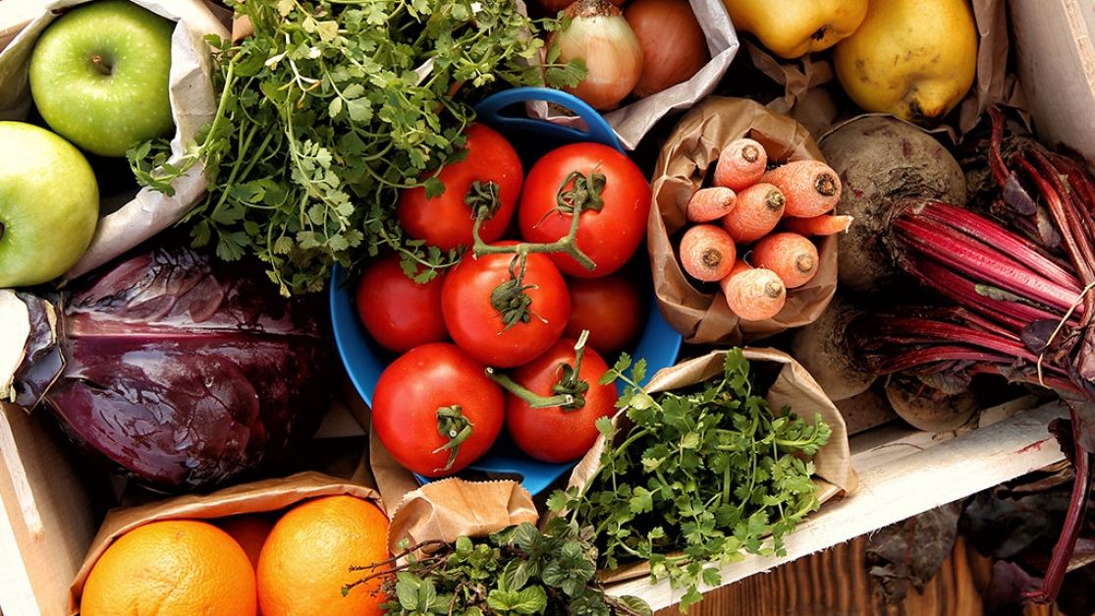
Nutrition to Support the Management of Diabetes Complications & Comorbidities

Slide 121
Mediterranean Eating Pattern
Description & Notes | Encourages plant-based foods, fish and shellfish, some dairy. Olive oil is primary fat source. Limitations: Moderate number of eggs, minimal red meat, wine in low to moderate amount, rare use of concentrated sugars or honey.
Current Literature | Improves CVD risk factors Energy restricted version of these meal plans can improve weight and glycemia
Notes:
Based on traditional eating in countries boarding the Mediterranean Sea
Mediterranean
Encouraged foods:
Plant-based foods, fish and shellfish, olive oil as main sources of culinary fat, some dairy (mainly cheese and yogurt)
Limitations: <4 eggs per week, minimal red meat, wine in low to moderate amounts, rare use of concentrated sugars or honey
Current literature shows this eating plan Improves CVD risk factors
Energy restricted version of this meal plan can improve weight and glycemia

Slide 122
DASH Eating Pattern
Description & Notes | Dietary Approaches to Stop Hypertension Encouraged foods: Fruits & Veg (8-10 servings/day), whole grains (6-8 servings/day), low-fat dairy (2-3 servings/day), poultry & fish (6 servings/week), nuts & seeds (4-5 servings/week) Limitations: Red meat, sweets, sugar-containing, processed food, excessive alcohol consumption
Current Literature | Improves BP and reduces risk for CVD in people w/o diabetes Limited evidence exists for people with diabetes but ”one would expect similar results”
Notes:
Dietary Approaches to Stop Hypertension
Encouraged foods: Fruits and veg (8-10 servings/day), whole grains (6-8 servings/day), low-fat dairy (2-3 servings/day), poultry and fish (6 servings/week), nuts and seeds (4-5 servings/week)
Limitations: Red meat, sweets and sugar-containing beverages, processed foods, excessive alcohol consumption
Current Literature shows this eating plan Improves BP and reduces risk for CVD in people w/o diabetes
Limited evidence exists for people with diabetes but “one would expect similar results”

Slide 123
Plant-Based Eating Pattern
Description & Notes | Limited/no flesh foods; may allow egg and/or dairy Associated with lower intake of saturated fat and cholesterol
Current Literature | Energy restricted version of these meal plans can improve CVD risk factors, weight, and glycemia

Slide 124
Intermittent Fasting & Time Restricted Eating
Description & Notes | Alternate-day fasting 5:2 diet Time-restricted eating
Current Literature | Results in mild to moderate weight loss over short durations No difference vs. continuous calorie restriction Time restricted eating may be easier to follow due to ease, no need to count calories, sustainability
Notes:
Alternate-day fasting (restrict ~500 kcals on alternating days with usual intake the other days)
5:2 diet (restriction of ~500 kcals 2x per week with usual intake the other days)
Time-restricted eating (daily restriction during window of time – typically 8-15 hours)
Shown to support mild to moderate weight loss of 3-8% overbaseline during short periods of time
No difference in weight loss when compared to continuous calorie restriction.

Slide 125
Other Eating Patterns/Plans
Partial/Total Meal Replacements | Bars, shakes, soups with set macros/micros Shown to improve nutrient quality and glucose control Effective short-term strategy for weight loss
Chrononutrition | Growing specialty Aims to understand how timing of nutrition impacts metabolic health Early studies indicate benefit of eating earlier

Slide 126

Nutrition for Lipid Management
Consider a calorie-restriction for weight loss
Mediterranean-style or DASH eating pattern
Reduce saturated and trans fat, increase omega-3 fatty acids
Increase fiber
Increase plant stanols/sterols
Add physical activity
Notes:
Lipid management
The Mediterranean diet or DASH diet are thought to be beneficial because they reduce saturated/trans fat, increase fiber. These eating plans increase fruits, vegetables, whole grains, nuts, seeds, fish while lowering red and processed meats and processed foods.
______________
______________
2022 Standards S151

Slide 127

Nutrition for Hypertension
Managing HTN reduces rate of micro/macrovascular complications
For individuals with BP >120/80 mmHg, focus on:
  Weight loss
  Increase physical activity
  Try DASH diet for healthy eating
  Sodium restriction (~2300 mg/day)
  Avoid excessive alcohol consumption
Notes:
Hypertension
Weight loss has the most significant impact. Adding exercise, then restricting salt, and alcohol moderation are also beneficial.
________
DASH
8-10 servings of fruits and vegetables
Low fat dairy (2-3 servings per day)
2022 Standard S148

Slide 128
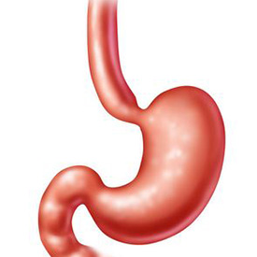
Nutrition for Gastroparesis
Gastroparesis: a form of autonomic neuropathy that delays emptying of the stomach
  Symptoms: nausea, vomiting, fullness with little food, bloating, and low appetite.
  Unpredictable movement of food thru GI can cause erratic BGs
  Timing of insulin delivery is important; hypo can result if insulin is given and gastric emptying is delayed
This Photo by Unknown Author is licensed under CC BY-NC-ND
Notes:
Gastroparesis: a form of autonomic neuropathy that delays emptying of the stomach.
Symptoms include nausea, vomiting, fullness with little food, bloating, and low appetite.
Unpredictable movement of food thru GI can cause erratic BGs
Timing of insulin delivery is important; hypo can result if insulin is given and gastric emptying is delayed

Slide 129
Nutrition for Gastroparesis
Dietary changes are a high priority in treatment
Consider the following dietary modifications:
  Decrease fiber (may lead to bezoar formation)
  Evaluate fat intake
    Fat is a good/high source of calories so limit only after other measures are exhausted
    Liquid fats may be tolerated better
This Photo by Unknown Author is licensed under CC BY-NC-ND
Notes:
Most nutrition therapy recommendations for gastroparesis are based on the knowledge of the pathophysiology and clinical judgement due to limited research- there are almost no clinical trial results to determine the success of any nutritional intervention for gastroparesis.
The advice focuses on selecting foods that are easy to digest or modifying foods so that they digest easier and faster. This minimizes symptoms.
Lowering fiber intake can be helpful. We need to consider fat intake more closely because it is a good source of calories and some people with gastroparesis struggle with intake. Liquid fat may be more tolerable
____________________________________
_____________________________________
Big book 165 / 2022 Standards 190

Slide 130
Nutrition for Gastroparesis
Consider dietary modifications:
  Multi supplement if intake is insufficient
  Small and frequent meals
  Liquid/pureed calories
    May need to try liquid calories later in the day
  Chew foods well
  Sit up for 1-2 hours after eating
This Photo by Unknown Author is licensed under CC BY-NC-ND
Notes:
Those with gastroparesis may need supplementation if their intake is low. Small frequent meals can help, as can having liquid or pureed calories. You can puree just about anything – we have a gentleman with gastroparesis that, every year, purees thanksgiving dinner and loves it!
Stabilizing glucose levels is particularly important because gastroparesis is exacerbated with wide swings in blood sugars, particularly with BG readings above 240 mg/dl which impairs emptying

Slide 131
Nutrition for NAFLD
Nonalcoholic fatty liver disease includes a range of liver conditions
Studies estimate it is prevalent in >70% of people with T2DM
Nutrition-Related Management
  Reduce calories and add exercise for weight loss of ≥5%, preferably ≥10% to improve liver histology
  Limit saturated fat, sugar, starch, and sugar
  Mediterranean diet has best evidence
This Photo by Unknown Author is licensed under CC BY-NC-ND
Notes:
Nonalcoholic fatty liver disease includes a range of liver conditions
Studies estimate it is prevalent in >70% of people with T2DM
Nutrition-Related Management
Weight loss of ≥5%, preferably ≥10% to improve liver histology, although more weight loss is needed to impact fibrosis

Slide 133
Knowledge Check
Jane has type 1 diabetes and was recently diagnosed with gastroparesis. She is a runner and has not been able to exercise recently due to nausea, vomiting, bloating, and intestinal pain. She experiences lows about 3 times a week. What hypoglycemia treatment should she use?
  Juice
  Fruit
  Glucose tablets or gels
  Peanut butter crackers
Notes:
glucose can be absorbed directly through oral tissue

Slide 134

Dietary Approaches for Diabetes Management
This Photo by Unknown Author is licensed under CC BY

Slide 135

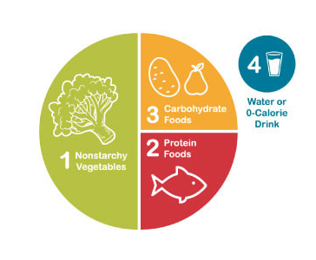

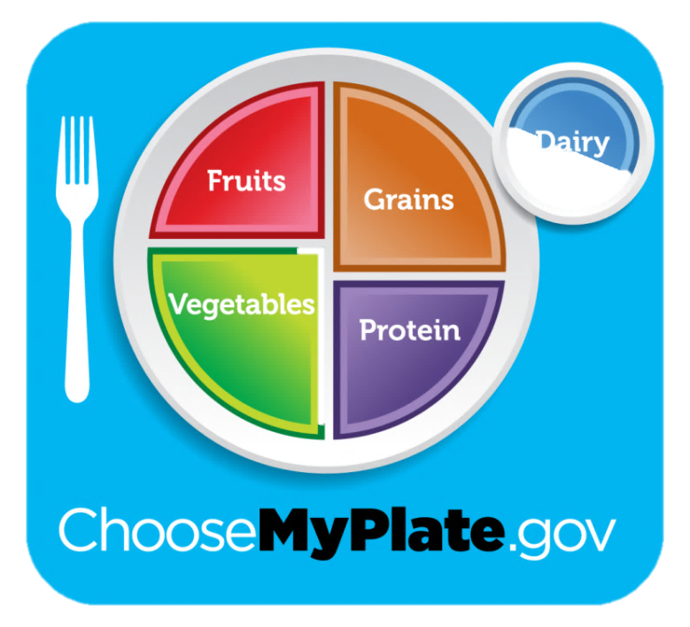
Dietary Approaches
Practical tool(s) to develop healthy eating patterns
  Plate Method
  Carbohydrate exchanges
  Carbohydrate Counting

Slide 136
Dietary Approaches
Therapy | Dietary Approach
Nutrition therapy only or on meds excluding insulin or insulin secretagogues | Consider reducing overall carb intake, portion sizes, plate method, or food exchange lists
Fixed insulin doses or insulin secretagogues | Educate on carbohydrate consistency with respect to time and amount. Consider tools like carbohydrate counting or choices, plate method, simplified meal plan, or food exchange lists
Flexible insulin therapy | Educate on carbohydrate counting and using an insulin-to-carb ratio
Notes:
When working on meal planning, strategies for carbohydrate management may vary depending on the medication therapy being used. When selecting a strategy, it’s important to consider numeracy and food literacy level.
For example, if someone is not using medications to manage glucose levels then the plate method may be a very effective education tool.
This, compared to someone who is using multiple daily injections of insulin and his or her meal time doses are flexible. In this case, carbohydrate counting and using an ICR may be an excellent strategy. With new AID systems, precise counting may be less important.
We are going to first focus on strategies that are likely more effective for those on oral medications, secretagogues, or fixed doses of insulin.
S66

Slide 137
Plate Method
MyPlate introduces simple nutrition
  Emphasizes portion control and healthy food choices
  Using a small plate and filling ½ plate with fruits and veg helps with calorie management
  Consider using with:
    Individuals with T2D not on insulin
    Those with limited health literacy or numeracy
    Older adults prone to hypoglycemia
Notes:
I love, love, love using my plate. It is so beautifully simple and there is so much that can be drawn from it. It’s very visual for individuals with limited literacy.
Myplate starts by emphasizing portion sizes – like filling half the plate with fruits and vegetables. The majority of folks aren’t getting enough – I am a firm believer that that simple change can improve health.

Slide 138

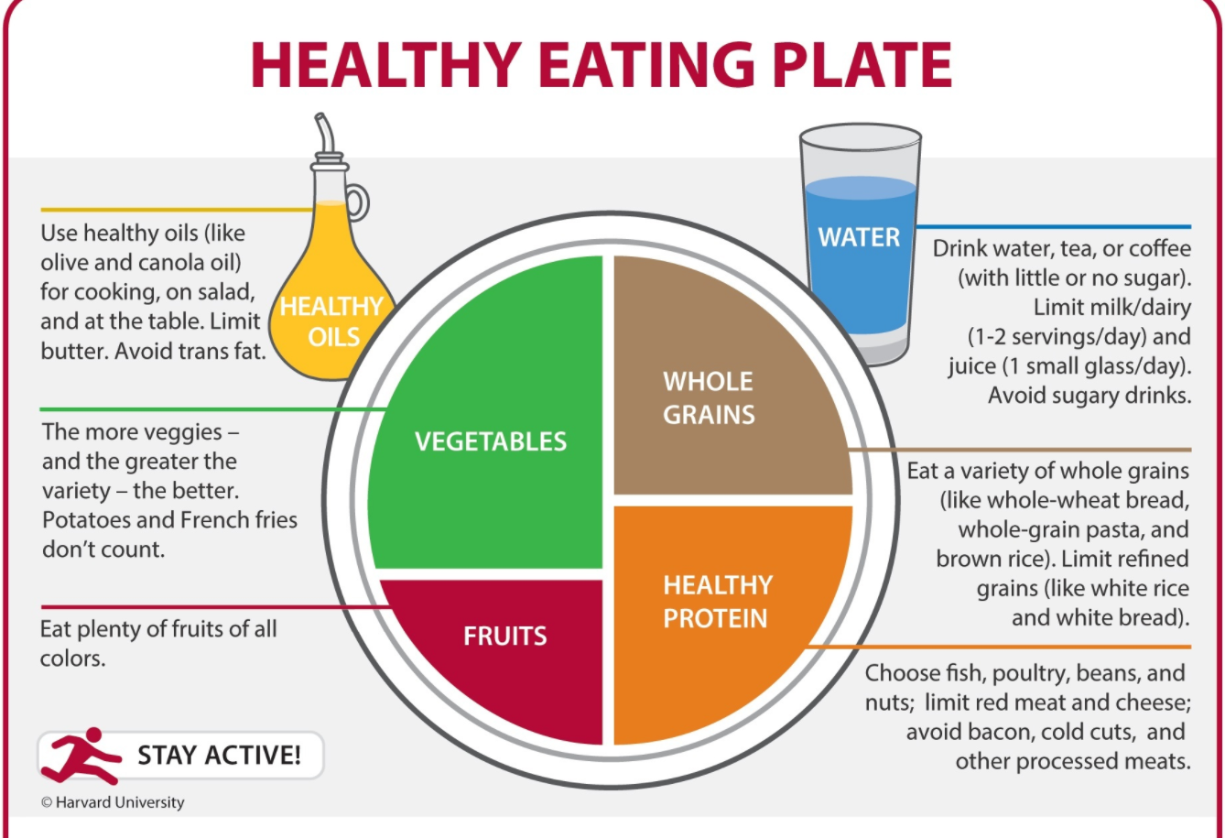
Plate Method Alternatives
Harvard School of Public Health alternative =“Healthy Eating Plate”
  Visit www.hsph.harvard.edu/nutritionsource
ADA alternative = “Diabetes Plate Method”
  Visit diabetesfoodhub.org
Notes:
There are a couple different alternatives to my plate
The Harvard School of Public Health provides an alternative version of MyPlate called the “Healthy Eating Plate”
The Healthy Eating Plate has key differences:
- Replaces milk with water, coffee, or tea
- Emphasizes healthy oils, a variety of fruits and vegetables, whole and intact grains rather than refined options
- protein sources other than red or processed meats which helps lower saturated fat
Provides examples of foods within each category
Another version that's may be a better fit is ADA's Diabetes plate method. Again, it swaps milk for water or other drinks without added sugar.
A great resources is ADA's cooking and nutrition site called food hub - I've included the link for you - it has visuals of healthy plates and lots of recipes.

Slide 139


Exchanges
The exchange system groups like foods that have similar nutritional value (specifically macronutrient and caloric value) into exchanges that can be swapped for another
  Example: the “starch” category has food items in predetermined servings that are ~80 kcals, ~15g of carb, and ~3g protein
An individual may count the number of food exchanges in each category at each meal/thru the day
Notes:
Exchange lists were developed years ago to help standardize meals for people with diabetes. In the original exchange-list system the diet is divided into six major categories, but it has since been expanded upon. Today there are multiple versions of the exchange list available.
The system groups like foods with similar energy and macronutrient content. Each food serving is known as an exchange and can be swapped or “exchanged” for another food within the same group.
An individual may count the number of food exchanges in each category at each meal. It can help with carbohydrate counting

Slide 140
Exchanges
Advantages
Disadvantages
  Allows for flexibility and personalization
  Encourages consistency in the timing and amounts at meals and snacks
  Requires learning how to fit unlisted foods into the plan (especially today with so many food choices)
  Less attention given to micronutrient content
Notes:
There are some advantages and disadvantages.

Slide 141


Exchanges
Categories within the exchange system
  Starch
  Fruit
  Dairy / Milk
  Sweets/ Dessert
  Vegetable
  Meat / Protein
  Fats
  “Free”
Notes:
The Exchange groups may include:
Starch (may be referred to as bread/cereal)
Fruit
Milk or dairy
Sweets / desserts
Veggies
Meat / meat substitutes, may be referred to as protein
Fat (sometimes called fats/oils)
Free foods – in the portion sizes described they are generally omitted from calculations since they don’t include significant amounts of macronutrients and usually have <15-20 kcals per serving. However, individuals may be cautioned to limit their intake to no more than 3 servings through the day because they can add up both from a calorie perspective and for their impact on blood glucose

Slide 142
 | Exchange | Carb | Prot | Fat | Cals | Examples
 | Starch | 15 | 3 | 0-1 | 80 | ⅓ cup beans, lentils, peas, rice, ½ cup cooked cereal, corn, potato, pasta 1 oz. bread (1 slice) or bagel (½), ½ english muffin
 | Fruit | 15 | 0 | 0 | 60 | 1 small apple or kiwi, ½ large banana, 1¼ cup whole strawberries, 1 cup raspberries, ¾ cup blackberries, ½ (most) to ⅓ (grape, cran) cup juice
 | Dairy / Milk | 12 | 8 | 0-8 | 90-120 | 1 cup milk, 8 oz. plain yogurt (any fat content)
 | Sweets/ Desserts | 15 | Varies | Varies | Varies | ¼ cup granola, 1 small granola bar, ½ cup frozen fruit yogurt, ½ cup ice cream (any flavor)
Notes:
<<Review how to read the table>>
- Notice that each exchange group here has 15g of carb per serving, with the exception of milk which has 12g
On the exam, exchanges may come up. So aim to understand how many carbs are in each exchange.
Someone is eating 2/3 cup of rice, 1.25 cups strawberrys, and 3 oz of fish. How many carbs are in the meal.
__________________
_________________
Sweets / desserts = combination food
Granola 1 starch, 1 fat
1 small granola bar 1 starch 1 fat
Frozen yogurt 1 starch
Ice c cream 1 starch, 2 fats

Slide 143
 | Exchange | Carb | Prot | Fat | Cals | Examples
 | Veggies | 5 | 2 | 0 | 25 | 1 cup raw vegetables, ½ cup cooked vegetables of vegetable juice
 | Meat / Protein | 0 | 7 | 1-8 | 35-100 | 1 oz. fish, chicken, beef, pork or cheese, ½ cup tofu, 1 egg
 | Fat | 0 | 0 | 5 | 45 | 1 tsp. oil, butter, or mayo, 6 almonds, 2 whole walnuts
 | Free | 0-5 | 0 | 0 | 0-25 | Sugar free gelatin, 1 tbsp catsup 2 tsp sugar free jam, 1-2 tbsp sugar free syrup, coffee, tea, spices
Notes:
And here are the vegetables, protein groups, fat, and the free group. I also want to mention that not all free foods are actually free. It depends on the serving size consumed.

Slide 144
General Rules for Serving Sizes
 | Exchange | Category | Measure
 | Starch | Beans/Lentils/Peas/Rice | ⅓ cup
 |  | Cooked Cereals/Pasta/Potato | ½ cup
 |  | Bread Products | 1 ounce
 | Fruit | Fresh | 1 small piece
 |  | Dried | ¼ cup
 |  | Juice/Canned/Applesauce | ½ cup
 |  | Cubed Melon | 1 cup
Notes:
The next couple of slides provide general guidance on serving sizes within each exchange group. For instance, with fresh fruit, 1 small piece is generally 1 carbohydrate exchange.
I encourage you to spend some time on starches, fruit, dairy, and the sweets (the carb foods) to be aware of the general measures for each of these categories. There are a few benefits of doing so:
- that if you’re preparing for the exam, test you’ll able to do the carb counts in any questions
- Good to have a baseline knowledge about carb containing foods and their amounts to help you teach this to a person with diabetes or assess someone’s ability to carb count.

Slide 145
General Rules for Serving Sizes
 | Exchange | Category | Measure
 | Dairy / Milk | Skim, 1%, 2%, Whole | 1 cup
 |  | Ice Cream | ½ cup
 |  | Yogurt | 1 cup
 | Sweets / Desserts | Cookies | 1 small (1¾”)
 |  | Granola | ¼ cup
 |  | Cake | 1½” square

Slide 146
General Rules for Serving Sizes
 | Exchange | Category | Measure
 | Vegetables | Raw | 1 cup
 |  | Cooked | ½ cup
 |  | Juice | ½ cup
 | Protein | Meats/Chicken/Fish | 1 ounce
 |  | Cheese | 1 ounce
 |  | Egg | 1

Slide 147

General Rules for Serving Sizes
 | Exchange | Category | Measure
 | Fat | Avocado | 1/8 whole
 |  | Butter/Margarine/Oil/Mayo | 1 tsp
 |  | Nuts/Seeds | 1 tbsp
 | Free | Coffee, tea | Unlimited
 |  | SF Syrup | 1-2 tbsp
 |  | SF Jam/Jelly | 2 tsp

Slide 148
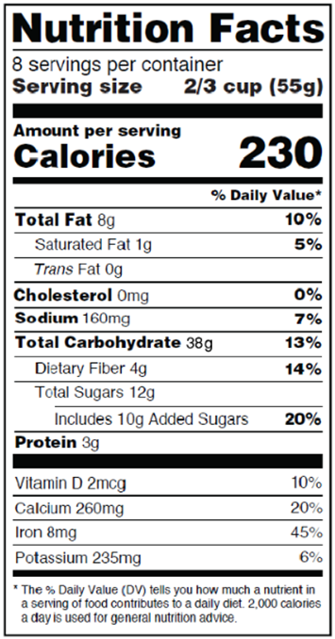
Carbohydrate Counting
Reading nutrition facts to carb count
  Look at the serving size
  Look at “Total Carbohydrates”
    Consider subtracting ½ of sugar alcohols and fiber content
  Adjust the count depending on the number of servings that will be eaten
  Total the carbs for all items in the snack/meal
Notes:
Next, we are going to review carb counting…
Carb counting may be something to do with some clients. Remember that carbohydrates do have the most significant impact on blood glucose levels, so being aware of carb counts may benefit some persons with diabetes.
Here are the steps to carb count…
Look at the serving size
Look at “Total Carbohydrates”
Consider subtracting ½ of sugar alcohols and fiber content
Adjust the count depending on the number of servings that will be eaten
Total the carbs for all items in the snack/meal

Slide 149
Carbohydrate Counting
Things to consider:
  Will simpler portion guidelines suffice?
  Does the PWD have measuring tools?
  Does the PWD feel comfortable doing the math?
  Is the PWD motivated to learn carb counting?

Slide 150
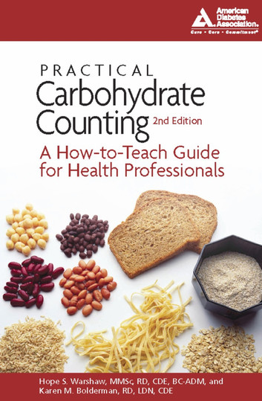
Tips for Carb Counting
Understanding and teaching carb counting:
  Practice carb counting your own meals!
  Keep foods in your office for practice
  Encourage the PWD to bring in familiar foods into the office to practice with you
  Encourage a “cheat sheet” with counts for regularly consumed foods

Slide 151


Tips for Carb Counting
Understanding and teaching carb counting:
  Buy measuring cups/spoons at the dollar store
  Watch/share online tutorials on fractions
  Encourage a calculator for math
  Encourage the PWD practice/record using food logs; review logs prior to moving on to more complicated topics like using an ICR
  Encourage books, phone apps, and carb counting sheets for assistance

Slide 152
Tools for Carbohydrate Counting
Resources for carbohydrate counting:
  Calorie King (book, website, smartphone app for iOS and Android – available in English & Spanish)
  Diabetes Tracker (app $)
  MyFitnessPal (smartphone application for iOS and Android)
  Nutrition.gov (website)
  Smart food scales

Slide 153
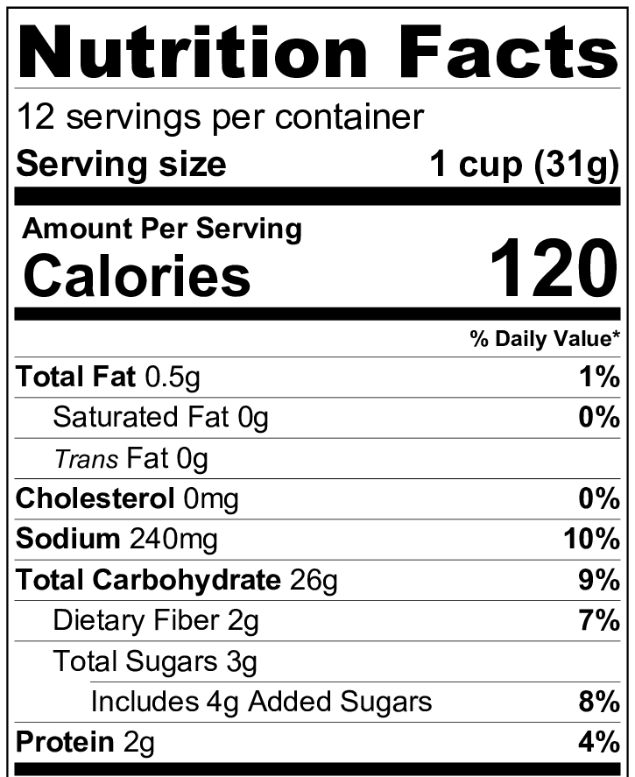

NOTE: The 1 cup measure as the serving size is for convenience only! All information provided by the Nutrition Facts label is based on the weight (the information in parentheses) of the food serving.
Notes:
Lets talk a minute about foods scales - food scales can be a great tool for someone with diabetes who carb counts.
For this label... (ADVANCE)
We have 26 grams carb (ADVANCE) in 1 cup of cereal.
The 1 cup measure at the top of the label is for convenience only.
The nutrition facts for a food are based on the weight of 1 serving of the food, which is found in parentheses next to that 1 cup measurement (in this case its 31g).
This can get tricky…think about when you first open the box of cereal when the pieces are whole vs at the very end, when the pieces are crumbled. You can fit a lot more of those crumbles into a measuring cup, and thus get a lot more carb in your 1 cup.
If a PWD is calculating an insulin dose based on that incorrect carb count, the dose is likely to be incorrect.
Another tricky point is counting the carbs in fruit or other foods without labels. How does one really count the carbs in those items, aside from memorizing a list of estimates? there can be a big difference between a small banana and a large banana.

Slide 154


Tools for Carbohydrate Counting
Smart food scales can be purchased to do the math
Kitrics Nutritional Scale
Perfect Portions Scale
Notes:
So without further ado, I want to introduce smart food scales.
These are so cool! ((Describe))
Available on Amazon and bed bath and beyond

Slide 155
Case Study: Patient L.J.
L.J. is a 43 year old female dx with T2DM 8 days ago
At dx, her PCP started her on the following medications:
  Metformin: 1000 mg BID
  Crestor: 10 mg per day
  Amlodipine: 5 mg per day
Lab Work / Vitals at Dx
BMI | 29.6 kg/m²
A1C | 6.9%
Total Cholesterol | 198 mg/dL
LDL | 127 mg/dL
HDL | 36 mg/dL
Triglycerides | 207 mg/dL
BP | 148/90 mm Hg
Notes:
So that is some of the information on the various diets and techniques you can use to teach people with diabetes about healthy eating.

Slide 156
Case Study: Patient L.J.
Other important considerations:
Eager to making dietary changes; would really like guidance on what types of foods to eat more/less of
Has a family hx of CVD
Has a strong family support system
Enjoys a variety of foods, cooking with her family, and her husband’s favorite dishes are chicken mole and pollo verde
Would like to increase the nutritious foods in her children’s diet, as well.

Slide 157
DASH Eating Pattern
Addresses elevated blood pressure and other CV risk factors
Incorporates chicken, where plant-based eating would minimize fleshy foods

Slide 158
Case Study: Patient C.S.
C.S. is a 68 year old male dx with with T2DM 13 years ago
Current medications:
  30u Lantus QHS
  10u Novolog TID before B, L, D
  1000 mg Metformin XR BID
  Lipitor 20 mg/day
  Lisinopril 10 mg/day
Other important considerations:
  Low health numeracy
  Has hypoglycemia unawareness
  Lives alone
Most Recent Lab Work / Vitals
BMI | 35.2 kg/m²
A1C | 7.9%
Total Cholesterol | 176 mg/dL
LDL | 103 mg/dL
HDL | 49 mg/dL
Triglycerides | 122 mg/dL
BP | 128/82 mm Hg

Slide 159
C.S.’s Dietary Recall
Fasting BG | Breakfast Meal | 2 Hrs PP
102 | 2 eggs scrambled with ½ cup beans and fajita vegetables, ½ large banana, 1 cup milk | 172
- | 2 eggs, 4 pieces turkey bacon, 2 slices bacon, water | 58
117 | 1 cup cooked oatmeal, 1 large banana 1 cup milk, 1 hardboiled egg | 199
108 | Large Carmel Macchiato and breakfast sandwich | 257
130 | 1 cup granola, 1.5 cups milk | 223
- | 4 corn tortillas, 2 scrambled eggs w/ potatos, peppers, and onions | 200
140 | 1 large banana with peanut butter, water | 165

Slide 160
ADA’s Plate Method
Encourages consistent carbohydrate intake to help balance fixed insulin dosages
Balance carbohydrates with protein/veg
Simple and avoids complicated math

Slide 161
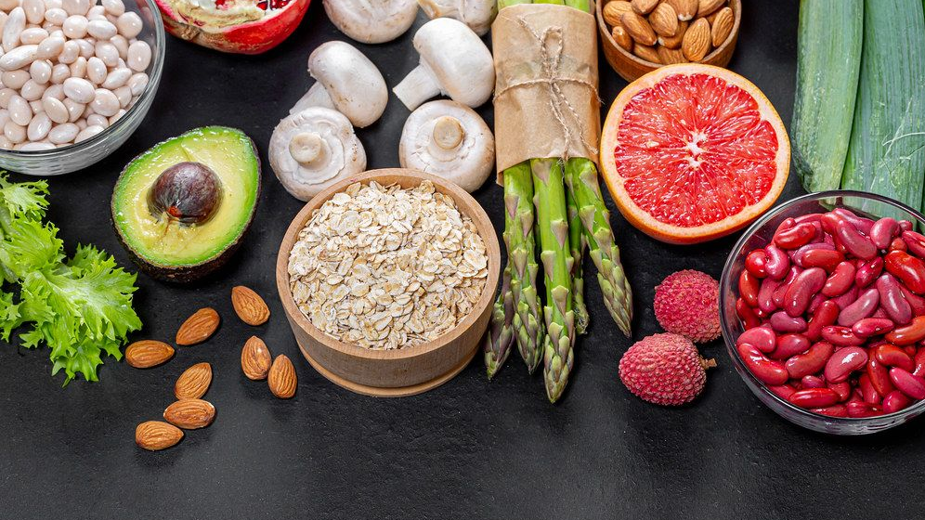
Calculating Mealtime Insulin
Carbs & Carb Ratios PLUS Blood Sugar & Correction Factors

Slide 162
Meal Planning: Strategies for Carb Management
Therapy | Strategies for Carbohydrate Management
Nutrition therapy only or on meds excluding insulin or insulin secretagogues | Use carbohydrate management strategies such as reducing overall carb intake, portion sizes, plate method, or food exchange lists
Fixed insulin doses or insulin secretagogues | Educate on carbohydrate consistency with respect to time and amount. Use tools such as carbohydrate counting or choices, plate method, simplified meal plan, or food exchange lists
Flexible insulin therapy | Educate on carbohydrate counting and using an insulin-to-carb ratio
Notes:
The previous strategies we discussed may assist you in guiding the PWD who is using dietary modifications, oral meds, or fixed insulin doses.
Now we are going to move into calculating meal time insulin for those who are on flexible insulin therapy. This will combine carb counting with use of an insulin to carb ratio, and we will also get into how to lower elevated blood sugars using a sensitivity factor.

Slide 163



Calculating Mealtime Insulin
Carb counting and using an insulin-to-carb ratio (ICR)
  Can be used with flexible insulin therapy, including MDI and CSII, where bolus insulin is used at mealtimes
Pros | Cons
Flexibility for the PWD Insulin/food matched precisely = improved BGs | It is easy to lose sight of overall nutritional quality
Notes:
Carb counting can be used with flexible insulin therapy, including MDI and CSII, where bolus insulin is used at mealtimes
Pros
Flexibility for the PWD
Insulin/food matched precisely = improved BGs
Cons
It is easy to lose sight of overall nutritional quality

Slide 164
Calculating Mealtime Insulin
To calculate mealtime insulin, you will need the following pieces of information:
  Total grams of carbohydrate being eaten
  Carbohydrate ratio (ICR)
  Current BG
  Target BG
  Insulin sensitivity factor (ISF)
To get the total bolus, add the food bolus and correction bolus
Food Bolus
Correction Bolus
Notes:
To calculate mealtime insulin using this method, you will need the following pieces of information: (ADVANCE)
** We are going to go through the calculation for the food bolus first, then the correction bolus afterwards***
To get the total bolus, we then add the two doses together

Slide 165
Calculating Mealtime Insulin
ICR: specifies how many grams of carb are “covered” by 1 unit of insulin
  For example, a 1-unit-per-10-grams-of-carb (1:10) ratio means that one unit of insulin will cover 10 grams of carb
  ICRs are personalized
Use this formula to calculate the amount of insulin needed for carbs:
Total carbs (g) =
ICR
Food Bolus
# of units of insulin required to cover carbs

Slide 166
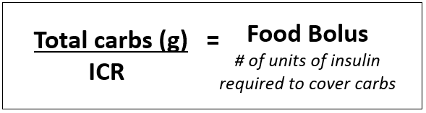
Calculating Mealtime Insulin
Example: Kathy needs to take her Novolog for a meal that has 86 grams of carbohydrate. Her insulin to carb ratio is 1:8. She uses an insulin pen. How many units of insulin does she need to cover her food?
86 grams of carb ÷ 8
= 10.75 units of insulin

Slide 167
Calculating Mealtime Insulin
Insulin sensitivity factor (ISF): specifies how far a unit of bolus insulin will lower blood glucose
  For example, a 1-unit-per-50 mg/dl (1:50) factor indicates that 1 unit of insulin will lower the blood glucose by 50 mg/dl.
  Also referred to as a “correction factor”
Use the following formula to calculate insulin to lower BG to goal:
(Current BG – Goal BG) =
ISF
Correction Bolus
# of units of insulin required to bring blood sugar to goal

Slide 168

Calculating Mealtime Insulin
Example: Kathy checks her blood sugar and it is 280 mg/dl. Her goal blood sugar is 120 mg/dl. Her ISF is 1:40. How many units of insulin does she need to lower her glucose to target?
(280 mg/dl – 120 mg/dl)
40
= 4.0 units of insulin

Slide 169


Calculating Mealtime Insulin
+ =Total Bolus

Slide 170
Calculating Mealtime Insulin
Food Bolus | Correction Bolus | Total Bolus
Kathy needs to take her Novolog for a meal that has 86 grams of carbohydrate. Her insulin to carb ratio is 1:8 | Kathy checks her blood sugar and it is 280 mg/dl. Her goal blood sugar is 120 mg/dl. Her ISF is 1:40. | Add the food bolus and correction bolus to get the total
10.75 units | 4.0 units | 14.75 units
Since Kathy is using an insulin pen…
15 units

Slide 171
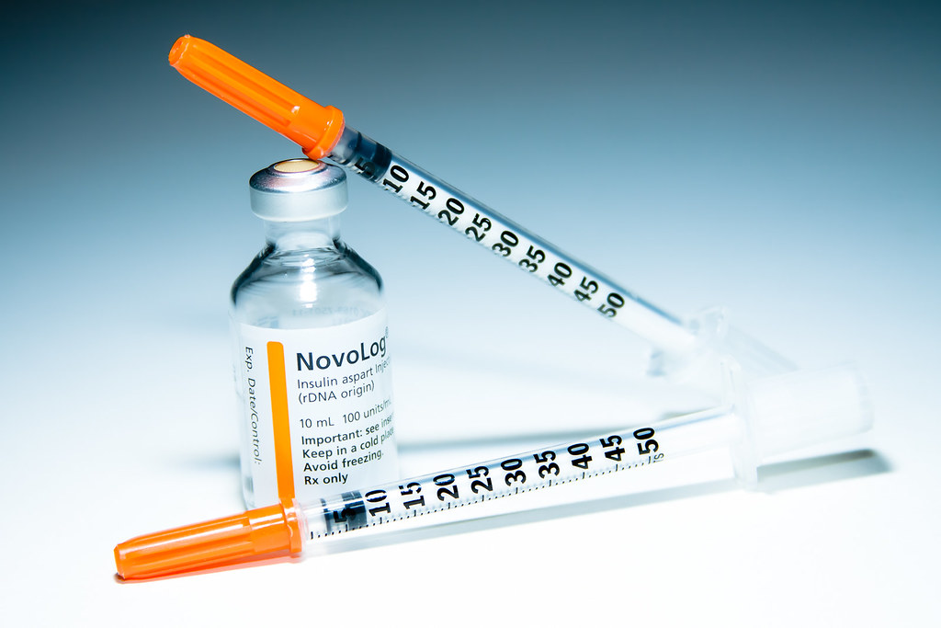
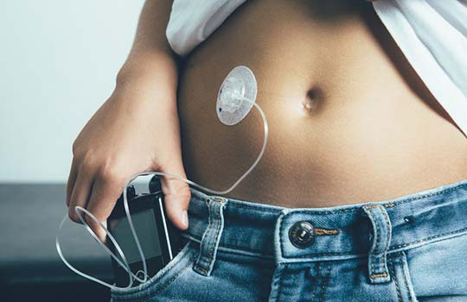
Calculating Mealtime Insulin
On the exam, round your final answer when using an insulin pen or syringe
  Round up to nearest whole unit if ≥ 0.5
  Round down to nearest whole unit if ≤ 0.4
On the exam, is ok to use decimal places if PWD uses CSII
In real life, consider:
  Insulin sensitivity
  Starting blood sugar
  What’s happening next
Notes:
On the exam, round your final answer when using an insulin pen or syringe
Round up to nearest whole unit if ≥ 0.5
Round down to nearest whole unit if ≤ 0.4
If a PWD is utilizing an insulin pump it is ok to use decimal places
In real life, consider:
Insulin sensitivity
Starting blood sugar (rounding up if starting blood sugar is above goal or down if starting blood sugar is below goal)
What’s happening next (round down if activity is expected or up if planning to be sedentary)

Slide 173
Knowledge Check
Erandy is going to eat the following breakfast: A whole english muffin, 2 scrambled eggs with 1 oz cheese, ½ a large banana, and an 8 oz. glass of 1% milk. How many grams of carbohydrate is she having?
  42g
  57g
  60g
  72g
Notes:
SHOW BREAKFAST
Answer B

Slide 174
Knowledge Check: Answered
Food | Amount | Carbs (g)
English muffin | 1 whole | 15 x 2 = 30
Eggs, scrambled | 2 | 0 x 2 = 0
Cheese | 1 oz. | 0 x 1 = 0
Banana, large | ½ | 15 x 1 = 15
Milk, 1% | 8 oz. | 12 x 1 = 12
Total 57g

Slide 175
Knowledge Check - Continued
Now Erandy checks her BG and it is 298 mg/dl. Her goal BG is 150 mg/dl. How much Humalog insulin will she need to take by syringe if her carb ratio is 1:12 and her correction factor is 1:60?
7 units
7.2 units
8 units
9.7 units
10 units
Notes:
Answer A

Slide 176

Knowledge Check - Answered
Calculate the food dose
  Total Carbs: 57g
  ICR: 1:12
Calculate the correction dose
  Current blood sugar: 298 mg/dl
  Goal blood sugar: 150 mg/dl
  ISF: 1:60
  +
57g ÷ 12
=
4.75 units
=
2.46 units
60

Slide 177
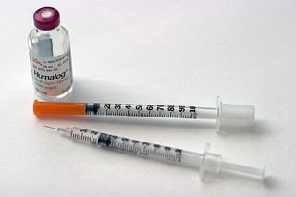
Knowledge Check - Answered
Erandy will need: 4.75 units + 2.46 units = 7.21 units
  = 7 units
*Remember: Since Erandy is injecting her insulin with a syringe, she is limited to giving herself whole units of insulin

Slide 178
Knowledge Check
The Nutrition Facts panel on a package of cookies reveals that there are 28 g of carbohydrate and 5 grams of fat in 2 cookies. If Ryan eats 4 cookies, how many carbohydrate and fat servings will he consume?
  2 carb serving and 1/2 fat serving
  2 carb servings and 1 fat serving
  4 carb servings and 1 fat servings
  4 carb servings and 2 fat servings
Notes:
Answer: D

Slide 179
Knowledge Check
Grace has T2DM controlled with lifestyle. Her typical weekday breakfast is 2 eggs, 2 slices turkey bacon, 1 slice WW toast with margarine, and ½ cup apple juice. Her 2-hour post-prandial BG generally runs <140. She has noticed that on weekends, when she eats her breakfast consisting of 1 English muffin with margarine, ½ banana, and 1 cup skim milk her 2-hour post-prandial BG generally runs higher. Why?
Breakfast carbohydrate intake is higher on the weekend
Breakfast carbohydrate intake is lower on the weekend
Physical activity is likely lower on the weekend
Variation in meal timing is contributing to glucose variation

Slide 180

Food Insecurity

Slide 181

Food Insecurity: Defined
Unreliable availability of nutritious food and inability to consistently obtain nutritious food
Lack of consistent access to enough food for an active, healthy life
Notes:
Summary 1 in the the standards of care is about improving care and promoting health in populations. One of the areas they look at is food insecurity – they reference that between 2005-2014, over 18% of Americans reported food insecurity and that the rate is slightly higher in people with diabetes.
That’s a lot- it’s 1 in 5. So for many of us, we are going to be working with those that are food insecure.
Also of note, food insecurity is associated with lower engagement in the self-care behaviors and med use, depression, diabetes distress, and worse glycemic control relative to those who have food security. People are more at risk for both uncontrolled hyperglycemia (consumption of inexpensive carb desne foods, financial contraints with obtaining medication) and severe hypoglycemia (in those on insulin or sulfonyureas where carb intake is inconsistent)
You can assess the risk for food insecurity with this two item screening tool – ask the following questions….

Slide 182
Food Insecurity: Screening
Assess food insecurity with two questions:
  ”Within the past 12 months, we worried whether our food would run out before we got money to buy more.”
  Within the past 12 months the food we bought just didn’t last, and we didn’t have the money to get more.”
Answers and their corresponding risk:
  Never true: not at risk
  Sometimes true: at risk
  Often true: at risk
Notes:
Summary 1 in the the standards of care is about improving care and promoting health in populations. One of the areas they look at is food insecurity – they reference that between 2005-2014, over 18% of Americans reported food insecurity and that the rate is slightly higher in people with diabetes.
That’s a lot- it’s 1 in 5. So for many of us, we are going to be working with those that are food insecure.
Also of note, food insecurity is associated with lower engagement in the self-care behaviors and med use, depression, diabetes distress, and worse glycemic control relative to those who have food security. People are more at risk for both uncontrolled hyperglycemia (consumption of inexpensive carb desne foods, financial contraints with obtaining medication) and severe hypoglycemia (in those on insulin or sulfonyureas where carb intake is inconsistent)
You can assess the risk for food insecurity with this two item screening tool – ask the following questions….

Slide 183
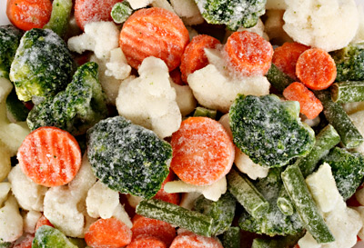
Food Insecurity: Providing Support
Refer to food programs when possible
Educate on:
  Planning meals
  Shopping smart with in season produce, frozen or canned fruits and vegetables, low-cost proteins (beans, peas, lentils, canned tuna, eggs), grains like brown rice and oatmeal are often more affordable
Remember: eating out is often more expensive than nutrient dense home prepped options!
This Photo by Unknown Author is licensed under CC BY-SA-NC
This Photo by Unknown Author is licensed under CC BY-NC-ND
Notes:
Remember that healthy eating doesn’t need to be expensive, and it is often cheaper when done at home compared to eating out:
Frozen or canned fruits and vegetables – on canned items you can teach people to look for those with less added sugar/sodium and also teach them to rinse
Low-cost proteins include beans, peas, lentils, canned tuna, eggs
Grains like brown rice and oatmeal are often more affordable

Slide 184
Healthy Eating on a Budget
Breakfast at Home
Bottle of water (16 oz) $0.21
2 eggs $0.45
½ banana $0.13
½ cup dry oatmeal $0.18
Total $0.97
Fast Food Breakfast
Sausage Egg Sandwich $5.15
Hash brown $3.01
Orange Juice $2.75
Total $10.91

Slide 185
Stand up & Stretch!

Slide 186

Activity, Movement, & Exercise

Slide 187

Types & Benefits of Exercise
Aerobic, Resistance Training, and Flexibility

Slide 188
Types of Exercise: Aerobic Activity
Aerobic, also called “Cardio”
  Repeated/continuous movement of the same large muscle groups
  Typically have the greatest acute impact on BG
  Examples: walking, biking, dancing, swimming
Studies show benefit of walking 10,000 steps a day
  2,000 steps = 1 mile
Notes:
Aerobic or cardio is continuous, dynamic exercise that uses large muscle groups and requires aerobic metabolic pathway to get energy.
Typically these types of activity have the greatest acute impact on BG.
It is the more traditionally prescribed activity for people with diabetes.
Examples: walking, biking, dancing, swimming
The recommended type of aerobic activity should be largely based on preference, and safety should also be considered

Slide 189

Impact of Aerobic Activity on DM
BG improves for 2-72 hours after aerobic activity; thus need to do it regularly to maintain improved BGs
Postprandial exercise can prevent/reduce the rise in BG levels that occurs after eating
Notes:
BG improves for 2-72 hours after aerobic activity; thus need to do it regularly to maintain improved BGs
Cardiovascular exercise after eating can lower the rise in BG levels that occurs after eating
For those on insulin:
Aerobic exercise will decrease insulin requirements, and so balancing insulin/food may become difficult. The risk for hypo may increase.

Slide 190

Types of Exercise: Resistance Training
Use of muscular strength to move a weight or work against a resistive load
Increases strength, endurance, and overall calories burned in a day
Example: weightlifting, sprinting
Notes:
Resistance training is also important - It increases strength, endurance, and burns calories.
It can also hep to maintain independence in performing the daily activities of living and reduce the possibility of injury.

Slide 191

Impact of Resistance Training on DM
Resistance training may improve glycemic levels more than aerobic activity in T2D
  Best results come from mix of resistance and aerobic
  Results are less clear for individuals with T1D
Notes:
Resistance training may improve glycemic levels more than aerobic activity in T2D
Best results come from mix of resistance and aerobic training.
Before starting resistance training, it is advised that individuals receive instruction on proper technique to ensure exercise is done safely.

Slide 192
Impact of Resistance Training on DM
Resistance exercise may weaken the exercise related decrease in BGs during and after exercise
  In T1D: complete resistance training 1st, aerobic training 2nd to ↑ glycemic stability ↓ post exercise hypo
Key for older adults for maintaining independence
  Improved strength/balance reduces fall risk
  Increases mobility
Notes:
Other benefits of resistance training:
Are that it is key for older adults for maintaining independence
Improved strength/balance reduces fall risk
Increases mobility
Resistance training may weaken the exercise related decrease in BGs during and after exercise
So, thinking about our special populations:
In T1D or those on insulin try complete resistance training 1st, aerobic training 2nd to improve glycemic stability and decrease post exercise hypo

Slide 193

Types of Exercise: Flexibility
Flexibility (stretching / postural):
  The ability to move a joint through complete range of motion
  Examples: Yoga, tai chi, or other with balance, agility, coordination
Notes:
And then we have flexibility training, which helps to support movement through a more complete range of motion

Slide 194

Impact of Flexibility Training on DM
Benefits less established than other exercise types
  Yoga and tai chi may improve glucose and lipid levels, body comp, neuropathic symptoms, and quality of life
  May help prevent falls
Minimal precautions needed with this type of activity
Notes:
The benefits of flexibility training are less established than other exercise types
The good news is that minimal precautions needed with this type of activity – so these can be used by individuals of all skill levels and ages.
Flexibility programs may provide introduction to a more physically active life for those who are deconditioned

Slide 195

Sedentary Time: The benefit of Reducing It
Long-periods of sedentary activity (regardless of physical activity) may be associated with the onset of T2D.
  Encourage breaks in sedentary activity every 30 minutes
  Small increases in activity may reduce mortality from all causes and improve insulin resistance/BG, BP, and BMI
Notes:
Long-periods of sedentary activity (regardless of physical activity) may be associated with the onset of T2D.
When working with clients, try to encourage breaks in sedentary activity every 30 minutes - it may ↓ postprandial glucose and insulin levels
I think this is so powerful….. Break up TV at commercial breaks, I have been trying to do a pushup between every client that I see, etc.
Small increases in activity may reduce mortality from all causes and improve insulin resistance/BG, BP, and BMI

Slide 196

Exercise Goals for Various Populations
Children, Adults, and Older Adults
Notes:
So now that we reviewed the types of exercise, lets touch on the goals for activity for various populations

Slide 197

Exercise: All Children
Exercise Goals:
  Aerobic: 60 minutes of moderate to vigorous-intensity activity daily
  Resistance training: at least 3 days/week
Other considerations if using insulin
  Due to risk of hypo, advise frequent glucose monitoring before, during, and after. Use CGM when possible
  Educate on targets, management of blood sugars including hypo
Notes:
For kiddos,
The goal is to reach 60 minutes of moderate or higher intensity activity each day
And resistance training several times per week.

Slide 198
Exercise: Children with T1DM
If using insulin, educate on strategies to prevent hypo before, during, and after exercise. Consider:
  Lowering meal or snack time insulin before exercise
  Reducing basal insulin
  Increasing carb intake
  Eating a bedtime snack
Some of these recommendations may be helpful for kids with T2DM on insulin, as well.
Notes:
If you have a client using insulin, educate on strategies to prevent hypo before, during, and after exercise. Consider:
- Lowering meal or snack time insulin before exercise
- Reducing other insulin doses – because of how long the impact of exercise can last.
- Increasing carb intake
- Eating a bedtime snack

Slide 199
Exercise: Adults with Prediabetes
Exercise Goals:
  Increase moderate-intensity physical activity to at least 150 minutes/week
    Example: brisk walking
    May include resistance training
  Break-up sedentary time
Achieving the behavioral goal of 150 minutes of physical activity per week reduces the incidence of type 2 diabetes by 44% (even w/o weight loss!)
Notes:
Exercise Goals for adults with prediabetes.
- Increase moderate-intensity physical activity to at least 150 minutes/week
Example: brisk walking
May include resistance training
Break-up sedentary time – this is associated with moderately lower postprandial glucose levels
Although weight loss is the most important factor to reduce the risk of incident diabetes, in the DPP we saw that achieving the behavioral goal of 150 minutes of physical activity per week reduced the incidence of type 2 diabetes dramatically, even without weight loss.

Slide 200
Exercise: Adults with T1 or T2 Diabetes
Exercise Goals:
  Aerobic: ≥150 minutes/week of moderate to vigorous-intensity activity
    Tips: spread over 3 or more days/week with no more than 2 consecutive days w/o activity
    For those who achieve weight loss goals, long-term maintenance is supported by 200-300 minutes/week
  Resistance exercise: 2-3 sessions/week on nonconsecutive days
Notes:
Recommendations For Adults with diabetes
A minimum of 150-300 min/wk. at moderate intensity
Federal guidelines state that it’s ok to get all the recommended aerobic exercise in one day (“weekend warrior”). This is for the general population.
For the person with diabetes, more benefit is obtained if exercise is spaced throughout the week. For people with diabetes, recommendation is to not go more than 2 consecutive days without aerobic activity because of the transient nature of improvements in insulin sensitivity that occur with aerobic exercise…
___________________
2022 standard
S67
S198

Slide 201
Exercise: Adults with T1 or T2 Diabetes
Exercise Goals:
  Sedentary Time: All adults, particularly those with T2DM, should reduce sedentary time
    Interrupt sitting every 30 minutes
  Flexibility and balance training: recommended 2-3x per week for older adults
Notes:
Also in adults with diabetes…
Remember to aim to reduce sedentary time by interrupting sitting
Flexibility training is also recommended for older adults.

Slide 202

Hormone Response with Diabetes & Exercise
Physiology of Exercise

Slide 203
Physiology of Exercise: Without Diabetes
Blood glucose levels remain stable
Normoglycemia is largely driven by hormones
  Insulin, glucagon, epinephrine, growth hormone, and cortisol
Initial energy: supplied from glucose in the muscle and liver glycogen
Later energy: TG’s in adipose break into FFA’s
  Occurs 20-40 minutes into activity
Notes:
First lets review the physiology of exercise in those without diabetes.
- Blood glucose levels remain stable. This is largely driven by a balancing act between various hormones in the body. There are quite a few involved, including: Insulin, glucagon, epinephrine, growth hormone, and cortisol
Initial energy for the activity is supplied from glucose in the muscle and liver glycogen
Later tthe energy is supplied by triglycerides from adipose that break into FFA’s; this is thought to occur 20-40 minutes into activity

Slide 204
Hormone Response Without Diabetes
Insulin production is decreased
Counter-regulatory hormones increase
  Release stored glucose and breakdown glycogen
Glycogen stores are replenished up to 48 hours after completion of exercise
Notes:
When exercise begins in someone without diabetes, hormone shifts will occur.
Insulin: DECREASES – supports glucose production in the liver and free fatty acid release from adipose tissue
Glucagon: INCREASES - leads liver to produce glucose from glycogenolysis and gluconeogenesis. This is going to move glucose into the blood to supply the body with fuel and help to maintain glucose levels.
Epinephrine: INCREASES – triggers muscles to breakdown glycogen and free fatty acids to be produced, which will provide glycerol for gluconeogenesis.
Norephinehrine: INCREASES – stimulates glucose production in the liver and reduces muscular glucose uptake. It also helps to decrease insulin secretion.
Growth hormone and cortisol: also INCREASE …. Increases breakdown of fat through lipolysis– this is particularly important for prolonged activity

Slide 205
Hormone Response with T1D / Insulin Use or Secretagogues
Insulin levels can remain high and can block counter-regulatory hormones
  Injected/pumped insulin continues to be released from subq depots (and at a faster rate)
  Cannot be regulated without pre-exercise planning
Increased insulin absorption/sensitivity
Notes:
In those on insulin, these same shifts my be inhibited:
Exogenous insulin remains high – once the person injects the insulin its there and cant be removed or down regulated. The insulin in the body can block counter-regulatory hormones
The insulin continues to be released from subq depots (and at a faster rate)
This Cannot be regulated without pre-exercise planning
We also get Increased insulin sensitivity
All this together will increase the risk of hypo
A similar result may be observed in those on insulin secretagogues, with the main difference being the source of the insulin being endogenous.

Slide 206
Hormone Response w/o Insulin or Secretagogues
Decreased secretion of endogenous insulin
  Counter-regulatory hormones kick in as needed
Increased sensitivity to insulin
Results in improved blood glucose levels
Notes:
In those who do not take insulin or medications that push the body to secrete insulin, the hormone response to exercise is the same as those who don’t have diabetes
Secretion of insulin in the body will decrease
And insulin sensitivity improves
Resuliting in improved blood sugar levels.

Slide 207

Hypoglycmia & Hyperglycemia with Activity
Hypoglycemia Risk and Prevention plus Hyperglycemia

Slide 208
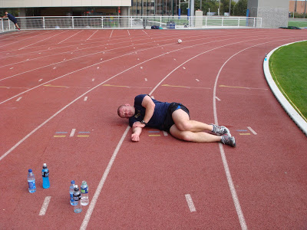
Exercise, Medications, and Hypoglycemia
Fear of hypo is most reported barrier to exercise in individuals on insulin and insulin secretagogues
If PWD has a low risk of hypo, communicate this to reduce the potential perceived risk
Notes:
Fear of hypo in individuals on insulin and secretagogues is the most reported barrier to exercise.
Hypoglycemia prevention and treatment can also be frustrating: individuals need to eat when trying to burn calories, which may feel futile. Plus, to top it off, foods used to treat hypoglycemia are often low in nutritional value. Trying to do something healthful and the needing to treat a low with juice or soda can also feel futile.
Keep in mind, when the risk of hypoglycemia is so low that it doesn’t realistically exist, it is important to communicate this the PWD and their family to lower perceived barrier to activity.
This is for people who are using medication classes that do not cause hypoglycemia.

Slide 209
Exercise, Medications, and Hypoglycemia
T1DM
  Exogenous insulin can prevent the increased mobilization of glucose needed in exercise
T2DM
  Low risk for hypo if treated w/ lifestyle and/or medications that do not cause hypo
  Concern if on insulin, and/or insulin secretagogues
  Anecdotal reports of hard-to-treat hypo with activity and GLP-1 agonists and pramlinitide
Notes:
Insulin creates the highest risk of hypo, followed by meglitinides and sulfonylureas.
Anecdotal reports of hard-to-treat hypo with activity and GLP-1 agonists and pramlinitide when medication was taken close to the start of exercise.
Someone living with type 2 diabetes not on any diabetes medications has a low risk of experiencing exercise-related hypoglycemia (remember, we have hepatic release of glucose into the blood to help keep glucose levels stable. However, there is still a low risk; as an example, someone who follows a low carbohydrate diet is more likely to deplete glycogen stores and then experience exercise

Slide 210
Hypoglycemia Risk
Risk is high during and immediately after exercise
Post exercise late onset hypoglycemia
  More often seen in T1D
  Associated with high intensity exercise >30 minutes
  May occur at night and up to ~24 hours after exercise
Best indicator of hypo risk is experience in the past
Notes:
Risk for low is highest in the 24 hours after activity. Consider consuming carbohydrates (5-30g) depending on the blood sugar, within 2 hours after high intensity exercise to restore muscle glycogen and reduce risk of lows. Need to be preaperd to treat lows.
Post exercise late onset hypoglycemia
More often seen in T1D
Associated with high intensity exercise >30 minutes
May occur at night
May occur for up to ~24 hours after exercise
Best indicator of hypo risk is past experience, so you can ask people with diabetes to keep logs to help notice patterns or record the exercise activity on their CGM.

Slide 211


Hypoglycemia Prevention
Planned exercise: reduce insulin or medications
Unplanned exercise: eat a snack with carbohydrate
  Consider a snack according to starting BG level and anticipated activity
  Not recommended unless on insulin or insulin secretagogues
Carry fast-acting carbohydrates
Consume extra carb in the post-exercise period
Caution use of alcohol after exercise
Notes:
Provide education on how to avoid lows
Risk of low is even higher if short- or rapid-acting insulin is injected 2-3 hours prior to activity
Risk mitigated if dose is lowered 25-75% in anticipation of activity
Adjust basal insulin
MDI: Consider reduction on the day before/after exercise
CSII: Reduce/suspend basal beginning 30-60 minutes prior to exercise
Unplanned activity will likely require carbohydrate/protein intake
Note that preventing hypoglycemia before starting exercise isn’t the same as treating hypoglycemia. When treating hypoglycemia youll want to select a quick digesting carbohydrate; when preventing lows prior to exercise a more balanced snack can help to slow the digestion and may better match exercise fuel requirements
Treatment with rapid acting carbohydrates
5-30 grams of carbohydrate in the post exercise period (within 2 hours of activity) can help to reset glycogen stores to prevent lows
Remember alcohol contributes to hypo so with exercise can exacerbate the risk
Insulin injections in the muscle can act much faster, thereby increasing risk of hypo

Slide 212
Hypoglycemia Prevention
Carbohydrate Replacement During Physical Activity
Intensity | Duration | Carb Replacement | Frequency
Mild to Moderate | <30 minutes | May not be needed | N/A
Moderate | 30-60 minutes | 15 grams | Each hour
High | >60 minutes | 30-50 grams | Each hour
Notes:
P 202 big book

Slide 213
Hyperglycemia Risk
Hyperglycemia during exercise occurs when there is too little insulin in circulation
T2D: Low risk of exercise worsening hyperglycemia
T1D: Risk of hyperglycemia with exercise
  Possible lack of insulin can impair glucose utilization
  Excessive counter-regulatory hormones
  Enhanced hepatic glucose production
  Lipolysis and ketogenesis

Slide 214
Ketone Testing
Type 1: recommendations vary but consider checking ketones in BG is >250 mg/dl
Do NOT exercise if ketones are positive; can worsen hyperglycemia
Not necessary to postpone exercise if BG is elevated, ketones are negative, and PWD feels well

Slide 216
Knowledge Check
Matt has T2D and runs 3-4 miles several times per week. Before his afternoon run on Tuesday his blood sugar is 156 mg/dl. After the run his BG was 43 mg/dl. Which of the following was not a possible contributor to the low?
  Elevated exogenous insulin
  Increased sensitivity to insulin
  Increased insulin absorption
  Elevated endogenous insulin
Notes:
D

Slide 217
Knowledge Check
Which of the following describes the normal hormonal response and acute metabolic impact of physical activity?
  Insulin levels increase to reduce FFA production
  Glucagon rises and hepatic glucose production is increased
  Both epinephrine and norepinephrine are reduced, and FFA production is inhibited
  Growth hormone and cortisol are decreased, and insulin-stimulated glucose uptake is enhanced
Notes:
C

