Slide 1

Diabetes: Back to the Basics and Beyond
Winchester, VA
March 7, 2025
Beverly Thomassian, RN, MPH, BC-ADM, CDCES
Pronouns: She, her and hers
Founder - www.DiabetesEd.net

Slide 2
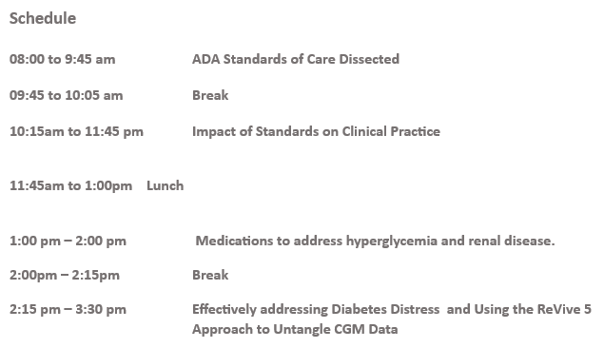
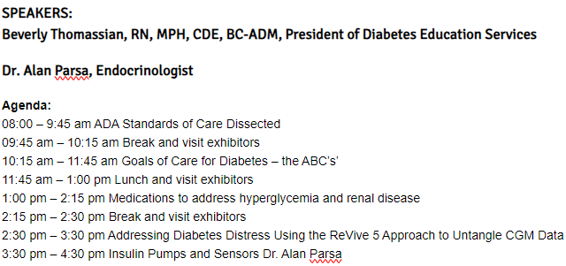
Agenda

Slide 3
Coach Bev has no Conflict of Interest
She’s not on any speaker's bureau
Does not invest or have any financial relationships with diabetes related companies.
Gathers information from reading package inserts, research and articles
The ADA Standards of Medical Care is main resource for course content

Slide 4
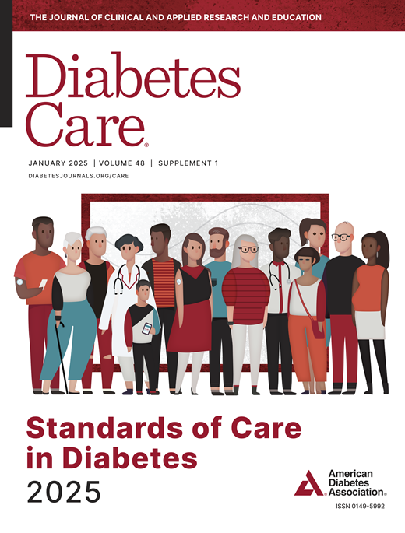
Standards of Care Update - Back to the Basics and Beyond
Objectives:
Review the changes & updates to the annual ADA Standards of Medical Care in Diabetes.
Identify the key elements of the standards that improve clinical care for people with diabetes.
Review and discuss appropriate use of the latest medications that address hyperglycemia and cardiorenal health.
Describe how diabetes distress affects self-management.
Share practical approaches to assess and address diabetes distress in clinical care.
Describe how to assess CGM reports and provide collaborative care.

Slide 5

17. Diabetes Advocacy
People living with diabetes deserve to be free from the burden of discrimination.
We need to all be a part of advocating to ensure a healthy and productive life for people living with diabetes.
Decrease barriers to diabetes self-management.
Diabetes Care needs to meet outlined standards in all settings.
- In school setting
Young children in childcare
For Drivers
In work settings
In Detention Facilities
Insulin Access & Affordability

Slide 6
CDC Announces
35% of Americans will have Diabetes by 2050
Boyle, Thompson, Barker, Williamson
2010, Oct 22:8(1)29
www.pophealthmetrics.com

Slide 7

Poll Question 1
What percent of total people in the U.S. are living with undiagnosed and diagnosed type 2 diabetes?
A. About 30%
B. 11.3%
C. 16.8%
D. 25.6%

Slide 8
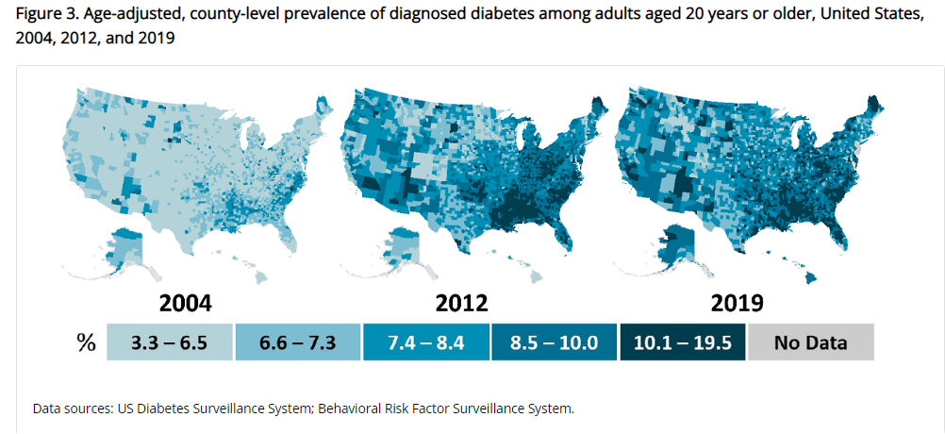
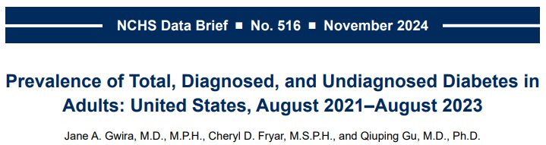
Type 2 Diabetes in America 2025
16.8% with Diabetes
  11% don’t know they have it
38% with Prediabetes – 97 million adults
https://www.cdc.gov/nchs/data/databriefs/db516.pdf
Centers for Disease Control and Prevention. National Diabetes Stats Report https://www.cdc.gov/diabetes/data/statistics-report/index.html. Accessed 1/23

Slide 9
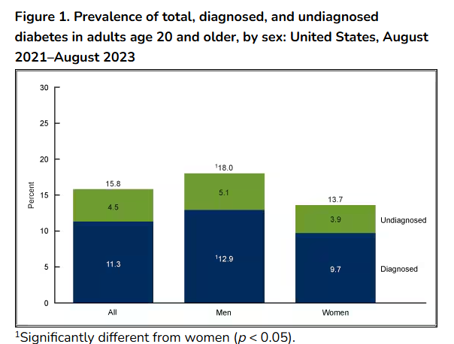
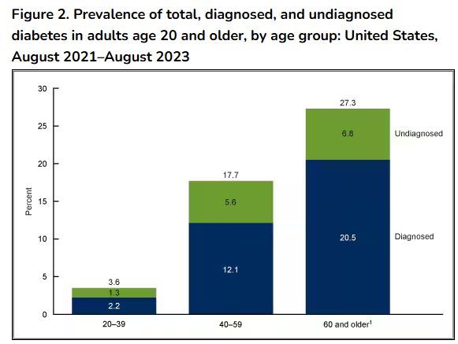
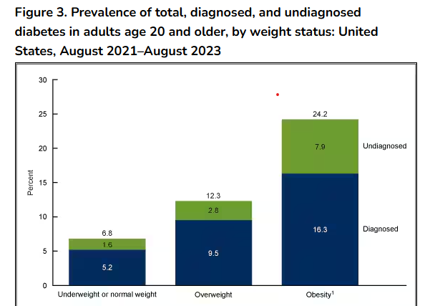
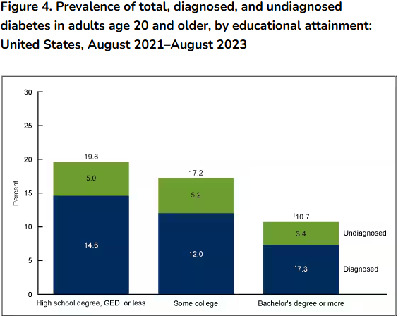
National Center for Health Statistics CDC | Data Brief No. 516, November 2024
https://www.cdc.gov/nchs/products/databriefs/db516.htm

Slide 10
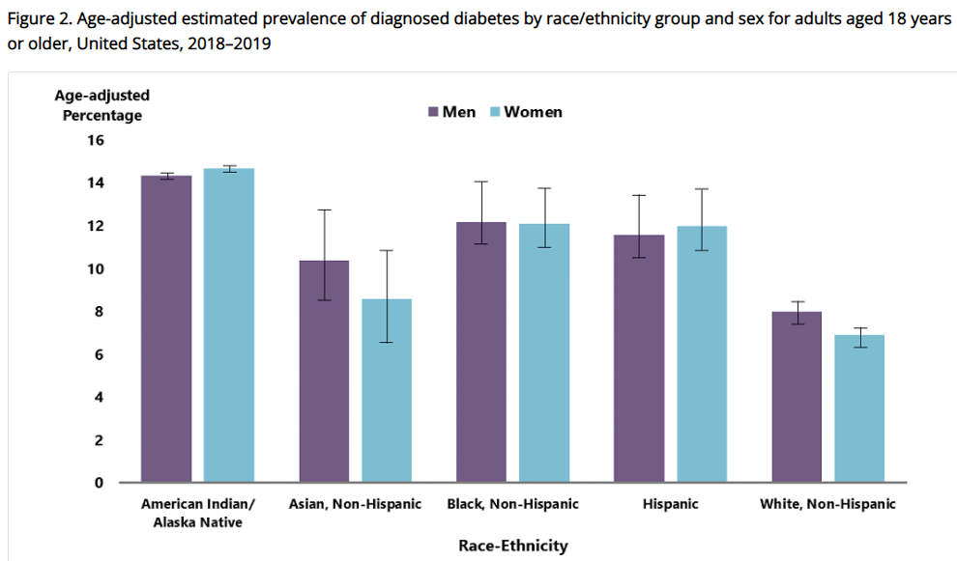
Diabetes Prevalence by Ethnic Group
For adults, diabetes prevalence highest among:
  American Indians and Alaska Natives (14.5%),
  Non-Hispanic Blacks (12.1%),
  People of Hispanic origin (11.8%),
  Non-Hispanic Asians (9.5%)
www.cdc.gov/diabetes/data/statistics-report/diagnosed-diabetes.html

Slide 11

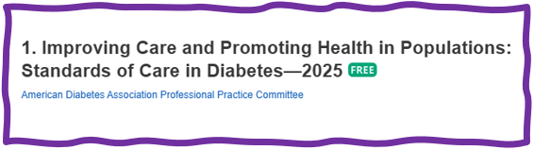
Improving Care - Population Health
“Health outcomes of a group of individuals
  including the distribution of health outcomes within the group”
These outcomes can be measured in terms of health outcome:
  mortality, morbidity, health, and functional status
  disease burden
    (incidence and prevalence)
  behavioral and metabolic factors
    (exercise, diet, A1C, etc.)
ADA Standards 2025

Slide 12
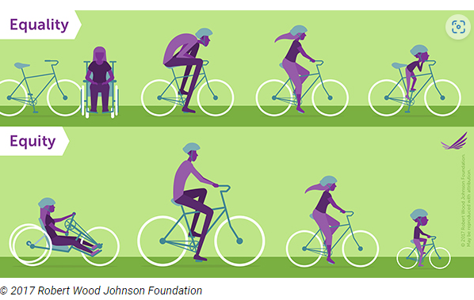
Equality vs Equity
Design and deliver diabetes care with goal of health equity across all populations.
https://coveragetoolkit.org/health-equity/defining-health-equity/

Slide 13
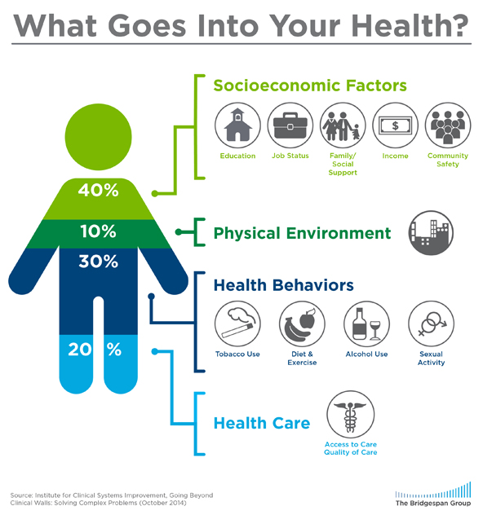
Address Barriers to Self Management
Barriers exist within health system, payer, health care professional & individual.
Address barriers through innovation, including community health workers, telehealth, other digital health solutions.
Consider social determinants of health in the target population when designing care.
https://coveragetoolkit.org/health-equity/defining-health-equity/
Notes:
Access and health equity is the ultimate goal when designing and delivering DSMES.
Creating culturally appropriate and varied modalities of settings has been shown to improve outcomes.
We know barriers to care exist at every level from the health system to individual.
However we can address these barriers by working to educate participants and health care providers on the critical times when DSMES is needed.
We can work with health systems and clinics to develop population health screening and clinical outreach,
create protocols to reduce time for referral and
collaborate health and community systems to address social needs.
We can include other health partners including community health workers to support delivery of diabetes peer support.
Barriers can be also be addressed by developing a diversity of delivery models.
From traditional inperson classrooms to community-based strategies and technology enabled solutions including telehealth or virtual environments varying modes can serve different needs.

Slide 14

Social Determinants of Health
SDOH are defined as the economic, environmental, political, and social conditions in which people live and are responsible for a major part of health inequality worldwide.
Greater exposure to adverse SDOH over the life course results in poor health. Use quality data to identify inequities & take action.

Slide 15

Tailoring Treatment for Social Context
“Social determinants of health (SDOH)—often out of direct control of the individual and potentially representing lifelong risk—contribute to health care and psychosocial outcomes and must be addressed to improve all health outcomes”
The ADA recognizes this relationship and is taking action.

Slide 16

Status of Diabetes Care
In 2015–2018, U.S. community-dwelling adults with diabetes achieved:
  A1C <7% by 50.5%
    75.4% achieved A1C <8%.
  BP target of <130/80 achieved by 47.7%
    70.4% achieved blood pressure <140/90 mmHg.
  Lipid control (non-HDL cholesterol) <130 mg/dL, achieved by 55.7%
22.2% met targets for all three risk factors
Many not receiving adequate lifestyle or pharmacotherapy.

Slide 17


Now, let’s get to the Nitty Gritty

Slide 18


Notes:
Measurement of C-peptide is preferable to the measurement of insulin as it has a longer half-life, not subjected to the first-pass hepatic metabolism, and a steady-state clearance from the circulation. Insulin undergoes first-pass hepatic metabolism, has variable clearance, a much shorter half-life, and exogenously administered insulin can confound results.

Slide 19
Hormones Effect on Glucose
Effect



⇒
⇒
⇒
Hormone
Glucagon (pancreas)
Stress hormones (kidney)
Epinephrine (kidney)
Insulin (pancreas)
Amylin (pancreas)
Gut hormones - incretins (GLP-1) released by L cells of intestinal mucosa, beta cell has receptors)

Slide 20


Pre Diabetes & Type 2- Screening Guidelines (ADA 2025 Clinical Practice Guidelines)
Start screening all people at age 35.
Screen at any age if BMI ≥ 25 (Asians BMI ≥ 23) plus one or > additional risk factor:
  First-degree relative w/ diabetes
  Member of a high-risk ethnic population
  Habitual physical inactivity
  History of heart disease
  Check more frequently if taking high risk meds; antiretrovirals, 2nd generation antipsychotics or steroids, thiazide diuretics, statins
  History of pancreatitis, prediabetes, GDM, periodontitis

Slide 21

Diabetes 2 - Who is at Risk?
(ADA 2024 Clinical Practice Guidelines)
Risk factors cont’d
  HTN - BP > 130/80
  HDL < 35 or triglycerides > 250
  History of Gestational Diabetes Mellitus
  Polycystic ovary syndrome (PCOS)
  Other conditions associated w/ insulin resistance:
    Elevated BMI, acanthosis nigricans (AN)
Screen using A1C, Fasting Blood Glucose or OGTT.
Repeat screening at least every 3 years if negative.
*If prediabetes or on high risk meds, recheck yearly

Slide 22
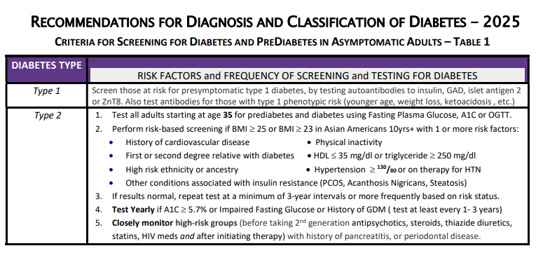



Diabetes Screening Guidelines
(ADA 2025 Clinical Practice Guidelines – Cheat Sheet)
DiabetesEd.net Cheat Sheets

Slide 23

Poll Question 2
Which of the following level is considered pre-diabetes range?
  a. Fasting BG of 62
  b. A1c of 5.9 %
  c. After meal BG of 137
  d. A1c of 7.1 %

Slide 24
Natural History of Diabetes
Healthy
FBG <100
Random <140
A1c <5.7%
Prediabetes
FBG 100-125
Random 140 - 199
A1c ~ 5.7- 6.4%
~ 50% working pancreas
Diabetes
FBG 126 +
Random 200 +
A1c 6.5% or +
~ 20% working pancreas
Yes!
NO
Development of type 2 diabetes happens over years or decades

Slide 25


PreDiabetes is FREAKING ME OUT
96 million people in US
80% don’t know they have it
In 3-5 years, about 30% of predm will get diabetes
Associated with higher rates of heart attack, stroke, neuropathy and vessel disease

Slide 26

Poll Question 3
What best describes prediabetes in the U.S.?
  Prediabetes affects 18-20% of people above the age of 20.
  The prevalence of prediabetes and diabetes are almost equal.
  Most people with BMI of 30 or greater have prediabetes.
  Prediabetes is associated with increased risk of CV disease

Slide 27

3. Detecting PreDiabetes Matters
Given the cost-effectiveness of lifestyle behavior modification programs for diabetes prevention:
  Offer diabetes prevention programs to adults at high risk of type 2 diabetes
  Prescribe effective eating patterns
  Address inconsistencies in access – leverage technology
Screening guidelines for people with Type 1

Slide 28


3. Prevent or Delay Diabetes for those with Prediabetes
Prediabetes defined as:
  A1c 5.7 – 6.4% or fasting BG 100 -125mg/dl
Action:
  Screen yearly for diabetes
  For adults with BMI 23/25
    Refer to DPP approved programs
    Includes intensive behavioral lifestyle interventions with 7% wt reduction goal + 150 min exercise week
    Provide in person or certified assisted programs

Slide 29

Get About 7 Hours of Quality Sleep to Prevent Diabetes
Poor sleep quality was associated with a 40–84% increased risk of developing type 2 diabetes in a meta-analysis.
Chronotype preference has been linked with many chronic diseases, including type 2 diabetes.
  For those with a preference for evenings (i.e., going to bed late and getting up late)
    2.5-fold higher odds ratio for type 2 diabetes than for those with a preference for mornings (i.e., going to bed early and getting up early),
    Independent of sleep duration and sleep sufficiency
The composition of the gut microbiome may also affect the likelihood of developing type 2 diabetes.

Slide 30
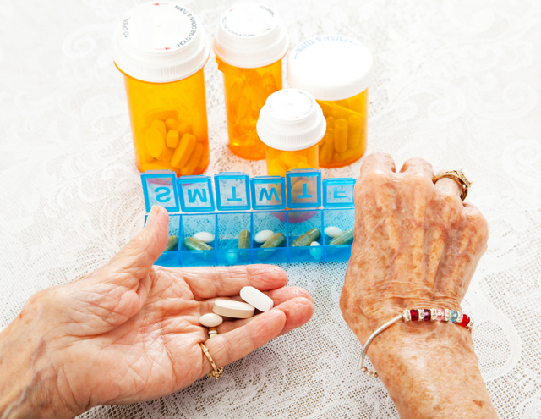
3. Person-Centered Care Goals
Use more intensive approach for high-risk individuals:
  BMI of 35+
  If A1C is ~6.0 or FPG is 110
  History of GDM
No FDA approved med for prevention (off label)
Consider Metformin Therapy for Prediabetes
  Monitor B12 level (esp with neuropathy or anemia)
CV Risk Mitigation important.
Statin can increase BG, stop if notice elevation
Consider low dose pioglitazone (Actos) if history of stroke.

Slide 31
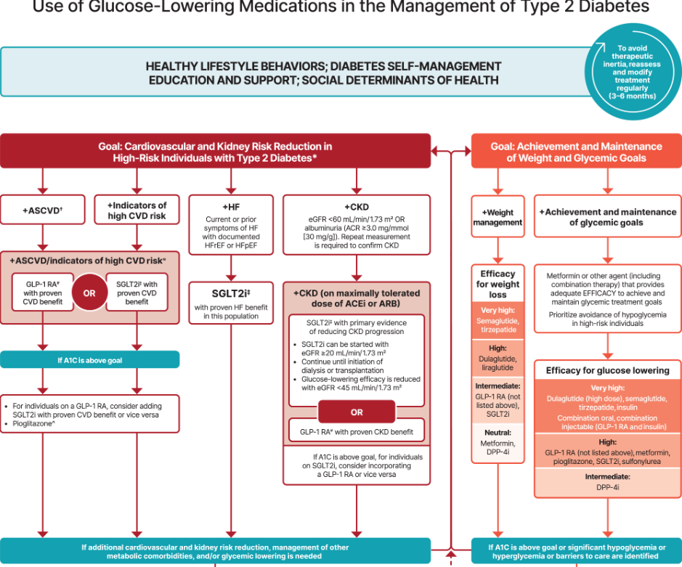
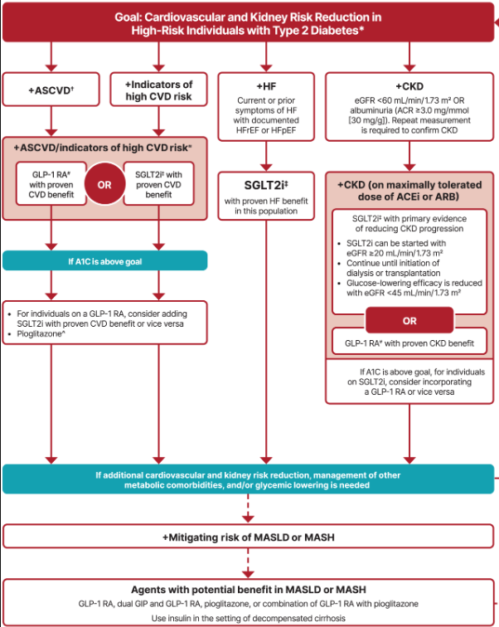
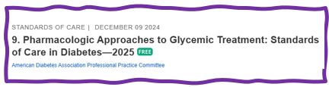

Let’s Break it Down ADA 2025

Slide 32
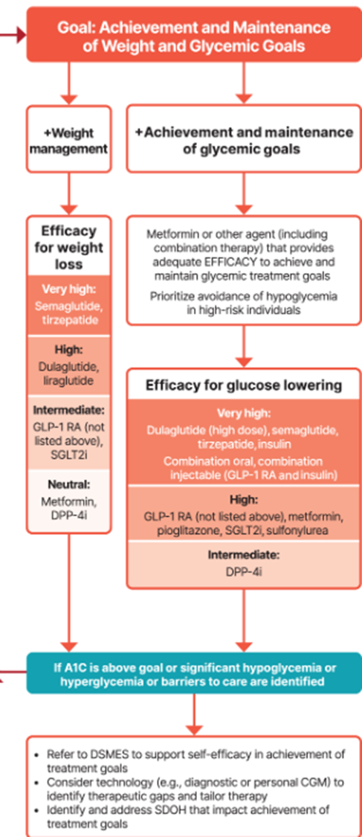
Metformin is “Usually” 1st Line
Why metformin?
  Longstanding evidence
  High efficacy and safety
  Inexpensive - 3 months for $12
  Weight neutral
  Check B12 levels at intervals especially if anemia or neuropathy.
If ASCVD, HF or CKD or high ASCVD risk, use SGLT2i or GLP-1 RA +/- metformin
If A1C ≥ 8.5%, consider combo therapy.

Slide 33
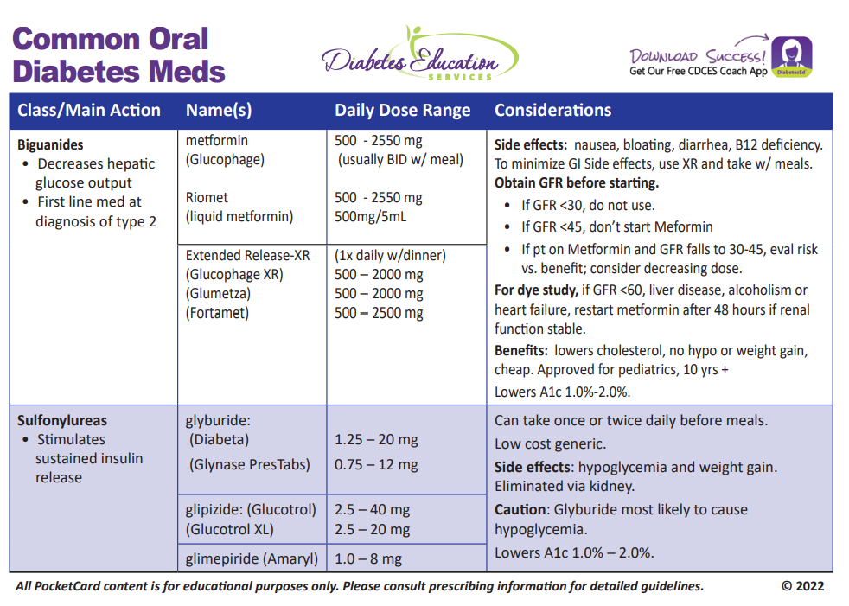
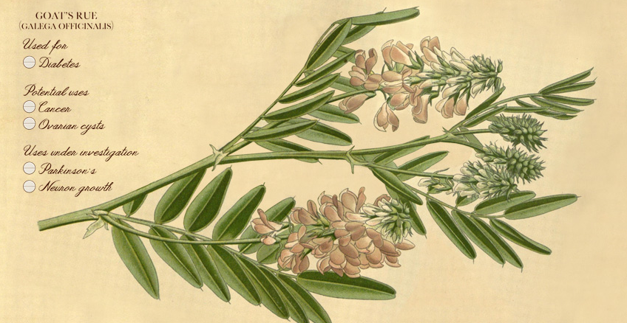
Biguanide derived from:
Goat’s Rue Galega officinalis,
French Lilac
Does NOT harm kidneys
$10 for 3-month supply from Walmart & other pharmacies

Slide 34

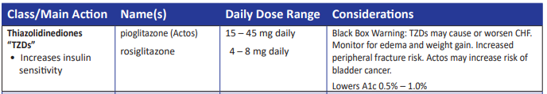
Indications for Insulin Sensitizers
Rosiglitazone, Pioglitazone (Actos)
Action: decrease insulin resistance by making muscle and adipose cells more sensitive to insulin. Decrease free fatty acids
Names:
  pioglitazone (Actos) – bladder cancer warning
    Dosing: 15-45 mg daily
    Consider adding low dose if history of stroke or have steatosis
  rosiglitazone Dosing: 4-8 mg daily
Efficacy/ Considerations
  Reduce A1C ~0.5-1.0%
  6 weeks for maximum effect
  Actos $5 a month, Avandia $300 a month
  Can cause fluid retention, not indicated w/ CHF
Notes:
34
34
Thiazolidinediones (TZDs) enhance insulin sensitivity in muscle and adipose tissue by binding to cell receptors,which leads to an increase in glucose transporter expression. TZDs encourage beta cells to respond more efficiently by lowering the amount of glucose and free fatty acids in the bloodstream, both of which are known to be detrimental to insulin secretion. Finally, these drugs reduce glucose production in the liver.
Clinical trials indicate that pioglitazone and rosiglitazone are slightly more effective at reducing A1C (1.5-1.6% reduction) than troglitazone (1.1% reduction).
Some of the beneficial side effects of thiazolidinediones include an increase in HDL cholesterol and reduction of triglyceride concentrations. This class of drugs has also been shown to lower blood pressure and decrease vascular inflammation in vitro. There are clinical studies underway to further examine the cardiovascular benefit to TZDs.
Some adverse effects of TZDs include weight gain, a potential increase in LDL cholesterol levels, and a possible increase in alanine aminotransferase levels (ALT). Because of the risk of weight gain, edema, and increased LDL cholesterol, thiazolidinediones are contraindicated in patients with advanced forms of congestive heart failure. Due to reported cases of liver failure and liver toxicity caused by the increase in ALT levels, TZDs are contraindicated in patients with abnormal liver function.
TZDs are the most expensive of the oral antidiabetic agents.

Slide 35

Poll question 4
JR is started on Metformin 500mg BID. Which of the following is true?
Hold metformin if blood glucose below 90 mg/dl.
Evaluate B12 levels before starting medication.
Metformin is considered weight neutral
Metformin can cause kidney damage, so increase fluid intake

Slide 36

Medication Taking Behaviors
Adequate medication taking is defined as 80%
23% of time, if A1c, B/P, lipids above target - due to med taking behavior
Assess for barriers
If taking meds 80% of time and goals not met, consider medication intensification
Barriers include:
Forgetting to fill Rx, forgetting to take, fear, depression, health beliefs, med complexity, cost, knowledge gap, system factors, etc.
Work on targeted approach for specific barrier

Slide 37

Diabetes is Complex
Goal – achieve well being and negotiated outcomes
Psychological factors:
  Environmental
  Social
  Behavioral
  Emotional
Keep it person centered while integrating care into daily life
  Consider the individual

Slide 38
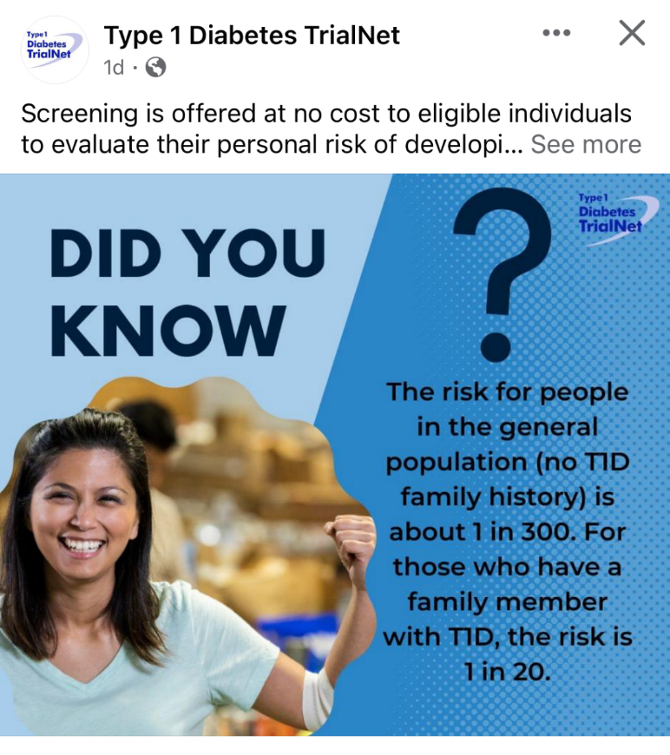

Type 1 ~ Immune Mediated
5-10% of Diabetes
1.5 Million people have type 1 in U.S.
Prevalence increasing:
2001 – 1.48 per 1000 youths diagnosed with diabetes
2017 - 2.15 per 1000 youths diagnosed with diabetes
Incidence & Prevalence increasing
Highest incidence in Finland or Northern Europe.
ADCES In Practice - March 2024 Recent Advances in Type 1 Diabetes: Teplizumab (Tzeild®)
Karen S. Fiano, PHARMD, BCACP, Devada Singh-Franco, PHARMD, CDCES, Young M. Kwon, BS, PHD

Slide 39

Type 1 – 10% of all Diabetes
Auto-immune pancreatic beta cells destruction
Most commonly expressed at age 10 - 14
Insulin sensitive (require 0.5 - 1.0 units/kg/day)
Expression due to a combo of genes and environment:
  Autoimmunity tends to run in families
  Exposure to virus or other environmental factors
Signs can include:
  Increased thirst and hunger
  Frequent urination or new bed-wetting at hs
  Unintended weight loss
  Fatigue and irritability
39
Diagnostic Criteria for Diabetes
Notes:
When you get to the insulin piece, please mention we will get into great detail about insulin in the pharmacotherapy module

Slide 40

Poll 6. What Kind of Diabetes?
AJ, a 29 year old female admitted to the ICU with a blood glucose of 476 mg/dl and a pH of 7.1. (normal pH 7.35-7.45). Lost 13 pounds, BMI 23.
What further testing is needed to determine if person has type 1 or type 2 diabetes?
A. Glutamic acid decarboxylase
B. Beta cells auto antibodies
C. Langerhan’s antibody
D. Endogenous insulin titer

Slide 41

Antibody Testing for Type 1
Glutamic acid decarboxylase (GAD) primary antibody measured
If negative, test islet tyrosine phosphatase 2 (IA-2) and/or zinc transporter 8 (ZnT8) where these tests are available.
In individuals who have not been treated with insulin, antibodies against insulin may also be useful.
5–10% of people with type 1 diabetes do not have antibodies.
  In those diagnosed at <35 years of age who have no clinical features of type 2 diabetes or monogenic diabetes, a negative result does not change the diagnosis of type 1 diabetes,
Rate of type 1 progression depends on:
  age at first detection of autoantibody,
  number of autoantibodies,
  autoantibody specificity, and autoantibody titer.
  Glucose and A1C levels may rise well before the clinical onset of diabetes

Slide 42
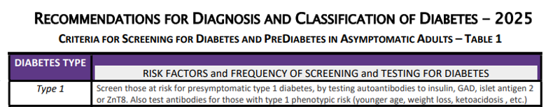
Type 1 Diabetes Progression
 | Stage 1 | Stage 2 | Stage 3
Characteristics | • Autoimmunity | • Autoimmunity | • Autoimmunity
 | • Normoglycemia | • Dysglycemia | • Overt hyperglycemia
 | • Presymptomatic | • Presymptomatic | • Symptomatic
Diagnostic criteria | • Multiple islet autoantibodies GAD, glutamic acid decarboxylase (primary) islet antigen 2, or Zinc transporter 8 (ZnT8) | • Islet autoantibodies Dysglycemia: Elevated IFG and/or IGT • FPG 100–125 mg/dL • 2-h PG 140–199 mg/dL • A1C 5.7–6.4% or ≥10% increase in A1C | • Autoantibodies may disappear over time (5-10% may not express antibodies) • Diabetes diagnosed by standard criteria

Slide 43


Pharmacologic Intervention to Delay Symptomatic Type 1 (in Stage 2)
Teplizumab-Tzield (CD3-monoclonal antibody)
14-day infusion can delay the onset of symptomatic type 1 diabetes (stage 3)
An option in selected individuals aged ≥8 years with stage 2 type 1 diabetes.
In a single trial, 44 individuals received 14-day course of teplizumab vs 32 placebo.
The median time to stage 3 diagnosis of type 1
  48.4 months in tep group
  24.4 months placebo
Cost: $193,000
Provention Bio has financial assist programs.

Slide 44
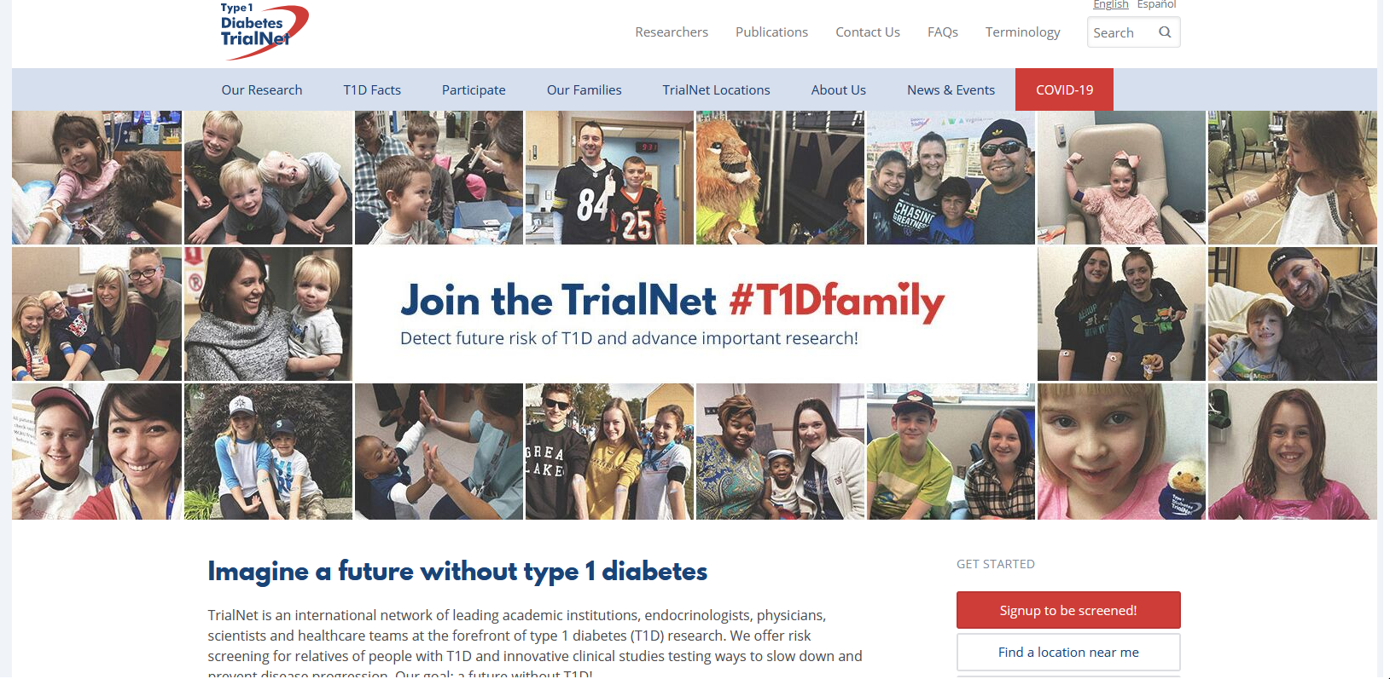
  Type 1 (stage 2) Delayed with Teplizumab by 2 years www.DiabetesTrialNet.org
How to get families linked to screening?

Slide 45

Determine if Type 1 - Use AABBCC Approach
Age
  e.g., for individuals <35 years old, consider type 1 diabetes
Autoimmunity
  e.g., personal or family history of autoimmune disease or polyglandular autoimmune syndromes
Body habitus
  e.g., BMI <25 kg/m2
Background
  e.g., family history of type 1 diabetes
Control
  e.g., level of glucose control on noninsulin therapies
Comorbidities
  e.g., treatment with immune checkpoint inhibitors for cancer can cause acute autoimmune type 1 diabetes or presence of other autoimmune conditions

Slide 46

Type 1 Diabetes Features?
For JR, a 28 admitted to the ICU with a blood glucose of 476 mg/dl, pH of 7.1, anion gap of 15. Recently lost 13 pounds.
Type 1 Most Discriminative Features
Younger than 35 years at diagnosis
Lower BMI (<25 kg/m²)
Unintentional weight loss
Ketoacidosis
Glucose 360 mg/dl or greater.
Misdiagnosis is common and can occur in ∼40% of adults with new type 1 diabetes

Slide 47
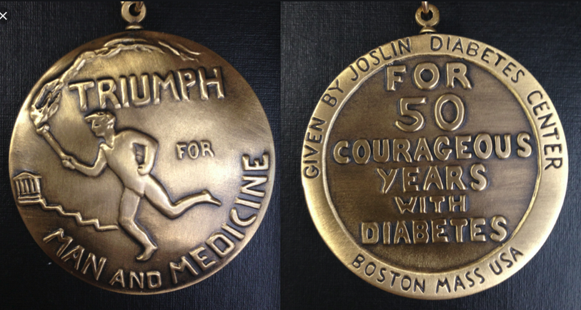

Medalist Study – Harvard Joslin Diabetes Center
After 50 years with diabetes
  Many still produced some insulin
  Many had no eye disease

Slide 48

Beta-Cell Mass Loss
In both type 1 and type 2 diabetes,
genetic and environmental factors can result in the progressive loss of β-cell mass and/or function
that manifests clinically as hyperglycemia.
Once hyperglycemia occurs, people with all forms of diabetes are at risk for developing the same chronic complications, although rates of progression may differ.

Slide 49

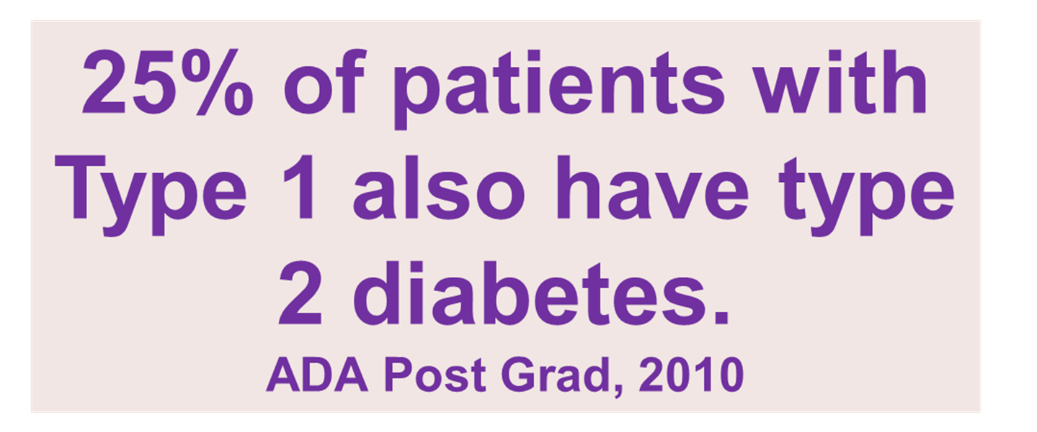
What kind of Diabetes?
MS is 58, states she has had type 1 diabetes for 18 years. Quit smoking a year ago and gained about 20 lbs. BMI 25.
Meds
  Humalog 18-23 units before meals
  Lantus 28 units at bedtime
  Metformin 500mg TID
What tests would you recommend?
people

Slide 50

Type 1 & Type 2 - Double Diabetes?
May be appropriate to recognize a person with type 1 diabetes and features classically associated with type 2 diabetes (e.g., insulin resistance, obesity, and other metabolic abnormalities.
Can help facilitate access to appropriate treatment:
  (e.g., GLP-1 RA or SGLT-2 inhibitor therapies for potential weight and other cardiometabolic benefits) and monitoring systems.

Slide 51
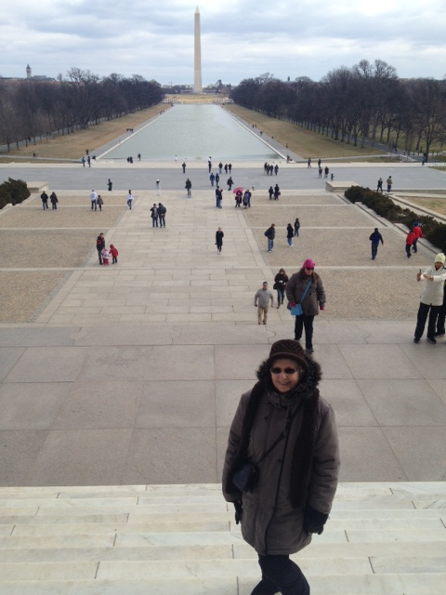
What type of Diabetes?
72 Years old
A1c 3 months prior 6.2%
A1c now 13.9%
BMI 24.5
Lost about 10 pounds over last month

Slide 52

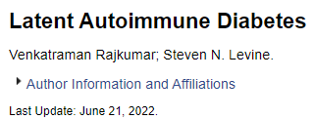
Latent AutoImmunity Diabetes in Adults (LADA)
Antibody positive to 1-2 of below
  GAD-65 autoantibodies
  Insulin Autoantibodies
  Islet Cell antigen-2
  ZnT8
Adult Age at onset
Usually benefit from insulin w/in first 6 months of diagnosis
Early insulin therapy may preserve beta cell function
Diabetes Care 26:536-538, 2003
Jerry P. Palmer, MD and Irl B. Hirsch, MD

Slide 53
LADA Clinical Features Compared to Type 2
Feature LADA Type 2
Age <50 63% 19%
Acute hyperglycemia 66 24
BMI < 25 33 13
Hx of autoimmune dx 27 12
Family hx autoimmune 46 35
Practical Diabetology March 08, Unger MD

Slide 54

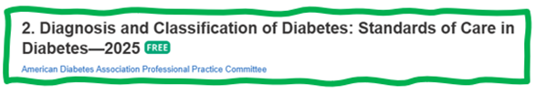
What about Latent Autoimmunity Diabetes in Adults (LADA)
Slowly progressive autoimmune diabetes with an adult onset should be termed:
  LADA or type 1 diabetes.
  Slow autoimmune β-cell destruction can lead to a long duration of marginal insulin secretory capacity.
  For this classification, all forms of diabetes mediated by autoimmune β-cell destruction independent of age of onset are included under the rubric of type 1 diabetes.

Slide 55
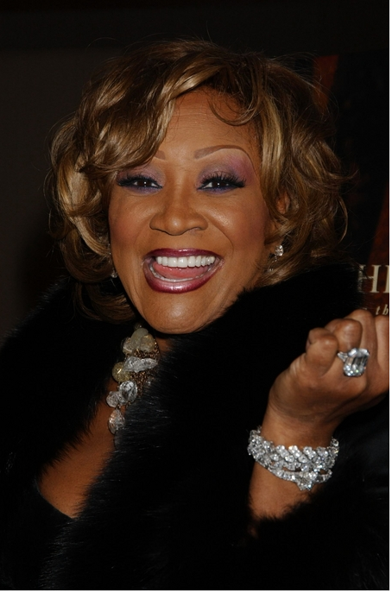
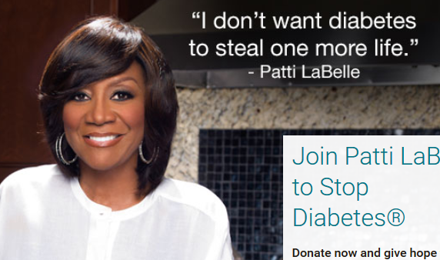
Patti Labelle
"divabetic”
“I have diabetes, it doesn’t have me”

Slide 56

Signs of Diabetes
Polyuria
Polydipsia
Polyphasia
Weight loss
Fatigue
Skin and other infections
Blurry vision
Glycosuria, H₂O losses
Dehydration
Fuel Depletion
Loss of body tissue, H₂O
Poor energy utilization
Hyperglycemia increases incidence of infection
Osmotic changes

Slide 57




Slide 58

What is Type 2 Diabetes?
Complex metabolic disorder ….
  (Insulin resistance and deficiency)
with social, behavioral and environmental risk factors unmasking the effects of genetic susceptibility.
New Diagnosis?
Call 800 – DIABETES to request “Getting Started Kit”
www.Diabetes.org

Slide 59

Ominous Octet
Decreased
satiation neuro-
transmission
Decreased
amylin, β-cell secretion
80% loss at dx
Increased renal glucose reabsorption
Decreased
Gut hormones
Increased glucagon secretion
G
I
G
I
G
G
I
I
G
Increased lipolysis
G
G
I
I
G
G
I
Increase glucose
production
I
G
G
Decreased glucose
uptake
Notes:
59
59

Slide 60
Poll Question 5
FZ is older and lives alone and has CHF. Very concerned about avoiding hypoglycemia, since brother almost died from a hypoglycemic incident. Which medication class would you recommend?
Meglitinides
SGLT-2 Inhibitors
Sulfonylureas
Analog insulins

Slide 61

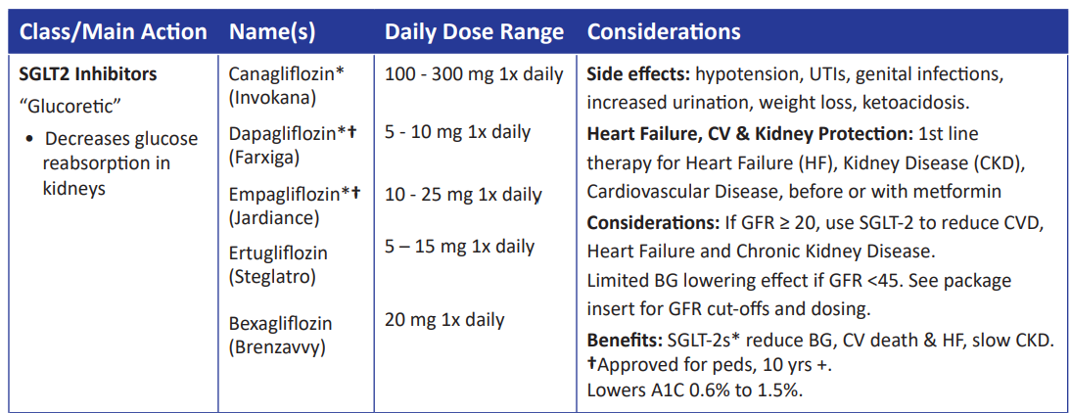
SGLT2 Inhibitors- “Glucoretics”
Action: decreases renal reabsorption of glucose proximal tubule of kidneys (reset renal threshold)
Preferred diabetes treatment for people with heart and kidney failure. Decreases BG & CV Risk.
AWP: ~$650 a month
% ‘f
Notes:
61
61
Thiazolidinediones (TZDs) enhance insulin sensitivity in muscle and adipose tissue by binding to cell receptors,which leads to an increase in glucose transporter expression. TZDs encourage beta cells to respond more efficiently by lowering the amount of glucose and free fatty acids in the bloodstream, both of which are known to be detrimental to insulin secretion. Finally, these drugs reduce glucose production in the liver.
Clinical trials indicate that pioglitazone and rosiglitazone are slightly more effective at reducing A1C (1.5-1.6% reduction) than troglitazone (1.1% reduction).
Some of the beneficial side effects of thiazolidinediones include an increase in HDL cholesterol and reduction of triglyceride concentrations. This class of drugs has also been shown to lower blood pressure and decrease vascular inflammation in vitro. There are clinical studies underway to further examine the cardiovascular benefit to TZDs.
Some adverse effects of TZDs include weight gain, a potential increase in LDL cholesterol levels, and a possible increase in alanine aminotransferase levels (ALT). Because of the risk of weight gain, edema, and increased LDL cholesterol, thiazolidinediones are contraindicated in patients with advanced forms of congestive heart failure. Due to reported cases of liver failure and liver toxicity caused by the increase in ALT levels, TZDs are contraindicated in patients with abnormal liver function.
TZDs are the most expensive of the oral antidiabetic agents.

Slide 62
Let’s Break it Down ADA 2025

Slide 63
SGLT-2i Indications Summary
Drug | Lower BG | Reduce CV Risk? | Use to treat Heart Failure? | Slow renal disease?
Dapagliflozin (Farxiga) | Yes | Yes | Yes +/- Diabetes | Yes
Empagliflozin (Jardiance) | Yes | Yes | Yes +/- Diabetes | Yes
Canagliflozin (Invokana) | Yes | Yes | Yes w/ Diabetes | Yes
Ertugliflozin (Steglatro) | Yes | No | Yes w/ Diabetes | Yes
Bexagliflozin (Brenzavvy) | Yes | NA | NA | NA
Package inserts, dailymed.nlm.nih.gov

Slide 64
Benefits of SGLT-2 Inhibitors
A1C lowering
Weight loss
Cardiovascular
Renal
Heart failure
Blood pressure lowering

Slide 65
Side Effects of SGLT-2 Inhibitors
Genitourinary infections
Volume depletion
Increased urination
Hypotension
UTI
Diabetes ketoacidosis (DKA)
Amputation risk? Fournier’s gangrene?
Notes:
Cana: bone mineral density decline: hip ≤1%; lumbar spine, femoral neck, and distal forearm <1%
UTI: 6%Genito infection: 11-12%
Increased serum K+: 9-27%
Amputation risk
Emgag: UTI: females 18%, males 4%
Genito infection: 5%
Dapag: UTI: 6%, genito infection: 3%

Slide 66

“Getting diabetes saved my life.”
~ Sherri Sheperd
Sherri Shepard decided to embrace diabetes and use it as a motivator to improve her health.

Slide 67
Comparison of Type 1,Type 2, LADA
Type 1
Type 2 LADA
Excess weight
x
xxx x
Insulin dependence
xxx
30% 6mos
Respond to oral agents
0
xxx x
Ketosis
xxx
x x
Antibodies present
xxx
0 xx
Typical Age of onset
teens
adult adult
Insulin Resistance
0
xxx
x

Slide 68

Other Types of Diabetes
Other specific types of diabetes
Gestational

Slide 69

Other Specific Types of DM
Medications such as: steroids, protease inhibitors and Prograf®
Secondary to Agent Orange
Liver failure
TPN or tube feedings
Diabetes Type 3c
  Cystic fibrosis, pancreatitis
  Pancreatic cancers or removal
  Hemochromatosis

Slide 70
Type 3c Diabetes (Pancreatogenic)
Includes both structural and functional loss of insulin secretion in the context of exocrine pancreatic dysfunction.
About 5-10% of diabetes, often misdiagnosed as type 2 diabetes.
The diverse set of etiologies includes:
  pancreatitis (acute and chronic) ~70%
  trauma or pancreatectomy
  neoplasia
  cystic fibrosis
  hemochromatosis
  fibrocalculous pancreatopathy
  rare genetic disorders, and idiopathic

Slide 71
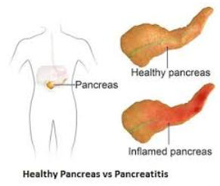
Pancreatitis
People with diabetes 2xs risk of acute pancreatitis
After episode of pancreatitis, one third of people will get prediabetes or diabetes
  About 25% to 80% of people with chronic pancreatitis develop Type 3c diabetes.
Pancreatitis is an exocrine dysfunction:
  Disrupts global architecture or physiology of pancreas
  Results in both exocrine and endocrine dysfunction.

Slide 72

Screening in early Pregnancy
Check glucose levels before 15 weeks of gestation:
  Can find undetected diabetes or hyperglycemia
  Prevent fetal exposure to hyperglycemia
  Allows providers and pregnant people to take action to prevent complications
Use standard diabetes diagnostic criteria.
  If positive, diagnosis “Diabetes complicating pregnancy”
If fasting BG 110+ or A1C 5.9%+
  At higher risk of adverse outcomes and more likely to experience GDM and need insulin.

Slide 73

Gestational Diabetes and Pregnancy
Test for GDM at 24-28 weeks
Test GDM women for post partum diabetes at 4-12 weeks, using OGTT
Women with GDM need lifelong screening for prediabetes/diabetes at least every 3 yrs
Women with hx of GDM, found to have prediabetes need intensive lifestyle interventions or metformin to prevent diabetes.

Slide 74
DiaBingo
B Frequent skin and yeast infections
B A BMI of ____ or greater indicates increased pre/diabetes risk?
B To reduce complications, control A1c, Blood pressure, Cholesterol
B PreDiabetes – fasting glucose level of ___ to ____
B Erectile dysfunction indicates greater risk for ____
B Diabetes – fasting glucose level____ or greater
B Type 1 diabetes is best described as an ______ disease
B People with diabetes are ______ times more likely to die of heart dx
B Elevated triglycerides, < HDL, smaller dense LDL
B Each percentage point of A1C = _____ mg/dl glucose
B At dx of type 2, about __% of the beta cell function is lost
B Diabetes – random glucose ____ or greater

Slide 75

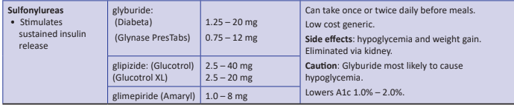
Sulfonylureas - Secretagogues or “Squirters”
Mechanism: Stimulate beta cells to release insulin
Dosed 1-2x daily before meals
Adverse effects
  Hypoglycemia, Weight gain, watch renal function
Low cost, $12 for 3 months supply
Can help with glucose toxicity, lowers A1C 1-2%
Notes:
CAROLINA tral (linagliptin vs glimepiride)
Meta-analysis: In type 2 diabetes, the use of sulfonylureas is associated with increased mortality and a higher risk of stroke

Slide 76

Reducing Hypoglycemia
Which are the only diabetes meds that directly cause hypoglycemia?
Insulin
Secretagogues (sulfonylureas, glitinides)

Slide 77
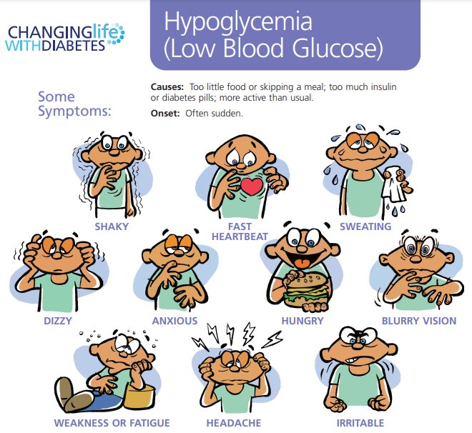
Hypoglycemia – A Big Deal

Slide 78

Hypoglycemia (Glucose) Alert Values
BG <70mg/dl – Level 1
Follow 15/15 rule and contact provider to make needed changes. At increased hypo risk.
BG < 54mg/dl – Level 2
Indicates serious hypo. Reassess BG Goals. Consider med decrease. Predictive of Level 3 Hypo. Needs Glucagon Emergency Kit
Severe Hypoglycemia – Level 3
Altered mental, physical functioning.
Requires external assistance – no threshold

Slide 79
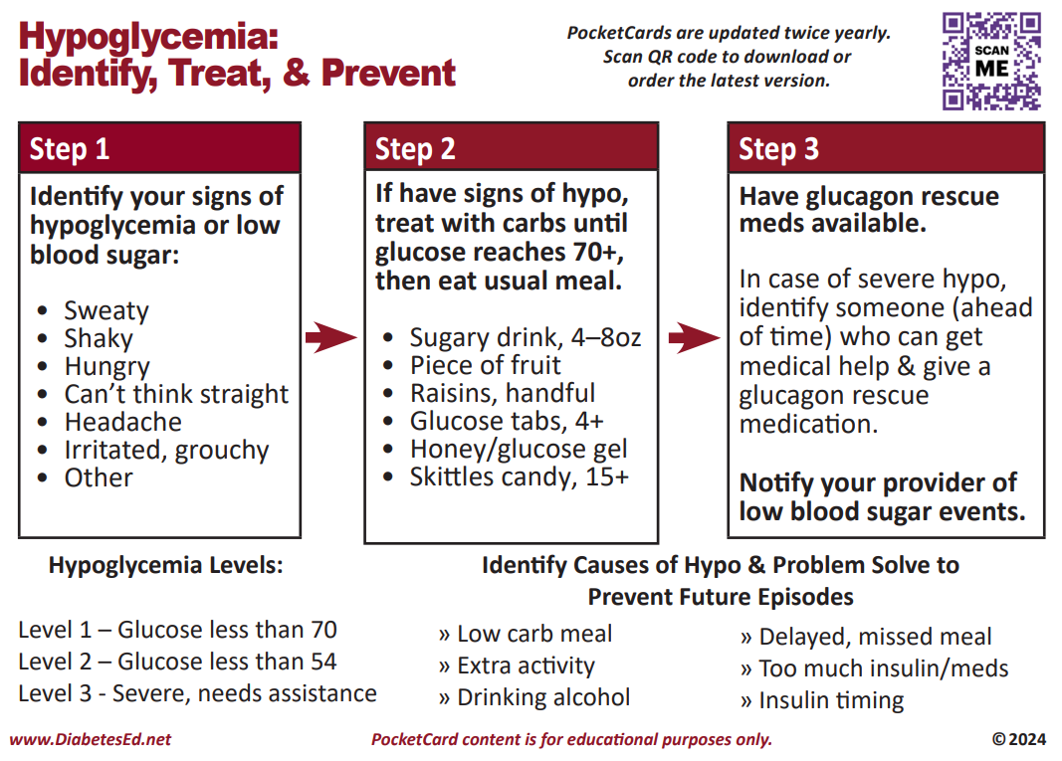
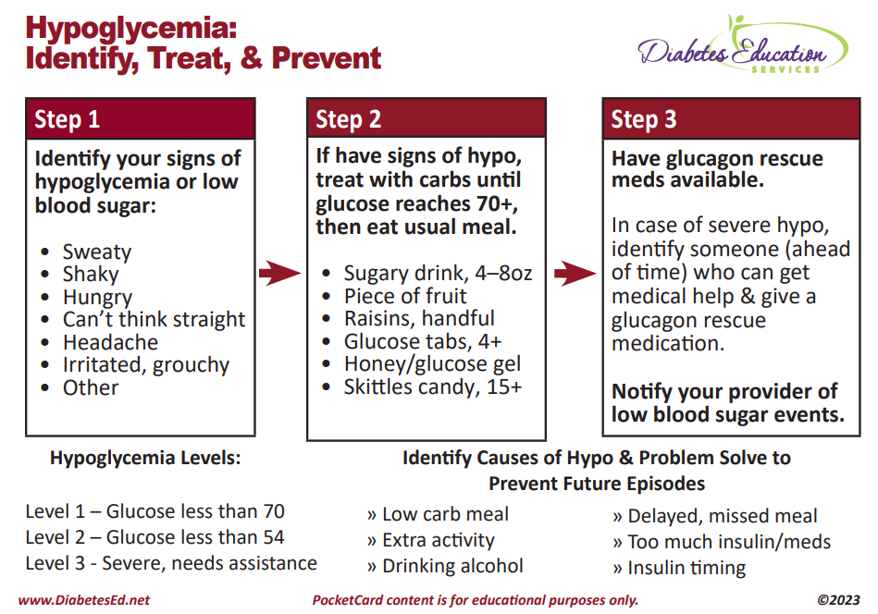

Slide 80
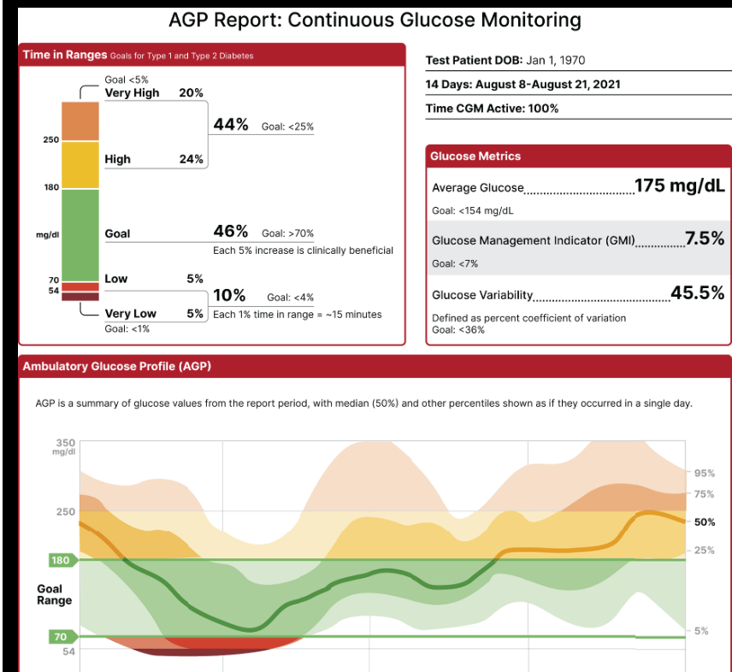

Slide 81
Hypo Marker of CV Events & Mortality
Severe hypoglycemia a potent marker of high absolute risk of cardiovascular events and mortality.
HCP need to be vigilant in preventing hypoglycemia.
Avoid aggressively attempting to achieve near-normal A1C levels if such goals cannot be safely and reasonably achieved.

Slide 82
SDOH and Hypoglycemia
Food insecurity, housing instability, underinsured, under-resourced living areas is associated with increased risk of hypoglycemia-related emergency department visits
Identify if fasting part of religious observances
Young children and older adults at highest risk
Insulin pumps with automated low-glucose suspend and automated insulin delivery systems have been shown to be effective in reducing hypoglycemia in type 1 diabetes

Slide 83

Assess for Hypo
Review history of hypoglycemia at every clinical encounter for all individuals at risk for hypoglycemia
Evaluate hypoglycemic events
Screen for impaired hypoglycemia awareness at least annually.
Consider individual’s risk for hypoglycemia when selecting diabetes medications and glycemic goals.
Use of CGM is beneficial and recommended for individuals at high risk for hypoglycemia.

Slide 84
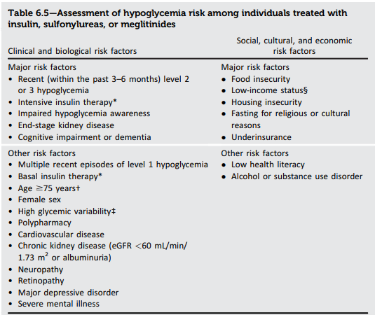
Hypoglycemia: Clinical Risk Factors

Slide 85

Tx of Level 2 & 3 Hypoglycemia
If can swallow w/out risk of aspiration, try gel, honey, etc. inside cheek
If unable to swallow, D50 IV or Glucagon
Glucagon injection (need Rx)
  Inform and instruct caregivers, school personnel, family, coworkers of hypo signs and appropriate action
  Dosing: Adults 1mg, Children <20kg 0.5mg
  Glycemic effect 20 - 30mg, short lived
  Must intake carb as soon as able
If on Insulin or level 2 or 3 hypo, (<54), get Glucagon ER Kit. Re-evaluate diabetes med treatment plan.

Slide 86
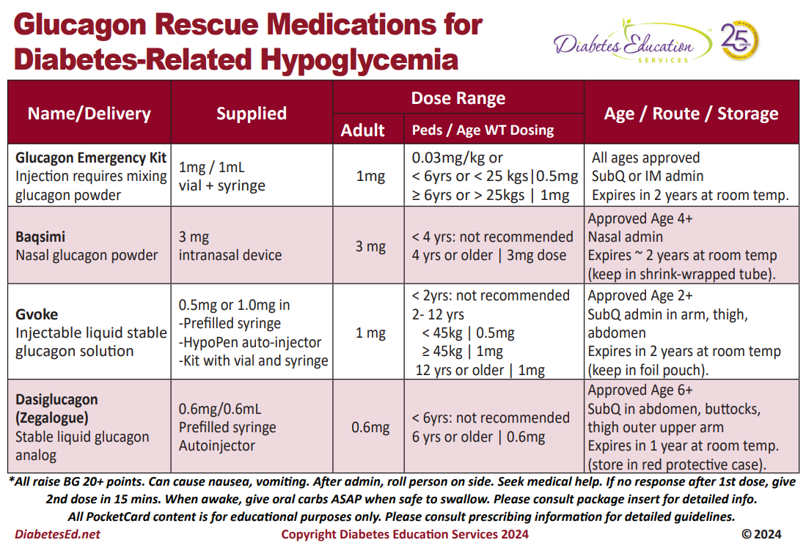

Slide 87


Poll Question 6
JL is 78 and drinks a “few cocktails” every night. Lives with partner and takes basal insulin at night and bolus insulin as needed. Has had a few low blood glucose levels in past week of 62, 49 and 51. What is the most important recommendation?
A. Decrease alcohol intake
B. Check BG at least 4 times a day.
C. Double check injection sites.
D. Get glucagon rescue medication.

Slide 88
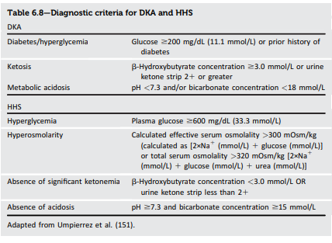
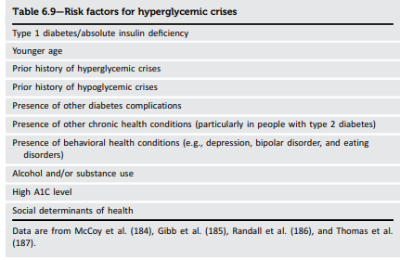
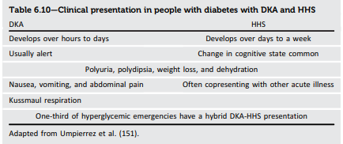
Hyperglycemic Crisis

Slide 89
HHS DKA EDKA
Labs | HHS | DKA
Glucose | 600+ | 200+
Beta-hydroxybutyrate | <3 | 3+
Urine ketones | <2 | 2+
Blood pH | 7.3+ | <7.3
Bicarb | 15+ | <18
Serum osmolality | 300+
Anion gap (if used) | <12 | >12
EDKA
<200
3+
2+
<7.3
<18
>12
Usually >60 yrs old
> 5 days symptoms
Glucose >600
Beta-hydroxybutyrate <3, urine ketones <2
pH normal 7.3+
Bicarb more than 18
Serum osmolality 300 +
Usually type 2
Anion Gap < 12
10 - 20% mortality
Usually < 40 yrs old
< 2 days symptoms
Glucose 200+ or anyone with diabetes
Beta-hydroxybutyrate 3.0 + or Urine ketone of 2+
pH less than 7.3
Bicarb less than 18 mmol/L
Serum osmolality 300 +
Usually type 1
Anion Gap > 12
3 – 10% mortality
ADA/EASD/AACE 2024 Hyperglycemic Crises in Adults Consensus Report – From Level 2 Hyperglycemic Crisis

Slide 90

Quick Question 7
JZ is excited about his A1c of 5.4%. He takes rapid acting insulin 4-6 times a day using a pen to keep his BG to target. Plus, adjusts glargine as needed if his pm BG is elevated. What is your biggest concern?
A. Does he change his needle each time?
B. Why is he adjusting glargine?
C. Is he adjusting insulin for exercise?
D. How many hypoglycemic events per week?

Slide 91


8. Obesity and Weight Management for Prevention & Treatment of Type 2 Diabetes
Use person centered language that fosters collaboration
Once a year, monitor obesity-related anthropometric measurements to inform treatment considerations
  BMI, waist circumference, waist-to-hip-ratio and waist to-height-ratio
Be sensitive and allow for privacy when weighing

Slide 92

Weight Stigma
Weight stigma, fat bias, and anti-fat bias are ways to describe the bias toward people living in larger bodies.
Fat bias is prevalent among health care professionals and general public.
Health care professionals are strongly encouraged to increase their awareness of implicit and explicit weight-biased attitudes.
Increasing empathy and understanding about the complexity of weight management among health care professionals is a useful avenue to help reduce weight bias.

Slide 93
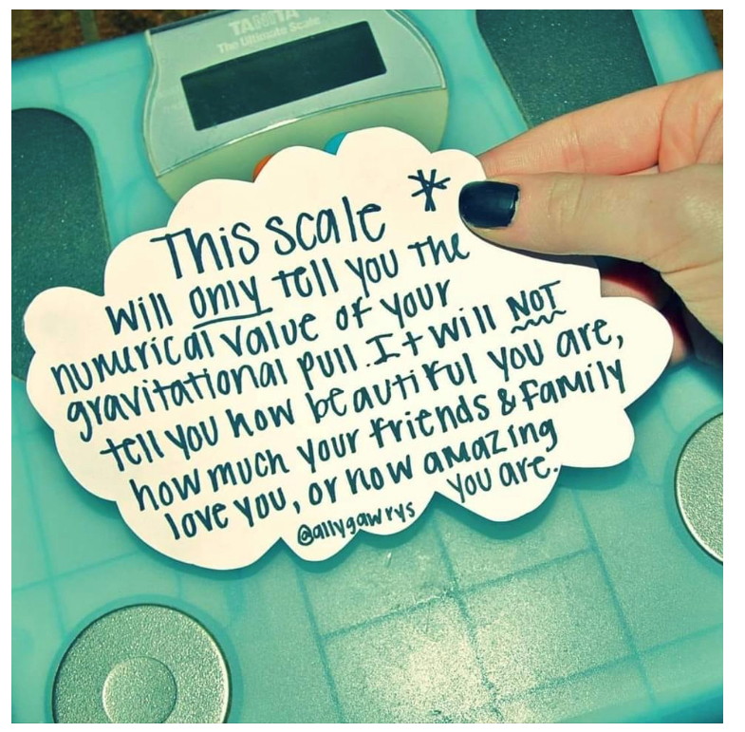
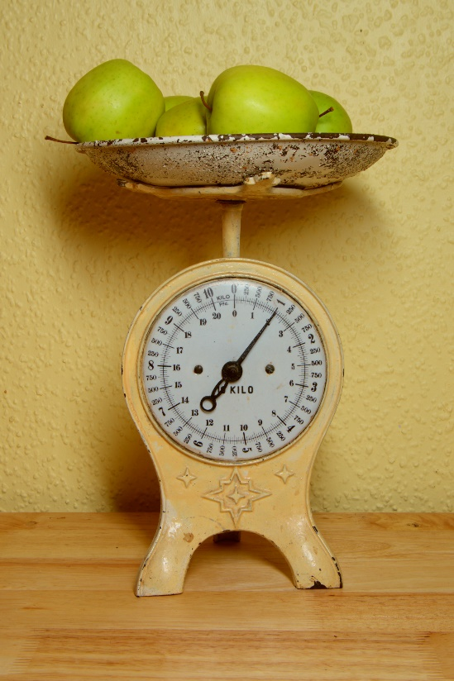
Weight is a Heavy Issue

Slide 94

Medical Nutrition Therapy Works
MNT is effective and beneficial to people with diabetes.
When delivered by an RDN, MNT is associated with A1C absolute decreases of
  1.0–1.9% for people with type 1 diabetes and
  0.3–2.0% for people with type 2 diabetes

Slide 95
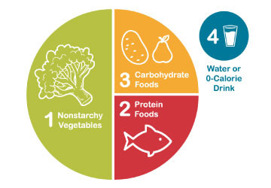
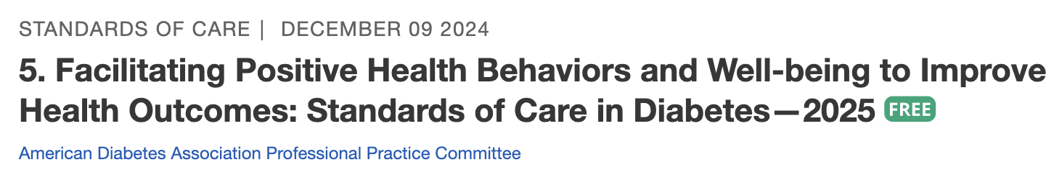
Healthy Eating Patterns/Approaches
Eating Patterns:
Total Foods Consumed
Mediterranean Diet
Plant based eating
DASH (Dietary Approaches to Stop Hypertension)
Low Carbohydrate
Eating Approach:
Tools for developing an eating pattern
Diabetes Plate Method
Carbohydrate Counting
Individualized behavioral approaches
Use Integrative food-based approach. “People eat food, not nutrients”.
Notes:
The standards of care call out the importance of understanding different terms in nutrition including eating patterns, meal plan or dietary approach.
Eating pattern the totality of the foods we consume over a time period. Examples include……
A Meal Plan is an individualized and created by an RDN and is
Dietary or Eating approach is the strategy or tool used to support implementation of healthy eating patterns.
There is no one pattern that is better than another so we work with the individual with diabetes to determine an effective eating pattern and approach.
The 2025 Standards of Care have added much detail about considering approaches that take into account religious fasting or other new concepts of intermittent fasting or chrononutrition

Slide 96
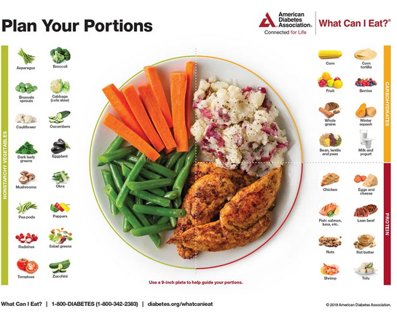
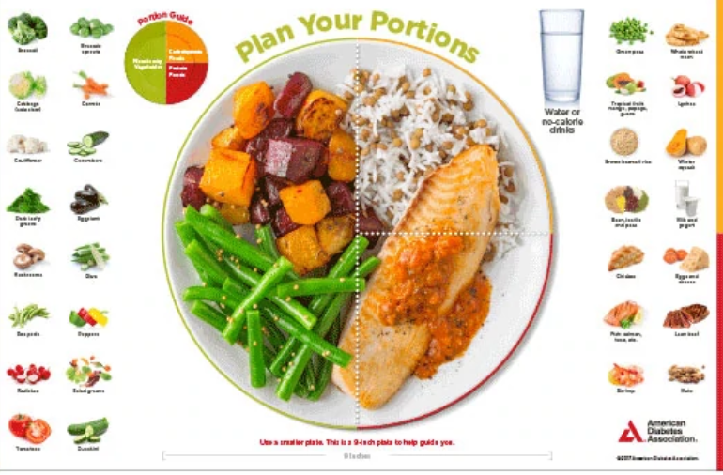



Plate example

Slide 97

Assessing Malnutrition
At Risks Groups:
  Individuals on GLP-1 or GIP RA or after metabolic surgery
  Individuals with multiple chronic conditions
  Older age groups
  Food insecurity and poverty
Screen:
  For malnutrition and sarcopenia
Recommend:
  Whole- food-based eating pattern
  Adequate protein
  Resistance training
Malnutrition is defined by the World Health Organization as “deficiencies, excesses, or imbalances in a person’s intake of energy and/or nutrients.”
Notes:
New this year the ADA calls out the importance of screening for malnutrition.
We frequently screen for malnutrition in individuals who are underweight or in hospital settings but starting BMI and desire for weight loss does to prevent malnutrition risk.
Individuals on incretin therapies or have had metabolic surgery and have experienced significant weight loss of > 20% or more than 4 kg (or about 9 pounds) should be screened for malnutrition. (Simplified Nutritional appetite Questionaries and Malnutrition Universal Screening tool).

Slide 98

Incretins: GLP & GIP Receptor Agonists
GLP-1: glucagon like peptide 1
GIP: glucose-dependent insulinotropic polypeptide

Slide 99

Actions of GLP-1 and GIP
Samms RJ, Coghlan MP, Sloop KW. How May GIP Enhance the Therapeutic Efficacy of GLP-1? Trends Endocrinol Metab. 2020 Jun;31(6):410-421.
Notes:
GIP: Glucose-dependent Insulinotropic Polypeptide
GLP: glucagon-like peptide

Slide 100

Pocket Card: GLP-1 & GIP RA
Notes:
Update with exenatide indication in pediatrics.

Slide 101

Counseling Points: GLP-1 RA & GLP-1/GIP
Avoid if personal or family history of medullary thyroid cancer
Avoid in combo with DPP-4 inhibitors
Watch for intestinal obstruction
Use of non-FDA compounded products not recommended
Avoid with history pancreatitis
If on tirzepitide, use back up contraception for first 4 weeks
Ask about recent eye exam
  Potential increase in diabetes retinopathy
Sudden discontinuation of semaglutide and tirzepitide results in regain of one-half to two-thirds of the weight loss within 1 year. Consider trying lowest effective dose, using intermittent therapy, or stopping medication followed by close weight monitoring.
Notes:
Inject at room temperature, let alcohol fully dry

Slide 102
Poll Question 8
AR is 36 years old with type 2 diabetes and a BMI of 41kg/m². Current diabetes medications include: metformin, sitagliptin (Januvia) and empagliflozin (Jardiance) at maximum doses. AR is prescribed tirzepatide (Mounjaro). Based on this information, what action do you recommend to the provider?
Verify kidney function first.
Stop the sitagliptin when initiating tirzepatide.
Decrease the dose of metformin to prevent hypoglycemia.
Evaluate thyroid function before starting tirzepatide.
Notes:
Answer is B.

Slide 103
Let’s Break it Down ADA 2025

Slide 104
GLP-1/GIP Receptor Agonist Indications
“Recent clinical trial suggests that the GLP-1 RA semaglutide has beneficial effect on CVD, mortality, and kidney outcomes among people with CKD - recommend that semaglutide be used as another first-line agent for people with CKD”.
Drug | Lower BG | Reduce CV / Kidney Risk? | Wt loss approved?
Exenatide IR (Byetta) Lixisenatide (Adlyxin) Semaglutide (Rybelsus) | Yes
Exenatide ER (Bydureon) | Yes for 10 yrs and older
Dulaglutide (Trulicity) | Yes for 10 yrs and older | Yes
Semaglutide (Ozempic) | Yes | Yes Kidney protective | Yes Wegovy 2.4mg
Liraglutide (Victoza) | Yes for 10 yrs and older | Yes | Yes Saxenda 3mg
Tirzepatide (Mounjaro) | Yes | ? | Yes, Zepbound up to 15 mg
Package inserts, dailymed.nlm.nih.gov

Slide 105
GLP-1 /GIPs Approved for Weight Loss
Liraglutide:
  Victoza 1.8 mg (diabetes)
  Saxenda 3 mg (wt loss)
  6% wt loss, $1349 a mo
Semaglutide:
Ozempic 2mg (diabetes)
  Wegovy 2.4mg (wt loss)
  6% wt loss, $1349 a mo
Tirzepatide
  Mounjaro 15mg (diabetes)
  Zepbound (wt loss)
  13% wt loss - $1056 a mo
All 3 Approved for use in adults with a:
  BMI of ≥ 30 or
  BMI of ≥ 27 or greater who have hypertension, type 2 diabetes, or dyslipidemia.

Slide 106
Metabolic Surgery Stats
Surgical Treatment and Medications Potentially Eradicate Diabetes Efficiently (STAMPEDE) trial, randomized 150 participants with diabetes to receive either metabolic surgery or medical treatment.
  A1C of 6.0% or lower after 5 years - 29% of those treated with RYGB and 23% treated with vertical sleeve gastrectomy (vs 5% med mgmt)
  Avg wt loss 25 -30% plus decreased CV mortality & improved QoL
Erosion of diabetes remission over time
  at least 35–50% of individuals who initially have remission eventually experience recurrence.
  Median disease-free period among such individuals following RYGB is 8.3 years
  Majority of those who undergo surgery maintain substantial improvement of glycemia from baseline for at least 5–15 yrs
Metabolic surgery, which results in an average >20% body weight loss, greatly improving glycemia and often leading to remission of diabetes, improved quality of life, improved cardiovascular outcomes, and reduced mortality

Slide 107

Exercise Standards
Adults – 150 min/wk moderate intensity
  over 3 days a week.
  Don’t miss > 2 consecutive days w/out exercise
  Get up every 30 mins - Reduce sedentary time
  Flexibility and balance training 2-3 xs a week (Yoga and Tai Chi)
  T1 and T2 – resistance training 2 -3 x’s a week

Slide 108

A hard truth
Exercise alone doesn’t cause weight loss
But….
  It helps keep weight off
  Decreases visceral adiposity
  Decreases CV Risk
To combat the rise in body weight, we need to change the food environment
“You cannot outrun an unhealthy diet”.

Slide 109


Where are we on this continuum?

Slide 110
Good Exercise Info / Quotes
“Passagiata” – take an after meal stroll
Exercise decreases A1C 0.7%
No change in body wt, but 48% loss in visceral fat.
“Every minute of activity lowers blood sugar one point.”
“I don’t have time to exercise, I MAKE time.”

Slide 111

6. Glycemic Goals & Hypo
  A1C
  Blood Pressure
  Cardiovascular risk reduction

Slide 112

6. Glycemic Targets for Non-Pregnant Adults
  A1c < 7% - a reasonable goal for adults.
  A1c < 6.5% - for those without significant risk of hypoglycemia
  A1c < 8% - for those with history of hypoglycemia, limited life expectancy, or those with longstanding diabetes and vascular complications.
  A1c Check Frequency:
    If meeting goal - At least 2 times a year
    If not meeting goal – Quarterly
  Also review Ambulatory Glucose Profile

Slide 113
6. Glycemic Targets
Individualize Targets – ADA
  Pre-Prandial BG 80- 130
  1-2 hr post prandial < than 180
    *for nonpregnant adults
  Time in Range: 70%
    BG of 70-180 mg/dL

Slide 114


A1c and Estimated Avg Glucose (eAG)
A1c (%) eAG__
5 97 (76-120)
6 126 (100-152)
7 154 (123-185)
8 183 (147-217)
9 212 (170 -249)
10 240 (193-282)
11 269 (217-314)
12 298 (240-347)
eAG = 28.7 x A1c-46.7 ~ 29 pts per 1%
Translating the A1c Assay Into eAG – ADAG Study

Slide 115

Ambulatory Glucose Profile
Standardized report with visual cues for those on CGM devices
Evaluate Time in Range (TIR)
  Target 70-180 mg/dl (70% of time)
  Eval % time below goal
    < 70 (less than 4% of time)
    <54 (less than 1% of time)
  Eval % time above > 180 (less than 25% of time)
  Eval % time above > 250 (less than 5% of time)
For those with frailty or at high risk of hypoglycemia recommend:
- Target of 50% time in range
- Less than1% time below range

Slide 116

(
American Diabetes Association Dia Care 2022 6.2 45- S89
Table 6.2
Notes:
Patient and disease factors used to determine optimal glycemic targets. Characteristics and predicaments toward the left justify more stringent efforts to lower A1C; those toward the right suggest less stringent efforts. A1C 7% = 53 mmol/mol. Adapted with permission from Inzucchi et al. (59).

Slide 117

“The highest form of wisdom is kindness.”
The Talmud

Slide 118
ADA 2025 Summary for Exams
A1c less than 7% (individualize)
Pre-meal BG 80-130
Post meal BG <180
Time in Range (70-180) 70% of time
Blood Pressure
<130/80
Cholesterol
Statin therapy based on age & risk status
If 40+ with ASCVD Risk, decrease LDL by 50%, LDL <70
If 40+ with ASCVD, decrease LDL by 50%, LDL <55

Slide 119
DiaBingo- G
G ADA goal for A1c is less than ____%
G People with DM need to see their provider at least every month
G Blood pressure goal is less than
G People with DM should see eye doctor (ophthalmologist) at least
G The goal for triglyceride level is less than
G Goal for LDL cholesterol for people 40+ with diabetes is _________
G The goal for blood sugars 1-2 hours after a meal is less than:
G People with DM should get this shot every year
G People with DM need to get urine tested yearly for ___________
G Periodontal disease indicates increased risk for heart disease
G The goal for blood sugar levels before meals is:
G The activity goal is to do ___ minutes on most days

Slide 120



Chronic Kidney Disease– 2025 Update
  Optimize glucose and BP to protect kidneys.
  Use SGLT-2 with demonstrated benefit to reduce CKD and CVD*
  To reduce CV risk and CKD, use a GLP-1* with demonstrated benefit.
  In people with CKD and albuminuria, a nonsteroidal MRA effective if GFR 25+
  Aim to reduce urinary albumin by ≥30% in people with CKD
    *SGLT-2i’s
      Empagliflozin (Jardiance), canagliflozin (Invokana), dapagliflozin (Farxiga)
    *GLP-1 RA’s
      Semaglutide (Ozempic), liraglutide (Victoza), dulaglutide (Trulicity)

Slide 121

Standard 11 – Protect Kidneys
Diabetes with CKD
- GFR ≥20
Start SGLT2 to reduce chronic kidney disease progression and cardiovascular events.
Also consider GLP-1 RA – (ie semaglutide)
If type 2 diabetes and established Chronic Kidney Disease (CKD)
  Start nonsteroidal mineralocorticoid receptor antagonist (finerenone) and/or GLP-1 RA recommended for cardiovascular risk reduction.

Slide 122
Let’s Break it Down ADA 2025

Slide 123

Poll Question 9
JR is newly diagnosed with type 2. A1C is 7.9. GFR is 63. UACR 26 mg/g. History of CHF. According to 2025 ADA Standards, what med along with lifestyle should be started first?
  a. Only Metformin, since A1C is close to target.
  b. Metformin or SGLT-2
  c. Sulfonylurea
  d. GLP-1 or Metformin

Slide 124

Finerenone Resource

Slide 125

Kidney Goals and MNT
In people with chronic kidney disease with UACR ≥300 mg/g
Goal is a reduction of 30% or greater in mg/g urinary albumin to slow chronic kidney disease progression
Nutrition Recommendations
For people with non–dialysis-dependent stage 3 or higher chronic kidney disease
  dietary protein intake aimed to a target level of 0.8 g/kg body weight per day.
For those on dialysis,
  consider protein intake of 1.0–1.2 g/kg/day since protein energy wasting is a major problem in some individuals on dialysis
Refer to nephrology
  If GFR < 30 or uncertain CKD etiology

Slide 126
A 67 yr old man, smokes ppd
A1c 8.9% (down from 10.4%)
B/P 139/76 AM BG 100, 2 hr pp 190
Chol – TG 54, HDL 46, LDL 98
GFR 47, UACR 34 mg/g
Meds:
  Insulin – 28 units basaglar insulin
  Losartan 25mg – ARB for blood pressure
  Metoprolol 50mg – Beta blocker
  Glyburide 5mg BID - Sulfonylurea
Any special instructions?
Any meds missing?
Stop any meds?
  Special instruction – sweating may indicate hypoglycemia

Slide 127

10. Cardiovascular Disease and Risk Management
Higher risk of Atherosclerotic cardiovascular disease (ASCVD):
  history of acute coronary syndrome,
  myocardial infarction (MI),
  stable or unstable angina,
  coronary or other arterial revascularization,
  stroke, transient ischemic attack,
  or peripheral artery disease (PAD) including aortic aneurysm.
Plus 2x’s risk of Heart Failure
Leading cause of morbidity and mortality in people with diabetes
Large benefits are seen when multiple CV risk factors are addressed simultaneously
With more aggressive goals, rates of CVD have decreased.
CV Risks predicted to increase in future.

Slide 128


Slide 129

Cardiac and Renal Disease
The combination of 3 comorbidities has been termed cardiorenal metabolic disease or cardiovascular-kidney-metabolic health
  ASCVD, heart failure, and chronic kidney disease (CKD)
Recognized interrelationship of cardiometabolic risk factors leading to cardiovascular disease and adverse kidney outcomes in people with diabetes.
  3 comorbidities frequently associated with metabolic risk factors & extra weight
  Incidence of all three conditions rises with increasing A1C levels.

Slide 130


Slide 131

Assess ASCVD and Heart Failure Risk Yearly
Duration of diabetes & 55+
BMI
Hypertension
Dyslipidemia
Smoking
Family history of premature coronary disease
Chronic kidney disease – presence of albuminuria
Treat modifiable risk factors as described in ADA guidelines.

Slide 132

BP Treatment in addition to Lifestyle
First Line B/P Drugs if 130/80 +
  With albuminuria or ASCVD
    Start either ACE or ARB*
  No albuminuria - Any of the 4 classes of BP meds can be used:
    *ACE Inhibitors, *ARBs, *thiazide-like diuretics or calcium channel blockers.
    *Monitor K+ 7-14 days after start/annually
  Avoid ACE and ARB at same time
  Multiple Drug Therapy often required
If B/P ≥ 150 /90 start 2 drug combo
*Albuminuria = Urinary albumin creatinine ratio of 30+

Slide 133


Lipid and HTN Meds Cheat Sheets
Website: https://diabetesed.net/coach-bevs-diabetes-cheat-sheets/
On CDCES Coach App too
For exam, know major classes, when used, side effects and considerations.

Slide 134

Hypertension Management

Slide 135

Poll Question 10
RZ is 47 years old with type 2 diabetes and hypertension. RZ takes metformin 1000 mg BID, plus lisinopril 20mg daily. RZs LDL is 130 mg/dL. Based on the most recent ADA Standards, what is the LDL Cholesterol target for RZ?
LDL less than 100 mg/dL.
Lower LDL by 30%.
LDL target of 65 mg/dL or less.
Determine LDL target based on ASCVD risk.

Slide 136

Lipid Goals – Primary Prevention
For people with diabetes aged 40–75:
No ACSVD Risk – Start Moderate intensity statin
Higher cardiovascular risk*
  (*HTN, Smoke, CKD, BMI 30+ albuminuria, family hx ACSVD)
  High-intensity statin therapy is recommended
Reduce LDL cholesterol by at least 50% of baseline AND
Target LDL cholesterol <70 mg/dL.
If LDL cholesterol 70 +
  it may be reasonable to add ezetimibe or a PCSK9 inhibitor to maximum tolerated statin therapy.

Slide 137
Statin Dosing
High Intensity:
Lowers LDL ≥50%
Moderate Intensity:
Lower LDL 30-<50%
  Lipitor (atorvastatin)
    40-80mg
  Crestor (rosuvastatin)
    20-40mg
  Lipitor (atorvastatin)
    10-20mg
  Crestor (rosuvastatin)
    5-10mg
  Zocor (Simvastatin)
    20-40mg
  Pravachol (pravastatin)
    40 – 80mg
  Mevacor (lovastatin) 40 mg
  Lescol (fluvastatin) XL 80mg
  Livalo (pitavastatin) 2-4mg
***If person can’t tolerate intended statin dose, use maximally tolerated dose

Slide 138


Lipid Goals for People with ASCVD
For people of all ages with diabetes and atherosclerotic cardiovascular disease:
  Add high-intensity statin to lifestyle therapy.
  Reduce LDL cholesterol by 50% or greater from baseline with LDL cholesterol goal of <55.
  Addition of ezetimibe or a PCSK9 inhibitor with proven benefit in recommended if goal is not achieved on maximum tolerated statin therapy.

Slide 139

From Meds Cheat Sheet Page

Slide 140



Lipid Therapy in Diabetes by Age 10.3
*Bempedoic acid, a novel LDL cholesterol–lowering agent acting in the same pathway as statin but without activity in skeletal muscle, which limits the muscle-related adverse effects, lowers LDL cholesterol levels by 15% for those on statins and 24% for those not taking statins (140). Use of this agent with ezetimibe results in an additional 19% reduction in LDL cholesterol
75 years or older and already on statin
  it is reasonable to continue statin treatment.
75 years or older
  it may be reasonable to initiate moderate-intensity statin therapy after discussion of potential benefits and risks.
All ages 20+ with ASCVD, add high-intensity statin to lifestyle
20–39 and additional ASCVD risk factors
  may be reasonable to initiate statin therapy in addition to lifestyle.
40-75 years
  Moderate to high intensity statin based on risk (see previous slides)
(Nexlizet) 180mg
Zetia or Praluent & Repatha

Slide 141

Coronary Vessel Disease Meds
In those with CVD or at higher risk:
  Get blood glucose to goal
  Statin therapy with addition of ezetimibe or a PCSK9 inhibitor recommended if goals not achieved on maximum tolerated statin therapy.
  B/P Med (ACE or ARB)
  Beta blocker after MI or CHF
  Aspirin (or another agent)
  Diabetes Meds that significantly decrease CV events:
    *SGLT-2i’s
      Empagliflozin (Jardiance), canagliflozin (Invokana), dapagliflozin (Farxiga)
    *GLP-1 RA’s
      Semaglutide (Ozempic), liraglutide (Victoza), dulaglutide (Trulicity)

Slide 142
A 67 yr old man, smokes ppd
A1C 8.9% (down from 10.4%)
B/P 139/76 AM BG 100, 2 hr pp 190
Chol – TG 54, HDL 46, LDL 98
GFR 47, UACR 34 mg/g
Meds:
  Insulin – 28 units basaglar insulin
  Losartan 25mg – ARB for blood pressure
  Metoprolol 50mg – Beta blocker
  Glyburide 5mg BID - Sulfonylurea
Any special instructions?
Any meds missing?
Stop any meds?

Slide 143
A 67 yr old man, smokes ppd
A1c 8.9% (down from 10.4%)
B/P 139/76 AM BG 100, 2 hr pp 190
Chol – TG 54, HDL 46, LDL 98
GFR 47, UACR 34 mg/g
Meds:
  Insulin – 28 units basaglar insulin
  Losartan 25mg – ARB for blood pressure
  Metoprolol 50mg – Beta blocker
  Glyburide 5mg BID - Sulfonylurea
Any special instructions?
Any meds missing?
- Statin
- SGLT 2
- Aspirin
Stop any meds?
  Special instruction – sweating may indicate hypoglycemia

Slide 144
DiaBingo - N
N DPP demonstrated that exercise and diet reduced risk of DM by__%
N Average A1c of 7% = Avg BG of ____
N The goal is to eat 14 gms per 1000 cals of this nutrient a day
N Rebound hyperglycemia
N Scare tactics are effective at motivating behavior change
N Get LDL less than ____for most people with diabetes 40 years+
N Drugs that can cause hyperglycemia
N 2/3 cups of rice equals ______ serving carbohydrate
N 1% A1c = how many points of blood sugar _____
N 1 gm of fat equal _____kilo/calories
N Metabolic syndrome = hyperinsulinemia, hyperlipidemia, hypertension
N Average American consumes 15 teaspoons of sugar a day.
N Medication derived from the saliva of the Gila Monster

Slide 145
ReVive 5 Steps
5 Steps to Address Distress Diabetes and Enhance Management (from EMBARK)
Assess diabetes distress
Begin a conversation to foster a new perspective
Consider different management choices that are not driven by tough thoughts and feelings
Optimize self-care based on personal choice and values—”find the expert within.”
Make changes and plan for next steps.

Slide 146

Embark Trial
EMBARK: A Randomized, Controlled Trial Comparing Three Approaches to Reducing Diabetes Distress and Improving HbA_{1c} in Adults With Type 1 Diabetes. Diabetes Care 2024; dc232452. https://doi.org/10.2337/dc23-2452

Slide 147

Impact of Embark Trial
The year I spent coaching study participants in the Embark Trial significantly changed my approach to diabetes self-management coaching.
~ Coach Beverly

Slide 148

Embark Trial Takeaways
Currently, diabetes education and management focuses on fostering self-management change.
  This strategy assumes that people will become less distressed as they engage more effectively with their management.
Need a Shift - Make emotional considerations our priority.
The key to improving glycemic outcomes is to directly address the feelings, beliefs, and expectations that underlie diabetes distress and serve as barriers to management change.

Slide 149

Releasing the Brake
This strategy recognizes that diabetes distress acts as a brake on the application of existing diabetes knowledge and skills.
By releasing the diabetes distress brake through emotion-focused intervention, the negative cycle can be efficiently ended.

Slide 150

Embark Trial Takeaways
Better outcomes when using an integrated approach that combines an education and management with a diabetes distress emotion-centered approach.
This capitalizes on the strengths of each, leading to a more effective and efficient strategy for reducing diabetes distress and improving glycemic management.

Slide 151
Embark Trial – Emotions as Priority
I have finally given myself permission to make addressing the emotional aspects of diabetes a priority. ~Coach Beverly

Slide 152

Trusting our Intuition
As healthcare professionals, we tend to focus on problem-solving around lifestyle, medications, and glucose levels.
The results of the Embark study confirm our intuition to prioritize addressing emotions to support individuals living with diabetes.
Let’s reprioritize our checklist by assessing and addressing distress and move into the heart of providing effective diabetes care.

Slide 153

Emotion Based Approach and DD
This emotion-based approach aligns with the 2025 American Diabetes Standards, which recommend annually assessing Diabetes Distress.
These important study results remind and prompt us to assess and address Diabetes Distress to improve diabetes care outcomes.
The ADA created a wonderful resource, the ADA Behavioral Health Toolkit, which houses diabetes distress and other screening tools for easy reference.

Slide 154




Diabetes Distress – Assess Annually
www.behavioraldiabetes.org
https://professional.diabetes.org/sites/default/files/media/ada_mental_health_toolkit_questionnaires.pdf.

Slide 155

Relationship Building │ Three Tools To Make It Happen
Relationship Building
1. Open-Ended Questions
2. Active Listening
3. Clinician Engagement Skills
Used with permission from ReVive 5 Program; Larry Fisher, PhD & Susan Guzman, PhD

Slide 156

Conversational Tools You Can Use To Address DD In Your Practice
The goal is to help the PWD label, verbalize, share, consider, and evaluate these frequently unaddressed and often hidden feelings and thoughts about diabetes.
Building the relationship with conversational skills is the intervention!
Start with Open Ended Questions
Used with permission from ReVive 5 Program; Larry Fisher, PhD & Susan Guzman, PhD

Slide 157

Clinical Engagement Tools: Label & Address Feelings
Common feeling words:
  Sad
  Frustrated
  Scared/fearful
  Disappointed
  Angry
  Hopeless
  Defeated
  Ashamed/embarrassed
  Burned out
Used with permission from ReVive 5 Program; Larry Fisher, PhD & Susan Guzman, PhD

Slide 158
Having the Conversation
Review and summarize the story you hear:
“Do I have this right?”
“Is there anything missing?”
Then ask:
“How does all of this strike you?”
“Does any of this surprise you?”
Used with permission from ReVive 5 Program; Larry Fisher, PhD & Susan Guzman, PhD

Slide 159

Case Study with MR
MR is 69 years old, lives alone, works in an office but is currently out of work and very stressed. Diabetes distress score is elevated in the areas of .
Looking at her ambulatory glucose profile, the TIR is around 46-50% and she has no episodes of hypo.
Insulin includes 30units glargine at bedtime and 10-15 of apidra with meals based only on what she is going to eat.

Slide 160
Case Scenario with MR
MR wears a CGM, but only checks the app results a few times a day. They tell you,
“I don’t want to look at the device because the numbers are always bad”.
What do you say?

Slide 161
MR says
The numbers always go up after I eat meals.
What do you say now?

Slide 162
We ask MR
Have you noticed if certain foods tend to increase your elevating your blood glucose?
MR says “when I eat shrimp”.
What do you say then?

Slide 163

Blood Sugars with Diabetes
Notes:
This is the CGM data for someone with type 1 diabetes – it does include several months but the point is the range of fluctuation - <40 on the low end and >400 on the high end.

Slide 164
At least 42 factors affect glucose!
Food
Meds
Activity
Biological
Environ-mental
Behavioral and decision making
↑↑ Carbo-hydrate quantity
→↑Carbo-hydrate type
→↑ Fat
→↑ Protein
→↑ Caffeine
↓↑Alcohol
↓↑ Meal timing
↑Dehydration
? Personal microbiome
→↓Dose
↓↑ Timing
↓↑ Inter-actions
↑↑ Steroid administration
↑ Niacin (vitamin B3)
→↓ Light exercise
↓↑ High/ moderate exercise
→↓ Level of fitness/training
↓↑ Time of day
↓↑ Food and insulin timing
↑ Insufficient sleep
↑ Stress and illness
↓ Recent hypoglycemia
→↑ During-sleep blood sugars
↑ Dawn phenomenon
↑ Infusion set issues
↑ Scar tissue and lipodystrophy
↓↓ Intramuscular insulin delivery
↑ Allergies
↑ A higher glucose level
↓↑ Menstruation
↑↑ Puberty
↓ Celiac disease
↑ Smoking
↑ Expired insulin
↑ Inaccurate BG reading
↓↑ Outside temperature
↑ Sunburn
? Altitude
↓ Frequency of glucose checks
↓↑ Default options and choices
↓↑ Decision-making biases
↓↑ Family relationships and social pressures
Adapted from Brown A. DiaTribe Learn: Making sense of diabetes... diatribe.org/42factors

Slide 165

BGM vs CGM
= glucometer readings
Undetected hyperglycemia
Undetected hypoglycemia
Image created and permission to use granted by John Moorman, PharmD.
SMBG, self-monitoring of blood glucose.

Slide 166

Time in Range
Evaluate Time in Range (TIR)
  Target 70-180 mg/dl
  Target time below goal
    Less than 70
    Less than 54
  Target time above goal
    Above 180
    Above 250
Battelino T, et al. Diabetes Care. 2019;42(8):1593-1603.

Slide 167

Ambulatory Glucose Profile Report
CGM key metrics
AGP
Daily tracings

Slide 168
Diabetes Distress Stories
Common events you will hear about:
Scary or embarrassing lows
Surprising highs
Difficulty managing BG
Eating challenges
Managing all of the tech
Situations with friends, family, colleagues
Managing health care (feeling judged and misunderstood), insurance, etc.
Used with permission from ReVive 5 Program; Larry Fisher, PhD & Susan Guzman, PhD

Slide 169
Example of A More Helpful Expectation:
From Perfectionism to “Healthy Good Enough”
Perfectionistic thinking: has 2 speeds, perfect or failure, not achievable for very long, exhausting, contributes to burnout
Healthy Good Enough
  Personalized
  Ambitious and realistic
  Allows for normal fluctuations, mistakes and experiments
  Sees small steps as valuable
  Focus is on efforts made, not numbers
  Forward looking: What now?
Used with permission from ReVive 5 Program; Larry Fisher, PhD & Susan Guzman, PhD

Slide 170

RT not sure what to tell partner
RK has lived with type 1 diabetes for over 20 years. After a divorce, RT started surfing and dating.
RK has told their partner they have diabetes but has not told them what to do in case of a low blood sugar emergency.
RT asks about treatment options.
How might you respond?

Slide 171

Having the Conversation
Eliciting a diabetes story
Listening for the major DD themes
Three approaches to fostering a new perspective
  Distinguish between thoughts/feelings & actions
  Address inaccurate beliefs
  Establish more realistic expectations
Considering different management choices

Slide 172

Hypoglycemia Conversation
What is the story you are telling yourself? (O)
It sounds like you are afraid that if you tell your boyfriend about your risk of low blood sugar, he might feel uncomfortable? Did I get that right? (R, S)
That makes sense to me. (N)
Would you be interested in exploring some newer treatment options for low blood sugar?
What do you think would be the next best step? (O)

Slide 173

Create a Judgement Free Zone – Roll out the Carpet of Acceptance
There are no bad or good blood glucose numbers.
There is no cheating.
You are not failing at your diabetes.
It is not your fault you have diabetes.
Thank you for showing up today.
Notes:
Judgement Free Zone
Creating a judgment-free zone during diabetes coaching and education sessions lays the groundwork to make meaningful connections. This “safety zone” provides individuals with a place to share their truth and have someone acknowledge and recognize what they are going through. It also helps to identify areas of distress and collaborate on problem-solving. Setting a judgment-free zone also opens the door to more fruitful conversation when gathering groups together in person or virtually. To create this environment, the facilitators need to establish the ground rules. For example, the facilitator might say, “There are no good or bad blood sugars or good or bad foods. If a person is stressed out and eats a donut, they are not cheating; they are choosing to have a donut. If people have blood glucose levels out of range, they are not failing; they need support and help with problem-solving based on their lived experiences.” If someone uses judgmental terms during the session, the educator gently reminds them that this is a judgment-free zone and encourages them to rephrase it.

Slide 174
List of typical “Problem Causers.”
Knowing the DD Story helps you anticipate the causes of BG problems
  Basal insulin dose or rates may need adjusting.
  Carb count accurate?
  Right meal carb ratio?
  Right correction bolus insulin?
  Timing of insulin dosing may need adjustment- insulin taken early or late.
  Type of food consumed affected glucose response (fats, protein, fiber).
  Effects of exercise and physical activity.
  ‘Stacking’ insulin boluses.
  Response to concerns about hypoglycemia.
  Stress: family, work, financial, etc.
Notes:
YOU HAVE A COPY OF THESE “TYPICAL” PROBLEM CAUSERS IN YOUR PACKET. AS WE WORK THROUGH SOME EXAMPLES, IT CAN BE HELPFUL TO GAVE THE LIST CLOSE BY TO HELP IDENTIFY WHAT MIGHT BE GOING ON.

Slide 175


Slide 176
The 5 M’s
The 5 M’s for Diabetes Self-Management Include:
Mood – including emotions, diabetes distress, and physical stress
Medicines – type and dose
Movement – physical activity
Meals – food, beverages, and portions
Minutes – the timing of medicine, meals, movement, and monitoring
Initially, facilitators explore the meaning of each of the 5 M’s and continue to use them as a discussion framework in each session.
The repetition of returning to the 5 M’s each meeting provides participants with a way to organize and integrate diabetes information into their own lives.

Slide 177

Informed vs Wise Decisions
Informed:
I know that tomatoes are a fruit.
Wise
I know not to put tomatoes in my fruit salad.

Slide 178
Making the Wise Choice
Wise choices consider and recognize the individual’s values, preferences, needs, and wants.
For example, if a person tells you, “I am going to cut out carbs to get my blood sugars under target,” we would acknowledge that this might be an informed choice.
“Yes, cutting out carbs will likely lower your blood sugars, but is it a “WISE” choice?”
Does it match their values, preferences, needs, and wants? Or would cutting out carbs significantly decrease their life’s pleasure and joy?
Notes:
Of course, the ultimate decision is up to the individual, but it is worth helping them explore and consider their choices out loud. After all, diabetes lasts a lifetime, and we want to support daily quality of life while reducing the risk of complications.

Slide 179

Insulin Duration and Stacking
Some people may bolus in between meals if they see their glucose rising
Duration of rapid insulin action is about 4 hours.
Important to wait for the correction dose to work.
Taking more insulin during that time, is called “stacking” the insulin and can lead to hypoglycemia.
“After eating, when I see my blood sugar rising, I keep bolusing to bring it down. Then I crash and I have to eat a ton of carbs to bring it up again.”

Slide 180
Having the Conversation
Eliciting a diabetes story
Listening for the major DD themes
Three approaches to fostering a new perspective
  Distinguish between thoughts/feelings & actions
  Address inaccurate beliefs
  Establish more realistic expectations
Considering different management choices

Slide 181
Stacking Conversation
What is the story you are telling yourself?
It sounds like you may be worried you will get complications if your blood sugars go too high and so you are giving extra bolus insulin? (R)
You’re not alone, I have talked to lots of people who do the same thing. (N)
It sounds like you want to work on avoiding low blood sugars due to stacking? (S) Is that right?
I am curious. Next time you see your arrows pointing up and you want to give an extra bolus of insulin before 4 hours, what could be an alternate plan? (O)
Stacking is sometimes referred to as “rage blousing”

Slide 182

Be a Detective – What is the Issue?
Put it all together: What do THEY think might be going on based on the DD Story?
  Get as specific as possible.
  This is a best guess – it might not be a correct guess, but it is a place to start.
  Usually, the first guess may be correct in perhaps 50% of the cases, so be prepared to use this only as a place to start.
Notes:
REMEMBER – THERE IS NO “RIGHT” OR “WRONG” ANSWER. THIS IS A PROCESS.

Slide 183
JR keeps getting low when bike riding
JR rides their bike for 1.5 hours twice weekly.
Limits carb intake to 30 gms daily to avoid weight gain.
Uses a pump and tries to manage glucose with basal insulin only.
Is reluctant to treat lows with carbs.
Over the past month, JR’s blood sugar has dropped below 70 while bike riding at least 3 times.
What questions would help you support problem solving?

Slide 184

Adjustments for Activity
People may decide to:
  Adjust their basal insulin or bolus insulin
  Adjust food intake in anticipation of activity
  Set higher blood glucose goal before activity
Assess and provide coaching to explore what approach works best for them.
Consider spontaneous and planned activity.
Options include:
  Reducing bolus coverage for previous meal
  Creating a temporary basal rate
  Eating additional carbs before or during activity
  Other?

Slide 185

Drops with Exercise – JR Log

Slide 186
Exercise Hypo – JR’s Situation
JR Tells You
You Explore
Story – limiting my carbs will keep my blood sugars on target.
I am worried about complications, so I try to avoid carbs, even with exercise.
Would you be willing to be present with that fear to try and keep blood sugars in a safe range during bike riding?
Are there any other strategies that might work to keep glucose in a safe range during your bike ride?

Slide 187
ReVive 5 – Explore Problem & Identify Patterns
Problem solve and enhance glucose management
    Now that you have collected the data.
    Now that you have identified patterns.
    Now that you have identified how DD drives the problem.
    Now you are ready to try an experiment.
Help the person decide what change(s) they can make
to address the problem

Slide 188
JR Decides and Makes a Plan
Make sure that the change they make is VERY specific.
The clearer and more specific the change, the more easily evaluated.
I will decrease my basal insulin 1 hour before and during my bike ride or
I will eat an extra 15gms of carb at meal before my bike ride days.
I will eat 15 gms of carb if my glucose drops less than 70 during my bike ride.

Slide 189

Helping People Succeed
  The change has to be achievable – something they actually can do.
  Remind them that feelings and action are not the same thing.
  The first change may not fix the problem, but it helps people discover what to do next.
  The first change may point them in the right direction, but it still might not be enough change.
  This is a step-wise process.

Slide 190
Checking in with JR 2 weeks later
JR Responds
You Say / Ask
Yes, I noticed my worry as I prepared for my ride.
I put my pump on exercise mode when I started my ride. I got a little low at first, had some glucose tabs, and then things stabilized.
Next time, I will start with a higher BG plus put my pump on exercise mode.
Thank you for keeping logs on your exercise days.
Did you notice your DD story showed up?
Were you able to try any of the experiments?
Did you discover anything new?

Slide 191
Setting Up Experiment/ Taking Action
Change experiments need to be time limited (not forever) – this is only an experiment – try it out for 3 days and see what happens.
They could realize that it actually isn’t an issue or maybe it is something different.
Based on JR results:
  Make a small change (exercise mode > higher BG)
  Realize, that the story and tough feelings can be major barrier to change. (It is scary, but I can feel worried and still try these new strategies)
  Discover an unexpected issue (maybe basal rate is too much).

Slide 192
What is happening here?

Slide 193

Diabetes Detectives

Slide 194
RT Loves Eating Out
RT loves to eat dinner out with their friends 2-3 times a week.
However, blood sugars always seem to go above target on those evenings.
Want to have improved time in range to feel better, worry less and enjoy time with friends.
Story- I am such a failure, my blood sugars are always going too high. Makes me not even want to try.
Action: I will tolerate these feelings and I will look up carb content of food to try and figure out how much insulin I actually need.

Slide 195
RT Sets up Experiment/ Takes Action
Steps
RT Changes
Make a small change
Realize, that the story and tough feelings can be major barrier to change.
Discover an unexpected issue
  Look up carbs on app/website.
  Ask her friends for support
  Asking for help is hard, but I think it will help.
  See how drinking wine with dinner affects BG

Slide 196
Checking in with RT 2 weeks later
RT Responds
You Say / Ask
We went to the same restaurant 2 times in the same week. My friends helped me figure out the carbs in my favorite dish, but the first night, it still went high. I noticed the DD story of feeling like a failure.
A few nights later, I tolerated my DD, ordered the same dish, and increased my bolus by 2 units. My blood sugar was right on track!
Thank you for keeping logs on your eating out days.
Did your DD Story show up?
Were you able to try any of the experiments?
Did you discover anything new?

Slide 197
Checking in with RT 2 weeks later
RT Responds
You Say / Ask
I didn’t have a chance to check that out yet. But next time, I am going to eat the same dish, take the same amount of insulin and add have a glass of wine to see what happens.
I see that I need to keep challenging myself to not give in to feeling like a failure and keep making new choices.
I know you also mentioned you wanted to see how wine affected your blood sugars.
Did you discover anything new?

Slide 198

Avoid and Lean Into
AVOID: Pressure, fix, or control.
We are careful to avoid forced solutions or controlling language. Our job is to help the person with diabetes find their own answers and solutions.
Let's stop "Shoulding" on people.
It's time to let go of terms like "You must, you should, you have to, it's better, it's important, do it for me" since they fall under the category of "controlling motivation"—which can be hurtful and lead to the individual becoming defensive or shutting down.
Ditch the scare tactics too!
Lean into - A person-centered approach energizes individuals to take the lead in managing their condition, in step with their providers and supporters.

Slide 199

ReVive 5 Program – Fresh Perspective
To help look at things differently.
To gain a new perspective.
To get out of a blood glucose rut.
With this new perspective, we partner with the person with diabetes, who is the expert in their lives, to figure out next steps.

Slide 200
ReVive 5 Steps
5 Steps to Address Distress Diabetes and Enhance Management
Assess diabetes distress
Begin a conversation to foster a new perspective
Consider different management choices that are not driven by tough thoughts and feelings
Optimize self-care based on personal choice and values—”find the expert within.”
Make changes and plan for next steps.

Slide 201

Thank You
Questions?
Email: info@diabetesed.net
Web: www.diabetesed.net
Phone 530-893-8635

