Slide 1

Tech Data Toolkit | Decoding the AGP Report: A Guide for CGM Data Interpretation - 2025
Guest Speaker: Diana Isaacs, PharmD, BCPS, BC-ADM, BCACP CDCES, FADCES, FCCP
Notes:
Add comparative effectiveness of slgt2 inhibitors
Add sotagliflozin slide.
add pocket card: bromocriptine/colsevelam-slide 212
Am I slides 205-207?

Slide 2
Land Acknowledgment
We acknowledge and are mindful that Diabetes Education Services stands on lands that were originally occupied by the first people of this area, the Mechoopda, and we recognize their distinctive spiritual relationship with this land, the flora, the fauna, and the waters that run through this area.

Slide 3
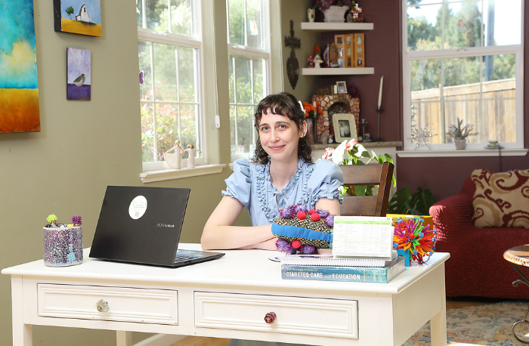
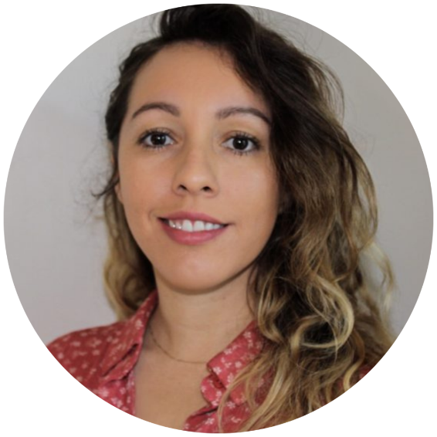
We are Here to Help!
Bryanna Sabourin
Director of Operations
Tiffany Bergeron
Customer Advocate &
Customer Happiness Expert
If you have questions, you can chat with us at www.DiabetesEd.net or call 530 / 893-8635 or email at info@diabetesed.net

Slide 4

Diabetes Education Services Inclusion Statement
Based on the IDEA Initiative inspired
Inclusion
Diversity
Equity
Access
We are committed to promoting diversity and inclusion in our educational offerings.
We recognize, respect, and include differences in ability, age, culture, ethnicity, gender, gender identity, sexual orientation, size, and socioeconomic characteristics.
Our goal is to promote equity and access, acknowledging historical and institutional inequities.
We are committed to practicing cultural humility and cultivating our cultural competence.
We wish to create a safe space within our community where one's beliefs, experiences, identity, and differences in ability, age, size, socio-cultural/socioeconomic characteristics, and political affiliations are considered and respected.

Slide 5
Tech Data Toolkit | Decoding the AGP Report
Diana Isaacs, PharmD, BCPS, BC-ADM, BCACP CDCES, FADCES, FCCP
Director, Education & Training in Diabetes Technology
Co-Director, Endocrine Disorders in Pregnancy
Cleveland Clinic Diabetes Center

Slide 6
Disclosures
Diana Isaacs, PharmD is a speaker or consultant for the following companies:
Lilly, Novo Nordisk, Sanofi, Mannkind, Insulet, Tandem, Medtronic, Dexcom, Abbott, Asensia, Cequr

Slide 7
Learning Objectives
Review the ambulatory glucose profile (AGP) report systematically and efficiently.
Understand the key metrics of CGM Data and person-centered goals.
Utilize CGM and connected data to make medication adjustments and lifestyle/behavior recommendations.
Apply data interpretation principles to a wide variety of cases in people with type 1 and type 2 diabetes.
Notes:
Apply clinical practice pearls and patient education techniques to best support the patients with diabetes using new and evolving diabetes technologies.
Describe strategies to increase utilization of diabetes technology for those with disabilities and disparities in access to healthcare.

Slide 8

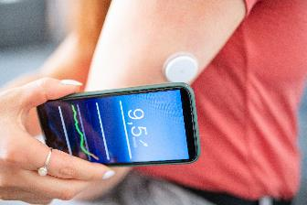

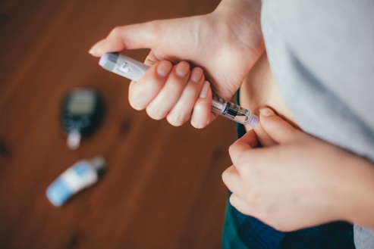
Workshop Focus
CONTINUOUS GLUCOSE MONITORS (CGM)
INSULIN PUMPS
CONNECTED PENS AND CAPS

Slide 9
Outline
Part 1, CGM Data Primer, intro to AGP, CGM key metrics, and data platforms
Part 2, CGM Cases + Q/A
***Break: 10 minute break/stretch***
Part 3, Insulin pump/connected pen Data Primer: insulin pump, connected pen reports and data platforms
Part 4, Insulin pump and connected pen cases + Q/A

Slide 10
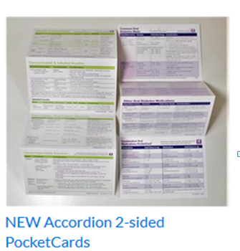
We will be addressing diabetes meds today along with the data
Download your FREE Medication PocketCards at www.DiabetesEd.net

Slide 11
Part 1: CGM Data Primer
Intro to AGP, CGM key metrics, and data platforms

Slide 12
At Least 42 Factors Affect Glucose!
Food
Medication
Activity
Biological
Environmental
Behavioral and decision making
↑↑ Carbo-hydrate quantity
→↑Carbo-hydrate type
→↑ Fat
→↑ Protein
→↑ Caffeine
↓↑Alcohol
↓↑ Meal timing
↑Dehydration
? Personal microbiome
↑ Insufficient sleep
↑ Stress and illness
↓ Recent hypoglycemia
→↑ During-sleep blood sugars
↑ Dawn phenomenon
↑ Infusion set issues
↑ Scar tissue and lipodystrophy
↓↓ Intramuscular insulin delivery
↑ Allergies
↑ A higher glucose level
↓↑ Menstruation
↑↑ Puberty
↓ Celiac disease
↑ Smoking
→↓Dose
↓↑ Timing
↓↑ Inter-actions
↑↑ Steroid administration
↑ Niacin (vitamin B3)
→↓ Light exercise
↓↑ High/ moderate exercise
→↓ Level of fitness/training
↓↑ Time of day
↓↑ Food and insulin timing
↑ Expired insulin
↑ Inaccurate BG reading
↓↑ Outside temperature
↑ Sunburn
? Altitude
↓ Frequency of glucose checks
↓↑ Default options and choices
↓↑ Decision-making biases
↓↑ Family relationships and social pressures
Adapted from Brown A. DiaTribe Learn: Making sense of diabetes... diatribe.org/42factors

Slide 13
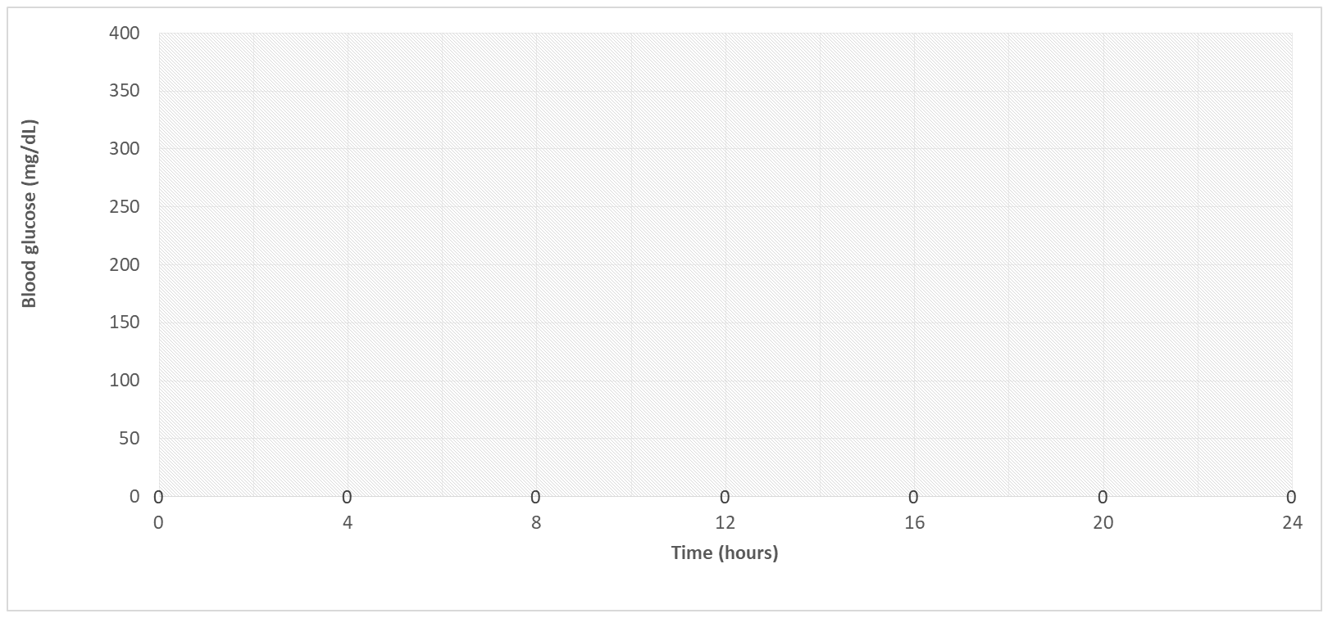
BGM vs CGM
= glucometer readings
Undetected hyperglycemia
Undetected hypoglycemia
Image created and permission to use granted by John Moorman, PharmD.
SMBG, self-monitoring of blood glucose.

Slide 14
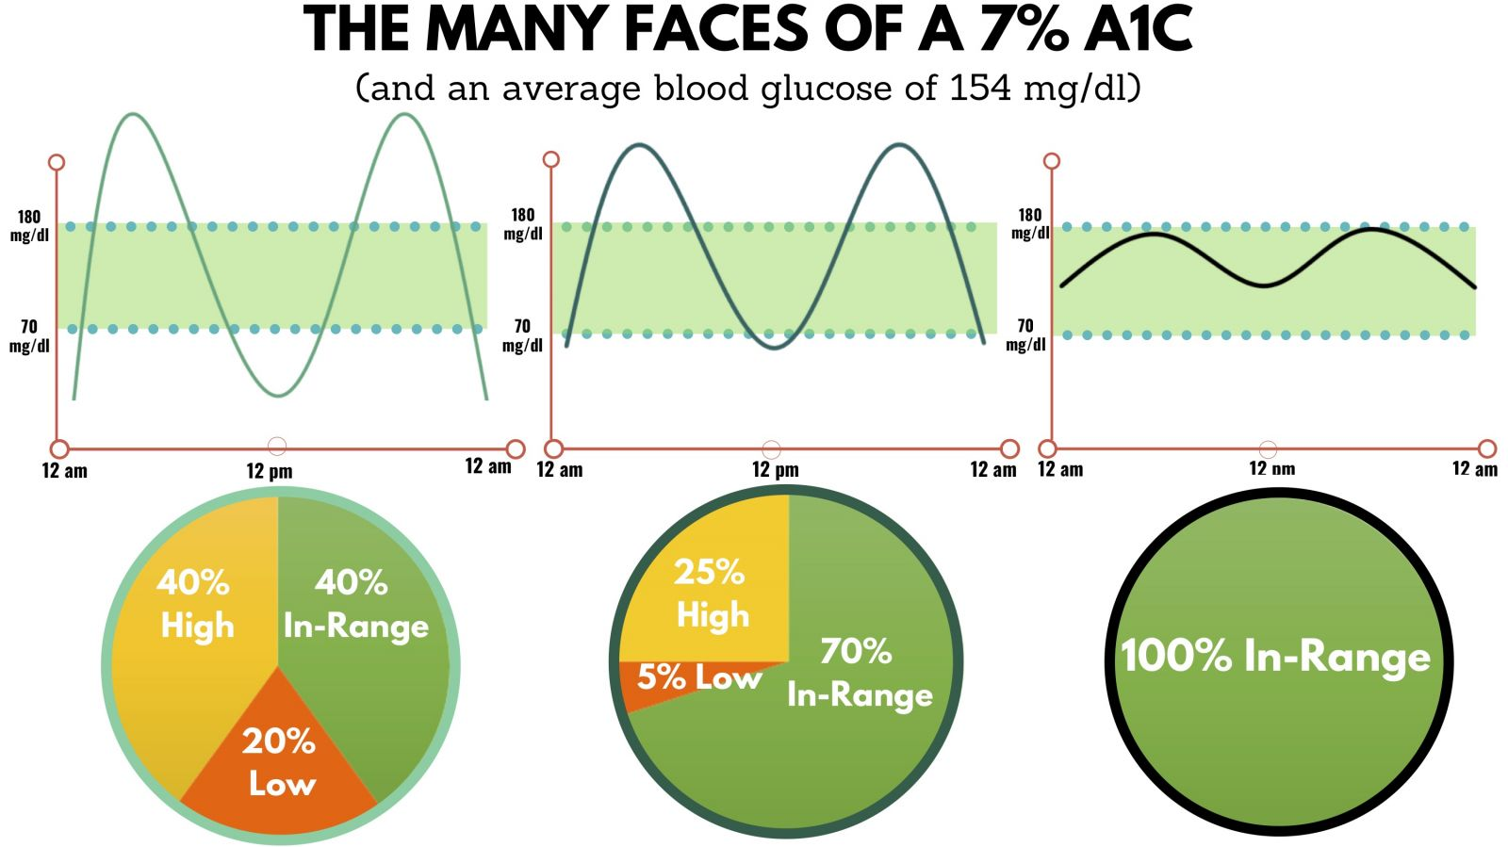
A1C Alone is Just Not Enough
https://diatribe.org/time-range.

Slide 15
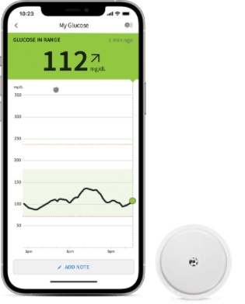
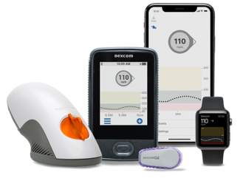
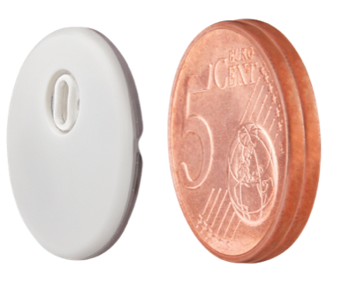
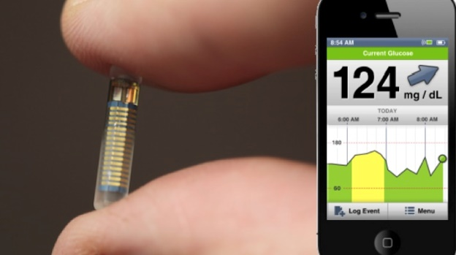
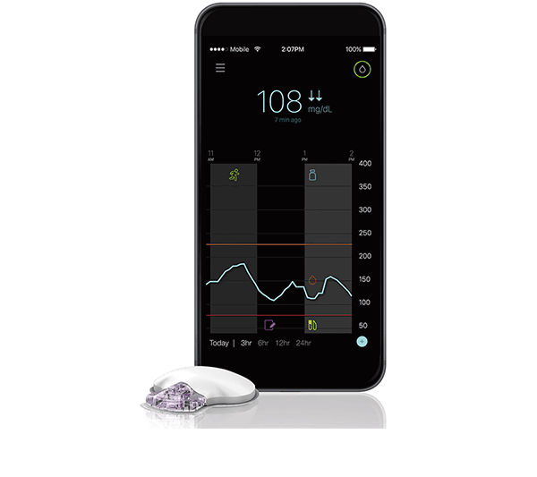
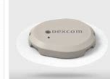
Personal CGM Options
Owed by the person with diabetes
Typically used long term
Device options include real-time glucose monitoring (rtCGM) or intermittent scanning (isCGM)
Some options can be integrated with insulin pumps or connected insulin pens
Freestyle Libre 2
Freestyle Libre 3
Guardian Connect or Guardian 3 or 4
Dexcom G6
Dexcom G7
Eversense

Slide 16
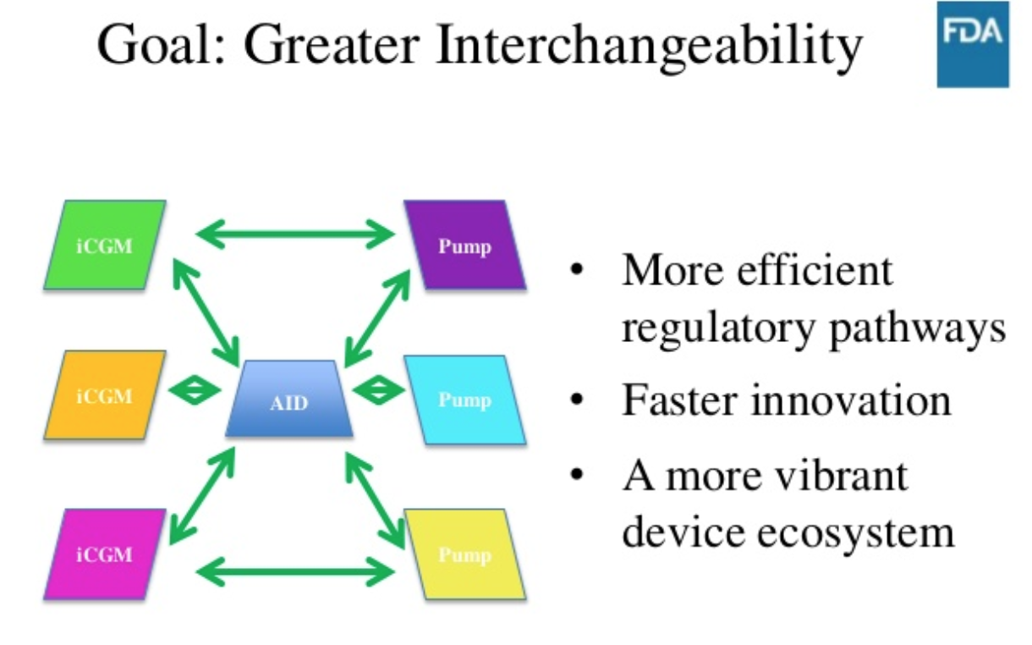
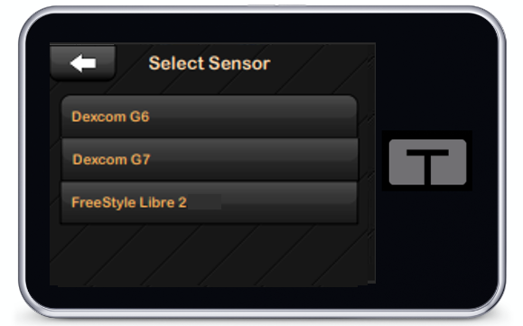
Integrated CGM
Dexcom G6, G7 and Libre 2, Libre 3 are integrated CGM (iCGM)
Integration with digitally connected devices (eg, pumps, pens, automated insulin dosing [AID] systems)

Slide 17
CGM Key Metrics
Recommended Time in Range
for most people with T1D & T2D
Target time
Time above range (TAR)
< 1 hr, 12 min, > 250 mg/dL
< 6 hr, > 180 mg/dL
Number of days CGM is worn 14 days is recommended
Percentage of time CGM is active 70% of data from 14 days is recommended
Mean glucose
Glucose management indicator (GMI) Estimated A1C
Coefficient of variation (CV) This is a measure of glycemic variability. A CV >36% is considered unstable.
>250 mg/dL
<5% Very High
>180 mg/dL
<25%* High
Target Range: 70-180 mg/dL
Time in range (TIR)
> 16 hr, 48 min
>70% In Range
Correlates with A1c ~7.0%
Time below range (TBR)
< 1hr < 70mg/dL
< 15 min < 54mg/dL
<70 mg/dL
<4%** Low
<54 mg/dL
<1% Very Low
Battelino T et al. Diabetes Care. 2019;42(8):1593-1603. . 2. American Diabetes Association. Diabetes Care 2021;44(Suppl. 1):S73–S84 | https://doi.org/10.2337/dc21-S006.

Slide 18
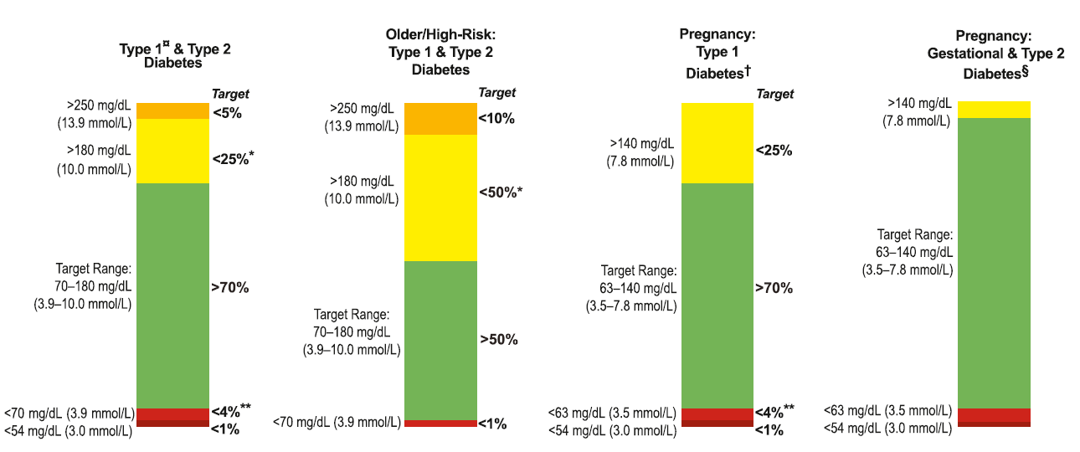
Time in Range (TIR) Goals: International Consensus
Battelino T, et al. Diabetes Care. 2019;42(8):1593-1603.
Notes:
Confirmed Figure 1

Slide 19
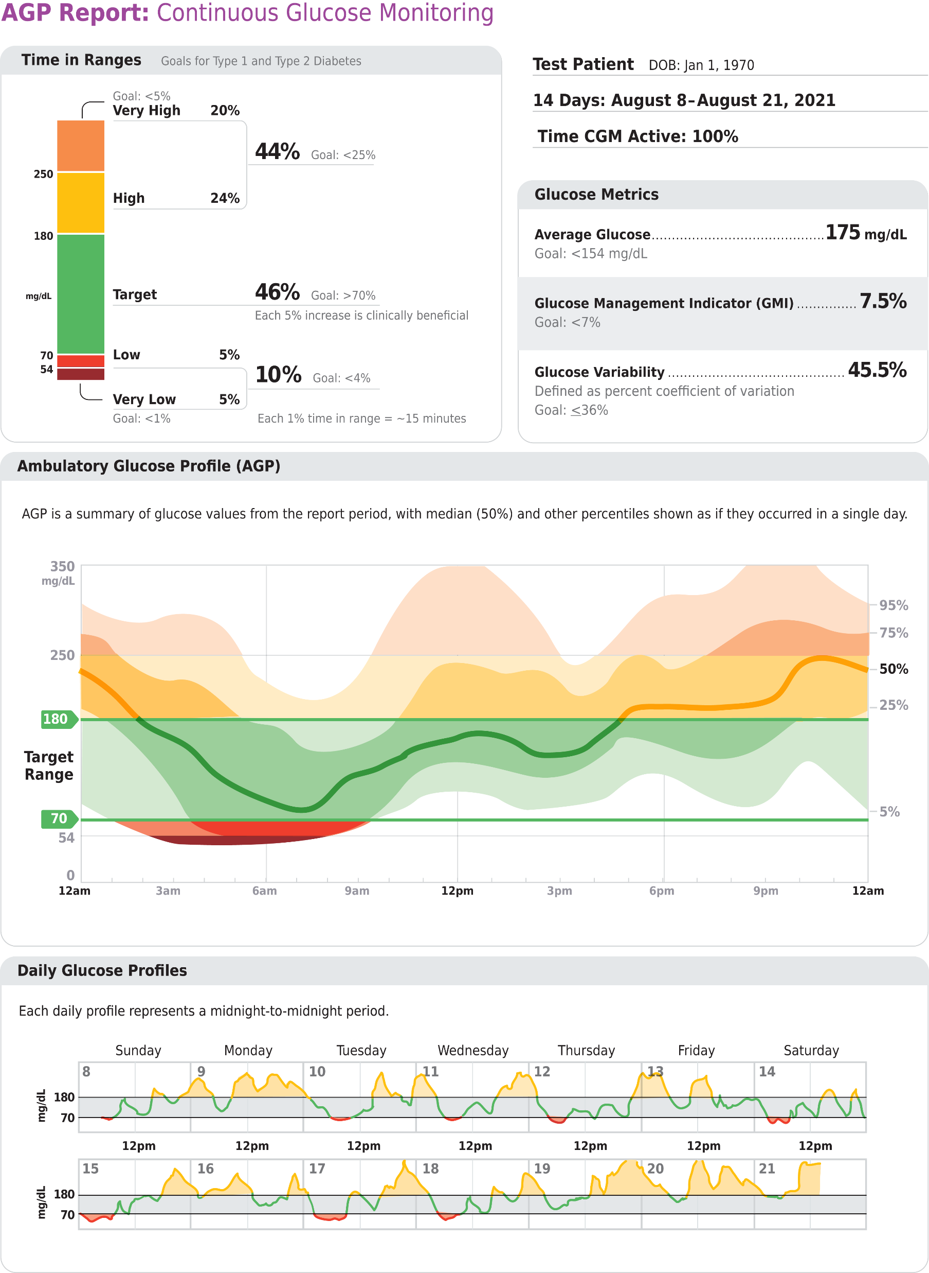
Ambulatory Glucose Profile Report
1
CGM Key Metrics
Ambulatory Glucose Profile
Daily Graphs
2
3
Notes:
Image from Freestyle Libre report

Slide 20
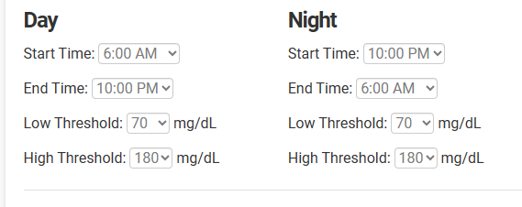
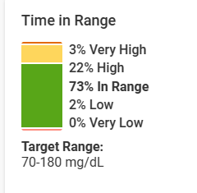
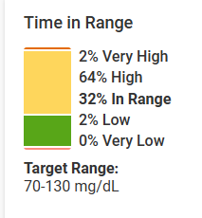
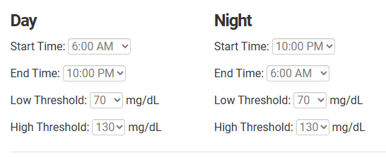
Target Glucose Ranges
Same person, same data, look at the difference in time in range!

Slide 21
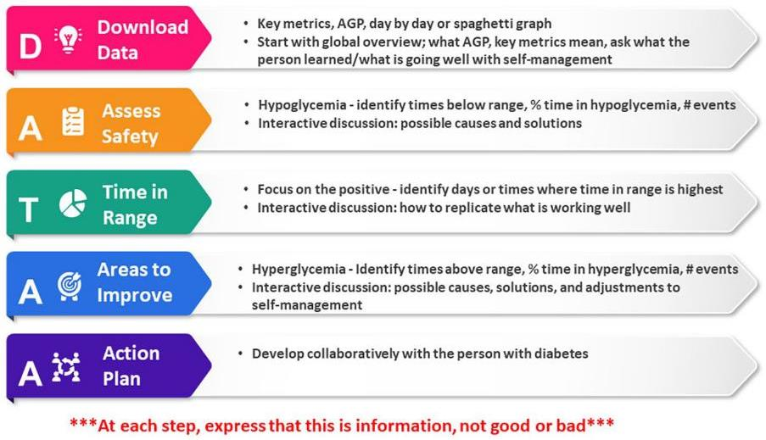
Review of DATA- DATAA
Isaacs D, et al. The Diabetes Educator. 2020;46(4):323-334.

Slide 22
Tips for DATA Interpretation
Start by asking the person what they’ve experienced and noticed with their glucose patterns
Avoid judgment
Learn from 1 time episodes, but make changes based on patterns
Fix lows first but some amount is expected (<1-4%) and if you remove all lows, you may end up with too many highs
If it’s not making sense, dig deeper (ex. missed doses, rationing, injection technique, food insecurity, etc)
Behavior Change
Mental Health
Medications
Notes:
Case: Mary becker. Inpen
Cgm first example with my new patient.

Slide 23
Data Systems

Slide 24
Viewing CGM Data
System: | Associated Mobile Apps to Share | Data Sources
Glooko | Glooko | Dexcom, Eversense,
Dexcom Clarity | Dexcom G6, G7, Clarity | Dexcom
LibreView | LibreLink, Libre 14 day, Libre 2, Libre 3 | Libre
Medtronic Carelink | Guardian Connect | Guardian CGM
Tidepool | Tidepool Mobile | Dexcom, Guardian, Libre
Eversense Data Management System | Eversense | Eversense

Slide 25
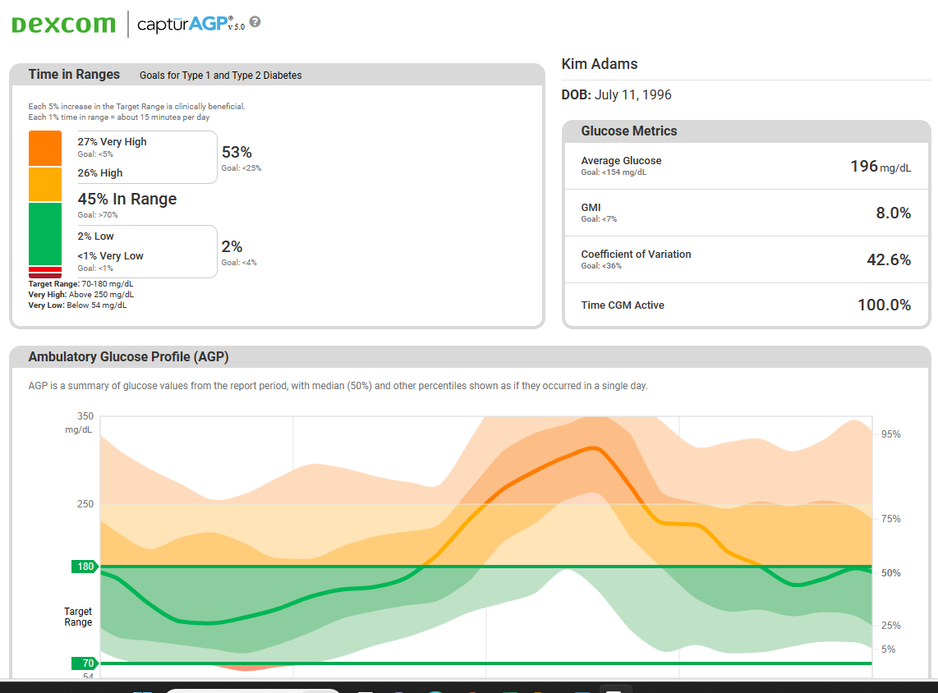
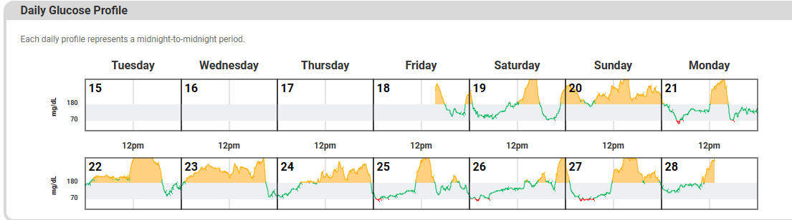
AGP Report Example CLARITY
Notes:
https://provider.dexcom.com/products/dexcom-clarity
Page 12 - https://global.eversensediabetes.com/sites/default/files/2019-12/LBL-1606-01-001%20Rev%20C_Eversense_DMS_User_Guide_mgdL_R4.pdf

Slide 26
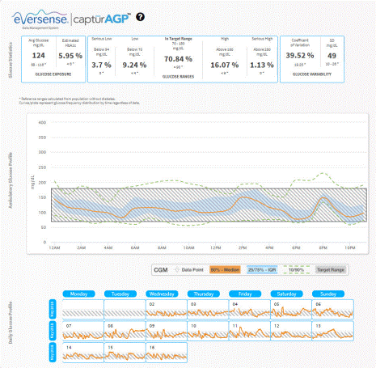
AGP Report Example: EVERSENSE
Notes:
https://provider.dexcom.com/products/dexcom-clarity
Page 12 - https://global.eversensediabetes.com/sites/default/files/2019-12/LBL-1606-01-001%20Rev%20C_Eversense_DMS_User_Guide_mgdL_R4.pdf

Slide 27
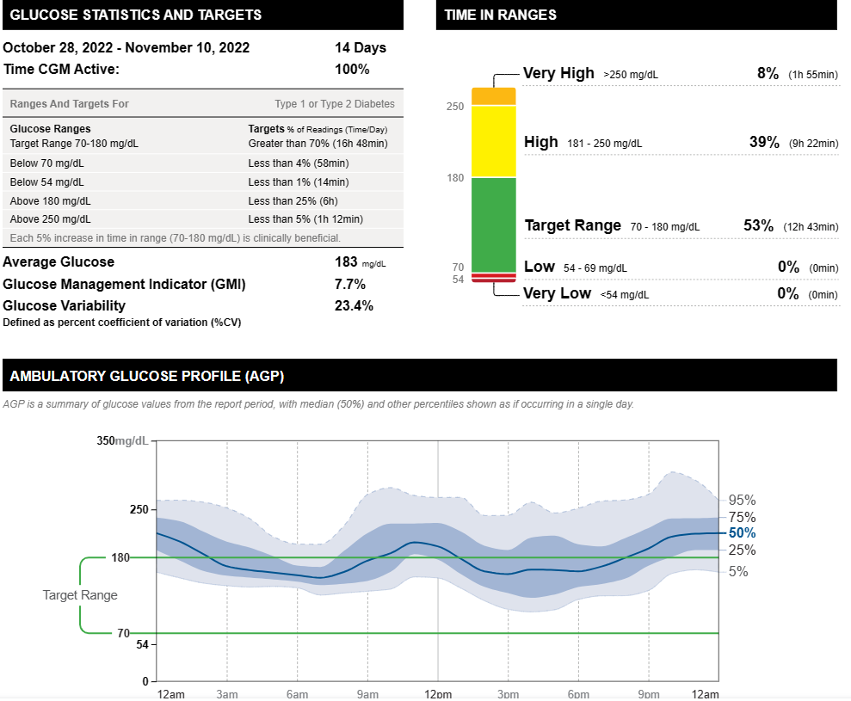
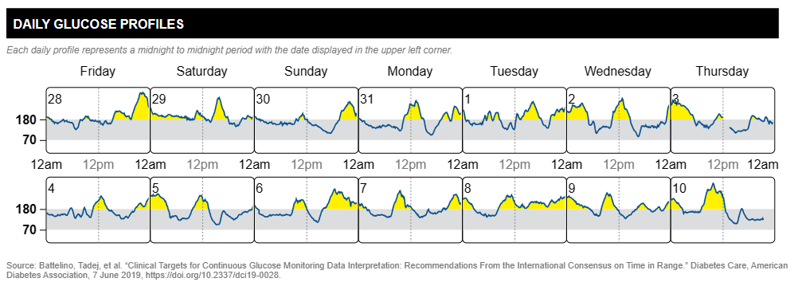
AGP Report Example Libreview
Notes:
https://www.freestyleprovider.abbott/us-en/libreview.html

Slide 28
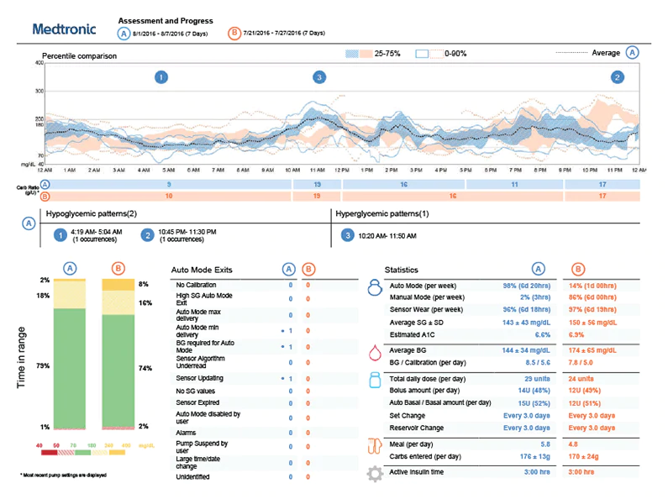
AGP Report Example Carelink

Slide 29
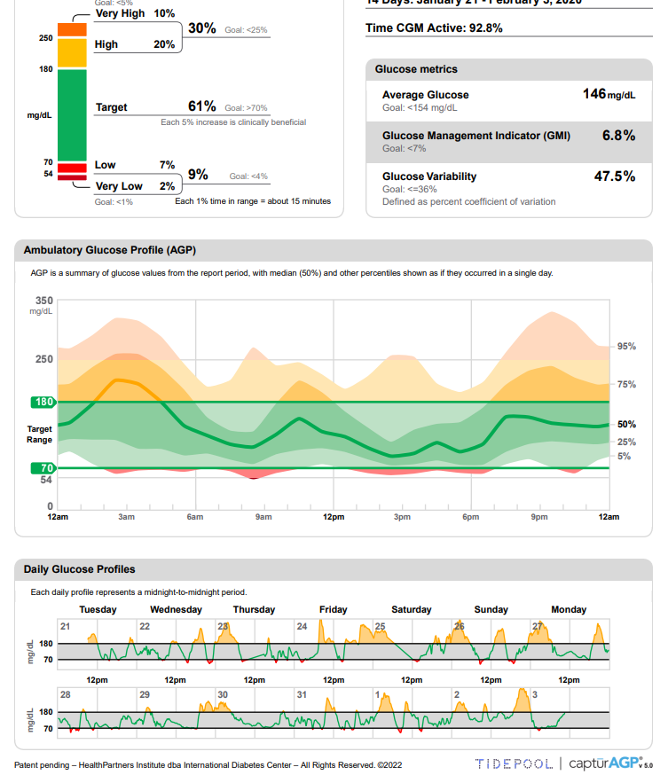
Tidepool

Slide 30
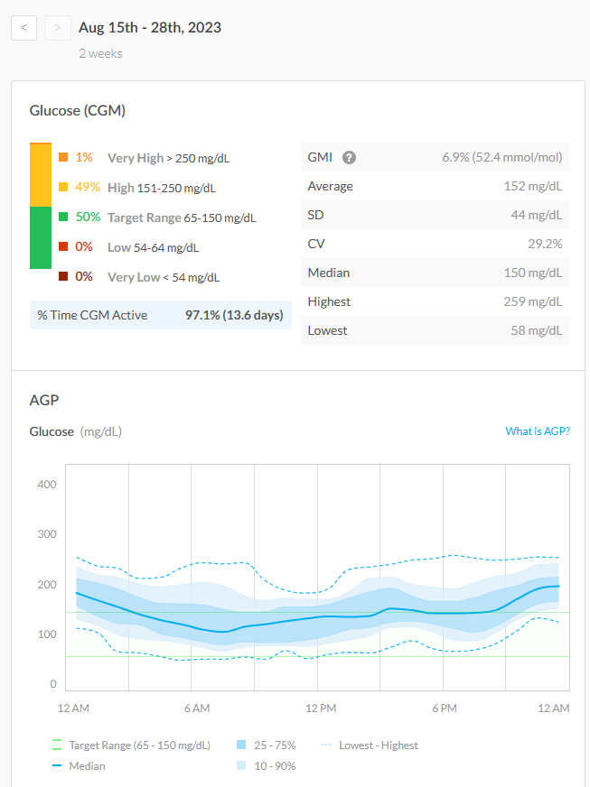
Glooko

Slide 31
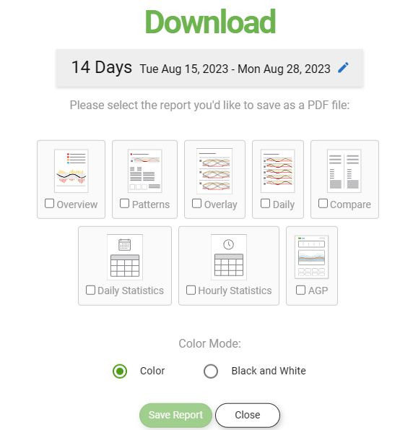
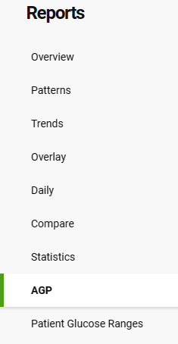
Dexcom Clarity
18+ pages if you click them all
My Favorite: Overview, AGP
Notes:
Break for example.

Slide 32
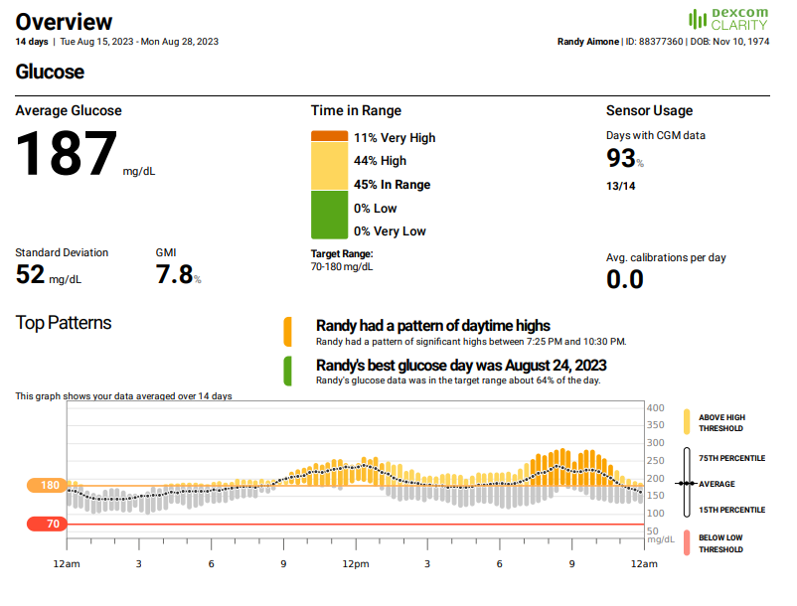

Slide 33
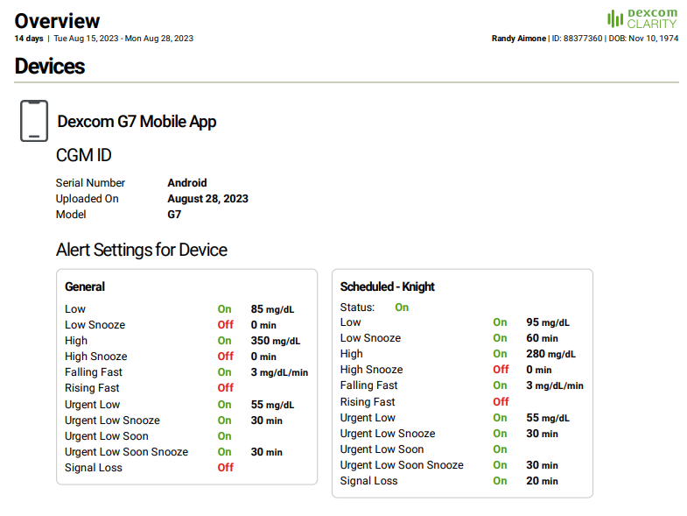

Slide 34
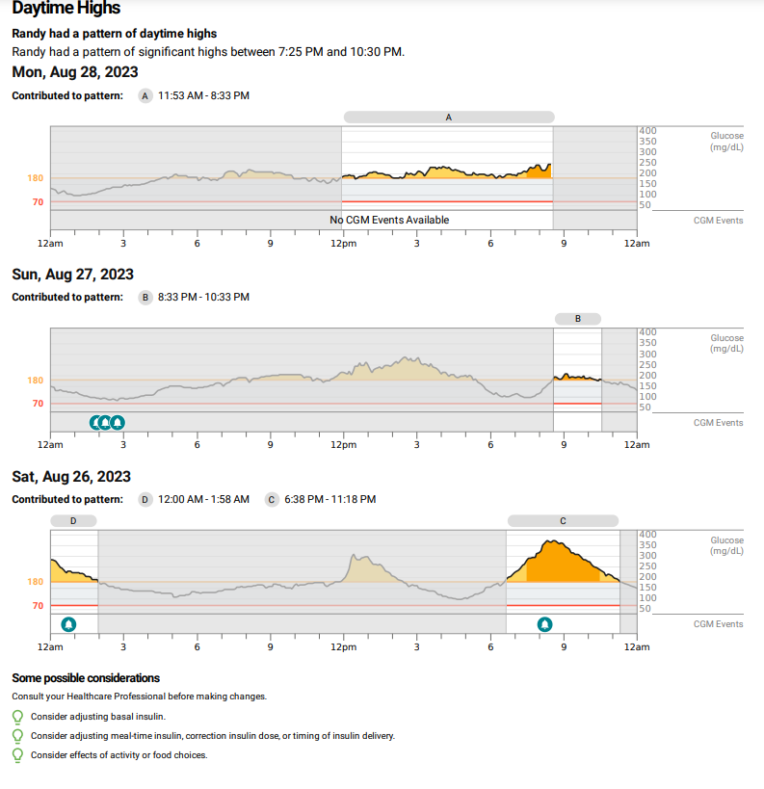

Slide 35
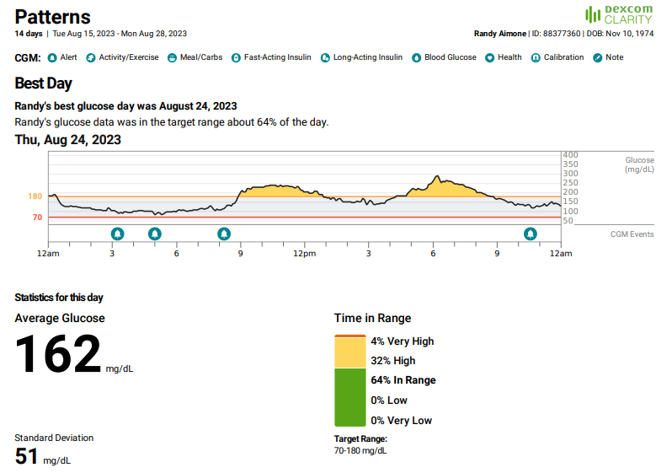

Slide 36
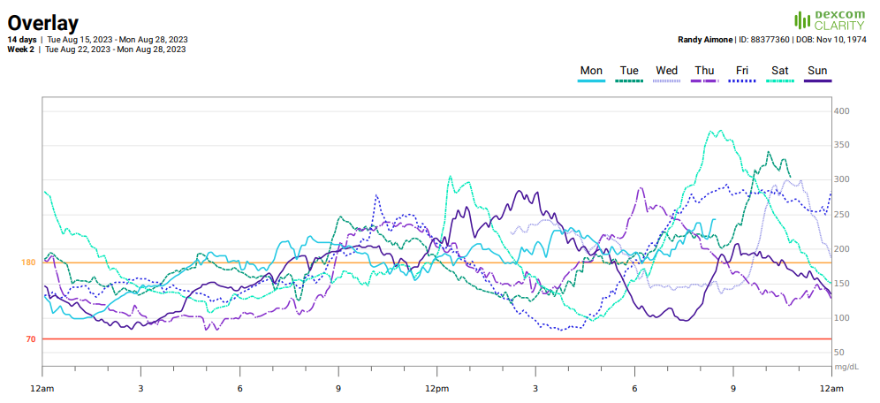

Slide 37
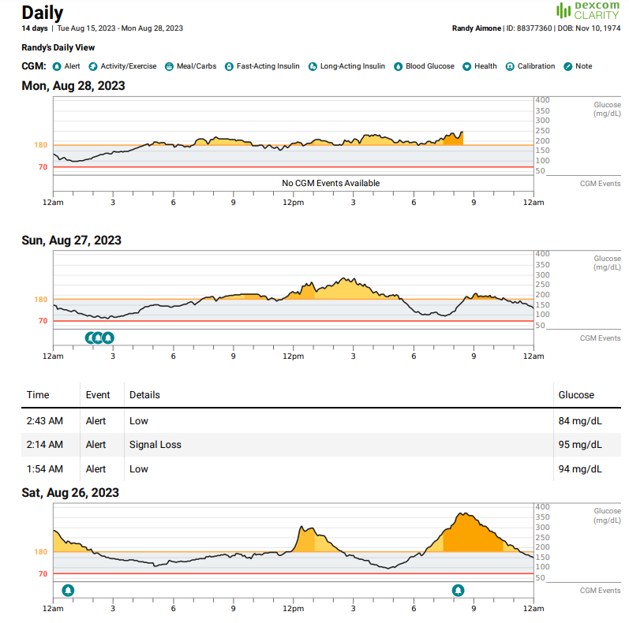

Slide 38
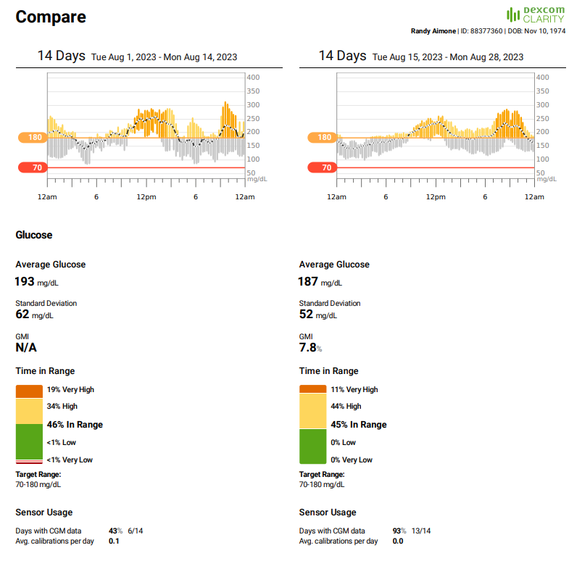
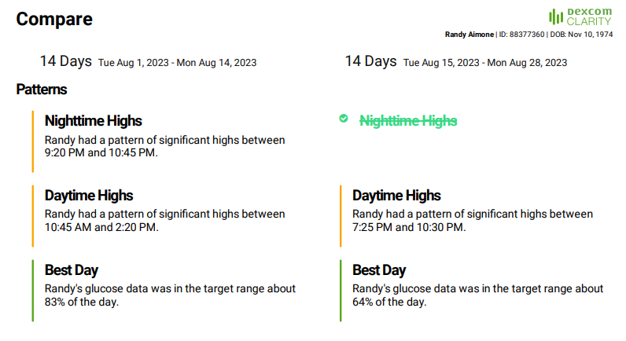

Slide 39
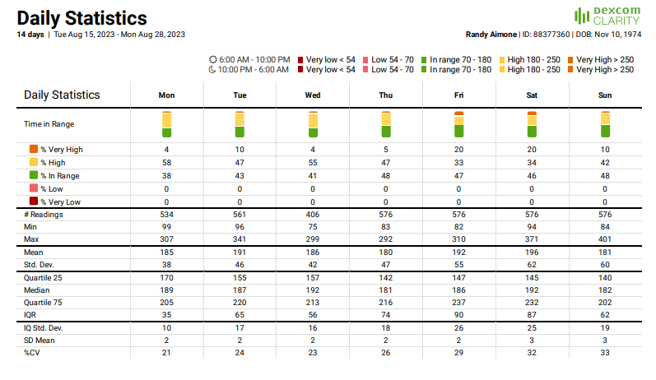

Slide 40
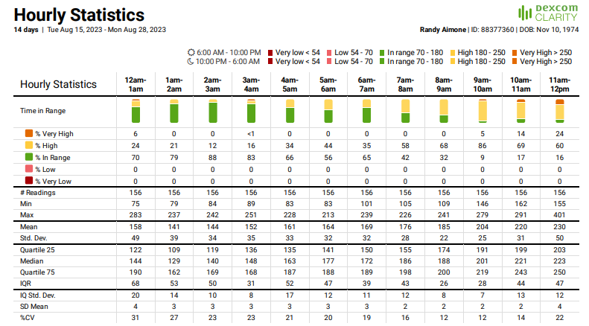

Slide 41
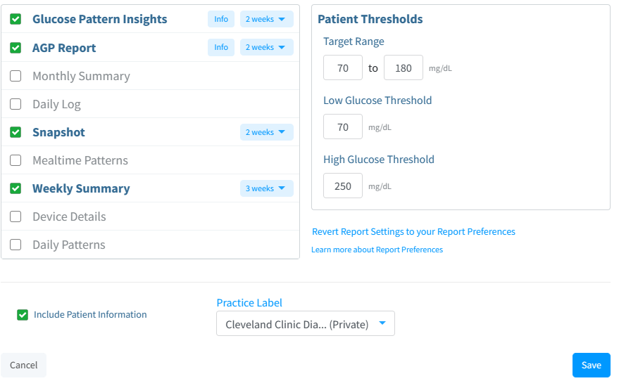
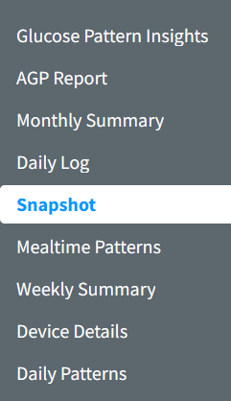
Libreview
12 pages if you click them all

Slide 42
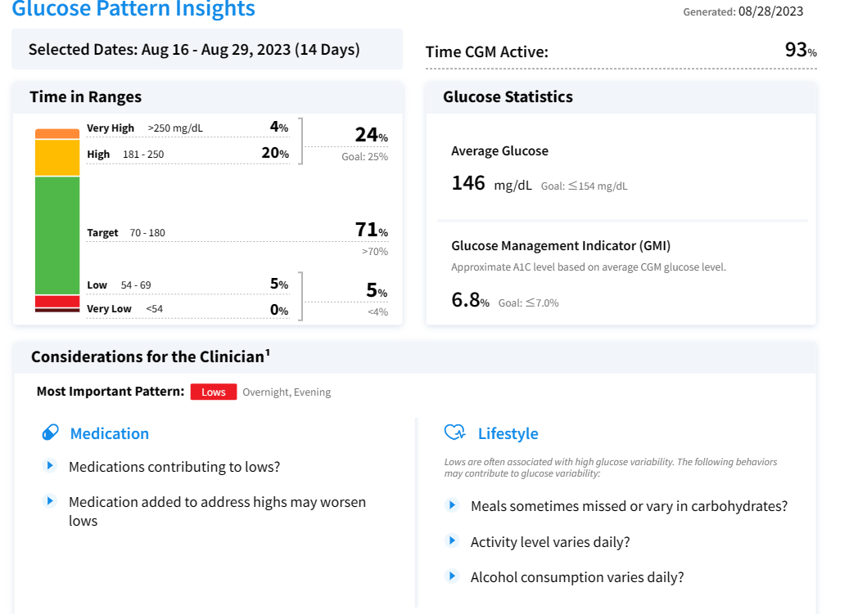

Slide 43
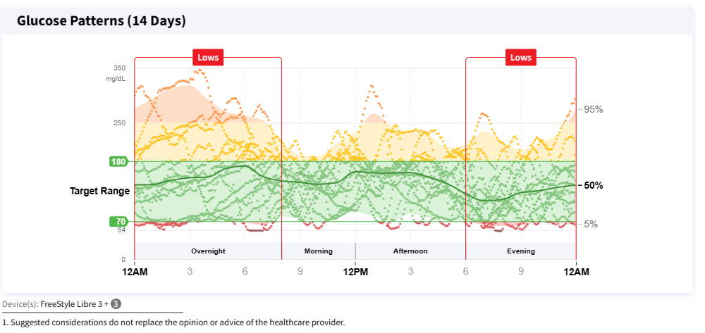
Glucose Patterns Insights

Slide 44
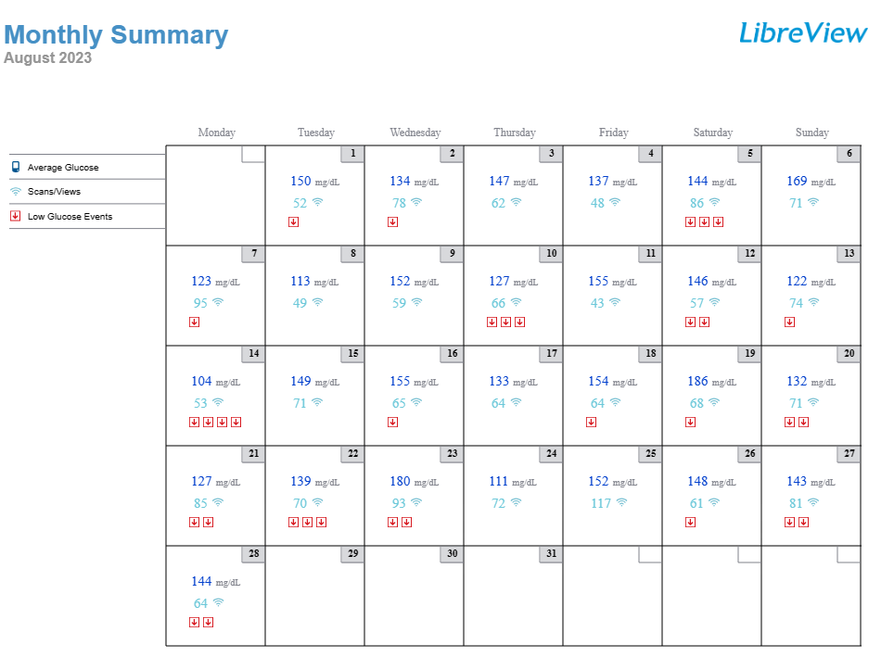

Slide 45
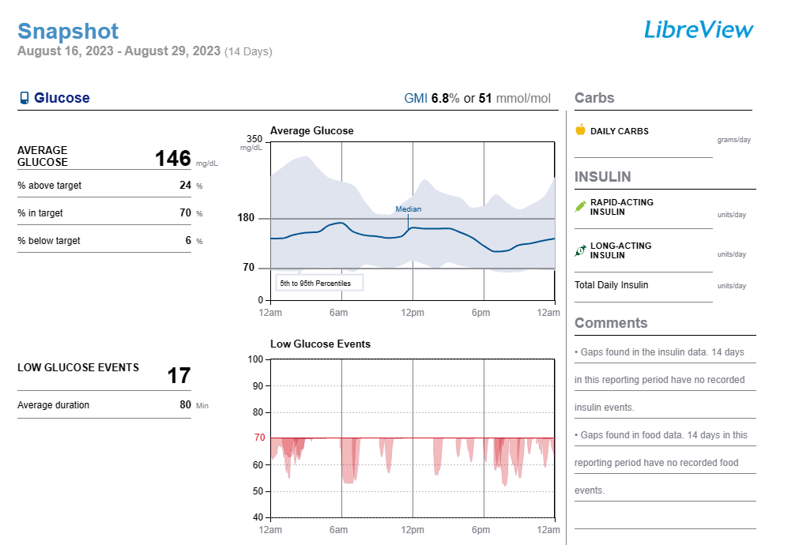
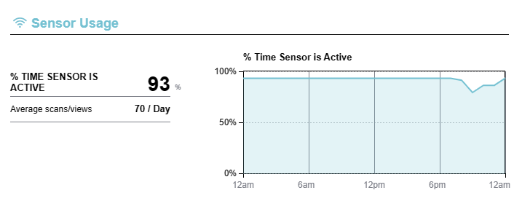

Slide 46
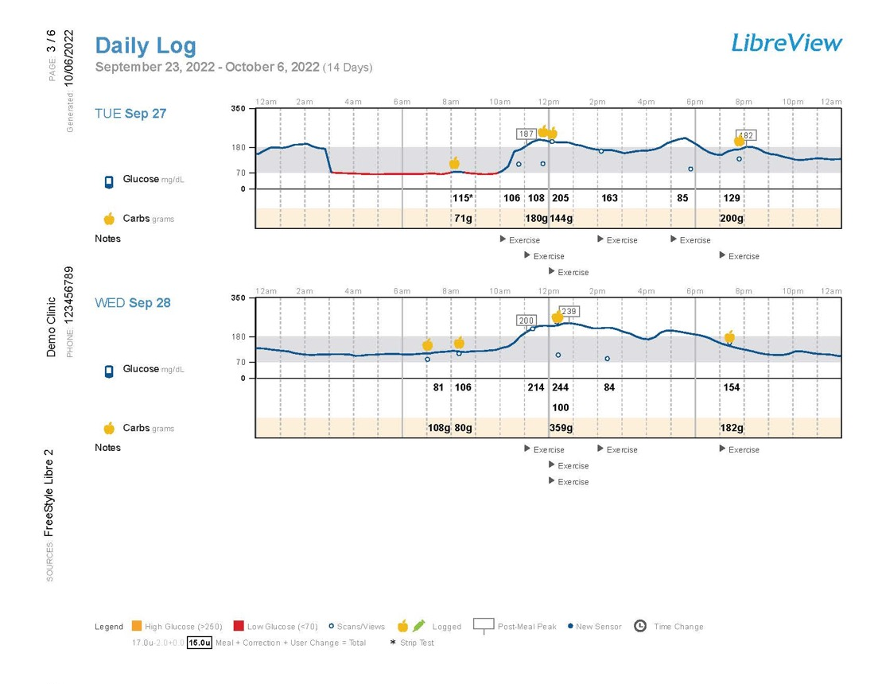

Slide 47


Slide 48


Slide 49


Slide 50


Slide 51

Glooko

Slide 52

My CGM favs:
Summary, overview, overlay

Slide 53


Slide 54

Overview

Slide 55

CGM Overlay

Slide 56

Resource: Which Reports?

Slide 57
Part 2: CGM Cases

Slide 58


Case 1
73 yo female with T2DM x 14 years, CKD with eGFR=40
A1C=7.5%, Weight=284lbs, BMI=55kg/m²
DM Meds:
Insulin degludec 18 units daily
Insulin lispro 5 units at meals 3 times daily + correction factor
Notes:
Global overview
Ask person what they’ve noticed, any patterns they’ve experienced, what’s working well with self-management.
Are metrics at goal

Slide 59



Reports stacking insulin

Slide 60



Missed dose of lispro
Balanced eating, walked after lunch

Slide 61

3 weeks later
She has learned from her data
Sees the benefits of walking after meals
Regular coke vs. diet coke
When she takes her insulin late
Is she meeting the metrics?
Time in range?
Time below range?
Glucose variability?

Slide 62

What Do the Guidelines Say?

Slide 63


Slide 64
Medication Choices Based on Guidelines
 | Hypoglycemia | Weight | Efficacy
Insulin | Yes | Gain | High
GLP-1 receptor agonist | No | Loss | High
SGLT2 inhibitor | No | Loss | Limited when eGFR<45
Metformin | No | Loss/neutral | Moderate
Shared decision making also includes a discussion on potential side effects, cost, and administration

Slide 65

Start semaglutide 0.25mg x 4 weeks, then increase to 0.5mg weekly x 4 weeks, then increase to 1mg weekly x 4 weeks, then 2mg weekly
Continue insulin degludec 18 units daily
Stop insulin lispro, change to correction factor before meals only (ICF 50, BG target 150)

Slide 66

6 Months Later
Insulin degludec 14 units daily
Semaglutide 2mg weekly
A1C=6.6%
Wt: 262lbs, BMI=51kg/m²

Slide 67

Case 2
57 year old woman with obesity, A1C=9.1%, needs a total knee replacement, but A1C was too high for surgery
Current DM2 meds:
Insulin glargine 40 units daily
Dulaglutide 4.5 mg weekly

Slide 68

Discussion

Slide 69
The plan:
Decrease insulin glargine to 36 units daily
Continue dulaglutide

Slide 70


Case 3
53yoW with T2DM
BMI=24kg/m2
Insulin glargine 16 units daily
Insulin lispro 14 ICR, ss1
Notes:
Sharon antion
10/29/70
Gad negative,
C peptide wnl, 1.4

Slide 71

Best Day

Slide 73


Case 4
GB is a 73yoM with neuropathy and CAD. BMI=25. T2DM. Current meds: pioglitazone 30mg daily, lispro 10 units TID at meals, glargine U300 14 units at bedtime, Metformin 500mg twice daily
Unable to afford semaglutide, empagliflozin
Notes:
Diet recall:
Breakfast (8-9 am): 1 pancake, something quick
Lunch (12:30-1 pm): soup, sandwich, leftovers, maybe fruit
Dinner (6-8 pm): meat (beef, fish, shrimp, pork chop), potatoes, veggies, salad
Snacks: fruit (peaches, plums, cherries, bananas), cookies, twinkies
Beverages: coke zero, ginger ale zero

Slide 74



Slide 75


Slide 76

What would be your plan?

Slide 77
My Plan
Continue glargine u300, 14 units daily, metformin 1000mg twice daily, pioglitazone 30mg daily
Decrease lispro from 10 units to 7 units TID
Complete PAP for Ozempic and jardiance
Notes:
Was hospitalized for LE edema
Then got samples from pcp for Jardiance
Then on glargine u300, 20 units and lispro 10 units TID
TIR 72% with 2% low and follow up

Slide 78


Case 5
WS is a 51yoM with T2DM, peripheral neuropathy, HTN, dyslipidemia. BMI=28.
Meds: metformin 500mg daily, empagliflozin 25mg daily, semaglutide 2mg weekly, insulin degludec 34 units evening
Notes:
Diarrhea at higher doses of metformin
Sent prescription for Mounjaro 5 mg once weekly to pharmacy
Will replace Ozempic if covered
Increase gabapentin dose to 400 mg one capsule in morning and two at bedtime
Continue:
Metformin ER 500 mg, one tablet daily (with food)
Jardiance 25 mg, one tablet once daily in morning
Tresiba U200, 34 units once daily in evening
Abbott Customer Service (call for Libre replacement sensors): 1-855-632-8658
Provide skin tac / barrier wipes to improve adhesion

Slide 79


Questions to ask?
What to Change?

Slide 80

Plan
Continue current meds, switch semaglutide 2mg weekly to tirzepatide 5mg weekly
1 week later

Slide 81

Case 6
54yoM, BMI=43,350 lbs, HTN, dyslipidemia, CAD, NAFLD, OSA
Takes empagliflozin 10mg daily, glipizide ER 10mg twice daily, insulin glargine 100 units daily, lispro 4 units TID +ss#2

Slide 82




Slide 83
Plan
Start tirzepatide 2.5mg weekly
Change lispro to ss#2 only
F/up in 2 weeks
At that time, patient only took one dose of tirzepatide (had a “low” in the 80s)

Slide 84

2 Months Later
Increase tirzepatide from 5 to 7.5mg weekly
Decrease insulin glargine U300 from 80 units daily to 70 units daily
Continue empagliflozin 25mg daily
Continue lispro ss#2 prn

Slide 85

1 Year Later
Lost 115 lbs
BMI=30
Current meds:
Tirzepatide 15mg weeklys
Empagliflozin 25mg daily
No insulin

Slide 86


FK is a 69 yo F with T2D, HTN, hyperlipidemia, anemia,
Wore professional CGM
A1C=6.9%
Concern A1C not accurate
Meds include glipizide 10mg BID, dulaglutide 1.5mg weekly
Previuosly tried metformin-GI AE’s
Notes:
OB: 1/17/54

Slide 87
Diet Recall
Diet Recall
Breakfast/Lunch (11 am-1pm): waffles, coffee, juice (7/30), eggs, bacon (7/31)
Dinner (630pm): porkchop, broccoli, fruit cup, baked potato (7/31); small chili with vegetables (8/1)
Snacks b/w meals: chips, fruit (apples, watermelon)
Beverages: coffee w/ cubed sugar w/ creamer
What would be your plan?

Slide 88
My Plan
Restart metformin ER (pt willing to try)
Increase dulaglutide to 3mg weekly, then 4.5mg weekly
Consider future addition of SGLT2i (instead of glipizide)
Dietary changes-fruits, chips, juice

Slide 89


Case 7
W is a 62yo F with T2DM since 2008. Lives with neuropathy, HLD, IBS, Lupus
BMI=29, A1C=7.4%
Meds: glimepiride 2mg qam, semaglutide 2mg weekly
Currently on prednisone, 40mg daily
Notes:
Sonja William
Diet recall:
Breakfast (9am): egg with bacon
Lunch (3p): fruit
Dinner (7pm): purple cabbage
Snacks: fruit, sugar-free popsicle
Beverages: water, green tea with sugar syrup, slushies - avoids non-nutritive sweeteners, associates all with headaches
s, 12/28/50
Previous meds: metformin-gi effects
Sglt2-UTI

Slide 90


Slide 91
Additional Info
Diet recall:
Breakfast (9am): egg with bacon
Lunch (3p): fruit
Dinner (7pm): purple cabbage
Snacks: fruit, sugar-free popsicle
Beverages: water, green tea with sugar syrup, slushies - avoids non-nutritive sweeteners, associates all with headaches
Previous meds: metformin-gi effects
Sglt2-UTI

Slide 92
The Plan
NPH or lispro 2 units + correction scale before meals
Reduce sugary beverages
Increase physical activity as able

Slide 93

Case 8
CB is a 66yo M, T1DM since 21yo, BMI=33, lives with hypothyroidism, HTN, HLD, obesity
Eats 2 meals/day
Recently started CGM
Meds:
Basaglar 25 units twice daily
Semaglutide 0.25mg weekly
Aspart 10 units +ss2, 2-3 units 1-2 hours post meal if glucose high
Notes:
Charles butters 2/5/57
DIET:
Significant diet changes since last appt? Cut back on snacking
The patient's current diet is: no particular diet, varies
Number of meals per day: 2 Number of snack per day: 1(afternoon)
Frequency of skipping meals 1 per day
Skips prandial insulin if skipping meal? Yes
Timing of prandial insulin w/ respect to meals? 15-20 min before meal
Diet recall:
Breakfast (7:30-8 am): cereal (cheerios), blueberries, toast
Lunch: Skips lunch, or small snack - half sw or chips, salsa
Dinner (7 pm): chicken/pork/meat, potatoes, bread and soup, salad
Snacks: chips, pb-crackers
Beverages: water, diet pop, iced tea
EXERCISE:
Tries to stay active, 10K steps per day
Remodeling kitchen with family

Slide 94


Let’s take a deeper data dive, since he recorded doses!

Slide 95



Slide 96



Slide 97



Slide 98
The Plan
Increase semaglutide to 0.5mg weekly
Change basaglar to 42 untis once daily
Advised to wait 4 hours between aspart doses, log doses into app

Slide 99


Case 9
MK is a 65yoM with T2DM
Meds include glargine 36 units daily, semaglutide 2mg weekly, lispro ss2
A1C=7.2%
BMI=27

Slide 100


Slide 101


Follow Up

Slide 102
Part 3: Insulin Pump & Connected Pen Data Primer
Insulin pump, connected pen reports and data platforms

Slide 103




Connected Pens
Bigfoot Unity with Libre 2
Medtronic InPen with Guardian Connect or Dexcom G6

Slide 104



Dose Calculator
InPen
Bigfoot Unity allows 3 set doses and IAT of 3 hours
Carb Counting
Meal Estimation
Fixed Dose
Ziegler R, Cavan DA, Cranston I, et al. Diabetes Care. 2013; 36(11):3613-3619.
Barnard KD, Parkin CG, Young A, et al. . J Diab Sci Tech. 2012;6:144–149.
Vallejo-Mora MdR, Carreira-Soler, Linares-Parrado F, Olveira G, et al.. Journal of Diabetes. 2017 (9):24-33.

Slide 105






AID Systems
T:slim X2 (Tandem)
Control IQ
780G & 770G
(Medtronic)
Omnipod 5 (Insulet)
iLet
(Beta Bionics)
Mobi (Tandem)
Control IQ
Tidepool Loop

Slide 106

Hybrid-Closed Loop
Automated insulin delivery (AID)
Auto adjust background insulin
Some systems give auto corrections
Maximize time 70-180mg/dL

Slide 107


Control IQ Targets
https://www.tandemdiabetes.com/providers/products/control-iq

Slide 108
Pump Comparison
 | Omnipod 5 | Control IQ | 780G | ILet
Min age | 2 years | 6 years | 7 years | 6 years
Min daily insulin | 5 units | 10 units, 55lbs | 8 units | 8 units
Max fill | 200 units | 300 units | 300 units | 160 units
Basal increment | 0.05 units | 0.001 units | 0.025 units | NA
Bolus increment | 0.05 units | 0.01 units | 0.025 units | NA
Site change frequency | 3 days | 3 days | 7 days (extended infusion set) | 3 days
CGM compatibility | G6 | G6 | Guardian 3 | G6
Calibration | No | No | 3-4/day | No
CGM trend in calculator | Increase up to 30% Decrease down to 100% | No | No | NA
Notes:
Omnipod-5_User-guide.pdf
MiniMed_770G_System_User_Guide.pdf (medtronicdiabetes.com)
AW-1007704_B User Guide, Mobile Bolus, t:slim X2, Control-IQ, 7.6, mg/dL, Artwork.pdf (tandemdiabetes.com)
User manuals
Omnipod-5_User-guide.pdf
MiniMed_770G_System_User_Guide.pdf (medtronicdiabetes.com)
AW-1007704_B User Guide, Mobile Bolus, t:slim X2, Control-IQ, 7.6, mg/dL, Artwork.pdf (tandemdiabetes.com)
770g and 780 g max is 250 units.

Slide 109
Pump Comparison
 | Omnipod 5 | Control IQ | iLet | 780G
Algorithm target | 110-150mg/dL | 112.5 – 160 mg/dL | 110-130mg/dL | 100-120mg/dL
Basal automation | Calculated from total daily insulin, updated each pod change, 60 min prediction | Increases or decreases from programmed basal rates, 30 min prediction | Initiated based on user weight and adapts with glucose profile | Calculated based on total daily insulin from past 2-6 days
Automated Corrections | No | Max 1/hour if glucose predicted >180 mg/dL, 60% of calculated dose | No | If glucose > 120 mg/dL and at max "auto basal" delivery, up to every 5min
Extended bolus | No, manual mode only | Yes, up to 2 hours | No | No, manual mode only
Insulin action time (IAT) | 2-6 hours | 5 hours (automated mode) | NA | 2-8 hours
Temporary targets | Activity 150 mg/dL | Exercise 140 -160 mg/dL Sleep 112.5 – 120 mg/dL | NA | 150 mg/dL
Bolus adjustments | ISF, IAT, ICR, max bolus, reverse correction | ISF, ICR, max bolus, reverse correction | Usual, more, Less meal announcements | ICR, IAT, max bolus
Ability to override bolus | Yes | Yes | No | No
Notes:
Omnipod-5_User-guide.pdf
MiniMed_770G_System_User_Guide.pdf (medtronicdiabetes.com)
AW-1007704_B User Guide, Mobile Bolus, t:slim X2, Control-IQ, 7.6, mg/dL, Artwork.pdf (tandemdiabetes.com)
User manuals
Omnipod-5_User-guide.pdf
MiniMed_770G_System_User_Guide.pdf (medtronicdiabetes.com)
AW-1007704_B User Guide, Mobile Bolus, t:slim X2, Control-IQ, 7.6, mg/dL, Artwork.pdf (tandemdiabetes.com)

Slide 110


Panther Tools

Slide 111
Data Platforms

Slide 112

InPen

Slide 113


Slide 114


Slide 115


Slide 116

Bigfoot Unity

Slide 117


Slide 118


Slide 119


Slide 121


Slide 122


Slide 123

T:Connect

Slide 124


T:Connect
Notes:
See my preferred in the handout.

Slide 125


Slide 126


Slide 127


Slide 128


Slide 129


Slide 130


Slide 131


Slide 132

Glooko
32 pages if you click them all

Slide 133

My Go To Reports

Slide 134


Slide 135

No reason to look at this one!

Slide 136


Slide 137


Slide 138


Slide 139


Slide 140


Slide 141


Slide 142



Slide 143


Slide 144


Slide 145

Carelink
9 pages if you click them all

Slide 146


Slide 147


Slide 148


Slide 149


Slide 150


Slide 151


Slide 152


Slide 153
Viewing Data: Pumps and Pens
System: | Associated Mobile Apps to Share | Data Sources
Glooko | Glooko | Insulin pumps (Omnipod, T:slim X2), InPen
Medtronic Carelink | Guardian Connect, MiniMed Mobile InPen | Medtronic insulin pumps, Guardian CGM, InPen
Tidepool | Tidepool Mobile | Insulin pumps (Medtronic, T:Slim X2, Omnipod Dash/Eros), InPen
T:Connect | T:Connect Mobile | T:Slim X2, Dexcom G6
InPen Insights Report | InPen | InPen, Dexcom, Guardian Connect
Bigfoot Unity | Bigfoot Unity | Bigfoot Unity pen cap, Libre 2
Lilly Tempo Platform | TempoSmart | TempoSmart Button, Dexcom

Slide 154
Part 4 Insulin pump and connected pen cases + Q/A

Slide 155






Dataa Model
Download Data
Assess Safety
Time in Range
Areas to Improve
Action Plan
Promotes Shared Decision Making:
Allows use of metrics to personalize therapy
Address glucose variability with patients using daily views
Identification of hypoglycemia
Education
Notes:
Isaacs D, Cox C, Schwab K, Oser TK, Rinker J, Mason MJ, Greenwood DA, Albanese-O'Neill A. Technology Integration: The Role of the Diabetes Care and Education Specialist in Practice. Diabetes Educ. 2020 Aug;46(4):323-334. doi: 10.1177/0145721720935123. PMID: 32780003.
Corathers SD, DeSalvo DJ. Therapeutic Inertia in Pediatric Diabetes: Challenges to and Strategies for Overcoming Acceptance of the Status Quo. Diabetes Spectr. 2020 Feb;33(1):22-30. doi: 10.2337/ds19-0017. PMID: 32116450; PMCID: PMC7026749.

Slide 156
Case 1: Are Pumps Just for T1D?
47 years old
T2D x 20+ years
A1C=8.1%
BMI=39kg/m²
Works as a bank teller
No diabetes complications
Meds:
Insulin glargine 100 units qpm
Insulin aspart 45 units TID a.c.
Dapagliflozin 10mg daily
Dulaglutide 1.5 mg weekly
Is this a good candidate for an insulin pump?
Notes:
HPI: The patient has Type 2 diabetes and was diagnosed 20 + years ago. There is a history of diabetes in the family. The disease course has been stable . Initially, the symptoms were thirst , excessive urination and fatigue. Currently, there are no symptoms. Her weight has increased by approximately 20 pounds over the past few months, as she started insulin and controlled her DM. The initial treatment was oral agents, currently the treatment is insulin for the past 15 years.
Her control has been poor until about six months because she was not taking her insulin due to weight gain. She claims to the weight gain of 20 lbs is due to insulin, but she does have calorie count.
Currently, she is taking Lantus 48 units at bedtime. She using Novolog up to 60 units pre meal.
She is following a diet plan and is exercising a little. She does monitor blood glucose levels 4 times daily using a one touch ultra mini meter. She does keep written records of blood glucose levels in a log book.
Her log book looks OK. She is unhappy with weight gain,
She self measures and self injects insulin dose. Terri has had symptoms of hypoglycemia. She has an awareness of what the symptoms are and what to do if she is having a reaction.
She has no complications from diabetes.
She may be interested in a CSII pump.
She is currently seeing an ophthalmologist.
The patient has additional risk factors for disease including high blood pressure and hyperlipidemia.

Slide 157

Guidelines: ADA
CGM should be offered for diabetes management in adults with diabetes on multiple daily injections (MDI) or CSII who are capable of using the devices safely (either by themselves or with a caregiver).
AID systems should be offered for diabetes management to youth and adults with T1D (A) and other forms of insulin deficient diabetes (E) who are capable of using the device safely.
The choice of device should be made based on the individual’s circumstances, preferences and needs.
Diabetes Care 2023;46(Supplement_1):S111–S127

Slide 158


Case 1
47yo T2DM, A1C=8.1%, BMI=39kg/m²
TDD decreased by 30%
Follow-Up A1C=6.7%

Slide 159

Case 2: Rebound Hyperglycemia
Tandem
T1 Diabetes
32 y/o male
Notes:
Jenna Scudder

Slide 160

Case 3
DS is a 52yoM with T1D and retinopathy.
BMI=30
Last A1C=9
Started OP5 2 months ago from Eros

Slide 161


Slide 162


Slide 163

Pump ran out of insulin

Slide 164

Accurate carb counts or need a more intensified ICR?

Slide 165

Daytime ICR worked well!

Slide 166

Higher in evening

Slide 167
Wonky sensor?

Slide 168

Correction not effective enough? Took a long time to come down

Slide 169

More ineffective corrections

Slide 170
Rule of 1700/61=28
Current ISF=
Rule of 450/61=7.3
Rule of 350/51=5.7

Slide 171

My Plan
Decrease ISF (all times) = 30
Decrease BG target = 110 (from 120)
Decrease BG correction threshold = 130 (from 160)
ICR of 7.2 at 5pm for dinner, 8 rest of day
Decrease max bolus to reflect ~30% TDD = 18 (from 30)
Encourage pre-bolusing 10-15 min before start of meal

Slide 172

Follow Up

Slide 173

Case 4
Allan is a 66 year old male with type 2 diabetes x 24 years
Current meds:
Insulin degludec 25 units daily
Insulin aspart 5-10 units at meals based on meal size
Metformin 1000mg twice daily
Semaglutide 1mg weekly
A1C=9.1%, using rtCGM
Starts a smart pen

Slide 174


Smart Pen Report

Slide 175



The Conversation
Reasons for overriding or not using dosing calculator?
Confidence in carb counting?
Reasons for missed doses?

Slide 176



6 Weeks Later
Long-acting increased
Carb ratios, corrections intensified
Lifestyle
Notes:
Carb ratios and correction adjusted.
Long acting insulin adjusted.

Slide 177






3 Months Later
Long acting increased since last visit + lifestyle
Avg glucose=143
A1C=6.9%
82% time in range!
Notes:
Improved medication taking, reminders to take, trusted bolus calculator

Slide 178
Case 5: Fake Carbs
Notes:
Image labeled for reuse.
Carelink report is my own from cleveland clinic.

Slide 179

Case 6
66yo woman with T1D post pancreatomy

Slide 180


Slide 181


Slide 182


Slide 183
Question
Using the rule of 450 and 1700, what are ICR and ISF calculated to be?

Slide 184

Plan

Slide 185

Case 7: Exercise
Omnipod 5 T1 Diabetes
28 y/o male
Activity feature temporarily increases target to 150
Notes:
Jenna Scudder

Slide 186


Case 8: Exercise
Tandem Control IQ T1 Diabetes
70 y/o female
Glucose steady
Glucose trending down
Insulin suspended
Exercise Activity increases target to 140-160
Notes:
Jenna Scudder

Slide 187

Case 9
EK is a 29yo with T1D using t:slim X2 with control IQ
BMI=24
A1C=5.9%
Notes:
Emily krimball
3/6/94
What is at goal
What is not at goal?

Slide 188


Slide 189


Slide 190


Slide 191


Slide 192

Rule of 1700
1700/33=51
450/33=13.6

Slide 193

The Plan
Decrease basals (~10% overnight)
De-intensify correction factor
Reduce carbs before workouts

Slide 194

Case 10
Omnipod dash with U500 switch to op5 with U200

Slide 195


Settings
Max bolus: 30 units

Slide 196



Slide 197

What did we learn?
What did we change?

Slide 198
Case 10 Key Takeaways
Decrease basals to match insulin from automated mode
Set max bolus to a lower #
Education on recognizing when in automated vs. manual mode
Rx for glucagon and teach family how to use

Slide 199

Case 11
CS has T1D, and is here for a pump tune up. Started OP5 about 3 months ago.

Slide 201

Notice anything surprising?

Slide 202

Not using the “use sensor”

Slide 203
Summary
Get familiar with the data platforms and identify your favorite reports
Think DATAA
Save yourself time by asking the PwD what patterns they’ve noticed
Identify big picture patterns (AGP) first
Have a good working knowledge of diabetes medications to maximize impact

Slide 204

Diana Isaacs, PharmD
isaacsd@ccf.org
Instagram/Twitter: dianamisaacs
Podcast: https://www.hcplive.com/podcasts/diabetes-dialogue
Notes:
Inpen case
Tiffany shaghnessy 10/12/77

Slide 205
Additional Resources

Slide 206
Viewing Data
System: | Associated Mobile Apps to Share | Data Sources
Glooko | Glooko | Insulin pumps (Omnipod, T:slim X2), Dexcom, Eversense, many glucose meters, InPen
Dexcom Clarity | Dexcom G6, G7, Clarity | Dexcom CGM, InPen
LibreView | LibreLink, Libre 14 day, Libre 2, Libre 3 | Libre CGM
Medtronic Carelink | Guardian Connect, MiniMed Mobile | Medtronic insulin pumps, Guardian CGM, InPen
Tidepool | Tidepool Mobile | Insulin pumps (Medtronic, T:Slim X2, Omnipod Dash/Eros), Dexcom, Guardian, Libre, many glucose meters, InPen
T:Connect | T:Connect Mobile | T:Slim X2, Dexcom G6
Eversense Data Management System | Eversense | Eversense
InPen Insights Report | InPen | InPen, Dexcom, Guardian Connect
Bigfoot Unity | Bigfoot Unity | Bigfoot Unity pen cap, Libre 2
Lilly Tempo Platform | TempoSmart | TempoSmart Button, Dexcom

Slide 207




Learn All About the Tech
https://pro.diabeteswise.org/
https://www.diabeteseducator.org/danatech/home)/

Slide 208




Simulation Apps to Test it Out
MiniMed Virtual Pump
Omnipod 5 Simulator
Dexcom Simulator
T:Slim Simulator
Notes:
Other options to try before you buy
: professional CGM, free trials (hello Dexcom, libre samples) and many pumps have 30 day free trial.

Slide 209
Panther Tools

Slide 210

Panther Tools

Slide 211


Thank You
Please email us with any questions.
info@diabetesed.net
www.diabetesed.net

