Slide 1

[Section Title] [Year]
[Program Title]
[Instructor Name and Credentials]
Pronouns: [instructor pronouns]
[Instructor Title]

Slide 2
[Course Orientation]
Added by Diabetes Ed Services (DES) team
  Skip slides 1 though 4 as they are added by DES team and introduced in the live course by DES facilitator
  Presentation begins on slide 10
  Delete Slides 6 through 9 before submitting presentation to DES

Slide 3

Diabetes Education Services Inclusion Statement
Based on the IDEA Initiative inspired by CDR
Inclusion
Diversity
Equity
Access
We are committed to promoting diversity and inclusion in our educational offerings.
We recognize, respect, and include differences in ability, age, culture, ethnicity, gender, gender identity, sexual orientation, size, and socioeconomic characteristics.
Our goal is to promote equity and access, acknowledging historical and institutional inequities.
We are committed to practicing cultural humility and cultivating our cultural competence.
We wish to create a safe space within our community where one's beliefs, experiences, identity, and differences in ability, age, size, socio-cultural/socioeconomic characteristics, and political affiliations are considered and respected.

Slide 4

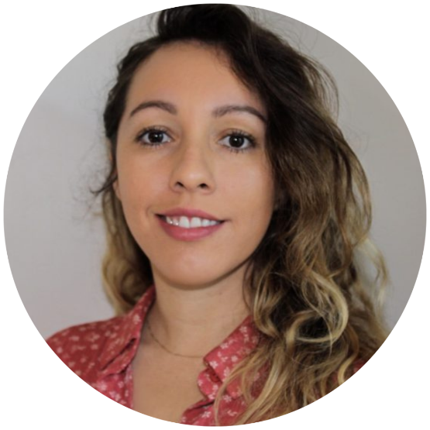
We are Here to Help!
Bryanna Sabourin
Director of Operations &
Customer Happiness Expert
Tiffany Bergeron
Customer Advocate Admin
If you have questions, you can chat with us at www.DiabetesEd.net or call 530 / 893-8635 or email at info@diabetesed.net

Slide 5
Land Acknowledgment
We acknowledge and are mindful that Diabetes Education Services stands on lands that were originally occupied by the first people of this area, the Mechoopda, and we recognize their distinctive spiritual relationship with this land, the flora, the fauna, and the waters that run through this area.

Slide 6
Course Target Audience
When developing your course content, keep in mind the target audience are individuals or groups of diabetes professionals, including RNs, RDs/RDNs, Pharmacists, Nurse Practitioners, Clinical Nurse Specialists, Physician Assistants, Social Workers, and other healthcare providers interested in staying up to date on current practices of care for people with prediabetes, diabetes, and other related conditions.

Slide 7
Slide Guidelines - Format
Font: use Calibri with a minimum of size 24 font.
Slide Size: Use the “Standard” 4:3 size. You can confirm by going to the “Design” tab in PowerPoint to check the “Slide Size” to the right.
Slide Headers: Add a title to each slide describing the topic covered.
Citations: For each section/slide, please list the relevant citations at the bottom of the slide (use font size 11)
Images: When images of people are used, they should reflect inclusivity—diverse ages, races, body types, genders, and abilities. Branded product images and branded images may not be included in lecture content for promotional purposes. Use only royalty-free, properly licensed, or original images. We use websites such as Pixabay, Pexels, Canva, or Microsoft Powerpoint.

Slide 8
Slide Guidelines - Standards
Person-Centered Language: Use respectful, strengths-based language aligned with ADA and ADCES guidance (e.g., “person living with diabetes,” instead of “diabetic”). Avoid shame-based or judgmental terms. Read more here.
Evidence-Based: Support key points with research or guidelines. Flag new/emerging data where appropriate.
Social Determinants of Health: Acknowledge how factors such as income, race, location, food access, and healthcare availability influence diabetes outcomes. Strive to approach care and communication with an understanding of how these social and systemic factors shape health behaviors and access to resources.

Slide 9
Slide Guidelines - Polls
Create around 3 polls for each hour of instruction
Focus on key concepts - Align each question with a specific learning goal that you think is most important
Use straightforward language – goal is to engage and assess
Short, simple vignettes provide good teaching opportunities and reinforcement of key concepts
Use 4-option multiple choice; avoid “all/none of the above.”
Add plausible wrong answers, so they can practice critical thinking
Discuss the correct answer and clarify misconceptions at the conclusion of each poll.

Slide 10
[Instructor Conflict of Interest]
Disclosure to Registrants: Any conflict of interest must be disclosed at the start of your presentation (before the reader engages with the content). If no conflict exists, state that clearly.
Examples: employee, researcher, consultant, advisor, speaker, independent contractor (including contracted researcher), royalties or patent beneficiary, executive, person with ownership interest, and recipient of in-kind products. Individual stocks and stock options should be disclosed. Research funding should be disclosed by the principal or named investigator.
Please list:
  The name of the company or organization with which the individual has a financial relationship.
  The nature of the financial relationship
  Declaration of conflicts of interest or lack thereof.

Slide 11
[Section Objectives & Learning Outcomes]
Outline the objectives/learning outcomes for the course that were previously submitted in your pre-course paperwork.

Slide 12
[Course Content]
See notes below for content guidelines.

Slide 13

Thank You
Thank you!
Please email or call us with any questions.
We are here to help
info@diabetesed.net
www.diabetesed.net
530-893-8635

