Slide 1
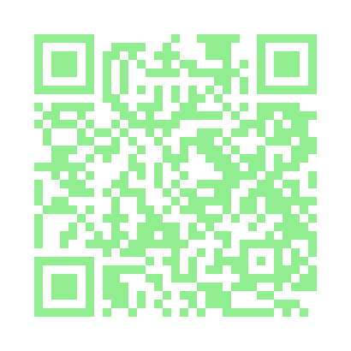

Diabetes: Implementing Person Centered Care
QR Code for Handouts/Resources
Sonoma County Indian Health Project
Beverly Thomassian, RN, MPH, BC-ADM, CDCES
Founder - www.DiabetesEd.net

Slide 2
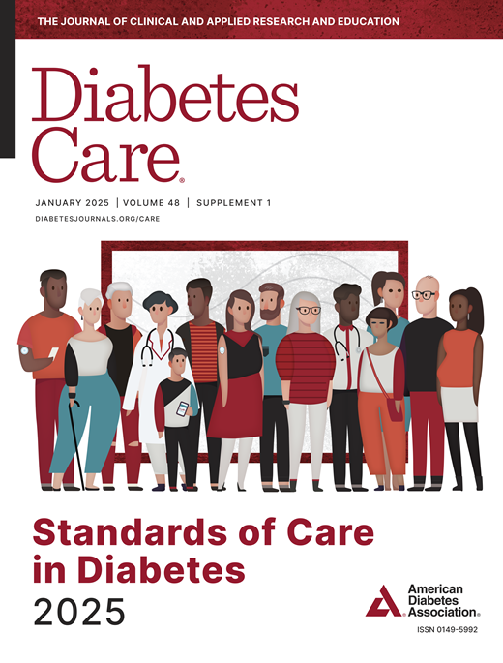
Diabetes: Implementing Person Centered Care
Objectives:
Review the changes & updates to the annual ADA Standards of Medical Care in Diabetes.
Identify the key elements of the standards that improve clinical care for people with diabetes.
Review and discuss use of the latest medications that address hyperglycemia and cardiorenal health.
State the elements included in a lower extremity assessment.
Describe person-centered education strategies that work.

Slide 3
Coach Bev has no Conflict of Interest
She’s not on any speaker's bureau
Does not invest or have any financial relationships with diabetes related companies.
Gathers information from reading package inserts, research and articles
The ADA Standards of Medical Care is main resource for course content

Slide 4
CDC Announces
35% of Americans will have Diabetes by 2050
Boyle, Thompson, Barker, Williamson
2010, Oct 22:8(1)29
www.pophealthmetrics.com

Slide 5

Poll Question 1
What percent of total people in the U.S. are living with undiagnosed and diagnosed type 2 diabetes?
A. About 30%
B. 11.3%
C. 16.8%
D. 25.6%

Slide 6
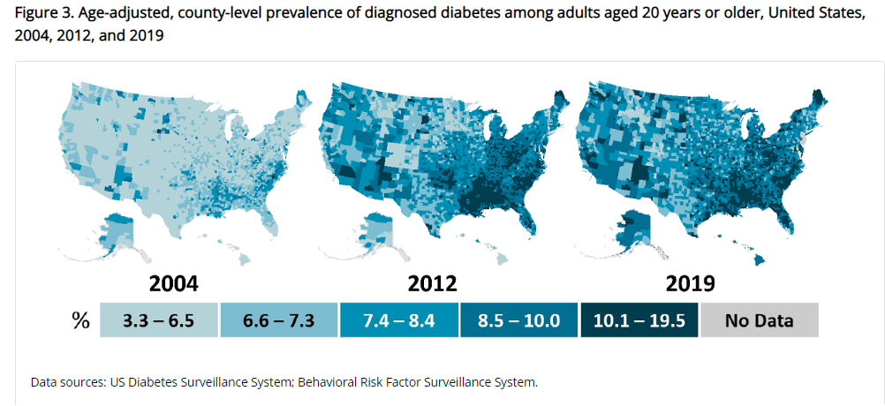
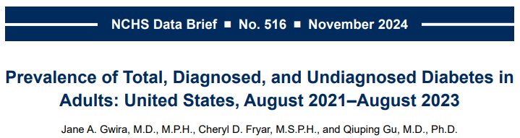
Type 2 Diabetes in America 2025
16.8% with Diabetes
11% don’t know they have it
38% with Prediabetes – 97 million adults
https://www.cdc.gov/nchs/data/databriefs/db516.pdf
Centers for Disease Control and Prevention. National Diabetes Stats Report https://www.cdc.gov/diabetes/data/statistics-report/index.html. Accessed 1/23

Slide 7
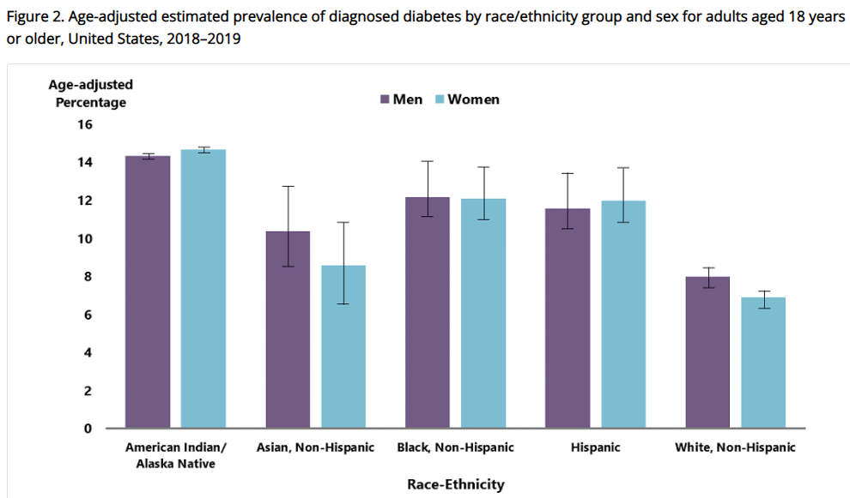
Diabetes Prevalence by Ethnic Group
For adults, diabetes prevalence highest among:
American Indians and Alaska Natives (14.5%),
Non-Hispanic Blacks (12.1%),
People of Hispanic origin (11.8%),
Non-Hispanic Asians (9.5%)
www.cdc.gov/diabetes/data/statistics-report/diagnosed-diabetes.html

Slide 8

17. Diabetes Advocacy
People living with diabetes deserve to be free from the burden of discrimination.
We need to all be a part of advocating to ensure a healthy and productive life for people living with diabetes.
Decrease barriers to diabetes self-management.
Diabetes Care needs to meet outlined standards in all settings.
- In school setting
Young children in childcare
For Drivers
In work settings
In Detention Facilities
Insulin Access & Affordability

Slide 9

Lived Experiences & Advocacy

Slide 10
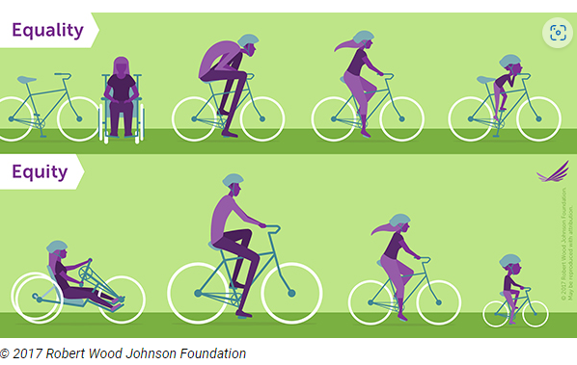
Equality vs Equity
Design and deliver diabetes care with goal of health equity across all populations.
https://coveragetoolkit.org/health-equity/defining-health-equity/

Slide 11
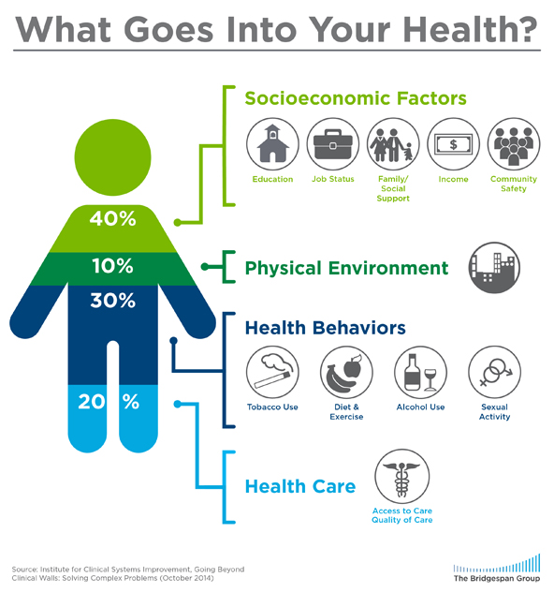
Address Barriers to Self Management
Barriers exist within health system, payer, health care professional & individual.
Address barriers through innovation, including community health workers, telehealth, other digital health solutions.
Consider social determinants of health in the target population when designing care.
https://coveragetoolkit.org/health-equity/defining-health-equity/
Notes:
Access and health equity is the ultimate goal when designing and delivering DSMES.
Creating culturally appropriate and varied modalities of settings has been shown to improve outcomes.
We know barriers to care exist at every level from the health system to individual.
However we can address these barriers by working to educate participants and health care providers on the critical times when DSMES is needed.
We can work with health systems and clinics to develop population health screening and clinical outreach,
create protocols to reduce time for referral and
collaborate health and community systems to address social needs.
We can include other health partners including community health workers to support delivery of diabetes peer support.
Barriers can be also be addressed by developing a diversity of delivery models.
From traditional inperson classrooms to community-based strategies and technology enabled solutions including telehealth or virtual environments varying modes can serve different needs.

Slide 12

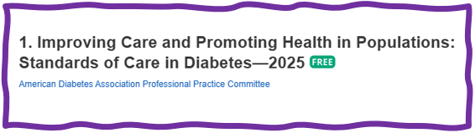
Social Determinants of Health
SDOH are defined as the economic, environmental, political, and social conditions in which people live and are responsible for a major part of health inequality worldwide.
Greater exposure to adverse SDOH over the life course results in poor health. Use quality data to identify inequities & take action.

Slide 13

Tailoring Treatment for Social Context
“Social determinants of health (SDOH)—often out of direct control of the individual and potentially representing lifelong risk—contribute to health care and psychosocial outcomes and must be addressed to improve all health outcomes”
The ADA recognizes this relationship and is taking action.

Slide 14


Now, let’s get to the Nitty Gritty

Slide 15


Notes:
Measurement of C-peptide is preferable to the measurement of insulin as it has a longer half-life, not subjected to the first-pass hepatic metabolism, and a steady-state clearance from the circulation. Insulin undergoes first-pass hepatic metabolism, has variable clearance, a much shorter half-life, and exogenously administered insulin can confound results.

Slide 16
Hormones Effect on Glucose
Effect



⇒
⇒
⇒
Hormone
Glucagon (pancreas)
Stress hormones (kidney)
Epinephrine (kidney)
Insulin (pancreas)
Amylin (pancreas)
Gut hormones - incretins (GLP-1) released by L cells of intestinal mucosa, beta cell has receptors)

Slide 17


Pre Diabetes & Type 2- Screening Guidelines (ADA 2025 Clinical Practice Guidelines)
Start screening all people at age 35.
Screen at any age if BMI ≥ 25 (Asians BMI ≥ 23) plus one or > additional risk factor:
First-degree relative w/ diabetes
Member of a high-risk ethnic population
Habitual physical inactivity
History of heart disease
Check more frequently if taking high risk meds; antiretrovirals, 2nd generation antipsychotics or steroids, thiazide diuretics, statins
History of pancreatitis, prediabetes, GDM, periodontitis

Slide 18

Diabetes 2 - Who is at Risk? (ADA 2024 Clinical Practice Guidelines)
Risk factors cont’d
HTN - BP > 130/80
HDL < 35 or triglycerides > 250
History of Gestational Diabetes Mellitus
Polycystic ovary syndrome (PCOS)
Other conditions associated w/ insulin resistance:
Elevated BMI, acanthosis nigricans (AN)
Screen using A1C, Fasting Blood Glucose or OGTT.
Repeat screening at least every 3 years if negative.
*If prediabetes or on high risk meds, recheck yearly

Slide 19
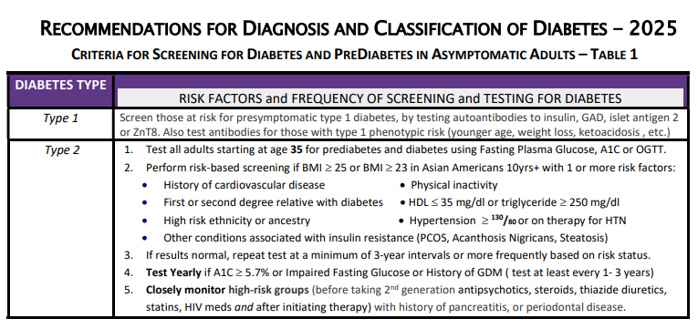



Diabetes Screening Guidelines (ADA 2025 Clinical Practice Guidelines – Cheat Sheet)
DiabetesEd.net Cheat Sheets

Slide 20

Poll Question 2
Which of the following level is considered pre-diabetes range?
a. Fasting BG of 62
b. A1c of 5.9 %
c. After meal BG of 137
d. A1c of 7.1 %

Slide 21
Natural History of Diabetes
Healthy
FBG <100
Random <140
A1c <5.7%
Prediabetes
FBG 100-125
Random 140 - 199
A1c ~ 5.7- 6.4%
~ 50% working pancreas
Diabetes
FBG 126 +
Random 200 +
A1c 6.5% or +
~ 20% working pancreas
Yes!
NO
Development of type 2 diabetes happens over years or decades

Slide 22


PreDiabetes is FREAKING ME OUT
96 million people in US
80% don’t know they have it
In 3-5 years, about 30% of predm will get diabetes
Associated with higher rates of heart attack, stroke, neuropathy and vessel disease

Slide 23

Poll Question 3
What best describes prediabetes in the U.S.?
Prediabetes affects 18-20% of people above the age of 20.
The prevalence of prediabetes and diabetes are almost equal.
Most people with BMI of 30 or greater have prediabetes.
Prediabetes is associated with increased risk of CV disease

Slide 24


3. Prevent or Delay Diabetes for those with Prediabetes
Prediabetes defined as:
A1c 5.7 – 6.4% or fasting BG 100 -125mg/dl
Action:
Screen yearly for diabetes
For adults with BMI 23/25
Refer to DPP approved programs
Includes intensive behavioral lifestyle interventions with 7% wt reduction goal + 150 min exercise week
Provide in person or certified assisted programs

Slide 25

Get About 7 Hours of Quality Sleep to Prevent Diabetes
Poor sleep quality was associated with a 40–84% increased risk of developing type 2 diabetes in a meta-analysis.
Chronotype preference has been linked with many chronic diseases, including type 2 diabetes.
For those with a preference for evenings (i.e., going to bed late and getting up late)
2.5-fold higher odds ratio for type 2 diabetes than for those with a preference for mornings (i.e., going to bed early and getting up early),
Independent of sleep duration and sleep sufficiency
The composition of the gut microbiome may also affect the likelihood of developing type 2 diabetes.

Slide 26
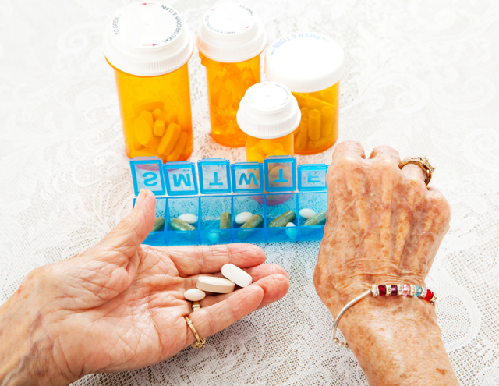
3. Pharmacologic Interventions
Use more intensive approach for high-risk individuals:
BMI of 35+
If A1C is ~6.0 or FPG is 110
History of GDM
No FDA approved med for prevention (off label)
Consider Metformin Therapy for Prediabetes
Monitor B12 level (esp with neuropathy or anemia)
CV Risk Mitigation important.
Statin can increase BG, stop if notice elevation
Consider low dose pioglitazone (Actos) if history of stroke.

Slide 27

Cost Related Barriers
Among people with chronic illnesses, 2/3 of those who reported not taking medications as prescribed due to CRB never shared this with their physician.
Especially associated with diabetes medications and insulin.

Slide 28

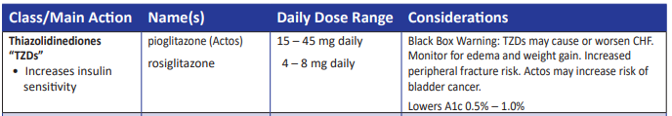
Indications for Insulin Sensitizers Rosiglitazone, Pioglitazone (Actos)
Action: decrease insulin resistance by making muscle and adipose cells more sensitive to insulin. Decrease free fatty acids
Names:
pioglitazone (Actos) – bladder cancer warning
Dosing: 15-45 mg daily
Consider adding low dose if history of stroke or have steatosis
rosiglitazone Dosing: 4-8 mg daily
Efficacy/ Considerations
Reduce A1C ~0.5-1.0%
6 weeks for maximum effect
Actos $5 a month, Avandia $300 a month
Can cause fluid retention, not indicated w/ CHF
Notes:
28
28
Thiazolidinediones (TZDs) enhance insulin sensitivity in muscle and adipose tissue by binding to cell receptors,which leads to an increase in glucose transporter expression. TZDs encourage beta cells to respond more efficiently by lowering the amount of glucose and free fatty acids in the bloodstream, both of which are known to be detrimental to insulin secretion. Finally, these drugs reduce glucose production in the liver.
Clinical trials indicate that pioglitazone and rosiglitazone are slightly more effective at reducing A1C (1.5-1.6% reduction) than troglitazone (1.1% reduction).
Some of the beneficial side effects of thiazolidinediones include an increase in HDL cholesterol and reduction of triglyceride concentrations. This class of drugs has also been shown to lower blood pressure and decrease vascular inflammation in vitro. There are clinical studies underway to further examine the cardiovascular benefit to TZDs.
Some adverse effects of TZDs include weight gain, a potential increase in LDL cholesterol levels, and a possible increase in alanine aminotransferase levels (ALT). Because of the risk of weight gain, edema, and increased LDL cholesterol, thiazolidinediones are contraindicated in patients with advanced forms of congestive heart failure. Due to reported cases of liver failure and liver toxicity caused by the increase in ALT levels, TZDs are contraindicated in patients with abnormal liver function.
TZDs are the most expensive of the oral antidiabetic agents.

Slide 29

Poll question 4
JR is started on Metformin 500mg BID. Which of the following is true?
Hold metformin if blood glucose below 90 mg/dl.
Evaluate B12 levels before starting medication.
Metformin is considered weight neutral
Metformin can cause kidney damage, so increase fluid intake

Slide 30
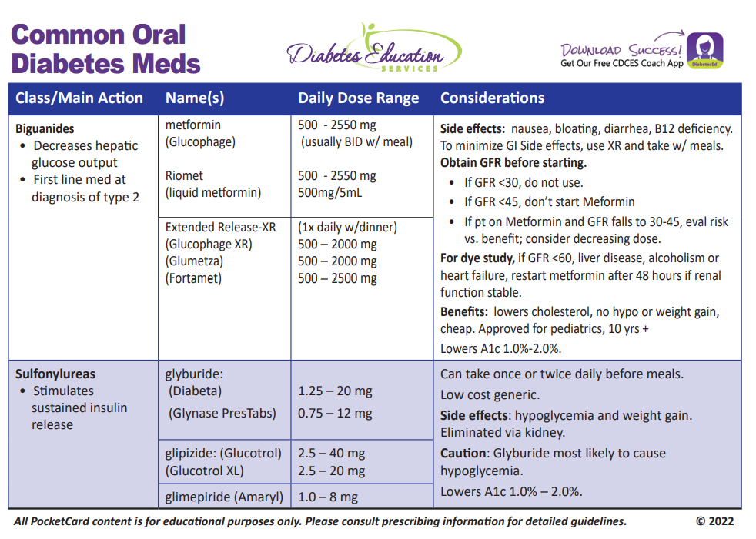

Biguanide derived from:
Goat’s Rue Galega officinalis,
French Lilac
Does NOT harm kidneys
$10 for 3-month supply from Walmart & other pharmacies

Slide 31

Let’s meet people where they are at.

Slide 32
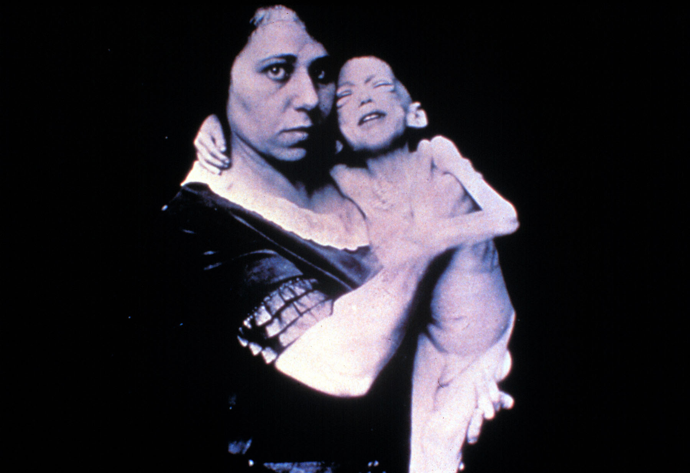

Slide 33



“Diabetes is my biggest competitor” Gary Hall Jr

Slide 34
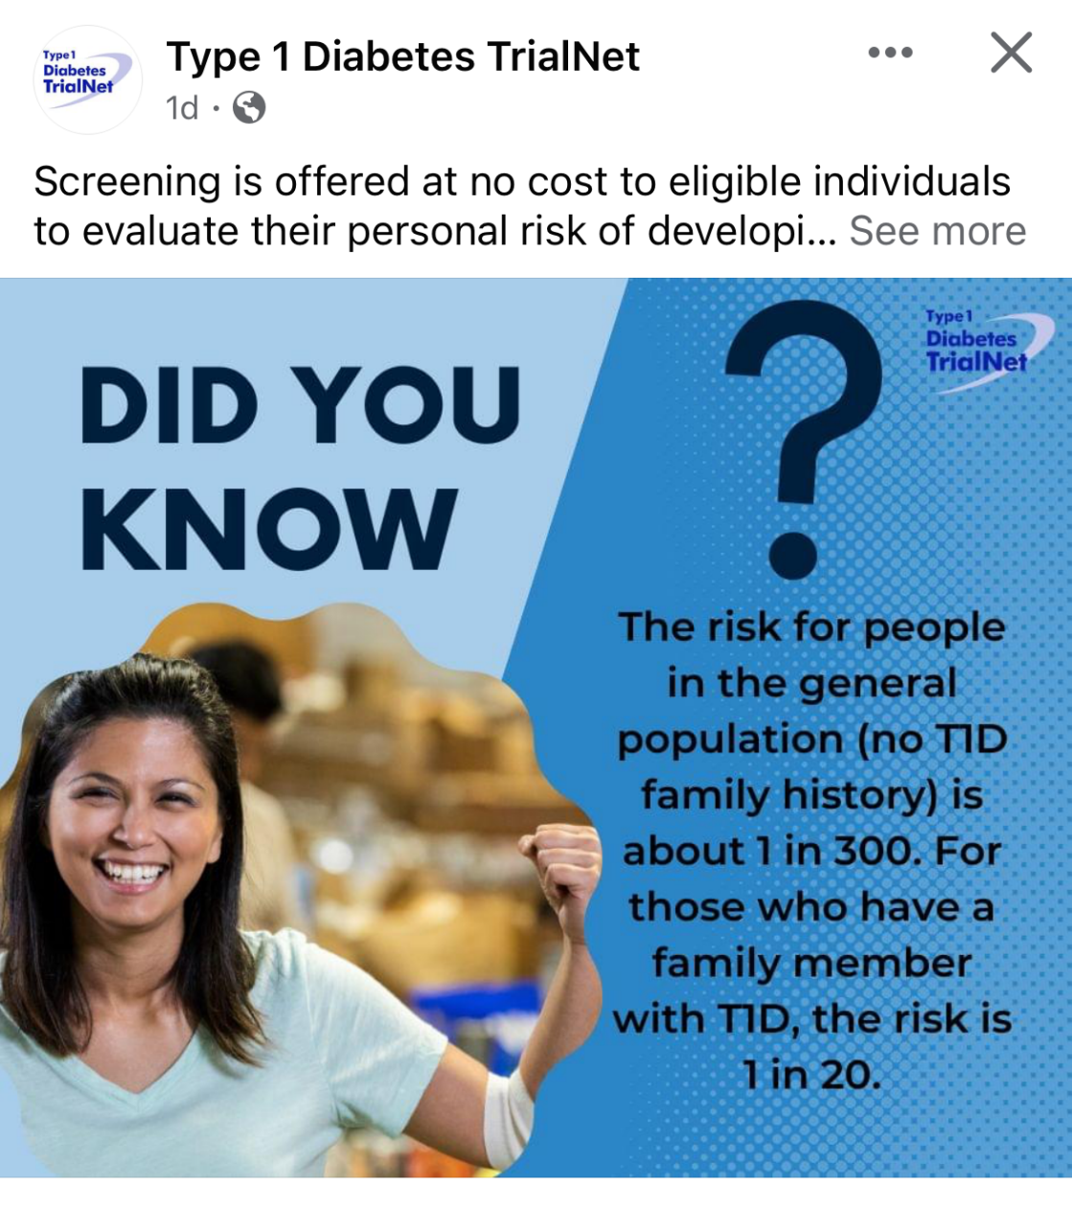

Type 1 ~ Immune Mediated 5-10% of Diabetes
1.5 Million people have type 1 in U.S.
Prevalence increasing:
2001 – 1.48 per 1000 youths diagnosed with diabetes
2017 - 2.15 per 1000 youths diagnosed with diabetes
Incidence & Prevalence increasing
Highest incidence in Finland or Northern Europe.
ADCES In Practice - March 2024 Recent Advances in Type 1 Diabetes: Teplizumab (Tzeild®)
Karen S. Fiano, PHARMD, BCACP, Devada Singh-Franco, PHARMD, CDCES, Young M. Kwon, BS, PHD

Slide 35

Type 1 – 10% of all Diabetes
Auto-immune pancreatic beta cells destruction
Most commonly expressed at age 10 - 14
Insulin sensitive (require 0.5 - 1.0 units/kg/day)
Expression due to a combo of genes and environment:
Autoimmunity tends to run in families
Exposure to virus or other environmental factors
Signs can include:
Increased thirst and hunger
Frequent urination or new bed-wetting at hs
Unintended weight loss
Fatigue and irritability
35
Diagnostic Criteria for Diabetes
Notes:
When you get to the insulin piece, please mention we will get into great detail about insulin in the pharmacotherapy module

Slide 36

Poll 5. What Kind of Diabetes?
AJ, a 29 year old female admitted to the ICU with a blood glucose of 476 mg/dl and a pH of 7.1. (normal pH 7.35-7.45). Lost 13 pounds, BMI 23.
What further testing is needed to determine if person has type 1 or type 2 diabetes?
A. Glutamic acid decarboxylase
B. Beta cells auto antibodies
C. Langerhan’s antibody
D. Endogenous insulin titer

Slide 37

Antibody Testing for Type 1
Glutamic acid decarboxylase (GAD) primary antibody measured
If negative, test islet tyrosine phosphatase 2 (IA-2) and/or zinc transporter 8 (ZnT8) where these tests are available.
In individuals who have not been treated with insulin, antibodies against insulin may also be useful.
5–10% of people with type 1 diabetes do not have antibodies.
In those diagnosed at <35 years of age who have no clinical features of type 2 diabetes or monogenic diabetes, a negative result does not change the diagnosis of type 1 diabetes,
Rate of type 1 progression depends on:
age at first detection of autoantibody,
number of autoantibodies,
autoantibody specificity, and autoantibody titer.
Glucose and A1C levels may rise well before the clinical onset of diabetes

Slide 38
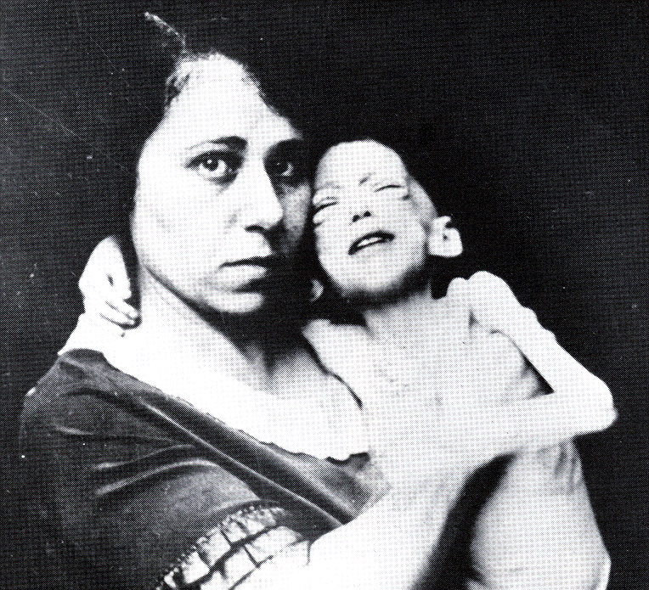

Miracle of Insulin
The Miracle of Insulin
February 15, 1923
Patient J.L., December 15, 1922

Slide 39

Beta-Cell Mass Loss
In both type 1 and type 2 diabetes,
genetic and environmental factors can result in the progressive loss of β-cell mass and/or function
that manifests clinically as hyperglycemia.
Once hyperglycemia occurs, people with all forms of diabetes are at risk for developing the same chronic complications, although rates of progression may differ.

Slide 40
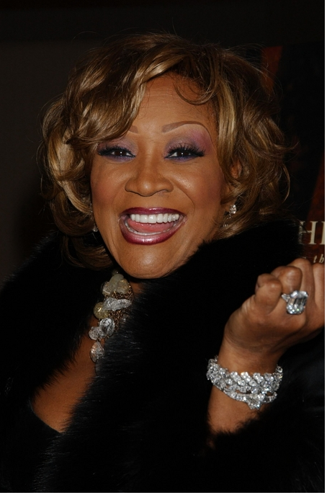
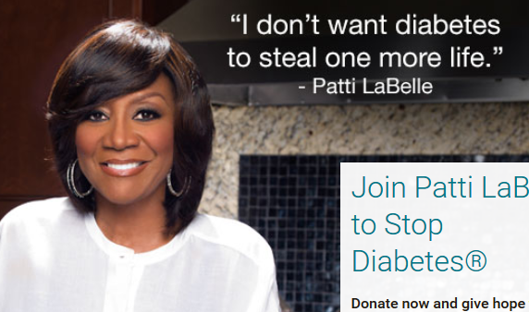
Patti Labelle
"divabetic”
“I have diabetes, it doesn’t have me”

Slide 41

Signs of Diabetes
Polyuria
Polydipsia
Polyphasia
Weight loss
Fatigue
Skin and other infections
Blurry vision
Glycosuria, H₂O losses
Dehydration
Fuel Depletion
Loss of body tissue, H₂O
Poor energy utilization
Hyperglycemia increases incidence of infection
Osmotic changes

Slide 42




Slide 43

What is Type 2 Diabetes?
Complex metabolic disorder ….
(Insulin resistance and deficiency)
with social, behavioral and environmental risk factors unmasking the effects of genetic susceptibility.
New Diagnosis? Call 800 – DIABETES to request “Getting Started Kit”
www.Diabetes.org

Slide 44

Ominous Octet
Decreased satiation neuro-
transmission
Decreased amylin, β-cell secretion
80% loss at dx
Increased renal glucose reabsorption
Decreased Gut hormones
Increased glucagon secretion
G
I
G
I
G
G
I
I
G
Increased lipolysis
G
G
I
I
G
G
I
Increase glucose
production
I
G
G
Decreased glucose
uptake
Notes:
44
44

Slide 45
Diabetes Bingo “DiaBingo” Shout out Right Answer

Slide 46
DiaBingo
B Frequent skin and yeast infections
B A BMI of ____ or greater indicates increased pre/diabetes risk?
B To reduce complications, control A1c, Blood pressure, Cholesterol
B PreDiabetes – fasting glucose level of ___ to ____
B Erectile dysfunction indicates greater risk for ____
B Diabetes – fasting glucose level____ or greater
B Type 1 diabetes is best described as an ______ disease
B People with diabetes are ______ times more likely to die of heart dx
B Elevated triglycerides, < HDL, smaller dense LDL
B Each percentage point of A1C = _____ mg/dl glucose
B At dx of type 2, about __% of the beta cell function is lost
B Diabetes – random glucose ____ or greater

Slide 47

SGLT-2 Inhibitors

Slide 48

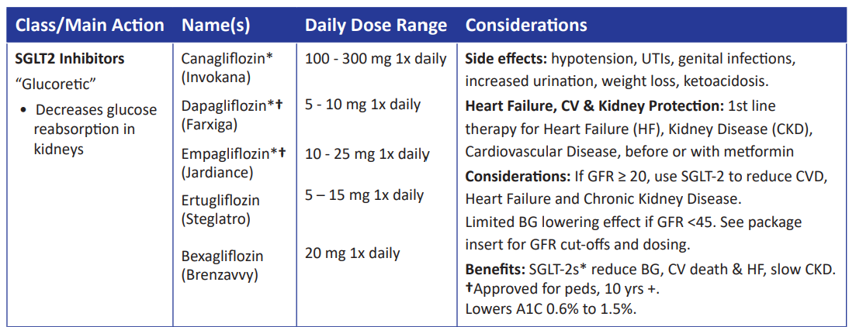
SGLT2 Inhibitors- “Glucoretics”
Action: decreases renal reabsorption of glucose proximal tubule of kidneys (reset renal threshold)
Preferred diabetes treatment for people with heart and kidney failure. Decreases BG & CV Risk.
AWP: ~$650 a month
% ‘f
Notes:
48
48
Thiazolidinediones (TZDs) enhance insulin sensitivity in muscle and adipose tissue by binding to cell receptors,which leads to an increase in glucose transporter expression. TZDs encourage beta cells to respond more efficiently by lowering the amount of glucose and free fatty acids in the bloodstream, both of which are known to be detrimental to insulin secretion. Finally, these drugs reduce glucose production in the liver.
Clinical trials indicate that pioglitazone and rosiglitazone are slightly more effective at reducing A1C (1.5-1.6% reduction) than troglitazone (1.1% reduction).
Some of the beneficial side effects of thiazolidinediones include an increase in HDL cholesterol and reduction of triglyceride concentrations. This class of drugs has also been shown to lower blood pressure and decrease vascular inflammation in vitro. There are clinical studies underway to further examine the cardiovascular benefit to TZDs.
Some adverse effects of TZDs include weight gain, a potential increase in LDL cholesterol levels, and a possible increase in alanine aminotransferase levels (ALT). Because of the risk of weight gain, edema, and increased LDL cholesterol, thiazolidinediones are contraindicated in patients with advanced forms of congestive heart failure. Due to reported cases of liver failure and liver toxicity caused by the increase in ALT levels, TZDs are contraindicated in patients with abnormal liver function.
TZDs are the most expensive of the oral antidiabetic agents.

Slide 49
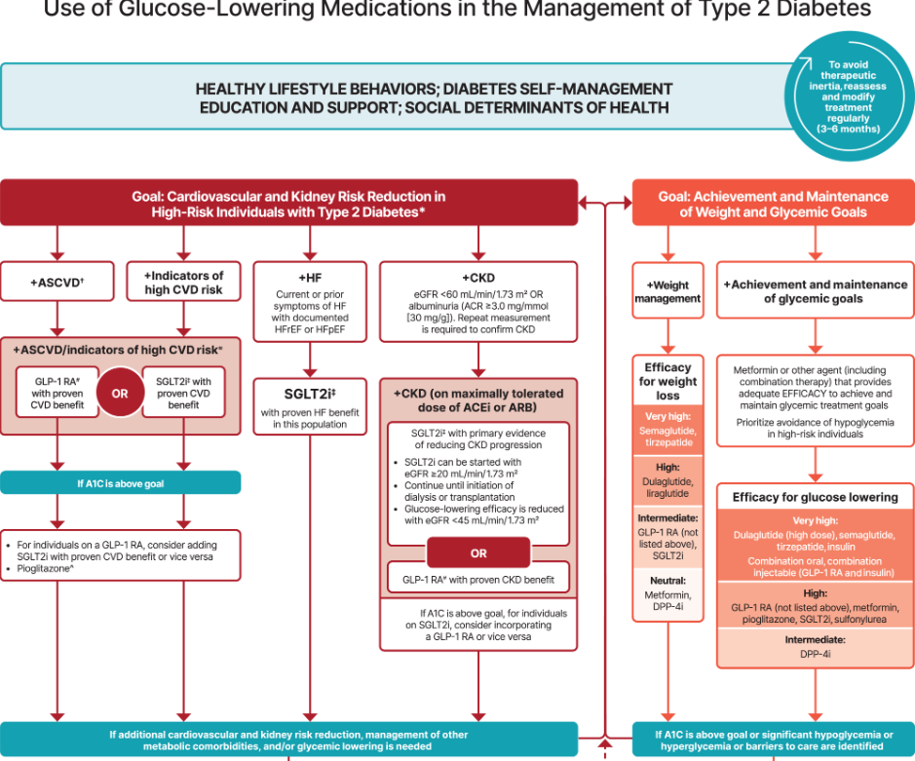
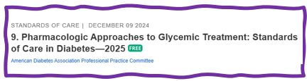
Let’s Break it Down ADA 2025

Slide 50
SGLT-2i Indications Summary
Drug | Lower BG | Reduce CV Risk? | Use to treat Heart Failure? | Slow renal disease?
Dapagliflozin (Farxiga) | Yes | Yes | Yes +/- Diabetes | Yes
Empagliflozin (Jardiance) | Yes | Yes | Yes +/- Diabetes | Yes
Canagliflozin (Invokana) | Yes | Yes | Yes w/ Diabetes | Yes
Ertugliflozin (Steglatro) | Yes | No | Yes w/ Diabetes | Yes
Bexagliflozin (Brenzavvy) | Yes | NA | NA | NA
Package inserts, dailymed.nlm.nih.gov

Slide 51
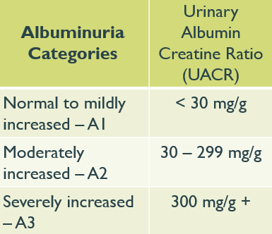
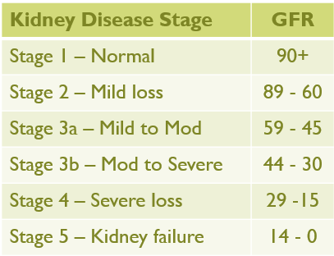

Chronic Kidney Disease– 2025 Update
Optimize glucose and BP to protect kidneys.
Use SGLT-2 with demonstrated benefit to reduce CKD and CVD*
To reduce CV risk and CKD, use a GLP-1* with demonstrated benefit.
In people with CKD and albuminuria, a nonsteroidal MRA effective if GFR 25+
Aim to reduce urinary albumin by ≥30% in people with CKD
*SGLT-2i’s
Empagliflozin (Jardiance), canagliflozin (Invokana), dapagliflozin (Farxiga)
*GLP-1 RA’s
Semaglutide (Ozempic), liraglutide (Victoza), dulaglutide (Trulicity)

Slide 52

Standard 11 – Protect Kidneys
Diabetes with CKD - GFR ≥20
Start SGLT2 to reduce chronic kidney disease progression and cardiovascular events.
Also consider GLP-1 RA – (ie semaglutide)
If type 2 diabetes and established Chronic Kidney Disease (CKD)
Start nonsteroidal mineralocorticoid receptor antagonist (finerenone) and/or GLP-1 RA recommended for cardiovascular risk reduction.

Slide 53
Poll Question 5
FZ is older and lives alone and has CHF. Very concerned about avoiding hypoglycemia, since brother almost died from a hypoglycemic incident. Which medication class would you recommend?
Meglitinides
SGLT-2 Inhibitors
Sulfonylureas
Analog insulins

Slide 54

6. Glycemic Goals
A1C
Blood Pressure
Cardiovascular risk reduction

Slide 55

6. Glycemic Targets for Non-Pregnant Adults
A1c < 7% - a reasonable goal for adults.
A1c < 6.5% - for those without significant risk of hypoglycemia
A1c < 8% - for those with history of hypoglycemia, limited life expectancy, or those with longstanding diabetes and vascular complications.
A1c Check Frequency:
If meeting goal - At least 2 times a year
If not meeting goal – Quarterly
Also review Ambulatory Glucose Profile

Slide 56
6. Glycemic Targets Individualize Targets – ADA
Pre-Prandial BG 80- 130
1-2 hr post prandial < than 180
*for nonpregnant adults
Time in Range: 70%
BG of 70-180 mg/dL

Slide 57

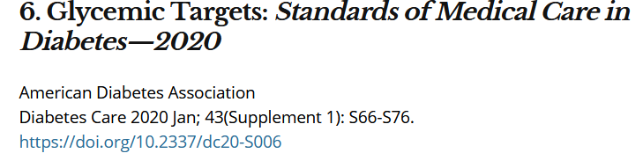
A1c and Estimated Avg Glucose (eAG)
A1c (%) eAG__
5 97 (76-120)
6 126 (100-152)
7 154 (123-185)
8 183 (147-217)
9 212 (170 -249)
10 240 (193-282)
11 269 (217-314)
12 298 (240-347)
eAG = 28.7 x A1c-46.7 ~ 29 pts per 1%
Translating the A1c Assay Into eAG – ADAG Study

Slide 58


Slide 59
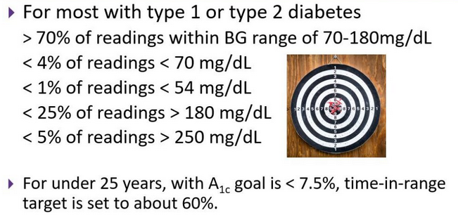
Ambulatory Glucose Profile
Standardized report with visual cues for those on CGM devices
Evaluate Time in Range (TIR)
Target 70-180 mg/dl (70% of time)
Eval % time below goal
< 70 (less than 4% of time)
<54 (less than 1% of time)
Eval % time above > 180 (less than 25% of time)
Eval % time above > 250 (less than 5% of time)
For those with frailty or at high risk of hypoglycemia recommend:
- Target of 50% time in range
- Less than1% time below range

Slide 60
At least 42 factors affect glucose!
Food
Meds
Activity
Biological
Environ-mental
Behavioral and decision making
↑↑ Carbo-hydrate quantity
→↑Carbo-hydrate type
→↑ Fat
→↑ Protein
→↑ Caffeine
↓↑Alcohol
↓↑ Meal timing
↑Dehydration
? Personal microbiome
→↓Dose
↓↑ Timing
↓↑ Inter-actions
↑↑ Steroid administration
↑ Niacin (vitamin B3)
→↓ Light exercise
↓↑ High/ moderate exercise
→↓ Level of fitness/training
↓↑ Time of day
↓↑ Food and insulin timing
↑ Insufficient sleep
↑ Stress and illness
↓ Recent hypoglycemia
→↑ During-sleep blood sugars
↑ Dawn phenomenon
↑ Infusion set issues
↑ Scar tissue and lipodystrophy
↓↓ Intramuscular insulin delivery
↑ Allergies
↑ A higher glucose level
↓↑ Menstruation
↑↑ Puberty
↓ Celiac disease
↑ Smoking
↑ Expired insulin
↑ Inaccurate BG reading
↓↑ Outside temperature
↑ Sunburn
? Altitude
↓ Frequency of glucose checks
↓↑ Default options and choices
↓↑ Decision-making biases
↓↑ Family relationships and social pressures
Adapted from Brown A. DiaTribe Learn: Making sense of diabetes... diatribe.org/42factors

Slide 61
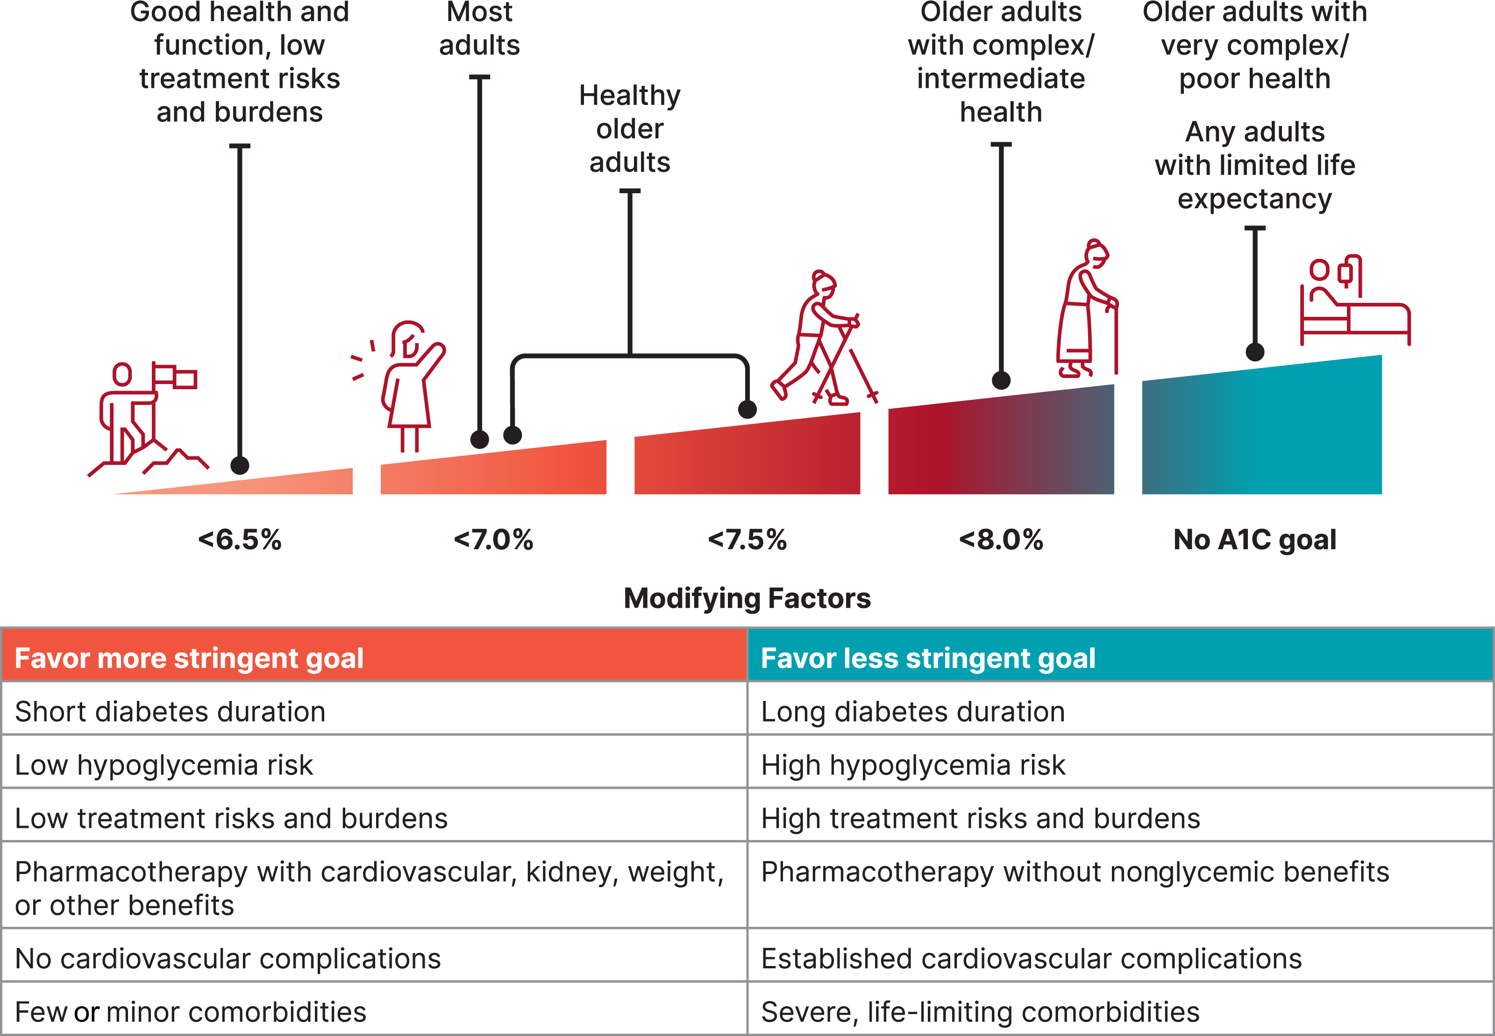
(
American Diabetes Association Dia Care 2022 6.2 45- S89
Table 6.2
Notes:
Patient and disease factors used to determine optimal glycemic targets. Characteristics and predicaments toward the left justify more stringent efforts to lower A1C; those toward the right suggest less stringent efforts. A1C 7% = 53 mmol/mol. Adapted with permission from Inzucchi et al. (59).

Slide 62
ADA 2025 Goal Summary
A1c less than 7% (individualize)
Pre-meal BG 80-130
Post meal BG <180
Time in Range (70-180) 70% of time
Blood Pressure
<130/80
Cholesterol
Statin therapy based on age & risk status
If 40+ with ASCVD Risk, decrease LDL by 50%, LDL <70
If 40+ with ASCVD, decrease LDL by 50%, LDL <55

Slide 63

“The highest form of wisdom is kindness.” The Talmud

Slide 64
Diabetes Bingo “DiaBingo” Shout out Right Answer

Slide 65
DiaBingo- G
G ADA goal for A1c is less than ____%
G People with DM need to see their provider at least every month
G Blood pressure goal is less than
G People with DM should see eye doctor (ophthalmologist) at least
G The goal for triglyceride level is less than
G Goal for LDL cholesterol for people 40+ with diabetes is _________
G The goal for blood sugars 1-2 hours after a meal is less than:
G People with DM should get this shot every year
G People with DM need to get urine tested yearly for ___________
G Periodontal disease indicates increased risk for heart disease
G The goal for blood sugar levels before meals is:
G The activity goal is to do ___ minutes on most days

Slide 66

Case Study - JR
38 yr old male, BMI 28, arrives in clinic for physical. Says he has been feeling tired lately, but attributes that to his job. In office fingerstick reads 228 mg/dl.
1. What lab tests are needed?
2. What would you include in your physical exam?
3. Next steps

Slide 67


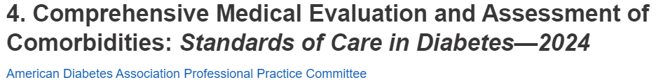
Lab Eval at Initial & Annual Visit
A1c (each 3-6 mo’s)
Each year
Lipids, CBC with platelets
Liver function
Spot urinary albumin-to-creat ratio (UACR))
Serum creat and GFR
TSH, celiac (type 1)
B12 if on metformin >5yrs
Calcium, Vita D, and phosphorus if appropriate
Serum K
If on ACE, ARBs or diuretics

Slide 68
Case Study - JR
38 yr old male, BMI 28, arrives in clinic for physical. Says he has been feeling tired lately, but attributes that to his job. In office fingerstick reads 228 mg/dl.
1. What lab tests are needed?
2. What would you include in your initial exam?
3. Reduce CV risk?

Slide 69
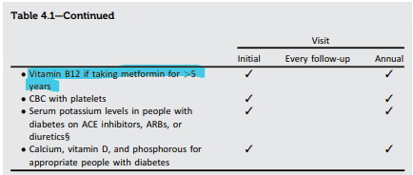
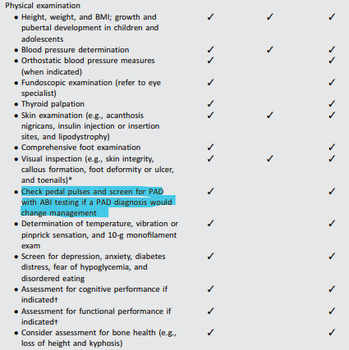

Standard 4 – Diabetes Medical Evaluation

Slide 70
Lab Test, BP, Family History
A1C – 9.8%
Cholesterol - 216
LDL – 164 mg/dL
HDL – 46
Triglycerides – 276
TSH – 1.43
GFR - >60
UACR - <30 mg/gm
ALT, AST 90 & 85
Platelets 217
K+ 3.8
Family history
Dad with type 2, history of stroke
B/P
156/88 then 148/82
BMI 31
Skin – some acanthosis nigricans visible on neck
Lower extremities calluses and foot issues
Mouth – gingivitis
Brush, floss, dentist

Slide 71
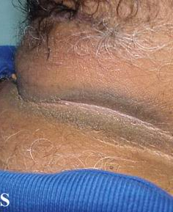
Acanthosis Nigricans
A skin disorder characterized by darkening (hyperpigmentation) and thickening (hyperkeratosis)of the skin
mainly in the folds of the skin in the armpit (axilla), groin and back of the neck.
Acanthosis nigricans is not a skin disease per se but a cutaneous sign of an underlying condition or disease.
Associated with extra weight and insulin resistance

Slide 72
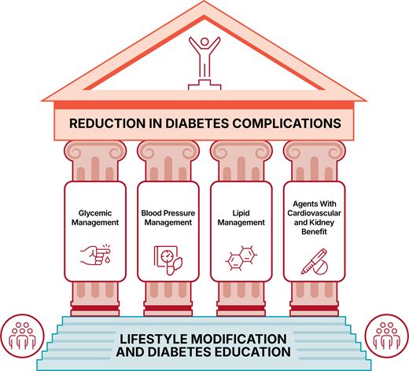


Slide 73

Assess ASCVD and Heart Failure Risk Yearly
Duration of diabetes & 55+
BMI
Hypertension
Dyslipidemia
Smoking
Family history of premature coronary disease
Chronic kidney disease – presence of albuminuria
Treat modifiable risk factors as described in ADA guidelines.

Slide 74

BP Treatment in addition to Lifestyle
First Line B/P Drugs if 130/80 +
With albuminuria or ASCVD
Start either ACE or ARB*
No albuminuria - Any of the 4 classes of BP meds can be used:
*ACE Inhibitors, *ARBs, *thiazide-like diuretics or calcium channel blockers.
*Monitor K+ 7-14 days after start/annually
Avoid ACE and ARB at same time
Multiple Drug Therapy often required
If B/P ≥ 150 /90 start 2 drug combo
*Albuminuria = Urinary albumin creatinine ratio of 30+

Slide 75
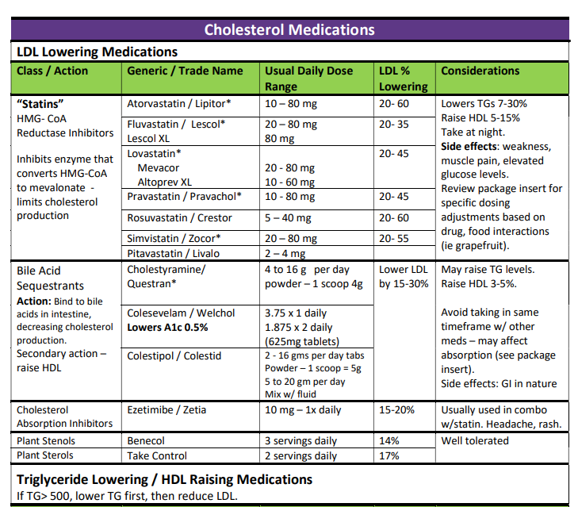
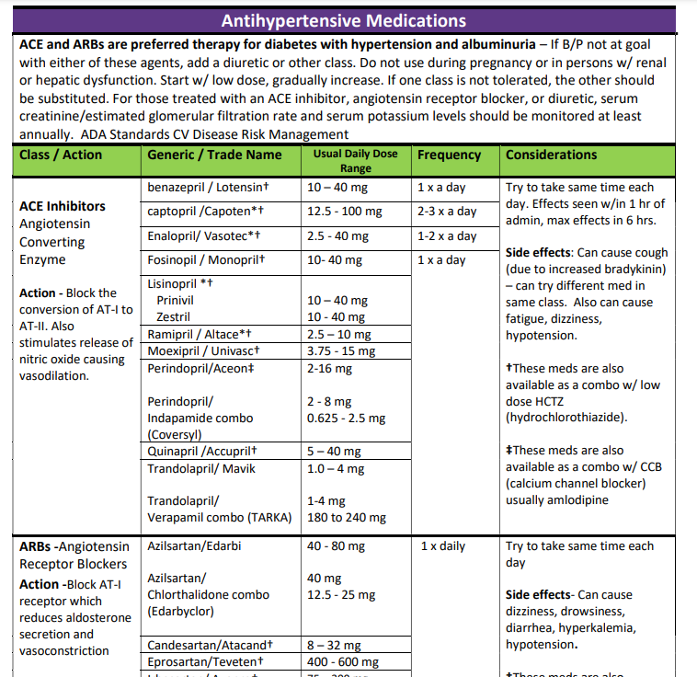
Lipid and HTN Meds Cheat Sheets
Website: https://diabetesed.net/coach-bevs-diabetes-cheat-sheets/
On CDCES Coach App too
For exam, know major classes, when used, side effects and considerations.

Slide 76
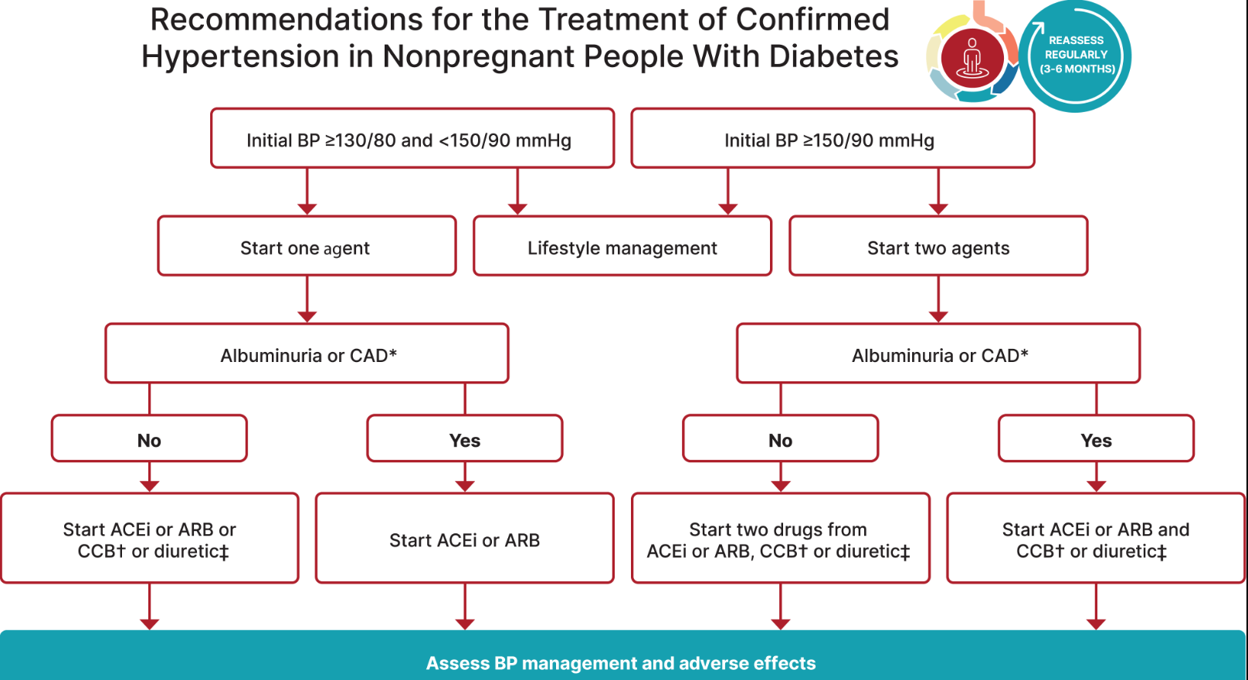
Hypertension Management

Slide 77

Poll Question 6
RZ is 47 years old with type 2 diabetes and hypertension. RZ takes metformin 1000 mg BID, plus lisinopril 20mg daily. RZs LDL is 130 mg/dL. Based on the most recent ADA Standards, what is the LDL Cholesterol target for RZ?
LDL less than 100 mg/dL.
Lower LDL by 30%.
LDL target of 65 mg/dL or less.
Determine LDL target based on ASCVD risk.

Slide 78
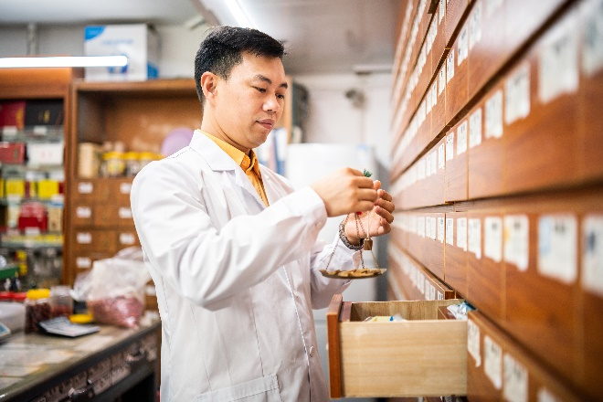
Lipid Goals – Primary Prevention
For people with diabetes aged 40–75:
No ACSVD Risk – Start Moderate intensity statin
Higher cardiovascular risk*
(*HTN, Smoke, CKD, BMI 30+ albuminuria, family hx ACSVD)
High-intensity statin therapy is recommended
Reduce LDL cholesterol by at least 50% of baseline AND
Target LDL cholesterol <70 mg/dL.
If LDL cholesterol 70 +
it may be reasonable to add ezetimibe or a PCSK9 inhibitor to maximum tolerated statin therapy.

Slide 79
Statin Dosing
High Intensity:
Lowers LDL ≥50%
Moderate Intensity:
Lower LDL 30-<50%
Lipitor (atorvastatin)
40-80mg
Crestor (rosuvastatin)
20-40mg
Lipitor (atorvastatin)
10-20mg
Crestor (rosuvastatin)
5-10mg
Zocor (Simvastatin)
20-40mg
Pravachol (pravastatin)
40 – 80mg
Mevacor (lovastatin) 40 mg
Lescol (fluvastatin) XL 80mg
Livalo (pitavastatin) 2-4mg
***If person can’t tolerate intended statin dose, use maximally tolerated dose

Slide 80

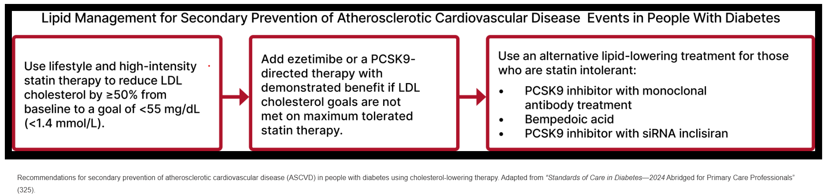
Lipid Goals for People with ASCVD
For people of all ages with diabetes and atherosclerotic cardiovascular disease:
Add high-intensity statin to lifestyle therapy.
Reduce LDL cholesterol by 50% or greater from baseline with LDL cholesterol goal of <55.
Addition of ezetimibe or a PCSK9 inhibitor with proven benefit in recommended if goal is not achieved on maximum tolerated statin therapy.

Slide 81

Half-Way Cuteness Break

Slide 82
Case Study - JR
38 yr old male, BMI 28, arrives in clinic for physical. Says he has been feeling tired lately, but attributes that to his job. In office fingerstick reads 228 mg/dl.
1. What lab tests are needed?
2. What would you include in your initial exam?
What medications?
What about his feet?

Slide 83
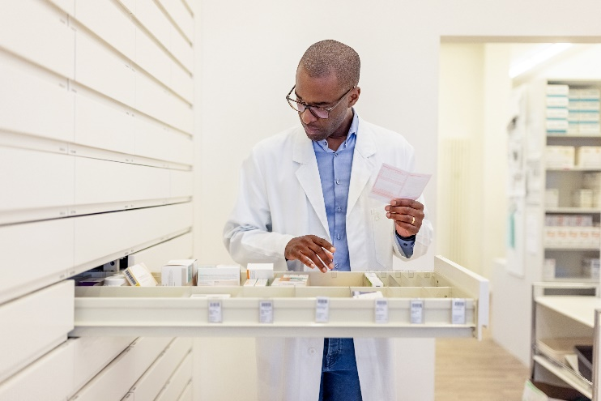
JR Started on These Medications
Meds started:
Metformin 1000 mg
Glipizide 10 mg BID (sulfonylurea)
Lovastatin 40 mg
Lisinopril 20mg (ACE Inhibitor)
Pioglitazone (Actos) 15mg
B/P 142/94 Pulse 86
A1C – 9.8%
Cholesterol - 216
LDL – 164 mg/dL
HDL – 46
Triglycerides – 276
TSH – 1.43
GFR - >60
UACR - <30 mg/gm
ALT, AST 90 & 85
Platelets 217
K+ 3.8

Slide 84
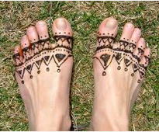
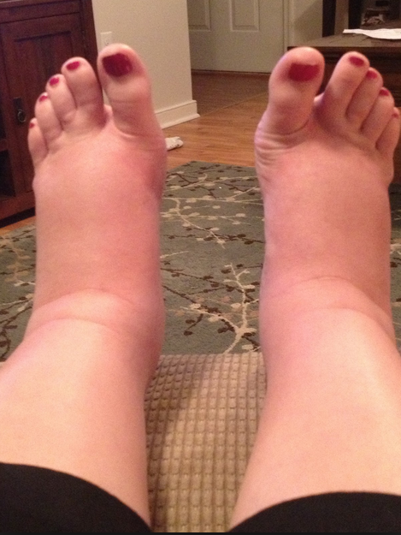
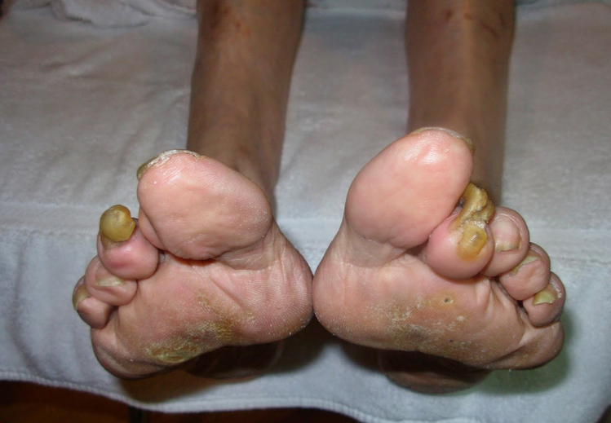
Lower Extremities
Lift the Sheets and Look at the Feet

Slide 85
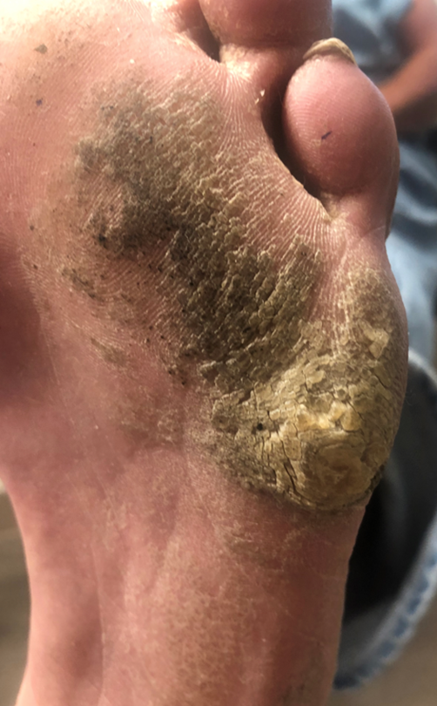
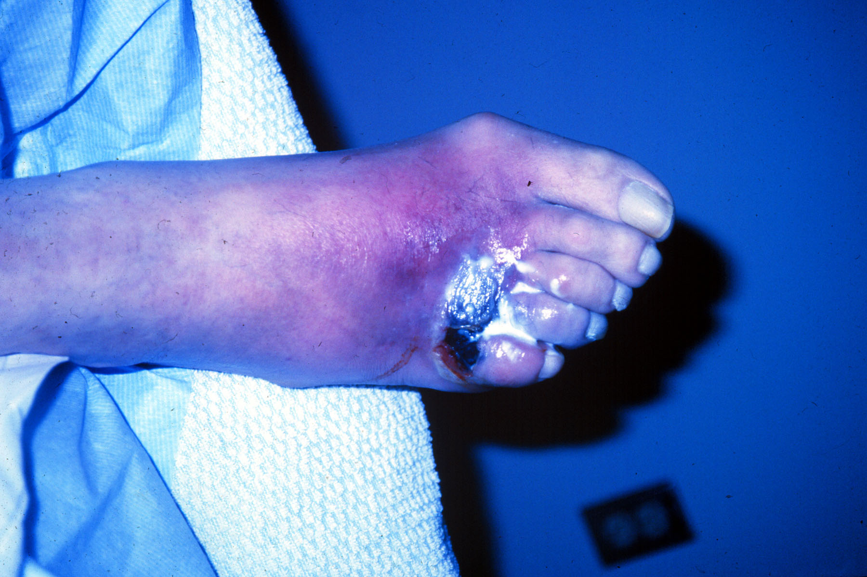

Slide 87
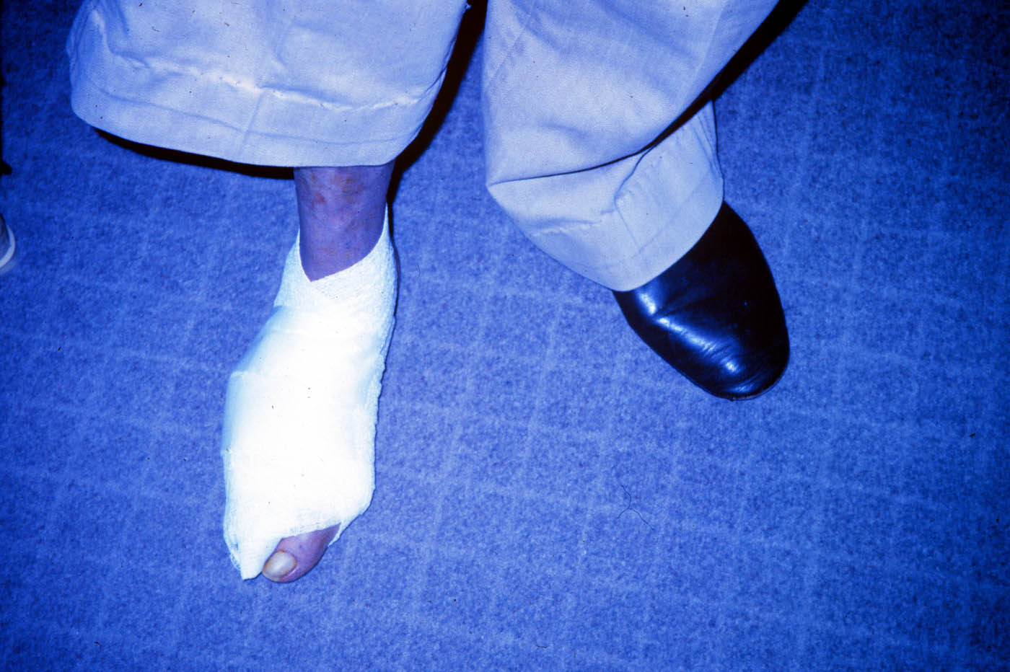

Slide 88
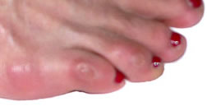
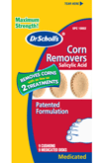

No Bathroom Surgery

Slide 89
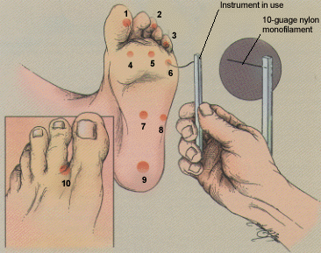
5.07 monofilament = 10gms linear pressure

Slide 90
Three Most Important Foot Care Tips
Inspect and apply lotion to your feet every night before you go to bed.
Do NOT go barefoot, even in your house. Always wear shoes!
Every time you see your provider, take off your shoes and show your feet.

Slide 91

Case Study - JR
38 yr old male, BMI 28, arrives in clinic for physical. In office fingerstick reads 228 mg/dL A1C is 12.3%.
How will we approach this new diabetes?

Slide 92
ABC’s of Diabetes Education
of Healing Through Connection

Slide 93
Ask about their life (SDOH)
Assess current self-management behaviors
Use opened ended questions
Listen for feeling words
Assess your feelings

Slide 94


2 Responses to A1C of 12.3%
Well, you know the A1C target is less than 7%. You are going to get complications if you don’t get your glucose under control.
Nobody can give themselves diabetes. It’s not your fault. We are here to help you manage your diabetes.

Slide 95
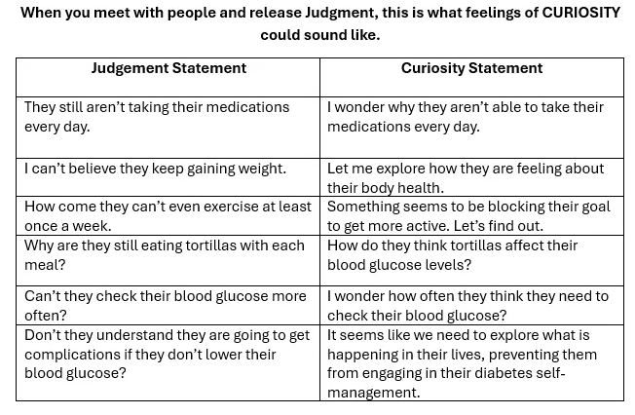
From Judgement to Curiosity

Slide 96
Ask about their life (SDOH)
Assess current self-management behaviors
Assess your feelings
Accept without judgement
Acknowledge one thing they are doing
Advocate for needed resources

Slide 97

Create a Judgement Free Zone – Roll out the Carpet of Acceptance
There are no bad or good blood glucose numbers.
There is no such thing as cheating.
You are not failing at your diabetes.
It is not your fault you have diabetes.
Thank you for showing up today.
Notes:
Judgement Free Zone
Creating a judgment-free zone during diabetes coaching and education sessions lays the groundwork to make meaningful connections. This “safety zone” provides individuals with a place to share their truth and have someone acknowledge and recognize what they are going through. It also helps to identify areas of distress and collaborate on problem-solving. Setting a judgment-free zone also opens the door to more fruitful conversation when gathering groups together in person or virtually. To create this environment, the facilitators need to establish the ground rules. For example, the facilitator might say, “There are no good or bad blood sugars or good or bad foods. If a person is stressed out and eats a donut, they are not cheating; they are choosing to have a donut. If people have blood glucose levels out of range, they are not failing; they need support and help with problem-solving based on their lived experiences.” If someone uses judgmental terms during the session, the educator gently reminds them that this is a judgment-free zone and encourages them to rephrase it.

Slide 98
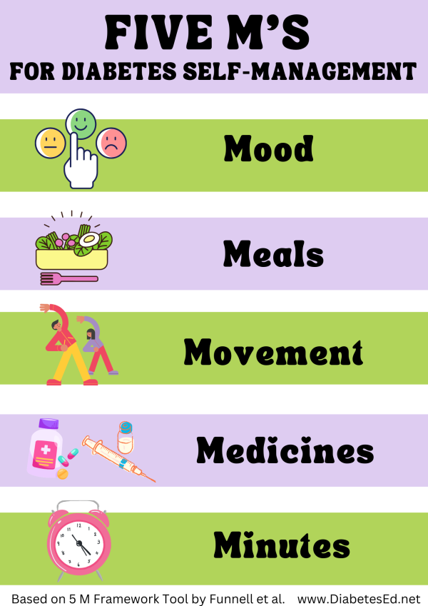

Slide 99
JR Returns in 1 month
Blood glucose improved
B/P 142/94 Pulse 86
BMI 32 – trying to lose wt
Meds started include:
Metformin 1000 mg
Glipizide 10 mg BID (sulfonylurea)
Lovastatin 40 mg
Lisinopril 20mg (ACE Inhibitor)
Pioglitazone (Actos) 15mg
JR checks BG 4-7 x’s a week.
Lowest 152, Highest 289
What other issues do we need to evaluate?
Activity – mostly sedentary
Sleep: 6-7 hrs a night
Pain issues – knees
Brushing – once daily
Alcohol and other drug use
Drinks a few beers on weekends
Coping - okay
Steatosis – elevated LFTs
Affordability
Met with CDCES and RD
Provider increases metformin/glipizide and adds SGLT-2 Empagliflozin 10 mg

Slide 100
Beliefs about health and diabetes
Barriers can be confused with non-compliance
Burnout lookout. On extended diabetes vacation due to diabetes distress?
Bouncing back – leaning into resilience

Slide 101

Diabetes is Complex
Goal – achieve well being and negotiated outcomes
Psychological factors:
Environmental
Social
Behavioral
Emotional
Keep it person centered while integrating care into daily life
Consider the individual

Slide 102
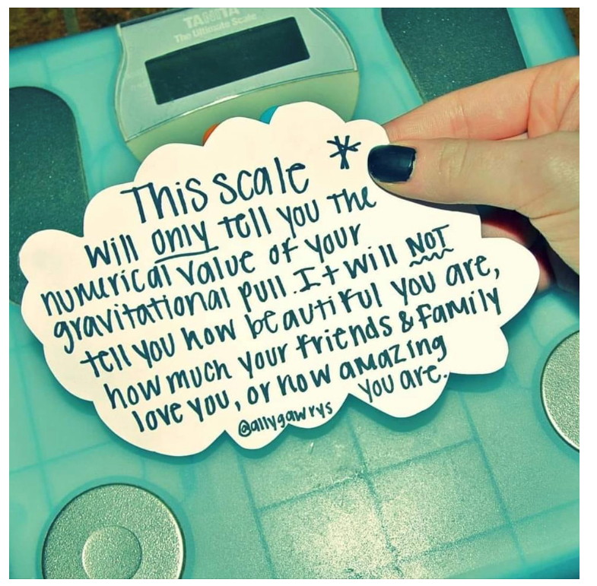
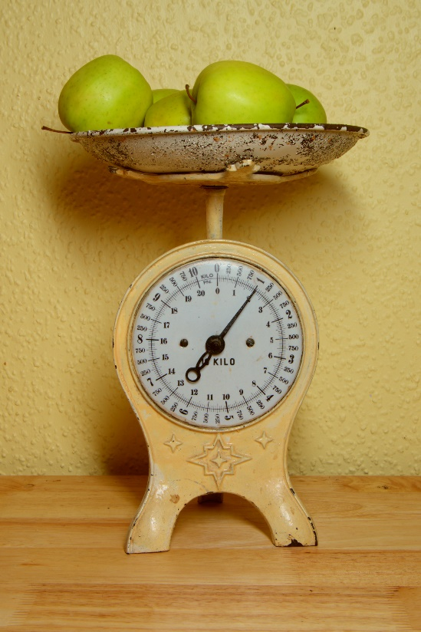
Weight is a Heavy Issue

Slide 103

Medical Nutrition Therapy Works
MNT is effective and beneficial to people with diabetes.
When delivered by an RDN, MNT is associated with A1C absolute decreases of
1.0–1.9% for people with type 1 diabetes and
0.3–2.0% for people with type 2 diabetes

Slide 104
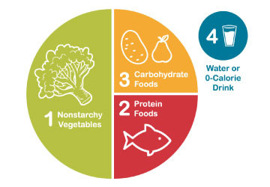

Healthy Eating Patterns/Approaches
Eating Patterns:
Total Foods Consumed
Mediterranean Diet
Plant based eating
DASH (Dietary Approaches to Stop Hypertension)
Low Carbohydrate
Eating Approach:
Tools for developing an eating pattern
Diabetes Plate Method
Carbohydrate Counting
Individualized behavioral approaches
Use Integrative food-based approach. “People eat food, not nutrients”.
Notes:
The standards of care call out the importance of understanding different terms in nutrition including eating patterns, meal plan or dietary approach.
Eating pattern the totality of the foods we consume over a time period. Examples include……
A Meal Plan is an individualized and created by an RDN and is
Dietary or Eating approach is the strategy or tool used to support implementation of healthy eating patterns.
There is no one pattern that is better than another so we work with the individual with diabetes to determine an effective eating pattern and approach.
The 2025 Standards of Care have added much detail about considering approaches that take into account religious fasting or other new concepts of intermittent fasting or chrononutrition

Slide 105





Plate example

Slide 106

Exercise Standards
Adults – 150 min/wk moderate intensity
over 3 days a week.
Don’t miss > 2 consecutive days w/out exercise
Get up every 30 mins - Reduce sedentary time
Flexibility and balance training 2-3 xs a week (Yoga and Tai Chi)
T1 and T2 – resistance training 2 -3 x’s a week

Slide 107

A hard truth
Exercise alone doesn’t cause weight loss
But….
It helps keep weight off
Decreases visceral adiposity
Decreases CV Risk
To combat the rise in body weight, we need to change the food environment
“You cannot outrun an unhealthy diet”.

Slide 108


Where are we on this continuum?

Slide 109
Good Exercise Info / Quotes
“Passagiata” – take an after meal stroll
Exercise decreases A1C 0.7%
No change in body wt, but 48% loss in visceral fat.
“Every minute of activity lowers blood sugar one point.”
“I don’t have time to exercise, I MAKE time.”

Slide 110

JR Return Visit 3 months
A1c 8.6% (was 9.8)
TSH 1.9 mIU/L
B/P 136/84 Pulse 76
Has gained about 4 pounds
Meds include:
Metformin 2000 mg
Empagliflozin 10 mg
Glipizide 20 mg BID
Lovastatin 40 mg
Lisinopril 20mg (increase to 40)
JR checks BG each morning and sometimes at hs
Lowest 68 after taking meds (usually around 140ish)
Highest 249
Has started walking after dinner.
Is trying to eat healthier, but upset he gained wt.
Says the meds are affordable so far.
Made dental appt and is trying to brush 2x day
Provider increases lisinopril & empagliflozin to 25mg and adds 10 units basal insulin
Would you suggest a different approach?

Slide 111


Sulfonylureas - Secretagogues or “Squirters”
Mechanism: Stimulate beta cells to release insulin
Dosed 1-2x daily before meals
Adverse effects
Hypoglycemia, Weight gain, watch renal function
Low cost, $12 for 3 months supply
Can help with glucose toxicity, lowers A1C 1-2%
Notes:
CAROLINA tral (linagliptin vs glimepiride)
Meta-analysis: In type 2 diabetes, the use of sulfonylureas is associated with increased mortality and a higher risk of stroke

Slide 112

Hypoglycemia (Glucose) Alert Values
BG <70mg/dl – Level 1
Follow 15/15 rule and contact provider to make needed changes
BG < 54mg/dl – Level 2
Indicates serious hypo. Contact provider for med change. Glucagon Emergency Kit
Severe Hypoglycemia – Level 3
Requires external assistance – no threshold

Slide 113



Slide 114

Approved Age 1+
< 1 yrs: not recommended
1 yr or older | 3mg dose

Slide 115

JR Return Visit 6 months
A1c 7.3% (was 8.6)
TSH 1.9 mIU/L
B/P 132/82 Pulse 76
Denies any low blood sugar
Lost 2 pounds
Meds include:
Metformin 2000 mg
Empagliflozin 25 mg
Glipizide 20 mg BID
Lovastatin 40 mg
Lisinopril 40mg
10 units basal insulin
Ask if he can try the medication that helps people lose weight?
JR checks BG each morning and sometimes at hs
Lowest 112 (usually around 130ish)
Highest 230
Still walking after dinner.
Hasn’t seen dentist
Sometimes forgets to take meds at night
Sleeping better
Worried if meds are causing harm
Started taking cinnamon capsules

Slide 116
Diabetes Bingo “DiaBingo” Shout out Right Answer

Slide 117
DiaBingo- G
G ADA goal for A1c is less than ____%
G People with DM need to see their provider at least every month
G Blood pressure goal is less than
G People with DM should see eye doctor at every
G The goal for triglyceride level is less than
G Goal for LDL cholesterol if 40+ with diabetes is ____
G The goal for blood sugars 1-2 hours after a meal is less than:
G People with DM need this shot every year
G People with DM need to get urine tested yearly for ___________
G Periodontal disease indicates increased risk for heart disease
G The goal for blood sugar levels before meals is:
G The activity goal is to do ___ minutes on most days

Slide 118

Incretins: GLP & GIP Receptor Agonists
GLP-1: glucagon like peptide 1
GIP: glucose-dependent insulinotropic polypeptide

Slide 119

Pocket Card: GLP-1 & GIP RA
Notes:
Update with exenatide indication in pediatrics.

Slide 120

Counseling Points: GLP-1 RA & GLP-1/GIP
Avoid if personal or family history of medullary thyroid cancer
Avoid in combo with DPP-4 inhibitors
Watch for intestinal obstruction
Use of non-FDA compounded products not recommended
Avoid with history pancreatitis
If on tirzepitide, use back up contraception for first 4 weeks
Ask about recent eye exam
Potential increase in diabetes retinopathy
Sudden discontinuation of semaglutide and tirzepitide results in regain of one-half to two-thirds of the weight loss within 1 year. Consider trying lowest effective dose, using intermittent therapy, or stopping medication followed by close weight monitoring.
Notes:
Inject at room temperature, let alcohol fully dry

Slide 121
Poll Question 7
AR is 36 years old with type 2 diabetes and a BMI of 41kg/m². Current diabetes medications include: metformin, sitagliptin (Januvia) and empagliflozin (Jardiance) at maximum doses. AR is prescribed tirzepatide (Mounjaro). Based on this information, what action do you recommend to the provider?
Verify kidney function first.
Stop the sitagliptin when initiating tirzepatide.
Decrease the dose of metformin to prevent hypoglycemia.
Evaluate thyroid function before starting tirzepatide.
Notes:
Answer is B.

Slide 122
GLP-1/GIP Receptor Agonist Indications
“Recent clinical trial suggests that the GLP-1 RA semaglutide has beneficial effect on CVD, mortality, and kidney outcomes among people with CKD - recommend that semaglutide be used as another first-line agent for people with CKD”.
Drug | Lower BG | Reduce CV / Kidney Risk? | Wt loss approved?
Exenatide IR (Byetta) Lixisenatide (Adlyxin) Semaglutide (Rybelsus) | Yes
Exenatide ER (Bydureon) | Yes for 10 yrs and older
Dulaglutide (Trulicity) | Yes for 10 yrs and older | Yes
Semaglutide (Ozempic) | Yes | Yes Kidney protective | Yes Wegovy 2.4mg
Liraglutide (Victoza) | Yes for 10 yrs and older | Yes | Yes Saxenda 3mg
Tirzepatide (Mounjaro) | Yes | ? | Yes, Zepbound up to 15 mg
Package inserts, dailymed.nlm.nih.gov

Slide 123

Assessing Malnutrition
At Risks Groups:
Individuals on GLP-1 or GIP RA or after metabolic surgery
Individuals with multiple chronic conditions
Older age groups
Food insecurity and poverty
Screen:
For malnutrition and sarcopenia
Recommend:
Whole- food-based eating pattern
Adequate protein
Resistance training
Malnutrition is defined by the World Health Organization as “deficiencies, excesses, or imbalances in a person’s intake of energy and/or nutrients.”
Notes:
New this year the ADA calls out the importance of screening for malnutrition.
We frequently screen for malnutrition in individuals who are underweight or in hospital settings but starting BMI and desire for weight loss does to prevent malnutrition risk.
Individuals on incretin therapies or have had metabolic surgery and have experienced significant weight loss of > 20% or more than 4 kg (or about 9 pounds) should be screened for malnutrition. (Simplified Nutritional appetite Questionaries and Malnutrition Universal Screening tool).

Slide 124

MASH is when fat reaches 5% of the liver's weight

Slide 125


Metabolic Sydrome & Steatohepatitis
Adults with type 2 diabetes.
>70% have MASLD
Of those 50% have MASH*
12-20% have fibrosis
Adults with type 1
20% have MASLD
Associated with :
Increased BMI (30+)
Cardiometabolic risk factors
Over 50 yrs
*ALT & AST 30 units/L +
*
*ALT & AST (Eval if more if 30+ for 6 mo’s - ADA)

Slide 126


Natural History of MASLD to MASH
MASLD – Metabolic Assoc Steatotic Liver Dx
MASH – Metabolic Assoc Steatohepatitis
https://liverfoundation.org/wp-content/uploads/2020/11/StagesFibrosis.jpg

Slide 127


Screening for MASH – FIB-4
FIB-4 estimates risk of hepatic cirrhosis (age 35+):
Calculated by imputing:
Age
plasma aminotransferases (AST and ALT)
and platelet count
FIB-4 Risk Levels
Lower risk is <1.3
Intermediate 1.3 to 2.67
High risk >2.67
considered as having a high probability of advanced fibrosis (F3–F4).
The American College of Gastroenterology considers Upper limit of normal ALT levels:
29–33 units/L for males
19–25 units/L for female individuals
(mdcalc.com/calc/2200/fibrosis-4-fib-4-index-liver-fibrosis).
www.DiabetesEd.net

Slide 128

Other Treatments for MASLD and MASH
Meds that lower glucose, cholesterol and weight
Bariatric surgery
Pioglitazone (Actos)
Improves lipid and glucose metabolism
Reverses steatohepatitis in prediabetes/diabetes
Causes 1-2% wt gain at 15 mg
3-5% wt gain at 45 mg
GLP-1 Receptor Agonists
Support lifestyle changes

Slide 129

JR Return Visit 1 Year – Big Strides
A1c 6.6%
LDL 104 (was 164), Trig 169
B/P 128/76
UACR < 30, GFR >60
Liver enzymes below 30
Saw dentist
Exercising regularly
Meds include:
Metformin 2000 mg
Empagliflozin 25 mg
Pioglitazone 15mg (for liver)
Glipizide 20 mg BID
Basal insulin 15 units
Lovastatin 40 mg (increase?)
Lisinopril 40 mg
Ozempic 0.5mg
JR checks BG 7 -10 times a week.
Experiencing 2-3 lows a week
Lowest BG was 54
Highest 198
Decide to hold insulin and stop glipizide.
If BG levels increase, add GLP-1 to plan.
Return in 3 mo’s

Slide 130

JR Return Visit 3 Years – Stuck
A1c 9.6%, not losing wt
B/P 128/76
UACR < 30, GFR >60
Liver enzymes below 30
Saw dentist
Exercising regularly
Meds include:
Metformin 2000 mg
Empagliflozin 25 mg
Semaglutide 2.0mg
Pioglitazone 15mg (for liver)
Lovastatin 40 mg
Lisinopril 40 mg
JR checks BG a few times a week.
“Diabetes is so much work”.

Slide 131
Having the Conversation
Coaching that highlights their knowledge and resilience.
Curiosity and Carrots.
Compassion for the people in our care and ourselves.

Slide 132

Relationship Building │ Three Tools To Make It Happen
Relationship Building
1. Judgement Free Zone
2. Active Listening
3. Open-Ended Questions

Slide 133

Conversational Tools You Can Use To Address Diabetes Distress
The goal is to help people label, verbalize, share, consider, and evaluate these frequently unaddressed and often hidden feelings and thoughts about diabetes.
Building the relationship with conversational skills is the intervention!
Start with Open Ended Question – How are you FEELING… ?
Used with permission from ReVive 5 Program; Larry Fisher, PhD & Susan Guzman, PhD

Slide 134

Clinical Engagement Tools: Label & Address Feelings
Common feeling words:
Sad
Frustrated
Scared/fearful
Disappointed
Angry
Hopeless
Defeated
Ashamed/embarrassed
Burned out
Used with permission from ReVive 5 Program; Larry Fisher, PhD & Susan Guzman, PhD

Slide 135
Having the Conversation
Review and summarize the story you hear:
“Do I have this right?”
“Is there anything missing?”
Then ask:
“How does all of this strike you?”
“Does any of this surprise you?”
Used with permission from ReVive 5 Program; Larry Fisher, PhD & Susan Guzman, PhD

Slide 136
Having the Conversation
Elicit diabetes story
Listening for the major diabetes distress themes
Communication Approaches
Open ended questions (O) -What, How, Why
Reflect feelings words (R) – Sad, upset, worried, hopeful, angry, happy, scared etc.
Summarize (S) – So what your saying is… Did I get that right?
Normalize (N) – A lot of people with diabetes feel that same way.
Active listening with empathy (E) – I hear you. That sounds really tough
Used with permission from ReVive 5 Program; Larry Fisher, PhD & Susan Guzman, PhD

Slide 137

Releasing the Distress Brake
This strategy recognizes that diabetes distress acts as a brake on the application of existing diabetes knowledge and skills.
By releasing the diabetes distress brake through emotion-focused intervention, the negative cycle can be efficiently ended.

Slide 138

Releasing the Break MR
MR is 69 years old, lives alone, works in an office but is currently out of work and very stressed.
“I’m going to be present with my fear of hypoglycemia and still adjust my insulin to get closer to target.”
Looking at her ambulatory glucose profile, the TIR is around 46-50% and she has no episodes of hypo.
Insulin includes 30units glargine at bedtime and 10-15 of apidra with meals based only on what she is going to eat.

Slide 139


When Treatment Goals aren’t met
Invoke Curiosity
Reassess treatment regimen and barriers
Social determinants of Health
Health & Numeral Literacy
Language barriers
Diabetes related distress or depression
Competing demands
Medication costs
Action Steps
Provide Diabetes Self- Management Education
Therapeutic connection
- Refer to RD/RDN
- Social Services
- Community Health Worker
- Support Group
- Other

Slide 140
Example of A More Helpful Expectation: From Perfectionism to “Healthy Good Enough”
Perfectionistic thinking: has 2 speeds, perfect or failure, not achievable for very long, exhausting, contributes to burnout
Healthy Good Enough
Personalized
Ambitious and realistic
Allows for normal fluctuations, mistakes and experiments
Sees small steps as valuable
Focus is on efforts made, not numbers
Forward looking: What now?
Used with permission from ReVive 5 Program; Larry Fisher, PhD & Susan Guzman, PhD

Slide 141

Avoid and Lean Into
AVOID: Pressure, fix, or control.
We are careful to avoid forced solutions or controlling language. Our job is to help the person with diabetes find their own answers and solutions.
Let's stop "Shoulding" on people.
It's time to let go of terms like "You must, you should, you have to, it's better, it's important, do it for me" since they fall under the category of "controlling motivation"—which can be hurtful and lead to the individual becoming defensive or shutting down.
Ditch the scare tactics too!
Lean into - A person-centered approach energizes individuals to take the lead in managing their condition, in step with their providers and supporters.

Slide 142

Support Self-Confidence
Support positive expectations for change…
emphasize personal responsibility,
instill confidence and hope,
increase sense of ability to cope.
“From what you’ve told me about your past successes…it really seems like you can do this!”

Slide 143
ABC’s of Diabetes Education
Healing Through Connection
Assess & Listen
Acknowledge
Accept without judgment
Advocate
Beliefs
Barriers
Burnout
Conversation
Curiosity & Carrots
Coaching with Compassion

Slide 144

Step 8 Compassion for Yourself
Get enough sleep
Keep active
Remind yourself that you are not responsible for the decisions of others. Love and release.
Connect with friends and family
Investigate unhealthy behaviors
Nourish your body
Consider a hobby

Slide 145





Slide 146


Thank You & QR for CE’s
Questions?
Email: bev@diabetesed.net
Web: www.DiabetesEd.net
Phone 530-893-8635
CDR and BRN approved CEs
Complete Survey by clicking QR Code https://survey.zohopublic.com/zs/DAD5oP
Then download the CE cert by pressing the link and adding you name and license number.

