Slide 1
Integrating Technology: CGM, Connected Pens, and Insulin Pumps
DiabetesEd Training Seminar
2025 – Day 2
Diana Isaacs, PharmD, BCPS, BC-ADM, BCACP CDCES, FADCES, FCCP
Director, Education & Training in Diabetes Technology

Slide 2
Learning Objectives
Discuss continuous glucose monitoring (CGM) and the clinical benefits for managing diabetes
Compare and contract different CGM, insulin pump, and connected pen devices
Describe critical teaching content for insulin pump, connected pen and CGM use
Describe appropriate candidates for insulin pump therapy
List inpatient considerations for insulin pump therapy and CGMs

Slide 3
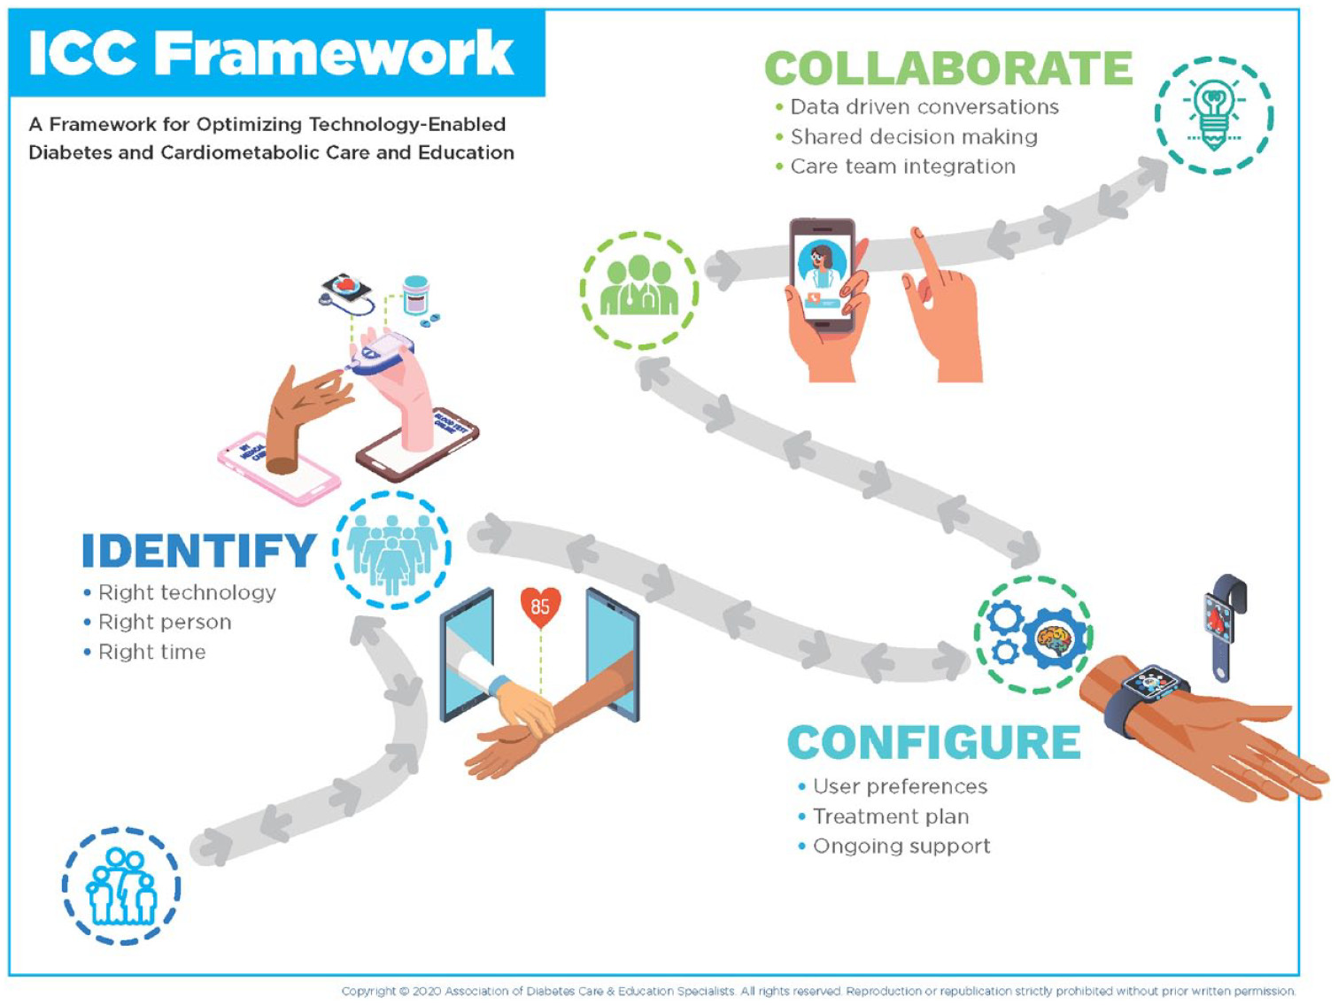
ICC Framework – Identify-Configure-Collaborate
A framework to overcome barriers to technology use and therapeutic inertia
Greenwood DA, Howell F, Scher L, et al. A Framework for Optimizing Technology-Enabled Diabetes and Cardiometabolic Care and Education: The Role of the Diabetes Care and Education Specialist. The Diabetes Educator. 2020;46(4):315-322. doi:10.1177/0145721720935125

Slide 4
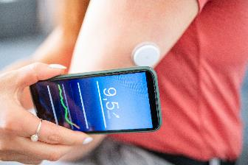

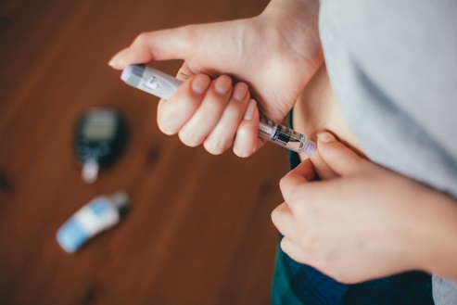
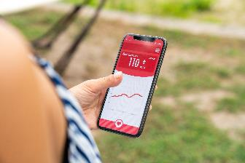
Technology is Here
CONTINUOUS GLUCOSE MONITORS (CGM)
INSULIN PUMPS
CONNECTED PENS AND CAPS
MOBILE APPS
Notes:
Diana start

Slide 5
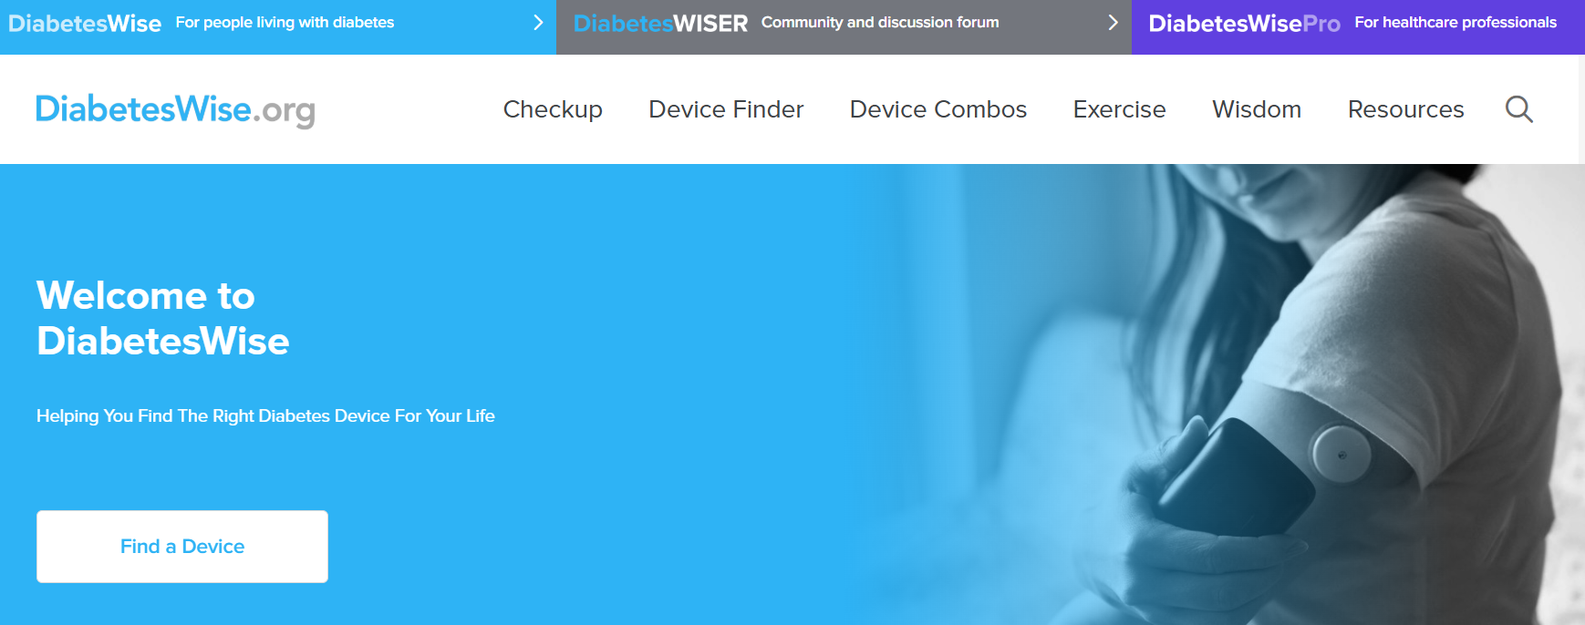
Identify: PWD Identify the “Right” Technology
Diabeteswise.org, providers.diabeteswise.org/#/

Slide 6
The Importance of Education & Training
“No device used in diabetes
management works optimally
without education, training, and ongoing support.”
ADA. Diabetes Care. 2025
Notes:
no device used in diabetes man agement works optimally without educa tion, training, and ongoing support

Slide 7
Continuous Glucose Monitors

Slide 8

ADA Standards of Care 2025
Diabetes devices should be offered to people with diabetes (A)^{*,1}
Recommend real-time CGM (A)* or IS-CGM (B) † for diabetes management to youth (C)§ and adults (B) † with diabetes on any type of insulin therapy¹
Consider using rtCGM and isCGM in adults with type 2 diabetes treated with glucose-lowering medications other than insulin to achieve and maintain individualized goals (B) ^{†,1}
Use of CGM is beneficial and recommended for individuals at high
risk for hypoglycemia (A)^{*,2}
Recommend early initiation, including at diagnosis, of CGM, CSII, and AID depending on a person's or caregiver's needs and preferences (C)^{§,1}
1 American Diabetes Association. Diabetes Care. 2025;48(Suppl. 1):S146-S166. 2 American Diabetes Association. Diabetes Care. 2025;48(Suppl. 1):S128-S145.
Notes:
*Grade A: Clear evidence from well-conducted, generalizable randomized controlled trials that are adequately powered; †Grade B: Supportive evidence from well-conducted cohort studies; §Grade C: Supportive evidence from poorly controlled or uncontrolled studies.

Slide 9
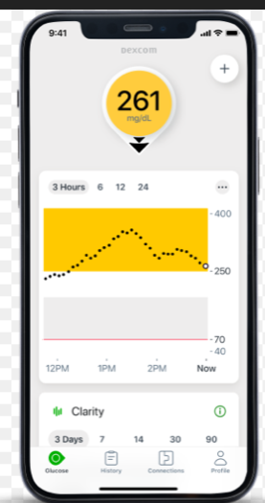
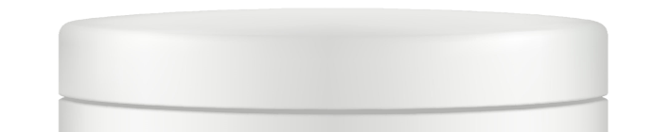
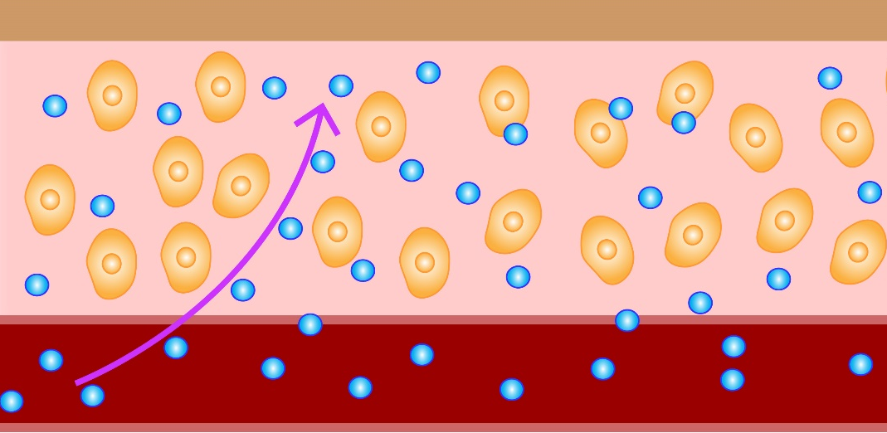
Continuous Glucose Monitors (CGM)
Measures glucose (sugar) every 1-5 mins and records it every 5-15 mins (up to 288 readings/day)
Includes 3 components: transmitter, sensor, receiver/reader
Lag time: capillary → interstitial fluid
Skin
The sensor filament is <0.4 mm thick
Interstitial fluid
Cells
Glucose
Capillary
For illustrative purposes only. Image not drawn to scale.

Slide 10
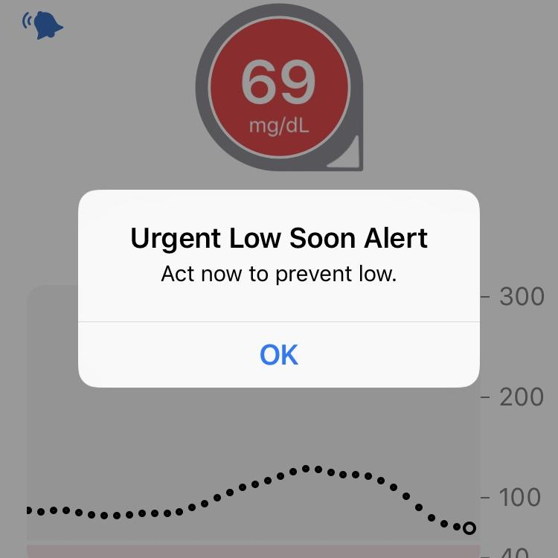
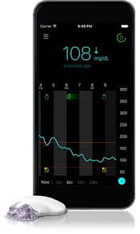
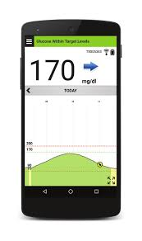
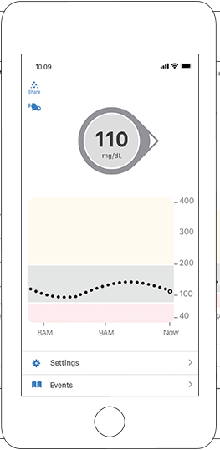
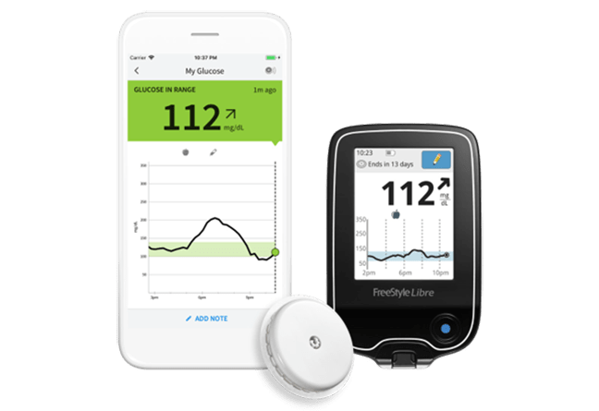
CGM: Real-Time Data

Slide 11
Types of CGM
Professional | Personal
Owned by the clinic | Owned by the person with diabetes
Blinded and unblinded (real-time feedback) options | Real-time feedback
Short-term use (3-14 days) | Long-term use
Insurance coverage for most people with type 1 or type 2 diabetes | Insurance coverage for most insulin users
Not compatible with insulin pumps or connected pens | Compatible with smartphones, connected pens and insulin pumps with select devices
Wright LA, Hirsch IB. Diabetes Technol Ther. 2017;19(suppl 2):S16-S26; Kruger DF, et al. Diab Educ. 2019;45(suppl 1):S3-S20.

Slide 12
Professional CGM
 | Dexcom G6 Pro
Blinded vs unblinded | Both
Maximum wear time of sensor | 10 days
Calibration | None
Downloading reports | Clarity
Care between transmitter use | Disposable-1 time use, must attached transmitter
Alarms for high/low glucose alerts | Yes
Interfering substances | Hydroxyurea
ADCES Practice Paper. The diabetes care and education specialist role in CGM.

Slide 13
Personal CGM Options (Rx)
Owed by the person with diabetes
Typically used long term
Device options include real-time glucose monitoring (rtCGM) or intermittent scanning (isCGM)
Some options can be integrated with insulin pumps or connected insulin pens
Guardian 4 and Guardian Connect
Freestyle Libre 2 and 2+
Freestyle Libre 3 and 3+
Dexcom G6
Dexcom G7
Eversense 365
Simplera

Slide 14
CGM Comparison
​ | G6​ | G7​ | Libre 2​ | Libre 3​ | Guardian 4, Guardian Connect | Eversense​ 365
Pump Integration​ | T:Slim X2, Omnipod 5, iLet, Mobi | T:Slim X2 , Omnipod 5, iLet, Mobi, | T:Slim X2 (Libre 2+) | Twiist (Libre 3+)​ | 780G | No​
Maximum wear time​ | 10 days​ | 10.5 days​ | 14 days​ (15 days with Libre2+and 3+) | 14 days​ | 7 days​ | 180 days​
Warm-up time​ | 2 hours​ | 30 min​ | 1 hour​ | 1 hour​ | Up to 2 hours​ | 24 hours​
Calibrations required​ | 0​ | 0​ | 0​ | 0​ | GC: 2/day G4: occasional | 2/day for 14 days, then 1/week ​
Water depth | 8 feet, 24h | 8 feet, 24h | 3 feet, 30 min | 3 feet, 30 min | 8 feet, 30 min | 3.28 feet, 30 min
Data Platform | Dexcom Clarity |  | LibreView |  | Carelink | Eversense Data Management System
Product user guides: Dexcom G6, Dexcom G7, Libre 2, Libre 3, Medtronic Guardian Connect, Guardian 3, Eversense

Slide 15
CGM Comparison (Continued)
 | G6 | G7 | Libre 2 | Libre 3 | Guardian 4, Guardian Connect | Eversense 365
FDA approved sites​ | Abdomen (ages2+) Upper buttocks (ages 2-17)​ | Upper arm (ages 7+)​ Upper buttocks (ages 2-6)​ | Upper arm​ | Upper arm​ | Upper arm, abdomen​ Upper buttocks (ages 2-13)​ | Upper arm​
Approved in pregnancy | No​ | Yes​ | Yes​ |  | No​ | No
Transmitter | 3 months | Disposable | Disposable |  | Charge weekly | Charge daily
FDA approved ages (years)​ | ≥2​ | ≥2​ ​ | ≥4​ (>2 with Libre2+ and 3+) ​ ​ | ≥4​ ​ | ≥2 (G4) >7 (GC) | ≥18​ ​
Drug interactions​ | Hydroxyurea​ | Hydroxyurea​ | Vitamin C​ | Vitamin C​ | Acetaminophen Hydroxyurea​ | Tetracycline antibiotics, mannitol​
Product user guides

Slide 16
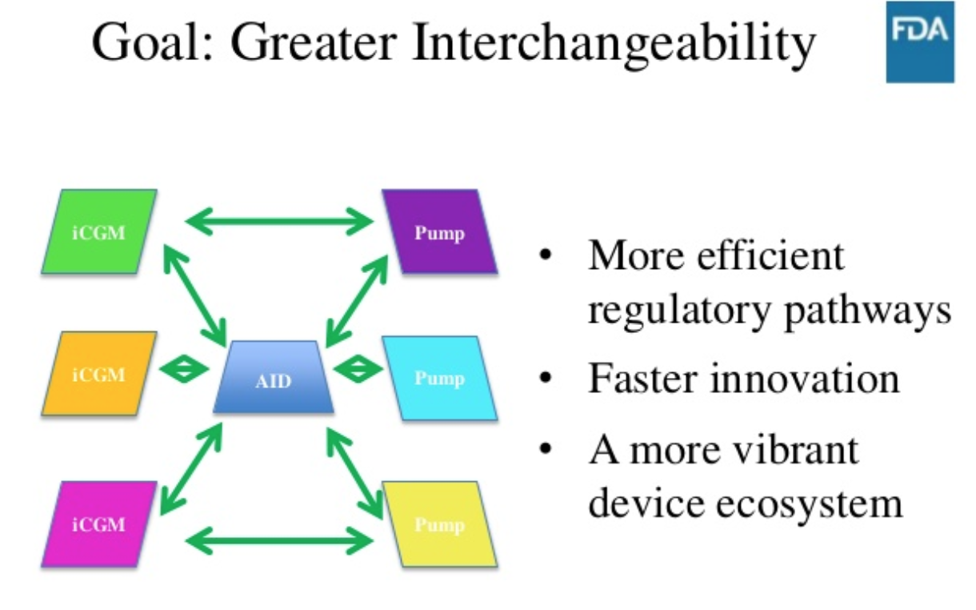
Integrated CGM
Dexcom G6, G7, Libre 2, Libre 2+ Libre 3+, Eversense 365 are integrated CGM (iCGM)
Integration with digitally connected devices (eg, pumps, pens, automated insulin dosing [AID] systems)

Slide 17
Poll Question 12
Which of the following sensors is sold over the counter without a prescription?
Dexcom G6
Dexcom G7
Libre 3
Dexcom Stelo

Slide 18
Dexcom Stelo
For people over 18 that don’t take insulin
Glucose range: 70-250mg/dL
Updates every 15 minutes, 30 minute warm-up
Stelo app + Dexcom Clarity
Spike detection, no high/low alerts
Education in app
Source: Stelo User Guide. (2025).

Slide 19
Abbott Lingo
For people over 18 not on insulin
Glucose range: 55-200mg/dL
Updates every minute, 1 hour warm-up
Lingo app
No real time alerts
Education in app, goal to stay under lingo count
Source: Abbott. (2025). Abbott Diabetes Care Lingo Biosensor Linbs1 FCC ID QXS-LINBS1.

Slide 20
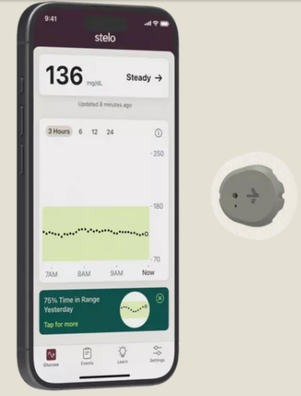
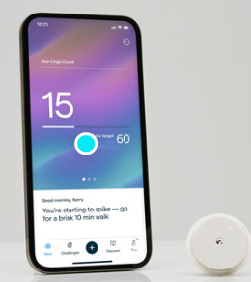
Personal CGM Comparison
OTC
​ | Lingo, Lingo Rio | Stelo
Patiient age | ≥ 18 years | ≥ 18 years
Maximum wear time​ | 14 days | 15.5 days
Glucose range | 55-200 mg/dL | 70 – 250 mg/dL
Frequency of glucose readings | 1 min | 15 mins
Real-time alerts | No | Yes, spikes detection only
Ability to share data | No | Yes, Dexcom Clarity
In-app education | Yes | Yes
Cost | $49 for 1 sensor, $89 for 2 sensors | $99 for two sensors (a 30-day supply) with a 10% discount for monthly subscription.
Product User Guides

Slide 21
CGM Counseling Points
Important to check glucose when indicated
  Symptoms do not match sensor value
  During warm-up period
  When making dosing decisions for select devices
Sensors are waterproof
  Showering, bathing, swimming OK
  Check water depth criteria for individual sensor
Overlays and skin preps to help it stay on
Avoid with MRI, CT, diathermy
  Exception: Eversense implantable, transmitter should be removed
Not FDA approved
  Dialysis, critically ill
  Pregnancy-Guardian,simplera eversense, G6
  If people choose to use, it is important they know it is off-label

Slide 22
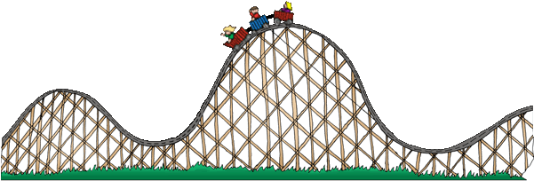
Lag Time
Refers to a delay in CGM sensor readings compared to finger stick blood glucose readings
  Estimated CGM sensor reading ~5 minutes behind
Most apparent when glucose is changing rapidly
Counsel patients on the train analogy

Slide 23
Causes of Falsely High or Low Readings
Interfering substances
  Falsely high
    Vitamin C (Libre)
    Acetaminophen (high dose Dexcom, Guardian)
    Tetracycline antibiotics (Eversense)
Compression Lows
Dehydration
Faulty sensor

Slide 24
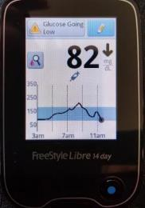
When to Check BGM?
A calibration or blood glucose symbol appears on the device
Symptoms or expectations do not match CGM readings
Off-label indications: dialysis
After correcting a low
If taking an interfering substance (ex. vitamin C, acetaminophen hydroxyurea)
Counsel patients about “lag time”
Per ADA, every person using CGM should have access to a meter and test strips
Notes:
Image obtained from: https://lada-diabetes.com/freestyle-libre-14-day-system-review-first-week-thoughts/

Slide 25
Downloading CGM Data

Slide 26
CGM Key Metrics
Recommended Time in Range
for most people with T1D & T2D
Target time
Time above range (TAR)
< 1 hr, 12 min, > 250 mg/dL
< 6 hr, > 180 mg/dL
Number of days CGM is worn 14 days is recommended
Percentage of time CGM is active 70% of data from 14 days is recommended
Mean glucose
Glucose management indicator (GMI) Estimated A1C
Coefficient of variation (CV) This is a measure of glycemic variability. A CV >36% is considered unstable.
>250 mg/dL
<5% Very High
>180 mg/dL
<25%* High
Target Range:
70-180 mg/dL
Time in range (TIR)
> 16 hr, 48 min
>70% In Range
Correlates with
A1c ~7.0%
Time below range (TBR)
< 1hr < 70mg/dL
< 15 min < 54mg/dL
<70 mg/dL
<4%** Low
<54 mg/dL
<1% Very Low
Battelino T et al. Diabetes Care. 2019;42(8):1593-1603. . 2. American Diabetes Association. Diabetes Care 2021;44(Suppl. 1):S73–S84 | https://doi.org/10.2337/dc21-S006.

Slide 27
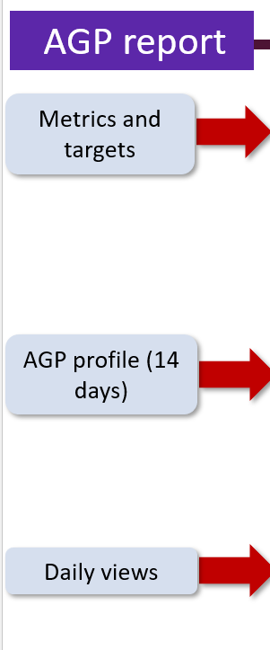
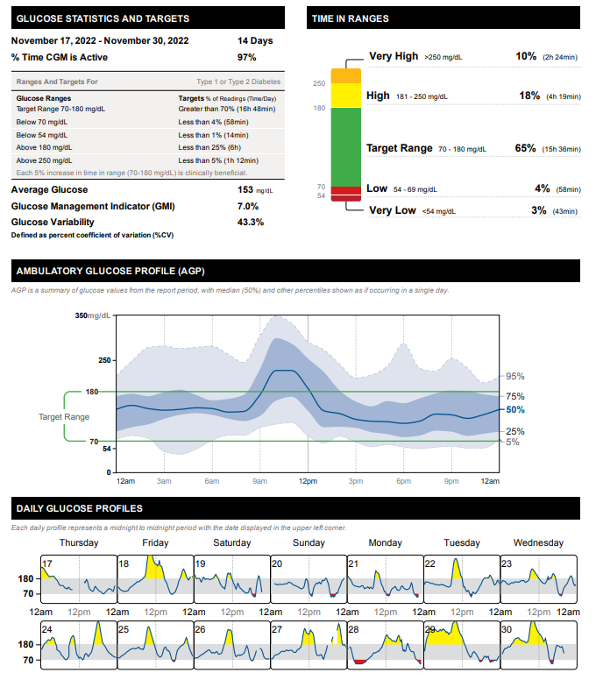
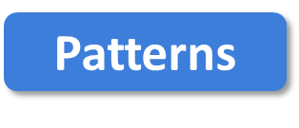
More Green, Less Red
FNIR
Flat Narrow
In Range
Notes:
Libreview report, my own image

Slide 28
Poll 17. What is the goal time in range for most adults with type 1 or 2 diabetes?
≥50%
≥70%
≥80%
≥90%
Notes:
Learning Objective #: 2
Rationale
Answer: B

Slide 29
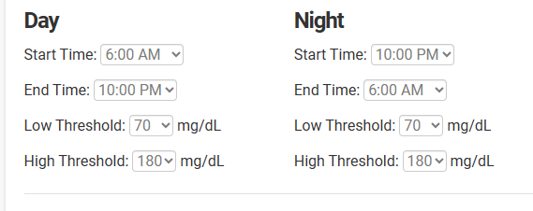
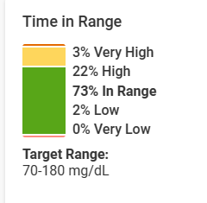
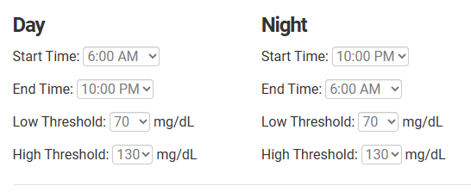
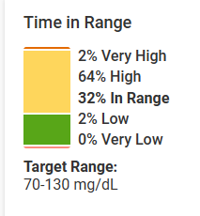
Target Glucose Ranges
Same person, same data, look at the difference in time in range!

Slide 30
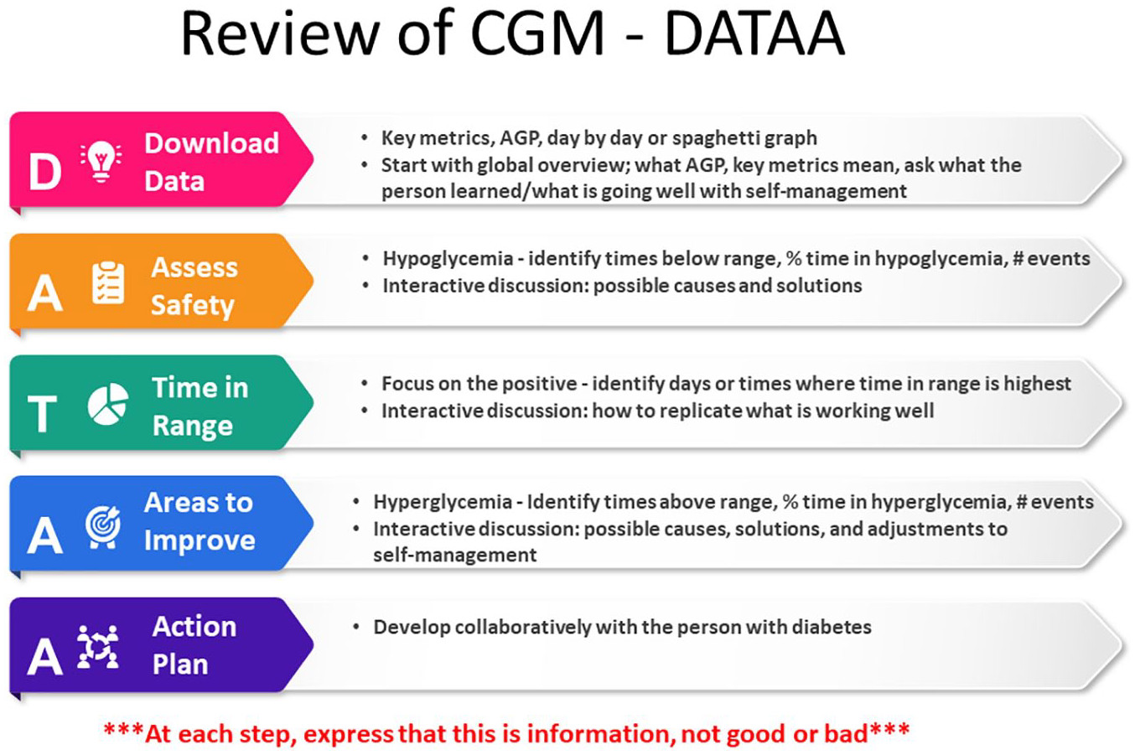
Isaacs D, Cox C, Schwab K, et al. Technology Integration: The Role of the Diabetes Care and Education Specialist in Practice. The Diabetes Educator. 2020;46(4):323-334. doi:10.1177/0145721720935123

Slide 31
Tips for DATA Interpretation
Behavior Change
Mental Health
Medications
Start by asking the person what they’ve experienced and noticed with their glucose patterns
Avoid judgment
Learn from 1 time episodes, but make changes based on patterns
Fix lows first but some amount is expected (<1-4%) and if you remove all lows, you may end up with too many highs
If it’s not making sense, dig deeper (ex. missed doses, rationing, injection technique, food insecurity, etc)
Notes:
Case: Mary becker. Inpen
Cgm first example with my new patient.

Slide 32

Case Studies & 2 min Stretch

Slide 33
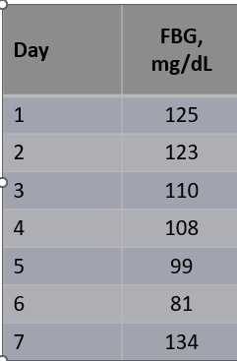
Case 1
Terrance is a 60-year-old man with T2D x 12 years
Current DM2 meds:
  Metformin 1000 mg twice daily
  Glimepiride 8mg daily
Other conditions
  CKD
  Hyperlipidemia
  Hypertension
Works in project management
Eats 3 meals/day, snacks at night, no regular exercise
Glucose log
Checks BGM once daily
Pertinent Labs
  SCr = 1.38 mg/dL, eGFR = 55
  A1C = 8.2%, BMI = 34 kg/m²
Notes:
Terrance starts CGM

Slide 34
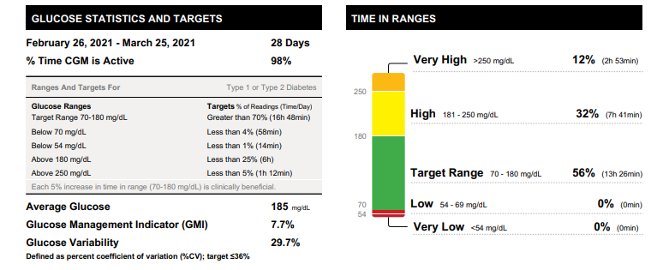


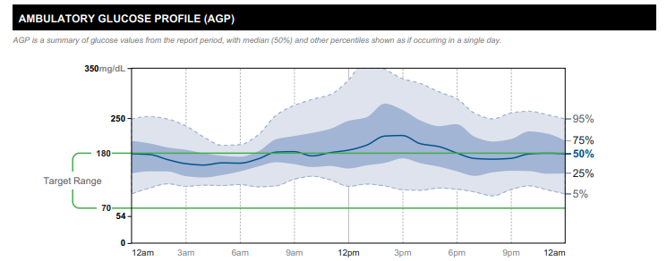
Starts CGM
Which CGM key metrics are at goal?
Which are not?
Overall patterns?

Slide 35
Poll Question 18
1. Which CGM key metrics are at goal?
  Time in range
  Time above range
  Time below range
  Glucose management indicator
Notes:
Correction answer: time below range

Slide 36
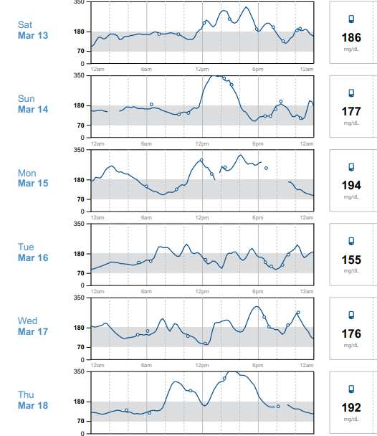

Time in Range
Focus on the positive: what’s worked well on Tue 3/16?
Time in range is high this day
Ate a granola bar for breakfast, grilled chicken salad at lunch, steak, greens, potato at dinner
No missed medication doses
Good night’s sleep, low stress

Slide 37

Areas for Improvement
Sun 3/14 glucose went high 12 pm
Reports eating rice bowl and coke
Silver lining
  Walked around 3 pm (helped to lower glucose)
  Avoided afternoon snacking
  Ate low-carb dinner (salmon, salad, small potato)
  Denies missed doses

Slide 38
Poll Question 19
What is the most appropriate medication adjustment for Terrance?
  Add DPP4 inhibitor
  Add GLP-1 receptor agonist
  Add SGLT2 inhibitor
  Lifestyle modifications only

Slide 39

Action Plan
In collaboration with Terrance
  Lifestyle changes
    Incorporate a brisk walk 3 days per week
    Reduce high-carbohydrate foods like fries
  CGM optimization
    Alerts, high for 280
  Medication adjustments
      Add a medication to help his CKD + optimize glucose → SGLT2 inhibitor
  Follow-up in 3-4 weeks

Slide 40
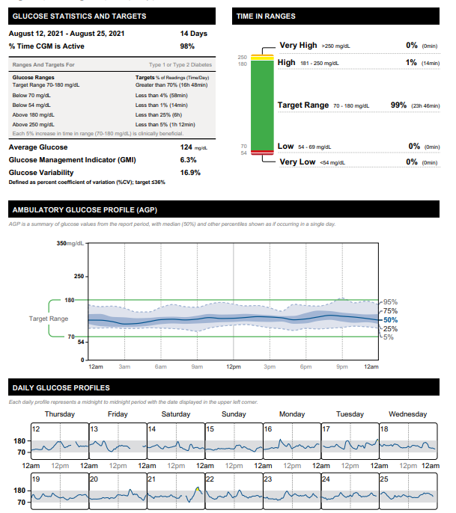
3 Months Later
T2D Meds:
Empagliflozin 10mg qday
Metformin 1000mg BID

Slide 41
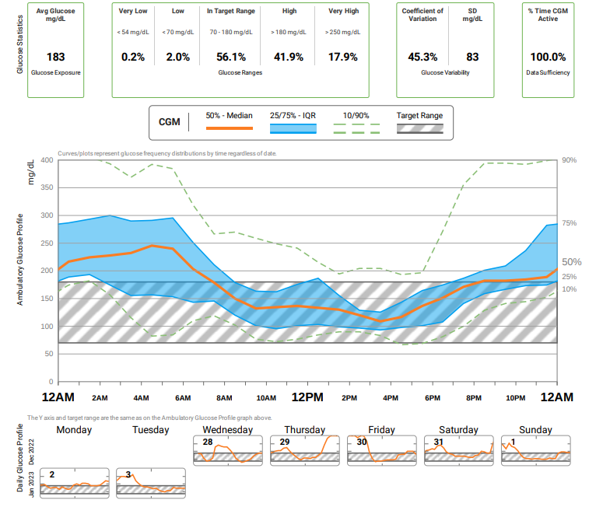

Case 2
75 yo F with 25 year h/o T2DM. PMH includes HTN, hyperlipidemia, hypothyroid, obesity, ASCVD.
Current DM Meds
-Insulin glargine inject 50 units QAM and 40 at night
-Insulin aspart 8-10-10 units plus correction scale
-Metformin 1000 mg daily
-Semaglutide, 0.25mg weekly (2 doses so far)
Clarity report obtained from Diana Isaacs
Notes:
Did not tolerate higher dose of metformin

Slide 42
Poll 20. Which of the following CGM key metrics is at target?
Time in range
Time above range
Coefficient of variation
Time below range
Clarity report obtained from Diana Isaacs
Notes:
Answer: D

Slide 43
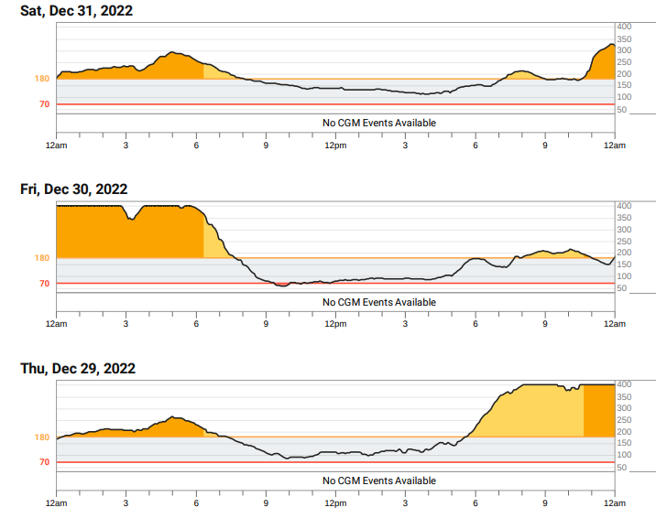



Using DATAA
Less of an appetite since taking semaglutide, often going low during the day
During the day, glucose often steady, but also having to drink juice to keep from going low
Skipping aspart doses because running low, leading to rebound highs
Clarity report obtained from Diana Isaacs

Slide 44

Action Plan
Continue semaglutide 0.25mg weekly x 2 more weeks, then titrate up to 0.5mg weekly
Decrease insulin glargine to 45 units qam and 35 units qpm
Continue insulin aspart 8-10-10 + correction scale
Continue metformin 1000mg daily
Notes:
Current DM Meds
-Insulin glargine inject 50 units QAM and 40 at night
-Insulin aspart 8-10-10 units plus SS
-Metformin 1000 mg daily
-Semaglutide, 0.25mg daily (2 doses so far)

Slide 45
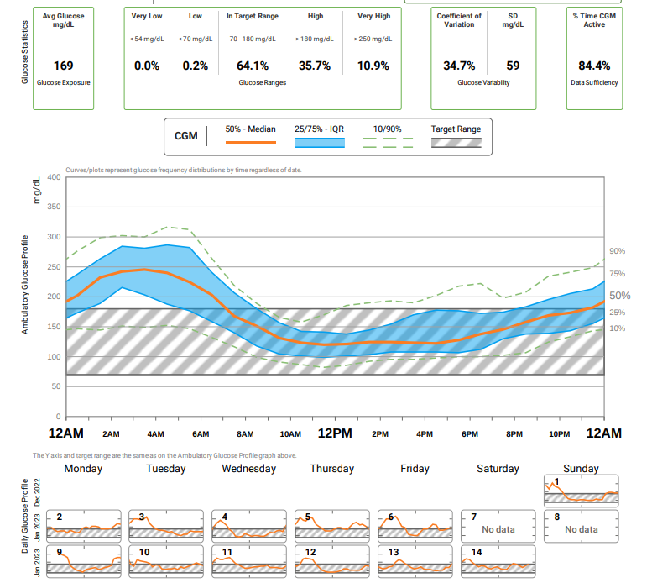
Follow-Up
1 month later
Average glucose improved
Time in range increased
Glucose variability improved
Less hypoglycemia
Clarity report obtained from Diana Isaacs
Notes:
Next plan: continue to titrate the semaglutide
Consider more aspart at dinner
Continue to titrate down the glargine

Slide 46
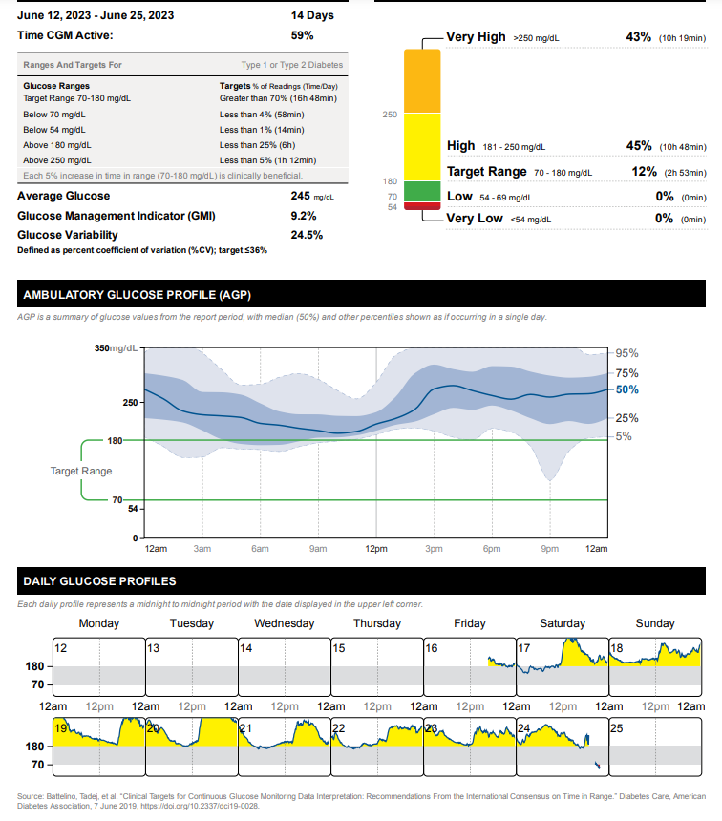
Case 3
Person with T2D taking metformin 1000mg twice daily and insulin glargine 20 units daily
Notes:
The whole curve is elevated
Needs more insulin-is the person taking insulin?
Ability to use non insulin therapies?
Low on Saturday likely false low.

Slide 47
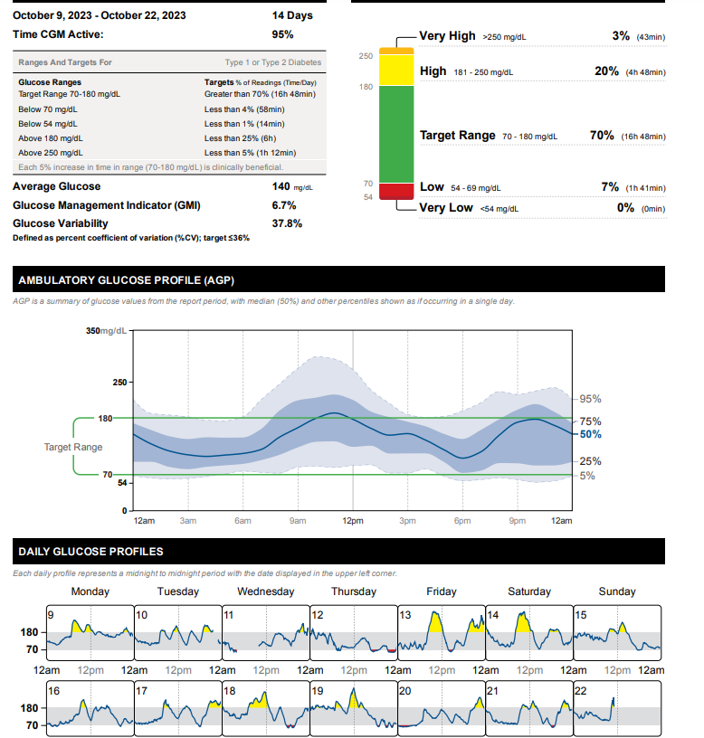
Case 4
Person with T2D
56yo, BMI=33, A1C=7%
Meds:
  Degludec 40 units daily
  Dulaglutide 4.5mg weekly
  Dapagliflozin 10mg daily
  Metformin 1000mg twice daily
Notes:
Fix lows: too much basals
Fix highs: dietary modifications, or another medication, possibly meal time insulin.

Slide 48
Insulin Pumps

Slide 49
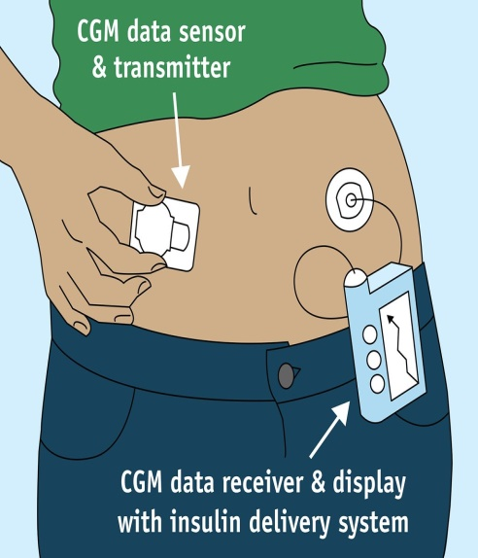
How a Pump Delivers Insulin
Normal Insulin Secretion
Insulin Pump
Insulin
Time
.
Notes:
229
Image available for reuse: https://www.flickr.com/photos/fdaphotos/15657970628

Slide 50
Common Insulin Pump Features
Bolus calculator
Temporary basal or temporary target
Insulin-on-board/active insulin feature to prevent stacking
Multiple basal patterns
Small dose increments
Integration with CGM
Designed to work with U100 insulin
Notes:
Alarms for occlusion or low insulin reservoir
Active insulin to prevent stacking
Keypad lock
Waterproof or watertight
Communication with CGM for auto-suspend and auto adjustment of basal
Reminders to bolus, change infusion set, etc

Slide 51
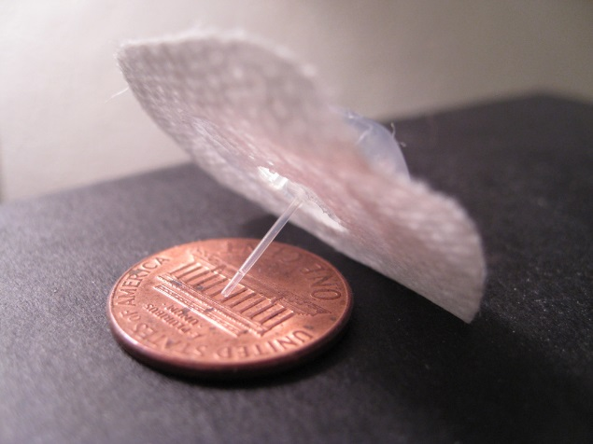
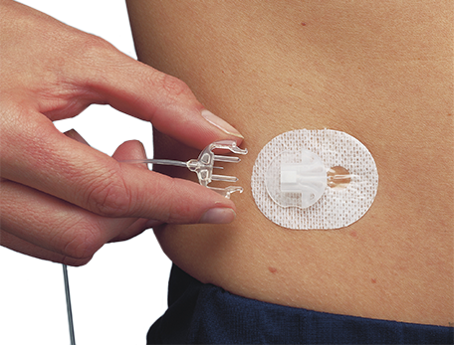
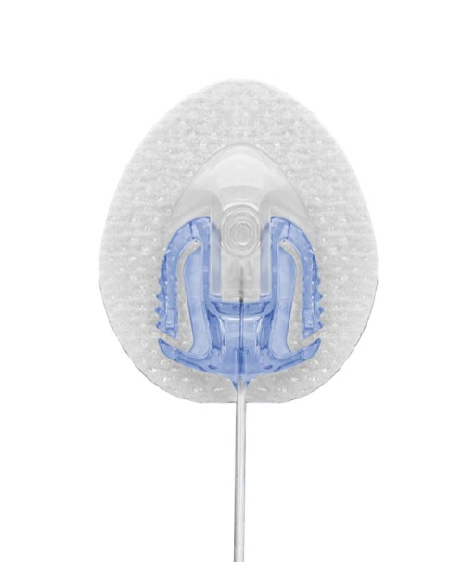
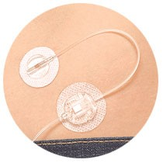
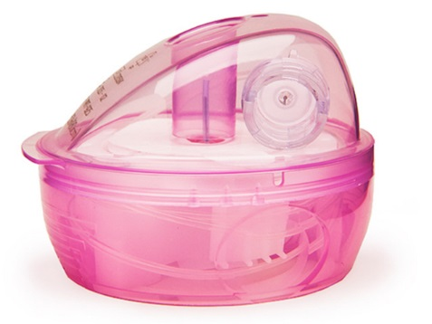
Infusion Sets
Infusion sets are usually Teflon
  Available in different sizes (ex. 9mm vs 6mm)
  Silhouette (angled) may be better for kids/thinner/very active people
  Steel infusion sets a good option for people with frequent site occlusions
Insert at least 1 inch from CGM site
  Auto-injectors vs. manually injecting
Site selection/rotation
Longer tubing options
  Good if connected on leg, arm or wearing pump further from site
Caution with kids/babies/pets-pouches available to hide pump
When changing out infusion set, check glucose or CGM 1-2 hours after
  Don't change right before bed

Slide 52
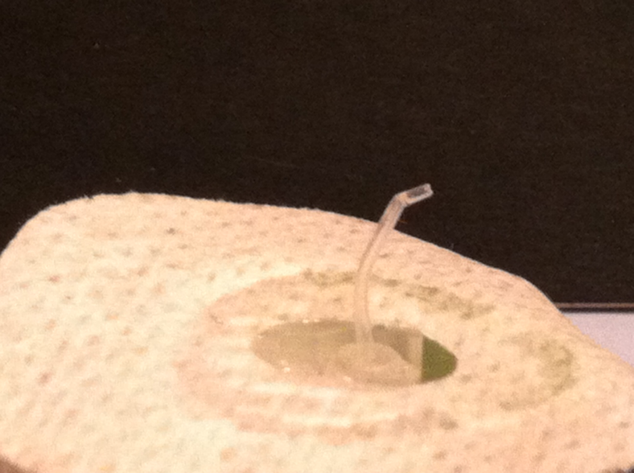
What Happens with a Bent Cannula?
Hyperglycemia
Hypoglycemia
No effect
Notes:
My own picture.

Slide 53
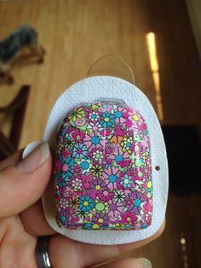
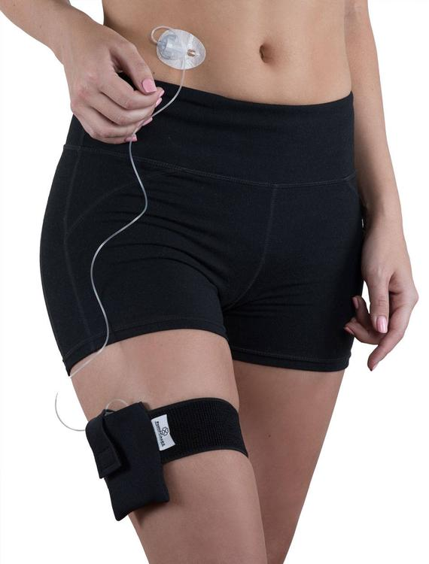
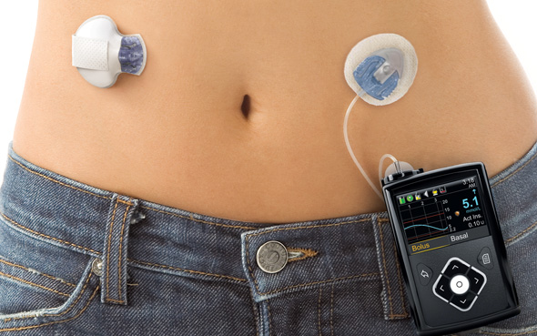
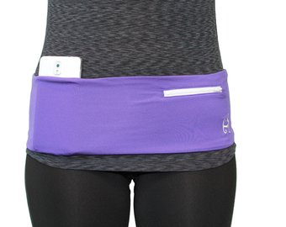
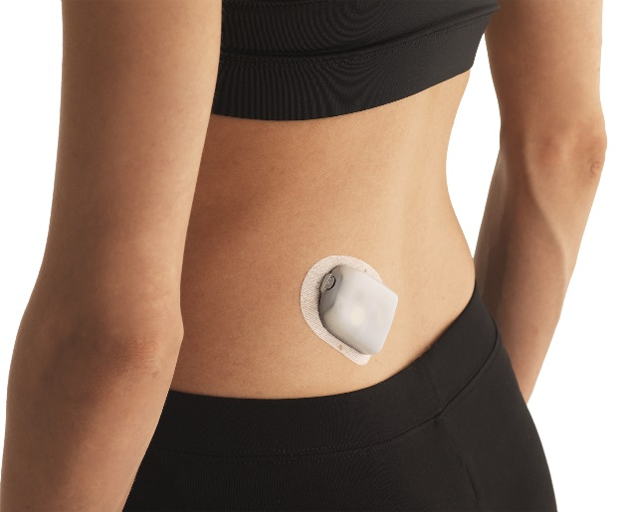
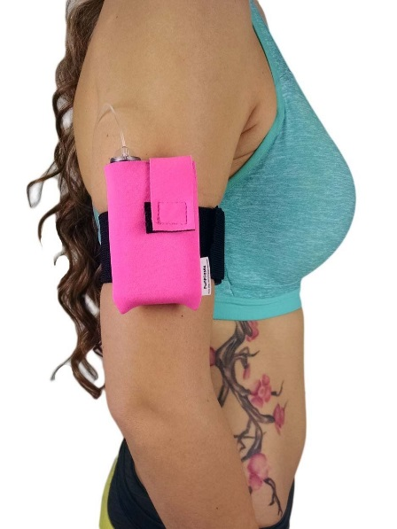
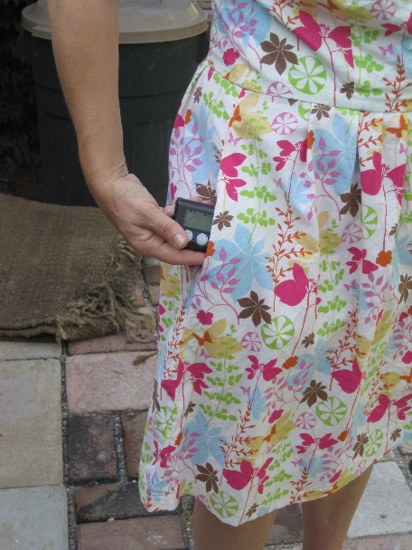

Where to Wear?

Slide 54

Ideal Pump Candidates
Require meal time insulin
Wearing CGM
Carbohydrate counting or good with estimates
Ability to learn pump programming or have caregivers that can
Willing to follow up regularly with health care team
Can afford the pump/supplies
Following hyperglycemia treatment instructions
Problem solving skills (ex. high or low glucose)

Slide 55


Patch Pumps
Cequr Simplicity
V-Go
Bolus pump patch only
Approved for adults with T1DM or T2DM
Holds up to 200 units of rapid acting insulin
On-demand bolus doses in 2 unit increments
Doses administered via clicks directly on the device
Must be changed every 4 days
24 hr. basal/bolus patch pump
Approved for adults with T2DM
Allows 20, 30, 40 unit basal rate options
On-demand bolus doses in 2 unit increments
  Up to 36 units/24 hrs
Doses administered via clicks directly on the device
Must be changed daily
Cequr Simplicity Product Guide: https://myceqursimplicity.com/wp-content/uploads/User-Guide.pdf
V-Go Product Guide: https://www.go-vgo.com/wp-content/uploads/2018/06/instructions-for-patient-use.pdf

Slide 56
Automated Insulin Delivery Systems
Omnipod 5
(Insulet)
T:slim X2 (Tandem)
Control IQ
780G
(Medtronic)
Mobi (Tandem)
Control IQ
iLet
(Beta Bionics)
Tidepool Loop (Sequel)

Slide 57

Hybrid-Closed Loop
Automated insulin delivery (AID)
Auto adjust background insulin
Some systems give auto corrections
Maximize time 70-180mg/dL

Slide 58
Omnipod® 5
No tubing
Holds 200 units
Uses last 4-5 pods for adjustments, based on TDD
Control system from smartphone or controller
Compatible with G6, G7, Libre 2+
SmartBolus calculator informed by CGM value and trend
Glucose targets from 110-150 mg/dL adjustable in 10 mg/dL increments
Activity mode to reduce risk of lows
Bluetooth connectivity with glooko, automatic data download
Requires charging cable
Source: Omnipod® 5 Automated Insulin Delivery System User Guide.
Notes:
New slide

Slide 59
Medtronic 780G
Holds 300 units
Compatible with Guardian Sensor 4 Meal detection (auto correction + basal)
Adjustable target (100, 110, 120)
Auto corrections every 5 minutes if above target
Bluetooth connectivity, remote software upgrades
Suspend before/on low options (in manual mode)
MiniMed and Carelink apps for data sharing/viewing
7 day infusion set
Uses AA battery

Slide 60
Beta Bionics iLet
Holds 180 units of insulin
Compatible with Dexcom G6, G7, Libre 3+
Works with pre-filled insulin cartridges (Fiasp) -160 units
Programmed by entering body weight and connecting to CGM
  No other insulin pump settings
Glucose targets (110, 120, or 130mg/dL)
Meal estimates: no carb counting (usual, less, more)
Provides calculated back up settings for boluses
Requires charger
Bluetooth connected, Bionic Circle app for up to 10 followers
Source: Bionic, iLet. (2025, June). ILET® bionic pancreas system user guide.
Notes:
Fiasp pre filled cartridges, more expected in the future.

Slide 61
Tandem T:Slim X2 with Control-IQ+
Holds 300 units
Compatible with Dexcom G6, Dexcom G7, Libre 2+
Algorithm adjusts insulin delivery from programed “manual” settings
Automatic correction doses
  Up to 1 every hour based on projected glucose >180mg/dL
  Calculated at 60% of programmed correction factor (target of 110)
Source for data downloads
Requires charging cable
Bolus from Tandem app from phone
Notes:
Keywords: Automated Insulin Delivery, Future Dexcom Technology, Tandem Control-IQ

Slide 62

Control IQ Targets
https://www.tandemdiabetes.com/providers/products/control-iq

Slide 63
Tandem Mobi
Compatible with Dexcom G6, G7
200 unit cartridge
Half the size of T:Slim X2
5 inch tubing option
Everything controlled from mobile app (iPhone)
Syringe driven-pump fill
Wireless charging
IP28 water resistant rating (8 feet for 2 hours)
Notes:
8 feet up to 2 hours.
IP28 water resistant rating

Slide 64


Sequel MedTech Twiist
Tidepool Loop Algorithm
iPhone controlled
Correction Range 87 mg/dL-180 mg/dL.
Food type for bolus speed
  Lollipop, Taco, Pizza Bolus
Insulin action is fixed with Ultra Rapid or Rapid Acting
Apple watch compatibility: bolus from watch
Holds 300 units of insulin
Source: User Guide: Sequel MedTech Twiist User Guide. (2025).

Slide 65
Pump Comparison
 | Omnipod 5 | Control IQ+ | 780G | ILet
Min age | 2 years | 2 years | 7 years | 6 years
Min daily insulin | 5 units | 5 units, 20lbs | 8 units | 8 units
Max fill | 200 units | 300 units-T:Slim X2 200 units: Mobi | 300 units | 160 units
Basal increment | 0.05 units | 0.001 units | 0.025 units | NA
Bolus increment | 0.05 units | 0.01 units | 0.025 units | NA
Site change frequency | 3 days | 3 days | 7 days (extended infusion set) | 3 days
CGM compatibility | G6, G7 | G6, G7, Libre 2+ | Guardian 4 | G6, G7
CGM trend in calculator | Increase up to 30% Decrease down to 100% | No | No | NA
Notes:
Omnipod-5_User-guide.pdf
MiniMed_770G_System_User_Guide.pdf (medtronicdiabetes.com)
AW-1007704_B User Guide, Mobile Bolus, t:slim X2, Control-IQ, 7.6, mg/dL, Artwork.pdf (tandemdiabetes.com)
User manuals
Omnipod-5_User-guide.pdf
MiniMed_770G_System_User_Guide.pdf (medtronicdiabetes.com)
AW-1007704_B User Guide, Mobile Bolus, t:slim X2, Control-IQ, 7.6, mg/dL, Artwork.pdf (tandemdiabetes.com)
770g and 780 g max is 250 units.

Slide 66
Pump Comparison
 | Omnipod 5 | Control IQ | iLet | 780G
Algorithm target | 110, 120, 130, 140, 150mg/dL | 112.5 – 160 mg/dL | 110, 120, 130mg/dL | 100, 110, 120mg/dL
Basal automation | Calculated from total daily insulin, updated each pod change, 60 min prediction | Increases or decreases from programmed basal rates, 30 min prediction | Initiated based on user weight and adapts with glucose profile | Calculated based on total daily insulin from past 2-6 days
Automated Corrections | No | Max 1/hour if glucose predicted >180 mg/dL, 60% of calculated dose | No | If glucose > 120 mg/dL and at max "auto basal" delivery, up to every 5min
Extended bolus | No, manual mode only | Yes, up to 2 hours | No | No, manual mode only
Insulin action time (IAT) | 2-6 hours | 5 hours (automated mode) | NA | 2-8 hours
Temporary targets | Activity 150 mg/dL | Exercise 140 -160 mg/dL Sleep 112.5 – 120 mg/dL | NA | 150 mg/dL
Bolus adjustments | ISF, IAT, ICR, max bolus, reverse correction | ISF, ICR, max bolus, reverse correction | Usual, more, Less meal announcements | ICR, IAT, max bolus
Ability to override bolus | Yes | Yes | No | No
Notes:
Omnipod-5_User-guide.pdf
MiniMed_770G_System_User_Guide.pdf (medtronicdiabetes.com)
AW-1007704_B User Guide, Mobile Bolus, t:slim X2, Control-IQ, 7.6, mg/dL, Artwork.pdf (tandemdiabetes.com)
User manuals
Omnipod-5_User-guide.pdf
MiniMed_770G_System_User_Guide.pdf (medtronicdiabetes.com)
AW-1007704_B User Guide, Mobile Bolus, t:slim X2, Control-IQ, 7.6, mg/dL, Artwork.pdf (tandemdiabetes.com)

Slide 67
Patient Case
47 years old
T2D x 20+ years
A1C=8.1%
BMI=39kg/m²
Works as a bank teller
No diabetes complications
Meds:
  Insulin glargine 100 units qpm
  Insulin aspart 45 units TID a.c.
  Dapagliflozin 10mg daily
  Dulaglutide 1.5 mg weekly
Is this a good candidate for an insulin pump?
Notes:
HPI: The patient has Type 2 diabetes and was diagnosed 20 + years ago. There is a history of diabetes in the family. The disease course has been stable . Initially, the symptoms were thirst , excessive urination and fatigue. Currently, there are no symptoms. Her weight has increased by approximately 20 pounds over the past few months, as she started insulin and controlled her DM. The initial treatment was oral agents, currently the treatment is insulin for the past 15 years.
Her control has been poor until about six months because she was not taking her insulin due to weight gain. She claims to the weight gain of 20 lbs is due to insulin, but she does have calorie count.
Currently, she is taking Lantus 48 units at bedtime. She using Novolog up to 60 units pre meal.
She is following a diet plan and is exercising a little. She does monitor blood glucose levels 4 times daily using a one touch ultra mini meter. She does keep written records of blood glucose levels in a log book.
Her log book looks OK. She is unhappy with weight gain,
She self measures and self injects insulin dose. Terri has had symptoms of hypoglycemia. She has an awareness of what the symptoms are and what to do if she is having a reaction.
She has no complications from diabetes.
She may be interested in a CSII pump.
She is currently seeing an ophthalmologist.
The patient has additional risk factors for disease including high blood pressure and hyperlipidemia.

Slide 68


Patient Case
47yo T2DM, A1C=8.1%, BMI=39kg/m²
TDD decreased by 30%
Follow-Up A1C=6.7%

Slide 69

Umpierrez G et al. Diabetes Care 2018 Aug; 41(8): 1579-1589.
Notes:
Most insulin pump users are more knowledgeable than their hospital health care providers about diabetes management; therefore, experienced pump users may be encouraged to self-manage their diabetes during their hospitalization

Slide 70
Contraindications to Insulin Pumps in the Hospital
Impaired level of consciousness (except during short-term anesthesia)
Patient’s inability to correctly demonstrate appropriate pump settings
Critical illness requiring intensive care
Psychiatric illness that interferes with a patient’s ability to self-manage diabetes
Diabetic ketoacidosis and hyperosmolar hyperglycemic state
Refusal or unwillingness to participate in self-care
Lack of pump supplies
Lack of trained health care providers, diabetes educators, or diabetes specialist
Patient at risk for suicide
Umpierrez G et al. Diabetes Care 2018 Aug; 41(8): 1579-1589.

Slide 71

ADA Standards of Care 2025
AID systems should be the preferred insulin delivery method to improve glycemic outcomes and reduce hypoglycemia and disparities in youth and adults with T1D (A ) and other forms of insulin deficient diabetes (E )
Insulin pump therapy, preferably with CGM, should be offered for diabetes management to tough and adults on MDI with T2D (A )
The choice of device should be made based on the individual’s circumstances, preferen ces, and needs. ( A)
*
Diabetes Care 2025;48(Suppl. 1):S146–S166

Slide 72
How to Share Data
System: | Associated Mobile Apps | Data Sources
Glooko | Glooko | Insulin pumps (Omnipod, Tandem)
Carelink | MiniMed Mobile | Medtronic pumps
Tidepool | Tidepool Mobile | Insulin pumps (Medtronic, Tandem, Twiist)
Source | T:Connect Mobile | Tandem pumps
Beta Bionics User Portal | Beta bionics smartphone app | iLet

Slide 73
Connected Insulin Pens

Slide 74
InPen
Delivers up to 30 units of insulin per dose
Delivers in ½-unit increments
Disposable needles (not included)
1 year life span
Does not require charging
Comes in blue, gray, and pink
Integrates with Apple Health and Glooko
Requires a prescription, uses cartridges
Compatible with: Humalog, NovoLog, and Fiasp U100 3.0 mL prefilled cartridges
Multiple pens can be paired to the InPen app.
Source: InPen user guide
Notes:
Not sure if I can use brand names, but they are specific to these brands
InPen
Delivers up to 30 units of insulin per dose
Delivers in half-unit increments
Disposable needles (not included)
1 year life-span
Does not require charging
Color comes in blue, grey and pink
Integrates with Apple Health and Glooko
Requires a prescription, utilizes cartridges
Compatible with: Humalog, NovoLog and Fiasp U-100 3.0 mL pre-filled cartridges
Multiple pens can be paired to the InPen App

Slide 75
Lilly Tempo Smart Button
Tempo pen available with Lyumjev, Basaglar, Humalog
Button uses Bluetooth to transfer insulin dose to mobile app
TempoSmart App integrates insulin dosing data with glucose, food, exercise, and sleep data
Set personalized reminders and alerts
Basal dose optimization
Notes:
*To transfer your insulin dose-related data automatically, the Tempo Smart Button must be connected to the app and be within 9 feet (3 meters) of your Bluetooth® enabled mobile device. You can also enter your insulin dosing information manually.

Slide 76




Therapy Settings
Carb Counting
Meal Estimation
Fixed Dose
Customize insulin settings:
Duration of Insulin Action
Target Blood Glucose
Insulin Sensitivity Factors
Insulin/carbohydrate ratios or meal-size dose
Adjust based on time of day or use same settings for entire day
Notes:
Permission to use from companion medical
Showing how it can be set to carb counting or meal estimates, for small, medium or high carb meals or just using set doses.
With all of the, you can set the insulin sensitivity factor and BG target, to add or subtract insulin if glucose is out of range.

Slide 77
In Summary
There are several CGM, connected pen and insulin pump options, and the DCES can help PWD select the best device for their individual needs
New era of hybrid closed loops
No artificial pancreas yet, but we are getting closer to closing the loop
Connected data can be used to discussion diabetes self-management with the person with diabetes and help to make meaningful changes-think DATAA

Slide 78
Resources

Slide 79
Collaborate: How to Share Data
System: | Associated Mobile Apps | Data Sources
Glooko | Glooko | Insulin pumps (Omnipod, T:slim X2), Dexcom, Eversense, many glucose meters, InPen, Libre
Clarity | Dexcom G6, G7, Clarity, Dexcom Follow, Undermyfork, Sugarmate | Dexcom, InPen
LibreView | LibreLink, LibreLinkUp, Libre 14 day, Libre 2, Libre 3 | Libre 14 day, Libre 2, Libre 3 and plus versions
Carelink | Guardian Connect, Carelink | 780G, Guardian CGM, InPen
Tidepool | Tidepool Mobile | Twoost,, Dexcom, Libre soon, many glucose meters, InPen
Source | Tandem t:slim mobile app, Tandem mobi mobile app | T:Slim X2, Mobi
Eversense Data Management System | Eversense | Eversense
InPen Insights Report | InPen | InPen, Dexcom, Guardian Connect
Tempo Platform | TempoSmart | TempoSmart Button, Dexcom

Slide 80




Learn All About the Tech
https://pro.diabeteswise.org/
https://www.diabeteseducator.org/danatech/home)/

Slide 81


Panther Tools

Slide 82

Panther Tools

Slide 83

Diana Isaacs, PharmD
isaacsd@ccf.org
Instagram/Twitter: dianamisaacs
Podcast: https://www.hcplive.com/podcasts/diabetes-dialogue

