Slide 1

DiabetesEd Training Seminar 2025 – Day 2
www. DiabetesEd.net
Notes:
Slide 60: update this year’s ada reference.

Slide 2

Insulin – Ultimate Hormone Replacement Therapy
Diana Isaacs, PharmD, BCPS, BCACP, CDCES, BC-ADM, FADCES, FCCP
Endocrine Clinical Pharmacy Specialist
Co-Director Endocrine Disorders in Pregnancy
Cleveland Clinic Diabetes Center
Notes:
2.5 hours.
Ideal is 150 slides.

Slide 3
Disclosures for Dr. Isaacs
Diana Isaacs, PharmD, BCPS, BCACP, CDCES, BC-ADM, FADCES, FCCP declares the following disclosures:
Speaker: Abbott, Dexcom, Novo Nordisk, Insulet, Medtronic, Lilly, Cequr, Sanofi
Consultant: Undermyfork, Sequel
ADCES Board Member

Slide 4
Objectives – Insulin –The Ultimate Hormone Replacement Therapy
Objectives:
Discuss the actions of different insulins
Describe how to use the ADA algorithm for insulin management
Counsel a person with diabetes on safe and effective insulin use
Discuss strategies to determine and fine-tune basal and bolus insulin settings based on glucose pattern management
Describe how insulin settings are used to program insulin pumps and connected insulin pens
Notes:
o Latest update on available insulins
o How to use ADA algorithm for insulin management
o Teaching pointers for safe and effective insulin use

Slide 5
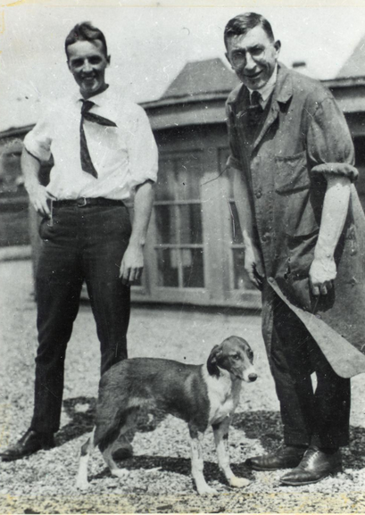
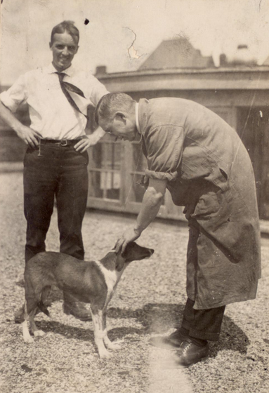
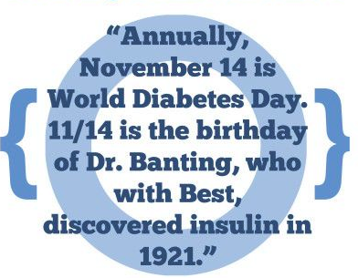
Best and Banting – U of Toronto 1921

Slide 6
History of insulin
Insulin is produced by beta cells in the pancreas
Discovered in 1921 by Frederick Banting and his assistant Charles Best from a dog’s pancreas
First used in a dog with diabetes and kept him alive for 70 days until they ran out of extract
With the help of JB Collip and John Macleod, insulin was derived from the pancreas of cattle and in January 1922, given to a 14-year-old dying from diabetes in a Toronto hospital
In 1923, Banting and Macleod received the Nobel Price in Medicine which they shared with Best and Collip
Soon after, Eli Lilly started large-scale production of insulin
ADA. The history of a wonderful thing we call insulin (accessed 2020 Aug 29).

Slide 7
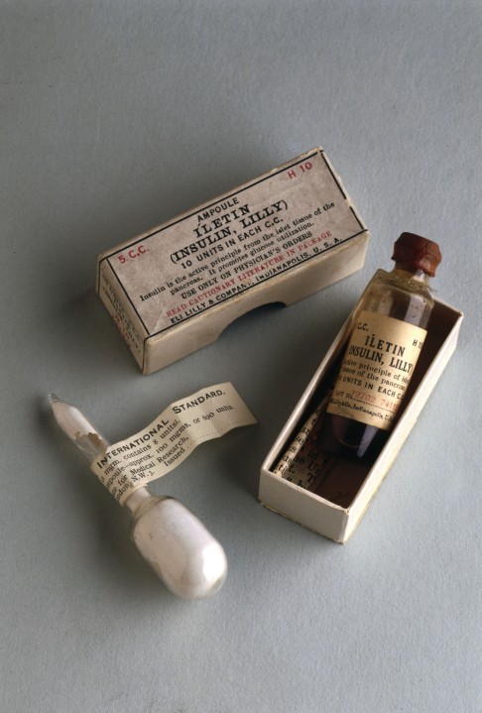
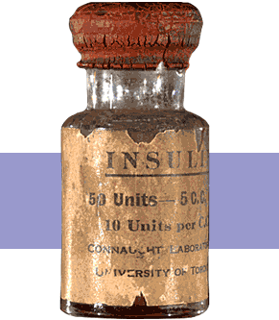
1st Insulin Available - 1922

Slide 8


Miracle of Insulin
The Miracle of Insulin
February 15, 1923
Patient J.L., December 15, 1922

Slide 9
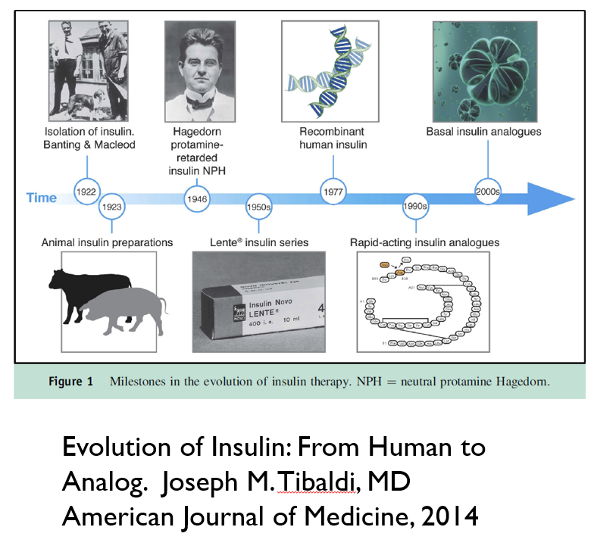
Notes:
Earlier insulins derived from bovine and porcine pancreas
All human insulin now made from recombinant DNA technology
Modification of human insulin molecules
Overcame problems with human insulin
Onset of action
Duration of action
Absorption

Slide 10
Physiologic Insulin Release: Individuals without diabetes
Insulin
Blood glucose
Basal insulin
Meal
Meal
Meal
Blood glucose– goes up after eating

Slide 11
Physiologic Insulin at Meals
1st phase: peak 1-2 minutes, duration 10 minutes, suppresses hepatic glucose production
2nd phase: duration 1-2 hours
The perfect insulin would be fast enough to match the absorption of carbohydrates
Freeman JS. J Am Osteopath Assoc. 2009;109:26-36.
Notes:
Freeman. The Journal of the American Osteopathic Association, January 2009, Vol. 109, 26-36.
http://jaoa.org/article.aspx?articleid=2093701#72978607
Within seconds of food ingestion, there is an initial release of insulin, which peaks in 1 to 2 minutes and lasts about 10 minutes.^{21,22} This first phase is responsible for suppressing hepatic glucose output, limiting PPG elevations, and stimulating phase 2 insulin release of newly manufactured insulin. This second phase lasts 1 to 2 hours until normoglycemia is restored.^{20,21} However, in patients with type 2 diabetes mellitus, phase 1 insulin secretion is markedly decreased or absent. As the disease progresses, phase 2 insulin release is also reduced, often by more than 50%

Slide 12
Insulin Overview
None of the commercially available insulins are as fast as true physiologic insulin
Almost all insulin is injected (SC or IV) with 1 inhaled option
All people with T1D require basal + bolus insulin or insulin pump therapy
Many people with T2D require insulin due to the progressive nature of the condition

Slide 13
Basal aka “Background” Insulin
The liver plays a major role in maintaining glucose levels by regulating the process of gluconeogenesis and glycogenolysis
Excessive hepatic glucose release leads to hyperglycemia
In a person without diabetes, there is a low level of insulin to keep glucose homeostasis from glucose produced by the liver (basal insulin)
People with T1D lack the ability to produce insulin to counteract the liver’s effects
People with T2D may not have enough insulin due to insulin resistance
Long-acting insulins or intermediate-acting insulins serve as a basal or “background insulin”
In an insulin pump, a regular or rapid-acting insulin can be given continuously to serve as the basal
Everyone with T1D need basal insulin and many with T2D may need it
Sharabi K et al. Mol Aspects Med. 2015; 46:21-22.

Slide 14
Bolus Insulin
Glucose rises in response to carbohydrates
A regular or rapid-acting insulin is given as a bolus to prevent the glucose from rising too much
A regular or rapid-acting insulin can also be given to “correct” or bring down a high glucose
Everyone with T1D needs bolus insulin, some people with T2D may need it to achieve glycemic targets

Slide 15
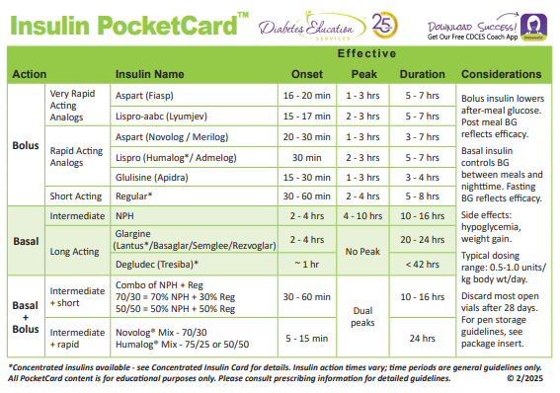
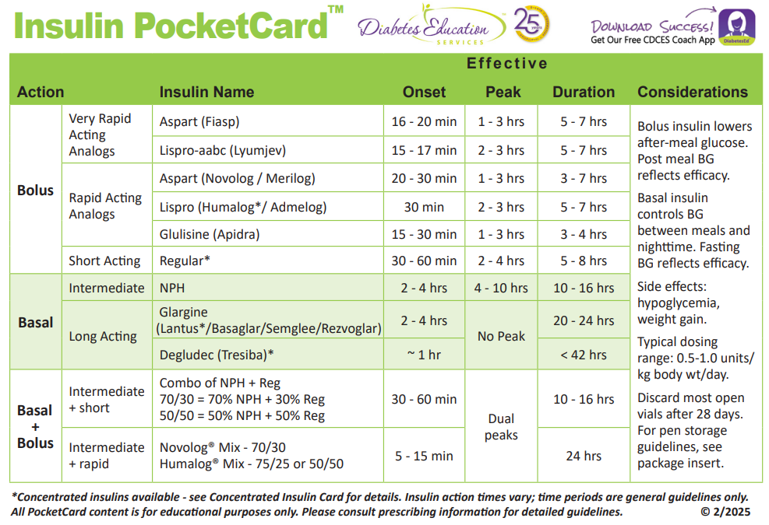

Slide 16
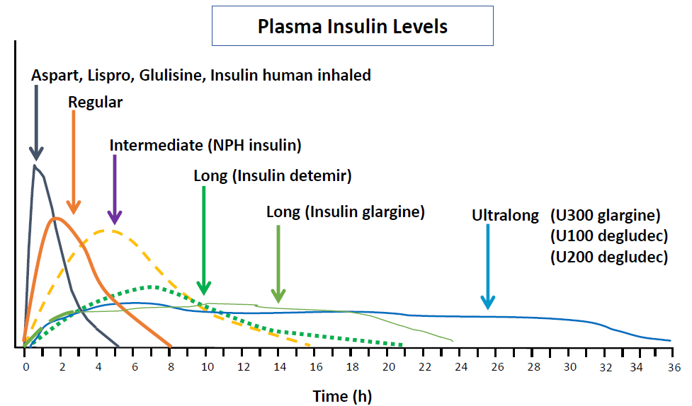
Insulin Profiles
Hirsch IB. NEJM 2005;352:174-183.
Lexicomp Online, Lexi-Drugs Online, Hudson, Ohio: UpToDate, Inc; 2020; August 21, 2020.

Slide 17
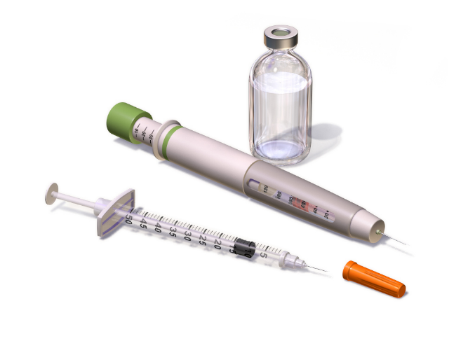
Insulin Concentration
Most insulin is U100: 100 units/mL
There is also concentrated insulin
U500 insulin, 500 units/mL, U300, 300 units/mL, and U200, 200 units/mL
Insulin is available in a vial, pen, or cartridge
U100 insulin:
1 vial =10mL = 1000 units
1 pen =3 mL = 300 units
1 cartridge = 3 mL = 300 units
1 box of pens = 5 pens = 1500 units
Inhaled insulin
4, 8, 12 units cartridges
Afrezza, Novolog, Humalog, Lantus, Levmir (package inserts) 2022
Image: :Blausen.com staff (2014). Medical gallery of Blausen Medical 2014. WikiJournal of Medicine 1 (2).

Slide 18
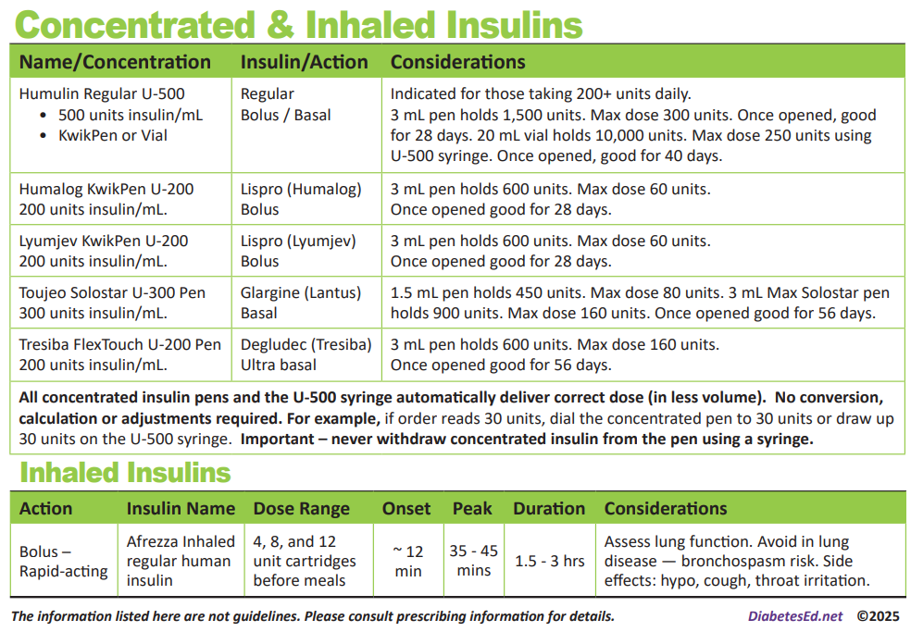
Concentrated and Inhaled Insulin

Slide 19
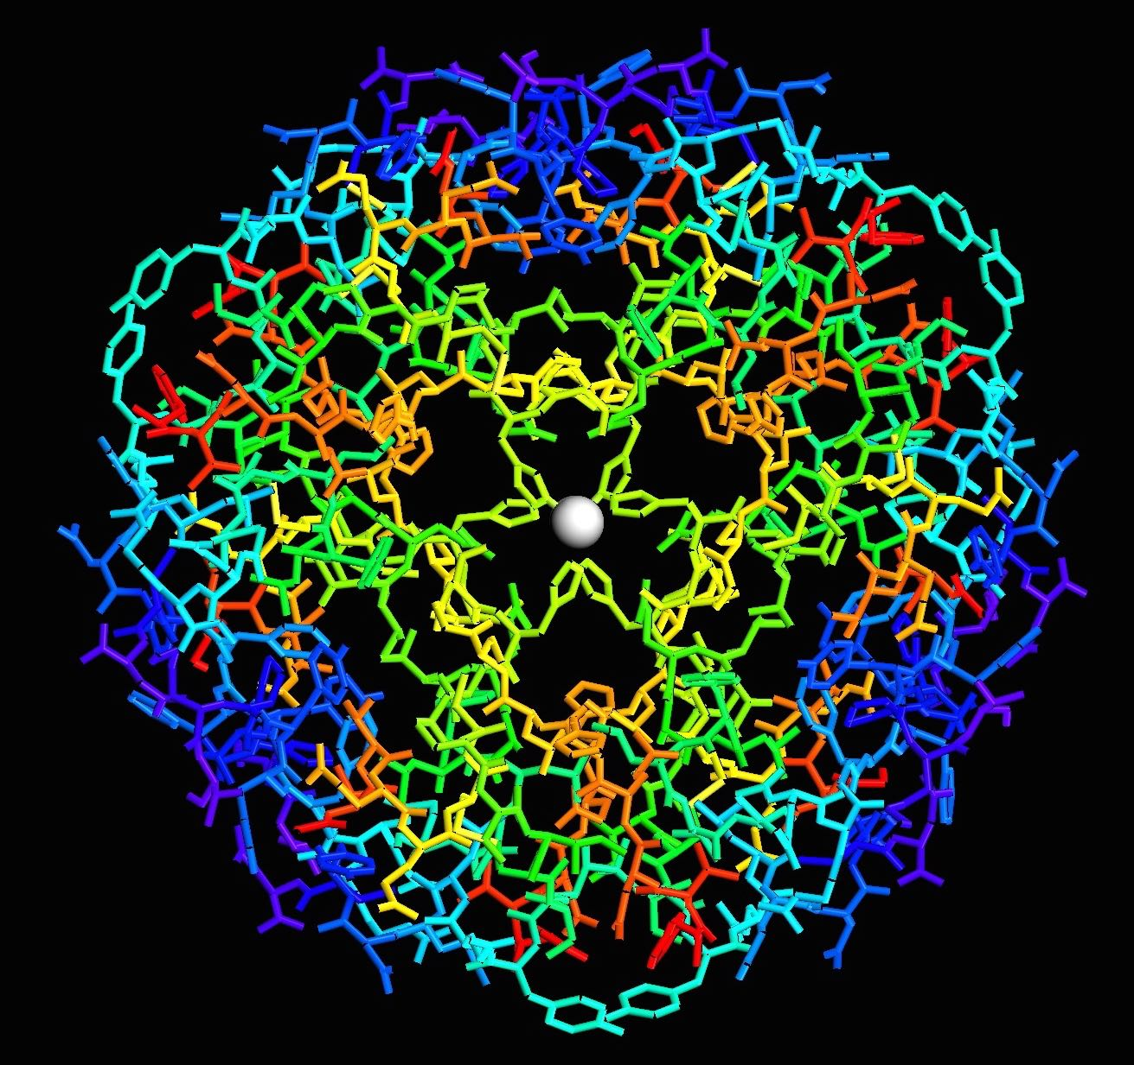
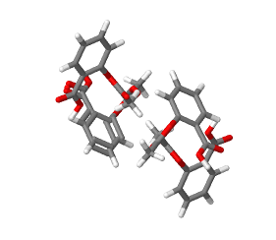
Follow-On Insulin & Biosimilars
These follow-on insulin products require a separate prescription (not directly interchangeable):
Insulin glargine (Lantus), follow-on product (Basaglar)
Insulin lispro (Humalog), follow-on product (Ademlog)
However, these have demonstrated bioequivalence and are interchangeable with the reference product:
Insulin glargine-yfgn (Semglee) interchangeable with Lantus
Insulin glargine-aglr (Rezvoglar) interchangeable with Lantus
Insulin aspart-szjj (Merilog) interchangeable with Novolog
Insulin – Large Molecule
Aspirin – Small Molecule
Notes:
MERILOG™ (insulin aspart-szjj)

Slide 20
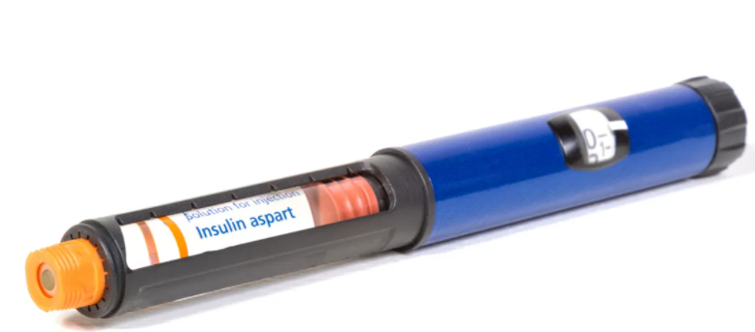
Generic Insulins
Insulin aspart
Insulin lispro
Insulin glargine
About half the cost of the brand name
Exact same formulation, produced by same manufacturer, interchangeable at pharmacy

Slide 21
Which Insulin is Interchangeable with Lantus (Insulin glargine U100)? Poll 1
Toujeo (Insulin glargine U300)
Basaglar (Insulin glargine U100)
Rezvoglar (Insulin glargine U100)
Tresiba (Insulin degludec U100)
All of the above
Notes:
Answer: C

Slide 22
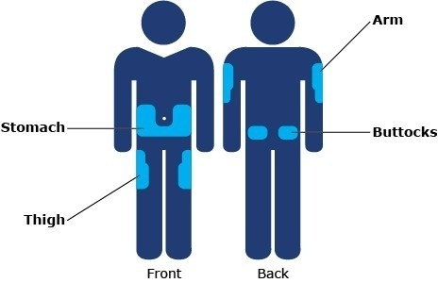
Insulin Injection Sites
Sites should be rotated
Notes:
https://www.bing.com/images/search?view=detailV2&ccid=J0qrzUzi&id=605DACD019791DB4D176BBBA06E2B08398849C0D&thid=OIP.J0qrzUzi0LJ2oJpx5HAGjQHaEy&mediaurl=https%3a%2f%2fwww.cornerstones4care.com%2fcontent%2fcornerstones4care%2fen%2fmedicine%2fwhat-to-do%2fusing-and-taking-care-of-your-medicine%2f_jcr_content%2fpar_left%2fheroimage.img.full.high.jpeg%2f1530054324694.jpeg&exph=300&expw=464&q=insulin+injection+sites&simid=607999160964812015&ck=30C0E430CA937537627C1715925BC74C&selectedIndex=9&qft=+filterui%3alicense-L2_L3_L5_L6&ajaxhist=0
Imagine free to use

Slide 23
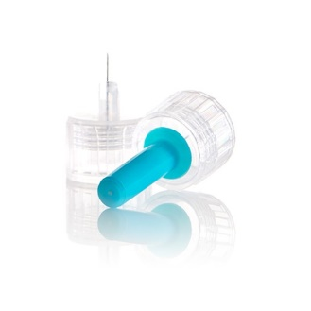
Insulin Key Counseling Points
Do not shake insulin
Cloudy insulin (NPH or pre-mixed) should be rolled before use so suspension is uniform
Skin thickness is usually 2mm regardless of person’s size, so shortest needles (4mm) work well for most
Take outer and inner covering off for pen needles
Leave the needle/syringe in the body for 5-10 seconds
Change needle or syringe with each injection
Dispose of needles/syringes in a sharps container or per local regulations
Dang DK. Taking medication. In: Cornell S et al, eds. The art and science of diabetes self-management education desk reference. 5th ed.

Slide 24
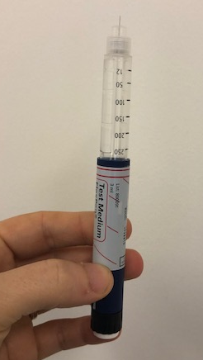
Priming insulin
Prime pens before every use to get air bubbles out
Hold vertically with needle at the top
Turn dial to 2 units
Push plunger
Repeat until insulin comes out of the top
May have to do multiple times for a new pen
This will ensure all air is out and that pen needle works
Do this every time an insulin pen injection is given
Notes:
Image obtained from Diana Isaacs.

Slide 25
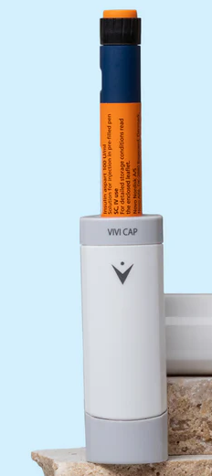

Storage Options
Notes:
Storage options include frio bag and vivicap, logos covered.

Slide 26
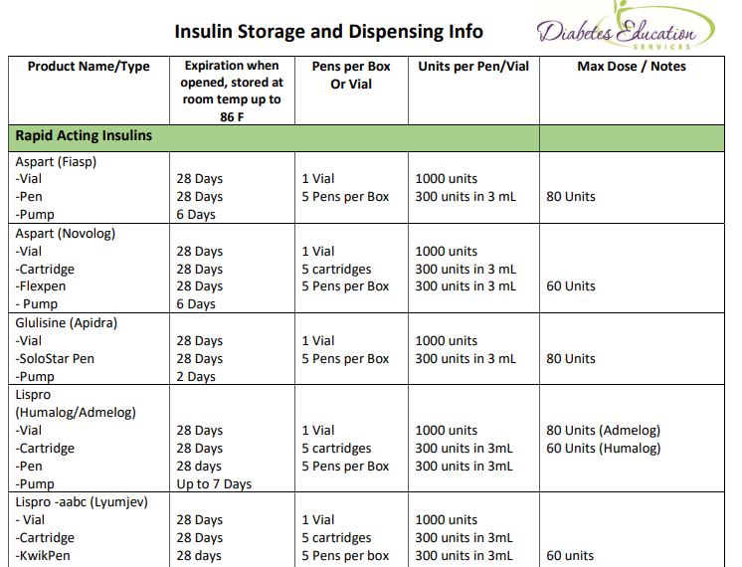
Insulin Storage and Expiration Cheat Sheet Available

Slide 27
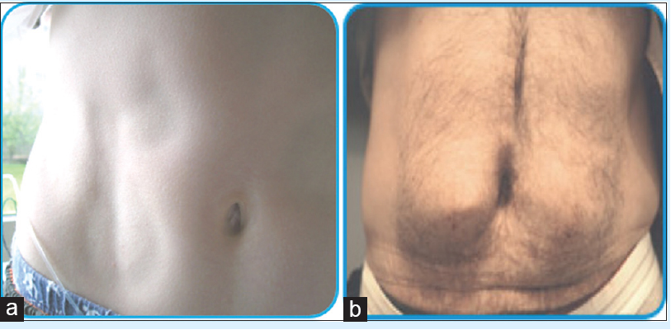
Side Effects of Insulin
Weight Gain
Lipodystrophy/
Lipohypertrophy
Hypoglycemia
Dang DK. Taking medication. In: Cornell S et al, eds. The art and science of diabetes self-management education desk reference. 4th ed.
Notes:
Weight gain is predominantly from increased truncal fat, and tends to be related to daily dose and plasma insulin levels present. Weight gain is undesirable in most type 2 DM patients, but can be seen as beneficial in underweight patients with type 1 DM. Weight gain appears to be related to intensive insulin therapy, and can be somewhat minimized by physiologic replacement of insulin.
Two forms of lipodystrophy, although much less common today in people with diabetes, still occur. Lipohypertrophy is caused by many injections into the same injection site. Because of insulin's anabolic actions, a raised fat mass is present at the injection site with resultant variable insulin absorption. Lipoatrophy, in contrast, is thought to be caused by insulin antibodies, with destruction of fat at the site of injection. Injection away from the site with more purified insulin is recommended, although several reports of lipoatrophy with lispro have been reported.

Slide 28
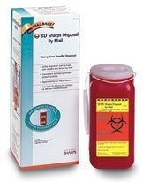
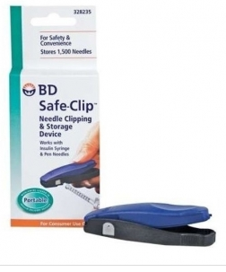
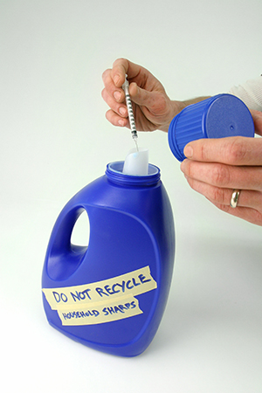
Sharps Disposal: Product and Info
Search for household hazardous waste listing for your city or county.
Call 1-800-CLEANUP (1-800-253-2687)

Slide 29
Polling Question 2
After how many days should an open vial of insulin degludec be discarded?
28 days
30 days
42 days
56 days
Notes:
Answer: D

Slide 30
How to Dose Insulin

Slide 31
Type 1 Diabetes (T1D)
Absolute deficiency in endogenous insulin
Exogenous insulin is required
The regimen should include:
Basal
Insulin
Bolus Insulin
+

Slide 32
How to Dose Insulin? T1D
Newly diagnosed T1D
Total insulin dose: 0.5-1.0 units/kg/day
50% basal
50% bolus
Bolus can initially start with set doses or calculations can be used to determine initial carbohydrate ratio and correction factor
Pamagluapatai LG et al. In: Cornell S et al., Pharmacolotherapy for Glucose Management. The art and science of diabetes self-management education desk reference. 5th ed.

Slide 33

Choice of Basal Insulin
NPH
Detemir
Glargine U-300
Delgudec U-100
Glargine
Degludec U-200
1.
2.
3.
1. Shortest duration, 2. Medium duration, 3. Longest duration

Slide 34
Weekly Insulins
Awiqli® (once-weekly basal insulin icodec) approved for use in the EU
Half-life: 196 hours ~8 days
U700 insulin, 3mL pen = 2100 units/pen
70 units icodec weekly = 10 units glargine daily
Efsitora alfa is also a weekly insulin
17 day half-life
Both have flatter insulin profiles compared to daily insulin
Rosenstock J, et al. Weekly Icodec versus Daily Glargine U100 in Type 2 Diabetes without Previous Insulin. N Engl J Med. 2023 Jul 27;389(4):297-308.
In a first-of-its-kind fixed dose study, once weekly insulin efsitora alfa leads to A1C reduction similar to daily insulin | Eli Lilly and Company
Notes:
The day of weekly administration can be changed if necessary, by up to 3 days. A minimum of 4 days between injections should always be ensured.

Slide 35
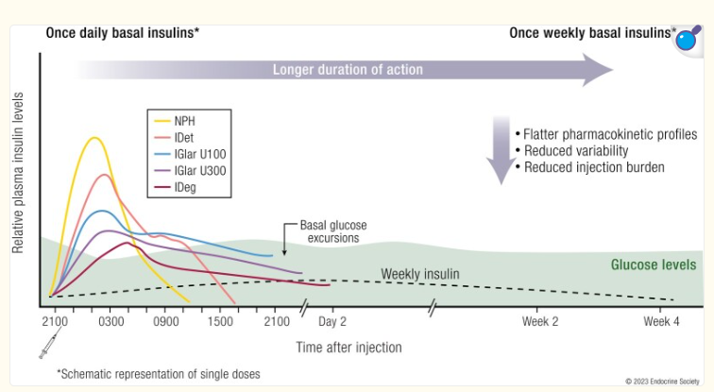
Weekly Insulins vs Standard Insulins

Slide 36
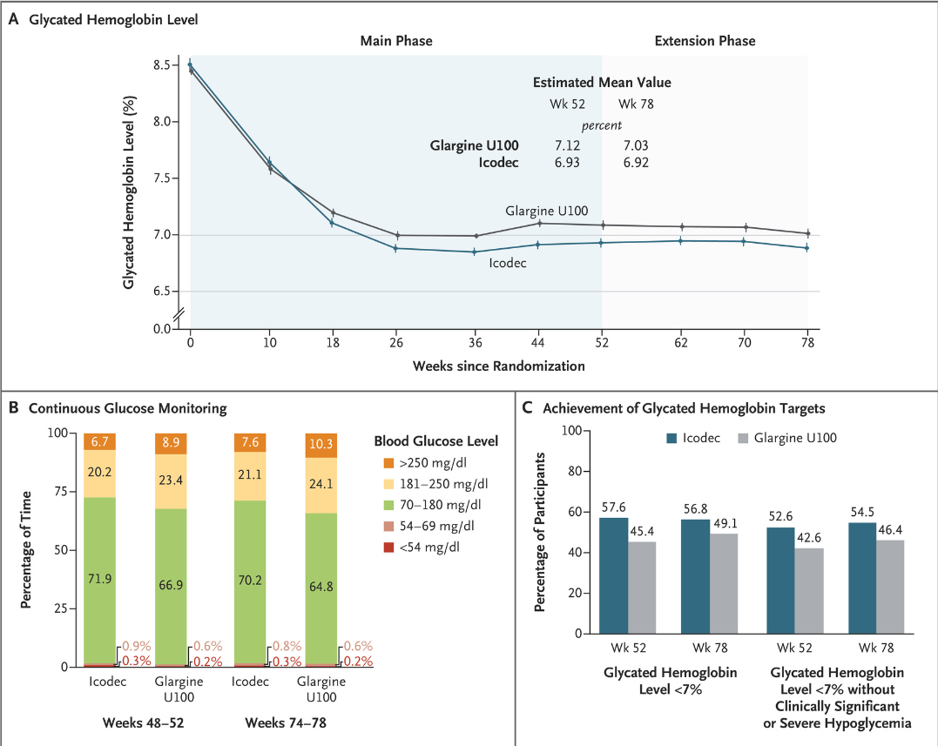
Glargine vs. Icodec in T2D
492 pts in each group
Primary outcome: change in A1C
Conclusion: glycemic control better with icodec
Rosenstock J, et al. Weekly Icodec versus Daily Glargine U100 in Type 2 Diabetes without Previous Insulin. N Engl J Med. 2023 Jul 27;389(4):297-308.
Notes:
Insulin naieve people with T2D
Background: Insulin icodec is an investigational once-weekly basal insulin analogue for diabetes management.
Methods: We conducted a 78-week randomized, open-label, treat-to-target phase 3a trial (including a 52-week main phase and a 26-week extension phase, plus a 5-week follow-up period) involving adults with type 2 diabetes (glycated hemoglobin level, 7 to 11%) who had not previously received insulin. Participants were randomly assigned in a 1:1 ratio to receive once-weekly insulin icodec or once-daily insulin glargine U100. The primary end point was the change in the glycated hemoglobin level from baseline to week 52; the confirmatory secondary end point was the percentage of time spent in the glycemic range of 70 to 180 mg per deciliter (3.9 to 10.0 mmol per liter) in weeks 48 to 52. Hypoglycemic episodes (from baseline to weeks 52 and 83) were recorded.
Results: Each group included 492 participants. Baseline characteristics were similar in the two groups. The mean reduction in the glycated hemoglobin level at 52 weeks was greater with icodec than with glargine U100 (from 8.50% to 6.93% with icodec [mean change, -1.55 percentage points] and from 8.44% to 7.12% with glargine U100 [mean change, -1.35 percentage points]); the estimated between-group difference (-0.19 percentage points; 95% confidence interval [CI], -0.36 to -0.03) confirmed the noninferiority (P<0.001) and superiority (P = 0.02) of icodec. The percentage of time spent in the glycemic range of 70 to 180 mg per deciliter was significantly higher with icodec than with glargine U100 (71.9% vs. 66.9%; estimated between-group difference, 4.27 percentage points [95% CI, 1.92 to 6.62]; P<0.001), which confirmed superiority. Rates of combined clinically significant or severe hypoglycemia were 0.30 events per person-year of exposure with icodec and 0.16 events per person-year of exposure with glargine U100 at week 52 (estimated rate ratio, 1.64; 95% CI, 0.98 to 2.75) and 0.30 and 0.16 events per person-year of exposure, respectively, at week 83 (estimated rate ratio, 1.63; 95% CI, 1.02 to 2.61). No new safety signals were identified, and incidences of adverse events were similar in the two groups.
Conclusions: Glycemic control was significantly better with once-weekly insulin icodec than with once-daily insulin glargine U100. (Funded by Novo Nordisk; ONWARDS 1 ClinicalTrials.gov number, NCT04460885.).

Slide 37
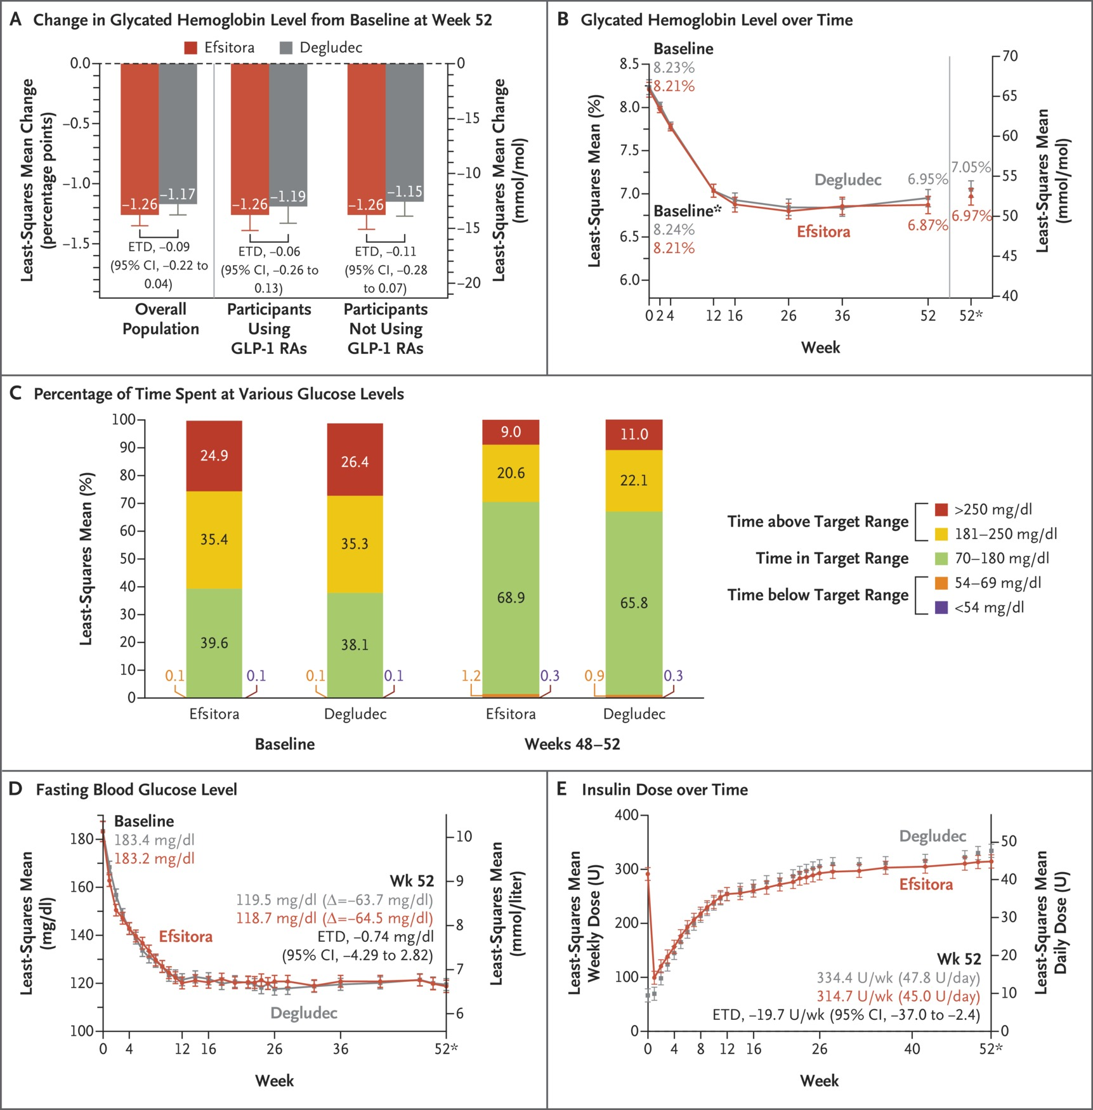
Degludec vs. Efsitora in T2D
928 pts
Primary outcome: change in A1C
Efsitora non-inferior

Slide 38
Choice of Bolus Insulin
Regular
Lispro (Humalog®, Admelog®)
Glulisine (Apidra®)
Aspart (Fiasp®)
Aspart (Novolog®)
Lispro (Lyumjev®)
Inhaled (Afrezza®)
Lowest Cost
1.
2.
3.
1. Slowest, 2. Medium, 3. Quickest

Slide 39
T1D: Insulin Dosing Regimens
Time of Insulin Administration | Before breakfast | Before lunch | Before dinner | Bedtime
Method 1 | Intermediate: Regular (2/3 TDD) 2:1 ratio |  | Intermediate: Regular (1/3 TDD) 2:1 ratio
Method 2 | Regular/ analog (1/2 TDD ÷ by 3) | Regular/ analog (1/2 TDD ÷ by 3) | Regular/ analog (1/2 TDD ÷ by 3) | Long-acting (1/2 TDD)
***These are starting regimens and are adjusted based on ability to carbohydrate count and glycemic management as determined by A1C, BGM and/or CGM

Slide 40
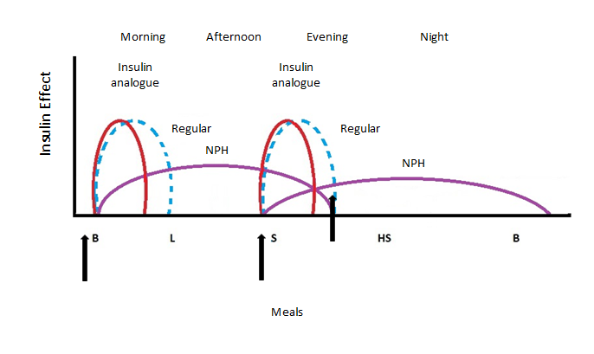
Intermediate-acting Insulin + Regular Insulin or Insulin Analog
Intermediate insulin serves as basal while
regular or insulin analog serves as bolus
Regular insulin: Novolin R, Humulin R
Intermediate insulin: Novolin N, Humulin N
Insulin analogue: aspart, lispro, glulisine
Dipiro JT et al, eds. Pharmacotherapy: a pathophysiologic approach. 11th ed. 2020.
Notes:
Drawn by Jill Haug

Slide 41
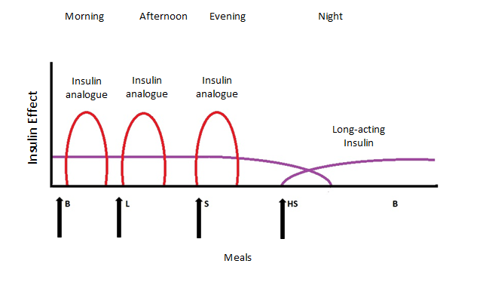
Long-acting Insulin with Insulin analog
Long-acting serves as basal
insulin analog serves as bolus
Dipiro JT et al, eds. Pharmacotherapy: a pathophysiologic approach. 11th ed. 2020.
Notes:
Drawn by Jill Haug

Slide 42
Carbohydrate Ratio
Insulin to carbohydrate ratio (ICR)
1 unit of insulin is expected to cover X grams of carbohydrates
Rule of 450 or 500 can be used
450/TDD = estimated carbohydrate ratio
Trujillo J et al. Diabetes mellitus. In: Dipiro JT et al., eds. Pharmacotherapy: a pathophysiologic approach. 11th ed.

Slide 43
Correction Factor
Insulin correction factor (ICF)
Also known as insulin sensitivity factor (ISF)
1 unit of insulin is expected to lower glucose by Y points
Rule of 1700 or 1800 can be used
1800/TDD = estimated ICF
For regular insulin, the rule of 1500 is typically used
Trujillo J et al. Diabetes mellitus. In: Dipiro JT et al., eds. Pharmacotherapy: a pathophysiologic approach. 11th ed.

Slide 44
An Example: Meet Austin
Austin is a 12-year-old newly diagnosed with T1D, he weighs 40kg
He is started on 0.5 units/kg/day of total insulin
40*0.5=20 units
50% basal=10 units
50% bolus=10 units
Austin is prescribed 10 units of long-acting insulin and 3 units of rapid-acting insulin at meals
The insulin doses will be adjusted based on glucose data

Slide 45

Austin Calculation cont’d
Austin is ready for carbohydrate counting
Based on the rule of 500 and rule of 1800, what should his ICR and ICF be?

Slide 46
Poll Question 3
Based on the rule of 500 and rule of 1800, what should Austin’s ICR and ICF be? (TDD=20 units/day)
ICR=25, ISF=90
ICR=20, ISF=60
ICR=15, ISF=50
ICR=30, ISF=75
I am not sure

Slide 47
Answer and Explanation
ICR=500/20=25
This means that 1 unit of insulin covers 25 grams of carbohydrate
If Austin eats 50 grams of carbohydrate, he should inject 2 units
ISF=1800/20=90
This means that 1 unit of insulin is expected to lower glucose by 90 mg/dL
Austin’s glucose target is 100
If his current glucose is 190, he should take 1 extra unit of insulin

Slide 48
Correction Scale 1 Rapid/Fast Acting Insulin (1 unit:50 mg/dl>150)
Less than 70 | Subtract 1 unit
70-150 mg/dl | 0 units
151-200 mg/dl | 1 unit
201-250 mg/dl | 2 units
251-300 mg/dl | 3 units
301-350 mg/dl | 4 units
351-400 mg/dl | 5 units

Slide 49
Correction Scale 2 Rapid/Fast Acting Insulin (2 units:50 mg/dl>150)
Less than 70 | Subtract 1 unit
70-150 mg/dl | 0 units
151-200 mg/dl | 2 unit
201-250 mg/dl | 4 units
251-300 mg/dl | 6 units
301-350 mg/dl | 8 units
351-400 mg/dl | 10 units

Slide 50

Poll Question 4
How much insulin does a person with type 1 diabetes need a day?
1 to 2 units/kg per day
No more than 0.5 units/kg per day
5 to 10 units/kg per day
0.5 to 1 units/kg per day

Slide 51
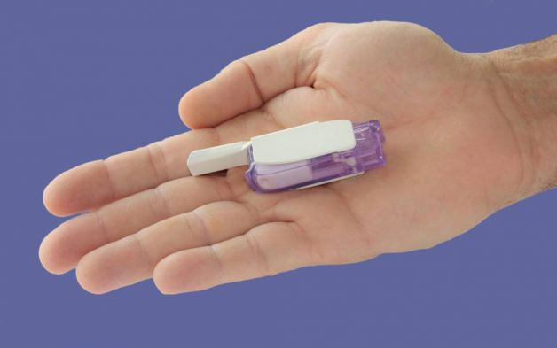
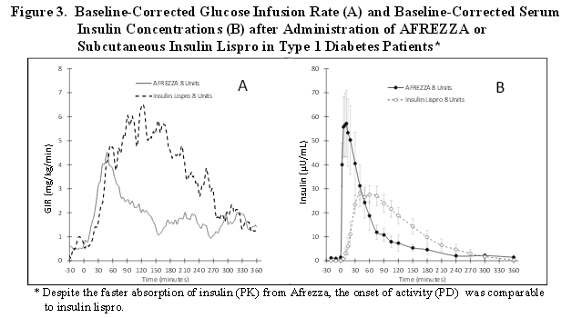
Inhaled Insulin
Injected Meal Time Dose | Inhaled Insulin Dose
Up to 4 units | 4 units
5-8 units | 8 units
9-12 units | 12 units
12-16 units | 16 units
17-20 units | 20 units
21-24 units | 24 units
FDA approved for adults over 18yo
Not indicated for pregnancy, while breastfeeding

Slide 52
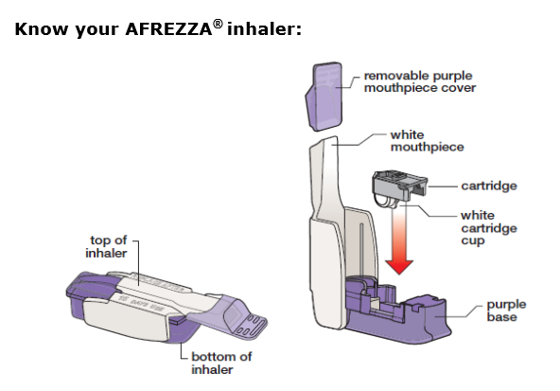
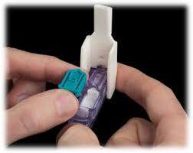
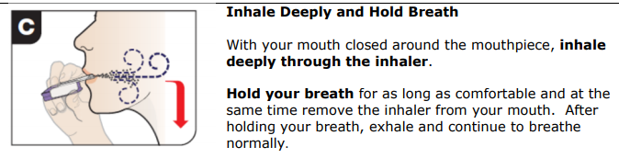
Inhaled Insulin

Slide 53
Inhaled Insulin Storage
Opened inhaler: use in 15 days
Sealed foil packages: refrigerate until expiration date on package
Sealed blister card strips: room temp-use within 10 days, fridge-30 days
Opened strips: room temperature, use within 3 days
Before using, inhaler and strips should be at room temperature for at least 10 minutes
https://afrezza.com/wp-content/uploads/2020/01/Afrezza-Storage-and-Handling-Guide.pdf

Slide 54
Inhaled Insulin Dosing and Counseling
Bolus insulin – inhaled before meals
Dosing: 4, 8 and 12 unit cartridges
Lung function test before start (FEV1)
Not for pts w/ chronic lung issues
Asthma, COPD, history of lung cancer, smoking within past 6 months
Can cause acute bronchospasm – Black box warning
Side effects:
Sore throat, cough
Less hypoglycemia than injected insulin

Slide 55

Bolus Insulin Timing
How is the effectiveness of bolus insulin determined?
1-2 hours post meal
Before next meal blood glucose
Glucose goals (may be modified based on pt specific factors)
1-2 hours peak post meal <180 (ADA)
2 hour post meal <140 (AACE)
Before next meal 80 - 130

Slide 56

Poll Question 5
Mary takes 4 units of insulin lispro before breakfast. Which BG result reflects that the dose was the right dose?
Before breakfast BG of 97
1 hour post lunch BG of 160
Before lunch BG of 94
2 hour post breakfast BG of 185

Slide 57
U500 Insulin

Slide 58
More than 200 units a day?
Drug Name | Availability | Pen Units | Expiration | Onset | Peak Effect | Duration of Action | Clinical Pearls
Insulin human regular (humulin R U500) | Pen, Vial | 5 unit | Vial: 40 days Pen: 28 days | 0.25-0.5 hours | 4-8 hr | 13-24 hr | This insulin is 5 time as concentrated. If using a vial, use the special U500 syringe.
DailyMed: https://dailymed.nlm.nih.gov/dailymed/index.cfm
Stahnke AM et al. ADCES in Practice. March, 2020. https://doi.org/10.1177/2633559X20896414

Slide 59
Switching to u500 insulin
Typically reserved for people requiring insulin >200 units/day
U500 acts like an intermediate acting insulin but replaces both the basal and bolus doses
If A1C< 8%, recommend to reduce TDD by 10-20%
If A1C≥ 8%, consider 1:1 conversion
Typically dosed 2-3 times daily
Take 30 minutes prior to meals
Often initiated as a 60/40 or 40/30/30 split
Reid TS, et al. Postgrad Med. 2017;129(5):554-562.
Notes:
New Reference: Reid TS, Schafer F, Brusko C. Higher concentration insulins: an overview of clinical considerations. Postgrad Med. 2017;129(5):554-562. doi:10.1080/00325481.2017.1325311

Slide 60
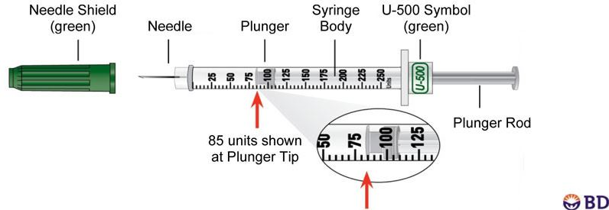
U500 example
A woman with obesity, T2D, and insulin resistance takes insulin glargine 120 units BID and insulin aspart 60 units TID a.c. Her most recent A1C=9%. How would she switch to U500?
1:1 conversion since A1C > 8%
TDD=180+240=420 units split as 40/30/30
New Dose:
U500 165 units QAM, 125 units at lunch, 125 units at dinner
Must round to nearest 5 unit increment
Inject 30 minutes before each meal
Use U500 syringe or U500 pen
Do not use U100 syringes!
Reid TS, et al. Postgrad Med. 2017;129(5):554-562.

Slide 61
Barriers to Insulin Use

Slide 62

Poll Question 6
AJ tells you she doesn't want to start on insulin. What is your best response?
a. The needles are so small, you won’t even feel it.
b. Lots of people are afraid of insulin.
c. It sounds like you are refusing to take insulin?
d. I’m sorry, but there is a doctors' order to start insulin.
e. What concerns do you have about taking insulin?

Slide 63

Psychological Insulin Resistance (PIR)
50% of providers in study threatened pts “with the needle”.
Less than 50% of providers realized insulins’ positive effect on T2D
Most pts don’t believe that insulin would “better help them manage their diabetes”.
Solutions: Find the root of PIR and address it
Diabetes Attitudes, Wishes, Needs Study - Rubin

Slide 64
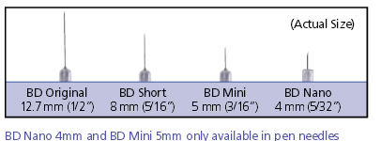
Needle Size often a Barrier: Size Matters
Use shortest needles – 4 mm
Effective for almost ALL patients
Keeps it subq
If thin, inject at angle
To avoid leakage, count to 10 before withdrawing needle
For needle phobias, consider insulin pumps, patches, iport, and inhaled insulin

Slide 65

Question Time
Break for Questions

Slide 66
How To’s of Adding Insulin in Type 2 DM

Slide 67

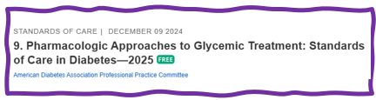
Intensifying Injectable Therapy – Type 2
Consider GLP1 or GLP/GIP first
Start basal insulin 10 units or 0.1 to 0.2 units/kg day
Titrate up 2 units every 3 days, until FBG at goal
If AM hypo, decrease basal insulin 20%
Adding bolus
Start with 4 units bolus at largest meal or
Start 1-2 injections with 10% of basal or
Switch to basal bolus combo (like 70/30 ins)

Slide 68

Overbasalization -2025 Update
Clinical signals of overbasalization include:
high bedtime-to-morning or preprandial-to-postprandial glucose differential
(e.g., bedtime-to-morning glucose differential ≥50 mg/dL),
hypoglycemia (aware or unaware)
high glucose variability
Evidence of overbasalization should prompt reevaluation of the glucose-lowering treatment plan to better address postprandial hyperglycemia

Slide 69
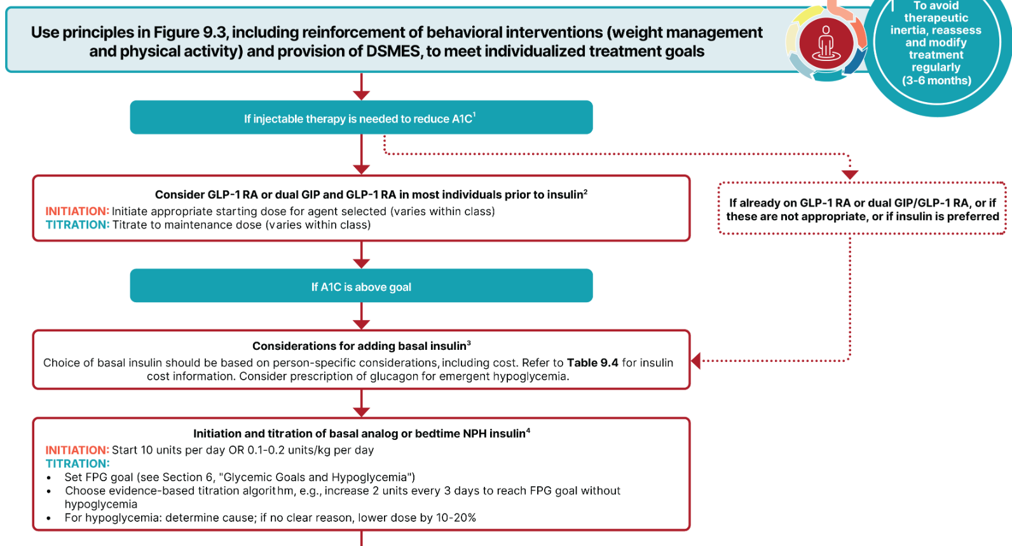
Figure 9.4 ADA Insulin Algorithm

Slide 70
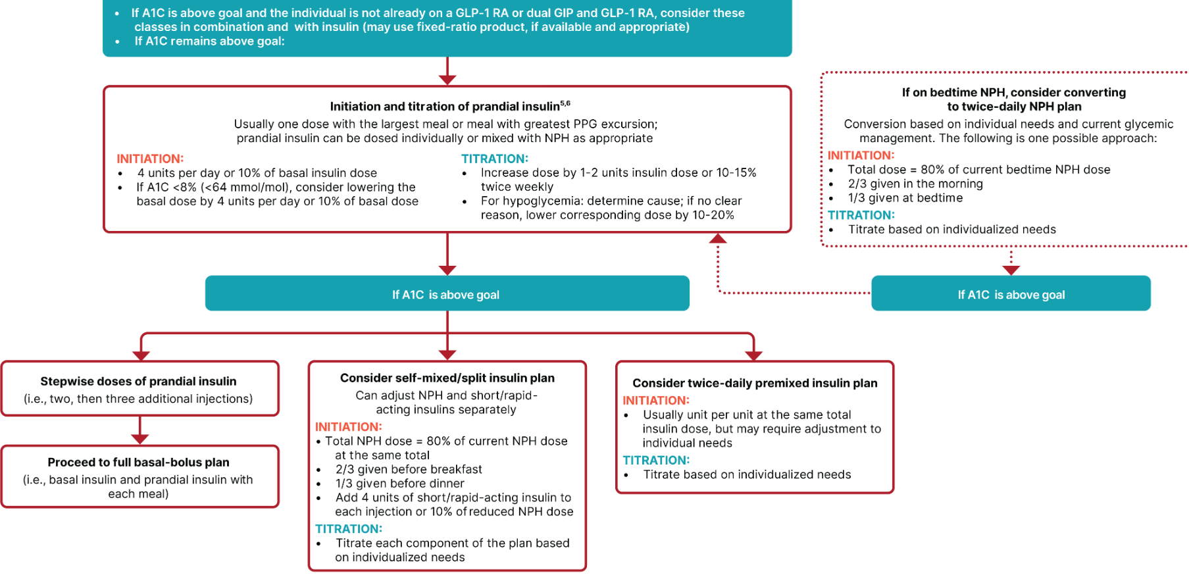
Figure 9.4—Continued

Slide 71

Intensifying Injectable Footnotes 9.2
Consider insulin as the first injectable if evidence of ongoing catabolism A1C levels (>10%) or BG levels ≥300mg/dL or a diagnosis of T1D is a possibility.
For those on GLP-1RA and basal insulin combination, consider using a fixed-ratio combination product (iDegLira or iGlarLixi).
Consider switching from evening NPH to a basal analog if there is hypoglycemia and/or the individual frequently forgets to administer NPH in the evening. In this case, an AM dose of a long-acting basal insulin could be a better choice.
If adding prandial insulin to NPH, consider initiation of a self-mixed or premixed insulin regimen to decrease number of injections.

Slide 72
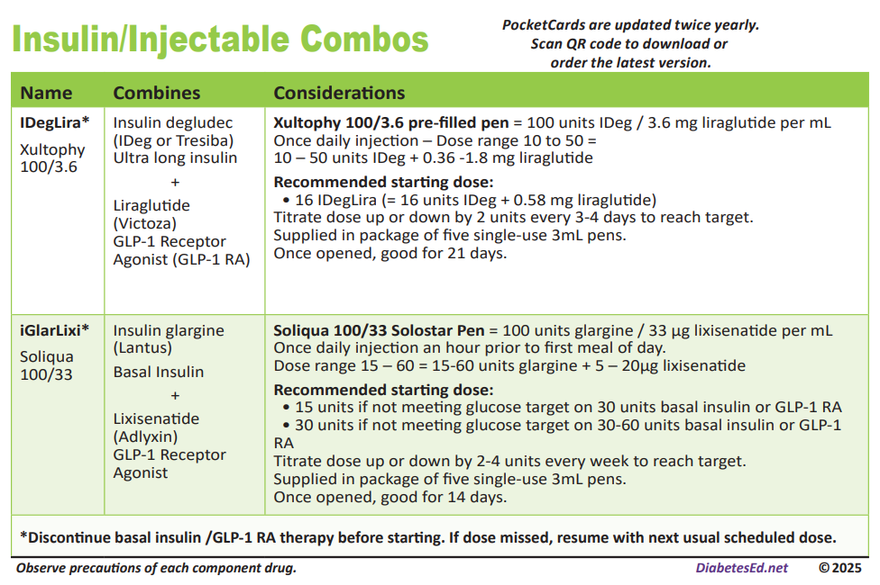

Slide 73
Case Study: Jenny
Jenny is a 50-year-old woman that takes insulin glargine 100 units daily, glipizide 10mg BID, metformin 1000mg BID, and linagliptin 5mg daily. A1C is 8.5%. She weighs 110kg. She checks glucose in the AM only and reports it’s 90-130mg/dL. Her eGFR is 70. She previously had UTI’s with empagliflozin.
What is the best recommendation to adjust this regimen?

Slide 74

Thinking about the choices
Continue glargine?
Continue glipizide?
Continue linagliptin?
Add GLP-1 agonist?
Switch to combination GLP1 receptor agonist /insulin injectable?
Add prandial insulin?
Add SGLT-2 inhibitor?

Slide 75
Piecing it Together
New Regimen:
Insulin glargine 80 units once daily (20% reduction)
Semaglutide 0.25mg weekly, titrated up to 2mg weekly
Stop linagliptin
Continue glipizide (for now)
Next step could be to retry SGLT2i with counseling on how to avoid UTIs
Or replacing glipizide with prandial insulin with largest meal
CGM!

Slide 76
Switching Insulin

Slide 77
How to Switch Basal Insulin
When going from twice daily NPH to long-acting insulin, reduce dose by 20%
Switching Insulin glargine U100:
To glargine U300: 1:1, higher dose 10-18% may be needed
To degludec: 1:1 or consider 20% reduction
To NPH: 1:1 or consider 20% reduction
Switching Insulin dedgludec to other basal insulins:
Reduce all by 20%
Switching insulin glargine U300:
To insulin glargine U100, reduce dose by 20%
To degludec: 1:1 or consider 20% reduction
To NPH: reduce dose by 20%
Switching NPH to other insulins:
If twice daily, decrease dose by 20%
If once daily, 1:1 or consider 20% reduction
Need to use clinical judgement
For example, if A1C, FBG, and pre-meal BG are all above target, then may not be necessary to reduce basal insulin dose
Clinical Resource, How to Switch Insulin Products. Pharmacist’s Letter/Pharmacy Technician’s Letter/Prescriber Insights. January 2025.

Slide 78

Poll 7 - Making the switch: Meet Joan
Joan is taking insulin glargine 30 units twice daily. Her insurance formulary wants her to switch to insulin degludec. Her current A1C is 6.9%. What is the best dose recommendation?
Insulin degludec 30 units twice daily
Insulin degludec 60 units once daily
Do not switch since her A1C is well-controlled and get a prior authorization to continue with insulin glargine
Insulin degludec 48 units once daily
Notes:
The correct answer is D. a 20% reduction when going from twice daily to once daily.

Slide 79
Switching Meal time Insulin
This is a 1:1 conversion when switching between regular insulin, aspart, lispro, and glulisine including Fiasp® and Lyumjev™.
The exception is when switching to inhaled insulin (Afrezza)
Injected Meal Time Dose | Inhaled Insulin Dose
Up to 4 units | 4 units
5-8 units | 8 units
9-12 units | 12 units
12-16 units | 16 units
17-20 units | 20 units
21-24 units | 24 units
Clinical Resource. Pharmacist’s Letter/Prescriber’s Letter. August 2019.
Afrezza (package insert) 2019.

Slide 80
Poll 8. Patient Case: Lumy
Lumy’s insurance formulary changed from insulin lispro to insulin aspart.
She was following an insulin to carbohydrate ratio of 1:12 and a correction factor of 1:50.
How should she dose insulin aspart when she switches?
Reduce all doses by 10%
Increase all doses by 10%
Same dosing
Submit prior authorization so she doesn’t change insulin

Slide 81
Insulin Pattern Management

Slide 82


Pattern Management –AKA
How to think like a pancreas

Slide 83

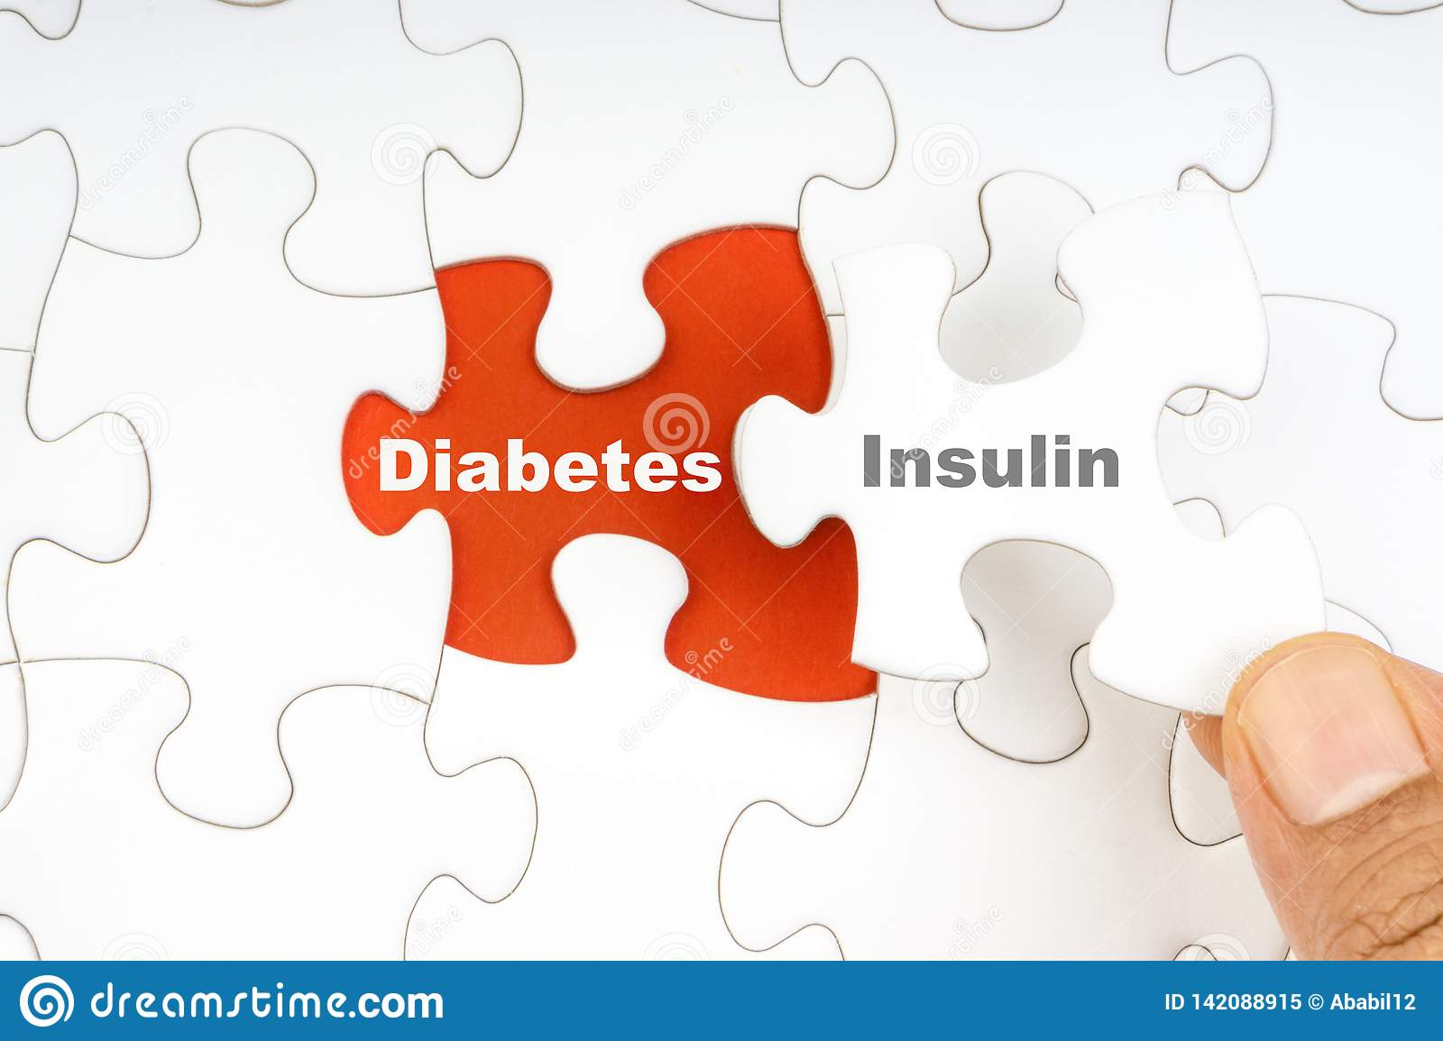
What do the numbers mean?
It’s like a BIG puzzle!
Notes:
Images Labeled for resuse
https://www.google.com/search?q=diabetes+puzzle&tbm=isch&ved=2ahUKEwim6amp8OvqAhUIG6wKHVFgBjAQ2-cCegQIABAA&oq=diabetes+puzzle&gs_lcp=CgNpbWcQAzIECAAQGDIECAAQGDoECCMQJzoECAAQQzoFCAAQsQM6AggAOgcIABCxAxBDOggIABCxAxCDAVC6iAJYsZUCYPeVAmgAcAB4AIABU4gBywiSAQIxNZgBAKABAaoBC2d3cy13aXotaW1nwAEB&sclient=img&ei=uPcdX6atHIi2sAXRwJmAAw&bih=869&biw=1902#imgrc=BxqsnbW3m9mE6M
https://www.researchgate.net/figure/Unlocking-the-puzzle-of-caring-for-the-patient-with-diabetes-mellitus-cardiometabolic_fig3_327175579

Slide 84
At Least 42 Factors Affect Glucose!
Food
Medication
Activity
Biological
Environmental
Behavioral and decision making
↑↑ Carbo-hydrate quantity
→↑Carbo-hydrate type
→↑ Fat
→↑ Protein
→↑ Caffeine
↓↑Alcohol
↓↑ Meal timing
↑Dehydration
? Personal microbiome
→↓Dose
↓↑ Timing
↓↑ Inter-actions
↑↑ Steroid administration
↑ Niacin (vitamin B3)
→↓ Light exercise
↓↑ High/ moderate exercise
→↓ Level of fitness/training
↓↑ Time of day
↓↑ Food and insulin timing
↑ Insufficient sleep
↑ Stress and illness
↓ Recent hypoglycemia
→↑ During-sleep blood sugars
↑ Dawn phenomenon
↑ Infusion set issues
↑ Scar tissue and lipodystrophy
↓↓ Intramuscular insulin delivery
↑ Allergies
↑ A higher glucose level
↓↑ Menstruation
↑↑ Puberty
↓ Celiac disease
↑ Smoking
↑ Expired insulin
↑ Inaccurate BG reading
↓↑ Outside temperature
↑ Sunburn
? Altitude
↓ Frequency of glucose checks
↓↑ Default options and choices
↓↑ Decision-making biases
↓↑ Family relationships and social pressures
Adapted from Brown A. DiaTribe Learn: Making sense of diabetes... diatribe.org/42factors

Slide 85

Poll Question 9
When looking at glucose patterns, which problem do you fix first?
a. Hyperglycemia
b. Hypoglycemia
c. Non-compliance
d. Legible writing

Slide 86
Pattern Management
Safety 1st!! - Evaluate 3 day patterns
Hypo: eval 1st and fix:
If possible, decrease medication dose
Timing of meals, exercise, medications
Hyperglycemia: evaluate 2nd
Identify patterns
Before increase insulin, make sure not missing something (carbs, exercise, omission)

Slide 87
General Rules with Basal Bolus
Optimize basal dose
Stay within 30mg/dL when not eating
Stay within 50mg/dL after a meal
Insulin Management
Fix hypoglycemia
Check basal/bolus ratio
Fine tune bolus settings
Optimize basal insulin

Slide 88
Adjusting Insulin doses in a Basal/Bolus regimen (T1D & T2D)
Out of Range Glucose | Insulin to Adjust
Fasting | Long acting insulin or bedtime NPH
Post-breakfast/pre-lunch | Pre-breakfast rapid/regular insulin
Post lunch/pre-dinner | Pre-lunch rapid/regular insulin or morning NPH
Post-dinner/before bedtime | Pre-dinner rapid/regular insulin

Slide 89
Tips for Data Interpretation
Start by asking the person what they’ve experienced and noticed with their glucose patterns
Avoid judgment
Learn from 1 time episodes, but make changes based on patterns
Fix lows first but some amount is expected (<1-4%) and if you remove all lows, you may end up with too many highs
If it’s not making sense, dig deeper (ex. missed doses, rationing, injection technique, food insecurity, etc)
Eating Patterns
Behaviors
Medications

Slide 90
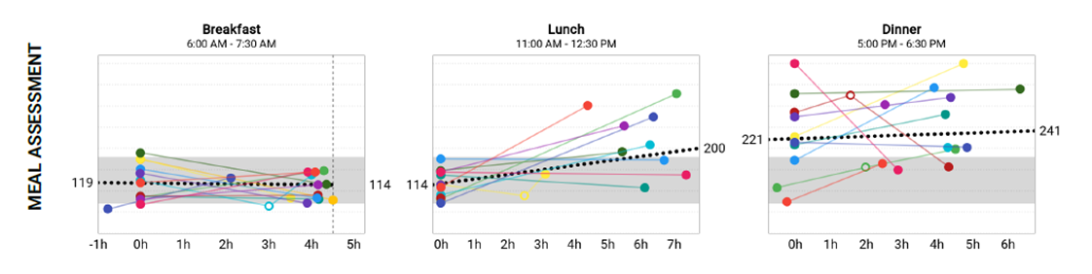
Meal Time Data Review
Glucose data before and after breakfast, lunch and dinner
Ideally, 2 hour post-meal should not rise above 180mg/dL or 50mg/dL from the pre-meal start
By 4-5 hours, glucose should return to pre-meal level
Notes:
Image from cleveland clinic companion medical patient report

Slide 91
Bolus Pattern Management
Does glucose go low after a correction dose?
May need a higher sensitivity
Ex. 1:60 instead of 1:50
Does glucose remain high after a correction dose?
May need a lower sensitivity
Ex. 1:40 instead of 1:50
Often people are more sensitive overnight (less insulin needed)
Does the person spike high after eating?
Is the person bolusing BEFORE the meal
Counting carbs correctly?
May need a more intensive carb ratio
Ex. 1:6 instead of 1:8
Does the person go low after eating?
Counting carbs correctly?
May need a less intensive carb ratio
Ex. 1:10 instead of 1:8
Adjustments typically made 10-20% at a time

Slide 92


Checking the Sensitivity
TDD=49 units
Rule of 1800
1800/49=37
Current sensitivity is 40
The calculation is slightly different from the current sensitivity. Look at the glucose data to determine if the sensitivity should be decreased.

Slide 93
Checking the Carb Ratio
TDD=49 units
Rule of 450
450/49=12.9
Current carb ratio is 15
The calculation is different from the current carb ratio. Look at the glucose data to determine if the carb ratio should be decreased.

Slide 94
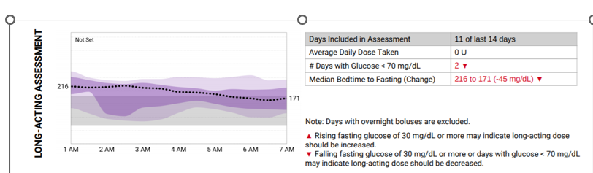
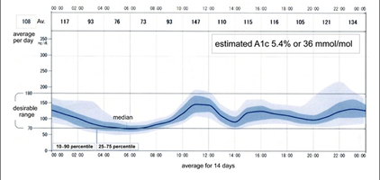
Basal Insulin Review

Slide 95
Case Study: Larry Poll Question 12
Larry takes metformin 1000mg BID, insulin glargine 50 units once daily, empagliflozin 10mg daily. His A1C is 7.8%. He weighs 90kg. FBG averages 100mg/dL. 2 hr PP breakfast=190mg/dL, 2 hr PP lunch=210mg/dL, and 2 hr PP dinner is 240mg/dL. What is the best recommendation for an agent to add to the regimen to achieve A1C target?
Initiate insulin aspart 5 units at dinner, decrease insulin glargine to 45 units daily
Initiate insulin aspart 5 units with all meals, decrease insulin glargine to 35 units daily
Initiate insulin aspart 5 units at dinner, continue insulin glargine 50 units daily
Initiate tirzepatide 2.5mg weekly, decrease insulin glargine to 45 units daily

Slide 96
Summary
Many different types of insulin
Basal + bolus needed for T1DM
Weight based dosing and rules of 1700/1800 and 500/450 can be used to calculate correction factor and carb ratio
GLP1 agonist preferred 1st injectable in T2D
Avoid overbasalization, if taking more than 0.5unit/kg/day or major bedtime/AM drop, think about GLP1 agonist +/- prandial insulin
Counsel patients on injection site technique, administration and storage
Fine tune insulin settings based on BGM and CGM data

Slide 97
Diabetes Bingo “DiaBingo” Shout out Right Answer

Slide 98
DiaBingo - I
I Inhaled insulin
I Glargine, Detemir, NPH are types of
I Breakdown of glycogen into glucose
I Anabolic hormone made by pancreatic beta cells
I Insulin is released when glucose levels are low
I In which injection site is insulin most rapidly absorbed?
I Elevated post-prandial glucose indicate need for pre-meaI
I Epinephrine increases insulin resistance
I Creation of glucose from amino acids and lactate
I Decreasing renal function for people on insulin can cause
I Bolus insulins
I A hormone that increases blood glucose levels

Slide 99

Break and Question Time
Energizing Ideas
Do some jumping jacks
Stretch and Breathe

Slide 100

Diabetes Interview – From Head to Toe & Microvascular Risk
During interviews, outline strategies to identify previously undiscovered diabetes co-conditions, identify clinical inertia and move to best health.
www.DiabetesEd.net
Beverly Thomassian, RN, MPH, BC-ADM, CDCES
President, Diabetes Education Services

Slide 101

Objectives
Identify common yet often under diagnosed co-conditions associated with type 1 and type 2 diabetes.
Describe the interrelationship between glucose, inflammation and diabetes complications.
List the elements of a head-to-toe assessment including lower extremity assessment.
Discuss barriers to sexual health and communication strategies.

Slide 102



4. Comprehensive Medical Evaluation and Assessment of Comorbidities
Person centered communication, strength-based language, active listening, literacy, quality of life
It is necessary to take into account all aspects of a person’s life circumstance (SDOH)
It is important to integrate medical eval, engagement and lifestyle changes.
Interdisciplinary teams provide best care

Slide 103

Communication Goals
The communication goal between health care professionals and people with diabetes is to:
Establish a collaborative relationship.
Assess and address self-management barriers without blaming people with diabetes for “noncompliance” or “nonadherence”
when the outcomes of self-management are not optimal.

Slide 104

Communication Strategies
Empathize and use active listening techniques to help facilitate communication :
open-ended questions,
reflective statements, and
summarizing what the person said,
Check in about perceptions of their:
Ability or self-efficacy to manage diabetes.
Address psychosocial factors to improve self-management and treatment outcomes.

Slide 105

EV Arrives and Requests Help
58 yr old complains of 4 lb wt gain for past month. BMI 31, wt 90 kg. B/P 142/96. A1C 8.3%
Meds include:
Sitagliptin, Metformin
Pioglitazone 15mg ac breakfast
glargine 58 units
Semaglutide 0.5mg weekly
Levothyroxine (ran out)
Lisinopril 10mg
Gabapentin 100 mg TID
What story do these meds tell?
Any med(s) missing?
Any med needs to be stopped?

Slide 106
EV Arrives and Requests Help
58 yr old complains of 4 lb wt gain for past month. BMI 31, wt 90 kg. B/P 142/96. Checks BG at hs & morning; 230 at hs, 150’s in AM. A1C 8.3%.
Meds include:
Sitagliptin (DPP-IV), Metformin
glargine 58 units (Basal)
Pioglitazone 15mg (TZD)
Semaglutide 0.5mg wk (GLP-1)
Levothyroxine (ran out)
Lisinopril 10mg (ACE)
Lovastatin 20mg (Statin)
Gabapentin 100 mg TID (leg pain)
What does this tell us about EV?
Struggling with weight
B/P & A1C above target
Overbasalized? BG drops > 70pts over hs
Why not taking thyroid med?
Lower extremity pain contributing to distress?
Elevated CV risk?

Slide 107

EV is Gaining Weight and is Tired
58 yr old complains of 4 lb wt gain for past month. BMI 31, wt 90 kg. B/P 142/96. Checks BG at hs & morning; 230 at hs, 150’s in AM. A1C 8.3%.
Meds include:
Sitagliptin, Metformin
Pioglitazone 15mg ac breakfast
glargine 58 units
Semaglutide 0.5mg weekly
Levothyroxine – ran out
Lisinopril 10mg
Gabapentin 100 mg TID
Labs
A1C – 8.3%
UACR 26 GFR >60
TSH 10.6
LDL 98 mg/dl, Trig 158
ALT 85 IU/L, AST 90 IU/L
Life situation
Takes care of dad with dementia
Gums inflamed
No eye doctor for year
Both feet hurt at night

Slide 108

ABC’s of Diabetes
A1c less than 7% (individualize)
Pre-meal BG 80-130
Post meal BG <180
AGP - Time in Range (70-180) 70% of time
Blood Pressure < 130/80
Cholesterol
Statin therapy based on age & risk status
If 40+ with ASCVD Risk, decrease 50%, LDL <70
If 40+ with ASCVD, decrease 50%, LDL <55

Slide 109
Assessment and Treatment Plan
Assessing risk of diabetes complications
• ASCVD and heart failure history
• ASCVD risk factors and 10-year ASCVD risk assessment
• Staging of chronic kidney disease
• Hypoglycemia risk
• Assessment for retinopathy
• Assessment for neuropathy
• Assessment for MASLD/MASH
Goal setting
• Set A1C/blood glucose/time in range
• If hypertension is present, establish blood pressure goal
• Weight management and physical activity goals
• Diabetes self-management goals
Therapeutic treatment plans
• Lifestyle management
• Pharmacologic therapy: glucose lowering
• Pharmacologic therapy: cardiovascular and kidney disease risk factors
• Weight management with pharmacotherapy or metabolic surgery, as appropriate
• Use of glucose monitoring and insulin delivery devices
• Referral to diabetes education, behavioral health, and medical specialists

Slide 110

Advocating for Best Health for people with Diabetes
Modifiable
Sleep
Activity
Smoking
Dietary Habits
Glucose
Blood Pressure
Lipids
Oral Care
Immunizations
Psychosocial care
Make small, achievable goals. We are in this for the long run.

Slide 111

Diabetes is a long path
Get at least 7 hours of sleep a night – Check for sleep apnea

Slide 112

Obstructive Sleep Apnea - OSA
OSA affects ~25% of people with type 2
Up to 60% of those with type 2 have disordered sleep
Associated with increased CVD risk
Signs include excessive daytime sleepiness, snoring and witnessed apnea
Treatment:
Lifestyle modification
Continuous positive oral airway pressure and devices
Surgery

Slide 113


Where are we on this continuum?
Only about 50% of us are meeting activity goals

Slide 114
Benefits of Exercise and Diabetes
Increase muscle glucose uptake 5-fold
Glucose uptake remains elevated for 24 - 48 hours (depending on exercise duration)
Increases insulin sensitivity in muscle, fat, liver.
Reduce CV Risk factors (BP, cholesterol, A1c)
Maintain wt loss
Contribute to well being
Muscle strength
Better physical mobility

Slide 115

Exercise decreases:
Sleep apnea
Diabetic kidney disease, retinopathy
Depression
Sexual dysfunction
Urinary incontinence
Knee pain
Need for medications
Health care costs

Slide 116

Tobacco, Electronic Cigarettes, Alcohol, and Cannabis
Advise all youth with diabetes not to use cannabis recreationally in any form.
2 to 3 times higher risk of developing DKA.
Can lead to cannabis hyperemesis syndrome
Screen adolescents and young for tobacco or nicotine, electronic cigarettes, substance use, and alcohol use at diagnosis and regularly thereafter.
Discourage smoking in youth who do not smoke and encourage smoking cessation in those who do smoke (including electronic cigarette use or vaping)

Slide 117
EV asks why the weight gain?
Fluid retention - diabetes doubles risk for Congestive Heart Failure (CHF). Check lower extremities.
Inaccurate nutrition knowledge
Pioglitazone can be associated with fluid wt gain.
Blood glucose improving
Thyroid disease under treated
Novel Antipsychotics
Depression / Increased intake

Slide 118

Poll question 9
Which of the following is a true statement?
Atypical antipsychotics are contraindicated for people with diabetes and thyroid disease.
Hypothyroidism is more common than hyperthyroidism.
Hyperthyroidism can be associated with weight gain or weight loss.
Hypothyroidism causes LDLs to decrease.

Slide 119
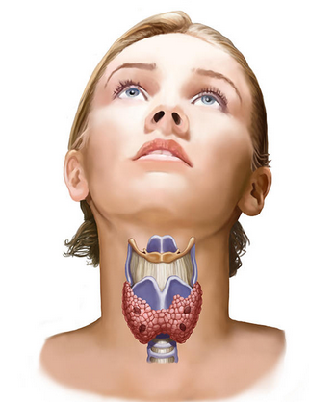
Thyroid Disease and Diabetes
15 to 30% of people w/ diabetes & their siblings or parents are likely to develop thyroid disease
Up to 60 percent of those with thyroid disease are unaware of their condition.
Women are 5-8x’s more likely than men to have thyroid problems.
Check TSH on Type 1 & 2 annually or if indicated.
Hashimoto’s thyroiditis – autoimmune thyroid
most common cause of hypothyroidism w/ dm
Associated with:
Elevated cholesterol levels
Increased risk of CV disease
Weight gain
AACE Website

Slide 120

Thyroid & TSH* Levels
*Thyroid Stimulating Hormone - secreted by pituitary gland
controls thyroid hormone thyroxine production
first and best test
TSH Norm = up to 4.5 mIU/mL
Treatment based on TSH plus symptoms.
4.5 – 10 based on risk, s/s
10 or more = treat
Lower = hyperthyroidism
Higher = hypothyroidism–
AACE Guidelines

Slide 121
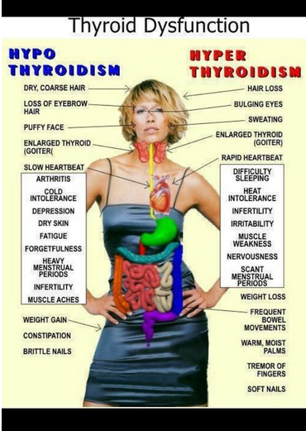
A TSH above 10 mIU/L,
in combination with
a subnormal free T4 characterizes overt hypothyroidism.
If TSH in range, but person is symptomatic,
Check for thyroid peroxidase atb or TPO antibodies
A low TSH indicates hyperthyroidism (0.1 ish)

Slide 122

Collaborative Action Plan
Increase semaglutide to 1.0mg
Decrease glargine by 10 units
Stop sitagliptin
Continue pioglitazone
Walk after lunch during work week
Restart levothyroxine, Re-Check TSH - Re-evaluate in 4 weeks.
Eat one serving of veggie a day and decrease meat intake to 4 nights a week.
Meet with RD/RDN
Check BG a few times a week before bed (in addition to am)
Labs
A1C – 8.3%
UACR 26 GFR >60
TSH 10.6
LDL 98 mg/dl, Trig 158
ALT 85 IU/L, AST 90 IU/L

Slide 123
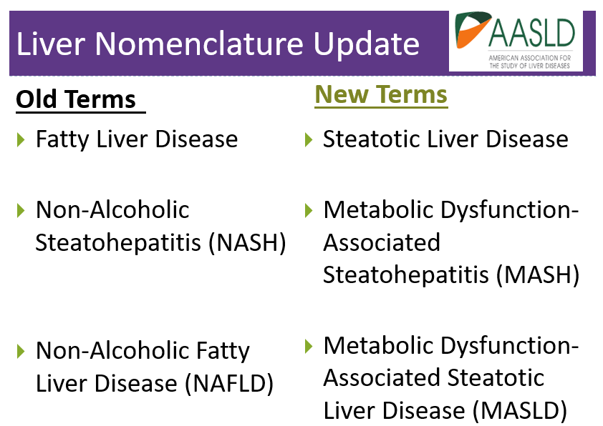

Slide 124

Metabolic Associated Steatohepatitis
MASH is when fat reaches 5% of the liver's weight
Without consumption of significant amounts of alcohol defined as:
Ingestion of less than 21 standard drinks per week in men and
Less than 14 standard drinks per week in women
over a 2-year period preceding evaluation) or the presence of other secondary causes of Steatosis disease.
Metabolic dysfunction–associated steatotic liver disease (MASLD)

Slide 125

Liver Disease & Steatohepatitis
Adults with type 2 diabetes.
>70% have MASLD
Of those 50% have MASH*
12-20% have fibrosis
Adults with type 1
20% have MASLD
Associated with :
Increased BMI (30+)
Cardiometabolic risk factors
Over 50 yrs
*ALT & AST 30 units/L +
*
*ALT & AST (Eval if more if 30+ for 6 mo’s - ADA)

Slide 126
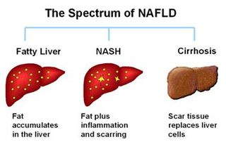
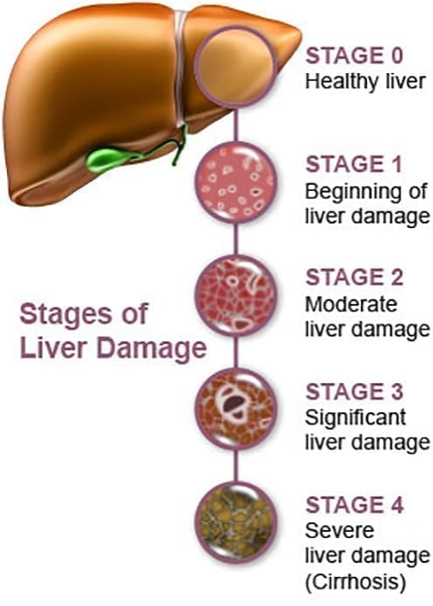
Natural History of NAFLD to NASH
NASH – Non-Alcoholic Steatohepatitis
MASH – Metabolic Assoc Steatohepatitis
https://liverfoundation.org/wp-content/uploads/2020/11/StagesFibrosis.jpg

Slide 127
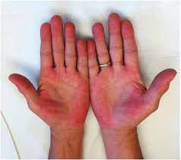
Symptoms of Steatosis
If symptoms do appear, they may include:
A feeling of fullness in the middle or upper right side of the abdomen
Abdominal pain, nausea
Loss of appetite or weight loss
Weakness
Jaundice
Swelling of the abdomen and legs
Mental confusion
Extreme fatigue or tiredness
Signs of advanced disease include:
Portal hypertension, spider angiomas, reddening of palms, declining platelet counts
Mayo Clinic
https://dermcollective.com/palmar-erythema/

Slide 128
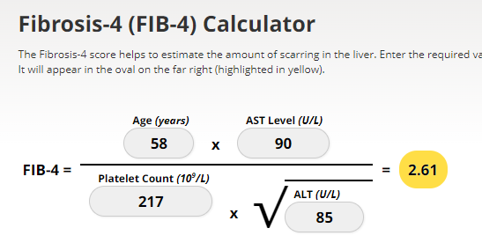
Screening for NASH – FIB-4
FIB-4 estimates risk of hepatic cirrhosis (age 35+):
Calculated by imputing:
Age
plasma aminotransferases (AST and ALT)
and platelet count
FIB-4 Risk Levels
Lower risk is <1.3
Intermediate 1.3 to 2.67
High risk >2.67
considered as having a high probability of advanced fibrosis (F3–F4).
The American College of Gastroenterology considers Upper limit of normal ALT levels:
29–33 units/L for males
19–25 units/L for female individuals
(mdcalc.com/calc/2200/fibrosis-4-fib-4-index-liver-fibrosis).
www.DiabetesEd.net

Slide 129



No More NAFLD
“MASLD is the hepatic manifestation of metabolic syndrome.”
Figure 4.2—ELF, enhanced liver fibrosis test; FIB-4, fibrosis-4 index; LSM, liver stiffness measurement, as measured by vibration-controlled transient elastography. “Fibroscan” *In the absence of LSM, consider ELF a diagnostic alternative. If ELF ≥ 9.8, an individual is at high risk of MASH with advanced liver fibrosis (≥F3–F4) and should be referred to a liver specialist.

Slide 130

Finding Liver Disease
Imaging procedures used to diagnose NAFLD include:
Abdominal ultrasound, which is often the initial test when liver disease is suspected.
Transient elastography, an enhanced form of ultrasound that measures the stiffness of liver. Liver stiffness indicates fibrosis or scarring.
Magnetic resonance elastography, works by combining MRI imaging with sound waves to create a visual map (elastogram) showing the stiffness of body tissues
Biopsy by liver specialist confirms definitive diagnosis
Referral to Hepatologist or GI specialist
Mayo Clinic

Slide 131

Other Treatments for MASLD & MASH
Meds that lower glucose, cholesterol and weight
Bariatric surgery
Pioglitazone (Actos)
Improves lipid and glucose metabolism
Reverses steatohepatitis in prediabetes/diabetes
Causes 1-2% wt gain at 15 mg
3-5% wt gain at 45 mg
GLP-1 Receptor Agonists
Support lifestyle changes

Slide 132
Actions To Decrease Steatosis
Increase activity
Strength training
Yoga or Thai Chi
Walking & aerobics
Thoughtful eating
More fiber
Less processed foods & less added sugar
Avoid alcohol
Treatment
Actos
GLP-1
Statin
Prevention
Cancer Screenings
Decrease inflammation

Slide 133

F0-F1, no to minimal fibrosis; F2-F3, moderate fibrosis; F4, cirrhosis;

Slide 134

Higher Fracture Risk
Hip fractures:
Type 1 - 6.3 relative risk associated w/ osteoporosis
Type 2 – 1.7 relative risk
Health care professionals can:
Assess risk fracture risk and history, esp with older clients
Recommend bone mineral density assessment
Assess if would benefit from vita d supplement
Home health/ Physical Therapy
Use TZDs and SGLT’s with caution

Slide 135
Bone Mineral Density Testing
People aged ≥65 years
Postmenopausal women and men aged ≥50 years with history of adult-age fracture or with diabetes–specific risk factors:
• Frequent hypoglycemic events
• Diabetes duration >10 years
• Diabetes medications: insulin, thiazolidinediones, sulfonylureas
• A1C >8%
• Peripheral or autonomic neuropathy, retinopathy, nephropathy
• Frequent falls
• Glucocorticoid use
If at Risk for Fracture - Advise people with diabetes on their intake of calcium (1,000–1,200 mg/day) and vitamin D to ensure it meets the recommended daily allowance through their diet or supplemental means.

Slide 136

Sensory Impairment
Hearing impairment 2xs as common in diabetes
Due to oxidative stress + hyperglycemia
Leads to cochlear microangiopathy and auditory neuropathy
Risk factors
Low HDL cholesterol, coronary heart disease, peripheral neuropathy, and general poor health have been reported as risk factors for hearing impairment

Slide 137

Cognitive Impairment
Meta-analysis showed individuals with diabetes had
43% higher risk of all types of dementia,
43% higher risk of Alzheimer dementia
91% higher risk of vascular dementia
compared with individuals without diabetes
People with Alzheimer dementia are more likely to develop diabetes than people without Alzheimer dementia.

Slide 138

Dental, Eye, and Nerve Care

Slide 139
Poll Question 10
Diabetes is associated with an increased risk of oral disease. Which of the following statements is true?
Diabetes is associated with decreased saliva production.
People with diabetes benefit from vinegar gargles to decrease bacterial load
People with diabetes are at greater risk for tongue cancer.
Diabetes is associated with increased tonsillitis.

Slide 140

Periodontal Disease
More severe and prevalent with diabetes and elevated A1C levels.
periodontal treatment associated with better glycemic control
(A1C 8.3% vs. 7.8%)
Benefits lasted for 12 mo’s
People with periodontal disease have higher rates of diabetes.
Bidirectional
Oral Care Matters
See dentist at least yearly
Dental hygienist twice yearly
Brush twice daily
Floss daily

Slide 141

Gingivitis

Slide 142


Mild to Severe Periodontitis

Slide 143

Periodontal disease and Heart Disease
Heart disease link:
oral bacteria enter the blood stream, attach to fatty plaques in coronary arteries increasing clot formation
inflammation increases plaque build up, which may contribute to arterial inflammation
Hyperglycemia = Gingivitis = Heart Disease

Slide 144

Keeping Oral Healthy
Oral disease linked with heart disease
Dental exams (every 6 mo’s)
Metabolic control critical
Quit smoking
Brush twice daily and floss daily.
Help access affordable dental care.
Treat infections with ATB’x, can lower A1c by 1-2%. Lowering BG shortens infection.
Best $10 investment

Slide 145

Movement Break – Before Microdisease

Slide 146


Retinopathy Changes How We See
View of boys by person with normal vision
View of boys by person with diabetic retinopathy.

Slide 147

Non - Proliferative to Proliferative Diabetic Retinopathy

Slide 148

Quick Question 15
Which of the following is correct regarding eye screening for people with diabetes?
A. All people with diabetes must get a complete eye exam every year
B. All people diagnosed with type 1 and 2 need an immediate eye exam.
C. All people diagnosed with type 2 need an immediate eye exam.
D. People with diabetes over age of 60 need an eye exam every 6 months.

Slide 149

12. Microvascular Complications - Eyes
Optimize BG and B/P Control to protect eyes
Screen with initial dilated and comprehensive eye exam by ophthalmologist or optometrist
Type 2 at diagnosis, then every year*
Type 1 within 5 years of dx, then every year*
*If no evidence of retinopathy and glycemic indicators within goal range, then screening every 1–2 years may be considered.
Type 1 or type 2 need eye exam before pregnancy and in the 1st trimester and may need monitoring every trimester and 1 year postpartum
Appropriate to use retinal photography with remote reading or U.S. FDA of approved artificial intelligence algorithms to improve access to diabetes retinopathy screening.

Slide 150
Retinopathy Prevention
To reduce the risk or slow the progression of retinopathy
Optimize glycemia
Optimize blood pressure
Optimize lipids
retinopathy progression may be slowed by the addition of fenofibrate

Slide 151

Collaborative Action Plan and F/U
Make appointment with dentist and eye doctor.
Brush twice daily and floss daily.
Need some relief from nerve pain.
Experiencing vaginal dryness.

Slide 152

Moving on to the Lower Half

Slide 153


Diabetes and Amputations
Rate declined 43% - 2000 – 2009
Increased 50% from 2009-2015
2.1 per 1000 then up to 4.2 per 1000
Driven by a 62% increase in minor amputations
Highest rates in young and middle age adults (18- 64 years).
50% of amputations can be avoided through self-care skill education and early intervention
Diabetes Care 2018

Slide 154

Poll Question 11
Which of the following is true about diabetes and lower extremities?
Excess hair on the toes indicates compromised circulation.
People with diabetes need to inspect lower extremities weekly.
People over 65, with high-risk feet, qualify for a pair of custom shoes annually
Once a person with diabetes has an amputation, they are not likely to have another.

Slide 155



Lower Extremities
Lift the Sheets and Look at the Feet
No DeFEET

Slide 156

12. Microvascular Complications Nerves
Nerve Disease
Optimize glucose to prevent/delay.
Optimize wt, BP, lipids to slow progression.
Screen for nerve disease using simple tests:
Type 2 at diagnosis, then annually
Type 1 diabetes 5 years, then annually
10-g Monofilament - protective sense
Pinprick & temperature - small nerve fiber
Reflexes & vibration – Large nerves
Assess and treat to reduce pain and symptoms to improve quality of life.
Avoid opioids for pain management

Slide 157


Testing for Small and Large Nerve Fiber Loss
Test for nerve fiber function and loss of protective sensation:
Small-fiber function: pinprick and temperature sensation.
Large-fiber function: vibration perception and 10-g monofilament.
Protective sensation: 10-g monofilament.
Up to 50% of diabetes peripheral neuropathy may be asymptomatic.

Slide 158

Consider Other Causes of Neuropathy
toxins (e.g., alcohol)
neurotoxic medications (e.g., chemotherapy)
vitamin B12 deficiency
hypothyroidism
renal disease
malignancies (e.g., multiple myeloma, bronchogenic carcinoma)
infections (e.g., HIV)
chronic inflammatory demyelinating neuropathy
inherited neuropathies, and vasculitis

Slide 159


Skin Biopsy to Assess Neuropathy

Slide 160

5.07 monofilament delivers 10gms linear pressure

Slide 161

Treating Neuropathy
Improve glycemic control
Control pain
Relief from depression from chronic pain
Massage, stretching,
Pain control clinic,
Transcutaneous Electrical Nerve Stimulation (TENS)
Avoid alcohol
Relaxation exercises....

Slide 162






Meds for Neuropathy – Cheat Sheet
Also consider Capsaicin cream 8% patch or
Lidocaine 5% patch

Slide 163

Other strategies to help ease the pain
Music
Podcasts
Movies
Pet’s
Massage
Touch
Topical creams
Lidocaine patches
Mineral salts baths
Neurostimulators
Acetaminophen / Ibuprofen
Earthing
Sleep
Hobbies
Aromatherapy
Time with special people
Work / volunteering

Slide 164

We Can Make A Difference
Assess
Nail condition, nail care, in between the toes
Who trims your nails
Have you ever cut your self?
Shoes – type and how often
Socks
Skin/skin care and vascular health
Ability to inspect
Loss of protective sensation
Nerve pain treatment

Slide 165

Lower Extremities
"Every time you see your provider, take off your shoes and socks and show your feet!"
For those at high risk for foot complications
with loss of protective sensation, foot deformities, or a history of foot ulcers
Everyone else needs a thorough, annual inspection

Slide 166

Feet Deserve Special Care
Daily inspection
With order from MD and Loss of Protective Sensation (LOPS), Medicare Covers:
Annual custom shoes
3 pairs of orthotic inserts

Slide 167
Medicare and Custom Shoes
The doctor who treats diabetes must certify need for therapeutic shoes or inserts and be a medicare provider.
A podiatrist or other qualified doctor must prescribe the shoes or inserts, and ind must get the shoes or inserts from one of these:
A podiatrist A prosthetist
A pedorthist An orthotist
Another qualified individual

Slide 168

“DAN” Diabetic Autonomic Neuropathy
50% of ind’s with peripheral neuropathy also have DAN
DAN associated with higher M/M Rates
hypoglycemia unawareness
resting tachycardia, orthostatic hypotension
gastroparesis, constipation, diarrhea, fecal incontinence
neurogenic bladder
sudomotor dysfunction with either increased or decreased sweating
erectile dysfunction
Who is DAN?

Slide 169

Sexual Functions as We Age
20-30 years trice daily
30-40 years tri weekly
40-50 years try weekly
50-60 years try weakly
60-70 years try oysters
70-80 years try anything
80-90 years try to remember
A touch of humor from AADE-New Perspectives on Erectile Dysfunction, 1999

Slide 170

Erectile Dysfunction
Affects about 50% of men with diabetes
Loss of erections sufficient for intercourse
Due to combo of vascular and nerve damage
Tests: penile tumescence to eval if organic or psychogenic
Treatment:
Sildenafil (Viagra), Vardenafil (Levitra), Tadalfil (Cialis)
Use caution if taking nitrate drugs. Check w/ MD first
Other meds, vacuum devices, prosthetics
HRT- testosterone gel, patches, injections, pills

Slide 171

Assess Sexual Health
In men with diabetes or prediabetes:
Inquire about sexual health (e.g., low libido and erectile dysfunction [ED].
If symptoms and/or signs of hypogonadism are detected (e.g., low libido, ED, and depression), screen with a morning serum total testosterone level.
Best predictors of ED are age (>40 years), CVD, diabetes, hypertension, obesity, dyslipidemia, metabolic syndrome, hypogonadism, smoking, depression, and use of medications such as antidepressants and opioids.
ED is also a predicator of heart disease.
Assess, treat and refer

Slide 172


Low Testosterone
Hypogonadism: loss of sex drive or activity
Screening: morning serum levels
Mean testosterone levels lower in men with diabetes – also associated with elevated BMI
Testosterone replacement therapy can improve:
Sexual function, strength, bone density, mood
Repeat am testosterone level after treatment to eval response

Slide 173

Asking about sexual health
“ I’m going to ask you a few questions about your sexual health. Since sexual health is very important to overall health, I ask each person these same questions.
Before I begin, do you have any questions or sexual concerns you’d like to discuss? ”
Have you noticed any changes in your sex life over the past year?
Trouble with erection, lowered libido, decreased sensation, painful intercourse or something else?

Slide 174

Assess Sexual Health
In women with diabetes or prediabetes, assess sexual health:
33% reported female sexual dysfunction (FSD)
Screen for desire (libido), arousal, orgasm difficulties, particularly in those with depression and/or anxiety and those with recurrent urinary tract infections.
In postmenopausal women - screen for symptoms and/or signs of genitourinary syndrome of menopause, including vaginal dryness and dyspareunia.

Slide 175

Improving Sex Life
Treatment
Lower blood glucose / blood pressure
Treat vaginal infections and UTI’s
Water based lubricants for vaginal dryness
Hormone replacement therapy
Eat to prevent lows during intimacy
Allow time, touching and romance
People with diabetes get more vaginal and bladder infections
Difficulty achieving orgasm due to neuropathy
Painful intercourse due to lack of vaginal lubrication
Many people with diabetes have issues with sexual desire, arousal, or orgasm. How about you?”

Slide 176

EV is feeling Empowered
Her A1c has dropped, she feels better about herself with healthier eating and increased activity.
She is back on her thyroid medication and has more energy.
The pain in her feet is better and she is more hopeful overall!

Slide 177

The ABC’s of Diabetes Management
A - A1c less than 7%, TIR 70%
B - Blood pressure < 130/80
C - Cholesterol
LDL< 70, HDL > 40, Triglycerides < 150
D - Drugs- Keep list on phone
E - Exercise and Eyes
F - Food and Feet
G – Glucose checks and goals
H- Healthy Coping - Hoorah for your hard work!
K – Kidneys – Check UACR & GFR

Slide 178

Questions and Lunch
Class starts again at 1:00 pm
Thank you

Slide 179


For exam, be familiar with content on Cheat Sheets
For CDCES – be familiar with the action, side effects and monitoring for the main BP meds and lipid meds.
For BC-ADM, be familiar with list above, plus dosing parameters and be comfortable looking at research results.

