Slide 1

Diabetes- Back to the Basics and Beyond Kaiser Permanente August 15, 2025
Beverly Thomassian, RN, MPH, BC-ADM, CDCES
Pronouns: She, her and hers
Founder - www.DiabetesEd.net

Slide 2
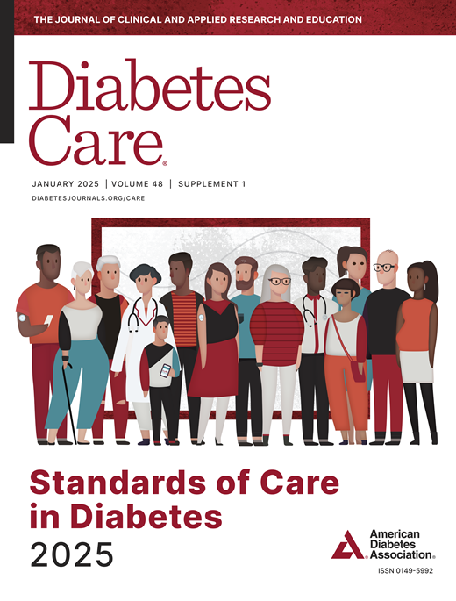
Standards of Care Update - Back to the Basics and Beyond
Objectives:
Review the changes & updates to the annual ADA Standards of Medical Care in Diabetes.
Identify the key elements of the standards that improve clinical care for people with diabetes.
Review and discuss appropriate use of the latest medications that address hyperglycemia and cardiorenal health.
Describe a five-step framework to empower people with diabetes to leverage technology to improve outcomes.
Describe how to assess CGM reports and provide collaborative care.

Slide 3
CDC Announces
35% of Americans will have Diabetes by 2050
Boyle, Thompson, Barker, Williamson
2010, Oct 22:8(1)29
www.pophealthmetrics.com

Slide 4

Poll Question 1
What percent of total people in the U.S. are living with undiagnosed and diagnosed type 2 diabetes?
A. About 30%
B. 11.3%
C. 16.8%
D. 25.6%

Slide 5
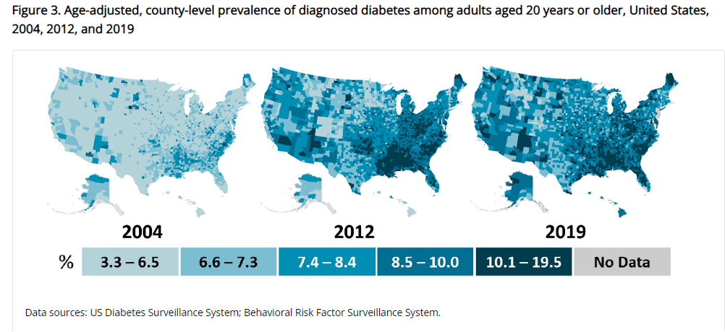
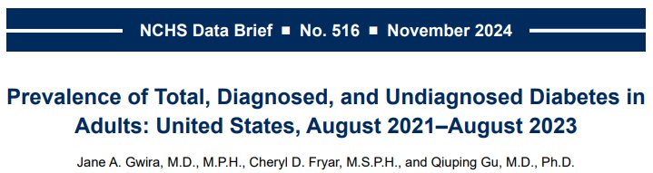
Type 2 Diabetes in America 2025
16.8% with Diabetes
11% don’t know they have it
38% with Prediabetes – 97 million adults
https://www.cdc.gov/nchs/data/databriefs/db516.pdf
Centers for Disease Control and Prevention. National Diabetes Stats Report https://www.cdc.gov/diabetes/data/statistics-report/index.html. Accessed 1/23

Slide 6
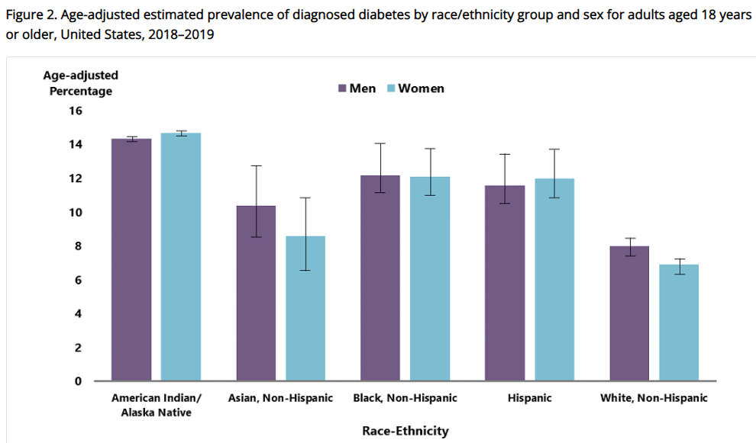
Diabetes Prevalence by Ethnic Group
For adults, diabetes prevalence highest among:
American Indians and Alaska Natives (14.5%),
Non-Hispanic Blacks (12.1%),
People of Hispanic origin (11.8%),
Non-Hispanic Asians (9.5%)
www.cdc.gov/diabetes/data/statistics-report/diagnosed-diabetes.html

Slide 7
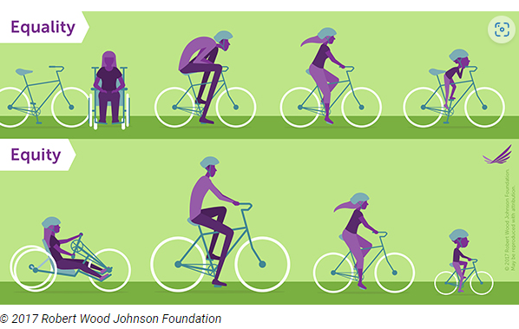
Equality vs Equity
Design and deliver diabetes care with goal of health equity across all populations.
https://coveragetoolkit.org/health-equity/defining-health-equity/

Slide 8
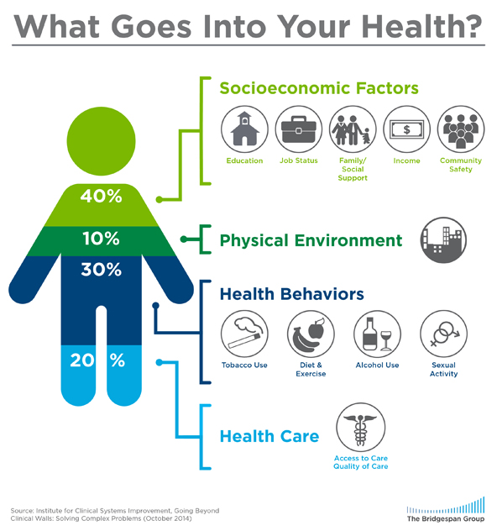
Address Barriers to Self Management
Barriers exist within health system, payer, health care professional & individual.
Address barriers through innovation, including community health workers, telehealth, other digital health solutions.
Consider social determinants of health in the target population when designing care.
https://coveragetoolkit.org/health-equity/defining-health-equity/
Notes:
Access and health equity is the ultimate goal when designing and delivering DSMES.
Creating culturally appropriate and varied modalities of settings has been shown to improve outcomes.
We know barriers to care exist at every level from the health system to individual.
However we can address these barriers by working to educate participants and health care providers on the critical times when DSMES is needed.
We can work with health systems and clinics to develop population health screening and clinical outreach,
create protocols to reduce time for referral and
collaborate health and community systems to address social needs.
We can include other health partners including community health workers to support delivery of diabetes peer support.
Barriers can be also be addressed by developing a diversity of delivery models.
From traditional inperson classrooms to community-based strategies and technology enabled solutions including telehealth or virtual environments varying modes can serve different needs.

Slide 9

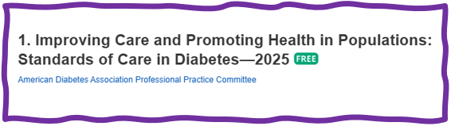
Social Determinants of Health
SDOH are defined as the economic, environmental, political, and social conditions in which people live and are responsible for a major part of health inequality worldwide.
Greater exposure to adverse SDOH over the life course results in poor health. Use quality data to identify inequities & take action.

Slide 10


Notes:
Measurement of C-peptide is preferable to the measurement of insulin as it has a longer half-life, not subjected to the first-pass hepatic metabolism, and a steady-state clearance from the circulation. Insulin undergoes first-pass hepatic metabolism, has variable clearance, a much shorter half-life, and exogenously administered insulin can confound results.

Slide 11
Hormones Effect on Glucose
Effect



⇒
⇒
⇒
Hormone
Glucagon (pancreas)
Stress hormones (kidney)
Epinephrine (kidney)
Insulin (pancreas)
Amylin (pancreas)
Gut hormones - incretins (GLP-1) released by L cells of intestinal mucosa, beta cell has receptors)

Slide 12


Pre Diabetes & Type 2- Screening Guidelines (ADA 2025 Clinical Practice Guidelines)
Start screening all people at age 35.
Screen at any age if BMI ≥ 25 (Asians BMI ≥ 23) plus one or > additional risk factor:
First-degree relative w/ diabetes
Member of a high-risk ethnic population
Habitual physical inactivity
History of heart disease
Check more frequently if taking high risk meds; antiretrovirals, 2nd generation antipsychotics or steroids, thiazide diuretics, statins
History of pancreatitis, prediabetes, GDM, periodontitis

Slide 13

Diabetes 2 - Who is at Risk? (ADA 2024 Clinical Practice Guidelines)
Risk factors cont’d
HTN - BP > 130/80
HDL < 35 or triglycerides > 250
History of Gestational Diabetes Mellitus
Polycystic ovary syndrome (PCOS)
Other conditions associated w/ insulin resistance:
Elevated BMI, acanthosis nigricans (AN)
Screen using A1C, Fasting Blood Glucose or OGTT.
Repeat screening at least every 3 years if negative.
*If prediabetes or on high risk meds, recheck yearly

Slide 14
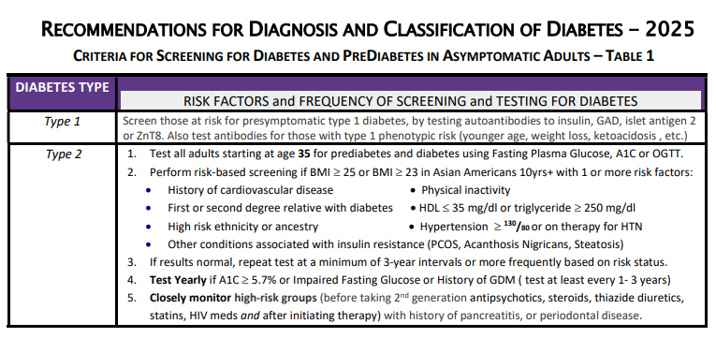



Diabetes Screening Guidelines (ADA 2025 Clinical Practice Guidelines – Cheat Sheet)
DiabetesEd.net Cheat Sheets

Slide 15

Poll Question 2
Which of the following level is considered pre-diabetes range?
a. Fasting BG of 62
b. A1c of 5.9 %
c. After meal BG of 137
d. A1c of 7.1 %

Slide 16
Natural History of Diabetes
Healthy
FBG <100
Random <140
A1c <5.7%
Prediabetes
FBG 100-125
Random 140 - 199
A1c ~ 5.7- 6.4%
~ 50% working pancreas
Diabetes
FBG 126 +
Random 200 +
A1c 6.5% or +
~ 20% working pancreas
Yes!
NO
Development of type 2 diabetes happens over years or decades

Slide 17


PreDiabetes is FREAKING ME OUT
96 million people in US
80% don’t know they have it
In 3-5 years, about 30% of predm will get diabetes
Associated with higher rates of heart attack, stroke, neuropathy and vessel disease

Slide 18

Poll Question 3
What best describes prediabetes in the U.S.?
Prediabetes affects 18-20% of people above the age of 20.
The prevalence of prediabetes and diabetes are almost equal.
Most people with BMI of 30 or greater have prediabetes.
Prediabetes is associated with increased risk of CV disease

Slide 19

3. Detecting PreDiabetes Matters
Given the cost-effectiveness of lifestyle behavior modification programs for diabetes prevention:
Offer diabetes prevention programs to adults at high risk of type 2 diabetes
Prescribe effective eating patterns
Address inconsistencies in access – leverage technology
Screening guidelines for people with Type 1

Slide 20

Get About 7 Hours of Quality Sleep to Prevent Diabetes
Poor sleep quality was associated with a 40–84% increased risk of developing type 2 diabetes in a meta-analysis.
Chronotype preference has been linked with many chronic diseases, including type 2 diabetes.
For those with a preference for evenings (i.e., going to bed late and getting up late)
2.5-fold higher odds ratio for type 2 diabetes than for those with a preference for mornings (i.e., going to bed early and getting up early),
Independent of sleep duration and sleep sufficiency
The composition of the gut microbiome may also affect the likelihood of developing type 2 diabetes.

Slide 21
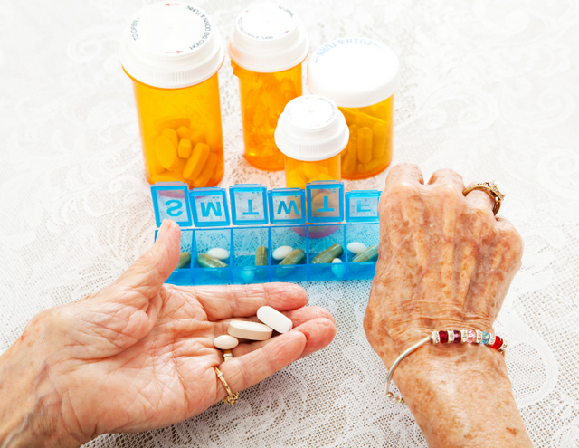
3. Pharmacologic Interventions
Use more intensive approach for high-risk individuals:
BMI of 35+
If A1C is ~6.0 or FPG is 110
History of GDM
No FDA approved med for prevention (off label)
Consider Metformin Therapy for Prediabetes
Monitor B12 level (esp with neuropathy or anemia)
CV Risk Mitigation important.
Statin can increase BG, stop if notice elevation
Consider low dose pioglitazone (Actos) if history of stroke.

Slide 22
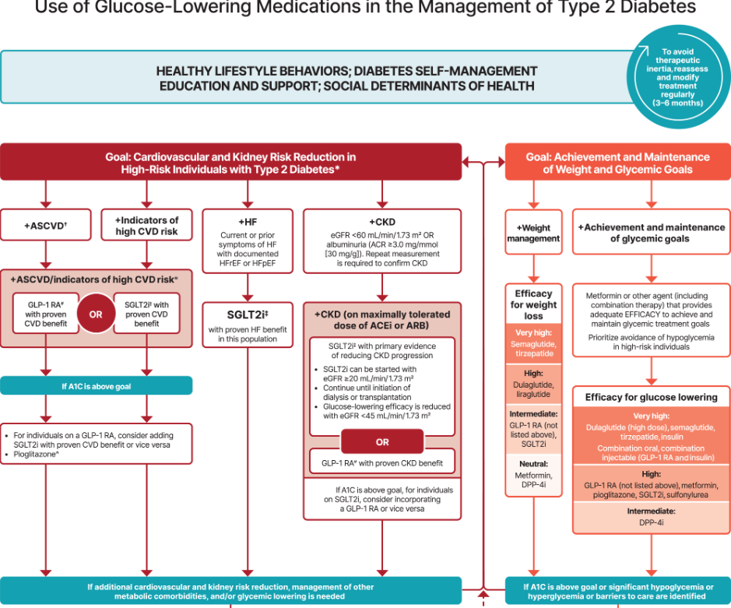
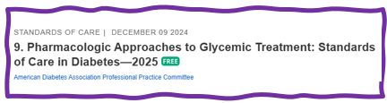

Let’s Break it Down ADA 2025

Slide 23
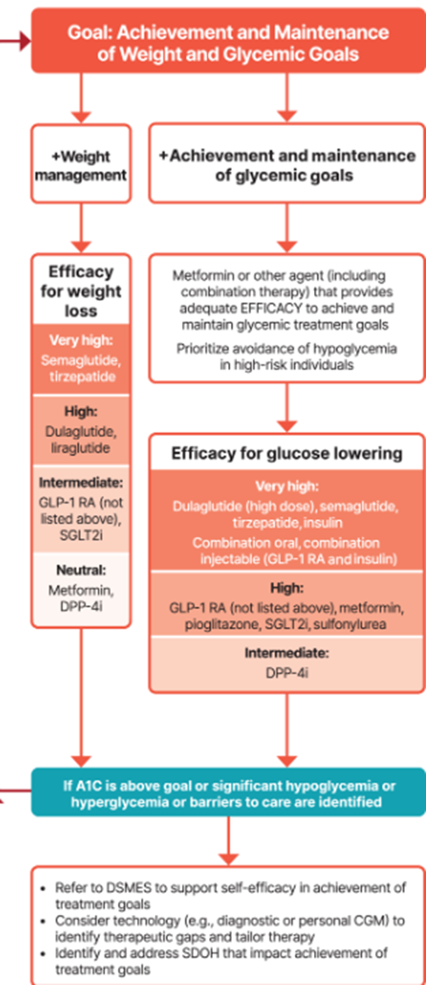
Metformin is “Usually” 1st Line
Why metformin?
Longstanding evidence
High efficacy and safety
Inexpensive - 3 months for $12
Weight neutral
Check B12 levels at intervals especially if anemia or neuropathy.
If ASCVD, HF or CKD or high ASCVD risk, use SGLT2i or GLP-1 RA +/- metformin
If A1C ≥ 8.5%, consider combo therapy.

Slide 24
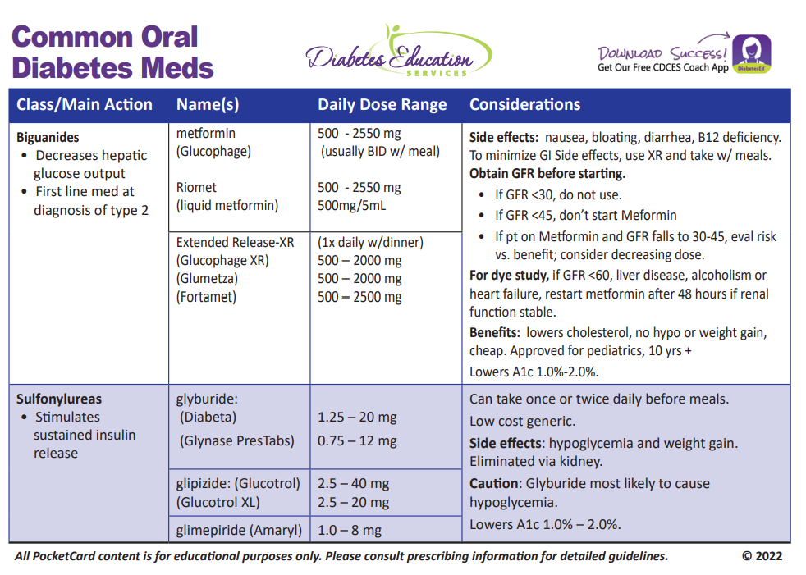
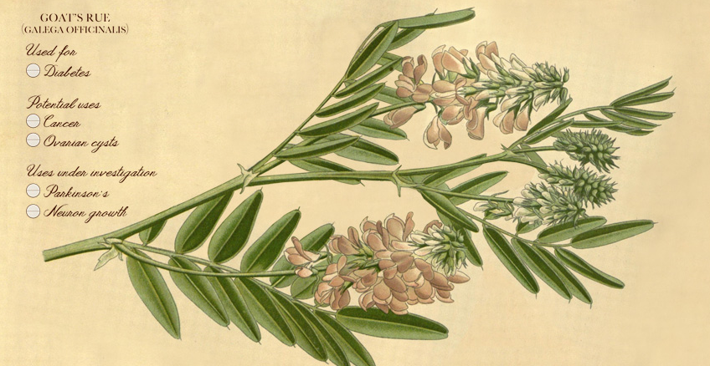
Biguanide derived from:
Goat’s Rue Galega officinalis,
French Lilac
Does NOT harm kidneys
$10 for 3-month supply from Walmart & other pharmacies

Slide 25

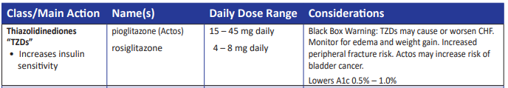
Indications for Insulin Sensitizers Pioglitazone (Actos)
Action: decrease insulin resistance by making muscle and adipose cells more sensitive to insulin. Decrease free fatty acids
Names:
pioglitazone (Actos) – bladder cancer warning
Dosing: 15-45 mg daily
Consider adding low dose if history of stroke or have steatosis
rosiglitazone Dosing: 4-8 mg daily
Efficacy/ Considerations
Reduce A1C ~0.5-1.0%
6 weeks for maximum effect
Actos $5 a month
Can cause fluid retention, not indicated w/ CHF
Notes:
25
25
Thiazolidinediones (TZDs) enhance insulin sensitivity in muscle and adipose tissue by binding to cell receptors,which leads to an increase in glucose transporter expression. TZDs encourage beta cells to respond more efficiently by lowering the amount of glucose and free fatty acids in the bloodstream, both of which are known to be detrimental to insulin secretion. Finally, these drugs reduce glucose production in the liver.
Clinical trials indicate that pioglitazone and rosiglitazone are slightly more effective at reducing A1C (1.5-1.6% reduction) than troglitazone (1.1% reduction).
Some of the beneficial side effects of thiazolidinediones include an increase in HDL cholesterol and reduction of triglyceride concentrations. This class of drugs has also been shown to lower blood pressure and decrease vascular inflammation in vitro. There are clinical studies underway to further examine the cardiovascular benefit to TZDs.
Some adverse effects of TZDs include weight gain, a potential increase in LDL cholesterol levels, and a possible increase in alanine aminotransferase levels (ALT). Because of the risk of weight gain, edema, and increased LDL cholesterol, thiazolidinediones are contraindicated in patients with advanced forms of congestive heart failure. Due to reported cases of liver failure and liver toxicity caused by the increase in ALT levels, TZDs are contraindicated in patients with abnormal liver function.
TZDs are the most expensive of the oral antidiabetic agents.

Slide 26

Poll question 4
JR is started on Metformin 500mg BID. Which of the following is true?
Hold metformin if blood glucose below 90 mg/dl.
Evaluate B12 levels before starting medication.
Metformin is considered weight neutral
Metformin can cause kidney damage, so increase fluid intake

Slide 27

Medication Taking Behaviors
Adequate medication taking is defined as 80%
23% of time, if A1c, B/P, lipids above target - due to med taking behavior
Assess for barriers
If taking meds 80% of time and goals not met, consider medication intensification
Barriers include:
Forgetting to fill Rx, forgetting to take, fear, depression, health beliefs, med complexity, cost, knowledge gap, system factors, etc.
Work on targeted approach for specific barrier

Slide 28

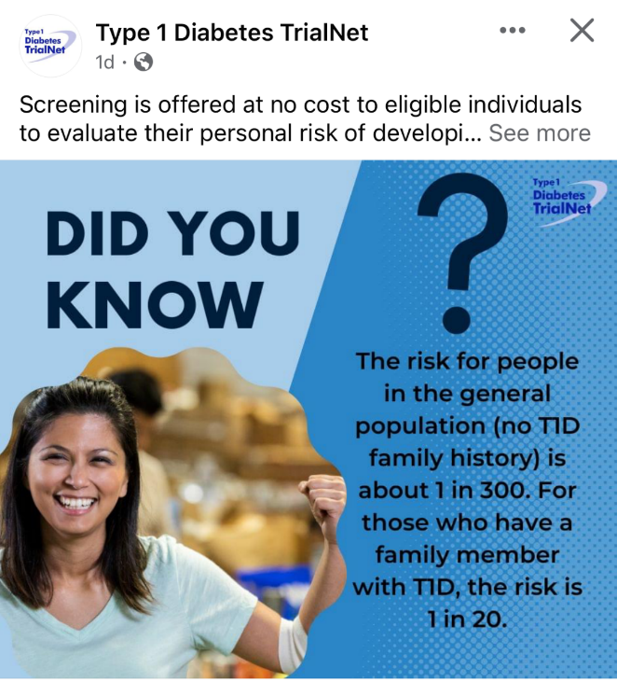
Type 1 ~ Immune Mediated 5-10% of Diabetes
1.5 Million people have type 1 in U.S.
Prevalence increasing:
2001 – 1.48 per 1000 youths diagnosed with diabetes
2017 - 2.15 per 1000 youths diagnosed with diabetes
Incidence & Prevalence increasing
Highest incidence in Finland or Northern Europe.
ADCES In Practice - March 2024 Recent Advances in Type 1 Diabetes: Teplizumab (Tzeild®)
Karen S. Fiano, PHARMD, BCACP, Devada Singh-Franco, PHARMD, CDCES, Young M. Kwon, BS, PHD

Slide 29

Type 1 – 10% of all Diabetes
Auto-immune pancreatic beta cells destruction
Most commonly expressed at age 10 - 14
Insulin sensitive (require 0.5 - 1.0 units/kg/day)
Expression due to a combo of genes and environment:
Autoimmunity tends to run in families
Exposure to virus or other environmental factors
Signs can include:
Increased thirst and hunger
Frequent urination or new bed-wetting at hs
Unintended weight loss
Fatigue and irritability
29
Diagnostic Criteria for Diabetes
Notes:
When you get to the insulin piece, please mention we will get into great detail about insulin in the pharmacotherapy module

Slide 30

Poll 5. What Kind of Diabetes?
AJ, a 29 year old female admitted to the ICU with a blood glucose of 476 mg/dl and a pH of 7.1. (normal pH 7.35-7.45). Lost 13 pounds, BMI 23.
What further testing is needed to determine if person has type 1 or type 2 diabetes?
A. Glutamic acid decarboxylase
B. Beta cells auto antibodies
C. Langerhan’s antibody
D. Endogenous insulin titer

Slide 31

Type 1 Diabetes Features?
For JR, a 28 admitted to the ICU with a blood glucose of 476 mg/dl, pH of 7.1, anion gap of 15. Recently lost 13 pounds.
Type 1 Most Discriminative Features
Younger than 35 years at diagnosis
Lower BMI (<25 kg/m²)
Unintentional weight loss
Ketoacidosis
Glucose 360 mg/dl or greater.
Misdiagnosis is common and can occur in ∼40% of adults with new type 1 diabetes

Slide 32
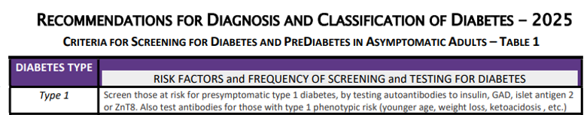
Type 1 Diabetes Progression
 | Stage 1 | Stage 2 | Stage 3
Characteristics | • Autoimmunity | • Autoimmunity | • Autoimmunity
 | • Normoglycemia | • Dysglycemia | • Overt hyperglycemia
 | • Presymptomatic | • Presymptomatic | • Symptomatic
Diagnostic criteria | • Multiple islet autoantibodies GAD, glutamic acid decarboxylase (primary) islet antigen 2, or Zinc transporter 8 (ZnT8) | • Islet autoantibodies Dysglycemia: Elevated IFG and/or IGT • FPG 100–125 mg/dL • 2-h PG 140–199 mg/dL • A1C 5.7–6.4% or ≥10% increase in A1C | • Autoantibodies may disappear over time (5-10% may not express antibodies) • Diabetes diagnosed by standard criteria

Slide 33


Pharmacologic Intervention to Delay Symptomatic Type 1 (in Stage 2)
Teplizumab-Tzield (CD3-monoclonal antibody)
14-day infusion can delay the onset of symptomatic type 1 diabetes (stage 3)
An option in selected individuals aged ≥8 years with stage 2 type 1 diabetes.
In a single trial, 44 individuals received 14-day course of teplizumab vs 32 placebo.
The median time to stage 3 diagnosis of type 1
48.4 months in tep group
24.4 months placebo
Cost: $193,000
Provention Bio has financial assist programs.

Slide 34
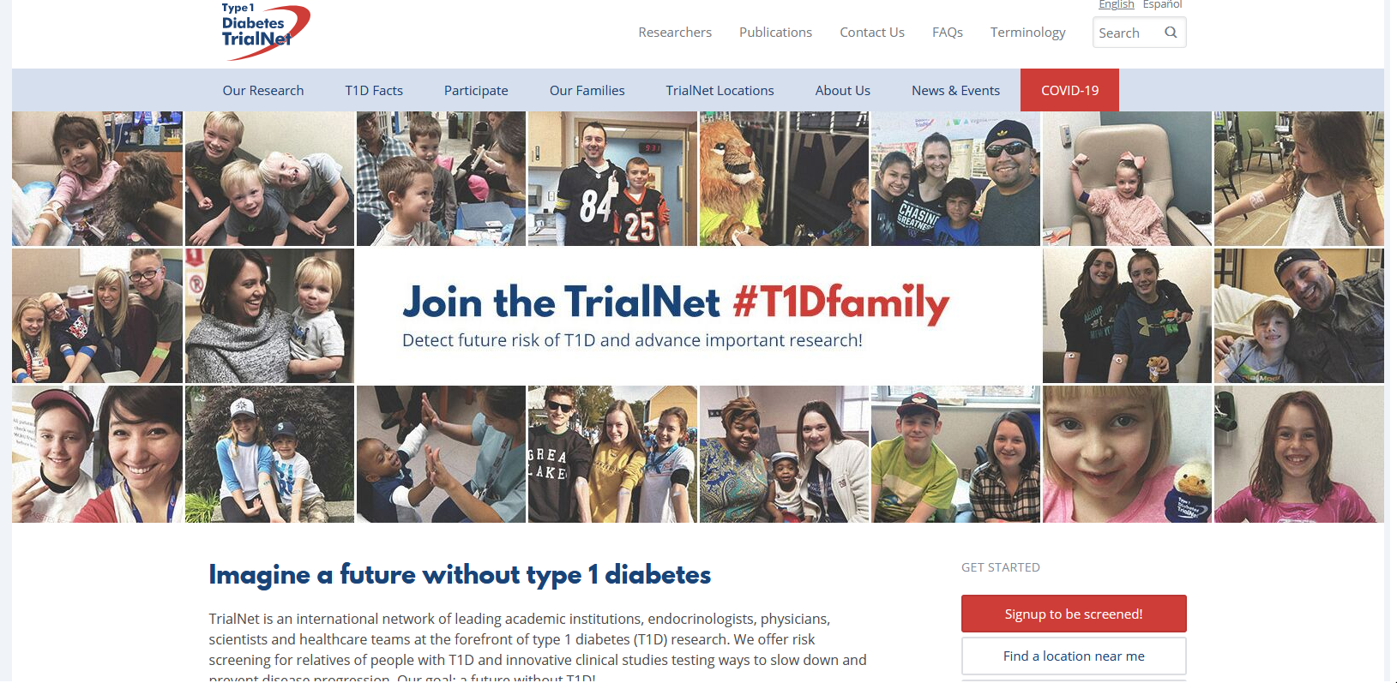
Type 1 (stage 2) Delayed with Teplizumab by 2 years www.DiabetesTrialNet.org
How to get families linked to screening?

Slide 35

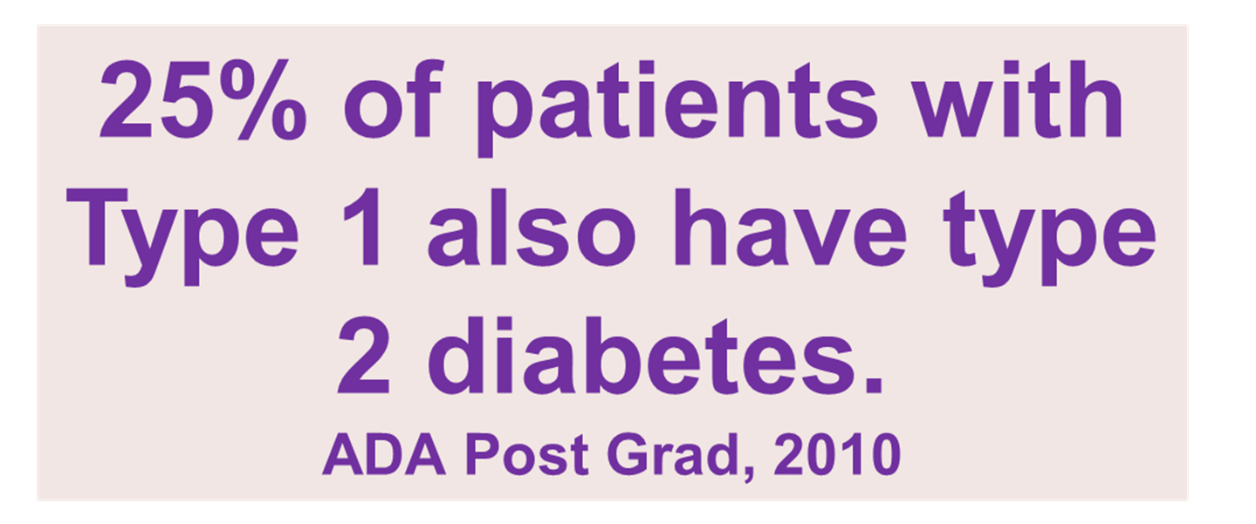
What kind of Diabetes?
MS is 58, states she has had type 1 diabetes for 18 years. Quit smoking a year ago and gained about 20 lbs. BMI 25.
Meds
Humalog 18-23 units before meals
Lantus 28 units at bedtime
Metformin 500mg TID
What tests would you recommend?
people

Slide 36

Type 1 & Type 2 - Double Diabetes?
May be appropriate to recognize a person with type 1 diabetes and features classically associated with type 2 diabetes (e.g., insulin resistance, obesity, and other metabolic abnormalities.
Can help facilitate access to appropriate treatment:
(e.g., GLP-1 RA or SGLT-2 inhibitor therapies for potential weight and other cardiometabolic benefits) and monitoring systems.

Slide 37
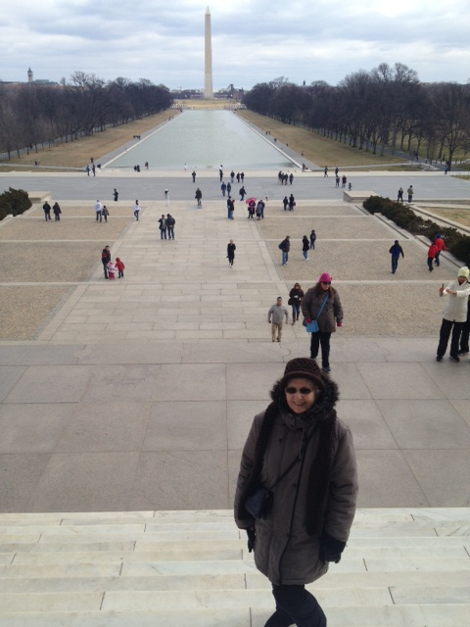
What type of Diabetes?
72 Years old
A1c 3 months prior 6.2%
A1c now 13.9%
BMI 24.5
Lost about 10 pounds over last month

Slide 38

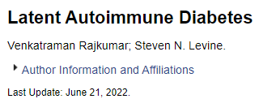
Latent AutoImmunity Diabetes in Adults (LADA)
Antibody positive to 1-2 of below
GAD-65 autoantibodies
Insulin Autoantibodies
Islet Cell antigen-2
ZnT8
Adult Age at onset
Usually benefit from insulin w/in first 6 months of diagnosis
Early insulin therapy may preserve beta cell function
Diabetes Care 26:536-538, 2003 Jerry P. Palmer, MD and Irl B. Hirsch, MD

Slide 39
LADA Clinical Features Compared to Type 2
Feature LADA Type 2
Age <50 63% 19%
Acute hyperglycemia 66 24
BMI < 25 33 13
Hx of autoimmune dx 27 12
Family hx autoimmune 46 35
Practical Diabetology March 08, Unger MD

Slide 40

Signs of Diabetes
Polyuria
Polydipsia
Polyphasia
Weight loss
Fatigue
Skin and other infections
Blurry vision
Glycosuria, H₂O losses
Dehydration
Fuel Depletion
Loss of body tissue, H₂O
Poor energy utilization
Hyperglycemia increases incidence of infection
Osmotic changes

Slide 41




Slide 42

What is Type 2 Diabetes?
Complex metabolic disorder ….
(Insulin resistance and deficiency)
with social, behavioral and environmental risk factors unmasking the effects of genetic susceptibility.
New Diagnosis? Call 800 – DIABETES to request “Getting Started Kit”
www.Diabetes.org

Slide 43

Ominous Octet
Decreased satiation neuro-
transmission
Decreased amylin, β-cell secretion
80% loss at dx
Increased renal glucose reabsorption
Decreased Gut hormones
Increased glucagon secretion
G
I
G
I
G
G
I
I
G
Increased lipolysis
G
G
I
I
G
G
I
Increase glucose
production
I
G
G
Decreased glucose
uptake
Notes:
43
43

Slide 44
Poll Question 6
FZ is older and lives alone and has CHF. Very concerned about avoiding hypoglycemia, since brother almost died from a hypoglycemic incident. Which medication class would you recommend?
Meglitinides
SGLT-2 Inhibitors
Sulfonylureas
Analog insulins

Slide 45

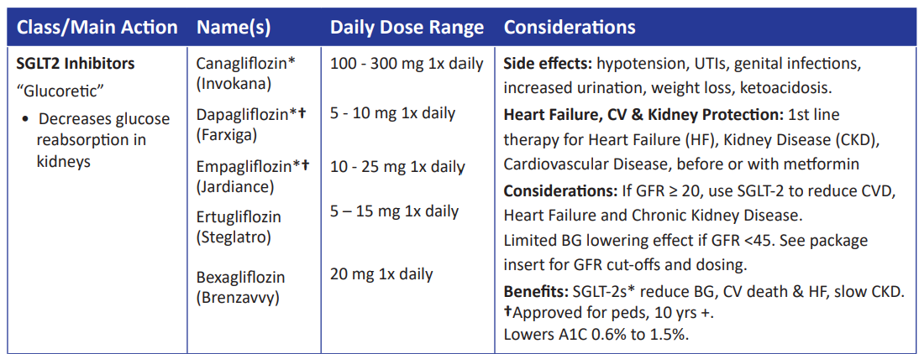
SGLT2 Inhibitors- “Glucoretics”
Action: decreases renal reabsorption of glucose proximal tubule of kidneys (reset renal threshold)
Preferred diabetes treatment for people with heart and kidney failure. Decreases BG & CV Risk.
AWP: ~$650 a month
% ‘f
Notes:
45
45
Thiazolidinediones (TZDs) enhance insulin sensitivity in muscle and adipose tissue by binding to cell receptors,which leads to an increase in glucose transporter expression. TZDs encourage beta cells to respond more efficiently by lowering the amount of glucose and free fatty acids in the bloodstream, both of which are known to be detrimental to insulin secretion. Finally, these drugs reduce glucose production in the liver.
Clinical trials indicate that pioglitazone and rosiglitazone are slightly more effective at reducing A1C (1.5-1.6% reduction) than troglitazone (1.1% reduction).
Some of the beneficial side effects of thiazolidinediones include an increase in HDL cholesterol and reduction of triglyceride concentrations. This class of drugs has also been shown to lower blood pressure and decrease vascular inflammation in vitro. There are clinical studies underway to further examine the cardiovascular benefit to TZDs.
Some adverse effects of TZDs include weight gain, a potential increase in LDL cholesterol levels, and a possible increase in alanine aminotransferase levels (ALT). Because of the risk of weight gain, edema, and increased LDL cholesterol, thiazolidinediones are contraindicated in patients with advanced forms of congestive heart failure. Due to reported cases of liver failure and liver toxicity caused by the increase in ALT levels, TZDs are contraindicated in patients with abnormal liver function.
TZDs are the most expensive of the oral antidiabetic agents.

Slide 46
SGLT-2i Indications Summary
Drug | Lower BG | Reduce CV Risk? | Use to treat Heart Failure? | Slow renal disease?
Dapagliflozin (Farxiga) | Yes | Yes | Yes +/- Diabetes | Yes
Empagliflozin (Jardiance) | Yes | Yes | Yes +/- Diabetes | Yes
Canagliflozin (Invokana) | Yes | Yes | Yes w/ Diabetes | Yes
Ertugliflozin (Steglatro) | Yes | No | Yes w/ Diabetes | Yes
Bexagliflozin (Brenzavvy) | Yes | NA | NA | NA
Package inserts, dailymed.nlm.nih.gov

Slide 47
Comparison of Type 1,Type 2, LADA
Type 1
Type 2 LADA
Excess weight
x
xxx x
Insulin dependence
xxx
30% 6mos
Respond to oral agents
0
xxx x
Ketosis
xxx
x x
Antibodies present
xxx
0 xx
Typical Age of onset
teens
adult adult
Insulin Resistance
0
xxx
x

Slide 48

Other Specific Types of DM
Medications such as: steroids, protease inhibitors and Prograf®
Secondary to Agent Orange
Liver failure
TPN or tube feedings
Diabetes Type 3c
Cystic fibrosis, pancreatitis
Pancreatic cancers or removal
Hemochromatosis

Slide 49
Type 3c Diabetes (Pancreatogenic)
Includes both structural and functional loss of insulin secretion in the context of exocrine pancreatic dysfunction.
About 5-10% of diabetes, often misdiagnosed as type 2 diabetes.
The diverse set of etiologies includes:
pancreatitis (acute and chronic) ~70%
trauma or pancreatectomy
neoplasia
cystic fibrosis
hemochromatosis
fibrocalculous pancreatopathy
rare genetic disorders, and idiopathic

Slide 50
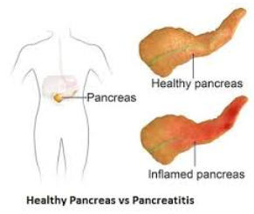
Pancreatitis
People with diabetes 2xs risk of acute pancreatitis
After episode of pancreatitis, one third of people will get prediabetes or diabetes
About 25% to 80% of people with chronic pancreatitis develop Type 3c diabetes.
Pancreatitis is an exocrine dysfunction:
Disrupts global architecture or physiology of pancreas
Results in both exocrine and endocrine dysfunction.

Slide 51
DiaBingo
B Frequent skin and yeast infections
B A BMI of ____ or greater indicates increased pre/diabetes risk?
B To reduce complications, control A1c, Blood pressure, Cholesterol
B PreDiabetes – fasting glucose level of ___ to ____
B Erectile dysfunction indicates greater risk for ____
B Diabetes – fasting glucose level____ or greater
B Type 1 diabetes is best described as an ______ disease
B People with diabetes are ______ times more likely to die of heart dx
B Elevated triglycerides, < HDL, smaller dense LDL
B Each percentage point of A1C = _____ mg/dl glucose
B At dx of type 2, about __% of the beta cell function is lost
B Diabetes – random glucose ____ or greater

Slide 52

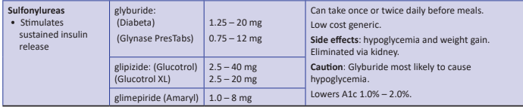
Sulfonylureas - Secretagogues or “Squirters”
Mechanism: Stimulate beta cells to release insulin
Dosed 1-2x daily before meals
Adverse effects
Hypoglycemia, Weight gain, watch renal function
Low cost, $12 for 3 months supply
Can help with glucose toxicity, lowers A1C 1-2%
Notes:
CAROLINA tral (linagliptin vs glimepiride)
Meta-analysis: In type 2 diabetes, the use of sulfonylureas is associated with increased mortality and a higher risk of stroke

Slide 53

Reducing Hypoglycemia
Which are the only diabetes meds that directly cause hypoglycemia?
Insulin
Secretagogues (sulfonylureas, glitinides)

Slide 54
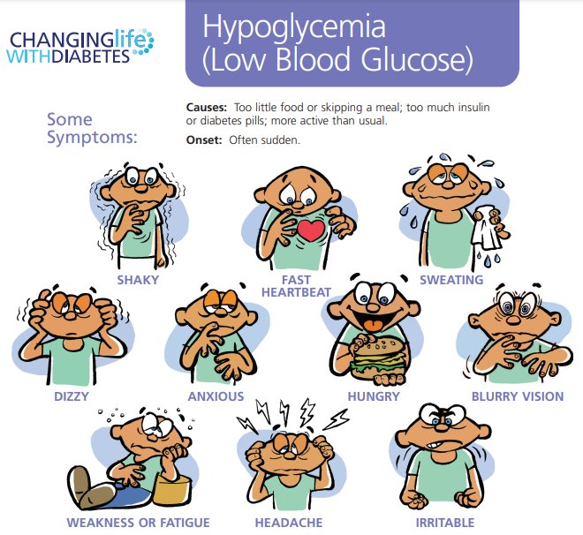
Hypoglycemia – A Big Deal

Slide 55

Hypoglycemia (Glucose) Alert Values
BG <70mg/dl – Level 1
Follow 15/15 rule and contact provider to make needed changes. At increased hypo risk.
BG < 54mg/dl – Level 2
Indicates serious hypo. Reassess BG Goals. Consider med decrease. Predictive of Level 3 Hypo. Needs Glucagon Emergency Kit
Severe Hypoglycemia – Level 3
Altered mental, physical functioning.
Requires external assistance – no threshold

Slide 56
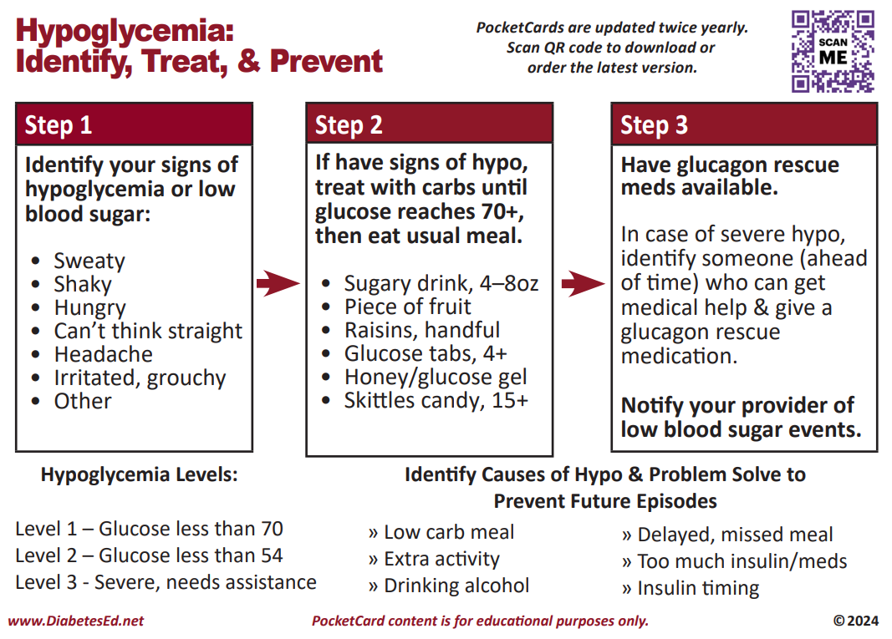
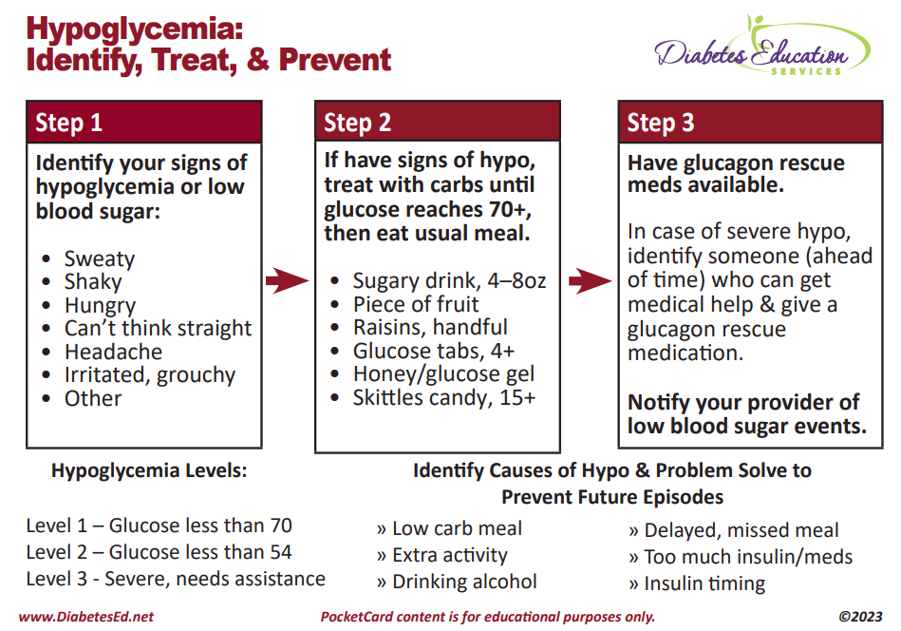

Slide 57
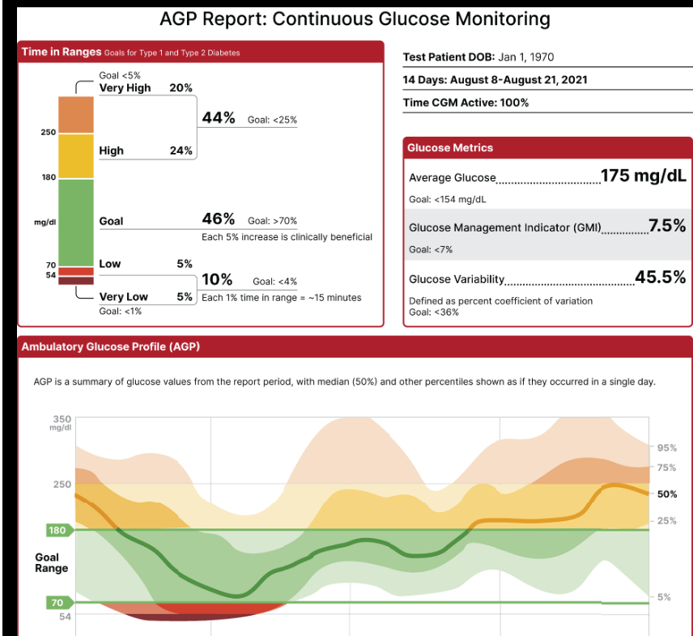

Slide 58
Hypo Marker of CV Events & Mortality
Severe hypoglycemia a potent marker of high absolute risk of cardiovascular events and mortality.
HCP need to be vigilant in preventing hypoglycemia.
Avoid aggressively attempting to achieve near-normal A1C levels if such goals cannot be safely and reasonably achieved.

Slide 59
SDOH and Hypoglycemia
Food insecurity, housing instability, underinsured, under-resourced living areas is associated with increased risk of hypoglycemia-related emergency department visits
Identify if fasting part of religious observances
Young children and older adults at highest risk
Insulin pumps with automated low-glucose suspend and automated insulin delivery systems have been shown to be effective in reducing hypoglycemia in type 1 diabetes

Slide 60
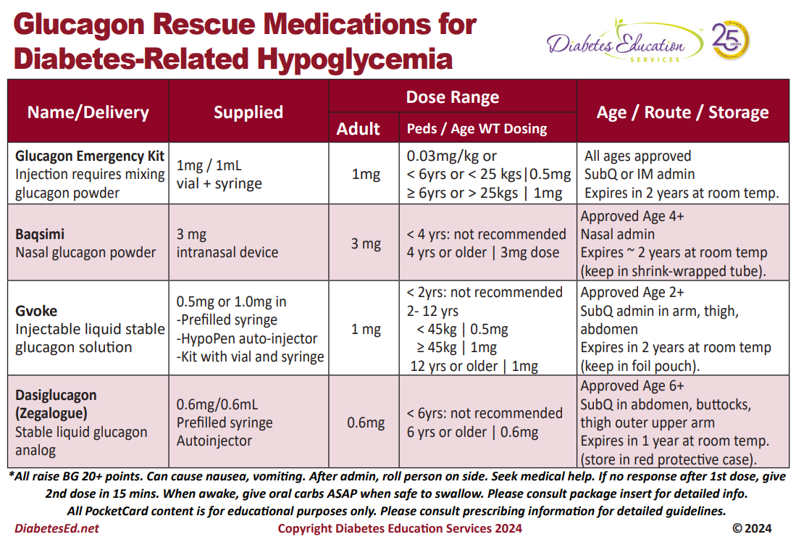

Slide 61


Poll Question 7
JL is 78 and drinks a “few cocktails” every night. Lives with partner and takes basal insulin at night and bolus insulin as needed. Has had a few low blood glucose levels in past week of 62, 49 and 51. What is the most important recommendation?
A. Decrease alcohol intake
B. Check BG at least 4 times a day.
C. Double check injection sites.
D. Get glucagon rescue medication.

Slide 62

Quick Question 8
JZ is excited about his A1c of 5.4%. He takes rapid acting insulin 4-6 times a day using a pen to keep his BG to target. Plus, adjusts glargine as needed if his pm BG is elevated. What is your biggest concern?
A. Does he change his needle each time?
B. Why is he adjusting glargine?
C. Is he adjusting insulin for exercise?
D. How many hypoglycemic events per week?

Slide 63
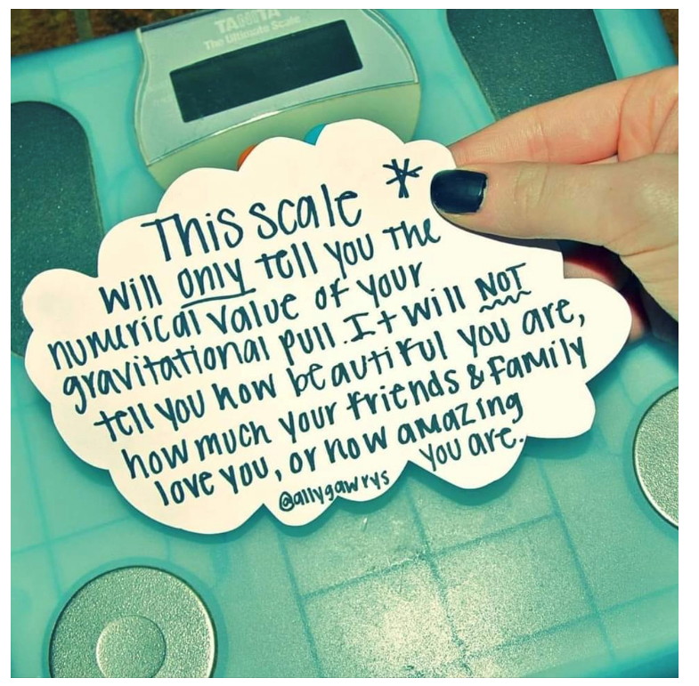
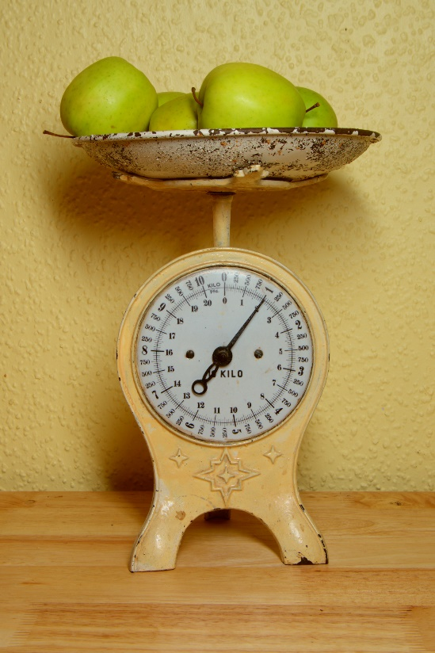
Weight is a Heavy Issue

Slide 64

Medical Nutrition Therapy Works
MNT is effective and beneficial to people with diabetes.
When delivered by an RDN, MNT is associated with A1C absolute decreases of
1.0–1.9% for people with type 1 diabetes and
0.3–2.0% for people with type 2 diabetes

Slide 65
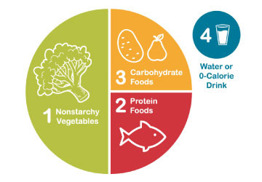
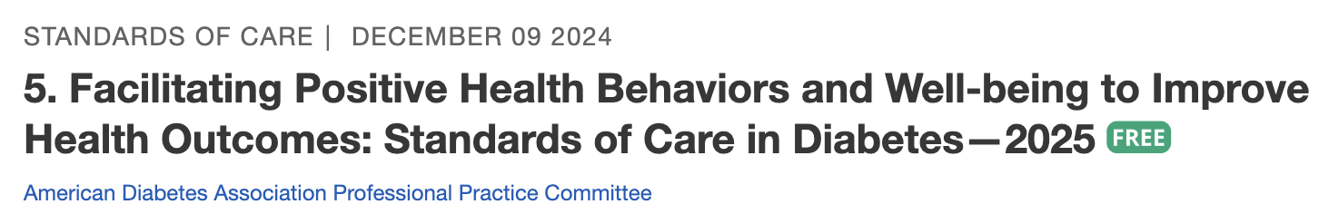
Healthy Eating Patterns/Approaches
Eating Patterns:
Total Foods Consumed
Mediterranean Diet
Plant based eating
DASH (Dietary Approaches to Stop Hypertension)
Low Carbohydrate
Eating Approach:
Tools for developing an eating pattern
Diabetes Plate Method
Carbohydrate Counting
Individualized behavioral approaches
Use Integrative food-based approach. “People eat food, not nutrients”.
Notes:
The standards of care call out the importance of understanding different terms in nutrition including eating patterns, meal plan or dietary approach.
Eating pattern the totality of the foods we consume over a time period. Examples include……
A Meal Plan is an individualized and created by an RDN and is
Dietary or Eating approach is the strategy or tool used to support implementation of healthy eating patterns.
There is no one pattern that is better than another so we work with the individual with diabetes to determine an effective eating pattern and approach.
The 2025 Standards of Care have added much detail about considering approaches that take into account religious fasting or other new concepts of intermittent fasting or chrononutrition

Slide 66
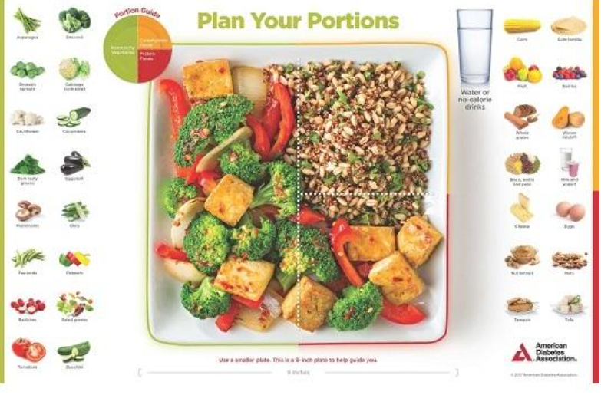
Plant-based, Vegetarian or Vegan Diet Patterns
https://oldwayspt.org/traditional-diets/vegetarian-vegan-diet
Notes:
Newest guidelines recommend PWD and at risk incorporate more plant-based proteins sources (nuts, seeds, legumes) as part of an overall dietary pattern to reduce risk of CVD.

Slide 67

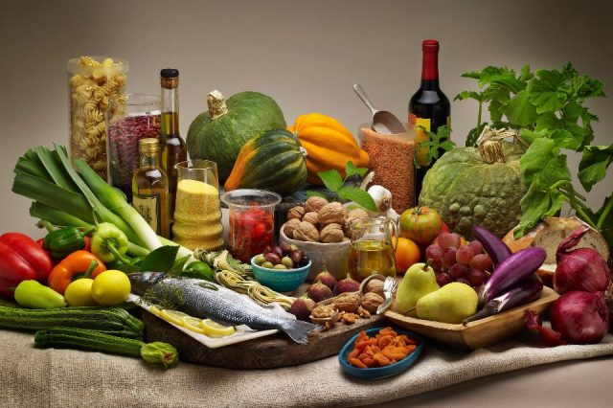
Mediterranean Diet
Emphasizes vegetables, fruits, whole grains, beans/ legumes
Includes low-fat/non-fat dairy, fish, poultry, oils, nuts
Limits highly processed foods/refined carbohydrates, added sugars, sugar-sweetened beverages, sodium, saturated fats, high fat/process meats
Find Recipes:
American Diabetes Association
Meal Planning Tips:
https://www.diabetesfoodhub.org/articles/meal-planning-for-a-mediterranean-style-eating-pattern.html
This Photo by Unknown Author is licensed under CC BY-NC-ND
Notes:
Remember to mention mono-unsaturated fats.
Another great resources is oldways which has lots of resources on Mediterranean diet.
The Mediterranean Diet is just one dietary pattern frequently discussed as it is associated with reduced risk of diabetes, A1c reduction, lower TG and reduced risk of major CVD events but other dietary patterns exist and modifications to the Mediterranean diet, such as low carb mediterranean is reviewed throughout the ADA guidelines report.
And visiting the 2019 Nutrition Consen reviews many eating patterns.

Slide 68
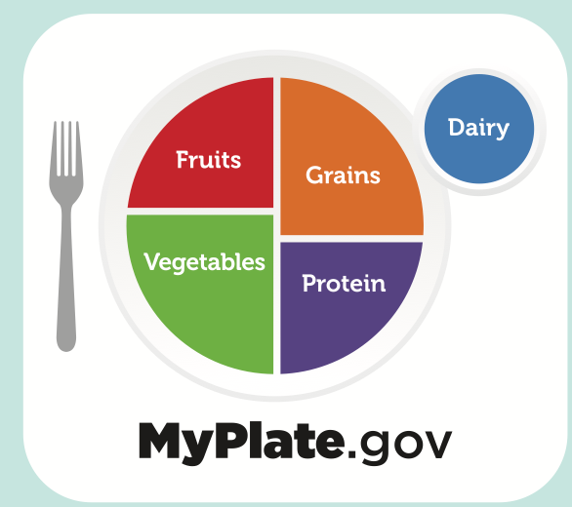
USDA MyPlate.gov
Make Every Bit Count
Eat a variety of fruits, vegetables, grains,
protein foods, dairy/fortified soy alternatives
Foods to Increase
Make half your plate fruits and vegetables.
Make at least half your grains whole grains.
Move to low-fat or fat-free dairy milk or yogurt (or lactose-free dairy or fortified soy versions)
Vary your protein
Foods to Reduce
Added sugars, saturated fat, and sodium
Check packaged foods that have less or no added sugar
Choose plain water/sparkling water with a squeeze of fruit
Tools: Myplate-Kitchen, Shop Simple with MyPlate
Notes:
Discussion of what to put on your plate supports implementation of change. Again, this pattern generally encourages increasing whole food based options.
MyPlate Kitchen provides recipes and resources to support building healthy and budget-friendly meals.
Shop simple with myplate – app that helps you find healthy choices within budget

Slide 69

Medical Nutrition Therapy – ADA Macronutrient Distribution
“No one-sized-fits-all eating pattern for individuals with diabetes”
no ideal percent of calories from protein, carbohydrate and fat.
Macronutrient distribution based on individualized assessment
Consider personal preferences
tradition, culture, religion, health beliefs and goals, economics
metabolic goals and comorbidities
Healthcare team members should complement MNT, providing guidance on healthy food choices for the individual and behavioral support
Notes:
Evidence suggests there is no one sized fits all approach for individuals with diabetes.
On average people with diabetes consume about 45% of calories from carbohydrate and 1-1.5% (15-20% of kcals from protein).

Slide 70
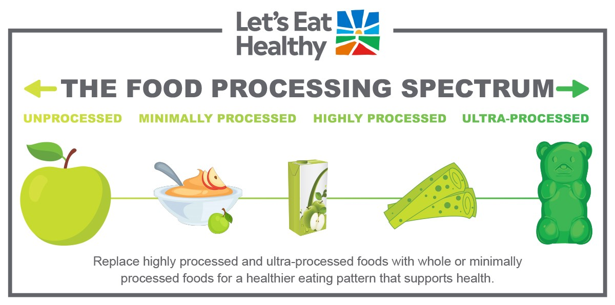
Limit Highly Processed Carbs and Added Sugars Eat more HIGH Fiber foods:
Choose High fiber carbs loaded with vitamins, minerals and phytonutrients
“Power Carbs” include:
Beans/Lentils
Veggies
Whole Fruits
Low-fat, low sugar milk/yogurt
Whole Grain foods
as culturally appropriate
Notes:
There is not ideal amount of carbohydrate for each individual with diabetes focus on quality, choosing unprocessed/minimally processed, nutrient-dense sources. Choosing high in fiber foods should be the focus.
Encourage whole grain foods as culturally appropriate. Otherwise focus on portion and increased fiber from other food sources.

Slide 71
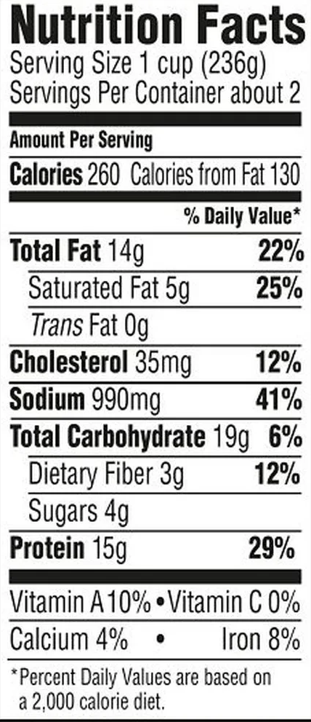
Fiber – the New “F” Word
Goal: minimum
14 gms / 1000 calories, ~ 30 gms a day
How?
Avoid highly processed foods
Choose > 3 gm fiber per serving
Foods: Whole intact grains, legumes, fruits, veggies, nuts/seeds, avocados
Why?
Lower all cause mortality and reduced risk of type 2 diabetes
Increased microbiome diversity
Notes:
Processed foods are ones that have undergone changes to their natural state.
Highly or ultra processed foods go beyond general chopping, blending, cooking etc and have multiple additives and ingredients.
These foods are often low in fiber. Low fiber is defined by < 3 grams of fiber and we consider a high fiber foods those with more than 5 grams of fiber.

Slide 72
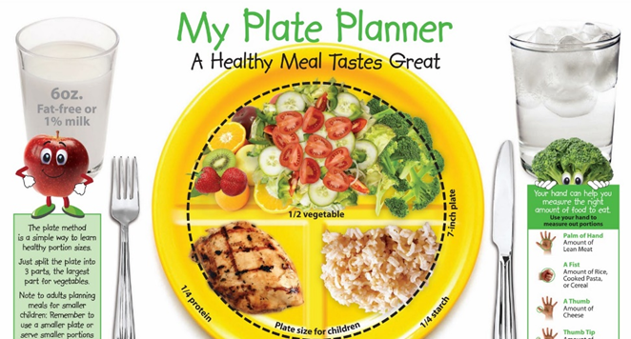
Eating Patterns: Key Nutrition Principles
Until there is more evidence:
Emphasize non-starchy vegetables in a rainbow of colors
“Power carbs”: fruit, legumes, whole grains, nuts and seeds, lean proteins, low-fat dairy
Minimize red meat, added sugars, sugary beverages, refined grains and ultra-processed foods
Any approach should consider:
Individual needs: “health status, personal and cultural preferences, ability to sustain recommendations, food access and nutrition security”
Notes:
No one eating pattern is better than another and we find many similarities among eating patterns. \
Until there is more evidence the ADA Standards of Care recommend we emphasize

Slide 73

Carbs and Lowering Glucose
Reducing carb intake has significant evidence for improved glycemia
Low Carb Definitions
Very Low = < 26% of kcals
Ketogenic: 20-50 gm carb, also high fat.
Most people consume 44-46% of Cals from carb
HOW: Focus on key nutrition principles, food quality, and choose minimally processed foods and high fiber foods.
Systematic reviews and RCT found:
Very low carbohydrate diet effectively reduced A1c at 6 months, less difference beyond 1 year.
Ketogenic Diet increased LDL and no sig. difference in A1c compared with low-carb Mediterranean diet.
Notes:
Reducing carbohydrate intake has shown most evidence for helping improve glycemia but where you start and where you end up is individualized. We can also apply this concept to a variety of eating patterns and nutrient quality is also taken into account.
One study published in the SOC found a low carb diet defined here as < 26% of carbs reduced A1c at 6 months but less differences were seen at 12 months. This was also seen in a systemic reduce which found lowering carbs 10% should outcomes at 6 months but limited these outcomes at 12 months or forward.

Slide 74

Very Low Carb Meal Plan Not Recommended for:
Women who are pregnant or lactating or children
People with or at risk for disordered eating
People who have kidney disease
Avoid ketogenic diets if taking SGLT-2 Inhibitor due to high risk of ketoacidosis
Educate on prevention, signs of DKA, how to measure ketones.
Notes:
Very low carb or less than 26% of kcals from carbohydrates is not recommended for the following individuals. We also should take caution in those that are using an SGLT2 due to risk of euglycemic ketoacidosis.
The 2025 ADA standards of care added emphasis in this recommendation with focus on T1 and T1 on SGLT-2 inhibitors should avoid ketogenic eating patterns and be educated on the signs and symptoms of ketoacidosis. It is important to

Slide 75

Poll Question 8
For people newly diagnosed with type 2 diabetes with an elevated BMI AND waist circumference, which best reflects ADA Standard of Care recommendations?
A. Avoid all desserts and processed foods
B. > 3-7% weight loss from current body
weight may be beneficial
C. Eat less than 7% saturated fat
D. Consume about 30-45 gms of carb at each meal

Slide 76
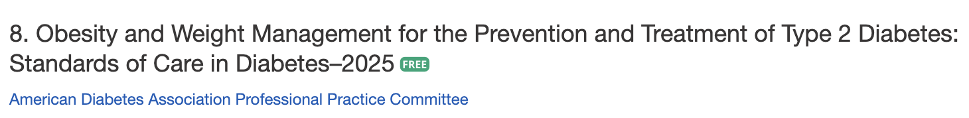
Use of BMI
WHO defines Obesity as: abnormal or excessive fat accumulation that presents a risk to health
BMI poor indicator for ”excessive fat” and health risk
Assess using:
BMI, distribution measures like waist circumference and associated health and well-being consequences
Notes:
Health at Every Size
ADA recognizes bias exists - person centered and to emphasize the importance of weight management within the overall context of the treatment of people with diabetes.

Slide 77
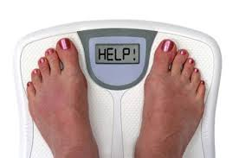
Weight Loss is Helpful
Prediabetes weight loss: 3-7%, higher to prevent diabetes progression.
Diabetes: Strong evidence that
Weight loss of 3–7% improves glycemia & intermediate CVD risk
>10% loss, may lead to remission of type 2 diabetes, CVD, & reduced mortality
Reduces need for medications
Optimal goal is weight maintenance
“People with diabetes and overweight or obesity may benefit from any magnitude of weight loss.”
Notes:
Any degree of weight reduction is helpful.
3-7%
>10% shows greater benefits and can reduce fatty liver metabolic dysfunction- associated steatohepatitis (MASH) which is a growing concern within diabetes population.
the justification for a weight-based approach to diabetes treatment has been expanded. The recommendations and text pertaining to weight management treatment have been expanded to acknowledge the expected range of benefits across the spectrum of weight loss.
In people at risk, 3–7% weight loss reduces progression to diabetes (2,7,8,41,42). Greater weight loss may produce additional benefits (20,21). Mounting data have shown that >10% body weight loss usually confers greater benefits on glycemia and possibly diabetes remission and improves other metabolic comorbidities, including cardiovascular outcomes, metabolic associated nonalcoholic steatohepatitis, adipose tissue inflammation, and sleep apnea, as well as physical comorbidities and quality of life
Nutrition, physical activity, and behavioral therapy to achieve and maintain 3-5% weight loss are recommended for people with type 2 diabetes and overweight or obesity

Slide 78

New Consult for Diabetes Ed
JR, 63 y/o, BMI 32, Waist circumference: 43”, A1c 9.3%, Type 2 diabetes 10+ years. On Metformin 2000mg daily + Glipizide 20mg. Low income and doesn’t like to drive much due to poor vision. Interested in losing weight.
Nutrition, typical day
Breakfast – doesn’t really eat. Has cup of coffee
Lunch around 11am – packaged breakfast sandwich
Dinner – Sandwich or burger
Evening – Snacks, nuts, crackers, boiled egg
Beverages – Diet sodas, tea, water

Slide 79

How to Achieve Weight Loss?
Individualized plan
Energy deficit + enhanced activity + behavior therapy
Goal: 500 -750 kcal/day energy deficit (3,500 kcals = 1 pound)
What is 500 kcals?
1 Large Fry, 1 Double Cheeseburger, 1 King Size Snickers, 1 bagel w/ cream cheese, 4 oz tortilla chips, ~ 3 cans sodas
5 apples, 2 sweet potatoes, 5 eggs, 2 cups of beans, 1 cup almonds
Notes:
Clinical benefits of weight loss can be seen with as little as 3% weight change, but benefits are progressive.

Slide 80
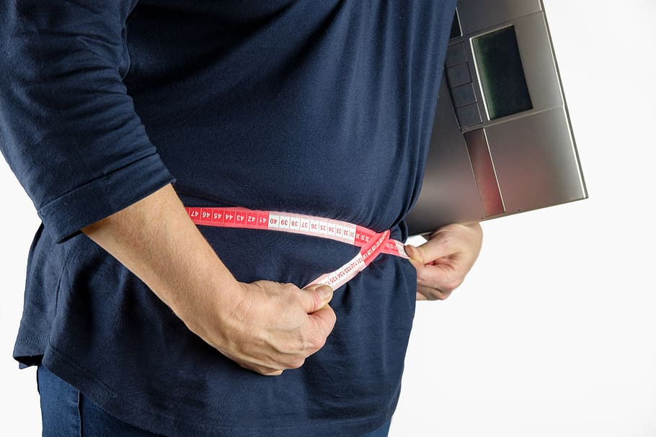
Weight Loss/Maintenance Strategies
Weekly self-weighing/tracking
Structured programs
Increase physical activity
200-300 minutes/week
Alter macronutrients
Use meal replacements
Eat “healthy” foods
Drink Water
Get Sleep, Consider Chrononutrition
Consider Incretin or metabolic surgery
Notes:
Eat Healthy- reduce ultra processed foods and replace with less processed foods isocalorically showed modest weight loss benefits.
Greater weight loss benefits seen in semaglutide or tirzepatide
It is important to note that the ADA calls out that in some populations, such as South Asian, traditional interventions have not been as effective in preventing or remission of type 2 diabetes so this group may need additional tailored approaches.

Slide 81
Intermittent Fasting
Results
Each produces mild to moderate weight loss of 3–8% loss from baseline over short durations (8–12 weeks)
No significant differences in weight loss, waist cir. when compared with continuous calorie restriction.
Longer term studies needed
3 overall approaches
Alternate-day fasting
500–600 calories on alternating days
5:2 diet
500–600 calories on two days with usual intake the other five
Time-restricted eating
Daily calorie restriction based on 8-15 hour window of time
Notes:
Consider medication regimen.
The ADA has added a significant recommendations and risk assessment related to religious fasting not addressed in this basic course.

Slide 82
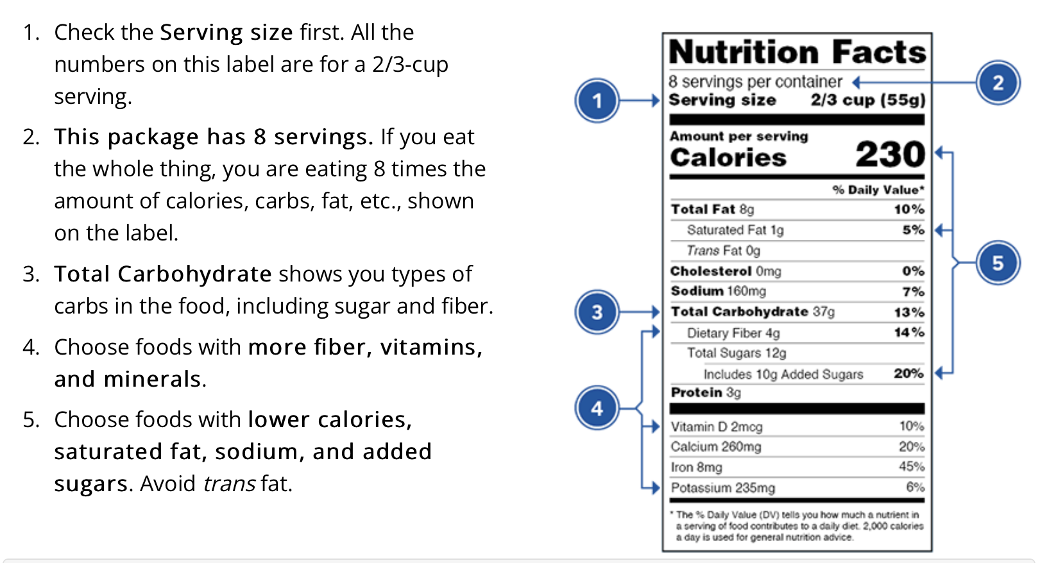
Reading the Food Label
1 tsp sugar =4 gms
https://www.fda.gov/food/food-labeling-nutrition/changes-nutrition-facts-label

Slide 83
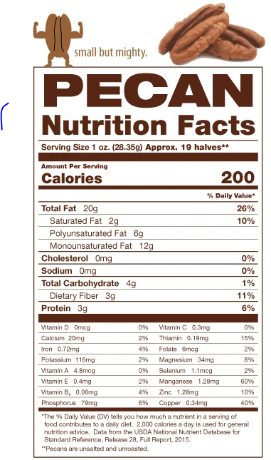
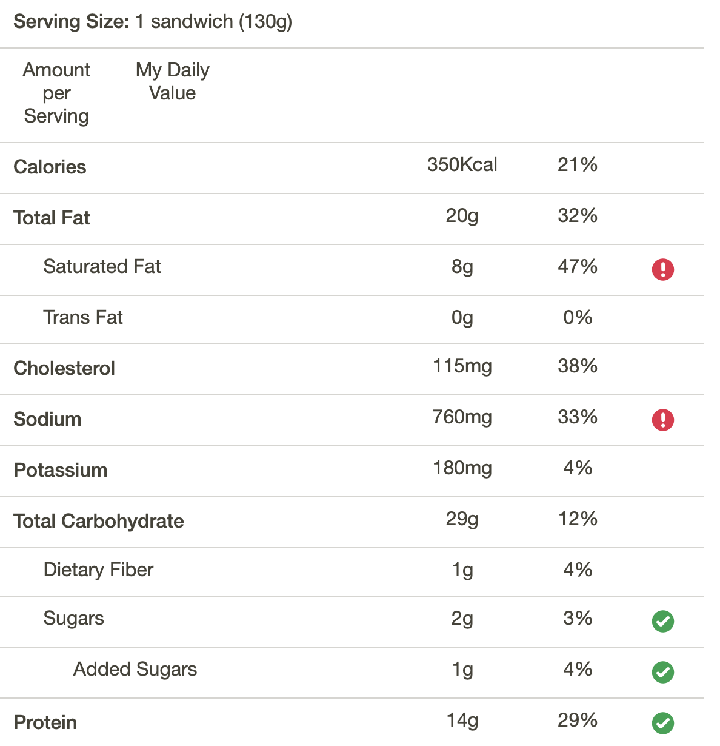
Packaged Breakfast Sandwich
Fooducate App – Gives grade and nutrition info.
Ideas for alternatives
Notes:
Or we can read the food label on the package. JR consumes pecans recently for his snack of nuts.

Slide 84
How Nutrients Affect Blood Glucose
If type 1/MDI, may need additional insulin or change in dosing strategy for high fat/ protein meals
Notes:
The ADA recommends providing education on the impact of carbohydrate, fat and protein and tailor individuals needs, insulin plan and preferences to optimal meal time dosing.
Understanding nutrients and the affect on blood sugar can be important for managing diabetes.
For people on insulin at mealtime understanding of the relationship between carbohydrate intake and insulin is important.
Consumption of fat and protein can affect early and delayed post-prandial hyperglycemia.
meals containing >40 g fat and 25 g protein, people should increase the insulin dose calculated based on their ICR by 25–30% using a combination (dual-wave) bolus, initially administering 30–50% of the dose and then extending the remainder over 2–2.5 hours.
35 g of dietary fat to 30 g of carbohydrate significantly increased postprandial BGL from 3 h onward. Studies investigating insulin dosing for high-fat, high-protein meals (+40 to 50 g fat) report ∼40–65% more insulin is needed despite identical carbohydrate content
Kirstine J. Bell, Chantelle Z. Fio, Stephen Twigg, Sally-Anne Duke, Gregory Fulcher, Kylie Alexander, Margaret McGill, Jencia Wong, Jennie Brand-Miller, Garry M. Steil; Amount and Type of Dietary Fat, Postprandial Glycemia, and Insulin Requirements in Type 1 Diabetes: A Randomized Within-Subject Trial. Diabetes Care 1 January 2020; 43 (1): 59–66.

Slide 85
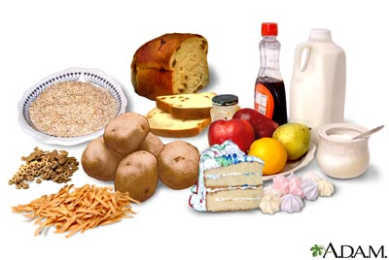
Carbs affect Post-Meal Glucose
Starch
Fruit
Milk
Desserts
Notes:
For individuals with type 1 diabetes or type 2 diabetes taking mealtime insulin.
Comprehensive education on nutrition content and need to pair insulin with carbohydrate intake.
For individuals with variable meal schedule, understanding the relationship between carb intake and insulin needs is important.
Education on using insulin to carbohydrate ratios can provide the most flexibility.
How do we determine the amount of carbohydrates in foods. We can read food labels like we already reviewed, we can use food databases or apps (even just ask siri), or we can estimate carbohydrates and portion size.
Working with individuals it is helpful for us to have general knowledge of portions and amounts.

Slide 86
Poll Question 9
Based on the Food list for Diabetes: which of the following food choices equals ~ 15 gms of carbohydrate? (multiple)
A. ½ bagel, 4 oz
B. 1 ¼ cup strawberries
C. 1 cup of milk
D. ½ cup of cooked rice
E. 1 oz trail mix with fruit

Slide 87
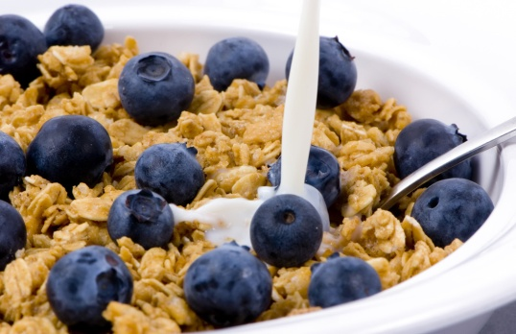

Estimating Carbohydrate for Meals Example (Not ADA Standard)
Grams Servings
Each Meal 45-60 gm 3 - 4
Snacks 15-30 gm 1- 2
Carbs affect Post-Meal Glucose
RDA – at least 130 grams of Carb a day
PWD get about 45% of Cals from carbs
Calories | 20% | 30% | 40% | 50%
1500 | 75 g | 113 g | 150 g | 188 g
2000 | 100 g | 150 g | 200 g | 250 g
Notes:
Carbohydrate counting is a more advanced tool and literacy and numeracy must be taken into account.
Carbohydrate counting is a recommended tool for individuals in multiple daily injections and pump therapy –although with updates to new algorithms meal size estimation is also an option.
When on fixed insulin doses individuals can be educated about following a fixed carbohydrate meal plan. We can work the the individual to determine what they are currently consuming and recommend specific foods to help meet those needs.
When helping create or support a meal plan as dietitians we help determine about how many grams of carbohydrate are appropriate for each individual.
We know most individuals with diabetes consume about 45% of kcals from carbs. We can determine this to be about 225 grams of carbohydrate for a 2000 calorie diet. We can then divide and develop a general meal if we don’t have a great starting point. We can also modify this goal depending upon the individualized eating pattern and meal pattern plan.
We no longer just provide the gram per meal goal but then help translate this into what to do.
Consideration of consistent meal size and carbohydrate content may be appropriate for individuals with type 1 and type 2 diabetes on a fixed insulin regimen. As health care providers understanding amounts of carbohydrates and contribution of fat and protein to rising glucose levels.
(Ps93)

Slide 88
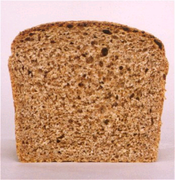


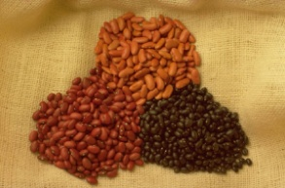

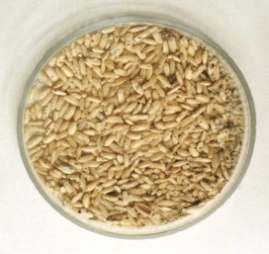





Carb Counting - Starch
1 small ear of corn or 1/2 cup corn
1 slice bread
1/3 cup cooked pasta
1/2 cup
cooked beans
3/4 cup cold cereal
Each Food has:
80 Calories
15 grams carb
1/3 cup cooked rice
1 small potato
1/2 English muffin
5-6 small crackers
6” tortilla
6” roti

Slide 89









Carb Counting- Fruit
½ cup fruit juice
½ banana, 4”
1 small fresh fruit
½ cup unsweetened apple sauce
Each Food has:
60 Calories
15 grams carb
17 small grapes
1 cup melon
¼ cup dried fruit
2 tbsp raisins
1 1/4 cup strawberries

Slide 90







Carb Counting - Milk
1 packet sugar-free
hot cocoa
8 oz buttermilk
6 oz low-fat plain yogurt
Each Food has:
100-160 calories
12 grams carb
8 oz milk
6 oz light, no added sugar
fruit yogurt
8 oz rice milk, plain
8 oz soy milk, plain

Slide 91









Carb Counting - Sweets
2-inch square cake or brownie, unfrosted
½ cup regular jello
2 tbsp light syrup
½ cup sugar-free pudding
Each Food has:
Calories vary
15 grams carb
1 tbsp syrup, jam, jelly, table sugar, honey
2 small cookies
¼ cup sorbet
½ cup ice cream or frozen yogurt
1 oz trail mix with fruit

Slide 92


Average American Consumes 17 teaspoons added sugar per day
WHO/DGA and AHA – Goals
< ~ 5 - 10 teaspoons/day
1 tsp = 4 gms sugar (15 Cals)
15 cals x 19 teaspoons a day =
285 cals a day just from added sugars
12oz. soda = 39 gm carb/10 tsps added sugar
https://www.cdc.gov/nutrition/php/data-research/added-sugars.html
Notes:
Good news is American sugar consumption is reducing but 3 in 5 Americans continue to consume added sugar in excess of diet recommendations.
The ADA does not have specific sugar goals but we can look to the WHO, DGA and AHA.
AHA goals is < 6% of kcals from added sugar and WHO/DGA is <10% kcals from added sugars. This is equal to about 5-10 teaspoons of sugar per day if considering a 2000 calories diet. Or 30 – 50 grams of added sugar per day.
In American diets, 24% of added sugar comes from sugar sweetened beverages.
285 kcals is 14% of 2000 Cal diet.

Slide 93

Reduce Refined Carbs, Added Sugars - ADA
To manage wt, reduce CVD risk and fatty liver disease
ADA strongly discourages consumption of:
Sugar sweetened beverages
Processed “low-fat” or “non-fat” foods with high amounts of refined grains & added sugar
Sugary and processed foods can displace healthier, more nutrient dense food choices
Water is recommended
Notes:
46.1% of PWD are Hispanic
C

Slide 94

Non-Nutritive Sweeteners
Use in moderation and short term to reduce overall calorie/carbohydrate.
Encourage decrease in both sweetened and non-nutritive sweetened beverages.
Emphasize water intake.
How: add lemon, lime, or cucumber slices to water, choose no calorie waters
https://www.fda.gov/food/food-additives-petitions/aspartame-and-other-sweeteners-food
Notes:
Last year the WHO – even called out does not apply to the population with diabetes and Cleveland clinics exposed concerns regarding use of non-nutritive sweeteners.

Slide 95
New Consult for Diabetes Ed
JR, 63 y/o, BMI 32, Waist circumference: 43”, A1c 9.3%, Type 2 diabetes 10+ years. On Metformin 2000mg daily + Glipizide 20mg. Low income and doesn’t like to drive much due to poor vision. Interested in losing weight.
Nutrition, typical day
Breakfast – doesn’t really eat. Has cup of coffee
Lunch around 11am – packaged breakfast sandwich
Dinner – Sandwich or burger
Evening – Snacks, nuts, crackers, boiled egg
Beverages – Diet sodas, tea, water
Notes:
Based on what we have learned so far how can we support JR in implementing nutrition interventions and consider additional medication management, including a incretin therapy or potentially metabolic surgery (given BMI > 30) to support additional A1c reduction along with weight loss.
BMI is indicative of stage I obesity and waist circumference greater than 40 “ in men is consider elevated which suggests increased central adiposity.
We will continue the discussion about JR below.

Slide 96
Poll Question 10
A person with diabetes presents with unexplained weight loss, what are some possible causes?
A. Taking less insulin than needed
B. Disordered eating
C. Finances
D. Poor dentition
E. All the above

Slide 97

Disordered Eating
For people with type 1
insulin omission causing glycosuria to lose weight is the most reported disordered eating behavior.
Have high rates of diabetes distress and fear of hypoglycemia.
For people with type 2
bingeing episodes with an accompanying sense of loss of control most reported.
If treated with insulin, intentional omission is also frequently reported.
People with diabetes and diagnosable eating disorders have high rates of other psychiatric disorders
Notes:
The standards of care recognizes people entering DSMES or MNT should be screened for past dieting behaviors and disordered eating patterns.
Insulin omission is 10% more common in women then men with T1D.

Slide 98

Screen for Disordered Eating
“DiaBulimia”
Anyone with insulin dependent diabetes who omits/restricts insulin as means of weight loss
Tends to start in adolescence, more likely to occur in women than men.
Signs: unexplainable hyperglycemia/ elevate A1c, weight loss, lack of marks from fingerpricks, lack of prescription refills for diabetes meds, records that don’t match A1c. May have other classic symptoms of eating disorders
Treatment – Mental health specialist and team
Notes:
Classic symptoms of eating disorders— excessive exercise, fatigue, weakness, lethargy, being overly critical of appearance, amenorrhea
In your resources we have given you links to screening tools such as the mSCOFF and DEPS-R which screen disordered eating behaviors and are most tested in type 1 diabetes.
These screening tools can then support referral to providers specialized in treatment of eating disorders.

Slide 99
Poll Question 11
Which of the following is true about alcohol and diabetes based on ADA Standards?
A. Only white wine decreases blood sugars
B. Men less than 2 drinks and women less than one drink a day
C. Alcohol increases risk of hyperglycemia
D. 6 ounces of wine is considered one serving.

Slide 100

Assessing Malnutrition
At Risks Groups:
Individuals on GLP-1 or GIP RA or after metabolic surgery
Individuals with multiple chronic conditions
Older age groups
Food insecurity and poverty
Screen:
For malnutrition and sarcopenia
Recommend:
Whole- food-based eating pattern
Adequate protein
Resistance training
Malnutrition is defined by the World Health Organization as “deficiencies, excesses, or imbalances in a person’s intake of energy and/or nutrients.”
Notes:
New this year the ADA calls out the importance of screening for malnutrition.
We frequently screen for malnutrition in individuals who are underweight or in hospital settings but starting BMI and desire for weight loss does to prevent malnutrition risk.
Individuals on incretin therapies or have had metabolic surgery and have experienced significant weight loss of > 20% or more than 4 kg (or about 9 pounds) should be screened for malnutrition. (Simplified Nutritional appetite Questionaries and Malnutrition Universal Screening tool).

Slide 101

Actions of GLP-1 and GIP
Samms RJ, Coghlan MP, Sloop KW. How May GIP Enhance the Therapeutic Efficacy of GLP-1? Trends Endocrinol Metab. 2020 Jun;31(6):410-421.
Notes:
GIP: Glucose-dependent Insulinotropic Polypeptide
GLP: glucagon-like peptide

Slide 102

Pocket Card: GLP-1 & GIP RA
Notes:
Update with exenatide indication in pediatrics.

Slide 103

Counseling Points: GLP-1 RA & GLP-1/GIP
Avoid if personal or family history of medullary thyroid cancer
Avoid in combo with DPP-4 inhibitors
Watch for intestinal obstruction
Use of non-FDA compounded products not recommended
Avoid with history pancreatitis
If on tirzepitide, use back up contraception for first 4 weeks
Ask about recent eye exam
Potential increase in diabetes retinopathy
Sudden discontinuation of semaglutide and tirzepitide results in regain of one-half to two-thirds of the weight loss within 1 year. Consider trying lowest effective dose, using intermittent therapy, or stopping medication followed by close weight monitoring.
Notes:
Inject at room temperature, let alcohol fully dry

Slide 104
Poll Question 12
AR is 36 years old with type 2 diabetes and a BMI of 41kg/m². Current diabetes medications include: metformin, sitagliptin (Januvia) and empagliflozin (Jardiance) at maximum doses. AR is prescribed tirzepatide (Mounjaro). Based on this information, what action do you recommend to the provider?
Verify kidney function first.
Stop the sitagliptin when initiating tirzepatide.
Decrease the dose of metformin to prevent hypoglycemia.
Evaluate thyroid function before starting tirzepatide.
Notes:
Answer is B.

Slide 105
Let’s Break it Down ADA 2025

Slide 106
GLP-1/GIP Receptor Agonist Indications
“Recent clinical trial suggests that the GLP-1 RA semaglutide has beneficial effect on CVD, mortality, and kidney outcomes among people with CKD - recommend that semaglutide be used as another first-line agent for people with CKD”.
Drug | Lower BG | Reduce CV / Kidney Risk? | Wt loss approved?
Exenatide IR (Byetta) Lixisenatide (Adlyxin) Semaglutide (Rybelsus) | Yes
Exenatide ER (Bydureon) | Yes for 10 yrs and older
Dulaglutide (Trulicity) | Yes for 10 yrs and older | Yes
Semaglutide (Ozempic) | Yes | Yes Kidney protective | Yes Wegovy 2.4mg
Liraglutide (Victoza) | Yes for 10 yrs and older | Yes | Yes Saxenda 3mg
Tirzepatide (Mounjaro) | Yes | ? | Yes, Zepbound up to 15 mg
Package inserts, dailymed.nlm.nih.gov

Slide 107
GLP-1 /GIPs Approved for Weight Loss
Liraglutide:
Victoza 1.8 mg (diabetes)
Saxenda 3 mg (wt loss)
6% wt loss, $1349 a mo
Semaglutide:
Ozempic 2mg (diabetes)
Wegovy 2.4mg (wt loss)
6% wt loss, $1349 a mo
Tirzepatide
Mounjaro 15mg (diabetes)
Zepbound (wt loss)
13% wt loss - $1056 a mo
All 3 Approved for use in adults with a:
BMI of ≥ 30 or
BMI of ≥ 27 or greater who have hypertension, type 2 diabetes, or dyslipidemia.

Slide 108

Exercise Standards
Adults – 150 min/wk moderate intensity
over 3 days a week.
Don’t miss > 2 consecutive days w/out exercise
Get up every 30 mins - Reduce sedentary time
Flexibility and balance training 2-3 xs a week (Yoga and Tai Chi)
T1 and T2 – resistance training 2 -3 x’s a week

Slide 109

A hard truth
Exercise alone doesn’t cause weight loss
But….
It helps keep weight off
Decreases visceral adiposity
Decreases CV Risk
To combat the rise in body weight, we need to change the food environment
“You cannot outrun an unhealthy diet”.

Slide 110
Good Exercise Info / Quotes
“Passagiata” – take an after meal stroll
Exercise decreases A1C 0.7%
No change in body wt, but 48% loss in visceral fat.
“Every minute of activity lowers blood sugar one point.”
“I don’t have time to exercise, I MAKE time.”

Slide 111

6. Glycemic Goals & Hypo
A1C
Blood Pressure
Cardiovascular risk reduction

Slide 112

6. Glycemic Targets for Non-Pregnant Adults
A1c < 7% - a reasonable goal for adults.
A1c < 6.5% - for those without significant risk of hypoglycemia
A1c < 8% - for those with history of hypoglycemia, limited life expectancy, or those with longstanding diabetes and vascular complications.
A1c Check Frequency:
If meeting goal - At least 2 times a year
If not meeting goal – Quarterly
Also review Ambulatory Glucose Profile

Slide 113
6. Glycemic Targets Individualize Targets – ADA
Pre-Prandial BG 80- 130
1-2 hr post prandial < than 180
*for nonpregnant adults
Time in Range: 70%
BG of 70-180 mg/dL

Slide 114


A1c and Estimated Avg Glucose (eAG)
A1c (%) eAG__
5 97 (76-120)
6 126 (100-152)
7 154 (123-185)
8 183 (147-217)
9 212 (170 -249)
10 240 (193-282)
11 269 (217-314)
12 298 (240-347)
eAG = 28.7 x A1c-46.7 ~ 29 pts per 1%
Translating the A1c Assay Into eAG – ADAG Study

Slide 115

Ambulatory Glucose Profile
Standardized report with visual cues for those on CGM devices
Evaluate Time in Range (TIR)
Target 70-180 mg/dl (70% of time)
Eval % time below goal
< 70 (less than 4% of time)
<54 (less than 1% of time)
Eval % time above > 180 (less than 25% of time)
Eval % time above > 250 (less than 5% of time)
For those with frailty or at high risk of hypoglycemia recommend:
- Target of 50% time in range
- Less than1% time below range

Slide 116

(
American Diabetes Association Dia Care 2022 6.2 45- S89
Table 6.2
Notes:
Patient and disease factors used to determine optimal glycemic targets. Characteristics and predicaments toward the left justify more stringent efforts to lower A1C; those toward the right suggest less stringent efforts. A1C 7% = 53 mmol/mol. Adapted with permission from Inzucchi et al. (59).

Slide 117
ADA 2025 Goals Summary
A1c less than 7% (individualize)
Pre-meal BG 80-130
Post meal BG <180
Time in Range (70-180) 70% of time
Blood Pressure
<130/80
Cholesterol
Statin therapy based on age & risk status
If 40+ with ASCVD Risk, decrease LDL by 50%, LDL <70
If 40+ with ASCVD, decrease LDL by 50%, LDL <55

Slide 118
DiaBingo- G
G ADA goal for A1c is less than ____%
G People with DM need to see their provider at least every month
G Blood pressure goal is less than
G People with DM should see eye doctor (ophthalmologist) at least
G The goal for triglyceride level is less than
G Goal for LDL cholesterol for people 40+ with diabetes is _________
G The goal for blood sugars 1-2 hours after a meal is less than:
G People with DM should get this shot every year
G People with DM need to get urine tested yearly for ___________
G Periodontal disease indicates increased risk for heart disease
G The goal for blood sugar levels before meals is:
G The activity goal is to do ___ minutes on most days

Slide 119



Chronic Kidney Disease– 2025 Update
Optimize glucose and BP to protect kidneys.
Use SGLT-2 with demonstrated benefit to reduce CKD and CVD*
To reduce CV risk and CKD, use a GLP-1* with demonstrated benefit.
In people with CKD and albuminuria, a nonsteroidal MRA effective if GFR 25+
Aim to reduce urinary albumin by ≥30% in people with CKD
*SGLT-2i’s
Empagliflozin (Jardiance), canagliflozin (Invokana), dapagliflozin (Farxiga)
*GLP-1 RA’s
Semaglutide (Ozempic), liraglutide (Victoza), dulaglutide (Trulicity)

Slide 120

Standard 11 – Protect Kidneys
Diabetes with CKD - GFR ≥20
Start SGLT2 to reduce chronic kidney disease progression and cardiovascular events.
Also consider GLP-1 RA – (ie semaglutide)
If type 2 diabetes and established Chronic Kidney Disease (CKD)
Start nonsteroidal mineralocorticoid receptor antagonist (finerenone) and/or GLP-1 RA recommended for cardiovascular risk reduction.

Slide 121

Kidney Goals and MNT
In people with chronic kidney disease with UACR ≥300 mg/g
Goal is a reduction of 30% or greater in mg/g urinary albumin to slow chronic kidney disease progression
Nutrition Recommendations
For people with non–dialysis-dependent stage 3 or higher chronic kidney disease
dietary protein intake aimed to a target level of 0.8 g/kg body weight per day.
For those on dialysis,
consider protein intake of 1.0–1.2 g/kg/day since protein energy wasting is a major problem in some individuals on dialysis
Refer to nephrology
If GFR < 30 or uncertain CKD etiology

Slide 122

Poll Question 13
JR is newly diagnosed with type 2. A1C is 7.9. GFR is 63. UACR 26 mg/g. History of CHF. According to 2025 ADA Standards, what med along with lifestyle should be started first?
a. Only Metformin, since A1C is close to target.
b. Metformin or SGLT-2
c. Sulfonylurea
d. GLP-1 or Metformin

Slide 123
A 67 yr old man, smokes ppd
A1c 8.9% (down from 10.4%)
B/P 139/76 AM BG 100, 2 hr pp 190
Chol – TG 54, HDL 46, LDL 98
GFR 47, UACR 34 mg/g
Meds:
Insulin – 28 units basaglar insulin
Losartan 25mg – ARB for blood pressure
Metoprolol 50mg – Beta blocker
Glyburide 5mg BID - Sulfonylurea
Any special instructions?
Any meds missing?
Stop any meds?
Special instruction – sweating may indicate hypoglycemia

Slide 124

10. Cardiovascular Disease and Risk Management
Higher risk of Atherosclerotic cardiovascular disease (ASCVD):
history of acute coronary syndrome,
myocardial infarction (MI),
stable or unstable angina,
coronary or other arterial revascularization,
stroke, transient ischemic attack,
or peripheral artery disease (PAD) including aortic aneurysm.
Plus 2x’s risk of Heart Failure
Leading cause of morbidity and mortality in people with diabetes
Large benefits are seen when multiple CV risk factors are addressed simultaneously
With more aggressive goals, rates of CVD have decreased.
CV Risks predicted to increase in future.

Slide 125


Slide 126

BP Treatment in addition to Lifestyle
First Line B/P Drugs if 130/80 +
With albuminuria or ASCVD
Start either ACE or ARB*
No albuminuria - Any of the 4 classes of BP meds can be used:
*ACE Inhibitors, *ARBs, *thiazide-like diuretics or calcium channel blockers.
*Monitor K+ 7-14 days after start/annually
Avoid ACE and ARB at same time
Multiple Drug Therapy often required
If B/P ≥ 150 /90 start 2 drug combo
*Albuminuria = Urinary albumin creatinine ratio of 30+

Slide 127

Hypertension Management

Slide 128

Poll Question 14
RZ is 47 years old with type 2 diabetes and hypertension. RZ takes metformin 1000 mg BID, plus lisinopril 20mg daily. RZs LDL is 130 mg/dL. Based on the most recent ADA Standards, what is the LDL Cholesterol target for RZ?
LDL less than 100 mg/dL.
Lower LDL by 30%.
LDL target of 65 mg/dL or less.
Determine LDL target based on ASCVD risk.

Slide 129

Lipid Goals – Primary Prevention
For people with diabetes aged 40–75:
No ACSVD Risk – Start Moderate intensity statin
Higher cardiovascular risk*
(*HTN, Smoke, CKD, BMI 30+ albuminuria, family hx ACSVD)
High-intensity statin therapy is recommended
Reduce LDL cholesterol by at least 50% of baseline AND
Target LDL cholesterol <70 mg/dL.
If LDL cholesterol 70 +
it may be reasonable to add ezetimibe or a PCSK9 inhibitor to maximum tolerated statin therapy.

Slide 130
Statin Dosing
High Intensity:
Lowers LDL ≥50%
Moderate Intensity:
Lower LDL 30-<50%
Lipitor (atorvastatin)
40-80mg
Crestor (rosuvastatin)
20-40mg
Lipitor (atorvastatin)
10-20mg
Crestor (rosuvastatin)
5-10mg
Zocor (Simvastatin)
20-40mg
Pravachol (pravastatin)
40 – 80mg
Mevacor (lovastatin) 40 mg
Lescol (fluvastatin) XL 80mg
Livalo (pitavastatin) 2-4mg
***If person can’t tolerate intended statin dose, use maximally tolerated dose

Slide 131


Lipid Goals for People with ASCVD
For people of all ages with diabetes and atherosclerotic cardiovascular disease:
Add high-intensity statin to lifestyle therapy.
Reduce LDL cholesterol by 50% or greater from baseline with LDL cholesterol goal of <55.
Addition of ezetimibe or a PCSK9 inhibitor with proven benefit in recommended if goal is not achieved on maximum tolerated statin therapy.

Slide 132

From Meds Cheat Sheet Page

Slide 133

Coronary Vessel Disease Meds
In those with CVD or at higher risk:
Get blood glucose to goal
Statin therapy with addition of ezetimibe or a PCSK9 inhibitor recommended if goals not achieved on maximum tolerated statin therapy.
B/P Med (ACE or ARB)
Beta blocker after MI or CHF
Aspirin (or another agent)
Diabetes Meds that significantly decrease CV events:
*SGLT-2i’s
Empagliflozin (Jardiance), canagliflozin (Invokana), dapagliflozin (Farxiga)
*GLP-1 RA’s
Semaglutide (Ozempic), liraglutide (Victoza), dulaglutide (Trulicity)

Slide 134
A 67 yr old man, smokes ppd
A1C 8.9% (down from 10.4%)
B/P 139/76 AM BG 100, 2 hr pp 190
Chol – TG 54, HDL 46, LDL 98
GFR 47, UACR 34 mg/g
Meds:
Insulin – 28 units basaglar insulin
Losartan 25mg – ARB for blood pressure
Metoprolol 50mg – Beta blocker
Glyburide 5mg BID - Sulfonylurea
Any special instructions?
Any meds missing?
Stop any meds?

Slide 135
A 67 yr old man, smokes ppd
A1c 8.9% (down from 10.4%)
B/P 139/76 AM BG 100, 2 hr pp 190
Chol – TG 54, HDL 46, LDL 98
GFR 47, UACR 34 mg/g
Meds:
Insulin – 28 units basaglar insulin
Losartan 25mg – ARB for blood pressure
Metoprolol 50mg – Beta blocker
Glyburide 5mg BID - Sulfonylurea
Any special instructions?
Any meds missing?
- Statin
- SGLT 2
- Aspirin
Stop any meds?
Special instruction – sweating may indicate hypoglycemia

Slide 136
DiaBingo - N
N DPP demonstrated that exercise and diet reduced risk of DM by__%
N Average A1c of 7% = Avg BG of ____
N The goal is to eat 14 gms per 1000 cals of this nutrient a day
N Rebound hyperglycemia
N Scare tactics are effective at motivating behavior change
N Get LDL less than ____for most people with diabetes 40 years+
N Drugs that can cause hyperglycemia
N 2/3 cups of rice equals ______ serving carbohydrate
N 1% A1c = how many points of blood sugar _____
N 1 gm of fat equal _____kilo/calories
N Metabolic syndrome = hyperinsulinemia, hyperlipidemia, hypertension
N Average American consumes 15 teaspoons of sugar a day.
N Medication derived from the saliva of the Gila Monster

Slide 137

Wait, What About Emotions?

Slide 138

Diabetes Visit – What do you think?
A small comment can make a BIG Difference
How Does John Feel?
John arrives at the clinic with a Time in Range slightly above 60%.
HCP says “You do know that the goal for TIR is 70% ” (Door shut)
Defeated
Embarrassed
Ashamed
Angry
Hurt
How does the HCP feel?
Healing through Connection for Healthcare Professionals – Beverly Thomassian

Slide 139

Missed Appointments due to Stigma and Shame
A recent survey of over 2,600 people with diabetes across eight countries revealed that nearly 40% of missed doctor’s appointments are due to stigma or shame.
Abbott. (2025, February 4). Abbott’s Above the Bias film reveals misconceptions can impact diabetes care. https://abbott. mediaroom.com/2025-02-04-Abbotts-Above-the-Bias-FilmReveals-Misconceptions-Can-Impact-Diabetes-Care
Notes:
Many healthcare professionals incorrectly assume that people with
diabetes are not reaching their goals due to a lack of effort. If they
“just tried hard enough,” they could reach the recommended timein-range target. Unfortunately, this false belief can build a wall of
misunderstanding between the HCP and the person with diabetes

Slide 140

Embark Trial
EMBARK: A Randomized, Controlled Trial Comparing Three Approaches to Reducing Diabetes Distress and Improving HbA_{1c} in Adults With Type 1 Diabetes. Diabetes Care 2024; dc232452. https://doi.org/10.2337/dc23-2452

Slide 141

Releasing the Brake
This strategy recognizes that diabetes distress acts as a brake on the application of existing diabetes knowledge and skills.
By releasing the diabetes distress brake through emotion-focused intervention, the negative cycle can be efficiently ended.

Slide 142

Embark Trial – Emotions as Priority
I have finally given myself permission to make addressing the emotional aspects of diabetes a priority.
~Coach Beverly
Healing through Connection for Healthcare Professionals – Beverly Thomassian

Slide 143

Healing through Connection for Healthcare Professionals – Beverly Thomassian

Slide 144

Diabetes Visit – Let’s Go through
How Does John Feel?
John arrives at the clinic with a Time in Range slightly above 60%.
HCP says “You do know that the goal for TIR is 70% ” (Door closed)
HCP smiles and says, “Wow John, I can see you are making an effort to improve your time in range.”
Door Open – Connection made
Reassured
Heard & Seen
Recognized
Confident
Connected
How does the HCP feel?
A small adjustment can make a BIG Difference
Healing to HCP
Bidirectional Healing
Healing to Person
Healing through Connection for Healthcare Professionals – Beverly Thomassian

Slide 145




Diabetes Distress – Assess Annually
www.behavioraldiabetes.org
https://professional.diabetes.org/sites/default/files/media/ada_mental_health_toolkit_questionnaires.pdf.

Slide 146

Diabetes Distress Stories
Common events you will hear about:
Scary or embarrassing lows
Surprising highs
Difficulty managing BG
Eating challenges
Managing all of the tech
Situations with friends, family, colleagues
Managing health care (feeling judged and misunderstood), insurance, etc.
Used with permission from ReVive 5 Program; Larry Fisher, PhD & Susan Guzman, PhD

Slide 147

Relationship Building │ Three Tools To Make It Happen
Relationship Building
1. Open-Ended Questions
2. Active Listening
3. Clinician Engagement Skills
Used with permission from ReVive 5 Program; Larry Fisher, PhD & Susan Guzman, PhD

Slide 148

Having the Conversation
Start with open Ended Question – How are you FEELING?
Active listening with curiosity
Review and summarize the story you hear:
“Do I have this right?”
“Is there anything missing?”
Then ask:
“How does all of this strike you?”
“Does any of this surprise you?”
Used with permission from ReVive 5 Program; Larry Fisher, PhD & Susan Guzman, PhD

Slide 149

Case Study with MR
MR is 69 years old, lives alone, works in an office but is currently out of work and very stressed. Diabetes distress score is elevated in the areas of .
Looking at her ambulatory glucose profile, the TIR is around 46-50% and she has no episodes of hypo.
Insulin includes 30units glargine at bedtime and 10-15 of apidra with meals based only on what she is going to eat.

Slide 150
Case Scenario with MR
MR wears a CGM, but only checks the app results a few times a day. They tell you,
“I don’t want to look at the device because the numbers are always bad”.
What do you say?

Slide 151
MR says
The numbers always go up after I eat meals.
What do you say now?

Slide 152
We ask MR
Have you noticed if certain foods tend to increase your elevating your blood glucose?
MR says “when I eat shrimp”.
What do you say then?

Slide 153
At least 42 factors affect glucose!
Food
Meds
Activity
Biological
Environ-mental
Behavioral and decision making
↑↑ Carbo-hydrate quantity
→↑Carbo-hydrate type
→↑ Fat
→↑ Protein
→↑ Caffeine
↓↑Alcohol
↓↑ Meal timing
↑Dehydration
? Personal microbiome
→↓Dose
↓↑ Timing
↓↑ Inter-actions
↑↑ Steroid administration
↑ Niacin (vitamin B3)
→↓ Light exercise
↓↑ High/ moderate exercise
→↓ Level of fitness/training
↓↑ Time of day
↓↑ Food and insulin timing
↑ Insufficient sleep
↑ Stress and illness
↓ Recent hypoglycemia
→↑ During-sleep blood sugars
↑ Dawn phenomenon
↑ Infusion set issues
↑ Scar tissue and lipodystrophy
↓↓ Intramuscular insulin delivery
↑ Allergies
↑ A higher glucose level
↓↑ Menstruation
↑↑ Puberty
↓ Celiac disease
↑ Smoking
↑ Expired insulin
↑ Inaccurate BG reading
↓↑ Outside temperature
↑ Sunburn
? Altitude
↓ Frequency of glucose checks
↓↑ Default options and choices
↓↑ Decision-making biases
↓↑ Family relationships and social pressures
Adapted from Brown A. DiaTribe Learn: Making sense of diabetes... diatribe.org/42factors

Slide 154

BGM vs CGM – What do you do with all this info?
= glucometer readings
Undetected hyperglycemia
Undetected hypoglycemia
Image created and permission to use granted by John Moorman, PharmD.
SMBG, self-monitoring of blood glucose.

Slide 155

Time in Range
Evaluate Time in Range (TIR)
Target 70-180 mg/dl
Target time below goal
Less than 70
Less than 54
Target time above goal
Above 180
Above 250
Battelino T, et al. Diabetes Care. 2019;42(8):1593-1603.

Slide 156

Ambulatory Glucose Profile Report
CGM key metrics
AGP
Daily tracings

Slide 157
Example of A More Helpful Expectation: From Perfectionism to “Healthy Good Enough”
Perfectionistic thinking: has 2 speeds, perfect or failure, not achievable for very long, exhausting, contributes to burnout
Healthy Good Enough
Personalized
Ambitious and realistic
Allows for normal fluctuations, mistakes and experiments
Sees small steps as valuable
Focus is on efforts made, not numbers
Forward looking: What now?
Used with permission from ReVive 5 Program; Larry Fisher, PhD & Susan Guzman, PhD

Slide 158

RT not sure what to tell partner
RK has lived with type 1 diabetes for over 20 years. After a divorce, RT started surfing and dating.
RK has told their partner they have diabetes but has not told them what to do in case of a low blood sugar emergency.
RT asks about treatment options.
How might you respond?

Slide 159

Having the Conversation
Eliciting a diabetes story
Listening for the major DD themes
Three approaches to fostering a new perspective
Distinguish between thoughts/feelings & actions
Address inaccurate beliefs
Establish more realistic expectations
Considering different management choices

Slide 160


Hypoglycemia Conversation
What is the story you are telling yourself? (O)
It sounds like you are afraid that if you tell your boyfriend about your risk of low blood sugar, he might feel uncomfortable? Did I get that right? (R, S)
That makes sense to me. (N)
Would you be interested in exploring some newer treatment options for low blood sugar?
What do you think would be the next best step? (O)

Slide 161
List of typical “Problem Causers.”
Knowing the DD Story helps you anticipate the causes of BG problems
Basal insulin dose or rates may need adjusting.
Carb count accurate?
Right meal carb ratio?
Right correction bolus insulin?
Timing of insulin dosing may need adjustment- insulin taken early or late.
Type of food consumed affected glucose response (fats, protein, fiber).
Effects of exercise and physical activity.
‘Stacking’ insulin boluses.
Response to concerns about hypoglycemia.
Stress: family, work, financial, etc.
Notes:
YOU HAVE A COPY OF THESE “TYPICAL” PROBLEM CAUSERS IN YOUR PACKET. AS WE WORK THROUGH SOME EXAMPLES, IT CAN BE HELPFUL TO GAVE THE LIST CLOSE BY TO HELP IDENTIFY WHAT MIGHT BE GOING ON.

Slide 162


Slide 163
The 5 M’s
The 5 M’s for Diabetes Self-Management Include:
Mood – including emotions, diabetes distress, and physical stress
Medicines – type and dose
Movement – physical activity
Meals – food, beverages, and portions
Minutes – the timing of medicine, meals, movement, and monitoring
Initially, facilitators explore the meaning of each of the 5 M’s and continue to use them as a discussion framework in each session.
The repetition of returning to the 5 M’s each meeting provides participants with a way to organize and integrate diabetes information into their own lives.

Slide 164

Informed vs Wise Decisions
Informed:
I know that tomatoes are a fruit.
Wise
I know not to put tomatoes in my fruit salad.

Slide 165
Making the Wise Choice
Wise choices consider and recognize the individual’s values, preferences, needs, and wants.
For example, if a person tells you, “I am going to cut out carbs to get my blood sugars under target,” we would acknowledge that this might be an informed choice.
“Yes, cutting out carbs will likely lower your blood sugars, but is it a “WISE” choice?”
Does it match their values, preferences, needs, and wants? Or would cutting out carbs significantly decrease their life’s pleasure and joy?
Notes:
Of course, the ultimate decision is up to the individual, but it is worth helping them explore and consider their choices out loud. After all, diabetes lasts a lifetime, and we want to support daily quality of life while reducing the risk of complications.

Slide 166

Insulin Duration and Stacking
Some people may bolus in between meals if they see their glucose rising
Duration of rapid insulin action is about 4 hours.
Important to wait for the correction dose to work.
Taking more insulin during that time, is called “stacking” the insulin and can lead to hypoglycemia.
“After eating, when I see my blood sugar rising, I keep bolusing to bring it down. Then I crash and I have to eat a ton of carbs to bring it up again.”

Slide 167
Having the Conversation
Eliciting a diabetes story
Listening for the major DD themes
Three approaches to fostering a new perspective
Distinguish between thoughts/feelings & actions
Address inaccurate beliefs
Establish more realistic expectations
Considering different management choices

Slide 168
Stacking Conversation
What is the story you are telling yourself?
It sounds like you may be worried you will get complications if your blood sugars go too high and so you are giving extra bolus insulin? (R)
You’re not alone, I have talked to lots of people who do the same thing. (N)
It sounds like you want to work on avoiding low blood sugars due to stacking? (S) Is that right?
I am curious. Next time you see your arrows pointing up and you want to give an extra bolus of insulin before 4 hours, what could be an alternate plan? (O)
Stacking is sometimes referred to as “rage blousing”

Slide 169

Be a Detective – What is the Issue?
Put it all together: What do THEY think might be going on based on the DD Story?
Get as specific as possible.
This is a best guess – it might not be a correct guess, but it is a place to start.
Usually, the first guess may be correct in perhaps 50% of the cases, so be prepared to use this only as a place to start.
Notes:
REMEMBER – THERE IS NO “RIGHT” OR “WRONG” ANSWER. THIS IS A PROCESS.

Slide 170
What is happening here?

Slide 171

Diabetes Detectives

Slide 172
RT Loves Eating Out
RT loves to eat dinner out with their friends 2-3 times a week.
However, blood sugars always seem to go above target on those evenings.
Want to have improved time in range to feel better, worry less and enjoy time with friends.
Story- I am such a failure, my blood sugars are always going too high. Makes me not even want to try.
Action: I will tolerate these feelings and I will look up carb content of food to try and figure out how much insulin I actually need.

Slide 173
RT Sets up Experiment/ Takes Action
Steps
RT Changes
Make a small change
Realize, that the story and tough feelings can be major barrier to change.
Discover an unexpected issue
Look up carbs on app/website.
Ask her friends for support
Asking for help is hard, but I think it will help.
See how drinking wine with dinner affects BG

Slide 174
Checking in with RT 2 weeks later
RT Responds
You Say / Ask
We went to the same restaurant 2 times in the same week. My friends helped me figure out the carbs in my favorite dish, but the first night, it still went high. I noticed the DD story of feeling like a failure.
A few nights later, I tolerated my DD, ordered the same dish, and increased my bolus by 2 units. My blood sugar was right on track!
Thank you for keeping logs on your eating out days.
Did your DD Story show up?
Were you able to try any of the experiments?
Did you discover anything new?

Slide 175
Checking in with RT 2 weeks later
RT Responds
You Say / Ask
I didn’t have a chance to check that out yet. But next time, I am going to eat the same dish, take the same amount of insulin and add have a glass of wine to see what happens.
I see that I need to keep challenging myself to not give in to feeling like a failure and keep making new choices.
I know you also mentioned you wanted to see how wine affected your blood sugars.
Did you discover anything new?

Slide 176
Ask about their life (SDOH)
Assess current self-management behaviors
Assess your feelings
Accept without judgement
Acknowledge one thing they are doing right
Advocate for needed resources

Slide 177
Beliefs about health and diabetes
Barriers can be confused with non-compliance
Burnout lookout. On extended diabetes vacation due to diabetes distress?
Bouncing back – leaning into resilience

Slide 178
Having the Conversation
Coaching that highlights their knowledge and resilience.
Carrots – problem solve together and dig for solutions that are meaningful in everyday life.
Compassion for the people in our care and ourselves.
Connection through – opening the door.

Slide 179

Thank You
Questions?
Email: info@diabetesed.net
Web: www.DiabetesEd.net
Phone 530-893-8635

