Slide 1
Diabetes and Beyond?
Alan A. Parsa, MD FACE

Slide 2
Plan for the afternoon
MODY – what is it and why do we care
Quick review of different forms of diabetes mellitus
How important is pharmacologic choices
Long term goals

Slide 3
Maturity-Onset Diabetes of the Young (MODY)
Rare form of Diabetes
Accounts for around 5 % of all U.S DM
A monogenetic form of diabetes (Autosomal Dominant)
If a parent has the gene mutation, child has 50% chance of inheritance
Typically develops MODY before age of 25 (regardless of lifestyle)

Slide 4
MODY Symptoms ? Or Symptoms of DM?
Polyuria
Polydipsia
Dehydration
Blurry vision
Recurrent yeast infection
Recurrent skin infection

Slide 5
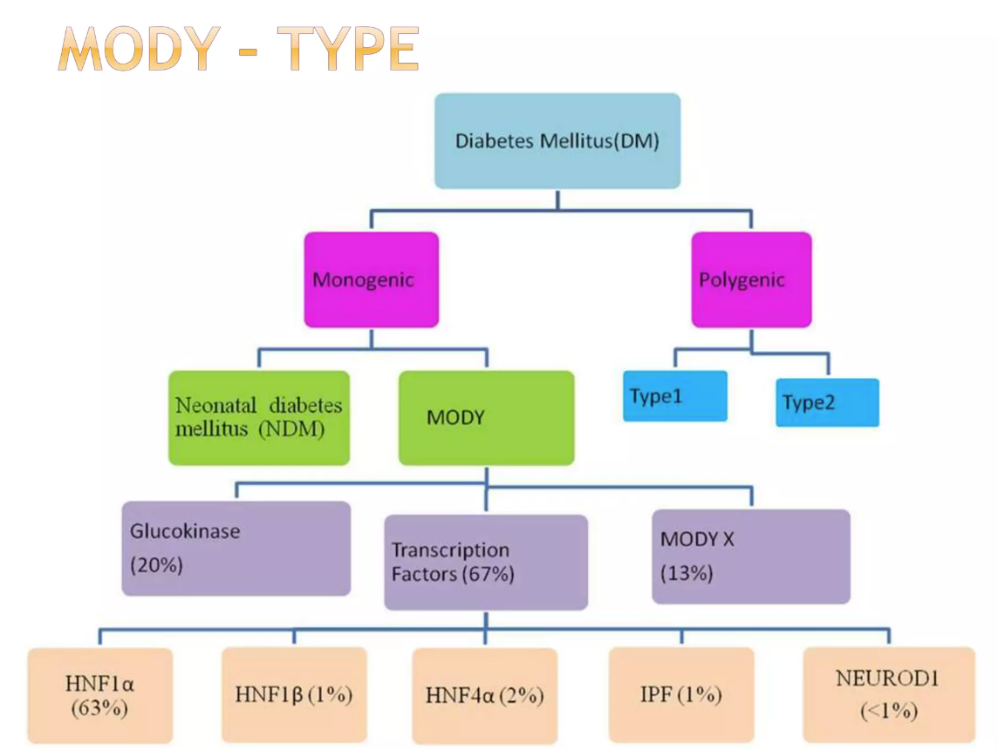

Slide 6
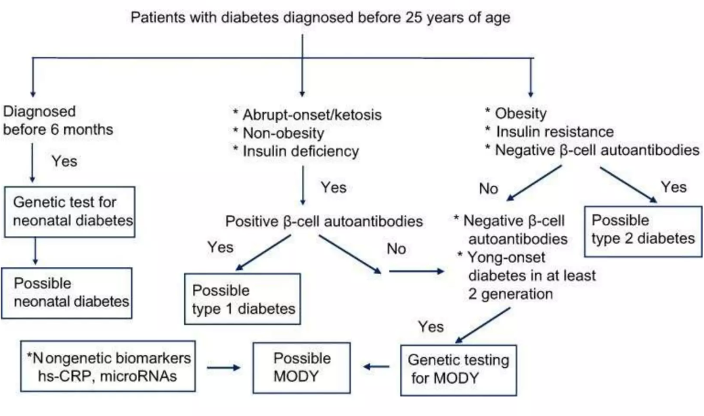

Slide 7
Neonatal Diabetes
Diagnosed before the age of 6 months
Due to insufficient insulin production
Transient or permanent
Monogenic with over 20 mutations identified

Slide 8
Treatment of MODY
Depends of form:
Does it cause Insulin resistance? Defect in Insulin secretion?
MODY 1 and 3 – Sulfonylurea works well
GCK – MODY – no therapy is typically needed
Other Types: insulin therapy may be needed

Slide 9
Why should we care? It’s rare!
Will treating MODY like Type 2 lead to improper treatment?

Slide 10
How to manage MODY long term
Evaluate family members (autosomal dominant)

Slide 11
Lets take a look back
How many forms of diabetes did you think there were and how many do you now know of?
Are there more forms of diabetes that are emerging?

Slide 12
Lets review the forms of DM
Monogenic forms of Diabetes
Neonatal Diabetes
MODY
Polygenic forms
Type 1 DM
LADA
Type 2 DM
Type 3 DM : Cerebral Insulin resistance leading to Alzheimer disease
Type 4 DM : Age related insulin resistance (not necessarily obese)
Type 5 DM : Malnutrition-related Diabetes

Slide 13
Is that it?
Oh yea:
Type3c (pancreatogenic diabetes)
Loss of beta cells from:
Destruction (pancreatitis/cystic fibrosis)
Removal (surgery)

Slide 14
Drug Induced
Corticosteroids
Prednisone
Antipsychotics
Olanzapine
Clozapine
Antibiotics
Fluroquinolones (cipro, levo)
Statins (typically higher doses)
Antirejection (tacrolimus)

Slide 15
How does pathophysiology effect treatment?
Understanding physiology helps direct treatment and avoid mistreatment

Slide 16
What are the treatments?
Monogenic forms of Diabetes
Neonatal diabetes?
MODY?

Slide 17
Autoimmune Diabetes Mellitus
Type 1 DM
Latent Autoimmune Diabetes in Adults (LADA)

Slide 18
Polygenic forms of Diabetes Mellitus
Type 2 DM
You know this one
Type 3 DM
Cerebral Insulin resistance leading to Alzheimer disease
Type 4 DM
Age related insulin resistance (not necessarily obese)
Type 5 DM
Malnutrition-related Diabetes

Slide 19
Beta Cell Loss
Type 3c – pancreatogenic

Slide 20
Drug Induced
Corticosteroids
Prednisone
Antipsychotics
Olanzapine
Clozapine
Antibiotics
Fluroquinolones (cipro, levo)
Statins (typically higher doses)
Antirejection (tacrolimus)

Slide 21
Who should evaluate and treat DM?
Depends on comfort level and desire

Slide 22
Questions?

