Slide 1


Welcome
From Fundamentals to Advanced Diabetes Practice
Beverly Thomassian, RN, MPH, BC-ADM, CDCES
Pronouns: She, her and hers Founder - www.DiabetesEd.net

Slide 2
Coach Bev has no Conflict of Interest
She’s not on any speaker's bureau.
Does not invest or have any financial relationships with diabetes related companies.
Gathers information from reading package inserts, research and articles.
The ADA Standards of Medical Care is main resource for course content.

Slide 3


Diabetes Management: From Fundamentals to Advanced Practice
Objectives:
Review the changes & updates to the annual ADA Standards of Medical Care in Diabetes.
Identify the key elements of the standards that improve clinical care for people with diabetes.
Review and discuss appropriate use of the latest medications and that address hyperglycemia and cardiorenal health.
Describe strategies to incorporate lifestyle changes into diabetes self-management.
Share practical approaches to assess and address diabetes distress in clinical care.

Slide 4

17. Diabetes Advocacy
People living with diabetes deserve to be free from the burden of discrimination.
We need to all be a part of advocating to ensure a healthy and productive life for people living with diabetes.
Decrease barriers to diabetes self-management.
Diabetes Care needs to meet outlined standards in all settings.
- In school setting
Young children in childcare
For Drivers
In work settings
In Detention Facilities
Insulin Access & Affordability

Slide 5
CDC Announces
35% of Americans will have Diabetes by 2050
Boyle, Thompson, Barker, Williamson
2010, Oct 22:8(1)29
www.pophealthmetrics.com

Slide 6

Poll Question 1
According to the CDC, what best describes the current prevalence of prediabetes and diabetes in the U.S.?
30% of people above the age of 20 have type 2 diabetes.
The rate of type 1 and type 2 diabetes have tripled since 2010.
A total of 50% of people have prediabetes or diabetes.
1 out of 2 persons above age 20 have prediabetes.

Slide 7
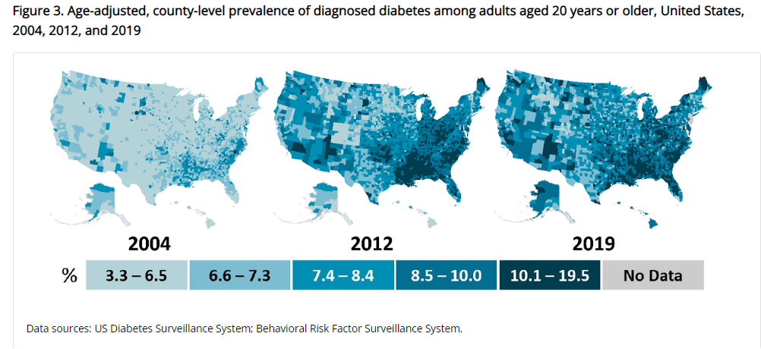
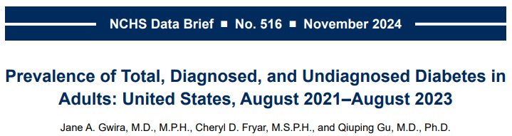
Type 2 Diabetes in America 2025
16.8% with Diabetes
11% don’t know they have it
38% with Prediabetes – 97 million adults
https://www.cdc.gov/nchs/data/databriefs/db516.pdf
Centers for Disease Control and Prevention. National Diabetes Stats Report https://www.cdc.gov/diabetes/data/statistics-report/index.html. Accessed 1/23

Slide 8
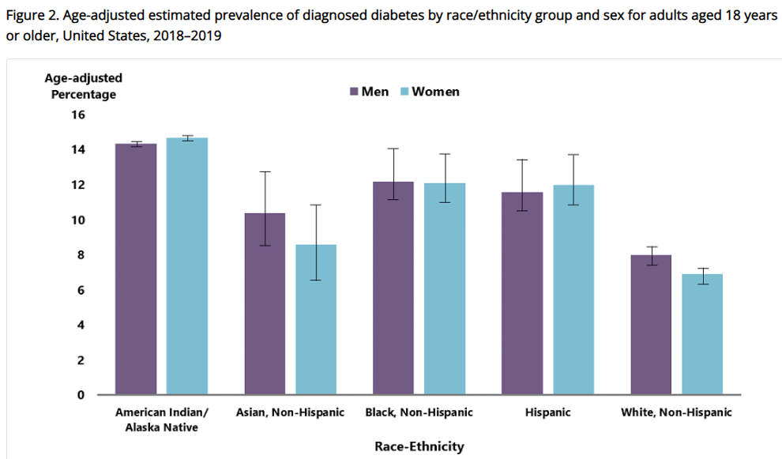
Diabetes Prevalence by Ethnic Group
For adults, diabetes prevalence highest among:
American Indians and Alaska Natives (14.5%),
Non-Hispanic Blacks (12.1%),
People of Hispanic origin (11.8%),
Non-Hispanic Asians (9.5%)
www.cdc.gov/diabetes/data/statistics-report/diagnosed-diabetes.html

Slide 9
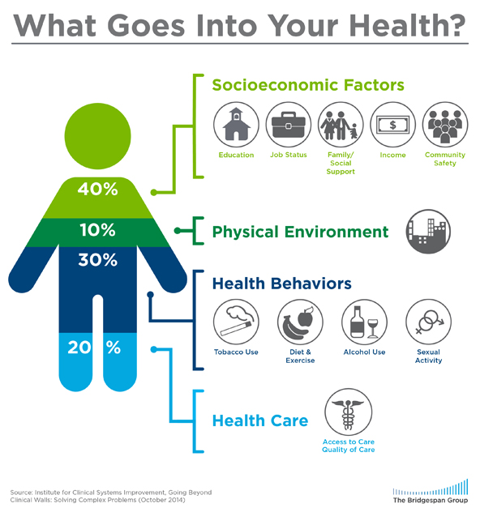
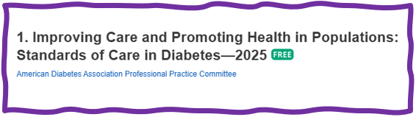
Address Barriers to Self Management
Barriers exist within health system, payer, health care professional & individual.
Address barriers through innovation, including community health workers, telehealth, other digital health solutions.
Consider social determinants of health in the target population when designing care.
https://coveragetoolkit.org/health-equity/defining-health-equity/
Notes:
Access and health equity is the ultimate goal when designing and delivering DSMES.
Creating culturally appropriate and varied modalities of settings has been shown to improve outcomes.
We know barriers to care exist at every level from the health system to individual.
However we can address these barriers by working to educate participants and health care providers on the critical times when DSMES is needed.
We can work with health systems and clinics to develop population health screening and clinical outreach,
create protocols to reduce time for referral and
collaborate health and community systems to address social needs.
We can include other health partners including community health workers to support delivery of diabetes peer support.
Barriers can be also be addressed by developing a diversity of delivery models.
From traditional inperson classrooms to community-based strategies and technology enabled solutions including telehealth or virtual environments varying modes can serve different needs.

Slide 10

Social Drivers of Health
The conditions in which people:
Play
Live
Work
Learn
Pray
Directly affects their health risks and outcome
AADE Population Health & Diabetes Educators Evolving Role 2019

Slide 11

Status of Diabetes Care
In 2015–2018, U.S. community-dwelling adults with diabetes achieved:
A1C <7% by 50.5%
75.4% achieved A1C <8%.
BP target of <130/80 achieved by 47.7%
70.4% achieved blood pressure <140/90 mmHg.
Lipid control (non-HDL cholesterol) <130 mg/dL, achieved by 55.7%
22.2% met targets for all three risk factors
Many not receiving adequate lifestyle or pharmacotherapy.

Slide 12

Let’s meet people where they are at.

Slide 13


Pre Diabetes & Type 2- Screening Guidelines (ADA 2025 Clinical Practice Guidelines)
Start screening all people at age 35.
Screen at any age if BMI ≥ 25 (Asians BMI ≥ 23) plus one or > additional risk factor:
First-degree relative w/ diabetes
Member of a high-risk ethnic population
Habitual physical inactivity
History of heart disease
Check more frequently if taking high risk meds; antiretrovirals, 2nd generation antipsychotics or steroids, thiazide diuretics, statins
History of pancreatitis, prediabetes, GDM, periodontitis

Slide 14

Diabetes 2 - Who is at Risk? (ADA 2024 Clinical Practice Guidelines)
Risk factors cont’d
HTN - BP > 130/80
HDL < 35 or triglycerides > 250
History of Gestational Diabetes Mellitus
Polycystic ovary syndrome (PCOS)
Other conditions associated w/ insulin resistance:
Elevated BMI, acanthosis nigricans (AN)
Screen using A1C, Fasting Blood Glucose or OGTT.
Repeat screening at least every 3 years if negative.
*If prediabetes or on high risk meds, recheck yearly

Slide 15

Poll Question 2
Which of the following level is considered diabetes range?
a. Random BG of 211
b. A1c of 5.9 %
c. After meal BG of 197
d. Fasting BG 119

Slide 16
2. Diagnosis and Classification and of Diabetes Natural History of Diabetes
No diabetes
FBG <100
Random <140
A1c <5.7%
Prediabetes
FBG 100-125
Random 140 - 199
A1c ~ 5.7- 6.4%
50% working pancreas
Diabetes
FBG 126 +
Random 200 +
A1c 6.5% or +
20% working pancreas
Yes!
NO
Development of type 2 diabetes happens over years or decades

Slide 17

Poll Question 3
What best describes prediabetes in the U.S.?
Prediabetes affects 18-20% of people above the age of 20.
Prediabetes is associated with increased risk of CV disease
The prevalence of prediabetes and diabetes are almost equal.
Most people with BMI of 30 or greater have prediabetes.

Slide 18



PreDiabetes is FREAKING ME OUT
96 million people in US
38% of population
80% don’t know they have it
In 3-5 years, about 30% of predm will get diabetes
Associated with higher rates of heart attack, stroke, neuropathy and vessel disease

Slide 19

Get About 7 Hours of Quality Sleep to Prevent Diabetes
Poor sleep quality was associated with a 40–84% increased risk of developing type 2 diabetes in a meta-analysis.
Chronotype preference has been linked with many chronic diseases, including type 2 diabetes.
For those with a preference for evenings (i.e., going to bed late and getting up late)
2.5-fold higher odds ratio for type 2 diabetes than for those with a preference for mornings (i.e., going to bed early and getting up early),
Independent of sleep duration and sleep sufficiency
The composition of the gut microbiome may also affect the likelihood of developing type 2 diabetes.

Slide 20
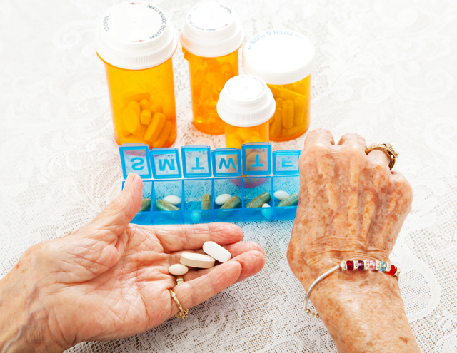
3. Pharmacologic Interventions
Use more intensive approach for high-risk individuals:
BMI of 35+
If A1C is ~6.0 or FPG is 110
History of GDM
No FDA approved med for prevention (off label)
Consider Metformin Therapy for Prediabetes
Monitor B12 level (esp with neuropathy or anemia)
CV Risk Mitigation important.
Statin can increase BG, stop if notice elevation
Consider low dose pioglitazone (Actos) if history of stroke.

Slide 21


Indications for Insulin Sensitizers Rosiglitazone (Avandia), Pioglitazone (Actos)
Action: decrease insulin resistance by making muscle and adipose cells more sensitive to insulin. Decrease free fatty acids
Names:
pioglitazone (Actos) – bladder cancer warning
Dosing: 15-45 mg daily
Consider adding low dose if history of stroke or with steatosis
Efficacy/ Considerations
Reduce A1C ~0.5-1.0%
6 weeks for maximum effect
Pioglitzone $5 a month
Can cause fluid retention, not indicated w/ CHF
Notes:
21
21
Thiazolidinediones (TZDs) enhance insulin sensitivity in muscle and adipose tissue by binding to cell receptors,which leads to an increase in glucose transporter expression. TZDs encourage beta cells to respond more efficiently by lowering the amount of glucose and free fatty acids in the bloodstream, both of which are known to be detrimental to insulin secretion. Finally, these drugs reduce glucose production in the liver.
Clinical trials indicate that pioglitazone and rosiglitazone are slightly more effective at reducing A1C (1.5-1.6% reduction) than troglitazone (1.1% reduction).
Some of the beneficial side effects of thiazolidinediones include an increase in HDL cholesterol and reduction of triglyceride concentrations. This class of drugs has also been shown to lower blood pressure and decrease vascular inflammation in vitro. There are clinical studies underway to further examine the cardiovascular benefit to TZDs.
Some adverse effects of TZDs include weight gain, a potential increase in LDL cholesterol levels, and a possible increase in alanine aminotransferase levels (ALT). Because of the risk of weight gain, edema, and increased LDL cholesterol, thiazolidinediones are contraindicated in patients with advanced forms of congestive heart failure. Due to reported cases of liver failure and liver toxicity caused by the increase in ALT levels, TZDs are contraindicated in patients with abnormal liver function.
TZDs are the most expensive of the oral antidiabetic agents.

Slide 22




Slide 23
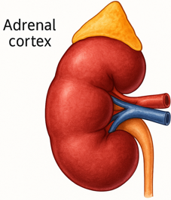

The Noxious Nine – Pathophysiology T2D
Hypercortisolism
Neurotrans-mission dysfunction
Decreased Insulin β-cell secretion
Increased renal glucose reabsorption
Decreased incretin effect Gut hormones
G
Increased glucagon α-cell secretion
I
G
I
G
G
I
I
G
Increased lipolysis
G
G
I
I
G
G
I
Increased hepatic glucose
production
I
G
G
Decreased muscle glucose uptake
DeFronzo, Auchus-Hypercortisolism June 2025
Notes:
23
ummary: The Noxious Nine in Diabetes Pathophysiology
Ralph A. DeFronzo expanded his earlier conceptual model of diabetes—known as the Ominous Octet—to include a ninth element: hypercortisolism. This updated framework is referred to as the Noxious Nine, highlighting the important role of cortisol dysregulation in difficult-to-control type 2 diabetes currentsciencedaily.com+8HCP Live+8HCP Live+8.
Recent research, including the CATALYST trial, shows that about 24% of patients with difficult-to-control T2D have underlying hypercortisolism. Treating this condition with mifepristone, a glucocorticoid receptor antagonist, led to significant improvements in HbA1c—averaging around a 1.5% reduction pmc.ncbi.nlm.nih.gov+3HCP Live+3medscape.com+3.
These findings emphasize the importance of recognizing hypercortisolism in T2D care and suggest that addressing it may help improve glycemic and metabolic control in a subset of patients.
23

Slide 24
POLL Question #4
AJ is a 52-year-old with type 2 diabetes presents with worsening hyperglycemia despite taking three diabetes medications. AJ says, “No matter what I do, I can’t seem to get my blood sugars down”.
Which of the following clusters of physical findings would increase your suspicion that AJ is struggling with hypercortisolism?
A. Dorsocervical fat pad, wide purple striae and bruising.
B. Peripheral muscle hypertrophy, thick hair growth, and flushed skin.
C. Weight loss, skin hyperpigmentation, and generalized muscle wasting.
D. Pallor, brittle nails, and spoon-shaped fingernails.

Slide 25
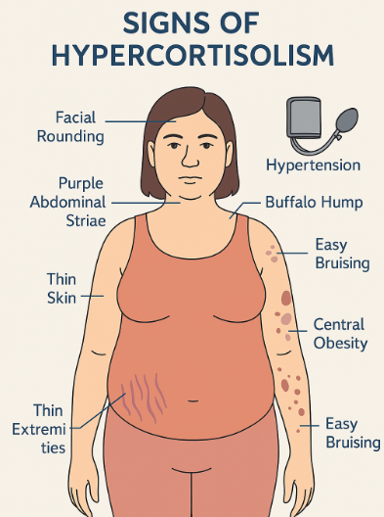
Signs of Hypercortisolism
Other signs
High blood pressure,
Hyperglycemia
Visceral adiposity
Bone loss, fractures
muscle weakness,
excessive hair growth,
acne,
mood changes like irritability and depression.
Hypothalamus → CRH → Pituitary → ACTH → Adrenal → Cortisol
Cortisol effects: gluconeogenesis, insulin resistance, fat redistribution

Slide 26
CATALYST Study Findings
Findings from the CATALYST study, the largest prospective trial of its kind, suggest that hypercortisolism may be a significant contributing factor in as many as one in four patients with difficult-to-control type 2 diabetes.

Slide 27
CATALYST Study: Hypercortisolism & Difficult-to-Control Type 2 Diabetes
Study Design Overview Prospective observational screening of ~1,000 adults with HbA1c 7.5–11.5%, on multiple antihyperglycemic agents.
Screening tool: Overnight 1 mg dexamethasone suppression test (DST).
Hypercortisolism defined as post-DST cortisol >1.8 µg/dL with adequate dexamethasone levels.

Slide 28
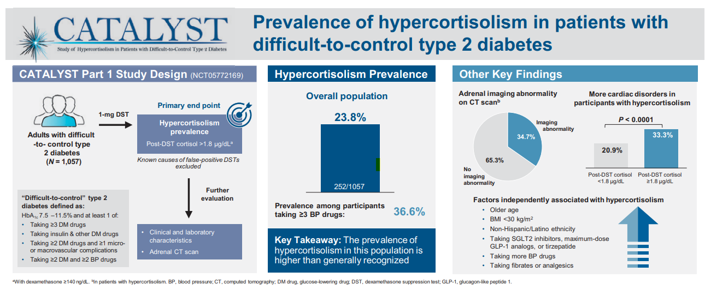
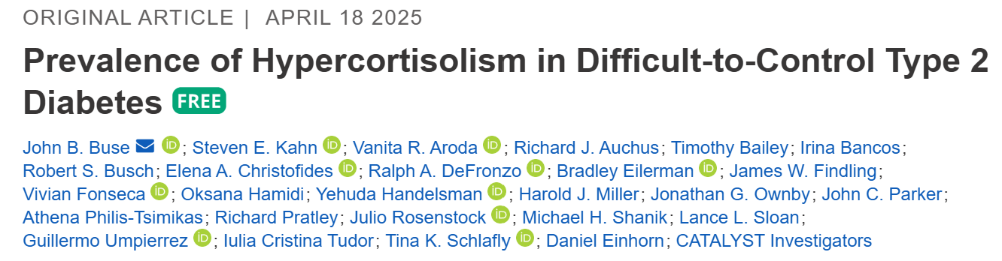
Study Design & Prevalence
Findings
23.8% of study participants had hypercortisolism
Prevalence 36.6% in those on ≥3 antihypertensives
34.7% adrenal abnormalities on CT

Slide 29
Study Design – Part 2 (Intervention)
Randomized, double-blind, placebo-controlled intervention
N = 136 participants with confirmed hypercortisolism
Mifepristone: 300 mg daily escalating up to 900 mg over 24 weeks
Primary endpoint: HbA1c reduction; Secondary: weight, meds, safety.
Mifepristone is a glucocorticoid (cortisol) receptor Antagonist.
SE’s include: fatigue, N/V, hypokalemia, edema, HTN
10% experience adverse side effects from glucocorticoid withdraw.

Slide 30
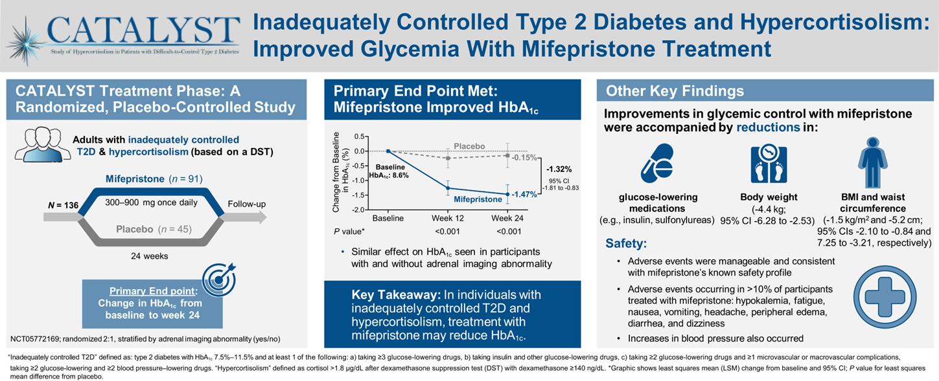
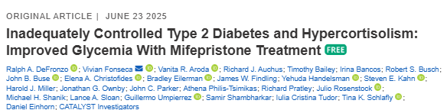
CATALYST Treatment Outcomes
Mifepristone significantly improves glycemic control and weight
Next steps: broader screening, novel cortisol-targeted therapies, long-term outcomes.

Slide 31
Intervention Outcomes
A1c ↓ ~1.5% vs. 0.2% in placebo group
Weight ↓ ~10 pounds; waist circumference ↓ ~2 inches
Many reduced or stopped other diabetes meds, including insulin.
Adverse events mostly mild to moderate (glucocorticoid withdrawal symptoms).
Hypokalemia observed; manageable clinically.
Discontinuation ~40%, mostly due to tolerability issues.
Question: How realistic is this to implement in primary care / Endo settings?

Slide 32
Hypercortisolism in Type 2
Cortisol increases gluconeogenesis in the liver
Reduces peripheral glucose uptake → insulin resistance
Stimulates protein catabolism and lipolysis
Chronic cortisol elevation → persistent hyperglycemia
Can lead to “Difficult to Control Type 2 Diabetes”
CATALYST study revealed about 24% of people with elevated BG despite meds, may be due to hypercortisolism.
Treatment with mifepristone decreased weight, waistline, BG.
DeFronzo, Auchus-Hypercortisolism June 2025
pmc.ncbi.nlm.nih.gov+3HCP

Slide 33

Step Wise Approach to Hyperglycemia 2025
Usually, start one medication at a time
However, evidence supports initial combo therapy if A1C 8.5% or more, to quickly reach goals and slow decline of glucose control.
Where to start?
Individual values
CVD, Heart failure or Kidney Disease
Minimize Hypoglycemia
Minimize wt gain or promote wt loss
Consider Cost

Slide 34
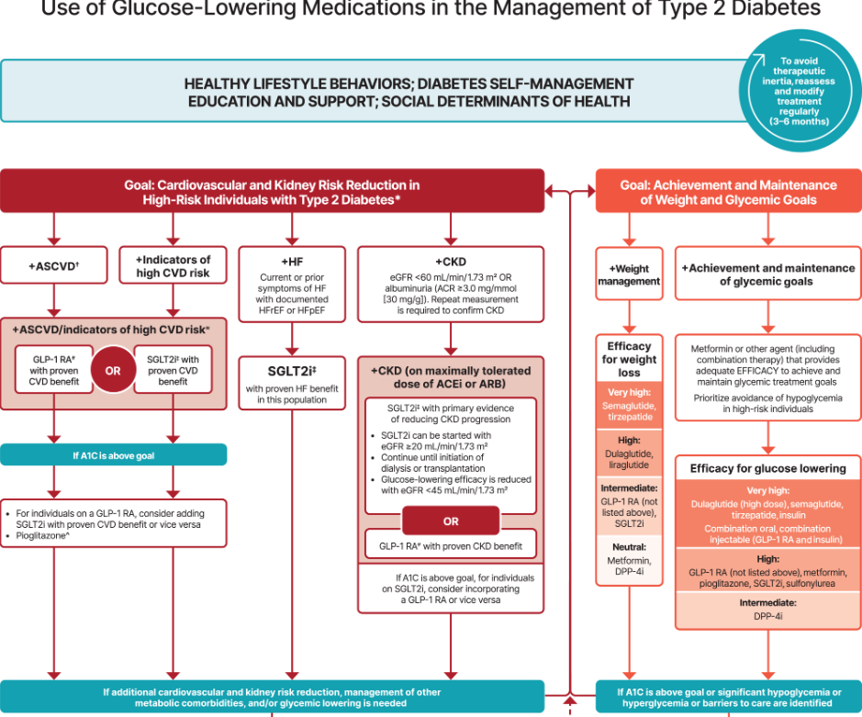

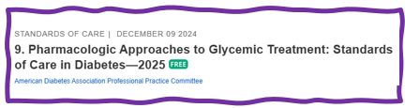
Let’s Break it Down ADA 2025

Slide 35

Quick Question 5
RT, a 61-year-old woman with BMI of 28 and type 2 diabetes 3 months. She wanted to try to manage diabetes with diet and exercise. GFR in 90s, UACR 14mg/gm, A1c 7.4%. Based on this info, which medication would you start?
A. Pioglitazone
B. Metformin
C. GLP1-RA
D. Sulfonylurea

Slide 36
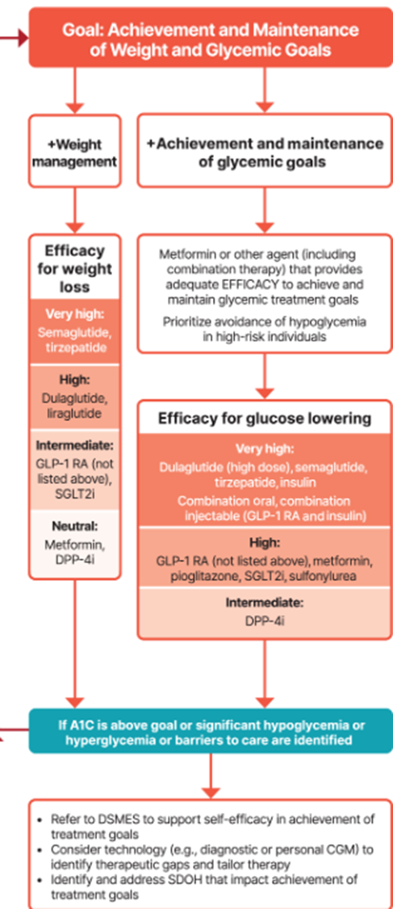
Metformin is “Usually” 1st Line
Why metformin?
Longstanding evidence
High efficacy and safety
Inexpensive - 3 months for $12
Weight neutral
Check B12 levels at intervals especially if anemia or neuropathy.
If ASCVD, HF or CKD or high ASCVD risk, use SGLT2i or GLP-1 RA +/- metformin
If A1C ≥ 8.5%, consider combo therapy.

Slide 37
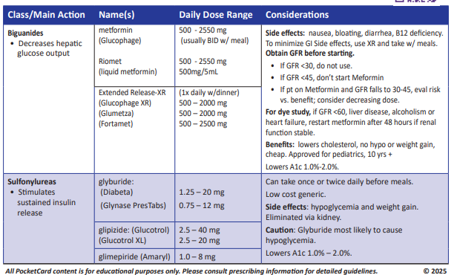

Slide 38

Metformin and Kidney Disease – 2025 Update
Metformin is also a preferred agent in CKD due to well-documented efficacy and safety profile in type 2 diabetes.
However, there is no documented direct kidney benefit.
Don’t start metformin if eGFR is <45
Reduce dose of metformin if eGFR is <45 individual is already on metformin.
Stop metformin once eGFR is <30

Slide 39

SGLT-2 Inhibitors

Slide 40

Poll Question 6
RL is a 43 year old who was on insulin after experiencing GDM. She then was started on a GLP-1, Metformin and an SGLT-2, and stopped the insulin completely. Her daughter told her, “Your breath smells funny”. A1C 7.9%. What are you worried about?
Euglycemic DKA
Dental caries
Renal failure
Steatosis

Slide 41
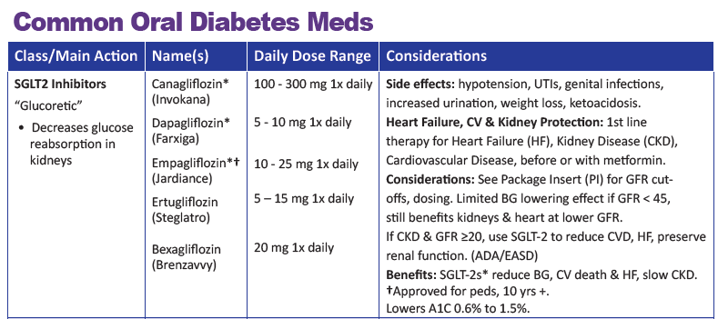
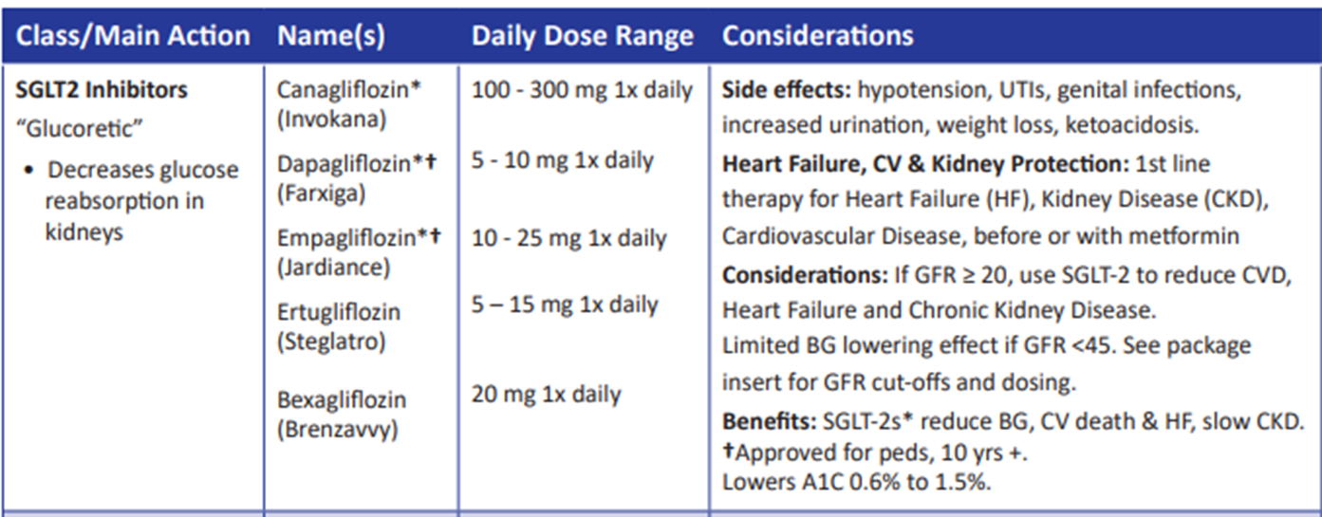

SGLT-2 Inhibitors
FDA Warning of DKA – Not approved for Type 1 (but used off-label) ~ increases risk of EDKA by 4-6%
Increased risk for those with type 2 on insulin + SGLT-2 Inhibitor
Decreased insulin dose due to lower BG on SGLT-2 Inhibitors
Can lead to insulin deprivation and ketoacidosis

Slide 42
Benefits of SGLT-2 Inhibitors
A1C lowering
Weight loss
Cardiovascular
Renal
Heart failure
Blood pressure lowering

Slide 43
Side Effects of SGLT-2 Inhibitors
Genitourinary infections
Volume depletion
Increased urination
Hypotension
UTI
Diabetes ketoacidosis (DKA)
Notes:
Cana: bone mineral density decline: hip ≤1%; lumbar spine, femoral neck, and distal forearm <1%
UTI: 6%Genito infection: 11-12%
Increased serum K+: 9-27%
Amputation risk
Emgag: UTI: females 18%, males 4%
Genito infection: 5%
Dapag: UTI: 6%, genito infection: 3%

Slide 44
SGLT-2i Indications Summary
Drug | Lower BG | Reduce CV Risk? | Use to treat Heart Failure? | Slow renal disease?
Dapagliflozin (Farxiga) | Yes | Yes | Yes +/- Diabetes | Yes
Empagliflozin (Jardiance) | Yes | Yes | Yes +/- Diabetes | Yes
Canagliflozin (Invokana) | Yes | Yes | Yes w/ Diabetes | Yes
Ertugliflozin (Steglatro) | Yes | No | Yes w/ Diabetes | Yes
Bexagliflozin (Brenzavvy) | Yes | NA | NA | NA
Package inserts, dailymed.nlm.nih.gov

Slide 45
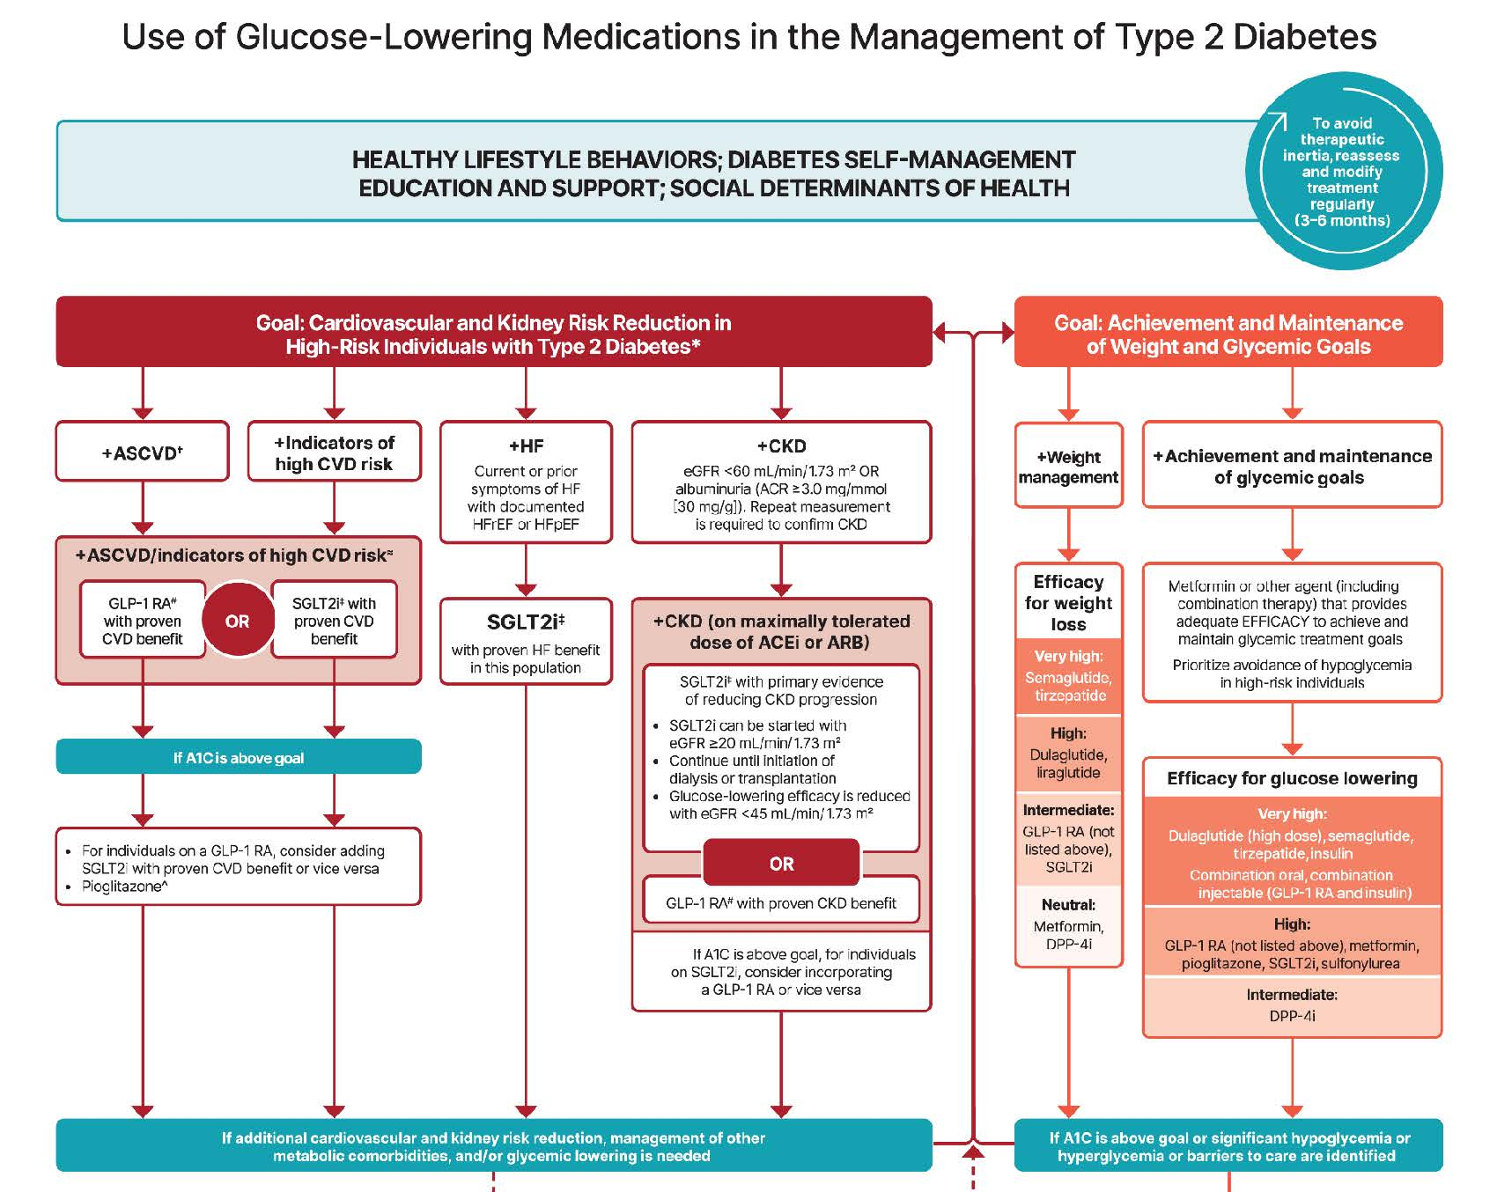


Slide 46

Case Study Question 7
MZ is complaining of nausea, and increased eructation?
What class of medication may be causing these side effects?
GLP-1/GIP Receptor Agonists
Metformin
SGLT-2 Inhibitor
DPP-IV Inhibitor

Slide 47

Incretins: GLP & GIP Receptor Agonists
GLP-1: glucagon like peptide 1
GIP: glucose-dependent insulinotropic polypeptide

Slide 48
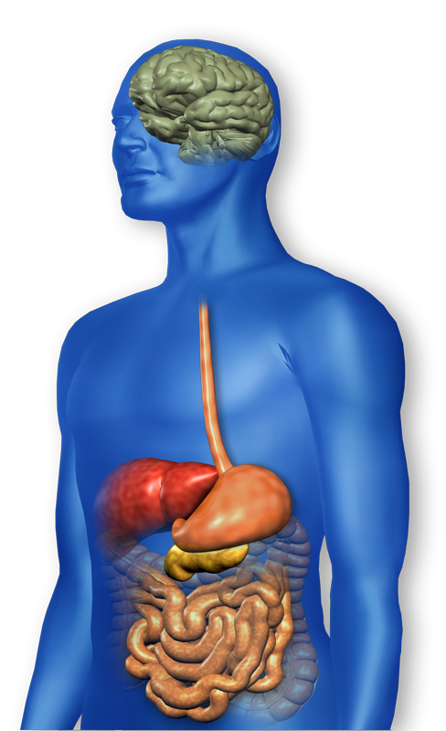
GLP-1 Effects in Humans Understanding the Natural Role of Incretins
GLP-1 secreted upon the ingestion of food
Promotes satiety and reduces appetite
Alpha cells:
↓ Postprandial glucagon secretion
↑ Beta-cell
response
Liver: ↓ Glucagon reduces hepatic glucose output
Beta cells: Enhances glucose-dependent insulin secretion
Stomach: Helps regulate gastric emptying
Adapted from Flint A, et al. J Clin Invest. 1998;101:515-520 Adapted from Larsson H, et al. Acta Physiol Scand. 1997;160:413-422 Adapted from Nauck MA, et al. Diabetologia. 1996;39:1546-1553 Adapted from Drucker DJ. Diabetes. 1998;47:159-169
GLP-1 degraded by
DPP-4 w/in minutes
Notes:
48
48
Required
DISCUSSION POINTS:
--Upon food ingestion, GLP-1 is secreted into the circulation from L cells of small intestine.
--GLP-1 increases beta-cell response by enhancing glucose-dependent insulin secretion.
--GLP-1 decreases beta-cell workload and hence the demand for insulin secretion by:
--Regulating the rate of gastric emptying such that meal nutrients are delivered to the small intestine and, in turn, absorbed into the circulation more smoothly, reducing peak nutrient absorption and insulin demand (beta-cell workload)
--Decreasing postprandial glucagon secretion from pancreatic alpha cells, which helps to maintain the counterregulatory balance between insulin and glucagon
--Reducing postprandial glucagon secretion, GLP-1 has an indirect benefit on beta-cell workload, since decreased glucagon secretion will produce decreased postprandial hepatic glucose output
--Having effects on the central nervous system, resulting in increased satiety (sensation of satisfaction with food intake) and a reduction of food intake
--By decreasing beta-cell workload and improving beta-cell response, GLP-1 is an important regulator of glucose homeostasis.
SLIDE BACKGROUND:
--Effect on Beta-cell: Drucker DJ. Diabetes. 1998; 47:159-169
--Effect on Alpha cell: Larsson H, et al. Acta Physiol Scand. 1997; 160:413-422
--Effects on Liver: Larsson H, et al. Acta Physiol Scand. 1997; 160:413-422
--Effects on Stomach: Nauck MA, et al. Diabetologia. 1996; 39:1546-1553
--Effects on CNS: Flint A, et al. J Clin Invest. 1998; 101:515-520

Slide 49
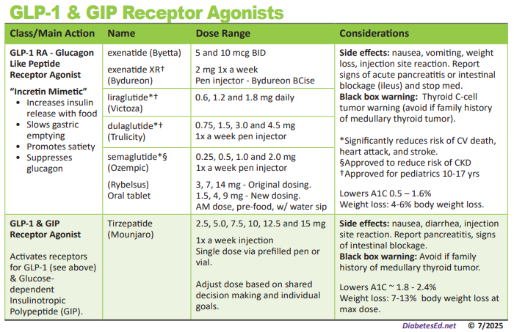
Pocket Card: GLP-1 & GIP RA
Notes:
Update with exenatide indication in pediatrics.

Slide 50

Counseling Points: GLP-1 RA & GLP-1/GIP
Avoid if personal or family history of medullary thyroid cancer
Avoid in combo with DPP-4 inhibitors
Watch for intestinal obstruction
Use of non-FDA compounded products not recommended
Avoid with history pancreatitis
If on tirzepitide, use back up contraception for first 4 weeks
Ask about recent eye exam
Potential increase in diabetes retinopathy
Sudden discontinuation of semaglutide and tirzepitide results in regain of one-half to two-thirds of the weight loss within 1 year. Consider trying lowest effective dose, using intermittent therapy, or stopping medication followed by close weight monitoring.
Notes:
Inject at room temperature, let alcohol fully dry

Slide 52
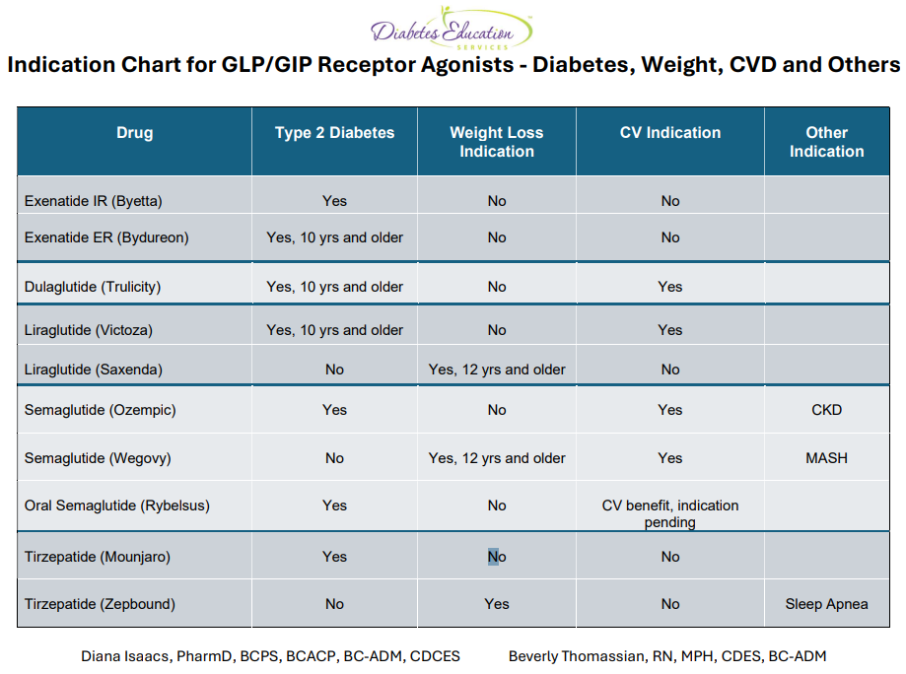
GLP-1/GIP Receptor Agonist Indications
Drug | Lower BG | Reduce CV / Kidney Risk? | Wt loss /other approved?
Exenatide IR (Byetta) Lixisenatide (Adlyxin) Semaglutide (Rybelsus) | Yes
Exenatide ER (Bydureon) | Yes for 10 yrs and older
Dulaglutide (Trulicity) | Yes for 10 yrs and older | Yes
Semaglutide (Ozempic) | Yes | Yes Approved for CKD | Wegovy 2.4mg Approved for Steatosis/CV disease
Liraglutide (Victoza) | Yes for 10 yrs and older | Yes | Yes Saxenda 3mg
Tirzepatide (Mounjaro) | Yes | ? | Zepbound up to 15 mg Sleep apnea approved
Package inserts, dailymed.nlm.nih.gov

Slide 53
Diabetes Bingo “DiaBingo” Shout out Right Answer

Slide 54
DiaBingo
B Frequent skin and yeast infections
B A BMI of ____ or greater indicates increased pre/diabetes risk?
B To reduce complications, control A1c, Blood pressure, Cholesterol
B PreDiabetes – fasting glucose level of ___ to ____
B Erectile dysfunction indicates greater risk for ____
B Diabetes – fasting glucose level____ or greater
B Type 1 diabetes is best described as an ______ disease
B People with diabetes are ______ times more likely to die of heart dx
B Elevated triglycerides, < HDL, smaller dense LDL
B Each percentage point of A1C = _____ mg/dl glucose
B At dx of type 2, about __% of the beta cell function is lost
B Diabetes – random glucose ____ or greater

Slide 55

Medication Taking Behaviors
Adequate medication taking is defined as 80%
23% of time, if A1c, B/P, lipids above target - due to med taking behavior
Assess for barriers
If taking meds 80% of time and goals not met, consider medication intensification
Barriers include:
Forgetting to fill Rx, forgetting to take, fear, depression, health beliefs, med complexity, cost, knowledge gap, system factors, etc.
Work on targeted approach for specific barrier

Slide 56

Wait, What About Emotions?

Slide 57

Diabetes Admit for Hyperglycemia
John is admitted for hyperglycemia because he stopped taking his diabetes meds.
HCP says, “Don’t you realize you are going to get complications, like kidney disease or amputation if you don’t take your medications?”
Door Closed – No Connection made
How Does John Feel?
Embarrassed
Ashamed
Defeated
Angry
Unheard
How does HCP feel?
Frustrated
Defeated
Worried

Slide 58

Missed Appointments due to Stigma and Shame
A recent survey of over 2,600 people with diabetes across eight countries revealed that nearly 40% of missed doctor’s appointments are due to stigma or shame.
Abbott. (2025, February 4). Abbott’s Above the Bias film reveals misconceptions can impact diabetes care. https://abbott. mediaroom.com/2025-02-04-Abbotts-Above-the-Bias-FilmReveals-Misconceptions-Can-Impact-Diabetes-Care
Notes:
Many healthcare professionals incorrectly assume that people with
diabetes are not reaching their goals due to a lack of effort. If they
“just tried hard enough,” they could reach the recommended timein-range target. Unfortunately, this false belief can build a wall of
misunderstanding between the HCP and the person with diabetes

Slide 59
Diabetes Visit – Let’s Go through
How Does John Feel?
A small adjustment can make a BIG Difference
Heard & Seen
Recognized
Connected
Engaged
How does the HCP feel?
Connected
Concerned
Collaborative
HCP says, “John, I am worried about you and your elevated blood glucose. Can you share what is going on in your life?”
Door Open – Connection made
Healing to HCP
Bidirectional Healing
Healing to Person

Slide 60
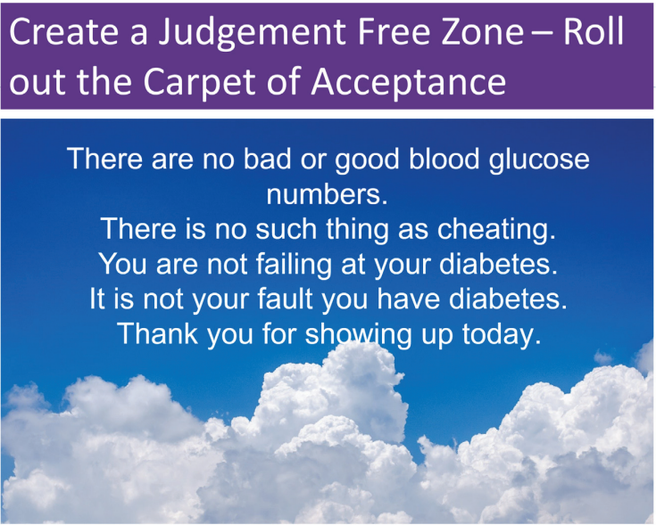

Slide 61
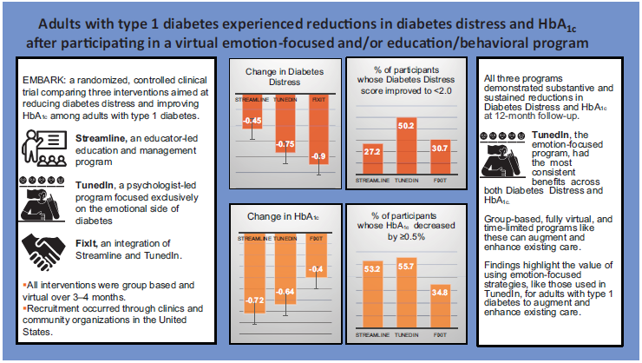
EMBARK Trial
EMBARK: A Randomized, Controlled Trial Comparing Three Approaches to Reducing Diabetes Distress and Improving HbA_{1c} in Adults With Type 1 Diabetes. Diabetes Care 2024; dc232452. https://doi.org/10.2337/dc23-2452

Slide 62

Embark Trial – Emotions as Priority
I have finally given myself permission to make addressing the emotional aspects of diabetes a priority.
~Coach Beverly

Slide 63

Releasing the Brake
This strategy recognizes that diabetes distress acts as a brake on the application of existing diabetes knowledge and skills.
By releasing the diabetes distress brake through emotion-focused intervention, the negative cycle can be efficiently ended.

Slide 64

Commit to Listening at least Half of the Time

Slide 65

Language of Diabetes Education
Old Way
New Way
Control diabetes
Test BG
Patient
Normal BG
Non-adherent, compliant
Refuse
Manage
Check
Participant
BG in target range
Focus on what they are accomplishing
Decided, chose

Slide 66

Diabetes is Complex
Goal – achieve well being and negotiated outcomes
Psychological factors:
Environmental
Social
Behavioral
Emotional
Keep it person centered while integrating care into daily life
Consider the individual

Slide 67



4. Comprehensive Medical Evaluation and Assessment of Comorbidities
Person centered communication, strength-based language, active listening, literacy, quality of life
It is necessary to take into account all aspects of a person’s life circumstance (SDOH)
It is important to integrate medical eval, engagement and lifestyle changes.
Interdisciplinary teams provide best care

Slide 68
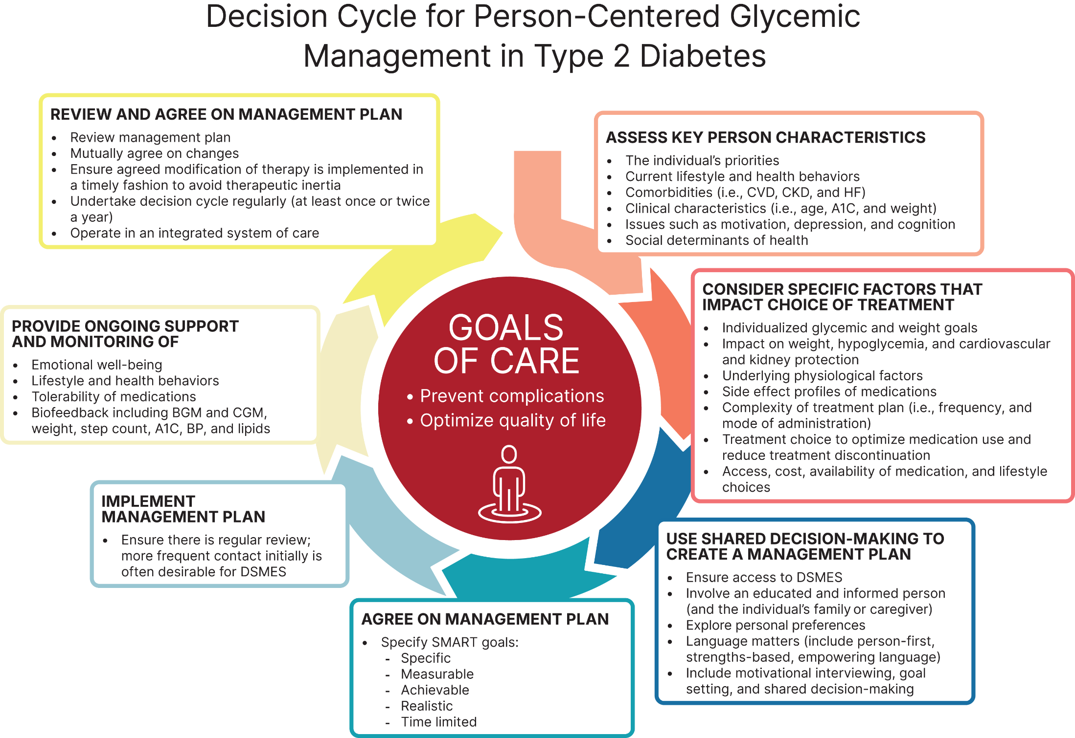


Slide 69
Diabetes Goals and Treatment Plan
The goals of treatment for diabetes are to prevent or delay complications and optimize quality of life.
Goals and plans co-created by the care team and individual based on preferences, values, and goals.
Management plan considers the person’s:
Age, cognitive abilities, school/work schedule and conditions,
Health beliefs, support systems, social situation, financial concerns, cultural factors, literacy and numeracy
Eating patterns, physical activity, (mathematical literacy)
Diabetes history (duration, complications, and current use of medications), comorbidities, disabilities, health priorities, other medical conditions
Preferences for care, access to health care services, and life expectancy

Slide 70

Case Study - JR
38 yr old male, BMI 28, arrives in clinic for physical. Says he has been feeling tired lately, but attributes that to his job. In office fingerstick reads 228 mg/dl.
1. What lab tests are needed?
2. What would you include in your physical exam?
What vaccinations?
What referrals?
What tools?

Slide 71

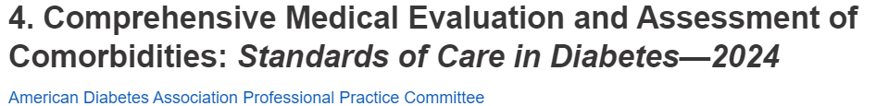
Lab Eval at Initial & Annual Visit
A1c (each 3-6 mo’s)
Each year
Lipids, CBC with platelets
Liver function
Spot urinary albumin-to-creat ratio (UACR))
Serum creat and GFR
TSH, celiac (type 1)
B12 if on metformin >5yrs
Calcium, Vita D, and phosphorus if appropriate
Serum K
If on ACE, ARBs or diuretics

Slide 72
Case Study - JR
38 yr old male, BMI 28, arrives in clinic for physical. Says he has been feeling tired lately, but attributes that to his job. In office fingerstick reads 228 mg/dl.
1. What lab tests are needed?
2. What would you include in your initial exam?
What vaccinations?
What referrals?
What tools?

Slide 73

Physical Exam
Height, weight, BMI, pubertal development
Blood pressure
Fundoscopic exam, thyroid
Skin exam –insertion sites, acanthosis, fungus, sores, feet
Bone health, Hypo
Depression, Distress Anxiety
Functional and cognitive issues
Comprehensive foot exam
Visual eval
Screen for Peripheral Arterial Disease
Monofilament and vibration assessment

Slide 74
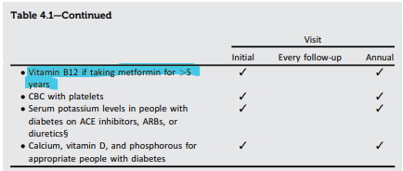
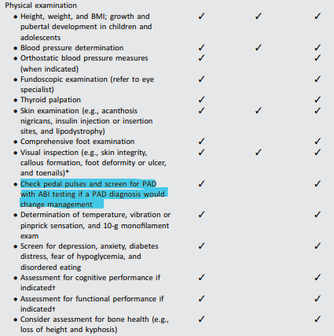
Standard 4 – Diabetes Medical Evaluation

Slide 75
Assessment and Treatment Plan
Assessing risk of diabetes complications
• ASCVD and heart failure history
• ASCVD risk factors and 10-year ASCVD risk assessment
• Staging of chronic kidney disease
• Hypoglycemia risk
• Assessment for retinopathy
• Assessment for neuropathy
• Assessment for MASLD/MASH
Goal setting
• Set A1C/blood glucose/time in range
• If hypertension is present, establish blood pressure goal
• Weight management and physical activity goals
• Diabetes self-management goals
Therapeutic treatment plans
• Lifestyle management
• Pharmacologic therapy: glucose lowering
• Pharmacologic therapy: cardiovascular and kidney disease risk factors
• Weight management with pharmacotherapy or metabolic surgery, as appropriate
• Use of glucose monitoring and insulin delivery devices
• Referral to diabetes education, behavioral health, and medical specialists

Slide 76

Assessment and Treatment of Disabilities
Diabetes associated with increased risks of disability due to neuropathy, visual impairment and lower limb complications
Refer to specialist
Take preventive action to maximize quality of life.
Assess for disability at the initial visit and for decline in function at each subsequent. If a disability is impacting functional ability or capacity to manage their diabetes, refer to appropriate specialist.

Slide 77
Lab Test, BP, Family History
A1C – 9.8%
Cholesterol - 216
LDL – 164 mg/dL
HDL – 46
Triglycerides – 276
TSH – 1.43
GFR - >60
UACR - <30 mg/gm
ALT, AST 90 & 85
Platelets 217
K+ 3.8
Family history
Dad with type 2, history of stroke
B/P
156/88 then 148/82
BMI 31
Skin – some acanthosis nigricans visible on neck
Lower extremities okay
Mouth - gingivitis

Slide 78
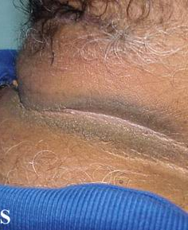
Acanthosis Nigricans
A skin disorder characterized by darkening (hyperpigmentation) and thickening (hyperkeratosis)of the skin
mainly in the folds of the skin in the armpit (axilla), groin and back of the neck.
Acanthosis nigricans is not a skin disease per se but a cutaneous sign of an underlying condition or disease.
Associated with extra weight and insulin resistance

Slide 79
Case Study - JR
38 yr old male, BMI 28, arrives in clinic for physical. Says he has been feeling tired lately, but attributes that to his job. In office fingerstick reads 228 mg/dl.
1. What lab tests are needed?
2. What would you include in your initial exam?
What vaccinations?
What referrals?
What tools?

Slide 80

Medical Evaluation Goal
Prioritize components based on time and resources.
Assess:
Diabetes self-management, nutrition, psychosocial health, risk of acute and chronic complications
Immunizations
Sleep habits
Cancer screenings
Bone Health
Liver Health
Cardiovascular disease
Smoking cessation
Ophthalmological, dental and podiatric referrals

Slide 81

Poll Question 8
JR is 38 years old and has new diabetes. Wondering what vaccinations they need this year. What is the BEST answer?
Influenza vaccine
Hepatitis B vaccine
Herpes Zoster vaccine
Both A and B

Slide 82
Immunization Schedule for Diabetes 2025
Vaccine | Who by Age | Series and Frequency
Hepatitis B Vaccine | Less than 60 years* | 2-3 dose series
RSV | Adults ≥ 60 years | Single dose
Influenza (avoid live attenuated vaccine) | All | Annually
Tetanus, diphtheria, pertussis (TDAP) | All adults; extra dose during pregnancy | Booster every 10 years.
Zoster | 50+ | 2 dose Shingrix
COVID-19 | Starting at age 6 mo’s | Initial vaccination and boosters
Pneumonia (PPSV23) Pneumovax | Adults19-64* | See Standards for schedule and details and for those 65 or older.
*Pneumococcal Conjugate Vaccine (PCV15, PCV20) | 19-64 with underlying risk factors or no previous vaccination*. | May need PPSV23 follow-up vaccine ≥1 year.* If 65+, discuss with provider.
2025 ADA Standards, Vol.48, S66-S67 *See Table 4.3 for detailed info/considerations
For a comprehensive list of vaccines, refer CDC & Prevention at cdc.gov/vaccines
.
For educational purposes only. www.DiabetesEd.net

Slide 83

Referrals for Initial Care Mgmt
Eye professional – annual check
Family planning
RD for nutrition therapy
DSMES - Diabetes Self-Management Education Support
Dentist for comprehensive dental examination
Behavioral health professional & audiology, if indicated
Social worker/community resources
Rehab medicine for cog/disability eval

Slide 84
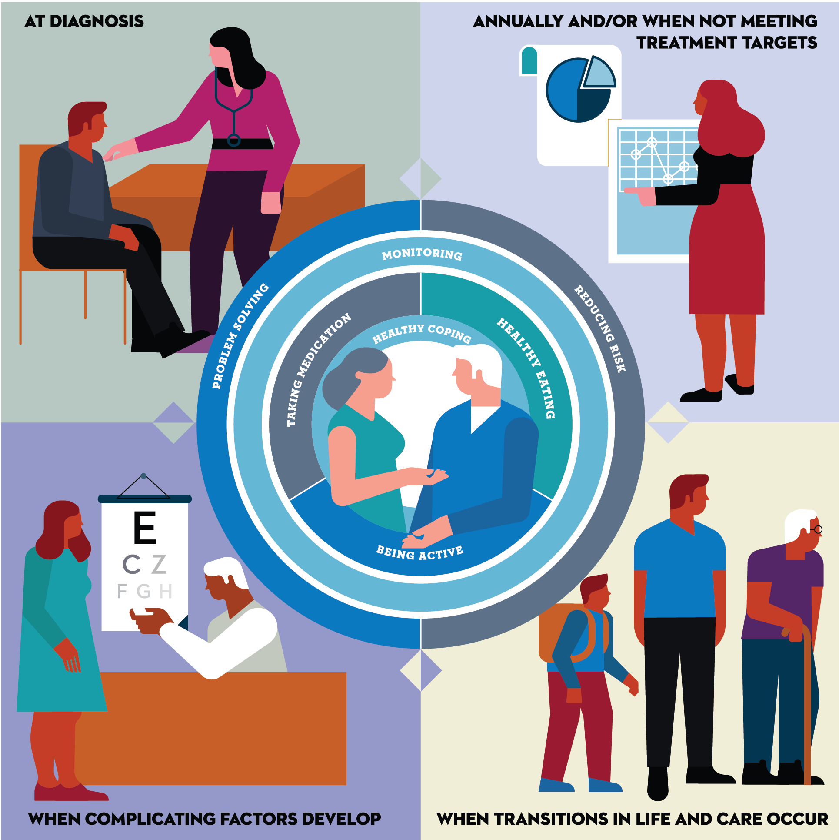

Critical times to provide and modify DSMES
- At diagnosis
- Annually and/or when not meeting treatment goals
- When complicating factors develop (medical, physical, psychosocial) develop
- When transitions in life and care occur.
Powers MA, Bardsley JK, et al. DSMES Consensus Report, The Diabetes Educator, 2020
ADCES. AADE7 Self-Care Behaviors, The Diabetes Educator, 2020

Slide 85

Diabetes Self-Management Topics
History of DSME attendance
Individual visit with RD, RN, CDCES
Hypoglycemia – timing of episodes, awareness, frequency and action
Pregnancy planning
Assess & Screen for Psychosocial /Emotional Issues
Anxiety
Depression
Distress
Serious mental illness (increases risk of diabetes)

Slide 86

Case Study - JR
38 yr old male, BMI 28, arrives in clinic for physical. Says he has been feeling tired lately, but attributes that to his job. In office fingerstick reads 228 mg/dl.
1. What lab tests are needed?
2. What would you include in your initial exam?
What vaccinations?
What referrals?
What tools?

Slide 87
Diabetes Toolkit - Individualize
Meter
Strips that aren’t expired?
List of Meds
Plan for Lows
Emergency Plan
Power back-up
BG Checks and logging results
Diabetes ID
Phone, medic alert, on person
Carbohydrate source
Granola bar, glucose tabs, GU, gummy bears
Rescue Meds

Slide 88

Behavioral Factors and Med Taking
Eating Patterns & weight history, carb counting
Sleep behaviors – goal 7 hrs
Tobacco, alcohol, substance use, physical activity
Social supports and coping skills, daily routine
Medication taking behaviors
How many times a day/week are you taking this medication?
Complimentary meds
Evaluate for hyper and hypo glycemia

Slide 89

Cost Related Barriers
Among people with chronic illnesses, 2/3 of those who reported not taking medications as prescribed due to CRB never shared this with their physician.
Especially associated with diabetes medications and insulin.

Slide 90
JR Returns in 1 month
Blood glucose improved
B/P 142/94 Pulse 86
Meds started include:
Metformin 1000 mg
Glipizide 10 mg BID (sulfonylurea)
Lovastatin 40 mg
Lisinopril 20mg (ACE Inhibitor)
JR checks BG 4-7 x’s a week.
Lowest 152, Highest 289
What other issues do we need to evaluate?
Activity – mostly sedentary
Sleep: 6-7 hrs a night
Pain issues – knees
Brushing – once daily
Alcohol and other drug use
Drinks a few beers on weekends
Coping - okay
Steatosis – elevated LFTs
Affordability
Met with CDCES and RD
Provider increases metformin/glipizide and adds SGLT-2 Empagliflozin 10 mg

Slide 91

JR Return Visit 3 months
A1c 8.6% (was 9.8)
TSH 1.9 mIU/L
B/P 136/84 Pulse 76
Has gained about 4 pounds
Meds include:
Metformin 2000 mg
Empagliflozin 10 mg
Glipizide 20 mg BID
Lovastatin 40 mg
Lisinopril 20mg (increase to 40)
JR checks BG each morning and sometimes at hs
Lowest 68 after taking meds (usually around 140ish)
Highest 249
Has started walking after dinner.
Is trying to eat healthier, but upset he gained wt.
Says the meds are affordable so far.
Made dental appt and is trying to brush 2x day
Provider increases lisinopril & empagliflozin to 25mg and adds 10 units basal insulin
Would you suggest a different approach?

Slide 92
ADA – Follow-up Visit to include:
Interval medical history
Psychosocial Status
Assess med taking behavior
Physical exam
Skin appearance
Ambulation and gate
Lower extremities, feet
Activity levels strengthening and cardiovascular workout
Health
Dental health
Eye check
Mammogram
Vaccinations
RDN, CDCES, Diabetes Ed Program
Nutritional status and relationship with food
GI health (constipation, diarrhea, gastroparesis, liver)
GU health – continence, creat, GFR, UACR
Menstruation and contraception
Thyroid – Symptoms + TSH
Heart – blood pressure, chest pain, heart rate, cholesterol

Slide 93
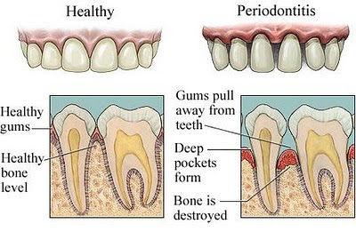
Periodontal Disease
More severe and prevalent with diabetes and elevated A1C levels.
periodontal treatment associated with better glycemic control
(A1C 8.3% vs. 7.8%)
Benefits lasted for 12 mo’s
People with periodontal disease have higher rates of diabetes.
Bidirectional
Oral Care Matters
See dentist at least yearly
Dental hygienist twice yearly
Brush twice daily
Floss daily

Slide 94

Hypoglycemia (Glucose) Alert Values
BG <70mg/dl – Level 1
Follow 15/15 rule and contact provider to make needed changes
BG < 54mg/dl – Level 2
Indicates serious hypo. Contact provider for med change. Glucagon Emergency Kit
Severe Hypoglycemia – Level 3
Requires external assistance – no threshold

Slide 95

Tx of Level 2 & 3 Hypoglycemia
If can swallow w/out risk of aspiration, try gel, honey, etc. inside cheek
If unable to swallow, D50 IV or Glucagon
Glucagon injection (need Rx)
Inform and instruct caregivers, school personnel, family, coworkers of hypo signs and appropriate action
Dosing: Adults 1mg, Children <20kg 0.5mg
Glycemic effect 20 - 30mg, short lived
Must intake carb as soon as able
If on Insulin or level 2 or 3 hypo, (<54), get Glucagon ER Kit and Sensor. Re-evaluate diabetes med treatment plan.

Slide 96
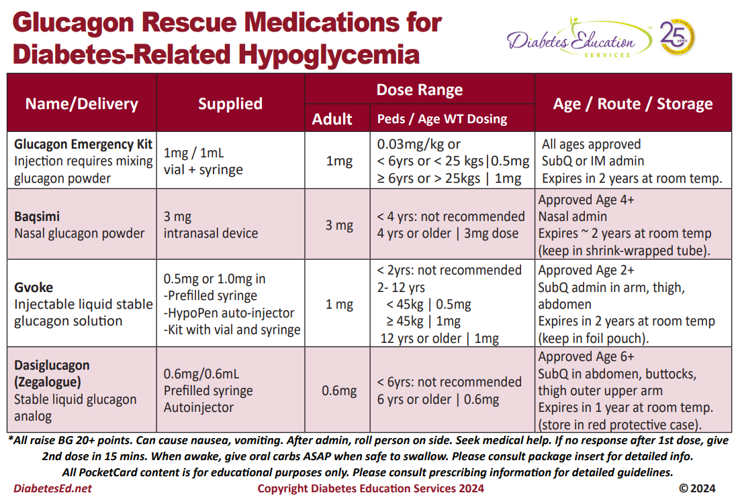
Approved Age 1+
< 1 yrs: not recommended
1 yr or older | 3mg dose

Slide 97
Assess for Hypo
Consider individual’s risk for hypoglycemia when selecting diabetes medications and glycemic goals.
Use of CGM is beneficial and recommended for individuals at high risk for hypoglycemia.
Review history of hypoglycemia at every clinical encounter for all individuals at risk for hypoglycemia
Evaluate hypoglycemic events
Screen for impaired hypoglycemia awareness at least annually.

Slide 98
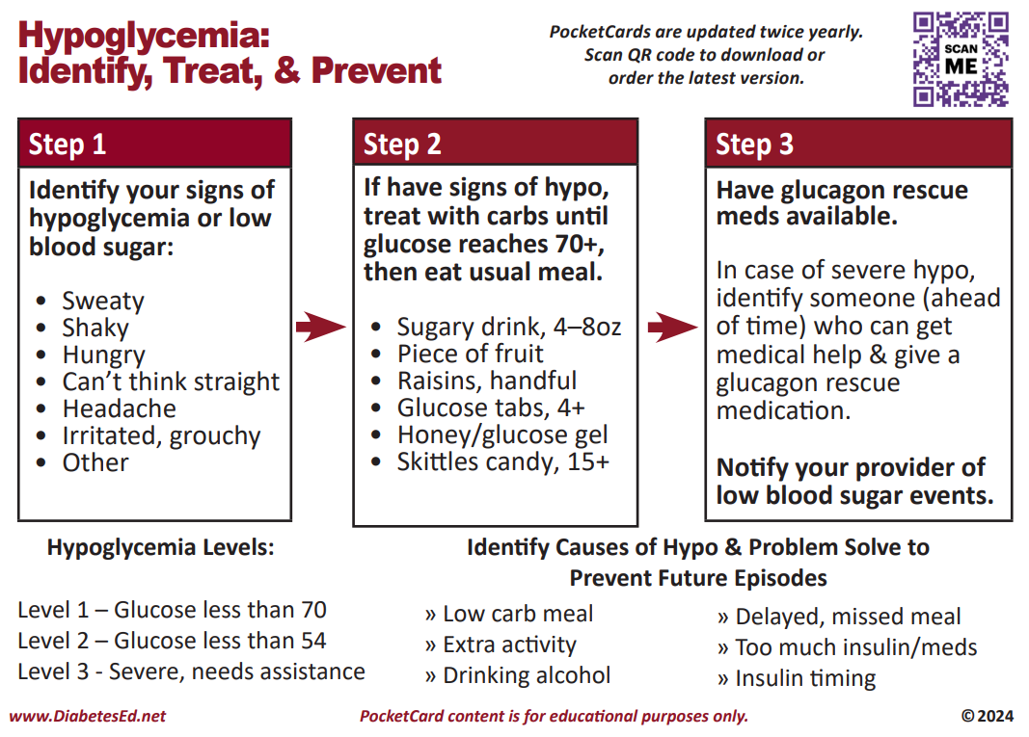
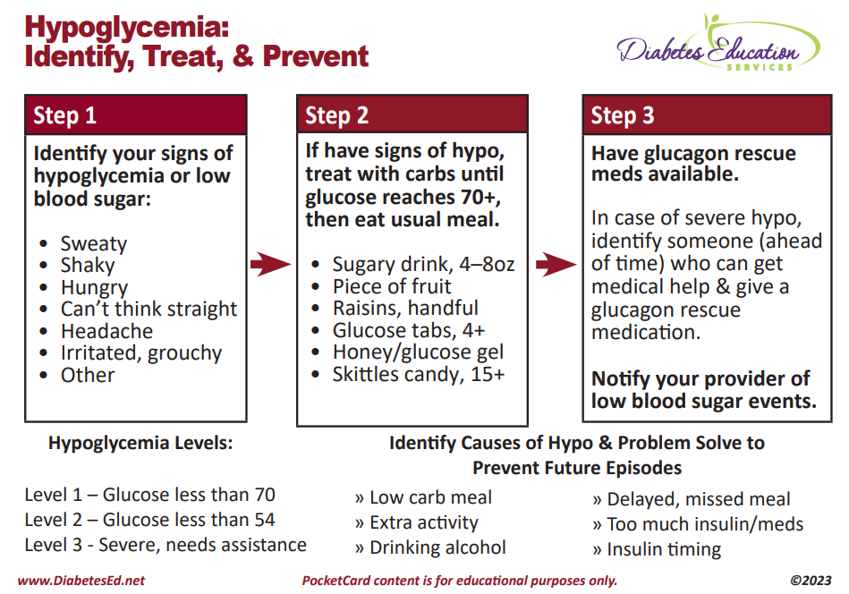

Slide 99
SDOH and Hypoglycemia
Food insecurity, housing instability, underinsured, under-resourced living areas is associated with increased risk of hypoglycemia-related emergency department visits
Identify if fasting part of religious observances
Young children and older adults at highest risk
Insulin pumps with automated low-glucose suspend and automated insulin delivery systems have been shown to be effective in reducing hypoglycemia in type 1 diabetes

Slide 100

If on insulin or sulfonylurea – special precautions required
Carb source on person, car, by bed at all times
Identification
Phone (ICE)
Wallet Card
Bracelet
If pattern of lows, med adjustment required
Pre-meal target
100-130?
Post meal
Less than 180
Bedtime
110 - 180

Slide 101

Break

Slide 102

JR Return Visit 6 months
A1c 7.3% (was 8.6)
TSH 1.9 mIU/L
B/P 132/82 Pulse 76
Denies any low blood sugar
Lost 2 pounds
Meds include:
Metformin 2000 mg
Empagliflozin 25 mg
Glipizide 20 mg BID
Lovastatin 40 mg
Lisinopril 40mg
10 units basal insulin
JR checks BG each morning and sometimes at hs
Lowest 112 (usually around 130ish)
Highest 230
Still walking after dinner.
Hasn’t seen dentist
Sometimes forgets to take meds at night
Sleeping better
Worried if meds are causing harm
Started taking cinnamon capsules

Slide 103

Diabetes Distress
High levels of diabetes distress significantly impact medication-taking behaviors and are linked to higher A1C, lower self-efficacy, and poorer dietary and exercise behaviors
Assess for Diabetes Distress yearly
Mindful Self-Compassion is important
Counseling and DSME can help

Slide 104
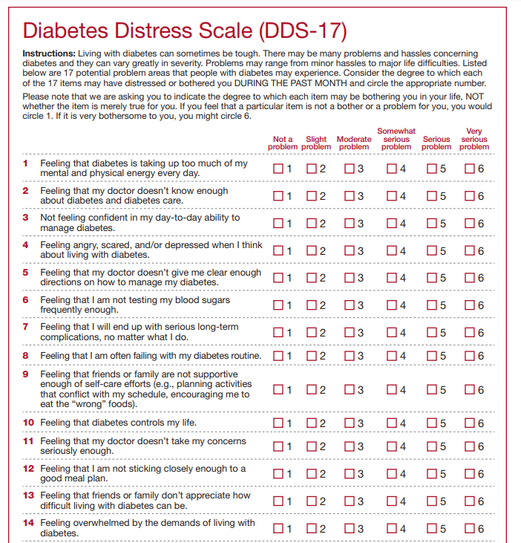
Diabetes Distress Scale cont.
Feeling that diabetes is taking up too much of my mental and physical
energy every day.
Feeling that my doctor doesn't know enough about diabetes and
diabetes care/ doesn't give me clear enough directions .
Feeling angry, scared, and/or depressed … think about living with diabetes
4. Feeling that I am not testing my blood sugars frequently enough.
5. Feeling that I am often failing with my diabetes routine.
Feeling that friends or family are not supportive enough of self-care
efforts (planning activities that …, encourage me to eat the "wrong" foods).
7. Feeling that diabetes controls my life.
8. Not feeling motivated to keep up my diabetes self management.
DDS (17) Scoring
https://professional.diabetes.org/sites/default/files/media/ada_mental_health_toolkit_questionnaires.pdf.

Slide 105

Initial Eval – Looking for Comorbidities
Other conditions that may appear
Cancer
Cognitive impairment
Hyper/Hypoglycemia
Psychosocial/Emotional Issues
Obstructive sleep apnea
Steatosis
Pancreatitis
Low Testosterone in Men
Sexual Health
Hearing Impairment
Fractures
Periodontal disease
Cardiovascular disease

Slide 106
Type 3c Diabetes (Pancreatogenic)
Includes both structural and functional loss of insulin secretion in the context of exocrine pancreatic dysfunction.
About 5-10% of diabetes, often misdiagnosed as type 2 diabetes.
The diverse set of etiologies includes:
pancreatitis (acute and chronic) ~70%
trauma or pancreatectomy
neoplasia
cystic fibrosis
hemochromatosis
fibrocalculous pancreatopathy
rare genetic disorders, and idiopathic

Slide 107
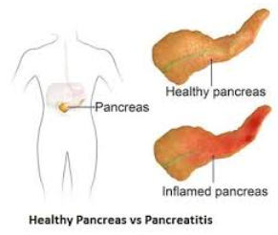
Pancreatitis
People with diabetes 2xs risk of acute pancreatitis
After episode of pancreatitis, one third of people will get prediabetes or diabetes
Pancreatitis is an exocrine dysfunction:
Disrupts global architecture or physiology of pancreas
Results in both exocrine and endocrine dysfunction

Slide 108
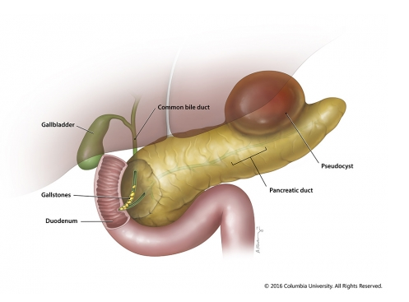
Pancreatitis
Pancreatitis caused by digestion of the organ from pancreatic enzymes normally carried to the SI through pancreatic duct.
Detected through elevated Amylase levels & pain
Causes:
HIV meds and other meds
Alcohol ingestion
Gallstones blocking pancreatic enzyme flow to SI
Elevated triglycerides
Cancer, injury and other

Slide 109
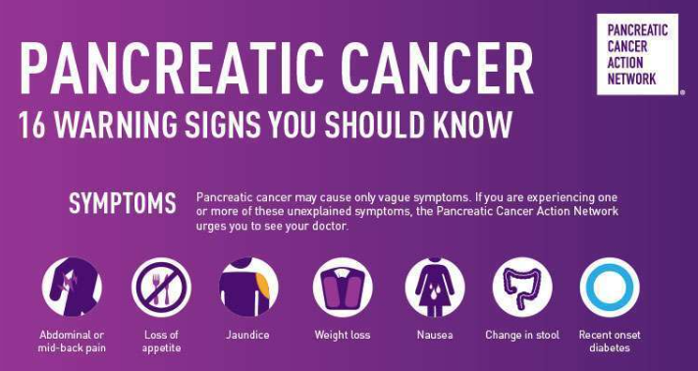
Pancreas Cancer
The American Cancer Society’s estimates for pancreatic cancer in U.S. for 2023 are:
About 64,050 people will be diagnosed with pancreatic cancer.
About 50,550 people will die of pancreatic cancer.
Pancreatic cancer accounts for about 3% of all cancers in the US and about 7% of all cancer deaths.
https://pancan.org/

Slide 110

Cancer and Diabetes
Diabetes is associated with increased risk of cancers of:
liver, pancreas, endometrium, colon and rectum, breast, and bladder.
Association may result from shared risk factors between type 2 diabetes and cancer
Older age, obesity, and physical inactivity
May also be due to diabetes-related factors such as underlying disease physiology
Encourage people with diabetes to undergo recommended age-and sex-appropriate cancer screenings

Slide 111
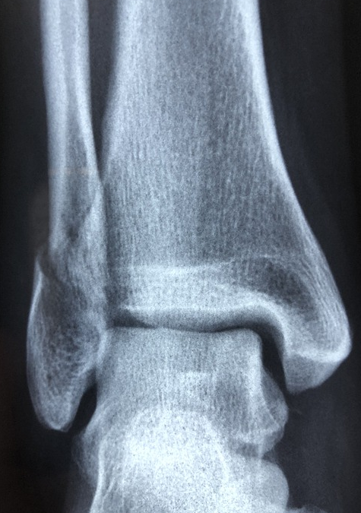
Fractures
Hip fractures:
Type 1 - 6.3 relative risk associated w/ osteoporosis
Type 2 – 1.7 relative risk
Health care professionals can:
Assess risk fracture risk and history, esp with older clients
Recommend bone mineral density assessment
Assess if would benefit from vita d supplement
Home health/ Physical Therapy
Use TZDs and SGLT’s with caution

Slide 112
Bone Mineral Density Testing
People aged ≥65 years
Postmenopausal women and men aged ≥50 years with history of adult-age fracture or with diabetes–specific risk factors:
• Frequent hypoglycemic events
• Diabetes duration >10 years
• Diabetes medications: insulin, thiazolidinediones, sulfonylureas
• A1C >8%
• Peripheral or autonomic neuropathy, retinopathy, nephropathy
• Frequent falls
• Glucocorticoid use
If at Risk for Fracture - Advise people with diabetes on their intake of calcium (1,000–1,200 mg/day) and vitamin D to ensure it meets the recommended daily allowance through their diet or supplemental means.

Slide 113

Other Diabetes Co-Conditions to Be on the Lookout for. Part II
Let’s Stretch

Slide 114

Sensory Impairment
Hearing impairment 2xs as common in diabetes
Due to oxidative stress + hyperglycemia
Leads to cochlear microangiopathy and auditory neuropathy
Risk factors
Low HDL cholesterol, coronary heart disease, peripheral neuropathy, and general poor health have been reported as risk factors for hearing impairment

Slide 115

Cognitive Impairment
Meta-analysis showed individuals with diabetes had
43% higher risk of all types of dementia,
43% higher risk of Alzheimer dementia
91% higher risk of vascular dementia
compared with individuals without diabetes
People with Alzheimer dementia are more likely to develop diabetes than people without Alzheimer dementia.

Slide 116
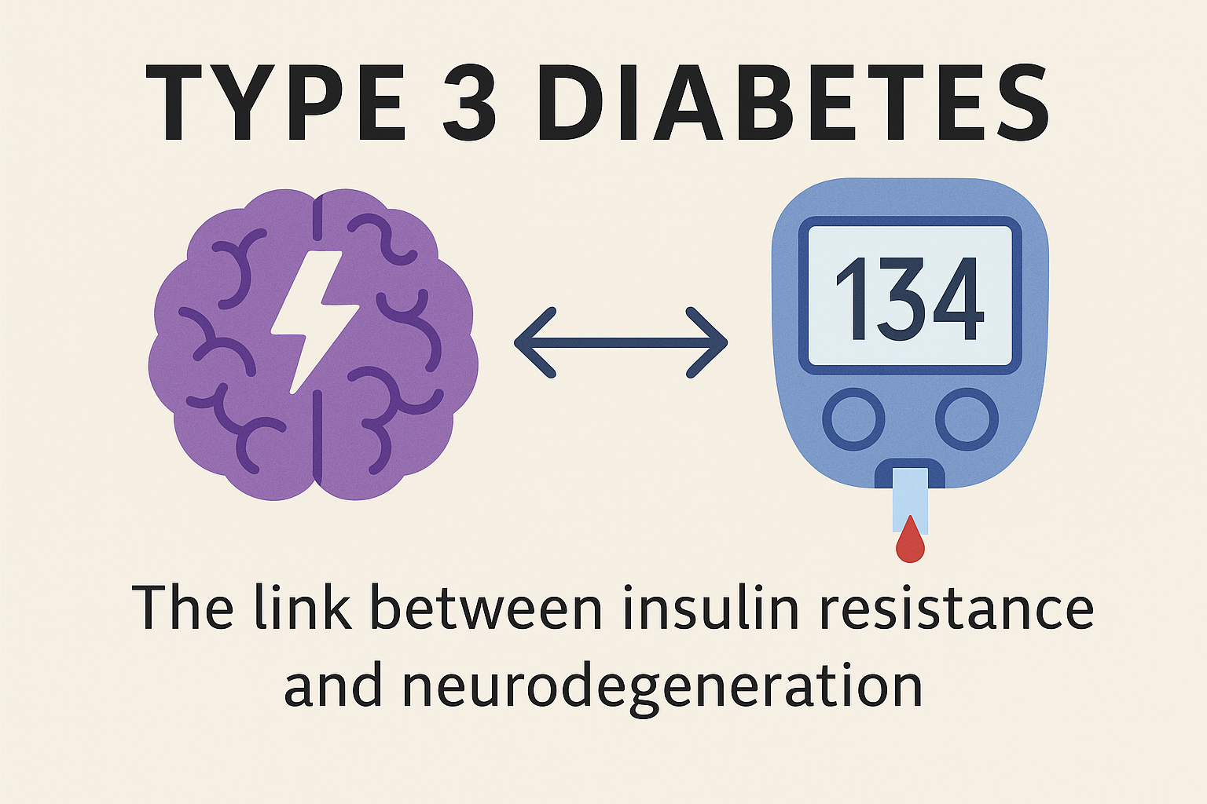
Diabetes Type 3

Slide 117
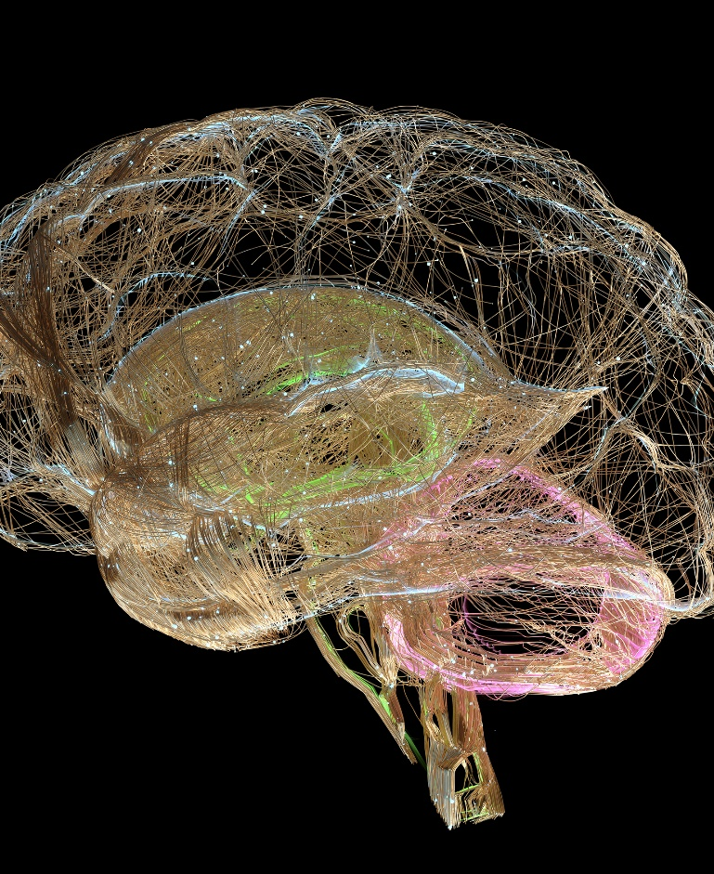
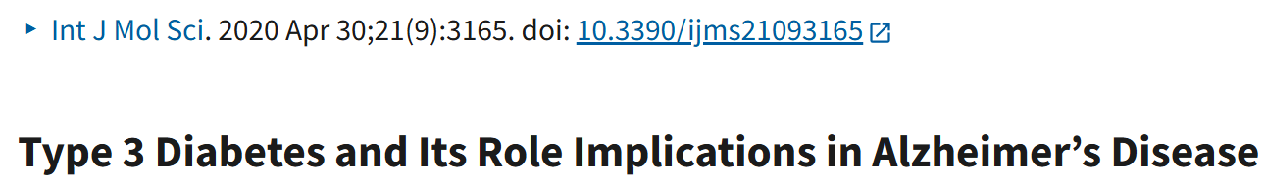
What is 'Type 3 Diabetes'?
A term linking Alzheimer's disease to insulin resistance in the brain.
Not an official diagnostic category.
Still an emerging field with ongoing studies
Suggests that Alzheimer's may be a form of brain-specific diabetes.
Notes:
Neurotransmitter deficits, degenerated neurons, synaptic dysfunction, extracellular buildup of β-amyloid (Aβ) and intracellular neurofibrillary tangles (NFT) are the major crude disfigurements present in AD
Peripheral insulin resistance leads to decrease insulin signaling in CNS, followed by alteration in brain metabolism. Increased Aβ toxicity, Tau hyperphosphorylation, oxidative stress and neuroinflammation are attributed to central insulin resistance, which leads to neurodegeneration. The work provides the relationship between T3DM and AD based on the fact that both the processing of amyloid-β (Aβ) precursor protein toxicity and the clearance of Aβ are attributed to impaired insulin signaling in the brain. Furthermore, insulin-related therapeutic strategies are suggested to succeed in the development of therapies in AD by slowing down their progressive nature or even halting their future complications.
AD is the 6th leading causes of death

Slide 118
Alzheimer’s & Diabetes Link
Type 2 Diabetes increases Alzheimer’s risk by 60–80%
Reduced insulin receptors in brains of people with Alzheimer’s
Insulin signaling is crucial for clearing amyloid beta plaques from brain.
The brain uses insulin for memory and learning- neuromodulator.
Insulin resistance contributes to cognitive decline.
Amyloid beta plaques and tau tangles are influenced by insulin signaling and availability.
Lead to neurodegeneration.
Notes:
Alzheimer's causes irreversible brain cell damage, primarily by building up toxic proteins called amyloid plaques and tau tangles, which disrupts brain cell communication and leads to neuron death and brain shrinkage. This progressive damage results in gradual memory loss, confusion, difficulty with language and reasoning, and challenges performing daily tasks, eventually leading to severe cognitive impairment and a need for total care.
What happens in the brain
Protein build-up:
.Abnormal clumps of proteins, known as amyloid plaques and tau tangles, form in the brain.
Neuron damage:
.These protein clumps disrupt the normal functioning of brain cells (neurons), leading to a loss of connections between them.
Neuron death:
.Eventually, neurons stop functioning, lose their connections, and die.
Brain shrinkage:
.The loss of neurons causes the brain to shrink, particularly in areas involved in memory, such as the hippocampus.
What it does to a person (Symptoms)
As the disease progresses, the damage affects different brain areas, leading to a range of symptoms:
Memory loss: Significant memory loss that interferes with daily life, starting with difficulty remembering recent information.
Cognitive changes: Difficulty planning or solving problems, confusion with time or place, and trouble understanding visual images.
Language difficulties: Problems with speaking or writing, and trouble finding the right words.
Loss of familiarity: Difficulty completing familiar tasks at home or work.
Decreased independence: An increasing need for help with daily activities like bathing and dressing.
Personality and behavior changes: Mood swings, hallucinations, delusions, and other personality changes can occur in later stages.
Progression
Alzheimer's is a progressive disease, meaning symptoms gradually worsen over time. It typically progresses through stages, from mild changes to severe late-stage symptoms where the person requires complete care and can no longer communicate effectively.
Alzheimer's causes irreversible brain cell damage, primarily by building up toxic proteins called amyloid plaques and tau tangles, which disrupts brain cell communication and leads to neuron death and brain shrinkage. This progressive damage results in gradual memory loss, confusion, difficulty with language and reasoning, and challenges performing daily tasks, eventually leading to severe cognitive impairment and a need for total care.
What happens in the brain
Protein build-up:
.Abnormal clumps of proteins, known as amyloid plaques and tau tangles, form in the brain.
Neuron damage:
.These protein clumps disrupt the normal functioning of brain cells (neurons), leading to a loss of connections between them.
Neuron death:
.Eventually, neurons stop functioning, lose their connections, and die.
Brain shrinkage:
.The loss of neurons causes the brain to shrink, particularly in areas involved in memory, such as the hippocampus.
What it does to a person (Symptoms)
As the disease progresses, the damage affects different brain areas, leading to a range of symptoms:
Memory loss: Significant memory loss that interferes with daily life, starting with difficulty remembering recent information.
Cognitive changes: Difficulty planning or solving problems, confusion with time or place, and trouble understanding visual images.
Language difficulties: Problems with speaking or writing, and trouble finding the right words.
Loss of familiarity: Difficulty completing familiar tasks at home or work.
Decreased independence: An increasing need for help with daily activities like bathing and dressing.
Personality and behavior changes: Mood swings, hallucinations, delusions, and other personality changes can occur in later stages.
Progression
Alzheimer's is a progressive disease, meaning symptoms gradually worsen over time. It typically progresses through stages, from mild changes to severe late-stage symptoms where the person requires complete care and can no longer communicate effectively.

Slide 119
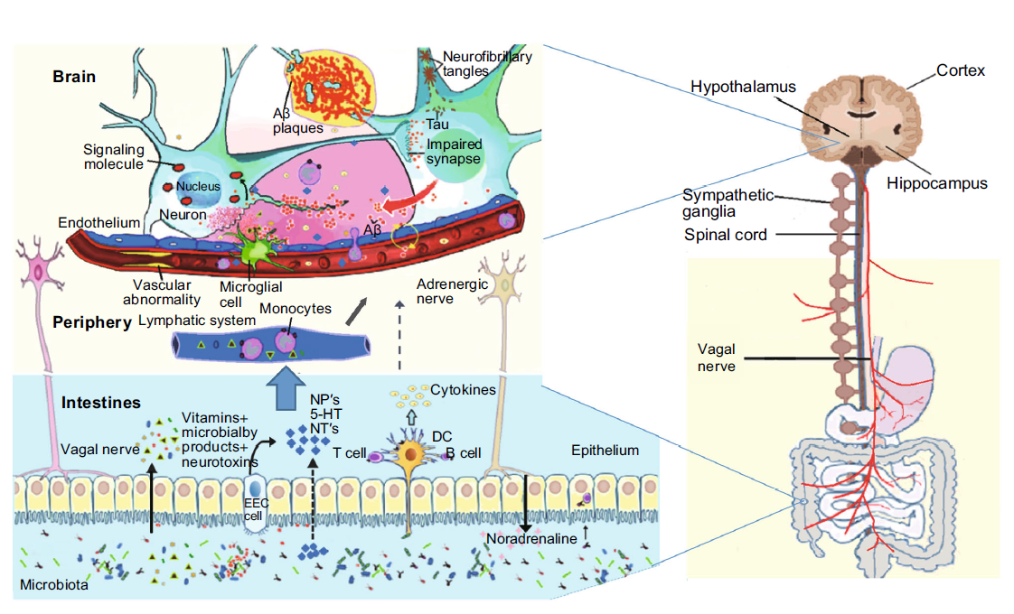

Link Between Gut and Brain

Slide 120

Potential Interventions
Lifestyle: Mediterranean diet, physical activity.
Optimize glucose and blood pressure.
Investigational: Intranasal insulin, GLP-1 agonists
Reduce systemic inflammation.
Improved nutrition and gut health.

Slide 121

Summary
'Type 3 Diabetes' reflects the link between metabolic and brain health
Early intervention can support cognitive function
Encourages whole-person, compassionate care

Slide 122

Assess Sexual Health
In men with diabetes or prediabetes:
52.5% in men with diabetes have ED.
inquire about sexual health (e.g., low libido and erectile dysfunction [ED].
If symptoms and/or signs of hypogonadism are detected (e.g., low libido, ED, and depression), screen with a morning serum total testosterone level.
Best predictors of ED are age (>40 years), CVD, diabetes, hypertension, obesity, dyslipidemia, metabolic syndrome, hypogonadism, smoking, depression, and use of medications such as antidepressants and opioids.
ED is also a predicator of heart disease.
Assess, treat and refer

Slide 123

Assess Sexual Health
In women with diabetes or prediabetes, assess sexual health:
33% reported female sexual dysfunction (FSD)
Screen for desire (libido), arousal, orgasm difficulties, particularly in those with depression and/or anxiety and those with recurrent urinary tract infections.
In postmenopausal women - screen for symptoms and/or signs of genitourinary syndrome of menopause, including vaginal dryness and dyspareunia.

Slide 124

Obstructive Sleep Apnea - OSA
OSA affects ~25% of people with type 2
Up to 60% of those with type 2 have disordered sleep
Associated with increased CVD risk
Signs include excessive daytime sleepiness, snoring and witnessed apnea
Treatment:
Lifestyle modification
Continuous positive oral airway pressure and devices
Surgery

Slide 125
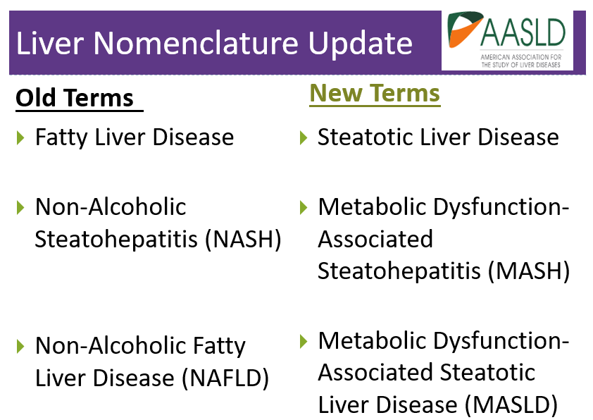

Slide 126

Poll Question 9
What best describes diabetes and Metabolic dysfunction–associated steatotic liver disease (MASLD)?
A. More than 60% of people with diabetes have MASLD.
B. MASLD likely to be found in individuals with type 2 diabetes and BMI < 25
C. Children don’t exhibit MASLD.
D. Almost all people with diabetes have MASLD.

Slide 127

MASH & Steatohepatitis
Adults with type 2 diabetes.
>70% have MASLD
Of those 50% have MASH*
12-20% have fibrosis
Adults with type 1
20% have MASLD
Associated with :
Increased BMI (30+)
Cardiometabolic risk factors
Over 50 yrs
*ALT & AST 30 units/L +
*
*ALT & AST (Eval if more if 30+ for 6 mo’s - ADA)

Slide 128

Metabolic Associated Steatohepatitis
MASH is when fat reaches 5% of the liver's weight
Without consumption of significant amounts of alcohol defined as:
Ingestion of less than 21 standard drinks per week in men and
Less than 14 standard drinks per week in women
over a 2-year period preceding evaluation) or the presence of other secondary causes of Steatosis disease.
Metabolic dysfunction–associated steatotic liver disease (MASLD)

Slide 129
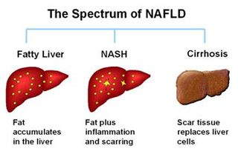
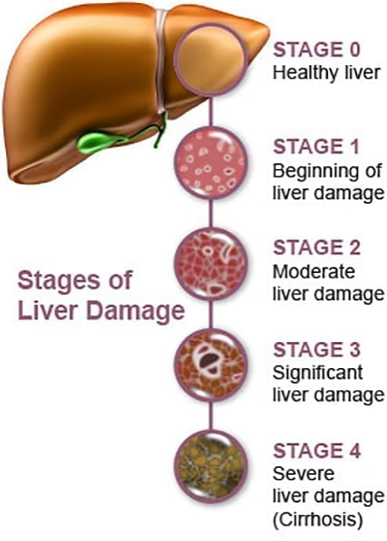
Natural History of MASLD to MASH
MASLD – Metabolic Assoc Steatotic Liver Dx
MASH – Metabolic Assoc Steatohepatitis
https://liverfoundation.org/wp-content/uploads/2020/11/StagesFibrosis.jpg

Slide 130
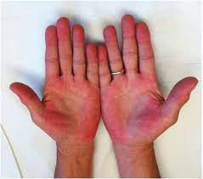
Symptoms of Steatosis
If symptoms do appear, they may include:
A feeling of fullness in the middle or upper right side of the abdomen
Abdominal pain, nausea
Loss of appetite or weight loss
Weakness
Jaundice
Swelling of the abdomen and legs
Mental confusion
Extreme fatigue or tiredness
Signs of advanced disease include:
Portal hypertension, spider angiomas, reddening of palms, declining platelet counts
Mayo Clinic
https://dermcollective.com/palmar-erythema/

Slide 131
Poll Question 10
AR lives with type 2 diabetes, and their waistline is 41 inches. Since their ALT and AST levels are elevated, you know they are at risk for steatosis (MASH). You quickly calculate their Fibrosis-4 Index (FIB-4), by plugging in AR’s Age, AST, ALT, platelet count into the FIB-4 calculator. AR’s result is 2.83. According to the ADA Standards, with a FIB-4 value of 2.83, which action is required?
A. Start AR on pioglitazone and recheck FIB-4 in 3 months.
B. Encourage AR to see a RDN and stop consumption of alcohol immediately.
C. Suggest increased high intensity activity coupled with a GLP-1 to reduce body weight.
D. Refer AR to liver specialist for further evaluation.

Slide 132
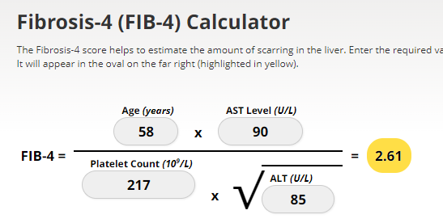
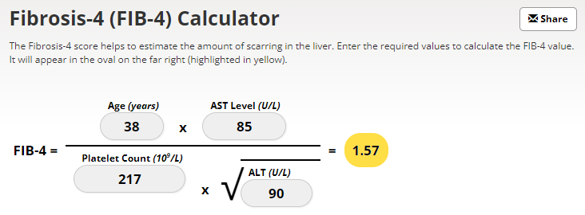
Screening for NASH – FIB-4
FIB-4 estimates risk of hepatic cirrhosis (age 35+):
Calculated by imputing:
Age
plasma aminotransferases (AST and ALT)
and platelet count
FIB-4 Risk Levels
Lower risk is <1.3
Intermediate 1.3 to 2.67
High risk >2.67
considered as having a high probability of advanced fibrosis (F3–F4).
The American College of Gastroenterology considers Upper limit of normal ALT levels:
29–33 units/L for males
19–25 units/L for female individuals
(mdcalc.com/calc/2200/fibrosis-4-fib-4-index-liver-fibrosis).
www.DiabetesEd.net

Slide 133
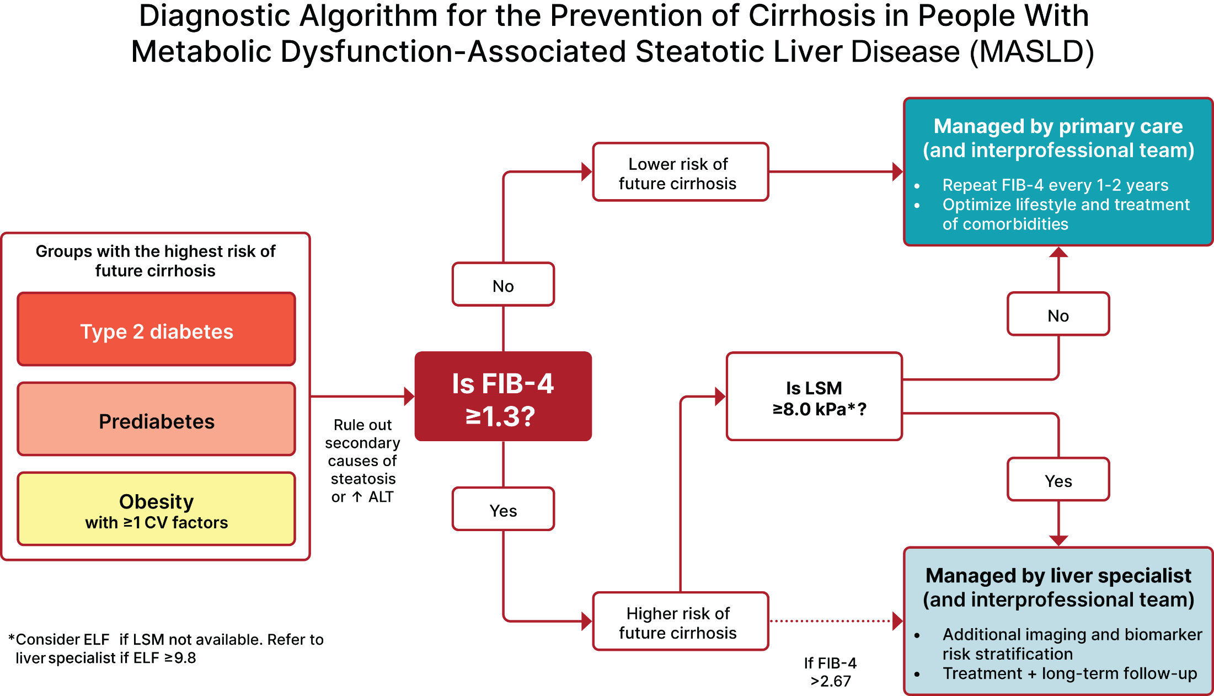


No More NAFLD
“MASLD is the hepatic manifestation of metabolic syndrome.”
Figure 4.2—ELF, enhanced liver fibrosis test; FIB-4, fibrosis-4 index; LSM, liver stiffness measurement, as measured by vibration-controlled transient elastography. “Fibroscan” *In the absence of LSM, consider ELF a diagnostic alternative. If ELF ≥ 9.8, an individual is at high risk of MASH with advanced liver fibrosis (≥F3–F4) and should be referred to a liver specialist.

Slide 134

Question : What does a Liver Elastography reveal?
The provider is sending JR for a Liver Elastography or FibroScan test since JR has elevated ALT and AST levels along with an elevated Fib-4 score. Which of the following are measured during this liver ultrasound procedure?
Liver diameter and density.
Liver scarring and ductal health.
Hepatocyte density and distribution.
Liver stiffness and fat density.

Slide 135

Other Treatments for NAFLD and NASH
Meds that lower glucose, cholesterol and weight
Bariatric surgery
Pioglitazone (Actos)
Improves lipid and glucose metabolism
Reverses steatohepatitis in prediabetes/diabetes
Causes 1-2% wt gain at 15 mg
3-5% wt gain at 45 mg
GLP-1 Receptor Agonists
Support lifestyle changes

Slide 136
Actions To Decrease Steatosis
Increase activity
Strength training
Yoga or Thai Chi
Walking & aerobics
Thoughtful eating
More fiber
Less processed foods & less added sugar
Avoid alcohol
Treatment
Pioglitazone
GLP-1 – semaglutide
Resmetirom
Statin
Prevention
Cancer Screenings
Decrease inflammation

Slide 137

F0-F1, no to minimal fibrosis; F2-F3, moderate fibrosis; F4, cirrhosis;

Slide 138

JR Return Visit 1 Year – Big Strides
A1c 6.6%
LDL 104 (was 164), Trig 169
B/P 128/76
UACR < 30, GFR >60
Liver enzymes below 30
Saw dentist
Exercising regularly
Meds include:
Metformin 2000 mg
Empagliflozin 25 mg
Pioglitazone 15mg (for liver)
Glipizide 20 mg BID
Basal insulin 15 units
Lovastatin 40 mg (increase?)
Lisinopril 40 mg
JR checks BG 7 -10 times a week.
Experiencing 2-3 lows a week
Lowest BG was 54
Highest 198
Decide to hold insulin and stop glipizide.
If BG levels increase, add GLP-1 to plan.
Return in 3 mo’s

Slide 139

6. Glycemic Goals & Hypo
A1C
Blood Pressure
Cardiovascular risk reduction

Slide 140
ADA 2025 Summary
A1c less than 7% (individualize)
Pre-meal BG 80-130
Post meal BG <180
Time in Range (70-180) 70% of time
Blood Pressure
<130/80
Cholesterol
Statin therapy based on age & risk status
If 40+ with ASCVD Risk, decrease LDL by 50%, LDL <70
If 40+ with ASCVD, decrease LDL by 50%, LDL <55

Slide 141


Poll Question 11
Which of the following methods can be used to assess glycemic status?
A. A1C
B. Blood glucose monitoring
C. Time in Range
D. Fructosamine
E. All of the above

Slide 142

Assess Glycemic Status
A1C measurement
Blood glucose monitoring (BGM)
by capillary (finger-stick) devices
Continuous glucose monitoring (CGM)
using time in range (TIR) or
mean CGM glucose.
Fructosamine – 2-4 wk glucose average
glycated albumin for those with anemia or hemoglobinopathies

Slide 143


A1c and Estimated Avg Glucose (eAG)
A1c (%) eAG__
5 97 (76-120)
6 126 (100-152)
7 154 (123-185)
8 183 (147-217)
9 212 (170 -249)
10 240 (193-282)
11 269 (217-314)
12 298 (240-347)
eAG = 28.7 x A1c-46.7 ~ 29 pts per 1%
Translating the A1c Assay Into eAG – ADAG Study

Slide 144


Slide 145

Ambulatory Glucose Profile
Standardized report with visual cues for those on CGM devices
Evaluate Time in Range (TIR)
Target 70-180 mg/dl (70% of time)
Eval % time below goal
< 70 (less than 4% of time)
<54 (less than 1% of time)
Eval % time above > 180 (less than 25% of time)
Eval % time above > 250 (less than 5% of time)
For those with frailty or at high risk of hypoglycemia recommend:
- Target of 50% time in range
- Less than1% time below range

Slide 146

Time in Range (TIR)
Strong correlation between TIR and A1C, with a goal of 70% TIR aligning with an A1C of ∼7%
For older adults using CGM, the recommended percent time spent in target range of 70–180 mg/dL is 50%, Hypo < 1%
Critical that the glycemic goals be woven into an individualized, person-centered strategy

Slide 147

Time In Range – Person Centered
“Hyperglance-emia”
Each 1% is 15 minutes (4% an hour)
There is 24 hours in a day.
Goal is 17 hours in range = 70% TIR = A1C of 7%
You get 7 hours outside of range.
You are not defined by your blood glucose.
What range feels safe for you?
Try and step back and take in the whole picture.
Sometimes you need a donut!

Slide 148
At least 42 factors affect glucose!
Food
Meds
Activity
Biological
Environ-mental
Behavioral and decision making
↑↑ Carbo-hydrate quantity
→↑Carbo-hydrate type
→↑ Fat
→↑ Protein
→↑ Caffeine
↓↑Alcohol
↓↑ Meal timing
↑Dehydration
? Personal microbiome
→↓Dose
↓↑ Timing
↓↑ Inter-actions
↑↑ Steroid administration
↑ Niacin (vitamin B3)
→↓ Light exercise
↓↑ High/ moderate exercise
→↓ Level of fitness/training
↓↑ Time of day
↓↑ Food and insulin timing
↑ Insufficient sleep
↑ Stress and illness
↓ Recent hypoglycemia
→↑ During-sleep blood sugars
↑ Dawn phenomenon
↑ Infusion set issues
↑ Scar tissue and lipodystrophy
↓↓ Intramuscular insulin delivery
↑ Allergies
↑ A higher glucose level
↓↑ Menstruation
↑↑ Puberty
↓ Celiac disease
↑ Smoking
↑ Expired insulin
↑ Inaccurate BG reading
↓↑ Outside temperature
↑ Sunburn
? Altitude
↓ Frequency of glucose checks
↓↑ Default options and choices
↓↑ Decision-making biases
↓↑ Family relationships and social pressures
Adapted from Brown A. DiaTribe Learn: Making sense of diabetes... diatribe.org/42factors

Slide 149

“The highest form of wisdom is kindness.” The Talmud

Slide 150

(
American Diabetes Association Dia Care 2022 6.2 45- S89
Table 6.2
Notes:
Patient and disease factors used to determine optimal glycemic targets. Characteristics and predicaments toward the left justify more stringent efforts to lower A1C; those toward the right suggest less stringent efforts. A1C 7% = 53 mmol/mol. Adapted with permission from Inzucchi et al. (59).

Slide 151

Cardiac and Renal Disease
The combination of 3 comorbidities has been termed cardiorenal metabolic disease or cardiovascular-kidney-metabolic health
ASCVD, heart failure, and chronic kidney disease (CKD)
Recognized interrelationship of cardiometabolic risk factors leading to cardiovascular disease and adverse kidney outcomes in people with diabetes.
3 comorbidities frequently associated with metabolic risk factors & extra weight
Incidence of all three conditions rises with increasing A1C levels.

Slide 152

Diabetes Meds Lower CardioRenal Risk
If diabetes plus ASCVD risk factors
SGLT-2s* and GLP-1s* reduce risk of major adverse CV events
Plus ACE or ARB
Post MI, continue beta blockers for 3 years.
If type 2 diabetes and heart failure
SGLT-2s reduce risk of heart failure and hospitalization.
Also consider beta blocker

Slide 153

Poll Question 12
Evaluating kidney function is important to determine most beneficial treatment interventions. Which of the following measurements would indicate that JR has healthy kidney function?
Urinary albumin creatinine ratio of 30-299 mg/g with GFR of 45.
GFR of 60 or greater and urinary albumin creatinine ratio of 12 mg/g.
Urinary albumin creatinine ratio less than 30 mg/g and GFR of 30-45.
Creatinine of 1.5 and urinary albumin creatinine ratio of 300 mg/g or greater.

Slide 154




CKD– 2025 Update
Optimize glucose and BP to protect kidneys
Use SGLT-2 with demonstrated benefit to reduce CKD and CVD*
To reduce CV risk and CKD, use a GLP-1* with demonstrated benefit.
In people with CKD and albuminuria, a nonsteroidal MRA effective if GFR 25+
Aim to reduce urinary albumin by ≥30% in people with CKD
*SGLT-2i’s
Empagliflozin, canagliflozin, dapagliflozin
*GLP-1 RA’s
Semaglutide has indication, liraglutide dulaglutide

Slide 155

Standard 11 – Protect Kidneys
Diabetes with a - GFR ≥20 and - UACR ≥200 mg/g
Start SGLT2 to reduce chronic kidney disease progression and cardiovascular events.
If type 2 diabetes and established Chronic Kidney Disease (CKD)
Start nonsteroidal mineralocorticoid receptor antagonist (Finerenone) and/or GLP-1 RA recommended for cardiovascular risk reduction.

Slide 156

Finerenone Resource

Slide 157

Figure 11-12 Holistic Approach to Diabetes + CKD

Slide 158

Risk of CKD Progression, CVD

Slide 159

Kidney Goals and MNT
In people with chronic kidney disease with UACR ≥300 mg/g
Goal is a reduction of 30% or greater in mg/g urinary albumin to slow chronic kidney disease progression
Nutrition Recommendations
For people with non–dialysis-dependent stage 3 or higher chronic kidney disease
dietary protein intake aimed to a target level of 0.8 g/kg body weight per day.
For those on dialysis,
consider protein intake of 1.0–1.2 g/kg/day since protein energy wasting is a major problem in some individuals on dialysis
Refer to nephrology
If GFR < 30 or uncertain CKD etiology

Slide 160

10. Cardiovascular Disease and Risk Management
Higher risk of Atherosclerotic cardiovascular disease (ASCVD):
history of acute coronary syndrome,
myocardial infarction (MI),
stable or unstable angina,
coronary or other arterial revascularization,
stroke, transient ischemic attack,
or peripheral artery disease (PAD) including aortic aneurysm.
2x high risk of Heart Failure
Leading cause of morbidity and mortality in people with diabetes
Large benefits are seen when multiple CV risk factors are addressed simultaneously
With more aggressive goals, rates of CVD have decreased.
CV Risks predicted to increase in future.

Slide 161

Assess ASCVD and Heart Failure Risk Yearly
Duration of diabetes & 55+
BMI
Hypertension
Dyslipidemia
Smoking
Family history of premature coronary disease
Chronic kidney disease – presence of albuminuria
Treat modifiable risk factors as described in ADA guidelines.

Slide 162


Slide 163


Slide 164

Poll Question 13
RJ is a 57 yr old with diabetes. RJ takes an ACE Inhibitor, insulin and a statin. They smoke a pack of cigarettes a day.
According to ADA Standards of Care, what is the blood pressure target for RJ?
A. Less than 120/80
B. Less than 130/80
C. Less than 140/90
D. Less than 135 /85

Slide 165

Hypertension Management

Slide 166

BP Treatment in addition to Lifestyle
First Line BP Drugs if 130/80 +
With albuminuria or CAD
Start either ACE or ARB*
No albuminuria - Any of the 4 classes of BP meds can be used:
ACE Inhibitors, ARBs, thiazide-like diuretics or calcium channel blockers.
Monitor K+/Scr 7-14 days after initiation and dose increase for diuretics, ACEI/ARB
Avoid ACE and ARB at same time
Multiple Drug Therapy often required
If BP ≥ 150 /90 start 2 drug combo
*Albuminuria = Urinary albumin creatinine ratio of 30+

Slide 167


Lipid and HTN Meds Cheat Sheets
Website: https://diabetesed.net/coach-bevs-diabetes-cheat-sheets/
On CDCES Coach App too
For exam, know major classes, when used, side effects and considerations.

Slide 168

Poll Question 13
RZ is 47 years old with type 2 diabetes and hypertension. RZ takes metformin 1000 mg BID, plus lisinopril 20mg daily. RZs LDL is 130 mg/dL. Based on the most recent ADA Standards, what is the LDL Cholesterol target for RZ?
LDL less than 100 mg/dL.
Lower LDL by 50%.
LDL target of 70 mg/dL or less.
Determine LDL target based on ASCVD risk.

Slide 169
Lipid Monitoring and Lifestyle Treatment Strategies
Lipid Goals
LDL < 70 or 55 based on risk
HDL >40
Triglycerides <150
Weight loss if indicated
Mediterranean or DASH Diet
Reduction of saturated fat intake
Increase of omega-3 fatty acids, viscous fibers and plant stanols/sterols
Increase activity level
BG lowering helps lower triglycerides and increase HDL
Monitoring:
If not taking statins and underage of 40.
- check at time of diagnosis and every 5 yrs.
On statin
Monitor lipids at diagnosis and yearly.
Monitor lipids 4-12 weeks after statin dose adjustment.

Slide 170

Statin Therapy
High intensity statins (lowers LDL 50%):
atorvastatin (Lipitor) 40-80mg
rosuvastatin (Crestor) 20-40mg
Moderate intensity (lowers LDL 30-50%)
atorvastatin (Lipitor) 10-20mg
rosuvastatin (Crestor) 5-10mg
simvastatin (Zocor) 20-40mg
pravastatin (Pravachol) 40 – 80mg
lovastatin (Mevacor) 40 mg
fluvastatin (Lescol) XL 80mg
pitavastatin (Livalo) 1-4mg

Slide 171

From Meds Cheat Sheet Page

Slide 172
Lipid Therapy in Diabetes by Age
All ages 20+ with ASCVD, add high-intensity statin to lifestyle
20–39 and additional ASCVD risk factors
may be reasonable to initiate statin therapy in addition to lifestyle.
40-75 years
Moderate to high intensity statin based on risk (see previous slides)
75 years or older and already on statin
it is reasonable to continue statin treatment.
75 years or older
it may be reasonable to initiate moderate-intensity statin therapy after discussion of potential benefits and risks.

Slide 173

Tobacco, Electronic Cigarettes, Alcohol, and Cannabis
Advise all youth with diabetes not to use cannabis recreationally in any form.
2 to 3 times higher risk of developing DKA.
Can lead to cannabis hyperemesis syndrome
Screen adolescents and young for tobacco or nicotine, electronic cigarettes, substance use, and alcohol use at diagnosis and regularly thereafter.
Discourage smoking in youth who do not smoke and encourage smoking cessation in those who do smoke (including electronic cigarette use or vaping)

Slide 174

RL needs your help
A1C 8.9% (down from 10.4%)
B/P 139/76 AM BG 100, 2 hr pp 190
Chol – TG 54, HDL 46, LDL 98
GFR 47, UACR 34 mg/g
Meds:
Insulin – 28 units basaglar insulin
Losartan 25mg – ARB for blood pressure
Metoprolol 50mg – Beta blocker
Glyburide 5mg BID - Sulfonylurea
Any special instructions?
Any meds missing?
Stop any meds?

Slide 175
RL Needs Your Help
A1c 8.9% (down from 10.4%)
B/P 139/76 AM BG 100, 2 hr pp 190
Chol – TG 54, HDL 46, LDL 98
GFR 47, UACR 34 mg/g
Meds:
Insulin – 28 units basaglar insulin
Losartan 25mg – ARB for blood pressure
Metoprolol 50mg – Beta blocker
Glyburide 5mg BID - Sulfonylurea
Any special instructions?
Any meds missing?
- Statin
- SGLT 2
- Aspirin?
Stop any meds?
Special instruction – sweating may indicate hypoglycemia

Slide 176

ABC’s of Diabetes
A1c less than 7% (individualize)
Pre-meal BG 80-130
Post meal BG <180
AGP - Time in Range (70-180) 70% of time
Blood Pressure < 130/80
Cholesterol
Statin therapy based on age & risk status
If 40+ with ASCVD Risk, decrease 50%, LDL <70
If 40+ with ASCVD, decrease 50%, LDL <55

Slide 177
Diabetes Bingo “DiaBingo” Shout out Right Answer

Slide 178
DiaBingo- G
G ADA goal for A1c is less than ____%
G People with DM need to see their provider at least every month
G Blood pressure goal is less than
G People with DM should see eye doctor (ophthalmologist) at least
G The goal for triglyceride level is less than
G Goal for LDL cholesterol for people 40+ with diabetes is _________
G The goal for blood sugars 1-2 hours after a meal is less than:
G People with DM should get this shot every year
G People with DM need to get urine tested yearly for ___________
G Periodontal disease indicates increased risk for heart disease
G The goal for blood sugar levels before meals is:
G The activity goal is to do ___ minutes on most days

Slide 179

Stretch and Reflect
Let’s take what we have learned and apply it to some different case studies.

Slide 180

Gaining Weight
68 yr old complains of 4 lb wt gain a week for past month. Wt 140lbs, BMI 27. BG levels 200-300s. B/P 142/96
Reported daily meds include:
Glyburide 10mg ac breakfast
Actos 30mg ac breakfast
Glargine 30units at night
Lispro sliding scale with meals
Synthroid (not sure of dose)
Lasix 20mg a day
A new med for “mental health”

Slide 181


Sulfonylureas - Squirters
Mechanism: Stimulate beta cells to release insulin
Dosed 1-2x daily before meals
Adverse effects
Hypoglycemia, Weight gain, watch renal function
Low cost, $12 for 3 months supply
Can help with glucose toxicity, lowers A1C 1-2%
Notes:
CAROLINA tral (linagliptin vs glimepiride)
Meta-analysis: In type 2 diabetes, the use of sulfonylureas is associated with increased mortality and a higher risk of stroke

Slide 182
Hypoglycemia & Next Steps
Do NOT Cause Hypoglycemia
Can Cause Hypoglycemia
DPP-4 Inhibitor
GLP-1 RA / GIP
SGLT-2 Inhibitor
TZD, Metformin
Sulfonylurea
Meglitinides
Insulin

Slide 183
Fluid Weight Gain
People with diabetes at greater risk for Congestive Heart Failure (CHF) due to increased CVD risk factors.
Actos and Avandia, (TZD’s), can cause fluid weight gain and CHF.
SGLT2 indicated in people with CHF

Slide 184

Novel/ Atypical Antipsychotics Linked to Hyperglycemia
Zyprexa – olanzapine
Geodon - ziprasidone
Seroquel – quetiapine
Risperdal - risperadone
Clozaril - clozapine
Abilify – aripiprazole
Latuda - lurasidone
Consensus Development Conference on Antipsychotic Drugs and

Slide 185

Novel / Atypical Antipsychotics Linked to Hyperglycemia
Severe cases of hyperglycemia – even death reported
Monitor BG regularly for DM individuals started on this class of med
If at risk for DM, determine fasting glucose before initiating therapy and monitor closely during treatment
Weight gain may require increased dosing of diabetes therapies.
Summary of FDA warning statement for atypical antipsychotics

Slide 186



ADA Standards 2025 – Section 5
“People eat food, not nutrients, nutrient recommendations need to be applied to WHAT people eat”
https://innerbody.com/nutrition/macronutrients
Notes:
The focus on the dietary guidelines is moving away from specific macronutrient recommendations and more towards eating patterns.
In the 2025 Standards Update the focus on HOW the individual will making nutrition behavior changes is emphasized.
Simply, people eat food, not nutrients, nutrient recommendations need to be applied to WHAT people eat. For example carbohydrates can come from legumes and whole grains or can come from added sugars.
As we will discuss in future slides, many of recommendations are specific to the individual and not the diabetes population.

Slide 187


Weight is a Heavy Issue

Slide 188


Weight Stigma
Weight stigma, fat bias, and anti-fat bias are ways to describe the bias toward people living in larger bodies.
Fat bias is prevalent among health care professionals and general public.
Health care professionals are strongly encouraged to increase their awareness of implicit and explicit weight-biased attitudes.
Increasing empathy and understanding about the complexity of weight management among health care professionals is a useful avenue to help reduce weight bias.

Slide 189
Health Behavior Change: Shifting Focus
Health at Every Size (HAES) Principles
Weight Inclusivity
Health Enhancement
Eating for Well-being
Respectful Care
Life-Enhancing Movement
"People might think they can tell who's fit and who's not by looking at them, but in fact, it's trickier than that.”
Health at Every Size: The Surprising Truth About Your Weight. Dr. Bacon holds a Ph.D. in physiology with a focus on nutrition and weight regulation.
“Lots of people are fat and fit—many avid dancers, runners, lifters, and sports team members are big to start with and stay that way. They tend to be far healthier than thin people who don't move around much or eat a nutritious mix of foods.”
"Health at Every Size is about taking care of your body without worrying about whether you're ‘too’ big or small."
Notes:
A Olson et al. reported that 32% of women with obesity and 55% of women with severe obesity reported delaying or canceling health care appointments because they knew they would have to be weighed during the appointment (Weight bias and health care utilization: a scoping review)
Principles:
WEIGHT INCLUSIVITY
Accept and respect the inherent diversity of body shapes and sizes and reject the idealizing or pathologizing of specific weights.
HEALTH ENHANCEMENT
Support health policies that improve and equalize access to information and services, and personal practices that improve human well-being, including attention to individual physical, economic, social, spiritual, emotional and other needs.
EATING FOR WELL-BEING
Promote flexible, individualized eating based on hunger, satiety, nutritional needs, and pleasure, rather than any externally regulated eating plan focused on weight control.
RESPECTFUL CARE
Acknowledge our biases, and work to end weight discrimination, weight stigma, and weight bias. Provide information and services from an understanding that socio-economic status, race, gender, sexual orientation, age, and other identities impact weight stigma, and support environments that address these inequities.
LIFE-ENHANCING MOVEMENT
Support physical activities that allow people of all sizes, abilities, and interests to engage in enjoyable movement, to the degree that they choose.

Slide 190



Get a Tape Measure & Other Assessments
Overall - assess individual’s
- adipose tissue mass
using waist circumference
35” woman, 40” man
waist-to-hip ratio
Waist smaller than hips
waist-to-height ratio
Waist < half height
- presence of associated health or well-being consequences: metabolic, physical, or psychological well-being
WHO defines Obesity as: abnormal or excessive fat accumulation that presents a risk to health
BMI poor indicator for ”excessive fat” and health risk
Notes:
Health at Every Size
Language throughout the section was amended to be person centered and to emphasize the importance of weight management within the overall context of the treatment of people with diabetes.

Slide 191

Interested in Weight Loss?
Ask Permission
Assess readiness/willingness to engage in changes for weight loss
Use non-judgmental language
Action-Based Goals
Use shared-decision making for weight-loss goals & intervention strategies
Strategies may include dietary changes, physical activity, behavioral therapy, pharmacologic therapy, medical devices, & metabolic surgery
Notes:
So on one hand weight loss is helpful but on the other hand we know PWD face weight stigma. So what can we do: 1. Ask permission to weight and discuss weight concerns, Use non-judgmental language about body size 3. focus on action-based goals vs. weight loss goal alone.
Initial and follow-up interventions should be individualized based on the person’s

Slide 192

Limit Highly Processed Carbs and Added Sugars Eat more HIGH Fiber foods:
Choose High fiber carbs loaded with vitamins, minerals and phytonutrients
“Power Carbs” include:
Beans/Lentils
Veggies
Whole Fruits
Low-fat, low sugar milk/yogurt
Whole Grain foods
as culturally appropriate
Notes:
There is not ideal amount of carbohydrate for each individual with diabetes focus on quality, choosing unprocessed/minimally processed, nutrient-dense sources. Choosing high in fiber foods should be the focus.
Encourage whole grain foods as culturally appropriate. Otherwise focus on portion and increased fiber from other food sources.

Slide 193

Fiber – the New “F” Word
Goal: minimum
14 gms / 1000 calories, ~ 30 gms a day
How?
Avoid highly processed foods
Choose > 3 gm fiber per serving
Foods: Whole intact grains, legumes, fruits, veggies, nuts/seeds, avocados
Why?
Lower all cause mortality and reduced risk of type 2 diabetes
Increased microbiome diversity
Notes:
Processed foods are ones that have undergone changes to their natural state.
Highly or ultra processed foods go beyond general chopping, blending, cooking etc and have multiple additives and ingredients.
These foods are often low in fiber. Low fiber is defined by < 3 grams of fiber and we consider a high fiber foods those with more than 5 grams of fiber.

Slide 194





Plate example

Slide 195
Poll Question 14
AR is 36 years old with type 2 diabetes and a BMI of 41kg/m². Current diabetes medications include: metformin, sitagliptin (Januvia) and empagliflozin (Jardiance) at maximum doses. AR is prescribed tirzepatide (Mounjaro). Based on this information, what action do you recommend to the provider?
Verify kidney function first.
Stop the sitagliptin when initiating tirzepatide.
Decrease the dose of metformin to prevent hypoglycemia.
Evaluate thyroid function before starting tirzepatide.
Notes:
Answer is B.

Slide 196


Metabolic (Bariatric) Surgery
Consider for adults with:
BMI >30 ( > 27.5 for Asian Americans) who are otherwise good surgical candidates
Perform at high volume center with an experienced team
Need lifelong medical & behavioral support & monitoring
Screen psychological & behavioral health prior to & ongoing
Monitor for post surgery hypoglycemia
Notes:
In 2023 the American Society for Metabolic and bariatric surgery change the surgery guidelines and lowered the BMI guideline for those to type 2 diabetes to > 30. The SOC followed these guidelines.

Slide 197

Metabolic Surgery Benefits
More likely to have remission*:
Younger age, duration of diabetes (< 8 yrs), no pre-surgical insulin, greater visceral fat to lose (Asian Americans)
Year 5 Remission: 86.1% (RYGB) & 83.5% (VSG)
35 – 50% re-developed diabetes
Average remission time 8.3 years
Majority maintain improved glycemia for 5-15 years
*complete remission = A1c levels <6.5% without meds
Notes:
Data is mounting on potential metabolic benefits in type 1 diabetes as well but more data is needed.

Slide 198
Metabolic Surgery Benefits
Superior glycemic mgmt & CVD risk reduction for people w/T2DM & Obesity compared to non-surgical interventions.
reduces microvascular disease
Improves quality of life
cancer risk reduction
Improved MASH
All cause mortality
Notes:
Data is mounting on potential metabolic benefits in type 1 diabetes as well but more data is needed.

Slide 199

Assessing Malnutrition
At Risks Groups:
Individuals on GLP-1 or GIP RA or after metabolic surgery
Individuals with multiple chronic conditions
Older age groups
Food insecurity and poverty
Screen:
For malnutrition and sarcopenia
Recommend:
Whole- food-based eating pattern
Adequate protein
Resistance training
Malnutrition is defined by the World Health Organization as “deficiencies, excesses, or imbalances in a person’s intake of energy and/or nutrients.”
Notes:
New this year the ADA calls out the importance of screening for malnutrition.
We frequently screen for malnutrition in individuals who are underweight or in hospital settings but starting BMI and desire for weight loss does to prevent malnutrition risk.
Individuals on incretin therapies or have had metabolic surgery and have experienced significant weight loss of > 20% or more than 4 kg (or about 9 pounds) should be screened for malnutrition. (Simplified Nutritional appetite Questionaries and Malnutrition Universal Screening tool).

Slide 200

SR is Losing Weight
SR, 49 yr old w/ lean “type 2” 7 yrs.
Monitors BG 1 x daily
A1c 13.9%
Insulin: 14u basal insulin at hs (uses pens)
Bolus analog if BG > 200 (says too expensive)
Also on Metformin 500mg BID
At 5’7, her usual wt is 120, but now 106 lbs
C/O of nausea, fullness, fatigue
No health insurance

Slide 201
Prevalence: Hypothyroidism in Diabetes
Type 1
Overt hypothyroidism ~4–10%
Subclinical hypothyroidism ~10–15%
Up to 30% of people with T1D will develop autoimmune thyroid disease in their lifetime.
Type 2 diabetes:
Overt hypothyroidism ~10–30%
Higher prevalence of subclinical hypothyroidism (~5–10%) than the general population.
More Women > men.
Hashimoto’s thyroiditis – autoimmune thyroid
most common cause of hypothyroidism w/ diabetes
NIH https://pmc.ncbi.nlm.nih.gov/articles/PMC3647563/

Slide 202

Thyroid & TSH* Levels
*Thyroid Stimulating Hormone - secreted by pituitary gland
controls thyroid hormone thyroxine production
first and best test
TSH Norm = up to 4.5 mIU/mL
Treatment based on TSH plus symptoms.
4.5 – 10 based on risk, s/s
10 or more = treat
Lower = hyperthyroidism
Higher = hypothyroidism–
AACE Guidelines

Slide 203

A TSH above 10 mIU/L,
in combination with
a subnormal free T4 characterizes overt hypothyroidism.
If TSH in range, but person is symptomatic,
Check for thyroid peroxidase atb or TPO antibodies
A low TSH indicates hyperthyroidism (0.1 ish)

Slide 204

Poll question 15
Which of the following is a true statement?
Atypical antipsychotics are contraindicated for people with diabetes.
Hyperthyroidism is more common than hypothyroidism.
Depression can be associated with weight gain or weight loss.
Hypothyroidism causes LDLs to decrease.

Slide 205
Diabetes Detective
What other comorbidities are you suspecting?
Any labs you would like to check?
What type of diabetes?
Social situation?
Consider her lack of insurance and low income level during your discussion.
Medication and Insulin changes

Slide 206


Type 1 ~ Immune Mediated 5-10% of Diabetes
1.5 Million people have type 1 in U.S.
Prevalence increasing:
2001 – 1.48 per 1000 youths diagnosed with diabetes
2017 - 2.15 per 1000 youths diagnosed with diabetes
Incidence & Prevalence increasing
Highest incidence in Finland or Northern Europe.
ADCES In Practice - March 2024 Recent Advances in Type 1 Diabetes: Teplizumab (Tzeild®)
Karen S. Fiano, PHARMD, BCACP, Devada Singh-Franco, PHARMD, CDCES, Young M. Kwon, BS, PHD

Slide 207



Clinical onset of T1D can occur at any age
* A longitudinal study comprising 32,476 commercially insured Americans aged 0-64 years who developed T1D between 2001 and 2015.
Rogers MAM, et al. BMC Med. 2017;15(1):199.

Slide 208

T1D is Often Misdiagnosed as T2D in Adults

Slide 209

Type 1 is 5- 10% of all Diabetes
Auto-immune pancreatic beta cells destruction
Most commonly expressed at age 10 – 14
Insulin sensitive (require 0.5 - 1.0 units/kg/day)
Expression due to a combo of genes and environment:
Autoimmunity tends to run in families
Exposure to virus or other environmental factors
209
Diagnostic Criteria for Diabetes
Notes:
When you get to the insulin piece, please mention we will get into great detail about insulin in the pharmacotherapy module

Slide 210

Type 1 Diabetes Features?
For JR, a 28 admitted to the ICU with a blood glucose of 476 mg/dl, pH of 7.1, anion gap of 15. Recently lost 13 pounds.
Type 1 Most Discriminative Features
Younger than 35 years at diagnosis
Lower BMI (<25 kg/m²)
Unintentional weight loss
Ketoacidosis
Glucose 360 mg/dl or greater.
Misdiagnosis is common and can occur in ∼40% of adults with new type 1 diabetes

Slide 211

Antibody Testing for Type 1
5–10% of people with type 1 diabetes do not have antibodies.
In those diagnosed at <35 years of age who have no clinical features of type 2 diabetes or monogenic diabetes, a negative result does not change the diagnosis of type 1 diabetes,
Rate of type 1 progression depends on:
age at first detection of autoantibody,
number of autoantibodies,
autoantibody specificity, and autoantibody titer.
Glucose and A1C levels may rise well before the clinical onset of diabetes

Slide 212

 | Stage 1 | Stage 2 | Stage 3
Characteristics | • Autoimmunity | • Autoimmunity | • Autoimmunity
 | • Normoglycemia | • Dysglycemia | • Overt hyperglycemia
 | • Presymptomatic | • Presymptomatic | • Symptomatic
Diagnostic criteria | • 2 or more islet autoantibodies Glucose levels are in normal range FBG<100mg/dL A1C<5.6% 2-h PG <140mg/dL | • 2 or more islet autoantibodies Dysglycemia: Elevated IFG and/or IGT • FPG 100–125 mg/dL • 2-h PG 140–199 mg/dL • A1C 5.7–6.4% or ≥10% increase in A1C | • Autoantibodies may disappear over time (5-10% may not express antibodies) • Diabetes diagnosed by standard criteria

Slide 213





Ordering Autoantibodies
Patients at increased risk should be screened for type 1 diabetes
First-degree relatives of individuals with T1D
Individuals with personal or family history of select autoimmune diseases
Screened for T1D autoantibodies is recommended by
2-3X greater risk of T1D in individuals with select autoimmune diseases
~15x greater risk
of T1D versus the general population
Thyroid disorders
Hashimoto’s thyroiditis
Graves’ disease
Celiac disease
Glutamic acid decarboxylase 65 autoantibody (GADA) Zinc transporter 8 autoantibody (ZnT8A) Insulin autoantibody (IAA)
Islet cell autoantibody (ICA) Insulinoma-associated antigen 2 autoantibody (IA-2A)

Slide 214


Poll Question 16
JR’s mom has type 1 diabetes and JR’s dad has type 2 diabetes. JR is 28 years old and in the emergency room with a glucose of 482 mg/dl. Besides checking glucose, ketones and A1C levels, what else needs to be evaluated?
Endogenous insulin titer
Glutamic Acid Decarboxylase
Beta cells auto antibodies
Langerhan’s antibody

Slide 215

Determine if Type 1 - Use AABBCC Approach
Age
e.g., for individuals <35 years old, consider type 1 diabetes
Autoimmunity
e.g., personal or family history of autoimmune disease or polyglandular autoimmune syndromes
Body habitus
e.g., BMI <25 kg/m2
Background
e.g., family history of type 1 diabetes
Control
e.g., level of glucose control on noninsulin therapies
Comorbidities
e.g., treatment with immune checkpoint inhibitors for cancer can cause acute autoimmune type 1 diabetes or presence of other autoimmune conditions

Slide 216

Pharmacologic Intervention to Delay Symptomatic Type 1 (in Stage 2)
Teplizumab (CD3-monoclonal antibody)
14-day infusion can delay the onset of symptomatic type 1 diabetes (stage 2)
An option in selected individuals aged ≥8 years with stage 2 type 1 diabetes.
In a single trial, 44 individuals received 14-day course of teplizumab vs 32 placebo.
The median time to stage 3 diagnosis of type 1
48.4 months in tep group
24.4 months placebo
Cost: $193,000
Financial assist programs available.

Slide 217

Type 1 (stage 2) Delayed with Teplizumab by 2 years www.DiabetesTrialNet.org
How to get families linked to screening?

Slide 218


Medalist Study – Harvard Joslin Diabetes Center
After 50 years with diabetes
Many still produced some insulin
Many had no eye disease

Slide 219


Initial Eval – Looking for Autoimmunity
Type 1 - Autoimmune Co -Conditions
Hashimoto Thyroiditis
Graves disease
Addison’s disease
Celiac disease
Vitiligo
Autoimmune hepatitis, gastritis
Myasthenia gravis
Pernicious anemia
Dermatomyositis

Slide 220

Hyperthyroidism
Graves Disease (most common)
0.5 – 2.0% risk in type 1
Autoimmune disorder:
Symptoms: wt loss, hypermetabolism, tremor, exopthalmus, palpitations, tachycardia, heat intolerance, nervousness, hyperglycemia
Diagnosis: Dx: low TSH, then check T3 & T4, autoantibodies, and thyroid scans
Treatment: antithyroid drugs, surgery, radioactive iodine. After treatment, may need thyroid replacement therapy.
AACE Thyroid Guidelines

Slide 221

Celiac Disease
Type 1 – Affects 1-16%
Screen at diagnosis of type 1 and if symptoms.
Immune reaction to gluten - affects function of villi in intestine, decreasing nutrient absorption
S/S: bloating, malabsorption, wt loss, fatty stools, diarrhea, muscle tenderness, failure to thrive
Diagnosis: measure either anti-endomysial antibodies (EMA) titers or tissue transglutaminase.
If positive, refer to GI specialist for endoscopy and biopsy of small intestine to confirm diagnosis.

Slide 222

Celiac Disease Treatment
Treatment for celiac disease is a lifetime gluten-free diet
Eliminate all wheat (including durum, semolina, spelt, and farro) and the related grains of rye, barley, and triticale.
Caution with oats – may be contaminated with wheat
Remember “BROW” – Barley, Rye, (some) Oats, Wheat
Refer to a dietitian for help with food selection/label reading
Notes:
Someone who is positive for celiac should be referred to a dietitian for food selection and label reading, as treatment for celiac disease is a lifetime gluten-free diet.
That means eliminate all wheat and the related grains of rye, barley and triticale (tri·tuh·kay·lee), which is a hybrid of wheat and rye.
We want to be cautious with oats – which are naturally gluten free but may be contaminated
A tip is to remember “BROW” – Barley, Rye, (some) Oats, Wheat
2022 - S215

Slide 223

Gastroparesis
Gastroparesis: affects 20 – 30% of individuals with longstanding diabetes
Delayed emptying of stomach contents due to nerve damage
S/S include early satiety, fullness, postprandial hypo, vomiting
Diagnosis: gastric emptying studies, post-prandial hypoglycemia
Tx: improve BG, small, low fat & fiber meals & meds

Slide 224

Disordered Eating
For people with type 1
insulin omission causing glycosuria in order to lose weight is the most reported disordered eating behavior
Have high rates of diabetes distress and fear of hypoglycemia.
For people with type 2
bingeing excessive food intake with an accompanying sense of loss of control most reported.
If treated with insulin, intentional omission is also frequently reported.

Slide 225

Disordered Eating
People with diabetes give themselves less insulin than needed to lose weight
Tends to start in adolescence, more likely to occur in women than men.
Signs: unexplainable spikes, A1c, weight loss, lack of marks from fingerpricks, lack of prescription refills for diabetes meds, records that don’t match A1C.
Treatment – Mental health specialist and team

Slide 226

Insulin - Suggested changes
Bolus insulin 2- 3 times a day – 3 units if don’t check BG (eat 45 gms of carb) – Stop metformin
If check BG, add 1 unit for each 50 pts above 150
Try and eat 3 times a day – use liquid calories as needed, low fiber
Check BG at least once a day
Weekly phone call check in

Slide 227


Slide 228


Slide 229



“Diabetes is my biggest competitor” Gary Hall Jr

Slide 230


Miracle of Insulin
The Miracle of Insulin
February 15, 1923
Patient J.L., December 15, 1922

Slide 231

What kind of Diabetes?
58 yr old, states she has had type 1 diabetes for 18 years. Quit smoking a year ago and gained about 20 lbs. BMI 25.
Meds
Humalog 18-23 units before each meal
Glargine 28 units at bedtime
Metformin 500mg TID
What tests would you recommend?
25% of ind’s with Type 1 also have type 2 diabetes.
ADA Post Grad, 2010

Slide 232

Type 5 Diabetes
Form of diabetes linked to chronic malnutrition or prolonged starvation
This condition primarily affects young, undernourished individuals in low- and middle-income countries, particularly in regions like Asia and Africa.
Estimates suggest that up to 25 million people worldwide may be affected with type 5 diabetes.
Mechanism:
Severe beta-cell dysfunction from malnutrition
Impaired insulin secretion (not autoimmune)
May present with hyperglycemia & ketosis
Genetic component

Slide 233

Features and Management
Typical features:
Onset in adolescents/young adults
History of prolonged malnutrition
Thin body habitus with muscle wasting
Hyperglycemia + recurrent ketosis, but not autoimmune
Management:
High-protein, low-carbohydrate diet
Micronutrient supplementation
Careful monitoring of insulin therapy, as inappropriate insulin administration can be harmful.
Improving nutrition and addressing poverty/food insecurity are central to treatment.

Slide 234


Our Curiosity Makes a Difference

Slide 235
Diabetes Visit – Let’s Go through
A small adjustment can make a BIG Difference
How Does John Feel?
John arrives at the clinic with a Time in Range slightly above 60%.
HCP says “You do know that the goal for TIR is 70% ” (Door closed)
HCP smiles and says, “Wow John, I can see you are making an effort to improve your time in range.”
Door Open – Connection made
Reassured
Heard & Seen
Recognized
Confident
Connected
How does the HCP feel?
Healing to HCP
Bidirectional Healing
Healing to Person

Slide 236
Ask about their life (SDOH)
Assess current self-management behaviors
Assess your feelings
Accept without judgement
Acknowledge one thing they are doing right
Advocate for needed resources

Slide 237
Beliefs about health and diabetes
Barriers can be confused with non-compliance
Burnout lookout. On extended diabetes vacation due to diabetes distress?
Bouncing back – leaning into resilience

Slide 238
Having the Conversation
Coaching that highlights their knowledge and resilience.
Carrots – problem solve together and dig for solutions that are meaningful in everyday life.
Compassion for the people in our care and ourselves.
Connection through – opening the door.

Slide 239
Diabetes Bingo “DiaBingo” Shout out Right Answer

Slide 240
DiaBingo - N
N DPP demonstrated that exercise and diet reduced risk of DM by__%
N Average A1c of 7% = Avg BG of ____
N The goal is to eat 14 gms per 1000 cals of this nutrient a day
N Rebound hyperglycemia
N Scare tactics are effective at motivating behavior change
N Get LDL less than ____for most people with diabetes 40 years+
N Drugs that can cause hyperglycemia
N 2/3 cups of rice equals ______ serving carbohydrate
N 1% A1c = how many points of blood sugar _____
N One % drop in A1c reduces risk of complications by ___ %
N 1 gm of fat equal _____kilo/calories
N Metabolic syndrome = hyperinsulinemia, hyperlipidemia, hypertension
N Average American consumes 15 teaspoons of sugar a day.
N Medication derived from the saliva of the Gila Monster

Slide 241

BREAK TIME

Slide 242

Thank You
Questions?
Email: info@diabetesed.net
Web: www.diabetesed.net
Phone 530-893-8635

