Slide 1

DiabetesEd Training Seminar 2025 – Day 1
www. DiabetesEd.net
Notes:
Slide 60: update this year’s ada reference.

Slide 2


DiabetesEd Training Seminar
October 22-23, 2025
Learning Objectives
Describe the current ADA Standards for diagnosis, goals, and person-centered diabetes management across the lifespan.
Demonstrate insulin pattern management and dosing strategies in clinical scenarios.
Implement timely screening and risk reduction strategies for microvascular and cardiovascular complications.
Incorporate behavior change techniques and medical nutrition therapy to support people with diabetes self-management and lifestyle adjustment.

Slide 3

Joint Accreditation Statement
Nursing Continuing Professional Development
The maximum number of hours awarded for this Nursing Continuing Professional Development activity is 15.5 contact hours.
Pharmacy Continuing Education
Partners designates this continuing education activity for 15.5 contact hour(s) (1.5 CEUs) of the Accreditation Council for Pharmacy Education.
(Universal Activity Number - J JA4008073-9999-25-206-L01-P)
Type of Activity: Application
Dietitian Continuing Education
This program offers 15.5 CPEUs for dietitians.
In support of improving patient care, this activity has been planned and implemented by Partners for Advancing Clinical Education (Partners) and Diabetes Education Services. Partners is jointly accredited by the Accreditation Council for Continuing Medical Education (ACCME), the
Accreditation Council for Pharmacy Education (ACPE), and the American Nurses Credentialing Center (ANCC), to provide continuing education for the healthcare team.
Physician Continuing Education
Partners designates this live activity for a maximum of 15.5 AMA PRA Category 1 Credit(s)™. Physicians should claim only the credit commensurate with the extent of their participation in the activity.

Slide 4
Disclosure of Unlabeled Use
This educational activity may contain discussion of published and/or investigational uses of agents that are not indicated by the FDA. The planners of this activity do not recommend the use of any agent outside of the labeled indications. The opinions expressed in the educational activity are those of the faculty and do not necessarily represent the views of the planners. Please refer to the official prescribing information for each product for discussion of approved indications, contraindications, and warnings.
Disclaimer
Participants have an implied responsibility to use the newly acquired information to enhance patient outcomes and their own professional development. The information presented in this activity is not meant to serve as a guideline for patient management. Any procedures, medications, or other courses of diagnosis or treatment discussed or suggested in this activity should not be used by clinicians without evaluation of their patient’s conditions and possible contraindications and/or dangers in use, review of any applicable manufacturer’s product information, and comparison with recommendations of other authorities.

Slide 5
Faculty and Disclosure of Conflicts of Interest
Partners requires every individual in a position to control educational content to disclose all financial relationships with ineligible companies that have occurred within the past 24 months. Ineligible companies are organizations whose primary business is producing, marketing, selling, re-selling, or distributing healthcare products used by or on patients.
All relevant financial relationships for anyone with the ability to control the content of this educational activity are listed below and have been mitigated according to Partners policies. Others involved in the planning of this activity have no relevant financial relationships.
Faculty | Financial Relationships
Beverly Thomassian | Has no relevant financial relationships.
​Diana Isaacs ​ | Consultant, Advisor, Speaker: Abbott, Dexcom, Medtronic, Novo Nordisk, Insulet, Lilly, Cequr, Sanofi, Undermyfork, and ADCES Board Member​

Slide 6
Coach Bev has no Conflict of Interest
She’s not on any speaker's bureau
Does not invest or have any financial relationships with diabetes related companies.
Gathers information from reading package inserts, research and articles
The ADA Standards of Medical Care is main resource for course content

Slide 7



Welcome Everyone
Welcome!
Class starts at 8:00am
Enjoy Breakfast & Beverages
Make yourself at home
Download CDCES Coach App for resource page, evals
Store open both days
Choose Team name & post photo on FB Page
Get booked signed at 5:30
Twiist dinner tonight at 6pm

Slide 8

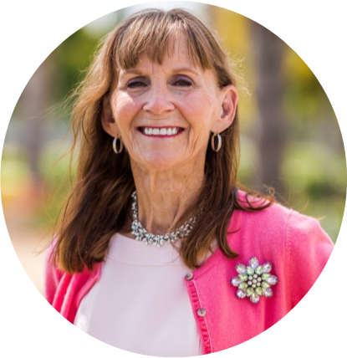
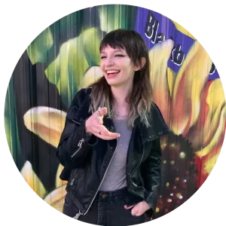
We are Here to Help!
Bryanna Sabourin
Director of Operations
Customer Happiness
Astraea Ballinger
Brand Ambassador
Customer Happiness Advocate
Lonnie Vaughn, RN, CDCES
Diabetes Nurse Champion/Mentor
Doctors Medical Center, Modesto
If you have questions, Ask Lonnie or Sheri
Or you can chat with Astraea or Bryanna

Slide 9



Slide 10
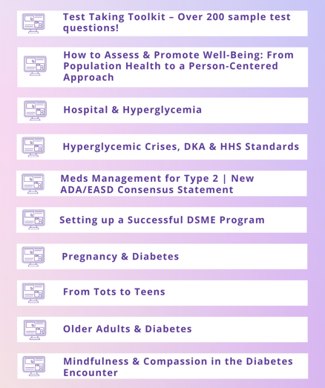
FREE Bonus Courses on Online University
We can’t cover it all in this live course.
So, we provide supplemental courses.
Now includes “Learning Theories made Easy”

Slide 11

Diabetes Education Services Inclusion Statement
Based on the IDEA Initiative inspired by CDR
Inclusion
Diversity
Equity
Access
We are committed to promoting diversity and inclusion in our educational offerings.
We recognize, respect, and include differences in ability, age, culture, ethnicity, gender, gender identity, sexual orientation, size, and socioeconomic characteristics.
Our goal is to promote equity and access, acknowledging historical and institutional inequities.
We are committed to practicing cultural humility and cultivating our cultural competence.
We wish to create a safe space within our community where one's beliefs, experiences, identity, and differences in ability, age, size, socio-cultural/socioeconomic characteristics, and political affiliations are considered and respected.

Slide 12
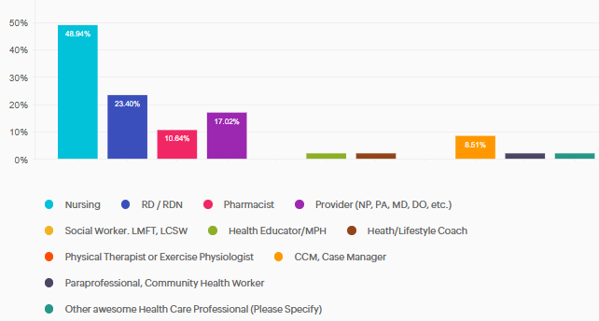
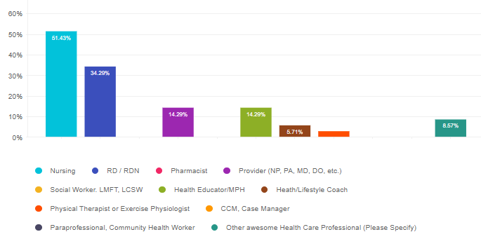
Who is attending this conference?
Other
Chronic Care Manager

Slide 13
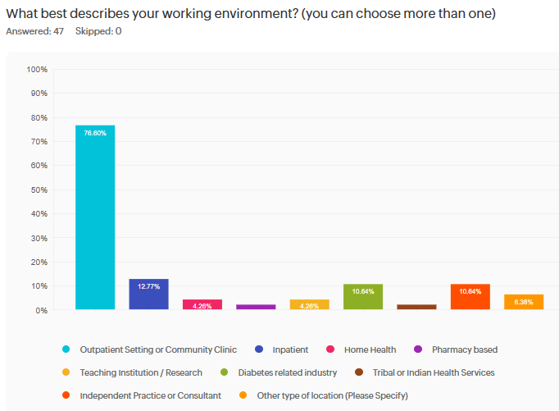
What is your job setting?
Other
Pharma Sales
DPP Program
Outpt Surgery

Slide 14
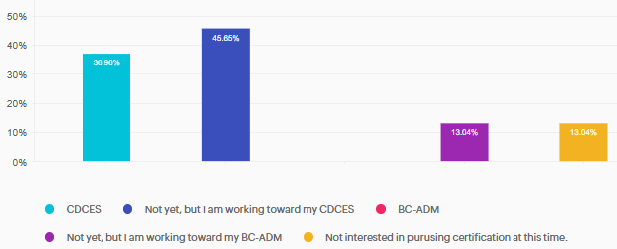
Certifications?

Slide 15
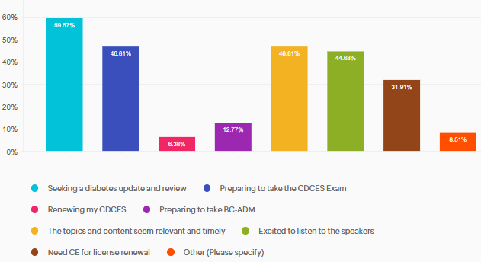
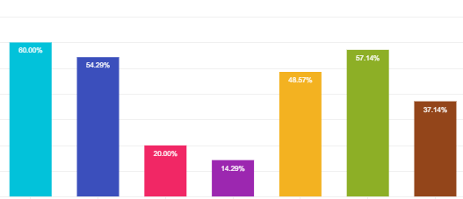
What motivated you to attend?

Slide 16

Important Stuff
Sign in each day please
Breakfast & lunch provided!
  Vegetarian options for those who requested
PocketCard Bundle
  Sticker, Chat 411
Resource page has PDF of all Slides
Team Names & Quick Quizzes– Note your table number
Giving Out Prizes is BACK
Enter Raffle
DiaBingo Prizes
We love having fun!

Slide 17


Thank you for Being a Part of This Awesome Community – Join Conference FB Page & Ad Pics

Slide 18
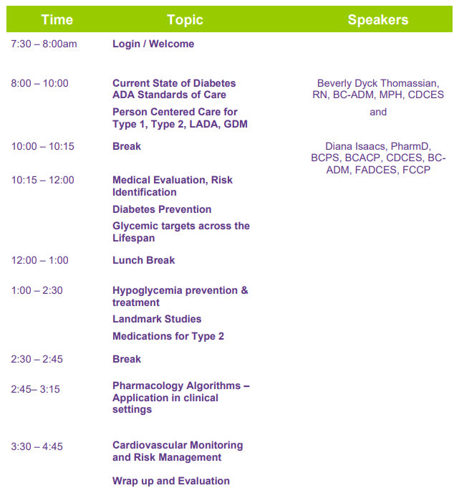
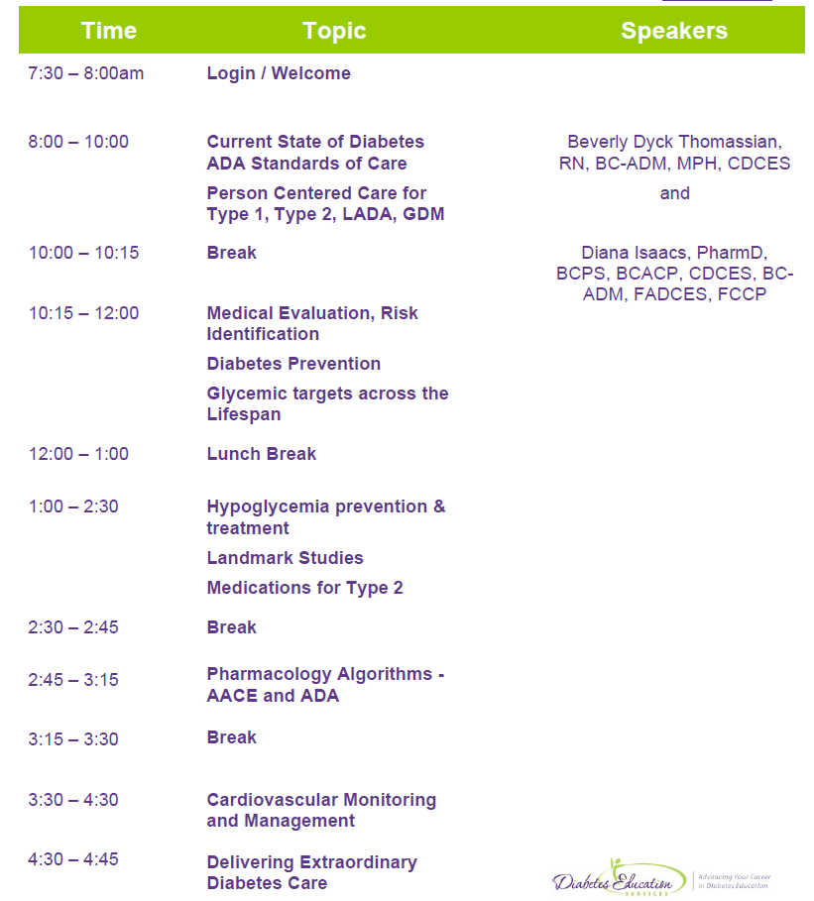

Course Schedule – Day 1
October 22
Handouts & Resource Page

Slide 19

Speaker Question and Answer
If you have a burning question, raise your hand, and ask it loud enough for everyone to hear.
We may have to limit to keep on schedule.
Parking lot question? Speakers will be available during breaks.
Can email us at info@diabetesed.net

Slide 20


Thank you Speakers & Participants

Slide 21

Diana Isaacs, PharmD, BCPS, BCACP,
BC-ADM, CDCES, FADCES, FCCP
Provides diabetes care to diverse population including T1D, T2D, transplant, pregnancy and other high-risk individuals
Engaged in clinical research and diabetes advocacy
Usually sees about 10 clients a day
Author & contributor
Endocrine Clinical Pharmacy Specialist
Director, Education & Training in Diabetes Technology
Co-Director Center for Endocrine Disorders in Pregnancy
Cleveland Clinic Endocrinology and Metabolism Institute
ADCES Educator of the Year in 2020

Slide 22
Disclosures for Dr. Isaacs
Diana Isaacs, PharmD, BCPS, BCACP, CDCES, BC-ADM, FADCES, FCCP declares the following disclosures:
Speaker: Abbott, Dexcom, Novo Nordisk, Insulet, Medtronic, Lilly, Cequr, Sanofi, Mannkind, Sequel, Sanofi
Consultant: Tandem

Slide 23

Diabetes Overview and Glycemic Goals
Objectives:
Discuss current Diabetes ADA Standards
Describe person-centered care for Type 1, Type 2, LADA, GDM
List steps for Medical Evaluation, Risk Identification and Prevention
State glycemic targets across the lifespan
Discuss hypoglycemia prevention & treatment
Describe significance of Landmark Diabetes Studies
List medications considerations for Type 2
Describe the pharmacology Algorithms
Discuss most recent cardiovascular risk mitigation strategies and goals.

Slide 24

17. Diabetes Advocacy
People living with diabetes deserve to be free from the burden of discrimination.
We need to all be a part of advocating to ensure a healthy and productive life for people living with diabetes.
Decrease barriers to diabetes self-management.
Diabetes Care needs to meet outlined standards in all settings.
- In school setting
Young children in childcare
For Drivers
In work settings
In Detention Facilities
Insulin Access & Affordability

Slide 25

CDC Announces
35% of Americans will have Diabetes by 2050
Boyle, Thompson, Barker, Williamson
2010, Oct 22:8(1)29
www.pophealthmetrics.com

Slide 26

Poll Question 1
What percent of total people in the U.S. are living with undiagnosed and diagnosed type 2 diabetes?
A. About 30%
B. 11.3%
C. 16.8%
D. 25.6%

Slide 27
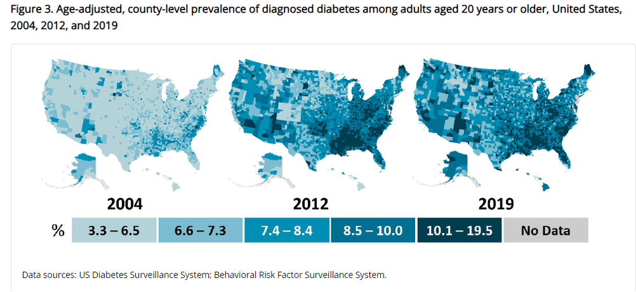
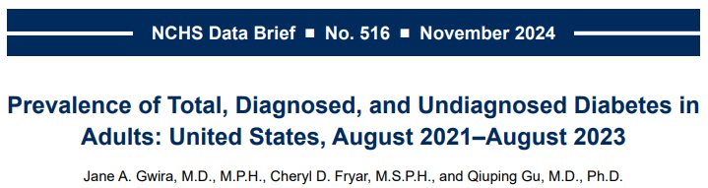
Type 2 Diabetes in America 2025
16.8% with Diabetes
  11% don’t know they have it
38% with Prediabetes – 97 million adults
https://www.cdc.gov/nchs/data/databriefs/db516.pdf
Centers for Disease Control and Prevention. National Diabetes Stats Report https://www.cdc.gov/diabetes/data/statistics-report/index.html. Accessed 1/23

Slide 28

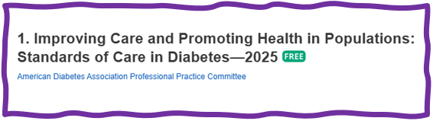
Improving Care - Population Health
“Health outcomes of a group of individuals
  including the distribution of health outcomes within the group”
These outcomes can be measured in terms of health outcome:
  mortality, morbidity, health, and functional status
  disease burden
    (incidence and prevalence)
  behavioral and metabolic factors
    (exercise, diet, A1C, etc.)
ADA Standards 2025

Slide 29
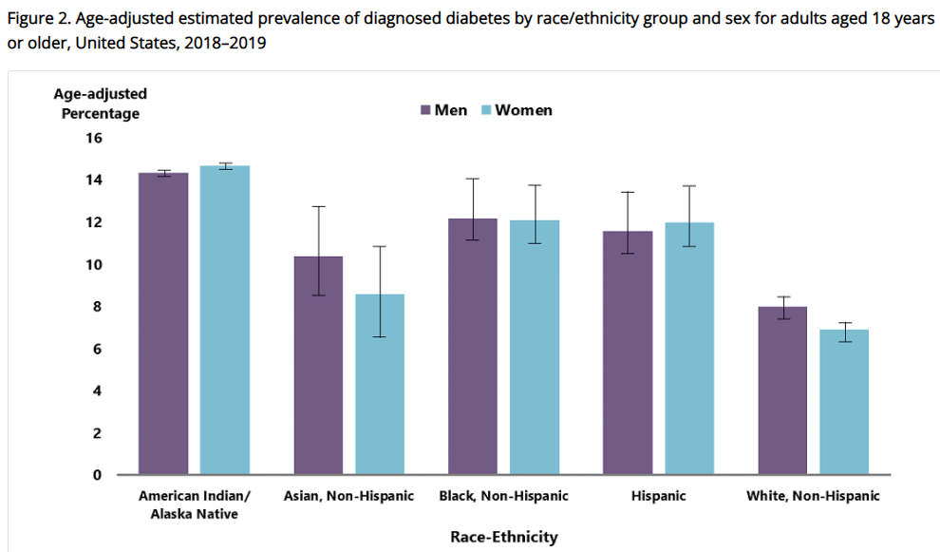
Diabetes Prevalence by Ethnic Group
For adults, diabetes prevalence highest among:
  American Indians and Alaska Natives (14.5%),
  Non-Hispanic Blacks (12.1%),
  People of Hispanic origin (11.8%),
  Non-Hispanic Asians (9.5%)
www.cdc.gov/diabetes/data/statistics-report/diagnosed-diabetes.html

Slide 30
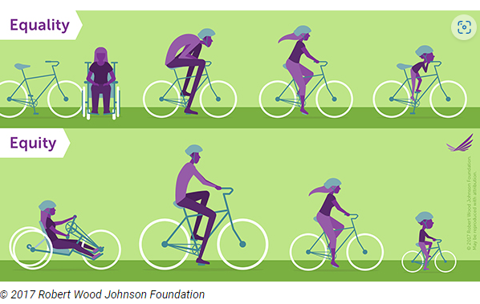
Equality vs Equity
Design and deliver diabetes care with goal of health equity across all populations.
https://coveragetoolkit.org/health-equity/defining-health-equity/

Slide 31
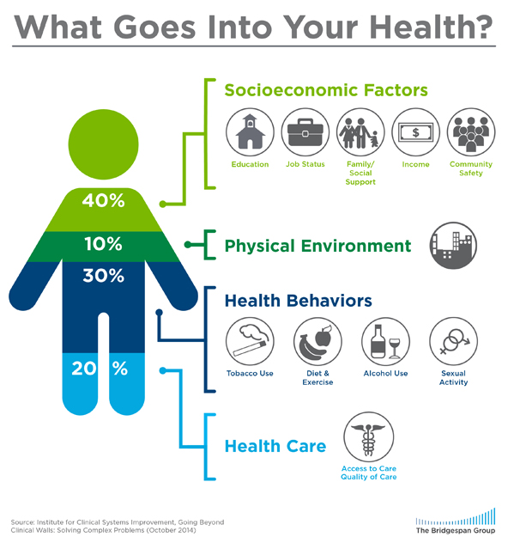

Address Barriers to Self Management
Barriers exist within health system, payer, health care professional & individual.
Address barriers through innovation, including community health workers, telehealth, other digital health solutions.
Consider social determinants of health in the target population when designing care.
https://coveragetoolkit.org/health-equity/defining-health-equity/
Notes:
Access and health equity is the ultimate goal when designing and delivering DSMES.
Creating culturally appropriate and varied modalities of settings has been shown to improve outcomes.
We know barriers to care exist at every level from the health system to individual.
However we can address these barriers by working to educate participants and health care providers on the critical times when DSMES is needed.
We can work with health systems and clinics to develop population health screening and clinical outreach,
create protocols to reduce time for referral and
collaborate health and community systems to address social needs.
We can include other health partners including community health workers to support delivery of diabetes peer support.
Barriers can be also be addressed by developing a diversity of delivery models.
From traditional inperson classrooms to community-based strategies and technology enabled solutions including telehealth or virtual environments varying modes can serve different needs.

Slide 32

Social Determinants of Health
The conditions in which people:
  Play
  Live
  Work
  Learn
  Pray
Directly affects their health risks and outcome
AADE Population Health & Diabetes Educators Evolving Role 2019

Slide 33

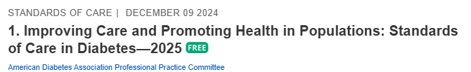
Status of Diabetes Care
In 2015–2018, U.S. community-dwelling adults with diabetes achieved:
  A1C <7% by 50.5%
    75.4% achieved A1C <8%.
  BP target of <130/80 achieved by 47.7%
    70.4% achieved blood pressure <140/90 mmHg.
  Lipid control (non-HDL cholesterol) <130 mg/dL, achieved by 55.7%
22.2% met targets for all three risk factors
Many not receiving adequate lifestyle or pharmacotherapy.

Slide 34


Notes:
Measurement of C-peptide is preferable to the measurement of insulin as it has a longer half-life, not subjected to the first-pass hepatic metabolism, and a steady-state clearance from the circulation. Insulin undergoes first-pass hepatic metabolism, has variable clearance, a much shorter half-life, and exogenously administered insulin can confound results.

Slide 35
Hormones Effect on Glucose
Effect



⇒
⇒
⇒
Hormone
Glucagon (pancreas)
Stress hormones (kidney)
Epinephrine (kidney)
Insulin (pancreas)
Amylin (pancreas)
Gut hormones
  incretins (GLP-1) released by L cells of small intestine and colon
  GIP found in K cells in duodenum and some in small intestine

Slide 36


Pre Diabetes & Type 2- Screening Guidelines (ADA 2025 Clinical Practice Guidelines)
Start screening all people at age 35.
Screen at any age if BMI ≥ 25 (Asians BMI ≥ 23) plus one or > additional risk factor:
  First-degree relative w/ diabetes
  Member of a high-risk ethnic population
  Habitual physical inactivity
  History of heart disease
  Check more frequently if taking high risk meds; antiretrovirals, 2nd generation antipsychotics or steroids, thiazide diuretics, statins
  History of pancreatitis, prediabetes, GDM, periodontitis

Slide 37

Diabetes 2 - Who is at Risk?
(ADA 2024 Clinical Practice Guidelines)
Risk factors cont’d
  HTN - BP > 130/80
  HDL < 35 or triglycerides > 250
  History of Gestational Diabetes Mellitus
  Polycystic ovary syndrome (PCOS)
  Other conditions associated w/ insulin resistance:
    Elevated BMI, acanthosis nigricans (AN)
Screen using A1C, Fasting Blood Glucose or OGTT.
Repeat screening at least every 3 years if negative.
*If prediabetes or on high risk meds, recheck yearly

Slide 38
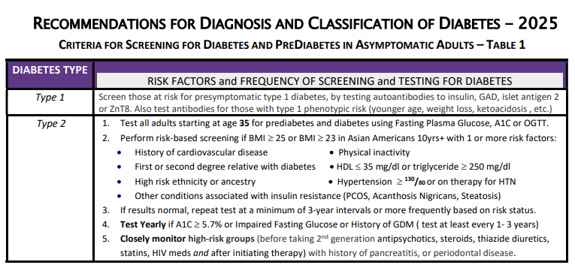



Diabetes Screening Guidelines
(ADA 2025 Clinical Practice Guidelines – Cheat Sheet)
DiabetesEd Cheat Sheets

Slide 39

Poll Question 2
Which of the following level is considered pre-diabetes range?
  a. Fasting BG of 62
  b. A1c of 5.9 %
  c. After meal BG of 137
  d. A1c of 7.1 %

Slide 40
Natural History of Diabetes
Healthy
FBG <100
Random <140
A1c <5.7%
Prediabetes
FBG 100-125
Random 140 - 199
A1c ~ 5.7- 6.4%
~ 50% working pancreas
Diabetes
FBG 126 +
Random 200 +
A1c 6.5% or +
~ 20% working pancreas
Yes!
NO
Development of type 2 diabetes happens over years or decades

Slide 41

Poll Question 3
What best describes prediabetes?
  Prediabetes affects 18-20% of people above the age of 20.
  The prevalence of prediabetes and diabetes are almost equal.
  Most people with BMI of 30 or greater have prediabetes.
  Prediabetes is associated with increased risk of CV disease

Slide 42


PreDiabetes is FREAKING ME OUT
96 million people in US
80% don’t know they have it
In 3-5 years, about 30% of predm will get diabetes
Associated with higher rates of heart attack, stroke, neuropathy and vessel disease

Slide 43

3. Prevent or Delay Diabetes for those with Prediabetes
Prediabetes defined as:
  A1c 5.7 – 6.4% or fasting BG 100 -125mg/dl
Action:
  Screen yearly for diabetes
  For adults with BMI 23/25
    Refer to DPP approved programs
    Includes intensive behavioral lifestyle interventions with 7% wt reduction goal + 150 min exercise week
    Provide in person or certified assisted programs

Slide 44

Get About 7 Hours of Quality Sleep to Prevent Diabetes
Poor sleep quality was associated with a 40–84% increased risk of developing type 2 diabetes in a meta-analysis.
Chronotype preference has been linked with many chronic diseases, including type 2 diabetes.
  For those with a preference for evenings (i.e., going to bed late and getting up late)
    2.5-fold higher odds ratio for type 2 diabetes than for those with a preference for mornings (i.e., going to bed early and getting up early),
    Independent of sleep duration and sleep sufficiency
The composition of the gut microbiome may also affect the likelihood of developing type 2 diabetes.

Slide 45
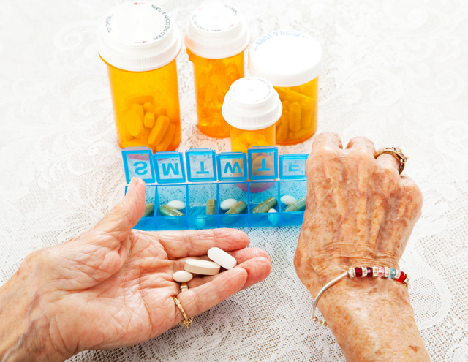
3. Pharmacologic Interventions
Use more intensive approach for high-risk individuals:
  BMI of 35+
  If A1C is ~6.0 or FPG is 110
  History of GDM
No FDA approved med for prevention (off label)
Consider Metformin Therapy for Prediabetes
  Monitor B12 level (esp with neuropathy or anemia)
CV Risk Mitigation important.
Statin can increase BG, stop if notice elevation
Consider low dose pioglitazone (Actos) if history of stroke.

Slide 46

Diabetes is Complex
Goal – achieve well being and negotiated outcomes
Psychological factors:
  Environmental
  Social
  Behavioral
  Emotional
Keep it person centered while integrating care into daily life
  Consider the individual

Slide 47

Tailoring Treatment for Social Context
“Social determinants of health (SDOH)—often out of direct control of the individual and potentially representing lifelong risk—contribute to health care and psychosocial outcomes and must be addressed to improve all health outcomes”
The ADA recognizes this relationship and is taking action.

Slide 48

Remember by Joy Harjo – Poet Laureate
Remember the earth whose skin you are:
red earth, black earth, yellow earth, white earth, brown earth, we are earth.
Remember the plants, trees, animal life who all have their tribes, their families, their histories, too. Talk to them,
listen to them. They are alive poems.
Remember the wind. Remember her voice. She knows the origin of this universe.
Remember you are all people and all people
are you.
Remember you are this universe and this
universe is you.
Remember all is in motion, is growing, is you.
Remember language comes from this.
Remember the dance language is, that life is.
Remember.
We are all connected

Slide 49

Let’s meet people where they are at.

Slide 50
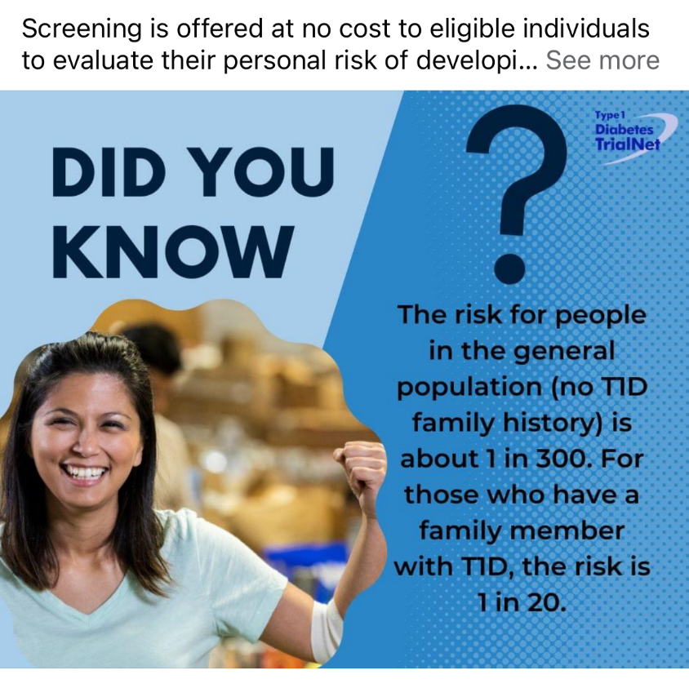

Type 1 ~ Immune Mediated
5-10% of Diabetes
1.5 Million people have type 1 in U.S.
Prevalence increasing:
2001 – 1.48 per 1000 youths diagnosed with diabetes
2017 - 2.15 per 1000 youths diagnosed with diabetes
Incidence & Prevalence increasing
Highest incidence in Finland or Northern Europe.
ADCES In Practice - March 2024 Recent Advances in Type 1 Diabetes: Teplizumab (Tzeild®)
Karen S. Fiano, PHARMD, BCACP, Devada Singh-Franco, PHARMD, CDCES, Young M. Kwon, BS, PHD

Slide 51


Slide 52



“Diabetes is my biggest competitor” Gary Hall Jr

Slide 53
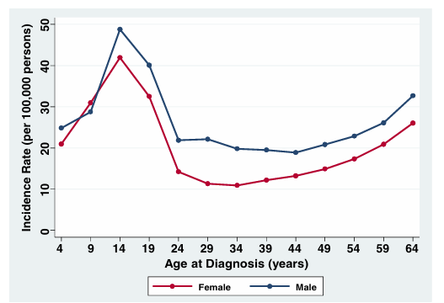


Clinical onset of T1D can occur at any age
* A longitudinal study comprising 32,476 commercially insured Americans aged 0-64 years who developed T1D between 2001 and 2015.
Rogers MAM, et al. BMC Med. 2017;15(1):199.

Slide 54
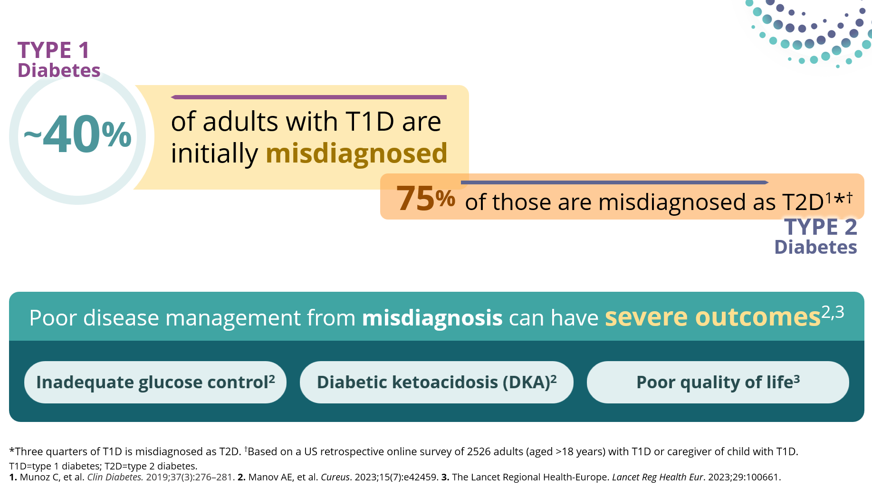
T1D is Often Misdiagnosed as T2D in Adults

Slide 55
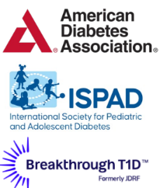



Screen people at increased risk of T1D
First-degree relatives of individuals with T1D
Individuals with personal or family history of select autoimmune diseases
Screening for T1D autoantibodies is recommended by
2-3X greater risk of T1D in individuals with select autoimmune diseases
~15x greater risk
of T1D versus the general population
Thyroid disorders
  Hashimoto’s thyroiditis
  Graves’ disease
Celiac disease

Slide 56
Benefits of early detection of pre-symptomatic T1D
Decreased frequency of insulin treatment at diagnosis
Lower HbA1C
Lower rates of DKA
98.1%
10.5%
62%
6.8%
72.3%
6%
Screened & diagnosed
Not screened
Screened & diagnosed
Not screened
Screened and diagnosed
Not screened
Sims E. et al. Diabetes. 2022 Apr 1;71(4):610-623.
Hummel S, et al. Diabetologia. 2023 Sep;66(9):1633-1642
Notes:
Hummel S, et al. Diabetologia. 2023 Sep;66(9):1633-1642. doi: 10.1007/s00125-023-05953-0. Epub 2023 Jun 17. PMID: 37329450; PMCID: PMC10390633.

Slide 57
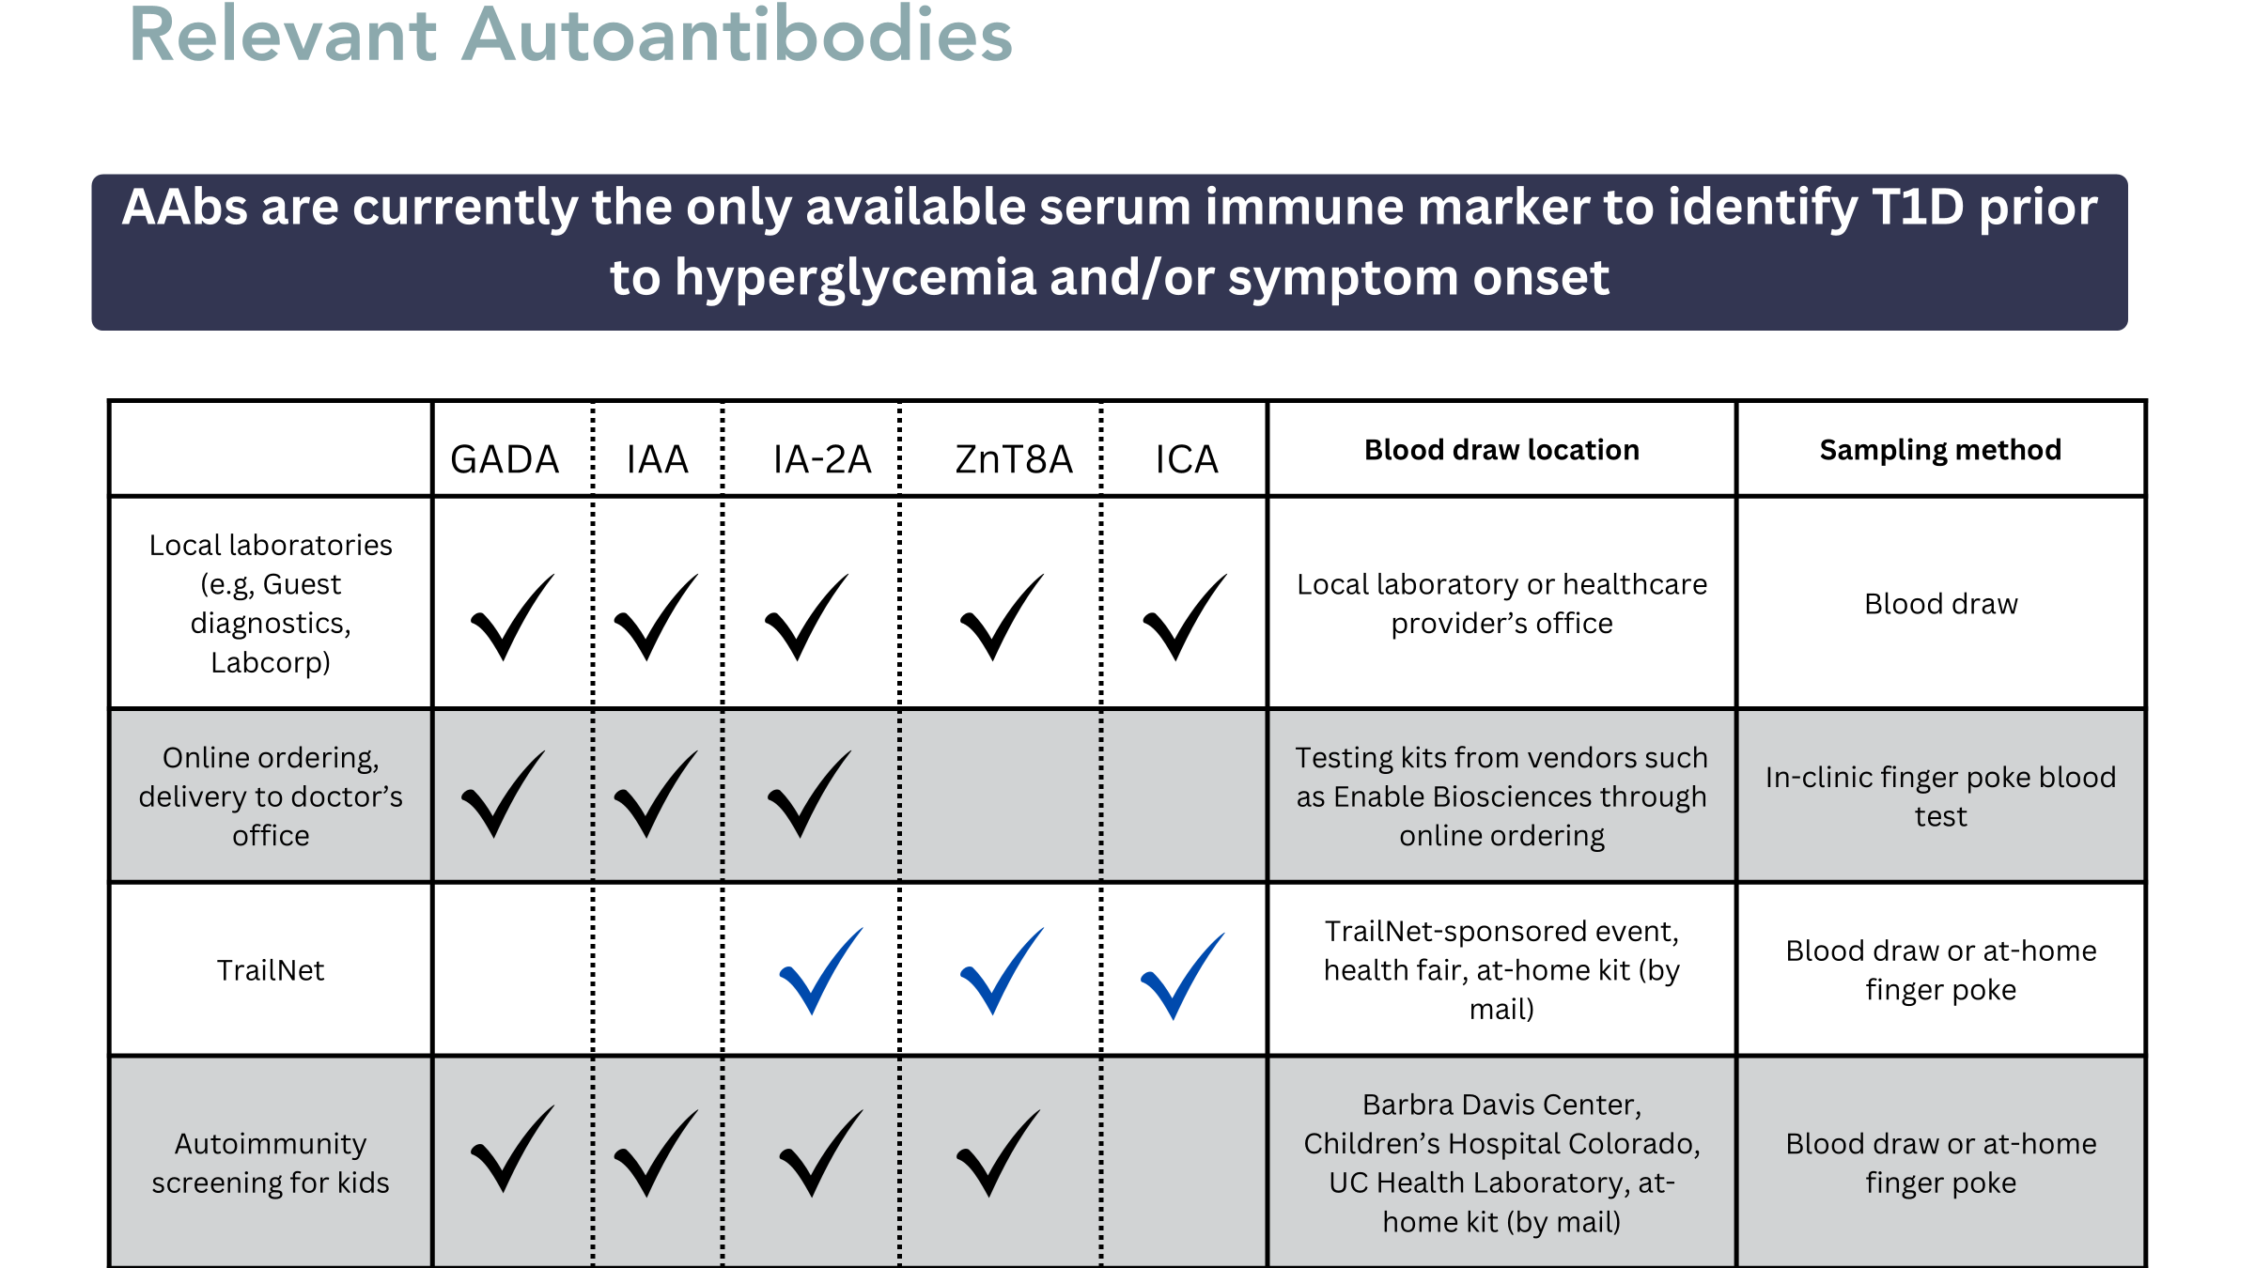
Ordering Autoantibodies
Patients at increased risk should be screened for type 1 diabetes
First-degree relatives of individuals with T1D
Individuals with personal or family history of select autoimmune diseases
Screened for T1D autoantibodies is recommended by
2-3X greater risk of T1D in individuals with select autoimmune diseases
~15x greater risk
of T1D versus the general population
Thyroid disorders
  Hashimoto’s thyroiditis
  Graves’ disease
Celiac disease
Glutamic acid decarboxylase 65 autoantibody (GADA)
Insulin autoantibody (IAA)
Insulinoma-associated antigen 2 autoantibody (IA-2A)
Zinc transporter 8 autoantibody (ZnT8A)
Islet cell autoantibody (ICA)

Slide 58
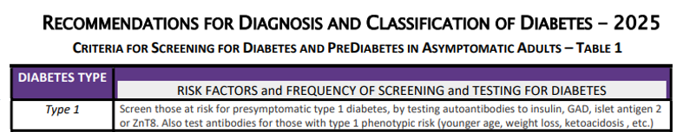
 | Stage 1 | Stage 2 | Stage 3
Characteristics | • Autoimmunity | • Autoimmunity | • Autoimmunity
 | • Normoglycemia | • Dysglycemia | • Overt hyperglycemia
 | • Presymptomatic | • Presymptomatic | • Symptomatic
Diagnostic criteria | • 2 or more islet autoantibodies Glucose levels are in normal range FBG<100mg/dL A1C<5.6% 2-h PG <140mg/dL | • 2 or more islet autoantibodies Dysglycemia: Elevated IFG and/or IGT • FPG 100–125 mg/dL • 2-h PG 140–199 mg/dL • A1C 5.7–6.4% or ≥10% increase in A1C | • Autoantibodies may disappear over time (5-10% may not express antibodies) • Diabetes diagnosed by standard criteria

Slide 59
Pharmacologic Intervention to Delay Stage 3 T1D
Teplizumab-Tzield (CD3-monoclonal antibody)
14-day infusion can delay the onset of symptomatic T1D (stage 3)
An option for individuals aged ≥8 years with stage 2 T1D
In a single trial, 44 individuals received 14-day course of teplizumab vs 32 in placebo
The median time to delay stage 3 T1D was 2 years
  48.4 months in teplizumab group vs. 24.4 months placebo
Financial assistance available
Herold KC, et al; Type 1 Diabetes TrialNet Study Group. An Anti-CD3 Antibody, Teplizumab, in Relatives at Risk for Type 1 Diabetes. N Engl J Med. 2019 Aug 15;381(7):603-613.
Notes:
Herold KC, Bundy BN, Long SA, Bluestone JA, DiMeglio LA, Dufort MJ, Gitelman SE, Gottlieb PA, Krischer JP, Linsley PS, Marks JB, Moore W, Moran A, Rodriguez H, Russell WE, Schatz D, Skyler JS, Tsalikian E, Wherrett DK, Ziegler AG, Greenbaum CJ; Type 1 Diabetes TrialNet Study Group. An Anti-CD3 Antibody, Teplizumab, in Relatives at Risk for Type 1 Diabetes. N Engl J Med. 2019 Aug 15;381(7):603-613. doi: 10.1056/NEJMoa1902226. Epub 2019 Jun 9. Erratum in: N Engl J Med. 2020 Feb 6;382(6):586. doi: 10.1056/NEJMx190033. PMID: 31180194; PMCID: PMC6776880.

Slide 60
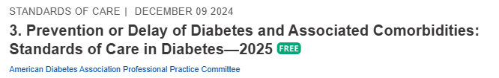
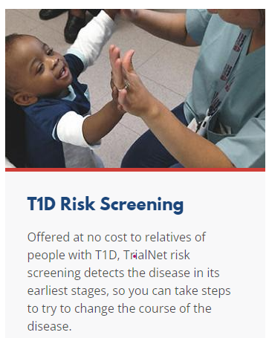
Monitoring for T1D Progression
Screen for AAB’s and if positive:
How to monitor for stage 2 adults:
  Screen A1C every 6 months
  75- OGTT every year
  Modify screening based on antibodies and glycemic metrics.
  May benefit from CGM to monitor progression
In kids, monitor every 3 months
Trialnet.org
Phillip M, et al. Diabetes Care. 2024 Aug 1;47(8):1276-1298.

Slide 61
Type 1 & Lifestyle Prevention
Observational studies in those with antibodies, shed light on factors that increase β-cell demand:
  Less physical activity
  Consuming higher glycemic index foods
  Sugar intake
Factors that reduced risk of progression from TEDDY study:
Daily minutes spent doing vigorous physical exercise.
More info needed

Slide 62
Quick Question 4
Question: LT has just been diagnosed with stage 1, type 1 diabetes. He has 2 positive autoantibodies and his blood sugars are slightly elevated. He asks you if he is a candidate for “that therapy” that can protect beta cells and slow progression of type 1 diabetes. What is the most accurate response?
  Unfortunately, you are not a candidate, since you already have 2 positive autoantibodies.
  Let’s talk to your provider about the possibility of starting Teplizumab therapy.
  With your blood sugar elevation, the best early intervention is insulin therapy.
  Since you are in stage 1, the therapy is not indicated, but let’s talk about monitoring.
Notes:
Answer, D

Slide 63
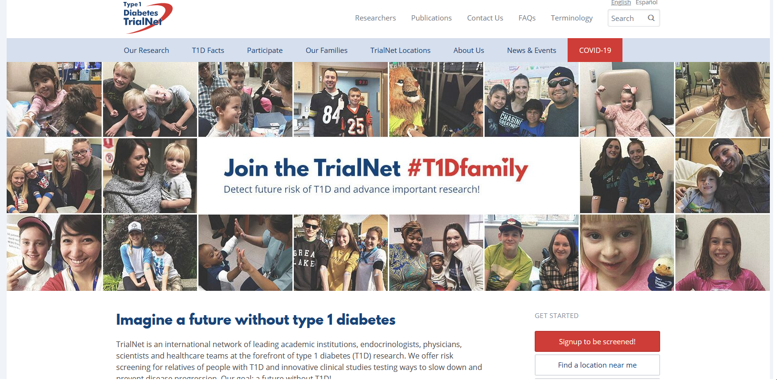
  www.DiabetesTrialNet.org
How to get families linked to screening?

Slide 64

Determine if Type 1 - Use AABBCC Approach
Age
  e.g., for individuals <35 years old, consider type 1 diabetes
Autoimmunity
  e.g., personal or family history of autoimmune disease or polyglandular autoimmune syndromes
Body habitus
  e.g., BMI <25 kg/m2
Background
  e.g., family history of type 1 diabetes
Control
  e.g., level of glucose control on noninsulin therapies
Comorbidities
  e.g., treatment with immune checkpoint inhibitors for cancer can cause acute autoimmune type 1 diabetes or presence of other autoimmune conditions

Slide 65

Type 1 Diabetes Features?
For JR, a 28 admitted to the ICU with a blood glucose of 476 mg/dl, pH of 7.1, anion gap of 15. Recently lost 13 pounds.
Type 1 Most Discriminative Features
Younger than 35 years at diagnosis
Lower BMI (<25 kg/m²)
Unintentional weight loss
Ketoacidosis
Glucose 360 mg/dl or greater.
Misdiagnosis is common and can occur in ∼40% of adults with new type 1 diabetes

Slide 66
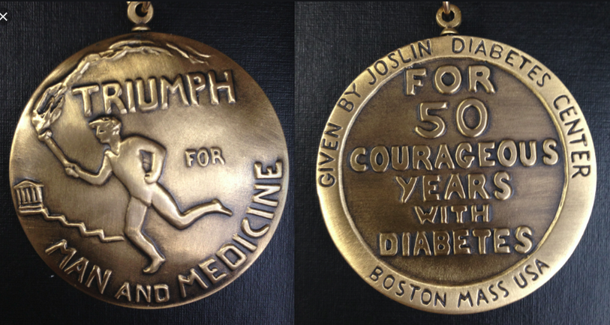

Medalist Study – Harvard Joslin Diabetes Center
After 50 years with diabetes
  Many still produced some insulin
  Many had no eye disease

Slide 67

What kind of Diabetes?
58 yr old, states she has had type 1 diabetes for 18 years. Quit smoking a year ago and gained about 20 lbs. BMI 25.
Meds
  Lispro 18-23 units before each meal
  Glargine 28 units at bedtime
  Metformin 500mg TID
What tests would you recommend?
25% of ind’s with Type 1 also have type 2 diabetes.
ADA Post Grad, 2010

Slide 68

Type 1 & Type 2 - Double Diabetes?
May be appropriate to recognize a person with type 1 diabetes and features classically associated with type 2 diabetes (e.g., insulin resistance, obesity, and other metabolic abnormalities.
Can help facilitate access to appropriate treatment:
  (e.g., GLP-1 RA or SGLT-2 inhibitor therapies for potential weight and other cardiometabolic benefits) and monitoring systems.

Slide 69
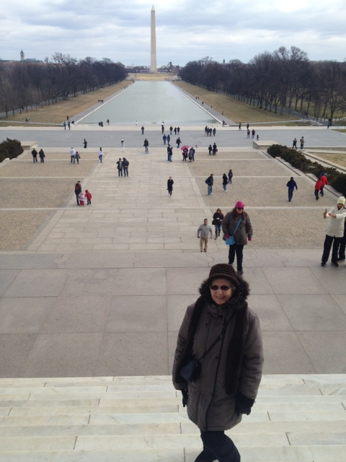
What type of Diabetes?
72 Years old
A1c 3 months prior 6.2%
A1c now 13.9%
BMI 24.5
Lost about 10 pounds over last month

Slide 70

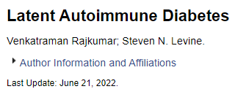
Latent AutoImmunity Diabetes in Adults (LADA)
Antibody positive to 1-2 of below
  GAD-65 autoantibodies
  Insulin Autoantibodies
  Islet Cell antigen-2
  ZnT8
Adult Age at onset
Usually benefit from insulin w/in first 6 months of diagnosis
Early insulin therapy may preserve beta cell function
Diabetes Care 26:536-538, 2003
Jerry P. Palmer, MD and Irl B. Hirsch, MD

Slide 71
LADA Clinical Features Compared to Type 2
Feature LADA Type 2
Age <50 63% 19%
Acute hyperglycemia 66 24
BMI < 25 33 13
Hx of autoimmune dx 27 12
Family hx autoimmune 46 35
Practical Diabetology March 08, Unger MD

Slide 72


What about Latent Autoimmunity Diabetes in Adults (LADA)
Slowly progressive autoimmune diabetes with an adult onset should be termed:
  LADA or type 1 diabetes.
  Slow autoimmune β-cell destruction can lead to a long duration of marginal insulin secretory capacity.
  For this classification, all forms of diabetes mediated by autoimmune β-cell destruction independent of age of onset are included under the rubric of type 1 diabetes.

Slide 73
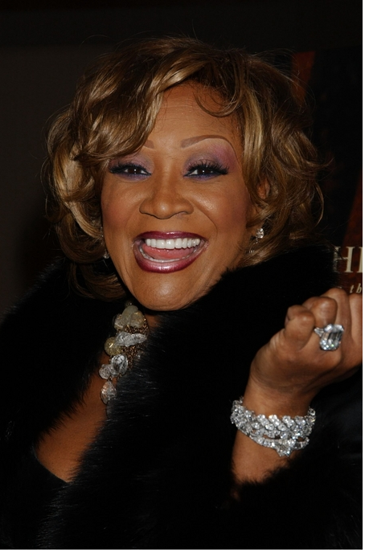
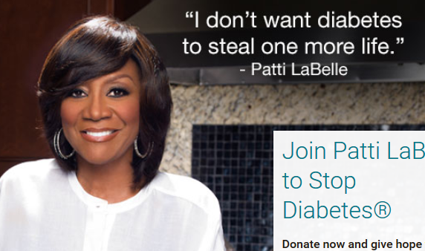
Patti Labelle
"divabetic”
“I have diabetes, it doesn’t have me”

Slide 74
Signs of Diabetes
Polyuria
Polydipsia
Polyphasia
Weight loss
Fatigue
Skin and other infections
Blurry vision
Glycosuria, H₂O losses
Dehydration
Fuel Depletion
Loss of body tissue, H₂O
Poor energy utilization
Hyperglycemia increases incidence of infection
Osmotic changes

Slide 75




Slide 76

What is Type 2 Diabetes?
Complex metabolic disorder ….
  (Insulin resistance and deficiency)
with social, behavioral and environmental risk factors unmasking the effects of genetic susceptibility.
New Diagnosis?
Call 800 – DIABETES to request “Getting Started Kit”
www.Diabetes.org

Slide 77
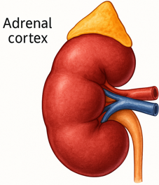

The Noxious Nine – Pathophysiology T2D
Hypercortisolism
Neurotrans-mission dysfunction
Decreased
Insulin β-cell secretion
Increased renal glucose reabsorption
Decreased
incretin effect
Gut hormones
G
Increased glucagon α-cell secretion
I
G
I
G
G
I
I
G
Increased lipolysis
G
G
I
I
G
G
I
Increased hepatic glucose
production
I
G
G
Decreased muscle glucose uptake
DeFronzo, Auchus-Hypercortisolism June 2025
Notes:
77
ummary: The Noxious Nine in Diabetes Pathophysiology
Ralph A. DeFronzo expanded his earlier conceptual model of diabetes—known as the Ominous Octet—to include a ninth element: hypercortisolism. This updated framework is referred to as the Noxious Nine, highlighting the important role of cortisol dysregulation in difficult-to-control type 2 diabetes currentsciencedaily.com+8HCP Live+8HCP Live+8.
Recent research, including the CATALYST trial, shows that about 24% of patients with difficult-to-control T2D have underlying hypercortisolism. Treating this condition with mifepristone, a glucocorticoid receptor antagonist, led to significant improvements in HbA1c—averaging around a 1.5% reduction pmc.ncbi.nlm.nih.gov+3HCP Live+3medscape.com+3.
These findings emphasize the importance of recognizing hypercortisolism in T2D care and suggest that addressing it may help improve glycemic and metabolic control in a subset of patients.
77

Slide 78
Hypercortisolism in Type 2
Cortisol increases gluconeogenesis in the liver
Reduces peripheral glucose uptake → insulin resistance
Stimulates protein catabolism and lipolysis
Chronic cortisol elevation → persistent hyperglycemia
Can lead to “Difficult to Control Type 2 Diabetes”
CATALYST study revealed about 24% of people with elevated BG despite meds, may be due to hypercortisolism.
Treatment with mifepristone decreased weight and BG.
DeFronzo, Auchus-Hypercortisolism June 2025
pmc.ncbi.nlm.nih.gov+3HCP

Slide 79

SGLT-2 Inhibitors

Slide 80
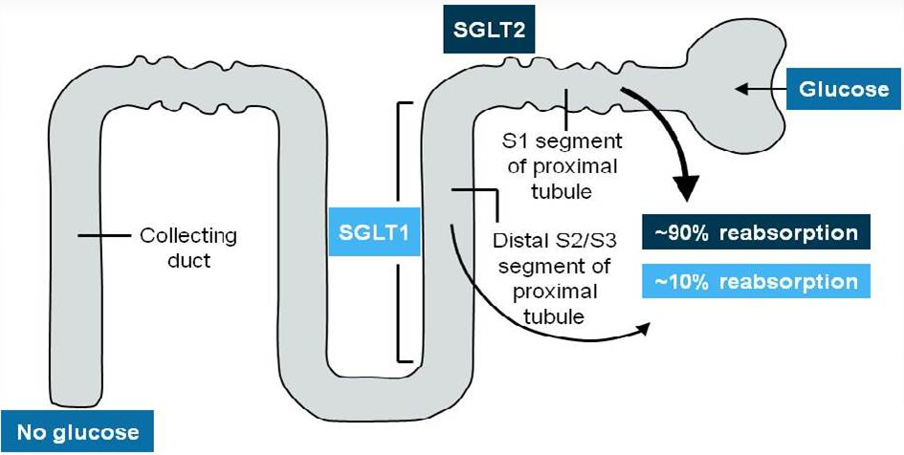
SGLT and the Kidney

Slide 81
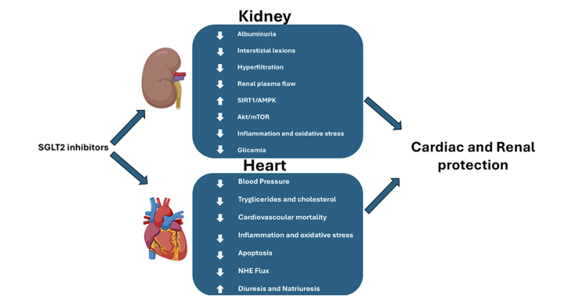
Additional SGLT2 Inhibitor Effects
Gaggini M, et al. Cells. 2025 Mar 6;14(5):387. doi: 10.3390/cells14050387.
Notes:
Gaggini M, Sabatino L, Suman AF, Chatzianagnostou K, Vassalle C. Insights into the Roles of GLP-1, DPP-4, and SGLT2 at the Crossroads of Cardiovascular, Renal, and Metabolic Pathophysiology. Cells. 2025 Mar 6;14(5):387. doi: 10.3390/cells14050387. PMID: 40072115; PMCID: PMC11898734

Slide 82

Poll Question 5
FZ has type 2 diabetes and heart failure. He was recently diagnosed with an A1C of 7.1%. What is the best medication to start?
Pioglitazone
Tirzepatide
Metformin
Dapagliflozin
Notes:
Answer: d

Slide 83

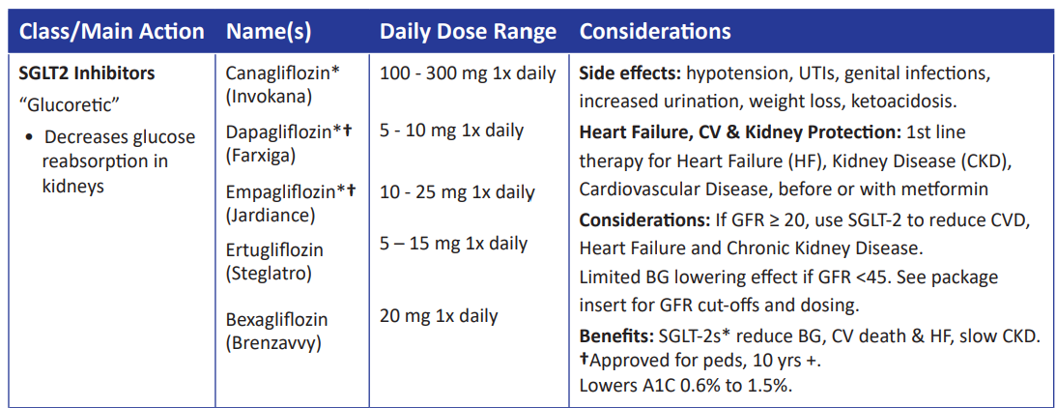
SGLT-2 Inhibitors- “Glucoretics”
Action: decreases renal reabsorption of glucose in the proximal tubule of kidneys (reset renal threshold)
Preferred diabetes treatment for people with heart and kidney failure. Decreases BG & CV Risk
AWP: ~$650 a month
% ‘f
Notes:
83
83

Slide 84
SGLT-2 Inhibitor Dosing and Renal Adjustments
Drug | Dose | Renal Adjustment
Ertugliflozin (Steglatro) | 5-15 mg daily | Not recommended for eGFR <45
Dapagliflozin (Farxiga) | 5-10 mg daily | Not recommended to initiate with eGFR <45 (glycemic control) or <25 (other conditions): may continue for CV, CKD benefits
Empagliflozin (Jardiance) | 10-25 mg daily | Not recommended to initiate for eGFR <30 (glycemic control) , may continue for CV, CKD benefits
Canagliflozin (Invokana) | 100-300 mg daily | eGFR 30 to <60: 100 mg once daily eGFR <30: avoid initiation, may continue 100mg daily until ESRD
Bexagliflozin (Brenzavvy) | 20 mg daily | Not recommended for eGFR <30
Package inserts, dailymed.nlm.nih.gov
Package inserts, dailymed.nlm.nih.gov
Notes:
Withhold DAPAGLIFLOZIN TABLETS for at least 3 days, if possible, prior to major surgery or procedures associated with prolonged fasting.

Slide 85
SGLT-2 Inhibitor Indications
Drug | Lowers BG | Reduces CV Risk? | Heart Failure Indication? | Kidney Indication?
Dapagliflozin (Farxiga) | Yes, for 10 yrs and older | Yes | Yes +/- Diabetes | Yes +/- Diabetes
Empagliflozin (Jardiance) | Yes for 10 yrs and older | Yes | Yes +/- Diabetes | Yes +/- Diabetes
Canagliflozin (Invokana) | Yes , for 10 yrs and older | Yes | Yes w/ Diabetes | Yes w/ Diabetes
Ertugliflozin (Steglatro) | Yes | No | No | No
Bexagliflozin (Brenzavvy) | Yes | NA | No | No
Package inserts, dailymed.nlm.nih.gov

Slide 86
Benefits of SGLT-2 Inhibitors
A1C lowering
Modest weight loss
Cardiovascular
Renal
Heart failure
Blood pressure lowering

Slide 87
Side Effects of SGLT-2 Inhibitors
Genitourinary infections
Volume depletion
Increased urination
Hypotension
UTI
Diabetes ketoacidosis (DKA)
Amputation risk? (Canagliflozin), Fournier’s gangrene?
Hold for 3 days prior to surgery or procedures with prolonged fasting

Slide 88
Managing Adverse Effects
Maintain good hygiene to reduce risk of genital mycotic infections
  Higher risk with higher glucose
DKA risk
  Use caution with reducing insulin dose
Discontinue 3 days prior to surgery or procedures that require prolonged fasting
Monitor BP
  May need to reduce antihypertensive meds
UTI risk greater with hyperglycemia
Amputations observed with canagliflozin
  Good foot care, check feet daily
Monitor renal function

Slide 89
Where do SGLT2-2 Inhibitors Fit within the Guidelines?

Slide 90
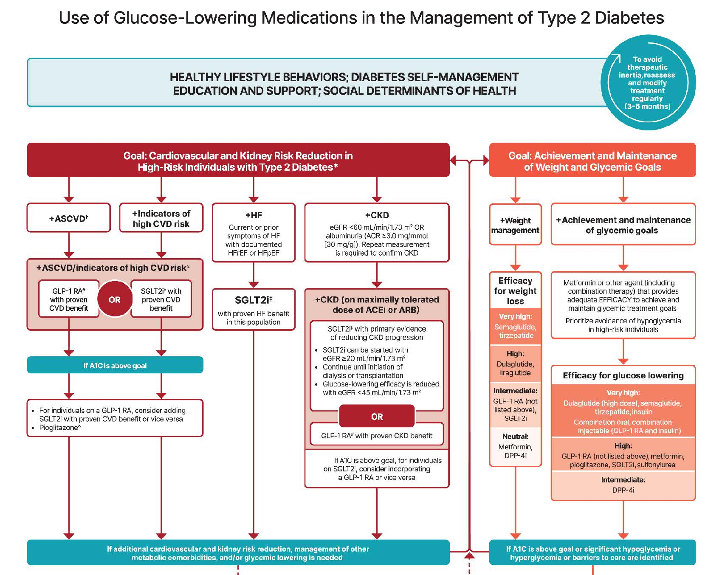
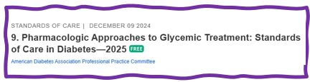


Slide 91
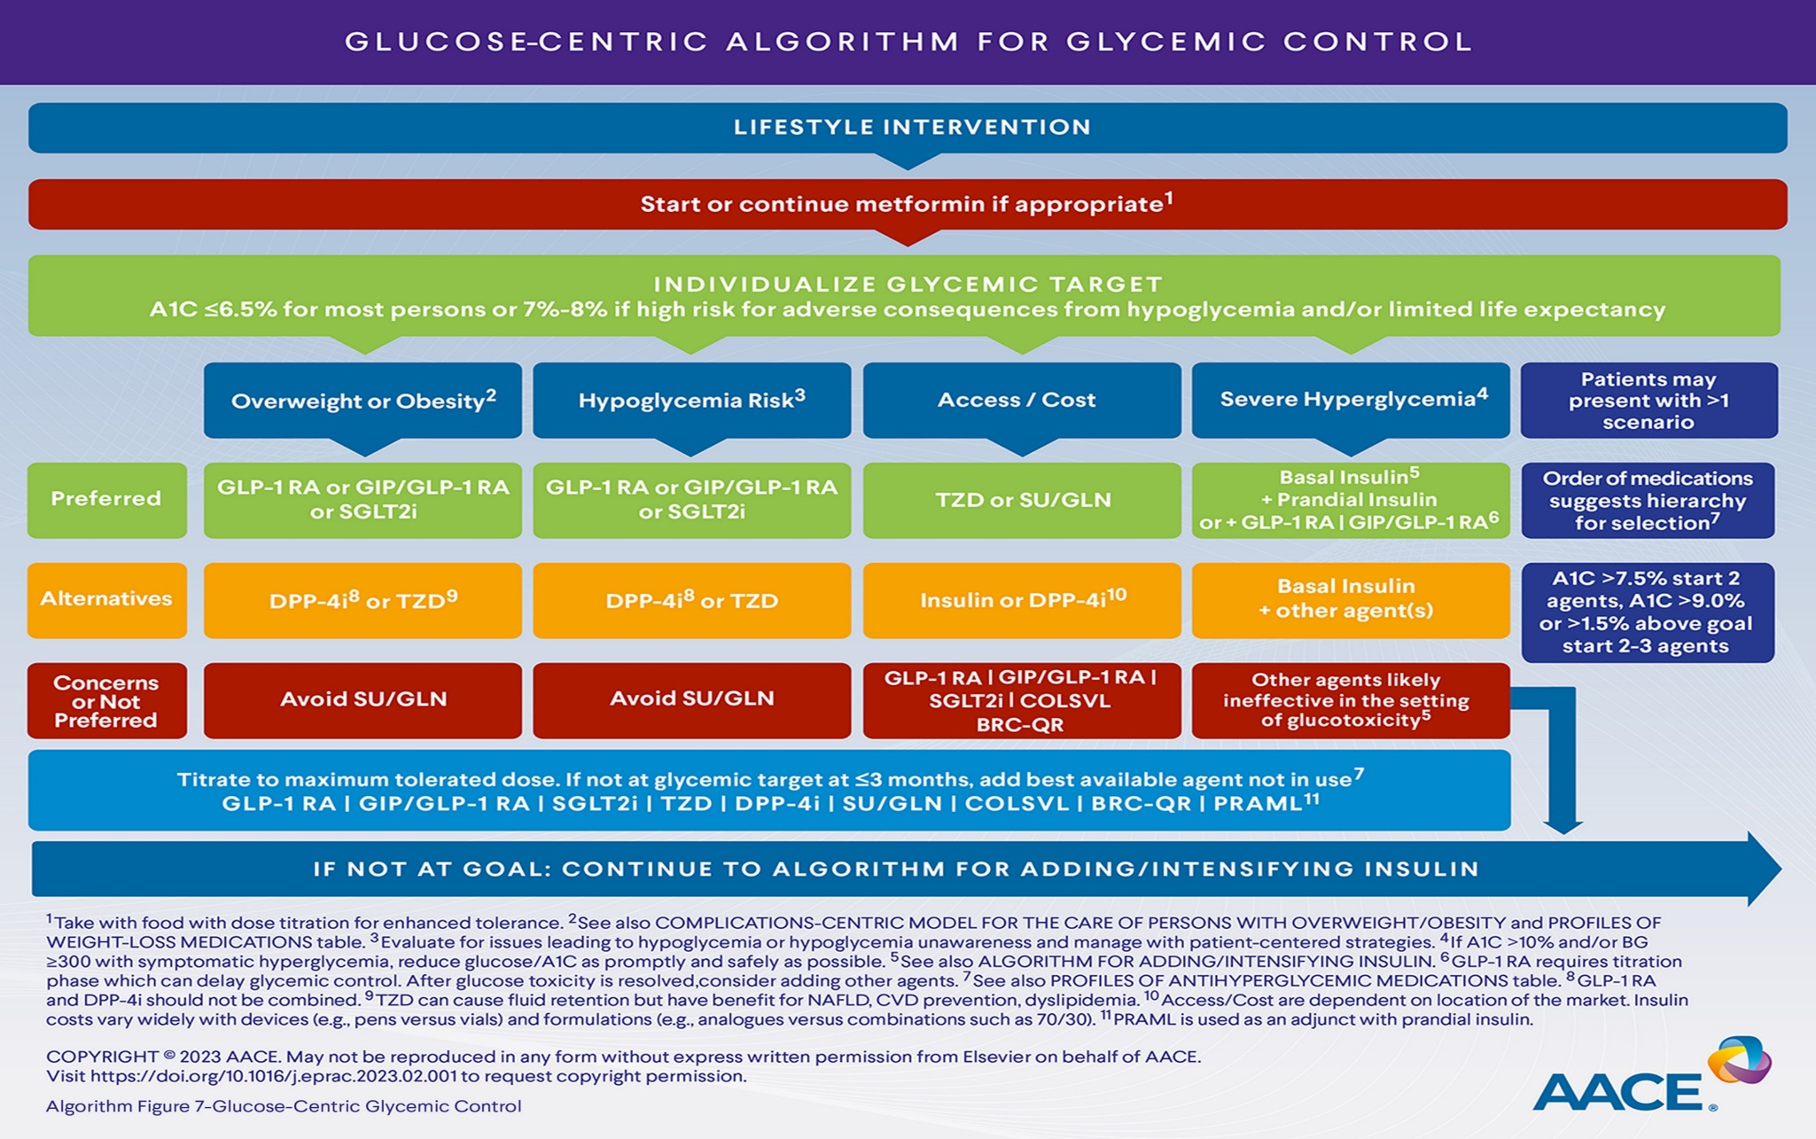
AACE Glucose-Centric Algorithm

Slide 92
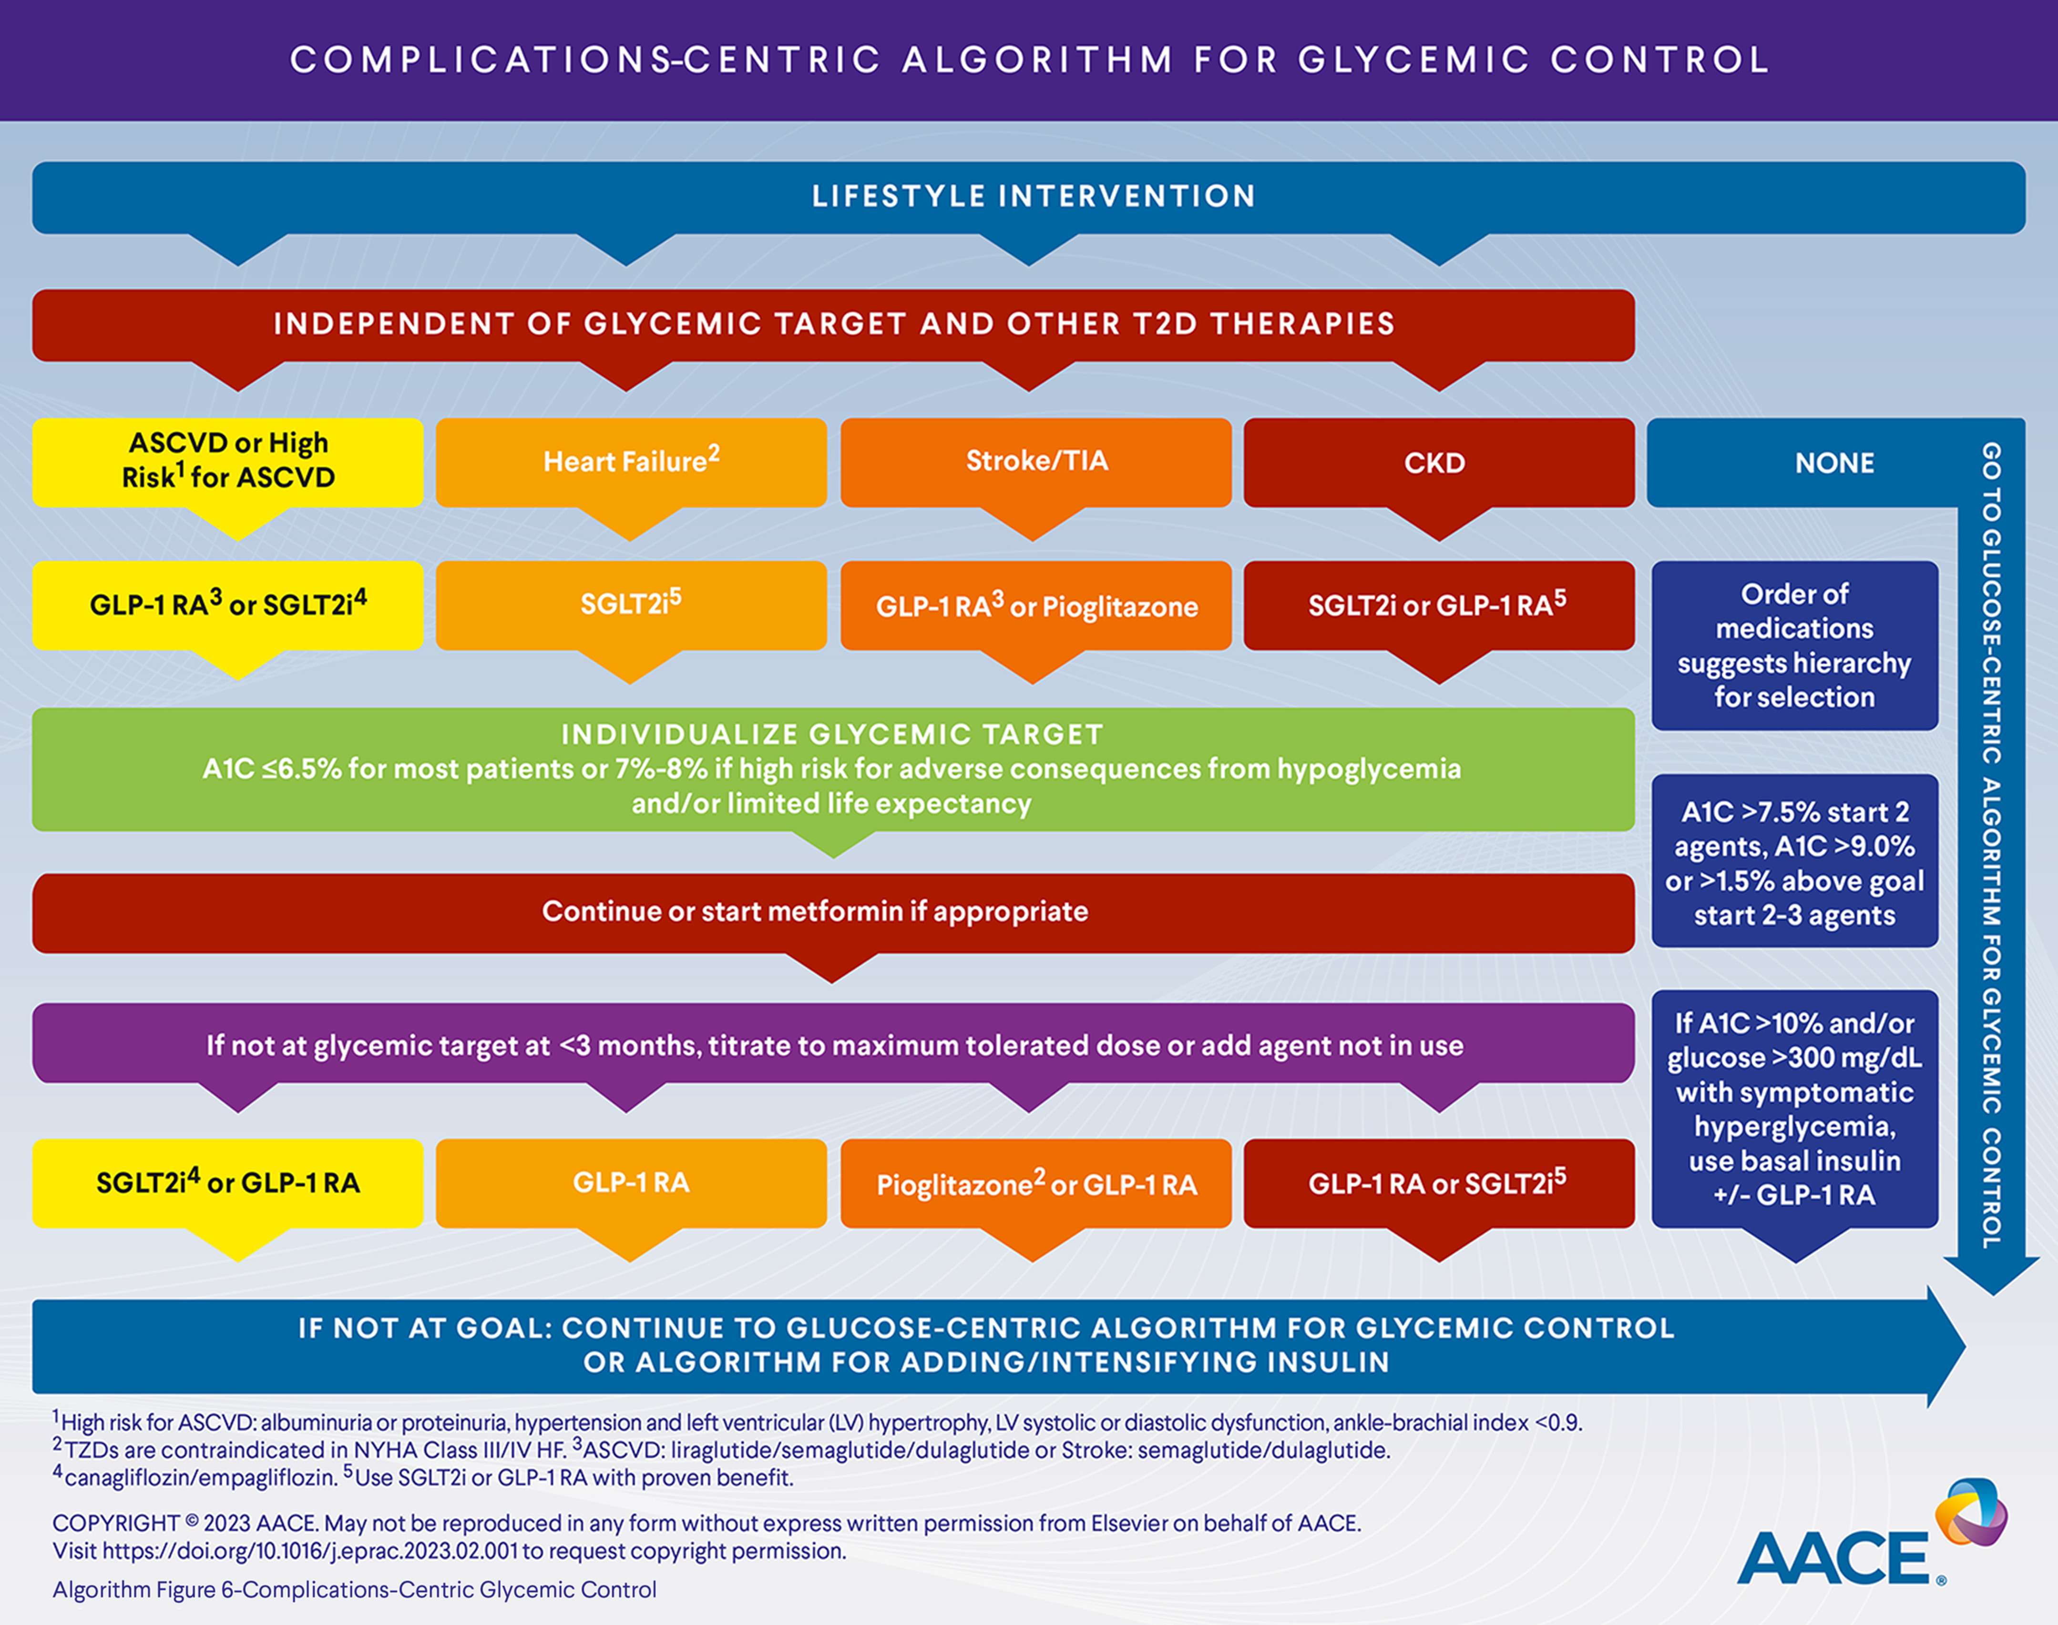
AACE Complication-Centric Algorithm

Slide 93

Case Study: Rick
Rick is a 51yoM diagnosed with type 2 diabetes 5 years ago.
He takes metformin 1000mg twice daily and semaglutide 2mg weekly. His A1C=7.3%.
In the last 3 months, he was diagnosed with kidney disease. He has albuminuria and eGFR=50.
Weight: 205lbs, 5”7, BMI=32kg/m²
He lost 20lbs in the last year
Notes:
Answer: D Metformin

Slide 94
Case Study: Rick
What is the best drug to add to Rick’s regimen?
Glipizide
Empagliflozin
Pioglitazone
Linagliptin
More than 1 correct answer
Notes:
Answer: B.

Slide 95
SGLT2 Inhibitors- How do they rate?
Question Answer
Cause hypoglycemia?
Cause weight gain?
Affordable?
Lowers Cardiorenal risk?
Can most tolerate /use?
No
No
No
Yes
Yes

Slide 96

“Getting diabetes saved my life.”
~ Sherri Sheperd
Sherri Shepard decided to embrace diabetes and use it as a motivator to improve her health.

Slide 97
Comparison of Type 1,Type 2, LADA
Type 1
Type 2 LADA
Excess weight
x
xxx x
Insulin dependence
xxx
30% 6mos
Respond to oral agents
0
xxx x
Ketosis
xxx
x x
Antibodies present
xxx
0 xx
Typical Age of onset
teens
adult adult
Insulin Resistance
0
xxx
x

Slide 98


Other Types of Diabetes
Gestational
Other specific types of diabetes

Slide 99

Screening in early Pregnancy
Check glucose levels before 15 weeks of gestation:
  Can find undetected diabetes or hyperglycemia
  Prevent fetal exposure to hyperglycemia
  Allows providers and pregnant people to take action to prevent complications
Use standard diabetes diagnostic criteria.
  If positive, diagnosis “Diabetes complicating pregnancy”
If fasting BG 110+ or A1C 5.9%+
  At higher risk of adverse outcomes and more likely to experience GDM and need insulin.

Slide 100

Poll question 6
What best describes gestational diabetes?
Diabetes discovered within the first 12 weeks of pregnancy.
Diabetes discovered in the 24-28 weeks of pregnancy.
Risk of getting diabetes before pregnancy.
Diabetes discovered at any point during pregnancy.

Slide 101

Gestational DM ~ 9% of all Pregnancies
Detected at 24-28 weeks of pregnancy (most insulin resistant phase)
50% chance of getting diabetes post delivery
Offspring at greater risk of insulin resistance and diabetes

Slide 102

Rates of Gestational Diabetes (GDM) and Diabetes in Pregnancy increasing
1% to 2% have type 1 or type 2 during pregnancy
6% to 9% develop GDM.
From 2000 to 2010
  GDM rates increased 56%
  Type 1 or type 2 before pregnancy increased 37%.
Asian and Hispanic women have higher rates of GDM
Black and Hispanic women have higher rates of type 1 or type 2 diabetes during pregnancy.
CDC https://www.cdc.gov/reproductivehealth/maternalinfanthealth/diabetes-during-pregnancy.htm

Slide 103
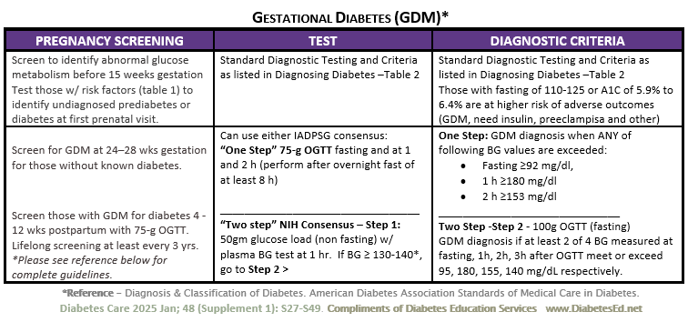
See Diabetes and Pregnancy Level 2
Screening and Diagnosis of Diabetes Cheat Sheet

Slide 104

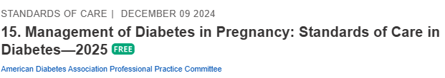
Gestational Diabetes and Pregnancy
Test for GDM at 24-28 weeks
Test GDM women for post partum diabetes at 4-12 weeks, using OGTT
People with GDM need lifelong screening for prediabetes/ diabetes at least every 3 yrs
Women with hx of GDM, found to have prediabetes need intensive lifestyle interventions or metformin to prevent diabetes.

Slide 105

Other Specific Types of DM
Medications such as: steroids, protease inhibitors and Tacrolimus
Secondary to Agent Orange
Liver failure
TPN or tube feedings
Diabetes Type 3c
  Cystic fibrosis, pancreatitis
  Pancreatic cancers or removal
  Hemochromatosis

Slide 106
Type 3c Diabetes (Pancreatogenic)
Includes both structural and functional loss of insulin secretion in the context of exocrine pancreatic dysfunction.
About 5-10% of diabetes, often misdiagnosed as type 2 diabetes.
The diverse set of etiologies includes:
  pancreatitis (acute and chronic) ~70%
  trauma or pancreatectomy
  neoplasia
  cystic fibrosis
  hemochromatosis
  fibrocalculous pancreatopathy
  rare genetic disorders, and idiopathic

Slide 107
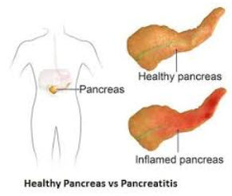
Pancreatitis
People with diabetes 2xs risk of acute pancreatitis
After episode of pancreatitis, one third of people will get prediabetes or diabetes
  About 25% to 80% of people with chronic pancreatitis develop Type 3c diabetes.
Pancreatitis is an exocrine dysfunction:
  Disrupts global architecture or physiology of pancreas
  Results in both exocrine and endocrine dysfunction.

Slide 108
Diabetes Bingo “DiaBingo”
Shout out Right Answer

Slide 109
DiaBingo
B Frequent skin and yeast infections
B A BMI of ____ or greater indicates increased pre/diabetes risk?
B To reduce complications, control A1c, Blood pressure, Cholesterol
B PreDiabetes – fasting glucose level of ___ to ____
B Erectile dysfunction indicates greater risk for ____
B Diabetes – fasting glucose level____ or greater
B Type 1 diabetes is best described as an ______ disease
B People with diabetes are ______ times more likely to die of heart dx
B Elevated triglycerides, < HDL, smaller dense LDL
B Each percentage point of A1C = _____ mg/dl glucose
B At dx of type 2, about __% of the beta cell function is lost
B Diabetes – random glucose ____ or greater

Slide 110

Incretins:
GLP-1 & GLP-1/GIP Receptor Agonists
GLP-1: glucagon like peptide 1
GIP: glucose-dependent insulinotropic polypeptide

Slide 111

The Rise of GLP-1 Agonists
1st available in 2005 (exenatide)
Semaglutide FDA approval 2017
Tirzepatide FDA approval 2022
12% (1 in 8 adults) said they have taken a GLP-1 agonist
KFF Health Tracking Poll May 2024: The Public’s Use and Views of GLP-1 Drugs | KFF
Notes:
KFF Health Tracking Poll May 2024: The Public’s Use and Views of GLP-1 Drugs | KFF
12% (1 in 8 adults) said they have taken a GLP-1 agonist including 43% of people with diabetes

Slide 112
Polling Question 6A
GLP-1 Medications are approved for all of the following conditions except:
Obesity
Type 2 Diabetes
Sleep apnea
Alcohol use disorder
Kidney disease
Notes:
Correct answer: D

Slide 113
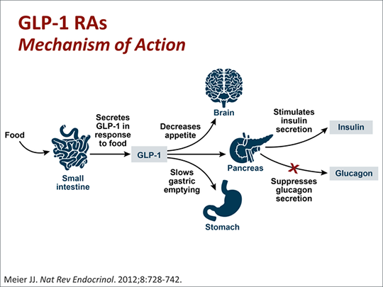
GLP-1 Receptor Agonist Mechanism

Slide 114
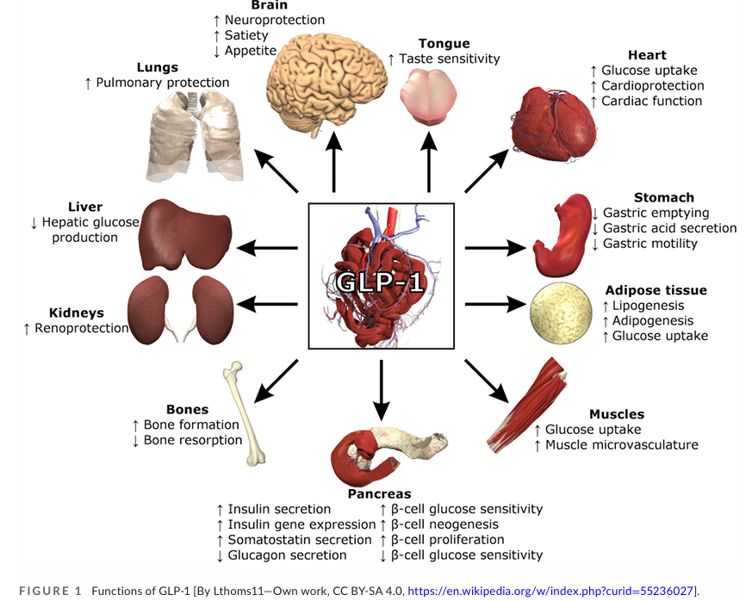
GLP-1: Additional Effects

Slide 115
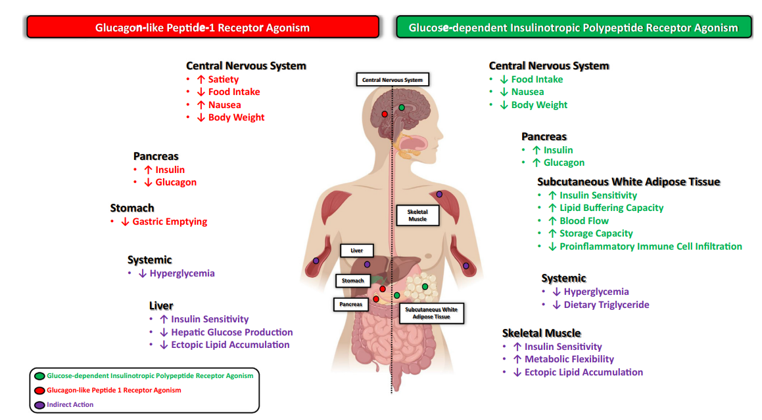
GLP-1 vs GIP
Samms RJ, Coghlan MP, Sloop KW. How May GIP Enhance the Therapeutic Efficacy of GLP-1? Trends Endocrinol Metab. 2020 Jun;31(6):410-421.
Notes:
GIP: Glucose-dependent Insulinotropic Polypeptide
GLP: glucagon-like peptide

Slide 116
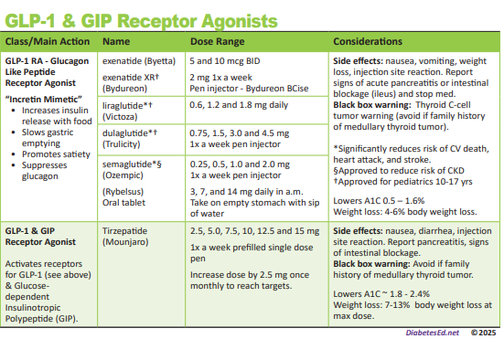
Pocket Card: GLP-1 & GIP RA

Slide 117
Oral Semaglutide (Rybelsus)
Barriers to GLP-1 oral absorption:
  Degradation by gastrointestinal enzymes
  pH induced conformational changes
  Limited protein permeability of the intestinal membrane
Semaglutide co-formulated with sodium N-(8-[2-hydroxybenzoyl] amino) caprylate (SNAC), an absorption enhancer
Absorbed in stomach where SNAC causes a localized increase in pH, leading to higher solubility and protection against proteolytic degradation
Take daily at least 30 mins before first food, beverage, or other oral meds
Take with no more than 4 ounces of plain water
Swallow tablets whole (don't cut or crush)

Slide 118
Incretin Device Show/Tell

Slide 119
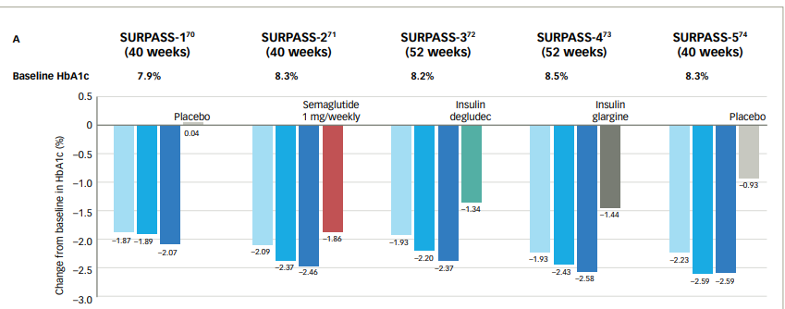

SURPASS (Tirzepatide): A1C Change
Rosenstock J, et al. Lancet. 2021;398:143–55. Frias JP, et al. N Engl J Med. 2021;358:503–15. 82. Ludvik B, et al. Lancet. 2021;398:583–98. 83. Del Prato S et al. Lancet. 2021;398:1811–24. 84. Dahl Det al. Diabetologia. 2021:64(Suppl. 1):S13. Abstr 20. Kaneko S.. touchREV Endocrinol. 2022 Jun;18(1):10-19.

Slide 120

SURPASS (Tirzepatide): Body Weight Change
Rosenstock J, et al. Lancet. 2021;398:143–55. Frias JP, et al. N Engl J Med. 2021;358:503–15. 82. Ludvik B, et al. Lancet. 2021;398:583–98. 83. Del Prato S et al. Lancet. 2021;398:1811–24. 84. Dahl Det al. Diabetologia. 2021:64(Suppl. 1):S13. Abstr 20. Kaneko S.. touchREV Endocrinol. 2022 Jun;18(1):10-19.

Slide 121

Poll Question 7
Alice injects tirzepatide once a week. Which of the following is true?
May experience constipation
May cause hypoglycemia
Muscle aches are common
Doubles risk of pancreatic cancer
Notes:
Answer: A

Slide 122

GLP-1 Safety Profile
Drucker DJ. Efficacy and Safety of GLP-1 Medicines for Type 2 Diabetes and Obesity. Diabetes Care. 2024 Nov 1;47(11):1873-1888.

Slide 123
GLP-1 Adverse Effects
GI side effects
  Nausea, appetite loss, diarrhea, constipation, dyspepsia, abdominal pain
Possible pancreatitis
Hypoglycemia with concomitant use of insulin or secretagogues
Acute kidney injury
Thyroid C-Cell tumors –black box warning
Acute gallbladder disease
Worsening retinopathy
Package inserts.
Notes:
Pancreatitis: Acute pancreatitis, including fatal and nonfatal hemorrhagic or necrotizing pancreatitis, has been observed in patients treated with GLP-1 receptor agonists. Pancreatitis has been reported in Mounjaro clinical trials. Mounjaro has not been studied in patients with a prior history of pancreatitis. It is unknown if patients with a history of pancreatitis are at higher risk for development of pancreatitis on Mounjaro. Observe patients for signs and symptoms including persistent severe abdominal pain sometimes radiating to the back, which may or may not be accompanied by vomiting. If pancreatitis is suspected, discontinue Mounjaro and initiate appropriate management.
In both male and female rats, tirzepatide causes dose-dependent and treatment-duration-dependent thyroid C-cell tumors at clinically relevant exposures. It is unknown whether Mounjaro causes thyroid C-cell tumors, including medullary thyroid carcinoma (MTC), in humans as human relevance of tirzepatide-induced rodent thyroid C-cell tumors has not been determined.
Mounjaro is contraindicated in patients with a personal or family history of MTC or in patients with Multiple Endocrine Neoplasia syndrome type 2 (MEN 2). Counsel patients regarding the potential risk for MTC with the use of Mounjaro and inform them of symptoms of thyroid tumors (e.g., a mass in the neck, dysphagia, dyspnea, persistent hoarseness). Routine monitoring of serum calcitonin or using thyroid ultrasound is of uncertain value for early detection of MTC in patients treated with Mounjaro.
Mounjaro has been associated with gastrointestinal adverse reactions, which include nausea, vomiting, and diarrhea. These events may lead to dehydration, which if severe could cause acute kidney injury. In patients treated with GLP-1 receptor agonists, there have been postmarketing reports of acute kidney injury and worsening of chronic renal failure, sometimes requiring hemodialysis. Some of these events have been reported in patients without known underlying renal disease. A majority of reported events occurred in patients who had experienced nausea, vomiting, diarrhea, or dehydration. Monitor renal function when initiating or escalating doses of Mounjaro in patients with renal impairment reporting severe adverse gastrointestinal reactions.
In clinical trials, acute gallbladder disease was reported by 0.6% of Mounjaro-treated patients and 0% of placebo-treated patients. If cholelithiasis is suspected, gallbladder diagnostic studies and appropriate clinical follow-up are indicated.

Slide 124
GLP-1 FDA Warning
Nov, 2024
Pulmonary Aspiration During General Anesthesia or Deep Sedation
Rare post marketing reports of pulmonary aspiration in patients receiving GLP-1 RA undergoing elective surgeries or procedures requiring general anesthesia or deep sedation who had residual gastric contents despite following preoperative fasting recommendations
Instruct patients to inform healthcare providers prior to any planned surgeries or procedures if they are taking a GLP-1 RA

Slide 125
Holding GLP-1 RA Before Surgery?
Balance withholding GLP-1 RA with risk of hyperglycemia
Consider rapid sequence intubation, longer liquid fast or POC ultrasound to reduce risk of aspiration
Bridging off therapy can be resource intensive, and lead to other SE-hyperglycemia or hypoglycemia
If decision to hold, general guidance
  1 day for daily formulations
  1 week for weekly formulations
Joshi, Girish P. et al. Preprocedure Care of Patients on Glucagon-like Peptide-1 Receptor Agonists: A Multisociety Clinical Practice Guidance. Anesthesiology 141(6):p 1208-1209, December 2024.
Notes:
1a. When an elevated risk of delayed gastric emptying and aspiration exist, withholding of GLP 1RAs should be balanced with the surgical and med ical risk of inducing the potential for a hazardous, metabolic disease state, like hyperglycemia. Further, bridging therapy off a GLP-1RA may be resource intensive, cost or insurance prohibitive, and risk other adverse side effects like hypoglycemia. Finally, with holding GLP-1RA perioperatively only for patients with the diseases of overweight and obesity, without an indication as described in Recommendation 1a, could constitute overweight and obesity bias, which should be avoided. c) If the decision to hold GLP-1RAs is indicated givenan unacceptable safety profile following shared decision making in the preoperative period, the duration to hold therapy is unknown [7]. At this time, it is suggested to follow the original guidance of the American Society of Anesthesiologists, holding the day of surgery for daily formulations, and a week prior to surgery for weekly formulations [4]. All patients should still be assessed on the day of procedure for symptoms sug gestive of delayed gastric emptying.

Slide 126

Counseling Points: Incretins
Avoid if personal or family history of medullary thyroid cancer.
Avoid in combo with DPP-4 inhibitors
Caution with gastroparesis
Use of non-FDA compounded products not recommended
Consider holding prior to surgery or prolonged fast
If on tirzepitide, use back up contraception for first 4 weeks
Ask about recent eye exam
  Potential increase in diabetes retinopathy
Sudden discontinuation of semaglutide and tirzepitide results in regain of ½ to 2/3 of the weight loss within 1 year. Consider trying lowest effective dose, using intermittent therapy, or stopping medication followed by close weight monitoring.
Section 8. Diabetes Care 2025;48(Supplement_1):S167–S180
Notes:
Inject at room temperature, let alcohol fully dry

Slide 127
Poll Question 8
AR is 36 years old with type 2 diabetes and a BMI of 41kg/m². Current diabetes medications include: metformin, sitagliptin (Januvia) and empagliflozin (Jardiance) at maximum doses. AR is prescribed tirzepatide (Mounjaro). Based on this information, what action do you recommend to the provider?
Verify kidney function first.
Stop the sitagliptin when initiating tirzepatide.
Decrease the dose of metformin to prevent hypoglycemia.
Evaluate thyroid function before starting tirzepatide.
Notes:
Answer is B.

Slide 128
Where Do Incretins Fit within the Guidelines for Diabetes?

Slide 129
GLP-1 /GIPs Approved for Weight Loss
Liraglutide:
  Victoza 1.8 mg (diabetes)
  Saxenda 3 mg (wt loss)
Semaglutide:
  Ozempic 2mg (diabetes)
    Wegovy 2.4mg (wt loss)
Tirzepatide
  Mounjaro 15mg (diabetes)
  Zepbound 15mg (wt loss)
All 3 Approved for use in adults with :
  BMI of ≥ 30 or
  BMI of ≥ 27 or greater who have hypertension, type 2 diabetes, or dyslipidemia.
Semaglutide (Wegovy) also indicated for those overweight/obesity & ASCVD to reduce CVD events and for those with metabolic dysfunction-associated steatohepatitis (MASH)
Tirzepatide (Zepbound) also indicated for those with obesity & Sleep Apnea

Slide 130

GLP-1/GIP Receptor Agonist Indications
Drug | Lower BG | Reduce CV / Kidney Risk? | Wt loss /other approved?
Exenatide IR (Byetta) Lixisenatide (Adlyxin) Semaglutide (Rybelsus) | Yes
Exenatide ER (Bydureon) | Yes for 10 yrs and older
Dulaglutide (Trulicity) | Yes for 10 yrs and older | Yes
Semaglutide (Ozempic) | Yes | Yes Approved for CKD | Wegovy 2.4mg Approved for Steatosis/CV disease
Liraglutide (Victoza) | Yes for 10 yrs and older | Yes | Yes Saxenda 3mg
Tirzepatide (Mounjaro) | Yes | ? | Zepbound up to 15 mg Sleep apnea approved
Package inserts, dailymed.nlm.nih.gov

Slide 131

Break

Slide 133
AACE Glucose-Centric Algorithm

Slide 134
AACE Complication-Centric Algorithm

Slide 135
The Future of Incretins is Bright
TIRZEPATIDE
PEMVIDUTIDE
SURVADUTIDE
ORAL
Monthly GLP-1/GIP agonist
Amylin and GLP-1 Agonist
Cagri-Sema Redefine
GIP
Glucagon
GLP-1 Agonist
Monoclonal antibody blocking activin type 2 receptors
GIP/GLP-1 Agonist
SURMOUNT trials
Glucagon/
GLP-1 Agonist
GLP-1 Agonist
High dose oral semaglutide
Non peptide
Orforglipron
Maritide
CAGRILINTIDE-SEMAGLUTIDE
RETATRUTIDE
BIMAGRUMAB

Slide 136

Medication Taking Behaviors
Adequate medication taking is defined as 80% of prescribed doses
23% of time, if A1c, B/P, lipids above target - due to med taking behavior
Assess for barriers
If taking meds 80% of time and goals not met, consider medication intensification
Barriers include:
Forgetting to fill Rx, forgetting to take, fear, depression, health beliefs, med complexity, cost, knowledge gap, system factors, etc.
Work on targeted approach for specific barrier

Slide 137

6. Glycemic Goals & Hypo
  A1C
  Blood Pressure
  Cardiovascular risk reduction

Slide 138
ADA 2025 Summary for Exams
A1c less than 7% (individualize)
Pre-meal BG 80-130
Post meal BG <180
Time in Range (70-180) 70% of time
Blood Pressure
<130/80
Cholesterol
Statin therapy based on age & risk status
If 40+ with ASCVD Risk, decrease LDL by 50%, LDL <70
If 40+ with ASCVD, decrease LDL by 50%, LDL <55

Slide 139


Poll Question 9
Which of the following methods can be used to assess glycemic status?
    A. A1C
    B. Blood glucose monitoring
    C. Time in Range
    D. Fructosamine
    E. All of the above

Slide 140

6. Assess Glycemic Status
A1C measurement
Blood glucose monitoring (BGM)
  by capillary (finger-stick) devices
Continuous glucose monitoring (CGM)
  using time in range (TIR) or
  mean CGM glucose.
Fructosamine – 2-4 wk glucose average
  glycated albumin for those with anemia or hemoglobinopathies

Slide 141

6. Glycemic Targets for Non-Pregnant Adults
  A1c < 7% - a reasonable goal for adults.
  A1c < 6.5% - for those without significant risk of hypoglycemia
  A1c < 8% - for those with history of hypoglycemia, limited life expectancy, or those with longstanding diabetes and vascular complications.
  A1c Check Frequency:
    If meeting goal - At least 2 times a year
    If not meeting goal – Quarterly
  Also review Ambulatory Glucose Profile

Slide 142
6. Glycemic Targets
Individualize Targets – ADA
  Pre-Prandial BG 80- 130
  1-2 hr post prandial < than 180
    *for nonpregnant adults
  Time in Range: 70%
    BG of 70-180 mg/dL

Slide 143


A1c and Estimated Avg Glucose (eAG)
A1c (%) eAG__
5 97 (76-120)
6 126 (100-152)
7 154 (123-185)
8 183 (147-217)
9 212 (170 -249)
10 240 (193-282)
11 269 (217-314)
12 298 (240-347)
eAG = 28.7 x A1c-46.7 ~ 29 pts per 1%
Translating the A1c Assay Into eAG – ADAG Study

Slide 144


Slide 145

(
American Diabetes Association Dia Care 2022 6.2 45- S89
Table 6.2
Notes:
Patient and disease factors used to determine optimal glycemic targets. Characteristics and predicaments toward the left justify more stringent efforts to lower A1C; those toward the right suggest less stringent efforts. A1C 7% = 53 mmol/mol. Adapted with permission from Inzucchi et al. (59).

Slide 146

Blood Glucose Monitoring vs. Continuous Glucose Monitoring (CGM)
= glucometer readings
Undetected hyperglycemia
Undetected hypoglycemia
Image created and permission to use granted by John Moorman, PharmD.
SMBG, self-monitoring of blood glucose.

Slide 147

A1C Alone is Not Enough
https://diatribe.org/time-range.

Slide 148

Ambulatory Glucose Profile
Standardized report with visual cues for those on CGM devices; time in range
Evaluate Time in Range (TIR)
  Target 70-180 mg/dl (70% of time)
  Eval % time below goal
    < 70 (less than 4% of time)
    <54 (less than 1% of time)
  Eval % time above > 180 (less than 25% of time)
  Eval % time above > 250 (less than 5% of time)
For those with frailty or at high risk of hypoglycemia recommend:
- Target of 50% time in range
- Less than1% time below range

Slide 149

Time in Range
1% of the day=15 minutes
Strong correlation between TIR and A1C, with a goal of 70% TIR aligning with an A1C of ∼7%
Battelino T, et al. Diabetes Care. 2019;42(8):1593-1603.
Notes:
Beck RW, Bergenstal RM, Cheng P, Kollman C, Carlson AL, Johnson ML, Rodbard D. The Relationships Between Time in Range, Hyperglycemia Metrics, and HbA1c. J Diabetes Sci Technol. 2019 Jul;13(4):614-626. doi: 10.1177/1932296818822496. Epub 2019 Jan 13. PMID: 30636519; PMCID: PMC6610606.

Slide 150

Ambulatory Glucose Profile Report
CGM key metrics
AGP
Daily tracings

Slide 151

15. ADA Pregnancy Targets –
For those with type 1, type 2 and GDM
A1c < 6-6.5% (closer to 6 in 2nd/3rd tri)
Time in range: 63-140 mg/dL
Fasting and Post Meal BG Goals
  Fasting glucose 70–95 mg/dL and either
  One-hour postprandial glucose 110–140 mg/dL or
  Two-hour postprandial glucose 100–120 mg/dL
No lower glucose limit if lifestyle controlled (no insulin)
Battelino T, et al. Diabetes Care. 2019;42(8):1593-1603.

Slide 152

Pharmacologic Treatment during Pregnancy
Insulin is preferred therapy for all forms of diabetes in pregnancy
  Does not cross placenta
  Can overcome insulin resistance assoc w/ type 2
Sulfonylureas pass through placenta / associated with neonatal hypo (glyburide)
Metformin – lower risk of hypo and maternal wt gain but may increase prematurity rate/childhood obesity
  Passes through placenta
  If using for PCOS, stop by end of first trimester
Refer to specialized center

Slide 153

Pregnancy and Hypertension
If pregnant with diabetes and chronic hypertension
  Blood pressure target of 110–135/85 mmHg
    Reduces risk for accelerated maternal hypertension
    Minimizes impaired fetal growth
  Stop potentially harmful medications in prep for pregnancy
    Avoid ACE inhibitors, angiotensin receptor blockers (ARBs), statins in sexually active women of childbearing age if not using reliable contraception
    Preferred HTN meds: labetolol, nifedipine

Slide 154

Case Study - Janet
Janet is a 36yoF with a history of GDM and newly diagnosed with type 2 diabetes. A1C=7.4%. Normal kidney function. Past medical history includes hypertension for which she takes HCTZ 25mg daily.
Weight: 220lbs, BMI=34kg/m²
Social history
  Works full time as an accountant
  Skips breakfast, eats a small lunch, eats a large dinner, snacks in evening
  No Exercise
  Loves Starbucks Frappuccino's
Notes:
Answer: D Metformin

Slide 155
Poll 11. What Treatment Should Janet Be Started On?
  A. Semaglutide (GLP-1 inhibitor)
  B. Linagliptin (DPP-4 inhibitor)
  C. Empagliflozin (SGLT-2 inhibitor)
  D. Metformin (Biguanide)
  E. Lifestyle modifications only
Notes:
Answer: A
In the past, would have said D.

Slide 156

Lunch Served 12:00 to 12:55 PDT
Question and Answer Session from
12:55 to 1pm

Slide 157
Metformin Dosing and Mechanism
Mechanism: decreases hepatic glucose production
Do not initiate when eGFR < 45
Data suggest metformin may be safely continued with eGFR of 30-45 mL/min/1.73m² with dose reductions
Max effective dose: 2000mg/day, max dose 2550mg/dy
Monitor vitamin B12 levels and renal function
GI issues: nausea, vomiting, diarrhea
  Consider long-acting formulation, dose reduction

Slide 158


Biguanide derived from:
Goat’s Rue Galega officinalis,
French Lilac
Does NOT harm kidneys
$10 for 3-month supply from Walmart & other pharmacies

Slide 159

Metformin is “Usually” 1st Line
Why metformin?
  Longstanding evidence
  High efficacy and safety
  Inexpensive - 3 months for $12
  Weight neutral
  Check B12 levels at intervals especially if anemia or neuropathy.
If ASCVD, HF or CKD or high ASCVD risk, use SGLT2i or GLP-1 RA +/- metformin
If A1C ≥ 8.5%, consider combo therapy.
Notes:
When A1C is >1.5% above the individualized glycemic goal (see Section 6, “Glycemic Goals and Hypoglycemia,” for appropriate goals), many individuals will require dual-combination therapy or a more potent glucose-lowering agent to achieve and maintain their goal A1C level

Slide 160
AACE 2023 Diabetes Guideline

Slide 161
Poll Question 12
Ricki is started on Metformin 500mg BID. Which of the following is true?
Hold metformin if blood glucose is below 80 mg/dL
Alcohol is contraindicated when taking metformin.
Metformin is weight neutral.
Metformin can cause kidney damage.
Notes:
Correction answer: C

Slide 162
Metformin – How Does it Rate?
Question Answer
Cause hypoglycemia?
Cause weight gain?
Affordable?
Lowers CV risk?
Can most tolerate /use?
(GI, CKD)
No
No
Yes
Yes
Yes/No

Slide 163

Risk-Based Screening for PreDiabetes or Type 2 in Children and Youth
Test youth with excess weight (BMI >85% percentile)
Plus any ONE of following risk factors:
    Maternal diabetes or GDM during child’s gestation
    Family history type 2 in 1st or 2nd degree relative
    Native American, African American, Latin, Asian, Pacific Islander
    Signs of insulin resistance (acanthosis nigricans, HTN, dyslipidemia, Polycystic Ovary Syndrome – PCOS or small for gestational age birth weight
Test at 10 yrs or puberty (whichever is first and at least every 3 yrs or more frequently if indicated. Consider earlier screening if multiple risk factors.

Slide 164

Type 2 and Kids Goals
A1c goal of 7% if on oral meds alone
A1c goal of 7.5% if at risk for hypoglycemia
Some children may benefit from A1c of 6.5% or less
Initiate pharmacologic therapy, in addition to lifestyle therapy, at diagnosis
Confirm diagnosis with antibody testing
Treat glucose, B/P and lipids
Engage in lifestyle coaching
Please see Kids and Diabetes Level 2 Course

Slide 165

14. Children & Adolescents: Glycemic Targets
A1c goal 6.5 – 8.0% for Type 1
  Generally, goal is <7.0%
  Individualization is encouraged.
  A goal <6.5% may be considered for those at low risk of excessive hypoglycemia
  A goal of 7.5 - 8.0 % may be needed
  CGM / Insulin pump important tools.

Slide 166

When Does Old Age Start?

Slide 167

Poll Question 13
What percent of the population over the age of 65 has type 2 diabetes?
  9.3%
  18%
  26%
  34%

Slide 168

13. Older Adults Goals – Whole Picture
Consider the assessment of medical, psychological and self-care domains to provide context to determine targets and therapeutic approaches for management.
Screen for geriatric issues
  polypharmacy,
  cognitive impairment, depression
  urinary incontinence, falls, and persistent pain
  that can affect diabetes self-management and diminish quality of life
See Level 2 Course, Older Adults and Diabetes

Slide 169

Treatment Goals Based On:
  Length of time living with diabetes (new onset, undiagnosed for many years or longer history)
  Presence or absence of complications
  Comorbidities
  Degree of frailty
  Cognitive function
  Life expectancy (often longer than expected)
  Functional status

Slide 170

Poll Question 14
RT, is a healthy 74-year-old who is on metformin 1000mg BID. Has had diabetes for 11 years. Latest A1c was 7.3% What is best response?
  A. Good job, let’s get the A1c less than 7%
  B. Have you been snacking more than usual?
  C. What do you think about your A1c level?
  D. Let’s add on another medication to get your A1c to target.

Slide 171


13. Older Adults
Healthy & Good Functional Status
Assess the medical, psychological, functional (self-management abilities), and social domains
Screen annually for geriatric syndromes (e.g., cognitive impairment, depression, urinary incontinence, falls, persistent pain, and frailty), hypoglycemia, and polypharmacy
  may affect diabetes management and diminish quality of life.
If on insulin or hx of hypo, eval for CGM or AIDS
Goals:
  Reasonable A1c goal <7.0 - 7.5%
  TIR ~ 70%, Below range ≤4%
  Fasting BG 80 – 130
  Bedtime Glucose 80-180
  Blood Pressure < 130/80
  Statin unless contraindicated or not tolerated
65 or older
- 29% have diabetes
- 50% have prediabetes

Slide 172
Poll 15 – Review Question
HR is a 78-year-old with a stroke and limited cognition. She has had diabetes for 8 years and is on intensive insulin therapy: Bolus coverage at meals and basal at night. Her A1c is 6.2%. She has a part time care taker. What do you suggest?
A. Evaluate food intake
B. Discuss de-intensifying insulin regimen
C. Move Glargine to morning
D. Stop insulin and start on oral medications

Slide 173

Older Adults and Medications
In older adults at increased risk of hypoglycemia, meds with low risk of hypoglycemia are preferred.
Overtreatment of diabetes is common in older adults and should be avoided.
Deintensification (or simplification) of complex regimens is recommended to reduce the risk of hypoglycemia, if it can be achieved within the individualized A1C target.

Slide 174

Older Adults with Complications and Reduced Functionality - Less Intense Goals
Intermediate remaining life expectancy, high treatment burden, hypo and fall risk.
Consider DE-Intensification
Goals:
  Reasonable A1c goal <8.0%
  TIR ~ 50%, Below range ≤1%
  Fasting BG 90 – 150
  Bedtime BG 100-180
  Blood Pressure < 130/80
  Statin unless contraindicated or not tolerated

Slide 175

4 M’s Framework of Age Friendly Health Systems

Slide 176

4. ADA – Complete Medical Evaluation
At initial visit :
  Whole person care and psychosocial evaluation
  Explore diabetes self-management and health status
  Evaluate if changes in diabetes treatment would improve well being.
Engagement in formulation of a care management plan
Develop a plan for continuing care

Slide 177



Slide 178
ADA Assess and Treatment Plan
Assess risk of diabetes complications
  ASCVD risk factors and heart failure history
  Stage chronic kidney disease
  Hypoglycemia risk
  Assess for neuropathy, retinopathy
Goal setting
  Set A1C/blood glucose targets & Time in Range
  Address hypertension and lipids
  Diabetes self-management goals
Therapeutic treatment plans
  Lifestyle management – referral to RD, DSME and specialists
  Pharmacologic therapy: glucose lowering
  Pharmacologic therapy: cardiorenal risk factors
  Use of glucose monitoring and insulin delivery devices
  Referral for DSME and RDN

Slide 179


Standard 4 – Diabetes Medical Evaluation

Slide 180

Assessment and Treatment of Disabilities
Diabetes associated with increased risks of disability due to neuropathy, visual impairment and lower limb complications
Refer to specialist
Take preventive action to maximize quality of life.
Assess for disability at the initial visit and for decline in function at each subsequent. If a disability is impacting functional ability or capacity to manage their diabetes, refer to appropriate specialist.

Slide 181



Lab Eval at Initial & Annual Visit
A1c (each 3-6 mo’s)
Each year
  Lipids, CBC with platelets
  Liver function
  Spot urinary albumin-to-creat ratio (UACR))
  Serum creat and GFR
  TSH, celiac (type 1)
  B12 if on metformin >5yrs
  Calcium, Vita D, and phosphorus if appropriate
Serum K
  If on ACE, ARBs or diuretics

Slide 182

Referrals for Initial Care Mgmt
Eye professional – annual check
Family planning
RD for nutrition therapy
DSMES - Diabetes Self-Management Education Support
Dentist for comprehensive dental examination
Behavioral health professional & audiology, if indicated
Social worker/community resources
Rehab medicine for cog/disability eval

Slide 183
Immunization Schedule for Diabetes 2025
Vaccine | Who by Age | Series and Frequency
Hepatitis B Vaccine | Less than 60 years ≥ 60 years, may consider | 2-3 dose series
RSV | Adults ≥ 60 years | Single dose
Influenza (avoid live attenuated vaccine) | All | Annually
Tetanus, diphtheria, pertussis (TDAP) | All adults; extra dose during pregnancy | Booster every 10 years
Zoster | 50+ | 2 dose Shingrix even if previous vaccinated
COVID-19 | Starting at age 6 mo’s | Initial vaccination and boosters
2025 ADA Standards, Vol.48, S66-S67
For a comprehensive list of vaccines, refer CDC & Prevention at cdc.gov/vaccines
.
For educational purposes only. www.DiabetesEd.net

Slide 184
Immunization Schedule for Diabetes 2025
Vaccine | Who by Age | Series and Frequency
Pneumonia PPSV23 (Pneumovax) | 19-64 years of age, vaccinate with Pneomovax | One dose is recommended for those who previously received PCV13; if PCV15 was used, follow with PPSV23 <1 years later; PPSV23 is not indicated after PCV20; adults who received only PPSV23 may receive PCV15 or PCV20 >1 year after the last dose
 | ≥ 65 years | Same as above
PCV20 or PCV15 | 19-64 with an immunocompromising condition | One dose of PCV20 or PCV15
 | Immunocompetent | One dose of PCV20 or PCV15 if no previous pneumococcal vaccines
 | ≥ 65 years | One dose of PCV15 or PCV20; PCSV23 may be given 8 weeks after PCV15; PPSV23 is not indicated after PCV20
2025 ADA Standards, Vol.48, S66-S67

Slide 185

Pneomococcal Vaccine, Ages 19-49
CDC offers PneumoRecs VaxAdvisor as a free app to quickly and easily provide patient-specific pneumococcal vaccine guidance

Slide 186

Pneumococcal Vaccine, Ages over 50

Slide 187

Herbal Supplements
Berberine
Zinc
Vitamin D
Cinnamon
Ginseng
Aloe Vera
Chromium
Alpha lipoic acid
Magnesium
Gymnema
Notes:
10 Supplements to Help Lower Blood Sugar
NatMed Pro
Natureal medicine database

Slide 188

Deciding to Take Herbal Supplements
Lack of regulation with herbal supplements
Provide reliable education on costs/benefits/risks
Empower patients to make informed decisions

Slide 189

Hypoglycemia (Glucose) Alert Values
BG <70mg/dl – Level 1
Follow 15/15 rule and contact provider to make needed changes. At increased hypo risk.
BG < 54mg/dl – Level 2
Indicates serious hypo. Reassess BG Goals. Consider med decrease. Predictive of Level 3 Hypo. Needs Glucagon Emergency Kit
Severe Hypoglycemia – Level 3
Altered mental, physical functioning.
Requires external assistance – no threshold

Slide 190



Slide 191
Hypo Marker of CV Events & Mortality
Severe hypoglycemia a potent marker of high absolute risk of cardiovascular events and mortality.
HCP need to be vigilant in preventing hypoglycemia.
Avoid aggressively attempting to achieve near-normal A1C levels if such goals cannot be safely and reasonably achieved.

Slide 192
SDOH and Hypoglycemia
Food insecurity, housing instability, underinsured, under-resourced living areas is associated with increased risk of hypoglycemia-related emergency department visits
Identify if fasting part of religious observances
Young children and older adults at highest risk
Insulin pumps with automated low-glucose suspend and automated insulin delivery systems have been shown to be effective in reducing hypoglycemia in type 1 diabetes

Slide 193
Assess for Hypo
Consider individual’s risk for hypoglycemia when selecting diabetes medications and glycemic goals.
Use of CGM is beneficial and recommended for individuals at high risk for hypoglycemia.
Review history of hypoglycemia at every clinical encounter for all individuals at risk for hypoglycemia
Evaluate hypoglycemic events
Screen for impaired hypoglycemia awareness at least annually.

Slide 194

Hypoglycemia: Clinical Risk Factors

Slide 195

Tx of Level 2 & 3 Hypoglycemia
If can swallow w/out risk of aspiration, try gel, honey, etc. inside cheek
If unable to swallow, D50 IV or Glucagon
Glucagon injection (need Rx)
  Inform and instruct caregivers, school personnel, family, coworkers of hypo signs and appropriate action
  Dosing: Adults 1mg, Children <20kg 0.5mg
  Glycemic effect 20 - 30mg, short lived
  Must intake carb as soon as able
If on Insulin or level 2 or 3 hypo, (<54), get Glucagon ER Kit. Re-evaluate diabetes med treatment plan.

Slide 196

Poll Question 16
JL is 78 and drinks a “few cocktails” every night. Lives with partner and takes basal insulin at night and bolus insulin as needed. Has had a few low blood glucose levels in past week of 62, 49 and 51. What is the most important recommendation?
A. Decrease alcohol intake
B. Check BG at least 4 times a day.
C. Double check injection sites.
D. Get glucagon rescue medication.

Slide 197


Sulfonylureas - Secretagogues or “Squirters”
Mechanism: Stimulate beta cells to release insulin
Dosed 1-2x daily before meals
Adverse effects
  Hypoglycemia, weight gain, watch renal function
Low cost, $12 for 3 months supply
Can help with glucose toxicity, lowers A1C 1-2%
Notes:
CAROLINA tral (linagliptin vs glimepiride)
Meta-analysis: In type 2 diabetes, the use of sulfonylureas is associated with increased mortality and a higher risk of stroke

Slide 198
Meglitinides - Squirts
Action: stimulate insulin secretion (rapid and short duration) when glucose present
Names:
  Repaglinide (Prandin)
    Dosing: 0.5 to 4 mg a.c. max dose 16mg
    Metabolized by liver and mostly excreted in feces (some renally).
  Nateglinide (Starlix)
    Dosing: 120 mg tid with meals
    Metabolized by liver, excreted by kidney
Efficacy:
  Decreases peak postprandial glucose
  Decreases plasma glucose 60-70 mg/dl
  Reduce A1C 0.5-1%%
Notes:
198
198
The mechanism of action of repaglinide is similar to that of the sulfonylurea drugs: binding to beta cell receptors to stimulate insulin secretion. The major difference between the two drug classes is that meglitinides are shorter-acting, and are most effective when taken after meals in the presence of glucose.
Adverse effects include weight gain and hypoglycemia. An additional drawback to this drug is the dosing schedule since it must be taken with meals.

Slide 199

Case Study Ken – Poll 17
Ken is a 67yoM with type 2 diabetes x 5 years. He complains of dizziness/shakiness 3x/week. Last A1C=6.7%. Which of his medications is most likely causing hypoglycemia?
  A. Metformin
  B. Sitagliptin
  C. Glimepiride
  D. Pioglitazone
Notes:
Answer. C

Slide 200

Reducing Hypoglycemia
Which are the only diabetes meds that directly cause hypoglycemia?
Insulin
Secretagogues (sulfonylureas, glitinides)

Slide 202
AACE Glucose-Centric Algorithm

Slide 203
AACE Complication-Centric Algorithm

Slide 204


Slide 205

Quick Question 18
JZ is excited about his A1c of 5.4%. He takes rapid acting insulin 4-6 times a day using a pen to keep his BG to target. Plus, adjusts glargine as needed if his pm BG is elevated. What is your biggest concern?
A. Does he change his needle each time?
B. Why is he adjusting glargine?
C. Is he adjusting insulin for exercise?
D. How many hypoglycemic events per week?

Slide 206
Preventing Hypoglycemia
In people taking insulin or secretagogues
Nocturnal Lows
If bedtime glucose <110, reduce meds
If increased daytime activity, may need extra snack
Eval pre-dinner insulin/meds
Other
Monitor kidney function / wt loss
Monitor BG trends
Too much meds?
Skipped /delayed meals?
Plan ahead
Alcohol precautions
Exercise planning
CGM

Slide 207

Landmark Trials

Slide 208

Quick Question 19
Which study demonstrated that keeping A1c less than 7% reduces complications for Type 1?
Diabetes Prevention Trial
Diabetes Control and Complications Trial
United Kingdom Prospective Diabetes Study
YOUTH Trial

Slide 209

Diabetes Control and Complications Trial (DCCT)
Type 1 – Does getting A1c <7% matter?
The largest, most comprehensive diabetes study ever conducted.
10 year study involved more than 1400 subjects with Type 1 DM.
Compared the effects of two treatment regimens:
  standard therapy and
  intensive control-on the complications of diabetes.

Slide 210

DCCT Conclusions
By maintaining A1C < 7%:
Eye disease - 76% reduced risk
Kidney disease - 50% reduced risk
Nerve disease - 60% reduced risk
Management elements included:
  SMBG 4 or more times a day
  4 daily insulin injections or insulin pump
  Greater risk of hypoglycemia
  More associated weight gain

Slide 211
UKPDS Results
United kingdom Prospective Diabetes Study
Conducted over 20 years involving over 5,100 patients with Type 2 diabetes
1% decrease in A₁c reduces microvascular complications by 35%
1% decrease in A₁c reduces diabetes related deaths by 25%
B/P control (144/82) reduced risk of:
  Heart failure (56%)
  Stroke (44%)
  Death from diabetes (32%)
Lancet 352: 837-865, 1998

Slide 212

“Legacy Effect”
For participants of DCCT and UKPDS
  long lasting benefit of early intensive BG control prevents
    Microvascular complications
    Macrovascular complications (15-55% decrease)
  Even though their BG levels increased over time
  Message – Catch early and
  Treat aggressively

Slide 213
Diabetes Bingo “DiaBingo”
Shout out Right Answer

Slide 214
DiaBingo- G
G ADA goal for A1c is less than ____%
G People with DM need to see their provider at least every month
G Blood pressure goal is less than
G People with DM should see eye doctor every
G The goal for triglyceride level is less than
G Goal for LDL cholesterol if 40+ with diabetes is ____
G The goal for blood sugars 1-2 hours after a meal is less than:
G People with DM need this shot every year
G People with DM need to get urine tested yearly for ___________
G Periodontal disease indicates increased risk for heart disease
G The goal for blood sugar levels before meals is:
G The activity goal is to do ___ minutes on most days

Slide 215

Question and Break Time – 2:50
Energizing Ideas
  Dance
  Walk outside
  Enjoy a snack
  Hydrate with spa water
  Stretch and Breathe

Slide 216
How Many Drug Options for Diabetes?
Biguanide
Sulfonylureas
Meglitinides
Glucagon-like-peptide-1 (GLP-1) receptor agonists
GLP/GIP receptor agonist
Sodium glucose cotransporter-2 (SGLT-2) inhibitors
Thiazolidinediones (TZD’s)
Dipeptidylpeptidase-4 (DPP-4) inhibitors
Alpha-glucosidase inhibitors
Bile acid sequestrant
Dopamine-2-agonist
Amylin mimetic
Insulin
Glucagon

Slide 217

Drug Targets in Diabetes
DeFronzo et al. Diabetes Spectrum Volume 27, Number 2, 2014

Slide 218


Section 9- Pharmacologic Approaches to Glycemic Treatment for Type 2 Diabetes
Person centered with focus on addressing:
  Atherosclerotic CV Disease (ASCVD)
  Heart failure (HF)
  Chronic Kidney Disease (CKD)
  Weight loss
  MASH/MASLD
Updated chart on cost and attributes of different meds

Slide 219


Insulin Sensitizers
Action: decrease insulin resistance by making muscle and adipose cells more sensitive to insulin; decrease free fatty acids
Names:
  pioglitazone (Actos) – bladder cancer warning
    Dosing: 15-45 mg daily
    Consider adding low dose if history of stroke or have steatosis
Efficacy/ Considerations
  Reduce A1C ~0.5-1.0%
  6 weeks for maximum effect
  pioglitazone $5 a month, rosiglitazone $300 a month
  Can cause fluid retention, not indicated w/ CHF
Notes:
219
219

Slide 220


Slide 221

When to Use TZD’s?

Slide 222
AACE Glucose-Centric Algorithm

Slide 223
TZDs – How Do They Rate?
Question Answer
Cause hypoglycemia?
Cause weight gain?
Affordable?
Lowers CV risk?
Can most tolerate /use?
No
Yes
Generic
Yes
Watch HF

Slide 224
Dipeptidyl Peptidase-4 (DPP-4) Inhibitors
Mechanism of action
    Prevents the breakdown of GLP-1 and GIP, resulting in 2-3X increased endogenous incretin levels
Efficacy
    Hemoglobin A1C reduction by 0.6%–0.8%
    Primarily lowers postprandial glucose levels
    Not as effective as GLP-1 agonists
    CV neutral, increased HF hospitalization with alogliptin/saxagliptin
Adverse effects
    Generally well tolerated, dosed once daily
    Avoid in combo with GLP-1 agonist
    Caution with h/o pancreatitis
    Potential joint pain
Dipeptidyl Peptidase-4 (DPP-4) Inhibitors

Slide 225
DPP4 Inhibitor Dosing
Drug | Dose | Renal Adjustment
Sitagliptin | 100 mg daily | 50 mg/day eGFR 30–45 mL/min/1.73m² 25 mg/day eGFR <30 mL/min/1.73m²
Linagliptin | 5 mg daily | None necessary
Saxagliptin | 5 mg daily | 2.5 mg/day eGFR < 45 mL/min/1.73m²
Alogliptin | 25 mg daily | 12.5 mg/day eGFR 30–59 mL/min/1.73m² 6.25 mg/day for eGFR <30 mL/min/1.73m²
Where do DPP4 inhibitors fit within the treatment algorithm?

Slide 227

Alpha-glucosidase Inhibitors
Action: blocks enzymes that digest starches in the small intestine
Name: acarbose (Precose) or miglitol (Glyset)
  Dosing: 25-100mg TID, max 300mg/day
Efficacy
  Decrease postprandial glucose 40-50 mg/dl
  Decrease A1C 0.5-1.0%
Other Effects
  Flatulence or abdominal discomfort
  Contraindicated in patients with inflammatory bowel disease or cirrhosis
Special Consideration
  In case of hypoglycemia, treat with glucose tabs or milk
  (other starches are blocked by medication))
Notes:
227
227
Alpha-glucosidase inhibitors (AGIs) work by blocking the enzyme in the small intestine that breaks down complex carbohydrates, alpha-glucosidase. By blocking this enzyme these drugs prevent starches from being absorbed into the bloodstream and in doing so lower blood glucose levels. AGIs are the only drug class used to treat type 2 diabetes that does not specifically target the pathology of the disease.
Because AGIs work in the digestive tract, they are more effective at lowering postprandial glucose levels than fasting plasma glucose levels. On average, AGIs are less effective at lowering A1c levels than biguanides or sulfonylureas.
What makes this class of drug attractive to patients and physicians is it's disassociation with weight gain and hypoglycemia. However, it is known to cause abdominal discomfort and diarrhea. AGIs are also rarely used as monotherapy because of their low efficacy.

Slide 228

Other Med Classes

Slide 229
Amylin Mimetic
Pramlintide (Symlin)
Indication: adjunctive treatment in patients with type 1 or type 2 diabetes who use mealtime insulin
Modest A1C reduction: less than ~0.5%
Boxed warning: severe hypoglycemia, other SE: N/V
Dosing:
  T2D: start with 60mcg before each meal, reduce meal time insulin by 50%
    If no nausea, increase to max dose 120mcg after 3 days
  T1D: start with 15mcg before each meal; reduce meal time insulin by 50%
    If no nausea, increase by 15mcg every 3 days until max dose 60mcg
Discontinued by end of 2025
Stay tuned for weekly cagrilinitide-semaglutide

Slide 230
AACE Glucose-Centric Algorithm

Slide 231
Non-Insulin Drug Comparison
Class | Efficacy | Hypo | Weight | Effect on MACE | Heart Failure | Kidney | MASH | Cost
Metformin | High | No | Neutral/ Loss | Potential benefit | Neutral | Neutral | Neutral | Low
SGLT2 Inhibitors | Intermediate to High | No | Loss, intermediate | Benefit | Benefit | Benefit | Unknown | High
GLP-1 RA | High to Very High | No | Loss, intermediate to very high | Benefit | Benefit: sema | Benefit | Benefit | High
GIP and GLP-1 RA | High to Very High | No | Loss, very high | Under investigation | Under investigation | Under investigation | Potential Benefit | High
DPP-4 Inhibitors | Intermediate | No | Neutral | Neutral | Risk: saxa/alogliptin | Neutral | Unknown | High
Pioglitazone | High | No | Gain | Potential benefit | Risk | Neutral | Potential Benefit | Low
Sulfonylurea | High | Yes | Gain | Neutral | Neutral | Neutral | Unknown | Low

Slide 232

Check Your Knowledge - 20
Which of the following medications is least affordable?
Pioglitazone (Actos)
Metformin (Glucophage)
Glimepiride (Amaryl)
Semaglutide (Ozempic)

Slide 233
Medication Cost Considerations
Lowest cost medications - AWP for a month
  Metformin - $3
  Sulfonylureas $3
  Pioglitazone $3
  Bexagliflozin -$48,
  Insulin-$35 co-pay or lower cost insulin (ex. NPH)
Highest cost medications – AWP for a month
  GLP-1 RA - $1000+
  GLP-1/GIP RA - 1000+
  SGLT2i - $650
  DPP-IV’s - $550-600

Slide 234

Cost Related Barriers
Among people with chronic illnesses, 2/3 of those who reported not taking medications as prescribed due to CRB never shared this with their physician.
Especially associated with diabetes medications and insulin.

Slide 235


Slide 236
Diabetes + CKD – Increases CVD Risk
Chronic kidney disease (CKD) is a frequent complication in diabetes
  Type 1 diabetes ~30%
  Type 2 diabetes ~up to 40%
In several studies, participants on SGLT2i with GFRs of 30-60 (stage 3) reduced ASCVD risk and improved renal function
  Slowed kidney disease or death
  Reduced albuminuria
National Kidney Foundation. https://www.kidney.org/atoz/content/diabetes

Slide 238


Risk of CKD Progression, CVD

Slide 239



CKD– 2025 Update
  Optimize glucose and BP to protect kidneys
  Use SGLT-2 with demonstrated benefit to reduce CKD and CVD*
  To reduce CV risk and CKD, use a GLP-1* with demonstrated benefit.
  In people with CKD and albuminuria, a nonsteroidal MRA effective if GFR 25+
  Aim to reduce urinary albumin by ≥30% in people with CKD
    *SGLT-2i’s
      Empagliflozin (Jardiance), canagliflozin (Invokana), dapagliflozin (Farxiga)
    *GLP-1 RA’s
      Semaglutide (Ozempic)-has indication, liraglutide (Victoza), dulaglutide (Trulicity)

Slide 240
SGLT2 Inhibitor CKD Evidence Summary
Trial Name | SGLT2 Inhibitor vs placebo | Outcomes (Primary Bolded)
CREDENCE | Canagliflozin | N=4401, Median follow-up 2.6 years, Prior CVD 50.4% ESRD, doubling of creatinine or death from renal or CV cause (primary): HR 0.70 (0.59-0.82) 3 point MACE 0.80 (0.67-0.95)
DAPA-CKD | Dapagliflozin | N=4304, 2906 with diabetes, Median follow-up 2.4 years, Prior CVD 37.4% >50% decline in eGFR, ESKD or renal/CV death (primary): HR 0.61 (0.51-0.72)
EMPA-Kidney | Empagliflozin | N=6609, Median follow-up 2.0 years, Prior CVD 27%, 46% with DM ESRD, >40% decline in eGFR, ESKD, or renal/CV death (primary): HR 0.72 (0.64-0.82), stopped early due to positive benefit
Perkovic V, Jardine MJ, Neal B, et al. Canagliflozin and renal outcomes in type 2 diabetes and nephropathy. N Engl J Med. 2019;380:2295–2306.
Heerspink HJL, Stefansson BV, Correa-Rotter R, et al. Dapagliflozin in patients with chronic kidney disease. N Engl J Med. 2020;383:1436–1446.
EMPA-KIDNEY Collaborative Group, Herrington WG, Staplin N, Wanner C, et al. Empagliflozin in Patients with Chronic Kidney Disease. N Engl J Med. 2022 Nov 4. doi: 10.1056/NEJMoa2204233. Epub ahead of print. PMID: 36331190.

Slide 241
GLP-1 Receptor Agonists in CKD
Flow: Semaglutide in CKD
Effects of Semaglutide on Chronic Kidney Disease in Patients with Type 2 Diabetes (FLOW)
Study Design | Phase III randomized, double-blind, placebo-controlled trial
Size & Duration | N = 3,533; median follow-up: 3.4 years
Intervention | Semaglutide 1 mg per week vs. placebo
Patient Population | Adults aged ≥ 18 years with type 2 diabetes (A1C level ≤10%) eGFR 25 to <50 mL/min/1.73m² and UACR > 100 mg/g to 5000 mg/g OR eGFR 50 to 75 mL/min/1.73m² and UACR ≥ 300 mg/g to 5000 mg/g On stable, max-tolerated ACEI or ARB; or patients with documented intolerance
Endpoints | Primary Composite Endpoint¹ HR 0.76 (0.66–0.88); NNT 23 → ≥50% reduction from baseline in eGFR: HR 0.73 (0.59–0.89) → Death from cardiovascular causes: HR 0.71 (0.56–0.89)
¹ Primary composite endpoint: onset of kidney failure (dialysis, transplantation, or an eGFR of <15 ml per minute per 1.73 m²), at least a 50% reduction in the eGFR from baseline, or death from kidney-related or cardiovascular causes
Perkovic V, et al. N Engl J Med. 2024;391(2):109-121.
Notes:
Perkovic V, Tuttle KR, Rossing P, et al. Effects of Semaglutide on Chronic Kidney Disease in Patients with Type 2 Diabetes. N Engl J Med. 2024;391(2):109-121.

Slide 242

Finerenone Resource

Slide 243

Kidney Goals and MNT
In people with chronic kidney disease with UACR ≥300 mg/g
Goal is a reduction of 30% or greater in mg/g urinary albumin to slow chronic kidney disease progression
Nutrition Recommendations
For people with non–dialysis-dependent stage 3 or higher chronic kidney disease
  dietary protein intake aimed to a target level of 0.8 g/kg body weight per day.
For those on dialysis,
  consider protein intake of 1.0–1.2 g/kg/day since protein energy wasting is a major problem in some individuals on dialysis
Refer to nephrology
  If GFR < 30 or uncertain CKD etiology

Slide 244

Figure 11-12 Holistic Approach to Diabetes + CKD

Slide 245
Diabetes Bingo “DiaBingo”
Shout out Right Answer

Slide 246
DiaBingo - O
SGLT-2 Inhibitors main action
Sitagliptin (Januvia) belongs to which class?
These classes of diabetes pills increase insulin release
People with high am fasting glucose may benefit from pm
On Acarbose (Precose) should treat hypo with ___
On Metformin (Glucophage) stop med if GFR ___
On which med should ind’s know about hypoglycemia SE’s
Possible side effects of TZD’s include
Metformin can damage kidney function
What warning for DPP- IV and GLP-1 RA
GLP-1 Receptor agonists cause increased satiety
Beneficial Effects of SGLT-2 Inhibitors include:
If GI side effects on Metformin try ____

Slide 247


Slide 248


Stroke and Heart Attack
Make sure people with diabetes know the signs and seek immediate help.
People with diabetes may not experience intense chest or jaw pain during heart attack due to neuropathy.

Slide 249



Stroke of Luck

Slide 250

10. Cardiovascular Disease and Risk Management
Higher risk of Atherosclerotic cardiovascular disease (ASCVD):
  history of acute coronary syndrome,
  myocardial infarction (MI),
  stable or unstable angina,
  coronary or other arterial revascularization,
  stroke, transient ischemic attack,
  or peripheral artery disease (PAD) including aortic aneurysm.
2x high risk of Heart Failure
Leading cause of morbidity and mortality in people with diabetes
Large benefits are seen when multiple CV risk factors are addressed simultaneously
With more aggressive goals, rates of CVD have decreased.
CV Risks predicted to increase in future.

Slide 251


Atherosclerotic Cardiovascular Disease
ASCVD risk
  Established CV disease
  High CV Risk
    55+ with 2 or more risk factors
    Risk factors include obesity, HTN, dyslipidemia, albuminuria, smoking
  Most effective meds based on Cardiovascular Outcomes Trials (CVOT)
    SGLT2i - Empagliflozin (Jardiance), canagliflozin (Invokana), Dapagliflozn (Farxiga)
    GLP-1 RAs - Semaglutide (Ozempic, Rybelsus), liraglutide (Victoza), dulaglutide (Trulicity), semaglutide (Wegovy)

Slide 252

Heart Failure
If HF or reduced Ejection Fraction (rEF) and Left Ventricular Ejection Fraction (LVEF) <45% (all except bexagliflozin)
Empagliflozin and dapagliflozin FDA approved for preserved EF
SGLT-2 inhibitor if eGFR is adequate (>20 to start, may continue until ESRD)
Avoid TZD
If using a DPP4 inhibitor, avoid saxagliptin and alogliptin
Semaglutide beneficial for people with HFpEF and overweight/obesity
Which SGLT2i have proven benefit in this population?
Notes:
All of them

Slide 253
SGLT2 Inhibitor HF/ASCVD Evidence Summary
Trial Name | SGLT2 Inhibitor vs. placebo | Outcomes (Primary Bolded)
EMPA-REG Outcome | Empagliflozin | N=7020, Median follow-up 3.1 years, Prior CVD 99% 3 Point MACE (primary): 0.86 (0.74-0.99), CV death: 0.62 (0.49-0.77)
EMPEROR Reduced | Empagliflozin | N=3730, 1856 with diabetes, Median follow-up 1.3 years, 100% HF with reduced EF CV death or HF hospitalization (primary) 0.75 (0.65-0.86)
EMPEROR Preserved | Empagliflozin | N=5988, 2938 with diabetes, Median follow-up 2.2 years, 100% HF with EF > 40% CV death or HF hospitalization (primary) 0.79 (0.69-0.90)
CANVAS Program | Canagliflozin | N=10142, Median follow-up 3.6 years, Prior CVD 65.6% 3 point MACE (primary): 0.86 (0.75-0.97), Worsening nephropathy 0.60 (0.47-0.77)
DECLARE-TIMI 58 | Dapagliflozin | N=17160, Median follow-up 4.2 years, Prior CVD 40% 3 point MACE (primary): 0.93 (0.84-1.03) CV death or HF hospitalization: 0.83 (0.73-0.95),
DAPA-HF | Dapagliflozin | N=4744 (1983 with diabetes), Median follow-up 1.5 years, 100% HF Worsening Hf or CV death (primary) 0.74 (0.65-0.85)
DELIVER | Dapagliflozin | N=6263, 2807 with diabetes, Median follow-up 2.3 years, 100% with HF with EF > 40% Worsening HF or CV death (primary) 0.82 (0.73-0.92)
VERTIS-CV | Ertugliflozin | N=8246, Median follow-up 3.5 years, Prior CVD 99.9% 3 point MACE (primary) 0.97 (0.85-1.11), HF hospitalization 0.70 (0.51-0.90)
American Diabetes Association. 10. Cardiovascular disease and risk management: Standards of Care in Diabetes—2023. Diabetes Care 2023;46(Suppl. 1):S158–S190

Slide 254
Sotagliflozin (Impefa)
SGLT1/SGLT2 inhibitor
Indicated to reduce risk of CV death, hospitalization for HF, and urgent HF visit in adults with:
  HF or
  T2D, CKD, and other CV risk factors
Dose: 200mg once daily not more than 1 hour before first meal
Titrate up to 400mg daily after at least 2 weeks
Studied in the SCORED and SOLOIST trials.
SCORED: A total of 10.584 people with T2D and additional CV risk factors
  After 16 months, rate of primary endpoint (death from CV causes, hospitalization for HF and urgent visits for GF) was reduced (5.6 events/100 patient years with sotagliflozin compared to 7.5/100 patient years with placebo)
Notes:
Sotagliflozin was evalu ated in the SCORED trial (281) and SOLOIST-WHF trial (297). A total of 10,584 people with type 2 diabetes, CKD, and additional cardiovascular risk were enrolled in SCORED and random ized to sotagliflozin200mgoncedaily (uptitrated to 400 mg once daily if toler ated) or placebo. SCORED ended early due to a lack of funding; thus, changes to the prespecified primary end points were made prior to unblinding to accom modate a lower-than-anticipated number of end point events. The primary end point of the trial was the total number of deaths from cardiovascular causes, hospi talizations for heart failure, and urgent visits for heart failure. After a median of 16 months of follow-up, the rate of pri mary end point events was reduced with sotagliflozin (5.6 events per 100 patient years in the sotagliflozin group and 7.5 events per 100 patient-years in the pla cebo group [HR 0.74; [95% CI 0.63–0.88]; P < 0.001]). Sotagliflozin also reduced the risk of the secondary end point of to tal number of hospitalizations for heart failure and urgent visits for heart failure (3.5% in the sotagliflozin group and 5.1% in the placebo group [HR 0.67 [95% CI 0.55–0.82]; P < 0.001]) but not the sec ondary end point of deaths from cardio vascular causes.

Slide 255
SGLT-2 Inhibitor Dosing & Indication
Once an SGLT2i is initiated, it is reasonable to continue an SGLT2i even if the eGFR falls below 20 ml/min/1.73 m2 , unless it is not tolerated or kidney replacement therapy is initiated.
Drug | Dose | FDA Approved Indications
Ertugliflozin (Steglatro) | 5-15 mg daily | As an adjunct to diet and exercise to improve glycemic control in adults with T2DM (All)
Dapagliflozin (Farxiga) | 5-10 mg daily | To reduce the risk of hospitalization for HF in adults with T2DM and established CVD or multiple CV risk factors. To reduce the risk of CV death and hospitalization for HF, and urgent HF visit in adults with HF. To reduce the risk of sustained eGFR decline, ESKD, CV death, and hospitalization for HF in adults with CKD at risk of progression.
Empagliflozin (Jardiance) | 10-25 mg daily | To reduce the risk of CV death in adults with T2DM and established CVD. To reduce the risk of CV death and hospitalization for HF in adults with HF To reduce the risk of sustained decline in eGFR, ESKD, CV death, and hospitalization in adults with CKD at risk of progression.
Canagliflozin (Invokana) | 100-300mg daily | To reduce MACE in adults with T2DM and established CVD. To reduce the risk of ESKD, doubling of serum creatinine, CV death, and hospitalization for HF in adults with T2DM and diabetic nephropathy with albuminuria >300 mg/day.
Bexagliflozin (Brenzavvy) | 20mg daily | As an adjunct to diet and exercise to improve glycemic control in adults with T2DM
Package inserts, dailymed.nlm.nih.gov

Slide 256
GLP-1 Analog CVOT Data Summary
Trial Name | GLP-1 Agent/ Comparator | Outcomes (Primary Bolded) | FDA Indication
LEADER | Liraglutide/placebo | 81% Prior CVD, 3 point MACE 0.87 (0.58-0.95) N=9340, Median follow-up 3.8 years Worsening nephropathy 0.78 (0.67-0.92) | As an adjunct to diet and exercise to improve glycemic control in patients 10 years and older with type 2 DM To reduce the risk of major adverse CV events in adults with type 2 DM and established CVD
ELIXA | Lixesenatide/placebo | 100% Prior CVD, 4 point MACE 1.02 (0.89-1.17) N=6068, Median follow-up 2.1 years | As an adjunct to diet and exercise to improve glycemic control in adults with type 2 DM
SUSTAIN-6 | Semaglutide inj/ placebo | 60% Prior CVD, 3 point MACE 0.74 (0.58-0.95) N=3297, Median follow-up 2.1 years Worsening nephropathy 0.64 (0.46-0.88) | As an adjunct to diet and exercise to improve glycemic control in adults with type 2 DM To reduce the risk of major adverse CV events in adults with type 2 DM and established CVD
SOUL | Semaglutide oral/ placebo | 56.6% Prior CVD, 3 point MACE 0.79 (0.77-0.96) N=9650, Median follow-up 4.1 years | As an adjunct to diet and exercise to improve glycemic control in adults with type 2 DM (future indication pending)
EXSCEL | Exenatide –(weekly)/ placebo | 73.1% Prior CVD, 3 point MACE 0.86 (0.83-1.00) N=14752, Median follow-up 3.2 years | As an adjunct to diet and exercise to improve glycemic control in patients 10 years and older with type 2 DM
REWIND | Dulaglutide/placebo | 32% Prior CVD, 3 point MACE 0.88 (0.79-0.99) N=9901, Median follow up 5. 4 years Worsening nephropathy 0.85 (0.77-0.93) | As an adjunct to diet and exercise to improve glycemic control in adults with type 2 DM To reduce the risk of major adverse CV events in adults with type 2 DM and established CVD or multiple CVD risk factors
American Diabetes Association. 10. Cardiovascular disease and risk management: Standards of Care in Diabetes—2023. Diabetes Care 2023;46(Suppl. 1):S158–S190

Slide 257
Meet Alice
Alice is a 56yo AAF presenting for follow-up for type 2 diabetes. Alice reports that her blood pressure has been higher lately. Denies s/sx of hypoglycemia.
PMH
  Type 2 diabetes x5 years
  HTN x 5 years
  Depression
Meds
  Metformin1000mg PO bid
  Glipizide 10mg PO qam
  Chlorthalidone 25mg PO daily
  Escitalopram 10mg PO daily
PE
  Ht: 5’3” Wt: 185lbs , BMI:32.8kg/m²
  BP: 140/88mmHg
  A1c=6.9%, K: 4.5mEq/L, Scr:0.8mg/dL, ACR 202 mg/g
  Tchol=204mg/dL, HDL=34mg/dL, LDL=120mg/dL, TG=250mg/dL
Social history
  (+)Alcohol: 1-2 drinks/week
  (+) Tobacco use: 1/2ppd
  Exercise: walks 15 min twice/week
  Occ: receptionist
Home monitoring
  FBG and pre-meal: 110-130 mg/dL
  BP: 140-150/80-90mmHg

Slide 258

Questions to Think About
What are Alice’s blood pressure, cholesterol and glucose targets?
What lifestyle changes should be advised to reduce cardiovascular risk?
What changes should be made to optimize Alice’s medication regimen?

Slide 259

Hypertension Management in People with Diabetes

Slide 260
Classifying Hypertension
BP Category | SBP |  | DBP
Normal | <120 mmHg | And | <80mmHg
Elevated | 120-129mmHg | And | <80mmHg
Hypertension
Stage 1 | 130-139 mmHg | Or | 80-89mmHg
Stage 2 | ≥140mmHg | Or | ≥90mmHg
Individuals with SBP and DBP in 2 categories should be designated to the higher BP category
Whelton et al. 2017 High Blood Pressure Clinical Practice Guideline

Slide 261


Taking an accurate Blood Pressure

Slide 262

BP and Diabetes Targets 2025
BP target <130/80
(if it can be safely attained)
Confirm systolic BP ≥ 130 or diastolic BP ≥ 80 using multiple readings, including measurements on a separate day, to diagnose hypertension.
If BP ≥ 180/110, can be diagnosed at single visit
BP target based on individual assessment, shared decision making and potential adverse effects
Monitor BP at home and at each visit
During pregnancy, with previous history of HTN
  B/P Target of 110 -135/85

Slide 263

Cost vs Benefit of BP Target<130/80
Consider potential adverse effects of BP medications
  Hypotension, syncope, falls, acute kidney injury, and electrolyte abnormalities
  Older people, those with CKD, and frailty have been shown to be at higher risk
  People with orthostatic hypotension, substantial comorbidity, functional limitations, or polypharmacy higher risk and may prefer relaxed BP targets to enhance quality of life.

Slide 264

BP Treatment in addition to Lifestyle
First Line BP Drugs if 130/80 +
  With albuminuria or CAD
    Start either ACE or ARB*
  No albuminuria - Any of the 4 classes of BP meds can be used:
    ACE Inhibitors, ARBs, thiazide-like diuretics or calcium channel blockers.
    Monitor K+/Scr 7-14 days after initiation and dose increase for diuretics, ACEI/ARB
  Avoid ACE and ARB at same time
  Multiple Drug Therapy often required
If BP ≥ 150 /90 start 2 drug combo
*Albuminuria = Urinary albumin creatinine ratio of 30+

Slide 265

Hypertension Management

Slide 266

Hypertension Management (Cont)

Slide 267

HTN Lifestyle Treatment Strategies
If BP > 120/80, start with lifestyle
DASH Diet
Weight loss if indicated
Sodium intake <2,300mg/day
Eat more fruits & veggies (8-10 a day)
Low fat dairy products (2-3 servings/day)
Limit alcohol 1-2 drinks a day
Increase activity level

Slide 268

Cardiac and Renal Disease
The combination of 3 comorbidities has been termed cardiorenal metabolic disease or cardiovascular-kidney-metabolic health
  ASCVD, heart failure, and chronic kidney disease (CKD)
Recognized interrelationship of cardiometabolic risk factors leading to cardiovascular disease and adverse kidney outcomes in people with diabetes.
  3 comorbidities frequently associated with metabolic risk factors & extra weight
  Incidence of all three conditions rises with increasing A1C levels.

Slide 269

Screening for Undiagnosed CV Disease

Slide 270

Back to Alice
Alice is a 56yo AAF presenting for follow-up for type 2 diabetes. Alice reports that her blood pressure has been higher lately. Denies s/sx of hypoglycemia.
PMH
  Type 2 diabetes x5 years
  HTN x 5 years
  Depression
Meds
  Metformin1000mg PO bid
  Glipizide 10mg PO qam
  Chlorthalidone 25mg PO daily
  Escitalopram 10mg PO daily
PE
  Ht: 5’3” Wt: 185lbs , BMI:32.8kg/m²
  BP: 140/88mmHg
  A1c=6.9%, K: 4.5mEq/L, Scr:0.8mg/dL, ACR 202 mg/g
  Tchol=204mg/dL, HDL=34mg/dL, LDL=120mg/dL, TG=250mg/dL
Social history
  (+)Alcohol: 1-2 drinks/week
  (+) Tobacco use: 1/2ppd
  Exercise: walks 15 min twice/week
  Occ: receptionist
Home monitoring
  FBG and pre-meal: 110-130 mg/dL
  BP: 140-150/80-90mmHg

Slide 271

Calculating ASCVD Risk
http://tools.acc.org/ASCVD-Risk-Estimator-Plus/#!/calculate/estimate/

Slide 272


What Is Alice’s ASCVD risk?
42% risk of a cardiovascular event in the next 10 years
This puts Alice at HIGH risk

Slide 273


Poll 1 - What is the blood pressure goal for Alice?
A. BP<120/80 mmHg
B. BP<130/80 mmHg
C. BP<140/80 mmHg
D. BP<140/90 mmHg
Notes:
Answer B

Slide 274
Hypertension Management

Slide 275

ACE Inhibitors
Initial dose adjustment may be needed for renal dysfunction or elderly
See Med Cheat Sheets

Slide 276

Angiotensin Receptor blockers (ARB’s)
Initial dose adjustment may be needed for renal dysfunction or elderly
Med Cheat Sheets

Slide 277

ACEI/ARB Adverse Effects
Adverse effects
  Dry cough with ACEI
    Caused by inhibition of bradykinin breakdown
  Hyperkalemia
  Angioedema (< 1%)
    Occurs 2-4x more frequently in African Americans
  Bump in SCr
    Up to 30% is acceptable
  Orthostatic hypotension (initial dose)
  Skin rash (captopril)
Contraindications
  Pregnancy
  Bilateral renal artery stenosis
Notes:
Hyperkalemia, especially in patients receiving potassium sparing diuretic, adlosterone antagonist, ARB or direct renin inhibitor,

Slide 278

Thiazide diuretics
See Med Cheat Sheets

Slide 279

Calcium Channel Blockers

Slide 280

Resistant hypertension
Not meeting BP targets on 3 classes of antihypertensive meds (including a diuretic) at optimal doses
Add mineralocorticoid receptor antagonist
  Spironolactone (Aldactone®) 25-100mg daily
  Eplerenone (Inspira®) 50-100mg daily
Monitor serum creatinine, potassium
Avoid use with finerenone

Slide 281

Beta Blockers
Use in recurrent MI, heart failure, angina
Side effects: depression, sexual dysfunction, exercise intolerance, sedation, dizziness
Monitor BP, lipids, heart rate, glucose
When stopping, taper dose gradually
Can elevate glucose and mask adrenergic symptoms of hypoglycemia (ex. tachycardia)
  Sweating will still occur (cholinergic mediated)

Slide 282

AHA/ACC/AANP/AAPA/ABC/ACCP/ACPM/AGS/AMA/ASPC/NMA/PCNA/SGIM Guideline for the Prevention, Detection, Evaluation and Management of High Blood Pressure in Adults: A Report of the American College of Cardiology/American Heart Association Joint Committee on Clinical Practice Guidelines. Aug 14, 2025.

Slide 283

Other Hypertension Meds
Direct renin inhibitors (Alsikiren-Tekturna®)
  Similar side effects to ACEI/ARB, rarely used in clinical practice
Loop diuretics (Furosemide, Torsemide, Bumetanide)
  Use when eGFR<30 or if greater diuresis is needed, monitor electrolytes
Potassium sparing diuretics (ex. Amiloride, Triamterene)
  Use in combination with thiazide to retain potassium, minimal effect on BP

Slide 284

Additional HTN Med Options
AHA/ACC/AANP/AAPA/ABC/ACCP/ACPM/AGS/AMA/ASPC/NMA/PCNA/SGIM Guideline for the Prevention, Detection, Evaluation and Management of High Blood Pressure in Adults: A Report of the American College of Cardiology/American Heart Association Joint Committee on Clinical Practice Guidelines. Aug 14, 2025.

Slide 285
Poll 2 - What Changes are Best to Make to Alice’s Hypertension Regimen?
Add lisinopril
Replace chlorthalidone with lisinopril
Add amlodipine
Replace chlorthalidone with amlodipine
Assume all choices include lifestyle modifications
Notes:
Answer: A

Slide 286

Heart Failure in People with Diabetes

Slide 287

Lipid Therapy for Primary Prevention
Risk factors: HTN, smoking, CKD, obesity, albuminuria, family hx ACSVD)

Slide 288

Poll Question 3
RZ is 47 years old with type 2 diabetes and hypertension. RZ takes metformin 1000 mg BID, plus lisinopril 20mg daily. RZs LDL is 140 mg/dL. Based on the most recent ADA Standards, what is the LDL Cholesterol target for RZ?
LDL less than 100 mg/dL.
LDL less than 70mg/dL
LDL less than 55mg/dL
Determine LDL target based on ASCVD risk.
Notes:
Answer: B since primary prevention.

Slide 289


Lipid Goals for People with ASCVD
For people of all ages with diabetes and ASCVD:
  Add high-intensity statin to lifestyle therapy.
  Reduce LDL cholesterol by 50% or greater from baseline with LDL goal <55.
  Addition of ezetimibe or a PCSK9 inhibitor with proven benefit is recommended if goal is not achieved on max tolerated statin therapy.

Slide 290
Statin Dosing
High Intensity:
Lowers LDL ≥50%
Moderate Intensity:
Lower LDL 30-<50%
  Atorvastatin (lipitor)
    40-80mg
  Rosuvastatin (crestor)
    20-40mg
  Atorvastatin (lipitor)
    10-20mg
  Rosuvastatin (crestor)
    5-10mg
  Simvastatin (zocor)
    20-40mg
  Pravastatin (pravachol)
    40 – 80mg
  Lovastatin (mevacor)
    40 mg
  Fluvastatin (lescol/XL)
    80mg
  Pitavastatin (livalo)
    2-4mg
***If person can’t tolerate intended statin dose, use maximally tolerated dose
See Med Cheat Sheets

Slide 291

Lipid and HTN Meds Cheat Sheets
Website: https://diabetesed.net/coach-bevs-diabetes-cheat-sheets/
On CDCES Coach App too
For exam, know major classes, when used, side effects and considerations.

Slide 292


For exam, be familiar with content on Cheat Sheets
For CDCES – be familiar with the action, side effects and monitoring for the main BP meds and lipid meds.
For BC-ADM, be familiar with list above, plus dosing parameters and be comfortable looking at research results.

Slide 293

From Meds Cheat Sheet Page – Diabetesed.net

Slide 294
Lipid Monitoring and Lifestyle Treatment Strategies
Lipid Goals
  HDL >40 (men), >50 (women)
  Triglycerides <150
  LDL target based on risk
Weight loss if indicated
Mediterranean or DASH Diet
Reduction of saturated fat intake
Increase of omega-3 fatty acids, viscous fibers and plant stanols/sterols
Increase activity level
BG lowering
Reduce alcohol
Monitoring:
If not taking statins and underage of 40.
- check at time of diagnosis and every 5 yrs.
On statin
Monitor lipids at diagnosis, 4-12 weeks after starting statin or dose adjustment and yearly

Slide 295

Additional Lipid Screening Tests

Slide 296
Additional Agents to Lower LDL
  Bempedoic acid (Nexletol)
  Novel LDL cholesterol lowering agent acting in the same pathway as statin but without activity in skeletal muscle, which limits the muscle-related adverse effects
  Lowers LDL cholesterol levels by 15% for those on statins and 24% for those not taking statins
  CLEAR Outcomes trial found a reduction in 4 point MACE events by 13% compared with placebo for individuals with established ASCVD or high ASCVD risk
  Dose: 180mg orally once daily
  Available with ezetimibie as Nexlizet
  Once daily with or without food
Notes:
. The Evaluation of Major Cardiovas cular Events in Patients With, or at High Risk for, Cardiovascular Disease Who Are Statin Intolerant Treated With Bempedoic Acid or Placebo (CLEAR Outcomes) trial found a reduction in four-point major ad verse cardiovascular events by 13% com pared with placebo for individuals with established ASCVD (70% of population) o

Slide 297
Additional Agents to Lower LDL
  Iclisiran (Leqvio)
  Indicated as adjunct to diet and statin therapy to lower LDL
  Lowers LDL by ~50% when added to statin
    Targets PCSK9
    SC injection, day 1, 90 days, then every 6 months
  Exploratory analysis showed reduced CV events vs. placebo
  Ongoing CV outcome trial in people with established CVD and primary prevention
Notes:
In addition to the monoclonal antibod ies, an siRNA, inclisiran, which also targets PSCK9, has demonstrated the ability to re duce LDL cholesterol by 49–52% in trials evaluating individuals with established cardiovascular disease or ASCVD risk equivalent (129). Inclisiran allows less frequent administration compared with monoclonal antibodies and was admin istered on day 1, on day 90, and every 6monthsinthesetrials.Inanexploratory analysis, the prespecified cardiovascular end point of nonadjudicated cardiovascu lar events, including cardiac death, signs or symptoms of cardiac arrest, nonfatal MI, or stroke, occurred less frequently with inclisiran than placebo (7.4% vs. 10.2% in one trial and 7.8% vs. 10.3% in another trial). Cardiovascular outcome trials using inclisiran in people with estab lished cardiovascular disease (130,131) and for primary prevention in those at high risk for cardiovascular disease (132) are currently ongoing.

Slide 298
Treating High TG
Consider fibrates or fish oil when TG>500mg/dL and definitely when TG>1000mg/dL
  High TG puts people at increased pancreatitis risk
  Rule out secondary causes
In adults with fasting TG >150 mg/dL or nonfasting TG >175 mg/dL treat lifestyle factors, secondary factors (diabetes, chronic liver or kidney disease and/or nephrotic syndrome, and hypothyroidism and medications that raise TG.
In People with ASCVD on a statin with controlled LDL but elevated TG (135-499mg/dL), adding icosapent ethyl (vascepa) can be considered to reduce CV risk (REDUCE-IT trial)
  Individuals randomized to 2g BID who had either established CVD or diabetes + at least 1 risk factor, icosapent ethyl demonstrated a 25% risk reduction in 3 point MACE
Notes:
10.30 For individuals with fasting triglyc eride levels $500 mg/dL ($5.7 mmol/L), evaluate for secondary causes of hyper triglyceridemia and consider medical therapy to reduce the risk of pancreati tis. C 10.31 In adults with hypertriglyceride mia (fasting triglycerides >150 mg/dL [>1.7 mmol/L] or nonfasting triglycer ides >175 mg/dL [>2.0 mmol/L]), clini cians should address and treat lifestyle factors (obesity and metabolic syn drome), secondary factors (diabetes, chronic liver or kidney disease and/or nephrotic syndrome, and hypothyroid ism), and medications that raise trigly cerides. C 10.32 In individuals with ASCVD or other cardiovascular risk factors on a statin with managed LDL cholesterol but elevated triglycerides (150–499 mg/dL [1.7–5.6 mmol/L]), the addi tion of icosapent ethyl can be consid ered to reduce cardiovascular risk. B

Slide 299
Fibrates
Statin plus fibrate combination therapy has not been shown to improve ASCVD outcomes and is generally not recommended. (A)
  Fibrates include fenofibrate and gemfibrozil
  May be appropriate for a person with very high TG
Statin plus niacin combination therapy has not been shown to provide additional cardiovascular benefit above statin therapy alone, may increase the risk of stroke with additional side effects, and is generally not recommended. (A)

Slide 300


Slide 301

Impacts on CV events with different agents
2025 AACE Dyslipidemia Guidelines

Slide 302

Back to Alice
Alice’s lipid panel is as follows:
  Total cholesterol: 204mg/dL
  LDL: 120mg/dL
  HDL: 34mg/dL
  Triglycerides: 250mg/dL
Which ASCVD risk factors does Alice have?
  Low HDL, smokes, obesity, HTN, albuminuria
10 year ASCVD risk=42%

Slide 303
Poll 4 - What is the best Lipid Recommendation for Alice?
Optimize lifestyle modifications only
Lifestyle + initiate a moderate intensity statin
Lifestyle + initiate a high intensity statin
Lifestyle + initiate high intensity statin + icosapent ethyl
Lifestyle + initiate high intensity statin + bempedoic acid
Notes:
Answer: C
Technically ezetimibe + high intensity statin could be considered since she’s such high risk.

Slide 304
Antiplatelet Agents

Slide 305

10 - ADA Antiplatelet Agents
Use aspirin therapy (75–162 mg/day) as a secondary prevention strategy in those with diabetes and a history of atherosclerotic cardiovascular disease.
    Aspirin therapy dose (75–162 mg/day)
    Increased bleeding risk
    Dual antiplatelet therapy with a P2Y12 inhibitor for 1 year after acute coronary syndrome and may have benefits beyond
Aspirin may be considered as a primary prevention strategy in diabetes (usually over age 50) with increased CV risk.
  Requires comprehensive discussion w/ person on benefits versus increased risk of bleeding.
Aspirin allergy, consider different agent

Slide 306

Should Alice start aspirin? No Poll
Yes
No
Individualized discussed with shared decision making
Notes:
Do not make this a polling question.

Slide 307
Would you change Alice’s Diabetes Regimen?
Current meds
  Metformin1000mg PO bid
  Glipizide 10mg PO qam
  Chlorthalidone 25mg PO daily
  Escitalopram 10mg PO daily
Home monitoring
  FBG and pre-meal: 110-130mg/dL
  Denies s/sx hypoglycemia.
A1C=6.9%

Slide 308
Which of the Following Changes Would you Make to Alice’s regimen? Poll 5
No changes since A1C is at target
Add empagliflozin (Jardiance)
Add dulaglutide (Trulicity)
Add linagliptin (Tradjenta)
If you add an agent, would you stop or decrease any of the others?
Notes:
Answer: b since albuminurea
And yes, would stop or decrease sulfonylurea.

Slide 309



Lifestyle Modifications to Reduce CV risk

Slide 310
Lifestyle modifications
Category | Recommendations
Nutrition | Maintain optimal weight Calorie restriction Plant based diet-high in polyunsaturated and monounsaturated fats Avoid trans fats, limit saturated fats Consider DASH/Mediterranean meal plans Increase omega-3 fatty acids, viscous fiber, plant stanols/sterols (lipids)
Physical Activity | 150 minutes/week moderate exertion Strength training
Sleep | 6-8 hours per night
Alcohol | 2 drinks/day for men 1 drink/day for women
Tobacco Cessation | Avoid tobacco products
Salt Intake | <2300mg/day
Diabetes Care 2020;43(Suppl. 1):S111-134
ENDOCRINE PRACTICE Vol 26 No. 1 January 2020

Slide 311
Poll 6- What Lifestyle Modifications are Recommended for Alice?
Tobacco cessation
Weight loss
Increase physical activity
Reduce alcohol intake
Reduce salt intake
Social history
  (+)Alcohol: 1-2 drinks/week
  (+) Tobacco use: 1/2ppd
  Exercise: walks 15 min twice/week
  Occ: receptionist
BMI:32.8kg/m²
Select all that apply

Slide 312
ADA 2025 Summary
A1c less than 7% (individualize)
Pre-meal BG 80-130
Post meal BG <180
Time in Range (70-180) 70% of time
Blood Pressure
<130/80
Cholesterol
Statin therapy based on age & risk status
If 40+ with ASCVD Risk, decrease LDL by 50%, LDL <70
If 40+ with ASCVD, decrease LDL by 50%, LDL <55

Slide 313

Thank You
Eval for Today on CDCES Coach App
Book Signing starts 5:30pm on Bayside Patio
Sequel Dinner at 6:00pm
Beautiful walking paths
Dream about a team name.
Breakfast and Vendors at 7:00am
Lecture start at 8:00am tomorrow!
Thank you

Slide 314

Instructions for Claiming Credit
To receive CE credit, learners must follow these steps:
Visit https://cme.partnersed.com/SD1025 or scan the QR Code:
Sign Up or Log in.
Complete the activity evaluation.
Upon completion of all evaluation questions your credit will be made available for download immediately.
For Pharmacists: Upon successfully completing the activity evaluation, your credit will be submitted to CPE Monitor. Please check your NABP account within thirty (30) days to make sure the credit has posted.

