Slide 1

ABCs of Assessing & Supporting Well-Being: Healing Through Connection
Beverly Thomassian, RN, MPH, CDCES, BC-ADM
Pronouns: She, her, hers
Notes:
Am I slides 205-207?

Slide 2

ABCs of Assessing & Supporting Well-Being: Healing Through Connection
State strategies to assess and address social determinants of health
Discuss health care delivery systems using a person-centered approach
List tools that can help detect distress, and mental health issues.
Describe psycho-social and emotional barriers to diabetes self-management
Discuss communication tools that healthcare professionals can use to address distress and support well-being.

Slide 3
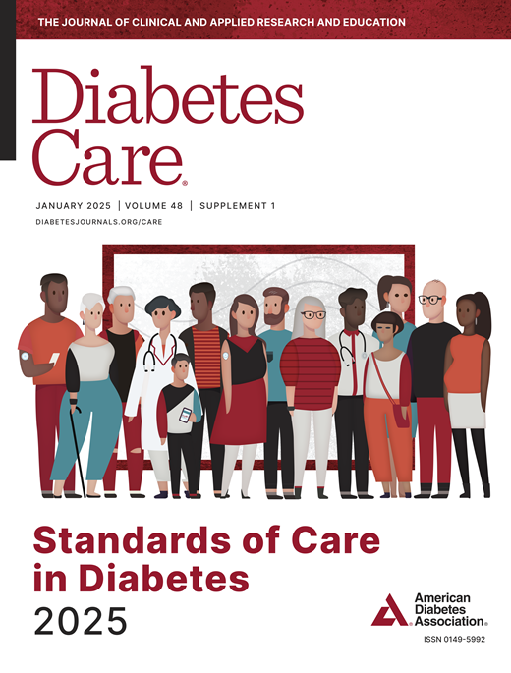


Improving Care and Well Being
American Diabetes Association Professional Practice Committee; 1. Improving Care and Promoting Health in Populations: Standards of Care in Diabetes—2025. Diabetes Care 1 January 2025; 48 (Supplement_1): S14–S26. https://doi.org/10.2337/dc25-S001
American Diabetes Association Professional Practice Committee; 5. Facilitating Positive Health Behaviors and Well-being to Improve Health Outcomes: Standards of Care in Diabetes—2025. Diabetes Care 1 January 2025; 48 (Supplement_1): S86–S127. https://doi.org/10.2337/dc25-S005

Slide 4
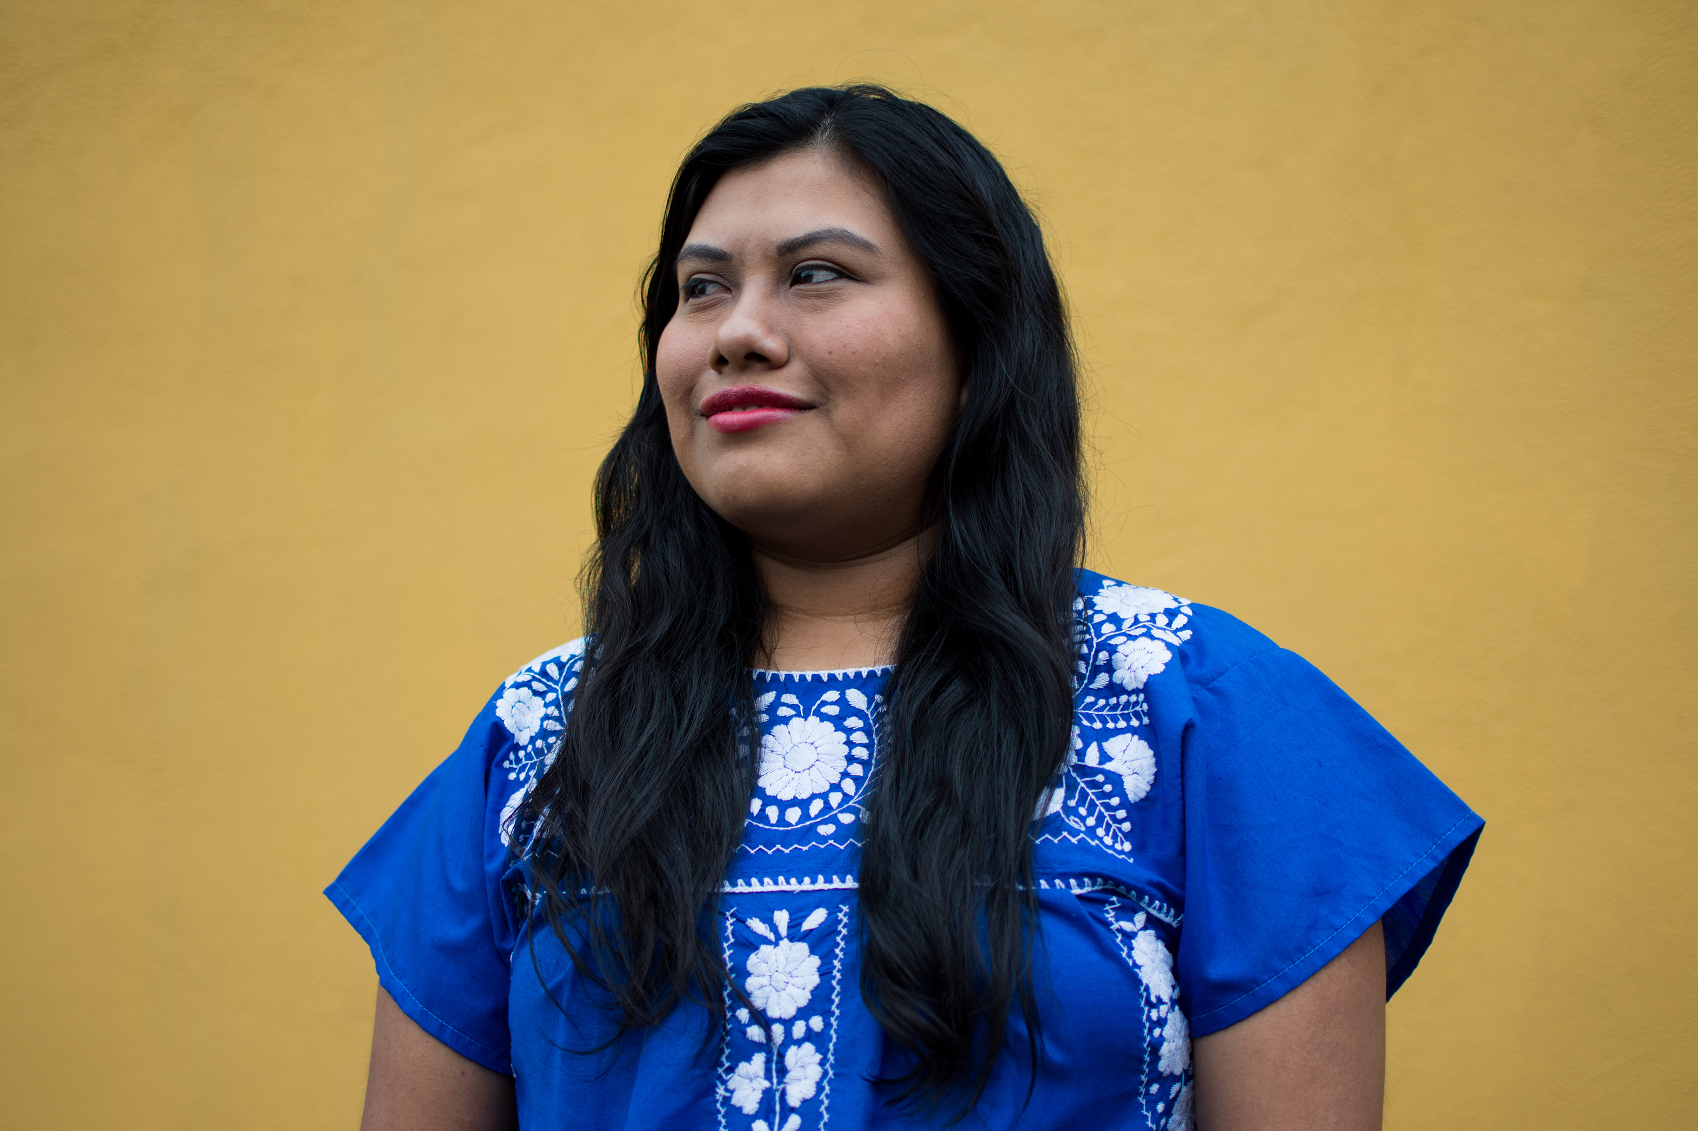
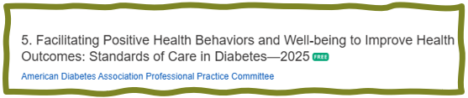
Facilitating Positive Health Behaviors and Well Being to Improve Health Outcomes – Standard 5
Building positive health behaviors and maintaining psychological well-being are foundational for achieving diabetes management goals and maximizing quality of life
Engage in person-centered collaborative care and shared decision making

Slide 5

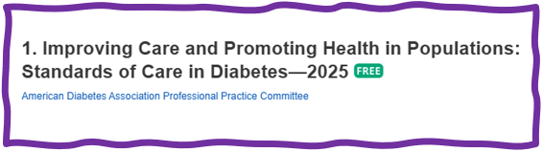
Well-Being Key Goal of Care
Timely treatment based on evidence and SDOH in collaboration with individual
Integrate long term treatment approaches w/ person centered care team.
Facilitate in person & virtual team-based care along with community involvement
We want to help people move from
Dis – Ease to
Well- Being

Slide 6
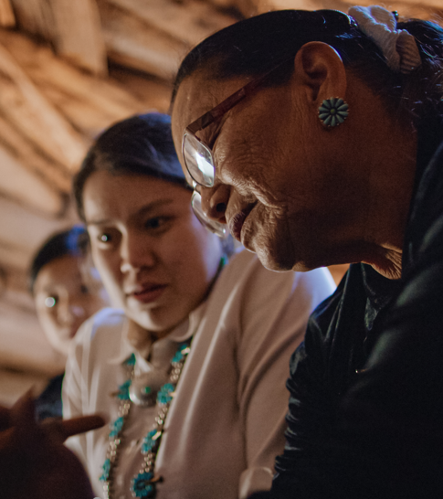
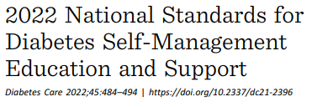
Diabetes Care and Education Specialist (CDCES) Definition
“A compassionate teacher and expert who, as an integral member of the care team, provides collaborative, comprehensive, and person-centered care and education for people with diabetes”
When I get lost or discouraged, I remember my why.

Slide 7

Diabetes Self-Management Education
DSMES facilitates the knowledge, decision-making, and skills mastery necessary for optimal diabetes self-care and incorporate the needs, goals, and life experiences of the person with diabetes.
Consider the burden of treatment and the person’s level of confidence and self-efficacy for management behaviors as well as the level of social and family support.
Use positive, strength-based words and phrases putting people first

Slide 8
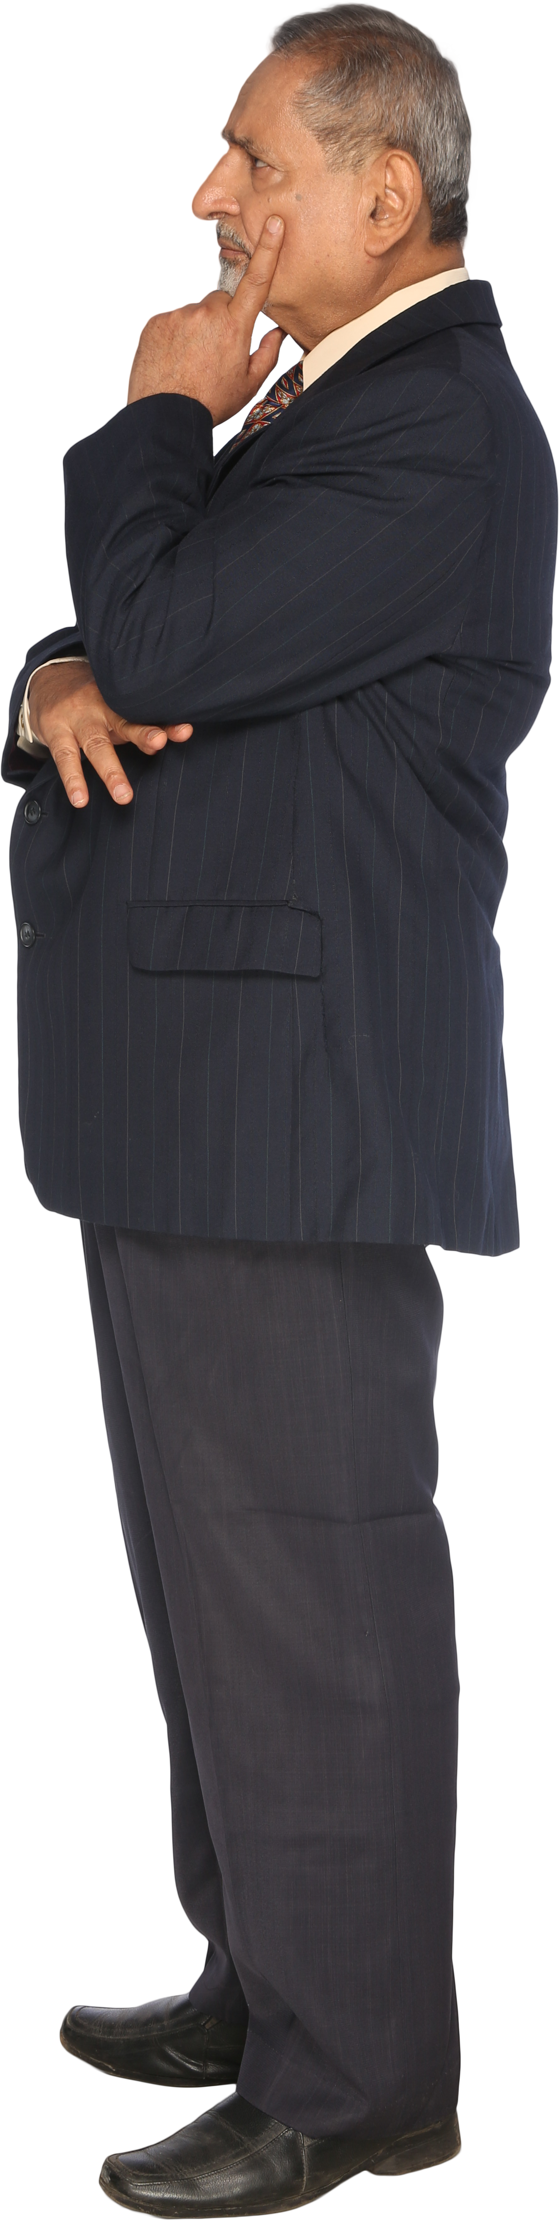
Barriers to DSMES
Only about 50% of eligible individuals receive DSMES
Barriers include health system, payor, clinic, HCP, and individual.
Due to lack of administrative leadership support to ineffective DSMES referral processes, transportation challenges etc.
Low participation can be due to lack of referrals, logistical issues (e.g., accessibility, timing, and costs), and lack of a perceived benefit
Efforts to identify and address potential barriers at all levels need to be made.

Slide 9
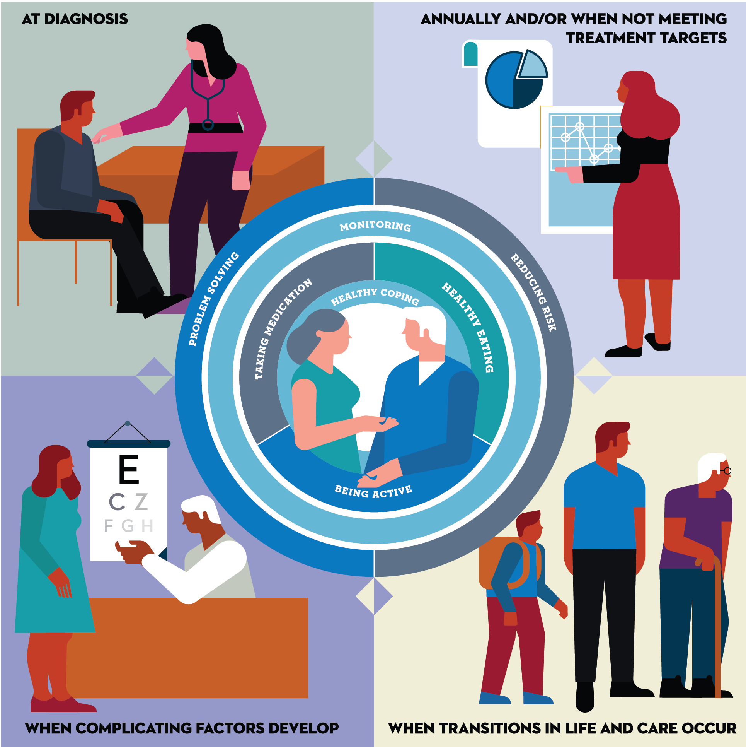
Critical times to provide and modify DSMES
- At Diagnosis
- Annually and/or when not meeting treatment goals
- When complicating factors develop (medical, physical, psychosocial) develop
- When transitions in life and care occur.
Powers MA, Bardsley JK, et al. DSMES Consensus Report, The Diabetes Educator, 2020
ADCES. AADE7 Self-Care Behaviors, The Diabetes Educator, 2020

Slide 10

Diabetes Self Management Ed Benefits
Improved knowledge
Lower weight
Improved quality of life
Reduced mortality
Positive coping
Reduced cost
Increased primary care, preventive services
Better outcomes
Less frequent use of acute care
More likely to follow best practice recommendations
Elevator Pitch: I help people with diabetes get to their best health through collaboration and education.

Slide 11

Individual & Population Health
Integrated person-centered care:
  ensures individual’s values guide all clinical decisions
  is respectful of and responsive to individual preferences, needs, and values;
  considers comorbidities and prognoses
For optimal outcomes individualize care across life span.
Improve population health through a combination of policy-level, system-level, and person-level approaches.

Slide 12
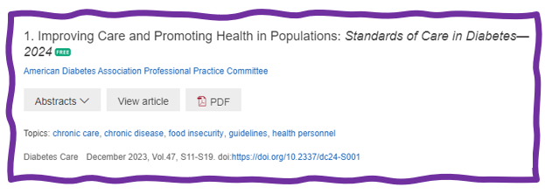
Chronic Care Model – 6 Core Elements
Delivery system design (moving from a reactive to a proactive care delivery system where planned visits are coordinated through a team-based approach)
Self-management support
Decision support (basing care on evidence-based, effective care guidelines)
Clinical information systems (using registries that can provide patient-specific and population-based support to the care team)
Community resources and policies (identifying or developing resources to support healthy lifestyles)
Health systems (to create a quality-oriented culture)
Studies show using chronic care delivery model decreases death & disease and improves outcomes.

Slide 13

Lived Experiences & Advocacy

Slide 14

Diabetes Admit for Hyperglycemia
John is admitted for hyperglycemia because he stopped taking his diabetes meds.
HCP says, “Don’t you realize you are going to get complications, like kidney disease or amputation if you don’t take your medications?”
Door Closed – No Connection made
How Does John Feel?
Embarrassed
Ashamed
Defeated
Angry
Unheard
How does HCP feel?
Frustrated
Defeated
Worried

Slide 15
Diabetes Visit – Let’s Go through
How Does John Feel?
A small adjustment can make a BIG Difference
Heard & Seen
Recognized
Connected
Engaged
How does the HCP feel?
Connected
Concerned
Collaborative
HCP says, “John, I am worried about you and your elevated blood glucose. Can you share what is going on in your life?”
Door Open – Connection made
Healing to HCP
Bidirectional Healing
Healing to Person

Slide 16
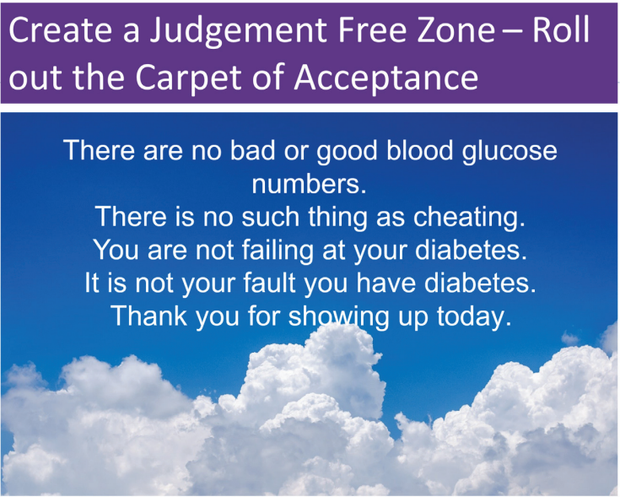

Slide 17
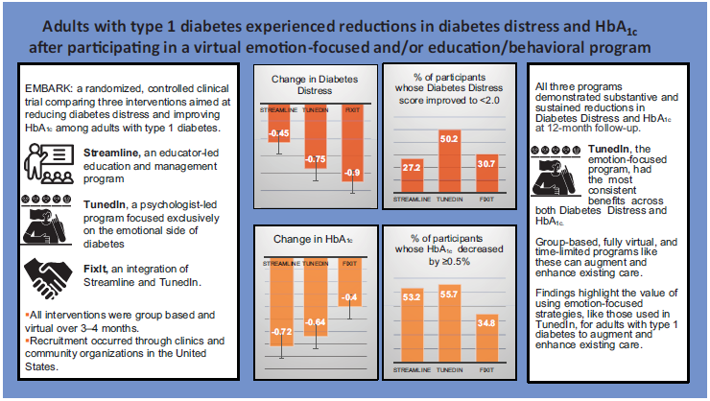
EMBARK Trial
EMBARK: A Randomized, Controlled Trial Comparing Three Approaches to Reducing Diabetes Distress and Improving HbA_{1c} in Adults With Type 1 Diabetes. Diabetes Care 2024; dc232452. https://doi.org/10.2337/dc23-2452

Slide 18

Embark Trial – Emotions as Priority
I have finally given myself permission to make addressing the emotional aspects of diabetes a priority.
~Coach Beverly

Slide 19
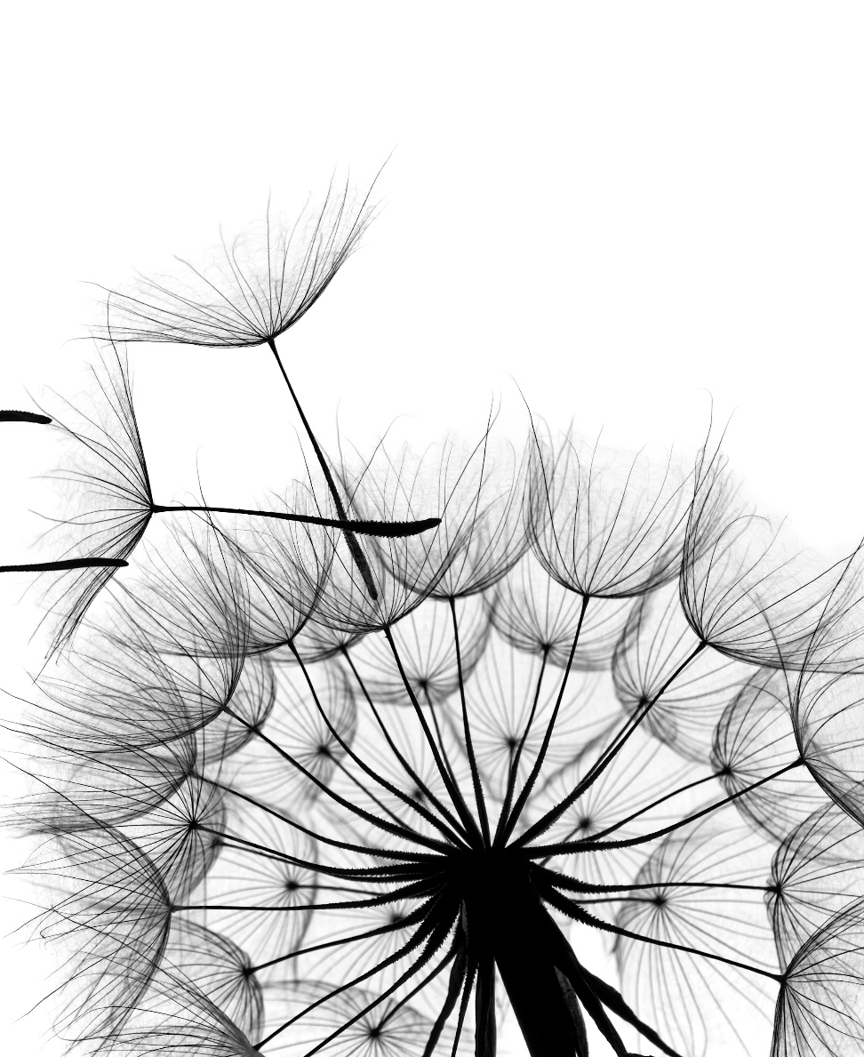
Releasing the Brake
This strategy recognizes that diabetes distress acts as a brake on the application of existing diabetes knowledge and skills.
By releasing the diabetes distress brake through emotion-focused intervention, the negative cycle can be efficiently ended.

Slide 20
ABC’s of Diabetes Education
of Healing Through Connection

Slide 21
Ask about their life (SDOH)
Assess current self-management behaviors
Assess your feelings
Accept without judgement
Acknowledge one thing they are doing right
Advocate for needed resources

Slide 22

Case Study
34-year-old transgender female, with type 2 diabetes, ends up in urgent care with an abscess due to elevated blood glucose – A1C 9.4%. Living with roommates.
On glipizide and metformin, but not taking because can’t afford strips to check glucose. Afraid of glucose going too low.
History of diabetes distress and anxiety.

Slide 23
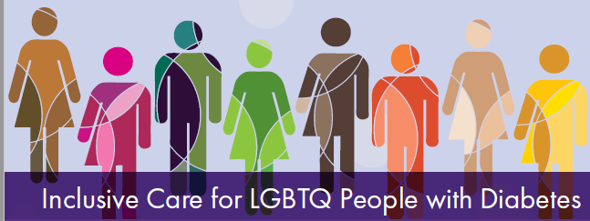
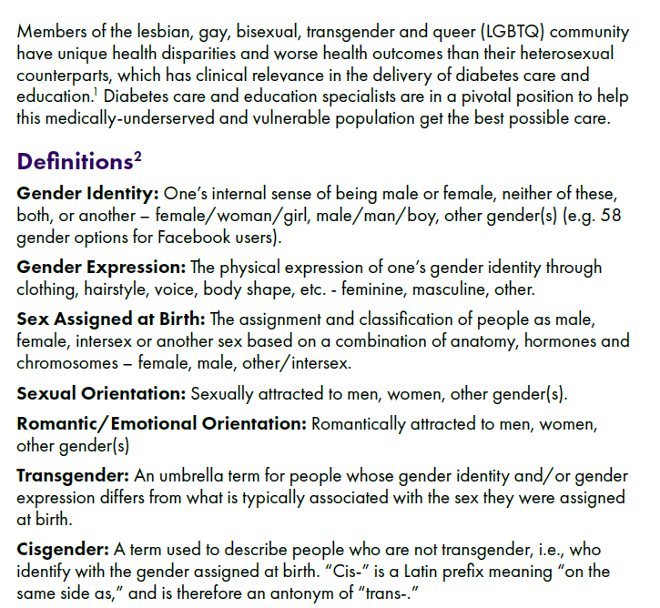


Slide 24
Social Determinants of Health
To improve health, support overall well-being, and eliminate disparities, it is crucial to address these determinants.
Individuals from racial and ethnic minority communities, underserved geographic areas (rural or urban), and those facing socioeconomic barriers to care and health at higher risk.

Slide 25
Care Quality Gaps
Growing gaps in diabetes care quality and outcomes due to high & risings costs of care.
Increased disparities experienced by individuals from racial and ethnic minoritized backgrounds and those facing socioeconomic barriers to care.
Calls for urgent, substantial, and multisectoral system-level improvements to care delivery

Slide 26
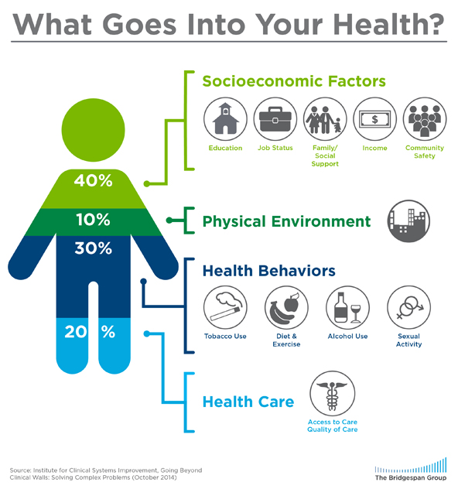
Assess Barriers to Self Management
Barriers exist within health system, payer, health care professional & individual.
Address barriers through innovation, including community health workers, telehealth, other digital health solutions.
Consider social determinants of health in the target population when designing care.
https://coveragetoolkit.org/health-equity/defining-health-equity/
Notes:
Access and health equity is the ultimate goal when designing and delivering DSMES.
Creating culturally appropriate and varied modalities of settings has been shown to improve outcomes.
We know barriers to care exist at every level from the health system to individual.
However we can address these barriers by working to educate participants and health care providers on the critical times when DSMES is needed.
We can work with health systems and clinics to develop population health screening and clinical outreach,
create protocols to reduce time for referral and
collaborate health and community systems to address social needs.
We can include other health partners including community health workers to support delivery of diabetes peer support.
Barriers can be also be addressed by developing a diversity of delivery models.
From traditional inperson classrooms to community-based strategies and technology enabled solutions including telehealth or virtual environments varying modes can serve different needs.

Slide 27
Case Study
34-year-old transgender female, with type 2 diabetes, ends up in urgent care with an abscess due to elevated blood glucose – A1C 9.4%. Living with roommates.
On glipizide and metformin, but not taking because can’t afford strips to check glucose. Afraid of glucose going too low.
History of diabetes distress and anxiety.

Slide 28
Ask about their life (SDOH)
Assess current self-management behaviors
Assess your feelings
Accept without judgement
Acknowledge one thing they are doing right
Advocate for needed resources

Slide 29
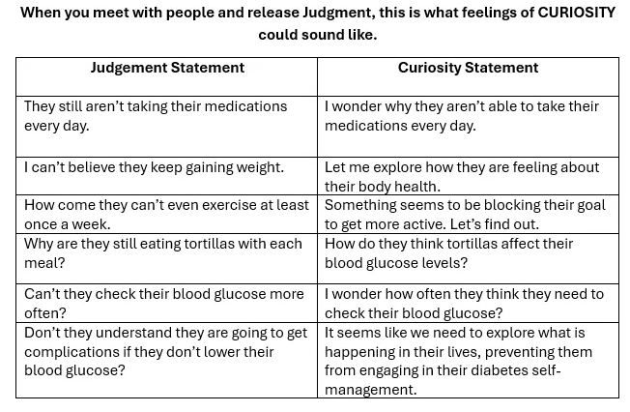
From Judgement to Curiosity

Slide 30

Psychosocial Care
Provide psychosocial care to all people with diabetes to optimize health-related quality of life and outcomes.
Integrate such care with routine medical care using a collaborative, person-centered, culturally informed approach.
Implement screening protocols for psychosocial concerns.

Slide 31

What to Assess?
Using standardized/validated tools
  Diabetes Distress
  Depression
  Anxiety
  Disordered Eating
  Cognitive Capacity
  Adverse Childhood Experiences
  Suicidality if appropriate

Slide 32

Poll Question 1
JT, a nine-year-old with type 1 diabetes, is struggling. Which of the following statements reflects that they may dealing with diabetes distress?
I sometimes just guess my carbs.
I just don’t want to get out of bed in the morning.
I just can’t keep up with all this diabetes self-care stuff.
I don’t want to wear a diabetes bracelet or necklace.

Slide 33

Diabetes Distress=DD
Diabetes distress refers to significant negative psychological reactions related to emotional burdens and worries specific to an individual’s experience in having to manage a demanding chronic condition such as diabetes.
Can impact A1C, cognition and mental health
  Type 2 - Affects ~ 60%
  Type 1 – Affects 22-42%

Slide 34

DDS 17: Diabetes Distress Scale
Yields a total Diabetes Distress Scale score plus 4 sub scores:
  Emotional burden
  Physician related Distress
  Regimen related Distress
  Interpersonal Distress
  Begin a conversation with any item rated 3 or more – See Distress Scale in your resources page
  44.5% of individuals reported diabetes distress
  Only 24% of providers asked pts how diabetes affected their life (DAWN Study)

Slide 35
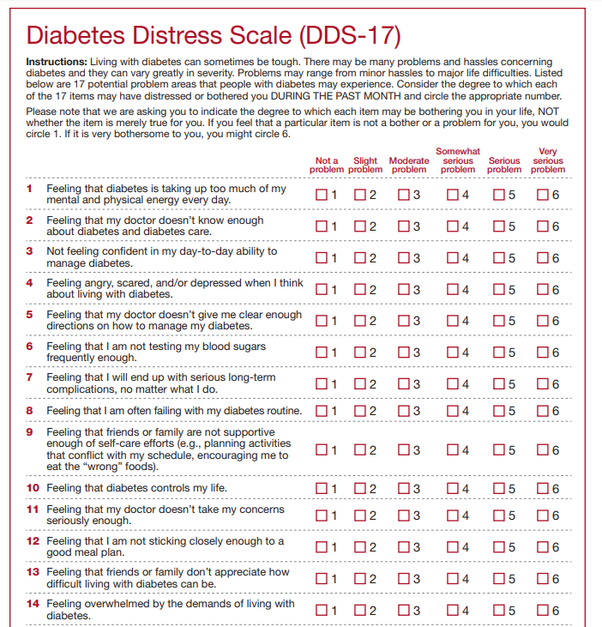
Diabetes Distress Scale cont.
Feeling that diabetes is taking up too much of my mental and physical energy every day.
Feeling that my doctor doesn't know enough about diabetes and diabetes care/ doesn't give me clear enough directions .
Feeling angry, scared, and/or depressed … think about living with diabetes
Feeling that I am not testing my blood sugars frequently enough.
Feeling that I am often failing with my diabetes routine.
Feeling that friends or family are not supportive enough of self-care efforts (planning activities that …, encourage me to eat the "wrong" foods).
Feeling that diabetes controls my life.
Not feeling motivated to keep up my diabetes self management. DDS (17) Scoring
https://professional.diabetes.org/sites/default/files/media/ada_mental_health_toolkit_questionnaires.pdf.

Slide 36
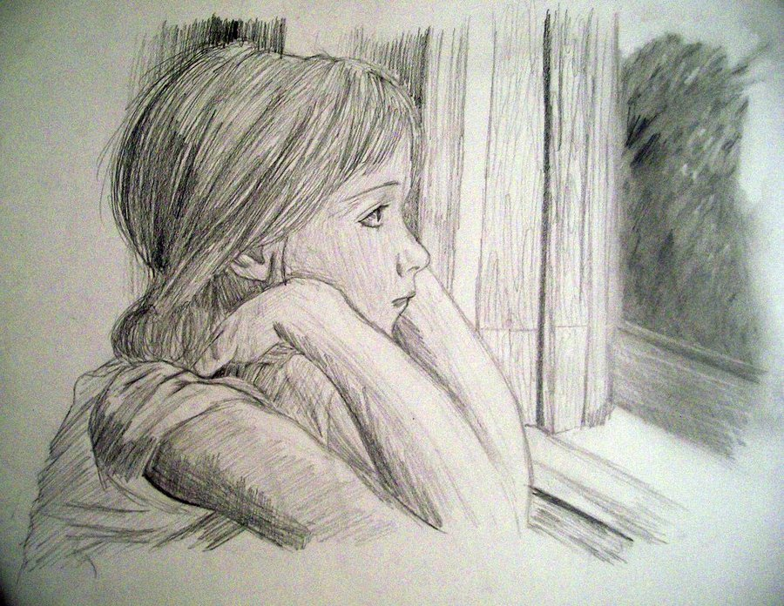
Diabetes Distress – *Assess Annually
High levels of diabetes distress significantly impact medication-taking behaviors and are linked to higher A1C, lower self-efficacy, and poorer dietary and exercise behaviors
Can also contribute to higher stress hormone levels
Address Distress
Mindful Self-Compassion is important
Counseling and DSME can help

Slide 37

Trusting our Intuition
As healthcare professionals, we tend to focus on problem-solving around lifestyle, medications, and glucose levels.
The results of the Embark study confirm our intuition to prioritize addressing emotions to support individuals living with diabetes.
Let’s reprioritize our checklist by assessing and addressing distress and move into the heart of providing effective diabetes care.

Slide 38

Anxiety Symptoms Common in Diabetes
19.5% lifetime prevalence of generalized anxiety disorder in type 1 or type 2 diabetes*
People with diabetes have higher rates of:
  generalized anxiety disorder,
  body dysmorphic disorder,
  obsessive compulsive disorder,
  specific phobias,
  Posttraumatic stress disorder.
  *Behavioral Risk Factor Surveillance System estimates
Common Anxieties
  Fear of Hypoglycemia
  Not meeting glycemic goals
  Insulin injection/infusion
  Onset of complications

Slide 39
Consider Referral to Mental Health Provider for Eval and Treatment
Low engagement in diabetes self-management
Screens positive for depression, anxiety, FoH*
Disordered eating or disrupted eating patterns
Not taking insulin/meds to lose weight
Serious mental illness is suspected
Youth with repeated hospitalizations, distress
Cognitive impairment or impairment of DSME
Before bariatric/metabolic surgery
*Fear of hypoglycemia

Slide 40
Care Study
Acknowledge – That makes sense you are not taking your meds due to fear of hypo.
What about just taking metformin?
If we can get strips for your meter, would you be interested in checking your BG?
34-year-old transgender female, with type 2 diabetes, ends up in urgent care with an abscess due to elevated blood glucose – A1C 9.4%. Living with roommates.
On glipizide and metformin, but not taking because can’t afford strips to check glucose. Afraid of glucose going too low.
History of diabetes distress and anxiety.
curiosity

Slide 41
Empowering and Promoting Health for Individuals and Populations
Our Actions Make a Difference

Slide 42
Beliefs about health and diabetes
Barriers can be confused with non-compliance
Burnout lookout. On extended diabetes vacation due to diabetes distress?
Bouncing back – leaning into resilience

Slide 43

When Treatment Goals aren’t met
Invoke Curiosity
Reassess treatment regimen and barriers
  Social determinants of Health
  Health & Numeral Literacy
  Language barriers
  Diabetes related distress or depression
  Competing demands
  Medication costs
Action Steps
Provide Diabetes Self- Management Education
Therapeutic connection
- Refer to RD/RDN
- Social Services
- Community Health Worker
- Support Group
- Other

Slide 44

Individualized Care Strategies
Consider individualized care and create environmental structures to support people with:
  Food insecurity
  Living situation & Housing
  Refugee, Migrant farm laborers
  Language barriers
Health disparities related to:
  Ethnicity, racism, culture, sex, socioeconomic status, LGBTQ

Slide 45

Food Insecurity
Food insecurity is the unreliable availability of nutritious food and the inability to consistently obtain food without resorting to socially unacceptable practices
Up to 20% in diabetes
  Higher in African American, Latinos, low income, single moms
Type 2 diabetes risk doubled in those with food insecurity

Slide 46
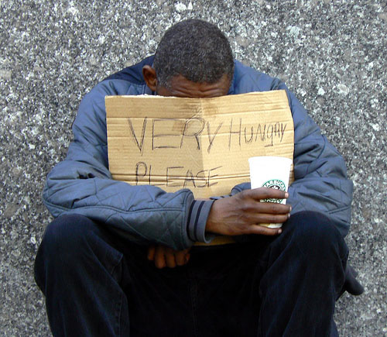
Living Situation impacts self-care
The prevalence of diabetes in the unhoused population is estimated to be around 8%
Need secure places to keep supplies and meds
Help connect with social resources
Housing insecurity has been shown to be directly associated with a person’s ability to maintain their diabetes self-management

Slide 47

Refugee, Migrant & Seasonal Workers
  Higher risk of having diabetes, CV Disease
  Poverty associated with chronic stress, food insecurity and higher risk of diabetes
  link to certain pesticides and the incidence of diabetes
Many barriers to care:
  Migration
  Culture and language
  Lack of funds for transportation
  Other barriers
Health care professionals need to attune to individual’s working and living conditions

Slide 48

Look Beyond – What impacts DSM
Improving diabetes treatment outcomes requires looking at multiple factors:
  Living situation
  Childhood trauma
  Adequacy of medical management
  Cost-related barriers to medication use
  Duration of diabetes
  Other health related problems
  Social structural factors
  Access to Care

Slide 49

Question - What is ACE?
ACE =
  Adverse
  Childhood
  Experiences
    (before 18 yrs)
What is the relationship between childhood trauma and health?

Slide 50
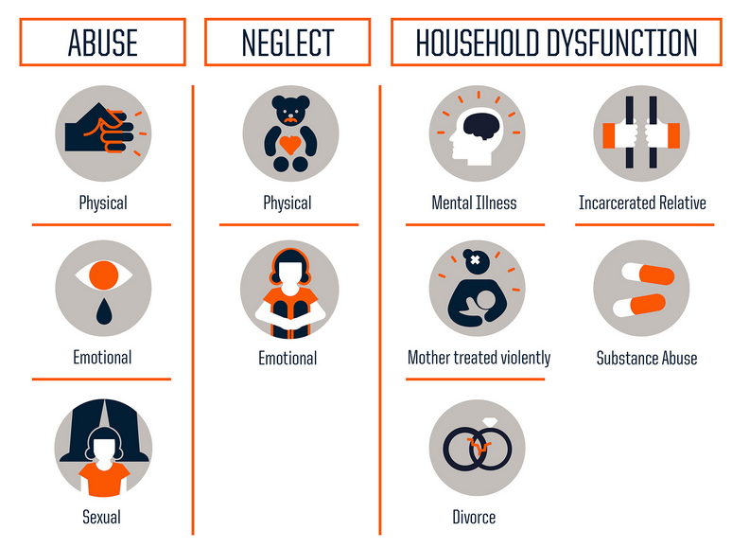
10 Assessment Areas for ACE – Use 10 Question Screening Tool to Assess
https://www.npr.org/sections/health-shots/2015/03/02/387007941/take-the-ace-quiz-and-learn-what-it-does-and-doesnt-mean

Slide 51
ACE increases risk for 9 out of 10 leading causes of death in US
Leading Cause of Death
Odds Ratio with ≥ 4 ACEs
Heart Disease
Stroke
Diabetes
Kidney Disease
Cancer
Alzheimer’s
Suicide(attempts)
2.1
2.0
1.4
1.7
2.3
4.2
37.5
https://www.cdc.gov/vitalsigns/aces/index.html

Slide 52

Supportive Relationships & Resilience

Slide 53
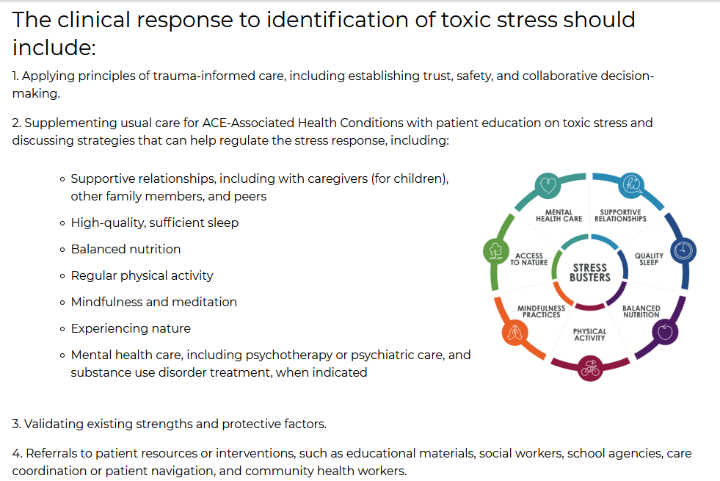

Slide 54

Awareness >> to Healing
https://www.acesaware.org

Slide 55
Having the Conversation
Coaching that highlights their knowledge and resilience.
Carrots – problem solve together and dig for solutions that are meaningful in everyday life.
Compassion for the people in our care and ourselves.

Slide 56
Example of A More Helpful Expectation:
From Perfectionism to “Healthy Good Enough”
Perfectionistic thinking: has 2 speeds, perfect or failure, not achievable for very long, exhausting, contributes to burnout
Healthy Good Enough
  Personalized
  Ambitious and realistic
  Allows for normal fluctuations, mistakes and experiments
  Sees small steps as valuable
  Focus is on efforts made, not numbers
  Forward looking: What now?
Used with permission from ReVive 5 Program; Larry Fisher, PhD & Susan Guzman, PhD

Slide 57

Poll question 2
  LR is a 16-year-old on an insulin pump and Continuous Glucose Monitor and is feeling very distressed because their glucose keeps going above target range. What is an appropriate intervention?
  A. Encourage them to ask their provider about starting medications for anxiety.
  B. Help them set a SMART goal to improve carb to insulin ratios.
  C. Explore their feelings.
  D. Remind them that alcohol can actually lower blood glucose.

Slide 58

Time In Range – Person Centered
“Hyperglance-emia”
Healthy Good Enough – not perfection
Each 1% is 15 minutes
There is 24 hours in a day.
  17 hours in range
  7 hours outside of range.
You are not defined by your blood glucose.
What range feels safe for you?
Try and step back and take in the whole picture.
Sometimes you need ice cream!

Slide 59

Relationship Building │ Three Tools To Make It Happen
Relationship Building
1. Judgement Free Zone
2. Active Listening
3. Open-Ended Questions

Slide 60
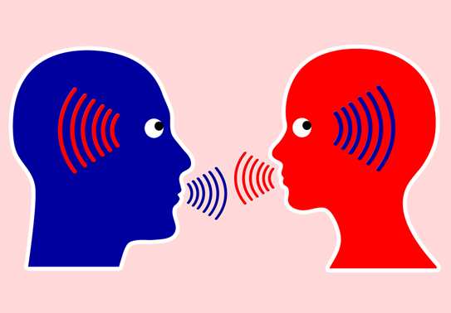
Conversational Tools You Can Use To Address Diabetes Distress
The goal is to help people label, verbalize, share, consider, and evaluate these frequently unaddressed and often hidden feelings and thoughts about diabetes.
Building the relationship with conversational skills is the intervention!
Start with Open Ended Questions
Used with permission from ReVive 5 Program; Larry Fisher, PhD & Susan Guzman, PhD

Slide 61

Clinical Engagement Tools: Label & Address Feelings
Common feeling words:
  Sad
  Frustrated
  Scared/fearful
  Disappointed
  Angry
  Hopeless
  Defeated
  Ashamed/embarrassed
  Burned out
Used with permission from ReVive 5 Program; Larry Fisher, PhD & Susan Guzman, PhD

Slide 62
Having the Conversation
Review and summarize the story you hear:
“Do I have this right?”
“Is there anything missing?”
Then ask:
“How does all of this strike you?”
“Does any of this surprise you?”
Used with permission from ReVive 5 Program; Larry Fisher, PhD & Susan Guzman, PhD

Slide 63
RT Loves Eating Out
RT loves to eat dinner out with their friends 2-3 times a week.
However, blood sugars always seem to go above target on those evenings.
Want to have improved time in range to feel better, worry less and enjoy time with friends.
States - I am such a failure, my blood sugars are always going too high. Makes me not even want to try.

Slide 64
Having the Conversation
Elicit diabetes story
Listening for the major diabetes distress themes
Communication Approaches
  Open ended questions (O) -What, How, Why
  Reflect feelings words (R) – Sad, upset, worried, hopeful, angry, happy, scared etc.
  Summarize (S) – So what your saying is… Did I get that right?
  Normalize (N) – A lot of people with diabetes feel that same way.
  Active listening with empathy (E) – I hear you. That sounds really tough
Used with permission from ReVive 5 Program; Larry Fisher, PhD & Susan Guzman, PhD

Slide 65
Our response to RT
You Say / Ask
A lot of people living with diabetes say the same thing.
I hear you. This sounds really tough.
What do you envision are some next steps?
It sounds like you feel like you are a failure if your blood sugars go above a certain level? Did I get that right?
I am also hearing that going out with your friends for dinner is important for you?

Slide 66

RT Sets up Experiment/ Takes Action
Steps
RT Changes
Make a small change
Realize, that the story and tough feelings can be major barrier to change.
Discover an unexpected issue.
  Be present with her fear of failure
  Look up carbs on app/website.
  Ask her friends for support
  Asking for help is hard, but I think it will help.
  See how drinking wine with dinner affects BG

Slide 67
Checking in with RT 2 weeks later
RT Responds
You Say / Ask
We went to the same restaurant 2 times in the same week. My friends helped me figure out the carbs in my favorite dish, but the first night, it still went high. I noticed the DD story of feeling like a failure.
A few nights later, I tolerated my DD, ordered the same dish, and increased my bolus by 2 units. My blood sugar was right on track!
Thank you for keeping logs on your eating out days.
What kind of feelings showed up for you?
Were you able to try any of your new approaches?
Did you discover anything new?

Slide 68
Checking in with RT 2 weeks later
RT Responds
You Say / Ask
I didn’t have a chance to check that out yet. But next time, I am going to eat the same dish, take the same amount of insulin and add have a glass of wine to see what happens.
I see that I need to keep challenging myself to not give in to feeling like a failure and keep making new choices.
I know you also mentioned you wanted to see how wine affected your blood sugars.
Did you discover anything new?

Slide 69

Support Self-Confidence
Support positive expectations for change…
  emphasize personal responsibility,
  instill confidence and hope,
  increase sense of ability to cope.
  “From what you’ve told me about your past successes…it really seems like you can do this!”

Slide 70
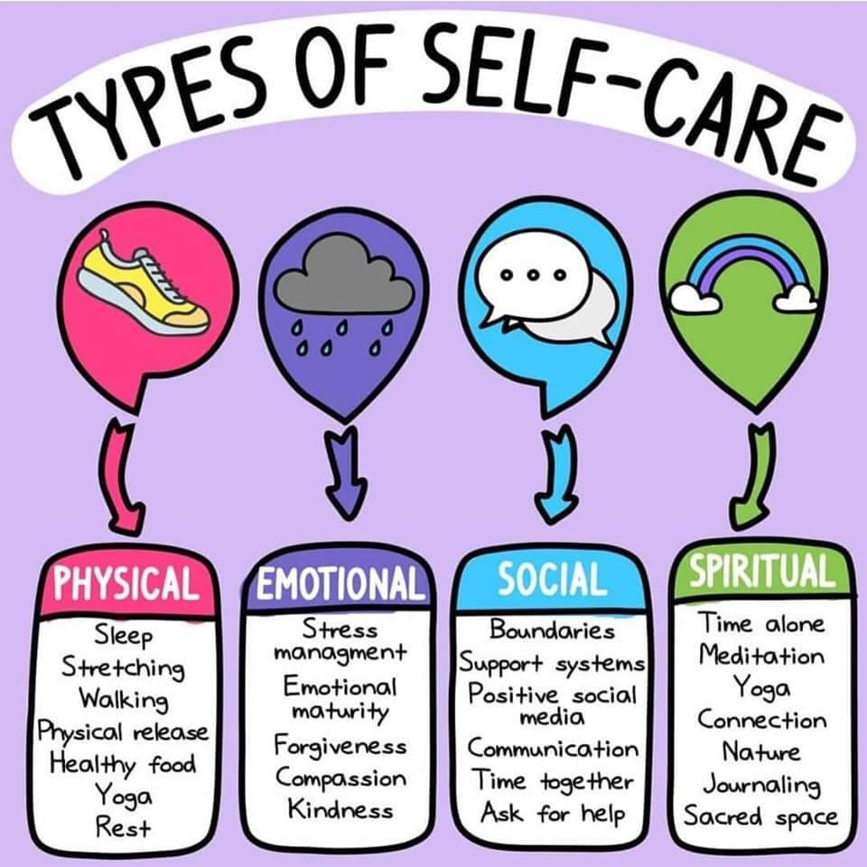
Step 8
Compassion for Yourself
Get enough sleep
Keep active
Remind yourself that you are not responsible for the decisions of others. Love and release.
Connect with friends and family
Investigate unhealthy behaviors
Nourish your body
Consider a hobby

Slide 71
Celebrate and Recognize
In conclusion: Celebrate and Recognize Each Person's Efforts.
Making behavior changes, like losing weight or adjusting lifelong eating habits, can be extremely difficult.
Find a way to recognize and affirm their efforts even if there is no or little change in clinical measures.
Our belief in people makes a difference!

Slide 72


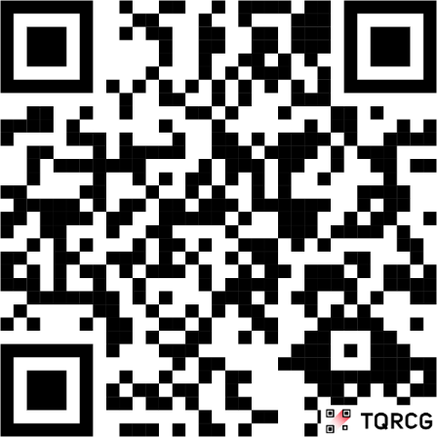
Instructions for Claiming Credit
To receive CE credit, learners must follow these steps:
Visit https://cme.partnersed.com/SD1025 or scan the QR Code:
Sign Up or Log in.
Complete the activity evaluation.
Upon completion of all evaluation questions your credit will be made available for download immediately.
For Pharmacists: Upon successfully completing the activity evaluation, your credit will be submitted to CPE Monitor. Please check your NABP account within thirty (30) days to make sure the credit has posted.

Slide 73

Thank You –
Thanks for joining us!
Questions?
Info@diabetesed.net
Call us at 530-893-8635
www.DiabetesEd.net

