Slide 1

Healing through Connection for Healthcare Professionals
Beverly Thomassian, RN, MPH, CDCES, BC-ADM
Pronouns: she, her and hers
President & Founder – Diabetes Education Services
www.DiabetesEd.net

Slide 2
Objectives
State the importance of making connections in healthcare.
Discuss the implications of the EMBARK Trial on diabetes care.
List healing strategies for healthcare professionals.

Slide 3
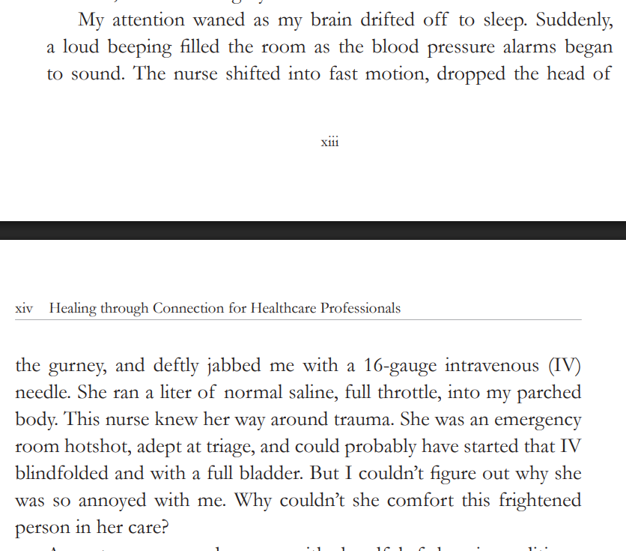
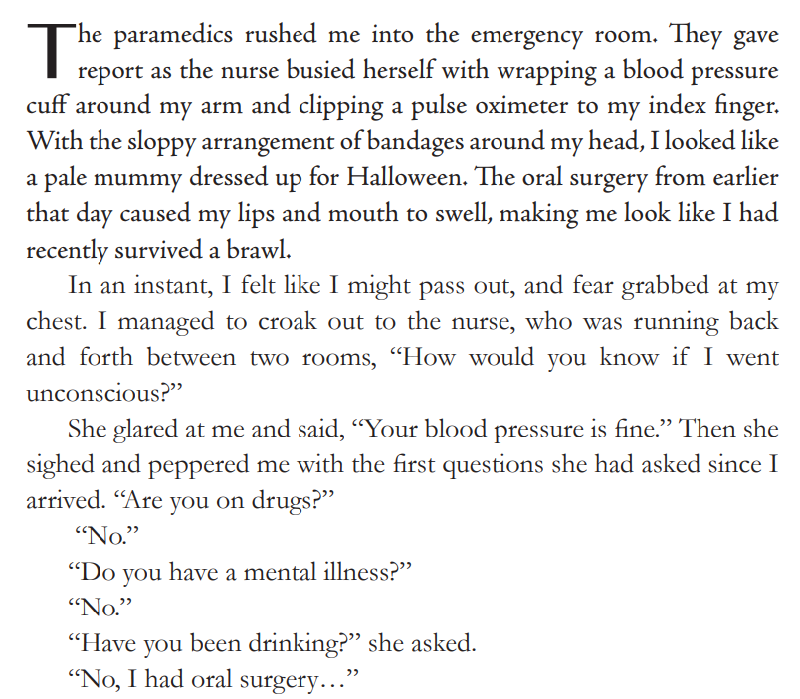
Emergency Room Visit

Slide 4

Emergency Room Visit - Prologue
What did ER Nurse Do Right?
How Did Patient Feel?
Assessed patient
Responded quickly when BP dropped
Started IV Quickly
Gave fluids
Lowered Bed
Scared
Alone
Worried that nurse wouldn’t notice if BP dropped.
Vulnerable
Indignant
Embarrassed
Ashamed

Slide 5

Emergency Room Visit – Nurse Feelings?
How Does Nurse Feel?
Activated by needy patient
Hungry/Tired
Needs a break
Has her own worries
Late to get home
Burned out?
Unattended trauma
“As a healthcare professional, you bring your own life experiences, traumas, wounds, triggers, blind spots, beliefs and inner narratives to each patient encounter. We all do.”

Slide 6

How Can We Heal through Connection?
The only way out is through.
Robert Frost
Let’s dive into the providing care then switch our focus to the caregiver – YOU.

Slide 7
Emergency Room Visit – Lets Go through
2 Simple Changes
How Does the Patient Feel?
Eye Contact – touch shoulder.
“Your blood pressure is fine. I am keeping a close eye on you.”
“Your blood pressure is fine. Press your call light if you feel funny.”
“Your blood pressure is fine. I know this is scary.”
Reassured
Heard & Seen
Calmer
Safe
Connected
Healing to Patient
Bidirectional Healing
Healing to HCP

Slide 8
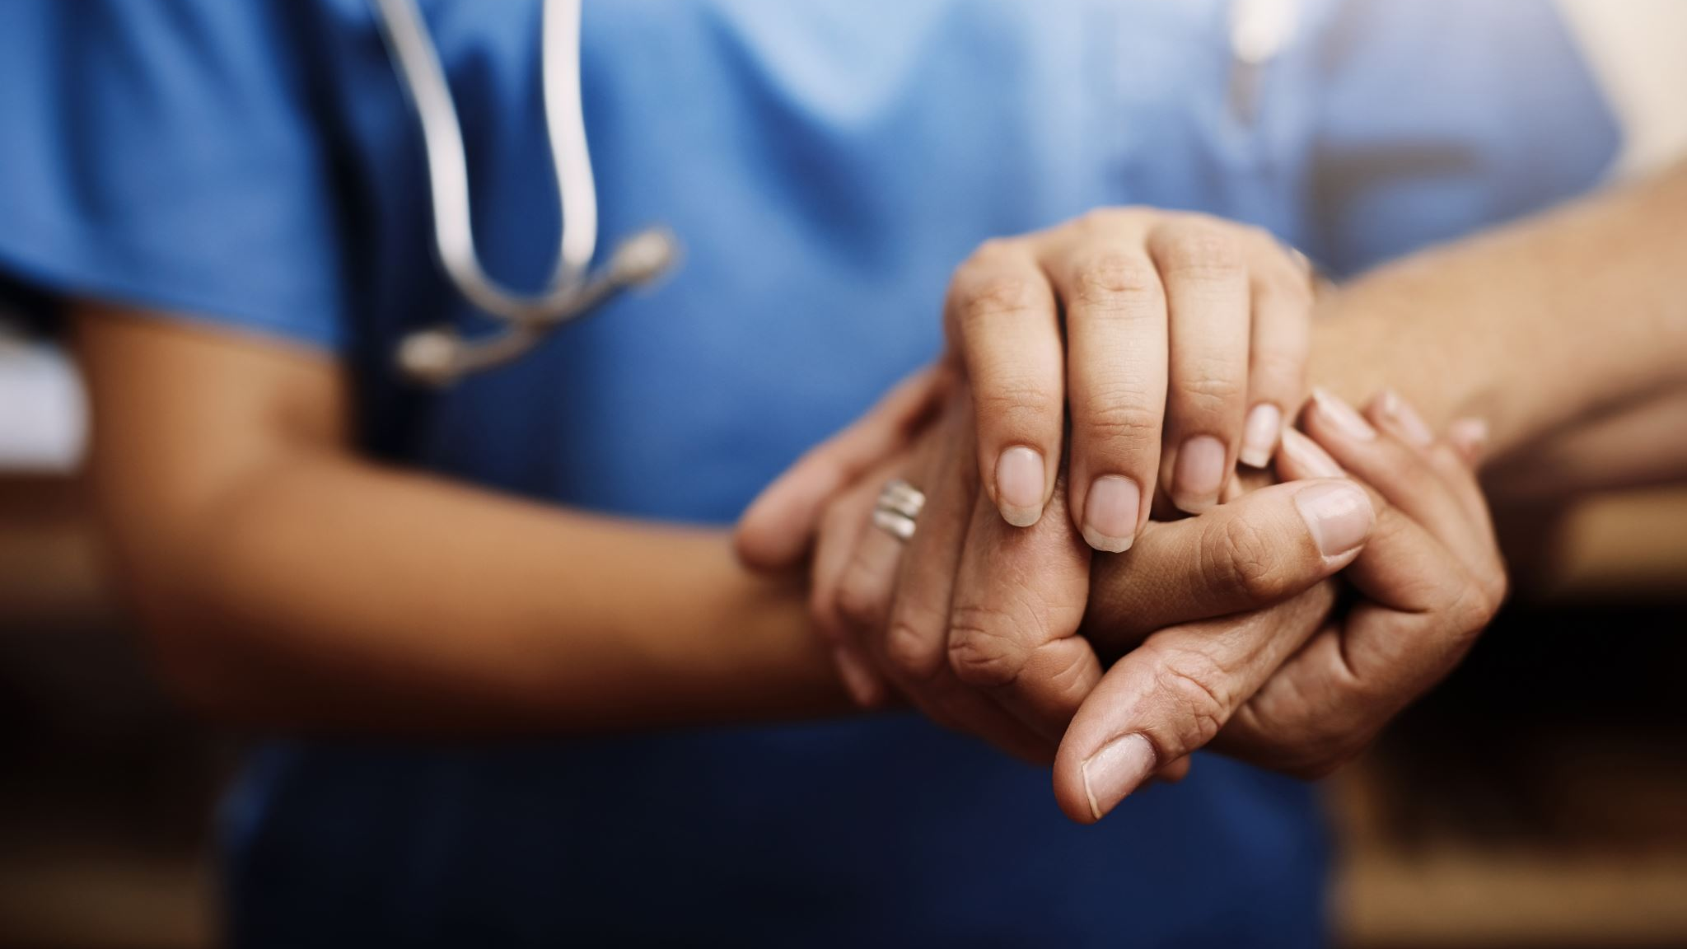
Kindness is Healing for both the Receiver & Giver

Slide 9

Could This Approach Apply To Working with People with Diabetes?
Is Diabetes All About the Numbers?
WAIT – What about FEELINGS?
Blood Glucose
A1C
Blood Pressure
Time in Range
Medications
Carb intake
Crises management
What about Connection?

Slide 10
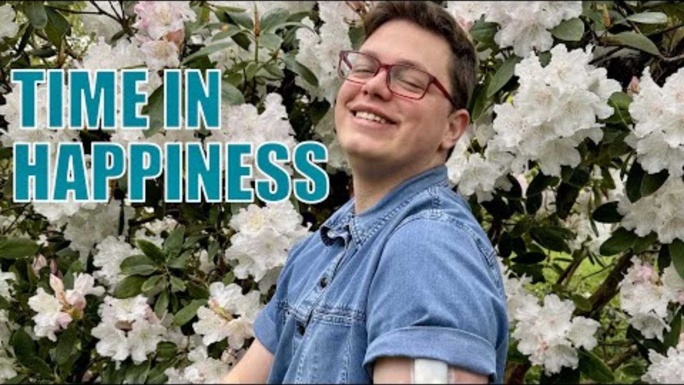

Slide 11

LR is a 16-year-old on an insulin pump and Continuous Glucose Monitor and is feeling very distressed because their glucose keeps going above target range. What is an appropriate intervention?
A. Encourage them to ask their provider about starting medications for anxiety.
B. Help them set a SMART goal to improve carb to insulin ratios.
C. Explore their feelings.
D. Remind them that alcohol can actually lower blood glucose.

Slide 12
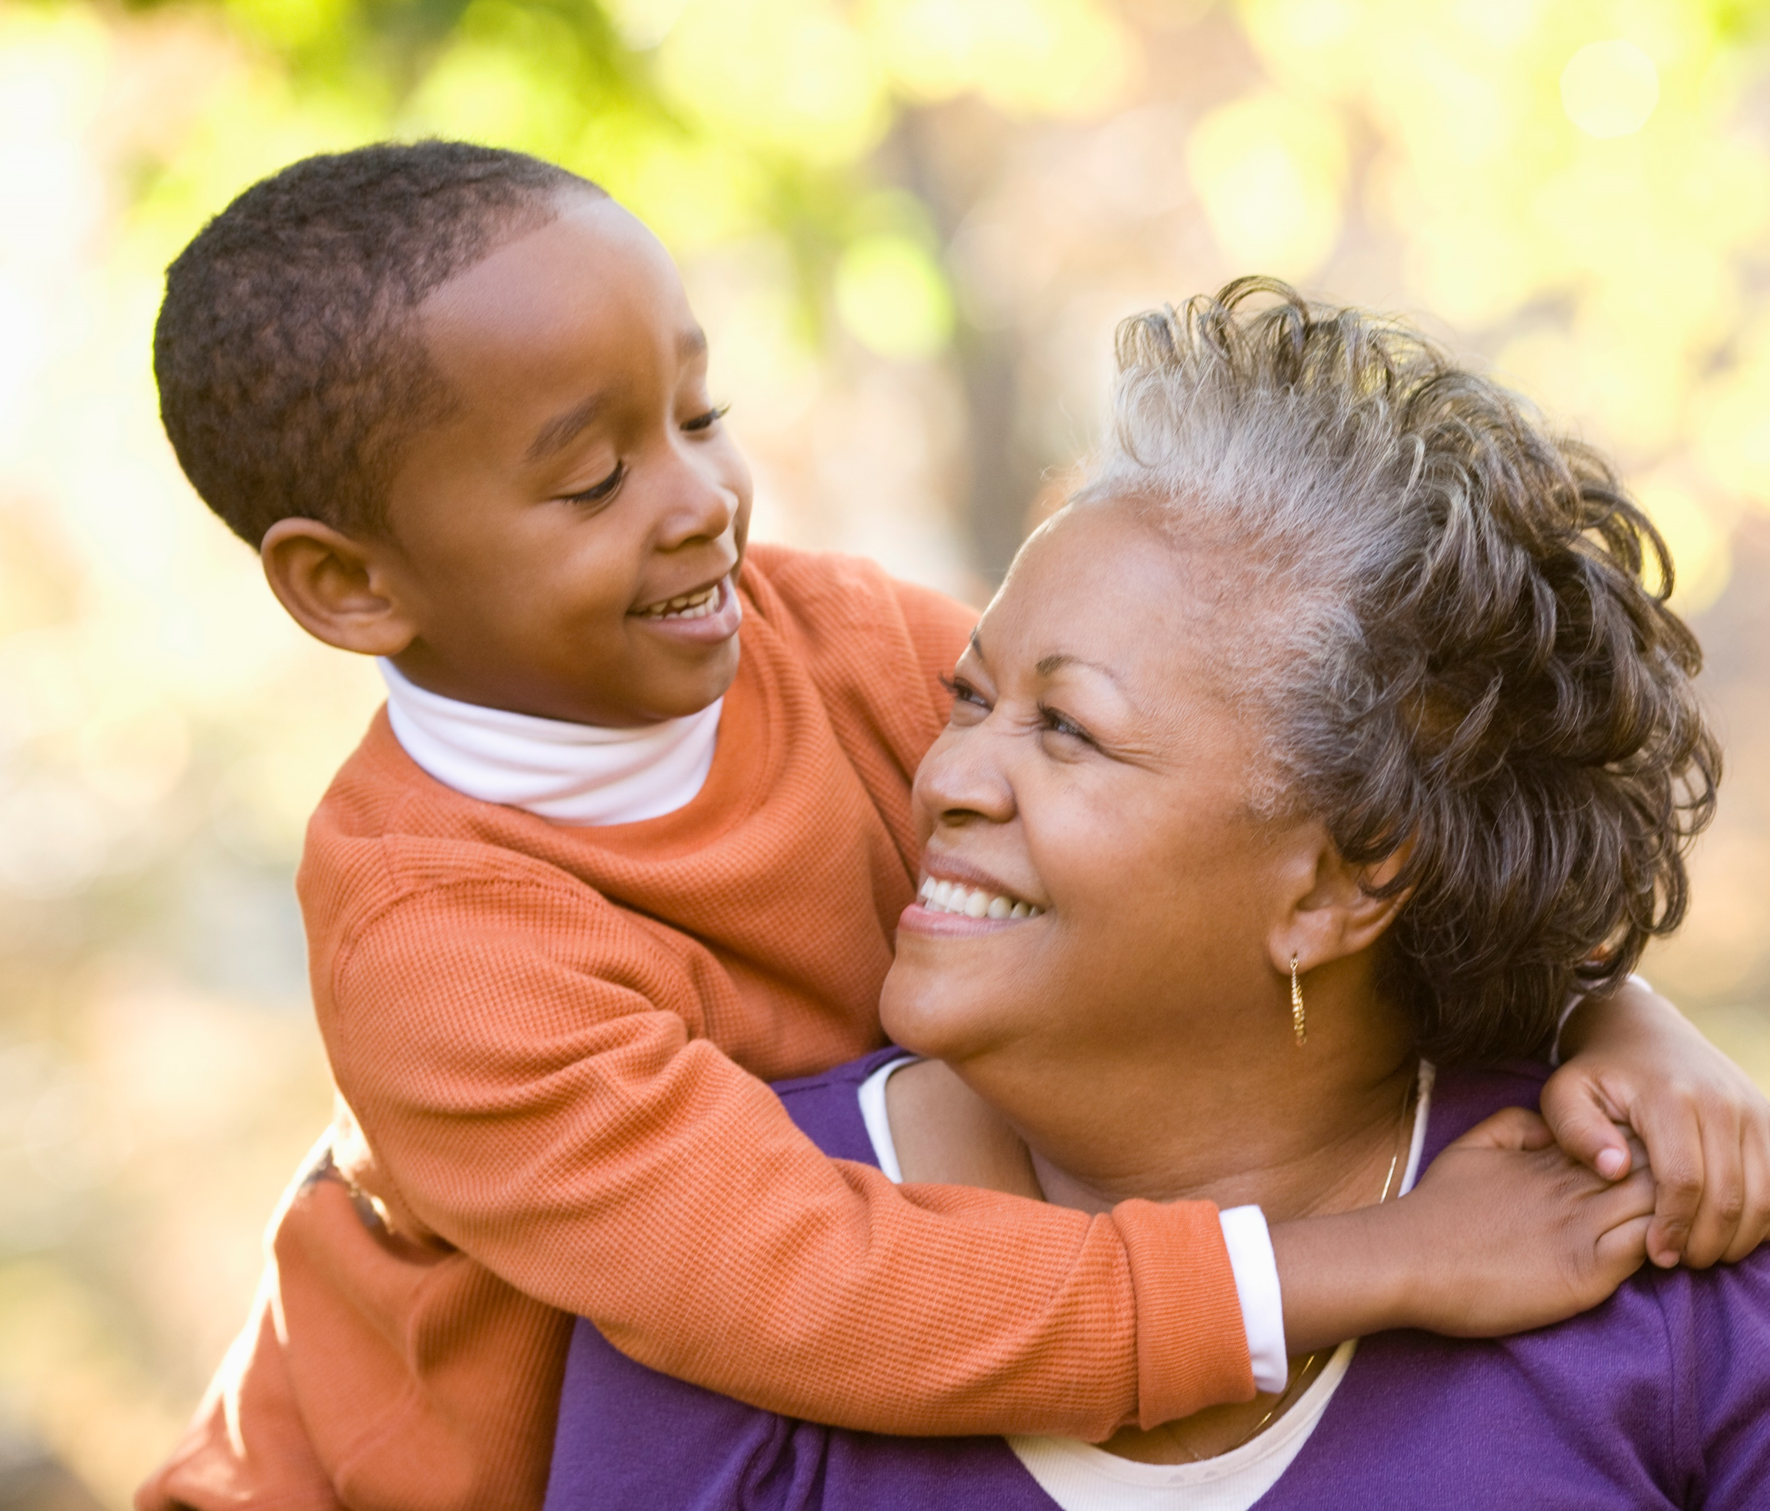
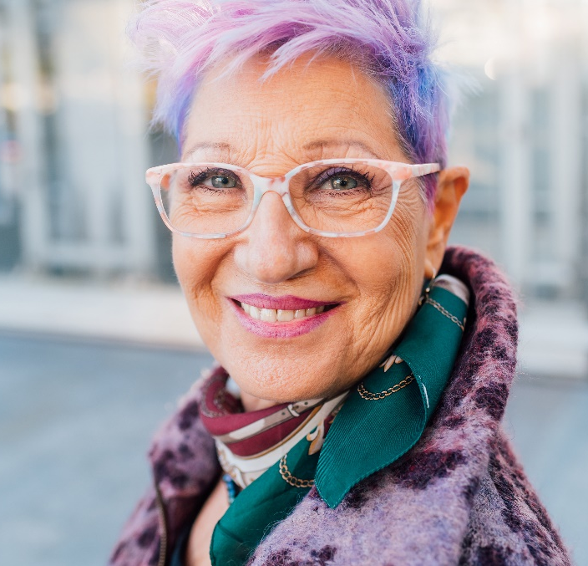
Time In Range – Person Centered
“Hyperglance-emia”
Each 1% is 15 minutes (4% an hour)
There is 24 hours in a day.
Goal is 17 hours in range = 70% TIR = A1C of 7%
You get 7 hours outside of range.
You are not defined by your blood glucose.
What range feels safe for you?
Try and step back and take in the whole picture.
Sometimes you need a donut!

Slide 13

Diabetes Visit – What do you think?
How Does JR Feel?
JR arrives at the clinic and says they are injecting their basal insulin 5 times a week.
HCP says “If you don’t inject your insulin everyday, you are going to get complications.” (Door closed)
Defeated
Embarrassed
Ashamed
Angry
Hurt
How does the HCP feel?

Slide 14
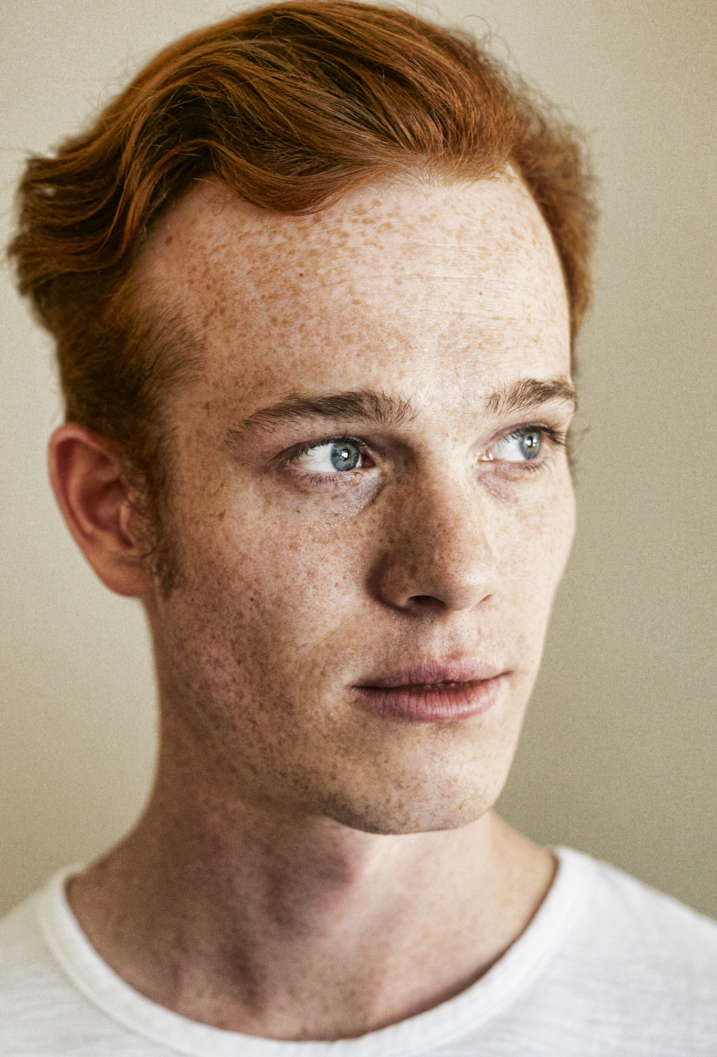
Missed Appointments due to Stigma and Shame
A recent survey of over 2,600 people with diabetes across eight countries revealed that nearly 40% of missed doctor’s appointments are due to stigma or shame.
Abbott. (2025, February 4). Abbott’s Above the Bias film reveals misconceptions can impact diabetes care. https://abbott. mediaroom.com/2025-02-04-Abbotts-Above-the-Bias-FilmReveals-Misconceptions-Can-Impact-Diabetes-Care
Notes:
Many healthcare professionals incorrectly assume that people with
diabetes are not reaching their goals due to a lack of effort. If they
“just tried hard enough,” they could reach the recommended timein-range target. Unfortunately, this false belief can build a wall of
misunderstanding between the HCP and the person with diabetes

Slide 15
Diabetes Visit – Let’s Go through
How Does JR Feel?
JR arrives at the clinic and says they are injecting their basal insulin 5 times a week.
HCP says “If you don’t inject your insulin everyday, you are going to get complications.” (Door closed)
HCP smiles and says, “Hi JR, how are you doing? I heard you are taking your insulin on most days. Great job. What’s going on on the other days?”
Door Open – Connection made
Reassured
Heard & Seen
Recognized
Confident
Connected
How does the HCP feel?
A small adjustment can make a BIG Difference
Healing to HCP
Bidirectional Healing
Healing to Person

Slide 16
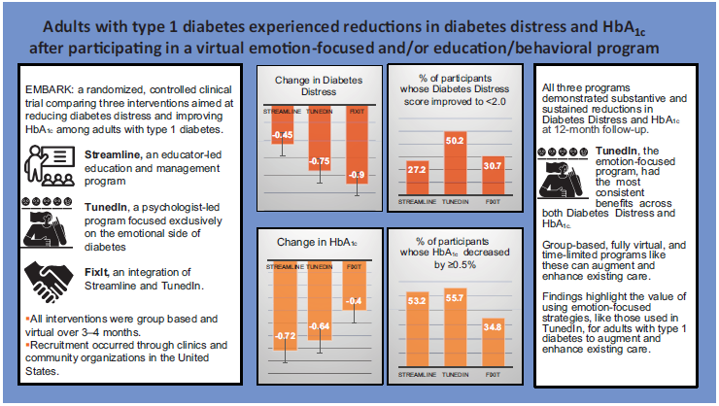
EMBARK Trial
EMBARK: A Randomized, Controlled Trial Comparing Three Approaches to Reducing Diabetes Distress and Improving HbA_{1c} in Adults With Type 1 Diabetes. Diabetes Care 2024; dc232452. https://doi.org/10.2337/dc23-2452

Slide 17

Embark Trial – Emotions as Priority
I have finally given myself permission to make addressing the emotional aspects of diabetes a priority.
~Coach Beverly

Slide 18
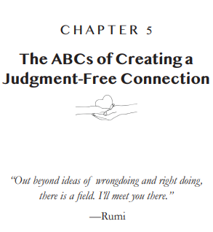
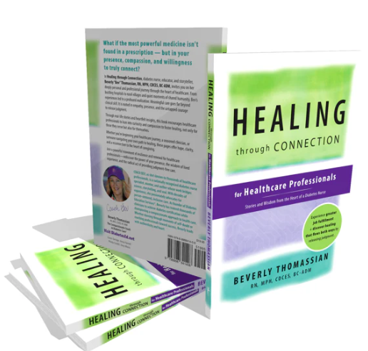

Slide 19
ABC’s of Diabetes Education
and Healing Through Connection

Slide 20

Ask, “How are you doing/feeling?”
Ask, “What is most difficult about your diabetes right now?
Ask about their life (SDOH)
Assess current self-management behaviors
Assess your feelings
Accept without judgement
Acknowledge one thing they are doing right
Advocate for needed resources

Slide 21

Commit to Listening at least Half of the Time

Slide 22
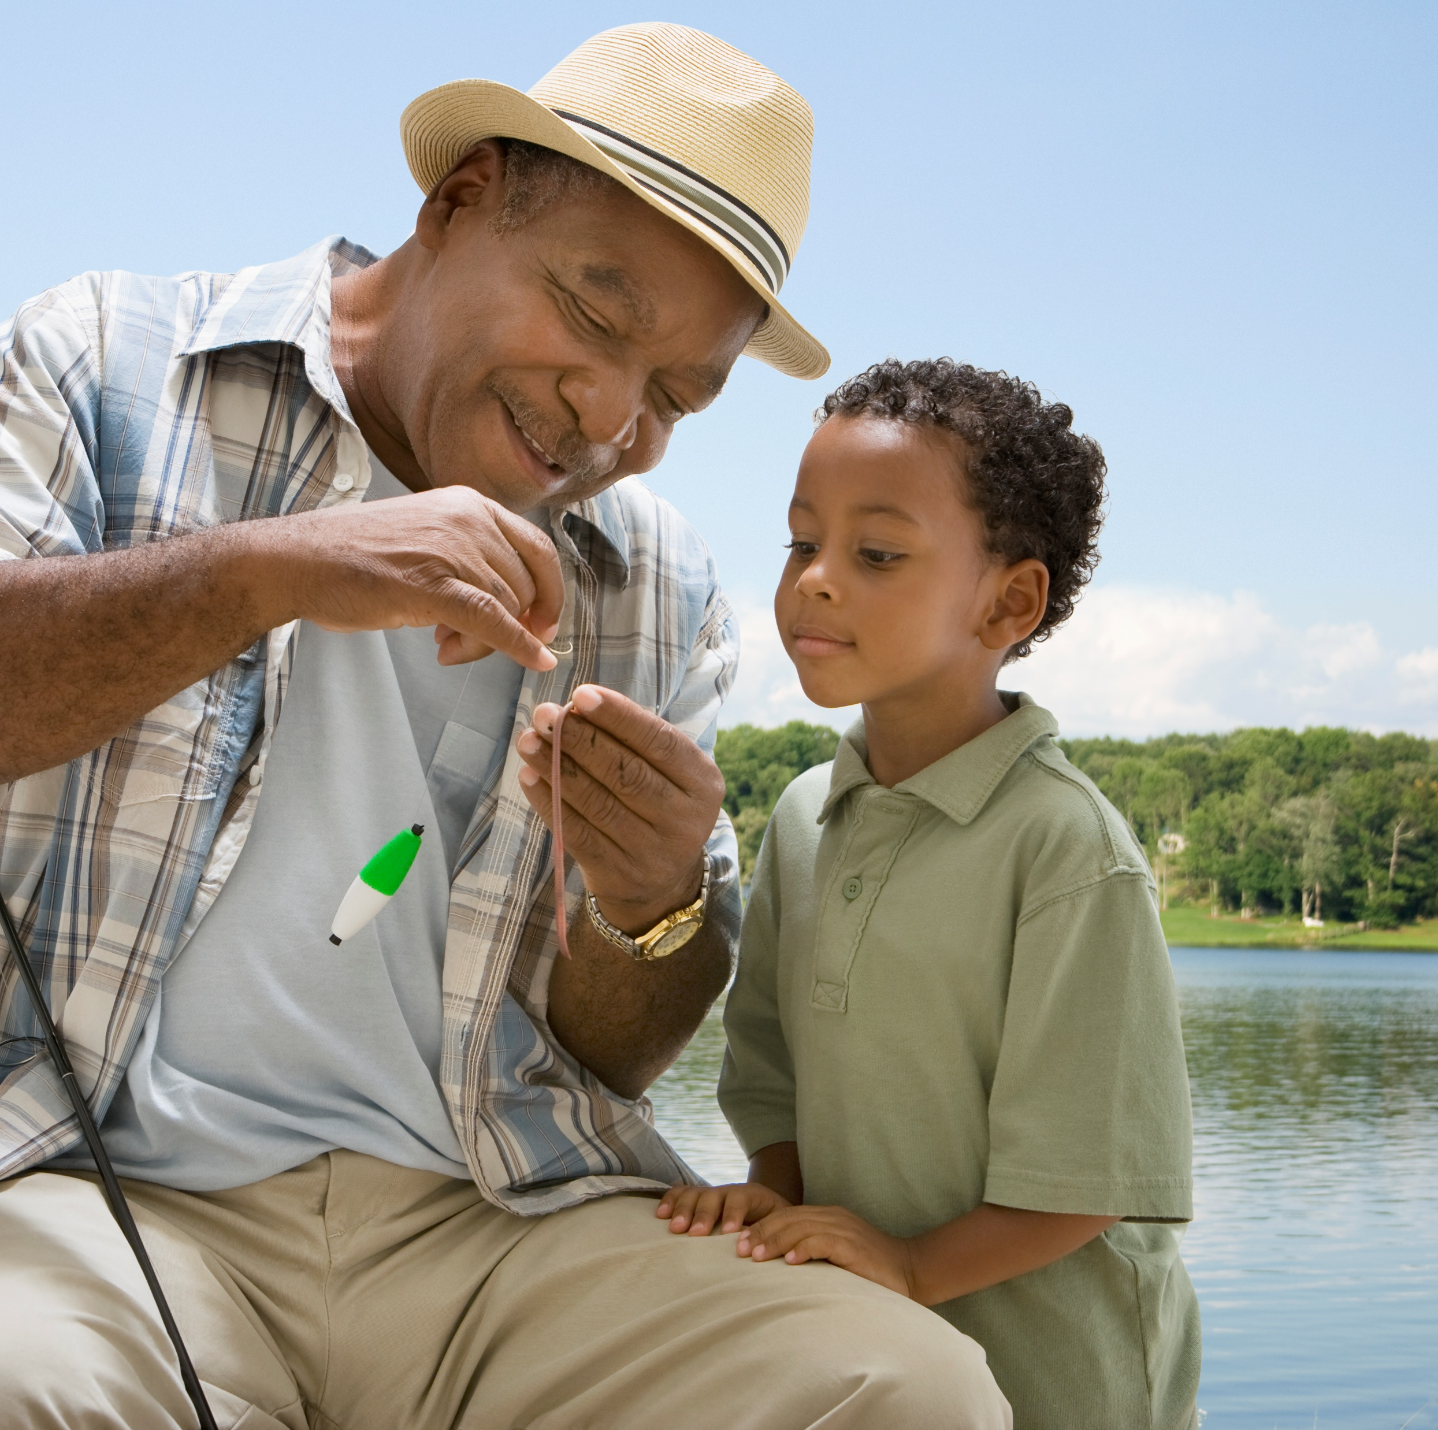
RT has type two diabetes and has been maintaining a time and range of 70% or greater. However, when they show up at the office, the last week’s time in range dropped to 30%. You ask what was different this week from the previous few months. RT tells you they went on a five day fishing trip and forgot their insulin.
What’s the best response?
Next time, make sure to take your insulin and put it in the refrigerator for safekeeping.
Before we dive into the diabetes stuff, tell me about your fishing trip.
I’m worried that you’re going get complications due to high blood glucose levels.
I’m just relieved you did not go into diabetes ketoacidosis.

Slide 23
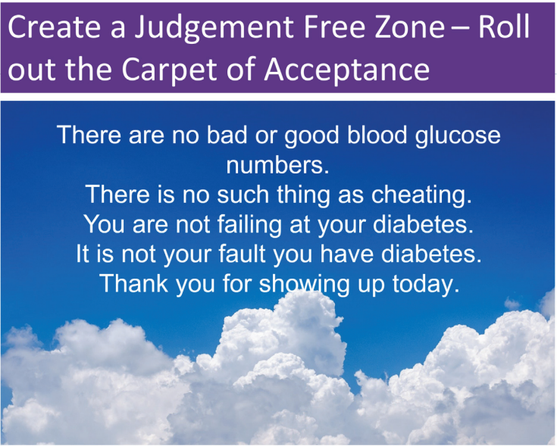

Slide 24

Beliefs about health and diabetes
Barriers can be confused with non-compliance
Burnout lookout. On extended diabetes vacation due to diabetes distress?
Bouncing back – leaning into resilience

Slide 25

Having the Conversation - Curiosity
Coaching that highlights their knowledge and resilience.
Carrots – problem solve together and dig for solutions that are meaningful in everyday life.
Compassion for the people in our care and ourselves.
Connection through – opening the door.

Slide 26

From Perfectionism to “Healthy Good Enough”
Perfectionistic thinking: has 2 speeds, perfect or failure.
Not achievable for very long, exhausting, contributes to burnout
Healthy Good Enough
Personalized
Ambitious and realistic
Allows for normal fluctuations, mistakes and experiments
Sees small steps as valuable
Focus is on efforts made, not numbers
Forward looking: What now?
Used with permission from ReVive 5 Program; Larry Fisher, PhD & Susan Guzman, PhD

Slide 27
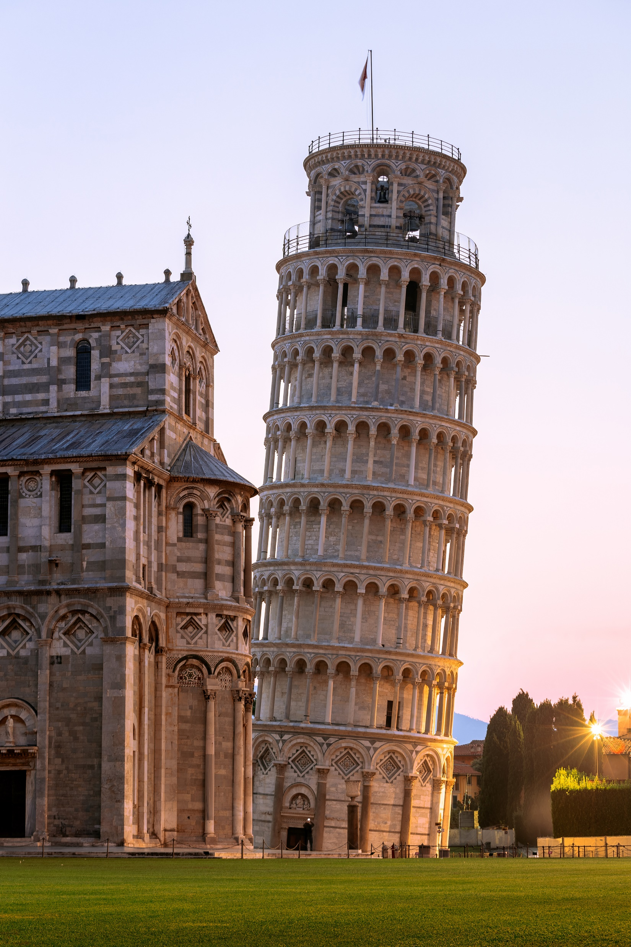

To My Healthcare Professional Colleagues
This is not about Perfection!
It’s about Presence

Slide 28


Our Curiosity Makes a Difference What is something you would like me to know about you?

Slide 29
Considering the Diabetes Connection as a Sacred Space
Have the stories of people living with diabetes stayed with you long after the conversation ended? Have their words, struggles, and triumphs echoed in your thoughts, quietly influencing the way you provide care?
Listening to these stories isn’t simply an exchange of information; it’s an invitation into someone’s lived experience. When we truly listen, with presence and without judgment, we enter a sacred space within diabetes care, where healing transcends clinical roles and traditional hierarchies. In these moments, connection becomes the medicine. The person receiving care feels seen, heard, and valued. And something extraordinary happens for us as HCPs, too.
We are reminded of our purpose. We feel reconnected to our humanity.

Slide 30

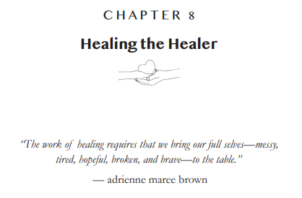
Healing the Healer

Slide 31
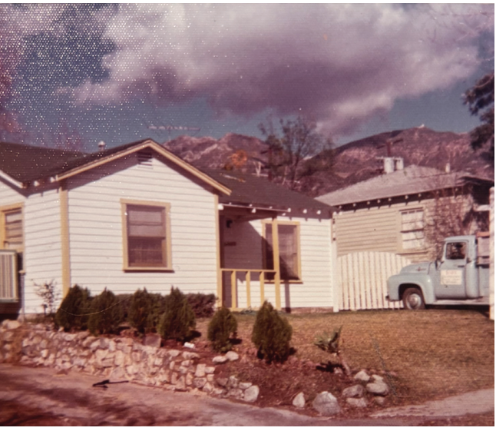
Sharing My Story
Chapter 1
My life started with a lot of promise
Many of you, like me, have experienced intense life challenges. While our experiences, backgrounds, and the people in our lives may differ, I suspect we hold something powerful in common: a calling to care for others.
This is my story—an offering of truth, vulnerability, and resilience. In telling it, I hope it resonates with something inside of you and is a catalyst toward healing.

Slide 32
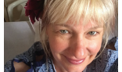

The arrival of health issues forced me pause.

Slide 33
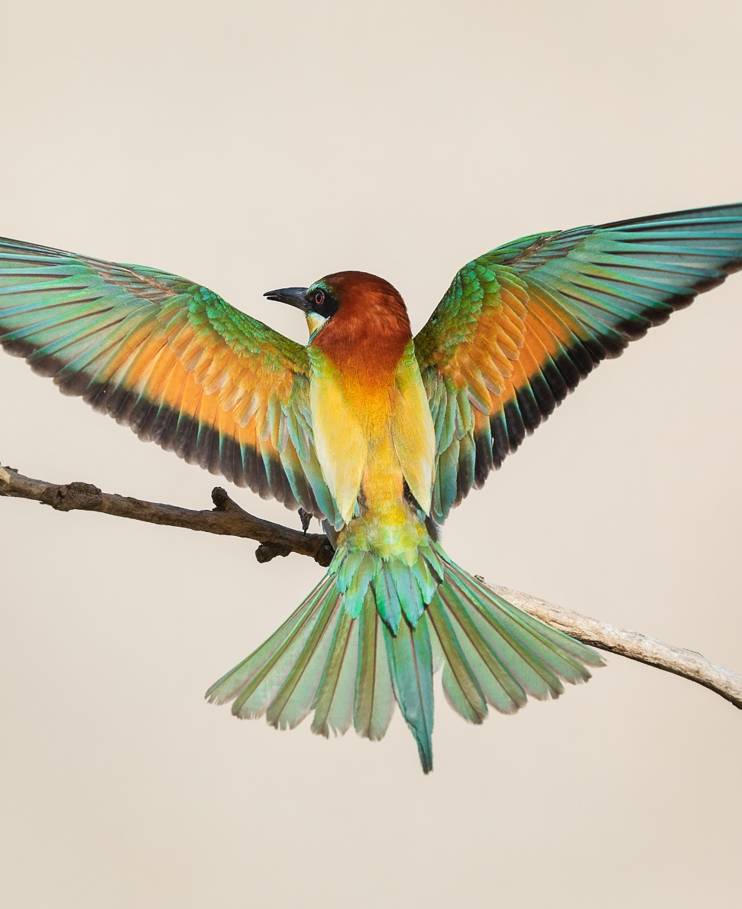
Chapter 7 – The Body Tells the Story
I was admitted to the neuro floor with the diagnosis of epileptic seizures and started on anti-seizure medications. The seizures continued despite the medications.
The nurses would sit with me during these episodes, hold my hand, and give me tissues. They reassured me that I was not a loser. They were angels who loved and protected this broken little soul, trying to find her way.
When I woke up scared one night, they moved me right next to the nurse’s station so I would feel safe. They intuitively knew what I needed, and I felt blanketed in their nurturing.
Healing through Connection

Slide 34
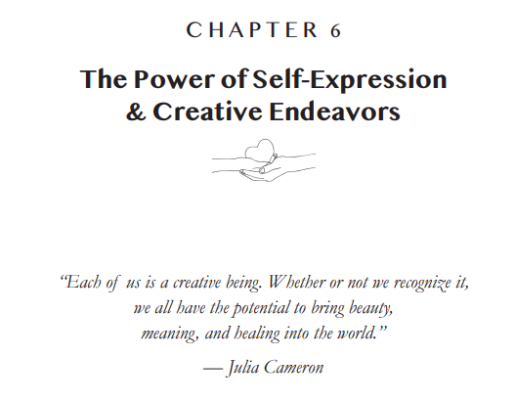
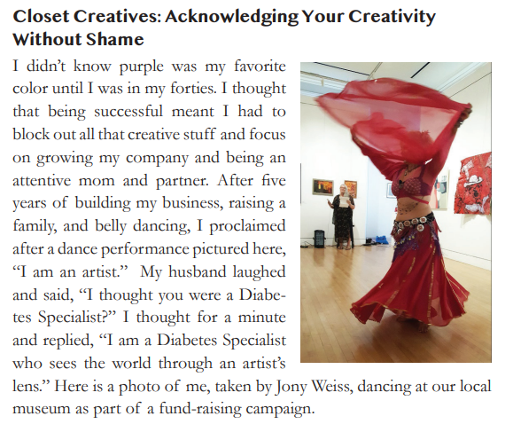
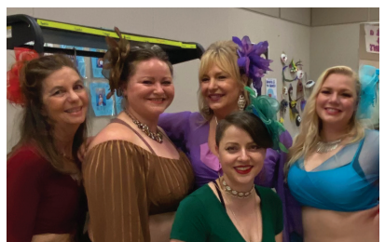
Healing trough Creativity & Connection

Slide 35







Activities
If you had 5 other lives to live, what would you do in each of them?
The point of these lives is to have fun in them – more fun than you might be having in this one.
Look over your list and select one.
Then do it this week.
Draw a circle with these categories.
Place a dot in each slice at the degree to which you are fulfilled in that area (outer rim indicates great, inner rim indicates not so great.)
Connect the dots to eval where things are off balance.

Slide 36

Creativity & Nobel Prizes
Scientists who are Nobel laureates are:
22 times more likely than typical scientists to perform, sing, or act in their spare time
12 times more likely to write fiction, plays, poetry, or short stories
5 times more likely to engage in crafting, woodworking, mechanics, or glassblowing
7 times more likely to enjoy designing, painting, drawing, or sculpting
They are more open to novel experiences and often turn to their creative endeavors when working through challenges.

Slide 37
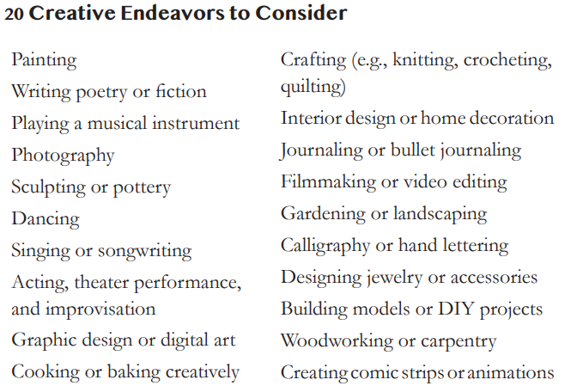
What creative endeavors do you enjoy?

Slide 38
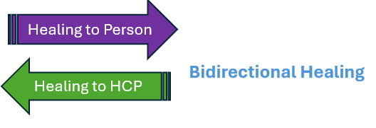
Healing Notes from Coach Beverly
Take the risk. Say yes.
Try that thing you’ve been putting off.
Love your body exactly as it is.
Be bold. Step into your authenticity.
Make time to rediscover yourself.
Think with your heart. Surrender. Show up.
Move beyond your comfort zone and speak your truth.
Get enough sleep.
Ask for help when you need it.
Stay connected to the people who lift you up.
Seek out deep conversations, embrace your growth, and get ready for transformation.
Dive into creativity.

Slide 39

Thank you for your dedication to healing.
www.DiabetesEd.net
bev@DiabetesEd.net
\

Slide 40

RT Sets up Experiment/ Takes Action
Steps:
RT Changes
Be present with her fear of failure
Look up carbs on app/website.
Ask her friends for support
Asking for help is hard, but I think it will help.
Engage with RT’s resilience, self-wisdom
Make a small change
Realize, that the story and tough feelings can be major barrier to change.
Discover an unexpected issue.

