Slide 1



The Different Faces of Diabetes – From Type 3 and Beyond
Beverly Thomassian, RN, MPH, BC-ADM, CDCES
Pronouns: She, her and hers Founder - www.DiabetesEd.net

Slide 2
Coach Bev has no Conflict of Interest
She’s not on any speaker's bureau.
Does not invest or have any financial relationships with diabetes related companies.
Gathers information from reading package inserts, research and articles.
The ADA Standards of Medical Care is main resource for course content.

Slide 3

The Different Faces of Diabetes
Objectives:
Discuss the diagnosis and symptoms of the different types of diabetes beyond type 1 & 2.
Describe clinical manifestations of hypercortisolism, LADA type 3, type 3c, ketosis prone and type 5 diabetes.
Consider emotional impact.

Slide 4

Other Types of Diabetes
Hypercortisolism
LADA
Ketosis Prone
Type 3c
Type 3
Type 5

Slide 5


Beta-Cell Mass Loss
In both type 1 and type 2 diabetes,
genetic and environmental factors can result in the progressive loss of β-cell mass and/or function
that manifests clinically as hyperglycemia.
Once hyperglycemia occurs, people with all forms of diabetes are at risk for developing the same chronic complications, although rates of progression may differ.

Slide 6
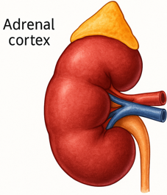
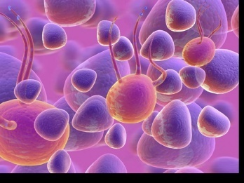
The Noxious Nine – Pathophysiology T2D
Hypercortisolism
Neurotrans-mission dysfunction
Decreased
Insulin β-cell secretion
Increased renal glucose reabsorption
Decreased
incretin effect
Gut hormones
G
Increased glucagon α-cell secretion
I
G
I
G
G
I
I
G
Increased lipolysis
G
G
I
I
G
G
I
Increased hepatic glucose
production
I
G
G
Decreased muscle glucose uptake
DeFronzo, Auchus-Hypercortisolism June 2025
Notes:
6
ummary: The Noxious Nine in Diabetes Pathophysiology
Ralph A. DeFronzo expanded his earlier conceptual model of diabetes—known as the Ominous Octet—to include a ninth element: hypercortisolism. This updated framework is referred to as the Noxious Nine, highlighting the important role of cortisol dysregulation in difficult-to-control type 2 diabetes currentsciencedaily.com+8HCP Live+8HCP Live+8.
Recent research, including the CATALYST trial, shows that about 24% of patients with difficult-to-control T2D have underlying hypercortisolism. Treating this condition with mifepristone, a glucocorticoid receptor antagonist, led to significant improvements in HbA1c—averaging around a 1.5% reduction pmc.ncbi.nlm.nih.gov+3HCP Live+3medscape.com+3.
These findings emphasize the importance of recognizing hypercortisolism in T2D care and suggest that addressing it may help improve glycemic and metabolic control in a subset of patients.
6

Slide 7
POLL Question #1
AJ is a 52-year-old with type 2 diabetes presents with worsening hyperglycemia despite taking three diabetes medications. AJ says, “No matter what I do, I can’t seem to get my blood sugars down”.
Which of the following clusters of physical findings would increase your suspicion that AJ is struggling with hypercortisolism?
A. Dorsocervical fat pad, wide purple striae and bruising.
B. Peripheral muscle hypertrophy, thick hair growth, and flushed skin.
C. Weight loss, skin hyperpigmentation, and generalized muscle wasting.
D. Pallor, brittle nails, and spoon-shaped fingernails.

Slide 8
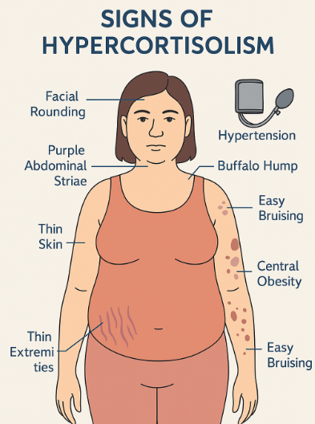
Signs of Hypercortisolism
Other signs
  High blood pressure,
  Hyperglycemia
  Visceral adiposity
  Bone loss, fractures
  muscle weakness,
  excessive hair growth,
  acne,
  mood changes like irritability and depression.
Hypothalamus → CRH → Pituitary → ACTH → Adrenal → Cortisol
Cortisol effects: gluconeogenesis, insulin resistance, fat redistribution

Slide 9
CATALYST Study Findings
Findings from the CATALYST study, the largest prospective trial of its kind, suggest that hypercortisolism may be a significant contributing factor in as many as one in four patients with difficult-to-control type 2 diabetes.

Slide 10
CATALYST Study: Hypercortisolism & Difficult-to-Control Type 2 Diabetes
Study Design Overview Prospective observational screening of ~1,000 adults with HbA1c 7.5–11.5%, on multiple antihyperglycemic agents.
Screening tool: Overnight 1 mg dexamethasone suppression test (DST).
Hypercortisolism defined as post-DST cortisol >1.8 µg/dL with adequate dexamethasone levels.

Slide 11
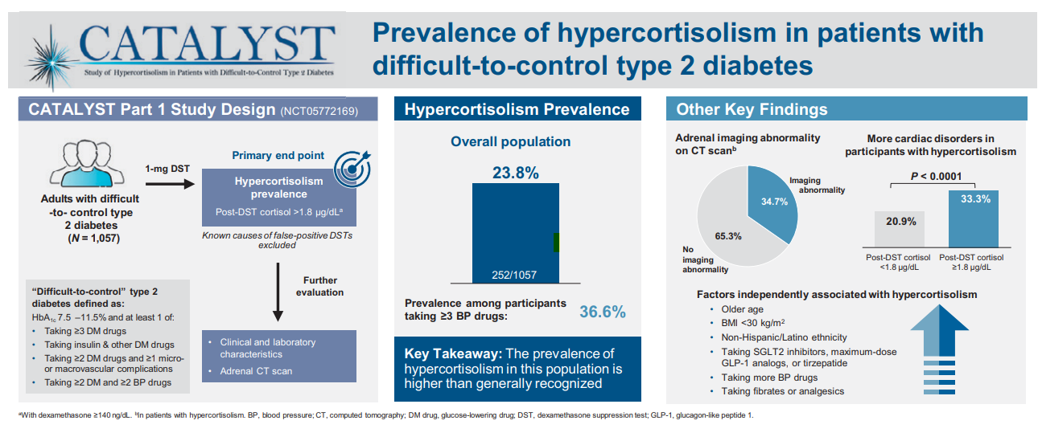
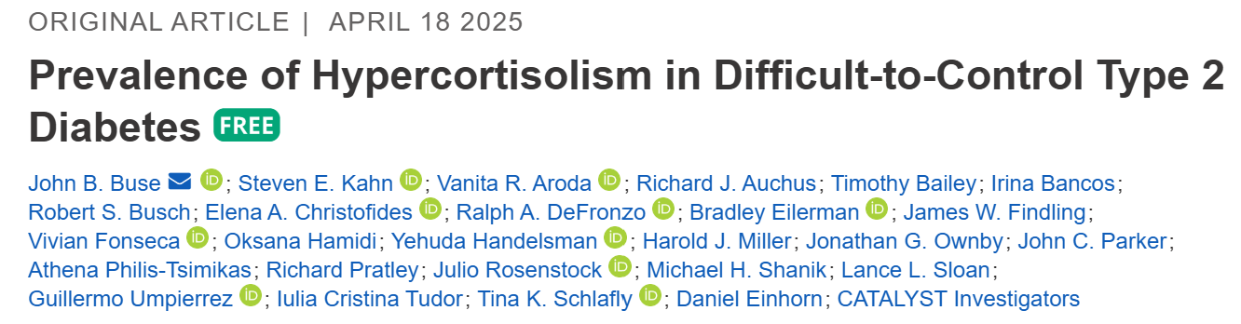
Study Design & Prevalence
Findings
23.8% of study participants had hypercortisolism
  Prevalence 36.6% in those on ≥3 antihypertensives
  34.7% adrenal abnormalities on CT

Slide 12
Study Design – Part 2 (Intervention)
Randomized, double-blind, placebo-controlled intervention
N = 136 participants with confirmed hypercortisolism
Mifepristone: 300 mg daily escalating up to 900 mg over 24 weeks
Primary endpoint: HbA1c reduction; Secondary: weight, meds, safety.
Mifepristone is a glucocorticoid (cortisol) receptor Antagonist.
SE’s include: fatigue, N/V, hypokalemia, edema, HTN
10% experience adverse side effects from glucocorticoid withdraw.

Slide 13
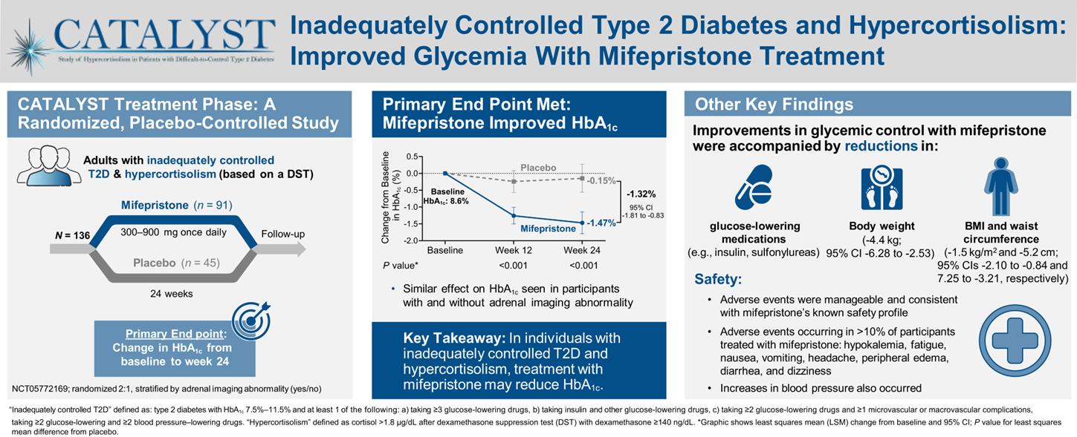
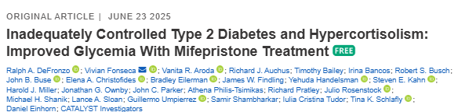
CATALYST Treatment Outcomes
Mifepristone (Korlym) significantly improves glycemia and weight
Next steps: broader screening, novel cortisol-targeted therapies, long-term outcomes.

Slide 14
Intervention Outcomes
A1c ↓ ~1.5% vs. 0.2% in placebo group
Weight ↓ ~10 pounds; waist circumference ↓ ~2 inches
Many reduced or stopped other diabetes meds, including insulin.
Adverse events mostly mild to moderate (glucocorticoid withdrawal symptoms).
Hypokalemia observed; manageable clinically.
Discontinuation ~40%, mostly due to tolerability issues.
Question: How realistic is this to implement in primary care / Endo settings?

Slide 15
Hypercortisolism in Type 2
Cortisol increases gluconeogenesis in the liver
Reduces peripheral glucose uptake → insulin resistance
Stimulates protein catabolism and lipolysis
Chronic cortisol elevation → persistent hyperglycemia
Can lead to “Difficult to Control Type 2 Diabetes”
CATALYST study revealed about 24% of people with elevated BG despite meds, may be due to hypercortisolism.
Treatment with mifepristone decreased weight, waistline, BG.
DeFronzo, Auchus-Hypercortisolism June 2025
pmc.ncbi.nlm.nih.gov+3HCP

Slide 16

What type of Diabetes?
72 Years old
A1c 3 months prior 6.2%
A1c now 13.9%
BMI 24.5
Lost about 10 pounds over last month

Slide 17


What about Latent Autoimmunity Diabetes in Adults (LADA)
Slowly progressive autoimmune diabetes with an adult onset should be termed:
  LADA or type 1 diabetes.
  Slow autoimmune β-cell destruction can lead to a long duration of marginal insulin secretory capacity.
  For this classification, all forms of diabetes mediated by autoimmune β-cell destruction independent of age of onset are included under the rubric of type 1 diabetes.

Slide 18


Latent AutoImmunity Diabetes in Adults (LADA)
Antibody positive to 1-2 of below
  GAD-65 autoantibodies
  Insulin Autoantibodies
  Islet Cell antigen-2
  ZnT8
Adult Age at onset
Usually benefit from insulin w/in first 6 months of diagnosis
Early insulin therapy may preserve beta cell function
Diabetes Care 26:536-538, 2003
Jerry P. Palmer, MD and Irl B. Hirsch, MD

Slide 19
LADA Clinical Features Compared to Type 2
Feature LADA Type 2
Age <50 63% 19%
Acute hyperglycemia 66 24
BMI < 25 33 13
Hx of autoimmune dx 27 12
Family hx autoimmune 46 35
Practical Diabetology March 08, Unger MD

Slide 20

What kind of Diabetes?
58 yr old, states she has had type 1 diabetes for 18 years. Quit smoking a year ago and gained about 20 lbs. BMI 25.
Meds
  Humalog 18-23 units before each meal
  Glargine 28 units at bedtime
  Metformin 500mg TID
What tests would you recommend?
25% of ind’s with Type 1 also have type 2 diabetes.
ADA Post Grad, 2010

Slide 21

Type 1 & Type 2 - Double Diabetes?
May be appropriate to recognize a person with type 1 diabetes and features classically associated with type 2 diabetes (e.g., insulin resistance, obesity, and other metabolic abnormalities.
Can help facilitate access to appropriate treatment:
  (e.g., GLP-1 RA or SGLT-2 inhibitor therapies for potential weight and other cardiometabolic benefits) and monitoring systems.

Slide 22
Type 3c Diabetes (Pancreatogenic)
Includes both structural and functional loss of insulin secretion in the context of exocrine pancreatic dysfunction.
About 5-10% of diabetes, often misdiagnosed as type 2 diabetes.
Insulin sensitive
Assess wt loss, fatty stools – indications may need pancreatic enzyme replacement therapy (PERT).
The diverse set of etiologies includes:
  pancreatitis (acute and chronic) ~70%
  trauma or pancreatectomy
  neoplasia
  cystic fibrosis
  hemochromatosis
  fibrocalculous pancreatopathy
  rare genetic disorders, and idiopathic

Slide 23
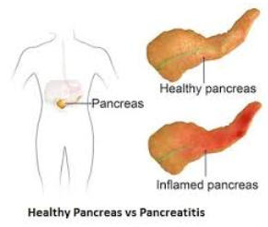
Pancreatitis
People with diabetes 2xs risk of acute pancreatitis
After episode of pancreatitis, one third of people will get prediabetes or diabetes
  About 25% to 80% of people with chronic pancreatitis develop Type 3c diabetes.
Pancreatitis is an exocrine dysfunction:
  Disrupts global architecture or physiology of pancreas
  Results in both exocrine and endocrine dysfunction.

Slide 24
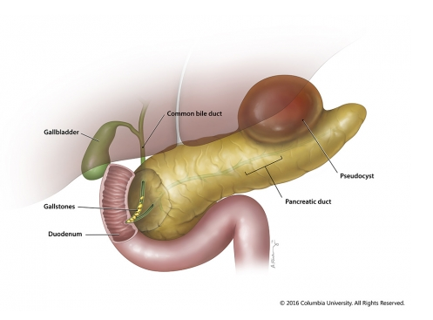
Pancreatitis
Pancreatitis caused by digestion of the organ from pancreatic enzymes normally carried to the SI through pancreatic duct.
Detected through elevated Amylase levels & pain
Causes:
  HIV meds and other meds
  Alcohol ingestion
  Gallstones blocking pancreatic enzyme flow to small intestine
  Elevated triglycerides
  Cancer, injury and other

Slide 25
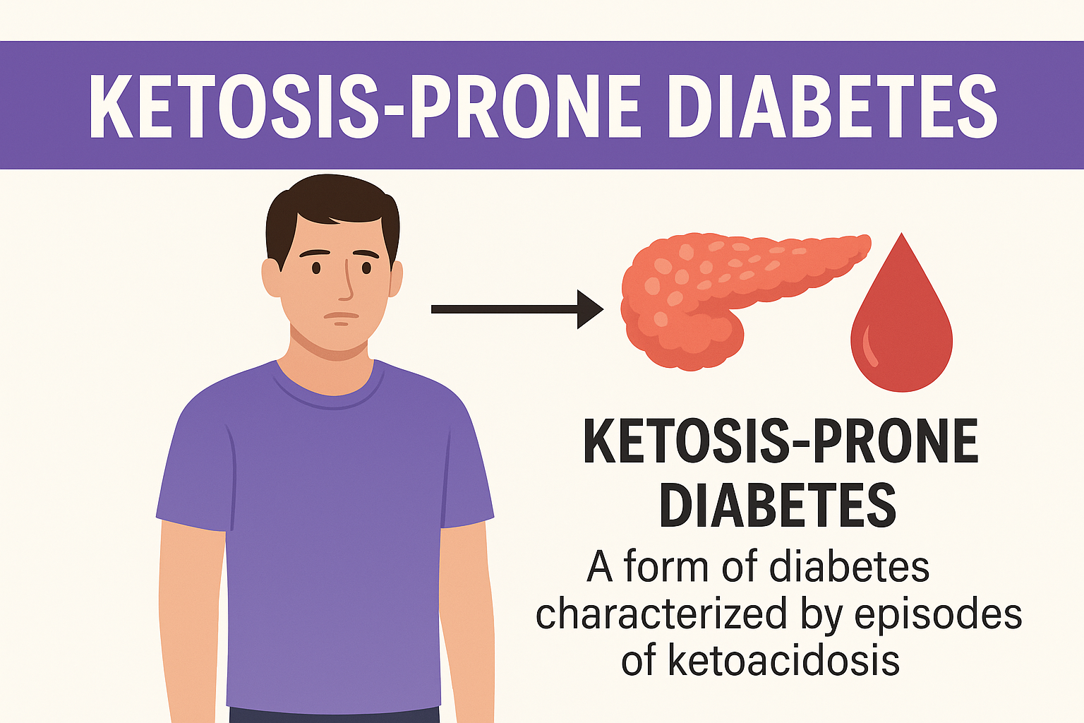
Treatment
A unique diabetes phenotype characterized by diabetic ketoacidosis (DKA) at onset, without autoimmune markers or obesity.
Transient insulin deficiency with preserved or recoverable beta-cell function
Can resemble type 1 or type 2 diabetes
More common in Black, Hispanic, and Asian populations

Slide 26

Ketosis-Prone Diabetes (KPD)
Presentation & Future
Present with DKA
Negative for islet cell autoantibodies (GAD, IA-2)
C-peptide testing post-recovery to assess insulin production
Insulin often tapered or discontinued
Transition to oral agents in some cases
Requires ongoing monitoring for recurrence of ketosis

Slide 27

Regardless of the cause, hyperglycemia needs to be treated.

Slide 28
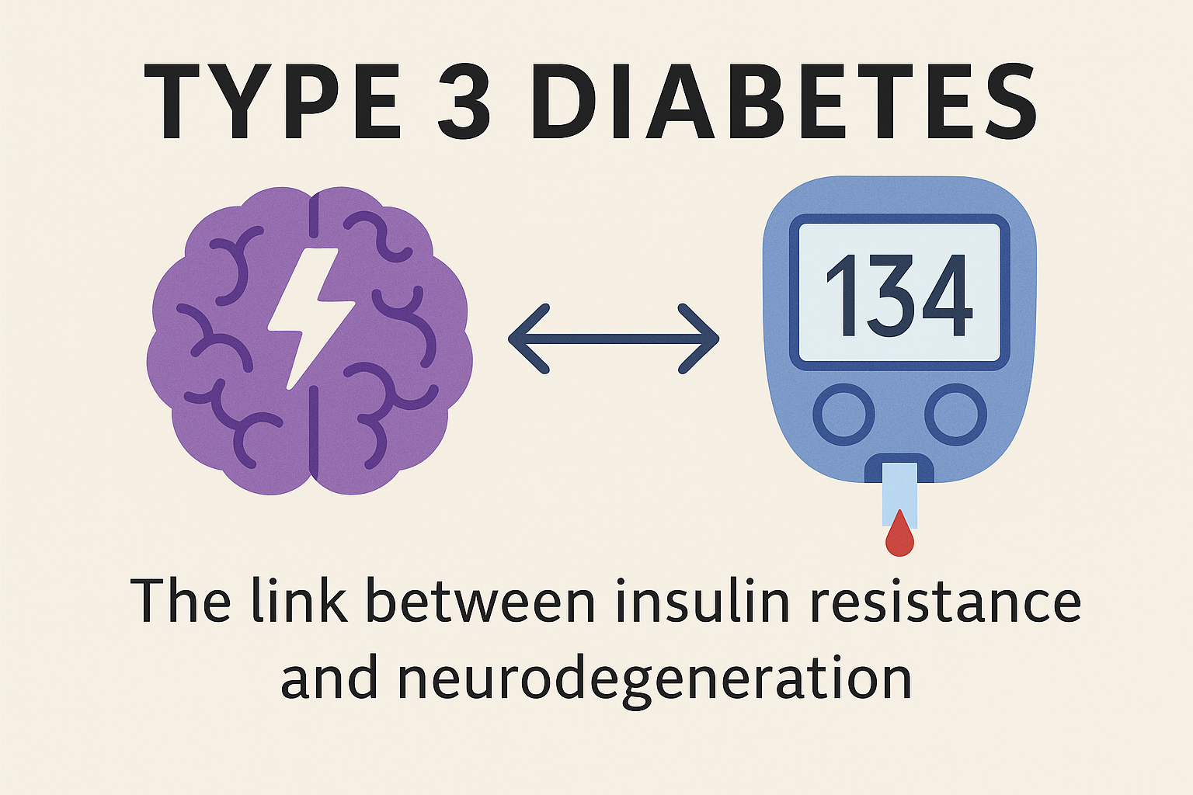
Diabetes Type 3

Slide 29
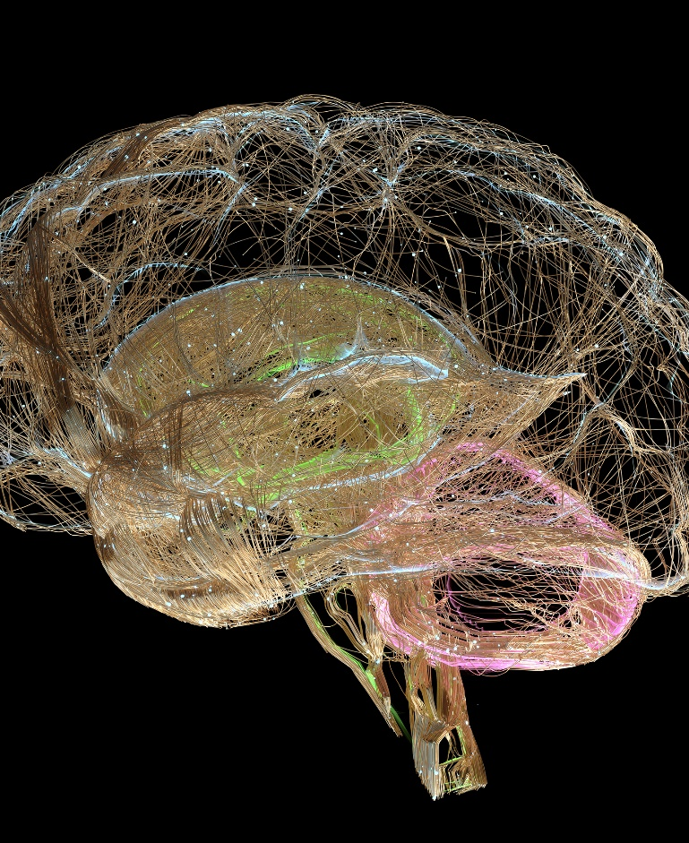
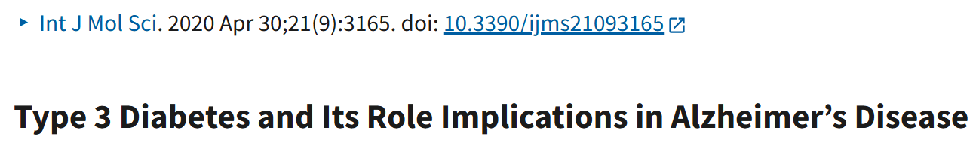
What is 'Type 3 Diabetes'?
A term linking Alzheimer's disease to insulin resistance in the brain.
Not an official diagnostic category.
Still an emerging field with ongoing studies
Suggests that Alzheimer's may be a form of brain-specific diabetes.
Notes:
Neurotransmitter deficits, degenerated neurons, synaptic dysfunction, extracellular buildup of β-amyloid (Aβ) and intracellular neurofibrillary tangles (NFT) are the major crude disfigurements present in AD
Peripheral insulin resistance leads to decrease insulin signaling in CNS, followed by alteration in brain metabolism. Increased Aβ toxicity, Tau hyperphosphorylation, oxidative stress and neuroinflammation are attributed to central insulin resistance, which leads to neurodegeneration. The work provides the relationship between T3DM and AD based on the fact that both the processing of amyloid-β (Aβ) precursor protein toxicity and the clearance of Aβ are attributed to impaired insulin signaling in the brain. Furthermore, insulin-related therapeutic strategies are suggested to succeed in the development of therapies in AD by slowing down their progressive nature or even halting their future complications.
AD is the 6th leading causes of death

Slide 30
Alzheimer’s & Diabetes Link
Type 2 Diabetes increases Alzheimer’s risk by 60–80%
Reduced insulin receptors in brains of people with Alzheimer’s
Insulin signaling is crucial for clearing amyloid beta plaques from brain.
The brain uses insulin for memory and learning- neuromodulator.
Insulin resistance contributes to cognitive decline.
Amyloid beta plaques and tau tangles are influenced by insulin signaling and availability.
Leads to neurodegeneration.
Notes:
Alzheimer's causes irreversible brain cell damage, primarily by building up toxic proteins called amyloid plaques and tau tangles, which disrupts brain cell communication and leads to neuron death and brain shrinkage. This progressive damage results in gradual memory loss, confusion, difficulty with language and reasoning, and challenges performing daily tasks, eventually leading to severe cognitive impairment and a need for total care.
What happens in the brain
Protein build-up:
.Abnormal clumps of proteins, known as amyloid plaques and tau tangles, form in the brain.
Neuron damage:
.These protein clumps disrupt the normal functioning of brain cells (neurons), leading to a loss of connections between them.
Neuron death:
.Eventually, neurons stop functioning, lose their connections, and die.
Brain shrinkage:
.The loss of neurons causes the brain to shrink, particularly in areas involved in memory, such as the hippocampus.
What it does to a person (Symptoms)
As the disease progresses, the damage affects different brain areas, leading to a range of symptoms:
Memory loss: Significant memory loss that interferes with daily life, starting with difficulty remembering recent information.
Cognitive changes: Difficulty planning or solving problems, confusion with time or place, and trouble understanding visual images.
Language difficulties: Problems with speaking or writing, and trouble finding the right words.
Loss of familiarity: Difficulty completing familiar tasks at home or work.
Decreased independence: An increasing need for help with daily activities like bathing and dressing.
Personality and behavior changes: Mood swings, hallucinations, delusions, and other personality changes can occur in later stages.
Progression
Alzheimer's is a progressive disease, meaning symptoms gradually worsen over time. It typically progresses through stages, from mild changes to severe late-stage symptoms where the person requires complete care and can no longer communicate effectively.
Alzheimer's causes irreversible brain cell damage, primarily by building up toxic proteins called amyloid plaques and tau tangles, which disrupts brain cell communication and leads to neuron death and brain shrinkage. This progressive damage results in gradual memory loss, confusion, difficulty with language and reasoning, and challenges performing daily tasks, eventually leading to severe cognitive impairment and a need for total care.
What happens in the brain
Protein build-up:
.Abnormal clumps of proteins, known as amyloid plaques and tau tangles, form in the brain.
Neuron damage:
.These protein clumps disrupt the normal functioning of brain cells (neurons), leading to a loss of connections between them.
Neuron death:
.Eventually, neurons stop functioning, lose their connections, and die.
Brain shrinkage:
.The loss of neurons causes the brain to shrink, particularly in areas involved in memory, such as the hippocampus.
What it does to a person (Symptoms)
As the disease progresses, the damage affects different brain areas, leading to a range of symptoms:
Memory loss: Significant memory loss that interferes with daily life, starting with difficulty remembering recent information.
Cognitive changes: Difficulty planning or solving problems, confusion with time or place, and trouble understanding visual images.
Language difficulties: Problems with speaking or writing, and trouble finding the right words.
Loss of familiarity: Difficulty completing familiar tasks at home or work.
Decreased independence: An increasing need for help with daily activities like bathing and dressing.
Personality and behavior changes: Mood swings, hallucinations, delusions, and other personality changes can occur in later stages.
Progression
Alzheimer's is a progressive disease, meaning symptoms gradually worsen over time. It typically progresses through stages, from mild changes to severe late-stage symptoms where the person requires complete care and can no longer communicate effectively.

Slide 31
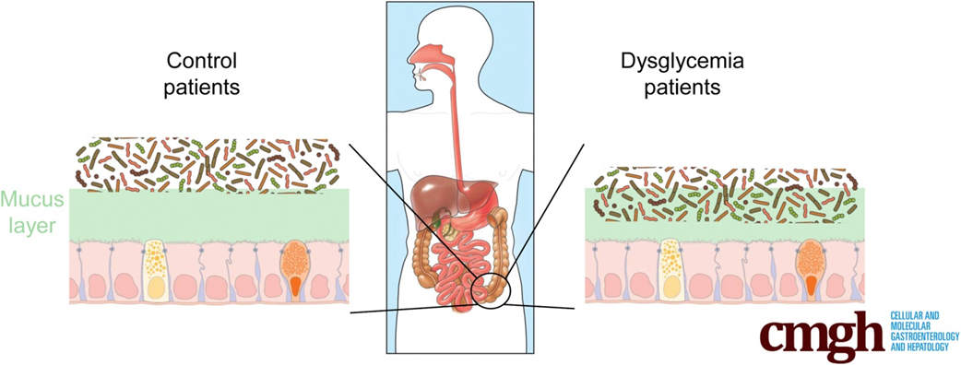
Colonic Microbiota Encroachment Correlates With Dysglycemia in Humans
Benoit Chassaing, Shreya M. Raja, James D. Lewis, Shanthi Srinivasan, Andrew T. Gewirtz
Cellular and Molecular Gastroenterology and Hepatology (September 2017)

Slide 32
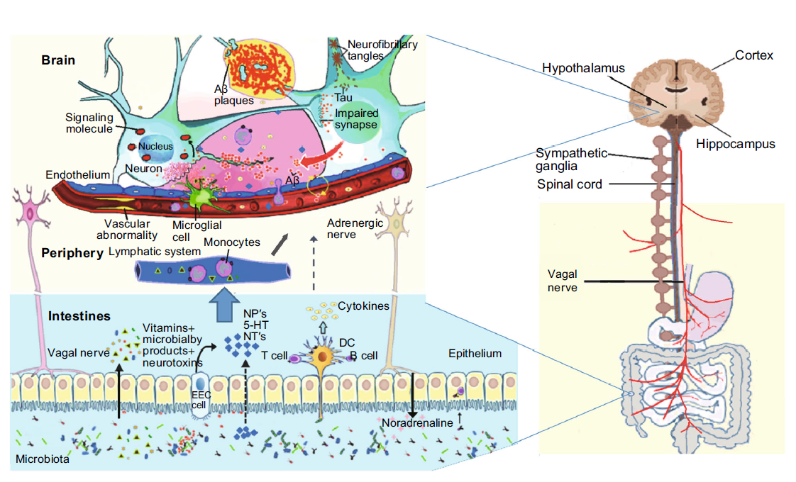
Link Between Gut and Brain
Benoit Chassaing, Shreya M. Raja, James D. Lewis, Shanthi Srinivasan, Andrew T. Gewirtz
Cellular and Molecular Gastroenterology and Hepatology (September 2017)

Slide 33

Potential Interventions
Lifestyle: Mediterranean diet, physical activity.
Optimize glucose and blood pressure.
Investigational: Intranasal insulin, GLP-1 agonists
Reduce systemic inflammation.
Improved nutrition and gut health.

Slide 34

Summary
'Type 3 Diabetes' reflects the link between metabolic and brain health
Early intervention can support cognitive function
Encourages whole-person, compassionate care

Slide 35

Type 5 Diabetes
Form of diabetes linked to chronic malnutrition or prolonged starvation
This condition primarily affects young, undernourished individuals in low- and middle-income countries, particularly in regions like Asia and Africa.
Estimates suggest that up to 25 million people worldwide may be affected with type 5 diabetes.
Mechanism:
  Severe beta-cell dysfunction from malnutrition
  Impaired insulin secretion (not autoimmune)
  May present with hyperglycemia & ketosis
  Genetic component
https://idf.org/news/new-type-5-diabetes-working-group/

Slide 36

Features and Management
Typical features:
  Onset in adolescents/young adults
  History of prolonged malnutrition
  Thin body habitus with muscle wasting
  Hyperglycemia + recurrent ketosis, but not autoimmune
Management:
  High-protein, low-carbohydrate diet
  Micronutrient supplementation
  Careful monitoring of insulin therapy, as inappropriate insulin administration can be harmful.
Improving nutrition and addressing poverty/food insecurity are central to treatment.

Slide 37

Wait, What About Emotions?

Slide 38

Diabetes Admit for Hyperglycemia
JR is admitted for hyperglycemia because he stopped taking his diabetes meds.
HCP says, “Don’t you realize you are going to get complications, like kidney disease or amputation if you don’t take your medications?”
Door Closed – No Connection made
How Does JR Feel?
Embarrassed
Ashamed
Defeated
Angry
Unheard
How does HCP feel?
Frustrated
Defeated
Worried

Slide 39
Diabetes Visit – Let’s Go through
How Does JR Feel?
A small adjustment can make a BIG Difference
Heard & Seen
Recognized
Connected
Engaged
How does the HCP feel?
Connected
Concerned
Collaborative
HCP says, “JR, I am worried about you and your elevated blood glucose. Can you share what is going on in your life?”
Door Open – Connection made
Healing to HCP
Bidirectional Healing
Healing to Person

Slide 40

Missed Appointments due to
Stigma and Shame
A recent survey of over 2,600 people with diabetes across eight countries revealed that nearly 40% of missed doctor’s appointments are due to stigma or shame.
Abbott. (2025, February 4). Abbott’s Above the Bias film reveals misconceptions can impact diabetes care. https://abbott. mediaroom.com/2025-02-04-Abbotts-Above-the-Bias-FilmReveals-Misconceptions-Can-Impact-Diabetes-Care
Notes:
Many healthcare professionals incorrectly assume that people with
diabetes are not reaching their goals due to a lack of effort. If they
“just tried hard enough,” they could reach the recommended timein-range target. Unfortunately, this false belief can build a wall of
misunderstanding between the HCP and the person with diabetes

Slide 41
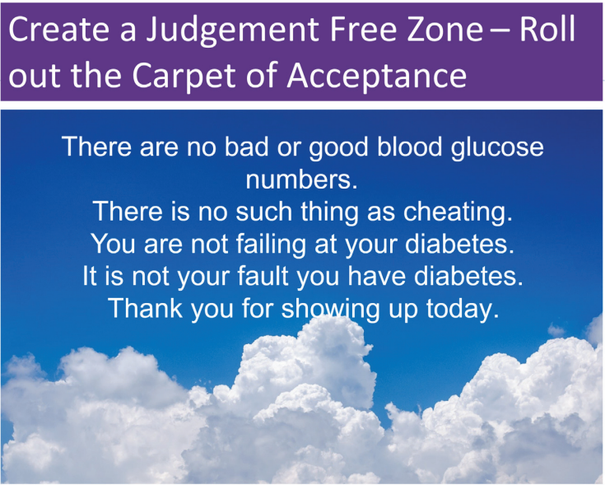

Slide 42

Embark Trial – Emotions as Priority
I have finally given myself permission to make addressing the emotional aspects of diabetes a priority.
~Coach Beverly

Slide 43

Commit to Listening at least Half of the Time

Slide 44


Our Curiosity Makes a Difference

Slide 45
Considering the Diabetes Connection as a Sacred Space
Have the stories of people living with diabetes stayed with you long after the conversation ended? Have their words, struggles, and triumphs echoed in your thoughts, quietly influencing the way you provide care?
Listening to these stories isn’t simply an exchange of information; it’s an invitation into someone’s lived experience. When we truly listen, with presence and without judgment, we enter a sacred space within diabetes care, where healing transcends clinical roles and traditional hierarchies.
In these moments, connection becomes the medicine. The person receiving care feels seen, heard, and valued. And something extraordinary happens for us as HCPs, too.
We are reminded of our purpose. We feel reconnected to our humanity.

Slide 46

Thank You
Questions?
Email: bev@diabetesed.net
Web: www.diabetesed.net
Phone 530-893-8635

