Slide 1

Diabetes Fundamentals Series 2026 Class 1 – Getting to the Nitty Gritty
Beverly Dyck Thomassian, RN, MPH, BC-ADM, CDCES
Pronouns: She, her, hers
President, Diabetes Education Services

Slide 2
Land Acknowledgment
We acknowledge and are mindful that Diabetes Education Services stands on lands that were originally occupied by the first people of this area, the Mechoopda, and we recognize their distinctive spiritual relationship with this land, the flora, the fauna, and the waters that run through this area.

Slide 3


We are Here to Help!
Bryanna Sabourin
Director of Operations
Astraea Ballinger
Brand Ambassador
Customer Happiness Advocate
If you have questions, you can chat with us at www.DiabetesEd.net or call 530 / 893-8635 or email at info@diabetesed.net

Slide 4

Diabetes Education Services Inclusion Statement
Based on the IDEA Initiative inspired by CDR
Inclusion
Diversity
Equity
Access
We are committed to promoting diversity and inclusion in our educational offerings.
We recognize, respect, and include differences in ability, age, culture, ethnicity, gender, gender identity, sexual orientation, size, and socioeconomic characteristics.
Our goal is to promote equity and access, acknowledging historical and institutional inequities.
We are committed to practicing cultural humility and cultivating our cultural competence.
We wish to create a safe space within our community where one's beliefs, experiences, identity, and differences in ability, age, size, socio-cultural/socioeconomic characteristics, and political affiliations are considered and respected.

Slide 5
Welcome to DiabetesEd Online U
This course offers foundational knowledge in diabetes care and education.
A recorded version will be available on DiabetesEd University (DEU) within 48 hours after the live broadcast.
Updated PowerPoint handouts will have 2026 in description
Earn CE credit by completing the Handouts & Resources module and the webinar module in the course. Then follow the steps in the Post-Assessment module to fill out the webinar evaluation.
Please contact us with any questions! Info@diabetesed.net

Slide 6

DiabetesEd Online University Goals
Get excited about diabetes care
Believe that you can make a difference
Explore communications approaches
Have fun
Engage your curiosity
Encourage each other to take risks

Slide 7
Coach Bev has no Conflict of Interest
She’s not on any speaker's bureau
Does not invest or have any financial relationships with diabetes related companies.
Gathers information from reading package inserts, research and articles
The ADA Standards of Medical Care is main resource for course content

Slide 8

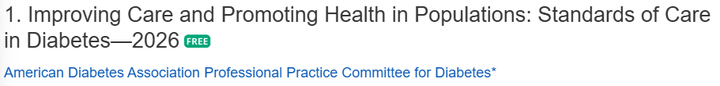
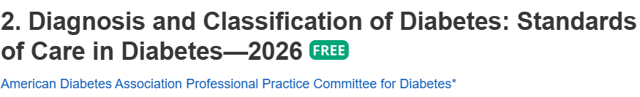


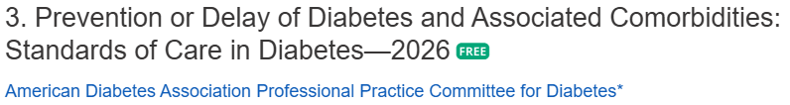
Improving Care & Diabetes Overview

Slide 9

Course Outcome & Objectives
Attendees will have increased knowledge and be able to articulate the different types of diabetes, risk factors and diagnostic criteria.
Discuss factors contributing to increasing prevalence of diabetes
Describe pathophysiological defects associated with the development of diabetes mellitus.
Differentiate the different types: prediabetes, Type 1, Type 2 and GDM
Discuss new language guidelines
Describe the impact of insulin resistance

Slide 10
CDC Announces
35% of Americans will have Diabetes by 2050
Boyle, Thompson, Barker, Williamson
2010, Oct 22:8(1)29
www.pophealthmetrics.com

Slide 11
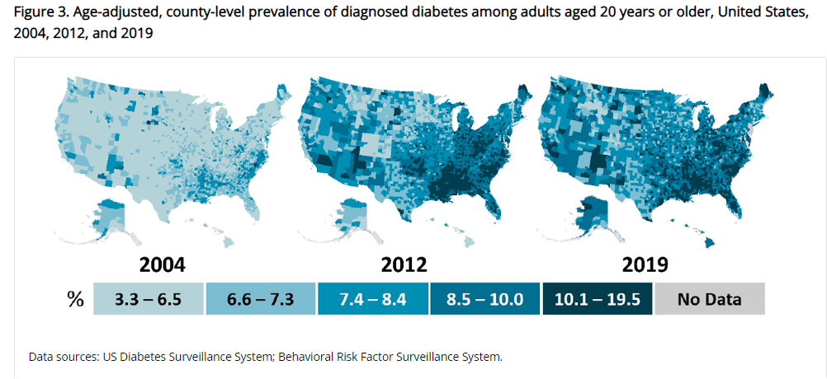
Type 2 Diabetes in America 2026
14.7% with Diabetes - 38 million adults
11% don’t know they have it
38% with Prediabetes – 98 million adults
https://www.cdc.gov/nchs/data/databriefs/db516.pdf
Centers for Disease Control and Prevention. National Diabetes Stats Report https://www.cdc.gov/diabetes/data/statistics-report/index.html. Accessed 1/23
https://www.cdc.gov/pcd/issues/2025/24_0273.htm

Slide 12
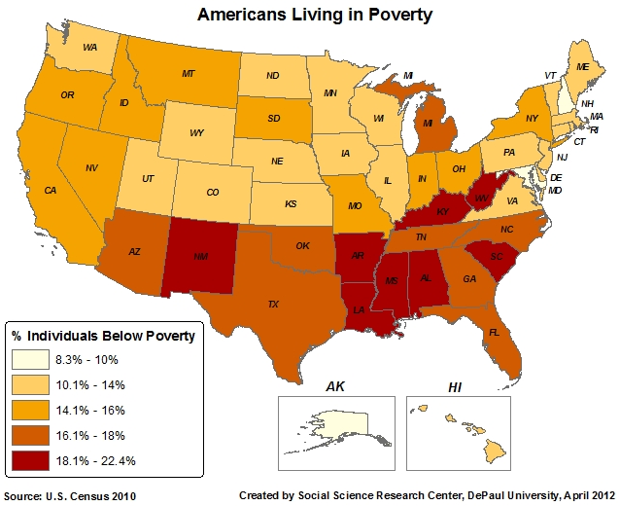
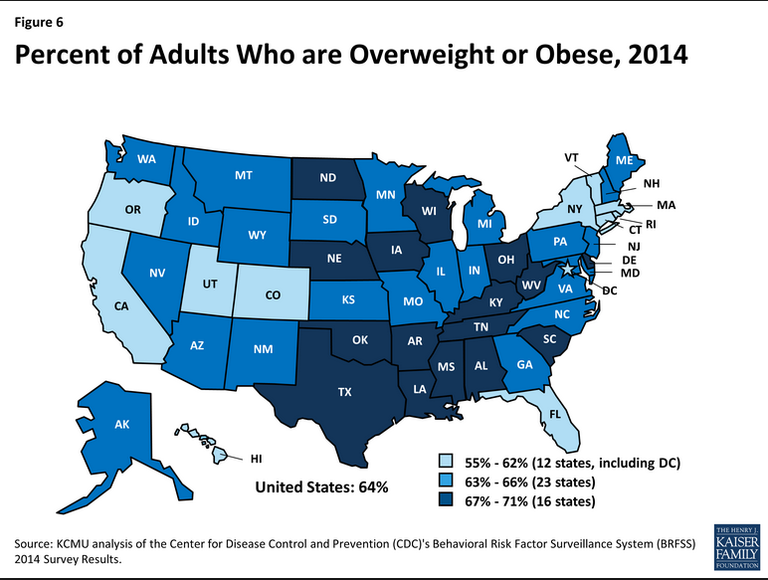
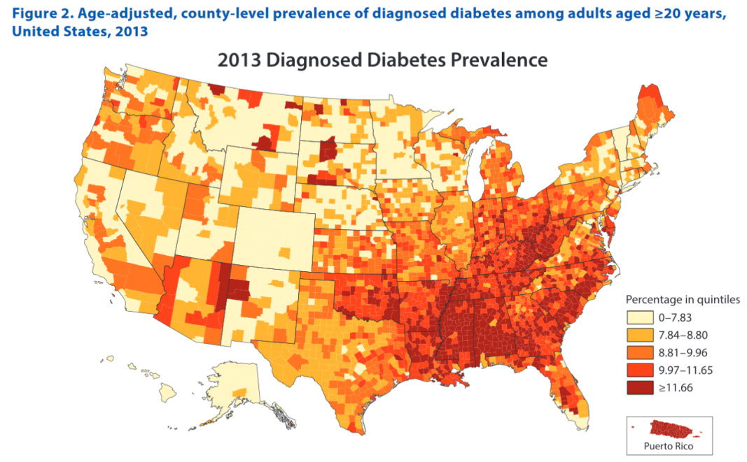
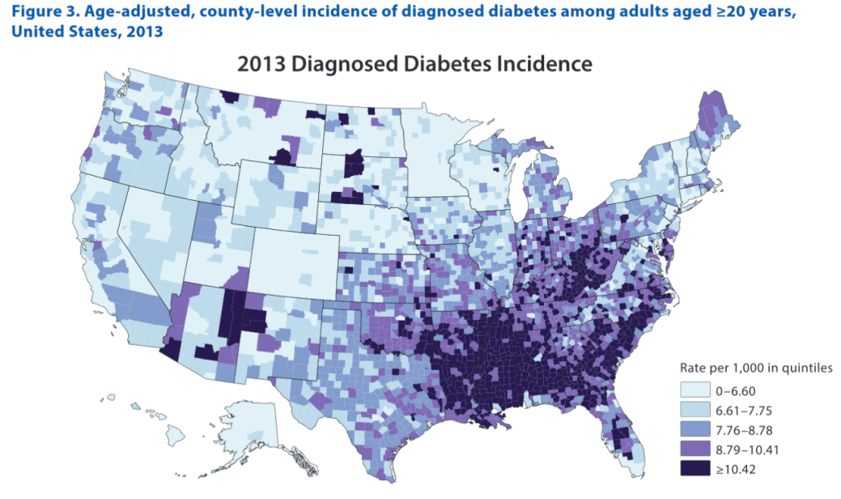
Type 2 Diabetes Distribution in U.S.
Centers for Disease Control and Prevention. National Diabetes Stats Report https://www.cdc.gov/diabetes/data/statistics-report/index.html. Accessed 1/23

Slide 13


Social Drivers of Health (SDOH)
SDOH are defined as the economic, environmental, political, and social conditions in which people live. Their uneven distribution are responsible for a major part of health inequality worldwide.

Slide 14

Social Determinants of Health (SDOH)
Factors often beyond an individual’s direct control and potentially representing lifelong risks—play a significant role in both clinical and psychosocial outcomes.
To improve health, support overall well-being, and eliminate disparities, it is crucial to address these determinants, particularly for individuals from racial and ethnic minoritized communities, underserved geographic areas (rural or urban), and those facing socioeconomic barriers to care and health

Slide 15
Care Quality Gaps
Growing gaps in diabetes care quality and outcomes due to high & risings costs of care.
Increased disparities experienced by individuals from racial and ethnic minoritized backgrounds and those facing socioeconomic barriers to care.
Calls for urgent, substantial, and multisectoral system-level improvements to care delivery

Slide 16

Individual & Population Health
Person-centered care:
care that considers an individual’s comorbidities and prognoses
respectful of and responsive to individual preferences, needs, and values;
ensures that the individual’s values guide all clinical decisions
For optimal outcomes individualize individual’s context and care needs across life span.
Improve population health through a combination of policy-level, system-level, and person-level approaches.

Slide 17
Diabetes Prevalence Stats
For adults in U.S., diabetes prevalence:
American Indians and Alaska Natives – highest rates
Non-Hispanic Blacks (17.4%),
People of Hispanic origin (15.5%),
Non-Hispanic Asians (16.7%)
White Individuals (13.6%)
Education and SES and Location
Less than high school ed (13.1%)
More than high school (6.9%)
Living below federal poverty (13.1%)
Living at 500% of federal poverty (5.1%)
Rural living (9.5%)
Metropolitan (8.1%)

Slide 18

Improving Care - Population Health
“Health outcomes of a group of individuals -
including the distribution of health outcomes within the group”
These outcomes can be measured in terms of health outcome:
mortality, morbidity, health, and functional status
disease burden
(incidence and prevalence)
behavioral and metabolic factors
(exercise, MNT, A1C, TIR etc.)

Slide 19
Poll Question 1
What percent of people with diabetes are achieving A1C <7% and BP < 130/80?
About 75%
Less than 30%
About 50%
Less than 20%

Slide 20

Status of Diabetes Care
In 2015–2018, U.S. community-dwelling adults with diabetes achieved:
A1C <7% by 50.5%
75.4% achieved A1C <8%.
BP target of <130/80 achieved by 47.7%
70.4% achieved blood pressure <140/90 mmHg.
Lipid control non-HDL cholesterol) <130 mg/dL, achieved by 55.7%
22.2% met targets for all three risk factors
20% of US children have elevated weight classified as obesity

Slide 21
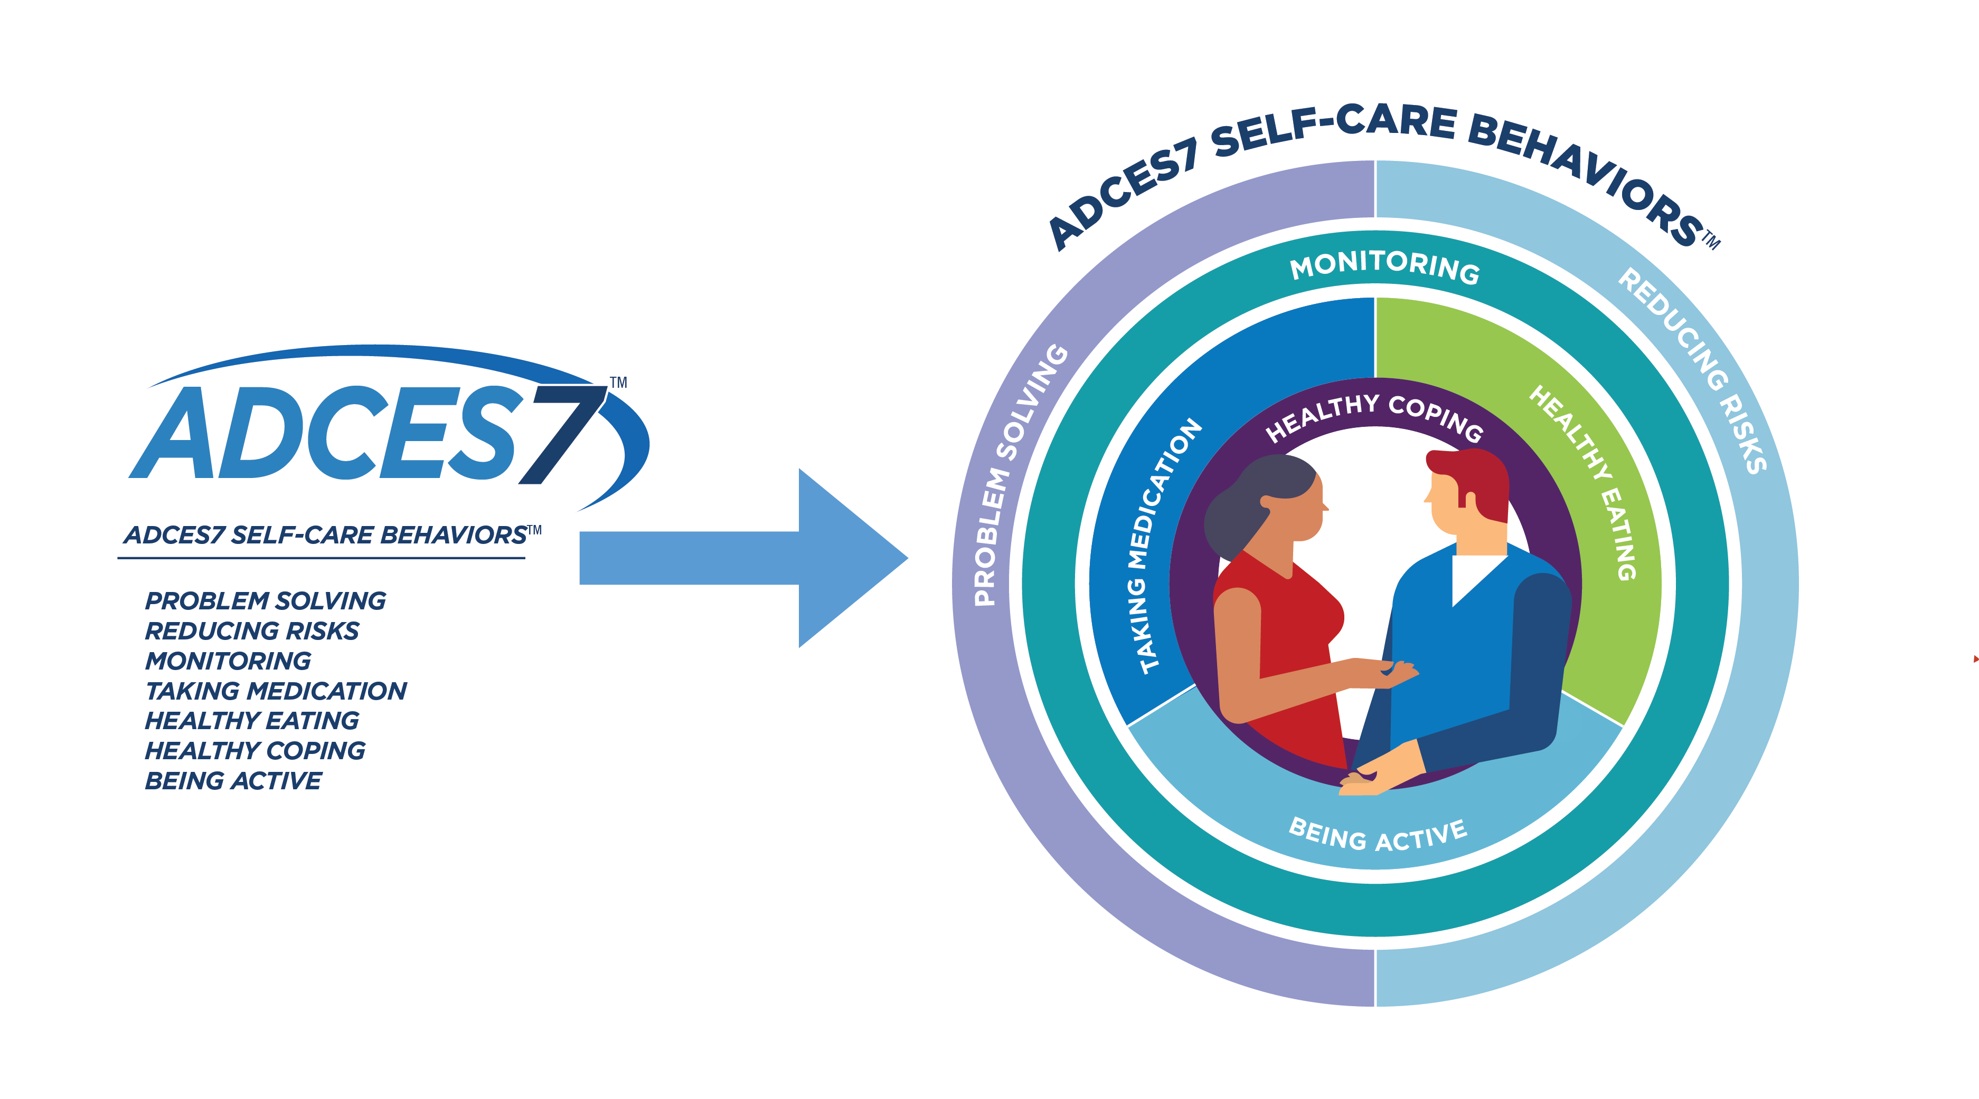
Foundations of Care – Well Being
Also known as the ADCES 7 Self-Care Behaviors

Slide 22


Now, let’s get to the Nitty Gritty

Slide 23



Slide 24

Poll Question 2
In the fasting state, hyperglycemia is directly related to:
Increased hepatic glucose production
Defective insulin stimulation of target tissue glucose disposal
Decreased adipocyte lipolysis
Loss of pancreatic alpha-cell function

Slide 25
Hormones Effect on Glucose
Effect



⇒
⇒
⇒
Hormone
Glucagon (pancreas)
Stress hormones (kidney)
Epinephrine (kidney)
Insulin (pancreas)
Amylin (pancreas)
Gut hormones - incretins (GLP-1 & GIP) released by L cells of intestinal mucosa, beta cell has receptors)

Slide 26

Signs of Diabetes
Polyuria
Polydipsia
Polyphasia
Weight loss
Fatigue
Skin and other infections
Blurry vision
Glycosuria, H₂O losses
Dehydration
Fuel Depletion
Loss of body tissue, H₂O
Poor energy utilization
Hyperglycemia increases incidence of infection
Osmotic changes

Slide 27

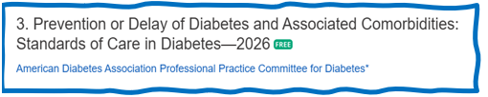
3. Detecting PreDiabetes Matters
Given the effectiveness of the Diabetes Prevention Program (DPP)
Refer adults with BMI 25+ at risk of diabetes to DPP
Achieve/maintain wt reduction of 5-7% through evidence-based eating patterns (Mediterranean, low carb, DASH.)
Participate in 150+ minutes activity a week
Should be covered by third-party payers,
Address inconsistencies in access – leverage technology
Monitor people with prediabetes at least annually for development of type 2 diabetes.

Slide 28
DPP Goal- Based Lifestyle Intervention
16-session structured core curriculum
completed within the first 6 months of the program,
followed by 6 months of a flexible maintenance program.
Sessions on:
reducing calories, increasing physical activity, self-monitoring, maintaining healthy lifestyle behavior, guidance on managing psychological, social, and motivational challenges
Two major goals of the DPP
achieve and maintain at least 7% weight loss
obtain 150 min of moderate-intensity activity per week
Link to National Diabetes Prevention Program Overviewcoveragetoolkit.org/about-national-dpp/ndpp-overview/.

Slide 29
Metformin & Prediabetes
Use metformin for prevention of type 2 for those at high risk:
25–59 yrs with BMI ≥35
A1C 6.0% or more
History of GDM
Periodic assess of B12, esp if have anemia, peripheral neuropathy.
Consider Metformin to prevent hyperglycemia in high-risk individuals:
Ind’s treated with
Phosphatidylinositol 3-kinase α (PI3Kα) inhibitor (e.g., alpelisib and inavolisib).
High dose steroids

Slide 30
Poll Question 3
Pre-diabetes is best defined as a glucose of:
Fasting BG of 100-125 mg/dl
Any BG above 99 mg/dl
Fasting BG 126 -200 mg/dl
Fasting BG of 140 mg/dl or more

Slide 31
Natural History of Diabetes
Healthy
FBG <100
Random <140
A1c <5.7%
Prediabetes
FBG 100-125
Random140- 199
A1c ~ 5.7- 6.4%
50% working pancreas
Diabetes
FBG 126 +
Random 200 +
A1c 6.5% or +
20% working pancreas
Yes!
NO
Development of type 2 diabetes happens over years or decades

Slide 32
Poll Question 4
Diabetes is defined as a confirmed random glucose of:
126-199 mg/dl
200 mg/dl or greater
140-199 mg/dl
140 mg/dl or greater

Slide 33
A1C Test – To diagnose & eval
Measures glycation of RBC’s over 2-3 months
Weighted mean (50% preceding month)
Each 1% ~ 29mg/dl
Accuracy: affected by some anemias, hemoglobinopathies
Use fructosamine or glucose monitoring if needed.
A measurement of glucose in fasting and postprandial states

Slide 34


Slide 35
Poll Question 5
Each percentage of A1C = how many mg/dl of blood glucose?
33
27
17
29

Slide 36

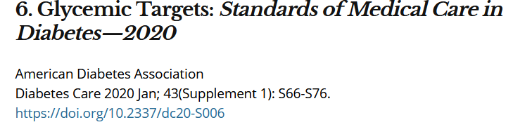
A1c and Estimated Avg Glucose (eAG)
A1c (%) eAG__
5 97 (76-120)
6 126 (100-152)
7 154 (123-185)
8 183 (147-217)
9 212 (170 -249)
10 240 (193-282)
11 269 (217-314)
12 298 (240-347)
eAG = 28.7 x A1c-46.7 ~ 29 pts per 1%
Translating the A1c Assay Into eAG – ADAG Study

Slide 37

​Type 1 Diabetes – Immune Mediated
Diagnostic Criteria for Diabetes
37

Slide 38
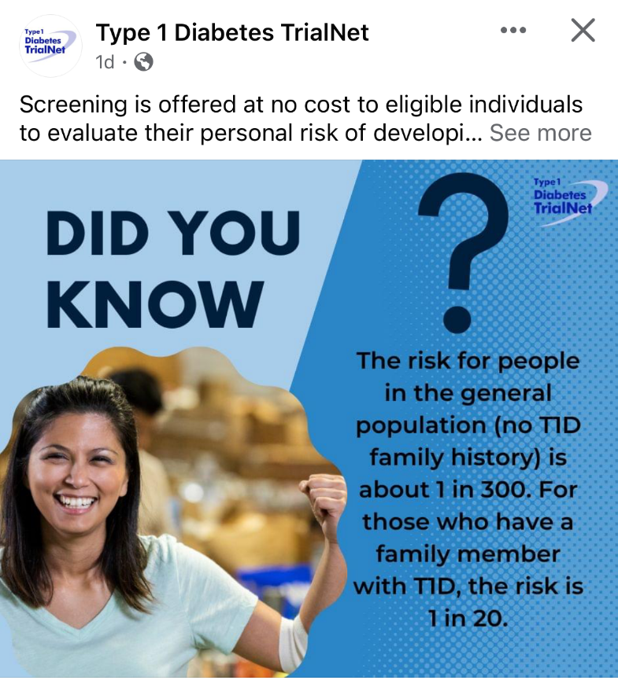

Type 1 ~ Immune Mediated 5-10% of Diabetes
1.5 Million people have type 1 in U.S.
Prevalence increasing:
2001 – 1.48 per 1000 youths diagnosed with diabetes
2017 - 2.15 per 1000 youths diagnosed with diabetes
Incidence & Prevalence increasing
Highest incidence in Finland or Northern Europe.
ADCES In Practice - March 2024 Recent Advances in Type 1 Diabetes: Teplizumab (Tzeild®)
Karen S. Fiano, PHARMD, BCACP, Devada Singh-Franco, PHARMD, CDCES, Young M. Kwon, BS, PHD

Slide 39
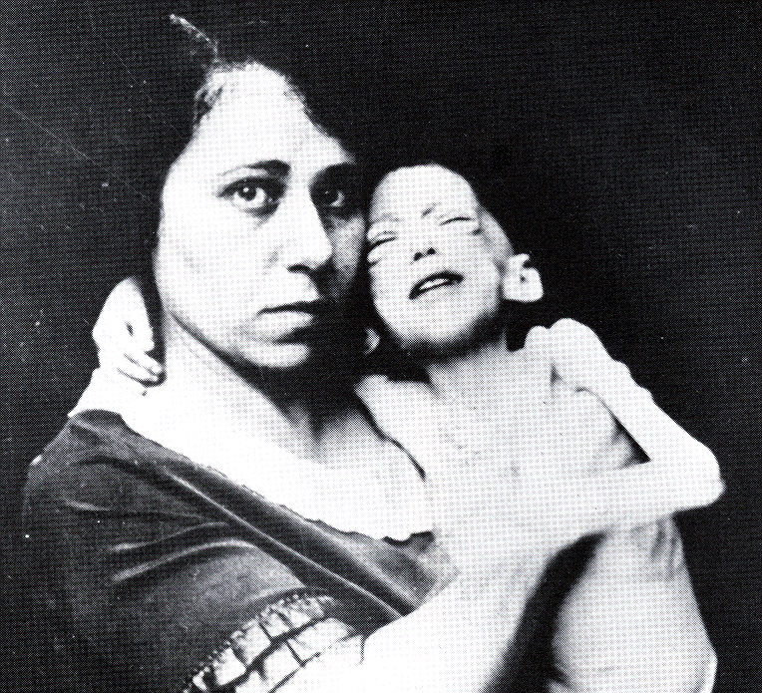

Miracle of Insulin
The Miracle of Insulin
Patient J.L., December 15, 1922
February 15, 1923

Slide 40

Type 1 is 5- 10% of all Diabetes
Auto-immune pancreatic beta cells destruction
Most commonly expressed at age 10 – 14
Insulin sensitive (require 0.4 - 1.0 units/kg/day)
Expression due to a combo of genes and environment:
Autoimmunity tends to run in families
Exposure to virus or other environmental factors
40
Diagnostic Criteria for Diabetes
Notes:
When you get to the insulin piece, please mention we will get into great detail about insulin in the pharmacotherapy module

Slide 41

Signs of Type 1 Diabetes
Sudden onset of nighttime bedwetting
Weight loss, thirst, hunger
40-60% discovered with acute DKA
Fruity breath
Hypothermic
Poor skin turgor
“Out of it”
Ketone positive (blood or urine)
Acidosis
Other

Slide 42

What Kind of Diabetes?
AJ, a 33-year-old admitted to the ICU with a blood glucose of 476 mg/dl, pH of 7.1. They recently lost 13 pounds.
What further questions and or testing is needed to determine if they have type 1 or type 2 diabetes?

Slide 43


Type 1 Diabetes Features?
AJ, a 33-year-old admitted to the ICU with a blood glucose of 476 mg/dl, pH of 7.1, anion gap of 15. Recently lost 13 pounds.
Type 1 Most Discriminative Features
Younger than 35 years at diagnosis
Lower BMI (<25 kg/m²)
Unintentional weight loss
Ketoacidosis
Glucose 360 mg/dl or greater.

Slide 44

How do we know someone has Type 1 vs Type 2?
Type 1 - Positive antibodies
GAD - glutamic acid decarboxylase (primary)
IA2 - islet antigen 2, or
ZnT8 - zinc transporter 8
Can also check C-peptide levels to determine endogenous insulin production
Younger people develop quickly
Older people take longer to develop
“misdiagnosis is common and can occur in ∼40% of adults with new type 1 diabetes”

Slide 45
Type 1 Diabetes Progression
 | Stage 1 | Stage 2 | Stage 3
Characteristics | • Autoimmunity | • Autoimmunity | • Autoimmunity
 | • Normoglycemia | • Dysglycemia | • Overt hyperglycemia
 | • Presymptomatic | • Presymptomatic | • Symptomatic
Diagnostic criteria | • Multiple islet autoantibodies GAD, glutamic acid decarboxylase (primary) islet antigen 2, or Zinc transporter 8 (ZnT8) | • Islet autoantibodies Dysglycemia: Elevated IFG and/or IGT • FPG 100–125 mg/dL • 2-h PG 140–199 mg/dL • A1C 5.7–6.4% or ≥10% increase in A1C | • Autoantibodies may disappear over time (5-10% may not express antibodies) • Diabetes diagnosed by standard criteria

Slide 46

Monitoring Presymptomatic Type 1
If a person has positive antibody(ies) for type 1:
Monitor for disease progression:
A1C approximately every 6 months and
75-g oral glucose tolerance test (i.e., fasting and 2-h plasma glucose) annually;
May need to modify frequency of monitoring.
Consider augmenting with other glycemic assessment tools such as CGM metrics based on individual risk assessment incorporating age, number and type of autoantibodies, and glycemic metrics

Slide 47

Pharmacologic Intervention to Delay Symptomatic Type 1 (in Stage 2)
Teplizumab (CD3-monoclonal antibody)
14-day infusion can delay the onset of symptomatic type 1 diabetes (stage 3)
An option in selected individuals aged ≥8 years with stage 2 type 1 diabetes.
In a single trial, 44 individuals received 14-day course of teplizumab vs 32 placebo.
The median time to stage 3 diagnosis of type 1
48.4 months in tep group
24.4 months placebo
Cost: $193,000
Manufacturer has financial assistance programs.

Slide 48
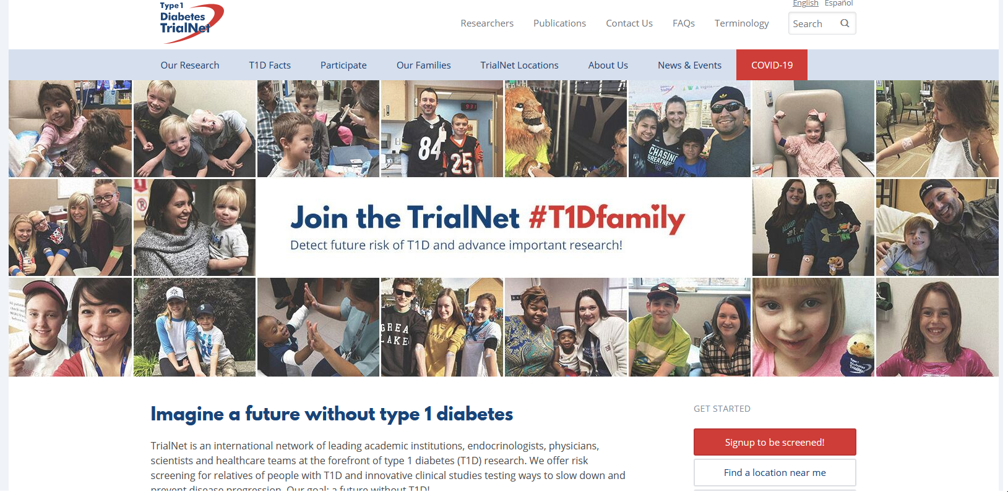
Type 1 (stage 2) Delayed with Teplizumab by 2 years www.DiabetesTrialNet.org
How to get families linked to screening?

Slide 49


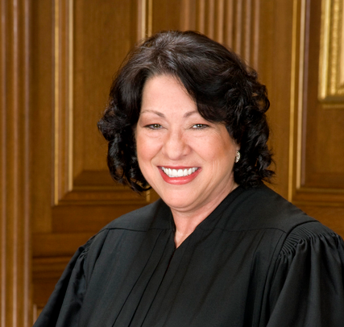
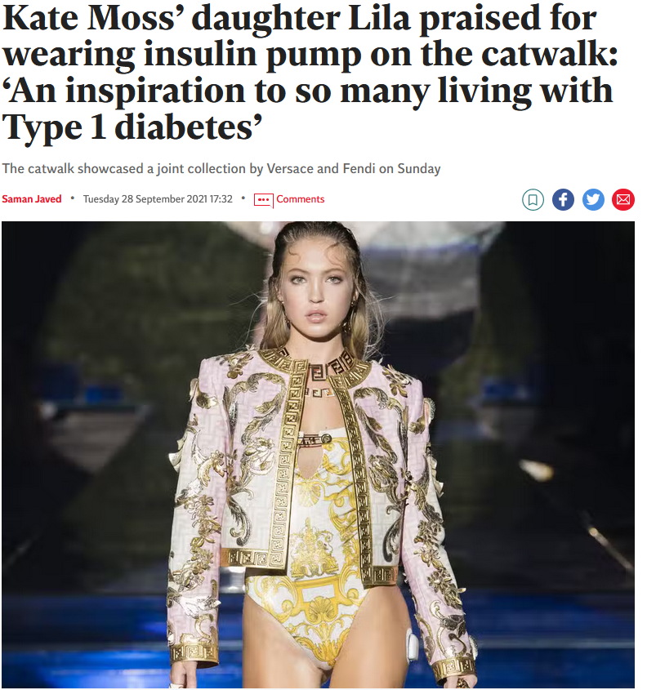


What Does Type 1 Look Like?
Mary Tyler Moore
Justice Sonia Sotomayor
Bret Michaels
Nick Jonas
Lila Grace Moss

Slide 50

Type 1 Summary
Immune mediated pancreatic destruction
Need insulin replacement therapy
Often first present in DKA
At risk for other autoimmune diseases
Eval coping strategies

Slide 51


Patti Labelle
"divabetic”
“I have diabetes, it doesn’t have me”

Slide 52




Slide 53

Factors Associated with Insulin Resistance
Visceral Adiposity
Sedentary lifestyle
Genetics
Gestational Diabetes
Polycystic ovary syndrome
Acanthosis Nigricans
Obstructive Sleep Apnea
Cancer
Steatosis
American College of Endocrinology

Slide 54
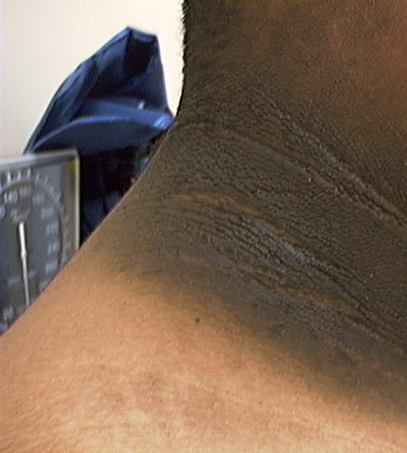
Acanthosis Nigricans
Signals high insulin levels in bloodstream
Patches of darkened skin over parts of body that bend or rub against each other
Neck, underarm, waistline, groin, knuckles, elbows, toes
Skin tags on neck and darkened areas around eyes, nose and cheeks.
No cure, lesions regress with treatment of insulin resistance

Slide 55
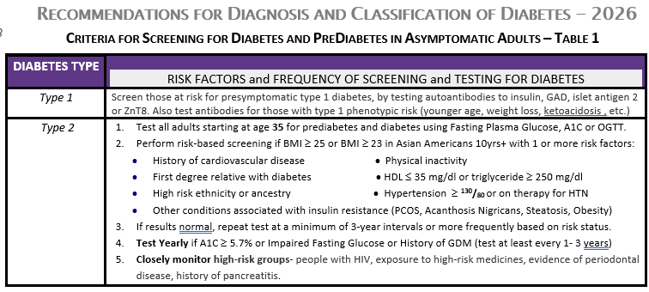

Diabetes Screening Guidelines (ADA 2026 Clinical Practice Guidelines – Cheat Sheet)
DiabetesEd.net Cheat Sheets

Slide 56
Poll Question 6
Frequent skin and yeast infections in people with diabetes are:
A sign of poor hygiene
Due to poor diet
A sign of ongoing hyperglycemia
A result of high sugar intake

Slide 57

Signs of Diabetes
Polyuria
Polydipsia
Polyphasia
Weight loss
Fatigue
Skin and other
infections
Blurry vision
Glycosuria, H₂O losses
Dehydration
Fuel Depletion
Loss of body tissue, H₂O
Poor energy utilization
Hyperglycemia increases incidence of infection
Osmotic changes

Slide 58


What is Type 2 Diabetes?
Type 2 diabetes is associated with insulin secretory defects related to
genetic predisposition,
epigenetic changes,
inflammation, and
metabolic stress.
Future classification schemes for diabetes will likely focus on the pathophysiology of the underlying β-cell dysfunction.

Slide 59
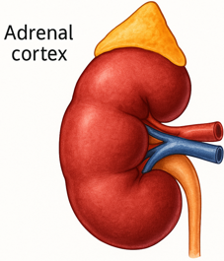
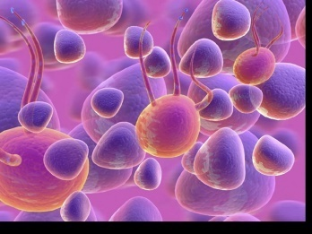
The Noxious Nine – Pathophysiology T2D
Hypercortisolism
Neurotrans-mission dysfunction
Decreased Insulin β-cell secretion
Increased renal glucose reabsorption
Decreased incretin effect Gut hormones
G
Increased glucagon α-cell secretion
I
G
I
G
G
I
I
G
Increased lipolysis
G
G
I
I
G
G
I
Increased hepatic glucose
production
I
G
G
Decreased muscle glucose uptake
DeFronzo, Auchus-Hypercortisolism June 2025
Notes:
59
ummary: The Noxious Nine in Diabetes Pathophysiology
Ralph A. DeFronzo expanded his earlier conceptual model of diabetes—known as the Ominous Octet—to include a ninth element: hypercortisolism. This updated framework is referred to as the Noxious Nine, highlighting the important role of cortisol dysregulation in difficult-to-control type 2 diabetes currentsciencedaily.com+8HCP Live+8HCP Live+8.
Recent research, including the CATALYST trial, shows that about 24% of patients with difficult-to-control T2D have underlying hypercortisolism. Treating this condition with mifepristone, a glucocorticoid receptor antagonist, led to significant improvements in HbA1c—averaging around a 1.5% reduction pmc.ncbi.nlm.nih.gov+3HCP Live+3medscape.com+3.
These findings emphasize the importance of recognizing hypercortisolism in T2D care and suggest that addressing it may help improve glycemic and metabolic control in a subset of patients.
59

Slide 60
Natural Progression of Type 2 Diabetes
Plasma
Glucose
Postprandial glucose
Fasting glucose
126 mg/dL
Relative β-Cell Function
Insulin resistance
Insulin secretion
-20
-10
0
10
20
30
Years of Diabetes
Prior to diagnosis
After diagnosis
Adapted from Bergenstal et al. 2000; International Diabetes Center.
Notes:
These graphs show the typical progressive nature of type 2 diabetes in terms of 2 key indices: increasing plasma glucose level (top panel) and decline in relative β-cell function as reflected by the drop in endogenous insulin and rise in insulin resistance (lower panel).
In the natural history of type 2 diabetes, insulin resistance rises, insulin secretion falls, and glucose levels begin to rise before diabetes is diagnosed.
Based on the natural history, type 2 diabetes is a disease of progressive insulin failure as shown in the graphic model developed by researchers at the International Diabetes Center.¹
Before the onset of diabetes, glucose levels start to rise, with a slightly sharper increase in the postprandial value than in fasting glucose. Both postprandial and fasting plasma glucose levels continue to rise if diabetes is left untreated.²
Prior to the diagnosis of diabetes, resistance of cell receptor sites to insulin starts to increase, while insulin secretion by β-cells decreases. Insulin resistance reaches a peak and remains constant. Endogenous insulin secretion continues to decline over the course of diabetes.²
References:
1. Kendall DM. Postprandial blood glucose in the management of type 2 diabetes: the emerging role of incretin mimetics. Available at: http://www.medscape.com/viewarticle/515693. Accessed April 21, 2006.
2. Ramlo-Halsted BA, Edelman SV. The natural history of type 2 diabetes: implications for clinical practice. Prim Care. 1999;26:771-789.

Slide 61

Diabetes is also associated with
Steatosis
Obstructive sleep apnea
Cancers:
pancreas, liver, breast, endometrium, colon, bladder
Dementia / Alzheimer’s

Slide 62

Life Study – Mrs. Jones
MJ is 62 years old, with a BMI of 36 and complains of feeling tired and urinating several times a night. Has a urinary tract infection. Her A1c is 8.3%, glucose 237.
MJ is hypertensive with a history of gestational diabetes. No ketones in urine.
What are risk factors and signs of diabetes?
You find a few moments to teach and MJ asks you some questions.

Slide 63

Language of Diabetes Education
Old Way
New Way
Control diabetes
Test BG
Patient
Normal BG
Non-adherent, compliant
Refuse
Manage
Check
Participant
BG in target range
Focus on what they are accomplishing
Decided, chose

Slide 64

Terminology matters – Avoiding weight stigma
For people with BMI >30, preferred terms
“person with elevated BMI”.
“person with higher weight”
“person with excess weight”
Other terms
Person in a larger body.
Person with extra weight
Pearl RL, et al. JAMA Surg. Sept 2018; doi:10.1001/jamasurg.2018.2702

Slide 65
Mrs. Jones asks you What Do You Say?
What is diabetes?
They say I am a diabetic because I am obese?
How am I going to control this?
What is a normal blood sugar?
Do I have to test my blood sugars?
My doctor told me to stay away from white foods. Is that true?

Slide 66

Mrs. Jones asks you What Do You Say?
You are wondering if your weight caused your diabetes?
You can manage your diabetes and improve your health at the same time.
For people without diabetes, fasting blood sugar is less than 100 and A1c is less than 5.7%
Checking blood sugars can help you figure out if the plan in working.

Slide 67

Empowerment Defined
“Helping people discover and develop their inherent capacity to be responsible for their own lives and gain mastery over their diabetes”.
Posits:
Choices made by the person (not HCPs) have greatest impact.
People are in charge of their self-management
The consequences of self-management decisions affect the individual most.
It is their right and responsibility to be the primary decision makers.

Slide 68


Other Types of Diabetes
Other specific types of diabetes
Gestational

Slide 69
Specific type of diabetes due to other causes
Medications:
Steroids
Anti-retroviral meds,
Antipsychotic meds
Transplant meds
Checkpoint inhibitors
Exocrine pancreas disease:
Cystic fibrosis
Type 3c
Pancreatitis
Monogenic diabetes syndromes
Agent Orange

Slide 70
Type 3c Diabetes (Pancreatogenic)
Includes both structural and functional loss of insulin secretion in the context of exocrine pancreatic dysfunction.
About 5-10% of diabetes, often misdiagnosed as type 2 diabetes.
The diverse set of etiologies includes:
pancreatitis (acute and chronic) ~70%
trauma or pancreatectomy
neoplasia
cystic fibrosis
hemochromatosis
fibrocalculous pancreatopathy
rare genetic disorders, and idiopathic

Slide 71
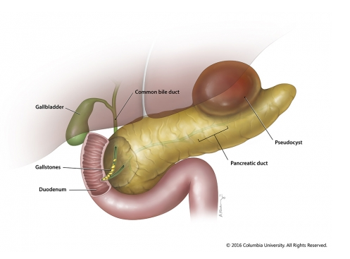
Pancreatitis
Pancreatitis caused by digestion of the organ from pancreatic enzymes normally carried to the Small intestine through the pancreatic duct.
Detected through elevated Amylase levels & pain
Causes:
HIV meds and other meds
Alcohol ingestion
Gallstones blocking pancreatic enzyme flow to small intestine
Elevated triglycerides
Cancer, injury and other

Slide 72
Poll Question 7
Which of the following is true about gestational diabetes? A. GDM can be identified in the first trimester.
B. Children of women w/ GDM are at greater risk of type 1
C. The rates of GDM are decreasing
D. People can decrease their risk of getting GDM

Slide 73

Gestational DM ~ 7% of all Pregnancies
GDM prevalence increased
∼10–100% during the past 20 yrs
Native Americans, Asians, Hispanics, African-American women at highest risk
Immediately after pregnancy, 5% to 10% of GDM diagnosed with type 2 diabetes
Within 5 years, 50% chance of developing DM in next 5 years.

Slide 74

Increasing Prevalence – A public health perspective
Body weight before and during pregnancy influences risk of GDM and future diabetes
Children born to people with GDM at greater risk of diabetes
Focus on prevention

Slide 75

Screen at First Prenatal Visit Before 15 weeks
Screen for undiagnosed Type 2 at the first prenatal visit using standard risk factors.
Those found to have diabetes at their initial prenatal visit treated as “Diabetes in Pregnancy”
If normal, recheck at 24-28 weeks

Slide 76
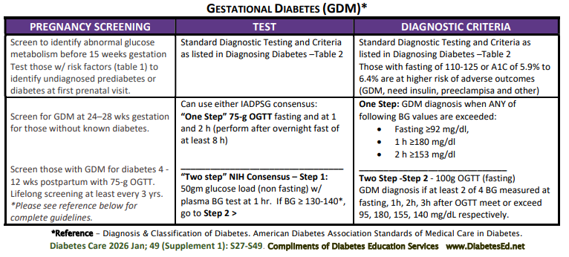
See Diabetes and Pregnancy Level 2
Screening and Diagnosis of Diabetes Cheat Sheet

Slide 77

Postpartum after GDM
50% risk of getting diabetes in 5 years
Screen at 4-12 wks post partum (75 gm OGTT)
Repeat at 3 yr intervals or signs of DM
Encourage Breast Feeding
Decreases risk of diabetes in mom 50%
Encourage activity, wt management
Encourage exercise
Make sure connected with health care
Preconception counseling
In individuals with previous history of GDM, the risk of type 2 diabetes increased by 18% for every 1-unit increase in BMI above the preconception baseline.

Slide 78

Key points
At the center of diabetes is someone living with it everyday.
Focus on their successes
Coach and support

Slide 79

Thank You
Discover more articles and info in your Student Center
Please contact us with any questions
info@diabetesed.net
530-893-8635
www.DiabetesEd.net

