Slide 1

Standard 10: Cardiovascular Disease and Risk Management- 2025 Level 2
Beverly Thomassian, RN, MPH, BC-ADM, CDCES
Diabetes Nurse Specialist
www.DiabetesEd.net
Notes:
Add comparative effectiveness of slgt2 inhibitors
Add sotagliflozin slide.
add pocket card: bromocriptine/colsevelam-slide 212
Am I slides 205-207?

Slide 2
Land Acknowledgment
We acknowledge and are mindful that Diabetes Education Services stands on lands that were originally occupied by the first people of this area, the Mechoopda, and we recognize their distinctive spiritual relationship with this land, the flora, the fauna, and the waters that run through this area.

Slide 3

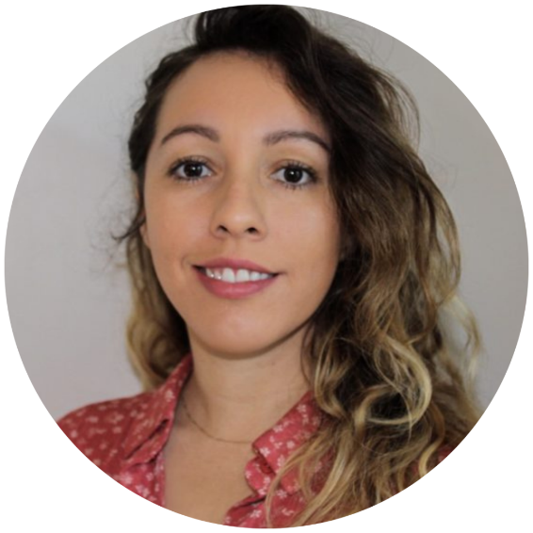
We are Here to Help!
Bryanna Sabourin
Director of Operations
Tiffany Bergeron
Customer Advocate &
Customer Happiness Expert
If you have questions, you can chat with us at www.DiabetesEd.net or call 530 / 893-8635 or email at info@diabetesed.net

Slide 4

Diabetes Education Services Inclusion Statement
Based on the IDEA Initiative inspired by CDR
Inclusion
Diversity
Equity
Access
We are committed to promoting diversity and inclusion in our educational offerings.
We recognize, respect, and include differences in ability, age, culture, ethnicity, gender, gender identity, sexual orientation, size, and socioeconomic characteristics.
Our goal is to promote equity and access, acknowledging historical and institutional inequities.
We are committed to practicing cultural humility and cultivating our cultural competence.
We wish to create a safe space within our community where one's beliefs, experiences, identity, and differences in ability, age, size, socio-cultural/socioeconomic characteristics, and political affiliations are considered and respected.

Slide 5
Coach Bev has no Conflict of Interest
She’s not on any speaker's bureau
Does not invest or have any financial relationships with diabetes related companies.
Gathers information from reading package inserts, research and articles
The ADA Standards of Medical Care is main resource for course content

Slide 6
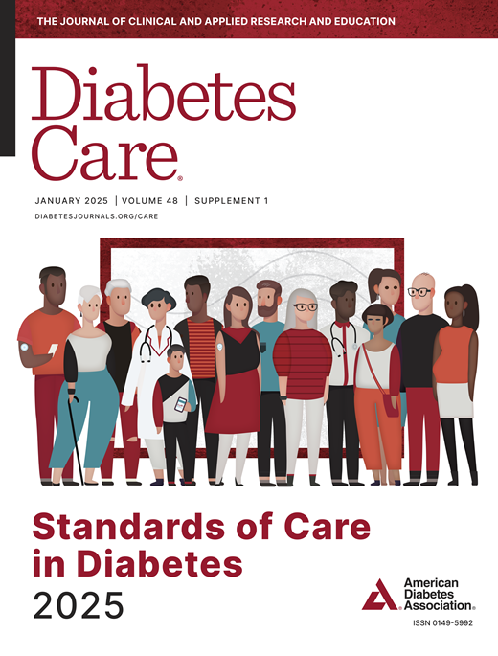

Standards of Care Update

Slide 7

Course Topics
Describe the impact of insulin resistance & hyperglycemia on vessel disease.
State the complications & factors associated with Atherosclerotic Cardiovascular disease (ASCVD)
List management goals to reduce the risk of ASCVD disease.
Discuss strategies to promote health.

Slide 8

Poll question 1
What is the relationship between diabetes and ASCVD disease?
A. Diabetes is associated with a lower rate of congestive heart failure.
B. Diabetes is associated with decreased incidence of heart attack and stroke
C. People with diabetes are destined to get CV complications.
D. People with diabetes can decrease their risk of a CV event

Slide 9
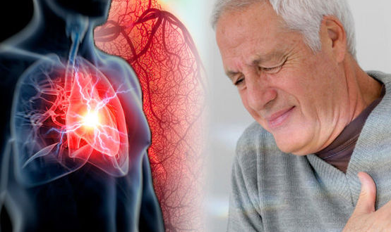
Cardiovascular Disease is the Leading Cause of Death in Diabetes
Good news is that ASCVD* mortality is decreasing.
What can we do to decrease ASCVD?
Address individual risk factors
Address multiple risk factors simultaneously
*Atherosclerotic Cardiovascular Disease

Slide 10
Poll question 2
Which of the following Cardiovascular Conditions are associated with diabetes?
A. Congestive Heart Failure
B. Hypervasodilation
C. Acanthosis Nigricans
D. CardioNephritis

Slide 11
Heart Disease & DM = 3-5xs Risk
Coronary heart disease
9.1 % w/ diabetes vs.
2.1 % no diabetes
Stroke
6.6 % w/ diabetes vs.
1.8 % no diabetes
CHF
7.9 % w/ diabetes vs.
1.1 % no diabetes
Heart attack
9.8 % w/ diabetes vs.
1.8 % no diabetes
AACE Website

Slide 12

10. Cardiovascular Disease and Risk Management
Higher risk of Atherosclerotic cardiovascular disease (ASCVD):
history of acute coronary syndrome,
myocardial infarction (MI),
stable or unstable angina,
coronary or other arterial revascularization,
stroke, transient ischemic attack,
or peripheral artery disease (PAD) including aortic aneurysm.
Plus 2x’s risk of Heart Failure
Leading cause of morbidity and mortality in people with diabetes
Large benefits are seen when multiple CV risk factors are addressed simultaneously
With more aggressive goals, rates of CVD have decreased.
CV Risks predicted to increase in future.

Slide 13

Atherosclerotic Cardiovascular Disease (ASCVD)
Targets Achieved in US Adults 2015-2018
A1C <7% by 50.5%
BP target of <130/80 achieved by 47.7%
Lipid control (non-HDL cholesterol) <130 mg/dL, achieved by 55.7%
22.2% met targets for all three risk factors
Largest contributor to direct and indirect costs - $37.3 billion/year
Rates of heart failure hospitalization are 2x higher in people with diabetes.
Notes:
Defined as ACS, history of MI, stable or unstable angina, coronary or other arterial revascularization, stroke, TIA, or PAD of atherosclerotic origin
Prevalence of HTN is 80% in adults with type 2 DM (AHA HTN guideline)

Slide 14
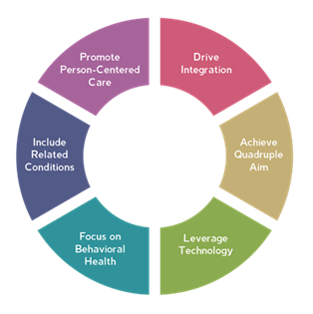
ADCES Focus – Diabetes Specialists and CVD Management
Demonstrate your expertise within the full range of cardiometabolic conditions: hypertension, obesity, prediabetes, diabetes and cardiac disorders.
CVD Resources (diabeteseducator.org)

Slide 15

Assess ASCVD and Heart Failure Risk Yearly
Duration of diabetes
BMI
Hypertension
Dyslipidemia
Smoking
Family history of premature coronary disease
Chronic kidney disease – presence of albuminuria
Treat modifiable risk factors as described in ADA guidelines.

Slide 16
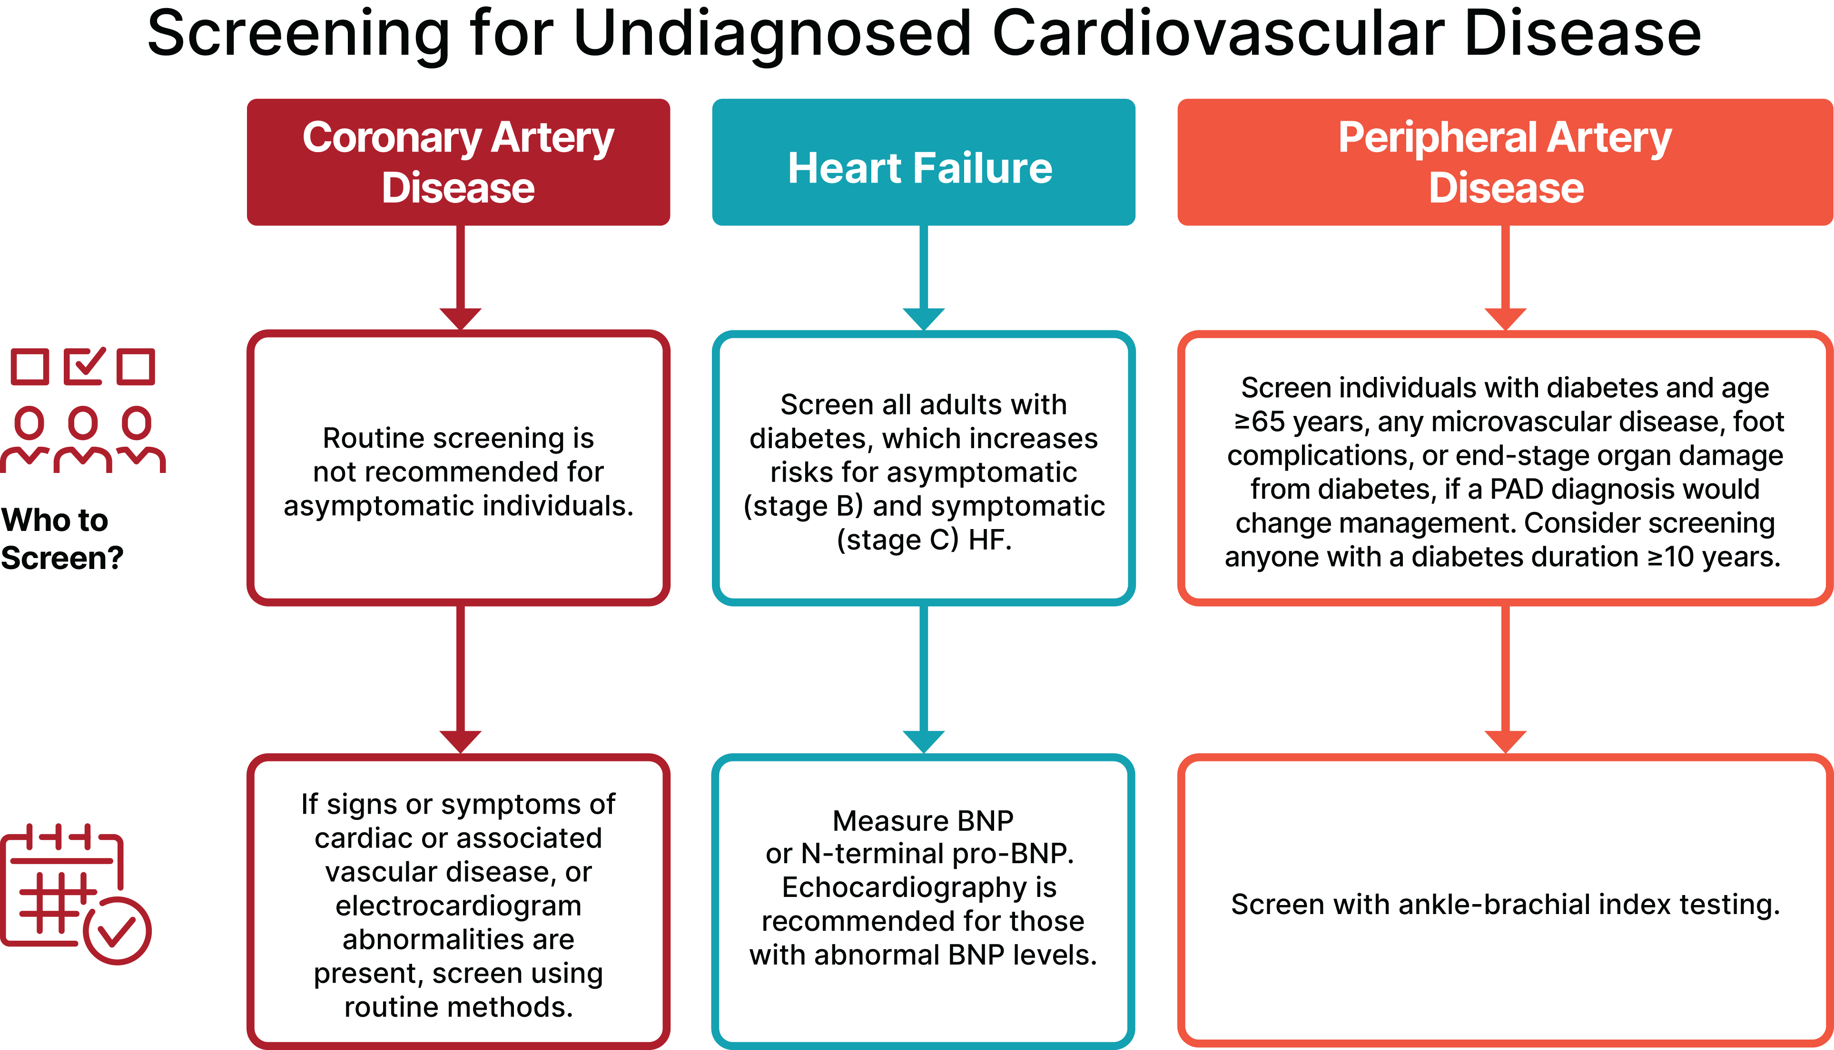
Screening for CV Disease

Slide 17

Insulin Resistance is the Seed
Muscles are insulin resistant
Building muscle decreases insulin resistance
Fat cells become more insulin resistant
Leads to more Free Fatty Acids and Triglycerides
More vascular inflammation
Liver and Pancreas becomes fatty
Losing weight and activity helps improve

Slide 18




Slide 19
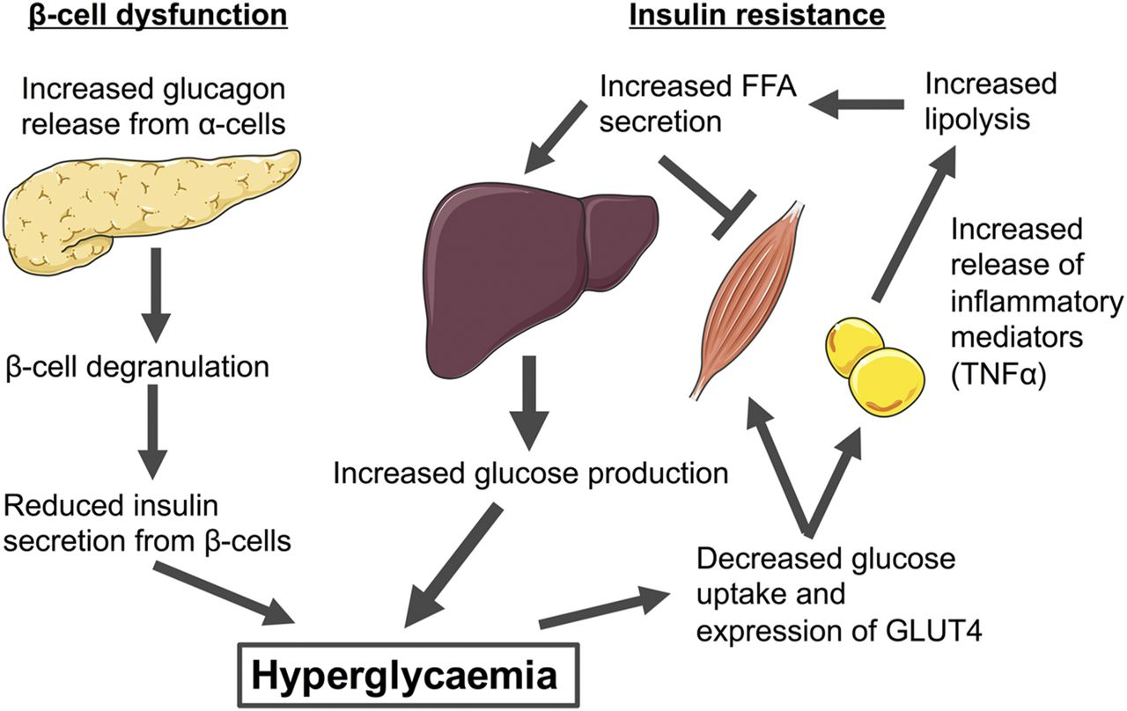
Insulin Resistance

Slide 20

Poll question 3
Which of the following BEST describes insulin resistance?
Visceral adipose tissue.
Excessive triglyceride levels
Lack of sufficient insulin receptors on fat and muscle cells.
Down regulation of Glut-4 transporters

Slide 21

Factors Associated with Insulin Resistance
Visceral adiposity
Sedentary lifestyle
Genetics / Ethnicity
Gestational Diabetes
Polycystic ovary syndrome
Acanthosis Nigricans
Obstructive Sleep Apnea
Cancer
American College of Endocrinology

Slide 22
Natural History of Diabetes
Healthy
FBG <100
Random <140
A1c <5.7%
Prediabetes
FBG 100-125
Random 140 - 199
A1c ~ 5.7- 6.4%
50% working pancreas
Diabetes
FBG 126 +
Random 200 +
A1c 6.5% or +
20% working pancreas
Yes!
NO
Development of type 2 diabetes happens over years or decades

Slide 23
Risk of CVD Is Elevated prior to Diagnosis of Type 2 Diabetes
Relative Risk of MI* or Stroke
*MI = myocardial infarction. Nurses Health Study
Adapted from: Hu F, et al. Diabetes Care. 2002;25:1129-1134.

Slide 24


PreDiabetes is FREAKING ME OUT
96 million people in US
80% don’t know they have it
In 3-5 years, about 30% of predm will get diabetes
Associated with higher rates of heart attack, stroke, neuropathy and vessel disease

Slide 25

Cardio Metabolic Risk - 5 Hypers -
Hyperinsulinemia (resistance)
Hyperglycemia
Hyperlipidemia
Hypertension
Hyper”waistline”emia (35” women, 40” men)
Manifestations of Insulin Resistance

Slide 26
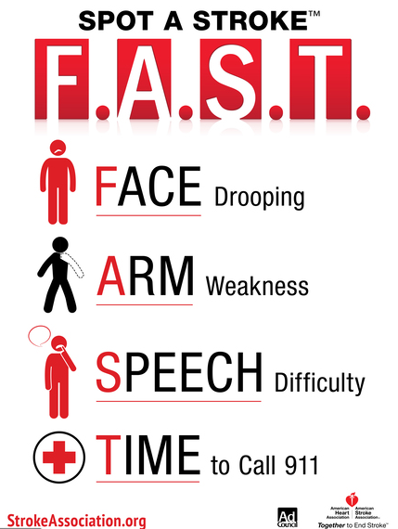
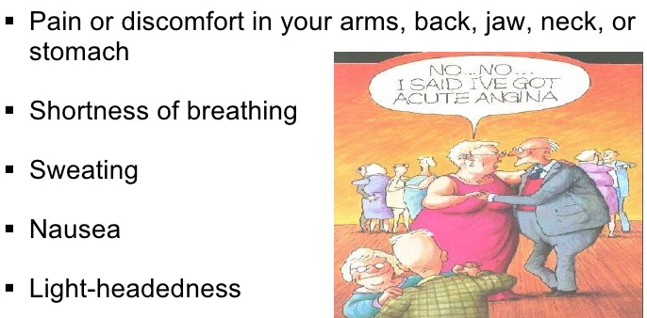
Stroke and Heart Attack
Make sure people with diabetes know the signs and seek immediate help.
People with diabetes may not experience intense chest or jaw pain during heart attack due to neuropathy.

Slide 27

What is Type 2 Diabetes?
Complex metabolic disorder ….
(Insulin resistance and deficiency)
with social, behavioral and environmental risk factors unmasking the effects of genetic susceptibility.
New Diagnosis? Call 800 – DIABETES to request “Getting Started Kit”
www.Diabetes.org

Slide 28
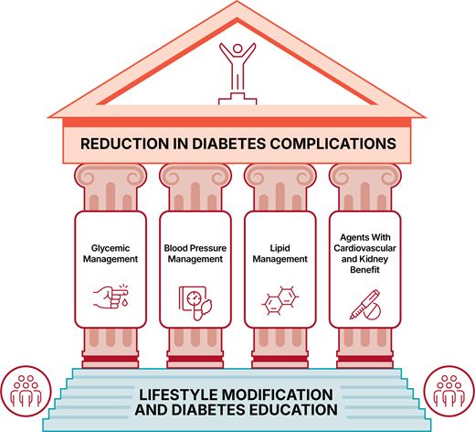

Slide 29

ABC’s of Diabetes - 2025
A1c less than 7% (individualize)
Pre-meal BG 80-130
Post meal BG <180
AGP - Time in Range (70-180) 70% of time
Blood Pressure < 130/80
Cholesterol
Statin therapy based on age & risk status
If 40+ with ASCVD Risk, decrease 50%, LDL <70
If 40+ with ASCVD, decrease 50%, LDL <55
Triglycerides <150, HDL> 40

Slide 30

Discouraged with diabetes
“I don’t check my BG, it’s always high”

Slide 31

It’s Worth IT! You are Worth IT!
Legacy Effect
For participants of DCCT and UKPDS
long lasting benefit of early intensive BG control prevents
Macrovascular complications
42% reduction in CV disease
57% reduction in nonfatal MI, Stroke or CVD death
Microvascular complications
Even though their BG levels increased over time
Message – Catch early and
Treat aggressively

Slide 32

Clinical Inertia Happens
Reassess every 3-6 months
CV guidelines are for Type 1 and Type 2 nonpregnant Adults
For Peds, see Level 2 - Standard 14: Children and Adolescents Course

Slide 33
ADA 2025 Summary
A1c less than 7% (individualize)
Pre-meal BG 80-130
Post meal BG <180
Time in Range (70-180) 70% of time
Blood Pressure
<130/80
Cholesterol
Statin therapy based on age & risk status
If 40+ with ASCVD Risk, decrease LDL by 50%, LDL <70
If 40+ with ASCVD, decrease LDL by 50%, LDL <55

Slide 34
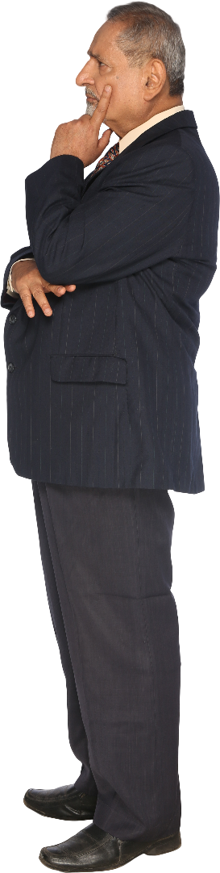
AR with Type 2 in Clinic
62 yrs old, A1c 10.6%.
100 units glargine plus metformin 1000mg BID.
BMI 39, B/P 138/78
LDL 148, Trig 282
UACR 319 mg/g, GFR 49
Other Meds: atorvastatin 20mg, metoprolol, fluticasone propionate
Daily habits / Hx
Mostly sedentary, takes care of mom
Dad died at 53 of MI
BMI was 43 last year
Skips meds sometimes
Sleep 5-6 hours a night
Doesn’t drink, smokes ½ pack a day
Eats fast food 4-6 times a week

Slide 35
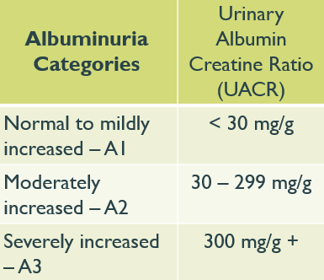
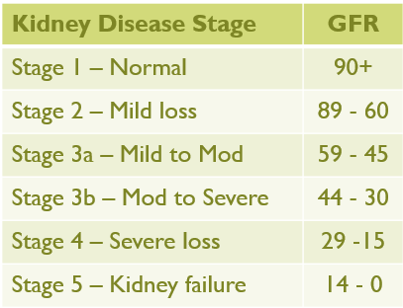

ADA 2025 Standard 11 - Chronic Kidney Disease and Risk Management
Optimize BG and BP to protect kidneys
Screen Urine Albumin Creatinine ratio (UACR) & GFR
Type 2 at dx then yearly
Type 1 with diabetes for 5 years, then yearly
If urinary albumin ≥300 and GFR 30–60 monitor 1-4 times a year to guide therapy.
Treat hypertension with ACEI or ARB and for elevated albumin-to-creatinine ratio of 30 -299.
Monitor serum creat and K+
if on ACE, ARB or diuretics

Slide 36

Reducing Vascular Risk Factors For Type 1 and Type 2
Modifiable
Sleep
Smoking
Oral Care
Weight
Dietary Habits
Glucose
Blood Pressure
Lipids
UACR
Make small, achievable goals. We are in this for the long run.

Slide 37
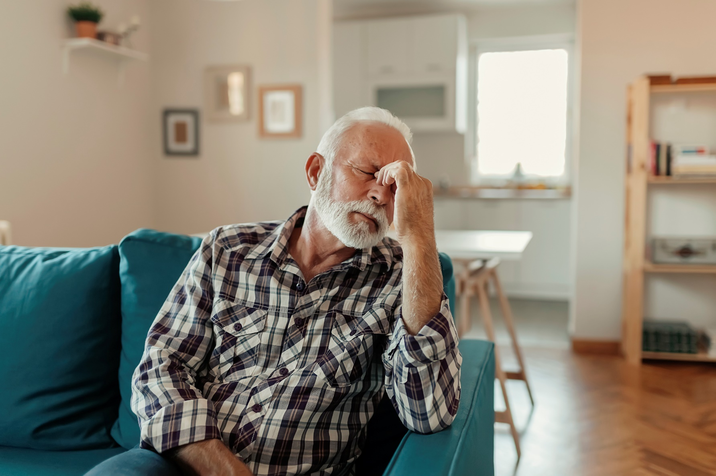
Where do We Start?
Get at least 7 hours of sleep a night – Check for sleep apnea

Slide 38
Poll Question 4
Which of the following is the best recommendation to protect cardiovascular health?
A. Avoid all fast foods
B. Stop smoking
C. Keep B/P as low as possible
D. Eliminate sugar from diet

Slide 39
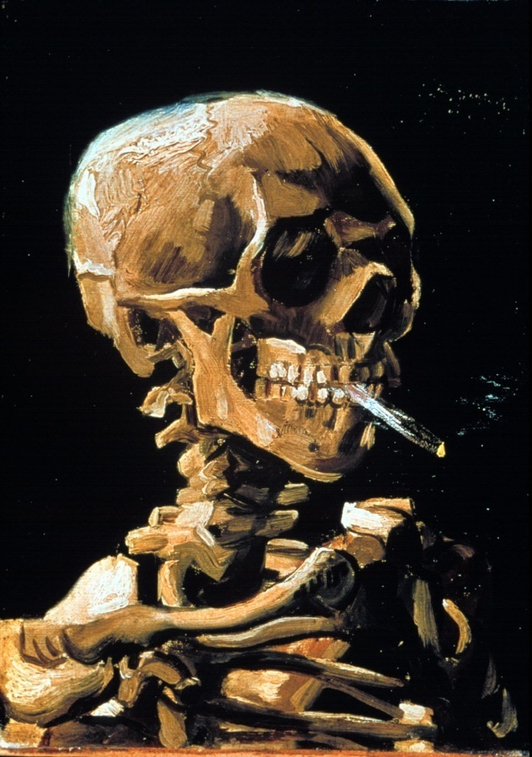
Smoking and Diabetes
Smoking and Diabetes
Smoking increases risk of diabetes 30%
Ask at every visit
Assess
Advise
Assist with stop smoking
Arrange for referrals
Organize your clinic

Slide 40

DASH Diet – Dietary Approaches to Stop Hypertension
The DASH diet emphasizes vegetables, fruits and low-fat dairy foods — and moderate amounts of whole grains, fish, poultry, nuts.
Pt recommendations
Eat lots of whole grains, fruits, vegetables and low-fat dairy products.
Also includes some fish, poultry and legumes, and encourages a small amount of nuts and seeds a few times a week.
Red meat, sweets and fats in small amounts.
Focus on low saturated fat, cholesterol, total fat.

Slide 41
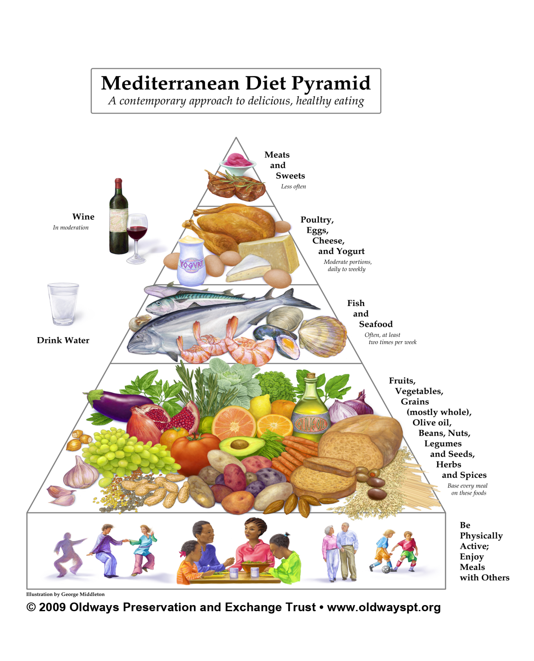
Mediterranean Diet Pyramid

Slide 42

Benefits of Exercise and Diabetes
Increase muscle glucose uptake 5-fold
Glucose uptake remains elevated for 24 - 48 hours (depending on exercise duration)
Increases insulin sensitivity in muscle, fat, liver.
Reduce CV Risk factors (BP, cholesterol, A1c)
Maintain wt loss
Contribute to well being
Muscle strength
Better physical mobility

Slide 43
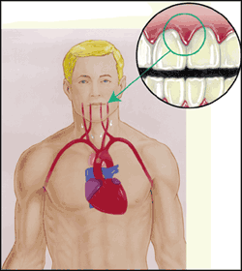
Periodontal disease and Heart Disease
Heart disease link:
oral bacteria enter the blood stream, attach to fatty plaques in coronary arteries increasing clot formation
inflammation increases plaque build up, which may contribute to arterial inflammation
Hyperglycemia = Gingivitis = Heart Disease
Preventive Action
Brush twice daily
Floss daily
See dental team a few times a year

Slide 44
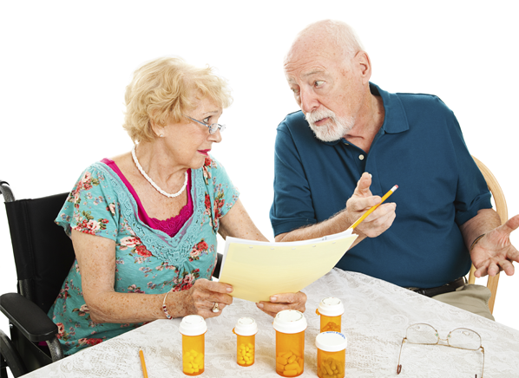
Medication Taking Behaviors
Check in with medication taking behaviors before suggesting adjustments.
Adequate medication taking is defined as 80%
Barriers to taking meds include:
Forgetting to fill Rx, fear, depression, health beliefs, medication complexity, cost, system factors, etc.
Work on targeted approach for specific barrier

Slide 45
AR with Type 2 in Clinic
Behavior Changes Goals collaboration:
Walk after dinner 3 times a week
Eat fast food 3 times a week
Make appointment with RD/ DSME
Take medications everyday
Consider starting varenicline to decrease smoking
Daily habits / Hx
Mostly sedentary, takes care of mom
Dad died at 53 of MI
BMI was 43 last year
Sleep 5-6 hours a night
Doesn’t drink, smokes ½ pack a day
Eats fast food 4-6 times a week
62 yrs old, A1c 10.6%.
100 units glargine plus metformin 1000mg BID.
BMI 39, B/P 138/78
LDL 148, Trig 282
UACR 319, GFR 49
Other Meds: atorvastatin 20mg, metoprolol, fluticasone propionate

Slide 46

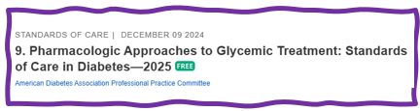
Section 9 Updates - Pharmacologic Approaches to Glycemic Treatment
Updated Algorithm for Oral Meds and Insulin Therapy
More attention to whole person approach to diabetes management.
Consider CVD, Heart failure and CKD when choosing diabetes medication

Slide 47
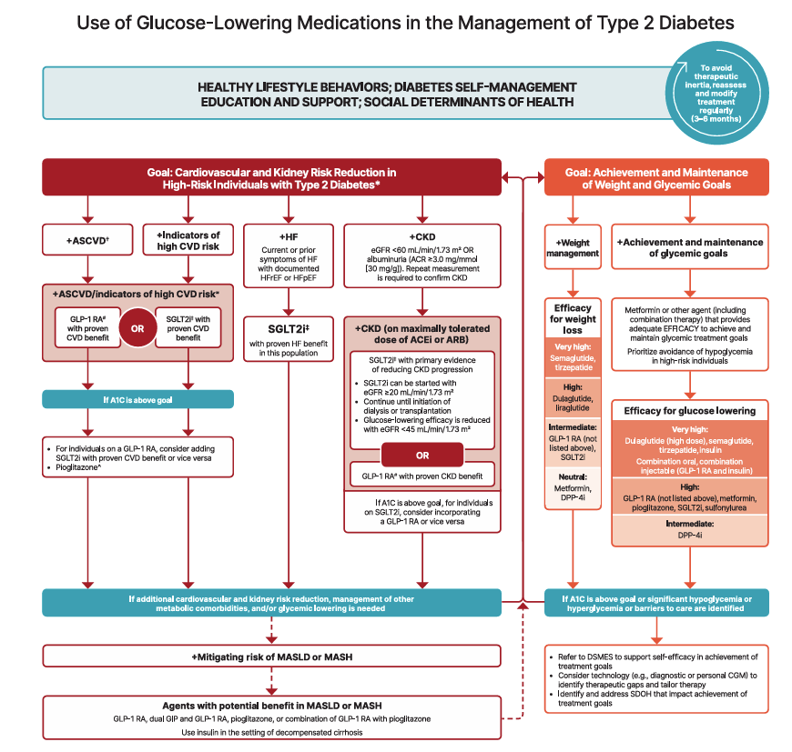

Slide 48

AR with Type 2 in Clinic
62 yrs old, A1C 10.6%.
100 units glargine plus metformin 1000mg BID.
BMI 39, B/P 138/78
LDL 148, Trig 282
UACR 319, GFR 49
Other Meds: atorvastatin 20mg, metoprolol, fluticasone propionate
What class of meds is AR on?
Any meds missing?

Slide 49
Meds -AR with Type 2 in Clinic
62 yrs old, A1c 10.6%.
100 units Glargine plus metformin 1000mg BID.
BMI 39, B/P 138/78
LDL 148, Trig 282
UACR 319, GFR 49
Other Meds: atorvastatin 20mg, metoprolol, fluticasone propionate
What class of meds?
Insulin
Biguanide
Statin
Beta blocker for?
Any med(s) missing?
CV and renal protection
Glucose improvement
BP improvement

Slide 50
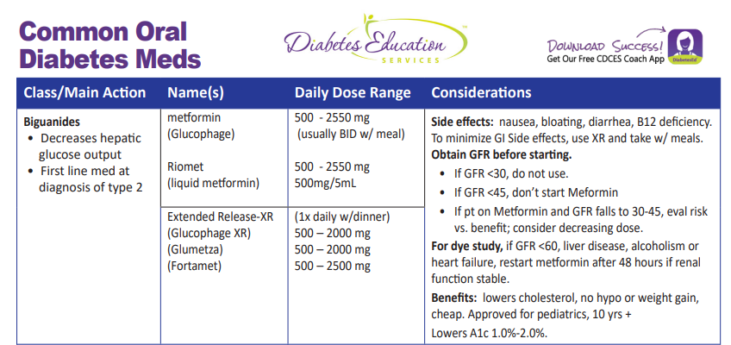

Slide 51
High Risk or Establish CVD, CKD, HF

Slide 52

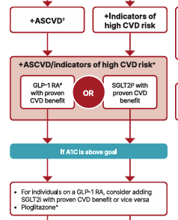
Atherosclerotic Cardiovascular Disease
ASCVD risk
Established CV disease
High CV Risk
55+ with 2 or more risk factors
Risk factors include obesity, HTN, dyslipidemia, albuminuria, smoking
Most effective meds based on Cardiovascular Outcomes Trials (CVOT)
SGLT2i - Empagliflozin (Jardiance), canagliflozin (Invokana), Dapagliflozn (Farxiga)
GLP-1 RAs - Semaglutide (Ozempic), liraglutide (Victoza), dulaglutide (Trulicity), semaglutide (Wegovy)

Slide 53
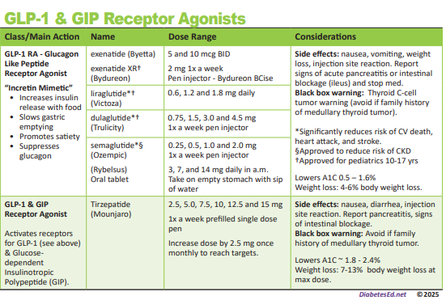
Pocket Card: GLP-1 & GIP RA
Notes:
Update with exenatide indication in pediatrics.

Slide 54
GLP-1/GIP Receptor Agonist Indications
Drug | Lower BG | Kidney Indication | CV Indication | Weight Loss Indication
Exenatide IR (Byetta) Lixisenatide (Adlyxin) Semaglutide (Rybelsus) | Yes | No | No | No
Exenatide ER (Bydureon) | Yes,10 yrs and older | No | No | No
Dulaglutide (Trulicity) | Yes,10 yrs and older | No | Yes | No
Semaglutide (Ozempic) | Yes | Yes | Yes, Ozempic & Wegovy | Yes Wegovy, 12 yrs and older
Liraglutide (Victoza) | Yes,10 yrs and older | No | Yes | Yes Saxenda
Tirzepatide (Mounjaro) | Yes | No | No | Yes, Zepbound
Package inserts, dailymed.nlm.nih.gov
Notes:
Recent clinical trial suggests that the GLP-1 RA semaglutide has beneficial effect on CVD, mortality, and kidney outcomes among people with CKD - recommend that semaglutide be used as another first-line agent for people with CKD”.

Slide 55
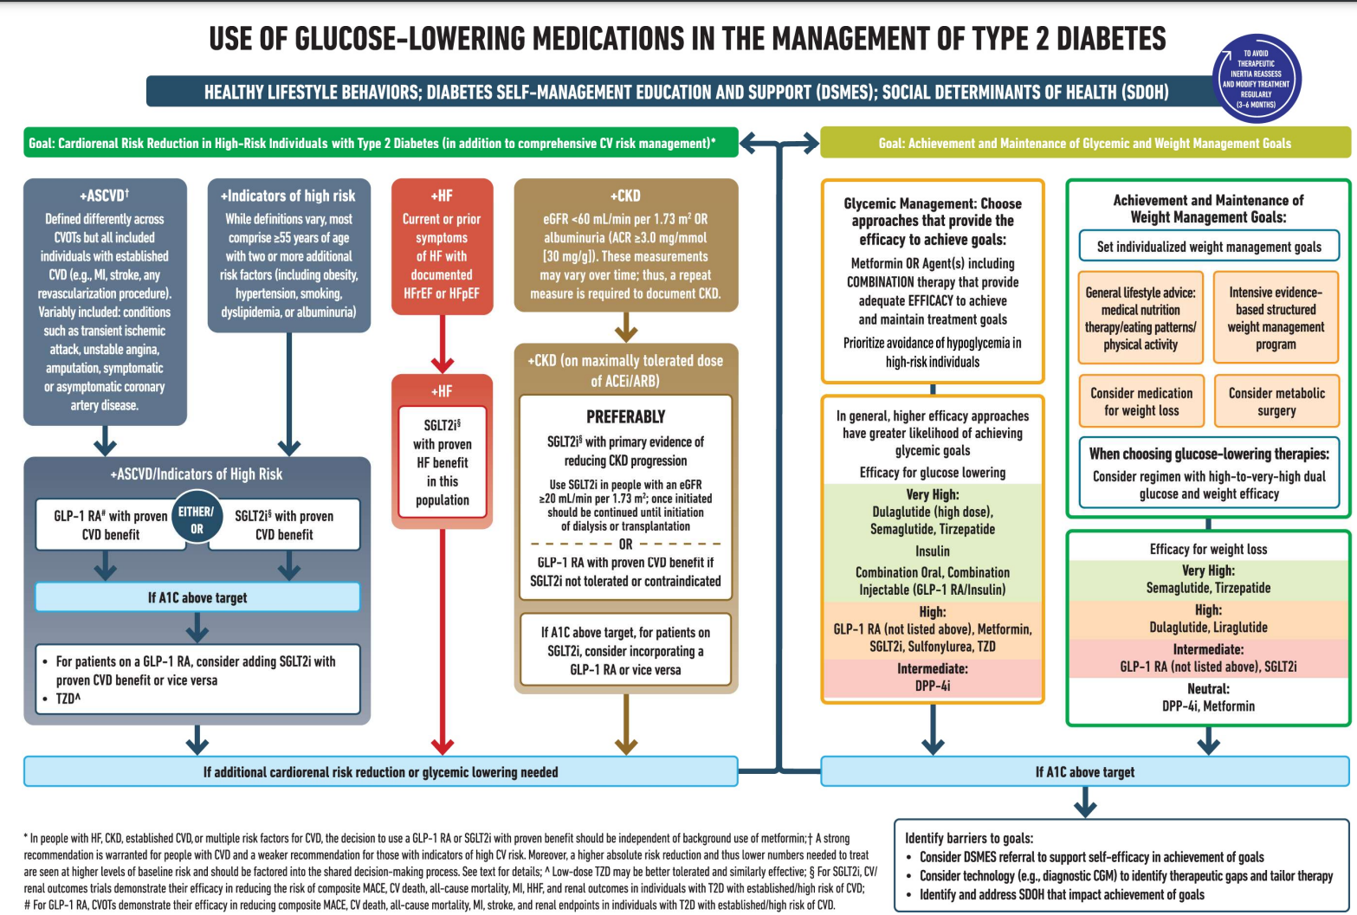

Std 9 - ADA Algorithm: Cardiorenal Protection

Slide 56

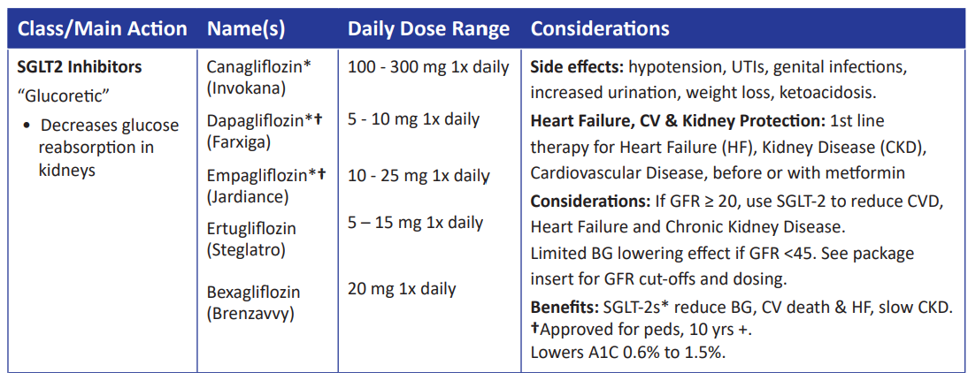
SGLT-2 Inhibitors- “Glucoretics”
Action: decreases renal reabsorption of glucose in the proximal tubule of kidneys (reset renal threshold)
Preferred diabetes treatment for people with heart and kidney failure. Decreases BG & CV Risk
AWP: ~$650 a month
% ‘f
Notes:
56
56

Slide 57

Heart Failure
If HF or reduced Ejection Fraction (rEF) and Left Ventricular Ejection Fraction (LVEF) <45% (all except bexagliflozin)
Empagliflozin and dapagliflozin FDA approved for preserved EF
SGLT-2 inhibitor if eGFR is adequate (>20 to start, may continue until ESRD)
Avoid TZD
If using a DPP4 inhibitor, avoid saxagliptin and alogliptin
Semaglutide beneficial for people with HFpEF and overweight/obesity
Which SGLT2i have proven benefit in this population?
Notes:
All of them

Slide 58
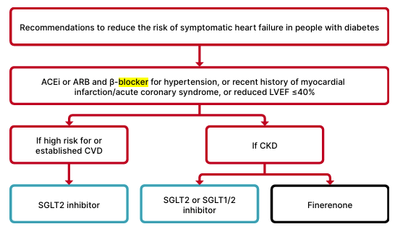
Heart Failure in People with Diabetes

Slide 59
SGLT-2 Inhibitor Indications
Drug | Lowers BG | Reduces CV Risk? | Heart Failure Indication? | Kidney Disease Indication?
Dapagliflozin (Farxiga) | Yes, for 10 yrs and older | Yes | Yes +/- Diabetes | Yes +/- Diabetes
Empagliflozin (Jardiance) | Yes for 10 yrs and older | Yes | Yes +/- Diabetes | Yes +/- Diabetes
Canagliflozin (Invokana) | Yes | Yes | Yes w/ Diabetes | Yes w/ Diabetes
Ertugliflozin (Steglatro) | Yes | No | No | No
Bexagliflozin (Brenzavvy) | Yes | NA | No | No
Package inserts, dailymed.nlm.nih.gov

Slide 60
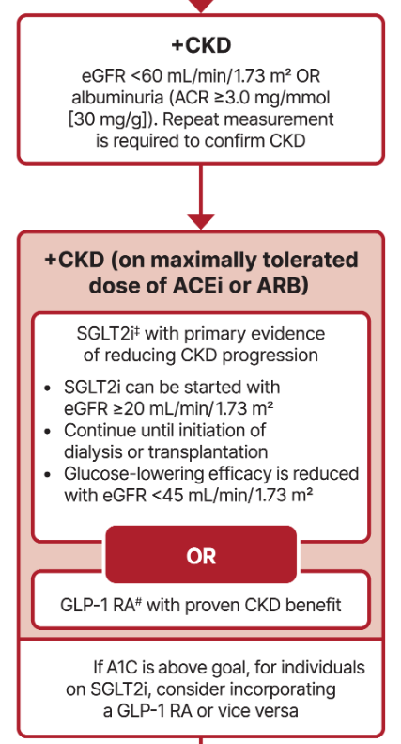
Chronic Kidney Disease
Optimize glucose and BP to protect kidneys.
Use SGLT-2 with demonstrated benefit to reduce CKD and CVD*
To reduce CV risk and CKD, use a GLP-1* with demonstrated benefit.
In people with CKD and albuminuria, a nonsteroidal MRA effective if GFR 25+
Aim to reduce urinary albumin by ≥30% in people with CKD
*SGLT-2i’s
Empagliflozin (Jardiance), canagliflozin (Invokana), dapagliflozin (Farxiga)
*GLP-1 RA’s
Semaglutide (Ozempic), liraglutide (Victoza), dulaglutide (Trulicity)

Slide 61
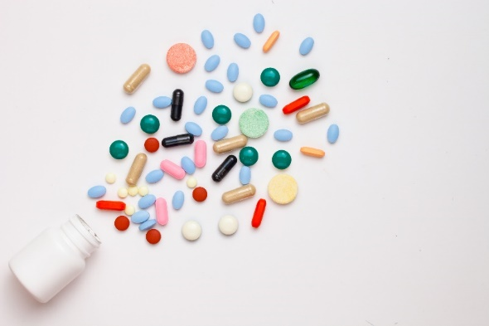
Meds to Protect Kidneys and CVD
Diabetes with a - GFR ≥20 and
Start SGLT2 to reduce chronic kidney disease progression and cardiovascular events.
If type 2 diabetes and established Chronic Kidney Disease (CKD)
Start nonsteroidal mineralocorticoid receptor antagonist (finerenone) and/or GLP-1 RA recommended for cardiovascular risk reduction.

Slide 62
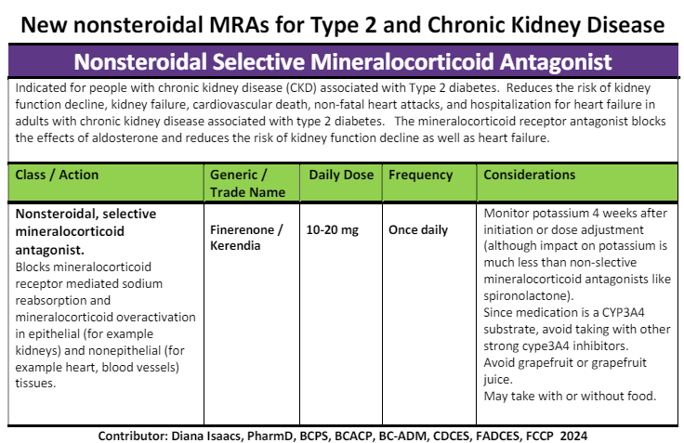
Finerenone
See Diabetes Cheat Sheets – Medications Cheat Sheets

Slide 63

Cardiac and Renal Disease
The combination of 3 comorbidities has been termed cardiorenal metabolic disease or cardiovascular-kidney-metabolic health
ASCVD, heart failure, and chronic kidney disease (CKD)
Recognized interrelationship of cardiometabolic risk factors leading to cardiovascular disease and adverse kidney outcomes in people with diabetes.
3 comorbidities frequently associated with metabolic risk factors & extra weight
Incidence of all three conditions rises with increasing A1C levels.

Slide 64

Diabetes Meds Lower CV Risk
If diabetes plus ASCVD risk factors or history:
SGLT-2s & GLP-1s reduce risk for major CV events
Add ACEi or ARB if hypertension + albuminuria
Statin therapy if 40+
Consider aspirin therapy if 50+
Post MI, continue beta blockers for 3 years.

Slide 65
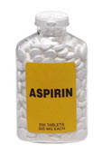
10 - ADA Antiplatelet Agents
Use aspirin therapy (75–162 mg/day) as a secondary prevention strategy in those with diabetes and a history of atherosclerotic cardiovascular disease.
Aspirin therapy dose (75–162 mg/day)
Increased bleeding risk
Dual antiplatelet therapy with a P2Y12 inhibitor for 1 year after acute coronary syndrome and may have benefits beyond
Aspirin may be considered as a primary prevention strategy in diabetes (usually over age 50) with increased CV risk.
Requires comprehensive discussion w/ person on benefits versus increased risk of bleeding.
Aspirin allergy, consider different agent

Slide 66

Poll Question 5
RJ is 62, smokes and has a family hx of early heart attack. According to ADA Standards of Care, what is the blood pressure target for RJ?
A. 120/70
B. 140/90
C. 135 /85
D. 130/80

Slide 67

BP and Diabetes Targets 2025
BP target <130/80 (if it can be safely attained)
Confirm systolic BP ≥ 130 or diastolic BP ≥ 80 using multiple readings, including measurements on a separate day, to diagnose hypertension.
If BP ≥ 180/110, can be diagnosed at single visit
BP target based on individual assessment, shared decision making and potential adverse effects
Monitor BP at home and at each visit
During pregnancy, with previous history of HTN
B/P Target of 110 -135/85

Slide 68

BP Treatment in addition to Lifestyle
First Line BP Drugs if 130/80 +
With albuminuria or CAD
Start either ACE or ARB*
No albuminuria - Any of the 4 classes of BP meds can be used:
ACE Inhibitors, ARBs, thiazide-like diuretics or calcium channel blockers.
Monitor K+/Scr 7-14 days after initiation and dose increase for diuretics, ACEI/ARB
Avoid ACE and ARB at same time
Multiple Drug Therapy often required
If BP ≥ 150 /90 start 2 drug combo
*Albuminuria = Urinary albumin creatinine ratio of 30+

Slide 69
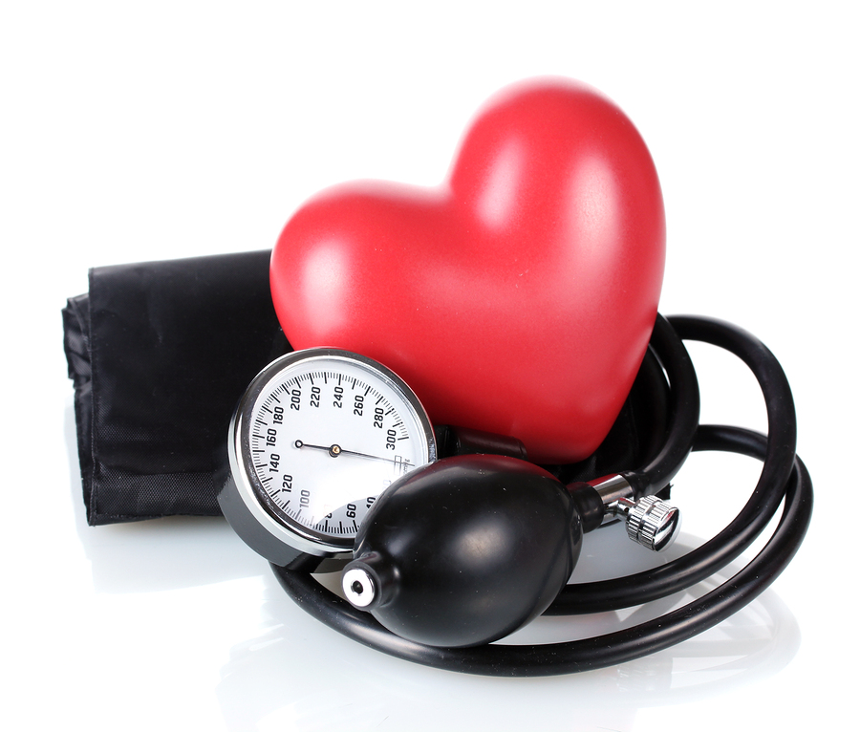
HTN Lifestyle Treatment Strategies
If BP > 120/80, start with lifestyle
DASH Diet
Weight loss if indicated
Sodium intake <2,300mg/day
Eat more fruits & veggies (8-10 a day)
Low fat dairy products (2-3 servings/day)
Limit alcohol 1-2 drinks a day
Increase activity level

Slide 70
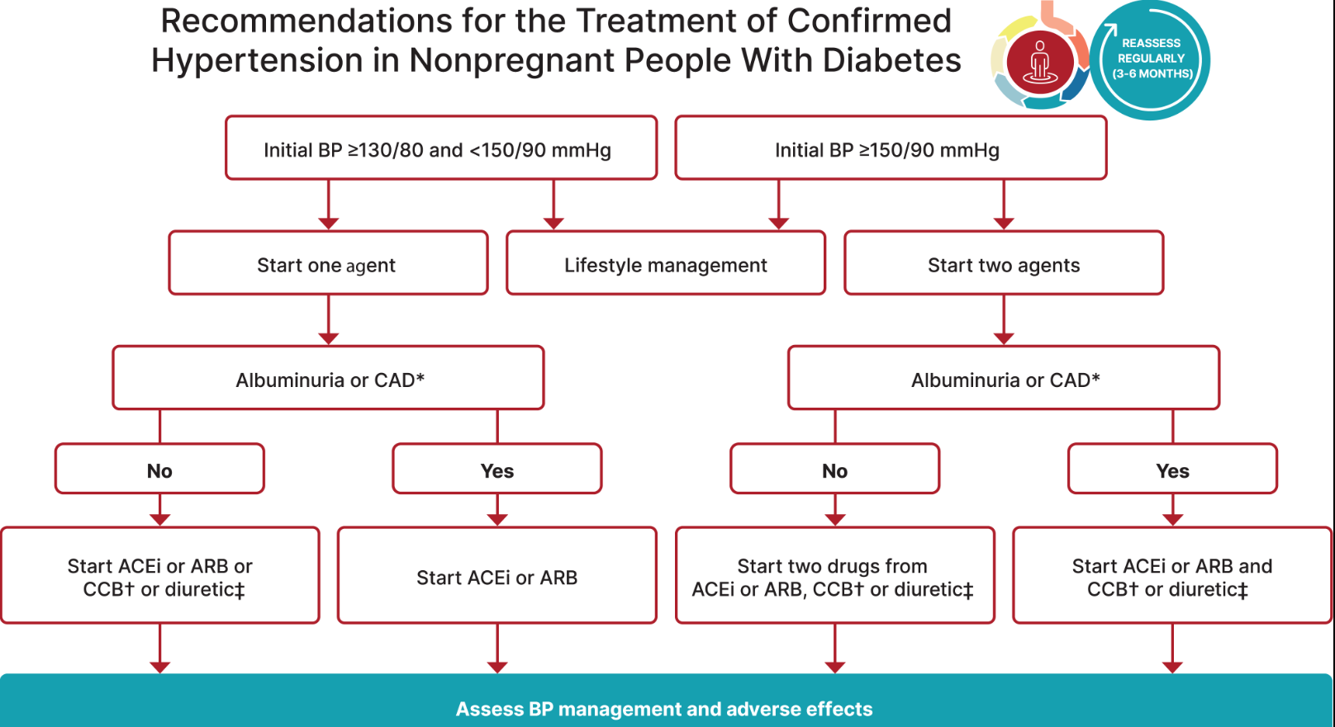
Hypertension Management

Slide 71
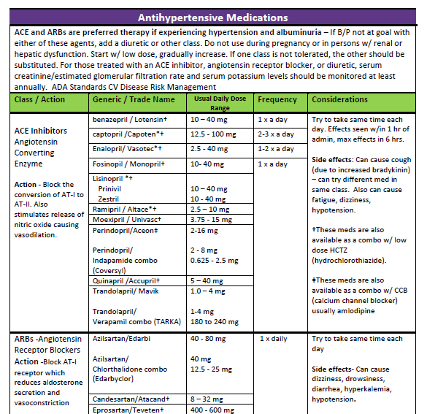
BP & Lipid Meds Cheat Sheet
www.DiabetesEd.net

Slide 72
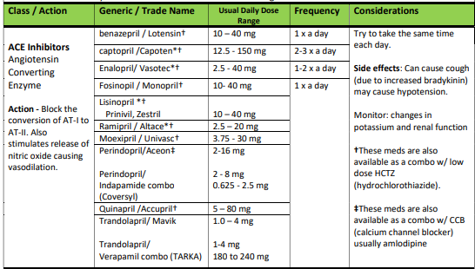
ACE Inhibitors
Initial dose adjustment may be needed for renal dysfunction or elderly
See Med Cheat Sheets

Slide 73
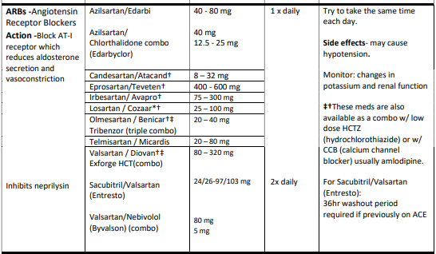
Angiotensin Receptor blockers (ARB’s)
Initial dose adjustment may be needed for renal dysfunction or elderly
Med Cheat Sheets

Slide 74
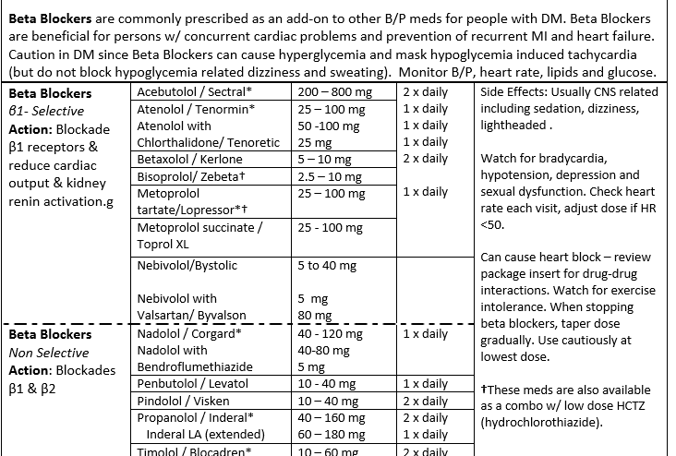
Beta Blockers

Slide 75

AR with Type 2 in Clinic
62 yrs old, A1c 10.6%.
80 units glargine plus metformin 1000mg BID.
BMI 39, B/P 138/78
LDL 148, Trig 282
UACR 319, GFR 49
Other Meds: atorvastatin 20mg, metoprolol, fluticasone propionate
Med adjustments
Added SGLT-2 or GLP-1 RA
Dapagliflozin 10mg
Semaglutide
0.5mg up to 2.0mg (next)
Reduce basal glargine insulin by 10 units if am BG less than 100.
Continue metformin and other meds
Add aspirin 81mg, add ACEi or ARB

Slide 76
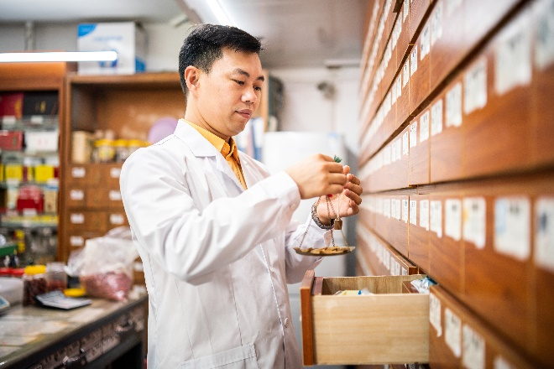
Lipid Goals – Primary Prevention
For people with diabetes aged 40–75:
Higher cardiovascular risk*
(*HTN, Smoke, CKD, BMI 30+ albuminuria, family hx ACSVD)
High-intensity statin therapy is recommended
Reduce LDL cholesterol by at least 50% of baseline AND
Target LDL cholesterol <70 mg/dL.
If LDL cholesterol 70 +
it may be reasonable to add ezetimibe or a PCSK9 inhibitor to maximum tolerated statin therapy.

Slide 77

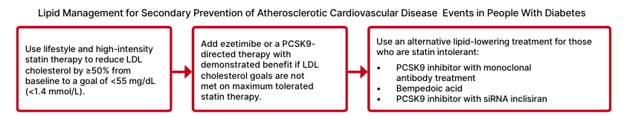
Lipid Goals for People with ASCVD
For people of all ages with diabetes and ASCVD:
Add high-intensity statin to lifestyle therapy.
Reduce LDL cholesterol by 50% or greater from baseline with LDL goal <55.
Addition of ezetimibe or a PCSK9 inhibitor with proven benefit is recommended if goal is not achieved on max tolerated statin therapy.

Slide 78
Statin Dosing
High Intensity:
Lowers LDL ≥50%
Moderate Intensity:
Lower LDL 30-<50%
Lipitor (atorvastatin)
40-80mg
Crestor (rosuvastatin)
20-40mg
Lipitor (atorvastatin)
10-20mg
Crestor (rosuvastatin)
5-10mg
Zocor (Simvastatin)
20-40mg
Pravachol (pravastatin)
40 – 80mg
Mevacor (lovastatin) 40 mg
Lescol (fluvastatin) XL 80mg
Livalo (pitavastatin) 2-4mg
***If person can’t tolerate intended statin dose, use maximally tolerated dose
See Med Cheat Sheets

Slide 79
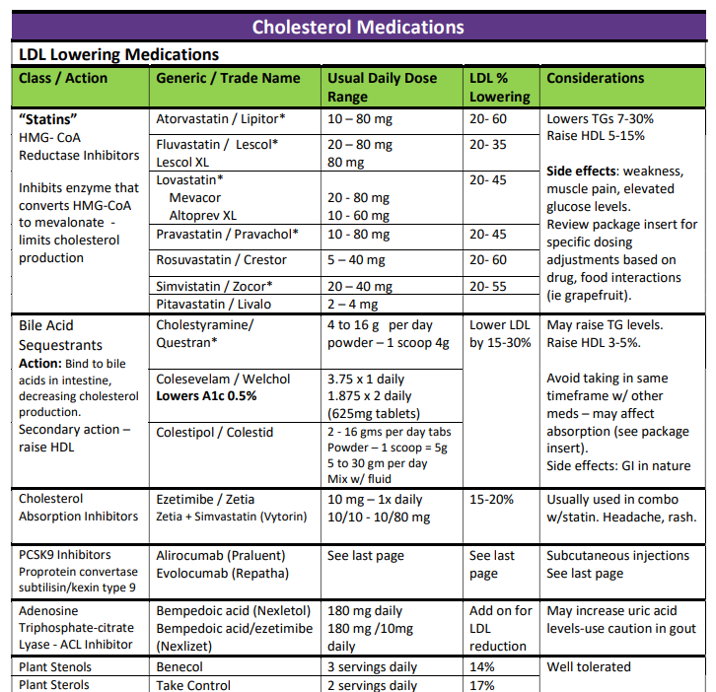
Lipid and Lipid Meds Cheat Sheets
Website: https://diabetesed.net/coach-bevs-diabetes-cheat-sheets/
On CDCES Coach App too
For exam, know major classes, when used, side effects and considerations.

Slide 80

Do Statins Work?
Meta-analyses, including data from over 18,000 people with diabetes from 14 randomized trials of statin therapy (mean follow-up 4.3 years).
Statin therapy demonstrated
9% proportional reduction in all-cause mortality and
13% reduction in vascular mortality for each 39 mg/dL reduction in LDL cholesterol

Slide 81
Lipid Goals for People with ASCVD
For people of all ages with diabetes and ASCVD:
Add high-intensity statin to lifestyle therapy.
Reduce LDL cholesterol by 50% or greater from baseline with LDL goal <55.
Addition of ezetimibe or a PCSK9 inhibitor with proven benefit is recommended if goal is not achieved on max tolerated statin therapy.

Slide 82
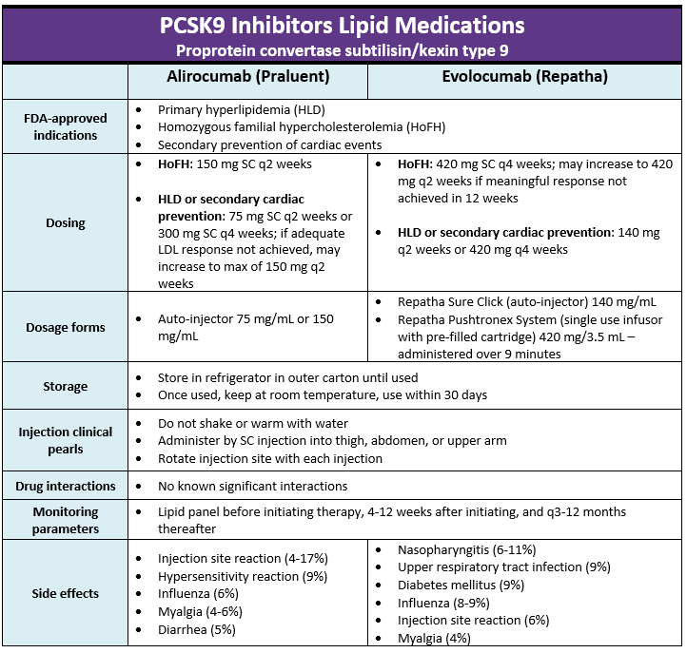
From Meds Cheat Sheet Page – Diabetesed.net

Slide 83
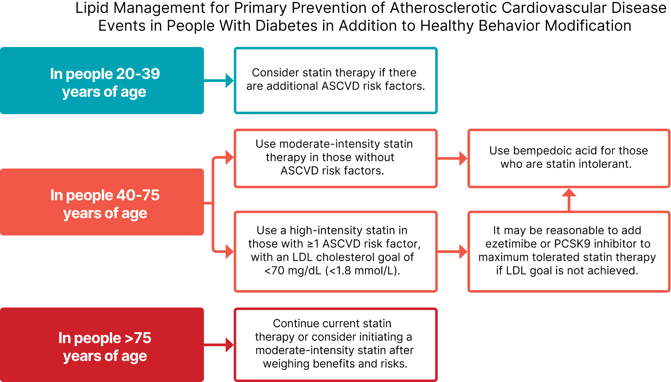

Lipid Therapy for Primary Prevention
75 years or older and already on statin
it is reasonable to continue statin treatment.
75 years or older
it may be reasonable to initiate moderate-intensity statin therapy after discussion of potential benefits and risks.
All ages 20+ with ASCVD, add high-intensity statin to lifestyle
20–39 and additional ASCVD risk factors
may be reasonable to initiate statin therapy in addition to lifestyle.
40-75 years
Moderate to high intensity statin based on risk (see previous slides)
180mg

Slide 84

Poll Question 6
As a Diabetes Specialist in a rural clinic, you are asked to consult on a 49 year old with type 2 diabetes and a BMI of 27. Blood pressure is 133/79 & last visit it was 136/78. Lab values; A1c 7.6%, LDL of 67 mg/di, triglycerides 138 and GFR of 59, UACR of 32mg/gm. Her medications include:
Metformin 850 mg three times a day, levothyroxine 100 mcg a day and cetirizine 10mg daily. According to the ADA Cardiovascular Standards of Care, in addition to lifestyle coaching, what medication therapy needs to be added?
Basal insulin and a statin
Beta blocker or a statin
ACE Inhibitor and a GLP-1 RA
ACE or ARB and SGLT-1i

Slide 85
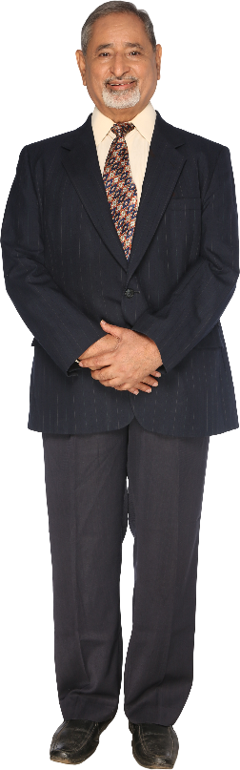
AR with Type 2 in Clinic
62 yrs old, A1c 7.6%
30 units Glargine with metformin 1000mg BID.
BMI 36 B/P 128/84
LDL 123 Trig 172
UACR 212 GFR 58
Original Meds atorvastatin 20mg metoprolol, fluticasone propionate
Original meds
Insulin
Biguanide
Statin
Beta blocker
New meds added
Aspirin
ACEi – lisinopril 20mg
GLP-1 RA and SGLT-2
Semaglutide
Dapagliflozin
Basal insulin reduced to 30 units
Increased atorvastatin to 40mg

Slide 86
ABC’s of Diabetes - 2025
A1c less than 7% (individualize)
Pre-meal BG 80-130
Post meal BG <180
AGP - Time in Range (70-180) 70% of time
Blood Pressure < 130/80
Cholesterol
Statin therapy based on age & risk status
If 40+ with ASCVD Risk, decrease 50%, LDL <70
If 40+ with ASCVD, decrease 50%, LDL <55
Triglycerides <150, HDL> 40

Slide 87

We can Make a Big Difference
What class of meds in this person on?
Insulin
Biguanide
Statin
Beta blocker for arrythmias
Basal insulin reduced to 30 units
New meds added
Aspirin
GLP-1 RA and SGLT-2
Semaglutide (Ozempic)
Dapagliflozin (Farxiga)
ACE inhibitor
62 yrs old, A1c 7.2%
30 units Glargine with metformin 1000mg BID.
BMI 36 B/P 128/78
LDL 103 Trig 172
UACR 212 GFR 58
Other Adjust Needed?:
Increase atorvastatin
Meet with RD/RDN
Started varenicline
We can make a difference in moving care forward.
Through behavior change coaching and advocating for best care, we can decrease risk.

Slide 88



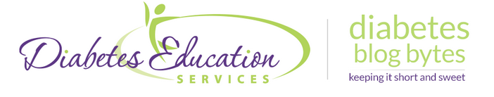
Keep in Touch
Facebook: https://www.facebook.com/DiabetesEducationalServices
Twitter: https://twitter.com/CDCESCoach
Instagram: https://www.instagram.com/cdcescoach/
Linked In: https://www.linkedin.com/in/beverlythomassian/
Monthly Newsletter: https://diabetesed.net/monthly-newsletter-past-issues/
Sign up for Blog Bytes – Question of Week: https://diabetesed.net/diabetes-blog-bytes-sign-up/

Slide 89

Thank You
Thank you!
Questions?
Email info@diabetesed.net
Web www.DiabetesEd.net
Phone 530-893-8635

