Slide 1

Standard 14: Children and Adolescents 2025
Beverly Thomassian, RN, MPH, BC-ADM, CDCES
Pronouns: She, her, hers
www.DiabetesEd.net
Notes:
Add comparative effectiveness of slgt2 inhibitors
Add sotagliflozin slide.
add pocket card: bromocriptine/colsevelam-slide 212
Am I slides 205-207?

Slide 2
Land Acknowledgment
We acknowledge and are mindful that Diabetes Education Services stands on lands that were originally occupied by the first people of this area, the Mechoopda, and we recognize their distinctive spiritual relationship with this land, the flora, the fauna, and the waters that run through this area.

Slide 3


We are Here to Help!
Bryanna Sabourin
Director of Operations
Tiffany Bergeron
Customer Advocate &
Customer Happiness Expert
If you have questions, you can chat with us at www.DiabetesEd.net or call 530 / 893-8635 or email at info@diabetesed.net

Slide 4

Diabetes Education Services Inclusion Statement
Based on the IDEA Initiative inspired by CDR
Inclusion
Diversity
Equity
Access
We are committed to promoting diversity and inclusion in our educational offerings.
We recognize, respect, and include differences in ability, age, culture, ethnicity, gender, gender identity, sexual orientation, size, and socioeconomic characteristics.
Our goal is to promote equity and access, acknowledging historical and institutional inequities.
We are committed to practicing cultural humility and cultivating our cultural competence.
We wish to create a safe space within our community where one's beliefs, experiences, identity, and differences in ability, age, size, socio-cultural/socioeconomic characteristics, and political affiliations are considered and respected.

Slide 5
Coach Bev has no Conflict of Interest
She’s not on any speaker's bureau
Does not invest or have any financial relationships with diabetes related companies.
Gathers information from reading package inserts, research and articles
The ADA Standards of Medical Care is main resource for course content

Slide 6


References

Slide 7

Diabetes Management – Children & Adolescents Topics
Discuss the goals of care for Peds with Type 1 and Type 2 with Diabetes
State strategies to prevent acute and chronic complications
Describe actions to minimize acute and chronic complications
Discuss the importance of positive psychosocial adjustment and resources

Slide 8

Support is Critical
Self-management in pediatric diabetes involves both the youth and their parents/adult caregivers.
No matter how sound the medical regimen is, it can only be effective if the family and/or affected individuals are able to implement it.

Slide 9
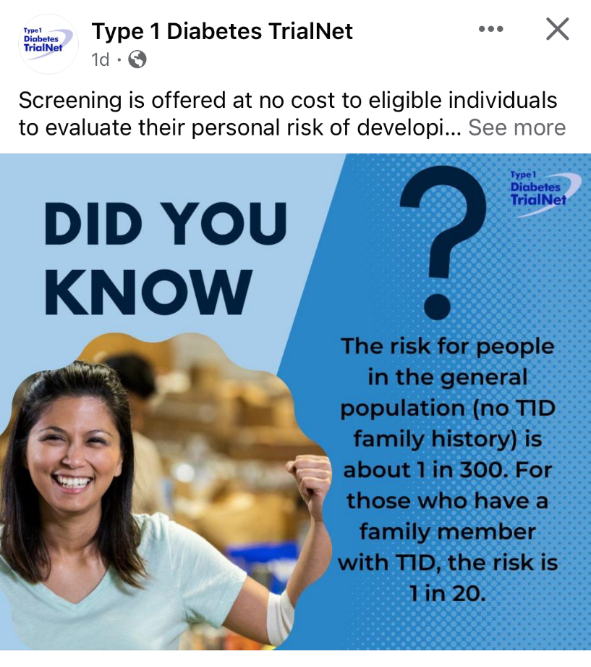

Type 1 ~ Immune Mediated 5-10% of Diabetes
1.5 Million people have type 1 in U.S.
Prevalence increasing:
2001 – 1.48 per 1000 youths diagnosed with diabetes
2017 - 2.15 per 1000 youths diagnosed with diabetes
Incidence & Prevalence increasing
Highest incidence in Finland or Northern Europe.
ADCES In Practice - March 2024 Recent Advances in Type 1 Diabetes: Teplizumab (Tzeild®)
Karen S. Fiano, PHARMD, BCACP, Devada Singh-Franco, PHARMD, CDCES, Young M. Kwon, BS, PHD

Slide 10

Type 1 or Type 2?
Distinguishing between type 1 and type 2 diabetes in children can be difficult.
Excess weight is common in children with type 1 diabetes
autoantibodies and ketosis may be present in pediatrics with features of type 2 diabetes (including excess weight and acanthosis nigricans)
Positive islet autoantibodies is associated with faster progression to insulin deficiency
With new type 2 diabetes in youth (10-19) DKA occurs in ∼11% of youth

Slide 11

Poll Question 1
JR’s mom has type 1 diabetes and JR’s dad has type 2 diabetes. JR is 17 years old and in the emergency room with a glucose of 482 mg/dl. Besides checking glucose, ketones and A1C levels, which of the following lab test can be used to determine if someone has autoimmune diabetes?
Endogenous insulin titer
Glutamic Acid Decarboxylase
Beta cells auto antibodies
Langerhan’s antibody

Slide 12


How do we know a child has Type 1 vs Type 2?
Type 1 - Positive antibodies
GAD - glutamic acid decarboxylase (primary)
IA2 - islet antigen 2, or
ZnT8 - zinc transporter 8
Can also check C-peptide levels to determine endogenous insulin production
Younger people develop quickly
Older people take longer to develop

Slide 13

Determine if Type 1 - Use AABBCC Approach
Age
e.g., for individuals <35 years old, consider type 1 diabetes
Autoimmunity
e.g., personal or family history of autoimmune disease or polyglandular autoimmune syndromes
Body habitus
e.g., BMI <25 kg/m2
Background
e.g., family history of type 1 diabetes
Control
e.g., level of glucose control on noninsulin therapies
Comorbidities
e.g., treatment with immune checkpoint inhibitors for cancer can cause acute autoimmune type 1 diabetes or presence of other autoimmune conditions

Slide 14

Type 1 – 10% of all Diabetes
Immune mediated pancreatic beta cells destruction
75% new cases diagnosed < age 18
Most commonly expressed during puberty, age 10 – 14
30% of new diagnosis present in DKA
Insulin sensitive (require 0.5 - 1.0 units/kg/day)
Expression due to a combo of genes and environment:
Autoimmunity tends to run in families
Exposure to virus or other environmental factors
14
Diagnostic Criteria for Diabetes
Notes:
When you get to the insulin piece, please mention we will get into great detail about insulin in the pharmacotherapy module

Slide 15

Poll Question 2
Which factor would most make you suspect type 1 diabetes?
a. Enuresis
b. Presents with low HDL cholesterol
c. Friend tells you she has been eating "tons of sweets“
d. Reports vivid dreams

Slide 16

Signs of Type 1 Diabetes
Sudden onset of nighttime bedwetting
Weight loss, thirst, hunger
May present in DKA
Fruity breath
Hypothermic
Poor skin turgor
“Out of it”
Ketone positive (blood or urine)
Other

Slide 17


Type 1 Diabetes Features?
For JR, a 17 admitted to the ICU with a blood glucose of 476 mg/dl, pH of 7.1, anion gap of 15. Recently lost 13 pounds.
Type 1 Most Discriminative Features
Younger than 35 years at diagnosis
Lower BMI (<25 kg/m²)
Unintentional weight loss
Ketoacidosis
Glucose 360 mg/dl or greater.

Slide 18

Type 1 Diabetes Progression
 | Stage 1 | Stage 2 | Stage 3
Characteristics | • Autoimmunity | • Autoimmunity | • Autoimmunity
 | • Normoglycemia | • Dysglycemia | • Overt hyperglycemia
 | • Presymptomatic | • Presymptomatic | • Symptomatic
Diagnostic criteria | • Multiple islet autoantibodies GAD, glutamic acid decarboxylase (primary) islet antigen 2, or Zinc transporter 8 (ZnT8) | • Islet autoantibodies Dysglycemia: Elevated IFG and/or IGT • FPG 100–125 mg/dL • 2-h PG 140–199 mg/dL • A1C 5.7–6.4% or ≥10% increase in A1C | • Autoantibodies may disappear over time (5-10% may not express antibodies) • Diabetes diagnosed by standard criteria
www.DiabetesEd.net

Slide 19
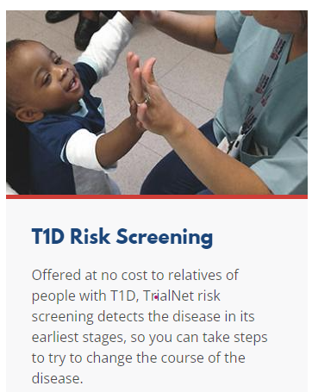
3. Prevention or Delay of Diabetes and Associated Comorbidities (for Preclinical Type 1 Diabetes)
Positive Antibodies with Prediabetes:
A1c 5.7 – 6.4% or fasting BG 100 -125mg/dl
Action:
Screen A1C every 6 months
75- OGTT every year
Modify screening based on antibodies and glycemic metrics.
May benefit from CGM to monitor progression
Trialnet.org

Slide 20
Type 1 & Lifestyle Prevention
Observational studies in those with antibodies, shed light on factors that increase β-cell demand:
Less physical activity
Consuming higher glycemic index foods
Sugar intake.
Factors that reduced risk of progression from TEDDY study:
Daily minutes spent doing vigorous physical exercise.
More info needed

Slide 21

Pharmacologic Intervention to Delay Symptomatic Type 1 (in Stage 2)
Teplizumab CD3-monoclonal antibody
14-day infusion can delay the onset of symptomatic type 1 diabetes (stage 3)
An option in selected individuals aged ≥8 years with stage 2 type 1 diabetes.
In a single trial, 44 individuals received 14-day course of teplizumab vs 32 placebo.
The median time to stage 3 diagnosis of type 1
48.4 months in tep group
24.4 months placebo
Cost: $193,000
Provention Bio has financial assist programs.

Slide 22
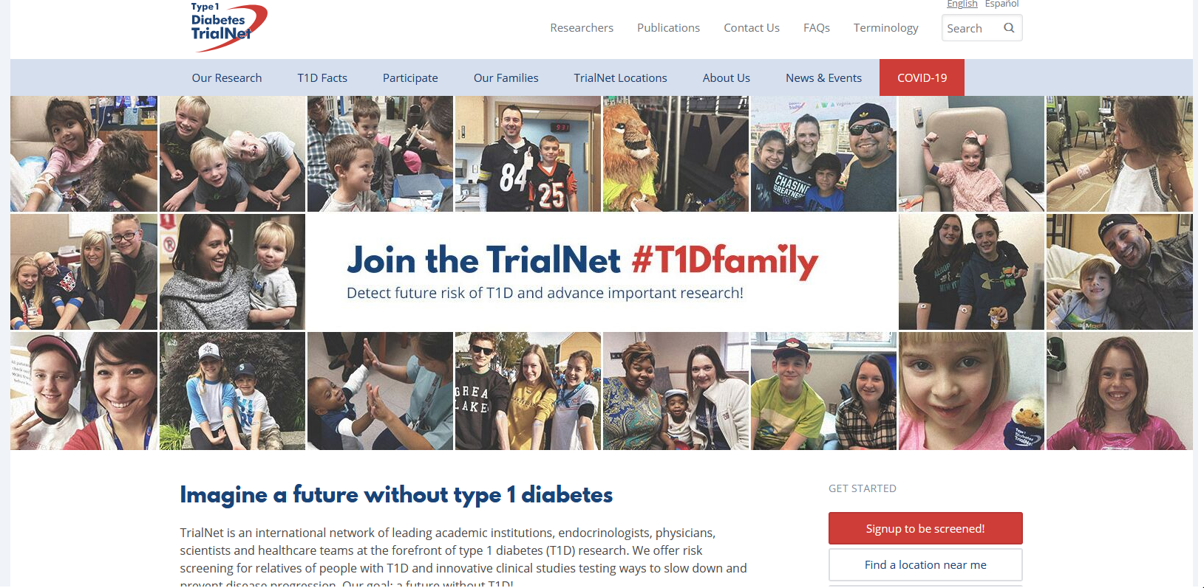
Type 1 (stage 2) Delayed with Teplizumab by 2 years www.DiabetesTrialNet.org
How to get families linked to screening?

Slide 23

Case Study
10-year-old female goes to Emergency Room, since mom suspected new diabetes. Based on ED report:
Blood glucose levels 500+ in ED
Urine ketones positive
Body weight 108 lbs
Family history
One parent has type 2
Uncle, older sister have type 1
No ATB results yet
Born in Mexico
Treatment?

Slide 24

Poll Question 3
A 10-year-old comes to ER with symptoms of new hyperglycemia and an A1c of 8.7% and positive urine ketones. What is most important initial treatment?
A. Insulin therapy
B. Try changes in diet immediately
C. Start exercise program STAT
D. Start a GLP-1 RA

Slide 25
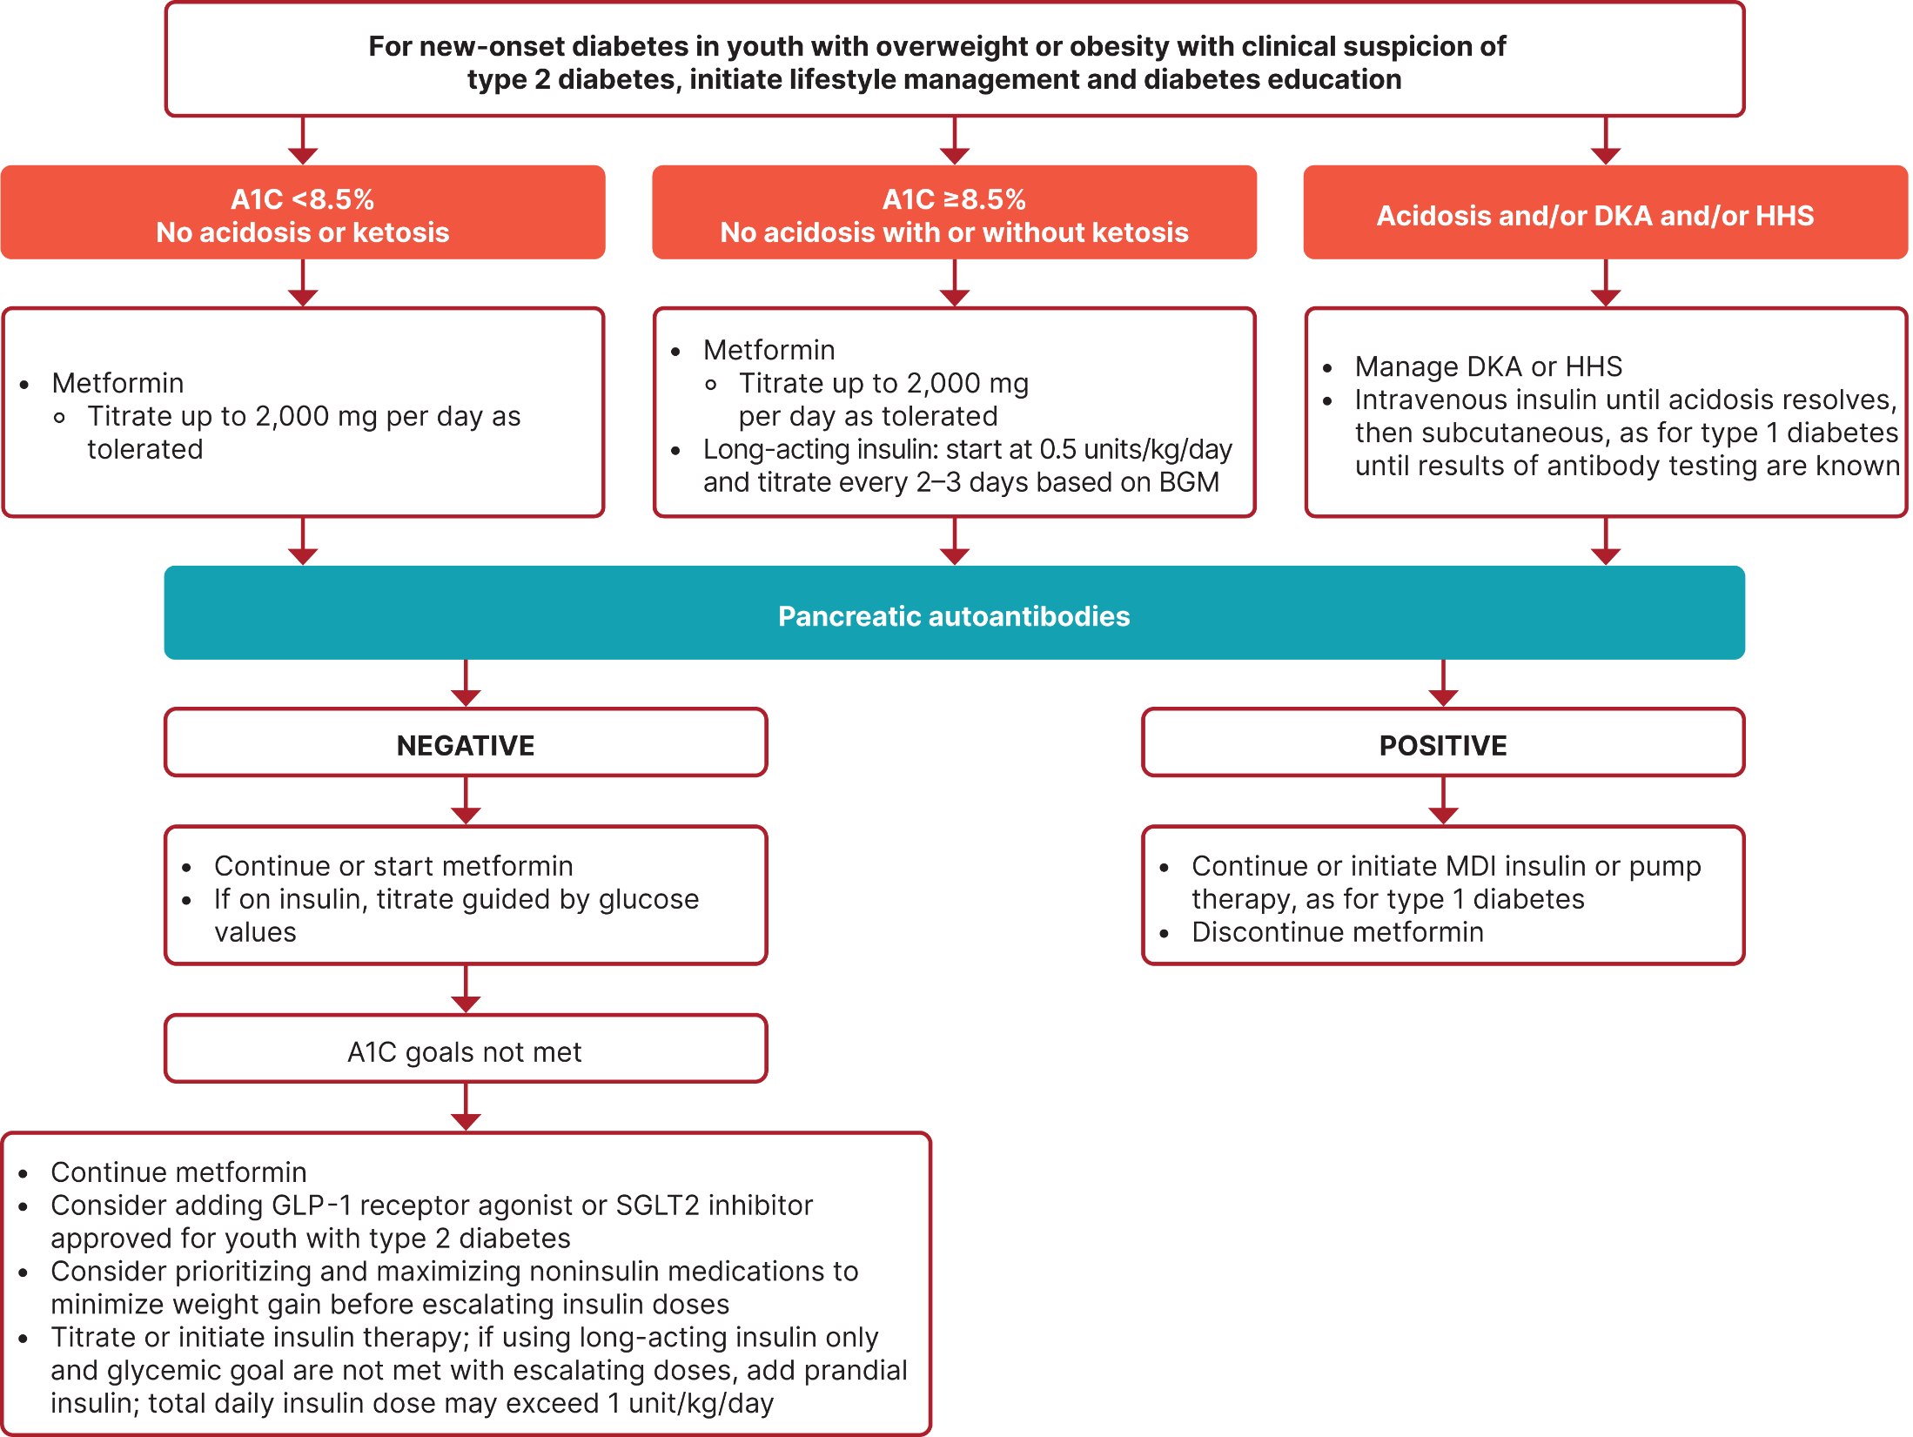


Slide 26
Case Study
10-year-old female goes to Emergency Room, since mom suspected new diabetes. Based on ED report:
Blood glucose levels 500+ in ED
Urine ketones positive
Body weight 108 lbs
Family history
One parent has type 2
Uncle, older sister with type 1
GAD, IA2 antibodies positive
Treatment
22 units basal at HS
1:7 carb ratio

Slide 27
Poll Question 4
How would you definitively differentiate between type 1 and type 2 diabetes?
A. Body weight at presentation
B. Positive ketone bodies
C. Autoantibody testing
D. Absence of acanthosis nigricans

Slide 28

Pediatric A1C Goals for Type 1 - Individualize
A1C of <7% appropriate for many peds.
A1C of <6.5% for selected individuals
<7.5% if cannot articulate symptoms of hypoglycemia or at high risk
<8.0% may be appropriate for some
If using CGM, evaluate Time in Range – no standard goal at this time.
• Individualize Goals ~ minimize hyper/hypo glycemia and keep safe
• Blood glucose goals are higher in children with frequent hypoglycemia or hypoglycemia unawareness.
• Measure postprandial blood glucose when there is a discrepancy between preprandial blood glucose values and A1C levels
Notes:
These goals apply to all pediatric age groups
28
References
American Diabetes Association. Standards of medical care in diabetes—2014. Diabetes Care 2014;37(suppl 1):S50
Seaquist ER, Anderson J, Childs B, et al. Hypoglycemia and diabetes: a report of a workgroup of the American Diabetes Association and The Endocrine Society. Diabetes Care 2013;36:1384–1395
Wysocki T, Harris MA, Mauras N, et al. Absence of adverse effects of severe hypoglycemia on cognitive function in school-aged children with diabetes over 18 months. Diabetes Care 2003;26:1100–1105
Blasetti A, Chiuri RM, Tocco AM, et al. The effect of recurrent severe hypoglycemia on cognitive performance in children with type 1 diabetes: a metaanalysis. J Child Neurol 2011;26:1383–1391
Cooper MN, O’Connell SM, Davis EA, Jones TW. A population-based study of risk factors for severe hypoglycaemia in a contemporary cohort of childhood-onset type 1 diabetes. Diabetologia 2013;56:2164–2170

Slide 29

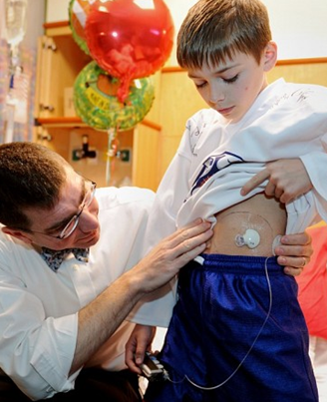
Strategies for Type 1 Management
Initiate intensive insulin regimens, either via multiple daily injections or insulin pump
Monitor BG with monitor or CGM up to 10 times daily including premeal, post meal, pre bedtime, and as needed for safety
Offer CGM as soon as possible for youth using insulin
Offer Automated insulin delivery (AID) systems to youth with type 1 diabetes who are capable of using the device safely (or with caregiver help)

Slide 30

Insulin Dosing
Younger children
Dose may be low during honeymoon period
After honeymoon – dose is 0.5 – 1.0 unit/kg/day
Basal / bolus combo
If difficulty injecting bolus at lunch, consider NPH pre breakfast
Pubertal hormones increase insulin required
up to 1.5 units/kg/day
Keep it flexible, may need to inject after meals
Insulin pump therapy coupled with CGM recommended

Slide 31

Insulin
Needle phobias common
Try pens, pumps, Auto Injectors
Needles
31 gauge short or mini needles
Use smallest barrel possible (ie 30 unit syringe)
Use ½ unit increment pens / syringes
Sites –
Young children: legs, arm, buttocks
School age can also use abdomen

Slide 32

Type 1 Nutrition Goals
Individualized medical nutrition therapy as an essential component treatment plan.
Monitor carbohydrate intake
by carbohydrate counting or experience-based estimation.
Apps can be helpful
Comprehensive MNT
At diagnosis, with annual updates
By experienced registered dietitian nutritionist
assess caloric and nutrition intake in relation to weight status
Eval cardiovascular disease risk factors to inform macronutrient choices.
Foster a positive relationship with food

Slide 33

Special Issues for Type 1

Slide 34

Infant and Toddler (birth to 2 years)
toddlers begin to separate, individuate
require lots of sleep and naps
3-4 hour feeding schedule - regular nighttime feedings very important
Lispro/aspart or used after meals
Aspart (Fiasp) & lispro aabc (Lyumjev) insulin also approved after 2 years of age
At risk for dehydration during illness, notify MD

Slide 35

Infant and Toddler Educational Approaches
Education directed toward parents/primary caregivers
Provide child with limited choices
teach parents signs of hypoglycemia
pallor, listlessness, crying, clammy skin, sleepy, hunger, restless, shakiness

Slide 36

Preschool children (3 - 5) Educational Approaches
Engage in magical thinking
play therapy helpful to express concerns
Concerned about intactness of body
Reassure them that body will remain intact, use Band-Aids after injection
Give limited choices
Would you like your injection on your right side or left side?
Can identify s/s hypo and alert adults
Provide education to staff in preschool/daycare

Slide 37

Diabetes and Rights
The Individuals with Disabilities Education Act of 1991 and American Disabilities Act protect children and adults with diabetes against discrimination.
Federal law requires ind assessment of child and accommodations in school setting
For more information and care plans visit:
American Diabetes Association www.diabetes.org
Juvenile Diabetes Foundation www.jdfcure.org
Childrenwithdiabetes.org

Slide 38
Safe at school
Schools need to provide trained staff to:
Monitor blood sugar levels, administer insulin and glucagon
Provide diabetes care during field trips, extracurricular events and all school-sponsored activities
Allow capable students to self-manage their diabetes anytime, anywhere
Schools should not:
Make family members go to school to care for a student’s diabetes
Transfer students to a different school to get needed diabetes care
Prevent students with diabetes from participating in field trips, sports and other school-sponsored activities
https://www.diabetes.org/resources/know-your-rights/safe-at-school-state-laws

Slide 39

Resources at Diabetes.Org (ADA)

Slide 40

School-Age Child (6 - 12) Educational Approaches
Speaks fluently, able to share and cooperate
games good teaching tools
Power, protection of parent very important
Parent needs to assume most of responsibility
Child can participate in self-care
Try to fit diabetes management into normal routine

Slide 41

Special Focus on Hypo for Kids under 6 years of age
In 10 – 20% of peds, extra exercise responsible for hypo events
At high risk for nocturnal hypo, even if hs BG > 130
Exercise can lower BG 1 – 16 hrs post event
Prevention critical:
Extra carb to cover extra activity
3 am checks if worried / Continuous Glucose Monitoring
May need insulin adjustment
Use AID systems when possible

Slide 42
Exercise Guidelines Type 1 | Hypo
Preexercise glucose target 126-180 (individualize)
Strategies to prevent exercise related hypo:
Reduce prandial insulin dosing for the meal/snack preceding (and, if needed, following) exercise
Reduce basal insulin dose by ~20% on heavy exercise days
Decrease pump basal rate by 10-50% during and for a few hours after exercise. Put on exercise mode.
Increase peri exercise carb intake, eating bedtime snacks, and/or using continuous glucose monitoring.
Carb coverage before or during activity – Ensure access
If fasting, 10–15 g of carb for low-to-moderate intensity aerobic activities (30–60 min)
Consider 0.5–1.0 g of carbohydrates/kg per hour of exercise (∼30–60 g)

Slide 43
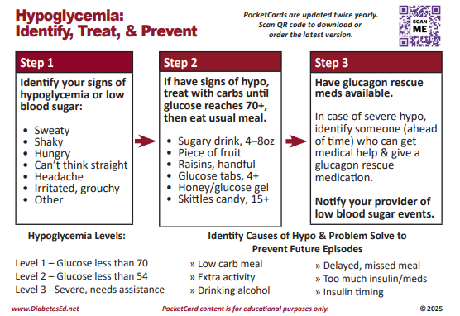

Slide 44
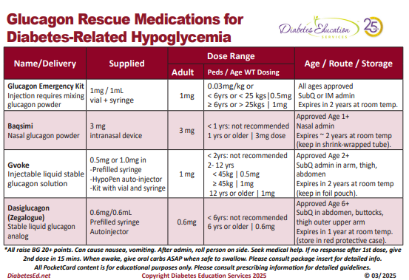

Slide 45


Recommendations for Pediatric Psychosocial Issues
At diagnosis and during routine follow-up care, assess psychosocial issues and family stresses that could impact with diabetes management /self-care.
Assess food security, housing.
Provide appropriate referrals to trained mental health professions, preferably experienced in childhood diabetes
Notes:
Diabetes management places substantial burdens on the youth and family
Ongoing parental involvement is necessary, due to the complexities of diabetes management
45
References
Arnett JJ. Emerging adulthood. A theory of development from the late teens through the twenties. Am Psychol 2000;55:469–480
Weissberg-Benchell J, Wolpert H, Anderson BJ. Transitioning from pediatric to adult care: a new approach to the post-adolescent young person with type 1 diabetes. Diabetes Care 2007;30:2441–2446
Peters A, Laffel L, for the American Diabetes Association Transitions Working Group. Diabetes care for emerging adults: recommendations for transition from pediatric to adult diabetes care systems: a position statement of the American Diabetes Association, with representation by other groups. Diabetes Care 2011;34:2477–2485
American Diabetes Association. Standards of medical care in diabetes—2014. Diabetes Care 2014;37(suppl 1):S53

Slide 46

Psychosocial Issues – Youth with diabetes
Assess for diabetes-related distress, generally starting at 7–8 years of age
Offer appts by themselves with provider at developmentally appropriate age (12 ish)
Screen youth with type 1 diabetes for distress, depression, anxiety, fear of hypo, disordered eating behavior between 10 -18 years of age.
The Diabetes Eating Problems Survey-Revised (DEPS-R)
Reliable, valid, and brief screening tool
Starting at puberty, preconception counseling, Assess for Social Determinants of Health

Slide 47

Screen for Disordered Eating
“DiaBulimia”
People with diabetes give themselves less insulin than needed to lose weight
Tends to start in adolescence, more likely to occur in women than men.
Signs: Avoiding CGM, elevated A1C, weight loss, lack of prescription refills for diabetes meds, records that don’t match A1C.
Treatment – Mental health specialist and team

Slide 48

Autoimmune Conditions -Type 1 Diabetes
Screening
Assess for the presence of additional autoimmune conditions at diagnosis and if symptoms develop
Notes:
Because of the increased frequency of autoimmune disease in type 1 diabetes, screening for thyroid dysfunction, vitamin B12 deficiency, (due to autoimmune gastritis, and celiac disease should be considered on based on signs and symptoms.
There are other autoimmune conditions (ie, Addison’s disease, etc.) that should be assessed and monitored as clinically indicated.
48
References
American Diabetes Association. Standards of medical care in diabetes—2014. Diabetes Care 2014;37(suppl 1):S50
Daniels M, DuBose SN, Maahs DM, et al.; T1D Exchange Clinic Network. Factors associated with microalbuminuria in 7,549 children and adolescents with type 1 diabetes in the T1D Exchange clinic registry. Diabetes Care 2013;36:2639–2645

Slide 49
Poll Question 5
What is the most common autoimmune condition associated with type 1 diabetes?
A. Thyroid disease
B. Celiac disease
C. DiaBulemia
D. Irritable bowel syndrome

Slide 50
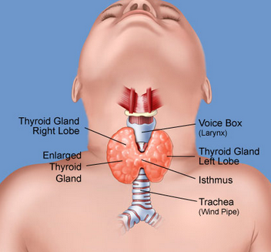
Screening for Pediatric Hypothyroidism - Type 1
25% positive for thyroid disease at diagnosis of type 1
Screen for anti-thyroid peroxidase, anti-thyroglobulin antibodies soon after diagnosis
Measure Thyroid-stimulating hormone (TSH) concentrations after metabolic control established.
If normal, consider rechecking every 1–2 years
Recheck if develops symptoms of thyroid dysfunction:
thyromegaly, abnormal growth rate, or unusual BG variation
Notes:
Consider screening children with type 1 diabetes for antithyroid peroxidase and antithyroglobulin antibodies at diagnosis (E)¹
Measuring TSH concentrations soon after diagnosis of type 1 diabetes, after metabolic control has been established, is reasonable. If normal, consider rechecking every 1–2 years, especially if the patient develops symptoms of thyroid dysfunction, thyromegaly, an abnormal growth rate, or unusual glycemic variation (E)¹
Autoimmune thyroid disease is the most common autoimmune disorder associated with diabetes, occurring in 17-30% of patients with type 1 diabetes²
About one-quarter of children with type 1 diabetes have thyroid autoantibodies at the time of diagnosis;³ presence of thyroid autoantibodies is predictive of thyroid dysfunction, generally hypothyroidism but less commonly hyperthyroidism⁴
Subclinical hypothyroidism may be associated with increased risk of symptomatic hypoglycemia⁵ and with reduced linear growth;⁶ hyperthyroidism alters glucose metabolism, potentially resulting in deterioration of metabolic control¹
50
References
American Diabetes Association. Standards of medical care in diabetes—2014. Diabetes Care 2014;37(suppl 1):S52
Roldán MB, Alonso M, Barrio R. Thyroid autoimmunity in children and adolescents with Type 1 diabetes mellitus. Diabetes Nutr Metab 1999;12:27–31
Triolo TM, Armstrong TK, McFann K, et al. Additional autoimmune disease found in 33% of patients at type 1 diabetes onset. Diabetes Care 2011;34:1211–1213
Kordonouri O, Deiss D, Danne T, Dorow A, Bassir C, Gruüters-Kieslich A. Predictivity of thyroid autoantibodies for the development of thyroid disorders in children and adolescents with Type 1 diabetes. Diabet Med 2002;19:518–521
Mohn A, Di Michele S, Di Luzio R, Tumini S, Chiarelli F. The effect of subclinical hypothyroidism on metabolic control in children and adolescents with Type 1 diabetes mellitus. Diabet Med 2002;19:70–73
Chase HP, Garg SK, Cockerham RS, Wilcox WD, Walravens PA. Thyroid hormone replacement and growth of children with subclinical hypothyroidism and diabetes. Diabet Med 1990;7:299–303

Slide 51

Screen for Pediatric Celiac Disease – Type 1
At diagnosis, screen by measuring IgA anti-tissue transglutaminase. Check again after 2 years then again at 5 yrs or more frequently with symptoms:
Consider testing in children with
Positive family history of celiac disease
Growth failure
Failure to gain weight, weight loss
Diarrhea, flatulence, abdominal pain, signs of malabsorption
Frequent unexplained hypoglycemia or deterioration in glycemic control
Notes:
Recommendations for the care of children with type 1 diabetes and celiac disease are summarized in two slides¹
Slide 1 of 2
Consider screening children with type 1 diabetes for celiac disease by measuring IgA antitissue transglutaminase or antiendomysial antibodies, with documentation of normal total serum IgA levels, soon after the diagnosis of diabetes (E)
Testing should be considered in children with a positive family history of celiac disease, growth failure, failure to gain weight, weight loss, diarrhea, flatulence, abdominal pain, or signs of malabsorption or in children with frequent unexplained hypoglycemia or deterioration in glycemic control (E)
Celiac disease is an immune-mediated disorder that occurs with increased frequency in patients with type 1 diabetes (1–16% of individuals compared with 0.3–1% in the general population)^{2,3}
Screening for celiac disease includes measuring serum levels of tissue transglutaminase or anti-endomysial antibodies, then small bowel biopsy in antibody positive children
In symptomatic children with type 1 diabetes and celiac disease, gluten-free diets reduce symptoms and rates of hypoglycemia⁴
51
References
American Diabetes Association. Standards of medical care in diabetes—2014. Diabetes Care 2014;37(suppl 1):S52
Holmes GK. Screening for coeliac disease in type 1 diabetes. Arch Dis Child 2002;87:495–498
Rewers M, Liu E, Simmons J, Redondo MJ, Hoffenberg EJ. Celiac disease associated with type 1 diabetes mellitus. Endocrinol Metab Clin North Am 2004;33:197–214, xi
Abid N, McGlone O, Cardwell C, McCallion W, Carson D. Clinical and metabolic effects of gluten free diet in children with type 1 diabetes and coeliac disease. Pediatr Diabetes 2011;12:322–325

Slide 52

Children with Celiac Disease – Type 1
Asymptomatic children with positive antibodies
Consider referral to gastroenterologist for evaluation with possible endoscopy and biopsy for confirmation of celiac disease
Children with biopsy-confirmed celiac disease
Place on a gluten-free diet
Consult with a dietitian experienced in managing both diabetes and celiac disease
Notes:
Recommendations for the care of children with type 1 diabetes and celiac disease are summarized in two slides
Slide 2 of 2
Consider referral to a gastroenterologist for evaluation with possible endoscopy and biopsy for confirmation of celiac disease in asymptomatic children with positive antibodies (E)
Children with biopsy-confirmed celiac disease should be placed on a gluten-free diet and have consultation with a dietitian experienced in managing both diabetes and celiac disease (B)
52
Reference
American Diabetes Association. Standards of medical care in diabetes—2014. Diabetes Care 2014;37(suppl 1):S52

Slide 53

Stretch Break

Slide 54

Case Study
17-year-old, diagnosed with diabetes at age 14.
Blood glucose in office 482
Urine ketones 2+ positive
On metformin, but only takes it intermittently
Weight: 184 lbs, ht 5’5”
Family history
One parent has type 2
ATB results came back neg
Plan
Review nutrition and activity
Add exenatide XR
This Photo by Unknown Author is licensed under CC BY-ND

Slide 55
Poll Question 6
Which factor puts children at higher risk of getting type 2?
A. Higher Income families
B. Living in rural areas
C. Limited opportunities
D. Eating a lot of sweets

Slide 56

Risk based Screening for PreDiabetes or Type 2 children and adolescents
Test at 10 yrs or puberty and every 3 yrs
Test children with excess weight
BMI >85% for age and sex, weight for height >85% or >120% of ideal for height
Plus any ONE of the following risk factors
Signs of insulin resistance (acanthosis nigricans), HTN, dyslipidemia, Polycystic Ovary Syndrome – PCOS or small for gestational age birth weight
Maternal diabetes or GDM during child’s gestation
Family history
American Indian, African American, Hispanic, Asian, South Pacific Islander

Slide 57

Type 2 in Kids
~5,000 new cases in U.S. annually.
New cases of type 2 in youth increasing 2.3% a year
Prevalence will quadruple in 40 years
Disproportionately impacts marginalized communities
Can occur in complex psychosocial and cultural environments, which may make it difficult to sustain healthy lifestyle changes and self-management behaviors
Other risk factors: adiposity, family history of diabetes, female sex, and low socioeconomic status.

Slide 58

Engaging and supporting Kids to help slow the epidemic
Phases of Life
During Childhood
Environment
Access to safe places to exercise
Access to healthy foods
Access to learning rich environments
Access to health care
LifeStyle
1 hour + a day of activity
Healthy Snacks
Limit processed foods, sugary beverages
Fruits and Veggies
Get the family involved

Slide 59

Type 2 Clinical Presentation
Glycosuria without ketonuria
But 33% have ketonuria
~11% present in DKA (10-19 yrs)
To make dx, assess antibodies prn
May need insulin during acute phase
Mild thirst, increased urination, little or no wt loss
At onset, may have retinopathy, microalbuminuria, hypertension, hyperlipidemia
Majority of individuals with type 2 diabetes diagnosed as youth had microvascular complications by young adulthood

Slide 60
Poll Question 7
LM is 11 years old and struggles with weight. LM blood pressure is elevated and LM has acanthosis nigricans.
Fasting blood glucose is 197 and 205 on 2 different lab draws.
Negative ketones.
What is best action?
A. Start insulin therapy
B. Discuss healthy eating
C. Initiate semaglutide
D. Start metformin and lifestyle

Slide 61
Type 2s– New Diagnosis
Start lifestyle modification program and metformin therapy.
Since fewer than 10% of children with T2DM will attain BG goals with lifestyle changes alone, initiate metformin alongside to exercise and healthy eating
Start metformin at low dose to mitigate GI side effects.
If BG not at target, add liraglutide or exenatide XR (after age 10) and/or insulin therapy

Slide 63

Type 2 Medication Strategy - Kids
Initiate pharmacologic therapy, in addition to lifestyle therapy, at diagnosis of type 2 diabetes.
If A1c <8.5% and asymptomatic, start metformin
If A1c >8.5% and no ketosis, start metformin and insulin
If ketotic, start insulin. Once resolved continue insulin, add metformin.
If A1C above target on metformin, add approved GLP-1 and/or SGLT-2 (empagliflozin or dapagliflozin)
If still above target start basal insulin therapy, start at 0.5 units/kg/day.

Slide 64

New Type 2 – Start Basal Insulin for:
10-18 yr olds w/ new onset hyperglycemia and:
A1c 8.5% or greater
Ketotic not sure if type 1 and type 2.
Even if it turns out a ketone positive child has T2DM, insulin therapy helps stop glucose toxicity so beta cells can "rest and recover".
Draw autoantibodies to determine correct diagnosis
If antibody negative, decrease and stop insulin of possible

Slide 65
Poll Question 8
Which of the following medications are FDA approved for pediatrics after the age of 10?
A. Glipizide, liraglutide, dapagliflozin
B. Liraglutide, exenatide XR, metformin
C. Metformin, sitagliptin, repaglinide
D. Acarbose, liraglutide, glyburide

Slide 66
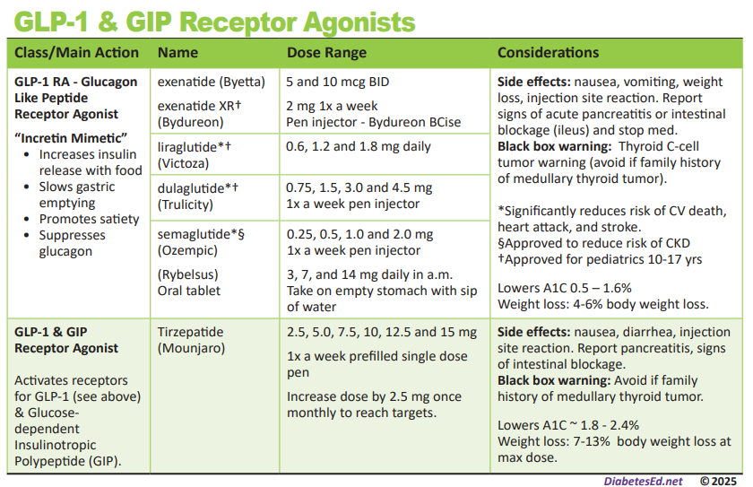
GLP-1s Approved for Kids 10yrs +

Slide 67
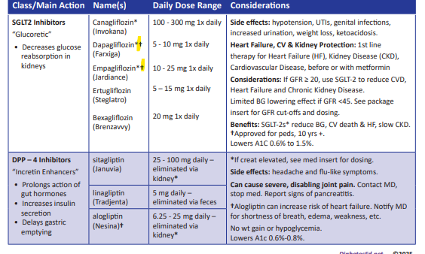
SGLT-2s Approved for 10 yrs & Up

Slide 68

Glycemic Targets - Type 2 Diabetes
A1C goal of < 6.5% if low risk of hypo.
Individualize
Glucose monitoring frequency based on pharmacologic treatment
Measure every 3 months
Use CGM for those using insulin. Evaluate time in range
Notes:
The recommendation for glycemic control in children and adolescents with type 1 diabetes¹ is included in this slide
In selecting glycemic goals, the long-term health benefits of achieving a lower A1C should be balanced against the risks of hypoglycemia and the developmental burdens of intensive regimens in children and youth¹
Special consideration should be given to the unique risks of hypoglycemia in young children¹
For young children (<7 years old), glycemic goals may need to be modified since most at that age have a form of “hypoglycemic unawareness,” including immaturity of and a relative inability to recognize and respond to hypoglycemic symptoms; this places them at greater risk for severe hypoglycemia
While it was previously thought that young children were at risk for cognitive impairment after episodes of severe hypoglycemia, current data have not confirmed this²⁻⁴
Furthermore, new therapeutic modalities, such as rapid and long-acting insulin analogs, technological advances (e.g., low glucose suspend), and education may mitigate the incidence of severe hypoglycemia⁵
68
References
American Diabetes Association. Standards of medical care in diabetes—2014. Diabetes Care 2014;37(suppl 1):S50
Seaquist ER, Anderson J, Childs B, et al. Hypoglycemia and diabetes: a report of a workgroup of the American Diabetes Association and The Endocrine Society. Diabetes Care 2013;36:1384–1395
Wysocki T, Harris MA, Mauras N, et al. Absence of adverse effects of severe hypoglycemia on cognitive function in school-aged children with diabetes over 18 months. Diabetes Care 2003;26:1100–1105
Blasetti A, Chiuri RM, Tocco AM, et al. The effect of recurrent severe hypoglycemia on cognitive performance in children with type 1 diabetes: a metaanalysis. J Child Neurol 2011;26:1383–1391
Cooper MN, O’Connell SM, Davis EA, Jones TW. A population-based study of risk factors for severe hypoglycaemia in a contemporary cohort of childhood-onset type 1 diabetes. Diabetologia 2013;56:2164–2170

Slide 69
Special Issues for Type 2

Slide 70

Metabolic Surgery in Youth
Metabolic surgery may be considered for the treatment of adolescents with type 2 diabetes with
BMI >35 or >120% of 95th percentile for age and sex, with elevated A1C and/or serious comorbidities despite lifestyle and pharmacologic intervention.

Slide 71

Type 2 Peds Special Issues
Steatosis (MASLD)
Measure AST and ALT at diagnosis and annually
Obstructive sleep apnea
Screen at each visit, refer to pediatric sleep specialist
Polycystic ovary syndrome
Eval for PCOS in females with type 2
Metformin improves menstrual cyclicity and hyperandrogenism

Slide 72

Preventing CV Disease 1 & 2
Youth with diabetes, both type 1 and 2, are at higher risk of CV disease
Encourage healthy habits early to protect blood vessels and quality of life
Management of dyslipidemia, hypertension, and glucose important to prevent overt macrovascular disease in early adulthood

Slide 73

Healthy Eating Type 2 Kids
Incorporate Evidence Based Nutrition Guidelines
Familiarity with carb counting (use apps)
Eat regular meals, reduce portion sizes if weight is an issue
Choose calorie free beverages
More fruits, veggies, limit high fat foods.
Choose less fast foods.

Slide 74

Activity Goals for all
Engage in physical exercise for at least 60 minutes daily plus strengthening activities
Limit nonacademic screen time to less than 2 hours per day.
Create an individualized approach that can be incorporated into the daily routine
Tailor to the child's physical ability and preferences while taking the families circumstances into account.

Slide 75

Behavior Change
Engage youth and family in decision making to maintain lifestyle and medication changes
Set realistic goals and take into account the families' health beliefs and behaviors.
Explore family's perception of diabetes
Dispel any myths or misconception negotiating a management plan.
Ensure culturally appropriate, family-centered care along with ongoing education.
This Photo by Unknown Author is licensed under CC BY

Slide 76

Screening at Diagnosis of 2 Diabetes
Due to the delay in detecting type 2 diabetes and insulin resistance, these tests are recommended at diagnosis:
Blood pressure measurement
Fasting lipid panel
Albumin excretion assessment
Dilated eye examination
Thereafter, screening and treatment guidelines in youth with type 2 diabetes are similar to youth with type 1 diabetes
Notes:
Autoantibodies and ketosis may be present in patients with features of type 2 diabetes
ADA consensus report “Type 2 Diabetes in Children and Adolescents”
76
References
Arnett JJ. Emerging adulthood. A theory of development from the late teens through the twenties. Am Psychol 2000;55:469–480
Weissberg-Benchell J, Wolpert H, Anderson BJ. Transitioning from pediatric to adult care: a new approach to the post-adolescent young person with type 1 diabetes. Diabetes Care 2007;30:2441–2446
Peters A, Laffel L, for the American Diabetes Association Transitions Working Group. Diabetes care for emerging adults: recommendations for transition from pediatric to adult diabetes care systems: a position statement of the American Diabetes Association, with representation by other groups. Diabetes Care 2011;34:2477–2485
American Diabetes Association. Standards of medical care in diabetes—2014. Diabetes Care 2014;37(suppl 1):S53

Slide 77
Poll Question 9
What is the blood pressure target for kids with type 1 or 2 diabetes before age 13?
A. Less than 140/90
B. Less than 120/70
C. Depends on family genetics
D. Less than 90th percentile for age, sex, and height

Slide 78

Screening and Treating for Hypertension in Peds
Measure blood pressure at each routine visit;
Target is less than 90th percentile or less than 120/80 after age 13.
confirm high-normal BP or hypertension on 3 separate days
Treat hypertension w/ACE or ARB if:
Systolic BP or Diastolic BP above 95th percentile for age, sex, height
After age 13, if > 130/80
Discuss preventing pregnancy
Notes:
Recommendations for the care of children and adolescents with hypertension¹ are summarized in four slides
Slide 1 of 4
Blood pressure should be measured at each routine visit; children found to have high-normal blood pressure or hypertension should have blood pressure confirmed on a separate day (B)
78
Reference
American Diabetes Association. Standards of medical care in diabetes—2014. Diabetes Care 2014;37(suppl 1):S50

Slide 79

Treatment for Pediatric Hypertension
Healthy eating, activity, weight loss if indicated
If target BP not reached with 3–6 months of lifestyle intervention, add meds
Pharmacologic treatment of hypertension
ACE inhibitors or ARBS
Provide appropriate reproductive counseling due to potential teratogenic effects
Eval urine albumin-to-creatinine ratio
Goal of treatment
Blood pressure consistently below the 90th percentile for age, sex, and height or less than 130/80 after age 13
Notes:
Recommendations for the care of children and adolescents with hypertension¹ are summarized in four slides
Slide 2 of 4
Initial treatment of high-normal blood pressure (SBP or DBP consistently above the 90th percentile for age, sex, and height) includes dietary intervention and exercise, aimed at weight control and increased physical activity, if appropriate; if target blood pressure is not reached with 3–6 months of lifestyle intervention, pharmacological treatment should be considered (E)
Blood pressure measurements should be determined correctly, using the appropriate size cuff, and with the child seated and relaxed
Hypertension should be confirmed on at least three separate days
Normal blood pressure levels for age, sex, and height and appropriate methods for determinations are available online at www.nhlbi.nih.gov/health/prof/heart/hbp/hbp_ped.pdf
79
Reference
American Diabetes Association. Standards of medical care in diabetes—2014. Diabetes Care 2014;37(suppl 1):S50

Slide 80

Screening for Dyslipidemia with Peds w Diabetes
Screening
Obtain a fasting lipid profile at diagnosis (after glucose control has been established)
If elevated, recheck every year
Optimal lipid goals are:
LDL <100
HDL >35
Triglycerides <150
Notes:
Recommendations for the screening and treatment of children and adolescents with type 1 diabetes for dyslipidemia are summarized in four slides¹
Slide 1 of 4
Children diagnosed with type 1 diabetes have a high risk of early subclinical²⁻⁴ and clinical⁵ CVD
80
References
American Diabetes Association. Standards of medical care in diabetes—2014. Diabetes Care 2014;37(suppl 1):S51
Hörtenhuber T, Rami-Mehar B, Satler M, et al. Endothelial progenitor cells are related to glycemic control in children with type 1 diabetes over time. Diabetes Care 2013;36:1647–1653
Haller MJ, Samyn M, Nichols WW, et al. Radial artery tonometry demonstrates arterial stiffness in children with type 1 diabetes. Diabetes Care 2004;27:2911–2917
Orchard TJ, Forrest KY, Kuller LH, Becker DJ, for the Pittsburgh Epidemiology of Diabetes Complications Study. Lipid and blood pressure treatment goals for type 1 diabetes: 10-year incidence data from the Pittsburgh Epidemiology of Diabetes Complications Study. Diabetes Care 2001;24:1053–1059

Slide 81
Poll Question 10
When is it indicated to start a statin for pediatrics with diabetes?
A. When LDL is greater than 100
B. After the age of 10
C. When LDL is more than 130
D. Both B and C

Slide 82

Treatment for Pediatric Dyslipidemia
Optimize BG, MNT aimed at 25-30% of dietary calories from fat, saturated fat <7%, avoid trans fats, 10% of cals from monounsaturated.
After age of 10 years, statin treatment is reasonable in those (after MNT and lifestyle changes) if:
If LDL >130 after 6 mos, consider statin
Goal: LDL cholesterol <100 mg/dL
If triglycerides >400 fasting or >1,000 mg/dL nonfasting, optimize glycemia and begin fibrate, with a goal of <400 mg/dL fasting
Notes:
Recommendations for the screening and treatment of children and adolescents with type 1 diabetes for dyslipidemia are summarized in four slides
Slide 4 of 4
Initial therapy may consist of optimization of glucose control and MNT using a Step 2 AHA diet aimed at a decrease in the amount of saturated fat in the diet (B)
After the age of 10 years, the addition of a statin in patients who, after MNT and lifestyle changes, have LDL cholesterol >160 mg/dL (4.1 mmol/L) or LDL cholesterol >130 mg/dl (3.4 mmol/L) and one or more CVD risk factors is reasonable (E)
The goal of therapy is an LDL cholesterol value <100 mg/dL (2.6 mmol/L) (E)
Statins are not approved for use under the age of 10 years, and statin treatment should generally not be used in children with type 1 diabetes prior to this age
For postpubertal girls, issues of pregnancy prevention are paramount, since statins are category X in pregnancy
82
Reference
American Diabetes Association. Standards of medical care in diabetes—2014. Diabetes Care 2014;37(suppl 1):S51

Slide 83

Screening and Treatment for Ped Nephropathy
Screen annually for Urinary Albumin Creat Ratio
Type 1 - start of puberty or age ≥10 years, whichever is earlier, once youth has had diabetes for 5 years
Type 2 – check at time of diagnosis and annually
random spot urine sample for albumin-to-creatinine (UACR) ratio – Goal is <30 mg/g
Measure creatinine clearance/ GFR at initial evaluation, then based on age, diabetes duration and treatment
Treatment
Start ACE inhibitor or ARB with HTN and when elevated UACR (>30 mg/g) confirmed on 2 of 3 urine samples from different days over 6-months
Or if GFR < 60 (type 2)
Notes:
Recommendations for pediatric nephropathy are summarized on this slide
Recent research demonstrates the importance of good glycemic and blood pressure control, especially as diabetes duration increases²
83
References
American Diabetes Association. Standards of medical care in diabetes—2014. Diabetes Care 2014;37(suppl 1):S50
Daniels M, DuBose SN, Maahs DM, et al.; T1D Exchange Clinic Network. Factors associated with microalbuminuria in 7,549 children and adolescents with type 1 diabetes in the T1D Exchange clinic registry. Diabetes Care 2013;36:2639–2645

Slide 84

Pediatric Eye Screening Guidelines
Type 1: after having type 1 diabetes for 3–5 years, provided they are aged ≥11 years or puberty has started, whichever is earlier.
Type 2: Consider initial dilated and comprehensive eye examination.
After initial examination
Routine follow-up every 1-2 years generally recommended
Notes:
Recommendations for those with type 1 diabetes and pediatric retinopathy are summarized on this slide
An initial dilated and comprehensive eye examination should be considered for the child at the start of puberty or age ≥10 years of age, whichever is earlier, once the youth has had diabetes for 3–5 years (E)
After the initial examination, annual routine follow-up is generally recommended; less frequent examinations may be acceptable on the advice of an eye care professional (E)
Although retinopathy (like albuminuria) most commonly occurs after the onset of puberty and after 5–10 years of diabetes duration,² it has been reported in prepubertal children and with diabetes duration of only 1–2 years
Referrals should be made to eye care professionals with expertise in diabetic retinopathy, an understanding of retinopathy risk in the pediatric population, and experience in counseling the pediatric patient and family on the importance of early prevention/ intervention
84
References
American Diabetes Association. Standards of medical care in diabetes—2014. Diabetes Care 2014;37(suppl 1):S52
Cho YH, Craig ME, Hing S, Gallego PH, Poon M, Chan A, Donaghue KC: Microvascular complications assessment in adolescents with 2- to 5-yr duration of type 1 diabetes from 1990 to 2006. Pediatr Diabetes 2011;12:682–689

Slide 85

Pediatric Neuropathy Screening
Type 2, screen at diagnosis, then annually
Type 1 annual comprehensive foot exam for the child at the start of puberty or at age > 10 years, whichever is earlier, once the youth has had type 1 diabetes for 5 years
Include: inspection, assessment of foot pulses, pinprick and 10-g monofilament sensation tests, testing of vibration sensation using a 128-Hz tuning fork, and ankle reflex tests.
Notes:
Neuropathy rarely occurs in prepubertal children with 1-2 years diabetes duration
Foot inspection can be performed at each visit as education for youth regarding the importance of foot care
85
References
American Diabetes Association. Standards of medical care in diabetes—2014. Diabetes Care 2014;37(suppl 1):S52
Cho YH, Craig ME, Hing S, Gallego PH, Poon M, Chan A, Donaghue KC: Microvascular complications assessment in adolescents with 2- to 5-yr duration of type 1 diabetes from 1990 to 2006. Pediatr Diabetes 2011;12:682–689

Slide 86

The Social Context of Diabetes Self-Management

Slide 87
Poll Question 11
When working with kids and families with type 2 diabetes, which approach work best to support behavior change?
A. Take time to understand their perception of diabetes self-care
B. Gently support avoidance of sugary treats.
C. Remind them about the risk of complications.
D. Reinforce that unless they make changes, insulin may be required.

Slide 88

Social Context & Lifestyle Changes
Assess social context and apply that information to treatment decisions:
Eval potential food insecurity, housing stability, and financial barriers, and
Find realistic life plan – Shared decision making
Social support, screenings, referrals
Diabetes Camps
Preconception counseling

Slide 89

Pregnancy, Youth and Diabetes
The TODAY study documented that despite disease- and age-specific counseling
10.2% of the females in the cohort became pregnant over an average of 3.8 years of study participation.
26.4% of pregnancies ended in a miscarriage, stillbirth, or intrauterine death
20.5% of the liveborn infants had a major congenital anomaly.

Slide 90

Preconception Planning
For teens of childbearing potential provide:
Info on effective contraception or abstinence to prevent unplanned pregnancy.
Use developmentally appropriate educational tools
Enable adolescents to make well-informed decisions
Free preconception counseling resources tailored for adolescents are available at ADA
Include education about the risks of malformations associated with elevated glucose levels

Slide 91

Ongoing Care For Pediatric Diabetes
See provider every 3 months
Refer to behavioral specialist, CDCES and RDN at least yearly
Eval for hypo awareness/frequency each visit
Eval normal growth and development
If delayed, assess hyperglycemia, celiac or thyroid disease (screen every 1-2 yrs)
Eval for distress starting at age 7-8
Depression screening at 10 yrs of age
Allow time for pt to see provider alone when appropriate

Slide 92

Pediatric Diabetes Self-Management Education and Support
Provide diabetes self-management education and support at diagnosis and routinely thereafter that is:
Culturally sensitive
Developmentally appropriate
Eval for social determinants of health.
Mental health professionals should be part of the team
Notes:
No matter how sound the medical regimen, it can only be as good as the ability of the family and/or individual to implement it.
Family involvement remains important for optimal management in childhood and adolescence
It may be necessary to assess education skills/needs of day care providers, school nurses, or school personnel
92
References
American Diabetes Association. Standards of medical care in diabetes—2014. Diabetes Care 2014;37(suppl 1):S52
Cho YH, Craig ME, Hing S, Gallego PH, Poon M, Chan A, Donaghue KC: Microvascular complications assessment in adolescents with 2- to 5-yr duration of type 1 diabetes from 1990 to 2006. Pediatr Diabetes 2011;12:682–689

Slide 93

Strategies for Working with Teens
Avoid judgment
Specific plan / realistic goals
Teach real life problem solving
Gradual increase responsibility
Diabetes self-care
Doctors appts
Referrals / prescriptions

Slide 94

Adolescence Overview
Hormones increase insulin resistance
Elevated glucose may be secondary to chronic family stress or parental over/under involvement
Identity and self image concerns
DKA & glucose levels above target can delay puberty
Movement to independence difficult due to parental protectiveness

Slide 95

Educational Content with Teens
Education directed primarily toward adolescent with parents included
Substance and tobacco use
Alcohol use
eating disorders
risk taking behaviors
driving considerations
self care:
BGM before driving, carrying supplies, safety

Slide 96

Tobacco, Electronic Cigarettes, Alcohol, and Cannabis
Advise all youth with diabetes not to use cannabis recreationally in any form.
2 to 3 times higher risk of developing DKA.
Can lead to cannabis hyperemesis syndrome
Screen adolescents and young for tobacco or nicotine, electronic cigarettes, substance use, and alcohol use at diagnosis and regularly thereafter.
Discourage smoking in youth who do not smoke and encourage smoking cessation in those who do smoke (including electronic cigarette use or vaping)

Slide 97
Poll Question 12
JR has type 1 diabetes for 7 years and is turning 18 this year. What will help him make a successful transition to diabetes self-care as an adult?
A. Encourage complete autonomy
B. Moving to his own apartment
C. Requiring he pay for his own diabetes supplies
D. Providing support and resources

Slide 98

Prepare for Transition from Pediatric to Adult Care
Prepare for transition at least 1 year ahead of time
Health care providers / families must recognize vulnerabilities and prepare
Both pediatricians and adult health care providers to provide support and resources for teen and emerging adult
Encourage family involvement in diabetes management tasks
Recognize that premature transfer of diabetes care to the child can result in non-adherence and deterioration of glycemic control
Notes:
Care and close supervision of diabetes management is increasingly shifted from parents and other older adults throughout childhood and adolescence; however, the shift from pediatric to adult health care providers often occurs very abruptly as the older teen enters the next developmental stage, referred to as emerging adulthood,¹ a critical period for young people who have diabetes
Though scientific evidence continues to be limited, it is clear that early and ongoing attention be given to comprehensive coordinated planning for seamless transition of all youth from pediatric to adult health care^{2,3}
A comprehensive discussion regarding the challenges faced during this period is found in the ADA position statement “Diabetes Care for Emerging Adults: Recommendations for the Transition from Pediatric to Adult Diabetes Care Systems”³
The National Diabetes Education Program (NDEP) has materials available to facilitate the transition process (http://ndep.nih.gov/transitions/) and The Endocrine Society in collaboration with the ADA and other organizations has developed transition tools for clinicians and youth/families: (http://www.endo-society.org/clinicalpractice/transition_of_care.cfm)
This slide includes recommendations for transitioning teens with diabetes into adulthood⁴
98
References
Arnett JJ. Emerging adulthood. A theory of development from the late teens through the twenties. Am Psychol 2000;55:469–480
Weissberg-Benchell J, Wolpert H, Anderson BJ. Transitioning from pediatric to adult care: a new approach to the post-adolescent young person with type 1 diabetes. Diabetes Care 2007;30:2441–2446
Peters A, Laffel L, for the American Diabetes Association Transitions Working Group. Diabetes care for emerging adults: recommendations for transition from pediatric to adult diabetes care systems: a position statement of the American Diabetes Association, with representation by other groups. Diabetes Care 2011;34:2477–2485
American Diabetes Association. Standards of medical care in diabetes—2014. Diabetes Care 2014;37(suppl 1):S53

Slide 99

Risk Reduction Critical – will have diabetes for a long time
Focus on prevention of complications
Vaccinations, oral care, eye exams
Glucose, lipid and blood pressure control
Lifetime weight management
Don’t smoke or use tobacco products
Keep active
Evaluate alcohol intake
Get support
Other

Slide 100

Thank You
Questions? We are here to help!
Email info@diabetesed.net
Call 530/ 893-8635
www.DiabetesEd.net

