Slide 1

Standard 15: Management of Pregnancy in Diabetes 2025
Diabetes Education Services Presents:
Diana Isaacs, PharmD, BCPS, BCACP, CDCES, BC-ADM, FADCES, FCCP
Co-Director, Endocrine Disorders in Pregnancy
Cleveland Clinic Endocrinology & Metabolism Institute

Slide 2
Land Acknowledgment
We acknowledge and are mindful that Diabetes Education Services stands on lands that were originally occupied by the first people of this area, the Mechoopda, and we recognize their distinctive spiritual relationship with this land, the flora, the fauna, and the waters that run through this area.

Slide 3


We are Here to Help!
Bryanna Sabourin
Director of Operations
Tiffany Bergeron
Customer Advocate &
Customer Happiness Expert
If you have questions, you can chat with us at www.DiabetesEd.net or call 530 / 893-8635 or email at info@diabetesed.net

Slide 4

Diabetes Education Services Inclusion Statement
Based on the IDEA Initiative inspired by CDR
Inclusion
Diversity
Equity
Access
We are committed to promoting diversity and inclusion in our educational offerings.
We recognize, respect, and include differences in ability, age, culture, ethnicity, gender, gender identity, sexual orientation, size, and socioeconomic characteristics.
Our goal is to promote equity and access, acknowledging historical and institutional inequities.
We are committed to practicing cultural humility and cultivating our cultural competence.
We wish to create a safe space within our community where one's beliefs, experiences, identity, and differences in ability, age, size, socio-cultural/socioeconomic characteristics, and political affiliations are considered and respected.

Slide 5

Diana Isaacs, PharmD, BCPS, BCACP, BC-ADM, CDCES, FADCES, FCCP
Provides diabetes care to all regardless of insurance
Provides care to specialized populations especially transplant, pregnancy and other high-risk individuals.
Usually sees about 10 clients a day
Diana Isaacs, PharmD, BCPS, BCACP, CDCES, BC-ADM, FADCES, FCCP
Co-Director, Endocrine Disorders in Pregnancy
Cleveland Clinic Endocrinology & Metabolism Institute ADCES Educator of the Year in 2020

Slide 6
Disclosures
Diana Isaacs, PharmD is a speaker or consultant for the following companies:
Dexcom, Abbott, Insulet, Tandem, Novo Nordisk, Lilly, Sanofi, Sequel, Medtronic, Corcept, Embecta, Cequr, Mannkind

Slide 7

Resources
The ADA Standards of Medical Care is main resource for course content
Notes:
Standards of Care in Diabetes—2025. Diabetes Care, January 2025; 48 (Supplement_1): S306-320. https://doi.org/10.2337/dc25-S015

Slide 8

Diabetes & Pregnancy Topics
List three issues that affect pregnancy with diabetes.
Describe the unique attributes of pre-existing diabetes in pregnancy & gestational diabetes.
State the diagnostic criteria & management goals for gestational diabetes.
Discuss the potential short-term & long-term complications of fetal exposure to hyperglycemia.
Describe prevention measures to ensure safety.

Slide 9
Background
Prevalence of diabetes in pregnancy is increasing
Definitions
Pre-gestational diabetes: pre-existing type 1 or type 2 diabetes in pregnancy
Gestational diabetes: diabetes diagnosed in the 2nd or 3rd trimester of pregnancy
Notes:
ADA SOC

Slide 10
Prevalence of Diabetes in Pregnancy
^{Total:}
^{8-12%}
^{Gestational:}
^{8-10% (US)}
^{14-17% (Worldwide)}
^{Pre-Diagnosed} ^{Type I and 2:}
^{1-2%}
Centers for Disease Control and Prevention. www.cdc.gov., https://my.clevelandclinic.org/health/diseases/9012-gestational-diabetes
Notes:
Women living with diabetes in pregnancy need tools and support outside of clinical encounters.

Slide 11

Gestational Diabetes (GDM)
Detected at 24-28 weeks of pregnancy (most insulin resistant phase)
GDM prevalence increased by
∼10–100% during the past 20 yrs
Women getting pregnant later
More obesity
Standards of Care in Diabetes—2025. Diabetes Care, January 2025; 48 (Supplement_1): S306-320. https://doi.org/10.2337/dc25-S015

Slide 12

Rates of GDM and Diabetes in Pregnancy increasing
1% to 2% have type 1 or type 2 during pregnancy
From 2000 to 2010
GDM rates increased 56%
Type 1 or type 2 before pregnancy increased 37%.
Asian and Hispanic women have higher rates of GDM
Black and Hispanic women have higher rates of type 1 or type 2 diabetes during pregnancy.
CDC Diabetes During Pregnancy | Maternal Infant Health | CDC

Slide 13
Risks of Diabetes in Pregnancy
Spontaneous abortion
Fetal anomalies
Preeclampsia
Fetal demise
Macrosomia
Neonatal hypoglycemia
Neonatal hyperbilirubinemia
Neonatal respiratory distress syndrome
Exposure to hyperglycemia in utero increases risks of obesity, hypertension, and T2D later in life

Slide 14

Perinatal care makes a difference
Reaching out before pregnancy has the potential for slowing the diabetes epidemic
Focus:
Prenatal,
perinatal and
postnatal health

Slide 15
Pre-conception: Checking for Diabetes
In individuals planning pregnancy, screen those with risk factors (B)
Consider screening all individuals of childbearing potential (E)
If BG in normal range, check at 24-28 weeks for Gestational Diabetes using OGTT
2. Diagnosis and Classification of Diabetes: Standards of Care in Diabetes—2025. Diabetes Care 1 January 2025; 48 (Supplement_1): S27–S49. https://doi.org/10.2337/dc25-S002

Slide 16
Screening in Early Pregnancy
Before 15 weeks, screen those with risk factors (B)
Consider screening everyone before 15 weeks (E)
If BG in normal range, recheck at 24-28 weeks for Gestational Diabetes using OGTT
If fasting BG 110+ or A1C 5.9%+
At higher risk of adverse outcomes and more likely to experience GDM and need insulin.
2. Diagnosis and Classification of Diabetes: Standards of Care in Diabetes—2025. Diabetes Care 1 January 2025; 48 (Supplement_1): S27–S49. https://doi.org/10.2337/dc25-S002

Slide 17

Risk Factors for Type 2 Diabetes
Start screening all people at age 35.
Screen at any age if BMI ≥ 25 (Asians BMI ≥ 23) plus one or > additional risk factor:
First-degree relative w/ diabetes
Member of a high-risk ethnic population
Habitual physical inactivity
PreDiabetes
History of heart disease
Taking high risk meds; antiretrovirals, 2nd generation antipsychotics or steroids
History of pancreatitis
2. Diagnosis and Classification of Diabetes: Standards of Care in Diabetes—2025. Diabetes Care 1 January 2025; 48 (Supplement_1): S27–S49. https://doi.org/10.2337/dc25-S002

Slide 18

Risk Factors for Type 2 Diabetes (Continued)
HTN - BP > 130/80 mmHg or on therapy
HDL < 35 or triglycerides > 250
History of GDM
Polycystic ovary syndrome (PCOS)
Other conditions associated w/ insulin resistance:
Elevated BMI, acanthosis nigricans, MASLD
Screen using A1C, Fasting Blood Glucose or OGTT.
2. Diagnosis and Classification of Diabetes: Standards of Care in Diabetes—2025. Diabetes Care 1 January 2025; 48 (Supplement_1): S27–S49. https://doi.org/10.2337/dc25-S002

Slide 19
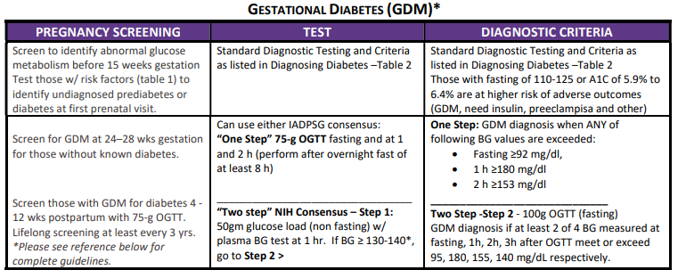
Gestational Diabetes and Pregnancy
Screening and Diagnosis of Diabetes Cheat Sheet
Diagnosis & Classification of Diabetes. American Diabetes Association of Medical Care in Diabetes.
Diabetes Care 2025, Jan; 48 (Supplement 1) :S27-S49. Compliments of Diabetes Education Services www.DiabetesEd.net

Slide 20

Case Study
KR has a history of polycystic ovary syndrome (PCOS) treated with metformin 850mg BID.
Monthly bleeding is 2 weeks late.
At provider visit, discovers that 4 wks pregnant
Fasting glucose is 103 mg/dl
What is PCOS?

Slide 21

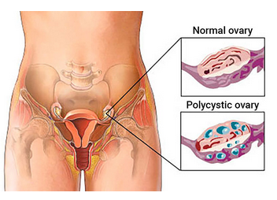

Polycystic Ovarian Syndrome
Reproductive disorder of hyperandrogenism, ovulatory dysfunction, polycystic ovaries
About 40% have prediabetes (10% DM)
Clinical findings
Infertility, amenorrhea, irregular menses, hirsutism, acne, obesity, dyslipidemia, acanthosis nigricans.
“PCOS is the 5 o’clock shadow of Metabolic Syndrome”
Treatment
Lifestyle changes (lose wt, exercise, healthy eating)
Meds (Metformin and others)
Monitor BG for prediabetes/ diabetes

Slide 22

Polycystic Ovarian Syndrome and Related Issues
Diabetes 50% with PCOS will have diabetes or pre-diabetes by age 40.
High blood pressure Greater risk of HTN
Cholesterol. Elevated LDL cholesterol and low HDL cholesterol.
Sleep apnea. If BMI 25+, increased sleep apnea risk.
Depression and anxiety more common
Endometrial cancer. PCOS, excess wt, insulin resistance, diabetes, increase risk of developing endometrium cancer

Slide 23
Case Study
KR has a history of polycystic ovary disease treated with metformin 850mg BID.
Monthly bleeding is 2 weeks late.
At provider visit, discovers 4 wks pregnant
Fasting glucose is 103 mg/dl
What are next actions?

Slide 24

Quick Question 1
KR is 4 weeks pregnant. Fasting glucose is 103 mg/dl. What best describes KRs current situation?
KR has gestational diabetes
KR needs a 75 gm OGTT
KR has type 2 diabetes
KR might have prediabetes

Slide 25
Quick Question 2
If prediabetes diagnosis is confirmed, what is the next step?
Continue metformin through 1st trimester
Start basal insulin
Add human basal bolus insulin
Stop metformin, start sulfonylurea

Slide 26

Metformin for Polycystic Ovary Syndrome
If metformin used to treat polycystic ovary syndrome and induce ovulation
Stop at end of first trimester.
Standards of Care in Diabetes—2025. Diabetes Care, January 2025; 48 (Supplement_1): S306-320. https://doi.org/10.2337/dc25-S015

Slide 27

How does Pregnancy Affect BG?

Slide 28
BG levels during pregnancy
Pregnancy normally associated with lower fasting glucose and higher post meal glucose
Early pregnancy, more insulin sensitive
Insulin needs may drop
2nd, 3rd trimester increased insulin resistance
Insulin needs may increase by 2-3x’s pre-pregnancy needs
After delivery – insulin needs drop dramatically

Slide 29
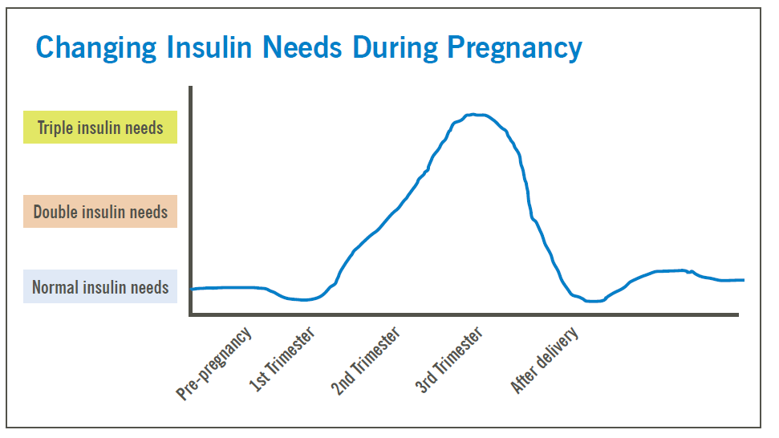
Insulin Needs During Pregnancy

Slide 30

Blood Glucose and Pregnancy
Non-diabetes usual glucose ranges
Mean fasting BG
61-75 mg/dl
Peak post prandial
Rarely exceeds 126 mg/dl
Maximal post prandial excursions 60 – 90 mins after start of meal.
Inturrisi, Lintner – Diagnosis and Treatment of Hyperglycemia in Pregnancy - 2011

Slide 31
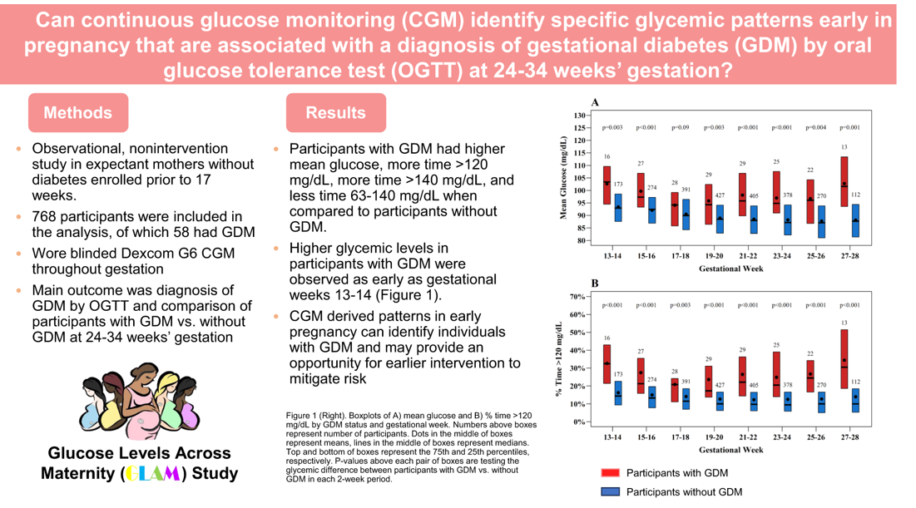
The GLAM Study
Durnwald C, Beck RW, Li Z, et al. CGM Profiles in Pregnancies With and Without GDM. Diabetes Care. 2024 Aug 1;47(8):1333-1341.

Slide 32






Hyperglycemia and Fetal Risk

Slide 33
Poll question 3
What best describes gestational diabetes?
Diabetes discovered within the first 12 weeks of pregnancy.
Diabetes discovered in the 24-28 week of pregnancy.
Risk of getting diabetes before pregnancy.
Diabetes discovered at any point during pregnancy.

Slide 34
KR Life Study – Question 4
KR meets with a dietitian and is able to adjust her meal plan and activity and lowers BG to non-diabetes range. At 25 weeks KR goes to the lab for one step 75gm OGTT.
Blood glucose results
FBG 91
1 hour 183
2 hr 156
What best describes KRs status?
Normal blood glucose with pregnancy
Pre diabetes associated pregnancy
Gestational diabetes
Diabetes in pregnancy

Slide 35

GDM Criteria - 2 Options “1 Step” – 75 gm OGTT
24-28 weeks
OGTT in am after overnight fast of 8 + hrs
GDM Diagnosis if ANY of the following values met or exceeded:
FBG 1 HR 2HR
≥92 or ≥180 or ≥153
Based on Hyperglycemia and Adverse
Pregnancy Outcomes Study - IADPSG
Standards of Care in Diabetes—2025. Diabetes Care, January 2025; 48 (Supplement_1): S306-320. https://doi.org/10.2337/dc25-S015

Slide 36
GDM Criteria – Option 2 “NIH 2 step”
Step 1
50 gm Oral Glucose Tolerance Test (non-fasting)
If BG is ≥ 130, 135, or 140 mg/dL after 1 hour, proceed to step 2
Step 2 – 100 gm Oral Glucose Tolerance (fasting)
GDM - If at least two of the following four plasma glucose levels (measured fasting and at 1, 2, and 3 h during OGTT) are met or exceeded (Carpenter-Coustan criteria)
Fasting: 95 mg/dL (5.3 mmol/L)
1 h: 180 mg/dL (10.0 mmol/L)
2 h: 155 mg/dL (8.6 mmol/L)
3 h: 140 mg/dL (7.8 mmol/L)
Standards of Care in Diabetes—2025. Diabetes Care, January 2025; 48 (Supplement_1): S306-320. https://doi.org/10.2337/dc25-S015

Slide 37
Risks associated w/ elevated BG -GDM Second and Third Trimester
Macrosomia: fetal wt > 4000g (~ 9lbs)
Birth trauma, shoulder dystocia, clavicular fracture
Increased risk of C-section
Still birth
Polyhydramnios (excess amniotic fluid)
Pre-eclampsia: edema, HTN, proteinuria
Neonatal hypoglycemia (should be >40)

Slide 38

A1C in Gestational Diabetes
Due to physiological increases in red blood cell turnover, A1C levels fall during normal pregnancy
A1C represents an integrated measure of glucose
May not fully capture postprandial hyperglycemia, which drives macrosomia.
A1C may be used as a secondary measure of glycemic control in pregnancy, after glucose monitoring.
Standards of Care in Diabetes—2025. Diabetes Care, January 2025; 48 (Supplement_1): S306-320. https://doi.org/10.2337/dc25-S015

Slide 39

A1c Target in Pregnancy
In early gestation, lowest rates of adverse fetal outcomes with A1C <6–6.5%
In 2-3rd trimester, A1c <6%, has lowest rates of macrosomia, preterm deliver and preeclampsia
An A1c < 6% is optimal during pregnancy, if it can be achieved with out significant hypo.
Evaluate for and avoid hypoglycemia
increases risk of low birth wt
Standards of Care in Diabetes—2025. Diabetes Care, January 2025; 48 (Supplement_1): S306-320. https://doi.org/10.2337/dc25-S015

Slide 40

Glycemic Targets in Pregnancy
Fasting glucose 70–95 mg/dL and either
One-hour postprandial glucose 110–140 mg/dL or
Two-hour postprandial glucose 100–120 mg/dL
Lower limits do not apply if managed with diet only
Standards of Care in Diabetes—2025. Diabetes Care, January 2025; 48 (Supplement_1): S306-320. https://doi.org/10.2337/dc25-S015

Slide 41
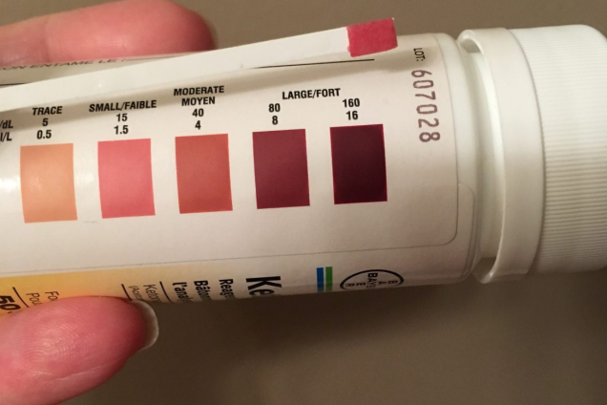
Nutrition Intervention: Pregnancy and Diabetes
Dietitian
Referral within 48 hours of diagnosis
MNT initiated within 1 week of diagnosis
Avoid ketonemia from ketoacidosis or starvation ketosis
Make sure consuming sufficient carbs
Monitor urine ketones
DKA associated with risk of stillbirth

Slide 42

Pre-pregnancy BMI and Weight Gain

Slide 43

70-85% of GDM Manage with Lifestyle
Food plan based on Dietary Reference Intakes (DRI).
DRI during pregnancy recommends a minimum of
175 g of carbohydrate (individualize)
a minimum of 71 g of protein
and 28 g of fiber.
Emphasis on monounsaturated and polyunsaturated fats while limiting saturated fats and avoiding trans fats.
Coaching on amount, type of carbohydrate and impact on BG
Standards of Care in Diabetes—2025. Diabetes Care, January 2025; 48 (Supplement_1): S306-320. https://doi.org/10.2337/dc25-S015

Slide 44

Nutrition Notes
Avoids diets that severely restrict any macronutrient class, specifically,
the ketogenic diet that lacks carbohydrates
the Paleo diet because of dairy restriction,
and any diet characterized by excess saturated fats.
Limit processed foods, fatty red meat, and sweetened foods and beverages
Nutrient-dense, whole foods are recommended, including
fruits, vegetables, legumes, whole grains
healthy fats with n-3 fatty acids that include nuts and seeds and fish, which are less likely to promote excessive weight gain.
Standards of Care in Diabetes—2025. Diabetes Care, January 2025; 48 (Supplement_1): S306-320. https://doi.org/10.2337/dc25-S015

Slide 45
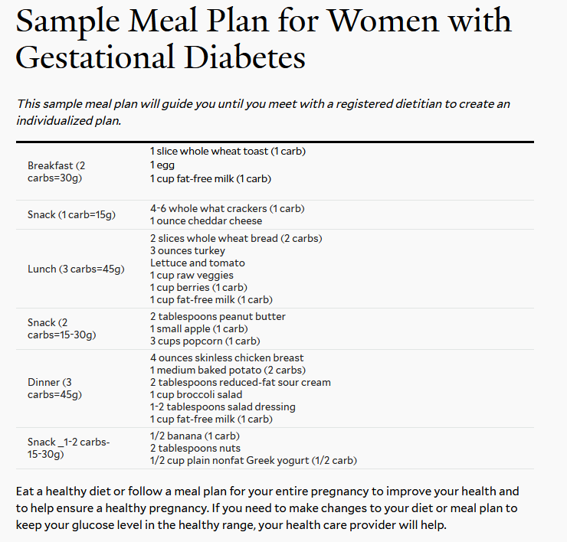
https://yalehealth.yale.edu/sample-meal-plan-women-gestational-diabetes

Slide 46

Management of Hyperglycemia in Type 2 or GDM
With type 2 or GDM, oral meds may not be sufficient to get BG to target.
Glyburide, metformin historically used, but no longer recommended
Both cross the placenta to the fetus
If lifestyle alone doesn’t help achieve glucose goals, insulin is recommended.

Slide 47
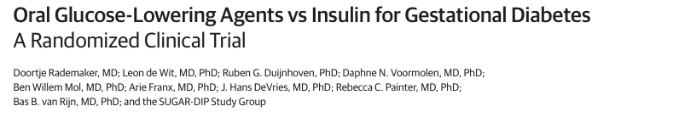
New Study: Insulin vs. Oral in GDM
Why it matters:
It would be nice to use oral agents in pregnancy because:
easier to administer
less costly
better accepted by patients
Study Design: Randomized, open-label noninferiority trial conducted at 25 Dutch centers, participants randomized to orals or insulin
Orals included metformin at max tolerated dose + glyburide if additional glucose lowering needed
Population: N = 820 people with GDM and singleton pregnancies
Primary endpoint: % of infants born large for gestational age (birth weight >90%)
Rademaker D, et al. JAMA. 2025 Feb 11;333(6):470-478.
.
Notes:
Population: N = 820 people with GDM and singleton pregnancies between 16 and 34 weeks gestation with insufficient glycemic control after 2 weeks of dietary changes (FBG > 95mg/dL, 1hrPPG>140mg/dL, 2hr PPG>120mg/dL, mean age 33.2 years
Primary endpoint: Between group difference in % of infants born large for gestational age (birth weight >90%)

Slide 48
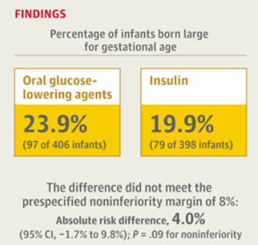
GDM Treatment: Insulin for the Win
Outcomes:
Maternal hypoglycemia reported in 20.9% with orals vs. 10.9% insulin (absolute risk difference 10%, 95% CI 2.7 to 21.2%)
In exploratory analysis with metformin alone, only 19.7% were LGA
Other secondary outcomes did not differ between groups
Clinical Takeaways
Metformin + glyburide is inferior to insulin for GDM
Insulin should remain 1st line for GDM
Rademaker D, et al. JAMA. 2025 Feb 11;333(6):470-478.
.
Notes:
In participants randomized to oral agents, 79% maintained glycemic goals without insulin, 23% needed glyburide

Slide 49

Management of Pregnancy and Diabetes
Insulin is preferred for GDM, type 1 and 2
Does not cross placenta
Can overcome insulin resistance associated w/ T2D
Either multiple daily injections or insulin pump
Refer to specialized center
Get eye exam before pregnancy and every 3 months
Counsel on the risk of development and/or progression of diabetic retinopathy.

Slide 50
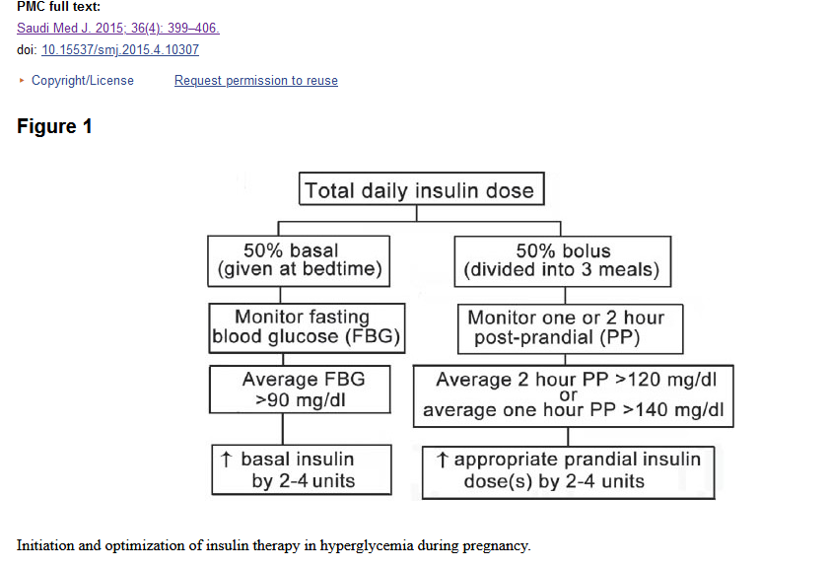
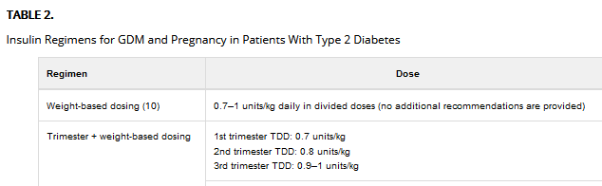
Sample Insulin Management Plan
https://spectrum.diabetesjournals.org/content/29/2/92.figures-only

Slide 51

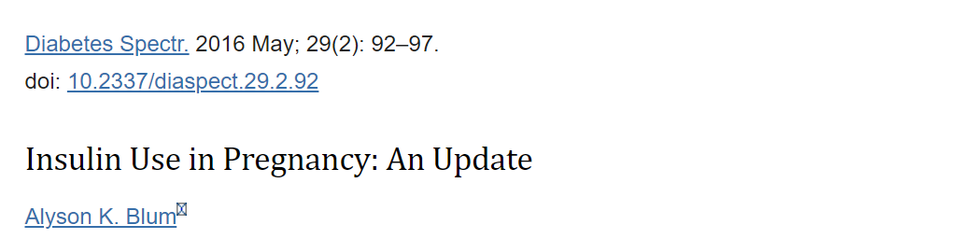
Delivering Insulin in Pregnancy
Human insulin preparations don’t cross the placenta
Detemir no longer available
Long acting: glargine, degludec, or NPH (intermediate acting)
Rapid acting preferred over regular insulin (aspart, lispro)
Many prefer insulin pumps in pregnancy
not clear that they are superior to multiple daily injections.
Insulin pumps can contribute to:
fasting and postprandial glycemic targets
reduced hypoglycemia and
more aggressive prandial dosing to achieve targets.

Slide 52

After Delivery - Gestational Diabetes
Test for undiagnosed diabetes at first prenatal visit in those with risk factors
Test for GDM at 24-28 weeks
Test GDM women for post partum diabetes at 4-12 weeks, using OGTT
Those with GDM need lifelong screening for prediabetes/diabetes at least every 3 yrs
Those with hx of GDM, found to have prediabetes need intensive lifestyle interventions or metformin to prevent diabetes.
Standards of Care in Diabetes—2025. Diabetes Care, January 2025; 48 (Supplement_1): S306-320. https://doi.org/10.2337/dc25-S015

Slide 53

Postpartum after GDM
History of GDM equals a 10-fold increased risk of developing type 2 diabetes
Actions to Prevent include
Encourage Breast Feeding (reduces future type 2 risk by 50%)
Encourage healthy weight
Encourage exercise
Make sure connected with health care
Lipid profile/ follow BP
Preconception counseling

Slide 54

Risk of Future GDM
Absolute risk of developing T2Dnafter GDM increases linearly through a person’s lifetime, being approximately
20% at 10 years,
30% at 20 years,
40% at 30 years,
50% at 40 years, and
60% at 50 years (ADA)
Standards of Care in Diabetes—2025. Diabetes Care, January 2025; 48 (Supplement_1): S306-320. https://doi.org/10.2337/dc25-S015

Slide 55

Improving Health / Preventing GDM
Connection, healthy environments plus resources critical before pregnancy.
Consider social determinants of health from youth through adulthood
Increase access to healthy foods, health care and provide opportunities
Improve screening and health equity
Promote prevention of GDM
Discuss family planning
Provide individuals and family with ongoing education, screening and resources

Slide 56

Poll Question #5
ML is 7 weeks pregnant. The midwife checks fasting BG and it is 134. What does ML have?
A. Gestational diabetes
B. Latent Autoimmune Diabetes
C. Pregnancy induced hyperglycemia
D. Pregestational diabetes

Slide 57

Pregestational Diabetes

Slide 58

31 year old with Type 1 Diabetes
Tells you I am ready to get pregnant.
Uses an insulin pump and CGM.

Slide 59

Pregestational Diabetes
Someone with pre-existing type 1 or 2 becomes pregnant
Elevated BG discovered in first 13 weeks of pregnancy
Preconception A1c goal < 6.5%.
2/3 of all pregnancies w/ diabetes not planned
Involve and empower to help prevent complications
Standards of Care in Diabetes—2025. Diabetes Care, January 2025; 48 (Supplement_1): S306-320. https://doi.org/10.2337/dc25-S015

Slide 60

Pregestational Diabetes– Why do glucose levels matter so much?
Risk of malformation associated w/ degree of hyperglycemia during first trimester
1st Trimester potential complications directly proportional to A1c levels
5-8 weeks is organogenesis.
Diabetes in pregnancy may increase risk of obesity, hypertension, and type 2 diabetes in offspring later in life

Slide 61

First 10 Weeks of Pregnancy Risks
Complications directly proportional to A1C elevations during the first 10 weeks of pregnancy.
Diabetic embryopathy, especially anencephaly, microcephaly
Congenital heart disease
Renal anomalies
Caudal regression

Slide 62

Pregnancy, Youth and Diabetes
The TODAY study documented that despite disease- and age-specific counseling
10.2% of the females in the cohort became pregnant over an average of 3.8 years of study participation.
26.4% of pregnancies ended in a miscarriage, stillbirth, or intrauterine death
20.5% of the liveborn infants had a major congenital anomaly.

Slide 63

Preconception Counseling
Start at puberty and continue for anyone with diabetes and reproductive potential
Incorporate preconception counseling into routine diabetes care.
Discuss family planning and effective contraception (with consideration of long-acting, reversible contraception) until treatment regimen and A1C are optimized for pregnancy.
Reinforce importance of working toward A1C <6.5% to reduce the risk of complications

Slide 64

Preconception Planning
For girls of childbearing potential provide:
Info on effective contraception or abstinence to prevent unplanned pregnancy.
Use developmentally appropriate educational tools
Enable adolescent girls to make well-informed decisions
Free preconception counseling resources tailored for adolescents are available at ADA
Include education about the risks of malformations associated with elevated glucose levels
Standards of Care in Diabetes—2025. Diabetes Care, January 2025; 48 (Supplement_1): S306-320. https://doi.org/10.2337/dc25-S015

Slide 65
Team Approach
Interprofessional team approach
Endocrinology healthcare professional
Maternal fetal medicine specialist
Registered dietitian nutritionist
Diabetes care and education specialist
Counsel on the risk of progression of diabetic retinopathy
Dilated eye exam before pregnancy and in 1st trimester, monitor every trimester and 1 year postpartum as recommended by eye care healthcare professional
Notes:
15.5 Individuals with preexisting dia betes who are planning a pregnancy should ideally begin receiving interpro fessional care for preconception, which includes an endocrinology health care professional, maternal-fetal medicine specialist, registered dietitian nutrition ist, and diabetes care and education specialist, when available. B 15.6 In addition to focused attention on achieving glycemic goals, A stan dard preconception care should be augmented with extra focus on nutri tion, physical activity, diabetes self-care education, and screening for diabetes comorbidities and complications. B 15.7 Individuals with preexisting diabe tes who are planning a pregnancy or who have become pregnant should be counseled on the risk of development and/or progression of diabetic retinop athy. Dilated eye examinations should occur ideally before pregnancy as well as in the first trimester, and then preg nant individuals should be monitored every trimester and for 1 year postpar tum as indicated by the degree of reti nopathy and as recommended by the eye care health care professional

Slide 66
31 year old with Type 1 Diabetes
Tells you I am ready to get pregnant.
Uses an insulin pump and CGM.
Also takes an ACE Inhibitor and statin.
What is A1c target pre-pregnancy and any other recommendations?

Slide 67
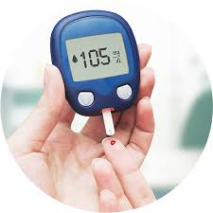
Glucose Monitoring in Pregnancy
GDM – check fasting blood glucose and post prandial BG
Pre-existing type 1 or type 2, need to also check premeal BG
Continuous glucose monitoring (CGM) can help to achieve A1C targets when used in addition to pre- and postprandial glucose monitoring
Can reduce macrosomia and neonatal hypoglycemia in pregnancy complicated by type 1 diabetes.
Standards of Care in Diabetes—2025. Diabetes Care, January 2025; 48 (Supplement_1): S306-320. https://doi.org/10.2337/dc25-S015

Slide 68
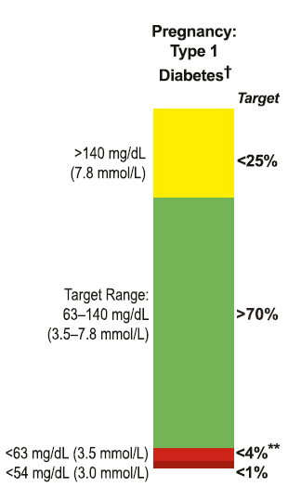

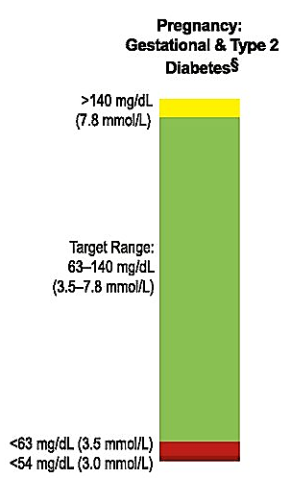



Time in Range Targets in Pregnancy
Pregnancy:
Type 1
Diabetes
Pregnancy:
Gestational and Type 2 Diabetes†
SAFELY INCREASE TIR
as quickly as possible while reducing time >140 mg/dL and glycemic variability
>70%
of day 63-140 mg/dL
<1 %
of day under 54 mg/dL
1. Battelino T et al. Diabetes Care. 2019;42(8):1593-1603.
Notes:
Target range 63–140 mg/( also called time in range or TIR) goal >70%
70% of day = 16 hours and 48 minutes – almost 17 hours/day
Time below range < 63 mg/dL, < 4%
Time below range < 54 mg/dL, < 1%
Time above range >140 mg/dL, < 25%
% time in targets for T2D and GDM not yet established but expected to be tight

Slide 69
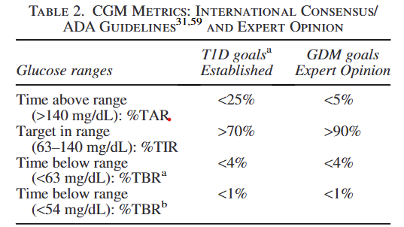
CGM in GDM Practical Considerations
A1GDM,managed with diet and exercise
A2GDM, treatment with antihyperglycemic medications
“Recommend CGM to all who are willing and able to safely use this technology”
Castorino K, Durnwald C, Ehrenberg S. et al; Continuous Glucose Monitoring for Gestational Diabetes Management Working Group. Practical Considerations for Using Continuous Glucose Monitoring in Patients with Gestational Diabetes Mellitus. J Womens Health (Larchmt). 2024 Oct 8.
Notes:
Given the demonstrated beneﬁts of CGM in improving glycemic management, and promoting healthy lifestyle GDM patients,51 we

Slide 70



FDA Approved CGM in Pregnancy
Dexcom G7
Freestyle Libre 2 and 2+
Freestyle Libre 3 and 3+

Slide 71
ADA Standards of Care 2025 (CGM)
CGM can help to achieve glycemic goals in T1D and pregnancy and may be beneficial for other types of diabetes in pregnancy.
Recommend CGM to pregnant individuals with T1D.
In conjunction with aims to achieve traditional pre- and postprandial glycemic goals, rtCGM can reduce the risk for large-for-gestational-age infants and neonatal hypoglycemia in pregnancy complicated by T1D.
Commonly used estimated A1C and glucose management indicator calculations should not be used in pregnancy as estimates of A1C.

Slide 72

Type 1 and Hypoglycemia
Increased risk of hypoglycemia in first trimester
Due to altered counterregulatory response in pregnancy that may decrease hypoglycemia awareness.
Education about prevention, recognition, and treatment of hypoglycemia is important before, during, and after pregnancy to help to decrease and manage the risk of hypoglycemia.
Insulin resistance drops rapidly with delivery of the placenta (leads to hypo post delivery)
Standards of Care in Diabetes—2025. Diabetes Care, January 2025; 48 (Supplement_1): S306-320. https://doi.org/10.2337/dc25-S015

Slide 73
Poll Question 7
MR has type 1 diabetes and is trying to get pregnant. According to ADA Standards, which of the following medications should be stopped before pregnancy?
A. Levothyroxine, labetalol
B. Atorvastatin, Lisinopril
C. Metformin, nifedipine
D. Flonase, folic acid

Slide 74

Meds and Blood Pressure Target During Pregnancy
Target B/P < 110-135/85
Meds contraindicated during pregnancy
ACE inhibitors and Angiotensin Renin Blockers (ARB)
Statins (shared decision-making)
B/P Meds approved
Methyldopa, nifedipine, labetalol, diltiazem, clonidine, prazosin.
Other beta blockers except atenolol can be used
Standards of Care in Diabetes—2025. Diabetes Care, January 2025; 48 (Supplement_1): S306-320. https://doi.org/10.2337/dc25-S015

Slide 75

Type 1 or 2 – Aspirin Therapy for Preeclampsia 100-150 mg daily
People with type 1 or 2 have 2-4x’s increased risk of preeclampsia during pregnancy.
Signs: HTN, Proteinuria, edema
Associated with decrease blood flow to fetus.
Start aspirin therapy at 12-16 weeks until birth
US Preventive Task Force 2018 recommendations
Taking ASA reduces morbidity, saves lives and lowers health care costs
Standards of Care in Diabetes—2025. Diabetes Care, January 2025; 48 (Supplement_1): S306-320. https://doi.org/10.2337/dc25-S015

Slide 76
Pregnancy Care
Prenatal Vitamins
At least 400-800 mg of folic acid
150mg of potassium iodine
Abstain from nicotine products, alcohol, and recreational drugs
Screen for STD’s, thyroid disorders, recommended vaccinations
Careful review of prescription and nonprescription medications
Notes:
Prescription of prenatal vitamins with at least 400–800 mg of folic acid (20) and 150 mg of potassium iodide (21) is recommended prior to conception. Review and counseling on abstaining from nicotine products, alcohol, and recreational drugs, including marijuana, is important

Slide 77
31 year old with Type 1 Diabetes
Uses an insulin pump and CGM, Time in Range
Stop ACE Inhibitor and statin
Other recommendations?
Find knowledgeable team
Monitor Blood Pressure and glucose with meter
Eye exam before and during each trimester
Prepare for glucose changes over each trimester and post delivery
Help with problem solving

Slide 78

Postpartum with PreExisting DM
Meal plan adjustment for goals/needs
Breastfeeding and BG balance
Family planning
Preconception counseling starts here
Connect with long term follow up care
Monitor for postpartum depression and provide support

Slide 79


Postnatal Health: Maternal Behavior
For children: Breastfeeding decreases risk type 1 and type 2 and excess weight
For parent:
Breastfeeding decreases diabetes risk by 50%.
Plus breastfeeding decreases blood pressure, risk of breast cancer and helps with weight management

Slide 80

Engaging and supporting
Environment
Access to safe places to exercise
Access to healthy foods
Adequate paying job/finances
Access to health care / Postnatal care
Access to child care
Phases of Life
After Delivery
LifeStyle
Breast feeding
Weight management
Keeping Active
Choose healthy foods
Role model for children

Slide 81

Health Legacy – Great opportunity to pass on your best for generations to come
Healthy eating before and during pregnancy matters
Keep Active
Family planning
Encourage active
participation in care; before, during and after.

Slide 82

Thank You
Questions? We are here to help!
Email info@diabetesed.net
Call 530/ 893-8635
www.diabetesed.net

Slide 83

Elevated Glucose in Pregnancy – Potential Complications
Spontaneous abortion
Fetal anomalies
Preeclampsia
Fetal demise
Macrosomia,
Neonatal hypoglycemia,
Hyperbilirubinemia
Neonatal respiratory distress syndrome

