Slide 1

Diabetes Education Services Presents:
Please download Meds PocketCards
Standards 8 & 9: Pharmacologic Approaches to Glycemic Management & Obesity 2025
Beverly Thomassian, RN, MPH, BC-ADM, CDCES
Pronouns: She, her, hers
www.DiabetesEd.net
Notes:
Add comparative effectiveness of slgt2 inhibitors
Add sotagliflozin slide.
add pocket card: bromocriptine/colsevelam-slide 212
Am I slides 205-207?

Slide 2
Land Acknowledgment
We acknowledge and are mindful that Diabetes Education Services stands on lands that were originally occupied by the first people of this area, the Mechoopda, and we recognize their distinctive spiritual relationship with this land, the flora, the fauna, and the waters that run through this area.

Slide 3

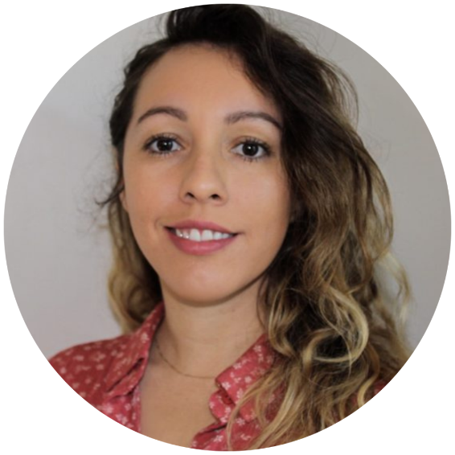
We are Here to Help!
Bryanna Sabourin
Director of Operations
Tiffany Bergeron
Customer Advocate &
Customer Happiness Expert
If you have questions, you can chat with us at www.DiabetesEd.net or call 530 / 893-8635 or email at info@diabetesed.net

Slide 4

Diabetes Education Services Inclusion Statement
Based on the IDEA Initiative inspired by CDR
Inclusion
Diversity
Equity
Access
We are committed to promoting diversity and inclusion in our educational offerings.
We recognize, respect, and include differences in ability, age, culture, ethnicity, gender, gender identity, sexual orientation, size, and socioeconomic characteristics.
Our goal is to promote equity and access, acknowledging historical and institutional inequities.
We are committed to practicing cultural humility and cultivating our cultural competence.
We wish to create a safe space within our community where one's beliefs, experiences, identity, and differences in ability, age, size, socio-cultural/socioeconomic characteristics, and political affiliations are considered and respected.

Slide 5
Coach Bev has no Conflict of Interest
She’s not on any speaker's bureau
Does not invest or have any financial relationships with diabetes related companies.
Gathers information from reading package inserts, research and articles
The ADA Standards of Medical Care is main resource for course content

Slide 6
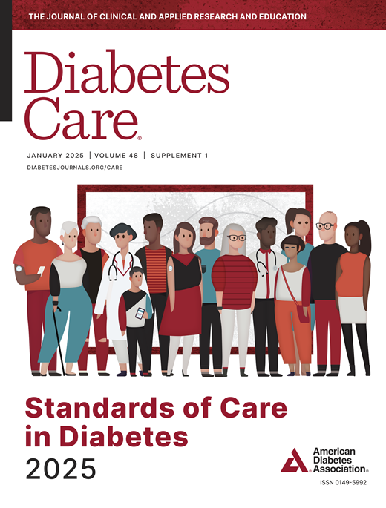
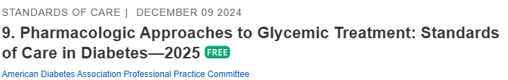
Pharmacologic Approaches to Glycemic Treatment: 9
American Diabetes Association Professional Practice Committee; 9. Pharmacologic Approaches to Glycemic Treatment: Standards of Care in Diabetes—2025. Diabetes Care 1 January 2025; 48 (Supplement_1): S181–S206. https://doi.org/10.2337/dc25-S009

Slide 7

Topics
1. Describe the role of Diabetes Care & Education Specialists in advocating for optimal therapeutic approaches.
2. Discuss the application of the new ADA Guidelines to improve glucose and reduce CV and renal risk.
3. List strategies to initiate & adjust oral & injectable therapy using a person-centered approach.
4. Apply new guidelines to individual case studies.

Slide 8
Natural History of Diabetes
No Diabetes
FBG <100
Random <140
A1c <5.7%
Prediabetes
FBG 100-125
Random 140 - 199
A1c ~ 5.7- 6.4%
50% working pancreas
Diabetes
FBG 126 +
Random 200 +
A1c 6.5% or +
20% working pancreas
Yes!
NO
Development of type 2 diabetes happens over years or decades

Slide 9

What is Type 2 Diabetes?
Complex metabolic disorder ….
(Insulin resistance and deficiency)
with social, behavioral and environmental risk factors unmasking the effects of genetic susceptibility.
New Diagnosis? Call 800 – DIABETES to request “Getting Started Kit”
www.Diabetes.org

Slide 10
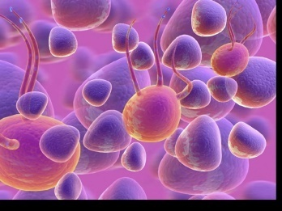
Ominous Octet
Decreased satiation neuro-
transmission
Decreased amylin, β-cell secretion
80% loss at dx
Increased renal glucose reabsorption
Decreased Gut hormones
Increased glucagon secretion
G
I
G
I
G
G
I
I
G
Increased lipolysis
G
G
I
I
G
G
I
Increase glucose
production
I
G
G
Decreased glucose
uptake
Notes:
10
10

Slide 11
ABCs of Diabetes – ADA 2025
A1C less than 7%
Pre-meal BG 80-130
Post meal BG <180
Time in Range (70-180) 70% of time
Blood Pressure < 130/80
Cholesterol
Statin therapy based on age & risk status
If 40+ with ASCVD Risk, decrease 50%, LDL <70
If 40+ with ASCVD, decrease 50%, LDL <55
Glycemic targets need to be woven into the overall person-centered strategy.

Slide 12
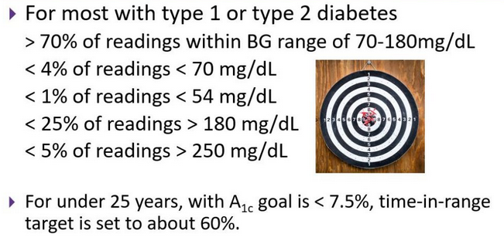
Ambulatory Glucose Profile
Standardized report with visual cues for those on CGM devices
Evaluate Time in Range (TIR)
Target 70-180 mg/dL
ADA Standards 2025

Slide 13

Breaking Through Clinical Inertia

Slide 14


Diabetes Specialists have a lot to offer
Person Centered Strength based approach
Pharmacology
Lifestyle
Mental health
Advocacy
Evidence Based Guides
ADA Standards
AACE Guidelines

Slide 15

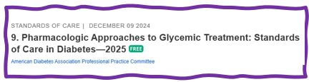
Choice of Glucose Lowering Meds
Person centered
Co-conditions
Values and needs
Social Determinants of Health
Reduce risk
CV and renal
Affordable
Weight impact

Slide 16
Cost of Insulin & Diabetes Meds- 2025 Update
Out-of-pocket costs for insulin are capped at $35 per month per insulin.
with Medicare.
Some commercial health plans.
and three major insulin manufacturers.
Individuals with high-deductible health plans and those without insurance coverage can incur very high out-of-pocket expenses for glucose-lowering therapies.
No such caps exist for diabetes durable medical equipment (i.e., equipment for glucose monitoring and insulin administration) or for noninsulin medications.
Reli-On Brand Walmart, offers Reg, NPH and 70/30 insulin at $25 per vial, no Rx required.

Slide 17
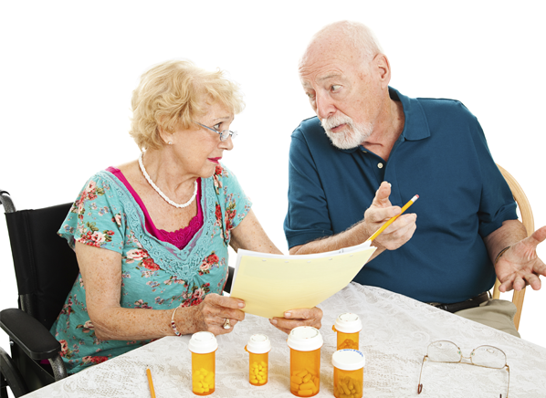
Medication Taking Behaviors
Adequate medication taking is defined as 80%
23% of time, if A1c, B/P, lipids above target - due to med taking behavior
Assess for barriers
If taking meds 80% of time and goals not met, consider medication intensification
Barriers include:
Forgetting to fill Rx, forgetting to take, fear, depression, health beliefs, med complexity, cost, knowledge gap, system factors, etc.
Work on targeted approach for specific barrier

Slide 18
Pharmacologic Approaches to Glycemic Treatment: 9
American Diabetes Association Professional Practice Committee; 9. Pharmacologic Approaches to Glycemic Treatment: Standards of Care in Diabetes—2025. Diabetes Care 1 January 2025; 48 (Supplement_1): S181–S206. https://doi.org/10.2337/dc25-S009

Slide 19
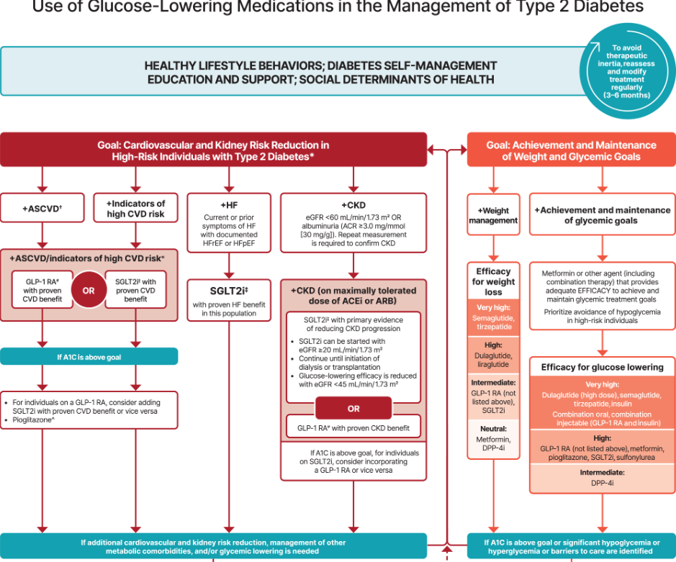
Let’s Break it Down ADA 2025

Slide 20


Metformin, Sulfonylureas, DPP-IV Inhibitors & TZD’s

Slide 21

Quick Question 1
RT, a 61-year-old woman with BMI of 28 and type 2 diabetes 3 months. She wanted to try to manage diabetes with diet and exercise. GFR in 90s, UACR 14mg/gm, A1c 7.4%. Based on this info, which medication class would you start?
A. TZD
B. Biguanide
C. GLP1-RA
D. Sulfonylurea

Slide 22
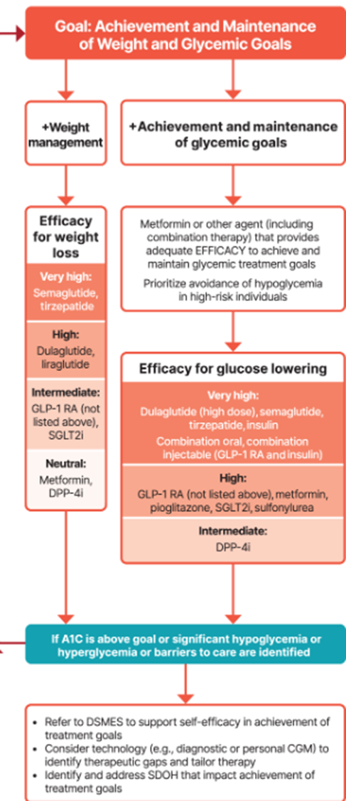
Metformin is “Usually” 1st Line
Why metformin?
Longstanding evidence
High efficacy and safety
Inexpensive - 3 months for $12
Weight neutral
Check B12 levels at intervals especially if anemia or neuropathy.
If ASCVD, HF or CKD or high ASCVD risk, use SGLT2i or GLP-1 RA +/- metformin
If A1C ≥ 8.5%, consider combo therapy.

Slide 23
Quick Question 1
RT, a 61-year-old woman with BMI of 28 and type 2 diabetes 3 months. She wanted to try to manage diabetes with diet and exercise. GFR in 90s, UACR 14mg/gm, A1c 7.4%. Based on this info, which medication class would you start?
A. TZD
B. Biguanide
C. GLP1-RA
D. Sulfonylurea

Slide 24
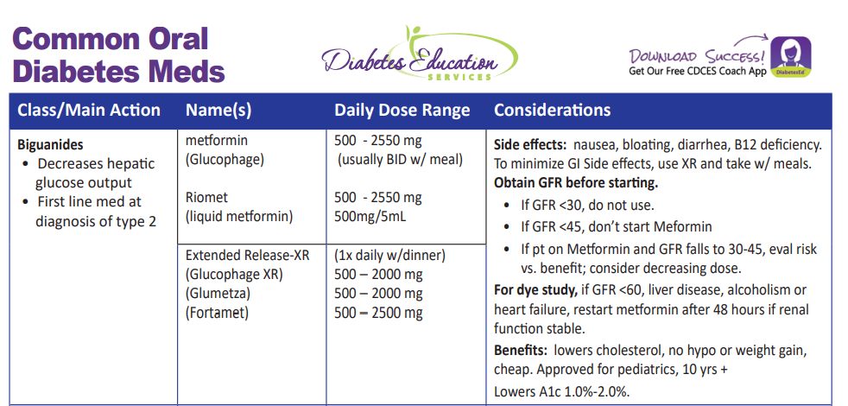

Slide 25

Quick Question 2
ZR has been on Metformin 1000mg BID therapy for over 10 years, but their GFR recently dropped to 40. A1C is 8.2%. Which of the following do you recommend?
Stop the metformin since the GFR is less than 45
Decrease the metformin dose
Monitor GFR every month to ensure safety.
Stop metformin since it can hasten kidney disease
Notes:
Correction answer: C

Slide 26

Metformin and Kidney Disease – 2025 Update
Metformin is also a preferred agent in CKD due to well-documented efficacy and safety profile in type 2 diabetes.
However, there is no documented direct kidney benefit.
Don’t start metformin if eGFR is <45
Reduce dose of metformin if eGFR is <45 individual is already on metformin.
Stop metformin once eGFR is <30 mL/min/1.73 m²

Slide 27
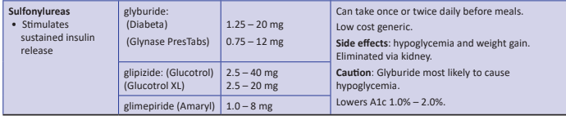
Sulfonylureas
Mechanism: Stimulate beta cells to release insulin
Dosed 1-2x daily before meals
Adverse effects
Hypoglycemia, Weight gain, watch renal function
Low cost, $12 for 3 months supply
Can help with glucose toxicity, lowers A1C 1-2%
Notes:
CAROLINA tral (linagliptin vs glimepiride)
Meta-analysis: In type 2 diabetes, the use of sulfonylureas is associated with increased mortality and a higher risk of stroke

Slide 28

Case Study KR – Poll 3
KR is a 47yoM with type 2 diabetes x 5 years. Complains of dizziness/shakiness 3x a week, especially after surfing. Last A1C 6.7%. Which of their medications is most likely causing hypoglycemia?
A. Metformin
B. Sitagliptin (Januvia)
C. Glimepiride (Amaryl)
D. Pioglitazone (Actos)
Notes:
Answer. C

Slide 29
Hypoglycemia & Next Steps
Do NOT Cause Hypoglycemia
Can Cause Hypoglycemia
DPP-4 Inhibitor
GLP-1 RA / GIP
SGLT-2 Inhibitor
TZD, Metformin
Sulfonylurea
Meglitinides
Insulin

Slide 30
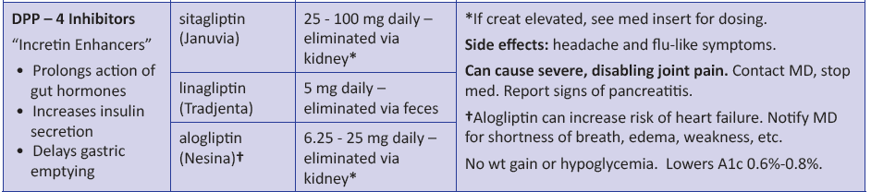
DPP-4 Inhibitors – “Incretin Enhancers” Januvia (sitagliptin) – Tradjenta (linagliptin) Nesina (alogliptin)
Action:
Increase insulin release w/ meals
Suppress glucagon
Efficacy:
Decreases A1c by 0.6 -0.8%
Alogliptin increased risk of heart failure
AWP $600 month
Notes:
30
30

Slide 31
Indications for Insulin Sensitizers – TZD’s Pioglitazone (Actos)
Action: decrease insulin resistance by making muscle and adipose cells more sensitive to insulin. Decrease free fatty acids
Name:
pioglitazone (Actos) – bladder cancer warning
Indicated for steatosis liver disease
Post stroke
Dosing: 15-45 mg daily (try lower doses)
Efficacy/ Considerations
Reduce A1C ~0.5-1.0%
6 weeks for maximum effect
Actos $5 a month
Can cause fluid retention, not w/ CHF
Notes:
31
31
Thiazolidinediones (TZDs) enhance insulin sensitivity in muscle and adipose tissue by binding to cell receptors,which leads to an increase in glucose transporter expression. TZDs encourage beta cells to respond more efficiently by lowering the amount of glucose and free fatty acids in the bloodstream, both of which are known to be detrimental to insulin secretion. Finally, these drugs reduce glucose production in the liver.
Clinical trials indicate that pioglitazone and rosiglitazone are slightly more effective at reducing A1C (1.5-1.6% reduction) than troglitazone (1.1% reduction).
Some of the beneficial side effects of thiazolidinediones include an increase in HDL cholesterol and reduction of triglyceride concentrations. This class of drugs has also been shown to lower blood pressure and decrease vascular inflammation in vitro. There are clinical studies underway to further examine the cardiovascular benefit to TZDs.
Some adverse effects of TZDs include weight gain, a potential increase in LDL cholesterol levels, and a possible increase in alanine aminotransferase levels (ALT). Because of the risk of weight gain, edema, and increased LDL cholesterol, thiazolidinediones are contraindicated in patients with advanced forms of congestive heart failure. Due to reported cases of liver failure and liver toxicity caused by the increase in ALT levels, TZDs are contraindicated in patients with abnormal liver function.
TZDs are the most expensive of the oral antidiabetic agents.

Slide 32

GLP & GIP Receptor Agonists
Reduce Major Adverse Cardiovascular Events (MACE)

Slide 33
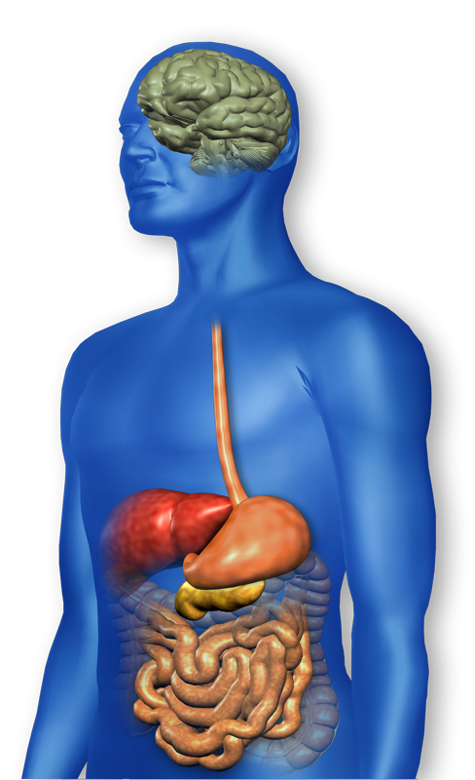
GLP-1 Effects in Humans Understanding the Natural Role of Incretins
GLP-1 secreted upon the ingestion of food
Promotes satiety and reduces appetite
Alpha cells:
↓ Postprandial glucagon secretion
↑ Beta-cell
response
Liver: ↓ Glucagon reduces hepatic glucose output
Beta cells: Enhances glucose-dependent insulin secretion
Stomach: Helps regulate gastric emptying
Adapted from Flint A, et al. J Clin Invest. 1998;101:515-520 Adapted from Larsson H, et al. Acta Physiol Scand. 1997;160:413-422 Adapted from Nauck MA, et al. Diabetologia. 1996;39:1546-1553 Adapted from Drucker DJ. Diabetes. 1998;47:159-169
GLP-1 degraded by
DPP-4 w/in minutes
Notes:
33
33
Required
DISCUSSION POINTS:
--Upon food ingestion, GLP-1 is secreted into the circulation from L cells of small intestine.
--GLP-1 increases beta-cell response by enhancing glucose-dependent insulin secretion.
--GLP-1 decreases beta-cell workload and hence the demand for insulin secretion by:
--Regulating the rate of gastric emptying such that meal nutrients are delivered to the small intestine and, in turn, absorbed into the circulation more smoothly, reducing peak nutrient absorption and insulin demand (beta-cell workload)
--Decreasing postprandial glucagon secretion from pancreatic alpha cells, which helps to maintain the counterregulatory balance between insulin and glucagon
--Reducing postprandial glucagon secretion, GLP-1 has an indirect benefit on beta-cell workload, since decreased glucagon secretion will produce decreased postprandial hepatic glucose output
--Having effects on the central nervous system, resulting in increased satiety (sensation of satisfaction with food intake) and a reduction of food intake
--By decreasing beta-cell workload and improving beta-cell response, GLP-1 is an important regulator of glucose homeostasis.
SLIDE BACKGROUND:
--Effect on Beta-cell: Drucker DJ. Diabetes. 1998; 47:159-169
--Effect on Alpha cell: Larsson H, et al. Acta Physiol Scand. 1997; 160:413-422
--Effects on Liver: Larsson H, et al. Acta Physiol Scand. 1997; 160:413-422
--Effects on Stomach: Nauck MA, et al. Diabetologia. 1996; 39:1546-1553
--Effects on CNS: Flint A, et al. J Clin Invest. 1998; 101:515-520

Slide 34
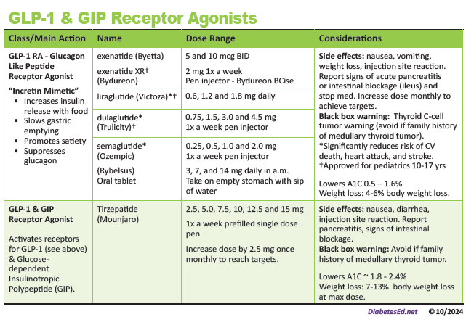
Pocket Card: GLP-1 & GIP RA
Notes:
Update with exenatide indication in pediatrics.

Slide 35
Benefits of GLP-1 RA & GIP/GLP-1 Receptor Agonists
A1C lowering
Substantial Weight loss
Cardiovascular benefits*
Decrease appetited
Lowers post meal glucose
Ease of use
*semaglutide, liraglutide, dulaglutide

Slide 36
Pocket Card: GLP-1 & GIP RA
Notes:
Update with exenatide indication in pediatrics.

Slide 37

Tirzepatide Wt loss and A1C impact
A1C drop in Surpass Trials of
1.9% to 2.6%
Weight loss in Surpass Trials of
7.8% to 12.9% or
13.6 to 28.4 pounds
Approved as wt loss medication in 11/23. “Zepbound”

Slide 38
GLP-1 /GIPs Approved for Weight Loss
Liraglutide:
Victoza 1.8 mg (diabetes)
Saxenda 3 mg (wt loss)
6% wt loss, $1349 a mo
Semaglutide:
Ozempic 2mg (diabetes)
Wegovy 2.4mg (wt loss)
6% wt loss, $1349 a mo
Tirzepatide
Mounjaro 15mg (diabetes)
Zepbound (wt loss)
13% wt loss - $1056 a mo
All 3 Approved for use in adults with a:
BMI of ≥ 30 or
BMI of ≥ 27 or greater who have hypertension, type 2 diabetes, or dyslipidemia.

Slide 39

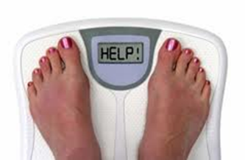
Assess Weight Loss Goals
These meds associated with weight loss
GLP-1 RA and GLP/GIP agonists
SGLT-2 Inhibitors
These meds are weight neutral
Metformin
DPP-4 Inhibitors

Slide 40
Case Study Question 4
RT is on max dose of metformin and is started on tirzepatide to help with BMI of 39 and decrease CV risk. What outcomes can KR expect at highest dose?
A1C drop of 3-4%, Wt loss of 3-5kg
Increased risk of UTI, A1C drop of 1-2%
Potential for ~10% body wt loss
Doubles risk of pancreatic cancer

Slide 41
GLP-1/GIP Receptor Agonist Indications
Drug | Lower BG | Reduce CV / Kidney Risk? | Wt loss approved?
Exenatide IR (Byetta) Lixisenatide (Adlyxin) Semaglutide (Rybelsus) | Yes
Exenatide ER (Bydureon) | Yes for 10 yrs and older
Dulaglutide (Trulicity) | Yes for 10 yrs and older | Yes
Semaglutide (Ozempic) | Yes | Yes Kidney protective | Yes Wegovy 2.4mg
Liraglutide (Victoza) | Yes for 10 yrs and older | Yes | Yes Saxenda 3mg
Tirzepatide (Mounjaro) | Yes | ? | Yes, Zepbound up to 15 mg
Package inserts, dailymed.nlm.nih.gov

Slide 42

Counseling Points: GLP-1 RA & GLP-1/GIP
Avoid if personal or family history of medullary thyroid cancer
Avoid in combo with DPP-4 inhibitors
Watch for intestinal obstruction
Eat smaller meals to reduce nausea
Avoid high fat meals
Use of non-FDA compounded products not recommended
Avoid with history pancreatitis
If on tirzepitide, use back up contraception for first 4 weeks
Ask about recent eye exam
Potential increase in diabetes retinopathy
Notes:
Inject at room temperature, let alcohol fully dry

Slide 43

BREAK TIME

Slide 44

SGLT-2 Inhibitors

Slide 45

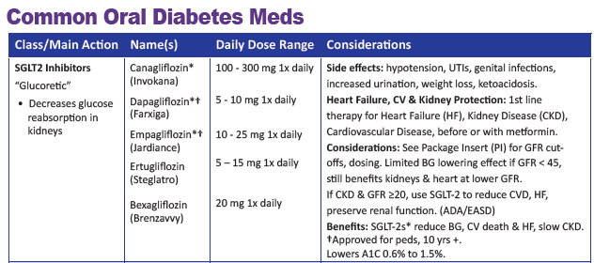

SGLT2 Inhibitors- “Flozins”
Action: decreases renal reabsorption of glucose proximal tubule of kidneys (reset renal threshold)
Preferred diabetes treatment for people with heartd failure and kidney disease. Decreases BG & CV Risk.
AWP: ~$650 a month
% ‘f
Notes:
45
45
Thiazolidinediones (TZDs) enhance insulin sensitivity in muscle and adipose tissue by binding to cell receptors,which leads to an increase in glucose transporter expression. TZDs encourage beta cells to respond more efficiently by lowering the amount of glucose and free fatty acids in the bloodstream, both of which are known to be detrimental to insulin secretion. Finally, these drugs reduce glucose production in the liver.
Clinical trials indicate that pioglitazone and rosiglitazone are slightly more effective at reducing A1C (1.5-1.6% reduction) than troglitazone (1.1% reduction).
Some of the beneficial side effects of thiazolidinediones include an increase in HDL cholesterol and reduction of triglyceride concentrations. This class of drugs has also been shown to lower blood pressure and decrease vascular inflammation in vitro. There are clinical studies underway to further examine the cardiovascular benefit to TZDs.
Some adverse effects of TZDs include weight gain, a potential increase in LDL cholesterol levels, and a possible increase in alanine aminotransferase levels (ALT). Because of the risk of weight gain, edema, and increased LDL cholesterol, thiazolidinediones are contraindicated in patients with advanced forms of congestive heart failure. Due to reported cases of liver failure and liver toxicity caused by the increase in ALT levels, TZDs are contraindicated in patients with abnormal liver function.
TZDs are the most expensive of the oral antidiabetic agents.

Slide 46
Benefits of SGLT-2 Inhibitors
A1C lowering
Weight loss
Cardiovascular benefits
Renal benefits
Heart failure benefits
Blood pressure lowering

Slide 47
Side Effects of SGLT-2 Inhibitors
Genitourinary infections
Volume depletion
Increased urination
Hypotension
Monitor Lytes
Diabetes ketoacidosis (DKA)
Notes:
Cana: bone mineral density decline: hip ≤1%; lumbar spine, femoral neck, and distal forearm <1%
UTI: 6%Genito infection: 11-12%
Increased serum K+: 9-27%
Amputation risk
Emgag: UTI: females 18%, males 4%
Genito infection: 5%
Dapag: UTI: 6%, genito infection: 3%

Slide 48
SGLT-2i Indications Summary
Drug | Lower BG | Reduce CV Risk? | Use to treat Heart Failure? | Slow renal disease?
Dapagliflozin (Farxiga) | Yes | Yes | Yes +/- Diabetes | Yes
Empagliflozin (Jardiance) | Yes | Yes | Yes +/- Diabetes | Yes
Canagliflozin (Invokana) | Yes | Yes | Yes w/ Diabetes | Yes
Ertugliflozin (Steglatro) | Yes | No | Yes w/ Diabetes | Yes
Bexagliflozin (Brenzavvy) | Yes | NA | NA | NA
Package inserts, dailymed.nlm.nih.gov

Slide 49

SGLT2i: Managing Adverse Effects
Maintain good hygiene to reduce risk of genital mycotic infections
Higher risk with higher glucose
DKA risk
Use caution with reducing insulin dose
Report nausea, vomiting and malaise
Monitor BP
May need to reduce antihypertensive meds
UTI risk greater with hyperglycemia

Slide 50

Case Study LS
LS is 69 with type 2 diabetes for over a decade. Takes metformin 1000mg twice daily and dulaglutide 3mg weekly. Recently diagnosed with heart failure.
A1C=7.3%.
UACR 212mg/gm
eGFR=56 B/P 146/82
Weight: 205lbs, 5”7, BMI=32kg/m²
Lost 10lbs in the last year
Notes:
Answer: D Metformin

Slide 51
LS continued Poll 5
What is the best med to add to LS regimen?
Glipizide
Dapagliflozin (Farxiga)
Pioglitazone (Actos)
Linagliptin (Tradjenta)
More than 1 correct answer
What teaching would you include? Would we adjust the dulaglutide (Trulicity) dose?
How would we manage other risk factors:
Use of ACE-inhibitor/ARB, BP management
Statin for CV risk Refer to RD
Notes:
What dose to start? Limit to 100mg daily
Answer: B

Slide 52

Combo therapy first?
Consider initial combination therapy in people presenting with A1C levels 1.5–2.0% above goal.
Data supports initial combination therapy for more rapid attainment of glycemic goals and later combination therapy for longer durability of glycemic effect.

Slide 53

Add Meds to Lower A1C
Each new class of oral noninsulin agents added to metformin
Lowers A1C 0.7–1.0%
If a GLP-1 RA or the dual GIP and GLP-1 RA is added,
Lowers A1C 1-2%

Slide 54
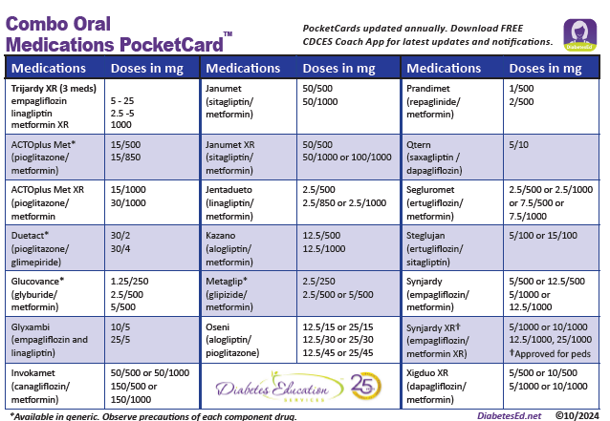
Consider Combo Meds

Slide 55
Next Step for KR
KR is a 47yoM with type 2 diabetes x 5 years. Complains of dizziness, shakiness 3x a week, especially after surfing. Last A1C=6.7%.
Stopped KR’s glimepiride due to hypoglycemia and wt gain.
Referred to DSME Program and RD/RDN
Had a recent “small stroke”
Goal is to reduce Major Adverse Cardiovascular Events (MACE)
Notes:
Answer. C

Slide 56
Next Step for KR – Question 6
KR is a 47yoM with type 2 diabetes x 5 years.
Had recent stroke. A1C was 6.7% now increased to 8.2% after stopping glimepiride. Not able to surf as much and gaining some weight. GFR 90+ and UACR less than 30mg/gm. What class of med would be best to start?
SGLT-2i
Biguanide - Metformin
DPP-IV
GLP-1 RA
Notes:
Answer. C

Slide 58
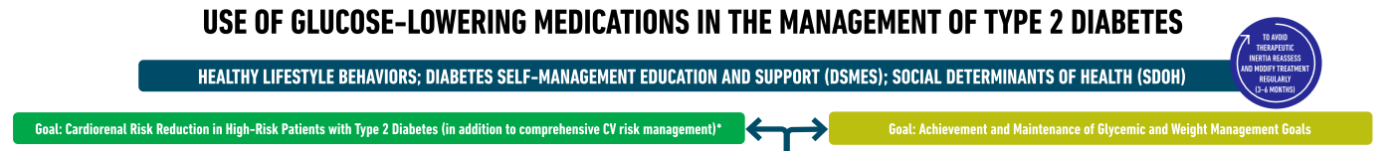
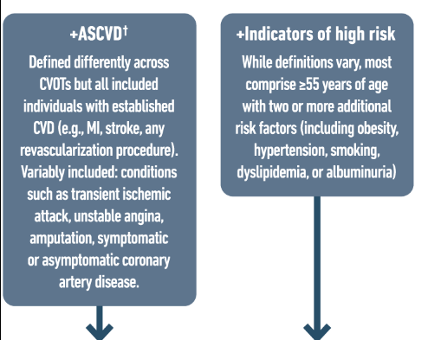
Atherosclerotic Cardiovascular Risk Reduction – High Importance
Goal is to reduce Major Adverse Cardiovascular Events (MACE)

Slide 59
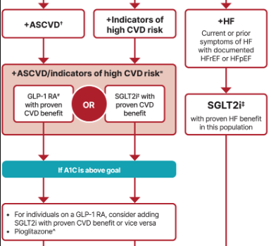
Choosing glucose-lowering medication in people with CVD
Most effective meds based on Cardiovascular Outcomes Trial (CVOT)
GLP-1 RA’s Preferred semaglutide (Ozempic), liraglutide (Victoza), dulaglutide (Trulicity)
~ Or~
SGLT2i empagliflozin (Jardiance), canagliflozin (Invokana), dapagliflozin (Farxiga)
ASCVD = atherosclerotic cardiovascular disease
Notes:
For people with established atherosclerotic cardiovascular disease or indicators of high risk our recommendation is to choose a GLP-1 receptor agonist or an SGLT-2 inhibitor with proven cardiovascular benefit. In case HbA1c remains above target one should add an agent from the other category or pioglitazone as deemed necessary. Our recommendation is based on the favourable results of cardiovascular outcomes trials that established the favourable effect of GLP-1 receptor agonists and SGLT-2 inhibitors on a series of hard clinical outcomes including major adverse cardiovascular events and all-cause mortality.

Slide 60

Heart Failure - Choosing glucose-lowering medication in people with
In people with heart failure, use SGLT2i because they improve heart failure and kidney outcomes.
SGLT2i empagliflozin (Jardiance), canagliflozin (Invokana), dapagliflozin (Farxiga)
ertugliflozin (Steglatro)
Notes:
For individuals with heart failure our recommendation is that SGLT2i with proven benefit should be used because they improve heart failure and kidney outcomes.

Slide 61

Diabetes + CKD – Increases CVD Risk
Chronic kidney disease (CKD) is a frequent complication in diabetes
Type 1 diabetes ~30%
Type 2 diabetes ~40%
In several studies, participants on SGLT2i with GFRs of 30-60 (stage 3) reduced ASCVD risk and improved renal function
Slowed kidney disease or death
Reduced albuminuria
National Kidney Foundation. https://www.kidney.org/atoz/content/diabetes

Slide 62

Life Study
71-year-old woman with type 2 diabetes for past year. BMI 27. Has been trying to manage diabetes by limiting carbs, keeping active and taking sitagliptin. GFR 30s, UACR 300+. Good social support. A1c 7.9%
What action needed?

Slide 63
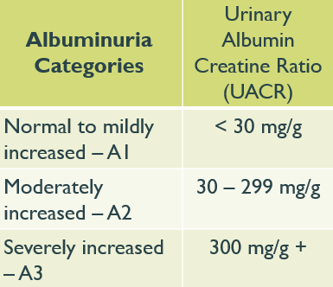
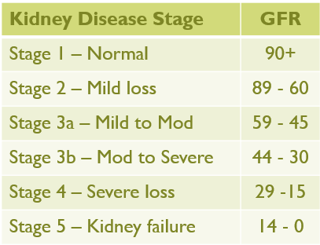
Chronic Kidney Disease and Hypo Prevention – 2025 Update
Optimize glucose and BP to protect kidneys.
Individuals with CKD, particularly advanced CKD and kidney failure, are at high risk for hypoglycemia.
If treated with insulin and/or sulfonylureas, treatment needs to be closely monitored and adjusted as eGFR declines and individuals need to be educated about and closely monitored for hypoglycemia occurrence.

Slide 64
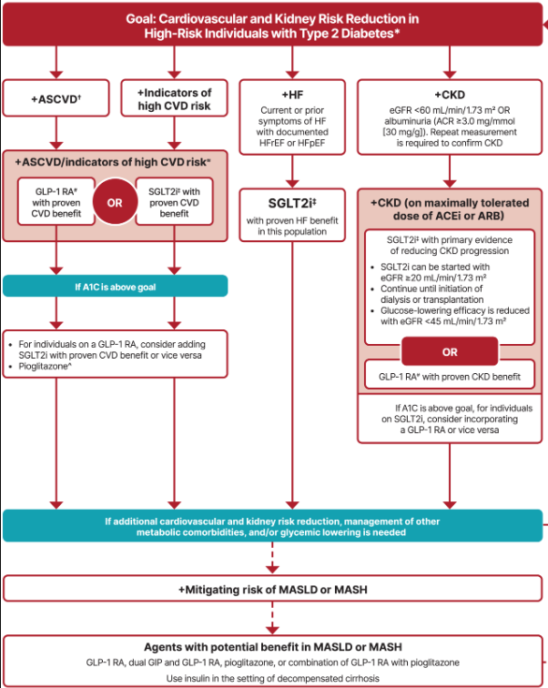
Chronic Kidney Disease - Choosing glucose-lowering medication
In renal failure, use SGLT-2 in people with GFR ≥ 20 and continue until initiation of dialysis or transplantation.
(When GFR <45, SGLT-2’s don’t lower BG much.)
Or
GLP* with proven CVD benefit if SGLT2 not tolerated or contraindicated
*Semaglutide improves kidney function.

Slide 65
Life Study
71-year-old woman with type 2 diabetes for past year. BMI 27. Has been trying to manage diabetes by limiting carbs, keeping active and taking sitagliptin. GFR 30s, UACR 300+. Strong social support. A1c 7.9%
What action needed?
Refer to RD/RDN
Start on SGLT-2

Slide 66

Poll Question 7
In the 2025 ADA Standards, they have updated the term Non-Alcoholic Steatohepatitis (NASH) to Metabolic Associated Steatohepatitis (MASH). They also recommend pharmacologic agents along with lifestyle interventions to treat people with diabetes and MASH. Which of the following diabetes medications are recommended to treat MASH?
Vitamin E and SGLT-2
Pioglitazone and/or GLP-1 RA / GIP
Fish oil supplements and statin
Metformin and/or bolus insulin therapy

Slide 67
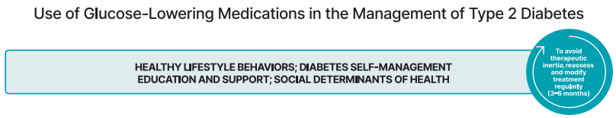
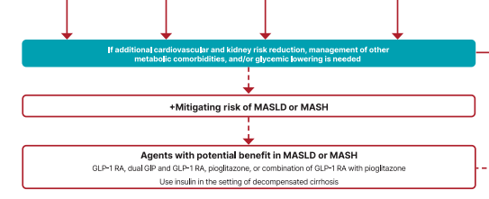
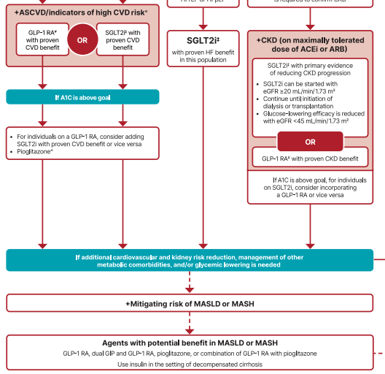

Slide 68
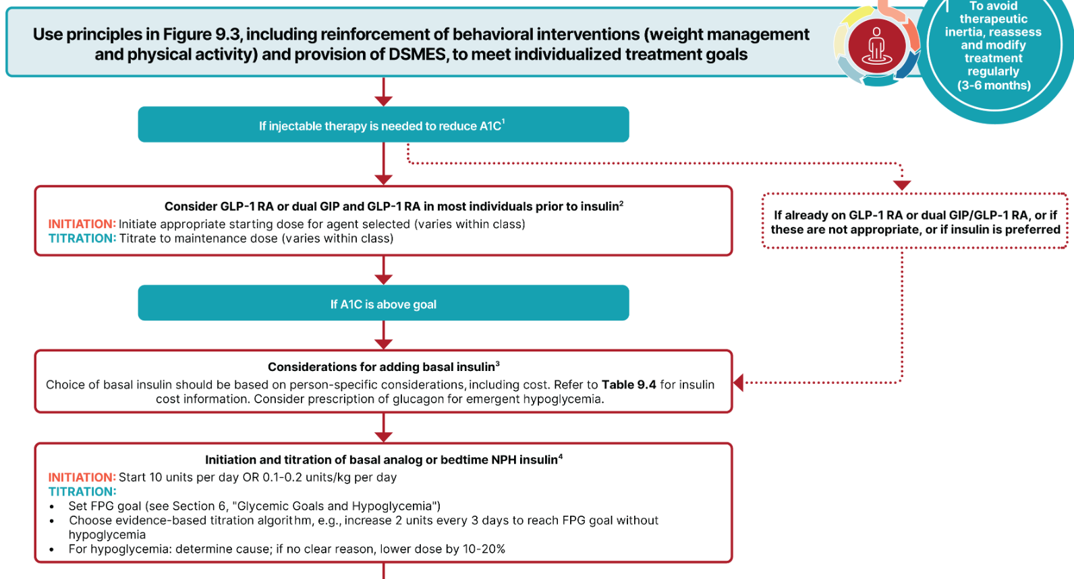
Wait, what about insulin?

Slide 69
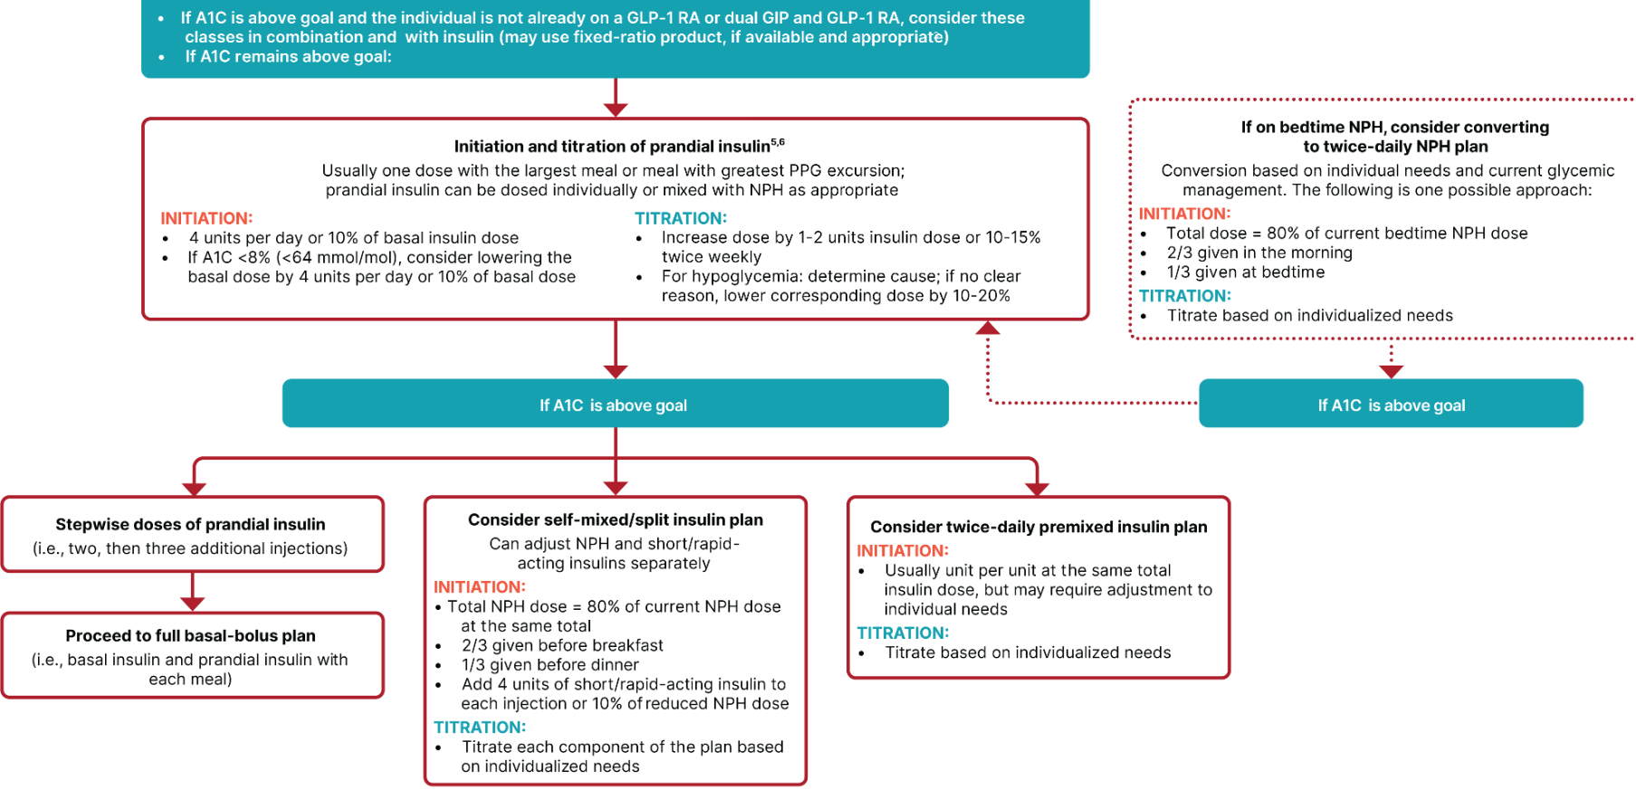
Figure 9.4—Intensifying to injectable therapies in type 2 diabetes.

Slide 70

Intensifying Injectable Therapy – Type 2
Consider GLP1 or GLP/GIP first
Start basal insulin 10 units or 0.1 to 0.2 units/kg day
Titrate up 2 units every 3 days, until FBG at goal
If AM hypo, decrease basal insulin 20%
Over basalization if (basal >0.5 unit/kg) day or overnight BG drops 50 mg/dL
Adding bolus
Start with 4 units bolus at largest meal or
Start 1-2 injections with 10% of basal or
Switch to basal bolus combo (like 70/30 ins)

Slide 71

Overbasalization -2025 Update
Clinical signals of overbasalization include:
high bedtime-to-morning or preprandial-to-postprandial glucose differential
(e.g., bedtime-to-morning glucose differential ≥50 mg/dL [≥2.8 mmol/L]),
hypoglycemia (aware or unaware),
high glucose variability.
Evidence of overbasalization should prompt reevaluation of the glucose-lowering treatment plan to better address postprandial hyperglycemia.

Slide 72

What next?
69 year old male, BMI 28, on Metformin 2000mg a day, Glipizide 40mg a day and Empagliflozin 25mg a day.
A1c 10.7%. GFR 50s.
Complains of foot pain, polyuria,
11 yr diabetes.
What next?

Slide 73
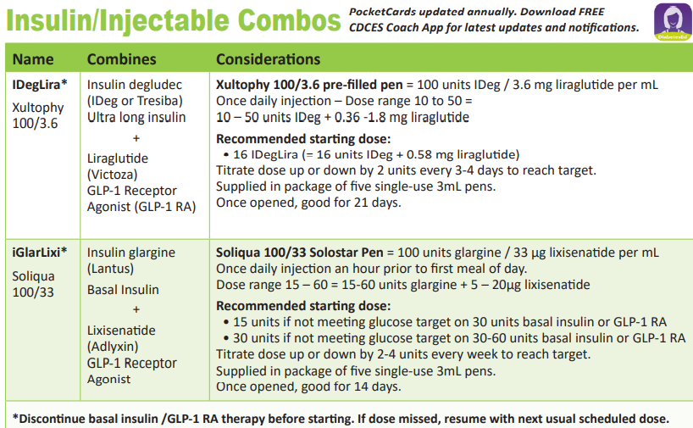
What next?
69-year-old male, BMI 28, on Metformin 2000mg a day, Glipizide 40mg a day and Empagliflozin 25mg a day.
A1c 10.7%. GFR 50s.
Possible Solutions
Add Basal + GLP-1 combo or
Start basal insulin, then add GLP-1, then bolus insulin (stop glipizide)
Start 70/30 insulin, stop glipizide, keep metformin,
Add 70/30 insulin 1-2 times a day
100kg x 0.5 = 50 units daily (30units am/ 20units dinner)

Slide 74
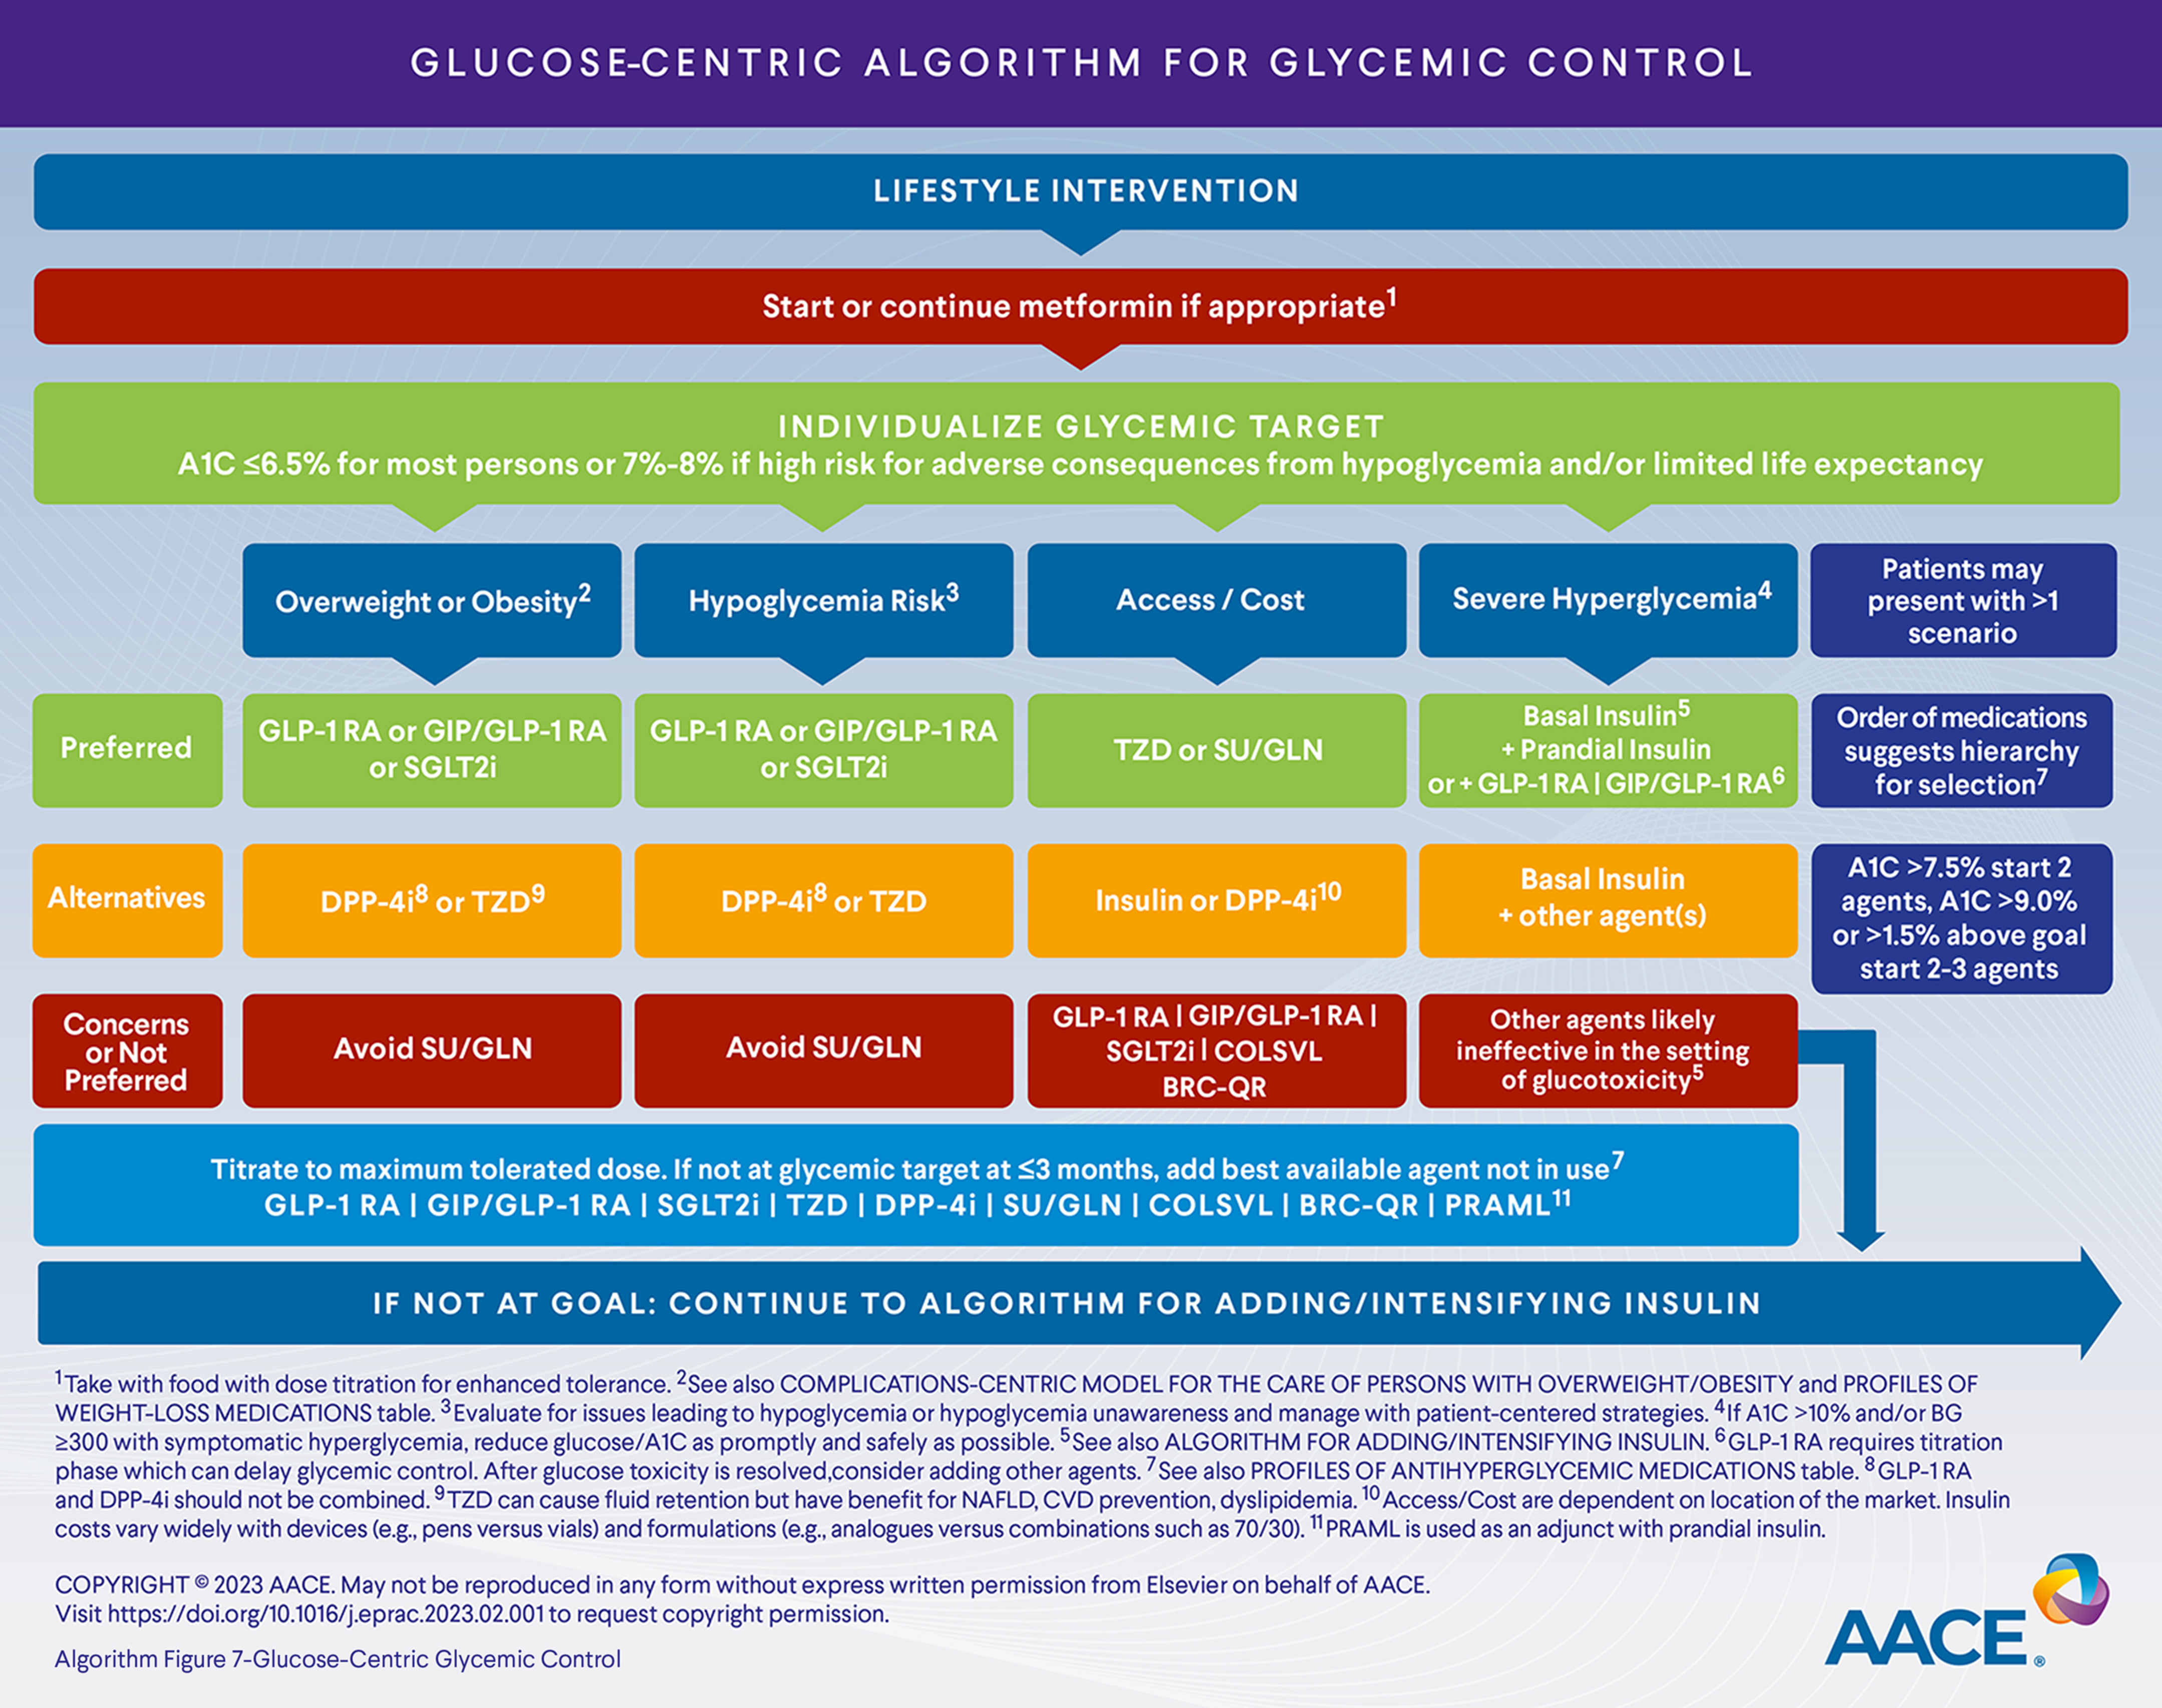
AACE 2023 Diabetes Guideline

Slide 75

Keep checking in
In all cases, treatment plans need to be continuously reviewed for efficacy, side effects, and burden.
Individual may require medication reduction or discontinuation.
Common reasons for this include ineffectiveness, hypoglycemia, intolerable side effects, new contraindications, expense, or a change in glycemic goals

Slide 76

Critical Points
Individualize Glycemic targets & BG-lowering approaches.
1st-line med based on careful assessment.
MNT, exercise, & education: foundation T2DM therapy.
ASCVD, Heart failure and CKD risk reduction - a major focus of therapy.
Most important, make all treatment decisions in conjunction with the person’s preferences, needs & values.
Diabetes Specialists can break the cycle of clinical inertia and improve Quality of Life

Slide 77

Thank You
Thanks for joining us!
Please let us know if we can be of more service
www.DiabetesEd.net
info@diabetesed.net
530 /893-8635

