Slide 1
Integrating Technology: CGM, Connected Pens, and Insulin Pumps DiabetesEd Training Seminar 2025 – Day 2
Diana Isaacs, PharmD, BCPS, BC-ADM, BCACP CDCES, FADCES, FCCP
Director, Education & Training in Diabetes Technology
Co-Director, Endocrine Disorders in Pregnancy

Slide 2
Learning Objectives
Discuss continuous glucose monitoring (CGM) and the clinical benefits for managing diabetes
Compare and contrast different CGM, insulin pump, and connected pen devices
Describe critical teaching content for insulin pump, connected pen and CGM use
Describe appropriate candidates for insulin pump therapy
List inpatient considerations for insulin pump therapy and CGMs

Slide 3
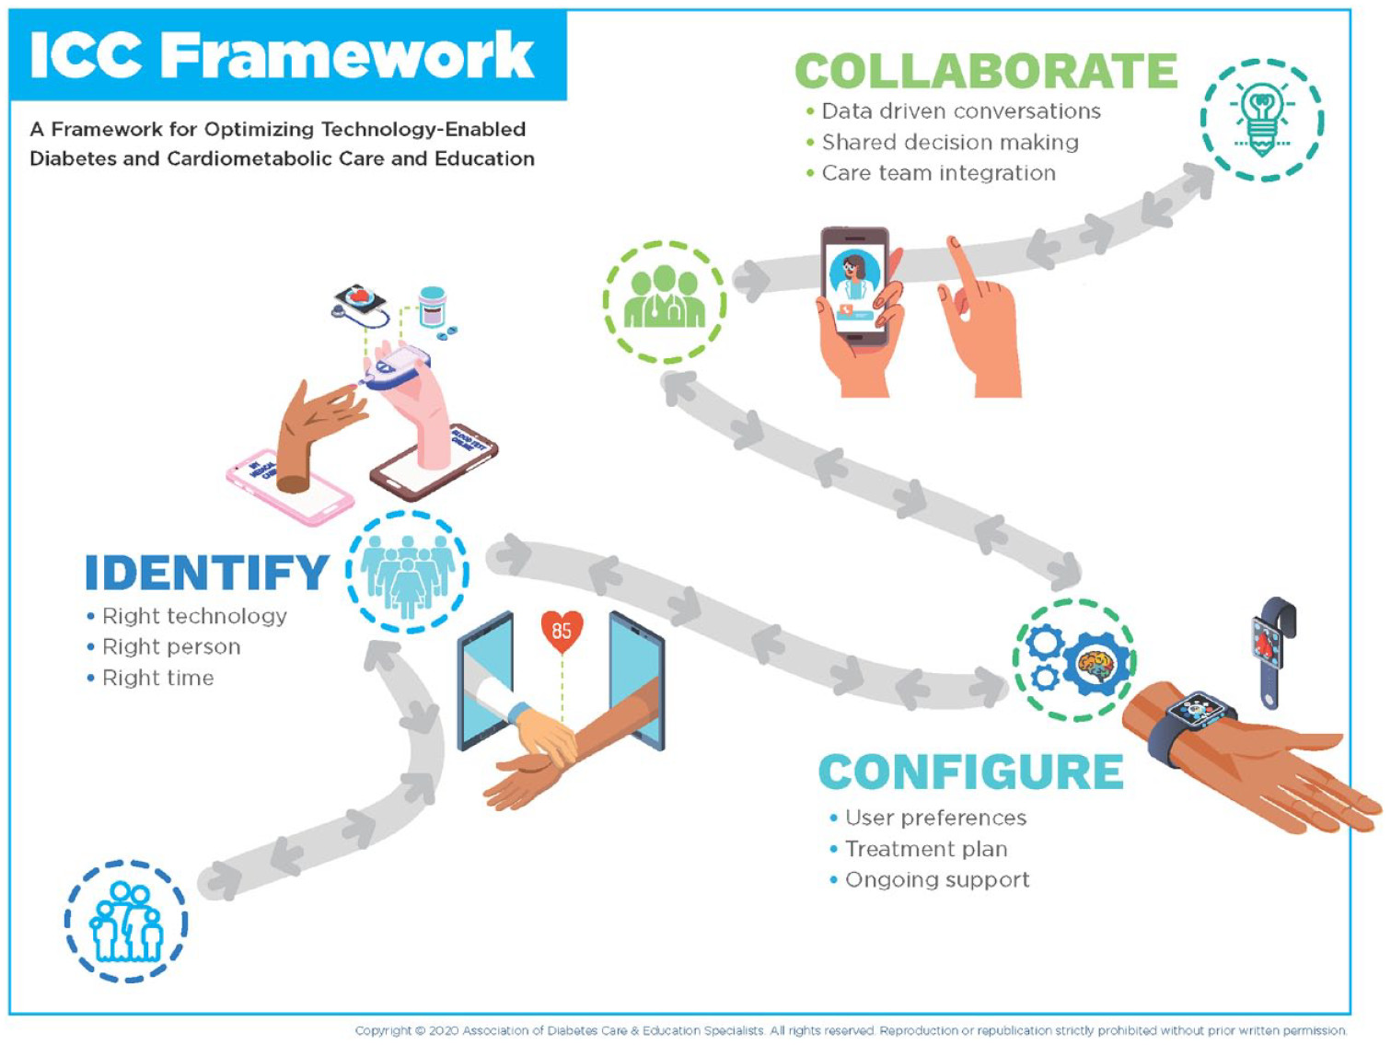
ICC Framework – Identify-Configure-Collaborate
A framework to overcome barriers to technology use and therapeutic inertia
Greenwood DA, Howell F, Scher L, et al. A Framework for Optimizing Technology-Enabled Diabetes and Cardiometabolic Care and Education: The Role of the Diabetes Care and Education Specialist. The Diabetes Educator. 2020;46(4):315-322. doi:10.1177/0145721720935125

Slide 4
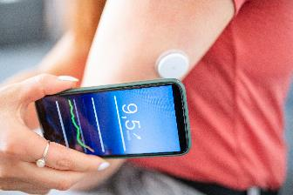

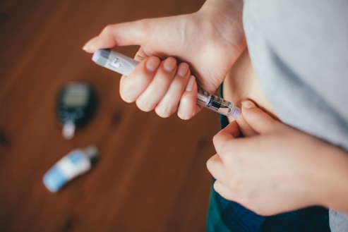
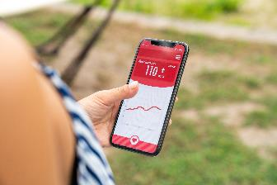
Technology is Here
CONTINUOUS GLUCOSE MONITORS (CGM)
INSULIN PUMPS
CONNECTED PENS AND CAPS
MOBILE APPS
Notes:
Diana start

Slide 5
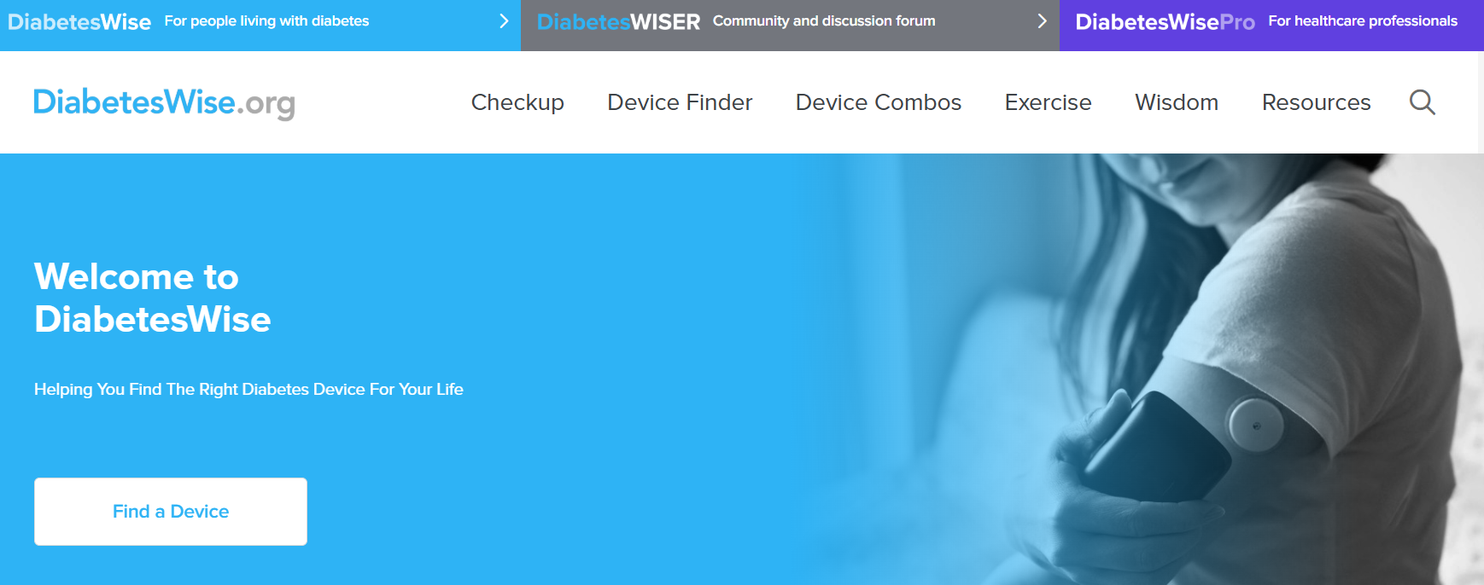
Identify: PWD Identify the “Right” Technology
Diabeteswise.org, providers.diabeteswise.org/#/

Slide 6
The Importance of Education & Training
“No device used in diabetes
management works optimally without education, training, and ongoing support.”
ADA. Diabetes Care. 2025
Notes:
no device used in diabetes man agement works optimally without educa tion, training, and ongoing support

Slide 7
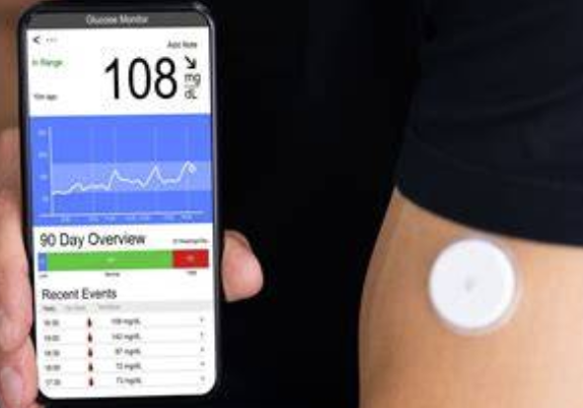
Continuous Glucose Monitors

Slide 8
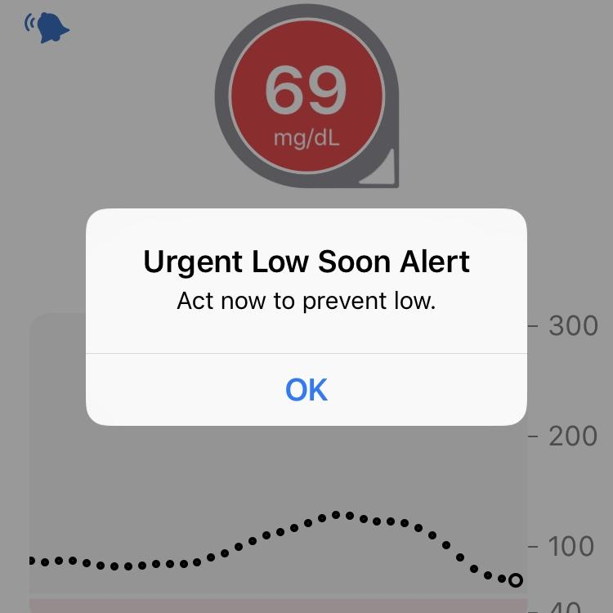
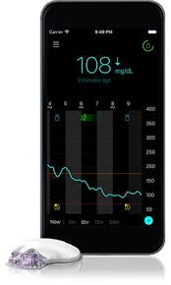
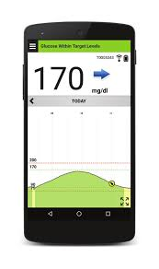
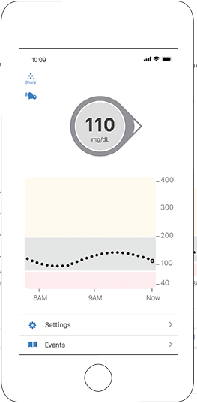
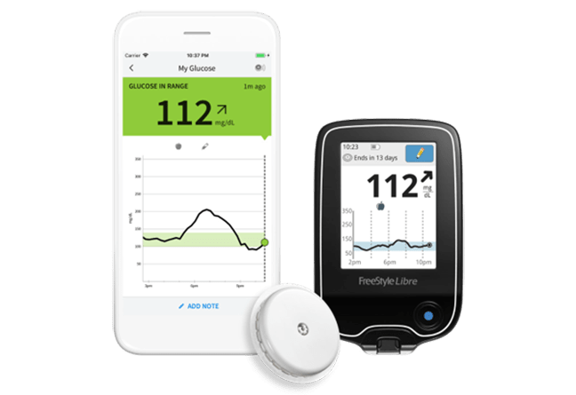
CGM: Real-Time Data

Slide 9

ADA Standards of Care 2025
Diabetes devices should be offered to people with diabetes (A)
Recommend real-time CGM (A) or IS-CGM (B) for diabetes management to youth (C) and adults (B) with diabetes on any type of insulin therapy
Consider using rtCGM and isCGM in adults with type 2 diabetes treated with glucose-lowering medications other than insulin to achieve and maintain individualized goals (B)
Use of CGM is beneficial and recommended for individuals at high
risk for hypoglycemia (A)
Recommend early initiation, including at diagnosis, of CGM, CSII, and AID depending on a person's or caregiver's needs and preferences (C)
1 American Diabetes Association. Diabetes Care. 2025;48(Suppl. 1):S146-S166. 2 American Diabetes Association. Diabetes Care. 2025;48(Suppl. 1):S128-S145.
Notes:
*Grade A: Clear evidence from well-conducted, generalizable randomized controlled trials that are adequately powered; †Grade B: Supportive evidence from well-conducted cohort studies; §Grade C: Supportive evidence from poorly controlled or uncontrolled studies.

Slide 10
Types of CGM
Professional | Personal
Owned by the clinic | Owned by the person with diabetes
Blinded and unblinded (real-time feedback) options | Real-time feedback
Short-term use (3-14 days) | Long-term use
Insurance coverage for most people with type 1 or type 2 diabetes | Insurance coverage for most insulin users
Not compatible with insulin pumps or connected pens | Compatible with smartphones, connected pens and insulin pumps with select devices
Wright LA, Hirsch IB. Diabetes Technol Ther. 2017;19(suppl 2):S16-S26; Kruger DF, et al. Diab Educ. 2019;45(suppl 1):S3-S20.

Slide 11
Types of CGM
 | Professional | Personal | OTC
How to obtain | Owned by the clinic | Requires a prescription | Available without a prescription
Type | Blinded and unblinded (real-time feedback) | Real-time | Real time
Wear duration | Short-term use (10 days) | Long-term use | Short- or long-term use
Access | Insurance coverage for most people living with diabetes or prediabetes | Insurance coverage more focused on people taking insulin , although expanding | Cash pay, available to all adults
Compatibility | Smartphone app | Smartphones, reader/receiver, connected pens, mobile apps, insulin pumps | Smartphone app, mobile apps/Oura ring
American Diabetes Association Professional Practice Committee. Diabetes Care. 2025;48(Supplement_1):S146-S166.

Slide 12
Professional CGM
Characteristics | Dexcom G6 Pro
Blinded vs unblinded | Both
Maximum wear time of sensor | 10 days
Calibration | None
Downloading reports | Clarity
Care between transmitter use | Disposable-1 time use, must attached transmitter
Alarms for high/low glucose alerts | Yes
Interfering substances | Hydroxyurea
Mobile app | Dexcom G6
ADCES Practice Paper. The diabetes care and education specialist role in CGM.

Slide 13
Personal CGM Options (Rx)
Freestyle Libre 2+
Freestyle Libre 3+
Eversense 365
Dexcom G6
Dexcom G7
Guardian 4
Simplera

Slide 14
CGM Comparison
​ | Dexcom G6​ | Dexcom G7​ | Libre 2​ + | Libre 3​ + | Simplera | Eversense​ 365
Pump Integration​ | T:Slim X2, Omnipod 5, iLet, Mobi | T:Slim X2 , Omnipod 5, iLet, Mobi, | T:Slim X2, Omnipod 5 | Twiist, iLet, Omnipod 5 | 780G | Twiist (soon)​
Maximum wear time​ | 10 days​ | 10.5 days​ | 14 days​ (15 days with Libre2+and 3+) | 14 days​ | 7 days​ | 180 days​
Warm-up time​ | 2 hours​ | 30 min​ | 1 hour​ | 1 hour​ | Up to 2 hours​ | 24 hours​
Calibrations ​ | Optional | Optional | 0No | 0​ | Only to enter auto mode | 2/day for 14 days, then 1/week ​
Water depth | 8 feet, 24h | 8 feet, 24h | 3 feet, 30 min | 3 feet, 30 min | 8 feet, 30 min | 3.28 feet, 30 min
Data Platform | Dexcom Clarity |  | LibreView |  | Carelink | Eversense Data Management System
Product user guides: Dexcom G6, Dexcom G7, Libre 2, Libre 3, Simplera, Eversense

Slide 15
CGM Comparison (Continued)
 | G6 | G7 | Libre 2+ | Libre 3+ | Simplera & Simplera Sync | Eversense 365
FDA approved sites​ | Abdomen (ages2+) Upper buttocks (ages 2-17)​ | Upper arm (ages 7+)​ Upper buttocks (ages 2-6)​ | Upper arm​ | Upper arm​ | Upper arm, abdomen​ Upper buttocks (ages 2-13)​ | Upper arm​
Approved in pregnancy | No​ | Yes​ | Yes​ |  | No​ | No
Transmitter | 3 months | Disposable | Disposable |  | Disposable | Charge daily
FDA approved ages (years)​ | ≥2​ | ≥2​ ​ | ≥2 ​ | ≥4​ ​ | ≥2 Simplera Sync ≥7 Simplera | ≥18​ ​
Pregnancy Indication | No | Yes | Yes |  | No | No
Drug interactions​ | Hydroxyurea​ | Hydroxyurea​ | Vitamin C​ | Vitamin C​ | Acetaminophen ​ | Tetracycline antibiotics, mannitol​
Product user guides: Dexcom G6, Dexcom G7, Libre 2, Libre 3, Simplera, Eversense

Slide 16
Poll Question 12
Which of the following sensors is sold over the counter without a prescription?
Simplera Sync
Dexcom G7
Libre 3
Dexcom Stelo

Slide 17
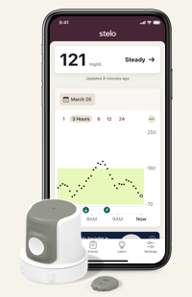
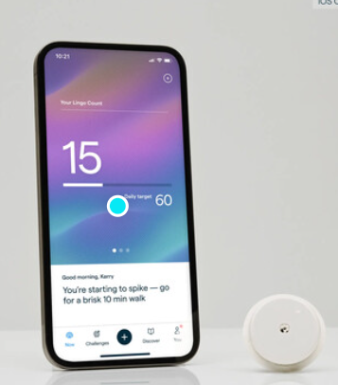
Over-The-Counter CGM
Available without a prescription
Ordered online
Intended for adults not taking insulin
No alerts for hypoglycemia
Works with mobile apps that incorporate education on lifestyle and glucose goals
Zahalka SJ, et al. Endocr Pract. 2025 May 21:S1530-891X(25)00893-6

Slide 18
OTC CGM Options
 | Dexcom Stelo | Abbott Lingo
Intended audience | Adults not on insulin with T2D, prediabetes, or who are interested in tracking their glucose | Adults not on insulin interested in understanding how to improve their metabolic health
Wear time | 15.5 days | 14 days
Ability to share data | Dexcom Clarity | No
Glucose range | 70-250mg/dL | 55-200mg/dL
Real-time alerts | Spike detection | No
Special features | “Spike Alerts” – notified that your glucose is rising at a rate the app determines to be a “Spike” Daily insights | Lingo Count – points assigned for elevations in glucose throughout the day, goal is to get fewer total points, Coaching program
Frequency of glucose readings | 15 minutes | 1 minute
Education within App | Yes | Yes
Age | ≥ 18 yr | ≥ 18 yr
Cost | $99/month or $85-$89/month with subscription plans | $49-1 sensor, $89-2 sensors, $249-6 sensors, subscription plan
Libre Rio
FDA cleared
Range: 40-400mg/dL
Information from manufacturers websites: https://www.stelo.com/en-us, Lingo - Made by Abbott: Your body has the answers (hellolingo.com).
Notes:
Zahalka SJ, Akturk HK, Galindo RJ, Shah VN, Low Wang CC. Continuous Glucose Monitoring for Prediabetes - Roles, Evidence, and Gaps. Endocr Pract. 2025 May 21:S1530-891X(25)00893-6. doi: 10.1016/j.eprac.2025.05.742. Epub ahead of print. PMID: 40409607.
Adults not on insulin with type 2 diabetes, prediabetes or who are interested in tracking their glucose Adults not on insulin interested in understanding their metabolic health and a p

Slide 19
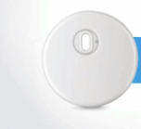
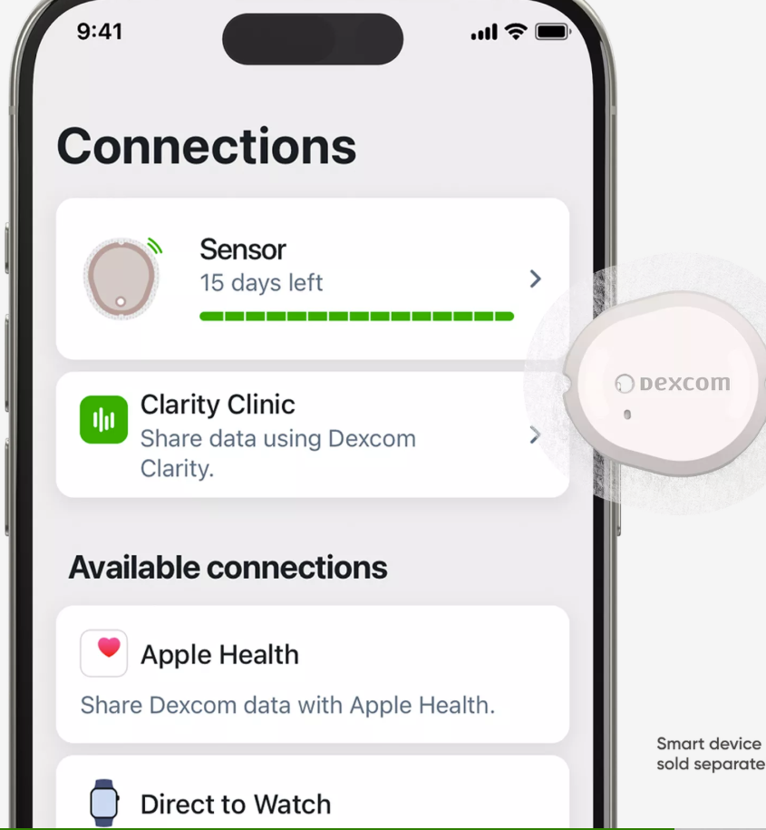
Coming Soon
Instinct sensor
Dexcom G7 15 day sensor
MiniMed Product Guide
Dexcom G7 15 Day Sensor User Guide

Slide 20
CGM Counseling Points
Important to check glucose when indicated
Symptoms do not match sensor value
During warm-up period for treatment decisions
Sensors are waterproof
Showering, bathing, swimming OK
Check water depth criteria for individual sensor
Overlays and skin preps to help it stay on
Avoid with MRI, CT, diathermy
Exception: Eversense implantable, transmitter should be removed
Libre now ok for MRI/CT
Not FDA approved
Dialysis, critically ill
Pregnancy-Guardian,simplera eversense, G6
If people choose to use, it is important they know it is off-label

Slide 21
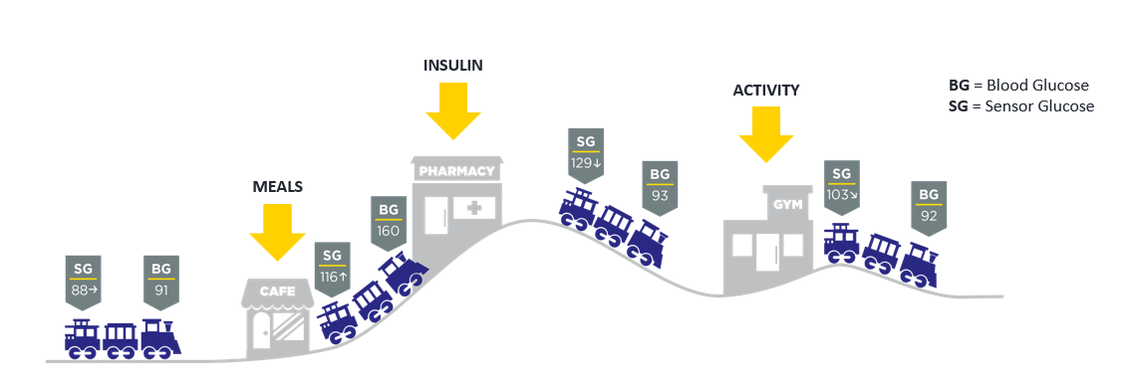
Lag Time
Refers to a slight delay in CGM sensor readings compared to finger sticks
Most apparent when glucose is changing rapidly
Counsel pwd on the train analogy

Slide 22
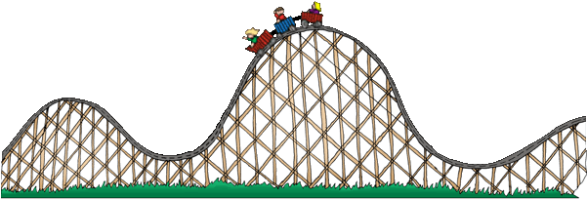
Lag Time
Refers to a delay in CGM sensor readings compared to finger stick blood glucose readings
Estimated CGM sensor reading ~5 minutes behind
Most apparent when glucose is changing rapidly
Counsel patients on the train analogy

Slide 23
Causes of Falsely High or Low Readings
Interfering substances
Falsely high
Vitamin C (Libre)
Acetaminophen (high dose Dexcom, Simplera)
Tetracycline antibiotics (Eversense)
Compression Lows
Dehydration
Faulty sensor

Slide 24
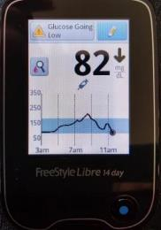
When to Check BGM?
A calibration or blood glucose symbol appears on the device
If making a dosing decisions
Symptoms or expectations do not match CGM readings
Off-label indications to ensure accuracy: dialysis, inpatient use
Possibly after correcting a low
If taking an interfering substance
Counsel pwd about “lag time”
Per ADA, every person using CGM should have access to a meter and test strips
Notes:
Image obtained from: https://lada-diabetes.com/freestyle-libre-14-day-system-review-first-week-thoughts/

Slide 25
Downloading CGM Data

Slide 26
CGM Key Metrics
Recommended Time in Range
for most people with T1D & T2D
Target time
Time above range (TAR)
< 1 hr, 12 min, > 250 mg/dL
< 6 hr, > 180 mg/dL
Number of days CGM is worn 14 days is recommended
Percentage of time CGM is active 70% of data from 14 days is recommended
Mean glucose
Glucose management indicator (GMI) Estimated A1C
Coefficient of variation (CV) This is a measure of glycemic variability. A CV >36% is considered unstable.
>250 mg/dL
<5% Very High
>180 mg/dL
<25%* High
Target Range: 70-180 mg/dL
Time in range (TIR)
> 16 hr, 48 min
>70% In Range
Correlates with A1c ~7.0%
Time below range (TBR)
< 1hr < 70mg/dL
< 15 min < 54mg/dL
<70 mg/dL
<4%** Low
<54 mg/dL
<1% Very Low
Battelino T et al. Diabetes Care. 2019;42(8):1593-1603. . 2. American Diabetes Association. Diabetes Care 2021;44(Suppl. 1):S73–S84 | https://doi.org/10.2337/dc21-S006.

Slide 27
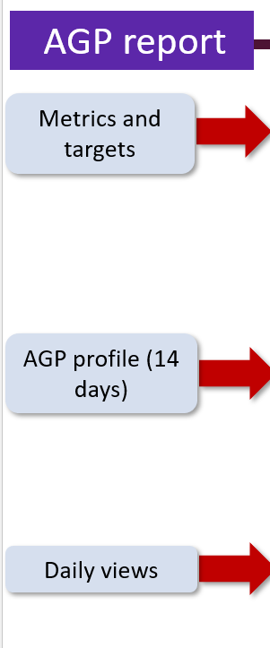
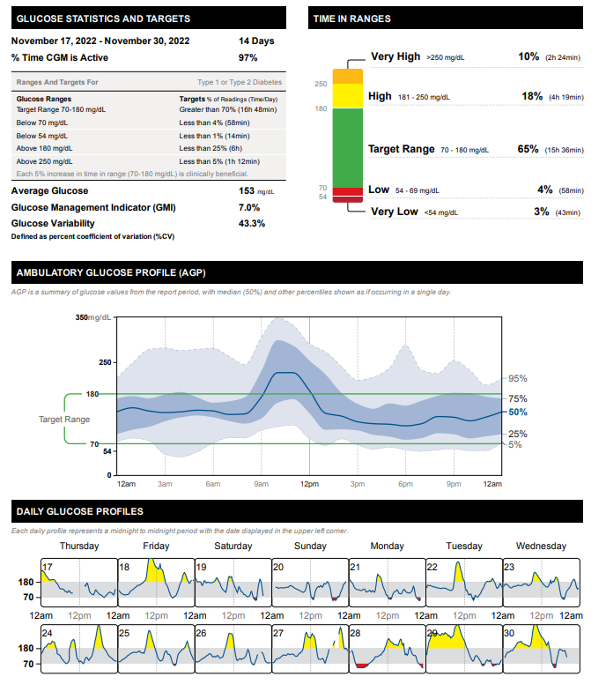
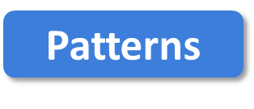
More Green, Less Red
FNIR
Flat Narrow
In Range
Notes:
Libreview report, my own image

Slide 28
Poll 17. What is the goal time in range for most adults with type 1 or 2 diabetes?
≥50%
≥70%
≥80%
≥90%
Notes:
Learning Objective #: 2
Rationale
Answer: B

Slide 29
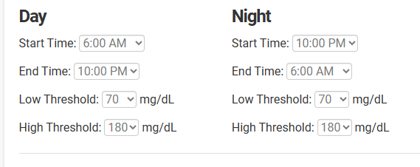
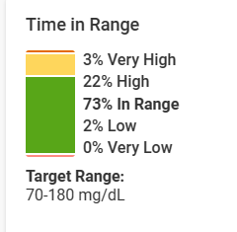
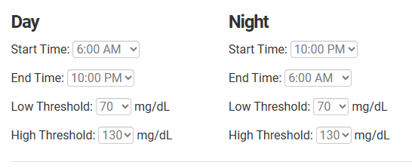
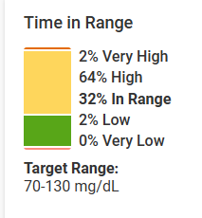
Target Glucose Ranges
Same person, same data, look at the difference in time in range!

Slide 30
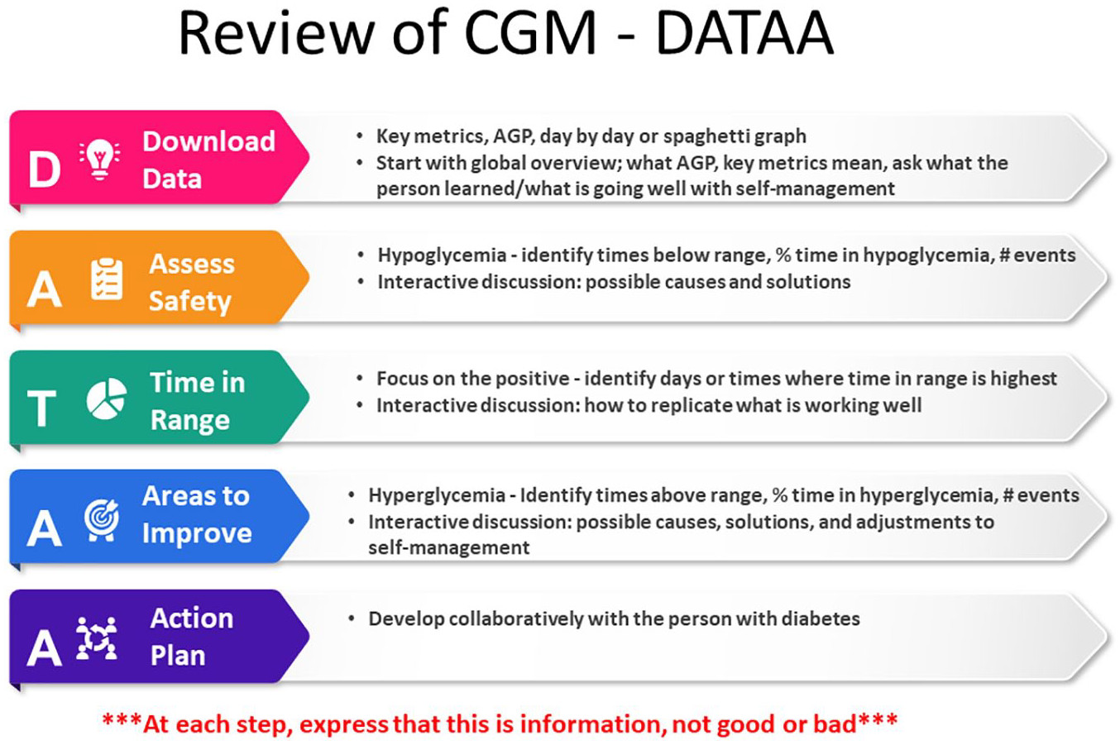
Isaacs D, Cox C, Schwab K, et al. Technology Integration: The Role of the Diabetes Care and Education Specialist in Practice. The Diabetes Educator. 2020;46(4):323-334. doi:10.1177/0145721720935123

Slide 31
Tips for DATA Interpretation
Behavior Change
Mental Health
Medications
Start by asking the person what they’ve experienced and noticed with their glucose patterns
Avoid judgment
Learn from 1 time episodes, but make changes based on patterns
Fix lows first but some amount is expected (<1-4%) and if you remove all lows, you may end up with too many highs
If it’s not making sense, dig deeper (ex. missed doses, rationing, injection technique, food insecurity, etc)

Slide 32

Case Studies & 2 min Stretch

Slide 33
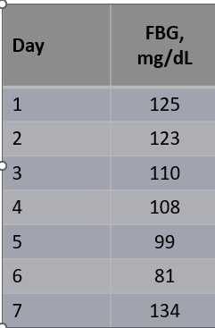
Case 1
Terrance is a 60-year-old man with T2D x 12 years
Current DM2 meds:
Metformin 1000 mg twice daily
Glimepiride 8mg daily
Other conditions
CKD
Hyperlipidemia
Hypertension
Works in project management
Eats 3 meals/day, snacks at night, no regular exercise
Glucose log
Checks BGM once daily
Pertinent Labs
SCr = 1.38 mg/dL, eGFR = 55
A1C = 8.2%, BMI = 34 kg/m²
Notes:
Terrance starts CGM

Slide 34
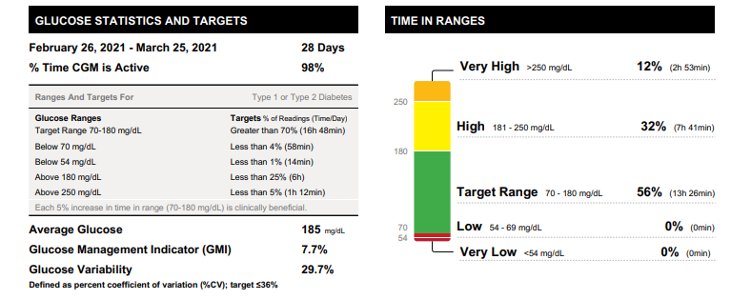


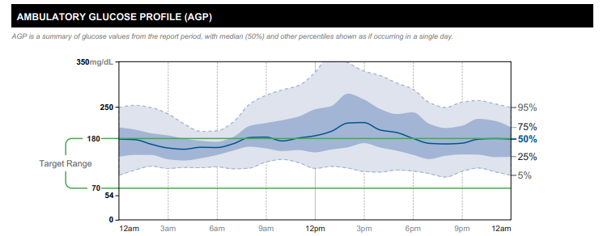
Starts CGM
Which CGM key metrics are at goal?
Which are not?
Overall patterns?

Slide 35
Poll Question 18
1. Which CGM key metrics are at goal?
Time in range
Time above range
Time below range
Glucose management indicator
Notes:
Correction answer: time below range

Slide 36
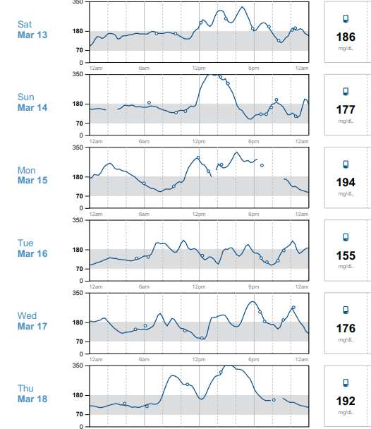

Time in Range
Focus on the positive: what’s worked well on Tue 3/16?
Time in range is high this day
Ate a granola bar for breakfast, grilled chicken salad at lunch, steak, greens, potato at dinner
No missed medication doses
Good night’s sleep, low stress

Slide 37

Areas for Improvement
Sun 3/14 glucose went high 12 pm
Reports eating rice bowl and coke
Silver lining
Walked around 3 pm (helped to lower glucose)
Avoided afternoon snacking
Ate low-carb dinner (salmon, salad, small potato)
Denies missed doses

Slide 38
Poll Question 19
What is the most appropriate medication adjustment for Terrance?
Add DPP4 inhibitor
Add GLP-1 receptor agonist
Add SGLT2 inhibitor
Lifestyle modifications only
More than 1 right answer
Notes:
Sglt2 inhibitor or semaglutide since CKD.

Slide 39

Action Plan
In collaboration with Terrance
Lifestyle changes
Incorporate a brisk walk 3 days per week
Reduce high-carbohydrate foods like fries
CGM optimization
Alerts, high for 280
Medication adjustments
Add a medication to help his CKD + optimize glucose → SGLT2 inhibitor
Follow-up in 3-4 weeks

Slide 40
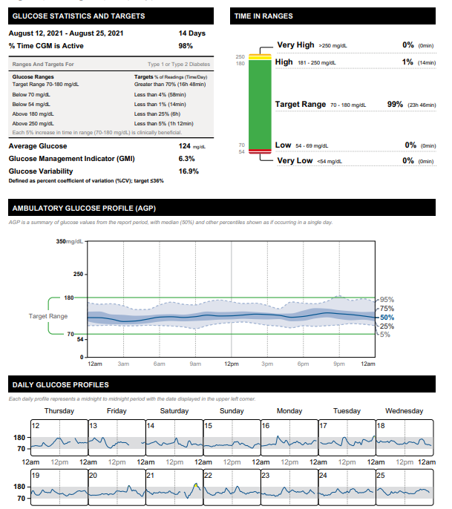
3 Months Later
T2D Meds:
Empagliflozin 10mg qday
Metformin 1000mg BID

Slide 41
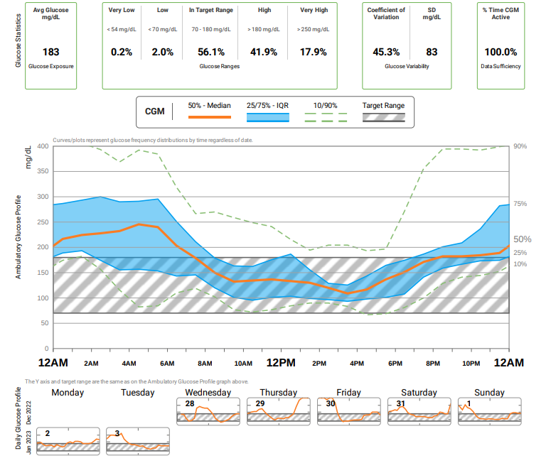

Case 2
75 yo F with 25 year h/o T2D. PMH includes HTN, hyperlipidemia, hypothyroid, obesity, ASCVD.
Current DM Meds
-Insulin glargine inject 50 units QAM and 40 at night
-Insulin aspart 8-10-10 units plus correction scale
-Metformin 1000 mg daily
-Semaglutide, 0.25mg weekly (2 doses so far)
Clarity report obtained from Diana Isaacs
Notes:
Did not tolerate higher dose of metformin

Slide 42
Poll 20. Which of the following CGM key metrics is at target?
Time in range
Time above range
Coefficient of variation
Time below range
Clarity report obtained from Diana Isaacs
Notes:
Answer: D

Slide 43
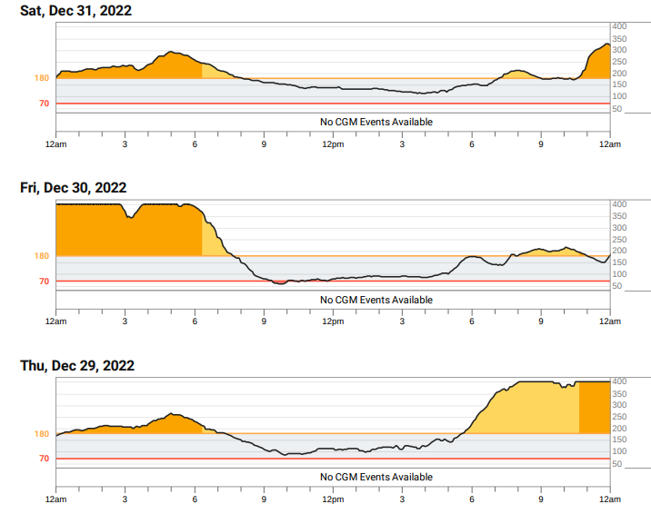



Using DATAA
Less of an appetite since taking semaglutide, often going low during the day
During the day, glucose often steady, but also having to drink juice to keep from going low
Skipping aspart doses because running low, leading to rebound highs
Clarity report obtained from Diana Isaacs

Slide 44

Action Plan
Continue semaglutide 0.25mg weekly x 2 more weeks, then titrate up to 0.5mg weekly
Decrease insulin glargine to 45 units qam and 35 units qpm
Continue insulin aspart 8-10-10 + correction scale
Continue metformin 1000mg daily
Notes:
Current DM Meds
-Insulin glargine inject 50 units QAM and 40 at night
-Insulin aspart 8-10-10 units plus SS
-Metformin 1000 mg daily
-Semaglutide, 0.25mg daily (2 doses so far)

Slide 45
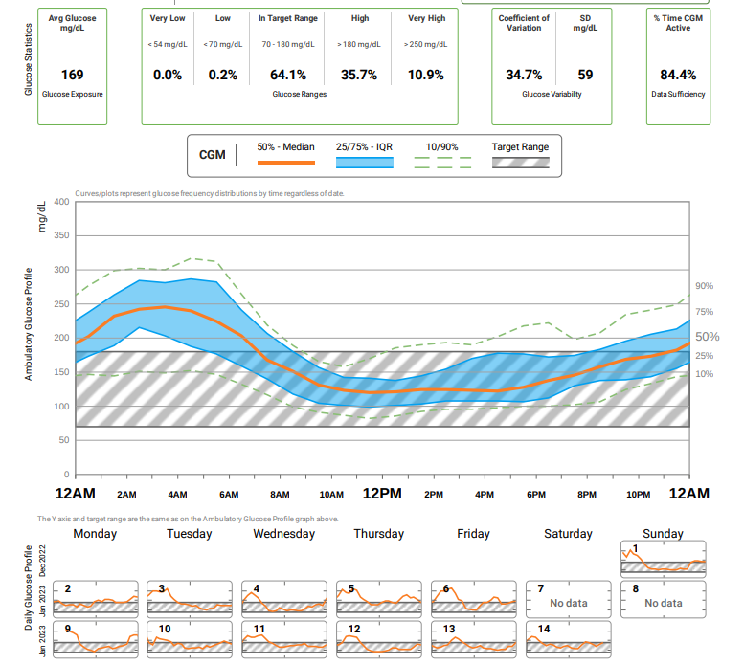
Follow-Up
1 month later
Average glucose improved
Time in range increased
Glucose variability improved
Less hypoglycemia
Clarity report obtained from Diana Isaacs
Notes:
Next plan: continue to titrate the semaglutide
Consider more aspart at dinner or lower carb dinner.
Continue to titrate down the glargine and aspart

Slide 46
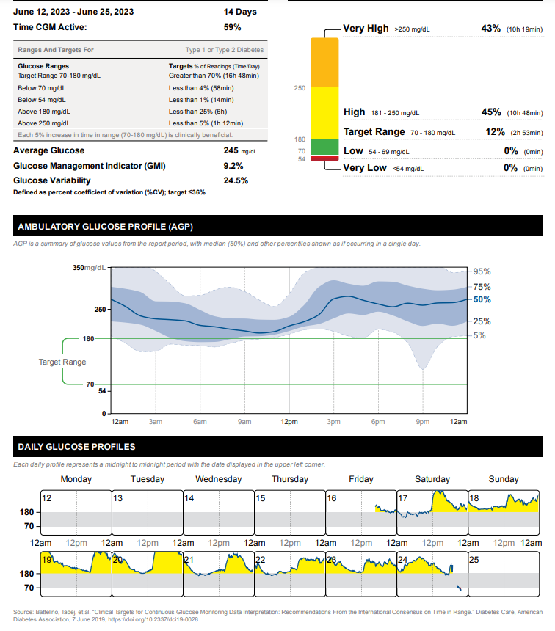
Case 3
Person with T2D taking metformin 1000mg twice daily and insulin glargine 20 units daily
Is TIR at goal?
What to ask?
What changes to make?
Notes:
The whole curve is elevated
Needs more insulin-is the person taking insulin?
Ability to use non insulin therapies?
Low on Saturday likely false low.

Slide 47
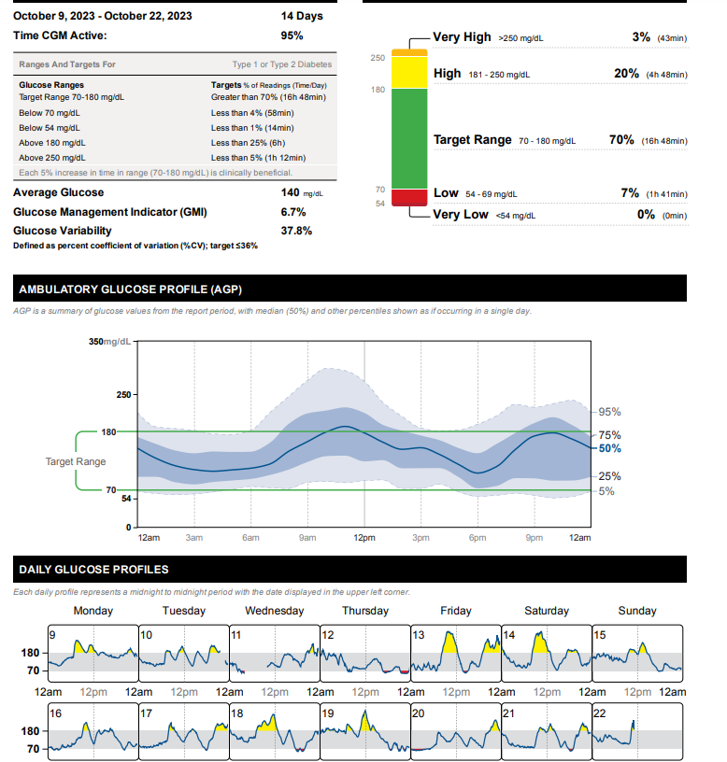
Case 4
Person with T2D
56yo, BMI=33, A1C=7%
Meds:
Degludec 40 units daily
Dulaglutide 4.5mg weekly
Dapagliflozin 10mg daily
Metformin 1000mg twice daily
Notes:
Fix lows: too much basals
Fix highs: dietary modifications, or another medication, possibly meal time insulin.

Slide 48
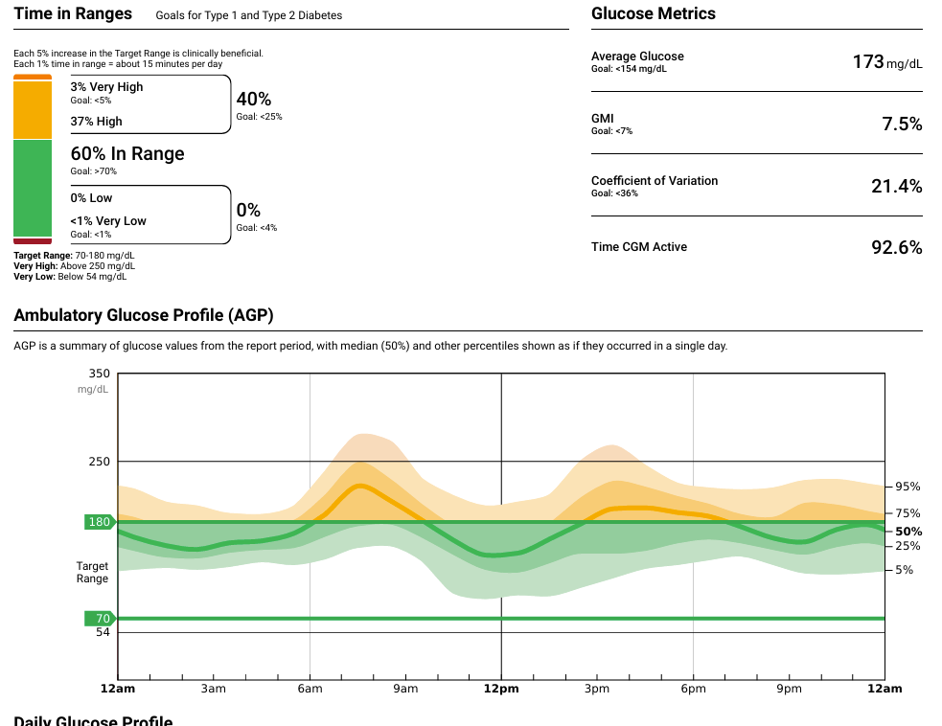
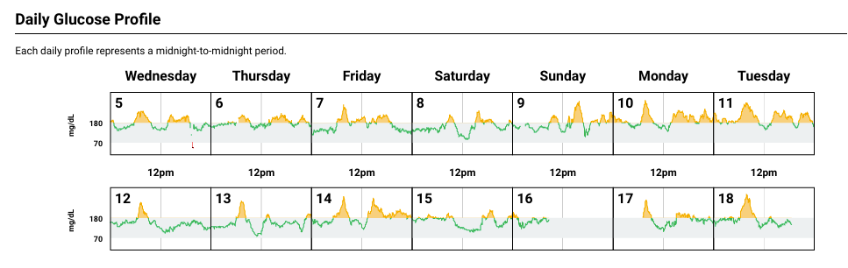
Case 4
40yo F with T2D, lost 20lbs since starting Semaglutide 6 months ago, A1C=7.4%, also has HTN, dyslipidemia, BMI=34kg/m2
DM Meds:
Metformin 1000mg twice daily
Empagliflozin 25mg daily
Semaglutide 2mg weekly
Is data at goal?
TBR?
TIR?
TAR?
Action plan?
Notes:
Options: additional oral or insulin or lifestyle.

Slide 49
Insulin Pumps

Slide 50
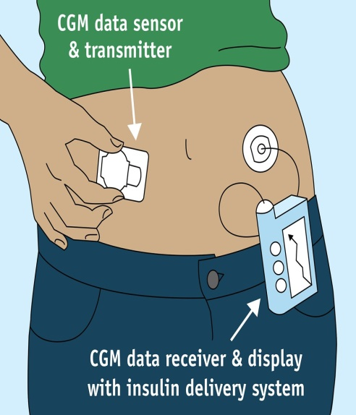
How a Pump Delivers Insulin
Normal Insulin Secretion
Insulin Pump
Insulin
Time
.
Notes:
230
Image available for reuse: https://www.flickr.com/photos/fdaphotos/15657970628

Slide 51
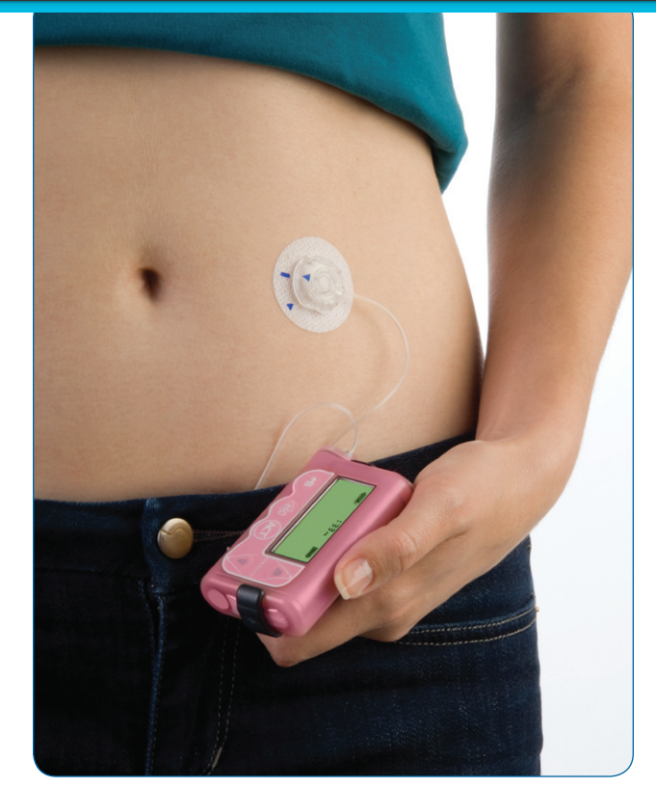
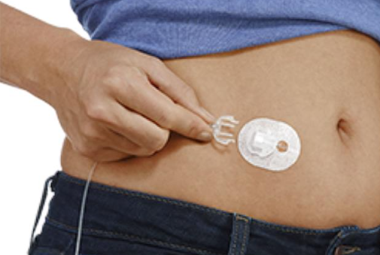
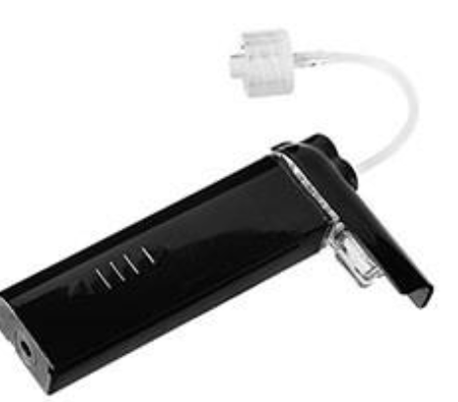
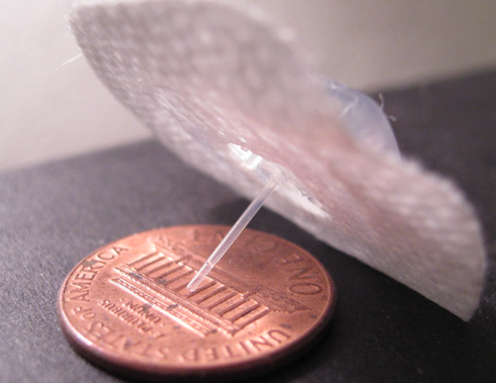
Insulin Pump Basics
Infusion Set
Tubing
Insulin reservoir
Pump

Slide 52
Insulin Pump Definitions
Basal rates
Carbohydrate ratios
Correction factors
Glucose targets
Active insulin time
Max bolus/Max basal
Extended boluses
Temp basals
Suspend on/before low
Sherr 2022

Slide 53
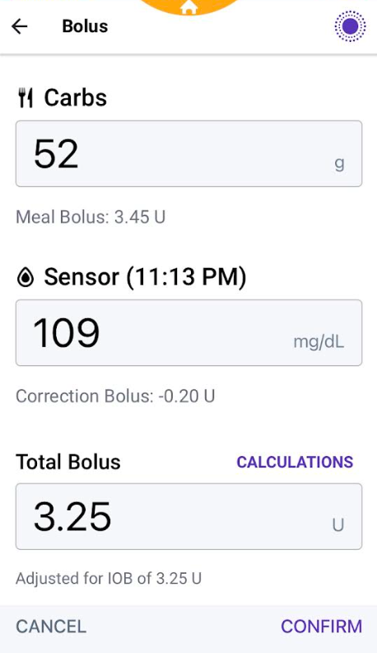
Insulin Pump Basics
Uses U100 rapid-acting insulin
Minimizes insulin variability
Must have dexterity to fill cartridge or device
Bolus calculator incorporating settings
Active insulin to prevent stacking
Multiple basal rates or automated delivery
Small dose increments
Temporary basal rates or temporary glucose targets
Alarms and reminder features
Notes:
Insulin pump basics include the use of U100 rapid-acting insulin, bolus calculators, and customizable basal rates. These features help minimize insulin

Slide 54

Ideal Pump Candidates
Require meal-time insulin
Wearing CGM or frequently checking BGM
Carbohydrate awareness
Willing to follow up regularly with health care team
Can afford the pump/supplies
Problem solving skills (eg, troubleshoot and treating high or low glucose)
Able to use the device independently or with caregiver support
Diabetes Care. 2025;48(Supplement_1):S146-S166. doi:10.2337/dc25-S007.
Notes:
In the past, there was more rigid criteria for who should go on an insulin pump. Because of the improved outcomes, the criteria is much more

Slide 55
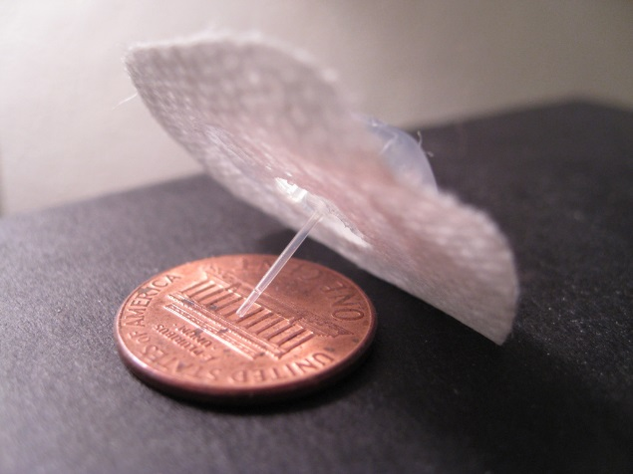
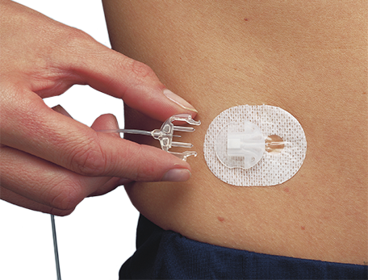
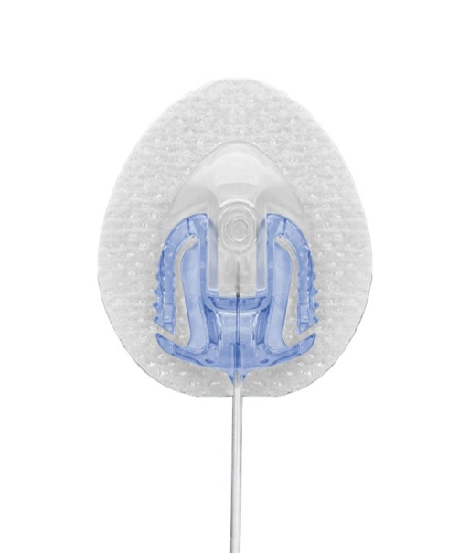
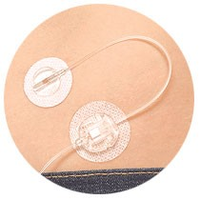
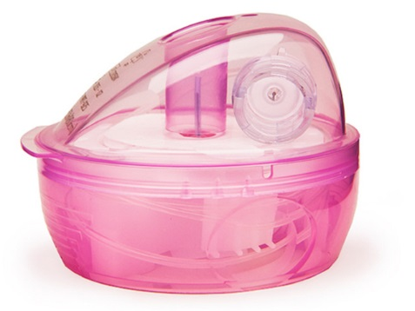
Infusion Sets
Infusion sets are usually Teflon
Available in different sizes (ex. 9mm vs 6mm)
Silhouette (angled) may be better for kids/thinner/very active people
Steel infusion sets a good option for people with frequent site occlusions
Insert at least 1 inch from CGM site
Auto-injectors vs. manually injecting
Site selection/rotation
Longer tubing options
Good if connected on leg, arm or wearing pump further from site
Caution with kids/babies/pets-pouches available to hide pump
When changing out infusion set, check glucose or CGM 1-2 hours after
Don't change right before bed

Slide 56
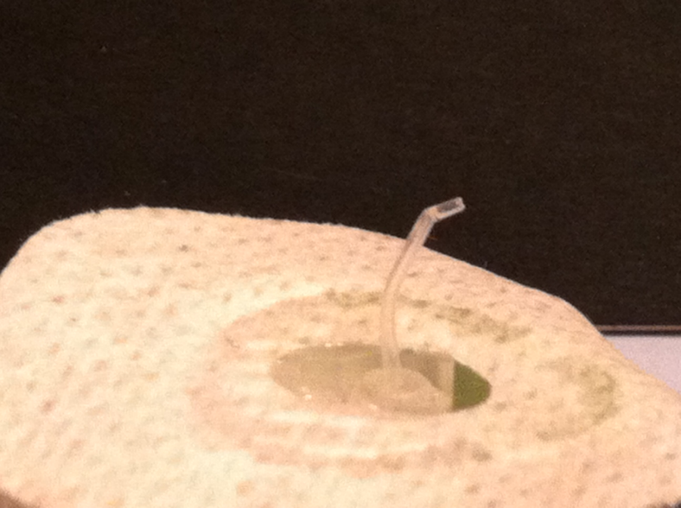
What Happens with a Bent Cannula?
Hyperglycemia
Hypoglycemia
No effect
Notes:
My own picture.

Slide 57








Where to Wear?

Slide 58


Patch Pumps
Cequr Simplicity
V-Go
Bolus pump patch only
Approved for adults with T1DM or T2DM
Holds up to 200 units of rapid acting insulin
On-demand bolus doses in 2 unit increments
Doses administered via clicks directly on the device
Must be changed every 4 days
24 hr. basal/bolus patch pump
Approved for adults with T2DM
Allows 20, 30, 40 unit basal rate options
On-demand bolus doses in 2 unit increments
Up to 36 units/24 hrs
Doses administered via clicks directly on the device
Must be changed daily
Cequr Simplicity Product Guide: https://myceqursimplicity.com/wp-content/uploads/User-Guide.pdf
V-Go Product Guide: https://www.go-vgo.com/wp-content/uploads/2018/06/instructions-for-patient-use.pdf

Slide 59
Automated Insulin Delivery Systems
Omnipod 5 (Insulet)
T:slim X2 (Tandem)
Control IQ+
780G
(Minimed)
Mobi (Tandem)
Control IQ+
iLet
(Beta Bionics)
Tidepool Loop (Sequel)

Slide 60

Hybrid-Closed Loop
Automated insulin delivery (AID)
Auto adjust background insulin
Some systems give auto corrections
Maximize time 70-180mg/dL

Slide 61

Omnipod 5
Holds 200 units
Compatible with Dexcom G6, G7, Libre 2+
No tubing
Control system from a compatible smartphone or controller
Uses last 4-5 pods for adjustments, based on TDD
SmartBolus calculator informed by CGM value and trend
Glucose targets from 110-150 mg/dL adjustable in 10 mg/dL increments
Activity mode to protect from lows
Bluetooth connectivity with Glooko, automatic data uploads
Omnipod 5 Automated Insulin Delivery System. User Guide.

Slide 62
Minimed 780G
Holds 300 units
Compatible with Guardian Sensor 3 or 4
Meal detection (auto correction + basal)
Adjustable target (100, 110, 120mg/dL)
Suspend before/on low options (in manual mode)
Bluetooth connectivity, remote software upgrades
MiniMed and Carelink apps for data sharing/viewing
7 day infusion set option
Uses AA battery
MiniMed™ 780G system - User Guides & Manuals | Medtronic

Slide 63
Beta Bionics iLet
Holds 180 units of insulin
Compatible with Dexcom G6, G7, Libre 3+
Works with pre-filled insulin cartridges (Fiasp) -160 units
Programmed by entering body weight and connecting to CGM
No other insulin pump settings
Glucose targets (110, 120, or 130mg/dL)
Meal estimates: no carb counting (usual, less, more)
Provides calculated back up settings for boluses
Requires charger
Bluetooth connected, Bionic Circle app for up to 10 followers
Beta Bionics User Resources

Slide 64
Tandem T:Slim X2 with Control-IQ+
Holds 300 units
Compatible with Dexcom G6, G7, Libre 2+
Algorithm adjusts insulin delivery from programed “manual” settings
Automatic correction doses
Up to 1 every hour based on projected glucose >180mg/dL
Calculated at 60% of programmed correction factor (target of 110)
Tandem T:Slim mobile app to bolus and for remote downloads
Requires charging cable
User Guides for Tandem Diabetes Care Products

Slide 65

Control IQ+ Targets
https://www.tandemdiabetes.com/providers/products/control-iq

Slide 66

Tandem Mobi with Control IQ+
Holds 200 units
Half the size of T:Slim X2
Dexcom G6, G7 integration
Runs the Control IQ algorithm
5-Inch tubing option
Everything controlled from mobile app except quick bolus option from pump (Tandem Mobi mobile app)
Syringe-driven pump fill
Wireless charging
IP28 water resistant rating (8 feet for 2 hours)
User Guides for Tandem Diabetes Care Products

Slide 67
Sequel Twiist
Holds 300 units of insulin
Superior occlusion detection
Tidepool Loop Algorithm
iPhone controlled
Bolus from Apple watch
6-hour predictions, uses manual settings for automation
Correction Range 87mg/dL-180 mg/dL
Glucose Safety Limit: 67-110 mg/dL
Food type for bolus speed
Lollipop, Taco, Pizza Bolus (up to 8 hr absorption)
Ability for retroactive carb entries
Pre-meal preset option (67-130mg/dL)
Work-out preset option (87-250mg/dL)
https://www.twiist.com/hcp-home

Slide 68
Patient Case
47 years old
T2D x 20+ years
A1C=8.1%
BMI=39kg/m²
Works as a bank teller
No diabetes complications
Meds:
Insulin glargine 100 units qpm
Insulin aspart 45 units TID a.c.
Dapagliflozin 10mg daily
Dulaglutide 1.5 mg weekly
Is this a good candidate for an insulin pump?
Notes:
HPI: The patient has Type 2 diabetes and was diagnosed 20 + years ago. There is a history of diabetes in the family. The disease course has been stable . Initially, the symptoms were thirst , excessive urination and fatigue. Currently, there are no symptoms. Her weight has increased by approximately 20 pounds over the past few months, as she started insulin and controlled her DM. The initial treatment was oral agents, currently the treatment is insulin for the past 15 years.
Her control has been poor until about six months because she was not taking her insulin due to weight gain. She claims to the weight gain of 20 lbs is due to insulin, but she does have calorie count.
Currently, she is taking Lantus 48 units at bedtime. She using Novolog up to 60 units pre meal.
She is following a diet plan and is exercising a little. She does monitor blood glucose levels 4 times daily using a one touch ultra mini meter. She does keep written records of blood glucose levels in a log book.
Her log book looks OK. She is unhappy with weight gain,
She self measures and self injects insulin dose. Terri has had symptoms of hypoglycemia. She has an awareness of what the symptoms are and what to do if she is having a reaction.
She has no complications from diabetes.
She may be interested in a CSII pump.
She is currently seeing an ophthalmologist.
The patient has additional risk factors for disease including high blood pressure and hyperlipidemia.

Slide 69


Patient Case
47yo T2DM, A1C=8.1%, BMI=39kg/m²
TDD decreased by 30%
Follow-Up A1C=6.7%

Slide 70

Umpierrez G et al. Diabetes Care 2018 Aug; 41(8): 1579-1589.
Notes:
Most insulin pump users are more knowledgeable than their hospital health care providers about diabetes management; therefore, experienced pump users may be encouraged to self-manage their diabetes during their hospitalization

Slide 71
Contraindications to Insulin Pumps in the Hospital
Impaired level of consciousness (except during short-term anesthesia)
Patient’s inability to correctly demonstrate appropriate pump settings
Critical illness requiring intensive care
Psychiatric illness that interferes with a patient’s ability to self-manage diabetes
Diabetic ketoacidosis and hyperosmolar hyperglycemic state
Refusal or unwillingness to participate in self-care
Lack of pump supplies
Lack of trained health care providers, diabetes educators, or diabetes specialist
Patient at risk for suicide
Umpierrez G et al. Diabetes Care 2018 Aug; 41(8): 1579-1589.

Slide 72

ADA Standards of Care 2025
AID systems should be the preferred insulin delivery method to improve glycemic outcomes and reduce hypoglycemia and disparities in youth and adults with T1D (A ) and other forms of insulin deficient diabetes (E )
Insulin pump therapy, preferably with CGM, should be offered for diabetes management to tough and adults on MDI with T2D (A )
The choice of device should be made based on the individual’s circumstances, preferences, and needs. ( A)
* Diabetes Care 2025;48(Suppl. 1):S146–S166

Slide 73
How to Share Data
System: | Associated Mobile Apps | Website to Access Portal | Data Sources
Glooko | Glooko | Glooko.com | Omnipod
Carelink | MiniMed Mobile, Carelink Mobile | https://carelink.medtronic.com/login | MiniMed pumps
Tidepool | Tidepool Mobile | Tidepool.org | Twiist
Source | T:Connect Mobile, Mobi | https://source.tandemdiabetes.com/patients | Tandem pumps
Beta Bionics User Portal | Beta bionics smartphone app | https://report.betabionics.com/ | iLet
Notes:
AU: Please add transcript of planned narrative here
This slide outlines how to share pump and CGM data with the care team. Pharmacists should ensure patients are trained on data upload and sharing platforms to facilitate collaborative care.

Slide 74
Connected Insulin Pens

Slide 75
Connected Insulin Pen Basics
A reusable pen or pen cap paired with a smartphone mobile app
Calculates and tracks insulin doses
Tracks active insulin time
Pairs with connected BGM and CGM
Cloud-based data access
Dose reminders
Insulin expiration
Temperature indicator

Slide 76
ADA SOC 2025: Who Should Use Connected Pens?
7.24 Offer connected insulin pens for people with diabetes taking multiple daily insulin injections. B
7.25 FDA-approved insulin dose calculators/decision support systems may be helpful for calculating insulin doses. B

Slide 77
US Products
Medtronic InPen
Tempo Smart Button
Notes:
Also novopen echo
NovoPen Echo®

Slide 78
InPen
Reusable pen for up to 1 year without charging
InPen app – Bluetooth connected
Integrated with Simplera Sync and Dexcom G6/G7
Works with Fiasp, Humalog, NovoLog cartridges
Delivers boluses in 0.5 unit increments up to 30 units/dose
Monitors insulin temperature excursions
Dose calculator, records exact doses, priming doses

Slide 79

User Guide
Notes:
Can be set up in different ways
Fixed Dose
Meal Estimation

Slide 80
Tempo Pen
Disposable prefilled insulin pen (Tempo)
Tempo Smart button goes on top of this pen
Works with the TempoSmart App
Functionality
Bolus calculator
Basal insulin titration (only BGM)
Set dose reminders and notifications
Compatible CGM:
Dexcom G6/G7
Available Colors: Gray
Compatible Insulin: Tempo Pens
Lyumjev (insulin lispro) 100 units/mL
Basaglar (insulin glargine) 100 units/mL
Humalog (insulin lispro) 100 units/mL

Slide 81



Dose Calculator
Carb Counting
Meal Estimation
Fixed Dose

Slide 82



Different Dose Calculators
Fixed dose
“I don’t even know what a carb is. I am just trying to reduce my portion sizes.“
Meal estimation
“Counting carbs is a bit overwhelming. But since I don’t always eat the same amount, I need to vary my dose!”
“I'm pretty good at figuring out the exact amount of carbs I eat; I use 3 different carb ratios in my dose calculator to match my insulin dose to my food.”
Carb counting
262

Slide 83




Therapy Settings
Carb Counting
Meal Estimation
Fixed Dose
Customize insulin settings: Duration of Insulin Action
Target Blood Glucose
Insulin Sensitivity Factors
Insulin/carbohydrate ratios or meal-size dose
Adjust based on time of day or use same settings for entire day
Notes:
Permission to use from companion medical
Showing how it can be set to carb counting or meal estimates, for small, medium or high carb meals or just using set doses.
With all of the, you can set the insulin sensitivity factor and BG target, to add or subtract insulin if glucose is out of range.

Slide 84
Connected Pen Settings
Correction factor: rule of 1700
1700/TDD
May use existing MDI settings
Long acting insulin
Meal time doses
Meal estimates:
Small: 20-25% less
Large: 20-25% more
Carb ratios: rule of 450
450/TDD

Slide 85
In Summary
There are several CGM, connected pen and insulin pump options, and the DCES can help PWD select the best device for their individual needs
New era of hybrid closed loops
No artificial pancreas yet, but we are getting closer to closing the loop
Connected data can be used to discussion diabetes self-management with the person with diabetes and help to make meaningful changes-think DATAA

Slide 86
Resources

Slide 87
Collaborate: How to Share Data
System: | Associated Mobile Apps | Data Sources
Glooko | Glooko | Omnipod 5, Dexcom, Eversense, many glucose meters, InPen, Libre
Clarity | Dexcom G6, G7, Clarity, Dexcom Follow, Undermyfork, Sugarmate | Dexcom, InPen
LibreView | LibreLink, LibreLinkUp, Libre, Libre 2, Libre 3 | Libre 14 day, Libre 2+, Libre 3+
Carelink | MiniMed Connect, Carelink Connect | 780G, Simplera, InPen
Tidepool | Tidepool Mobile | Twiist,, Dexcom, Libre, many glucose meters, InPen
Source | Tandem t:slim mobile app, Tandem mobi mobile app | T:Slim X2, Mobi
Eversense Data Management System | Eversense | Eversense
InPen Insights Report | InPen | InPen, Dexcom, Simplera
Tempo Platform | TempoSmart | TempoSmart Button, Dexcom

Slide 88




Learn All About the Tech
https://pro.diabeteswise.org/
https://www.diabeteseducator.org/danatech/home)/

Slide 89


Panther Tools

Slide 90

Panther Tools

Slide 91

Diana Isaacs, PharmD
isaacsd@ccf.org
Instagram/Twitter: dianamisaacs
Podcast: https://www.hcplive.com/podcasts/diabetes-dialogue

