Slide 1

Welcome to
Diabetes Survival Camp
You can strive and thrive with diabetes
We are in office on Tuesdays (530) 876-7297

Slide 2
Camp Counselors
You can strive and thrive with diabetes
Camp Counselors
  Beverly Thomassian, RN, CDE
  Georgia Juney, RN
  Dawn DeSoto, RD, CDE
  Jenae Hawkins, RD

Slide 3
Survival Camp Topics
Training 1
  What is Diabetes?
  Healthy Foods to nourish your lifetime journey
  Surviving & thriving w/ everyday foods
  Training 2
  Calibrate your Diabetes Compass
  Boots are made for Walking!
  Medications and Insulin – Survival Tools

Slide 4
Survival Camp Topics
  Training 3
  Navigating restaurant menus and fatty foods
  Safely lifting “Spirits”
  Keep heart healthy
  Peaks and Valleys and understanding your numbers
  Training 4
  Keep those small blood vessels flowing
  Weathering the Storms of Diabetes
  Healthy ~Happy~! Hiking Feet!
  Final camp day festivities
  Graduation

Slide 5
Campers Responsibility
Come to every class
Keep it confidential
Be a Graduate (certificate and survival kit)
Check your A1c after graduation
Please return post test and class evaluation
Don’t leave any food in your tent (bear avoidance)
Please take a moment to introduce yourself

Slide 6
Welcome to 1st Camp Session
  What is Diabetes?
  Healthy Foods to nourish your
  lifetime journey
  Surviving & thriving w/ everyday foods

Slide 7
Diabetes Overview
26 million or (8.3%) of Americans have Diabetes
1/4 of Americans remain undiagnosed
Age 64 or older: 25% of all people in this age group
have diabetes
Good levels of glucose, blood pressure and blood fats
can prevent and reduce your risk of complications.
UHDHHS and CDC 1997

Slide 8
  What is Diabetes?

Slide 9
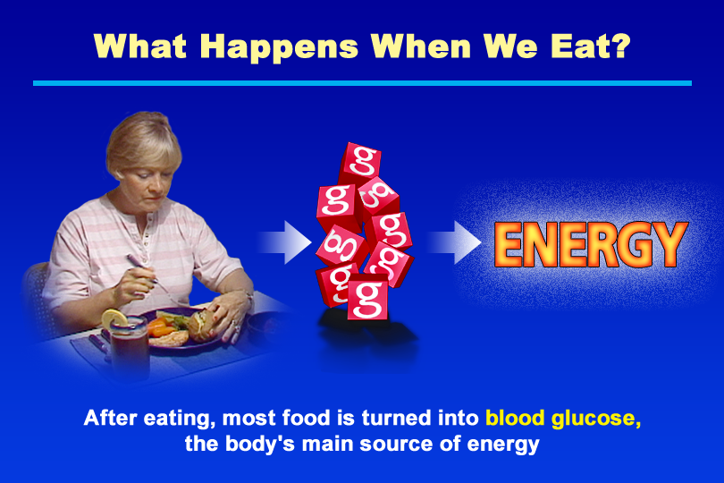
What Happens When We Eat?
Notes:
KEY MESSAGE: To understand diabetes, it is helpful to know some basic facts about metabolism and the role of blood glucose in providing cells with energy.
Supporting Points
In diabetes, too much glucose (a type of sugar) builds up in the blood. To understand normal blood glucose control, people need to know what happens to food after eating. Explain that:
In the digestive tract, food is broken down into protein, carbohydrates, and fat. These nutrients then are absorbed into the blood.
Carbohydrates in food are converted into blood glucose. Glucose is transported from the blood into the body’s cells. Inside the cells, glucose is used as fuel to supply most of the body’s energy. Extra glucose is stored as fat, an energy source that is used when glucose is not available.

Slide 10
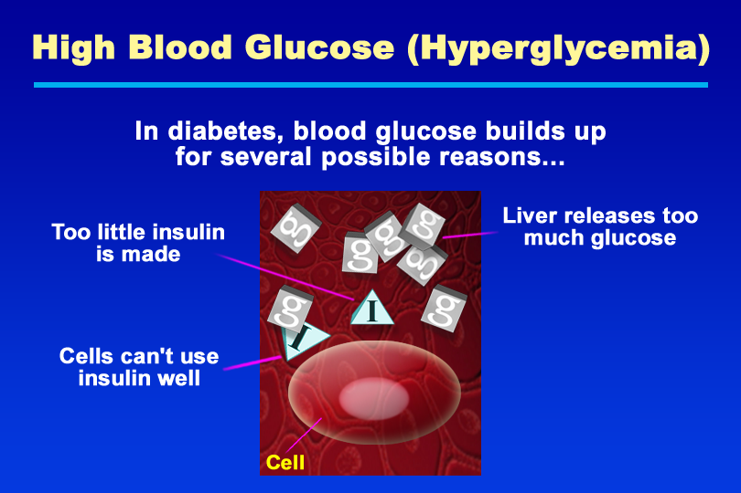
High Blood Glucose (Hyperglycemia)
Notes:
KEY MESSAGE: Although diabetes has different causes, affected people share a common problem: too much blood glucose.
Supporting Points
Diabetes has a number of different causes. Reasons for high blood glucose, also known as hyperglycemia, include:
Insulin deficiency. If the insulin-producing beta cells of the pancreas have failed or are failing, or if the pancreas is damaged, the body no longer can make sufficient insulin. This condition occurs in people with type 1 diabetes. People with type 2 diabetes also may not have enough insulin to meet their needs, such as if insulin is released too slowly after eating. Without sufficient insulin, glucose cannot be transported into cells, causing blood glucose to build up.
Insulin resistance. Although insulin may be present, cells may not be able to respond to its actions. This condition is called “insulin resistance.” Insulin resistance is an important cause of type 2 diabetes, the most common form of diabetes. In people with insulin resistance, glucose cannot enter cells efficiently, causing hyperglycemia.
Excess production and release of glucose by the liver. In the liver, insulin deficiency or resistance leads to increased glucose production and release, further contributing to hyperglycemia.

Slide 11
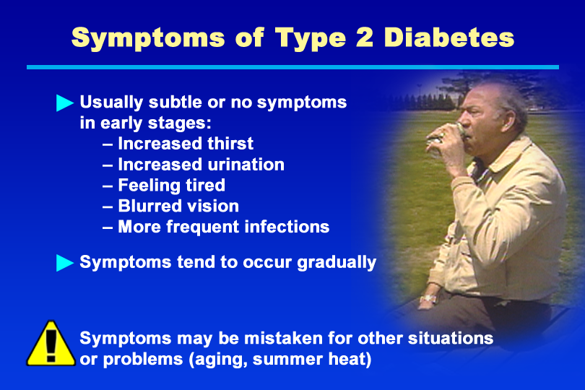
Symptoms of Type 2 Diabetes
Notes:
KEY MESSAGE: Type 2 diabetes is often silent in its early stages and may go undiagnosed.
Supporting Points
Unlike type 1 diabetes, type 2 usually does not appear suddenly. Instead, a person may have no noticeable symptoms or only mild symptoms for years.
Symptoms, when they occur, are similar to those of type 1 diabetes. In addition, people with type 2 diabetes may experience more frequent infections and have cuts and bruises that are slow to heal. Symptoms of type 2 diabetes typically do not occur until blood glucose levels are very high. Emphasize the need for a thorough medical evaluation should a person experience suspected symptoms of diabetes.
People with diabetes may mistake their symptoms for other conditions or situations, such as aging, summer heat leading to excessive thirst and urination, or side effects of various medications.

Slide 12
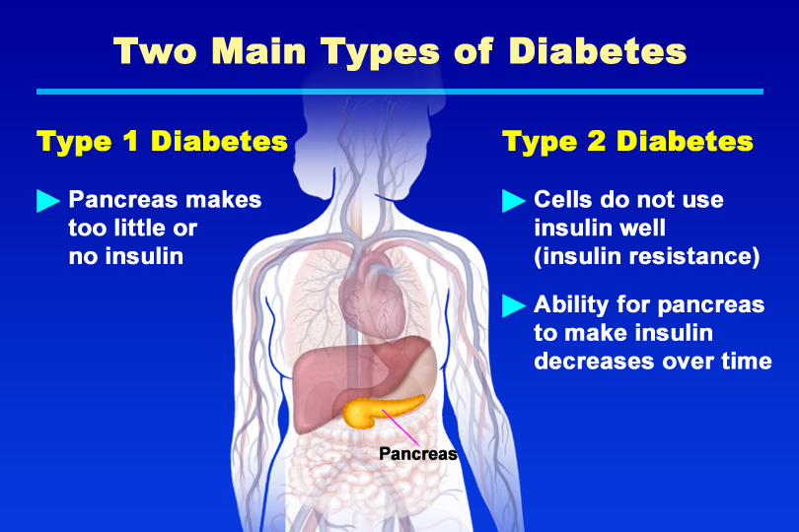
Two Main Types of Diabetes
Notes:
KEY MESSAGE: The two most common types of diabetes are type 1 and type 2.
Supporting Points
Type 1 and type 2 diabetes are the most common forms of the disease. In type 1 diabetes, the beta cells of the pancreas stop producing insulin. Type 2 diabetes is a metabolic disorder in which the body does not properly use insulin or produce insulin in the right amounts or at the right times.
Other types of diabetes can occur. Gestational diabetes develops in 2% to 5% of all pregnancies. Women with gestational diabetes are at increased risk for developing type 2 diabetes after pregnancy or later in life. Other specific types of diabetes may result from surgery, use of certain medications, various illnesses, and other specific causes.

Slide 13
Natural History of Diabetes
Normal
FBG <100
Random <140
A1c <5.7%
Prediabetes
FBG 100-125
Random 140 - 199
A1c ~ 5.7- 6.4%
50% working pancreas
Diabetes
FBG 126 +
Random 200 +
A1c 6.5% or +
20% working pancreas
Yes!
NO
Development of type 2 diabetes happens over years or decades

Slide 14
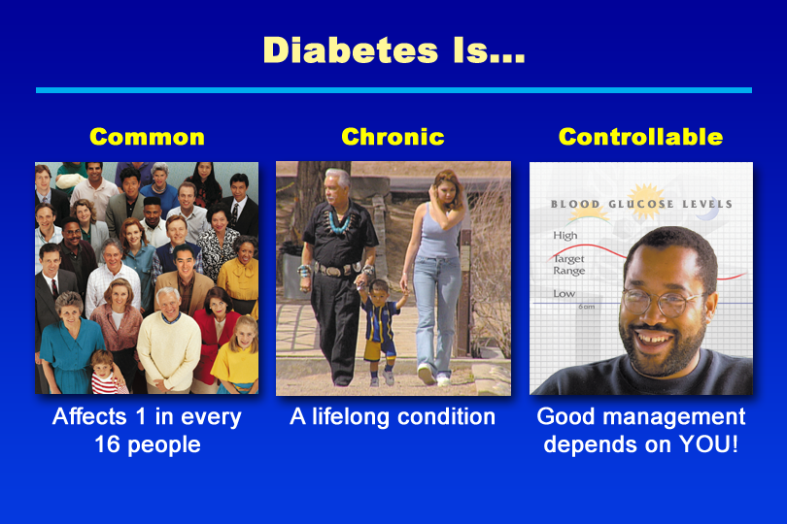
Diabetes Is…
Notes:
KEY MESSAGE: Although diabetes is a lifelong disease, people with diabetes can take steps to manage it and prevent serious medical problems.
Supporting Points
Diabetes is common. According to the American Diabetes Association (ADA), 18.2 million people in the United States (6.3% of the population) have diabetes. Many people with type 2 diabetes do not know they have the disease, which is typically “silent” (asymptomatic) in its early stages. Although an estimated 13 million have been diagnosed, 5.2 million Americans—more than one third of people with diabetes—are unaware they have the disease.
Diabetes is chronic. Diabetes is a lifelong disease that has no cure at present.
Diabetes is controllable. Diabetes can be managed when people take charge of the disease by adopting a healthier lifestyle, learning self-care skills, and receiving regular care from their health professionals.

Slide 15
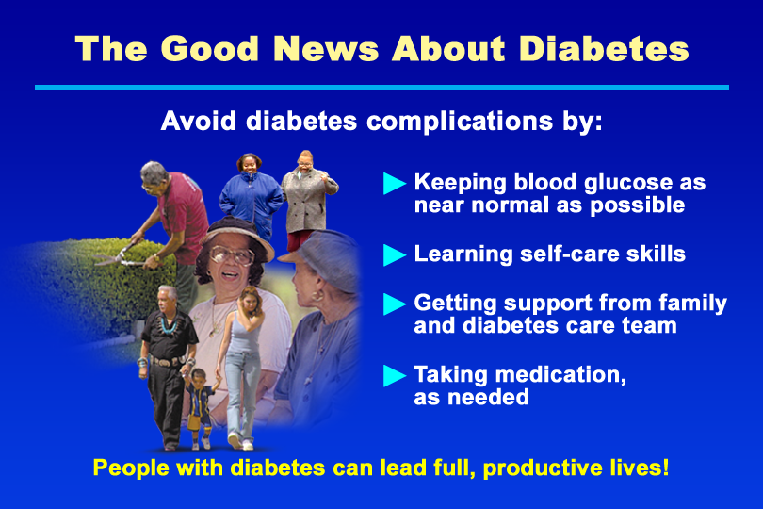
The Good News About Diabetes
Notes:
KEY MESSAGE: Although diabetes is serious, people with diabetes can live active, full, and productive lives by taking charge of their health.
Supporting Points
With proper care, diabetes complications can be prevented or delayed. People with diabetes can reduce their risk of complications if they are educated about their disease, practice skills to manage blood glucose levels, and receive regular checkups from their health care team.

Slide 16


Slide 17
Diabetes ABC’s
A 1c (less than 7%)
B lood Pressure (140/80)
C holesterol
(LDL <100, HDL > 40, Trig < 150)

Slide 18
Glucose Goals –
How do we Get there?
Test
  Pre-meal blood sugar
  1-2 hours after meal blood sugar
Goal
  70 – 130
  Less than 180
Healthy Eating
Exercise
Medication / Insulin
Monitoring

Slide 19
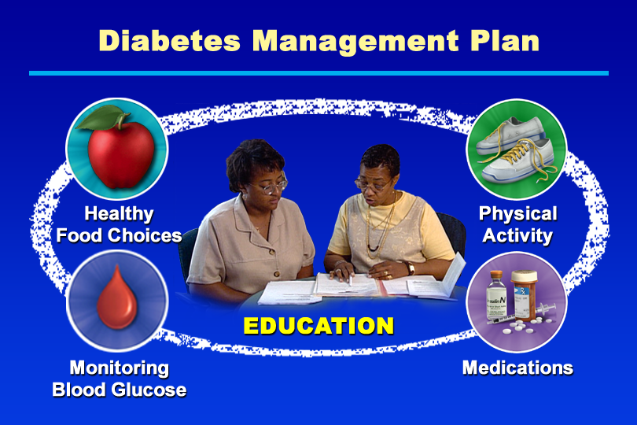
Diabetes Management Plan
Notes:
KEY MESSAGE: Successful diabetes management is based on an individualized care plan, tailored to a person’s lifestyle and needs.
Supporting Points
Patient education is the heart of the care plan. By learning about diabetes and its management, people can reduce their risk of complications, recognize and manage symptoms, and lead full, active lives.
Lifestyle changes, such as making healthy food choices and becoming more physically active, are important for everyone with diabetes. Blood glucose monitoring is an essential self-care skill that can help people reach their blood glucose goals and make informed choices about managing diabetes. Reaching and maintaining a healthy body weight is another important component of diabetes self-management for many people. Learning to manage stress through relaxation techniques and other methods also is key to successful diabetes management.
Many people with diabetes also need oral diabetes medications, insulin injections, or both. Insulin is always needed in people with type 1 diabetes, because the pancreas no longer makes sufficient insulin in this disease. In people with type 2 diabetes, oral medications, insulin, or both may be prescribed if lifestyle changes alone are not enough to control blood glucose.

Slide 20
Eating to Survive and Thrive
Dawn DeSoto RD, CDE
Jenae Hawkins, RD
Notes:
Introduction
Name
Education
Length at Feather River Hospital, Work at Feather River Health Center
14 years experience in outpatient nutrition education with an emphasis in diabetes
Diabetes—a clear problem that responds to nutrition

Slide 21
Eating to Survive and Thrive
  Healthy Foods to nourish your
  lifetime journey
  Surviving & thriving with everyday
  foods
  Building your Nutrition Survival
  tool kit

Slide 22

Thriving through Food
Controlling portions and carbohydrates can affect blood sugars immediately
Better blood sugar means a lower risk of diabetes complications
Sometimes medications are needed despite excellent nutrition

Slide 23
Diabetes is a Puzzle
Monitoring
Exercise
Medication
Nutrition, not Diet

Slide 24
Eating Healthy Improves Life
Promote Normal Blood sugar
Provide optimal nutrient intake
Helps with weight
Prevent, delay or treat diabetes
related complications

Slide 25
What are Protein, Fat and Carbohydrate (CHO) ?
Proteins are needed for growth, repair, maintenance and energy. They are found in meats, poultry, fish, dairy products, eggs, beans, peas, & lentils.
Fats provide energy & are needed for cells BUT you only need a small amount of fat in your diet. The best sources are the monounsaturated (canola & olive oil, nuts, and avocado).
Carbohydrates provide energy for your cells & brain. They are the sugars, starches & fibers in foods. Foods that provide carbs are potatoes, rice, pasta, bread, beans, corn, peas & lentils. Sugars are naturally present in fruits, milk, yogurt & a small amount in vegetables.

Slide 26
How Does Food Affect Blood Sugar?
Food>>digestion>>> proteins, fats, carbohydrates and vitamins & minerals
Carbohydrates>>>Blood glucose
Blood glucose + insulin>>into cell and converted
to energy that your body can use.

Slide 27
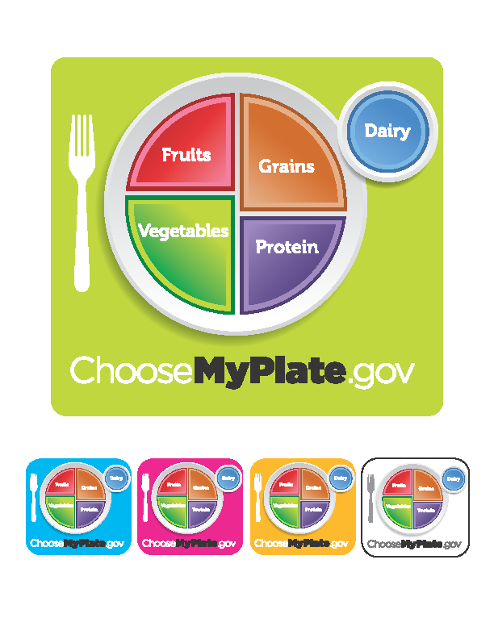

Slide 28
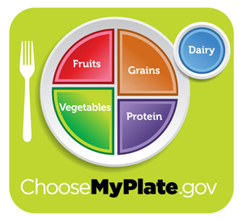
USDA Food Pyramid www.myplate.gov
Balancing Calories
Enjoy your food, but eat less.
Avoid oversized portions.
Foods to Increase
Make half your plate fruits and vegetables.
Make at least half your grains whole grains.
Switch to fat-free or low-fat (1%) milk.
Foods to Reduce
Compare sodium in foods like soup, bread, and frozen meals ― and choose the foods with lower numbers.
Drink water instead of sugary drinks.

Slide 29
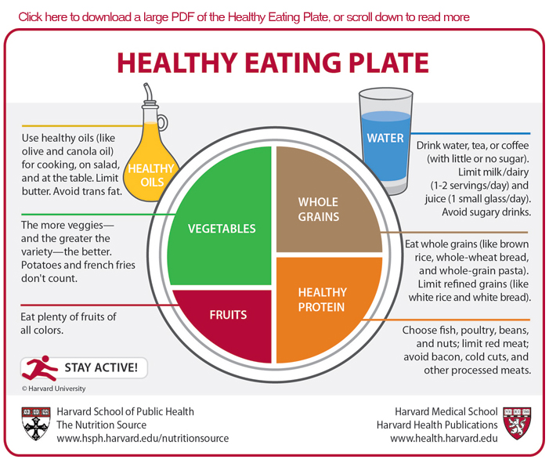

Slide 30






Move toward the Tomato

Slide 31
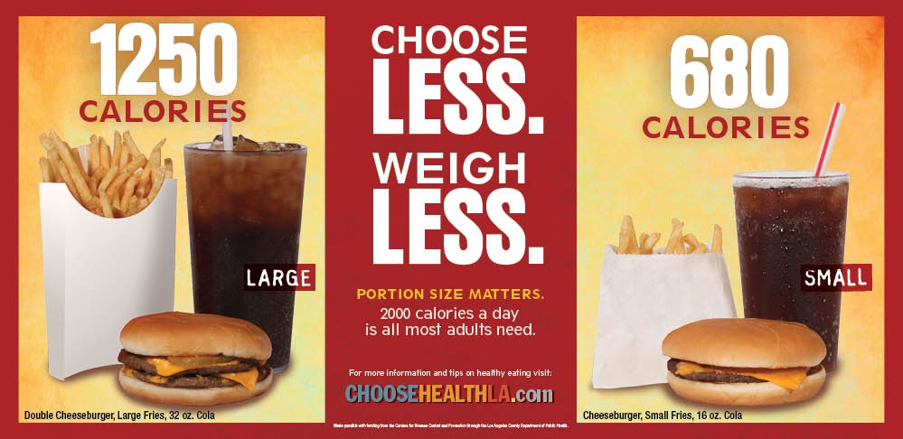
Health Campaigns

Slide 32
Eating Away From Home
Plan Ahead - Know your goals and meal plan.
Choose salads - dressing on side
Watch for gravies, cream sauce, fried foods
Count your starches - take extra home
Choose desserts wisely
Take control - Ask your waitress questions!

Slide 33
Superfoods
Found in the pigments, chemicals, and fiber of plants
Sources include:
  Greens: Kale, spinach, bok choy
  Deep orange fruit and veggies: carrots, winter squash, apricots, sweet potatoes
  Red and purple fruits and veggies: berries, beets, plums, red grapes and red peppers
  Nuts, onions, citrus, cruciferous vegetables, dark chocolate!

Slide 34
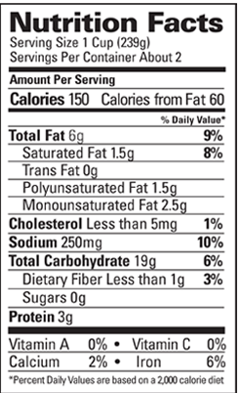
Label Lessons

Slide 35
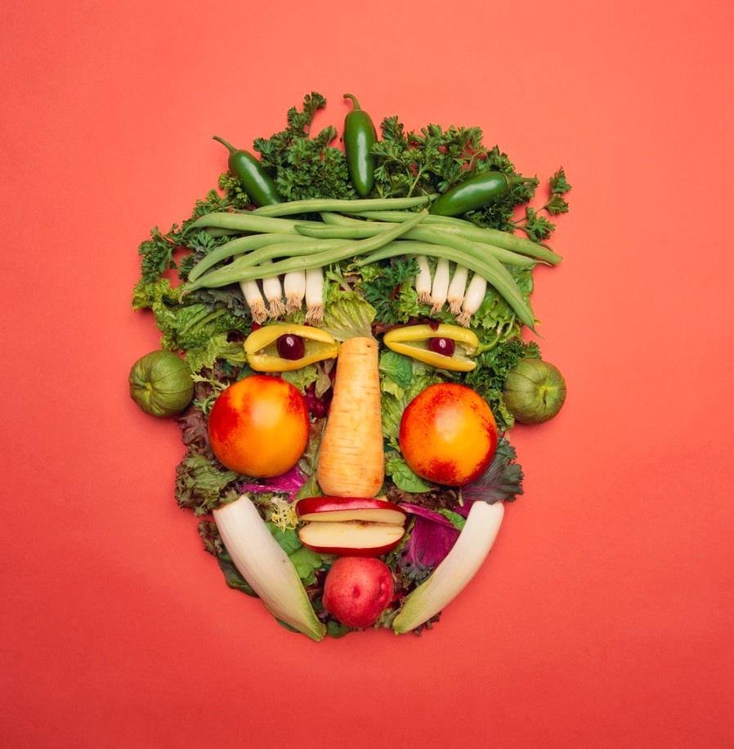
Choose Healthy Carbs
Carbs have fiber, vitamins, minerals and phytonutrients
25-38 gms of fiber a day
Power Carbs include:
  Beans
  Veggies
  Fruits
  Whole grain foods

Slide 36
Strategies for Counting Carbohydrates per Meal
Men: 4 exchanges per meal (60 grams of carbohydrate)
Women: 3 exchanges per meal (45 grams of carbohydrate)
  1 exchange = 15 grams carbohydrate
  =1 carbohydrate choice

Slide 37
Carbohydrate Values of
Major Foods
Starches = 15 grams of carbohydrate = 1 exchange
Milk/Yogurt = 12 grams of carbohydrate = 1 exchange
Fruit = 15 grams of carbohydrate = 1 exchange
Vegetables = 5 grams of carbohydrates
Meats/Proteins = 0 grams of carbohydrate
Fats = 0 grams of carbohydrate

Slide 38
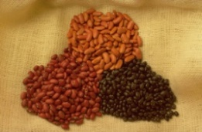


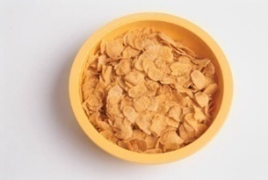
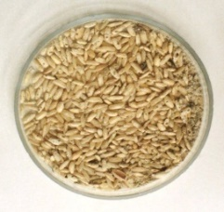
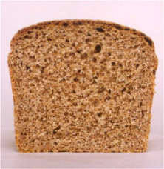

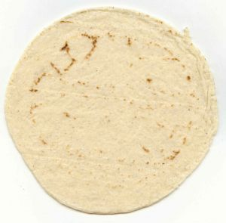
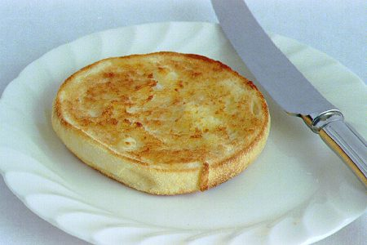
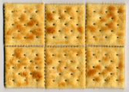
Carb counting- starch
Each Food has:
80 Calories
15 grams carb
1 small ear of corn or 1/2 cup corn
1/3 cup cooked pasta
1/2 cup
cooked beans
3/4 cup cold cereal
1 slice bread
1/3 cup cooked rice
1 small potato
1 small tortilla
1/2 English muffin
5-6 small crackers

Slide 39



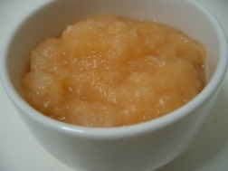

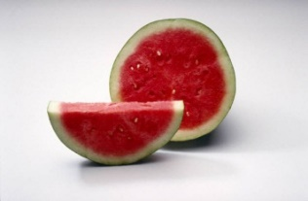



Carb counting- fruit
Each Food has:
60 Calories
15 grams carb
1 small fresh fruit
½ cup fruit juice
½ banana
½ cup unsweetened apple sauce
1 slice bread
17 small grapes
1 cup melon
¼ cup dried fruit
1 1/4 cup strawberries
2 tbsp raisins

Slide 40


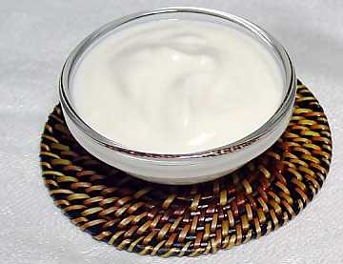
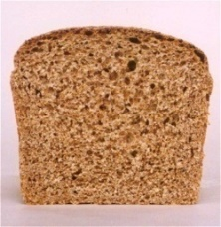

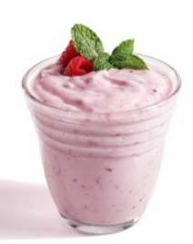

Carb counting- milk
Each Food has:
90-150 calories
12-15 grams carb
8 oz buttermilk
1 packet diet hot cocoa
6 oz plain yogurt
1 slice bread
8 oz milk
6 oz light fruit yogurt
8 oz soy milk

Slide 41
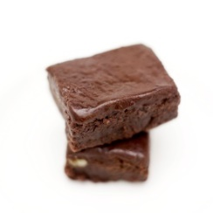
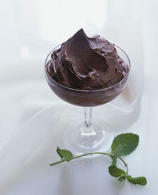
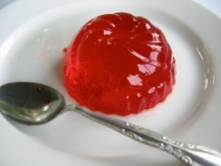

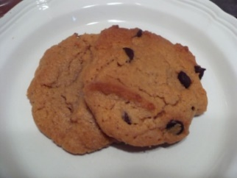
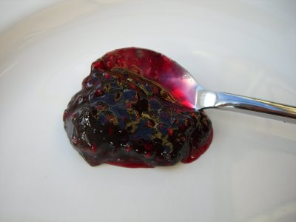
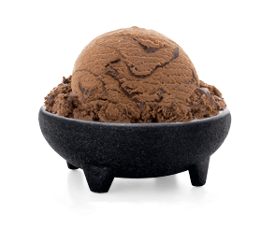

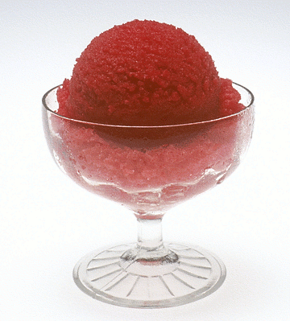
Carb counting - sweets
Each Food has:
Calories vary
15 grams carb
½ cup regular jello
2 tbsp light syrup
2 inch square cake or brownie, unfrosted
½ cup diet pudding
1 slice bread
1 tbsp syrup, jam, jelly, table sugar, honey
2 small cookies
½ cup ice cream or frozen yogurt
¼ cup sorbet
½ cup sherbet

Slide 42
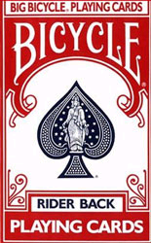
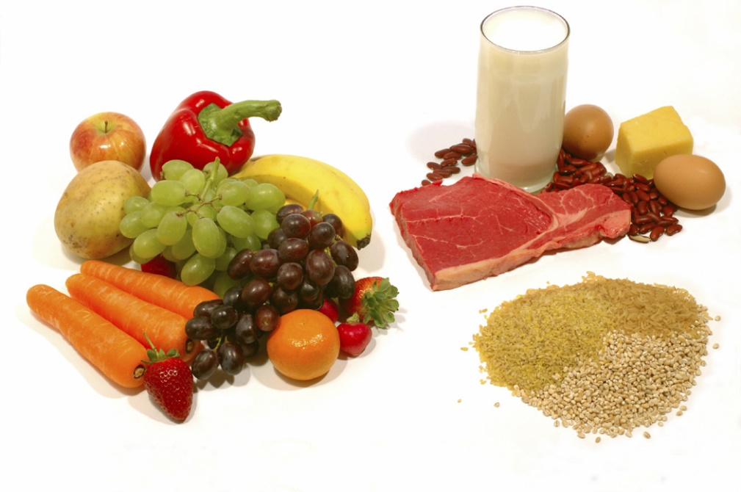
Go Lean with Protein
Choose lean protein
  Poultry, fish, egg, lean beef
  Plant sources- beans, lentils, nuts
  Low fat cheese- cottage cheese, mozzarella cheese
Limit high fat protein
  Bacon & sausage
  High fat cuts of beef
  Whole milk cheese
Serving size
  1 oz = ¼ cup
  3 oz = deck of cards

Slide 43
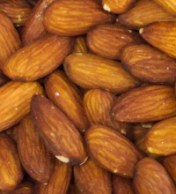
Fats - Aim for heart health
Saturated fats (LIMIT)
  (trans fats)
Monounsaturated
Polyunsaturated
Serving sizes
1 tsp butter, margarine, oil, mayonnaise
1 Tbsp salad dressing, cream cheese, seeds
2 Tbsp avocado, cream, sour cream
1 slice bacon

Slide 44
Food & Activity Tracker
Tracking food and activity helps us accomplish blood sugar control and weight loss goals

Slide 45
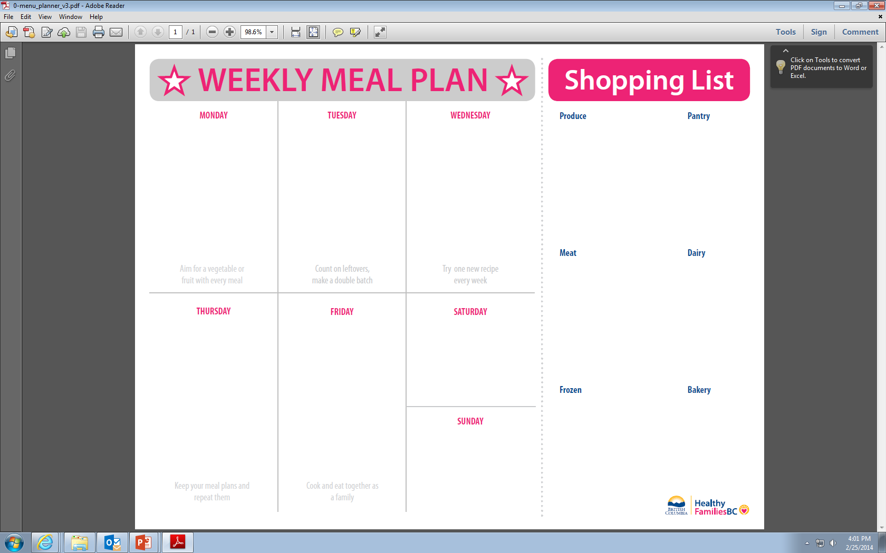

Slide 46
Thank You!

