Slide 1


Diabetes Fundamentals
Nutrition and Exercise
Beverly Dyck Thomassian, RN, MPH, BC-ADM, CDE
President, Diabetes Education Services
© Copyright 1999-2014, Diabetes Education Services, All Rights Reserved.

Slide 2
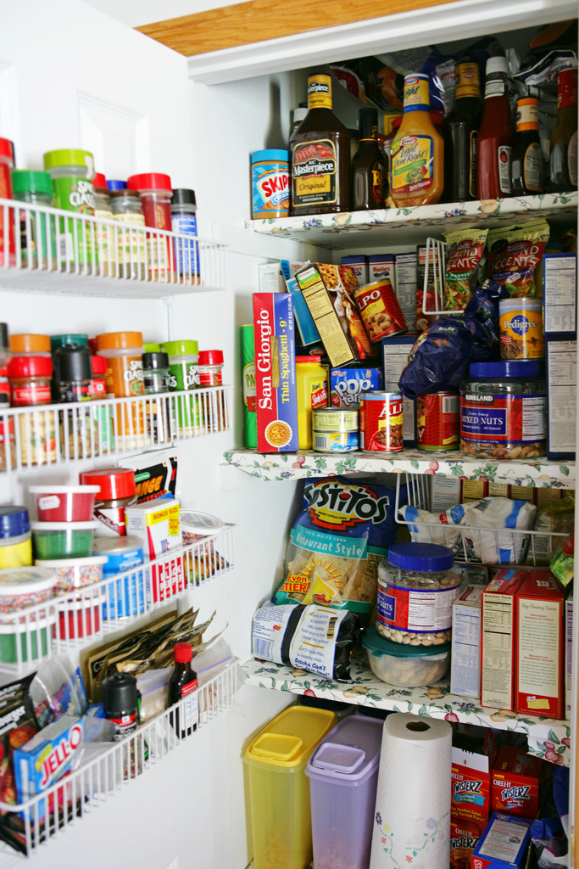
Diabetes Fundamentals
Nutrition guidelines
  Describe current MNT recommendations
  List 3 teaching strategies to help patients succeed
Exercise Guidelines
  Discuss exercise goals for people with diabetes
  Describe safety precautions

Slide 3

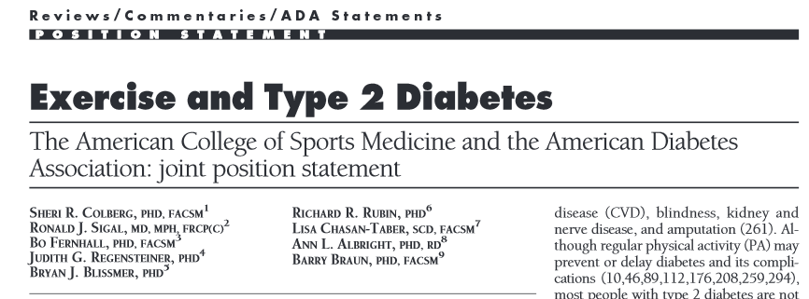
Good Resources
Review Exchange List
Review ADA Standards of Care:

Slide 4
Assess Knowledge, Self Management Skills
Eating Patterns
  Preferences, portion sizes, timing on meals and snacks, eating environment, disordered eating

Slide 5

Medical Nutrition Therapy – ADA 2014
No ideal percentage of calories from protein, carbohydrate and fat for people with diabetes.
Macronutrient distribution should be based on an individualized assessment of eating patterns, preferences and metabolic goals.

Slide 6
Medical Nutrition Therapy – ADA 2014
Focus on the Individual
Maintain pleasure of eating
Provide positive messages about food
Limit food choices only when backed by science
Provide practical tools
Refer to a RD and Diabetes Education – Lowers A1c by 1-2%

Slide 7

Medical Nutrition Therapy – What Medicare Covers
3 hours initial benefit in first calendar year
2 hours follow-up annually
Must be ADA/AADE Recognized
MNT for diabetes and renal

Slide 8

Approach Depends on Patient
New Type 2
  Portion Control
  Plate Method
  Record Keeping
  Education
On Insulin?
  Carb counting
  Post prandial checks

Slide 9
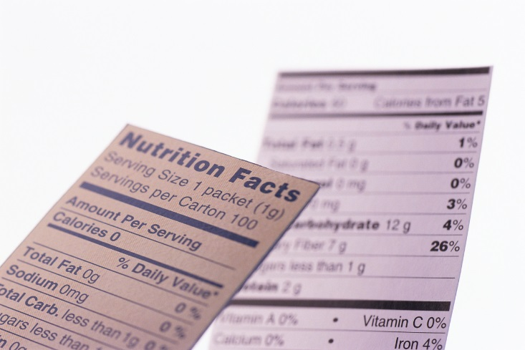
Sodium, Fat and Fiber
Sodium – Try and keep less than 2,300 mg a day
Vitamin and mineral supplements not recommended -lack of evidence.
Fat - same as recommended for general population
  Less than 10% saturated fat,
  Limit trans fats
  Less than 300 mg cholesterol daily
  Mediterranean Diet looks like good option
Fiber 25 -38 gms a day

Slide 10
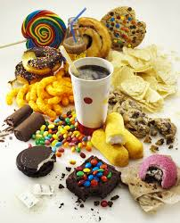
Average American Consumes
25 teaspoons of sugar a day (400 cals)
Warning label on sodas proposed
One soda has 12 teaspoons sugar
On avg, 1 person consumes 40 gallons of soda each year
ADA guidelines “limit sodas and beverages with sugar, High Fructose Corn Syrup, (HFCS)

Slide 11


ADA recommendation
Eat Less Junk Food & Sugary Drinks –
Less Processed Foods
Less Sugary Beverages
  increase visceral adiposity
  With sugar or
  High fructose corn syrup
Soda Tax?
Junk Food Tax?

Slide 12

Teaching About Eating Healthy
Major food groups
“Handy Diet”
Plate Method
Exchange Lists
Food Diaries / Glucose Records
Carbohydrate Counting
Assess what is best for the situation.

Slide 13






Move toward the Tomato

Slide 14
Losing 2-8kg Early in diagnosis Type 2 Helpful
ADA 2014
Weight Loss –
  The optimal macronutrient intake to lose weight not known
  The literature does not support one particular nutrition therapy to reduce weight, but rather a spectrum of eating patterns that result in reduced energy intake.
  To lose one pound – avoid 3,500 cals
    Decrease intake 250-500 cals daily + exercise

Slide 15

Successful weight loss strategies include
Weekly self-weighing
Eat breakfast
Reduce fast food intake.
Decrease portion size
Increase physical activity
Use meal replacements
Eat healthy foods

Slide 16
Bariatric Surgery
Consider for adults with BMI 35 or greater
Increases gut hormone availability
Need life long support and monitoring
More likely to cause remission* with recently diagnosed diabetes (more beta cell mass)
  68% remission within 5 years
  35% redeveloped diabetes
Long term benefits still under investigation
*remission = BG levels normal without meds

Slide 17
USDA www.myplate.gov
Balancing Calories
Enjoy your food, but eat less.
Avoid oversized portions.
Foods to Increase
Make half your plate fruits and vegetables.
Make at least half your grains whole grains.
Switch to fat-free or low-fat (1%) milk.
Foods to Reduce
Compare sodium in foods like soup, bread, and frozen meals ― and choose the foods with lower numbers.
Drink water instead of sugary drinks.

Slide 18

Another plate example

Slide 19
How nutrients affect blood sugar

Slide 20

Carbs affect Post meal Blood Glucose
Starch
Fruit
Milk
Desserts

Slide 21
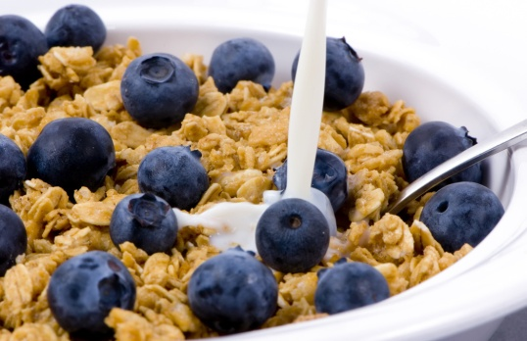
Carbohydrate Needs for
Most Adults
Grams Servings
Each Meal 45-60 gm 3 - 4
Snacks 15-30 gm 1- 2
Carbs affect Post Meal Blood Glucose
RDA – at least 130 gms of Carb a day

Slide 22
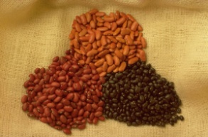


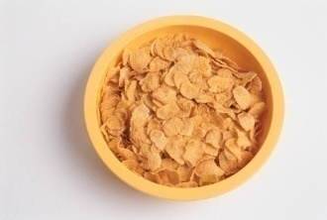
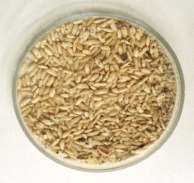
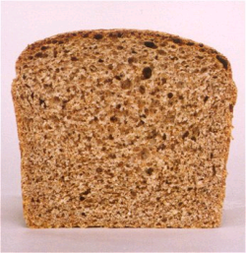

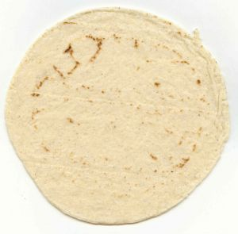
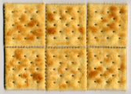

Carb Counting - Starch
Each Food has:
80 Calories
15 grams carb
1 small ear of corn or 1/2 cup corn
1/3 cup cooked pasta
1/2 cup
cooked beans
3/4 cup cold cereal
1 slice bread
1/3 cup cooked rice
1 small potato
1/2 English muffin
1 small tortilla
5-6 small crackers

Slide 23









Carb counting- fruit
Each Food has:
60 Calories
15 grams carb
½ cup fruit juice
½ banana
1 small fresh fruit
½ cup unsweetened apple sauce
1 slice bread
17 small grapes
1 cup melon
¼ cup dried fruit
2 tbsp raisins
1 1/4 cup strawberries

Slide 24


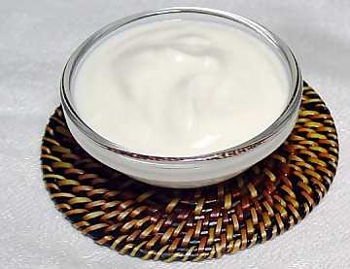
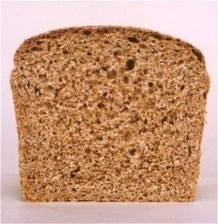



Carb Counting - Milk
Each Food has:
90-150 calories
12-15 grams carb
8 oz buttermilk
1 packet diet hot cocoa
1 slice bread
6 oz plain yogurt
8 oz milk
6 oz light fruit yogurt
8 oz soy milk

Slide 25





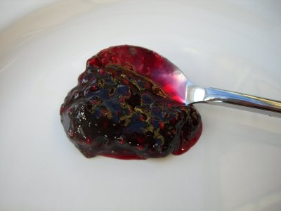



Carb Counting - Sweets
Each Food has:
Calories vary
15 grams carb
2 inch square cake or brownie, unfrosted
½ cup regular jello
2 tbsp light syrup
½ cup diet pudding
1 slice bread
1 tbsp syrup, jam, jelly, table sugar, honey
2 small cookies
¼ cup sorbet
½ cup ice cream or frozen yogurt
½ cup sherbet

Slide 26

Choose Healthy Carbs
Carbs have fiber, vitamins, minerals and phytonutrients
25 gms of fiber a day
Power Carbs include:
  Beans
  Veggies
  Fruits
  Whole grain foods

Slide 27
10 Superfoods
Beans
Dark Green Leafy Vegs
Citrus Fruit
Sweet Potatoes
Berries
Tomatoes
Fish High in Omega-3 Fatty Acids
Whole Grains
Nuts
Fat-Free Milk and Yogurt

Slide 28

Nutrition Facts
Serving Size 1/2 cup (114 g)
Servings Per Container 4
Amount Per Serving
Calories 90 Calories from Fat 30
Fooducate App – gives grade and nutrition info.
% Daily Value*
Total Fat 3g 5%
Saturated Fat 0g 0%
Cholesterol 0g 0%
Sodium 300mg 13%
Total Carbohydrate 13g 4%
Dietary Fiber 3g 12%
1 tsp sugar =4 gms
Sugars 3g
Protein 3g
Vitamin A 80% * Vitamin C 60%
Calcium 4% * Iron 4%
* Percent Daily Values are based on a 2,000 calorie diet. Your daily values may be higher or lower depending on your calorie needs:
Calories _ 2000 2500
Total Fat Less than 65g 80g
Sat Fat Less than 20g 25g
Cholesterol Less than 300mg 300mg
Sodium Less than 2400mg 2400mg
Total Carbohydrate 300g 375g
Fiber 25g 30g
Calories per gram: Fat 9 Carbohydrates 4 Protein 4

Slide 29

Dietary Fat and Cholesterol Guidelines
  Avg Calorie distribution for PWD
    45% of calories from carbs
    30-40% from fat,
    16-18% from protein
  Guidelines from ADA
    Saturated fats <10% of calories
    Limit trans fat as much as possible
    Limit total dietary cholesterol to 300 mg/day

Slide 30
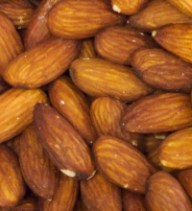
Fats- 9 calories per gram
Monounsaturated - healthy
  Olive & canola oils, Nuts, Avocado
  Lowers total cholesterol and LDL
  Raise HDL, high in omega 3 fatty acids
Polyunsaturated - healthy
  corn, walnut, safflower, soybean
  Lowers total cholesterol and LDL
Saturated fats (limit <10%)
  Animal products – meat, chicken, pork, fish, skin, cheese butter, dairy
  Plant products include; palm, coconut, palm kernel oil
  Solid at room temp
Serving sizes
1 tsp butter, margarine, oil, mayonnaise
1 Tbsp salad dressing, cream cheese, seeds
2 Tbsp avocado, cream, sour cream
1 slice bacon

Slide 31
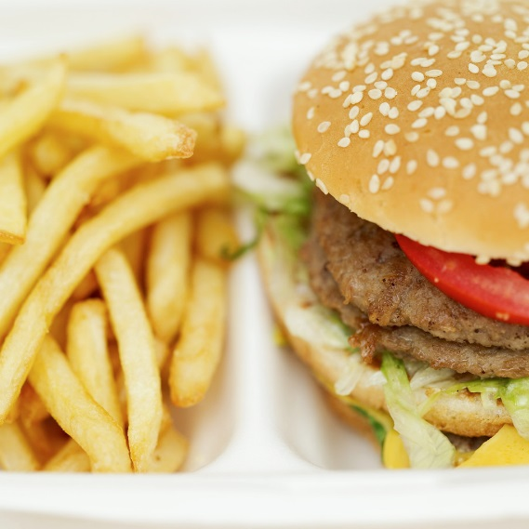

Unhealthy Dietary Fats
Trans Fat – strong link between diet high in trans fat and heart disease
  Lowers HDL
  Increases LDL
  May increase wt gain and abdominal fat
  May contribute to type 2 diabetes
Look on label and look for words “hydrogenated” or “partially hydrogenated”.

Slide 32
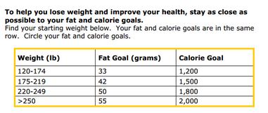
Diabetes Prevention Program
Focus on fat = wt loss success
http://www.cdc.gov/diabetes/prevention/recognition/curriculum.htm

Slide 33

Protein Recommendations -2014
For people with diabetes and no diabetes kidney disease, evidence is inconclusive for ideal amount of protein; there fore, goals should be individualized.
RDA – 0.8gm good quality protein/kg/day
  Protein seems to stimulate insulin response, do not use to treat hypoglycemia
  For those with kidney failure, reducing the amount of dietary protein is not recommended. Does not improve outcomes.

Slide 34

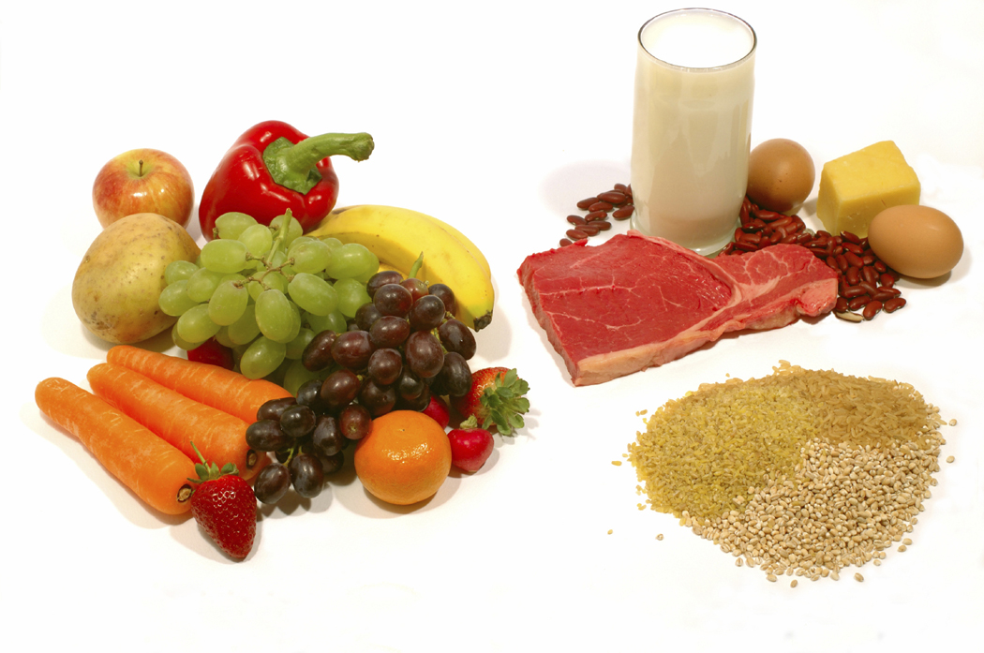
Protein – 4 cals per gram
Choose lean protein
  Poultry, fish, egg, lean beef
  Plant sources- beans, lentils, nuts
  Low fat cheese- cottage cheese, mozzarella cheese
Limit high fat protein
  Bacon & sausage
  High fat cuts of beef
  Whole milk cheese
Serving size
  1 oz = ¼ cup
  3 oz = deck of cards

Slide 35
Using Alcohol Safely
Women- 1 or fewer alcoholic drinks a day
Men 2 or fewer alcoholic drinks a day
  1 alcoholic drink equals
    12 oz beer, 5 oz glass of wine, or 1.5 oz distilled spirits (vodka, gin etc)
If drink, limit amount and drink w/ food.
Can cause hypo and worsen neuropathy

Slide 36
Ms. Gonzales’ Daily Meal plan

Slide 37
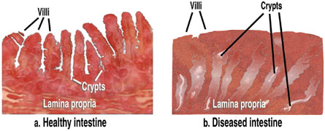
Celiac Disease
Type 1 – Affects ~10 \%
Immune reaction to gluten - affects function of villi in intestine, decreasing nutrient absorption
S/S: bloating, malabsorption, wt loss, fatty stools, diarrhea, muscle tenderness, failure to thrive
Diagnosis: measure either anti-endomysial antibodies (EMA) titers or tissue transglutaminase.
If positive, refer to GI specialist for endoscopy and biopsy of small intestine to confirm diagnosis.

Slide 38

Treatment – Gluten Free for Life
Avoid
  Wheat (einkorn, durum, faro, graham, kamut, semolina, spelt),
  Rye
  Barley
Refer to a dietitian
ASSOCIATED AUTOIMMUNE DISORDERS
Insulin-dependent Type 1 Diabetes Mellitus, Liver diseases, Thyroid Disease-Hashimoto’s Thyroiditis, Lupus (SLE), Addison’s Disease, Chronic Active Hepatitis, Rheumatoid Arthritis

Slide 39
Ex of Gluten Containing Foods
•Pastas
•Processed luncheon meats
•Sauces, gravies
•Self-basting poultry
•Soy sauce or soy sauce solids
•Soup bases
•Stuffings, dressing
•Thickeners (Roux)
•Communion wafers
And more!
•Brown rice syrup
•Breading & coating mixes
•Croutons
•Energy Bars
•Flour or cereal products
•Imitation bacon
•Imitation seafood
•Marinades

Slide 40
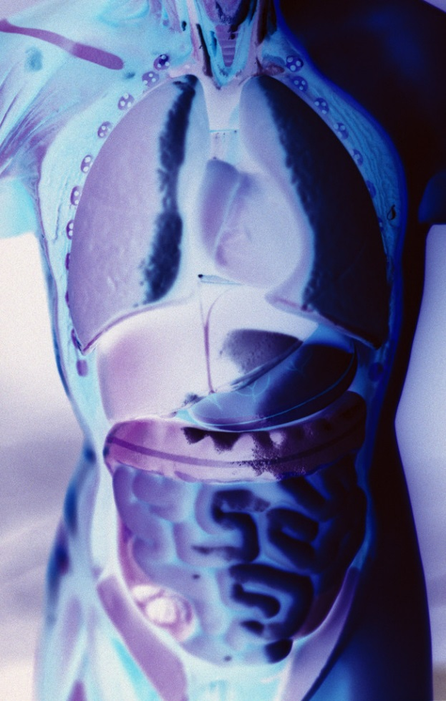
Gastroparesis
Gastroparesis: affects 20 – 30% of pt’s w/ longstanding dm
Delayed emptying of stomach contents due to nerve damage
S/S include early satiety, fullness, postprandial hypo, vomiting
Diagnosis: gastric emptying studies, post-prandial hypoglycemia
Tx: improve BG, small, low fat & fiber meals meds: reglan, erythromycin

Slide 41

Disordered Eating
“DiaBulimia”
People with type 1 diabetes give themselves less insulin than needed to lose weight
Tends to start in adolescence, more likely to occur in women than men.
Signs: unexplainable spikes, A1c, weight loss, lack of marks from fingerpricks, lack of prescription refills for diabetes meds, records that don’t match A1c.
Treatment – Mental health specialist and team

Slide 42

Physical Activity – Key areas
ADA and American College of Sports Medicine recommendations
Benefits, barriers precautions
Exercise and activity plan (aerobic, resistance training, etc)
Adjustment and monitoring of food and/or meds

Slide 43

Physical Activity - Kids
Children should be encouraged to engage in at least 60 minutes of physical activity a day.

Slide 44

Physical Activity - ADA
Adults with diabetes –
  150 minutes a week of moderate-intensity aerobic physical activity
  spread over at least 3 days/wk
  Don’t miss more than 2 consecutive days of exercise.
In absence of contraindications, type 2 adults should engage in resistance training 2x’s a wk

Slide 45
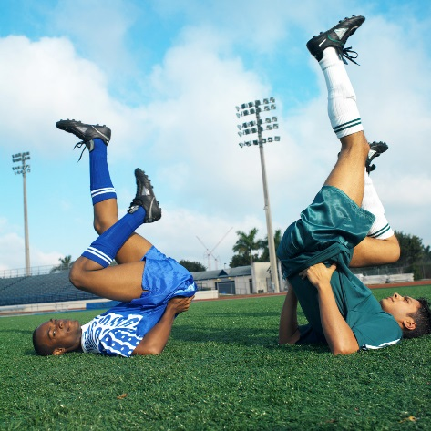

Definitions
Physical activity
  Bodily movement produced by the contraction of skeletal muscle that requires more energy than when resting
Exercise
  Subset of physical activity that is planned, structured and includes repetitive body movements
  Performed to improve or maintain physical fitness
Sedentary behavior
  Little on no movement or physical activity

Slide 46
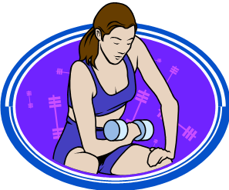
Progressive Resistance exercise
Improves insulin sensitivity
Goal is 2 sessions a week
Examples include:
  Exercise with free weights, wt machines
Each session consisting of least:
  One set of five or more resistance exercises using large muscle groups

Slide 47
Benefits of Exercise
Improve BG
  Improves insulin sensitivity
Reduce CV Risk factors
Maintain wt loss
Contribute to well being
Muscle strength
Slows decline in mobility

Slide 48
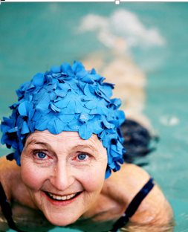
Importance of Exercise with Diabetes
Vital component of prevention as well of the management of type 2 diabetes
Greatest impact in improving metabolic abnormalities in type 2 when started early in progression from IR to Pre Diabetes to DM
Type 1 – emphasis on adjusting insulin to allow for safe participation in all forms of activity.

Slide 49
Pre-exercise Eval
Use clinical judgment when making physical activity suggestions and check in with provider if unsure.
Encourage high risk pts to start with low intensity and short time.
  Increase duration and intensity slowly
Contraindications to certain types of exercise:
  Uncontrolled HTN, severe autonomic or peripheral neuropathy, history of foot lesions, unstable proliferative retinopathy.
  Pt w/ complications require a more thorough assessment.

Slide 50
Patients to discuss symptoms with provider before starting exercise
Chest pain and/or shortness of breath
Leg cramps that go away with rest
Head, shoulder, neck and or back aches.
Any unexplained pain above the belt line should be considered cardiac in origin until proven otherwise.

Slide 51

Hormone Response –Type 1
Exogenous insulin remains high
Increased insulin sensitivity
Increased insulin absorption
What is this group at risk for?
What strategies to stay safe before, during and after exercise?

Slide 52
Hormone Response –Type 2
Decreased secretion of endogenous insulin
Increased insulin sensitivity
Increased glucose disposal
What is this group at risk for?
What strategies to stay safe before, during and after exercise?

Slide 53
Duration of Hypoglycemia Risk
During exercise
Immediately after exercise
Post exercise late onset hypo
  More often in type 1
  More often at night
  Moderate to high intensity exercise > 30 min
  4 to 15 hours following an exercise session

Slide 54
Hypoglycemia Prevention Strategies
If planned activity, adjust insulin in anticipation of activities
Reduce insulin in post exercise period
Frequent monitoring in post exercise period
Pt to keep log to determine how responds to different activities, duration and intensity.

Slide 55
Hypoglycemia Prevention Strategies
Carry fast acting carb/ glucagon ER Kit
Extra CHO in post exercise period
Caution with alcohol post exercise
Adjust carbohydrate prior to planned activity:
  If BG < 100 prior to exercise
  If using insulin and /or secretagogues
    15 gms carb snack

Slide 56
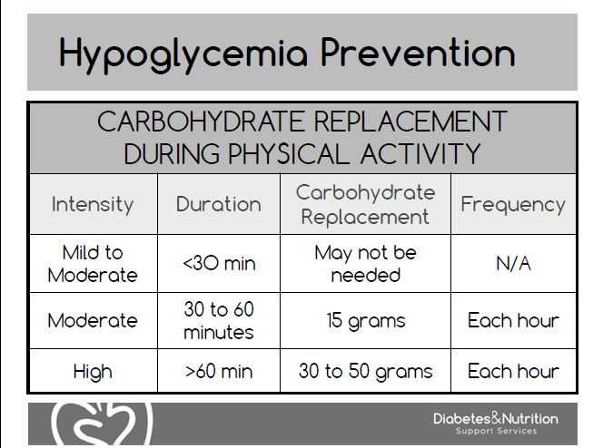

Slide 57

Behavior Change and Smart Goals
Julie currently walks her dog 3 times a week around the block.
Is this exercise?
What new and revised SMART Goal could you set with her?

Slide 58

Setting SMART Goals
Specific
Measurable
Attainable
Realistic
Timely
Behavioral Goal –
  Walk the dog around the block 4 days a week.
  Walk the dog around the block two times.
  Do 10 minutes of weight bearing activity on 2 of the days you don’t walk the dog.

Slide 59

Help Patients Prepare for Setbacks

Slide 60

Thank You
Questions?
Email bev@diabetesed.net
Web www.diabetesed.net

