Slide 1

Becoming a Diabetes Educator – Day 1
Beverly Thomassian, RN, MPH, BC-ADM, CDE
President, Diabetes Education Services
Diabetes Nurse Specialist
bev@diabetesed.net
www.diabetesed.net

Slide 2

Becoming A CDE
Free Webinar –Sign up at www.DiabetesEd.net
To become CDE
Professional license (RN, RD, PharmD etc)
Complete 1000 hr diabetes self mgmt
40% or 400 hours in year of exam
More info at www.NCBDE.org

Slide 3

Day 1
Diabetes – Not Just Hyperglycemia
Goals of Care
Insulin – the Ultimate Hormone Replacement Therapy and Pattern Mgmt
Medications for Type 2 Diabetes
Monitoring, Sick Days and Hospitalization

Slide 4
CDC Announces
35% of Americans will have Diabetes by 2050
Boyle, Thompson, Barker, Williamson
2010, Oct 22:8(1)29
www.pophealthmetrics.com

Slide 5

Global Epidemic
Every 10 seconds
1 person dies with diabetes
2 people develop diabetes
Every year
3 million deaths
6 million new cases
World Diabetes Day is November 14
March is ADA Sound the Alert Day “find people w/ undetected diabetes”

Slide 6


World diabetes day- November 14
DIABETES: PROTECT OUR FUTURE

Slide 7
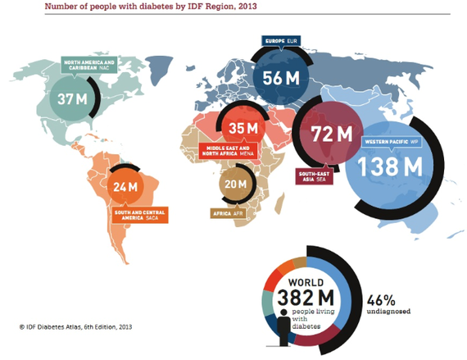
World wide Epidemic

Slide 8
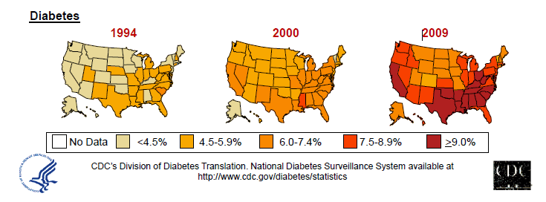
Diabetes in America 2014
25.8 million or > 8.3%
79 million have pre diabetes
CDC 2011

Slide 9
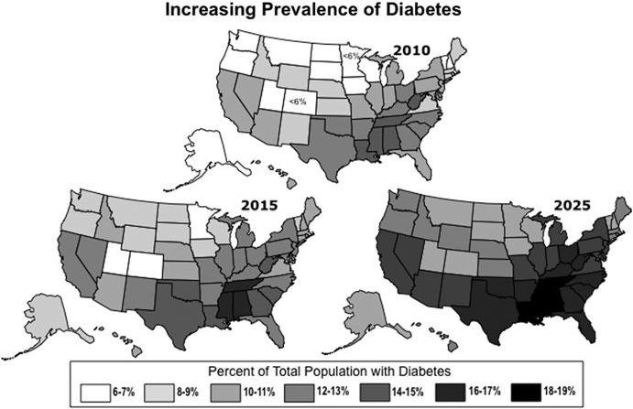

Future of Diabetes

Slide 10
The relationship between BMI and the risk of developing type 2 diabetes
93.2
100
Women
70
54.0
Men
40.3
42.1
40
27.6
21.3
15.8
Risk of type 2 diabetes
11.6
10
8.1
6.7
4.3
5.0
4.4
5
2.9
2.2
1.0
1.0
1.0
1.5
0
<22
<23
23-
24-
25-
27-
29-
31-
33-
35+
23.9
24.9
26.9
28.9
30.9
32.9
34.9
Body mass index (kg/m²)
Notes:
Adapted from: Klein S and Romijn J, in: Williams Textbook of Endocrinology, 10th ed, 2003
From the IDF publication: ‘Diabetes and Obesity’, p.25

Slide 11
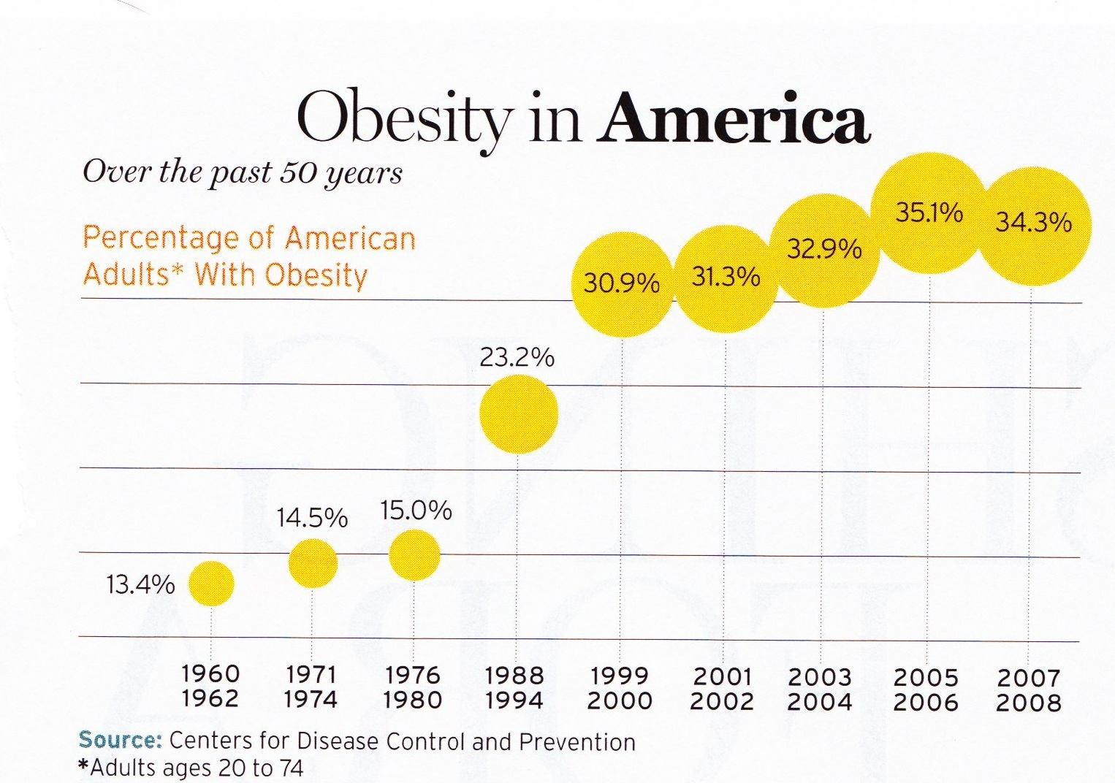
34% BMI 30 +, 34% BMI 25-29
We burn 100 cals less a day at work
1/3 of all overwt people don’t get diabetes

Slide 12


BMI Cutoff for Diabetes Risk Differs based on Ethnicity
Ethnicity BMI Cut-off
South Asians 24 kg/m²
Chinese 25 kg/m²
African American 26 kg/m²
Whites 30 kg/m²

Slide 13

Age-adjusted Diabetes Prevalence 20 yrs or older, by race/ethnicity— U.S. 2008
Native Americans 16.5%
Alaska Natives 16.5%
Blacks 11.8%
Hispanics 10.4%
Asian Americans 7.5%
Whites 6.6%
In 2002, Native Hawaiians and Japanese and Filipino residents of Hawaii aged twenty years or older were approximately 2 times as likely to have diagnosed diabetes as white residents of Hawaii

Slide 14

32% of Medicare dollars go to tReat diabetes.
2012 - Total cost of diabetes $245 billion
The largest components of medical expenditures are:
hospital inpatient care (43%),
prescription medications to treat complications of diabetes (18%),
anti-diabetic agents and diabetes supplies (12%),
physician office visits (9%), and
nursing/residential facility stays (8%).
Indirect costs: $69 billion (disability, work loss, premature mortality)
People with diabetes had 2-4 x’s greater medical expenditures
CDC - ADA Stats 2007-13

Slide 15
Thoughts on Diabetes, Weight, Social Change
“The only way on a societal basis to reduce the prevalence of obesity is through community action” –
Dr. Frieden, CDC
Food insecurity
Poverty, Obesity, Diabetes inter-related

Slide 16

Why Should Zip Code Determine Life Expectancy?

Slide 17
New and Early Research on Gut Bacteria
Leaner people appear to have higher proportion of bacteroidetes
Gut bacteria less efficient at converting food to calories
Obese people appear to have higher levels of firmicutes
Gut bacteria very efficient at calorie extraction
Bacteria tend to run in families
Newsweek. Don’t Just Blame Calories – July 6, 2010 DM Forecast – Feb 2011

Slide 18
Why Understand Pathology?
Understand interaction between food, activity, medications, blood glucose levels
Decision making and promoting self management
Understand medication therapies
To teach other providers and patients
Understand genesis of complications
To teach prevention: modifiable risk factors

Slide 19
Role of the Pancreas Endocrine Functions
Beta Cells - Insulin
Anabolic hormone - helps store glucose as glycogen in muscle, liver
secreted in response to elevated glucose
halts breakdown of glycogen in liver
increases protein synthesis, fat storage
powerful hypoglycemic
Beta Cells - Amylin
secreted in 1:1 ratio with insulin
Causes satiety
Lowers post-prandial glucagon response
Slows gastric emptying
Type 1 make none
Type 2 make less than normal amounts

Slide 20
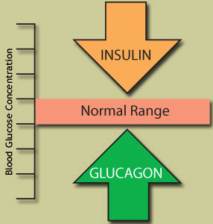
Role of the Pancreas Endocrine Functions
Alpha cells - Glucagon
Opposes action of insulin at the liver
stimulated in response to low glucose levels
stimulates liver to convert glycogen to glucose
inhibits liver from glucose uptake
causes hyperglycemia

Slide 21
Hormones Effect on Glucose
Hormone
Glucagon (pancreas)
Stress hormones (kidney)
Epinephrine (kidney)
Insulin (pancreas)
Amylin (pancreas)
Gut hormones - incretins (GLP-1) released by L cells of intestinal mucosa, beta cell has receptors)
Effect

Slide 22
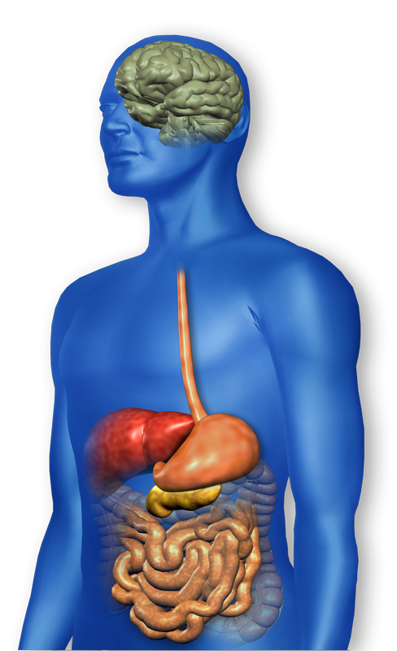
GLP-1 Effects in Humans Understanding the Natural Role of Incretins
GLP-1 secreted upon the ingestion of food
Promotes satiety and reduces appetite
Alpha cells:
↓ Postprandial glucagon secretion
↑ Beta-cell
response
Liver: ↓ Glucagon reduces hepatic glucose output
Beta cells: Enhances glucose-dependent insulin secretion
Stomach: Helps regulate gastric emptying
GLP-1 degraded by
DPP-4 w/in minutes
Adapted from Flint A, et al. J Clin Invest. 1998;101:515-520 Adapted from Larsson H, et al. Acta Physiol Scand. 1997;160:413-422 Adapted from Nauck MA, et al. Diabetologia. 1996;39:1546-1553 Adapted from Drucker DJ. Diabetes. 1998;47:159-169
Notes:
22
22
Required
DISCUSSION POINTS:
--Upon food ingestion, GLP-1 is secreted into the circulation from L cells of small intestine.
--GLP-1 increases beta-cell response by enhancing glucose-dependent insulin secretion.
--GLP-1 decreases beta-cell workload and hence the demand for insulin secretion by:
--Regulating the rate of gastric emptying such that meal nutrients are delivered to the small intestine and, in turn, absorbed into the circulation more smoothly, reducing peak nutrient absorption and insulin demand (beta-cell workload)
--Decreasing postprandial glucagon secretion from pancreatic alpha cells, which helps to maintain the counterregulatory balance between insulin and glucagon
--Reducing postprandial glucagon secretion, GLP-1 has an indirect benefit on beta-cell workload, since decreased glucagon secretion will produce decreased postprandial hepatic glucose output
--Having effects on the central nervous system, resulting in increased satiety (sensation of satisfaction with food intake) and a reduction of food intake
--By decreasing beta-cell workload and improving beta-cell response, GLP-1 is an important regulator of glucose homeostasis.
SLIDE BACKGROUND:
--Effect on Beta-cell: Drucker DJ. Diabetes. 1998; 47:159-169
--Effect on Alpha cell: Larsson H, et al. Acta Physiol Scand. 1997; 160:413-422
--Effects on Liver: Larsson H, et al. Acta Physiol Scand. 1997; 160:413-422
--Effects on Stomach: Nauck MA, et al. Diabetologia. 1996; 39:1546-1553
--Effects on CNS: Flint A, et al. J Clin Invest. 1998; 101:515-520

Slide 23
Signs of Diabetes
Polyuria
Polydipsia
Polyphasia
Weight loss
Fatigue
Skin and other infections
Blurry vision
Glycosuria, H₂O losses
Dehydration
Fuel Depletion
Loss of body tissue, H₂O
Poor energy utilization
Hyperglycemia increases incidence of infection
Osmotic changes

Slide 24
Natural History of Diabetes
Normal
FBG <100
Random <140
A1c <5.7%
Prediabetes
FBG 100-125
Random 140 - 199
A1c ~ 5.7- 6.4%
50% working pancreas
Diabetes
FBG 126 +
Random 200 +
A1c 6.5% or +
20% working pancreas
Yes!
NO
Development of type 2 diabetes happens over years or decades

Slide 25

Diabetes Classifications
Type 1
Type 2
Gestational
Secondary
Notes:
Type 1-absent insulin
Type 2-too much insulin early, then resistence and less secretion
GDm-simliar to Type 2, found during pregnancy

Slide 26
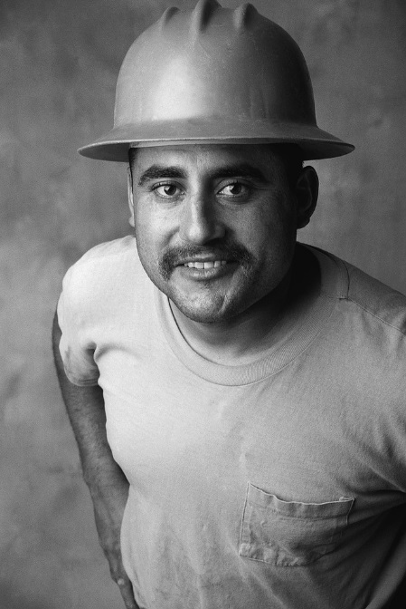

Case Study
1. Pt profile: 5’8”, 192 lb male
Diabetes 12 years, on insulin 3 yrs
What type of DM and how do you know?
2. Pt profile: 5’6”, 108 lb female
On insulin 3u Novolog before meals, 10u Lantus at bedtime
What type of DM and how do you know?

Slide 27

Type 1 Rates Increasing Globally
23% rise in type 1 diabetes incidence from 2001-2009
Why?
Autoimmune disease rates increasing over all
Changes in environmental exposure and gut bacteria?
Hygiene hypothesis
Obesity?

Slide 28
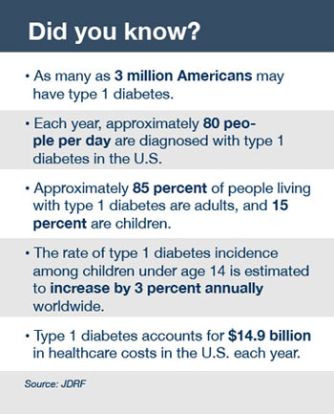
Type 1 Diabetes Facts

Slide 29

Incidence of Type 1 in Youth
General Pop 0.3%
Sibling 4%
Mother 2-3%
Father 6-8%
Rate doubling every 20 yrs
Many trials underway to detect and prevent (Trial Net)

Slide 30
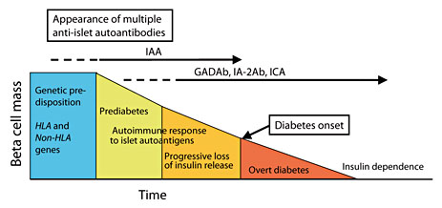
Natural History of Type 1

Slide 31
The Honeymoon
By diagnosis, 15-40% of beta cell function remains
Length of honeymoon varies
10-15% of teens and adults still have clinically significant insulin production > 5 yrs after DM onset (DCCT, NEJM 1993)
Rate of beta cell loss is correlated with age
Younger pts tend to have shorter honeymoons

Slide 32

Remaining Beta Cells
Can serve one well while it lasts…even if on supplemental insulin.
Better overall glucose control lower HbA1C, less glycemic excursion, lower risk for severe hypoglycemia

Slide 33

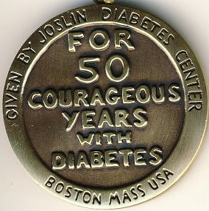
Medalist Study – Harvard Joslin Diabetes Center
After 50 years with diabetes
Many still produced some insulin
Many had no eye disease

Slide 34
Type 1 – 10% of all Diabetes Genetics and Risk Factors
Auto-immune pancreatic beta cells destruction
Most commonly expressed at age 10-14
Insulin sensitive (require 0.5 - 1.0 units/kg/day)
Combo of genes and environment:
Autoimmunity tends to run in families
Higher rates in non breastfed infants
Viral triggers: congenital rubella, coxsackie virus B, cytomegalovirus, adenovirus and mumps.

Slide 35
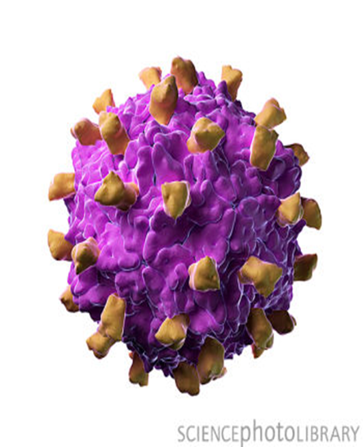
Coxsackie Virus Vaccine?
Opens up novel possibilities for future research aimed at developing vaccines against these viruses to prevent type 1 diabetes.
Since the group B coxsackieviruses includes only six enterovirus types it may be possible to include all of them in the same vaccine.

Slide 36

How do we know someone has Type 1 vs Type 2
Type 1
Positive antibodies
GAD
ICA
IAA and others
Younger the person is, the more quickly it develops
Older people take longer to develop

Slide 37
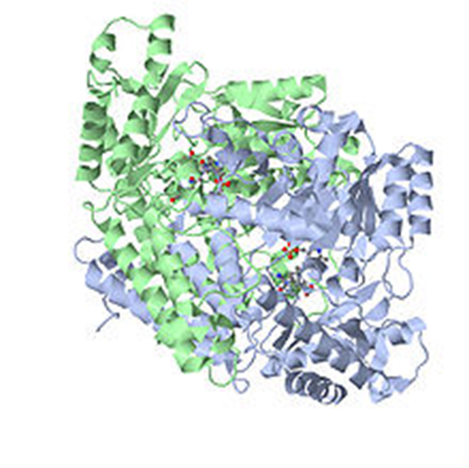
Autoantibodies Assoc w/ Type 1
Panel of autoantibodies –
GAD65 - Glutamic acid decarboxylase –
ZnT8 - Zinc Co-Transporter 8
ICA - Islet Cell Cytoplasmic Autoantibodies
IA-2A - Insulinoma-Associated-2 Autoantibodies
IAA - Insulin Autoantibodies

Slide 38
Prevention to Cure of Type 1
Determining who is at risk
Environmental triggers
Pharmacologic interventions to halt autoimmune destruction
Transplantation
Artificial Pancreas

Slide 39
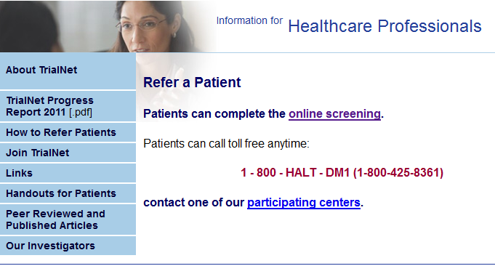

How to Get Screened? www.DiabetesTrialNet.org
How to get families linked to screening?

Slide 40
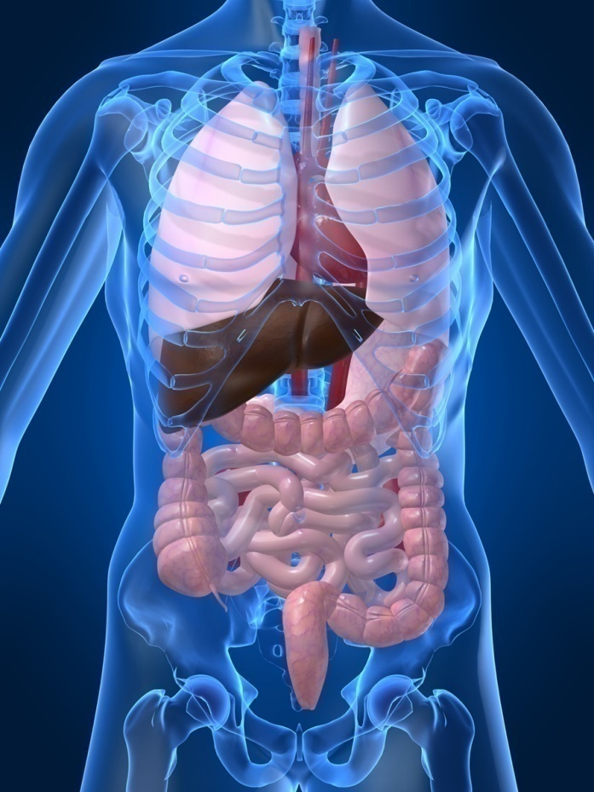
Type 1 Diabetes Associated with other immune conditions
Celiac disease (gluten intolerance)
Thyroid disease
Addison’s Disease
Rheumatoid arthritis
Other

Slide 41

Type 1 Summary
Autoimmune
Complete pancreatic destruction
Need insulin shots
Often first present in DKA

Slide 42

Type 1 in Hospital
43 yr old admitted to evaluate angina.
Morning blood sugar is 92.
Based on Regular insulin sliding scale, no insulin required.
Breakfast tray shows up and patient says, I need my insulin shot before I eat.
What do you say?

Slide 43

Latent AutoImmunity Diabetes in Adults (LADA)
Antibody positive to 1-2 of below
GAD-65 autoantibodies
Insulin Autoantibodies
Islet Cell antigen-2
Adult Age at onset
Usually need insulin w/in first 6 months of diagnosis
Early insulin therapy may preserve beta cell function
Diabetes Care 26:536-538, 2003 Jerry P. Palmer, MD and Irl B. Hirsch, MD

Slide 44
LADA Clinical Features Compared to Type 2
Feature LADA Type 2
Age <50 63% 19%
Acute hyperglycemia 66 24
BMI < 25 33 13
Hx of autoimmune dx 27 12
Family hx autoimmune 46 35
Practical Diabetology March 08, Unger MD

Slide 45
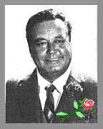
“How Sweet It Is”

Slide 46




Slide 47
Natural Progression of Type 2 Diabetes
Plasma
Glucose
Postprandial glucose
Fasting glucose
126 mg/dL
Relative β-Cell Function
Insulin resistance
Insulin secretion
-20
-10
0
10
20
30
Years of Diabetes
Prior to diagnosis
After diagnosis
Adapted from Bergenstal et al. 2000; International Diabetes Center.
Notes:
These graphs show the typical progressive nature of type 2 diabetes in terms of 2 key indices: increasing plasma glucose level (top panel) and decline in relative β-cell function as reflected by the drop in endogenous insulin and rise in insulin resistance (lower panel).
In the natural history of type 2 diabetes, insulin resistance rises, insulin secretion falls, and glucose levels begin to rise before diabetes is diagnosed.
Based on the natural history, type 2 diabetes is a disease of progressive insulin failure as shown in the graphic model developed by researchers at the International Diabetes Center.¹
Before the onset of diabetes, glucose levels start to rise, with a slightly sharper increase in the postprandial value than in fasting glucose. Both postprandial and fasting plasma glucose levels continue to rise if diabetes is left untreated.²
Prior to the diagnosis of diabetes, resistance of cell receptor sites to insulin starts to increase, while insulin secretion by β-cells decreases. Insulin resistance reaches a peak and remains constant. Endogenous insulin secretion continues to decline over the course of diabetes.²
References:
1. Kendall DM. Postprandial blood glucose in the management of type 2 diabetes: the emerging role of incretin mimetics. Available at: http://www.medscape.com/viewarticle/515693. Accessed April 21, 2006.
2. Ramlo-Halsted BA, Edelman SV. The natural history of type 2 diabetes: implications for clinical practice. Prim Care. 1999;26:771-789.

Slide 48

What is Type 2 Diabetes?
Complex metabolic disorder ….
(Insulin resistance and deficiency)
with social, behavioral and environmental risk factors unmasking the effects of genetic susceptibility.

Slide 49

Ominous Octet
Increased
liver production of glucose
free fatty acid circulation
alpha cell secretion of glucagon
glucose reabsorption from the kidney
Decreased
insulin secretion (80% of beta cells lost by dx)
muscle absorption of glucose
gut hormones GLP-1 and GIP
neurotransmitter function from the brain (affects appetite control)
From the Triumvirate to the Ominous Octet – a new paradigm for the treatment of T2DM. DeFronzo at the 2008 Banting Lecture.

Slide 50
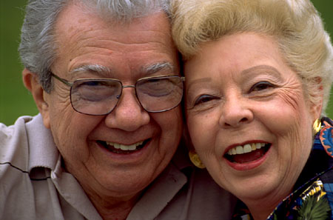
Diabetes 2 - Who is at Risk? (ADA Clinical Practice Guidelines)
Testing should be considered in all adults who are overweight (BMI ≥ 25) and have additional risk factors:
First-degree relative w/ diabetes
Member of a high-risk ethnic population
Habitual physical inactivity
PreDiabetes
History of heart disease

Slide 51
Diabetes 2 - Who is at Risk? (ADA Clinical Practice Guidelines)
Risk factors cont’d
HTN - BP > 140/90
HDL < 35 or triglycerides > 250
baby >9 lb or history of Gestational Diabetes Mellitus (GDM
Polycystic ovary syndrome (PCOS)
Other conditions assoc w/ insulin resistance:
Severe obesity, acanthosis nigricans (AN)

Slide 52
Acanthosis Nigricans (AN)
Signals high insulin levels in bloodstream
Patches of darkened skin over parts of body that bend or rub against each other
Neck, underarm, waistline, groin, knuckles, elbows, toes
Skin tags on neck and darkened areas around eyes, nose and cheeks.
No cure, lesions regress with treatment of insulin resistance

Slide 53
Signs of Diabetes
Polyuria
Polydipsia
Polyphasia
Weight loss
Fatigue
Skin and other infections
Blurry vision
Glycosuria, H₂O losses
Dehydration
Fuel Depletion
Loss of body tissue, H₂O
Poor energy utilization
Hyperglycemia increases incidence of infection
Osmotic changes

Slide 54

Diabetes is also associated with
Fatty liver disease
Obstructive sleep apnea
Cancer; pancreas, liver, breast
Alzheimer’s
Depression

Slide 55
Comparison of Type 1,Type 2, LADA
Type 1
Type 2 LADA
Obesity
x
xxx x
Insulin dependence
xxx
30% 6mos
Respond to oral agents
0
xxx x
Ketosis
xxx
x x
Antibodies present
xxx
0 xx
Typical Age of onset
teens
adult adult
Insulin Resistance
0
xxx
x

Slide 56

Life Study – Mrs. Jones
Mrs. Jones is 62 years old, overweight and complaining of feeling tired and urinating several times a night. She is admitted with a urinary tract Infection. Her WBC is 12.3, glucose 237. She is hypertensive with a history of gestational diabetes. No ketones in urine.
What are her risk factors, signs of diabetes
What type of diabetes does she have?
Does she have insulin resistance?

Slide 57

Unconditional Positive regard
unconditional positive regard involves showing complete support and acceptance of a person no matter what that person says or does.
Term coined by humanist, Carl Rogers
Can you think of a time when someone gifted you with unconditional positive regard?

Slide 58
What Do You Say? Mrs. Jones asks you
What is type 2 diabetes?
Will this go away?
Will I get complications?
Will I need to take diabetes medication for the rest of my life?
How come I got diabetes?
Do I have to check my blood sugars?

Slide 59


Other Types of Diabetes
Gestational
Other specific types of diabetes

Slide 60

Gestational Diabetes

Slide 61
Increasing Prevalence of GDM A public health perspective
GDM prevalence increased by
∼10–100% in several race/ethnicity groups during the past 20 years
In the U.S., Native Americans, Asians, Hispanics, and African-American women are at higher risk for GDM than non-Hispanic white women
Ferrara, Diabetes Care July 2007 vol. 30 no. Supplement 2 S141-S146

Slide 62
Screen for GDM
Screen for undiagnosed Type 2 at the first prenatal visit in those with risk factors using standard diagnostic criteria.

Slide 63
Other Specific Types of DM
Medications such as: steroids, protease inhibitors and Prograf®
Secondary to Agent Orange
Liver failure
TPN or tube feedings
Pancreatic cancers or removal
Cystic fibrosis, pancreatitis
Other

Slide 64
Control Matters
Trials
Practice Recommendations

Slide 65
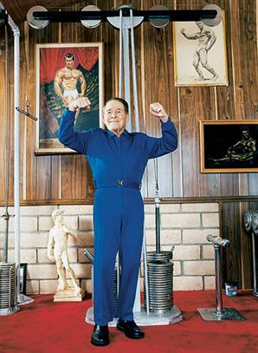
Can Type 2 be Prevented in Older Adults?
Overall, 9 of 10 new cases of diabetes attributable to these 5 lifestyle factors.
89% risk reduction when all at goal.
35% rel risk reduction for each additional
Physical activity (30 mins a day)
Dietary score (higher fiber intake, low saturated fat and trans-fat , lower mean glycemic index)
Not Smoking
Alcohol use (up to 2 drinks a day);
BMI <25 and waist circumference
Dariush Mozaffarian, MD,
Arch Intern Med. 2009;169(8):798-807.

Slide 66
Diabetes Prevention Program (DPP) August 2001
3, 234 people w/ Pre-Diabetes randomized to:
Placebo,
Diet/Exercise or
Metformin
over a three year period.

Slide 67
Diabetes Prevention Program Results
Standard Group - 29% developed DM
Lifestyle Results - 14% developed DM
30 mins daily activity/ low fat diet reduced DM risk by 58% (71% for 60yrs +)
On avg, participants lost 5-7% of body wt
Metformin 850 BID - 22% developed DM
reduced risk by 31% (less effective with elderly and thinner pt’s)

Slide 68
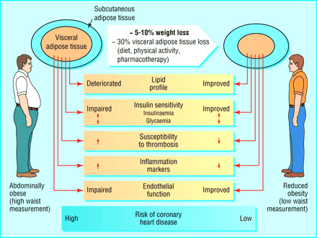

Slide 69

Have Pre-Diabetes? Steps to Prevent Type 2
Lose 7% of body weight
Healthy eating, high fiber, low fat, avoid sugar sweetened beverages, reduce total caloric intake
Exercise 150 minutes a week
Consider Metformin Therapy for
Women with history of GDM
Patients with BMI of 35 or greater
Under the age of 60
Follow-up and group education
Annual monitoring and tx of CVD risk factors

Slide 70

Diabetes Self Management Education and Support (DSMES)
People w/ DM and prediabetes need education that:
Addresses psychosocial and emotional well-being
Meets National Standards
Focuses on promoting self-care and behavior change
Evidence that DSMES programs work
Lower A1c, wt loss, improved quality of life, better coping and lower costs

Slide 71
Diabetes Control and Complications Trial (DCCT)
In June, 1993 the New England Journal of Medicine published the results of the landmark DCCT.
The largest, most comprehensive diabetes study ever conducted. The 10 year study involved more than 1400 subjects with Type 1 DM. It compared the effects of two treatment regimens-standard therapy and intensive control-on the complications of diabetes.

Slide 72
DCCT Conclusions
By maintaining A1C < 7%:
Eye disease - 76% reduced risk
Kidney disease - 50% reduced risk
Nerve disease - 60% reduced risk
Management elements included:
SMBG 4 or more times a day
4 daily insulin injections or insulin pump
Greater risk of hypoglycemia

Slide 73
UK Prospective Diabetes Study (UKPDS) 1998
Conducted over 20 years involving over 5,100 patients with Type 2 diabetes.
Questions:
1. Does tight glucose control prevent or delay the onset of DM complications?
2. Is there a best medical treatment for glucose and B/P?
3. Does B/P control improve outcomes?

Slide 74
UKPDS Results
1% decrease in A₁c reduces microvascular complications by 35%
1% decrease in A₁c reduces diabetes related deaths by 25%
B/P control (144/82) reduced risk of:
Heart failure (56%)
Stroke (44%)
Death from diabetes (32%)
Lancet 352: 837-865, 1998

Slide 75

“Legacy Effect”
For participants of DCCT and UKPDS
long lasting benefit of early intensive BG control prevents
microvascular complications
Macrovascular complications (15-55% decrease)
Even though their BG levels increased over time
Message – Catch early and
Treat aggressively

Slide 76

Goals of Care

Slide 77
ABC’s of Diabetes
A1C
Blood Pressure
Cholesterol
Standards of Medical Care – American Diabetes Association

Slide 78
A1c Test
Measures glycation of RBC’s over 2-3 months
Weighted mean (50% preceding month)
Each 1% ~ 29mg/dl
Accuracy: affected by some anemias, hemoglobinopathies
A measurement of glucose in fasting and postprandial states

Slide 79
A1c Goals for Non Pregnant Adults Individualize Targets – ADA
< 7% for patients in general
For individual pts, as close to normal as possible (<6%) w/out significant hypo*
Goals based on:
Duration of dm
Life expectancy
Co morbid conditions
Know CVD or advanced micro complications
Individual patient considerations

Slide 80

A1c and Estimated Avg Glucose (eAG) 2008
A1c (%) eAG
5 97
6 126
7 154
8 183
9 212
10 240
11 269
12 298
eAG = 28.7 x A1c-46.7 ~ 29 pts per 1%
Translating the A1c Assay Into Estimated Average Glucose Values – ADAG Study
Diabetes Care: 31, #8, August 2008
Order teaching tool kit free at diabetes.org

Slide 81
Glucose Goals Individualize Targets – ADA
Pre-Prandial BG 70- 130
1-2 hr post prandial < than 180
*for nonpregnant adults

Slide 82
BP Goal ADA Clinical Practice Recommendations
BP < 140 / 80
Some pts may benefit from B/P 130/80
Lifestyle changes +
First Line B/P Drugs
ACE Inhibitors-
Angiotensin receptor blocker (ARBs) (type 2)
Then add diuretic
Many pts require 2 or > anti-HTN meds at max dose

Slide 83
*Lipid Goals ADA Clinical Practice Recommendations
LDL < 100 mg/dL
LDL <70 in high risk pts = CVD + DM
HDL > 40 mg/dL men
HDL > 50 mg/dL women
Trig < 150 mg/dl
*alternative goal is 40% lower than baseline levels if on max statin therapy & above goals not met
Screen biannually or annually, more often if indicated

Slide 84
Lipid Management ADA Clinical Practice Recommendations
Treatment Recommendations
Lifestyle interventions
reduce saturated & trans fat, cholesterol
wt loss, physical activity, glucose control
Add Statins to Lifestyle, regardless of baseline lipids for pts:
With CVD
Without CVD who are 40+ with CVD risk factor
For lower risk pts, consider statin if LDL >100 or w/ multiple CVD risk factors

Slide 85
Lipid Management ADA Clinical Practice Recommendations
LDL cholesterol lowering - first goal
1st choice - statins
HDL cholesterol raising
wt loss, stop smoking, exercise
Niacin (caution) or fibrates
Triglyceride lowering
Glycemic control, lifestyle intervention
Fibrates, or niacin
If high LDL and Trig, high dose statins

Slide 86
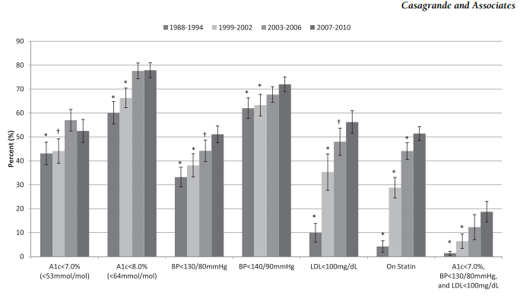
How are we doing? Reaching goal
Diabetes Care, 2/13

Slide 87
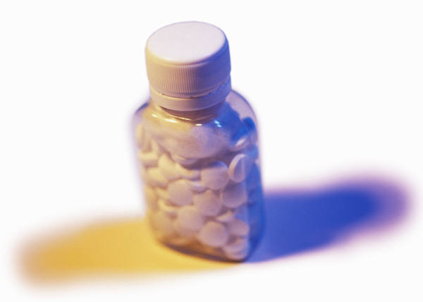
Aspirin Therapy (75-162/day)
Use for pts w/ increased CV risk (50+ yrs men, 60+ yrs women) primary prev
Use aspirin therapy for diabetes pts with history of CV disease (secondary prev)
Combo therapy of aspirin + clopidogrel is reasonable for a year after MI
Do not use in pts < 30, w/ allergy (use clopidogrel), bleeding tendency
ADA Clinical Practice Recommendations

Slide 88

Smoking and Diabetes
Advise all patients not to smoke. Include smoking cessation counseling and other forms of treatment
Ask
Assess
Advise
Assist
Arrange
Organize your clinic

Slide 89
ABCs of Diabetes –
A1c less than 7% (avg 3 month BG)
Pre-meal BG 70-130
Post meal BG <180
Blood Pressure < 140/80
Cholesterol
HDL >40
LDL <100 (if CHD, <70)
Triglyceride < 150

Slide 90

Treatment Goals Not Met?
Assess barriers
Health literacy, diabetes distress, income, depression, competing demands
Other strategies
Co management w/ diabetes team
Mental health referral, support groups
Assess treatment regimen and frequency of glucose monitoring and use of results

Slide 91
Diabetes Care Guidelines- ADA
Test / Exam Frequency
A1c At least twice a year
B/P Each diabetes visit
Cholesterol (LDL, HDL, Tri) Yearly (less if normal)
Weight each diabetes visit
Microalbumin/GFR/Creat Yearly
Eye exam Yearly
Dental Care At least twice a year
Comprehensive Foot Exam Yearly (more if high risk)
Physical Activity Plan As needed to meet goals
Preconception counseling As needed

Slide 92
Vaccinations- Immunizations
Flu vaccine
every year starting 6 months
Pneumococcal starting at 2 years.
One time Revaccination for those over 64 and had first vaccine >5 years prior
Hepatitis B Vaccine
For diabetes pts age 19 – 59 (not previously vaccinated)
Double risk of Hep B due to lancing devices/ glucose meter exposure

Slide 93

Mr. Jones - What are Your Recommendations for Self-Care
Patient Profile
62 yr old with newly dx type 2. History of previous MI.
Meds: Lasix, synthroid
Labs:
A1c 9.3%
HDL 37 mg/dl
LDL 156 mg/dl
Triglyceride 260mg/dl
Proteinuria - neg
B/P 142/92
Self-Care Skills
Walks dog around block 3 x’s a week
Bowls every Friday
Widowed, so usually eats out

Slide 94
High Numbers Got You Down?
By getting glucose less than 150 you will:
have more energy
spend fewer days in bed
feel less depressed
urinate less often
improve your vision
think more clearly
miss work less often
Testa, Simonson JAMA 280: 1998

Slide 95
DiaBingo- G
G ADA goal for A1c is less than ____%
G People with DM need to see their provider at least every month
G Blood pressure goal is less than
G People with DM should see eye doctor (ophthalmologist) at least
G The goal for triglyceride level is less than
G Goal for my HDL cholesterol is more than
G The goal for blood sugars 1-2 hours after a meal is less than:
G People with DM should get this shot every year
G People with DM need to get urine tested yearly for ___________
G Periodontal disease indicates increased risk for heart disease
G The goal for blood sugar levels before meals is:
G The activity goal is to do ___ minutes on most days

Slide 96
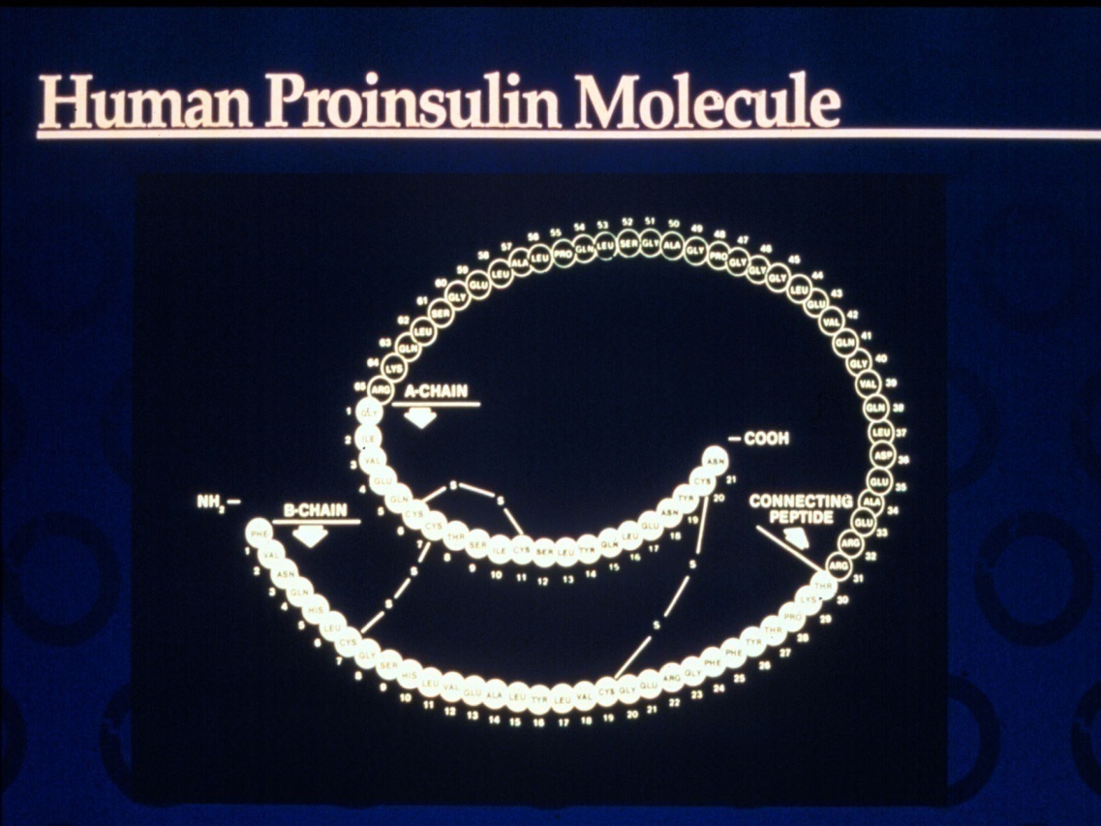
Insulin – the Ultimate Hormone Replacement Therapy
Objectives:
Discuss the actions of different insulins
Describe using pattern management as an insulin adjustment tool.

Slide 97

Psychological Insulin Resistance (PIR)
50% of providers in study threatened pts “with the needle”.
Less than 50% of providers realized insulins’ positive effect on type 2 dm
Most pts don’t believe that insulin would “better help them manage their diabetes”.
Solutions: Find the root of PIR and address it, use more insulin pens
Diabetes Attitudes, Wishes, Needs Study - Rubin

Slide 98
Needle Size often a Barrier Size Does Matter
Use more short needles – 4 mm
Effective for pts with BMI of 24- 49
Keeps it subq
If pt thin, inject at angle
To avoid leakage, count to 10 before withdrawing needle
½ the patients who could benefit from insulin are not using it due to needle phobias

Slide 99
Physiologic Insulin Secretion: 24-Hour Profile
50
Insulin
(µU/mL)
Bolus Insulin
25
0
Basal Insulin
Breakfast Lunch Dinner
150
Glucose
(mg/dL)
100
Mealtime Glucose
50
Basal Glucose
0
7
8
9
10
11
12
1
2
3
4
5
6
7
8
9
A.M.
P.M.
Time of Day

Slide 100
Insulin Action Teams
Bolus: lowers after meal glucose levels
Rapid Acting
Aspart, Lispro, Glulisine
Short Acting
Regular
Basal: controls glucose between meals, hs
Intermediate
NPH
Long Acting
Detemir (Levemir)
Glargine (Lantus)

Slide 101
Bolus Insulins (½ of total daily dose ÷ meals)
Name Onset Peak Action
Lispro (Humalog) 15-30 min 1-1.5 hrs
Aspart (NovoLog)
Glulisine (Apidra)
Regular 30 mins 2-4 hrs

Slide 102
Bolus Insulin Summary
Regular, Novolog, Humalog, Apidra,
Starts working fast (15-30 mins)
Gets out fast (3-6 hours)
Post meal BG reflects effectiveness
Should comprise about ½ total daily dose
Covers food or hyperglycemia.
1 unit
Covers ≈ 10 -15 gms of carb
Lowers BG ≈ 30 – 50 points

Slide 103
Bolus Insulin Timing
How is the effectiveness of bolus insulin determined?
2 hour post meal (if you can get it)
Before next meal blood glucose
Glucose goals (ADA) – may be modified by provider/pt
1-2 hours post meal <180
Before next meal – 70 - 130

Slide 104
Bolus – Insulin Sliding Scale Starts at 150, 2 units for every 50 mg/dl >150

Slide 105
Basal Insulins (½ of total daily dose)
Intermediate Acting Peak Action Duration
NPH 4-12 hrs 12-24
Long Acting Peak Action Duration
Detemir (Levemir) peakless 20 hrs
Glargine (Lantus) No peak 24 hrs
Fasting BG reflects efficacy of basal

Slide 106
Basal Insulin Summary
NPH, Levemir, Lantus
Covers in between meals, through night
Starts working slow (4 hours)
Stays in long (12-24 hours)
NPH/ Lente 12 hrs
Levemir, Lantus 20-24 hrs
Fasting blood glucose reflects effectiveness

Slide 107
Basal Only Type 2, 60kg

Slide 108
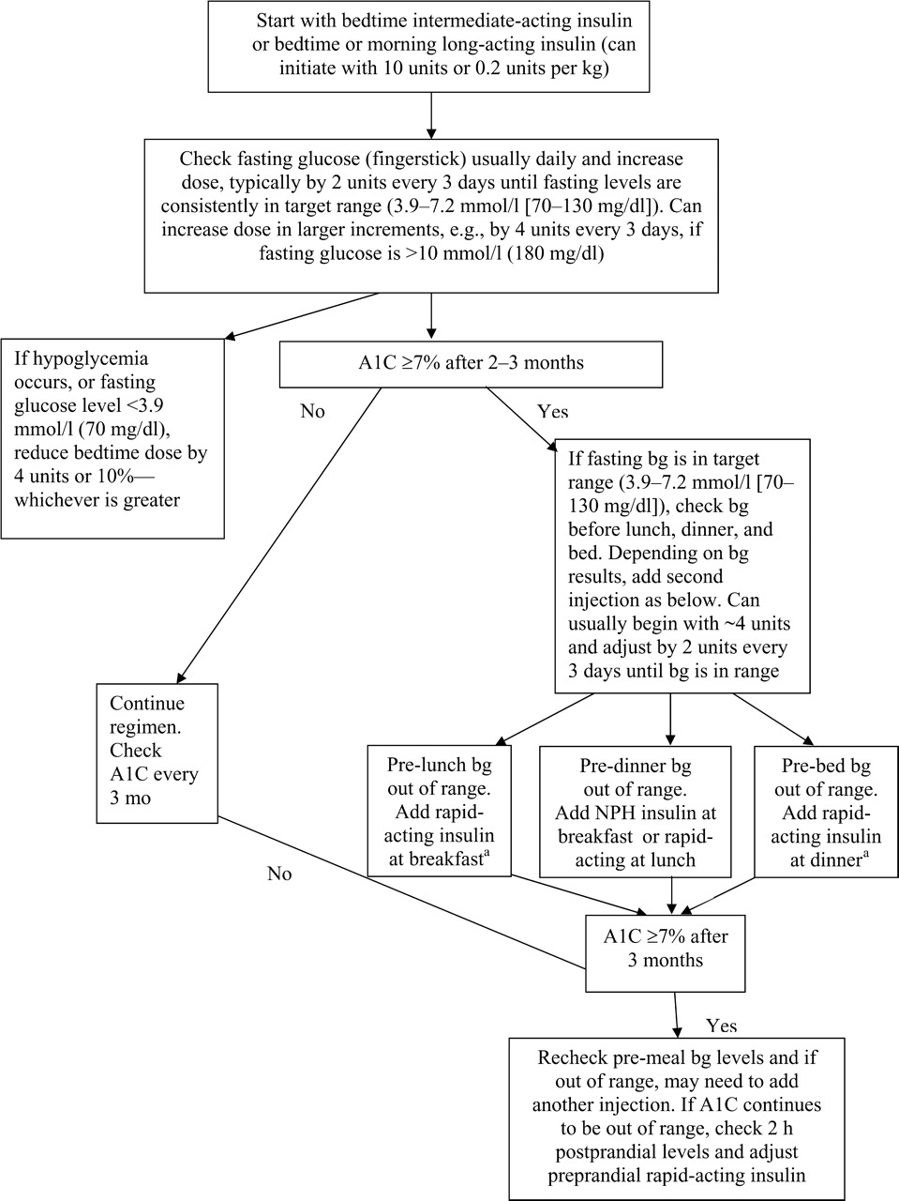
Diabetes Care 32:193-203, 2009

Slide 109
Combination SQ Insulin

Slide 110
10u 70/30 BID Patterns? Changes needed?

Slide 111
Pattern Management

Slide 112
Pattern Management
Safety 1st!! - Evaluate 3 day patterns
Hypo: eval 1st and fix:
If possible, decrease medication dose
Timing of meals, exercise, medications
Hyperglycemia: evaluate 2nd
Identify patterns
Before increase insulin, make sure not missing something (carbs, exercise, omission)

Slide 113
Type 2 – New diagnosis – No meds Patterns? Questions

Slide 114
Type 2 – Amaryl 4mg AM, 10u Lantus pm

Slide 115
Basal Bolus – What Adjustments? Pt weighs 80kg

Slide 116
Intensive Diabetes Therapy Insulin Dosing Strategy
50/50 Rule
0.5-1.0 units/kg day
Basal = 50% of total
Glargine QD
NPH or Detemir BID
Bolus = 50% of total
usually divided into 3 meals
Example
Wt 50kg x 0.5 = 25 units of insulin/day
Basal dose: 13 units
Glargine 13 units QD
NPH/Detemir 6u BID
Bolus dose: 12 units
4 units NovoLog, Apidra Humalog, Regular each meal

Slide 117
Intensive Diabetes Therapy Insulin Dosing Strategy
50/50 Rule
0.5-1.0 units/kg day
Basal = 50% of total
Glargine QD
NPH or Detemir BID
Bolus = 50% of total
usually divided into 3 meals
Example – You Try
Wt 60 kg x 0.5 = ___ units of insulin/day
Basal dose: ____ units
Glargine ____ QD
NPH/Detemir __ BID
Bolus dose: ____ units
___units NovoLog, Apidra Humalog, Reg each meal

Slide 118
Basal Bolus – Using 50/50 Rule - Pt weighs 80kg

Slide 119
Insulin Teaching Keys
Bolus insulin with meals
Basal 1-2xs daily
Abdomen preferred injection site
Stay 1” away from previous site
Don’t re-use ultra fine syringes
Keep unopened insulin in refrigerator
Toss opened insulin vial after 28 days
Proper disposal
Review patients ability to withdraw and inject.
Side effects include hypoglycemia/wt gain
Insulin pens –
Prime needle to assure accurate insulin dose given
Hold needle in for 5 seconds after injection
Roll 70/30 pens

Slide 120
Bolus Basics
Carbohydrate/ Prandial Coverage
Match the insulin to the carbohydrates
1 unit for 15 gms - Common starting point
Correction Bolus - targets hyperglycemia
1 unit for every 30-50 points over target
Adjust ratios depending on sensitivity and response
Notes:
Importance of MD writing for a diabetic diet cannot be overemphasized. It sets into motion the timing of meals that are delivered, makes it easier for RN to know when to check glucose and administer the insulin.

Slide 121
Adjusting Bolus and Correction Doses Carbohydrate-to-Insulin Ratio
Based on three questions before meals:
How much carbohydrate am I going to eat?
What is my insulin dose for this amount of carbohydrate?
Should I lower the dose because I plan to be very active or have recently been active?

Slide 122
Carbohydrate Ratio How does that work? Rapid/Fast Acting Insulin
Serving Size | Gms CHO | Insulin
1 | 15 gms cho | 1 unit
2 | 30 gms cho | 2 units
3 | 45 gms cho | 3 units
4 | 60 gms cho | 4 units
Dinner (60 gms cho)
Lemon Chicken
1 cup rice pilaf
(45 gms cho)
Asparagus
Dinner Roll
(15 gms cho)
Blood Glucose 184mg/dl
67 mg/dl

Slide 123
Correction Bolus Rapid/Fast Acting Insulin (1 unit:50 mg/dl>150)
Less than 70 | Subtract 1 unit
70-150 mg/dl | 0 units
151-200 mg/dl | 1 unit
201-250 mg/dl | 2 units
251-300 mg/dl | 3 units
301-350 mg/dl | 4 units
351-400 mg/dl | 5 units

Slide 124

Type 1 and a Teen
Cindy is trying to carb count and adjust her insulin, but is still having trouble. She weighs 60kg.
What is her daily dose of insulin?
What is her basal dose?
1. Pre meal target BG less than 150
2. Post meal goal < 180.
3. Carb ratio: 1 unit for every 15 gms
4. Hyperglycemic correction factor is one unit for every 50 above 150

Slide 125
How much Insulin Needed?
Morning - BG 173
Breakfast – slice cold pizza, ½ c. applesauce
Lunch BG 69
Menu- ham sandwich, pear, diet 7-up, mini snickers bar.
2 hours after lunch, BG 148 - ran track
Before dinner - BG 98
Cheeseburger, small fries, chocolate chip cookie
At bedtime, BG 173

Slide 126
Medical Waste Management Act Effective Sept 1, 2008
CA Senate Bill 1305
New law requires proper disposal of home generated syringes, needles, lancets
Disposal in solid waste containers no longer permitted
EPA in 2004 also discourages sharps disposal in trash.

Slide 127
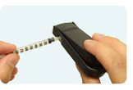

Sharps Disposal: Product and Info
Look in the Government section white pages for a household hazardous waste listing for your city or county.
Call 1-800-CLEANUP (1-800-253-2687)
Search for collection centers on the California Integrated Waste Management Board (CIWMB) Web site: http://www.ciwmb.ca.gov/HHW/HealthCare/Collection/

Slide 128
DiaBingo - I
I Injected hormone that is an analog of amylin
I Glargine, Detemir, NPH are types of
I Breakdown of glycogen into glucose
I Anabolic hormone
I Insulin is released when glucose levels are low
I Once opened, insulin vials are good for one _____
I Elevated post-prandial glucose indicate need for pre-meaI
I Epinephrine increases insulin resistance
I Creation of glucose from amino acids and lactate
I Decreasing renal function for people on insulin can cause
I Bolus insulins
I A hormone that increases blood glucose levels

Slide 129
Resources for Medications
Partnership for Prescription Assistance
www.pparx.org
NeedyMeds.org
www.rxassist.org
© Copyright 1999-2012, Diabetes Educational Services, All Rights Reserved.
Notes:
129
129

Slide 130
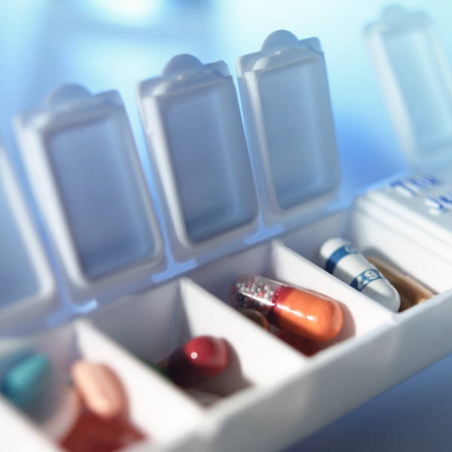
Diabetes Meds for Type 2: Objectives
1. Describe the main action of the 5 different categories of type 2 diabetes medications.
2. Discuss strategies to determine the right medication for the right patient.
3. List the side effects and clinical considerations of each category of medication.
Notes:
130
130

Slide 131

Resources for Medications
Partnership for Prescription Assistance
www.pparx.org
NeedyMeds.org
www.rxassist.org
Notes:
131
131

Slide 132
Diabetes Agents Considerations
Diabetes medications can be used as monotherapy, in combo or with insulin
Combining agents from different classes has additive effect
Most reduce A1c 0.5 – 2.0%
Not to be used during preconception, pregnancy or when breastfeeding
Notes:
132
132

Slide 133
Diabetes Agents Considerations
Diabetes medications can be used as monotherapy, in combo or with insulin
Combining agents from different classes has additive effect
Most reduce A1c 0.5 – 2.0%
Not to be used during preconception, pregnancy or when breastfeeding
Notes:
133
133

Slide 134
ADA-EASD Position Statement: Management of Hyperglycemia in T2DM
Patient-Centered Approach
“...providing care that is respectful of and responsive to individual patient preferences, needs, and values - ensuring that patient values guide all clinical decisions.”
Gauge patient’s preferred level of involvement.
Explore, where possible, therapeutic choices.
Utilize decision aids.
Shared decision making – final decisions re: lifestyle choices ultimately lie with the patient.
Diabetes Care 2012;35:1364–1379
Diabetologia 2012;55:1577–1596

Slide 135
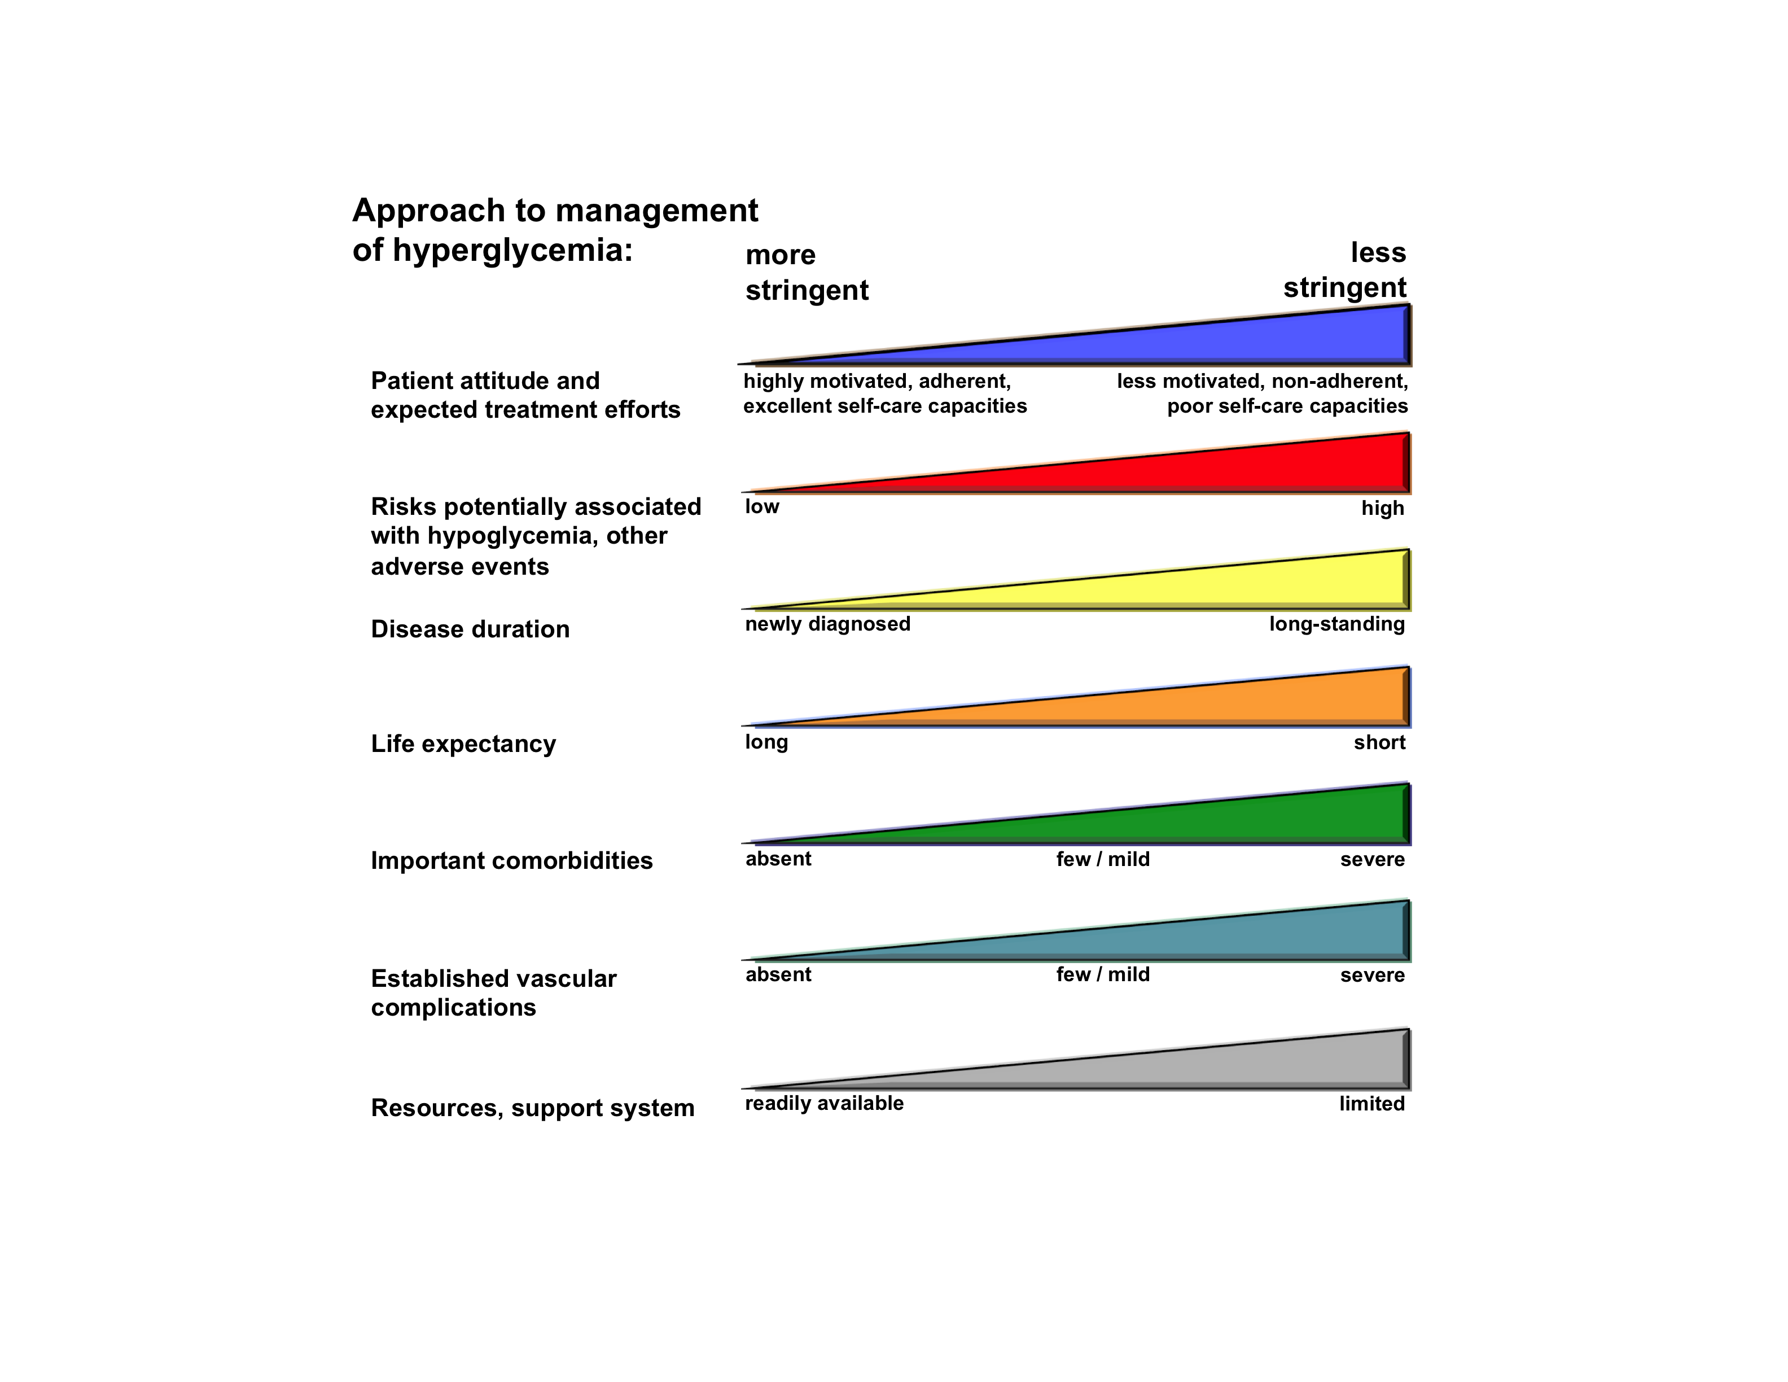
Diabetes Care 2012;35:1364–1379
Diabetologia 2012;55:1577–1596
(Adapted with permission from: Ismail-Beigi et al. Ann Intern Med 2011;154:554)
Figure 1
Notes:
Depiction of the elements of decision-making used to determine appropriate efforts to achieve glycaemic targets. Greater concerns about a particular domain are represented by increasing height of the ramp. Thus, characteristics/predicaments towards the left justify more stringent efforts to lower HbA1c, whereas those towards the right are compatible with less stringent efforts. Where possible, such decisions should be made in conjunction with the patient, reflecting his or her preferences, needs and values. This ‘scale’ is not designed to be applied rigidly but to be used as a broad construct to help guide clinical decisions. Adapted with permission from Ismail-Beigi et al [ref 20]

Slide 136
Action/Classes of Type 2 Meds
1. Suppressor
2. Squirter
3. Satiators
4. Sensitizer
5. Glucoretics
6.Circadian Switchers
7. Slower
Biguanide – Metformin
Sulfonylureas
Meglitinides
AmylinoMimetics
Incretin Mimetics
DPP-4 Inhibitors
Thiazolidinediones (TZD)
SGLT2 Inhibitors
Dopamine Receptor Agonists
Alpha-glucosidase inhibitors
Notes:
136
136
There are five major classes of oral diabetes medications: thiazolidinediones, biguanides, sulfonylureas, meglitinides, and alpha-glucosidase inhibitors. These five classes of medication operate in essentially three different ways.
Thiazolidinediones and biguanides decrease glucose production in the liver and increase insulin sensitivity in peripheral body tissues.
Sulfonylureas and meglitinides stimulate the pancreatic beta cells to make more insulin.
Finally, alpha-glucosidase inhibitors slow the absorption of starches in the gut, reducing the amount of glucose that enters the bloodstream.

Slide 137
Meds- Fill in the Blanks
 | Biguanide | Sulfa Glinide | TZD | DPP- 4 Inhibit | GLP-1 | SGLT-2 Inhibitor | Glucosi-dase Inhibit | Dopamine Agonist
Hypo?
Wt gain?
Easy to use -well tolerated
Affordable
Other issues

Slide 138

Ideal Diabetes Med -
No hypoglycemia
No weight gain
Affordable
Lowers CV risk
Most people can tolerate /use?

Slide 139
Biguanides – Suppressor Metformin (Glucophage®)
Action: suppresses release of glycogen from the liver
Who?
Fasting hyperglycemia
Dysmetabolic Syndrome
For pediatrics starting age 10
(XR age 17)
Glycogen Stopper
Notes:
139
139

Slide 140
Biguanides - Metformin
Action: decrease hepatic glucose (glycogen)
Names:
Metformin (Glucophage)
Starting dose: 500 BID, max 2500mg daily
Metformin extended release (3 different versions)
Starting dose 500mg at dinner, max dose 2000 to 2500 mg daily
Efficacy:
Decrease fasting plasma glucose 60-70 mg/dl
Reduce A1C 1.0-2.0%
Notes:
140
140
The mechanism of action of metformin is not entirely understood, but it's predominant effect is to suppress hepatic glucose production and to enhance insulin sensitivity in peripheral tissues (primarily muscle). It is unclear if insulin sensitivity occurs by metformin binding to cell receptors,which leads to an increase in glucose transporter expression, or whether insulin sensitivity is simply a secondary effect of the suppressed glucose production.
Metformin's ability to lower A1C and decrease fasting plasma glucose is similar to that of sulfonylurea drugs. However, the UKPDS showed that those who received metformin had less hypoglycemia and weight gain than those who received sulfonylureas.
Metformin must be avoided in patients with renal impairments, as those patients are at higher risk of experiencing lactic acidosis. However, metformin is an effective monotherapy and may be an ideal drug for overweight patients since it does not cause weight gain and has been seen to cause modest amounts of weight loss when first administered. Diarrhea and abdominal discomfort can be alleviated by changes in diet and slow increases in metformin dosage.

Slide 141
Biguanides - Metformin
Side effects
Diarrhea and abdominal discomfort
Lactic acidosis if improperly prescribed
Decrease LDL cholesterol and triglycerides
No weight gain, with possible modest weight loss
Watch for B12 deficiency
Hold prior to IV contrast dye studies and use caution during acute illness. Resume when kidney function adequate
Notes:
141
141
The mechanism of action of metformin is not entirely understood, but it's predominant effect is to suppress hepatic glucose production and to enhance insulin sensitivity in peripheral tissues (primarily muscle). It is unclear if insulin sensitivity occurs by metformin binding to cell receptors,which leads to an increase in glucose transporter expression, or whether insulin sensitivity is simply a secondary effect of the suppressed glucose production.
Metformin's ability to lower A1C and decrease fasting plasma glucose is similar to that of sulfonylurea drugs. However, the UKPDS showed that those who received metformin had less hypoglycemia and weight gain than those who received sulfonylureas.
Metformin must be avoided in patients with renal impairments, as those patients are at higher risk of experiencing lactic acidosis. However, metformin is an effective monotherapy and may be an ideal drug for overweight patients since it does not cause weight gain and has been seen to cause modest amounts of weight loss when first administered. Diarrhea and abdominal discomfort can be alleviated by changes in diet and slow increases in metformin dosage.

Slide 142
Considerations Biguanide - Metformin (Glucophage®)
Contraindications due to lactic acidosis:
creatinine >1.4 females, >1.5 males
liver disease
alcohol abuse
over 80 years old
risk of acidosis
during IV dye study
CHF requiring meds
Notes:
142
142

Slide 143
Metformin – How does it rate?
Question Answer
Cause hypoglycemia?
Cause weight gain?
Affordable?
Lowers CV risk?
Can most tolerate /use?

Slide 144

Sulfonylureas –
Action: tells pancreas to squirt insulin all day
Who?
Lean type 2
Notes:
144
144

Slide 145
Sulfonylureas - Squirts
Action: Increase endogenous insulin secretion
Efficacy:
Decrease FPG 60-70 mg/dl
Reduce A1C by 1.0-2.0%
Primary failures: about 20% no response
R/O glucose toxicity or low beta cell function
Secondary failures: 5-10% shortly after initial response, many more later
Usually after 5 or more years of therapy due to natural history of DM 2
Notes:
145
145
Sulfonylureas (SUs) increase insulin secretion by binding to receptors on the surface of pancreatic beta cells, triggering a series of reactions which leads to insulin secretion.
Because SUs cause circulating insulin levels to increase, there is a risk of hypoglycemia. There is also some concern that increased insulin levels are associated with cardiovascular disease, however the UKPDS did not show a relationship between increased mortality and SU administration. Finally, there is concern that SUs will exhaust beta cell function by increasing insulin secretion. However, the decline in beta cell function is more likely caused by the disease itself, and not the use of SUs.
First generation sulfonylureas are just as efficacious as the second generation drugs, however the second generation may be more potent and safer than first. When diet and exercise fail, SUs are an effective monotherapy.

Slide 146
Sulfonylureas: 2nd Generation
Generic Trade Duration
Glyburide Diabeta, Micronase, 12-24 hrs
Glynase Prestabs
Glipizide* Glucotrol, Glucotrol Xl 12-24 hrs
Glimepiride Amaryl 16-24 hrs
*take short acting product on empty stomach
Notes:
146
146

Slide 147
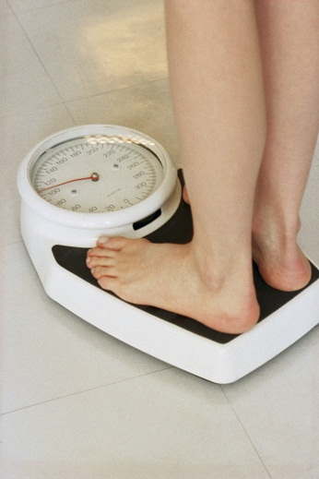
Sulfonylureas
Other Effects
Hypoglycemia
Weight gain
Cleared by kidney, use caution for pts with kidney problems
Generally the least expensive class of medication
Amaryl safest for those with CV Disease
Notes:
147
147
Sulfonylureas (SUs) increase insulin secretion by binding to receptors on the surface of pancreatic beta cells, triggering a series of reactions which leads to insulin secretion.
Because SUs cause circulating insulin levels to increase, there is a risk of hypoglycemia. There is also some concern that increased insulin levels are associated with cardiovascular disease, however the UKPDS did not show a relationship between increased mortality and SU administration. Finally, there is concern that SUs will exhaust beta cell function by increasing insulin secretion. However, the decline in beta cell function is more likely caused by the disease itself, and not the use of SUs.
First generation sulfonylureas are just as efficacious as the second generation drugs, however the second generation may be more potent and safer than first. When diet and exercise fail, SUs are an effective monotherapy.

Slide 148
Indication for “Fast Acting” Insulin Secretagogues- Meglitinides
Action: tells pancreas to squirt insulin with meals
Who?
Targets post-prandial hyperglycemia
Notes:
148
148

Slide 149
Meglitinides - Squirts
Action: stimulate insulin secretion (rapid and short duration) when glucose present
Names:
repaglinide (Prandin)
Dosing: 0.5 to 4 mg a.c. Max dose 16mg
Metabolized by liver and mostly excreted in feces (some renally).
nateglinide (Starlix)
Dosing: 120 mg tid with meals
Metabolized by liver, excreted by kidney
Efficacy:
Decreases peak postprandial glucose
Decreases plasma glucose 60-70 mg/dl
Reduce A1C 1.0-2.0%
Notes:
149
149
The mechanism of action of repaglinide is similar to that of the sulfonylurea drugs: binding to beta cell receptors to stimulate insulin secretion. The major difference between the two drug classes is that meglitinides are shorter-acting, and are most effective when taken after meals in the presence of glucose.
Adverse effects include weight gain and hypoglycemia. An additional drawback to this drug is the dosing schedule since it must be taken with meals.

Slide 150
Meglitinides
Other Effects
Hypoglycemia (less than with sulfonylureas if patient has a variable eating schedule)
Minimal weight gain
No significant effect on plasma lipid levels
Safe at higher levels of serum Cr than sulfonylureas
Notes:
150
150
The mechanism of action of repaglinide is similar to that of the sulfonylurea drugs: binding to beta cell receptors to stimulate insulin secretion. The major difference between the two drug classes is that meglitinides are shorter-acting, and are most effective when taken after meals in the presence of glucose.
Adverse effects include weight gain and hypoglycemia. An additional drawback to this drug is the dosing schedule since it must be taken with meals.

Slide 151
Squirters – How does they rate?
Question Answer
Cause hypoglycemia?
Cause weight gain?
Affordable?
Lowers CV risk?
Can most tolerate /use?

Slide 152

What questions?
72 yr old, thin, lives alone, A1c 7.3%. History of MI, stroke. DM for 12 yrs, “diet controlled”. Limited income. Creat 1.4.

Slide 153
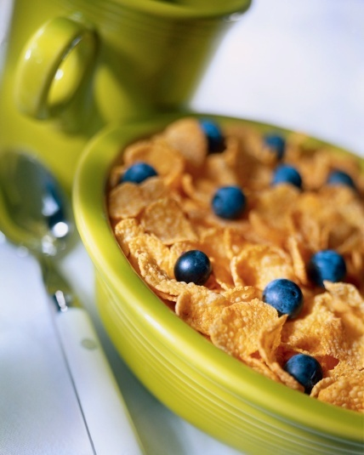
Indications for Amylin Mimetics Incretin Mimetics DPP-4 Inhibitors
Action: Satiates
Who?
Target post-prandial hyperglycemia
Avoid hypoglycemia, wt gain
For type 2s only, except Amylin Mimetics used in type 1 and 2.
Notes:
153
153

Slide 154
Amylin Mimetic Pramlintide (Symlin) 2005
Action:
prevents post-meal rise in glucagon
slowing gastric emptying
Increases satiety
Efficacy: Decreases A1c by 0.7%, wt by 3lbs
Dosing:
Type 2 – max 120 mcg, BID before meals
Type 1 – max 60 mcg ac meals (meal = 30 gms carbs)
Other: approved only as adjunct to insulin therapy – can’t mix in same syringe with insulin

Slide 155
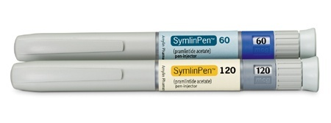
Pramlintide (Symlin) Considerations
WARNING
SYMLIN is used with insulin and has been associated with an increased risk of insulin-induced severe hypoglycemia, particularly in patients with type 1 diabetes. When severe hypoglycemia associated with SYMLIN use occurs, it is seen within 3 hours following a SYMLIN injection.
Sub-Q injection in abd or thigh prior to meal
Reduce insulin by 50% when starting pramlintide
Side effects include hypoglycemia, nausea, loss of appetite, redness, swelling at inject site
Don’t use in pts with gastroparesis, hypoglycemia unawareness
Store unopened vials in refrig, toss after 28 days Cost: $100 for 5 ml vial
Notes:
155
155

Slide 156
Amylin Mimetic– How does it rate?
Question Answer
Cause hypoglycemia?
Cause weight gain?
Affordable?
Lowers CV risk?
Can most tolerate /use?

Slide 157

Great time to Take a Break Not Coffee - Exercise
Exercises to do while studying
Jumping Jacks
Chair push ups
Water Wheels
Twisties
Burpees (modified)
The Hulk
Squat and Jump
Punches
Notes:
157
157

Slide 158

Incretin Mimetics – “Gut Hormones” DPP-IV Inhibitors
How do they work?
Notes:
158
158

Slide 159
GLP-1 Effects in Humans Understanding the Natural Role of Incretins
GLP-1 secreted upon the ingestion of food
Promotes satiety and reduces appetite
Alpha cells:
↓ Postprandial glucagon secretion
↑ Beta-cell
response
Liver: ↓ Glucagon reduces hepatic glucose output
Beta cells: Enhances glucose-dependent insulin secretion
Stomach: Helps regulate gastric emptying
GLP-1 degraded by
DPP-4 w/in minutes
Adapted from Flint A, et al. J Clin Invest. 1998;101:515-520 Adapted from Larsson H, et al. Acta Physiol Scand. 1997;160:413-422 Adapted from Nauck MA, et al. Diabetologia. 1996;39:1546-1553 Adapted from Drucker DJ. Diabetes. 1998;47:159-169
Notes:
159
159
Required
DISCUSSION POINTS:
--Upon food ingestion, GLP-1 is secreted into the circulation from L cells of small intestine.
--GLP-1 increases beta-cell response by enhancing glucose-dependent insulin secretion.
--GLP-1 decreases beta-cell workload and hence the demand for insulin secretion by:
--Regulating the rate of gastric emptying such that meal nutrients are delivered to the small intestine and, in turn, absorbed into the circulation more smoothly, reducing peak nutrient absorption and insulin demand (beta-cell workload)
--Decreasing postprandial glucagon secretion from pancreatic alpha cells, which helps to maintain the counterregulatory balance between insulin and glucagon
--Reducing postprandial glucagon secretion, GLP-1 has an indirect benefit on beta-cell workload, since decreased glucagon secretion will produce decreased postprandial hepatic glucose output
--Having effects on the central nervous system, resulting in increased satiety (sensation of satisfaction with food intake) and a reduction of food intake
--By decreasing beta-cell workload and improving beta-cell response, GLP-1 is an important regulator of glucose homeostasis.
SLIDE BACKGROUND:
--Effect on Beta-cell: Drucker DJ. Diabetes. 1998; 47:159-169
--Effect on Alpha cell: Larsson H, et al. Acta Physiol Scand. 1997; 160:413-422
--Effects on Liver: Larsson H, et al. Acta Physiol Scand. 1997; 160:413-422
--Effects on Stomach: Nauck MA, et al. Diabetologia. 1996; 39:1546-1553
--Effects on CNS: Flint A, et al. J Clin Invest. 1998; 101:515-520

Slide 160
For all the Following GLP-1 Agonists
Pancreatitis Warning
Please tell all patients to report signs right away and discontinue meds
Signs include:
Sudden abdominal pain, nausea and vomiting
May also be associated w/ increased risk of pancreatic cancer? Studies ongoing.

Slide 161


Incretin Mimetics Exenatide (Byetta), Exenatide XR
Action:
Insulin release in response to meal
Slows gastric emptying
Causes Satiety
Exenatide Dosing: - 5-10 mcg ac break, dinner
Long acting version in pipeline (LAR)
Efficacy: Decreases A1c by 0.7%, wt by 3lbs
Indication: For type 2s only - mono or in combo
Other: In prefilled pens in 5 or 10 mcg doses
Notes:
161
161

Slide 162
Incretin Mimetics – Exenatide XR - Bydureon
Once a Week Dosing: 2mg
Efficacy: Decreases A1c by 1.6%, wt by ~6lbs
Indication: For type 2s only
Other: Pt will need to mix powdered form and inject
Caution: not indicated for those with history of medullary thyroid tumor - pancreatitis warning
Notes:
162
162

Slide 163
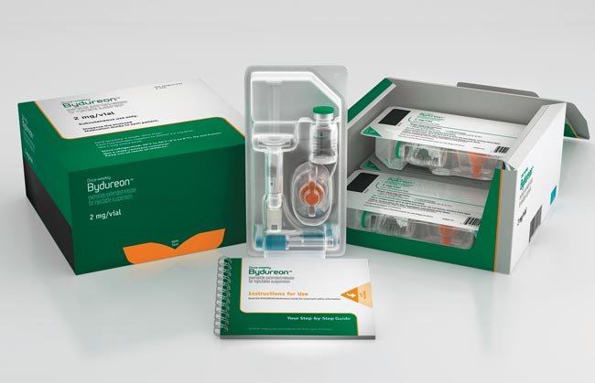
$323.44 for four doses, or about $4,200 a year.

Slide 164
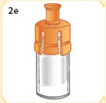
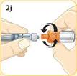
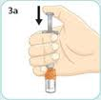
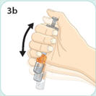
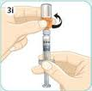
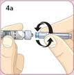
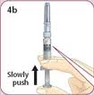
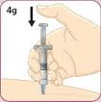
Basic Overview of Exenatide XR Set-Up

Slide 165
Incretin Mimetics GLP-1 Analog Liraglutide (Victoza)
Liraglutide Dosing: 1x daily, time not critical
0.6 x 1 week – if tolerated (nausea), go to >
1.2 x 1 week – if tolerated go to >
1.8 mg daily
Efficacy: lowers; A1c by 1%, body wt by ~ 2.5kg
Indication: Monotherapy or in combo . Type 2 only
Other: In pen, with preset dosing
Black box–thyroid tumor warning (avoid if family hx, notify MD of hoarseness, lump).
Notes:
165
165

Slide 166
Incretin Mimetics Considerations Exenatide, Liraglutide
Store pens in refrig, toss after 30 days
Sub-Q Injection in abd, thigh, upper arm
To prevent hypoglycemia , reduce sulfonylurea/insulin dose when starting
Side effects include nausea, diarrhea
Pancreatitis warning (instruct pt to report abd pain, vomiting)
Don’t use w/ gastroparesis, severe renal disease
Exenatide Cost : $150-175 for month supply of pen devices
Notes:
166
166

Slide 167
Incretin Mimetics – How do they rate?
Question Answer
Cause hypoglycemia?
Cause weight gain?
Affordable?
Lowers CV risk?
Can most tolerate /use?

Slide 168
DPP-4 Inhibitors – “Incretin Enhancers” Januvia (sitagliptin) – Tradjenta (linagliptin) Onglyza (saxagliptin) Nesina (alogliptin)
Action:
Increase insulin release w/ meals
Suppress glucagon
Dosing: Januvia – 100mg a day
Onglyza – up to 5mg a day
Tradjenta – 5mg a day
Nesina – up to 25 mg a day
Efficacy: Decreases A1c by 0.6 -0.8%
Indication: For type 2s
Notes:
168
168

Slide 169
DPP-4 Inhibitors – “Incretin Enhancers” Januvia (sitagliptin) – Tradjenta (linagliptin) Onglyza (saxagliptin) - Nesina (alogliptin)
Januvia, Onglyza eliminated via kidney, lower dose needed
Do not cause wt gain or hypoglycemia
Side effects – headache, runny nose, sore throat - watch for pancreatitis
Cost $100 - $150 mo
Notes:
169
169

Slide 170
DPP-IV Inhibitors – How do they rate?
Question Answer
Cause hypoglycemia?
Cause weight gain?
Affordable?
Lowers CV risk?
Can most tolerate /use?

Slide 171
Indications for Insulin Sensitizers Rosiglitazone (Avandia), Pioglitazone (Actos)
Action: Sensitizers
Who?
Insulin resistant patient
Dysmetabolic syndrome
© Copyright 1999-2013, Diabetes Educational Services, All Rights Reserved.
Notes:
171
171

Slide 172
Thiazolidinediones – TZD’s
Action: decrease insulin resistance by making muscle and adipose cells more sensitive to insulin. Decrease free fatty acids
Names:
pioglitazone (Actos)
Dosing: 15-45 mg daily
rosiglitazone (Avandia) – restriction relaxed
Dosing: 4-8 mg daily
Efficacy/ Considerations
Reduce A1C ~0.5-1.0%
6 weeks for maximum effect
$30 a month
Can cause fluid retention, not indicated w/ CHF
Notes:
172
172
Thiazolidinediones (TZDs) enhance insulin sensitivity in muscle and adipose tissue by binding to cell receptors,which leads to an increase in glucose transporter expression. TZDs encourage beta cells to respond more efficiently by lowering the amount of glucose and free fatty acids in the bloodstream, both of which are known to be detrimental to insulin secretion. Finally, these drugs reduce glucose production in the liver.
Clinical trials indicate that pioglitazone and rosiglitazone are slightly more effective at reducing A1C (1.5-1.6% reduction) than troglitazone (1.1% reduction).
Some of the beneficial side effects of thiazolidinediones include an increase in HDL cholesterol and reduction of triglyceride concentrations. This class of drugs has also been shown to lower blood pressure and decrease vascular inflammation in vitro. There are clinical studies underway to further examine the cardiovascular benefit to TZDs.
Some adverse effects of TZDs include weight gain, a potential increase in LDL cholesterol levels, and a possible increase in alanine aminotransferase levels (ALT). Because of the risk of weight gain, edema, and increased LDL cholesterol, thiazolidinediones are contraindicated in patients with advanced forms of congestive heart failure. Due to reported cases of liver failure and liver toxicity caused by the increase in ALT levels, TZDs are contraindicated in patients with abnormal liver function.
TZDs are the most expensive of the oral antidiabetic agents.

Slide 173
rosiglitazone (Avandia)
Avandia FDA Restriction lifted.
New studies show not associated w/ increased risk of Myocardial Infarction
Notes:
173
173
Thiazolidinediones (TZDs) enhance insulin sensitivity in muscle and adipose tissue by binding to cell receptors,which leads to an increase in glucose transporter expression. TZDs encourage beta cells to respond more efficiently by lowering the amount of glucose and free fatty acids in the bloodstream, both of which are known to be detrimental to insulin secretion. Finally, these drugs reduce glucose production in the liver.
Clinical trials indicate that pioglitazone and rosiglitazone are slightly more effective at reducing A1C (1.5-1.6% reduction) than troglitazone (1.1% reduction).
Some of the beneficial side effects of thiazolidinediones include an increase in HDL cholesterol and reduction of triglyceride concentrations. This class of drugs has also been shown to lower blood pressure and decrease vascular inflammation in vitro. There are clinical studies underway to further examine the cardiovascular benefit to TZDs.
Some adverse effects of TZDs include weight gain, a potential increase in LDL cholesterol levels, and a possible increase in alanine aminotransferase levels (ALT). Because of the risk of weight gain, edema, and increased LDL cholesterol, thiazolidinediones are contraindicated in patients with advanced forms of congestive heart failure. Due to reported cases of liver failure and liver toxicity caused by the increase in ALT levels, TZDs are contraindicated in patients with abnormal liver function.
TZDs are the most expensive of the oral antidiabetic agents.

Slide 174
Pioglitazone (Actos) Warning
Bladder Cancer Risk
Risk increased with increasing dose and duration
France has pulled Actos, Germany restricted access
Patient Instructions
Report symptoms of bladder cancer: blood or red color in urine; urgent need to urinate or pain while urinating; pain in back or lower abdomen.
Notes:
174
174
Thiazolidinediones (TZDs) enhance insulin sensitivity in muscle and adipose tissue by binding to cell receptors,which leads to an increase in glucose transporter expression. TZDs encourage beta cells to respond more efficiently by lowering the amount of glucose and free fatty acids in the bloodstream, both of which are known to be detrimental to insulin secretion. Finally, these drugs reduce glucose production in the liver.
Clinical trials indicate that pioglitazone and rosiglitazone are slightly more effective at reducing A1C (1.5-1.6% reduction) than troglitazone (1.1% reduction).
Some of the beneficial side effects of thiazolidinediones include an increase in HDL cholesterol and reduction of triglyceride concentrations. This class of drugs has also been shown to lower blood pressure and decrease vascular inflammation in vitro. There are clinical studies underway to further examine the cardiovascular benefit to TZDs.
Some adverse effects of TZDs include weight gain, a potential increase in LDL cholesterol levels, and a possible increase in alanine aminotransferase levels (ALT). Because of the risk of weight gain, edema, and increased LDL cholesterol, thiazolidinediones are contraindicated in patients with advanced forms of congestive heart failure. Due to reported cases of liver failure and liver toxicity caused by the increase in ALT levels, TZDs are contraindicated in patients with abnormal liver function.
TZDs are the most expensive of the oral antidiabetic agents.

Slide 175
TZD – How does they rate?
Question Answer
Cause hypoglycemia?
Cause weight gain?
Affordable?
Lowers CV risk?
Can most tolerate /use?

Slide 176

SGLT2 Inhibitor-
Action: “Glucoretic” decreases renal reabsorption in the proximal tubule of the kidneys (reset renal threshold and increase glucosuria)
Name:
Canagliflozin (Invokana)
Dosing: 100 – 300 mg once daily ac first meal
If eGFR 45-60: do not exceed 100mg a day
If eGFR <45, do not use
Efficacy:
Weight loss of 1-3 lbs
Reduce A1C ~0.7-1.0%
Decreases Glucose
Reabsorption
© Copyright 1999-2013, Diabetes Education Services, All Rights Reserved.
Notes:
176
176
Thiazolidinediones (TZDs) enhance insulin sensitivity in muscle and adipose tissue by binding to cell receptors,which leads to an increase in glucose transporter expression. TZDs encourage beta cells to respond more efficiently by lowering the amount of glucose and free fatty acids in the bloodstream, both of which are known to be detrimental to insulin secretion. Finally, these drugs reduce glucose production in the liver.
Clinical trials indicate that pioglitazone and rosiglitazone are slightly more effective at reducing A1C (1.5-1.6% reduction) than troglitazone (1.1% reduction).
Some of the beneficial side effects of thiazolidinediones include an increase in HDL cholesterol and reduction of triglyceride concentrations. This class of drugs has also been shown to lower blood pressure and decrease vascular inflammation in vitro. There are clinical studies underway to further examine the cardiovascular benefit to TZDs.
Some adverse effects of TZDs include weight gain, a potential increase in LDL cholesterol levels, and a possible increase in alanine aminotransferase levels (ALT). Because of the risk of weight gain, edema, and increased LDL cholesterol, thiazolidinediones are contraindicated in patients with advanced forms of congestive heart failure. Due to reported cases of liver failure and liver toxicity caused by the increase in ALT levels, TZDs are contraindicated in patients with abnormal liver function.
TZDs are the most expensive of the oral antidiabetic agents.

Slide 177
SGLT2 Inhibitors – Considerations
Increased Glucose
Reabsorption
Monitor B/P, K+ & renal function.
Side effects: hypotension, UTI, increased urination, genital yeast infections.
Improves beta cell function?
Reverses glucoses toxicity by increasing GLUT4 transport in muscle
Increase liver sensitivity to insulin and decreases gluconeogenesis.

Slide 178
SGLT-2 Inhibitor – How does it rate?
Question Answer
Cause hypoglycemia?
Cause weight gain?
Affordable?
Lowers CV risk?
Can most tolerate /use?

Slide 179
“Circadian Switchers” Dopamine Receptor Agonist bromocriptine mesylate QR “Quick Release”
Action: Increases dopamine levels
Decreases insulin resistance
Decreases dyslipidemia
No weight gain
Notes:
179
179

Slide 180
Dopamine Agonists – Circadian Re-Setters
Action: Increase am dopamine levels
Name: bromocriptine mesylate QR (Cycloset)
Dosing: 1.6 to 4.8 mg per day
Each tab 0.8 mg, start at one tab a day, increase one tab a week
Give w/in 2 hrs of waking (before food)
Efficacy:
Reduces A1C 0.6 – 0.9%
Reduces death from CV events
Side Effects:
Nausea, vomiting, headaches, fatigue (watch for syncope)
Notes:
180
180
The mechanism of action of repaglinide is similar to that of the sulfonylurea drugs: binding to beta cell receptors to stimulate insulin secretion. The major difference between the two drug classes is that meglitinides are shorter-acting, and are most effective when taken after meals in the presence of glucose.
Adverse effects include weight gain and hypoglycemia. An additional drawback to this drug is the dosing schedule since it must be taken with meals.

Slide 181

Circadian Switchers” bromocriptine mesylate QR
Other considerations:
Avoid in patients:
With syncopal migraines
With psychotic disorders
Who are breastfeeding (stops lactation)
Eval for somnolence
Weight neutral
Notes:
181
181

Slide 182
Cycloset– How does it rate?
Question Answer
Cause hypoglycemia?
Cause weight gain?
Affordable?
Lowers CV risk?
Can most tolerate /use?

Slide 183

Indications for Glucosidase Inhibitors Acarbose (Precose®), Miglitol (Glyset®)
Action: Slower
Target post-prandial blood glucose
Minimal systemic absorption
Notes:
183
183

Slide 184
Alpha-glucosidase Inhibitors
Action: blocks enzymes that digest starches in the small intestine
Name: acarbose (Precose)
Dosing: 75-300mg based on weight
Efficacy
Decrease postprandial glucose 40-50 mg/dl
Decrease A1C 0.5-1.0%
Other Effects
Flatulence or abdominal discomfort
Contraindicated in patients with inflammatory bowel
disease or cirrhosis
Special Consideration
In case of hypoglycemia, treat with glucose tabs or milk
(other starches are blocked by medication)cation)
Notes:
184
184
Alpha-glucosidase inhibitors (AGIs) work by blocking the enzyme in the small intestine that breaks down complex carbohydrates, alpha-glucosidase. By blocking this enzyme these drugs prevent starches from being absorbed into the bloodstream and in doing so lower blood glucose levels. AGIs are the only drug class used to treat type 2 diabetes that does not specifically target the pathology of the disease.
Because AGIs work in the digestive tract, they are more effective at lowering postprandial glucose levels than fasting plasma glucose levels. On average, AGIs are less effective at lowering A1c levels than biguanides or sulfonylureas.
What makes this class of drug attractive to patients and physicians is it's disassociation with weight gain and hypoglycemia. However, it is known to cause abdominal discomfort and diarrhea. AGIs are also rarely used as monotherapy because of their low efficacy.

Slide 185
Acarbose– How does it rate?
Question Answer
Cause hypoglycemia?
Cause weight gain?
Affordable?
Lowers CV risk?
Can most tolerate /use?

Slide 186
Juvisync Januvia + Simvastatin
Incretin Enhancer + Cholesterol Lowering
3 Doses:
100 mg sitaglipitin + 10 mg simvistatin
100 mg sitaglipitin + 20 mg simvistatin
100 mg sitaglipitin + 40 mg simvistatin
Plan to develop 50 mg sitagliptin dose
Observe precautions of each.
Pancreatitis & muscle weakness/ soreness

Slide 187
Juvisync– How does it rate?
Question Answer
Cause hypoglycemia?
Cause weight gain?
Affordable?
Lowers CV risk?
Can most tolerate /use?

Slide 188
Combo Pills for Type 2
Sulfonylurea + Biguanide
Glyburide + Metformin - Glucovance
Glipizide + Metformin - Metaglip
Thiazolidinedione + Biguanide
Pioglitazone + Metformin - Actoplus Met
Thiazolidinedione + Sulfonylurea
Actos + Amaryl - Duetact
DPP-4 Inhibitor + Biguanide
Januvia + Metformin - Janumet
Onglyza + Metformin XR Kombiglyze
DPP-4 Inhibitor + Statin
Januvia + Zocor - Juvisync
Notes:
188
188
This slide illustrates the fixed combination pills available.

Slide 189
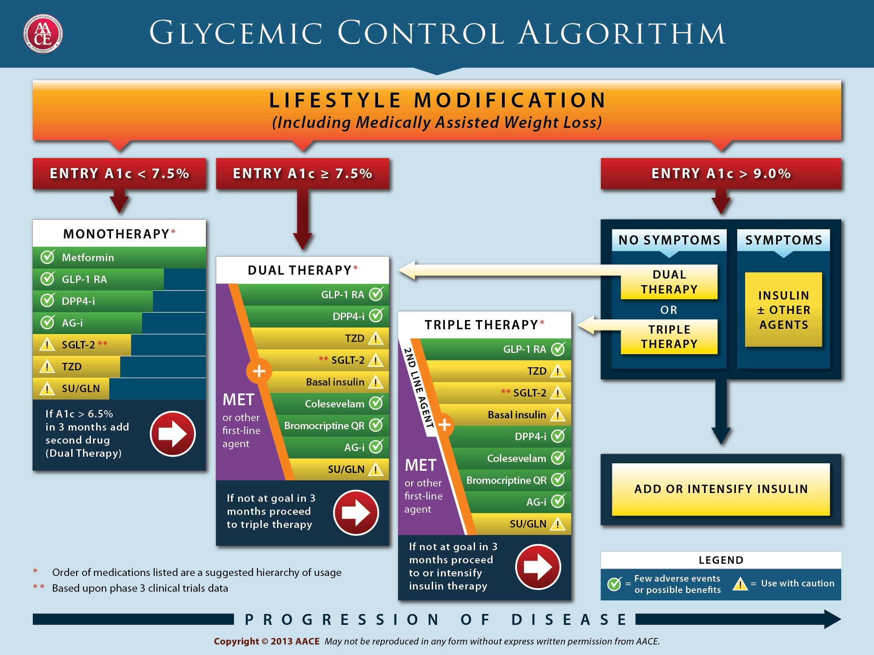

Slide 190
List the Treatment Options
35 yr old, BMI 28, creat 0.8, A1c 6.7%
Sit 1: Wants to try lifestyle changes before meds
Sit 2: Started on Januvia, can’t afford it. What alt med?
72 yr old, thin, lives alone, A1c 7.3%. History of MI, stroke. On glyburide 10mg a day and beta blocker. Creat 1.4.
69 year old male, BMI 25, on Metformin 1000mg BID. AM glucose 120s, A1c 8.1%. Creat 1.3
64 yr old on daily; amaryl 4mg, Januvia 100mg, Avandia® 4 mg. A1c 9.2%. Pt c/o of 12 lb wt gain over past month. Creat 1.2, LDL 138
Pt on Exenatide 10mcg BID, c/o of sudden abd pain.

Slide 191
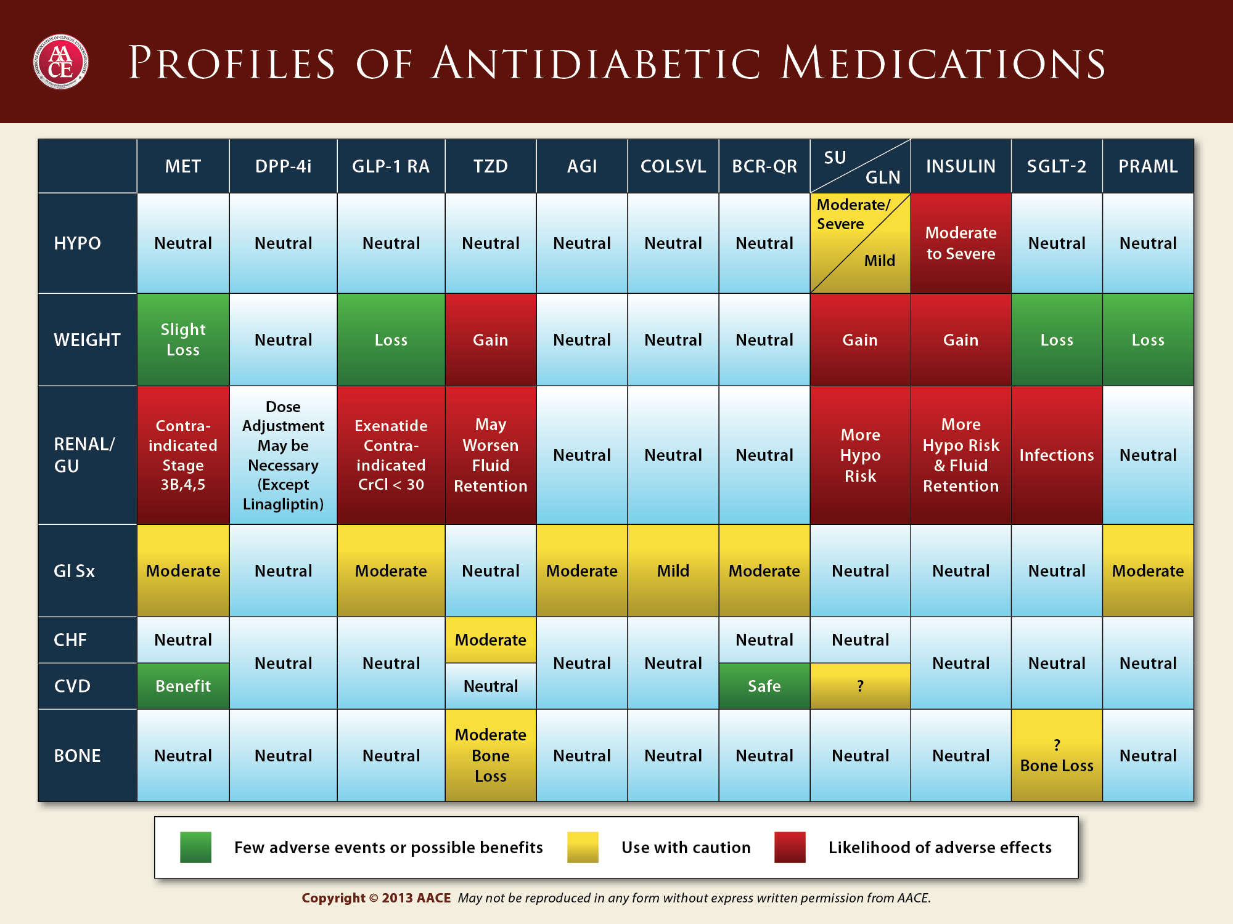

Slide 192
Monitoring, Sick Days and Getting to Goal in the Hospital
Beverly Thomassian

Slide 193
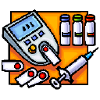
Diabetes Monitoring
Objective: Identify barriers to monitoring and strategies to overcome them.

Slide 194
Self-Monitoring Why Should I do it?
Feel better everyday – sense of control
Avoid hospital admissions
Fewer missed work /school days
Avoid hypoglycemia or embarrassing situations related to hypo
Avoid unwanted weight gain
Enhanced athletic performance

Slide 195
How will it help me?
See if your treatment plan is working
Make decisions regarding food and/or med adjustment when exercising
Find out how that pizza affected your BG
Find patterns
Manage illness

Slide 196
How Often Should I Check?
Be realistic!!
Type 1 – at least 3 times a day
Type 2 – as often as needed to achieve goals (ADA)
Consider:
Types and timing of meds
Goals
Ability (physical and emotional)
Finances

Slide 197
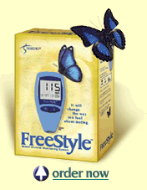

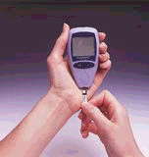
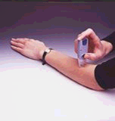
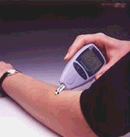
New Meters
0.3 microliters of blood
minimal pain
Alternate site testing
Show patients 800 number on back

Slide 198


Alternate Site Testing
Use blood from a fingertip rather than an alternative site if:
Have hypoglycemia symptoms
Have hypoglycemia unawareness
If BG results don’t match how patient is feeling
If BG is rapidly rising/ falling

Slide 199
Monitoring Issues
“Monitor Talk”
avoid judging glucose levels as good and bad
Say stuff like..
I am so impressed you are checking your blood sugar at least once a day and writing it down.
Tell me what is helping you succeed with blood sugar testing.
I see that you are skipping some days. Do you know what has been stopping you from checking?

Slide 200

Sick Days and Hospitalization Objectives
Describe sick day management strategies.
Discuss the consequence of hyperglycemia in hospitalized patients.
State two strategies to improve glucose levels in hospitalized patients.

Slide 201
Sick Day Patient Guidelines
Continue to take diabetes medication, may need adjust dose down or up
Test glucose at least every 4 hrs
Drink plenty of liquids
Rest
Contact physician
Plan ahead
Check urine ketones, if BG >240 & ill

Slide 202
Sick Day Guidelines Reasons to Call MD
Vomiting more than once
Diarrhea > than 5x’s or for > 24 hrs
Difficulty breathing
Blood glucose > than 300mg/dl on 2 consecutive readings
Temperature > 101 F.
Positive ketones in urine.

Slide 203
Preparation for Surgery
Try to schedule surgery in am, resume meds/insulin when eating and stable.
Oral medications: In am, hold all diabetes oral medications
Basal Insulin: for type 2s, give 50% of usual am basal dose and for type 1s give 100% of basal dose.
Bolus insulin: Use mild insulin bolus coverage for type 1 and type 2’s

Slide 204

Glucose Management and Hospitalized Patients
In hospitalized patients with critical illness, hyperglycemia is a signal that warrants our attention.

Slide 205

Hospitals and Hyperglycemia What’s the Big Deal?
Hyperglycemia is associated with increased morbidity and mortality in hospital settings.
Acute Myocardial Infarction
Stroke
Cardiac Surgery
Infection
Longer lengths of stay

Slide 206
Stress response and hyperglycemia
Decreased WBC’s
Catabolism
Abnormal inflammatory response
Endothelial cell dysfunction
Increased clotting, blood viscosity
Tissue breakdown
Inflammatory changes
Increased blood pressure, pulse
Leads to: Longer lengths of stay, complications, death
Diabetes Care, v. 27, #2, Feb 2004

Slide 207
Hyperglycemia*: A Common Comorbidity in Medical-Surgical Patients in a Community Hospital
12%
26%
62%
Normoglycemia
n = 2,020
* Hyperglycemia: Fasting BG ≥ 126 mg/dl
or Random BG ≥ 200 mg/dl X 2
Known Diabetes
New Hyperglycemia
Umpierrez G et al, J Clin Endocrinol Metabol 87:978, 2002
Umpierrez et al
Notes:
In a more recent study that involved 2020 consecutive patients admitted to a community hospital in Atlanta, we found that 64% of patients had normal glucose values, 26% had a prior history of diabetes, and that 12% of patients with hyperglycemia, as determined by 2 or more FBG > 126 or RBG > 200, did not had a know history of diabetes prior to admission.

Slide 208
Effect of Hyperglycemia on Hospital Mortality
Prior history of
*
Mortality (%)
*
*
*P<.01 compared with normoglycemia and known diabetes.
Umpierrez GE et al. J Clin Endocrinol Metab. 2002;87:978-982.
Notes:
The medical records of 2030 consecutive adult patients were analyzed for the presence of hyperglycemia and any association with poor hospital outcomes.
New hyperglycemia was associated with a 16% mortality rate compared with 3% and 1.7% for patients with a prior history of diabetes or normoglycemia (P<.01).
The mortality rate was significantly higher for patients with new hyperglycemia regardless of whether they were admitted to the ICU (P<.01 for both ICU and non-ICU patients compared with those with diabetes or normoglycemia). Mortality rates were 10% for non-ICU patients with new hyperglycemia and 31% for ICU patients.
Reference
Umpierrez GE, Isaacs SD, Bazargan N, You X, Thaler LM, Kitabchi AE. Hyperglycemia: an independent marker of in-hospital mortality in patients with undiagnosed diabetes. J Clin Endocrinol Metab. 2002;87:978-982.

Slide 209

BG Above Normal = Trouble
Pre Diabetes
Fasting Glucose = 100-125mg/dl
A1c 5.7 – 6.4%
Diabetes
Fasting Glucose = 126 mg/dl +
Random Glucose = 200 mg/dl +
A1c 6.5% +
Any blood glucose above 140 requires treatment
Umpierrez et al

Slide 210
Diabetes Detectives Needed
On average – takes 6.5 years to diagnose diabetes
1/4 of all people with diabetes don’t know they have it

Slide 211

WHAT SHOULD WE AIM FOR?
Critically Ill pts
BG > 180- Start insulin
BG goal 140-180
Non Critically Ill patients BG Goals
Premeal <140
Post meal <180
Insulin therapy preferred treatment
Consensus: Inpt Hyperglycemia, Endocr Pract. 2009;15 (No.4)

Slide 212
Management of Hyperglycemia and Diabetes
Non-ICU
Basal/bolus therapy (MDI)
NPH and Regular insulin
Long-acting and rapid-acting insulin
Premixed insulin
ICU and Critical Care
Insulin Drips
Basal /Bolus

Slide 213

RABBIT 2 Trial Randomized Study of Basal-Bolus Insulin Therapy in the Inpatient Mgmt of Type 2 DM
Goal: Achieve BG <140 in non-ICU hospital pts
Set-up:
Prospective, multi center randomized trial for pts w/ diagnosed diabetes.
Compared insulin sliding scale to basal bolus combo
Outcome:
Achieved in 66% of pts on Basal bolus
Achieved in 38% in sliding scale group
Umpierrez et al – Diabetes Care, v 30, #9, Sept 07

Slide 214
Getting Glucose to Goal
Subq insulin therapy (oral agents stopped)
Determine insulin needs based on wt/BG
0.4 units kg/day if BG 140-200mg/dl
0.5 units kg/day if BG 201-400mg/dl
50% of total dose - Basal Insulin (eg Lantus)
Increased by 20% if fasting BG elevated
Reduced for BG <70mg/dl
50% of total dose Bolus Insulin (eg Lispro) divided evenly into 3 meals
If premeal BG elevated, increased bolus dose

Slide 215

Bottom Line
30-40% of hospitalized patients have diabetes
10% aren’t officially diagnosed
Cardiovascular disease is the leading cause of hospitalization for people with diabetes
Look for patients with hyperglycemia and cardiometabolic risk factors: smokers, HTN,
central obesity, abnormal lipids, Acanthosis.
Provide education and promote self-advocacy

Slide 216
Summary
Hyperglycemia is a marker of metabolic dysregulation and deserves our attention.
Glucose control improves outcomes.
Insulin drips and basal bolus regimes are two strategies to improve glucose.
Inpatient glucose control is cost effective.
We can make a difference.

Slide 217

Thank You
Questions?
Email – bev@diabetesed.net
Web- www.diabetesed.net
We are happy to help

