Slide 1

Becoming a Diabetes Educator – Day 2
Beverly Thomassian, RN, MPH, BC-ADM, CDE
President, Diabetes Education Services
Diabetes Nurse Specialist
bev@diabetesed.net
www.diabetesed.net

Slide 2
Becoming a Diabetes Educator – Day 2
Topics:
Macrovascular Complications
Microvascular Complications
Acute Complications
Medical Nutrition Therapy
Exercise

Slide 3
Diabetes and Vascular Disease
Objectives:
Describe 3 vascular conditions associated with diabetes.
State 3 teaching strategies to prevent vascular complications.

Slide 4
Complications Key Considerations
Prevent, Delay, Reduce
Early treatment
Routine exams
Report unusual findings right away
Use ed materials that work
Resources and referrals

Slide 5
Diabetes and the Heart
Diabetes is a Vascular Disease

Slide 6
DM = 3-5xs Risk of Heart disease
CHF
  7.9 % w/ diabetes vs.
  1.1 % no diabetes
Heart attack
  9.8 % w/ diabetes vs.
  1.8 % no diabetes
Coronary heart disease
  9.1 % w/ diabetes vs.
  2.1 % no diabetes
Stroke
  6.6 % w/ diabetes vs.
  1.8 % no diabetes
  2007 AACE

Slide 7
Vascular Disease & Diabetes “atheroscleropathy”
  Normal endothelial cells are protective
  Abnormal glucose = Endothelial cell dysfunction
    Poor vasodilation due to lower Nitric Oxide (NO) levels
    Release of inflammatory mediators
    = Increased risk of acute thrombotic event
  Increased arterial stiffness
      Due to chronic hyperglycemia, endothelial inflammation
      Higher systolic/lower diastolic pressures = more vascular disease

Slide 8
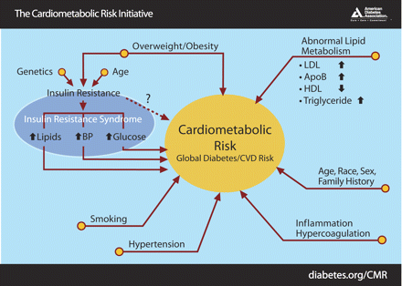

Slide 9
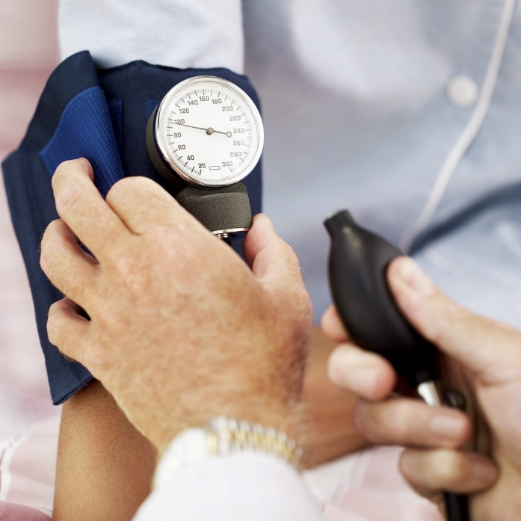
Hypertension
1.5 - 3xs greater in DM
Type 1, due to nephropathy
Type 2, due to metabolic syndrome
Increases risk of kidney, eye and possibly nerve disease
DM + HTN 2x’s CVD risk compared to no DM

Slide 10
Lipid Abnormalities
Common diabetes lipid pattern:
  Smaller, denser LDL
  Increased triglyceride levels
  Decreased HDL cholesterol
  “Atherogenic dyslipidemia”

Slide 11

CardioMetabolic Risk -
“5 Hypers”
Hyperinsulinemia (insulin resistance)
Hyperglycemia
Hyperlipidemia
Hypertension
Hyper”waistline”emia
  Waist >35 in (women) or > 40 in (men)
Plus increased clotting risk, microalbuminuria, PolyCystic Ovarian Syndrome (PCOS), acanthosis nigricans

Slide 12
People with Diabetes in the Dark about CVD Link
Recent survey of 2000 pt’s w/ DM
68% did not consider CVD a complication of diabetes
Only 17% thought diabetes increased risk of CVD
Survey: American Diabetes Association and American College of Cardiology

Slide 13

Vascular Risk Factors
Nonmodifiable
  Duration of diabetes – longer = more risk
  Age – older increased risk
  Gender – women have more CV protection pre-menopause
  Race – risk varies
  Genetics – family history

Slide 14
Vascular Risk Factors
Modifiable
  Blood Pressure
  Lipids
  Smoking
  Obesity
  Other factors – lack of exercise, Type A personality, dietary habits

Slide 15

Lower Extremity and Dental Care

Slide 16

Financial Advisor
Mid 30s, friendly, he smiles to greet you and you notice his gums are inflamed. You’d guess a BMI of 26 or so, with most of the extra weight in the waist area.
If you could give him some health related suggestions, what would they be?

Slide 17
Dental & Oral Disease
periodontal disease accelerated
  Periodontitis and tooth loss, gingivitis and dental abscesses
  Increased risk of oral thrush
oral infections often more severe, undetected, cause hyperglycemia
Routine dental exams, metabolic control critical
Quit smoking

Slide 18

Diabetes and Amputations
Diabetes = 8 fold risk of amputations
Highest rate in those over 75
50% of amputations can be avoided through self-care skill education and early intervention
Rate declined by 65% from 1996-2008
  From 11.2 per 1000 to 3.9 per 1000
  Stats from CDC 2012

Slide 19
Peripheral Vascular Disease – Venous Disease
On exam
  Skin brownish, reddish, mottled
  Skin warm to touch, may be edematous
  May have stasis ulcers on lower leg
  Pulses difficult to locate due to edema
Treatment
  Support hose
  Elevate feed
  Avoid constriction
  Shoes that can accommodate feet

Slide 20
Peripheral Arterial Disease (PAD)
Affects 30% of people w/ diabetes over age 50
Inadequate blood & oxygen to lower extremities
Signifies ↑ risk of stroke, HTN, sudden death
  Pain w/ walking, relieved by rest “intermittent claudication”
  Pt c/o pain, cramping in calves, thighs, buttocks
PAD + Neuropathy = increased amputation risk

Slide 21
Peripheral Arterial Disease
Intermittent Claudication
Physical Exam – Skin
  Pale or blue, purple
  Dependent rubor, blanching when elevated
  Cool to touch, loss of hair, nonhealing wounds, gangrenous
  Diminished pulses
Treatment = Protect feet
  Avoid constriction, increase walking, stop smoking, medications and/or surgery

Slide 22
Profile of a High Risk Foot ADA
Previous amputation
Previous foot ulcer history
Peripheral neuropathy
Foot deformity
Peripheral vascular disease
Vision impairment
Diabetic neuropathy (esp if on dialysis)
Poor glycemic control
Cigarette smoking

Slide 23
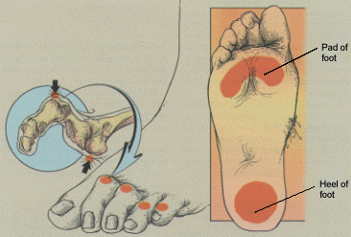
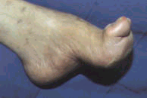
Foot Deformities

Slide 24
You Can Make A Difference
Assess
  Nail condition, nail care, inbetween the toes
  Who trims your nails
  Have you ever cut your self?
  Shoes – type and how often
  Socks
  Skin/skin care and vascular health
  Ability to inspect
  Loss of protective sensation

Slide 25
5.07 10-g single use monofilament
Highly predictive
Used world wide
One or more anatomic sites on plantar surface-large fiber nerve function
Test four sites on each foot
1st, 3rd, 5th metatarsal heads and distal hallux (big toe)
Some commercial ones inaccurate

Slide 26
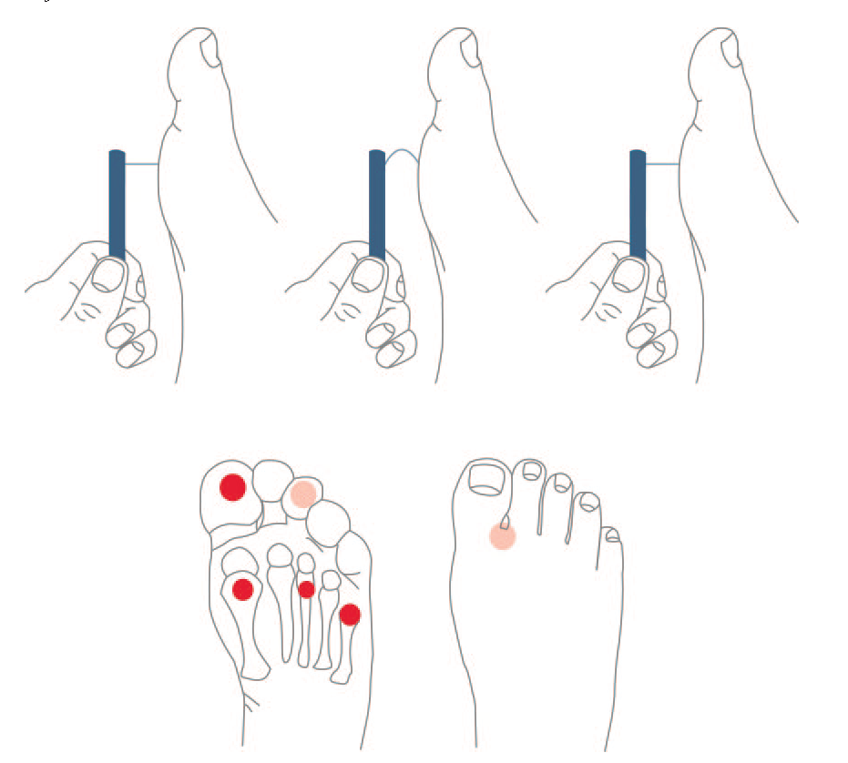
5.07 monofilament delivers 10gms linear pressure
10 Free Monofilaments
www.hrsa.gov/hansensdisease/leap/

Slide 27
Key Considerations -Teaching Guidelines
Proper care of nails, calluses, injuries
Proper fitting footwear
Daily inspection of feet
Follow-up care as recommended
Never go barefoot
Show provider feet at each visit

Slide 28
DiaBingo - N
N Injected hormone called an incretin mimetic
N DPP demonstrated that exercise and diet reduced risk of DM by ___%
N An _______a day can help prevent heart attack and stroke
N Rebound hyperglycemia
N Scare tactics are effective at motivating patients to change behavior
N Losing ___ % of body weight, can improve blood glucose, BP, lipids
N Drugs that can cause hyperglycemia
N 2/3 cups of rice equals ______ serving carbohydrate
N A1c of 7% equals glucose of
N One % drop in A1c reduces risk of complications by ___ %
N 1gm of fat equal _____kilo/calories
N Metabolic syndrome = hyperglycemia, hyperlipidemia, hypertension

Slide 29
Diabetes –Microvascular Complications and Goals of Care
Objectives:
Identify 3 microvascular complications
Describe modifiable and non-modifiable risk factors for diabetes complications
List screening guidelines

Slide 30
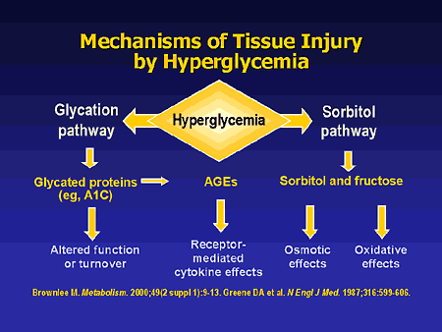

Slide 31
Eye Disease and Adaptive Education Objectives
Diabetes Retinopathy
Other Diabetes Eye Complications
Prevention and Treatment
Promoting Self-Care

Slide 32
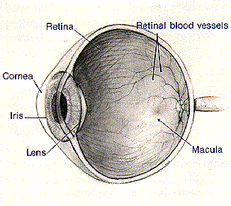
Healthy Eye Function

Slide 33
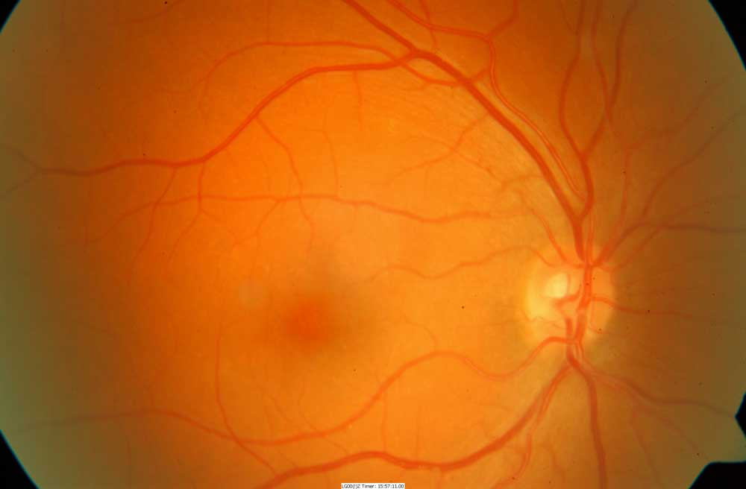
Healthy Retina
Optic Nerve
Macula

Slide 34
Eye Disease Overview
Leading cause of blindness ages 20-74
  Retinopathy and Diabetic Macular Edema
DM pt’s 25x’s risk of ocular complications
20% of type 2 have retinopathy at dx
Development / progression correlates strongly with duration of diabetes, glucose control, and other risk factors
Only 60% of pt’s receive appropriate tx

Slide 35
What is Retinopathy?
Retina – layer of nerve tissue in back of eye responsible for processing images and light
Damage to the microvascular layer that nourishes the retina
Leads to leakage of blood components through vessel walls and creation of unstable blood vessels secondary to hypoxia
Disturbance in nerve layer = visual symptoms

Slide 36

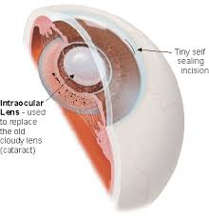
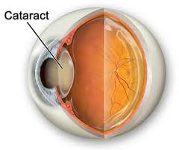
Cataracts
Cataracts – elevated glucose levels glycosylate lens, decreasing permeability
  Treatment = surgery

Slide 37
Macular Edema
Macular edema
  Risk 10-15% for pt’s w/ dm 15yrs +
  macula responsible for central vision
  retinal thickening w/in 3mm from the macula
  can impair central vision – causing blurring to blindness
  Tx: argon photocoagulation

Slide 38
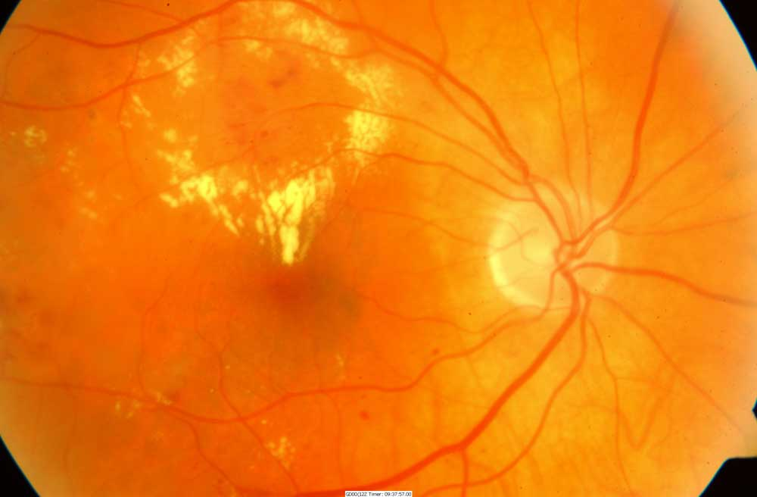
Macular Edema
Macular swelling caused by leaking microaneurisms with exudates (in yellow). Most common cause of visual loss among type 2 diabetes
http://www.virginiaretina.org/diabetic_retinopathy.html

Slide 39
Natural History of Diabetic Retinopathy
Mild nonproliferative diabetic retinopathy (NPDR)
  Microaneurysms only
  Reexamined annually
Moderate NPDR
  Microaneurysms plus other abnormalities
  Reexamined w/in 6-12 months
Notes:
There are several stages of retinopathy. The earliest clinical stage of diabetic retinopathy is identified as mild nonproliferative diabetic retinopathy (NPDR). Progression of disease from NPDR to proliferative diabetic retinopathy (PDR) is related to the level or severity of NPDR, and therefore the severity of NPDR should determine follow-up and management of diabetic retinopathy.
The next four slides will review the clinical findings and management of each stage of retinopathy.

Slide 40
Severe non-proliferative retinopathy
Any of the following:
  20+ intraretinal hemorrhages in each 4 quadrants
  Venous beading in 2 or > quadrants
  Prominent intraretinal microvascular abnormalities in 1 or more quadrant
  No signs of proliferative disease
Reexamination several times a year

Slide 41
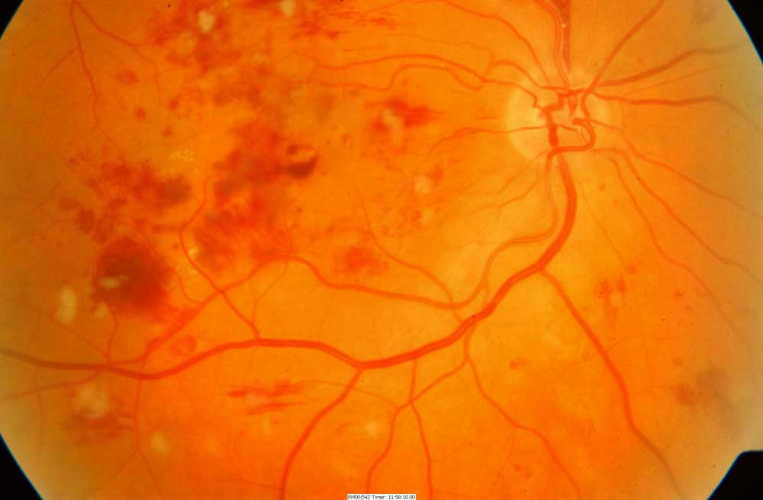
Non Proliferative
Dilated capillaries (microaneurisms) leak red blood cells and plasma into retina. Results in retinal hemorrhages, edema and deposits (exudates).

Slide 42
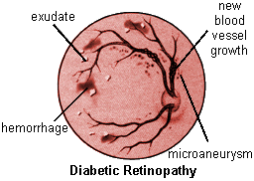
Proliferative Diabetic Retinopathy

Slide 43
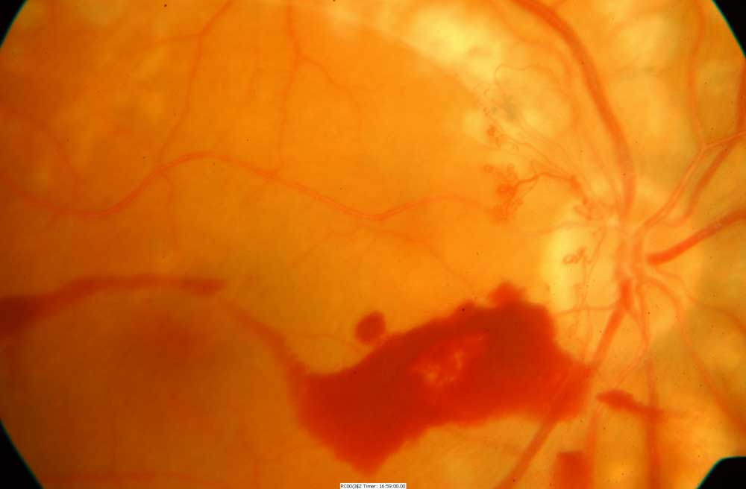
Proliferative retinopathy
Characterized by new blood vessel formation on surface of retina or the optic nerve. Severe visual loss can occur due to vitreous hemorrhage and retinal detachment. Note fine network of new blood vessels on the surface of the optic nerve

Slide 44
Proliferative Diabetic Retinopathy
Clinical Findings
  Ischemia induced neovascularization
    at the optic disk (NVD)
    elsewhere in the retina (NVE)
  Vitreous hemorrhage
  Retinal traction, tears, and detachment
  Diabetes Macular Edema must also be evaluated
Notes:
When proliferation of new blood vessels occurs, the patient is diagnosed as having PDR. New blood vessel formation is caused by retinal ischemia. Neovascularization can occur at the optic disk (NVD) or elsewhere in the retina (NVE). These new vessels are weak and, when they break, can cause vitreous hemorrhage. They can also cause retinal traction, retinal tears, and retinal detachment over time.

Slide 45
PDR Management
Management/Treatment
  2-4 month follow-up
  Color fundus photography
  Panretinal photocoagulation (3-4 month follow-up)
  Vitrectomy if bleeding into vitreous
  If macular edema present: focal photocoagulation, fluorescein angiography
Notes:
PDR should be managed with panretinal laser photocoagulation, color fundus photography, and follow-up every 3-4 months to monitor treatment success. If panretinal photocoagulation is not performed, patients should be evaluated every two to three months because of the high risk of developing CSME, retinal detachment, or vitreous hemorrhage that can lead to vision loss. Vitrectomy should be considered when there is substantial amount of hemorrhaging in the vitreous fluid, and when neovascularization causes retinal traction or retinal detachment. CSME is treated in the same manner as described for severe NPDR.

Slide 46
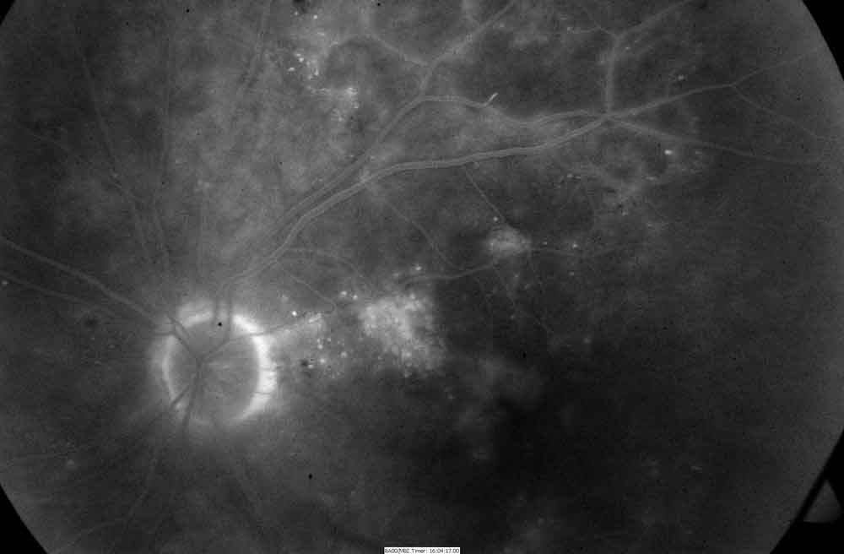
Fluorescein Angiogram
Fluorescein Angiogram, 5 Minutes After Dye Injection.
Fuzzy white areas represent dye leaking into retina from microaneurisms. This illustrates the mechanism which causes macular edema.

Slide 47
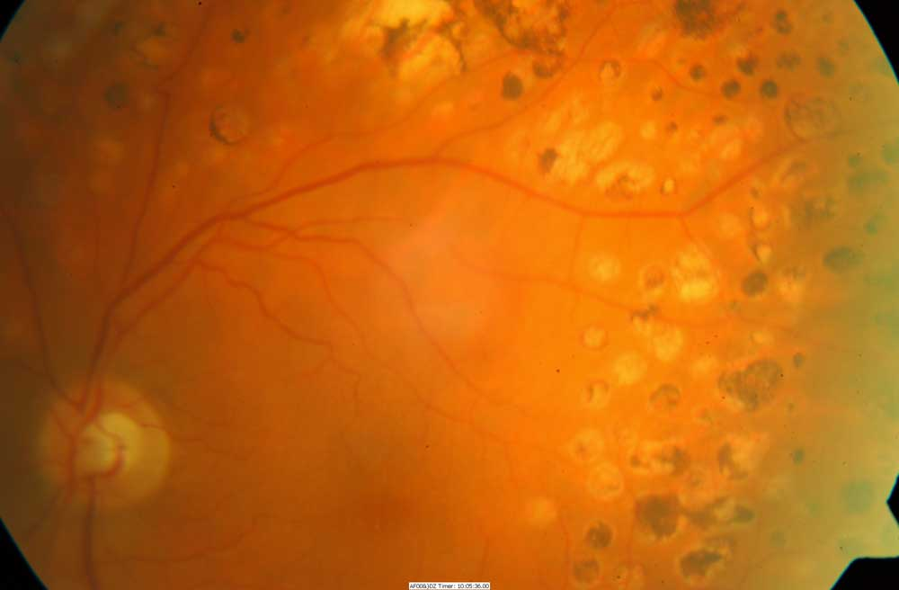
Pan Retinal Photocoagulation
Decreases risk of severe vision loss by 50% or more
Destroys 12% of retina and loss of visual field.
Once stabilized, can achieve excellent control of PDR
if B/P and BG well controlled.

Slide 48

Retinopathy Prevention
To reduce the risk or slow the progression of retinopathy
  Optimize glycemic control
  Optimize blood pressure control

Slide 49
Retinopathy Screening
Initial dilated and comprehensive eye exam by an ophthalmologist or optometrist
  Type 1 - children age 10 + and adults
    screen within 5 years of diagnosis
  Type 2 diabetes - screen at time of diagnosis
  Women with preexisting diabetes who are planning pregnancy or are pregnant
    Comprehensive eye examination
    Eye examination should occur in the first trimester
    Close follow-up throughout pregnancy and for 1 year postpartum
Notes:
A comprehensive eye exam should be given to all patients with diabetes. The exam should include all of the components recommended by the American Academy of Ophthalmology and the American Optometric Association for non-diabetic patients, however additional attention should be given to assess abnormalities of the retina and vitreous fluid. Dilated indirect ophthalmoscopy, slitlamp biomicroscopy, and fundus examination should be used to identify retinal or vitreous hemorrhages, microaneurysms, retinal tears or detachment, intraretinal microvascular abnormality (IRMA), neovascularization at the optic disk (NVD) and elsewhere in the retina (NVE).
Patients with type 1 diabetes should be screened for NPDR (non-proliferative diabetic retinopathy) within three to five years of diagnosis after age 10. Retinopathy leading to vision loss rarely develops in children prior to puberty, regardless of how long the child has had diabetes. Patients with type 2 diabetes should be screened at time of diagnosis.
Finally, women with preexisting diabetes should be screened prior to conception and during the first trimester. Follow-up exams should be scheduled at the physicians discretion based on the results of the first trimester exam.
Note that follow-up exams should be conducted yearly, however new ADA Clinical Practice Recommendations state that less frequent exams every 2-3 years can be considered in the setting of a normal eye exam upon the advice of an eye care professional.

Slide 50
Ongoing Retinopathy Screening
After initial exam, then…
  Annual exam
  Less frequent (every2-3) yrs can be considered if one or more normal eye exam
  More frequent exams if retinopathy progressing
Notes:
A comprehensive eye exam should be given to all patients with diabetes. The exam should include all of the components recommended by the American Academy of Ophthalmology and the American Optometric Association for non-diabetic patients, however additional attention should be given to assess abnormalities of the retina and vitreous fluid. Dilated indirect ophthalmoscopy, slitlamp biomicroscopy, and fundus examination should be used to identify retinal or vitreous hemorrhages, microaneurysms, retinal tears or detachment, intraretinal microvascular abnormality (IRMA), neovascularization at the optic disk (NVD) and elsewhere in the retina (NVE).
Patients with type 1 diabetes should be screened for NPDR (non-proliferative diabetic retinopathy) within three to five years of diagnosis after age 10. Retinopathy leading to vision loss rarely develops in children prior to puberty, regardless of how long the child has had diabetes. Patients with type 2 diabetes should be screened at time of diagnosis.
Finally, women with preexisting diabetes should be screened prior to conception and during the first trimester. Follow-up exams should be scheduled at the physicians discretion based on the results of the first trimester exam.
Note that follow-up exams should be conducted yearly, however new ADA Clinical Practice Recommendations state that less frequent exams every 2-3 years can be considered in the setting of a normal eye exam upon the advice of an eye care professional.

Slide 51
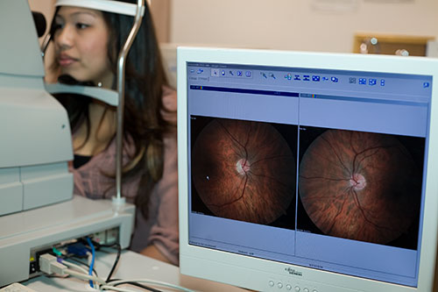
High Quality Fundus Photography to Screen for Retinopathy
Can detect most clinically significant
diabetic retinopathy
Interpretation of the images
  Performed by a trained eye care provider
May serve as a screening tool for retinopathy, it is not a substitute for a comprehensive eye exam
Perform comprehensive eye exam at least initially and at intervals thereafter
Notes:
A comprehensive eye exam should be given to all patients with diabetes. The exam should include all of the components recommended by the American Academy of Ophthalmology and the American Optometric Association for non-diabetic patients, however additional attention should be given to assess abnormalities of the retina and vitreous fluid. Dilated indirect ophthalmoscopy, slitlamp biomicroscopy, and fundus examination should be used to identify retinal or vitreous hemorrhages, microaneurysms, retinal tears or detachment, intraretinal microvascular abnormality (IRMA), neovascularization at the optic disk (NVD) and elsewhere in the retina (NVE).
Patients with type 1 diabetes should be screened for NPDR (non-proliferative diabetic retinopathy) within three to five years of diagnosis after age 10. Retinopathy leading to vision loss rarely develops in children prior to puberty, regardless of how long the child has had diabetes. Patients with type 2 diabetes should be screened at time of diagnosis.
Finally, women with preexisting diabetes should be screened prior to conception and during the first trimester. Follow-up exams should be scheduled at the physicians discretion based on the results of the first trimester exam.
Note that follow-up exams should be conducted yearly, however new ADA Clinical Practice Recommendations state that less frequent exams every 2-3 years can be considered in the setting of a normal eye exam upon the advice of an eye care professional.

Slide 52
Retinopathy Risk Factors
Duration of dm, age at diagnosis, race other genetic factors
Glycemic control, hypertension, smoking, hyperlipidemia, proteinuria and renal disease
Aspirin therapy (to treat CVD) can be used in presence of retinopathy
  Does not increase the risk of retinal hemorrhage

Slide 53
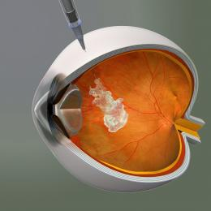
New Approved Treatment for Macular Edema
Anti-vascular endothelial growth factor (VEGF) therapy is indicated for diabetic macular edema
Trials using Ranibizumab (Lucentis) demonstrated improved vision with treatment

Slide 54
Assess adaptation to low vision
necessary vision to perform self-care skills?
  insulin
  BGM
  read instructions
  shopping/home safety/transportation
refer to rehab education (800-AFBLIND)
psychosocial issues

Slide 55
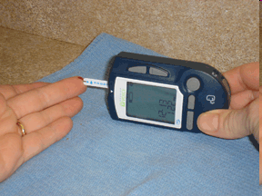
Prodigy Voice Meter – A+ Access Award Am Fed Blind
Prodigy Meter only completely accessible meter for sale in U.S. - independent access for visually impaired -
www.prodigymeter.com
800-243-2636
Independent set up
Self coding
Audible Memory
Audible warning/error
Cost: $84.95
50 Strips $34.95

Slide 56

Diabetes Nerve Disease Objectives
Causes of neuropathy
Different types of neuropathy
Detection, prevention and treatment
Key info to teach about neuropathy

Slide 57
Microvascular Disease and Polyol Theory
  hyperglycemia ↑ glucose level in cells
  sorbitol pathway - glucose reduced to sorbitol by aldose reductase
  polylol pathway - sorbitol oxidized to fructose by sorbitol dehydrogenase
  glucose, sorbitol, fructose toxic to cells
  nerve velocity, oxygenation, increases oxidative stress

Slide 58
Neuropathy Screening
All patients should be screened for distal symmetric polyneuropathy (DPN)
  At diagnosis of type 2 diabetes and 5 years after diagnosis of type 1 diabetes
  At least annually thereafter using simple clinical tests
Electrophysiological testing rarely needed
  Except in situations where clinical features are atypical

Slide 59
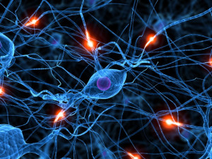
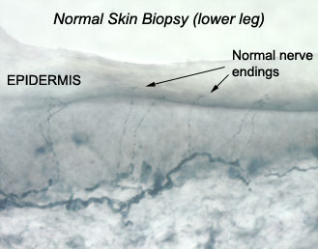
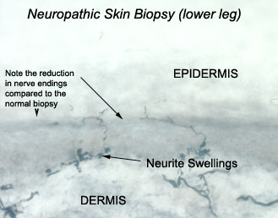
Skin Biopsy to Assess Neuropathy

Slide 60
3 Types of Neuropathy
Generalized Symmetrical Polyneuropathy
  Acute sensory
  Chronic sensory (distal)
    Small fiber
    Large fiber
Autonomic Neuropathy
Focal and Multifocal Neuropathy

Slide 61
Generalized Symmetrical Polyneuropathy
Chronic Sensorimotor Neuropathy
Small Nerve Fiber
Sensory deficits in distal portions, spreading medially “stocking-glove”
Small Nerve Fiber Neuropathy
  C-fiber pain = burning and superficial
  Allodynia (all stimuli interpreted as painful)
  Later, loss of pressure and temp sensation
  Decrease blood flow, sweating
  Detect w/ Monofilament
  High risk for ulceration, Charcot, gangrene

Slide 62
Generalized Symmetrical Polyneuropathy
Chronic Sensorimotor Neuropathy – Large Nerve Fiber
Involve sensory and/or motor nerves
Fibers are myelinated, rapid conductors
Can detect destruction w/ nerve testing
Symptoms may be minimal:
  Impaired vibration perception/position sense
  Ataxia “moon-walking”, in-coordination
  Pain described as deep-seated gnawing
  Shortening of Achilles tendon and claw foot
  Increased blood flow “hot foot”

Slide 63
“DAN” Diabetic Autonomic Neuropathy
50% of pt’s with peripheral neuropathy also have DAN
DAN increases M & M rates
  neurogenic bladder, sexual dysfunction
  GI related disorders / gastroparesis
  orthostatic hypotension
  fixed heart rate, silent MI, sudden death
  hypoglycemia unawareness
  sudomotor, pupillary

Slide 64

Sexual Functions as We Age
20-30 years trice daily
30-40 years tri weekly
40-50 years try weekly
50-60 years try weakly
60-70 years try oysters
70-80 years try anything
80-90 years try to remember
A touch of humor from AADE-New Perspectives on Erectile Dysfunction, 1999

Slide 65

Erectile Dysfunction
Affects about 50% of men with diabetes
Loss of erections sufficient for intercourse
Due to combo of vascular and nerve damage
Tests: penile tumescence to eval if organic or psychogenic
Treatment:
  Sildenafil (Viagra), Vardenafil (Levitra), Tadalfil (Cialis)
    Use caution if taking nitrate drugs. Check w/ MD first
  Other meds, vacuum devices, prosthetics
  HRT- testosterone gel, patches, injections, pills

Slide 66
Take Charge. Talk T. www.diabeteseducator.org
Men w/ DM, 2x risk of low testosterone levels
  Symptoms include low sex drive, ED, depression, lack of energy and vitality
  Low T easily diagnosed and managed, only 10% of men currently treated
  Initial Screening:
    Total testosterone: if < 300 ng/dl = hypogonadal
    am testing preferred, repeat to confirm
  Treatment: determine cause, testosterone replacement therapy

Slide 67
Treating Neuropathy
Improve glycemic control
Control pain
Relief from depression from chronic pain
  Massage, stretching, pain control clinic, TENS, avoiding alcohol, relaxation exercises....

Slide 68
Pharmacologic Therapy for Neuropathy
Try Alpha lipoic acid: 600 – 1,800mg /day
Prescription Therapy
1st line
  Tricyclic antidepressants (ie amitriptyline, nortriptyline
  Calcium channel modulators (ie gababentin, pregabalin)
  Serotonin Norepinephrine Reuptake Inhibitors (SNRI)
2nd line
  Topical Capsaicin Cream
  Opioids (tramadol, oxycodone)
Reasons for treatment failure:
  Dose too low, inadequate trial, pt expecting elimination of symptoms, not changing class when no response
Ziegler, D Painful diabetic neuropathy. Diabetes Care, 2009

Slide 69
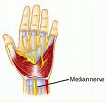
Focal Neuropathies
Often occurs in middle aged pt’s or those w/ polyneuropathy
4 major focal neuro
  mono - compression or entrapment
    carpal tunnel most common
  plexopathy- femoral neuropathy
    pain from hip to ant and lat aspects of thigh
  radioculopathy - intercostal neuropathy
  cranial - abrupt onset, HA, eye pain

Slide 70
Neuropathy Risk Factors
Age
Hypertension
Hyperglycemia
Elevated LDL
Smoking
Overweight
Excess alcohol
Nutrition (eat lots of omega-3 fatty acids)
Lack of exercise

Slide 71
Neuropathy Key Considerations
Very common long-term complication often not recognized and treated
Management / treatment complex
Thorough history /assessment critical
Treatment based on underlying process, presentation, and cost effectiveness
Treatable condition with new therapies on horizon.

Slide 72
Nephropathy Objectives
epidemiology of dm nephropathy / CKD
basic functions of the kidney
major stages in progression of nephropathy
diagnostic tests to assess and monitor renal function
treatment of nephropathy

Slide 73
Diabetic Nephropathy
Over 45% of new cases of Chronic Kidney Disease (CKD) are attributed to diabetes.
In 2001, 41,312 people with diabetes began treatment for end-stage renal disease.
In 2001, it cost $22.8 billion in to treat kidney failure.
Minorities experience higher than average rates of nephropathy and kidney disease
Notes:
Diabetes is the most common cause of kidney failure, accounting for more than 40% of new cases. Treatment for end stage renal disease is expensive; in 2001 it cost the United States over $22 billion to treat patients with kidney failure. Dialysis, one form of treatment for kidney failure, can relieve the symptoms of kidney disease, but over time the damaged kidneys will continue to contribute to problems such as heart disease, bone disease, arthritis, nerve damage, infertility, and malnutrition. Kidney transplant, another treatment alternative, may prove to be a more permanent solution to kidney disease for some patients. However, transplantation has its own risks including the risk of surgery, the risk of organ rejection, and the risk of infection and other complications from immunosuppressant drugs.
The best course of action is to prevent kidney disease from developing in the first place. Minorities with diabetes have an even greater challenge in preventing kidney disease, since African Americans, Hispanics, and American Indians experience higher rates of kidney disease than Caucasians.

Slide 74
Diabetes and Kidney Disease Considerations
CKD = 30 x’s higher risk of CVD than general population
CVD leading cause of death in CKD
  microalbuminuria = increased risk of CVD
1/4 to 1/3 of insulin cleared by kidney
renal retinal syndrome
70 - 80% of people w/ dm DON’T get kidney disease
early and aggressive intervention crucial

Slide 75
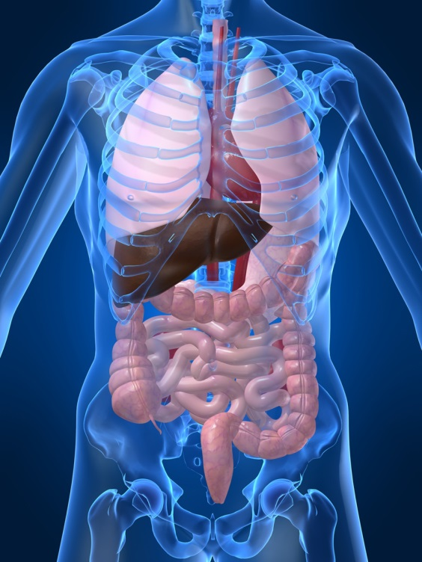
Keep Kidneys Healthy
To reduce the risk or slow the progression of nephropathy
Optimize glucose control (A)
Optimize blood pressure control (A)

Slide 76
Kidney Physiology
kidneys in posterior portion of abd cavity
size and shape of Idaho potato
excretory organ:
  removes water, urea, waste
  maintains blood volume
  acid base balance and lytes
  regulates B/P
  synthesizes erythropoietin – RBC
  Maintains calcium /phosphorus levels, activates vitamin D – helps absorb calcium

Slide 77
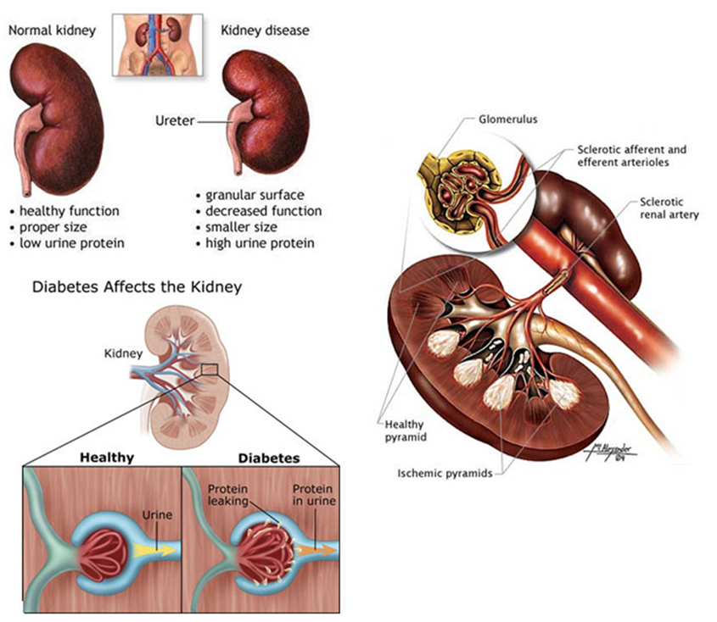
Nephropathy

Slide 78
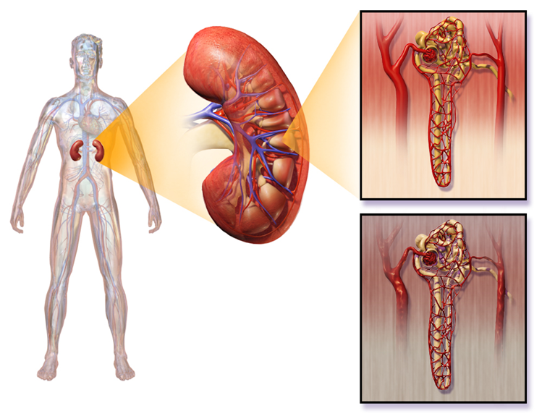
What is Nephropathy?
Hyperglycemia causes renal hyperfiltration and glomerular capillary hyperperfusion.
Causes functional and structural damage to glomeruli, increasing permeability, proteinuria, mesangial expansion and sclerosis… destroys nephrons
Due to insufficient insulin, glycosylation, increased growth hormone, glucagon, and vasoactive hormones.

Slide 79
Diagnosis and Renal Function Tests
Assess urine albumin excretion annually
  In type 1 diabetes duration of ≥5 years
  In all type 2 diabetic patients at diagnosis
Measure serum creatinine at least annually
  In all adults with diabetes regardless of degree of urine albumin excretion
  Used to estimate GFR and stage level of chronic kidney disease, if present

Slide 80
Microalbuminuria / Creatinine to eval kidney function yearly
Microalbuminuria = Spot urine creatinine/albumin ratio
  Category ug/mg creatinine
    normal <30
    microalbuminuria 30-299
    Macro (clinical) alb. ≥ 300
  2 of 3 tests w/in 6 mo high to confirm
  Exercise within 24 h, infection, fever, CHF, marked hyperglycemia, and marked hypertension may elevate urinary excretion over baseline values. ADA

Slide 81
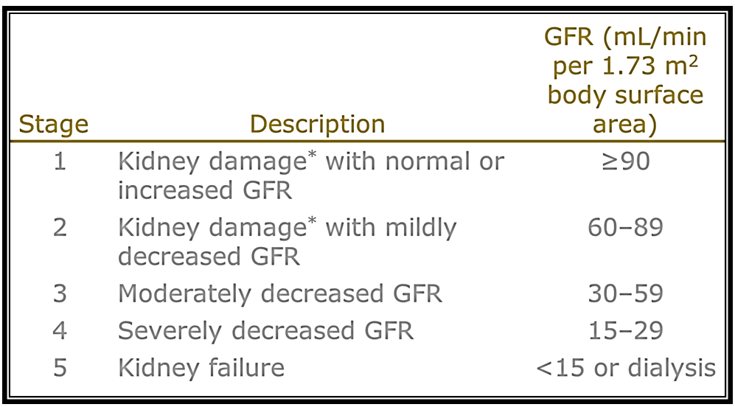
Stages of Chronic Kidney Dx

Slide 82
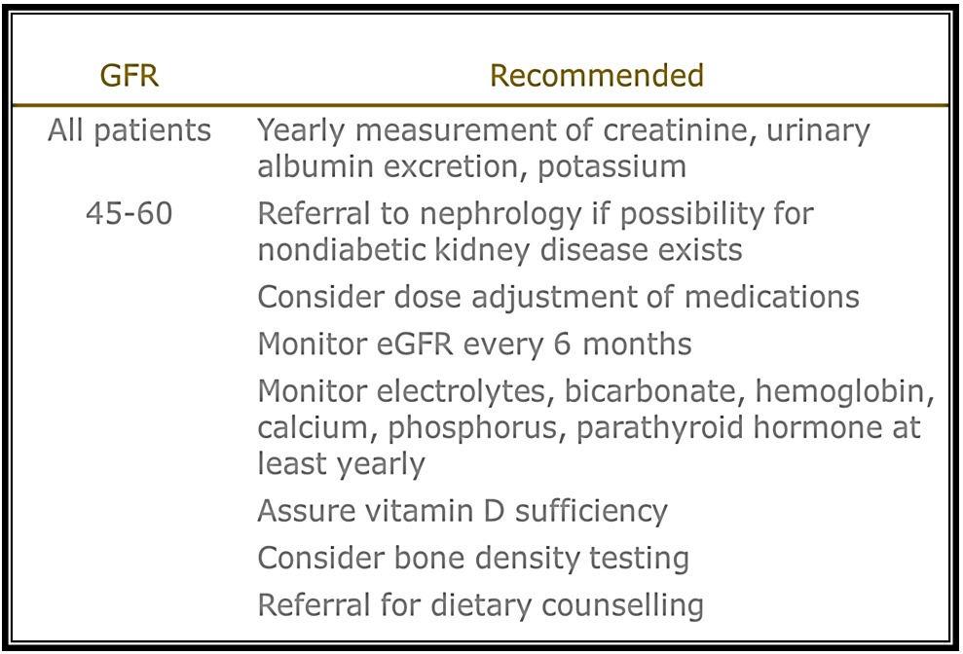
Management of CKD in DM

Slide 83
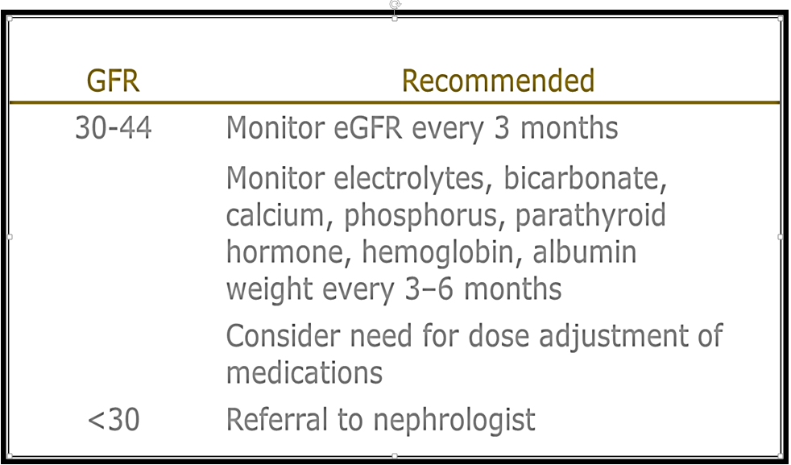
Management of CKD in DM

Slide 84
Nephropathy Risk Factors
Genetic/racial predisposition (African American, Latino, American Indian), duration of dm, age at diagnosis, other genetic factors
Glycemic control, hypertension, smoking, diet, dyslipidemia, frequent urinary tract infections, exposure to IV dyes

Slide 85
Treatment of End-Stage Renal Disease (CKD)
There are four primary treatment options for individuals who experience ESRD:
1. Hemodialysis
2. Peritoneal Dialysis
3. Kidney Transplantation
4. No treatment
Notes:
There are currently three treatment options available to patients who experience kidney failure: Hemodialysis, peritoneal dialysis, and kidney transplantation. Although kidney transplantation is a serious operation, it offers patients with kidney failure their best opportunity for survival. For patients who choose dialysis, approximately one third are still alive after five years of treatment vs. a possible 90% survival rate for individuals who receive a kidney from a living relative. The next part of this presentation will review the procedures, risks and complications associated with each of these options.

Slide 86

Psychosocial Issues associated w/ ESRD
depression
stress
anxiety
support groups, counseling and coping skills

Slide 87
The ABC’s of Diabetes Control
A - A1c less than 7%
B - Blood pressure less than 130/80
C - Cholesterol HDL > 40, Triglycerides < 150
D - Drugs- Keep list for emergencies/ MD
E - Exercise and Eyes
F - Food and Feet
G – Glucose checks and goals
H- Healthy Coping - Hoorah for your hard work!

Slide 88
Hyperglycemic Crisis

Slide 89
Hyperglycemia Objectives
Causes of hyperglycemia
Precipitating factors of DKA*/ HHS*
Pathophysiology of DKA/ HHS
Treatment goals of DKA / HHS
  *DKA = Diabetes Ketoacidosis
  *HHS = Hyperosmolar Hyperglycemic State

Slide 90
AM Hyperglycemia
Possible Solutions?
Exercise
Metformin
HS basal insulin
Prevent hypo – check meds
HS basal insulin or insulin pump
Excessive Hepatic Glucose Production –
Rebound Hyperglycemia or Somogyi Effect
Dawn Phenomena

Slide 91

Meds linked to hyper
  phenytoin (Dilantin®)
  corticosteroids
  protease inhibitors
  Atypical antipsychotics
    Seroquel – quetiapine
    Risperdal - risperadone
    Clozaril - clozapine
    Zyprexa – olanzapine
    Abilify – aripiprazole
    Geodon – ziprasidone

Slide 92

Diabetes KetoAcidosis
135,000 Hospitalizations a year
$2.4 billion U.S. dollars spent on treatment
Often a cry for help
ADA article on Hyperglycemic Crises

Slide 93
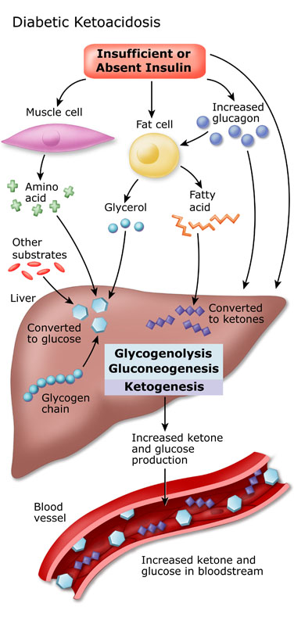
DKA Pathophysiology
Cells use fatty acids for energy.
Insulin not present to inhibit fatty acid breakdown
Acetone – blow off
Betahydroxybuterate
Acetoacetate
Acidosis – Anion Gap >12

Slide 94
DKA Precipitating Factors
25 -30% of time, illness and infection
  increases stress hormone release
50% inadequate insulin dosage
initial manifestation of type 1
emotional stress - especially with teens, neglect or mismanagement

Slide 95
Extreme Hyperglycemia –
Diabetes KetoAcidosis (DKA)
DKA - profound insulin deficiency
Excess stress hormones such as glucagon, epinephrine, and cortisol render insulin less effective
Excess glucose production by liver
Lipolysis leads to FFA’s and ketones
Osmotic diuresis, dehydration, lyte imbalances, acidosis

Slide 96
DKA Signs and Symptoms
hyperglycemia- leads to weakness, lethargy, malaise, headache
GI symptoms - N/V, abd pain
Kussmaul’s deep, rapid breathing
hypothermia, acetone breath
hyperpnea - to rid acidosis
changes in mentation, hyporeflexia/tonia
dehydration, ortho hypo

Slide 97
Extreme Hyperglycemia –
Hyperosmolar Hyperglycemic State (HHS)
occurs in elderly pt’s w/ type 2 - esp if not closely monitored
often precipitated by illness or stress
symptoms may go unrecognized for wks
massive fluid loss from osmotic diuresis
  burns, hypeglycemia, diarrhea, hemodialysis, diuretics, steroids
MI, infections, hypertonic feedings

Slide 98
DKA vs HHS
Usually < 40 yrs old
< 2 days symptoms
Glucose >250
Serum Ketones: +++
pH low (<7.3)
Anion Gap > 12
Usually Type 1
3 – 10% mortality
Usually >60 yrs old
> 5 days symptoms
Glucose >600
Ketones: none to +
pH normal (>7.3)
Usually Type 2
10 - 20% mortality

Slide 99
DKA - HHS Presentation
Action
  maintain insulin drip until ketone neg, glucose <150
  maintain hydration
  check BG q1 hour
  assess lytes
  give sub-Q insulin before d/c IV insulin
  teach, teach, teach
Labs
  NA - low to high
  K+ - moves into vascular space
  Hct and Hgb ⬆ dehydration
  BUN / Creatinine ⬆
  WBC ⬆
  pH low to normal

Slide 100
Tx of DKA Tx of HHS
Insulin - correct glucose, pH, ketosis
Fluids-rehydrate
3. Correct lyte imbalances
4. Prevent complications
5. Provide Glucose
6. Pt and family ed
1. Fluids-rehydrate
2. Insulin - correct glucose
3. Correct lyte imbalances
4. Prevent complications
5. Treat underlying medical condition
6. Pt and family ed

Slide 101
DKA and HHS
5 most important interventions
  Fluids (NS, →0.45 NS, →D51/2 NS once glucose 300mg/dl)
  Insulin (.05 - 0.1unit/kg per hour)
  Potassium / lyte replacement
    (K^{+,} Mg, Ca, Phos)
  Determine, treat precipitating cause
  Education to prevent future episodes

Slide 102

Thank You
Questions?
Email – bev@diabetesed.net
Web- www.diabetesed.net
We are happy to help

