Slide 1


Welcome to
Diabetes in the 21st Century
Beverly Dyck Thomassian, RN, MPH, BC-ADM, CDE
President, Diabetes Education Services
www.DiabetesEd.net
© Copyright 1999-2014, Diabetes Education Services, All Rights Reserved.

Slide 2
Diabetes in the 21st Century:
A Clinical and Educational Update
Describe impact of diabetes
Discuss prevention, management strategies
Discuss different types of diabetes
Describe insulin therapy
Review glucose patterns and determine how to adjust therapy to improve glucose.
Discuss medical nutrition therapy
Gain understanding of Type 2 Meds.
Demonstrate successful teaching strategies

Slide 3
CDC Announces
35% of Americans will have Diabetes by 2050
Boyle, Thompson, Barker, Williamson
2010, Oct 22:8(1)29
www.pophealthmetrics.com

Slide 4
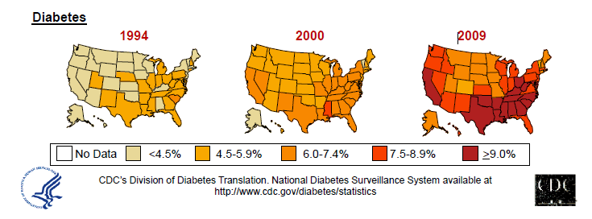
Diabetes in America 2014
29 million or > 9.3%
27% don’t know they have it
1 in 3 of US adults have pre diabetes (79 mil)

Slide 5


Type 2 in Kids
7 fold increase 1990
1 in 6 overwt kids (age 12- 19) have prediabetes.
~2,500 to 3,700 new cases in U.S. annually.
Highest risk: very obese, minority, female, low socioeconomic status, limited education
In age range 12-19, less than 1% have Type 2 – NHANES
Environmental changes to urgently needed

Slide 6

Global Epidemic
Every 10 seconds
  1 person dies with diabetes
  2 people develop diabetes
Every year
  3 million deaths
  6 million new cases
World Diabetes Day is November 14
March is ADA Sound the Alert Day “find people w/ undetected diabetes”

Slide 7


World Diabetes Day
November 14

Slide 8
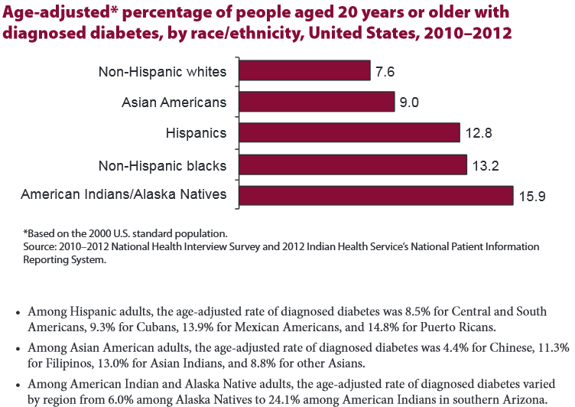

Age-adjusted Diabetes Prevalence
20 yrs or older, by race/ethnicity— U.S. 20014

Slide 9

Why Should Zip Code Determine Life Expectancy?
California Endowment – look up your zip code at www.measureofamerica.org

Slide 10

Free Live Webinars and Live Seminars at DiabetesEd.net
Free Webinars
  Preparing to take CDE
  New Frontiers
  New Medications
  BC-ADM

Slide 11
Role of the Pancreas
Endocrine Functions
Beta Cells - Insulin
  Anabolic hormone - helps store glucose as glycogen in muscle, liver
  secreted in response to elevated glucose
  halts breakdown of glycogen in liver
  increases protein synthesis, fat storage
  powerful hypoglycemic
Beta Cells - Amylin
  secreted in 1:1 ratio with insulin
  Causes satiety
  Lowers post-prandial glucagon response
  Slows gastric emptying
  Type 1 make none
  Type 2 make less than normal amounts

Slide 12
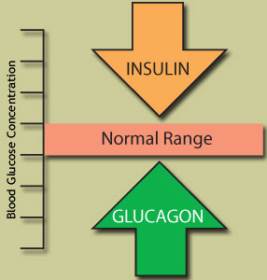
Role of the Pancreas
Endocrine Functions
Alpha cells - Glucagon
  Opposes action of insulin at the liver
  stimulated in response to low glucose levels
  stimulates liver to convert glycogen to glucose
  inhibits liver from glucose uptake
  causes hyperglycemia

Slide 13
Hormones Effect on Glucose
Hormone
Glucagon (pancreas)
Stress hormones (kidney)
Epinephrine (kidney)
Insulin (pancreas)
Amylin (pancreas)
Gut hormones - incretins (GLP-1) released by L cells of intestinal mucosa, beta cell has receptors)
Effect



⇒
⇒
⇒

Slide 14
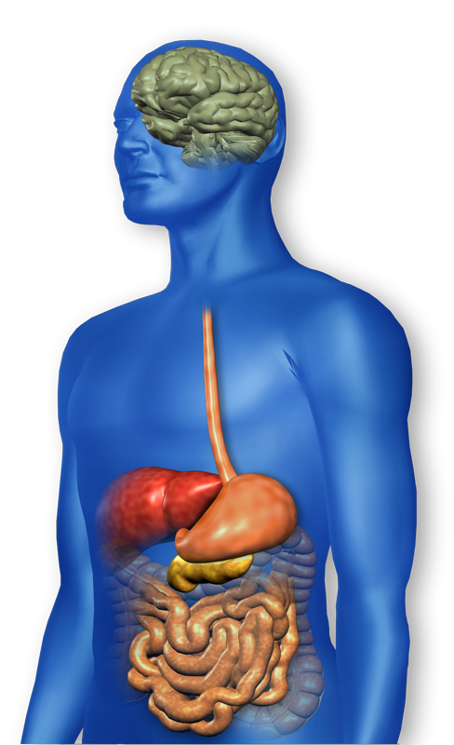
GLP-1 Effects in Humans
Understanding the Natural Role of Incretins
GLP-1 secreted upon the ingestion of food
Promotes satiety and
reduces appetite
Alpha cells:
↓ Postprandial
glucagon secretion
↑ Beta-cell
response
Liver:
↓ Glucagon reduces hepatic glucose output
Beta cells:
Enhances glucose-dependent insulin secretion
Stomach:
Helps regulate gastric emptying
Adapted from Flint A, et al. J Clin Invest. 1998;101:515-520
Adapted from Larsson H, et al. Acta Physiol Scand. 1997;160:413-422
Adapted from Nauck MA, et al. Diabetologia. 1996;39:1546-1553
Adapted from Drucker DJ. Diabetes. 1998;47:159-169
GLP-1 degraded by
DPP-4 w/in minutes
Notes:
14
14
Required
DISCUSSION POINTS:
--Upon food ingestion, GLP-1 is secreted into the circulation from L cells of small intestine.
--GLP-1 increases beta-cell response by enhancing glucose-dependent insulin secretion.
--GLP-1 decreases beta-cell workload and hence the demand for insulin secretion by:
--Regulating the rate of gastric emptying such that meal nutrients are delivered to the small intestine and, in turn, absorbed into the circulation more smoothly, reducing peak nutrient absorption and insulin demand (beta-cell workload)
--Decreasing postprandial glucagon secretion from pancreatic alpha cells, which helps to maintain the counterregulatory balance between insulin and glucagon
--Reducing postprandial glucagon secretion, GLP-1 has an indirect benefit on beta-cell workload, since decreased glucagon secretion will produce decreased postprandial hepatic glucose output
--Having effects on the central nervous system, resulting in increased satiety (sensation of satisfaction with food intake) and a reduction of food intake
--By decreasing beta-cell workload and improving beta-cell response, GLP-1 is an important regulator of glucose homeostasis.
SLIDE BACKGROUND:
--Effect on Beta-cell: Drucker DJ. Diabetes. 1998; 47:159-169
--Effect on Alpha cell: Larsson H, et al. Acta Physiol Scand. 1997; 160:413-422
--Effects on Liver: Larsson H, et al. Acta Physiol Scand. 1997; 160:413-422
--Effects on Stomach: Nauck MA, et al. Diabetologia. 1996; 39:1546-1553
--Effects on CNS: Flint A, et al. J Clin Invest. 1998; 101:515-520

Slide 15
Bariatric Surgery
Consider on diabetes pts w/ BMI >35, esp with comorbidities
Remission (BG normalized)
  rates range from 40 – 95%
  Better results with newer diabetes (more beta cell mass)
  Due to increase incretins (gut hormones)
Still researching long term benefits, cost effectiveness and risk

Slide 16
Natural History of Diabetes
Normal
FBG <100
Random <140
A1c <5.7%
Prediabetes
FBG 100-125
Random 140 - 199
A1c ~ 5.7- 6.4%
50% working pancreas
Diabetes
FBG 126 +
Random 200 +
A1c 6.5% or +
20% working pancreas
Yes!
NO
Development of type 2 diabetes happens over years or decades

Slide 17
Signs of Diabetes
Polyuria
Polydipsia
Polyphasia
Weight loss
Fatigue
Skin and other
infections
Blurry vision
Glycosuria, H₂O losses
Dehydration
Fuel Depletion
Loss of body tissue, H₂O
Poor energy utilization
Hyperglycemia increases incidence of infection
Osmotic changes

Slide 18

Diabetes Classifications
Type 1
Type 2
Gestational
Secondary
Notes:
Type 1-absent insulin
Type 2-too much insulin early, then resistence and less secretion
GDm-simliar to Type 2, found during pregnancy

Slide 19
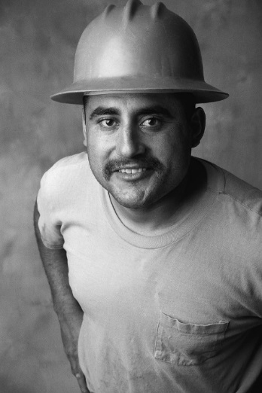

Case Study
1. Pt profile: 5’8”, 192 lb male
Diabetes 12 years, on insulin 3 yrs
What type of DM and how do you know?
2. Pt profile: 5’6”, 108 lb female
On insulin 3u Novolog before meals,
10u Lantus at bedtime
What type of DM and how do you know?

Slide 20

Type 1 Rates Increasing Globally
23% rise in type 1 diabetes incidence from 2001-2009
Why?
  Autoimmune disease rates increasing over all
  Changes in environmental exposure and gut bacteria?
  Hygiene hypothesis
  Obesity?

Slide 21
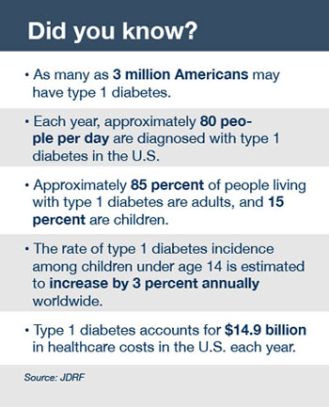
Type 1 Diabetes Facts

Slide 22

Type 1 – 10% of all Diabetes
Genetics and Risk Factors
  Auto-immune pancreatic beta cells destruction
  Most commonly expressed at age 10-14
  Insulin sensitive (require 0.5 - 1.0 units/kg/day)
  Combo of genes and environment:
    Autoimmunity tends to run in families
    Higher rates in non breastfed infants
    Viral triggers: congenital rubella, coxsackie virus B, cytomegalovirus, adenovirus and mumps.

Slide 23
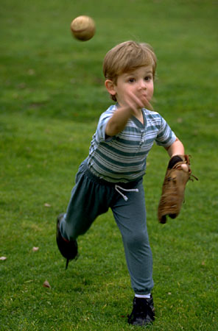
Incidence of Type 1 in Youth
General Pop 0.3%
Sibling 4%
Mother 2-3%
Father 6-8%
Rate doubling every 20 yrs
Many trials underway to detect and prevent (Trial Net)

Slide 24
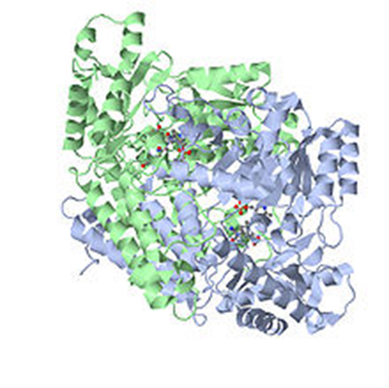
Autoantibodies Assoc w/ Type 1
Panel of autoantibodies –
  GAD65 - Glutamic acid decarboxylase –
  ICA - Islet Cell Cytoplasmic Autoantibodies
  IAA - Insulin Autoantibodies

Slide 25
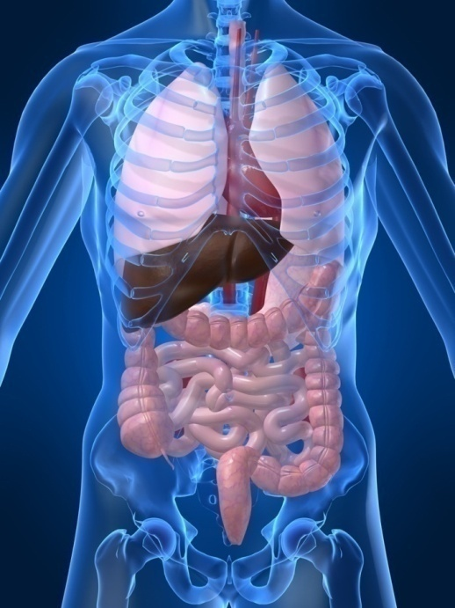
Type 1 Diabetes Associated with other immune conditions
Celiac disease (gluten intolerance)
Thyroid disease
Addison’s Disease
Rheumatoid arthritis
Other

Slide 26





What Does Type 1 Look Like?
Bret Michaels
Mary Tyler Moore
Adam Morrison
Nick Jonas
Justice Sonia Sotomayor
From Debbie Nagata’s slide collection

Slide 27

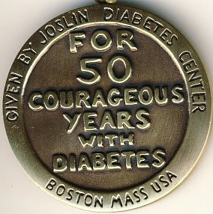
Medalist Study – Harvard
Joslin Diabetes Center
After 50 years with diabetes
  Many still produced some insulin
  Many had no eye disease

Slide 28

Type 1 Summary
Autoimmune
Complete pancreatic destruction
Need insulin shots
Often first present in DKA

Slide 29

Type 1 in Hospital
43 yr old admitted to evaluate angina.
Morning blood sugar is 92.
Based on Regular insulin sliding scale, no insulin required.
Breakfast tray shows up and patient says, I need my insulin shot before I eat.
What do you say?

Slide 30
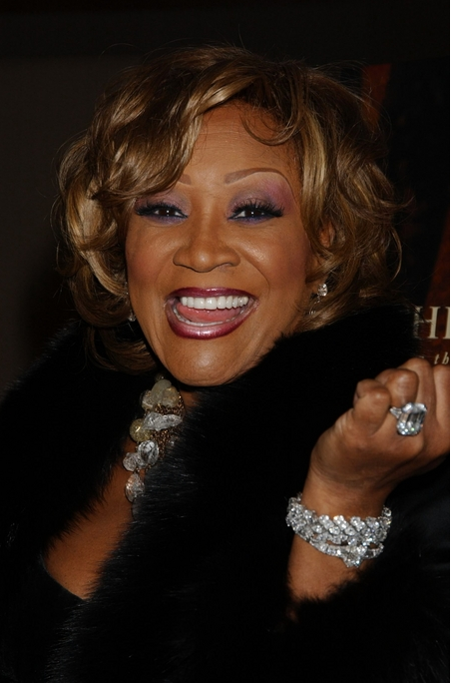
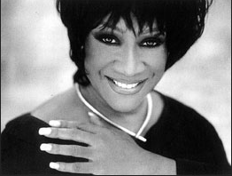
Patti Labelle
"divabetic" -- that's a mix of diabetic and diva

Slide 31

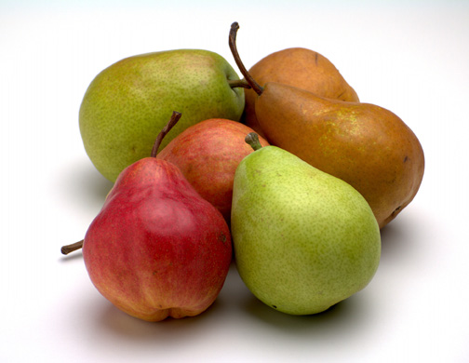


Slide 32
Natural Progression of Type 2 Diabetes
Plasma
Glucose
Postprandial glucose
Fasting glucose
126 mg/dL
Relative
β-Cell
Function
Insulin resistance
Insulin secretion
-20
-10
0
10
20
30
Years of Diabetes
Prior to diagnosis
After diagnosis
Adapted from Bergenstal et al. 2000; International Diabetes Center.
Notes:
These graphs show the typical progressive nature of type 2 diabetes in terms of 2 key indices: increasing plasma glucose level (top panel) and decline in relative β-cell function as reflected by the drop in endogenous insulin and rise in insulin resistance (lower panel).
In the natural history of type 2 diabetes, insulin resistance rises, insulin secretion falls, and glucose levels begin to rise before diabetes is diagnosed.
Based on the natural history, type 2 diabetes is a disease of progressive insulin failure as shown in the graphic model developed by researchers at the International Diabetes Center.¹
Before the onset of diabetes, glucose levels start to rise, with a slightly sharper increase in the postprandial value than in fasting glucose. Both postprandial and fasting plasma glucose levels continue to rise if diabetes is left untreated.²
Prior to the diagnosis of diabetes, resistance of cell receptor sites to insulin starts to increase, while insulin secretion by β-cells decreases. Insulin resistance reaches a peak and remains constant. Endogenous insulin secretion continues to decline over the course of diabetes.²
References:
1. Kendall DM. Postprandial blood glucose in the management of type 2 diabetes: the emerging role of incretin mimetics. Available at: http://www.medscape.com/viewarticle/515693.
Accessed April 21, 2006.
2. Ramlo-Halsted BA, Edelman SV. The natural history of type 2 diabetes: implications for clinical practice. Prim Care. 1999;26:771-789.

Slide 33

Cardio Metabolic Risk -
5 Hypers -
Hyperinsulinemia (resistance)
Hyperglycemia
Hyperlipidemia
Hypertension
Hyper”waistline”emia (35” women, 40” men)
Manifestations of Insulin Resistance

Slide 34

Diabetes 2 - Who is at Risk?
(ADA Clinical Practice Guidelines)
Testing should be considered in all adults who are overweight (BMI ≥ 25) and have additional risk factors:
  First-degree relative w/ diabetes
  Member of a high-risk ethnic population
  Habitual physical inactivity
  PreDiabetes
  History of heart disease

Slide 35

Diabetes 2 - Who is at Risk?
(ADA Clinical Practice Guidelines)
Risk factors cont’d
  HTN - BP > 140/90
  HDL < 35 or triglycerides > 250
  baby >9 lb or history of Gestational Diabetes Mellitus (GDM
  Polycystic ovary syndrome (PCOS)
  Other conditions assoc w/ insulin resistance:
    Severe obesity, acanthosis nigricans (AN)

Slide 36
Acanthosis Nigricans (AN)
Signals high insulin levels in bloodstream
Patches of darkened skin over parts of body that bend or rub against each other
  Neck, underarm, waistline, groin, knuckles, elbows, toes
  Skin tags on neck and darkened areas around eyes, nose and cheeks.
No cure, lesions regress with treatment of insulin resistance

Slide 37
Diabetes Detectives Needed
On average – takes 6.5 years to diagnose diabetes
1/4 of all people with diabetes don’t know they have it

Slide 38
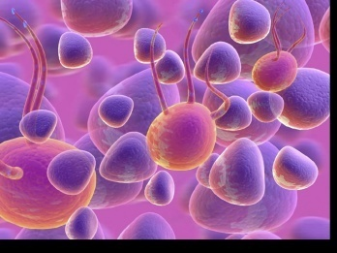
Ominous Octet
Decreased
satiation neuro-
transmission
Increased renal glucose reabsorption
Decreased
amylin, β-cell secretion
80% loss at dx
Decreased
Gut hormones
Increased glucagon secretion
G
I
G
I
G
G
I
Increased lipolysis
I
G
G
G
I
I
G
G
I
Increase glucose
production
I
G
G
Decreased glucose
uptake
Notes:
38
38

Slide 39
Comparison of Type 1 and Type 2
Type 1
Type 2
Obesity
x
xxx
Insulin dependence
xxx
30%
Respond to oral agents
0
xxx
Ketosis
xxx
x
Antibodies present
xxx
0
Typical Age of onset
teens
adult
Insulin Resistance
0
xxx

Slide 40

Diabetes is also associated with:
Fatty liver disease
Obstructive sleep apnea
Cancer; pancreas, liver, breast
Alzheimer’s
Depression

Slide 41

Gestational DM ~ 7% of all Pregnancies
GDM prevalence increased by
  ∼10–100% during the past 20 yrs
Native Americans, Asians, Hispanics, African-American women at highest risk
Immediately after pregnancy, 5% to 10% of GDM diagnosed with type 2 diabetes
Within 5 years, 50% chance of developing DM in next 5 years.

Slide 42
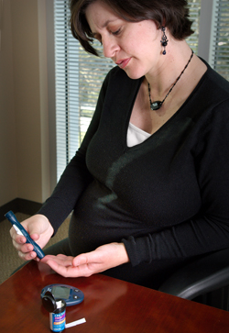
Diabetes in pregnant mothers associated with …
Offspring
  Fetal Complications
  Obesity and diabetes later in life
Mother
  More complicated pregnancy and delivery
  Diabetes later in life
Intrauterine environment is important

Slide 43
Postnatal Health:
Maternal Behavior
Encourage breastfeeding for one year
  (25% of women achieving this goal)
Screening 6-12 weeks post partum using non-pregnant OGTT criteria (50%)
Repeat at 3 yr intervals or signs of DM
Encourage weight control and exercise
Make sure connected with health care
Preconception counseling

Slide 44

Start Metformin therapy
For women with PreDiabetes and History of GDM

Slide 45
Other Causes of Hyperglycemia
  Steroids
  Agent Orange
  Tube feedings / TPN
  Transplant medications
  Cystic Fibrosis
  Regardless of cause, requires treatment
    Insulin always works
    Sign of pancreatic malfunction

Slide 46
Flash Mob – World Diabetes Day to Beat It
  March R/C/R
  Fred Astaire
  Point R/L
  Arms up, down
  Shoulder Walk
  Punch down/up
  Scoot Rt/Left
  Reach up R/L
  Shoulder Walk
Open door
Ride Horse
Scoot Rt/Left
Turn R & Clap, then L
Shoulder Walk
Punch down/up

Slide 47
DiaBingo
B Frequent skin and yeast infections
B A BMI of ____ or greater is considered overweight
B To reduce complications, control A1c, Blood pressure, Cholesterol
B PreDiabetes – fasting glucose level of ___ to ____
B Erectile dysfunction indicates greater risk for ____
B Diabetes – fasting glucose level____ or greater
B Type 1 diabetes is best described as an ______ disease
B People with diabetes are ______ times more likely to die of heart dx
B Elevated triglycerides, < HDL, smaller dense LDL
B Each percentage point of A1c = _____ mg/dl glucose
B At dx of type 2, about __% of the beta cell function is lost
B Diabetes – random glucose ____ or greater

Slide 48

Glucose Management and Hospitalized Patients
In hospitalized patients with critical illness, hyperglycemia is a signal that warrants our attention.

Slide 49

Hospitals and Hyperglycemia –
What’s the Big Deal?
Hyperglycemia is associated with increased morbidity and mortality in hospital settings.
  Acute Myocardial Infarction
  Stroke
  Cardiac Surgery
  Infection
  Longer lengths of stay

Slide 50
Hyperglycemia*: A Common Comorbidity in Medical-Surgical Patients in a Community Hospital
Umpierrez G et al, J Clin Endocrinol Metabol 87:978, 2002
12%
26%
62%
Normoglycemia
Umpierrez et al
n = 2,020
* Hyperglycemia: Fasting BG ≥ 126 mg/dl
or Random BG ≥ 200 mg/dl X 2
Known Diabetes
New Hyperglycemia
Notes:
In a more recent study that involved 2020 consecutive patients admitted to a community hospital in Atlanta, we found that 64% of patients had normal glucose values, 26% had a prior history of diabetes, and that 12% of patients with hyperglycemia, as determined by 2 or more FBG > 126 or RBG > 200, did not had a know history of diabetes prior to admission.

Slide 51
Effect of Hyperglycemia on Hospital Mortality
Prior history of
*
Mortality (%)
*
*
*P<.01 compared with normoglycemia and known diabetes.
Umpierrez GE et al. J Clin Endocrinol Metab. 2002;87:978-982.
Notes:
The medical records of 2030 consecutive adult patients were analyzed for the presence of hyperglycemia and any association with poor hospital outcomes.
New hyperglycemia was associated with a 16% mortality rate compared with 3% and 1.7% for patients with a prior history of diabetes or normoglycemia (P<.01).
The mortality rate was significantly higher for patients with new hyperglycemia regardless of whether they were admitted to the ICU (P<.01 for both ICU and non-ICU patients compared with those with diabetes or normoglycemia). Mortality rates were 10% for
non-ICU patients with new hyperglycemia and 31% for ICU patients.
Reference
Umpierrez GE, Isaacs SD, Bazargan N, You X, Thaler LM, Kitabchi AE. Hyperglycemia: an independent marker of in-hospital mortality in patients with undiagnosed diabetes. J Clin Endocrinol Metab. 2002;87:978-982.

Slide 52

BG Above Normal = Trouble
Pre Diabetes
  Fasting Glucose = 100-125mg/dl
  A1c 5.7 – 6.4%
Diabetes
  Fasting Glucose = 126 mg/dl +
  Random Glucose = 200 mg/dl +
  A1c 6.5% +
  Any blood glucose above 140 requires treatment
  Umpierrez et al

Slide 53

WHAT SHOULD WE AIM FOR?
Critically Ill pts
  BG > 180- Start insulin
  BG goal 140-180
Non Critically Ill patients BG Goals
  Premeal <140
  Post meal <180
Insulin therapy preferred treatment
Consensus: Inpt Hyperglycemia, Endocr Pract. 2009;15 (No.4)

Slide 54

Management of Hyperglycemia and Diabetes
Stop oral agents (ie) metformin & sulfonylurea on admission
“The sole use of Sliding Scale insulin is discouraged” – ADA 2014
For discharge, oral meds can be resumed
  Start Basal/bolus therapy
    NPH and Regular insulin
    Long-acting and rapid-acting insulin
    Premixed insulin

Slide 55

Life Study – Mrs. Jones
Mrs. Jones is 62 years old, overweight and complaining of feeling tired and urinating several times a night. She is admitted with a cellulitis of her foot. Her WBC is 12.3, glucose 237. She is hypertensive with a history of gestational diabetes. No ketones in urine.
What are her risk factors, signs of diabetes
What type of diabetes does she have?
Does she have insulin resistance?

Slide 56
What Do You Say?
Mrs. Jones asks you
What is type 2 diabetes?
Will this go away?
Will I get complications?
Will I need to take diabetes medication for the rest of my life?
How come I got diabetes?
Do I have to check my blood sugars?

Slide 57

In Patient Strategies – Start Early, Focus on Survival Skills
Look for
“teaching moment” opportunities

Slide 58

Running into Roadblocks?
HUG Patients
Unconditional Positive Regard –
involves showing complete support and acceptance of a person no matter what that person says or does.
  Carl Rogers
Help with
Unconditional
Guidance and Support
  Anne Peters, MD, CDE
  ADA Post Grad

Slide 59
No one is Unmotivated
…. to lead and long and healthy life
These are the 3 usual Critical Barriers
  Perceived worthlessness
  Too many personal obstacles
  Absence of support and resources
  Bill Polonsky, PhD, CDE

Slide 60
Overcoming barriers
Confront the key misbelief. Ask the question, does dm cause complications?
Offer pts evidence based hope message –
Frequent contact
Paired glucose testing
Ask pt, “Tell me 1 thing that is driving you crazy about your diabetes”
Discuss medication beliefs
To improve outcomes, see pts more often
  Bill Polonsky, PhD, CDE

Slide 61

How Often Should I Check?
Be realistic!!
Type 1 – as often as needed
Type 2 – as needed
Consider:
  Types and timing of meds
  Goals
  Ability (physical and emotional)
  Finances

Slide 62
How will it help me?
See if your treatment plan is working
Make decisions regarding food and/or med adjustment when exercising
Find out how that pizza affected your BG
Avoid unwanted weight gain
Enhanced athletic performance
Find patterns
Manage illness

Slide 63

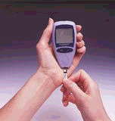
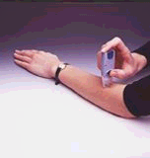
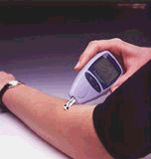
New Meters – a little goes a long way
0.3 microliters of blood
minimal pain
Customer Service (toll-free): Look for 800 number

Slide 64
Foot Care
Lift the sheets and look at the Feets!

Slide 65
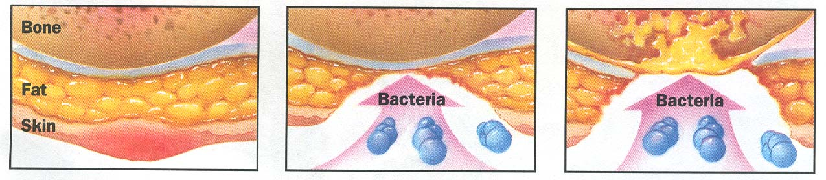
Foot Wounds
Blisters Ulcers Bone infection
Calluses

Slide 66
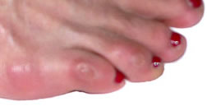
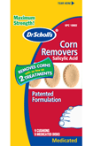

No Bathroom Surgery

Slide 67
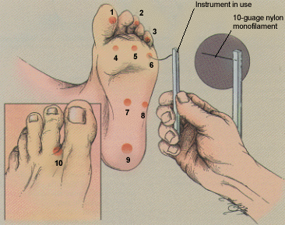
5.07 monofilament = 10gms linear pressure
If pt can’t feel pressure = neuropathy
Free Monofilaments
http://www.hrsa.gov/leap/

Slide 68
3 Most Important Foot Care Tips
Three Most Important Foot Care Tips
Inspect and apply lotion to your feet every night before you go to bed.
Do NOT go barefoot, even in your house. Always wear shoes!
Every time you see your doctor, take off your shoes and show your feet.

Slide 69
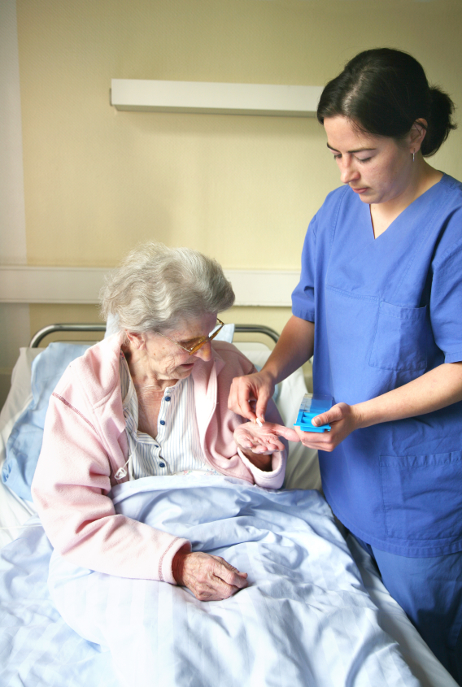
Life Study – Mrs. Jones
How would we manage her BG in hospital?

Slide 70
Now What?
Nurse administered insulin and pt only ate a few bites of turkey and drank non sugar tea?
Nurse had an emergency and pt already ate lunch?
You just gave 3 units of Aspart and patient needs to go to OR NOW!

Slide 71

Medication for Discharge?
Mrs. Jones is improved and ready to go home.
What glucose management strategies for home?
Her A1c is 9.3%

Slide 72
Discharge insulin Algorithm
Discharge Treatment
A1C < 7%
A1C 7%-9%
A1C >9%
Re-start outpatient treatment regimen
(Orals and/or insulin)
Re-start outpatient oral agents and D/C on glargine once daily at 50-80% of hospital dose
D/C on basal bolus at same hospital dose.
Alternative: re-start oral agents and D/C on glargine once daily at 50-80% of hospital dose
Clinical Guidelines for the Management of Hyperglycemia in Hospitalized Patients in a Non-Critical Care Setting

Slide 73

Discharge Teaching
What supplies will she need?
What top 5 things do we need to teach her?
What resources can we provide?
What referrals?

Slide 74
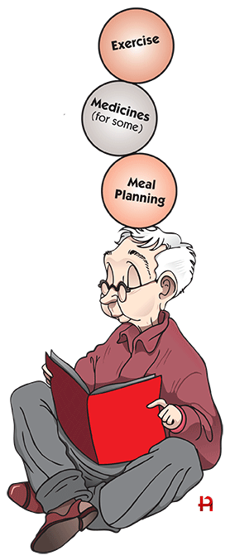
5 Survival Skills
Basics of Diabetes
Can patient perform self blood glucose monitoring? Do they need meter?
Can pt safely take meds / insulin? Teach side effects.
Meal Planning?
Self Care including hypo prevent/treat
Follow-Up plan - Does pt know who to contact when need help?
Diabetes Education and more!

Slide 75
Insulin Teaching Keys
Bolus insulin with meals
Basal 1-2xs daily
Abdomen preferred injection site
Stay 1” away from previous site
Don’t re-use ultra fine syringes
Keep unopened insulin in refrigerator
Toss opened insulin vial after 28 days
Proper disposal
Review patients ability to withdraw and inject.
Side effects include hypoglycemia/wt gain

Slide 76
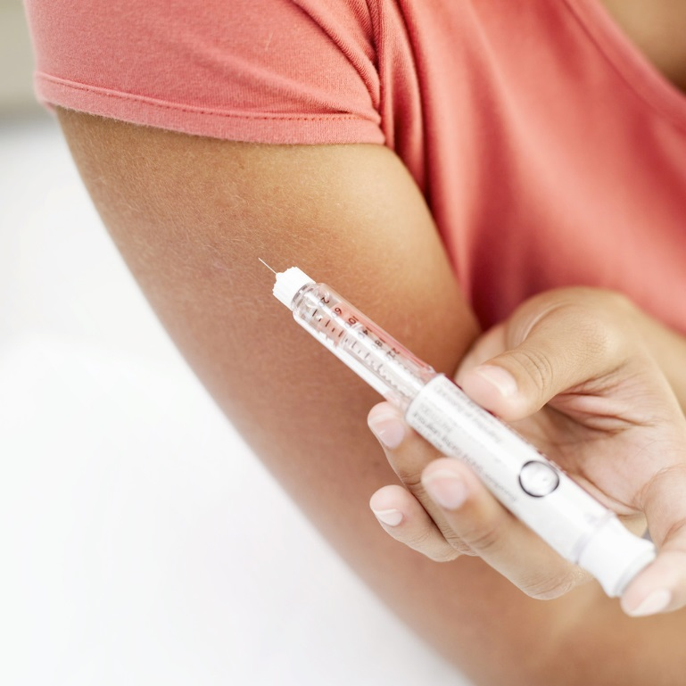
Insulin Pens
Instructions
    Prime needle to assure accurate insulin dose given
    Hold needle in for 5 seconds after injection
    Roll 70/30 pens
    Replace large needle cap (white),
      Unscrew and remove needle after injection. Do not leave needle on pen
    Remember that inpatient safety pen needles are different than home pen needles.

Slide 77

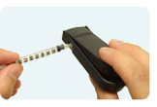
Sharps Disposal: Product and Info
Look in the Government section white pages for a household hazardous waste listing for your city or county.
Call 1-800-CLEANUP (1-800-253-2687)
Search for collection centers on the California Integrated Waste Management Board (CIWMB) Web site: http://www.ciwmb.ca.gov/HHW/HealthCare/Collection/

Slide 78
Medical Waste Management Act Effective Sept 1, 2008
CA Senate Bill 1305
New law requires proper disposal of home generated syringes, needles, lancets
Disposal in solid waste containers no longer permitted
EPA in 2004 also discourages sharps disposal in trash.

Slide 79
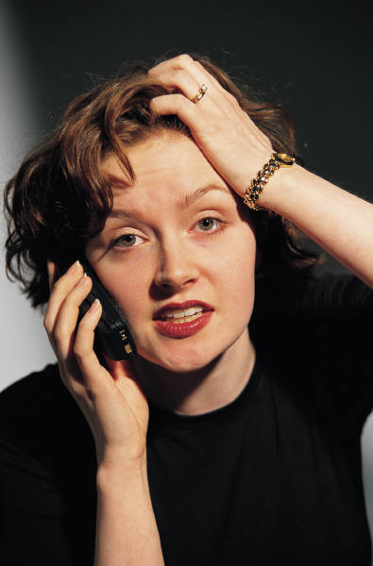
When to Call Provider?*
Blood glucose <70
Blood glucose > 250 twice in a day (adults)
Blood glucose >240 x 3
*When sick with fever
*Individualize based on pt/provider

Slide 80
Mrs Jones – Teaching Priorities
Foot Care
How to use meter
Insulin Injections
Signs of Hypo/Hyper
When and who to call for help
Follow-up Care

Slide 81

Based on Mr R’s clinical picture – In hospital
How Much Insulin Needed?
Creatinine 1.6
76 years old
Not very hungry
BMI 21
Weighs 80kg
Glucotrol 5mg at home
A1c 7.2%

Slide 82

How Much Insulin Does a Patient Need?
It depends, based on:
  Body weight
    Overwt, normal wt, or thin
  Frail, elderly
  Eating status
    Normal, poor intake or NPO
  Renal or hepatic insufficiency
  Type of Diabetes
  Current meds; steroids, insulin, oral dm agents
  Infected or Septic

Slide 83
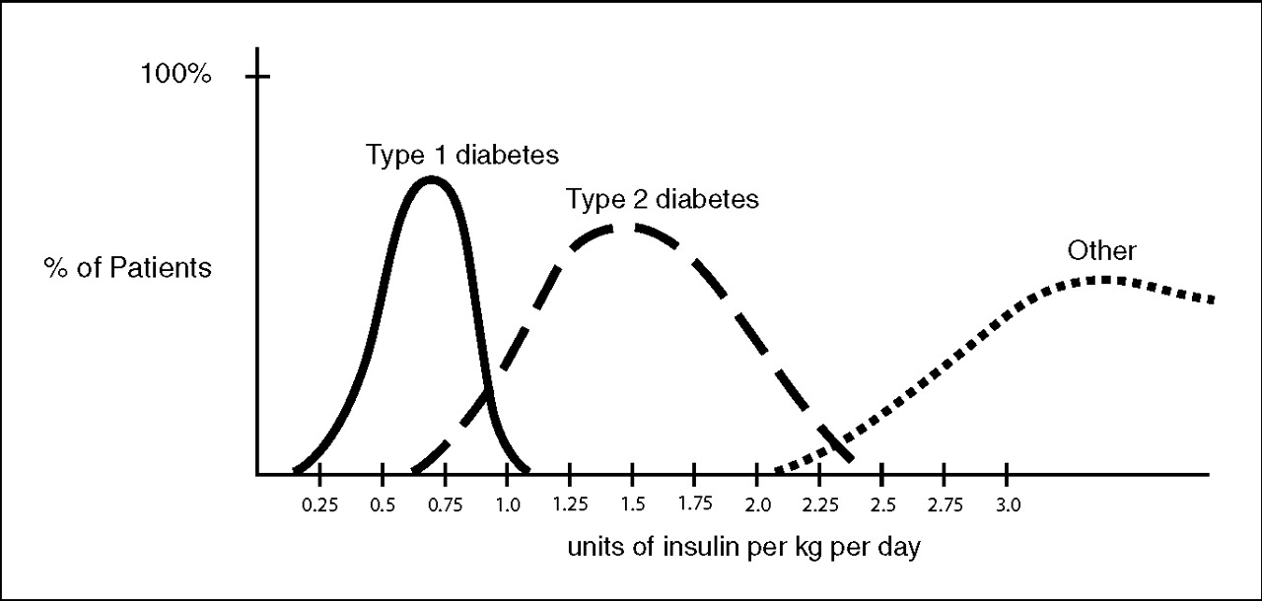
Insulin Dosing Type 1 & 2
U-500 Insulin: When More With Less Yields Success: Diabetes Spectrum March 20, 2009 vol. 22 no. 2 116-122

Slide 84
Calculate Daily Insulin Needs
Based on unique characteristics of pt, where would you start?
  Body wt in Kg x _________ = total daily dose
  May need more or less based on clinical presentation
  Divided into 50% basal and 50% bolus
  Less 0.3 u/kg 0.5u/kg More 1.0 u/kg
  Thin, elderly,  creat Heavy, infection, steroids

Slide 85
Calculate Insulin Needs
Basal/ insulin carb/ correct
Body wt in Kg x 0.3
80kg x 0.3 = 24 units daily
Basal = 12 units (50%)
Bolus = 12 units / 3 meals = 4 units each meal
What if he is nauseated?

Slide 86
Mr. Rs Pattern
4 unit meal bolus + 12 unit Lantus hs

Slide 87

BG Running Low?
Possible Causes
  Too much insulin
    Premeal bolus
    HS basal
  Glucose toxicity improving
  Infection improving
  Stopped/lowered steroids
  Poor kidney function
  Skipped meal, poor PO intake
  Not eating enough carbs

Slide 88
Hypoglycemia = “Limiting Factor”
Defined as glucose of 70mg/dl or below
50% of episodes occur during the night
Higher mortality rate with severe hypoglycemia secondary to sulfonylureas
  Especially (glyburide) Micronase®, Diabeta®
Blood glucose levels don’t describe severity, response is individual

Slide 89

Hypoglycemia Symptoms
Autonomic
  Anxiety
  Palpitations
  Sweating
  Tingling
  Trembling
  Hypoglycemic Unawareness
Neuroglycopenia
  Irritability
  Drowsiness
  Dizziness
  Blurred Vision
  Difficulty with speech
  Confusion
  Feeling faint

Slide 90
Treatment of Hypoglycemia
If blood glucose 70mg/dl or below:
  10-15 gms of carb to raise BG 30 - 45mg/dl
Retest in 15 minutes, if still low, treat again, even without symptoms
Follow with usual meal or snack
If BG less than 40, allow recovery time

Slide 91
15 - 20 Gms Carb Sources
3 - 4 Glucose Tablets
8 - 10 Lifesavers candy
8 - 10 Hard candies
2 Tablespoons Raisins
4 - 6 oz’s Nondiet soda
4 - 6 oz’s Fruit Juice
8 oz Milk (non fat)

Slide 92

BG Too Low? Insulin Adjustment Guidelines
Before meal Blood glucose <70?
  Implement hypoglycemia protocol
  Evaluate cause and make needed adjustments
    Missed meal?
    Too much insulin?
Morning blood glucose < 90?
  Decrease evening Lantus by 10%
Evaluate trends, provide feedback

Slide 93
3 days poor intake, pt started on Tube Feeding
If on continuous tube feeding, how would this change his insulin regimen?
If on intermittent tube feeding, how would this change his insulin regimen?
If patients tube feeding is interrupted, what precautions would you take?

Slide 94
Glycemic Management During Enteral Nutrition
Continuous enteral nutrition (EN)
  Basal insulin: once or twice daily
  Prandial bolus insulin: to match the feeding or 70/30 mix BID
Cycled enteral nutrition: Based on situation:
  Basal insulin
  Bolus insulin administered q4 to 6 hours
  Correctional insulin given for BG above goal
Bolus enteral nutrition
  Rapid acting analog or short acting insulin given prior to each bolus
  May also need basal on board
  If tube pulled out, consider hanging IV D10%

Slide 95
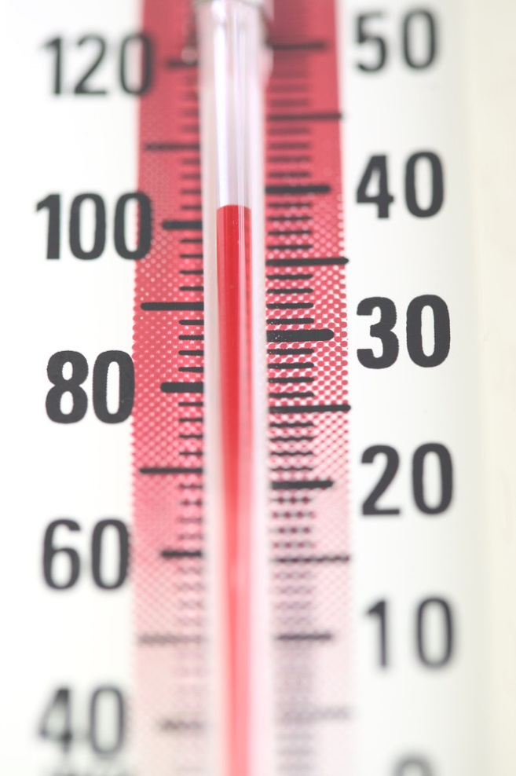
BG Running High?
Possible Causes
  Glucose Toxic
  Infection
  Started on steroids
  Physical stress
  Insulin dose too low

Slide 96
Calculate Daily Insulin Needs
Based on unique characteristics of pt, where would you start?
  Body wt in Kg x _________ = total daily dose
  May need more or less based on clinical presentation
  Less 0.3 u/kg 0.5u/kg More 1.0 u/kg
  Thin, elderly,  creat Heavy, infection, steroids

Slide 97

Intensify Insulin therapy or start insulin Drip
100 units insulin in 100 cc NS Bag
1 cc = 1unit of insulin
Society of Hospital Medicine listing of sample Insulin Drip Protocols

Slide 98
Preparation for Surgery
Try to schedule surgery in am, resume meds/insulin when eating and stable.
Oral medications: In am, hold all diabetes oral medications
Basal Insulin: Night before
  type 2s, may need to adjust basal dose
  type 1s give up to 100% of basal dose.
Bolus insulin: may need mild insulin bolus coverage for type 1 and type 2’s
Have D5 or D10 IV bags available in case of hypo

Slide 99
Special Considerations During Hospital Stay
Hypoglycemia –
  treat with 15 gms carb and recheck every 15-30 minutes until BG stable
  Notify MD to change insulin orders
Contact Diabetes Ed Team if patient admitted with insulin pump.
IV Insulin – look carefully at insulin sensitivity and adjust insulin drip rate based on BG Trends
Give basal insulin, even if pt isn’t eating. Dose may need adjustment.

Slide 100

Bottom Line
30-40% of hospitalized patients have diabetes
  10% aren’t officially diagnosed
Cardiovascular disease is the leading cause of hospitalization for people with diabetes
Look for patients with hyperglycemia and cardiometabolic risk factors: smokers, HTN,
central obesity, abnormal lipids, Acanthosis.
Provide education and promote self-advocacy

Slide 101
Diabetes Self-Management
Prevention
Goals
Insulin
Meal Plan
Exercise / Activity
Medications

Slide 102

Financial Advisor
Mid 30s, friendly, he smiles to greet you and you notice his gums are inflamed. You’d guess a BMI of 26 or so, with most of the extra weight in the waist area.
If you could give him some health related suggestions, what would they be?

Slide 103

Can we stop pre diabetes from progressing?
3, 234 people w/ Pre-Diabetes randomized:
  Placebo
  Diet/Exercise or
  Metformin
over a three year period
Diabetes Prevention Program (DPP) 2001

Slide 104

Diabetes Prevention Program
Standard Group - 29% developed DM
Lifestyle Results - 14% developed DM
  58% (71% for 60yrs +) Risk reduction
    30 mins daily activity
    5-7% of body wt loss
Metformin 850 BID - 22% developed DM
  31% risk reduction (less effective with elderly and thinner pt’s)

Slide 105

Weight loss and Prevention
For every 2.2 pounds of weight loss, risk of type 2 diabetes was reduced by 13%.

Slide 106
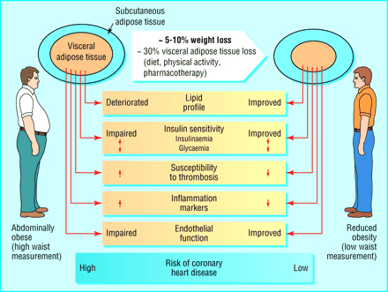

Slide 107
Control Matters
Trials
Practice Recommendations

Slide 108
Complications - Why?
Degree of hyperglycemia “glucose toxicity”
Duration of hyperglycemia
Genes
Multiple risk factors: smoking, vascular disease, dyslipidemia, hypertension, other

Slide 109

Diabetes Complications
Heart disease leading cause of death.
CAD death rates are about 2 -4x’s as high as adults without diabetes (it’s not getting better)
Risk of stroke is 2 - 4 times higher
60% - 65% of people with DM have HTN.
DM accounts for 40% of new cases of ESRD
60 - 70% have mild - severe forms of neuropathy
Diabetes is the leading cause of blindness
Accounts for 50% of lower limb amputations

Slide 110

Goals of Care

Slide 111
ABCs of Diabetes –
A1c less than 7% (avg 3 month BG)
  Pre-meal BG 70-130
  Post meal BG <180
Blood Pressure < 140/80
Cholesterol
  HDL >40
  LDL <100 (if CHD, <70)
  Triglyceride < 150

Slide 112

A1c and Estimated Avg Glucose (eAG) 2008
A1c (%) eAG
5 97
6 126
7 154
8 183
9 212
10 240
11 269
12 298
eAG = 28.7 x A1c-46.7 ~ 29 pts per 1%
Translating the A1c Assay Into Estimated Average Glucose Values – ADAG Study
Diabetes Care: 31, #8, August 2008
Order teaching tool kit free at diabetes.org

Slide 113

“Legacy Effect”
For participants of DCCT and UKPDS
  long lasting benefit of early intensive BG control prevents
    microvascular complications
    Macrovascular complications (15-55% decrease)
  Even though their BG levels increased over time
  Message – Catch early and
  Treat aggressively

Slide 114
Diabetes Care Guidelines- ADA
Test / Exam Frequency
A1c At least twice a year
B/P Each diabetes visit
Cholesterol (LDL, HDL, Tri) Yearly (less if normal)
Weight each diabetes visit
Microalbumin/GFR/Creat Yearly
Eye exam Yearly
Dental Care At least twice a year
Comprehensive Foot Exam Yearly (more if high risk)
Physical Activity Plan As needed to meet goals
Preconception counseling As needed

Slide 115
Vaccinations- Immunizations
Flu vaccine
  every year starting 6 months
Pneumococcal starting at 2 years.
  One time Revaccination for those over 64 and had first vaccine >5 years prior
Hepatitis B Vaccine (ADA Stds 2013, pg s28)
  For diabetes pts age 19 – 59 (not previously vaccinated)
  Double risk of Hep B due to lancing devices/ glucose meter exposure

Slide 116
Mr. Jones - What are Your Recommendations?
Self-Care Skills
Walks dog around block 3 x’s a week
Bowls every Friday
3 beers daily
Widowed, so usually eats out
15 lbs overweight
My foot hurts
Patient Profile
64 yr old with type 2 for 11 yrs. Hx of CVD.
Labs:
  A1c 9.3%
  HDL 37 mg/dl
  LDL 114 mg/dl
  Triglyceride 260mg/dl
  Proteinuria - neg
  B/P 142/92

Slide 117
DiaBingo- G
G ADA goal for A1c is less than ____%
G People with DM need to see their provider at least every month
G Blood pressure goal is less than
G People with DM should see eye doctor (ophthalmologist) at least
G The goal for triglyceride level is less than
G Goal for my HDL cholesterol is more than
G The goal for blood sugars 1-2 hours after a meal is less than:
G People with DM should get this shot every year
G People with DM need to get urine tested yearly for ___________
G Periodontal disease indicates increased risk for heart disease
G The goal for blood sugar levels before meals is:
G The activity goal is to do ___ minutes on most days

Slide 118
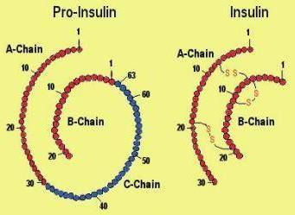
Insulin – the Ultimate Hormone Replacement Therapy
  Objectives:
  Discuss the actions of different insulins
  Describe using pattern management as an insulin adjustment tool.

Slide 119
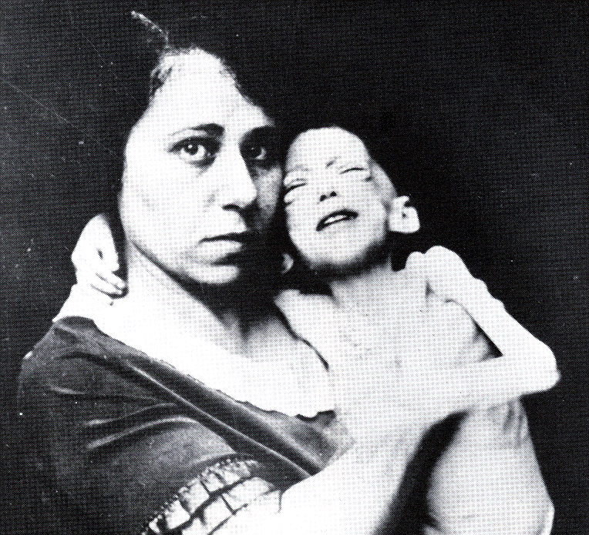

The Miracle of Insulin
The Miracle of Insulin
Patient J.L., December 15, 1922
February 15, 1923

Slide 120
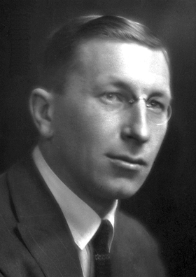
The Nobel Prize in Physiology or Medicine 1923
Born: 14 November 1891, Alliston, Canada
Died: 21 February 1941, Newfoundland, Canada
Affiliation at the time of the award: University of Toronto, Toronto, Canada
Prize motivation: "for the discovery of insulin"
Field: endocrinology, metabolism
Frederick G. Banting

Slide 121

Psychological Insulin Resistance (PIR)
50% of providers in study threatened pts “with the needle”.
Less than 50% of providers realized insulins’ positive effect on type 2 dm
Most pts don’t believe that insulin would “better help them manage their diabetes”.
Solutions: Find the root of PIR and address it, use more insulin pens
Diabetes Attitudes, Wishes, Needs Study - Rubin

Slide 122
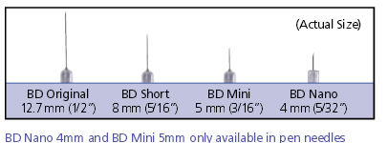
Needle Size often a Barrier
Size Does Matter
Use more short needles – 4 mm
Effective for pts with BMI of 24- 49
Keeps it subq
If pt thin, inject at angle
To avoid leakage, count to 10 before withdrawing needle
½ the patients who could benefit from insulin are not using it due to needle phobias
Consider inhaled insulin

Slide 123
Physiologic Insulin Secretion: 24-Hour Profile
50
Insulin
(µU/mL)
Bolus Insulin
25
0
Basal Insulin
Breakfast Lunch Dinner
150
100
Mealtime Glucose
Glucose
(mg/dL)
50
Basal Glucose
0
7
8
9
10
11
12
1
2
3
4
5
6
7
8
9
A.M.
P.M.
Time of Day

Slide 124
Insulin Action Teams
Bolus: lowers after meal glucose levels
  Rapid Acting
    Aspart, Lispro, Glulisine
  Short Acting
    Regular
  Afrezza - Inhaled
Basal: controls glucose between meals, hs
  Intermediate
    NPH
  Long Acting
    Detemir (Levemir)
    Glargine (Lantus)

Slide 125

Case Study
70 yr old, weighs 100kg
History of CABG, tobacco
A1c – 11.3%, BG 400-500 for past weeks
Insulin – 100+ units Lantus at hs (solostar)
Oral Meds: Metformin, Invokana
What is a better insulin dosing strategy?
Pt can’t afford insulin pen – what other option
Diabetes Meds on a Budget - 2014 - provides practical and affordable strategies to manage hyperglycemia

Slide 126
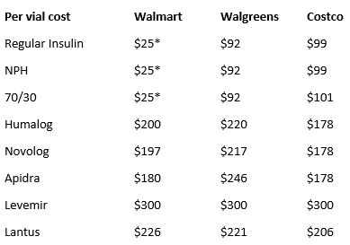
Cost Per Vial in Northern CA

Slide 127

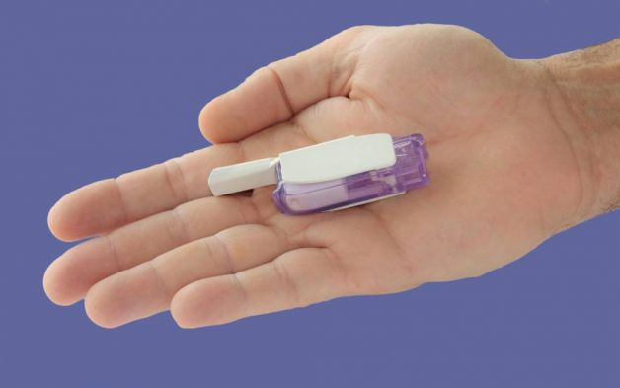
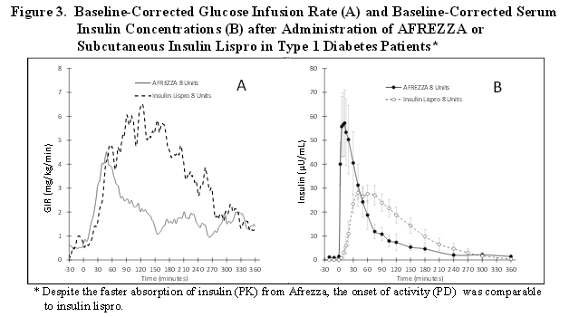
Afrezza – Inhaled Insulin –
Approved 2014
For adults over 18
Not indicated for pregnancy, while breastfeeding

Slide 128
Bolus Insulins
(½ of total daily dose ÷ meals)
Name Onset Peak Action
Lispro (Humalog) 15-30 min 1-1.5 hrs
Aspart (NovoLog)
Glulisine (Apidra)
Afrezza (Inhaled)
Regular 30 mins 2-4 hrs

Slide 129
Afrezza Dosing and Considerations
Bolus regular insulin – inhaled before meals
Dosing: 4 and 8 unit cartridges
  Convert with 1:1 ratio to existing insulin dose
Lung function test before start (incentive spiro)
  Not for pts w/ chronic lung issues
    Asthma, COPD, history of lung cancer, smokers
    Can cause acute bronchospasm
Side effects:
  Hypoglycemia, sore throat, cough

Slide 130
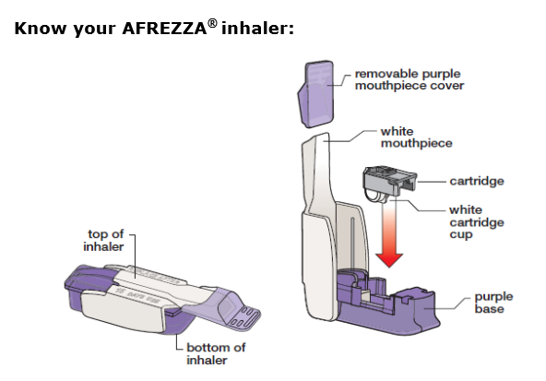
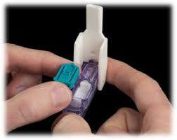
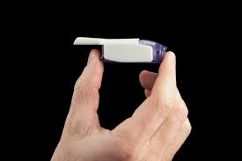
Afrezza Inhaler
Replace inhaler every 15 days

Slide 131
Bolus Insulin Summary
Regular, Novolog, Humalog, Apidra, Afrezza
Starts working fast (15-30 mins)
Gets out fast (3-6 hours)
Post meal BG reflects effectiveness
Should comprise about ½ total daily dose
Covers food or hyperglycemia.
1 unit
  Covers ≈ 10 -15 gms of carb
  Lowers BG ≈ 30 – 50 points

Slide 132
Bolus Insulin Timing
How is the effectiveness of bolus insulin determined?
  2 hour post meal (if you can get it)
  Before next meal blood glucose
Glucose goals (ADA) – may be modified by provider/pt
  1-2 hours post meal <180
  Before next meal – 70 - 130

Slide 133
Bolus – Insulin Sliding Scale
Starts at 150, 2 units Novolog for every 50 mg/dl >150

Slide 134
Basal Insulins
(½ of total daily dose)
Intermediate Acting Peak Action Duration
NPH 4-12 hrs 12-24
Long Acting Peak Action Duration
Detemir (Levemir) peakless 20 hrs
Glargine (Lantus) No peak 24 hrs
Fasting BG reflects efficacy of basal

Slide 135
Basal Insulin Summary
NPH, Levemir, Lantus
Covers in between meals, through night
Starts working slow (4 hours)
Stays in long (12-24 hours)
  NPH/ Lente 12 hrs
  Levemir, Lantus 20-24 hrs
Fasting blood glucose reflects effectiveness

Slide 136
Basal Only
Type 2, 60kg – A1c 8.7%

Slide 137
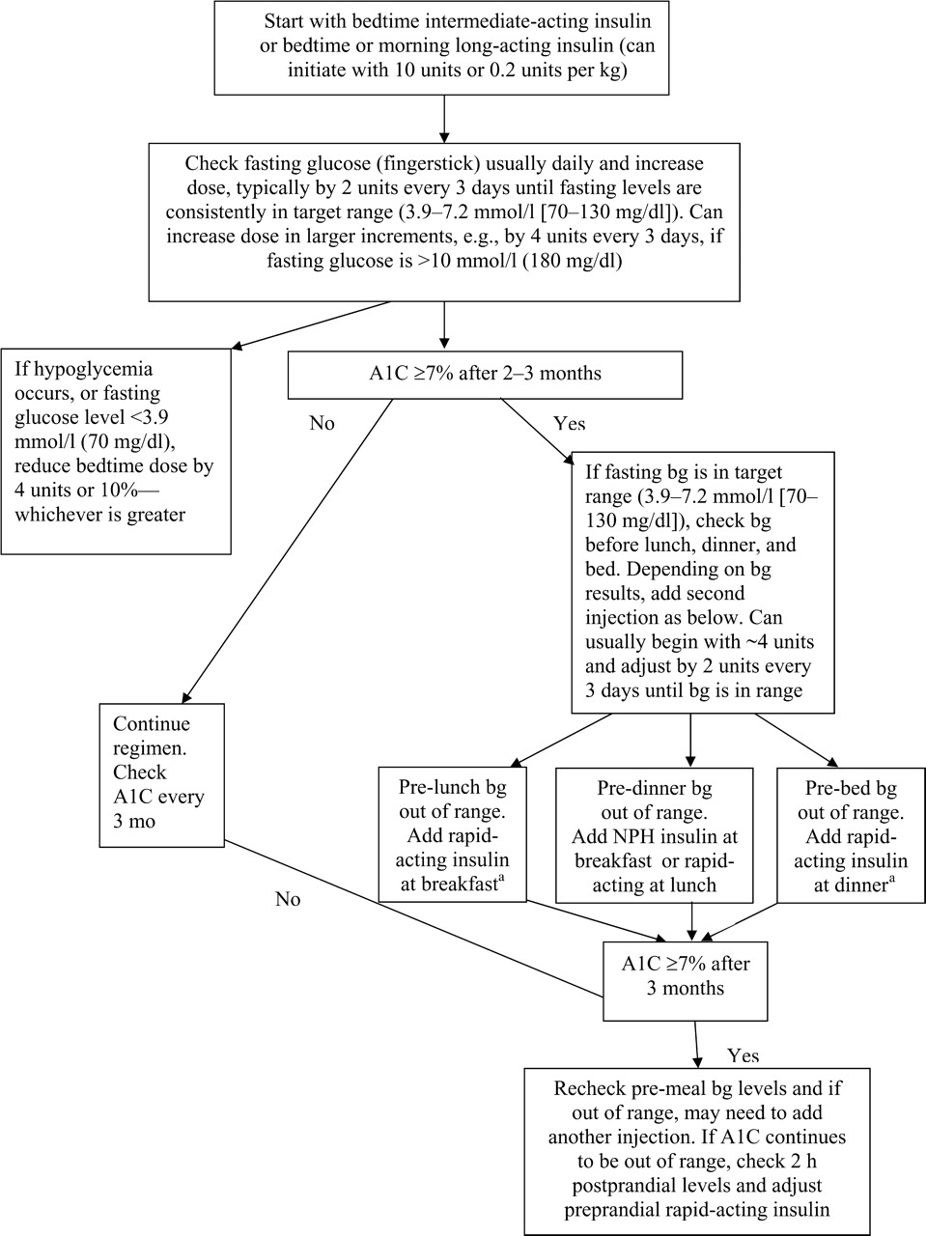
Diabetes Care 32:193-203, 2009

Slide 138
Combo Sub-Q Insulin

Slide 139
10u 70/30 BID
Patterns? Changes needed?

Slide 140
Pattern Management
Safety 1st!! - Evaluate 3 day patterns
Hypo: eval 1st and fix:
  If possible, decrease medication dose
  Timing of meals, exercise, medications
Hyperglycemia: evaluate 2nd
  Identify patterns
  Before increase insulin, make sure not missing something (carbs, exercise, omission)

Slide 141
Type 2 – New diagnosis – No meds Patterns? Questions

Slide 142
Type 2 – Amaryl 4mg AM, 10u Lantus pm

Slide 143
Basal Bolus – What Adjustments?
Pt weighs 80kg – Novolog Bolus

Slide 144
Intensive Diabetes Therapy
Insulin Dosing Strategy
50/50 Rule
0.5-1.0 units/kg day
Basal = 50% of total
  Glargine QD
  NPH or Detemir BID
Bolus = 50% of total
  usually divided into 3 meals
Example
Wt 50kg x 0.5 = 25 units of insulin/day
Basal dose: 13 units
  Glargine 13 units QD
  NPH/Detemir 6u BID
Bolus dose: 12 units
  4 units NovoLog, Apidra Humalog, Regular each meal

Slide 145
Intensive Diabetes Therapy
Insulin Dosing Strategy
50/50 Rule
0.5-1.0 units/kg day
Basal = 50% of total
  Glargine QD
  NPH or Detemir BID
Bolus = 50% of total
  usually divided into 3 meals
Example – You Try
Wt 60 kg x 0.5 = ___ units of insulin/day
Basal dose: ____ units
  Glargine ____ QD
  NPH/Detemir __ BID
Bolus dose: ____ units
___units NovoLog, Apidra Humalog, Reg each meal

Slide 146
Intensive Diabetes Therapy
Insulin Dosing Strategy
50/50 Rule
0.5-1.0 units/kg day
Basal = 50% of total
  Glargine QD
  NPH or Detemir BID
Bolus = 50% of total
  usually divided into 3 meals
Example – You Try
Wt 60kg x 0.5 = 30 units of insulin/day
Basal dose: 15 units
  Glargine 15 QD or
  NPH/Detemir 7u BID
Bolus dose: 15 units
  5 NovoLog, Apidra, Humalog, Reg each meal

Slide 147
Basal Bolus – Using 50/50 Rule - Pt weighs 80kg – Novolog Bolus

Slide 148
DiaBingo - I
I Injected hormone that is an analog of amylin
I Glargine, Detemir, NPH are types of
I Breakdown of glycogen into glucose
I Anabolic hormone
I Insulin is released when glucose levels are low
I Once opened, insulin vials are good for one _____
I Elevated post-prandial glucose indicate need for pre-meaI
I Epinephrine increases insulin resistance
I Creation of glucose from amino acids and lactate
I Decreasing renal function for people on insulin can cause
I Bolus insulins
I A hormone that increases blood glucose levels

Slide 149

Medical Nutrition Therapy
“Let food be thy medicine and medicine be thy food.”
“Walking is man's best medicine.”
― Hippocrates

Slide 150
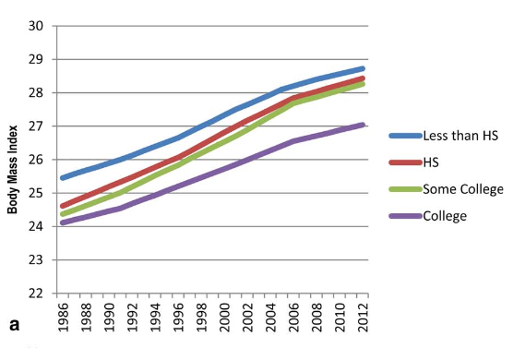
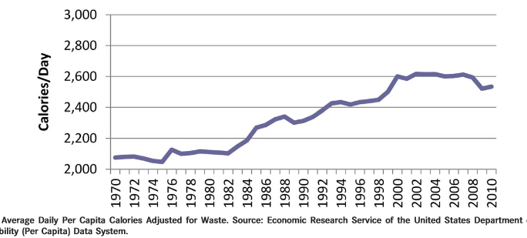
Obesity in America
68% overweight or obese
  34% BMI 30 +, 34% BMI 25-29
1/3 of all overwt people don’t get diabetes
We burn 100 cals less a day at work
Overall, food costs ~ 10-15% of income
Calorie Intake is on the rise

Slide 151
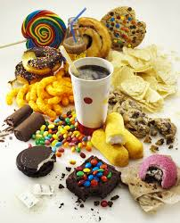
Average American Consumes
25 teaspoons of sugar a day (400 cals)
Warning label on sodas proposed
One soda has 12 teaspoons soda
On avg, 1 person consumes 40 gallons of soda each year
ADA guidelines “limit sodas and beverages with sugar, High Fructose Corn Syrup, (HFCS)

Slide 152
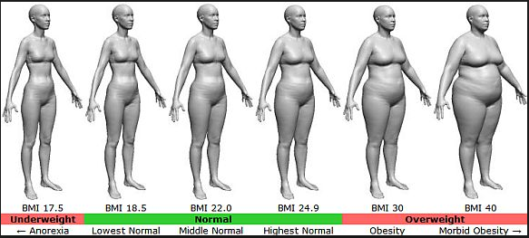
BMI – Visual Image

Slide 153

Medical Nutrition Therapy – ADA 2014 Updates
No ideal percentage of calories from protein, carbohydrate and fat for people with diabetes.
Macronutrient distribution should be based on an individualized assessment of eating patterns, preferences and metabolic goals.

Slide 154
Medical Nutrition Therapy – ADA 2014
Focus on the Individual
Maintain pleasure of eating
Provide positive messages about food
Limit food choices only when backed by science
Provide practical tools
Refer to a RD and Diabetes Education – Lowers A1c by 1-2%

Slide 155
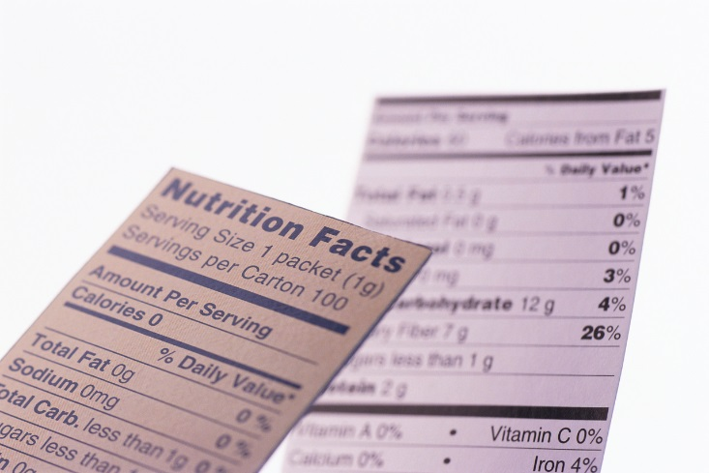
Sodium, Fat and Fiber
Sodium – Try and keep less than 2,300 mg a day
Vitamin and mineral supplements not recommended -lack of evidence.
Fat - same as recommended for general population
  Less than 10% saturated fat,
  Limit trans fats
  Less than 300 mg cholesterol daily
  Mediterranean Diet looks like good option
Fiber 25 -38 gms a day

Slide 156

Approach Depends on Patient
New Type 2
  Portion Control
  Plate Method
  Record Keeping
  Education
On Insulin?
  Carb counting
  Post prandial checks

Slide 157
Losing 2-8kg Early in diagnosis Type 2 Helpful
ADA 2014
Weight Loss –
  The optimal macronutrient intake to lose weight not known
  The literature does not support one particular nutrition therapy to reduce weight, but rather a spectrum of eating patterns that result in reduced energy intake.
  To lose one pound – avoid 3,500 cals
    Decrease intake 250-500 cals daily + exercise

Slide 158

Successful weight loss strategies include
Weekly self-weighing
Eat breakfast
Reduce fast food intake.
Decrease portion size
Increase physical activity
Use meal replacements
Eat healthy foods

Slide 159
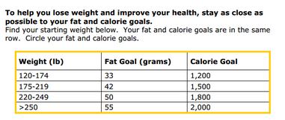
Diabetes Prevention Program
Focus on fat = wt loss success
http://www.cdc.gov/diabetes/prevention/recognition/curriculum.htm

Slide 160
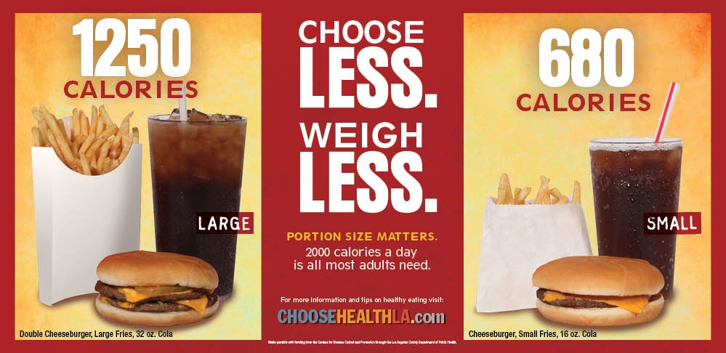
Public Health Issue?
66% of our people are obese/overweight
Rates of gestational diabetes on rise
30% of kids are obese/overweight

Slide 161
How nutrients affect blood sugar

Slide 162
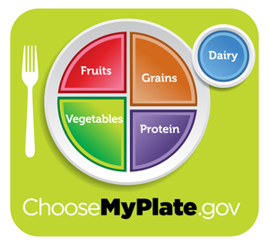
Teaching About Eating Healthy
Major food groups
“Handy Diet”
Plate Method
Exchange Lists
Food Diaries / Glucose Records
Carbohydrate Counting
Assess what is best for the situation.

Slide 163






Move toward the Tomato

Slide 164

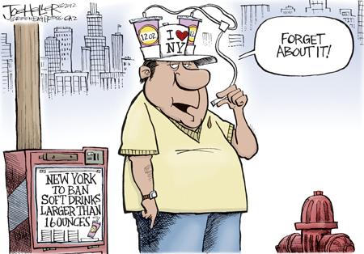
ADA recommendation
Eat Less Junk Food & Sugary Drinks –
Less Processed Foods
Less Sugary Beverages
  increase visceral adiposity
  With sugar or
  High fructose corn syrup
Soda Tax?
Junk Food Tax?

Slide 165
10 Superfoods
Beans
Dark Green Leafy Vegs
Citrus Fruit
Sweet Potatoes
Berries
Tomatoes
Fish High in Omega-3 Fatty Acids
Whole Grains
Nuts
Fat-Free Milk and Yogurt

Slide 166
USDA Food Pyramid www.myplate.gov
Balancing Calories
Enjoy your food, but eat less.
Avoid oversized portions.
Foods to Increase
Make half your plate fruits and vegetables.
Make at least half your grains whole grains.
Switch to fat-free or low-fat (1%) milk.
Foods to Reduce
Compare sodium in foods like soup, bread, and frozen meals ― and choose the foods with lower numbers.
Drink water instead of sugary drinks.

Slide 167

Another plate example

Slide 168

Mindful Eating

Slide 169

Nutrition Facts
Serving Size 1/2 cup (114 g)
Servings Per Container 4
Amount Per Serving
Calories 90 Calories from Fat 30
Fooducate App – gives grade and nutrition info.
% Daily Value*
Total Fat 3g 5%
Saturated Fat 0g 0%
Cholesterol 0g 0%
Sodium 300mg 13%
Total Carbohydrate 13g 4%
Dietary Fiber 3g 12%
1 tsp sugar =4 gms
Sugars 3g
Protein 3g
Vitamin A 80% * Vitamin C 60%
Calcium 4% * Iron 4%
* Percent Daily Values are based on a 2,000 calorie diet. Your daily values may be higher or lower depending on your calorie needs:
Calories _ 2000 2500
Total Fat Less than 65g 80g
Sat Fat Less than 20g 25g
Cholesterol Less than 300mg 300mg
Sodium Less than 2400mg 2400mg
Total Carbohydrate 300g 375g
Fiber 25g 30g
Calories per gram: Fat 9 Carbohydrates 4 Protein 4

Slide 170

Carbs affect Post meal Blood Glucose
Starch
Fruit
Milk
Desserts

Slide 171

Carbohydrate Needs for
Most Adults
Grams Servings
Each Meal 45-60 gm 3 - 4
Snacks 15-30 gm 1- 2
Carbs affect Post Meal Blood Glucose

Slide 172

Choose Healthy Carbs
Carbs have fiber, vitamins, minerals and phytonutrients
25 gms of fiber a day
Power Carbs include:
  Beans
  Veggies
  Fruits
  Whole grain foods

Slide 173
Handy Meal Plan
Per Meal Serving
  Each finger = 15 gms carb (can have 3-4 servings/meal)
  Palm of hand = 3 oz’s protein
  Thumbnail = 1 tsp fat serving

Slide 174










Carb Counting - Starch
Each Food has:
80 Calories
15 grams carb
1 small ear of corn or 1/2 cup corn
1/3 cup cooked pasta
1/2 cup
cooked beans
3/4 cup cold cereal
1 slice bread
1/3 cup cooked rice
1 small potato
1/2 English muffin
1 small tortilla
5-6 small crackers

Slide 175









Carb counting- fruit
Each Food has:
60 Calories
15 grams carb
½ cup fruit juice
½ banana
1 small fresh fruit
½ cup unsweetened apple sauce
1 slice bread
17 small grapes
1 cup melon
¼ cup dried fruit
2 tbsp raisins
1 1/4 cup strawberries

Slide 176







Carb Counting - Milk
Each Food has:
90-150 calories
12-15 grams carb
8 oz buttermilk
1 packet diet hot cocoa
1 slice bread
6 oz plain yogurt
8 oz milk
6 oz light fruit yogurt
8 oz soy milk

Slide 177









Carb Counting - Sweets
Each Food has:
Calories vary
15 grams carb
2 inch square cake or brownie, unfrosted
½ cup regular jello
2 tbsp light syrup
½ cup diet pudding
1 slice bread
1 tbsp syrup, jam, jelly, table sugar, honey
2 small cookies
¼ cup sorbet
½ cup ice cream or frozen yogurt
½ cup sherbet

Slide 178
Using Alcohol Safely
Women- 1 or fewer alcoholic drinks a day
Men 2 or fewer alcoholic drinks a day
  1 alcoholic drink equals
    12 oz beer, 5 oz glass of wine, or 1.5 oz distilled spirits (vodka, gin etc)
If drink, limit amount and drink w/ food.
Ask HCP if safe for you to drink. Tell them your usual quantity and frequency.
Can cause hypo and worsen neuropathy

Slide 179
Ms. Gonzales’ Daily Meal plan

Slide 180
Resources
www.eatright.org American Dietetic Association website for nutrition information, resources, and access to Registered Dietitians
www.diabetes.org American Diabetes Association website, advocates to prevent, cure and improve the lives of all people affected diabetes
www.americanheart.org American Heart Association website; resources, recipes and tips; learn about efforts to reduce death caused by cardiovascular disease
www.dce.org/publications/education-handouts/

Slide 181
Resources
www.nhlbi.nih.gov contains information for professionals and the general public about heart and vascular diseases, lung diseases, blood diseases.
www.niddk.nih.gov National Institute of Diabetes and Digestive and Kidney Diseases (NIDDK) information and resources clearinghouse.

Slide 182
DiaBingo - N
N Injected hormone called an incretin mimetic
N DPP demonstrated that exercise and diet reduced risk of DM by ___%
N An _______a day can help prevent heart attack and stroke
N Rebound hyperglycemia
N Scare tactics are effective at motivating patients to change behavior
N Losing ___ % of body weight, can improve blood glucose, BP, lipids
N Drugs that can cause hyperglycemia
N 2/3 cups of rice equals ______ serving carbohydrate
N A1c of 7% equals glucose of
N One % drop in A1c reduces risk of complications by ___ %
N 1 gm of fat equal _____kilo/calories
N Metabolic syndrome = hyperglycemia, hyperlipidemia, hypertension
N 1% A1c = _______ of Blood Glucose

Slide 183

Diabetes Meds for Type 2:
Objectives
1. Describe the main action of the 5 different categories of type 2 diabetes medications.
2. Discuss strategies to determine the right medication for the right patient.
3. List the side effects and clinical considerations of each category of medication.
Notes:
183
183

Slide 184
Diabetes Agents Considerations
Diabetes medications can be used as monotherapy, in combo or with insulin
Combining agents from different classes has additive effect
Most reduce A1c 0.5 – 2.0%
Not to be used during preconception, pregnancy or when breastfeeding
Notes:
184
184

Slide 185
ADA-EASD Position Statement: Management of Hyperglycemia in T2DM
Patient-Centered Approach
“...providing care that is respectful of and responsive to individual patient preferences, needs, and values - ensuring that patient values guide all clinical decisions.”
Gauge patient’s preferred level of involvement.
Explore, where possible, therapeutic choices.
Utilize decision aids.
Shared decision making – final decisions re: lifestyle choices ultimately lie with the patient.
Diabetes Care 2012;35:1364–1379
Diabetologia 2012;55:1577–1596

Slide 186
Action/Classes of Type 2 Meds
1. Suppressor
2. Squirter
3. Satiators
4. Sensitizer
5. Glucoretics
6.Circadian Switchers
7. Slower
  Biguanide – Metformin
  Sulfonylureas
  Meglitinides
  AmylinoMimetics
  Incretin Mimetics
  DPP-4 Inhibitors
  Thiazolidinediones (TZD)
  SGLT2 Inhibitors
  Dopamine Receptor Agonists
  Alpha-glucosidase inhibitors
Notes:
186
186
There are five major classes of oral diabetes medications: thiazolidinediones, biguanides, sulfonylureas, meglitinides, and alpha-glucosidase inhibitors. These five classes of medication operate in essentially three different ways.
Thiazolidinediones and biguanides decrease glucose production in the liver and increase insulin sensitivity in peripheral body tissues.
Sulfonylureas and meglitinides stimulate the pancreatic beta cells to make more insulin.
Finally, alpha-glucosidase inhibitors slow the absorption of starches in the gut, reducing the amount of glucose that enters the bloodstream.

Slide 187
Biguanides – Suppressor
Metformin (Glucophage®)
Action: suppresses release of glycogen from the liver
Who?
  Fasting hyperglycemia
  Dysmetabolic Syndrome
  For pediatrics starting age 10
    (XR age 17)
Glycogen Stopper
Notes:
187
187

Slide 188
Biguanides - Metformin
Action: decrease hepatic glucose (glycogen)
Names:
  Metformin (Glucophage)
    Starting dose: 500 BID, max 2500mg daily
    Metformin XR - extended release – less GI upset
    Starting dose 500mg at dinner, max dose 2000 to 2500 mg daily
  Efficacy:
    Decrease fasting plasma glucose 60-70 mg/dl
    Reduce A1C 1.0-2.0%
© Copyright 1999-2013, Diabetes Educational Services, All Rights Reserved.
Notes:
188
188
The mechanism of action of metformin is not entirely understood, but it's predominant effect is to suppress hepatic glucose production and to enhance insulin sensitivity in peripheral tissues (primarily muscle). It is unclear if insulin sensitivity occurs by metformin binding to cell receptors,which leads to an increase in glucose transporter expression, or whether insulin sensitivity is simply a secondary effect of the suppressed glucose production.
Metformin's ability to lower A1C and decrease fasting plasma glucose is similar to that of sulfonylurea drugs. However, the UKPDS showed that those who received metformin had less hypoglycemia and weight gain than those who received sulfonylureas.
Metformin must be avoided in patients with renal impairments, as those patients are at higher risk of experiencing lactic acidosis. However, metformin is an effective monotherapy and may be an ideal drug for overweight patients since it does not cause weight gain and has been seen to cause modest amounts of weight loss when first administered. Diarrhea and abdominal discomfort can be alleviated by changes in diet and slow increases in metformin dosage.

Slide 189
Biguanides - Metformin
Benefits
  Decrease LDL cholesterol and triglycerides
  No weight gain, possible modest weight loss
  Cancer protective?
Concerns
  Diarrhea and abdominal discomfort – Use XR
  Lactic acidosis if improperly prescribed
  Watch for B12 deficiency
  Hold prior to IV contrast dye studies and use caution during acute illness. Resume when kidney function adequate
Notes:
189
189
The mechanism of action of metformin is not entirely understood, but it's predominant effect is to suppress hepatic glucose production and to enhance insulin sensitivity in peripheral tissues (primarily muscle). It is unclear if insulin sensitivity occurs by metformin binding to cell receptors,which leads to an increase in glucose transporter expression, or whether insulin sensitivity is simply a secondary effect of the suppressed glucose production.
Metformin's ability to lower A1C and decrease fasting plasma glucose is similar to that of sulfonylurea drugs. However, the UKPDS showed that those who received metformin had less hypoglycemia and weight gain than those who received sulfonylureas.
Metformin must be avoided in patients with renal impairments, as those patients are at higher risk of experiencing lactic acidosis. However, metformin is an effective monotherapy and may be an ideal drug for overweight patients since it does not cause weight gain and has been seen to cause modest amounts of weight loss when first administered. Diarrhea and abdominal discomfort can be alleviated by changes in diet and slow increases in metformin dosage.

Slide 190

Considerations
Biguanide - Metformin (Glucophage®)
Contraindications due to lactic acidosis:
  creatinine >1.4 females, >1.5 males
  liver disease
  alcohol abuse
  over 80 years old
  risk of acidosis
  during IV dye study
  CHF requiring meds
© Copyright 1999-2013, Diabetes Educational Services, All Rights Reserved.
Notes:
190
190

Slide 191
Metformin – How does it rate?
Question Answer
Cause hypoglycemia?
Cause weight gain?
Affordable?
Lowers CV risk?
Can most tolerate /use?
No
No
Yes
Yes
Yes/No

Slide 192

What is next step?
69 year old male, BMI 25, on Metformin 1000mg BID.
AM glucose 120s, A1c 8.1%.
Creat 1.3

Slide 193

Sulfonylureas –
Action: tells pancreas to squirt insulin all day
Who?
  Lean type 2
Notes:
193
193

Slide 194
Sulfonylureas - Squirts
Action: Increase endogenous insulin secretion
Efficacy:
  Decrease FPG 60-70 mg/dl
  Reduce A1C by 1.0-2.0%
Secondary failures: 5-10% shortly after initial response, many more later
  Usually after 5 or more years of therapy due to natural history of DM 2
Notes:
194
194
Sulfonylureas (SUs) increase insulin secretion by binding to receptors on the surface of pancreatic beta cells, triggering a series of reactions which leads to insulin secretion.
Because SUs cause circulating insulin levels to increase, there is a risk of hypoglycemia. There is also some concern that increased insulin levels are associated with cardiovascular disease, however the UKPDS did not show a relationship between increased mortality and SU administration. Finally, there is concern that SUs will exhaust beta cell function by increasing insulin secretion. However, the decline in beta cell function is more likely caused by the disease itself, and not the use of SUs.
First generation sulfonylureas are just as efficacious as the second generation drugs, however the second generation may be more potent and safer than first. When diet and exercise fail, SUs are an effective monotherapy.

Slide 195
Sulfonylureas:
2nd Generation
Generic Trade Duration
  Glyburide Diabeta, Micronase, 12-24 hrs
        Glynase Prestabs
  Glipizide* Glucotrol, Glucotrol Xl 12-24 hrs
  Glimepiride Amaryl 16-24 hrs
Notes:
195
195

Slide 196

Sulfonylureas
Other Effects
  Hypoglycemia
  Weight gain
  Cleared by kidney, use caution for pts with kidney problems
  Generally the least expensive class of medication
  Amaryl safest for those with CV Disease
Notes:
196
196
Sulfonylureas (SUs) increase insulin secretion by binding to receptors on the surface of pancreatic beta cells, triggering a series of reactions which leads to insulin secretion.
Because SUs cause circulating insulin levels to increase, there is a risk of hypoglycemia. There is also some concern that increased insulin levels are associated with cardiovascular disease, however the UKPDS did not show a relationship between increased mortality and SU administration. Finally, there is concern that SUs will exhaust beta cell function by increasing insulin secretion. However, the decline in beta cell function is more likely caused by the disease itself, and not the use of SUs.
First generation sulfonylureas are just as efficacious as the second generation drugs, however the second generation may be more potent and safer than first. When diet and exercise fail, SUs are an effective monotherapy.

Slide 197
Squirters – How does they rate?
Question Answer
Cause hypoglycemia?
Cause weight gain?
Affordable?
Lowers CV risk?
Can most tolerate /use?
Yes
Yes
Yes
No
Yes/No

Slide 198
What Medications Cause Hypoglycemia?
Insulin
Sulfonylureas
Meglitinides
Or any combo medication that includes these

Slide 199

What questions?
72 yr old, thin, lives alone, A1c 7.3%. History of MI, stroke. DM for 12 yrs, “diet controlled”. Limited income. Creat 1.4.

Slide 200
DPP-4 Inhibitors – “Incretin Enhancers”
Januvia (sitagliptin) – Tradjenta (linagliptin)
Onglyza (saxagliptin) Nesina (alogliptin)
Action:
  Increase insulin release w/ meals
  Suppress glucagon
Dosing: Januvia – 100mg a day
        Onglyza – up to 5mg a day
        Tradjenta – 5mg a day
        Nesina – up to 25 mg a day
Efficacy: Decreases A1c by 0.6 -0.8%
Indication: For type 2s
Notes:
200
200

Slide 201

Januvia, Onglyza eliminated via kidney, lower dose needed
Do not cause wt gain or hypoglycemia
Side effects – headache, runny nose, sore throat - watch for pancreatitis
Cost $100 - $150 mo
Notes:
201
201

Slide 202
DPP-IV Inhibitors – How do they rate?
Question Answer
Cause hypoglycemia?
Cause weight gain?
Affordable?
Lowers CV risk?
Can most tolerate /use?
No
No
No
No
Yes

Slide 203

If on Metformin and Sulfonylurea – BG still high, other options?
Pt overweight.

Slide 204

Incretin Mimetics –
“Gut Hormone Imitators”
GLP-1 Agonists
How do they work?
Notes:
204
204

Slide 205
GLP-1 Effects in Humans
Understanding the Natural Role of Incretins
GLP-1 secreted upon the ingestion of food
Promotes satiety and
reduces appetite
Alpha cells:
↓ Postprandial
glucagon secretion
↑ Beta-cell
response
Liver:
↓ Glucagon reduces hepatic glucose output
Beta cells:
Enhances glucose-dependent insulin secretion
Stomach:
Helps regulate gastric emptying
Adapted from Flint A, et al. J Clin Invest. 1998;101:515-520
Adapted from Larsson H, et al. Acta Physiol Scand. 1997;160:413-422
Adapted from Nauck MA, et al. Diabetologia. 1996;39:1546-1553
Adapted from Drucker DJ. Diabetes. 1998;47:159-169
GLP-1 degraded by
DPP-4 w/in minutes
Notes:
205
205
Required
DISCUSSION POINTS:
--Upon food ingestion, GLP-1 is secreted into the circulation from L cells of small intestine.
--GLP-1 increases beta-cell response by enhancing glucose-dependent insulin secretion.
--GLP-1 decreases beta-cell workload and hence the demand for insulin secretion by:
--Regulating the rate of gastric emptying such that meal nutrients are delivered to the small intestine and, in turn, absorbed into the circulation more smoothly, reducing peak nutrient absorption and insulin demand (beta-cell workload)
--Decreasing postprandial glucagon secretion from pancreatic alpha cells, which helps to maintain the counterregulatory balance between insulin and glucagon
--Reducing postprandial glucagon secretion, GLP-1 has an indirect benefit on beta-cell workload, since decreased glucagon secretion will produce decreased postprandial hepatic glucose output
--Having effects on the central nervous system, resulting in increased satiety (sensation of satisfaction with food intake) and a reduction of food intake
--By decreasing beta-cell workload and improving beta-cell response, GLP-1 is an important regulator of glucose homeostasis.
SLIDE BACKGROUND:
--Effect on Beta-cell: Drucker DJ. Diabetes. 1998; 47:159-169
--Effect on Alpha cell: Larsson H, et al. Acta Physiol Scand. 1997; 160:413-422
--Effects on Liver: Larsson H, et al. Acta Physiol Scand. 1997; 160:413-422
--Effects on Stomach: Nauck MA, et al. Diabetologia. 1996; 39:1546-1553
--Effects on CNS: Flint A, et al. J Clin Invest. 1998; 101:515-520

Slide 206


Incretin Mimetics
Exenatide (Byetta), Exenatide XR (Bydureon)
Action:
  Insulin release in response to meal
  Slows gastric emptying
  Causes Satiety
  Preserves Beta Cells
Exenatide Dosing:
    5-10 mcg before break, dinner
    Long acting version - 1x week (available in pens in 2015)
Efficacy: Decreases A1c by 0.7%, wt by 3lbs
Indication: For type 2s only - mono or in combo
Notes:
206
206

Slide 207


Incretin Mimetics –
Albiglutide - Tanzeum
Once a Week Dosing: 30 – 50mg
Efficacy:
Decreases A1c by ~ 1%, wt by ~2lbs
Indication: For type 2s only
Other: Pen injector
Caution: not indicated for those with history of medullary thyroid tumor - pancreatitis warning
Notes:
207
207

Slide 208


Slide 209

For all the Previous DPP-IV and GLP-1 Agonists
Pancreatitis Warning
  Please tell all patients to report signs right away and discontinue meds
  Signs include:
  Sudden abdominal pain, nausea and vomiting

Slide 210
Incretin Mimetics – How do they rate?
Question Answer
Cause hypoglycemia?
Cause weight gain?
Affordable?
Lowers CV risk?
Can most tolerate /use?
(GI)
No
No
No
No
Yes/No

Slide 211

Next Step?
69 year old male, BMI 25, on Metformin 1000mg BID and Exenatide 10mcg before breakfast and dinner.
Pt overweight - A1c 8.1%. Creat 1.2

Slide 212



SGLT2 Inhibitors- “Glucoretics”
Action: “Glucoretic” decreases renal reabsorption in the proximal tubule of the kidneys (reset renal threshold and increase glucosuria)
Decreases Glucose
Reabsorption
Notes:
212
212
Thiazolidinediones (TZDs) enhance insulin sensitivity in muscle and adipose tissue by binding to cell receptors,which leads to an increase in glucose transporter expression. TZDs encourage beta cells to respond more efficiently by lowering the amount of glucose and free fatty acids in the bloodstream, both of which are known to be detrimental to insulin secretion. Finally, these drugs reduce glucose production in the liver.
Clinical trials indicate that pioglitazone and rosiglitazone are slightly more effective at reducing A1C (1.5-1.6% reduction) than troglitazone (1.1% reduction).
Some of the beneficial side effects of thiazolidinediones include an increase in HDL cholesterol and reduction of triglyceride concentrations. This class of drugs has also been shown to lower blood pressure and decrease vascular inflammation in vitro. There are clinical studies underway to further examine the cardiovascular benefit to TZDs.
Some adverse effects of TZDs include weight gain, a potential increase in LDL cholesterol levels, and a possible increase in alanine aminotransferase levels (ALT). Because of the risk of weight gain, edema, and increased LDL cholesterol, thiazolidinediones are contraindicated in patients with advanced forms of congestive heart failure. Due to reported cases of liver failure and liver toxicity caused by the increase in ALT levels, TZDs are contraindicated in patients with abnormal liver function.
TZDs are the most expensive of the oral antidiabetic agents.

Slide 213
Considerations
SGLT2 Inhibitors –
Monitor B/P, K+ & renal function.
Side effects: hypotension, UTI, increased urination, genital yeast infections.
Improves beta cell function?
  Reverses glucoses toxicity by increasing GLUT4 transport in muscle
  Increase liver sensitivity to insulin and decreases gluconeogenesis.

Slide 214
SGLT2 Inhibitors- How do they rate?
Question Answer
Cause hypoglycemia?
Cause weight gain?
Affordable?
Lowers CV risk?
Can most tolerate /use?
No
No
No
No
Yes?

Slide 215
Indications for Insulin Sensitizers
Rosiglitazone (Avandia), Pioglitazone (Actos)
Action: decrease insulin resistance by making muscle and adipose cells more sensitive to insulin. Decrease free fatty acids
Names:
  pioglitazone (Actos) – bladder cancer warning
    Dosing: 15-45 mg daily
  rosiglitazone (Avandia) – restriction relaxed
    Dosing: 4-8 mg daily
Efficacy/ Considerations
  Reduce A1C ~0.5-1.0%
  6 weeks for maximum effect
  $100 a month
  Can cause fluid retention, not indicated w/ CHF
Notes:
215
215
Thiazolidinediones (TZDs) enhance insulin sensitivity in muscle and adipose tissue by binding to cell receptors,which leads to an increase in glucose transporter expression. TZDs encourage beta cells to respond more efficiently by lowering the amount of glucose and free fatty acids in the bloodstream, both of which are known to be detrimental to insulin secretion. Finally, these drugs reduce glucose production in the liver.
Clinical trials indicate that pioglitazone and rosiglitazone are slightly more effective at reducing A1C (1.5-1.6% reduction) than troglitazone (1.1% reduction).
Some of the beneficial side effects of thiazolidinediones include an increase in HDL cholesterol and reduction of triglyceride concentrations. This class of drugs has also been shown to lower blood pressure and decrease vascular inflammation in vitro. There are clinical studies underway to further examine the cardiovascular benefit to TZDs.
Some adverse effects of TZDs include weight gain, a potential increase in LDL cholesterol levels, and a possible increase in alanine aminotransferase levels (ALT). Because of the risk of weight gain, edema, and increased LDL cholesterol, thiazolidinediones are contraindicated in patients with advanced forms of congestive heart failure. Due to reported cases of liver failure and liver toxicity caused by the increase in ALT levels, TZDs are contraindicated in patients with abnormal liver function.
TZDs are the most expensive of the oral antidiabetic agents.

Slide 216
TZDs – How do they rate?
Question Answer
Cause hypoglycemia?
Cause weight gain?
Affordable?
Lowers CV risk?
Can most tolerate /use?
No
Yes
Yes/No
??
Yes/No

Slide 217

Thank You
Questions?
Email bev@diabetesed.net
Web www.DiabetesEd.net

