Slide 1


Welcome to Diabetes in the 21st Century
Beverly Dyck Thomassian, RN, MPH, BC-ADM, CDE
President, Diabetes Education Services
www.DiabetesEd.net
© Copyright 1999-2014, Diabetes Education Services, All Rights Reserved.

Slide 2
Diabetes in the 21st Century: A Clinical and Educational Update
Describe impact of diabetes
Discuss prevention, management strategies
Discuss different types of diabetes
Describe insulin therapy
Review glucose patterns and determine how to adjust therapy to improve glucose.
Discuss medical nutrition therapy
Gain understanding of Type 2 Meds.
Demonstrate successful teaching strategies

Slide 3
CDC Announces
35% of Americans will have Diabetes by 2050
Boyle, Thompson, Barker, Williamson
2010, Oct 22:8(1)29
www.pophealthmetrics.com

Slide 4
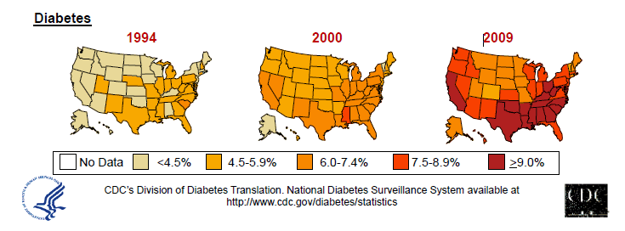
Diabetes in America 2014
29 million or > 9.3%
27% don’t know they have it
37% of US adults have pre diabetes

Slide 5

My Boys –Robert and Jackson
By the time they are 50, 1/3 will have diabetes

Slide 6


Type 2 in Kids
7 fold increase 1990
1 in 6 overwt kids (age 12- 19) have prediabetes.
~2,500 to 3,700 new cases in U.S. annually.
Highest risk: very obese, minority, female, low socioeconomic status, limited education
In age range 12-19, less than 1% have Type 2 – NHANES
Environmental changes to urgently needed

Slide 7

Global Epidemic
Every 10 seconds
1 person dies with diabetes
2 people develop diabetes
Every year
3 million deaths
6 million new cases
World Diabetes Day is November 14
March is ADA Sound the Alert Day “find people w/ undetected diabetes”

Slide 8


World Diabetes Day November 14

Slide 9
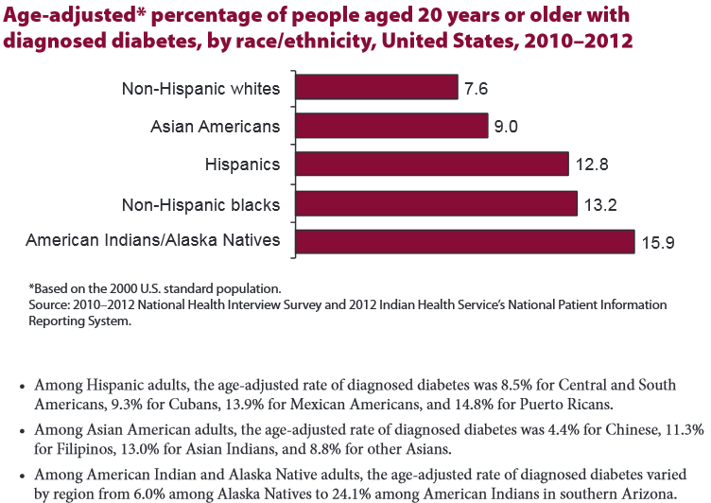

Age-adjusted Diabetes Prevalence 20 yrs or older, by race/ethnicity— U.S. 20014

Slide 10

Why Should Zip Code Determine Life Expectancy?
California Endowment – look up your zip code at www.measureofamerica.org

Slide 11

Engaging and supporting Kids to help slow the epidemic
Phases of Life
During Childhood
Environment
Access to safe places to exercise
Access to healthy foods
Access to learning rich environments
Access to health care
LifeStyle
Limit screen time to 2 hours a day
1 hour a day of activity
Healthy Snacks
Limit junk food, sugary beverages
Fruits and Veggies

Slide 12


Thoughts on Diabetes, Weight, Social Change
“The only way on a societal basis to reduce the prevalence of obesity is through community action” – Dr. Frieden, CDC
Obesity (BMI 30+) prevalence 22% to 40%
Poverty, Obesity, Diabetes inter-related

Slide 13
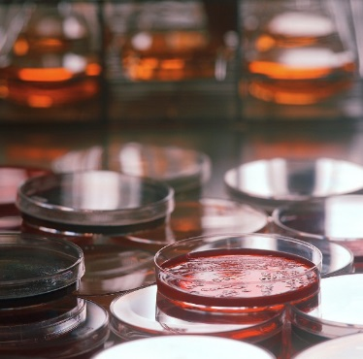
Weight and Gut Bacteria New and Early Research
Lower levels among obese and DM patients compared with healthy controls of:
Firmicutes: 4% lower in obese patients, 13% lower in DM
Bifidobacteria: 14% lower in obese patients, 28% lower DM
Clostridium Leptum: 14% lower in obese patients, 11% lower DM
Based on prospective study involving:
27 morbidly obese pts with mean BMI of 40
26 pts with new type 2 – BMI 29
28 healthy controls (mean BMI 23 kg/m2).
“The human gut microbiome consists of some 100 trillion bacteria, or some 100 trillion friends you didn't know you had.”
Yalcin Basaran, MD, presented at International Endocrine Meeting

Slide 14

Free Live Webinars and Live Seminars at DiabetesEd.net
Free Webinars
Preparing to take CDE
New Frontiers
New Medications
BC-ADM

Slide 15


Slide 16
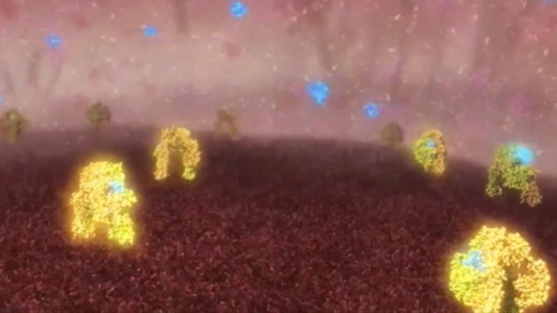
Images shows insulin (blue) molecules binding with insulin receptors (yellow) Jan 2013
The international research team was led by scientists from the Walter and Eliza Hall Institute (WEHI) in Melbourne, with collaborators from La Trobe University, the University of Melbourne, Case Western Reserve University, the University of Chicago, the University of York and the Institute of Organic Chemistry and Biochemistry in Prague.

Slide 17
Role of the Pancreas Endocrine Functions
Beta Cells - Insulin
Anabolic hormone - helps store glucose as glycogen in muscle, liver
secreted in response to elevated glucose
halts breakdown of glycogen in liver
increases protein synthesis, fat storage
powerful hypoglycemic
Beta Cells - Amylin
secreted in 1:1 ratio with insulin
Causes satiety
Lowers post-prandial glucagon response
Slows gastric emptying
Type 1 make none
Type 2 make less than normal amounts

Slide 18
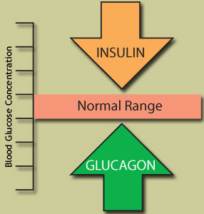
Role of the Pancreas Endocrine Functions
Alpha cells - Glucagon
Opposes action of insulin at the liver
stimulated in response to low glucose levels
stimulates liver to convert glycogen to glucose
inhibits liver from glucose uptake
causes hyperglycemia

Slide 19
Hormones Effect on Glucose
Hormone
Glucagon (pancreas)
Stress hormones (kidney)
Epinephrine (kidney)
Insulin (pancreas)
Amylin (pancreas)
Gut hormones - incretins (GLP-1) released by L cells of intestinal mucosa, beta cell has receptors)
Effect



⇒
⇒
⇒

Slide 20
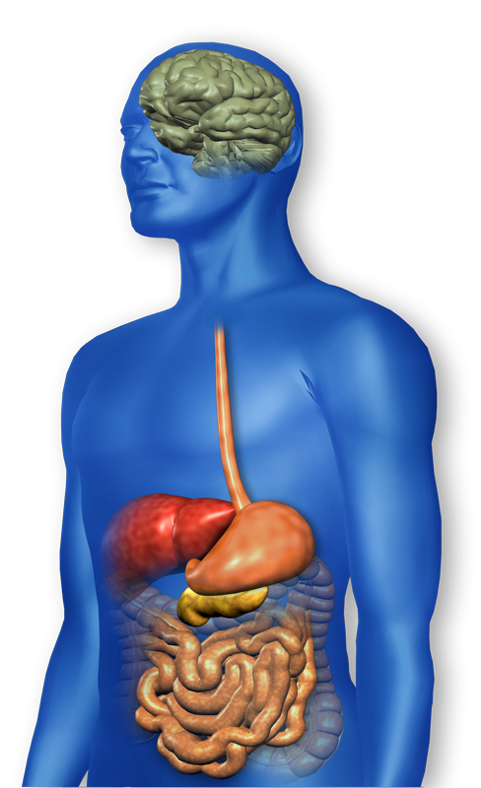
GLP-1 Effects in Humans Understanding the Natural Role of Incretins
GLP-1 secreted upon the ingestion of food
Promotes satiety and reduces appetite
Alpha cells:
↓ Postprandial glucagon secretion
↑ Beta-cell
response
Liver: ↓ Glucagon reduces hepatic glucose output
Beta cells: Enhances glucose-dependent insulin secretion
Stomach: Helps regulate gastric emptying
Adapted from Flint A, et al. J Clin Invest. 1998;101:515-520 Adapted from Larsson H, et al. Acta Physiol Scand. 1997;160:413-422 Adapted from Nauck MA, et al. Diabetologia. 1996;39:1546-1553 Adapted from Drucker DJ. Diabetes. 1998;47:159-169
GLP-1 degraded by
DPP-4 w/in minutes
Notes:
20
20
Required
DISCUSSION POINTS:
--Upon food ingestion, GLP-1 is secreted into the circulation from L cells of small intestine.
--GLP-1 increases beta-cell response by enhancing glucose-dependent insulin secretion.
--GLP-1 decreases beta-cell workload and hence the demand for insulin secretion by:
--Regulating the rate of gastric emptying such that meal nutrients are delivered to the small intestine and, in turn, absorbed into the circulation more smoothly, reducing peak nutrient absorption and insulin demand (beta-cell workload)
--Decreasing postprandial glucagon secretion from pancreatic alpha cells, which helps to maintain the counterregulatory balance between insulin and glucagon
--Reducing postprandial glucagon secretion, GLP-1 has an indirect benefit on beta-cell workload, since decreased glucagon secretion will produce decreased postprandial hepatic glucose output
--Having effects on the central nervous system, resulting in increased satiety (sensation of satisfaction with food intake) and a reduction of food intake
--By decreasing beta-cell workload and improving beta-cell response, GLP-1 is an important regulator of glucose homeostasis.
SLIDE BACKGROUND:
--Effect on Beta-cell: Drucker DJ. Diabetes. 1998; 47:159-169
--Effect on Alpha cell: Larsson H, et al. Acta Physiol Scand. 1997; 160:413-422
--Effects on Liver: Larsson H, et al. Acta Physiol Scand. 1997; 160:413-422
--Effects on Stomach: Nauck MA, et al. Diabetologia. 1996; 39:1546-1553
--Effects on CNS: Flint A, et al. J Clin Invest. 1998; 101:515-520

Slide 21
Bariatric Surgery
Consider on diabetes pts w/ BMI >35, esp with comorbidities
Remission (BG normalized)
rates range from 40 – 95%
Better results with newer diabetes (more beta cell mass)
Due to increase incretins (gut hormones)
Still researching long term benefits, cost effectiveness and risk

Slide 22
Natural History of Diabetes
Normal
FBG <100
Random <140
A1c <5.7%
Prediabetes
FBG 100-125
Random 140 - 199
A1c ~ 5.7- 6.4%
50% working pancreas
Diabetes
FBG 126 +
Random 200 +
A1c 6.5% or +
20% working pancreas
Yes!
NO
Development of type 2 diabetes happens over years or decades

Slide 23
Signs of Diabetes
Polyuria
Polydipsia
Polyphasia
Weight loss
Fatigue
Skin and other
infections
Blurry vision
Glycosuria, H₂O losses
Dehydration
Fuel Depletion
Loss of body tissue, H₂O
Poor energy utilization
Hyperglycemia increases incidence of infection
Osmotic changes

Slide 24

Diabetes Classifications
Type 1
Type 2
Gestational
Secondary
Notes:
Type 1-absent insulin
Type 2-too much insulin early, then resistence and less secretion
GDm-simliar to Type 2, found during pregnancy

Slide 25
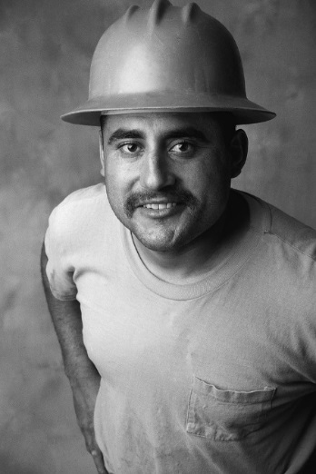

Case Study
1. Pt profile: 5’8”, 192 lb male
Diabetes 12 years, on insulin 3 yrs
What type of DM and how do you know?
2. Pt profile: 5’6”, 108 lb female
On insulin 3u Novolog before meals,
10u Lantus at bedtime
What type of DM and how do you know?

Slide 26


Slide 27


Slide 28

Type 1 Rates Increasing Globally
23% rise in type 1 diabetes incidence from 2001-2009
Why?
Autoimmune disease rates increasing over all
Changes in environmental exposure and gut bacteria?
Hygiene hypothesis
Obesity?

Slide 29
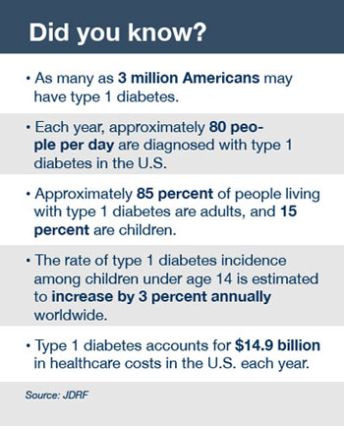
Type 1 Diabetes Facts

Slide 30

Type 1 – 10% of all Diabetes Genetics and Risk Factors
Auto-immune pancreatic beta cells destruction
Most commonly expressed at age 10-14
Insulin sensitive (require 0.5 - 1.0 units/kg/day)
Combo of genes and environment:
Autoimmunity tends to run in families
Higher rates in non breastfed infants
Viral triggers: congenital rubella, coxsackie virus B, cytomegalovirus, adenovirus and mumps.

Slide 31

Incidence of Type 1 in Youth
General Pop 0.3%
Sibling 4%
Mother 2-3%
Father 6-8%
Rate doubling every 20 yrs
Many trials underway to detect and prevent (Trial Net)

Slide 32
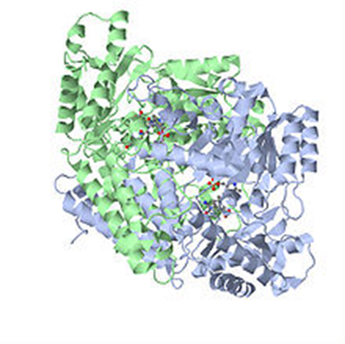
Autoantibodies Assoc w/ Type 1
Panel of autoantibodies –
GAD65 - Glutamic acid decarboxylase –
ICA - Islet Cell Cytoplasmic Autoantibodies
IAA - Insulin Autoantibodies

Slide 33
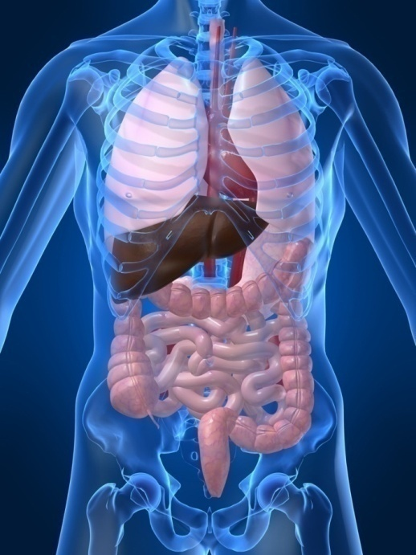
Type 1 Diabetes Associated with other immune conditions
Celiac disease (gluten intolerance)
Thyroid disease
Addison’s Disease
Rheumatoid arthritis
Other

Slide 34





What Does Type 1 Look Like?
Bret Michaels
Mary Tyler Moore
Adam Morrison
Nick Jonas
Justice Sonia Sotomayor
From Debbie Nagata’s slide collection

Slide 35



Ms. Idaho and Ms America – Pumpin’ It

Slide 36

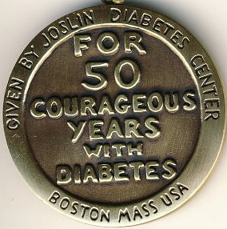
Medalist Study – Harvard Joslin Diabetes Center
After 50 years with diabetes
Many still produced some insulin
Many had no eye disease

Slide 37

Type 1 Summary
Autoimmune
Complete pancreatic destruction
Need insulin shots
Often first present in DKA

Slide 38

Type 1 in Hospital
43 yr old admitted to evaluate angina.
Morning blood sugar is 92.
Based on Regular insulin sliding scale, no insulin required.
Breakfast tray shows up and patient says, I need my insulin shot before I eat.
What do you say?

Slide 39

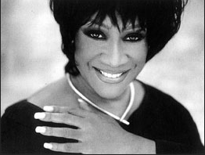
Patti Labelle
"divabetic" -- that's a mix of diabetic and diva

Slide 40




Slide 41
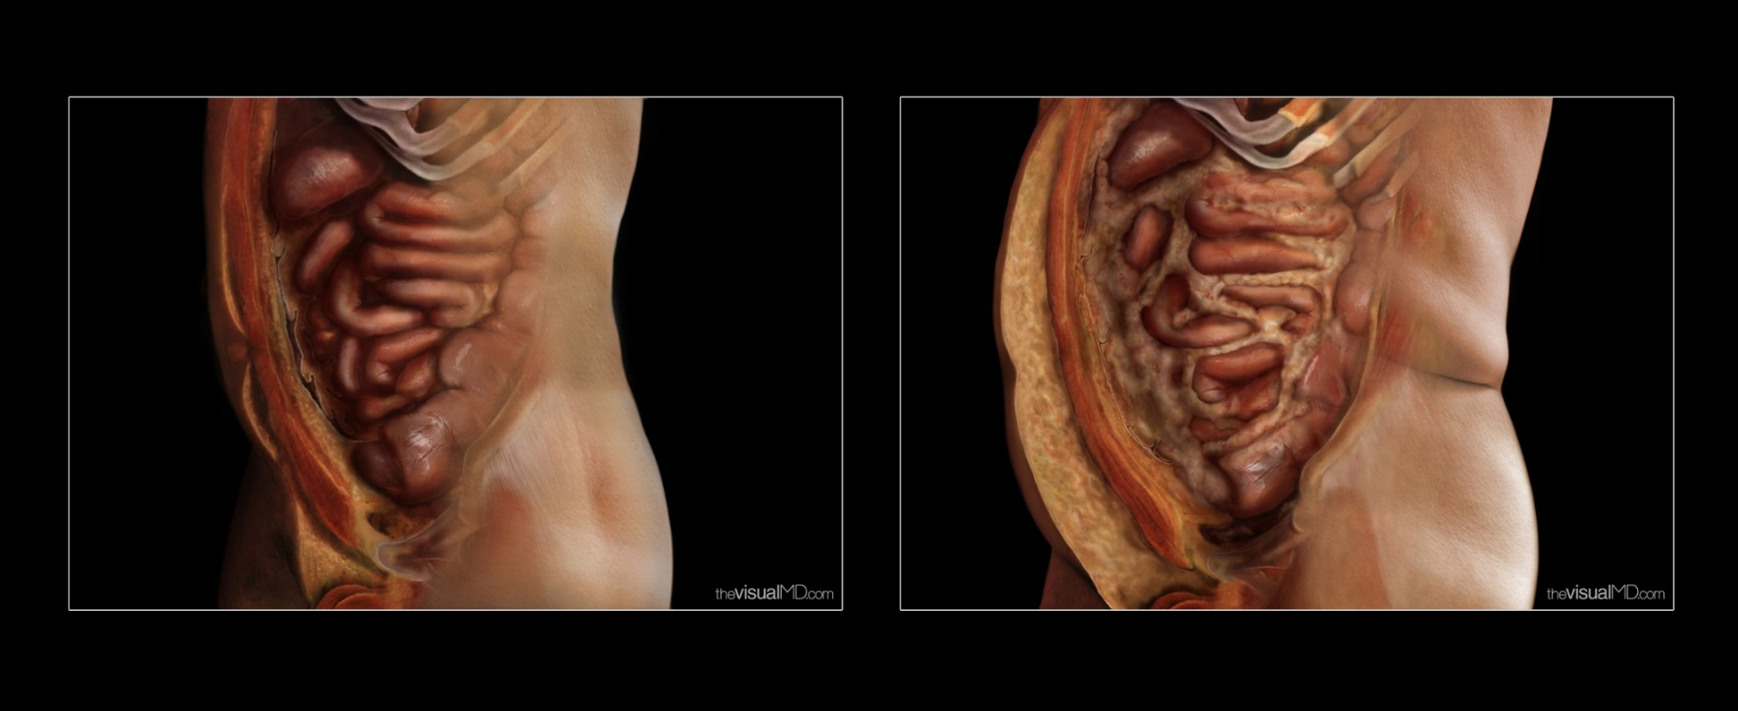
Visceral Fat – “Endocrine Organ”

Slide 42
Natural Progression of Type 2 Diabetes
Plasma
Glucose
Postprandial glucose
Fasting glucose
126 mg/dL
Relative β-Cell Function
Insulin resistance
Insulin secretion
-20
-10
0
10
20
30
Years of Diabetes
Prior to diagnosis
After diagnosis
Adapted from Bergenstal et al. 2000; International Diabetes Center.
Notes:
These graphs show the typical progressive nature of type 2 diabetes in terms of 2 key indices: increasing plasma glucose level (top panel) and decline in relative β-cell function as reflected by the drop in endogenous insulin and rise in insulin resistance (lower panel).
In the natural history of type 2 diabetes, insulin resistance rises, insulin secretion falls, and glucose levels begin to rise before diabetes is diagnosed.
Based on the natural history, type 2 diabetes is a disease of progressive insulin failure as shown in the graphic model developed by researchers at the International Diabetes Center.¹
Before the onset of diabetes, glucose levels start to rise, with a slightly sharper increase in the postprandial value than in fasting glucose. Both postprandial and fasting plasma glucose levels continue to rise if diabetes is left untreated.²
Prior to the diagnosis of diabetes, resistance of cell receptor sites to insulin starts to increase, while insulin secretion by β-cells decreases. Insulin resistance reaches a peak and remains constant. Endogenous insulin secretion continues to decline over the course of diabetes.²
References:
1. Kendall DM. Postprandial blood glucose in the management of type 2 diabetes: the emerging role of incretin mimetics. Available at: http://www.medscape.com/viewarticle/515693. Accessed April 21, 2006.
2. Ramlo-Halsted BA, Edelman SV. The natural history of type 2 diabetes: implications for clinical practice. Prim Care. 1999;26:771-789.

Slide 43

Cardio Metabolic Risk - 5 Hypers -
Hyperinsulinemia (resistance)
Hyperglycemia
Hyperlipidemia
Hypertension
Hyper”waistline”emia (35” women, 40” men)
Manifestations of Insulin Resistance

Slide 44

Diabetes 2 - Who is at Risk? (ADA Clinical Practice Guidelines)
Testing should be considered in all adults who are overweight (BMI ≥ 25) and have additional risk factors:
First-degree relative w/ diabetes
Member of a high-risk ethnic population
Habitual physical inactivity
PreDiabetes
History of heart disease

Slide 45

Diabetes 2 - Who is at Risk? (ADA Clinical Practice Guidelines)
Risk factors cont’d
HTN - BP > 140/90
HDL < 35 or triglycerides > 250
baby >9 lb or history of Gestational Diabetes Mellitus (GDM
Polycystic ovary syndrome (PCOS)
Other conditions assoc w/ insulin resistance:
Severe obesity, acanthosis nigricans (AN)

Slide 46
Acanthosis Nigricans (AN)
Signals high insulin levels in bloodstream
Patches of darkened skin over parts of body that bend or rub against each other
Neck, underarm, waistline, groin, knuckles, elbows, toes
Skin tags on neck and darkened areas around eyes, nose and cheeks.
No cure, lesions regress with treatment of insulin resistance

Slide 47
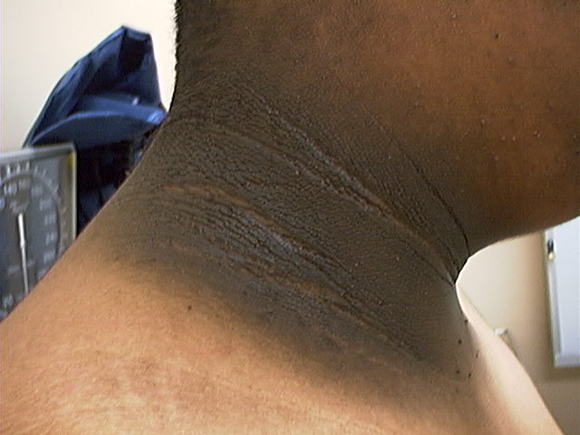
Acanthosis Nigricans

Slide 48
Diabetes Detectives Needed
On average – takes 6.5 years to diagnose diabetes
1/4 of all people with diabetes don’t know they have it

Slide 49
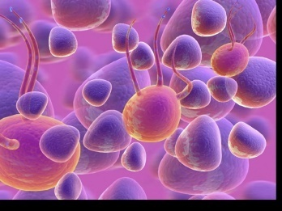
Ominous Octet
Decreased satiation neuro-
transmission
Increased renal glucose reabsorption
Decreased amylin, β-cell secretion
80% loss at dx
Decreased Gut hormones
Increased glucagon secretion
G
I
G
I
G
G
I
Increased lipolysis
I
G
G
G
I
I
G
G
I
Increase glucose
production
I
G
G
Decreased glucose
uptake
Notes:
49
49

Slide 50
Comparison of Type 1 and Type 2
Type 1
Type 2
Obesity
x
xxx
Insulin dependence
xxx
30%
Respond to oral agents
0
xxx
Ketosis
xxx
x
Antibodies present
xxx
0
Typical Age of onset
teens
adult
Insulin Resistance
0
xxx

Slide 51

Diabetes is also associated with:
Fatty liver disease
Obstructive sleep apnea
Cancer; pancreas, liver, breast
Alzheimer’s
Depression

Slide 52

Gestational DM ~ 7% of all Pregnancies
GDM prevalence increased by
∼10–100% during the past 20 yrs
Native Americans, Asians, Hispanics, African-American women at highest risk
Immediately after pregnancy, 5% to 10% of GDM diagnosed with type 2 diabetes
Within 5 years, 50% chance of developing DM in next 5 years.

Slide 53
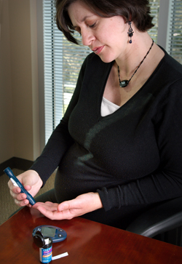
Diabetes in pregnant mothers associated with …
Offspring
Fetal Complications
Obesity and diabetes later in life
Mother
More complicated pregnancy and delivery
Diabetes later in life
Intrauterine environment is important

Slide 54

Screen Pregnant Women Before 13 weeks
Screen for undiagnosed Type 2 at the first prenatal visit using standard risk factors.
Women found to have diabetes at their initial prenatal visit treated as “Diabetes in Pregnancy”
If normal, recheck at 24-28 weeks

Slide 55

Increasing Prevalence – A public health perspective
Body weight before and during pregnancy influences risk of GDM and future diabetes
Children born to women with GDM at greater risk of diabetes
Focus on prevention

Slide 56
Postnatal Health: Maternal Behavior
Encourage breastfeeding for one year
(25% of women achieving this goal)
Screening 6-12 weeks post partum using non-pregnant OGTT criteria (50%)
Repeat at 3 yr intervals or signs of DM
Encourage weight control and exercise
Make sure connected with health care
Preconception counseling

Slide 57

Start Metformin therapy
For women with PreDiabetes and History of GDM

Slide 58
Other Causes of Hyperglycemia
Steroids
Agent Orange
Tube feedings / TPN
Transplant medications
Cystic Fibrosis
Regardless of cause, requires treatment
Insulin always works
Sign of pancreatic malfunction

Slide 59
Flash Mob – World Diabetes Day to Beat It
March R/C/R
Fred Astaire
Point R/L
Arms up, down
Shoulder Walk
Punch down/up
Scoot Rt/Left
Reach up R/L
Shoulder Walk
Open door
Ride Horse
Scoot Rt/Left
Turn R & Clap, then L
Shoulder Walk
Punch down/up

Slide 60

Life Study – Mrs. Jones
Mrs. Jones is 62 years old, overweight and complaining of feeling tired and urinating several times a night. She is admitted with a urinary tract Infection. Her WBC is 12.3, glucose 237. She is hypertensive with a history of gestational diabetes. No ketones in urine.
What are her risk factors, signs of diabetes
What type of diabetes does she have?
Does she have insulin resistance?

Slide 61
What Do You Say? Mrs. Jones asks you
What is type 2 diabetes?
Will this go away?
Will I get complications?
Will I need to take diabetes medication for the rest of my life?
How come I got diabetes?
Do I have to check my blood sugars?

Slide 62
I don’t want to!

Slide 63

Running into Roadblocks?
HUG Patients
Unconditional Positive Regard –
involves showing complete support and acceptance of a person no matter what that person says or does.
Carl Rogers
Help with
Unconditional
Guidance and Support
Anne Peters, MD, CDE
ADA Post Grad

Slide 64
No one is Unmotivated
…. to lead and long and healthy life
These are the 3 usual Critical Barriers
Perceived worthlessness
Too many personal obstacles
Absence of support and resources
Bill Polonsky, PhD, CDE

Slide 65
Overcoming barriers
Confront the key misbelief. Ask the question, does dm cause complications?
Offer pts evidence based hope message –
Frequent contact
Paired glucose testing
Ask pt, “Tell me 1 thing that is driving you crazy about your diabetes”
Discuss medication beliefs
To improve outcomes, see pts more often
Bill Polonsky, PhD, CDE

Slide 66

How Often Should I Check?
Be realistic!!
Type 1 – as often as needed
Type 2 – as needed
Consider:
Types and timing of meds
Goals
Ability (physical and emotional)
Finances

Slide 67
How will it help me?
See if your treatment plan is working
Make decisions regarding food and/or med adjustment when exercising
Find out how that pizza affected your BG
Avoid unwanted weight gain
Enhanced athletic performance
Find patterns
Manage illness

Slide 68

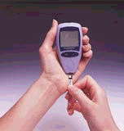
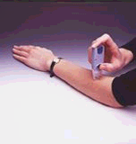
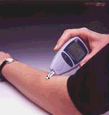
New Meters – a little goes a long way
0.3 microliters of blood
minimal pain
Customer Service (toll-free): Look for 800 number

Slide 69
Diabetes Bingo - “DiaBingo” Shout out Right Answer

Slide 70
DiaBingo
B Frequent skin and yeast infections
B A BMI of ____ or greater is considered overweight
B To reduce complications, control A1c, Blood pressure, Cholesterol
B PreDiabetes – fasting glucose level of ___ to ____
B Erectile dysfunction indicates greater risk for ____
B Diabetes – fasting glucose level____ or greater
B Type 1 diabetes is best described as an ______ disease
B People with diabetes are ______ times more likely to die of heart dx
B Elevated triglycerides, < HDL, smaller dense LDL
B Each percentage point of A1c = _____ mg/dl glucose
B At dx of type 2, about __% of the beta cell function is lost
B Diabetes – random glucose ____ or greater

Slide 71
Complications - Why?
Degree of hyperglycemia “glucose toxicity”
Duration of hyperglycemia
Genes
Multiple risk factors: smoking, vascular disease, dyslipidemia, hypertension, other

Slide 72

Diabetes Complications
Heart disease leading cause of death.
CAD death rates are about 2 -4x’s as high as adults without diabetes (it’s not getting better)
Risk of stroke is 2 - 4 times higher
60% - 65% of people with DM have HTN.
DM accounts for 40% of new cases of ESRD
60 - 70% have mild - severe forms of neuropathy
Diabetes is the leading cause of blindness
Accounts for 50% of lower limb amputations

Slide 73
Control Matters
Trials
Practice Recommendations

Slide 74

Financial Advisor
Mid 30s, friendly, he smiles to greet you and you notice his gums are inflamed. You’d guess a BMI of 26 or so, with most of the extra weight in the waist area.
If you could give him some health related suggestions, what would they be?

Slide 75

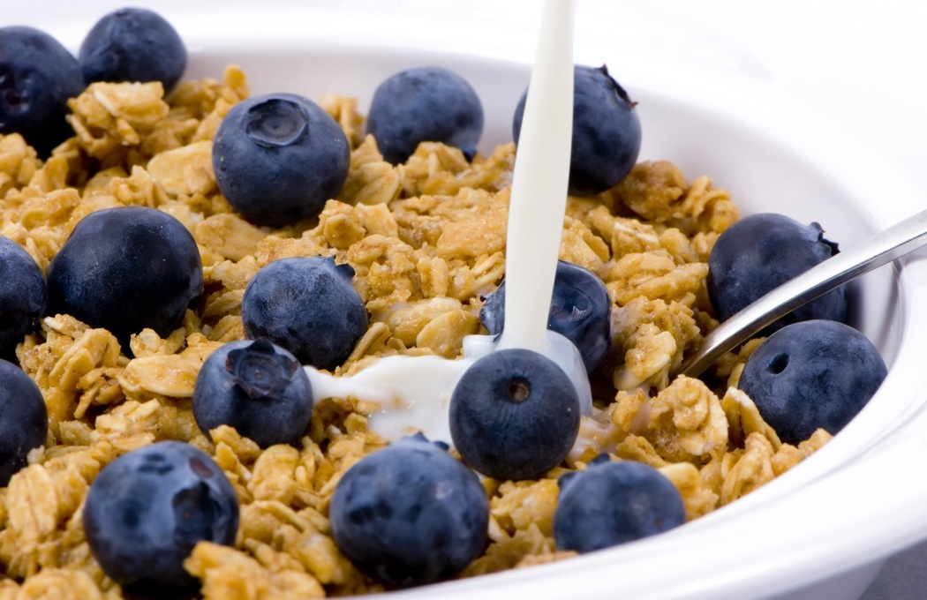


Preventing Pre Diabetes

Slide 76
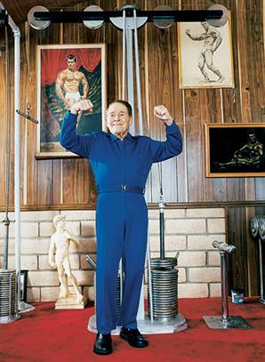
Can Type 2 be Prevented in Older Adults?
Overall, 9 of 10 new cases of diabetes attributable to these 5 lifestyle factors.
89% risk reduction when all at goal.
35% rel risk reduction for each additional
Physical activity (30 mins a day)
Dietary score (higher fiber intake, low saturated fat and trans-fat , lower mean glycemic index)
Not Smoking
Alcohol use (up to 2 drinks a day);
BMI <25 and waist circumference
Dariush Mozaffarian, MD,
Arch Intern Med. 2009;169(8):798-807.

Slide 77
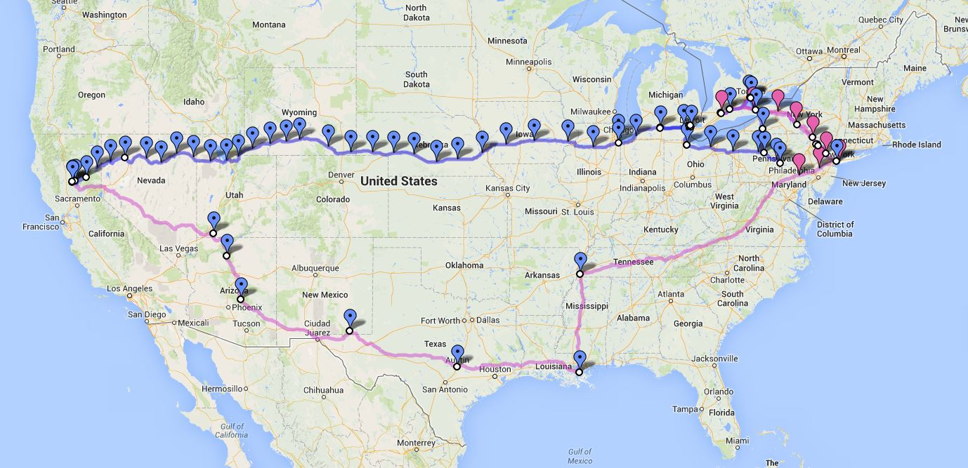

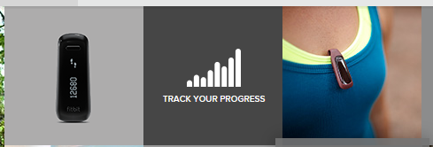
We Made It – 3129 miles- Now Walking Back
Track miles with fitbit
Fitbit.com
Lifespan Treadmill Desk - Amazon

Slide 78

Can we stop pre diabetes from progressing?
3, 234 people w/ Pre-Diabetes randomized:
Placebo
Diet/Exercise or
Metformin
over a three year period
Diabetes Prevention Program (DPP) 2001

Slide 79

Diabetes Prevention Program
Standard Group - 29% developed DM
Lifestyle Results - 14% developed DM
58% (71% for 60yrs +) Risk reduction
30 mins daily activity
5-7% of body wt loss
Metformin 850 BID - 22% developed DM
31% risk reduction (less effective with elderly and thinner pt’s)

Slide 80

Weight loss and Prevention
For every 2.2 pounds of weight loss, risk of type 2 diabetes was reduced by 13%.

Slide 81
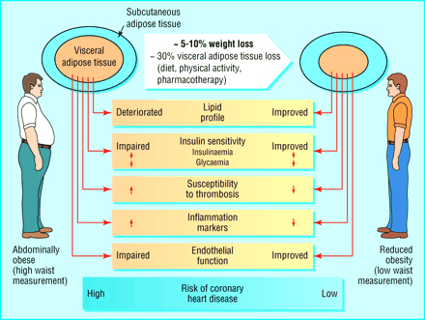

Slide 82

Goals of Care

Slide 83
ABCs of Diabetes
A1C
Blood Pressure
Cholesterol
Standards of Medical Care – American Diabetes Association

Slide 84

1% decrease in A₁c reduces microvascular complications by 35%
1% decrease in A₁c reduces diabetes related deaths by 25%
B/P control (144/82) reduced risk of:
Heart failure (56%)
Stroke (44%)
Death from diabetes (32%)
Lancet 352: 837-865, 1998

Slide 85

A1c and Estimated Avg Glucose (eAG) 2008
A1c (%) eAG
5 97
6 126
7 154
8 183
9 212
10 240
11 269
12 298
eAG = 28.7 x A1c-46.7 ~ 29 pts per 1%
Translating the A1c Assay Into Estimated Average Glucose Values – ADAG Study
Diabetes Care: 31, #8, August 2008
Order teaching tool kit free at diabetes.org

Slide 86


Slide 87
ABCs of Diabetes –
A1c less than 7% (avg 3 month BG)
Pre-meal BG 70-130
Post meal BG <180
Blood Pressure < 140/80
Cholesterol
HDL >40
LDL <100 (if CHD, <70)
Triglyceride < 150

Slide 88

“Legacy Effect”
For participants of DCCT and UKPDS
long lasting benefit of early intensive BG control prevents
microvascular complications
Macrovascular complications (15-55% decrease)
Even though their BG levels increased over time
Message – Catch early and
Treat aggressively

Slide 89
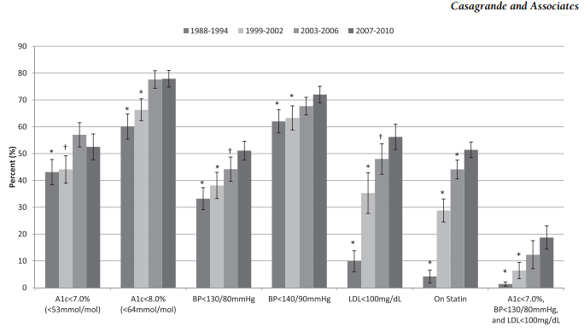
How are we doing? Reaching goal
Diabetes Care, 2/13

Slide 90
Vaccinations- Immunizations
Flu vaccine
every year starting 6 months
Pneumococcal starting at 2 years.
One time Revaccination for those over 64 and had first vaccine >5 years prior
Hepatitis B Vaccine (ADA Stds 2013, pg s28)
For diabetes pts age 19 – 59 (not previously vaccinated)
Double risk of Hep B due to lancing devices/ glucose meter exposure

Slide 91
Diabetes Bingo “DiaBingo” Shout out Right Answer

Slide 92
DiaBingo- G
G ADA goal for A1c is less than ____%
G People with DM need to see their provider at least every month
G Blood pressure goal is less than
G People with DM should see eye doctor (ophthalmologist) at least
G The goal for triglyceride level is less than
G Goal for my HDL cholesterol is more than
G The goal for blood sugars 1-2 hours after a meal is less than:
G People with DM should get this shot every year
G People with DM need to get urine tested yearly for ___________
G Periodontal disease indicates increased risk for heart disease
G The goal for blood sugar levels before meals is:
G The activity goal is to do ___ minutes on most days

Slide 93
Mr. Jones - What are Your Recommendations?
Self-Care Skills
Walks dog around block 3 x’s a week
Bowls every Friday
3 beers daily
Widowed, so usually eats out
15 lbs overweight
My foot hurts
Patient Profile
64 yr old with type 2 for 11 yrs. Hx of CVD.
Labs:
A1c 9.3%
HDL 37 mg/dl
LDL 114 mg/dl
Triglyceride 260mg/dl
Proteinuria - neg
B/P 142/92

Slide 94
Diabetes Care Guidelines- ADA
Test / Exam Frequency
A1c At least twice a year
B/P Each diabetes visit
Cholesterol (LDL, HDL, Tri) Yearly (less if normal)
Weight each diabetes visit
Microalbumin/GFR/Creat Yearly
Eye exam Yearly
Dental Care At least twice a year
Comprehensive Foot Exam Yearly (more if high risk)
Physical Activity Plan As needed to meet goals
Preconception counseling As needed

Slide 95
Foot Care
Lift the sheets and look at the Feets!

Slide 96
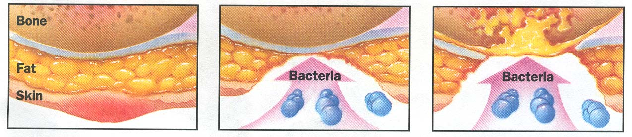
Foot Wounds
Blisters Ulcers Bone infection
Calluses

Slide 97
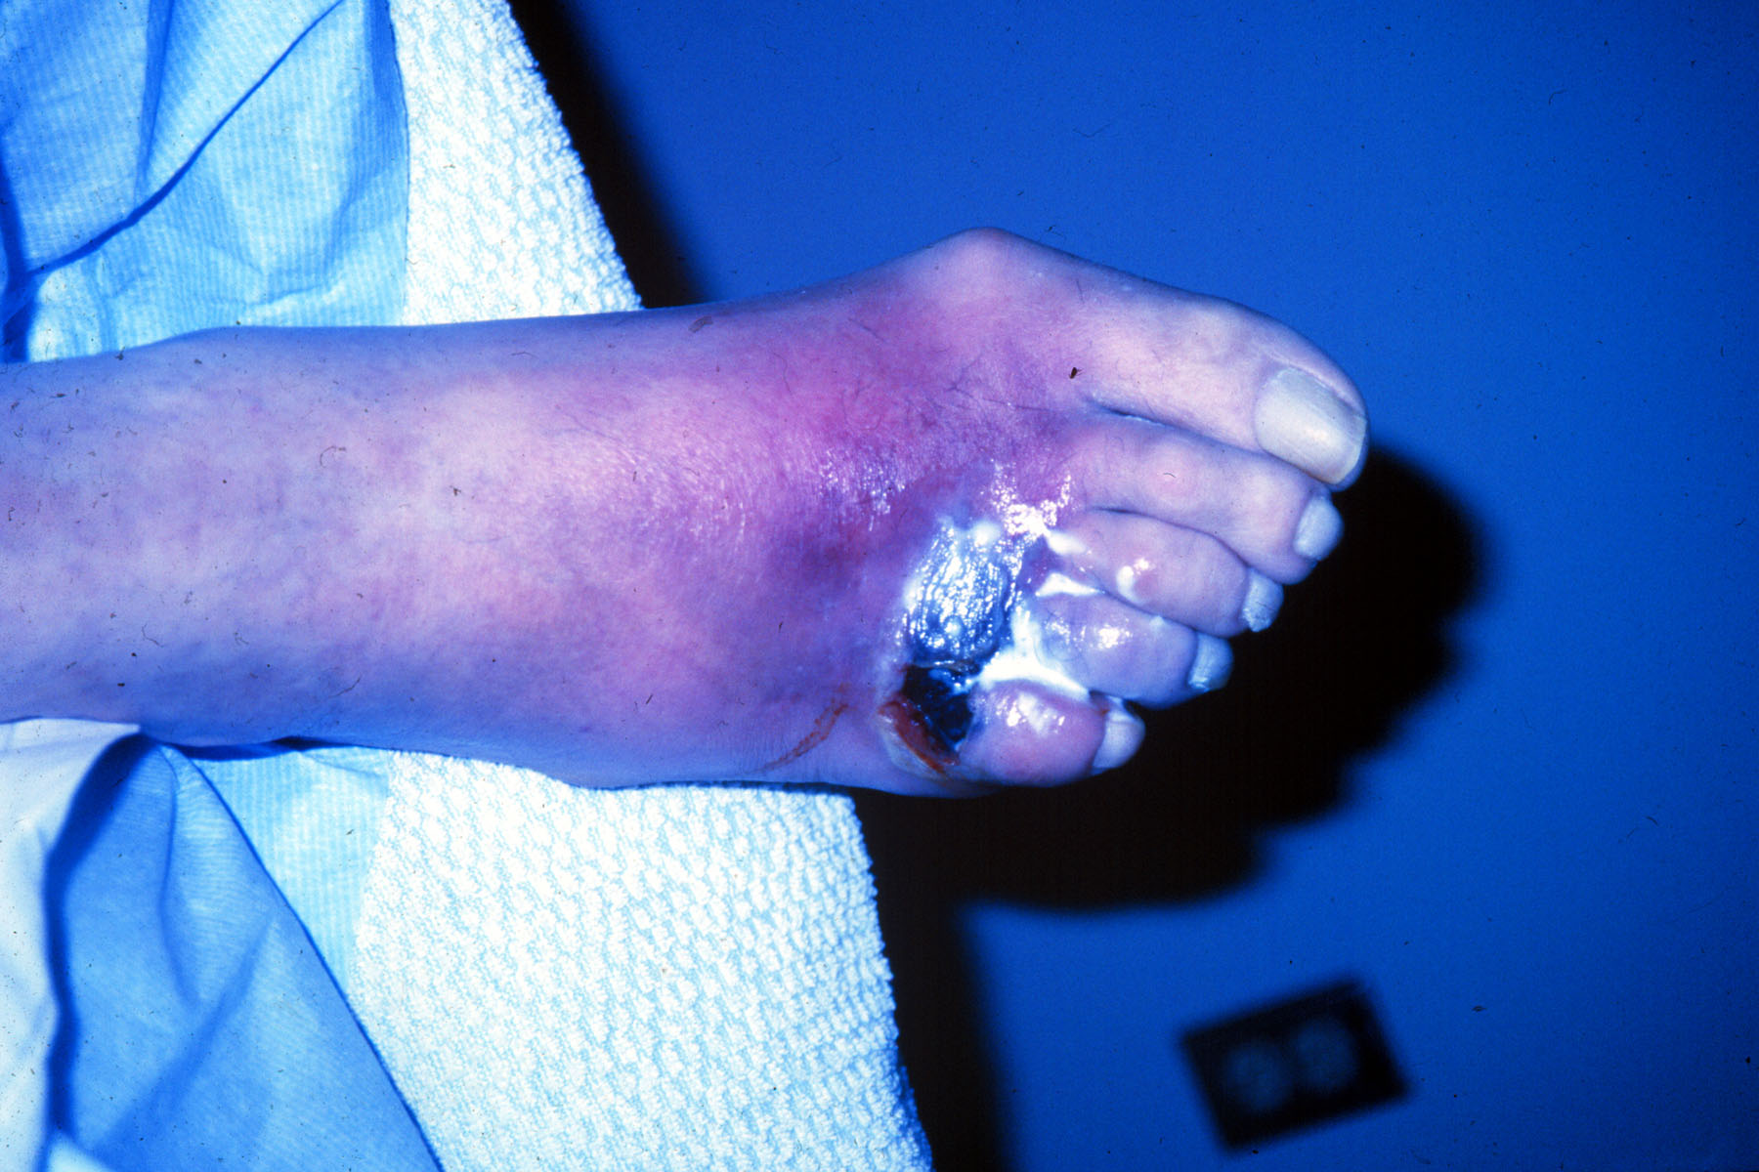

Slide 98
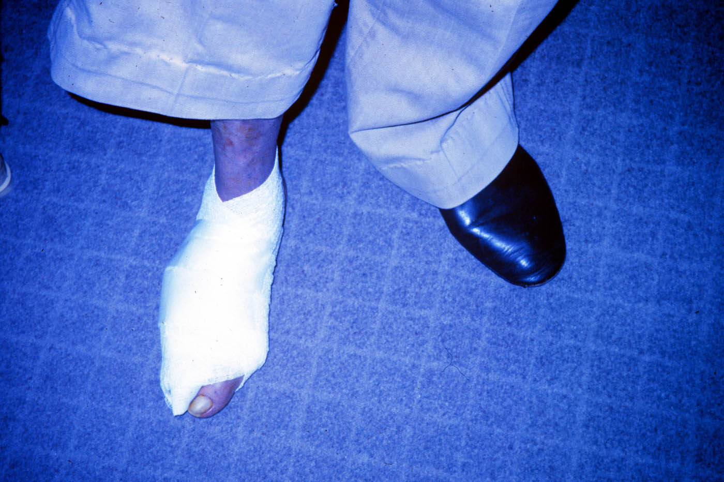

Slide 99
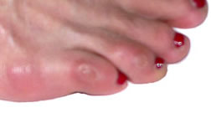
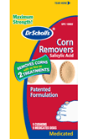

No Bathroom Surgery

Slide 100
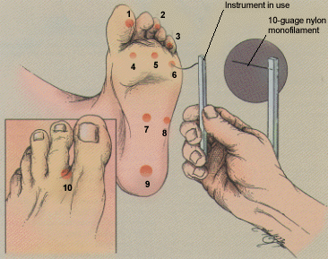
5.07 monofilament = 10gms linear pressure If pt can’t feel pressure = neuropathy
Free Monofilaments
http://www.hrsa.gov/leap/

Slide 101
3 Most Important Foot Care Tips
Three Most Important Foot Care Tips
Inspect and apply lotion to your feet every night before you go to bed.
Do NOT go barefoot, even in your house. Always wear shoes!
Every time you see your doctor, take off your shoes and show your feet.

Slide 102

Glucose Management and Hospitalized Patients
In hospitalized patients with critical illness, hyperglycemia is a signal that warrants our attention.

Slide 103

Hospitals and Hyperglycemia – What’s the Big Deal?
Hyperglycemia is associated with increased morbidity and mortality in hospital settings.
Acute Myocardial Infarction
Stroke
Cardiac Surgery
Infection
Longer lengths of stay

Slide 104
Hyperglycemia*: A Common Comorbidity in Medical-Surgical Patients in a Community Hospital
Umpierrez G et al, J Clin Endocrinol Metabol 87:978, 2002
12%
26%
62%
Normoglycemia
Umpierrez et al
n = 2,020
* Hyperglycemia: Fasting BG ≥ 126 mg/dl
or Random BG ≥ 200 mg/dl X 2
Known Diabetes
New Hyperglycemia
Notes:
In a more recent study that involved 2020 consecutive patients admitted to a community hospital in Atlanta, we found that 64% of patients had normal glucose values, 26% had a prior history of diabetes, and that 12% of patients with hyperglycemia, as determined by 2 or more FBG > 126 or RBG > 200, did not had a know history of diabetes prior to admission.

Slide 105
Effect of Hyperglycemia on Hospital Mortality
Prior history of
*
Mortality (%)
*
*
*P<.01 compared with normoglycemia and known diabetes.
Umpierrez GE et al. J Clin Endocrinol Metab. 2002;87:978-982.
Notes:
The medical records of 2030 consecutive adult patients were analyzed for the presence of hyperglycemia and any association with poor hospital outcomes.
New hyperglycemia was associated with a 16% mortality rate compared with 3% and 1.7% for patients with a prior history of diabetes or normoglycemia (P<.01).
The mortality rate was significantly higher for patients with new hyperglycemia regardless of whether they were admitted to the ICU (P<.01 for both ICU and non-ICU patients compared with those with diabetes or normoglycemia). Mortality rates were 10% for non-ICU patients with new hyperglycemia and 31% for ICU patients.
Reference
Umpierrez GE, Isaacs SD, Bazargan N, You X, Thaler LM, Kitabchi AE. Hyperglycemia: an independent marker of in-hospital mortality in patients with undiagnosed diabetes. J Clin Endocrinol Metab. 2002;87:978-982.

Slide 106

BG Above Normal = Trouble
Pre Diabetes
Fasting Glucose = 100-125mg/dl
A1c 5.7 – 6.4%
Diabetes
Fasting Glucose = 126 mg/dl +
Random Glucose = 200 mg/dl +
A1c 6.5% +
Any blood glucose above 140 requires treatment
Umpierrez et al

Slide 107

WHAT SHOULD WE AIM FOR?
Critically Ill pts
BG > 180- Start insulin
BG goal 140-180
Non Critically Ill patients BG Goals
Premeal <140
Post meal <180
Insulin therapy preferred treatment
Consensus: Inpt Hyperglycemia, Endocr Pract. 2009;15 (No.4)

Slide 108

Management of Hyperglycemia and Diabetes
Stop oral agents (ie) metformin & sulfonylurea on admission
“The sole use of Sliding Scale insulin is discouraged” – ADA 2014
For discharge, oral meds can be resumed
Start Basal/bolus therapy
NPH and Regular insulin
Long-acting and rapid-acting insulin
Premixed insulin

Slide 109
In Patient Strategies – Start Early, Focus on Survival Skills

Slide 110
Discharge insulin Algorithm
Discharge Treatment
A1C < 7%
A1C 7%-9%
A1C >9%
Re-start outpatient treatment regimen
(Orals and/or insulin)
Re-start outpatient oral agents and D/C on glargine once daily at 50-80% of hospital dose
D/C on basal bolus at same hospital dose.
Alternative: re-start oral agents and D/C on glargine once daily at 50-80% of hospital dose
Clinical Guidelines for the Managment of Hyperglycemia in Hospitalized Patients in a Non-Critical Care Setting

Slide 111
Now What?
Nurse administered insulin and pt only ate a few bites of turkey and drank non sugar tea?
Nurse had an emergency and pt already ate lunch?
You just gave 3 units of Aspart and patient needs to go to OR NOW!

Slide 112
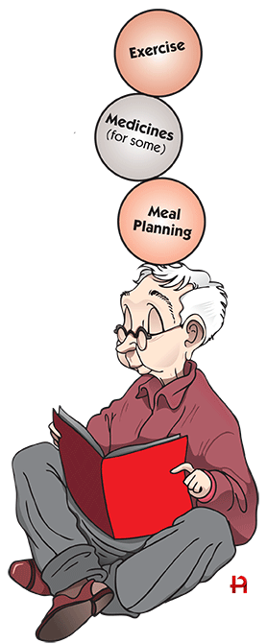
5 Survival Skills
Basics of Diabetes
Can patient perform self blood glucose monitoring? Do they need meter?
Can pt safely take meds / insulin? Teach side effects.
Meal Planning?
Self Care including hypo prevent/treat
Follow-Up plan - Does pt know who to contact when need help?
Diabetes Ed, PCP, Home Health

Slide 113

Bottom Line
30-40% of hospitalized patients have diabetes
10% aren’t officially diagnosed
Cardiovascular disease is the leading cause of hospitalization for people with diabetes
Look for patients with hyperglycemia and cardiometabolic risk factors: smokers, HTN,
central obesity, abnormal lipids, Acanthosis.
Provide education and promote self-advocacy

Slide 114
Diabetes Self-Management
Self Monitor Blood Glucose
Meal Plan
Exercise / Activity
Medications

Slide 115
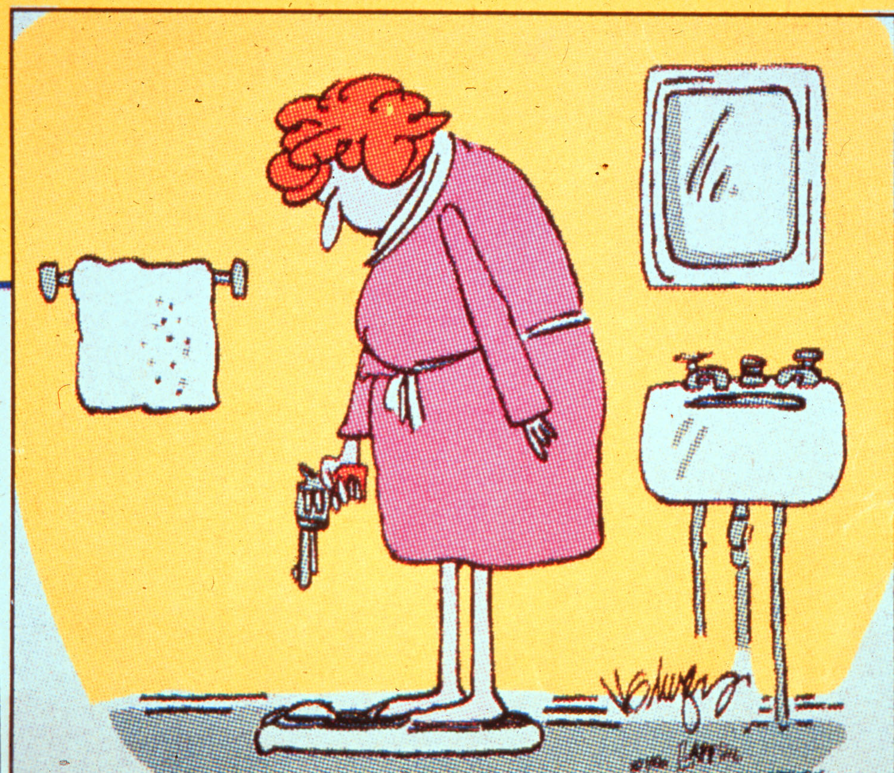

Slide 116
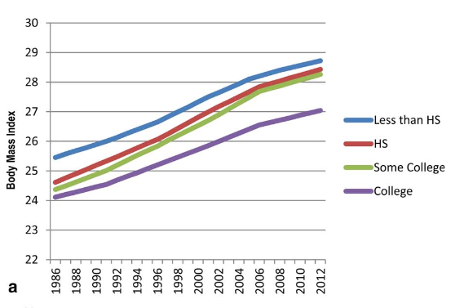
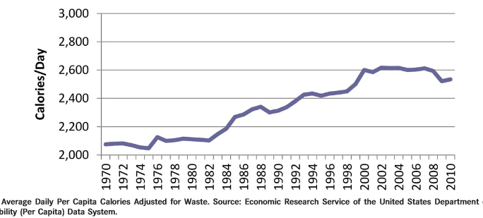
Obesity in America
68% overweight or obese
34% BMI 30 +, 34% BMI 25-29
1/3 of all overwt people don’t get diabetes
We burn 100 cals less a day at work
Overall, food costs ~ 10-15% of income
Calorie Intake is on the rise

Slide 117
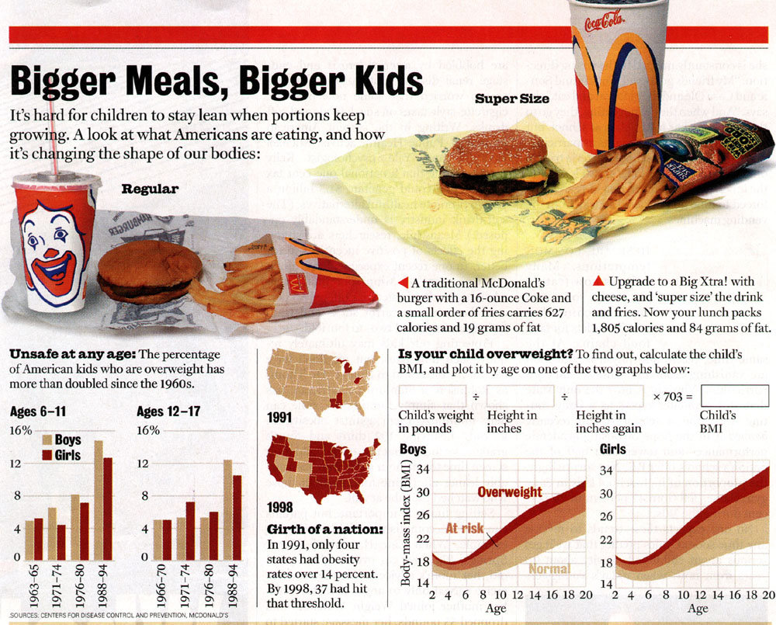
Bigger Meals, Bigger Kids

Slide 118
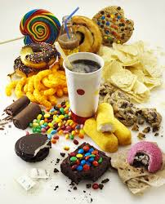
Average American Consumes 25 teaspoons of sugar a day (400 cals)
Warning label on sodas proposed
One soda has 12 teaspoons soda
On avg, 1 person consumes 40 gallons of soda each year
ADA guidelines “limit sodas and beverages with sugar, High Fructose Corn Syrup, (HFCS)

Slide 119
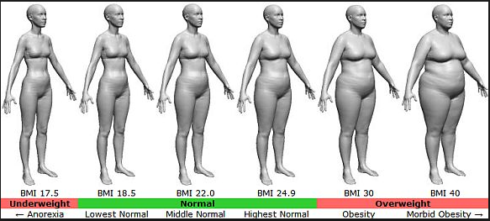
BMI – Visual Image

Slide 120

Medical Nutrition Therapy – ADA 2014 Updates
No ideal percentage of calories from protein, carbohydrate and fat for people with diabetes.
Macronutrient distribution should be based on an individualized assessment of eating patterns, preferences and metabolic goals.

Slide 121
Medical Nutrition Therapy – ADA 2014
Focus on the Individual
Maintain pleasure of eating
Provide positive messages about food
Limit food choices only when backed by science
Provide practical tools
Refer to a RD and Diabetes Education – Lowers A1c by 1-2%

Slide 122
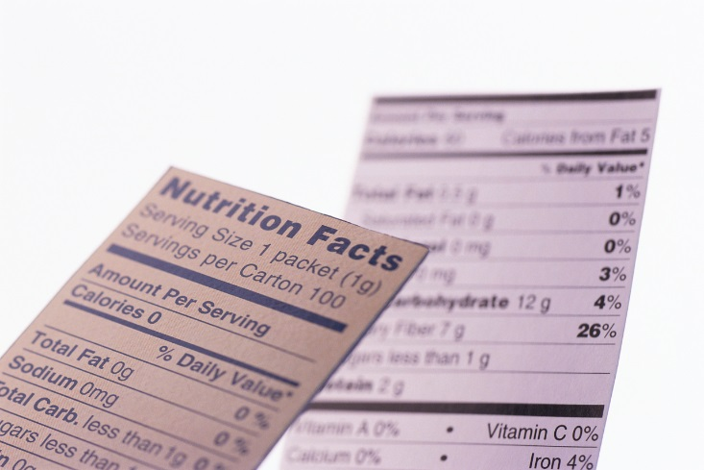
Sodium, Fat and Fiber
Sodium – Try and keep less than 2,300 mg a day
Vitamin and mineral supplements not recommended -lack of evidence.
Fat - same as recommended for general population
Less than 10% saturated fat,
Limit trans fats
Less than 300 mg cholesterol daily
Mediterranean Diet looks like good option
Fiber 25 -38 gms a day

Slide 123

Approach Depends on Patient
New Type 2
Portion Control
Plate Method
Record Keeping
Education
On Insulin?
Carb counting
Post prandial checks

Slide 124
Losing 2-8kg Early in diagnosis Type 2 Helpful ADA 2014
Weight Loss –
The optimal macronutrient intake to lose weight not known
The literature does not support one particular nutrition therapy to reduce weight, but rather a spectrum of eating patterns that result in reduced energy intake.
To lose one pound – avoid 3,500 cals
Decrease intake 250-500 cals daily + exercise

Slide 125

Successful weight loss strategies include
Weekly self-weighing
Eat breakfast
Reduce fast food intake.
Decrease portion size
Increase physical activity
Use meal replacements
Eat healthy foods

Slide 126
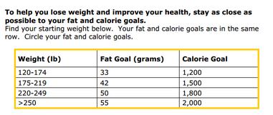
Diabetes Prevention Program Focus on fat = wt loss success
http://www.cdc.gov/diabetes/prevention/recognition/curriculum.htm

Slide 127
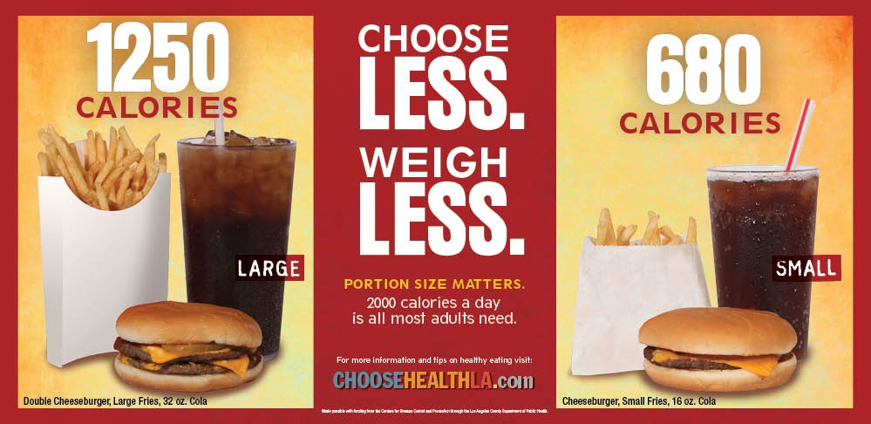
Public Health Issue?
66% of our people are obese/overweight
Rates of gestational diabetes on rise
30% of kids are obese/overweight

Slide 128
How nutrients affect blood sugar

Slide 129

Teaching About Eating Healthy
Major food groups
“Handy Diet”
Plate Method
Exchange Lists
Food Diaries / Glucose Records
Carbohydrate Counting
Assess what is best for the situation.

Slide 130






Move toward the Tomato

Slide 131

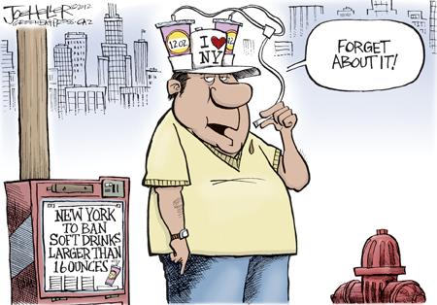
ADA recommendation Eat Less Junk Food & Sugary Drinks –
Less Processed Foods
Less Sugary Beverages
increase visceral adiposity
With sugar or
High fructose corn syrup
Soda Tax?
Junk Food Tax?

Slide 132
10 Superfoods
Beans
Dark Green Leafy Vegs
Citrus Fruit
Sweet Potatoes
Berries
Tomatoes
Fish High in Omega-3 Fatty Acids
Whole Grains
Nuts
Fat-Free Milk and Yogurt

Slide 133
USDA Food Pyramid www.myplate.gov
Balancing Calories
Enjoy your food, but eat less.
Avoid oversized portions.
Foods to Increase
Make half your plate fruits and vegetables.
Make at least half your grains whole grains.
Switch to fat-free or low-fat (1%) milk.
Foods to Reduce
Compare sodium in foods like soup, bread, and frozen meals ― and choose the foods with lower numbers.
Drink water instead of sugary drinks.

Slide 134

Another plate example

Slide 135
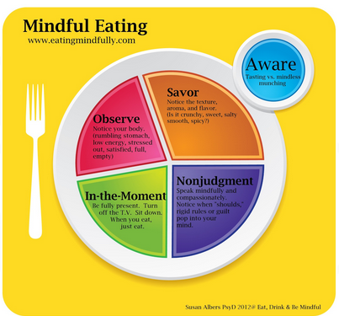
Mindful Eating

Slide 136

Nutrition Facts
Serving Size 1/2 cup (114 g)
Servings Per Container 4
Amount Per Serving
Calories 90 Calories from Fat 30
Fooducate App – gives grade and nutrition info.
% Daily Value*
Total Fat 3g 5%
Saturated Fat 0g 0%
Cholesterol 0g 0%
Sodium 300mg 13%
Total Carbohydrate 13g 4%
Dietary Fiber 3g 12%
1 tsp sugar =4 gms
Sugars 3g
Protein 3g
Vitamin A 80% * Vitamin C 60%
Calcium 4% * Iron 4%
* Percent Daily Values are based on a 2,000 calorie diet. Your daily values may be higher or lower depending on your calorie needs:
Calories _ 2000 2500
Total Fat Less than 65g 80g
Sat Fat Less than 20g 25g
Cholesterol Less than 300mg 300mg
Sodium Less than 2400mg 2400mg
Total Carbohydrate 300g 375g
Fiber 25g 30g
Calories per gram: Fat 9 Carbohydrates 4 Protein 4

Slide 137
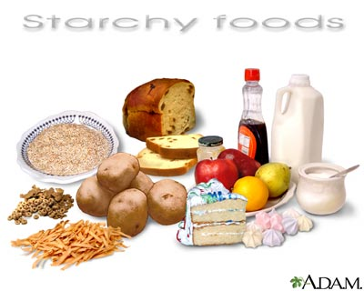
Carbs affect Post meal Blood Glucose
Starch
Fruit
Milk
Desserts

Slide 138

Carbohydrate Needs for Most Adults
Grams Servings
Each Meal 45-60 gm 3 - 4
Snacks 15-30 gm 1- 2
Carbs affect Post Meal Blood Glucose

Slide 139

Choose Healthy Carbs
Carbs have fiber, vitamins, minerals and phytonutrients
25 gms of fiber a day
Power Carbs include:
Beans
Veggies
Fruits
Whole grain foods

Slide 140
Handy Meal Plan
Per Meal Serving
Each finger = 15 gms carb (can have 3-4 servings/meal)
Palm of hand = 3 oz’s protein
Thumbnail = 1 tsp fat serving

Slide 141
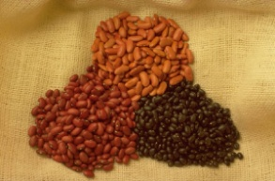


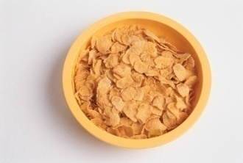
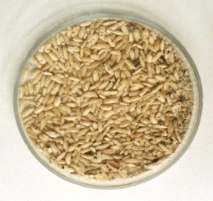
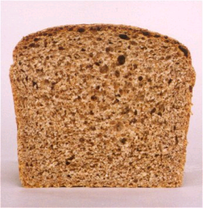

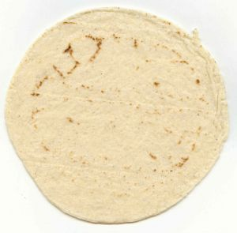
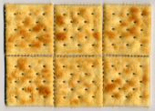

Carb Counting - Starch
Each Food has:
80 Calories
15 grams carb
1 small ear of corn or 1/2 cup corn
1/3 cup cooked pasta
1/2 cup
cooked beans
3/4 cup cold cereal
1 slice bread
1/3 cup cooked rice
1 small potato
1/2 English muffin
1 small tortilla
5-6 small crackers

Slide 142









Carb counting- fruit
Each Food has:
60 Calories
15 grams carb
½ cup fruit juice
½ banana
1 small fresh fruit
½ cup unsweetened apple sauce
1 slice bread
17 small grapes
1 cup melon
¼ cup dried fruit
2 tbsp raisins
1 1/4 cup strawberries

Slide 143







Carb Counting - Milk
Each Food has:
90-150 calories
12-15 grams carb
8 oz buttermilk
1 packet diet hot cocoa
1 slice bread
6 oz plain yogurt
8 oz milk
6 oz light fruit yogurt
8 oz soy milk

Slide 144









Carb Counting - Sweets
Each Food has:
Calories vary
15 grams carb
2 inch square cake or brownie, unfrosted
½ cup regular jello
2 tbsp light syrup
½ cup diet pudding
1 slice bread
1 tbsp syrup, jam, jelly, table sugar, honey
2 small cookies
¼ cup sorbet
½ cup ice cream or frozen yogurt
½ cup sherbet

Slide 145


Go Lean with Protein
Choose lean protein
Poultry, fish, egg, lean beef
Plant sources- beans, lentils, nuts
Low fat cheese- cottage cheese, mozzarella cheese
Limit high fat protein
Bacon & sausage
High fat cuts of beef
Whole milk cheese
Serving size
1 oz = ¼ cup
3 oz = deck of cards

Slide 146

Fats- Aim for heart health
Saturated fats (LIMIT)
Solid
Animal
Tropical (palm, coconut)
Trans fats (deep fried)
Monounsaturated
Olive & canola oils
Nuts
Avocado
Polyunsaturated
veg oils: canola, corn, walnut, safflower, soybean
Serving sizes
1 tsp butter, margarine, oil, mayonnaise
1 Tbsp salad dressing, cream cheese, seeds
2 Tbsp avocado, cream, sour cream
1 slice bacon

Slide 147
Using Alcohol Safely
Women- 1 or fewer alcoholic drinks a day
Men 2 or fewer alcoholic drinks a day
1 alcoholic drink equals
12 oz beer, 5 oz glass of wine, or 1.5 oz distilled spirits (vodka, gin etc)
If drink, limit amount and drink w/ food.
Ask HCP if safe for you to drink. Tell them your usual quantity and frequency.
Can cause hypo and worsen neuropathy

Slide 148
Ms. Gonzales’ Daily Meal plan

Slide 149
Resources
www.eatright.org American Dietetic Association website for nutrition information, resources, and access to Registered Dietitians
www.diabetes.org American Diabetes Association website, advocates to prevent, cure and improve the lives of all people affected diabetes
www.americanheart.org American Heart Association website; resources, recipes and tips; learn about efforts to reduce death caused by cardiovascular disease
www.dce.org/publications/education-handouts/

Slide 150
Resources
www.nhlbi.nih.gov contains information for professionals and the general public about heart and vascular diseases, lung diseases, blood diseases.
www.niddk.nih.gov National Institute of Diabetes and Digestive and Kidney Diseases (NIDDK) information and resources clearinghouse.

Slide 151
Diabetes Bingo - “DiaBingo” Shout out Right Answer

Slide 152
DiaBingo - N
N Injected hormone called an incretin mimetic
N DPP demonstrated that exercise and diet reduced risk of DM by ___%
N An _______a day can help prevent heart attack and stroke
N Rebound hyperglycemia
N Scare tactics are effective at motivating patients to change behavior
N Losing ___ % of body weight, can improve blood glucose, BP, lipids
N Drugs that can cause hyperglycemia
N 2/3 cups of rice equals ______ serving carbohydrate
N A1c of 7% equals glucose of
N One % drop in A1c reduces risk of complications by ___ %
N 1 gm of fat equal _____kilo/calories
N Metabolic syndrome = hyperglycemia, hyperlipidemia, hypertension
N 1% A1c = _______ of Blood Glucose

Slide 153

Insulin Therapy From Ants to Analogs:

Slide 154

Insulin – the Ultimate Hormone Replacement Therapy
Objectives:
Discuss the actions of different insulins
Describe using pattern management as an insulin adjustment tool.

Slide 155


Slide 157


Insulin Finally Available - 1922

Slide 158


The Miracle of Insulin
The Miracle of Insulin
Patient J.L., December 15, 1922
February 15, 1923

Slide 159

The Nobel Prize in Physiology or Medicine 1923
Born: 14 November 1891, Alliston, Canada
Died: 21 February 1941, Newfoundland, Canada
Affiliation at the time of the award: University of Toronto, Toronto, Canada
Prize motivation: "for the discovery of insulin"
Field: endocrinology, metabolism
Frederick G. Banting

Slide 160

Psychological Insulin Resistance (PIR)
50% of providers in study threatened pts “with the needle”.
Less than 50% of providers realized insulins’ positive effect on type 2 dm
Most pts don’t believe that insulin would “better help them manage their diabetes”.
Solutions: Find the root of PIR and address it, use more insulin pens
Diabetes Attitudes, Wishes, Needs Study - Rubin

Slide 161

Needle Size often a Barrier Size Does Matter
Use more short needles – 4 mm
Effective for pts with BMI of 24- 49
Keeps it subq
If pt thin, inject at angle
To avoid leakage, count to 10 before withdrawing needle
½ the patients who could benefit from insulin are not using it due to needle phobias
Consider inhaled insulin

Slide 162
Physiologic Insulin Secretion: 24-Hour Profile
50
Insulin
(µU/mL)
Bolus Insulin
25
0
Basal Insulin
Breakfast Lunch Dinner
150
100
Mealtime Glucose
Glucose
(mg/dL)
50
Basal Glucose
0
7
8
9
10
11
12
1
2
3
4
5
6
7
8
9
A.M.
P.M.
Time of Day

Slide 163
Insulin Action Teams
Bolus: lowers after meal glucose levels
Rapid Acting
Aspart, Lispro, Glulisine
Short Acting
Regular
Afrezza - Inhaled
Basal: controls glucose between meals, hs
Intermediate
NPH
Long Acting
Detemir (Levemir)
Glargine (Lantus)

Slide 164

Cost Per Vial in Northern CA

Slide 165


Slide 166



Afrezza – Inhaled Insulin – Approved 2014
For adults over 18
Not indicated for pregnancy, while breastfeeding

Slide 167
Bolus Insulins (½ of total daily dose ÷ meals)
Name Onset Peak Action
Lispro (Humalog) 15-30 min 1-1.5 hrs
Aspart (NovoLog)
Glulisine (Apidra)
Afrezza (Inhaled)
Regular 30 mins 2-4 hrs

Slide 168
Afrezza Dosing and Considerations
Bolus regular insulin – inhaled before meals
Dosing: 4 and 8 unit cartridges
Convert with 1:1 ratio to existing insulin dose
Lung function test before start (incentive spiro)
Not for pts w/ chronic lung issues
Asthma, COPD, history of lung cancer, smokers
Can cause acute bronchospasm
Side effects:
Hypoglycemia, sore throat, cough

Slide 169



Afrezza Inhaler
Replace inhaler every 15 days

Slide 170

Afrezza – Foil Packages Contain 30 cartridges – Use w/in 10 days
Let cartridges and inhaler sit at room temp for 10 minutes before using

Slide 171

Afrezza– Storage
Storage:
Refrigerated - Not in use and sealed –till expires
Foil package at room temp – use within 10 days
Once strips opened, good for 3 days

Slide 172


Afrezza – Combos to get right dose

Slide 173


Afrezza – Loading Cartridge into device
Hold inhaler level
Open inhaler by lifting white mouthpiece
Hold insulin cartridge with cup facing down.
Place cartridge inside and close lid. Keep level.
Make sure cartridge has been at room temp for 10 minutes

Slide 174

Afrezza – Proper Inhale Technique
Exhale
Position inhaler in mouth (take off cover)
Tilt inhaler down toward chin, keep head leveo
Inhale deeply and hold breath for as long as comfortable
Remove cartridge
Replace cover

Slide 175
Bolus Insulin Summary
Regular, Novolog, Humalog, Apidra, Afrezza
Starts working fast (15-30 mins)
Gets out fast (3-6 hours)
Post meal BG reflects effectiveness
Should comprise about ½ total daily dose
Covers food or hyperglycemia.
1 unit
Covers ≈ 10 -15 gms of carb
Lowers BG ≈ 30 – 50 points

Slide 176
Bolus Insulin Timing
How is the effectiveness of bolus insulin determined?
2 hour post meal (if you can get it)
Before next meal blood glucose
Glucose goals (ADA) – may be modified by provider/pt
1-2 hours post meal <180
Before next meal – 70 - 130

Slide 177
Bolus – Insulin Sliding Scale Starts at 150, 2 units for every 50 mg/dl >150

Slide 178
Basal Insulins (½ of total daily dose)
Intermediate Acting Peak Action Duration
NPH 4-12 hrs 12-24
Long Acting Peak Action Duration
Detemir (Levemir) peakless 20 hrs
Glargine (Lantus) No peak 24 hrs
Fasting BG reflects efficacy of basal

Slide 179
Basal Insulin Summary
NPH, Levemir, Lantus
Covers in between meals, through night
Starts working slow (4 hours)
Stays in long (12-24 hours)
NPH/ Lente 12 hrs
Levemir, Lantus 20-24 hrs
Fasting blood glucose reflects effectiveness

Slide 180
Basal Only Type 2, 60kg – A1c 8.7%

Slide 181

Diabetes Care 32:193-203, 2009

Slide 182
Combo Sub-Q Insulin

Slide 183
10u 70/30 BID Patterns? Changes needed?

Slide 184
Pattern Management

Slide 185
Pattern Management
Safety 1st!! - Evaluate 3 day patterns
Hypo: eval 1st and fix:
If possible, decrease medication dose
Timing of meals, exercise, medications
Hyperglycemia: evaluate 2nd
Identify patterns
Before increase insulin, make sure not missing something (carbs, exercise, omission)

Slide 186
Type 2 – New diagnosis – No meds Patterns? Questions

Slide 187
Type 2 – Amaryl 4mg AM, 10u Lantus pm

Slide 188
Basal Bolus – What Adjustments? Pt weighs 80kg

Slide 189
Intensive Diabetes Therapy Insulin Dosing Strategy
50/50 Rule
0.5-1.0 units/kg day
Basal = 50% of total
Glargine QD
NPH or Detemir BID
Bolus = 50% of total
usually divided into 3 meals
Example
Wt 50kg x 0.5 = 25 units of insulin/day
Basal dose: 13 units
Glargine 13 units QD
NPH/Detemir 6u BID
Bolus dose: 12 units
4 units NovoLog, Apidra Humalog, Regular each meal

Slide 190
Intensive Diabetes Therapy Insulin Dosing Strategy
50/50 Rule
0.5-1.0 units/kg day
Basal = 50% of total
Glargine QD
NPH or Detemir BID
Bolus = 50% of total
usually divided into 3 meals
Example – You Try
Wt 60 kg x 0.5 = ___ units of insulin/day
Basal dose: ____ units
Glargine ____ QD
NPH/Detemir __ BID
Bolus dose: ____ units
___units NovoLog, Apidra Humalog, Reg each meal

Slide 191
Intensive Diabetes Therapy Insulin Dosing Strategy
50/50 Rule
0.5-1.0 units/kg day
Basal = 50% of total
Glargine QD
NPH or Detemir BID
Bolus = 50% of total
usually divided into 3 meals
Example – You Try
Wt 60kg x 0.5 = 30 units of insulin/day
Basal dose: 15 units
Glargine 15 QD or
NPH/Detemir 7u BID
Bolus dose: 15 units
5 NovoLog, Apidra, Humalog, Reg each meal

Slide 192
Basal Bolus – Using 50/50 Rule - Pt weighs 80kg

Slide 193
Insulin Teaching Keys
Bolus insulin with meals
Basal 1-2xs daily
Abdomen preferred injection site
Stay 1” away from previous site
Don’t re-use ultra fine syringes
Keep unopened insulin in refrigerator
Toss opened insulin vial after 28 days
Proper disposal
Review patients ability to withdraw and inject.
Side effects include hypoglycemia/wt gain
Insulin pens –
Prime needle to assure accurate insulin dose given
Hold needle in for 5 seconds after injection
Roll 70/30 pens

Slide 194


Sharps Disposal: Product and Info
Look in the Government section white pages for a household hazardous waste listing for your city or county.
Call 1-800-CLEANUP (1-800-253-2687)
Search for collection centers on the California Integrated Waste Management Board (CIWMB) Web site: http://www.ciwmb.ca.gov/HHW/HealthCare/Collection/

Slide 195
Diabetes Bingo - “DiaBingo” Shout out Right Answer

Slide 196
DiaBingo - I
I Injected hormone that is an analog of amylin
I Glargine, Detemir, NPH are types of
I Breakdown of glycogen into glucose
I Anabolic hormone
I Insulin is released when glucose levels are low
I Once opened, insulin vials are good for one _____
I Elevated post-prandial glucose indicate need for pre-meaI
I Epinephrine increases insulin resistance
I Creation of glucose from amino acids and lactate
I Decreasing renal function for people on insulin can cause
I Bolus insulins
I A hormone that increases blood glucose levels

Slide 197

Diabetes Meds for Type 2: Objectives
1. Describe the main action of the 5 different categories of type 2 diabetes medications.
2. Discuss strategies to determine the right medication for the right patient.
3. List the side effects and clinical considerations of each category of medication.
Notes:
197
197

Slide 198

Resources for Medications
Partnership for Prescription Assistance
www.pparx.org
NeedyMeds.org
www.rxassist.org
Notes:
198
198

Slide 199
Diabetes Agents Considerations
Diabetes medications can be used as monotherapy, in combo or with insulin
Combining agents from different classes has additive effect
Most reduce A1c 0.5 – 2.0%
Not to be used during preconception, pregnancy or when breastfeeding
Notes:
199
199

Slide 200
ADA-EASD Position Statement: Management of Hyperglycemia in T2DM
Patient-Centered Approach
“...providing care that is respectful of and responsive to individual patient preferences, needs, and values - ensuring that patient values guide all clinical decisions.”
Gauge patient’s preferred level of involvement.
Explore, where possible, therapeutic choices.
Utilize decision aids.
Shared decision making – final decisions re: lifestyle choices ultimately lie with the patient.
Diabetes Care 2012;35:1364–1379
Diabetologia 2012;55:1577–1596

Slide 201

Diabetes Care 2012;35:1364–1379
Diabetologia 2012;55:1577–1596
(Adapted with permission from: Ismail-Beigi et al. Ann Intern Med 2011;154:554)
Figure 1
Notes:
Depiction of the elements of decision-making used to determine appropriate efforts to achieve glycaemic targets. Greater concerns about a particular domain are represented by increasing height of the ramp. Thus, characteristics/predicaments towards the left justify more stringent efforts to lower HbA1c, whereas those towards the right are compatible with less stringent efforts. Where possible, such decisions should be made in conjunction with the patient, reflecting his or her preferences, needs and values. This ‘scale’ is not designed to be applied rigidly but to be used as a broad construct to help guide clinical decisions. Adapted with permission from Ismail-Beigi et al [ref 20]

Slide 202
Ideal Diabetes Med -
No hypoglycemia
No weight gain
Affordable
Lowers CV risk
Most people can tolerate /use?

Slide 203
Action/Classes of Type 2 Meds
1. Suppressor
2. Squirter
3. Satiators
4. Sensitizer
5. Glucoretics
6.Circadian Switchers
7. Slower
Biguanide – Metformin
Sulfonylureas
Meglitinides
AmylinoMimetics
Incretin Mimetics
DPP-4 Inhibitors
Thiazolidinediones (TZD)
SGLT2 Inhibitors
Dopamine Receptor Agonists
Alpha-glucosidase inhibitors
Notes:
203
203
There are five major classes of oral diabetes medications: thiazolidinediones, biguanides, sulfonylureas, meglitinides, and alpha-glucosidase inhibitors. These five classes of medication operate in essentially three different ways.
Thiazolidinediones and biguanides decrease glucose production in the liver and increase insulin sensitivity in peripheral body tissues.
Sulfonylureas and meglitinides stimulate the pancreatic beta cells to make more insulin.
Finally, alpha-glucosidase inhibitors slow the absorption of starches in the gut, reducing the amount of glucose that enters the bloodstream.

Slide 204
Biguanides – Suppressor Metformin (Glucophage®)
Action: suppresses release of glycogen from the liver
Who?
Fasting hyperglycemia
Dysmetabolic Syndrome
For pediatrics starting age 10
(XR age 17)
Glycogen Stopper
Notes:
204
204

Slide 205
Biguanides - Metformin
Action: decrease hepatic glucose (glycogen)
Names:
Metformin (Glucophage)
Starting dose: 500 BID, max 2500mg daily
Metformin XR - extended release – less GI upset
Starting dose 500mg at dinner, max dose 2000 to 2500 mg daily
Efficacy:
Decrease fasting plasma glucose 60-70 mg/dl
Reduce A1C 1.0-2.0%
© Copyright 1999-2013, Diabetes Educational Services, All Rights Reserved.
Notes:
205
205
The mechanism of action of metformin is not entirely understood, but it's predominant effect is to suppress hepatic glucose production and to enhance insulin sensitivity in peripheral tissues (primarily muscle). It is unclear if insulin sensitivity occurs by metformin binding to cell receptors,which leads to an increase in glucose transporter expression, or whether insulin sensitivity is simply a secondary effect of the suppressed glucose production.
Metformin's ability to lower A1C and decrease fasting plasma glucose is similar to that of sulfonylurea drugs. However, the UKPDS showed that those who received metformin had less hypoglycemia and weight gain than those who received sulfonylureas.
Metformin must be avoided in patients with renal impairments, as those patients are at higher risk of experiencing lactic acidosis. However, metformin is an effective monotherapy and may be an ideal drug for overweight patients since it does not cause weight gain and has been seen to cause modest amounts of weight loss when first administered. Diarrhea and abdominal discomfort can be alleviated by changes in diet and slow increases in metformin dosage.

Slide 206
Biguanides - Metformin
Benefits
Decrease LDL cholesterol and triglycerides
No weight gain, possible modest weight loss
Cancer protective?
Concerns
Diarrhea and abdominal discomfort – Use XR
Lactic acidosis if improperly prescribed
Watch for B12 deficiency
Hold prior to IV contrast dye studies and use caution during acute illness. Resume when kidney function adequate
Notes:
206
206
The mechanism of action of metformin is not entirely understood, but it's predominant effect is to suppress hepatic glucose production and to enhance insulin sensitivity in peripheral tissues (primarily muscle). It is unclear if insulin sensitivity occurs by metformin binding to cell receptors,which leads to an increase in glucose transporter expression, or whether insulin sensitivity is simply a secondary effect of the suppressed glucose production.
Metformin's ability to lower A1C and decrease fasting plasma glucose is similar to that of sulfonylurea drugs. However, the UKPDS showed that those who received metformin had less hypoglycemia and weight gain than those who received sulfonylureas.
Metformin must be avoided in patients with renal impairments, as those patients are at higher risk of experiencing lactic acidosis. However, metformin is an effective monotherapy and may be an ideal drug for overweight patients since it does not cause weight gain and has been seen to cause modest amounts of weight loss when first administered. Diarrhea and abdominal discomfort can be alleviated by changes in diet and slow increases in metformin dosage.

Slide 207

Considerations Biguanide - Metformin (Glucophage®)
Contraindications due to lactic acidosis:
creatinine >1.4 females, >1.5 males
liver disease
alcohol abuse
over 80 years old
risk of acidosis
during IV dye study
CHF requiring meds
© Copyright 1999-2013, Diabetes Educational Services, All Rights Reserved.
Notes:
207
207

Slide 208
Metformin – How does it rate?
Question Answer
Cause hypoglycemia?
Cause weight gain?
Affordable?
Lowers CV risk?
Can most tolerate /use?
No
No
Yes
Yes
Yes/No

Slide 209

What is next step?
69 year old male, BMI 25, on Metformin 1000mg BID.
AM glucose 120s, A1c 8.1%.
Creat 1.3

Slide 210


Slide 211

Sulfonylureas –
Action: tells pancreas to squirt insulin all day
Who?
Lean type 2
Notes:
211
211

Slide 212
Sulfonylureas - Squirts
Action: Increase endogenous insulin secretion
Efficacy:
Decrease FPG 60-70 mg/dl
Reduce A1C by 1.0-2.0%
Secondary failures: 5-10% shortly after initial response, many more later
Usually after 5 or more years of therapy due to natural history of DM 2
Notes:
212
212
Sulfonylureas (SUs) increase insulin secretion by binding to receptors on the surface of pancreatic beta cells, triggering a series of reactions which leads to insulin secretion.
Because SUs cause circulating insulin levels to increase, there is a risk of hypoglycemia. There is also some concern that increased insulin levels are associated with cardiovascular disease, however the UKPDS did not show a relationship between increased mortality and SU administration. Finally, there is concern that SUs will exhaust beta cell function by increasing insulin secretion. However, the decline in beta cell function is more likely caused by the disease itself, and not the use of SUs.
First generation sulfonylureas are just as efficacious as the second generation drugs, however the second generation may be more potent and safer than first. When diet and exercise fail, SUs are an effective monotherapy.

Slide 213
Sulfonylureas: 2nd Generation
Generic Trade Duration
Glyburide Diabeta, Micronase, 12-24 hrs
Glynase Prestabs
Glipizide* Glucotrol, Glucotrol Xl 12-24 hrs
Glimepiride Amaryl 16-24 hrs
Notes:
213
213

Slide 214

Sulfonylureas
Other Effects
Hypoglycemia
Weight gain
Cleared by kidney, use caution for pts with kidney problems
Generally the least expensive class of medication
Amaryl safest for those with CV Disease
Notes:
214
214
Sulfonylureas (SUs) increase insulin secretion by binding to receptors on the surface of pancreatic beta cells, triggering a series of reactions which leads to insulin secretion.
Because SUs cause circulating insulin levels to increase, there is a risk of hypoglycemia. There is also some concern that increased insulin levels are associated with cardiovascular disease, however the UKPDS did not show a relationship between increased mortality and SU administration. Finally, there is concern that SUs will exhaust beta cell function by increasing insulin secretion. However, the decline in beta cell function is more likely caused by the disease itself, and not the use of SUs.
First generation sulfonylureas are just as efficacious as the second generation drugs, however the second generation may be more potent and safer than first. When diet and exercise fail, SUs are an effective monotherapy.

Slide 215
Squirters – How does they rate?
Question Answer
Cause hypoglycemia?
Cause weight gain?
Affordable?
Lowers CV risk?
Can most tolerate /use?
Yes
Yes
Yes
No
Yes/No

Slide 216
What Medications Cause Hypoglycemia?
Insulin
Sulfonylureas
Meglitinides
Or any combo medication that includes these

Slide 217
Hypoglycemia = “Limiting Factor”
Defined as glucose of 70mg/dl or below
50% of episodes occur during the night
Higher mortality rate with severe hypoglycemia secondary to sulfonylureas
Especially (glyburide) Micronase®, Diabeta®
Blood glucose levels don’t describe severity, response is individual

Slide 218

Hypoglycemic Symptoms
Autonomic
Anxiety
Palpitations
Sweating
Tingling
Trembling
Hypoglycemic Unawareness
Neuroglycopenia
Irritability
Drowsiness
Dizziness
Blurred Vision
Difficulty with speech
Confusion
Feeling faint

Slide 219
Treatment of Hypoglycemia
If blood glucose 70mg/dl or below:
10-15 gms of carb to raise BG 30 - 45mg/dl
Retest in 15 minutes, if still low, treat again, even without symptoms
Follow with usual meal or snack
If BG less than 40, allow recovery time

Slide 220
15 - 20 Gms Carb Sources
3 - 4 Glucose Tablets
8 - 10 Lifesavers candy
8 - 10 Hard candies
2 Tablespoons Raisins
4 - 6 oz’s Nondiet soda
4 - 6 oz’s Fruit Juice
8 oz Milk (non fat)

Slide 221

What questions?
72 yr old, thin, lives alone, A1c 7.3%. History of MI, stroke. DM for 12 yrs, “diet controlled”. Limited income. Creat 1.4.

Slide 222
DPP-4 Inhibitors – “Incretin Enhancers” Januvia (sitagliptin) – Tradjenta (linagliptin) Onglyza (saxagliptin) Nesina (alogliptin)
Action:
Increase insulin release w/ meals
Suppress glucagon
Dosing: Januvia – 100mg a day
Onglyza – up to 5mg a day
Tradjenta – 5mg a day
Nesina – up to 25 mg a day
Efficacy: Decreases A1c by 0.6 -0.8%
Indication: For type 2s
Notes:
222
222

Slide 223

Januvia, Onglyza eliminated via kidney, lower dose needed
Do not cause wt gain or hypoglycemia
Side effects – headache, runny nose, sore throat - watch for pancreatitis
Cost $100 - $150 mo
Notes:
223
223

Slide 224
DPP-IV Inhibitors – How do they rate?
Question Answer
Cause hypoglycemia?
Cause weight gain?
Affordable?
Lowers CV risk?
Can most tolerate /use?
No
No
No
No
Yes

Slide 225

If on Metformin and Sulfonylurea – BG still high, other options? Pt overweight.

Slide 226

Incretin Mimetics – “Gut Hormone Imitators” GLP-1 Agonists
How do they work?
Notes:
226
226

Slide 227
GLP-1 Effects in Humans Understanding the Natural Role of Incretins
GLP-1 secreted upon the ingestion of food
Promotes satiety and reduces appetite
Alpha cells:
↓ Postprandial glucagon secretion
↑ Beta-cell
response
Liver: ↓ Glucagon reduces hepatic glucose output
Beta cells: Enhances glucose-dependent insulin secretion
Stomach: Helps regulate gastric emptying
Adapted from Flint A, et al. J Clin Invest. 1998;101:515-520 Adapted from Larsson H, et al. Acta Physiol Scand. 1997;160:413-422 Adapted from Nauck MA, et al. Diabetologia. 1996;39:1546-1553 Adapted from Drucker DJ. Diabetes. 1998;47:159-169
GLP-1 degraded by
DPP-4 w/in minutes
Notes:
227
227
Required
DISCUSSION POINTS:
--Upon food ingestion, GLP-1 is secreted into the circulation from L cells of small intestine.
--GLP-1 increases beta-cell response by enhancing glucose-dependent insulin secretion.
--GLP-1 decreases beta-cell workload and hence the demand for insulin secretion by:
--Regulating the rate of gastric emptying such that meal nutrients are delivered to the small intestine and, in turn, absorbed into the circulation more smoothly, reducing peak nutrient absorption and insulin demand (beta-cell workload)
--Decreasing postprandial glucagon secretion from pancreatic alpha cells, which helps to maintain the counterregulatory balance between insulin and glucagon
--Reducing postprandial glucagon secretion, GLP-1 has an indirect benefit on beta-cell workload, since decreased glucagon secretion will produce decreased postprandial hepatic glucose output
--Having effects on the central nervous system, resulting in increased satiety (sensation of satisfaction with food intake) and a reduction of food intake
--By decreasing beta-cell workload and improving beta-cell response, GLP-1 is an important regulator of glucose homeostasis.
SLIDE BACKGROUND:
--Effect on Beta-cell: Drucker DJ. Diabetes. 1998; 47:159-169
--Effect on Alpha cell: Larsson H, et al. Acta Physiol Scand. 1997; 160:413-422
--Effects on Liver: Larsson H, et al. Acta Physiol Scand. 1997; 160:413-422
--Effects on Stomach: Nauck MA, et al. Diabetologia. 1996; 39:1546-1553
--Effects on CNS: Flint A, et al. J Clin Invest. 1998; 101:515-520

Slide 228


Incretin Mimetics Exenatide (Byetta), Exenatide XR (Bydureon)
Action:
Insulin release in response to meal
Slows gastric emptying
Causes Satiety
Preserves Beta Cells
Exenatide Dosing:
5-10 mcg before break, dinner
Long acting version - 1x week (available in pens in 2015)
Efficacy: Decreases A1c by 0.7%, wt by 3lbs
Indication: For type 2s only - mono or in combo
Notes:
228
228

Slide 229
Incretin Mimetics – Exenatide XR - Bydureon
Once a Week Dosing: 2mg
Efficacy: Decreases A1c by 1.6%, wt by ~6lbs
Indication: For type 2s only
Other: Pt will need to mix powdered form and inject – Pen in future
Caution: not indicated for those with history of medullary thyroid tumor - pancreatitis warning
Notes:
229
229

Slide 230

$323.44 for four doses, or about $4,200 a year.

Slide 231


Incretin Mimetics – Albiglutide - Tanzeum
Once a Week Dosing: 30 – 50mg
Efficacy: Decreases A1c by ~ 1%, wt by ~2lbs
Indication: For type 2s only
Other: Pen injector
Caution: not indicated for those with history of medullary thyroid tumor - pancreatitis warning
Notes:
231
231

Slide 232
Incretin Mimetics - GLP-1 Analog Liraglutide (Victoza)
Liraglutide Dosing: 1x daily, time not critical
0.6 x 1 week – if tolerated (nausea), go to >
1.2 x 1 week – if tolerated go to >
1.8 mg daily
Efficacy: lowers; A1c by 1%, body wt by ~ 2.5kg
Indication: Monotherapy or in combo . Type 2 only
Other: In pen, with preset dosing
Black box–thyroid tumor warning (avoid if family hx, notify MD of hoarseness, lump).
Notes:
232
232

Slide 233

For all the Previous GLP-1 Agonists
Pancreatitis Warning
Please tell all patients to report signs right away and discontinue meds
Signs include:
Sudden abdominal pain, nausea and vomiting

Slide 234
Incretin Mimetics – How do they rate?
Question Answer
Cause hypoglycemia?
Cause weight gain?
Affordable?
Lowers CV risk?
Can most tolerate /use?
(GI)
No
No
No
No
Yes/No

Slide 235

Next Step?
69 year old male, BMI 25, on Metformin 1000mg BID and Exenatide 10mcg before breakfast and dinner.
Pt overweight - A1c 8.1%. Creat 1.2

Slide 236

SGLT2 Inhibitors- “Glucoretics”
Action: “Glucoretic” decreases renal reabsorption in the proximal tubule of the kidneys (reset renal threshold and increase glucosuria)
Names:
Canagliflozin (Invokana)
Dosing: 100 – 300 mg once daily ac first meal
If eGFR 45-60: do not exceed 100mg a day
If eGFR <45, do not use
Dapagliflozin (Farxiga)
Dosing: 5 – 10 mg once daily ac first meal
If eGFR <60, do not use
Don’t use if pt has bladder cancer and report blood in urine
Efficacy:
Weight loss of 1-3 lbs
Reduce A1C ~0.7-1.5%
Decreases Glucose
Reabsorption
Notes:
236
236
Thiazolidinediones (TZDs) enhance insulin sensitivity in muscle and adipose tissue by binding to cell receptors,which leads to an increase in glucose transporter expression. TZDs encourage beta cells to respond more efficiently by lowering the amount of glucose and free fatty acids in the bloodstream, both of which are known to be detrimental to insulin secretion. Finally, these drugs reduce glucose production in the liver.
Clinical trials indicate that pioglitazone and rosiglitazone are slightly more effective at reducing A1C (1.5-1.6% reduction) than troglitazone (1.1% reduction).
Some of the beneficial side effects of thiazolidinediones include an increase in HDL cholesterol and reduction of triglyceride concentrations. This class of drugs has also been shown to lower blood pressure and decrease vascular inflammation in vitro. There are clinical studies underway to further examine the cardiovascular benefit to TZDs.
Some adverse effects of TZDs include weight gain, a potential increase in LDL cholesterol levels, and a possible increase in alanine aminotransferase levels (ALT). Because of the risk of weight gain, edema, and increased LDL cholesterol, thiazolidinediones are contraindicated in patients with advanced forms of congestive heart failure. Due to reported cases of liver failure and liver toxicity caused by the increase in ALT levels, TZDs are contraindicated in patients with abnormal liver function.
TZDs are the most expensive of the oral antidiabetic agents.

Slide 237
Considerations
SGLT2 Inhibitors –
Monitor B/P, K+ & renal function.
Side effects: hypotension, UTI, increased urination, genital yeast infections.
Improves beta cell function?
Reverses glucoses toxicity by increasing GLUT4 transport in muscle
Increase liver sensitivity to insulin and decreases gluconeogenesis.

Slide 238
SGLT2 Inhibitors- How do they rate?
Question Answer
Cause hypoglycemia?
Cause weight gain?
Affordable?
Lowers CV risk?
Can most tolerate /use?
No
No
No
No
Yes?

Slide 239
Indications for Insulin Sensitizers Rosiglitazone (Avandia), Pioglitazone (Actos)
Action: decrease insulin resistance by making muscle and adipose cells more sensitive to insulin. Decrease free fatty acids
Names:
pioglitazone (Actos) – bladder cancer warning
Dosing: 15-45 mg daily
rosiglitazone (Avandia) – restriction relaxed
Dosing: 4-8 mg daily
Efficacy/ Considerations
Reduce A1C ~0.5-1.0%
6 weeks for maximum effect
$100 a month
Can cause fluid retention, not indicated w/ CHF
Notes:
239
239
Thiazolidinediones (TZDs) enhance insulin sensitivity in muscle and adipose tissue by binding to cell receptors,which leads to an increase in glucose transporter expression. TZDs encourage beta cells to respond more efficiently by lowering the amount of glucose and free fatty acids in the bloodstream, both of which are known to be detrimental to insulin secretion. Finally, these drugs reduce glucose production in the liver.
Clinical trials indicate that pioglitazone and rosiglitazone are slightly more effective at reducing A1C (1.5-1.6% reduction) than troglitazone (1.1% reduction).
Some of the beneficial side effects of thiazolidinediones include an increase in HDL cholesterol and reduction of triglyceride concentrations. This class of drugs has also been shown to lower blood pressure and decrease vascular inflammation in vitro. There are clinical studies underway to further examine the cardiovascular benefit to TZDs.
Some adverse effects of TZDs include weight gain, a potential increase in LDL cholesterol levels, and a possible increase in alanine aminotransferase levels (ALT). Because of the risk of weight gain, edema, and increased LDL cholesterol, thiazolidinediones are contraindicated in patients with advanced forms of congestive heart failure. Due to reported cases of liver failure and liver toxicity caused by the increase in ALT levels, TZDs are contraindicated in patients with abnormal liver function.
TZDs are the most expensive of the oral antidiabetic agents.

Slide 240
TZDs – How do they rate?
Question Answer
Cause hypoglycemia?
Cause weight gain?
Affordable?
Lowers CV risk?
Can most tolerate /use?
No
Yes
Yes/No
??
Yes/No

Slide 241
Keeping Healthy in Long Run
HUG Patients
Unconditional Positive Regard –
involves showing complete support and acceptance of a person no matter what that person says or does.
Carl Rogers
Help with
Unconditional
Guidance and Support
Anne Peters, MD, CDE
ADA Post Grad

Slide 242

Thank You
Questions?
Email bev@diabetesed.net
Web www.DiabetesEd.net

